Slide 1
Canadian Oil & Gas
Presenters:
Aryeman Shah
Jordan Tieu
Wayne Kim

Slide 2
AGENDA
Terminology
Industry Analysis
  Oil Industry
  Gas Industry
Company Analysis
  Husky Energy
  Imperial Oil
  Suncor Energy

Slide 3

What is Natural Gas?
A flammable Gas that consists largely of methane and other hydrocarbons.
Colorless and Odorless.
A fossil fuel and it originates from the remains of plants and animals that lived millions of years ago.
It is used for residential , commercial and Industrial purposes.
For ex: Cooking, Generation of Electricity, hot water tanks

Slide 4
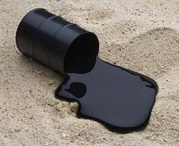
What is Crude Oil?
An Unrefined petroleum product composed of hydrocarbon deposits and other organic materials.
Obtained through oil drilling like natural gas.
A fossil fuel ; a limited resource
It can be refined to produce usable products like Gasoline, diesel and various kinds of petrochemicals.

Slide 5
Resources vs Reserves
01
02
03
04
Both refer to some amount of mineral or fuels.
Resource refers to the amount of Oil/ Natural Gas that exists.
Reserves are deposits of fossil fuels that are known to exist with a reasonable level of certainty.
Newer or improved drilling technology has resulted in more oil becoming “reserve oil” as it is leads to higher profits.

Slide 6
Sources of Energy
Two main sources:
Conventional:
  Consists of Non-renewable resources.
  Coal, Petroleum, Crude oil, Natural Gas.
  Easier and cheaper to produce.
Non-Conventional:
  Bio Energy, Solar Energy, Wind Energy
  More costlier to produce.

Slide 7
Characterization of Crude Oil
Light/Heavy
Compares the Density of oils.
  Heavier oils are more difficult to transport.
  Heavier the oil, lower the API gravity
  Light if 28 degrees API or higher.
  Heavy if below 28 degrees API .
Sweet/Sour
Refers to sulfur content in the oil.
  Sweet=lower content, Sour=higher content
  More sour oils require further processing to prevent damage on pipes and refineries.

Slide 8
Sectors of the oil and gas industry
It is the petroleum industry and is about getting oil and gas out of the ground. It includes all the activities that happen in the field such as shooting seismic, drilling wells, pumping oil, mining oil sands .
  Upstream
It gathers, stores and transports crude oil, natural gas, natural gas liquids and Sulphur. It links upstream activities with consumers who are located downstream.
  Midstream
This is the industry where petroleum meets the consumer. It includes crude oil refineries, gas processing plants, petrochemical plants, retail gas stations etc. It also includes sale and marketing of refined petroleum products to wholesalers and industrial commercial customers.
  Downstream

Slide 9
Exploration and Production Segment
Conventional; drilling a hole into the earth with an oil rig to create an oil well.
Onshore; extraction from under land.
  Carbon tool drilling
  Horizontal drilling
  Hydraulic Fracturing (aka. Fracking)
Offshore; extraction from under the sea bed.
  Much more difficult due to remote and highly variable environments.

Slide 10
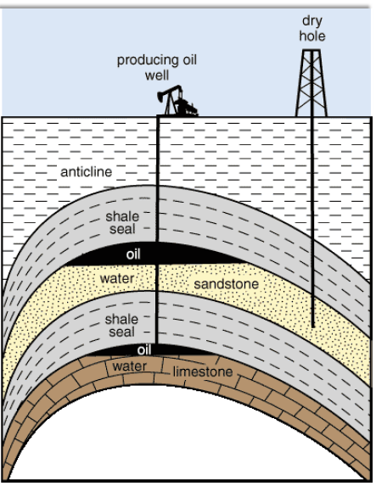
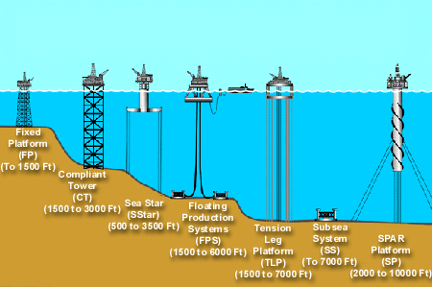
Onshore & Offshore

Slide 11
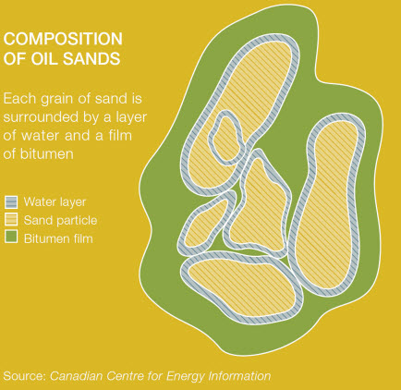
Exploration and Production : cont.
Unconventional; extraction of oil sands.
  Extremely viscous and heavy mixture in the earth comprised of sand, clay, various minerals, bitumen, and water.
  Separate/recover the bitumen from other substances and upgrade to higher end products.
Primary methods of recovery: Surface mining & In-situ
Surface mining; when bitumen is within 250 feet from the surface.
In-Situ; extract deeper deposits without removing the soil above it.

Slide 12
Surface Mining
Strip mining; removing layers of rock and dirt to reach a mineral deposit.
Open pit mining; removing materials and rock through a large hole/pit.
Mountaintop removal mining; explosives are used to remove the mountaintop to expose the resources underneath.

Slide 13
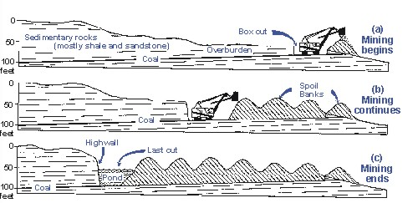
Strip Mining

Slide 14
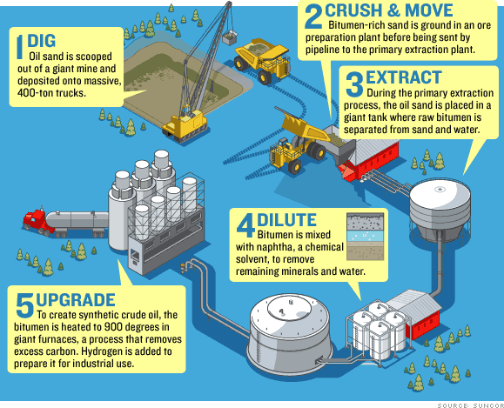
Open Pit Mining
A surface mining technique of extracting rock or minerals from the earth by their removal from an open pit or borrow.

Slide 15
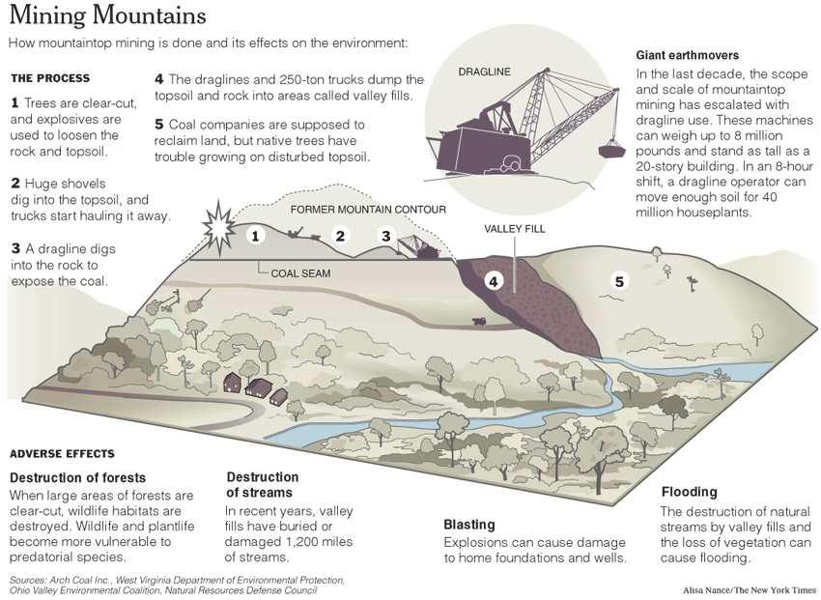
Mountaintop Removal Mining

Slide 16
In Situ Recovery
Steam Assisted Gravity Drainage (SAGD)
Cyclic Steam Stimulation (CSS)
Vapor Extraction Process (VAPEX)
Toe-to-heel Air Injection (THAI)
Cold Heavy Oil Production with Sand (CHOPS)

Slide 17
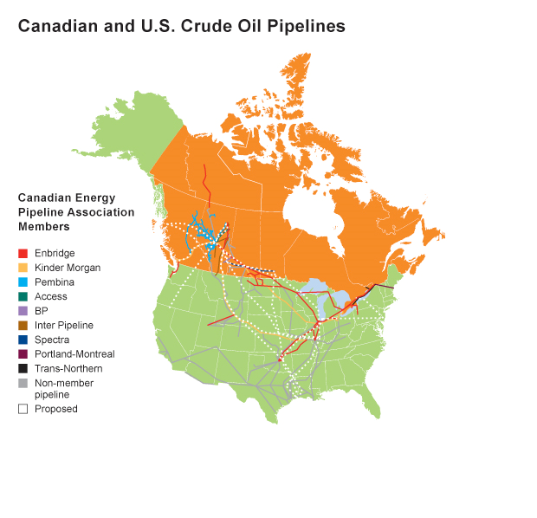
Oil and Gas Transportation
Transportation of oil through pipelines, rail, shipping, and trucking.
Different types of pipelines for different purposes:
  Gathering system field lines
  Transmission truck lines
  Distribution lines
Notes:
Gathering system field lines: move crude oil and natural gas from wells to processing facilities. After processing, feeder lines carry the hydrocarbons to the major, long distance transmission lines.
Transmission trunk lines: deliver product to small-diameter distribution pipelines, as well as industrial users, local distributors, refineries or connection pipelines to the United States.
Distribution lines: Local distribution companies (LDCs) use distribution lines to deliver natural gas to homes and businesses. Crude oil transmission lines also transport natural gas liquids (NGLs) and other refined petroleum products, while natural gas transmission lines only transport natural gas

Slide 18
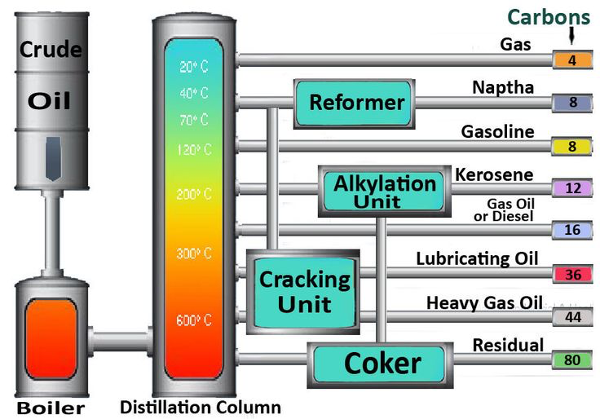
Oil and Gas Refining & Marketing
Converting crude oil into finished products such as liquefied petroleum gas, gasoline, jet fuel, etc.
Crude oil is boiled, distilled, and goes through various subunits in the distillation unit depending on the intended finished product.
Distribute and sell the refined product and natural gas.

Slide 19
INDUSTRY ANALYSIS

Slide 20
Oil & Gas
Largest Industry in the World.
Canada’s economy is heavily dependent on Oil and Gas.
Canada is ranked as the 5th largest producer of oil , producing more than 3.5 million barrels a day.
Canada is the world’s 4th largest producer of natural gas.
U.S.A is Canada’s no 1 competitor.
Canada has the third largest crude oil reserves in the world.
The Oil Sands in Northern Alberta give Canada the world’s third largest crude oil reserves after Saudi Arabia and Venezuela.

Slide 21
Canadian Oil and Gas
Alberta is Canada’s largest oil and natural gas producers and is home to vast deposits of oil sands.
British Columbia is Canada’s second largest natural gas producer.
Canadian oil and natural gas industry is active in 12 of 13 provinces and territories.
The Canadian oil sands help pay for public services and are creating jobs.
Investment of 37$ B in 2016.
The oil and gas industry account for about 425,000 direct and indirect jobs and that number is expected to grow
Notes:
The Canadian oil sands are the most powerful sources of Canadian energy .
They help pay for public services, they are creating jobs.
They are boosting the economy.
Canada’s oil and gas industrys the single largest private investor in the country with an investment of $37 Billion in 2016.
They have contributed an estimated $15 Billion to government revenues in the form of royalty payments, land or bonus payments and corporate and municipal taxes, ensuring all Canadians benefit from the responsible resources development.
Canada is a major supplier of secure, reliable crude oil to international markets, producing nearly 3.8 million barrels a day.

Slide 22
Underline Products from Crude Oil
Residuals
  Coke
  Asphalt
  Tar
  Waxes
  Starting material to make other products
Lubricating Oil
  Used for motor Oil
  Grease and other lubricants.
Petroleum Gas
  Used for heating
  Cooking
  Making plastics
Gas Oil/Diesel
  Distillate
  Used for diesel fuel
  Heating Oil
Gasoline
  Motor Fuel
Heavy Gas
  Also called Fuel Oil
  Used for industrial fuel
Kerosene
  Fuel for jet engines
  Tractors

Slide 23
Natural Gas Usage
Space and Water Heating
Climate Control Systems
Appliances, Industrial uses for ex: processing forest products and manufacturing steel
Electricity Generation
Co-generation systems, and transportation

Slide 24
Macroeconomic Environment
Oil prices are determined by:
  US interest rate-US federal reserve-FOMC
  OPEC and Non OPEC Production
  U.S Shale Oil Revolution

Slide 25
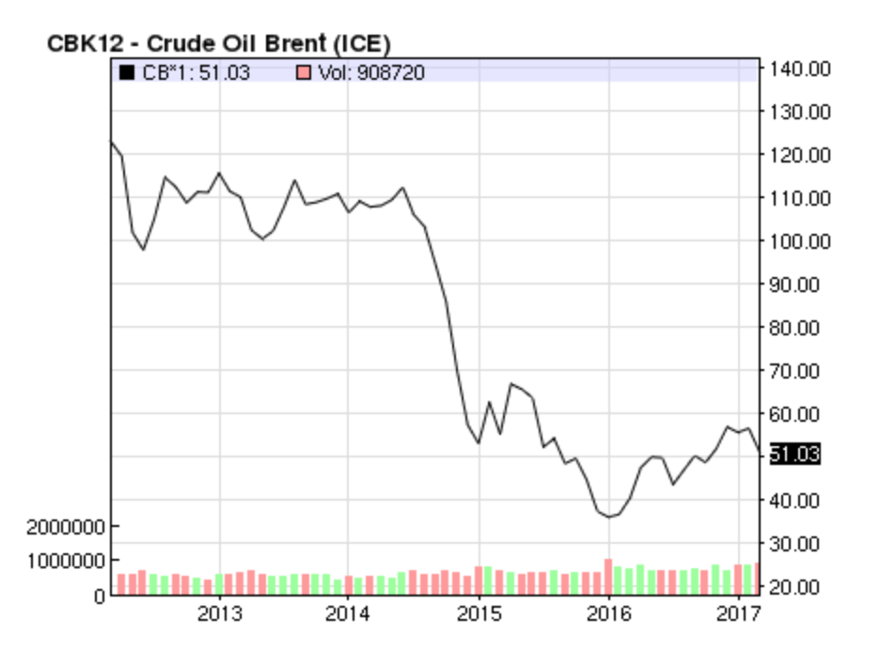
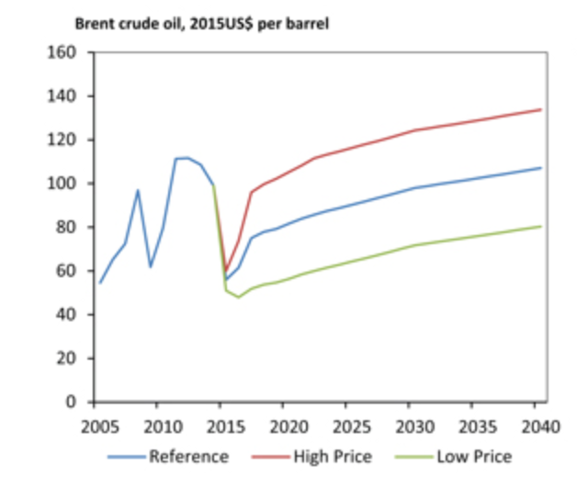
Global Oil Prices
Brent crude oil prices to average $55/b in 2017 and $57/b in 2018.
General expected rise in crude oil prices in upcoming year, but have been generally volatile.
Brent Crude is a major trading classification of sweet light crude oil that serves as a major benchmark price for purchases of oil worldwide. This grade is described as light because of its relatively low density, and sweet because of its low sulfur content.
Higher the prices better the exports and worse off the importers.

Slide 26
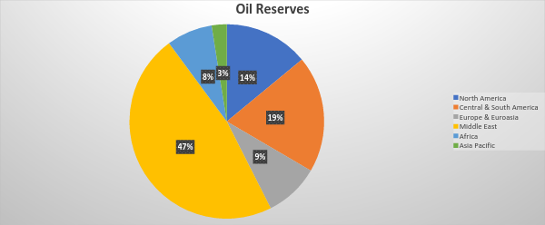
Oil Reserves Market share: Geographically

Slide 27
Top 10 Oil Reserves Countries
COUNTRY | Units: BBLS or Billions of Barrels
Venezuela | 300.9
Saudi Arabia | 266.6
Canada | 172.2
Iran | 157.8
Iraq | 143.9
Russia | 102.4
Kuwait | 101.5
UAE | 97.8
The U.S | 55
Libya | 48.4

Slide 28
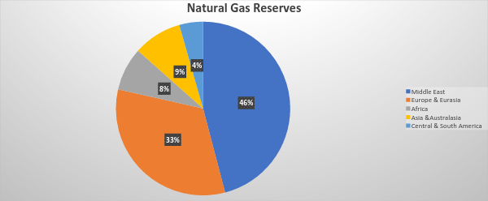
Natural Gas Reserves: Market Share

Slide 29
Top 10 Natural Gas Reserve Countries
Iran: 1,201.4 Units:Trillions Cubic Feet
Russia: 1,139.6
Qatar: 866.2
Turkmenistan: 617.3
The U.S: 368.7
Saudi Arabia: 294
UAE: 215.1
Venezuela: 198.4
Nigeria: 180.5
Algeria: 159.1

Slide 30
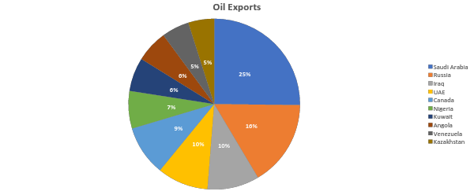
Top 10 Oil Exporting Countries : 67.5% of World Exports

Slide 31
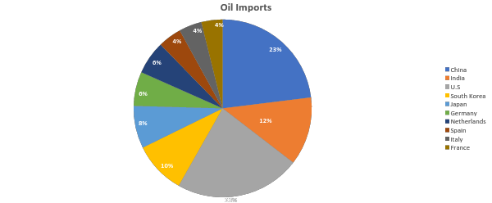
Top 10 Oil Importing Countries: 72.5% of the World

Slide 32
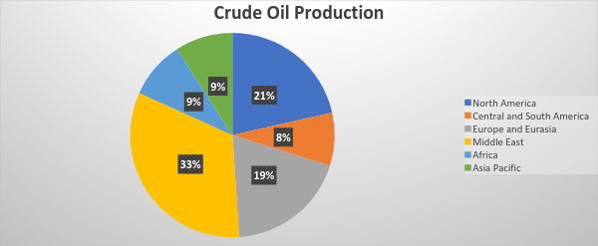
Global Crude Oil Production
Out of which: OECD
Countries: 23,534
OPEC Countries: 38,225.5
(MBPD)

Slide 33
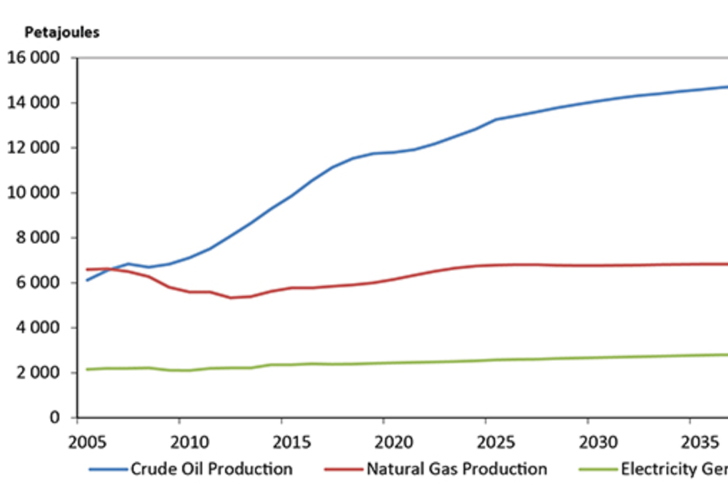
Canadian Oil and Gas Production
Takeaway with general increase of oil but natural gas has plateaued.
Oil reserves have decreased from 4.1 billion barrels to 3.9 barrels from 2014 to 2015.
NG reserves have increased from 70.5 trillion cubic feet to 77 trillion cubic feet.
Natural gas exports is an important driver for natural gas production.
Total end-use energy in Canada is increasing less quickly than the past, so exports will be main driver for production.
Energy production grows faster than energy use.
Notes:
Natural gas exports is an important driver for natural gas production.
Total end-use energy in Canada is increasing less quickly than the past, so exports will be main driver for production.
Energy production grows faster than energy use.
http://www.capp.ca/publications-and-statistics/statistics/basic-statistics
https://www.neb-one.gc.ca/nrg/ntgrtd/ftr/2016/index-eng.html

Slide 34
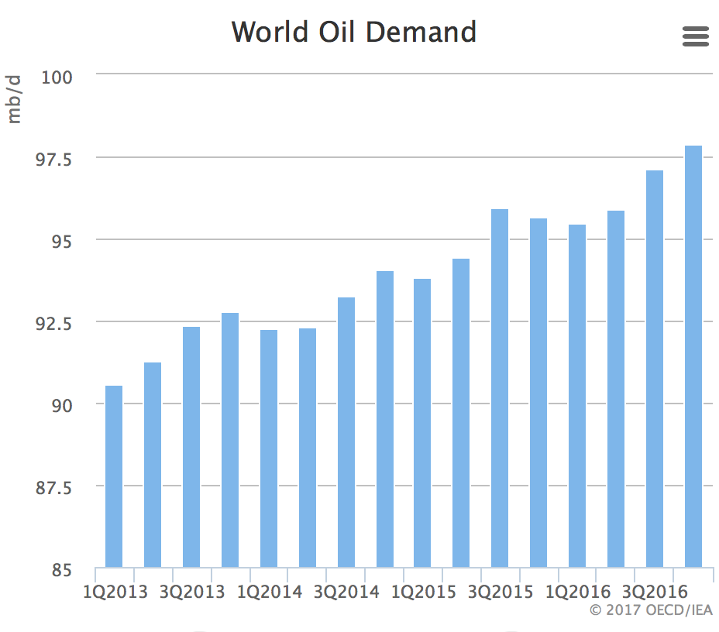
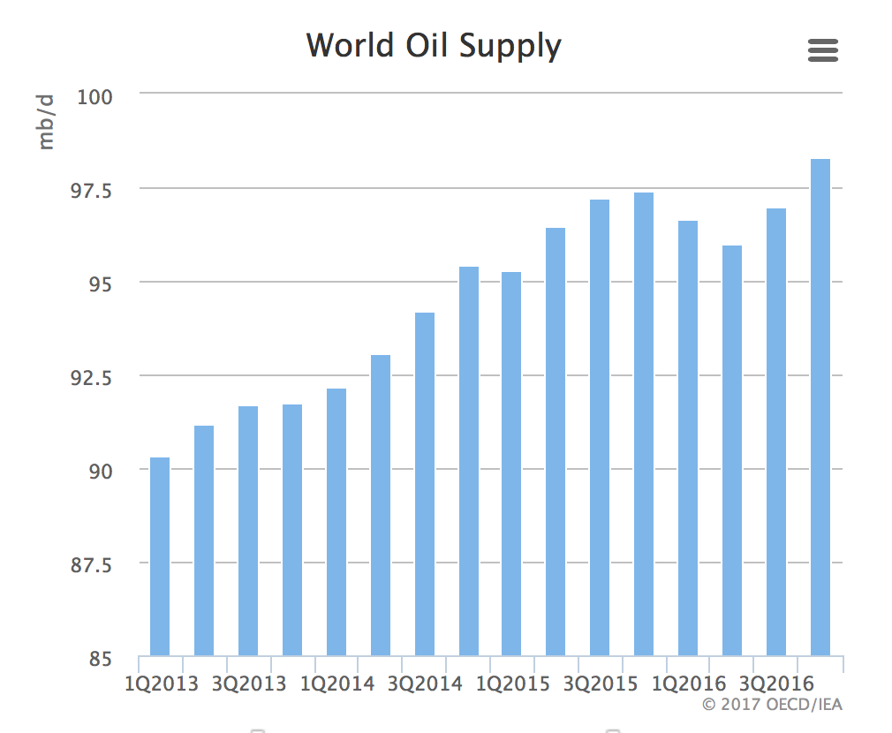
Global Oil Demand and Supply

Slide 35


Slide 36
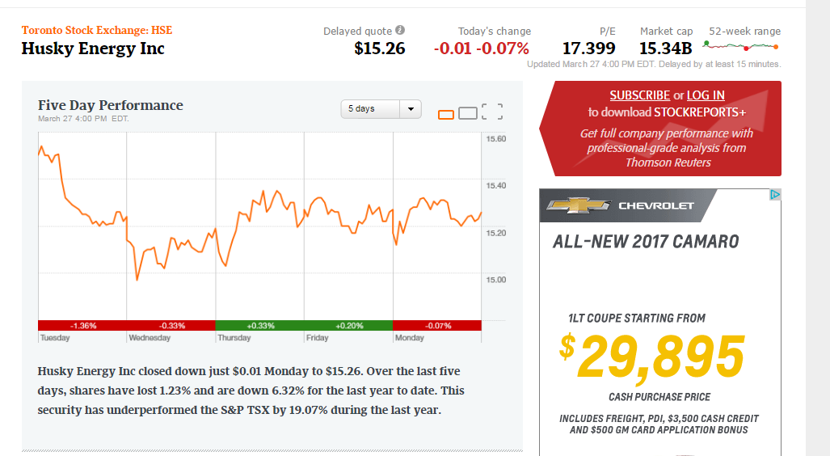

Slide 37
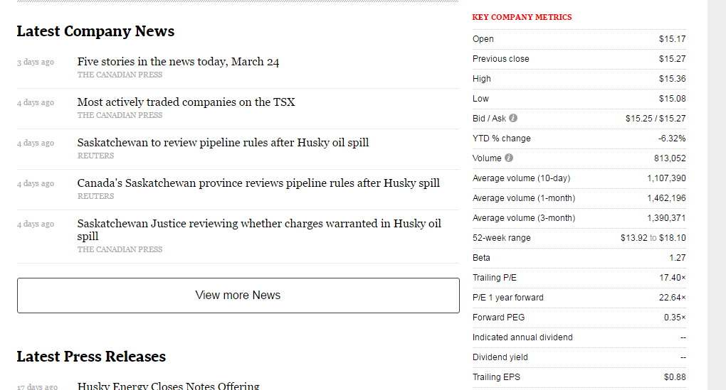

Slide 38
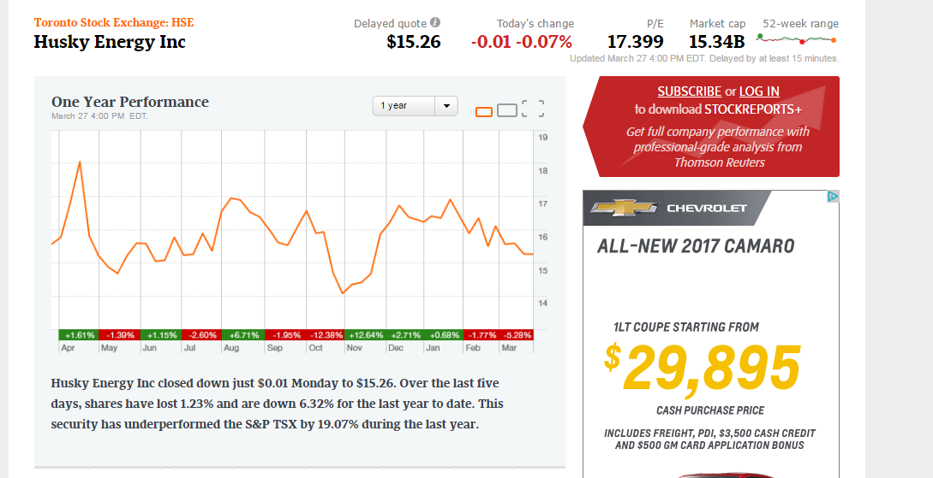

Slide 39
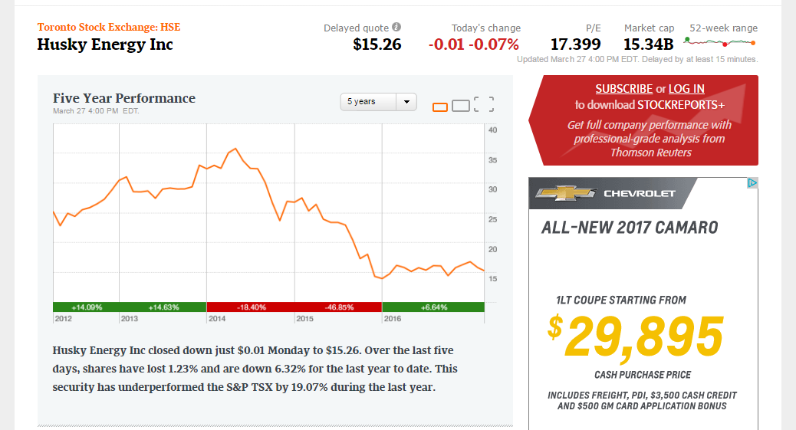

Slide 40
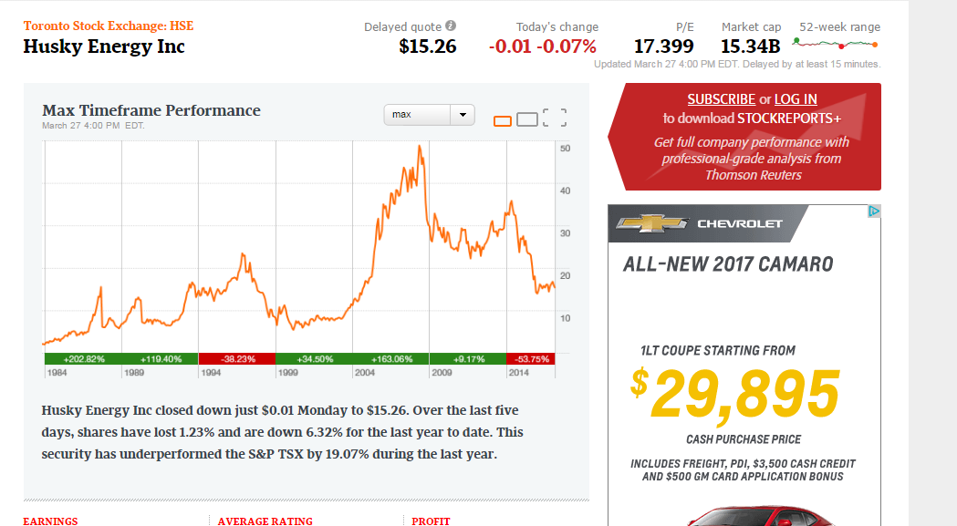

Slide 41
Husky Energy MVE, Revenue and Earnings
Its ticker symbol is HSE and is listed on the TSX.
Total Number of Outstanding shares: 1,005.45 million
Current share price(As of February 10, 2017)-$15.97
Market Value of Equity : (1005.45 million).(15.97)=$16.06 Billion
Revenue and Earnings History:
Timeline | 2016 | 2015 | 2014 | 2013 | 2012
Revenue | 13,312 | 16,763 | 25,052 | 23,869 | 22,550
Earnings | 922 | (3,850) | 1,258 | 1,829 | 2,022
E.P.S | .88 | (3.95) | 1.26 | 1.85 | 2.06

Slide 42
Share Structure
Weighted Average Shares Outstanding ( in Millions)
2013 | 2014 | 2015 | 2016
 | 1004.7 | 984.1 | 1004.9
Annual Diluted Earnings per share
2013 | 2014 | 2015 | 2016
1.81 | 1.17 | (4.01) | .88

Slide 43
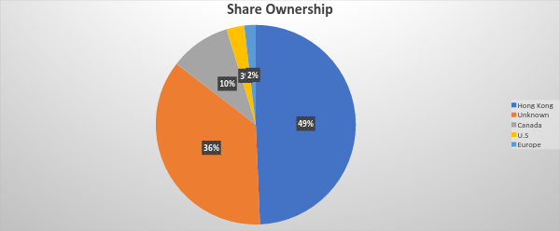
Geographical ownership Of Husky CN Equity

Slide 44
Company History
In 1938, Husky was Founded in Cody, Wyoming, U.S.
In 1941, the demand for Husky’s bunker fuel rose for U.S navy ships during World War 2.
In 1946, Husky Moved its refinery from Wyoming to Alberta, Canada to process heavy oil into asphalt and bunker fuel.
Husky’s first IPO in 1949 in Canada, shares offered in 1952 in the U.S
In 1956, Husky’s Canadian Operations were incorporated under the name Husky Oil Limited.
In 1967, Husky purchased the refining and marketing assets of the Frontier Refining company . As a result the two frontier refineries brought Husky’s refining capacity to 45.8 mbbls/day and retail outlet network to 1,223 outlets in the U.S and 408 outlets in Canada.

Slide 45
Company History
In the 1970s, Husky began exploration of the Athabasca Oil Sands, their sales exceeded $1Billion for the first time and Nova Corporation gained control of Husky.
In the 1980s, Husky pursued private ownership with Hong Kong investor Li Ka-shing and it also acquired Canterra Energy.
In the late 1990s, Husky announced a joint venture oil exploration agreement offshore China with CNOOC.
In the 2000s , the company acquired Renaissance Energy, listed on the stock exchange, acquire Marathon Canada Limited, named as Canada’s Top 75 companies.
Major projects had been established like Husky’s tucker oil sands project was completed and underbudget, The White rose project was ahead of schedule.
In 2009, it purchased 98 retail store outlets from Suncor Energy Inc. in the Ontario Market. After this Husky Has a total of 571 retail outlets.
In 2012, Husky completed approximately 80% of the Liwan Gas project, and the first oil was achieved at the Pikes Peak South and Paradise Hill Heavy Oil Thermal Projects.
In 2016, Rob Peabody was appointed as the new CEO and President.

Slide 46
Company Profile: Today
One of the largest integrated energy companies in Canada.
Headquartered in Calgary, Alberta and traded on the Toronto Stock Exchange under the symbol HSE.
Operation countries: Canada, The U.S.A and the Asia Pacific Region.
Two business segments
Upstream(32.3% of Husky’s Total Revenue)
Downstream(67.7% of Husky’s Total Revenue)
Husky Energy is involved in the exploration, development and production of crude oil and natural gas in Canada and in international areas.
The firm also conducts upgrading operations, pipeline operations, commodity trading and energy infrastructure projects.
In addition, it manufactures market refined products and operates a retail network.

Slide 47
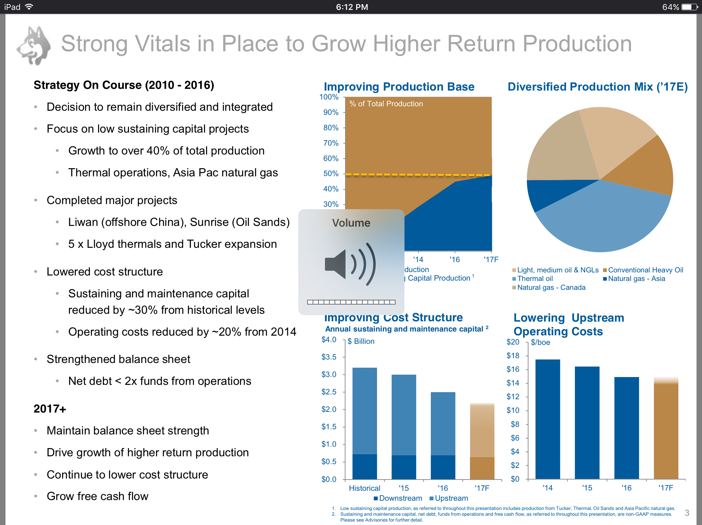
Business Model
Notes:
Mission: To maximize returns to shareholders in a socially responsible manner.
Visions: To create superior shareholder value through financial discipline and a quality asset base.
Goals:
Decision to remain diversified and integrated
Focus on low sustaining capital projects
Complete major projects like Sunrise Oil sands, Liwan.
Maintain Balance sheet strength.
Continue to lower cost structure.
Grow free cash flow.
Grow margins and high return production

Slide 48
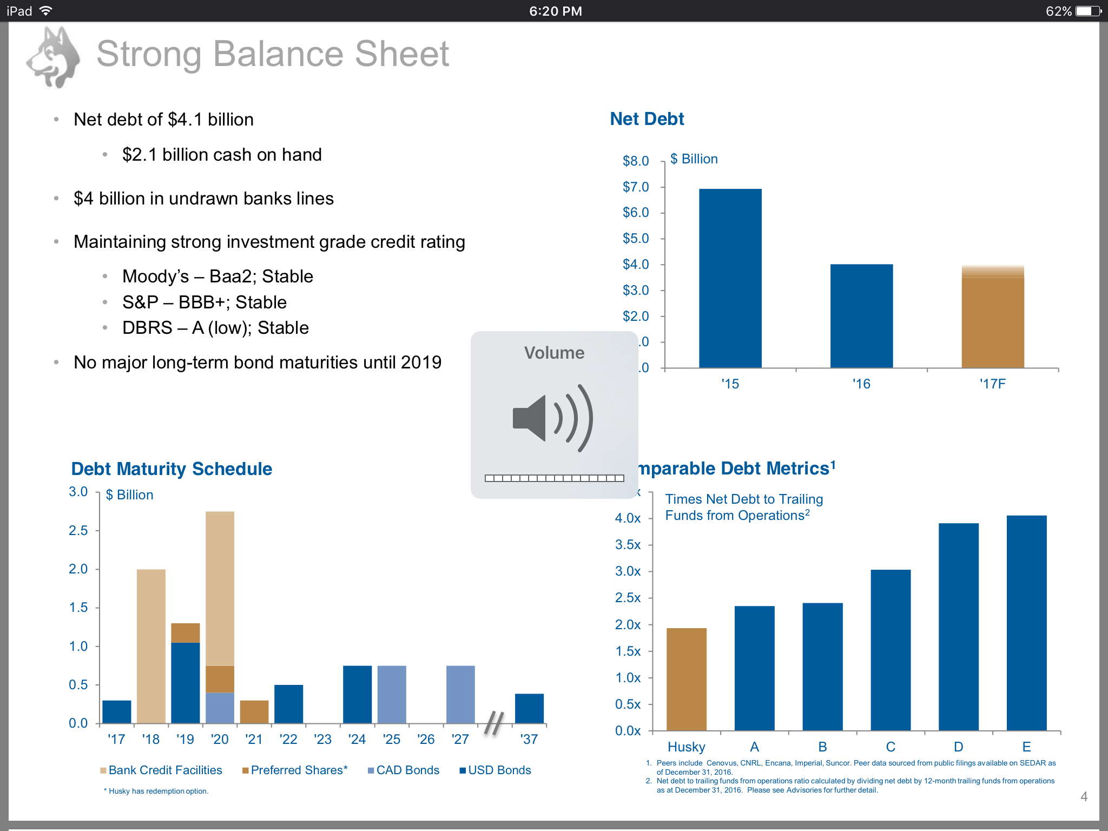
FOCUS

Slide 49
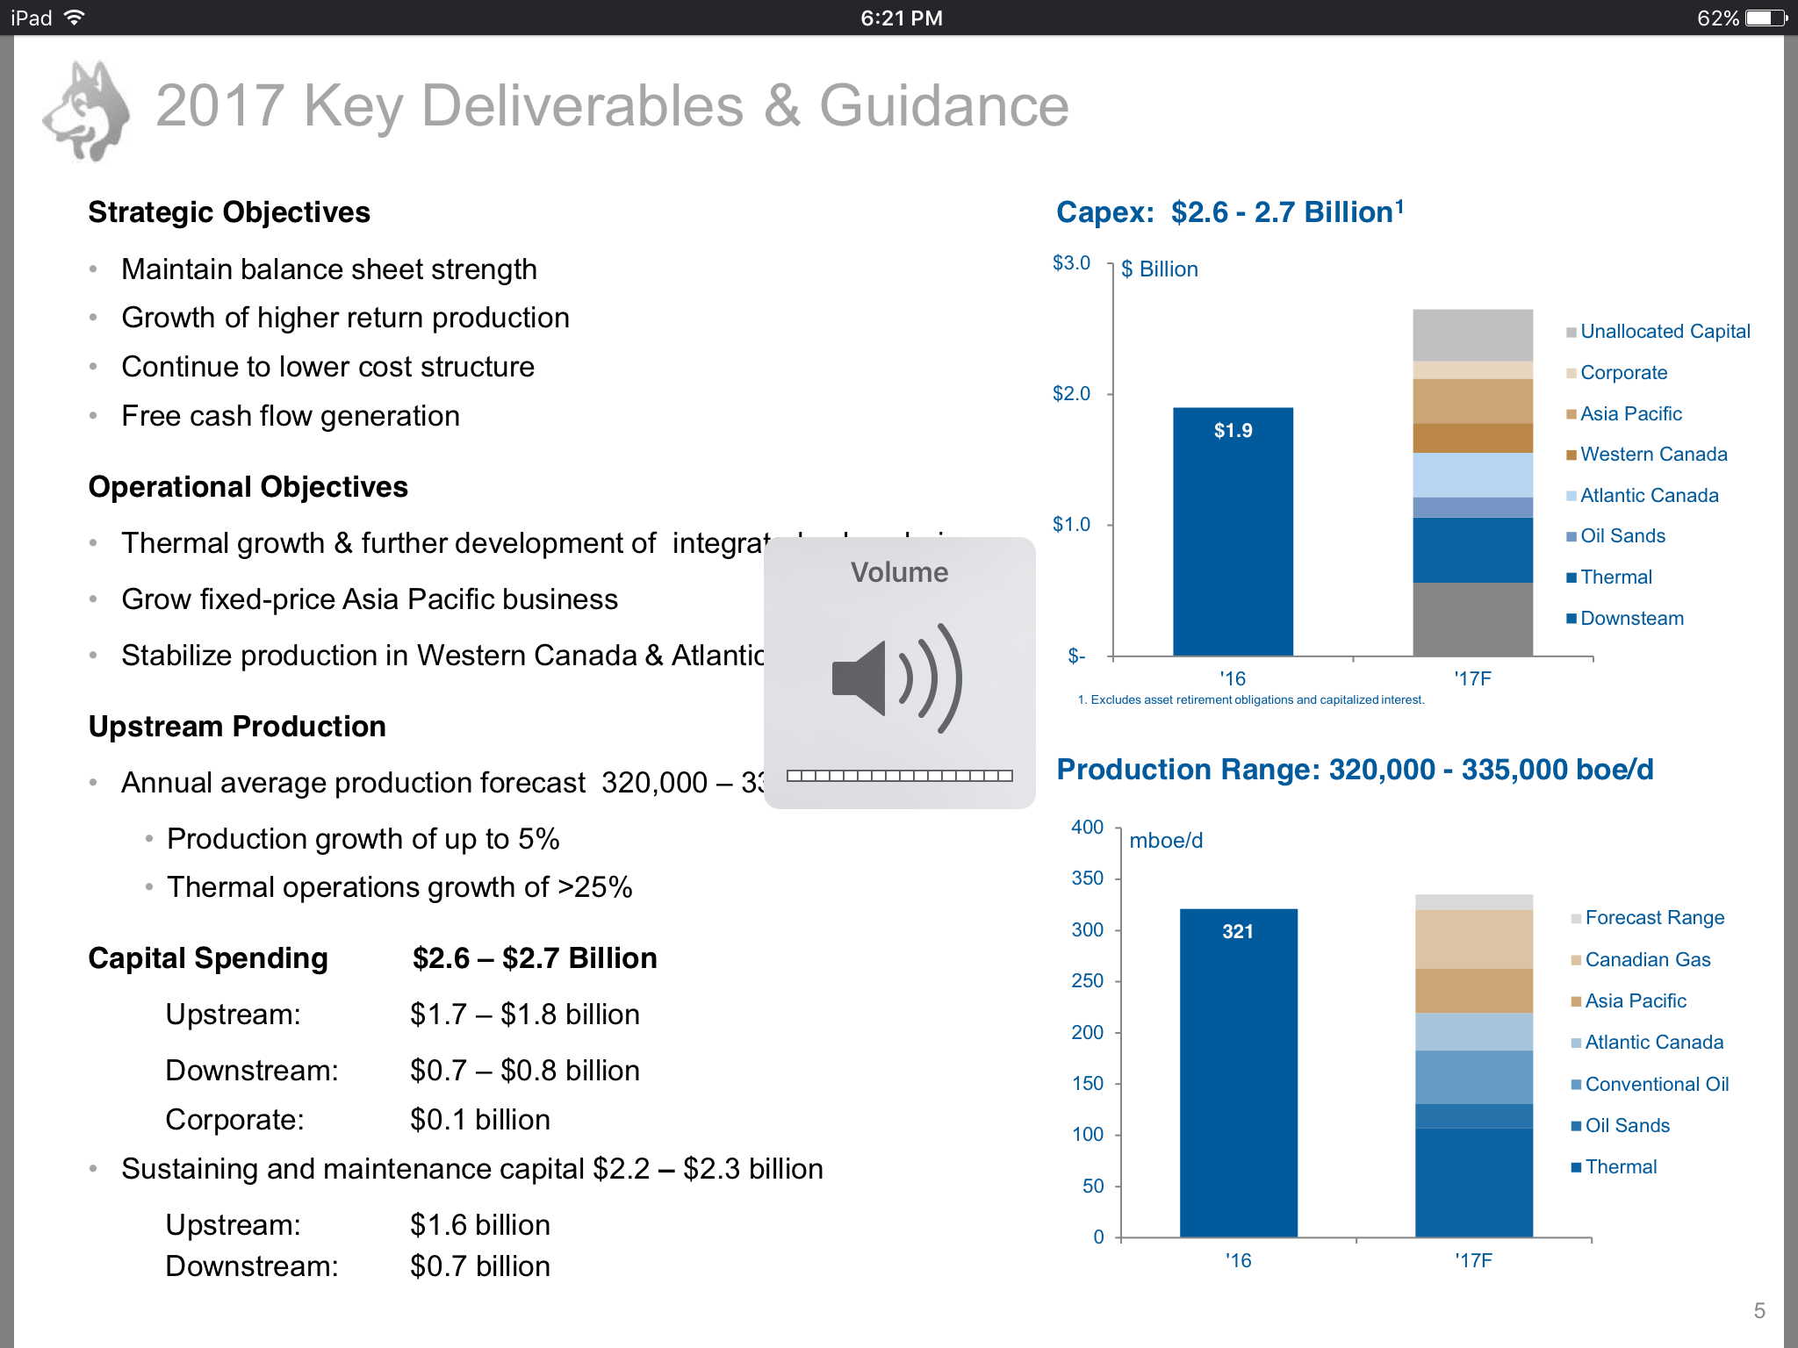
Goals

Slide 50
Husky Energy Overview
It has emerged as one of Canada’s largest oil and gas enterprises.
The company’s main energy assets are in Alberta and Saskatchewan, although it has oil and gas operations worldwide(China, Greenland, Libya).
The firm has a 75,000 barrel per day heavy oil upgrader and operates or franchises 485 retail gas stations in Canada.
The firm is controlled by Hong kong billionaire Li Ka-shing and his flagship company , CK Hutchinson Holdings.
In 2016, the company created Husky midstream Limited Partnership to assume ownership of some midstream assets.

Slide 51
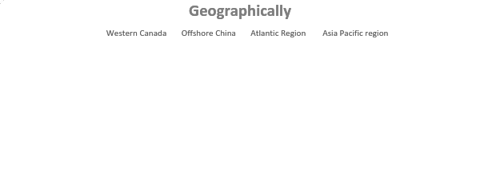
Husky’s Business Overview
Upstream: Operations
The Heavy Oil Thermal Portfolio, including the Tucker Thermal project increased production to 84,600 bbls/day in 2016, in comparison to 59,900 bbls/day in 2015.
Three new oil projects have been sanctioned :
Dee Valley
Spruce Lake North
Spruce Lake Central(Expected by 2020)

Slide 52
Husky’s Upstream and Downstream Business Overview
At the Oil Sands , Production for the Sunrise Energy project Increases to 25,600 bbls/day and is expected to increase to 40,000-44,000 bbls /day in 2017.
Major Projects are Liwan Gas Project, White Rose Field project.
Downstream Operations:
U.S and Canada
The Heavy oil Upgrading facility is located in Saskatchewan.
Largest producer of ethanol in Western Canada.

Slide 53
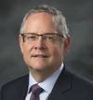
Key Executives
Robert J.Peabody, President & CEO
Appointed President and CEO in December 2016.
He joined husky as a Chief Operating Officer since 2006.
Former member of the leadership team at British Petroleum.
Master of Science in Management from Stanford University.
Bachelor of Science in Mechanical Engineering from the University of British Columbia.

Slide 54
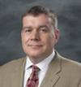
Chief Financial Officer
Jonathan Mckenzie
Appointed as CFO IN April 2015.
Highly experienced executive in the extensive energy and utility sector.
Prior to Husky, he was Chief Commercial Officer with Irving Oil Ltd. In New Brunswick.
Bachelor of Commerce and Bachelor of Arts Degree from University of Alberta.
He is a Chartered Accountant.

Slide 55
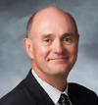
Chief Operating Officer
Rob Symonds
COO since February, 2017.
Prior to Husky, He was Senior Vice-President of Western Canada Production since 2011.
Responsible for leading Husky’s Upstream and Downstream businesses.
Responsible for Exploration, Safety , Engineering and Procurement.
Master of Science in Petroleum Engineering from the University of Alberta.
Bachelor of Science(Chemical Engineering) from the University of Edinburgh

Slide 56
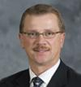
Senior Vice-President, Western Canada Production
Gerald Alexander
Appointed as Senior VP in February 2017.
Prior to this , he was VP of Western Canada Development.
Joined Husky in 2000.
Bachelor of Science in Petroleum Engineering from the University of Montana.
Diploma in Petroleum Technology from the Southern Alberta Institute of Technology.
Responsible for leadership and management of Upstream business.

Slide 57
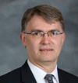
Senior VP Exploration
Brad Allison
Appointed VP Exploration in June 2010.
Started of as a Deep Basin Exploration Manager.
Senior Vice President in 2012.
Prior to Husky, he was VP and Chief Geoscientist with Advantage Services Ltd.
Bachelor of Science(Honours) in Geology from Mount Allison University.

Slide 58
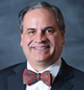
Senior VP Downstream
Bob I. Baird
Appointed as Senior VP in April 2012.
Previously, he was VP of Downstream and VP of upgrading and Refining for Canada.
Bachelor of Engineering from Concordia University in 1982.
Member of APEGA(Association of the Professional Engineers and Geoscientists of Alberta).
Responsible for integrated downstream including upgrading, refining, pipeline, transportation.

Slide 59
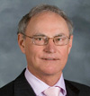
Senior VP Heavy Oil
Edward T. Connolly
Joined Husky as VP of Heavy Oil in 2006.
Appointed as Senior VP in 2012.
Prior to Husky, he was manager of Drilling, Well Completions and Facilities Construction with Talisman Energy Canada.
Bachelor of Science in Chemical Engineering from the University of Tulsa.
Diploma in gas technology from the Northern Alberta Institute of Technology.

Slide 60
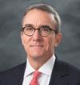
Senior VP Business Development
David A. Gardner
Appointed Senior VP in December 2014.
Prior to Husky , worked 17 years with British Petroleum on position such as Director of Upstream Business Development , Vice President Business Development.
Bachelor of Science(Geology) from the College of William and Mary in Virginia.
Masters in Geology from the University of Wisconsin.
MBA, Finance & Entrepreneurship from University of California.

Slide 61
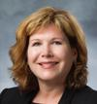
Senior VP Human and Corporate Resources
Nancy Foster
Appointed as Senior VP in 2012.
Joined Husky as VP in 2011.
Prior to Husky, she was Country Manager of Norway for Nexen Inc.
Bachelor of Arts Degree from Mcmaster University.
Graduate of the Harvard Advanced Management Program.
Responsible for Human Resources, Diversity, Real Estate, Corporate Responsibility.

Slide 62
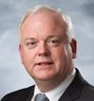
Senior VP Atlantic Region
Malcolm Maclean
More than 30 years of experience in the Upstream Sector.
Joined Husky as VP, Developments for the Atlantic regions in 2011.
Appointed Senior VP in October 2012.
Prior to Husky, he was VP, Developments for Petrofac.
Bachelor of Science in Mechanical Engineering from Dundee College of Technology, Scotland.
Postgraduate Diploma in Offshore Engineering From Robert Gordon’s Institute of Technology, Aberdeen.

Slide 63
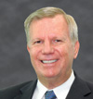
Chief Operating Officer, Asia Pacific
Robert Hinkel
30 years of experience in energy and mining.
Joined Husky in 2010 as the COO, Asia Pacific.
Prior to joining Husky, held the position of Senior VP of operations for an Asian private exploration and production company.
Bachelor of Science Degree in Petroleum at the University of Texas.(Magna cum laude)
He was president and CEO of Enventure Global Technology from 2003 to 2007.

Slide 64
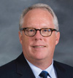
Senior VP, Oil Sands
John Myer
Appointed VP, Oil Sands in November 2010.
Became Senior VP in 2012.
Prior to Husky, he was with Suncor Energy for 20 years at different positions like VP Exploration and Development, VP Production.
Bachelor of Science in Engineering.
Masters degree in Business Administration.
Masters degree in Petroleum Engineering, all from University of Calgary.

Slide 65
Main Competitors
Suncor Energy
Repsol
Cenovus Energy
Gibson Energy
Imperial Oil
Canadian Natural Resources Ltd.

Slide 66
Risk Measures
The company is exposed to risks related to commodity prices, foreign exchange rates and interest rates.
It is also exposed to financial risks related to liquidity, credit and contract risks.
The company uses derivative instruments to manage the company’s exposure to such risks.
Disasters, explosions, spills, although 80% is usually insured.

Slide 67
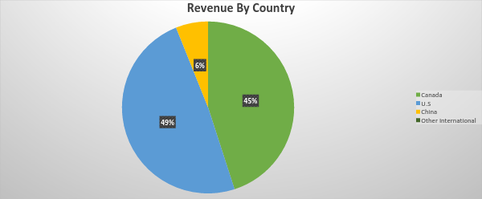
Geographic reach: Revenue

Slide 68
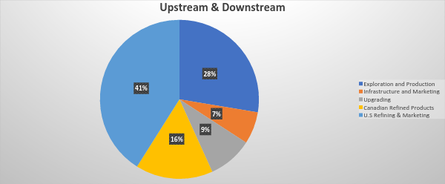
Segmented financial information-Revenues

Slide 69
Comparison vs last 4 yrs
Revenue | 2016 | 2015 | 2014 | 2013 | 2012
Exploration & Production | 4,036 | 5,374 | 8634 | 7333 | 6581
Infrastructure & Marketing | 955 | 1,264 | 2202 | 2134 | 2377
Upgrading | 1,324 | 1,319 | 2212 | 2023 | 2191
Canadian Refined Products | 2,301 | 2,886 | 4020 | 3737 | 3848
U.S Refining & Marketing | 5,995 | 7,345 | 10663 | 10728 | 9856

Slide 70
Earnings comparison in the last 5 years
Earnings | 2016 | 2015 | 2014 | 2013 | 2012
Exploration & Production | (217) | (4338) | 992 | 952 | 976
Infrastructure & Marketing | 1,308 | 84 | 114 | 292 | 346
Upgrading | 175 | 93 | 168 | 297 | 226
Canadian Refined Products | 110 | 170 | 214 | 194 | 231
U.S. Refined & Marketing | 57 | 397 | (19) | 339 | 436

Slide 71
Financial Performance
The company saw its revenue drop 43% from 2014 to $11.8 B in 2015, due to weaker oil and natural gas prices and adverse effect of the strong US dollar against the Canadian dollar.
It posted a net loss of $ 2.8 B, compared to a net income of $1.1 Billion in 2014, due to the lower revenue and overall effects of the weak oil industry economy.

Slide 72
Financial Performance: Continued
We have had a solid balance sheet over the course of the last year. We reduced our debt by about 40% to $4 Billion, which has positioned our debt metrics amongst the best in the industry.
We reduced our debt , but we reduced it in a very strategic way. For example: we created a midstream partnership that has provided significant advantages to our business. We unlocked $1.7 billion in cash with that midstream partnership, but we maintained 35% stake
Operatorship of this asset which allows us to continue to have tight integration along our heavy oil value chain.

Slide 73
Institutional Holdings
No of Institutional Owners: 239 institutions
Total = 119.37 million shares
Top Holders:
Hutchinson Whampoa: 40.18 %
KA-SHING LI: 29.31%
IG INVESTMENT MANAGEMENT LTD: 3.19%
RBC GLOBAL ASSET MANAGEMENT : 1.99%
Blackrock: .65%
Vanguard Group: .59%

Slide 74
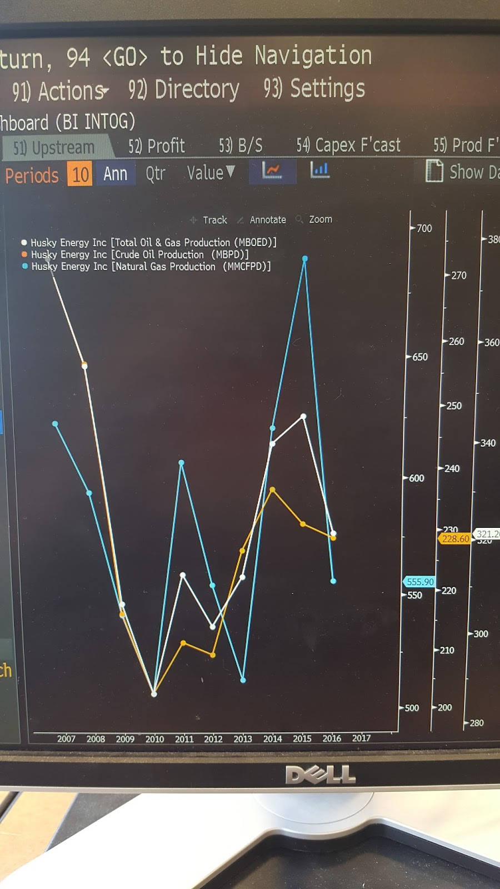
Husky Energy Production
Time | 2016 | 2015 | 2014 | 2013 | 2012
Oil & Gas (MBOED) | 321.2 | 345.7 | 340.1 | 312 | 301.5
Crude Oil (MBPD) | 228.6 | 230.9 | 236.6 | 226.5 | 209.2
Natural Gas(MMCFPD) | 555.9 | 689 | 621 | 512.7 | 554

Slide 75
Important metrics
Time Line | 2016 | 2015 | 2014 | 2013 | 2012
Dividends per share($) | No dividends paid | .9 | 1.17 | 1.2 | 1.2
ROE(%) | 5.46 | (21.74) | 6.2 | 9.3 | 10.9
ROA(%) | 2.82 | (10.71) | 3.32 | 5.08 | 5.98
ROC(%) | 5.37 | (14.75) | 5.78 | 8.44 | 9.79
Debt/Equity(%) | 30.29 | 40.73 | 25.72 | 20.36 | 20.04
Debt/ Capital(%) | 23.25 | 28.94 | 20.46 | 16.92 | 16.69
ROIC(%) | 4.82 | (12.89) | 4.56 | 6.71 | 7.91

Slide 76
Credit ratings
Company | Outlook | Rating
Moody’s | STABLE | Baa2
Standard and Poor’s | STABLE | BBB+
Egan-Jones Ratings Company | STABLE | BB+
DBRS | STABLE | AL

Slide 77
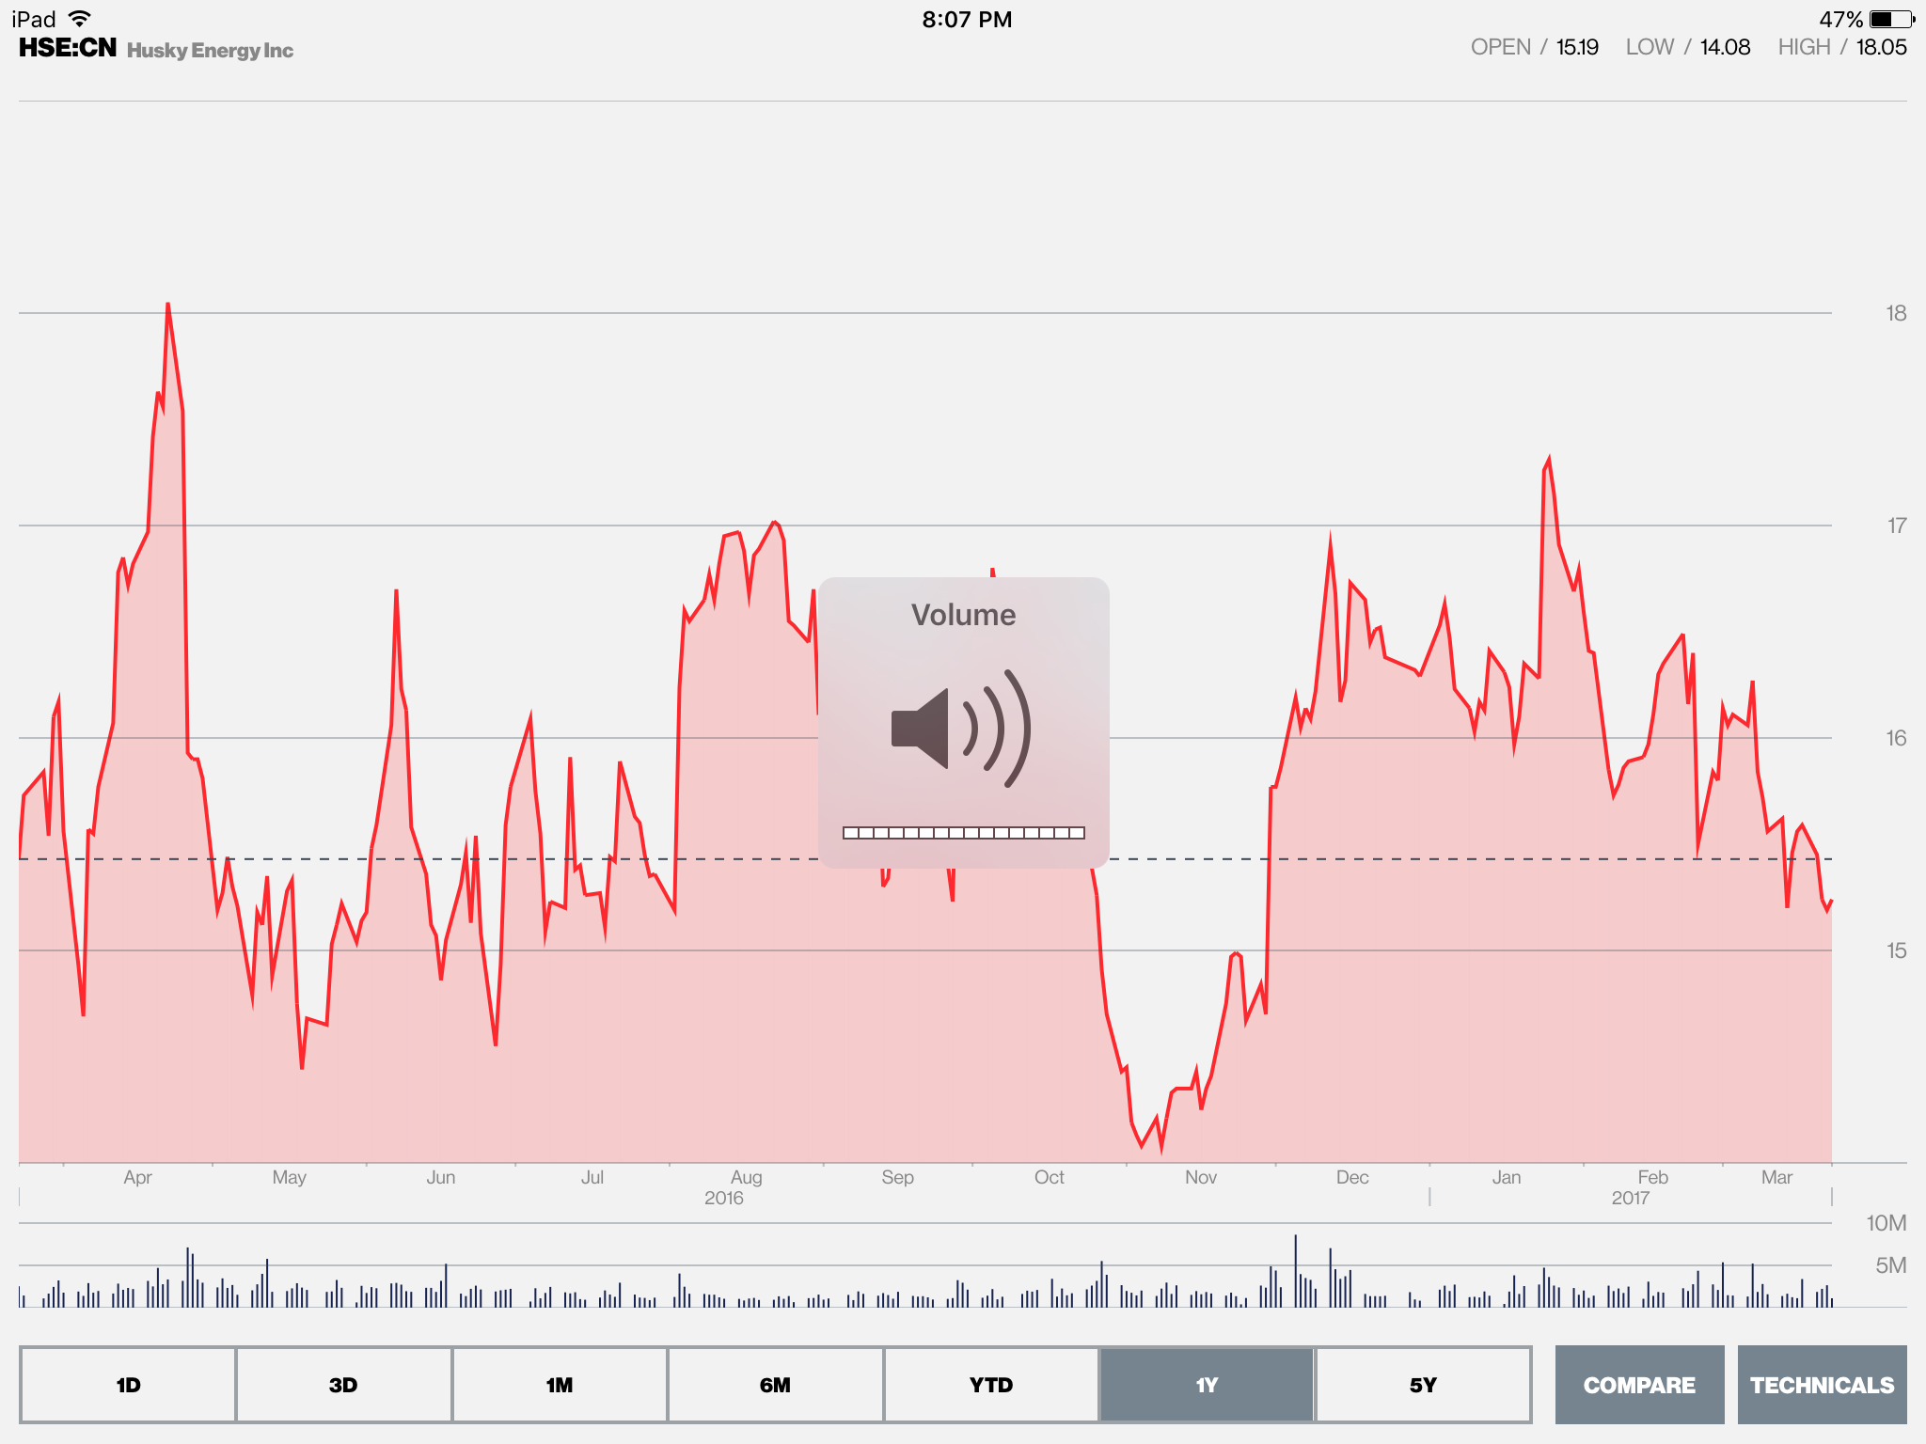
Performance: 1 Year prices

Slide 78
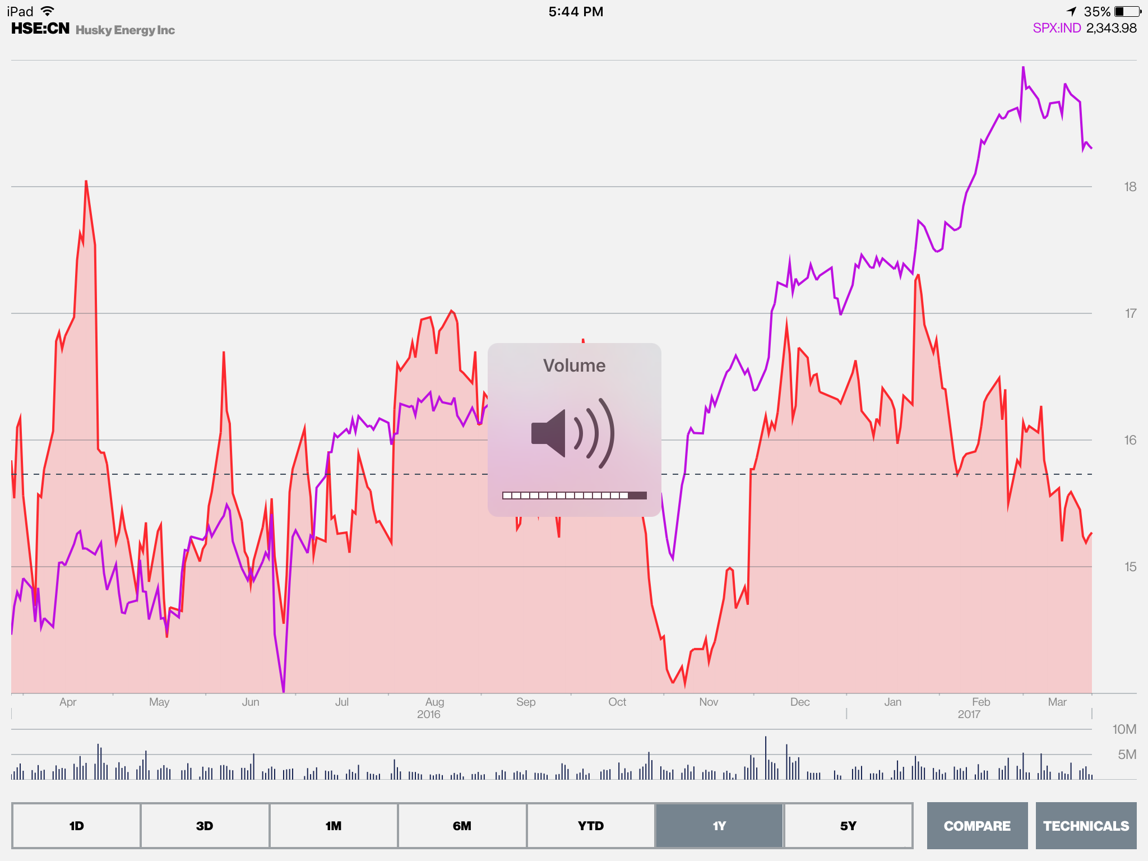
Husky Energy vs S&P 500-1 year

Slide 79
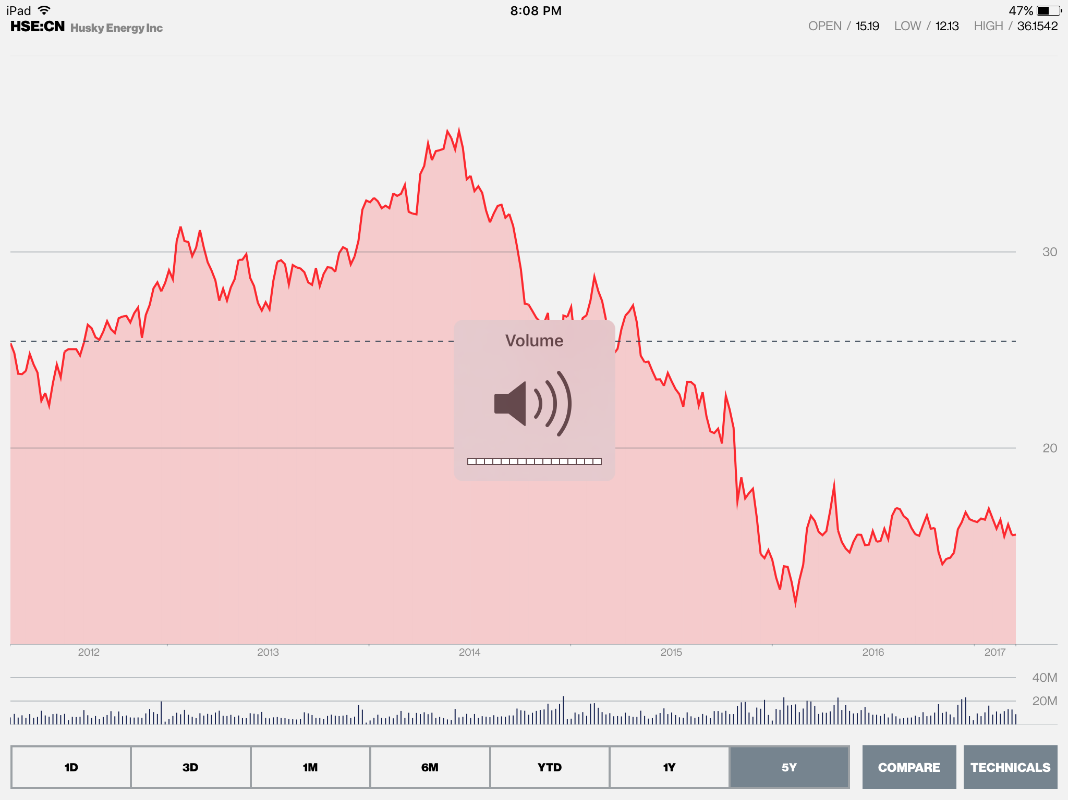
HSE CN 5 year prices

Slide 80
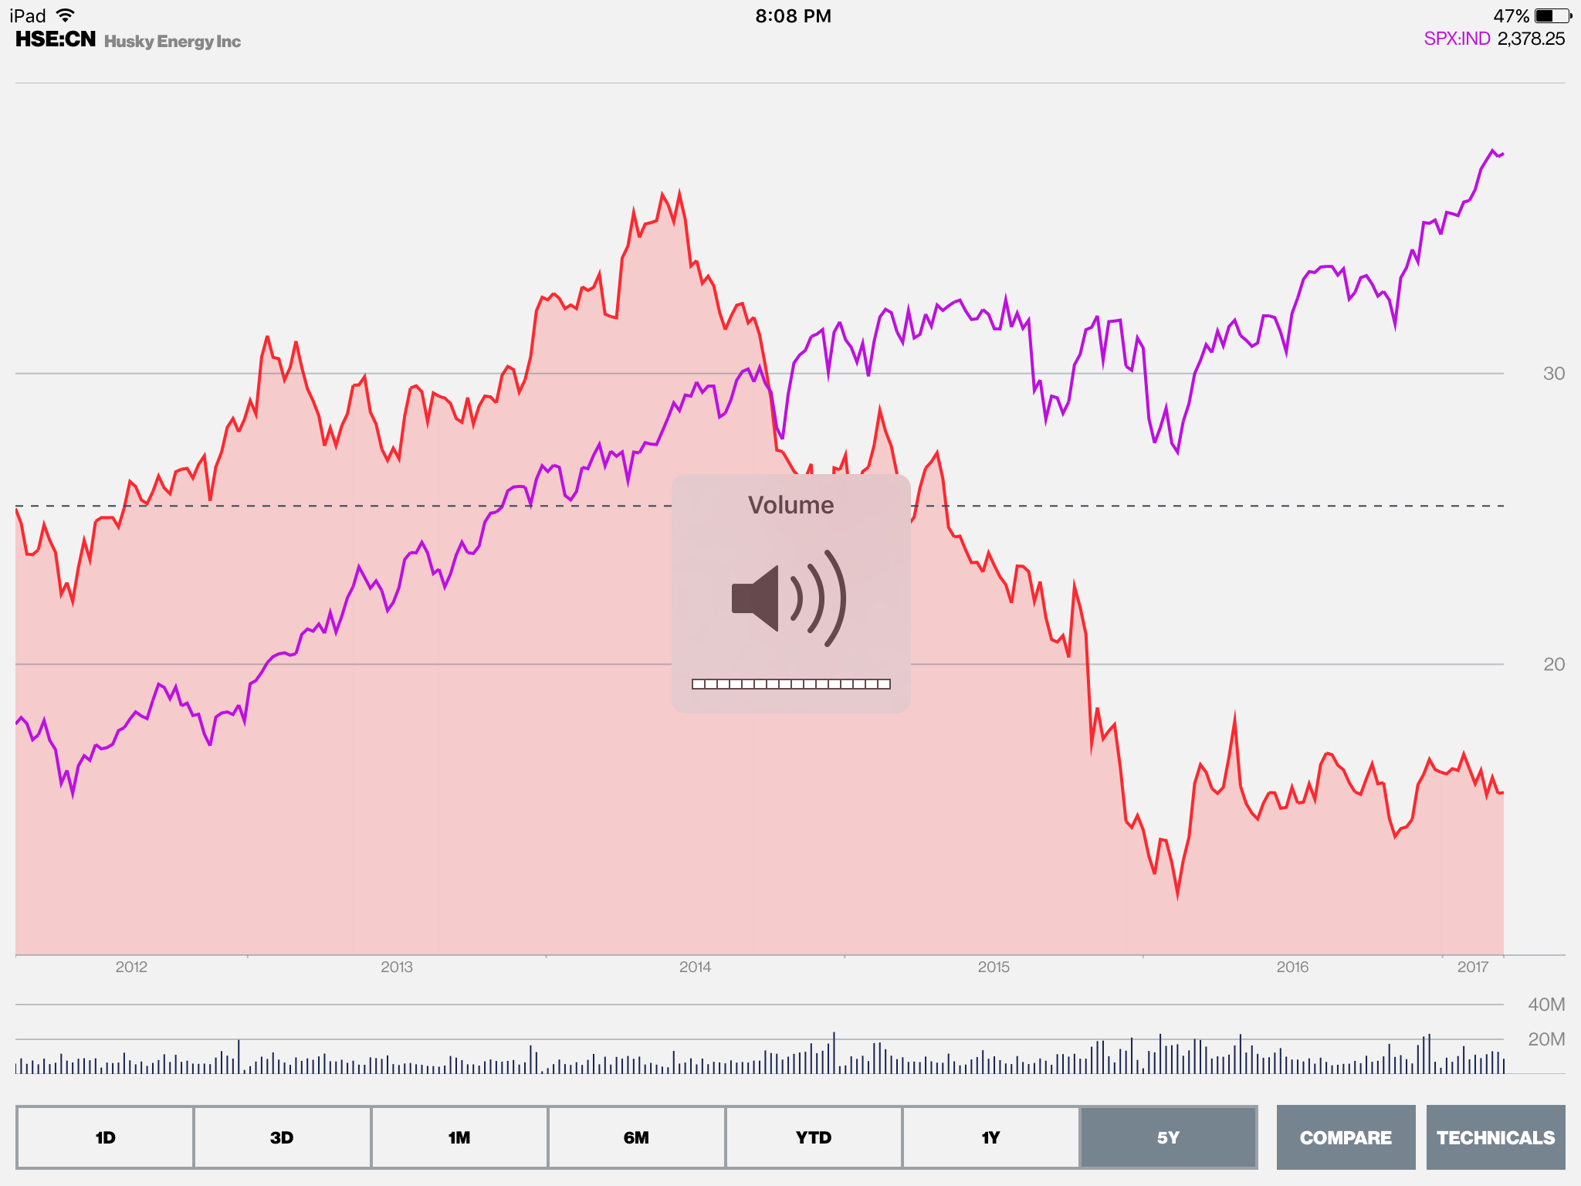
Husky Energy vs S&P 500- 5 years

Slide 81
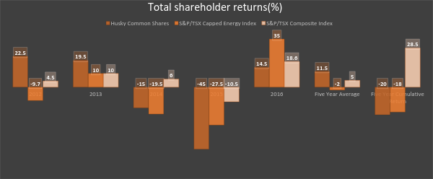
Total Shareholders Returns: 5 Yrs

Slide 82
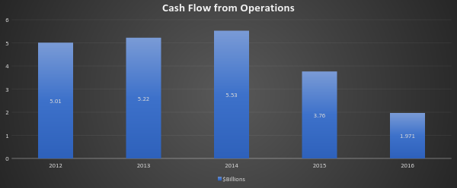
Cash Flow from Operations

Slide 83

Financial Statements

Slide 84

Continued

Slide 85

Continued

Slide 86
Hold

Slide 87


Slide 88



Slide 89


Slide 90


Slide 91


Slide 92


Slide 93

Suncor vs S&P/TSX Composite (5 Year)

Slide 94

Suncor vs S&P/TSX Composite (10 Year)

Slide 95
Agenda
Company Profile
Business Model
Executive Profile
Financials
Recommendation

Slide 96

Company Profile
Canada’s leading integrated energy company based in Calgary, Alberta
Founded in 1919 in montreal as Sun Company of Canada, a subsidiary of Sun Oil
Pioneered and developed the Athabasca Oil Sands since 1967
Became a publicly traded company in 1992
On March 23, 2009, Suncor announced the acquisition of Petro-Canada
Has refineries in Alberta, Ontario, Quebec and Colorado, US

Slide 97
Suncor’s MVE
Ticker symbol: SU:CN (listed on the Toronto Stock Exchange)
Total number of outstanding shares: 1,668,600,000
Current share price: $40.81
Market value of equity: ($40.81) x (1,668,600,000) = $68,095,566,000
Revenue and Earnings History:
Timeline | 2016 | 2015 | 2014 | 2013 | 2012
Revenue | 26807 | 29,208 | 39,862 | 39,593 | 38,107
Earnings | 434 | -1995 | 2699 | 3911 | 2740
E.P.S | 0.27 | -1.38 | 1.84 | 2.61 | 1.77

Slide 98
Key Ratios
Timeline | 2016 | 2015 | 2014 | 2013 | 2012
Dividends per share ($) | 1.16 | 1.14 | 1.02 | 0.73 | 0.5
ROE (%) | 1.04 | (4.95) | 6.52 | 9.73 | 7.06
ROA (%) | 0.52 | (2.54) | 3.42 | 5.06 | 3.62
ROC (%) | 2.04 | (2.48) | 5.83 | 8.44 | 6.21
Debt/Equity (%) | 39.05 | 39.2 | 32.04 | 27.82 | 28.11
Debt/Capital (%) | 28.09 | 28.16 | 24.26 | 21.77 | 21.94
ROIC (%) | 1.11 | (0.55) | 4.99 | 6.83 | 4.43

Slide 99

Geographical Ownership of Suncor CN Equity

Slide 100
Credit Ratings
Company | Outlook | Rating
Moody's | STABLE | Baa1
Standard and Poor's | NEGATIVE | A-
Egan-Jones Ratings Company | STABLE | BB+
DBRS | STABLE | AL

Slide 101

Dividends

Slide 102

Business Model

Slide 103

Segment Summary

Slide 104
Business Model
Upstream: Oil Sands, Exploration, and Production
Midstream: Supply and Trading
Downstream: Refining and Marketing

Slide 105
Business Model
Oil Sands Segment
Assets located in the Athabasca oil sands of northeast Alberta
Operations include mining, extraction, upgrading, in situ, related logistics and storage assets
Oil sands Ventures include:
    Fort Hills mining project (50.8%)
    Syncrude oil sands mining and upgrading joint operation (53.74%)
    Idled Joslyn North mining prospect (36.75%)
Notes:
Interest in Syncrude increased 12% : Purchased 5% interest from Murphy and acquisition of COS

Slide 106

Business Model
Fort Hills Mining Project (50.8% working interest)
Expected first oil date: Q4 2017
Increased capacity from 180,000 bbls/d to 194,000 bbls/d due to optimization and technical review
Production: 98.6 mbbls/d
Mine life for recoverable resources: 50 years

Slide 107


Business Model
Oil sands production increased 9%, despite production outages at Oil Sands Operations and Syncrude due to Fort McMurray forest fire in Q2 2016
Canadian Oil Sands Limited Acquisition : $6.9 billion

Slide 108

Suncor Crude Oil & Natural Gas Production (10 Year)

Slide 109

2017 Corporate Guidance
8% increase from 2015

Slide 110
Business Model
Exploration and Production Segment
Consists of offshore operations and onshore assets
  Offshore: East coast of Canada and in the North Sea
  Onshore: North America, Libya and Syria

Slide 111
Business Model
Exploration and Production Segment
E&P in Canada includes:
  Operation in Terra Nova (37.675%)
  Non-operated interests:
    Hibernia (20% in base project and 19.132% in Hibernia Southern Extension Unit)
    White Rose (27.5% in base project and 26.125% in extensions)
    Hebron Project (21.034%)
  Several exploration licences offshore Newfoundland and Labrador and Nova Scotia

Slide 112

Business Model
Hebron Field Project (21.03% working interest)
Expected first oil date: Q4 2017
Expecting gross oil production: 150,000 bbls/d
Production: 31.6 mboe/d

Slide 113
Business Model
Exploration and Production Segment
E&P International includes:
  Non-operated interests:
    Buzzard (29.89%) - North Sea U.K. sector
    Golden Eagle Development (26.69%) - North Sea U.K. sector
    Rosebank future development project acquired in 2016 (30%) - North Sea U.K. sector
    Oda Project (30%) - Norwegian North Sea
  Several exploration licences offshore U.K. and Norway
  Oil fields in Sirte Basin in Libya - Production halted for majority of 2016
  Ebla gas development in Syria - Operations suspended indefinitely in 2011
Notes:
Production in Libya remained shut in through the majority of 2016 due to political unrest, with the timing of a return to facility is currently being expanded to blend normal operations remaining uncertain.
Suncor’s operations in Syria were suspended indefinitely in 2011, due to political unrest in the country

Slide 114

Business Model
Production increased 52,900 boe/d from 47,000 boe/d
Notes:
Purchased more wells for Hibernia oil field

Slide 115

Business Model

Slide 116
Business Model
Refining and Marketing Segment
Refining and Supply
Consists of refining crude oil and intermediate raw materials to produce petroleum and petrochemical products
Refineries in North America includes:
  Edmonton, Alberta and Commerce City, Colorado
Refineries in Eastern North America includes:
  Montreal, Quebec and Sarnia, Ontario
  During 2016, entered agreement to sell its lubricants business in Mississauga, Ontario
Interests in petrochemical plant, sulphur recovery facility in Montreal, Quebec, ethanol plant, product pipelines and terminals

Slide 117
Business Model
Refining and Marketing Segment
Marketing
Sell refined petroleum products to retail, commercial and industrial customers
Sold through company-owned brands and other retail stations
  Petro-Canada and Sunoco
  Retail stations in Colorado
  Nationwide commercial road transport network in Canada
  Bulk sales channel in Canada

Slide 118

Business Model

Slide 119
Business Model
Corporate, Energy Trading and Eliminations Segment
Consists of investments in renewable energy projects, energy marketing, supply and trading activities, and other activities not directly related to other operating segments
Renewable Energy
  Operating wind power facilities in Alberta, Saskatchewan, and ontario
  Optioned lands for future wind and solar power project development
  Sold 50% share of Cedar Point wind facility in 2016
Energy Trading
  Crude oil, natural gas, power and byproducts
Eliminations
  Sale of product between company segments and insurance for portion of operations

Slide 120

Business Model

Slide 121

Executive Profile
Steven Walter Williams (President and CEO)
Joined Suncor in May 2002 as Executive VP, Corporate Development and CFO
Served as Executive VP, Oil Sands and COO
39 years of international energy industry experience, including 18 years at Esso/Exxon
B.Sc (Hons.) in Chemical Engineering from Exeter University
Graduate of business economics program at Oxford University
Graduate of advanced management program at Harvard Business School

Slide 122

Executive Profile
James Simpson (Chair of the Board)
Elected to Suncor’s Board of Directors in 2004
Previously a director of Petro-Canada and past president of Chevron Canada Resources
Serves as lead director for Canadian Utilities Limited
B.Sc. and M.Sc. degree and graduated from a senior executive program at M.I.T Sloan School of Business
Retires at conclusion of annual general meeting on April 27,2017

Slide 123

Executive Profile
Eric Axford (VP, Business Services)
Joined Suncor in 1996
Appointed to a number of senior upstream, downstream and corporate roles within company
Previously held senior policy positions with Alberta Government
B.A in economics from University of Calgary
M.A. in business from University of Alberta

Slide 124

Executive Profile
Alister Cowan (Executive VP and CFO)
Joined Suncor in 2014
Previously led finance function for BC Hydro and TransAlta Corporation
Most recently was CFO of Husky
B.A. in accounting and finance from Heriot-Watt University
Member of the Institute of Chartered Accountants of Scotland

Slide 125

Executive Profile
Mark Little (President, Upstream)
Appointed to current role in January 2017
Previously served as Executive VP, Upstream
Experience in leading the development of oil sands projects for major international energy company
Holds degrees in both computer science and applied petroleum engineering technology

Slide 126

Executive Profile
Paul Gardner (Senior VP, Human Resources)
Joined Suncor in 2007
Appointed Chair of Suncor Energy Foundation in 2015
Bachelor’s degree in public administration
Master’s degree in industrial relations from Queen’s University

Slide 127

Executive Profile
Mike MacSween (Executive VP, Major Projects)
Joined Suncor in 1996
Previous VP roles within Suncor:
  Strategy and Development
  Upgrading
  In Situ
Previously held roles at Betz Process Chemicals Inc, and Shell Canada Inc.
B.Sc degree in chemical engineering from University of New Brunswick
M.A. in business from Queen’s University

Slide 128

Executive Profile
Steve Reynish (Executive VP, Strategy and Development)
Extensive experience in joint venture partnerships
Held several senior positions developing oil sands operations
Recently served as president of Marathon Oil Canada
Master's degree in both mining engineering and business administration
Graduate of IMD in Switzerland and Wharton School at University of Pennsylvania

Slide 129

Executive Profile
Kris Smith (Executive VP, Downstream)
Joined Suncor in 2000
Recently served as Suncor’s VP, Supply Trading & Corporate Development
Held positions in General Counsel’s office, U.S downstream business, and Suncor’s Oil Sands operations
B.A (Hons.) from University of Alberta
LL.B from Dalhousie

Slide 130
Share Structure
Annual Diluted Earnings per Share
2012 | 2013 | 2014 | 2015 | 2016
1.76 | 2.6 | 1.84 | (1.38) | 0.27
Weighted Average Shares Outstanding (in millions)
2012 | 2013 | 2014 | 2015 | 2016
1,545.00 | 1,501.00 | 1,462.00 | 1,446.00 | 1,610.00

Slide 131

Consolidated Balance Sheets

Slide 132

Consolidated Statements of Comprehensive Income

Slide 133

Consolidated Statements of Cash Flow

Slide 134
RECOMMENDATION
HOLD

Slide 135


Slide 136

5 DAY PERFORMANCE

Slide 137

1 YEAR STOCK PERFORMANCE

Slide 138


Slide 139


Slide 140


Slide 141


Slide 142


Slide 143

5 YEAR EARNINGS PER SHARE

Slide 144

5 YEAR DIVIDEND YIELD

Slide 145
OVERVIEW
Background
  1880: incorporated in Ontario
  1898: ExxonMobil, formerly “Standard Oil of New Jersey”, acquired controlling stake in Imperial Oil
    Retail brands include Esso and Mobil
  2005: Headquarters in Calgary, Alberta
Business Segments
  Natural Resources: Oil Sands & Natural Gas
  Petroleum
  Chemicals

Slide 146
TOP HOLDERS OF IMPERIAL OIL
HOLDER | AMOUNT OWNED
EXXON MOBIL CORP | 589,928,303
FMR LLC | 31,194,771
ROYAL BANK OF CANADA (RBC) | 17,236,053
ARTISAN PARTNERS LTD | 17,170,333
TORONTO-DOMINION BANK (TD) | 10,709,233

Slide 147


GEOGRAPHIC OWNERSHIP

Slide 148
OPERATIONS

Slide 149
UPSTREAM
Produces crude oil and natural gas mainly in North American markets
Capturing material and accretive opportunities to high-grade the resource portfolio
Disciplined investing and cost management
Developing and applying high-impact technologies
Pursuing productivity and efficiency gains
Growing profitable oil and gas production

Slide 150



OIL SANDS
COLD LAKE
COLD LAKE
KEARL
SYNCRUDE

Slide 151

TECHNOLOGY ADVANCEMENTS

Slide 152

OIL SANDS: COLD LAKE
Producing since 1985
operation produces, on average, about 160,000 barrels of bitumen a day (gross)
local leases cover about 780 square kilometers (about 300 square miles)
operate five processing plants in the area
About 400 employees and up to 1,000 contractors

Slide 153

COLD LAKE

Slide 154

COLD LAKE CONT.

Slide 155

OIL SANDS: KEARL
Producing since 2013
Imperial owns 71% of Kearl
Kearl is one of Canada’s highest quality oil sands deposits and represents the next generation of oil sands mining
Paraffinic Froth Treatment technology and the integration of energy-saving cogeneration means Kearl is able to produce blended bitumen with about the same life-cycle greenhouse gas emissions as many other crude oils refined in the United States
Estimated 4.6 billion barrels of recoverable bitumen resource
Capacity: 220,000 barrels per day
Notes:
- oil sands mine in the Athabasca Oil Sands region
- later expansions to more than 300,000 barrels per day

Slide 156

KEARL

Slide 157
OIL SANDS: SYNCRUDE
Producing since 1978
Imperial owns 25% of Syncrude Canada
joint venture established to recover shallow deposits of oil sands using open-pit mining methods to extract bitumen & upgrade it to produce a high-quality, light, sweet, synthetic crude oil
leases cover about 63,000 net acres.
60,000 - 70,000 bpd before royalties.
Notes:
located just outside Fort McMurray in the Athabasca Oil Sands

Slide 158

UPSTREAM ASSET GROWTH

Slide 159

NATURAL GAS: NORMAN WELLS
Norman Wells
producing wells drilled from natural and artificial islands, and a central processing facility, which also generates electricity for the town of Norman Wells
suspension is in response to the continued shutdown of the Line 21 pipeline to Alberta that was closed due to concern over slope stability on a section of the pipeline that runs underneath the Mackenzie River near Fort Simpson
shut-in will begin in early February and it will be transitioning the operation into a care and maintenance phase

Slide 160

NATURAL GAS: SABLE PROJECT
Sable Project
Producing natural gas and liquids since 1999
Canada’s first offshore natural gas project
The Sable Project is made up of 7 offshore platforms in five different fields with 21 wells, and 340 kilometres of subsea pipeline
Interfield pipelines connect satellite fields to the central Thebaud complex
Sable project is now in a period of naturally declining production
planning for its decommissioning is underway
Notes:
-The Sable Project is operated by ExxonMobil Canada Properties (50.8% ownership). The other owners are Shell Canada Limited (31.3%), Imperial Oil Resources (9%), Pengrowth Energy Corporation (8.4%) and Mosbacher Operating Ltd (0.5%).

Slide 161

NATURAL GAS: XTO ENERGY CANADA
XTO Energy Canada
Imperial is a 50-50 partner with ExxonMobil Canada in XTO Energy Canada (formerly Celtic Exploration)
asset includes 545,000 net acres in the liquids-rich Montney shale, 75,000 net acres in the Duvernay shale and additional acreage in other areas
XTO holdings provide Imperial with flexible options and potential diluent supply
Notes:
-Leading natural gas and oil producer in North America and Western Canada, with expertise in developing tight gas, shale gas, coal bed methane and unconventional oil resources
-Provides operational support for unconventional resource development in Argentina
-Operations in 14 states in the United States, with holdings in every major shale play
-Headquarters in Fort Worth, Texas
11 million acres with 139 trillion cubic feet (equivalent) of natural gas resources in North America
40,000 gross operated wells
-Approximately 5,000 employees

Slide 162
DOWNSTREAM
Mainly serves Canadian markets with refining, logistics and marketing assets
Canada’s largest Refiner of Petroleum Products
3 refineries in Canada (Aggregate capacity of 423,000 barrels/day)
Servers customers with petroleum products through Esso & wholesale/industrial operations primary
Intense competition, carbon policy, other climate related regulations, growth in biofuel mandates will negatively impact downstream business

Slide 163

PETROLEUM REFINERIES

Slide 164

REFINERY UTILIZATION

Slide 165

ESSO BRAND
In 1991, Standard Oil was divided in 34 companies within the US
  1937, Federal court injunction forced different brand names to be used (Enco & Humble)
  2016, successfully lifted 1930’s injunction
1700+ Esso-branded retail sites
In 2016, IMO completed sale of remaining-owned Esso-Branded retail sites (conversion to branded wholesaler)

Slide 166

ESSO BRAND

Slide 167
CHEMICAL
In North America, unconventional natural gas continued to provide favorable margin environment for integrated chemical producers
Strategy for chemical business: Reduce costs and maximize value by continuing the integration of its chemical plant in Sarnia with the refinery
Additional benefits from integration within ExxonMobil’s North American chemical businesses, allowing Imperial to maintain leadership position in its key market segments

Slide 168
CHEMICAL PLANT: SARNIA
Chemical plant: The Sarnia chemical plant has access to feedstocks ranging from light gases to heavy liquids, including ethane from abundant supplies of North American shale energy
Production of a wide range of products used in the manufacture of many things that we use every day, for example: polyethylene, solvents, higher olefins (often used in lubricants) and aromatics (e.g., benzene used in making dyes or synthetic detergents, and polyurethanes and xylenes used to make plastics and synthetic fibers

Slide 169

SAFETY

Slide 170
MARKET RISKS
Commodity Price
Exchange Rate
Interest Rate
Notes:
-In the competitive downstream and chemical environments, earnings are primarily determined by margin capture rather than absolute price levels on products sold. Market prices for the range of products produced. These prices in turn depend on global and regional supply / demand balances, inventory levels, refinery operations, import / export balances and weather
-The majority of Imperial’s sales and purchases are related to these industry U.S. dollar benchmarks. As the company records and reports its financial results in Canadian dollars, to the extent that the Canadian / U.S. dollar exchange rate fluctuates, the company’s earnings will be affected.
-Imperial is exposed to changes in interest rates, primarily on its debt which carries floating interest rates

Slide 171

CHAIRMAN, PRESIDENT AND CHIEF EXECUTIVE OFFICER
RICK KRUGER
1981: held various technical, supervisory, and management positions with Exxon in Houston, Texas
1996: technical manager for Exxon's engineering activities in the former Soviet Union
1999: VP, of Africa Deepwater, ExxonMobil Development Company
2001: director and chairman of ExxonMobil's subsidiaries in Malaysia
2003: VP, Asia Pacific/Middle East, for ExxonMobil Production Company
2005: VP ExxonMobil Production Company
2006: executive vice president ExxonMobil Production Company
2008: President of ExxonMobil Production Company & VP of Exxon Mobil Corporation
2013: Chairman, President, and CEO of Imperial Oil Ltd

Slide 172

SENIOR VICE PRESIDENT, UPSTREAM
John Whelan
1988: subsurface engineer in Drayton Valley, Alberta for Mobil Oil Canada
1999: various managerial assignments related to ExxonMobil Canada's east coast producing operations
2004: planning and business analyst at ExxonMobil Production Company
2006: operations technical manager with ExxonMobil’s US production
2008: operations manager for ExxonMobil’s Norwegian affiliate
2013: planning and commercial manager for ExxonMobil Production Company

Slide 173

SENIOR VICE-PRESIDENT, FINANCE AND ADMINISTRATION AND CONTROLLER
Beverley Babcock
held a variety of diverse assignments over the course of her career with Imperial in Canada
global assignments with Exxon Mobil Corporation in the United States and the United Kingdom ( assistant controller of financial reporting and treasury finance manager)
2015: Senior VP, finance and administration and controller

Slide 174

SENIOR VICE-PRESIDENT, COMMERCIAL AND CORPORATE DEVELOPMENT
Theresa Redburn
worked for Imperial for over 30 years in a range of positions within the downstream, corporate and upstream segments of the business
2009: global assignments with Exxon Mobil Corporation in Houston, as manager business analysis in gas marketing
2014: vice-president upstream commercial at Imperial
2017: Senior vice-president, commercial and corporate development

Slide 175

VICE-PRESIDENT AND GENERAL COUNSEL
Peter Dinnick
undertook various assignments within Esso Australia's law department
2004: international contracts and projects manager
2007-2012: general counsel of Exxon Neftegas Limited (ENL), operator of the Sakhalin 1 Project, based in Yuzhno-Sakhalinsk, Sakhalin Island (Far East Russia) and ExxonMobil Russia Inc. (Moscow) and manager of the law function in Russia for ExxonMobil
2012-2016: assistant general counsel, upstream, with Imperial Oil Limited
2017: VP and general counsel of Imperial Oil

Slide 176

TREASURER
David Bailey
1999: joined Exxon Mobil Corporation’s treasurer’s department as a financial analyst and held several positions of increasing responsibility in cash management, capital markets, credit, and business services
2007: advisor in ExxonMobil’s investor relations department communicating ExxonMobil’s core strategies and strengths to the investment community
2010: manager of the Dallas Treasury Center, where he directed a multi-billion-dollar portfolio of short-term investments and borrowing, foreign exchange, and treasury share purchases for ExxonMobil’s affiliates across Canada, the U.S., and South America
2013: treasurer of Imperial Oil Limited

Slide 177
FINANCIAL ANALYSIS

Slide 178
HISTORICAL & PREDICTED REVENUE
CAD | 2014 | 2015 | 2016 | 2017 | 2018 | 2019
Q1 | 8.86B | 5.83B | 5.22B | 8.93B | 7.92B | 8.07B
Q2 | 10.05B | 7.30B | 6.25B | 9.14B | 7.53B | 8.07B
Q3 | 9.66B | 7.16B | 7.44B | 9.92B | 7.59B | 8.56B
Q4 | 7.68B | 5.84B | 8.44B | 10.06B | 7.83B | 8.80B
YEAR | 35.40B | 25.32B | 27.35B | 32.59B | 32.30B | 33.24B

Slide 179

REVENUE BREAKDOWN
75.8%, 19%, 5.12%
70.4%, 24.8%, 4.7%

Slide 180

HISTORICAL & PREDICTED REVENUE

Slide 181


Slide 182


Slide 183


Slide 184


Slide 185
RECOMMENDATION
HOLD

