Slide 1

Canadian Telecom
Steven Hu, Shane Xie, Vlad Pivnicov

Slide 2












Canadian Telecom Service
Telephone
Media
Cable

Slide 3
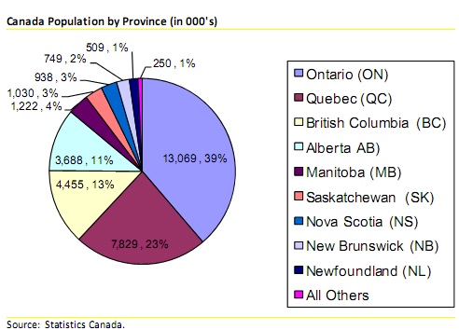
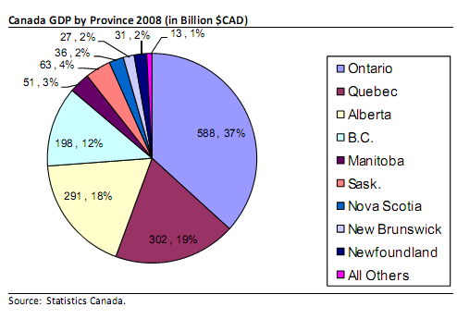
2008 Statistics
Canadian Population
Canadian GDP

Slide 4
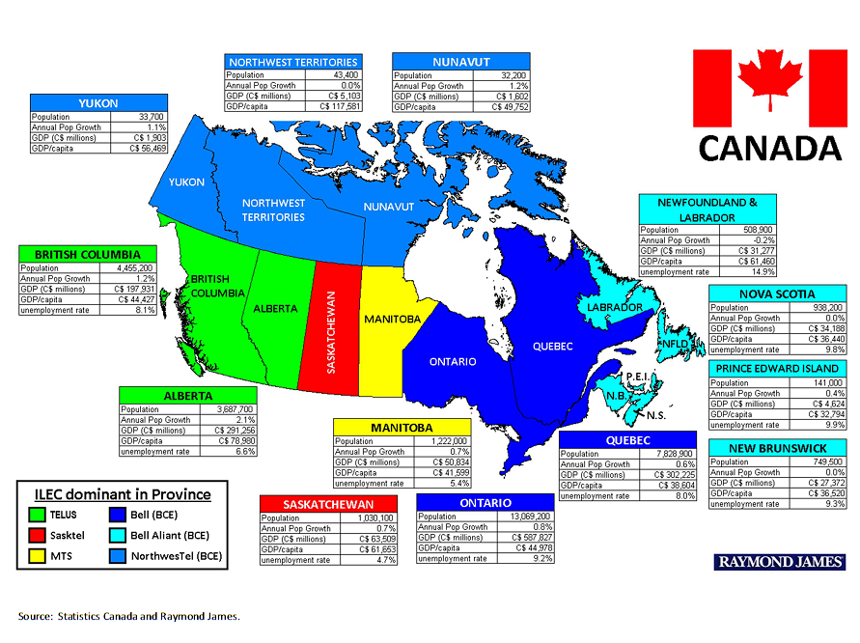
Fixed Line Geographic Breakdown

Slide 5
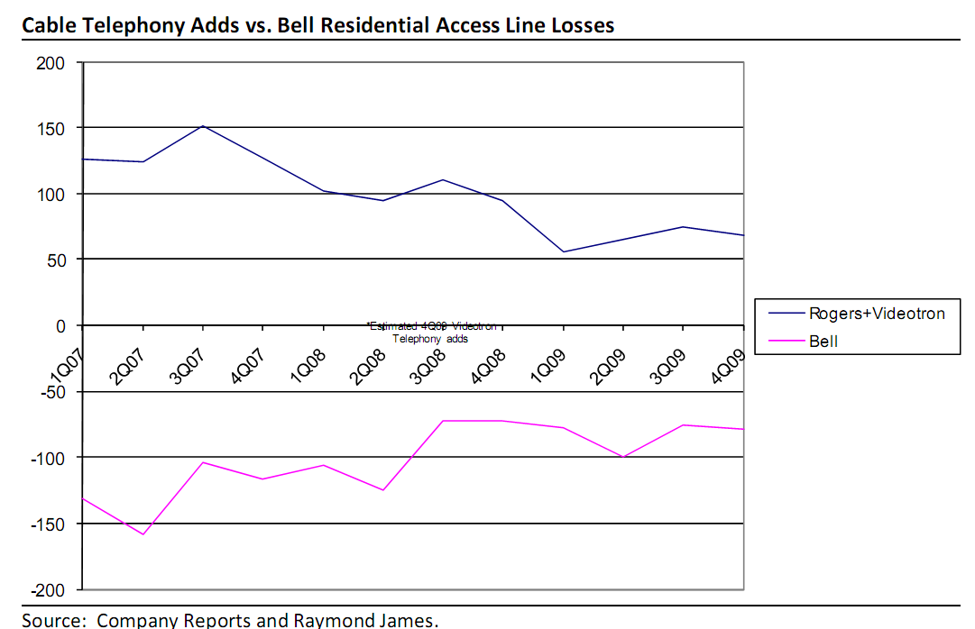
Cable Telephony
Cable Telephony:
Form of digital telephone over cable network that converts analog signal to digital signal which is sent via cable to the company’s switchboard
Alternative to fixed landline at a lower cost

Slide 6
Fixed Line Revenue
Source: BTRTC Canada

Slide 7
Number of Fixed Lines
Source: BTRTC Canada

Slide 8
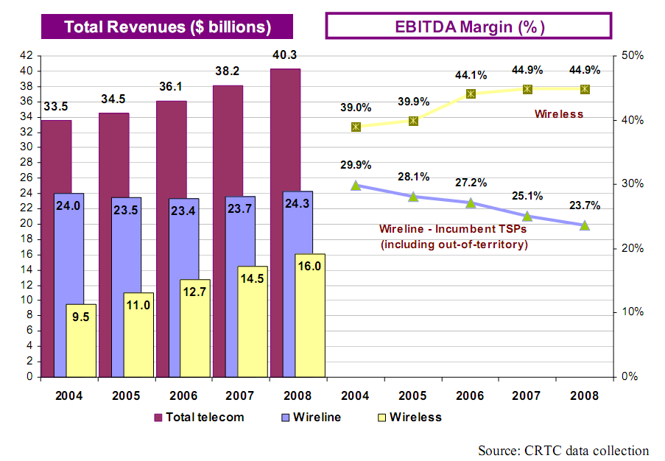
Wireline vs. Wireless

Slide 9
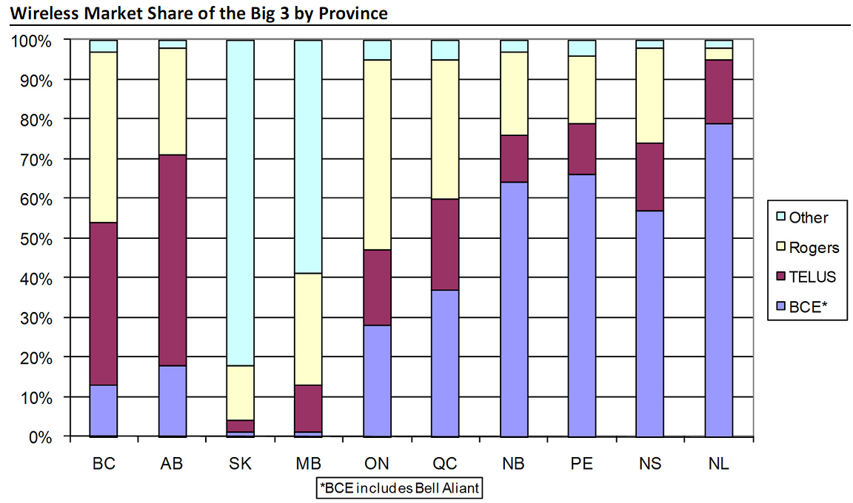
Wireless Marketshare

Slide 10
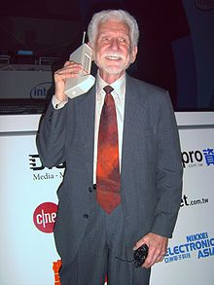
Technology – 1G
Launched in 1970
Increased the market growth from 30% to 50%
1990 → 20 million subscribers
Dr. Martin Cooper of Motorola, made the first US analogue mobile phone call on a larger prototype model in 1973. This is a reenactment in 2007

Slide 11
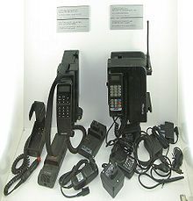
Technology – 2G
Developed in the early 90’s.
GSM and GPRS networks offered improved voice quality.
2.5G used GPRS to increase the data transfer rate, but had some weaknesses, e.g. security
1991 GSM mobile phones

Slide 12
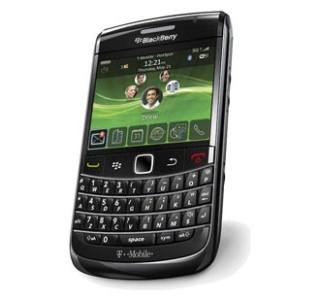
Technology – 3G
Substantially higher data transfer rates.
Substituted the need to have different networks types.
Made global roaming possible
1X/EVDO – allowed for higher data transfer rates for CDMA phones.
EDGE – allowed for higher data transfer rates for GSM phones.
Blackberry Bold 9700

Slide 13
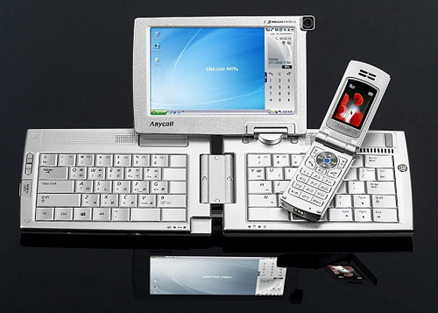
Technology – 4G
High-performance streaming of multimedia content.
Sorts out the problems of limited bandwidth in 3G when people are on the move while using the technology.
Provide higher bandwidth coverage (HSPA/HSPA+ cover 93% of the people in Canada).
Samsung SPH-P9000

Slide 14
Government regulations
Government may have to amend the Telecommunications Act and the Broadcasting Act, which have Canadian foreign ownership restrictions – Globalive might set a precedent
A 2006 report recommended that the government liberalize investment restrictions in the telecom and broadcasting sectors.
The restrictions stipulated that a company has to be “Canadian” – Canadian owned and controlled

Slide 15
Government regulations
The budget states that with regard to the telecommunications sector, “the government proposes to remove the existing restrictions on foreign ownership of Canadian satellites” March 4, 2010
Official clarification to follow

Slide 16
Government regulation – change proposal
Amending the Investment Canada Act to reduce barriers to foreign investment by increasing the financial review thresholds
Reversing the requirement of government to demonstrate that an investment would be contrary to the national interest before disallowing a transaction
Increasing transparency and predictability
Preserving a distinct approach for the cultural sector while also initiating a broad review of Canada’s cultural policies

Slide 17
Foreign ownership possible outcomes
Complete removal of the current restrictions (politically difficult)
Removal of the restrictions for non-incumbent carriers, as recommended by the Telecommunications Policy Review Panel Final Report 2006 (most probable outcome)
No change.
Source: Bank of America Merrill Lynch

Slide 18
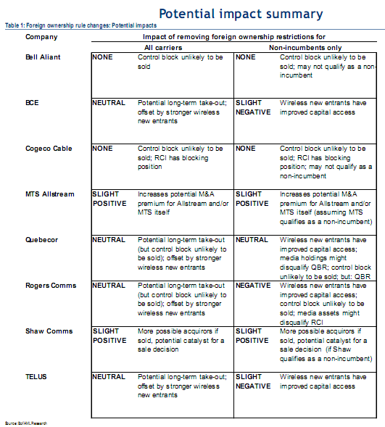
Source: Bank of America Merrill Lynch

Slide 19
CRTC – Broadcasting policy update
Fee for carriage - companies and satellite providers will be forced to pay TV broadcasters for their signals.
The CRTC has indicated that it will allow local broadcasters to negotiate carriage fees from cable and satellite TV providers (BDU)
The Court of Appeals will hear the case to determine if CRTC has the authority to do so.
The CRTC’s proposed guideline is more balanced on a “negotiated” structure than was previously thought.
A broadcaster will be able to choose to negotiate a fee from the BDUs, but doing so would have them forgo all regulatory protections for private local TV stations including mandatory carriage and priority channel placement.
On the announcement date share price of cable and satellite providers decreased
Notes:
604-631-2683
TRAVIS.STEWART@GMAIL.COM

Slide 20
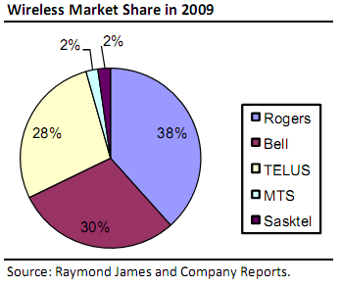
Wireless Marketshare
Current
Threat of new entrants
D.A.V.E. Wireless
Globalive – Wind Mobile
Shaw
Videotron

Slide 21
Spectrum auction
Several firms participated in the bidding for the spectrum reserved for new entrants in May 2008’s auction and 10 of them had winning bids.
Some of the new entrants have already announced their intention to compete in the prepaid market with unlimited voice plans that will be priced below where the incumbents have traditionally been.
The Canadian government will allow the auction winners to flip their spectrum ownership after five years, therefore new networks might not get built.
Not a single new entrant was able to piece together a complete nationwide spectrum footprint.

Slide 22
Spectrum auction
Each license has been assigned a series of points for the spectrum available in the area and the population, which frames the opening bids the government has already set. (20Mhz of spectrum for Prince George, B.C. is worth eight points and bidding will open for it at $699,170)
Each bidder has already had to put a deposit down on points to play in the auction, under a formula based on those minimums. (Globalive’s $235 million deposit bought it 1,892 points)

Slide 23
Spectrum auction
During the auction, participants will bid on each license with money, but they have to also keep in mind the total points of the licenses they are bidding on.
The government forces participants to bid an increasing percentage of their points in each of the rounds.

Slide 24
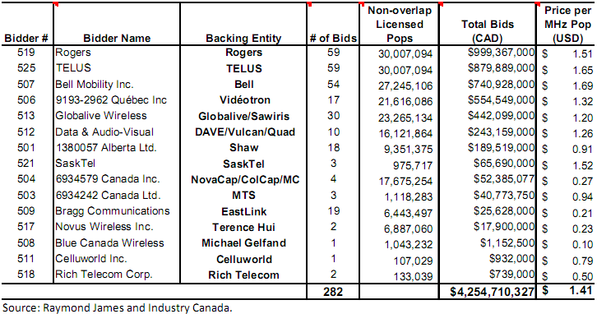
Spectrum auction bids

Slide 25
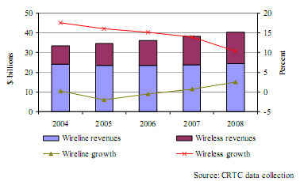
Telecommunication revenue and percentage annual growth

Slide 26
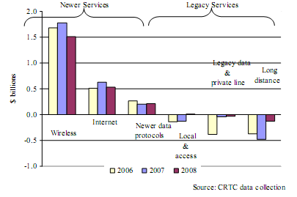
Annual revenue growth by market segment

Slide 27
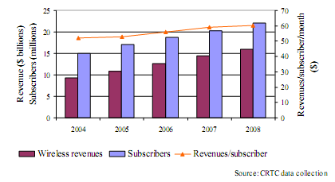
Wireless revenues , subscribers and ARPU

Slide 28
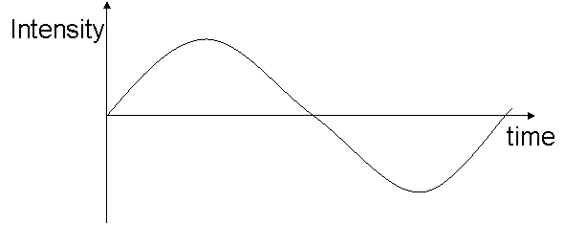
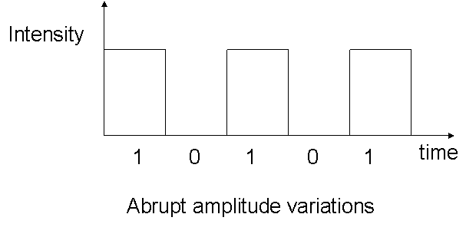
Technology
Analog:
a continuous signal for which the time varying feature (variable) of the signal is a representation of some other time varying quantity
Wildly used by 1G
Analog Signal
Digital Signal
Digital:
Digital signals are non-continuous, they change in individual steps. They consist of pulses or digits with discrete levels or values
it is used starting from 2 G
Notes:
Starting 2.5 G, it’s getting into digital

Slide 29
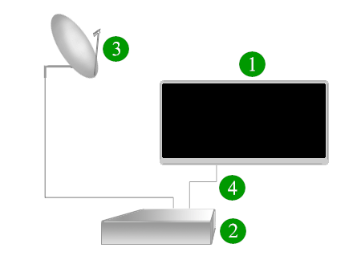
Technology
HD:
the highest resolution format of digital television
most commonly involves display resolutions of 1280×720 pixels (720p) or 1920×1080 pixels (1080i/1080p)
HD has one or two million pixels per frame, roughly five times that of standard – definition
Components of a typical satellite HDTV system: 1. HDTV Monitor 2. HD satellite receiver 3. Standard satellite dish 4. HDMI cable, DVI-D and audio cables, or audio and component video cables

Slide 30
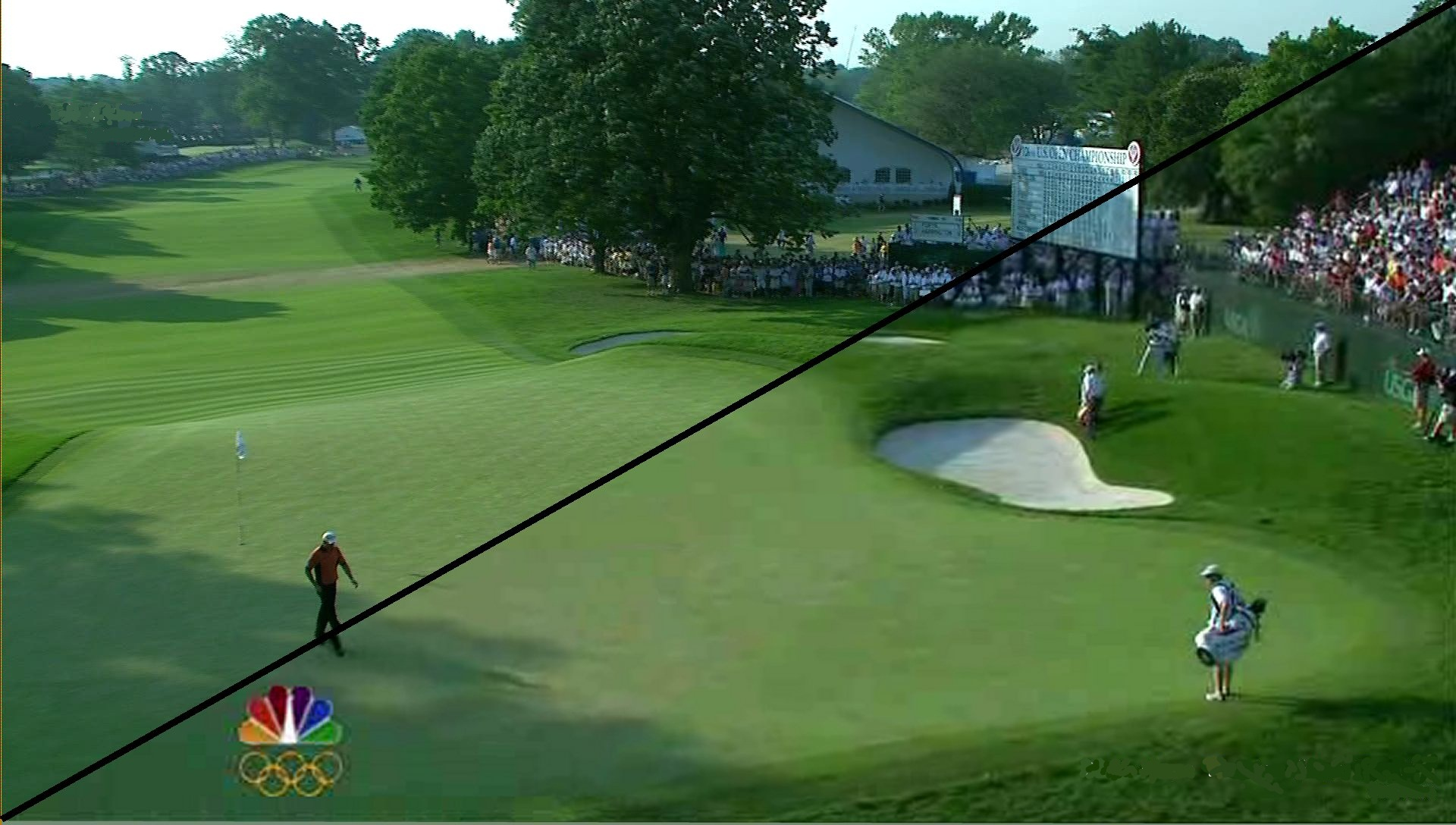
Technology
HD vs SD

Slide 31
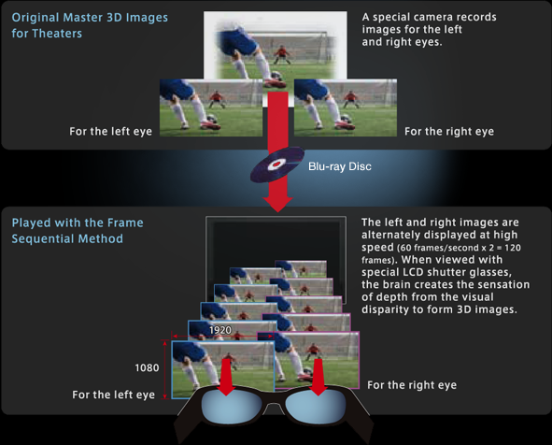
Technology
Future HD3D:
Separate images for the left and right eyes are recorded with 1920 X 1080 full-HD quality and alternately played at high speed
through special LCD glasses that are timed to open and close the right and left lenses in synchronization with the alternating images to experience 3D realism.

Slide 32

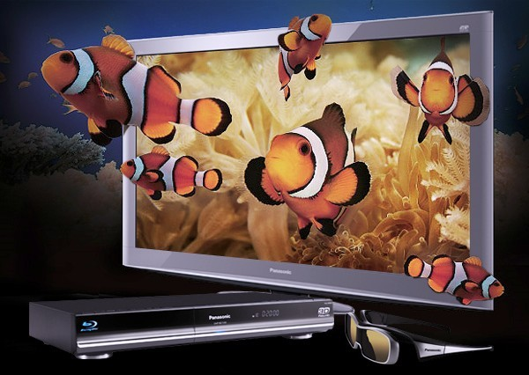
Technology

Slide 33
Internet
Revenue Growth
 | 2004 | 2005 | 2006 | 2007 | 2008 | Growth | CAGR
Residential Total | 2,523 | 2,838 | 3,191 | 3,622 | 3,899 | 7.6% | 11.5%
Business Total | 862 | 903 | 924 | 1,011 | 1,073 | 6.1% | 5.6%
Wholesale Total | 201 | 206 | 202 | 201 | 215 | 7.0% | 0.5%
Other Internet - related services | 569 | 583 | 720 | 835 | 1,015 | 21.6% | 15.6%
Subtotal | 4,155 | 4,530 | 5,037 | 5,669 | 6,202 | 9.4% | 10.5%
Source: Statistics Canada

Slide 34
Internet
Residential Subscribers
 | 2004 | 2005 | 2006 | 2007 | 2008 | Growth | CAGR
Dial - up | 2,025 | 1,568 | 1,239 | 934 | 732 | -21.6% | -22.5%
High - Speed | 5,641 | 6,429 | 7,461 | 8,356 | 9,077 | 8.6% | 13.8%
Subtotal | 7,666 | 7,997 | 8,700 | 9,290 | 9,809 | 5.6% | 7.1%
Source: Statistics Canada

Slide 35

Hello, My name is Steven

Slide 36
TSX: RCI’A
TSX: RCI’B
NYSE: RCI

Slide 37
Overview
Segment Analysis
Financial Statement Analysis
Recommendation

Slide 38
Rogers Snapshot

Slide 39
1 Year Price-volume
Source: Bloomberg

Slide 40
1 Year Relative Performance
Source: Bloomberg

Slide 41
5 Years Price-volume
Source: Bloomberg

Slide 42
5 Years Relative Performance
Source: Bloomberg

Slide 43
15 Years Price-volume
Source: Bloomberg

Slide 44
15 Years Relative Performance
Source: Bloomberg

Slide 45
Shares Outstanding
Class A Shares
1-to-1 convertible to Class B
Restricted to foreign transfers
Class B Shares
Restricted to foreign transfers
Preferred Shares
Non-outstanding
Stock-Options
No tradable options
Employee Stock Options
Source: Rogers 2000-2009 Annual Reports

Slide 46
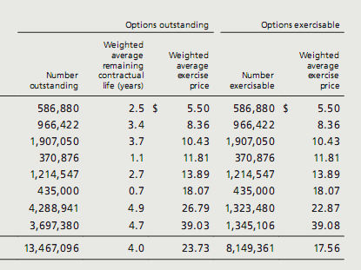
Ownership
Employee B-Class Stock Options Outstanding
Ownership Structure – Class A
Source: Rogers 2009 Proxy Circular
Bloomberg
SEDI
Source: Rogers 2009 Annual Reports

Slide 47
Dividend History
Source: Rogers 2005-2009 Annual Reports

Slide 48
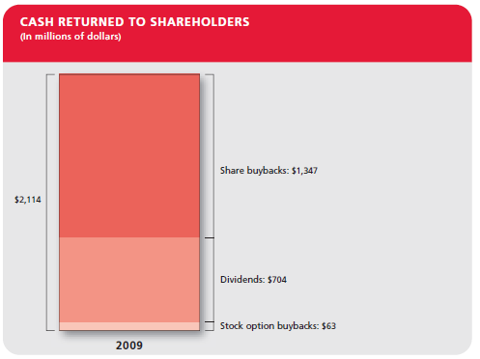
Cash to Shareholders
Source: Rogers 2009 Annual Reports

Slide 49
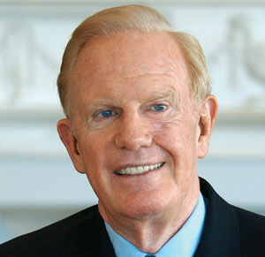
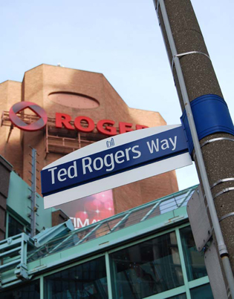
Edward S. “Ted” Rogers
Created Rogers Radio Broadcasting Limited
Founded CFTR-AM in 1962
Won license to create a cable company in March, 1967.
Officer of the Order of Canada in October, 1990
Died of heart failure on December 2, 2008
After his death, his control of Rogers Communication was transferred to “Rogers Control Trust “ which the board consists of his family members
Directorships
Cable Television Laboratories, Inc.
The Canadian Cable Telecommunications Association
Education
Bachelor of Arts from the University of Toronto in 1956
LL.B. from Osgoode Hall Law School in 1961
Doctorate of Science, Clarkson University of Potsdam, New York, May 1989
Doctorate of Law, University of Victoria, BC, June 1990;
Doctorate of Law, York University, Ont., June 1994;
Doctorate of Law, University of Western Ontario, Ont. 1996;
Doctor of Sacred Letters, Trinity College, University
Doctor of Letters, University of New Brunswick, October 2001; and
Doctor of Laws, University of Toronto, Ontario, June 2002
Doctor of Laws, Ryerson University, Ontario, June 2004

Slide 50


Nadir H. Mohamed
Career
President and CEO, RCI (March 2009)
President and CEO, Rogers Wireless (July 2001)
President and COO, Rogers Wireless (August 2000)
Senior VP of Marketing and Sales, Telus Communications Inc. (February 1999 and August 2000)
President and COO, BC Tel Mobility (August 1997 and January 1999)
Directorships
Rogers Communication
TD Financial Group
Education & Designation
Undergraduate degree from UBC
Chartered Accountant
Achievement at Rogers Wireless
13 consecutive quarters double digit network revenue growth
14 consecutive quarters of double digit operating profit growth
FCF turnaround from -$800M in 2001 to +$270M in 2004
During his tenure as CEO, stock price increased from $26.10 to $54.56
Acquisition of Microcell (Fido Brand) in November 2004

Slide 51




Management
Source: Rogers 2009 AIF, Holding information from SEDI

Slide 52




The Rogers Family
Source: Rogers 2009 AIF, Holding information from SEDI

Slide 53







Organization Structure
Rogers Communication Inc.
Wireless
Cable
Rogers Wireless
Fido Solution
Rogers Cable
Media
Rogers Publishing
Rogers Broadcasting
Rogers Sportsnet
Blue Jays Holdco
Source: Rogers 2009 AIF

Slide 54
Corporate Actions
2008 Channel M, Outdoor network, Aurora Cable Acquisition
May 2005 Call-net Acquisition
Jan 2010 Blink Acquisition
Nov 2004 Fido Acquisition
2007 Acquisition of Citytv
Dec 2008 Ted Rogers passed away, leaving control of the company to Rogers Control Trust
Feb2010
Dividend increase

Slide 55
Overview
Segment Analysis
Financial Statement Analysis
Recommendation

Slide 56
Business Breakdown
2009 Revenue
2009 Profit
Source: Rogers 2005 - 2009 AR
Source: Rogers 2005 - 2009 AR

Slide 57

Wireless
Wireless Revenue Breakdown
Largest Canadian wireless voice and data communications service provider serving approximately 8.5 million customers as at December 31, 2009
Products marketed under both the Rogers Wireless and Fido brands through a nationwide distribution network of over 3,600 dealer and retail locations across Canada
Products includes subscriptions to service plans, handsets and prepaid air time and prepaid cards
Source: Rogers 2009 AR and AIF

Slide 58
Wireless Operating Metrics
Average Revenue Per User
Churn Rate
Subscribers
Revenue from Data
Source: Rogers 2009 AR

Slide 59
2010 Theme: Technological Upgrade Vs. Competition
Rogers currently operates a 3G GSM wireless network (7.2 Mbps speed), began upgrading the network to HSPA+ in 2009 (upto 21.1 Mbps), additional upgrade to 42 Mbps
Rogers has indicated it does not expect to upgrade to LTE until 2011 or 2012 (a move towards 4G)
Reduced capex in the near future allows Rogers to:
keep returning value to share holders (Share repurchase / dividend increase)
Build war chest to compete with newcomers (Wind mobile, Public Mobile …)

Slide 60
Cable
Cable Revenue Breakdown
Cable provides: digital cable service to ~ 1.7 mm households
Residential High-speed Internet service to ~ 1.6 mm residential subscribers
Residential cable telephony services to ~ 0.94 mm subscribers in Ontario, New Brunswick and Newfoundland and Labrador
Residential telephony services to ~0.12mm subscribers across Canada
Source: Rogers 2009 AR and AIF

Slide 61
Cable Operating Metrics
Digital TV
High Definition TV
Internet
Cable Telephony
Source: Rogers 2009 AR

Slide 62
Media
Rogers Publishing: 70+ magazines and journals
Media Revenue Breakdown
Rogers Broadcasting:
54 radio stations
OMNI
Citytv
Rogers Sportsnet
Shopping Network
Outdoor Life Network
Canadian Biography Channel
G4TechTV
Rogers Sports Entertainment
Toronto Blue Jays
The Rogers Center
Source: Rogers 2009 AR and AIF

Slide 63
Overview
Segment Analysis
Financial Statement Analysis
Recommendation

Slide 64
Balance Sheet
Source: Rogers 2005 - 2009 AR

Slide 65
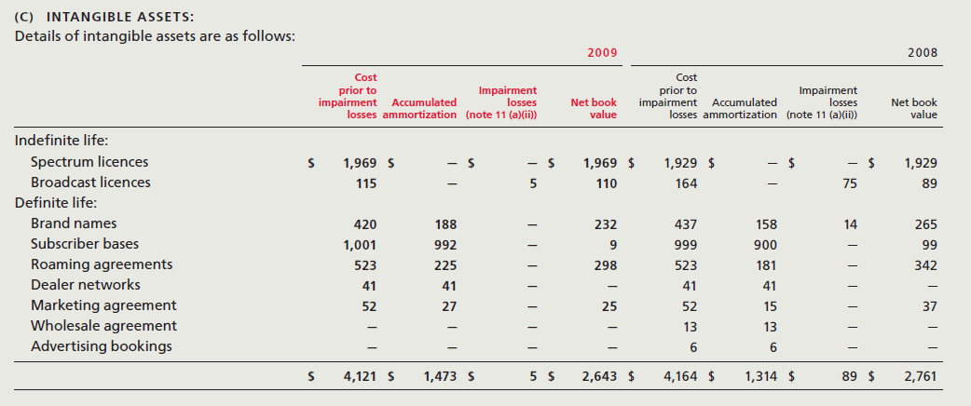
Intangible Assets
Source: Rogers 2009 AR

Slide 66
Balance Sheet
Source: Rogers 2005-2009 AR

Slide 67
Income Statement
Source: Rogers 2005 - 2009 AR

Slide 68
Cash Flow
Source: Rogers 2005 - 2009 AR

Slide 69
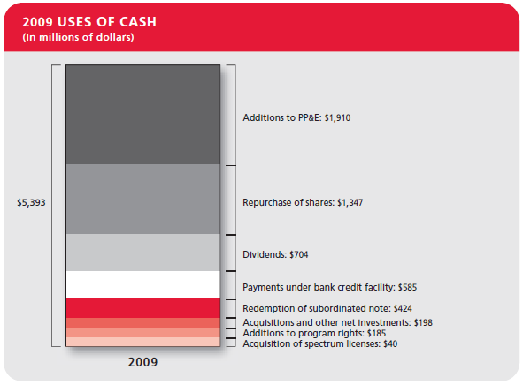
2009 Cash Use

Slide 70
Company Operating Metrics
Revenue, EBITDA and Net Income
Price-to-Earnings Ratio
Debt-to-Asset Ratio
Debt-to-Equity Ratio
Source: Rogers 2009 AR

Slide 71
Overview
Segment Analysis
Financial Statement Analysis
Recommendation

Slide 72
Recommendation
Hold

Slide 73
Bell (B.C.E.)
Hello, My name is Vlad

Slide 74
B.C.E. Snapshot

Slide 75
1 Year – Price Value

Slide 76
1 Year – Relative Performance

Slide 77
5 year – Price Value

Slide 78
5 Year – Relative Performance

Slide 79
15 Year – Price Value

Slide 80
15 Year – Relative Performance

Slide 81
Common shares outstanding

Slide 82
Ownership – only 52% found
Investor Name | Current Position | % OS | Pos Change | % Change | Val($MM)
RBC Capital Partners | 20,766,506.00 | 2.71 | 20,763,815.00 | 771,602.19 | 602.85
Pyramis Global Advisors, LLC | 19,223,249.00 | 2.51 | -3,526,385.00 | -15.50 | 530.75
RBC Asset Management, Inc. | 19,037,553.00 | 2.48 | -21,826,312.00 | -53.41 | 552.66
Harris Investment Management, Inc. | 17,975,427.00 | 2.34 | 1,513,303.00 | 9.19 | 496.30
BlackRock Asset Management Canada Limited | 17,961,455.00 | 2.34 | -14,485.00 | -0.08 | 495.92
McLean Budden Ltd. | 14,022,324.00 | 1.83 | -359,821.00 | -2.50 | 387.16
TD Asset Management Inc. | 13,443,766.00 | 1.75 | 1,308,222.00 | 10.78 | 371.18
Mackenzie Financial Corporation | 12,977,729.00 | 1.69 | -1,003,695.00 | -7.18 | 358.32
Capital Research Global Investors | 12,298,660.00 | 1.60 | 7,461,360.00 | 154.25 | 339.57
Greystone Managed Investments Inc. | 12,036,498.00 | 1.57 | 11,237,558.00 | 1,406.56 | 332.33
I. G. Investment Management, Ltd. | 11,821,407.00 | 1.54 | -1,720,800.00 | -12.71 | 326.39
CIBC Global Asset Management Inc. | 11,333,402.00 | 1.48 | -612,436.00 | -5.13 | 312.92
Letko, Brosseau & Associates Inc. | 11,299,419.00 | 1.47 | -115,904.00 | -1.02 | 311.98
TD Securities, Inc. | 10,233,252.00 | 1.33 | -2,411,170.00 | -19.07 | 282.54
MFC Global Investment Management | 9,319,021.00 | 1.21 | 104,854.00 | 1.14 | 257.30
British Columbia Investment Management Corp. | 8,772,981.00 | 1.14 | 3,640,820.00 | 70.94 | 174.58
Jones Heward Investment Counsel Inc. | 8,418,241.00 | 1.10 | -527,425.00 | -5.90 | 232.43
BlackRock Institutional Trust Company, N.A. | 7,834,711.00 | 1.02 | 1,717,882.00 | 28.08 | 216.32
GWL Investment Management Ltd. | 6,160,067.00 | 0.80 | 343,720.00 | 5.91 | 170.08
Invesco Trimark Ltd. | 5,861,676.00 | 0.76 | -1,613,275.00 | -21.58 | 161.84
Scotia Cassels Investment Counsel Ltd. | 4,862,960.00 | 0.63 | -608,737.00 | -11.13 | 134.27
CPP Investment Board | 4,719,643.00 | 0.62 | 3,733,450.00 | 378.57 | 130.31
DWS Investment GmbH | 4,174,344.00 | 0.54 | 58,562.00 | 1.42 | 121.18
PSP Investments | 3,972,622.00 | 0.52 | -415,884.00 | -9.48 | 109.68
Industrial Alliance Investment Management Inc. | 3,962,582.00 | 0.52 | 500.00 | 0.01 | 109.41
Institutional Capital, LLC | 3,870,950.00 | 0.50 | 547,850.00 | 16.49 | 106.88
American Century Investment Management, Inc. | 3,838,566.00 | 0.50 | -1,671,381.00 | -30.33 | 105.98
Bank of Nova Scotia | 3,596,898.00 | 0.47 | 35,993.00 | 1.01 | 99.31
Allianz Global Investors Kapitalanlagegesellschaft mbH | 3,589,606.00 | 0.47 | 3,589,606.00 | 100.00 | 99.11
Credit Suisse Securities (USA) LLC | 3,514,560.00 | 0.46 | 52,001.00 | 1.50 | 102.03
Goodman & Company, Investment Counsel | 3,269,892.00 | 0.43 | 461,069.00 | 16.42 | 90.28
Fidelity Management & Research | 2,953,852.00 | 0.39 | -1,004,865.00 | -25.38 | 81.56
Connor, Clark & Lunn Investment Mgmt., Ltd. | 2,912,080.00 | 0.38 | -3,130,553.00 | -51.81 | 80.40
Franklin Templeton Investments Corp. | 2,900,867.00 | 0.38 | 256,217.00 | 9.69 | 80.09

Slide 83
Dividend history

Slide 84
Segment Analysis

Slide 85
Organization Structure
Bell Canada Enterprises
Bell Wireline
Bell Wireless
Bell TV
Bell Mobility
Bell Aliant
Bell Home Phone
Bell Internet
Source: BCE 2009 AR

Slide 86
Business Description – B.C.E.
Canada's largest communications company with over 13 million service subscribers.
Offers a full range of communication services to residential and business consumers across Canada.
The company operates mainly under the Bell brand.
Source: Bell 2009 AIF

Slide 87
Business breakdown

Slide 88
Business Revenue Breakdown

Slide 89
Business Income Breakdown

Slide 90
Business Description – Bell Wireline
Satellite TV provides digital and HD service to ~ 2.0 mm households.
High-speed Internet service to ~ 2.9 mm subscribers.
Local telephone service to ~ 10 mm subscribers across Canada.
Source: Rogers 2009 AIF

Slide 91
Bell Wireline Breakdown

Slide 92
Bell Wireline operating metrics

Slide 93
Business Description – Bell Wireless
Operating on the newest network in Canada with more than 7 million customers as of December 31, 2009.
74% post paid – long term contract
Uses different brands ( Mobility, Solo, Virgin) and sales networks (Bell and Solo corporate stores, 3rd party dealers, The Source).
Provides a variety of competitive and innovative plans and accessories.
Source: Rogers 2009 AIF

Slide 94
Bell Wireless Operation Metrics

Slide 95
Business Description – Bell Aliant
Provides services to Canada’s Atlantic provinces, and in rural and regional areas of Ontario and Québec.
At December 31, 2009, BCE owned approximately 44.1% of Bell Aliant, with the remaining 55.9% publicly held.
Source: Rogers 2009 AIF

Slide 96
Bell Aliant breakdown

Slide 97
Financial statements

Slide 98
Balance Sheet
Annual Balance Sheet
 |  | 12/31/2008 CAD | 12/31/2007 CAD | 12/31/2006 CAD restated | 12/31/2005 CAD restated | 12/31/2004 CAD restated
Assets
Cash & ST Investments |  | 3,059.0 | 2,658.0 | 569.0 | 349.0 | 313.0
Receivables (Net) |  | 1,429.0 | 1,940.0 | 1,864.0 | 1,525.0 | 1,951.0
Inventories - Total |  | 272.0 | 266.0 | 329.0 | 335.0 | 295.0
Finished Goods |  | 236.0 | 219.0 | 295.0 | - | -
Prepaid Expenses |  | - | 277.0 | 235.0 | 191.0 | 232.0
Other Current Assets |  | 818.0 | 71.0 | 687.0 | 1,283.0 | 917.0
Current Assets - Total |  | 5,578.0 | 5,212.0 | 3,684.0 | 3,683.0 | 3,708.0
Long Term Receivables |  | 281.0 | 336.0 | 480.0 | 402.0 | 135.0
Other Investments |  | 275.0 | 666.0 | 754.0 | 346.0 | 261.0
Property Plant & Equipment - Net |  | 19,407.0 | 18,600.0 | 19,533.0 | 19,534.0 | 18,654.0
Property Plant & Equipment - Gross |  | 54,503.0 | 51,617.0 | 50,845.0 | 48,704.0 | 47,375.0
Land |  | 77.0 | 76.0 | 79.0 | 78.0 | 95.0
Buildings |  | 3,459.0 | 3,245.0 | 3,204.0 | 3,063.0 | 2,681.0
Machinery & Equipment |  | 49,535.0 | 46,598.0 | 45,646.0 | 43,511.0 | 42,779.0
Rental/Lease Property |  | - | - | - | - | -
Transportation Equipment |  | - | - | - | - | -
PP&E - Other |  | 333.0 | 393.0 | 337.0 | 200.0 | 215.0
PP&E Under Capitalized Leases |  | - | - | - | - | -
(Less) Accumulated Depreciation |  | 35,096.0 | 33,017.0 | 31,312.0 | 29,170.0 | 28,721.0
Accum Depr-Land |  | - | - | - | - | -
Accum Depr-Buildings |  | 1,570.0 | 1,551.0 | 1,470.0 | 1,314.0 | 1,384.0
Accum Depr-Machinery & Equip. |  | 33,393.0 | 31,387.0 | 29,739.0 | 27,790.0 | 27,266.0
Accum Depr-Rental/Lease Property |  | - | - | - | - | -
Accum Depr-Transport Equip. |  | - | - | - | - | -
Accum Depr-PP&E Other |  | 133.0 | 79.0 | 103.0 | 66.0 | 71.0
Accum Depr-PP&E Under Cap Leases |  | - | - | - | - | -
Other Assets |  | 14,044.0 | 12,849.0 | 12,465.0 | 16,150.0 | 15,528.0
Deferred Charges |  | 1,636.0 | 1,240.0 | 1,413.0 | 1,072.0 | 90.0
Tangible Other Assets |  | 355.0 | 298.0 | 129.0 | 3,975.0 | 2,316.0
Intangible Other Assets |  | 12,053.0 | 11,311.0 | 10,923.0 | 11,103.0 | 13,122.0
Total Assets |  | 39,585.0 | 37,663.0 | 36,916.0 | 40,140.0 | 38,396.0

Slide 99
Balance Sheet

Slide 100
Income Statement

Slide 101
Cash Flow Statement

Slide 102
News
2007 Telasat Sale
2009
The Source, Virgin mobile acquisitions
2008 Privatization deal falls through
2010 Olympic Sponsor
Rumors of Telus buying out Bell

Slide 103
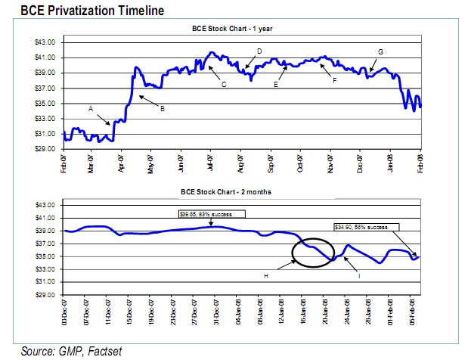
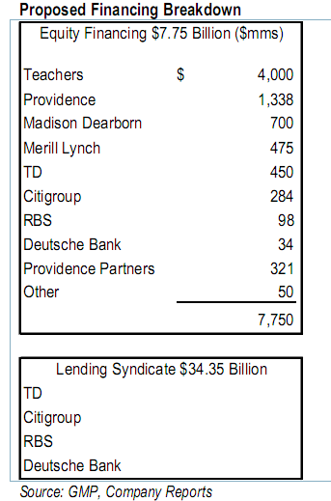
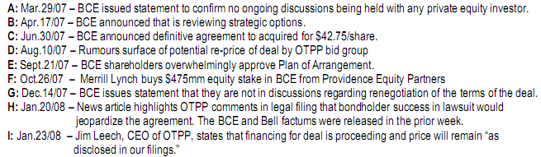

Slide 104
Termination of privatization transaction
June 29, 2007 – BCE is to be acquired, through subsidiaries, by the Ontario Teacher’s Pension Plan on or before Dec 11, 2008
The transaction was stopped due to a failed solvency test done by KPMG prior to the deadline.
Dec 11, 2008 - KPMG announced BCE that it would not be able to pass the required solvency test. All other necessary conditions were met.
Dec 12, 2008 – BCE terminates the Agreement and demand payment of 1.2 billion break-up fee.
Source: Rogers 2009 AIF

Slide 105
Transaction over watch
The CRTC requested that Teachers have 6 of the 13 board nominations vs. the group’s proposal of 5 and a veto of one independent director
Any vacancy of the board or committees caused by a decrease in Teachers ownership be filled by the designee of the Canadian investor who acquires the largest number of shares from Teachers
The transaction still required approval from Industry Canada (regarding the transfer of wireless spectrum)

Slide 106
Recommendation
HOLD/buy
Soft buy depending on government regulation about foreign ownership – possible M&A further down the line

Slide 107

Our mission - our focus - is to deliver true value as seen through the eyes of our customers
Hello, My name is Shane
Source: MTS
Notes:
MTS one of Canada's leading national communications providers, delivers innovative products and services to our customers in consumer markets in Manitoba and business markets across Canada

Slide 108
Company Snapshot
Source: Bloomberg
Notes:
BBB: Medium safe investment

Slide 109
Overview
Segment Analysis
Financial Statement Analysis
Recommendation

Slide 110
1 Year Price-volume
Source: Bloomberg

Slide 111
1 Year Relative Performance
Source: Bloomberg

Slide 112
5 Years Price-volume
Source: Bloomberg

Slide 113
5 Years Relative Performance
Source: Bloomberg

Slide 114
15 Years Price-volume
Source: Bloomberg

Slide 115
15 Years Relative Performance
Source: Bloomberg

Slide 116
Shares Outstanding
Source: MTS 2005-2009 Annual Reports
Notes:
Issue 17 mm Class A preference shares in 2004

Slide 117
Ownership
Employee Stock Options Outstanding
Ownership Structure
Year Granted | Option Outstanding | Options Exercisable | Expiry date
2010 | 367,195 | - | 2019
2008 | 455,000 | - | 2018
2007 | 357,000 | 82,600 | 2017
2006 | 266,300 | 120,500 | 2016
2005 | 621,700 | 389,300 | 2015
2004 | 147,280 | 120,400 | 2014
2003 | 102,160 | 102,160 | 2013
2002 | 1,221,003 | 122,100 | 2012
2001 | 56,500 | 56,500 | 2011
2000 | 40,000 | 40,000 | 2010
Manitoba Telecom Services (MTS) | Shares
CI Investments Inc. | 4,906,830 | 5.72%
CIBC Global Asset Management Inc. | 3,062,023 | 4.73%
Invesco Trimark Ltd. | 2,821,491 | 4.36%
Bell | 7,628,259 | 11.8%
Others | 9,160,376 | 14.17%
Unidentified | 37,067,287 | 57.35%
Total Shares | 64,646,266 | 100%
Source: MTS 2009 Annual Reports
Source: Thomson One

Slide 118
Dividend History
Source: MTS 2005-2009 Annual Reports

Slide 119
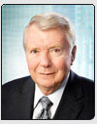
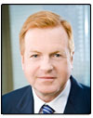

Management
Name | Position | Description | Common Shares | DSUs | RSUs | Total
Thomas E. Stefanson | Chairman of MT Inc. & MTS Allstream | • Appointed as Chairman in 1988 • currently chairs the Governance & Nominating Committee, and is a member of the Human Resources & Compensation Committee and the Strategic Planning Committee | 12,000 | 22,512 | Nil | 34,512
David Leith | Chairman of the MTS Inc. | • Appointed as Chairman in 2010 • Mr. Leith has extensive equity, debt, government finance, and mergers and acquisition experience through his 25 years with CIBC World Markets and its predecessors • Got BA from U of T, MA from Cambridge University | 5,000 | Nil | Nil | 5,000
Pierre J. Blouin | CEO of MTS Inc. & MTS Allstream | • Appointed as CEO in 2005 • Was Group President - Consumer Markets of Bell Canada from 2003 - 2005 • Was presidence & CEO of Emergis Inc from 2002-2003 Executive Vice President of BCE Inc. from March 2002 to May 2002 President and Chief Executive Officer of Bell Mobility Inc from 2000 to 2002 | 9,172 | 48,028 | 13,472 | 70,672
Source: MTS 2009 AIF, Holding information from SEDI
Notes:
“DCUs” refers to the number of deferred compensation units held by the nominee as at March 17, 2009 under the Directors Share Appreciation Plan as described in “Compensation of Directors”.
“RSUs” refers to the number of restricted share units held by him under the Corporation’s Restricted Share Unit Plan as at March 17, 2009

Slide 120
Organization Structure
Manitoba Telecom Service Inc.
MTS
Internet
Allstream
Enterprise Solutions
Data
Digital TV
Wireless
Wireline
Source: MTS 2009 AIF

Slide 121
MTS unit
Consumer Markets Division
An important service provider in the national telecommunications market in Manitoba as well as outside the province
Provide customers in targeted major Canadian centre with a range of innovative business Internet, data and voice services under the Allstream brand
Source: MTS 2009 Annual Information Form

Slide 122
Allstream unit
Enterprise Solutions Division
A leading player in the national business and wholesale markets
Operates an extensive national broadband fibre optic network that spans almost 30,000 kilometers
Provides international connections through strategic alliances and interconnection agreements with other international service providers
Solutions : IP connectivity, Unified Communications, Security, Virtual Workplace, Managed Services
Core Services: Data Networks, Hosting, Internet Access, Voice
Source: MTS 2009 Annual Information Form

Slide 123
MTS Unit Vs Allstream Unit
2009 Revenue
2008 Revenue
2007 Revenue
Source: MTS 2005-2009 Annual Reports

Slide 124
Corporate Actions
May 2004 Allstream Acquisition
July 2008 Spectrum license issued
August 2006
Yellow Pages Group Co
Acquired MTS Media
($275 million)
Notes:
In June 2004, MTS acquired Allstream (formerly AT&T Canada) for $1.7 billion and merged both companies.
In 2006, MTS Allstream sold MTS Media to yellow pages group to generate $275 million in cash

Slide 125
Allstream Acquisition
1.0909 MTS common shares
$23 in cash for each Class A or Class B Allstream Share
Canadian residents
1.0909 MTS Class B non-voting exchangeable preference shares (Canadian ownership limitations)
$23 in cash for each Class A or Class B Allstream Share
Non-Canadian residents
Source: Merrill Lynch 2004
Notes:
Under the terms of the arrangement agreement, Allstream shareholders who are Canadian residents will receive 1.0909 MTS common shares and $23.00 in cash for each Class A or Class B Allstream share. In order to comply with Canadian ownership limitations, Allstream shareholders who are non-Canadian residents will receive 1.0909 MTS Class B non-voting exchangeable preference shares and $23.00 for each Class A or Class B Allstream share. The MTS Class B preference shares will participate equally with common shares in all dividends and the Class B shares are exchangeable into common shares on a 1 for 1 basis subject to foreign ownership restrictions.

Slide 126
Allstream Acquisition
Allstream’s $700 million of tax losses (discounted at 8.5%) that will allow Manitoba Tel to avoid paying taxes for a period of time.
Gains access to Allstream's leading edge fibre based network and ability to offer IP based solutions to its enterprise customers with out-of-province requirements.
Faster to market with solutions for its corporate customers and have greater flexibility for addressing their needs than in the past
Source: Merrill Lynch 2004

Slide 127
Spectrum Auction
In July 2008, Successfully bid for, and were the provisional licensees with respect to, licenses representing 35 MHz of spectrum in the province of Manitoba, at an auction price of approximately $41 million
10-year term license, enhance service, covering 1.2 million people in Manitoba
Source: MTS 2009 Annual Information Form

Slide 128
Overview
Segment Analysis
Financial Statement Analysis
Recommendation

Slide 129
Business Breakdown
2008 Revenue
2007 Revenue
2007 Revenue
Source: MTS 2005-2009 Annual Reports

Slide 130
Business Description - Wireless
Provide wireless services to both consumer and business customers in Manitoba
As at December 31, 2009, the customer base totaled 458,478 cellular subscribers
Services include postpaid and prepaid cellular, wireless data, paging and group communications services
Acquisition of wireless spectrum at a cost of $45 million to cover 1.2 million people in Manitoba
Source: MTS 2009 Annual Information Form

Slide 131
Wireless
Revenue from Data
Average Revenue Per User
Subscribers
Source: MTS 2005-2009 Annual Reports

Slide 132
Business Description – Data Service
Data services provided by both of our operating segments connect data, video and voice networks to establish private connections across office locations and to integrate traffic over highly secure networks
Data line of business includes revenues from the provision of data, Internet and security services
Source: MTS 2009 Annual Information Form

Slide 133
Data Service
Revenue from Data
Average Revenue Per User
Subscribers
Source: MTS 2005-2009 Annual Reports

Slide 134
Business Description - Internet
Offers Internet services to both residential and business customers within Manitoba
Provide both digital subscriber line (“DSL”) high-speed and dial-up Internet services
Provide access speeds ranging from 3 Mbps to 1 G per second
Source: MTS 2009 Annual Information Form

Slide 135
Internet
Revenue Growth
Subscribers
19.2%
Source: MTS 2005-2009 Annual Reports

Slide 136
Business Description –Local Services
Provide local voice access services for residential and business customers within Manitoba’s local exchanges
Include payphones and enhanced local calling features, such as Call Answer, Call Display, Call Waiting, and 3-Way Calling
Source: MTS 2009 Annual Information Form

Slide 137
Local Services
Local Operating Revenue
Service Bundle Customers
*Purchases at least two of wireless, high-speed Internet, and digital television services.
Source: MTS 2005-2009 Annual Reports
Notes:
2006:
The effects of competitive pricing pressures across all of our market segments are reflected in these results.
Our Consumer Markets division continued to experience decreased revenue due to local line losses and customer migration to lower-priced long distance plans along with wireless and e-mail substitutions.
Our Enterprise Solutions division was impacted negatively by lower rates in the domestic, cross-border and international markets, which were offset partly by higher cross-border and international volumes.

Slide 138
Business Description – Long Distance Services
Offer a variety of long distance savings plans to our Manitoba customers and dial-around service in British Columbia and Alberta
Long Distance Revenue
Offer calling cards and prepaid cards for national and international long distance calling
Offer teleconferencing, toll-free and featured long distance services to our business customers
Source: MTS 2005-2009 Annual Reports
Notes:
lower rates and volumes in the domestic and cross-border markets contributing to the decreases in our revenues from long distance services.

Slide 139
Digital Television
Digital television services:
MTS Classic TV, targeted at residential customers in Winnipeg
Market Share of 34% in 2008
Digital TV was launched in 2003
Service includes:
High definition
Video-on-demand, pay-per-view and games services
“Email on Demand” service
“Photos on Demand” service
Source: MTS 2009 Annual Information Form
Notes:
Video on demand: movies
Pay-per-view: live shows such as UFC (Mixed Martial Arts), boxing, wrestling, hocky
Our “Email on Demand” service allows our customers who subscribe to both our digital television service and Internet service to check their e-mail on their own television set, while our “Photos on Demand” service allows customers to view a slide show of their own photographs in digital quality on their television screen.

Slide 140
Digital Television
Digital Television Revenue
Average Revenue Per User
Subscribers
Source: MTS 2005-2009 Annual Reports

Slide 141
Overview
Segment Analysis
Financial Statement Analysis
Recommendation

Slide 142
Balance Sheet
Annual Balance Sheet
 |  | 12/31/2009 CAD | 12/31/2008 CAD | 12/31/2007 CAD | 12/31/2006 CAD restated | 12/31/2005 CAD restated
Assets
Cash & ST Investments |  | 110.2 | 6.5 | 0.0 | 106.7 | 0.0
Receivables (Net) |  | 166.2 | 62.2 | 171.0 | 215.8 | 212.6
Inventories - Total |  | 23.9 | 30.5 | 14.7 | 6.9 | 0.0
Finished Goods |  | 23.9 | 30.5 | 14.7 | 6.9 | 0.0
Prepaid Expenses |  | 34.1 |  | 33.9 |  | 20.5
Other Current Assets |  | 97.6 | 90.5 | 109.1 | 111.4 | 155.5
Current Assets - Total |  | 432 |  | 328.7 |  | 388.6
Long Term Receivables |  | 17.8 | 15.0 | 11.8 | 9.2 | -
Other Investments |  | 0.1 | 1.5 | 17.3 | 17.4 | 17.6
Property Plant & Equipment - Net |  | 1,362.2 | 1,490.3 | 1,486.1 | 1,452.7 | 1,502.9
Property Plant & Equipment - Gross |  | 3,749.4 | 3,796.1 | 3,750.5 | 3,600.7 | 3,517.7
Land |  | 6.3 | 6.3 | 5.8 | 5.6 | 6.8
Buildings |  | 267.7 | 262.4 | 248.5 | 230.1 | 229.1
(Less) Accum Depr-Buildings |  | 152.9 | 142.9 | 128.3 | 118.3 | 110.8
Machinery & Equipment |  | 3,359.7 | 3,409.3 | 3,340.4 | 3,266.4 | 2,707.1
(Less) Accum Depr-Machinery & Equip. |  | 2,233.3 | 2,162.3 | 2,134.2 | 2,027.9 | 1,629.2
PP&E - Other |  | 17.0 | 21.3 | 21.0 | 15.2 | 486.8
(Less) Accum Depr-PP&E Under Cap Leases |  | 1.0 | 0.6 | 1.9 | 1.8 | 1.6
Other Assets |  | 722.2 | 476.7 | 364.2 | 322.9 | 271.5
Deferred Charges |  | 462.7 | 369.4 | 305.7 | 271.1 | 174.3
Tangible Other Assets |  | 5.5 | 0.0 | 0.0 | 0.0 | 0.0
Intangible Other Assets |  | 254.0 | 107.3 | 58.5 | 51.8 | 97.2
Total Assets |  | 2,534.3 | 2,216.2 | 2,208.1 | 2,267.3 | 2,180.6
Source: MTS 2005-2009 Annual Reports

Slide 143
Balance Sheet
Annual Balance Sheet
 |  | 12/31/2009 CAD | 12/31/2008 CAD | 12/31/2007 CAD | 12/31/2006 CAD restated | 12/31/2005 CAD restated
Assets
Liabilities
Accounts Payable |  | 349.1 | 351.6 | 390.9 | 387.0 | 362.4
ST Debt & Current Portion of LT Debt |  | 16.1 | 318.8 | 105.9 | 111.0 | 170.3
Other Current Liabilities |  | 61.5 | 51.4 | 49.2 | 38.8 | 57.5
Current Liabilities - Total |  | 426.7 | 721.8 | 546.0 | 536.8 | 590.2
Long Term Debt |  | 1,053.0 | 445.2 | 666.2 | 757.7 | 865.6
LT Debt Excl Capital Leases |  | 1,039.6 | 430.2 | 649.8 | 739.4 | 848.1
Non-Convertible Debt |  | 1,039.6 | 430.2 | 649.8 | 739.4 | 848.1
Capitalized Lease Obligations |  | 13.4 | 15.0 | 16.4 | 18.3 | 17.5
Provision for Risks & Charges |  | 43.1 | 44.2 | 45.0 | 46.4 | 51.4
Deferred Income |  | 32.0 | 34.5 | 12.6 | 10.5 | 11.1
Deferred Taxes |  | (360.9) | (435.1) | (515.2) | (650.8) | (801.7)
Deferred Taxes - Credit |  | 1.2 | 1.7 | 2.7 | 3.2 | 1.9
Deferred Taxes - Debit |  | 362.1 | 436.8 | 517.9 | 654.0 | 803.6
Other Liabilities |  | 23.5 | 23.6 | 49.5 | 60.8 | 34.2
Total Liabilities |  | 1,217.4 | 834.2 | 804.1 | 761.4 | 750.8
Shareholders' Equity
Common Equity |  | 1,316.9 | 1,382.0 | 1,404.0 | 1,505.9 | 1,429.8
Common Stock |  | 1,266.9 | 1,265.8 | 1,265.5 | 1,305.1 | 1,315.0
Capital Surplus |  | 19.6 | 19.4 | 17.7 | 16.9 | 18.2
Retained Earnings |  | 30.4 | 96.8 | 120.8 | 183.9 | 96.6
Total Shareholders Equity |  | 1,316.9 | 1,382.0 | 1,404.0 | 1,505.9 | 1,429.8
Total Liabilities & Shareholders Equity |  | 2,534.3 | 2,216.2 | 2,208.1 | 2,267.3 | 2,180.6
Source: MTS 2005-2009 Annual Reports

Slide 144
Income Statement
Annual Income Statement
 |  | 12/31/2009 CAD | 12/31/2008 CAD | 12/31/2007 CAD | 12/31/2006 CAD restated | 12/31/2005 CAD restated
Income Statement
Net Sales or Revenues |  | 1,809.9 | 1,921.5 | 1,905.8 | 1,926.4 | 1,980.3
Operating Expenses - Total |  | 1,521.0 | 1,616.8 | 1,555.9 | 1,590.7 | 1,639.6
Cost of Goods Sold |  | 1,198.3 | 1,286.8 | 1,237.2 | 1,260.1 | 1,323.5
Selling, General & Admin Expenses |  | - | - | - | - | -
Depreciation, Depletion & Amortization |  | 322.7 | 330.0 | 318.7 | 330.6 | 316.1
Depreciation |  | 182.2 | 284.5 | 279.0 | 287.1 | 278.4
Amortization of Intangibles |  | 92.9 | 4.6 | 3.1 | 10.2 | 9.4
Amortization of Deferred Charges |  | 47.6 | 40.9 | 36.6 | 33.3 | 28.3
Other Operating Expenses |  | 0.0 | 0.0 | 0.0 | 0.0 | 0.0
Operating Income |  | 288.9 | 304.7 | 349.9 | 335.7 | 340.7
Extraordinary Credit - Pretax |  | 0.0 | 0.0 | 0.0 | 0.0 | 0.0
Extraordinary Charge - Pretax |  | 52.4 | 20.8 | 11.9 | 56.8 | 61.6
Interest Expense On Debt |  | 59.5 | 48.9 | 51.7 | 60.6 | 60.8
Other Income/Expense - Net |  | 11.6 | 7.1 | 6.7 | 5.5 | 3.0
Pretax Income |  | 188.6 | 242.1 | 293.0 | 223.8 | 221.3
Income Taxes |  | 84.7 | 98.1 | 123.3 | 126.7 | 22.5
Minority Interest |  | 0.0 | 0.0 | 0.0 | 0.0 | 0.0
Equity In Earnings |  | 0.0 | 0.0 | 0.0 | 0.0 | 0.0
Discontinued Operations |  | 0.1 | 0.0 | 0.0 | - | -
Net Income Before Extra Items/Preferred Div |  | 104.0 | 144.0 | 169.7 | 97.1 | 198.8
Extr Items & Gain(Loss) Sale of Assets |  | (2.3) | 0.0 | 0.0 | 202.3 | 0.0
Net Income Before Preferred Dividends |  | 101.7 | 144.0 | 169.7 | 299.4 | 198.8
Preferred Dividend Require |  | 0.0 | 0.0 | 0.0 | 0.0 | 0.0
Net Income to Common Shareholders |  | 104.0 | 144.0 | 169.7 | 97.1 | 198.8
Source: MTS 2005-2009 Annual Reports

Slide 145
Cash Flow
Annual Cash Flow Statement
 |  | 12/31/2009 CAD | 12/31/2008 CAD | 12/31/2007 CAD | 12/31/2006 CAD restated | 12/31/2005 CAD restated
Operations
Net Income / Starting Line |  | 104.0 | 144.0 | 169.7 | - | -
Depreciation, Depletion & Amortization |  | 322.7 | 330.0 | 318.7 | 330.6 | 316.1
Depreciation & Depletion |  | 182.2 | 284.5 | 279.0 | - | -
Amortization of Intangible Assets |  | 140.5 | 45.5 | 39.7 | 43.5 | 37.7
Deferred Income Taxes & Investment Tax Credit |  | 85.7 | 97.8 | 137.3 | 144.1 | 51.2
Other Cash Flow |  | (131.0) | (91.7) | (66.0) | 164.0 | (144.0)
Funds From Operations |  | 381.4 | 480.1 | 559.7 | 441.6 | 438.7
Funds From/For Other Operating Activities |  | (117.6) | 45.9 | 29.0 | (18.0) | (8.5)
Net Cash Flow - Operating Activities |  | 263.8 | 526.0 | 588.7 | 423.6 | 430.2
Investing
Capital Expenditures (Addition to Fixed Assets) |  | (295.2) | (335.7) | (312.0) | (272.7) | (342.4)
Additions To Other Assets |  | (0.0) | (0.0) | (0.0) | (0.0) | (0.0)
Net Assets From Acquisitions |  | (2.1) | (4.4) | (8.1) | (4.3) | (18.6)
Increase In Investments |  | (0.0) | (0.0) | (0.0) | (0.0) | (0.0)
Other Use/(Source) - Investing |  | 0.6 | 3.4 | 2.9 | (294.4) | (1.7)
Other Uses - Investing |  | (2.0) | (3.4) | (2.9) | (0.0) | (0.0)
Other Sources - Investing |  | 1.4 | 0.0 | 0.0 | 294.4 | 1.7
Net Cash Flow - Investing |  | (297.9) | (343.5) | (323.0) | 71.6 | (351.2)
Financing
Net Proceeds From Sale/Issue of Com & Pref |  | 0.9 | 0.2 | 5.9 | 15.1 | 4.9
Other Proceeds From Sale/Issuance of Stock |  | 0.9 | 0.2 | 5.9 | 15.1 | 0.0
Com/Pfd Purchased |  | (0.0) | (0.0) | (111.0) | (61.9) | (0.0)
Long Term Borrowings |  | 625.0 | 0.0 | 0.0 | 0.0 | 0.0
Reduction In Long Term Debt |  | (315.0) | (89.7) | (106.5) | (48.1) | (60.1)
Inc(Dec) In Short Term Borrowings |  | 0.0 | 95.0 | 0.0 | (108.0) | 108.0
Cash Dividends Paid - Total |  | (168.1) | (168.0) | (170.6) | (176.6) | (175.9)
Common Dividends (Cash) |  | 168.1 | 168.0 | 170.6 | 176.6 | 175.9
Other Source (Use) - Financing |  | (5.0) | (3.4) | (0.3) | 0.9 | 2.6
Other Sources - Financing |  | 0.0 | 0.0 | 0.0 | 0.9 | 2.6
Other Uses - Financing |  | (5.0) | (3.4) | (0.3) | (0.0) | -
Net Cash Flow - Financing |  | 137.8 | (165.9) | (382.5) | (378.6) | (120.5)
Effect of Exchange Rate On Cash |  | - | - | - | - | -
Inc(Dec) In Cash & Short Term Investments |  | 103.7 | 16.6 | (116.8) | 116.6 | (41.5)
Source: MTS 2005-2009 Annual Reports

Slide 146
Company Operating Metrics
Revenue, EBITDA and Net Income
Price-to-Earnings Ratio
Debt-to-Asset Ratio
Debt-to-Equity Ratio
Source: Thomson One

Slide 147
Overview
Segment Analysis
Financial Statement Analysis
Recommendation

Slide 148
Recommendation
HOLD

