Slide 1
Canadian Telecommunications
                Yongkai Wang
                Roger Yang
                Leon Xie
                Kathy Tse

Slide 2
Agenda
Industry Overview
BCE
Rogers
Manitoba

Slide 3
History
In the Middle Ages, beacons
In 1792, the first visual telegraphy system
In 1839, the first commercial electrical telegraph
In 1866, the first permanent transatlantic telegraph cable
In 1876, the conventional telephone
In 1878, the first commercial telephone services
In 1901, wireless communication
In 1926, the first television system
In 1969, ARPANET

Slide 4
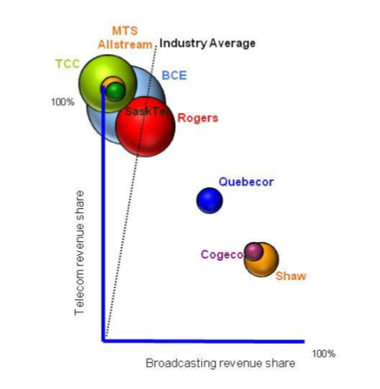
Canadian telecommunications industry

Slide 5
Market Sectors
Wireless
Wireline
  Local and access and long distance
  Internet
Television

Slide 6
Wireless
wireless communication is the transfer of information without the use of wires. It encompasses various types of fixed, mobile, and portable two-way radios, cellular telephones, personal digital assistants, and wireless networking.

Slide 7
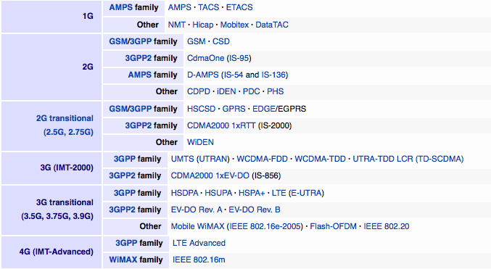
Technology

Slide 8
1G
The first generation of wireless telephone technology
Launched in Japan in 1979
The analog telecommunications standards

Slide 9
2G
Advantages
Disadvantages
digitally encrypted
more efficient on the spectrum
data services such as text messages and emails
in less populous areas, the weaker digital signal may not be sufficient to reach a cell tower.
digital has a jagged decay curve.

Slide 10
3G
Application services
  wide-area wireless voice telephone
  mobile Internet access
  video calls and mobile TV
Allows simultaneous use of speech and data services
Provides peak data rates of at least 200 kbit/s

Slide 11
4G
Requirement
  4G must have target peak data rates of up to approximately 100 Mbit/s for high mobility and up to approximately 1 Gbit/s for low mobility
Current technologies
  3GPP Long Term Evolution (LTE)
  Mobile WiMAX (IEEE 802.16e)

Slide 12
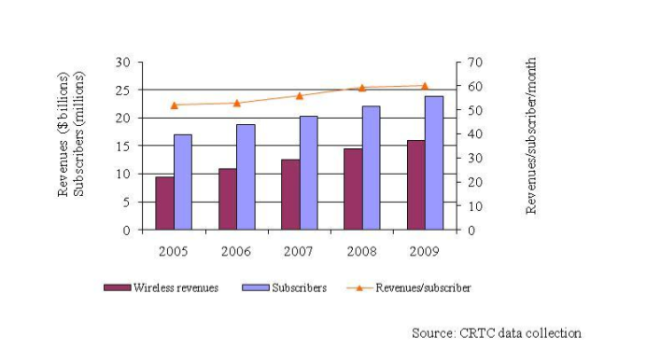
Wireless revenues and subscribers

Slide 13
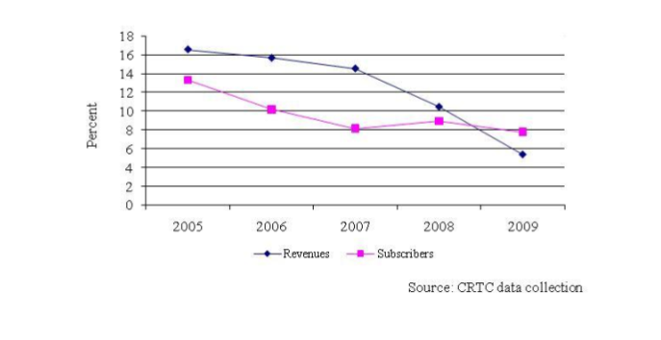
Wireless revenue and subscriber growth rates

Slide 14
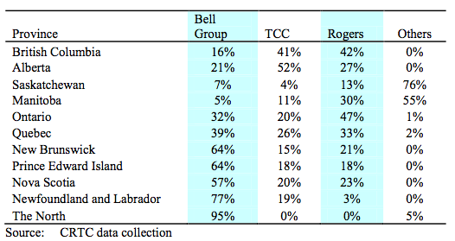
Wireless subscriber market share by province

Slide 15
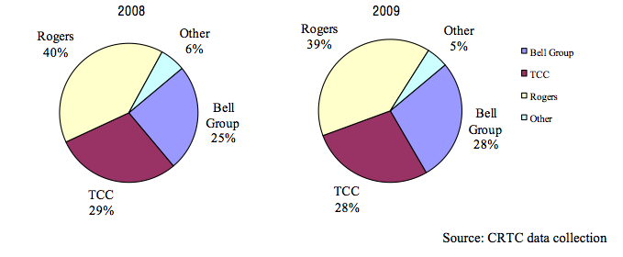
Wireless revenue market share

Slide 16
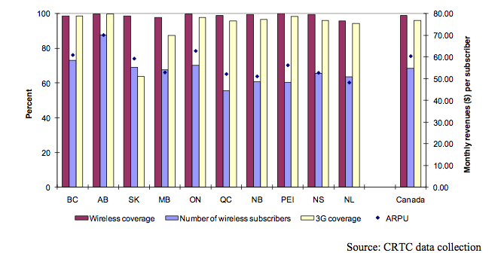
Population coverage and penetration

Slide 17
Local and access and long distance
91% of Canadian households subscribed to wireline voice communications service
Service providers:
  Large incumbent TSPs
  Small incumbent TSPs
  Cable BDUs
  Resellers

Slide 18
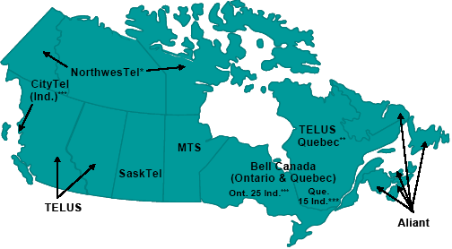
Local and access and long distance

Slide 19
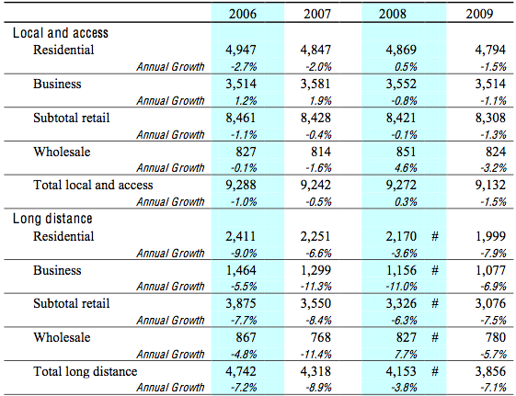
Local and access and long distance revenues by service category ($millions)

Slide 20
Internet
A global system of interconnected computer networks that use the standard Internet Protocol to serve users worldwide
The use of Internet has grown considerably

Slide 21
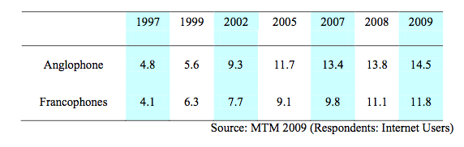
Average weekly hours spent online by Canadians Internet users

Slide 22
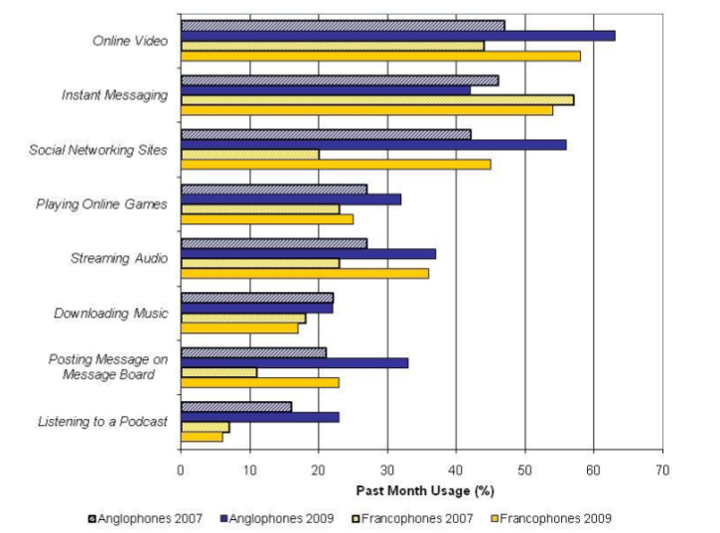
Popular Internet activities for Canadian Internet users

Slide 23
Television
CBC conventional television station
Private conventional television stations
  English-language: CTVglobemedia,
  Canwest
  Rogers
  French-language: Quebecor
    Remstar

Slide 24
Television (continued)
Canadian specialty, pay, pay-per-view, video-on-demand services
  English-language: CTVglobemedia
  Corus
  Canwest
  Rogers
  Astral Media
  French-language: Astral Media
  CTVglobemedia
  CBC

Slide 25


Categories
Cable TV
  widely used in the world
Digital TV (HDTV and SDTV)
  more digital channels in the same space, high-definition television service, and other non-television services
  special services

Slide 26

Categories (continued)
Internet Protocol television
  Interactivity
  Video-on-demand
  IPTV-based converged services

Slide 27
Regulator
The Canadian Radio-television and Telecommunications Commission (CRTC)
  establishing, monitoring, assessing and reviewing, where appropriate, regulatory frameworks to meet its policy objectives
  implementing procedures for the efficient and effective resolution of competitive disputes
  making determinations on industry mergers, acquisitions and changes of ownership in the industry

Slide 28
The 1993 Telecommunications Act
Canadian Ownership Policy
  The fundamental objective is to ensure that the Canada's telecommunications infrastructure is owned and controlled by Canadians
  80% of voting shares owned by Canadians
  80% of the members of their board of directors are Canadians

Slide 29
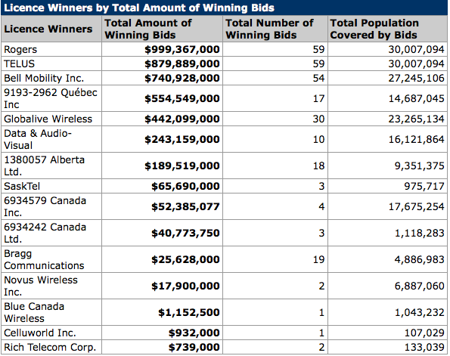
Spectrum Auctions

Slide 30
BCE – Bell Canada Enterprises

Slide 31
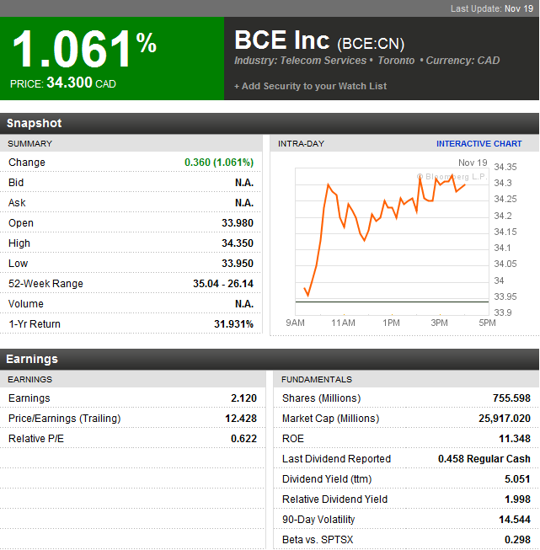
Financial snapshot
Notes:
Low beta, high dividend payout ratio

Slide 32
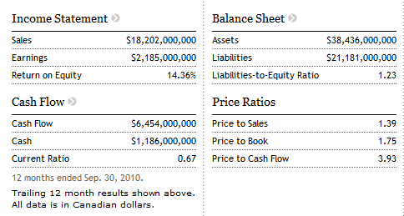
Financial snapshot
Notes:
ROE 14.36%
L to E ratio 1.23, more than 50% leveraged – typical utility firm
current ratio less than 1.

Slide 33
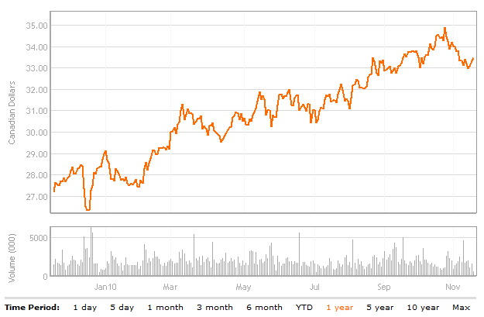
1 Year Movement

Slide 34
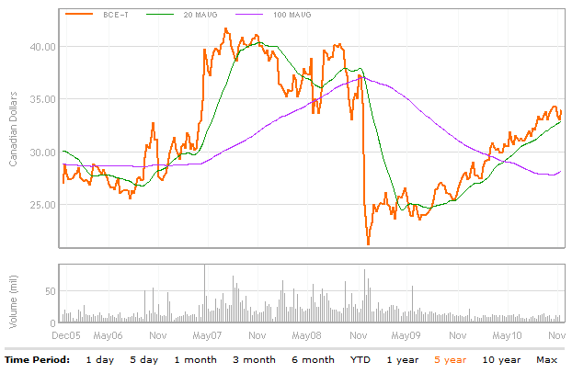
5 Year Movement with moving average
Announced BCE failing to meet solvency test, Nov. 26, 2007
Seeking privatization, April 17, 2007

Slide 35
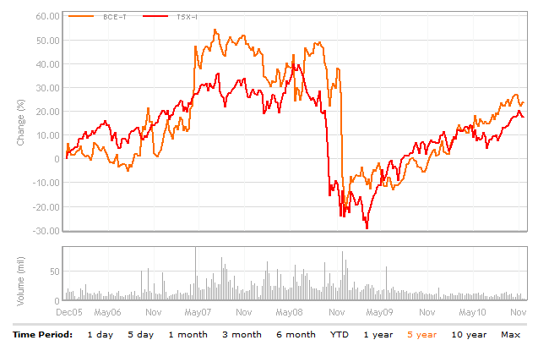
5 Year vs. S&P/TSX Composite

Slide 36
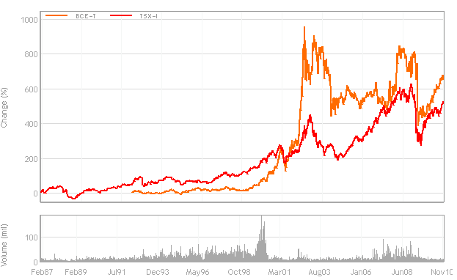
Max Years vs. S&P/TSX Composite
IT bubble
Privatization

Slide 37
The biggest LBO in Canada
2004-2006 | Shrinking fixed line market, losing market share in both wireline and wireless
2006 | To be wound down, to convert to income trust, canceled because of change in taxation law
Dec 2006 | Recapitalized Telesat
April 17, 2007 | Announced reviewing strategic alternatives: privatization
Jun 30, 2007 | BCE Reaches Definitive Agreement to be Acquired By Investor Group Led by Teachers
Sep 21, 2007 | BCE shareholders approved acquisition
Mar 6, 2008 | Debenture holders' lawsuits dismissed
Mar 27, 2008 | CRTC issued approval of acquisition – with non-Canadian terms
Nov 26, 2008 | KPMG informed BCE not meeting solvency test as defined in the definitive agreement, as amended
Nov 26, 2008 | Stock price dropped by 34.16%, from 38.350 to 25.250
Dec 12, 2008 | Definitive Agreement terminated and demanded payment of the $1.2 billion break-up fee from the Purchaser (Refused)

Slide 38
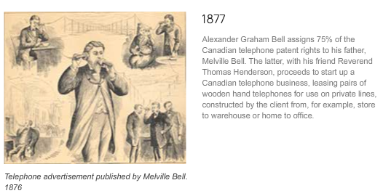
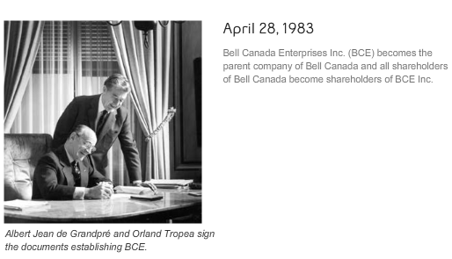
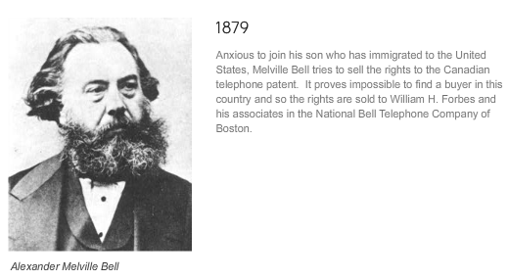
Early history

Slide 39
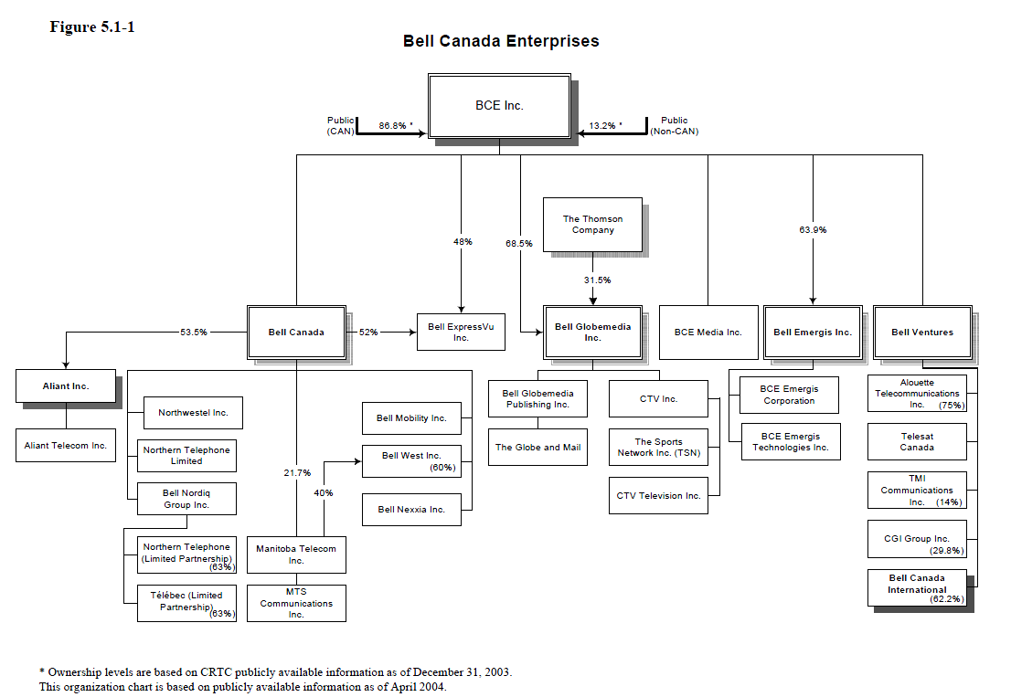
BCE Organizational chart
Notes:
Owns 44% of Aliant inc.

Slide 40
Company profile – Services
“BCE is Canada's largest communications company.” Services include:
  Bell Home phone local and long distance
  Bell Mobility, Virgin Mobile and Solo Mobile wireless
  High-speed Bell Internet
  Bell Satellite TV and Bell Fibe TV
  IP-broadband
  Information and communications technology (ICT) services.
Notes:
Mostly diversified
Reduce risk
Utilize synergy

Slide 41
Company profile – 5 Strategic imperatives
Improve customer service
Accelerate wireless
Leverage wireline momentum
Invest in broadband networks and services
Achieve a competitive cost structure
Notes:
Wireline and Wireless, network, cost structure

Slide 42
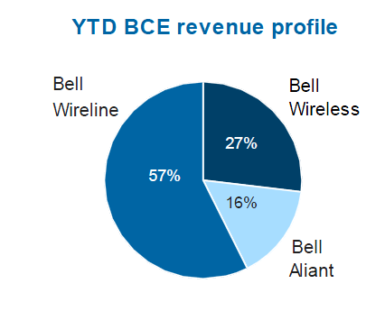
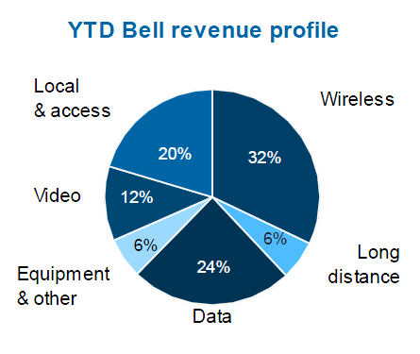
Company Profile – Business Segments
Notes:
Wireline takes more than 50%
Q3’10

Slide 43
Management

Slide 44

THOMAS C. O'NEILL
Chair of the Board (Since February 2009)
Chartered Accountant
Director of Adecco S.A., Bell Canada, Loblaw Companies Limited, Nexen Inc. and The Bank of Nova Scotia
Chief Executive Officer of PricewaterhouseCoopers Consulting in 2002
B.Comm from Queen’s University

Slide 45

GEORGE COPE
President and Chief Executive Officer (Since July 2008)
  Director of Bank of Montreal, since 2006
Experiences
  Director of NII Holdings Inc., (formerly, Nextel International) 2004 – 2010
  Chief Operating Officer, Bell Canada Inc. and Bell Canada Holdings Inc. 2005 – 2008
  Executive Vice President, TELUS Corporation, President and CEO, TELUS Mobility, 2000 – 2005
  President and Chief Executive Officer of Clearnet Communications Inc., 1987 – 2000
  Vice President of Corporate Development at Lenbrook Inc., before 1987
Notes:
A strong background, more than 20 years experiences in telecom. Degree in Comm.

Slide 46
GEORGE COPE (cont’d)
Education
  B.Comm. degree in Business Administration, the University of Western Ontario,1984
Total Compensation: $4,637,161.00
Value of unexercised options: $7,836,450.00
4th highest paid CEO in Canada
Notes:
A strong background, more than 20 years experiences in telecom. Degree in Comm.

Slide 47
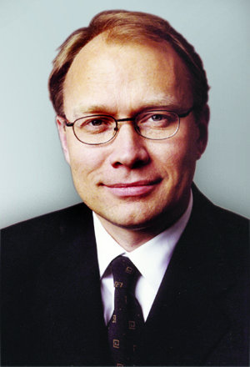
SIIM A. VANASELJA
Executive Vice-President & Chief Financial Officer
Experience
  Partner at the accounting firm KPMG Canada in Toronto
  Member of the Institute of Chartered Accountants of Ontario
  member of the Conference Board of Canada's National Council of Financial Executives, the Corporate Executive Board's Working Council for Chief Financial Officers and Moody’s Council of Chief Financial Officers
Education
  Honours Bachelor of Business degree from the Schulich School of Business

Slide 48
Business Performance – Wireline

Slide 49
Overview
Wireline services include:
  Local and access services (fixed line)
  Long distance services (fixed line)
  Data services (internet/broadband)
  Video services (Bell TV)
  Equipment and other
57% of Bell’s total revenue, 39% of operating income in Q3’10
Notes:
LAS – households
LDS - business

Slide 50
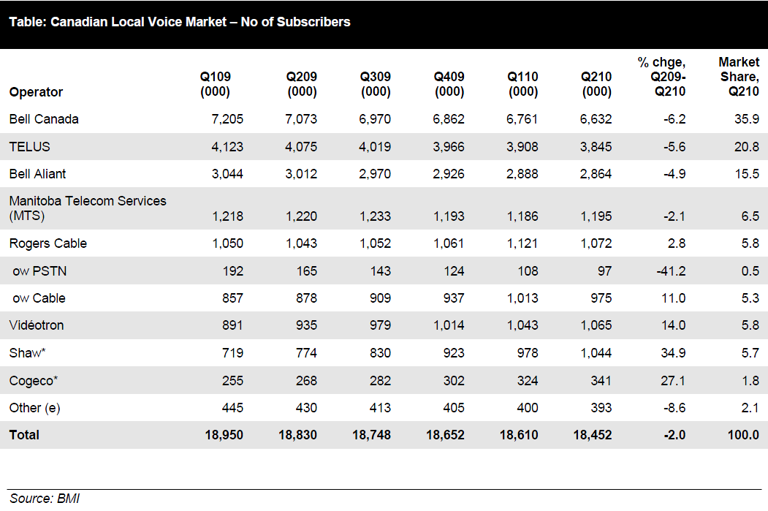
Fixed line market
(Local and access & Long distance services)

Slide 51
Fixed line market
Fixed line market is still an important market of telecommunication in Canada
Mature market with slow and stable growth
Competition is fierce with many services providers
Facing threats from mobile or other substitutions – lowering customer base and increasing price pressure
  Slow growth rate compared with mobile users
    74.3% of Canadian households used a mobile phone in 2008, up from 72.4%in 2007
  Losing younger users
    “8% of households had no landline at the end of 2008, compared with 6.4% in 2007”
  More business users turning to “mobile-only”
  New technology substitutions, IP based services

Slide 52
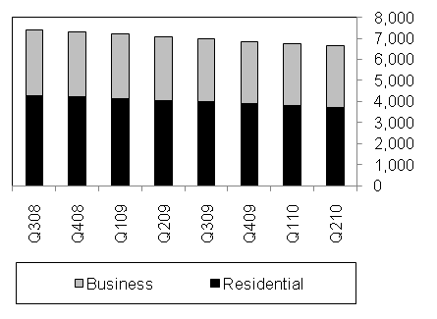
Bell Canada Fixed Line Subscriber Composition
Notes:
Business
More stable
Smaller but accelerating decline on NAS:
3.7% in 2009 vs. 1.7% in 2008
Residential
More flexible
More threatened from mobile
Greater but decelerating decline:
7.9% in 2009 vs. 8.3% in 2008

Slide 53
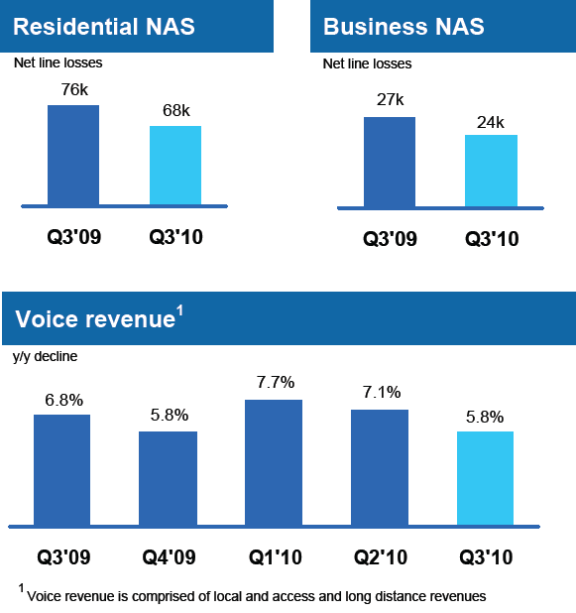
Q3’ 10: Best performance in 5 years

Slide 54
Fixed line takes a large portion of BCE’s total revenue
Operating margin is low
BCE remained its dominant position in this market with 35.9% + 15.5% market share
Both Bell Canada and Bell Aliant are losing market shares gradually, compared to its competitors, Rogers and Shaw, etc.
Losing speed decelerated
  “Best local voice performance in over 5 years”
  Residential NAS losses reduced 10.3% y/y
  Business NAS losses reduced 11.3% y/y

Slide 55

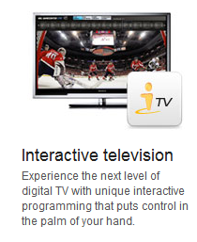
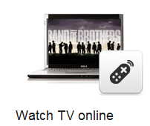
Bell TV
Satellite TV
  “Best HDTV”
  Pay per view and On demand TV
  Interactive TV: iTV
Launched FibeTV in Sept. 13

Slide 56
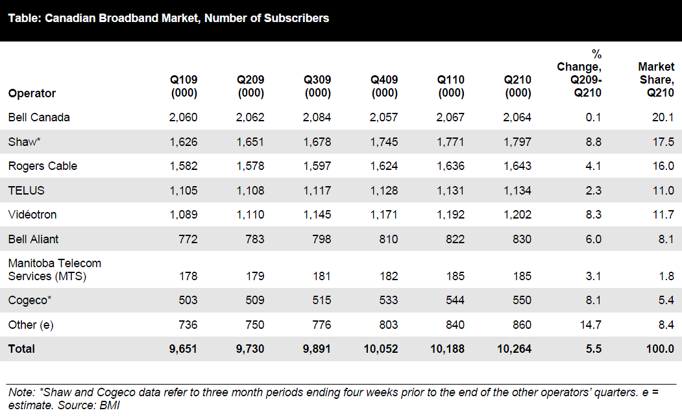
Internet Market
Notes:
Broadband market is growing promisingly, highly technology driven
Competition is fierce with many service providers
BCE still takes the leading position but didn’t enjoy the market growth, falling behind the market rate
Bell’s internet APRU is improving, resulted in increased revenue
Data revenue growth of 5.0% in Q3’10

Slide 57
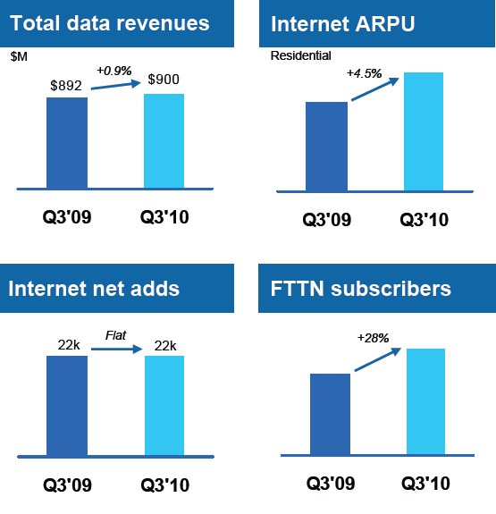
Q3’10 in Internet

Slide 58
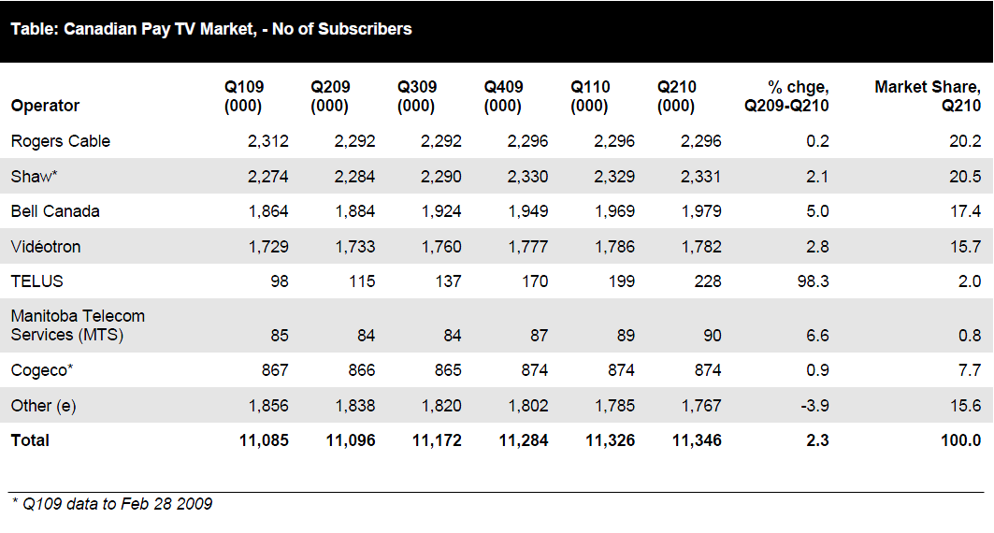
Pay-TV market (Video)
Notes:
Pay-TV market is growing
Bell is in leading market growth rate

Slide 59
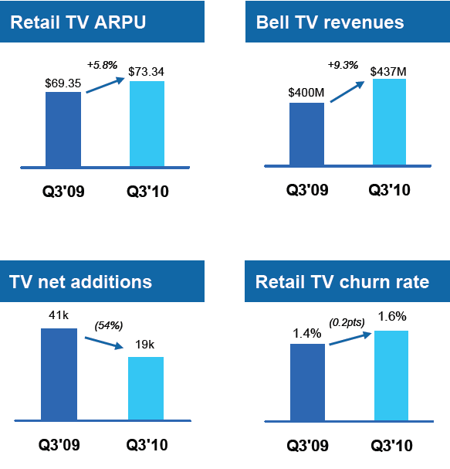
Q3’10 in TV

Slide 60
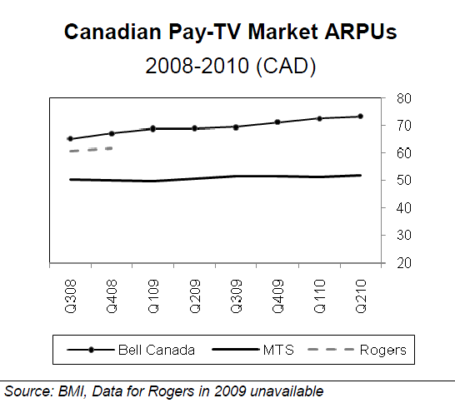
BCE in Pay-TV Market
Notes:
Bell also enjoys a high ARPU

Slide 61
Equipment and other
Recently acquired The Source, which contributed to the increase of BCE’s revenue and net income

Slide 62
Summary on Wireline Segment
Market | ARPU | Total Size | Bell’s market share | Bell’s strategy | Results in revenue
Fixed line | Low | Shrinking slowly | Dominating but losing, decelerated | “Leveraging” | Less loss
Internet | High | Growing | Leading and stable | “Investing” | Increasing
Pay-TV | High | Growing | Increasing | “Investing” | Increasing

Slide 63
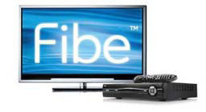


Big events in Wireline Segment
Bell Fibe TV launched on Sept. 13
Acquisition of CTV ($3.2 billion)
Acquisition of The Source($161 mil)
Three-year plan to deploy FTTH technology
Exclusive telecommunications partner to the Vancouver 2010 Olympic and Paralympic Winter Games
Sold Telesat in 2007 ($3.42 billion)
Notes:
IPTV Interactively enhance its internet and TV market

Slide 64
Business Performance – Wireless

Slide 65
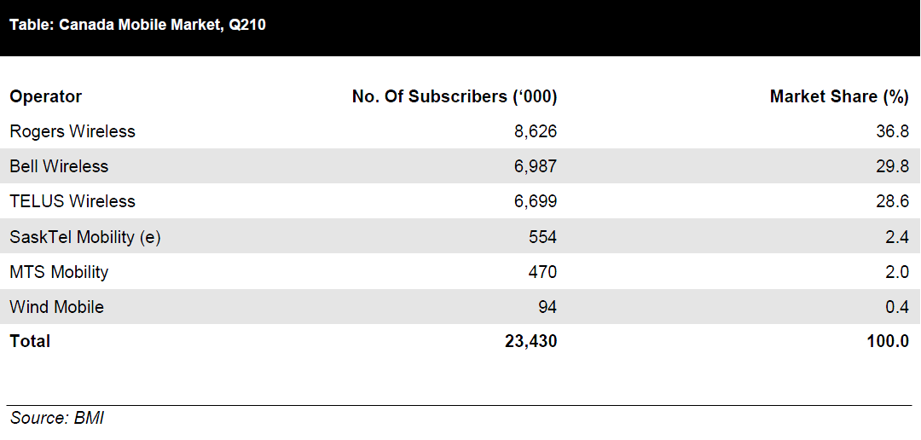
Overview

Slide 66
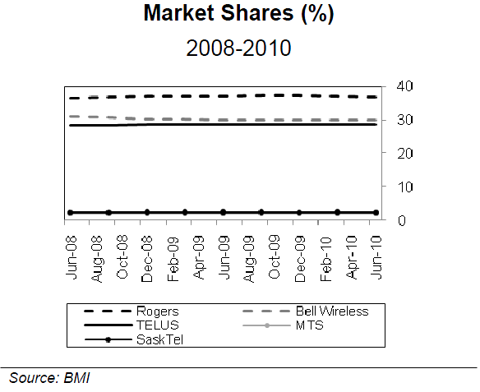
Overview

Slide 67
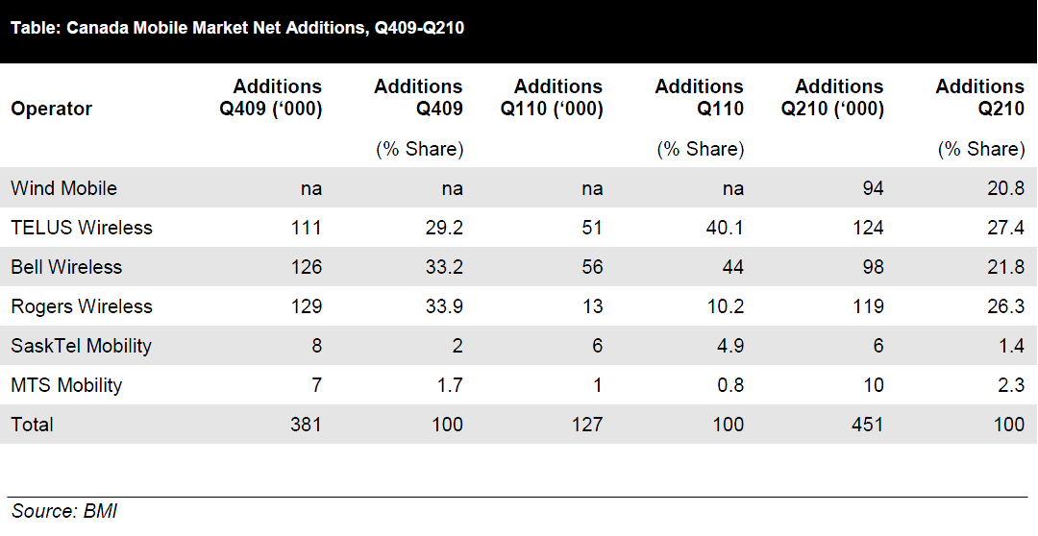
Overview – Net Additions

Slide 68
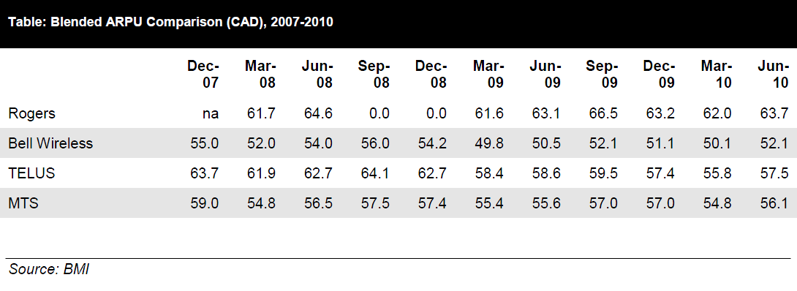
Overview – ARPU

Slide 69
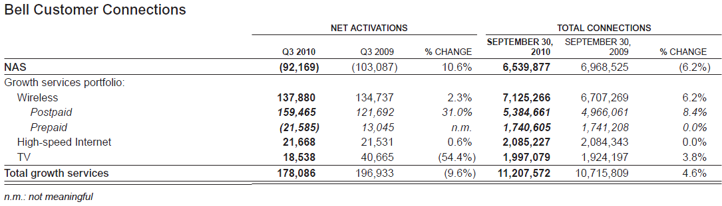
Overview – Q3 Connections
Notes:
27% of Bell’s total revenue in Q3’10
38% of operating income
The second between Rogers and TELUS, in terms of market share
Growing customers, along with the market
Higher growth in postpaid customers
Postpaid net adds 31% higher y/y in Q3 2010

Slide 70
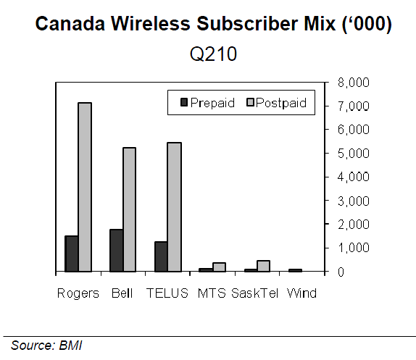
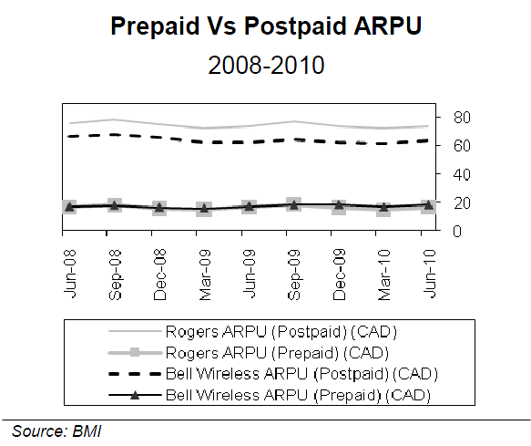
ARPU in Wireless
More prepaid customers, which has lower ARPU

Slide 71
Canada’s Best Network
On its official site:
  “Fastest network, according to tests of average upload and download speeds using HSPA devices, in large Canadian urban centres”
  “Largest network, based on total square kms of coverage”
  “Tests for dropped calls and call clarity in large Canadian urban centres using HSPA devices; all on the shared HSPA/HSPA+ network available from Bell, vs. Rogers HSPA/HSPA+ network as of Sept. 15, 2009”

Slide 72
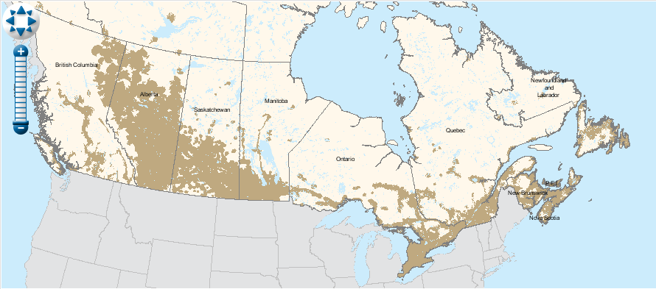
Bell’s Coverage Map

Slide 73
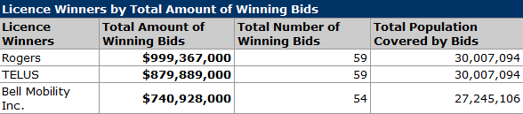
Less winnings on Spectrum Auction

Slide 74
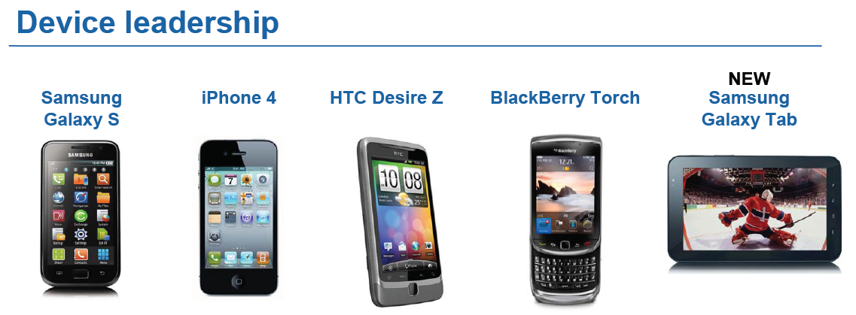
Focus on smartphones and data service
Device leadership:
  “Customers line up for Bell’s exclusive Galaxy S smartphone”
Notes:
Accelerated smartphone penetration
Subscriber base up 74% y/y
ARPU up 2.7% y/y to $53.54 in Q3’10
Wireless data growth of 39% in Q3’10
7 new devices launched in Q3’10
Unique and growing Mobile TV content

Slide 75
Big events in Wireless Segment
Launch of a new national HSPA/HSPA+ wireless network in 2009
Mobile TV:
Sole telecommunications provider of the Vancouver Winter Olympics
Fully acquired Virgin Mobile in 2009 ($161 million)
Advanced Wireless Services Spectrum Auction in 2008($741 million)
4G LTE technology trial activities in 2010

Slide 76
Cost control
BCE emphasizes cost control as stated in its strategic imperatives, taking actions such as:
  Reduced total workforce by 2,500 in 2009
  Combined multiple business units into one
  Replaced 1 billion debt with lower costs
  Reduced operating expenses
  Reduced travel and entertainment expenses by 17% in 2009

Slide 77
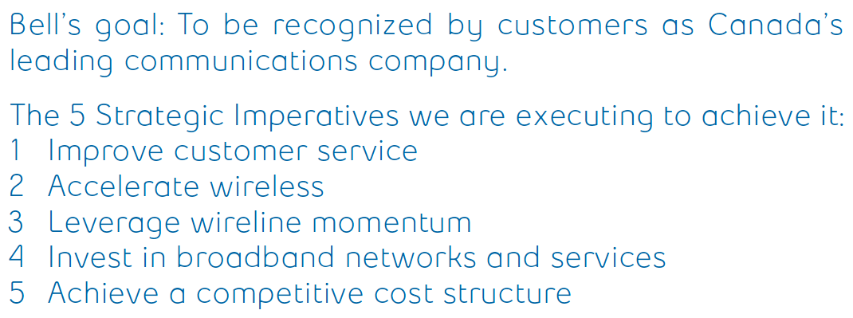
5 Strategic Imperatives

Slide 78
Financial Performance

Slide 79
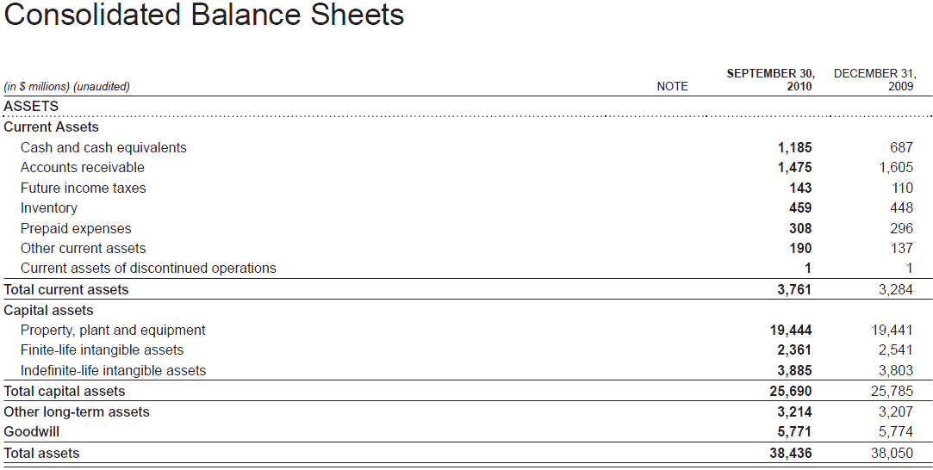
Notes:
Goodwill – spectrum, acquisition and recapitalization
High PPE, but the depreciation expense is not high
Low contributed surplus in total shareholder’s equity (high dividend?)
High goodwill (frequent acquisition?)
Highly leveraged – D/E ratio of 1.18
Utility firm? With less risk (beta of 0.4)?

Slide 80
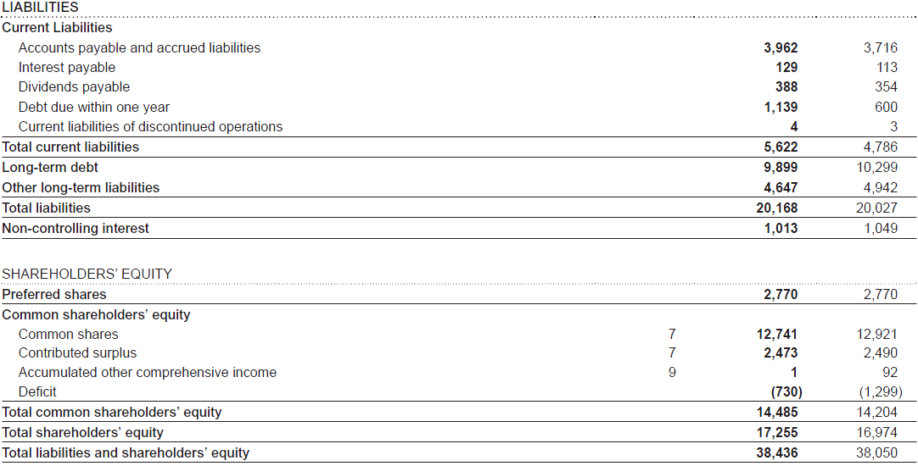
(cont’d)

Slide 81
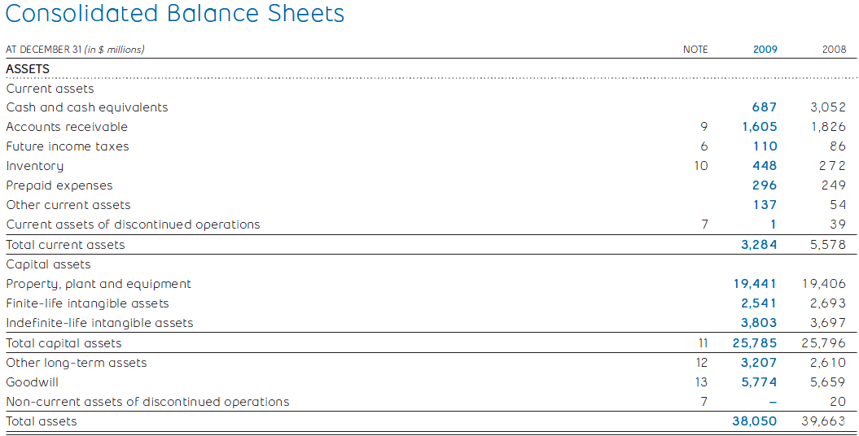
(2009 Annual)
Notes:
Unsurprisingly high PPE, but the depreciation expense is not high
High goodwill, possibly due to frequently acquisition

Slide 82

(Cont’d)
(2009 Annual)
Notes:
Almost 50% leveraged
Low contributed surplus – High dividend payout

Slide 83

Subscribers in years

Slide 84

(2009 Annual)
Notes:
Revenue:
Mostly from 3 products – Local and access, data and wireless
Decreasing in traditional services – local and access, long distance
Increasing in higher value services – wireless, video
Wireline contributed 69% of revenue while 47% of operating income
Expenses:
Mostly from cost of revenue and selling, general and administrative expenses
Not very high depreciation, given that PPE takes a great portion in total assets
Total operating expenses reduced in 2009, resulting from reducing in workforce by 2500 in 2009, and better cost control
Decreasing interest expenses
Dividends:
Increased dividends 3 times since Q4’08, indicating better profitability
Reached 65% dividend payout ratio
(Sale of Telesat contributed 2,300 million other income which should be adjusted)

Slide 85

(2009 Annual)
Notes:
Wireless has higher profit margin
That’s why Bell turning to wireless?

Slide 86

(2009 Annual)
Notes:
3 major business: NAS, Data, Wireless, consistent with its strategic imparatives

Slide 87

Q3’10 Performance

Slide 88

Quarterly financials
Notes:
Trends in service segments continued
Wireline:
revenue in Local access and long distance reduce, represented declining residence and business users
Growth in revenues from video, Internet, and IP broadband connectivity services moderated this decline
Wireless:
a larger subscriber base and higher ARPU resulting primarily from growth in wireless data usage

Slide 89

Notes:
Revenue is pretty stable, gross margin is pretty stable, with a little bit improvement – strategic imperative 5
higher revenues at Bell Wireless, offset partly by a decrease at our Bell Wireline segment
Higher COR because…
• greater year-over-year wireless subscriber acquisition and handset upgrade volumes
• signifi cant growth in wireless data usage, related content and services offered due to accelerated customer adoption of
smartphones and other similar mobile devices
• increased wireless network expenses related to the new HSPA+ network facilities and to growth in roaming
• higher cost of service at Bell TV driven by a larger subscriber base and increased programming costs.
lower selling general and adm. Exp
• lower labour costs due to a reduced workforce and decreased use of outsourced labour resulting from productivity and efficiency
improvements in both our field service operations and residential call centres
• decreased capital taxes and real estate costs
• lower net benefit plans cost.
Revenue: +1.3, +2.3
OI:11.1%, 16.2%

Slide 90

Notes:
In Wireline, Local access and long distance reduce, represents residence and business users
Growth in revenues from video, Internet, and IP broadband connectivity services moderated this decline.
Wireless, a larger subscriber base and higher ARPU resulting primarily from growth in data usage

Slide 91

(2009 Annual)
Notes:
Indirect method, the depreciation now seems taking a larger part in CFO and net income.
Large but decreasing capital expenditures

Slide 92

(Cont’d)
(2009 Annual)

Slide 93

Adjusted EPS
(2009 Annual)
Notes:
Increasing EPS

Slide 94

Notes:
Increased CFO
Decreased use of cash flow in financing

Slide 95


Slide 96

Dividend payout history

Slide 97
Recommendation
HOLD

Slide 98

ROGERS

Slide 99

Market Profile
Notes:
dividends

Slide 100


1 Year Performance
Notes:
Drop at end due to bad earnings report.

Slide 101

1 Year Relative Performance vs TSX Composite
Notes:
Outperforming the TSX for most of the year

Slide 102

1 Year Relative Performance vs TSX Telecom

Slide 103


5 Years Performance

Slide 104


10 Year Performance

Slide 105
Shares
Class A Voting Shares (Controlled mostly by Rogers Control Trust)
Class B Non-Voting Shares (565.62 Million Shares as of Nov 19, 2010)
January 1, 2008
527 million
January 1, 2009
523.43 million
January 1, 2010
479.95 million
November 19, 2010
565.62 million
Notes:
In 2009, buyback program

Slide 106
History - Timeline
1962 – Ted Rogers founded Rogers Radio Broadcasting Limited and also bought CHFI-FM which quickly became a popular radio station
1967 – Rogers cable started and expanded past 12 channels in 1972 (first company in Canada to do so)
1985 – Rogers Cantel Inc. founded and signalled beginning of expansion into mobile phone market (now called Rogers Wireless)
1994 –Launches 3.1 billion takeover for Maclean Hunter, the largest Canadian takeover at the time

Slide 107
History – Timeline (Continued)
2000 – Acquires the Toronto Blue Jays, a major league baseball team
2001 – Acquires Sportsnet and launches HDTV (up to 8 channels, the widest selection in Canada)
2004 – Buys back AT&T interest in Rogers Wireless for $1.8 billion and purchases Microcell(a wireless provider) for $1.6 billion
2007 – Acquires 5 Citytv television stations
2008 – Rogers Wireless launches Apple iPhone

Slide 108
Company Strategy
“Our Business is to maximize subscribers, revenue, operating profit and return on invested capital by enhancing our position as one of Canada’s leading diversified communications and media companies”(2009 Rogers Annual Report)
  Bundling and cross promotions between different Rogers Divisions (ex. Rogers cable with Wireless to form Rogers Communications in Sept 2009) to maximize customer benefits and lower customer costs
  Acquisition Strategy
  Promotes “Rogers” brand as a symbol of innovation and quality
Notes:
From 2009 Annual Report

Slide 109
Recent Acquisition History
2010
Bounce FM (Edmonton Radio Station)
Atria Networks LP
2009
K-Rock 1057 Inc.
2008
Outdoor Life Network
Aurora Cable TV Limited
Channel M (Vancouver Based TV Channel)
CIKZ-FM Kitchener
Citytv
BV Media Inc.
Notes:
From 2009 Annual Report

Slide 110
Operations
3 Main Divisions of Operations
  Rogers Wireless
  Rogers Cable
  Rogers Media

Slide 111


Wireless
Largest provider of wireless services in Canada under the Rogers and Fido brands
8.5 million subscribers in Canada (approximately 37%)
Only Canadian carrier on both GSM(global standard) and 3G HSPA+ technology
3G HSPA+ technology has speeds up to 21.1Mbps launched in 2009 (nearly 3 times the speed previously available)

Slide 112

Wireless Coverage 2G

Slide 113

Wireless Coverage 3G

Slide 114
Wireless

Slide 115
Cable
Leading Canadian cable services provider, covers approximately 3.5 million homes
Offers extensive line-up of high-definition Television using advanced digital 2 way hybrid fibre-coax network
High speed internet bundled with Cable (71%)
1.2 million residential and business land-lines

Slide 116
Cable

Slide 117




Media
Rogers Publishing Limited
  Canada’s largest publishing company (70 consumer and business publications ex. Maclean’s)
54 Radio Stations
Television division includes Citytv network, Rogers Sportsnet, and the Shopping channel
Owns the Toronto Bluejays Baseball team
Owns Roger’s centre and naming rights to Roger’s Arena

Slide 118
Media

Slide 119
Key Individuals

Slide 120

Ted Rogers
Former CEO & Founder
Died December 2, 2008
CEO of Rogers from launch in 1960 until his death in 2008
Grew Rogers Communications into one of Canada’s largest media conglomerates

Slide 121

Nadir H. Mohamed
CEO/Director/President
Appointed CEO in March 2009
Joined in August 2000 as COO of Rogers Wireless
UBC Undergraduate Degree
Chartered Accountant

Slide 122
Alan Douglas Horn
Chairman of Board
Chairman of Board since March 2006
Oct 2008 – Mar 2009: Acting President and CEO
Sept 1996 – March 2006: CFO
B.Sc in Mathematics from University of Aberdeen (Scotland)
Chartered Accountant

Slide 123
Other Executives
William W. Linton
CFO
Robert W. Bruce
President, Rogers Communications
CFO since September 2009
President and CEO of Call-net Enterprises from 2000 to July 2005
Chartered Accountant
Appointed in September 2009
Served as President for Rogers Wireless from May 2005 to September 2009
Joined in 2001 as Chief Marketing Officer
Previously SVP, Marketing at BCE Mobile Communications

Slide 124
Financial Statement Analysis

Slide 125


Slide 126


Slide 127


Slide 128


Slide 129


Slide 130


Slide 131


Slide 132
Recommendation
HOLD

Slide 133

Our mission is to deliver true value as seen through
the eyes of our customers

Slide 134

Current Market Position
11/19/2010
August 2010: Manitoba Telecom Services Inc. cut its quarterly dividend to 42.5 Canadian cents a share from 65 Canadian cents.
Notes:
The opening price is 29.170
The P/E ratio is 16.113
Last Dividend reported is 0.425 regular cash, which is a cut back from last quarter which was 65 cents
Dividend Yield is 8.142, which is relatively high, compared to other telecom companies

Slide 135

1 Year Price Volume
Source: Globe and Mail

Slide 136

1 Year Relative Performance
Notes:
This is the one year relative performance compared with the Toronto Stock index and the Toronto stock index Capped Telecommunication Services Sector Index. The index includes BCE, Bell Alliant, Manitoba Telecom Services, Rogers Communications and TELUS. It seems that under the 1 year relative performance Manitoba Telecom isn’t doing as well and is under performing in the latter half of the year but was performing great at the beginning of the year in around January to March (First Quarter).

Slide 137

5 Year Price Volume

Slide 138

5 Year Relative Performance

Slide 139

10 Year Price Volume

Slide 140

10 Year Relative Performance

Slide 141

MTS Share Performance
This graph compares the cumulative total return on MTS’ Common Shares over the last 13 years to the cumulative total return of the S&P / TSX Composite Index, assuming a $100 investment at the initial offering price of $13 and reinvestment of dividends.

Slide 142

Operating Revenue 2005-2009

Slide 143
Revenue Breakdown per Segment 2005-2009
Notes:
Our data line of business includes revenues earned from providing
converged IP, high-speed Internet, unifi ed communications, legacy
data and security services. Data services connect data, video and
voice networks to establish private connections across offi ce locations
and to integrate traffi c over highly secure networks. We provide a wide
range of Internet connectivity services to meet the needs of residential
customers in Manitoba and business customers across the country.
We also offer security and hosting services to business customers
across Canada.

Slide 144

Growth Services Revenues 2005-2009

Slide 145

EPS trend for 2005-2009

Slide 146
Company Overview

Slide 147

MTS Allstream
Provides a broad range of solutions including high-speed internet, wireless, digital TV, converged IP networking, and unified communications.
Operates through two divisions: national and Manitoba division
Fourth-largest communications provider in Canada

Slide 148
Corporate Profile
MTS Allstream (TSX: MBT)
• Serving customers for more than 100 years
• More than 1.94 million customer connections
• Revenues of $1.8 billion in 2009
• 30,000 kilometre national IP fibre network
• One of Canada’s top employers
Allstream (Enterprise Solutions)
• Operating in business markets nationally
• Coast-to-coast national IP fibre network
•Provides international connections through strategic alliances and interconnection agreements with other international service providers
Solutions
MTS (Consumer market)
• Operating in consumer and business markets in Manitoba
• #1 in all telecom markets in Manitoba
• Highest in-region margins in Canadian
telecom industry
Notes:
MTS:
Consumer Markets Division
An important service provider in the national telecommunications market in Manitoba as well as outside the province
Provide customers in targets major Canadian centre with a range of innovative business internet, data and voice services under the Allstream brand
Allstream Unit:
Enterprise Solutions Division
A leading player in the national business and wholesale markets
Operates an extensive national broadband fibre optic network that spans almost 30,000 kilometers
Provides international connections through strategic alliances and interconnection agreements with other international service providers
Solutions : IP connectivity, Unified Communications, Security, Virtual Workplace, Managed Services
Core Services: Data Networks, Hosting, Internet Access, Voice

Slide 149

MTS Allstream product lines
MTS
Wireless
High-speed Internet
Television services
Converged IP
Unified communications, security and
monitoring services
Local access
Long distance and data
Allstream
Converged IP
Unified communications and security
Local access
Long distance and data

Slide 150

MTS Coverage across Canada
MTS broadband coverage in Canada runs across majority of the country, with services in several fields

Slide 151
History
1908
Manitoba Telecom Services Inc. (MTS) was founded by the Manitoba government
Manitoba Telecom Service became a public traded company
1999
Strategic alliance with Bell to form Intrigna, which was a company created to expand telecommunications options for the business market in Alberta and British Columbia.
1997
2000
Initiate broadband service in Manitoba

Slide 152
History
2005
MTS Allstream acquired Delphi Solutions Corp.
Former BCE executive Pierre Blouin named new Chief Executive Officer of Manitoba Telecom Services Inc. and MTS Allstream Inc.
2006
MTS Allstream acquires Valley Cable Vision (local cable company serving 3700 cable customers)
2009
MTS Allstream forms strategic partnership with Rogers to build state-of-the art HSPA network in Manitoba , and gains access to Rogers’ leading national and international roaming capabilities
2004
End strategic alliance with Bell in Western Canada
Acquired Allstream ($1.6 billion) and become the 3rd largest national telecom provider in Canada
MTS Allstream strategic alliance with BT: broaden its IP based technology service globally
On June 9, 2009, MTS signed an agreement with Sprint Nextel providing MTS with a cost-effective way of offering a larger and more exciting selection of CDMA handsets and applications
Notes:
In 2009, MTS Allstream forms strategic partnership with Rogers , builds state-of-the art HSPA (High speed download packet access) network in Manitoba , and gains access to Rogers’ leading national and international roaming capabilities.
On June 9, 2009, MTS signed an agreement with Sprint Nextel providing MTS with a cost-effective way of offering a larger and more exciting selection of CDMA handsets and applications to Manitoba customers
Both partnerships in 2009 is part of MTS’ strategy to strengthen and expand their wireless capabilities. They are used to offer customers a wider range of wireless services at a lower cost than if MTS were to develop these services on their own.

Slide 153

Wireless
August 9, 2010: Canadian Wireless Carrier, Manitoba Telecom has launched their first Android based device, the HTC 6250.
Specs include:
* Android OS
* HTC Sense UI
* 3.2″ 320 x 480 HVGA
capacitive touchscreen display
* 5 megapixel camera with auto focus
* WiFi 802.11 b/g
* GPS
* G-sensor digital compass
* Bluetooth 2.0
* 512 MB of internal memory
(expandable to 32 GB via microSD)
* 3.5 mm headset jack

Slide 154


Key Individuals MTS
Pierre J. Blouin
Chief Executive Officer
Appointed CEO of each of Manitoba Telecom Services Inc. and MTS Allstream Inc. on December 7, 2005.
Group President - Consumer Markets of Bell Canada from May 2003 to October 2005.
CEO of Emergis Inc. (formerly known as BCE Emergis Inc.) from May 2002 to May 2003
Executive Vice President of BCE Inc. from March 2002 to May 2002,
President and CEO of Bell Mobility Inc., a subsidiary of Bell Canada, from January 2000 to March 2002.
David Leith
Chairperson
became Chair of the Manitoba Telecom Services Inc. Board of Directors on January 8, 2010.
was Deputy Chairman and Managing Director of CIBC World Markets and Head of the firm's Investment, Corporate and Merchant Banking activities until February 2009.
Adviser to the Minister of Natural Resources on the restructuring of Atomic Energy of Canada Limited (AECL).
Director of the Children's Aid Foundation.

Slide 155


Key Individuals MTS
Wayne S. Demkey, CA
Chief Financial Officer
Wayne Demkey is Chief Financial Officer of each of Manitoba Telecom Services Inc. ("MTS") and MTS Allstream Inc.
eleven years with KPMG Chartered Accountants, most recently in the position of Senior Manager Audit and Business Advisory Services.
member of the Board of Directors of The Winnipeg Humane Society.
Chairman of the Board of Directors of The Winnipeg Humane Society Foundation.
Kelvin A. Shepherd, P.Eng.
President, MTS
Mr. Shepherd joined the company in 2000 as Vice-President Network Services and Chief Technology Officer.
20 years with Saskatchewan Telecommunications ,most recently as Senior Vice-President and Chief Technology Officer.
Chairman of the Executive Board for LCL Cable Communications Ltd. (Leicester, England) prior to its sale by SaskTel in 1995
Chairman of the Board of TR Labs, a leading Western Canadian-based telecommunications research and development organization.
Chairperson of the Board of Trustees of Victoria General Hospital in Winnipeg.

Slide 156
Financial Analysis

Slide 157

Balance Sheet

Slide 158

Income Statement

Slide 159

Cash Flow Statement

Slide 160

Q3 Financial Results
Notes:
Our results in the third quarter of 2010 were sequentially stable with the first and second quarters of 2010.
While revenues, EBITDA, earnings per share (“EPS”) and free cash flow were lower in the third quarter of
2010 compared to the same period in 2009, results have been consistent since that time. Our results in the
first nine months of 2010 reflect the slow pace of economic recovery nationally, costs associated with
aggressive competition in the Manitoba market, and higher non-cash pension expense. We have maintained
our market share in most of our key growth products, although we have seen a slight increase in the rate of
local line losses and a decrease in Internet ARPU, which affected our EBITDA.

Slide 161
Q3 Information
MTS wireless and digital television revenues up strongly by 6.7% and 10.2% in Q3
Number of bundled customers in Manitoba climbs by 10.2% in Q3
Allstream achieves strong converged IP sales for fourth consecutive month
Cost reduction program reaches annual target range with $31.4 million in annualized savings
Board of Directors declares $0.425 per share cash Q4 dividend

Slide 162
Forecast and Recommendation

Slide 163

2010 financial outlook (continuing operations)

Slide 164
Strategic Imperative
1. Drive profitable increases in our growth services including converged IP, wireless, high-speed Internet, and digital television.
subscriber bases rose by 2.4%, 6.4% and 5.4%, respectively.
Allstream’s converged IP revenues continued to grow, increasing by 2.6% in the first nine months of 2010.
2. Continue to focus on delivering superior customer service while achieving further cost reductions.
MTS achieved $31.4 million in annualized cost savings from initiatives within the first nine months of the year.
In 2009, MTS met and exceeded customer experience targets as measured through independent surveys.
3. Drive innovation in product and service development to exceed customer expectations.
In 2009, launched MTS Ultimate TV service. The service is expected to reach 96% coverage of Winnipeg by the end of 2010.
During the third quarter of 2010, MTS announced plans to accelerate investment in fibre-to-thehome, also referred to as fibre optic network (“FiON”). FiON allows customers to access top-of-the-line digital television, high-speed Internet, and phone services.
MTS’ first Android device, the HTC 6250 smartphone in August 2010.
Notes:
MTS Ultimate TV service provides customers with unique whole home personal video recorder functionality as well as access to their fastest Internet speeds. MTS continue to enhance the attractiveness of premium television offering by adding new features.

Slide 165
Strategic Imperative
4. Selectively and prudently investing in strategic initiatives to broaden market reach and enhance leadership position.
In July 2009, MTS entered into an agreement with Rogers Wireless Partnership (“Rogers Wireless”) that saw both companies share the cost to deploy an HSPA wireless network across Manitoba. HSPA services is expected to launch in the first quarter of 2011. HSPA technology will give MTS access to new data services, the potential to grow data average revenue per user (“ARPU”) and an efficient upgrade path overtime.
In August 2010, MTS announced plans to invest $125 million over the next five years as part of an accelerated deployment of our fibre-to-the-home network, also referred to as fibre optic network (“FiON”), in Manitoba..
In 2010, MTS has expanded their national IP fibre network to improve the profitability of Allstream and support future growth.
Three-year target plan to extend fibre to 675 select multi-tenant buildings that are within 200 metres of existing national network and to enhance Ethernet capabilities in co-location areas.
In the three months ending September 30, 2010, Allstream won 38 new IP contracts.For the first nine months of 2010, Allstream won a total of 87 contracts. An additional 65 IP contracts won in Allstream’s expanded IP co-location footprint.
Based on the sales cycle for enterprise customers, MTS anticipate the benefits from this program to begin to positively impact our financial results in 2011.
Notes:
The expansiveness and sophistication of our wireless infrastructure in Manitoba is a significant competitive advantage which will be strengthened by the deployment of HSPA technology over our regional wireless network in Manitoba.
We were the first in Manitoba to launch fibre-to-the-home in January in the Waverley West neighbourhood of Winnipeg. By the end of 2015, we expect to deploy fibre to approximately 120,000 homes in close to 20 Manitoba communities such as Steinbach, Thompson, The Pas, and in areas of Winnipeg. Once this plan is completed, 65% of Manitoba households will be covered by either Very-high-bit-rate Digital Subscriber Line (“VDSL”) or fibre-to-the-home service.

Slide 166
Growth Strategy
Strategic investment in Fibre-to-the-home (FTTH)
FTTH provides growth opportunities for MTS
Over the next five years, we are investing $125 million to accelerate FTTH
technology deployment across Manitoba
By the end of 2015, fibre is expected to be passed to 120,000 homes in
Manitoba in 20 communities
Once completed, 65% of Manitoba households will have access to either
VDSL or FTTH technology
FTTH will:
Strengthen MTS’ product leadership
Enable MTS to provide customers with access to its most
advanced high-speed Internet (100Mbps+ with fibre) and television services
Provide solid opportunities for growth in TV, broadband and bundles
Leverage HSPA billing environment to create single billing platform

Slide 167
Recommendation
Hold

