Slide 1




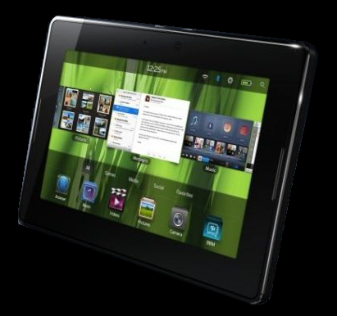
Canadian Telecommunication
Presented by : Jerry Cai
Michael Jiang
Ian So
Tina Wu

Slide 2




Industry Overview
Manitoba Telecom
Rogers Communication
Bell Canada
Agenda
Manitoba Telecom (MBT)
Rogers Communication (RCI)
Bell Canada (BCE)
Industry Overview

Slide 3
Industry Overview
Manitoba Telecom
Rogers Communication
Bell Canada
Telecommunication
Distance communication by cable, telephone, video, or internet
Involves the sending of information, through a medium, to a receiver

Slide 4
Industry Overview
Manitoba Telecom
Rogers Communication
Bell Canada
History of Telecommunication
In the Middle Ages, beacons
In 1792, the first visual telegraphy system
In 1839, the first commercial electrical telegraph
In 1866, the first permanent transatlantic telegraph cable
In 1876, the conventional telephone
In 1878, the first commercial telephone services
In 1901, wireless communication
In 1926, the first television system
In 1969, ARPANET

Slide 5
Industry Overview
Manitoba Telecom
Rogers Communication
Bell Canada
Segmentation
Fixed line telephone
Wireless
Cable (TV)
Internet

Slide 6
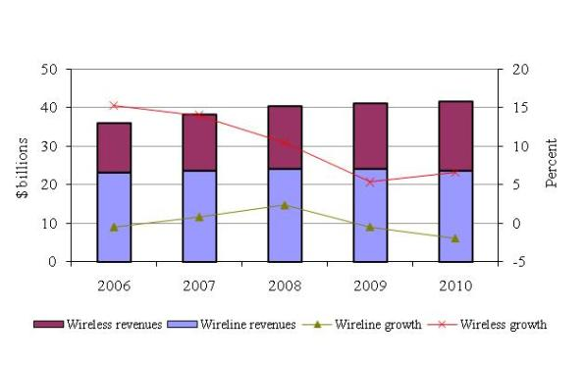
Industry Overview
Manitoba Telecom
Rogers Communication
Bell Canada
Telecommunications revenues and annual growth

Slide 7
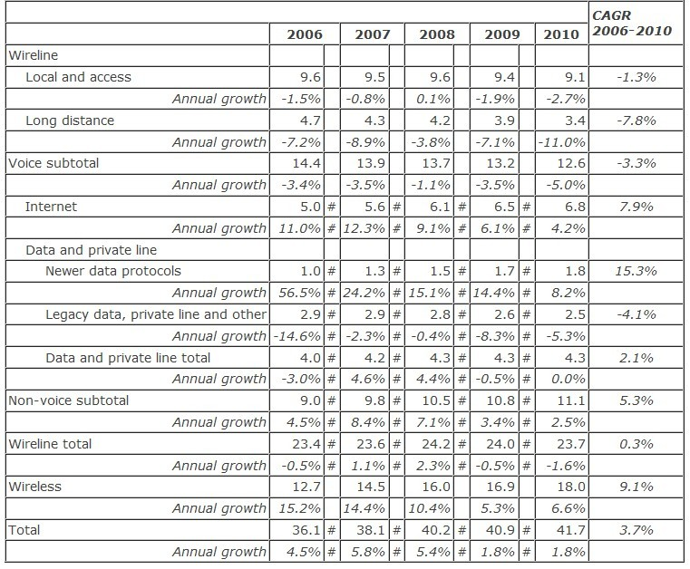
Industry Overview
Manitoba Telecom
Rogers Communication
Bell Canada
Telecommunications revenues, by market sector ($ billions)

Slide 8
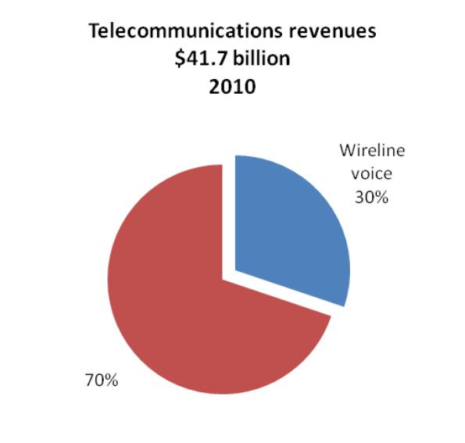
Industry Overview
Manitoba Telecom
Rogers Communication
Bell Canada
Fixed Line Telephone

Slide 9


Industry Overview
Manitoba Telecom
Rogers Communication
Bell Canada
Wireline voice market
In 2010, 91% of Canadian households subscribed to wireline voice communication services.
There were over 100 providers of local and access services and over 150 providers of long distance services in 2010.
Large incumbent TSPs
Small incumbent TSPs
Cable BDUs
Resellers

Slide 10
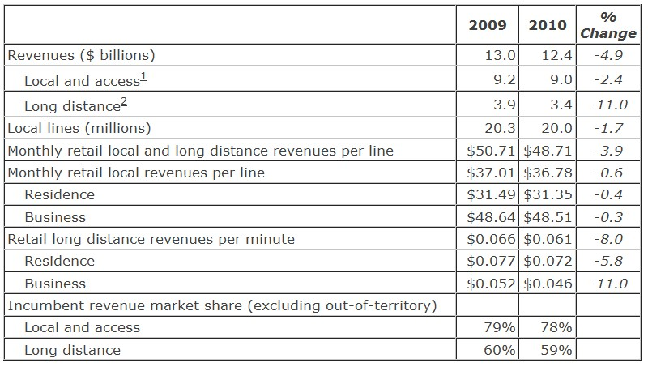
Industry Overview
Manitoba Telecom
Rogers Communication
Bell Canada
Revenues

Slide 11
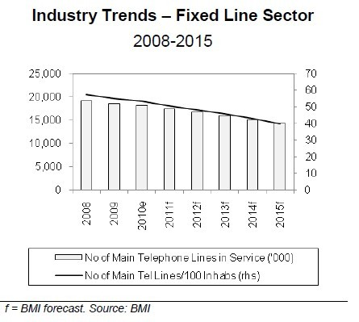
Industry Overview
Manitoba Telecom
Rogers Communication
Bell Canada

Slide 12
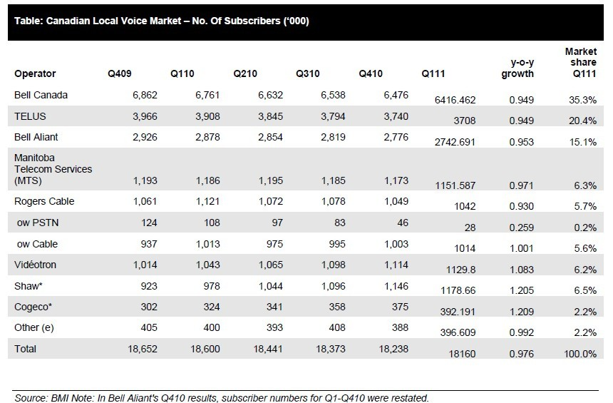
Industry Overview
Manitoba Telecom
Rogers Communication
Bell Canada

Slide 13
Industry Overview
Manitoba Telecom
Rogers Communication
Bell Canada
Wireless Communication
wireless communication is the transfer of information without the use of wires. It encompasses various types of fixed, mobile, and portable two-way radios, cellular telephones, personal digital assistants, and wireless networking.

Slide 14
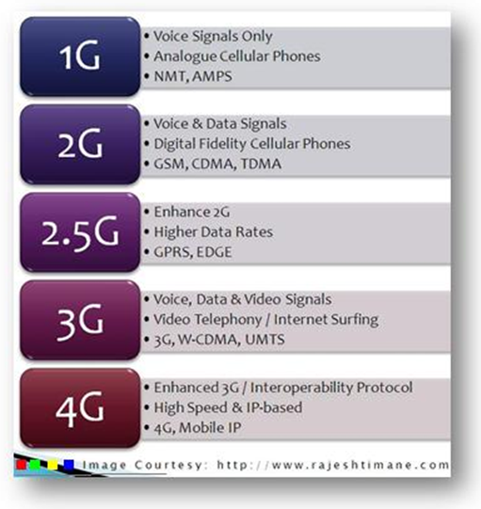
Industry Overview
Manitoba Telecom
Rogers Communication
Bell Canada
Technology

Slide 15
Industry Overview
Manitoba Telecom
Rogers Communication
Bell Canada
Technology
1G 1st generation of wireless telephone technology Launched in Japan in 1979 The analog telecommunications standards | 2G Launched on the GSM standard in Finland by Radiolinja in 1991 Phone conversations were digitally encrypted 2G systems were significantly more efficient on the spectrum allowing for far greater mobile phone penetration levels 2G introduced data services for mobile, starting with SMS text messages

Slide 16
Industry Overview
Manitoba Telecom
Rogers Communication
Bell Canada
Technology
3G Application services - wide-area wireless voice telephone - mobile Internet access - video calls and mobile TV Allow simultaneous use of speech and data services Provides peak data rates of at least 200 kbit/s | 4G In 2009, the ITU-R organization specified the IMT-Advanced requirements for 4G standards Setting peak speed requirements for 4G service at 100 Mbit/s for high mobility communication and 1 Gbit/s for low mobility communication HSPA+ (up to 42Mbps) LTE (up to 75 Mbps)

Slide 17
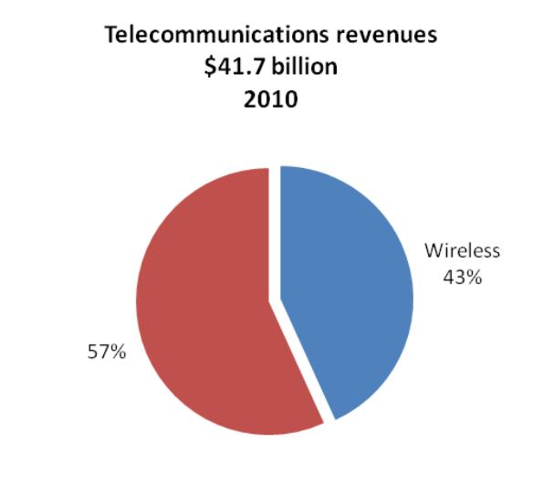
Industry Overview
Manitoba Telecom
Rogers Communication
Bell Canada
Revenue Breakdown

Slide 18
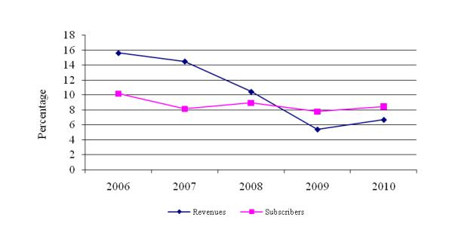
Industry Overview
Manitoba Telecom
Rogers Communication
Bell Canada
Wireless revenue and subscriber growth rates

Slide 19
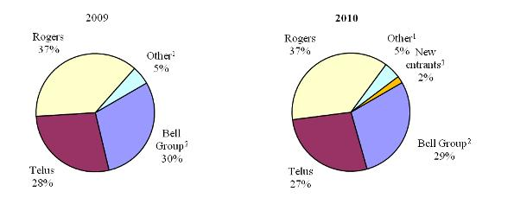
Industry Overview
Manitoba Telecom
Rogers Communication
Bell Canada
Wireless revenue market share

Slide 20
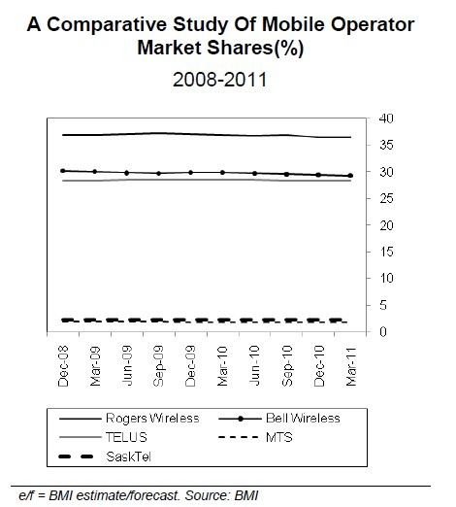
Industry Overview
Manitoba Telecom
Rogers Communication
Bell Canada

Slide 21
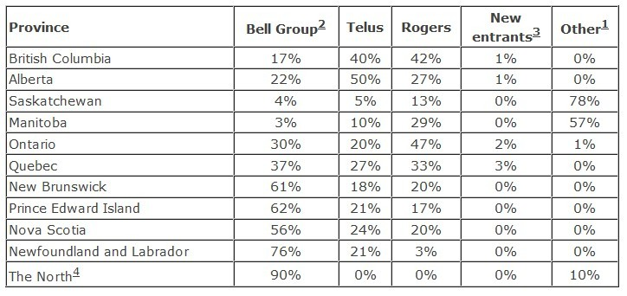
Industry Overview
Manitoba Telecom
Rogers Communication
Bell Canada
Wireless subscriber market share, by province (2010)

Slide 22
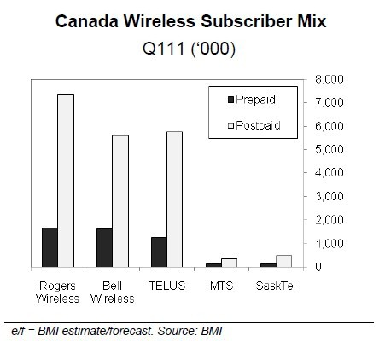
Industry Overview
Manitoba Telecom
Rogers Communication
Bell Canada

Slide 23
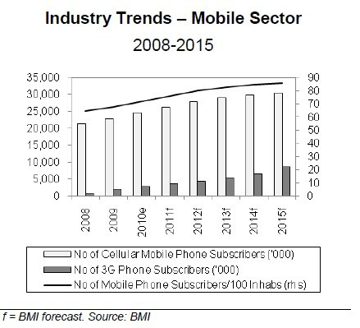
Industry Overview
Manitoba Telecom
Rogers Communication
Bell Canada

Slide 24

Industry Overview
Manitoba Telecom
Rogers Communication
Bell Canada
Internet
The use of Internet has grown considerably
In 2010, 80% of individuals aged 16 and older used the Internet for personal use.
Significant differences in use rates exist based on age, income, location and other factors.

Slide 25
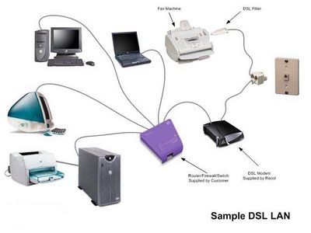
Industry Overview
Manitoba Telecom
Rogers Communication
Bell Canada
Technology – Digital Subscriber Line (DSL)
A family of technologies that provides digital data transmission over the wires of a local telephone network

Slide 26
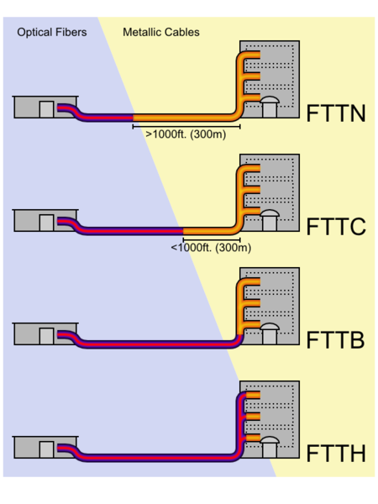
Industry Overview
Manitoba Telecom
Rogers Communication
Bell Canada
Technology – Fiber to the x (FTTx)
A generic term for any broadband network architecture using optical fiber to replace all or part of the usual metal local loop used for last mile telecommunications

Slide 27
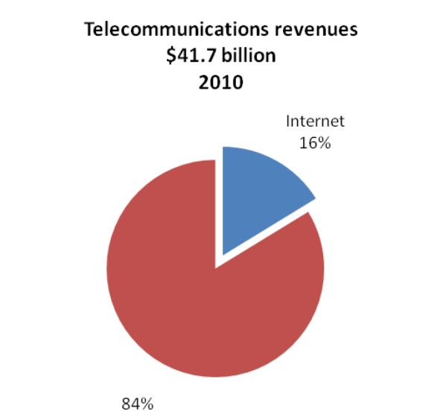
Industry Overview
Manitoba Telecom
Rogers Communication
Bell Canada
Revenue

Slide 28
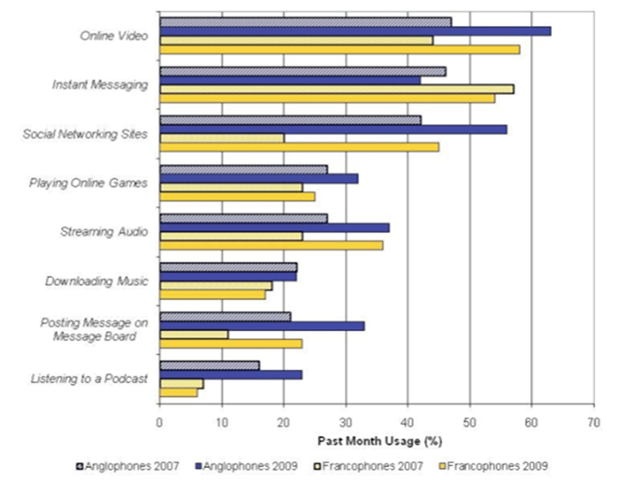
Industry Overview
Manitoba Telecom
Rogers Communication
Bell Canada
Popular Internet activities for Canadian Internet users

Slide 29
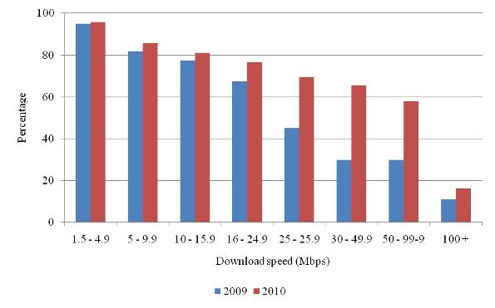
Industry Overview
Manitoba Telecom
Rogers Communication
Bell Canada
Broadband availability, by speed

Slide 30
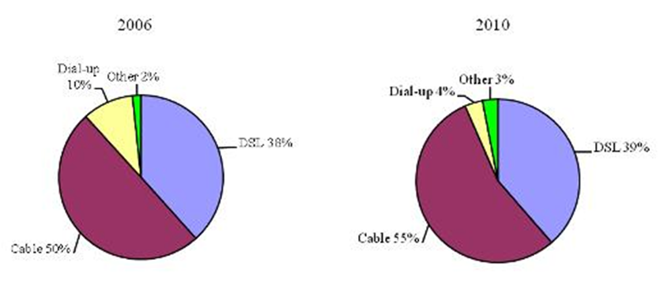
Industry Overview
Manitoba Telecom
Rogers Communication
Bell Canada
Residential Internet access technology mix

Slide 31
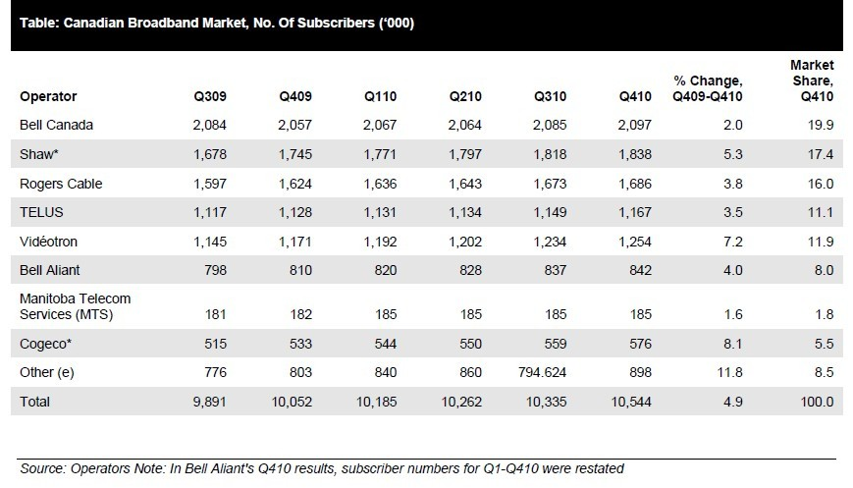
Industry Overview
Manitoba Telecom
Rogers Communication
Bell Canada

Slide 32
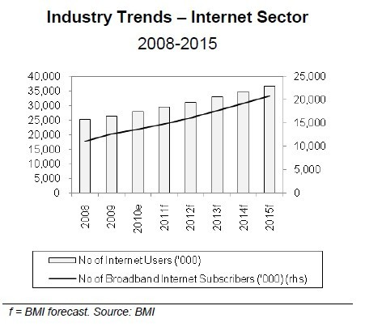
Industry Overview
Manitoba Telecom
Rogers Communication
Bell Canada

Slide 33
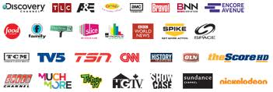
Industry Overview
Manitoba Telecom
Rogers Communication
Bell Canada
Television
The television broadcasting industry delivers over 700 television services to Canadians.
The industry includes a number of large ownership groups representing over 92% of television revenues from private conventional television stations and pay, PPV, VOD, and specialty services.

Slide 34
Industry Overview
Manitoba Telecom
Rogers Communication
Bell Canada
Categories
Cable TV
widely used in the world
Digital TV (HDTV and SDTV)
more digital channels in the same space, high-definition television service, and other non-television services
special services
Internet Protocol television
Interactivity
Video-on-demand
IPTV-based converged services

Slide 35
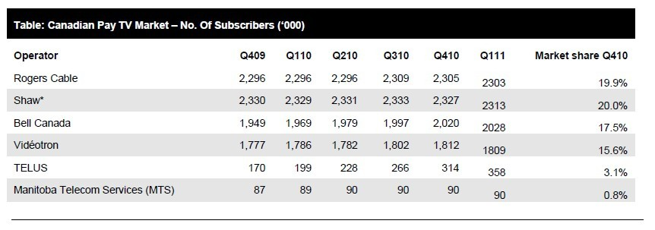
Industry Overview
Manitoba Telecom
Rogers Communication
Bell Canada
Market share of major operators

Slide 36
Industry Overview
Manitoba Telecom
Rogers Communication
Bell Canada
Regulator
The Canadian Radio-television and Telecommunications Commission (CRTC)
establishing, monitoring, assessing and reviewing, where appropriate, regulatory frameworks to meet its policy objectives
implementing procedures for the efficient and effective resolution of competitive disputes
making determinations on industry mergers, acquisitions and changes of ownership in the industry

Slide 37
Industry Overview
Manitoba Telecom
Rogers Communication
Bell Canada
Spectrum Auction
Last Spectrum Auction: 2008
Next Spectrum Auction is for 700 and 2500 MHz bands
Rules for next spectrum auction will be released by the end of 2011
Rumor: Government will relax the foreign-ownership restrictions in telecommunications
Future: Intense competition (some smaller companies are expected to merge)
Notes:
Revenue generated: C$4.25Billion for the government

Slide 38
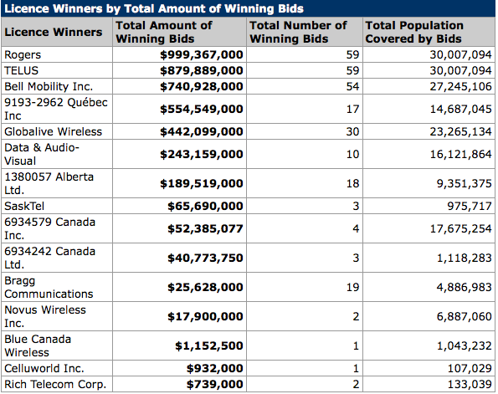
Industry Overview
Manitoba Telecom
Rogers Communication
Bell Canada
Spectrum Auction (2008)
Notes:
Revenue generated: C$4.25Billion for the government

Slide 39

Industry Overview
Manitoba Telecom
Rogers Communication
Bell Canada
MBT – Manitoba Telecom Services

Slide 40
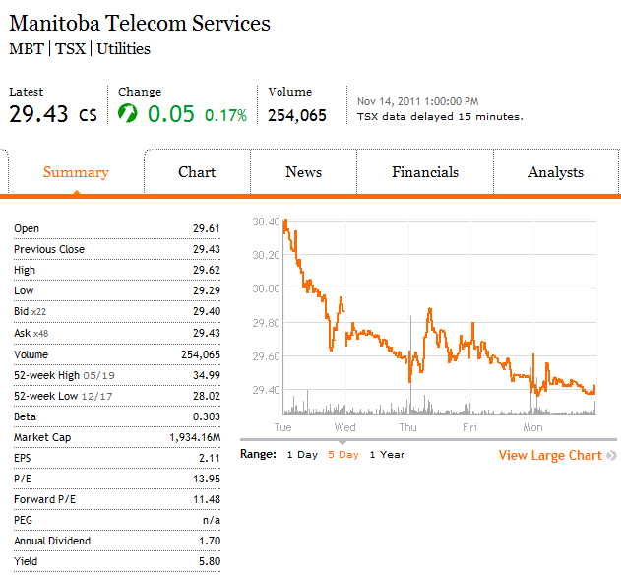
Industry Overview
Manitoba Telecom
Rogers Communication
Bell Canada
Financial Snapshot

Slide 41
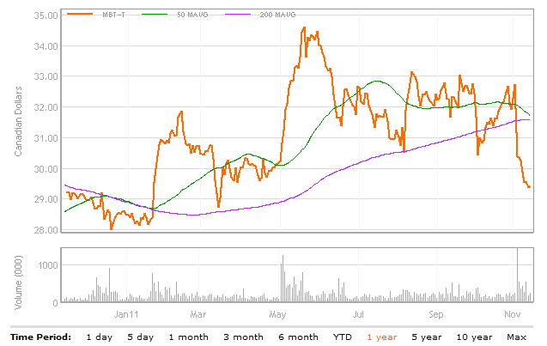
Industry Overview
Manitoba Telecom
Rogers Communication
Bell Canada
1 Year Performance

Slide 42
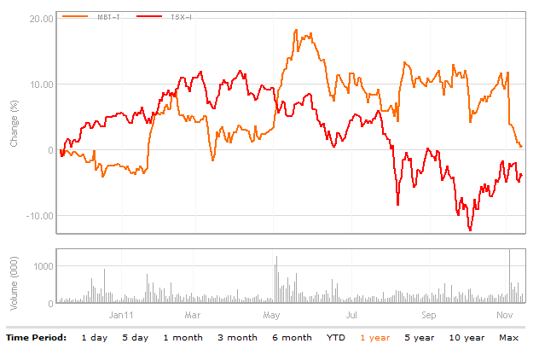
Industry Overview
Manitoba Telecom
Rogers Communication
Bell Canada
1 Year Relative Performance vs TSX Composite

Slide 43
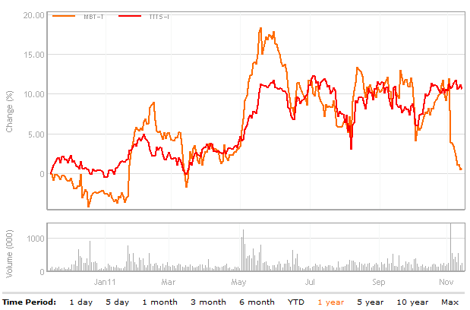
Industry Overview
Manitoba Telecom
Rogers Communication
Bell Canada
1 Year Relative Performance vs TSX Telecom

Slide 44
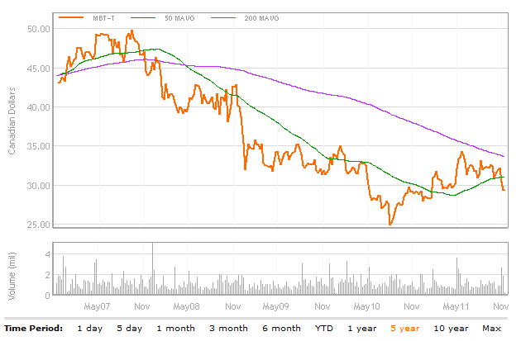
Industry Overview
Manitoba Telecom
Rogers Communication
Bell Canada
5 Year Performance

Slide 45
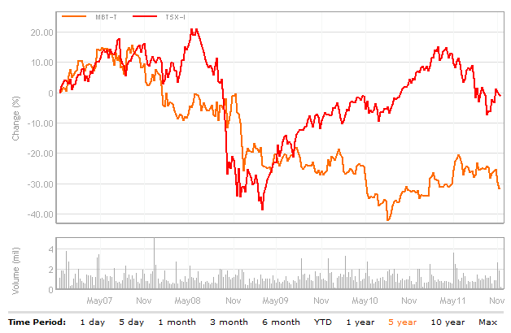
Industry Overview
Manitoba Telecom
Rogers Communication
Bell Canada
5 Year vs. TSX Composite

Slide 46
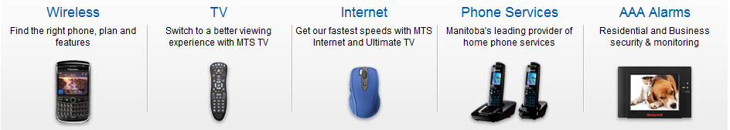
Industry Overview
Manitoba Telecom
Rogers Communication
Bell Canada
MTS Allstream
Provides a broad range of solutions including high-speed internet, wireless, digital TV, converged IP networking, and unified communications.
Operates through two divisions: national and Manitoba division
Fourth-largest communications provider in Canada

Slide 47
Industry Overview
Manitoba Telecom
Rogers Communication
Bell Canada
History
1908: Manitoba Telecom Services Inc. (MTS) was founded by the Manitoba government
1988: MTS entered the wireless business
1994: MTS came under CRTC regulations
1997: Manitoba Telecom Service became a public traded company
1999: Strategic alliance with Bell to form Intrigna, which was a company created to expand telecommunications options for the business market in Alberta and British Columbia.
2004: Ended strategic alliance with Bell and acquired Allstream ($1.6 billion) and become the 3rd largest national telecom provider in Canad
2006: MTS Allstream acquired Valley Cable Vision (local cable company serving 3700 cable customers)
2009: MTS Allstream formed strategic partnership with Rogers to build state-of-the art HSPA network in Manitoba , and gains access to Rogers’ leading national and international roaming capabilities

Slide 48
Industry Overview
Manitoba Telecom
Rogers Communication
Bell Canada
MTS Allstream
MTS Allstream (TSX: MBT)
• Serving customers for more than 100 years
• More than 1.94 million customer connections
• Revenues of $1.8 billion in 2009
• 30,000 kilometre national IP fibre network
• One of Canada’s top employers
Allstream (Enterprise Solutions)
• Operating in business markets nationally
• Coast-to-coast national IP fibre network
•Provides international connections through strategic alliances and interconnection agreements with other international service providers
Solutions
MTS (Consumer market)
• Operating in consumer and business markets in Manitoba
• #1 in all telecom markets in Manitoba
• Highest in-region margins in Canadian
telecom industry

Slide 49
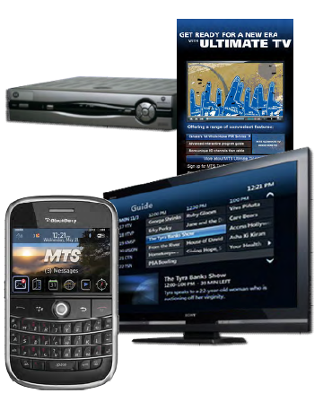
Industry Overview
Manitoba Telecom
Rogers Communication
Bell Canada
MTS Allstream operations
MTS
Wireless
High-speed Internet
Television services
Converged IP
Unified communications, security and
monitoring services
Local access
Long distance and data
Allstream
Converged IP
Unified communications and security
Local access
Long distance and data

Slide 50
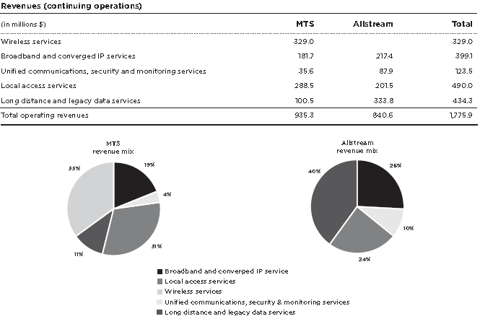
Industry Overview
Manitoba Telecom
Rogers Communication
Bell Canada
MTS Allstream Revenue Breakdown

Slide 51
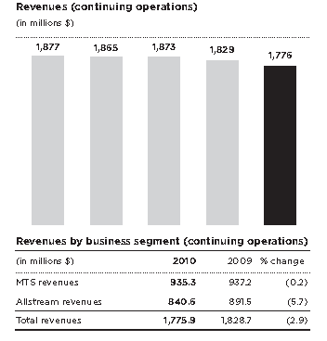
Industry Overview
Manitoba Telecom
Rogers Communication
Bell Canada
MTS Allstream Revenue (year-to-year)

Slide 52
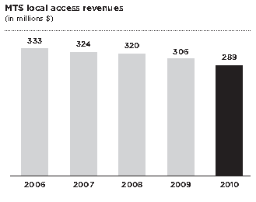
Industry Overview
Manitoba Telecom
Rogers Communication
Bell Canada
MTS Wireline Revenue (year-to-year)

Slide 53
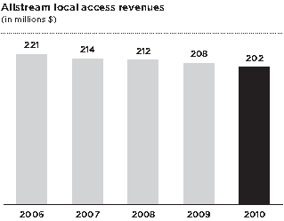
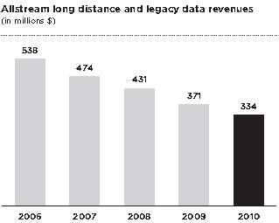
Industry Overview
Manitoba Telecom
Rogers Communication
Bell Canada
Allstream Revenue (year-to-year)

Slide 54
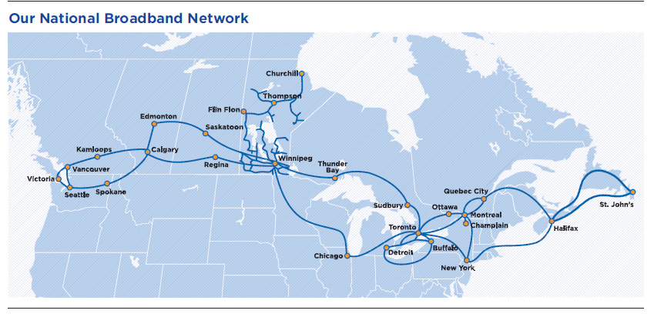
Industry Overview
Manitoba Telecom
Rogers Communication
Bell Canada
Coverage

Slide 55

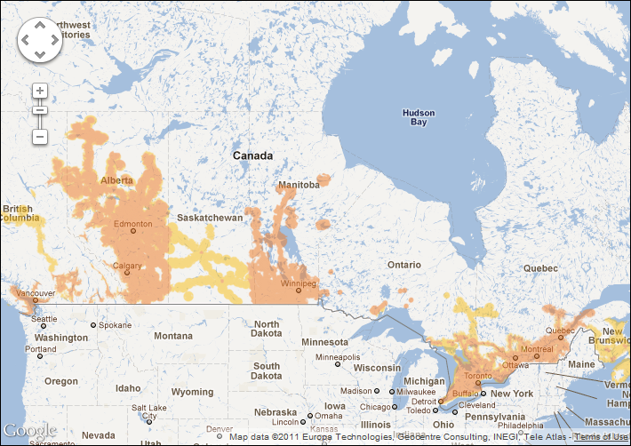
Industry Overview
Manitoba Telecom
Rogers Communication
Bell Canada
Coverage (Wireless)

Slide 56

Industry Overview
Manitoba Telecom
Rogers Communication
Bell Canada
Management
Pierre J. Blouin
Chief Executive Officer
Appointed CEO of each of Manitoba Telecom Services Inc. and MTS Allstream Inc. on December 7, 2005.
Group President - Consumer Markets of Bell Canada from May 2003 to October 2005.
CEO of Emergis Inc. (formerly known as BCE Emergis Inc.) from May 2002 to May 2003
Executive Vice President of BCE Inc. from March 2002 to May 2002,
President and CEO of Bell Mobility Inc., a subsidiary of Bell Canada, from January 2000 to March 2002.
holds a Bachelor degree in Finance and Marketing from the École des Hautes Etudes Commerciales “HEC” (affiliated to the University of Montreal) in Montreal

Slide 57
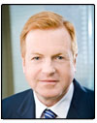
Industry Overview
Manitoba Telecom
Rogers Communication
Bell Canada
Management
David Leith
Chairperson
became Chair of the Manitoba Telecom Services Inc. Board of Directors on January 8, 2010.
was Deputy Chairman and Managing Director of CIBC World Markets and Head of the firm's Investment, Corporate and Merchant Banking activities until February 2009.
Adviser to the Minister of Natural Resources on the restructuring of Atomic Energy of Canada Limited (AECL).
Director of the Children's Aid Foundation.

Slide 58
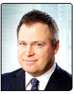
Industry Overview
Manitoba Telecom
Rogers Communication
Bell Canada
Management
Wayne S. Demkey, C.A.
Chief Financial Officer
Wayne Demkey is Chief Financial Officer of each of Manitoba Telecom Services Inc. ("MTS") and MTS Allstream Inc.
eleven years with KPMG Chartered Accountants, most recently in the position of Senior Manager Audit and Business Advisory Services.
member of the Board of Directors of The Winnipeg Humane Society.
Chairman of the Board of Directors of The Winnipeg Humane Society Foundation

Slide 59

Industry Overview
Manitoba Telecom
Rogers Communication
Bell Canada
Management
Kelvin A. Shepherd, P.Eng.
President, MTS
Mr. Shepherd joined the company in 2000 as Vice-President Network Services and Chief Technology Officer.
20 years with Saskatchewan Telecommunications ,most recently as Senior Vice-President and Chief Technology Officer.
Chairman of the Executive Board for LCL Cable Communications Ltd. (Leicester, England) prior to its sale by SaskTel in 1995
Chairman of the Board of TR Labs, a leading Western Canadian-based telecommunications research and development organization.
Chairperson of the Board of Trustees of Victoria General Hospital in Winnipeg

Slide 60
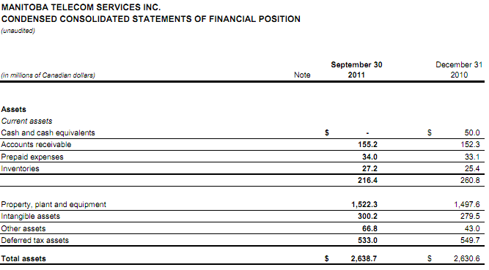
Industry Overview
Manitoba Telecom
Rogers Communication
Bell Canada
Financials (Quarterly)

Slide 61
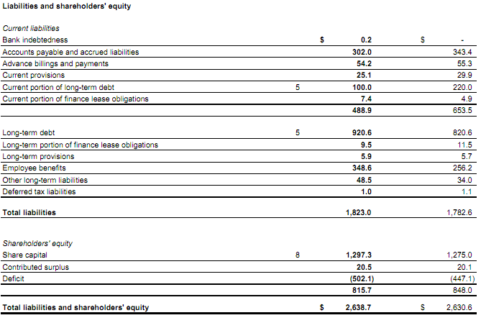
Industry Overview
Manitoba Telecom
Rogers Communication
Bell Canada
Financials (Quarterly)

Slide 62
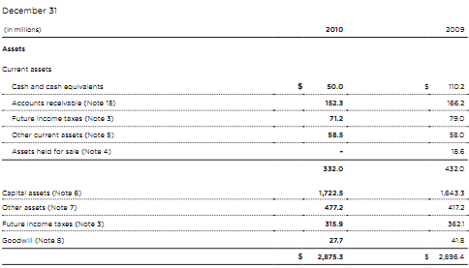
Industry Overview
Manitoba Telecom
Rogers Communication
Bell Canada
Financials

Slide 63
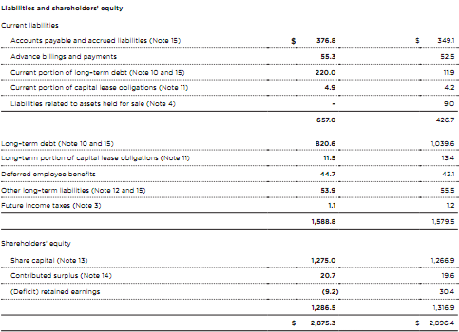
Industry Overview
Manitoba Telecom
Rogers Communication
Bell Canada
Financials

Slide 64
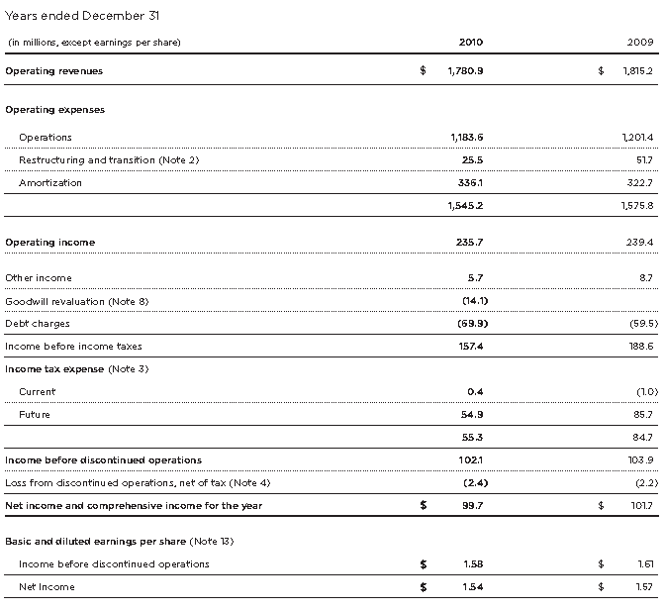
Industry Overview
Manitoba Telecom
Rogers Communication
Bell Canada
Financials

Slide 65
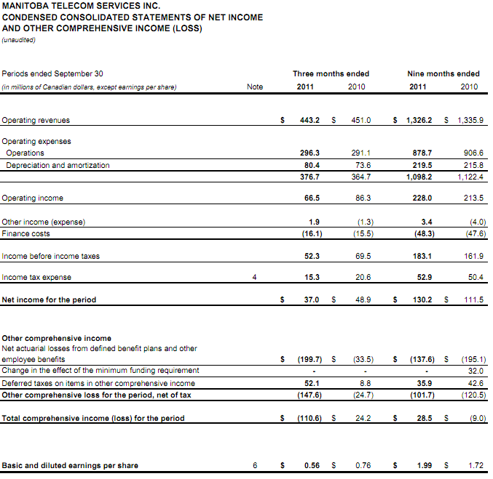
Industry Overview
Manitoba Telecom
Rogers Communication
Bell Canada
Financials
(Quarterly)

Slide 66
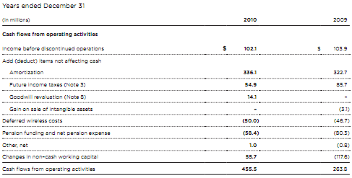
Industry Overview
Manitoba Telecom
Rogers Communication
Bell Canada
Financials

Slide 67

Industry Overview
Manitoba Telecom
Rogers Communication
Bell Canada
Financials

Slide 68

Industry Overview
Manitoba Telecom
Rogers Communication
Bell Canada
Financials (Quarterly)

Slide 69

Industry Overview
Manitoba Telecom
Rogers Communication
Bell Canada
Recommendation
SELL AND MONITOR!

Slide 70

Industry Overview
Manitoba Telecom
Rogers Communication
Bell Canada
RCI - Rogers Communication Inc.

Slide 71

Industry Overview
Manitoba Telecom
Rogers Communication
Bell Canada
Financial Snapshot

Slide 72

Industry Overview
Manitoba Telecom
Rogers Communication
Bell Canada
1 Year Performance

Slide 73

Industry Overview
Manitoba Telecom
Rogers Communication
Bell Canada
1 Year Relative Performance vs TSX Composite

Slide 74

Industry Overview
Manitoba Telecom
Rogers Communication
Bell Canada
1 Year Relative Performance vs TSX Telecom

Slide 75

Industry Overview
Manitoba Telecom
Rogers Communication
Bell Canada
1 Year Relative Performance vs Dow Jones Canada Titans 60

Slide 76

Industry Overview
Manitoba Telecom
Rogers Communication
Bell Canada
5 Year Performance

Slide 77

Industry Overview
Manitoba Telecom
Rogers Communication
Bell Canada
10 Year Performance

Slide 78

Industry Overview
Manitoba Telecom
Rogers Communication
Bell Canada
2010 Financial and Operating Highlights

Slide 79

Industry Overview
Manitoba Telecom
Rogers Communication
Bell Canada
2010 Financial Highlights

Slide 80


Industry Overview
Manitoba Telecom
Rogers Communication
Bell Canada
2010 Financial Highlights

Slide 81

Industry Overview
Manitoba Telecom
Rogers Communication
Bell Canada
Returning Cash to Shareholders

Slide 82

Industry Overview
Manitoba Telecom
Rogers Communication
Bell Canada
2010 Cash Return to Shareholders

Slide 83
Industry Overview
Manitoba Telecom
Rogers Communication
Bell Canada
History
1962 – Ted Rogers founded Rogers Radio Broadcasting Limited and also bought CHFI-FM which quickly became a popular radio station
1967 – Rogers cable started and expanded past 12 channels in 1972 (first company in Canada to do so)
1985 – Rogers Cantel Inc. founded and signalled beginning of expansion into mobile phone market (now called Rogers Wireless)
1994 –Launches 3.1 billion takeover for Maclean Hunter, the largest Canadian takeover at the time

Slide 84
Industry Overview
Manitoba Telecom
Rogers Communication
Bell Canada
History
2000 – Acquires the Toronto Blue Jays, a major league baseball team
2001 – Acquires Sportsnet and launches HDTV (up to 8 channels, the widest selection in Canada)
2004 – Buys back AT&T interest in Rogers Wireless for $1.8 billion and purchases Microcell(a wireless provider) for $1.6 billion
2007 – Acquires 5 Citytv television stations
2008 – Rogers Wireless launches Apple iPhone
2008 – Rogers takeover Aurora Cable

Slide 85

Industry Overview
Manitoba Telecom
Rogers Communication
Bell Canada
Business & Strategy
strategy- “Our Business is to maximize subscribers, revenue, operating profit and return on invested capital by enhancing our position as one of Canada’s leading diversified communications and media companies”

Slide 86
Industry Overview
Manitoba Telecom
Rogers Communication
Bell Canada
2010 Financial Highlights
Consolidated revenues up 4% to $12.2B with contributions from all three operating segments
Expanded adjusted operating profit margin 80 basis points despite economic & competitive pressures
Wireless data revenue up 34% to represent 28% of network revenue
Adjusted net income up 10% to $1.7B, with adjusted EPS up 18%
Consolidated pre-tax free cash flow increased 14% to $2.1B
Repurchased 37.1M Rogers Class B shares for $1.3B
Annualized dividend increase 10% to $1.28, further increased 11%to $1.42 in February 2011
Issued $1.7B of investment grade long-term notes on favorable terms reducing the average cost of debt by 59 basis points

Slide 87
Industry Overview
Manitoba Telecom
Rogers Communication
Bell Canada
Operations
3 Main Divisions of Operations
Rogers Wireless
Rogers Cable
Rogers Media

Slide 88

Industry Overview
Manitoba Telecom
Rogers Communication
Bell Canada
Wireless
the largest Canadian wireless communications service provider
serving approximately 9.0 million retail voice and data subscribers
carry on both GSM(global standard, coverage to 95% Canada’s population) and 3G HSPA(88% population) technology platforms
offers wireless voice, data and messaging services including related handset devices and accessories, across Canada

Slide 89
Industry Overview
Manitoba Telecom
Rogers Communication
Bell Canada
Recent Wireless Industry Trends
Focus on Customer Retention
Demand for Sophisticated Data Applications
Increased Competition from Other Wireless Operators
Migration to Next Generation Wireless Technology
Development of Additional Technologies(WiFi, WiMAX and LTE)

Slide 90

Industry Overview
Manitoba Telecom
Rogers Communication
Bell Canada
Rogers Wireless Strategy
Continually enhancing its scale and competitive position
Focusing on offering innovative voice and wireless data services
Enhancing the customer experience
Increasing revenue from existing customers
Maintaining the most technologically advanced, high-quality and national wireless network possible with global coverage
provide bundled product and service offerings at attractiveprices to common customers

Slide 91

Industry Overview
Manitoba Telecom
Rogers Communication
Bell Canada
Rogers Wireless Coverage

Slide 92


Industry Overview
Manitoba Telecom
Rogers Communication
Bell Canada
Wireless Operating and Financial Results

Slide 93

Industry Overview
Manitoba Telecom
Rogers Communication
Bell Canada
Cable
one of Canada’s largest providers of cable television, high-speed Internet access and cable telephony services
has 2.3 million television subscribers, representing approximately 29% of all television subscribers in Canada
provided digital cable services to approximately 1.7 million of its television subscribers and high-speed Internet service to approximately 1.7 million residential subscribers
146,000 local line equivalents and 42,000 broadband data circuits in service
operates a retail distribution chain with approximately 400 stores

Slide 94
Industry Overview
Manitoba Telecom
Rogers Communication
Bell Canada
Rogers Cable’s Strategy
Maintaining technologically advanced
Offering a wide selection of advanced and innovative products and services
Ongoing focus on enhanced customer experience
Targeting its product and content development to the changing demographic trends
Continuing to lead the development and expansion
Continuing to deepen our presence and core connections

Slide 95


Industry Overview
Manitoba Telecom
Rogers Communication
Bell Canada
Cable Operating and Financial Results

Slide 96

Industry Overview
Manitoba Telecom
Rogers Communication
Bell Canada
Cable Operating and Financial Results

Slide 97
Industry Overview
Manitoba Telecom
Rogers Communication
Bell Canada
Media
Including radio and television broadcasting and specialty television businesses
Comprises 55 radio stations
Television division includes Citytv network, Rogers Sportsnet, Shopping channel, Outdoor Life Network, The Biography Channel and G4 Canada.
Publishes consumer magazines and trade and professional publications and directories
Owns the Toronto Blue Jays, “MLB” club, and Rogers Centre sports and entertainment venue

Slide 98
Industry Overview
Manitoba Telecom
Rogers Communication
Bell Canada
Recent Media Industry Trends
Migration to Digital Media
Consolidation and Ownership of Industry Competitors

Slide 99


Industry Overview
Manitoba Telecom
Rogers Communication
Bell Canada
Media Operating and Financial Results

Slide 100

Industry Overview
Manitoba Telecom
Rogers Communication
Bell Canada
Management
Ted Rogers
Former CEO & Founder
Died December 2, 2008
CEO of Rogers from launch in 1960 until his death in 2008
Grew Rogers Communications into one of Canada’s largest media conglomerates

Slide 101

Industry Overview
Manitoba Telecom
Rogers Communication
Bell Canada
Management
Nadir Mohamed, F.C.A.
President and Chief Executive Officer
Rogers Communications
Appointed CEO in March 2009
Joined in August 2000 as COO of Rogers Wireless
UBC Undergraduate Degree
Chartered Accountant

Slide 102

Industry Overview
Manitoba Telecom
Rogers Communication
Bell Canada
Management
Alan D. Horn, C.A.
Chairman, Rogers Communications
and President and Chief Executive Officer,
Rogers Telecommunications Limited
Chairman since 2006
served as VP, CFO of Rogers Communications (1996-2006)
President and COO of Rogers Telecommunications Limited (1990-1996)
A Chartered Accountant and received a B.Sc. with First Class Honors in Mathematics from the University of Aberdeen, Scotland

Slide 103

Industry Overview
Manitoba Telecom
Rogers Communication
Bell Canada
Management
Philip B. Lind, C.M.
Executive Vice President Regulatory and Vice
Chairman
joined the Corporation in 1969
director of the Council for Business and Contemporary Art Gallery
former member of the Board of the National Cable Television Association in the U.S
former Chairman of the Canadian Cable Television Association
Chairman of the Board of the CCPTA
B.A. (Political Science and Sociology) from UBC
M.A. (Political Science) from the University of Rochester

Slide 104

Industry Overview
Manitoba Telecom
Rogers Communication
Bell Canada
Financials (Balance Sheet - Quarterly)

Slide 105

Industry Overview
Manitoba Telecom
Rogers Communication
Bell Canada
Financials (Balance Sheet - Quarterly)

Slide 106

Industry Overview
Manitoba Telecom
Rogers Communication
Bell Canada
Financials (Balance Sheet)

Slide 107

Industry Overview
Manitoba Telecom
Rogers Communication
Bell Canada
Financials (Income Statement)

Slide 108

Industry Overview
Manitoba Telecom
Rogers Communication
Bell Canada
Financials (Income Statement - Quarterly)

Slide 109

Industry Overview
Manitoba Telecom
Rogers Communication
Bell Canada
Financials (Income Statement - Quarterly)

Slide 110

Industry Overview
Manitoba Telecom
Rogers Communication
Bell Canada
Financials (Statement of Cash Flows)

Slide 111

Industry Overview
Manitoba Telecom
Rogers Communication
Bell Canada
Financials (Statement of Cash Flows - Quarterly)

Slide 112

Industry Overview
Manitoba Telecom
Rogers Communication
Bell Canada
Financials (Statement of Cash Flows - Quarterly)

Slide 113

Industry Overview
Manitoba Telecom
Rogers Communication
Bell Canada
Financials (Statement of Shareholders’ Equity)

Slide 114

Industry Overview
Manitoba Telecom
Rogers Communication
Bell Canada
Five-Year Summary of Consolidated Financial Results

Slide 115

Industry Overview
Manitoba Telecom
Rogers Communication
Bell Canada
Recommendation
BUY!

Slide 116

Industry Overview
Manitoba Telecom
Rogers Communication
Bell Canada
BCE – Bell Canada Enterprises

Slide 117

Industry Overview
Manitoba Telecom
Rogers Communication
Bell Canada
Financial Snapshot

Slide 118

Industry Overview
Manitoba Telecom
Rogers Communication
Bell Canada
1 Year vs. TSX Telecom

Slide 119

Industry Overview
Manitoba Telecom
Rogers Communication
Bell Canada
5 Year with 10/20 MAVG

Slide 120

Industry Overview
Manitoba Telecom
Rogers Communication
Bell Canada
5 Year vs. TSX Telecom
Privatization target, April 2007
Acquisition
cancelled

Slide 121

Industry Overview
Manitoba Telecom
Rogers Communication
Bell Canada
Max Year vs. TSX Telecom

Slide 122

Industry Overview
Manitoba Telecom
Rogers Communication
Bell Canada
Max Year vs. TSX Composite
IT bubble

Slide 123




Industry Overview
Manitoba Telecom
Rogers Communication
Bell Canada
History

Slide 124
Industry Overview
Manitoba Telecom
Rogers Communication
Bell Canada
Organization Chart
BCE Inc.
Bell Wireline
Bell Wireless
Bell Phone
Bell Mobility
Bell TV
Bell Internet
Bell Aliant
Bell Media
CTV

Slide 125
Industry Overview
Manitoba Telecom
Rogers Communication
Bell Canada
Privatization Target
On June 30, 2007, BCE accepted a bid of $42.75 per share in cash (total $51.7 billion), from the group led by the Ontario Teachers' Pension Plan.
On November 26, 2008, KPMG had informed BCE that it would not be able to issue a statement on the solvency of the company after its privatization.
As a result, the purchase was cancelled.

Slide 126
Industry Overview
Manitoba Telecom
Rogers Communication
Bell Canada
Acquisition of CTV
Completed on April 1, 2011.
BCE acquired the remaining 85% of CTV common shares that it did not already own.
Bell Media - Canada's premier multimedia company, include:
CTV, CTV2,TSN radio and other specialty TV channels.

Slide 127
Industry Overview
Manitoba Telecom
Rogers Communication
Bell Canada
Services
Bell Home phone local and long distance
Bell Mobility, Virgin Mobile and Solo Mobile wireless
High-speed Bell Internet and Fibe Internet
Bell Satellite TV and Bell Fibe TV
IP-broadband
Information and communications technology (ICT) services.
Bell Media in television, radio and digital media
Equipment

Slide 128


Industry Overview
Manitoba Telecom
Rogers Communication
Bell Canada
Revenue Breakdown

Slide 129

Industry Overview
Manitoba Telecom
Rogers Communication
Bell Canada
Subscribers: Quarterly

Slide 130
Industry Overview
Manitoba Telecom
Rogers Communication
Bell Canada
Subscribers: Quarterly

Slide 131
Industry Overview
Manitoba Telecom
Rogers Communication
Bell Canada
Bell Wireline
Wireline services include:
Local and access services (fixed line)
Long distance services (fixed line)
Data services (internet/broadband)
Video services (Bell TV)
Equipment and other

Slide 132

Industry Overview
Manitoba Telecom
Rogers Communication
Bell Canada
Bell Wireline Subscribers

Slide 133

Industry Overview
Manitoba Telecom
Rogers Communication
Bell Canada
Bell Wireline Revenue

Slide 134


Industry Overview
Manitoba Telecom
Rogers Communication
Bell Canada
Best in five years

Slide 135

Industry Overview
Manitoba Telecom
Rogers Communication
Bell Canada
Q3 11 Wireline Revenue

Slide 136

Industry Overview
Manitoba Telecom
Rogers Communication
Bell Canada
Fixed line market (Local and access & Long distance services)

Slide 137


Industry Overview
Manitoba Telecom
Rogers Communication
Bell Canada
Bell TV
provide DTH satellite television services
on a nationwide basis.
Launched FibeTV in Sept. 2010
(IPTV-Internet Protocol television)

Slide 138



Industry Overview
Manitoba Telecom
Rogers Communication
Bell Canada
Bell TV Q3 2011

Slide 139

Industry Overview
Manitoba Telecom
Rogers Communication
Bell Canada
Bell TV Connections Q3 2011

Slide 140

Industry Overview
Manitoba Telecom
Rogers Communication
Bell Canada
Bell Internet
provide high-speed Internet access service for residential and business customers
through digital subscriber line (DSL) technology, fibre-optic or wireless broadband service.
On December 31, 2010, has 2.1 million customers.
Launched Bell Fibe internet on Feb 4, 2010 in the Montréal and Greater Toronto areas. (25Mbps, through FTTN network)
Deploy the Dual cell technology (42Mbps)

Slide 141

Industry Overview
Manitoba Telecom
Rogers Communication
Bell Canada
Internet Market

Slide 142

Industry Overview
Manitoba Telecom
Rogers Communication
Bell Canada
Bell Internet Q3 2011

Slide 143

Industry Overview
Manitoba Telecom
Rogers Communication
Bell Canada
Equipment and other
The Source - a Canadian electronics retailer with over 800 locations across Canada.
Purchased by Bell in 2009 from Circuit City Stores
renting, selling and maintaining business terminal equipment

Slide 144
Industry Overview
Manitoba Telecom
Rogers Communication
Bell Canada
Bell Wireless
Bell Mobile- a CDMA and HSPA+ based wireless network
Solo Mobile-a mobile brand started by Bell Mobility in 2000. Solo is considered a discount wireless brand, offering low price monthly plans with some unlimited options in BC, Alberta, Ontario and Quebec.
Virgin Mobile Canada- acquired by Bell in May 2009 for CAN$142 million.
26% of Bell’s total revenue in Q3’11
Sole telecommunications provider of the Vancouver Winter Olympics

Slide 145

Industry Overview
Manitoba Telecom
Rogers Communication
Bell Canada

Slide 146

Industry Overview
Manitoba Telecom
Rogers Communication
Bell Canada
Coverage Map

Slide 147
Industry Overview
Manitoba Telecom
Rogers Communication
Bell Canada
Bell Wireless Connections Q3 2011

Slide 148

Industry Overview
Manitoba Telecom
Rogers Communication
Bell Canada
Bell Wireless Revenue

Slide 149

Industry Overview
Manitoba Telecom
Rogers Communication
Bell Canada
Bell Wireless Operation Q3 2011

Slide 150



Industry Overview
Manitoba Telecom
Rogers Communication
Bell Canada
Bell Media
9% of total revenue
CTV (including 21 operated stations)
CTV-TWO
30 cable TV specialty channels (e.g. TSN2, MTV, CTV News)
TSN radio (fifth-largest private-sector radio broadcaster)

Slide 151

Industry Overview
Manitoba Telecom
Rogers Communication
Bell Canada
Bell Media Quarterly Revenue

Slide 152
Industry Overview
Manitoba Telecom
Rogers Communication
Bell Canada
Executing on cost reduction imperative
Reduced 1200 management position
~100M in annualized saving (2010)
Wire-line cost reductions in Q3 ~$80M
Cost reductions help drive 1.7 point improvement in wire-line EBITDA margin

Slide 153

Industry Overview
Manitoba Telecom
Rogers Communication
Bell Canada
Management
George Cope
President and Chief Executive Officer (Since July 2008)
BComm (Honours) degree from the University of Western Ontario
He had served in public-company CEO roles in the industry for more than 15 years prior to joining Bell in 2005.
Also Board Members of BMO

Slide 154

Industry Overview
Manitoba Telecom
Rogers Communication
Bell Canada
Management
4th highest paid CEO in Canada

Slide 155

Industry Overview
Manitoba Telecom
Rogers Communication
Bell Canada
Management
Siim A. Vanaselja
Executive Vice-President & Chief Financial Officer
Honours Bachelor of Business degree from the York University
He joined BCE in February 1994 and has held a variety of senior positions in the BCE group.
Has been the CFO of BCE since Jan 15,2001
Prior to joining BCE, Mr. Vanaselja was a partner at the accounting firm KPMG Canada

Slide 156

Industry Overview
Manitoba Telecom
Rogers Communication
Bell Canada
Financials (Quarterly)

Slide 157

Industry Overview
Manitoba Telecom
Rogers Communication
Bell Canada
Financials (Quarterly)

Slide 158

Industry Overview
Manitoba Telecom
Rogers Communication
Bell Canada
Financials

Slide 159

Industry Overview
Manitoba Telecom
Rogers Communication
Bell Canada
Financials

Slide 160

Industry Overview
Manitoba Telecom
Rogers Communication
Bell Canada
Financials

Slide 161

Industry Overview
Manitoba Telecom
Rogers Communication
Bell Canada
Financials (Consolidated Income Statement - Quarterly)

Slide 162

Industry Overview
Manitoba Telecom
Rogers Communication
Bell Canada

Slide 163

Industry Overview
Manitoba Telecom
Rogers Communication
Bell Canada

Slide 164


Industry Overview
Manitoba Telecom
Rogers Communication
Bell Canada

Slide 165

Industry Overview
Manitoba Telecom
Rogers Communication
Bell Canada
Dividend History (past 5 years)

Slide 166

Industry Overview
Manitoba Telecom
Rogers Communication
Bell Canada
Summary of Cash Flows

Slide 167

Industry Overview
Manitoba Telecom
Rogers Communication
Bell Canada

Slide 168

Industry Overview
Manitoba Telecom
Rogers Communication
Bell Canada

Slide 169

Industry Overview
Manitoba Telecom
Rogers Communication
Bell Canada
Quarterly Financials (Consolidated Statement of Cash Flows)

Slide 170

Industry Overview
Manitoba Telecom
Rogers Communication
Bell Canada
Quarterly Financials (Consolidated Statement of Cash Flows)

Slide 171
Industry Overview
Manitoba Telecom
Rogers Communication
Bell Canada
Have BCE shares peaked?
It is a belief that BCE has become fully valued following a long run-up in share price since the end of 2008.
Including dividends, the return to shareholders has been increased over 100 per cent.

Slide 172
Industry Overview
Manitoba Telecom
Rogers Communication
Bell Canada
Have BCE shares peaked?
Positives
Negatives
A diversified company with financial strengths
Raised its dividend eight times since Q4 2008.
Spent $1.5B on buying back
Launched IPTV in 2010, U.S. experience appears to be encouraging.
Competition is becoming more intense.
Cost of revenue up 9.4%
(cost of launch IPTV, spending to retain more customers, acquisitions of the source, virgin..)

Slide 173

Industry Overview
Manitoba Telecom
Rogers Communication
Bell Canada
Recommendation
HOLD!

