Slide 1
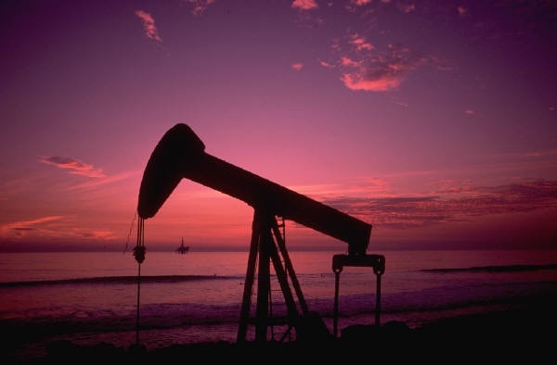
David Li
James Annable
William Pao
William Wong
William Zhao
Canadian Oil & Gas

Slide 2
Agenda
Industry Analysis
Overview
Oil Industry
Gas Industry
Company Analysis
Canadian Oil Sands (COS)
Crescent Point (CPG)
Baytex Energy (BTE)

Slide 3
Overview

Slide 4
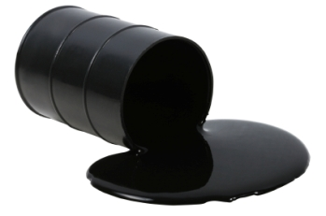
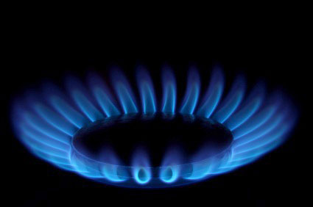
Overview
[What is it?]
Oil
Crude oil is a fossil fuel, the result of dead organisms decomposing underground
Gas
Natural gas is generated biogenically from bogs/marshes or thermogenically from buried organisms

Slide 5


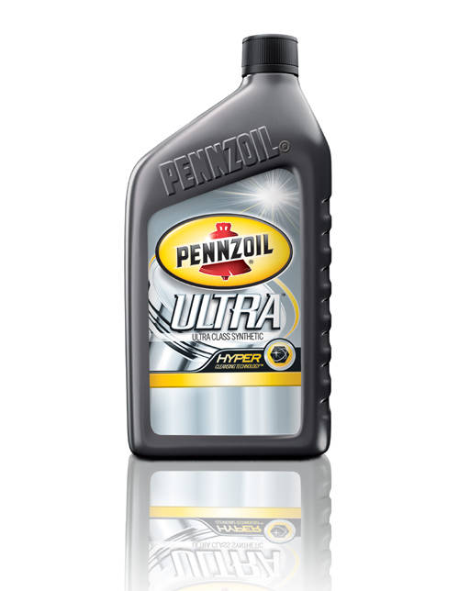
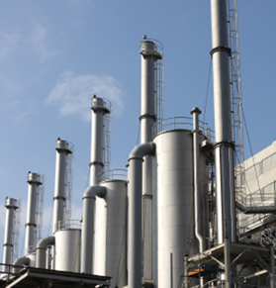

Overview
[What is it Used For?]
Oil
Gasoline
Kerosene
Petroleum gas
Diesel
Industrial oils
Fuels
Lubricants
Gas
Electricity
Appliance
Heating
Transportation

Slide 6
Overview
[Economic Impact]
The industry accounts for approximately $80.7 billion in revenue.
Around 2 300 enterprises operate across the various sub-sectors.
Employs approximately 230 000 people
Oil and gas extraction accounts for about 4.5% of Canada’s GDP
Oil and gas companies account for about 20% of TSX/TSXV capitalization
Spending is highest in Western Canada, oil sands

Slide 7
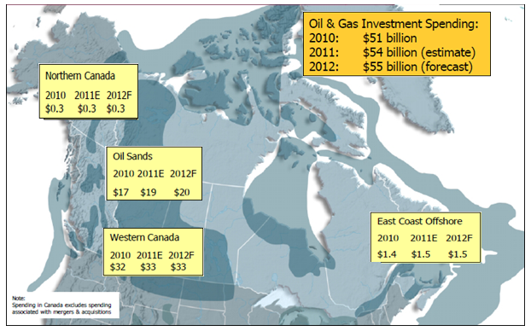
Overview
[Oil & Gas Capital Spending]

Slide 8
Overview
[Industry Value Chain]
Upstream
Exploration and Production
Midstream
Storage, Processing and Transportation
Downstream
Refining, Product Distributors

Slide 9

Oil Industry

Slide 10
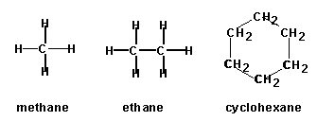
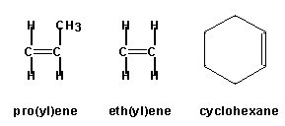
Oil / Petroleum / Hydrocarbons?
Methane | CH₄ | CH₄
Ethane | C₂H₆ | CH₃CH₃
Propane | C₃H₈ | CH₃CH₂CH₃
Butane | C₄H₁₀ | CH₃ (CH₂)₂ CH₃
Pentane | C₅H₁₂ | CH₃ (CH₂)₃ CH₃
Hexane | C₆H₁₄ | CH₃ (CH₂)₄ CH₃
Heptane | C₇H₁₆ | CH₃ (CH₂)₅ CH₃
Octane | C₈H₁₈ | CH₃ (CH₂)₆ CH₃
Nonane | C₉H₂₀ | CH₃ (CH₂)₇ CH₃
Decane | C₁₀H₂₂ | CH₃ (CH₂)₈ CH₃
(Crude Oil and Natural Gas often contain substantial amounts of nitrogen, sulfur, oxygen, trace metals, and other elements)
Notes:
Petroleum is a substance, usually liquid or gas, consisting of organic molecules composed of hydrogen and carbon atoms. Thus the general name "hydrocarbons" is often used. The possible variations in the construction of the molecules and mixtures of different molecules to form naturally occurring oil (crude oil) are virtually limitless. No two crude oils are identical. Because these complex mixtures of organic matter are found in rock, they are called "petroleum," a word derived from the Latin words for rock (petra) and for oil (oleum).

Slide 11
Types of Crude Oil
Light crude oil: liquid petroleum with a gravity of 28°API or higher
Heavy crude oil: liquid petroleum with a gravity below 28°API
Sweet crude oil (light/heavy) : lower content of Sulfur
Sour crude oil (light/heavy) : higher content Sulfur
Pentanes: hydrocarbons containing molecules of 5 carbon atoms and 12 hydrogen atoms.
Bitumen: petroleum in semi-solid or solid form that is found in bituminous sands. It is so heavy (gravity below 12°API) and viscous that it will not flow unless heated or diluted.
Synthetic crude oil: a product similar to a high-quality light crude oil. It is made by refining or upgrading heavy oil or bitumen. From 31-33°API

Slide 12
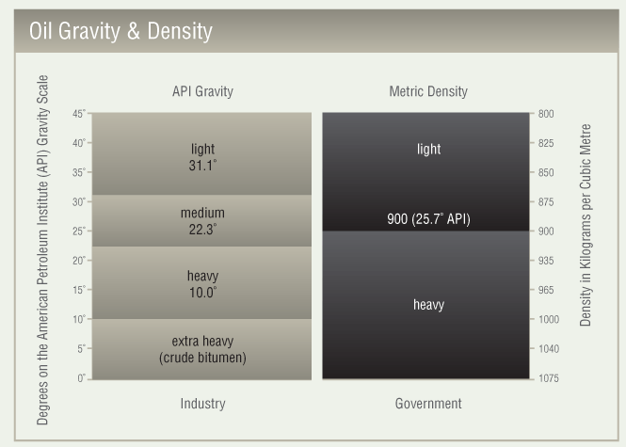
Types of Crude Oil
[Oil & Gravity Density]

Slide 13
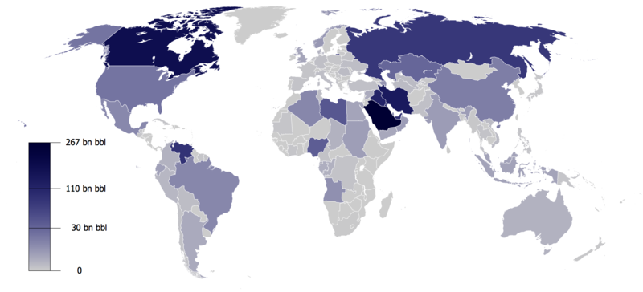
Types of Crude Oil
[Oil & Gravity Density]
(Proven Oil Reserves, as published by the CIA Factbook, 2009)
Notes:
Proven reserves are those reserves claimed to have a reasonable certainty (normally at least 90% confidence) of being recoverable under existing economic and political conditions, with existing technology. Industry specialists refer to this as P90 (i.e., having a 90% certainty of being produced). Proven reserves are also known in the industry as 1P.[
Unproven reserves are based on geological and/or engineering data similar to that used in estimates of proven reserves, but technical, contractual, or regulatory uncertainties preclude such reserves being classified as proven. with a 50% probability of being produced in the future, and discovered reserves which have a 5-10% possibility of being produced in the future are referred to as 2P/Probable (50%), and 3P/Possible (5-10%).^{[56]}

Slide 14
Oil Reserves (millions of barrels)

Slide 15
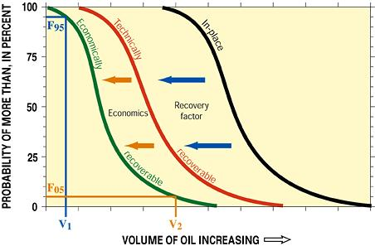
Oil Reserves vs. Resource

Slide 16
Reserve & Resource Definition
Proved Reserves are reserves that can be estimated with a high degree of certainty to be recoverable. NI 51-101 further identifies the certainty level for proved reserves as “at least a 90% probability that the quantities actually recovered will equal or exceed the estimated proved reserves”.
Proved plus Probable Reserves are those additional reserves that are less certain to be recovered than proved reserves. NI 51-101 defines the certainty level as “at least a 50 percent probability that the quantities actually recovered will equal or exceed the sum of the estimated proved plus probable reserves”. Therefore, under NI 51-101, the proved plus probable reserves represent a “best estimate” or “expected reserves”.
Contingent Resources are those quantities of petroleum estimated, as of a given date, to be potentially recoverable from known accumulations using established technology or technology under development, but which are not currently considered to be commercially recoverable due to one or more contingencies.
Prospective Resources are those quantities of petroleum estimated, as of a given date, to be potentially recoverable from undiscovered accumulations by application of future development projects. Prospective resources have both an associated chance of discovery and a chance of development.
Best Estimate is a term used to describe an uncertainty category for resources estimates referring to the best estimate of the quantity that will actually be recovered. It is equally likely that the actual remaining quantitative recovered will be greater or less than the “best estimate”. The best estimate of Contingent and Prospective Resource is prepared independent of the risks associated with achieving commercial production.
(Source: COS Presentation – February 27, 2012)

Slide 17
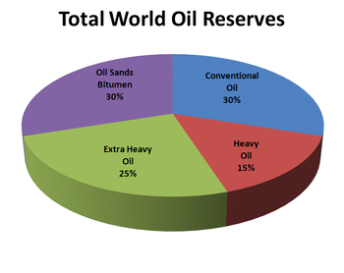
Total World Oil Reserves

Slide 18
Oil Production (thousands bbl/day)

Slide 19
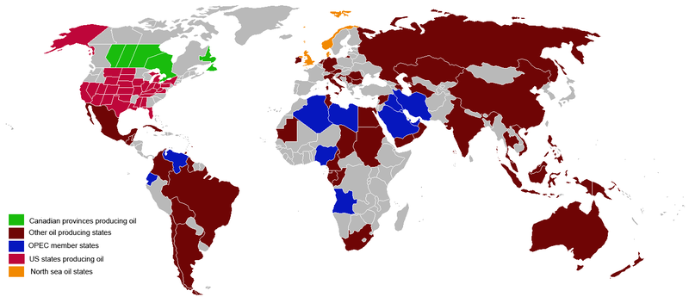
Oil Production

Slide 20
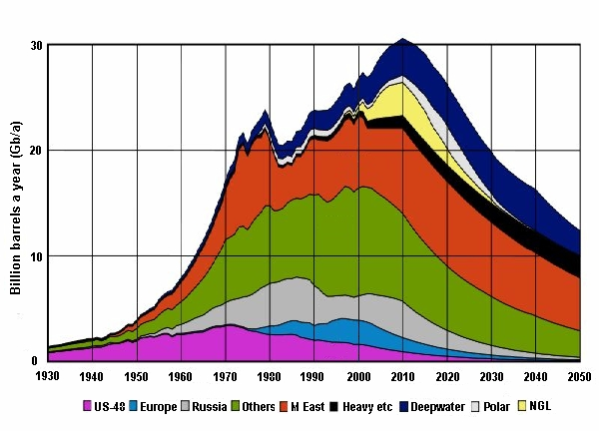
World Oil Production

Slide 21
Oil Consumption (thousands bbl/day)

Slide 22
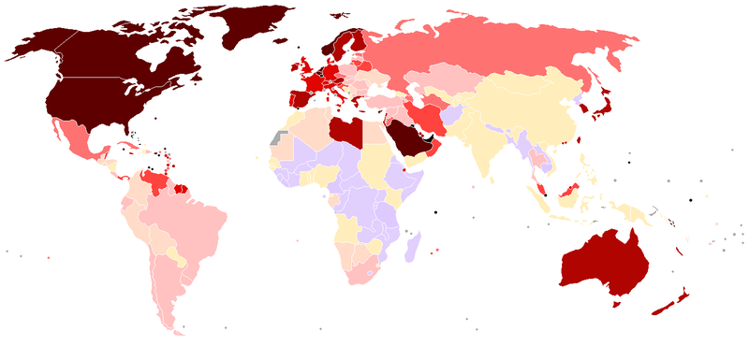
Oil Consumption (per Capita)

Slide 23
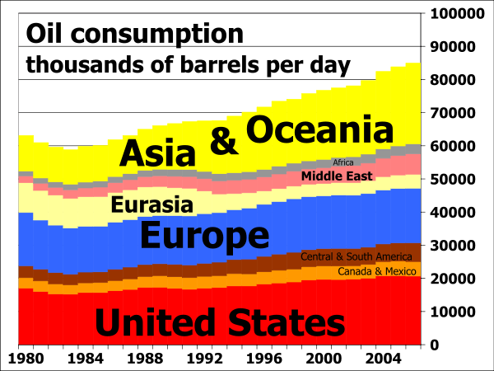
Oil Consumption (Country)

Slide 24
Oil Exports (thousands bbl/day)

Slide 25
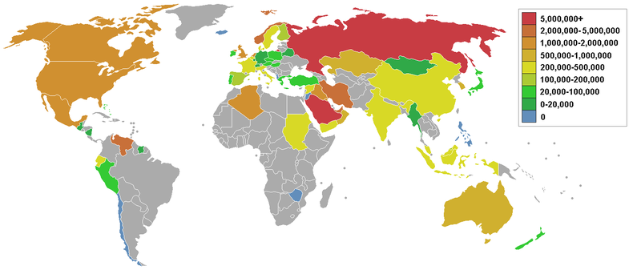
Oil Exports

Slide 26
Oil Imports (thousands of bbl/day)

Slide 27
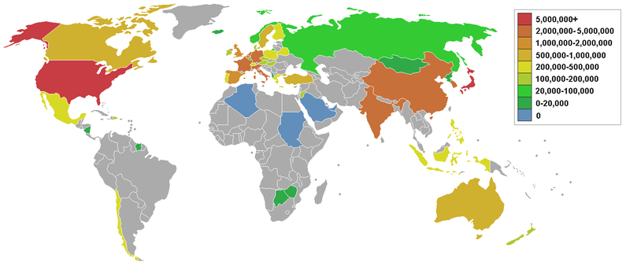
Oil Imports

Slide 28
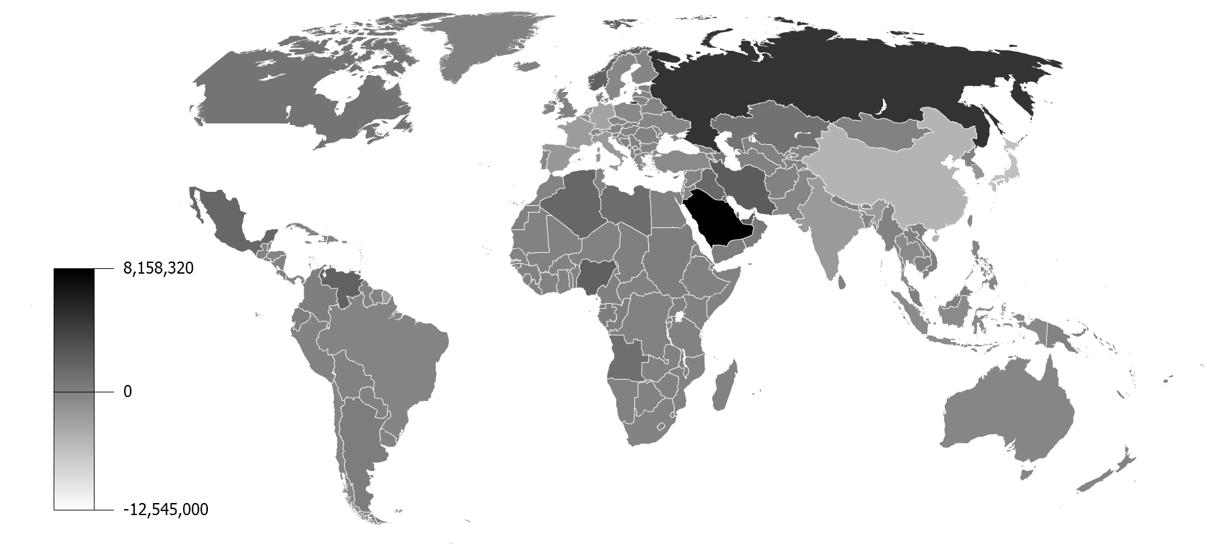
Oil Balance

Slide 29
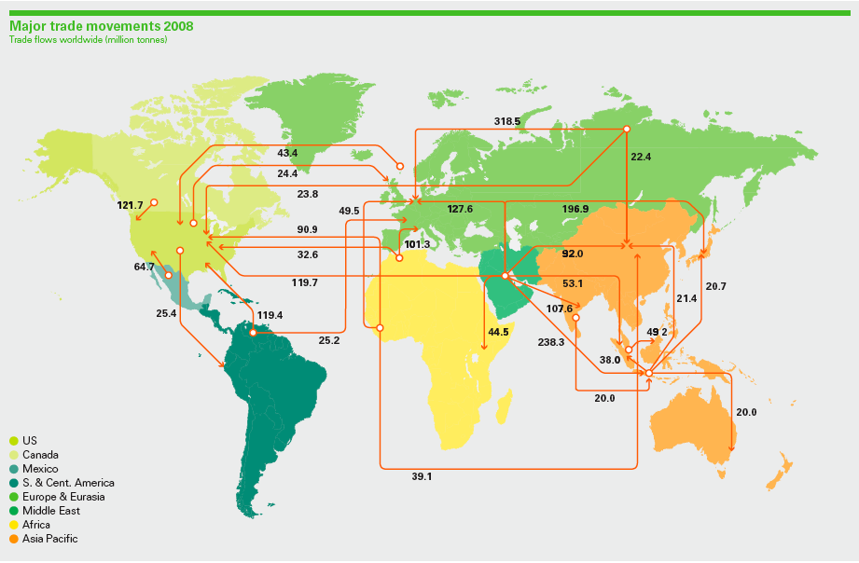
Oil Trade

Slide 30
Oil Demand

Slide 31
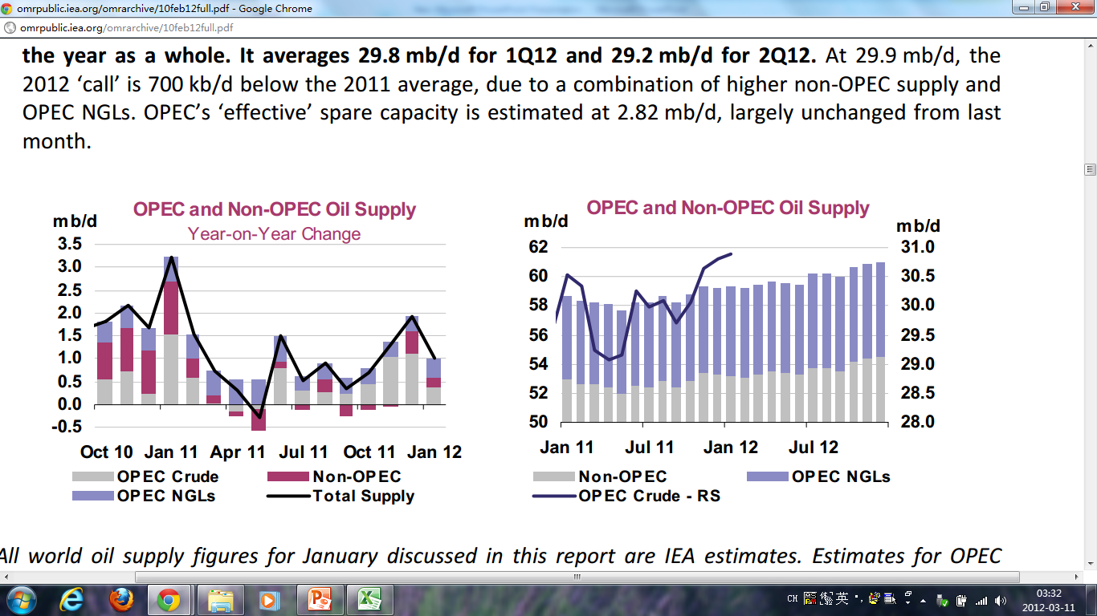
Oil Supply

Slide 32
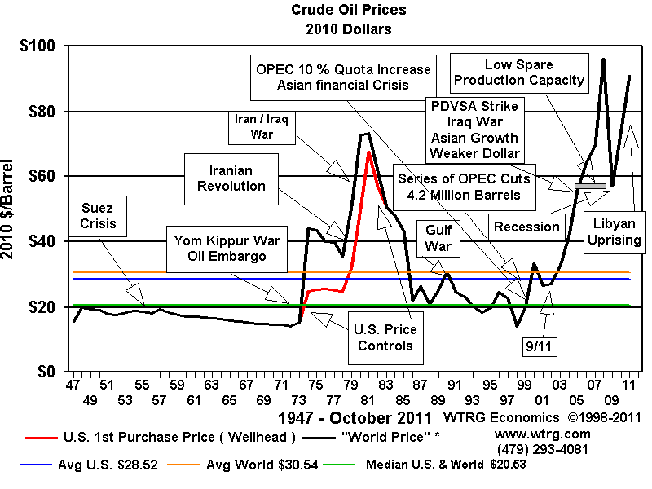
Oil Price
(http://www.oil-price.net/)

Slide 33
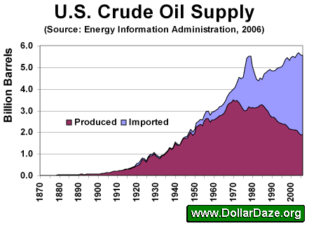
U.S. Oil Production

Slide 34
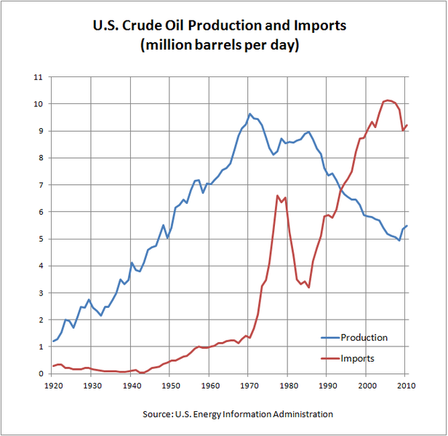
U.S. Crude Oil Production & Imports

Slide 35
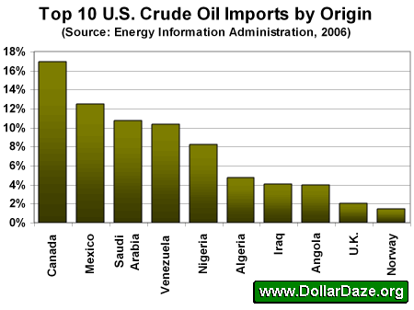
Top 10 U.S. Crude Oil Imports by Origin

Slide 36
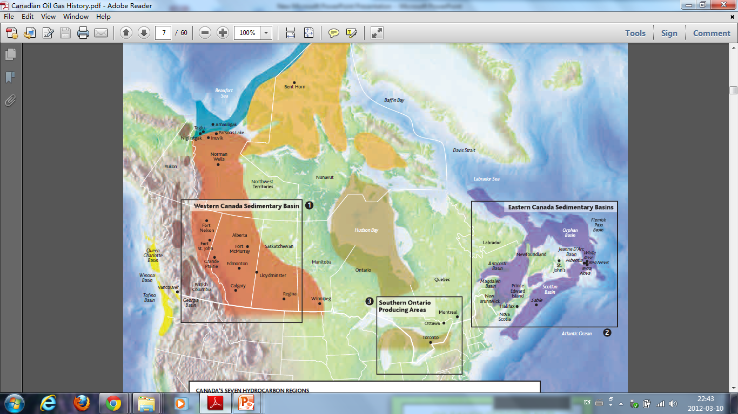
Canada’s Seven Hydrocarbon Regions
Notes:
CANADA'S SEVEN HYDROCARBON REGIONS
Percentage of Canada’s estimated conventional
hydrocarbon resources
Region
Western Canada Sedimentary Basin* 57%
Atlantic Margin 18%
Arctic Cratonic 10%
Arctic Margin 6%
Pacific Margin 4%
Intermontane 3%
Eastern Cratonic 2%

Slide 37
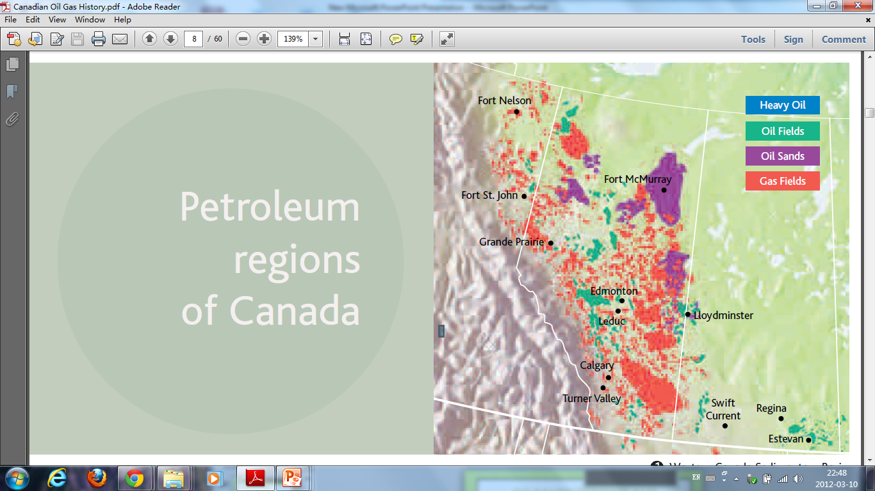
Western Canada Sedimentary Basin
Notes:
Includes parts of all four western
provinces, the Northwest Territories
and the Yukon
In 2003, accounted for about
87 per cent of Canada’s crude
oil and 97 per cent of its natural
gas production
Bitumen, contained in oilsands,
is the world’s largest known
petroleum resource

Slide 38
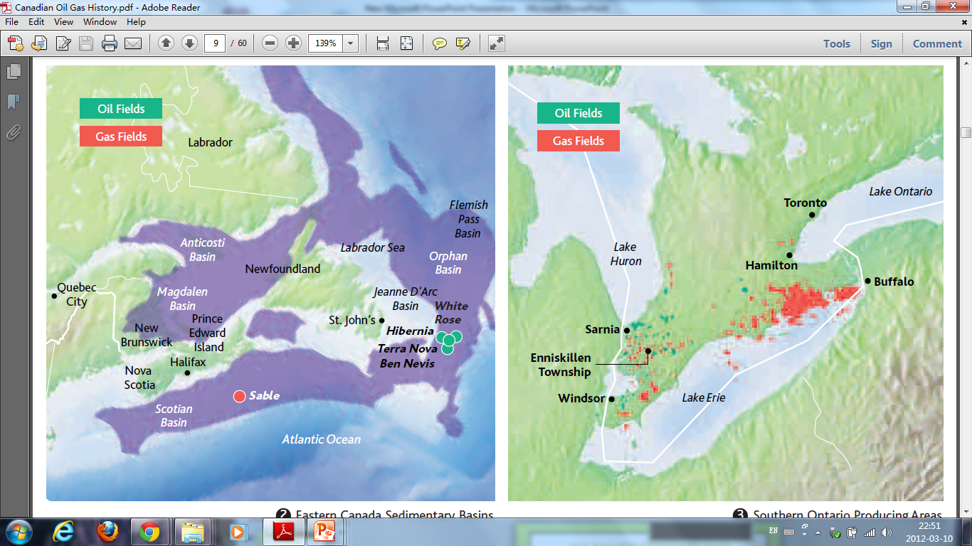
Eastern Canada Sedimentary Basins
Notes:
First major crude oil discovery in
1979 at Hibernia site on the Grand
Banks off Newfoundland and Labrador
First crude oil production in 1992
from the Panuke and Cohasset
fields near Sable Island offshore
of Nova Scotia
• Crude oil production began from
Hibernia platform in 1997
• Natural gas production began
in 1999 near Sable Island
• Terra Nova crude oil production
began in 2002, to be followed by
White Rose in 2005 and eventually
by development of nearby fields
such as Hebron, Ben Nevis and
West Ben Nevis

Slide 39
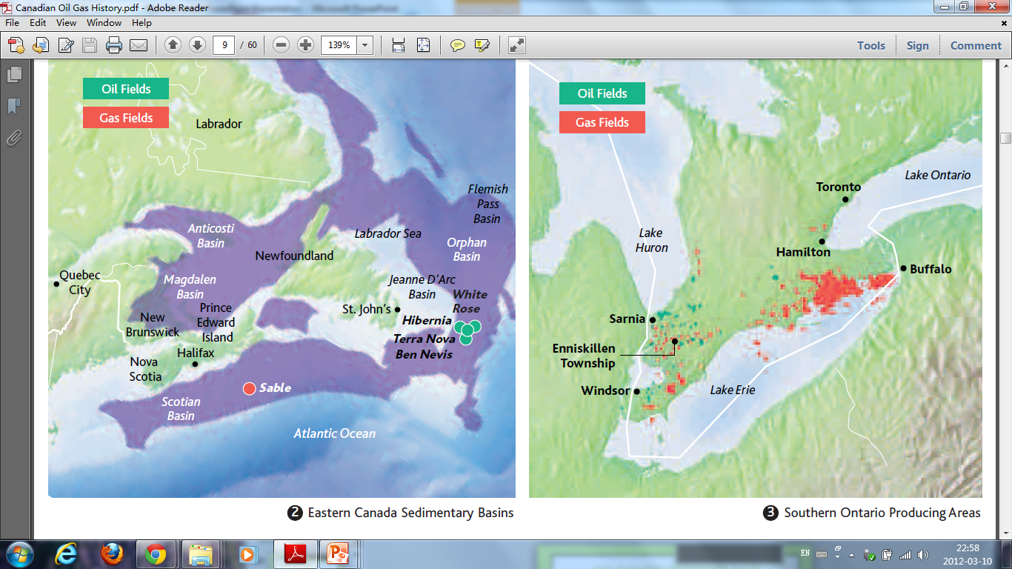
Southern Ontario Producing Areas
Notes:
Relatively small amounts of crude
oil and natural gas production
continue today

Slide 40
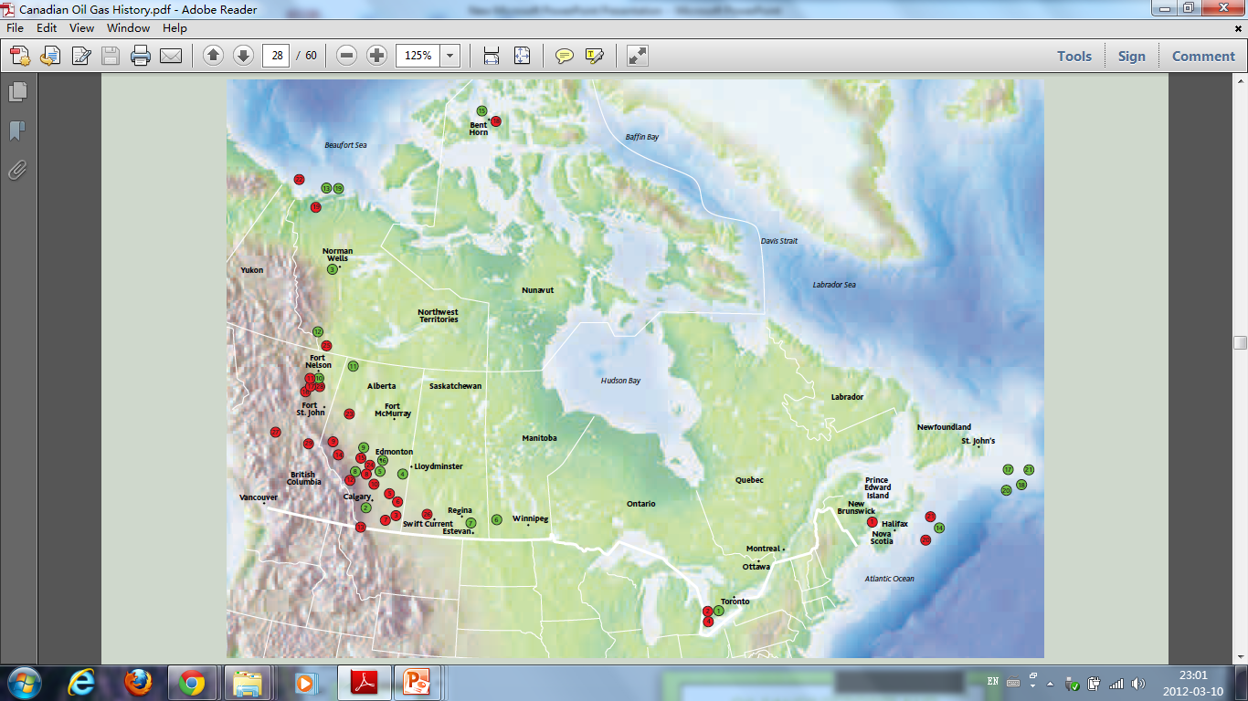
Crude Oil & Natural Gas Discoveries

Slide 41
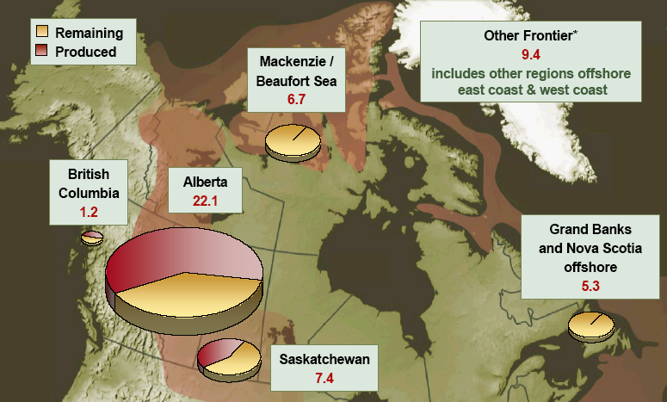
Crude Oil Resources

Slide 42
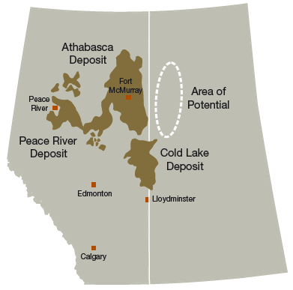
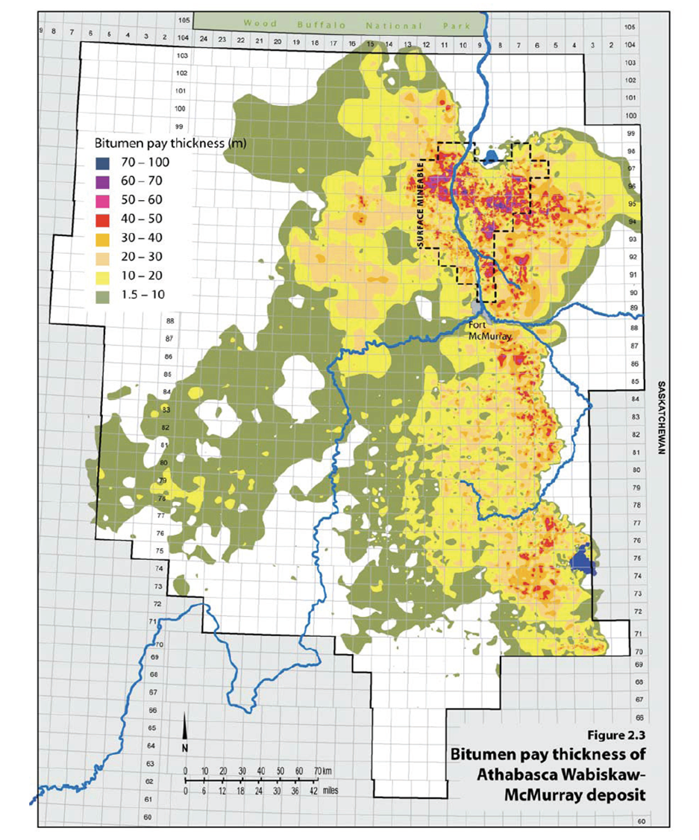
Oil Sands Deposits
Notes:
Oil sands in Canada (1.7-2.5 TRILLION) barrels!)

Slide 43
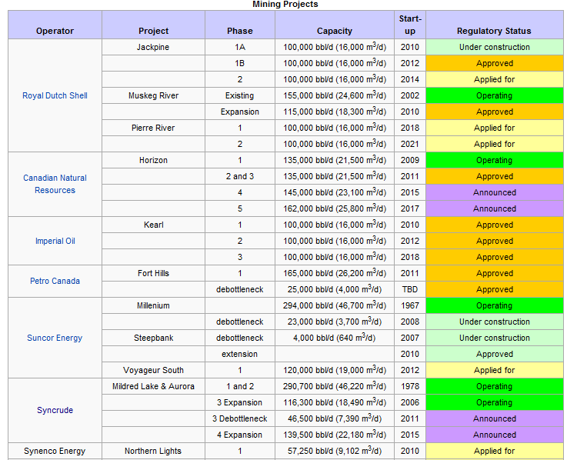
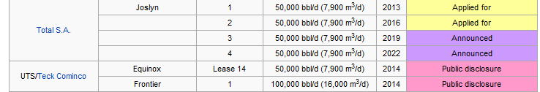
Mining Projects

Slide 44
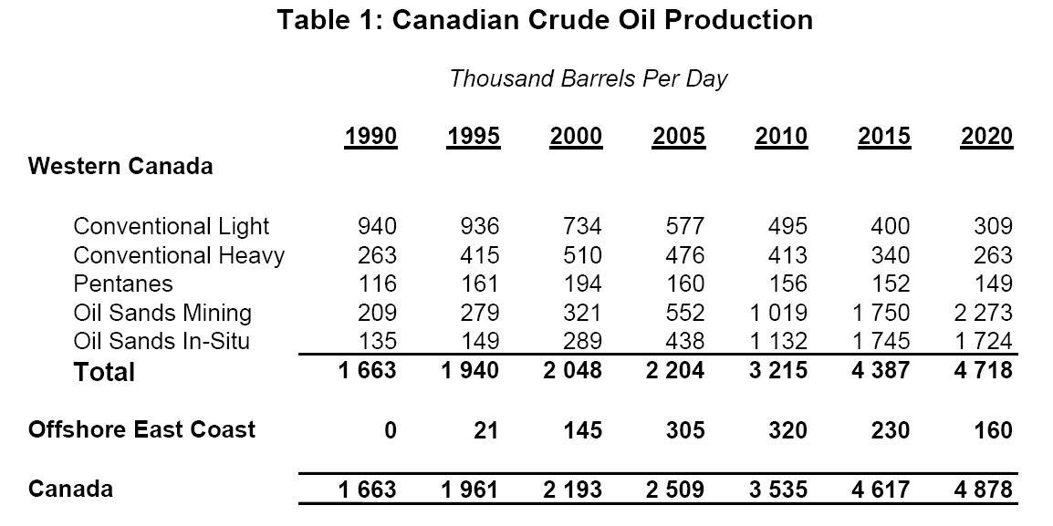
Canadian Oil Production
Notes:
Over 95 percent are oil sands deposits in Alberta, which are more difficult to process than conventional crude oil.

Slide 45
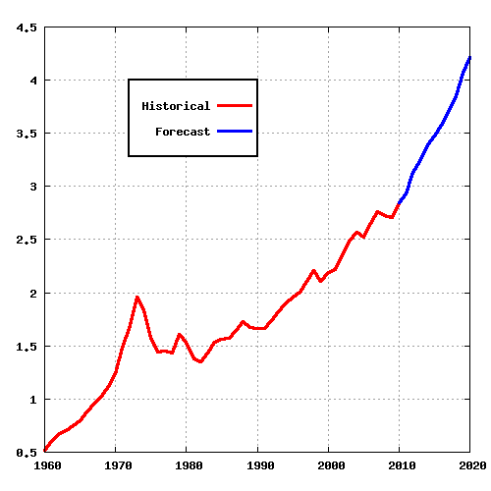
Canadian Peak Oil

Slide 46
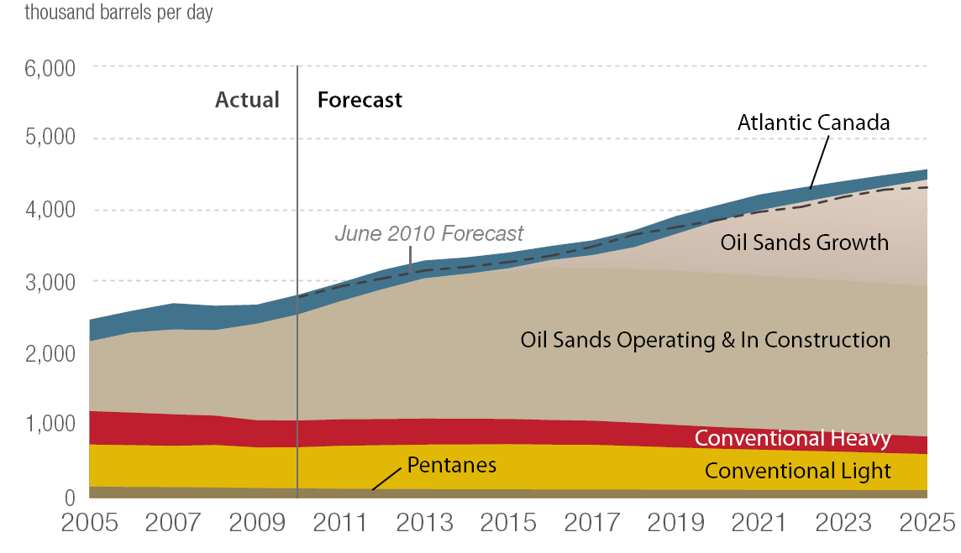
Canadian Oil Production

Slide 47
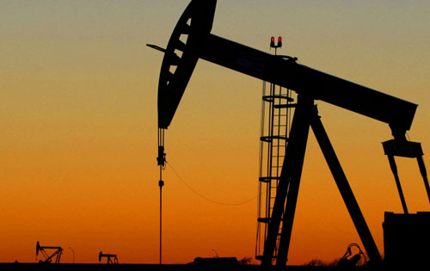
Upstream
[Exploration& Production]

Slide 48
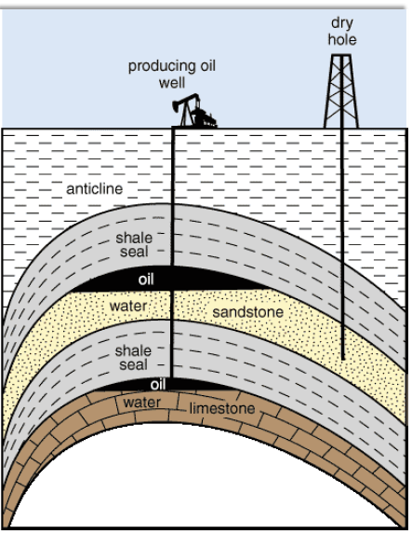
Conventional Oil
(Crude Oil can be pumped from a reservoir)
Notes:
Conventional Oil
Petroleum found in liquid form, flowing naturally or capable of being pumped without further processing or dilution
Light crude oil
Cheaper to produce

Slide 49
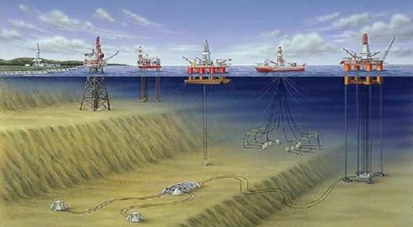
Conventional Oil

Slide 50
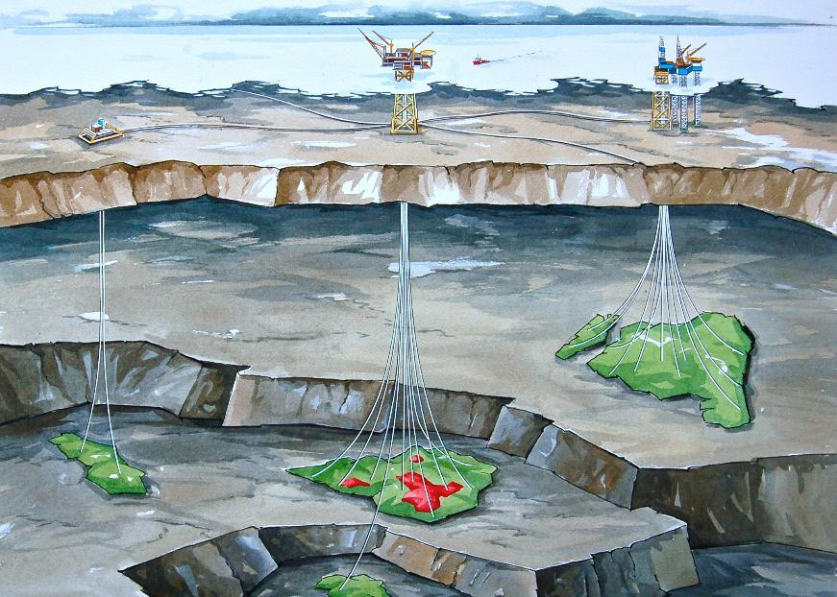
Conventional Oil

Slide 51
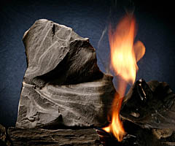
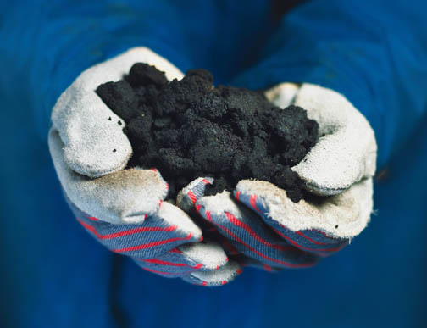
Unconventional Fossil Fuel
(Oil Shale)
(Oil Sand)
Notes:
Oil shale, an organic-rich fine-grained sedimentary rock, contains significant amounts of kerogen (a solid mixture of organic chemical compounds) from which liquid hydrocarbons called shale oil (not to be confused with tight oil—crude oil occurring naturally in shales) can be produced. Shale oil is a substitute for conventional crude oil; however, extracting shale oil from oil shale is more costly than the production of conventional crude oil both financially and in terms of its environmental impact.
Oil Sands is a thick mixture of sands, bitumen, mineral rich clays and water
Synthetic crude oil is extracted from oil sands and it is often sold at a premium because of its high quality
More costly to produce

Slide 52
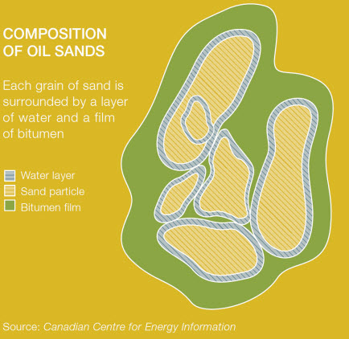
Oil Sands
Notes:
83% sand, 3% clay, 4% water, and 10% bitumen
2 tones of oil sands to make a barrel of bitumen heavy oil

Slide 53
Transportation
Extraction
Upgrading
Refining

Slide 54
Recovery Methods
Open-Pit Mining
In-situ Drilling
Notes:
Open-pit mining
Recovers bitumen closer to the surface (< 200 ft)
Uses trucks and shovels
Able to recover only 20% of oil sands
In situ drilling
Recovers bitumen deeper underground (> 200 ft)
Uses advanced drilling technology
directional drilling
Able to recover 80% of oil sands
Injects steam or solvents into the reservoir to mobilize the thick bitumen so it can be pumped to the surface

Slide 55
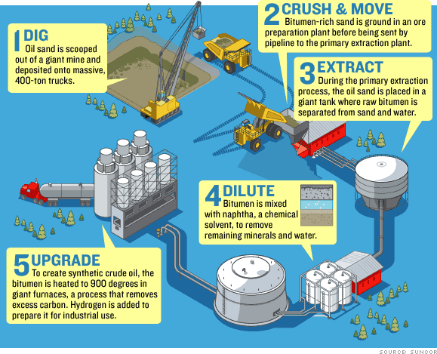
Open-Pit Mining

Slide 56
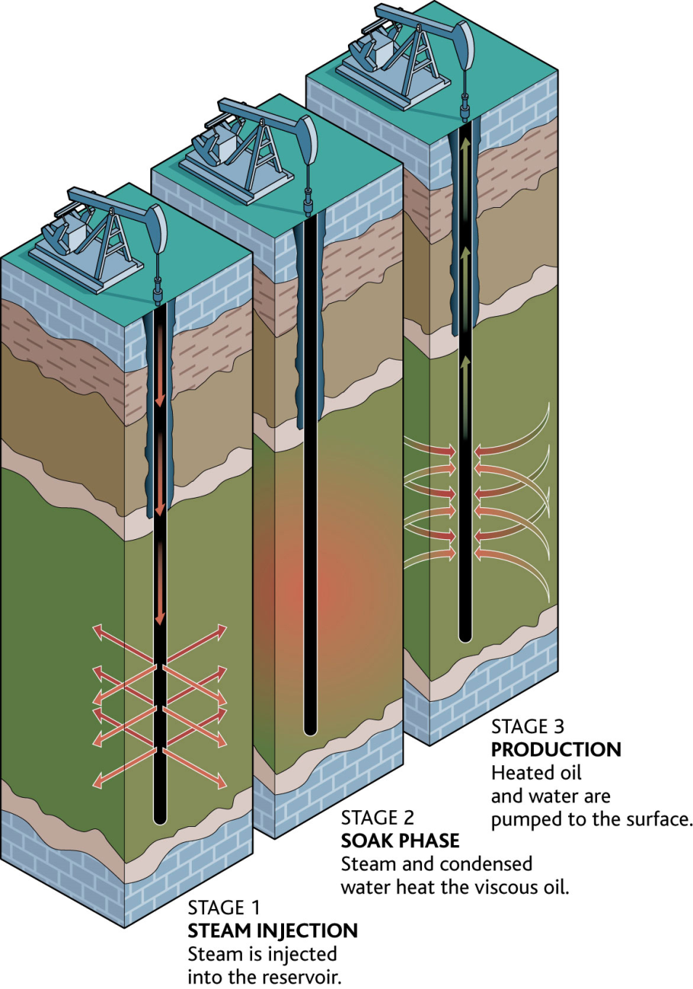
In-Situ Technology
[Cyclic Steam Stimulation (CSS)]
Notes:
-Inject high-pressure steam into the reservoir where heat softens bitumen and water dilutes and separates bitumen from sand
-The pressure creates cracks and openings through which the bitumen can flow back into the steam injector wells
The CSS method is currently used at Imperial Oil’s Cold Lake project and CNRL’s Wolf Lake-Primrose project.

Slide 57
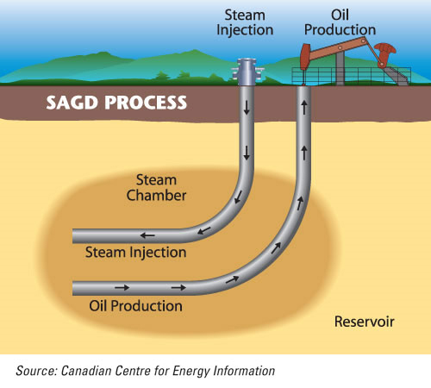
In-Situ Technology
[Steam Assisted Gravity Drainage (SAGD)]
Notes:
Employs 2 horizontal wells: 1 injection well with high pressure steam and 1 production well (lower well) which the softened bitumen continuously flows so it can be pumped to the surface.

Slide 58
In-Situ Technology
[VAPEX & Solvent Technology ]
Notes:
Combinations of solvents are injected into the ground using injection wells and equipment similar to SAGD.
Vaporized hydrocarbon solvents are injected into the reservoir, reducing the viscosity of bitumen by “dissolving” it in the solvent rather than by heating it and thereby causing it to drain into a horizontal production well.
Pros & Cons
Pros: Reduce operating steam-to-oil (SOR) ratios by 30 % and 85 % fewer GHG emissions.
Cons: Decreased efficiency: longer to produce oil

Slide 59
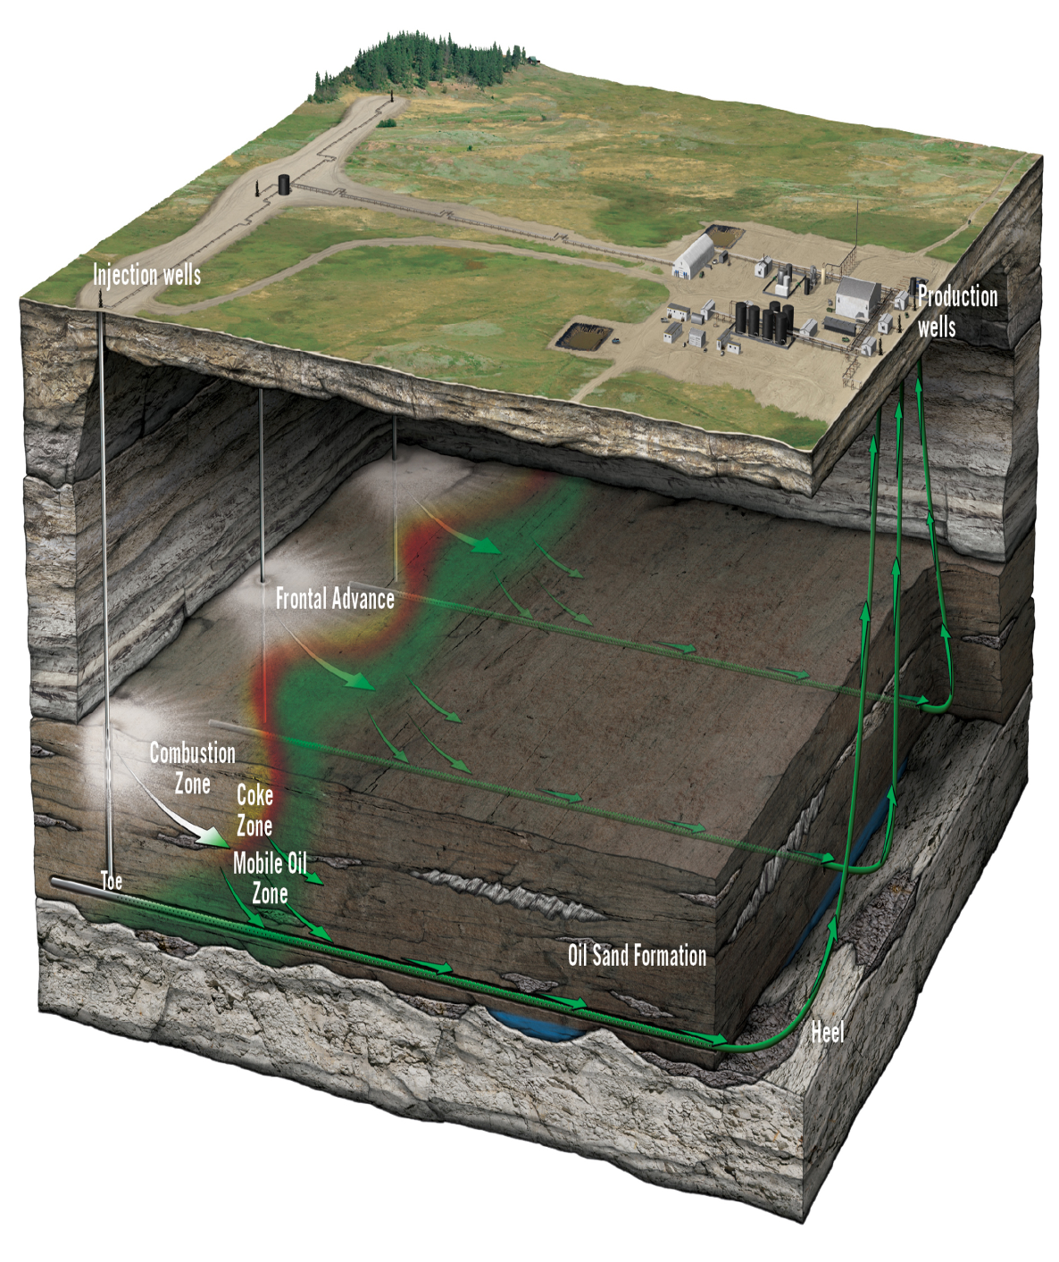
In-Situ Technology
[Toe-to-Heel Air Injection (THAI)]
Notes:
-THAI uses two wells; a vertical air injection well with a horizontal production well
-Injects air and then relies on underground combustion of a portion of the oil in the ground to generate the heat required to “melt” the remainder of the bitumen and allow it to flow into the production well.
Pros:
-much less energy intensive than other in-situ technologies
-50 % lower GHGs than other oil sands production methods and low water use

Slide 60
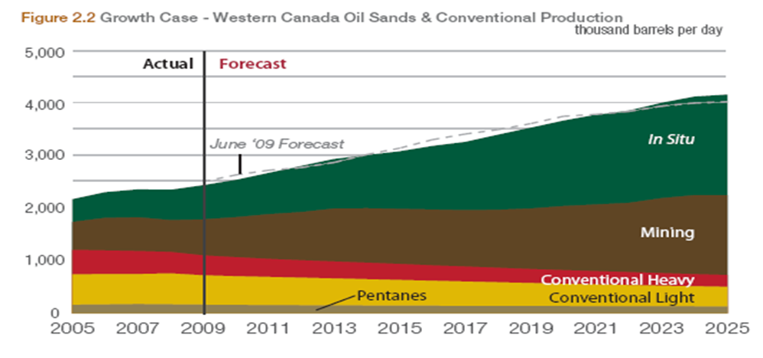
Canadian Oil Production

Slide 61


Slide 62

Bitumen Upgrading
Notes:
In order for bitumen to be processed in refineries, the molecules must be broken up and reorganized. Upgrading means removing some carbon while adding additional hydrogen to make more valuable hydrocarbon products.
Coking – removes Carbon and breaks down large molecules
Distillation – separates them
Catalytic Conversion – Changes the structure
Hydro-treating is used to remove sulfur and nitrogen
Once extracted (separating bitument from other molecules), oil sands producers must add lighter hydrocarbons to the bitumen to allow it to
flow through pipelines. Upgraders then process some of the bitumen into “synthetic crude,” a
relatively light, sweet form of crude oil that can be sold to a traditional oil refinery. Some of the
bitumen is also sold in raw form, marketed to specialized refineries with deep conversion capacity.
Once in situ is used to pump the crude oil to the surface. Transportation along pipeline occurs.
The heavy crude oil or crude bitumen extracted from oil sands is a viscous, solid or semisolid form that does not easily flow at normal oil pipeline temperatures, making it difficult to transport to market and expensive to process into gasoline, diesel fuel, and other products. Despite the difficulty and cost, oil sands are now being mined by energy companies on a vast scale to extract the bitumen, which is then converted into synthetic oil (syncrude) by bitumen upgraders, or refined directly into petroleum products by specialized refineries.[
Twp upgrading/processing methods to prepare for pipelines:
“carbon rejection,” which typically uses a coking process and produces a great deal of solid waste as a byproduct.
Most prevalent method
hydrogen addition, or “hydrocracking,” is a catalytic conversion process that produces almost no solid waste at all.
Hydrocracking Upgrading Pocess:
Transporting and separating bitumen - Bitumen is separated from sand, water, clay, and other soil deposits in the extraction facility at the mine. It is then blended with a diluent for transport via pipeline to the upgrader site. Here, the diluent is separated, treated, and piped back to the mine.
Initial distillation - Bitumen is distilled to separate the lightest hydrocarbons, such as naphtha, from heavy oils. The residue is further distilled to extract oils under vacuum conditions. The vacuum residue product is then sent to the LC-Finer.
Ebullated Bed Hydrocracker - core of the upgrading process is the ebullated bed hydrocracker, which uses a catalyst to remove heavy metals and “crack” large hydrocarbons in the oil residue at high temperature and pressure. The cracked hydrocarbons recombine with purified hydrogen to create products that can be further treated to yield high-quality synthetic crude oil. Catalyst particles have a limited life span due to metals and coke contamination. A portion of the catalyst is replaced daily, allowing continuous operation for several years.
Atmospheric distillation - The oil-hydrogen mix leaving the LC-Finer is separated and the hydrogen with lighter cracked oils is sent to the hydrotreater. Heavier oil is sent to an atmospheric distiller to separate the cracked stock from the unconverted oil.
Hydrotreating & stabilization - Vacuum gas oils and LC-Finer cracked oils are now routed to the integrated hydrotreater. Here, more hydrogen is added to further upgrade the synthetic oil and improve properties, such as its smoke point. Hydrotreating removes chemical impurities, such as sulphur and nitrogen. This produces a very “sweet” premium oil that is easy to refine
Blending - Finally, each output is blended to produce synthetic crude blends that are ready for pipelining to the refinery.

Slide 63

Midstream
[Pipeline, Transportation, Storage]
Notes:
Pipelines are necessary to transport raw materials from their source to refineries and gas processing facilities and then to market.
Pipelines provide a safe, economical and constant flow of crude oil, natural gas and petroleum products
Cheaper than shipping and driving
580,000 km of pipeline in Canada
2.7 million barrels of crude oil per day travel through Canada’s crude oil pipeline network.
15.1 billion cubic feet of natural gas per day travel through Canada’s natural gas pipeline network.

Slide 64

Crude Oil Production & Distribution

Slide 65

Canadian & U.S. Crude Oil Pipelines

Slide 66

Major Oil Pipelines Regulated by the NEB
Notes:
The National Energy Board (NEB or Board) is an independent, quasi-judicial federal agency whose purpose is to promote safety and security, environmental protection and efficient energy infrastructure and markets in the Canadian public interest

Slide 67

Types of Pipelines

Slide 68

Delivery Network

Slide 69

CEPA’s pipeline network transport 3 million barrels of oil everyday

Slide 70

Frequency of Pipeline Failure
Total hydrocarbons
Natural Gas
Crude Oil

Slide 71



Price Differential & Capacity Adequacy
Notes:
When there is adequate pipeline capacity between two market hubs, commodity prices will be connected and the price differential will be equal to, or less than, the transportation costs between the two points. As long as the price differential is less than the toll (plus fuel for natural gas pipelines), the market is indicating that there is adequate pipeline capacity between the two pricing points.
Figure 2.1 - Light Sweet Crude Export Price vs. Edmonton Par
Figure 2.2 - Heavy Crude Export Price vs. WCS at Hardisty
Figure 2.3 - Canadian Crude Oil Prices and Differential
The two prices track closely, indicating that the market is working and that, overall, adequate pipeline capacity did exist in 2008 to transport western Canada supply.

Slide 72


Downstream
Refining, Marketing, & Retailing
Notes:
Refining: An industrial process where crude oil is processed and refined into more useful petroleum products.

Slide 73

Oil Refining Process
Fractional Distillation ~ boil and cool
Conversion ~ chemicals
Treatment ~ impurities
Recombination ~ octane ratings
Notes:
This is what happens in an oil refinery - in one part of the process, crude oil is heated and the different chains are pulled out by their vaporization temperatures. Each different chain length has a different property that makes it useful in a different way. As mentioned previously, a barrel of crude oil has a mixture of all sorts of hydrocarbons in it. Oil refining separates everything into useful substances. Chemists use the following steps:
The oldest and most common way to separate things into various components (called fractions), is to do it using the differences in boiling temperature. This process is called fractional distillation. You basically heat crude oil up, let it vaporize and then condense the vapor.
Newer techniques use Chemical processing on some of the fractions to make others, in a process called conversion. Chemical processing, for example, can break longer chains into shorter ones. This allows a refinery to turn diesel fuel into gasoline depending on the demand for gasoline.
Refineries must treat the fractions to remove impurities.
Refineries combine the various fractions (processed, unprocessed) into mixtures to make desired products. For example, different mixtures of chains can create gasolines with different octane ratings.

Slide 74

Refinery

Slide 75

Natural Gas Industry

Slide 76


Natural Gas Demand
(Source: US Energy Information Administration)

Slide 77




Natural Gas Production
(Source: US Energy Information Administration)

Slide 78


Natural Gas Production & Reserves
Production:
Reserves:

Slide 79


Natural Gas Price History

Slide 80
Conventional vs. Unconventional
Conventional gas (shale gas) is natural gas trapped in shale rock formations. It is difficult to locate and wells typically only last about 5 years, but is generally lost costly to extract.
Unconventional gas is contained in low porosity formations usually spread over a large geographic area. It is easier to find but harder to extract. Unconventional gas makes up an increasing large portion of worldwide supply

Slide 81

Technology
Drilling
Once a deposit is located, a well is set and drilling proceeds similar to oil extraction

Slide 82

Technology
Hydraulic fracturing
This technique involves shooting water into the ground with high pressure, creating fractures in the rock so the gas can reach the well

Slide 83
Industry Risks
Oil
Environmental concern
Concern over climate change may change the role of fossil fuels
Pipeline concerns
Demand continues to be high, could continue to drive prices up
Cleanliness of oil sands uncertain
Political actions could affect supply
Gas
High Supply of natural gas could keep prices low, leading to cost concerns
Impact of fracking
Strong competition from other countries with high reserves

Slide 84
Industry Outlook
Crude oil demand continuing to rise, especially in developing countries
Particularly China, with estimated 10% growth per year in energy needs
Oil prices will continue to be driven up, while gas prices will remain low as supply outstrips demand
Despite the search for renewable resources, oil and gas will continue to supply a large portion of the worlds energy in the coming years
Technology will play an increasing role, as extracting oil and gas in an economically efficient manner continues to be a difficulty

Slide 85




Canadian Oil Sands Limited (COS.to)

Slide 86
Agenda
Company Overview
Operations
Management Team
Financial Analysis
Valuation
Recommendation

Slide 87
Company Overview

Slide 88

Company Overview
[Stock Performance]
Shares Outstanding: 484,533,464
Sources: The Globe and Mail

Slide 89

Company Overview
[Stock Performance – 5 Year]

Slide 90

Company Overview
[Overview]
Former Energy Trust Company, converted to corporation in 2011
Investors earned 23% on average since 1995
Holds a 36.74% stake in Syncrude Canada
100% of revenue comes from ownership of Syncrude Canada Ltd.:

Slide 91
Company Overview
[Syncrude Canada Ltd.]
Ownership Breakdown:

Slide 92


Company Overview
[Oil Sands Leases]
Syncrude owns eight leases in the Athabasca Oil Sands (101,960 hectares)
All leases minable, top quality ore, & low strip ratio
Map of Oil Sands Leases:

Slide 93
Company Overview
[Reserves & Resources]
Operations located in the Athabasca Oil Sands in northeast Alberta, Canada.

Slide 94
Operations

Slide 95


Operations
[ Current Operations – Production Process]
Operations resembles more like a manufacturing plant than a conventional oil operation
Mining Process
Source: www.cdnoilsands.com

Slide 96

Operations
[ Current Operations – Net Income per Barrel]

Slide 97

Operations
[ Current Operations – Production Numbers]
Current Production:
Historical Production:

Slide 98
Operations
[ Upcoming Projects]
Mine Train Replacement & Relocation
4 out of the 5 mine trains replaced by 2014
In operation until Midred Lake and Aurora North Mines are depleted
Mildred Lake Mine Replacement
2 mine trains built at new location
Incorporate wet crushing technology to improve efficiencies
Aurora North Mine Relocation
2 movable mine trains moved to new location
Third mine train will be left in place

Slide 99
Operations
[ Environmental Projects]
Aurora North Tailings Management
Construction of composite tails plant
transforms tailings waste into solid material
Centrifuge Tailings Management
Tailings is placed into spinning vessel to separate water
Water is recycles for operations
Design costs pending

Slide 100
Management Team

Slide 101

Management Team
[Executive Team]
Donald J. Lowry (Chairman of the Board)
Became a director in 2007, then became Chairman on 2009.
Over 25 years of experience in the industry. Also the President and CEO of EPCOR Utilities, Chairman of Capital Power Corporation, director of Canadian Electricity association, the Conference Board of Canada
Holds B.Comm (Hons), MA from University of Manitoba, graduate of Harvard Advanced Management Program
(Source: www.cdnoilsands.com)

Slide 102

Management Team
[Executive Team]
Marcel R. Coutu (President & CEO)
Held position since 2001.
Also Chairman for Syncrude Canada. Director of Brookfield Asset Management, and Great-West Lifeco.
More than 25 years of experience on energy sector. Was CFO of Gulf Canada, VP of Finance at TransCanada Pipelines.
Holds an H.B.Sc. in geology from University of Waterloo, MBA from University of Western Ontario
(Source: www.cdnoilsands.com)

Slide 103

Management Team
[Executive Team]
Ian A. Bourne (Corporate Director)
Director since November 2007
Chairman of Ballard Power Systems, also director of Canada Pension Plan Investment Board, Wajax Corporation, SNC-Lavalin Group
Completed the Institute of Corporate Directors, Corporate Governance program certified under ICD.D. designation
(Source: www.cdnoilsands.com)

Slide 104

Management Team
[Executive Team]
Gerald W. Grandey (Corporate Director)
Joined board in 2011
Former CEO and Director of Cameco Corporation, director of Centerra Gold, and director of Bruce Power
Currently on the Board of Sandspring Resources Ltd.
Geophysical engineering from Colorado School of Mines, and law degree from Northwestern University
(Source: www.cdnoilsands.com)

Slide 105
Management Team
[Executive Team]
Sarah E. Raiss (Corporate Director)
John K. Read (Corporate Director)
Brant Sangster (Corporate Director)
C.E. (Chuck) Shultz (Corporate Director)
Wesley R. Twiss (Corporate Director)
John B. Zaozirny (Corporate Director)

Slide 106
Financial Analysis

Slide 107

Financial Analysis
[Income Statement Analysis]

Slide 108

Financial Analysis
[Cash Flow Statement Analysis]

Slide 109

Financial Analysis
[Balance Sheet Analysis]

Slide 110

Financial Analysis
[Quarterly Results Analysis]

Slide 111


Financial Analysis
[Debt & Liabilities Analysis]
Near-Term CAPEX
Long-Term Debt
Commitments: Pipeline commitments, Pension plan solvency deficiency payments, Capital expenditure commitments, Management services agreement, other commitments

Slide 112

Financial Analysis
[Earnings Estimate]
(Source: theglobeandmail.com)

Slide 113
Valuation

Slide 114
Valuation
[Discount Dividend Model Analysis]
Target Price:
Target Price $25.31
Expected Return 12.79%
DDM Assumptions:
Share Price $22.44
Annual Dividend $1.20
Dividend Yield 5.35%
Dividend Growth Rate 2.00%
Discount Rate 6.84%
WACC:
Risk Free Rate 3.00%
Expected Market Return 8.00%
Beta 0.86
Cost of Equity 7.30%
Borrowing Rate 7.00%
Tax Rate 27.00%
After-tax Cost of Debt 5.11%
Gearing Ratio 0.27
WACC 6.84%

Slide 115
Valuation
[Discount Dividend Model Analysis]
Discount Dividend Model Sensitivities
Div. Growth Rate
WACC | 1.50% | 1.75% | 2.00% | 2.25% | 2.50%
5.84% | 28.23 | 29.96 | 31.91 | 34.13 | 36.69
6.34% | 25.31 | 26.69 | 28.23 | 29.96 | 31.91
6.84% | 22.94 | 24.07 | 25.31 | 26.69 | 28.23
7.34% | 20.97 | 21.91 | 22.94 | 24.07 | 25.31
7.84% | 19.32 | 20.11 | 20.97 | 21.91 | 22.94

Slide 116

Valuation
[Comparable Analysis]
Comparable Highlights:
Highest peer group dividend
Strong returns

Slide 117
Recommendation

Slide 118
Recommendation
[Buy– Sector Perform Rating]
Target Price: $25.31 (13.80% upside)
Investment Highlights:
High Dividend Yield – Currently at 5.35%; highest amongst its peers
Pure Play – 100% Operations in Canadian Oil Sands, leveraged to the price of oil
Self-Sufficient – CAPEX program fully funded with internal cash flows
Production Capacity – Ability to increase production, which will directly increase bottom line
Long-Life Resource – Over 40+ years of minable production life

Slide 119


Crescent Point Energy(CPG.to)

Slide 120
Agenda
Company Overview
Operations
Management Team
Financials
Valuation
Recommendation

Slide 121
Company Overview

Slide 122

Company Overview
[Stock Performance]
Sources: The Globe and Mail
Shares Outstanding: 303,495,782

Slide 123

Company Overview
[Stock Performance – 5 Year]

Slide 124

Company Overview
[Stock Performance – 10 Year]

Slide 125

Company Overview
[Relative Performance - CPG to Light Sweet Crude]

Slide 126
Company Overview
[Product Mix]

Slide 127
Operations

Slide 128


Operations
[Current Operations]
Conventional Oil
Natural Gas

Slide 129

Operations
[ Reserves & Resources ]

Slide 130

Operations
[ Reserves & Resources ]

Slide 131

Operations
[ Current Operations – Netback per Barrel ]

Slide 132


Operations
[ Current Operations – Production Numbers ]
Current Production:
Historical Production:

Slide 133
Operations
[ Current Operations – Core Assets ]
Bakken Waterflood Area Acquisition
More than 2900 boe/d of 90% oil weighted production
More than 78 net internal identified drilling locations
Increased CPG’s land position to more than 96% of proposed waterflood unit boundaries
Manitoba Asset Acquisition
940 boe/d of high quality light oil
Low decline of 10%
Netback of $70/boe (based on $95/bbl WTI)
Bakken Oil Resource Play
Greater than 36% of total 2012 capital program (154 net wells)
Waterflood with plans to convert 35 wells to injectors in 2012
Potential 241M bbls reserves
Source: www.cdnoilsands.com

Slide 134
Operations
[ Current Operations – Core Operating Areas ]
Shaunavon Oil Resource Play
1890 net well drilling inventory
22% of total 2012 capital program (91 net wells)
2841 M barrels of possible reserves
Beaverhill Lake Light Oil Resource Play
Recently acquired Crown land and Wild Stream Acquisition
$170M of 2012 spending
14% of total 2012 capital budget (27 net well)
Hold 19% of Arcan Resources Ltd(leading Beaver Lake producer)
North Dakota Bakken/Three Forks
$130M of 2012 spending
11% of total 2012 capital budget (14 net wells)
Source: www.cdnoilsands.com

Slide 135
Operations
[ Recent Acquisitions ]
Bakken Waterflood Assets Acquisition
Deal Expected to Close of March 14, 2012
Acquired waterflood area of Viewfield Bakken light oil resource play from PetroBakken for $427M
Working interest is 96% in the area
>2,900 boe/d
90% high-quality, long-life light crude oil
10.5M boe of proved plus probable reserves
(6.4M proved reserves)
Expects additional 2.1 boe proved plus probable reserves through current developmental plans
Reserve life index of 11.9 years p+p (8.4 years proved)
$96 netback (based on US$95 WTI)

Slide 136
Operations
[ Recent Acquisitions ]
Wild Stream
Expected to close March 15, 2012)
Acquired all of Wild Stream’s outstanding shares at an exchange ratio of 0.17 Crescent Point Shares to Wild Stream shares
Aggregate consideration: $610.9M (based on $45.62/CPG)
Assuming $50.8M net debt
3% premium
Taking over 5400 boe/d of production (of 6400 boe/d)
Balance is transferred to new junior exploration company: Newco
Newco will assume $43.5M in debt
NAV of $1.61/share
28.7M boe of proven plus probable reserves (17.6M boe proved)
Reserve life index of 14.6 years for proved and probable (8.9 years of proved)
Wild Stream:
90% oil weighted
Operates in Shaunavon, Beaverhill Lake and Battrum

Slide 137
Operations
[ Recent Acquisitions ]
Manitoba Asset Acquisition
Completed January 25, 2011
940 boe/d in Manitoba
100% high quality long-life light oil
$70 netback based on US$95/bbl WTI
5.6M boe of proved plus probably reserves
(4.6M boe of proved reserves)
Reserve life index of 16.3 years for p+p and 13.4 years proved

Slide 138
Management Team

Slide 139
Management Team

Slide 140


Management Team
[ Executive Team ]
Scott Saxberg (CEO & Director) B.Sc from University of Manitoba
Co-founder of Crescent Point Energy Ltd in 2001
Has been in the industry since 1992
Serves on Board of Directors of Bellamont Exploration Ltd., and Wild Stream Resources Ltd.
Greg Tisdale (CFO) MBA from University of Calgary
Has been in the industry since 1995
Director of Petroleum and Acquisition Association
Serves on Board of Directors of Small Explorers and Producers Association of Canada
Dave Balutis (VP, Exploration) B.Sc (Geology ) from University of Alberta
Co-founder of Crescent Point Energy Ltd in 2001
Has been in the industry since 1981

Slide 141
Management Team
Derek Christie (VP, Geosciences) B.Sc (Geology) from University of Calgary
Has been in the industry since 1991
Ryan Gritzfeldt (VP, Engineering East) BASc from University of Regina
Has been in the industry since 1998
Tamara MacDonald (VP, Land) Bcomm w/ Major in Petroleum Land Management
Has been in the industry since 1992
Steven Toews (VP, Engineering West) B.Sc (Mechanical Engineering)
Has been in the industry since 1989
Peter Vannister (Chairman) B.Sc (Geology)
Been on Crescent Point’s board since 2001
President of Destiny Energy Inc.
Has been in the industry since 1982
Serves on Board of Directors of Cequence Energy and Surge Energy Inc.
Former Director of Mission Oil and Gas Inc. , Breaker Energy, Impact Energy Inc., Boomerang Resources Ltd. And Laurasia Resources Ltd.

Slide 142
Financials

Slide 143

Financials
[ Annual Balance Sheet Analysis ]
s

Slide 144

Financials
[ Annual Income Statement Analysis ]

Slide 145

Financials
[ Annual Cash Flow Statement Analysis ]

Slide 146

Financials
[ Quarterly Balance Sheet Analysis ]

Slide 147

Financials
[ Quarterly Income Statement Analysis ]

Slide 148

Financials
[ Quarterly Cash Flow Statement Analysis ]

Slide 149


Financials
[ Commodity Hedge ]

Slide 150
Valuation

Slide 151
Valuation
[ Comparable Analysis ]

Slide 152
Valuation
[ Target Price (End 2012): $29.34 ]

Slide 153
Recommendation

Slide 154
Recommendation
[ Hold – Sector Perform ]
Target Price: $29.34
Investment Highlights:
High Dividend Yield – 6.03%
High Oil Production Mix – 2012 Production Guidance: 91% Oil
High Netback – $53.75/boe netback (based based on US$95/bbl WTI)

Slide 155

Baytex Energy Corp.(BTE.to)

Slide 156
Agenda
Company Overview
Operations
Management Team
Financials
Valuation
Recommendation

Slide 157
Company Overview

Slide 158

Company Overview
[Stock Performance]
Shares Outstanding: 118,548,427
Sources: The Globe and Mail

Slide 159

Company Overview
[Stock Performance – 5 Year]

Slide 160
Company Overview
[Relative Performance – 52 weeks]

Slide 161

Company Overview
[Relative Performance – 5 years]
TSX Composite
TSX
Energy
Baytex
Energy
Sources: The Globe and Mail

Slide 162

Company Overview
[Relative Performance – vs Light Sweet Crude]

Slide 163

Company Overview
[Distribution/Dividend History]
Sources: Company Filing

Slide 164
Company Overview
BAYTEX ENERGY CORP. is a conventional oil and gas E&P corporation engaged in the acquisition, development and production of oil and natural gas in the Western Canadian Sedimentary Basin and the United States (North Dakota and Wyoming).
Q3|2011 Production Mix:
13.6% Light Oil
70.8% Heavy Oil
15.6% Natural Gas

Slide 165
Company Overview
[Company Conversion]
Baytex Energy Ltd. – Publicly-traded E&P corporation from 1993-2003
One of only six independent E&P names from 1993 that are still traded on the TSX
Baytex Energy Trust – Income trust from 2003-2010
Highest total return among oil and gas trusts during Baytex Energy Trust era
Baytex Energy Corp. – Publicly-traded E&P corporation since January 2011
As a result of changes to trust taxation laws in Canada
Continues to execute a growth-and-income model

Slide 166
Company Overview
[Overall theme]
Sustainable model: Dividend + organic oil growth generally within internally-generated cash flow
Conservative payout ratio (~40%) and strong balance sheet
Long-term, low-cost development inventory in both heavy and light oil

Slide 167
Operations

Slide 168

Operations
[Oil-Equivalent Production Growth]
Sources: Company Filing

Slide 169

Operations
[Oil Production Growth]
18.8% LO & NGL
8.3% LO & NGL
Sources: Company Filing

Slide 170


Operations
[Capital Expenditure]
Sources: Company Filing
Growing trend towards organic growth

Slide 171

Operations
[Capital Investment Efficiency]
Sources: Company Filing

Slide 172

Operations
[ Operating Netback]

Slide 173

Operations
[Capital Program Efficiency]
Sources: Company Filing

Slide 174

Operations
[Reserve/Production ratio]
Sources: Company Filing

Slide 175

Operations
[Oil-Equivalent Reserve Growth]
Sources: Company Filing

Slide 176

Operations
[Organic Production & FFO Growth]
Sources: Company Filing

Slide 177

Operations
[Operating Metrics]

Slide 178

Operations
[ Areas of Operations]

Slide 179

Operations
[ Peace River - Seal]
No mining around area
Minimum environmental impact
Not your typical oil sand
Low cost
Sources: Company Filing
Notes:
Not your typical oil sand
Low cost

Slide 180

Operations
[Seal – 8+ Horizontal Laterals per Well]
Primary/cold production
Improvement in drilling economics
Fewer surface location & smaller environmental footprint
Vertical: 600m
Horizontal: mile long & staggered to maximize reservoir coverage
Reservoir characteristics allows oil to be pumped to flow to surface
Sources: Company Filing

Slide 181

Operations
[Seal – Thermal Development]
1st CSS project (cyclic steam stimulation)
Single mile long horizontal well
Repeated 15+ cycles over the life of the well
Increased expected recovery rate from 5%~7% to 30%
Sources: Company Filing

Slide 182

Operations
[Lloydminster Area]
Majority of BTE's heavy oil production in 2010 (20,900 boe/d)
9 Months 2011 Production = 20,600 boe/d (42% of total Baytex volumes)
Vertical and horizontal cold drilling
Waterflood & Thermal SAGD
2P Reserve: 88 MMboe
11.6 RLI
Sources: Company Filing

Slide 183

Operations
[Lloydminster Area]
Sources: Company Filing

Slide 184

Operations
[Light Oil Resources Play]
Sources: Company Filing

Slide 185

Operations
[Projected Organic Growth]
Sources: Company Filing

Slide 186
Management

Slide 187

Management
[President & CEO]

Slide 188

Management
[CFO]

Slide 189

Management
[COO]

Slide 190

Management
[VP - Exploration]

Slide 191
Hedging

Slide 192

Hedging
[Oil Hedge Coverage]
Sources: Company Filing

Slide 193

Hedging
[Other Commodities Hedge Coverage]
Sources: Company Filing

Slide 194

Hedging
[Heavy Oil Differential – hedged against WCS differential]
Sources: Company Filing

Slide 195
Financials

Slide 196

Financials
[Average Sales Prices]

Slide 197

Financials
[Balance Sheet Improvement]
Sources: Company Filing

Slide 198
Q4|2011 Earnings
[March 14th, 2012]
4Q Profit double QoQ
October-December profit rose to C$57.8 million
Stock down 3.23% intraday
Sources: company filings

Slide 199

Q4|2011 Earnings
[Royalties]
Sources: company filings

Slide 200
Financials
[Balance Sheet]
Sources: Company Filing

Slide 201
Financials
[Income Statement]

Slide 202
Financials
Financials
Financials
[Cash Flow Statement]
Sources: Company Filing

Slide 203
Valuation

Slide 204

Valuation
[Value Comparison to Oil-Weighted Canadian Corporations]
Sources: Scotia Research, Company Filing

Slide 205

Valuation
[Comparable Analysis – Salman Partners]
Sources: Salman Partners

Slide 206
Recommendation
[ Buy – Sector Outperform]
Wednesday March 14th
$52.44
12 month Target Price
$62.42 based on 18 analysts average
High: $71.00
Low: $52.00

