Slide 1
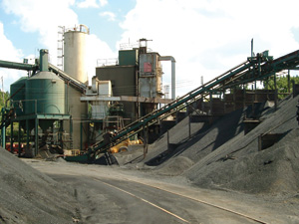
Canadian Minerals and Materials
Group 2
Mike McCann
Hans Melis
Amandeep Grewal

Slide 2
Industry Overview

Slide 3
Industry Overview: Canadian Materials and Metals
Industry Characteristics
Uranium
Coal
Zinc
Copper
Gold

Slide 4
Industry Characteristics
Capital Intensive
Consolidating
Sensitive to Business Cycle

Slide 5
Industry Characteristics: Types of Mining
Types of Surface Mining
  Strip Mining
  Open-pit Mining
  Mountaintop Removal
  Dredging
  Highwall mining
Shaft Mining
Solution Mining

Slide 6
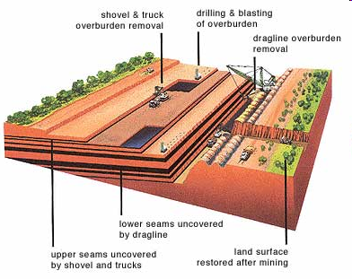
Surface Mining
Strip Mining

Slide 7
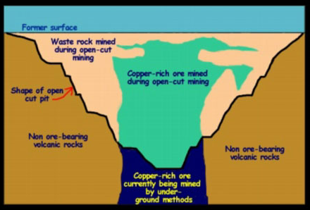
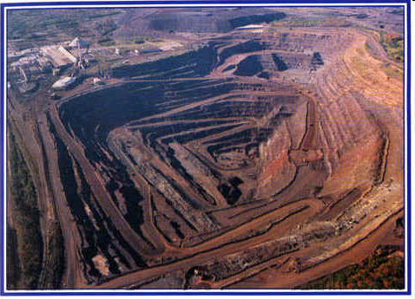
Open Pit Mining
Open Pit Mining
Notes:
Diamond, and Metal Ores like Copper, Iron, Gold, and Molybdenum
Ex Copper 0.15%

Slide 8
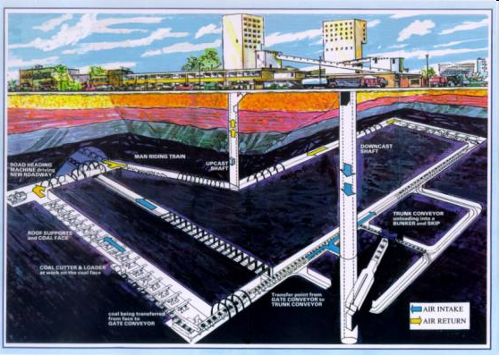
Underground Shaft Mining

Slide 9
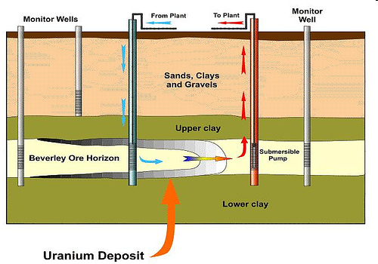
Solution Mining
Notes:
Uranium

Slide 10
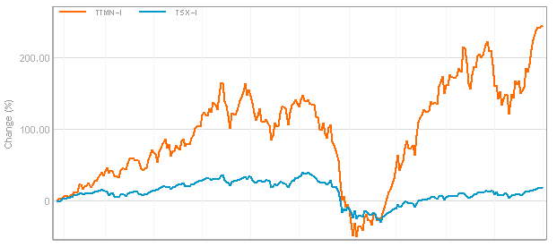

Industry Overview
S&P/TSX Capped Metals and Mining Index (red) compared with S&P 500 5YR (blue)

Slide 11
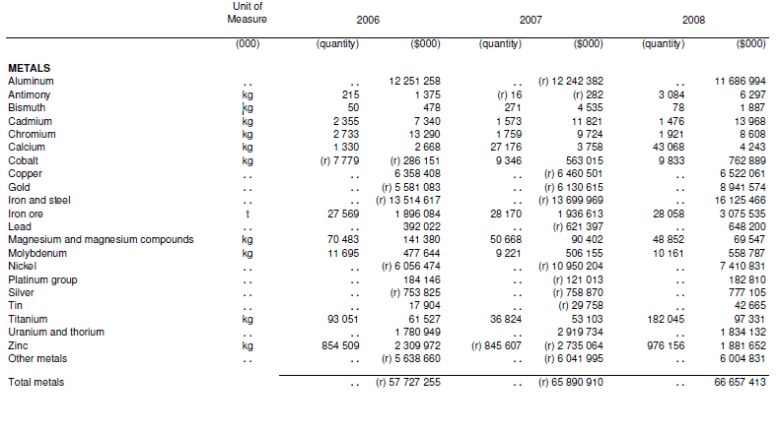
Main Minerals produced in Canada

Slide 12
Main Cost and Revenue Drivers
Revenue Driver: Commodity Price and FX
  Hedging Strategies vary considerably
Cost of land acquisition and mine construction
Cost Drivers: Operating Expenses
  Fuel Costs
  Energy Costs
  Labor Costs
  Maintenance Costs

Slide 13
Important Terminology
“Mineral Resource”
  Inferred Mineral Resource (L)
  Indicated Mineral Resource (M)
  Measured Mineral Resource (H)
“Mineral Reserve”
  Probable Mineral Reserve (L)
  Proven Mineral Reserve (H)
Notes:
A Qualified personal is an engineer or geoscientist with 5 years experience in the mineral exploration processes.
Mineral Resource: amount of mineral
Conduct feasibility analysis
Mineral Reserve: Mineable portion of Mineral Resource given feasibility
A Mineral Reserve is the economically mineable part of a Measured or Indicated Mineral Resource demonstrated by at least a Preliminary Feasibility Study. This Study must include adequate information on mining, processing, metallurgical, economic and other relevant factors that demonstrate, at the time of reporting, that economic extraction can be justified. A Mineral Reserve includes diluting materials and allowances for losses that may occur when the material is mined.

Slide 14
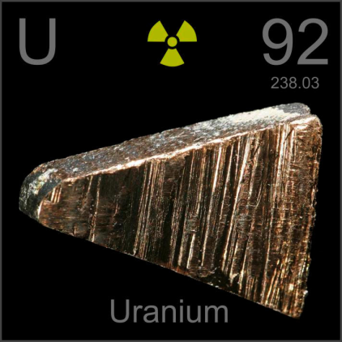
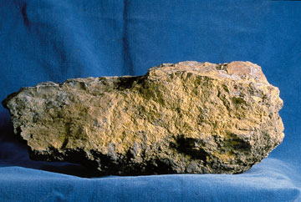
Uranium

Slide 15
Uranium
About Uranium
Major Producers
Global Reserves
Competitors
Price
Supply and Demand

Slide 16
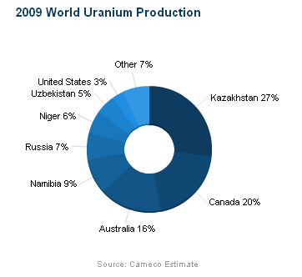
About Uranium
Uranium is found usually in low concentrations so it is very volume-intensive mining
It is only found in economical, given current prices, in a few areas

Slide 17
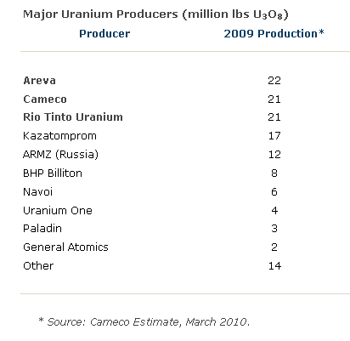
Major Uranium Producers
Notes:
Areva – French Company, have mines in Saskatchewan
Rio Tinto – Namibia and Australia
Kazatomprom – Kazahkstan

Slide 18
Mining Uranium
Mined using:
  Open Pit
  Shaft Mining
  Heap Leaching
  Solution Mining
Uranium is generally used for nuclear power plants
Uranium is required to be processed
  Grinding into a uniform granulate then chemically treated to form “yellow cake” which is sold on the market as U3O8
Notes:
Heap leaching, using sulphuric acid on uranium ore

Slide 19
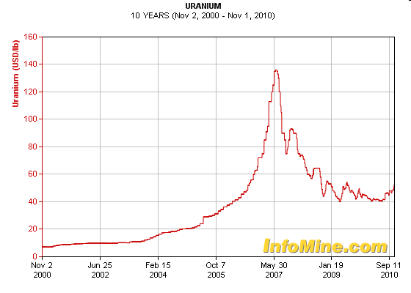
Uranium Price

Slide 20
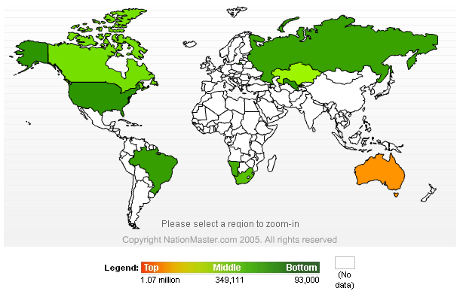
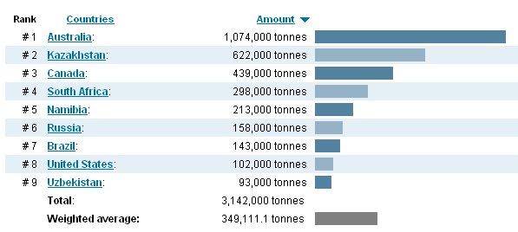
World Reserves

Slide 21
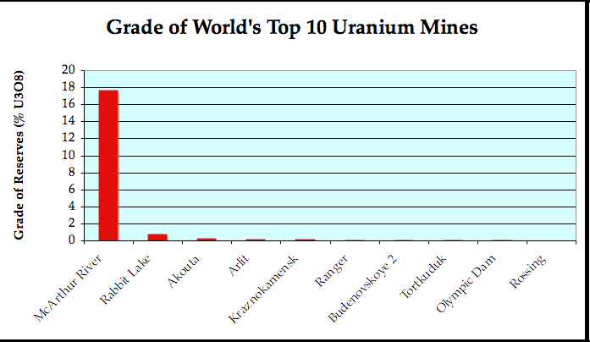
Grade of Global Uranium

Slide 22
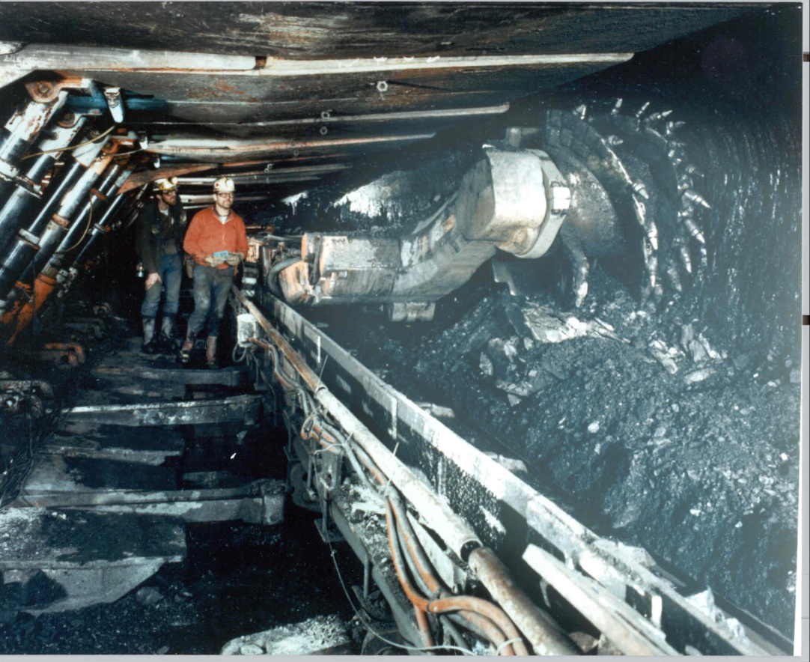
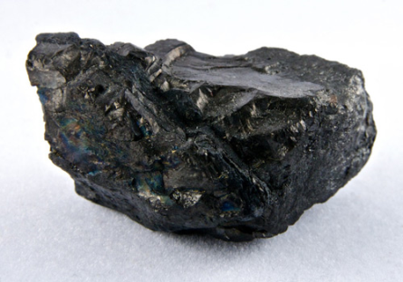
Coal

Slide 23
Coal
Readily combustible sedimentary rock; fossil fuel
Black (or brownish-black)
Occurs in rock strata
  In layers or veins called coal beds or coal seams
Mining methods: modern surface mining and underground mining
Comprised mainly of carbon
  Formed over time as plant matter settles in layers at the bottom of bodies of water; covered by sediment and metamorphoses into coal

Slide 24
Important Types of Coal
Lignite
--aka. “brown coal”; used as fuel for electric power generation
Sub-bituminous coal
--used as fuel for steam-electric power generation and in the chemical synthesis industry
Bituminous coal
-used as fuel for steam-electric power generation and used to make coke (which is used as a fuel and to smelt iron ore in blast furnaces; very little smoke under combustion conditions)
Anthracite
-hard, glossy, black coal; used mainly for commercial and residential space heating
Graphite
-difficult to ignite (therefore, not used as fuel very commonly); primarily used in pencils and as a lubricant (when powdered)
Notes:
Arrows indicate procession of type of coal due to pressure applied to dead biotic material as time passes.
Peat, considered to be a precursor of coal, has industrial importance as a fuel in some regions, for example, Ireland and Finland. In its dehydrated form, peat is a highly effective absorbent for fuel and oil spills on land and water
Lignite, also referred to as brown coal, is the lowest rank of coal and used almost exclusively as fuel for electric power generation. Jet is a compact form of lignite that is sometimes polished and has been used as an ornamental stone since the Iron Age
Sub-bituminous coal, whose properties range from those of lignite to those of bituminous coal are used primarily as fuel for steam-electric power generation. Additionally, it is an important source of light aromatic hydrocarbons for the chemical synthesis industry.
Bituminous coal, dense mineral, black but sometimes dark brown, often with well-defined bands of bright and dull material, used primarily as fuel in steam-electric power generation, with substantial quantities also used for heat and power applications in manufacturing and to make coke
Steam coal is a grade between bituminous coal and anthracite, once widely used as a fuel for steam locomotives. In this specialized use it is sometimes known as sea-coal in the U.S.^{[2]} Small steam coal (dry small steam nuts or DSSN) was used as a fuel for domestic water heating
Anthracite, the highest rank; a harder, glossy, black coal used primarily for residential and commercial space heating. It may be divided further into metamorphically altered bituminous coal and petrified oil, as from the deposits in Pennsylvania
Graphite, technically the highest rank, but difficult to ignite and is not so commonly used as fuel: it is mostly used in pencils and, when powdered, as a lubricant.

Slide 25
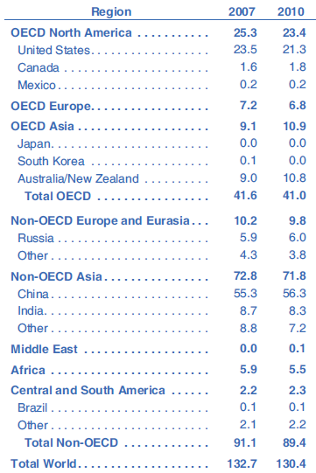
World Coal Production (by region)
Units: quadrillion Btu (British thermal unit ~ approximate amount needed to heat 1 pound of water 1 °F)
Source: U.S. Energy Information Administration
Notes:
OECD = Organisation for Economic Co-operation and Development

Slide 26
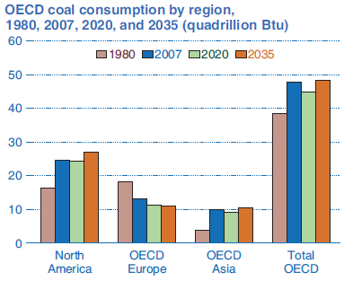
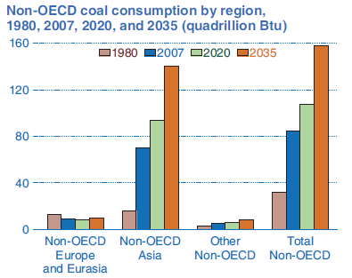
World Coal Consumption
Source: U.S. Energy Information Administration
Source: U.S. Energy Information Administration
Notes:
Examples of OECD Asia: South Korea, Japan
Main member of Non-OECD coal consumers is China.

Slide 27
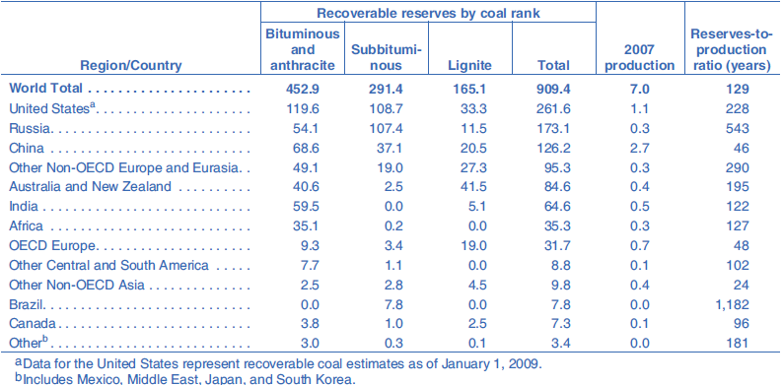
World Recoverable Coal Reserves
-as of January 1, 2008
-unit of measurement: billion short tons
Source: U.S. Energy Information Administration
Notes:
Recoverable reserves are those quantities of coal which geological and engineering information indicates with reasonable certainty can
be extracted in the future under existing economic and operating conditions.

Slide 28
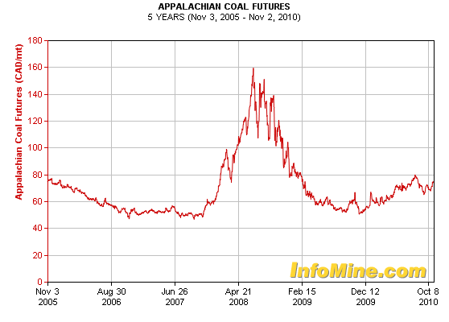
Coal Futures
-(5 year trend; per metric tonne)

Slide 29
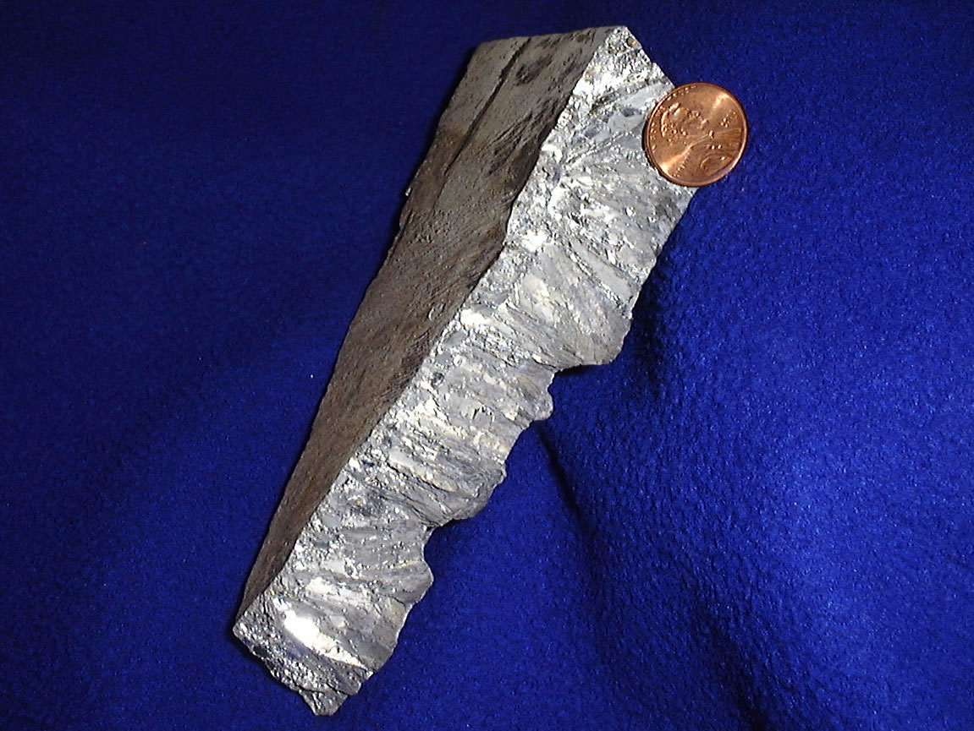

Zinc

Slide 30
Zinc
Also known as spelter
A metallic chemical element; 24th most abundant element in Earth’s crust
4th most common metal in use (follows iron, aluminum, and copper); annual production is approximately 10 megatonnes
Largest deposits that can be exploited are located in Australia, Asia, and the U.S.

Slide 31
Primary Uses of Zinc
Galvanizing: applying a protective metallic coating to an underlying piece of metal
Diecasting: metal casting process (for tools, etc.)

Slide 32
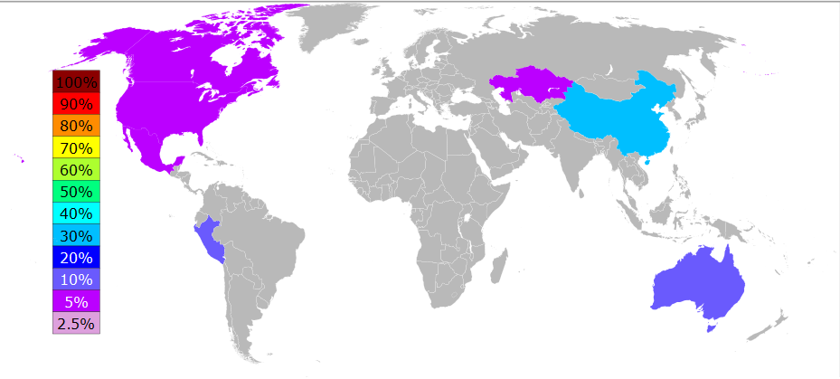
World Zinc Output (2006)
-Roughly 70% of the world's zinc comes from mining processes (remaining 30% comes from recycling secondary zinc)
-At the current rate of consumption, the largest zinc reserves are estimated to become depleted by 2027
Notes:
OECD = Organisation for Economic Co-operation and Development

Slide 33
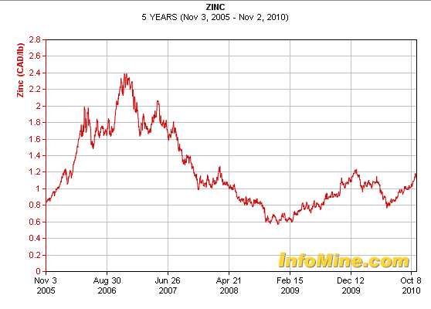
Zinc Prices (5 year trend)
-(5 year trend; per pound)

Slide 34
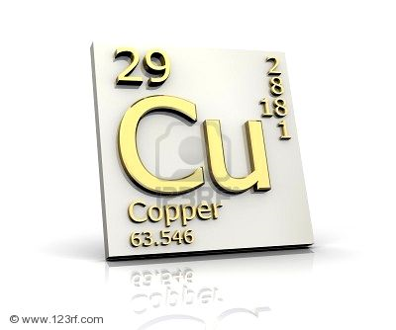
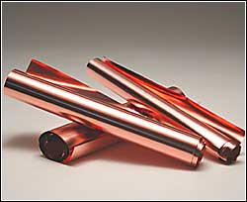
Copper

Slide 35
Properties of Copper
Good conductor
  Electrical wire
Slow corrosion and heats well
  Plumbing and heating applications
  Cooking utensils
Durable
  Coins
Used for making various alloys
  Bronze

Slide 36
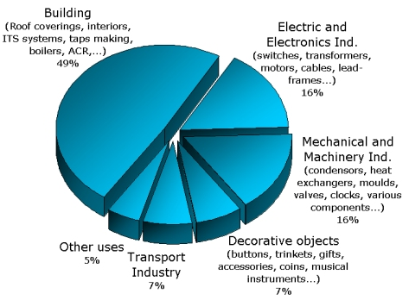
Copper Usage
Notes:
http://www.kme.com/en/press_center/discover_copper/a_wide_range_of_uses/

Slide 37
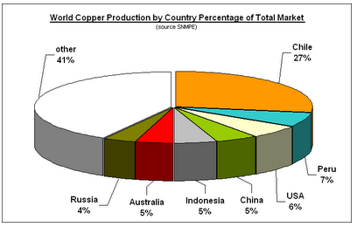
World Copper Production

Slide 38
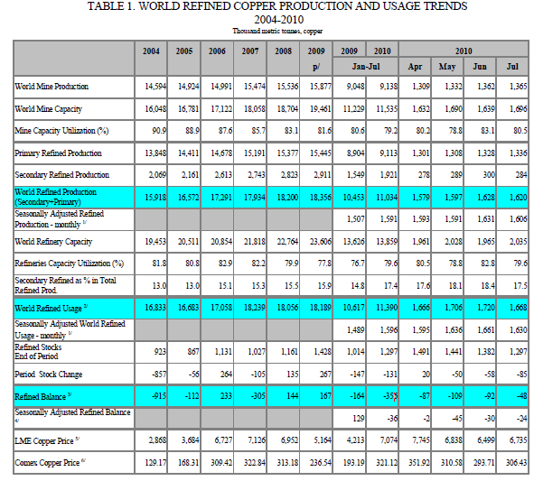
Notes:
http://www.icsg.org/index.php?option=com_content&task=view&id=57&Itemid=60

Slide 39
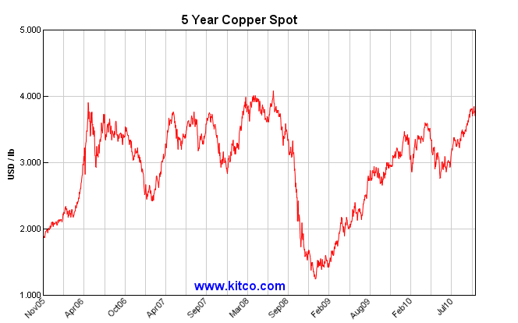
Spot Price of Copper

Slide 40
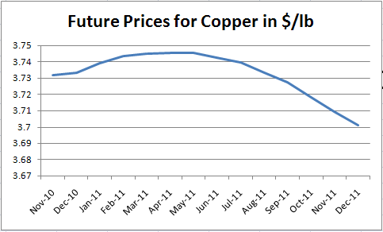
Futures Price of Copper

Slide 41
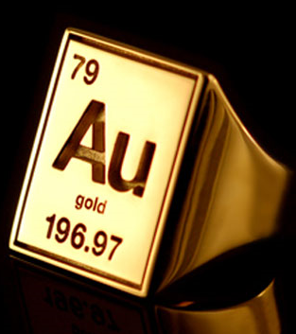
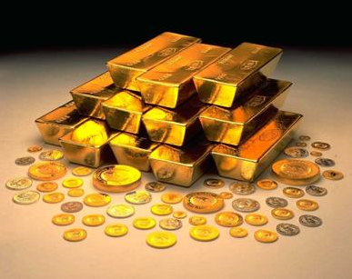
Gold

Slide 42
Properties of Gold
Malleable and ductile
  Jewelry
Superior conductivity
  Electrical components
Used for making various alloys
  Restorative dentistry
Holds value
  Used as a investment tool to hedge against inflation

Slide 43
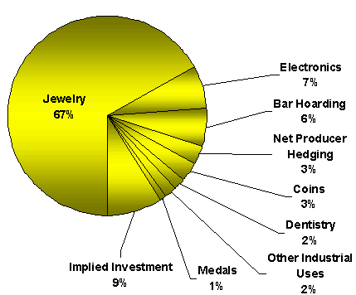
Gold Usage
Notes:
http://www.kme.com/en/press_center/discover_copper/a_wide_range_of_uses/

Slide 44
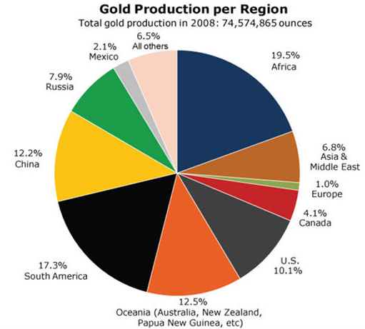
World Gold Production

Slide 45
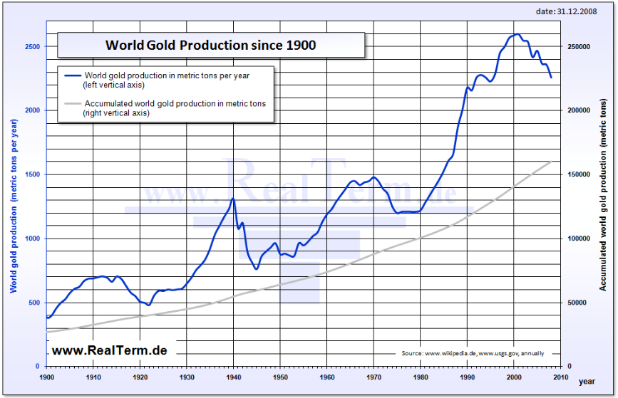
World Gold Production

Slide 46
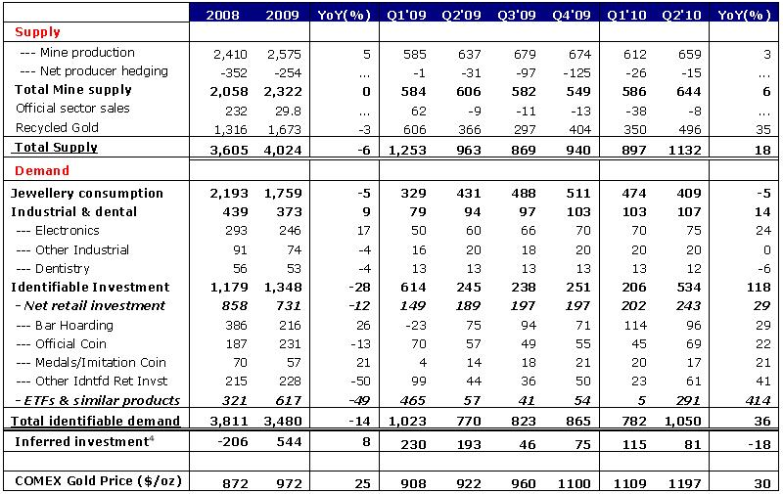
World Production and Usage of Gold

Slide 47
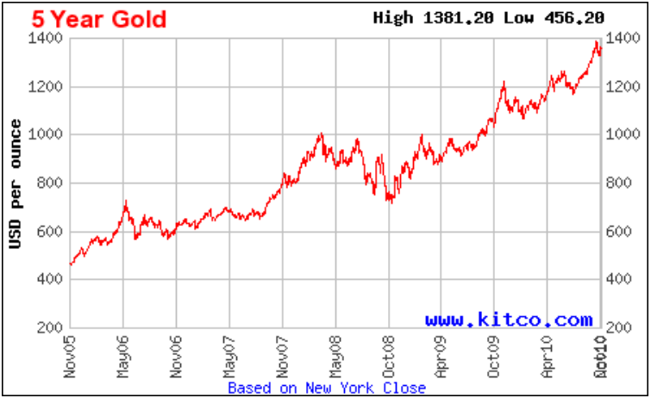
Spot Price of Gold

Slide 48
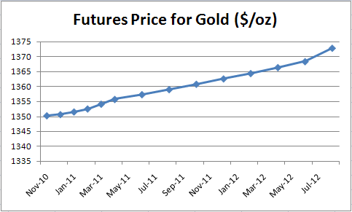
Futures Price of Gold

Slide 49

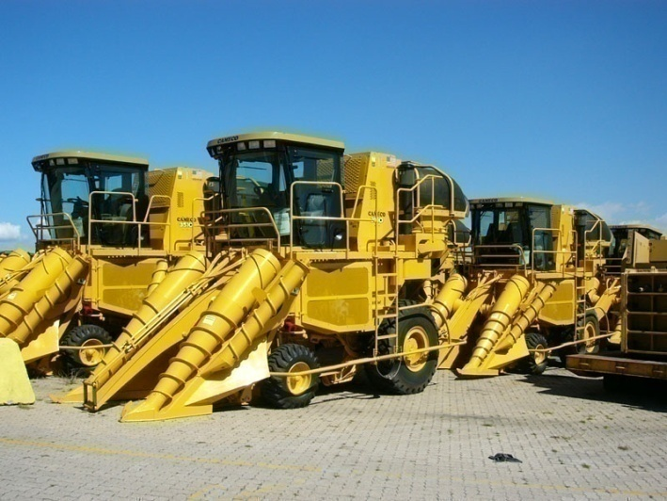
Cameco

Slide 50
Market Profile
Stock Summary (TSX: CCO-T) (As of November 3, 2010)
Open | 31.69 CAD
Change | -0.20 (-.63%)
High | 32.29
Low | 31.33
52-Week Range | 22.14– 35.00
Shares Outstanding | 393.03 million
Market Cap. | $12,399.97 million
Valuation (As of November 3, 2010)
ROE | 19.79%
EPS | 2.50
P/E | 12.62
Dividend Yield | 0.90
Stock Summary (TSX: CCJ) (As of November 3, 2010)
Open | 31.50 USD
Change | 0.11 (-0.35%)
52wk Range: | 20.70 – 33.74

Slide 51
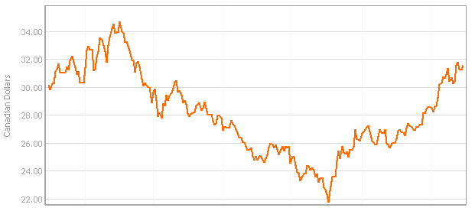

1- Yr Price Movement

Slide 52
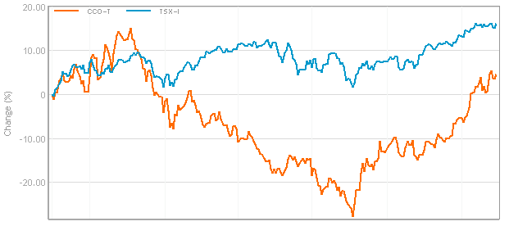
1- Yr Return Vs. S&P/TSX

Slide 53
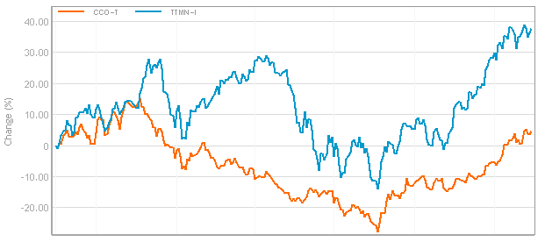
1- Yr Return vs. TTMN-I

Slide 54
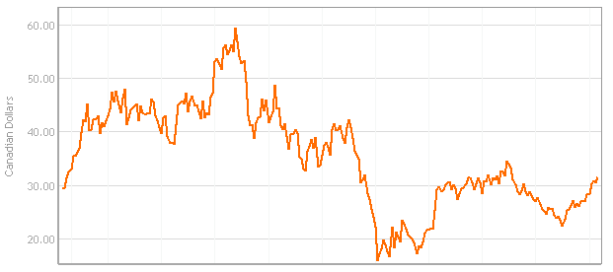

5- Yr Price Movement

Slide 55
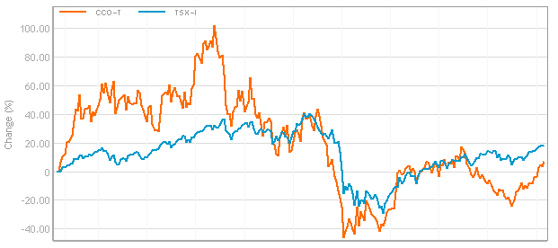
5- Yr Return Vs. S&P/TSX

Slide 56
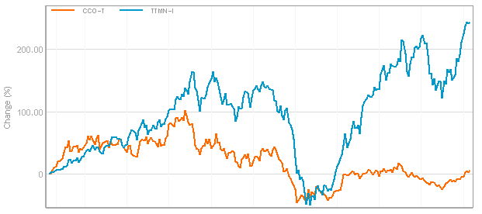
5- Yr Return Vs. TTMN-I

Slide 57
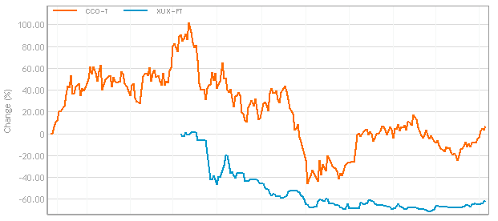
5- Yr Return Vs. Price of Uranium
Notes:
Include a chart of stock vs forward contract price?

Slide 58
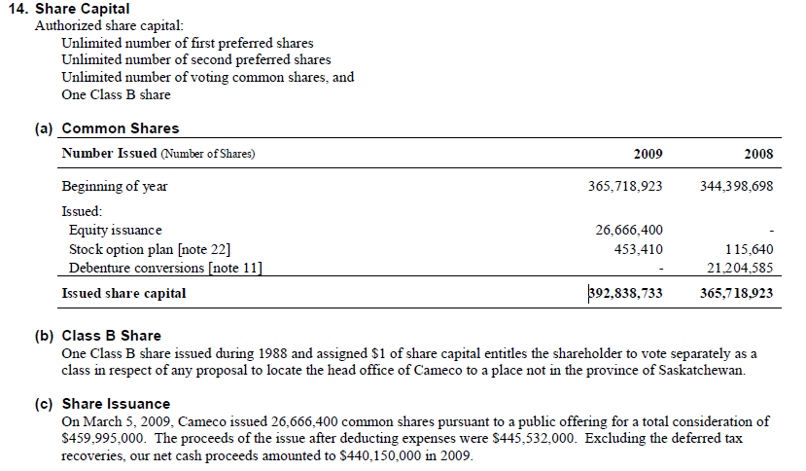
Common Share Structure

Slide 59
History
Created by the merger of two Crown corporations-Saskatchewan Mining Development Corporation and Eldorado Nuclear Limited in 1998
In 1991 completes its IPO and shares begin trading on the Toronto and Montreal exchanges
In 1996 shares begin trading on the NYSE and forms a subsidiary named Cameco Gold to conduct the company’s gold business
Period of expansion as CCO moved into USA, Kyrgyzstan, and Central in 1997-1998
McArthur River mine in Saskatchewan achieves full production and becomes the worlds 3rd largest high-grade uranium mine in 2000
2000-2002 expands into the energy sector, acquiring stakes in Bruce Power, an Ontario based nuclear power company

Slide 60
History
2004 begins construction on mines in Inkai, Kazakhstan and Cigar Lake, Saskatchewan, and creates consolidates gold operations into Centerra Gold
2008 expands into Western Australia, and signs memorandums of intent to further exploration and production in Kazatomprom, the national uranium producer of Kazakhstan
In 2009, Cameco announces they opened an office in India to help serve sales functions

Slide 61
Overview
One of the world’s largest uranium producers, accounting for 16% of the world’s production in 2009
Have controlling interest in the world’s high-grade reserves with ore grades up to 100 times the world average
Relative low-cost operation
Approximately 480 million pounds of proven and probable reserves
Business segments in Uranium Production, Fuel Services, Electricity, and Exploration

Slide 62
Overview
Uranium Production
Operating properties to mine Uranium in Canada (Saskatchewan), USA (Wyoming and Nebraska), Kazakhstan
Development projects: Cigar Lake, Saskatchewan
Expansion Projects: Kazakhstan, Saskatchewan
Fuel Services (conversion and enrichment services)
Ontario and United Kingdom
Exploration Projects
United States, Mongolia, Kazakhstan, Saskatchewan, Australia, South America
Electricity
Own 31.6% stake in Bruce Power Limited Partnership which operates four nuclear reactors in South Ontario
Generate 15% of Ontario’s electricity

Slide 63

Global Presence
Notes:
Uranium
Operating properties to mine Uranium in Canada (Saskatchewan), USA (Wyoming and Nebraska), Kazakhstan
Development projects: Cigar Lake, Saskatchewan
Expansion Projects: Kazakhstan, Saskatchewan

Slide 64
Recent Acquisitions and Dispositions
  Sold shares in Centerra Gold Inc., Cameco’s gold segment, $872 million
    transferred $260 million to Kyrgyzaltyn to compensate Kyrgyz Republic for their stake in Centerra
    After tax gain to CCO was $374million
  Acquisition in 2008 for $346 million to acquire a 70% interest of mine in Western Australia
  Adds potential for low-cost and diversifies the production by geography and deposit type

Slide 65


Production (2009)

Slide 66

Spot and Long-term Sales Contracts
Notes:
Long Term contract is 2 to 10 years
Global average is 85% of production sold on long term
However, LT contracts do have price escalators in them so there is some exposure to spot prices.

Slide 67

Reserves (2009)
Notes:
Important to note the quality of McArthur River and Cigar Lake reserves.

Slide 68

Current Issues
World demand for Uranium is increasing at a 3% rate per year

Slide 69

World Uranium Outlook

Slide 70
Current Issues
McArthur Lake, Saskatchewan
  Owns 83.33%: World’s largest, high grade uranium mine
  Ore grades at McArthur are 19.5%, 100x world’s average
  Problems with the mine extends to significant groundwater and weak rock formations
  Solution: Ground Freezing and Raisebore Mining have been successful so far
  Workers accepted new contract on November 1, 2010
Key Lake, Saskatchewan
  Owns 69.805%: World’s largest uranium mill in the world
  Refines raw ore into sellable “yellow cake”
Notes:
Ground Freezing: Freeze ground
Raisebore Mining: less invasive technique and involves large amounts of pumping cement into areas areas with weak rock formations

Slide 71
Current Issues (Cont)
Cigar Lake
  World’s second largest high grade deposit, with grades that are 100x world average (Avg Grade 17.3%)
  209.3 “proven” and “probable” million pounds
  50% owner (Areva, 37%)
  Mine construction began in 2005 but with setbacks, mid-2013
  Use available refinery capacity located in Saskatchewan

Slide 72
Management

Slide 73

Gerald W. Grandey
[CEO]
Appointed CEO on January 1, 2003
Appointed President and elected as a director on CCO board May, 2000
Joined Cameco in 1993 and promoted to senior VP 1997
Former chair of the World Nuclear Association
Law degree from Northwestern and BA in geophysical engineering

Slide 74

Tim S. Gitzel
[President and COO]
Appointed President May 14, 2010
Appointed Senior VP and COO January 9, 2007
Extensive experience in the uranium industry from working for 16 in senior roles in various uranium related firms
Practiced as a lawyer in Saskatchewan

Slide 75
Financial Analysis

Slide 76

2nd Qtr Balance Sheet

Slide 77

Annual (2009 YE) Balance Sheet

Slide 78

Annual
Income
Statement

Slide 79

Quarterly
Income
Statement

Slide 80

Annual
Statement of CF

Slide 81

Quarterly
Statement of CF

Slide 82
Recommendation
HOLD

Slide 83


Teck Resources Ltd.

Slide 84
Teck Stock Snapshot

Slide 85
Teck Snapshot
Stock Summary (TSX: TCK.B) (As of October 20, 2010)
Current Price | 45.31 CAD
Open | 43.90
Change | +1.42 (+3.24%)
High | 45.75
Low | 43.90
52-Week Range | 29.76– 46.92
Shares Outstanding | 580.14 million
Market Cap. | $26,710.92 million
Valuation (As of October 20, 2010)
ROE | 14.42%
EPS | 3.28
P/E | 13.81
Dividend Yield | 0.44%
Stock Summary (NYSE: TCK) (As of October 20, 2010)
Current Price | 44.40 USD
Open | 42.75
Change | +1.87 (+4.40%)
52wk Range: | 27.59 – 46.92

Slide 86

1- Yr Price Movement

Slide 87

1- Yr Return Vs. S&P/TSX

Slide 88

1- Yr Return Vs. TTMN-I
Notes:
TTMN = S&P/TSX Capped Metals & Mining

Slide 89

5- Yr Price Movement

Slide 90

5- Yr Return Vs. S&p/TSX

Slide 91

5- Yr Return Vs. TTMN-I

Slide 92

5- Yr Return Vs. Price Of Copper

Slide 93

5- Yr Return Vs. NYMEX Spec Coal MNTH
Notes:
UNYMM1:IND
-coal futures index
Nymex (New York Mercantile Exchange (NYMEX) is the world's largest physical commodity futures exchange, located in New York City)

Slide 94
Shareholders’ Equity
Brief Overview
  Authorized share capital: unlimited Class A common shares, unlimited Class B subordinate voting shares, and unlimited preferred shares, all without par value.
    Class A → 100 votes per share; convertible into Class B shares.
    Class B → 1 vote per share
    Dual class share structure allows the Keevil family to keep control of the company.

Slide 95

Shareholders’ Equity
Share split in 2007
Private placement of Class B shares to China Investment Corporation in 2009
  Issued approximately 101.3 million shares for this purpose; proceeds = roughly $1.5b

Slide 96
Company Details

Slide 97
Company History
Formerly known as Teck Cominco (changed to Teck Resources Ltd. in April of 2009)
  Cominco started in 1906 as The Consolidated Mining and Smelting Company of Canada (became Cominco in 1966)
  Teck started in 1913 as Teck-Hughes Gold Mines Limited
Merger between Teck and Cominco occurred in July 2001

Slide 98
Company Overview
Largest diversified mining, mineral processing, and metallurgical company in Canada
Owns or has an interest in 13 mines, located in Canada, the U.S., Chile, and Peru.
Runs one metallurgical complex in Canada
Headquartered in Vancouver, B.C.
Production focused on cooper, zinc, coal, molybdenum and specialty metals
Also hold interests in oil sands development assets

Slide 99
Management

Slide 100

Donald R. Lindsay
President and CEO since 2005
Graduate of Queens University
(B.Sc., Hons.) and Harvard Business School (M.B.A.)
President of CIBC World markets Inc. (investment banking) from 1985 to 2004
2009 total compensation: $4,992,038

Slide 101

Norman B. Keevil
Chairman of the Board since 2001
Graduate of the University of
Toronto (B.A. Sc.) and the University of California at Berkeley (Ph. D.)
Received an honorary LL.D from the University of British Columbia in May 1993.
Joined the Board of Teck Corporation in 1963 (formerly: VP Exploration at Teck from 1962-1968, Executive VP from 1968-1981, President and CEO form 1981-2001)
2009 total compensation: $565,450

Slide 102
Operations + Events

Slide 103

Operations

Slide 104

2010 Second Quarter Production
Notes:
Coal is their most significant product by production, and as we’ll see in next slide, by revenue and/or profit as well.

Slide 105

2010 Second Quarter Revenue & Profit by Business Unit

Slide 106
Summary of Operations - Coal
In 2008, purchased 60% stake in Elk Valley Coal Partnership (in addition to the 40% it already owned) from Fording Canadian Coal Trust
Operations include:
Cardinal River Operations→
  Located in Alberta
  Pay 2.5% net revenue royalty to each former owner, Luscar and CONSOL
  Current annual production capacities of the mine and preparation plant are 2 and 3 million tonnes of clean coal, respectively
  Primarily metallurgical coal, some thermal
  Mine life of approximately 27 years at 2009 production rates
Coal Mountain Operations→
  Located in southeastern B.C.
  Mine site is 3,836 hectares; 1,016 hectares mined at this time or scheduled for mining
  Both metallurgical and thermal coal
  Current annual production capacities of the mine and preparation plant are 2.7 and 3.5 million tonnes of clean coal, respectively
  Mine life of approximately 9 years at 2009 production rates

Slide 107
Summary of Operations - Coal
Elkview Operations→
  Open-pit coal mine located in southeastern B.C.
  95% partnership; 5% split equally between Nippon Steel Corporation and POSCO
  Mine has 27,054 hectares of coal lands; 3,599 hectares have been mined or are scheduled to be
  Primarily high-quality mid-volatile hard coking coal; some lower grade coking coal
  Current annual production capacities of the mine and preparation plant are 5.6 and 6.5 million tonnes of clean coal, respectively
  Mine life of approximately 55 years at 2009 production rates
Fording River Operations→
  Located in southeastern B.C.
  Mine has 20,304 hectares of coal lands; 4,263 have been mined or are scheduled to be
  Primarily metallurgical coal; some thermal
  Current annual production capacities of the mine and preparation plant are 8 and 10 million tonnes of clean coal, respectively
  Mine life of approximately 41 years at 2009 production rates

Slide 108
Summary of Operations - Coal
Greenhills Operations→
  Located in southeastern B.C.
  Mine has 11,806 hectares of coal lands; 2,265 have been mined or are scheduled to be
  80% interest; 20% owned by POSCAN
  Primarily metallurgical coal; some thermal
  Current annual production capacities of the mine and preparation plant (on a 100% basis) are 4 and 4.5 million tonnes of clean coal, respectively
  Mine life of approximately 25 years at 2009 production rates
Line Creek Operations→
  Located in southeastern B.C.
  Mine has 8,183 hectares of coal lands; 2,267 have been mined or are scheduled to be
  Produces metallurgical and thermal coal
  Current annual production capacities of the mine and preparation plant are 2.5 and 3.5 million tonnes of clean coal, respectively
  Mine life of approximately 10 years at 2009 production rates

Slide 109

Summary of Operations - Copper
Highland Valley Copper→
  Open pit mine located near Kamloops, B.C.
  97.5% interest
  Produces copper as well as significant quantities of molybdenum
  Two-stage mine expansion underway; expected to increase mine life to 2020
Notes:
Sales are higher in the 2nd quarter of 2010 than in 2nd quarter of 2009. Possible explanation: didn’t sell some in 2009 due to fall in copper prices in 2008 (still recovering); now selling when copper prices back up

Slide 110
Summary of Operations - Copper
Additional Copper Operations:
Antamina→
  Open pit operation located in the Andes mountain range (270km north of Lima, Peru)
  22.5% interest; partners are BHP Billiton (33.75%), Xstrata plc (33.75%), and Mitsubishi Corporation (10%)
  Produces copper, zinc, molybdenum, and lead/bismuth concentrates
Quebrada Blanca→
  Open pit operation in northern Chile
  76.5% interest; partners are Inversiones Mineras S.A. (“IMSA”) at 13.5% and Empresa Nacional de Minera (“ENAMI”) at 10%

Slide 111
Summary of Operations - Copper
Carmen de Andacollo→
  Open pit operation located in central Chile
  90% interest; ENAMI holds 10%
Duck Pond Operations→
  Both open pit and underground operation located in central Newfoundland
  100% interest after acquisition of Aur Resources Inc. in 2007
  Produces copper and zinc concentrates
Galore Creek Project→
  One of world’s largest undeveloped copper-gold deposit located in northwestern B.C.
  50/50 partnership formed in 2007 with NovaGold Resources Inc. to develop site
  Construction activities suspended in 2007; since 2008 studies and further evaluation aimed at optimizing project underway

Slide 112

Summary of Operations - Zinc
Trail Operations→
  Located in B.C.
  Includes one of the world’s largest fully integrated zinc and lead smelting and refining complexes and the Waneta hydroelectric dam and transmission system.
  Waneta Dam provides power to the metallurgical operations
  The metallurgical operations produce refined zinc and lead and a variety of precious and specialty metals, chemicals and fertilizer products
  Sold one-third interest in Waneta Dam to BC Hydro in 2009 for $825 million
  The company's Red Dog mine in Alaska supplies 50% of Trail's zinc concentrate requirements, and all the production of the Pend Oreille zinc mine in nearby Washington State is trucked to Trail.
Notes:
Historically, power that was surplus to Teck’s requirements was sold to customers in Canada and the U.S.
Sold 1/3rd interest in Waneta Dam to BC Hydro. Transaction closed on March 5, 2010.

Slide 113
Summary of Operations - Zinc
Additional Zinc Operations:
Red Dog Operations→
  One of world’s largest zinc mines, located in northwest Alaska, U.S.A.
  Produces zinc and lead concentrate
  Due to weather conditions, usually ship to customers between early July and late October
Pend Oreille Operations→
  Located in northeastern Washington State
  Produced zinc and lead concentrates
  Mine shut down in February 2009 and placed on care because of low zinc prices and reduced metal demand
  Site kept ready in anticipation of restart

Slide 114
Summary of Operations - Energy
Fort Hills→
  Located in Northern Alberta
  20% interest in the Fort Hills Energy Limited Partnership which owns the Fort Kills oil sands project; partners are UTS (20%) and Suncor Energy Inc. (60%) who is the project operator
Frontier & Equinox→
  Two oil sands mine projects located in Athabasca Oil Sands of Alberta
  The Equinox project consists of approximately 2,890 hectares of oil sands leases and the Frontier project consists of approximately 26,112 hectares of oil sands leases.
  Plant testing and engineering studies continue
  Data analysis concerning design assumptions expected in 2010

Slide 115

Major Dispositions
No longer a producer of Gold
Will identify gold and then engage in definition drilling + engineering studies
Will sell those resources when in a position to maximize returns
Notes:
The indicated dispositions represent Teck’s sales of gold-related operations, in accordance with their effort to stop producing gold.
Mention proceeds, etc.

Slide 116
Fording Canadian Coal Trust Acquisition
In 2008, purchased 60% stake in Elk Valley Coal Partnership (in addition to the 40% it already owned) from Fording Canadian Coal Trust for $14b
Elk Valley Coal Partnership renamed to Teck Coal Limited
Incurred approximately $10b in debt (included a $5.8b short-term bridge loan due)
Global financial crisis hit around the same time
Prices of Teck products such as coal and copper fell significantly
Result: Teck stock plummeted
In response: suspended dividends, sold assets, cut 1,400 jobs (13% of workforce)
Stock climbed significantly in 2009

Slide 117

Current Debt Situation
In April 2010, Teck repaid the remaining bank debt associated with the purchase of Fording Canadian Coal Trust
Credit ratings reported in 2010 Third Quarter report:
  Moody’s: Baa3 with positive outlook
  Standard & Poor’s: BBB with stable outlook
  Dominion Bond Rating Services: BBB (low) with positive trend
  Fitch Ratings: BBB- with stable outlook
Notes:
Less Debt then before. Debt to debt-plus-equity ratio and net debt to debt-plus-equity percentages fell significantly.

Slide 118

Agreement with Canadian Pacific Railway
10-year agreement announced on Oct. 6, 2010 to transport Teck’s steelmaking coal from 5 mines in southeast B.C. to ports in the Vancouver area
Agreement provides for investments to be made by CP to enhance coal handling capacity
Supports Teck’s growth strategy and ability to deliver to key markets in a timely fashion
Agreement commences April 1, 2011

Slide 119
Financial Analysis

Slide 120

Financial Highlights
Notes:
As you’d expect, Teck’s net earnings from continuing operations and net earnings were significantly lower in 2008 than in both 2007 and 2009. This is related to the effects of the global financial crisis, declining prices of Teck’s core products, etc.

Slide 121

2nd Qtr Balance Sheet
Notes:
Payments of debt are a significant factor that Teck has been dealing with for some period now. To a certain extent, the declining cash balances in recent quarters and/or years can be attributed to the need to pay off debt.

Slide 122

3rd Qtr Balance Sheet
Notes:
Quick glance at the 3rd quarter balance sheet (came out october 26).

Slide 123

Annual Balance Sheet
Notes:
Drastic decrease in short term debt, due primarily to the retiring of the bridge debt associated with the Fording Canadian Coal Trust acquisition.

Slide 124

Annual Income Statement
Notes:
As we saw in the financial highlights, net earnings were drastically lower in 2008.

Slide 125

2nd Qtr Income Statement
Notes:
The change in cash flow estimates and accretion relating to asset retirement obligations at closed properties are recognized in other income (expense)

Slide 126

3rd Qtr Income Statement
Notes:
Quick glance at the 3rd quarter income statement (came out october 26).

Slide 127

Annual Cash Flow Statement
Notes:
Large value for business acquisitions in 2008 (relative to other years) likely due to purchase of remaining 60% in Fording Canadian Coal Trust.
As is issuance of debt (allowed them to purchase). Remember: borrowed about $10b to help fund the purchase.

Slide 128

2nd Qtr Cash Flow Statement
Notes:
Cash flow from operations, before changes in non-cash working capital items, was $675 million in the second quarter compared with $424 million a year ago. The increase in cash flow from a year ago was due to higher operating cash flow from our copper and coal business units as a result of higher sales volumes and base metal prices.

Slide 129

3rd Qtr Cash Flow Statement
Notes:
Quick glance at the 3rd quarter cash flow statement (came out october 26).
Note: Negative financing activities means debt is being repayed.

Slide 130
Recommendation
HOLD

Slide 131


Goldcorp

Slide 132
Market Profile
Stock Summary (TSX: G-T) (As of November 03, 2010)
Open | 45.14 CAD
Change | -0.49 (-1.08%)
High | 45.26
Low | 44.15
52-Week Range | 35.12– 48.37
Shares Outstanding | 736.207 million
Market Cap. | $33,052.60 million
Valuation (As of November 03, 2010)
ROE | 7.82%
EPS | 1.83
P/E | 24.53
Dividend Yield | 0.80
Stock Summary (NYSE: GG) (As of November 03, 2010)
Open | 44.58 USD
Change | -0.41 (-0.91%)
52wk Range: | 32.84 – 47.41

Slide 133

1- Yr Price Movement

Slide 134

1 – Yr Return vs. S&P/TSX

Slide 135

1- Yr Return vs. TTMN-I

Slide 136

5- Yr Price Movement

Slide 137

5- Yr Return Vs. S&P / TSX

Slide 138

5- Yr Return vs. TTMN-I

Slide 139

5- Yr Return Vs. Price of Gold

Slide 140

Common Share Structure
At December 31, 2009 had a total of 9.2 million warrants outstanding
 | 2010 | 2009 | 2008
SHARES | 734.79M | 733.5M | 729.6M

Slide 141
History
Began in 1989 when Robert McEwen bought control of two mining companies
  Stepped aside from Goldcorp in 2005
In 1990, he hired a new management and changed the board of directors for both companies
In 1994, four mining companies merged to create Goldcorp Inc.
Transformed Goldcorp from a collection of small companies into a mining powerhouse
Overcame many challenges: bid to extract the gold he believed all along was at Red Lake, lawsuits, family feud, debilitating strike, and a death threat.

Slide 142
Overview
A gold producer engaged in the operating, exploration, development and acquisition of precious metal properties
One of the world’s lowest cost and fastest growing multi-million ounce gold producers with operations throughout the Americas.
Setup mines in countries which have low political risk
Growth company that performs lots of acquisitions
Does not hedge their gold prices
Has paid monthly dividends to shareholders since 2003 ($0.15 CAD)
Zero net debt position with an undrawn credit facility of $1.5 Billion
Increased gold production to 2.42 million ounces in 2009
  Sixth consecutive year of gold reserve growth

Slide 143

Current issues
$10 million donation to the Simon Fraser University downtown campus
  University’s new arts complex will be named the Goldcorp Centre for the Arts
Goldcorp’s Peñasquito Mine achieves commercial production
  On track to meet 2010 gold production guidance of 180,000 ounces
Los Filos Mine (Mexico) Wins Coveted Silver Helmet Award for Best Safety Record
Gold prices at $1350 / oz

Slide 144
Recent Acquisitions and Dispositions
  Sold investment in Terrane Metals Corp to Thompson Creek Metals Inc.
  Acquisition Of Andean Resources
    Located in the Santa Cruz province of Argentina
  Disposition of the San Dimas gold-silver mine in Mexico
    Sold to Primero Mining Corp.
  Acquisition of Canplats Resources
  Acquisition of 70% interest in El Morro project
    Advanced stage copper-gold project located in north-central Chile
  Acquisition of Gold Eagle Mines Ltd. (2009)

Slide 145

Operations
Operational
Red Lake
Alumbrera
Porcupine
Musselwhite
Wharf
Marigold
El Sauzal
Marlin
San Martin
Los Filos
Developing
Éléonore
Cerro Blanco
Dee JV/South Arturo
Peñasquito
Camino Rojo
Pueblo Viejo
El Morro

Slide 146

Production

Slide 147

Production

Slide 148

Red lake
Goldcorp invested $7 million in exploration costs in 1995 and found a high-grade gold mineralization
Canada’s largest gold mine
One of the worlds richest mines and
lowest cost producer
In 2009 produced 623,000 oz at a cost of $280 / oz.
  650,000 oz estimated for 2010
Consists of two operating complexes:
  The Red Lake Complex
  Campbell Complex
A $32 million exploration investment is planned for 2010

Slide 149
Pueblo Viejo
Located in the Dominican Republic
One of the largest gold assets in the world with a projected mine life of more than 25 years
Partnership with Barrick Gold Corporation
Has a a 23.7 million ounce proven and probable gold reserve
  Goldcorp’s interest represents 9.5 million ounces
Project is advancing on schedule with first gold expected in the fourth quarter of 2011
Goldcorp's 40% share of estimated annual gold production in its first five years is 415,000-450,000 ounces at a total cash cost of $250-$275 per ounce.

Slide 150

Reserves (2009)

Slide 151
Management

Slide 152

Charles A. Jeannes
[CEO and President]
Appointed CEO and President in December 2008
Previously was Executive Vice President, Corporate Development
Former Executive Vice President, Administration, General Counsel and Secretary of Glamis Gold (1999 -2006)
Has broad experience in mining transactions, public and private financing, permitting and international regulation
B.A. from the University of Nevada and Law degree (Honors) from the University of Arizona

Slide 153

Lindsay Hall
[Executive Vice President and CFO]
Appointed Executive Vice-President and CFO on April 2006
Previously held the position of Vice-President, Finance, for Westcoast Energy
Chartered Accountant with extensive experience in senior financial positions in the energy industry
B.A. in Economics and a Bachelor of Commerce (Honors) from the University of Manitoba

Slide 154
Financial Analysis

Slide 155

Financial Highlights

Slide 156

2nd Qtr
Balance
Sheet
Notes:
Cash and Cash equivlants:
Acquisition of Canplats Resources Corporation for $289 million
Acquisition of 70% interest in Sociedad Contractual Minera El Morro for $513.0 million in cash

Slide 157

3rd Qtr
Balance
Sheet
Notes:
$209.7 million from disposition of San Dimas
Shares, promissory note and convertible note

Slide 158

Annual
Balance
Sheet
Notes:
- On June 5, 2009, the Company issued convertible senior notes with an aggregate
principal amount of $862.5 million. The notes are unsecured and bear interest at an annual rate of 2.0% payable semiannually
in arrears on February 1 and August 1 of each year, beginning on February 1, 2010, and mature on August 1, 2014.
- Investments are mostly equities

Slide 159

Annual
Income
Statement

Slide 160

2nd Qtr
Income
Statement

Slide 161

3rd Quarter
Income
Statement

Slide 162

Annual
Statement of CF
Notes:
-Sold 49% stake in Silver Wheaton for 1.6 Billion dollars

Slide 163

2nd Quarter
Statement of CF

Slide 164

3rd Quarter
Statement of CF

Slide 165
Recommendation
Hold

