Slide 1
Canadian Minerals and Materials
BUS 417: Security Analysis
Joanna Chen
Dennis Lo
Yonghan Xu
Michael Liu

Slide 2
Agenda
Industry Overview
Facts
Terms
Regulation
Commodities
Copper
Coal
Zinc
Uranium
Gold
Companies
Teck
Goldcorp
Cameco

Slide 3
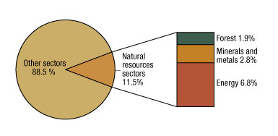
Natural Resources Sectors and Canada’s Gross Domestic Product in 2010
Canada's total GDP was $1 234.9

Slide 4
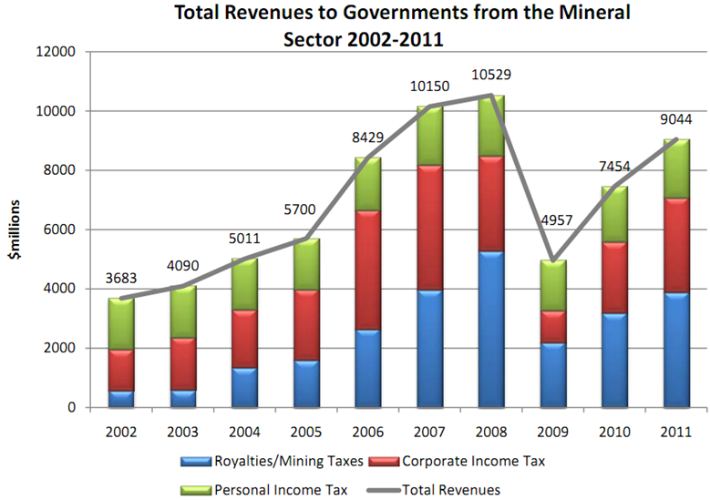

Slide 5
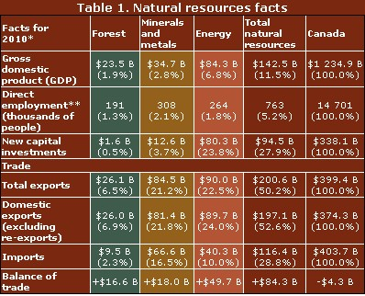
Natural Resources Facts
Notes:
The data reported for each of the natural resources sectors reflect the value of primary industries and related downstream manufacturing industries as of October 2010. “Minerals” includes uranium and coal mining. “Balance of trade” is the difference between the total exports and the total imports of goods. Services and capital flows are not included.

Slide 6
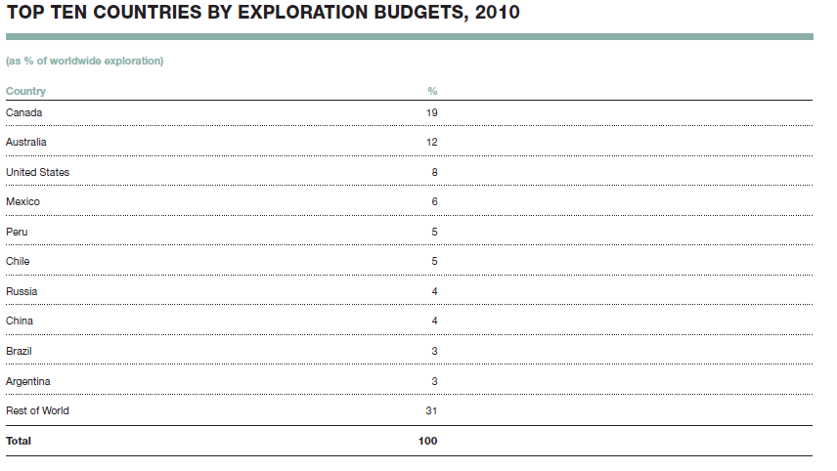
Global Leader for Exploration Budgets in 2010
Notes:
In 2009, Canada held 16% of the total global mineral exploration budget. In 2010, they accounted for 19%, making them the global leader in mineral exploration expenditure. An aggressive exploration budget may indicate that Canada will continue to seek global dominance in mineral exploration. Another note: the United States increased their exploration budget, passing Peru in 2010.

Slide 7
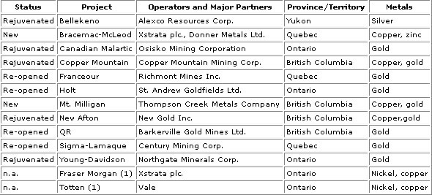
Production Decisions Added to Canadian Reserve Totals as of December 31, 2010

Slide 8
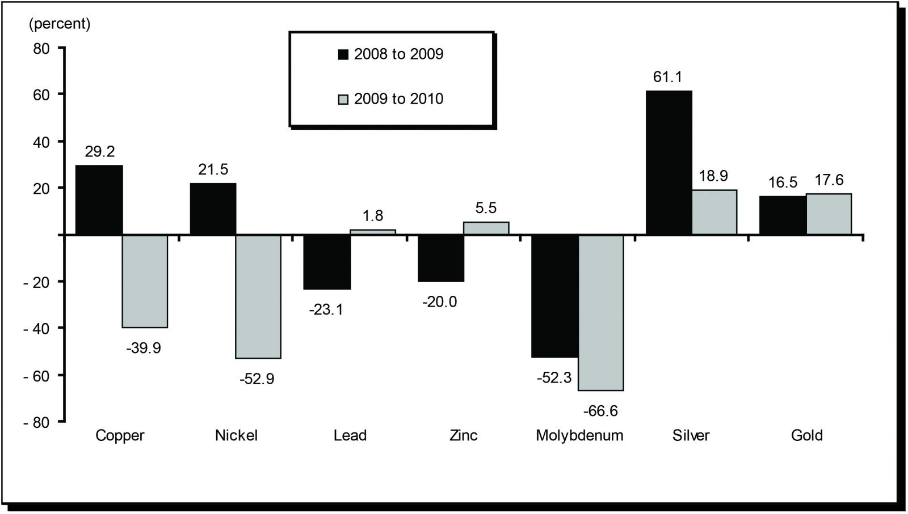
Annual Rates of Change of Canadian Reserves of Selected Major Metals, 2008-10
Notes:
It is a bar chart indicating the percent change from one year to the next of contained metal in resources by metal from 2008 to 2010.

Slide 9
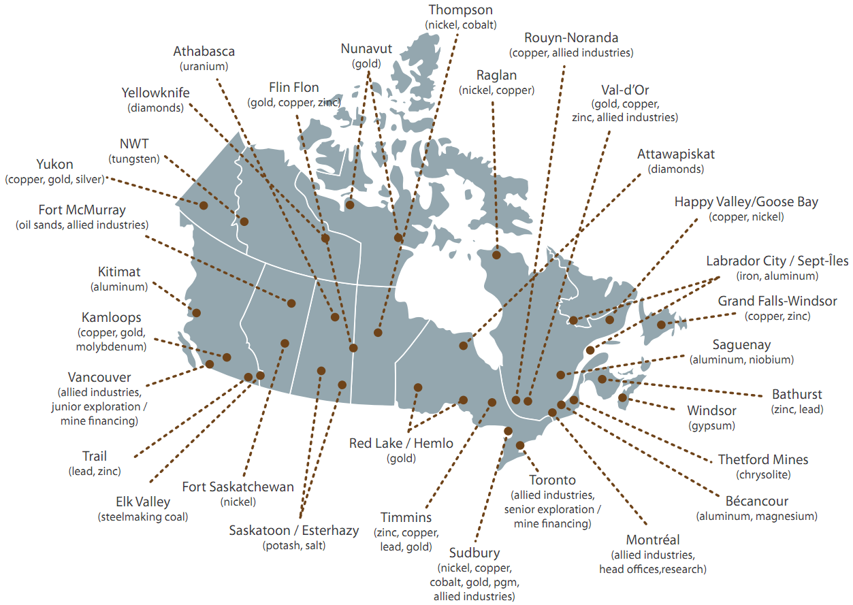
Mining in Canada

Slide 10
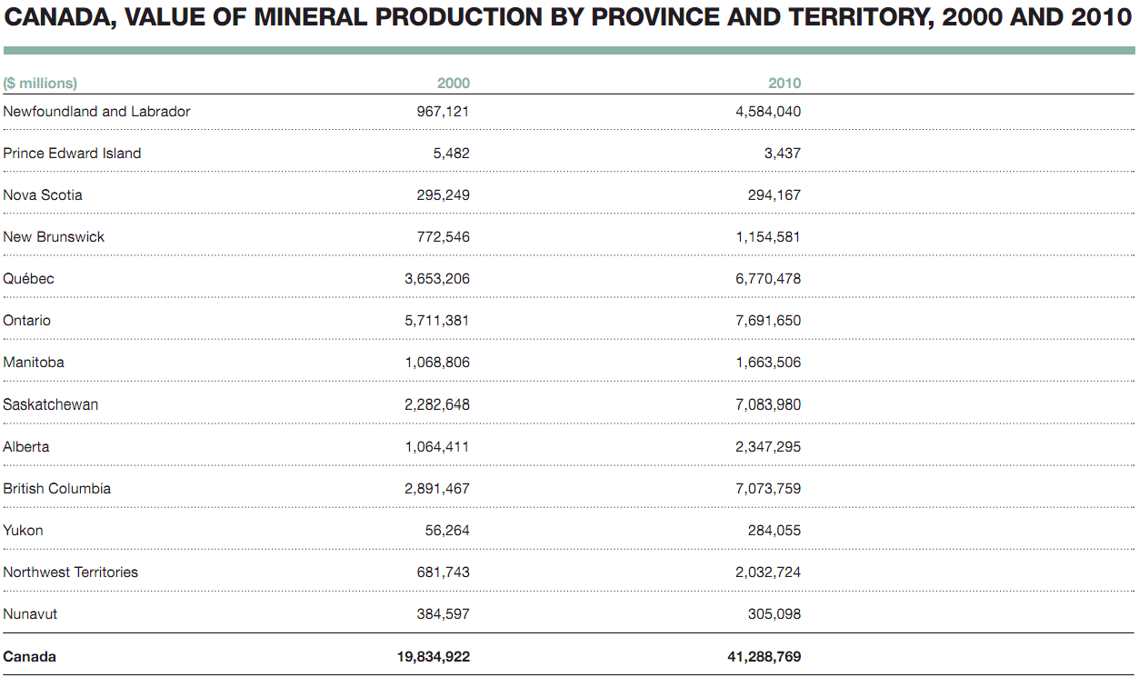

Slide 11
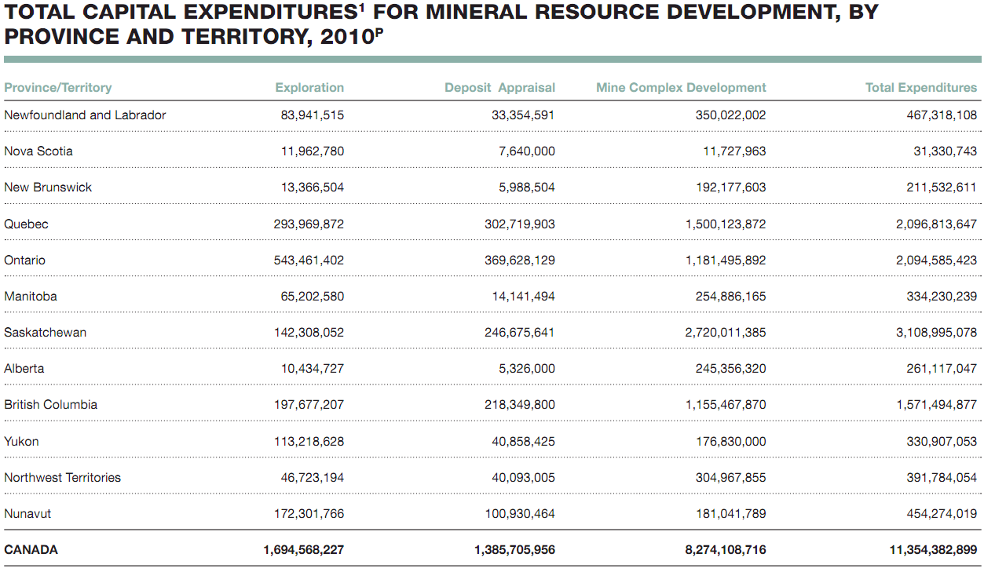

Slide 12
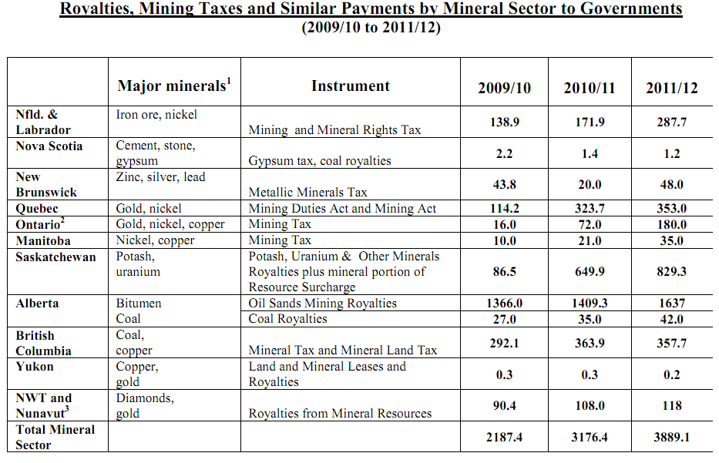

Slide 13
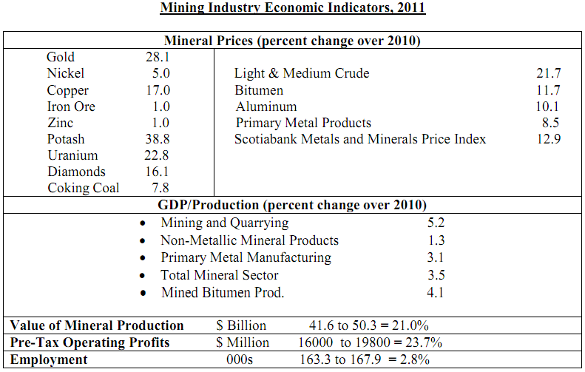

Slide 14
Mineral Resource Classification
Mineral Resources
Mineral resources that are potentially valuable, and for which reasonable prospects exist for eventual economic extraction
Mineral Reserves
Mineral reserves or Ore reserves that are valuable and legally and economically and technically feasible to extract

Slide 15
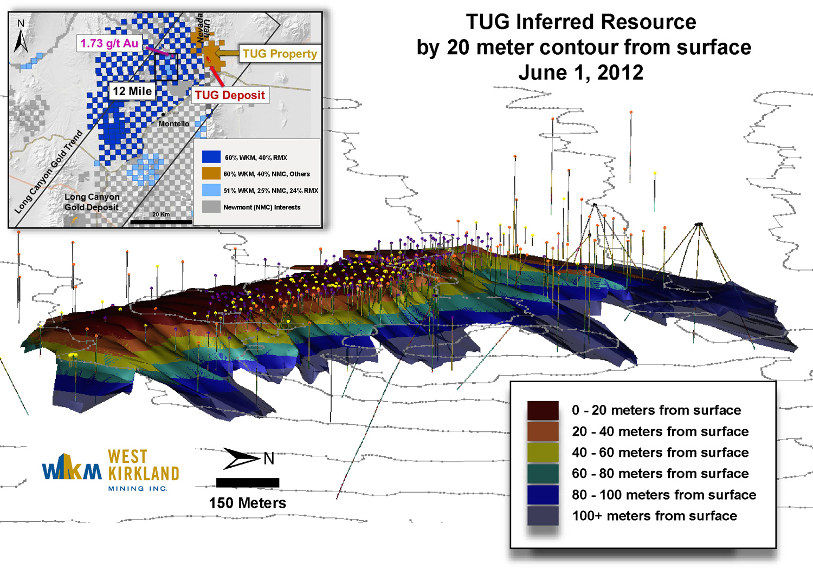
Mineral Resources Inferred Mineral Resource
Notes:
Inferred Mineral Resource is that part of a mineral resource for which tonnage, grade and mineral content can be estimated with a low level of confidence. It is inferred from geological evidence and assumed but not verified geological/or grade continuity. It is based on information gathered through appropriate techniques from location such as outcrops, trenches, pits, workings and drill holes which may be of limited or uncertain quality and reliability.

Slide 16
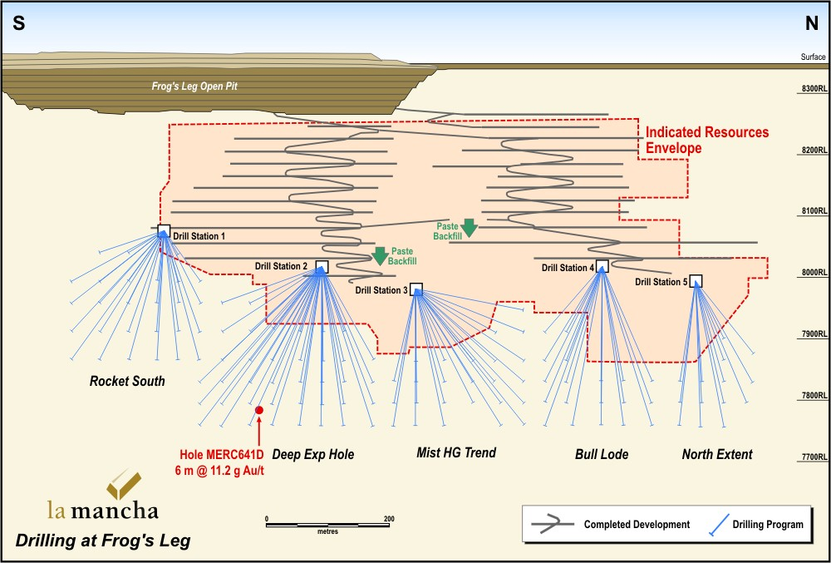
Mineral Resources Indicated resources
Notes:
Indicated resources are simply economic mineral occurrences that have been sampled (from locations such as outcrops, trenches, pits and drillholes) to a point where an estimate has been made, at a reasonable level of confidence, of their contained metal, grade, tonnage, shape, densities, physical characteristics

Slide 17
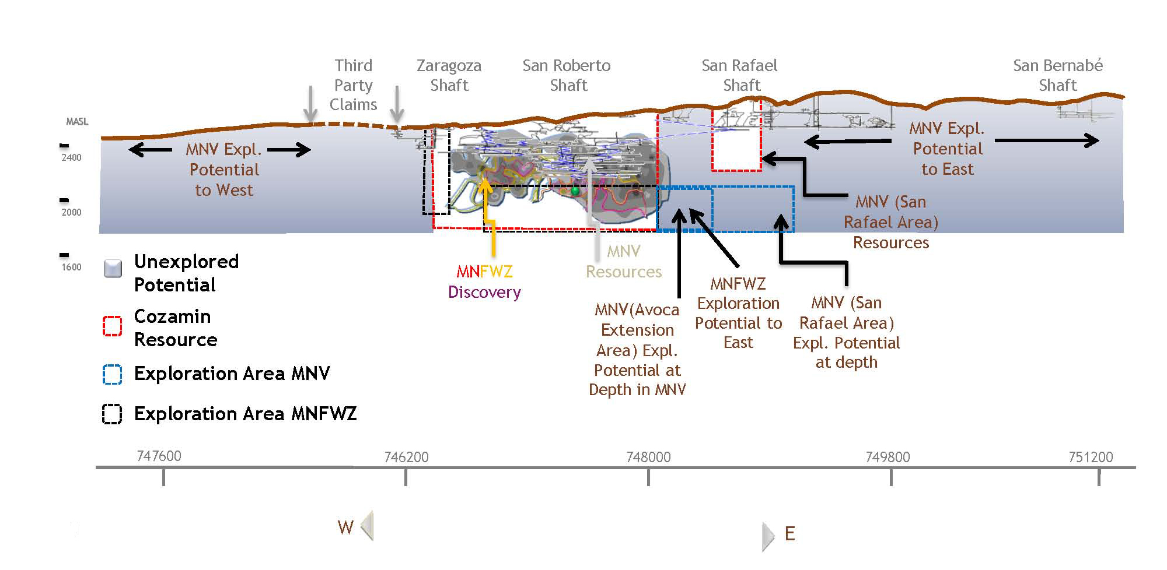
Mineral Resources Measured resources
Notes:
Measured resources are indicated resources that have undergone enough further sampling that a 'competent person' (defined by the norms of the relevant mining code; usually a geologist) has declared them to be an acceptable estimate, at a high degree of confidence, of the grade, tonnage, shape, densities, physical characteristics and mineral content of the mineral occurrence

Slide 18
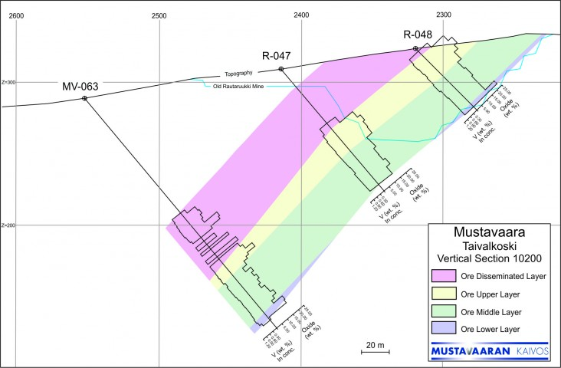
Mineral Reserves A Probable Ore Reserve
Notes:
A Probable Ore Reserve is the part of Indicated resources that can be mined in an economically viable fashion, and in some circumstances, a Measured Mineral Resource. It includes diluting material and allowances for losses which may occur when the material is mined. A Probable Ore Reserve has a lower level of confidence than a Proved Ore Reserve but is of sufficient quality to serve as the basis for decision on the development of deposit.

Slide 19
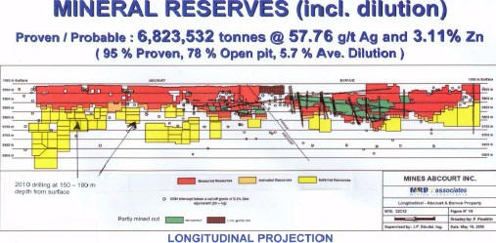
Mineral Reserves A Proven Ore Reserve
Notes:
A Proven Ore Reserve is the part of Measured resources that can be mined in an economically viable fashion. It includes diluting materials and allowances for losses which occur when the material is mined.
A Proven Ore Reserve represents the highest confidence category of reserve estimate. The style of mineralization or other factors could mean that Proven Ore Reserves are not achievable in some deposits

Slide 20
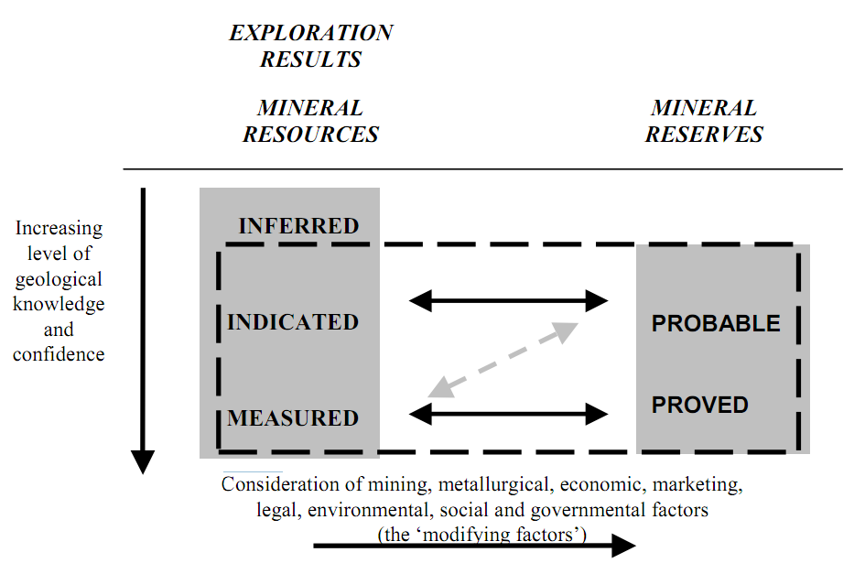
Notes:
An Inferred Mineral Resource is that part of a Mineral Resource for which tonnage, grade and mineral content (quantity and grade or quality in the CIM Standards) can be estimated based on geological evidence and assumed, but not verified, geological and/or grade continuity. In Canada, this assumption must also be reasonable. The information on which the estimates are based, may be limited or of uncertain quality and reliability. It has a lower level of confidence than that applying to an Indicated Mineral Resource. Due to the uncertainty attached to Inferred Mineral Resources, it cannot be assumed that all or a portion of such resource will be upgraded to an Indicated or Measured Mineral Resource as a result of more exploration.

Slide 21
Legislation and Regulations
The provincial governments are responsible for mining within their jurisdiction.
Direct federal involvement in the regulation of mining operations is limited and specific in nature.
Notes:
The provincial governments are responsible for mining – the exploration for and the development and extraction of mineral resources, as well as he construction, management, reclamation and closure of mine sites – within their jurisdiction.
Direct federal involvement in the regulation of mining operations is limited and specific in nature. It includes uranium in the context of the nuclear fuel cycle (i.e., from exploration through to the final disposal of reactor and mine waste), mineral activities related to federal Crown corporations, and mineral activities on federal lands and in offshore areas.

Slide 22
Regulation
Northwest Territories and Nunavut Mining Regulations
Territorial Coal Regulations
Territorial Quarry Regulations
Notes:
In the northern territories sub-surface lands include hard-rock minerals, precious gems and coal. The rights to these materials are administered through the Northwest Territories and Nunavut Mining Regulations (formerly known as the Canada Mining Regulations) and the Territorial Coal Regulations . There is a distinction between sub-surface minerals and surface mineral substances that have specific purposes such as carving stone and building materials. These special use surface minerals are administered through the Territorial Quarry Regulations .

Slide 23
NI43-101
Governs the quality of information shared by mining companies in the Canadian industry.
Disclosure is based on the advice of a qualified person
Entitles investors to a standard of information to evaluate investment potential
Notes:
the NI43-101 regulation governs all information disclosure for Canadian minerals and mining companies. National Instrument 43-101 (NI 43-101) is a rule developed by the Canadian Securities Administrators (CSA) and administered by the provincial securities commissions that govern how issuers disclose scientific and technical information about their mineral projects to the public. It covers oral statements as well as written documents and websites. It requires that all disclosure be based on advice by a "qualified person" and in some circumstances that the person be independent of the issuer and the property. This rule is important to understand because it sets the standard for all companies involved in this sector. Reliance on a qualified person This standard is currently under revision,

Slide 24
Minerals and Metals Policy of the Government of Canada
The Minerals and Metals Policy of the Government of Canada fulfills important commitments the government made in Creating Opportunity, Mining Agenda and A Guide to Green Government
The Policy was developed after an extensive consultation process involving representatives from federal departments and agencies, provincial and territorial mines ministries, industry, environmental groups, labor, and Aboriginal communities
Notes:
The Policy affirms provincial jurisdiction over mining, delineates a role for the federal government in minerals and metals that is tied to other federal responsibilities, and commits the government to pursuing partnerships with stakeholders in addressing issues within its jurisdiction.
As part of this process, Natural Resources Canada published an issues paper entitled “Sustainable Development and Minerals and Metals” in 1995.

Slide 25
Challenges of Canadian Minerals and Metals Industry
concerns about the state of our natural environment
rapidly growing competitive forces brought on by globalization and the emergence of new mineral-producing countries in the developing world
a need for a more efficient and effective federation; and the need to achieve sustainable development
The new Minerals and Metals Policy addresses these challenges and responds to important government commitments.
Notes:
As we look ahead to the future of Canada's minerals and metals industry, dramatic change is occurring. This change is brought on by several challenges:
For example, in Creating Opportunity, the Government acknowledged that sustainable development must be integrated into the way the Government defines its business and makes its decisions. It also made jobs and growth the centrepiece of its agenda for the 1990s, and committed itself to the renewal of Canada's rural regions. In A Guide to Green Government, the Government elaborated upon its commitment to a sustainable development approach. All ministers undertook to ensure that the concept is given due consideration in their respective mandates.

Slide 26
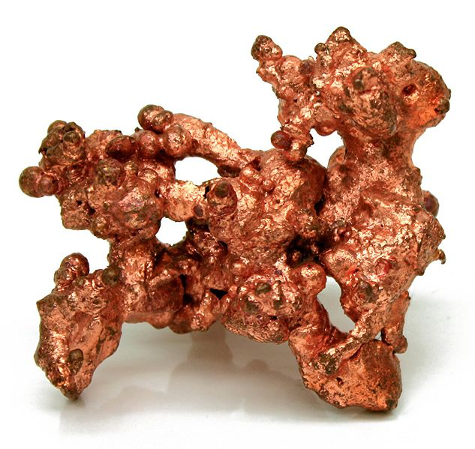
Copper

Slide 27
Copper Facts
Most copper is mined or extracted as copper sulfides from large open pit mines in porphyry copper deposits that contain 0.4 to 1.0% copper.
In 2005, Chile was the top mine producer of copper with at least one-third world share followed by the United States, Indonesia and Peru
95% of all copper ever mined and smelted has been extracted since 1900
The total amount of copper on Earth is vast (around 10¹⁴ tons just in the top kilometer of Earth's crust, or about 5 million years worth at the current rate of extraction)
Various estimates of existing copper reserves available for mining vary from 25 years to 60 years
Recycling is a major source of copper in the modern world

Slide 28
Copper Reserves
In December 2010, Canadian reserves of copper were estimated at around 10.7 Mt, an increase of 47% (3.5 Mt) compared to one year earlier.
In British Columbia, additions to copper reserves occurred at
the Gibraltar mine (1.08 Mt)
Mt. Milligan (1.06 Mt), Copper Mountain (757 000 t)
New Afton (450 000 t).
Highland Valley mine in British Columbia
Xstrata’s Sudbury operations in Ontario
new Bracemac-MacLeod mine in Quebec
Minto mine in the Yukon.
Decreases occurred at
Kidd Creek mine (48 000 t)
Vale’s Ontario operations (46 000 t)
Voisey’s Bay mine (38 000 t) in Newfoundland and Labrador.
Since 2005, copper reserves have been on an increasing trend.
Notes:
In December 2010, Canadian reserves of copper were estimated at around 10.7 Mt, an increase of 47% (3.5 Mt) compared to one year earlier.
In British Columbia, additions to copper reserves occurred at the Gibraltar mine (1.08 Mt) and at three new mines: Mt. Milligan (1.06 Mt), Copper Mountain (757 000 t), and New Afton (450 000 t). Increases were also recorded by the Highland Valley mine in British Columbia, by Xstrata’s Sudbury operations in Ontario, at the new Bracemac-MacLeod mine in Quebec, and at the Minto mine in the Yukon. Decreases occurred at the Kidd Creek mine (48 000 t), at Vale’s Ontario operations (46 000 t), and at the Voisey’s Bay mine (38 000 t) in Newfoundland and Labrador.
Since 2005, copper reserves have been on an increasing trend.

Slide 29
Copper Uses
The major applications of copper are in electrical wires (60%), roofing and plumbing (20%) and industrial machinery (15%).
Copper is 100% recyclable
80% of the copper ever mined is still in use today

Slide 30
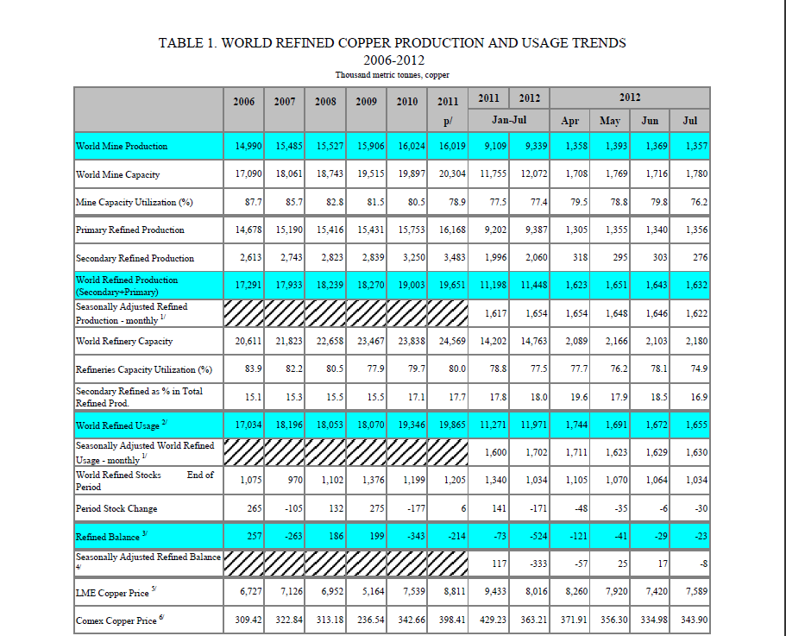

Slide 31
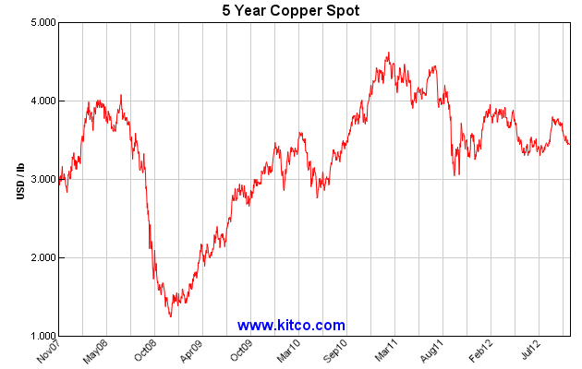
Copper Spot Price
Notes:
The price of copper has historically been unstable, and it quintupled from the 60-year low of US$0.60/lb (US$1.32/kg) in June 1999 to US$3.75 per pound (US$8.27/kg) in May 2006. It dropped to US$2.40/lb (US$5.29/kg) in February 2007, then rebounded to US$3.50/lb (US$7.71/kg) in April 2007. In February 2009, weakening global demand and a steep fall in commodity prices since the previous year's highs left copper prices at US$1.51/lb.

Slide 32
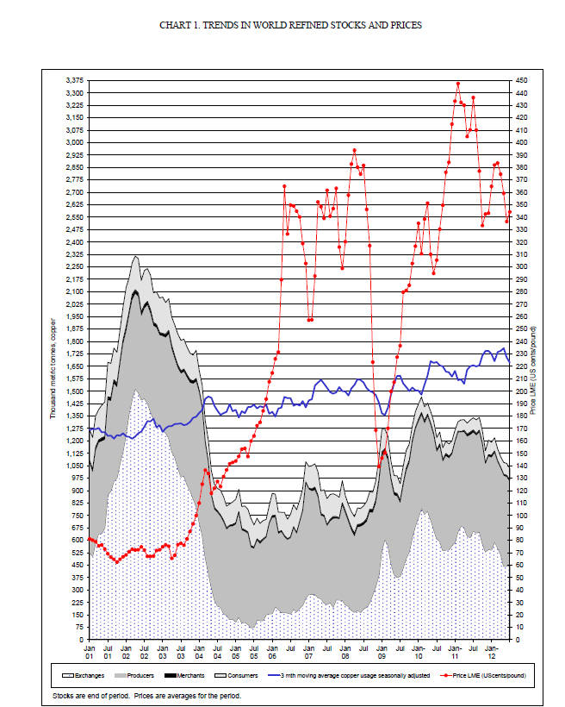

Slide 33
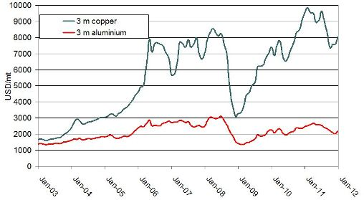
Copper VS Aluminum
Notes:
Copper is currently much more expensive than aluminium in terms of US$/tonne. As the price of copper has recently moved ahead much faster than the price of aluminium, the ratio of copper and aluminium prices has increased. The simple comparison of the two metals in terms of price per tonne is in some respects misleading, since aluminium is a much lighter metal than copper (2.7 g/cm3 compared to 8.9 g/cm3), though its conductivity is lower (61% of copper). For many cable applications a more meaningful comparison of the metals is the cost per unit conductance; on this basis a tonne of aluminium is close to 2.0 times as effective as a tonne of copper. The price of aluminium, already lower than copper in terms of US$/tonne, needs to be divided by 2.0 to give a comparison on the basis of electrical performance, which makes the cost difference even wider.

Slide 34
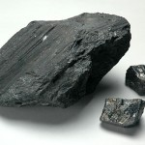
Coal

Slide 35
Types of Coal
Coking (metallurgical) coal
Steam (thermal) coal
Notes:
Coking (metallurgical) coal is used in steel making and thermal (steam) coal is used in power generation.

Slide 36
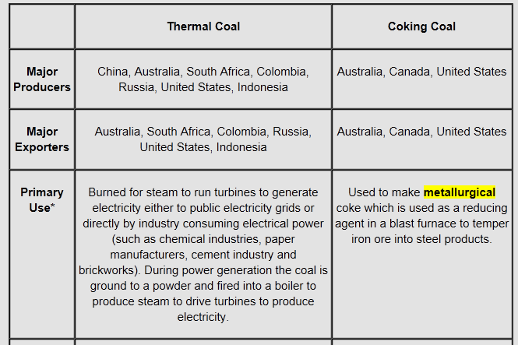
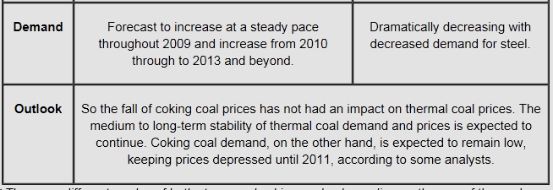

Slide 37
Coal Facts
Coal provides over 23% of global primary energy needs
Canada has an abundant coal resource. The largest known reserves are located in the western provinces, which are also Canada’s principal producers. Coal is also mined in Atlantic Canada.
Canada ranks tenth in the world in total coal reserves with 4 billion tonnes of bituminous coal.
Canadian coal is exported to 21 countries on five continents with an annual value of approximately $2 billion.
Canada also imports coal, primarily for electricity generation, as well as for metallurgical applications.
Coal consumption may eventually decline in Canada as a result of environmental policies. It could also continue to thrive with the development of new technologies aimed at reducing air emissions.

Slide 38
Coal Reserves
Canada has a large coal endowment.
Canada currently holds 8.7 billion tonnes of proved resources of coal-in-place,
The geological resource in Canada is far larger
Notes:
Canada has a large coal endowment. British Columbia, Alberta and Saskatchewan have the largest known reserves and resources in Canada that are actively mined. Coal is also mined in Nova Scotia and New Brunswick. Coal reserves and resources have been identified in Yukon, Ontario, Newfoundland and Labrador, Northwest Territories and Nunavut, but these resources are not currently mined.
Canada currently holds 8.7 billion tonnes of proved resources of coal-in-place, which are the resources in known deposits that have been carefully measured and assessed. Of that amount, 6.6 billion tonnes are deemed recoverable using existing technology under current and expected local economic conditions. At today’s production rate, these recoverable resources will last about 100 years.
The geological resource in Canada is far larger, however. In addition to the proved resources, there are 190 billion tonnes of estimated resources of coal-in-place, which is the indicated and inferred tonnage with foreseeable economic interest. This estimate includes amounts that could exist in unexplored extensions of known deposits or in undiscovered deposits in known coal-bearing areas, as well as amounts inferred from favourable geological conditions. Speculative amounts are not included.

Slide 39
Coal Uses
Over half of its production is used domestically for electricity generation and various industrial applications. The remaining production is exported.
Almost 70% of total global steel production is dependent on coal.

Slide 40
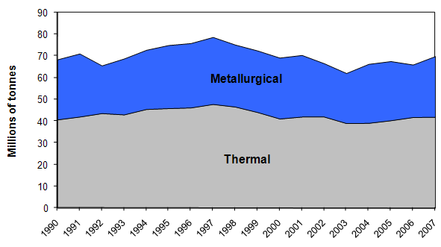
Canadian Coal Production
Notes:
Annual coal production in Canada has remained relatively steady since 1990, hovering between 65 and 75 million tonnes. Canada produces both thermal and metallurgical coals. This graph illustrates in millions of tons the amount of thermal and metallurgical coals produced between 1990 and 2007. In 2007, 70 million tonnes of coal were produced.

Slide 41
Two Types of Coal Mining
Surface mining
Underground mining
Notes:
Surface mining is used to produce most of the coal because it is less expensive than underground mining. Surface mining can be used when the coal is buried less than 200 feet underground.
In surface mining, giant machines remove the top soil and layers of rock known as "overburden" to expose the coal seam. Once the mining is finished, the dirt and rock are returned to the pit, the topsoil is replaced, and the area is replanted.
Underground mining, sometimes called deep mining, is used when the coal is buried several hundred feet below the surface. Some underground mines are 1,000 feet deep. To remove coal in these underground mines, miners ride elevators down deep mine shafts where they run machines that dig out the coal.

Slide 42
Exports and Imports
More than 40 per cent of coal production are exported
Canada exports coal to many countries:
Asia
Japan
European countries
the United States
Mexico
Latin American countries
Canadian coal exports are mainly from Elk Valley Coal’s five coal mines in British Columbia, with smaller volumes from mines in Alberta.
About 90% of exports were shipped by sea through coal terminals in Vancouver while the rest was shipped through terminals in Prince Rupert in northern British Columbia.
Imports coal into central and eastern Canada.
Notes:
Coal exports are vital to the Canadian coal industry, with more than 40 per cent of production being exported. In 2007, Canada exported 31 million tonnes of coal valued at $2.9 billion. While Canada is a mid-size coal producer, it is a significant exporter of metallurgical coal, which accounts for about 90% of Canada’s coal exports.
Canada exports coal to many countries. Asia is Canada’s primary export area, accounting for more than half of its exports, and Japan is the country that imports the most coal. Canada also exports significant volumes of coal to a number of European countries, the United States, Mexico and Latin American countries.
Canadian coal exports are mainly from Elk Valley Coal’s five coal mines in British Columbia, with smaller volumes from mines in Alberta. About 90% of exports were shipped by sea through coal terminals in Vancouver while the rest was shipped through terminals in Prince Rupert in northern British Columbia.
While Canada is an exporter of coal, it also imports coal into central and eastern Canada. This is mainly due to geography since it is cheaper to obtain coal from the east and central regions of the United States than from the western provinces. Canada imported 19 million tonnes of coal in 2007, of which about 80 per cent was thermal coal for electricity generation in Ontario, Nova Scotia and New Brunswick. The largest imports were from the United States, with smaller volumes from Colombia, Venezuela and Russia.

Slide 43
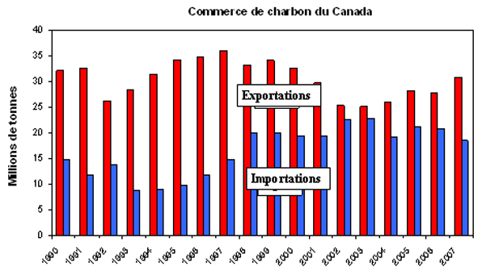
Exports and Imports
Notes:
This graph illustrates, in millions of tons, the amount of coal that Canada exports and imports. Canada exports coal to many countries. Asia is Canada’s primary export area, accounting for more than half of its exports. Canada also imports coal into central and eastern Canada. This is mainly due to geography since it is cheaper to obtain coal from the east and central regions of the United States than from the western provinces. Canada imported 19 million tonnes

Slide 44
Price
On the export market, Canadian coking-coal exporters have benefited from strong price increases in recent years.
Coal is not priced as if on the market. Its price is merely the cost of mining the coal.
The remaining volumes of coal consumed in Canada are imported and purchased at the prevailing global market price.
Notes:
On the export market, Canadian coking-coal exporters have benefited from strong price increases in recent years. These increases were the result of continuing demand increases and tight supply on global coal markets. About 70 per cent of domestic coal production is consumed by electricity-generation plants adjacent to coal mines, commonly referred to as “mine mouth” operations. Where production and consumption operations are integrated, coal is not priced as if on the market. Its price is merely the cost of mining the coal.
The remaining volumes of coal consumed in Canada are imported and purchased at the prevailing global market price.

Slide 45
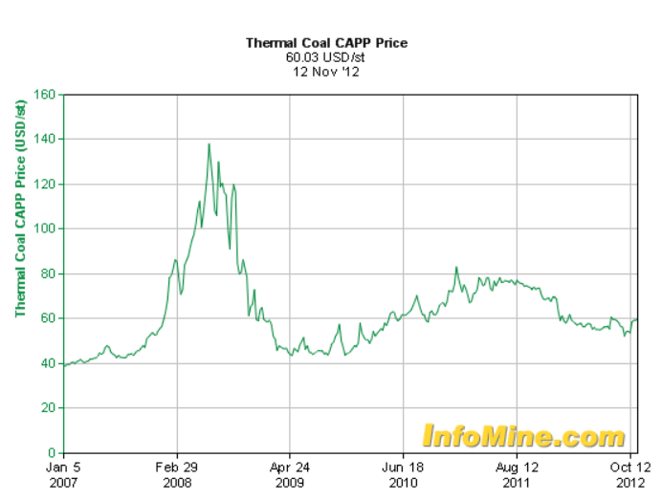

Slide 46
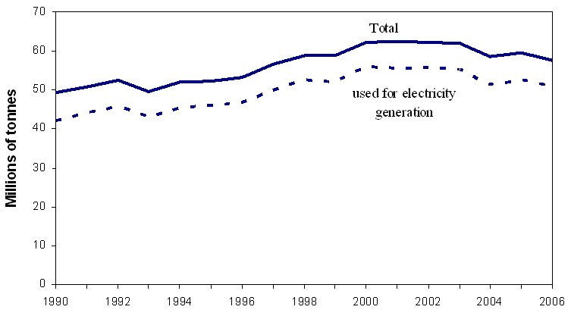
Canadian Coal Consumption
Notes:
This graph illustrates Canada's coal consumption between 1990 and 2006. Canada consumed 58 million tonnes of coal in 2006. Most of this coal (51 million tonnes) was used to generate electricity.

Slide 47
Coal Industry Structure
Large private-sector firms include
Sherritt International
Fording Canadian Coal Trust
Teck Cominco Limited.
A number of firms provide services to coal producers in fields such as
exploration
equipment supply
engineering services and transportation (e.g., the rail carriers Canadian National and Canadian Pacific).
Some own coal mines or are involved in coal production (e.g., TransAlta Corporation, NB Power).
Other power companies (e.g., Ontario Power Generation) generate electricity from purchased coal.
The Coal Association of Canada represents the interests of coal producers, service companies and major users.
In Canada, the provinces regulate the mining of publicly owned coal
Notes:
The coal industry is composed of firms that mine coal. Large private-sector firms include Sherritt International, Fording Canadian Coal Trust and Teck Cominco Limited.
A number of firms provide services to coal producers in fields such as exploration, equipment supply, engineering services and transportation (e.g., the rail carriers Canadian National and Canadian Pacific).
Some power-generating companies not only use coal for electricity generation but also own coal mines or are involved in coal production (e.g., TransAlta Corporation, NB Power). Other power companies (e.g., Ontario Power Generation) generate electricity from purchased coal.
The Coal Association of Canada represents the interests of coal producers, service companies and major users.
In Canada, the provinces regulate the mining of publicly owned coal. Provincial departments and agencies, such as British Columbia’s Ministry of Energy, Mines and Petroleum Resources, therefore play an important role in the regulation of coal production in Canada.

Slide 48
Coal Outlook
Canada’s metallurgical coal production and exports will benefit from
the growing global demand for metallurgical coal (short to medium term)
the global economy and steel-industry development (Long-term )
Canada’s coal consumption could eventually decline
Development and implementation of new technologies
carbon capture
storage and clean coal
Notes:
Canada is the world’s second largest metallurgical coal supplier. Canada’s metallurgical coal production and exports will benefit from the growing global demand for metallurgical coal in the short to medium term, as global demand is forecasted to exceed supply. Long-term growth will depend on the global economy and steel-industry development because Canada’s metallurgical coal is export oriented. Thermal coal production is expected to be stable.
Canada’s coal consumption could eventually decline as a result of measures to reduce greenhouse gas emissions, such as the closure or retrofitting of existing coal-fired generation facilities. The development and implementation of new technologies such as carbon capture and storage and clean coal could, however, help sustain the use of coal for electricity generation in a carbon-constrained future.

Slide 49
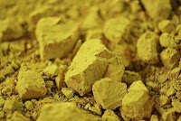
Uranium

Slide 50
Canadian Uranium Facts
Canada was the world's largest uranium producer for many years, accounting for about 22% of world output, but in 2009 was overtaken by Kazakhstan.
Production comes mainly from the McArthur River mine in northern Saskatchewan province, which is the largest in the world.
Production is expected to increase significantly from 2013 as the new Cigar Lake mine comes into operation.
With known uranium resources of 572,000 tonnes of U3O8 (485,000 tU), as well as continuing exploration, Canada will have a significant role in meeting future world demand.

Slide 51
Uranium Price
Uranium does not trade on an open market like other commodities. Buyers and sellers negotiate contracts privately. Prices are published by independent market consultants Ux Consulting and TradeTech.

Slide 52
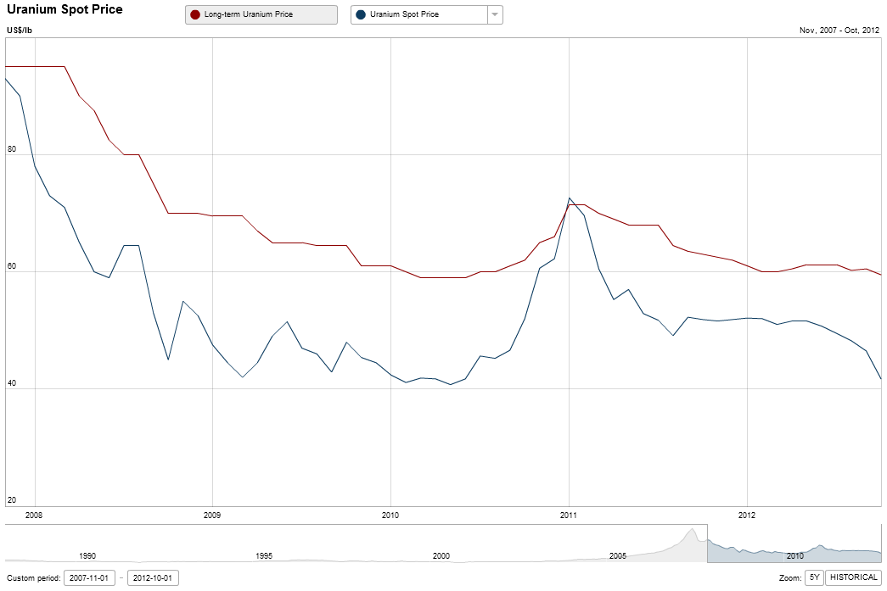
Uranium Spot Price – 5 Year

Slide 53
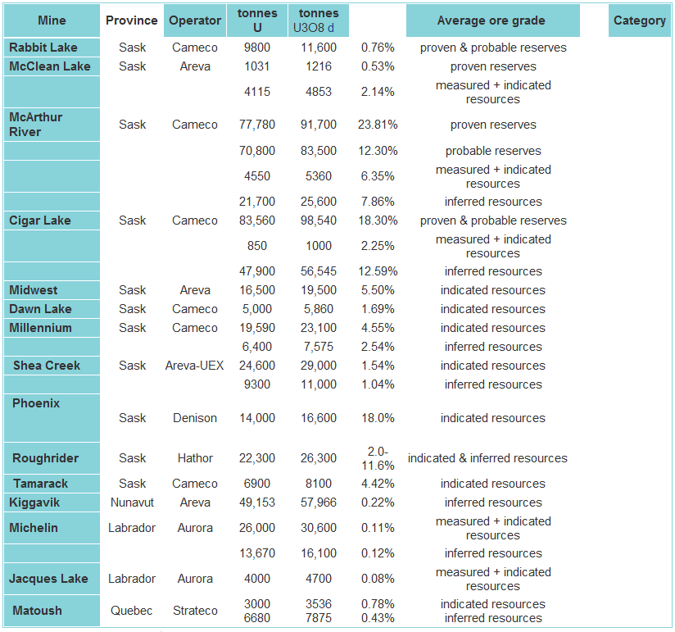
Canadian Uranium Resources

Slide 54
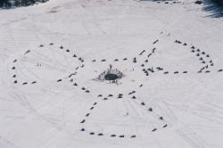
Exploration
Notes:
Uranium is one of the heaviest and more common elements in the earth's crust. Its most distinctive physical property is its radioactivity, which contributes largely to the natural background radiation of the earth. Deposits of sufficient size and grade are required to make mining economically feasible. Locating such uranium deposits generally involves either ground or airborne radiometric surveys in areas of favourable geology, followed by drilling programs to more accurately delineate the deposit size and grade, prior to making a decision to develop a mine.

Slide 55
Mining
Technical challenges:
ground water
rock properties
radiation protection
Overcome the challenges:
developing innovative ground freezing techniques and mechanized
"non-entry" underground-mining methods.
For lower-grade deposits, more traditional open-pit and underground mining methods are used.
Safety
Notes:
Mining uranium deposits presents several technical challenges in terms of ground water, rock properties and radiation protection. Uranium producers overcome these challenges to mine very high-grade deposits by developing innovative ground freezing techniques and mechanized, "non-entry" underground-mining methods. For lower-grade deposits, more traditional open-pit and underground mining methods are used. Safety is complicated by the presence of radioactive radon gas. This potential hazard is minimized by using powerful ventilation systems in underground mines, as well as remote-controlled and specially shielded equipment.

Slide 56
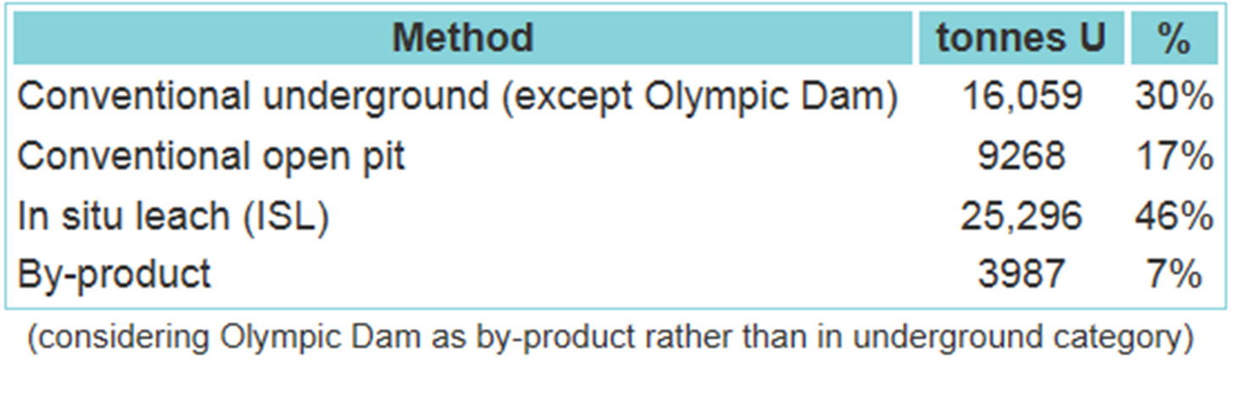
Mining Methods
Uranium ore is removed from the ground in one of four ways depending on the characteristics of the deposit.

Slide 57
Uranium Processing
Milling
Refining
Conversion
Fuel Fabrication
Notes:
Milling
Ore is crushed and processed in mills, generally located at or near the mines, to isolate uranium by using chemical processes that remove impurities. A fine powder, called "yellowcake", is the resulting product and is packed in 55 U.S. gallon ring-sealed drums containing approximately one-half tonne of yellowcake. All waste and water from the mine and mill tailings area is treated prior to release.
Refining
The yellowcake produced at the mills is about 70% uranium. At a refinery, in Canada at Blind River, Ontario, it is further processed to remove impurities, then chemically converted to uranium trioxide, a form suitable for further processing.
Conversion
Additional processing at a "conversion" facility, in Canada at Port Hope, Ontario, is required to chemically transform the product to either uranium dioxide, for CANDU reactor fuel, or uranium hexafluoride, the feedstock for enriched light water reactor fuel. Most reactors outside Canada are light water reactors that use enriched uranium fuel.
Fuel Fabrication
In Canada, natural uranium dioxide powder, packaged in drums at the conversion plant, is shipped to one of the two fuel fabricators. Currently, both fuel fabricators manufacture only uranium fuel assemblies comprised of natural uranium. The uranium dioxide powder is first pressed into cylindrical shapes and "fired" to produce fuel pellets. The pellets, about 2 cm long and 1 cm in diameter, are then trucked to a plant where they are placed in 50 cm-long zirconium alloy tubes, and fastened together into 10 cm-diameter fuel bundles for CANDU-type reactors in Canada and abroad.
All natural uranium hexafluoride produced in Canada is transported in specially designed steel shipping containers to enrichment plants in the U.S., France, the U.K., Germany or the Netherlands.

Slide 58
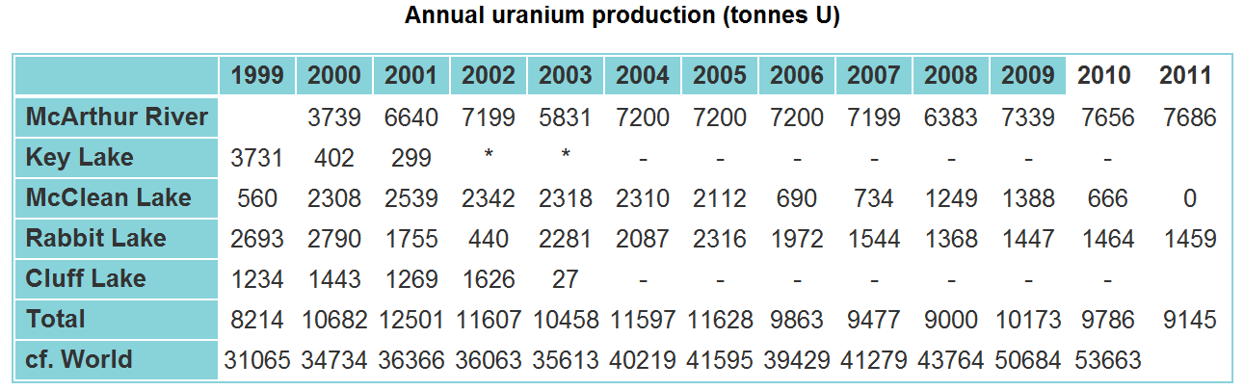
Domestic Annual Uranium Production

Slide 59
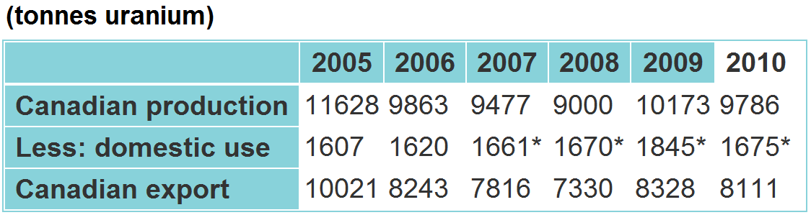
Canadian Uranium Exports

Slide 60
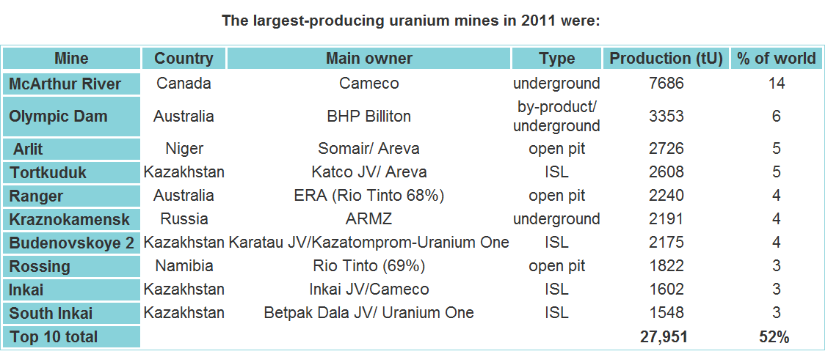
The Largest-Producing Uranium Mines in 2011

Slide 61
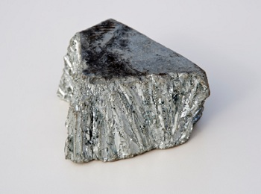
Zinc

Slide 62
Zinc Facts
The element is normally found in association with other base metals such as copper and lead in ores
Identified world zinc resources total about 1.9 billion tonnes
Total reserve base of 500 million tonnes has been identified
At the current rate of consumption, these reserves are estimated to be depleted sometime between 2027 and 2055
Commercially pure zinc is known as Special High Grade, often abbreviated SHG, and is 99.995% pure

Slide 63
Zinc Uses
Brass, which is an alloy of copper and zinc, has been used since at least the 10th century BC
Applications of zinc include:
Galvanizing (59%)
Die-casting (16%)
Brass and bronze(10%)
Rolled zinc (6.5%)
Chemicals (6.0%)
Miscellaneous (2.5%)

Slide 64
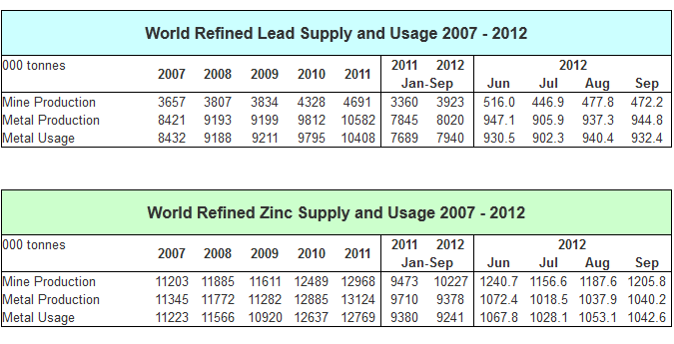

Slide 65
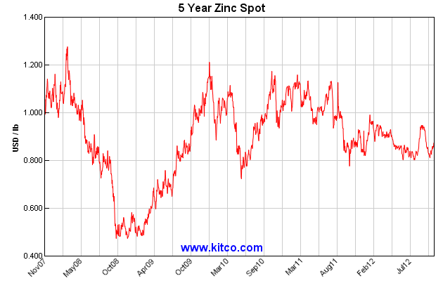
Zinc Spot Price

Slide 66
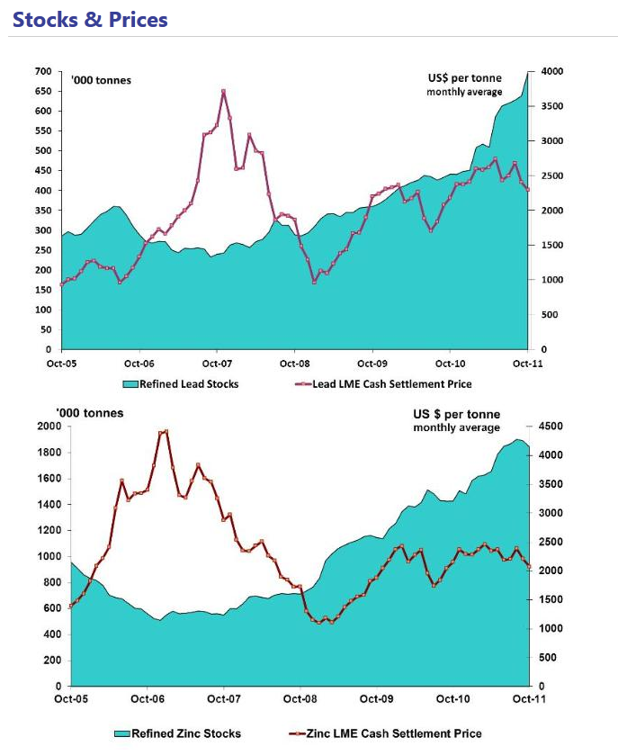

Slide 67
Zinc Reserves
During 2010, Canadian reserves of zinc declined by about 117 000 t (3%) to a year-end total of approximately 4.13 million tonnes (Mt).
The greatest reduction in zinc reserves was recorded at:
the Kidd Creek mine in Timmins, Ontario (134 000 t)
the LaRonde mine in Quebec (98 000 t)
the Brunswick No. 12 mine in New Brunswick (78 000 t)
The only addition to zinc reserves (362 000 t) occurred at the new Bracemac-MacLeod mine in Mattagami, Quebec.
Notes:
During 2010, Canadian reserves of zinc declined by about 117 000 t (3%) to a year-end total of approximately 4.13 million tonnes (Mt).
The greatest reduction in zinc reserves was recorded at the Kidd Creek mine in Timmins, Ontario.
As the result of lower tonnage and grades, Kidd Creek’s reserves decreased by 134 000 t. Decreases were also recorded at the LaRonde mine in Quebec (98 000 t) and the Brunswick No. 12 mine in New Brunswick (78 000 t), which is nearing the end of its mine life. The only addition to zinc reserves (362 000 t) occurred at the new Bracemac-MacLeod mine in Mattagami, Quebec.

Slide 68
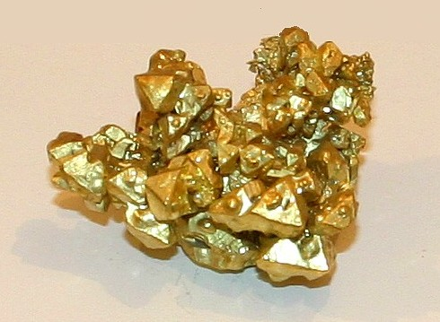
Gold

Slide 69
Gold Facts
The native metal occurs as nuggets or grains in rocks, in veins and in alluvial deposits
It is mined in shafts or historically by panning through silt
It is chemically stable and conducts electricity

Slide 70
Gold Reserves
1473 tonnes (t) of gold contained in Canadian mine reserves in December 2010
Increase of 60% (555 t) compared to December 2009.
The largest addition to gold reserves came from:
the new Canadian Malartic mine in Val-d’Or, Quebec, which added 278 t
the soon-to-be-re-opened Young-Davidson mine in Matachewan, Ontario
the New Afton mine in British Columbia
the recently opened Timmins mine in Ontario with 88 t, 33 t, and 27 t, respectively
Notes:
There was 1473 tonnes (t) of gold contained in Canadian mine reserves in December 2010. This represents an increase of 60% (555 t) compared to December 2009. The largest addition to gold reserves came from the new Canadian Malartic mine in Val-d’Or, Quebec, which added 278 t, followed by the soon-to-be-re-opened Young-Davidson mine in Matachewan, Ontario, the New Afton mine in British Columbia, and the recently opened Timmins mine in Ontario with 88 t, 33 t, and 27 t, respectively. In total, two new mines and five re-opened mines added to the gold reserves total in 2010. A 13-t decrease in gold reserves was recorded at the Black Fox mine near Timmins, Ontario. Since 2005, gold reserves have been on an increasing trend.

Slide 71
Gold Uses
Gold is used to make jewellery and other art items- 50%
Electronic applications represent a significant amount of the United States’ annual gold consumption- 10%
Dentistry and a variety of other applications.
Held in reserves- 40%

Slide 72
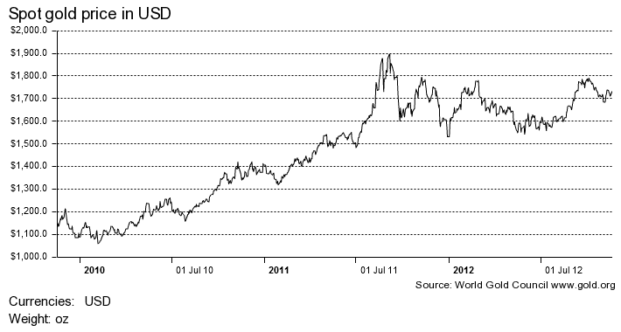
Gold Spot Price

Slide 73
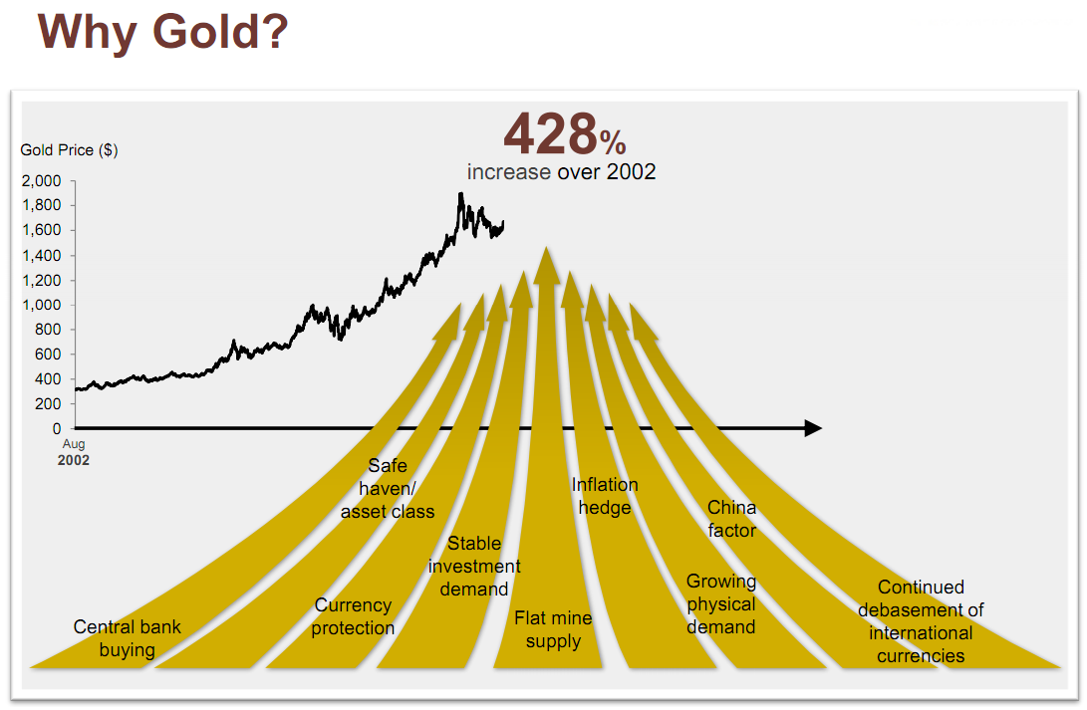
Factors Effect Gold Price

Slide 74
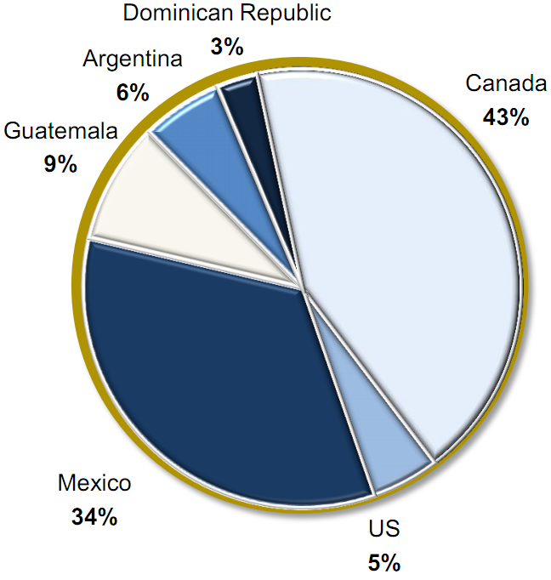
Gold Production

Slide 75
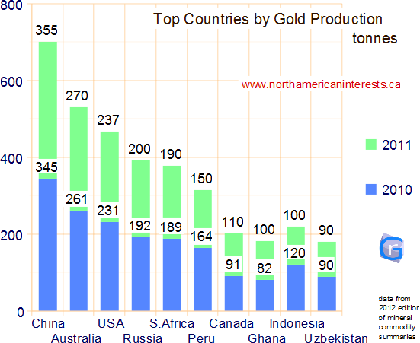

Slide 76
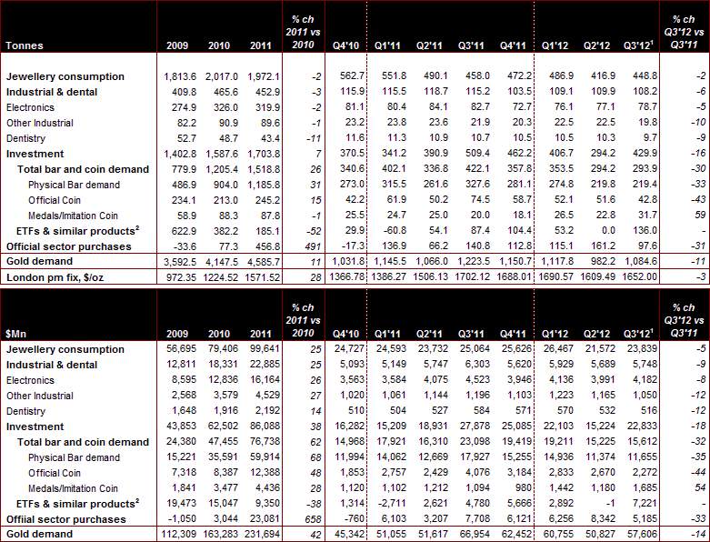
Gold Demand

Slide 77



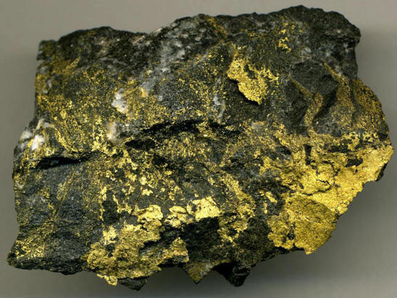
GOLDCORP

Slide 78
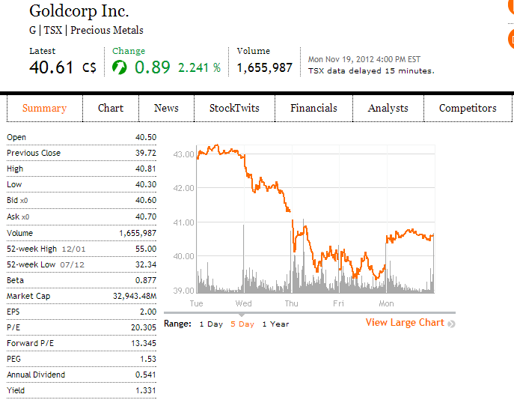
Stock Snapshot
Notes:
Stock price was decreasing last week
They do pay dividends to their shareholders

Slide 79
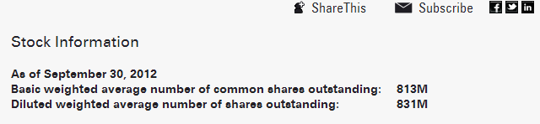
Shares Outstanding
Source: http://www.goldcorp.com/English/Investor-Resources/Stock-Information/default.aspx

Slide 80

Max Chart

Slide 81

1-Year Stock Performance

Slide 82

1 Year Moving Average

Slide 83

1 Year vs. S&P/TSX Composite

Slide 84

1 Year vs. S&P/TSX Metals & Mining Index

Slide 85

1 Year vs. Gold

Slide 86

5-Year Stock Performance

Slide 87

5-Year Moving Average

Slide 88

5-Year vs. S&P/TSX Composite

Slide 89

5-Year vs. S&P/TSX Metals & Mining Index

Slide 90

5-Year vs. Gold

Slide 91

Trends of Market Cap. over past 4 yrs

Slide 92
Company Profile

Slide 93

Overview
Vancouver based gold producer
Engaged in the operation, exploration, development and acquisition of precious metal properties
Operations and development projects throughout the Americas: Canada, USA, Mexico, Guatemala, Argentina
Other by-products: silver, copper, lead, zinc
Production growth leader in the industry
One of the world’s lowest cost and fastest growing multi-million ounce gold producers
The world’s second largest gold producer based on market capitalization
No hedging of gold price
Keep expanding by using the profit
Start paying monthly dividends to shareholders since 2003
More than $25 million charitable contributions annually

Slide 94

History
Robert McEwen
Notes:
Who was the founder and former Chairman and CEO of Goldcorp Inc.

Slide 95

History
Market capitalization has grown from $50 million to over $10 billion and share price has increased @31% compound annual growth rate
Robert McEwen bought control of two mining companies
Goldcorp has been transferred from a collection of small companies into a mining powerhouse
Four mining companies have been merged to create Goldcorp Inc.
1989
1990
1993
1994
Notes:
In 1990 McEwen stepped into the mining industry, where he transformed Goldcorp from a collection of small companies into a mining powerhouse.
Since 1993, when McEwen started re-structuring Goldcorp, its market capitalization has grown from $50 million USD to over $10 billion and Goldcorp's share price has increased at a 31% compound annual growth rate.

Slide 96
Firm Strategies
Industry-leading Gold Production Growth
Low Production Costs
Strong Balance Sheet
Active Dividend Policy
Good relationships with employees and business partners
Low Political Risk Areas
Notes:
1.Pursue industry-leading gold production growth 2.Maintain low production costs 3.Focus on areas of the world with low political risk
4.Manage the strong balance sheet to fund growth internally 5.Invest with discipline and return value to shareholders through an active dividend policy
6.Maintain a good relationships with employees and business partners

Slide 97

Gold Productions over Past 5 Years
Source: http://www.goldcorp.com/files/april-24-2012/financial-highlights.html

Slide 98

Production Forecast
Source: http://www.goldcorp.com/files/april-24-2012/financial-highlights.html
Notes:
Production will be increased by 70% over the next 5 yrs

Slide 99

Production Costs over past 3 yrs.
Source: http://www.goldcorp.com/files/april-24-2012/financial-highlights.html

Slide 100

Dividends over past 5 yrs
Source: http://www.goldcorp.com/files/april-24-2012/financial-highlights.html
Notes:
increased the dividend over 200%

Slide 101
Macroeconomic Facts
Gold prices surged past $1,700 in the summer 2012
A recent fallback on the gold price
U.S. fiscal cliff
Euro zone recession
Federal Reserve's vow to keep interest rates low until at least 2014
Increase in Gold trade on Nov 19th, 2012
Greek debt negotiations
Prospect of a political compromise regarding the U.S. fiscal cliff
Gold futures for December delivery jumped to $1,732.10 on Nov 19th, 2012
Gold prices are likely to continue to move upward

Slide 102
Recent Acquisition History
2006:
Eleonore gold project from Virginia Gold Mines Ltd.
Placer Dome assets from Barrick Gold for $1.6 billion
Glamis Gold, creating one of the world’s largest gold companies
2008:
Disposed of Silver Wheaton for $1.57 billion
Gold Eagle Mines (adjacent to Red Lake mine)
2010:
70% interest in El Morro project
Andean Resources for $3.4 billion

Slide 103

Operating Mines & Development Projects

Slide 104

Operating Mines & Development Projects
Notes:
Goldcorp’s operating assets include five mines in Canada, and the USA, three mines in Mexico, and two in Central and South America.

Slide 105

Highlights on Operation Results (2012 Q3)

Slide 106

Red Lake (Canada)
Gold mine located in Ontario, Canada
One of the richest gold mines in the world
And also the lowest cost of production
Contains the world's richest grade gold ore
2 troy ounces of gold per metric ton
Goldcorp invested $7 million in exploration in 1995
Produced 622,000 ounces of gold in 2011
Largest gold production mine

Slide 107

Peñasquito (Mexico)
Gold, silver, lead and zinc mine
Located in Zacatecas State, Mexico
The fifth largest silver mine in the world and the second largest in Mexico
Wholly owned by Goldcorp through a Mexican subsidiary
Generated approximately $360 million in cash flow from operations in 2011
First year production (including by-products and gold) has already approached 1,000,000 ounces
Expected to bring a bright future to Goldcorp

Slide 108

Source: http://www.goldcorp.com/files/april-24-2012/operational-highlights.html

Slide 109

Gold Resources (2010)
Source: http://www.goldcorp.com/files/doc_financial/Goldcorp_2010AnnualReport_FINAL_FullBook.pdf

Slide 110

Gold Resources (2011)
Source: http://www.goldcorp.com/files/april-24-2012/_docs/Goldcorp_AR%202011_R&R.pdf

Slide 111

Gold Reserves (2010)
Source: http://www.goldcorp.com/files/doc_financial/Goldcorp_2010AnnualReport_FINAL_FullBook.pdf

Slide 112

Gold Reserves (2011)
Source: http://www.goldcorp.com/files/april-24-2012/_docs/Goldcorp_AR%202011_R&R.pdf

Slide 113

Growth of Gold Reserve
Source: http://www.goldcorp.com/files/april-24-2012/financial-highlights.html
Notes:
increased 8% to nearly 65 million ounces

Slide 114
Key Facts
Finding cost per ounce of gold = $14
Increases in Gold Reserve:
20% from a higher gold price
80% from drilling success

Slide 115
Management

Slide 116

Management
Charles A. Jeannes
President and Chief Executive Officer (CEO)
Appointed in December 2008
Former Executive Vice President, Corporate Development from Nov 2006 to Dec 2008
Former Executive Vice President in Administration, General Counsel and Secretary of Glamis Gold from 1999 to 2006
B.A. from the University of Nevada and graduate degree from the University of Arizona of Law
Broad experience in law, mining transactions, public and private financing, permitting and international regulation

Slide 117
Management
George R. Burns
Executive Vice President and Chief Operating Officer (COO)
Appointed in August 2012
Former Senior Vice President, Mexican Operations and Vice President, Canada and United States respectively
Former Chief Operating Officer & Vice President of Centerra Gold, Inc., Former Vice President of Asarco, Inc., and Former Vice President of Cyprus Minerals Company, Inc.
Bachelor of Science degree in Mining Engineering from the University of Montana
30 years of experience in the mineral sector including executive, operations, development and engineering leadership roles in gold, copper and coal operations
Notes:
undergraduate degree from the University of Montana

Slide 118
Management
Lindsay Hall
Executive Vice President & Chief Financial Officer (CFO)
Appointed in April 2006
Chartered Accountant with extensive experience in senior financial positions in the energy industry
Former Treasurer & Vice President of Duke Energy Corp. and Vice President-Finance of Westcoast Energy, Inc
B.A. in Economics and Bachelor of Commerce from the University of Manitoba

Slide 119
Analysis of Financial Statements

Slide 120

Financial Highlights

Slide 121



Financial Highlights
Source: http://www.goldcorp.com/files/april-24-2012/financial-highlights.html

Slide 122

2012 Q3 Balance Sheet
Notes:
No Property, plant and equipment
Strong Balance Sheet since Assets>Liabilities so much
Low Liabilities-to-Equity Ratio (=0.36)

Slide 123

2011 Annual Balance Sheet

Slide 124


2011 Annual Income Statement

Slide 125


2012 Q3 Income Statement

Slide 126

2011 Annual Cash Flow Statement

Slide 127

2012 Q3 Cash Flow Statement

Slide 128
Conclusions
Continuous Growth of Dividend
Expected Increase in Gold Price
Reliable Production Growth
Diversified Asset Mix
Mines and Projects are well diversified and distributed over countries in Americas
Low political risk
Strong Balance Sheet
Recent price decrease = time to buy

Slide 129

Recommendation BUY!

Slide 130





Slide 131

Stock Snapshot
Shares Outstanding: | 395,349,044

Slide 132

1-Year Stock Price V.S. 20 & 100 MAVG
Notes:
S&P/TSX Composite

Slide 133

1-Year Stock Price V.S. TSX-I & TTMN-I

Slide 134

5-Year Stock Performance V.S. 20 & 100 MAVG

Slide 135

5-Year Stock Price V.S. TSX-I & TTMN-I

Slide 136

10-Year Stock Performance V.S. 20 & 100 MAVG

Slide 137

10-Year Stock Price V.S. TSX-I & TTMN-I

Slide 138

Max
Notes:
Uranium bubble of 2007. The upward trend for the prices of uranium was already apparent since 2003. A possible direct cause for the bubble is the flooding of the Cigar Lake Mine, Saskatchewan, which has the largest undeveloped high-grade uranium ore deposits in the world.

Slide 139

Company Overview
Formed in 1988
Initially owned 62% by the provincial government and 38% by the federal government
Full privatization in February 2002
Head office in Saskatoon, Saskatchewan
The third largest uranium producer in the world
With uranium assets on three continents
Accounts for 16% of the world’s uranium production
Employs nearly 3,500 people
Notes:
Cameco is short for Canadian Mining and Energy Corporation. It is formed in 1988. Initially provincial government owned 62% interest of Cameco and federal government owned 38% interest of Cameco. Cameco is privatized in February 2002. Its head office is located in Saskatoon, Saskatchewan. Cameco is the third world’s largest uranium producer with uranium assets on three continents. Cameco accounts for 16% of the world’s uranium production in 2011. There are nearly 3500 people in the company.

Slide 140
Continued
435 million pounds of proven and probable reserves and extensive resources
Holds premier land positions in the world’s most promising areas of new uranium discoveries in Canada and Australia as part of an intensive global exploration program
Leading provider of processing services required to produce fuel for nuclear power plants
Generates 1,000 megawatts of clean electricity through a partnership in North America’s largest nuclear generating station located in Ontario

Slide 141
Company Strategy
Focus on uranium segment
Replace depleted mineral reserves
Looking for acquisition opportunities

Slide 142
Strengths
World-class assets
Employee expertise
Strong customer relationships
Uranium price leverage
Financial Strength
Disciplined portfolio management
Focus risk management
Innovation
Reputation
Notes:
World-class assets: extensive reserves and resources, large portfolio of low-cost mining operations and geographically diverse uranium assets with controlling interests in the world’s largest high-grade uranium reserves
Employee expertise: Filled with talented and creative people who are committed to achieving Cameco’s strategy
Strong customer relationships: large creditworthy customers that continue to need uranium, even during weak economic conditions
Uranium price leverage: plans to increase production of uranium, combined with company’s contracting strategy so that Cameco can leverage when uranium prices go up or down.
Financial Strength: Strong financial position to proceed with its growth plans
Disciplined portfolio management: it has a disciplined portfolio management process that incorporates all capital projects into a single capital plan and uses a stage gate decision process.
Focused risk management: it has a formal enterprise-wide risk management process that it applys consistently and systematically across the oranization,
Innovation: always looking for ways to improve processes, to increase safety and environment performance, and reduce costs.
Reputation: recognized as a reliable supplier and business partner, strong community supporter and employer of chice.

Slide 143

Uranium Growing Production
Notes:
Cameco has a strategy and process in place to increase its annual production to 40 million pounds by 2018. It advances each project through a stage gate process that includes several defined decision points in the assessment and development stages. At each point, it will re-evaluate the project based on current economic, competitive, social, legal, political and environmental considerations. If it continues to meet its criteria, it proceeds to the next stage. This process allows Cameco to build a pipeline of projects ready for a production decision.

Slide 144

Double U Project Pipeline
Notes:
The chart shows the mix of projects it had when it started its Double U strategy in 2008 and how it expects each of these sources to progress towards achieving its 2018 production goal.
Many of these projects are in the early stage. Depending on the results of its evaluation activities or changing market signals, the mix of projects to reach its 2018 goal may change.

Slide 145


Business Segments
Notes:
The bar chart shows each of the business segments’ gross margin. These two pie charts show the proportion of Cameco’s three business segments in revenue and gross profit of 2011.

Slide 146

Performance of Each Segment
Notes:
Uranium production volumes in 2011 were 2% lower than 2010 due to lower production from Smith Ranch-Highland and Inkai.
Uranium revenues this year were up 19% compared to 2010, due to an 11% increase in sales volumes and an increase of 7% in the Canadian dollar average realized price. Sales volumes in 2011 were higher than 2010 due to some customers deferring 2010 deliveries under contracts until 2011.

Slide 147

Financial Highlights
Notes:
Third quarter
Net earnings increase compared to 2010 were probably impacted by higher mark-to-market gains on foreign exchange derivatives.
Cameco uses adjusted net earnings to reflects the matching of the underlying financial performance for the reporting period.
Its adjusted net earnings reduced compared to the third quarter of 2011 mainly due to:
Lower earnings from its uranium business based on lower sales volumes, lower realized prices and higher costs
Higher expenditures for exploration and administration
Partially offset by higher earnings from its electricity business due to an increase in sales and lower costs
Nine months
The adjusted net earnings change has the same reasons as three months financial results, there is another reason is that a $30 million (US) contract termination charge

Slide 148

2012 Financial Outlook
Notes:
The outlook reflects the growth expenditures necessary to help Cameco achieve its strategy.

Slide 149

Liquidity

Slide 150

Long-term Contractual Obligations
Notes:
Long-term debt obligations increase the risk of default but also prove the company is in a strong expanding plan.

Slide 151
Dividends Per Year 2001-2012
Notes:
Bar chart of dividends paied out per year from 2001-2012

Slide 152

Business Overview

Slide 153
Operations
Exploration
Mining
Fuel & Power
Notes:
Cameco

Slide 154
Exploration
Strategy
Major Projects
Athabasca Basin
Investments
Australia
Mongolia
Nunavut
Hold the world most prospective areas for uranium
Enter into joint venture and strategic alliances
Reserves
Build partnerships with numerous large and small companies
21.4% interest in UEX
50% interest in MINERGIA
11% interest in GoviEx
Sufficient proven and probable reserves
Extensive mineral resources
Notes:
Strategy
Cameco's uranium exploration strategy is designed to leverage its industry leadership and financial strength to expand and diversify its base of quality assets.
Cameco has maintained an active exploration program through uranium market cycles preserving its knowledge base. Since 1988 Cameco has assembled about 4.8 million hectares of Cameco and partner-operated lands in the world's most prospective areas for uranium including the Athabasca Basin where Cameco holds a dominant land position. Being consistently engaged in uranium exploration over the long term allows Cameco to preserve knowledge and talent and recognize opportunities.
Cameco's long-term commitment to uranium, combined with company’’s record for sustainability, financial strength, and in-house geological and mining expertise, makes itself a partner of choice for juniors as well as larger players. Through partnerships and conditional equity investments Cameco seeks to expand the reach of the technical and financial resources it commits to exploration. The company has forged relationships with numerous companies large and small and have entered into joint ventures and strategic alliances with rights to obtain majority ownership in and develop significant discoveries.

Slide 155

Exploration Operations Map

Slide 156

Athabasca Basin

Slide 157
Kintyre
owns 70% interest
Angela
owns 50% interest
Arnhem Land
owns 100% interest
Ashburton-Turee Creek
owns 50% interest in Ashburton, 70% interest in Turee Creek
Paterson-Rudall River
owns 60% interest
Australia

Slide 158

Mongolia
Cameco Mongolia LLC
Based in Ulannbataar
Established in 2005
Wholly-owned
Finding the next generation of uranium deposits

Slide 159

Nunavut
Turqavik-Aberdeen
85km west of Baker Lake
100% percent owned
Focused in the southern portion of the two claims
Notes:
Current exploration is focused in the southern portion of the two claims

Slide 160

Mineral Reserves – 2010

Slide 161

Mineral Reserves – 2011

Slide 162

Mineral Resources – 2010

Slide 163

Mineral Resources - 2011

Slide 164

Inferred - 2010

Slide 165

Inferred - 2011

Slide 166
McArthur River
Key Lake
Rabbit Lake
Cigar Lake
Crow Butte
Smith Ranch-Highland
Inkai
Mining

Slide 167

Mining Operations Map

Slide 168

McArthur River/Key Lake
McArchur River is the world’s largest high-grade uranium mine.
Key Lake is the world’s largest high-grade uranium mill.

Slide 169

McArthur River

Slide 170

Mineral Distribution in McArthur River
Notes:
McArthur river currently has four zones with delineated mineral reserves (zones 1 to 4).
Parts of zone 1, 2, 3 and 4 also have mineral resouces. In addtion zones A and B to the north contain mineral sources.

Slide 171

Cigar Lake – Development Project
The world’s largest undeveloped high-grade uranium deposit

Slide 172

Mineral Distribution in Cigar Lake
Notes:
In 2011:
Cameco
completed remediation of the underground
Resumed underground construction in the south end of the mine
Completed the sinking of shaft 2 to the 480 level in early 2012
Substantially completed the ore loadout facility
In 2012:
Cameco
Expects to complete the sinking of shaft 2 to its final depth of 500 metres
Begin installing shaft 2 infrastructure, including construction of a concrete ventilation partition, installation of electrical cable, water services, ore slurry pipes and hoist systems

Slide 173

Rabbit Lake
The longest operating uranium production facility in North America
The second largest uranium mill in the world

Slide 174

Inkai

Slide 175

Fuel & Power
Refining & Conversion
Blind River
Port Hope
Springfields (A United Kingdom company)
Fuel Manufacturing
Bruce Power

Slide 176

Refining & Conversion
Major supplier of uranium processing services required to produce fuel for the generation of clean electricity by nuclear power plants
The world’s largest conversion supplier, managing 35% of western world nameplate capacity
Singed toll-processing agreement with Springfields Fuels Ltd. in the United Kingdom

Slide 177

Refining & Conversion

Slide 178


Blind River
World's largest commercial uranium refinery
100% owned by Cameco
Licensed production capacity of 18,000 tonnes of uranium per year
Includes a uranium trioxide (UO₃) processing plant, water treatment plant, power plant, nitric acid recovery system and analytical lab services
Shipping UO₃ to Springfields, UK for toll conversion to UF₆ - utilizing unused production capacity

Slide 179


Port Hope
The only uranium conversion facility in Canada and one of only four in the western world
100% owned by Cameco
Include uranium dioxide (UO₂) and uranium hexafluoride (UF₆) processing plants and technology development laboratories
The only supplier of UO₂ for Canadian-made Candu reactors
Employs more than 400 people
Licensed to produce 12,500 tonnes uranium per year as UF₆and 2,800 tonnes uranium per year as UO₂
Cameco’s research centre

Slide 180


Springfields
The world's newest UF₆ plant
Cameco controls its capacity through a 10-year toll-processing agreement
A base quantity of 5 million kgU as UO₃ to UF₆ for Cameco
UO₃ is shipped from Cameco's Blind River refinery
Shipments from Blind River began in mid-2006

Slide 181

Fuel Manufacturing
One of two nuclear fuel manufacturers in Canada
A 100% wholly owned subsidiary of Cameco
Capacity to produce 1,200 tonnes of uranium annually as finished fuel
Produces natural uranium dioxide (UO₂) fuel bundles for Candu reactors
Provides consulting services and technology transfer to Candu operators around the world
Supplier of specialized metals and fabrication services
Quality assurance program meets CSA Z299.1 standard
Employs 320 people
Notes:
Candu reactor is a Canadian-invented, pressurized heavy water reactor.

Slide 182



Bruce Power
The reactors are capable of producing enough electricity to supply about 20% of Ontario's needs
Produces nuclear electricity through Cameco’s 31.6% share of the four Bruce B reactors
The fuel procurement manager to the Bruce reactors

Slide 183
Competitors

Slide 184
Acquisition
2012 – Acquired Nukem Energy
2011 – Increased its ownership to 53% controlling Interest in UFP Investments LLC
2008 – Acquired 70% Kintyre projects in Western Australia
Notes:
Nukem Energy a german company
Since the 1970s, Nukem has transitioned from playing a modest role in uranium brokerage to becoming one of the world's largest intermediaries in the international nuclear fuel market. The company markets nuclear fuel components to utilities in North and South America, Western Europe and the Far East.

Slide 185
News
2012 November – Prime Minster Stephen Harper said Canada concluded negotiations with India to export uranium and other nuclear supplies for civilian use.
2012 – For the fourth consecutive time, Cameco has received the honour of being named one of Canada's Top 100 Employers in a national competition organized by Mediacorp Canada Inc. and published in The Globe and Mail.
2011 – Uranium Spot price decrease after Tōhoku earthquake and tsunami
2010 – Cameco signs two key uranium supply agreements with China Guangdong Nuclear Power and China Nuclear Energy Industry Corporation for a total commitment of 52 million pounds of uranium concentrate.

Slide 186
Management

Slide 187

Management
Victor J. Zaleschuk
Chairman
Former president and CEO of Nexen Inc.
Chair of audit committee, human resources & compensation committee of Agrium
Chair of finance committee, health, safety environment & social responsibility committee, reserves committee of Nexen Inc.
Chartered accountant, since 1967
Bachelor of commerce degree from the University of Saskatchewan

Slide 188

Management
Tim S. Gitzel
President and Chief Executive Officer
Appointed on July 1, 2011
More than 25 years of management and legal experience in Canadian and international uranium mining industry
Former executive vice president of AREVA, based in Paris, France
Served as a lawyer with the firm MacPherson, Leslie and Tyerman in Saskatoon.
Currently serves as chair of the World Nuclear Association the co-chair of the 2013 Mastercard Memorial Cup and a governor with Junior Achievement of Saskatchewan
Graduated from the College of Arts &Science and the College of Law at the University of Saskatchewan in 1990

Slide 189

Management
Grant E. Isaac
Senior Vice-President and Chief Financial Officer
Appointed in July 2011
Dean of the Edwards School of Business, University of Saskatchewan from 2006 to 2009
Professor at the Edwards School of Business, University of Saskatchewan from 2000 to 2009
Author of two books on trade and regulations
Currently serving on the boards of Saskatchewan Chamber of Commerce, W. Brett Wilson Centre for Entrepreneurial Excellence, Advisory Committee for the Edwards School of Business
Received a bachelor of arts (economics) and a master of arts (economics) from the University of Saskatchewan and a PhD from the London School of Economics

Slide 190

Management
Gary M. S. Chad, Queen’s Counsel
Senior Vice-President, Chief Legal Officer and Corporate Secretary
Joined Cameco in 1990 as general counsel, corporate secretary and assistant to the chair
Assumed in October 2007
Received the designation of Queen's Counsel December 20, 2006
Member of the Law Society of Saskatchewan and the Canadian Bar Association
Previously was a partner with the Saskatoon law firm of Robertson Stromberg from 1987 to 1990
Received a commerce degree (Honors) in 1973 and a law degree in 1977 from the University of Saskatchewan

Slide 191
Financial Reporting Analysis

Slide 192

Consolidated Statements of Balance Sheet (2012 Q3)

Slide 193

Consolidated Statements of Balance Sheet (2011 Annual)

Slide 194

Consolidated Statements of Earnings (2011 Annual)

Slide 195

Consolidated Statements of Earnings (2012 Q3)

Slide 196

Consolidated Statements of Cash Flow (2011 Annual)

Slide 197

Consolidated Statements of Cash Flow (2012 Q3)

Slide 198
Recommend
Buy/Hold!

Slide 199

TECK

Slide 200
About Teck
Teck is a diversified resource company committed to responsible mining and mineral development with major business units focused on copper, steelmaking coal, zinc and energy. Headquartered in Vancouver, Canada, its shares are listed on the Toronto Stock Exchange under the symbols TCK.A and TCK.B and the New York Stock Exchange under the symbol TCK

Slide 201



Corporate information

Slide 202
Shares outstanding and dividends paid
Dividends on Class A and B shares
Shares Outstanding at December 31, 2011
Amount per share | Payment Date
$0.30 | July 5, 2011
$0.40 | January 3, 2012
Class A common shares | 9,353,470
Class B subordinate voting shares | 577,204,051

Slide 203

Stock Summary (type A)

Slide 204

Stock Summary (type B)

Slide 205

1 Year Stock Performance

Slide 206

1 Year Moving Average

Slide 207

1 Year vs. S&P/TSX Composite

Slide 208

1 Year vs. S&P/TSX Metals & Mining Index

Slide 209

5 Year StockPerformance

Slide 210

5 Year Moving Average

Slide 211

5 Year vs. S&P/TSX Composite

Slide 212

5 Year vs. S&P/TSX Metals & Mining Index

Slide 213


Slide 214

Teck Resources
Company History:
Teck began as The Teck-Hughes Gold Mines Limited in 1913, to develop a gold discovery by prospectors Sandy McIntyre and James Hughes at Kirkland Lake. The Teck-Hughes mine was in production for 50 years until 1965. Teck purchased the Beaverdell mine in 1969. This silver mine was first explored in 1898 and was in production until 1991.

Slide 215

Business Model : Diversified mining

Slide 216

Current Business Sectors
Coal: As the world’s second largest seaborne exporter of steelmaking coal, grow our participation in this market through our existing resource base, in accordance with the demand of the global steel industry. On average, the reserve life of our six mines is 25 years, with significant resources beyond that.

Slide 217
Continued…….
Copper: As a significant copper producer, continue to grow our copper business by optimizing production potential at our existing five mines , develop our extensive portfolio of potentially long-life copper resources and discover new resources in our extensive and highly prospective property portfolio.
Zinc: As the third largest miner of zinc in the world, secure and improve the value of our long life assets in this business by supporting market growth initiatives.
Gold: Explore, find, and develop gold resources through our targeted exploration activity in secure jurisdictions, and capture the value accorded to gold properties through periodic divestitures into an opportune gold market.
Energy: Develop our extensive oil sands resource base into multi-generation oil production.

Slide 218

Coal Operations
Quintette Project
Quintette mine in northeast British Columbia (B.C.) has been closed since 2000. A feasibility study to reopen the mine was initiated in 2010. Long-lead equipment items, including trucks, shovels and drills have been ordered; preliminary on-site work has commenced; and stakeholder consultation and permitting processes are ongoing. The mine could be in production in the second half of 2013.

Slide 219


Zinc Operations
Red Dog
Red Dog is located in northwest Alaska and is one of the world’s largest zinc mines
Trail Operation
Trail Operations in B.C. is one of the world’s largest fully integrated zinc and lead smelting and refining complexes
Notes:
Red Dog is located in northwest Alaska and is one of the world’s largest zinc mines. Red Dog’s gross profit before depreciation and amortization was $547 million, compared with $571 million in 2010. The lower 2011 gross profit was mainly due to lower metal prices and lower sales volumes as a result of the timing of shipments. In 2011, zinc production at Red Dog was 572,200 tonnes compared to 538,000 tonnes in 2010. This was due to record mill throughput. Lead production in 2011 was 84,000 tonnes compared to 109,900 in 2010 due to lower ore grades and lower recoveries from near-surface weathered ore from the Aqqaluk pit. 2012 production is expected to be in the range of 525,000 to 545,000 tonnes of zinc contained in concentrate and approximately 70,000 tonnes of lead contained in concentrate.
Trail Operations in B.C. is one of the world’s largest fully integrated zinc and lead smelting and refining complexes. It has a two-thirds interest in the Waneta hydroelectric dam as well as ownership of the related transmission system. The Waneta Dam provides low-cost, clean, renewable power to the metallurgical operations. Trail Operations contributed $256 million to gross profits before depreciation and amortization in 2011, compared with $155 million in 2010. The increase in gross profit was due primarily to higher prices for silver and higher production and sales volumes of zinc, lead and silver. Refined zinc production totalled 291,200 tonnes in 2011, compared with 278,300 tonnes the previous year. This increase is due, in part, to improved performance of the zinc electrolytic plant.

Slide 220

Expected Share from Operations

Slide 221
Mines and Refineries of Teck
Teck Corporation |  | Cominco Ltd.
1900 - 1930
Teck-Hughes - gold | 1915-1965 | Trail - zinc, lead complex | 1902-
Yukon Consolidated Gold | 1923-1966 | Sulllivan - zinc, lead | 1909-2001
1931 - 1960
Lamaque - gold | 1935-1998 | Con - gold | 1938-1986 ⁽²⁾
Pickle Crow - gold | 1935-1966 | Pinchi Lake - mercury | 1940-1975
Temagami - copper | 1956-1972 | Bluebell - zinc, lead | 1952-1971
Mattagami - copper, zinc | 1963-1973 ⁽²⁾ | HB - zinc, lead | 1955-1978

Slide 222
1961-2001
1961 - 1980
Silverfields - silver | 1965-1983 | Pine Point - zinc, lead | 1964-1989
Tribag - copper | 1967-1973 ⁽²⁾ | Magmont - lead | 1968-1994
Beaverdell - silver ⁽¹⁾ | 1969-1991 | Vade - potash | 1969-1996 ⁽²⁾
Newfoundland Zinc | 1975-1990 | Black Angel - zinc | 1973-1986 ⁽²⁾
Niobec - niobium | 1975-2001 ⁽²⁾ | Rubiales - zinc, lead | 1978-1991
Afton - copper | 1978-1997
1981 - 1990
Highmont - copper, moly | 1981-1984 ⁽³⁾ | Polaris - zinc, lead | 1982-2002
Bullmoose - coal | 1983-2003 | Valley Copper ⁽³⁾ | 1983-
David Bell - gold | 1985-2009⁽²⁾ | Buckhorn - gold | 1984-1991
Williams - gold | 1985-2009⁽²⁾ | Troya - lead, zinc | 1987-1993
 |  | Red Dog - zinc, lead | 1989-

Slide 223
1991-2001
1991 - 2001
Elkview - coal ⁽¹⁾ | 1991-2003 ⁽⁴⁾ | Snip - gold | 1991-1996 ⁽²⁾
Quintette - coal | 1992-2000 | Cajamarquilla - zinc refinery | 1995-2004 ⁽²⁾
Quebrada Blanca - copper | 1994-2000 ⁽²⁾ | Quebrada Blanca - copper | 1994-2000 ⁽²⁾
Louvicourt - copper, zinc | 1995-2005
Tarmoola - gold ⁽¹⁾ | 1998-2001 ⁽²⁾
Carosue Dam - gold | 2000-2001 ⁽²⁾
Antamina - copper, zinc | 2000-

Slide 224
2002-
2002 -
Teck Resources Limited ⁽⁵⁾
 | Teck Coal⁽⁶⁾ - coal | 2003-
 | Pend Oreille - zinc | 2004-
 | Pogo - gold | 2006-2009⁽²⁾
 | Lennard Shelf - zinc | 2007-2008
 | Carmen de Andacollo - copper ⁽¹⁾ | 2007-
 | Duck Pond - copper, zinc ⁽¹⁾ | 2007-
 | Quebrada Blanca - copper ⁽¹⁾ | 2007-

Slide 225
Mineral Reserves
Mineral Reserves⁽¹⁾ at December 31, 2011
 | Proven |  | Probable |  | Total |  | Teck Interest
 | Tonnes (000's) | Grade (%) | Tonnes (000's) | Grade (%) | Tonnes (000's) | Grade (%) | Teck Ownership (%) | Recoverable⁽⁷⁾Metal (000 t)
Copper
Highland Valley Copper | 347,800 | 0.34 | 325,500 | 0.24 | 673,300 | 0.29 | 97.5% | 1,720
Antamina
Copper only ore | 89,800 | 1.05 | 475,500 | 0.95 | 565,300 | 0.96 | 22.5% | 1,120
Copper-zinc ore | 43,200 | 0.82 | 176,900 | 0.83 | 220,100 | 0.83 | 22.5% | 330
 | 133,000 | 0.97 | 652,400 | 0.91 | 785,400 | 0.92 | 22.5% | 1,450
Quebrada Blanca
Heap leach⁽²⁾ | 9,900 | 0.81 | 3,600 | 0.83 | 13,500 | 0.82 | 76.5% | 70
Dump leach⁽²⁾ | 60,400 | 0.34 | 34,100 | 0.30 | 94,500 | 0.32 | 76.5% | 140
 | 70,300 | 0.40 | 37,700 | 0.35 | 108,000 | 0.39 | 76.5% | 210

Slide 226
Minerals Reserves Continued
Andacollo
Heap leach⁽²⁾ | 6,100 | 0.33 | 1,100 | 0.39 | 7,200 | 0.34 | 90% | 10
Andacollo - Mill | 162,400 | 0.38 | 314,200 | 0.34 | 476,600 | 0.35 | 90% | 1,340
Galore | 69,000 | 0.61 | 459,100 | 0.58 | 528,000 | 0.59 | 50% | 1,390
Duck Pond | 1,900 | 3.03 | 300 | 2.28 | 2,200 | 2.93 | 100% | 50
Relincho | 149,300 | 0.49 | 955,200 | 0.39 | 1,104,500 | 0.41 | 100% | 3,910
Molybdenum
Highland Valley Copper | 347,800 | 0.008 | 325,500 | 0.009 | 673,300 | 0.008 | 97.5% | 40
Antamina | 89,800 | 0.033 | 475,500 | 0.027 | 565,300 | 0.028 | 22.5% | 26
Relincho | 149,300 | 0.024 | 955,200 | 0.020 | 1,104,500 | 0.021 | 100% | 140
Zinc
Red Dog | 200 | 14.6 | 50,500 | 16.1 | 50,700 | 16.1 | 100% | 6,830
Pend Oreille | 1,600 | 6.4 | 300 | 4.4 | 1,900 | 6.1 | 100% | 100
Antamina | 43,200 | 1.8 | 176,900 | 2.0 | 220,100 | 2.0 | 22.5% | 790
Duck Pond | 1,900 | 4.2 | 300 | 2.3 | 2,200 | 3.9 | 100% | 60
Lead
Red Dog | 200 | 5.4 | 50,500 | 4.1 | 50,700 | 4.1 | 100% | 1,260
Pend Oreille | 1,600 | 1.3 | 300 | 0.6 | 1,900 | 1.2 | 100% | 20

Slide 227
……….
Proven |  | Probable |  | Total |  | Teck Interest
Tonnes (000's) | Grade (g/t)⁽⁴⁾ | Tonnes (000's) | Grade (g/t)⁽⁴⁾ | Tonnes (000's) | Grade (g/t)⁽⁴⁾ | Teck Ownership (%) | Clean Coal (000 t)
Metallurgical Coal⁽³⁾
Fording River | 53,800 |  | 567,700 |  | 621,500 |  | 100% | 621,500
Elkview | 36,200 |  | 178,800 |  | 215,000 |  | 95% | 204,250
Greenhills | 57,000 |  | 13,900 |  | 71,000 |  | 80% | 56,800
Line Creek | 40,600 |  | 22,100 |  | 62,700 |  | 100% | 62,700
Cardinal River | 13,800 |  | 19,300 |  | 33,100 |  | 100% | 33,100
PCI Coal⁽³⁾
Greenhills | 2,300 |  | 600 |  | 2,900 |  | 80% | 2,320
Coal Mountain | 2,500 |  | 12,000 |  | 14,500 |  | 100% | 14,500
Line Creek | 900 |  | 300 |  | 1,200 |  | 100% | 1,200
Cardinal River | 300 |  | 600 |  | 900 |  | 100% | 900
Thermal Coal ⁽³⁾
Fording River | 300 |  | 4,700 |  | 5,000 |  | 100% | 5,000
Greenhills | 500 |  | 900 |  | 1,400 |  | 80% | 1,120
Coal Mountain | 400 |  | 1,100 |  | 1,400 |  | 100% | 1,400
Line Creek | 1,800 |  | 1,500 |  | 3,300 |  | 100% | 3,300

Slide 228
………….
PCI Coal⁽³⁾
Greenhills | 2,300 |  | 600 |  | 2,900 |  | 80% | 2,320
Coal Mountain | 2,500 |  | 12,000 |  | 14,500 |  | 100% | 14,500
Line Creek | 900 |  | 300 |  | 1,200 |  | 100% | 1,200
Cardinal River | 300 |  | 600 |  | 900 |  | 100% | 900
Thermal Coal ⁽³⁾
Fording River | 300 |  | 4,700 |  | 5,000 |  | 100% | 5,000
Greenhills | 500 |  | 900 |  | 1,400 |  | 80% | 1,120
Coal Mountain | 400 |  | 1,100 |  | 1,400 |  | 100% | 1,400
Line Creek | 1,800 |  | 1,500 |  | 3,300 |  | 100% | 3,300
 | Proven |  | Probable |  | Total |  | Teck Interest
 | Tonnes (000's) | Grade (g/t)⁽⁴⁾ | Tonnes (000's) | Grade (g/t)⁽⁴⁾ | Tonnes (000's) | Grade (g/t)⁽⁴⁾ | Teck Interest | Recoverable⁽⁷⁾Metal (000 oz)
Gold
Andacollo-Mill⁽⁶⁾ | 162,400 | 0.13 | 314,200 | 0.11 | 476,600 | 0.12 | 90% | 980
Galore Creek | 69,000 | 0.52 | 459,100 | 0.29 | 528,000 | 0.32 | 50% | 2,040

Slide 229
Financial Strength
Beginning in late 2008, total debt was reduced by C$8.1 billion over 18 months, contributing to an investment grade credit rating.
Teck currently pays an annual dividend of C$0.60 per share, C$0.30 paid semi-annually
With increasing copper and coal production, combined with significant reserves and resources, Teck is well positioned for future growth

Slide 230
Economic Analysis

Slide 231
Macroeconomic Outlook: USA
Economic Outlook for Fiscal 2013 (Courtesy: CBO)
Scenario 1: US goes over the ‘fiscal cliff’
Scenario 2: Fiscal cliff is avoided
Unemployment will rise to 9 percent by Q4 2013
GDP will shrink by 0.5 percent in 2013
The deficit will shrink to $641 billion in fiscal 2013 — roughly 4.0 percent of projected GDP
Inflation will remain low in 2013
Unemployment will fall to 8 percent by Q4 2013
GDP will grow by 1.7 percent in 2013
The deficit will shrink to $1 trillion from $1.1 trillion in 2012
Notes:
http://www.cbo.gov/publication/43694

Slide 232

Macroeconomic Outlook: World
Global growth forecast 3.2% for 2013(Deutsche Bank)
The global economy will continue to expand, though risks from Europe and the Persian Gulf could slow expansion considerably(Forbes)
2013 forecast has been revised to 3.3% from 3.5% prior(T.D. Canada)
Notes:
“The outlook for the world economy has deteriorated,” analysts led by Chief Economist Peter Hooper wrote in the report. “While new policy stimulus from the ECB and US Federal Reserve has underpinned equity and commodity prices in recent weeks, disappointing recoveries in the United States and Japan have left us little choice but to reduce our forecasts for global growth.”

Slide 233

Growth Prospects for Mining Industry in Canada
Forecast for average annual industry growth of 3.1% between 2012 and 2017 as Canada's stable business environment attracts consistent investment. (Business Monitor International)
Graph courtesy: Industrial Info Resources Inc.

Slide 234

Provincial Expenditures
Notes:
Compared to the other provinces, since 2009, BC has witnessed an increase in expenditure %age from 11% in 2009 to 15% in 2011. As Teck resources have most of their mining projects currently operating in BC, this is a net positive for the company.

Slide 235

Provincial Expenditure on Commodity
Notes:
As can be seen from the chart, BC also spends the second most provincially on the extraction of Base metals such as Copper at $107.7 million next only to Ontario that spends $118.6 million

Slide 236
Management

Slide 237

Teck’s Leadership

Slide 238

Chairman of the Board

Slide 239

Deputy Chairman

Slide 240

President and CEO

Slide 241
New Vice President Appointments
Keith Stein to Vice President, Project Development;
Bill Fleming to Vice President, Engineering, Projects and Business Improvement, Coal;
Robin Sheremeta to Vice President, Operations, Coal;
Bob Kelly to Vice President, Health & Safety.

Slide 242

Technical Analysis
Notes:
The above daily chart of Teck resources represents the stock performance for the year 2012. The chart shows the stock bottoming out near its Oct 2009 low of around $26 and has been on an uptrend since September.

Slide 243
Key Metrics
Sector | Basic Materials
Industry | Industrial Metals & Minerals
Market Cap | $18.80B
Beta | 3.44
Operating Profit Margin | 30.28%
Earnings Per Share Growth Rate | 46.42%
Current Ratio | 3.48
Quick Ratio | 2.53
Short Interest | 1.16%
Notes:
With a market cap of $18.8 billion and an implied beta of 3.44 (which is fairly high) compared to some of its competitors in the industry such as Vale (Beta = 1.53) and Goldcorp. (Beta = 0.53). The operating profit margin however shows considerable potential growth and EPS growth rate is higher than the industry average growth rate of 30.5%. Current ratio of 3.48 displays the vast amount of assets (probable reserves + proven reserves) the company has at its disposal.

Slide 244


Stock Performance:
Notes:
The chart above represents the stock performance over 5 years time. The stock hit its all time low during the 2008 financial collapse and has recovered considerably since reflecting a strong fundamental business model, even though the commodity prices and demand has been fairly volatile since.
From the graph below, one can see that the stock currently is under its 200 DMA for the year 2012 and is expected to rise further into the new year as the seasonal demand picks up.

Slide 245
News and Updates

Slide 246
Dividend Increase
it will pay an eligible dividend of $0.45 per share on its outstanding Class A common shares and Class B subordinate voting shares on January 2, 2013, to shareholders of record at the close of business on December 14, 2012. This represents a 12.5% increase from the previous dividend.

Slide 247

Neptune Coal Terminal Update

Slide 248

Rail Improvement Update

Slide 249

Highland Valley Copper Update

Slide 250
Financial Statement

Slide 251

Q3 2012 Highlights

Slide 252

Adjusted Profit

Slide 253

Interest Expense Reduced by US$250M

Slide 254

Consolidated Balance Sheets (2012 Q3)

Slide 255

Consolidated Balance Sheets (2011 Annual)

Slide 256

Consolidated Statements of Income (2011 Annual)

Slide 257

Consolidated Statements of Income (2012 Q3)

Slide 258

Consolidated Statements of Cash Flow (2011 Annual)

Slide 259

Consolidated Statements of Cash Flow (2012 Q3)

Slide 260
Identifying Catalysts
Company fundamentals remain strong despite lack of demand
Metallurgical coal remains high value commodity and is expected to rise in future
Stock undervalued by as much as 150% (compared to its fair value estimation)
Cash at hand ($4,402 Million) for potential meaningful acquisitions and investments

Slide 261
Conclusion/Recommendation
Strong Buy
Buy*
Neutral
Hold
Sell
Strong Sell
[* Expected to underperform due to lack of activity in short term but long term potential is good. Recommended for value investors]

