Slide 1
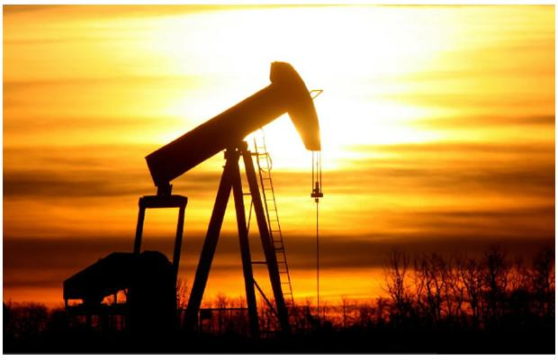
Canadian Oil and Gas Companies
Suncor, Crescent Point, Canadian Oil Sands
Prepared by Group 5: Sandy Tzu Ju Chen, Vincent Chen, Jenny Song, Cuong

Slide 2
AGENDA
Oil and gas industry overview
Crude oil introduction
Key stats of crude oil
Oil Sands technology
Oil production and reserves
Natural gas introduction
Key stats of natural gas
Natural gas production and reserves
Drilling activities and reserve remaining in Canada
Canadian oil and gas industry outlook
Company Analysis
1. Suncor
2. Crescent Point
3. Canadian Oil Sands

Slide 3
Underlying products from crude oil
Petroleum gas: used for heating, cooking, making plastics
Gasoline: motor fuel
Gas oil / Diesel distillate: used for diesel fuel and heating oil
Lubricating oil: used for motor oil, grease, other lubricants
Heavy gas or Fuel oil: used for industrial fuel
Residuals : coke, asphalt, tar, waxes; starting material for making other products
Kerosene: fuel for jet engines and tractors
Notes:
http://science.howstuffworks.com/environmental/energy/oil-refining2.htm

Slide 4
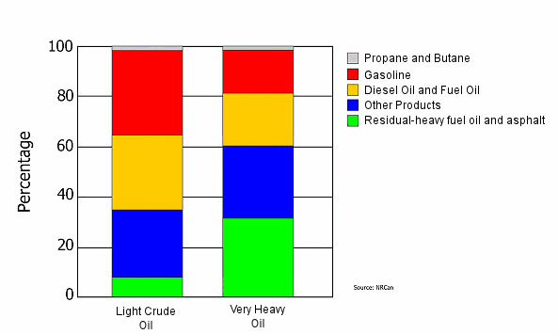
Underlying products from crude oil

Slide 5
Application of natural gas
Space and water heating
Climate control systems
Appliances, industrial uses
ex: processing forest products and manufacturing steel, fertilizers and cement
Electricity generation
Co-generation systems, and transportation.
Notes:
http://www.canadiannaturalgas.ca/faq/
What is natural gas?
Natural gas is naturally occurring hydrocarbon gas. Hydrocarbons are a class of organic compounds consisting of only carbon and hydrogen. Natural gas consists primarily of methane, but also ethane, propane, butane, pentanes and heavier hydrocarbons.

Slide 6
Canadian oil & gas industry components
Upstream/ Exploration & Production sector: Finds and produces crude oil and natural gas, mostly based in Calgary, Alberta
Midstream: Processes, stores, markets and transports commodities such as crude oil, natural gas, natural gas liquids (NGLs, mainly ethane, propane and butane) and sulphur to population centers
Downstream: Oil refineries, petrochemical plants, petroleum products distributors, retail outlets and natural gas distribution companies, provides underlying products from crude oil and gas
Notes:
Upstream:
Because Alberta accounts for more than 80 per cent of Canada's oil and gas production, many upstream businesses are based in Alberta and most have their head offices in Calgary.
Midstream: Processes, stores, markets and transports commodities such as crude oil, natural gas, natural gas liquids (NGLs, mainly ethane, propane and butane) and sulphur
Transmission pipeline companies are a major part of the midstream petroleum industry. Most of these companies are also based in Calgary, although their activities extend across the country, into the United States and sometimes abroad.
Downstream:
Although many downstream companies are headquartered in Calgary, the largest centres of activity are near Sarnia, Ontario, and Edmonton, Alberta. The downstream industry touches every province and territory-wherever consumers are located-and provides thousands of products such as gasoline, diesel, jet fuel, heating oil, asphalt, lubricants, synthetic rubber, plastics, fertilizers, antifreeze, pesticides, pharmaceuticals, natural gas and propane.
The upstream petroleum industry in Canada includes more than 1,000 exploration and production companies as well as hundreds of associated service businesses such as seismic and drilling contractors, service rig operators, engineering firms and various scientific, technical, service and supply companies.
The Canadian upstream petroleum industry has attained an international reputation for excellence in many areas including:
* high-tech exploration and production methods
* cold-climate operations
* development of oil sands, heavy oil and sour gas
* gas processing, sulphur extraction and heavy oil upgrading
* construction and operation of pipelines
* specialized controls and computer applications
* services, equipment and training for environmental protection and safety
* more

Slide 7
Canadian Oil and Gas Overview
Economic Factors
Mining, Quarrying, and Oil and Gas Extraction sector contributed 9.3 % GDP ($55.3 billion) in 2010 according to Statistic Canada
Toronto Stock Exchange and TSX Venture Exchange have a total of 439 public oil and gas companies in Canada with total value of $272 Billion
Oil and Gas accounts for 20% of TSX/TSXV total market capitalization
Oil and gas investment spending increased from 34 Billion to approximately 42 Billion in 2010
Notes:
http://www40.statcan.gc.ca/l01/cst01/gdps04a-eng.htm
http://www.tmx.com/en/pdf/OilGas_Presentation.pdf
Understanding GDP and Economic Growth
Economic growth is often measured as the percentage increase in GDP, adjusted for inflation, from one year over an earlier year. Trend growth rates for an economy, sector or industry are calculated over a series of years. In Canadian Industry Statistics, the compound annual growth rate (CAGR) is frequently used to depict trends in real GDP growth and other economic indicators.
GDP growth is an important economic indicator. It measures progress or the rate of expansion of the economy's capacity to produce output (goods and services). It is examined as a measure of the short term stability or instability of the economy. GDP growth is also reflective of the future consumption possibilities for a nation and is the main source of improvements to our standard of living over time.
Economic growth occurs from accumulating human capital (knowledge and skills), investing in physical capital (factories, machinery and equipment) and the implementation of new technologies in the production process.
With benefits to economic growth come costs. One cost to economic growth is that in order to increase the consumption possibilities for tomorrow, we have to forego some consumption today. To maintain economic growth more effort has to be placed on the production of technology and capital in order to produce goods for future consumption, rather than the production of goods for current consumption.
Other costs may occur from sustaining a high rate of economic growth, such as resource and environmental degradation. However, the impact faster economic growth has on our environment and resources are not reflected in the measure GDP growth.
Overview
According to the Oil and Gas Journal (OGJ),
-Canada had 178 billion barrels of proven oil reserves as of January 2009, second only to Saudi Arabia.
-The bulk of these reserves (over 95 percent) are oil sands deposits in Alberta, which are more difficult to extract and process than conventional crude oil.
-Canada is a net exporter of oil, with 2008 net exports of 1.0 million bbl/d (Barrel Per Day). Almost all of the countries exports flow to the United States, and it is consistently the top supplier of U.S. oil imports.

Slide 8
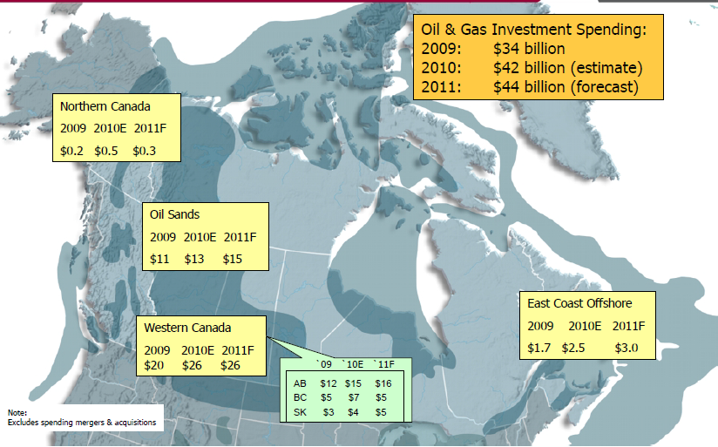
Oil and gas investment spending

Slide 9
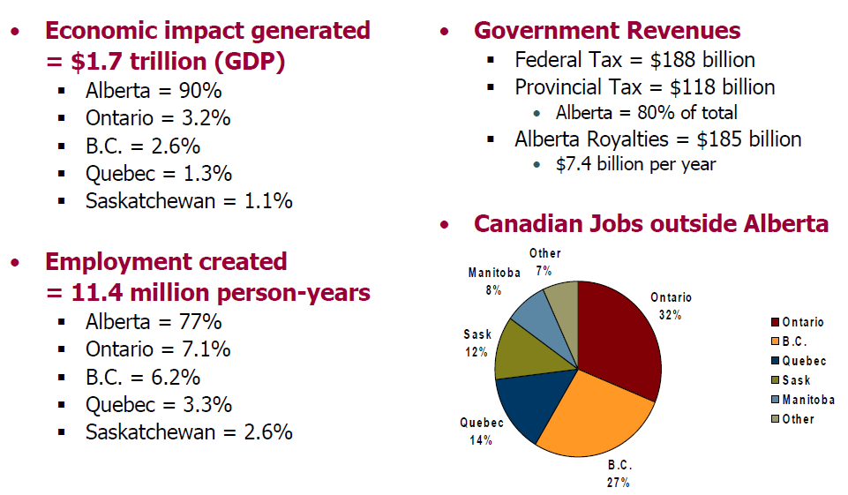
Canadian economic benefits of oil
Source: Canadian Energy Research Institute, 2009- over 25 years period

Slide 10
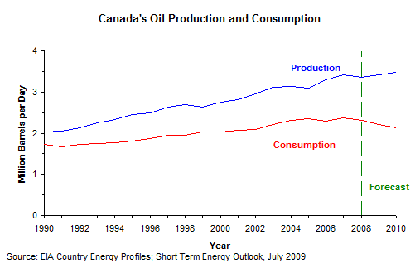
Canadian oil production key stats
-Canada had 175 billion barrels of proven oil reserves as of Dec 2010
-Over 95 percent are oil sands deposits in Alberta, which are more difficult to extract and process than conventional crude oil.
-Canada is consistently the top supplier of U.S. oil imports.

Slide 11
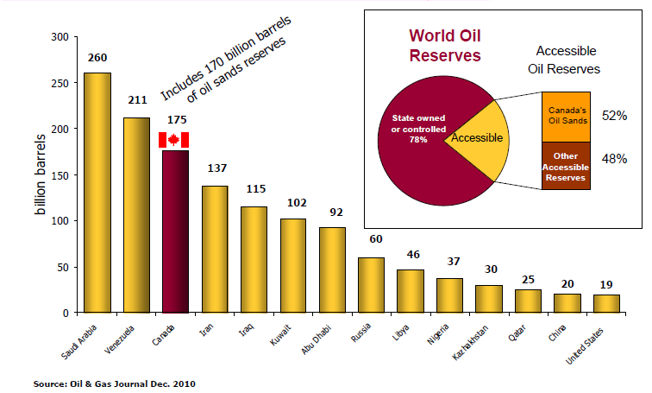
Canadian Oil Reserve and supply

Slide 12
How is the price of oil determined?
Worldwide supply and demand
Climate related events like hurricanes.
War and political unrest in some major producing regions.
OPEC (Organization of the Petroleum
Exporting Countries)
Value of the U.S. dollar (the currency at which crude oil is traded globally)
Notes:
Gasoline is refined from oil, the
price you pay at the pump generally follows
the ups and downs of the oil markets.
What is OPEC?
The Organization of the Petroleum Exporting
Countries (OPEC) is a permanent,intergovernmental Organization, representing
12 countries: Algeria, Angola, Ecuador,
Islamic Republic of Iran, Iraq, Kuwait,
Socialist People’s Libyan Arab Jamahiriya,
Nigeria, Qatar, Saudi Arabia, United Arab
Emirates and Venezuela. The Organization
has its headquarters in Vienna, Austria.
Because its members produce over 37% of
the world’s crude oil and have more than two
-thirds of the world’s estimated crude oil
reserves, OPEC has significant influence on
world oil prices. OPEC members are also the
only countries that have “spare production
capacity” and the ability to bring more oil
into production relatively quickly.
OPEC's objective is to co-ordinate and unify
petroleum policies among Member
Countries, in order to secure fair and stable
prices for petroleum producers; an efficient,
economic and regular supply of petroleum to
consuming nations; and a fair return on
capital to those investing in the industry.

Slide 13
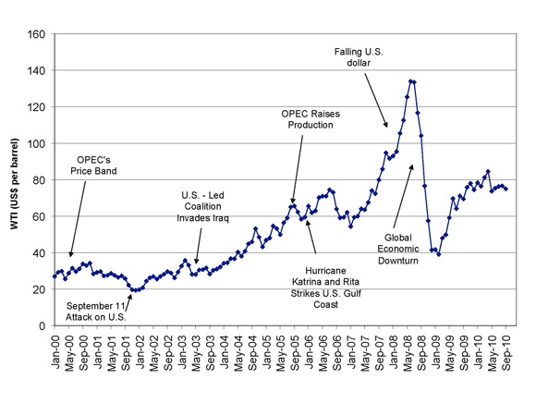
Crude Oil Market Timeline
Notes:
http://www.eia.gov/countries/index.cfm?view=production

Slide 14
Type of crude oil produced in Canada
Conventional crude oil: Refers to oil containing light, medium and heavy hydrocarbons based on American Petroleum Gravity (API) gravity and viscosity
Heavy crude oil: Thick consistency that does not flow easily
Light crude oil : can flow naturally to the surface
Bitumen: Heavy and extremely viscous oil from oil sands and must be treated before it can be used by refineries to produce usable fuels
Sweet crude oil (light/heavy) : lower content of Sulfur
Sour crude oil (light/heavy) : higher content Sulfur
Synthetic crude oil: low sulfur light crude oil. It is made by refining or upgrading heavy oil or bitumen or extracts from oil sands
Condensates: hydrocarbons recovered from a natural gas reservoir.
Pentanes: hydrocarbons containing molecules of 5 carbon atoms and 12 hydrogen atoms.
Notes:
Light crude oil: liquid petroleum with a gravity of 28°API or higher
Heavy crude oil: liquid petroleum with a gravity below 28°API
Bitumen: petroleum in semi-solid or solid form that is found in bituminous sands. It is so heavy (gravity below 12°API) and viscous that it will not flow unless heated or diluted.
Synthetic crude oil: a product similar to a high-quality light crude oil. It is made by refining or upgrading heavy oil or bitumen.
Condensates: hydrocarbons recovered from a natural gas reservoir.
Pentanes: hydrocarbons containing molecules of 5 carbon atoms and 12 hydrogen atoms.

Slide 15
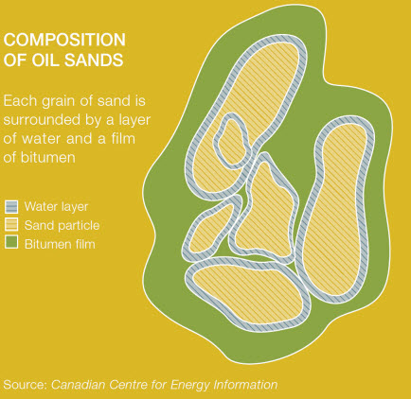
Oil sand
-Oil sand is a naturally occurring mixture of sand, clay or other minerals, water and bitumen
Notes:
Oil sand is a naturally occurring mixture of sand, clay or other minerals, water and bitumen, which is a heavy and extremely viscous oil that must be treated before it can be used by refineries to produce usable fuels such as gasoline and diesel. Bitumen is so viscous that at room temperature it acts much like cold molasses. A variety of treatment methods are currently available to oil sands producers and new methods are put into practice as more research is completed and new technology is developed.

Slide 16
Oil Sands & Conventional crude oil
Oil sands: extract bitumen from the ground then process it into a higher quality crude oil
Higher cost due to addition production cost to turn it into synthetic crude oil
Conventional oil: naturally occur oil that can be used immediately
Off shore drilling
2 methods currently used to extract bitumen from the ground:
Open pit mining: extract oil deposit near the surface
In situ (in place): extract deeper oil deposit
No additional processing cost
Notes:
Surface mining is used when the bitumen deposits are close to the surface, using truck and shovel technology. The sands are transported to a processing facility where hot water is used to separate the bitumen from the sands. Only 20 per cent of all oil sands is close enough to the surface to be mined.
In situ production recovers deposits that are deeper underground, using techniques that are similar to conventional oil production. Advanced drilling technology is used, typically injecting steam or solvents into the reservoir to mobilize the thick bitumen so it can be pumped to the surface through wells. Steam-assisted gravity drainage (SAGD) uses parallel pairs of horizontal wells, one drilled for steam injection and one for oil recovery.
1. "Open pit mining" resembles conventional mining techniques and is effective in extracting oil sands deposits near the surface.
2. “In situ” reaches deeper deposits. In situ extraction involves the use of steam to heat and separate bitumen from the surrounding sands, causing it to pool closer to the surface. The bitumen is then pumped from these pools using horizontal drain wells. To date, Canadian oil sands producers have employed each method almost equally, but future production will likely shift to emphasize in situ extraction.
Once extracted, oil sands producers must add lighter hydrocarbons to the bitumen to allow it to flow through pipelines. Upgraders then process some of the bitumen into synthetic crude, a relatively light, sweet form of crude oil that can be sold to a traditional oil refinery. Some of the bitumen is also sold in raw form, marketed to specialized refineries with deep conversion capacity. Some oil sands projects have integrated upgrading capacity, while others must send their raw bitumen production to another facility.

Slide 17
Oil sands: Synthetic crude oil process
Extraction: Separate bitumen from oil sands. (not required for in situ )
Bitumen is heated and sent to drums where excess carbon (petroleum coke) is removed.
Superheated hydrocarbon vapours sent to fractionators where vapour condenses into naphtha, kerosene and gas oil.
End product is Synthetic Crude Oil
Shipped via underground pipelines to refinery and refined into jet fuels, gasoline and other petroleum products.

Slide 18
Crude oil: Offshore drilling
Drill wells to confirm whether crude oil or natural gas is present deep within the earth.
1. Geoscientists determine the best location to search for these resources
2. Rig workers drill deep into the sea floor
Exploration drilling rigs used off the coast of Atlantic Canada are called Mobile Offshore Drilling Units (MODUs).
Notes:
To handle these challenges, the industry uses large, stable, self-contained platforms to drill wells
3 types of wells: exploration, delineation and development
-Exploration: confirm whether geological formations identified from seismic surveys do contain hydrocarbons.
-If results are promising, a company may drill delineation wells into different areas of the formation to confirm the formation’s size as well as characteristics of the hydrocarbon resources.
-Then decides whether it will be economically attractive to produce the resource. If test results are favourable, the company will proceed to the third stage, drilling a development well.

Slide 19
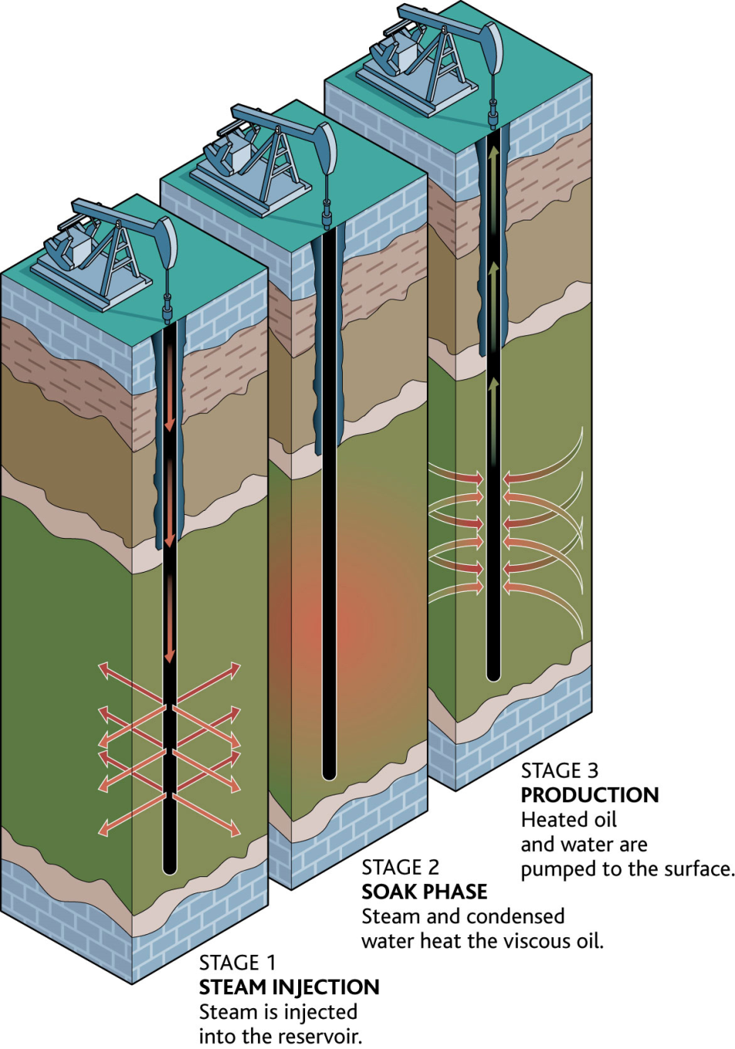
In-situ Technology: Cyclic Steam Stimulation (CSS)
-Inject high-pressure steam into the reservoir where heat softens bitumen and water dilutes and separates bitumen from sand
-The pressure creates cracks and openings through which the bitumen can flow back into the steam injector wells
The CSS method is currently used at Imperial Oil’s Cold Lake project and CNRL’s Wolf Lake-Primrose project.
Notes:
http://www.oilsandsdevelopers.ca/index.php/oil-sands-technologies/in-situ/the-process-2/toe-to-heel-air-injection-thai/
CSS Advantages:
Robust, proven technology
Requires 1 well bore (reduced capital investment)
Adaptable to thinner inter-bedded reservoirs
CSS Disadvantages:
Lower recovery factor (approx. 20%)
http://www.oilsandsdevelopers.ca/index.php/oil-sands-technologies/in-situ/the-process-2/cyclic-steam-stimulation-css/
The CSS in-situ method involves injecting the high-pressure steam into the reservoir for several weeks. Once the reservoir is filled with steam, the
reservoir is left to “soak” for several weeks. The heat softens the bitumen and the water dilutes and separates the bitumen from the sand. The pressure creates cracks and openings through which the bitumen can flow back into the steam injector wells. In the ensuing production phase, the bitumen is pumped up the same well through which the steam was injected. The CSS method is currently used at Imperial Oil’s Cold Lake project and CNRL’s Wolf Lake-Primrose project.

Slide 20
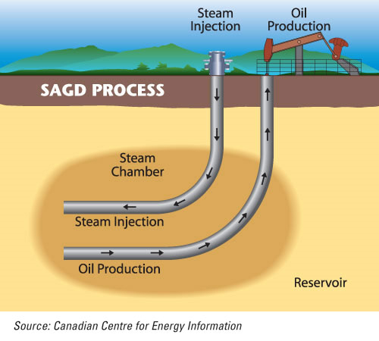
In-situ Technology: Steam Assisted Gravity Drainage (SAGD)
Employs 2 horizontal wells: 1 injection well with high pressure steam and 1 production well (lower well) which the softened bitumen continuously flows so it can be pumped to the surface.
Notes:
http://www.oilsandsdevelopers.ca/index.php/oil-sands-technologies/in-situ/the-process-2/toe-to-heel-air-injection-thai/

Slide 21
In-situ Technology: VAPEX and Solvent Technology
Combinations of solvents are injected into the ground using injection wells and equipment similar to SAGD.
Vaporized hydrocarbon solvents are injected into the reservoir, reducing the viscosity of bitumen by “dissolving” it in the solvent rather than by heating it and thereby causing it to drain into a horizontal production well.
Pros & Cons
Pros: Reduce operating steam-to-oil (SOR) ratios by 30 % and 85 % fewer GHG emissions.
Cons: Decreased efficiency: longer to produce oil
Notes:
http://www.oilsandsdevelopers.ca/index.php/oil-sands-technologies/in-situ/the-process-2/toe-to-heel-air-injection-thai/
Combinations of solvents are injected into the ground using injection wells and equipment similar to SAGD.
Vaporized hydrocarbon solvents are injected into the reservoir, reducing the viscosity of bitumen by “dissolving” it in the solvent rather than by heating it and thereby causing it to drain into a horizontal production well.
Cold solvent technology is a non-thermal in-situ production method that results in as much as 85 per cent fewer GHG emissions than thermal processes; however, it also takes considerably longer to produce the oil.
Solvent-steam technology uses solvents along with steam to increase the efficiency of steam-assisted oil sands production while still minimizing environmental impacts.
Laricina Energy Ltd. has explored the possibility of using solvents with steam in different geologic formations using Genetic Algorithms software, a computer program that mimics the genetic process in order to find the best possible solvent-steam recipe for getting the most oil out of a reservoir.
Using solvents instead of steam could mean reducing the operating steam-to-oil (SOR)* ratios by 30 per cent, with the accompanying reduction in GHG emissions.
*Note: SOR is the volume of steam required to produce one unit volume of oil. The lower the SOR, the more efficiently the steam is utilized and the lower the associated fuel costs.
To date, solvent use is still in the development stage and is not yet commercially applicable.

Slide 22
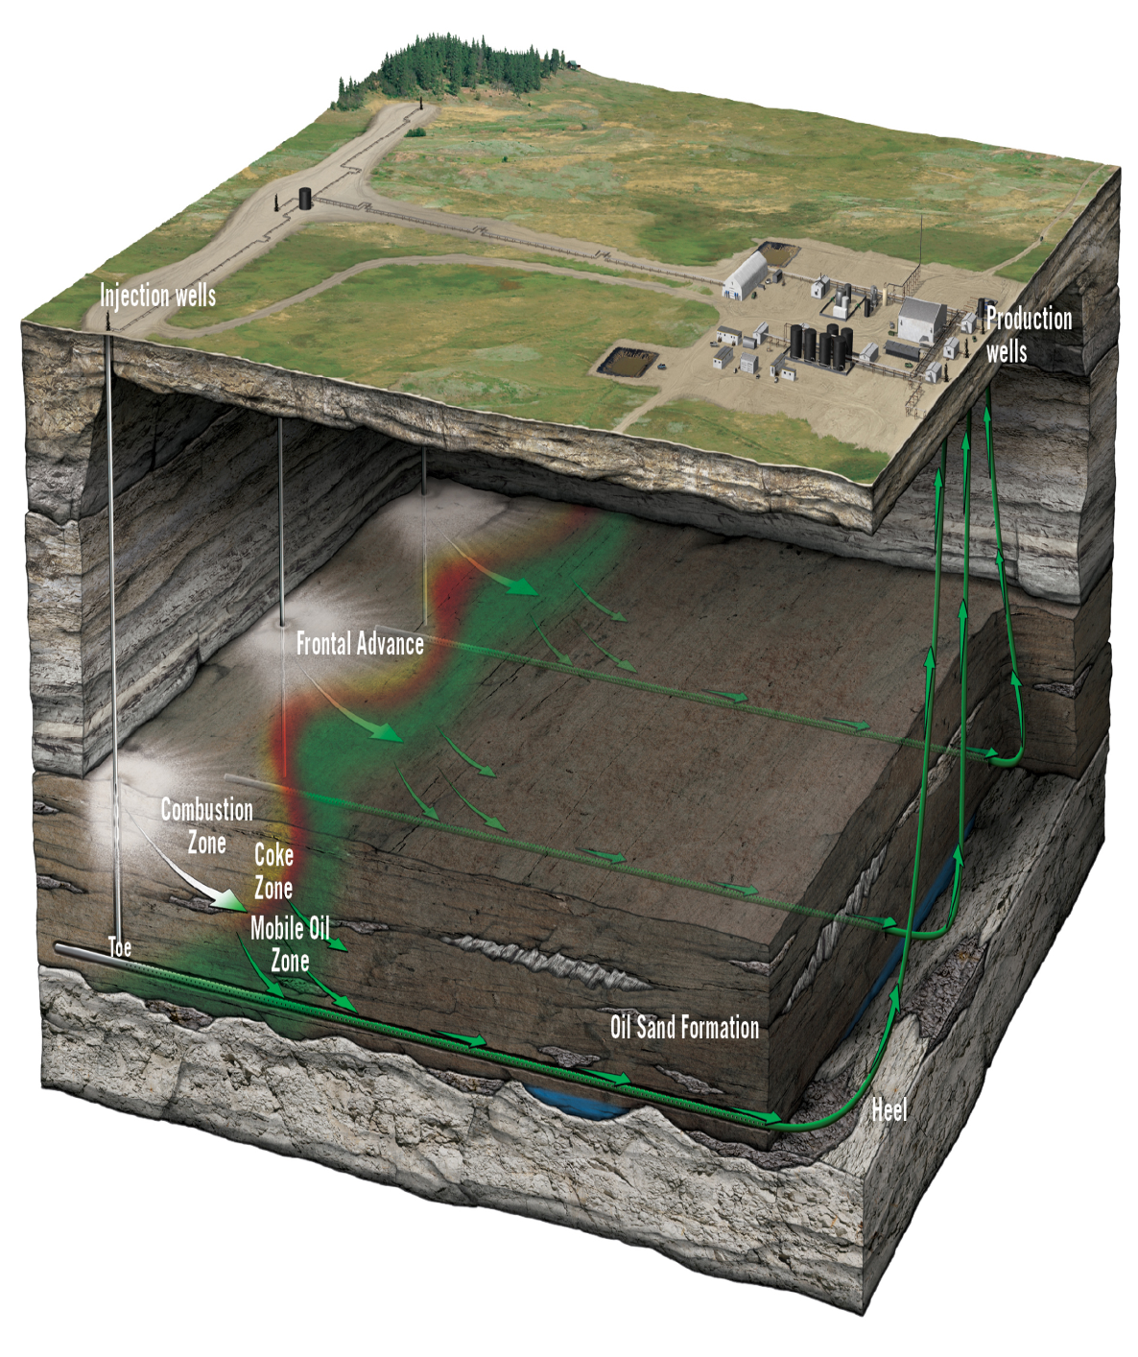
In-situ Technology: Toe-to-Heel Air Injection (THAI)
-THAI uses two wells; a vertical air injection well with a horizontal production well
-Injects air and then relies on underground combustion of a portion of the oil in the ground to generate the heat required to “melt” the remainder of the bitumen and allow it to flow into the production well.
Pros:
-much less energy intensive than other in-situ technologies
-50 % lower GHGs than other oil sands production methods and low water use
Notes:
http://www.oilsandsdevelopers.ca/index.php/oil-sands-technologies/in-situ/the-process-2/toe-to-heel-air-injection-thai/
Like CSS and SAGD, THAI technology also uses heat to reduce the viscosity of the bitumen; however, the heat is generated underground by the combustion of a small portion of the bitumen in the ore body.Employed chiefly by Petrobank Energy and Resources Ltd., THAI technology uses two wells; a vertical air injection well with a horizontal production well.Rather than steam, THAI technology injects air and then relies on underground combustion of a portion of the oil in the ground to generate the heat required to “melt” the remainder of the bitumen and allow it to flow into the production well. Air is injected into an injection well where the process ignites oil in the reservoir where it smolders like the embers of a campfire and creates a vertical wall of hot embers. This firewall moves from the injection well (the toe) to the production well (the heel), pushed forward by the pressure of the injected air, causing the heavier oil components to burn and softening the lighter components causing them to flow ahead of the firewall and into the production well where they can be pumped to the surface. THAI technology has the potential to be much less energy intensive than other in-situ technologies because the bitumen “cokes”, meaning it sheds heavy carbon molecules as it moves through the ground towards the production well. This results in a lighter, partially upgraded oil product being brought to the surface, meaning less life-cycle GHG emissions overall as it also reduces the amount of energy-intensive upgrading the produced oil has to undergo. As well, minimal natural gas is used in the process and, as there is little steam required, very little water is used.
Overall, THAI technology produces 50 per cent fewer GHGs than other oil sands production methods, requires very low water use and, like other in-situ projects, has a minimal surface footprint.

Slide 23
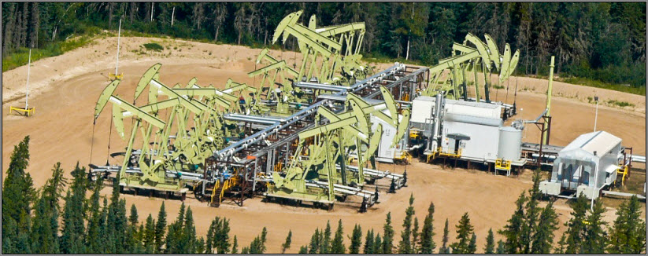
Canada’s oil sands deposits
170 billion barrels of economically viable oil
Current oil sands production is about 1.3 (out of total 3.29 M bbl/day) million barrels of oil per day in 2009
Notes:
Canada’s oil sands deposits contain as much as 173 billion barrels of economically viable oil, second only in size to Saudi Arabia
Current oil sands production is about one million barrels of oil per day. By 2020, production is expected to grow to almost four million barrels per day. There is the potential for over 100 years of production.
There are three deposits of oil sands in Alberta. The largest is near Fort McMurray but there are two more near Peace River and Cold Lake (see map). There are currently more than 20 active mining and in-situ oil sands projects in these three areas.
The oil in the oil sands is called bitumen. Bitumen is extra heavy oil that does not flow in its natural state (it is as thick as peanut butter). It must be processed, or upgraded, to resemble light crude oil. There are two kinds of oil sands production -- mining and in situ.
Surface mining is used when the bitumen deposits are close to the surface, using truck and shovel technology. The sands are transported to a processing facility where hot water is used to separate the bitumen from the sands. Only 20 per cent of all oil sands is close enough to the surface to be mined.
In situ production recovers deposits that are deeper underground, using techniques that are similar to conventional oil production. Advanced drilling technology is used, typically injecting steam or solvents into the reservoir to mobilize the thick bitumen so it can be pumped to the surface through wells. Steam-assisted gravity drainage (SAGD) uses parallel pairs of horizontal wells, one drilled for steam injection and one for oil recovery.
The oil sands are owned by the people of Canada through their governments. Companies buy rights to access the resource, and pay royalties to government on their production.

Slide 24
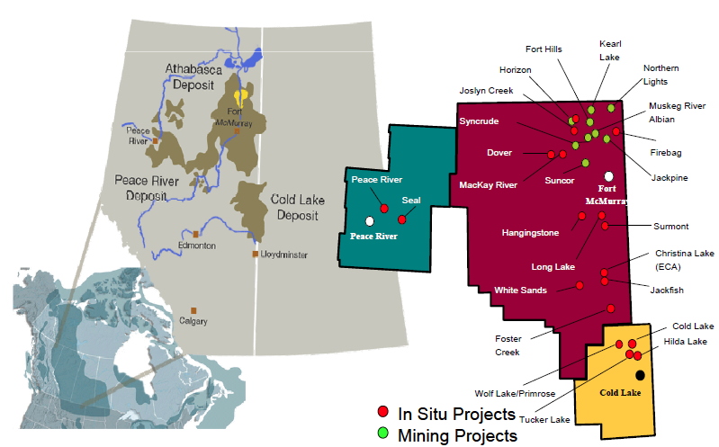
OIL SANDS DEPOSITS AND PROJECTS

Slide 25
Oil Sands Rights
Oil Sands Tenure
Crown-owned mineral rights, including oil sands rights, are leased and administered
How to Acquire Oil Sands Rights
a corporation must be registered to conduct business in the Province of Alberta and comply with Section 23 and 16 of the Mines and Minerals Act
Oil sands agreements convey the right to “drill for, win, work, recover and remove” oil sands that are owned by the Crown.
2 types of Oil Sands agreements
Permits that are issued for a term of 5 years.
Leases that are issued for a term of 15 years.
2 ways to acquire Oil Sands agreements
By a registered transfer (to buy into an existing agreement)
By public sale by meeting a standard criteria: 1) active tenure client 2)have Electronic Transfer System (ETS) account 3) have EFT account
Notes:
About Oil Sands Tenure
The term tenure describes the system through which Crown-owned mineral rights, including oil sands rights, are leased and administered. By facilitating the leasing of these rights, the tenure system makes it possible for individuals and companies to explore for and develop Alberta's mineral resources for the benefit of the citizens of the province.
The viability of Alberta's economy and its non-renewable resource industries depends on the orderly development of the province's oil, gas, oil sand and other mineral resources. It is important that both the people of Alberta and producers realize an acceptable return from the development of these resources. At the same time, non-renewable resources must be managed in a manner that considers the environment and promotes sustainable development.
How to Acquire Oil Sands Rights
The following is a general summary of the necessary steps towards acquiring oil sands rights. More detailed guidelines can be found in the Oil Sands Tenure Guidelines.
In order to acquire oil sands rights, a corporation must be registered to conduct business in the Province of Alberta and comply with Section 23 of the Mines and Minerals Act. Crown-owned oil sands rights are disposed by means of agreements under Section 16 of the Mines and Minerals Act. Oil sands agreements convey the right to “drill for, win, work, recover and remove” oil sands that are owned by the Crown.
There are two types of Oil Sands agreements:
Permits that are issued for a term of 5 years.
Leases that are issued for a term of 15 years.
There are two ways to acquire an Oil Sands agreement:
By way of a registered transfer (that is, to buy into an existing agreement). The Department does not participate in the negotiations between the lease holders and the interested buyer. The transfer can either convey the entire agreement or just a specified interest. Contact: Retha Purkis – Manager, P&NG Sales and Registrations, 780-422-9426.
By way of public sale. To acquire by public sale, the interested stakeholder must meet the following criteria:
Be an active Tenure client (obtain a unique client identifier from the Department).
Have an Electronic Transfer System (ETS) account. Contact: Agnes Kilmarnock, Supervisor - Crown Land Data Services, 780-422-1378.
Have an Electronic Funds Transfer (EFT) account. Contact: Chris Rudland - Manager, P&NG Sales and Registrations, 780-422-9426.
Provide a GST registration number to the Department or be liable to pay the Goods and Services Tax. Contact: Yasmin Suleman - Business Analyst, Financial Services, 780-422-5860.
Note: All sale parcels are published here, eight weeks prior to the date of the sale.

Slide 26
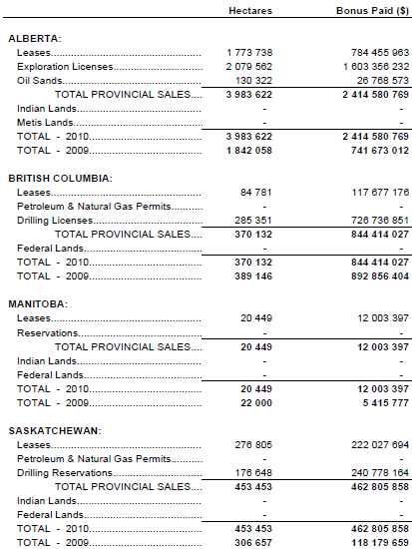
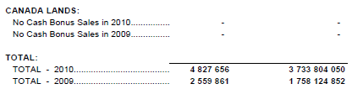
2010 crown land sales western canada and canada lands
←
→
Notes:
83% alberta
88% increase from 2009

Slide 27
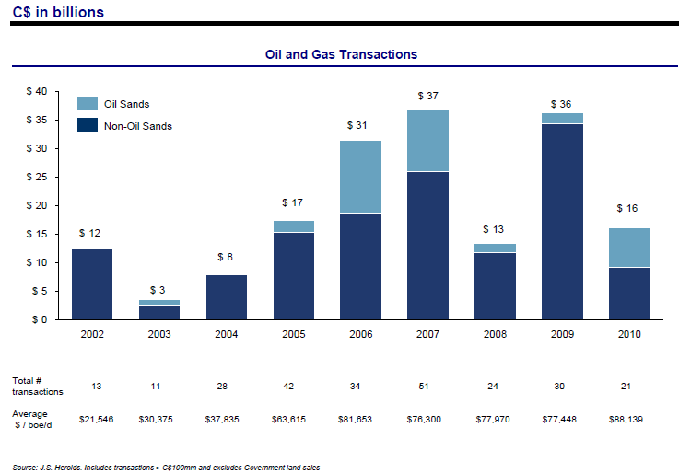
Acquisition activity

Slide 28

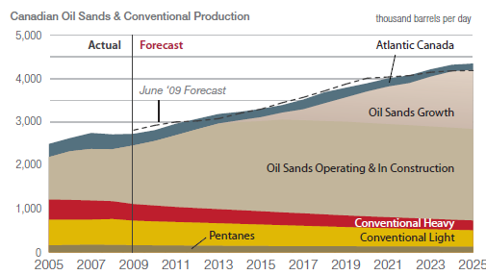
Canadian Oil Production
Source: Western Canada Sedimentary Basin (WCSB); the oil sands deposits of northern Alberta; and offshore fields in the Atlantic Ocean. Alberta contains the largest share of Canada’s oil production

Slide 29
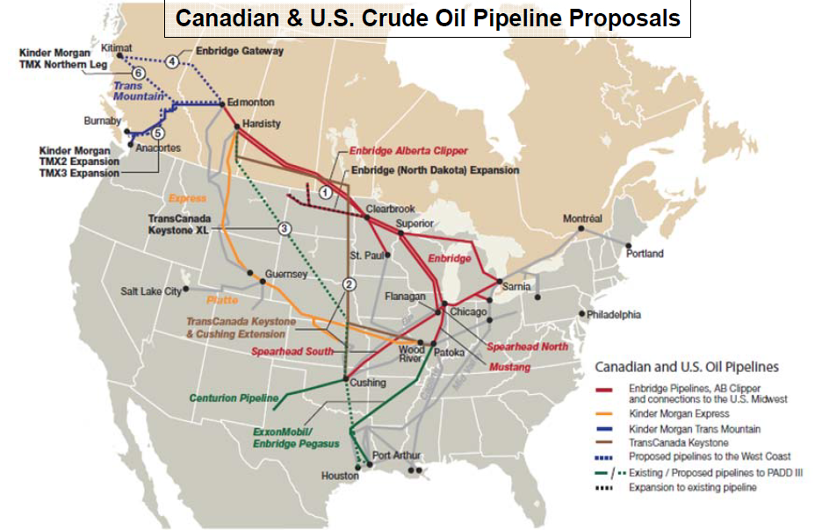
Access to current and new oil markets

Slide 30
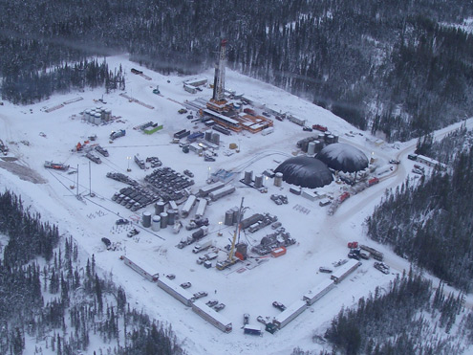
Canada natural gas
Overview and Industry Analysis

Slide 31
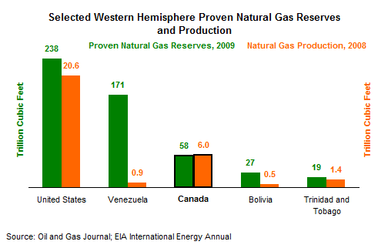
Natural Gas-Key factors
Wholesale prices in 2010 (Jan to Sept) averaged $4.60/MMbtu, 34% below the 5-year average of $7/MMBtu.
Canada had 57.9 trillion cubic feet (Tcf) of proven natural gas reserves in January 2009
Moderate post-recession demand growth provide market conditions for lower prices which are a direct benefit for gas consumers.
Notes:
In 2008 net export revenue totaled $28 billion making it the second largest contributor to Canada’s energy trade surplus.
North America has over a century of natural gas supply at today’s consumption levels. This abundant supply will ensure that natural gas continues to be a capable, reliable, secure, safe, and environmentally acceptable fuel.

Slide 32
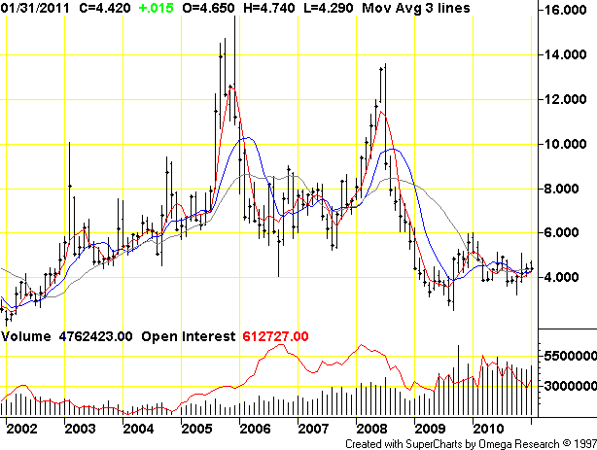
Natural oil gas price
Y-AXIS: price per MMBTU
Highs and lows of stock price
Blue, red and grey are moving avg
X-AXIS: YEAR
Notes:
http://futures.tradingcharts.com/chart/NG/M
Y-AXIS measures price per MMBTU:
A BTU (British thermal unit) is the amount of heat required to increase the temperature of a pint of water (which weighs exactly 16 ounces) by one degree Fahrenheit. Since BTUs are measurements of energy consumption, they can be converted directly to kilowatt-hours (3412 BTUs = 1 kWh) or joules (1 BTU = 1,055.06 joules). A wooden kitchen match produce approximately 1 BTU, and air conditioners for household use typically produce between 5,000 and 15,000 BTU.
Candle stick graph. Shows the highs and lows of the stock price in every month as well as the opening and closing price. The dot is the closing price.
The blue, red, and grey represent moving averages.
Grey line is 18 day moving average
Blue line is 9 day
Red line is 4 day
Reasons for price fluctuations:
In 2008, Hurricane Ike, in the golf of Mexico, struck the Texas coast and caused refineries to close, causing shortage in supply, and driving up prices.
In 2008 – early 2009, the recession hit and drove down the price.
Currently, the decreasing prices have led people to believe that the natural gas isn’t profitable, and so fewer are willing to mine conventional natural gas, lowering the supply and driving the prices up again.
Why do natural gas prices fluctuate?
North American natural gas prices are set in an open continental marketplace and are subject to the forces of supply and demand. A variety of factors put pressure on the supply/demand balance and increase and decreases the market price of natural gas.
On the supply side, these pressures include:
plateaus in natural gas production from the conventional supply basins in North America and slower than expected development of new gas supplies such as liquefied natural gas, coalbed methane, and arctic gas.
high oil prices which can put pressure on natural gas as an alternative fuel in industrial applications.
occasional production disruptions (e.g. due to hurricanes).
On the demand side, these pressures include:
generally strong North American economic growth increasing demand for natural gas
substitution between certain higher priced petroleum based products and natural gas, particularly for some industrial and heating uses
stronger natural gas demand by homeowners, schools, and businesses motivated by environmental concerns to seek efficient, clean and reliable natural gas based energy
colder than normal winter weather

Slide 33
Natural gas price fluctuations
Supply side influences:
Production efficiency and output: slower than expected development of new gas supplies such as liquefied natural gas, coalbed methane, and arctic gas.
Substitutes: high oil prices which can put pressure on natural gas as an alternative fuel in industrial applications.
Environmental factors: occasional production disruptions (e.g. due to hurricanes).
Demand side influences:
Economic state: growth increases demand for natural gas
Substitution: Higher priced petroleum based products and natural gas for some industrial and heating uses
Natural gas demand: homeowners, schools & businesses motivated by environmental concerns to seek efficient, clean and reliable natural gas based energy
Seasonality: Colder than normal winter weather
Notes:
Natural gas prices are set in an open continental marketplace and are subject to forces of supply and demand
A variety of factors put pressure on the supply/demand balance and increase and decreases the market price of natural gas.

Slide 34
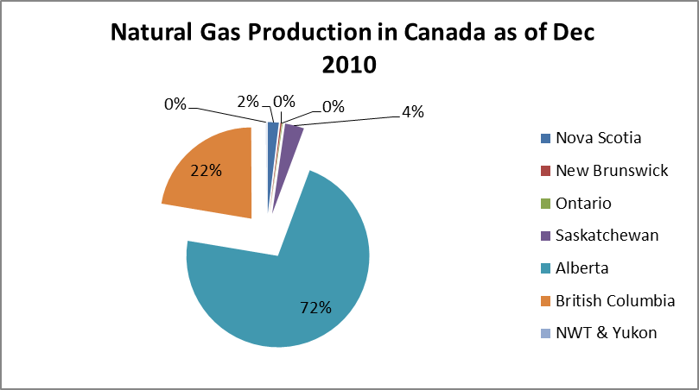
Sources of Canadian Natural Gas Production
Notes:
http://www.neb.gc.ca/clf-nsi/rnrgynfmtn/sttstc/mrktblntrlgsprdctn/mrktblntrlgsprdctn-eng.html
Natural gas is found in many parts of Canada with producing regions concentrated primarily in the western provinces (B.C., Alberta and Saskatchewan), and offshore fields in Canada’s Maritimes, with minor production in Ontario and Northern Canada.

Slide 35
Conventional & unconventional gas
Conventional gas/shale gas: Shale gas is natural gas stored in organic rich rocks such as dark-coloured shale and sandstone
less costly to drill via traditional vertical wells
A conventional gas well may be fully depleted in 5 years and becoming increasingly scarce and harder to pinpoint geographically
Unconventional natural gas: gas contained in low porosity formations typically spread over larger geographic areas
Pinpointing reservoirs and choosing drilling sites is easier
Production is costly requiring specialized horizontal drilling, completion
(fracking), and production technology that allow economic gas flow rates
Notes:
What is unconventional gas?
“Unconventional” gas is the same substance as “conventional” natural gas. The key difference is the manner and ease with which the resource is extracted. Natural gas comes from both ‘conventional’ (easier to produce) and ‘unconventional’ (more difficult to produce) geological formations. Unconventional gas reservoirs include tight gas, coal bed methane, gas hydrates, and shale gas. While most potential unconventional gas reservoirs have been known for many years only recently have technological advancements in drilling and wellbore stimulation allowed for the economic extraction of these resources.
Renewable natural gas is methane obtained
from biomass which has been upgraded to
a quality similar to fossil natural gas. By
upgrading the quality to that of natural
gas, it becomes possible to distribute the
gas to customers through the existing
natural gas pipeline system and burned
within existing appliances

Slide 36
Unconventional gas type
Shale Gas: Found in extremely fine-grained, essentially impermeable sedimentary rocks requiring complex reservoir stimulation to help the natural gas flow.
Tight Gas: Found in the pore space of sedimentary rocks that have very low permeability. Reservoir stimulation is required to recover tight gas resources.
Coal Bed Methane: Formed during the process of coalification where methane is trapped as peat turns into coal. A range of reservoir stimulation methods are used to recover the resource.
Notes:
In coal seams, methane is primarily stored by adsorption to solid hydrocarbon molecules.
What is unconventional gas?
“Unconventional” gas is the same substance as “conventional” natural gas. The key difference is the manner and ease with which the resource is extracted. Natural gas comes from both ‘conventional’ (easier to produce) and ‘unconventional’ (more difficult to produce) geological formations. Unconventional gas reservoirs include tight gas, coal bed methane, gas hydrates, and shale gas. While most potential unconventional gas reservoirs have been known for many years only recently have technological advancements in drilling and wellbore stimulation allowed for the economic extraction of these resources.

Slide 37
Natural gas: Technology
How is natural gas produced?
Natural gas is brought to the surface from a reservoir using gas wells and to processing plants
Technology:
Shale gas fracking: Input water pressure and sand via horizontal well bore to fracture shale, forcing gas to expand and pumped to surface from the vertical drilled well bore
Notes:
How is natural gas produced?
Natural gas is brought to the surface from a reservoir using gas wells. Pipeline gathering systems transport gas from individual wells to processing plants. Processed natural gas consists almost entirely of methane, with most other hydrocarbon components (byproducts) and non-hydrocarbon components removed from the natural gas either at processing facilities at the gas field or at plants located along the pipeline system.
Fracking: http://www.theglobeandmail.com/report-on-business/industry-news/energy-and-resources/how-fracking-works/article1755918/?from=1874941

Slide 38
Drilling activity-Canada
Test/exploration nearby productive area or inspection for productive reservoir:
New field wildcat
New pool wildcat
Deeper pool test (within productive area of developed pools to explore deeper unknown prospects)
Shallower pool test
Outposts
Stratigraphic test
Dry development hole: the well is not completed for production and is abandoned
Active development wells:
Bitumen Wells
Service Wells
Miscellaneous Wells ( storage wells)

Slide 39
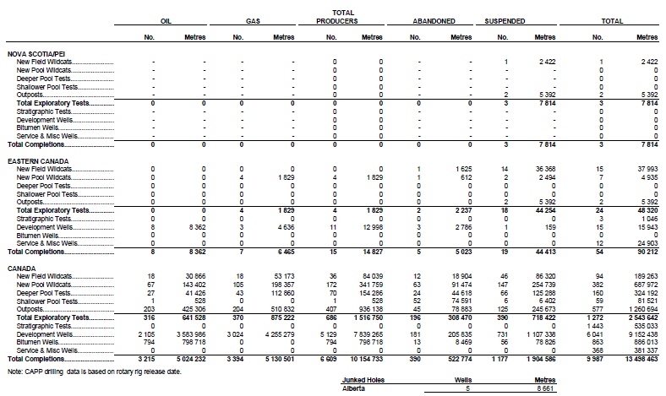
overall drilling 2009

Slide 40
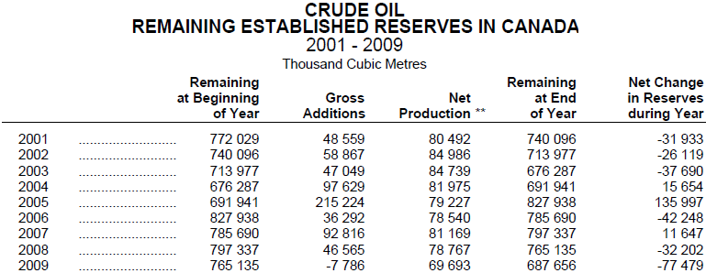
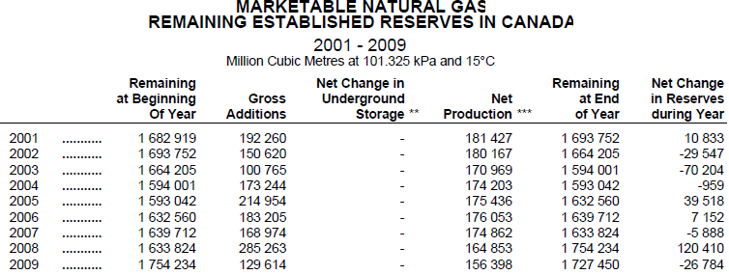
Remaining Reserves of oil & gas

Slide 41
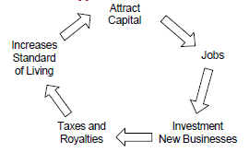
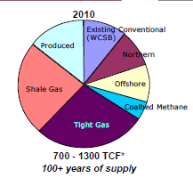
Industry Analysis: Canada’s advantage
Rich resources
Supportive government structure
Alberta Energy
“Open for business” approach.
Established infrastructure
Well-established skills and capacity
Technology advancement increases production of non-conventional gas
Notes:
http://www.energy.alberta.ca/AboutUs.asp
http://www.capp.ca/getdoc.aspx?dt=PDF&docID=180184

Slide 42
Industry Analysis: Risks and constraints
Crude oil and oil sands
Oil Price stable
Local / regional environmental & social impacts
Global climate change
Role of fossil fuels in future energy system.
Risk of natural gas
Strong global competition against geographic, cost and infrastructure challenges.
Shale gas pipeline safety concerns
Prices remain low
Potential competitiveness impacts - e.g., climate policy in B.C.
Jurisdictional overlap & complexity - e.g., Species-at-risk (caribou)
Notes:
http://www.capp.ca/getdoc.aspx?dt=PDF&docID=180184
Oil
Drilling activity driven by resource plays – Cardium, Bakken etc. (triple vs year ago)
Record land sales in Alberta driven by Cardium play
Oil sands projects back on the table

Slide 43
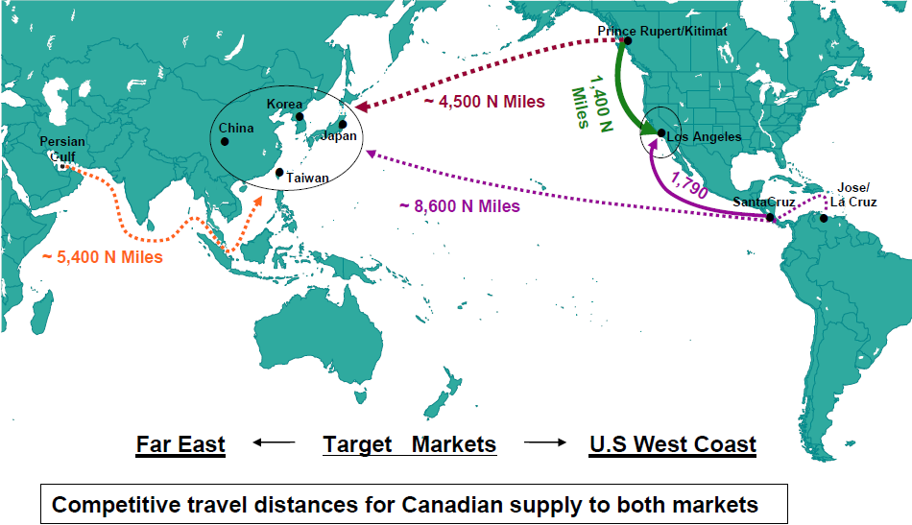
Competitive travel distance btw both target markets

Slide 44
Industry Analysis: Outlook
Economic recovery boosts energy demand growth
Increasing role for renewables
Increase number of deeper horizontal wells
Continuing reliance on hydrocarbons
Increase role for non-conventional crude oil & natural gas
Increase global investment interest : China, Japan, Korea
To sustain growth:
Production Process eg: efficiency and maximized output
Cost competiveness eg: travel distance challenge
Environmental performance eg: water, air, surrounding
Technology advancement

Slide 45
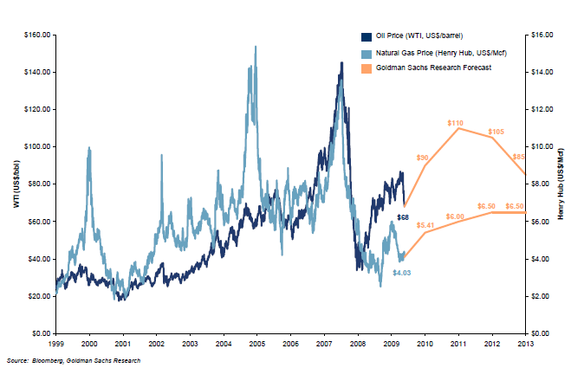
Trend: Canada’s crude oil and gas price

Slide 46
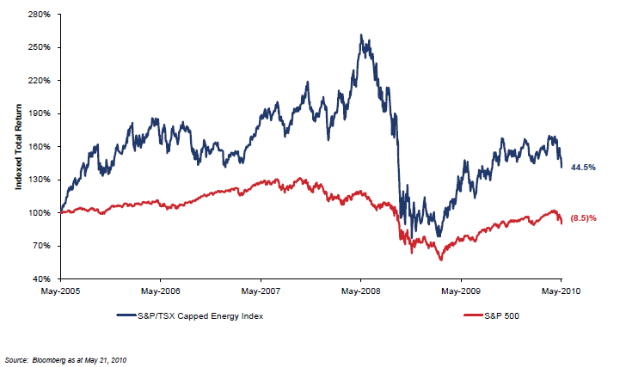
Trend: Total Return Performance of Canadian Energy Sector

Slide 47
Top players by market capitalization
Stock | Latest Price | 5-day % Chg | 1-year % Chg | Market Cap | Yield
Ecopetrol S.A. | 39.16 | -3.05 | -- | 79,245.35 | --
Suncor Energy | 44.12 | 2.39 | 42.88 | 69,069.37 | 0.90
Canadian Natural Resources | 47.78 | -0.06 | 33.02 | 51,967.96 | 0.80
Imperial Oil | 50.15 | 0.14 | 30.02 | 42,507.09 | 0.90
Cenovus Energy | 37.69 | 4.09 | 49.68 | 28,368.32 | 2.10
TransCanada Corp. | 39.20 | 1.42 | 3.65 | 27,292.22 | 4.30
Husky Energy | 29.49 | -0.71 | 7.43 | 26,267.00 | 4.10
EnCana Corp. | 34.04 | 1.16 | 11.42 | 25,063.65 | 2.30
Talisman Energy | 23.80 | 0.68 | 39.67 | 24,259.12 | 1.10
Enbridge Inc. | 59.70 | 3.65 | 21.42 | 22,268.10 | 3.30
Canadian Oil Sands | 31.40 | 0.58 | 9.26 | 15,197.60 | 2.60
Data taken from Globe and Mail on March 27, 2011
Notes:
http://www.theglobeandmail.com/globe-investor/markets/stocks/competitors/?q=SU-T
Market capitalization (often market cap) is a measurement of size of a business enterprise (corporation) equal to the share price times the number of shares outstanding (shares that have been authorized, issued, and purchased by investors) of a publicly traded company.
What Does Market Capitalization Mean? The total dollar market value of all of a company's outstanding shares. Market capitalization is calculated by multiplying a company's shares outstanding by the current market price of one share. The investment community uses this figure to determining a company's size, as opposed to sales or total asset figures.

Slide 48

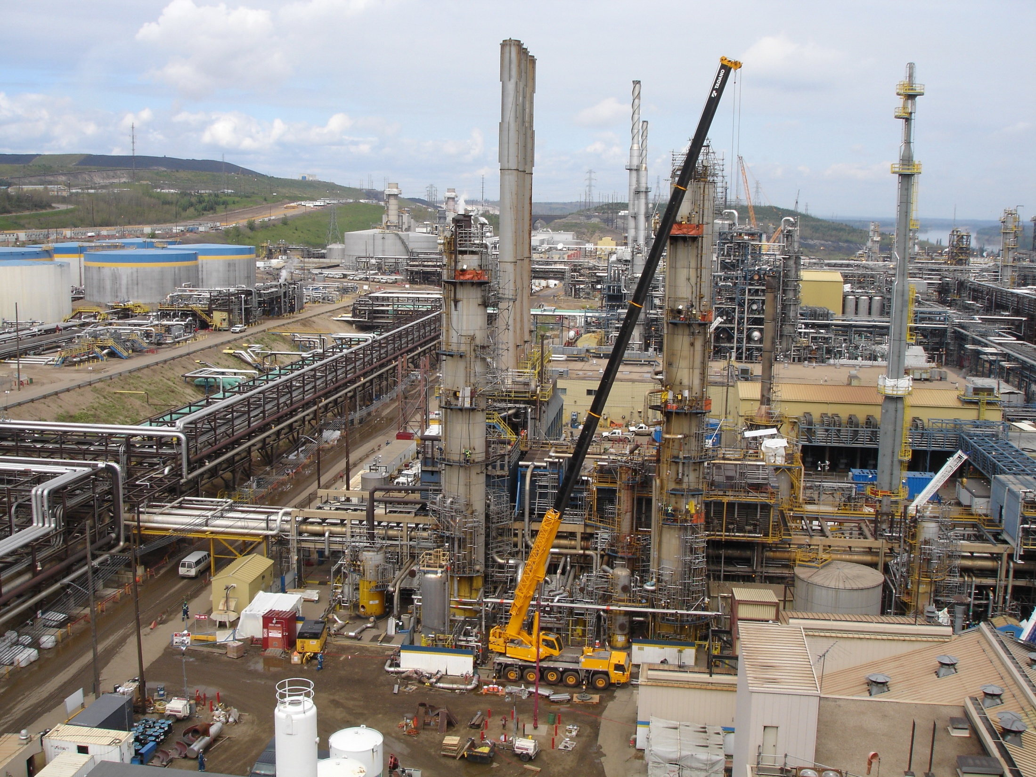
Notes:
Oil sands upgrader

Slide 49
Agenda
Stock Information as of March 15, 2011
Company Background
Management Team
Integrated Strategy
Analysis on Suncor’s Consolidated Financial Statements
Recommendation

Slide 50
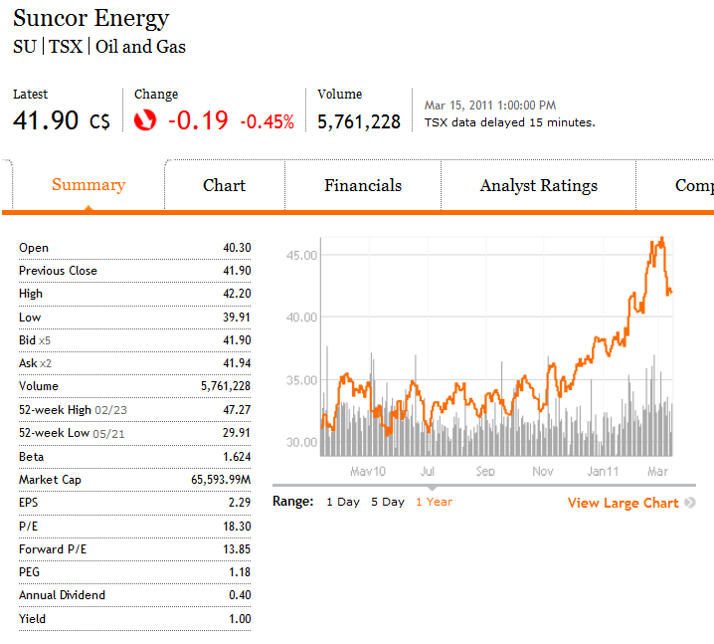
Stock Performance

Slide 51
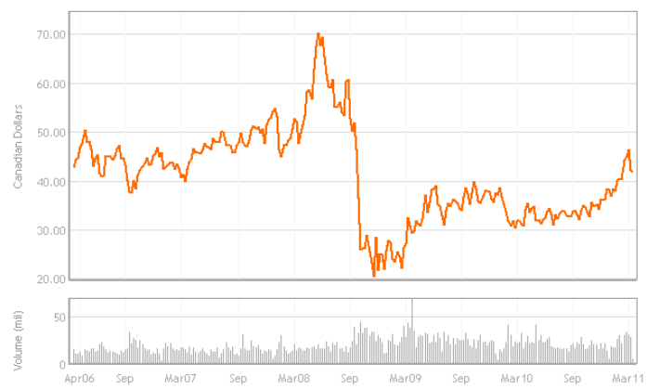
5 year Movement

Slide 52
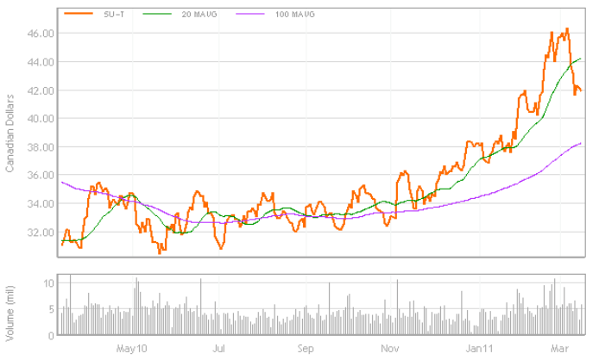
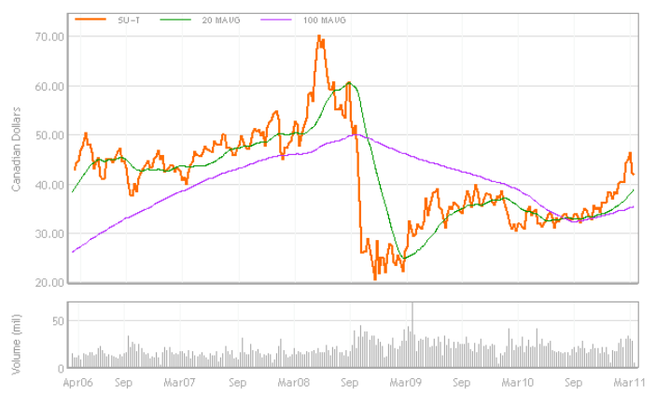
Moving Averages
Moving Averages
1 year period
5 year period

Slide 53
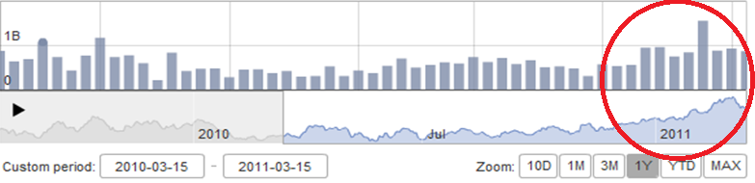
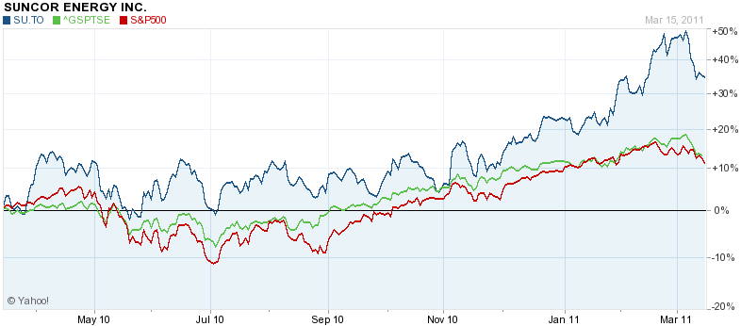
Trading Volumes and Relative Performance
Outperform: S/P 500 & TSX Composite Index

Slide 54
Outstanding Common Shares

Slide 55
Merger with Petro-Canada
On August 1, 2009, Suncor completed its merger with Petro-Canada
Accounted as “Business Combination”, Suncor is the acquirer and Petro-Canada is acquiree
Product marketing under the Petro-Canada brand
The merger increased Suncor’s asset base by $35.8 billion, including goodwill, and long-term debt by $4.4 billion
Solid performance from assets during 2010 after the August 2009 merger with Petro-Canada
Additional upstream production and refining product sales
Notes:
The merger increased Suncor’s asset base by $35.8 billion, including goodwill, and long-term debt by $4.4 billion.

Slide 56
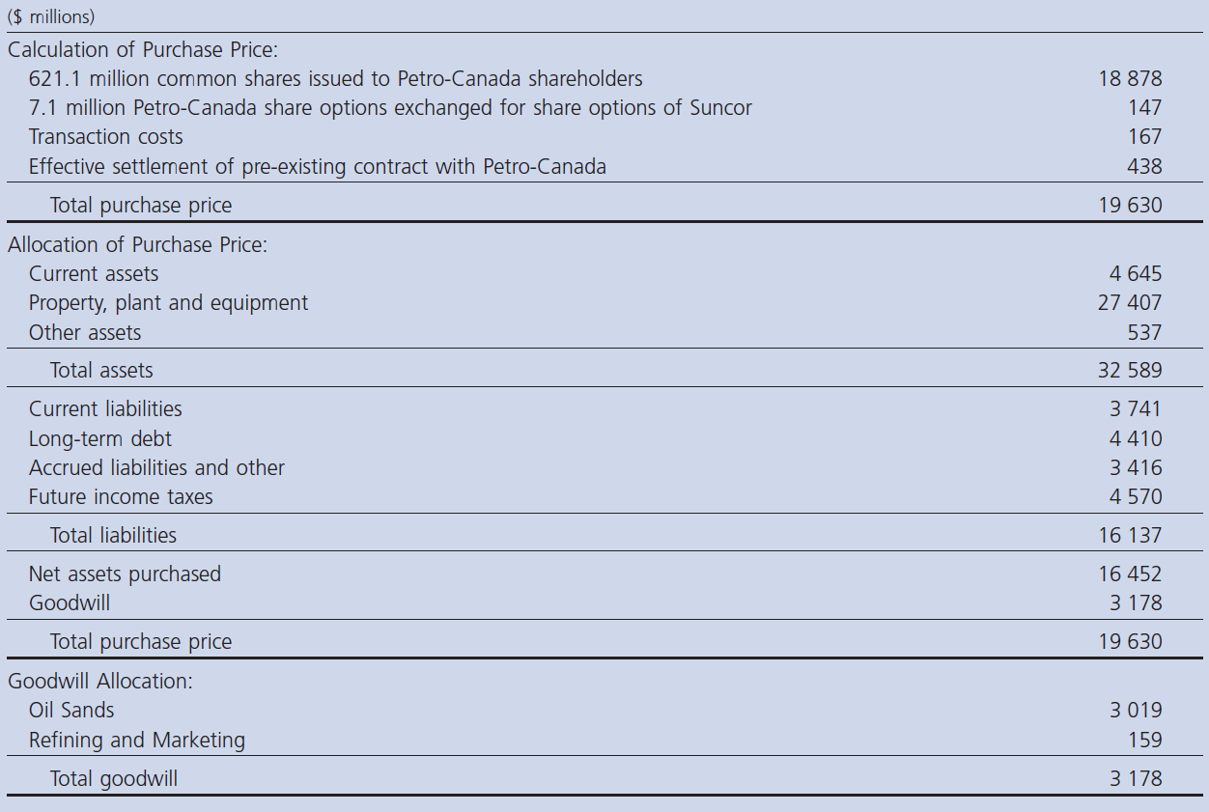
Merger with Petro-Canada

Slide 57
Company Profile
Beginning in the 1960s, Strategically focused on developing one of the world’s largest petroleum resource basins – Canada’s Athabasca oils sands
Pioneering the industry in 1967 and became a publicly traded company in 1992
The core oil sands business is supported by conventional natural gas production in Western Canada and downstream refining, marketing and retail businesses in Ontario and Colorado
Significant progress since 1992:
- Daily oil sands production has more than tripled
- One of the lowest cost producers in North America
- Growth in market capitalization ($1 billion to more than $19 billion at the end of 2004)
Notes:
Oil Sands Development Beginning in the 1960s
Oil sands development eventually would account for 85 percent of the company's crude oil, but when Sun Oil began building its presence in the business during the mid-1960s the field was regarded as experimental, its financial viability in dispute. Nevertheless, the company committed its resources to the business, beginning construction of the Great Canadian Oil Sands plant at Fort McMurray in 1964. The 45,000-barrel-a-day plant was finished five days ahead of schedule, its opening in 1967 heralding the debut of the first commercial-scale oil sands processing facility.
In 1967, we pioneered commercial development of Canada's Athabasca oil sands — one of the world's largest petroleum resource basins. Since then, Suncor has grown to become a globally competitive, Canadian-based integrated energy company with a balanced portfolio of high-quality assets, a strong balance sheet and significant growth prospects.
Read more: Suncor Energy Inc. - Company Profile, Information, Business Description, History, Background Information on Suncor Energy Inc. http://www.referenceforbusiness.com/history2/84/Suncor-Energy-Inc.html#ixzz1GiNs1DJW

Slide 58
Company Profile
Integrated Energy Company, headquartered in Calgary
Classified into the following segments:
- Oil Sands
- Natural Gas
- International and Offshore
- Refining and Marketing
- Third Party Energy Trading Activities
Notes:
Oil sands: Its Oil Sands division produces bitumen recovered from oil sands through mining and in-situ technology, and upgrades it into refinery feedstock, diesel fuel, and by-products. Its products include gasoline and distillates.
Natural Gas: The company’s Natural Gas division acquires, explores, develops, and produces natural gas, natural gas liquids, oil, and by-products from reserves located primarily in western Canada and the United States Rockies. It also has operations in Alaska, the Northwest Territories, and the Arctic Islands
International and offshore: Suncor Energy Inc.’s East Coast Canada engages in the exploration and production activities in offshore Newfoundland and Labrador.
Refining and Marketing: Suncor Energy Inc.’s Refining and Marketing division refines crude oil for petroleum and petrochemical products; and produces ethanol, and specialty lubricants and waxes. This division sells its products to retail, commercial, and industrial customers principally in Canada and Colorado, as well as in other parts of the United States and Europe. It also transports crude oil through company-owned pipelines in Wyoming and Colorado.
focused principally on buying and selling futures contracts and other derivative instruments based on the commodities that it produces

Slide 59
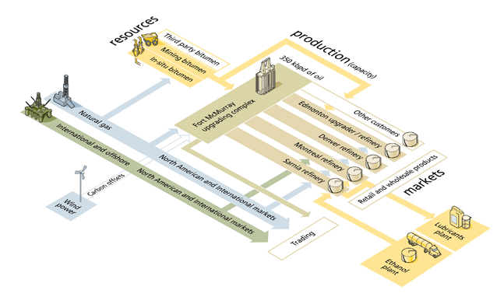
Integrated Strategy

Slide 60
Oil Sands
Located near Fort McMurray, Alberta
Recovers bitumen through mining and in-situ
development and upgrades it into refinery feedstock,
diesel fuel and by products.
Products include gasoline and distillates
The foundation of Suncor’s growth strategy and represents the most significant portion of the company’s assets.
Suncor pioneered the world’s first commercially successful oil sands operation in 1967 and today, the company remains a leader in oil sands development.
Notes:
Its Oil Sands division produces bitumen recovered from oil sands through mining and in-situ technology, and upgrades it into refinery feedstock, diesel fuel, and by-products. Its products include gasoline and distillates.

Slide 61
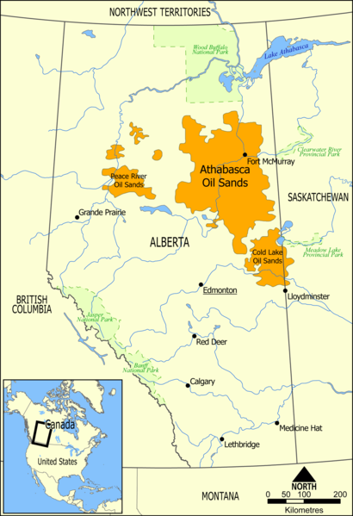
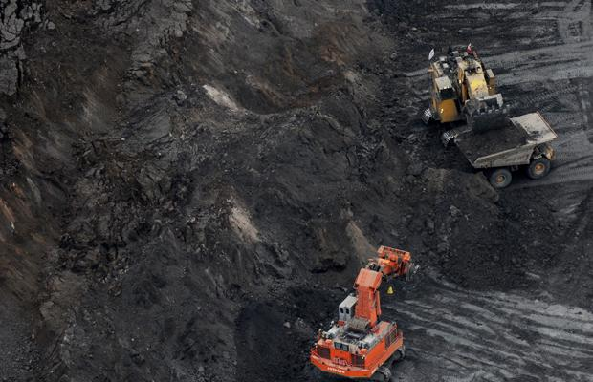
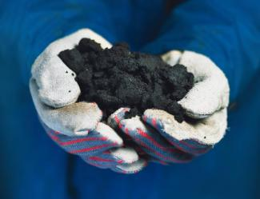
Oil Sands Production in Canada

Slide 62
Oil Sands – Strategic Partnership with Total
On December 17 2010, strategic partnership with Total E&P Canada Ltd. (Total)
- together developed two key oil sands mining projects: the Fort Hills mine (operated by Suncor) and the Joslyn mine (operated by Total)
Restarting construction of the 200,000 barrel per day Voyageur Upgrader at Suncor’s oil sands operations north of Fort McMurray, Alberta

Slide 63
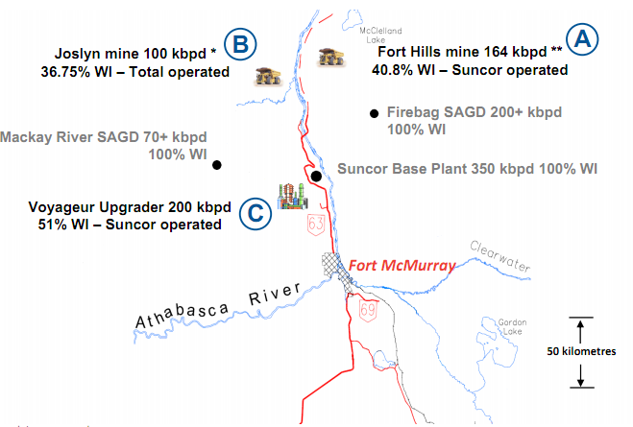
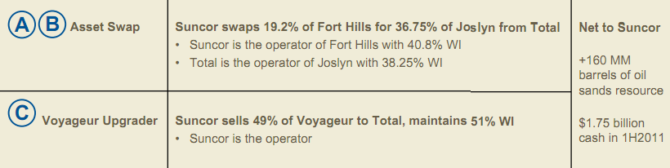
Oil Sands – Strategic Partnership

Slide 64
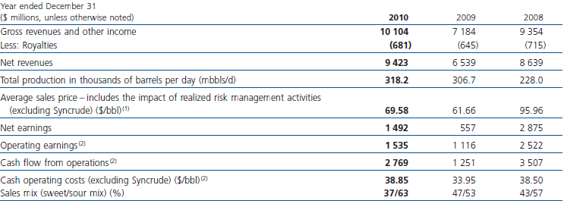
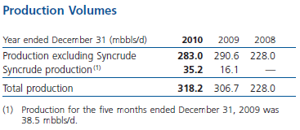
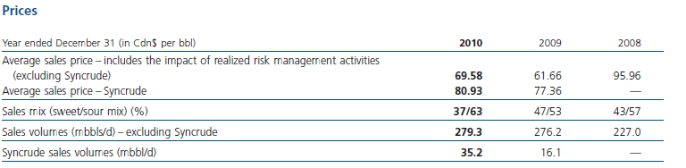
Oil Sands Production, Price & Earnings

Slide 65
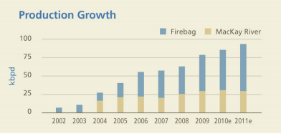
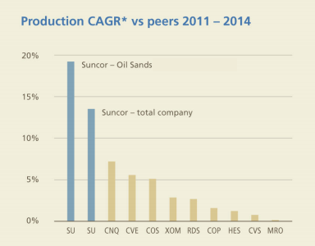
Oil Sands 2011 Outlook
Oil Sands production, 280 – 310 kbpd
– Sales mix % (sweet/sour/bitumen), 47/49/4
WTI @ Cushing less C$7.00 – 8.00
– Realization on crude sales basket,
– Cash operating cost (ex Syncrude), $39 – 43/bbl
• Syncrude production, 35 – 37 kbpd

Slide 66
Natural Gas
Acquires, explores, develops, and produces natural gas, natural gas liquids, oil, and by-products from reserves located primarily in western Canada and the United States Rockies
It also has operations in Alaska, the Northwest Territories, and the Arctic Islands
Produce natural gas as a natural price hedge against the cost of energy consumption at Suncor’s oil sands operation.

Slide 67
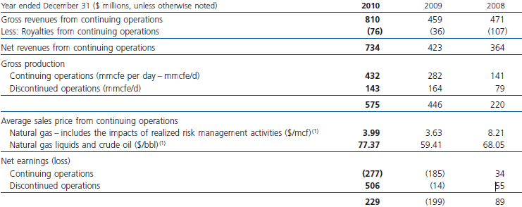

Natural Gas Production
Notes:
Strategic focus to improve profitability as
measured by ROCE
• High-grading portfolio
do not meet return – Sell assets that
criteria, regardless of volume impact
– Shift capital to most profitable plays
• Improve lifting costs and G&A to
become low cost producer
• Acquire better drilling inventory with a
shift towards unconventional gas
• Further planned asset sales of 220
mmcfe/d in 2011, pending market
conditions

Slide 68
Marketing and Refining
Refines crude oil for petroleum and petrochemical products
Sells products to retail, commercial, and industrial customers principally in Canada and Colorado, as well as in other parts of the United States and Europe
Transports crude oil through company-owned pipelines in Wyoming and Colorado
Forecasted to generate > $1 billion cash flow in 2011
Notes:
Suncor Energy Inc.’s Refining and Marketing division refines crude oil for petroleum and petrochemical products; and produces ethanol, and specialty lubricants and waxes. This division sells its products to retail, commercial, and industrial customers principally in Canada and Colorado, as well as in other parts of the United States and Europe. It also transports crude oil through company-owned pipelines in Wyoming and Colorado.
focused principally on buying and selling futures contracts and other derivative instruments based on the commodities that it produces

Slide 69

Refining Capacity Forecast
443,000 bpd of refining capacity, roughly half of which is capable of handling oil sands feeds

Slide 70

Volumes and Earnings

Slide 71
Suncor’s Management

Slide 72

Suncor’s Management
Richard L. George President & Chief Executive Officer
Appointed president and chief executive officer of Suncor Energy in 1991
a member of the board of directors of the world’s largest U.S. offshore drilling company, Transocean Offshore Deepwater Drilling Inc.
Bachelor of Science degree in engineering from Colorado State University, a law degree from the University of Houston Law School and is a graduate of the Harvard Business School Program for Management Development

Slide 73

Suncor’s Management
Steven W. Williams Chief Operating Officer
Joined Suncor in May 2002
Before appointment, he was responsible for Octel Corporation's global operation and managed the operation of the largest refinery in the United Kingdom for Esso
Bachelor of Science degree in chemical engineering from Exeter University and graduate from the Advanced Management Program at Harvard Business School as well as the Business Economics Program at Oxford University.

Slide 74
Senior Executives
Kirk Bailey, executive vice president, Oil Sands Ventures, ensures the successful approvals, development, commissioning and start up of oil sands growth projects planned under Suncor’s strategic partnership with Total.
Mark Little, executive vice president, Oil Sands, leads improvements in safety, sustainability and competitiveness at the company's oil sands operation.
Boris Jackman, executive vice-president, Refining and Marketing, has overall responsibility for operations at four refineries, as well as industrial and retail marketing of refined products and lubricants under the Petro-Canada brand.
Mike MacSween, senior vice-president, In Situ, leads Suncor’s in situ operations. The combined assets of Petro-Canada and Suncor form a significant growth platform for growing in situ oil sands recovery.
Eric Axford, senior vice-president, Operations Support, is responsible forensuring safe, reliable and environmentally responsible operations across Suncor’s integrated businesses.

Slide 75
Suncor’s Financial Statements

Slide 76
Risk Factors
Commodity prices
Exchange rates
Environmental regulations
Stakeholder support for growth plans
Extreme winter weather
Regional labour issues
Each business segment Risk/Success factors

Slide 77


Price Indicators and Economic Sensitivity

Slide 78

Financial Highlights

Slide 79
Consolidated Balance Sheets

Slide 80

Notes:
Increase in A/R → higher sales
Good will → majorly comes from acquisition of petro canada

Slide 81
Consolidated Statement of Earnings

Slide 82

Notes:
Upstream production for 2010 averaged 561,100 boe per day (boe/d), compared to 411,700 boe/d in 2009. Total sales of refined petroleum products averaged 87,800 cubic metres per day (m3/d) during 2010, up from 54,900 m3/d in 2009. Both production and sales volumes increases were primarily due to the additional volumes resulting from the merger.

Slide 83

Tripled Net Earnings
Upstream production for 2010 averaged 561,100 boe per day (boe/d), compared to 411,700 boe/d in 2009
Total sales of refined petroleum products averaged 87,800 cubic metres per day (m3/d) during 2010, up from 54,900 m3/d in 2009
Both production and sales volumes increases were primarily due to the additional volumes resulting from the merger

Slide 84

Increase in Operating Expenses
Operating, selling and general expenses → INCREASE
-a full twelve months of legacy Petro-Canada operations, whereas only 5 months in 2009
Depreciation Expenses →INCREASE
- the additional assets acquired through the merger and asset writedowns recorded in 2010.
Financing Income → DECREASE
-lower foreign exchange gains on U.S. dollar denominated long- term debt in 2010.
Notes:
Financing income was $30 million in 2010, compared to
stronger Canadian dollar relative to the U.S. dollar. financing income of $488 million in 2009, largely due
to lower foreign exchange gains on U.S. dollar
Suncor recognized a pre-tax gain of $295 million
denominated long-term debt in 2010.

Slide 85

Operating Earning in Each Segment
Oil Sands division contributed 57% of net earnings in continuing operations
Refining and Marketing – 29%
International and Offshore – 37%

Slide 86
Consolidated Statements of Cash Flows

Slide 87

Operating Activities

Slide 88

Investing and Financing Activities

Slide 89




Capital Expenditure
Oil Sands:
Growth spending in 2010 was primarily focused on the construction of Firebag Stage 3.
Notes:
Spending has been primarily focused on exploration drilling in Libya, development pending in the U.K. and Syria, and exploration drilling in Norway.

Slide 90
Firebag
In-situ project located on leases known as "Firebag“
Uses underground wells to inject steam into the oil sands deposits and collect the bitumen released by the heat.
Uses recycled water in a closed system for steam generation. No additional surface or groundwater is required and no tailings ponds are created
The planned expansion is targeted to begin production late in the second quarter of 2011, ramping up toward capacity of 62,500 bpd of bitumen over approximately 24 months thereafter. The 2010 expenditures focused primarily on construction of cogeneration and central plant facilities and well pads

Slide 91

Debt Repayment in 2011
Significant portion of long term debt (20%) needed to be repaid in 2011
Only 518 millions in 2010

Slide 92

2011 Capex and Cash Flow Outlook

Slide 93

Return on Capital Employed (ROCE)

Slide 94
Recommendation
BUY

Slide 95


Slide 96

Security Information
Ticker symbol: CPG, on TSX

Slide 97

One-Year Stock Prices

Slide 98

Five-Year Stock Prices

Slide 99
Company Overview
Crescent point began as a junior exploration and production company in 2001.
In 2003, they became an income trust with organization of junior oil and gas companies Crescent Point Energy Ltd. (CPE) and Tappit Resources Ltd.
In 2009, they converted to a dividend paying corporation upon the Wild River Arrangement, and continued to operate as one
Crescent point has a dominant position in two of the largest light and medium oil pools ever discovered in western Canada: the Lower Shaunavon in southwest Saskatchewan and the Bakken in the southeast Saskatchewan.

Slide 100


Slide 101
Company Update
Drilling inventory of 6,000 locations
New production record: 69,779 boe/d in 4th Quarter 2010
Total proved reserves of 223 mmboe
Consistent monthly dividend: $0.23 per share, every month on 15th/16th
89% light and medium crude oil and liquids, 11% natural gas
9 consecutive years of growth in Net Asset Value (“NAV”) per share, production, cash flow, and strong positive technical and development reserve additions
As at March 8, 2011, the Company had hedged 55 percent, 44 percent, 35 percent and 19 percent of production, net of royalty interest, for the balance of 2011, 2012, 2013 and the first half of 2014, respectively.

Slide 102

Company Update
Drilled 406 (302.2 net) wells in 2010 with a 99 percent success rate.

Slide 103


Growth

Slide 104


Growth

Slide 105

Officers
Scott Saxberg
President and CEO
Bachelor of Science in Mechanical Engineering from the University of Manitoba
Over 18 years of experience in the oil and gas industry
Greg Tisdale
Chief Financial Officer
Bachelor of Commerce from University of Alberta
Chartered Accountant

Slide 106
Strategies
Three-part Business Strategy:
Acquire
Uses its excellent balance sheet and growth capital to acquire focused, long-life, high-quality reserves and production in Western Canada
Develop and Exploit
Uses its large, low-risk drilling inventory to maintain production, reserves and dividends; Currently has more than 6,000 locations. Crescent Point’s project portfolio has become an industry leader among companies of our size.
Manage Risk
Strives to manage the risks associated with the oil and gas industry and to provide long-term stability to its dividends.
Maintain a conservative balance sheet with significant unutilized lines of credit.
Target a debt to cash flow of 1.0 times or less.
Hedges commodity prices, using a rolling 36-month price risk management program (swaps, collars and put option instruments)

Slide 107
Strategies - Acquisitions
Bulldog Energy Inc. (2005)
Mission Oil & Gas Inc. (2007) – largest acquisition to date
Innova Exploration Ltd. (2007)
Pilot Energy Ltd. (2008)
Landex Petroleum Corp. (2008)
Talisman Energy Inc. (2009)
Rylan Oil Corp. (2010)

Slide 108



Strategies- Development and Exploit
89% light and medium crude oil and liquids, 11% natural gas

Slide 109

Strategies – Manage Risk

Slide 110

Strategies – Manage Risk

Slide 111

Strategies – Manage Risk
Hedging Results

Slide 112

Consolidated Balance Sheets

Slide 113

Consolidated Statements of Earnings

Slide 114

Consolidated Statements of Cash Flows

Slide 115

Summary of Quarterly Results

Slide 116
Outlook
Detailed five-year growth planning model
Including the Bakken and Three Forks, Crescent Point has planned 14 net development and exploration wells for the area in 2011.
Spend approximately:
-62 percent of its 2011 budget in the Viewfield Bakken resource play
-16 percent in the Lower Shaunavon resource play,
- a combined 10 percent in the Flat Lake Bakken resource play and the emerging plays in southern Alberta.
Expects to drill approximately 311 net wells in 2011
Spend $101 million on facilities infrastructure, primarily in the Bakken and Lower Shaunavon resource plays.
Notes:
Crescent Point now has more than 6,500 net low-risk drilling locations in inventory, representing more than 450,000 boe/d of risked potential production additions. This depth of drilling inventory positions the Company well for long-term sustainable growth in production, reserves and NAV and also provides support for long-term dividends.

Slide 117
Evaluation
High-quality reserve base and development drilling inventory
Excellent balance sheet
Solid risk management program
Potential production additions

Slide 118
Recommendation
BUY!

Slide 119


Slide 120

Company Snapshot

Slide 121

Trading Activity
Notes:
Note the significant trading activity increase from Q1 to Q3 and Q4

Slide 122

1 Year Stock Movement

Slide 123

5 Year Stock Movement
Notes:
Large drop due to 2008 financial crisis , U.S. $34 per barrel early in 2009.

Slide 124

Max Year Stock Movement
Notes:
Gradual run-up with large runs ups in recent year due to rise in oil

Slide 125

COS vs. S&P/TSX EQ WGHT OIL & GAS
Notes:
Under performance in latter half of the year

Slide 126

COS vs. Light Crude Oil

Slide 127

Total Shareholder Returns

Slide 128

COS 200 Day Moving Average

Slide 129

COS 100 Day Moving Average
Notes:
Underperformance with collates with moveing averages poor performance when stocks are in a trading range rather then a trading trend

Slide 130

Background
Formed in 1995 as the largest joint venture owner of the Syncrude Projects
Owns 36.74% of the Syncrude Projects
On Dec 31, 2010 , COS completed its conversion from an income trust to a corporate structure
Notes:
Pure play and only significant asset is syncrude ownership
Gradually increase syncrude ownership from 11.74% to current ownership of 36.74%

Slide 131

Syncrude Oil
Syncrude operates in the Athabasca Oil Sands region
Syncrude consortium was formed in 1964, initial objectives of research
Construction began in 1973, and the first barrel of oil was shipped in 1978. The billionth barrel of oil was shipped in 1998.
Management Service Agreement entered into with Imperial Oil Resources in late 2006
Notes:
Syncrude Canada and Imperial Oil Resources entered into the MSA in late 2006. The agreement is directed at improving operational performance by enabling Syncrude to access Imperial Oil/ExxonMobil’s global best practices, systems and senior management expertise. The MSA also provides ExxonMobil’s project management support for Syncrude’s large capital projects, including expansions. The initial term of the agreement is 10 years with 5-year renewal provisions; Imperial Oil Resources receives service fees, and potential fee incentives if certain performance targets are met.

Slide 132

The Syncrude Projects Joint Owners

Slide 133

Syncrude Oil Production
Syncrude currently produces a single, high-quality light synthetic crude oil
The final product is sent by pipeline to three Edmonton area refineries and to pipeline terminals which ship it to refineries in Canada and the United States
Each Syncrude participant receives its share of production in kind and is responsible for the subsequent marketing

Slide 134

Syncrude Deposits
Three major reserves of oil sands in the province of Alberta; Peace River Althabasca and Cold Lake
Combined estimated reserves of one trillion barrels of bitumen, spanning 140,400 square kilometres.
Althabasca reserves is the largest out of the three in terms of size and potential

Slide 135

Syncrude Deposits
Syncrude has a vast resource base to support its future growth
Only the Mildred Lake mine and the Aurora North mine are under active development
The largest block of leases east of the Athabasca River is yet to be developed

Slide 136

Syncrude Reserves
Notes:
Based on the current annual production outlook for 2011 of 110 million barrels, or 40 million barrels net to Canadian Oil Sands, Syncrude’s estimated proved plus probable reserve life is approximately 44 years.

Slide 137
Syncrude Oil Production
 | Total Production | Daily Average Production | Canadian Oil Sands Total Production | Canadian Oil Sand Daily Average
2010 | 107 Mil | 293,150 | 39.3 Mil | 107,671
2009 | 102.2 Mil | 280,000 | 37.5 Mil | 102,900
2008 | 105.8 Mil | 289,100 | 38.9 Mil | 106,200
2007 | 111 Mil | 304,109 | 40.78 Mil | 111,726

Slide 138

Syncrude Oil Production
Notes:
second highest production year on record

Slide 139

Syncrude Projected Growth
Notes:
50 per cent or 200,000 barrels per day later this decade

Slide 140

Canadian Oil Sands Management
Became President and Chief Executive Officer in 2001
More then 25 years experience in the energy sector, with a corporate finance focus
Previously held positions include CFO of Gulf Canada and Vice President Finance at TransCanada Pipelines
President and Chief Executive Officer: Marcel R. Coutu

Slide 141

Canadian Oil Sands Management
Join Canadian Oil Sands in 2002 as Treasurer, and promoted to CFO in 2007
Previously held senior finance positions with EnCana Corporation, Pan Canadian Energy and Pricewaterhouse Cooper
CFA and CA designation with a BBA from the University of Calgary
Chief Financial Officer: Ryan M. Kubik

Slide 142

Canadian Oil Sands Management
Join Canadian Oil Sands in 2005 as COO
Previously held senior Vice President with Suncor Energy and senior positions with Shell Canada Limited
Holds a Bachelor of Chemical Engineering degree from the University of Waterloo
Chief Operations Officer: Trevor R. Roberts

Slide 143

Canadian Oil Sands Strategic Plan
Capital Management: Manage net debt in anticipation of funding major sustaining capital projects. Maintain discipline of paying a quarterly dividend and growth opportunities.
Operations: Sustain production rates to average 350,000 barrels per day at Syncrude.
Growth: Proceed with construction of mine trains at Aurora South and upgrader debottleneck following project sanctioning by Syncrude owners.
Sustainability: Complete the Syncrude Emissions Reduction project by the end of 2011, thereby leading to a 60 per cent reduction in sulphur dioxide emissions.

Slide 144

COS Sensitivity Analysis

Slide 145

Operating Cost per Barrel

Slide 146

Net Income per Barrel
Notes:
FX gains and losses are primarily the result of changes in the Canadian dollar value of our U.S. dollar denominated long-term debt caused by fluctuations in U.S. and Canadian dollar exchange rates.
The FX gains on long-term debt in 2010 were the result of a strengthening in the value of the Canadian dollar relative to the U.S. dollar from $0.96 U.S./Cdn at December 31, 2009 to $1.01 U.S./Cdn at December 31, 2010.
The Corporation did not have any foreign currency hedges in place at December 31, 2010, and as at February 23, 2011, we do not intend to enter into any new currency hedge positions. The Corporation may, however, hedge foreign currency exchange rates in the future, depending on the business environment and growth opportunities.
Canadian Oil Sands prefers to remain un-hedged on crude oil prices; however, during periods of significant capital spending and financing requirements, management has in the past, and may again, hedge prices and exchange rates to reduce revenue and cash flow volatility to the Corporation. Canadian Oil Sands did not have any crude oil price hedges in place for 2010 or 2009. Instead, a strong balance sheet was used to mitigate the risk around crude oil price movements.As at February 23, 2011, and based on current expectations, the Corporation remains un-hedged on its crude oil price exposure.

Slide 147

COS Distributions
Notes:
In 2010, cash from operating activities exceeded Unitholder distributions by $323 million. Cash from operating activities, along with opening cash balances and drawdowns on the operating credit facility were sufficient to fund the Corporation’s capital expenditures, contributions to the reclamation trust fund, and Unitholder distributions.
Unitholder distributions in 2010 exceeded net income by $10 million, reflecting the impact of non-cash expenses included in the calculation of net income such as depreciation, depletion and accretion. These non-cash items do not affect the Corporation’s cash from operating activities or ability to pay dividends over the near term.
On January 27, 2011, the Corporation declared a quarterly dividend of $0.20 per Share in respect of the first quarter of 2011 for a total distribution of approximately $97 million. The dividend will be paid on February 28, 2011 to Shareholders of record on February 22, 2011.

Slide 148

COS Obligations and Commitments

Slide 149

2010 Financial and Operating Highlights

Slide 150

COS 5 Year Financial Highlights

Slide 151

COS Quarterly Results
Notes:
Our 2010 realized selling price averaged $80.53 per barrel, an increase from $69.47 per barrel in 2009, as the price for U.S. dollar WTI oil continued to strengthen through 2010 after reaching lows of U.S. $34 per barrel early in 2009.
Partially offsetting these higher oil prices, the Canadian dollar was stronger in 2010, averaging $0.97 U.S./Cdn and closing at $1.01 U.S./Cdn at December 31, 2010 compared with a $0.88 U.S./Cdn average rate in 2009.

Slide 152

Canadian Oil Sands Financial Report

Slide 153

Canadian Oil Sands Financial Report

Slide 154

Canadian Oil Sands Financial Report
Notes:
Capital expenditures in 2010 rose to $506 million compared with $409 million in 2009, as spending began on large multi-year capital projects to replace or relocate four of Syncrude’s five mining trains and to support Syncrude’s tailings management plans.

Slide 155

Canadian Oil Sands Financial Report

Slide 156

Canadian Oil Sands 2011 Outlook

Slide 157

Recommendation
BUY

