Slide 1
Canadian Oil & Gas
Kevin Chen, Michael Chiu, Rosie Yu, Linda Duan

Slide 2
Agenda
Industry overview
Companies fundamental analysis
Canadian Natural Resources Ltd.
Imperial Oil Ltd.
Suncor Energy Ltd.

Slide 3
Industry Overview Agenda
Industry Value Chain
Canadian oil and gas Factors
Technology used in producing crude oil
Natural gas demand
Pipeline and future outlook
Index and commodity price

Slide 4
Industry Value Chain

Slide 5
Oil & Gas Industry Value Chain
Upstream
Exploration & Production sector: Finds and produces crude oil and natural gas, mostly based in Calgary, Alberta
Midstream
Processes, stores, markets and transports commodities such as crude oil, natural gas, to population centers
Downstream
Oil refineries, petrochemical plants, petroleum products distributors, retail outlets and natural gas distribution companies, provide underlying products from crude oil and gas

Slide 6
Underline Products from Crude Oil
Residuals : coke, asphalt, tar, waxes; starting material for making other products
Gas oil / Diesel distillate: used for diesel fuel and heating oil
Heavy gas or Fuel oil: used for industrial fuel
Lubricating oil: used for motor oil, grease, other lubricants
Petroleum gas: used for heating, cooking, making plastics
Kerosene: fuel for jet engines and tractors
Gasoline: motor fuel

Slide 7
Application of natural gas
Space and water heating
Climate control systems
Appliances, industrial uses
ex: processing forest products and manufacturing steel
Electricity generation
Co-generation systems, and transportation.
Notes:
http://www.canadiannaturalgas.ca/faq/
What is natural gas?
Natural gas is naturally occurring hydrocarbon gas. Hydrocarbons are a class of organic compounds consisting of only carbon and hydrogen. Natural gas consists primarily of methane, but also ethane, propane, butane, pentanes and heavier hydrocarbons.

Slide 8
Industry Factors

Slide 9
Canadian oil production key factors
Proven to have the second largest oil reserves in the world.
Over 95 percent are oil sands deposits in Alberta, which are more difficult to process than conventional crude oil.
Ranked to be the 6th oil producing country and the 9th oil exporting country in the world, and the top supplier of U.S. oil imports.

Slide 10
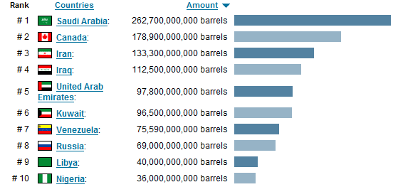
Total 10 Oil Reserves Countries
Notes:
Source: http://www.nationmaster.com/graph/ene_oil_res-energy-oil-reserves (NationMaster energy)

Slide 11
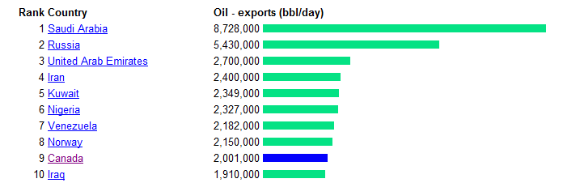
Top 10 Oil Exporting Counties
Notes:
Source:

Slide 12
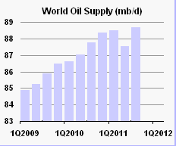
Notes:
Source: http://omrpublic.iea.org/ (international oil agency)

Slide 13
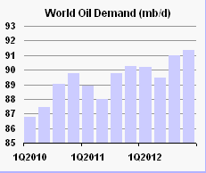
Notes:
Source: http://omrpublic.iea.org/ (international oil agency)

Slide 14
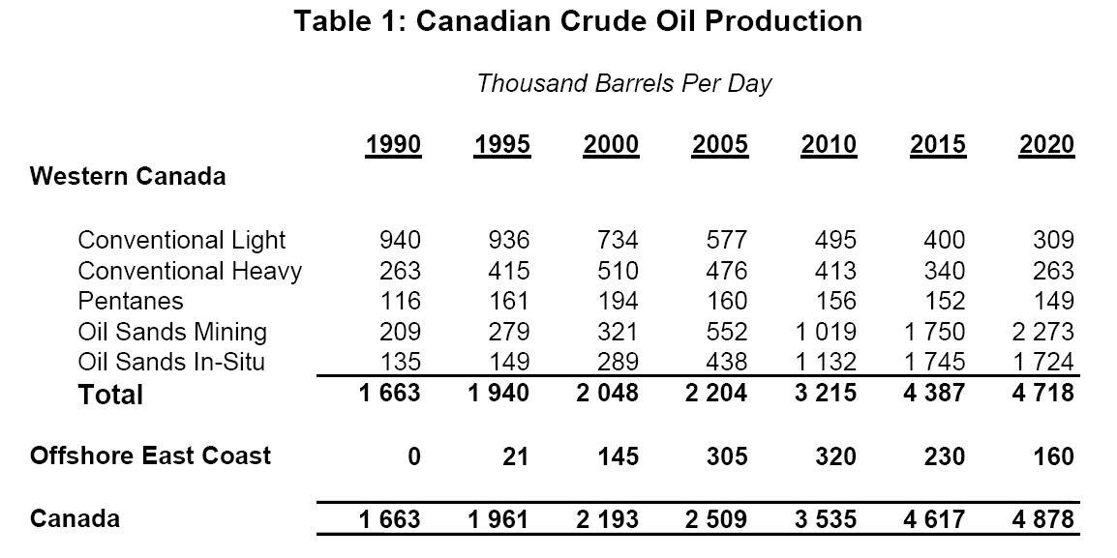
Canadian Crude Oil Production

Slide 15

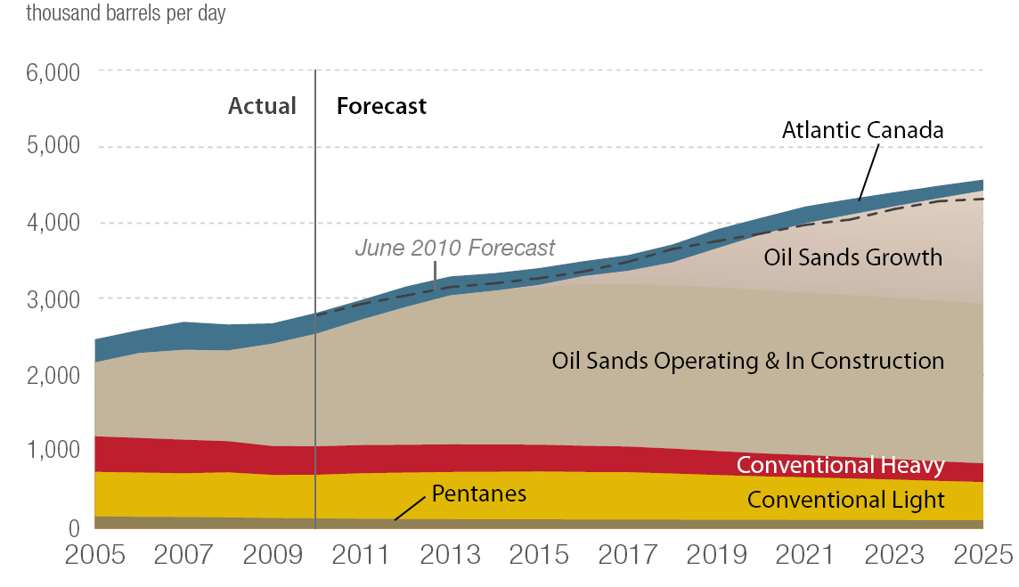
Canadian Oil Production
Source: CAPP (Canadian Association of Petroleum Producers), June 2011, Crude Oil Report

Slide 16
Technology

Slide 17
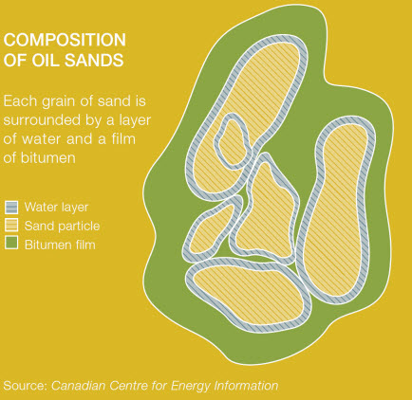
Oil sand
-Oil sand is a naturally occurring mixture of sand, clay or other minerals, water and bitumen
Notes:
Oil sand is a naturally occurring mixture of sand, clay or other minerals, water and bitumen, which is a heavy and extremely viscous oil that must be treated before it can be used by refineries to produce usable fuels such as gasoline and diesel. Bitumen is so viscous that at room temperature it acts much like cold molasses. A variety of treatment methods are currently available to oil sands producers and new methods are put into practice as more research is completed and new technology is developed.

Slide 18
Oil Sands & Conventional crude oil
Oil sands: extract bitumen from the ground then process it into a higher quality crude oil
Higher cost due to addition production cost to turn it into synthetic crude oil
Conventional oil: naturally occur oil that can be used immediately
Off shore drilling
2 methods currently used to extract bitumen from the ground:
Open pit mining: extract oil deposit near the surface
In situ (in place): extract deeper oil deposit
No additional processing cost
Notes:
Surface mining is used when the bitumen deposits are close to the surface, using truck and shovel technology. The sands are transported to a processing facility where hot water is used to separate the bitumen from the sands. Only 20 per cent of all oil sands is close enough to the surface to be mined.
In situ production recovers deposits that are deeper underground, using techniques that are similar to conventional oil production. Advanced drilling technology is used, typically injecting steam or solvents into the reservoir to mobilize the thick bitumen so it can be pumped to the surface through wells. Steam-assisted gravity drainage (SAGD) uses parallel pairs of horizontal wells, one drilled for steam injection and one for oil recovery.
1. "Open pit mining" resembles conventional mining techniques and is effective in extracting oil sands deposits near the surface.
2. “In situ” reaches deeper deposits. In situ extraction involves the use of steam to heat and separate bitumen from the surrounding sands, causing it to pool closer to the surface. The bitumen is then pumped from these pools using horizontal drain wells. To date, Canadian oil sands producers have employed each method almost equally, but future production will likely shift to emphasize in situ extraction.
Once extracted, oil sands producers must add lighter hydrocarbons to the bitumen to allow it to flow through pipelines. Upgraders then process some of the bitumen into synthetic crude, a relatively light, sweet form of crude oil that can be sold to a traditional oil refinery. Some of the bitumen is also sold in raw form, marketed to specialized refineries with deep conversion capacity. Some oil sands projects have integrated upgrading capacity, while others must send their raw bitumen production to another facility.

Slide 19
Oil sands: Synthetic crude oil process
Extraction: Separate bitumen from oil sands. (not required for in situ )
Bitumen is heated and sent to drums where excess carbon (petroleum coke) is removed.
Superheated hydrocarbon vapours sent to fractionators where vapour condenses into naphtha, kerosene and gas oil.
End product is Synthetic Crude Oil
Shipped via underground pipelines to refinery and refined into jet fuels, gasoline and other petroleum products.

Slide 20
Crude oil: Offshore drilling
Drill wells to confirm whether crude oil or natural gas is present deep within the earth.
1. Geoscientists determine the best location to search for these resources
2. Rig workers drill deep into the sea floor
Exploration drilling rigs used off the coast of Atlantic Canada are called Mobile Offshore Drilling Units (MODUs).
Notes:
To handle these challenges, the industry uses large, stable, self-contained platforms to drill wells
3 types of wells: exploration, delineation and development
-Exploration: confirm whether geological formations identified from seismic surveys do contain hydrocarbons.
-If results are promising, a company may drill delineation wells into different areas of the formation to confirm the formation’s size as well as characteristics of the hydrocarbon resources.
-Then decides whether it will be economically attractive to produce the resource. If test results are favourable, the company will proceed to the third stage, drilling a development well.

Slide 21
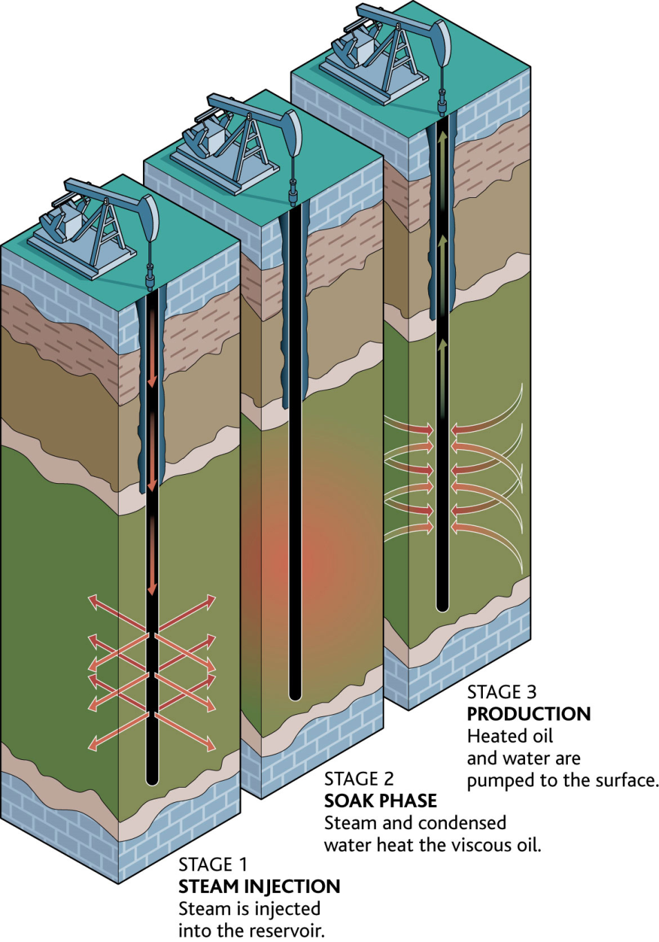
In-situ Technology: Cyclic Steam Stimulation (CSS)
-Inject high-pressure steam into the reservoir where heat softens bitumen and water dilutes and separates bitumen from sand
-The pressure creates cracks and openings through which the bitumen can flow back into the steam injector wells
The CSS method is currently used at Imperial Oil’s Cold Lake project and CNRL’s Wolf Lake-Primrose project.
Notes:
http://www.oilsandsdevelopers.ca/index.php/oil-sands-technologies/in-situ/the-process-2/toe-to-heel-air-injection-thai/
CSS Advantages:
Robust, proven technology
Requires 1 well bore (reduced capital investment)
Adaptable to thinner inter-bedded reservoirs
CSS Disadvantages:
Lower recovery factor (approx. 20%)
http://www.oilsandsdevelopers.ca/index.php/oil-sands-technologies/in-situ/the-process-2/cyclic-steam-stimulation-css/
The CSS in-situ method involves injecting the high-pressure steam into the reservoir for several weeks. Once the reservoir is filled with steam, the
reservoir is left to “soak” for several weeks. The heat softens the bitumen and the water dilutes and separates the bitumen from the sand. The pressure creates cracks and openings through which the bitumen can flow back into the steam injector wells. In the ensuing production phase, the bitumen is pumped up the same well through which the steam was injected. The CSS method is currently used at Imperial Oil’s Cold Lake project and CNRL’s Wolf Lake-Primrose project.

Slide 22
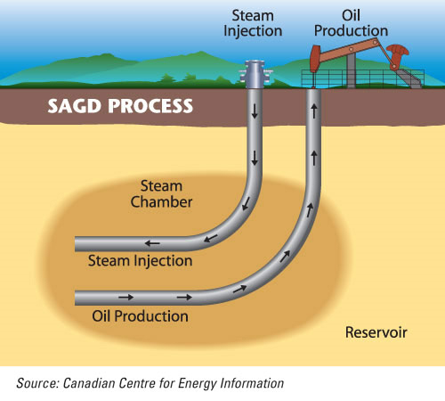
In-situ Technology: Steam Assisted Gravity Drainage (SAGD)
Employs 2 horizontal wells: 1 injection well with high pressure steam and 1 production well (lower well) which the softened bitumen continuously flows so it can be pumped to the surface.
Notes:
http://www.oilsandsdevelopers.ca/index.php/oil-sands-technologies/in-situ/the-process-2/toe-to-heel-air-injection-thai/

Slide 23
In-situ Technology: VAPEX and Solvent Technology
Combinations of solvents are injected into the ground using injection wells and equipment similar to SAGD.
Vaporized hydrocarbon solvents are injected into the reservoir, reducing the viscosity of bitumen by “dissolving” it in the solvent rather than by heating it and thereby causing it to drain into a horizontal production well.
Pros & Cons
Pros: Reduce operating steam-to-oil (SOR) ratios by 30 % and 85 % fewer GHG emissions.
Cons: Decreased efficiency: longer to produce oil
Notes:
http://www.oilsandsdevelopers.ca/index.php/oil-sands-technologies/in-situ/the-process-2/toe-to-heel-air-injection-thai/
Combinations of solvents are injected into the ground using injection wells and equipment similar to SAGD.
Vaporized hydrocarbon solvents are injected into the reservoir, reducing the viscosity of bitumen by “dissolving” it in the solvent rather than by heating it and thereby causing it to drain into a horizontal production well.
Cold solvent technology is a non-thermal in-situ production method that results in as much as 85 per cent fewer GHG emissions than thermal processes; however, it also takes considerably longer to produce the oil.
Solvent-steam technology uses solvents along with steam to increase the efficiency of steam-assisted oil sands production while still minimizing environmental impacts.
Laricina Energy Ltd. has explored the possibility of using solvents with steam in different geologic formations using Genetic Algorithms software, a computer program that mimics the genetic process in order to find the best possible solvent-steam recipe for getting the most oil out of a reservoir.
Using solvents instead of steam could mean reducing the operating steam-to-oil (SOR)* ratios by 30 per cent, with the accompanying reduction in GHG emissions.
*Note: SOR is the volume of steam required to produce one unit volume of oil. The lower the SOR, the more efficiently the steam is utilized and the lower the associated fuel costs.
To date, solvent use is still in the development stage and is not yet commercially applicable.

Slide 24
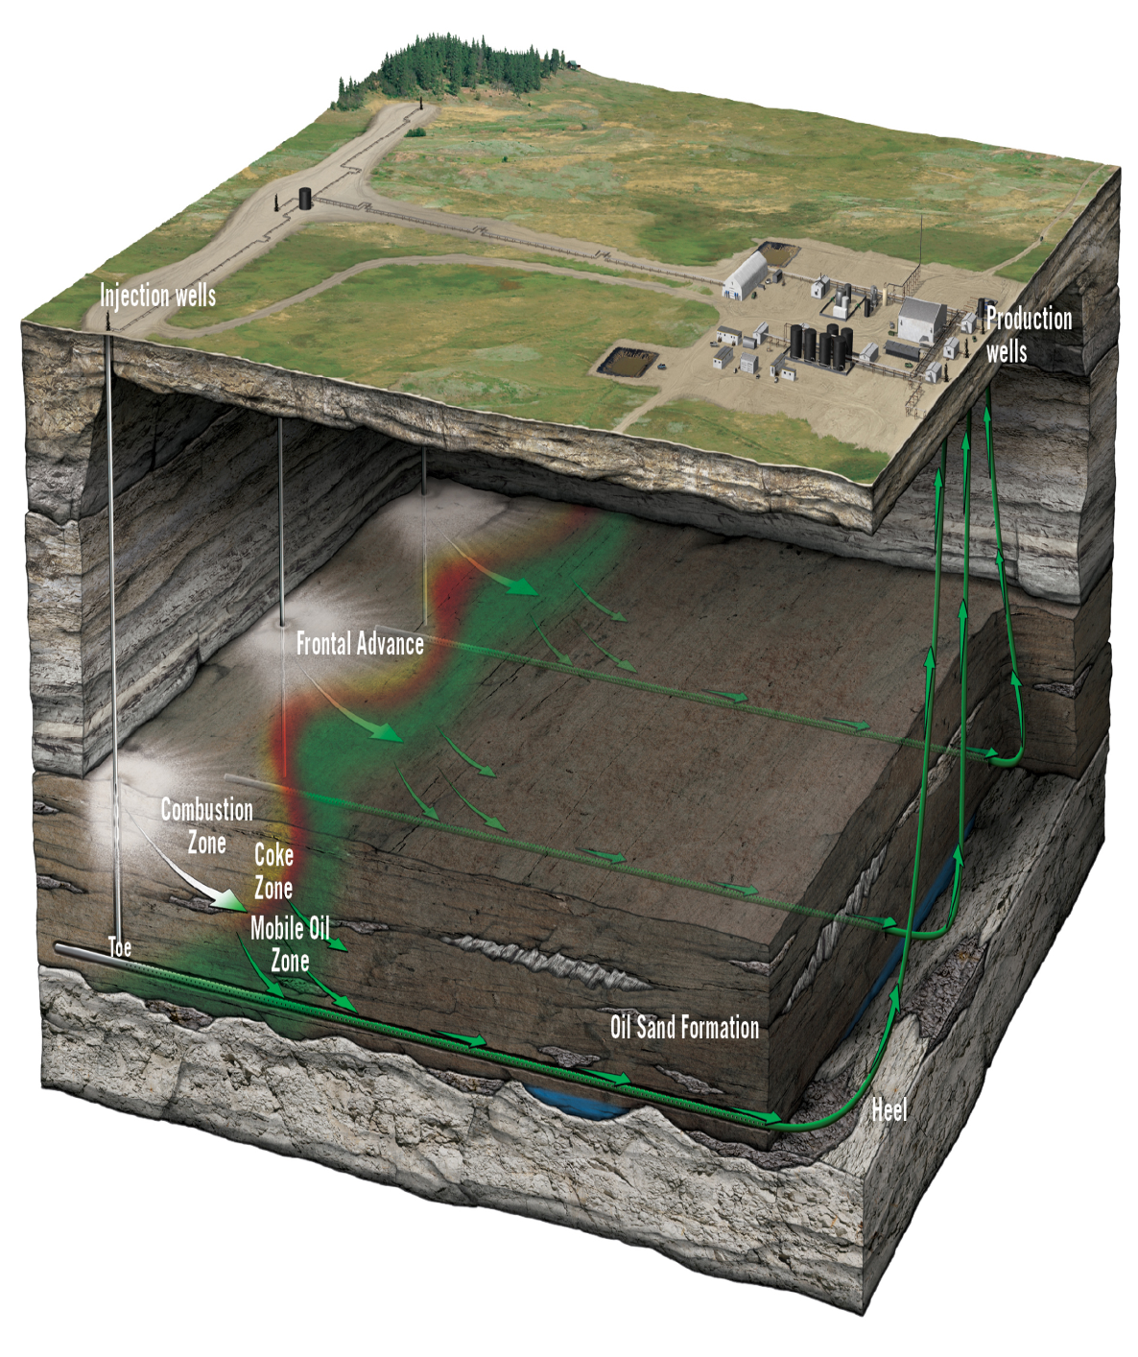
In-situ Technology: Toe-to-Heel Air Injection (THAI)
-THAI uses two wells; a vertical air injection well with a horizontal production well
-Injects air and then relies on underground combustion of a portion of the oil in the ground to generate the heat required to “melt” the remainder of the bitumen and allow it to flow into the production well.
Pros:
-much less energy intensive than other in-situ technologies
-50 % lower GHGs than other oil sands production methods and low water use
Notes:
http://www.oilsandsdevelopers.ca/index.php/oil-sands-technologies/in-situ/the-process-2/toe-to-heel-air-injection-thai/
Like CSS and SAGD, THAI technology also uses heat to reduce the viscosity of the bitumen; however, the heat is generated underground by the combustion of a small portion of the bitumen in the ore body.Employed chiefly by Petrobank Energy and Resources Ltd., THAI technology uses two wells; a vertical air injection well with a horizontal production well.Rather than steam, THAI technology injects air and then relies on underground combustion of a portion of the oil in the ground to generate the heat required to “melt” the remainder of the bitumen and allow it to flow into the production well. Air is injected into an injection well where the process ignites oil in the reservoir where it smolders like the embers of a campfire and creates a vertical wall of hot embers. This firewall moves from the injection well (the toe) to the production well (the heel), pushed forward by the pressure of the injected air, causing the heavier oil components to burn and softening the lighter components causing them to flow ahead of the firewall and into the production well where they can be pumped to the surface. THAI technology has the potential to be much less energy intensive than other in-situ technologies because the bitumen “cokes”, meaning it sheds heavy carbon molecules as it moves through the ground towards the production well. This results in a lighter, partially upgraded oil product being brought to the surface, meaning less life-cycle GHG emissions overall as it also reduces the amount of energy-intensive upgrading the produced oil has to undergo. As well, minimal natural gas is used in the process and, as there is little steam required, very little water is used.
Overall, THAI technology produces 50 per cent fewer GHGs than other oil sands production methods, requires very low water use and, like other in-situ projects, has a minimal surface footprint.

Slide 25
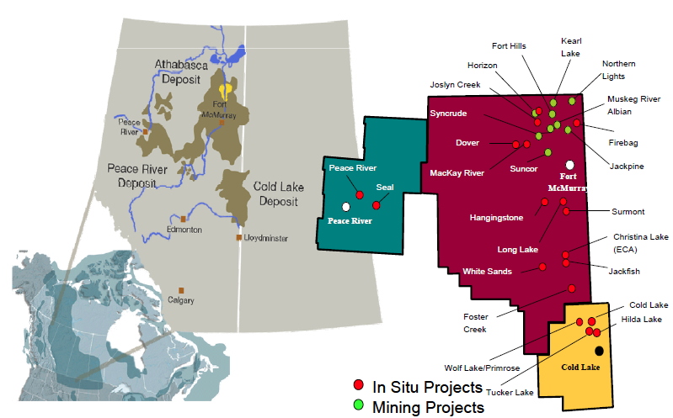
OIL SANDS DEPOSITS AND PROJECTS

Slide 26
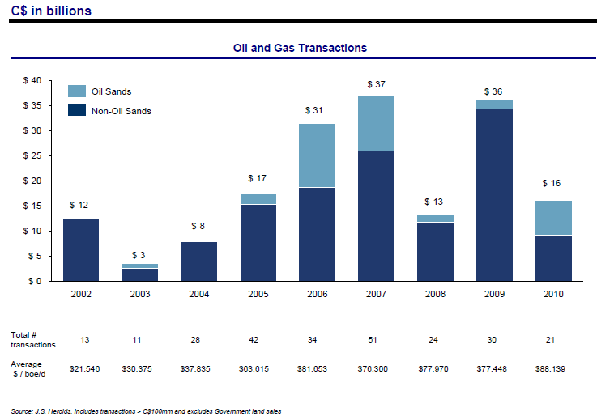
Acquisition activity
Notes:
Recession hits the economy in 2008—acquisition for oil sands is low
Commodity price in 2008 is low.

Slide 27
Natural Gas Demand

Slide 28
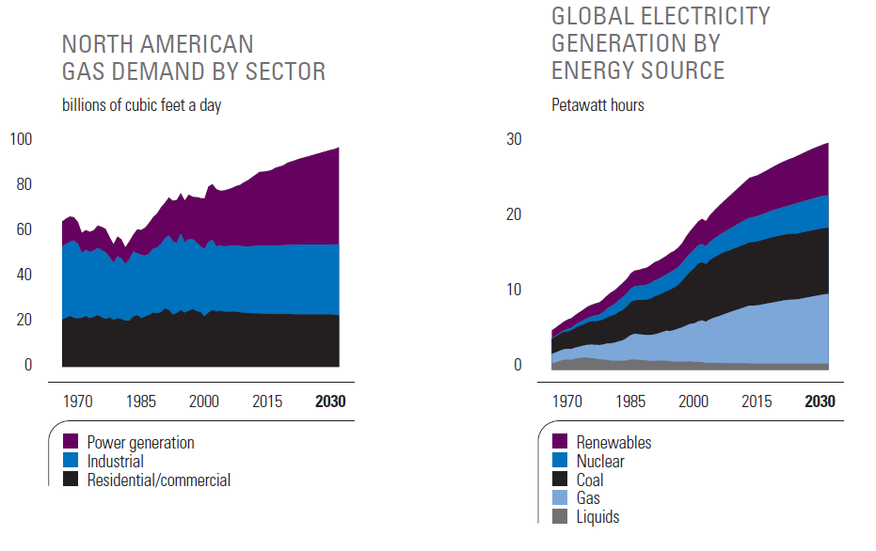
Electricity drivers gas demand

Slide 29
Pipeline and future outlook

Slide 30
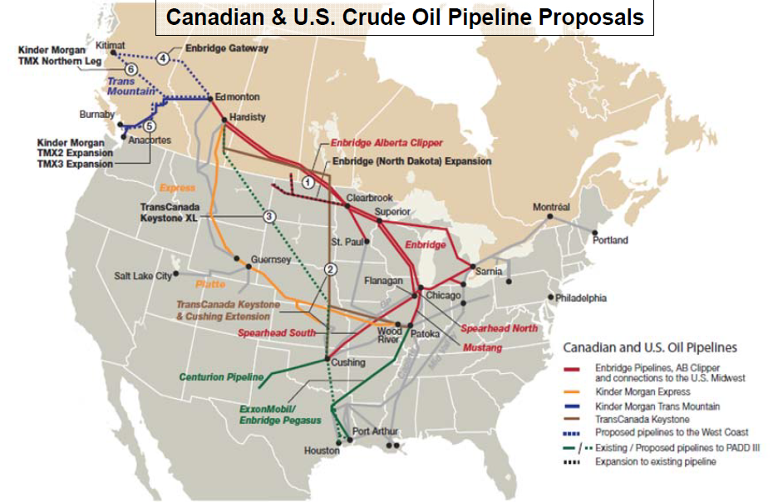
Notes:
Source: CAPP crude oil report, June 2011

Slide 31
Future outlook
Global energy demand is projected to be about 30 percent higher in 2030 compared to today’s level.
The vast majority of increased demand will occur in developing countries.
Due to their availability, affordability and versatility, oil and natural gas will continue to supply about 60 percent of the world's energy needs over the outlook period.
Supplying increasing amounts of oil and natural gas is a long-term proposition that will require access to resources, large-scale investment, and the development of new technology to tap frontier energy sources.
Notes:
Despite the current economic downturn, and even with significant strides in improving energy efficiency, global energy demand is projected to be about 30 percent higher in 2030 compared to today’s level.
The vast majority of increased demand will occur in developing countries, where populations, economic activity and improvements in quality of life are growing most rapidly.
Due to their availability, affordability and versatility, oil and natural gas will continue to supply about 60 percent of the world's energy needs over the outlook period.
Supplying increasing amounts of oil and natural gas is a long-term proposition that will require access to resources, large-scale investment, and the development of new technology to tap frontier energy sources.

Slide 32
Index and commodity price

Slide 33
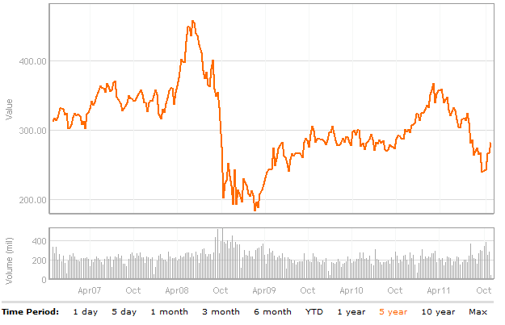
S&P/TSX Capped Energy Index (TTEN)
consists of Canadian energy sector companies listed on the TSX, selected by Standard & Poor’s (S&P)
Notes:
50-60 Canadian oil and gas companies listed on TSX

Slide 34
Index performance
Notes:
Global mail

Slide 35
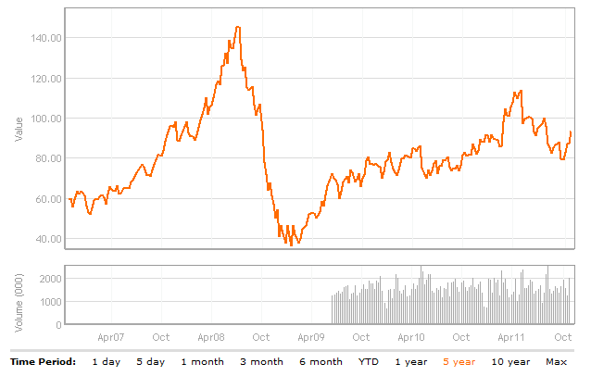
Oil Commodity Price
Notes:
Source: global mail
Positive relationship between the commodity price and the index performance.

Slide 36
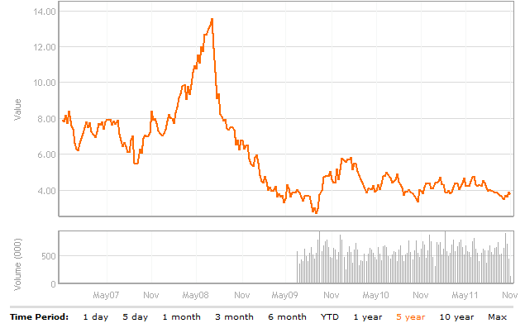
Natural Gas Commodity price

Slide 37
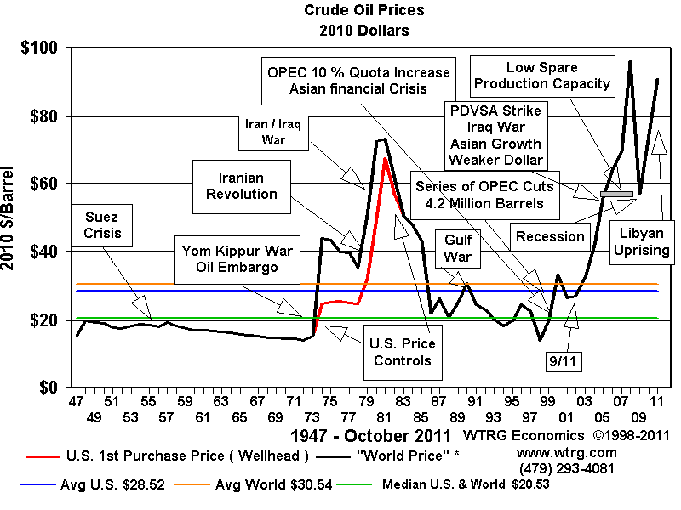
World Event VS Oil Price
Notes:
Source: http://www.wtrg.com/oil_graphs/oilprice1947.gif

Slide 38

Canadian Natural Resources Ltd.

Slide 39
Agenda
Snapshot (as of October 28, 2011)
Management
Business Activity
2010 40-F
2011 Q2 Performance
Recommendation

Slide 40
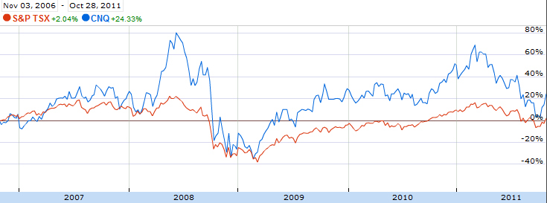
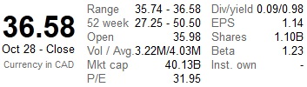
Snapshot
RECOMMENDATION: HOLD

Slide 41
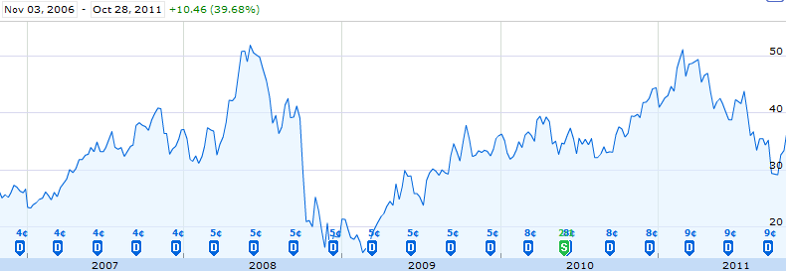
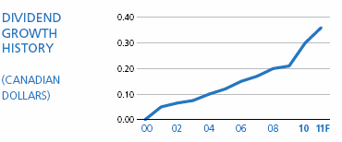

Snapshot
Notes:
Dividend paid quarterly since 2001.

Slide 42
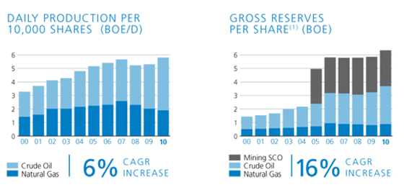
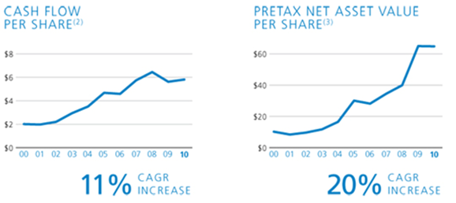
Snapshot

Slide 43
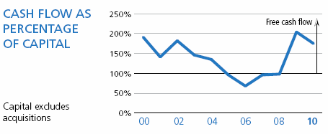
Snapshot

Slide 44
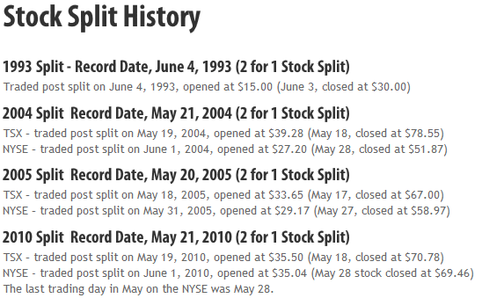
Snapshot

Slide 45
Snapshot
Investment Drivers
Horizons Project Growth Potential
Large reserves
250,000 bbl/d at full capacity, with a target of 500,000 bbl/d by 2018
Shifts company into SCO producer
Low Cost Producer

Slide 46
Snapshot
Investment Risks
Volatility of Crude Oil & Natural Gas Prices
Factor for every company in the industry
Market reaction to oil prices
Completion Risk
Timely and effective execution of Horizons project is crucial towards valuation
Labor supply

Slide 47
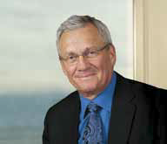
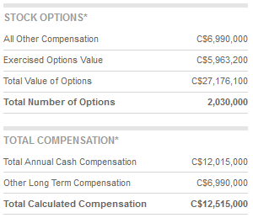
Management
Allen P. Markin,
Chairman
Chemical Engineer
66 Years old
Chairman since 1989
Nearly 40 years in the Industry
Former CEO/President of Amoco Petroleum

Slide 48

Management
N. Murray Edwards,
Vice-Chairman
Bachelor of Commerce (Honours)
Age: 51
Chairman and Board of Directors of Ensign Energy Services Inc.
Served as director since 1988
Net Worth 2.2B

Slide 49
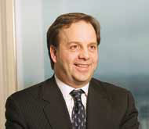
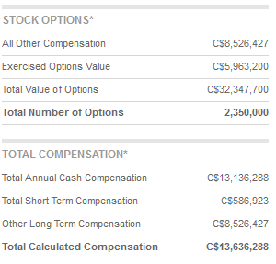
Management
Steve Laut,
President
President since 2005
Director since 2006
Mechanical Engineer
Serves as Principal Executive Officer
Previously Executive Vice-President of Operations

Slide 50
Business Activity
History
1973: Founded
1991: Entered NE BC natural gas industry
1993: Heavy Crude Oil Operations Begin
1996: Enters Thermal in-situ heavy crude oil
2000: Acquires international offshore properties
2005: Horizons Project begins
2010: Kirby In situ Oil Sands Project Phase I

Slide 51
Company Description
Overview
Oil & Natural Gas Exploration
Main operating locations:
Western Canada
North Sea
Offshore West Africa
Headquartered in Calgary, Alberta
4,571 Employees Wordwide;376 International

Slide 52
Business Activity
Main Operations
Natural Gas
Second largest independent producer in Canada
Largest undeveloped land bass in Northeast BC and Northwest Alberta
North American Crude Oil & NGLs
Largest Heavy Oil producer in Canada
Light, Primary Heavy, in-situ oil sands, Light Synthetic Upgraded Oil Sands Mining, Pelican Lake Oil and Natural Gas Liquids
International Crude Oil & NGLs
10% of total production
Horizons Project

Slide 53
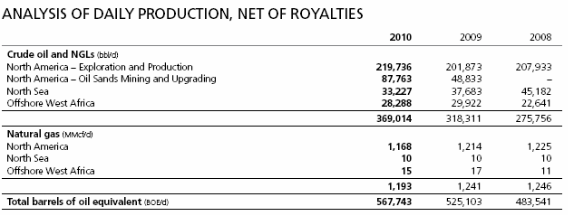
Business Activity
Main Operations
Approximately 567,743 boe/d net royalties

Slide 54
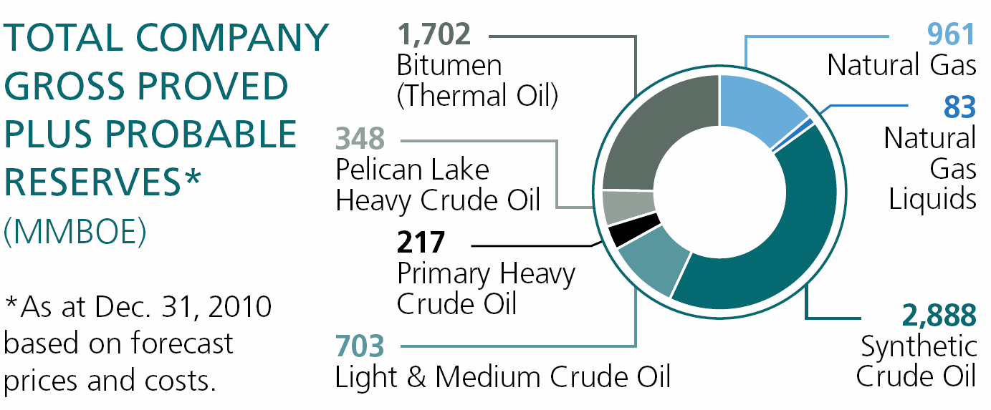
Business Activity
Notes:
Majorityu Reserves in SCO

Slide 55
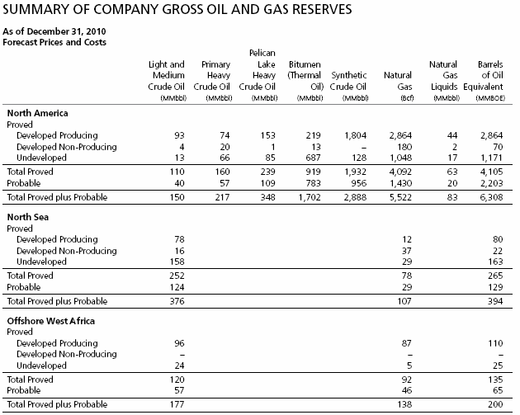
Notes:
Majorityu Reserves in SCO

Slide 56
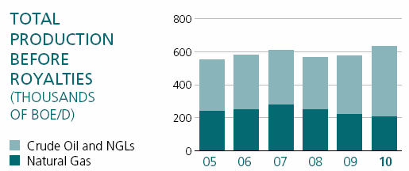
Business Activity
Main Operations
Approximately 632,000 boe/d

Slide 57
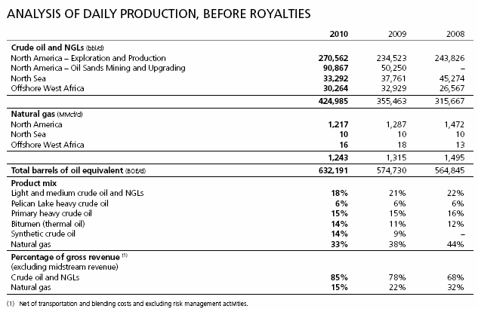
Main Operations

Slide 58
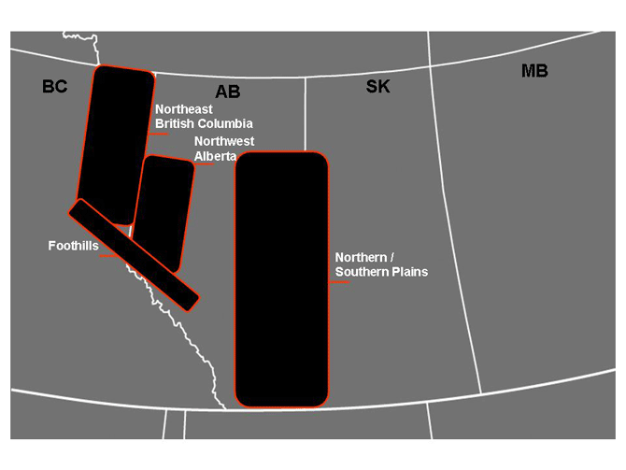
Business Activity
North American Natural Gas

Slide 59
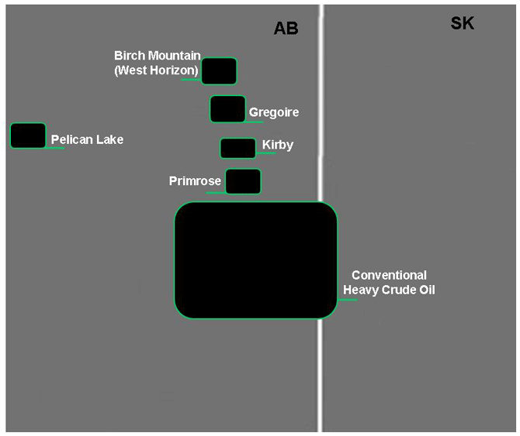
Business Activity
North American Heavy Crude

Slide 60
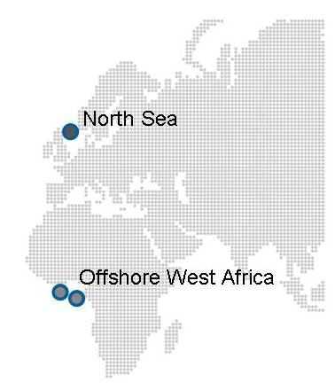
Business Activity
International

Slide 61
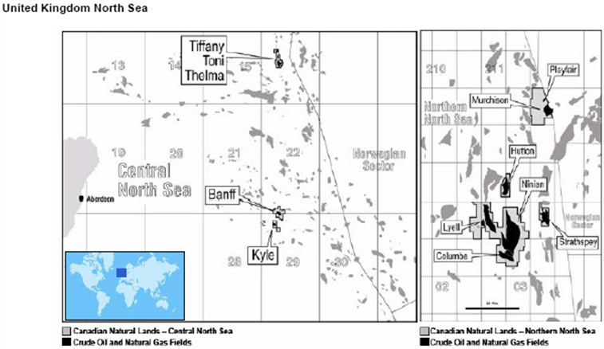
Business Activity
International

Slide 62
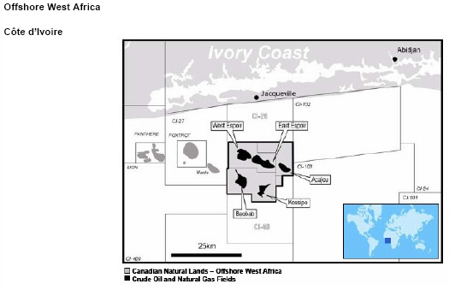
Business Activity
International

Slide 63
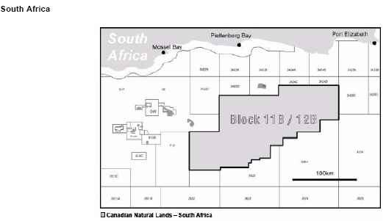
Business Activity
International

Slide 64
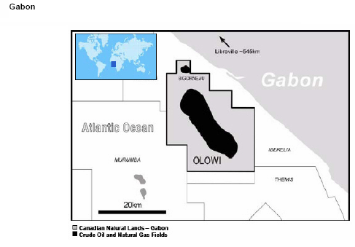
Business Activity

Slide 65
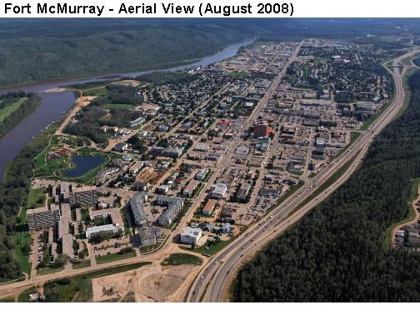
Business Activity
Drivers of Future Growth
Horizon Oil Sands
Potential of 6 billion barrels
Phase 1 mining operations complete
Projected 232,000 – 250,000 barrels/day of light, sweet, crude oil production for 40 years
Current production of 34º API SCO at 110,000bbl/d
Projected $25 - $35 operating cost / barrel over lifetime

Slide 66
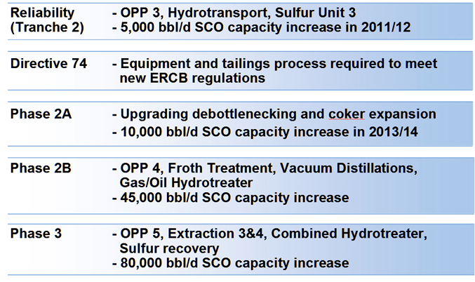
Business Activity
Future Phases of Horizon

Slide 67
Business Activity
Horizons Project
Stop Use Order issued after accident
Halted production; Lifted on June 28
Production resumes on August 16, 2011 at 75,000bbl/d
Full production at 110,000 bbl/d resumed in September
Alberta forest fires
They are insured

Slide 68
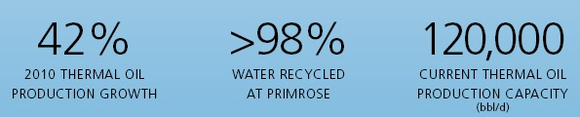
Business Activity
Drivers of Future Growth
Thermal Oil
Cold Lake & Athabasca Region, Alberta
Company projects expansion to 445,000bbl/d by 2024
Projects a 30,000 – 60,000 bbl/d addition every 2-3 years

Slide 69
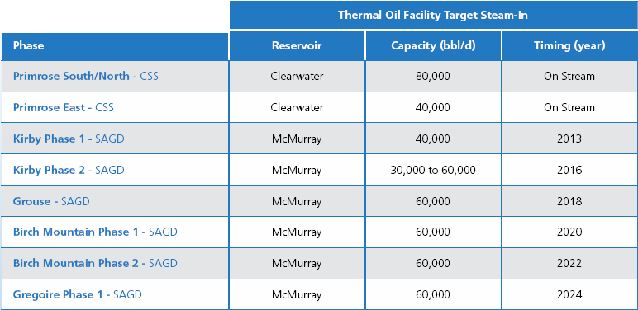
Business Activity

Slide 70
Business Activity
Drivers of Future Growth
Kirby Phase 1 (40,000bbl/d capacity SAGD)
McMurray region, Alberta
Total capital costs of $1.25 billion
First steam-in targeted for late 2013
Project is 19% complete
All major equipment ordered

Slide 71
Business Activity
Risk Management
Commodity Price Risk
Interest Rate
FX Risk
Liquidity Risk

Slide 72
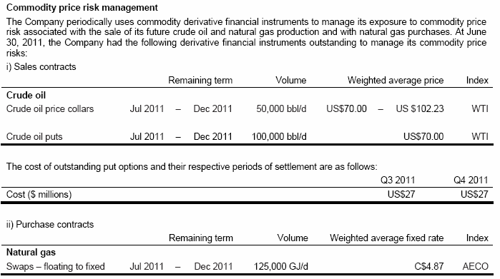
Risk Management
Commodity Price

Slide 73
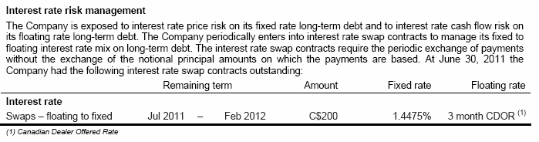

Slide 74
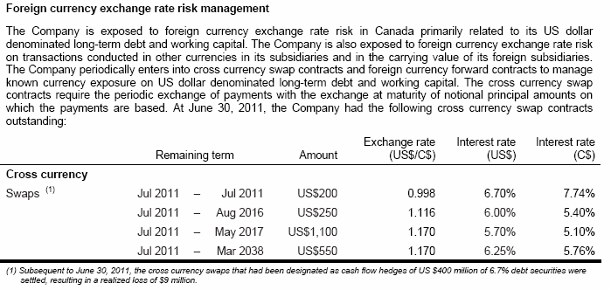
Risk Management
FX Risk

Slide 75
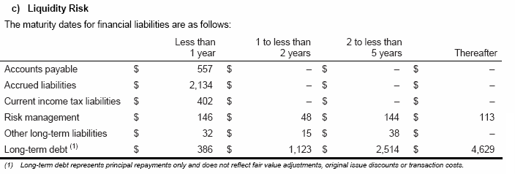

Slide 76

Business Activity

Slide 77

Business Activity

Slide 78

40-F

Slide 79
40-F
Income Statement
(In millions of CAD, share information) | 2010 | 2009 | 2008
REVENUES
REVENUES | $14,322 | $11,078 | $16,173
Less Royalties | $ (1,421) | $ (936) | $ (2,017)
 | 12,901 | 10,142 | 14,156
EXPENSES
Production | 3,447 | 2,987 | 2,451
Trasnportation and Blending | 1,783 | 1,218 | 1,936
Asset retirement obligation accretion | 107 | 90 | 71
Administration | 210 | 181 | 180
Stock-based compensation expense (recovery) | 294 | 355 | (52)
Risk Management Activities | -121 | 738 | -1230
 | 5,720 | 5,569 | 3,356
EBITDA | 7,181 | 4,573 | 10,800
Depletion, Depreciation, Amortization | 4,036 | 2,819 | 2,683
EBIT | 3,145 | 1,754 | 8,117
Interest,net | 449 | 410 | 128
Foreign exchange (gain) loss | -182 | -631 | 718
 | 267 | (221) | 846
EBT | 2,878 | 1,975 | 7,271
Taxes other than income tax | 119 | 106 | 178
Current Income Tax Expense | 698 | 388 | 501
Future Income Tax Expense | 364 | (99) | 1,607
 | 1,181 | 395 | 2,286
NET INCOME | $1,697 | $1,580 | $4,985

Slide 80
40-F
Income Statement
(In millions of CAD, share information) | 2010 | 2009 | 2008
Revenue Growth | 29.3% | -31.5%
EBITDA Margin | 55.7% | 45.1% | 76.3%
EBIT Margin | 24.4% | 17.3% | 57.3%
EBT Margin | 22.3% | 19.5% | 51.4%
Net Income Margin | 13.2% | 15.6% | 35.2%
Tax Rate | 36.9% | 14.6% | 29.0%

Slide 81


Slide 82

40-F

Slide 83

40-F

Slide 84

40-F

Slide 85


Slide 86


Slide 87

Q2 Performance

Slide 88

Q2 Performance

Slide 89

Q2 Performance

Slide 90


Slide 91

Q2 Performance

Slide 92

Q2 Performance

Slide 93

Q2 Performance

Slide 94


Slide 95

Q2 Performance

Slide 96
Q2 Performance
Q2’s Performance
1.38% YoY increase in Natural Gas production
21.02% YoY decrease in crude oil & NGL
14.30% YoY decrease in Equivalent Production
42.70% increase in net earnings

Slide 97

Q2 Performance
Net Earnings
33.98% YoY decrease in Operating Net Earnings

Slide 98

Q2 Performance

Slide 99

Q2 Performance
North American Natural Gas
0.4% YoY decrease in production
36% YoY decrease in successful drilled wells

Slide 100

Q2 Performance
North American Crude Oil
10.93% YoY increase NA Crude oil
52% increase in net successful wells drilled

Slide 101

Q2 Performance
Horizon Oil Sands
Virtual standstill after January accident

Slide 102


Slide 103

Q2 Performance
International Activity
March 2011, UK government increased tax from 50% – 62%
15.31% YoY decrease in international crude
8% YoY increase in international gas

Slide 104
Recommendation
HOLD
Trading below 1x NAVPS
Trading at 6.4x 2010 CFPS
Traditionally trades at 6x forward CFPS
Q1/Q2 2011 are outliers performances
Exposed potential risks of company

Slide 105

Imperial Oil Ltd.
Rosie Yu

Slide 106
Company Overview-Imperial Oil
One of Canada’s largest corporations
A leading member of the country’s petroleum industry
A major producer of crude oil and natural gas
Canada’s largest petroleum refiner
A key petrochemical producer
A leading marketer with a coast-to-coast supply network (1,850 retail service stations)

Slide 107

Imperial Oil IMO TSX Oil and Gas

Slide 108

IMO-Stock Price
Notes:
quarterly profit misses on refinery maintenance.
shuts kearl lake oil sands sites for the first phase.
2011.04.28 announces estimated first quarter financial and operating results
IQ11 earning surprises & preview: expert to beat consensus by wide margin
Announces estimated 4th quarter financial and operating results

Slide 109


Moving averages
1 year period
5 year period

Slide 110

10 year stock price

Slide 111

Trading Volumes and Relative Performance
Outperform: S/P 500 & TSX Composite Index after Year 2006

Slide 112


Slide 113


Slide 114


Slide 115
Business Segments
Four product segments:
Natural Resources (Upstream)
Conventional Oil and Gas
Oil sands operation
Petroleum Products (Downstream)
Refining, distributing and marketing
Chemicals
Technology

Slide 116

Upstream
Exploring for oil and gas
Developing energy
Producing oil and gas

Slide 117
Exploring for oil and gas
Our key exploration areas are:
Athabasca region: oil sands area in northern Alberta
Horn River Basin: shale gas area in northeast British Columbia
Beaufort Sea: hydrocarbon area in Canada's Far North
Orphan Basin: hydrocarbon area in offshore Atlantic Canada
Notes:
Finding new energy resources underground and in the oceans.

Slide 118
Developing energy (Kearl, Nabiye Project , Mackenzie gas project)
Their approach involves:
developing large projects in phases, allowing them to incorporate new best practices and technologies
using innovation and technology to solve environmental challenges
engaging community groups throughout project development
investing in local communities
Notes:
Planning and building major operations to meet future energy demand – developing Canada’s energy resources responsibly.

Slide 119
Horizon Projects (upstream)
Kearl: new oil sands mining project in northeast Alberta
Nabiye Project: next phase of expansion for our Cold Lake operation
Mackenzie gas project: proposed co-venture that would advance development of discovered onshore gas resources in the Mackenzie Delta region

Slide 120

Kearl
One of Canada’s largest open-pit oil sands mining operations:
4.6 billion barrels of resource
A project lifespan of over 40 years
Initial production of about 110,000 bpd before royalties, Potential production of up to 345,000 bpd
Developed using progressive reclamation, reclaiming land as soon as it becomes available over the life of the project.

Slide 121


Nabiye Project
To further improve environmental performance:
upgraded field development plan to reduce the surface footprint
additional cogeneration plant to improve energy efficiency
new sulphur removal facilities to reduce sulphur dioxide emissions.

Slide 122


Mackenzie gas project
To develop a commercially sound project that will also serve as a basin-opening investment for Canada's North.

Slide 123


Slide 124
Producing oil and gas
Key production assets are:
Cold Lake: wholly-owned heavy oil operation at Cold Lake, Alberta
Syncrude: 25 percent interest in Syncrude, world's largest oil sands operation
Conventional oil and natural gas: production fields across Western, Northern, and Eastern Canada
Notes:
Helping to extract energy responsibly and efficiently from existing operations.

Slide 125

Downstream
Making petroleum products(refining crude oil into useful products)
Selling petroleum products(ensure their fuels and motor oils help keep Canada moving)

Slide 126
Making petroleum products
Our refinery operations include:
Strathcona refinery: 187,000-barrel-per-day plant near Edmonton, Alberta
Sarnia refinery: 121,000-barrel-per-day plant in Sarnia, Ontario
Nanticoke refinery: 112,000-barrel-per-day plant in Nanticoke, Ontario
Dartmouth refinery: 82,000-barrel-per-day plant in Dartmouth, Nova Scotia

Slide 127
Selling petroleum products
Selling fuel products and services to consumers and businesses: retail, aviation, marine
Selling lubricants and specialized products and providing the expertise to improve your industrial processes

Slide 128

Selling fuel products and services
Retail: at about 1,850 Esso-branded retail service stations - the largest network of service stations in Canada.
Industrial and wholesale: We market quality fuels and services to different industrial and wholesale customers.
mining
manufacturing
forestry
construction
agriculture
transpiration companies

Slide 129
Selling lubricants and specialized products
engine oils and gear oils for passenger vehicles and heavy duty engines
hydraulic oils, turbine oils, greases and other products designed to enhance peak performance from industrial equipment and operations
asphalts for road construction and roofing

Slide 130

Chemical

Slide 131

Responsible Care® (chemical)
We work for the improvement of people’s lives and the environment, while striving to do no harm;
We take preventative action to protect health and the environment;
We innovate for safer products and processes that conserve resources and provide enhanced value;
We work with all stakeholders for public policy and standards that enhance sustainability, act to advance legal requirements and meet or exceed their letter and spirit;
We promote awareness of Responsible Care® and inspire others to commit to these principles.

Slide 132

Technology
Their research investments are focused on:
resource recovery technologies: finding better, cleaner ways to develop oil sands
petroleum products : developing new or improved products
environmental technologies: developing new ways to reduce operational impacts

Slide 133
Analysis of financial statements
Despite the tenuous economic backdrop, Imperial’s earnings of $2.2 billion were up from 2009’s $1.6 billion.
Return on average capital employed (ROCE) was 20.5 percent, up from 16.8 percent in 2009 even with our large capital expenditures.
Cash flow from operations and asset sales was $3.4 billion.
From 2006-2011, they have distributed more than $8.5 billion to shareholders.

Slide 134

Total shareholder returns

Slide 135
Third quarter 2011 vs. third quarter 2010
Due to stronger industry refining margins of about $270 million,
Higher crude oil commodity prices of about $190 million,
Increased Cold Lake bitumen production of about $90 million and
Higher Syncrude volumes of about $45 million.

Slide 136

Capital and exploration expenditures
Disciplined investment strategy-resilience through business cycles
Supported by ExxonMobil project execution expertise
Retain balance sheet flexibility

Slide 137


Quick facts

Slide 138

Superior ROCE
Strength of asset base
Focus on extracting maximum value of each asset
Disciplined investment

Slide 139

Income per share in 2010

Slide 140

Financial Plan
In 2011, they are on track to increase spending to between $4 and 4.5 billion as they look to invest between $35 and 40 billion over the next decade.
They will likely continue to face economic uncertainties both in terms of demand for their products and price volatility.

Slide 141
Forecasting relevant payoffs
Imperial Oil’s perspective-topics that affect the company, industry and our world.
Oil sands -developing the oil sands is vital to Canada's economy.
Energy outlook -oil and natural gas will continue to supply about 60 percent of the world's energy over the next two decades.
Gasoline prices in Canada-the many factors that influence prices at the pump.

Slide 142


Slide 143
Corporate Profile
Imperial Oil, holds sway over a vast empire of oil and gas resources.
It has proved reserves of 63 million barrels of oil, 1,661 million barrels of bitumen, 691 million barrels of synthetic oil, and 590 billion cu. ft. of natural gas.
It sells petroleum products, including gasoline, heating oil, and diesel fuel, under the Esso name and other brand names.
Most of the company's production comes from fields in Alberta and the Northwest Territories.
Exxon Mobil owns about 70% of Imperial.

Slide 144

Synergies

Slide 145

Management

Slide 146

Management
Bruce March
chairman, president and chief executive officer and has been a director of Imperial since Jan. 1, 2008.
A native of Middleport, N.Y., Mr. March is a graduate of the Rochester Institute of Technology.
In 2007, he was appointed as director, refining Europe/Africa/Middle East with ExxonMobil Petroleum & Chemicals BVBA in Brussels, Belgium.

Slide 147

Management
T.G. (Glenn) Scott
senior vice-president, resources division in June 2010.
A native of Austin, Texas, Mr. Scott is a Texas A&M University graduate with a Bachelor of Science degree in petroleum engineering.
Mr. Scott became operations manager with ExxonMobil Production Company in 2004, based in Houston, Texas, and in that role was responsible for approximately one-third of ExxonMobil’s operated production in the United States.

Slide 148

Management
Paul Masschelin
senior vice-president, finance and administration and treasurer in May 2010. Mr. Masschelin, a native of Belgium, holds an MBA from Catholic University in Leuven, Belgium as well as undergraduate degrees in commercial engineering and actuarial sciences.
He joined Exxon in Brussels, Belgium in 1980 and has held a variety of positions during his career in audit, controller’s, and treasurer’s across Exxon's chemical, upstream and corporate activities.

Slide 149
Financial Statement Analysis
Income statement
Cash flow statement
Balance sheet
Statement of shareholder’s equity

Slide 150

10-Q Balance Sheet

Slide 151

10-K Balance Sheet

Slide 152

10-K Cash Flow Statement

Slide 153

10-Q Cash Flow Statement

Slide 154

10-K Income Statement

Slide 155

10-Q Income Statement

Slide 156

Annual Report-Shareholders’ Equity

Slide 157

Recommendation
-
Price sensitive
Uncertain commodity price
Uncertain economy
Volatile markets
+
Leader in the market
Sustainable growth
Disciplined business strategy
Outperform major indices
Hold for now ,
buy for long-term investment!

Slide 158


Notes:
Oil sands upgrader

Slide 159


Stock Performance

Slide 160

5 year Movement

Slide 161


Moving averages
1 year period
5 year period

Slide 162


Trading Volumes and Relative Performance – 1 year
Suncor outperformed TSX Composite and Dow Jones before September, 2011
Trading volumes in 2011: 6 mil on average

Slide 163
Outstanding Common Shares
By June 30, 2011, the number of outstanding common shares amount to 1573,765.

Slide 164
COMPANY PROFILE
Beginning in the 1960s, Strategically focused on developing one of the world’s largest petroleum resource basins – Canada’s Athabasca oils sands
Pioneering the industry in 1967 and became a publicly traded company in 1992
The core oil sands business is supported by conventional natural gas production in Western Canada and downstream refining, marketing and retail businesses in Ontario and Colorado
Significant progress since 1992:
- Daily oil sands production has more than tripled
- One of the lowest cost producers in North America
- Growth in market capitalization ($1 billion to more than $19 billion at the end of 2004)
Notes:
Oil Sands Development Beginning in the 1960s
Oil sands development eventually would account for 85 percent of the company's crude oil, but when Sun Oil began building its presence in the business during the mid-1960s the field was regarded as experimental, its financial viability in dispute. Nevertheless, the company committed its resources to the business, beginning construction of the Great Canadian Oil Sands plant at Fort McMurray in 1964. The 45,000-barrel-a-day plant was finished five days ahead of schedule, its opening in 1967 heralding the debut of the first commercial-scale oil sands processing facility.
In 1967, we pioneered commercial development of Canada's Athabasca oil sands — one of the world's largest petroleum resource basins. Since then, Suncor has grown to become a globally competitive, Canadian-based integrated energy company with a balanced portfolio of high-quality assets, a strong balance sheet and significant growth prospects.
Read more: Suncor Energy Inc. - Company Profile, Information, Business Description, History, Background Information on Suncor Energy Inc. http://www.referenceforbusiness.com/history2/84/Suncor-Energy-Inc.html#ixzz1GiNs1DJW

Slide 165

BUSINESS SEGMENTS
Four major business divisions:
Oil Sands
Natural Gas and Renewable Energy –Western Canada
Energy Marketing and Refining – Ontario
Refining and Marketing – Colorado

Slide 166
Oil Sands
Located near Fort McMurray, Alberta
Extracts and upgrades oil sands into crude oil products and diesel fuel
Joint venture with the Syncrude oil sands and the Fort Hills project
Strategic partnership with Total on December 17, 2010
The foundation of Suncor’s growth strategy and represents the most significant portion of the company’s assets
With the goal of producing one million barrels of oil equivalent per day by 2020
Products sold to industrial, commercial and retail customers
On shore and off shore developments, both within Canada and around the world

Slide 167


Oil Sands – Strategic Partnership

Slide 168


Oil Sands

Slide 169

Oil Sands
Total production increased by 4% in 2010 due to the merger
Higher realized prices

Slide 170


Oil Sands
Decreased production volumes due to a planned maintenance at Upgrader 2
Sweet/sour sales impacted by unplanned maintenance on the Upgrader 1
Price realizations continued to be strong

Slide 171

Natural Gas
Primarily produces conventional natural gas in Western Canada
Serves as a price hedge that provides the company with a degree of protection from volatile market prices of natural gas purchased for internal consumption.
To ensure natural gas production keeps pace with company-wide natural gas purchases, NG is targeting production increases of 3% to 5% per year.

Slide 172

Natural gas

Slide 173

Natural gas
Higher production volumes as a result of the merger
Lower exploration expenses
Higher realized prices

Slide 174
International and offshore
Off shore exploration and production activities in Newfoundland and in the North Sea
On shore production and exploration activity in Libya and Syria
Interests held in multiple projects such as Terra Nova, Hibernia, etc.

Slide 175

International and offshore

Slide 176

International and offshore
Increased production as a result of the merger
A new production coming on-stream in 2010
Higher realized commodity prices
Gains realized on asset dispositions

Slide 177


Exploration and Production
Impairment charges of $514 million on assets in Libya
Partially offset by gains on assets disposals, higher prices and lower operating expenses
Lower production volume from Buzzard and Terra Nova
Higher tax rate on UK earnings

Slide 178
Refining and Marketing – US
Downstream assets based in Denver, Colorado (acquired in August 2003)
This acquisition is part of an integration strategy aimed at improving access to the North American energy markets through acquisitions, long-term contracts and possible joint-ventures.
Operates a 60,000 barrel per day (bpd) capacity refinery
Markets refined products to customers primarily in Colorado, including retail marketing through 43 Phillips 66-branded retail stations in the Denver area.

Slide 179

Refining Capacity Forecast
443,000 bpd of refining capacity, roughly half of which is capable of handling oil sands feeds

Slide 180

Refining and marketing - US

Slide 181

Refining and marketing - US
Additional refining capacity gained through the merger
Favorable margins
A $67 million negative fair value adjustment
Improved operational reliability gained from the addition of the Edmonton refinery, Montreal refinery, and the lubricants plant

Slide 182


Refining and Marketing - US
Decreased sales volumes due to maintenance on crude oil processing units
Prices for refined products remained at high levels
Strong demand and margins in wholesale and lubricants channels

Slide 183

Operating Earning in Each Segment
Oil sands contributed most to overall operating earnings, followed by international and offshore, and then refining and marketing.

Slide 184

Suncor’s Management
Richard L. George President & Chief Executive Officer
Appointed president and chief executive officer of Suncor Energy in 1991
a member of the board of directors of the world’s largest U.S. offshore drilling company, Transocean Offshore Deepwater Drilling Inc.
Bachelor of Science degree in engineering from Colorado State University, a law degree from the University of Houston Law School and is a graduate of the Harvard Business School Program for Management Development

Slide 185

Suncor’s Management
Steven W. Williams Chief Operating Officer
Joined Suncor in May 2002
Before appointment, he was responsible for Octel Corporation's global operation and managed the operation of the largest refinery in the United Kingdom for Esso
Bachelor of Science degree in chemical engineering from Exeter University and graduate from the Advanced Management Program at Harvard Business School as well as the Business Economics Program at Oxford University.

Slide 186
Senior Executives
Kirk Bailey, executive vice president, Oil Sands Ventures, ensures the successful approvals, development, commissioning and start up of oil sands growth projects planned under Suncor’s strategic partnership with Total.
Mark Little, executive vice president, Oil Sands, leads improvements in safety, sustainability and competitiveness at the company's oil sands operation.
Boris Jackman, executive vice-president, Refining and Marketing, has overall responsibility for operations at four refineries, as well as industrial and retail marketing of refined products and lubricants under the Petro-Canada brand.
Mike MacSween, senior vice-president, In Situ, leads Suncor’s in situ operations. The combined assets of Petro-Canada and Suncor form a significant growth platform for growing in situ oil sands recovery.
Eric Axford, senior vice-president, Operations Support, is responsible forensuring safe, reliable and environmentally responsible operations across Suncor’s integrated businesses.

Slide 187
Merger with Petro-Canada
Completion of a merger with Petro-Canada on August 1, 2009
Suncor's name is used for operation and the brand of Petro-Canada for marketing
Combined market worth of over $43 billion
Petro-Canada’s existing investors will get a 40 per cent piece of the merged entity, and Suncor shareholders own the remaining 60% of the new firm
Notes:
The merger increased Suncor’s asset base by $35.8 billion, including goodwill, and long-term debt by $4.4 billion.
The merged company will operate under Suncor's name, and the brand of Petro-Canada will be used for the refining oil products

Slide 188

Merger with Petro-Canada
Notes:
Consideration offered to complete the merger included 621.1 million shares of Suncor with a value of $18,878 million, or $30.39 per share, that were issued to Petro-Canada shareholders and 7.1 million Suncor share options with a fair value of $147 million, that were exchanged for existing Petro-Canada share options. The replacement of stock options and other stock-based compensation plans that are accounted for as liabilities are not included in consideration (see note 9).
The total purchase price for the acquisition was $19,630 million, consisting of the following amounts
The following estimated fair values were assigned to the assets and liabilities of Petro-Canada as at August 1, 2009:
$3,019 million of the goodwill has been allocated to the Oil Sands segment and the remaining $159 million has been allocated to the Refining and Marketing segment.

Slide 189
Synergies Obtained through Merger
Improved financial strength
Increased asset base by $35.8 billion, including goodwill
Stronger cash position primarily due to increased production volumes, higher refining and marketing sales, and higher realized prices
Reduced costs
Job reductions and smaller gas station networks
Reduced capital spending
Shared resources
Petro-Canada: oil sands production and reserves
Save $812 million in capital efficiencies per year
Notes:
The stock deal gives Petro-Canada investors a 25 percent premium compared with the share price over the past 30 days, the two companies estimated. Petro-Canada's shares have traded at a perceived discount to its asset value for months
produces a company with a combined market worth of over $43 billion.
Petro-Canada equity holders receive 1.28 shares in the new company for each Petro-Canada share, resulting in existing investors getting a 40 per cent piece of the merged entity.
The combined portfolio boasts the largest oil sands resource position, a strong Canadian downstream brand, solid conventional exploration and production assets
would save about $300.0 million in operating expenditures

Slide 190
Suncor’s Financial Statements

Slide 191

Selected financial information

Slide 192

Selected financial information

Slide 193

Financial Highlights (2010)

Slide 194

Financial Highlights (2011)

Slide 195
Consolidated Balance Sheets

Slide 196


Slide 197
Consolidated Statement of Earnings

Slide 198

Notes:
Upstream production for 2010 averaged 561,100 boe per day (boe/d), compared to 411,700 boe/d in 2009. Total sales of refined petroleum products averaged 87,800 cubic metres per day (m3/d) during 2010, up from 54,900 m3/d in 2009. Both production and sales volumes increases were primarily due to the additional volumes resulting from the merger.

Slide 199

Tripled Net Earnings
Upstream production for 2010 averaged 561,100 boe per day (boe/d), compared to 411,700 boe/d in 2009
Total sales of refined petroleum products averaged 87,800 cubic metres per day (m3/d) during 2010, up from 54,900 m3/d in 2009
Both production and sales volumes increases were primarily due to the additional volumes resulting from the merger

Slide 200

Increase in Operating Expenses
Operating, selling and general expenses → INCREASE
-a full twelve months of legacy Petro-Canada operations, whereas only 5 months in 2009
Depreciation Expenses →INCREASE
- the additional assets acquired through the merger and asset writedowns recorded in 2010.
Financing Income → DECREASE
-lower foreign exchange gains on U.S. dollar denominated long- term debt in 2010.
Notes:
Financing income was $30 million in 2010, compared to
stronger Canadian dollar relative to the U.S. dollar. financing income of $488 million in 2009, largely due
to lower foreign exchange gains on U.S. dollar
Suncor recognized a pre-tax gain of $295 million
denominated long-term debt in 2010.

Slide 201


Slide 202
Interpretations
Upstream production during the second quarter of 2011 averaged 460,000 boe per day, compared to 633,900 boe/d during the second quarter of 2010
Divestiture of non-core asset
Significant planned maintenance at oil sands facilities
Shut-in of production in Libya
The increase in earnings was primarily due to higher realized prices for crude oil, strong refining margins
Operating expenses were higher in the second quarter of 2011, due mainly to higher planned and unplanned maintenance costs in Oil Sands

Slide 203
Consolidated Statements of Cash Flows

Slide 204

Operating Activities

Slide 205

Investing and Financing Activities

Slide 206

Operating Activities

Slide 207

Investing and Financing Activities

Slide 208



Capital Expenditure
Notes:
Spending has been primarily focused on exploration drilling in Libya, development pending in the U.K. and Syria, and exploration drilling in Norway.

Slide 209
Capital Expenditure
Oil Sands:
- Capital expenditures on maintenance event at Upgrader 2
- Firebag Stage3: total costs up-to-date: 4.15 billion; planned capacity of 62,500 bbls/d of bitumen
- Firebag Stage4: total costs up-to-date 819 million
- Start production from the North Steepbank Extension (NSE) mining area in 2012
- Continued construction of the Millennium Naphtha Unit (MNU)
- Currently drilling an oil production well associated with the Ebla project in Syria.
Notes:
Suncor plans to start production from the North Steepbank Extension (NSE) mining area in 2012. the expanded area is expected to provide additional recoverable bitumen.
The company continued construction of the Millennium Naphtha Unit (MNU), which is on schedule to be completed during the fourth quarter of 2011, with resulting increases to hydrotreating capacity expected in the first quarter of 2012.

Slide 210
Firebag
In-situ project located on leases known as "Firebag“
Uses underground wells to inject steam into the oil sands deposits and collect the bitumen released by the heat.
Uses recycled water in a closed system for steam generation. No additional surface or groundwater is required and no tailings ponds are created
The planned expansion is targeted to begin production late in the second quarter of 2011, ramping up toward capacity of 62,500 bpd of bitumen over approximately 24 months thereafter. The 2010 expenditures focused primarily on construction of cogeneration and central plant facilities and well pads

Slide 211
Capital Expenditure
Exploration and Production:
- White Rose is proceeding with a pilot project to provide additional information about the West White Rose field that is part of the White Rose Extensions.
- In the second quarter of 2011, Suncor was awarded new exploration licenses in the Norway portion of the North Sea.
Refining and Marketing:
- Spent $186 million on capital expenditures in the second quarter of 2011, focused primarily on planned maintenance events at three of the company’s refineries
- A project to reduce benzene content in gasoline production at the Commerce City refinery

Slide 212
Risk Factors
Commodity prices
Exchange rates
Environmental regulations
Stakeholder support for growth plans
Extreme winter weather
Regional labour issues
Each business segment Risk/Success factors

Slide 213
Recommendation
BUY

