Slide 1
Energy Sector Analysis – Global Energy Fundamentals and Canada’s Emergence as a Key Player of the Vital Resource
Presenters:
Allan Chim
Caty Liu
Marco Tang
Kevin Zheng
Eugene Wong

Slide 2
Presentation Outline:
Oil Industry at a Glance – Allan Chim
Gas Industry at a Glance – Caty Liu
Case Study: Suncor Energy – Marco Tang
Case Study: Cenovus Energy – Kevin Zheng
Case Study: Encana Corp – Eugene Wong

Slide 3
Proven Crude Oil Reserves:
1.65 Trillion Bbls (approx. 40 years supply)
Saudi Arabia – 265.4B Bbls
Canada – 175.2B Bbls
Iran – 151.17B Bbls
Iraq – 143.1B Bbls
Africa – 132.4B Bbls

Slide 5
Global Oil Production: 76.2% Crude Oil, 23.8% Gas
Saudi Arabia – 11.15 Million Bbl/day
Russia – 10.23 Million Bbl/day
United States – 10. 23 Million Bbl/day
China – 4.234 Million Bbl/day
Canada – 3.6 Million Bbl/day
OPEC produces ~30 million bbl/day, but level of influence lowered from 1970’s, when they produced close to 50% of world’s supply

Slide 6
Expected to double by 2020

Slide 8
Crude Oil Properties
Light/Heavy – Has to do with the viscosity of the oil. The heavier/thicker it is, the harder it is to transport.
  Bitumen from Canadian Oilsands requires to be blended with condenstate
Sweet/Sour – Oil with high Sulfuric content (sour) requires further processing or else damages to pipes and refineries will occur

Slide 9
Benchmark Crude Oil Grades
Brent – International Standard, light and sweet (North Sea)
WTI (Western Texas Intermediate) – Cushing, Oklahoma
  Light, sweet grade with main hub in Cushing; Bottleneck constraints
Western Canada Select – Heavy crude grade developed by Oil Sands producers, heavy bitumen blended with condensate
Others – SCO, Louisiana Light Sweet, Mayan Heavy Crude

Slide 11
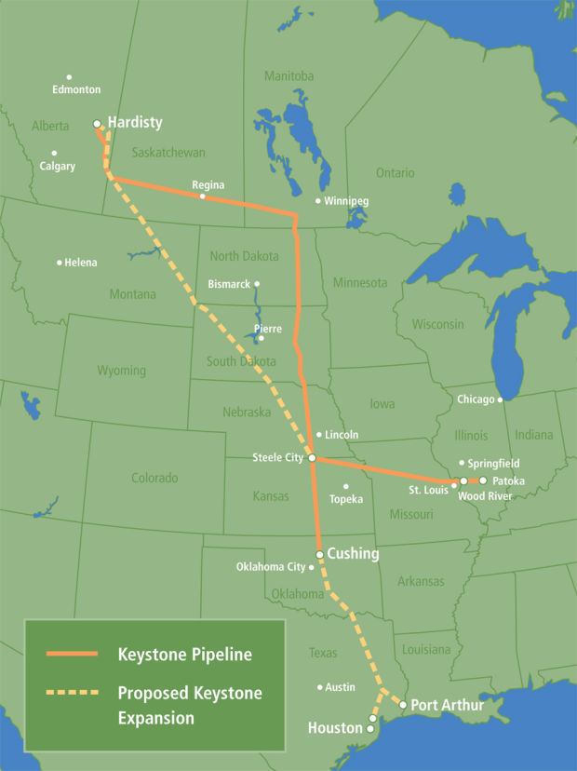
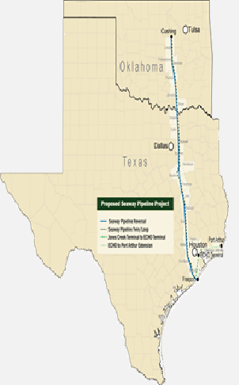
Cushing Bottleneck Alleviation?

Slide 12
Technological Improvements
SAGD (Steam Assisted Gravity Drainage) – Alternative to mining/extracting crude from oil sands
Horizontal Drilling – Oil/gas producers able to access tight oil plays within shallow rocks
Hydraulic Fracturing – process of injecting highly pressurized fluid into oil site in order to increase surface area for extraction

Slide 13
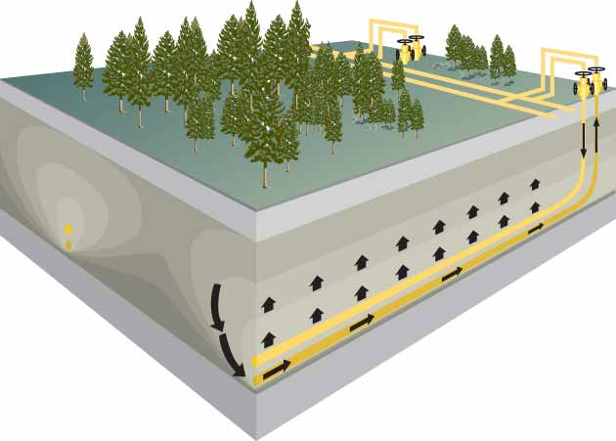
SAGD Well Operation

Slide 14
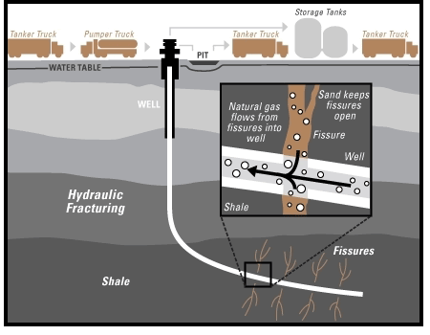
Hydraulic Fracturing Concepts

Slide 16
Is Oil a Scarce Resource?
Using proven reserves, the world only has 40 years of supply
Recent research from Harvard and IEA suggests no “peak oil” in sight
  Worldwide recovery rates less than 35% of total original oil in place
    Technological improvements allowing previously untapped oil become economically feasible
  Wrong depletion rates (forecasters use 6-10%)
    70% of oil production is from oilfields producing for decades
  Factoring all risks, projected 17.6mmbbl/day of oil production increase by 2020, IEA states that US could be energy self sufficent by 2020
    Western Hemisphere will become key oil player by 2020
Notes:
There are 5 major shale plays in North America. Only the Bakken has been extensively developed at this point

Slide 17
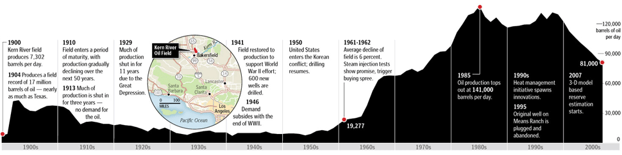
Case Study – Kern River
Originally discovered in 1899. Estimated production life 50 years
Kern River is still producing today
Water Flooding and future technological developments can yield additional output
Notes:
There are 5 major shale plays in North America. Only the Bakken has been extensively developed at this point

Slide 18
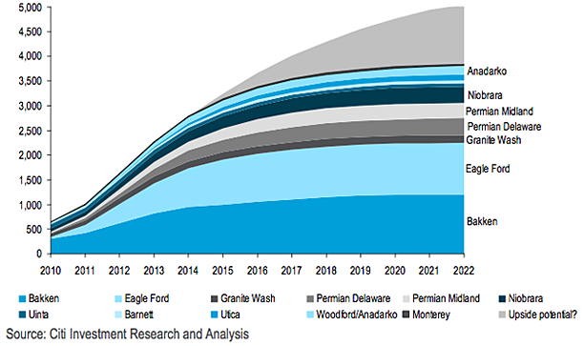
Projected Liquids Production from Shale Plays

Slide 19
Natural Gas Industry

Slide 20
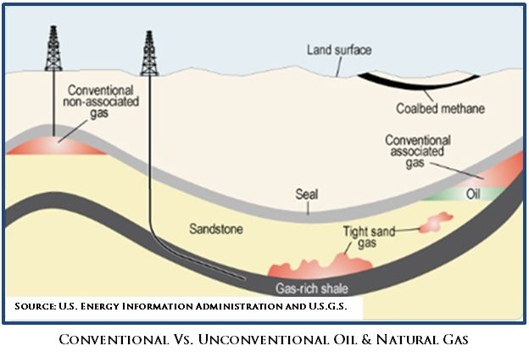
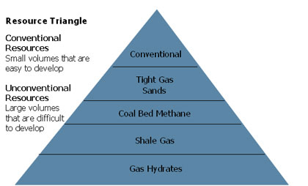
What is natural gas?
Conventional
Unconventional
Shale gas
Notes:
Natural gas consists primarily of methane, but also ethane, propane, butane, pentanes and heavier hydrocarbons. It exists in many different formations; some are harder to access than others.
Conventional (easier to produce) & Unconventional (more difficult to produce):
Conventional: Exploration for conventional gas has been almost the sole focus of the oil and gas industry since it began nearly 100 years ago. Conventional gas is typically “free gas” trapped in multiple, relatively small, porous zones in various naturally occurring rock formations such as carbonates, sandstones, and siltstones.
Unconventional: However, most of the growth in supply from today’s recoverable gas resources is found in unconventional formations. Unconventional gas reservoirs include tight gas, coal bed methane, gas hydrates, and shale gas. The technological breakthroughs in horizontal drilling and fracturing hat have made shale and other unconventional gas supplies commercially viable have revolutionized Canada’s natural gas supply picture.
The key difference between “conventional” and “unconventional” natural gas is the manner, ease and cost associated with extracting the resource.
Shale gas: Shale gas is natural gas found in very fine-grained sedimentary rock. The gas is tightly locked in very small spaces within the reservoir rock requiring advanced technologies to drill and stimulate (fracture) the gas bearing zones. While large-scale commercial production of shale gas has not yet been achieved in Canada, many companies are now exploring for and developing shale gas resources in Alberta, British Columbia, Quebec, and New Brunswick.

Slide 21
Industry: From Wellhead to Burner Tip
Exploration & Extraction
Production
Transportation
Storage
Distribution & Marketing
Notes:
Industry: Canada is the world’s third largest producer of natural gas with average annual production of 6.4 trillion cubic feet (tcf). Producing regions are concentrated primarily in the western provinces (B.C., Alberta and Saskatchewan), and offshore fields in Canada’s Maritimes, with minor production in Ontario and Northern Canada.

Slide 22
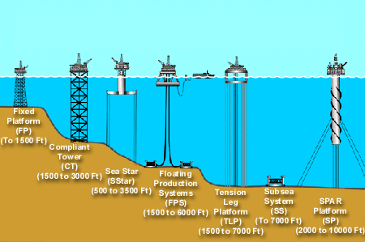
Exploration & Extraction
Onshore
Offshore
Notes:
Technology has allowed for a remarkable increase in the success rate of locating natural gas reservoirs. Geologists and geophysicists use and knowledge of the properties of underground natural gas deposits to gather data that can be used to make educated guesses as to where natural gas deposits exist
Once a potential natural gas deposit has been located, it is up to a team of drilling experts to dig down to where the natural gas is thought to exist
We focus on two drilling platforms: onshore and offshore
Onshore drilling: drilling into the earth in the hopes of uncovering valuable resources. There are two main types of onshore drilling
Cable tool drilling: The basic concept for cable tool drilling consists of repeatedly dropping a heavy metal bit into the ground, eventually breaking through rock and punching a hole through to the desired depth.
Horizontal drilling: allows for the extraction of natural gas that had previously not been feasible. On the surface it resembles a vertical well, beneath the surface; the well inclines so that it runs parallel to the natural gas formation. Horizontal drilling is often used with shale gas wells.
Offshore drilling
Refers to a mechanical process where a wellbore is drilled through the seabed. There are a number of challenges over drilling onshore due to the remote and harsher environment.

Slide 23
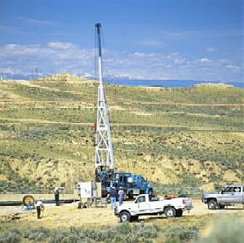
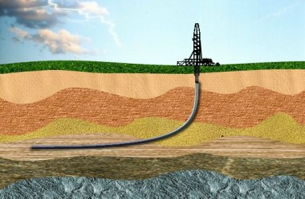
Onshore Drilling
Carbon tool drilling
Horizontal drilling

Slide 24
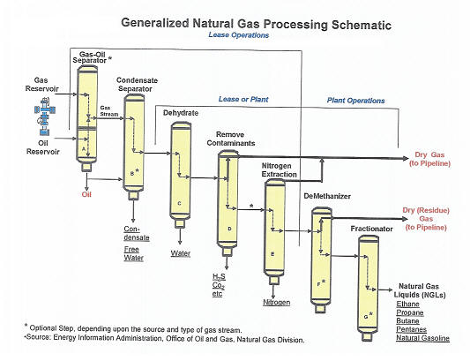
Production
Oil and condensate removal
Water removal
Separation of natural gas liquids
Sulfur and carbon dioxide removal
Notes:
Production: When we find natural gas underground, it comes associated with a variety of other compounds and gases, as well as oil and water, which must be removed. Natural gas processing consists of four main processes: 1.) oil and condensate removal; 2.) water removal; 3.) separation of natural gas liquids; 4.) sulfur and carbon dioxide removal. This produces what is known as 'pipeline quality' dry natural gas. Major transportation pipelines usually impose restrictions on the make-up of the natural gas that is allowed into the pipeline. That means that before the natural gas can be transported it must be purified.

Slide 25
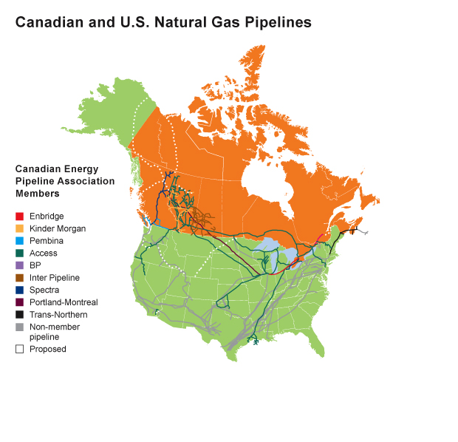
Transportation
Gathering system field lines
Transmission trunk lines
Distribution lines
Notes:
Transportation: Natural gas produced from a particular well will have to travel a great distance to reach its point of use. Transportation of natural gas is closely linked to its storage: should the natural gas being transported not be immediately required, it can be put into storage facilities for when it is needed. There are three major types of pipelines along the transportation route:
Gathering system field lines: move crude oil and natural gas from wells to processing facilities. After processing, feeder lines carry the hydrocarbons to the major, long distance transmission lines.
Transmission trunk lines: deliver product to small-diameter distribution pipelines, as well as industrial users, local distributors, refineries or connection pipelines to the United States.
Distribution lines: Local distribution companies (LDCs) use distribution lines to deliver natural gas to homes and businesses. Crude oil transmission lines also transport natural gas liquids (NGLs) and other refined petroleum products, while natural gas transmission lines only transport natural gas

Slide 26
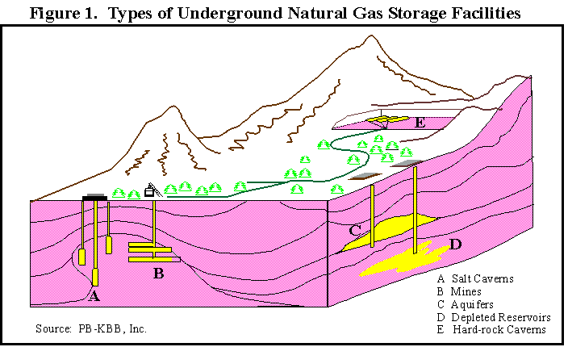
Storage
Underground
Depleted gas reservoirs
Aquifers
Salt caverns
Liquefied natural gas
Notes:
Storage: Natural gas is usually stored underground, in large storage reservoirs. There are three main types of underground storage:
Depleted gas reservoirs
Aquifers
Salt caverns
In addition to underground storage, however, natural gas can be stored as liquefied natural gas (LNG). LNG allows natural gas to be shipped and stored in liquid form, meaning it takes up much less space than gaseous natural gas

Slide 27
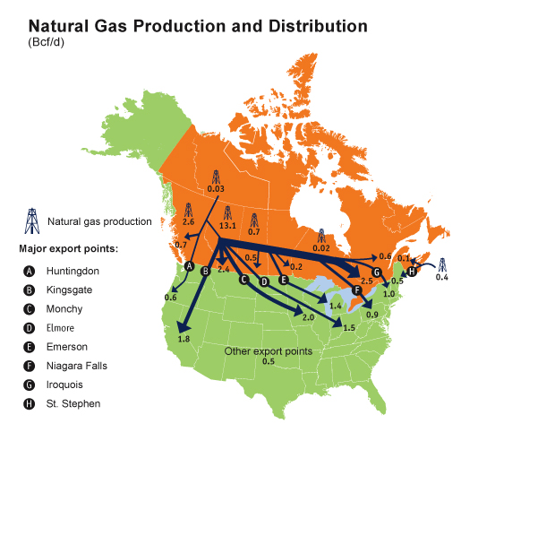
Distribution & Marketing
Notes:
Distribution & Marketing: Distribution is the final step in delivering natural gas to customers. While some large industrial, commercial, and electric generation customers receive natural gas directly from high capacity interstate and intrastate pipelines (usually contracted through natural gas marketing companies), most other users receive natural gas from their local gas utility, also called a local distribution company (LDC).

Slide 28
Business Overview
Market structure
Natural gas demand
Natural gas supply

Slide 29
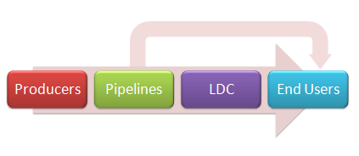
Market Structure
Prior to deregulation and pipeline unbundling

Slide 30
Market Structure
Producer
LDC
Marketers
End Users
Transporters
Simplified structure after pipeline unbundling

Slide 31
Natural Gas Demand
Factors affecting long term demand
  Residential and commercial demand
  Industrial demand
  Electric generation demand
  Transportation sector demand
Factors affecting short term demand
  Cyclical cycle
  Weather
  Capacity to switch fuel
  Economy

Slide 32
Natural Gas Supply
Short term barriers
  Availability of skilled workers
  Equipment permitting and well development
  Weather and delivery disruptions
Other barriers
  Onshore and offshore access
  Pipeline infrastructure
  Financial environment
Notes:
Supply
The production of natural gas is based on competitive market forces. Canadian natural gas production has dropped 15 per cent since 2008, a direct result of a downturn in drilling activity due to gas price declines. Activity in the last few years has increasingly focused on deeper conventional, tight, and shale gas resources as technological advancements in horizontal drilling and/or multi-stage hydraulic fracturing have lowered their supply costs. Supplying natural gas is dependent on a number of factors. These factors may be broken down into two segments:
Factor affecting the supply of natural gas: in a perfect market, price signals would be recognized and acted upon immediately, and there would be little lag time between increased demand for natural gas, and an increase in supplies reaching the market. However, in reality, this lag time does exist. Some factors that affect this lag time are:
(Short term supply barriers) availability of skilled workers, equipment, permitting and well development, weather and deliver disruptions
In addition to the short-term impediments to increasing natural gas supply, there exist other barriers:
Onshore and offshore access, pipeline infrastructure, the financial environment

Slide 33
Regulations
Federal regulation
Provincial regulation

Slide 34
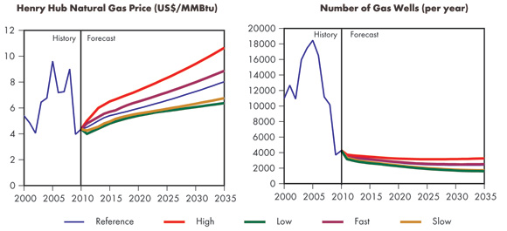
Outlook
Drilling
Notes:
Drilling: Canadian natural gas production has dropped 15 per cent since 2008, a direct result of a downturn in drilling activity due to gas price declines. Activity in the last few years has increasingly focused on deeper conventional, tight, and shale gas resources as technological advancements in horizontal drilling and/or multi-stage hydraulic fracturing have lowered their supply costs.

Slide 35
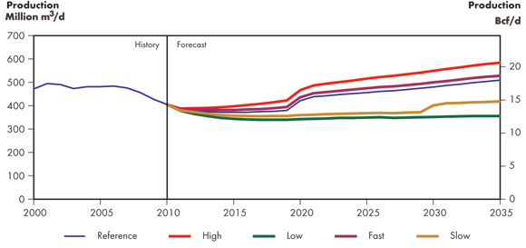
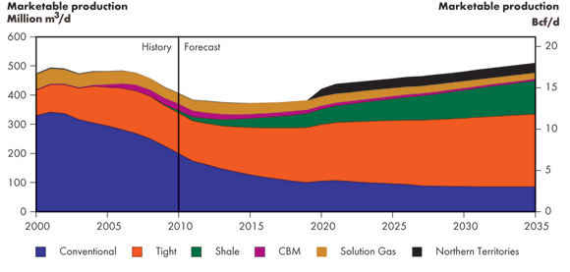
Outlook
Drilling
Production
Notes:
Production: By 2014, tight gas production becomes larger than all other conventional production in Canada and stays larger over the projection period, accounting for 49 per cent of total Canadian production in 2035 in the Reference Case. The proportion of shale gas also grows, making up 22 per cent of production in 2035. CBM production declines over the projection period, as investment is drawn to other resources. Production of solution gas (gas produced from oil wells) increases slightly through 2014 along with conventional oil production.

Slide 36
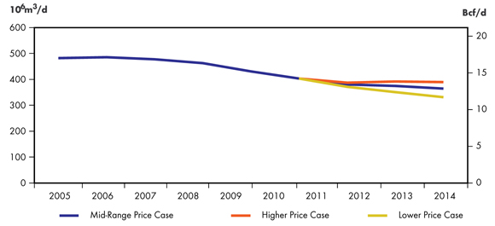
Outlook
Drilling
Production
Deliverability
Notes:
Deliverability: The three price cases cover a range from a Lower Price Case where almost all drilling of natural gas is uneconomic unless the gas has a high NGL content, to a Higher Price Case where natural gas supply and demand move into balance and provide an incentive for the resumption of dry natural gas drilling. The levels of drilling activity that provide these deliverability outcomes are the result of capital investment assumptions and estimates of drilling costs.

Slide 37
Outlook
Drilling
Production
Deliverability
Uncertainties
Future natural gas prices
Potential labour shortages
Future growth of U.S. shale gas production
Well production rates
Notes:
Uncertainties
Future natural gas prices are a key uncertainty in the production projections.
Potential labour shortages could impact the pace of development in the oil and gas sector.
Future growth of U.S. shale gas production and its impact on North American gas prices will influence Canadian production
Well production rates

Slide 38

Company Snapshot

Slide 39
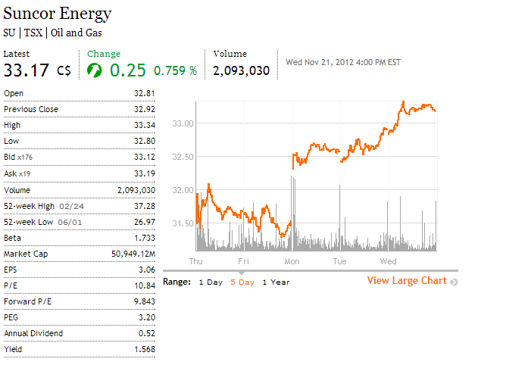
Mainly been trading flat for the year
Recently upgraded by JPM as they expect a dividend hike in the near future
Source: The Globe and Mail

Slide 40
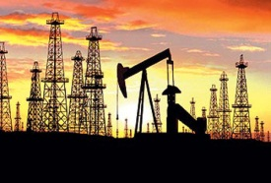
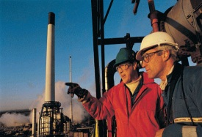
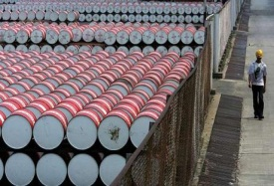

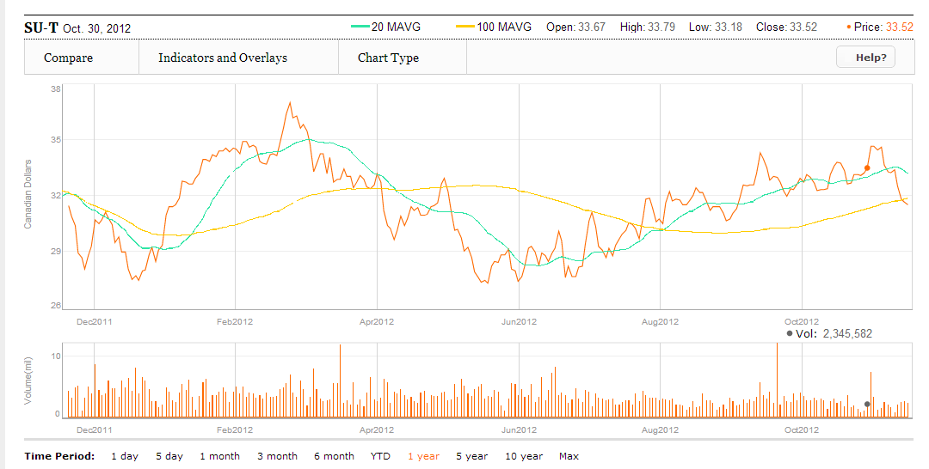
Oil & Gas Industry Presentation Company Snapshot
1 Year Stock Chart
Source: The Globe and Mail
November 21, 2012 | Canadian Oil & Gas Industry Presentation | BUS 417
Notes:
A - Rick George the company CEO since 1991 retired in Dec 2011

Slide 41
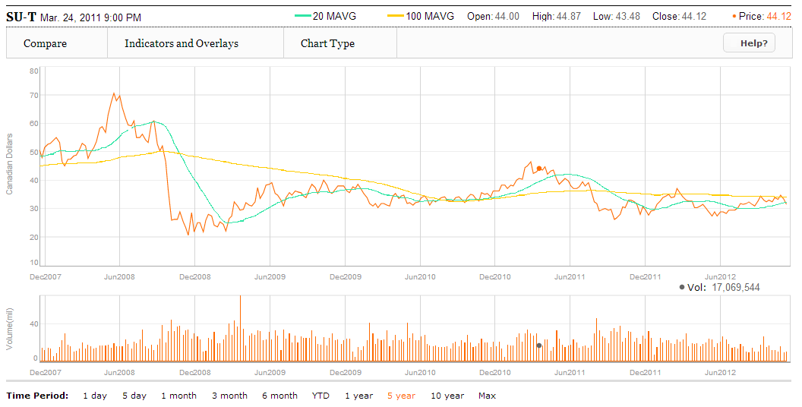
5 Year Stock Chart
Source: The Globe and Mail
Notes:
A: When Crude Oil Dropped (I think to ~$98/barrel)

Slide 42
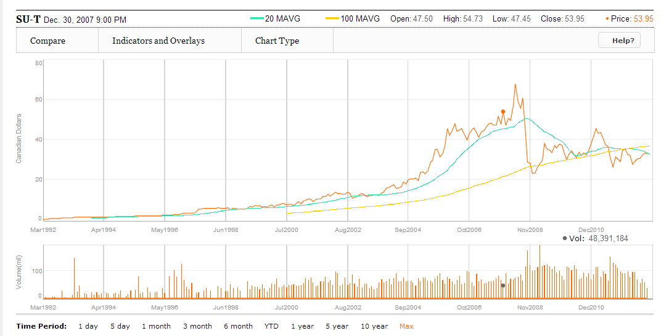
Max Year Stock Chart

Slide 43
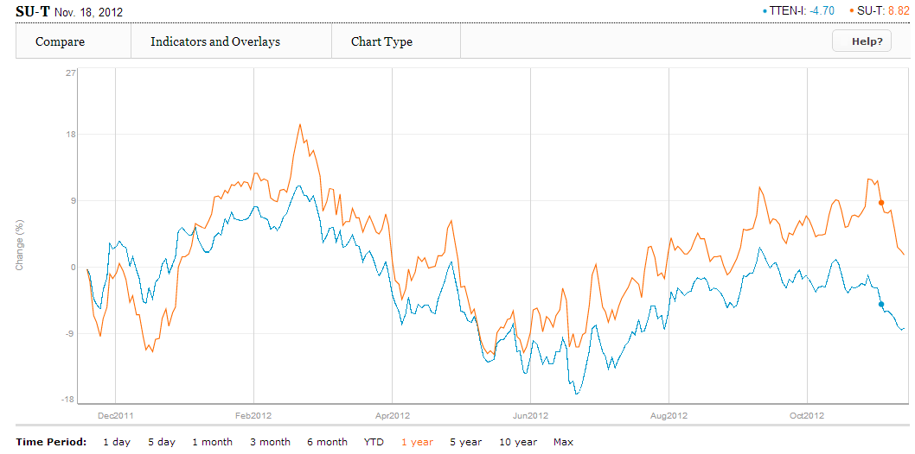
1 Year Stock Chart v. TSX Capped Energy (XEG)
Source: The Globe and Mail

Slide 44
Company History

Slide 45
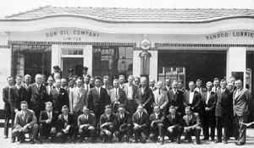
1917
Sun Company Inc. opens in Canada as a supplier to war plants in the Montreal area
1923
Sun Company incorporates as Sun Oil Company Limited
1930
First Sunoco branded stations open in Toronto, Montreal and Quebec City

Slide 46

1950
Sun Company drills first Canadian producing well in Alberta
1979
Suncor forms when all Canadian operations of the Sun Company are amalgamated with the Great Canadian Oil Sands
1985
Federal government deregulates oil prices, allowing producers to sell at market value

Slide 47
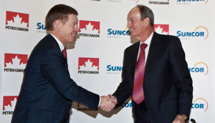
1992
Suncor becomes a publicly listed company (listed NYSE in 97)
1999
Construction begins on the Project Millennium aimed at increasing oil sands production to 225,000 by 2002
2009
Suncor and Petro-Canada merged to create Canada’s largest energy company

Slide 48
Petro Canada
All-stock offer of $19B
Creates a $43B company (now at $50B market cap)
Suncor
More than a 100 years worth of reserves
Canadian oil-sands centric strategy
Petro-Canada shareholders get 40% of new company and Suncor shareholders get 60%
$300M/Y in cost savings and $1B/Y in capital efficiencies

Slide 49
Business Overview

Slide 50
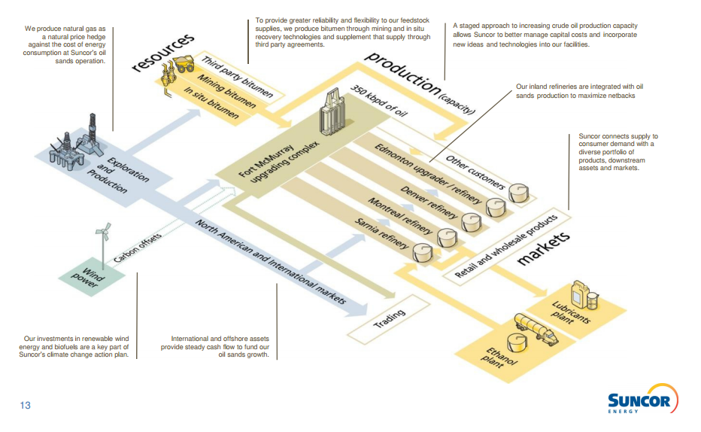
Notes:
Oil Sands -

Slide 51
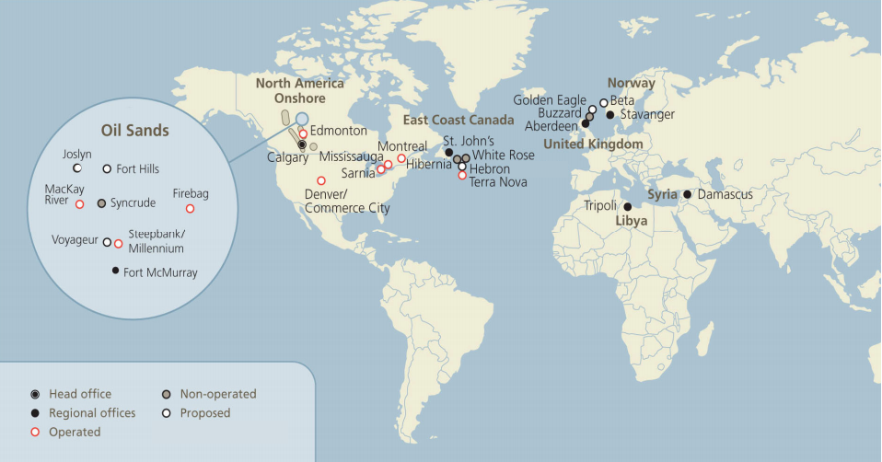
Oil weighted assets are very Canada centric

Slide 52
Oil Sands | Assets located in northeast Alberta Recovers bitumen and upgrades the production into refinery feeds Includes growth ventures that Suncor is a part of Fort Hills (40.8%) & Voyageur (51%)
Exploration and Production | Consists of offshore on the East Coast of Canada and North Sea Consists of onshore operations in North America, Libya* and Syria*
Refining and Marketing | Refining into broad range of petroleum and petrochemical products with various locations in Canada and US
Corporate, Energy Trading and Eliminations | Investments in renewable energy Other activities not directly attributable to operating activities
Notes:
Libya – looking to restart exploration drilling in 2013 and paid $200M relating to Exploration and Production Sharing Agreements (EPSA’s) with the Lbyan government
Syria – originally 3% of revenue and CF from operations, suspended operations in Syria on Dec 2011 and have written down $694M impairment ($604 to PPE, $23M to other current assets and $67M to A/R)

Slide 53
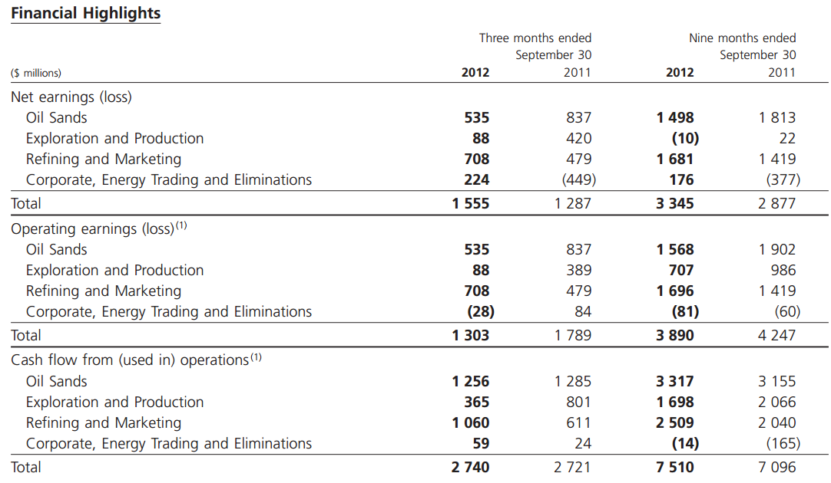

Slide 54
Cash from operations were $2.74B in 2012Q3 compared to $2.721B in 2011Q3
Oil sands is the largest portion of operating CF as well as revenue
Notes:
The increase was due primarily to higher refining margins and higher production volumes for the Oil Sands segment, partially offset by lower average price realizations and lower production volumes for the Exploration and Production segment

Slide 55
Oil Sands
Production volumes averaged a record 341,300 bbls/d for the third quarter of 2012 Lower realized average sale prices ($80.79 in 2012Q3 compared to $85.09 in 2011Q3) Projects Syncrude Venture (12% Ownership) Millenium, Firebag, MacKay River (Fort McMurray)
Notes:
Syncrude is a joint venture between seven partners: Canadian Oil Sands Limited (36.74%), Imperial Oil (25%), Suncor Energy (12%), Sinopec (9.03%),Nexen (7.23%), Mocal Energy (a subsidiary of Nippon Oil Exploration) (5%), and Murphy Oil (5%).
Just outside Fort McMurray

Slide 56
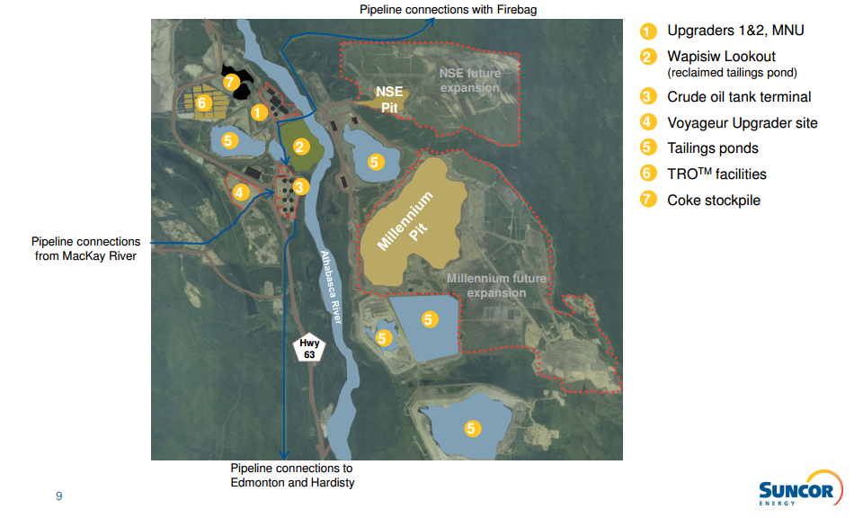

Slide 57
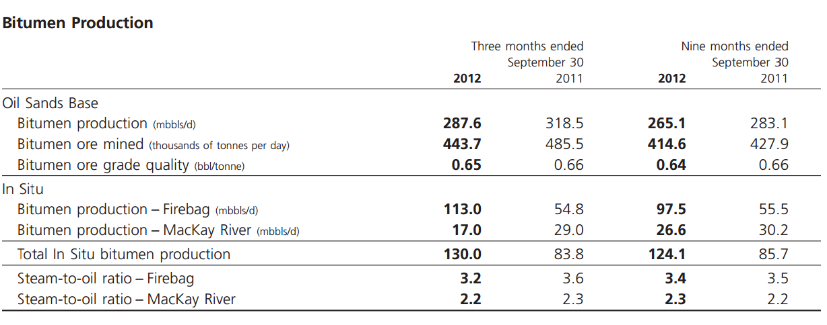
Average production from Firebag with the ramp up of operations and use of infill well technology (up from 54,800 bbls/d → 113,000 bbls/d)

Slide 58
Exploration and Production
Production volumes down from 202.4 (Mboe/d) in 2011 to 193.8 (Mboe/d) in 2012 Higher realized average sale prices ($84.15 in 2012Q3 compared to $78.86 in 2011Q3) Projects Eastern Canada (Terra Nova, White Rose, Hibernia) International (Libya, Buzzard, Syria*) North American Onshore (SW of Alberta, NE of BC)

Slide 59
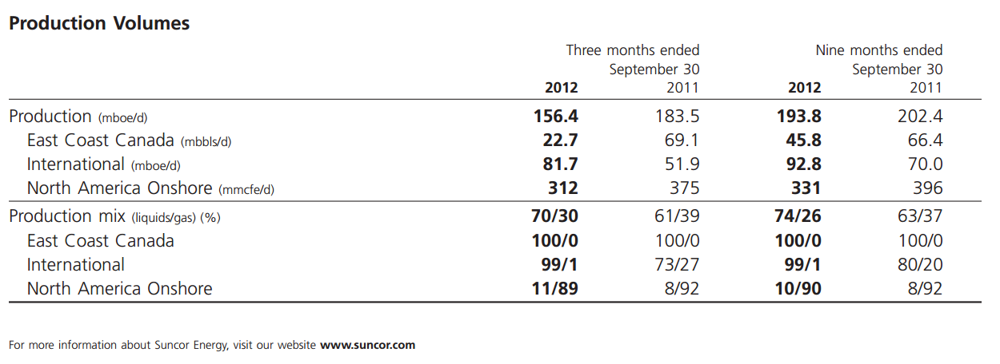
Production volumes down from 2011Q3 to 2012Q3
Due to maintenance in a East Coast Canada operation (zero production from Terra Nova)

Slide 60
Refining and Marketing
Refined product sales (gasoline from pumps) recorded 87.5 (m3/d) in 2012Q3 up slightly from 86.7 (m3/d) in 2011Q3 Higher demand for gasoline in Western North America but lower demand in Eastern North America Customers Retail Consumers Wholesale Consumers

Slide 61
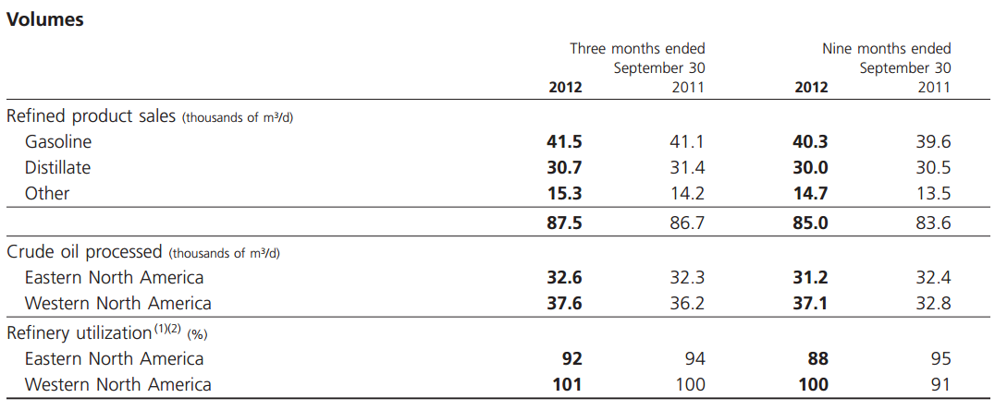
Higher demand and high utilization rates in Western North America

Slide 62
Corporate, Energy Trading and Eliminations
Small part of operations but it was a $(28M) loss in 2012Q3 compared to a $84M gain in 2011Q3 Segments Renewable Energy Energy Trading Corporate Activities Group Eliminations
Notes:
Loss due to higher corporate operating costs (higher depreciation and share-based comp exp)

Slide 63
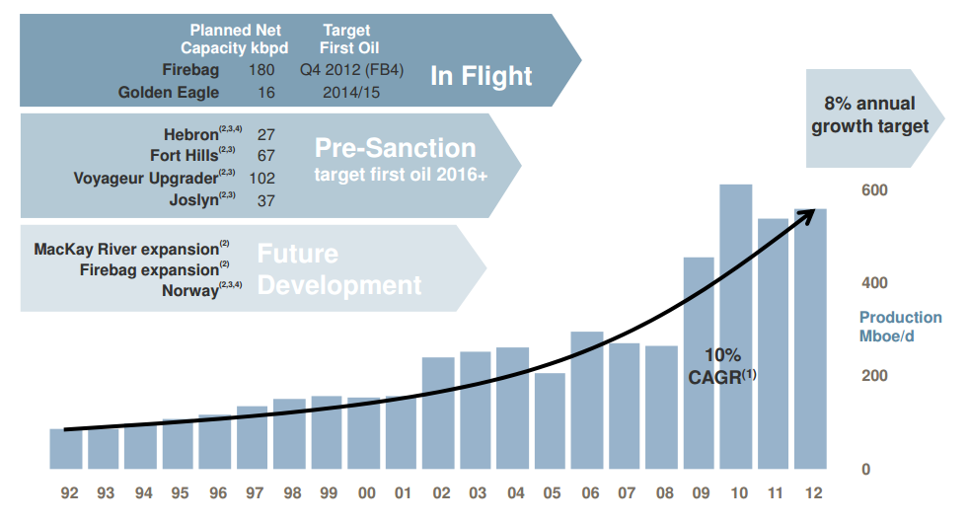
Growth Opportunities

Slide 64
Executive Profile

Slide 65

BSc in engineering from Colorado State University
Law degree from the University of Houston Law School
Graduate of the Harvard Business School Program for Management Development
Was Suncor CEO from 1991 to 2011
Numerous awards for Top CEO and inducted into Canadian Petroleum Hall of Fame
Richard George (Former CEO)

Slide 66

BSc in Chemical Engineering from Exeter University
Graduate of Advanced Management Program at Harvard Business School
Graduate of Business Economics Program at Oxford University
Been with Suncor since 2002
Steve Williams (President and CEO)

Slide 67

BA in Economics from University of Calgary
Honours graduate from the University of Calgary Management Development Program
Over 20 years of industry experience in strategy and development, finance, risk management and energy supply and trading
Been with Suncor since 2006
Bart Demosky (Chief Financial Officer)

Slide 68

BA in Economics from University of Calgary
MBA from the University of Alberta
Been with Suncor since 1996
Eric Axford (VP, Business Services)

Slide 69
Financial Overview

Slide 70
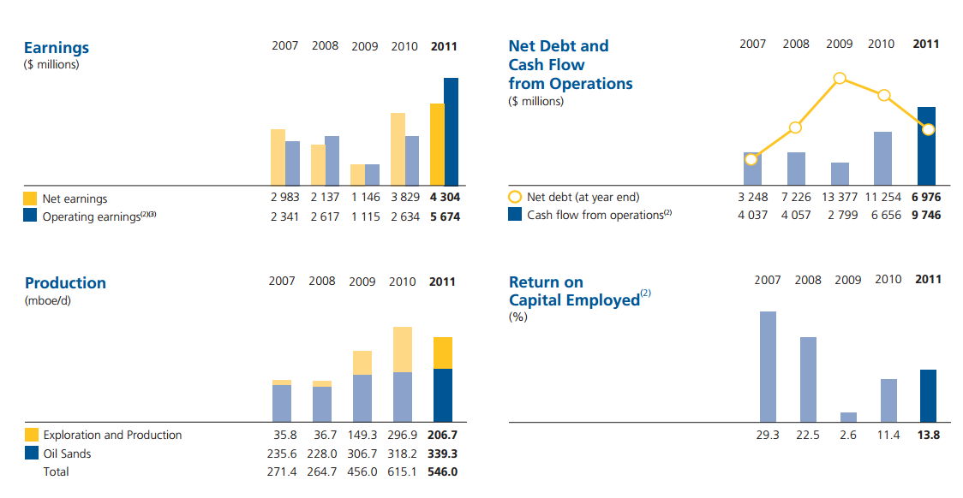
2011 Financial Highlights

Slide 71
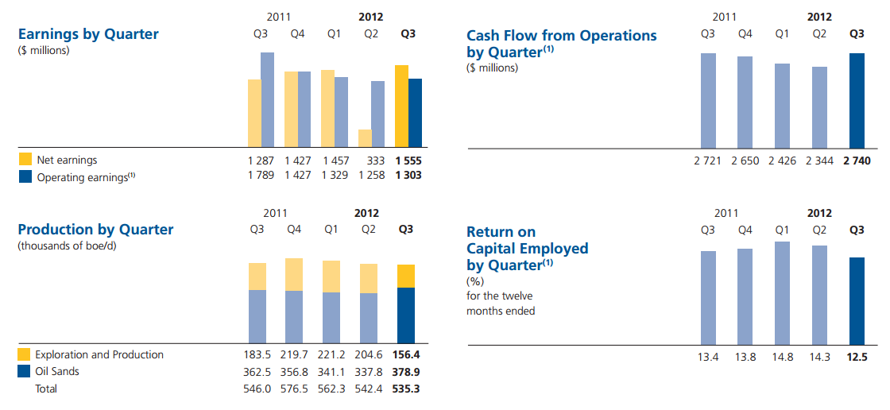
2012Q3 Financial Highlights

Slide 72
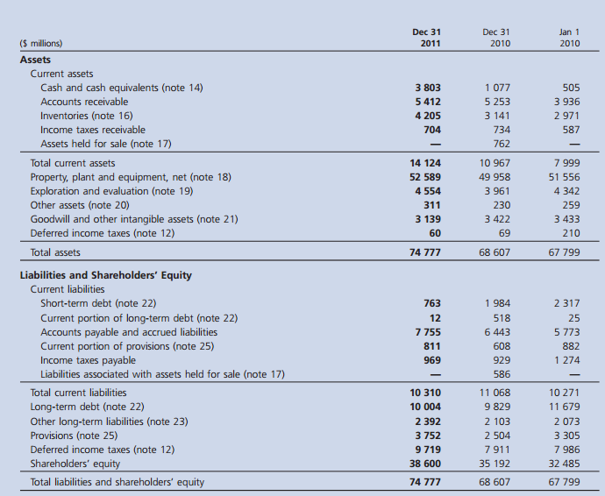
2011 Balance Sheet
Notes:
Build up in A/R and Inv (caution)
Decrease in ST Debt

Slide 73
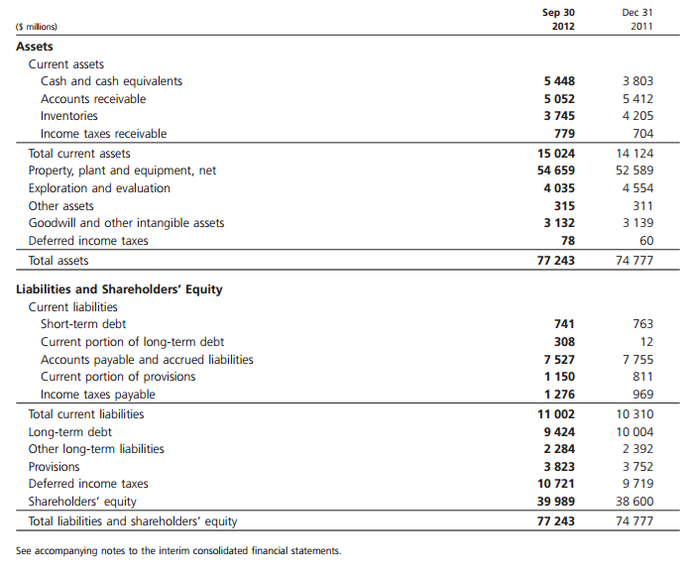
2012Q3 Balance Sheet
Notes:
Slight decrease in A/R and INV (more positive)
Paying off LT debt as well

Slide 74
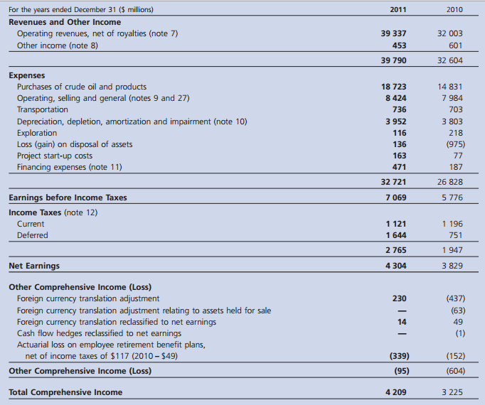
2011 Income Statement
Notes:
2011 was a strong year with op. rev up $7B

Slide 75
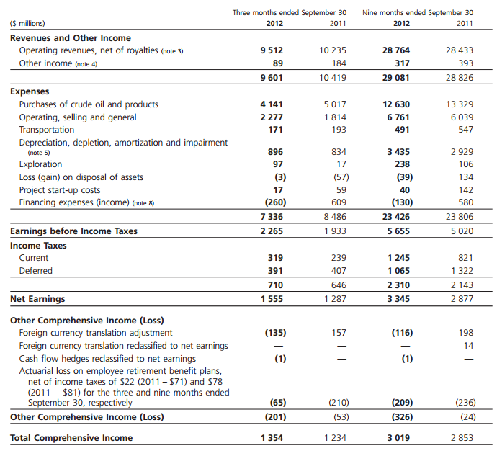
2012Q3
Income Statement
Notes:
In line so far with 9M 2011 and crude oil purchases are by far the largest expense
Slightly higher Depn numbers due to the Syria impairment cost

Slide 76
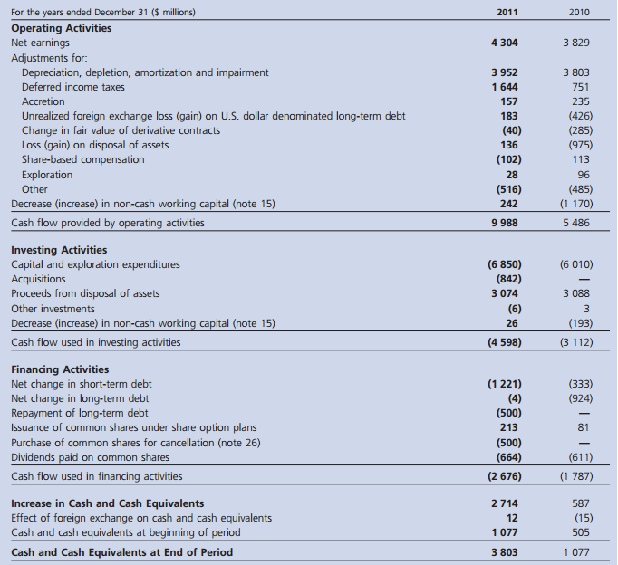
2011
Cash Flow Statement
Notes:
Increase in CAPX and Acquisitions
Same story as B/S → paying off ST and LT debt

Slide 77
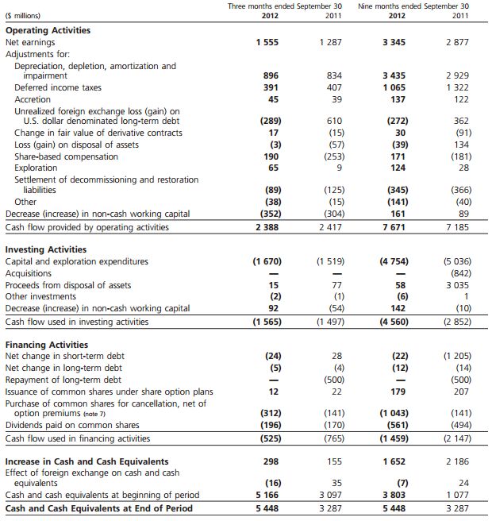
2012Q3
Cash Flow Statement
Notes:
Less proceeds, sold less assets
Bought back more shares and paid off less debt

Slide 78
BUY!

Slide 79

Oil & Gas Industry Presentation Cenovus Energy Inc.
Cenovus Energy Inc.
(CVE.TO)
November 21, 2012 | Canadian Oil & Gas Industry Presentation | BUS 417

Slide 80
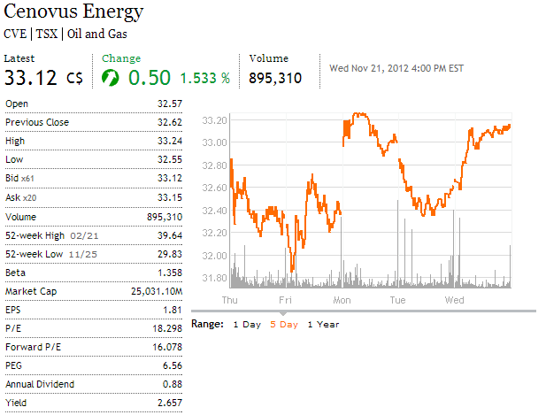
Source: The Globe and Mail

Slide 81
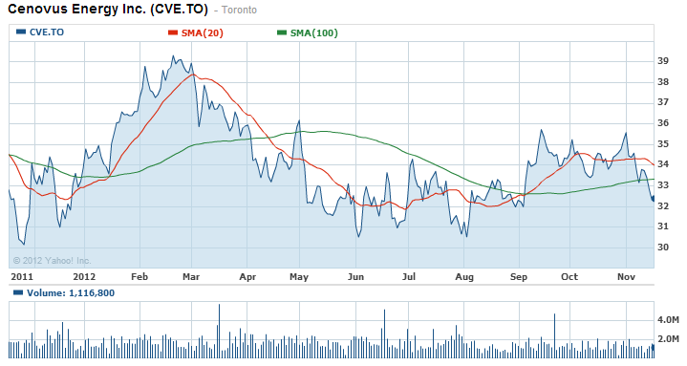
1 Year Stock Chart
Source: Yahoo! Finance

Slide 82
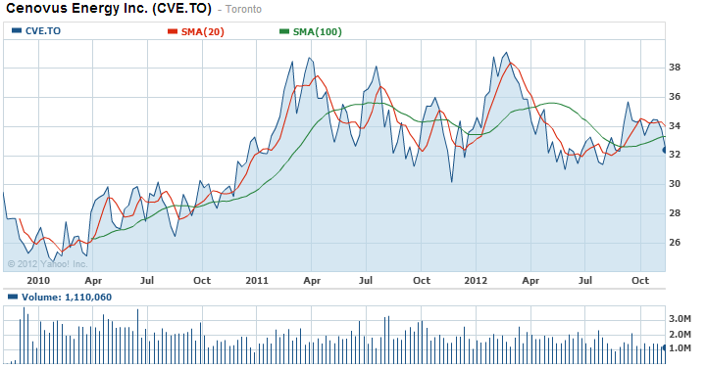
Max Years Stock Chart
Source: Yahoo! Finance

Slide 83
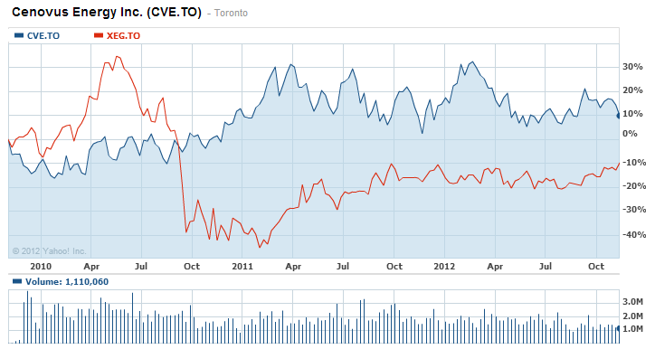
CVE vs Industry
Source: Yahoo! Finance
Notes:
iShares S&P/TSX Capped Energy Index: Large Cap Growth Companies ETF

Slide 84
Headquartered in Calgary, Canada
Employs approx. 5000 people
December 1, 2009 - Became independent from EnCana Corporation
  EnCana split into: 1. EnCana
  2. Cenovus Energy
Cenovus retained assets from PanCanadian and Alberta Energy Company
  These 2 companies originally merged to form EnCana in 2002

Slide 85
Canadian oil company
Products includes: bitumen, crude oil, natural gas, and natural gas liquids (NGL)
  *bitumen: deposits of extremely heavy crude oil
Main operations includes…
Oil Producing Projects
Emerging Oil Projects
Natural Gas Projects
Refining Projects

Slide 86
Operations – Oil Producing Projects
Oil Sands & Conventional Oil
2 types
  Oil sands needs to be processed to separate the bitumen so that it can be upgraded for usage
    “Oil sands are a thick, viscous mixture of bitumen hydrocarbons combined with water, sand, heavy metal and clay” – Alberta Canada
  Conventional oil is oil that can flow through a pipeline without processing or dilution.
    “Mixture of mainly pentanes and heavier hydrocarbons recoverable at a well from an underground reservoir and liquid at atmospheric pressure and temperature” – Alberta Canada

Slide 87
Operations – Oil Producing Projects
Oil Sands & Conventional Oil
Oil Production Breakdown for Third Quarter 2012
44%
56%

Slide 88

Operations – Oil Producing Projects
Oil Sands
Two 50/50 Venture Oil Sands Operations with ConocoPhillips
  Foster Creek, Alberta Oil Sands (36.9% of Total Oil Production for Third Quarter 2012)
      -Production increased 12% in third quarter 2012 from third quarter 2011
  Christina Lake, Alberta Oil Sands (18.9% of Total Oil Production for Third Quarter 2012)
      -Production grew more than threefold in third quarter 2012 compared to 2011

Slide 89
Operations – Oil Producing Projects
Oil Sands
  At Christina Lake and Foster Creek…
  The oil is 350-450m below surface.
  Primary technology used is steam-assisted gravity drainage (SAGD)
    Process which injects steam to soften the oil so that it can be pumped to the surface.
  Average Steam to Oil Ratio (SOR) of 2 – approx. 2 barrels of steam needed for 1 barrel of oil
    Current industry average in Alberta is around 3

Slide 90

Operations – Oil Producing Projects
Conventional Oil
Two conventional oil producing projects in
  1. Pelican Lake, Northern Alberta (Heavy oil assets) (13.7% of Total Oil Production for Third Quarter 2012)
      -Third quarter 2012 production increased 16% compared to same quarter in 2011 (Averaging more than 23,500 bbls/d)
  2. Weyburn Facility, Southeast Saskatchewan (9.4% of Total Oil Production for Third Quarter 2012)
      Third quarter 2012 production same as third quarter 2011 (Averaging around 16,000 bbls/day)
Notes:
Other conventional oil locations are the Bakken and Lower Shaunavon regions in Southern Saskatchewan, and other properties in Southern Alberta

Slide 91

Operations – Oil Producing Projects
Increases in Production
  Significant increase in volume produced since 2010 especially at Christina Lake and Foster Creek
Notes:
Foster Creek: production also increased over 20% in 2 years
Christina Lake: production increased by over 300% in 2 years

Slide 92
Operations – Emerging Oil Projects
Three Main Operations in
  Telephone Lake
      -Expected to produce 90,000 bbls/day in initial phase with potential to produce 300,000 bbls/day
  Narrows Lake
      -Expected to produce 130,000 bbls/day at full capacity
  Grand Rapids
      -Expected to produce 180,000 bbls/day at full capacity
Notes:
Joint regulatory application and environmental impact assessment for a commercial SAGD project at Cenovus’s wholly owned Grand Rapids asset in the Greater Pelican Region is being reviewed by the regulators (SAGD=steam-assisted gravity drainage)
The revised joint regulatory application and environmental impact assessment for the 100%-owned Telephone Lake project in the Borealis Region is also being reviewed by the regulators
The Narrows Lake regulatory approval included the option to use a combination of SAGD and solvent aided process (SAP) for oil production

Slide 93
Operations – Natural Gas Projects
Operations
  Majority from shallow gas play that covers more than 3 million acres in Southeast Alberta
      More than 25,000 gross producing natural gas wells in the Suffield, Brooks, and Langevin areas that produced an average of 577 million cubic feet per day (MMcf/d) in Q3 2012
      Declined about 12% from Q3 2011: mainly due to expected natural declines and divestures of non-core property in first quarter 2012
Notes:
Natural gas production acts as an economic hedge for the
natural gas required as a fuel source at both our upstream and refining operations.

Slide 94

Operations – Refining & Marketing Projects
Refining crude oil products into petroleum and chemical products
  Converting to regular gas
Notes:
Focused on the refining of crude oil products into petroleum and chemical products at two refineries located in the U.S
Refineries are jointly owned with and operated by Phillips 66, an unrelated U.S. public company
Also markets crude oil and natural gas

Slide 95

Operations – Refining & Marketing Projects
Benefits of refining due to rising price of regular unleaded gasoline and decline in price of crude oil
Notes:
3-2-1 crack spread: refining margin generated by converting three barrels of crude oil into two barrels of regular unleaded gasoline and one barrel of ultra-low sulphur diesel
Profit Margin for refining is about 60%

Slide 96

What is Generating Cash?
Notes:
Oil sands generating over 30% (Growing very fast)
Refining and Marketing generating over 40%
Refining and Marketing rose due primarily to higher refinery output, stronger refining margins resulting from high market cracks and
discounted crude oil processed

Slide 97

HISTORY
Joined predecessor (Alberta Energy Company) (1984)
Became EnCana’s Executive Vice-President & CFO (2006)
Became Cenovus’ President & CEO (2009)
EDUCATION
Bachelor of Commerce - University of Alberta (1980)
Executive Management Program - University of Western Ontario (1993)
Chartered Accountant (1983)
Brian Ferguson
President
Chief Executive Officer
Director (Non-independent)
Notes:
Responsible for the overall leadership of Cenovus Energy’s strategic and operational performance

Slide 98

HISTORY
Joined in 2001 as a Senior Vice-President
Was Managing Director for International & New Ventures (2003-2007)
Became Executive Vice-President and COO (2010)
EDUCATION
Bachelor of Science degree in mechanical engineering – Texas A&M University
Member of the Association of Professional Engineers, Geologists, and Geophysicists of Alberta
John Brannan
Chief Operating Officer
Executive Vice-President
Notes:
Responsible for all upstream, midstream, and downstream oil and gas operations

Slide 99

HISTORY
Joined in 2006 as Vice-President, Finance of the Corporate Finance Group
Became CFO and Executive Vice-President (2009)
Used to be a Managing Partner of KMPG LLP in Edmonton (1998-2006)
EDUCATION
Bachelor of Commerce - University of Alberta
Fellow Chartered Accountant
Ivor Ruste
Chief Financial Officer
Executive Vice-President
Notes:
Oversees a team responsible for the company's financial functions including comptrollers, treasury, tax, financial risk and enterprise risk reporting, acquisitions and divestitures, and Sarbanes-Oxley Act compliance

Slide 100

Balance Sheet – Quarterly Data
Notes:
Cash increase -On August 17, 2012 Cenovus completed a public offering in the U.S. of senior unsecured notes in the aggregate
principal amount of US$1.25 billion under the Company’s U.S. base shelf prospectus.
Used for general corporate purposes, including repayment of commercial paper indebtedness
Decent Debt/Equity Ratios
Current Ratio about 1 and a bit higher this quarter because of the long term financing

Slide 101

Balance Sheet – Annual Data

Slide 102

Income Statement – Quarterly Data
Notes:
Healthy revenue
Net earnings decreased this quarter because of risk management hedges on commodity price for crude oil

Slide 103

Income Statement – Annual Data

Slide 104

Shareholders’ Equity Statement
Notes:
Retained earnings growing and paying dividends
No heavy dilution of shares

Slide 105

Cash Flow Statement – Quarterly Data
Notes:
Increasing operating cash flow
constant dividends

Slide 106

Cash Flow Statement – Annual Data
Notes:
Positive cash flow before financing activities – has been paying dividends

Slide 107
Advantages of Cenovus Energy
Hedges
  Refining Operations
  Natural Gas
Cost efficiencies
  SOR 2:1 (industry average 3:1)
Superior properties
  Christina Lake & Foster Creek

Slide 108
METHOD: Cash Flow Multiple Valuation with Comparable Companies
  Husky Energy Inc.
  Imperial Oil Ltd.
  Suncor Energy Inc.

Slide 109
 | Price/CashFlow FY1
Husky Energy Inc. | 5.456455489
Imperial Oil Limited | 8.441097887
Suncor Energy | 4.824105231
Average | 6.240552869
Cenovus Energy Inc. | Cash Flow per Share FY1 | Target Price per Share
 | 4.951827774 | $ 30.90

Slide 110
HOLD

Slide 111

Company Snapshot

Slide 112

Trending up with the appreciation of natural gas prices
Price increase with speculation on buyout of liquids rich assets
Source: The Globe and Mail

Slide 113

Oil & Gas Industry Presentation Company Snapshot
1 Year Stock Chart
Source: The Globe and Mail
November 21, 2012 | Canadian Oil & Gas Industry Presentation | BUS 417
Notes:
Announcement of Petronas deal
Chesapeake & Ecana supposed land plot price suppressing
Recent earnings

Slide 114

5 Year Stock Chart
Source: The Globe and Mail
Notes:
A: When Crude Oil Dropped (I think to ~$98/barrel)

Slide 115

Max Year Stock Chart
Notes:
Spinoff of Cenovus
Plummet in Natural gas prices

Slide 116

1 Year Stock Chart v. TSX Capped Energy (XEG)

Slide 117
Company History

Slide 118
2002
Originated from two Canadian independent oil companies in 2002:
2003
Acquires Cutbank Ridge natural gas resource play and commences storage expansion in the States
2005
Gulf of Mexico Assets sold to Statoil
Pan Canadian Energy Corporation
Alberta Energy Company Ltd.
2007
Upstream oil interests in Chad and Brazil are sold
Encana and ConocoPhillips create integrated NA business
2009
Company split into to focused companies - Cenovus (integrated oil) and Encana (natural gas)
2010
3 Year Joint Venture with Kogas Canada Ltd.
2012
First LNG station in Louisiana
Announcement of 40% interest by Mitsubishi in Cutbank Ridge Partnership

Slide 119
Encana
Focus in Natural Gas Assets
Shareholders of Encana received 1 share of Cenovus for every one share of Encana
Cenovus
Focus in Integrated Oil Operations
Canadian oil-sands centric strategy
Fallen from its high of $60/share
Risen from $25.50

Slide 120
Business Overview

Slide 121
Goal: Encana's goal is to be the lowest-cost, highest-growth senior natural gas producer in North America through the following six-faceted strategy:
  Comprehensive disclosure of reserves and resources.
  Accelerated pace of development.
  Advancing resource play hub design and development.
  Increasing exposure to oil and natural gas liquids.
  Attracting third-party investments in undeveloped
  reserves and resources.
  Growing the market for North American natural gas

Slide 122
Strategy: unlock the tremendous value unrecognized within our asset base
  investing in the highest-return projects
  establishing increased liquids weighting and diversifying revenue sources
  maintaining industry-leading cost structures
  leveraging third-party funding through farm-outs, partnerships and joint ventures

Slide 123
Natural gas,
NGLs and Crude Oil
Refined petroleum products
Notes:
Oil Sands -

Slide 124



Slide 125

Reserves
Notes:
Libya – looking to restart exploration drilling in 2013 and paid $200M relating to Exploration and Production Sharing Agreements (EPSA’s) with the Lbyan government
Syria – originally 3% of revenue and CF from operations, suspended operations in Syria on Dec 2011 and have written down $694M impairment ($604 to PPE, $23M to other current assets and $67M to A/R)

Slide 126

Operations – Production Profile

Slide 127

Operations – Canadian Core Assets
Cutbank Ridge
  4500 wells with EUR of 4-16 Bcfe
  Production of 600 MMcfe/d
  Montney formation: liquids rich gas
  Horizontal & Multi-stage hydraulic fracture
  Oil gravity: 45-65 API
Bighorn
  1400 wells with EUR of 2-12 Bcfe
  Oil gravity: 55-60 API
  Well inventory: 1400 wells
Coalbed Methane
  Production of 475 MMcfe/d
  Sweet natural gas with high methane content (over 90%)
  Oil gravity: 55-60 API
  Well inventory: 1400 wells
Notes:
The increase was due primarily to higher refining margins and higher production volumes for the Oil Sands segment, partially offset by lower average price realizations and lower production volumes for the Exploration and Production segment

Slide 128

Operations – US Core Assets
Haynesville
  Production of 508 MMcfe/e
  $1.018B capex spent in expansion of assets and drilling program
  Reserves: 5.0 Tcfe
Jonah
  Production of 497 MMcfe/e
  Reserve life: 40-60 years
  Joint venture with Northwest Natural
Notes:
Syncrude is a joint venture between seven partners: Canadian Oil Sands Limited (36.74%), Imperial Oil (25%), Suncor Energy (12%), Sinopec (9.03%),Nexen (7.23%), Mocal Energy (a subsidiary of Nippon Oil Exploration) (5%), and Murphy Oil (5%).
Just outside Fort McMurray

Slide 129
Operations – Joint Ventures
Cutbank Ridge Partnership
  Mitsubishi acquring 40% of the property for $2.9 billion
  $1.45 billion upfront to fuel commitments on the projects
  Alleviates capital commitments for Encana
Kogas Joint Venture
  Extension of former JV agreement for partnership in Horn River operations
  Invest a further $185 million in 20,000 additional acres
Kitimat LNG
  BC’s first LNG export facility
  Partners may include: Apache, EOG, and Encana (30% interest)
  Proposed plant capacity is 700 MMcf/d of LNG
  Pending final investment decision

Slide 130

Operations – Kitimat LNG

Slide 131

Operations – Natural Gas Capital Efficiency

Slide 132

Operations – Liquids Capital Efficiency

Slide 133

Operations – Resource Play Hub

Slide 134
Higher demand and high utilization rates in Western North America

Slide 135

Operations – Shifting Exposure
Notes:
Loss due to higher corporate operating costs (higher depreciation and share-based comp exp)

Slide 136

Hedging

Slide 137
Executive Profile

Slide 138

Management Team
HISTORY
Joined in Encana’s predecessor companies in 1980
Chief Operating Officer (2002)
EDUCATION
Bachelor of Science in Petroleum Engineering – Northern Alberta Institute of Technology
ASSOCIATION
Association of Professional Engineers, Geologists, and Geophysicists of Alberta
World Presidents’ Organization
Canadian Council of Chief Executives
Randy Eresman
President
Chief Executive Officer
Notes:
Responsible for the overall leadership of Cenovus Energy’s strategic and operational performance

Slide 139

Management Team
HISTORY
Joined in Encana’s predecessor companies in 1985
Vice President of Strategic Planning & Portfolio Management (2007)
EDUCATION
Bachelor’s Degree in Economics – University of Calgary
Sherri Brillon
Chief Financial Officer
Executive Vice-President
Notes:
Responsible for all upstream, midstream, and downstream oil and gas operations

Slide 140

Management Team
HISTORY
Joined in Encana’s predecessor companies in 1985
Roles in asset management, business development, acquisitions and divestitures
EDUCATION
Bachelor of Science in Engineering – Dalhousie University
Bachelor of Science in Mechanical Engineering – Nova Scotia Technical College
ASSOCIATION
Association of Professional Engineers, Geologists, and Geophysicist of Alberta
Society of Petroleum Engineers
Bob Grant
Corporate Development
Executive Vice-President
Notes:
Oversees a team responsible for the company's financial functions including comptrollers, treasury, tax, financial risk and enterprise risk reporting, acquisitions and divestitures, and Sarbanes-Oxley Act compliance

Slide 141

Management Team
HISTORY
Promoted to Vice President (2009)
Promoted to Vice-President of the South Rockies Business Unit (2002)
Joined in Encana’s predecessor companies (2000)
Production/Operations Manager at Questar
EDUCATION
Bachelor of Science in Petroleum Engineering – University of Wyoming
ASSOCIATION
Canadian Natural Gas Initiative Executive Committee
ANGA Cross Border Committee
Eric Marsh
Senior Vice President (USA Division)
Executive Vice-President
Notes:
Oversees a team responsible for the company's financial functions including comptrollers, treasury, tax, financial risk and enterprise risk reporting, acquisitions and divestitures, and Sarbanes-Oxley Act compliance

Slide 142

Management Team
HISTORY
Joined in Encana’s predecessor companies (2000)
Leadership roles at Taxaco Canada and Imperial Oil
EDUCATION
Bachelor of Science in Mechanical Engineering – Concordia University
Awarded the Mechanical Engineering Medal
Mike McAllister
Senior Vice President (Canadian Division)
Executive Vice-President
Notes:
Oversees a team responsible for the company's financial functions including comptrollers, treasury, tax, financial risk and enterprise risk reporting, acquisitions and divestitures, and Sarbanes-Oxley Act compliance

Slide 143
Financial Statement Analysis

Slide 144

Balance Sheet – Quarterly Data
Notes:
Cash increase -On August 17, 2012 Cenovus completed a public offering in the U.S. of senior unsecured notes in the aggregate
principal amount of US$1.25 billion under the Company’s U.S. base shelf prospectus.
Used for general corporate purposes, including repayment of commercial paper indebtedness
Decent Debt/Equity Ratios
Current Ratio about 1 and a bit higher this quarter because of the long term financing

Slide 145

Balance Sheet – Annual Data

Slide 146

Income Statement – Quarterly Data
Notes:
Healthy revenue
Net earnings decreased this quarter because of risk management hedges on commodity price for crude oil

Slide 147

Income Statement – Annual Data

Slide 148

Shareholders’ Equity Statement
Notes:
Retained earnings growing and paying dividends
No heavy dilution of shares

Slide 149

Cash Flow Statement – Quarterly Data
Notes:
Increasing operating cash flow
constant dividends

Slide 150

Cash Flow Statement – Annual Data
Notes:
Positive cash flow before financing activities – has been paying dividends

Slide 151
SELL

