Slide 1
Real Estate Investment Trusts (REITs)
Date: November 22, 2012
Presented by: Adrian Siy-Yap, Alex Hung, Mingca Wang, Irina Nogina
Presented to: BUS 417 D-100

Slide 2
Agenda
REIT Overview
RioCan
Calloway
H&R
Conclusion

Slide 3
What are REITs
Corporate entity that invests in real estate assets
Can be publically or privately held
Capital pooled from investors
Alternative to directly investing in real estate
Distribute at majority of taxable income
No corporate tax

Slide 4
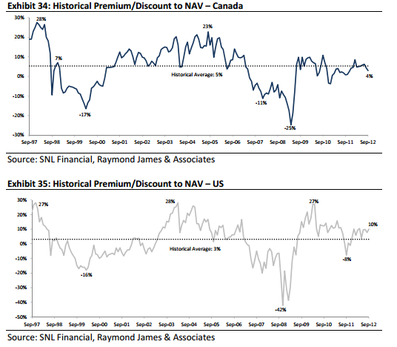
Dual Market for Real Estate
REITs create a secondary market for trading real estate
The private market and the REIT market may disagree on market values of property
This causes a REIT to trade at a discount or premium to its Net Asset Value (NAV)

Slide 5
Structure of REITs
Trustee
Trustee Fees
Act on Behalf of Unitholders
Distributions
Property Income
Unitholder
REIT
Properties
Investment
Ownership
Management Services
Management Fees
Management

Slide 6
Types of REITs
Equity REITs
Invest in and own properties
Mortgage REITs
Loan money for mortgages
Revenue primarily from interest income
Hybrid REITs
Invest in and own both properties and mortgages
Revenue primarily from rent income
Revenue from both rent and interest income
Invest in existing mortgages or MBS

Slide 7
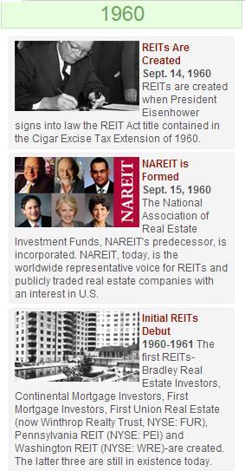
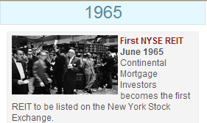


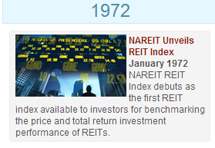
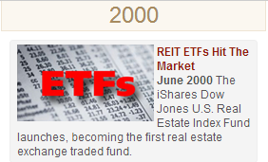
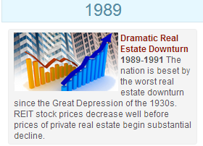
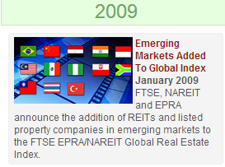
History of REITs
The first Canadian REIT was listed on the Toronto Stock Exchange

Slide 8
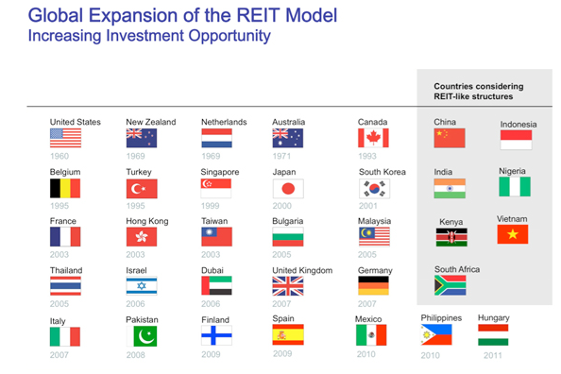
Future of REITs

Slide 9
REIT Requirements
Feature | U.S. REITs | Canadian REITs
Governed by | Requirements of Internal Revenue Code | Self Imposed Trust Declaration and certain requirements of the Income Tax Act
Vehicle | Corporation, Trust, or Association | Open- or closed-ended mutual fund trust
Investors | Min 100 Investors No more than 50% of units held by 5 or fewer individuals | Min 150 unit holders Must be listed on a recognized Canadian Exchange
Revenue Rules | Min 75% of Gross Income must be from real estate related sources Min 95% must be from real estate related sources and passive income sources | For closed-end funds: Min 95% of income must be from disposition of, or income earned from qualifying investments*. (The above rules do not apply to open-ended mutual funds.)
*qualifying investments: cash, shares, bonds, debentures and mortgages

Slide 10
REIT Requirements
Feature | U.S. REITs | Canadian REITs
Asset Rules | 1. At least 75% of gross asset value of total assets is represented by real estate assets, cash and cash items, and government securities 2. Not more than 25% of the value of total assets is represented by securities other than those included in 1 above 3. Not more than 20% of the value of total assets is represented by securities of one or more taxable REIT subsidiaries 4. Not more than 5% of the value of the assets is represented by securities of any one issuer, other than those securities included in 1 & 3 above 5. The REIT does not hold securities possessing more than 10% of the total voting power or having more than 10% of the total value of the outstanding securities of any one issuer, other than those securities included in 1 & 3 above. | 1. At least 80% of its property must be held in any combination of real property in Canada and other qualifying investments 2. No more than 10% of its property (on a non-consolidated basis) consisted of bonds, securities or shares in the capital stock of any one corporation or debtor. (The above rules do not apply to open-ended mutual funds.)

Slide 11
REIT Requirements
Feature | U.S. REITs | Canadian REITs
Distributions | Generally, must be at least 90% of Taxable Income without regard to distributions and excluding net capital gains | Set individually by the trust declaration, however usually around 85%-95% of distributable income
Taxation | Income is not taxed as long as it is distributed to investors. Income that is not distributed will be taxed at normal corporate rates. | Income is not taxed within the trust as long it is distributed to unitholders
Transfer of real estate to the REITs | Companies able to move assets to REIT on a tax deferred basis. | Limited ability to move assets to REIT on a tax deferred basis.
*Source: Deloitte (2004)

Slide 12
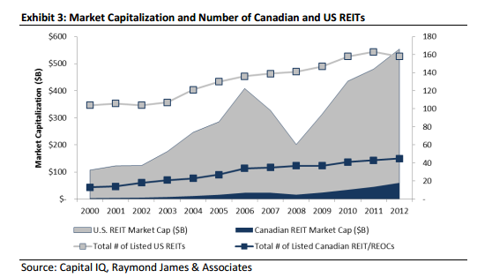
Market Cap. and Number of Can. & US REITs

Slide 13
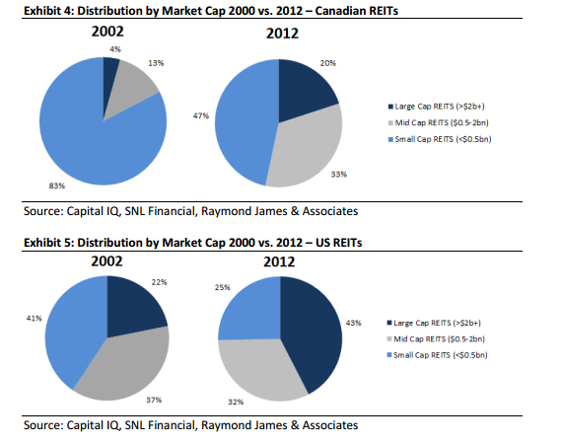
Market Cap. Distribution of Can. & US REITs

Slide 14
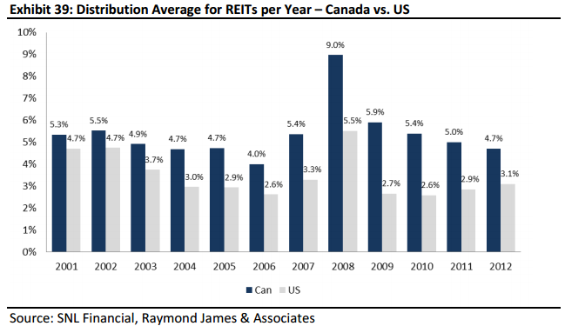
REIT Distribution Average

Slide 15
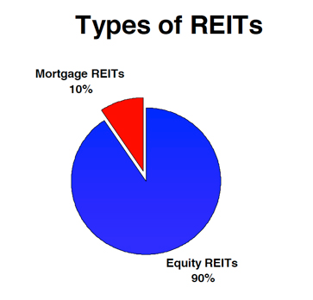
US REITs
As of Jan. 1, 2012
166 REITs registered with the SEC with combined market capitalization of $579 billion
1,100 U.S. REITs that have filed tax returns -> privately held REITs

Slide 16
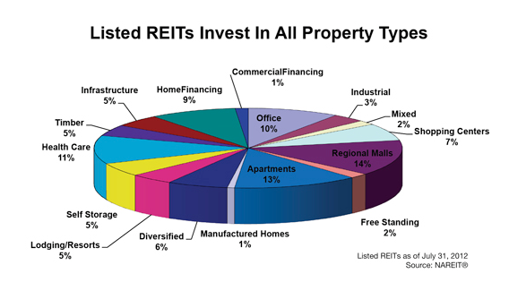
US Equity REITs

Slide 17
US Mortgage REITs
Agency vs. Non-Agency MBS
For Agency MBS the principal and interest payments are guaranteed by a U.S. Government-sponsored entity or agency
Fixed vs. Floating/Adjustable
Leverage

Slide 18
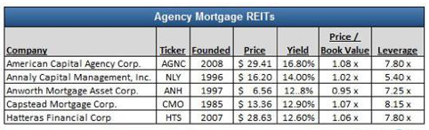
US Mortgage REITs

Slide 19
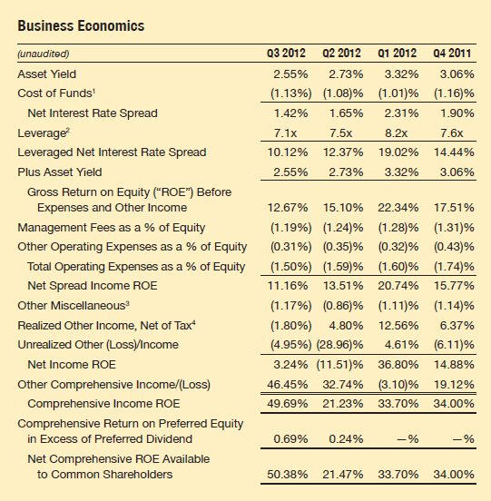
US Mortgage REITs – Business Economics

Slide 20
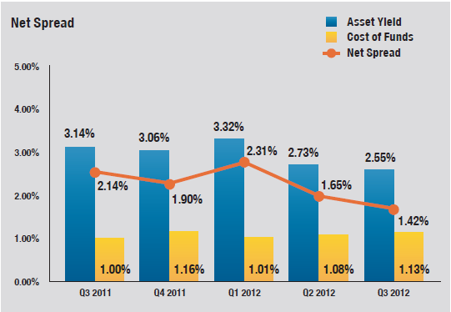
US Mortgage REITs – Net Spread

Slide 21
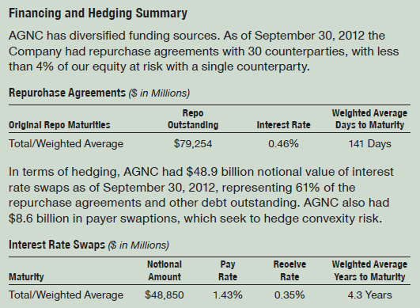
US Mortgage REITs – Financing and Hedging

Slide 22
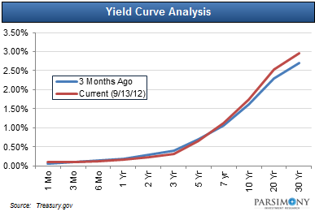
US Mortgage REITs – Yield Curve
steep yield curve ideal for mortgage REITs – borrow short term & invest long term

Slide 23
US Mortgage REITs - Risks
Prepayment
reinvest at lower rates
Interest rate increase
value of MBS decrease and cost of borrowing increase faster than MBS yield (lower duration)
Changes in yield curve
Default risk
minimal for REITs that invest in agency MBS

Slide 24
Canadian REITs

Slide 25
Canadian REITS Dividends

Slide 26
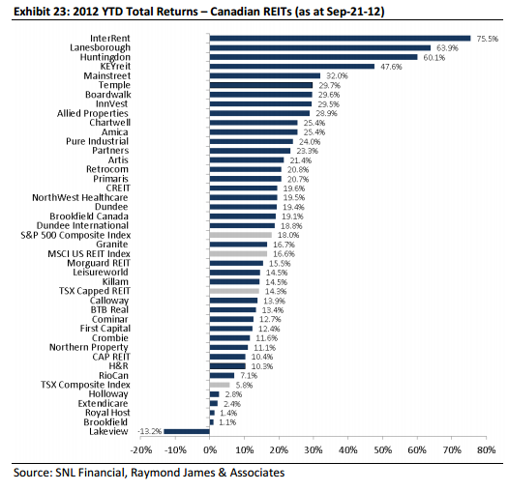
Canadian REITs Return

Slide 27
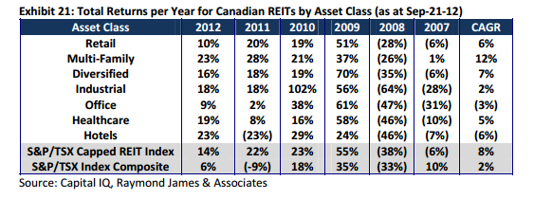
Return by Asset Class (Can. REITs)

Slide 28
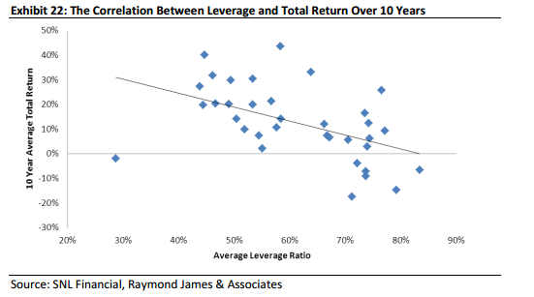
Leverage and Total Return (Can. REITs)

Slide 29
Tax Fairness Plan (Canada)
Announced on Nov 1st, 2006
Is applicable to all Canadian trusts companies, except REITs given certain conditions
Before the plan, trust companies do not need to pay corporate tax
Federal and Provincial government lose $1 billion annually in tax revenue to trusts
Main purpose is to reduce the growing number of companies converting to trust
Effective for trusts that begin trading after Oct 31, 2006
Four year transition period for existing trusts (2011)

Slide 30
New Requirements for REITs
At no time in the year hold any non-portfolio property other than real properties situated in Canada
At least 95% of its income for the year from properties
At least 75% of its income to be directly or indirectly attributable to rents from, mortgages on, or gains from the disposition of real properties situated in Canada
At least 75% of the value of REIT must be attributable to real property situated in Canada, cash and debt and obligations of Canadian governments

Slide 31
Types of REITs affected
Cross-border REITs
Fail to comply with Rule 3
Significant US or foreign holdings
Hotel REITs & Senior Housing REITs
Fail to comply with Rule 2
Passive Income vs. Active Income

Slide 32
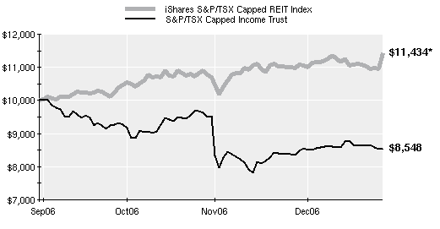
Effect of Tax Fairness Plan

Slide 33
Benefits to Investor
Portfolio diversification
Liquid asset
High yield
Professional and active management
Daily pricing
Stringent regulations on leverage and financial reporting

Slide 34
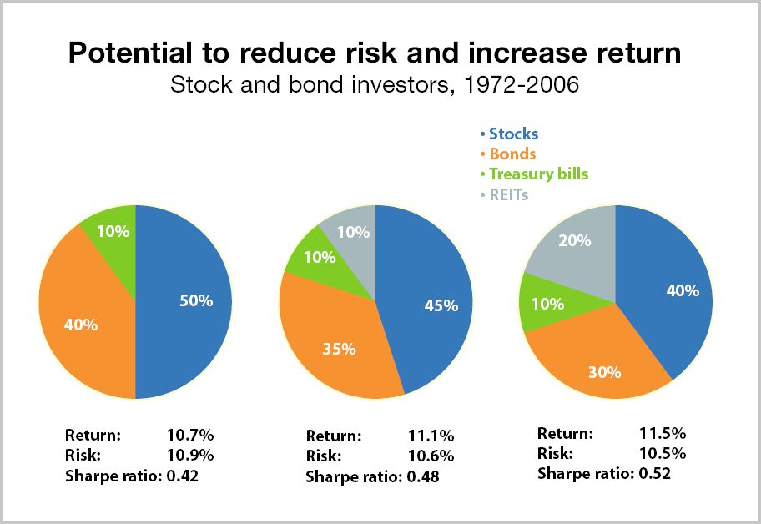
Diversification Benefit

Slide 35
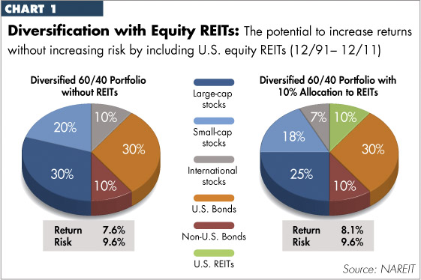
Diversification Benefit

Slide 36
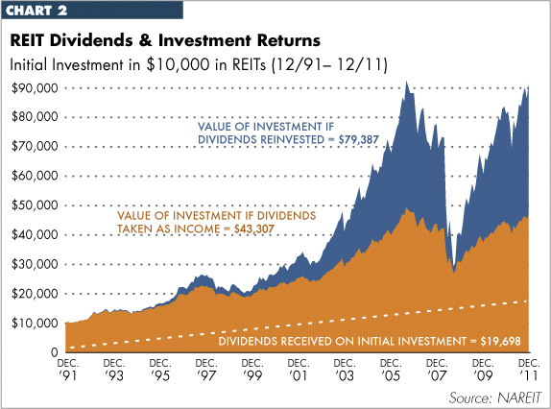
Dividends and Investment Returns

Slide 37
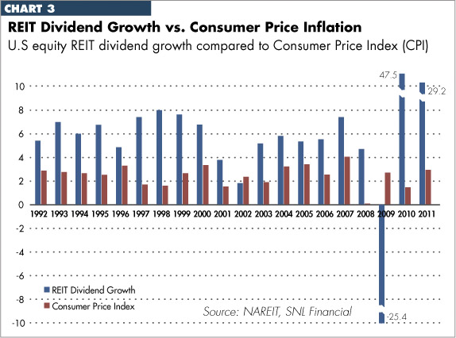
Dividend Growth vs. CPI

Slide 38
How to Measure Performance
Leverage
Net Asset Value
Value a REIT by valuing its real estate assets then adjusting for its other assets and subtracting liabilities
Net Income (Accounting Earnings) is not a good measure of performance
Depreciation allowance is irrelevant to performance
FFO, AFFO, FAD

Slide 39
FFO
Net income
+ Depreciation & Amortization
- Net Gain on Asset Sales
= Funds From Operations (FFO)
FFO approximates how much the REIT can issue in dividends on a recurring basis from year to year

Slide 40
AFFO
Funds From Operations (FFO)
- Maintenance CapEx
+ Other Adjustments
= Adjusted Funds From Operations (AFFO)
AFFO takes into account the CapEx required to maintain all your properties

Slide 41
FAD
Funds From Operations (FFO)
- All CapEx
+ Other Adjustments
= Funds Available for Distribution (FAD)
Also called “Cash Available for Distribution (CAD)”, measures cash that is available to be distributed as dividends to unit holders.

Slide 42
FCFE
Funds available for distribution
- Real estate acquisitions (new investments)
- Changes in working capital
- Principal payments
+ New debt issue
+ Gain on sale of real estate
+ New equity issue
= Free Cash Flow to Equity

Slide 43
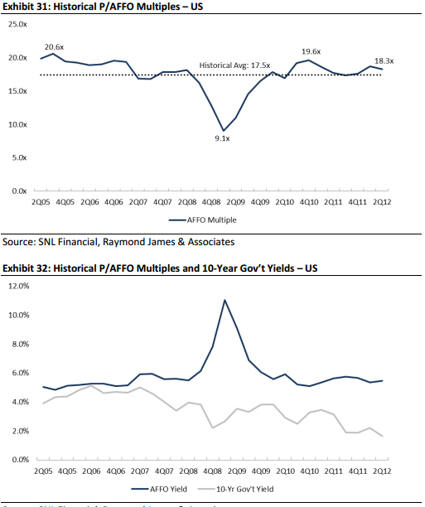
Historical P/AFFO Multiples

Slide 44
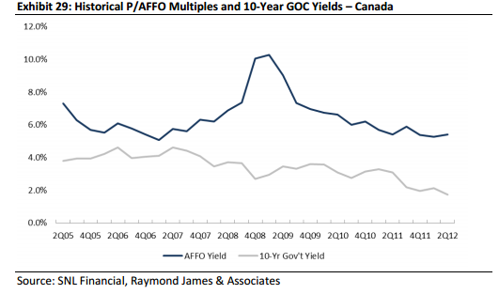
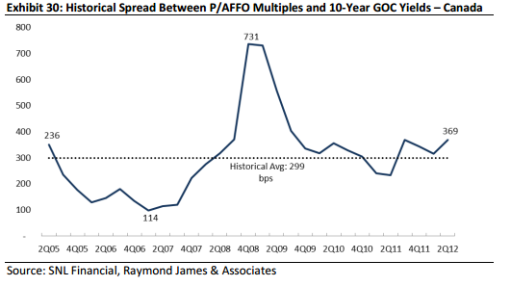
AFFO Yield vs. 10-Year Can. Govt Yield

Slide 45
AFFO Yield vs. 10-Year US Govt Yield

Slide 46
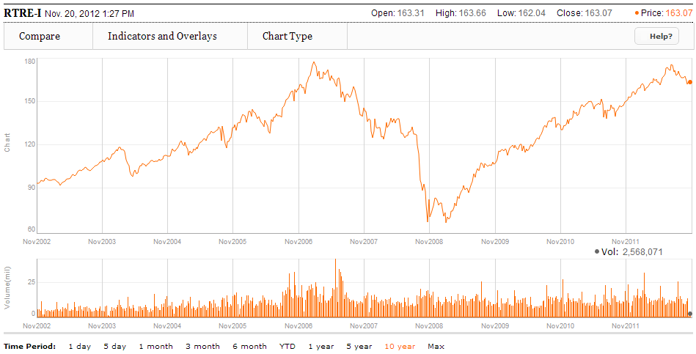
REIT Historical Performance

Slide 47
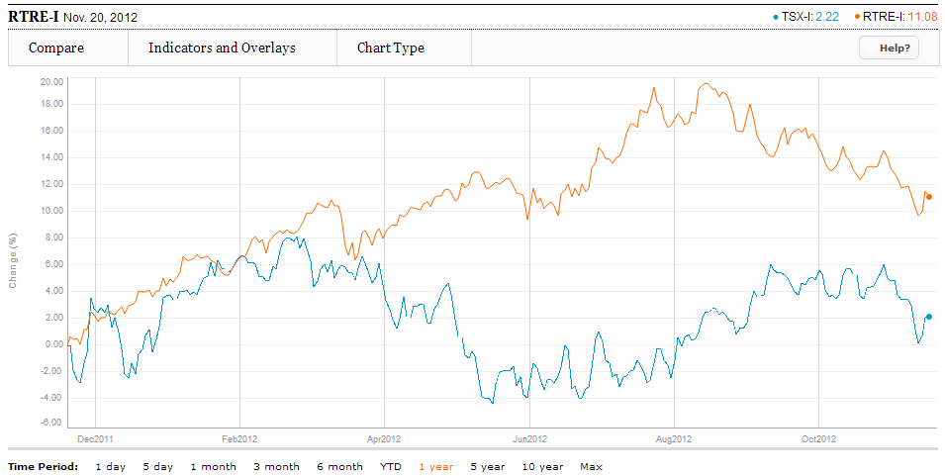
1YR REIT Index vs. S&P/TSX Composite

Slide 48
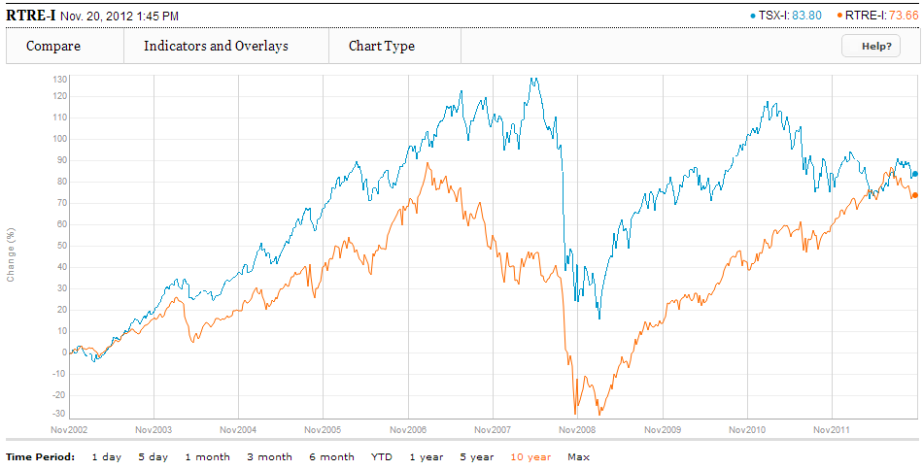
10YR REIT Index vs. S&P/TSX Composite

Slide 49
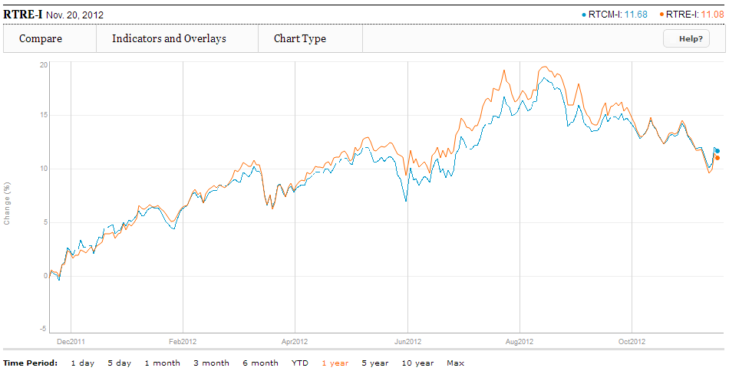
1YR REIT Index Vs. Income Trust Index

Slide 50
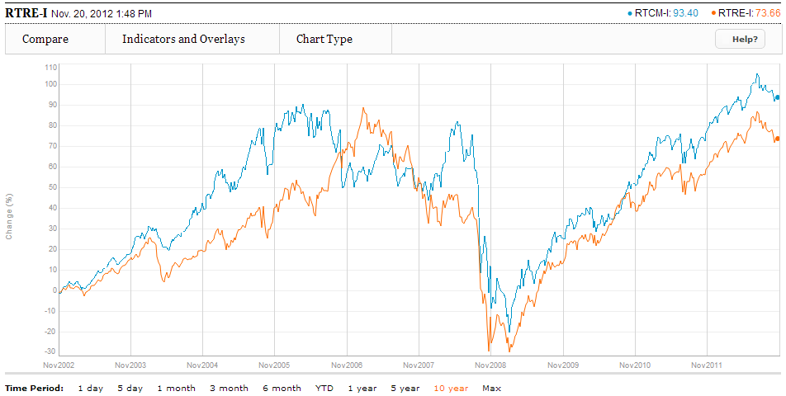
10 YR REIT Index Vs. Income Trust Index

Slide 51


Slide 52

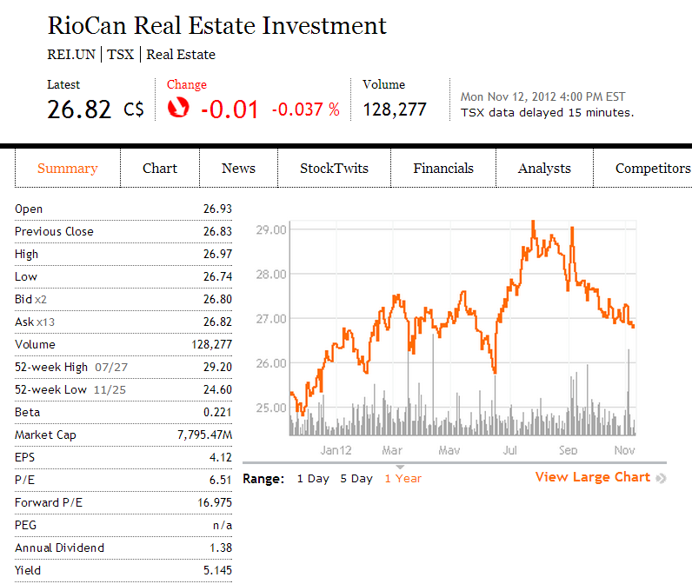
Security Snapshot

Slide 53
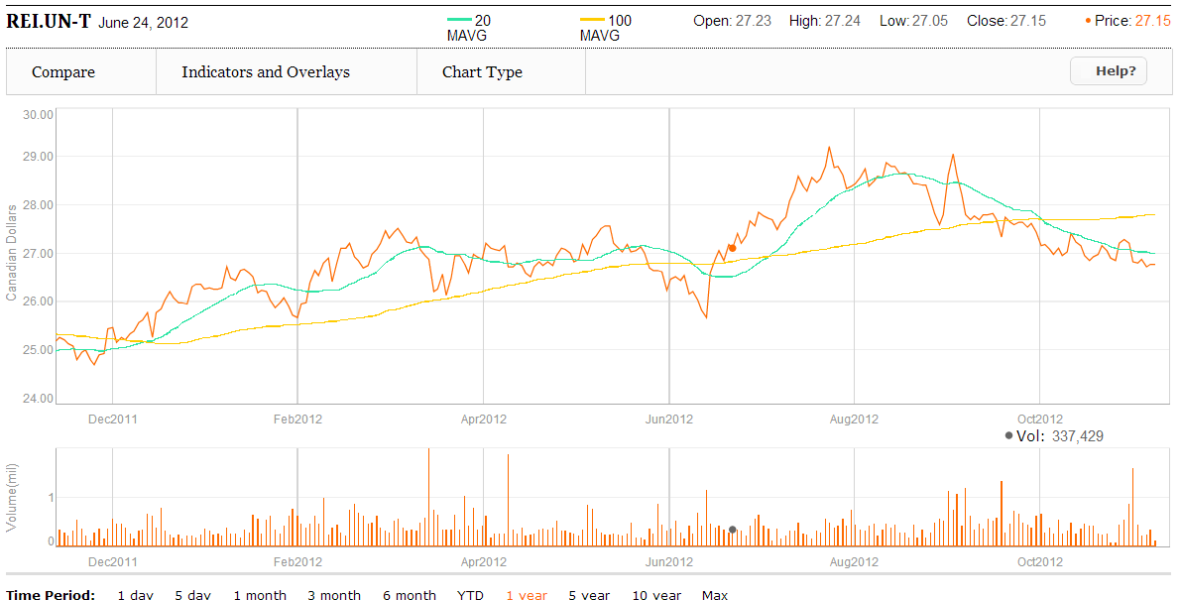
1 year chart and Moving Average at 20 & 100

Slide 54
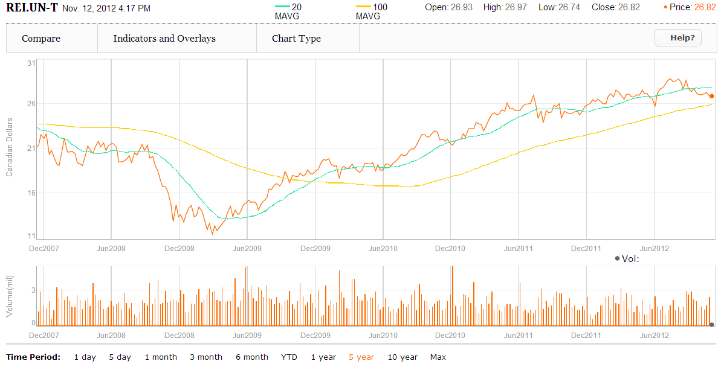
5 year chart and moving avg at 20 & 100

Slide 55
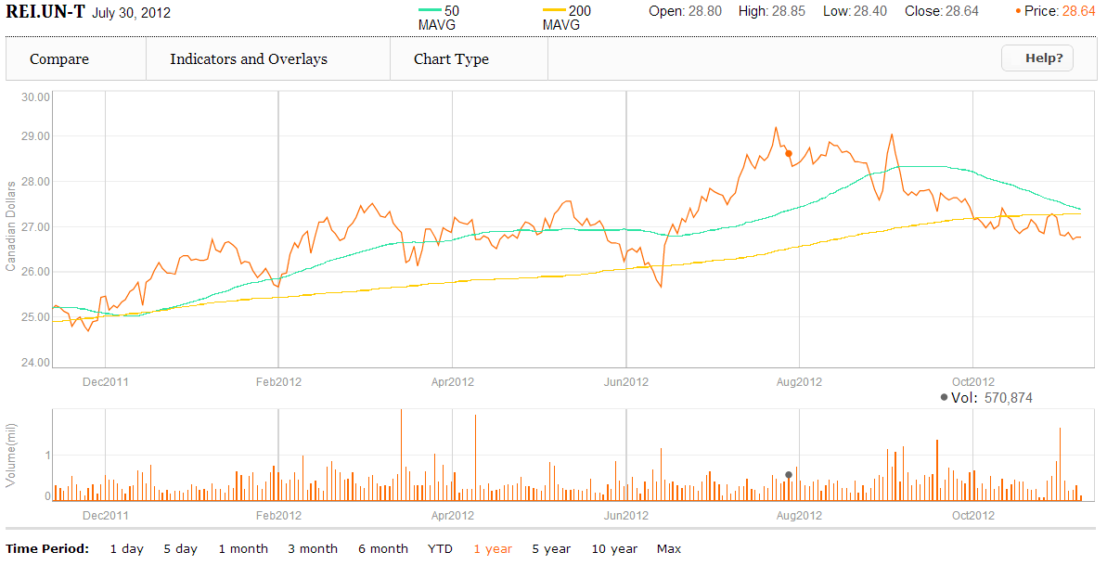
1 year chart and moving avg at 50 & 200

Slide 56
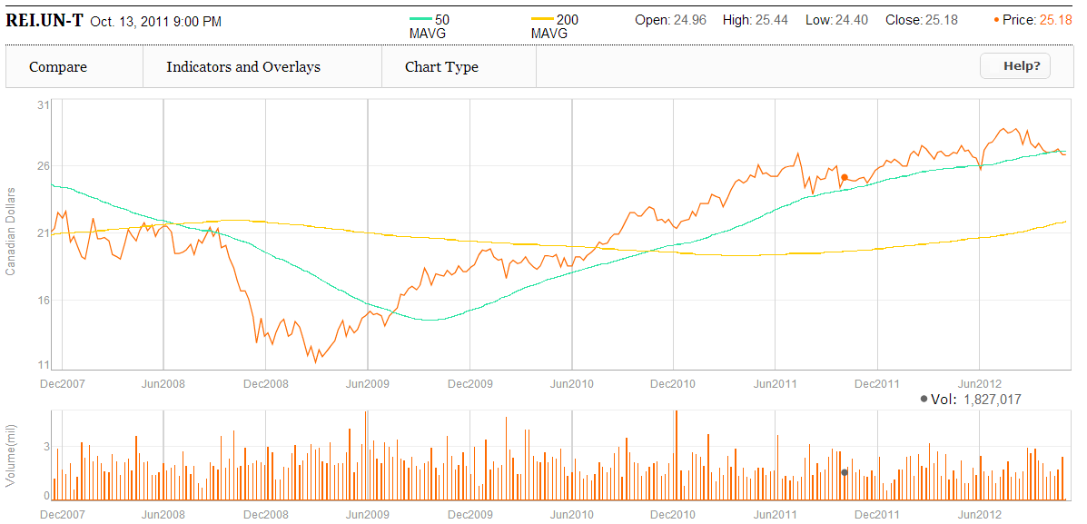
5 year chart and moving avg at 50 & 200

Slide 57
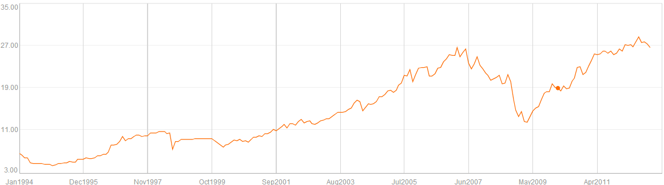
Max Chart

Slide 58
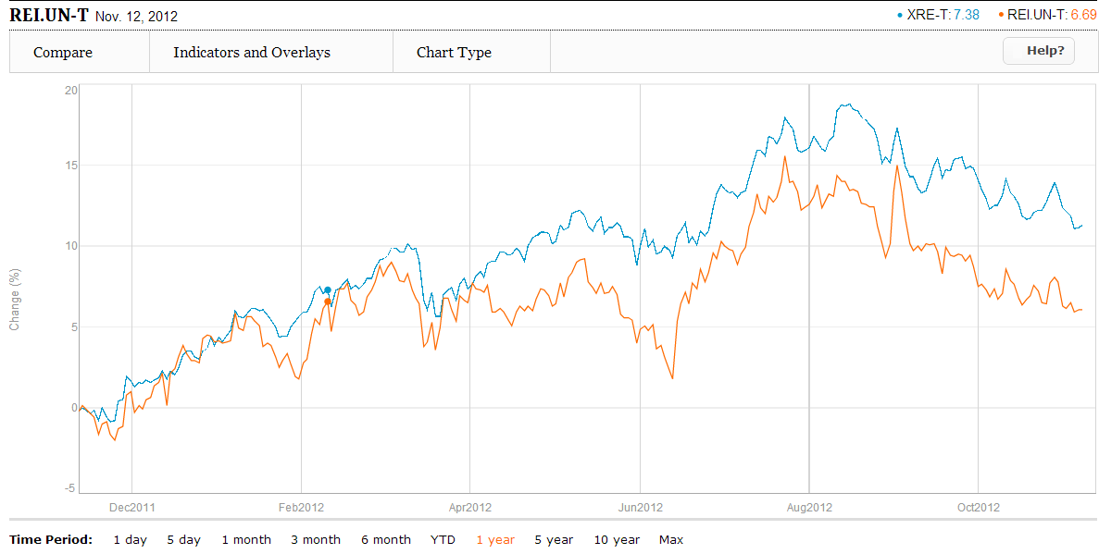
Comparing RioCan and iShare S&P TSX Capped REIT (1 Year)

Slide 59
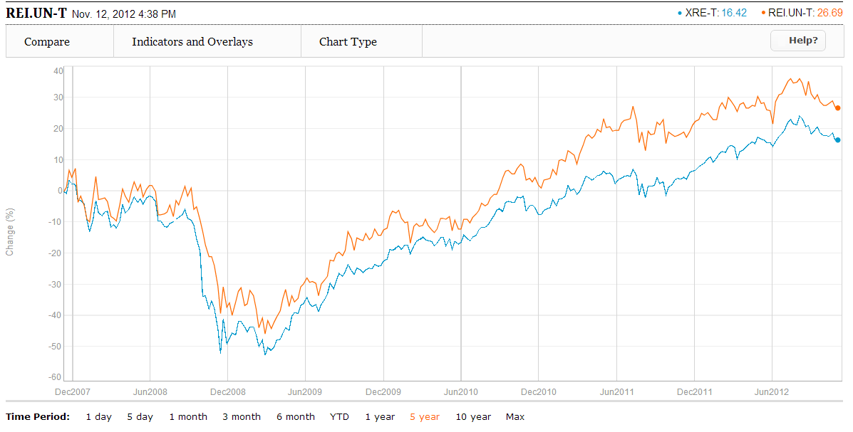
Comparing RioCan and iShare S&P TSX Capped REIT (5 Year)

Slide 60
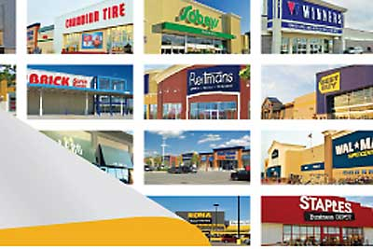
Company Overview

Slide 61
About RioCan
Largest REIT in Canada
Invests throughout North America, but most revenue comes from Ontario
336 retail properties
$13.6 billion in enterprise value
$8.1 billion market cap
Top tenants include: Walmart, Canadian Tire, Famous players, Future Shop
None of the tenants provide over 4.5% of annualized rental income

Slide 62
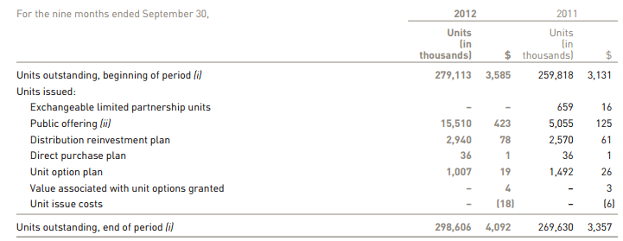
Unit Holder Summary

Slide 63
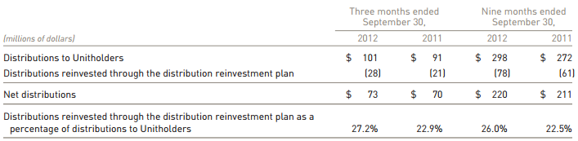
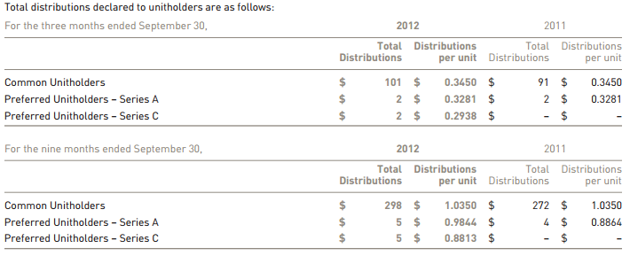
Distributions to Unit Holder

Slide 64
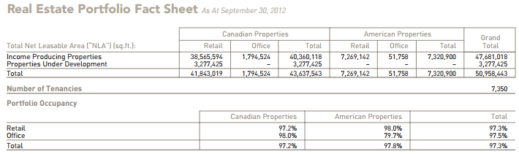
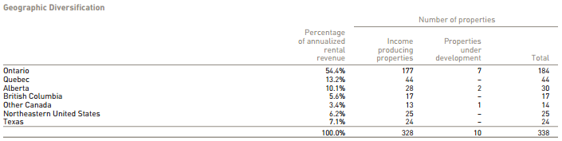
RioCan Real Estate Portfolio

Slide 65
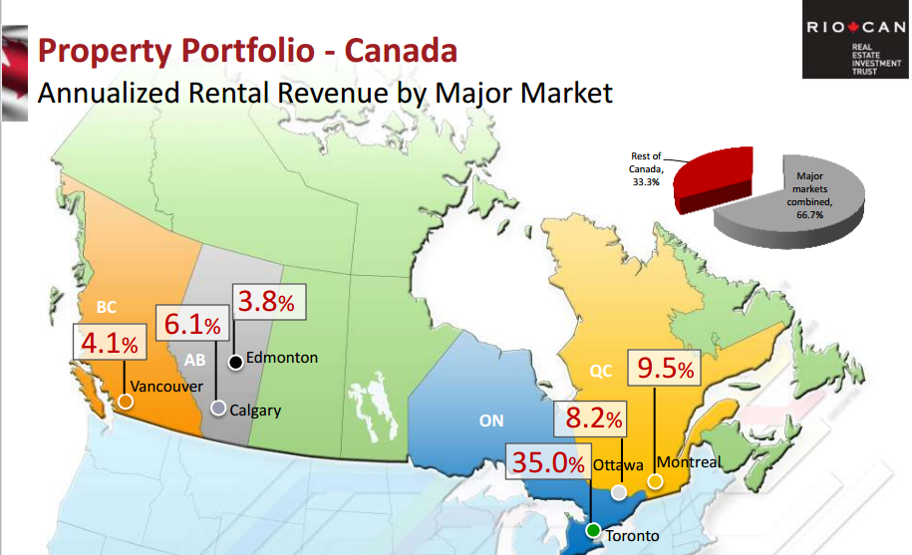
Annualized Rental Revenue - Canada

Slide 66
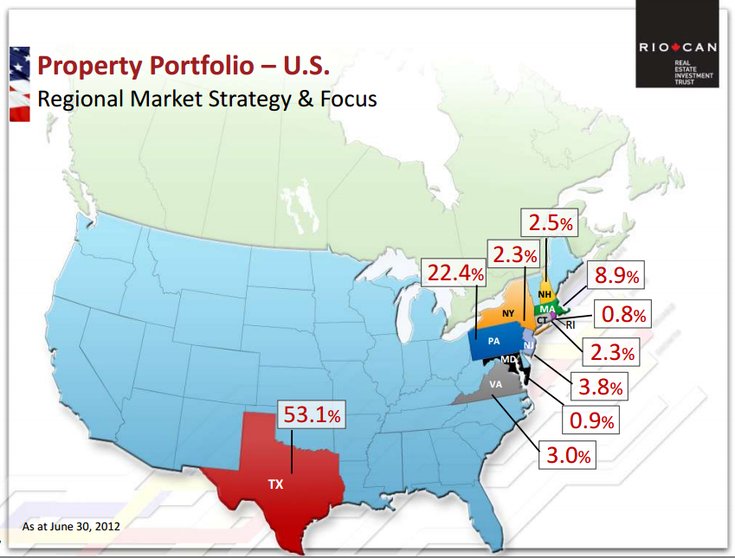
Annualized Rental Revenue – U.S.

Slide 67

Top 10 Tenants

Slide 68

Occupancy Rates

Slide 69

New Leasing Activities - Canada

Slide 70

New Leasing Activities - US

Slide 71

Lease Expiries

Slide 72

Acquisition Summary – Q3

Slide 73

Acquisition Summary - YTD

Slide 74
Q3 Highlights: Joint Venture Detail - Cedar
Sept. 6, 2012 /PRNewswire/ -- Cedar Realty Trust, Inc. (Cedar) reached agreement with RioCan Real Estate Investment Trust (RioCan) (TSX: REI.UN) to exit the 20% Cedar / 80% RioCan joint venture that owns 22 retail properties.
Cedar will acquire RioCan's 80% ownership interest in Franklin Village located in Franklin Massachusetts for approximately $60.1 million including the assumption of the related in-place mortgage financing of $34.7 million.
Cedar will sell its 20% ownership interest in the remaining twenty-one joint venture properties for approximately $119.5 million including the assumption of related in-place mortgage financings of $54.4 million.

Slide 75


Joint Venture Transaction Summary

Slide 76

Pre/Post Cedar Acquisition

Slide 77

Capital Structure
Notes:
Decrease in ratio of debt to asset

Slide 78

Debt and Leverage Metrics

Slide 79

Revolving Lines of Credit

Slide 80

Aggregate Maturities
Weighted average term to maturity of 4.6 years

Slide 81

Maturity by Lenders

Slide 82


Looking Forward: Development Activity
Target will open 23 locations in RioCan’s portfolio
First 8 are anticipated to open in Spring 2013
Trinity Common Mall – Brampton, Ontario

Slide 83

Management Team

Slide 84

Edward Sonshine Chief Executive Officer
CEO since 1993
65 years old
Served as President of RioCan REIT until January 1, 2012
Law degree from Osgoode Hall Law School and a Bachelor of Arts degree from the University of Toronto.

Slide 85

Frederic A. Waks President & Chief Operating Officer
President since January 1, 2012
Joined RioCan in 1995 as Senior Vice President and was promoted to COO in 2007
Have also served as Executive Vice President, and Senior Vice President

Slide 86

Raghunath Davloor Executive Vice President, Chief Financial Officer & Corporate Secretary
Chief Financial Officer, Executive Vice President (Since January 2012)
Senior Vice President and Chief Financial Officer of the Trust (2008 - 2011)
Past Experience:
VP and Director of Investment Banking for TD Securities Inc.
From 2000 to 2005, Chief Financial Officer for O&Y Properties Corp. and O&Y REIT.
Bachelor of Commerce from the University of Manitoba and holds a CA designation

Slide 87

Financial
Notes:
affo

Slide 88

Consolidated Balance Sheet (quarterly)
Notes:
Annual balance sheet

Slide 89

Consolidated Balance Sheets (Annual)

Slide 90

Annual Statement of Earnings

Slide 91

Interim Statement of Earnings

Slide 92

Consolidated Statement of Cash Flows

Slide 93

Consolidated Statement of Cash Flows Continued

Slide 94

Funds from Operations

Slide 95

Adjusted Funds from Operations

Slide 96

Q3 Funds from Operations

Slide 97

Q3 Adjusted Funds from Operations

Slide 98
Recommendation
HOLD

Slide 99





Slide 100

Security Snapshot

Slide 101

1 Year Chart and Moving Average at 10 & 100

Slide 102

1 Year Chart and Moving Average at 50 & 200

Slide 103

5 Year Chart and Moving Average at 10 & 100

Slide 104

5 Year Chart and Moving Average at 50 & 200

Slide 105

Max Chart

Slide 106

Compared with S&P/TSX Capped REIT

Slide 107
Company Overview

Slide 108

About Calloway
The Trust is an unincorporated open-ended mutual fund trust governed by the laws of the Province of Alberta
Commercial rental services provider – owns and manages 26 million sq. ft. in 118 value-oriented retail centers
Enterprise value of approx. $6.2 billion
Features:
Convenient locations
Intelligent design
Desirable tenant mix
Notes:
The Trust’s purpose is to own and manage shopping centres that provide our retailers with a platform to reach their customers through convenient locations, intelligent designs, and a desirable tenant mix
The Trust’s shopping centres focus on value oriented retailers and include the strongest national and regional names as well as strong neighbourhood merchants (i.e. Walmart)
Owns 127 shopping centres, one office building and one industrial building, with total gross leasable area of 25.5 million square feet, located in communities across Canada
Subject to the availability of acquisition opportunities, the Trust intends to grow distributions, in part, through the accretive acquisition of properties
Calloway is one of Canada’s largest real estate investment trusts with an enterprise value of approximately
$6.2 billion. It owns and manages approximately 26 million square feet in 118 value-oriented retail centres
having the strongest national and regional retailers, as well as strong neighbourhood merchants. Calloway’s
vision is to provide a value-oriented shopping experience to Canadian consumers. For more information on
Calloway, visit www.callowayreit.com.

Slide 109

Investment Theory

Slide 110

Investment Theory Continued

Slide 111
Recent Developments
Oct. 31, 2012 Major Use Development Announced
a 50/50 joint venture with SmartCentres to develop a vast tract of land (53 acres) within the
Oct. 18, 2012 Sale of Three shopping centers
Entered a binding purchase agreement with Retrocom REIT to sell three Ontario properties for a total of $59.8 million.
June 2012
Disposing of 13 non-core assets
Zellers (Penticton, BC) closing June 2012, Loblaws on schedule to open renovated store November 2012
Zellers (Oakville, ON) and Zellers (Kitchener, ON) to open as Target stores July 2013
May 2012
Announced strong Q1 2012 results
FFO – 5% growth Q1 2012 over Q1 2011 – $0.434 per unit
Occupancy – 9thsequential quarter at 99%
Payout ratio Q1 2012 – 93.7%, Debt-to-GBV – 48.9% (from 51.5%)
Announced JV with Simon Property Group to develop Montreal Premium Outlets
Announced conditional deal to acquire up to a 50% interest in a Walmart anchored GTA centre
April 2012
Announced 500,000 square foot Toronto Premium Outlet (Halton Hills)
Notes:
1) Toronto, Ontario (October 31, 2012) – Calloway Real Estate Investment Trust (Calloway) today
announced a 50/50 joint venture with SmartCentres to develop a vast tract of land (53 acres) within the
Vaughan Metropolitan Centre (VMC). The Calloway VMC lands are strategically located adjacent to the
terminus of the Spadina-York subway station in Vaughan and will be home to almost 6 million square
feet of commercial, residential and retail development. Construction of the first building will begin in
2013.
3) Calloway Real Estate Investment Trust ("Calloway" or the
"REIT") (TSX:CWT.UN) announced today that it has closed its previously announced $150 million
aggregate principal amount issue of Series H senior unsecured debentures. These debentures carry a
coupon rate of 4.05% and mature on July 27, 2020. The issue was offered by a syndicate of
underwriters led by CIBC.
Calloway intends to use the net proceeds of the offering for repayment of operating lines and other
indebtedness, funding of future acquisitions, and for general trust purposes.
DBRS Limited has provided Calloway with a credit rating of BBB, with a Stable trend, related to
the debentures.
This offering is being made by way of a prospectus supplement to Calloway’s existing $2 billion
base shelf prospectus dated October 31, 2011. The terms of offering are described in a prospectus
supplement dated July 23, 2012, which was filed with Canadian securities regulators.
4) Calloway Real Estate Investment Trust (“Calloway”) (TSX:CWT.UN)
announced today that it has agreed to issue $125 million principal amount of Series H senior unsecured
debentures on a bought deal basis (the “Debentures”). These Debentures will carry a coupon rate of 4.05%
and will mature on July 27, 2020. The issue is being offered by a syndicate of dealers led by CIBC.
Closing of the offering is expected on or about July 27, 2012. Calloway intends to use the net proceeds from
the offering for repayment of operating lines, funding of future acquisitions and for general trust purposes.
Dominion Bond Rating Service has provided Calloway with a provisional credit rating of BBB with a stable
trend to the Debentures. Calloway has granted the underwriters an option, exercisable at any time up to 48
hours prior to the closing of the Debenture offering, to purchase a further $25 million principal amount of
Debentures at the same terms as set forth above.
This offering is being made by way of a Prospectus Supplement to Calloway’s existing $2 billion base shelf
prospectus dated October 31, 2011. The terms of offering will be described in prospectus supplements to be
filed with Canadian securities regulators.
The press release shall not constitute an offer to sell, or the solicitation of an offer to buy, any securities in
any jurisdiction. The Debentures being offered have not been and will not be registered under the U.S.
Securities Act of 1933 and state securities laws. Accordingly, the Debentures may not be offered or sold to
U.S. persons except pursuant to applicable exemptions from registration.
August 2011
acquired 3 Walmart anchored shopping centres
raised $90 million of 7-year unsecured debentures @ 4.70%
renewed 3-year secured operating line of $200 million and a 1-year unsecured operating line of $35 million @ BA + 1.65%
September 2011
Announced Target taking over Zellers leases in Oakville and Kitchener and Loblaws taking over in Penticton
November 2011
announced Q3 2011 results – strong results, ahead of analyst expectations: AFFO per unit – 2% increase over Q2 2011 and 14% increase over Q3 2010.
December 2011
raised $100 million equity on a bought deal basis @ C$27.05

Slide 112

Highlights

Slide 113

Portfolio Highlights

Slide 114

Asset Features

Slide 115

Example - Oshawa S

Slide 116

Occupancy
Notes:
Calloway has maintained high and industry-leading occupancy.

Slide 117

Stable and Growing Income
Notes:
Portfolio of high quality, newly developed assets with an average age of 9.6 years
Minimal capex
No deferred maintenance
Modern format

Slide 118


Unit Holder Summary
Notes:
In the consolidated financial statements, LP Units classified as equity are presented separately from Trust Units as noncontrolling interests. However, management views the LP Units as economically equivalent to the Trust Units; therefore,
they have been combined in this analysis of the MD&A.
As at December 31, 2011, equity totalled $2,553.5 million (December 31, 2010 – $2,286.2 million). As at December 31,
2011, Trust and LP Unit equity totalled $2,386.7 million and Units outstanding, including Class B Series 1 and Class B Series
3 LP Units, Class B LP II Units and Class B LP Series 4 and Class B Series 5 LP III Units of subsidiary partnerships, totalled
123,638,493 Units.
The Trust has entered into an Equity Distribution Agreement dated December 5, 2011 with an exclusive agent for the
issuance and sale, from time to time, until November 30, 2013, of up to 2,000,000 Trust Units by way of “at-the-market
distributions”. Sales of Trust Units, if any, pursuant to the Equity Distribution Agreement will be made in transactions
that are deemed to be “at-the-market distributions”, including sales made directly on the TSX. During the year ended
December 31, 2011, nil Trust Units were issued as part of the Equity Distribution Agreement.
During the year ended December 31, 2011, the Trust issued $244.3 million in Units as follows:
2) Distributions declared by the Trust totalled $185.3 million (of which $1.7 million is treated as interest expense) during the
year ended December 31, 2011 (December 31, 2010 – $165.5 million of which $25.7 million is treated as interest expense)
or $1.55 per Unit (December 31, 2010 – $1.55 per Unit). The Trust paid $164.5 million in cash and the balance by issuing
832,393 Trust Units under the distribution reinvestment plan.
Distributions to the Unitholders in 2011, as compared to 2010, were as follows:

Slide 119

Distribution to Unit Holders

Slide 120

Distribution to Unit Holders

Slide 121

Investment Properties
The portfolio consists of 25.5 million square feet of built gross leasable area, 4.3 million square feet of future potential gross leasable area in 129 properties and the option to acquire 50.0% or 100.0% interests (1.6 million square feet) in 11 income properties upon their completion pursuant to the terms of mezzanine loans
The Trust targets major urban centres and shopping centres that are dominant in their trade area
Well-located centres attracts quality tenants

Slide 122

Investment Properties

Slide 123

Top 10 Clients

Slide 124

Tenants Ratings

Slide 125

Gross Revenue by Tenant

Slide 126

Gross Revenue & Area by Province

Slide 127

Portfolio Occupancy and Age
Notes:
99.0% as at December 31, 2011

Slide 128

Lease Maturity
Average lease term of 8.3 years
Average remaining lease term for Walmart is 11.3 years
Average remaining lease term excluding Walmart is 6.3 years
Average retention rate >90% and lifts on renewals of 7.3%
Average expected “same store” NOI growth is 1.0% to 1.5% p.a.

Slide 129

Lease Expiration Schedule

Slide 130
Strategic Partners
Greater access to acquisition opportunities
Enhanced development structure
Access to new Canadian and US retailers
Broader market knowledge
Main:
SmartCentres
Walmart
Simon Property Group
Notes:
Largest developer of open format shopping centres in Canada
Largest unitholder (21%)
Relationship provides:
Market intelligence, tenant relationships
Development and leasing infrastructure
Acquisition opportunities and earnout pipeline
Strategic guidance (3 of 9 board seats)
Shared administrative services (for efficiency)
All transactions with SmartCentres are approved by Independent Trustees

Slide 131


SmartCentres

Slide 132


Walmart

Slide 133

Simon Property Group

Slide 134
Halton Hills Premium Outlets
50:50 JV with Simon Property Group (NYSE:SPG) at closing
First of its kind in Canada (high-end fashion)
450,000 SF
SPG & CWT partnership working well
Site owned by Calloway – zoned
15 minutes outside of Toronto
6 million population within 1 hour drive
In pre-leasing; expected to commence construction Spring 2012

Slide 135

CAPEX on Acquisitions and Development
$163.0 million of Earnouts and Calloway Developments were completed and transferred to investment properties, compared to $151.3 million in 2010, summarized as follows:

Slide 136

Sustaining Capital Expenditures
Sustaining capital expenditures totalling $1.9 million and leasing costs of $3.4 million were incurred
Since the Trust’s investment properties are relatively new and in good condition, management anticipates only modest increases for each of 2012 and 2013, and thus, they are not expected to have an impact on the Trust’s ability to pay distributions at its current level

Slide 137

Capital Structure

Slide 138

Debt Maturity

Slide 139

Debt Ratios

Slide 140


Potential Future Pipeline

Slide 141

Internal Growth

Slide 142
Strategic Focus Moving Forward
Ongoing
1. Maintain 99%+ occupancy and 85%+ retention rates
2. Manage lease renewal rent increases in 5-10% range
3. Enhance asset quality and maximize “same store NOI” growth
4. Harvest 5.8 million square feet development and acquisition option pipeline including first Premium Outlet Mall
5. Deploy capital in selective acquisition opportunities
Opportunistic
1. Capitalize on intensification opportunities in appropriate locations
New subway stations (Vaughan, Westside Mall)
Higher growth markets
2. Re-merchandising opportunities
Hopedale Mall (Target taking over Zellers)

Slide 143
Management

Slide 144

Chief Executive Officer/President
Al Malwani
President, CEO
Replaced Simon Nyilassy as CEO on May 2, 2011
Chartered accountant
MBA from the University of Toronto and a Masters of Laws from Osgoode Hall Law School
Previously the President of Exponent Capital Partners, a real estate advisory and private equity firm
Previously the CFO of Oxford Properties Group for over 10 years
2010 compensation for previous CEO Simon Nyilassy: $951,862

Slide 145

Chief Financial Officer
Bart Munn
Chief Financial Officer
Chartered Accountant
Bachelor of Commerce from Queen’s University
Vice President and CFO of Morguard Corporation (1999-2005)
Vice President and CFO of Morguard Real Estate Investment Trust (1997-1999)
Senior Vice President Finance and Administration for Morguard Investments Limited (1991-2005)
2010 compensation: $617,823

Slide 146

Vice President & Controller
Mario Calabrese
Vice President and Controller
Senior Director, Operations Accounting of Calloway from Jan 2007 to May 2009
Senior Director, Operations Accounting of SmartCentres from April 2005 to De 2006
Bachelor of Commerce and Accountancy from Concordia University.
Chartered Accountant

Slide 147

EVP Asset Management
Rudy Gobin
Executive Vice President Asset Management
Chartered Accountant
Bachelor of Commerce from the University of Toronto
Former Strategy Officer of Calloway
Former Executive Vice President, Finance and Operations of SmartCentres (2001-2006)
CFO of Nexacor Realty Management (1998-2001)
2010 compensation: $570,171

Slide 148
Financial Performance

Slide 149

2012
3rd quarter
Balance
Sheet

Slide 150

2011
Annual
Balance
Sheet

Slide 151

2011 Annual Income Statement

Slide 152

2012 3rd Quarter Income Statement

Slide 153

Cashflow
Statement

Slide 154

Supplemental Cash Flow Information

Slide 155

Cash from Operations

Slide 156

Results from Operations

Slide 157

FFO and AFFO
Notes:
Pg 37

Slide 158

AFFO & FFO

Slide 159

FFO and
AFFO
Quarterly
Information

Slide 160
Recommendation:
Hold

Slide 161

H&R Real Estate Investment Trust

Slide 162

Financial Snapshot
Notes:
H&R REAL estate investment trust in currently trading at $23.91.
The yield is 5.228 which is lower than in Calloway but Higher than in RioCan
The annual dividend is 1.25 and market cap is 4,435 million
The earning per share are negative 0.26

Slide 163
Unit Price History
12 Month Trading Range* | $22.89 - $26.29
Recent Payout (annualized) | $1.25
Current Yield | 5.319
Units Outstanding | 187,792,798

Slide 164

Max Chart

Slide 165

1 Year Chart and Moving Average at 10 & 100

Slide 166

1 Year Chart and Moving Average at 50 & 200

Slide 167

5 Year Chart and Moving Average at 10 & 100

Slide 168

5 Year Chart and Moving Average at 50 & 200

Slide 169

1 Year H&R Vs. iShares S&P TSX Capped (XEG-T)

Slide 170

5 Year H&R Vs. iShares S&P TSX Capped (XEG-T)
Notes:
http://www.theglobeandmail.com/globe-investor/markets/stocks/chart/?q=HR.UN-T

Slide 171

Company Overview
Notes:
http://www.newswire.ca/en/story/978773/h-r-reit-to-acquire-one-third-interest-in-scotia-plaza-one-of-canada-s-preeminent-office-properties
The new Bow skyscraper in downtown Calgary, Alberta
http://www.google.ca/imgres?um=1&hl=en&client=firefox-a&sa=N&rls=org.mozilla:en-US:official&channel=fflb&biw=1280&bih=905&tbm=isch&tbnid=xWIjLUFyCRGvLM:&imgrefurl=http://business.financialpost.com/2012/03/15/hr-reit-pursues-mortgage-bond-program-for-the-bow/&docid=keYBN7q9CtghtM&imgurl=http://financialpostbusiness.files.wordpress.com/2012/03/thebow.jpg%253Fw%253D620&w=620&h=465&ei=TYKlUJ_6M8KbjAKltYCoBA&zoom=1&iact=hc&vpx=399&vpy=450&dur=1308&hovh=194&hovw=259&tx=152&ty=73&sig=103176350227970510343&page=1&tbnh=143&tbnw=199&start=0&ndsp=29&ved=1t:429,r:14,s:0,i:111

Slide 172
H&R REIT
Open-ended Real Estate Investment Trust
Current payout ratio of approximately 90.9% of adjusted funds from operations to Unitholders
Property Portfolio is dominated by creditworthy tenants signed to accretive long-term leases, with contractual rental increases throughout the lease period
Notes:
1.An open-end(ed) fund is a collective investment scheme which can issue and redeem shares at any time. An investor will generally purchase shares in the fund directly from the fund itself rather than from the existing shareholders. It contrasts with a closed-end fund, which typically issues all the shares it will issue at the outset, with such shares usually being tradeable between investors thereafter.
2. among the most conservative in the industry

Slide 173
Objectives
The REIT has two primary objectives:
To provide unitholders with stable and growing cash distributions, generated by the revenue it derives from investments in income producing real estate properties; and
To maximize unit value through ongoing active management of the REIT’s assets, acquisition of additional properties and the development and construction of projects which are pre-leased to creditworthy tenants.

Slide 174
Strategy
The REIT’s strategy to accomplish these two objectives is to accumulate a diversified portfolio of high quality income producing properties in Canada and the United States occupied by creditworthy tenants on a long-term basis. The REIT does not have any specific allocation targets as to property type, but rather focuses on creditworthy tenants with long-term leases.
Notes:
The primary purpose of Finance Trust is to be a flow-through vehicle to allow the REIT to indirectly access the capital markets in a tax-efficient manner by indirectly borrowing money from the REIT’s unitholders. Finance Trust’s primary activity is to hold debt
issued by H&R REIT (U.S.) Holdings Inc. (“U.S. Holdco”), a wholly owned U.S. subsidiary of the REIT.

Slide 175


Slide 176


Slide 177


H&R REIT & H&R FINANCE TRUST (Stapled Unit) Unit Holder Distributions
December 31, 2011
December 31, 2010
Notes:
They have increased the number of outstanding units by 36, 557, 695 from 2010 to 2011 and increased the total distribution per unit by 18 cents.

Slide 178

Portfolio Overview
Notes:
The total number of properties are 289 total of 43 million square feet with the majority located in the US (112). In Canada the majority of properties are located in Ontario (104)

Slide 179

Portfolio Overview

Slide 180

Diversified Portfolio
Notes:
The largest percentage of fair value is in ontario (48%), followed by US 27%, Alberta 14% and Quebec 5%.
The property type is dominated by offices rentals 59%. Than comes the industrial 22 and the retail type 19%.

Slide 181

Portfolio of Properties
Notes:
The largest fair value of 4, 725 millions are coming from 41 office ares with tenants such as Bell Canada, Royal Bank of Canada, Sony Pictures entertainment, Bank of Nova Scotioa, Nestle, and Tellus communication.
However, the largest net rentable area of 22 milliom square feet is rented to such companies as Canadian Tire and Nestle USA
The largest number of properties 135 is rented to Rona Inc, Shell Oil products, Home Depot, Wall-mart

Slide 182

Top 15 Tenants by Revenue As at September 30, 2012
Notes:
The Top 15 tenants are responsible for 54% of the rental income. Only one of the tenants have a credit ranking of BBB- according to S&P.
With limited new construction underway, shrinking vacancies and rising rents, the fundamentals for Canadian real estate are
promising. These factors together with the low interest rate environment and easy access to capital markets continue to compress capitalization rates lower

Slide 183
2011 Highlights
Maintained portfolio occupancy rate at virtually 100% for the 15th consecutive year
Invested $1.4 billion in the acquisition of 11 properties, which were partially funded with mortgages
Three of these acquisitions were full ownership interests in Atrium on Bay in Toronto ($345M), Two Gotham Center in New York City (US $416M) and Hess Tower in Houston (US $443M).
Invested $349 million in properties under development, including $329 million for construction of The Bow office complex in Calgary
Raised $867 million of funding, primarily by issuing 23 million units ($512M) and debentures ($355M)
Increased distributions per stapled unit by 24%, while H&R’s unit price rose 20%
Notes:
A security which is comprised of two parts that cannot be separated from one another. The two parts of a stapled security are a unit of a trust and a share of a company. The resulting security is influenced by both parts, and must be treated as one unit at all times, such as when buying or selling the security

Slide 184
2011 Highlights
H&R executed its conservative strategy of pursuing stability and growth through discipline

Slide 185

) 2012 Major Acquisitions
Scotia Plaza (Downtown Toronto)
Acquired a one‐third interest in Scotia Plaza
for $422.2 million, closed June 15, 2012
$216.7 million first mortgage bonds issued at
3.21% for a 7‐year term, secured by
Scotia Plaza
The largest office node in Canada
Comprises approximately 2.0 million sq. ft. of prime office and retail space across four connected buildings
Class “AAA” Property
Outstanding anchor tenant: Bank of Nova Scotia will lease approximately 61% of Scotia Plaza for an average lease term of 13.5 years
Fair Value: $440,000,000
Notes:
Acquired a one‐third interest in Scotia Plaza
for $422.2 million, closed June 15, 2012
The largest office node in Canada
Class “AAA” Property
Outstanding anchor tenant: Bank of Nova Scotia
Located in the heart of Toronto’s Financial district
Other major tenants include: Borden
Ladner Gervais LLP, Cassels Brock &
Blackwell LLP and Miller Thompson LLP

Slide 186

2012 Major Acquisitions
Corus Quay (Downtown Toronto)
$186 million acquisition closed March 9, 2012
$60 million interest only mortgage; 20‐year term at 4.91% per annum
$37 million first mortgage, 10‐year term at 4.14% per annum
Class “AAA” Property
Fair Value: $ 197, 000, 000
Notes:
Corus Ki
http://www.hr-reit.com/downloads/current_investor_update.pdf
Principal tenant is Corus Entertainment Inc., a leading Canadian based
media and entertainment company;

Slide 187

2011 Acquisitions
Notes:
Overall, in 2011 they acquired properties for cash purchase price of 1,403 million dollars for 4 million square feet

Slide 188

2011 Dispositions
Notes:
The 2011 industrial dispositions result in gross proceeds of 17 million.

Slide 189

Liquidity and Capital Resources
Notes:
The Cash provided by operating activities, the actual cash distributions paid or payable relating to the period has been increasing from 2009 to 2011. However, there is a net loss of 40,585 in 2011.

Slide 190

Liquidity and Capitalization
Notes:
The total capitalization as at September 30,2012 was 10,000 million consisting from mortgages of 4, 157 million dollars, market capitalization of 4,724 million, unsecured debentures of 810 million and the bank debentures of 19 million

Slide 191

Properties

Slide 192

The Bow, Calgary, Alberta
The tallest office building in Western Canada
Costs approximately $1.1 billion
The office tower and 700 parking bays will be leased to EnCana Corporation for 25 years with annual rental escalations
Expected annualized first year rent $93.5M
Fair Value: $1,795,000,000
Class: AAA
Notes:
The 1.9m square foot state-of-the-art office tower will be the .
Is located Calgary's downtown core will cost and is expected to be completed in 2011.
The Bow is a world-class, approximately two-million square foot downtown office complex, fully leased to EnCana Corporation on a triple-net basis for a term of 25 years. EnCana is a leading North American natural gas producer and one of Canada’s largest public companies.
The Class AAA skyscraper is an iconic landmark in Calgary’s financial district.
At December 31, 2011, H&R REIT had invested approximately $1.5 billion in the 58-storey project (excluding capitalized interest costs). The annualized year-one net income from The Bow is expected to be approximately $93.5 million, and rental rates will increase 0.75% per annum on the office space and 1.5% per annum on the parking space during the lease.
Occupancy in tranches between May 2012 and January 2013

Slide 193

Bell Canada Office Campus
The 1.1million square foot office complex
Leased to Bell Canada and Bell Mobility for a term of 20 years
Ownership interest: 100%
Fair Value: $525,000,000
Notes:
Immediately south of Toronto
Developed 2002-2009

Slide 194

TransCanada Pipeline Tower
The 936,000 square foot, 38 storey
Class A head office tower of TransCanada PipeLines
Fair Value: $475,000,000
Notes:
Calgary
Developed in 2001

Slide 195

Management Team

Slide 196
Thomas J. Hofstedter President and Chief Executive Officer
Has more than 30 years of real estate industry experience.
Became President and Chief Executive Officer of H&R REIT at its creation in December 1996.
Was responsible for building most of the properties that comprised the initial assets of the REIT (home of such tenants as NCR and the Royal Bank, head office of Nestlé Canada).
In addition to commercial development, Mr. Hofstedter has considerable experience in high-rise residential and was responsible for building many prominent Toronto condominiums such as Wellington Square, the Penrose, and the Metropole.
Attended the University of Toronto
Notes:
NCR is a global technology company with self-service solutions for ATM machines and software, POS systems and software and airline check-in systems.

Slide 197
Larry Froom C.A., Chief Financial Officer
Has over 15 years of real estate industry experience.
Joined H&R Developments in 1997 as Controller, was promoted to VP - Finance for the H&R Group in 2003, was appointed VP - Finance for H&R REIT in January 2006 and CFO in September 2006.
Is responsible for overseeing all financial transactions, Unit offerings and investor relations.
Prior to joining H&R, he was manager at Ernst & Young where he serviced clients in the real estate industry.
Is a member of Realpac (Canada’s most influential voice in the real property investment industry; formerly CIPPREC).

Slide 198
Nathan Uhr Chief Operating Officer
Has over 30 years of real estate industry experience.
He was H&R Developments' Director of Leasing and Property Management and held various other positions with H&R over 20 years before becoming Vice-President, Acquisitions of H&R REIT, at its inception, in December 1996.
Leads the due diligence team on any acquisition or mezzanine financing planned by the REIT
Responsible for management and leasing issues relating to the REIT's properties
Is a member of BOMA and the Canadian Urban Institute.

Slide 199

Financial Data

Slide 200

Q3 Balance Sheet
Notes:
There had been an increase of approximately of 1 million in mortgages payable.
From asset side there had been an increase of 370,000 in investment properties, of assets classified as held for sale of 47,000 and of cash of 24,000

Slide 201

Annual Balance Sheet

Slide 202

Annual Income Statement
Notes:
The Income Tax Act (Canada) contains legislation (the “SIFT Rules”) affecting the tax treatment of “specified investment flowthrough”
(“SIFT”) trusts. The SIFT Rules provide for a transition period until 2011 for
publicly-traded trusts like the REIT which existed prior to November 1, 2006. Under the SIFT Rules, distributions of certain
income by a SIFT are not deductible in computing the SIFT’s taxable income, and a SIFT is subject to tax on such income at a
rate that is substantially equivalent to the general tax rate applicable to a Canadian corporation. The SIFT Rules do not apply to
a publicly-traded trust that qualifies as a real estate investment trust under the Income Tax Act (Canada). The REIT completed
the necessary tax restructuring to qualify as a real estate investment trust effective June 30, 2010. For periods before it
qualified, the REIT recorded deferred tax liabilities in respect of temporary differences expected to reverse after January 1, 2011.
Such deferred tax liability was reversed as an adjustment to deferred income tax expense in income and as an adjustment to
other comprehensive income during the second quarter of 2010, when the REIT became a qualifying REIT.

Slide 203

Q3 Income Statement

Slide 204

Annual Cash Flow

Slide 205

Q3 Cash Flow

Slide 206

Annual Financial Summary

Slide 207

Funds From Operations (Q3)

Slide 208


Adjusted Fund from Operations (Q3)

Slide 209

Funds From Operations (Annual)

Slide 210

Adjusted Fund from Operations (Annual)

Slide 211
Recommendation:
Hold

Slide 212
Conclusion
RioCan - Hold
Calloway - Hold
H&R - Hold

