Slide 1



Global Gadgets.
Bryan Lam
Leah Cong
Gagan Jassal
Anthony Chan
Kyle Maggio
Notes:
CHRIS START

Slide 2
Agenda
Industry Overview
Apple
Google
RIM

Slide 3

Industry Overview
Industry History
Products
Industry Structure
Overview
Apple
Google
RIM

Slide 4
Industry history
Notes:
GOLYA START

Slide 5
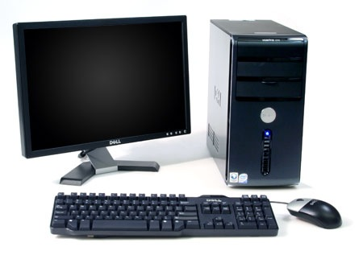
Industry History
Computer
Internet
Mobile Phones
The Computer
1936: first freely programmable computer
1951: first commercial computer released
1974: first consumer computers (IBM)
1976: Apple I,II
1984: Apple Macintosh
1985: Microsoft Windows
Overview
Apple
Google
RIM
Notes:
1936 Z1 Computer First freely programmable computer.
1951 UNIVAC Computer First commercial computer & able to pick presidential winners.

Slide 6

Industry History
Computer
Internet
Mobile Phones
The Internet
1969: the original internet
1972: first email sent
1990: Archie, the first search engine
1991: Internet available for commercial use
1996: more email than post mail in the USA; BackRub search engine (Stanford)
1997: Google (googol)
Overview
Apple
Google
RIM

Slide 7
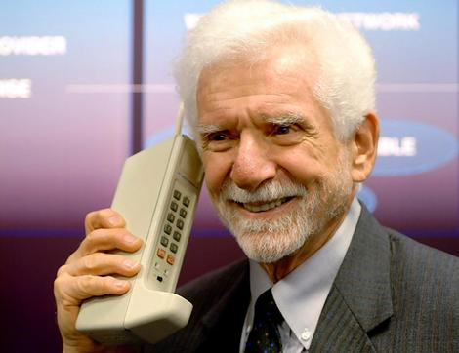
Industry History
Computer
Internet
Mobile Phones
Mobile Phones
1973: Motorola cell phone created
April 3, 1973: first cell phone call made by Martin Cooper
1983: first cell phone available to consumers
2009: 4.1 million mobile phone subscribers
Feb 2010 : 5.6 billion subscriptions
June 2012: (Top 3)
1.04 billion in China
960 million in India
328 million in US
Overview
Apple
Google
RIM
Notes:
Inventor of Mobile Phone – Martin Cooper
American former Motorola vice president and division manager who in the 1970s led the team that developed the handheld mobile phone.
http://en.wikipedia.org/wiki/List_of_countries_by_number_of_mobile_phones_in_use
In the twenty years from 1990 to 2011, worldwide mobile phone subscriptions grew from 12.4 million to over 5.6 billion, penetrating the developing economies and reaching the bottom of the economic pyramid
China, the world's most populated nation, had been deemed the first country in the world to reach one billion mobile phone subscribers

Slide 8
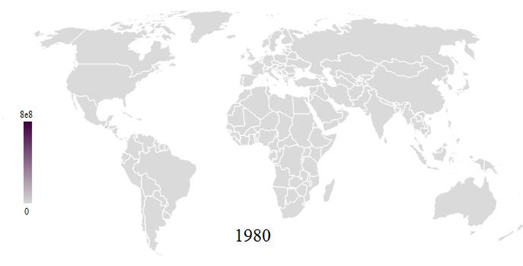
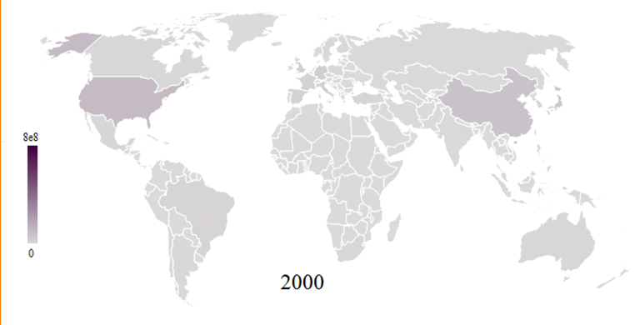
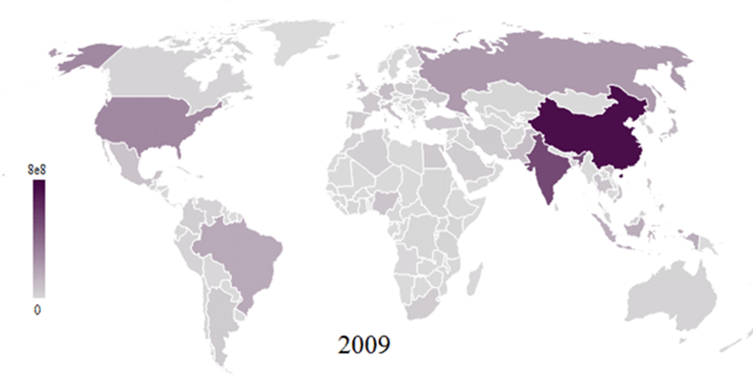
Industry History
Computer
Internet
Mobile Phones
Mobile Phones Subscription1980 - 2009
Overview
Apple
Google
RIM
Notes:
http://en.wikipedia.org/wiki/File:Mobile_phone_map_1980-2009.gif

Slide 9
Industry History
Computer
Internet
Mobile Phones
Mobile Phones – Digital Revolution
1990:
Cell phone subscribers: 12.4 million (0.25% of world population)
Internet users: 2.8 million (0.05% of world population)
2002:
Cell phone subscribers: 1.174 billion (19% of world population)
Internet users: 631 million (11% of world population)
2010:
Cell phone subscribers: 5.4 billion (76% of world population)
Internet users: 1.9 billion (28% of world population)
2011:
Cell phone subscribers: 6 billion (87% of world population)
Internet users: 2.1 billion (30% of world population)
2012:
Cell phone subscribers: Predicted 6.5 billion by end of 2012 (92% of world population)
Internet users: 2.4 billion as of June 30th (33% of world population)
Overview
Apple
Google
RIM

Slide 10
Products

Slide 11
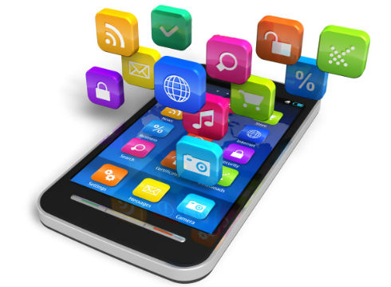
Products
Smart Phones
Smart Phone OS
Tablet PCs
Apps
A smartphone is a mobile phone built on a mobile operating system, with more advanced computing capability and connectivity than a feature phone.
Overview
Apple
Google
RIM
Notes:
All in one device that can be used as a cell phone and has computing, PDA functions
Variety of applications available
High Speed Data Access
Multimedia

Slide 12
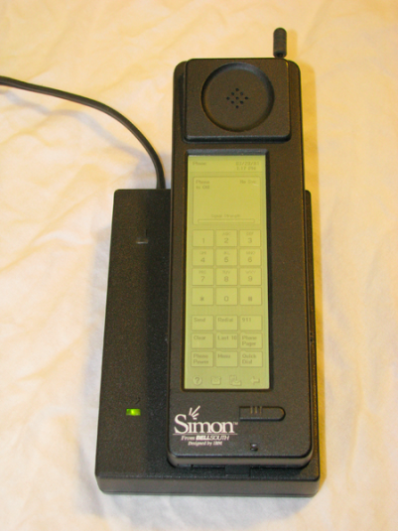
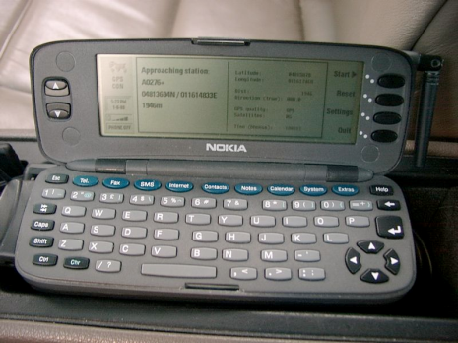
Products
Smart Phones
Smart Phone OS
Tablet PCs
Apps
Evolution of Smartphones
1992: IBM Simon
Touch screen, fax, email, predictive keyboard
1996: Nokia 9000
2002: Handspring Treo 180 (Palm OS)
2002: Blackberry
2007: iPhone
2008: First Android OS phones
Overview
Apple
Google
RIM

Slide 13
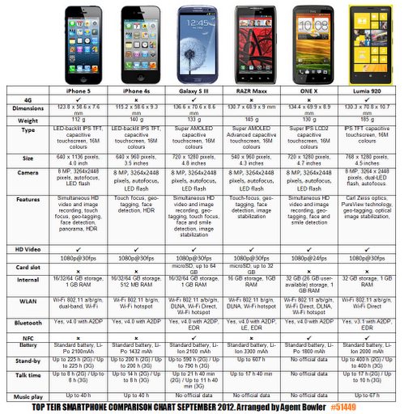
Products
Smart Phones
Smart Phone OS
Tablet PCs
Apps
Overview
Apple
Google
RIM
Notes:
https://lh3.googleusercontent.com/-3l8ebfS6ut4/UFIQEikSbMI/AAAAAAAAJ7I/0eObyJ5vFTQ/smartphone%2Bcomparrison.png

Slide 14
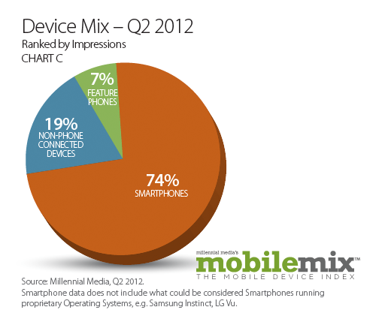
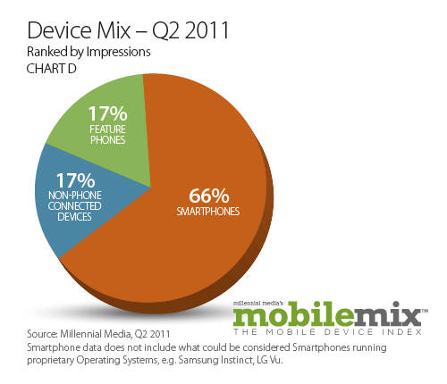
Products
Smart Phones
Smart Phone OS
Tablet PCs
Apps
Overview
Apple
Google
RIM
Notes:
http://www.businessinsider.com/bii-report-heres-where-massive-smartphone-growth-will-come-from-2012-10
Here's a brief rundown of why we are primed for international smartphone growth:
There are many more dumbphones out there than smartphones: Roughly 20% of the six billion mobile handsets in the world are smartphones. That is nearly five billion handsets that will likely be replaced by smartphones in the next few years.
U.S. smartphone penetration has reached over 50%: Nielsen reported that two-thirds of handsets sold in Q2 2012 were smartphones and that the market is now 55% penetrated. 78% of the primary smartphone market, U.S. adults between 18-54, already have smartphones.
And the U.S. is only in the middle of the pack: Singapore, Hong Kong, Sweden, and Australia all have at least 79% penetration of the primary smartphone market in their respective countries, topping the U.S. Countries such as the U.K., Denmark and Norway are not far behind.
So, where will the growth come from? Brazil has less than 20% penetration, while China is only 33% penetrated. Those are the most significant growth areas. Spain, Italy, and France -- all clocking in below 40% penetration -- are smaller opportunities as well.
According to recent smartphone penetration statistics from several sources including Netsize Guide, Informa, Google, Ipsos, and Go-Gulf.com, it is concluded that by December 2011, Singapore is the champion in terms of smartphone penetration, and also is the world's first country that have more smartphone than feature phone in used.
Read more: http://www.businessinsider.com/bii-report-heres-where-massive-smartphone-growth-will-come-from-2012-10#ixzz2DCHmj800

Slide 15
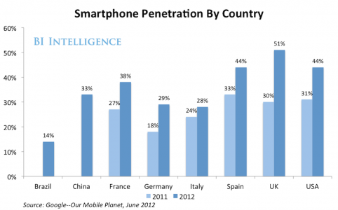
Products
Smart Phones
Smart Phone OS
Tablet PCs
Apps
Overview
Apple
Google
RIM
Notes:
http://www.businessinsider.com/bii-report-heres-where-massive-smartphone-growth-will-come-from-2012-10
Here's a brief rundown of why we are primed for international smartphone growth:
There are many more dumbphones out there than smartphones: Roughly 20% of the six billion mobile handsets in the world are smartphones. That is nearly five billion handsets that will likely be replaced by smartphones in the next few years.
U.S. smartphone penetration has reached over 50%: Nielsen reported that two-thirds of handsets sold in Q2 2012 were smartphones and that the market is now 55% penetrated. 78% of the primary smartphone market, U.S. adults between 18-54, already have smartphones.
And the U.S. is only in the middle of the pack: Singapore, Hong Kong, Sweden, and Australia all have at least 79% penetration of the primary smartphone market in their respective countries, topping the U.S. Countries such as the U.K., Denmark and Norway are not far behind.
So, where will the growth come from? Brazil has less than 20% penetration, while China is only 33% penetrated. Those are the most significant growth areas. Spain, Italy, and France -- all clocking in below 40% penetration -- are smaller opportunities as well.
According to recent smartphone penetration statistics from several sources including Netsize Guide, Informa, Google, Ipsos, and Go-Gulf.com, it is concluded that by December 2011, Singapore is the champion in terms of smartphone penetration, and also is the world's first country that have more smartphone than feature phone in used.
Read more: http://www.businessinsider.com/bii-report-heres-where-massive-smartphone-growth-will-come-from-2012-10#ixzz2DCHmj800

Slide 16
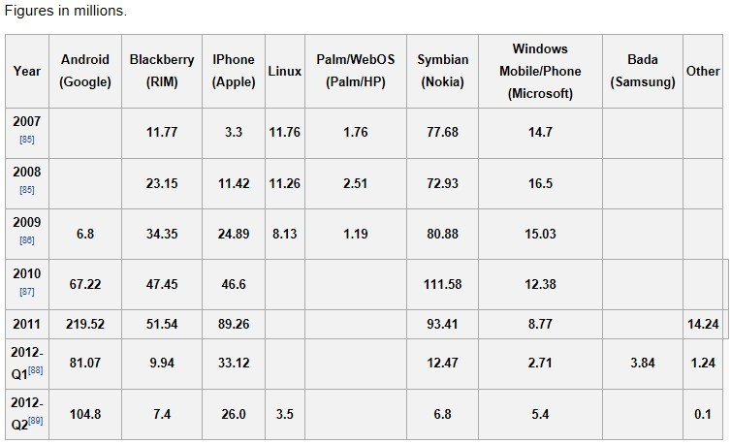
Products
Smart Phones
Smart Phone OS
Tablet PCs
Apps
Historical Smart Phone Sales
Overview
Apple
Google
RIM

Slide 17
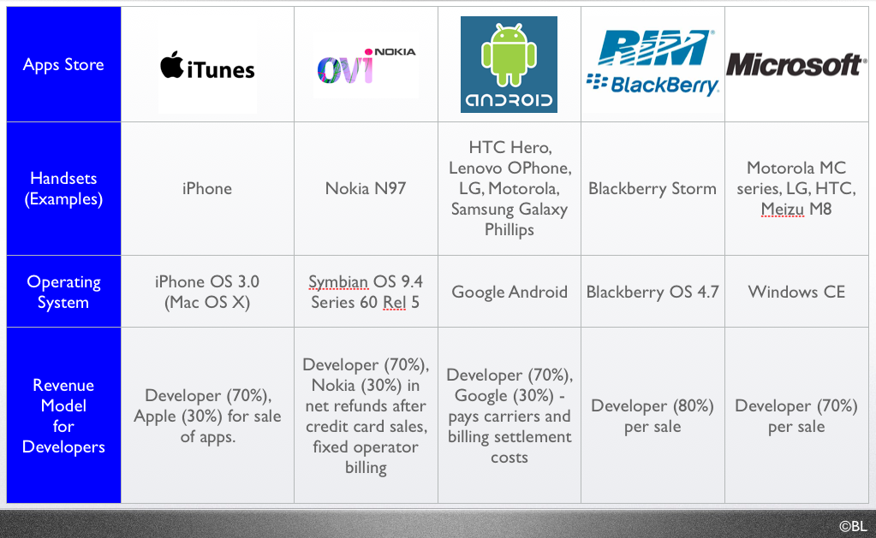
Products
Smart Phones
Smart Phone OS
Tablet PCs
Apps
Smartphone Operating System
Overview
Apple
Google
RIM

Slide 18
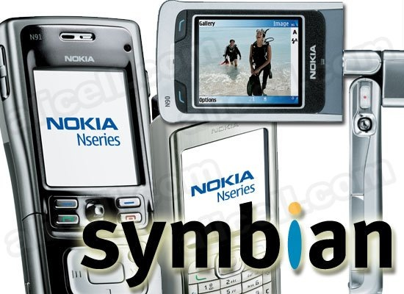
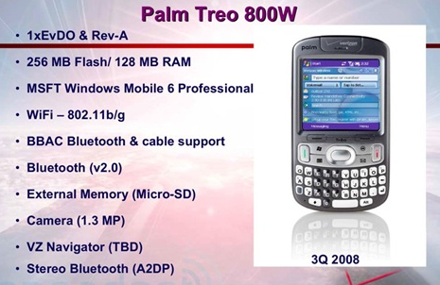
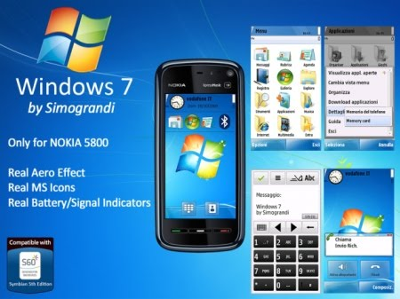
Products
Symbian Ltd.: Symbian
Popular outside of the United States
Acquired by Nokia in 2008
Palm, Inc.: Palm
Initially designed for PDA’s
Microsoft: Windows Phone 7
Replacing Windows Mobile
Overview
Apple
Google
RIM

Slide 19
Products
Smart Phones
Smart Phone OS
Tablet PCs
Apps
Apple, Inc. – iPhone OS
Originally released in 2007
Mobile version of Mac OSX
Multi-TouchTM user interface
Third-party developed applications
Overview
Apple
Google
RIM

Slide 20

Products
Smart Phones
Smart Phone OS
Tablet PCs
Apps
Google Android OS
Based on Linux Kernel
Created by Android Corporation, acquired by Google in July 2005
Multi-touch and media features
Overview
Apple
Google
RIM

Slide 21

Products
Smart Phones
Smart Phone OS
Tablet PCs
Apps
RIM – Blackberry
Popular among business professionals
Unique push-email feature
Traditionally secured network
Third party applications
Overview
Apple
Google
RIM

Slide 22
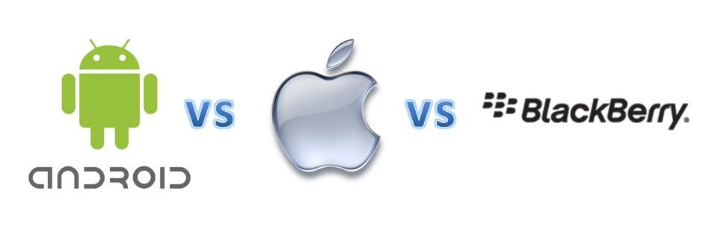
Products
Smart Phones
Smart Phone OS
Tablet PCs
Apps
 | Android | IOS | Blackberry
Pros | Seamless integration with apps Multi-tasking | Media playing abilities Better quality and quantity apps | Battery life Good quality hardware
Cons | Poor battery performance Google account needed | No flash capabilities Poor notification system | Lack applications Weak web browsing
Overview
Apple
Google
RIM
Notes:
http://www.callingallgeeks.org/34829/android-vs-ios-pros-and-cons/
http://www.straight.com/article-337702/vancouver/blackberry-iphone-or-android-pros-and-cons-mobile-devices-business

Slide 23
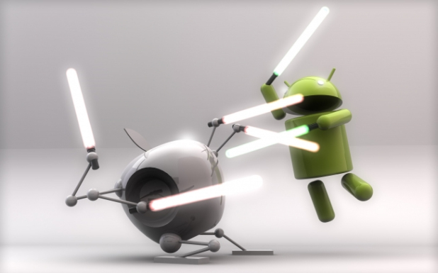
Products
Smart Phones
Smart Phone OS
Tablet PCs
Apps
Smartphone OS
Overview
Apple
Google
RIM

Slide 24
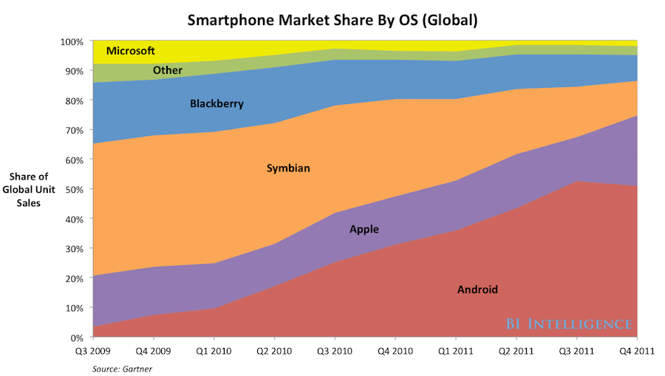
Products
Smart Phones
Smart Phone OS
Tablet PCs
Apps
Overview
Apple
Google
RIM

Slide 25
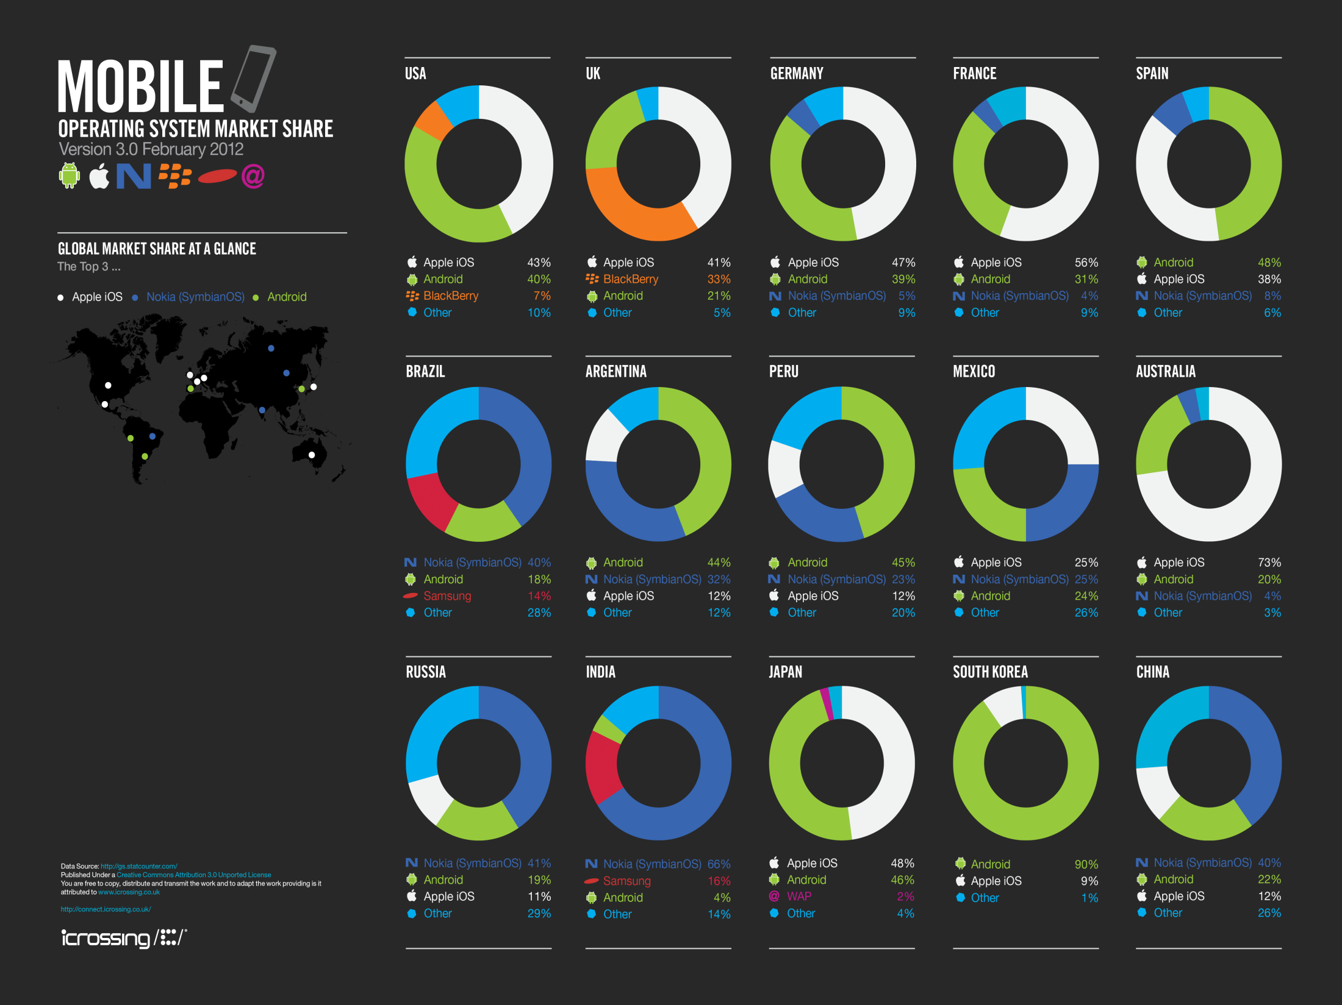
Products
Industry Growth
Overview
Apple
Google
RIM
Notes:
http://connect.icrossing.co.uk/2012-mobile-market-share-infographic_7962
2011 has been a big year for Android, with the platform seeing massive growth in many countries, growing from 17% to 47% in Spain in the last year and from 6% to 45% in Peru. In the UK Android has grown by 10% which has mostly been at the expense of Nokia and BlackBerry which have fallen 2% and 7% respectively.
Of the 15 countries we looked at, BlackBerry only had a significant presence in two markets (USA & UK) and has lost a significant amount of market share in the USA dropping 26% in the last 12 months, with both Apple(iOS) and Android picking up the slack and growing 9% and 15% respectively.
Android’s strongest market is currently South Korea where it commands an impressive 90% market share, perhaps not so surprising given that Android powered Samsung smart phones command such a strong presence in South Korea with the Galaxy S II by itself taking a whopping 25% of the entire smartphone market. Nokia’s Symbian OS performs well in emerging markets such as India and Brazil, however even here it is losing market share, having lost 8% in Brazil and 6% in India in the last year. Apple’s iPhone and other iOS devices are strongest in Australia where they currently command 73% of the market.

Slide 26
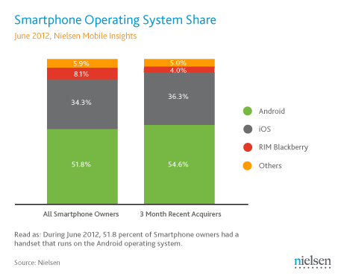
Products
Smart Phones
Smart Phone OS
Tablet PCs
Apps
iPhone Operating System
Overview
Apple
Google
RIM

Slide 27
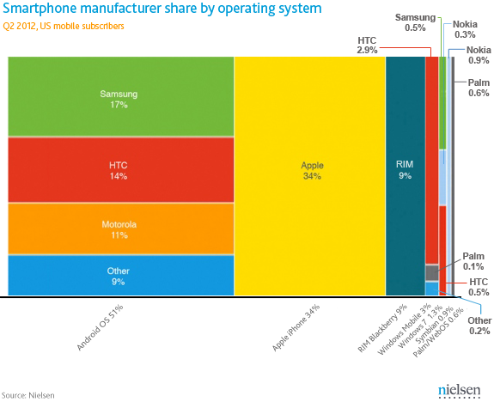
Products
Smart Phones
Smart Phone OS
Tablet PCs
Apps
iPhone Operating System
Overview
Apple
Google
RIM
Notes:
http://blog.nielsen.com/nielsenwire/online_mobile/two-thirds-of-new-mobile-buyers-now-opting-for-smartphones/
During Q2 2012 smartphone penetration continued to grow, with 54.9 percent of U.S. mobile subscribers owning smartphones as of June 2012. This growth is driven by increasing smartphone purchases: 2 out of 3 Americans who acquired a new mobile phone in the last three months chose a smartphone instead of a feature phone.
Android continues to lead the smartphone market in the U.S., with a majority of smartphone owners (51.8%) using an Android OS handset. Over a third (34.3%) of smartphone owners use an Apple iPhone, and Blackberry owners represented another 8.1 percent of the smartphone market.
Overall among smartphone owners, Apple had the highest manufacturer share of smartphone handsets. Among recent acquirers who obtained their smartphone during June 2012, 54 percent said they chose an Android handset and 36 percent bought an iPhone.

Slide 28
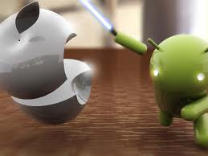
Products
Smart Phones
Smart Phone OS
Tablet PCs
Apps
Android Wins!
Overview
Apple
Google
RIM

Slide 29
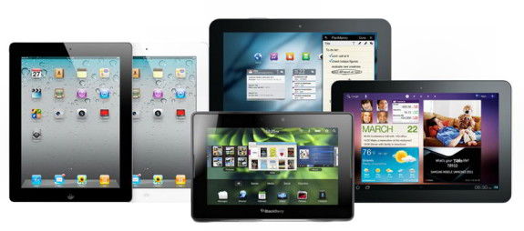
Products
Smart Phones
Smart Phone OS
Tablet PCs
Apps
A tablet computer is a mobile computer, larger than a mobile phone or personal digital assistant, integrated into a flat touch screen and primarily operated by touching the screen and instead of using a physical keyboard it often uses an onscreen virtual keyboard.
Overview
Apple
Google
RIM
Notes:
Combines the Smartphone, laptop and PDA
Apple iPad 1 , 2, 3 & Mini
MS Surface
Blackberry Playbook
Samsung Galaxy Tab 1 & 2
Motorola Xoom
Hp TouchPad
LG Optimus Pad
HTC Flyer
Asus transformer pad infinity
Amazon Kindle Fire
Nexus 7
The Kindle Fire is a tablet computer version of Amazon.com's Kindle e-book reader. Announced on 28 September 2011, the Kindle Fire has a color 7" multi-touch display with IPS technology and runs a forked version of Google's Android operating system. The device—which includes access to the Amazon Appstore, streaming movies and TV shows, and Kindle's e-books—was released on November 15, 2011.
The Kindle Fire retails for US$199.
Analysts have projected the device to be a strong competitor to Apple's iPad,^{[8][11]} and that other Android device makers will suffer lost sales.^{[12][13]}Amazon's business strategy is to make money on the selling of digital content on the Fire, rather than through the device itself.
customers purchased over 1 million Kindle devices per week.^{[18]} Analysts had estimated that over 6 million Amazon Kindle Fire tablets would be sold in the fourth quarter of 2011.^{[19]}
Rumor: Nexus(google choosen asus) tablet is a “done deal”, to retail as low as $149
Google is building a 7-inch "Nexus tablet" with Asus that will possibly be cheaper than the $200 Kindle Fire and come with the next version of Android.
The "confirmation" (and we suggest you treat it as a highly suspect rumor until Google officially confirms the news themselves) comes from Android and Me.
According to Android and Me, an anonymous "senior employee at a supply chain company based in the United States" has told the tech blog that Asus is scrapping plans to release the 7-inch MeMo 370T Android tablet that it unveiled at CES. Instead, it's using that tablet as a template for Google's official tablet.
Pricing is said to be much lower than the $250 price point that Digitimes reported last week — coming in at a possible $150 to $199 price.
At such a low price, the Google tablet would essentially undercut the Kindle Fire and Nook Tablet's $200 to $250 pricing, setting it up to be an "impulse buy" for many consumers who haven't hopped on the tablet bandwagon.
The mobile trend doesn’t just bring joy to mobile ad companies, it also boosts the adoption rate of social sites like Twitter and facebook. ??

Slide 30
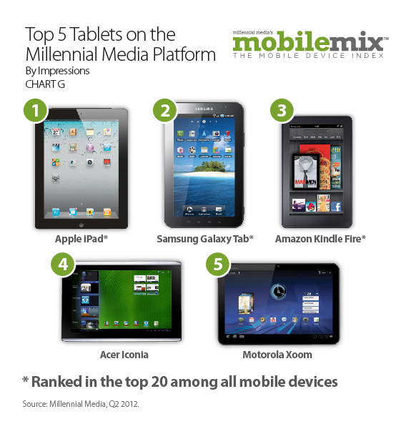
Products
Smart Phones
Smart Phone OS
Tablet PCs
Apps
Overview
Apple
Google
RIM
Notes:
The new iPad pretty much beats everything else in the chart. It's hard to see a single compelling reason to take the Galaxy Tab 2 10.1 over it or the Transformer (other than price). Amazon's Kindle Fire and BlackBerry's Playbook likewise get chomped, but here at least there is a significant difference in price. $200 is very cheap. For people who primarily want a tablet for reading books and watching the occasional movie, the Kindle Fire might just be a more frugal investment.
iPad starts is $500, $600, or $700 for the 16GB Wi-Fi only version at 16, 32, and 64GB, respectively. For Wi-Fi plus 4G it's $630, $730, and $830, for the the 16, 32, and 64GB versions, respectively.

Slide 31
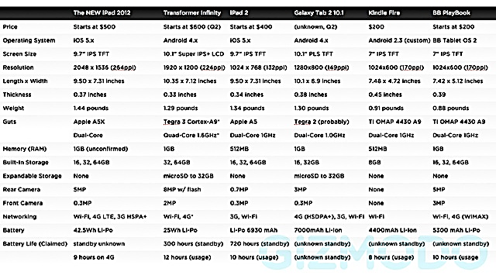
Products
Smart Phones
Smart Phone OS
Tablet PCs
Apps
Overview
Apple
Google
RIM
Notes:
The new iPad pretty much beats everything else in the chart. It's hard to see a single compelling reason to take the Galaxy Tab 2 10.1 over it or the Transformer (other than price). Amazon's Kindle Fire and BlackBerry's Playbook likewise get chomped, but here at least there is a significant difference in price. $200 is very cheap. For people who primarily want a tablet for reading books and watching the occasional movie, the Kindle Fire might just be a more frugal investment.
iPad starts is $500, $600, or $700 for the 16GB Wi-Fi only version at 16, 32, and 64GB, respectively. For Wi-Fi plus 4G it's $630, $730, and $830, for the the 16, 32, and 64GB versions, respectively.

Slide 32
Products
Smart Phones
Smart Phone OS
Tablet PCs
Apps
Major Functions
Wireless mobile browser
E-mail and social media devices
Potential cell phone functions
GPS satellite navigation
Stills and video camera functions
E-book reading
Downloadable apps (games, education, utilities)
Portable media player function
Overview
Apple
Google
RIM
Notes:
Major Functions
Wireless mobile browser functions (using 2G, 3G, 4G or WiFi)
E-mail and social media devices (typically with integration apps to bring all feeds into the same view)
Potential cell phone functions (Messaging, video calling, speakerphone or headset cellphone uses)
GPS satellite navigation
Stills and video camera functions, photo and video viewing and editing
E-book reading (including electronic versions of periodicals)
Downloadable apps (games, education, utilities)
Portable media player function
Weigh around one or two pounds (0.5 - 1 kilogram)
Battery life of three to twelve hours depending on usage pattern

Slide 33
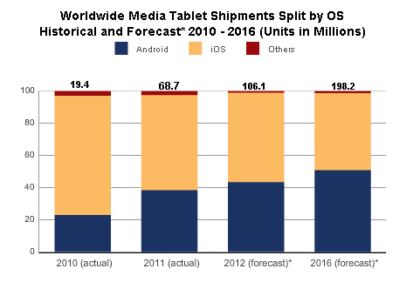
Products
Smart Phones
Smart Phone OS
Tablet PCs
Apps
Overview
Apple
Google
RIM
Notes:
Apple iOS
Google Android
Others: RIM QNX
The “new” iPad goes on sale, March 16th, and is still “King of the Tablets.” However, sales for Q3 2011 show Apple dropping in worldwide tablet marketshare for the first time–impacted by the Kindle Fire. A new study by the IDC predicts Android and iOS will split the tablet market share in half by 2016, with other manufacturers holding a marginally small share.
Alex Cocotas of BI Intelligence predicts that smartphone sales will be twice that of PC sales this year and that smartphone sales will reach 1.5 billion units by 2016.
IDC forecasts that while the iPad will remain dominant for the foreseeable future, Google's tablet OS will overtake Apple in market share in 2015. However, said Mainelli, "We expect iOS to remain the revenue market share leader through the end of our 2016 forecast period and beyond."

Slide 34
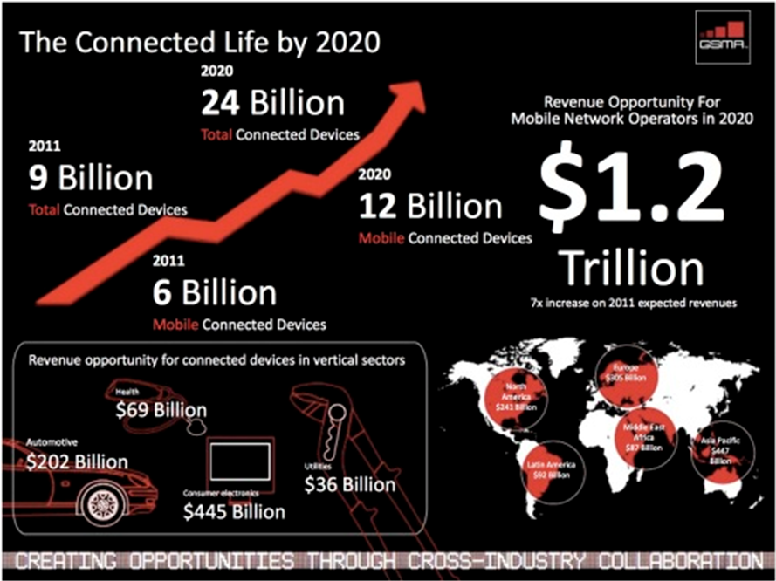
Products
Smart Phones
Smart Phone OS
Tablet PCs
Apps
A Mobile, Post-PC World
Overview
Apple
Google
RIM
Notes:
http://www.hl7standards.com/blog/2012/03/15/the-future-is-quantified/
A mobile, Post-PC world
It’s hard to imagine that the iPad didn’t even exist only two years ago, and now more than 40 million have been sold. With the iPad, we saw a Super Mobile revolution that launched the BYOD, “Bring Your Own Device”, trend and a Post-PC world.

Slide 35
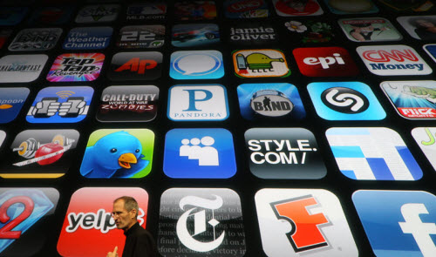
Products
Smart Phones
Smart Phone OS
Tablet PCs
Apps
Apps is an abbreviation for application. An app is a piece of software. It can run on the Internet, on your computer, or on your phone or other electronic device.
Overview
Apple
Google
RIM
Notes:
Specific to particular OS, but versions may be made for various OS
Available through “app stores”
Creators of applications may be contracted to produce apps for a particular OS, but many are not
Quickly growing market

Slide 36
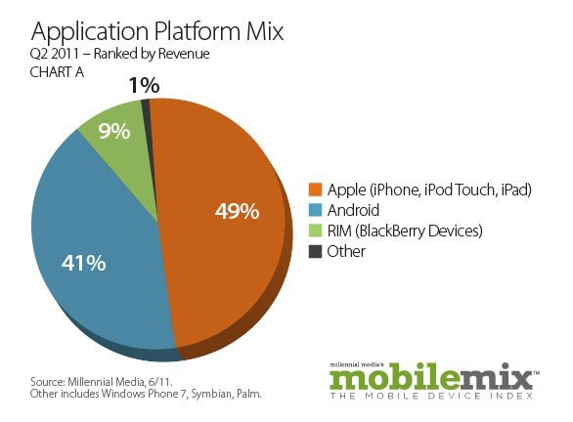
Products
Smart Phones
Smart Phone OS
Tablet PCs
Apps
Overview
Apple
Google
RIM

Slide 37
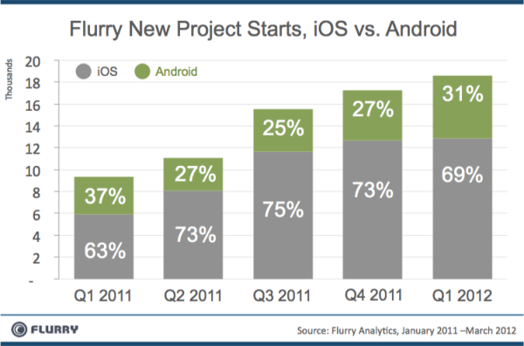
Products
Smart Phones
Smart Phone OS
Tablet PCs
Apps
Overview
Apple
Google
RIM
Notes:
Comparison between iOS Appsand Android Apps Revenue Sharing, it’s revealed that iOS Apps are much profitable in terms of revenue as compare to Android Apps. iOS Apps make four times higher revenue as compare to Android platform. Android is an open source platform and many big phone maker companies like Samsung, Motorola, Sony etc. is now offering Android devices but the statistic makes it clear that Apple iOS is still more popular platform in terms of Apps Revenue as compare Android platform.
http://www.bgr.com/2012/06/07/ios-android-developers-apps-apple-ipad/

Slide 38
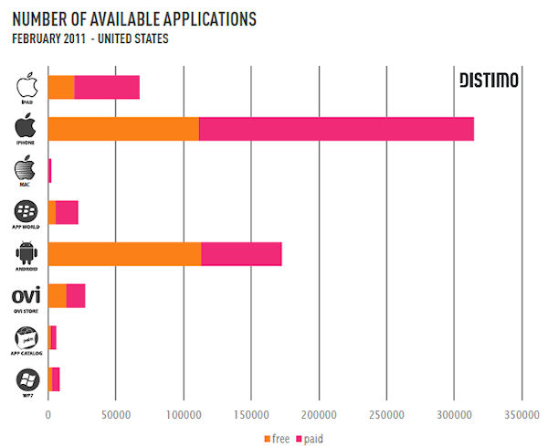
Products
Smart Phones
Smart Phone OS
Tablet PCs
Apps
Overview
Apple
Google
RIM
Notes:
http://hexus.net/mobile/news/apple/29636-mac-app-store-revenue-almost-half-ipads/

Slide 39
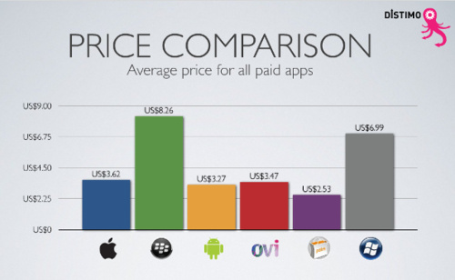
Products
Smart Phones
Smart Phone OS
Tablet PCs
Apps
Overview
Apple
Google
RIM

Slide 40
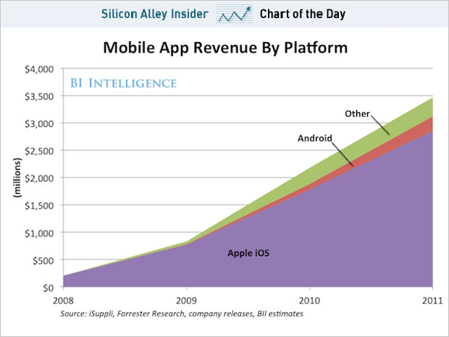
Products
Smart Phones
Smart Phone OS
Tablet PCs
Apps
Overview
Apple
Google
RIM
Notes:
http://www.businessinsider.com/chart-of-the-day-the-app-economy-is-35-billion-2012-6

Slide 41
Industry Structure
Notes:
GOLYA START

Slide 42
Global Gadgets Industry
Structure
Barriers to Entry
Patents
Capital
Customer Loyalty
Economy of Scale
R&D
Overview
Apple
Google
RIM

Slide 43
Global Gadgets Industry
Structure
Competition
Market dominated by small number of very large companies
Profit margins are extremely high
Rapid change in Market Shares
Overview
Apple
Google
RIM

Slide 44

Global Gadgets Industry
Digital Music
Social Media
Market Trends
Broadly spread in mobile devices
iTunes Store provides revenue stream for digital content:
Music
Podcasts
Books
Apps
Overview
Apple
Google
RIM

Slide 45

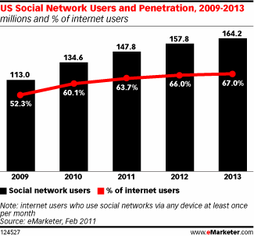
Global Gadgets Industry
Digital Music
Social Media
Market Trends
Facebook, Twitter, YouTube, Myspace, etc
Overview
Apple
Google
RIM
Notes:
March 20, 2011
social networking is reaching a saturation point in some age groups. A closer look at the graph reveals that the growth has been slowing down when compared to previous years and it is now expected to grow at a very small percentage till 2013. Year 2009-10 witnessed the highest jump in number of users while 2012-13 is expected to be the sluggiest of them all.
estimates nearly 150 million US web users will use social networks via any device at least monthly this year, bringing the reach of such sites to 63.7% of the online population. By 2013, 164.2 million Americans will use social networks, or 67% of internet users.

Slide 46
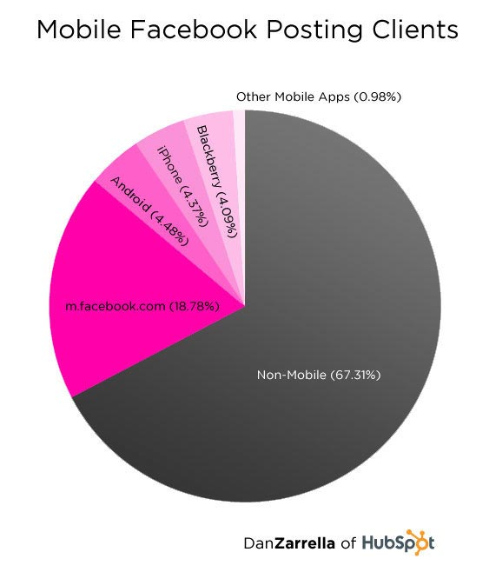
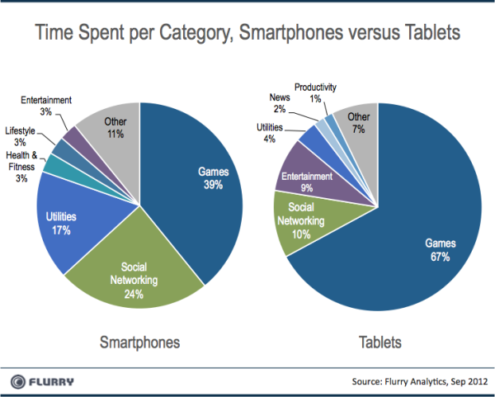
Global Gadgets Industry
Digital Music
Social Media
Market Trends
Social Media Goes Mobile
Overview
Apple
Google
RIM
Notes:
Social media will focus more on mobile devices in the next five years, including smartphones and tablet PCs.
Over 300 million active users of Facebook currently access Facebook through their mobile devices. (Facebook Statistics, Stats and Facts for 2011 )

Slide 47
Global Gadgets Industry
Market Trends
Consumer Trends
Market Trends
Growth of mobile phone and Smartphone usage in developing countries
The Smartphone was originally for the business user, but now targets wider range of consumers
Virtualization and “cloud computing” more popular
Overview
Apple
Google
RIM

Slide 48
Global Gadgets Industry
Market Trends
Consumer Trends
Market Trends
Research by Consumer Electronics Association in 2012:
Global spending on technology device is $1.038 trillion
Annual smartphone sales growth is 22%
Annual tablet sales growth is 59%
Overview
Apple
Google
RIM
Notes:
http://web.ebscohost.com.proxy.lib.sfu.ca/bsi/detail?sid=ed7a9962-b794-48b5-ae70-784c8368a48d%40sessionmgr10&vid=3&hid=9&bdata=JnNpdGU9YnNpLWxpdmUmc2NvcGU9c2l0ZQ%3d%3d#db=bth&AN=70335232
The article discusses the global gadget industry analysis presentation of Consumer Electronics Association and GfK Boutique Research. They estimate that global technology device spending to increase to 1.038 trillion dollars in 2012 from 993 billion dollars in 2011. In 2012, tablets and smartphones are estimated to grow 59 percent and 22 percent, respectively. The low end smartphone is estimated to provide 81 percent of the overall growth in smartphones in 2012.

Slide 49
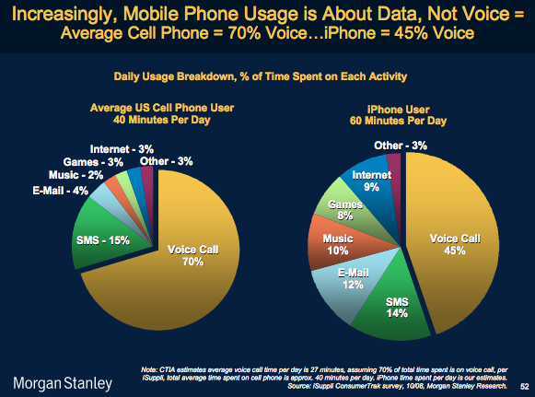
Global Gadgets Industry
Market Trends
Consumer Trends
Market Trends
Overview
Apple
Google
RIM

Slide 50

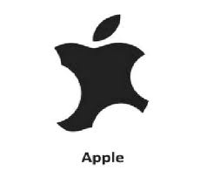
Global Gadgets Industry
Market Trends
Consumer Trends
Market Trends
Battle on Apps
Increased market growth
Apple’s competitors increased their market share
Overview
Apple
Google
RIM

Slide 51
Global Gadgets Industry
Market Trends
Consumer Trends
Market Trends
Legal Environment
Constant battle for patent rights
Patents are crucial for profitability
Overview
Apple
Google
RIM

Slide 52
Global Gadgets Industry
Market Trends
Consumer Trends
Market Trends
Intangible Assets & Cash
Critical items on financial statements
Intangible assets include goodwill, intellectual property, representation on balance sheet should be examined
A large amount of cash is common - representation of current and future performance of the company
Overview
Apple
Google
RIM
Notes:
Intellectual property
Protected by patents, trademarks, copyrights
Human capital

Slide 53
Apple Inc.

Slide 54
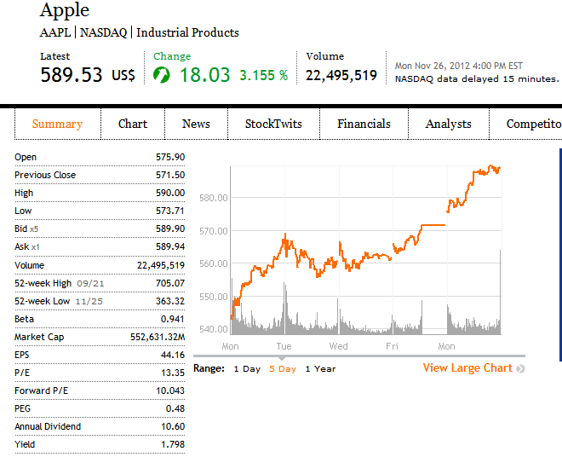
Financial Snapshot

Slide 55
Financial Snapshot

Slide 56
Common Share Structure
 | 2012 | 2011 | 2010 | 2009 | 2008
Shares Outstanding (in thousands) | 940,692 | 929,277 | 915,970 | 899,806 | 888,326
As of Oct 19th, 2012

Slide 57
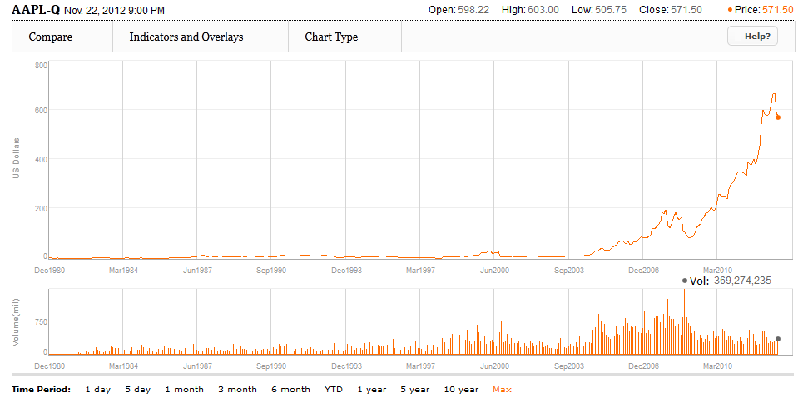
Max Chart

Slide 58
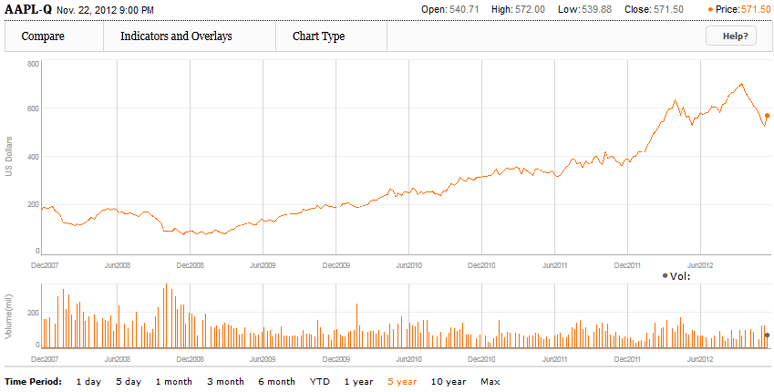
5-Year Stock Performance

Slide 59
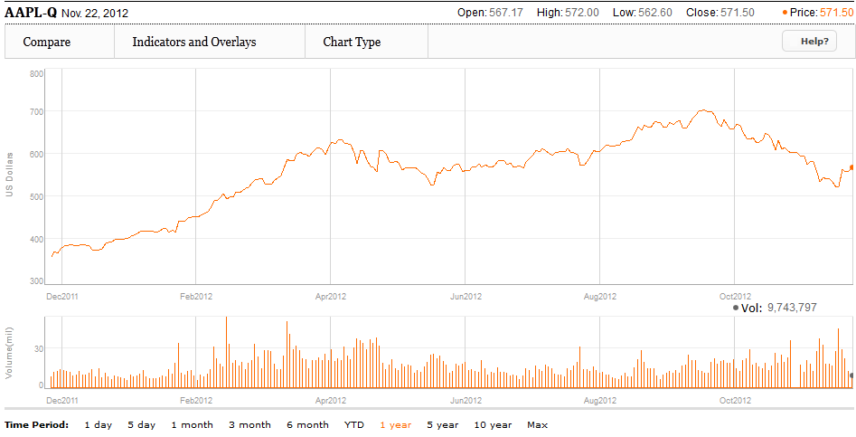
1-Year Stock Performance

Slide 60
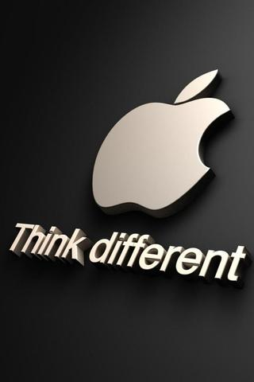
Company Overview

Slide 61
Company Profile
Founded in 1976 by Steve Jobs, Steve Wozniak, and Ronald Wayne.
Headquartered in Cupertino, California
Design, manufacture, and market personal computers and related personal computing and mobile communication devices.
Sell its products worldwide through its online store, its retail stores, its direct sales force, third-party wholesalers, and resellers

Slide 62
Mission Statement
Apple designs Macs, the best personal computers in the world, along with OS X, iLife, iWork and professional software. Apple leads the digital music revolution with its iPods and iTunes online store. Apple has reinvented the mobile phone with its revolutionary iPhone and App Store, and is defining the future of mobile media and computing devices with iPad.

Slide 63
Products and Services
iPhone
iPad
Mac
iPod/iTunes
Apple TV
iOS and Mac OS X operating systems
iCloud
Accessories, software, and warranties

Slide 64
iTunes Revenue
Sales of third-party digital content such as:
Digital music
Podcasts
Movies and TV shows
Audio books
Manage contents on iPod, iPhone, iPod Touch and iPad
“iTunes store revenue was $1.8 billion for the third quarter of 2012, which is down $100 million from last quarter, in which Apple took in $1.9 billion.” (VentureBeat)

Slide 65
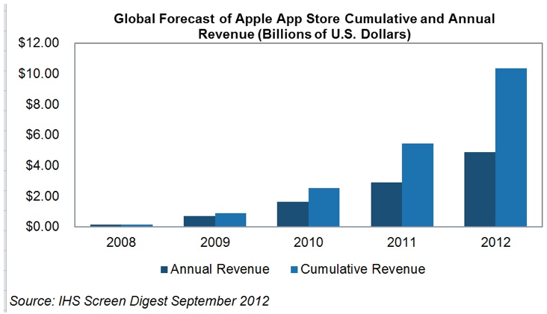
The App Store
Allows users to browse and download applications from the iTunes Store directly on their computer or mobile device
30% of revenue from the store goes to Apple and 70% go to the producer of the app.

Slide 66
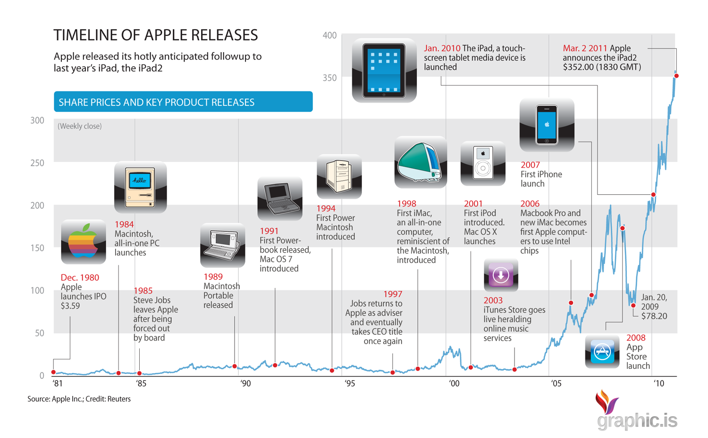
Milestones

Slide 67
Recent Milestones
Sept 12,2012 – iPhone 5 launched
Sept 17,2012 – Pre-orders for iPhone 5 top 2 million in first 24 hours
Sept 24,2012 – iPhone 5 first weekend sales top 5 million
Oct 23,2012 – iPad mini introduced
Nov 5,2012 – 3 million iPads sold in three days

Slide 68
Key Company Trends
Global Growth
Key products and regional growth
Litigation (10-k)

Slide 69
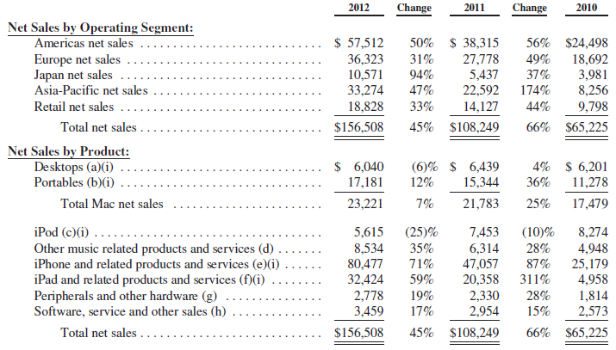
Key Products & Regional Growth (Annual)

Slide 70
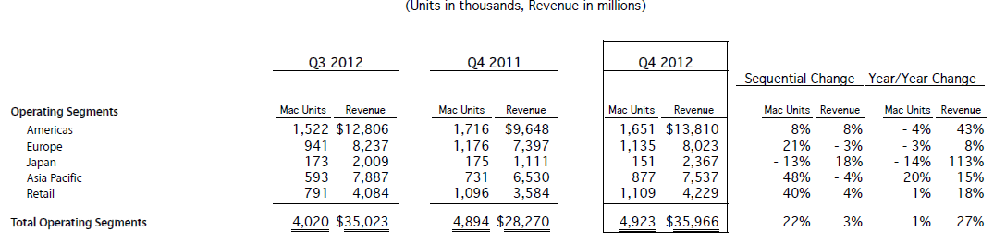
Key Products & Regional Growth (Quarterly)

Slide 71
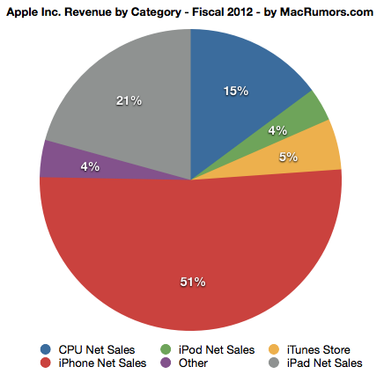
Revenue by Product

Slide 72

Product Revenue by Quarter

Slide 73
Dividends
On March 19, 2012, Apple announced plans to issue a quarterly dividend of $2.65 per share in Q4 2012
Apple also announced a $10 billion share repurchase plan starting in fiscal 2013
An attempt to neutralize the impact of dilution from future employee equity grants and employee stock purchase programs
Re-announced $2.65 dividend on October 25, 2012, payable November 15, 2012

Slide 74
Litigations
Apple Inc. vs Samsung Electronics Co., Ltd.
Apple sued Samsung, claiming patent infringement
Samsung counter sued
As of July 2012, over 50 lawsuits pending around the globe
Aug 24,2012 – Apple was awarded the case in U.S. in the amount of $1.05 billion.

Slide 75
Key Management

Slide 76

Steve Jobs
Co-founder of Apple Inc.
Previous CEO
Business icon, visionary, and a pioneer
Oversaw the development for iMac, iTunes, iPod, iPhone, and iPad
Apple became world’s most valuable publicly traded company in 2011
Resigned as CEO in Aug 2011
Passed away on Oct 5,2011 from cancer

Slide 77

Tim Cook
CEO since Aug 2011
Previous Chief Operating Officer
M.B.A. from Duke University
Bachelor of Science degree in Industrial Engineering from Auburn University
As of 2012, his $378 M compensation package makes him highest paid CEO in the world

Slide 78

Scott Forstall
Former Senior Vice President of iOS software
In Oct 2012, Apple announced Scott’s departure
Current advisor to Tim Cook until Apr 2013
Came under fire for faulty Maps app introduced in iOS6

Slide 79

Eddy Cue
Senior Vice President of Internet Software and Services
23-year Apple veteran
Oversees Apple's industry-including the iTunes Store, App Store, iBookstore, Siri, Maps, iAd and Apple's innovative iCloud services
Bachelor's degree in Computer Science and Economics from Duke University

Slide 80

Jonathan Ive
Senior Vice President of Industrial Design
Bachelor of Arts and an honorary doctorate from Newcastle Polytechnic
In 2003, named Designer of the Year by the Design Museum London and awarded the title Royal Designer for Industry by The Royal Society of Arts

Slide 81

Phillip W. Schiller
Senior Vice President of Worldwide Marketing
Over 25years of marketing and management experience, including 20 years at Apple
Bachelor of Science degree in Biology from Boston College

Slide 82

Bob Mansfield
Senior Vice President of Technologies
Leads all of Apple's wireless and semiconductor teams across the company
BSEE degree from The University of Texas

Slide 83
Financial Analysis

Slide 84

Annual Balance Sheet

Slide 85

Quarterly Balance Sheet

Slide 86

Annual Income Statement

Slide 87

Quarterly Income Statement

Slide 88

Annual Cash Flow Statement

Slide 89

Quarterly Cash Flow Statement

Slide 90

Statement of Shareholders Equity

Slide 91

Recommendation
BUY!

Slide 93

Financial Snapshot

Slide 94
Financial Snapshot

Slide 95

Common Share Structure
Rights, including the liquidation and dividend rights, of the holders of our Class A and Class B common stock are identical, except with respect to voting
Voting rights of shares:
Class A: 1 Vote/share
Class B: 10 Votes/share
Class B shares are only offered to Google Insiders and Executives

Slide 96

Shares Outstanding Since 2009

Slide 97

1 Year Chart

Slide 98

5 Year Chart

Slide 99

Max Chart

Slide 100

50 Day vs 200 Day MA

Slide 101

Google VS. Nasdaq

Slide 102
History and Milestones
1996
Larry Page and Sergey Brin create a search engine as a research project
Featured a very efficient algorithm dubbed “PageRank”
Called BackRub initially
Originally, Google ran under the Stanford University website, with the domain google.stanford.edu
1998
Incorporated in Menlo Park, California
1999
Obtained funding from venture capital firms Kleiner Perkins Caufield & Byers, and Sequoia Capital. Officially launched as a site.
2000
Began selling advertisements- paid web links associated with search keywords

Slide 103
History and Milestones
2001
Eric Schmidt becomes CEO and Chairman of the Board
“PageRank” granted a patent
2003
Re-incorporated in Delaware
2004
Initial Public Offering that raised $1.67 billion
19,605,052 shares sold
$85 per share
Conducted via Dutch auction

Slide 104
History and Milestones
Oct 2007
Share price hits $700 for the first time
July 2011
Google+ reaches 25 million users only 4 weeks after its launch in June 2011
May 2011
unique visitors of Google surpassed 1 billion mark for the first time
Oct 2012
Google is the dominant search engine globally- 88.8% market share
Currently the most visited site in the world

Slide 105
Key Acquisitions
Apr 2003: Applied Semantics
Lead to the launch of Google AdSense
Jul 2004: Picasa Inc.
Digital photo management
Oct 2004: Keyhole Corp.
Leads to launch of Google Maps and Google Earth.
Aug 2005: Android
Oct 2006: Youtube
Mar 2008: Doubleclick.
Enhances the company’s advertising revenue.
Aug 2011: Motorola

Slide 106



Major Acquisitions in 2012
Meebo: Best known for its web-based instant messaging service for
Acquired for $100M
Sparrow: Email client for iOS and OSX devices
Acquired for $25M
Wildfire: social marketing software developer
Acquired for $350M and another $100M in earn outs & retention bonuses

Slide 107
Products and Services
iGoogle
Google+
Google Search
Google Image
Google Ads
Google Docs
Google Finance
Google Photos
Google Calendar
Google Scholar
Google Books
Google Chrome
Google Chrome OS
Gmail
Google Wallet
Google TV
Google Translate
Google Ventures
Google Patent Search
Google Maps
Google Earth
Android mobile OS
Google Play
Google Blog Search
Blogger
YouTube

Slide 108

Distribution of Revenues

Slide 109


Slide 110
Ad Sources: AdWords
Advertisers create ads to show alongside Google search results
Consists of 1 headline, 25 characters
2 text lines, 35 characters each
Advertisers may bid on certain specific keywords to have their ads displayed alongside
Cost-per-impression (CPM)
Cost-per-click (CPC)

Slide 111


Slide 112

Ad Sources: Google Maps Ads

Slide 113

Ad Sources: AdSense
Helps websites/publishersearn revenue by “showing relevant and engaging ads alongside your online content” – Google
Displays ads on your site
Earn money from valid clicks
Google shares the profits with the publishers
Per click
Per impression

Slide 114

Ad Sources: Google Network Ads

Slide 115

Gmail
Features:
When released, it was the first e-mail service to offer 1Gb of storage
Built-in chat features and message views to redefine the e-mail experience
Integrated with Google Chrome and other Google applications
Google Drive
Google Voice
Google+

Slide 116
Google+
A new social network to compete against Facebook and Twitter
Features include:
Video Hangouts
Circles: organize the people that you want to follow
Sandbar Notifications
Currently over 90 million users worldwide

Slide 117

Google Fiber
Experimental broadband internet network using fiber optics
Released in March for residence at Kansas city
Offers 1Gbit/s internet speeds
100 times faster than what most Americans have
Also offers free internet @ 5Mbit/s

Slide 118

YouTube
Biggest video site in the world
Purchased by Google in November 2006 for US$1.65 billion
Google has established partnerships with content companies to aid in monetizing video in the mobile space

Slide 119


Android Mobile OS
Open source
Promotes the development of new applications using Java
OS is based off of Linux
Growing selection of third-party applications
Downloaded through the Google Play Store
Nearly 105 million Android phones were shipped in the 2nd quarter of 2012
more than double the number shipped at the same time last year.
U.S. Market shares reached 52.2% in July 2012
Android App store reached 25 billion downloaded at the end of September 2012

Slide 120
Android OS and the Manufacturers
Continued partnerships with manufacturers such as Samsung, HTC, and Sony
Joint venture with Samsung: Galaxy Nexus
Recent partnership with LG: Galaxy Nexus 4
Acquisition of Motorola Mobility
Retains independence as a subsidiary
Establishes Google as a smartphone manufacturer
Portfolio of patents loosens up some of the legal burden

Slide 121


Slide 122

Google Play
Combines Android Market, Google Music, and Google eBookstore
Similar to iTunes store and Amazon in oferings
Removal of Android brand means opportunities to roll it out on non-Android devices in the future

Slide 123

Google Chrome and Chrome OS
Chrome Web Browser
Free to use, integrates with other Google and third-party applications
Has 34% worldwide usage share (StatCounter, Sept 2012)
Offered for desktop and mobile operating systems
iOS, Windows, etc.
Chrome OS
Open Source (based on Linux)
Works primarily for web applications
Found in Chromebooks built by Samsung and Acer
Hybrid between cloud client and traditional laptop

Slide 124
Strategy
Revenue = Amount of time on the Web
Mission Statement:
“To organize the world’s information and make it universally accessible and useful”
Slogan (mantra)
“Don’t be evil”

Slide 125
Strategy in 2012
Mobile:
Continued partnerships with other manufacturers
Growth of different types of content in the Play Store
Inexpensive smartphones initiative throughout the world
Market penetration purposes
E.g. Google Nexus 4
Increasing LTE Compatibility as high speed upgrade to 4G networks
Implementation of Google Wallet
Mobile electronic money as a means of payment based on near field communications technology

Slide 126
Legal Issues
Oracle
- Java patent that it got when it acquired Sun Microsystems
Microsoft
-EU lawsuit regarding a Motorola patent for web video
Apple
- Disputes over patents with Android device makers Samsung, HTC, and Motorola
Privacy concerns
- Lawsuits from users i.e., Google Street View

Slide 127

Future Outlook
Connect more people online through Google Applications and services to create greater advertising opportunities
Continuing legal concerns/battles
Privacy Issues
Increased competition with multiple companies, including Apple, Facebook, and Microsoft (Bing)

Slide 128

Management
CEO: Larry Page
Co-Founder in 1998
CEO since April 2011
Was President of Products from 2001-2011
Bachelor of Engineering from Michigan
Master of Computer Science at Stanford
PhD (dropout) in Computer Science at Stanford

Slide 129

Management
Co-Founder: Sergey Brin
Co-Founder in 1998
Served as President of Technology from 2001-2011
B.Sc. in Math and Computer Science
Master of Computer Science from Stanford
PhD (dropout) in Computer Science from Stanford

Slide 130

Management
Executive Chairman: Eric Schmidt
Former CEO
Former CEO of Novell & CTO of Sun Microsystems
Bachelor of Engineering degree from Princeton
Master’s and PhD in Comp. Sci. from UC Berkley
Member of President Obama’s council of Science and Technology

Slide 131
Five Year Diversification Plan
Larry, Sergey, and Eric currently hold 92% of the company’s Class B common stock
Hold 66% of the voting power in company decisions
Since 2010, Larry and Sergey will each sell $5.5 billion shares of common stock until 2015
Will retain 48% of the voting power after the sell-out

Slide 132

Management
Senior VP and Chief Business Officer: Nikesh Arora
Joined Google in 2004
Responsible for creating and expanding strategic partnerships
Former Chief Marketing Officer at T-Mobile
Masters degree from Boston College
MBA from Northeastern University
CFA Designation

Slide 133

Management
Senior Vice President, Corporate Development and Chief Legal Officer: David Drummond
Responsible for company’s business development (Investments and M&A)
Previous experience at a leading law firm in US
Bachelors of Arts – Major in History
JD in Law from Stanford University

Slide 134

Management
Senior VP and Chief Financial Officer: Patrick Pichette
Joined Google in 2008
Worked at McKinsey and at Bell Canada (2001-2008)
An expert in the telecommunications industry
BBA Université du Québec à Montréal (1987)
MA in Philosphy, Politics, and Economics from Oxford
Rhodes Scholar

Slide 135

Balance Sheet – Q3

Slide 136

Balance Sheet – Q3

Slide 137


Slide 138

Income Statement – Q3

Slide 139


Slide 140

2011 Income Statement

Slide 141

Cash-Flow – Q3

Slide 142

Cash-Flow – Q3

Slide 143


Slide 144
Recommendation
BUY

Slide 145

Research In Motion, Ltd.

Slide 146

Financial Snapshot
Notes:
*Update on day of presentation

Slide 147
Recent Surge
Rising optimism over the Blackberry maker’s new smartphones with BB 10
RIM’s stock price has rallied 47 percent in the month of November but remains down 20 percent on the year
Analyst hype & stock upgrades

Slide 148
Financial Snapshot
Notes:
*Update on day of presentation

Slide 149
Common Shares Outstanding
3-for-1 stock split on August 15th, 2007
On December 13, 2011, there were 524 million voting common shares, options to purchase 4 million voting common shares, 8 million restricted share units and 91,204 deferred share units outstanding

Slide 150

1 Year Chart
Notes:
*Update on day of presentation

Slide 151

5 Year Chart

Slide 152

10 Year Chart

Slide 153

5 Year S&P/TSX Comp.

Slide 154

Company Profile

Slide 155
Milestones
1984: RIM was founded in Ontario by two engineering students: Mike Lazaridis and Douglas Fregin
1988: Began to work on wireless data-only applications
1996: Introduced first two-way messaging pager and PCMIA plug-in card for computer-enabled wireless email
1997: Rim was listed on the TSE
1998: Launched its first BlackBerry - RIM 950
1999: RIM was listed on the Nasdaq (RIMM)
2002: Launched its first true Blackberry device
2008: Reach 14 million subscribers
2011: Released BlackBerry Playbook

Slide 156
Key Acquisitions
June 2009 – Acquired Dash Navigation (primarily used in BlackBerry Traffic)
August 2009 – Acquired Torch Mobile (Webkit-browser technology)
March 2010 – Acquired Viigo (BlackBerry applications developer)
April 2010 – QNX Software Systems (integrate smart-phone and in-vehicle infotainment systems)
March 2011 – tinyHippos (Mobile Web development)
October 2011 – NewBay (Cloud-based content provider)
March 2012 – Paratek (RF multi-band handsets)

Slide 157
Recent Developments
BlackBerry global expansion continues
BlackBerry 7 Smartphones introduced
RIM searches for more carrier billing and operator billing on BlackBerry App World
On Jan 22, 2012, RIM named Thorsten Heins President and CEO
On Feb 21, 2012, BlackBerry PlayBook OS 2.0 was introduced
Currently working on BlackBerry10
BB10 release date set for Jan. 30, 2013

Slide 158

Products
Mobile Phones:
From the RIM 950 to the Bold 9930
Notes:
Design and technological improvement
Basic keypad → Scroll ball → track-pad → touch capability

Slide 159

Products
Blackberry Playbook:
Manage both email and social network messages with a unified inbox
Can edit MS Word, Excel, PowerPoint files and attachments with Documents To Go (mobile office suite)
BlackBerry App World
BlackBerry Bridge
(device linking)

Slide 160


BB 7 Operating System
BB 7 Features:
Liquid Graphics™ technology
Fastest Blackberry browser
Near Field Communication and BlackBerry Tag
Voice-activated universal search
Pre-installed apps and services
Mobile hotspot
Wi-fi calling

Slide 161

Smartphones with BB 7

Slide 162

About 100,000 total apps
Over 6 million daily downloads from BB App World.
Second most profitable app store
Generate more profit than Android apps
Give developers 80% of the purchase price

Slide 163

Blackberry Messenger
BBM™ lets you send instant messages with unlimited characters and emoticons
Real time confirmation when messages have been delivered and read
Add contacts by swapping PINs or scanning barcodes
Create personal groups of friends, family or coworkers with BlackBerry Groups.
Share calendar entries and locations
Swap pictures, videos, voice notes and more—send files up to 6 MB
Show what music you're listening to on your BlackBerry smartphone
Nov. 13, 2012 RIM announced BBM Voice
Notes:
BBM Voice – voice chats for free over wi-fi connection to other BBM users around the world

Slide 164
BB 10 Operating System
BB 10 launch event scheduled for Jan. 30, 2013
The first two BB 10 smartphones will be unveiled
BB 10 key features already revealed:
Blackberry Flow and Blackberry Hub
Blackberry Keyboard (adapts to your style)
Blackberry Balance (personal & professional)
Camera app allowing user adjust portrait by moving through time to optimize picture quality
720 screen resolution
Notes:
Blackberry balance – personal apps and info are kept separate from work data

Slide 165
Competitive Advantage
Its proprietary email system is popular with many corporations and government agencies
Communication security
Its patent portfolio
Declining:
Losing customer loyalty
Service outages - millions of BlackBerry users were without service for 3 days in October 2011 due to critical network failure
Faltering tech support
No longer #1 in security
Apps from other providers are more appealing
Failed attempt to sell tablet PCS

Slide 166
Patents
RIM has about 3000+ patents registered under “Research In Motion” on the United States Patents and Trademark Office.
Acquired an additional 6000 patents and patent applications from Nortel on June 30, 2011
RIM has focused its patents research on the following technology fields:
- Electric communication technique – transmission and telephonic communication
- Arrangements or circuits for control of indicating devices using static means
- Electric digital data processing

Slide 167
Litigations
Currently, Rim is involved in over 30 litigation in which some as a plaintiff and some as a defendant. These litigation may severely impact Rim’s profitability.
RIM’s most prominent lawsuit is by NTP over delivery of e-mail in wireless system. RIM settled the lawsuit; it recorded $612.5 million as Litigation entry in Annual Report 2006.
In June 2010, RIM and Motorola announced settlement through cross-licenses of various patent rights.
RIM settled patent dispute with Visto Corp., agreed to pay $268m to receive perpetual, fully-paid license on all Visto patents, $164m of full amount was expensed, the rest was recorded as intangible assets .

Slide 168

Sales Trends
Notes:
*graph showing blackberry sales

Slide 169

Revenue Across Countries

Slide 170


Revenue and Sales
Intangible Assets

Slide 171

Acquisitions

Slide 172


Slide 173

Management Team

Slide 174

Michael Lazaridis
Founder (1984), Former President, and Former Co-CEO (with Jim Balsillie)
Currently serves as Non-Independent Vice Chairman of the Board at RIM
Holds an Honorary Doctor of Engineering degree from the University of Waterloo
Founded the Perimeter Institute of Theoretical Physics and the Institute for Quantum Computing
Has more than 50 patents and received dozens of industry and community awards for his innovations in wireless radio technology/software
In 2009, inducted to the Order of the Business Hall of Fame

Slide 175

Jim Balsillie
Former Co-CEO
Recruited in 1992
MBA from Harvard School of Business
Chartered Accountant
Former EVP and CFO of Sutherland-Schultz, an industrial service provider
Great passion for hockey
Stepped down as a Chairman in 2007 as a settlement with Ontario Security Commission regarding $250 million improper accounting due to options backdating

Slide 176

Thorsten Heins
President and CEO since Jan. 2012
Previously COO, Product Engineering
Joined RIM in 2007
CTO of Siemens’ Communications Division and several general management positions in hardware and software businesses
Master's degree in Science and Physics from the University of Hannover in Germany
Serves as a member of the Board of Directors for the Canadian German Chamber of Industry and Commerce Inc.

Slide 177

Brian Bilduka
Chief Financial Officer (CFO) at RIM since Dec. 2009
Previously CAO responsible for all financial reporting and compliance activities
Joined RIM in 2005
Held finance positions at Molson Inc. and Ernst & Young LLP
Chartered Accountant’s designation in 1989
Honors Bachelor of Commerce degree from McMaster University

Slide 178

Kristian Tear
Chief Operating Officer (COO) since May 2012
Will oversee all operational functions for handhelds and services
Was Exec. VP at Sony Mobile Communications
Held key operational leadership positions with Ericsson in Europe, Asia and Latin America
Masters Degree in Science from Royal Institute of Technology in Sweden
Completed the Ericsson Executive MBA program at Columbia University of New York

Slide 179

Robin Bienfait
Chief Information Officer (CIO) since Jan. 2007
Overseas BlackBerry Operations and Corporate IT
Held senior leadership positions within AT&T Labs and Global Network Services
Master’s degree in Management of Technology from Georgia Institute of Technology
Bachelor’s degree in engineering from Central Missouri State University
Associate in business degree from Maryland University - European Division

Slide 180

Frank Boulben
Chief Marketing Officer (CMO) since May 2012
Oversee RIM’s global marketing efforts
Was Exec. VP of strategy, mktg. and sales for LightSquared
Previously served as Global Director of commercial stratgey for Vodafone Group
Previously Exec. VP of brand and consumer mktg. for Orange Group
Diplomas from the École Polytechnique and from the École Nationale des Ponts et Chaussées, where he studied mathematics, physics and economics

Slide 181

Steve Zipperstein
Chief Legal Officer (CLO) at RIM since July 2012
Previously worked at Verizon Wireless and GTE Corporation
Worked almost 10 years with the United States Department of Justice as a federal prosecutor
Bachelor’s Degree in Political Science at UCLA with a juris doctorate
Law Review Editor and Member of the Moot Court Board

Slide 182

Barbara Stymiest
Independent Chairman of the Board of RIM since Jan. 22, 2012
Served as a director of the company since March 2007
HBA degree from Richard Ivey School of Business
FCA from Institute of Chartered Accountants of Ontario
From 2004-2011, held senior mgmt. positions at RBC
Former CEO at TSX Group, Inc.
Former Exec. VP and CFO at BMO Nesbitt Burns and Partner of Ernst & Young LLP.

Slide 183

Prem Watsa
Founder, chairman, and CEO of Fairfax Financial Holdings Ltd.
Join the RIM board of directors on January 2012
His company has recently doubled its stake in RIM, currently holding $359 million
Received MBA from the Richard Ivey School of Business

Slide 184

Financial Statement Analysis

Slide 185

Annual Balance Sheet

Slide 186

Quarterly Balance Sheet

Slide 187

Annual Income Statement

Slide 188

Quarterly Income Statement

Slide 189

Annual Cash Flow Statement

Slide 190

Semi-Annual Cash Flow

Slide 191

Recommendation: HOLD/BUY

