Slide 1


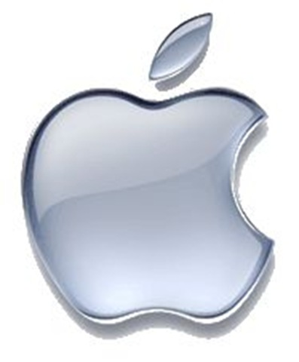
Global Gadgets
Elida Kong
Toan Le
Chitralekha Ramdoyal
Julia Hadary

Slide 2
Agenda
Industry Overview
RIM
Apple
Google

Slide 3
Industry History
The Computer
The Internet
Mobile Phones
Smartphones

Slide 4
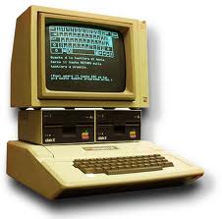
The Computer
1936: first freely programmable computer
1951: first commercial computer released
1974: first consumer computers (IBM)
1976: Apple I,II
1984: Apple Macintosh
1985: Microsoft Windows

Slide 5

The Internet
1969: the original internet
1971: first email sent
1990: Archie, the first search engine
1991: Internet available for commercial use
1996: more email than post mail in the USA
: BackRub search engine (Stanford)
1997: Google (googol)

Slide 6
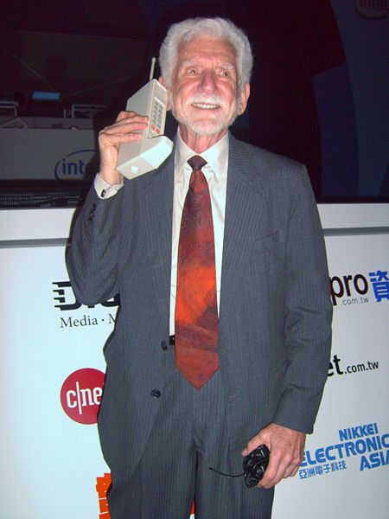
Mobile Phones
1973: Motorola cell phone created
April 3, 1973: first cell phone call made by Martin Cooper
1983: first cell phone available to consumers
1990: 12 million mobile phone subscribers
2010: 4.6 billion mobile phone subscribers

Slide 7
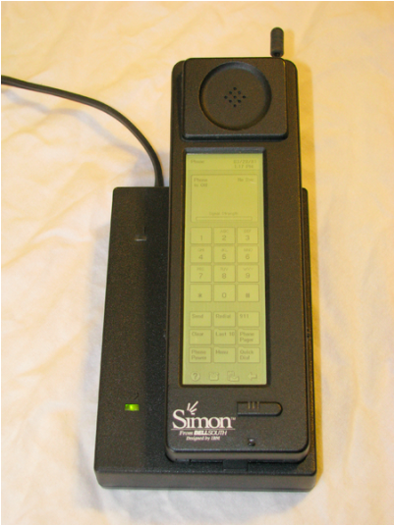
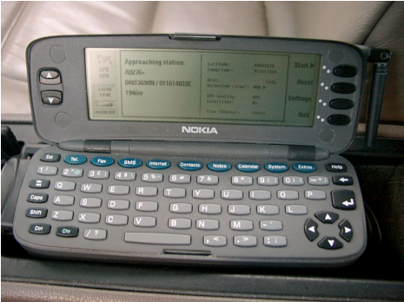
Smartphones
1992: Simon
  Created by IBM
  Touch screen, fax, email, predictive keyboard
1996: Nokia 9000
2002: Handspring Treo 180 (Palm OS)
2002: Blackberry
2007: iPhone
2008: First Android OS phones

Slide 8
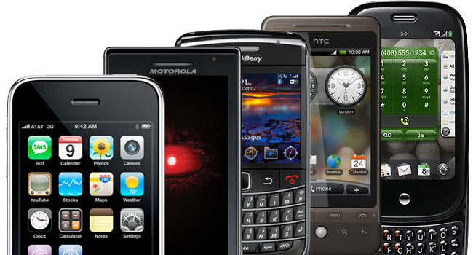
What is a Smartphone?
  All in one device that can be used as a cell phone and has computing, PDA functions
  Variety of applications available

Slide 9
Products
Smartphones
Smartphone Operating Systems
Tablet PCs
Apps

Slide 10
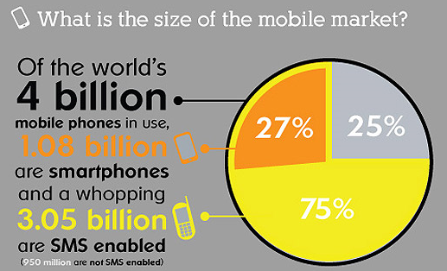
Smartphones

Slide 11
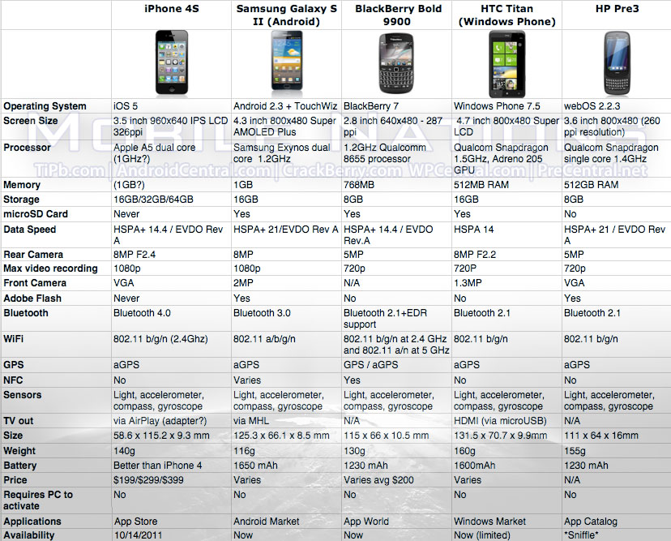

Slide 12
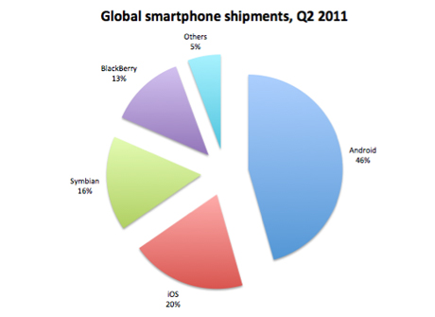

Slide 13
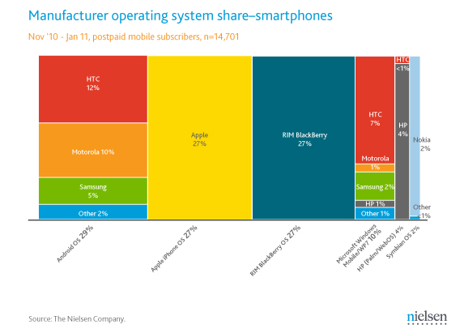

Slide 14
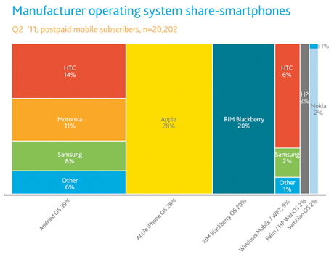

Slide 15
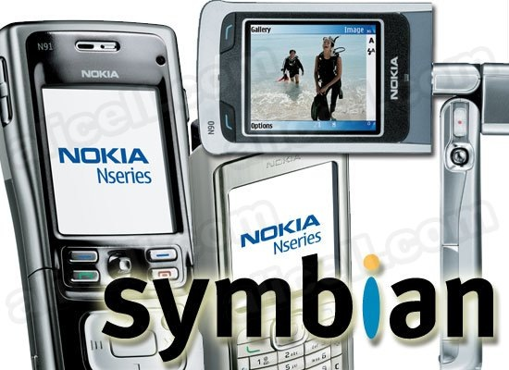
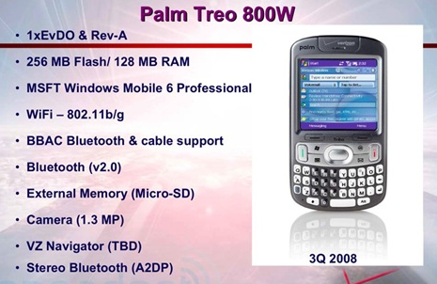
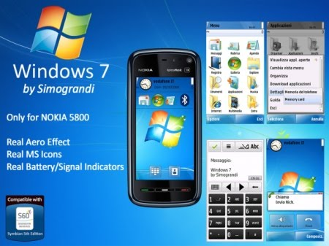
Smartphone Operating Systems
Symbian Ltd.: Symbian
    Popular outside of the United States
    Acquired by Nokia in 2008
Palm, Inc.: Palm
    Initially designed for PDA’s
Microsoft: Windows Phone 7
    Replacing Windows Mobile

Slide 16
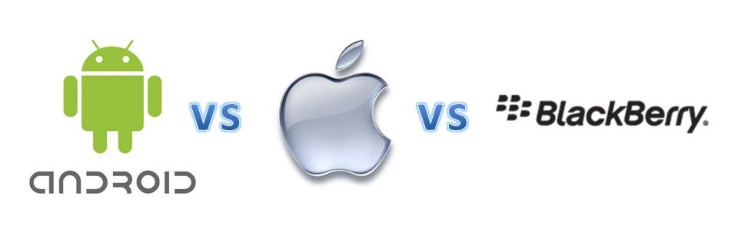
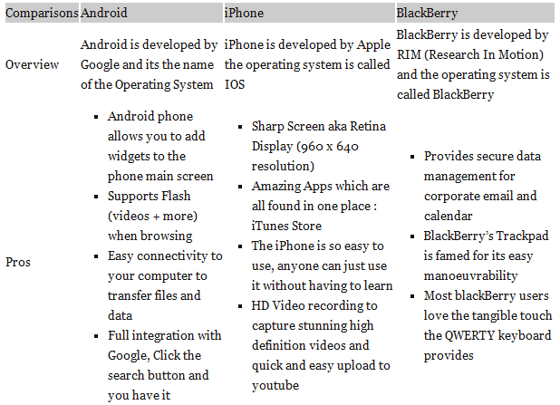

Slide 17
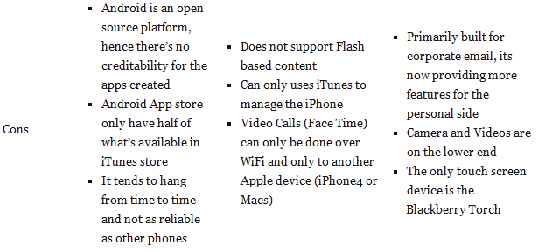

Slide 18
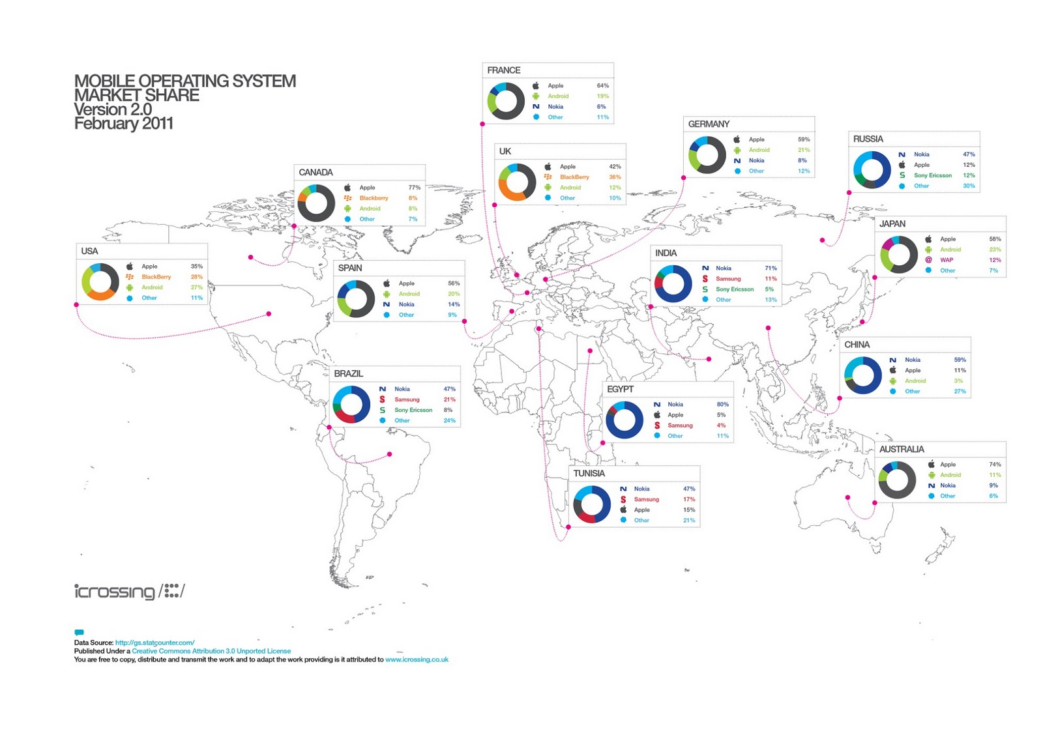

Slide 19
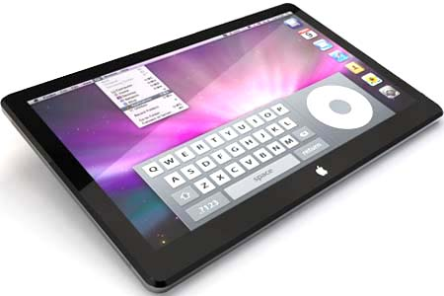
Tablet PC:
  Combines the Smartphone, laptop and PDA
    iPad 1 & 2
    Motorola Xoom
    Hp Touch Pad
    Blackberry Playbook
    Samsung Tab 1 & 2

Slide 20
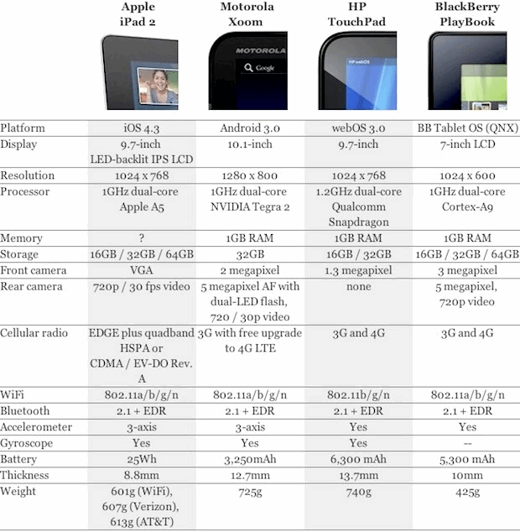
Tablet PC
The mobile trend doesn’t just bring joy to mobile ad companies, it also boosts the adoption rate of social sites like Twitter and facebook.

Slide 21
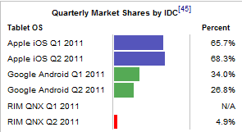
Tablet PC

Slide 22
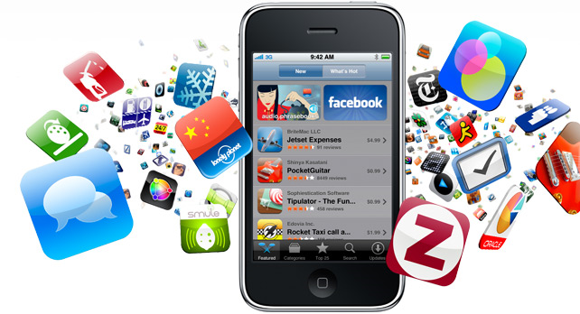
Apps
Specific to particular OS, but versions may be made for various OS
Available through “app stores”
Creators of applications may be contracted to produce apps for a particular OS, but many are not
Quickly growing market

Slide 23
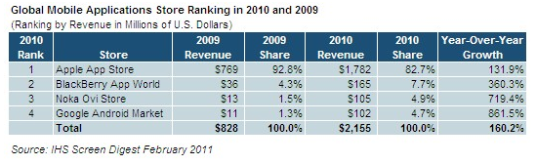
Apps

Slide 24
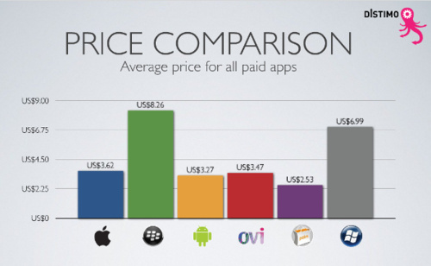

Slide 25
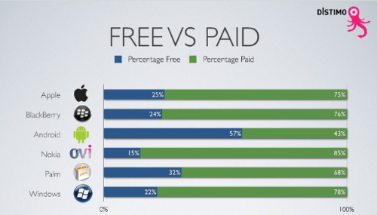

Slide 26
Industry Structure
Digital Revolution
Advertising
Trends in Usage

Slide 27
Digital Revolution
1990:
Cell phone users: 12.4 million (0.25% of world population)
Internet users: 2.8 million (0.05% of world population)
2002:
Cell phone users: 1.174 billion (19% of world population)
Internet users: 631 million (11% of world population)
2011:
Cell phone users: 5 billion (75% of world population)
Internet users: 2 billion (30% of world population)

Slide 28

Digital Music
Broadly spread in mobile devices
iTunes Store provides revenue stream for digital content:
  Music
  Podcasts
  Books
  Apps

Slide 29
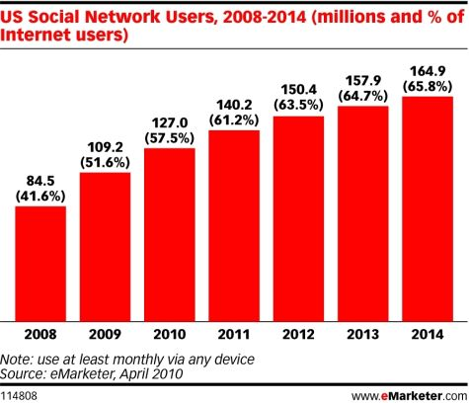

Social Media
Facebook, Twitter, YouTube, Myspace, etc

Slide 30
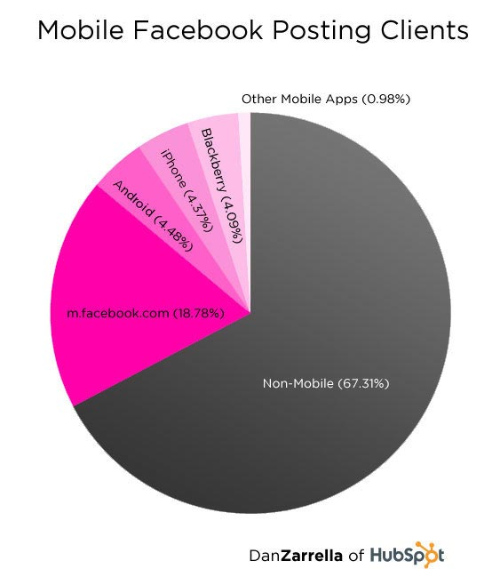
Social Media Goes Mobile
Social media will focus more on mobile devices in the next five years, including smartphones and tablet PCs.
“More than 350 million active users [of Facebook] currently access Facebook through their mobile devices “

Slide 31

Advertising
Google; Sponsored links
Smartphone advertising in applications
Application advertising
  Build an application under the company name
Social media advertising
  Facebook, twitter, myspace

Slide 32
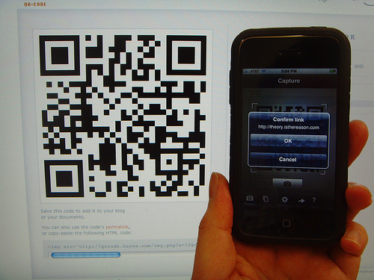
Advertising
Currently little revenue generated from advertisement through mobile devices
Ads throughout OS-specific components of mobile devices have a great potential for generating revenues, a likely trend for the future
QR codes increasing in popularity: gadget-specific opportunity for revenue
Gartner projected revenues from mobile advertising will reach $3.3 billion in 2011.

Slide 33

Trends in Usage
Growth of mobile phone and
Smartphone usage in developing countries
The Smartphone was originally for the business user, but now targets wider range of consumers
Movement towards internet-based computing solutions (S&P for AAPL)
Virtualization and “cloud computing” more popular

Slide 34
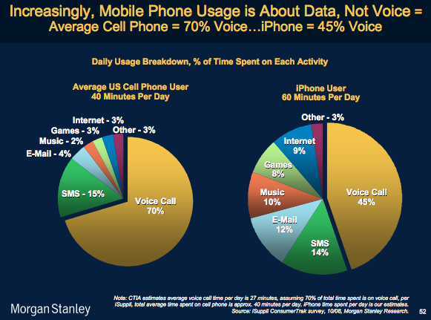
Trends in Usage

Slide 35
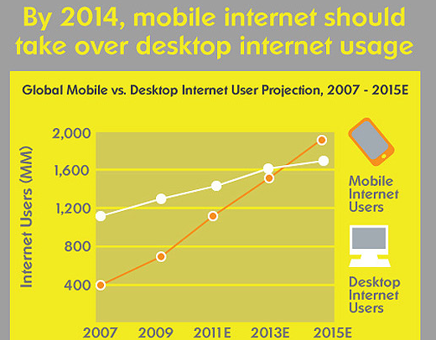

Slide 36
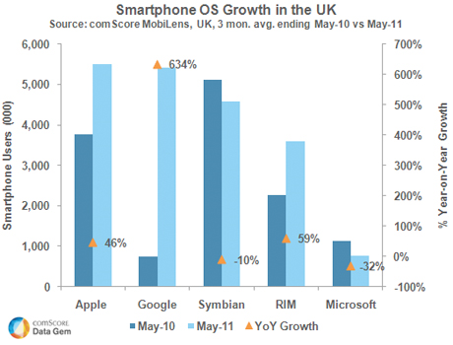
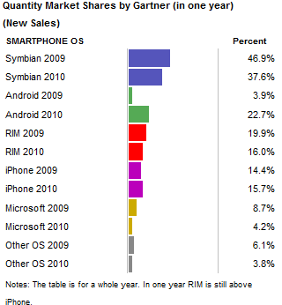

Slide 37

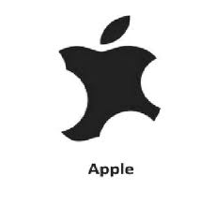
Battle on Apps
Increased market growth
Apple’s competitors increased their market share

Slide 38
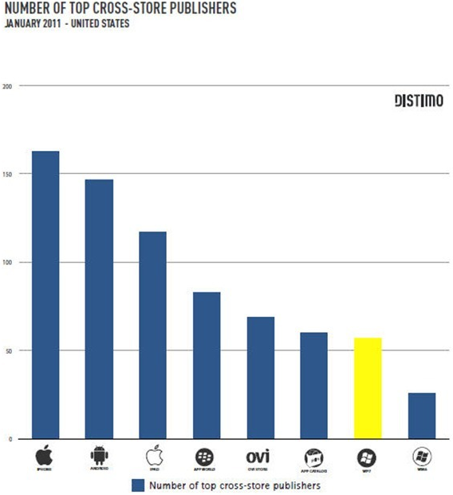
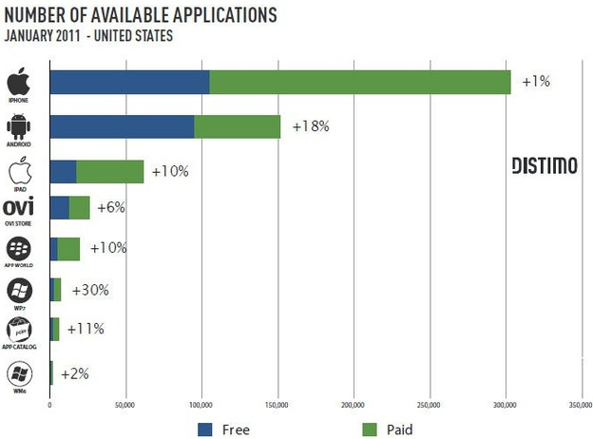
Application Store Comparison

Slide 39
Legal environment
Highly competitive
Constant battle between companies for patents
Patents crucial for success

Slide 40

Intangible Assets
Cash
Important components of financial statements to consider
Intangible assets include goodwill, intellectual property, representation on balance sheet should be examined
A large amount of cash is common - representation of current and future performance of the company

Slide 41

Research In Motion, Ltd.
1984 – 2010 | Waterloo Ontario

Slide 42
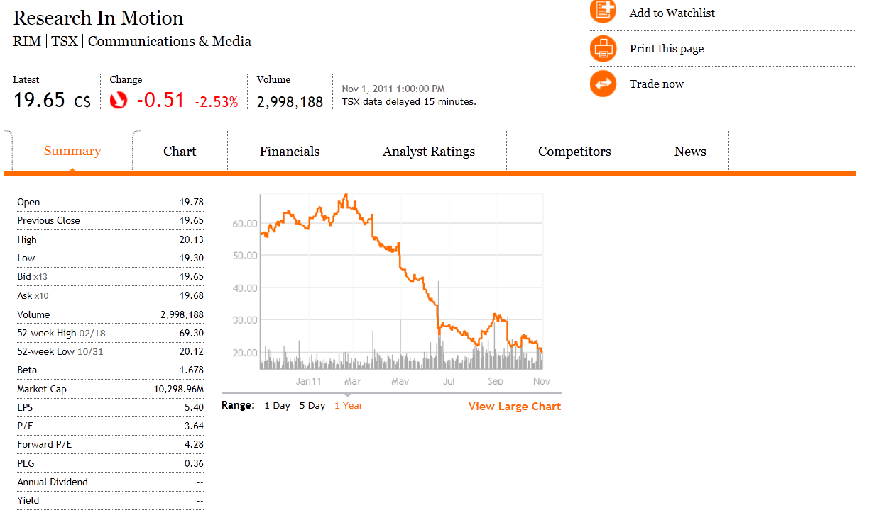
Financial Snapshot
Source: Globe and Mail
Notes:
RIM’s short interest is twice that of Apple even though RIM’s market cap is only 10% of Apple.

Slide 43
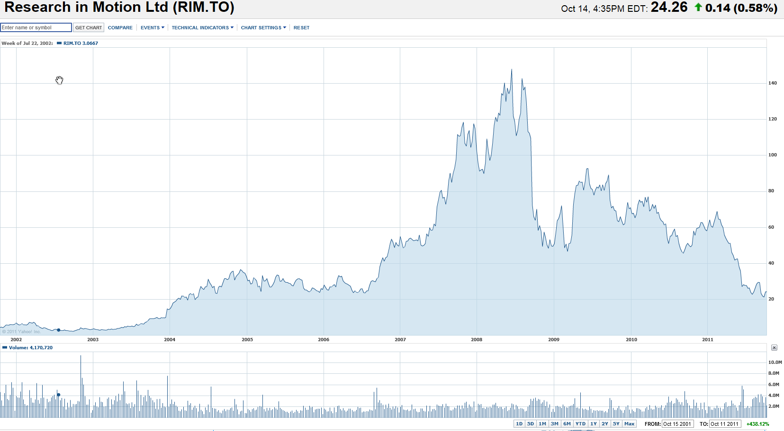
Stock Performance – 10year

Slide 44
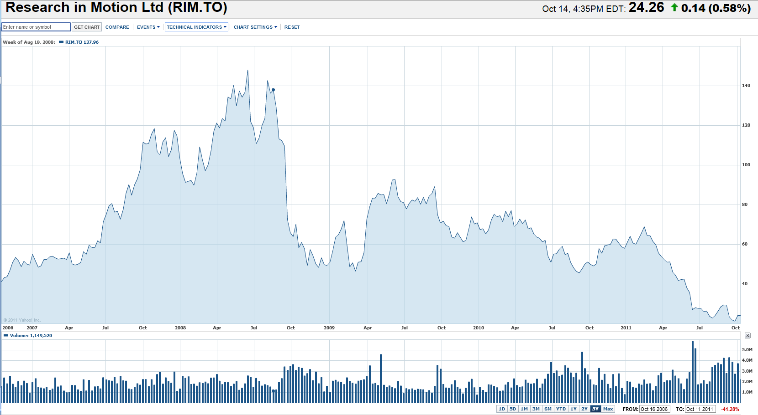
Stock Performance – 5 year

Slide 45
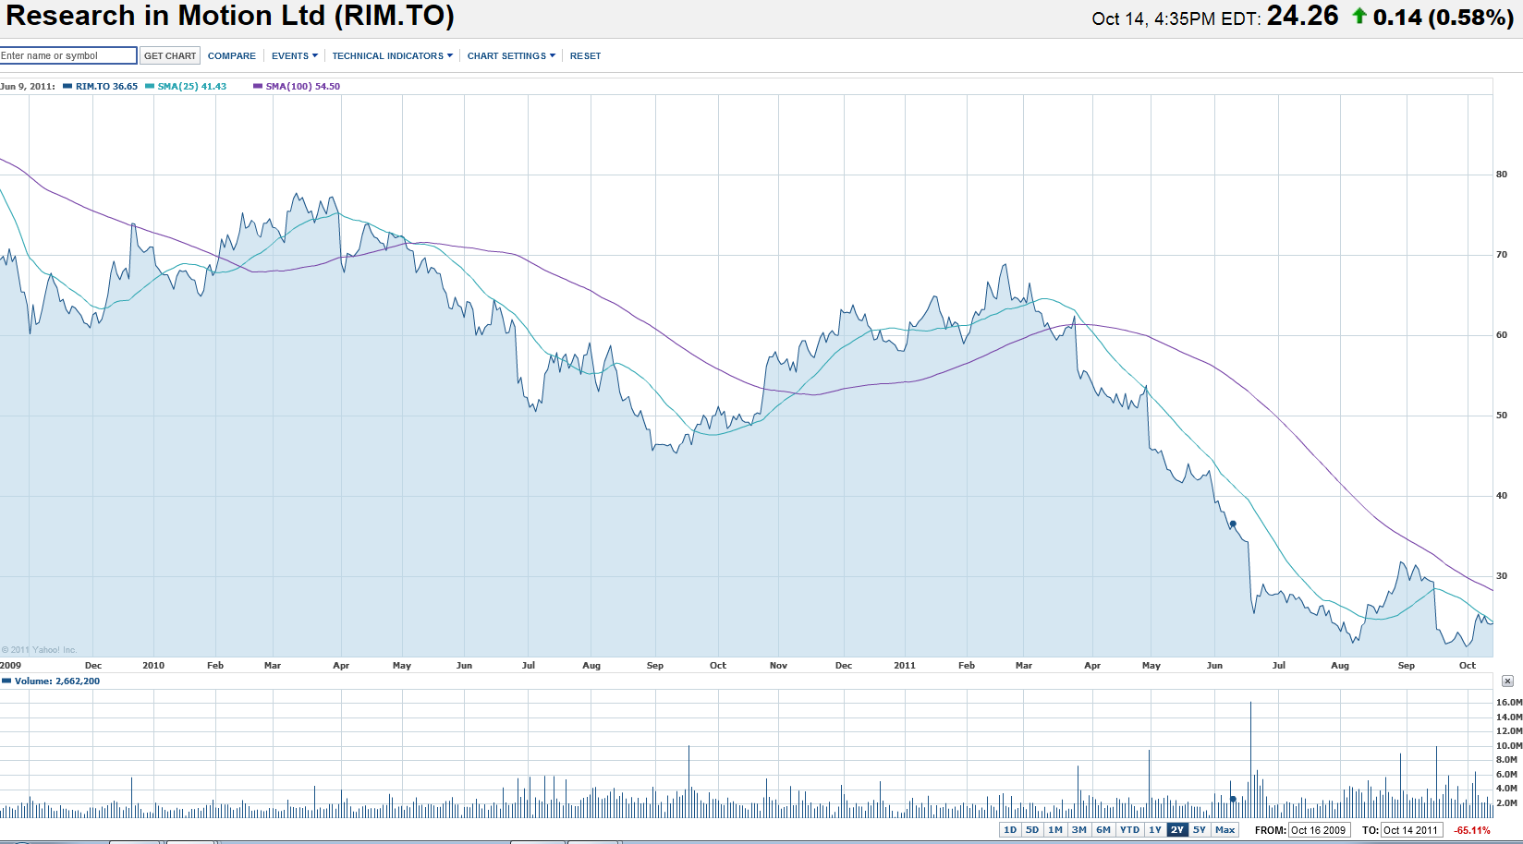
Stock Performance – 1 year

Slide 46
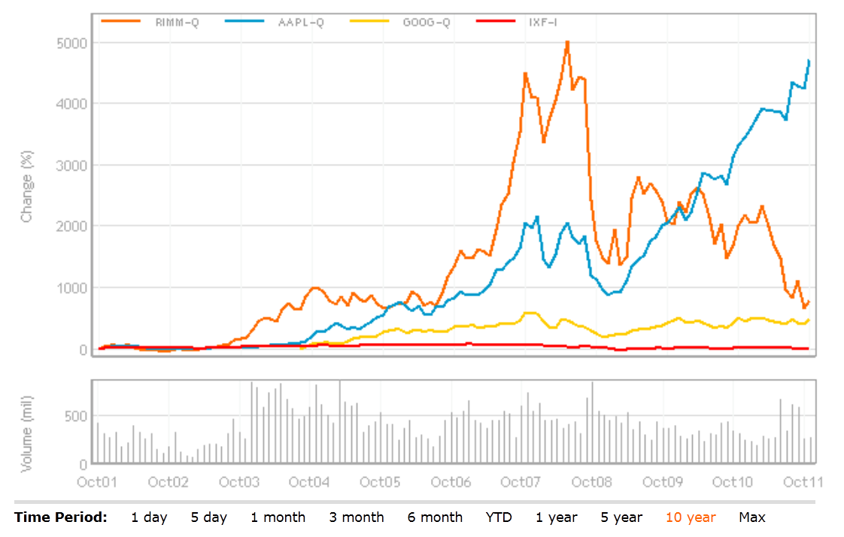
Rim vs Apple vs Google vs Nasdaq 100: 10 yr
Notes:
Comparative one year rim vs the nasdaq

Slide 47
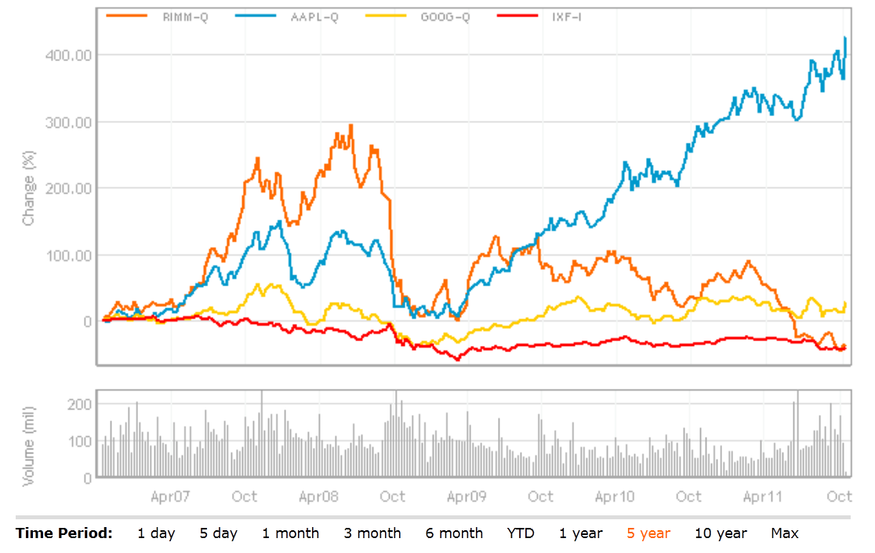
Rimm vs Apple vs Google vs Nasdaq 100: 5 yr

Slide 48
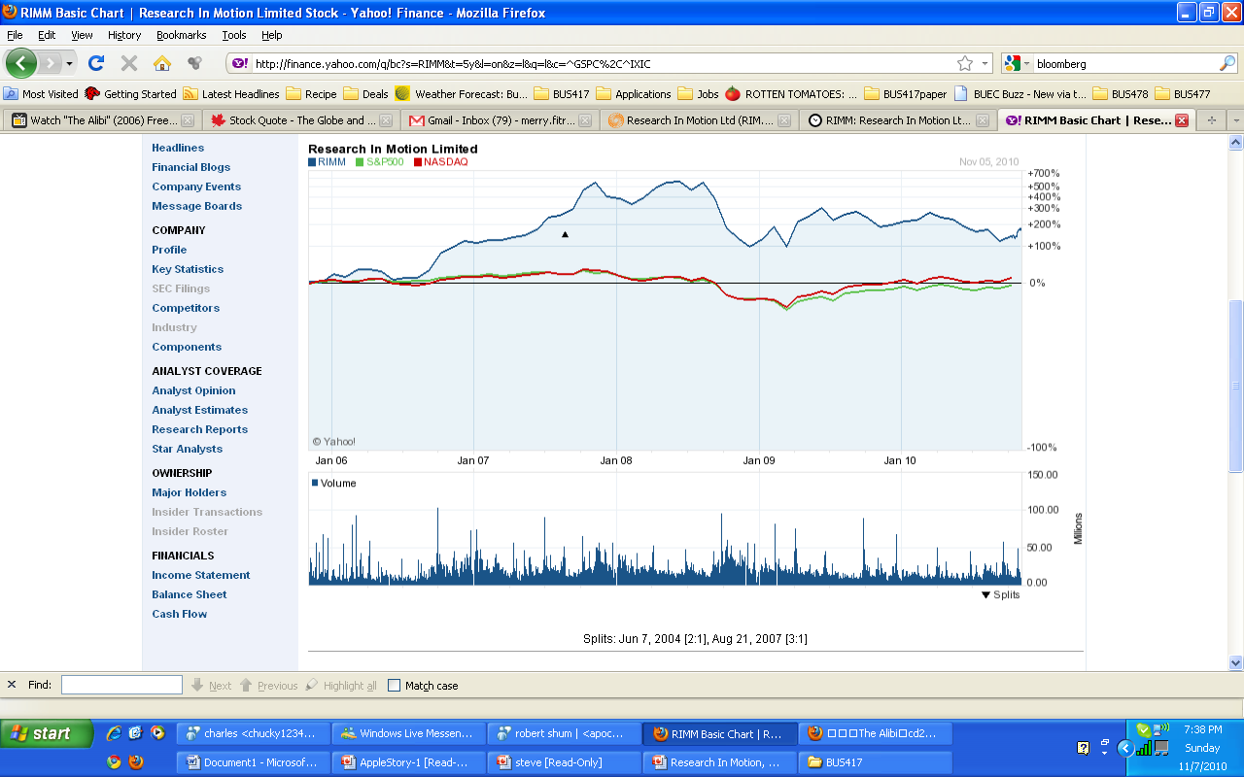
5-year Cumulative Return

Slide 49
Company overview
Research In Motion, Ltd.

Slide 50
Recent Development
Nov 1, 2011: RIM’s North American Smartphone Market share fell to 9 percent from 24 percent a year ago
Announces New OS, BBX, for Playbook and blackberry
Delays Software Update for its PlayBook until early 2012
4 day global black out for Blackberry users, multiple class action Lawsuit pending
Corporate downsizing, laid off 2000 worker as of this summer (10% of workforce)
Rim is launch BlackBerry Music Service
Jim Tobin, senior vice-president for software and business service left a month ago; Don Morrison, one of Rim’s three chief operating officers, resigned in July; Keith Pardy, the company’s chief marketing officer, signed earlier this year, and several other executives have left the firm.
Insiders have not purchase any shares since July 2010.
Notes:
Black out could cost the company between 32 cent and 2.67 dollar a day based on a Spanish Counsumer watchdog organizaition, FACUA. Total cost could be nearly 190 million for 70 million users. (Blackout) Started October 10, 2011, Several Class Action Law suit have been filed.
Do insiders know something that we don’t?
Delay in software Update for the playbook will hit Playbook sales this Christmas season. May take a massive write-off of inventory.
- Blackberry Music Service allows users to share music with their friends as long as they are subscribed to the service. Rim is expected to charge 4.99 USD per month.

Slide 51
Company Milestone
1984: RIM was founded in Ontario by two engineering student: Mike Lazaridis and Douglas Fregin
1996: Introduced first two-way messaging pager
1997: Rim was listed on the TSE
1998: Launch RIM 950
1999: Rim was listed on the Nasdaq
2002: launched its first true Blackberry device
2004: Hit 2 million subscribers
2008: Hit 14 million subscribers
Notes:
-RIM 950 was what started the Blackberry trend

Slide 52
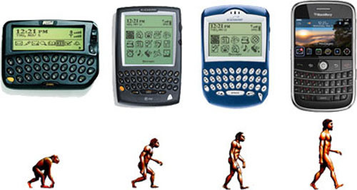
Product History
RIM 950
Blackberry 5790
Blackberry 6710
Blackberry Bold
1996
2000
2002
2008
Notes:
1996: Rim 950
2000: Rim 857
2000: Blackberry 5810
2008: Blackberry bold

Slide 53
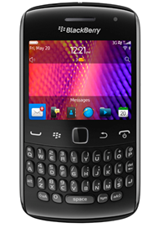
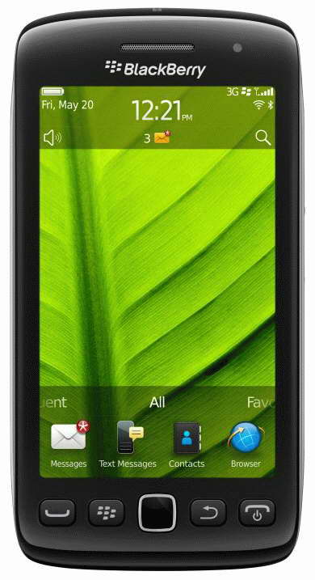
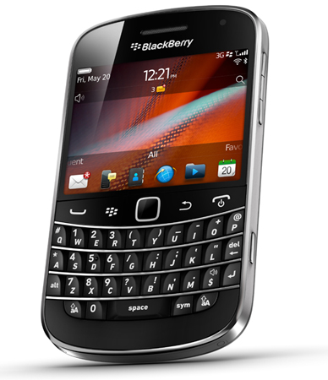
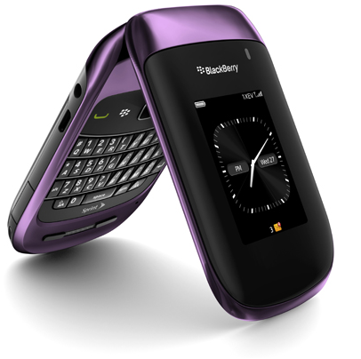
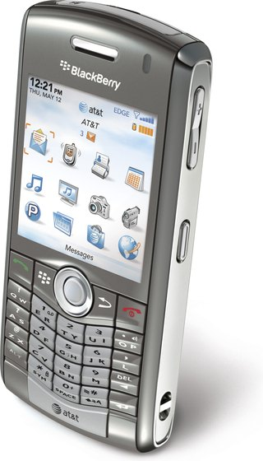
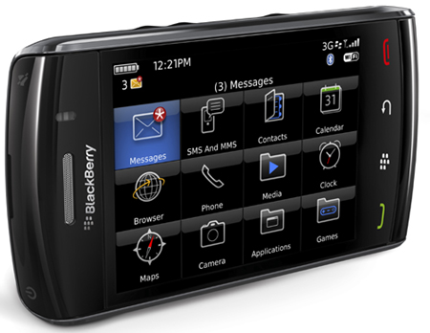
Current line-up

Slide 54
WHY DO PEOPLE BUY BLACKBERRIES?

Slide 55
Competitive Advantage
BlackBerry’s core competency in the smart-phones market:
a) Blackberry Enterprise Server
-“push” e-mail technology
- Security through 128 bit encryption
- BlackBerry Enterprise Server is proven as a reliable network during the Hurricane Katrina and 9/11.
b) BlackBerry Messenger (BBM) (Global real time chat)
The encryption also allows BlackBerry to re-size the webpage so it uses less data plan
f) Full size keyboard
Notes:
- Rim runs all data from blackberrys through its closed, global network. This provides corporate users and personal users security unless traditional email.
- Apple launch an new app called Imessage which is very similar to BBM

Slide 56
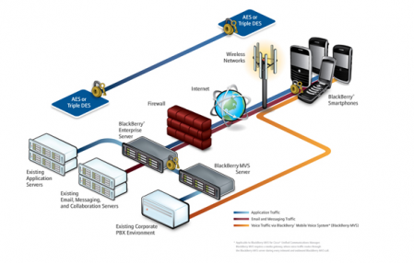
Blackberry Enterprise Server
Notes:
Rim makes doing this. Rim earns about 3 to 6 dollar per a user. (Low end) 70 million * 3 = roughly 210 Million dollar
-

Slide 57

Problem with BES
Oct 10, 2011 to Oct 13, 2011 :Blackout out could cost the company between 32 cent and 2.67 dollar a day based on a Spanish Consumer watchdog organization, FACUA. Total cost could be nearly 190 million for 70 million users.

Slide 58
RIM’s Competitive Advantage Eroding
Oct 2011:
Rogers Communication and Trellia is planning to enable corporate customers to use Apple and Google Android devices to send secure business email.
Other companies will probably follow suit
Sept 2011:
Apple launched Imessage; its own version of BBM
Will Android launch its own real-time chat program??

Slide 59

Break down of Rim’s Revenue
Rim’s profitability is a function of its ability to sale Blackberry, since 80.2% of Rim’s revenue comes from devices sales.
Notes:
Other revenue = sales of accessories.
Risky as there is big dependency on one business segment.

Slide 60

Revenue

Slide 61

BlackBerry Subscribers
As of October 2011, there are roughly 70 million Blackberry subscribers around the world

Slide 62
Is it all good news?

Slide 63

Smartphone Shipment

Slide 64
What happened?
Is RIM out of touch with consumers?

Slide 65

Smartphone Usage

Slide 66


Slide 68

Rim was at 62 % about 18 months ago.
Based on a sample size of 515 Smartphone owners. Survey was conducted by the investment bank UBS.
Survey date: Sept 2011

Slide 69


Profit Margin comparison
Blackberry 8700
Released year: 2006
Blackberry 9800
Released year: 2010
Estimated Cost: $123
Based on Isuppli data
Selling Price: $299 (Cingular Wireless)
Based on a 2 year contract
Estimated Cost: $183.05
Based on Isuppli data
Selling Price: $199 (AT&T)
Based on 2 year contract
Notes:
- Estimated Cost excludes development cost, marketing cost and etc. Estimated Cost is based on the estimated cost of the phone components alone.
- The price of a Blackberry 9800 dropped down to $99 a few months afterwards

Slide 70

Profit Margin comparison
IPhone 4 (16gb; 32 gb; 64gb)
Released year: 2010
Blackberry 9800
Released year: 2010
Estimated Cost: $188; $207; $245.
Based on Isuppli data
Selling Price: $199; $299; $399(AT &T)
Based on a 2 year contract
Estimated Cost: $183.05
Based on Isuppli data
Selling Price: $199 (AT&T)
Based on 2 year contract
Notes:
- Apple doesn’t make very much money on the basic model but they make a lot on the higher end models. Apple makes money on the upgrades. From 16gb to 32gb, it cost apple an additional 19 dollar but it earn 92 dollar instead of 11 dollars.

Slide 71


Slide 72

The Future in Tablet
“The first tablet certified for deployment within U.S. federal government agencies.”
Since it’s release on April 19, 2011, only 700,000 units were sold worldwide, while Apple Ipad 2 sold close to 1 million units during its debut weekend. Rim’s bottom line will be hurt by the write down of its excess Playbook inventory.
Rim announces that Playbook will now support Android apps. This would mean that Blackberry users will soon be able to utilize Android apps as well, since Playbook and Blackberry will be using the same OS (BBX).
Notes:
Reason why Playbook did not sell very while: it did not come with BBM and native email.
Why? It may be that BBM and push email technology is strictly secure

Slide 73
BlackBerry App World more profitable than Andriod??
About 140 million applications are downloaded each month
Blackberry users downloaded 1 billion applications since App World launch.
App World generates more paid downloads than Android Market
World’s second most profitable app store behind Apple

Slide 76
Acquisitions
June 2009 – Acquired Dash Navigation (primarily used in BlackBerry Traffic)
Oct 2011 -Announced plans to acquire NewBay (cloud based service)
August 2009 – Acquired Torch Mobile (webkit-browser technology)
March 2010 – Acquired Viigo (BlackBerry applications developer)
April 2010 – Acquire QNX Software Systems
Notes:
Active acquisitions to complement its technology. However, none of these companies have resulted in amazing result after integration with BlackBerry. Except…QNX that yet to be launched in the PlayBook

Slide 77
Patents
RIM has about 3000+ patents registered under “Research In Motion” on the United States Patents and Trademark Office.
Acquired an additional 6000 patents and patent applications from Nortel on June 30, 2011
RIM has focused its patents research on the following technology fields:
  Electric communication technique – transmission and telephonic communication
  Arrangements or circuits for control of indicating devices using static means
  Electric digital data processing

Slide 78
Patents
Most recent patent filings include:
  Technology that prioritizes different components of a webpage when loading and displaying.
  System and method for managing call routing in a network environment.
  Various advertising methods on a handheld device.

Slide 79
Litigation
Currently, Rim is involved in over 30 litigation in which some as a plaintiff and some as a defendant. These litigation may severely impact Rim’s profitability.
RIM’s most prominent lawsuit is by NTP over delivery of e-mail in wireless system. RIM settled the lawsuit; it recorded $612.5 million as Litigation entry in Annual Report 2006.
In June 2010, RIM and Motorola announced settlement through cross-licenses of various patent rights.
RIM settled patent dispute with Visto Corp., agreed to pay $268m to receive perpetual, fully-paid license on all Visto patents, $164m of full amount was expensed, the rest was recorded as intangible assets .
Notes:
Active acquisitions to complement its technology. However, none of these companies have resulted in amazing result after integration with BlackBerry. Except…QNX that yet to be launched in the PlayBook

Slide 80
Management Team
Research In Motion, Ltd.

Slide 81

Mike Lazaridis
(President, Founder, and Co-CEO)
Age 20: $600,000 GM contract to build a computer network control display
Founded the Perimeter Institute of Theoretical Physics and the Institute for Quantum Computing
Owner of 50 patents including wireless range, industrial display systems, and DigiSync
1994 Emmy Award and 1999 Academy Award for DigiSync technology in film editing
NET WORTH : $800 million
Owns 26.2 million shares of RIM
Roughly about 5.0% of the company
Notes:
Very passionate about physics and quantum computing. Very focus on research centric.

Slide 82

Jim Balsillie (Co-CEO)
Recruited in 1992
MBA from Harvard School of Business
Chartered Accountant
Former EVP and CFO of Sutherland-Schultz, an industrial service provider
Great passion for hockey
Stepped down as a Chairman in 2007 as a settlement with Ontario Security Commission regarding $250 million improper accounting due to options backdating
NET WORTH : $800 million
Owns 26.7 million shares of RIM
Roughly about 5.0% of the company

Slide 83


Executive Team
Oversees and manages the development of software for RIM
Worked for Sybase Inc, an industry leader in enterprise and mobile software
Holds a Bachelor’s degree in Mathematics and a MBA from Wilfrid Laurier University
CTO
David Yach
Oversees Blackberry Operations and Corporate IT
Held senior leadership positions within AT&T Labs and Global Network Services
A graduate of the Georgia Institute of Technology with a master’s degree in Management of Technology, Robin also holds a bachelor’s degree in engineering from Central Missouri State University and an associate in business degree from Maryland University – European Division.
CIO
Robin Bienfait

Slide 84


Executive Team
Brian Bidulka is Chief Financial Officer at Research In Motion serving as the Company's senior financial officer overseeing all financial reporting and compliance activities.
Prior to joining RIM in 2005, Brian held numerous finance positions at Molson Inc. and Ernst & Young LLP.Brian received
his Chartered Accountant's designation in 1989 and holds an Honours Bachelor of Commerce degree from McMaster University.
CFO
Brain Bilduka
Thorsten Heins is the Chief Operating Officer, Product Engineering at Research In Motion. Thorsten oversees the BlackBerry Smartphone portfolio world-wide.
Ex-Chief Technology Officer for Siemens’ Communications Division
Thorsten holds a master’s degree in Science and Physics from the University of Hannover in Germany. Thorsten also serves as a member of the Board of Directors for the Canadian German Chamber of Industry and Commerce Inc.
COO
Thorsten Heins

Slide 85
Financial Analysis
Research In Motion, Ltd.

Slide 86

Financial Highlights

Slide 87

Quarterly Balance Sheet
Cash /per a share = $1.62

Slide 88

Annual Balance Sheet

Slide 89

Annual Income Statement

Slide 90

Quarterly Income Statement

Slide 91

Annual Cash Flow

Slide 92

Quarterly Cash Flow

Slide 93
Common Share Structure
2011 | 2010 | 2009 | 2008 | 2007 | 2006
524 M | 557 M | 566 M | 562 M | 188.9 M | 187.7 M
RIM announced 3-for-1 stock split in 2007.
From November, 2009 to the fall of 2010, Rim has spent $2.9 billion to repurchased nearly 50 million shares. WHY?????
Notes:
Why would Rim be buying back shares when it could be using the money to expand the business? Are they out of ideas? Or, they are trying to support the price of the stock??
The CEOs say that they are bullish about the stock but both CEO and other executives have not purchase any of RIMM stock since July 2010

Slide 94

Intangible Assets (Q2)

Slide 95


Slide 96

Business Acquisitions

Slide 97

Shareholder’s Equity

Slide 98
Recommendation
Research In Motion, Ltd.

Slide 99
SELL and
MONITOR

Slide 100


Slide 101


Financial Snapshot
Notes:
Google’s stock rose 6.31% - from 550 to 594 after it released its 3rd quarter earnings report of $9.72 billion in revenues.

Slide 102


Max Chart – 7 years
Notes:
August 2004 – google auctioned off its shares at $85 a share at its IPO. 7 years later, it trades between 500 and 600.
Hit by recession but recovered

Slide 103

5 Year Chart
Notes:
We can see the impact of the recession here

Slide 104

1 Year Chart
Notes:
In July, Price fell to $474.88 when it was revealed that the FTC was preparing a major antitrust investigation into Google’s “core search advertising business.”
But it bounced back in August when Google unveiled Google+

Slide 105

Google vs. Nasdaq – 1 Year

Slide 106

Google vs. Nasdaq – 5 Years

Slide 107

Google vs. S&P Info Tech

Slide 108

Google vs. S&P Info Tech

Slide 109

Google vs. Dow Jones Internet Composite

Slide 110

Google vs. Dow Jones Internet Composite

Slide 111

Google vs. NYSE Composite

Slide 112


Slide 113
History
1996
    Larry Page and Sergey Brin create search engine as a research project
    Originally called BackRub
    Originally, Google ran under the Stanford University website, with the domain google.stanford.edu
1998
    Incorporated in California
    1999
    Went to Excite CEO, George Bell, and offered to sell Google to him for $1 million
2000
    Began selling advertisements associated with search keywords

Slide 114
History
    2001
        Eric Schmidt joined Google as CEO
2003
    Re-incorporated in Delaware
2004
    Initial Public Offering
    19,605,052 shares sold
    $85 per share
    Unique online auction

Slide 115
Milestones
google.com → Internet's most visited website
May 2011→ unique visitors of Google surpassed 1 billion mark for the first time
November 2009 → Google is the dominant search engine in the United States market, with a market share of 65.6%
October 31, 2007 → Shares hit $700 for the first time
2010 → Google Energy made its first investment in a renewable-energy project, putting $38.8 million into two wind farms in North Dakota
Google+ reached 25 million users → only 4 weeks after its launch
Notes:
May 2011→ unique visitors of Google surpassed 1 billion mark for the first time, an 8.4 percent increase from a year ago with 931 million unique visitors
Now there are about 40 million google+ users

Slide 116
Acquisitions
Companies Acquired | Products
Motorola Mobility | Google Tv
Outride | Google Personalized Search
Pyra Labs | Blogger
Neotonic Software Postini, reMail | Gmail
Applied Semantics DoubleClick | Adsense + Adword
Picasa | Blogger
Keyhole | Google Map , Google Earth 3D
Android | Android
Youtube, On2, Omnisio Episodic, fflick | Youtube
SocialGrapple , Fridge | Google+
Notes:
Google has acquired over 130 companies since 2001.

Slide 117
Products and Services
      iGoogle
      Google+
      Google Docs
      Google Finance
      Google Photos
      Google Scholar
      Google Books
      Google Chrome
      Google Chrome OS
      Google Wallet
      Google Nexus One and Nexus S
      Google TV
      Google Search Appliance
      Google Translate
Notes:
Some of Google’s products and services

Slide 118

Revenue Source
Notes:
This table presents the revenues, by revenue source, as a percentage of total revenues for the periods presented:
Ninety-six percent of Google's revenue is derived from advertising programs
Google’s expectation is that growth in advertising revenues from their websites will continue to exceed that from their Google Network Members’ websites, which will have a positive impact on their operating margins;

Slide 119

Revenue Source
Notes:
Revenues – Google reported revenues of $9.72 billion in the third quarter of 2011, representing a 33% increase over third quarter 2010 revenues of $7.29 billion.
Google-owned sites generated revenues of $6.74 billion, or 69% of total revenues, in the third quarter of 2011. This represents a 39% increase over third quarter 2010 revenues of $4.83 billion.
Google had Network revenues of $2.60 billion, or 27% of total revenues, in the third quarter of 2011. This represents a 18% increase from third quarter 2010 network revenues of $2.20 billion

Slide 120
AdWords
Shows ads alongside Google search results
Advertisers “bid” in an auction to have their ads displayed alongside certain keywords
Pay-per-click
Cost-per-thousand
Free tools for advertiser to make advertising more measurable and efficient
  Google Analytics,
  Website Optimizer,
  Ad Planner
Notes:
AdWords is Google's main advertising product and main source of revenue.
It allows advertisers to display their advertisements in the Google content network, through either a cost-per-click or cost-per-thousand scheme

Slide 121
Gmail
Features:
first online email service with one gigabyte of storage
first to keep emails from the same conversation together in one thread, similar to an Internet forum.
Interactive webpages without having to refresh browser
Notes:
Gmail is one of the google websites that uses Adwords.

Slide 122

Gmail Ads
Notes:
Example of AdWords

Slide 123

Google Finance Ads
Notes:
Another Example of AdWords

Slide 124

Google Maps Ads
Notes:
Another Example of AdWords
Google maps is used in 130 countries

Slide 125

YouTube Ads
Notes:
Another Example of AdWords

Slide 126
Google+
Features:
Video Hangouts
Hangouts on the phone
Hangouts on air
100 features launched in 90 days
Share circles
Limit information to certain circles
Over 40 million users world-wide
"people are flocking into Google+ at an incredible rate”
Notes:
hangouts on air--will.i.am did a hangout from his concert in Central Park

Slide 127

Google+ Ads
Notes:
Another Example of AdWords
Only have Game Ads on Google+ at this time

Slide 128
Adsense
Google partners with website publishers (Google Network members )
Advertisers post their ads on websites that are relevant to their products
Google shares profit with website publishers
Per click
Per impression
Notes:
Adsense is google’s second largest source of revenues.
Advertisers pay to Adsense for managing and showing ads and Adsense pays to publishers for placing ads,publishers get paid according to clicks,impressions.Which means Google Adsense shares revenue with publishers.
Google shares 68% of revenue with publishers for content based ads
51% for search based ads from the amount they receive from advertisers

Slide 129

Google Network Ads
Notes:
Example of Adsense
Builder guy earns money from Adsense

Slide 130
Android
190 million Android phones activated around the world
Over 200,000 Android Apps
Promotes more searching
  Using keyboard
  Voice
  Camera
Notes:
Android brings more Search revenue
Google gives away the OS for free, but it makes money by licensing the Google Apps that come on most Android phones (but not all). Apps like Gmail, the Android Market, Google Search, and others.
Google is especially interested in the market; google is making money with every app sold through the Market (Even free apps). Developers have to pay to have an account to list their apps under. Even ad-sponsored apps are likely using Google Mobile Ads, so Google's getting revenue from that source as well. Other sources of revenue from Android will soon also come from mobile payments using Google Wallet and daily deals using Google Offers.
Not only that Google made its search engine fit in your pocket, they made search easier. You can search through Google's database by using your keyboard, using your voice, and even by using the camera on your phone. You can "scan" a barcode and see who has the best price (getting ads along the way) before you make your purchase.

Slide 131
Google Chrome and Chrome OS
Chrome web browser
200 million users
Chrome Web Store
Chrome OS
Open Source Software(Free)
Profits come from:
  Partnership with carriers (Rogers) and mobile phone producers (HTC, Samsung)
  Free Google apps (supported by ads)
  Android Apps Market (70% developers; 30% Operation cost to Google and carriers)
Notes:
Google came out with its own web browser to increase its advertising revenue. With Chrome, Google is able to better analyse users online behaviour thereby providing them with better search results and better matched ads!
Also the Chrome Web Store is designed to get the world to rely on web-based applications more.
You might see a pattern of what Google is trying to do now. Nearly every Google product is designed to get you on the web. Gmail is integrated with Gtalk online, Google Docs exists in the cloud.
Likewise, Chrome OS also encourages people to do everything online. It is designed to get users onto the internet as fast as possible and works exclusively with web applications.
Like Android, Chrome OS also encourages people to use Google's services more often. "People search more when they use the Chrome browser or Android phones, which increases Google's core business,
Google came up with an innovative subscription model for businesses and schools. Instead of paying for the hardware, organizations can pay $20-$33/device/month and get a notebook, enterprise support, new devices every 3 years or even more often, a Web-based central management console, integration with Google AppsGoogle had signed revenue sharing deals with some of the carriers and mobile handset producers.

Slide 132
Strategy
Revenue = Amount of Time on the Web
Notes:
Which leads to Google’s revenue equation.
Since nearly every website holds a Google ad slot, every impression and every second you spend on the web is revenue for Google. Every second you’re playing a desktop game, using Microsoft Office, or using AOL Instant Messenger, that’s unrealized potential revenue.

Slide 133
Strategy
Mission Statement
  “to organize the world's information and make it universally accessible and useful”
Slogan
    “Don’t Be Evil"
Notes:
In 2005 Google was criticized that it was loosing its anti-corporate, no-evil philosophy so Google designated a Chief Culture Officer in order to develop and maintain the culture and work on ways to keep true to the core values that the company was founded on: a flat organization with a collaborative environment.

Slide 134
2011 Strategy
Mobile!
Inexpensive smartphones initiative
Mobile Money – Google Wallet
LTE Compatibility
Notes:
In 2011 Google is focusing on 1,2,3.
.
Google was bidding to buy Nortel’s patents but it went to Microsoft, Apple, Ericsson, EMC, Sony and RIM.
in August Google announced that it will acquire Motorola Mobility Holdings Inc , subject to approval, to be more competitive in the telecommunication business. Google's acquisition of Motorola Mobility is a strategic move to strengthen Google's patent portfolio and reduce court battles.
Unlike its competitors, Google is not looking to generate high profit margins from its newly acquired Motorola Mobility mobile phone business. Instead it’s strategy is to produce a smartphone in the $50-$100 range. Its primary objective is to make sure that the Android platform remains the predominant mobile operating system.
Why?
Because an increasing number of Internet searches will be conducted on mobile phones and more online ad dollars will shift to mobile advertising (mobile search, localized search and localized deals). This is also the motivation behind Google’s acquisition of AdMob as well as the launch of Google Deals
Google has recently acquired NFC specialist Zetawire. It also came out with the Google Wallet app in September
development of high-speed mobile networks – referred to as 4G
While Google is the expert on search advertising, AdMob will bring its experience in web display and app display ads to the table, which could be later added to a partnership deal with carriers if it hasn’t been already.
With Android, this trend is already wellunderway. There are several Android-based smartphones now available for under $100. And with the launch of Broadcom's mass-market 3G chipset (BCM2157), phones made with those components can retail for less than $100, even as low as $75. Plus, chip maker MIPS also just launched Android smartphones with MIPS chips at this year's Consumer Electronics Show, in order to reach the low-end market. The MIPS phones could retail for under $100, even without a contract.

Slide 135
Legal Matters
Yahoo
infringements of the company's pay-per-click and bidding patents
Microsoft
Apple
Android device makers such as HTC, Samsung and Motorola taken to court
Notes:
Patent Battle
As the smartphone market exploded -- threatening to revolutionize personal computing -- Apple needed to protect its iPhone and Microsoft wanted Android handset makers to pay for technology it believes it invented. Google, and its handset partners, needed protection from both. → acquired motorola
Will now be able to be a serious competitor in the telecommunications business
patent, copyright, and trademark infringement lawsuits filed against us claiming that certain of our products, services, and technologies, including Android, Google WebSearch, Google AdWords, Google AdSense, Google Books, Google News, Google Image Search, Google Chrome, Google Talk, Google Voice, and YouTube, infringe the intellectual property rights of others. Adverse results in these lawsuits may include awards of substantial monetary damages, costly royalty or licensing agreements, or orders preventing us from offering certain features, functionalities, products, or services, and may also cause us to change our business practices, and require development of non-infringing products or technologies, which could result in a loss of revenues for us and otherwise harm our business.

Slide 136
Looking Forward
Android is a big advertising opportunity
Privacy Issues
Legal Battles may continue

Slide 137

Management
CEO
Larry Page
  Co-Founder
  CEO from April 2011
  Bachelor of Computer Engineering from Michigan
  Master of Computer Science from Stanford
  PhD of Computer Science (dropped out)

Slide 138

Management
Co-Founder
Sergey Brin
  B.Sc. in Math and Computer Science from U of Maryland
  Master of Computer Science from Stanford
  PhD of Computer Science (dropped out)
Notes:
Today, he directs special projects.

Slide 139
Five Year Diversification Plan
Larry and Sergey currently hold ~57.7 million shares of Class B common stock
Representing ~18% of Google’s outstanding capital stock
And 59% of the voting power
Larry and Sergey will each sell 5 million shares over the next five years
47.7 million shares, representing ~15% of Google’s outstanding capital stock
and ~48% of the voting power
Notes:
Using these plans, they can gradually diversify their investment portfolios and can spread stock trades out over an extended period of time to reduce market impact

Slide 140

Management
Executive Chairman
Eric Schmidt
  Former CEO
  Former CEO of Novelli & CTO of Sun Microsystems
  Bachelor of Engineering from Princeton
  Master’s and PhD in Comp. Sci. from UC Berkley
  Member of President Obama’s council of Science and Technology

Slide 141

Management
  Senior VP and Chief Business Officer
  Nikesh Arora
  Joined Google in 2004
  Responsible for creating and expanding strategic partnerships
  Former Chief Marketing Officer at T-Mobile
  Masters degree from Boston College
  MBA from Northeastern University
  CFA Designation

Slide 142
Financials

Slide 143
Common Share Structure
Class B
  10 votes per share
  Reserved for Google insiders
Class A
  1 vote per share
Employee Stock Options
  10 year term
 | 2011 | 2010 | 2009 | 2008
Shares Outstanding | 322.89M | 319.77M | 317.77M | 315.11M
Notes:
Dual class common shares

Slide 144

Stock Option Activity

Slide 145
Google Inc.c
CONSOLIDATED BALANCE SHEETS
(In millions, except share and par value amounts which are reflected in thousands, and par value per share amounts)
 | As of December 31, 2009 |  | As of December 31, 2010
Assets
Current assets:
Cash and cash equivalents | 10,198 |  | 13,630
Marketable securities | 14,287 |  | 21,345
Total cash, cash equivalents, and marketable securities (including securities loaned of $0 and $4031) | 24,485 |  | 34,975
Accounts receivable, net of allowance of $79 and $101 | 3,178 |  | 4,252
Receivable under reverse repurchase agreements | - |  | 750
Deferred income taxes, net | 644 |  | 259
Income taxes receivable, net | 23 |  | -
Prepaid revenue share, expenses and other assets | 837 |  | 1,326
Total current assets | 29,167 |  | 41,562
Prepaid revenue share, expenses and other assets, non-current | 415 |  | 442
Deferred income taxes, net, non-current | 263 |  | 265
Non-marketable equity securities | 129 |  | 523
Property and equipment, net | 4,845 |  | 7,759
Intangible assets, net | 775 |  | 1,044
Goodwill | 4,903 |  | 6,256
Total assets | 40,497 |  | 57,851
Liabilities and Stockholders' Equity
Current liabilities:
Accounts payable | 216 |  | 483
Short-term debt | - |  | 3,465
Accrued compensation and benefits | 982 |  | 1,410
Accrued expenses and other current liabilities | 570 |  | 961
Accrued revenue share | 694 |  | 885
Securities lending payable | - |  | 2,361
Deferred revenue | 285 |  | 394
Income taxes payable, net | - |  | 37
Total current liabilities | 2,747 |  | 9,996
Deferred revenue, non-current | 42 |  | 35
Income taxes payable, non-current | 1,392 |  | 1,200
Other long-term liabilities | 312 |  | 379
Commitments and contingencies
Stockholders' equity:
Convertible preferred stock, $0.001 par value ver share, 100,000 shares authorize; no shares issued and outstanding | - |  | -
Class A and Class B common stock and additional paid-in capital, $0.001 par value per share: 9,000,000 shares authorized; 317,772 (Class A 243,611, Class B 74,161) and par value of $318 (Class A $244, Class B $74) and 321,301 (Class A 250,413, Class B 70,888) and par value of $321 (Class A $250, Class B $71) shares issued and outstanding | 15,817 |  | 18,325
Accumulated other comprehensive income | 105 |  | 138
Retained earnings | 20,082 |  | 27,868
Total stockholders' equity | 36,004 |  | 46,241
Total liabilities and stockholders' equity | 40,497 |  | 57,851

Slide 146
Consolidated Statements of Income Data: | Year Ended December 31
 | 2006 | 2007 | 2008 | 2009 | 2010
Revenues | 10,605 | 16,594 | 21,796 | 23,651 | 29,321
Costs and Expenses
Costs of Revenues | 4,225 | 6,649 | 8,622 | 8,844 | 10,417
Research and Development | 1,229 | 2,120 | 2,793 | 2,843 | 3,762
Sales and Marketing | 850 | 1,461 | 1,946 | 1,984 | 2,799
General and Administrative | 751 | 1,280 | 1,803 | 1,668 | 1,962
Total Costs and Expenses | 7,055 | 11,510 | 15,164 | 15,339 | 18,940
Income from Operations | 3,550 | 5,084 | 6,632 | 8,312 | 10,381
Impairment of Equity Investments | 0 | 0 | (1,095) | 0 | 0
Interest and Other Income, Net | 461 | 590 | 316 | 69 | 415
Income Before Taxes | 4,011 | 5,674 | 5,853 | 8,381 | 10,796
Provision for Taxes | 934 | 1,470 | 1,626 | 1,861 | 2,291
Net Income | 3,077 | 4,204 | 4,227 | 6,520 | 8,505
Net Income per share of Class A and
Class B common stock
Basic | 10.21 | 13.53 | 13.46 | 20.62 | 26.69
Diluted | 9.94 | 13.29 | 13.31 | 20.41 | 26.31
 | Year Ended December 31
Consolidated Balance Sheet Data: | 2006 | 2007 | 2008 | 2009 | 2010
Cash, Equivalents, and Securities | 11,244 | 14,219 | 15,846 | 24,485 | 34,975
Total Assets | 18,473 | 25,336 | 31,768 | 40,497 | 57,851
Total Long-Term Liabilities | 129 | 611 | 1,227 | 1,746 | 1,614
Total Stockholder's Equity | 17,040 | 22,690 | 28,239 | 36,004 | 46,241

Slide 147
Google Inc.
CONSOLIDATED STATEMENTS OF CASH FLOWS
(In millions)
 | Year Ended December 31,
 | 2008 |  | 2009 |  | 2010
Operating Activities
Net Income | 4,227 |  | 6,520 |  | 8,505
Adjustments:
Depreciation and amortization of property and equipment | 1,212 |  | 1,240 |  | 1,067
Amortization of intangible and other assets | 288 |  | 284 |  | 329
Stock-based compensation expense | 1,120 |  | 1,164 |  | 1,376
Excess tax benefits from stock-based award activities | (159) |  | (90) |  | (94)
Deferred income taxes | (225) |  | (268) |  | 9
Impairment of equity investments | 1,095 |  | 0 |  | 0
Other | (32) |  | (20) |  | (12)
Changes in assets and liabilities, net of effects of acquisitions and divestiture:
Accounts receivable | (334) |  | (504) |  | 1,129
Income taxes, net | 626 |  | 217 |  | 102
Prepaid revenue share, expenses and other assets | (147) |  | 262 |  | (414)
Accounts payable | (212) |  | 34 |  | 272
Accrued expenses and other liabilities | 339 |  | 243 |  | (745)
Accrued revenue share | 14 |  | 158 |  | 214
Deferred revenue | 41 |  | 76 |  | 111
Net cash provided by operating activities | 7,853 |  | 9,316 |  | 11,081
Investing Activities
Purchases of property and equipment | (2,359) |  | (810) |  | (4,018)
Purchases of marketable securities | (15,356) |  | (29,139) |  | (43,985)
Maturities and sales of marketable securities | 15,763 |  | 22,103 |  | 37,099
Investments in non-marketable equity securities | (47) |  | (65) |  | (320)
Cash collateral received from securities lending | 0 |  | 0 |  | 2,361
Investments in reverse repurchase agreements | 0 |  | 0 |  | (750)
Acquisitions, net of cash acquired and proceeds received from divesture, and purchases of intangible and other assets | (3,320) |  | (108) |  | 1,067
Net cash used in investing activities | (5,319) |  | (8,019) |  | (10,680)
Financing activities
Net proceeds (payments) from stock-based award activities | (72) |  | 143 |  | 294
Excess tax benefits from stock-based award activities | 159 |  | 90 |  | 94
Repurchase of common stock in connection with acquisitions | 0 |  | 0 |  | (801)
Proceeds from issuance of short-term debt | 0 |  | 0 |  | 5,246
Repayment of short-term debt | 0 |  | 0 |  | (1,783)
Net cash provided by financing activities | 87 |  | 233 |  | 3,050
Effect of exchange rate on cash and cash equivalents | (46) |  | 11 |  | (19)
Net increase in cash and cash equivalents | 2,575 |  | 1,541 |  | 3,432
Cash and cash equivalents at beginning of year | 6,082 |  | 8,657 |  | 10,198
Cash and cash equivalents at end of year | 8,657 |  | 10,198 |  | 13,630
Supplemental disclosures of cash flow information
Cash paid for taxes | 1,224 |  | 1,896 |  | 2,175
Non-cash financing activity:
Fair value of common stock issued and vested options assumed in connection with acquisitions | 0 |  | 0 |  | 750

Slide 148

Balance Sheet – Q3

Slide 149

Income Statement – Q3

Slide 150

Cash-Flow – Q3

Slide 151

Key Statistics

Slide 152
Recommendation
Buy!
Notes:
Still lots of money to be made in the mobile advertising area

