Slide 1

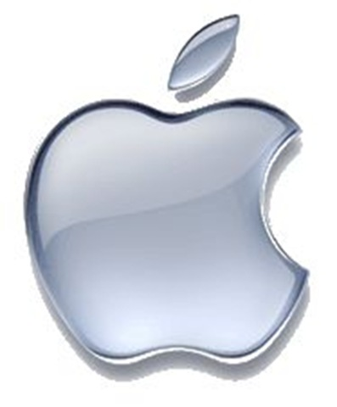

GLOBAL GADGETS
Kristy Tang
Cathyrine Zhang
Sani Dzafic
Carrie Zhu

Slide 2
Agenda
Industry Overview
History
Products
Structure
Apple
Google
RIM

Slide 3
Industry Overview

Slide 4
Industry History
The Computer
The Internet
Mobile Phones
Smartphones

Slide 5
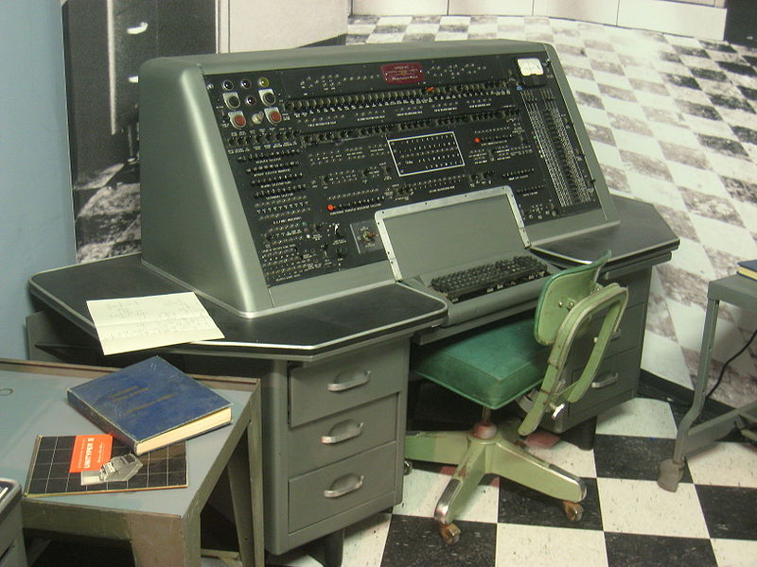
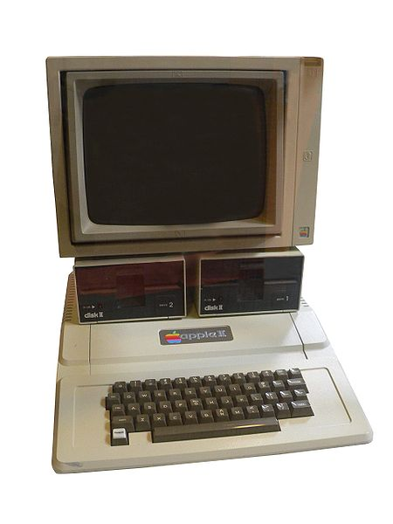
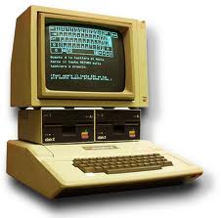
The Computer
1936: first freely programmable computer
1951: first commercial computer released
1974: first consumer computers (IBM)
1976: Apple I,II
1984: Apple Macintosh
1985: Microsoft Windows
Notes:
1936 Z1 Computer First freely programmable computer.
1951 UNIVAC Computer First commercial computer & able to pick presidential winners.

Slide 6

The Internet
1969: the original internet
1972: first email sent
1990: Archie, the first search engine
1991: Internet available for commercial use
1996: more email than post mail in the USA
: BackRub search engine (Stanford)
1997: Google (googol)

Slide 7
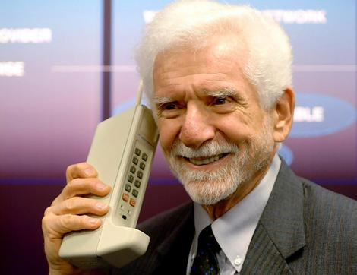
Mobile Phones
1973: Motorola cell phone created
April 3, 1973: first cell phone call made by Martin Cooper
1983: first cell phone available to consumers
2009: 4.1 million mobile phone subscribers
Feb 2010 : 5.6 billion subscriptions
Mar 2012: (Top 3)
1 billion in China
904 million in India
328 million in US
Mobiles in Africa:
*Expected to reach 735 million by the end of 2012
Notes:
http://en.wikipedia.org/wiki/List_of_countries_by_number_of_mobile_phones_in_use
In the twenty years from 1990 to 2011, worldwide mobile phone subscriptions grew from 12.4 million to over 5.6 billion, penetrating the developing economies and reaching the bottom of the economic pyramid
China, the world's most populated nation, had been deemed the first country in the world to reach one billion mobile phone subscribers

Slide 8
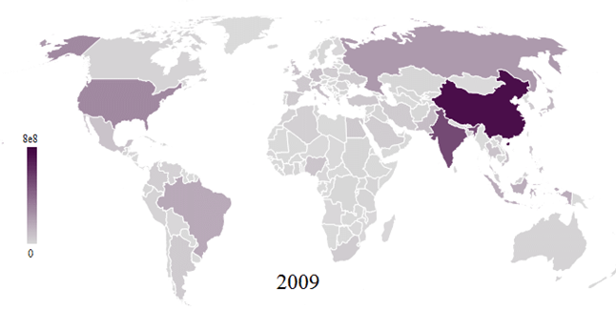
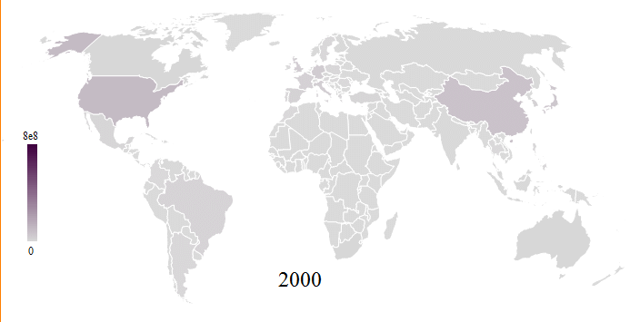
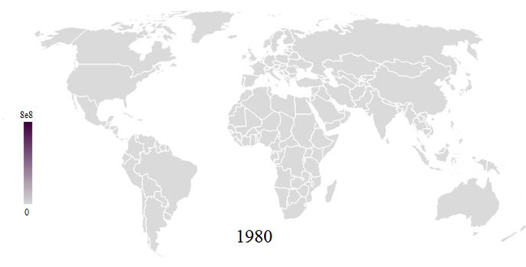
Mobile phone map
Notes:
http://en.wikipedia.org/wiki/File:Mobile_phone_map_1980-2009.gif

Slide 9
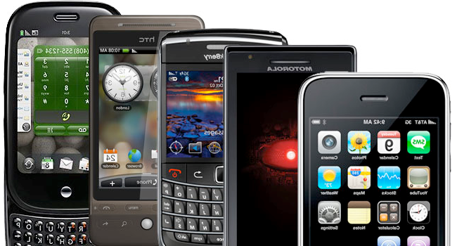
What is a Smartphone?
All in one device that can be used as a cell phone and has computing, PDA functions
Variety of applications available

Slide 10
Products
Smartphones
Smartphone Operating Systems
Tablet PCs
Apps

Slide 11
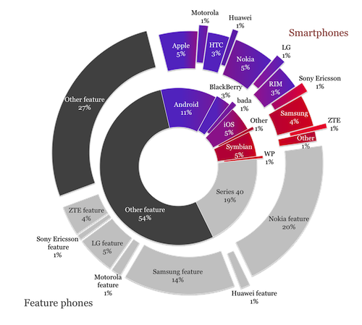
Smartphones
Nov 2011
Notes:
http://www.visionmobile.com/blog/2011/11/the-elusive-long-tail-of-mobile-shipments/

Slide 12
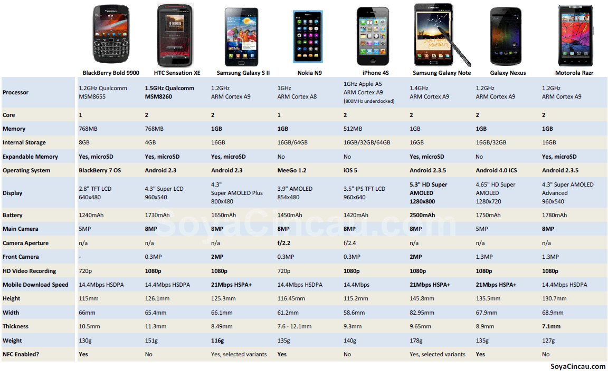
Oct 2011

Slide 13
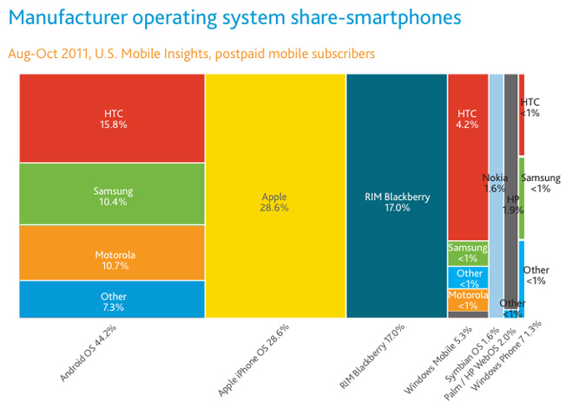
Notes:
http://www.bgr.com/2011/12/15/smartphone-penetration-skyrockets-in-2011-iphone-becomes-no-1-handset/
Apple narrowly increased its lead as the top smartphone maker by operating system vendor share in the three-month period ended in October. Apple’s iPhone represented 28.6% of the market during that period compared to28.3% between July and September. Android again showed the biggest market share gains of any smartphone platform, growing its market share to 44.2% from 42.8% in the third quarter.
RIM’s platform dropped from a 17.8% share in the third quarter to an even 17% between August and October, and Microsoft’s combined share dipped to 5.3% from 6.1%. Nielsen noted that in 2009, RIM’s BlackBerry line was the most popular smartphone range in the U.S.

Slide 14
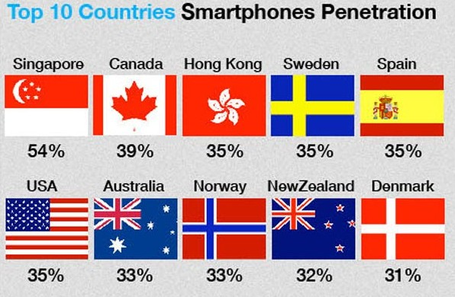
Smartphone Penetration Statistics: Dec 2011
Notes:
According to recent smartphone penetration statistics from several sources including Netsize Guide, Informa, Google, Ipsos, and Go-Gulf.com, it is concluded that by December 2011, Singapore is the champion in terms of smartphone penetration, and also is the world's first country that have more smartphone than feature phone in used.

Slide 15
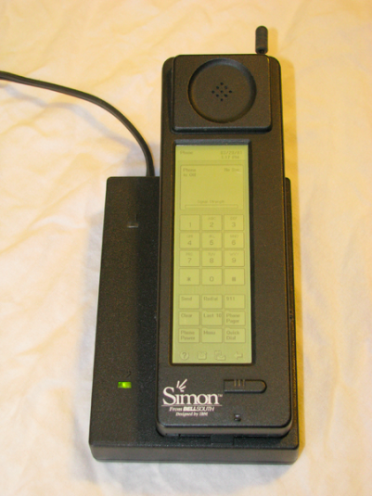
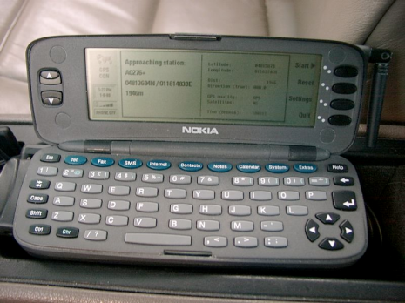
Evolution of the Smartphone?
1992: Simon
Created by IBM
Touch screen, fax, email, predictive keyboard
1996: Nokia 9000
2002: Handspring Treo 180 (Palm OS)
2002: Blackberry
2007: iPhone
2008: First Android OS phones

Slide 16
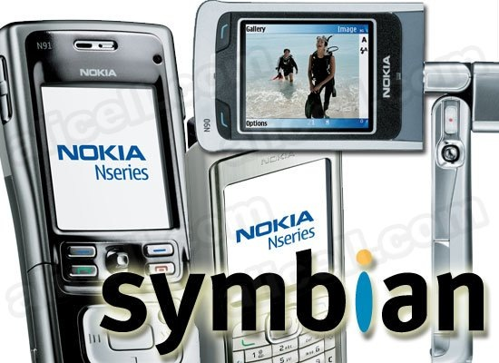
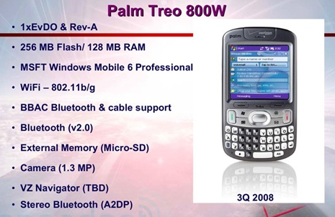
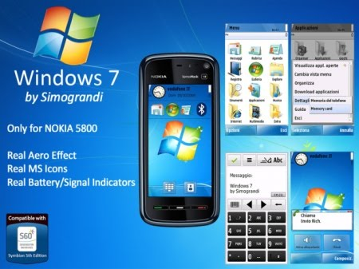
Smartphone Operating Systems
Symbian Ltd.: Symbian
Popular outside of the United States
Acquired by Nokia in 2008
Palm, Inc.: Palm
Initially designed for PDA’s
Microsoft: Windows Phone 7
Replacing Windows Mobile

Slide 17
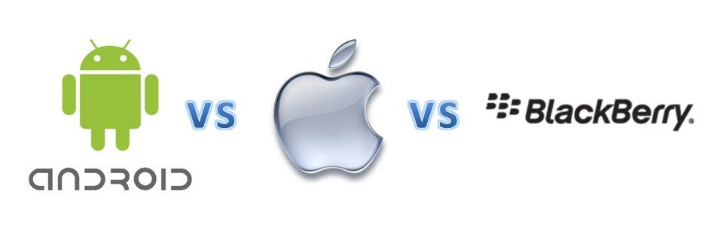
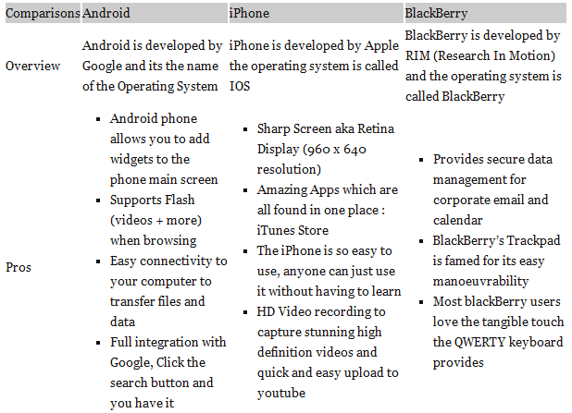

Slide 18
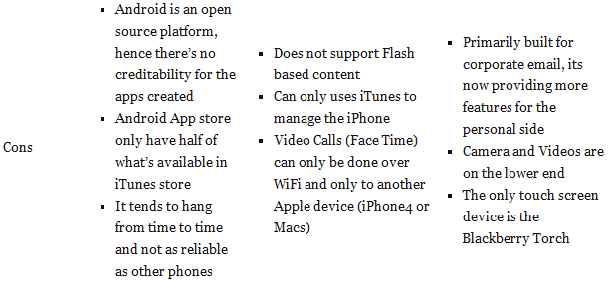

Slide 19
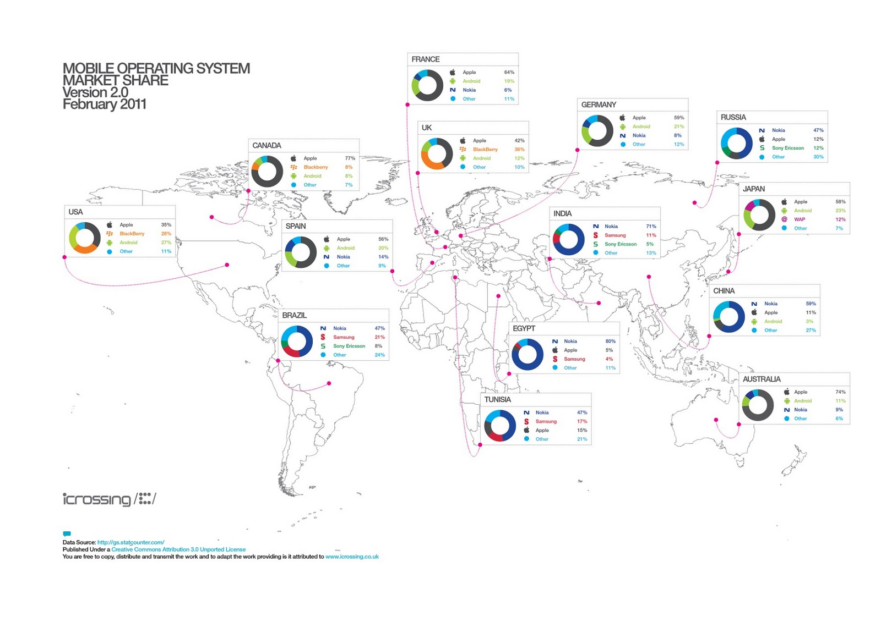

Slide 20
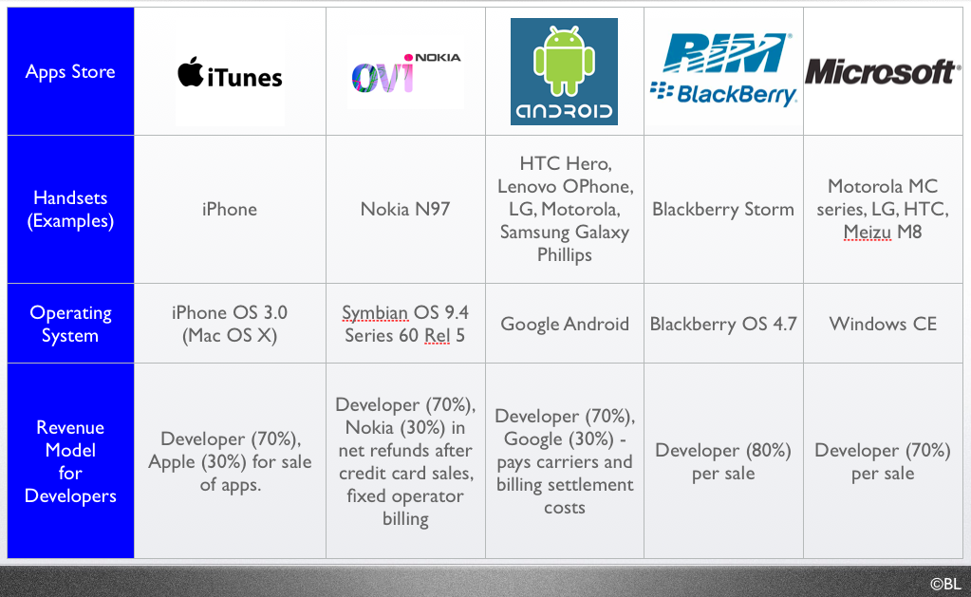
Smartphone Operating Systems

Slide 21
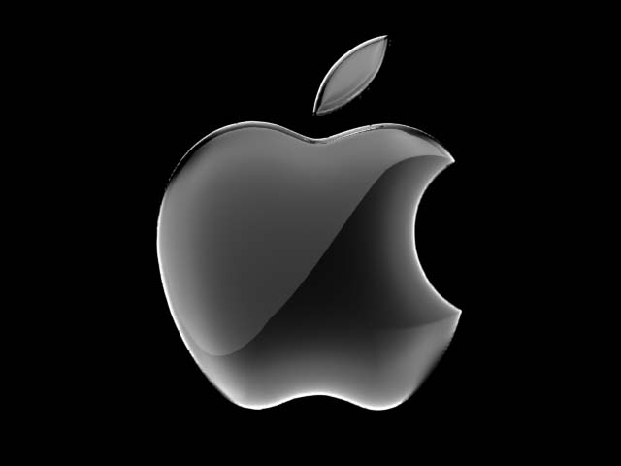
Smartphone Operating Systems
Apple, Inc. - iPhone OS
Mobile version of Mac OSX
Multi-TouchTM user interface
Third-party developed applications

Slide 22

Smartphone Operating Systems
Google Android OS
Based on Linux Kernel
Created by Android Corporation; purchased in July 2005 by Google
Multi-touch and media feature

Slide 23

Smartphone Operating Systems
RIM: Blackberry
Popular among business professionals
Unique push-email feature
Traditionally secure network
Third party applications

Slide 24
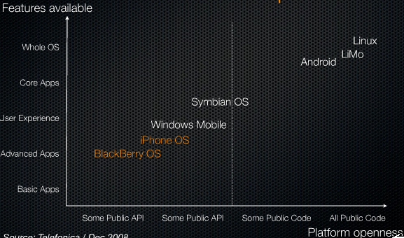
Market Positioning Diagram

Slide 25
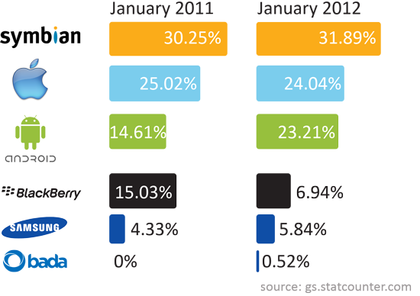
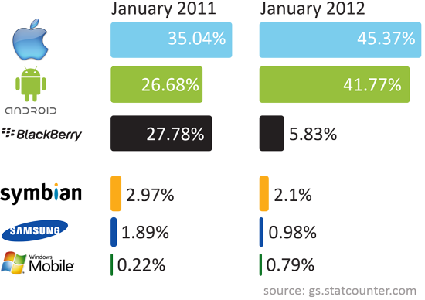
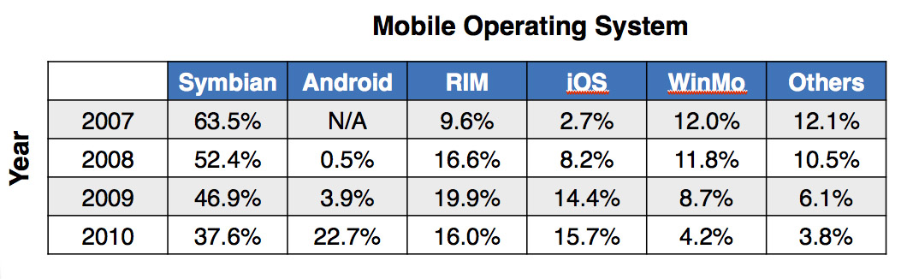
Mobile OS popularity in the world
Mobile OS popularity in the USA

Slide 26
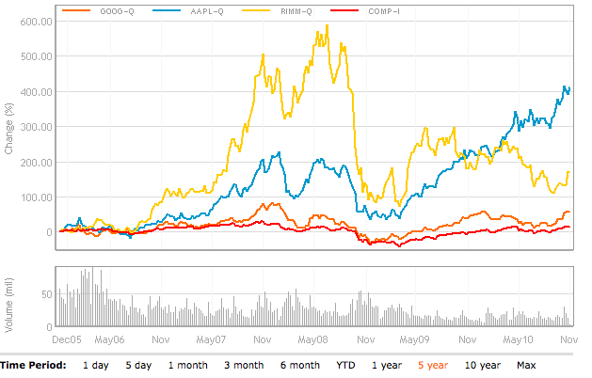
Three of Today’s Major Players

Slide 27
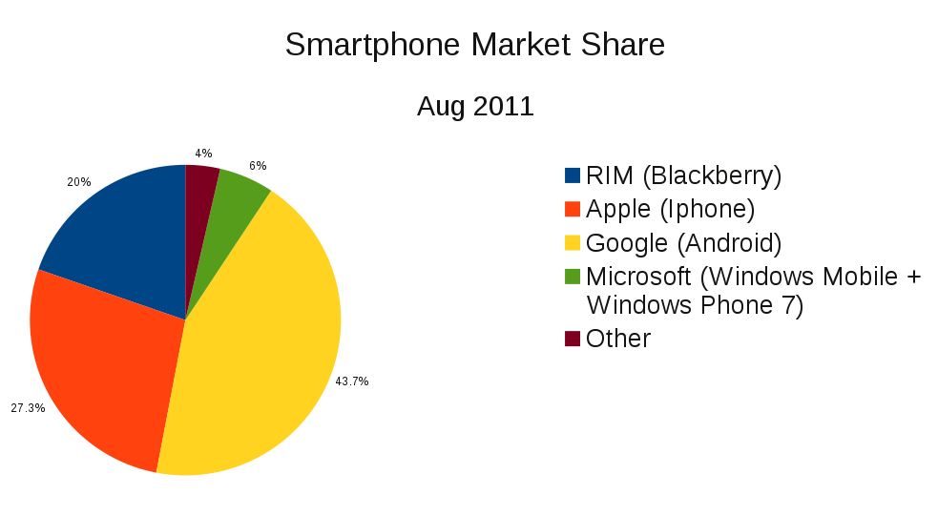
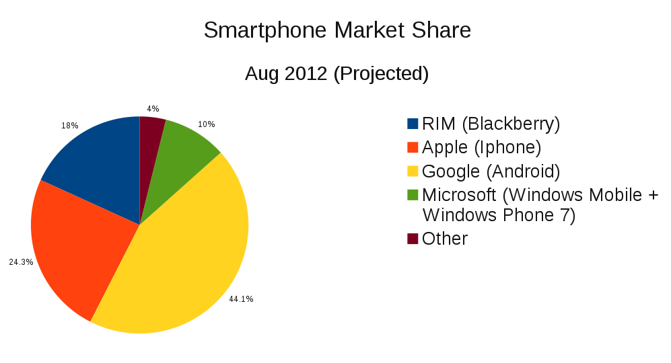
Smartphone Market Shares
Notes:
http://mobilewebup.com/reports/mobile-landscape/

Slide 28
Mobile and Smartphone usage:
Growth of mobile phone and Smartphone usage in developing countries
The Smartphone was originally for the business user
Jan 2012: 100 million Americans own Smartphones
Notes:
Mobile browsing represents 2.8% of all browsing

Slide 29
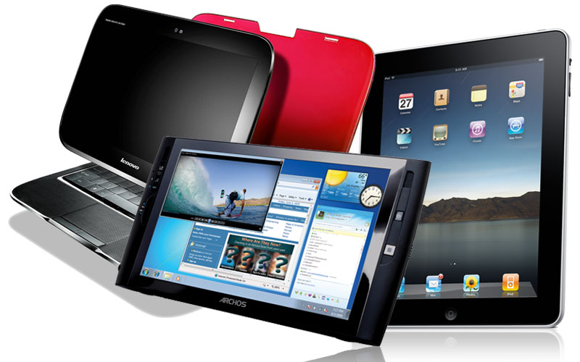
Tablet PC:
Combines the Smartphone, laptop and PDA
Apple iPad 1 , 2 & 3
Blackberry Playbook
Samsung Galaxy Tab
Motorola Xoom
Hp TouchPad
LG Optimus Pad
HTC Flyer
Asus transformer pad infinity
Amazon Kindle Fire
(Rumors: Nexus expected to release in May, 2012)
Notes:
The Kindle Fire is a tablet computer version of Amazon.com's Kindle e-book reader. Announced on 28 September 2011, the Kindle Fire has a color 7" multi-touch display with IPS technology and runs a forked version of Google's Android operating system. The device—which includes access to the Amazon Appstore, streaming movies and TV shows, and Kindle's e-books—was released on November 15, 2011.
The Kindle Fire retails for US$199.
Analysts have projected the device to be a strong competitor to Apple's iPad,^{[8][11]} and that other Android device makers will suffer lost sales.^{[12][13]}Amazon's business strategy is to make money on the selling of digital content on the Fire, rather than through the device itself.
customers purchased over 1 million Kindle devices per week.^{[18]} Analysts had estimated that over 6 million Amazon Kindle Fire tablets would be sold in the fourth quarter of 2011.^{[19]}
Rumor: Nexus(google choosen asus) tablet is a “done deal”, to retail as low as $149
Google is building a 7-inch "Nexus tablet" with Asus that will possibly be cheaper than the $200 Kindle Fire and come with the next version of Android.
The "confirmation" (and we suggest you treat it as a highly suspect rumor until Google officially confirms the news themselves) comes from Android and Me.
According to Android and Me, an anonymous "senior employee at a supply chain company based in the United States" has told the tech blog that Asus is scrapping plans to release the 7-inch MeMo 370T Android tablet that it unveiled at CES. Instead, it's using that tablet as a template for Google's official tablet.
Pricing is said to be much lower than the $250 price point that Digitimes reported last week — coming in at a possible $150 to $199 price.
At such a low price, the Google tablet would essentially undercut the Kindle Fire and Nook Tablet's $200 to $250 pricing, setting it up to be an "impulse buy" for many consumers who haven't hopped on the tablet bandwagon.
The mobile trend doesn’t just bring joy to mobile ad companies, it also boosts the adoption rate of social sites like Twitter and facebook. ??

Slide 30
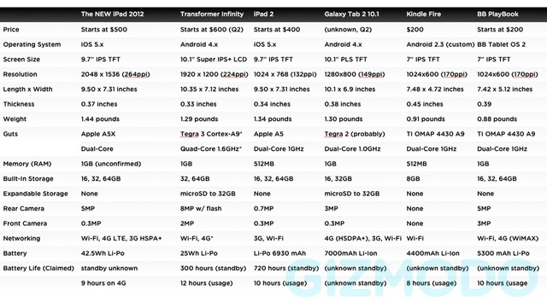
Tablet PC
Notes:
The new iPad pretty much beats everything else in the chart. It's hard to see a single compelling reason to take the Galaxy Tab 2 10.1 over it or the Transformer (other than price). Amazon's Kindle Fire and BlackBerry's Playbook likewise get chomped, but here at least there is a significant difference in price. $200 is very cheap. For people who primarily want a tablet for reading books and watching the occasional movie, the Kindle Fire might just be a more frugal investment.
iPad starts is $500, $600, or $700 for the 16GB Wi-Fi only version at 16, 32, and 64GB, respectively. For Wi-Fi plus 4G it's $630, $730, and $830, for the the 16, 32, and 64GB versions, respectively.

Slide 31
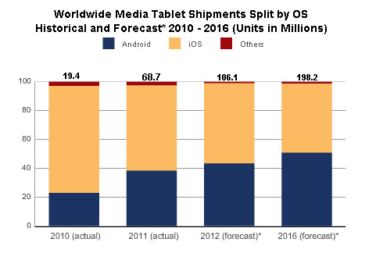
Tablet PC
Notes:
Apple iOS
Google Android
Others: RIM QNX
The “new” iPad goes on sale, March 16th, and is still “King of the Tablets.” However, sales for Q3 2011 show Apple dropping in worldwide tablet marketshare for the first time–impacted by the Kindle Fire. A new study by the IDC predicts Android and iOS will split the tablet market share in half by 2016, with other manufacturers holding a marginally small share.
Alex Cocotas of BI Intelligence predicts that smartphone sales will be twice that of PC sales this year and that smartphone sales will reach 1.5 billion units by 2016.
IDC forecasts that while the iPad will remain dominant for the foreseeable future, Google's tablet OS will overtake Apple in market share in 2015. However, said Mainelli, "We expect iOS to remain the revenue market share leader through the end of our 2016 forecast period and beyond."

Slide 32
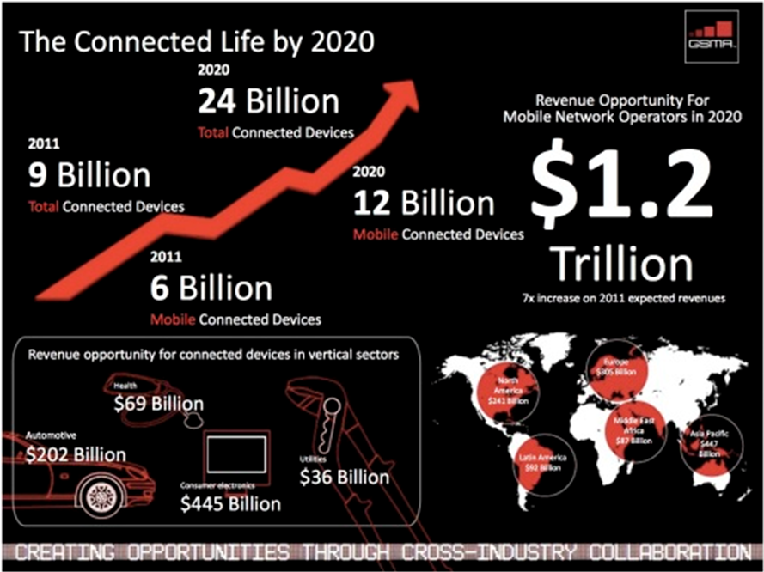
A Mobile, Post-PC world
Notes:
http://www.hl7standards.com/blog/2012/03/15/the-future-is-quantified/
A mobile, Post-PC world
It’s hard to imagine that the iPad didn’t even exist only two years ago, and now more than 40 million have been sold. With the iPad, we saw a Super Mobile revolution that launched the BYOD, “Bring Your Own Device”, trend and a Post-PC world.
The “new” iPad goes on sale, March 16th, and is still “King of the Tablets.” However, sales for Q3 2011 show Apple dropping in worldwide tablet marketshare for the first time–impacted by the Kindle Fire. A new study by the IDC predicts Android and iOS will split the tablet market share in half by 2016, with other manufacturers holding a marginally small share.

Slide 33
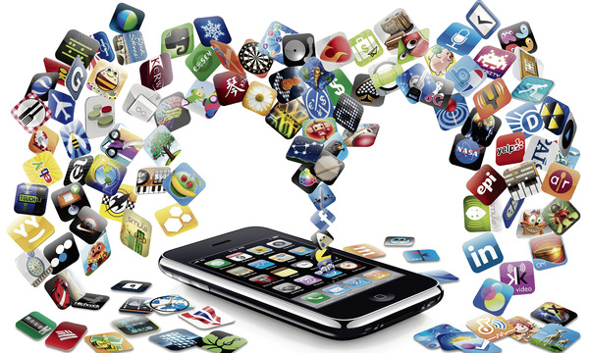
Apps
Specific to particular OS, but versions may be made for various OS
Available through “app stores”
Creators of applications may be contracted to produce apps for a particular OS, but many are not
Quickly growing market

Slide 34
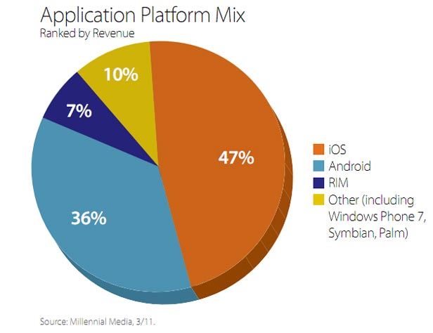
Apps

Slide 35
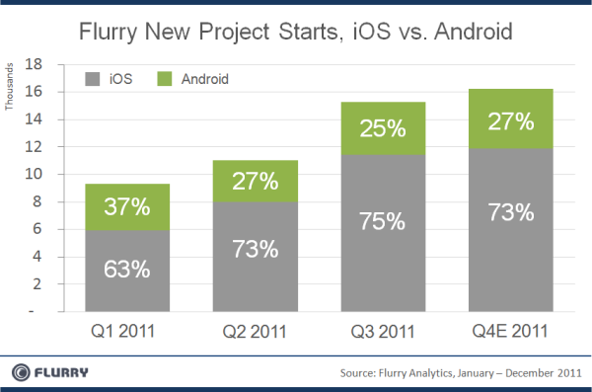
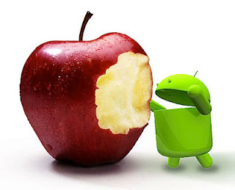
Apps
Notes:
Comparison between iOS Appsand Android Apps Revenue Sharing, it’s revealed that iOS Apps are much profitable in terms of revenue as compare to Android Apps. iOS Apps make four times higher revenue as compare to Android platform. Android is an open source platform and many big phone maker companies like Samsung, Motorola, Sony etc. is now offering Android devices but the statistic makes it clear that Apple iOS is still more popular platform in terms of Apps Revenue as compare Android platform.

Slide 36
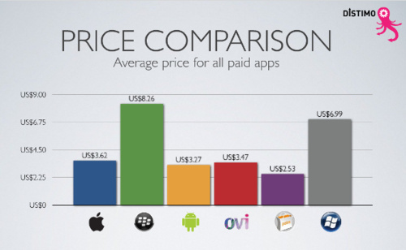

Slide 37
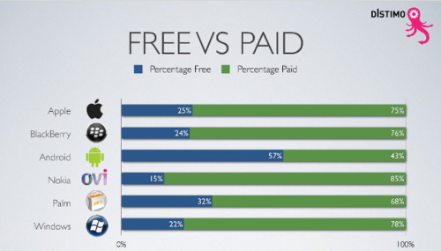

Slide 38
Industry Structure
Digital Revolution
Advertising
Trends in Usage

Slide 39
Digital Revolution
1990:
Cell phone users: 12.4 million (0.25% of world population)
Internet users: 2.8 million (0.05% of world population)
2002:
Cell phone users: 1.174 billion (19% of world population)
Internet users: 631 million (11% of world population)
2010:
Cell phone users: 5.4 billion (76% of world population)
Internet users: 1 billion (14% of world population)
2011:
Cell phone users: 6 billion (87% of world population)
Internet users: 2 billion (30% of world population)

Slide 40

Digital Music
Broadly spread in mobile devices
iTunes Store provides revenue stream for digital content:
Music
Podcasts
Books
Apps

Slide 41

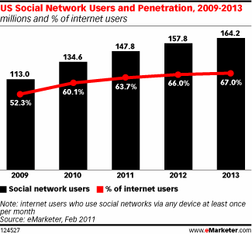
Social Media
Facebook, Twitter, YouTube, Myspace, etc
Notes:
March 20, 2011
social networking is reaching a saturation point in some age groups. A closer look at the graph reveals that the growth has been slowing down when compared to previous years and it is now expected to grow at a very small percentage till 2013. Year 2009-10 witnessed the highest jump in number of users while 2012-13 is expected to be the sluggiest of them all.
estimates nearly 150 million US web users will use social networks via any device at least monthly this year, bringing the reach of such sites to 63.7% of the online population. By 2013, 164.2 million Americans will use social networks, or 67% of internet users.

Slide 42
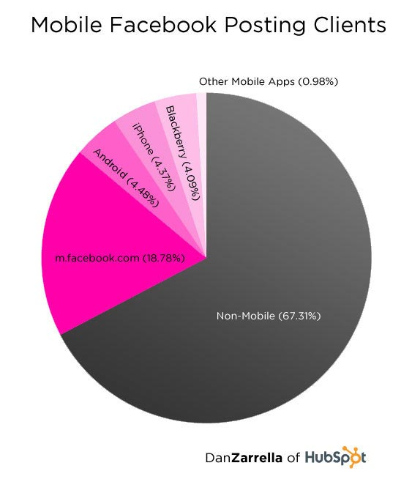
Social Media Goes Mobile
Social media will focus more on mobile devices in the next five years, including smartphones and tablet PCs.
Over 300 million active users of Facebook currently access Facebook through their mobile devices. (Facebook Statistics, Stats and Facts for 2011 )

Slide 43

Advertising
Google; Sponsored links
Smartphone advertising in applications
Application advertising
Build an application under the company name
Social media advertising
Facebook, twitter, myspace

Slide 44

Trends in Usage
Growth of mobile phone and
Smartphone usage in developing countries
The Smartphone was originally for the business user, but now targets wider range of consumers
Movement towards internet-based computing solutions (S&P for AAPL)
Virtualization and “cloud computing” more popular

Slide 45
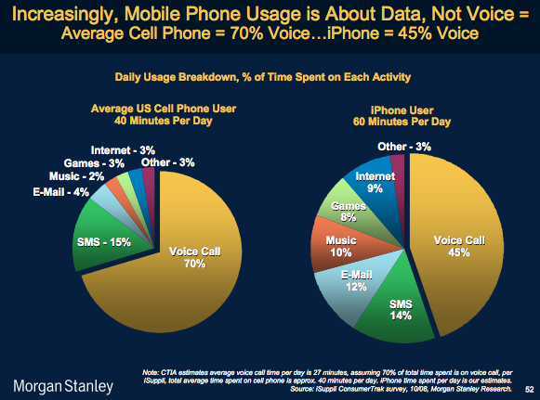
Trends in Usage

Slide 46
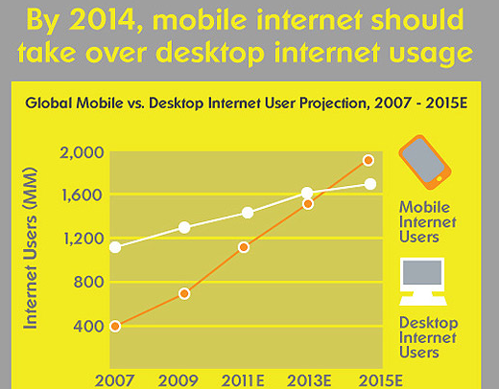
Notes:
Mobile web browsing is predicted to surpass desktop web browsing
The mobile web is growing at a phenomenal pace, and it is forecast to overtake the desktop web in 2014: in other words, more users will access the Internet using a mobile phone rather than a PC for the first time. Approximately 900 million people currently access the web with mobile phones, compared to 1.4 billion desktop Internet users.

Slide 47
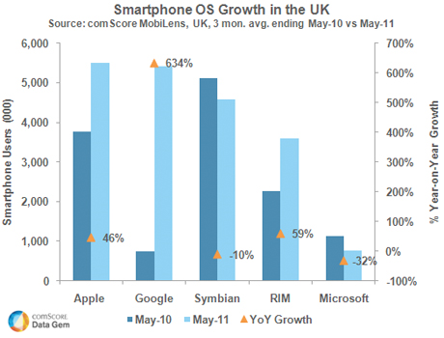
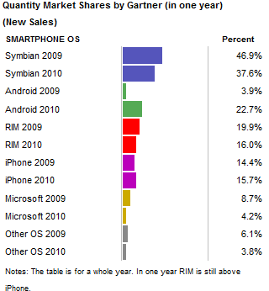

Slide 48
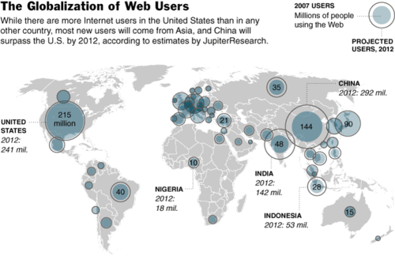
Notes:
http://socialmarketing.blogs.com/r_craiig_lefebvres_social/2009/02/demographics-of-social-network-users.html

Slide 49

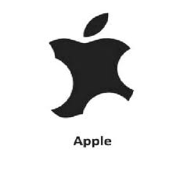
Battle on Apps
Increased market growth
Apple’s competitors increased their market share

Slide 50
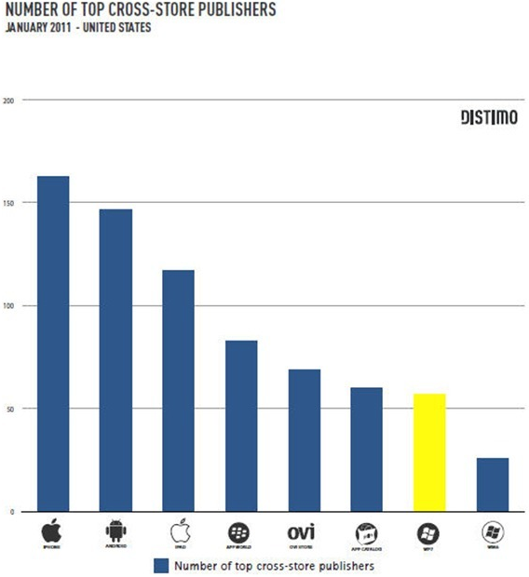

Application Store Comparison

Slide 51
Legal environment
Highly competitive
Constant battle between companies for patents
Patents crucial for success

Slide 52

Intangible Assets Cash
Important components of financial statements to consider
Intangible assets include goodwill, intellectual property, representation on balance sheet should be examined
A large amount of cash is common - representation of current and future performance of the company
Notes:
Intellectual property
Protected by patents, trademarks, copyrights
Human capital

Slide 53

Apple Inc.

Slide 54

Financial Snapshot
Shares Outstanding: 932,370,000
Source: Globe Investor

Slide 55
Common Share Structure
 | 2011 | 2010 | 2009 | 2008
Shares Outstanding (Thousands) | 932,370 | 915,970 | 889,806 | 888,326
Common stock, no par value; 1,800,000,000 shares authorized
(Source: Apple Inc. 10-K)

Slide 56

5- Year Stock Performance
Source: Globe Investor

Slide 57

1- Year Stock Performance
Source: Globe Investor

Slide 58

Apple’s Current Valuation EPS Growth and Share Price Growth

Slide 59


summary of the Company’s stock option activity
Source: Apple 10-Q

Slide 60
Company Overview

Slide 61
Company Profile
Apple Inc. (formerly Apple Computer, Inc.) founded by Steve Jobs, Steve Wozniak and Ronald Wayne (1976)
design, manufacture, and market personal computers and related personal computing and mobile communication devices
sell its products worldwide through its online stores, its retail stores, its direct sales force, third-party wholesalers, and resellers.
Headquartered in Cupertino, California

Slide 62
Mission Statement
Apple designs Macs, the best personal computers in the world, along with OS X, iLife, iWork, and professional software. Apple leads the digital music revolution with its iPods and iTunes online store. Apple reinvented the mobile phone with its revolutionary iPhone and App Store, and has recently introduced its magical iPad which is defining the future of mobile media and computing devices.

Slide 63
Products and Services
iPhone
iPad
Mac
iPod
Apple TV
The iOS and Mac OS X operating systems
iCloud
accessory, service and support offerings

Slide 64

iTunes Revenues
Sales of third-party digital content such as:
- digital music
- audio books
- music videos
- short films
Manage contents on iPod, iPhone, iPod Touch and iPad.
“Apple will generate $13 billion in iTunes Revenue in 2013, says analyst” ( from Business Insider)

Slide 65


The App Store
Allows users to browse and download applications from the iTunes Store.
30% of revenue from the store goes to Apple and 70% go to the producer of the app.
Apple App Store dominates the market

Slide 66

iBook
An e-book application
On Jan 19th, 2012 Apple announced the free release of iBooks 2, operating in landscape mode and allowing for interactive reading
A new app, iBooks Author, was announced for the App Store, allowing anyone to create interactive textbooks for reading in iBooks; and the iBookstore was expanded with a textbook category.
Source: Wikipedia

Slide 67
Milestones
•1977: Apple II meets success
•1991: Powerbook 100, Apple’s portable computer
•2001: iPod introduced ( 220 Million sold as of 2009)
•2003: iTunes open; first successful revenue stream for digital music.
•2007: iPhone “reinvents the mobile phone”
2008: iPhone 3G
2009: iPhone 3GS
•2010: iPad 1, iPhone 4
2011: iPad 2, iPhone 4S
2012: New iPad (3rd Generation)

Slide 68
Key Company Trends
Global Growth
Key Product Growth (Revenue Trends)
Litigation (10-K)

Slide 69

Global Growth (from Apple 10-Q)
( in millions)
Notes:
On Jan 25, 2012 Apple filed with the SEC its form 10-Q for the quarterly period ended Dec 31, 2011.

Slide 70

Percent of Revenue By Region- FY 2011

Slide 71


Key Product Growth

Slide 72

Revenue Distribution from 07 to 11
Notes:
In 2007, iPod was the main revenue source for Apple company. Now, iPhone becomes the main revenue source of Apple Inc.

Slide 73


Revenue Distribution
Expected
Actual
Total Revenue : $46, 333 million

Slide 74

Litigation (2011)
v.
Apple v. Amazon.com: “App Store” dispute
“In 2011, Apple filed suit against Amazon.com, alleging trademark infringement and unfair competition over Amazon’s use of the ‘ App Store’ phrase relating to Amazon’s ‘Amazon Appstore Developer Portal’ and Amazon’s alleged other similar uses of the phrase. ”
Apple v. HTC
Apple v. Samsung: Android phones and tablets
“In the spring of 2011, Apple and Samsung began to engage in the mobile device patent wars (infringement on Apple’s patents, trademarks, user interface and style). By August 2011, Apple and Samsung were carrying out their legal battles in 19 ongoing lawsuits in 12 courts in 9 countries ( U.S., France, Italy, Japan, South Korea, Germany, etc.).”
Source: Wikipedia (Apple Inc. litigation)

Slide 75
Key Issues
1) How much bigger could Apple Inc. get?
2) What to do with the cash?

Slide 76

How much bigger could Apple Inc. get?
Notes:
Investment is declining dramatically

Slide 77

How much bigger could Apple Inc. get?

Slide 78


iPhone 4 Vs.
iPhone 4S

Slide 79


iPad 2 v.
New iPad

Slide 80

The New York Times called New iPad “A Polishing of the Old” on Mar 14th, 2012

Slide 81

Mar 14th, 2012-New iPad arrives in the US & 9 additional countries
the stock price started to fall
Source:Bloomberg

Slide 82

Cash
Source: Bloomberg
Apple now has more cash than U.S government.
Tim Cook admitted that the company has more cash than it needs. (Source: Time Magazine)

Slide 83
Cash
Tim Cook’s Response: We will think it over “very deeply”.
He and the rest of Apple’s board are still trying to figure out whether it makes sense to dip into the nearly $100 billion cash hoard to pay shareholders a dividend this year.
Source: Time Magazine
Notes:
If Apple pays out the cash as dividend, then the stock price will drop significantly.

Slide 84
Finally,
Source: Bloomberg (Mar 19th, 2012)
“ Apple Inc. will pay its first dividend in 17 years and buy back $10 million in stock.”
“Shareholders will receive a quarterly dividend of $2.65 a share starting in the period beginning July 1, Cupertino, California-based Apple said today in a statement. The buybacks will begin in the fiscal year starting Sept.30 and happen over three years, the company said.”
“The dividend will cost Apple about $10 billion a year and represents a yield of 1.8 percent on the stock’s March 16 closing price.”

Slide 85
Management

Slide 86

Steve Jobs (1955-2011)
Previous CEO and Co-founder of Apple Inc.
Business icon and inventor
Born in Silicon Valley
Tumultuous past with the company; but, his 1997 return coincides with major turnaround.
Died on October 5, 2011.

Slide 87

CEO: Tim Cook
Named the CEO of Apple on Aug 12, 2011
Previous Chief Operating Officer
B.S. degree in industrial engineering from
Auburn University in 1982
M.B.A. from Duke University's Fuqua School
of Business in 1988
Earned top salary for 2011 with $378 million
package(majority came in a grant of a million restricted stocks units worth $376 million). He became the highest paid CEO in America
in 2011.

Slide 88

Eddy Cue
Senior vice president internet, software and services
Oversees Apple’s industry-leading content stores
With Apple for 23 years
Earned a bachelor’s degree in Computer Science and Economics from Duke University
Awarded by 100,000 Restricted Stock Units
(RSU) as promotion bonus

Slide 89

Scott Forstall
Senior vice president of iPhone Software
Responsible for delivering the software for iPhone, including the user interface, applications, etc.
Joined Apple in 1997
Earned a bachelor degree of Science in
Symbolic Systems and a master degree of
Computer Science from Stanford University
Total calculated compensation: $1,416,527
as of FY 2011

Slide 90

Jonathan Ive
Senior vice president, industrial design
Design team leader since 1996
Numerous design awards
2003 Designer of the Year by the Design
Museum London
B.A and an honorary doctorate from
Newcastle Polytechnic

Slide 91

Bob Mansfield
Senior vice president, hardware engineering
Joined Apple in 1999
Has delivered dozens of breakthrough Mac products, including the MacBook Air and
the all-in-one iMac line
A BSEE degree from The University of
Texas at Austin in 1982

Slide 92

Philip W. Schiller
Senior Vice President, Worldwide Product Marketing
Responsible for product marketing, developer relations, and business marketing
With Apple sine 1997
Over 24 years marketing experience
B.Sc in Biology from Boston College

Slide 93
Financial Analysis

Slide 94

Annual Balance Sheet

Slide 95


Quarterly Balance Sheet

Slide 96

Annual Income statement

Slide 97

Quarterly Income statement

Slide 98

Annual Cash Flow Statement

Slide 99

Quarterly Cash Flow statement

Slide 100

Expectations
Money Morning: The 3 innovations (iPhone, Apple iTV, iBooks) will make Apple Inc. the first $1 trillion company
Posts An Eventide: Apple price target: $790 per share
Expect an Apple share split and resumption of a quarterly dividend over the next 12 months

Slide 101
Recommendation
BUY

Slide 102


Slide 103

Financial Snapshot
Common Shares Outstanding: 67.3 million

Slide 104
Common Share Structure
Class B
- 10 votes per share
- Only available to Google insiders and executives
- 2011: 257.55 million shares outstanding
Class A
- 1 vote per share
- 2011: 67.3 million shares outstanding
Employee Stock Options
- 10-year term

Slide 105

Stock Option Activity

Slide 106

Stock Option Activity

Slide 107

Max Chart

Slide 108

5 Year Chart

Slide 109

1 Year Chart

Slide 110

Google vs. Nasdaq – 1 Year

Slide 111

Google vs. Nasdaq – 5 Years

Slide 112

Google vs. S&P Info Tech

Slide 113

Google vs. S&P Info Tech (5 Yr)

Slide 114

Google vs. Dow Jones Internet Composite – 1 Year

Slide 115

Google vs. Dow Jones Internet Composite – 5 Year

Slide 116

Google vs. NYSE Composite

Slide 117


Slide 118
History
1996
Larry Page and Sergey Brin create a search engine as a research project
Featured a very efficient algorithm dubbed “PageRank”
Called BackRub initially
Originally, Google ran under the Stanford University website, with the domain google.stanford.edu
1998
Incorporated in Menlo Park, California
1999
Obtained funding from venture capital firms Kleiner Perkins Caufield & Byers, and Sequoia Capital. Officially launched as a site.
2000
Began selling advertisements- paid web links associated with search keywords

Slide 119
History
2001
Eric Schmidt becomes CEO and Chairman of the Board
“PageRank” granted a patent
2003
Re-incorporated in Delaware
2004
Initial Public Offering that raised $1.67 billion
19,605,052 shares sold
$85 per share
Conducted via Dutch auction

Slide 120
History and Milestones
October 31, 2007 → Share price hits $700 for the first time
November 2009 → Google is the dominant search engine in the United States market, with a market share of 65.6%
2010 → Google Energy made its first investment in a renewable-energy project, putting $38.8 million into two wind farms in North Dakota
Google+ reaches 25 million users only 4 weeks after its launch in June 2011
May 2011→ unique visitors of Google surpassed 1 billion mark for the first time
Currently, the most visited site in the world

Slide 121
Key Acquisitions
April 2003: Applied Semantics. Leads to launch of Google AdSense
July 2004: Picasa Inc. Digital photo management. Users can organize, manage, and share photos.
October 2004: Keyhole Corp. Leads to launch of Google Maps and Google Earth.
October 2006: Youtube
March 2008: Doubleclick. Enhances the company’s advertising revenue.
August 2011: Motorola for $12.5 billion.

Slide 122
Products and Services
iGoogle
Google+
Google Docs
Google Finance
Google Photos
Google Scholar
Google Books
Google Chrome
Google Chrome OS
Gmail

Slide 123
Products and Services
Google Wallet
Google TV
Google Translate
Google Ventures
Google Patent Search
Google Maps
Google Earth
Android mobile OS
Google Play
Google Blog Search
Blogger

Slide 124


Slide 125

Revenue Source

Slide 126
AdWords
Shows ads alongside Google search results
Advertisers “bid” in an auction to have their ads displayed alongside certain specific keywords
- Pay per click
- Cost-per-thousand
Free tools to make advertising more efficient and measurable for the advertiser:
- Google Analytics
- Website Optimizer
- Ad Planner

Slide 127

Gmail
Features:
- First e-mail service that gave users one gigabyte of storage space
- First e-mail service to group e-mails from the same conversation into one thread
- Interactive webpages that don’t require a refresh

Slide 128

Gmail Ads

Slide 129

Google Finance Ads

Slide 130


Google Maps Ads

Slide 131

YouTube
The biggest video site in the world
More and more mobile viewers
Google has established partnerships with content companies to aid in monetizing video in the mobile space

Slide 132


YouTube Ads

Slide 133
Google+
New social network competing with Facebook and Twitter
Video Hangouts
Hangouts over the phone and on air
Within the first 90 days of launch, 100 features present
Share circles
Allows one to limit information shared to certain circles
Over 90 million users worldwide

Slide 134


Google+ Ads

Slide 135
AdSense
Google partnerships with Google Network Members
Advertisers post their ads on websites in terms of relevancy to their products
Google shares profits with the website publishers
- Per click
- Per impression

Slide 136

Google Network Ads

Slide 137


Slide 138

Android Mobile OS
Open source
Promotes development of new apps (using Java)
Based off of Linux OS
180 million Android phones sold worldwide in 2011
Over 450,000 Android apps as of February 2012
Over 10 billion apps downloaded in total by end of 2011

Slide 139
Google Mobile
Continued partnerships with manufacturers such as Samsung, HTC, and Sony
Joint venture with Samsung: Galaxy Nexus
Acquisition of Motorola Mobility
-Retains independence as a subsidiary
- Establishes Google as a smartphone manufacturer
- Portfolio of patents loosens up some of the legal burden

Slide 140



Slide 141

Play Store
Combines Android Market, Google Music, and Google eBookstore
Removal of Android brand means opportunities to roll it out on non-Android devices in the future

Slide 142

Google Chrome and Chrome OS
Chrome web browser
25-28% of browser market
More popular than Firefox and IE
Chrome Web Store
Chrome OS
Open Source (based on Linux)
Works primarily for web applications
Found in Chromebooks built by Samsung and Acer
Hybrid between cloud client and traditional laptop

Slide 143
Google Energy
The company consumes a lot of energy, in particular with data centers that facilitate Google search
30% of its energy needs drawn from wind power, currently the least expensive renewable form of energy
Google buys electricity from NextEra Energy, which owns wind farms, and resells it to local utilities for renewable energy credits
Made $917 million in investments in renewable energy in 2011, with $622 million dedicated to solar power

Slide 144
Strategy
Revenue = Amount of time on the Web
Mission Statement:
“To organize the world’s information and make it universally accessible and useful”
Slogan (mantra)
“Don’t be evil”

Slide 145
Strategy in 2012
Mobile:
Motorola as an independent subsidiary that produces smart phones and tablets
Continued partnerships with other manufacturers
Growth of different types of content in the Play Store
Inexpensive smartphones initiative throughout the world
Increasing LTE Compatibility as high speed upgrade to 4G networks
Google Wallet = mobile electronic money as a means of payment based on near field communications technology

Slide 146
Legal Issues
Oracle
- Java patent that it got when it acquired Sun Microsystems
Microsoft
-EU lawsuit regarding a Motorola patent for web video
Apple
- Disputes over patents with Android device makers Samsung, HTC, and Motorola
Privacy concerns
- Lawsuits from users i.e., Google Street View

Slide 147
The Future
Android and Google Mobile as an opportunity for advertising
Privacy Issues
- New privacy policy for all products as of March 1, 2012
Continuing legal battles
Increased competition with multiple companies, including Apple, Facebook, and Microsoft (Bing)
Innovation issues:
-Google Labs closed in 2011
-70-20-10 rule no longer mandated by Page

Slide 148

Management
CEO
Larry Page
Co-Founder
CEO since April 2011
Bachelor of Computer Engineering from Michigan
Master of Computer Science from Stanford
PhD in Computer Science (dropped out)

Slide 149

Management
Co-Founder
Sergey Brin
B.Sc. in Math and Computer Science from University of Maryland
Master of Computer Science from Stanford
PhD in Computer Science (dropped out)

Slide 150

Management
Executive Chairman
Eric Schmidt
Former CEO
Former CEO of Novell & CTO of Sun Microsystems
Bachelor of Engineering degree from Princeton
Master’s and PhD in Comp. Sci. from UC Berkley
Member of President Obama’s council of Science and Technology

Slide 151
Five-year Diversification Plan
Larry, Sergey, and Eric currently hold 92% of the company’s Class B common stock
Hold 66% of the voting power in company decisions
Since 2010, Larry and Sergey will each sell $5.5 billion shares of common stock until 2015
Will retain 48% of the voting power when all is said and done

Slide 152

Management
Senior VP and Chief Business Officer
Nikesh Arora
Joined Google in 2004
Responsible for creating and expanding strategic partnerships
Former Chief Marketing Officer at T-Mobile
Masters degree from Boston College
MBA from Northeastern University
CFA Designation

Slide 153

Management
Senior VP and Chief Financial Officer
Patrick Pichette
Joined Google in 2008
Worked at McKinsey and at Bell Canada (2001-2008)
An expert in the telecommunications industry
BBA Université du Québec à Montréal (1987)
MA in Philosphy, Politics, and Economics from Oxford
Rhodes Scholar

Slide 154
Financials

Slide 155


Slide 156


Slide 157


Slide 158


Slide 159

Quarterly Income Statement

Slide 160


Slide 161


Slide 162

Recommendation

Slide 163

Research In Motion, Ltd.
1984 – 2012 | Waterloo Ontario

Slide 164

Financial Snapshot
Shares outstanding =524,160,000

Slide 165

Common Shares
2011 | 2010 | 2009 | 2008 | 2007 | 2006
524 M | 557 M | 566 M | 562 M | 188.9 M | 187.7 M
RIM announced 3-for-1 stock split in 2007
On December 13, 2011, there were 524 million voting common shares, options to purchase 4 million voting common shares, 8 million restricted share units and 91,204 deferred share units outstanding

Slide 166

Stock Performance - 10 year

Slide 167

Stock Performance - 5 year

Slide 168

Stock Performance - 1 year

Slide 169
Company Profile
Research In Motion, Ltd.

Slide 170
Company Milestone
1984: RIM was founded in Ontario by two engineering student: Mike Lazaridis and Douglas Fregin
1988: Began to work on wireless data-only applications
1996: Introduced first two-way messaging pager and PCMIA plug-in card for computer-enabled wireless email
1997: Rim was listed on the TSE
1998: Launched its first BlackBerry - RIM 950
1999: Rim was listed on the Nasdaq; introduced BlackBerry PDA
Notes:
-RIM 950 was what started the Blackberry trend

Slide 171
Company Milestone
2000: Launched its Wireless Handheld product line
2002: Launched its first true Blackberry device
2004: Hit 2 million subscribers
2008: Hit 14 million subscribers
2011: Released BlackBerry Playbook tablet computer

Slide 172
Acquisitions
June 2009 – Acquired Dash Navigation (primarily used in BlackBerry Traffic)
August 2009 – Acquired Torch Mobile (webkit-browser technology)
March 2010 – Acquired Viigo (BlackBerry applications developer)
April 2010 – Acquire QNX Software Systems (integrate smart-phone and in-vehicle infotainment systems)
Oct 2011 - Announced plans to acquire NewBay (cloud based service)
Notes:
Active acquisitions to complement its technology. However, none of these companies have resulted in amazing result after integration with BlackBerry. Except…QNX that yet to be launched in the PlayBook

Slide 173
Recent Development
BlackBerry global expansion continues
BlackBerry 7 Smartphones introduced
RIM searches for more carrier billing and operator billing on BlackBerry App World
On Jan 22, 2012, RIM named Thorsten Heins President and CEO
On Feb 21, 2012, BlackBerry PlayBook OS 2.0 was introduced
On May 10, 2012, BlackBerry 7 OS Awarded TUV Certification

Slide 174

Products

Slide 175

Product History
RIM 850
Blackberry 5XXX
Blackberry 6XXX
Blackberry Bold
1996
2000
2002
2008
Notes:
1996: Rim 950
2000: Rim 857
2000: Blackberry 5810
2008: Blackberry bold

Slide 176






Current Products

Slide 177
BlackBerry 7 OS
Like BlackBerry 6 OS in appearance and functionality
Adds BlackBerry Balance - maintain your personal and business life all on one phone
Adds HTML 5 support
NFC support (Bold 9900 only) - make payments with the phone and exchange information with another NFC-enabled phone
a fun augmented-reality app
No legacy support - the older BlackBerrys, even those running version 6 cannot get an upgrade

Slide 178

The Future in Tablet
“The first tablet certified for deployment within U.S. federal government agencies.”
Since it’s release on April 19, 2011, only 700,000 units were sold worldwide, while Apple Ipad 2 sold close to 1 million units during its debut weekend. Rim’s bottom line will be hurt by the write down of its excess Playbook inventory.
Rim announces that Playbook will now support Android apps. This would mean that Blackberry users will soon be able to utilize Android apps as well, since Playbook and Blackberry will be using the same OS (BBX).
Notes:
Reason why Playbook did not sell very while: it did not come with BBM and native email.
Why? It may be that BBM and push email technology is strictly secure

Slide 179
BlackBerry PlayBook OS 2.0
Build-in Messages with a unified inbox
Can edit MS Word, Excel and PowerPoint files and attachments with Documents To Go
BlackBerry App World
Dual core processor, two HD 1080p video cameras, 1GB of RAM and QNX technology
New BlackBerry Bridge features allow your BlackBerry smartphone to act as a keyboard and mouse for your PlayBook
Multi-tasking

Slide 180
Competitive Advantage
BlackBerry’s core competency in the smart-phones market:
a) Blackberry Enterprise Server
-“push” e-mail technology
- Security through 128 bit encryption
- BlackBerry Enterprise Server is proven as a reliable network during the Hurricane Katrina and 9/11.
b) BlackBerry Messenger (BBM) (Global real time chat)
C) The encryption also allows BlackBerry to re-size the webpage so it uses less data plan
d) Full size keyboard
Notes:
- Rim runs all data from blackberrys through its closed, global network. This provides corporate users and personal users security unless traditional email.
- Apple launch an new app called Imessage which is very similar to BBM

Slide 181
BlackBerry App World more profitable than Android??
About 6 million daily downloads from BB App world, totaling 174m per month
App World generates 43 percent more daily downloads per app than Apple’s App Store and has more paid downloads than Google’s Android Market
World’s second most profitable app store behind Apple

Slide 182

US Smartphone Subscribers

Slide 183

Operating System Share

Slide 184

Why BlackBerry is Losing its Competitive Advantage?

Slide 185
Why BlackBerry is Losing its Competitive Advantage?
Losing customer loyalty - only 48% RIM customers want to keep their BlackBerry phones
Service outages - millions of BlackBerry users were without service for 3 days in October 2011 due to critical network failure
Faltering tech support
No longer #1 in security
Apps are less than “appetizing”
Failed attempt to sell tablet PCS

Slide 186
Patents
RIM has about 3000+ patents registered under “Research In Motion” on the United States Patents and Trademark Office.
Acquired an additional 6000 patents and patent applications from Nortel on June 30, 2011
RIM has focused its patents research on the following technology fields:
- Electric communication technique – transmission and telephonic communication
- Arrangements or circuits for control of indicating devices using static means
- Electric digital data processing

Slide 187
Litigation
Currently, Rim is involved in over 30 litigation in which some as a plaintiff and some as a defendant. These litigation may severely impact Rim’s profitability.
RIM’s most prominent lawsuit is by NTP over delivery of e-mail in wireless system. RIM settled the lawsuit; it recorded $612.5 million as Litigation entry in Annual Report 2006.
In June 2010, RIM and Motorola announced settlement through cross-licenses of various patent rights.
RIM settled patent dispute with Visto Corp., agreed to pay $268m to receive perpetual, fully-paid license on all Visto patents, $164m of full amount was expensed, the rest was recorded as intangible assets .
Notes:
Active acquisitions to complement its technology. However, none of these companies have resulted in amazing result after integration with BlackBerry. Except…QNX that yet to be launched in the PlayBook

Slide 188
Management Team
Research In Motion, Ltd.

Slide 189

Mike Lazaridis
Founder, Former President, , and Former Co-CEO
Age 20: $600,000 GM contract to build a computer network control display
Founded the Perimeter Institute of Theoretical Physics and the Institute for Quantum Computing
Owner of 50 patents including wireless range, industrial display systems, and DigiSync
1994 Emmy Award and 1999 Academy Award for DigiSync technology in film editing
Notes:
Very passionate about physics and quantum computing. Very focus on research centric.

Slide 190

Jim Balsillie
Former Co-CEO
Recruited in 1992
MBA from Harvard School of Business
Chartered Accountant
Former EVP and CFO of Sutherland-Schultz, an industrial service provider
Great passion for hockey
Stepped down as a Chairman in 2007 as a settlement with Ontario Security Commission regarding $250 million improper accounting due to options backdating
Notes:
Is not a great figure in the business world. He is in the NHL….

Slide 191

President and CEO
Thorsten Heins
President and CEO in January 2012
Previously as COO, Product Engineering
Joined RIM in 2007
Held several positions in wireless arena - CTO of Siemens’ Communications Division and several general management positions in hardware and software business
master's degree in Science and Physics from the University of Hannover in Germany.
serves as a member of the Board of Directors for the Canadian German Chamber of Industry and Commerce Inc.

Slide 192

Executive Team
Overseas and manages the development of software
David’s teams create software ranging from the BlackBerry Enterprise Server to the applications, operating systems and radio firmware on BlackBerry smartphones
Joined RIM in 1998
Worked for Sybase Inc.
Bachelor’s degree in Mathematics from the University of Waterloo and an MBA from Wilfrid Laurier University
CTO
David Yach

Slide 193

Executive Team
Overseas BlackBerry Operations and Corporate IT
Held senior leadership positions within AT&T Labs and Global Network Services
Master’s degree in Management of Technology from Georgia Institute of Technology
Bachelor’s degree in engineering from Central Missouri State University
Associate in business degree from Maryland University - European Division
CIO
Robin Bienfait

Slide 194

Executive Team
Overseas all financial reporting and compliance activities
Joined RIM in 2005
Worked for Molson Inc. and Ernst & Young LLP
Chartered Accountant’s designation in 1989
Honors Bachelor of Commerce degree from McMaster University
CFO
Brain Bilduka

Slide 195

Executive Team
Responsible for all aspects of product manufacturing and logistics at RIM
Charged with creating the infrastructure capabilities and processes needed to enable RIM to grow in the competitive wireless arena
Worked as Executive Vice President of World Wide Operations for Celestica
Studied Mechanical and Production Engineering and Electrical Engineering at Glasgow Caledonian University and Glasgow School of Technology
COO
Jim Rowan

Slide 196

Salary and Bonuses

Slide 197
Financials
Research In Motion, Ltd.

Slide 198

Financial Highlights

Slide 199

Annual Balance Sheet

Slide 200

Quarterly Balance Sheet

Slide 201

Annual Income Statement

Slide 202

Quarterly Income Statement

Slide 203

Annual Cash Flow Statement

Slide 204

Quarterly Cash Flow Statement

Slide 205

Revenue

Slide 206

Revenue

Slide 207

Revenue (Q3)
Revenue of $5.2 billion, a decrease of approximately $326 million, or 6%, from $5.5 billion in the third quarter of fiscal 2011

Slide 208

Intangible Assets (Q3)

Slide 209

Business Acquisitions

Slide 210

Business Acquisitions (Q3)

Slide 211

Statement of Shareholders’ Equity

Slide 212

Share Holder Equity (Q3)

Slide 213
Recommendation: HOLD
Research In Motion, Ltd.

