Slide 1
Global Gadgets
Matt Streit
Cameron Nichol
Michael Martin
Joyce Zhou
Carson Ha

Slide 2
Agenda
Industry Overview
History
Industry Structure
Products
Apple
Google
RIM

Slide 3
Industry Overview

Slide 4
Industry History
The Computer
The Internet
Mobile Phones

Slide 5
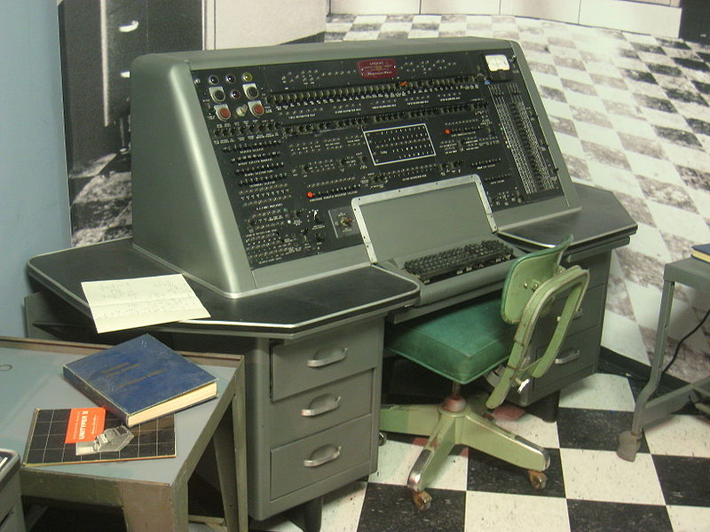
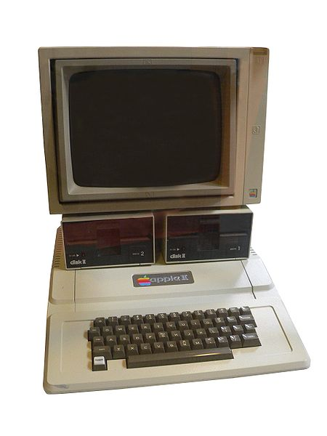
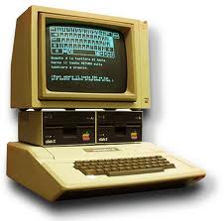
The Computer
1936: first freely programmable computer
1951: first commercial computer released
1974: first consumer computers (IBM)
1976:/1977 Apple I,II
1984: Apple Macintosh
1985: Microsoft Windows
Notes:
1936 Z1 Computer First freely programmable computer.
1951 UNIVAC Computer First commercial computer & able to pick presidential winners.

Slide 6

The Internet
1969: the original internet
1971: first email sent
1990: Archie, the first search engine
1991: Internet available for commercial use
1996: more email than post mail in the USA
: BackRub search engine (Stanford)
1997: Google (googol)

Slide 7
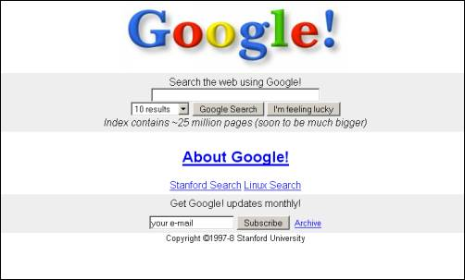

Slide 8
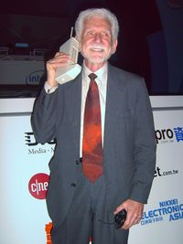
Mobile Phones
1973: Motorola cell phone created
April 3, 1973: first cell phone call made by Martin Cooper
1983: first cell phone available to consumers
1994: First smartphone
2001: First Commercial 3g Network
2007: First Iphone Released
2008: First Android phone released
Notes:
http://en.wikipedia.org/wiki/List_of_countries_by_number_of_mobile_phones_in_use
In the twenty years from 1990 to 2011, worldwide mobile phone subscriptions grew from 12.4 million to over 5.6 billion, penetrating the developing economies and reaching the bottom of the economic pyramid
China, the world's most populated nation, had been deemed the first country in the world to reach one billion mobile phone subscribers

Slide 9
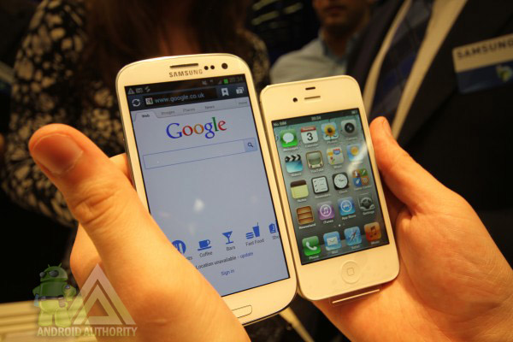
What is a Smartphone?
All in one device that can be used as a cell phone and has computing, PDA functions
Variety of applications available
High Speed Data Access
Multimedia

Slide 10
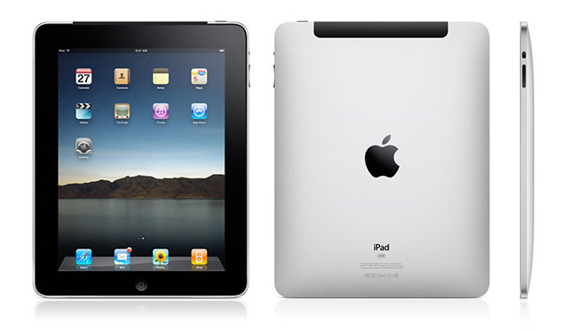
What is a Tablet?
Larger than a smartphone
Touchscreen used as primary method of input
Some typical functions are:
Mobile Browsing
Portable Media Player
Camera
Downloadable Apps

Slide 11
Industry Structure

Slide 12
Digital Revolution
1990:
Cell phone subscribers: 12.4 million (0.25% of world population)
Internet users: 2.8 million (0.05% of world population)
2002:
Cell phone subscribers: 1.174 billion (19% of world population)
Internet users: 631 million (11% of world population)
2010:
Cell phone subscribers: 5.4 billion (76% of world population)
Internet users: 1.9 billion (28% of world population)
2011:
Cell phone subscribers: 6 billion (87% of world population)
Internet users: 2.1 billion (30% of world population)
2012:
Cell phone subscribers: Predicted 6.5 billion by end of 2012 (92% of world population)
Internet users: 2.4 billion as of June 30th (33% of world population)

Slide 13


Digital Music
Integral component of many high tech devices
On the iTunes Store you can purchase
Music
Podcasts
Books
Apps
Google Music
Streaming Music Services

Slide 14

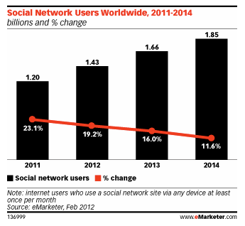
Social Media
Facebook, Twitter, YouTube, Myspace, etc
Notes:
March 20, 2011
social networking is reaching a saturation point in some age groups. A closer look at the graph reveals that the growth has been slowing down when compared to previous years and it is now expected to grow at a very small percentage till 2013. Year 2009-10 witnessed the highest jump in number of users while 2012-13 is expected to be the sluggiest of them all.
estimates nearly 150 million US web users will use social networks via any device at least monthly this year, bringing the reach of such sites to 63.7% of the online population. By 2013, 164.2 million Americans will use social networks, or 67% of internet users.

Slide 15
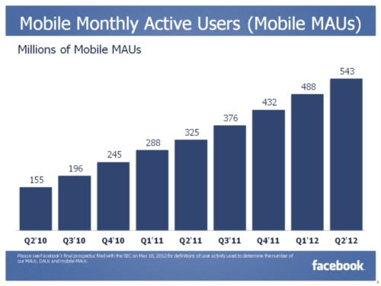
Social Media Goes Mobile
Social media will focus more on mobile devices in the next five years, including smartphones and tablet PCs.
Over 600 million active users of Facebook currently access Facebook through their mobile devices.

Slide 16
Trends in Usage
Growth of mobile phone and
Smartphone usage in developing countries
Mobile Payments: Becoming increasingly popular in both developed and developing countries
The Smartphone was originally for the business user, but now targets wider range of consumers
Movement towards internet-based computing solutions
Cloud Computing

Slide 17
00

Slide 18
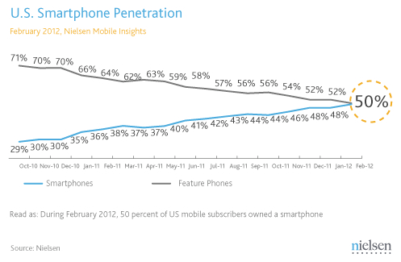

Slide 19
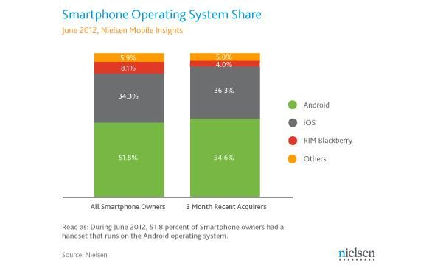
Notes:
United States

Slide 20
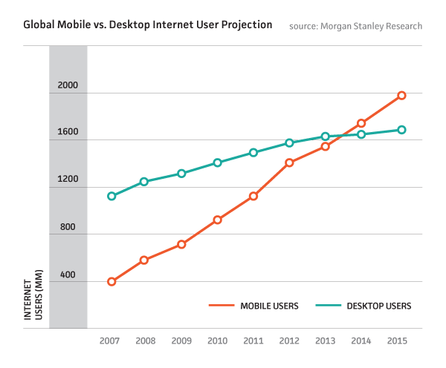

Slide 21
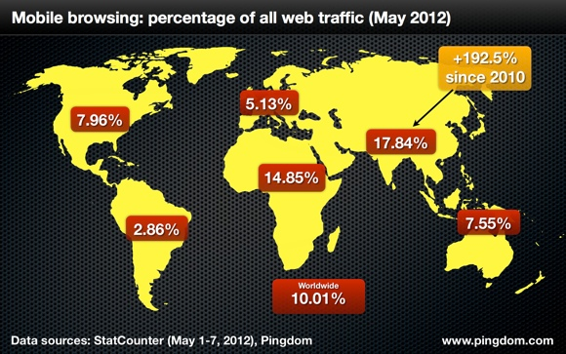

Slide 22
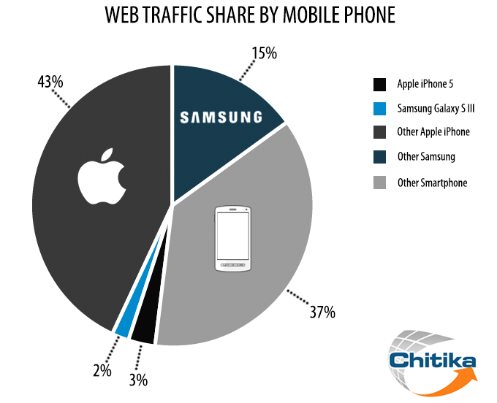

Slide 23
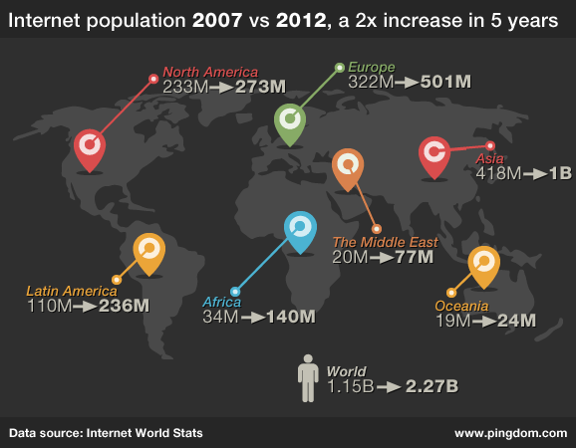

Slide 24
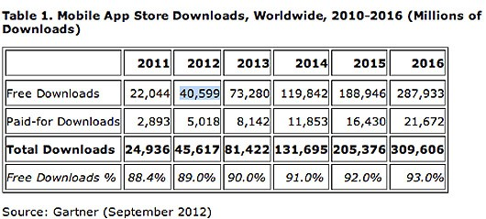
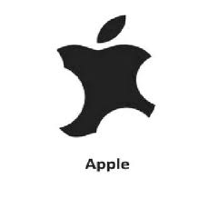
Battle on Apps
Increased market growth
Apple’s competitors increased their market share

Slide 25
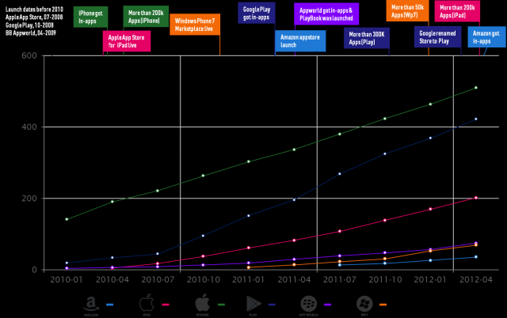

Slide 26
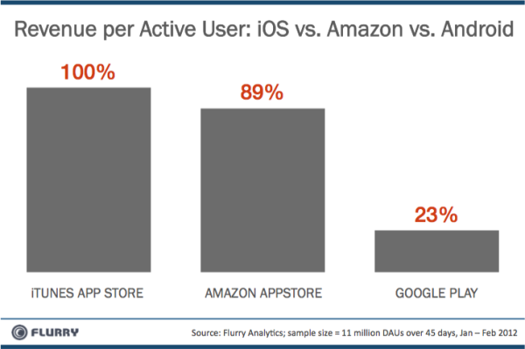

Slide 27
Legal environment
Constant battle between companies for patents
Patents crucial for success
Recent large lawsuits between Apple and Samsung
Potential future Lawsuits over LTE

Slide 28
Intangible Assets Cash
Important components of financial statements to consider
Intangible assets include goodwill, intellectual property
A large amount of cash is common - representation of current performance of the company
Notes:
Intellectual property
Protected by patents, trademarks, copyrights
Human capital

Slide 29
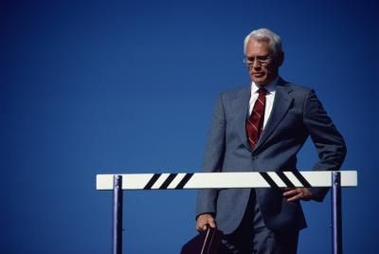
Barriers to Entry
Patents
Capital
Customer Loyalty
Economy of Scale
R and D

Slide 30
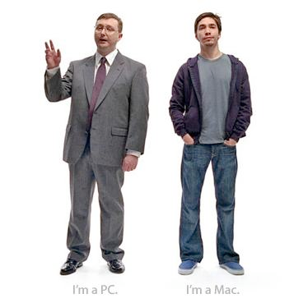
Competition
Market dominated by small number of very large companies
Profits are extremely high
Rapid change in Market Shares

Slide 31
Products
Smartphones
Smartphone Operating Systems
Tablet PCs
Apps

Slide 32
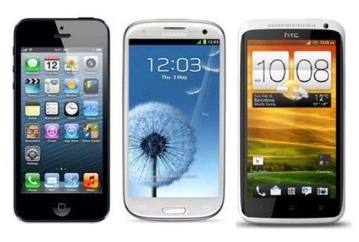
Smartphones
Notes:
http://www.gforgames.com/gadgets/iphone-5-vs-samsung-galaxy-s3-vs-htc-one-x-navigates-faster-25926/
http://retrocell.ca/index.php?main_page=index&manufacturers_id=1

Slide 33
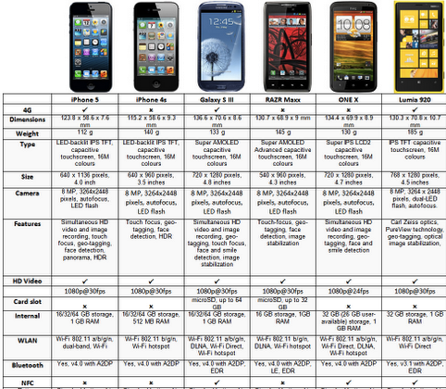
Notes:
https://lh3.googleusercontent.com/-3l8ebfS6ut4/UFIQEikSbMI/AAAAAAAAJ7I/0eObyJ5vFTQ/smartphone%2Bcomparrison.png

Slide 34
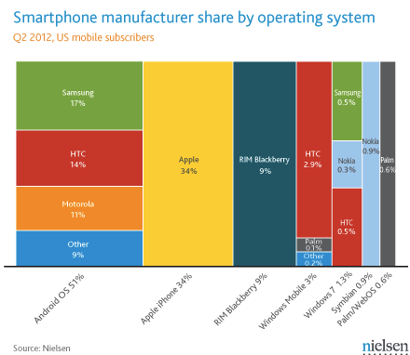
Notes:
http://www.google.ca/imgres?q=smartphone+manufacturer+market+share+2012&um=1&hl=en&sa=N&biw=1007&bih=683&tbm=isch&tbnid=JX8jcXgHX48ghM:&imgrefurl=http://www.talkandroid.com/122207-android-and-samsung-continue-to-dominate-smartphone-market-share/nielsen_q2-2012-us-smartphone-manufacturers-share/&docid=wyTC1JbwKba_tM&imgurl=http://www.talkandroid.com/wp-content/uploads/2012/07/Nielsen_Q2-2012-US-Smartphone-manufacturers-share.png%253F3995d3&w=459&h=404&ei=QcNpUNjxCoPKiwKgiYDIDA&zoom=1&iact=hc&vpx=398&vpy=309&dur=600&hovh=211&hovw=239&tx=121&ty=110&sig=101773451168038558016&page=1&tbnh=143&tbnw=163&start=0&ndsp=13&ved=1t:429,r:6,s:0,i:90
Apple narrowly increased its lead as the top smartphone maker by operating system vendor share in the three-month period ended in October. Apple’s iPhone represented 28.6% of the market during that period compared to28.3% between July and September. Android again showed the biggest market share gains of any smartphone platform, growing its market share to 44.2% from 42.8% in the third quarter.
RIM’s platform dropped from a 17.8% share in the third quarter to an even 17% between August and October, and Microsoft’s combined share dipped to 5.3% from 6.1%. Nielsen noted that in 2009, RIM’s BlackBerry line was the most popular smartphone range in the U.S.

Slide 35
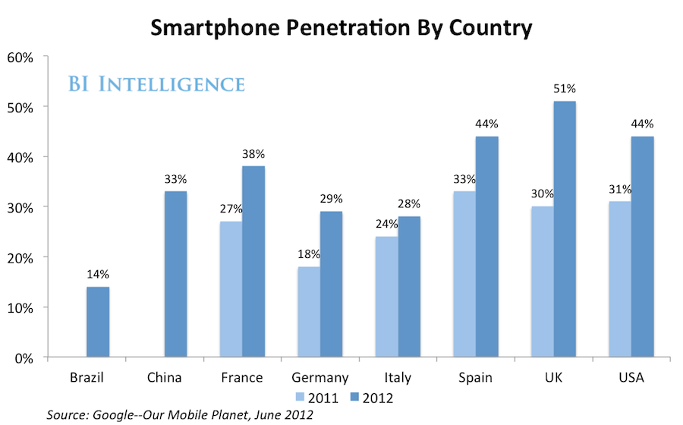
Notes:
http://www.businessinsider.com/us-smartphone-market-2012-9
According to recent smartphone penetration statistics from several sources including Netsize Guide, Informa, Google, Ipsos, and Go-Gulf.com, it is concluded that by December 2011, Singapore is the champion in terms of smartphone penetration, and also is the world's first country that have more smartphone than feature phone in used.

Slide 36
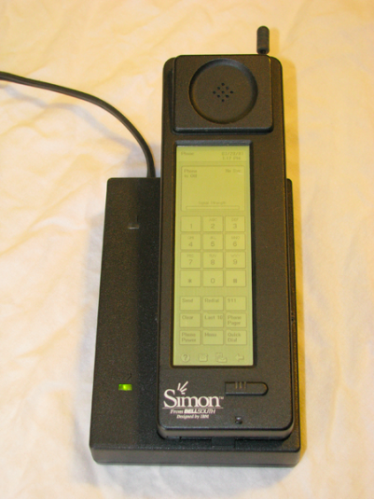
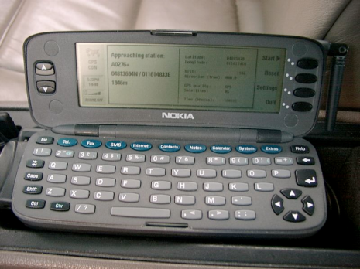
Evolution of the Smartphone?
1992: Simon
Created by IBM
Touch screen, fax, email, predictive keyboard
1996: Nokia 9000
2002: Handspring Treo 180 (Palm OS)
2002: Blackberry
2007: iPhone
2008: First Android OS phones

Slide 37
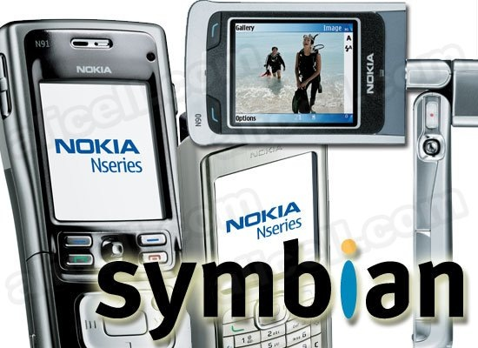
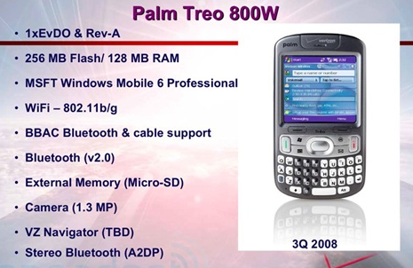
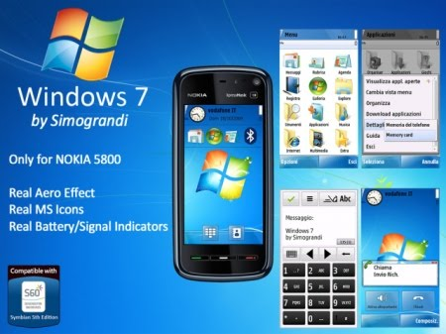
Smartphone Operating Systems
Symbian Ltd.: Symbian
Popular outside of the United States
Acquired by Nokia in 2008
Palm, Inc.: Palm
Initially designed for PDA’s
Microsoft: Windows Phone 7
Replacing Windows Mobile

Slide 38
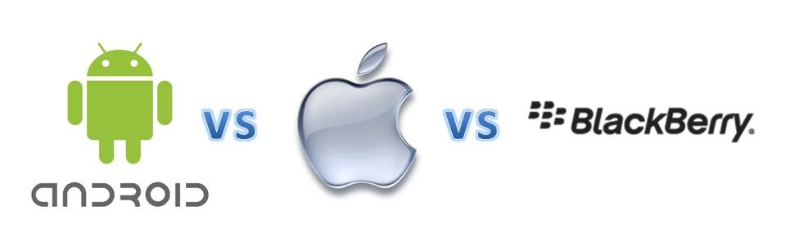
Pros
Android | Apple | Blackberry
Multi-tasking Functions | User Friendly | Security
Notification System | Desktop Syncing | QWERTY Keyboard
Open-Platform for Development | Large App Store

Slide 39
Cons
Android | Apple | Blackberry
Poor Battery Life | Non-Customizable | Lack of Apps
OS Variations | Maps Application | Outdated OS
Lack of Quality Control for Apps | No Flash Capabilities | Small Screens

Slide 40
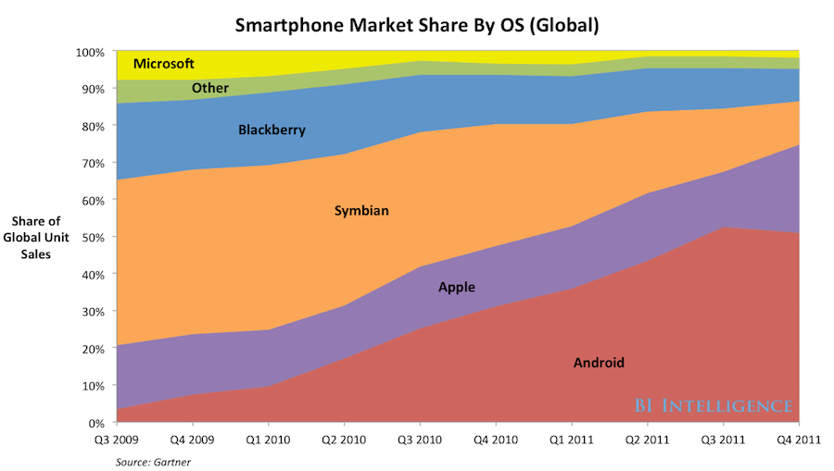
Notes:
http://articles.businessinsider.com/2012-02-29/research/31109566_1_smartphones-pc-sales-mobile-phone-sales/2

Slide 41
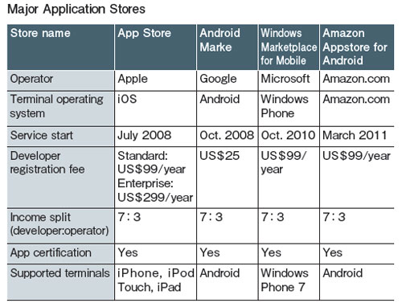
Smartphone Operating Systems

Slide 42
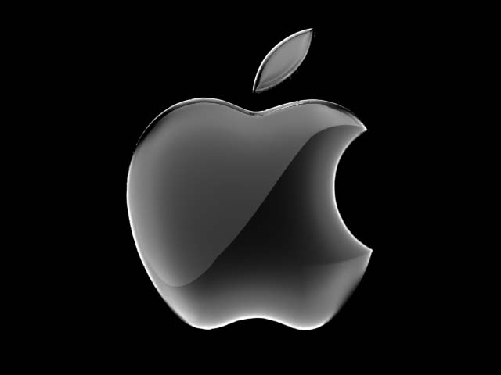
Smartphone Operating Systems
Apple, Inc. - iPhone OS
Mobile version of Mac OSX
Multi-TouchTM user interface
Third-party developed applications
User-Friendly

Slide 43

Smartphone Operating Systems
Google Android OS
Based on Linux Kernel
Created by Android Corporation; purchased in July 2005 by Google
Multi-touch and media feature
Open-Platform

Slide 44

Smartphone Operating Systems
RIM: Blackberry
Popular among business professionals
Unique push-email feature
Traditionally secure network
Third party applications

Slide 45
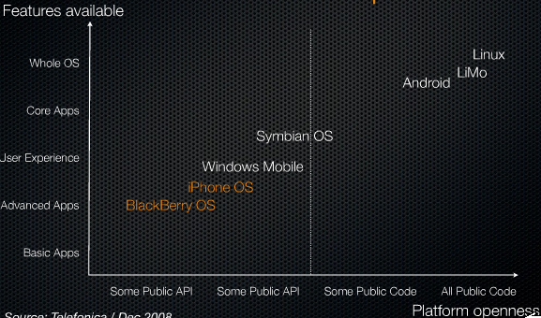
Market Positioning Diagram

Slide 46
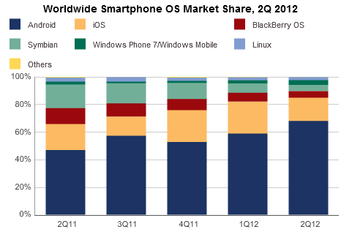
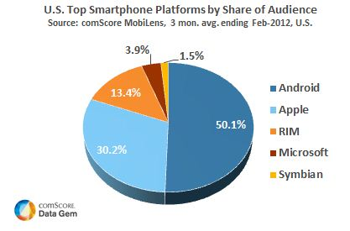
Smartphone Market Share
Notes:
Apple has higher share in US than samsung, and less globally
http://arstechnica.com/apple/2012/08/apple-owns-us-smartphone-market-while-samsung-dominates-worldwide/
http://www.comscoredatamine.com/2012/04/android-captures-majority-share-of-us-smartphone-market/

Slide 47
Mobile and Smartphone usage:
Growth of mobile phone and Smartphone usage in developing countries
The Smartphone was originally for the business user
March 2012: 140 million Americans own Smartphones
Notes:
Mobile browsing represents 2.8% of all browsing

Slide 48
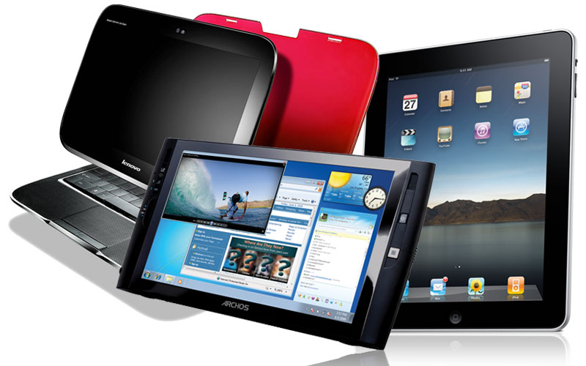
Tablet PC:
Combines the Smartphone, laptop and PDA
Apple iPad 1 , 2, 3 & Mini
Blackberry Playbook
Samsung Galaxy Tab 1 & 2
Motorola Xoom
Hp TouchPad
LG Optimus Pad
HTC Flyer
Asus transformer pad infinity
Amazon Kindle Fire
Nexus 7
Notes:
The Kindle Fire is a tablet computer version of Amazon.com's Kindle e-book reader. Announced on 28 September 2011, the Kindle Fire has a color 7" multi-touch display with IPS technology and runs a forked version of Google's Android operating system. The device—which includes access to the Amazon Appstore, streaming movies and TV shows, and Kindle's e-books—was released on November 15, 2011.
The Kindle Fire retails for US$199.
Analysts have projected the device to be a strong competitor to Apple's iPad,^{[8][11]} and that other Android device makers will suffer lost sales.^{[12][13]}Amazon's business strategy is to make money on the selling of digital content on the Fire, rather than through the device itself.
customers purchased over 1 million Kindle devices per week.^{[18]} Analysts had estimated that over 6 million Amazon Kindle Fire tablets would be sold in the fourth quarter of 2011.^{[19]}
Rumor: Nexus(google choosen asus) tablet is a “done deal”, to retail as low as $149
Google is building a 7-inch "Nexus tablet" with Asus that will possibly be cheaper than the $200 Kindle Fire and come with the next version of Android.
The "confirmation" (and we suggest you treat it as a highly suspect rumor until Google officially confirms the news themselves) comes from Android and Me.
According to Android and Me, an anonymous "senior employee at a supply chain company based in the United States" has told the tech blog that Asus is scrapping plans to release the 7-inch MeMo 370T Android tablet that it unveiled at CES. Instead, it's using that tablet as a template for Google's official tablet.
Pricing is said to be much lower than the $250 price point that Digitimes reported last week — coming in at a possible $150 to $199 price.
At such a low price, the Google tablet would essentially undercut the Kindle Fire and Nook Tablet's $200 to $250 pricing, setting it up to be an "impulse buy" for many consumers who haven't hopped on the tablet bandwagon.
The mobile trend doesn’t just bring joy to mobile ad companies, it also boosts the adoption rate of social sites like Twitter and facebook. ??

Slide 49
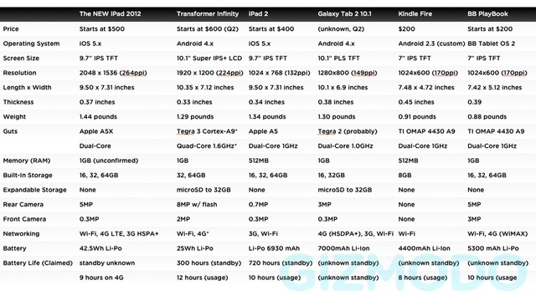
Tablet PC
Notes:
The new iPad pretty much beats everything else in the chart. It's hard to see a single compelling reason to take the Galaxy Tab 2 10.1 over it or the Transformer (other than price). Amazon's Kindle Fire and BlackBerry's Playbook likewise get chomped, but here at least there is a significant difference in price. $200 is very cheap. For people who primarily want a tablet for reading books and watching the occasional movie, the Kindle Fire might just be a more frugal investment.
iPad starts is $500, $600, or $700 for the 16GB Wi-Fi only version at 16, 32, and 64GB, respectively. For Wi-Fi plus 4G it's $630, $730, and $830, for the the 16, 32, and 64GB versions, respectively.

Slide 50
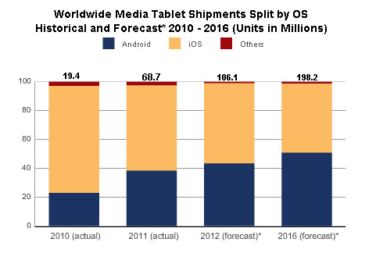
Tablet PC
Notes:
Apple iOS
Google Android
Others: RIM QNX
The “new” iPad goes on sale, March 16th, and is still “King of the Tablets.” However, sales for Q3 2011 show Apple dropping in worldwide tablet marketshare for the first time–impacted by the Kindle Fire. A new study by the IDC predicts Android and iOS will split the tablet market share in half by 2016, with other manufacturers holding a marginally small share.
Alex Cocotas of BI Intelligence predicts that smartphone sales will be twice that of PC sales this year and that smartphone sales will reach 1.5 billion units by 2016.
IDC forecasts that while the iPad will remain dominant for the foreseeable future, Google's tablet OS will overtake Apple in market share in 2015. However, said Mainelli, "We expect iOS to remain the revenue market share leader through the end of our 2016 forecast period and beyond."

Slide 51
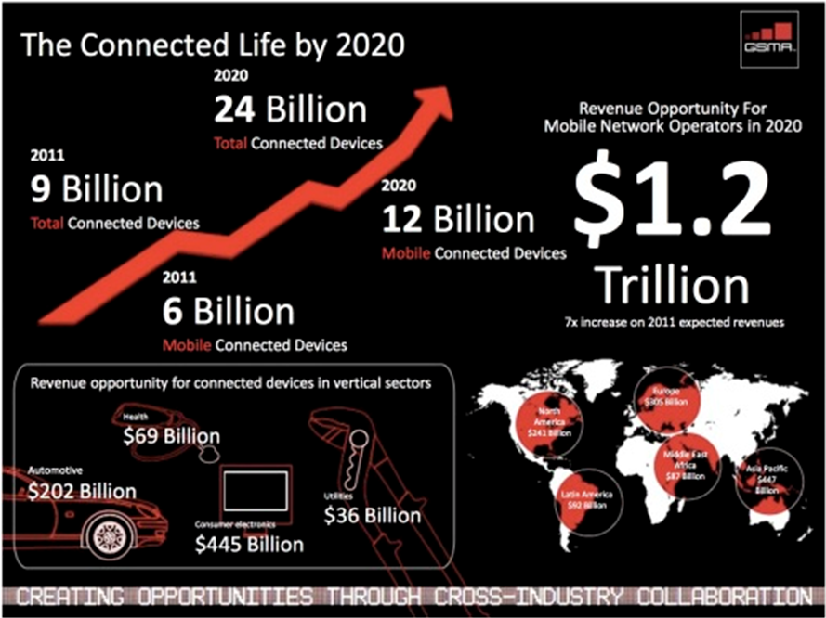
A Mobile, Post-PC world
Notes:
http://www.hl7standards.com/blog/2012/03/15/the-future-is-quantified/
A mobile, Post-PC world
It’s hard to imagine that the iPad didn’t even exist only two years ago, and now more than 40 million have been sold. With the iPad, we saw a Super Mobile revolution that launched the BYOD, “Bring Your Own Device”, trend and a Post-PC world.
The “new” iPad goes on sale, March 16th, and is still “King of the Tablets.” However, sales for Q3 2011 show Apple dropping in worldwide tablet marketshare for the first time–impacted by the Kindle Fire. A new study by the IDC predicts Android and iOS will split the tablet market share in half by 2016, with other manufacturers holding a marginally small share.

Slide 52
Apps
Specific to particular OS, but versions may be made for various OS
Available through “app stores”
Creators of applications may be contracted to produce apps for a particular OS, but many are not
Quickly growing market

Slide 53
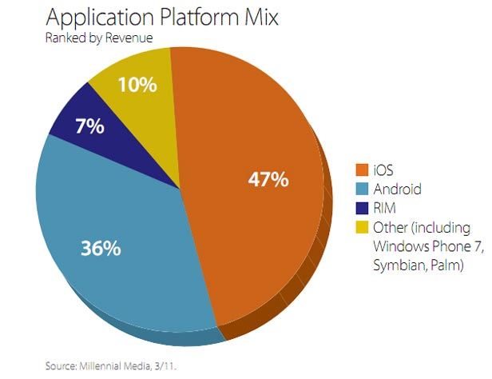
Apps

Slide 54
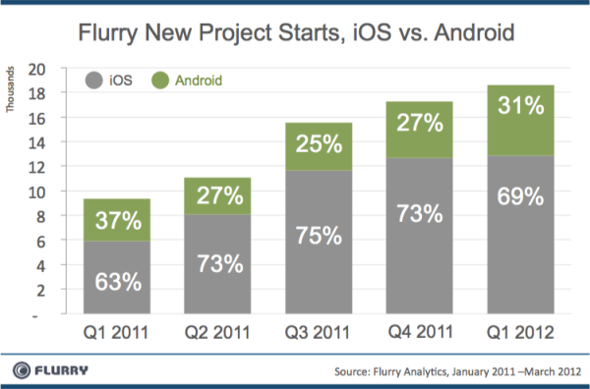
Apps
Notes:
Comparison between iOS Appsand Android Apps Revenue Sharing, it’s revealed that iOS Apps are much profitable in terms of revenue as compare to Android Apps. iOS Apps make four times higher revenue as compare to Android platform. Android is an open source platform and many big phone maker companies like Samsung, Motorola, Sony etc. is now offering Android devices but the statistic makes it clear that Apple iOS is still more popular platform in terms of Apps Revenue as compare Android platform.
http://www.bgr.com/2012/06/07/ios-android-developers-apps-apple-ipad/

Slide 55
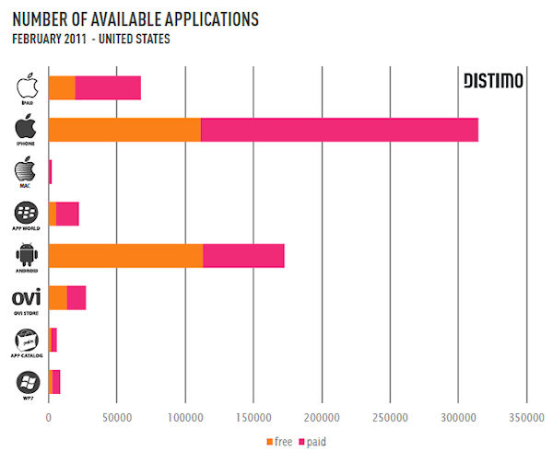
Notes:
http://hexus.net/mobile/news/apple/29636-mac-app-store-revenue-almost-half-ipads/

Slide 56
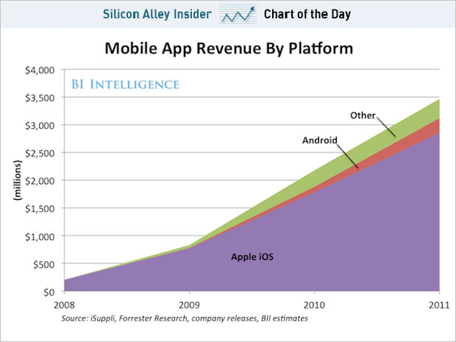
Notes:
http://www.businessinsider.com/chart-of-the-day-the-app-economy-is-35-billion-2012-6

Slide 57
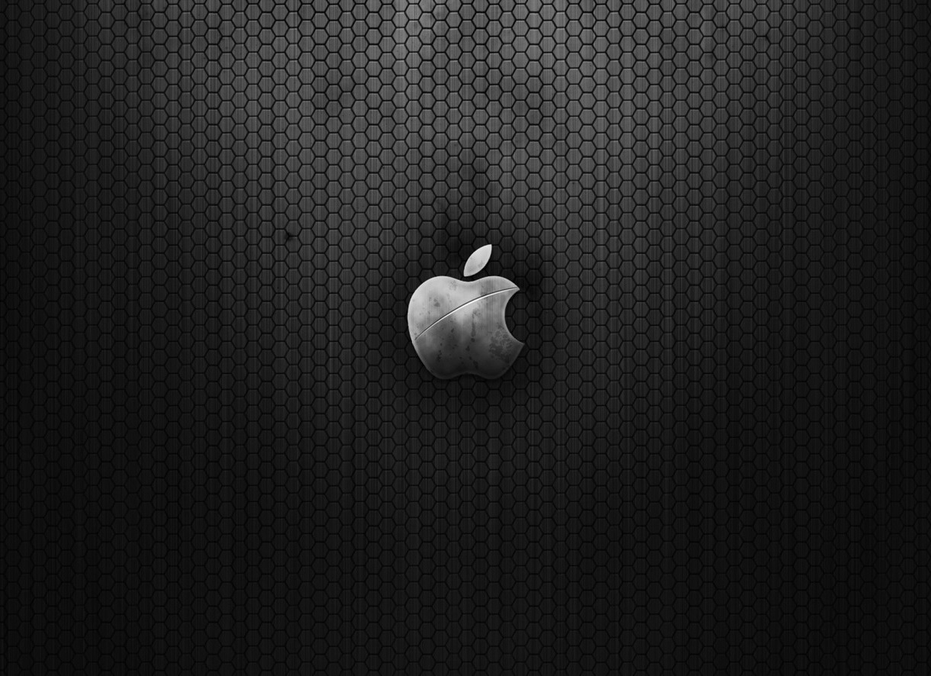
Apple Inc.

Slide 58
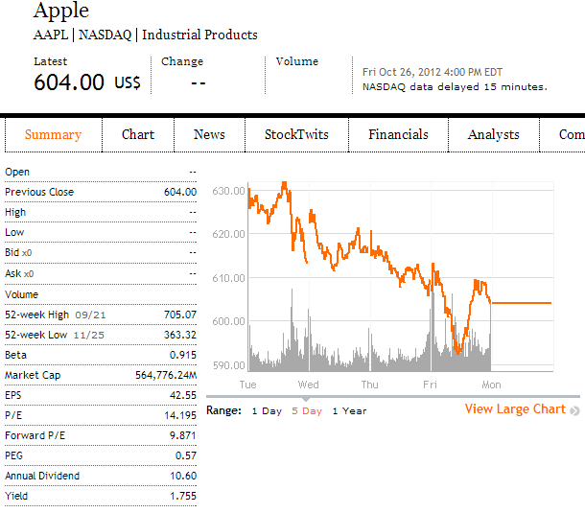
Financial Snapshot
Shares Outstanding: 932,370,000

Slide 59
Common Share Structure
 | Current | 2011 | 2010 | 2009 | 2008
Shares Outstanding (Millions) | 939.21 | 932.37 | 915.97 | 889.81 | 888.33
Common stock, no par value; 1,800,000 shares authorized; 939,208 and 929,277 shares issued and outstanding, respectively
(Source: Apple Inc. 10-K)

Slide 60
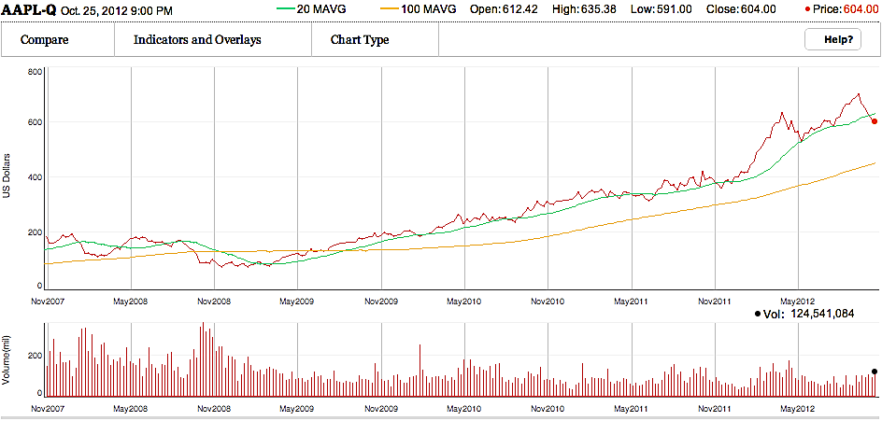
5 Year Stock Performance
Source: Globe Investor

Slide 61
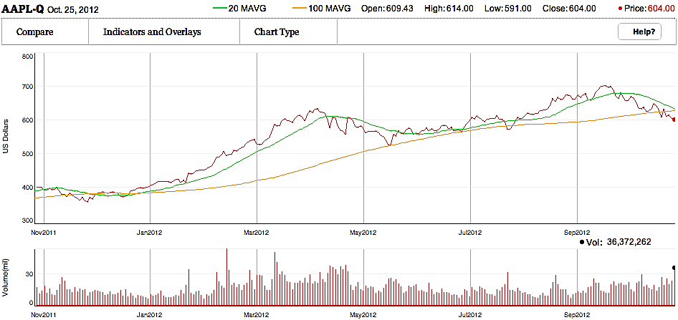
1 Year Stock Performance

Slide 62
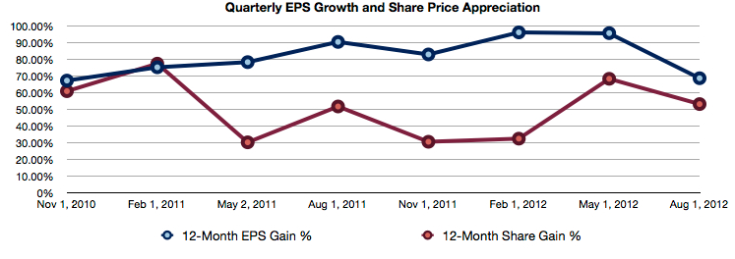
Apple’s Current Valuation
Notes:
http://www.postsateventide.com/2012/08/apple-price-target-950-per-share.html

Slide 63
Company Overview

Slide 64
Company Profile
Apple Inc. (formerly Apple Computer, Inc.) founded by Steve Jobs, Steve Wozniak and Ronald Wayne (1976)
Design, manufacture, and market personal computers and related personal computing and mobile communication devices
Sell its products worldwide through its online stores, its retail stores, its direct sales force, third-party wholesalers, and resellers
Headquartered in Cupertino, California

Slide 65
Mission Statement
Apple designs Macs, the best personal computers in the world, along with OS X, iLife, iWork and professional software. Apple leads the digital music revolution with its iPods and iTunes online store. Apple has reinvented the mobile phone with its revolutionary iPhone and App Store, and is defining the future of mobile media and computing devices with iPad.

Slide 66
Products and Services
iPhone
iPad
Mac
iPod/iTunes
Apple TV
iOS and Mac OS X operating systems
iCloud
Accessories, software, and warranties

Slide 67

iTunes Revenue
Sales of third-party digital content such as:
Digital music
Podcasts
Movies and TV shows
Audio books
Manage contents on iPod, iPhone, iPod Touch and iPad
“iTunes store revenue was $1.8 billion for the third quarter of 2012, which is down $100 million from last quarter, in which Apple took in $1.9 billion.” (VentureBeat)

Slide 68

The App Store
Allows users to browse and download applications from the iTunes Store directly on their computer or mobile device
30% of revenue from the store goes to Apple and 70% go to the producer of the app.

Slide 69
iBookstore
An e-book application
Allows users to download and read books directly onto their mobile devices
A new app, iBooks Author, was announced for the App Store, allowing anyone to create interactive textbooks for reading in iBooks; and the iBookstore was expanded with a textbook category

Slide 70

Milestones

Slide 71







Recent Milestones
Jan 2012
Announced best quarterly results for a tech company ever
Sep 2012
iPhone 5 released
Aug 2011
Tim Cook becomes CEO
Oct 2011
Steve Jobs dies
Oct 2012
iPad Mini released
Mar 2012
3rd generation iPad released

Slide 72
Key Company Trends
Global Growth
Key Product Growth (Revenue Trends)
Litigation (10-K)

Slide 73

Key Product and Regional Growth (Quarterly)
(in millions) Source: Apple 8-K

Slide 74

Key Product and Regional Growth (Annually)
(in millions) Source: Apple 10-K

Slide 75

Global Revenue Composition
Source: techcrunch.com

Slide 76

Revenue Distribution 2007-2012
Source: Silicon Alley Insider
Notes:
In 2007, iPod was the main revenue source for Apple company. Now, iPhone and iPad are the main revenue source of Apple Inc.

Slide 77
Apple Inc. v. Samsung Electronics Co., Ltd.
Apple filed on April 15, 2011
Claimed Samsung infringed Apple’s intellectual property on its phones and tablets
Samsung counter-sued one week later
By July 2012, they were engaged in 50 lawsuits around the globe
Both companies attempting to ban rival’s products that infringe certain patents
On August 24, 2012, Apple was awarded $1.049 billion in damages in U.S. case; Samsung’s counter suit dismissed

Slide 78

Effect on Apple’s stock
Damages awarded

Slide 79
Key Issues
Future growth
Cash and dividend decisions

Slide 80


Earnings Forecast
Notes:
http://investing.businessweek.com/research/stocks/earnings/earnings.asp?ticker=AAPL

Slide 81


Earnings Forecast
Notes:
http://investing.businessweek.com/research/stocks/earnings/earnings.asp?ticker=AAPL

Slide 82
Stagnant Product Growth
 | iPhone 5 16GB/32GB/ 64GB | iPhone 4S 16GB/ 32GB/ 64GB | iPhone 4 16GB/ 32GB | iPhone 3GS 16GB/ 32GB | iPhone 3G 8GB/ 16GB | iPhone 4GB/8GB
Screen Size | 4 | 3.5 | 3.5 | 3.5 | 3.5 | 3.5
Resolution | 1136x640 | 960x640 | 960x640 | 480x320 | 480x320 | 480x320
Processor | Apple A6 | Apple A5 | 1 Ghz Apple A4 | 600 Mhz Samsung ARM Cortex | 412 Mhz Samsung ARM | 412 Mhz Samsung ARM
Max Connectivity | 4G LTE | 3G | 3G | 3G | 3G | EDGE
Max. OS | iOS 6 | iOS 6 | iOS 6 | iOS 5 | iOS 4, limited | iOS 3
Camera | 2 cameras: 8 Megapixel & 720p HD | 2 cameras: 8 Megapixel & VGA | 2 cameras: 5 Megapixel & VGA | 3 Megapixel | 2 Megapixel | 2 Megapixel
Records Video? | 1080p HD at 30 fps | 1080p HD at 30 fps | 720p HD at 30 fps | VGA at 30 fps | No | No
FaceTime | Yes | Yes | Yes | No | No | No
Siri | Yes | Yes | No | No | No | No
Weight (ounces) | 3.95 | 4.9 | 4.8 | 4.8 | 4.7 | 4.8
Size** | 4.87 x 2.31 x .30 | 4.5 x 2.31 x .37 | 4.51 x 2.31 x .37 | 4.5 x 2.4 x .48 | 4.5 x 2.4 x .48 | 4.5 x 2.4 x .46
Battery Life (in hours) | Talk: 8 Video: 10 Web: 10 Audio: 40 | Talk: 8 Video: 10 Web: 9 Audio: 40 | Talk: 7 Video: 10 Web: 10 Audio: 40 | Talk: 5 Video: 10 Web: 9 Audio: 30 | Talk: 5 Video: 7 Web: 5 Audio: 24 | Talk: 8 Video: 7 Web: 6 Audio: 24
Notes:
http://ipod.about.com/od/decidingwhichipodtobuy/a/iphone_chart.htm

Slide 83

Losing Competitive Edge?

Slide 84


Slide 85
iOS 6 Maps Upgrade
The Globe and Mail reported on September 28, 2012 that “Apple CEO Tim Cook says the company is “extremely sorry” for the frustration its Maps application has caused” and that that Apple “fell short”
Users complained that “the new map software offers fewer details, lacks public transit directions and misplaces landmarks, among other problems”
Notes:
http://www.theglobeandmail.com/technology/tech-news/apple-ceo-extremely-sorry-about-maps-failure/article4574167/

Slide 86


Stock Price Drop Following iPhone 5 and iOS 6 Release
Sept 26
$665.18
Sept 21
$700.09
*iOS 6 released for iPhone 4 and 4S on September 19, 2012

Slide 87
iPad mini
Apple has lost market share due to its high price
CNET: “The spike [of Samsung Galaxy tablet sales] after the [iPad mini] launch suggests that consumers hung around to see what Apple had to show off, weren't impressed, and went with a Galaxy instead.”
Digital Journal: “Amazon's Kindle Fire sales also took a leap upon the release of the iPad Mini… Based on the current releases, it appears Apple has run out of ideas for what to produce next with each generation of iPhones and iPads bug prone and expensive.”
Notes:
http://www.digitaljournal.com/article/335696

Slide 88
iPad mini
eWeek: “The sell-out of both editions suggests that despite a higher-than-expected $329 starting price, consumers really want to get their hands on an iPad mini.”
“A recent IHS report said the iPad Mini could help the 7-inch tablet market double in size in 2012 and 2013, if Apple could provide enough iPad mini tablets to meet market demand.”
“With its foot now firmly planted in the 7-inch tablet space, and the full-size iPad still commanding nearly 70 percent of the worldwide tablet market, Apple’s position is undoubtedly robust…and we believe the iPad mini significantly expands Apple’s tablet addressable market internationally and should lead to strong sales throughout the holiday season and F2013 as international distribution increases”
Notes:
http://www.eweek.com/mobile/ipad-mini-black-version-sells-out/

Slide 89

Cash
$121.25B in cash reserves
Notes:
Apple 10-Q

Slide 90

Notes:
http://www.businessinsider.com/apple-cash-balance-2013-2012-6

Slide 91
Dividends
On March 19, 2012, Apple announced plans to issue a quarterly dividend of $2.65 per share in Q4 2012
Apple also announced a $10 billion share repurchase plan starting in fiscal 2013
An attempt to neutralize the impact of dilution from future employee equity grants and employee stock purchase programs
Predict using approximately $45 billion of domestic cash in the first three years of the programs
Re-announced $2.65 dividend on October 25, 2012, payable November 15, 2012
Notes:
http://www.apple.com/ca/pr/library/2012/03/19Apple-Announces-Plans-to-Initiate-Dividend-and-Share-Repurchase-Program.html

Slide 92

Effect on Share Price
Dividend
paid
Dividend
declared
Notes:
http://www.apple.com/ca/pr/library/2012/03/19Apple-Announces-Plans-to-Initiate-Dividend-and-Share-Repurchase-Program.html

Slide 93
Management

Slide 94

Steve Jobs (1955-2011)
Previous CEO and Co-founder of Apple Inc.
Business icon and inventor
Born in Silicon Valley
Had a volatile past with Apple but helped the company significantly once returning in 1997
Diagnosed with pancreatic cancer in 2003
Resigned as CEO on August 24, 2011
Past away on October 5, 2011

Slide 95
CEO: Tim Cook
Named the CEO of Apple on Aug 12, 2011
Previous Chief Operating Officer
B.S. Degree in industrial engineering from
Auburn University in 1982
MBA from Duke University's Fuqua School
of Business in 1988
Earned top salary for 2011 with $378 million
(majority came in a grant of a million restricted stocks units worth $376 million)
Has led the releases of the iPhone 5 and
iPad mini to mixed reviews

Slide 96

Scott Forstall
Senior vice president of iPhone Software
Responsible for delivering the software for iPhone, including the user interface, applications, and operating system
One of the original architects of Mac OS X
Joined Apple in 1997
Earned a Bachelor Degree of Science in
Symbolic Systems and a Master Degree of
Computer Science from Stanford
Will be leaving the company sometime next year, possibly due to the recent problems with Apple Maps

Slide 97

Eddy Cue
Senior Vice President, Internet, Software and Services
Oversees Apple's content stores including the iTunes Store, the App Store and the iBookstore, as well as iAd and Apple's iCloud services.
With Apple for 23 years
Earned a Bachelor Degree in Computer Science and Economics from Duke University
Will be taking over Scott Forstall’s previous responsibilities with iOS software

Slide 98

Jonathan Ive
Senior Vice President, Industrial Design
Design team leader since 1996
Lead designer of many products such as the MacBook Pro, iMac, MacBook Air, iPod,
iPhone and iPad
Numerous design awards
2003 Designer of the Year by the Design Museum London
B.A and an honorary doctorate from
Newcastle Polytechnic

Slide 99

Bob Mansfield
Senior Vice President, Hardware Engineering
Joined Apple in 1999
Has delivered dozens of breakthrough Mac products, including the MacBook Air and the all-in-one iMac line
A BSEE degree from The University of Texas
in 1982

Slide 100

Philip Schiller
Senior Vice President, Worldwide Product Marketing
Responsible for product marketing, developer relations, and business marketing
With Apple since 1997
Over 24 years marketing experience
B.Sc in Biology from Boston College

Slide 101
Financial Analysis

Slide 102
Quarterly Balance Sheet

Slide 103
Annual Balance Sheet

Slide 104

Annual Income Statement

Slide 105

Quarterly Income Statement

Slide 106
Annual Cash Flow Statement

Slide 107

Quarterly Cash Flow Statement

Slide 108
Expectations
Yahoo! Finance: “There are still hundreds of millions of potential new customers for the products Apple has already launched. China Mobile, for example, has yet to strike a deal to sell the iPhone to its hundreds of millions of subscribers, and when it does, Apple will have access to a huge new market.”
Seeking Alpha: “Apple is of interest to investors based on its healthy financials, which reveal it is undervalued.”
Notes:
http://finance.yahoo.com/blogs/daily-ticker/ignore-apple-quarter-analyst-says-stock-still-buy-151729869.html
http://seekingalpha.com/article/949831-is-apple-a-buy

Slide 109

Stock Forecast
Notes:
http://money.cnn.com/quote/quote.html?symb=AAPL

Slide 110
Recommendation
BUY

Slide 111


Slide 112

Financial Snapshot
Notes:
Stock price, current trend
EPS, P/E, market Cap

Slide 113
Common Share Structure
Common Shares Outstanding: 327.03 Million
Class A
- 1 vote per share
- July 2012: 261.97 million shares outstanding
Class B
- 10 votes per share
- Only available to Google insiders and executives
- July 2012: 65.06 million shares outstanding
Notes:
Introduce Common Share Structure:
Dual-class Share Structure, basically wanting to maintain control but still acquire funds from public
- Class A, Class B (executive exclusive)

Slide 114

Max Chart
Notes:
- Cover the points where the stock was at the highest

Slide 115

1 Year Chart
Notes:
- Cover the trend with this year, low and high points, and current trend

Slide 116

5 Year Chart
Notes:
- Ever since the low in Nov 2008, the general trend is upward, relate high points to company milestones and events

Slide 117

Google vs. Nasdaq
Notes:
The Nasdaq Composite is a stock market index of the common stocks and similar securities (not exclusive to common stocks) listed on the NASDAQ stock market, has over 3,000 components.
highly followed in the U.S. as an indicator of the performance of stocks of technology companies and growth companies.

Slide 118

Google vs. S&P Info Tech

Slide 119

Google vs. Dow Jones Internet Composite

Slide 120

Google vs. Moving Averages

Slide 121
Milestones
1996
Larry Page and Sergey Brin create a search engine as a research project
Featured a very efficient algorithm dubbed “PageRank”
Called BackRub initially
Originally, Google ran under the Stanford University website, with the domain google.stanford.edu
1998
Incorporated in Menlo Park, California
1999
Obtained funding from venture capital firms Kleiner Perkins Caufield & Byers, and Sequoia Capital. Officially launched as a site.
Notes:
Google started out in 1996 as a research project by Larry Page and Sergey Brin when they are doing their PhD in Stanford, it was basically a search engine with an algorithm called pageRank.

Slide 122
Milestones
2000
Began selling advertisements- paid web links associated with search keywords
2001
Eric Schmidt becomes CEO and Chairman of the Board
“PageRank” granted a patent
2003
Re-incorporated in Delaware
2004
Initial Public Offering that raised $1.67 billion
19,605,052 shares sold
$85 per share
Conducted via Dutch auction

Slide 123
Milestones
Oct 2007
Share price hits $700 for the first time
July 2011
Google+ reaches 25 million users only 4 weeks after its launch in June 2011
May 2011
unique visitors of Google surpassed 1 billion mark for the first time
Oct 2012
Google is the dominant search engine globally- 88.8% market share
Currently the most visited site in the world

Slide 124
Key Acquisitions
Apr 2003: Applied Semantics - Leads to the launch of Google AdSense
Jul 2004: Picasa Inc. Digital photo management
Oct 2004: Keyhole Corp. - Leads to launch of Google Maps and Google Earth.
Aug 2005: Android
Oct 2006: Youtube
Mar 2008: Doubleclick. Enhances the company’s advertising revenue.
Aug 2011: Motorola for $12.5 billion.
Notes:
Applied semantics: a producer of software applications for online advertising, domain manes and enterprise info mgmt marketing
- Picasa: has since became one of the most used photo organizer and viewer in the world
Android: the top operating system with mobile and tablet along with Apple’s IOS
Youtube
DoubleClick – developer and provider of internet ad servicing to advertising agencies and media companies

Slide 125
Major Acquisitions in 2012
Jun 2012: Meebo
Jun 2012: Quickoffice
Jul 2012: Sparrow
Aug 2012: Wildfire Interaction

Slide 126

Revenue Sources

Slide 127
AdWords
Advertisers create ads to show alongside Google search results
Advertisers “bid” in an auction to have their ads displayed alongside certain specific keywords
- Pay per click
- Cost-per-thousand

Slide 128


Google Maps Ads

Slide 129
AdSense
Google partnerships with publishers within Google Network Members, who sell the ad space of their websites
Ads are shown on publishers’ websites in terms of relevancy to their products
Google shares profits with the website publishers
- Per click
- Per impression

Slide 130

Google Network Ads

Slide 131
Products and Services
iGoogle
Google+
Google Search
Google Image
Google Ads
Google Docs
Google Finance
Google Photos
Google Calendar
Google Scholar
Google Books
Google Chrome
Google Chrome OS
Gmail
Google Wallet
Google TV
Google Translate
Google Ventures
Google Patent Search
Google Maps
Google Earth
Android mobile OS
Google Play
Google Blog Search
Blogger
YouTube

Slide 132

Gmail
Features:
- First e-mail service that gave users one gigabyte of storage space
- First e-mail service to group e-mails from the same conversation into one thread
- Interactive webpages that don’t require a refresh

Slide 133
Google+
New social network competing with Facebook and Twitter
Video Hangouts
Hangouts over the phone and on air
Within the first 90 days of launch, 100 features present
Share circles
Allows one to limit information shared to certain circles
Over 90 million users worldwide

Slide 134

YouTube
The biggest video site in the world
More and more mobile viewers
Google has established partnerships with content companies to aid in monetizing video in the mobile space

Slide 135

Android Mobile OS
Open source
Promotes development of new apps (using Java)
Based off of Linux OS
Nearly 105 million Android phones were shipped in the 2nd quarter of 2012
more than double the number shipped at the same time last year.
U.S. Market shares reached 52.2% in July 2012
Android App store reached 25 billion downloaded at the end of September 2012.

Slide 136
Google Mobile
Continued partnerships with manufacturers such as Samsung, HTC, and Sony
Joint venture with Samsung: Galaxy Nexus
Acquisition of Motorola Mobility
-Retains independence as a subsidiary
- Establishes Google as a smartphone manufacturer
- Portfolio of patents loosens up some of the legal burden

Slide 137



Slide 138

Play Store
Combines Android Market, Google Music, and Google eBookstore
Removal of Android brand means opportunities to roll it out on non-Android devices in the future

Slide 139

Google Chrome and Chrome OS
Chrome web browser
25-28% of browser market
More popular than Firefox and IE
Chrome Web Store
Chrome OS
Open Source (based on Linux)
Works primarily for web applications
Found in Chromebooks built by Samsung and Acer
Hybrid between cloud client and traditional laptop

Slide 140
Strategy
Revenue = Amount of time on the Web
Mission Statement:
“To organize the world’s information and make it universally accessible and useful”
Slogan (mantra)
“Don’t be evil”

Slide 141
Strategy in 2012
Mobile:
Motorola as an independent subsidiary that produces smart phones and tablets
Continued partnerships with other manufacturers
Growth of different types of content in the Play Store
Inexpensive smartphones initiative throughout the world
Increasing LTE Compatibility as high speed upgrade to 4G networks
Google Wallet = mobile electronic money as a means of payment based on near field communications technology

Slide 142
The Future
Android and Google Mobile as an opportunity for advertising
Privacy Issues
- New privacy policy for all products as of March 1, 2012
Continuing legal battles
Increased competition with multiple companies, including Apple, Facebook, and Microsoft (Bing)
Innovation issues:
-Google Labs closed in 2011
-70-20-10 rule no longer mandated by Page

Slide 143

Management
CEO
Larry Page
Co-Founder
CEO since April 2011
Bachelor of Computer Engineering from Michigan
Master of Computer Science from Stanford
PhD in Computer Science (dropped out)

Slide 144

Management
Co-Founder
Sergey Brin
B.Sc. in Math and Computer Science from University of Maryland
Master of Computer Science from Stanford
PhD in Computer Science (dropped out)

Slide 145

Management
Executive Chairman
Eric Schmidt
Former CEO
Former CEO of Novell & CTO of Sun Microsystems
Bachelor of Engineering degree from Princeton
Master’s and PhD in Comp. Sci. from UC Berkley
Member of President Obama’s council of Science and Technology

Slide 146
Five-year Diversification Plan
Larry, Sergey, and Eric currently hold 92% of the company’s Class B common stock
Hold 66% of the voting power in company decisions
Since 2010, Larry and Sergey will each sell $5.5 billion shares of common stock until 2015
Will retain 48% of the voting power when all is said and done

Slide 147

Management
Senior VP and Chief Business Officer
Nikesh Arora
Joined Google in 2004
Responsible for creating and expanding strategic partnerships
Former Chief Marketing Officer at T-Mobile
Masters degree from Boston College
MBA from Northeastern University
CFA Designation

Slide 148

Management
Senior VP and Chief Financial Officer
Patrick Pichette
Joined Google in 2008
Worked at McKinsey and at Bell Canada (2001-2008)
An expert in the telecommunications industry
BBA Université du Québec à Montréal (1987)
MA in Philosphy, Politics, and Economics from Oxford
Rhodes Scholar

Slide 149
Financials

Slide 150

Balance Sheet – Q3

Slide 151

Balance Sheet – Q3

Slide 152


Slide 153

Income Statement – Q3

Slide 154


Slide 155

2011 Income Statement

Slide 156

Cash-Flow – Q3

Slide 157

Cash-Flow – Q3

Slide 158


Slide 159

Recommendation

Slide 160

Research In Motion, Ltd.
1984 – 2012 | Waterloo Ontario

Slide 161

Financial Snapshot
Shares outstanding =524,160,000

Slide 162

Common Shares
2012 | 2011 | 2010 | 2009 | 2008 | 2007 | 2006
524M | 524M | 557M | 566M | 562M | 189M | 188M
RIM announced 3-for-1 stock split in 2007
On December 13, 2011, there were 524 million voting common shares, options to purchase 4 million voting common shares, 8 million restricted share units and 91,204 deferred share units outstanding

Slide 163

Stock Performance - 1 year

Slide 164

Stock Performance - 5 year

Slide 165

Stock Performance - 10 year

Slide 166
Company Profile
Research In Motion, Ltd.

Slide 167
Company Milestone
1984: RIM was founded in Ontario by two engineering student: Mike Lazaridis and Douglas Fregin
1988: Began to work on wireless data-only applications
1996: Introduced first two-way messaging pager and PCMIA plug-in card for computer-enabled wireless email
1997: Rim was listed on the TSE
1998: Launched its first BlackBerry - RIM 950
1999: RIM was listed on the Nasdaq (RIMM)
2002: Launched its first true Blackberry device
2008: Reach 14 million subscribers
2011: Released BlackBerry Playbook
Notes:
-RIM 950 was what started the Blackberry trend

Slide 168
Acquisitions
June 2009 – Acquired Dash Navigation (primarily used in BlackBerry Traffic)
August 2009 – Acquired Torch Mobile (Webkit-browser technology)
March 2010 – Acquired Viigo (BlackBerry applications developer)
April 2010 – QNX Software Systems (integrate smart-phone and in-vehicle infotainment systems)
March 25, 2011 – tinyHippos (Mobile Web development)
Oct 2011 – NewBay (Cloud-based content provider)
March 8, 2012 – Paratek (RF multi-band handsets)

Slide 169
Recent Development
BlackBerry global expansion continues
BlackBerry 7 Smartphones introduced
RIM searches for more carrier billing and operator billing on BlackBerry App World
On Jan 22, 2012, RIM named Thorsten Heins President and CEO
On Feb 21, 2012, BlackBerry PlayBook OS 2.0 was introduced
Currently working on BlackBerry10

Slide 170

Products

Slide 171

Product History
RIM 950
BlackBerry 5000
BlackBerry 6000
BlackBerry 9000

Slide 172






Mobile Phones

Slide 173
BlackBerry 7 OS
BlackBerry Balance
Liquid Graphics™ technology
Near Field Communication and BlackBerry Tag
HD 720p video recording
Mobile Hotspot
Wi-Fi calling
Notes:
BB Balance: Apps and data that are sent by your organization to BlackBerry devices it manages are restricted from being accessed by personal apps. This helps ensure work information is kept separate and secure. So users’ personal apps can’t access work information, and work information can’t be copied and pasted into personal apps or email messages.
Liquid Graphic: graphics processing technology that makes the BlackBerry experience faster and more responsive. delivers instant response times, smoother rendering and fluid animations.

Slide 174

BlackBerry PlayBook
Build-in Messages with a unified inbox
Can edit MS Word, Excel and PowerPoint files and attachments with Documents To Go
BlackBerry App World
BlackBerry Balance
BlackBerry Bridge

Slide 175
BlackBerry 10
Currently developing the BB10 operating system
Set to launch in early 2013
Implementation of a whole new user interface:
Hub
Personal and Work modes
New app world
Touch screen keyboard
Camera

Slide 176
Competitive Advantage
Its proprietary email system is popular with many corporations and government agencies
Communication security
Its patent portfolio
Notes:
- Rim runs all data from blackberrys through its closed, global network. This provides corporate users and personal users security unless traditional email.
- Apple launch an new app called iMessage which is very similar to BBM

Slide 177
Why BlackBerry is Losing its Competitive Advantage?
Losing customer loyalty
Service outages - millions of BlackBerry users were without service for 3 days in October 2011 due to critical network failure
Faltering tech support
No longer #1 in security
Apps from other providers are more appealing
Failed attempt to sell tablet PCS

Slide 178
BlackBerry App World
About 100,000 total apps
Over 6 million daily downloads from BB App World.
Second most profitable app store
Generate more profit than Android apps
Give developers 80% of the purchase price

Slide 179

BlackBerry Sales

Slide 180
Patents
RIM has about 3000+ patents registered under “Research In Motion” on the United States Patents and Trademark Office.
Acquired an additional 6000 patents and patent applications from Nortel on June 30, 2011
RIM has focused its patents research on the following technology fields:
- Electric communication technique – transmission and telephonic communication
- Arrangements or circuits for control of indicating devices using static means
- Electric digital data processing

Slide 181
Litigation
Currently, Rim is involved in over 30 litigation in which some as a plaintiff and some as a defendant. These litigation may severely impact Rim’s profitability.
RIM’s most prominent lawsuit is by NTP over delivery of e-mail in wireless system. RIM settled the lawsuit; it recorded $612.5 million as Litigation entry in Annual Report 2006.
In June 2010, RIM and Motorola announced settlement through cross-licenses of various patent rights.
RIM settled patent dispute with Visto Corp., agreed to pay $268m to receive perpetual, fully-paid license on all Visto patents, $164m of full amount was expensed, the rest was recorded as intangible assets .
Notes:
Active acquisitions to complement its technology. However, none of these companies have resulted in amazing result after integration with BlackBerry. Except…QNX that yet to be launched in the PlayBook

Slide 182

Revenue in Different Countries

Slide 183


Revenue and Sales
Intangible Assets

Slide 184

Business Acquisitions

Slide 185
Management Team
Research In Motion, Ltd.

Slide 186

Mike Lazaridis
Founder, Former President, and Former Co-CEO
Age 20: $600,000 GM contract to build a computer network control display
Founded the Perimeter Institute of Theoretical Physics and the Institute for Quantum Computing
Owner of 50 patents including wireless range, industrial display systems, and DigiSync
1994 Emmy Award and 1999 Academy Award for DigiSync technology in film editing
Notes:
Very passionate about physics and quantum computing. Very focus on research centric.

Slide 187

Jim Balsillie
Former Co-CEO
Recruited in 1992
MBA from Harvard School of Business
Chartered Accountant
Former EVP and CFO of Sutherland-Schultz, an industrial service provider
Great passion for hockey
Stepped down as a Chairman in 2007 as a settlement with Ontario Security Commission regarding $250 million improper accounting due to options backdating
Notes:
Is not a great figure in the business world. He is in the NHL….

Slide 188

President and CEO
Thorsten Heins
President and CEO in January 2012
Previously as COO, Product Engineering
Joined RIM in 2007
Held several positions in wireless arena - CTO of Siemens’ Communications Division and several general management positions in hardware and software business
master's degree in Science and Physics from the University of Hannover in Germany.
serves as a member of the Board of Directors for the Canadian German Chamber of Industry and Commerce Inc.

Slide 189

Executive Team
Overseas BlackBerry Operations and Corporate IT
Held senior leadership positions within AT&T Labs and Global Network Services
Master’s degree in Management of Technology from Georgia Institute of Technology
Bachelor’s degree in engineering from Central Missouri State University
Associate in business degree from Maryland University - European Division
CIO
Robin Bienfait

Slide 190

Executive Team
Overseas all financial reporting and compliance activities
Joined RIM in 2005
Worked for Molson Inc. and Ernst & Young LLP
Chartered Accountant’s designation in 1989
Honors Bachelor of Commerce degree from McMaster University
CFO
Brain Bilduka

Slide 191

Executive Team
Responsible for all aspects of product manufacturing and logistics at RIM
Held several senior management roles at Sony Ericsson prior to joining RIM
Masters Degree in Science from Royal Institute of Technology in Sweden
Completed the Ericsson Executive MBA program at Columbia University of New York
COO
Kristian Tear

Slide 192

Executive Team
Leads all RIM’s global marketing functions
Worked for Vodafone and Orange
Previously was Vice President for Strategy, Marketing and Sales for LightSquared
diplomas from the École Polytechnique and from the École Nationale des Ponts et Chaussées, where he studied mathematics, physics and economics
CMO
Frank Boulben

Slide 193

Executive Team
Previously worked at Verizon Wireless and GTE Corporation
Worked almost 10 years with the United States Department of Justice as a federal prosecutor
Bachelor’s Degree in Political Science at UCLA with a juris doctorate
Law Review Editor and Member of the Moot Court Board
CLO
Steve Zipperstein

Slide 194

Executive Team
Founder, chairman, and CEO of Fairfax Financial Holdings Ltd.
Join the RIM board of directors on January 2012
His company has recently doubled its stake in RIM, currently holding $359 million
Received MBA from the Richard Ivey School of Business
Prem Watsa

Slide 195

Executive Team
Independent Chairman of the Board at RIM
Named one of Fortune’s 50 most powerful women in business three times
Was the president and CEO of the TSX
Obtained her Business degree from Richard Ivey School of Business
Barbara Stymiest

Slide 196
Financials
Research In Motion, Ltd.

Slide 197

2012 Q2 Balance Sheet

Slide 198

Consolidated Annual Balance Sheet

Slide 199

Annual Income Statement

Slide 200

Quarterly and Semi-Annual Income Statement

Slide 201

Annual Cash Flow Statement

Slide 202
Recommendation: HOLD
Research In Motion, Ltd.

