Slide 1
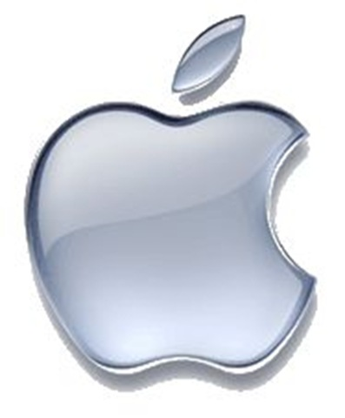


GLOBAL GADGETS
Jae Wook Lee
Andy Su
Forrest Zhou
Kirsten Hallam

Slide 2
Agenda
Industry Overview
Apple
Google
RIM

Slide 3
Industry Overview
Industry History
Industry Structure
Products

Slide 4
Industry History
The Computer
The Internet
Mobile Phones
Smartphones

Slide 5
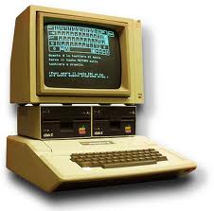
The Computer
1936: first freely programmable computer
1951: first commercial computer released
1974: first consumer computers (IBM)
1976: Apple I,II
1984: Apple Macintosh
1985: Microsoft Windows

Slide 6

The Internet
1969: the original internet
1971: first email sent
1990: Archie, the first search engine
1991: Internet available for commercial use
1996: more email than post mail in the USA
: BackRub search engine (Stanford)
1997: Google (googol)

Slide 7
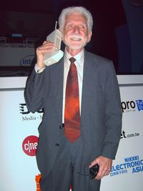
Mobile Phones
1973: Motorola cell phone created
April 3, 1973: first cell phone call made by Martin Cooper
1983: first cell phone available to consumers
1994: First smartphone
2001: First Commercial 3g Network
2007: First Iphone Released
2008: First Android phone released
2010: First LTE Network

Slide 8
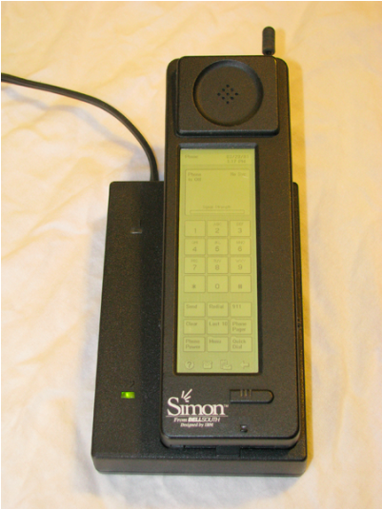
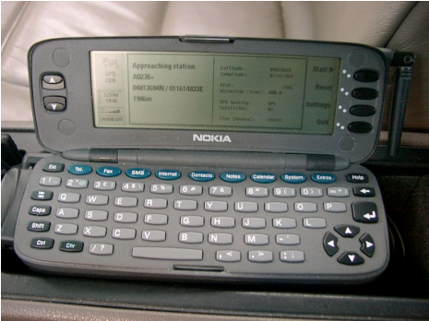
Smartphones
1992: Simon
  Created by IBM
  Touch screen, fax, email, predictive keyboard
1996: Nokia 9000
2002: Handspring Treo 180 (Palm OS)
2002: Blackberry
2007: iPhone
2008: First Android OS phones

Slide 9
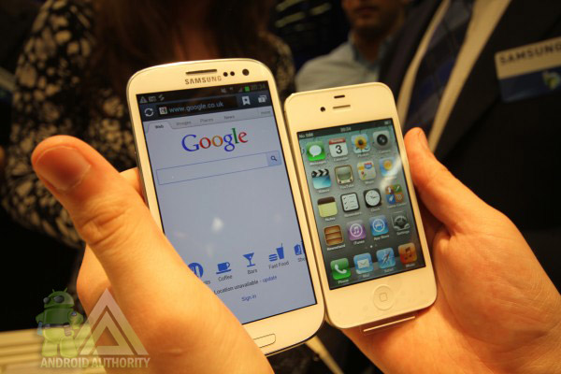
What is a Smartphone?
  All in one device that can be used as a cell phone and has computing, PDA functions
  Variety of applications available
  High Speed Data Access
  Multimedia

Slide 10
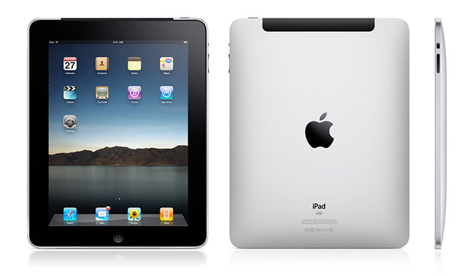
What is a Tablet?
Larger than a smartphone
Touchscreen used as primary method of input
Some typical functions are:
  Mobile Browsing
  Portable Media Player
  Camera
  Downloadable Apps

Slide 11
Industry Structure

Slide 12
Digital Revolution
1990:
Cell phone users: 12.4 million (0.25% of world population)
Internet users: 2.8 million (0.05% of world population)
2002:
Cell phone users: 1.174 billion (19% of world population)
Internet users: 631 million (11% of world population)
2010:
Cell phone users: 5.4 billion (76% of world population)
Internet users: 1 billion (14% of world population)
2011:
Cell phone users: 6 billion (87% of world population)
Internet users: 2 billion (30% of world population)

Slide 13

Digital Music
Broadly spread in mobile devices
iTunes Store provides revenue stream for digital content:
  Music
  Podcasts
  Books
  Apps

Slide 14

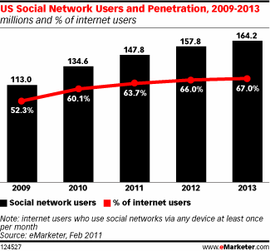
Social Media
Facebook, Twitter, YouTube, Myspace, etc

Slide 15
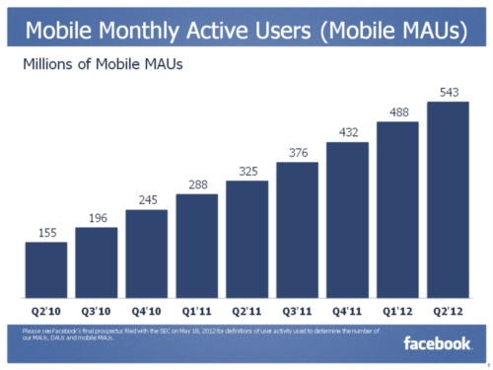
Social Media Goes Mobile
Social media will focus more on mobile devices in the next five years, including smartphones and tablet PCs.
Over 600 million active users of Facebook currently access Facebook through their mobile devices.

Slide 16

Advertising
Google; Sponsored links
Smartphone advertising in applications
Application advertising
  Build an application under the company name
Social media advertising
  Facebook, twitter, myspace

Slide 17
Trends in Usage
Growth of mobile phone and
Smartphone usage in developing countries
  Mobile Payments: Becoming increasingly popular in both developed and developing countries
The Smartphone was originally for the business user, but now targets wider range of consumers
Movement towards internet-based computing solutions
  Cloud Computing

Slide 18
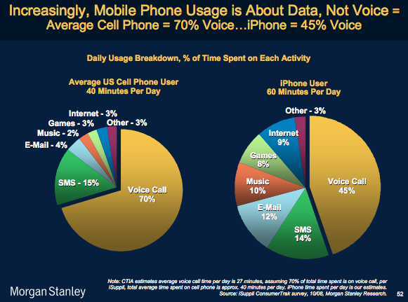
Trends in Usage

Slide 19
Sales Growth
Research by Consumer Electronics Association in 2012:
  Global spending on technology device is $1.038 trillion
  Annual smartphone sales growth is 22%
  Annual tablet sales growth is 59%

Slide 20
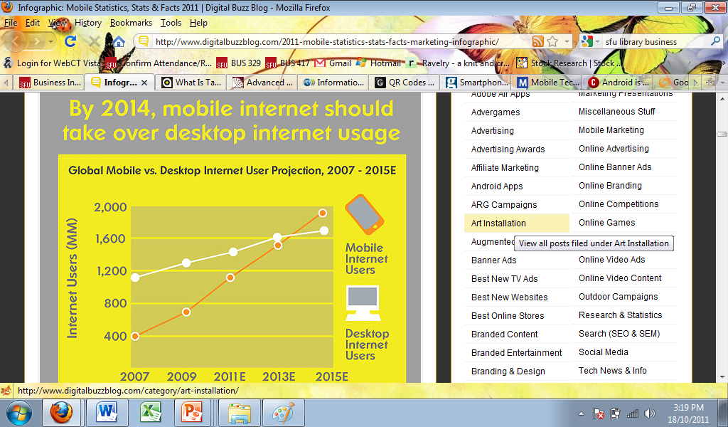

Slide 21
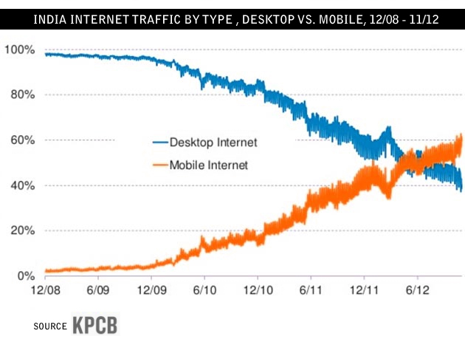

Slide 22
Battle on Apps
Increased market growth
Apple’s competitors increased their market share

Slide 23
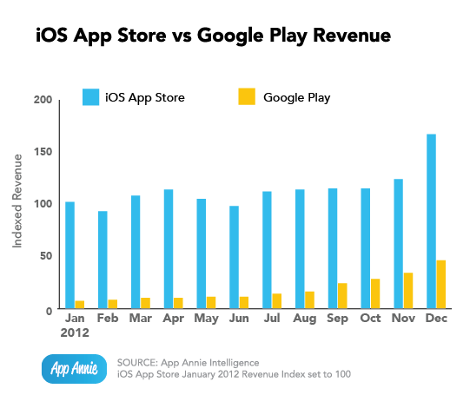
Application Store Comparison

Slide 24
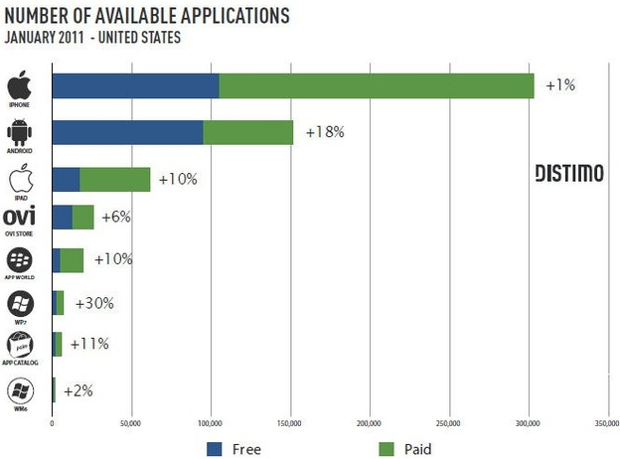
Application Store Comparison(Cont.)

Slide 25
Legal environment
Constant battle between companies for patents
Patents crucial for success
Recent large lawsuits between Apple and Samsung

Slide 26
Intangible Assets
Cash
Important components of financial statements to consider
Intangible assets include goodwill, intellectual property, representation on balance sheet should be examined
A large amount of cash is common - representation of current and future performance of the company

Slide 27
Products
Smartphones
Smartphone Operating Systems
Tablet PCs
Apps

Slide 28
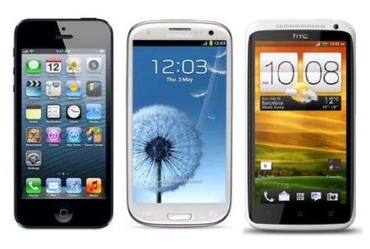
Smartphones
Notes:
http://www.gforgames.com/gadgets/iphone-5-vs-samsung-galaxy-s3-vs-htc-one-x-navigates-faster-25926/
http://retrocell.ca/index.php?main_page=index&manufacturers_id=1

Slide 29
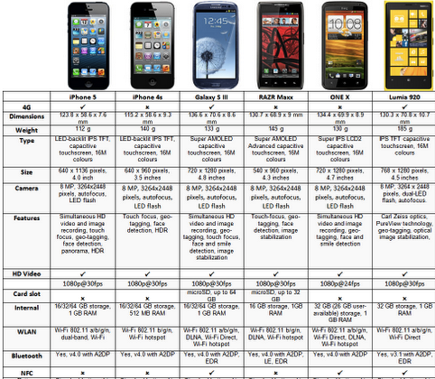

Slide 30
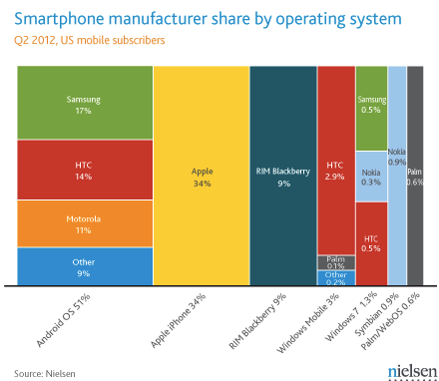

Slide 31
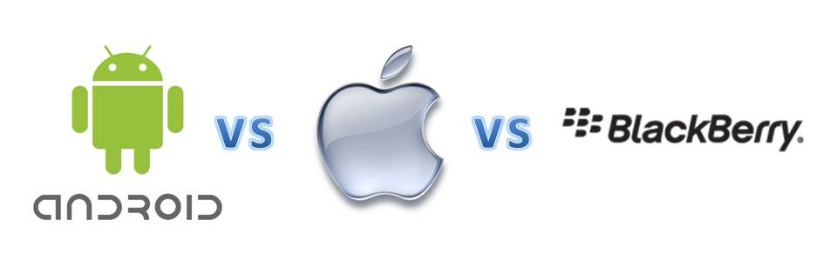
Smart Phone Operating System

Slide 32

Apple, Inc. – iPhone OS
  Originally released in 2007
  Mobile version of Mac OSX
  Multi-TouchTM user interface

Slide 33

Google Android OS
  Based on Linux Kernel
  Created by Android Corporation, acquired by Google in July 2005
  Multi-touch and media features

Slide 34

RIM – Blackberry
  Popular among business professionals
  Unique push-email feature
  Traditionally secured network
  Third party applications

Slide 35
Pros
Android | Apple | Blackberry
Multi-tasking Functions | User Friendly | Security
Notification System | Desktop Syncing | QWERTY Keyboard
Open-Platform for Development | Large App Store

Slide 36
Cons
Android | Apple | Blackberry
Poor Battery Life | Non-Customizable | Lack of Apps
OS Variations | Maps Application | Outdated OS
Lack of Quality Control for Apps | No Flash Capabilities | Small Screens

Slide 37
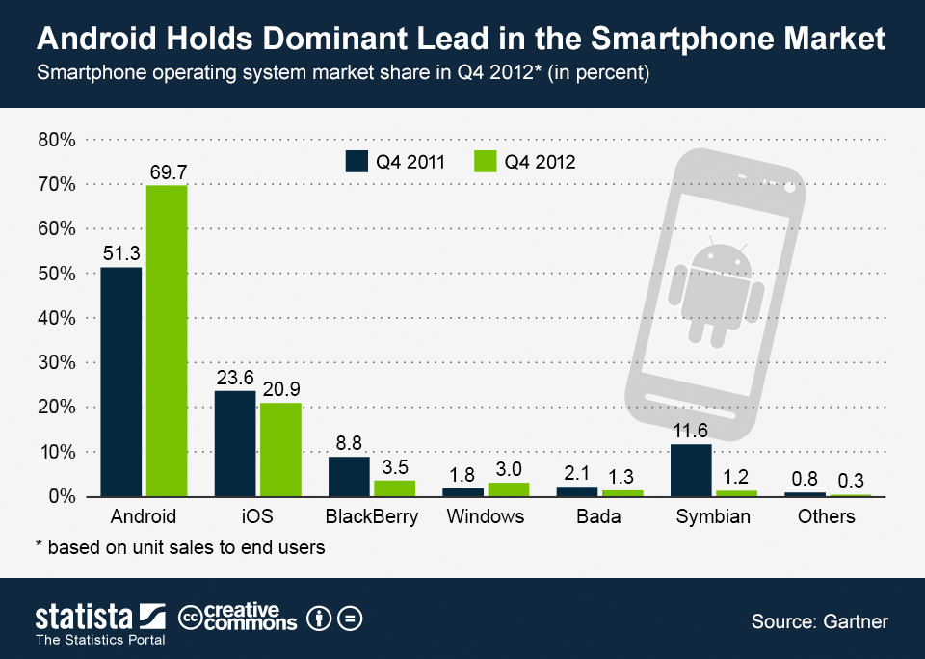

Slide 38
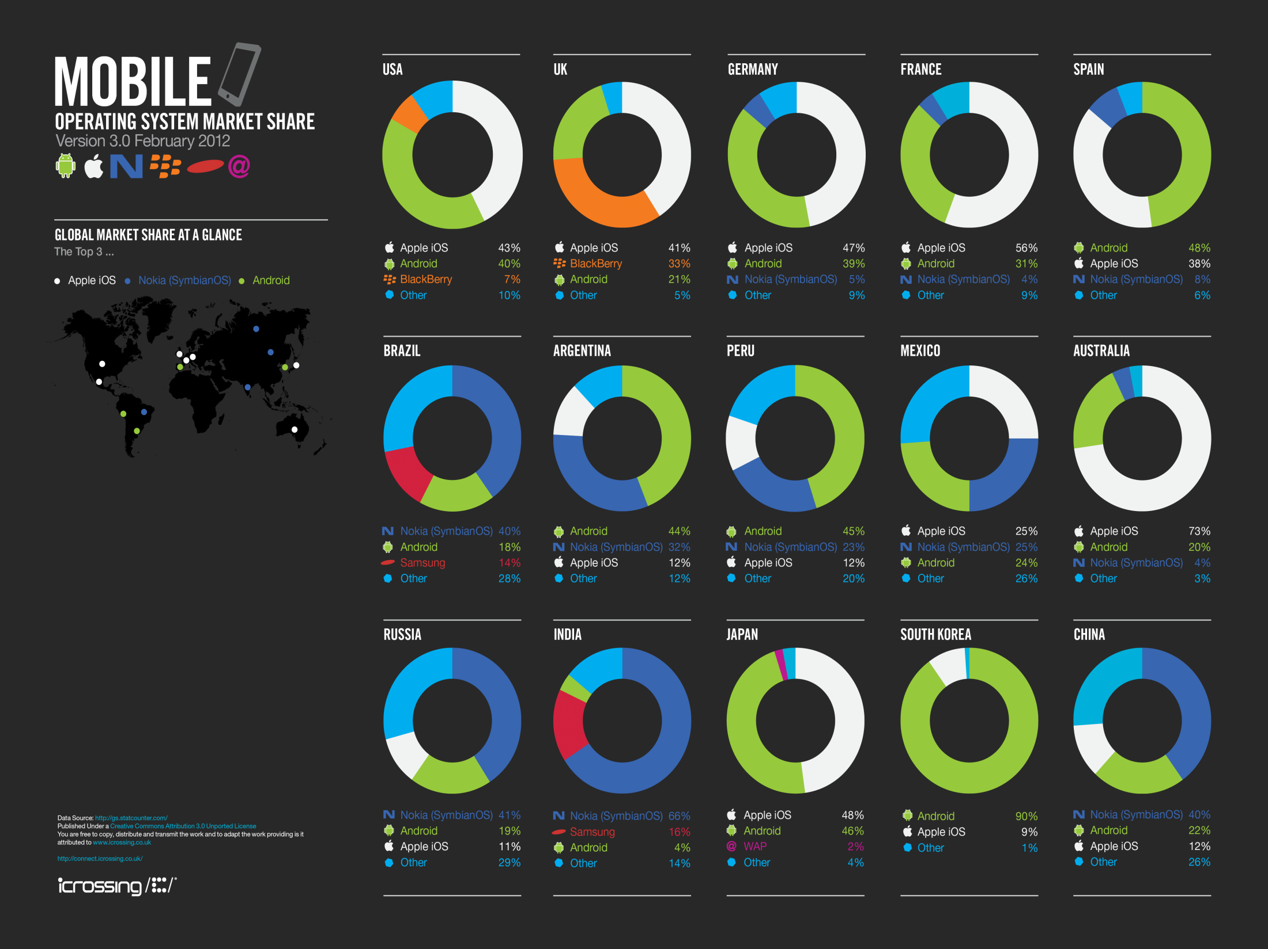
Products
Industry Growth
Overview
Apple
Google
RIM

Slide 39
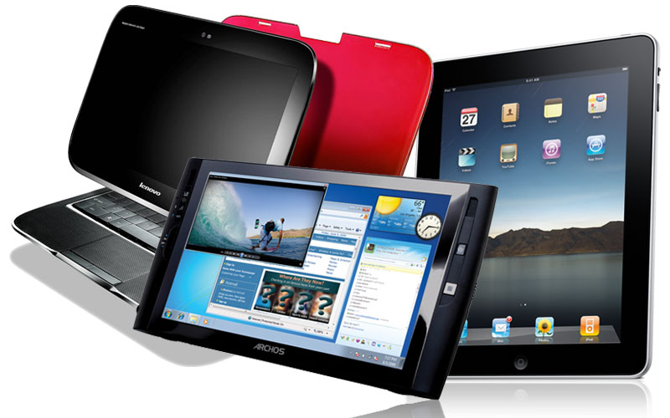
Tablet PC:
  Combines the Smartphone, laptop and PDA
    Apple iPad 1 , 2, 3(New Ipad), 4 & Mini
    Blackberry Playbook
    Samsung Galaxy Tab 1 & 2, Note 1 & 2
    Motorola Xoom
    Hp TouchPad
    LG Optimus G, Pad
    HTC One Series
    Asus transformer pad infinity
    Amazon Kindle Fire
    Nexus 7, 10

Slide 40
Major Function of Tablet PC
  Wireless mobile browser
  E-mail and social media devices
  Potential cell phone functions
  GPS satellite navigation
  Stills and video camera functions
  E-book reading
  Downloadable apps (games, education, utilities)
  Portable media player function

Slide 41
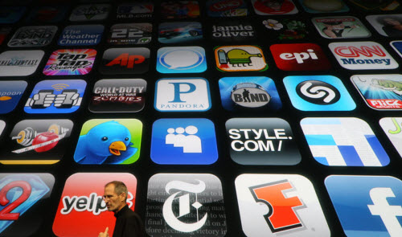
Apps
Apps is an abbreviation for application. An app is a piece of software. It can run on the Internet, on your computer, or on your phone or other electronic device.

Slide 42
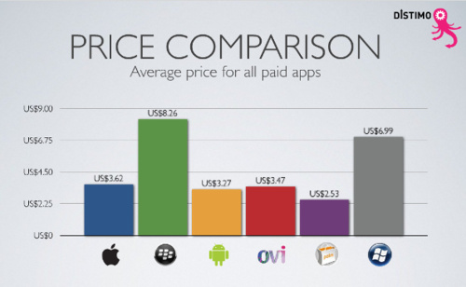

Slide 43
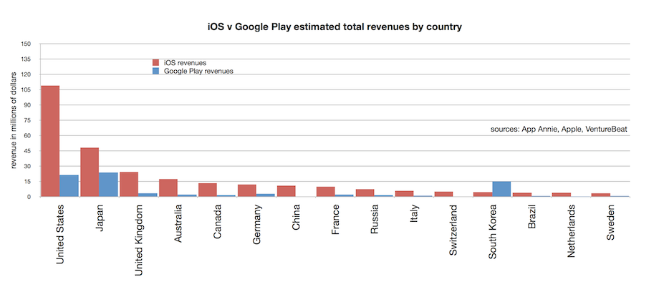

Slide 44
Apple Inc.

Slide 45
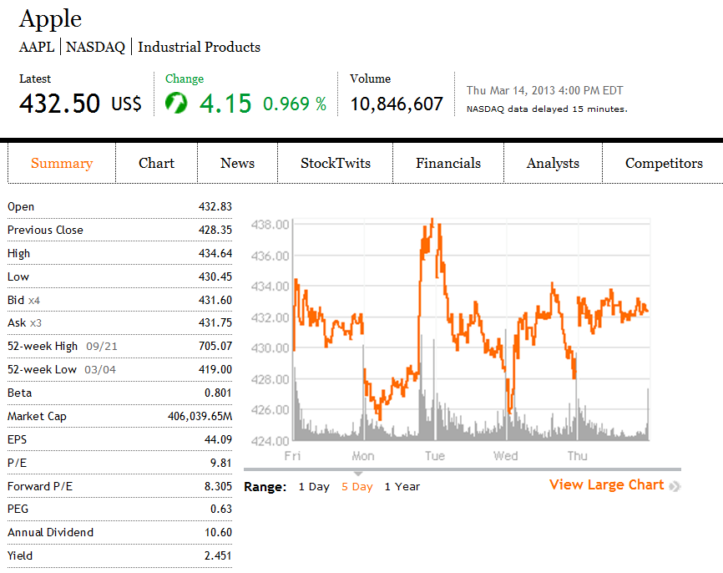
Financial Snapshot

Slide 46
Common Share Structure
 | Current | 2011 | 2010 | 2009 | 2008
Shares Outstanding (Millions) | 939.06 | 932.37 | 915.97 | 889.81 | 888.33
Common stock, no par value; 1,800,000 shares authorized; 939,208 and 929,277 shares issued and outstanding, respectively
(Source: Apple Inc. 10-K)

Slide 47
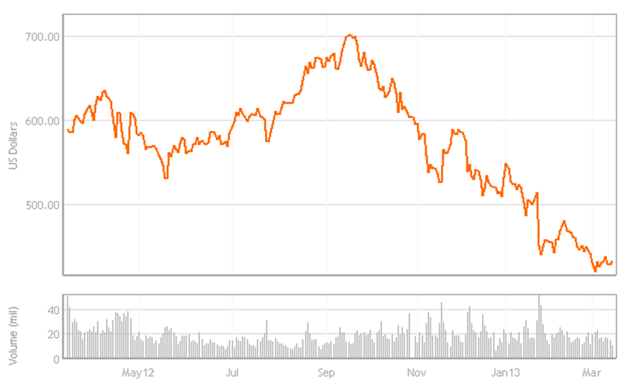
1 Year Stock Performance

Slide 48
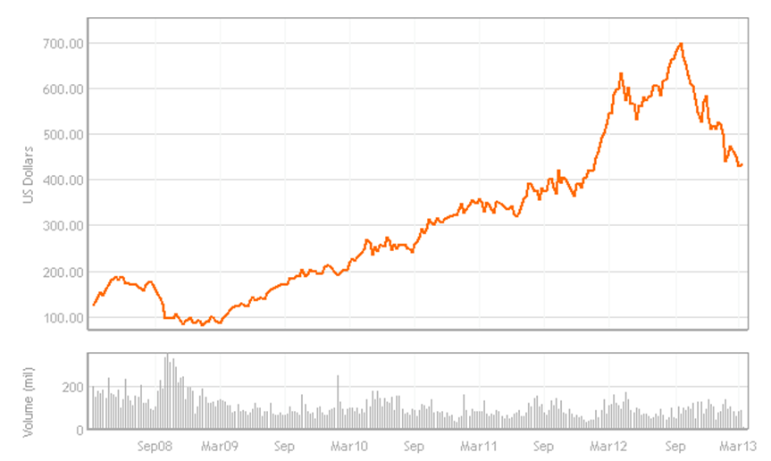
5 Year Stock Performance

Slide 49
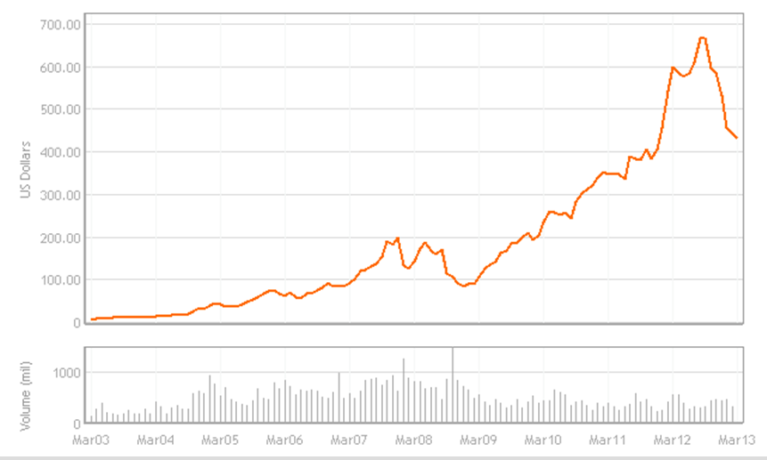
10 Year Stock Performance

Slide 50
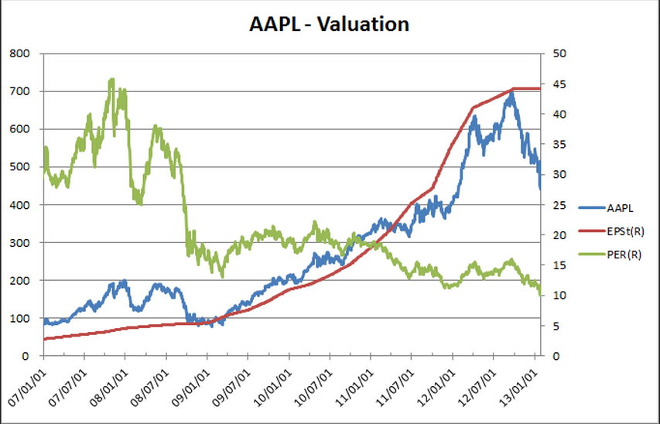
Apple’s Current Valuation
Source: Nasdaq.com
Notes:
http://www.nasdaq.com/symbol/aapl/revenue-eps#.UQPSe78018E

Slide 51
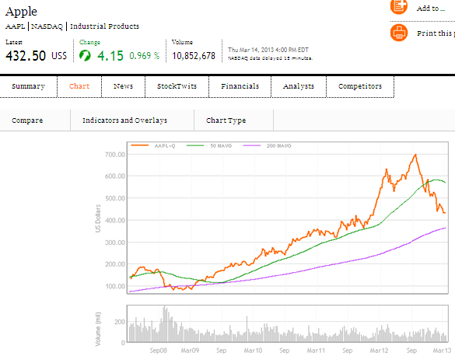
50 vs 200 Day MA

Slide 52
Company Overview

Slide 53
Company Profile
Apple Inc. (formerly Apple Computer, Inc.) founded by Steve Jobs, Steve Wozniak and Ronald Wayne (1976)
Design, manufacture, and market personal computers and related personal computing and mobile communication devices
Sell its products worldwide through its online stores, its retail stores, its direct sales force, third-party wholesalers, and resellers
Headquartered in Cupertino, California

Slide 54
Mission Statement
Apple designs Macs, the best personal computers in the world, along with OS X, iLife, iWork and professional software. Apple leads the digital music revolution with its iPods and iTunes online store. Apple has reinvented the mobile phone with its revolutionary iPhone and App Store, and is defining the future of mobile media and computing devices with iPad.

Slide 55
Products and Services
iPhone
iPad
Mac
iPod/iTunes
Apple TV
iOS and Mac OS X operating systems
iCloud
Accessories, software, and warranties

Slide 56

iTunes Revenue
Sales of third-party digital content such as:
    Digital music
    Podcasts
    Movies and TV shows
    Audio books
Manage contents on iPod, iPhone, iPod Touch and iPad
iTunes Store generated total net sales of $7.5 billion for 2012 compared to net sales of $5.4 billion during 2011. (10-K)

Slide 57
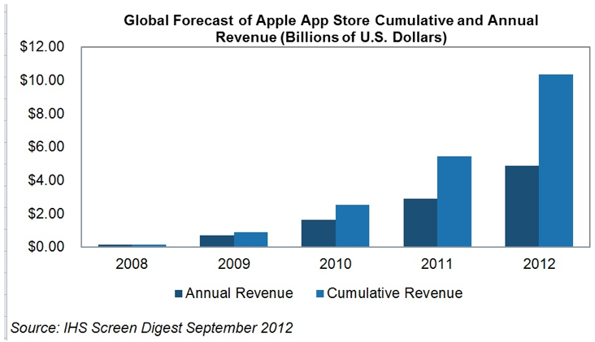
The App Store
Allows users to browse and download applications from the iTunes Store directly on their computer or mobile device
30% of revenue from the store goes to Apple and 70% go to the producer of the app.
Notes:
Apple has announced that music fans have purchased and downloaded more than 25 billion songs from the iTunes Store (February 6, 2013. Apple.com).
Apple announced that iTunes U has reached a new milestone — over one billion content downloads. iTunes U features the world’s largest online catalog of free educational content from top schools and prominent libraries, museums, and organizations (February 28, 2013. Apple.com).

Slide 58
iBookstore
An e-book application
Allows users to download and read books directly onto their mobile devices
A new app, iBooks Author, was announced for the App Store, allowing anyone to create interactive textbooks for reading in iBooks; and the iBookstore was expanded with a textbook category

Slide 59
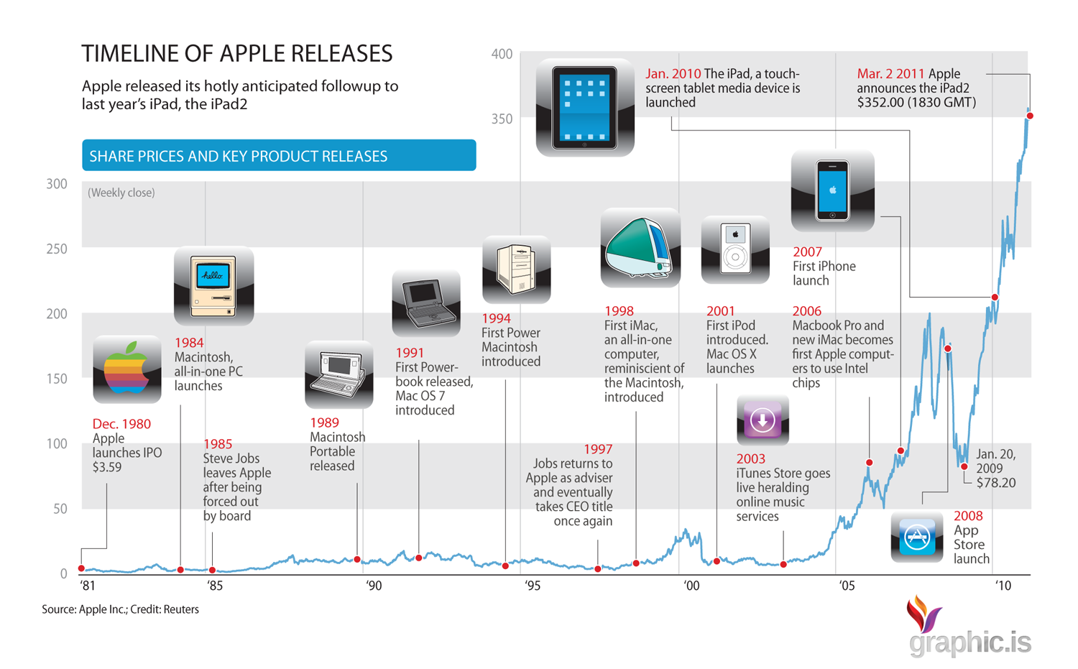
Milestones

Slide 60
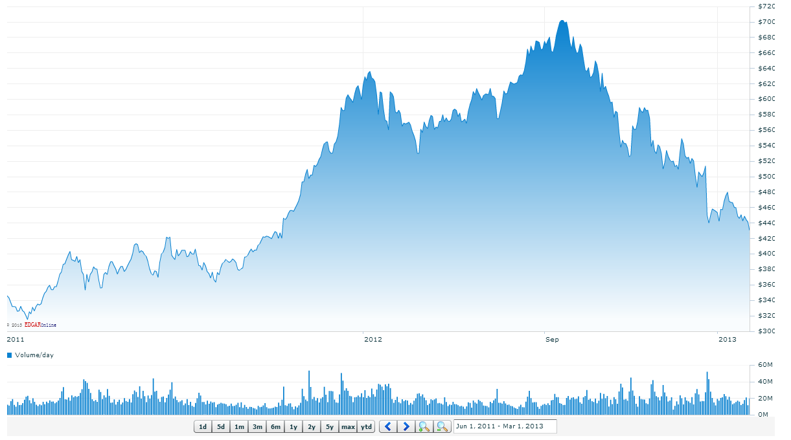



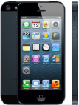
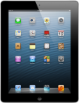

Recent Milestones
Jan 2012
Announced best quarterly results for a tech company ever
Sep 2012
iPhone 5 released
Aug 2011
Tim Cook becomes CEO
Oct 2011
Steve Jobs dies
Nov 2012
iPad mini and 4th generation iPad released
Mar 2012
3rd generation iPad released

Slide 61
Key Company Trends
Global Growth
Key Product Growth
Litigation

Slide 62
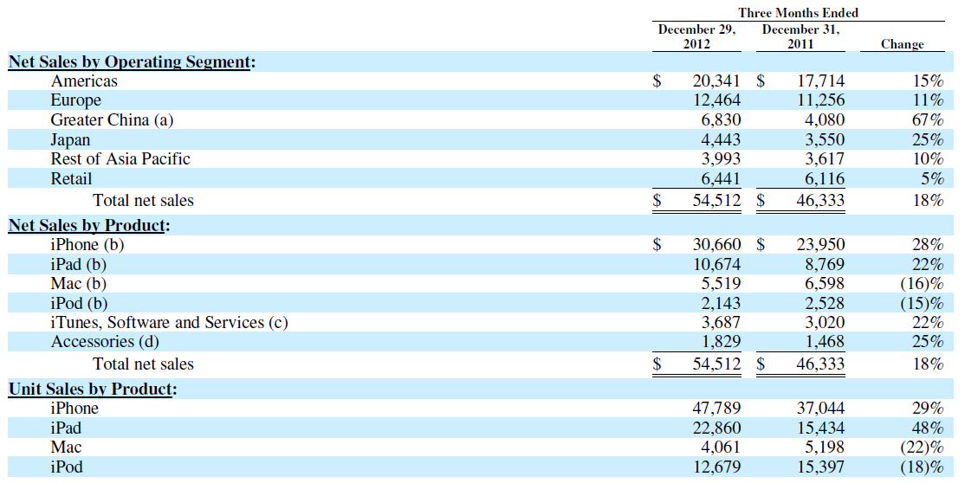
Key Product and Regional Growth (Quarterly)
(in millions) Source: Apple 10-Q

Slide 63
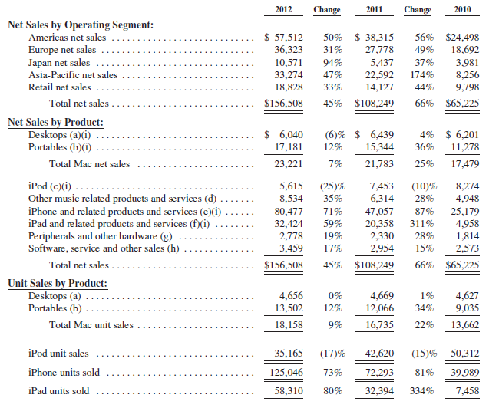
Key Product and Regional Growth (Annually)
(in millions) Source: Apple 10-K

Slide 64
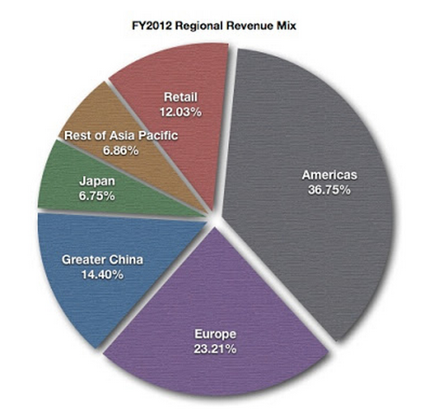
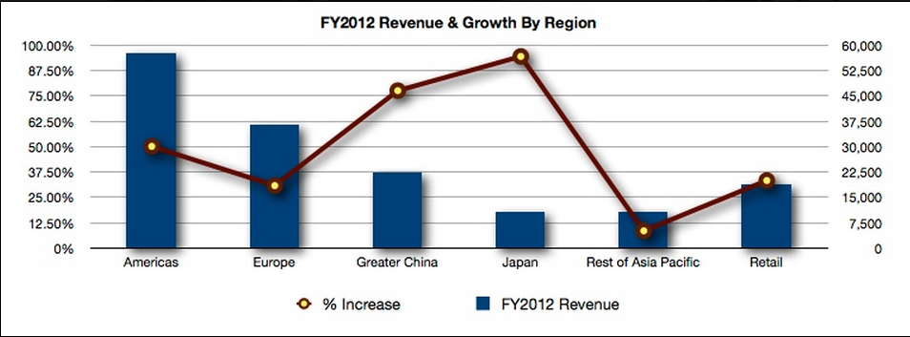
Global Revenue Composition
Source: postsateventide.com
Notes:
http://www.postsateventide.com/2013/02/apples-revenue-by-region-theres-more-to.html

Slide 65
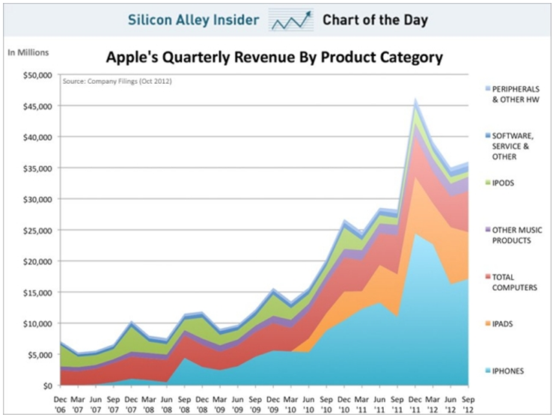
Revenue Distribution 2007-2012
Source: Silicon Alley Insider
Notes:
http://www.iclarified.com/25378/apples-quarterly-revenue-by-product-category-chart
In 2007, iPod was the main revenue source for Apple company. Now, iPhone and iPad are the main revenue source of Apple Inc.

Slide 66
Stagnant Product Growth
 | iPhone 5 16GB/32GB/ 64GB | iPhone 4S 16GB/ 32GB/ 64GB | iPhone 4 16GB/ 32GB | iPhone 3GS 16GB/ 32GB | iPhone 3G 8GB/ 16GB | iPhone 4GB/8GB
Screen Size | 4 | 3.5 | 3.5 | 3.5 | 3.5 | 3.5
Resolution | 1136x640 | 960x640 | 960x640 | 480x320 | 480x320 | 480x320
Processor | Apple A6 | Apple A5 | 1 Ghz Apple A4 | 600 Mhz Samsung ARM Cortex | 412 Mhz Samsung ARM | 412 Mhz Samsung ARM
Max Connectivity | 4G LTE | 3G | 3G | 3G | 3G | EDGE
Max. OS | iOS 6 | iOS 6 | iOS 6 | iOS 5 | iOS 4, limited | iOS 3
Camera | 2 cameras: 8 Megapixel & 720p HD | 2 cameras: 8 Megapixel & VGA | 2 cameras: 5 Megapixel & VGA | 3 Megapixel | 2 Megapixel | 2 Megapixel
Records Video? | 1080p HD at 30 fps | 1080p HD at 30 fps | 720p HD at 30 fps | VGA at 30 fps | No | No
FaceTime | Yes | Yes | Yes | No | No | No
Siri | Yes | Yes | No | No | No | No
Weight (ounces) | 3.95 | 4.9 | 4.8 | 4.8 | 4.7 | 4.8
Size** | 4.87 x 2.31 x .30 | 4.5 x 2.31 x .37 | 4.51 x 2.31 x .37 | 4.5 x 2.4 x .48 | 4.5 x 2.4 x .48 | 4.5 x 2.4 x .46
Battery Life (in hours) | Talk: 8 Video: 10 Web: 10 Audio: 40 | Talk: 8 Video: 10 Web: 9 Audio: 40 | Talk: 7 Video: 10 Web: 10 Audio: 40 | Talk: 5 Video: 10 Web: 9 Audio: 30 | Talk: 5 Video: 7 Web: 5 Audio: 24 | Talk: 8 Video: 7 Web: 6 Audio: 24
Notes:
http://ipod.about.com/od/decidingwhichipodtobuy/a/iphone_chart.htm

Slide 67
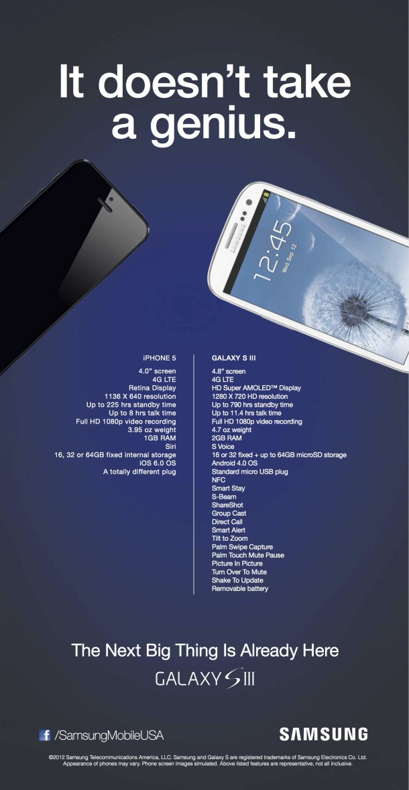
Losing Competitive Edge?

Slide 68
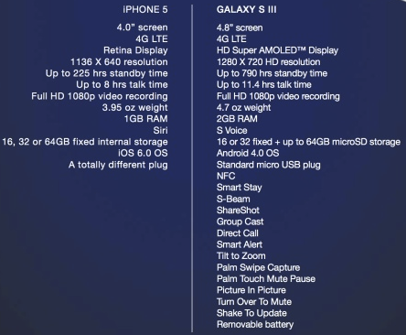
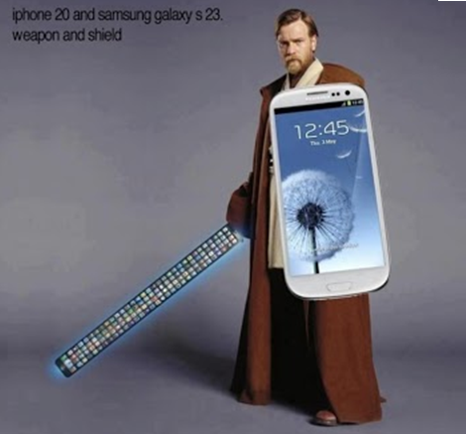

Slide 69
iOS 6 Maps Upgrade
The Globe and Mail reported on September 28, 2012 that “Apple CEO Tim Cook says the company is “extremely sorry” for the frustration its Maps application has caused” and that that Apple “fell short”
Users complained that “the new map software offers fewer details, lacks public transit directions and misplaces landmarks, among other problems”
Notes:
http://www.theglobeandmail.com/technology/tech-news/apple-ceo-extremely-sorry-about-maps-failure/article4574167/

Slide 70
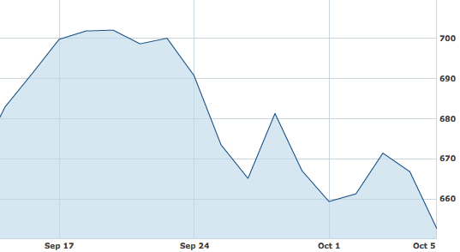

Stock Price Drop Following iPhone 5 and iOS 6 Release
Sept 26
$665.18
Sept 21
$700.09
*iOS 6 released for iPhone 4 and 4S on September 19, 2012
Notes:
Only in short term
After this drop the pr

Slide 71
iPad mini
Apple has lost market share due to iPad’s high price
CNET: “The spike of Samsung Galaxy tablet sales after the iPad mini launch suggests that consumers hung around to see what Apple had to show off, weren't impressed, and went with a Galaxy instead.”
Digital Journal: “Amazon's Kindle Fire sales also took a leap upon the release of the iPad Mini… Based on the current releases, it appears Apple has run out of ideas for what to produce next with each generation of iPhones and iPads bug prone and expensive.”
Notes:
http://www.digitaljournal.com/article/335696

Slide 72
iPad mini
eWeek: “The sell-out of both editions suggests that despite a higher-than-expected $329 starting price, consumers really want to get their hands on an iPad mini.”
“A recent IHS report said the iPad Mini could help the 7-inch tablet market double in size in 2012 and 2013, if Apple could provide enough iPad mini tablets to meet market demand.”
“With its foot now firmly planted in the 7-inch tablet space, and the full-size iPad still commanding nearly 70 percent of the worldwide tablet market, Apple’s position is undoubtedly robust…and we believe the iPad mini significantly expands Apple’s tablet addressable market internationally and should lead to strong sales throughout the holiday season and F2013 as international distribution increases”
Notes:
http://www.eweek.com/mobile/ipad-mini-black-version-sells-out/

Slide 73
Apple Inc. v. Samsung Electronics Co., Ltd.
Apple filed on April 15, 2011
Claimed Samsung infringed Apple’s intellectual property on its phones and tablets
Samsung counter-sued one week later
By July 2012, they were engaged in 50 lawsuits around the globe
Both companies attempting to ban rival’s products that infringe certain patents
On August 24, 2012, Apple was awarded $1.049 billion in damages in U.S. case; Samsung’s counter suit dismissed
“U.S. District Judge Lucy Koh overturned a jury's damage award for about half of the devices at issue in the case. The ruling slashes the amount Samsung is obligated to pay Apple by about $450.5 million, or nearly 43%, to $598.9 million.”(Mar 1, Dow Jones Business News)
Notes:
http://www.nasdaq.com/article/judge-reduces-apples-patent-award-in-samsung-case-20130301-00974#.UTPzhW_U_oQ

Slide 74
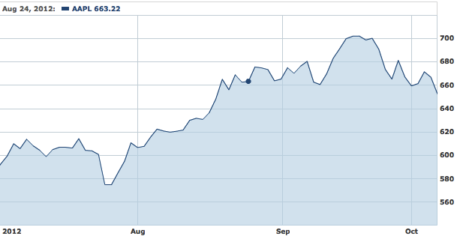
Effect on Apple’s stock
Damages awarded

Slide 75
Key Issues
1. Future growth
2. Cash and dividend decisions

Slide 76
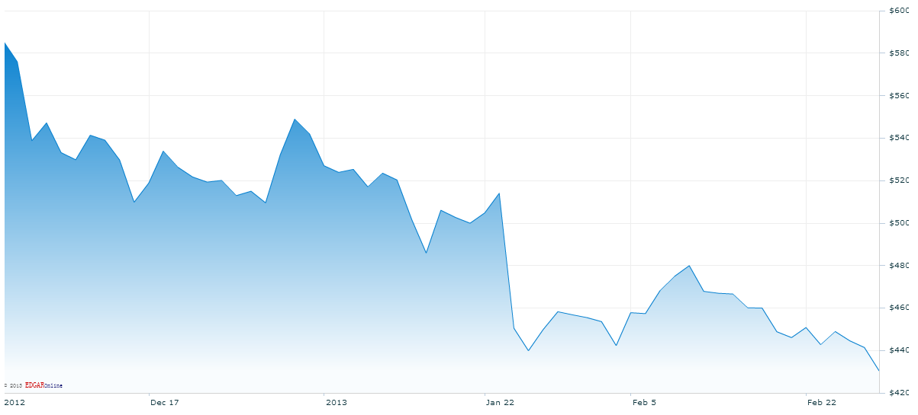
Company Growth
“Apple’s slowing growth rate has taken a major bite out of the company’s stock price, which has declined by nearly 30% since its peak in September — and that’s before Wednesday’s 10% after-hours free fall.”
“For the third consecutive quarter, Apple, the world’s largest technology company, fell short of analyst estimates, sending the company’s stock down a whopping 10% in after-hours trading, wiping out nearly $50 billion in shareholder value.”
Jan 23, $514.00
Jan 24, $450.50
Notes:
http://business.time.com/2013/01/24/apple-shares-plunge-10-on-slowing-growth-new-product-jitters/
Apple sold 47.8 million iPhones and 22.9 million iPads during the holiday quarter, but both of those figures were about one million short of analyst expectations. The company generated profit of $13.1 billion, but that was flat compared to the year ago period — the company’s lowest rate of profit growth in a decade — in part because of higher production costs associated with new products. Revenue came in at $54.5 billion, an 18% increase over one year ago, but less than the $55 billion that analysts had been expecting.

Slide 77
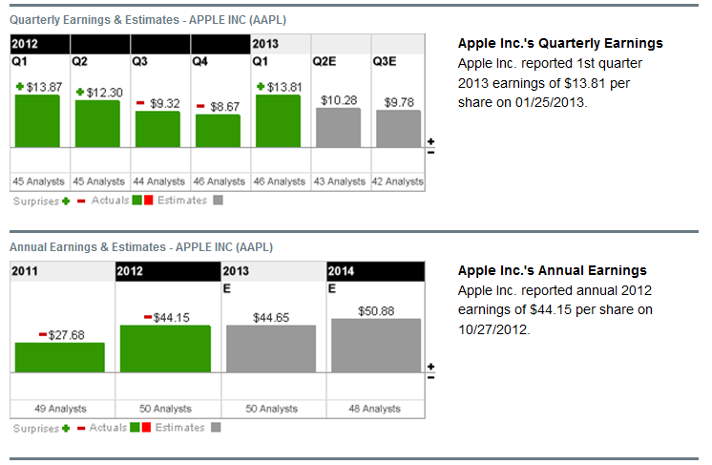
Earnings Forecast
Notes:
http://investing.businessweek.com/research/stocks/earnings/earnings.asp?ticker=AAPL

Slide 78
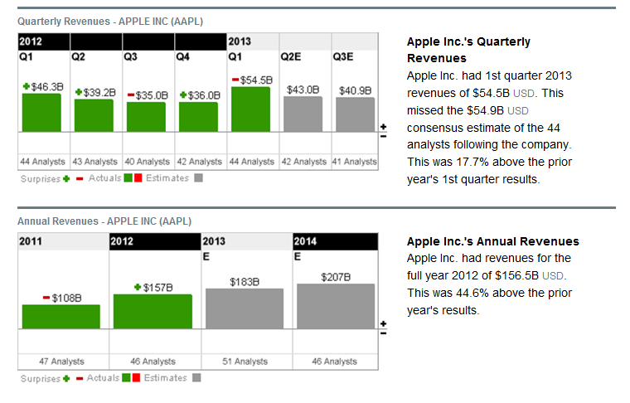
Earnings Forecast
Notes:
http://investing.businessweek.com/research/stocks/earnings/earnings.asp?ticker=AAPL

Slide 79
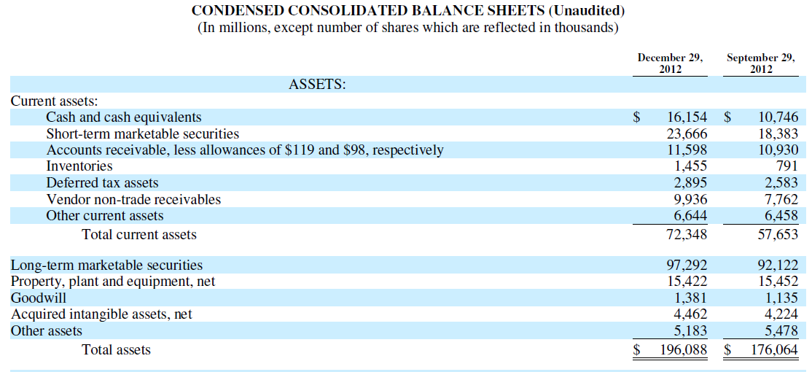
Cash

Slide 80
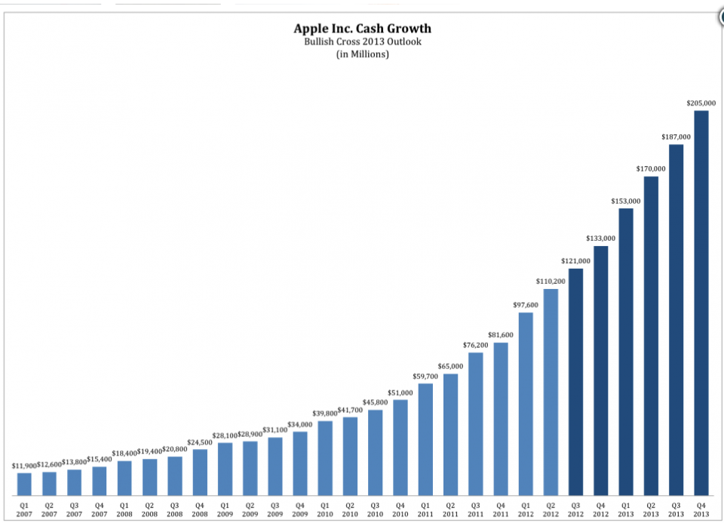

Source: businessinsider
Notes:
http://www.businessinsider.com/apple-cash-balance-2013-2012-6

Slide 81
Dividends
An attempt to neutralize the impact of dilution from future employee equity grants and employee stock purchase programs
Predict using approximately $45 billion of domestic cash in the first three years of the programs
Dividends ($2.65) paid on Aug 8 and Nov 7, 2012; Feb 7, 2013.
Apple announced a $10 billion share repurchase plan starting in fiscal 2013
Notes:
http://www.apple.com/ca/pr/library/2012/03/19Apple-Announces-Plans-to-Initiate-Dividend-and-Share-Repurchase-Program.html
New: http://www.bloomberg.com/news/2013-02-08/apple-with-137-billion-in-cash-considers-preferred-stock-tech.html
http://news.yahoo.com/apple-shareholder-drops-lawsuit-preferred-stock-180027147--finance.html

Slide 82

Effect on Share Price
Aug 8 2012 amount: $2.65
Nov 7 2012 amount: $2.65
Feb 7 2013 amount: $2.65
Notes:
http://www.nasdaq.com/symbol/aapl/interactive-chart#.UTQMHG_U_oS

Slide 83
Management

Slide 84

Steve Jobs (1955-2011)
Previous CEO and Co-founder of Apple Inc.
Business icon and inventor
Born in Silicon Valley
Had a volatile past with Apple but helped the company significantly once returning in 1997
Diagnosed with pancreatic cancer in 2003
Resigned as CEO on August 24, 2011
Passed away on October 5, 2011

Slide 85

CEO: Tim Cook
Named the CEO of Apple on Aug 12, 2011
Previous Chief Operating Officer
B.S. Degree in industrial engineering from
Auburn University in 1982
MBA from Duke University's Fuqua School
of Business in 1988
Earned $1.36M in base salary and $2.8M in
incentive plan compensation (cash bonus)
Has led the releases of the iPhone 5 and
iPad mini to mixed reviews
Notes:
Last year, when Cook was named CEO, he was given 1 million restricted stock units. In four years, he'll own half of those shares. In August 2021, if he's still CEO of Apple, he'll receive the other 500,000. Apple shares are currently at $512. If they stay there and Cook is CEO for the next ten years, then he's in line to $512 million, or ~$51 million a year.

Slide 86

Eddy Cue
Senior Vice President, Internet, Software and Services
Oversees Apple's content stores including the iTunes Store, the revolutionary App Store and the iBookstore, as well as Siri, Maps, iAd and Apple's innovative iCloud services.
With Apple for 24 years
Earned a Bachelor Degree in Computer Science and Economics from Duke University

Slide 87

Craig Federighi
Senior Vice President, Software Engineering
Returned to Apple in 2009 to lead Mac OS X engineering; Previously worked for NeXT and Ariba
Oversees the development of iOS,
Mac OS X and Apple's common
operating system engineering teams
Master of Science degree in Computer
Science; B.Sc in Electrical Engineering and Computer Science from the University of California

Slide 88

Jonathan Ive
Senior Vice President, Industrial Design
Design team leader since 1996
Lead designer of many products such as the MacBook Pro, iMac, MacBook Air, iPod, iPhone and iPad
Numerous design awards
2003 Designer of the Year by the Design
Museum London
Awarded the title Royal Designer for Industry by
The Royal Society of Arts
B.A and an honorary doctorate from
Newcastle Polytechnic

Slide 89

Bob Mansfield
Senior Vice President, Technologies
Joined Apple in 1999
Has delivered dozens of breakthrough Mac products, including the MacBook Air and the all-in-one iMac line
A BSEE degree from The University of Texas
in 1982

Slide 90

Peter Oppenheimer
Senior Vice President, CFO
Oversees the controller, treasury, investor relations, tax, information systems, internal audit and facilities functions
With Apple since 1996
Bachelors degree from California Polytechnic University, San Luis Obispo; M.B.A. from the University of Santa Clara (both with honors)

Slide 91

Dan Riccio
Senior Vice President, Hardware Engineering
leads the Mac, iPhone, iPad and iPod engineering teams which have delivered dozens of breakthrough products
With Apple since 1998
Bachelor degree in Mechanical
Engineering from the University of
Massachusetts Amherst

Slide 92

Philip Schiller
Senior Vice President, Worldwide Marketing
Responsible for product marketing, developer relations, and business marketing
With Apple since 1997
Over 24 years marketing experience
B.Sc in Biology from Boston College

Slide 93

Bruce Sewell
Senior vice president of Legal and Government Affairs; General Counsel
Oversees all legal matters
Joined Apple from Intel Corporation in
September 2009
J.D. from George Washington University;
Bachelor of Science degree from the
University of Lancaster

Slide 94

Jeff Williams
Senior Vice President, Operations
Responsible for end-to-end supply chain management and led worldwide operations for iPod and iPhone
With Apple since 1998
Bachelor degree in Mechanical
Engineering from North Carolina
State University; MBA from Duke University

Slide 95
Financial Analysis

Slide 96
Annual Balance Sheet

Slide 97

Quarterly Balance Sheet

Slide 98

Annual Income Statement

Slide 100

Quarterly Income Statement

Slide 101
Annual Cash Flow Statement

Slide 102

Quarterly Cash Flow Statement

Slide 103
Expectations
Yahoo! Finance: “There are still hundreds of millions of potential new customers for the products Apple has already launched. China Mobile, for example, has yet to strike a deal to sell the iPhone to its hundreds of millions of subscribers, and when it does, Apple will have access to a huge new market.”
Stockhouse: “Chart is scary, but the fundamentals are good.”
Notes:
http://finance.yahoo.com/blogs/daily-ticker/ignore-apple-quarter-analyst-says-stock-still-buy-151729869.html
http://www.stockhouse.com/columnists/2012/dec/21/apple-(nasdaq--aapl)--will-it-rebound-in-2013-

Slide 104


Stock Forecast
CNNMoney
Nasdaq.com
Notes:
http://money.cnn.com/quote/quote.html?symb=AAPL
http://www.nasdaq.com/symbol/aapl/analyst-research#.UTQX0G_U_oQ
Price targets are calculated by estimating future earnings per share and then applying a price-to-earnings multiple, known as the P/E ratio.

Slide 105


Nasdaq.com
Notes:
http://www.nasdaq.com/symbol/aapl/recommendations#.UTQd-W_U_oQ

Slide 106

MarketWatch
Notes:
http://www.marketwatch.com/investing/stock/AAPL/analystestimates

Slide 107
Recommendation
HOLD

Slide 108


Slide 109

Financial Snapshot

Slide 110

Google Revenue Source

Slide 111
Common Share Structure
Common Shares Outstanding: 328.59 Million (Dec-31, 2012)
Class A
  - 1 vote per share
  - Dec 2012: 267.4 million shares outstanding
Class B
  - 10 votes per share
  - Only available to Google insiders and executives
  - Dec 2012: 62.4 million shares outstanding
Notes:
Introduce Common Share Structure:
Dual-class Share Structure, basically wanting to maintain control but still acquire funds from public
- Class A, Class B (executive exclusive)

Slide 112

1 Year Chart

Slide 113

5 Year Chart

Slide 114

Max Chart

Slide 115

50 Day vs 200 Day MA

Slide 116

Google VS. Nasdaq

Slide 117
History and Milestones
1996
    Larry Page and Sergey Brin create a search engine as a research project
    Featured a very efficient algorithm dubbed “PageRank”
    BackRub operates on Stanford servers for more than a year—eventually taking up too much bandwidth to suit the university.
1997
    Larry and Sergey decide that the BackRub search engine needs a new name. After some brainstorming, they go with Google—a play on the word “googol,” a mathematical term for the number represented by the numeral 1 followed by 100 zeros. The use of the term reflects their mission to organize a seemingly infinite amount of information on the web.
1998
    Incorporated in Menlo Park, California with the help of co-founder Andy Bechtolsheim
1999
    Obtained $25 million funding from venture capital firms Kleiner Perkins Caufield & Byers, and Sequoia Capital. Officially launched as a site.
2000
    Began selling advertisements- paid web links associated with search keywords

Slide 118
History In Depth
2001
Eric Schmidt becomes CEO and Chairman of the Board
“PageRank” granted a patent
2003
Re-incorporated in Delaware
2004
Initial Public Offering that raised $1.67 billion
19,605,052 shares sold @ $85
Conducted via Dutch auction

Slide 119
History and Milestones
Oct 2007
Share price hits $700 for the first time
July 2011
Google+ reaches 25 million users only 4 weeks after its launch in June 2011
May 2011
unique visitors of Google surpassed 1 billion mark for the first time
Oct 2012
Google is the dominant search engine globally- 88.8% market share
Currently the most visited site in the world

Slide 120
Key Acquisitions
Apr 2003: Applied Semantics
  Lead to the launch of Google AdSense
Jul 2004: Picasa Inc.
  Digital photo management
Oct 2004: Keyhole Corp.
  Leads to launch of Google Maps and Google Earth.
Aug 2005: Android
Oct 2006: Youtube (1.65 Billion)
April 2007: Double clicks (3.1 Billion)
Mar 2008: AdMob ( 750 Million)
  Enhances the company’s advertising revenue.
Aug 2011: Motorola (12.5 Billion)

Slide 121



Major Acquisitions in 2012
Meebo: web-based instant messaging service acquired for $100M
Sparrow: Email client for iOS and OSX devices, acquired for $25M
Wildfire: social marketing software developer, acquired for $450M
Quickoffice: Productivity suite for Google docs, and smart devices.

Slide 122
Products and Services
Flight Explorer
Google+
Search
Google Image
Google Ads
Google Docs
Google Finance
Google Photos
Google Calendar
Google Scholar
Google Books
Chrome
Chrome OS
Gmail
Google Wallet
Google TV
Translate
Google Ventures
Patent Search
Google Maps
Google Earth
Android mobile OS
Google Play
Google Blog Search
Blogger
YouTube

Slide 123
Ad Sources: AdWords
Advertisers create ads to show alongside Google search results
  Consists of 1 headline, 25 characters
  2 text lines, 35 characters each
Advertisers may bid on certain specific keywords to have their ads displayed alongside
  Cost-per-impression (CPM)
  Cost-per-click (CPC)

Slide 124

Sponsored links

Slide 125

Ad Sources: Google Maps Ads

Slide 126

Ad Sources: AdSense
Helps websites/publishers earn revenue by “showing relevant and engaging ads alongside your online content” – Google
  Displays ads on your site
  Earn money from valid clicks
Google shares the profits with the publishers
  Per click
  Per impression

Slide 127

Ad Sources: Google Network Ads

Slide 128
Google+
A new social network to compete against Facebook and Twitter
Features include:
    Video Hangouts
    Circles: organize the people that you want to follow
    Sandbar Notifications
    Currently over 90 million users worldwide

Slide 129



Google Fiber
Experimental broadband internet network using fiber optics
Released in March for residence at Kansas city

Slide 130

YouTube
Biggest video site in the world
Purchased by Google in November 2006 for US$1.65 billion
Google has established partnerships with content companies to aid in monetizing video in the mobile space

Slide 131

Android Mobile OS
Open source based off of Linux
OS is Growing selection of third-party applications
  Downloaded through the Google Play Store
Half a billion Android devices sold by Dec 2012
  more than double the number shipped at the same time last year.
U.S. Market shares reached 52.2% in July 2012
Android App store reached 25 billion downloaded at the end of September 2012

Slide 132
Android OS and the Manufacturers
Continued partnerships with manufacturers such as Samsung, HTC, and Sony
Joint venture with Samsung: Galaxy Nexus
Recent partnership with LG: Nexus 4, Asus: Nexus 7, Samsung: Nexus 10
Acquisition of Motorola Mobility
  Retains independence as a subsidiary
  Establishes Google as a smartphone manufacturer
  Portfolio of patents loosens up some of the legal burden

Slide 133


Slide 134

Combines BOOKS, MAGAZINES, MOVIES, ANDROID APPS, and DEVICES
  similar to iTunes store and Amazon in offerings
Removal of Android brand means opportunities to roll it out on non-Android devices in the future

Slide 135

Google Chrome and Chrome OS
Chrome Web Browser
  Free to use, integrates with other Google and third-party applications
  Has 34% worldwide usage share (StatCounter, Sept 2012)
  Offered for desktop and mobile operating systems
    iOS, Windows, etc.
Chrome OS (Chrome Book)
  Open Source (based on Linux)
  Works primarily for web applications
  Found in Chromebooks built by Samsung and Acer
  Hybrid between cloud client and traditional laptop

Slide 136

Google Glass
http://www.google.com/glass/start/how-it-feels/

Slide 137
Strategy
Revenue = Amount of time on the Web
Mission Statement:
  “To organize the world’s information and make it universally accessible and useful”
  Slogan (mantra)
    “Don’t be evil”

Slide 138
Strategy in 2013
  Google in the Hardware Industry (Google Glass, Autopilot car, Chrome Devices)
  Continued partnerships with other manufacturers
  Growth of different types of content in the Play Store
  Afforded smartphones initiative throughout the world
    Market penetration purposes
    E.g. Google Nexus 4
  Increasing LTE Compatibility as high speed upgrade to 4G networks
  Implementation of Google Wallet (NFC)
    Mobile electronic money as a means of payment based on near field communications technology

Slide 139
Legal Issues
Microsoft
  -EU lawsuit regarding a Motorola patent for web video
Apple
  - Disputes over patents with Android device makers Samsung, HTC (Settled), and Motorola
Privacy concerns
  - Lawsuits from users i.e., Google Glass, Google Street View

Slide 140

Future Outlook
Connect more people online through Google Applications and services to create greater advertising opportunities
Continuing legal concerns/battles
Privacy Issues
Increased competition with multiple companies, including Apple, Facebook, and Microsoft (Bing)

Slide 141

Management
CEO: Larry Page
Co-Founder in 1998
CEO since April 2011
  Was President of Products from 2001-2011
Bachelor of Engineering from Michigan
Master of Computer Science at Stanford
PhD (dropout) in Computer Science at Stanford

Slide 142

Management
Co-Founder: Sergey Brin
Co-Founder in 1998
Served as President of Technology from 2001-2011
B.Sc. in Math and Computer Science
Master of Computer Science from Stanford
PhD (dropout) in Computer Science from Stanford

Slide 143

Management
Executive Chairman: Eric Schmidt
  Former CEO
  Former CEO of Novell & CTO of Sun Microsystems
  Bachelor of Engineering degree from Princeton
  Master’s and PhD in Comp. Sci. from UC Berkley
  Member of President Obama’s council of Science and Technology

Slide 144
Five Year Diversification Plan
Larry, Sergey, and Eric currently hold 92% of the company’s Class B common stock
Hold 66% of the voting power in company decisions
Since 2010, Larry and Sergey will each sell $5.5 billion shares of common stock until 2015
Will retain 48% of the voting power after the sell-out

Slide 145

Management
  Senior VP and Chief Business Officer: Nikesh Arora
  Joined Google in 2004
  Responsible for creating and expanding strategic partnerships
  Former Chief Marketing Officer at T-Mobile
  Masters degree from Boston College
  MBA from Northeastern University
  CFA Designation

Slide 146

Management
  Senior Vice President, Corporate Development and Chief Legal Officer: David Drummond
  Responsible for company’s business development (Investments and M&A)
  Previous experience at a leading law firm in US
  Bachelors of Arts – Major in History
  JD in Law from Stanford University

Slide 147

Management
  Senior VP and Chief Financial Officer: Patrick Pichette
  Joined Google in 2008
  Worked at McKinsey and at Bell Canada (2001-2008)
  An expert in the telecommunications industry
  BBA Université du Québec à Montréal (1987)
  MA in Philosphy, Politics, and Economics from Oxford
  Rhodes Scholar

Slide 148

Balance Sheet (2012 10K)

Slide 149

Balance Sheet (2012 10K)

Slide 150


Slide 151


Slide 152

Cash-Flow (2012 10K)

Slide 153


Cash-Flow (2012 10K) Continues

Slide 154
Recommendation
BUY

Slide 155

Research in Motion, Ltd.
1984 – 2013 | Waterloo Ontario

Slide 156

Financial Snapshot

Slide 157

Common Shares
2013 | 2012 | 2011 | 2010 | 2009 | 2008 | 2007 | 2006
524M | 524M | 524M | 557M | 566M | 562M | 189M | 188M
RIM announced 3-for-1 stock split in 2007
On December 14, 2012, there were 524 million voting common shares, options to purchase 7.6 million voting common shares, 15.5 million restricted share units and 300,000 deferred share units outstanding
  Substantial increase from previous periods

Slide 158

Stock Performance - 1 year

Slide 159

Stock Performance - 5 year

Slide 160

Stock Performance - 10 year

Slide 161

50 vs 200 Day MA

Slide 162
Company Profile
Research In Motion, Ltd.

Slide 163
Company Milestones
1984: RIM was founded in Ontario by two engineering student: Mike Lazaridis and Douglas Fregin
1988: Began to work on wireless data-only applications
1996: Introduced first two-way messaging pager and PCMIA plug-in card for computer-enabled wireless email
1997: Rim was listed on the TSE
1998: Launched its first BlackBerry - RIM 950
1999: RIM was listed on the Nasdaq (RIMM)
2002: Launched its first true Blackberry device
2008: Reach 14 million subscribers
2011: Released BlackBerry Playbook
2013: Released BlackBerry Z10 (and Q10 coming in April)
Notes:
-RIM 950 was what started the Blackberry trend

Slide 164
Acquisitions
June 2009 – Acquired Dash Navigation (primarily used in BlackBerry Traffic)
August 2009 – Acquired Torch Mobile (Webkit-browser technology)
March 2010 – Acquired Viigo (BlackBerry applications developer)
April 2010 – QNX Software Systems (integrate smart-phone and in-vehicle infotainment systems)
March 25, 2011 – tinyHippos (Mobile Web development)
Oct 2011 – NewBay (Cloud-based content provider)
March 8, 2012 – Paratek (RF multi-band handsets, incorporated into Blackberry products)

Slide 165
Recent Development
BlackBerry global expansion continues
BlackBerry 7 Smartphones introduced
RIM searches for more carrier billing and operator billing on BlackBerry App World
On Jan 22, 2012, RIM named Thorsten Heins President and CEO
On Feb 21, 2012, BlackBerry PlayBook OS 2.0 was introduced
BlackBerry Z10 Released (and Q10 coming in April)
Announced pending name change to BlackBerry

Slide 166

Products

Slide 167

Product History
RIM 950
BlackBerry 5000
BlackBerry 6000
BlackBerry 9000

Slide 168






Mobile Phones

Slide 169
BlackBerry 7 OS
BlackBerry Balance
Liquid Graphics™ technology
Near Field Communication and BlackBerry Tag
HD 720p video recording
Mobile Hotspot
Wi-Fi calling
Notes:
BB Balance: Apps and data that are sent by your organization to BlackBerry devices it manages are restricted from being accessed by personal apps. This helps ensure work information is kept separate and secure. So users’ personal apps can’t access work information, and work information can’t be copied and pasted into personal apps or email messages.
Liquid Graphic: graphics processing technology that makes the BlackBerry experience faster and more responsive. delivers instant response times, smoother rendering and fluid animations.

Slide 170

BlackBerry PlayBook
Build-in Messages with a unified inbox
Can edit MS Word, Excel and PowerPoint files and attachments with Documents To Go
BlackBerry App World
BlackBerry Balance
BlackBerry Bridge

Slide 171
BlackBerry 10
Recently released the BB10 operating system
Implementation of a whole new user interface:
  Hub
  Personal and Work modes
  New app world
  Touch screen keyboard
  Camera

Slide 172

Blackberry Z10 Reviews
Positives
Constant smooth performance
A great messaging phone
Lots of built-in accessories
Negatives
Minimalistic design
Really short battery life
Difficult to reduce smudging on screen

Slide 173
Competitive Advantage
Its proprietary email system is popular with many corporations and government agencies
Communication security
Its patent portfolio
Notes:
- Rim runs all data from blackberrys through its closed, global network. This provides corporate users and personal users security unless traditional email.
- Apple launch an new app called iMessage which is very similar to BBM

Slide 174
Why BlackBerry is Losing its Competitive Advantage?
Losing customer loyalty
Service outages - millions of BlackBerry users were without service for 3 days in October 2011 due to critical network failure
Faltering tech support
No longer #1 in security
Apps from other providers are more appealing
Failed attempt to sell tablet PCS

Slide 175
BlackBerry App World
Over 100,000 total apps
Over 6 million daily downloads from BB App World.
Second most profitable app store
Generate more profit than Android apps
Give developers 80% of the purchase price
Available to customers in over 100 markets globally, with more to follow

Slide 176

BlackBerry Sales

Slide 177
Patents
RIM has about 3000+ patents registered under “Research In Motion” on the United States Patents and Trademark Office.
Acquired an additional 6000 patents and patent applications from Nortel on June 30, 2011
RIM has focused its patents research on the following technology fields:
  - Electric communication technique – transmission and telephonic communication
  - Arrangements or circuits for control of indicating devices using static means
  - Electric digital data processing

Slide 178
Litigation
Currently, Rim is involved in over 30 litigations in which some as a plaintiff and some as a defendant. These litigation may severely impact Rim’s profitability.
Rim entered a new license patent agreement with Nokia in settlement of all litigation between the companies and Nokia dropping actions in the USA, Canada, UK, and Germany on December 21, 2012
RIM’s most prominent lawsuit is by NTP over delivery of e-mail in wireless system. RIM settled the lawsuit; it recorded $612.5 million as Litigation entry in Annual Report 2006. Currently involved in litigation concerning synthetic voice technologies.
In June 2010, RIM and Motorola announced settlement through cross-licenses of various patent rights.
RIM settled patent dispute with Visto Corp., agreed to pay $268m to receive perpetual, fully-paid license on all Visto patents, $164m of full amount was expensed, the rest was recorded as intangible assets .
Notes:
Active acquisitions to complement its technology. However, none of these companies have resulted in amazing result after integration with BlackBerry. Except…QNX that yet to be launched in the PlayBook

Slide 179

Revenue in Different Countries

Slide 180


Revenue and Sales
Intangible Assets

Slide 181

Business Acquisitions

Slide 182
Management Team
Research In Motion, Ltd.

Slide 183

Mike Lazaridis
Founder, Former President, and Former Co-CEO
Age 20: $600,000 GM contract to build a computer network control display
Founded the Perimeter Institute of Theoretical Physics and the Institute for Quantum Computing
Owner of 50 patents including wireless range, industrial display systems, and DigiSync
1994 Emmy Award and 1999 Academy Award for DigiSync technology in film editing
Notes:
Very passionate about physics and quantum computing. Very focus on research centric.

Slide 184

Jim Balsillie
Former Co-CEO
Recruited in 1992
MBA from Harvard School of Business
Chartered Accountant
Former EVP and CFO of Sutherland-Schultz, an industrial service provider
Great passion for hockey
Stepped down as a Chairman in 2007 as a settlement with Ontario Security Commission regarding $250 million improper accounting due to options backdating
Notes:
Is not a great figure in the business world. He is in the NHL….

Slide 185

President and CEO
Thorsten Heins
Previously as COO, Product Engineering
President and CEO in January 2012
Joined RIM in 2007
Held several positions in wireless arena - CTO of Siemens’ Communications Division and several general management positions in hardware and software business
master's degree in Science and Physics from the University of Hannover in Germany.
serves as a member of the Board of Directors for the Canadian German Chamber of Industry and Commerce Inc.

Slide 186

Executive Team
Overseas BlackBerry Operations and Corporate IT
Held senior leadership positions within AT&T Labs and Global Network Services
Master’s degree in Management of Technology from Georgia Institute of Technology
Bachelor’s degree in engineering from Central Missouri State University
Associate in business degree from Maryland University - European Division
CIO
Robin Bienfait

Slide 187

Executive Team
Overseas all financial reporting and compliance activities
Joined RIM in 2005
Worked for Molson Inc. and Ernst & Young LLP
Chartered Accountant’s designation in 1989
Honors Bachelor of Commerce degree from McMaster University
CFO
Brain Bilduka

Slide 188

Executive Team
Responsible for all aspects of product manufacturing and logistics at RIM
Held several senior management roles at Sony Ericsson prior to joining RIM
Masters Degree in Science from Royal Institute of Technology in Sweden
Completed the Ericsson Executive MBA program at Columbia University of New York
COO
Kristian Tear

Slide 189

Executive Team
Leads all RIM’s global marketing functions
Worked for Vodafone and Orange
Previously was Vice President for Strategy, Marketing and Sales for LightSquared
diplomas from the École Polytechnique and from the École Nationale des Ponts et Chaussées, where he studied mathematics, physics and economics
CMO
Frank Boulben

Slide 190

Executive Team
Previously worked at Verizon Wireless and GTE Corporation
Worked almost 10 years with the United States Department of Justice as a federal prosecutor
Bachelor’s Degree in Political Science at UCLA with a juris doctorate
Law Review Editor and Member of the Moot Court Board
CLO
Steve Zipperstein

Slide 191

Executive Team
Founder, chairman, and CEO of Fairfax Financial Holdings Ltd.
Join the RIM board of directors in January 2012
His company has recently doubled its stake in RIM, currently holding $359 million
Received MBA from the Richard Ivey School of Business
Prem Watsa

Slide 192

Executive Team
Independent Chairman of the Board at RIM
Named one of Fortune’s 50 most powerful women in business three times
Was the president and CEO of the TSX
Obtained her Business degree from Richard Ivey School of Business
Barbara Stymiest

Slide 193
Financials
Research In Motion, Ltd.

Slide 194

Quarterly Balance Sheet

Slide 195

Consolidated Annual Balance Sheet

Slide 196

Consolidated Annual Balance Sheet (Cont’d.)

Slide 197

Annual Income Statement

Slide 198

Quarterly Income Statement

Slide 199

Annual Cash Flow Statement

Slide 200
Recommendation
HOLD

