Slide 1
BUS 417 Presentation:
Gadgets
Group 1

Slide 2
Agenda
Industry Overview
Apple
Google
Microsoft

Slide 3
Gadgets
A form of mobile technology that is supported by a variety of services which provide connectivity and improve utility
Always increase productivity and convenience
Can be used for work or entertainment
Profit is derived from physical sales and service fees

Slide 4
Industry History
The Computer
The Internet
Mobile Phone

Slide 5
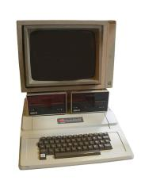
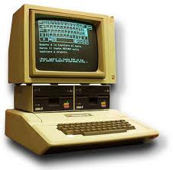
The Computer
1936: First freely programmable computer
1951: First commercial computer released
1974: First consumer computers (IBM)
1976: Apple I,II
1984: Apple Macintosh
1985: Microsoft Windows

Slide 6



The Internet
1969: The original internet
1971: First email sent
1990: Archie, the first search engine
1991: Internet available for commercial use
1996: More email than post mail in the USA
: BackRub search engine (Stanford)
1997: Google (googol)

Slide 7
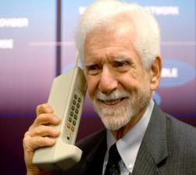
Mobile Phone
1973: Motorola cell phone created
April 3, 1973: first cell phone call made by Martin Cooper
1983: first cell phone available to consumers
1994: First smartphone
2001: First Commercial 3g Network
2007: First Iphone Released
2008: First Android phone released
2010: First LTE Network

Slide 8
Products and Services

Slide 9
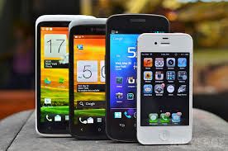
What is a Smartphone?
  All in one device that can be used as a cell phone and has computing, PDA functions
  Variety of applications available
  High Speed Data Access
  Multimedia

Slide 10
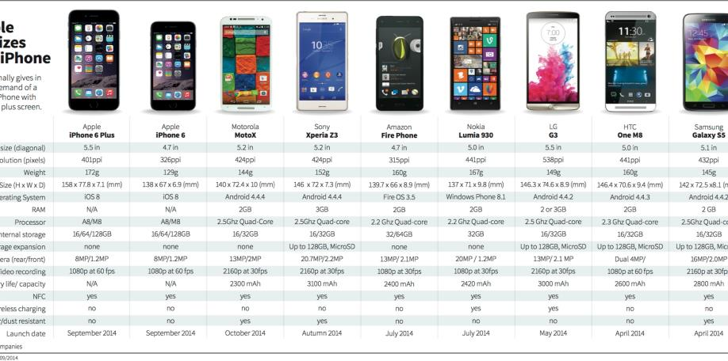
Smartphones

Slide 11
Operating system Overview
An operating system (OS) is software that manages computer hardware resources and provides services for computer programs.
Human Users
Application Software
Operating System
Other System Software
Hardware

Slide 12
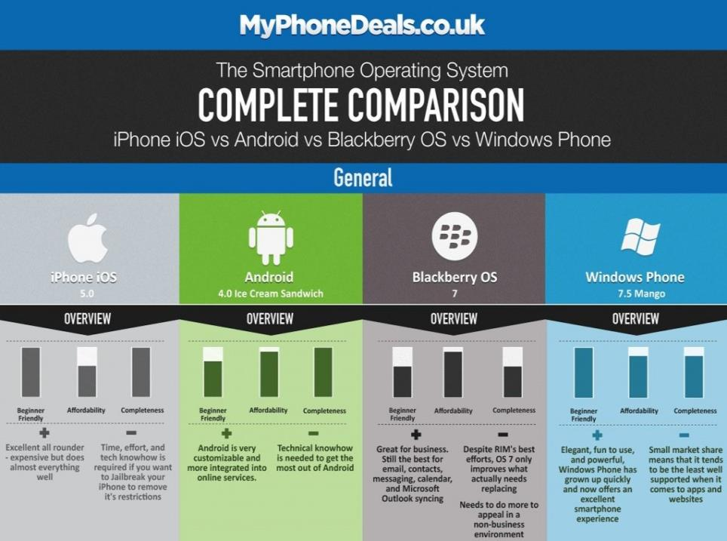

Slide 13
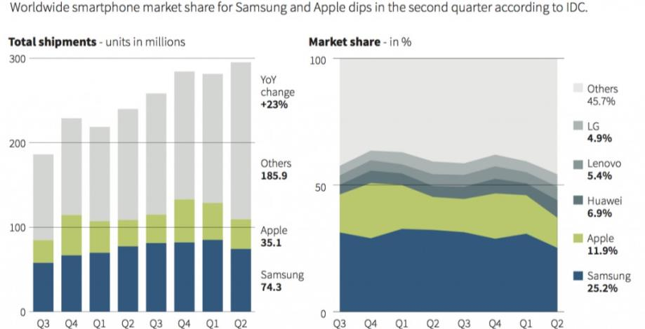
Smartphones

Slide 14
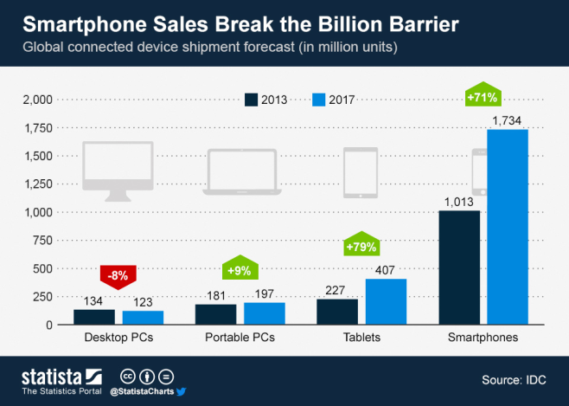
Smartphones Growth

Slide 15
Mobile Operating System Market Share

Slide 16
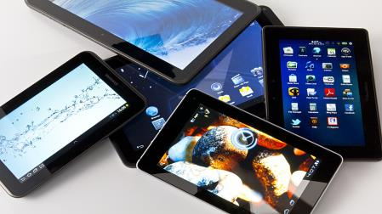
What is a tablet?
Larger than a Smartphone
Touchscreen used as primary method of input
Some typical functions are:
  Mobile Browsing
  Portable Media Player
  Camera
  Downloadable Apps

Slide 17
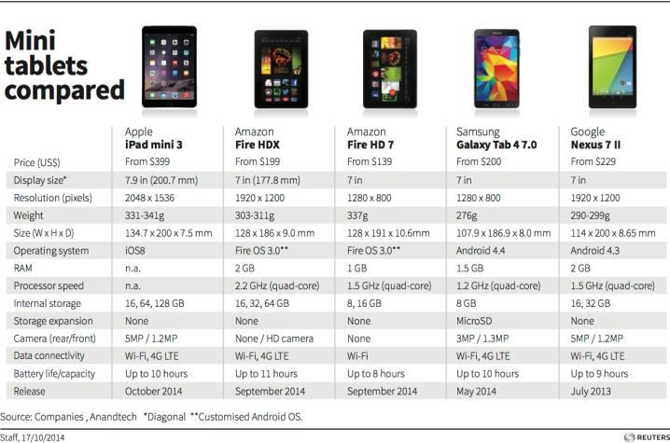
Tablet Comparison

Slide 18
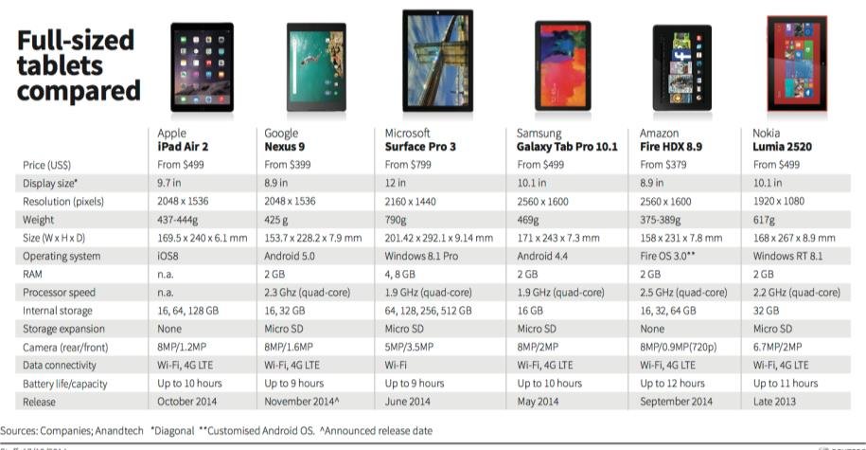
Full Sized Tablets

Slide 19
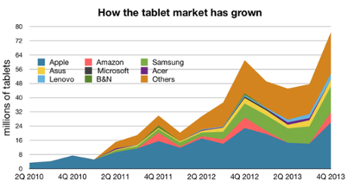
Tablets Growth

Slide 20
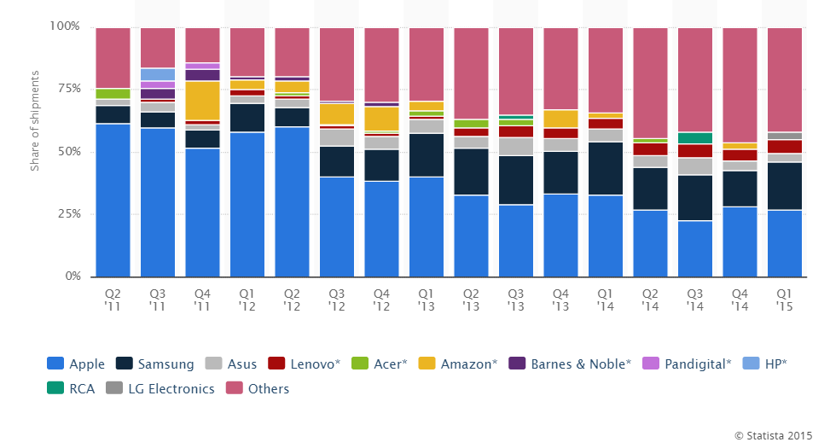
Tablet Manufacturer Market Share

Slide 21
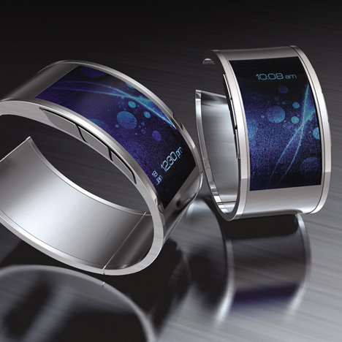
Smart Watch
A computerized wristwatch with functionality that is enhanced beyond timekeeping, and is often comparable to a personal digital assistant device

Slide 22
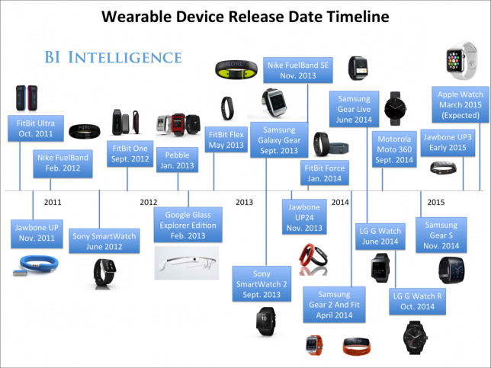
Smart Watch

Slide 23
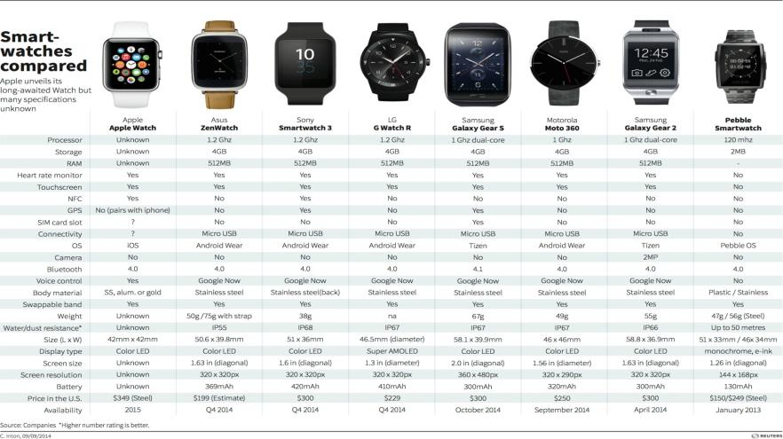
Smart Watches

Slide 24
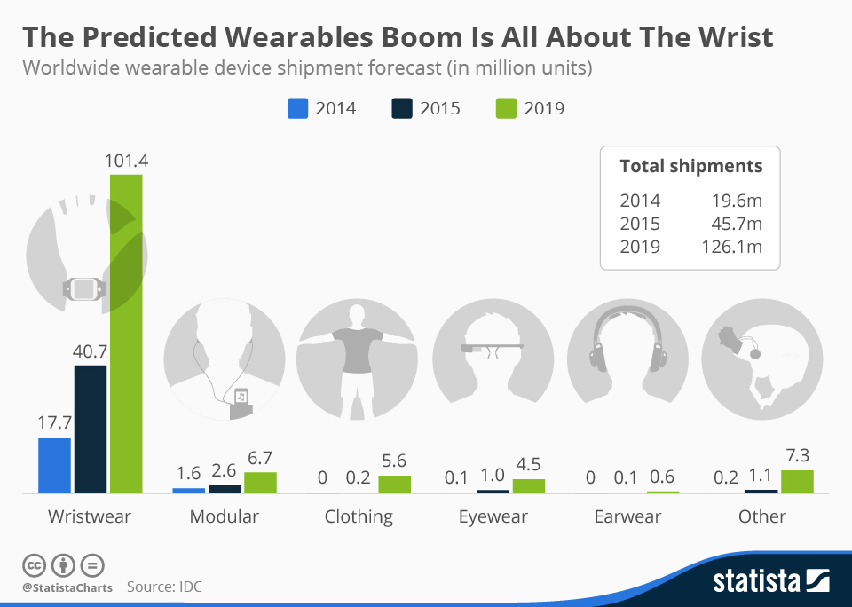
Smart Watch Growth

Slide 25
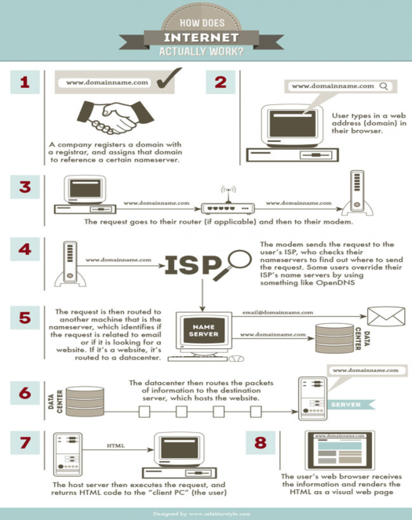
Internet

Slide 26
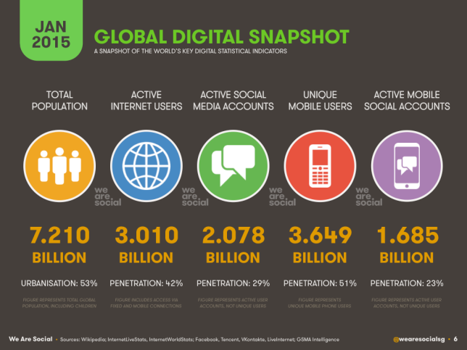
Internet Usage

Slide 27
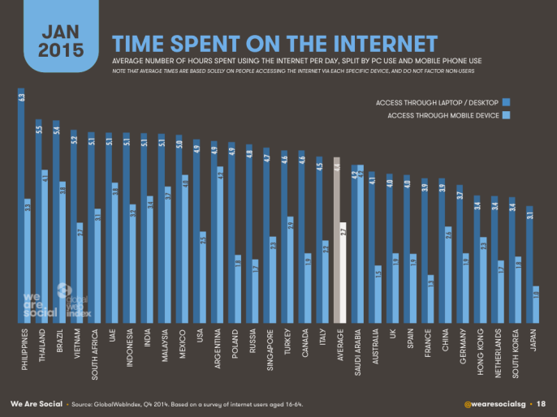
Internet Usage

Slide 28
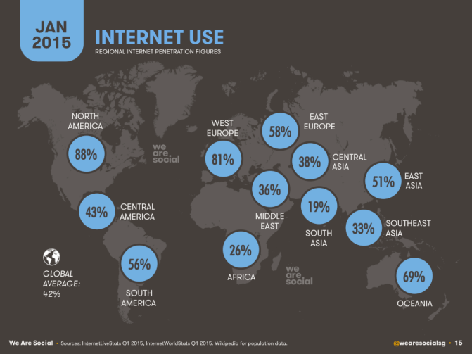
Internet Penetration by Region

Slide 29
Application Software

Slide 30
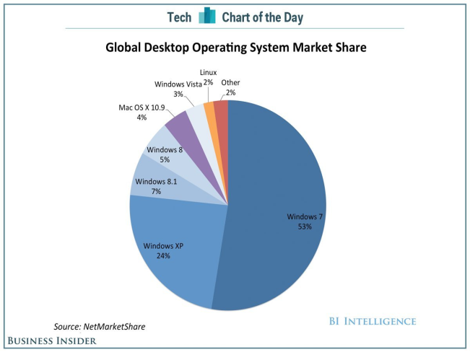
Computer OS market share

Slide 31
Legal Regulations
Net Neutrality in US- ban paid prioritization of Internet traffic
Patent laws and infringements
Antitrust laws

Slide 32


Slide 33
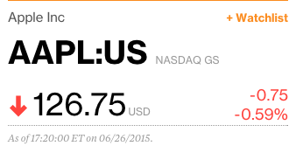
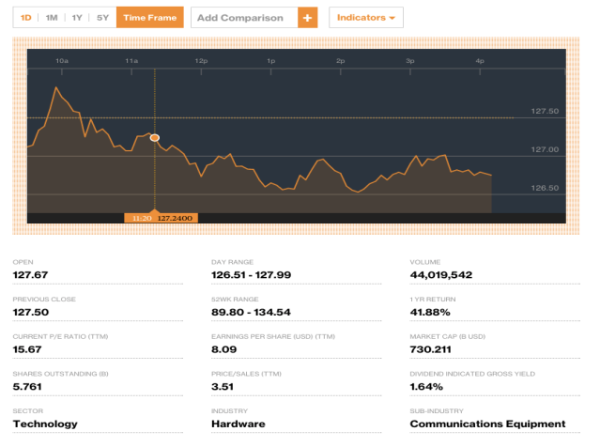
Financial Snapshot

Slide 34
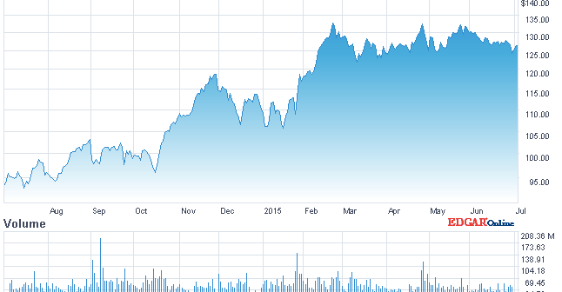
One Year Performance

Slide 35
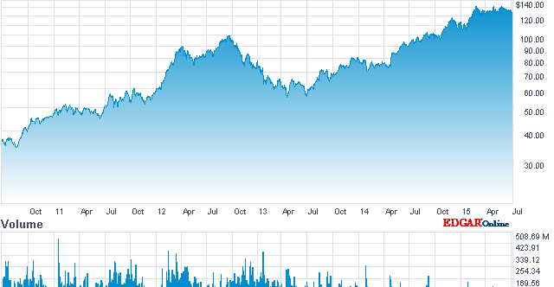
Five Years Performance

Slide 36
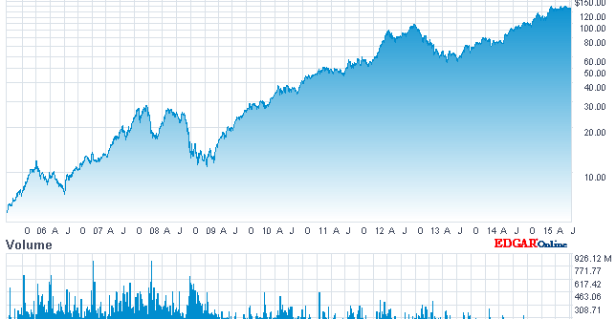
Ten Years Performance

Slide 37
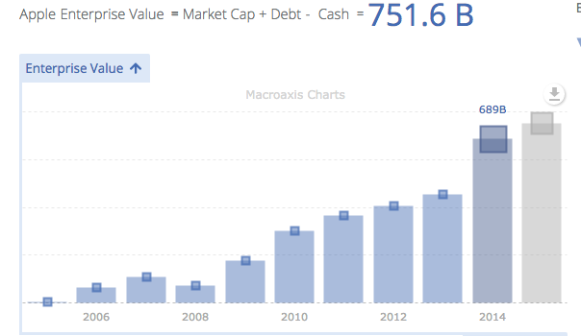
Current Valuation

Slide 38
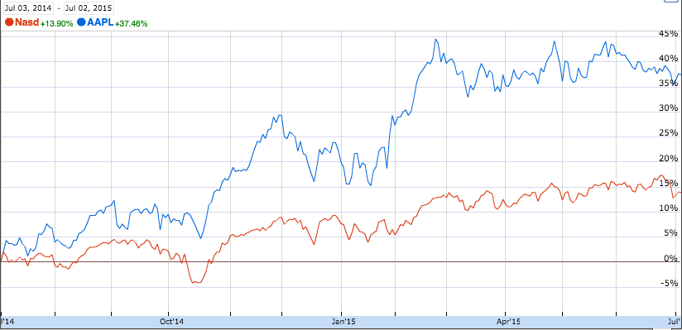
Apple Vs. NASDAQ

Slide 39
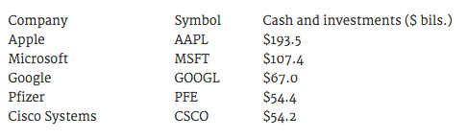
Apple Cash and Investment

Slide 40
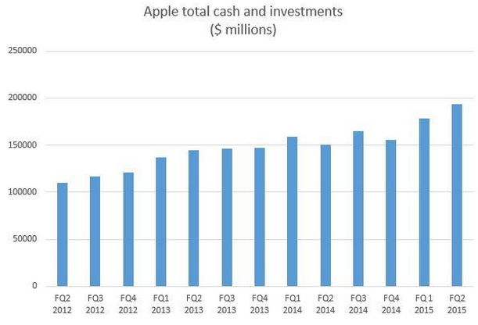

Slide 41
Company Profile
Apple Inc. (formerly Apple Computer, Inc.) founded by Steve Jobs, Steve Wozniak and Ronald Wayne (1976)
It designs, manufactures, and markets mobile communication and media devices, personal computers, and portable digital music players, and sells a variety of related software, services, peripherals, networking solutions, and third-party digital content and applications.
Products sold worldwide through its online stores, its retail stores, its direct sales force, third-party cellular network carriers, wholesalers, and resellers
Headquartered in Cupertino, California

Slide 42
Business Strategy
The Company is committed to bringing the best user experience to its customers through its innovative hardware, software and services.
The Company believes continual investment in research and development, marketing and advertising is critical to the development and sale of innovative products and technologies.
Enhancing and expanding its own retail and online stores and its third-party distribution network to effectively reach more customers and provide them with a high-quality sales and post-sales support experience.

Slide 43
Mission
Apple designs Macs, the best personal computers in the world, along with OS X, iLife, iWork and professional software. Apple leads the digital music revolution with its iPods and iTunes online store. Apple has reinvented the mobile phone with its revolutionary iPhone and App Store, and is defining the future of mobile media and computing devices with iPad.

Slide 44
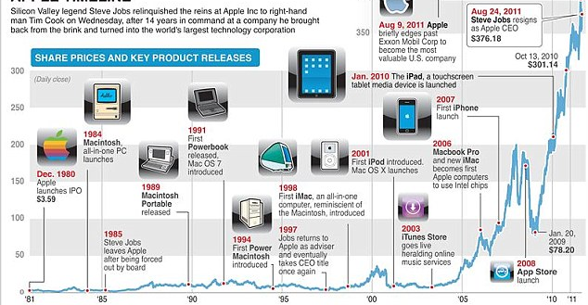
A Brief History of Apple

Slide 45
Products
Mac
iPhone
Apple Watch
iPad
iPod
Apple TV
iTunes
iCloud

Slide 46
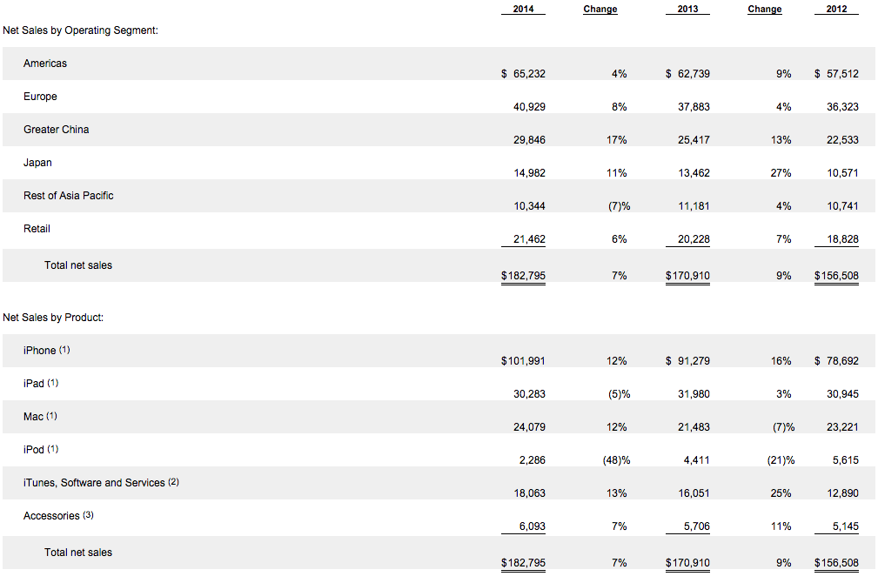
Net Sale by Segments and Products

Slide 47

Mac
Use OS X operating system
Intel microprocessors
Product line includes iMac, Mac Pro, and Mac Mini and MacBook.
Latest products include the iMac 5K and the new Retina Macbook

Slide 48
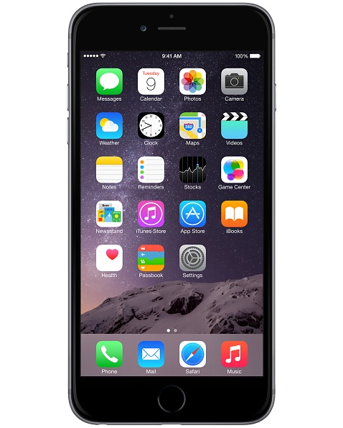
iPhone
A phone, music player, and internet device in one product
Based on Apple’s iOS Multi-Touch operating system
Introduced Siri, a voice activated intelligent assistant
Thin and Light Design
Late versions: iPhone 6 and iPhone 6 plus

Slide 49
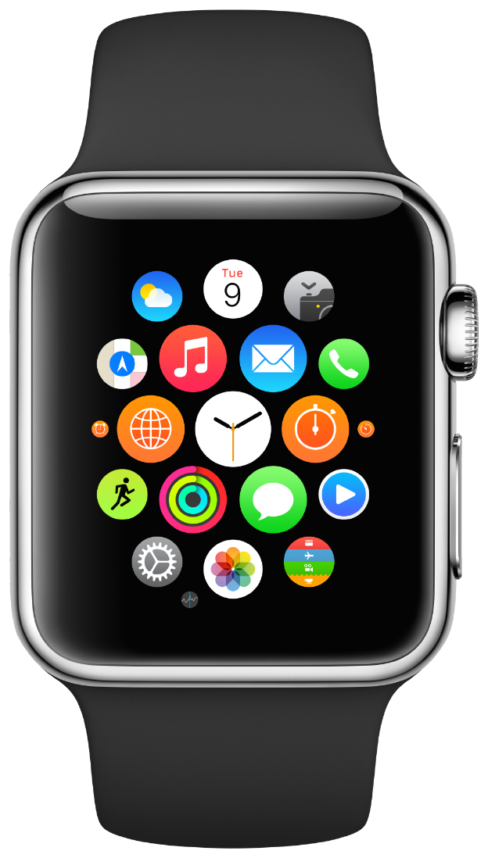
Apple Watch
Smart Watch
Released in 2015
Comes in different designs
Revolutionize the way people look at fitness
Watch OS2 comes out in Fall

Slide 50
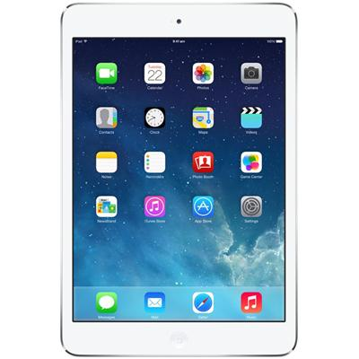
iPad
Multi-purpose tablets based on Apple’s iOS Multi-Touch operating system
Compatible with both Mac and Windows personal computers and Apple’s iCloud services
iPad Mini and iPad Air
Widely used in education and medical field

Slide 51
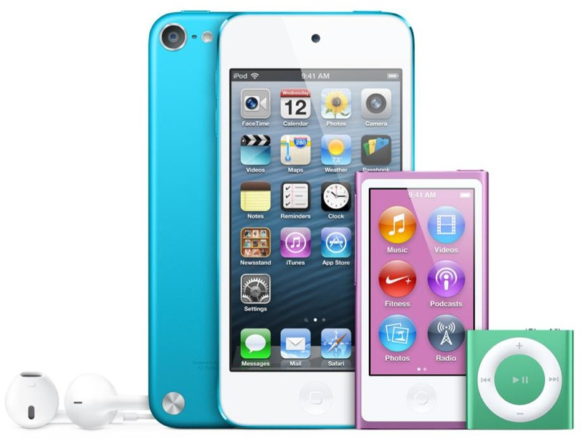
iPod
iPod Touch
iPod nano
Portable digital music and media players
work with iTunes to purchase and synchronize content

Slide 52
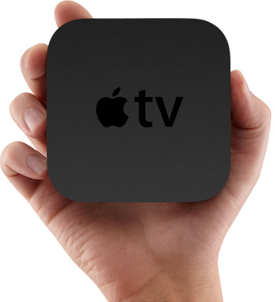
Apple TV
Connects to consumers’ high definition TVs and enables them to access iTunes content directly
Content from media services available
Allows streaming iTunes content from Macs and Windows personal computers

Slide 53

iCloud
Cloud service
Stores music, photos, applications, contacts, calendars, documents and more
Users can sign up for free access to iCloud using a device running qualifying versions of iOS or OS X

Slide 54
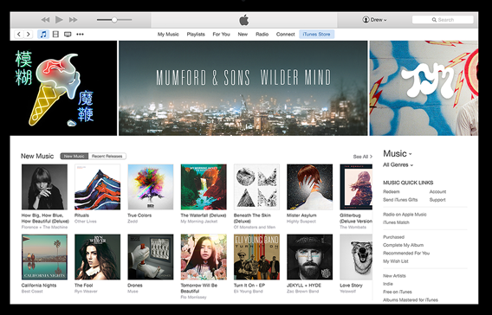
iTunes
Available for both Mac and Windows computers
Keeps users’ music, movies, and TV shows organized in one place
The iBooks Store features e-books from major and independent publishers
Passed 25 billion song downloads in 2013

Slide 55

Apple Music
Music streaming service
WWDC 15
June 30
Subscription based, first three months free
$9.99/mo or $14.99/mo
Deepen the connection between artist and fans

Slide 56
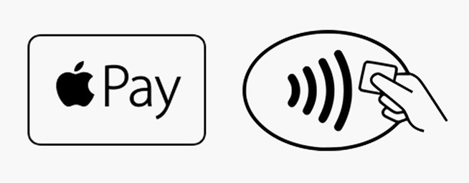
Apply Pay
IPhone 6 and Apple Watch
October 2014 in the US
UK launch on July 14th 2015
Supports all the major banks

Slide 57
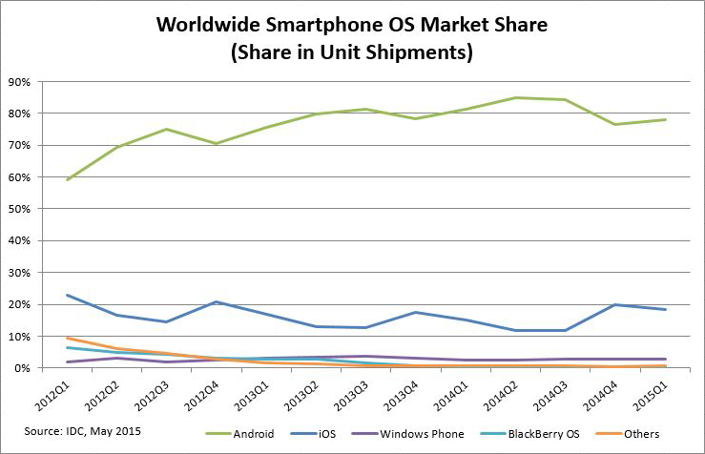
iOS

Slide 58
OSX
Mac operating system
Built on an open-source UNIX-based foundation and provides an intuitive and integrated computer experience
High new OS adoption rate

Slide 59
Management Team

Slide 60
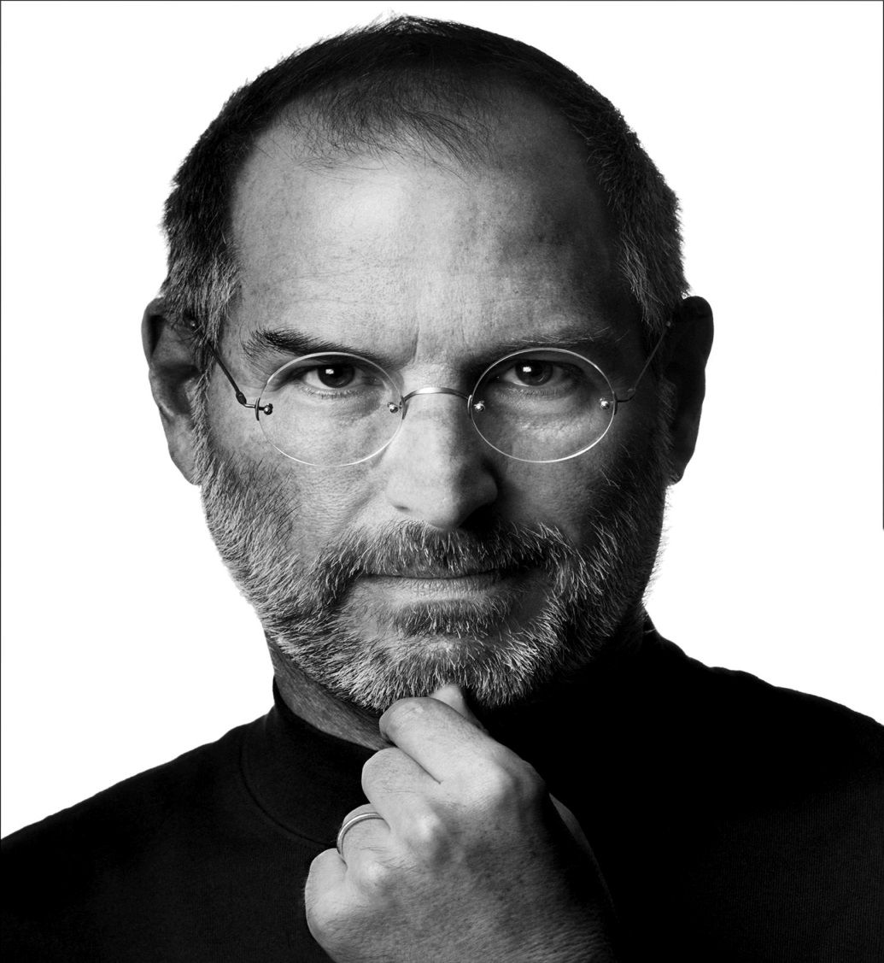
Steve Jobs
Co-Founder and former CEO
Education:
  Reed College – Dropped Out
Oversaw development of iMac, iTunes, iPhone, and iPad on the services side as well as Apple’s retail stores
Demanding perfectionist
Always aimed to position Apple at the forefront of IT
Design influenced by modernist architectural styles of Joseph Eichler and industrial designs of Braun’s Dieter Rams
Passed away in 2011

Slide 61
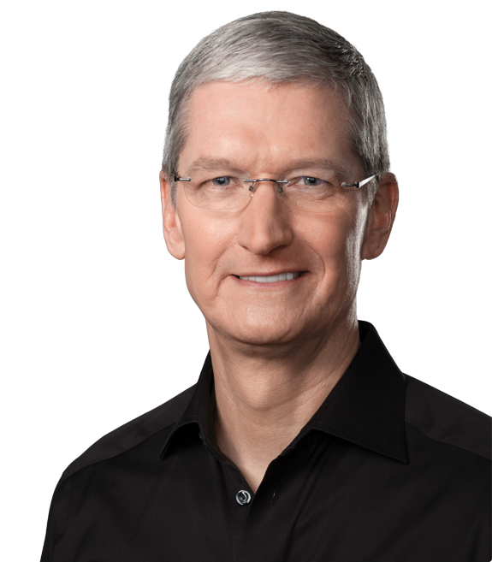
Tim Cook
Chief Executive Officer
  Since 08/12/2011
Chief Finance Officer (2005-2011)
Executive VP, Worldwide Sales and Operations (2002-2005)
Senior VP, Worldwide Operations, Sales, Service, and Support (2000-2002)
Senior VP, Worldwide Sales and Operations (1998-200)
Education:
  Auburn University – (B) Industrial Engineering
  Duke University - MBA
Prior to joining Apple, has worked with IE, IBM, and Compaq

Slide 62
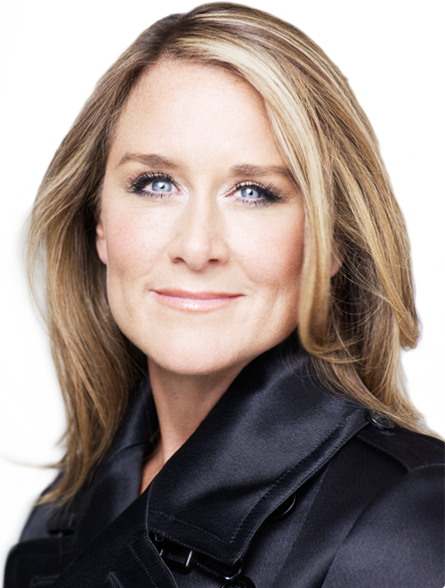
Angela Ahrendts
Senior VP, Retail and Online Stores
Joined Apple from Burberry, where she served as CEO and led the company through a period of outstanding global growth.
Joined the company on may 1, 2014
Plan for the future of Apple Retail: China emphasis, mobile payments, revamped experience
A member of the UK’s Prime Minister’s Business Advisory Council; named honorary dame commander of the British Empire
Marketing and Merchandising degree from
Ball state University in Indiana, where she
was awarded an honorary doctorate

Slide 63
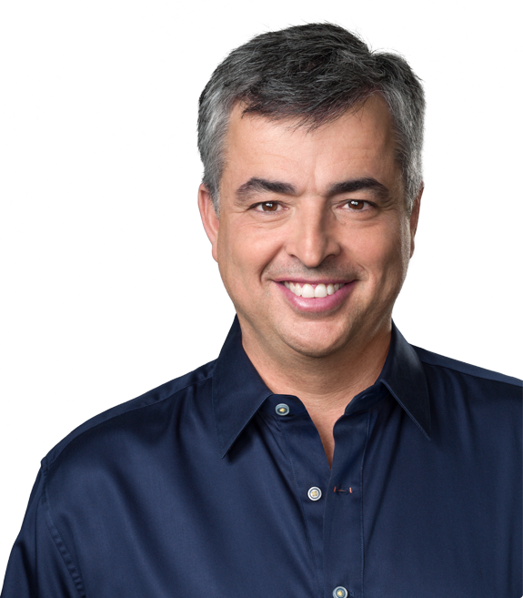
Eddy Cue
Senior VP, Internet, Software and Services
Oversees Apple's content stores including the iTunes Store, the revolutionary App Store and the iBookstore, as well as Siri, Maps, iAd and Apple's innovative iCloud services.
26-year Apple veteran
Earned a Bachelor Degree in Computer Science and Economics from Duke University

Slide 64
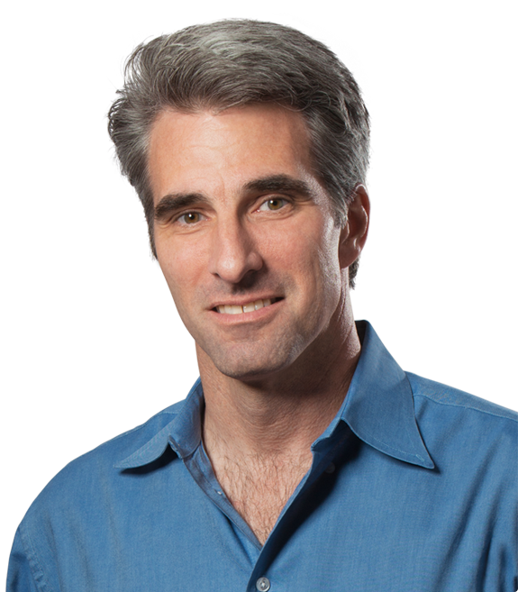
Craig Federighi
Senior VP, Software Engineering
  Since 08/27/2012
Joined Apple in 1996 after acquisition of NeXT
Rejoined Apple in 2009
Education:
  University of California – (B) Computer Science
  University of California - (M) Electrical Engineering and Computer Science

Slide 65
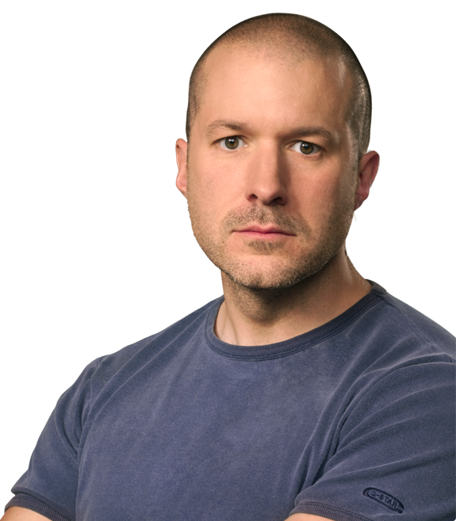
Jonathan Ive
Senior VP, Design
  Since 07/2010
Senior VP, Industrial Design (1997-2010)
Designed MacBook Pro, iMac, MacBook Air, iPod, iPod Touch, iPhone, iPad, iPad Mini, the new Macbook.
Education:
  North Carolina University – (M) Mechanical Engineering
  Duke University - MFA

Slide 66
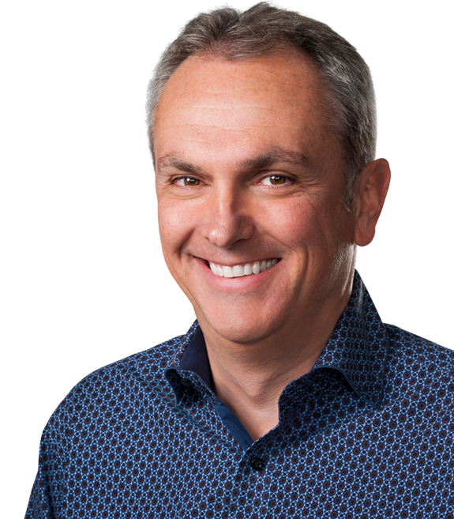
Luca Maestri
Senior VP and Chief Financial Officer
Joined Apple in 2013 as vice president of Finance and corporate controller, previously worked as CFO at Xerox, Nokia Siemens Networks and GM
Master’s degree in Science of Management from Boston University; B.A in Economics from Luiss University

Slide 67
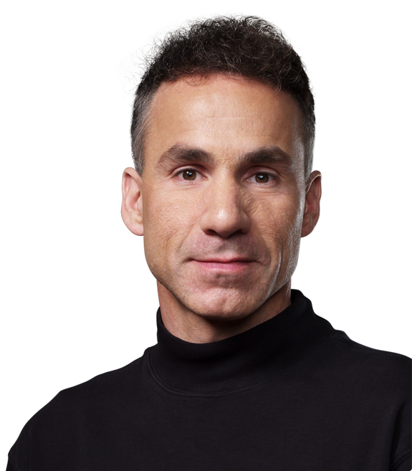
Dan Riccio
Senior VP, Hardware Engineering
  Since 06/28/2012
Joined Apple in 1998
Education:
  University of Massachusetts – (B) Engineering
Teams responsible for delivering multiple product breakthroughs such as Mac, iphone and iPad.

Slide 68
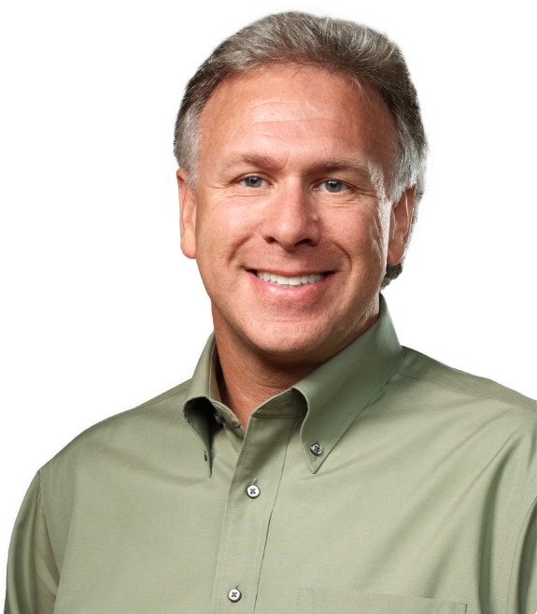
Phillip W. Schiller
Senior VP, Worldwide Marketing
  Since 04/1997
Rejoined Apple in 1997
Always involved in marketing roles
Education:
  Boston College – (B) Biology

Slide 69

Bruce Sewell
Senior VP and General Counsel
Oversees all legal matters
Joined Apple from Intel Corporation in
September 2009
J.D. from George Washington University;
Bachelor of Science degree from the
University of Lancaster

Slide 70

Jeff Williams
Senior VP, Operations
  Since 07/2010
Joined Apple in 1998
Worked a variety of operational roles
Education:
  North Carolina University – (M) Mechanical Engineering
  Duke University - MFA

Slide 71
Financial Strategy
Charge premium to create high quality reputation
Invest more on the new services

Slide 72
Future Outlook
New iPhone
New iPad
Apple Watch
Higher spec Macs
iOS 9
Apple Music

Slide 73
Contingencies
Many legal proceedings still in process, the effects might not be favorable for Apple
Limited source supply
More competitions from both the phone and tablets fields.

Slide 74
Financial Analysis

Slide 75

Balance Sheet (Assets) 10-Q

Slide 76

Balance Sheet (Liabilities) 10-Q

Slide 77

Balance Sheet (Assets) 10-K

Slide 78

Balance Sheet (Liabilities) 10-K

Slide 79

Income Statement 10-K

Slide 80

Income Statement 10-Q

Slide 81

Cash Flow (Operating) 10-K

Slide 82

Cash Flow (Investing) 10-K

Slide 83

Cash Flow (Financing) 10-K

Slide 84

Cash Flow (Operating) 10-Q

Slide 85

Cash Flow (Investing) 10-Q

Slide 86

Cash Flow (Financing) 10-Q

Slide 87

Stock Forecast

Slide 88


Slide 89
Recommendation
Higher dividend
Strong management team with original member still on board
Potential products release in Fall
Low inventory storage cost
Has high consistently increasing cash and investment
More exciting projects e.g. iCar on the horizon
Potential Apple Music success

Slide 90
Recommendation
BUY

Slide 91


Slide 92

Financial Snapshot

Slide 93

1 Year

Slide 94

5 Year

Slide 95

10 Year

Slide 96

Google Vs NASDAQ

Slide 97

Common Share Structure
Annual Data (in millions of shares)
 | Dec-10 | Dec-11 | Dec-12 | Dec-13 | Dec-14
Shares Outstanding | 642 | 649 | 659 | 671 | 681
Quarterly (in millions of shares)
 | Mar-14 | Jun-14 | Sep-14 | Dec-14 | Mar-15
Shares Outstanding | 675 | 676 | 679 | 681 | 683

Slide 98
Common Share Structure
Class A (GOOGL)
  1 vote per share
  As of Q1 2015: 340.6 Million shares outstanding
Class B
  10 votes per share
  Only available to Google Insiders and executives
  As of Q1 2015: 53 Million shares outstanding
Class C (GOOG)
  Issued on January 30, 2014
    Shareholders gained 1 class C share for each class A share they previously held, similar to a stock-split.
  0 votes: Maintain control of Google’s direction
  As of Q1 2015: 340.6 Million shares outstanding

Slide 99
5 Year Diversification Plan
Larry, Sergey, and Eric held 92% of the company’s Class B common stock
  66% of the voting power in company decisions
Since 2010, Larry and Sergey will each sell $5.5 billion shares of common stock until 2015
  Will retain 48% of the voting power after the sell-out

Slide 100
Strategy
Revenue = Amount of time on the Web
MISSION:
  “To organize the world’s information and make it universally accessible and useful”
  Unofficial motto: “Don’t be evil,”

Slide 101
Philosophy
Focus on the user and all else will follow.
It’s best to do one thing really, really well.
Fast is better than slow.
Democracy on the web works.
You don’t need to be at your desk to need an answer.
You can make money without doing evil.
There’s always more information out there.
The need for information crosses all borders.
You can be serious without a suit.
Great just isn’t good enough.

Slide 102
History
1996: Larry and Sergey create a search engine called BackRub (Operating on Stanford servers)
1997: Google.com is registered as a domain
1998: Andy Bechtolsheim becomes first investor ($100,000), and Google files for incorporation in California
1999: Kleiner Perkins Caufield & Byers as well as Sequoia Capital provide $25 million; Website officially launched
2000: Google AdWords launched (Paid web links with associated searches)
2001: Eric Schmidt becomes CEO and Chairman of the Board of Directors; “PageRank” granted a patent
2002: Google labs, Google Scholar released,.. AdWords becomes cost-per-click

Slide 103
History
  2004: Google Local released (became Google Maps), Gmail released, IPO raised $1.67 billion for 20 million shares at $85
2005: Google Maps, Google Earth launched
2007: Share prices hit $700
2011: Android exceeds 10billion app downloads, growth rate of 1billion downloads per month, Google Drive launched
2012: Google is the dominant search engine globally with 88.8% market share, Most visited website in the world
2013: 1 billion android devices activated, Calico founded, a company focused on health and well being
2014:Prototypes of self driving cars revealed

Slide 104
Key Acquisitions
Apr 2003: Applied Semantics
  Lead to the launch of Google AdSense
Jul 2004: Picasa Inc.
  Digital photo management
Oct 2004: Keyhole Corp.
  Leads to launch of Google Maps and Google Earth.
Aug 2005: Android
Oct 2006: YouTube (1.65 Billion)
April 2007: Double clicks (3.1 Billion)
Mar 2008: Ad Mob (750 Million)
  Enhances the company’s advertising revenue.
Aug 2011: Motorola (12.5 Billion)

Slide 105
Key Acquisitions
2012:
  Meebo: web-based instant messaging service acquired for $100M
  Sparrow: Email client for iOS and OSX devices, acquired for $25M
  Wildfire: social marketing software developer, acquired for $450M
  Quickoffice: Productivity suite for Google docs, and smart devices.
2014
  Nest: makes various products for the home such as thermostats and smoke alarms (3.2 Billion)

Slide 106
Products and Services
Flight Explorer
Google+
Search
Google Image
Google Ads
Google Docs
Google Finance
Google Photos
Google Calendar
Google Scholar
Google Books
Chrome
Chrome OS
Gmail
Google Wallet
Google TV
Translate
Google Ventures
Patent Search
Google Maps
Google Earth
Android mobile OS
Google Play
Google Blog Search
Blogger
YouTube

Slide 107

Revenue Growth

Slide 108

Revenue by Geography

Slide 109

Revenue by Source

Slide 110




Market Share
Search Engine Market Share
Mobile/Tablet OS Market Share
52%
70%
(Desktop) Browser Market Share
(Mobile) Browser Market Share
26%
31%
Notes:
https://www.google.ca/search?q=google+2014+revenue+breakdown&espv=2&biw=1242&bih=606&source=lnms&tbm=isch&sa=X&ei=4aiDVeSvOMzCggTOtILABg&ved=0CAcQ_AUoAg#imgrc=c11ps2YnhmX7rM%253A%3BkewPTvHiD65h7M%3Bhttp%253A%252F%252Fcdn.bgr.com%252F2014%252F02%252Fgoogle-revenue-chart.jpg%3Bhttp%253A%252F%252Fbgr.com%252F2014%252F02%252F06%252Fapple-google-microsoft-revenue-sources%252F%3B620%3B452

Slide 111
Company Overview
Google is a global technology leader focused on improving the ways people connect with information.
Their mission is to organize the world’s information and make it universally accessible and useful. Their innovations in web search and advertising have made their website a top internet property and their brand one of the most recognized in the world. Google generates revenues primarily by delivering relevant, cost-effective online advertising. Businesses use Google’s AdWords program and AdSense program to promote their products and services with advertising on both Google- owned properties and publishers' sites across the web.
Their business is primarily focused around the following key areas: search and display advertising, the Android operating system platform, consumer content through Google Play, enterprise, commerce and hardware products.

Slide 112
AdWords
Advertisers create ads to show alongside Google search results
Advertisers “bid” in an auction to have their ads displayed alongside certain specific keywords
  Pay per click
  Cost-per-thousand
Advertisers create ads to show alongside Google search results
  Consists of 1 headline, 25 characters
  2 text lines, 35 characters each
Advertisers may bid on certain specific keywords to have their ads displayed alongside
  Cost-per-impression (CPM)
  Cost-per-click (CPC)

Slide 113

AdWords

Slide 114

Google Maps Ads

Slide 115
Adsense
Google partnerships with publishers within Google Network Members, who sell the ad space of their websites
Ads are shown on publishers’ websites in terms of relevancy to their products
Google shares profits with the website publishers
  Per click
  Per impression

Slide 116
Gmail
Features:
first online email service with one gigabyte of storage
first to keep emails from the same conversation together in one thread, similar to an Internet forum.
Interactive webpages without having to refresh browser

Slide 117

Gmail Ads

Slide 118

Google Finance Ads

Slide 119

YouTube
The biggest video site in the world
Increasing mobile user base
Google has established partnerships with content companies to aid in monetizing video in the mobile space

Slide 120

Google Glass
  The beginning of wearable technology
  Searches the web
  Records videos
  GPS navigation
  MP3

Slide 121

Google+
Social Network like Facebook
Integrated to Google owned platforms such as YouTube
Google Hangout
An OS designed for touch screen devices
  Nexus, HTC One, Galaxy, Xperia Z
Opened sourced
300 Million users worldwide

Slide 122
Google Chrome and Chrome OS
Chrome web browser
200 million users
Chrome Web Store
Chrome OS
Open Source Software(Free)
Profits come from:
  Partnership with carriers (Rogers) and mobile phone producers (HTC, Samsung)
  Free Google apps (supported by ads)
  Google Play (70% developers; 30% Operation cost to Google and carriers)

Slide 123

Chromecast
Plays HD audio or videos by directly streaming it on the internet
Controlled with mobile app or webapps
Use Google Chrome

Slide 124

Android
1 Billion Android Devices around the world
  51.8% of global smartphone market share
Over 1.5 million Android Apps (1.4 in Apple)
Promotes more searching
  Using keyboard
  Voice
  Camera

Slide 125

Google Play
Used to be Android Market
Digital Distribution of music, books etc. (iOS)
Apps for Android and Chromecast

Slide 126
Google Play

Slide 127

Larry Page
Chief Executive Officer
  Since 04/2011
President, Products (2001-2011)
Co-Founder (1998)
Education:
  Michigan University – (B) Engineering
  Stanford – (M) Computer Science
  Stanford – (PhD) Dropped Out
Met Sergey at Stanford during the PhD program

Slide 128

Sergey Brin
President of Technology
  2001 to 2011
Co-Founder (1998)
Education:
  University of Maryland – (B) Mathematics and Computer Sciences
  Stanford – (M) Computer Science
  Stanford – (PhD) Dropped Out
Met Larry at Stanford during the PhD program

Slide 129

Eric Schmidt
Executive Chairman, Board of Directors
  Since 2011
Chief Executive Officer (2001-2011)
CEO, Novell (1997-2001)
CTO, Sun Microsystems (1983-1997)
Education:
  Princeton– (B) Engineering
  University of California – (M) Computer Science
  University of California – (PhD) Computer Science
Member of Obama’s Council of Science and Technology

Slide 130

Omid Kordestani
Senior VP and Chief Business Officer
  Since 2014
Special advisor to CEO
  Since 2009
Education:
  San Jose State University—(B) Electrical Engineering
  Stanford—MBA
Worked at Netscape, Hewlett-Packard,
Go Corporation before Google

Slide 131

David C. Drummond
Senior VP, Corporate Development and Chief Legal officer
  Since 2002
Helped Larry Page and Sergey Brin incorporate the company, and secure its initial rounds of financing
  Responsible for company’s business development (Investments and M&A)
Education:
  Santa Clara University– (B) History
  Stanford– (JD) Law
  University of California – (PhD) Computer Science
Serves on Board of Directors of Uber Technologies

Slide 132
Financial Strategy
Become the primary interface of the world
Improve quality and reach of the Internet
Own the home
Control more of the purchase cycle
Extend and improve life and cure diseases

Slide 133
Future Outlooks
Android M (update to Android)
  Chrome integration, battery life, offline maps in Google for developing world (poor connectivity)
Improvements to “Smart Home” applications
Android Pay (similar to Apple Pay)
Virtual Reality (partner with GoPro)
Fi Wireless (Wifi Hotspot service)
Android Auto (Phone display through Dashboard)

Slide 134
Potential Risks
Google has a lot of competition, must continually innovate
  Apple, Microsoft
New investments are inherently risky
Most revenue is from advertisements
Growth can decline over time

Slide 135

Balance Sheet (Assets) 10-Q

Slide 136

Balance Sheet (Liabilities) 10-Q

Slide 137

Balance Sheets (Assets) 10-K

Slide 138

Balance Sheet (Liabilities) 10-K

Slide 139

Income Statement 10-K

Slide 140

Income Statement 10-Q

Slide 141

Cash Flow (Operating) 10-K

Slide 142

Cash Flow (Investing&Finance) 10-K

Slide 143

Cash Flow (Operating) 10-Q

Slide 144

Cash Flow (Investing&Finance) 10-Q

Slide 145

Retained Earnings

Slide 146

Stock Forecast

Slide 147
Recommendation
BUY

Slide 148


Slide 149

Financial Snapshot

Slide 150

Financial Snapshot

Slide 151

Common Share Structure

Slide 152

One Year Performance

Slide 153

Five Years Performance

Slide 154

Ten Years Performance

Slide 155

Comparison with Nasdaq and S&P (5Y)

Slide 156
Goals
At Microsoft, our goal is to enable people and businesses throughout the world to realize their full potential
We deliver on that commitment by striving to create technology that is accessible to everyone—of all ages and abilities.

Slide 157
History and Milestones
1975
Microsoft founded
1981
Microsoft incorporates
IBM introduces its personal computer MS-DOS 1.0
1986
Microsoft stock goes public
1990
launches Windows 3.0
1995
launches Windows 95
1998
launches Windows 98
2000
launches Windows 2000

Slide 158
History and Milestones
2001
launches Office XP and Xbox
2005
launches Xbox 360
2007
launches Windows Vista
2009
launches Windows 7
2010
launches general availability of Office
launches Kinect for Xbox 360
launches Windows Phone 7
2011
launches Office 365
Microsoft closes its acquisition of Skype

Slide 159
History and Milestones
2012
Microsoft launches Windows 8 and Microsoft Surface
2013
launches Office 2013, Outlook.com, Windows 8.1
launches Surface 2 and Surface Pro 2, and launches Xbox One
Microsoft announces decision to acquire Nokia
2014
Satya Nadella named chief executive officer for Microsoft
Microsoft launches Office for iPad, Surface Pro 3
Minecraft to join Microsoft announcement
Microsoft announces Office apps for Android tablets
2015
Microsoft reveals Windows 10

Slide 160
Key Acquisitions
1987 – Forethought
  Forethought was founded in 1983 tat later be know as Microsoft PowerPoint
1997 – Hotmail
  Acquired Hotmail for $500 million
2000 – Visio Corporation
  Acquired Visio for $1.375 billion
2002 – Navision
  Purchased Navision for $1.33 billion; turned into a new division as Microsoft Business Solutions (now Microsoft Dynamics)
2011 – Skype Technologies
  Purchased for $8.5 billion; 32 times larger than its value
2013 – Nokia (Hardware Division)
  Formerly developed phones for Microsoft; highlights Microsoft’s move into hardware

Slide 161
Products and Services
Windows
Office
Internet Explorer
Bing and MSN
Xbox and PC Games
Email and Communications
One Drive
Solution Business
Servers
Hardware and Multimedia

Slide 162

Revenue by Geography

Slide 163

Revenue by Product

Slide 164

Microsoft Operating Segments

Slide 165

Windows
Windows 8.1
Easier access to the apps and key controls
More familiar mouse and keyboard options
Simpler to find new apps
More PCs and devices to choose from
Benefits for businesses
Windows 10
Coming after July 29, 2015
Notes:
http://windows.microsoft.com/en-ca/windows-8/whats-new

Slide 166


Microsoft Applications

Slide 167

Surface
tablet computer created and sold by Microsoft.
Windows 8-based tablets was introduced on June 18, 2012.
The most recent models, the Surface Pro 3 and the Surface 3, were released on June 20, 2014, and May 5, 2015, respectively.

Slide 168

XBOX
XBOX is a video gaming brand created and owned by Microsoft.
Xbox 360, was released in 2005 and has sold over 77.2 million consoles worldwide as of April 18, 2013.
Xbox One, was revealed in 21 markets in total on May 21, 2013.

Slide 169

Management Team
John W. Thompson
Chairman
John W. Thompson joined the Microsoft Board in February 2012 and became independent chairman of Microsoft Corporation on Feb. 4, 2014.
Education:
Thompson received a bachelor’s degree in Business Administration from Florida A&M, and a master’s degree in Management from the Sloan Fellows program of the MIT Sloan School of Management.

Slide 170

Management Team
Bill Gates
Founder and Technology Advisor
William (Bill) H. Gates is founder, technology advisor and board member of Microsoft Corporation. He served as chairman of the board until Feb. 4, 2014.
Education:
In 1973, Gates entered Harvard University as a freshman. In his junior year, Gates left Harvard to devote his energies to Microsoft, a company he had begun in 1975 with his childhood friend Paul Allen.

Slide 171

Management Team
Satya Nadella
Chief Executive Officer
Satya Nadella is Chief Executive Officer of Microsoft. Before being named CEO in February 2014, Nadella held leadership roles in both enterprise and consumer businesses across the company.
Education:
He earned a bachelor’s degree in electrical engineering from Mangalore University, a master’s degree in computer science from the University of Wisconsin – Milwaukee and a master’s degree in business administration from the University of Chicago.

Slide 172

Management Team
Chris Capossela
Executive Vice President and Chief Marketing Officer
As chief marketing officer, Chris Capossela leads Microsoft’s global product marketing, advertising, brand, research and communications functions for businesses and consumers.
He oversaw the creation of new business opportunities with partners to deliver new consumer experiences through Windows, Windows Phone, Office and Xbox.
Education:
Capossela holds a bachelor’s degree in computer science and economics from Harvard University.

Slide 173
Business Strategy
“One Microsoft, One Strategy”- Alignment Strategy
PC sales falls
The realignment aims at improving revenues due to declining PC sales.
Server and Tools have higher revenue
Market shifting

Slide 174

Balance Sheet 10-Q (Assets)

Slide 175

Balance Sheet 10-Q (Liabilities and S/E)

Slide 176
Balance Sheet 10-K (Assets)
Period Ending |  | Jun 30, 2014 | Jun 30, 2013 | Jun 30, 2012
Assets
Current Assets
 | Cash And Cash Equivalents | 8,669,000 | 3,804,000 | 6,938,000
 | Short Term Investments | 77,040,000 | 73,218,000 | 56,102,000
 | Net Receivables | 21,485,000 | 19,118,000 | 17,815,000
 | Inventory | 2,660,000 | 1,938,000 | 1,137,000
 | Other Current Assets | 4,392,000 | 3,388,000 | 3,092,000
Total Current Assets |  | 114,246,000 | 101,466,000 | 85,084,000
Long Term Investments |  | 14,597,000 | 10,844,000 | 9,776,000
Property Plant and Equipment |  | 13,011,000 | 9,991,000 | 8,269,000
Goodwill |  | 20,127,000 | 14,655,000 | 13,452,000
Intangible Assets |  | 6,981,000 | 3,083,000 | 3,170,000
Accumulated Amortization |  | - | - | -
Other Assets |  | 3,422,000 | 2,392,000 | 1,520,000
Deferred Long Term Asset Charges |  | - | - | -
Total Assets |  | 172,384,000 | 142,431,000 | 121,271,000

Slide 177

Balance Sheet 10-K (Liabilities and S/E)

Slide 178

Income Statement 10-Q

Slide 179

Income Statement 10-K

Slide 180

Cash Flow 10-K

Slide 181

Cash Flow 10-Q

Slide 182

Stock Forecast

Slide 183

Recommendation

