Slide 1
Global Gadgets
AAPL, GOOG, MSFT
Arnold Lam
Jason Chow
Jeff Ong
Tony Hsieh

Slide 2
Global Gadgets
Industry Overview
Apple
Google
Microsoft
Conclusion

Slide 3
What are Gadgets?
Gadgets are small technological objects such as devices and tools that have particular functions
Increase of productivity and convenience in daily life
“Smart”: multi-purpose, multi-tasking
For work, entertainment, or sense of style
Benefits that gadgets provide are through hardware, software, and service

Slide 4


Gadget as a Product
Profit relies on gadget sales and service, with the support of software, including OS and apps
Hardware
Software
Service

Slide 5
Gadgets: Hardware
Normal Consumer Electronics
Novelty
Devices that have proven to be useful and have substantially embedded into daily life
  PCs
  Smart phones
  Tablets
  GPS’s
  E-book readers
Tools with features that change or will change the way users conduct daily activities
  Smart watch
  Smart wristbands
  Google glasses
  Portable camcorders
  Others

Slide 6
Gadgets: Software & Service
Software & Apps
Service
Operation System
App Stores
  Apple’s App Store, Google Play
Third-party contents
  Apps
Online payment
  PayPal, Alipay
E-commerce
Advertising
Telecommunication service
Open source/Closed Environment
Internet
Wireless connection/Mobile networking

Slide 7
Gadget Industry Overview: Structure
The industry employs a host of engineers, designers, marketers, salespeople, customer service reps, and finance personnel to continually improve familiar products as well as come up with the next big must-have gadget.
Much of the actual manufacturing of the products is done in low labor-cost locations
Involves multi-players in industry’s value chain, such as supplies for parts and materials, tech integration and developing, manufacturing, marketing, etc.
Blurring of traditional categorization: telecommunications, computer hardware, and consumer electronics

Slide 8
Gadget Industry Overview: Trend
Convergence
  players in the consumer electronics, computer hardware, and telecom sectors are increasingly finding themselves competing head-to-head
  Turmoil, in the form of mergers and acquisitions and fluctuations in profitability, is likely to result in each of these industries as time passes.
Falling price
  Technology improves all the time
  Products go by fast
  Only cutting-edge products cost more for developers and consumers

Slide 9
Today’s Gadget Industry
Part of the consumer electronics industry.
Has seen exciting new developments in recent years and at a rapid pace.
It is continually growing and evolving
Anticipating $606 billion of revenue globally

Slide 10
Challenges
Slim operating margins
High capital expenditure
Shortening product lifecycle
Managing a global supply chain
Volatile Industry that is rapidly changing

Slide 11
Competition
Market dominated by small number of very large companies
Profits are extremely high
Rapid change in Market Shares

Slide 12
Intangible Assets and Cash
Important components of financial statements to consider
Intangible assets include goodwill, intellectual property, representation on balance sheet should be examined
A large amount of cash is common - representation of current and future performance of the company

Slide 13
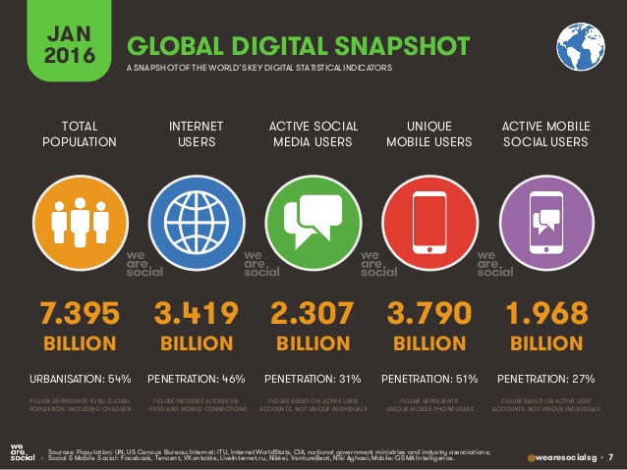
Global Digital Snapshot

Slide 14
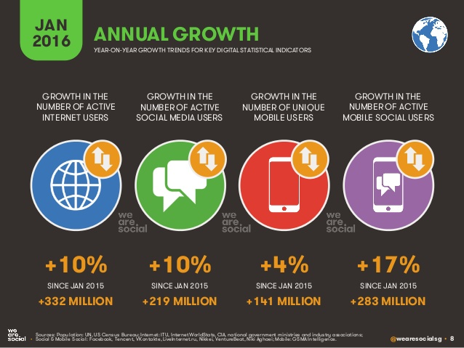
Annual Growth

Slide 15
Main Aspects of the Industry
Internet
Computers
Smartphones
Tablets
Smart watches
Operating Systems
Cloud Computing
App Store

Slide 16
The Internet
Massive network of networks, which connects billions of people online through which communication and other various activities may occur

Slide 17
Internet History
1969: The original internet
1971: First email sent
1990: Archie, the first search engine
1991: Internet available for commercial use
1996: More email than post mail in the USA
1996: BackRub search engine (Stanford)
1997: Google (googol)

Slide 18
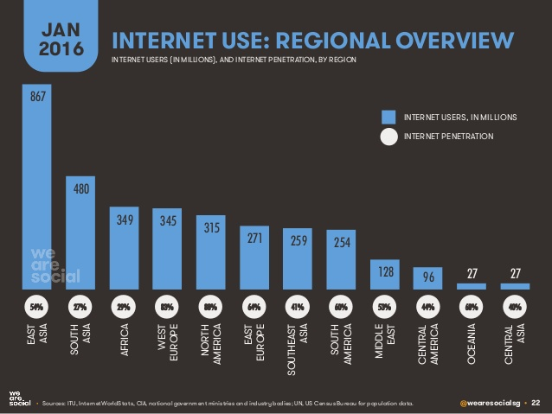
Internet Use: Regional Overview

Slide 19
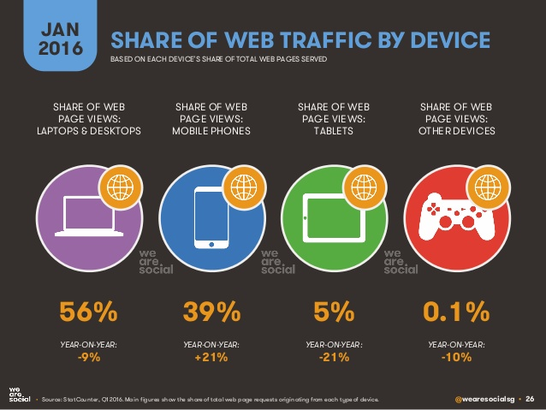
Share of Web Traffic by Device

Slide 20
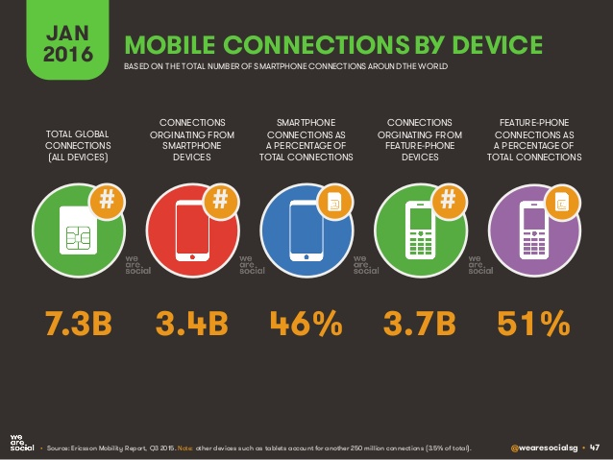
Mobile Connections by Device

Slide 21
Computers
A device which can do a multitude of tasks ranging from processing and storing data to, doing set tasks based on the software it is operating on.

Slide 22
Computer History
1936: First freely programmable computer
1951: First commercial computer released
1974: First consumer computers (IBM)
1976: Apple I,II
1984: Apple Macintosh
1985: Microsoft Windows

Slide 23

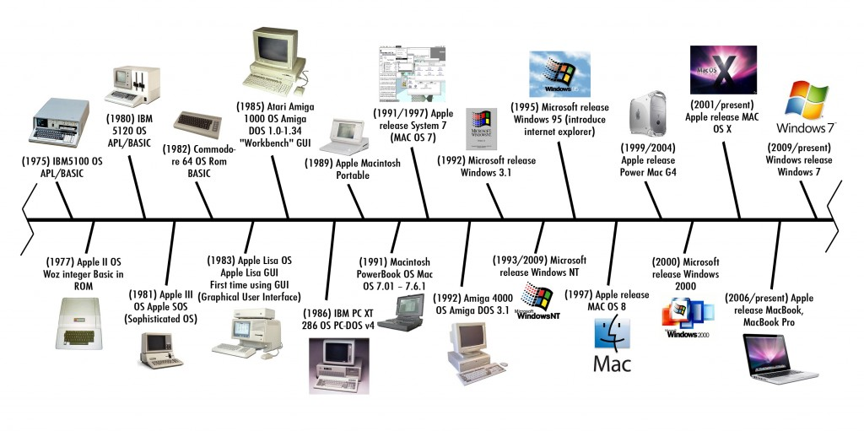
Computer Timeline
Notes:
More recently, windows 10 released in July 2015

Slide 24
Smartphones
What is a Smartphone?
  All in one device that can be used as a cell phone and has computing, PDA functions
  Variety of applications available
  High Speed Data Access
  Multimedia

Slide 25
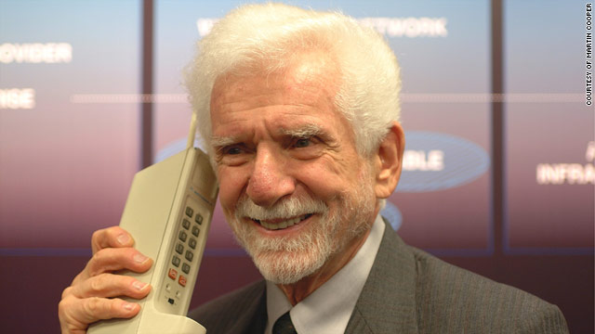
Mobile Phone History
1973: Motorola cell phone created
April 3, 1973: first cell phone call made by Martin Cooper
1983: first cell phone available to consumers
1994: First smartphone
1999: First mobile watch phone
2001: First Commercial 3g Network
2007: First Iphone Released
2008: First Android phone released
2010: First LTE Network
2013: First smart watch

Slide 26
4G/LTE Networks
Speeds of 1Gbs when stationary
100Mbps when mobile
However this standard is so high that no commercialized standard actually meets them hence why we have LTE networks
  LTE is part of this generation

Slide 27
Broadband vs Regular Phone Connection
Broadband
Regular internet connection
Wireless internet access
  Nearly all 2G and 3G phones are broadband
Wired internet access
  More common in underdeveloped countries

Slide 28
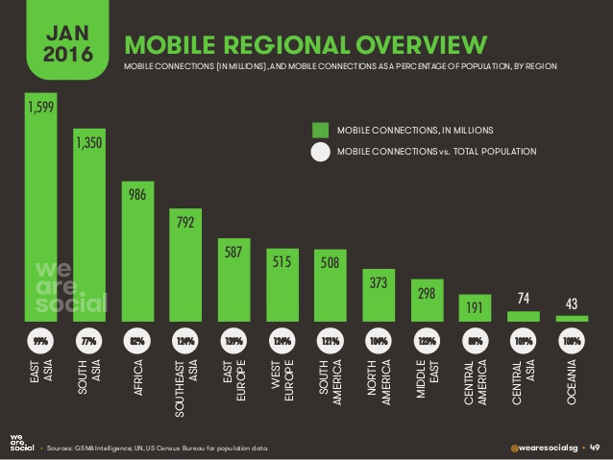
Mobile Regional Overview

Slide 29
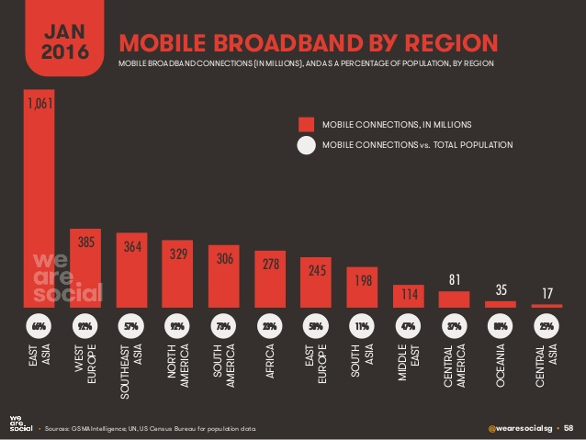
Mobile Broadband by Region

Slide 30
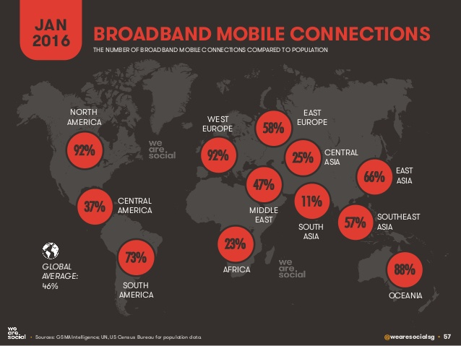
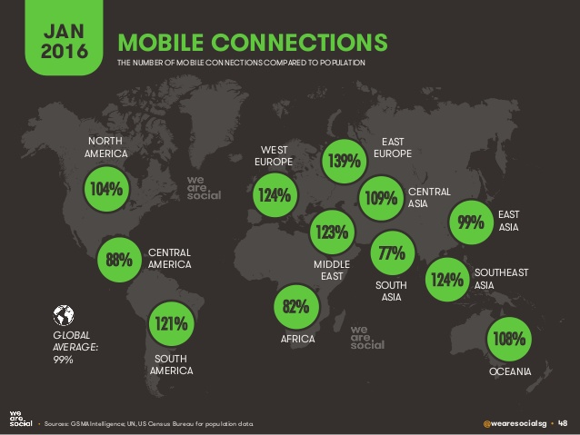
Broadband vs Normal Connections

Slide 31
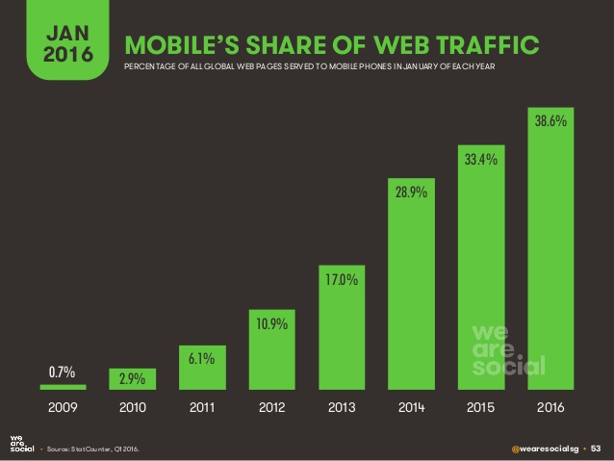
Mobile Share of Web Traffic

Slide 32
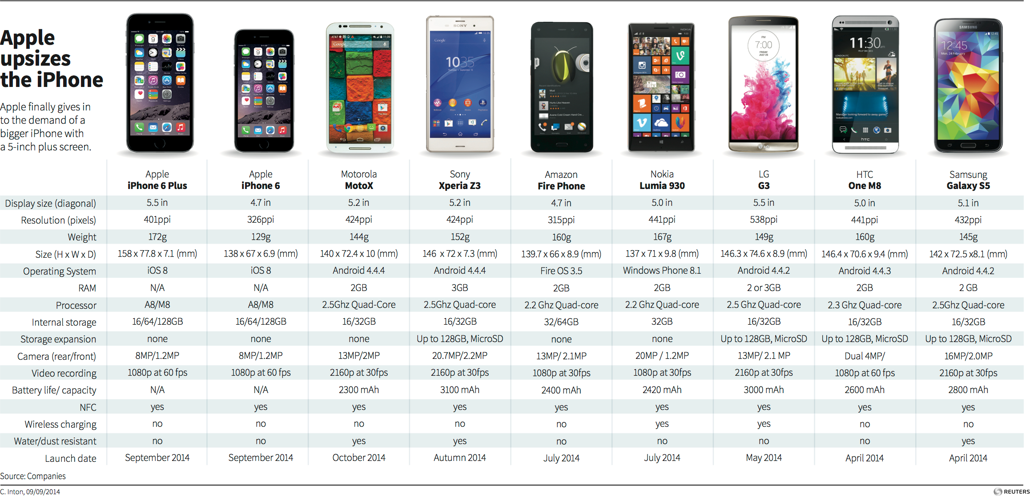
Current Smartphones on the Market

Slide 33
Notes:
Statistic Reference: http://bgr.com/2016/05/23/smartphone-market-share-q1-2016/

Slide 34
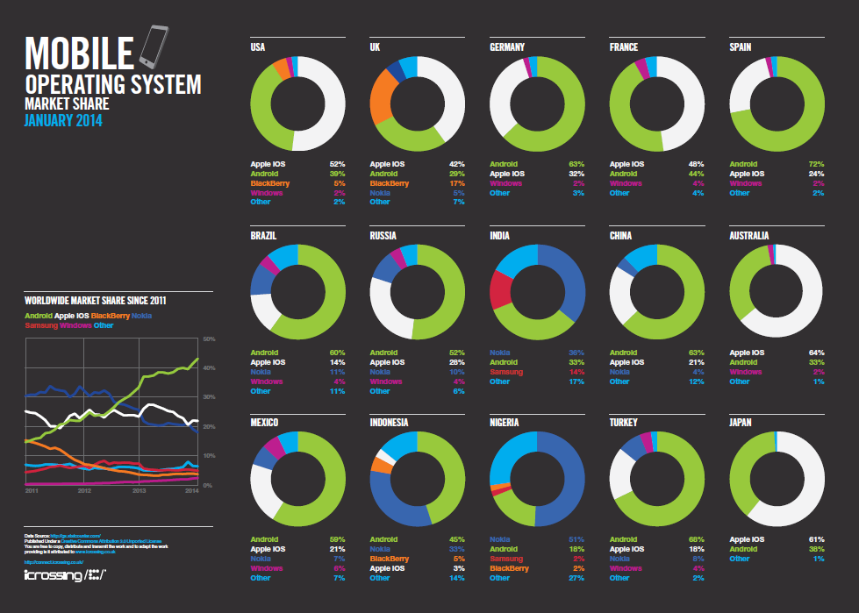

Slide 35
Tablets
What is a Tablet?
  Larger than a Smartphone
  Touchscreen used as primary method of input
  Some typical functions are:
  Mobile Browsing
  Portable Media Player
  Camera
  Downloadable Apps

Slide 36
Tablet History
1971: Allan Kay describges a tablet computer at Xerox PARC
1983: Apple and AT&T work on a tablet prototype
1991: IBM markets a tablet computer but fails
1993: Apple Newton launched, also fails
1996: NewsPad debuts; considered one of the first serious prototypes
2009: Various computer manufacturers release tablets to market
2010: Apple iPad launched

Slide 37
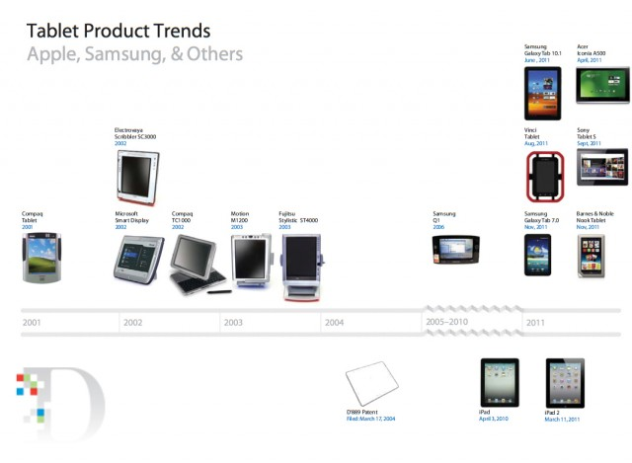

Slide 38
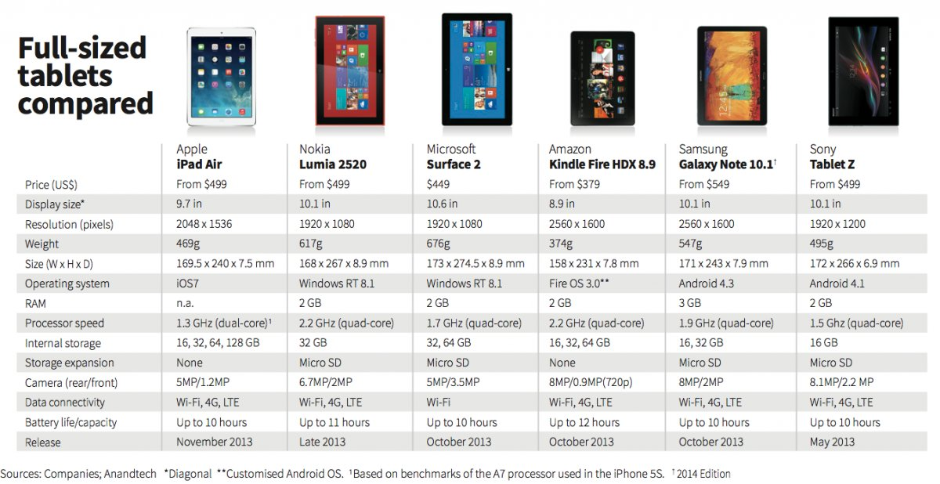
Current Tablets on the Market

Slide 39
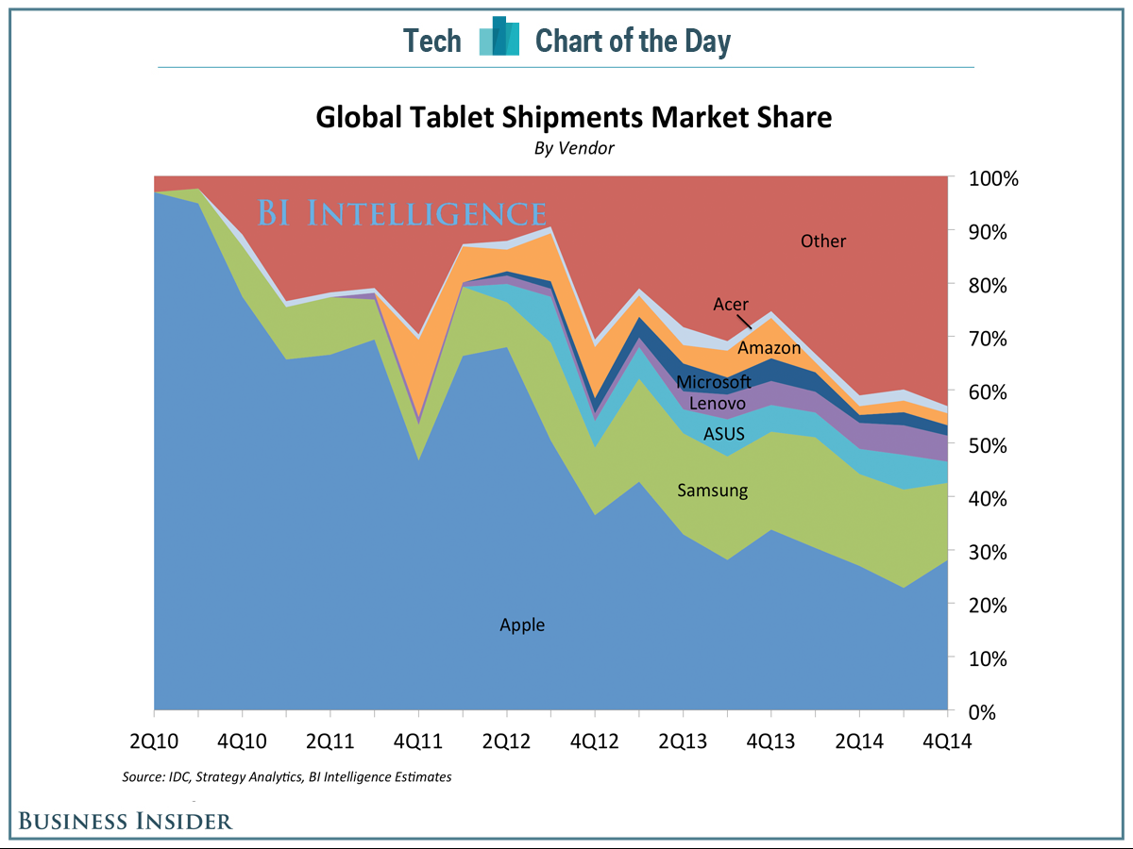
Tablet Shipments Market Share

Slide 40
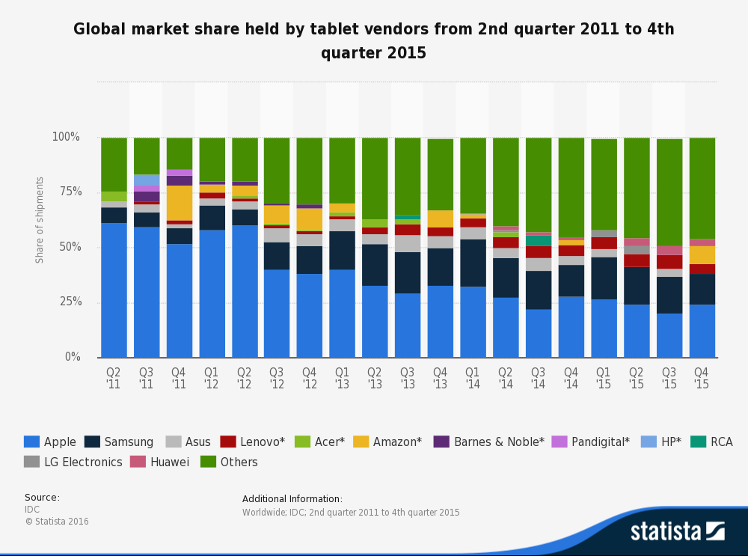
Market Share by Vendor

Slide 41
Smart Watch
What is a Smart watch?
  A computerized wristwatch with functionality that is enhanced beyond timekeeping, and is often comparable to a personal digital assistant device

Slide 42
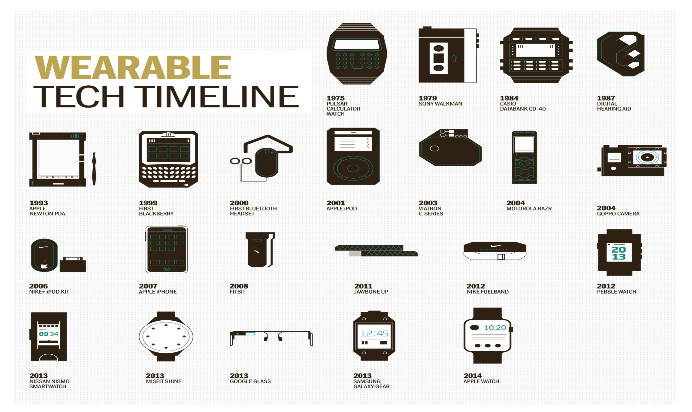

Slide 43
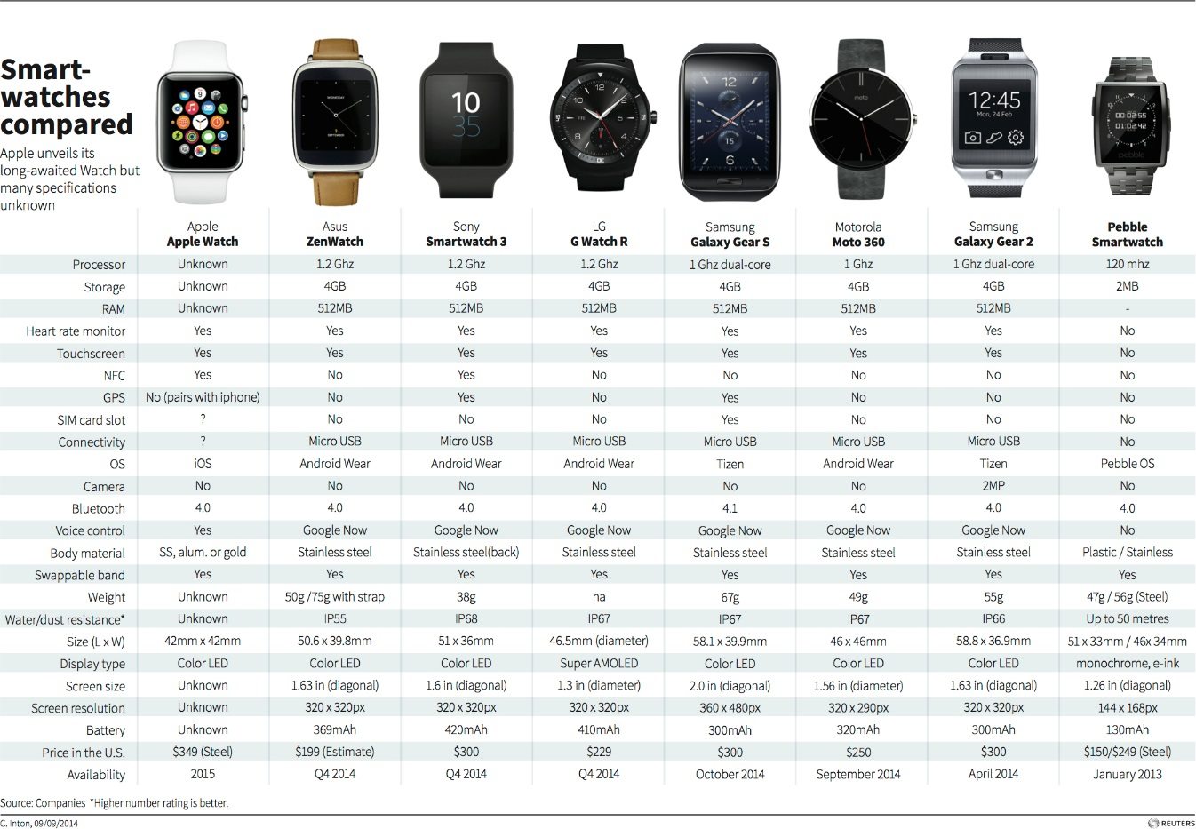
Current Smartwatches on the Market

Slide 44
Operating System (OS)
What is an Operating System?
  An operating system (OS) is software that manages computer hardware resources and provides services for computer programs.

Slide 45
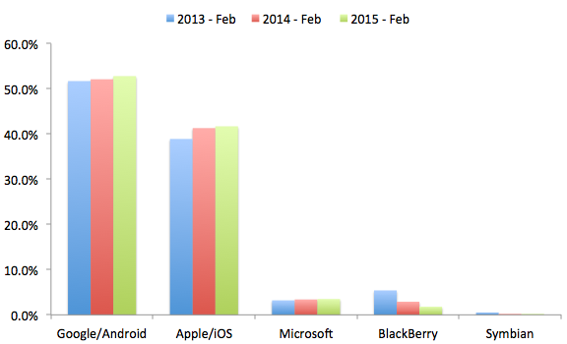
Global Mobile Operating System Share

Slide 46
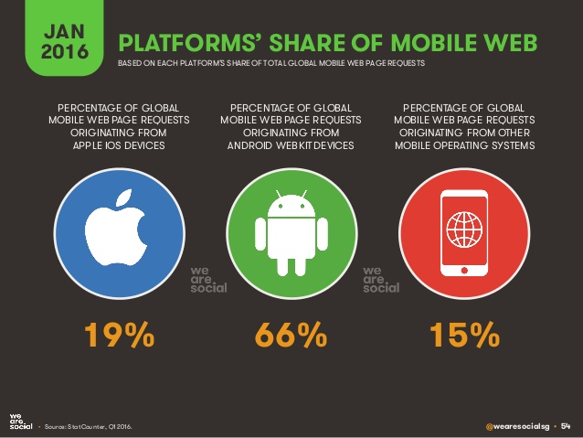
Platforms Share of Mobile Web

Slide 47
Cloud Computing
A model of network computing where a program or application runs on a connected server or servers rather than on a local computing device.

Slide 48
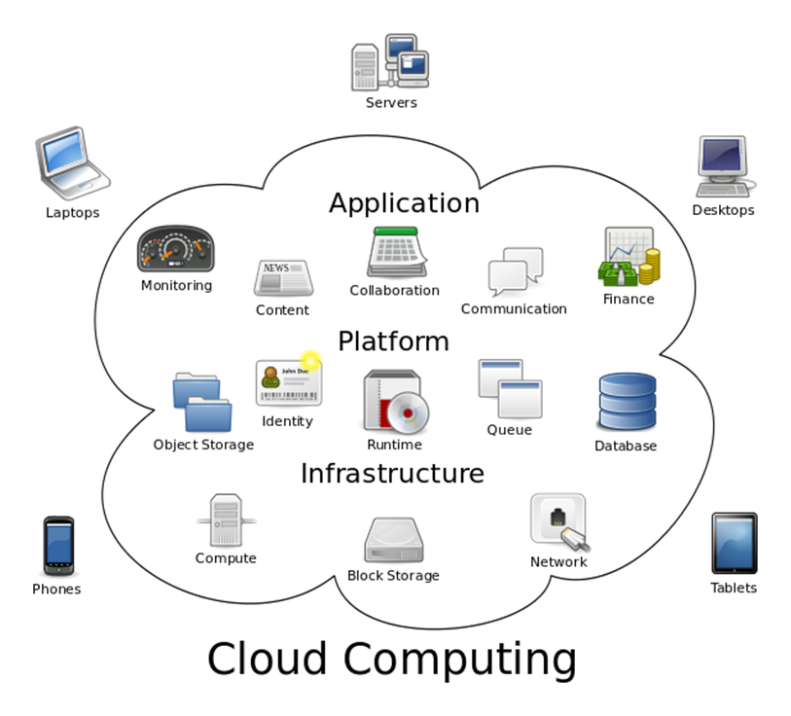
Cloud Computing

Slide 49
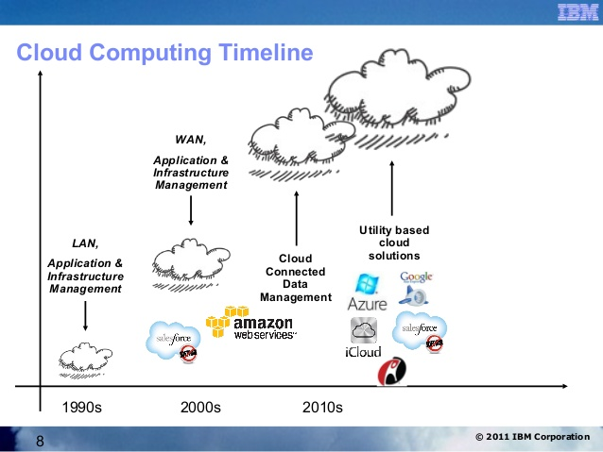
Cloud Computing Timeline

Slide 50
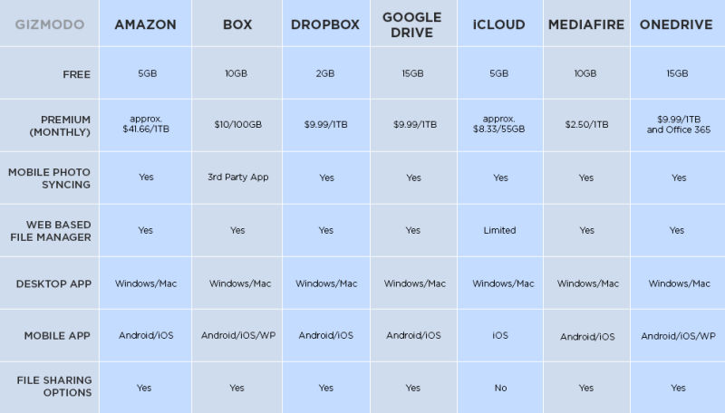

Slide 51
App Store
A place where applications can be downloaded directly to a device to supplement the experience of the device, for recreational use, etc. Some apps are free some have to be bought

Slide 52
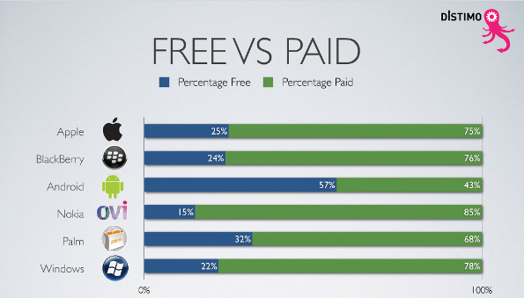

Slide 53
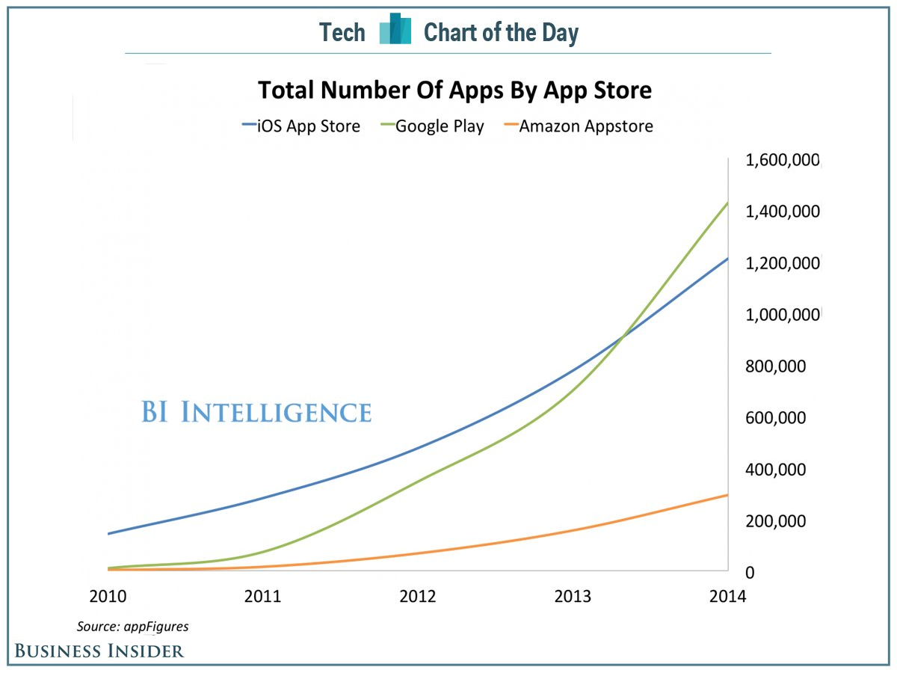

Slide 54
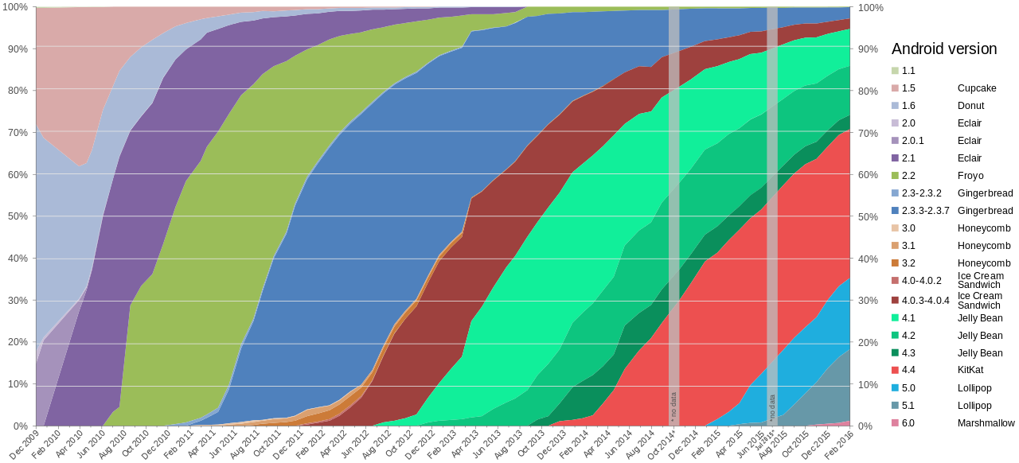
Android Versions

Slide 55
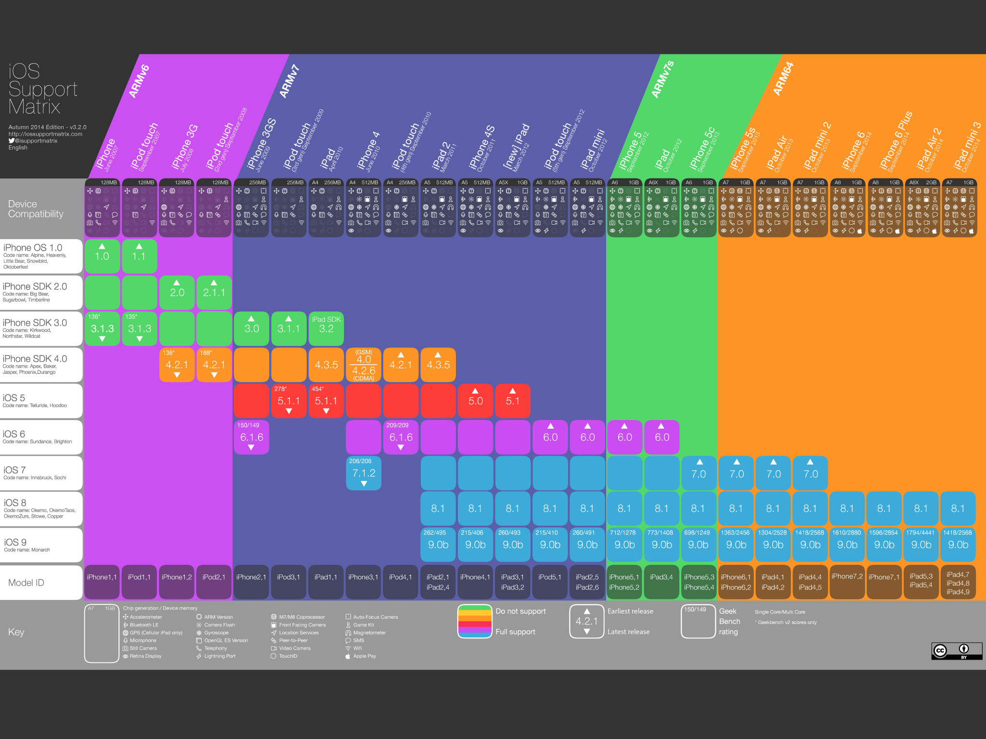
IOS Support Matrix
Notes:
Recent changes: IOS 9.1 and 9.3

Slide 56


Slide 57
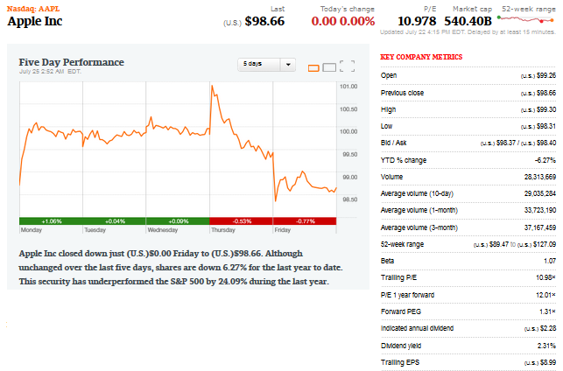
Financial Snapshot

Slide 58
Share Structure
Weighted Average Shares Outstanding (in Millions)
2013 | 2014 | 2015 | Mar 26 2016
6.477 | 6.085 | 5.753 | 5.537
Annual Diluted Earnings Per Share
2013 | 2014 | 2015 | Last Quarterly
5.68 | 6.45 | 9.22 | 5.19

Slide 59
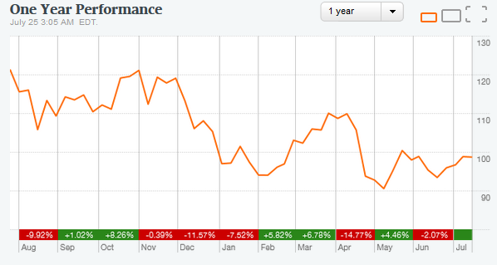
1 Year

Slide 60
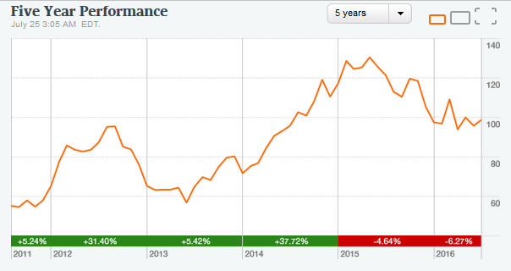
5 Year
Notes:
3.28 EPS 3 months ending December 2015 translates to about $75.9 Billion revenue
60

Slide 61
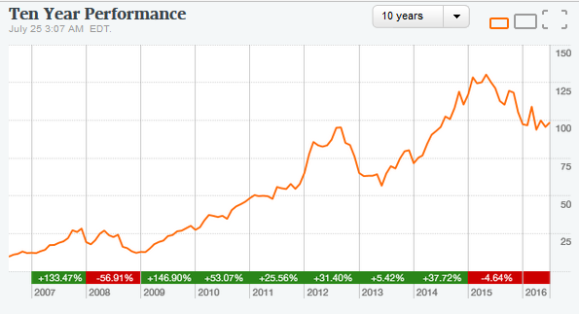
10 Year

Slide 62
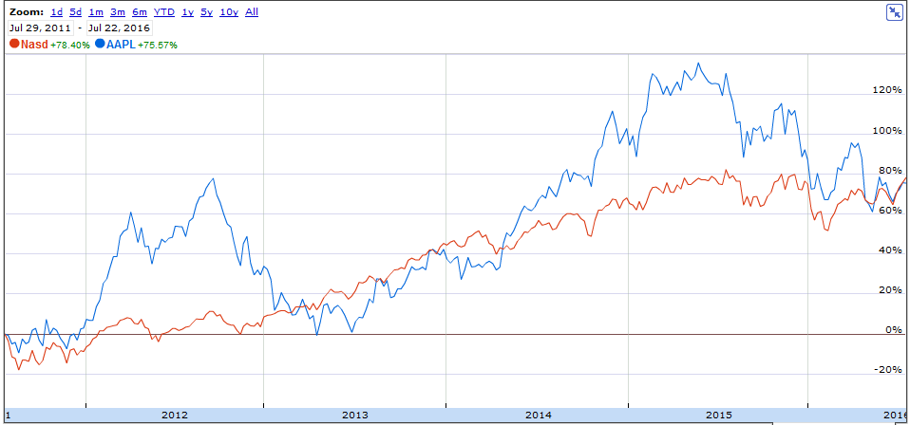
APPL v. NASDAQ

Slide 63
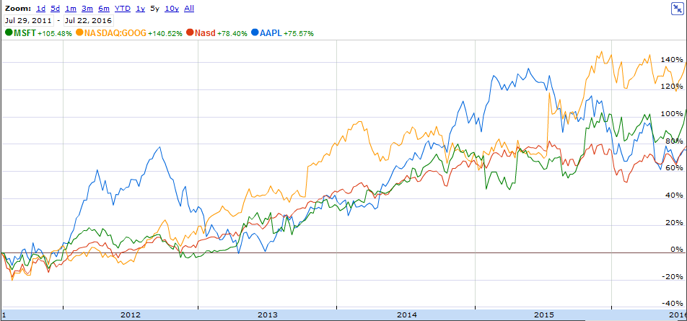
APPL v. MSFT & GOOGL

Slide 64
Apple’s Mission
“Apple designs Macs, the best personal computers in the world, along with OS X, iLife, iWork and professional software. Apple leads the digital music revolution with its iPods and iTunes online store. Apple has reinvented the mobile phone with its revolutionary iPhone and App store, and is defining the future of mobile media and computing devices with iPad.”

Slide 65
Company Profile
•HQ: Cupertino, California
•The Company designs, manufactures and markets mobile communication and media devices, personal computers and portable digital music players, and sells a variety of related software, services, accessories, networking solutions and third-party digital content and applications
•115,000 permanent full-time employees
•463 retail stores worldwide
•Most products are designed in the US but manufactured abroad
•Brand loyalty: 90% as of March 2014

Slide 66
Strategy
“The Company believes ongoing investment in research and development (“R&D”), marketing and advertising is critical to the development and sale of innovative products and technologies”
•Bring the best user experience to its customers through its innovative hardware, software and services
•Expand its platform for the discovery and delivery of digital content and applications through its internet services
•Build and expand retail and online stores and its third-party distribution network to effectively reach more customers and provide them with a high-quality sales and post-sales support experience
•Support a community for the development of third-party software and hardware products and digital content that complement the Company’s offerings

Slide 67
History of Apple
Notes:
DO: APPLE vs. S&P 500 Index, the S&P Information Tech Index and Dow Jones US Tech Index
67

Slide 68
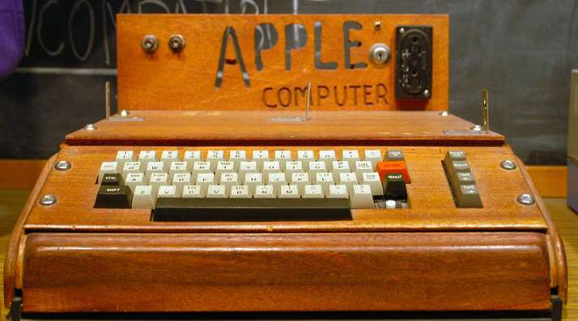
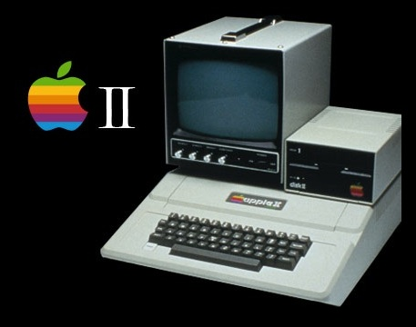
Early Years
1976: Founded in Cupertino, California by Steve Jobs, Ronald Wayne and Steve Wozniak
Apple I sells for $666.66 (200 units)
1977
  Apple II released at $1300
  Apple incorporates in California
1979: First app unveiled: VisiCalc

Slide 69
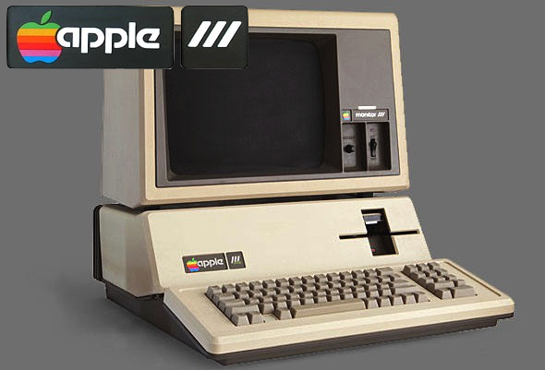
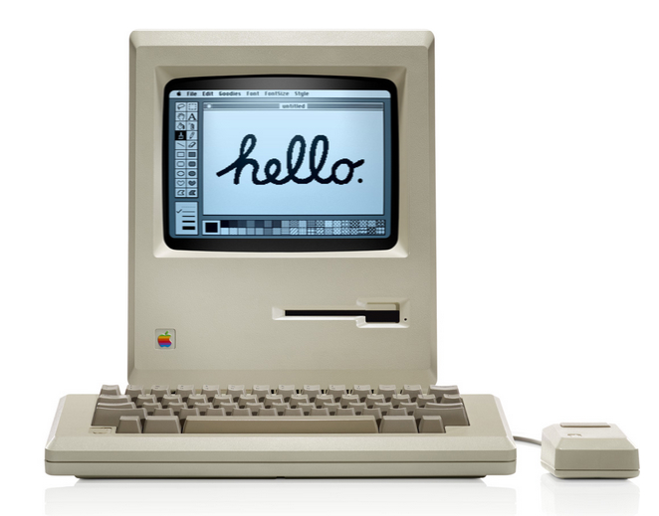
The ’80s
1980:
  IPO launched at $22, selling 4.2 million shares
  Apple III released
1983: LISA released for 9,995
1984 : Macintosh 1 launched for $2,495
1985: Jobs leaves Apple and starts NeXT

Slide 70
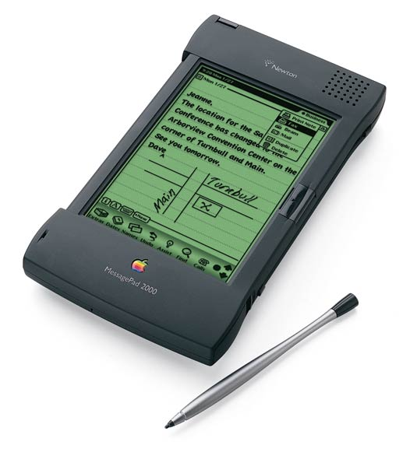
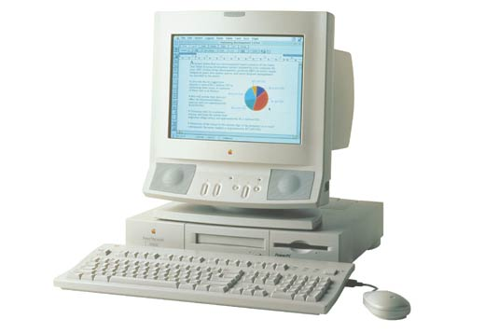
The ‘90s
1993: The Newton released (early PDA model)
1994 - Apple releases its first PowerPC-based desktop computers and notebooks.
1997:
Apple acquires NeXT and its OS, NeXTstep
Steve Jobs back to the company he co-founded as an advisor.
Apple is in financial trouble, with its stock reaching a 12-year low
Steve Jobs appointed interim CEO
Apple Online Store Launched
Notes:
http://www.macworld.co.uk/feature/apple/history-of-apple-steve-jobs-what-happened-mac-computer-feb-16-3606104/
the Apple II ‘was the first of its type to provide usable colo[u]r graphics... contained expansion slots for which other hardware manufacturers could design devices that could be installed into the computer to perform functions that Apple has never even considered.’
70

Slide 71
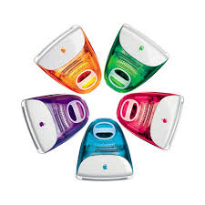
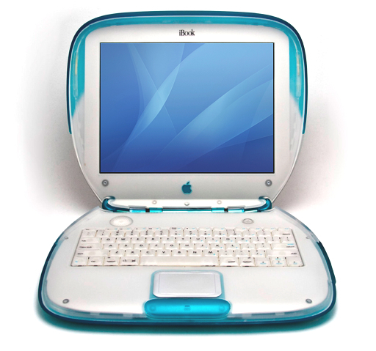
The ‘90s
1998: iMac launched
1999: iBook launched

Slide 72
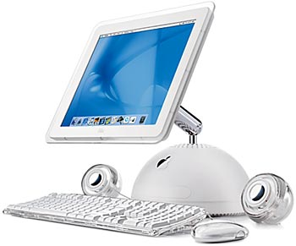
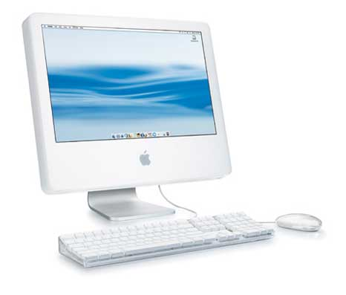
2000s
2001
  Mac OS X
  Opening of Apple retail stores
  First iPod
2002: iMac G4
2003: iTunes music store
2004
  iMac G5
  iPod mini

Slide 73
2000s
2005:
iPod shuffle
iPod nano
2006: MacBook Pro
2007
  iPhone and iPhone 3G
  iPod Touch
  Apple TV
2008: MacBook Air

Slide 74
2010s
2010:
  iPad
  iPhone 4
2011
  iCloud announced
  Steve Jobs resigns as CEO, replaced by Tim Cook
  becomes the world's most valuable publicly traded company on august 9
  iPhone 4S
  Steve Jobs passes away
  2012
  - iPhone 5 and iPad Mini released
- Apple Maps launches

Slide 75
2013: iPhone 5S/5C launched
2014: Apple Pay launched
2015:
  iPhone 6S and 6S Plus released
  iPad Pro
  Apple Watch
  Apple Music launched
  2016: iPhone SE

Slide 76
Key Acquisitions
1997: NeXT (computer programming services)
  Derived Products: OS X and iOS
  $404 million
2000: SoundJam MP (Software)
  Derived Products: iTunes
  2005: Fingerworks
  Derivied Product: Multi-touchscreen
2008: P.A. Semi (semiconductors)
  Derived Products: Apple A4 and A5 chips
  $278 million
2009: Lala.com (music streaming)
  Derived Products: iCloud, iTunes Match
  $80 million
Notes:
NEXTstep OS brought Steve Jobs back into Apple and was the precursor for the Mac OS X operating system
76

Slide 77
Key Acquisitions
2010: Siri (Voice control software)
  Derived Products: Siri
  $200 million
February 23, 2012: Chomp (App search engine)
  Derived Products: App store
  $50 million
July 27, 2012: AuthenTec (PC and mobile security)
  Derived Products: Touch ID
  $356 million

Slide 78
Key Acquisitions
2014: Beats Electronics
  Derived Products: iPhone, iTunes
  $3 billion
2015: IinX (camera)
  Derived Products: iPod, iPhone, iPad
  $20 million
2016:
Flyby Media (Augmented reality software)
  iPhone, iPod, iPad
  Shares in Didi Chuxing
  $1,000,000,000

Slide 79
APPLE MANAGEMENT TEAM

Slide 80
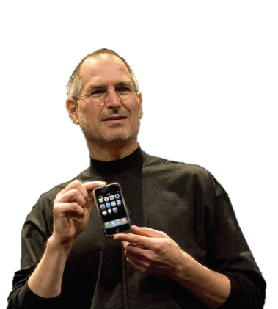
Steve Jobs
Co-Founder and former CEO
Education:
  Reed College – Dropped Out
-Left in 1985, came back in 1997
▪ NeXT: computer company
▪ Pixar: computer animation film studio
Oversaw development of iMac, iTunes, iPhone, and iPad on the services side as well as Apple’s retail stores
Demanding perfectionist belief in premium design and craftsmanship
Passed away in 2011

Slide 81
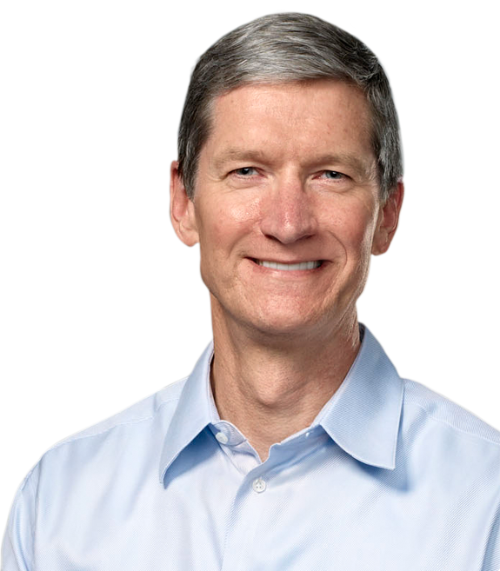
Tim Cook
Chief Executive Officer
  Since 08/12/2011
Chief Finance Officer (2005-2011)
Executive VP, Worldwide Sales and Operations (2002-2005)
Senior VP, Worldwide Operations, Sales, Service, and Support (2000-2002)
Senior VP, Worldwide Sales and Operations (1998-2000)
Education:
  Auburn University – (B) Industrial Engineering
  Duke University – MBA
Notes:
Next: Computer programming services
Soundjam
APPLE SOC: Apple Inc. has developed a range of APPLE SOC: Apple Inc. has developed a range of "System on Chip" (SoC) as well as APPLE SOC: Apple Inc. has developed a range of "System on Chip" (SoC) as well as "System in Package" (SiP) mobile application processors to power their to power their mobile consumer devices. In order to meet the stringent power and space constraints common to mobile devices, these chips combine a to power their mobile consumer devices. In order to meet the stringent power and space constraints common to mobile devices, these chips combine a central processing unit (CPU) with other components into a single compact physical package.
81

Slide 82
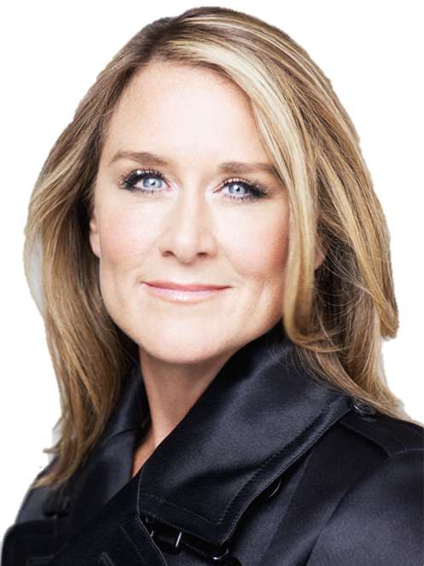
Angela Ahrendts
Senior VP, Retail and Online Stores
Joined Apple in 2014
Formerly, Burberry, CEO
Plan for the future of Apple Retail: China emphasis, mobile payments, revamped experience
.
A member of the UK’s Prime Minister’s Business Advisory Council; named honorary dame commander of the British Empire
Marketing and Merchandising degree from Ball state University in Indiana, where she was awarded an honorary doctorate
Notes:
Beats: Headphones, music streaming (Beats music)
82

Slide 83

Eddy Cue
Senior VP, Internet, Software and Services
•Joined Apple in 1989
Oversees Apple's content stores including the iTunes Store, the revolutionary App Store and the iBookstore, as well as Siri, Maps, iAd and Apple's innovative iCloud services.
Earned a Bachelor Degree in Computer Science and Economics from Duke University

Slide 84
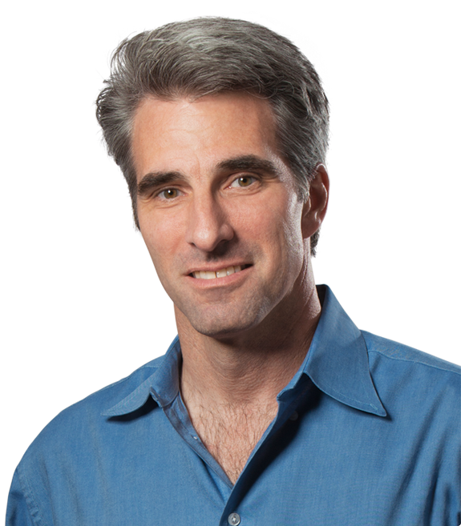
Craig Federighi
▪Senior VP of Software Engineering
▪A former NeXT employee
▪Joined Apple in 2009
▪Oversees the development of iOS, OS X and Apple's common operating system engineering teams
▪Education: University of California
  ▪Computer Science (B)
  ▪Electrical Engineering and Computer Science (M)

Slide 85
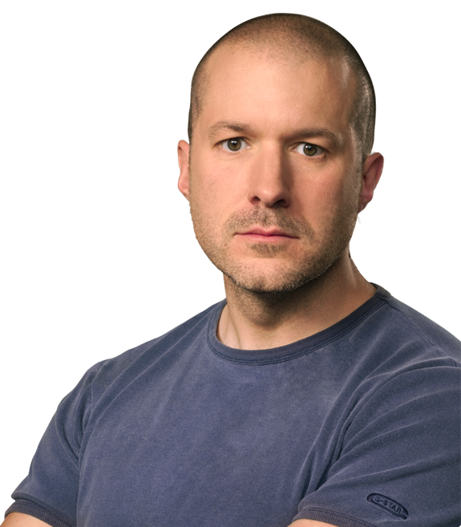
Jonathan Ive
Senior VP, Design
  Since 07/2010
Senior VP, Industrial Design (1997-2010)
Oversees the designs of Apple hardware, user interface, packaging, major architectural projects such as Apple Campus 2 and Apple's retail stores, as well as new ideas and future initiatives
▪Notable honors and awards:
▪2007: National Design Award (US)
▪2012: Knight Commander of the British Empire
▪Education: Newcastle Polytechnic
▪ Bachelor of Arts degree

Slide 86

Dan Riccio
Senior VP, Hardware Engineering
  Since 06/28/2012
Joined Apple in 1998
  Leads the Mac, iPhone, iPad and iPod engineering teams
  •Prior to Apple:
  •Compaq: Senior Manager of Mechanical Engineering
Education:
  University of Massachusetts – (B) Engineering

Slide 87

Philip W. Schiller
Senior VP, Worldwide Marketing
  Since 04/1997
At Apple, Schiller worked in the formation and marketing of iMac, iBook, PowerBook G4, iPod, Mac OS X, and subsequent products. Schiller is credited with coming up with the idea for the original iPod's click wheel interface.
Education:
  Boston College – (B) Biology

Slide 88

Jeff Williams
Senior VP, Operations
  Since 07/2010
Joined Apple in 1998
Oversees Apple’s supply chain, service and support, and the social responsibility initiatives which protect more than one million workers worldwide
▪2013: leads the Apple Watch project
Education:
  North Carolina University – (M) Mechanical Engineering
  Duke University - MFA

Slide 89

Luca Maestri
Senior VP and Chief Financial Officer
Joined Apple in 2013 as vice president of Finance and corporate controller,
Oversees the accounting, business support, financial planning and analysis, treasury, M&A, investor relations, internal audit and tax functions at Apple
•Prior to Apple:
  CFO at Xerox, Nokia Siemens Networks, and GM
•Education:
  Luiss University in Rome: Economics (B)
  Boston University: Management (M)

Slide 90
Bruce Sewell
•Senior VP and General Counsel
•Joined Apple in 2009
•Oversees legal matters:
•Prior to Apple
  Intel: VP and deputy general counsel
Education:
•University of Lancaster: Science (B)
•George Washington University: JD

Slide 91

Johny Srouji
Senior VP of Hardware Technologies
Joined Apple in 2008
Oversees Apple’s custom silicon and hardwaretechnologies:
Prior to Apple:
  Intel and IBM: processor development and design
Education:
  Technion, Israel’s Institute of Technology: Computer Science (B and M)

Slide 92
Apple Inc. Products
Apple TV
iTunes
iCloud
Apple Music
Productivity App
iBooks
iPod
iPhone
iPad
Apple Watch
iMac
MacBook
  MacBook Pro
  MacBook Air

Slide 93
iPod
October 2001: 1st release
Latest: iPod Touch 6th gen
Portable digital music and media players
Lines:
  Classic
  Nano
  Mini
  Shuffle
  Touch
Global Apple iPod sales Q1 2006 –Q4 2014 (in million units)

Slide 94

iPhone
2007: iPhone 1
2015: iPhone 6s and 6s Plus
13M iPhones sold three days after launch
•Provide synchronization across other Apple’s devices
•Siri: voice-controlled assistant
•Retina HD display

Slide 95

iPad
April 2010: 1stiPad
•Multi-purpose tablets based on Apple’s iOS Multi-Touch operating system
•Lines:
•iPad Air (9.4”)
•iPad mini (8”)
•iPad Pro (12.9”)

Slide 96

Apple Watch
April 2015: 1strelease
•Price: CA$399 –22,000 !!!
•Incorporates fitness tracking and health-oriented capabilities with integration with iOS and other Apple products and services
•Need an iPhone nearby to pair to
•iPhone 5 and up

Slide 97
iMac
Apple’s line of desktop and portable personal computers
▪Desktops: iMac. Mac Mini, Mac Pro
▪Portables: MacBook, MacBook Air, MacBook Pro
▪Runs on Mac OS X
▪Intel processors
iMac 21.5 - 27 inch

Slide 98

Apple TV
•January 2007: 1strelease
•2015: 4thgen
•tvOS: enables App Store
•Connects to HD TVs
•Streams digital contents from iTunes Store:
•Photos, videos, music
•Movies

Slide 99
iTunes
Released 2001
Store allows for digital purchase of various entertainment media
iTunes U for downloading free material from top universities, museums, and other institutions
Media player and library to play and download digital audio and video including radio (iTunes Radio)

Slide 100

iCloud
•October 2011: release date
•Stores data such as photos, applications, contacts, calendars, and documents
•5GB of free storage
•Keep data up-to-date
•Wireless backups

Slide 101

Apple Music
Launched June 30, 2015
On demand music streaming service with 3-month free trial, $9.99 per month
In excess of 13 million subscribers as of April 2016, up from 11 million in February 2016

Slide 102

iBooks
E-book app for iOS
Installation of books and text books from the iTunes store
Millions of titles available, in different languages
Reading of content using VoiceOver

Slide 103

Apple Retail Store
Founded in May 2001 by Ron Johnson
Primarily sells computers and consumer electronics
Genius Bar for technical support and repairs
Over 450 Retail locations worldwide

Slide 104

App Store
Launched June 2008
Digital platform for mobile apps, available directly for download through iOS devices
Over 1.5 million apps and 100 billion downloads since 2008
At the end of 2013, App Store users spent over $10 billion

Slide 105

Apple Pay
mobile payment service that offers an easy, secure and private way to pay.
Pay accepts credit and debit cards, reward programs and store-issued credit and debit
Available in US, UK, CAN, AUS, CHINA, SING, SWI, FRA,

Slide 106

Net Sales by Product

Slide 107

Net Sales by Product

Slide 108

Net Sales by Operating Segment

Slide 109

Net Sales by Operating Segment

Slide 110
Contingencies
Possible legal proceeding in the future regarding access to private information
Competition in current and future markets

Slide 111

Balance Sheet [Assets] 10-Q

Slide 112



Balance Sheet [Liabilities and Shareholder’s EQ] 10-Q

Slide 113

Balance Sheet [Assets] 10-K

Slide 114

Balance Sheet [Liabilities and Shareholder’s EQ] 10-K
Notes:
http://www.economist.com/blogs/graphicdetail/2016/01/daily-chart-20
114

Slide 115

Income Statement 10-Q

Slide 116

Income Statement 10-K

Slide 117

CF Statement [Operating] 10-Q

Slide 118


CF [Investing and Financing] 10-Q

Slide 119

CF Statement [Operating] 10-K
Notes:
http://www.marketwatch.com/story/apple-vs-the-fbi-a-complete-guide-2016-02-20
119

Slide 120


CF [Investing and Financing] 10-K

Slide 121




Slide 122


Slide 123

Recommendation
HOLD

Slide 124
MICROSOFT

Slide 125
Financial Snapshot
Notes:
In millions
Number of shares in thousands
125

Slide 126
Share Holders Equity

Slide 127

Common Stock

Slide 128


Share Repurchase Program

Slide 129
1 Year

Slide 130
5 Year

Slide 131

10 Year

Slide 132
MSFT Vs NASDAQ
Notes:
http://markets.ft.com/research/Markets/Tearsheets/Forecasts?s=AAPL:NSQ
132

Slide 133
200 MA vs 50 MA

Slide 134
Mission and Strategy
Mission
Empower every person and every organization on the planet to achieve more
Strategy
Build best-in-class platforms and productivity services for a mobile-first, cloud-first world
Notes:
134

Slide 135
History and Milestones
1975
Microsoft founded
1981
Microsoft incorporates
IBM introduces its personal computer MS-DOS 1.0
1986
Microsoft stock goes public
1990
launches Windows 3.0
1995
launches Windows 95
1998
launches Windows 98
2000
launches Windows 2000

Slide 136
History and Milestones
2001
launches Office XP and Xbox
2005
launches Xbox 360
2007
launches Windows Vista
2009
launches Windows 7
2010
launches general availability of Office
launches Kinect for Xbox 360
launches Windows Phone 7
2011
launches Office 365
Microsoft closes its acquisition of Skype

Slide 137
History and Milestones
2012
Microsoft launches Windows 8 and Microsoft Surface
2013
launches Office 2013, Outlook.com, Windows 8.1
launches Surface 2 and Surface Pro 2, and launches Xbox One
Microsoft announces decision to acquire Nokia
2014
Satya Nadella named chief executive officer for Microsoft
Microsoft launches Office for iPad, Surface Pro 3
Minecraft to join Microsoft announcement
Microsoft announces Office apps for Android tablets
2015
Microsoft reveals Windows 10

Slide 138
Key Acquisitions
1987 – Forethought
  Forethought was founded in 1983 tat later be know as Microsoft PowerPoint
1997 – Hotmail
  Acquired Hotmail for $500 million
2000 – Visio Corporation
  Acquired Visio for $1.375 billion
2002 – Navision
  Purchased Navision for $1.33 billion; turned into a new division as Microsoft Business Solutions (now Microsoft Dynamics)
2011 – Skype Technologies
  Purchased for $8.5 billion; 32 times larger than its value
2013 – Nokia (Hardware Division)
  Formerly developed phones for Microsoft; highlights Microsoft’s move into hardware

Slide 139
Other Acquisition 2015-2016
Company | Industry
Xamarin | Software- Mobile Application
SwiftKey | Mobile Productivity
Metanautix | Data Analytics
Secure Islands | Data Protection Technology
Mobile Data Labs | Mobile
Linkedin | Professional Networking

Slide 140

Management Team
John W. Thompson
Chairman
John W. Thompson joined the Microsoft Board in February 2012 and became independent chairman of Microsoft Corporation on Feb. 4, 2014.
Education:
Thompson received a bachelor’s degree in Business Administration from Florida A&M, and a master’s degree in Management from the Sloan Fellows program of the MIT Sloan School of Management.

Slide 141

Management Team
Bill Gates
Founder and Technology Advisor
William (Bill) H. Gates is founder, technology advisor and board member of Microsoft Corporation. He served as chairman of the board until Feb. 4, 2014.
Education:
In 1973, Gates entered Harvard University as a freshman. In his junior year, Gates left Harvard to devote his energies to Microsoft, a company he had begun in 1975 with his childhood friend Paul Allen.

Slide 142

Management Team
Satya Nadella
Chief Executive Officer
Satya Nadella is Chief Executive Officer of Microsoft. Before being named CEO in February 2014, Nadella held leadership roles in both enterprise and consumer businesses across the company.
Education:
He earned a bachelor’s degree in electrical engineering from Mangalore University, a master’s degree in computer science from the University of Wisconsin – Milwaukee and a master’s degree in business administration from the University of Chicago.

Slide 143

Management Team
Chris Capossela
Executive Vice President and Chief Marketing Officer
As chief marketing officer, Chris Capossela leads Microsoft’s global product marketing, advertising, brand, research and communications functions for businesses and consumers.
He oversaw the creation of new business opportunities with partners to deliver new consumer experiences through Windows, Windows Phone, Office and Xbox.
Education:
Capossela holds a bachelor’s degree in computer science and economics from Harvard University.

Slide 144

Revenue by geography

Slide 145
Operating Segments

Slide 146
Personal Computing

Slide 147
Personal Computing
Devices
Phone
  The principal products provided by the Phone Hardware segment are Lumia phones and other non-Lumia phones, which were begun manufacturing and selling with the acquisition of NDS on April 25, 2014. Other Lumia phones run Windows and are designed to enable people and organizations to connect to people and content that matter most, using integrated Microsoft services such as Outlook, OneDrive, Skype and Office
Surface
  Surface is designed to help organizations, students, and consumers to be more productive. The latest Surface devices, the Surface Pro 4 and Surface Book, were released in October 2015
Microsoft HoloLens
  Microsoft HoloLens is the first fully untethered holographic computer running Windows 10. It is completely untethered–no wires, phones, or connection to a PC needed. MicrosoftHoloLens allows you to place holograms in your physical environment and provides a new way to see yourworld.
Microsoft Band
  A product helps you reach your health and fitness goals by tracking your heart rate, exercise, calorie burn and sleep quality, and be productive with email, text and calendar alerts on your wrist.
Microsoft PC Accessories

Slide 148
Personal Computing
Gaming
  Xbox
  is a video gaming brand created and owned by Microsoft.
  Gaming Console
  Xbox Live, Comprising Transactions, Subscriptions, and Advertising

Slide 149

Personal Computing

Slide 150



Personal Computing
Search Advertising
Search and display advertising includes Bing, Bing Ads, MSN. Microsoft has a partnership with Yahoo! in which Microsoft provides algorithmic and paid search platform for Yahoo! websites worldwide. In June 2015, Microsoft entered into agreements with AOL outsource our display sales efforts.

Slide 151
Strategy
Reinvent productivity and business processes
Build the intelligent cloud platform
Create more personal computing

Slide 152
Balance Sheet Q3 (Assets)

Slide 153
Balance Sheet Q3 (Liabilities and S/E)

Slide 154
Balance Sheet Annual (Assets)

Slide 155
Balance Sheet Annual (Liabilities and S/E)

Slide 156
Income Statement Q3
Notes:
http://windows.microsoft.com/en-ca/windows-8/whats-new
156

Slide 157
Income Statement Annual

Slide 158
Cash Flow Q3 (Operations)

Slide 159
Cash Flow Q3 (Financing and Investing )

Slide 160
Cash Flow Annual (operations)

Slide 161
Cash Flow Annual (Financing and Investing)

Slide 162
Discounted Free Cash Flow Model

Slide 163

Dividend Discount Model

Slide 164
Recommendation
Buy
Technical Analysis indicative up an uptrend
  Broke above the 5 year resistance
  50 MA recently broke above the 200 MA
  Outperforming Nasdaq
Strong Management Team
Upward pressure from share repurchasing program
Increasing sales in other segments
Investment Activities consistently increased but Financing remains flat
Increasing price to book ratio
  Market expecting stronger profits
  Investors believes the assets are undervalued
Positive Economic Profit
Intrinsic Value of stock price is below market price

Slide 165


Slide 166

Financial Snapshot

Slide 167

1 year Performance

Slide 168

5 year Performance

Slide 169

10 year Performance

Slide 170

Google vs. Nasdaq vs. S&P 500 -YTD

Slide 171

Google vs. NASDAQ vs. S&P 500 - 5 Years
Google vs. Nasdaq vs. S&P 500 -5 years

Slide 172

Common Share Structure
Annual Data (in millions of shares)
FY 2004 | FY 2005 | FY 2006 | FY 2007 | FY 2008 | FY 2009 | FY 2010 | FY 2011 | FY 2012 | FY 2013 | FY 2014 | FY2015
533.8 | 586.1 | 618.0 | 625.8 | 630.2 | 635.5 | 642.6 | 649.8 | 660.0 | 671.7 | 680.2 | 687.3

Slide 173
Common Share Structure (cont.)
Common Shares Outstanding: 686,792 (Balance as of March 31, 2016)
Class A (GOOGL)
  Listed on the NASDAQ Global Select Market since August 19, 2004
  1 vote per share
  2016 Q1: 293,573 million shares outstanding
  2015 Q4: 292,297
Class B
  10 votes per share
  Only available to Google insiders and executives
  As of December 2015, Larry, Sergey, and Eric owned approximately 92.5% of outstanding Class B common stocks, which represents approximately 58.5% of the voting power of our outstanding capital stock
  2016 Q1: 49,536
  2016 Q4: 50,295
Class C (GOOG)
  Listed on the NASDAQ Global Select Market since April 3, 2014
  No voting rights: maintain control of Google's direction
  2016 Q1: 343,683
  2015 Q4: 344,756

Slide 174
History
1996: Larry and Sergey create a search engine called BackRub (Operating on Stanford servers). It featured an efficient
algorithm named “PageRank”
1997: Google.com is registered as a domain
1998: Andy Bechtolsheim becomes first investor ($100,000), and Google files for incorporation in California
1999: Venture capital firms Kleiner Perkins Caufield & Byers and Sequoia Capital provide $25 million; Website officially launched
2000: Google AdWords launched (Paid web links with associated searches)
2001: Eric Schmidt becomes CEO and Chairman of the Board of Directors; “PageRank” granted a patent
2002: Google labs, Google Scholar released,.. AdWords becomes cost-per-click
2003: Re-incorporated in Delaware
2004: Google Local released (became Google Maps), Gmail released, IPO raised $1.67 billion for 20 million shares at $85
2005: Google Maps, Google Earth launched
2007: Share prices hit $700
2011: Android exceeds 10 billion app downloads, growth rate of 1 billion downloads per month, Google Drive launched
2012: Google is the dominant search engine globally with 88.8% market share, Most visited website in the world
2013: 1 billion android devices activated, Calico founded, a company focused on health and well being
2014: Prototypes of self-driving cars revealed
2015: In October, Alphabet Inc. was founded as the parent company of Google and several other companies

Slide 175


Key Acquisitions
April 2003: Applied Semantics (AdSense and AdWords) - 102m
October 2004: Keyhole Corp. (Google Maps/ Google Earth)
August 2005: Android
October 2006: Youtube - 1.65B
April 2007: Double Click - 3.1B
March 2008: Ad Mob - 750m
August 2011: Motorola 12.5B
February 2014: Nest 3.2B
June 2014: Skybox - 478m
July 2014: dropcam - 517m
195 purchases since 2001

Slide 176
Products and Services
Flight Explorer
Google+
Search
Google Image
Google Ads
Google Docs
Google Finance
Google Photos
Patent Search
Google Maps
Google Earth
Google Play
Google Calendar
Google Scholar
Google Books
Chrome
Chrome OS
Gmail
Google Wallet
Google TV
Translate
Google Ventures
Android mobile OS
Google Blog Search
Blogger
YouTube

Slide 177
Revenue by Geography

Slide 178
Revenue Breakdown

Slide 179
Company Overview and Business Strategy
Focuses on improving the way people connect with information
Their mission is to organize the world's information and make it universally accessible and useful
  Innovation in web search and advertising have made their website a top internet property and their brand one of the most recognized in the world.
  Google generates revenue primarily by delivering relevant, cost-effective online advertising
  Google's AdWords program and AdSense program to promote their products and services with advertising
Their business is primarily focused around the following key areas: search and display advertising, the Android operating system platform, consumer content through Google Play, enterprise, commerce and hardware products.

Slide 180
AdWords
Advertisers create ads to show alongside Google search results
  Consists of 1 headline, 25 characters
  2 text lines, 35 characters each
Advertisers may bid on certain specific keywords to have their ads displayed alongside
Cost-per-impression (CPM)
Cost-per-click (CPC)

Slide 181

AdWords

Slide 182

Ads on Google Maps

Slide 183

Adsense
Google partnerships with publishers within Google Network Members, who sell the ad space of their websites
Ads are shown on publishers’ websites in terms of relevancy to their products
Google shares profits with the website publishers
Per click
Per impression

Slide 184
Youtube
The biggest video site in the world
Increasing mobile user base
Google has established partnerships with content companies to aid in monetizing video in the mobile space

Slide 185
Google+
Social Network like Facebook
Integrated to Google owned platforms such as YouTube
Google Hangout
An OS designed for touch screen devices
  Nexus, HTC One, Galaxy, Xperia Z
Opened sourced
300 Million users worldwide

Slide 186

Management Team
Larry Page
CEO of Alphabet Inc.
CEO of Google (2011-2015) President
Products (2001-2011) Co-Founder (1998)
Education:
Michigan University – (B) Engineering
Stanford – (M) Computer Science
Stanford – (PhD) Dropped Out Met Sergey at Stanford during the PhD program

Slide 187

Management Team
Sundar Pichai
CEO of Google (August 2015)
Born in Chennai, Tamil Nadu, India
Joined Google in 2004
Wharton School of the University of Pennsylvania
Stanford University
Indian Institute of Technology Kharagpur

Slide 188

Management Team
Eric Schmidt
Former CEO of Google (2001-2011)
Former CEO of Novell & CTO of Sun Microsystems‘
Bachelor of engineering degree from Princeton
Master's and PhD in Computer science from UC Berkley
Member of Obama’s Council of Science and Technology

Slide 189

Management Team
David Drummond
Corporate Development and Chief Legal Officer, Senior Vice President
Education
  Bachelor in History from Santa Clara University
  (JD) Law Stanford
  PhD Computer Science University of California
Serves on Board of Directors of Uber Technologies

Slide 190

Management Team
Sergey Brin
President of Alphabet Inc
President of Technology at Google 2001 to 2011
Co-Founder (1998)
Education:
  B.Sc. Mathematics and Computer Sciences University of Maryland
  Masters of Computer Science Stanford
  (PhD) Dropped Out Met Larry at Stanford during the PhD program

Slide 191
Risk Factors
Intense Competition
  If Google does not continue to innovate and provide products and services that are useful to users, they may not remain competitive, and their revenues and operating results could be adversely affected.
Ongoing investment in new businesses and new products, services and technologies is inherently risky, and could disrupt our ongoing businesses
More people are using devices other than desktop computers to access the Internet and accessing new devices to make search queries. If manufacturers and users do not widely adopt versions of our search technology, products, or operating systems developed for these devices, our business could be adversely affected.
Google generate a significant portion of their revenues from advertising, and a reduction in spending by or loss of advertisers could seriously harm their business.

Slide 192

2016 Q1 Consolidated Balance Sheet

Slide 193

Cont.

Slide 194

Cont. (2)

Slide 195

2015

Slide 196

2015 Cont.

Slide 197

Balance Sheet Summary

Slide 198

2016 Q1 Consolidated Statements of Income

Slide 199

2015

Slide 200

Consolidated Statement of Income Summary

Slide 201

2016 Q1 Consolidated Statements of Cash Flows

Slide 202

Cont.

Slide 203

2015

Slide 204

Cont.

Slide 205

Cash Flow Summary

Slide 206

Valuation Methods
FCFE Model
$$Cost of equity=0.0225+1.02×0.055=0.0573375 (30yr)$$
$$Cost of equity=0.0158+1.02 ×0.055=0.0724 (10yr)$$
EPS = 23.74
CAPX per share = 14.44
Depreciation per share = 6.01841
Debt raio = 0.0376
$$∆ in Working Capital per share=13$$
FCFE = 3.1246672
Recall GOOGL is at $758.82
$$\$758.82=\frac{3.125 ×(1+x)}{\left(0.0573375−x\right)}$$
$$x=0.053001$$
$$758.82=\frac{3.125 ×\left(1+x\right)}{\left(0.0724−x\right)}$$
$$x=0.06799518$$

Slide 207

Recommendation

Slide 208
Questions and Answers Session

