Slide 1
Gadgets
Bus 417 - 2018

Slide 2

Industry

Slide 3
What is Gadgets?
Small devices or tools that have multiple functions
Used for convenience, increase productivity, entertainment, lifestyle, or even healthcare
Benefit gadgets provides through hardware, software, and applications
Software gadgets usually refer as Widgets
Gadgets are used almost EVERYWHERE

Slide 4

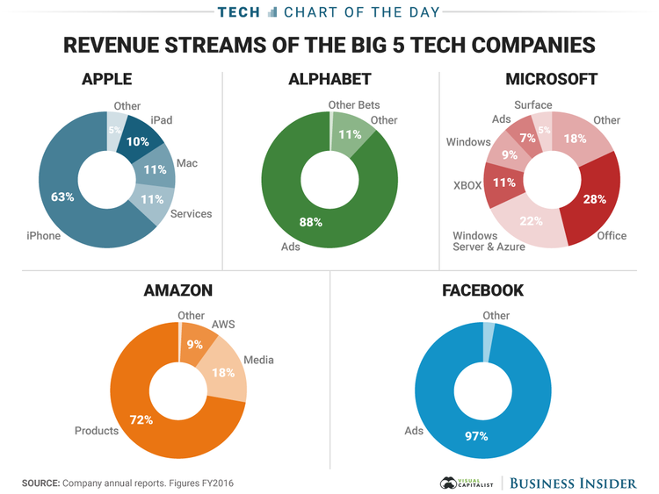

Slide 5

Profit
Sales of the gadgets
Advertisement
Licensing
Application fees

Slide 6

Hardware
Common Gadgets
Smartphones
Personal Computers
Laptops
Tablets
Global Position Systems (GPS)
E-book Readers

Slide 7
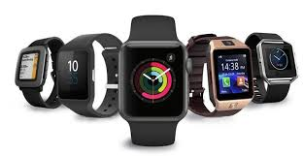

Hardware
Novelty Gadgets
Contactless Payment System
Smart watches
Smarttracker
Google Glasses, Virtual Reality (VR) & Augmented Reality (AR)
Smart Home Device (smart speakers) (amazon Echo)
Game Consoles
3-D Printer
Electric Scooter

Slide 8


Software & Services
Software & Apps
Operating System (OS)
App Stores
Applications
Social Media
Open Source/Closed Environment
Services
Advertisements
Internet
Online Payment / E-commerce
Telecommunication (Wireless/Cellular Data)

Slide 9
Gadget Industry Structure
Employs software and electronic engineers, IT professionals, designers, Marketers, Salespeople, Customer Service Representatives and finance personnel to keep innovating and improving products to compete for the next essential gadgets
Most of the production made in low labour cost countries
Involves multi-players in value chain, such as suppliers for parts and material, technology and developing, manufacturing, marketing, etc
Combination of traditional industries, telecoms, computers, and consumer electronics

Slide 10
Gadget Industry Trend
Convergence:
Harder to categorize products and services in the industry
Industries in electronics, computer hardware, and telecom are competing to be the leader in the novelty product categories
Price Competition:
Most of the technology gadgets heavily rely on semiconductor industry
Moore’s Law: Industry need to compete in price and performance in order to capture a share in the market

Slide 11
Today’s Gadget Industry
Under Consumer Electronics Industry
Rapidly changing and growing
Continually growing and evolving
New wearable products are getting popular in consumer markets
Revenue in the Consumer Electronics segment amounts to US$297B in 2018
Notes:
https://www.statista.com/outlook/251/100/consumer-electronics/worldwide#market-globalRevenue

Slide 12
Today’s Gadget Industry
Revenue is expected to show an annual growth rate (CAGR 2018-2022) of 8.4%, resulting in a market volume of US$410B by 2022
In global comparison, most revenue is generated in China (US$115,522m in 2018)
Notes:
https://www.statista.com/outlook/251/100/consumer-electronics/worldwide#market-globalRevenue

Slide 13
Today’s Gadget Industry
Revenue is expected to show an annual growth rate (CAGR 2018-2022) of 8.4%, resulting in a market volume of US$410B by 2022
In global comparison, most revenue is generated in China (US$115,522m in 2018)
Notes:
https://www.statista.com/outlook/251/100/consumer-electronics/worldwide#market-globalRevenue

Slide 14
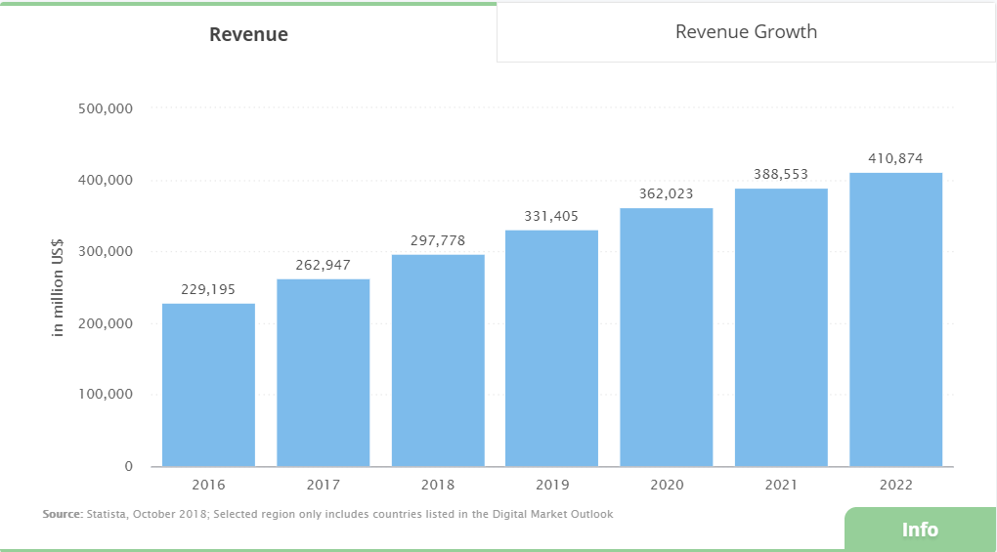
Worldwide Consumer Electronics Revenue

Slide 15
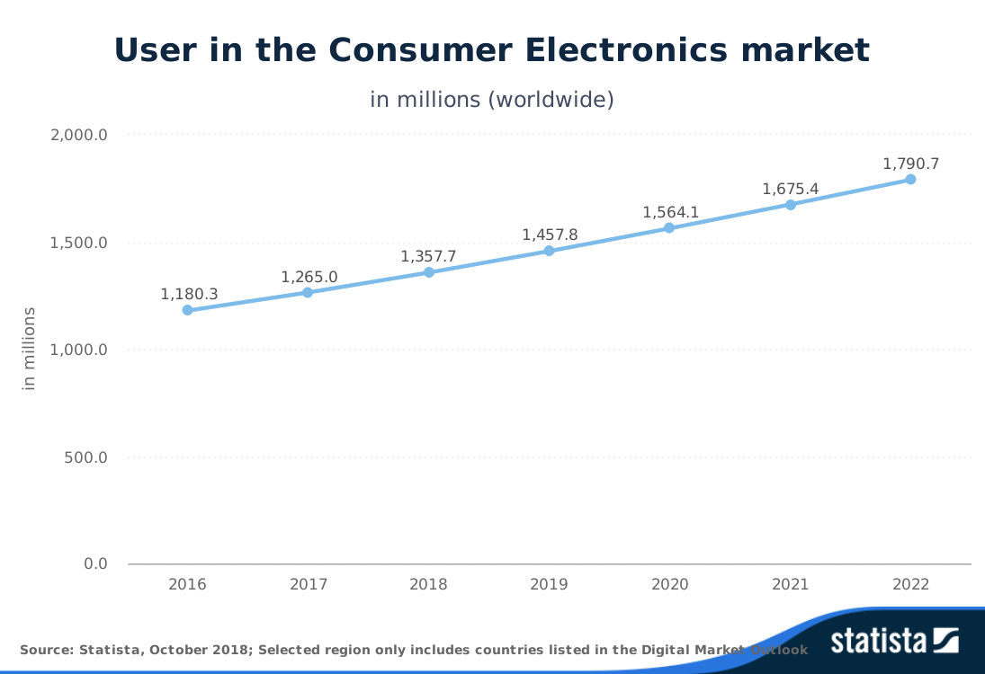
Expecting Number of Users

Slide 16
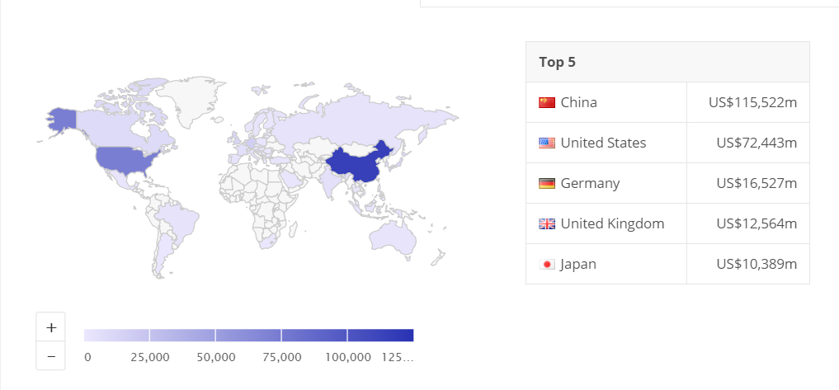
Global Comparison Revenue

Slide 17
Challenges
Constant changes in trends
Managing global supply chain
Shortening product life-cycle
High capital expenditure
Politic Issue
Slim operating margins
Notes:
https://www.statista.com/outlook/251/100/consumer-electronics/worldwide#market-globalRevenue

Slide 18
Competition
Rapidly changes in market shares
New innovations and reduce production cost
Profits are extremely high only for couple large and successful companies
Dominated by small number of very large companies
Notes:
https://www.statista.com/outlook/251/100/consumer-electronics/worldwide#market-globalRevenue

Slide 19
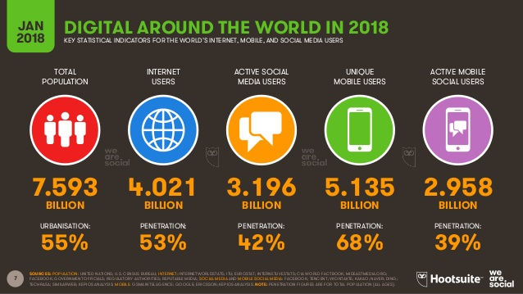

Slide 20
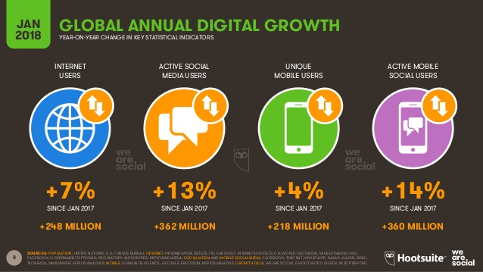

Slide 21
Main Aspects of the Industry
Internet (Network)
Computer
Smartphones
Tablets
Smart Watches
Operation System & Apps
Cloud Computing

Slide 22

The Internet
Massive network of networks, which connects billions of people online through which communication and other various activities may occur
Notes:
It is a network of networks that consists of private, public, academic, business, and government networks of local to global scope, linked by a broad array of electronic, wireless, and optical networking technologies. The Internet carries a vast range of information resources and services, such as the inter-linked hypertextdocuments and applications of the World Wide Web (WWW), electronic mail, telephony, and file sharing.

Slide 23
Timeline of the Internet
1969 Original Internet (US Dep of Defense)
1969 First message was sent from UCLA to SRI
1990 The first search engine - Archie
1991 CERN introduced the WWW to the public
1994-95 Yahoo!, Amazon, eBay, go live
1998 Google search engine is born
2004 Facebook goes online
The era of social networking begins.
Notes:
https://www.livescience.com/20727-internet-history.html
https://en.wikipedia.org/wiki/History_of_the_Internet

Slide 24
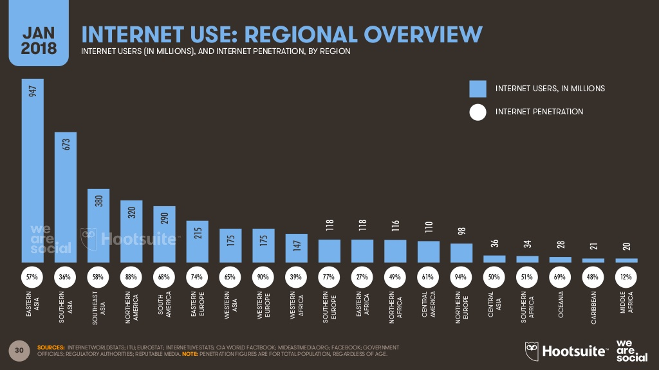

Slide 25
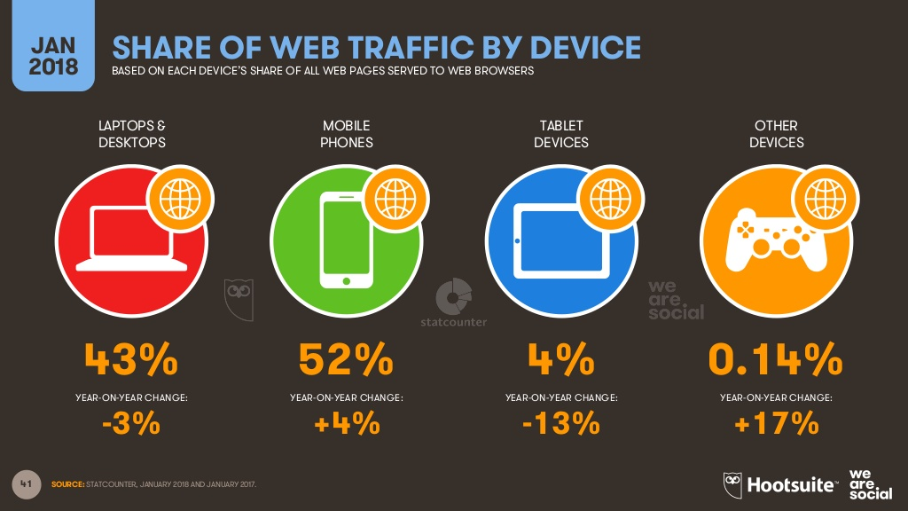
Notes:
https://wearesocial.com/blog/2018/01/global-digital-report-2018

Slide 26
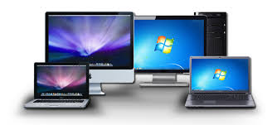
Computers
A device which can do a multitude of tasks ranging from processing and storing data to, doing set tasks based on the software it is operating on.

Slide 27
Computer History
First Generation:
1937 First electronic digital computer
1946 First general purpose digital computer
Second Generation:
1951 First computer for commercial use
Third Generation:
1980 Microsoft Disk Operating System was born
1981 IBM introduce the personal computer
Notes:
https://www.livescience.com/20727-internet-history.html
https://en.wikipedia.org/wiki/History_of_the_Internet
http://people.bu.edu/baws/brief%20computer%20history.html

Slide 28
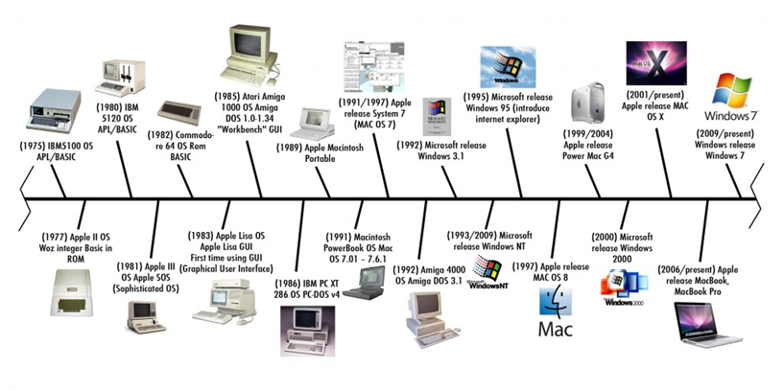
Computer Timeline
Notes:
https://www.livescience.com/20727-internet-history.html
https://en.wikipedia.org/wiki/History_of_the_Internet

Slide 29
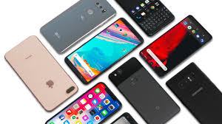
Smartphones
All in one Multi-purpose mobile computing device
With large screen that support for touch rather than physical keyboards
Allow users to download or purchase applications from centralized store in high speed
Multi-media platform
21st century essential personal device

Slide 30
Mobile Phone History
1973: Motorola cell phone created
April 3, 1973: first cell phone call made by Martin Cooper
1983: first cell phone available to consumers
1994: First smartphone
1999: First mobile watch phone
2001: First Commercial 3g Network
2007: First Iphone Released
2008: First Android phone released
2010: First LTE Network
Notes:
https://www.livescience.com/20727-internet-history.html
https://en.wikipedia.org/wiki/History_of_the_Internet
http://people.bu.edu/baws/brief%20computer%20history.html

Slide 31
4G LTE Network
Long-Term Evolution (LTE) is standard for high-speed wireless communication for mobile devices and data terminals.
Peak download rates up to 299.6 Mbit/s and upload rates up to 75.4 Mbit/s
Improved support for mobility
Low data transfer latencies 5ms

Slide 32
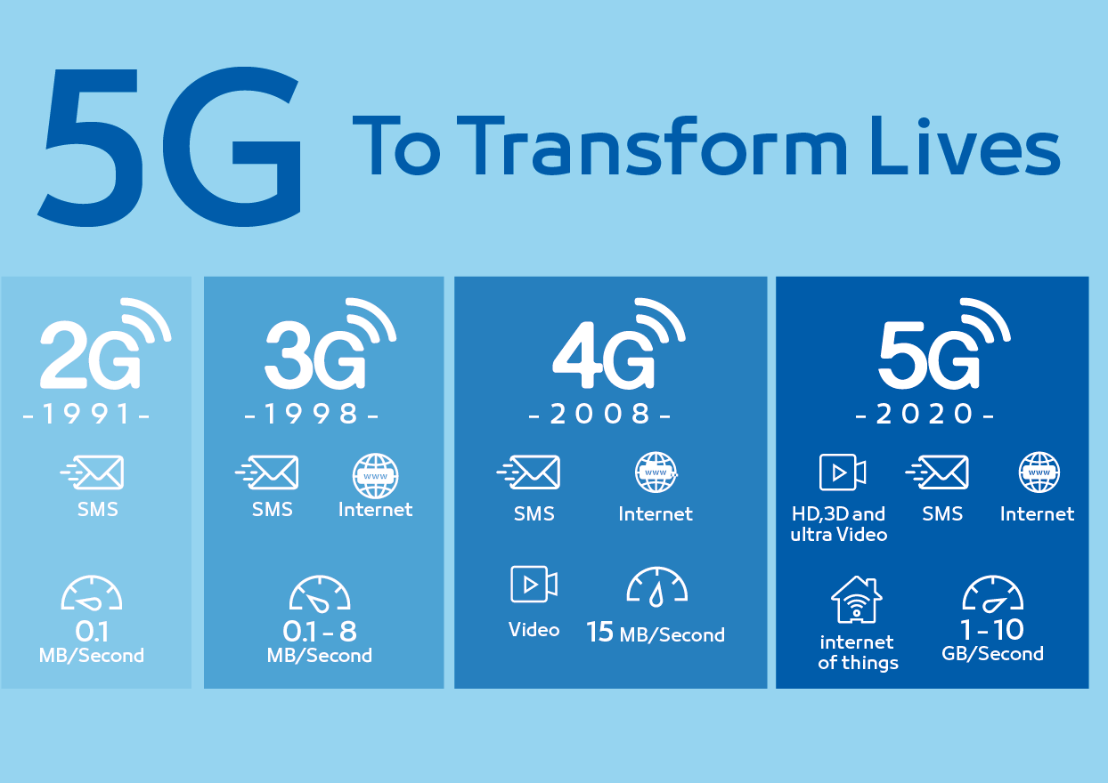
The Future - 5G Network
Targets high data rate 1GB/s
Reduce latency 1ms
Energy saving
Higher system capacity
Massive device connectivity
Estimated at 15% to 50% faster

Slide 33
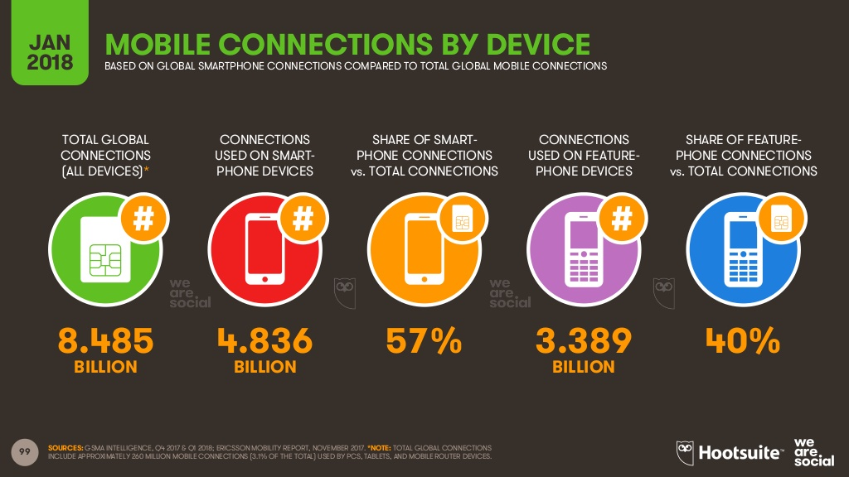

Slide 34
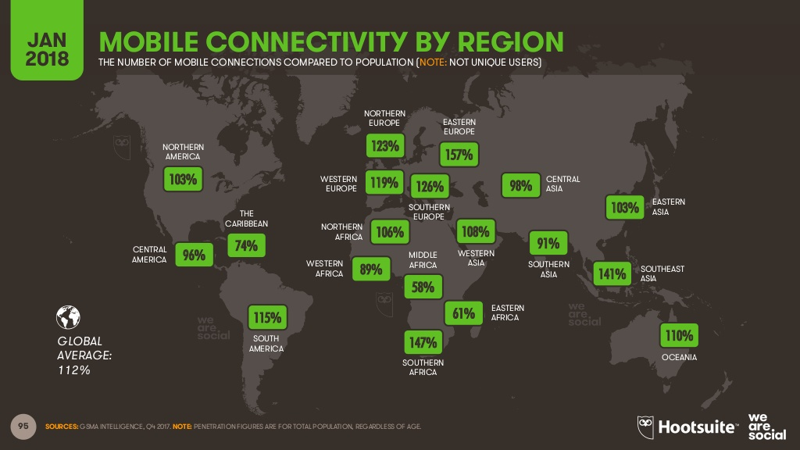

Slide 35
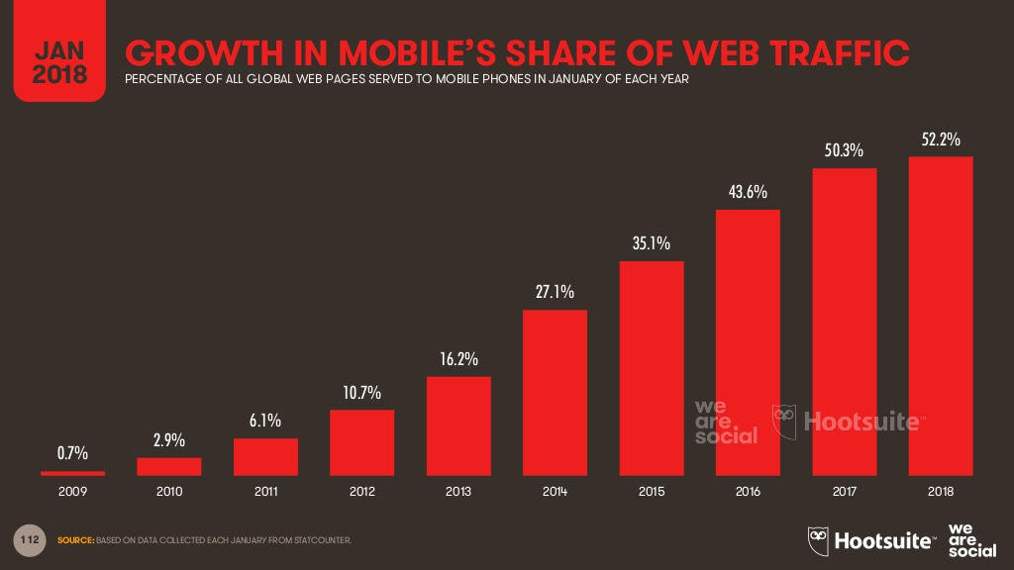

Slide 36
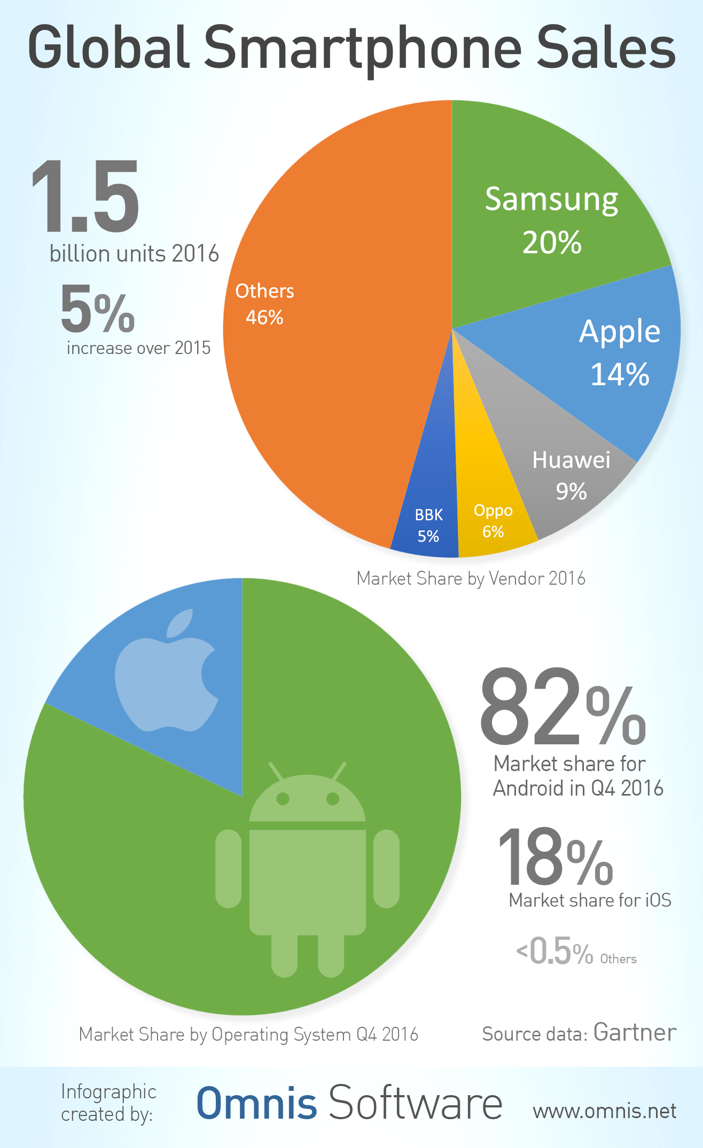

Slide 37
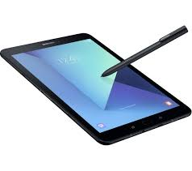
Tablets
Larger than Smartphones
Similar features and functions as smartphones
  Web browsing
  Access to social media platform
  Applications
Cell phone calling is not primary function of tablets
Larger battery life – Up to 12 hours

Slide 38
Tablets
1971 Allan Kay describges a tablet computer at Xerox PARC
1983 Apple and AT&T work on a tablet prototype
1991 IBM markets a tablet computer but fails
1993 Apple Newton launched, also fails
1996 NewsPad debuts; considered one of the first serious prototypes
2009 Various computer manufacturers release tablets to market
2010 Apple iPad launched

Slide 39
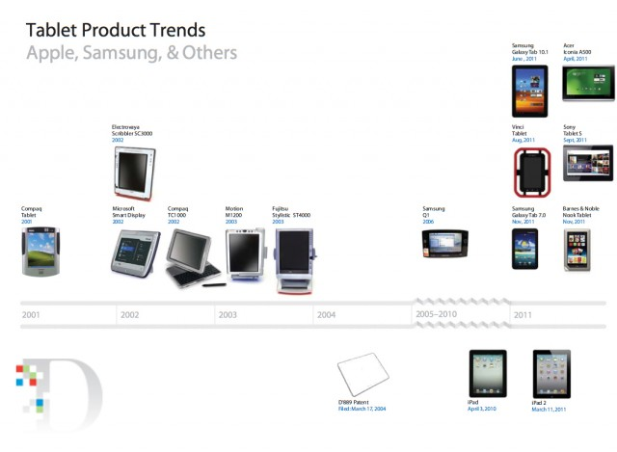

Slide 40
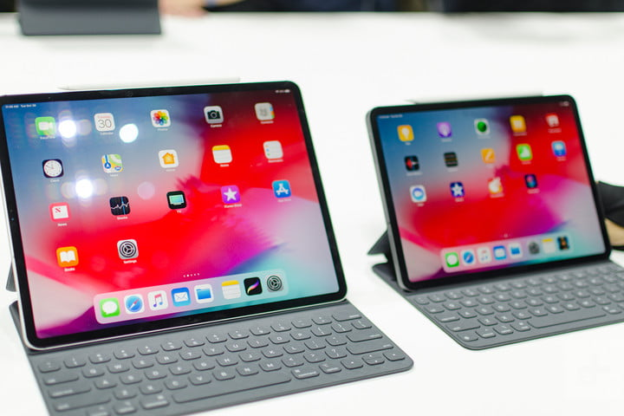
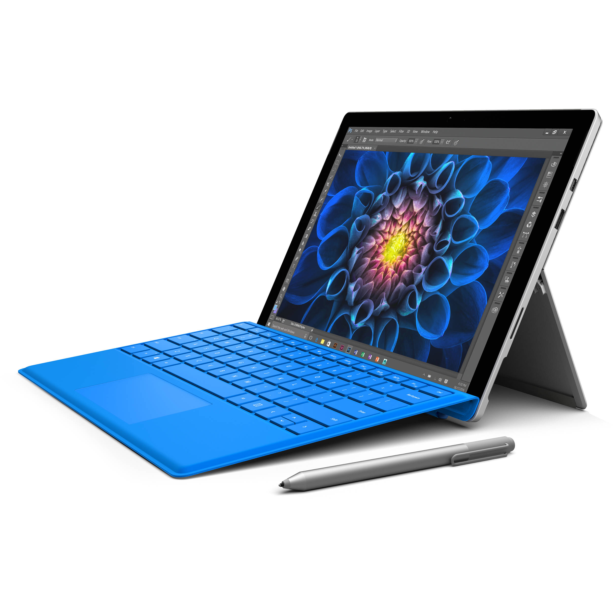
2018 Popular Tablet
Apple iPad Pro 12.9”/9.7”
Microsoft Surface Pro 4
Samsung Galaxy Book
Samsung Galaxy Tab S4
Huawei MateBook Signature Edition
Samsung Galaxy View
Lenovo Tab 4
Samsung Galaxy Pro 12.2”

Slide 41
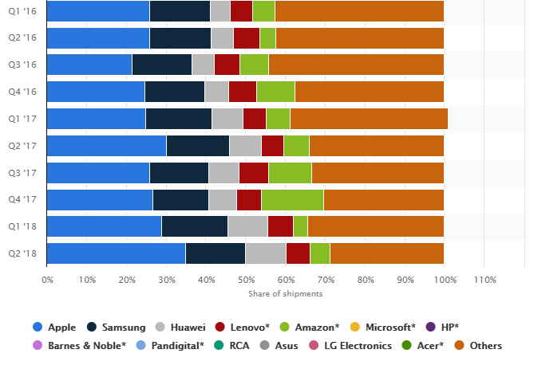
Global tablet market share held by tablet vendors from 1st quarter 2016 to 2nd quarter 2018
Notes:
https://www.statista.com/statistics/276635/market-share-held-by-tablet-vendors/

Slide 42
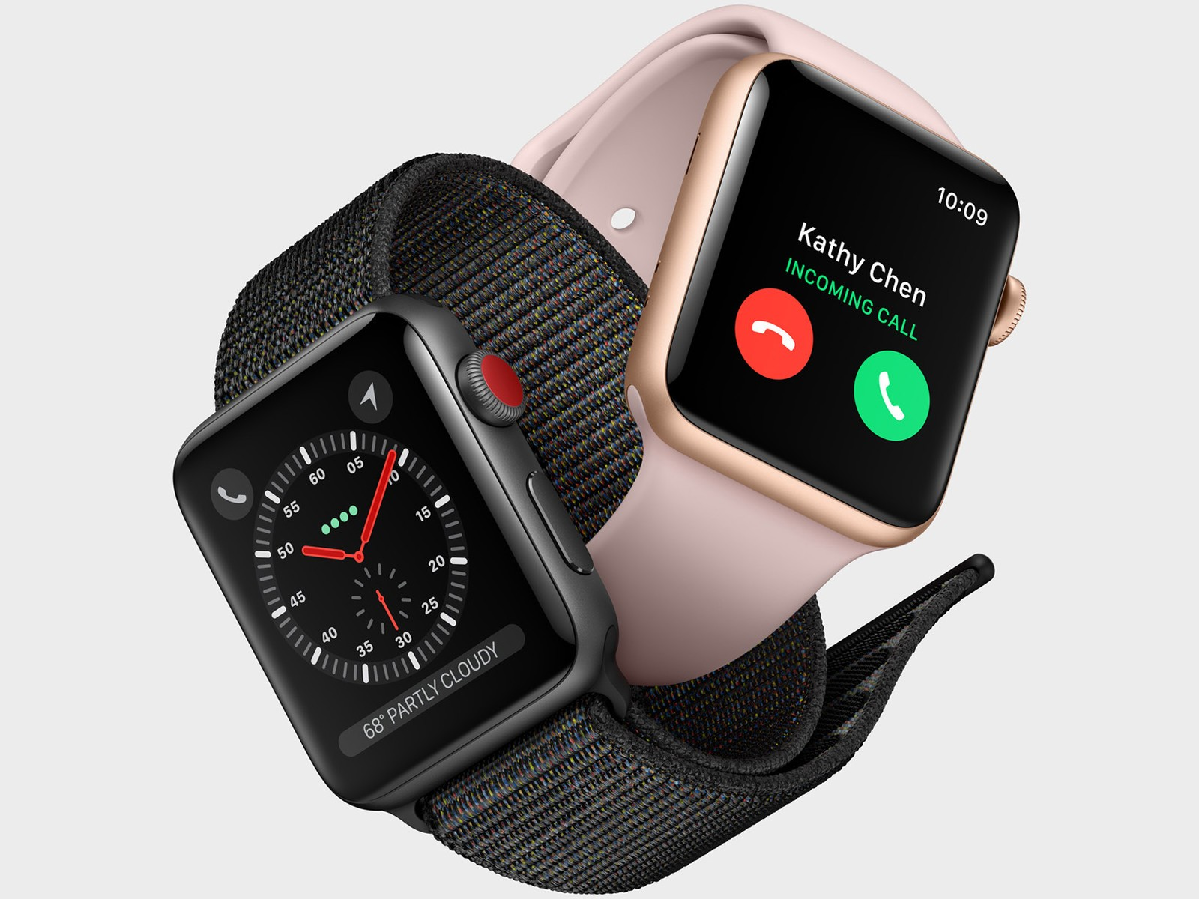
Smart Watch
A computerized wristwatch with functionality that is enhanced beyond timekeeping, and is often comparable to a personal digital assistant device.
Additional feature for the new Apple Watch even monitor users’ heart rate and falling warning.

Slide 43
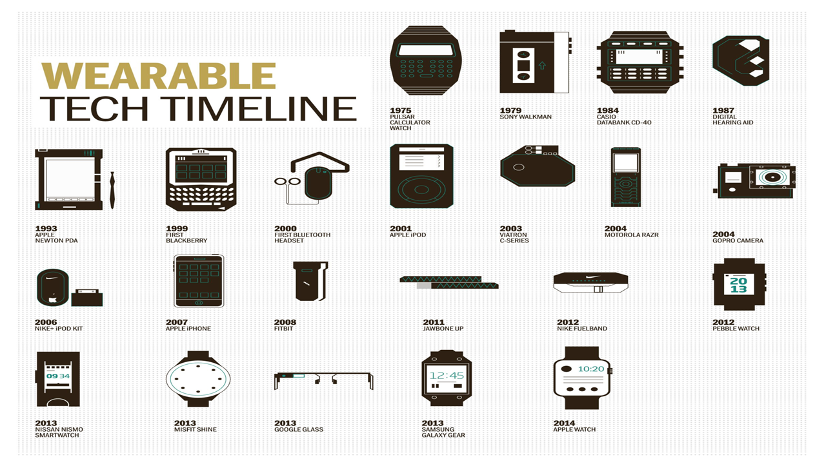

Slide 44
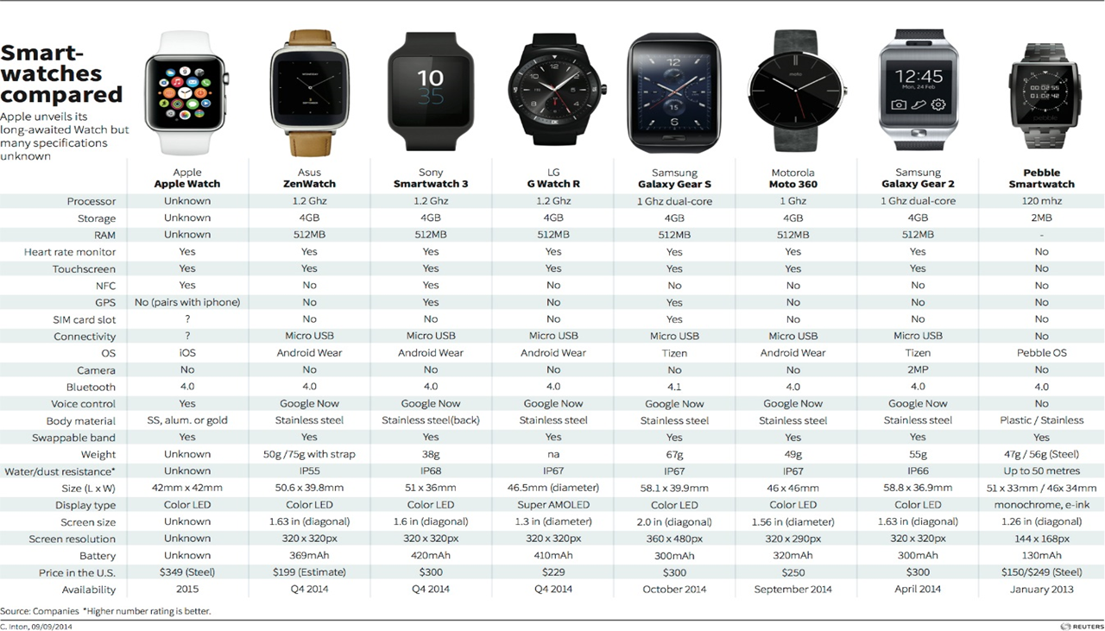

Slide 45
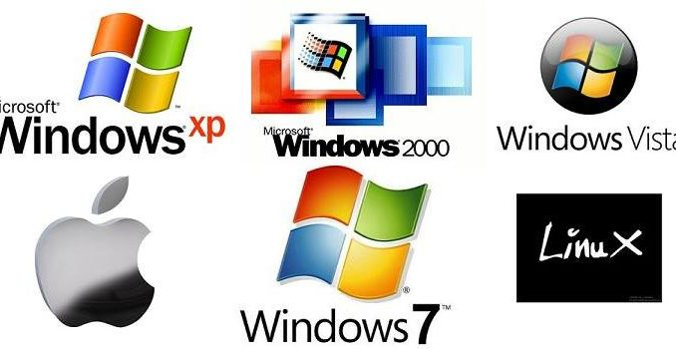
Operating System(OS)
What is an Operating System?
  An operating system (OS) is software that manages computer hardware resources and provides services for computer programs.

Slide 46
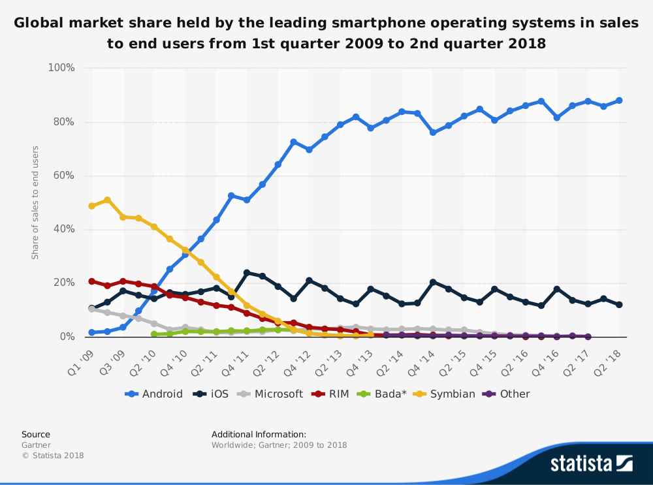

Slide 47
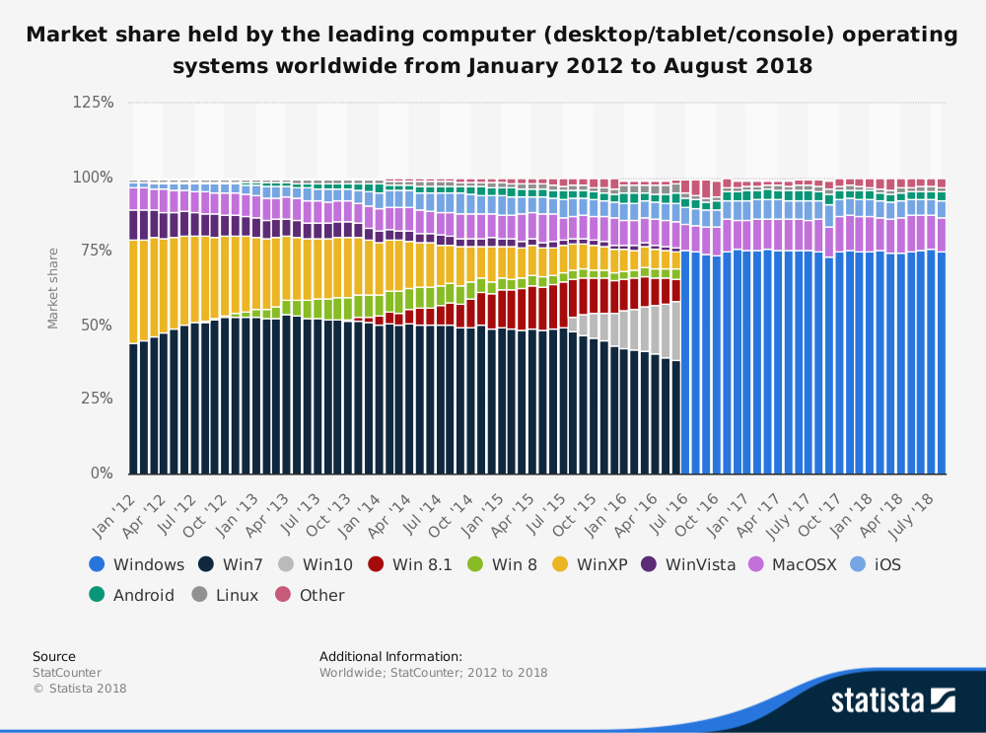

Slide 48
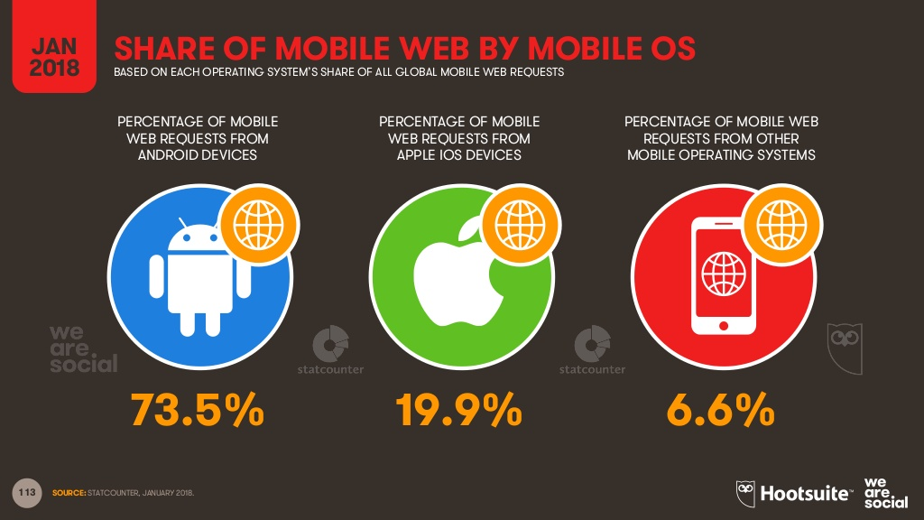

Slide 49

Cloud Computing
What is Cloud Computing
Programs and applications run on a connected server(s) rather than on a local computing device
Save data outside local server
Ease of accessibility for data

Slide 50
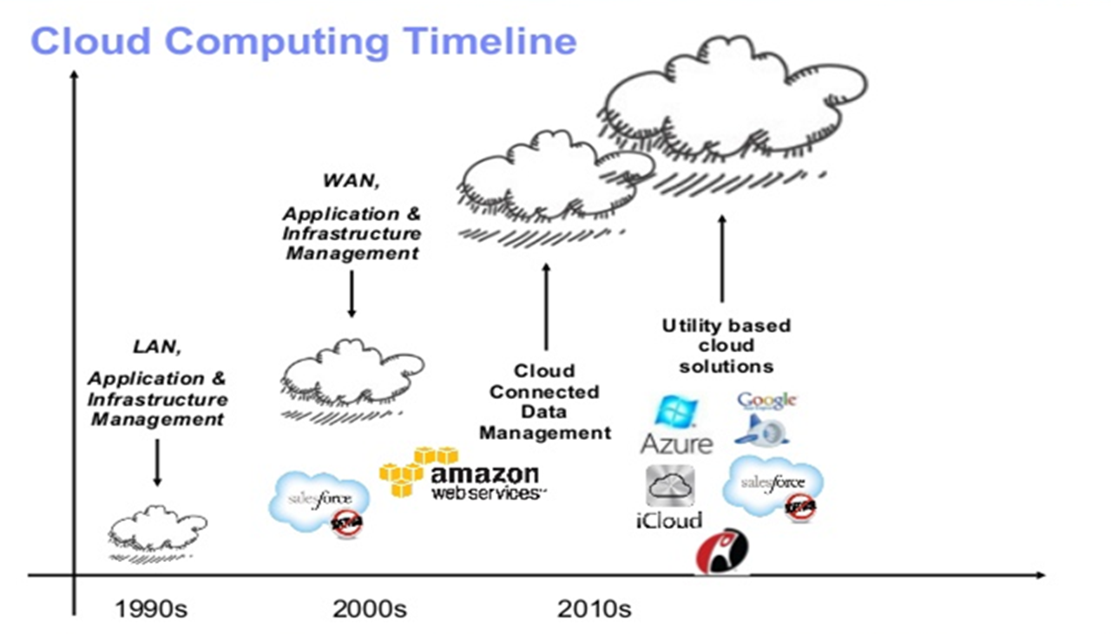

Slide 51
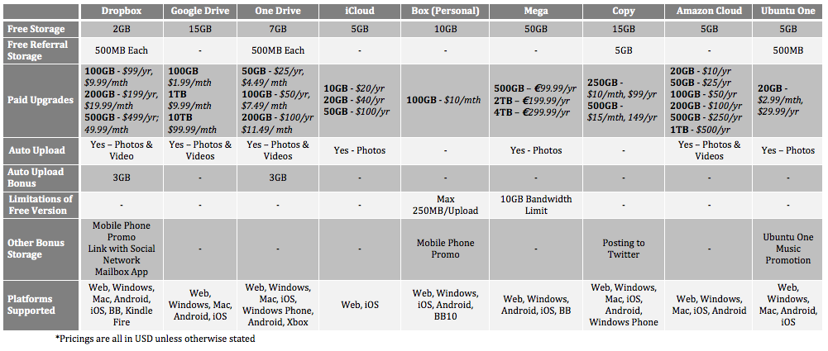

Slide 52

App Stores
A centralized application store where users can download or purchase the application to the device
For entertainment, education, lifestyle, etc
Free apps and Paid apps

Slide 53
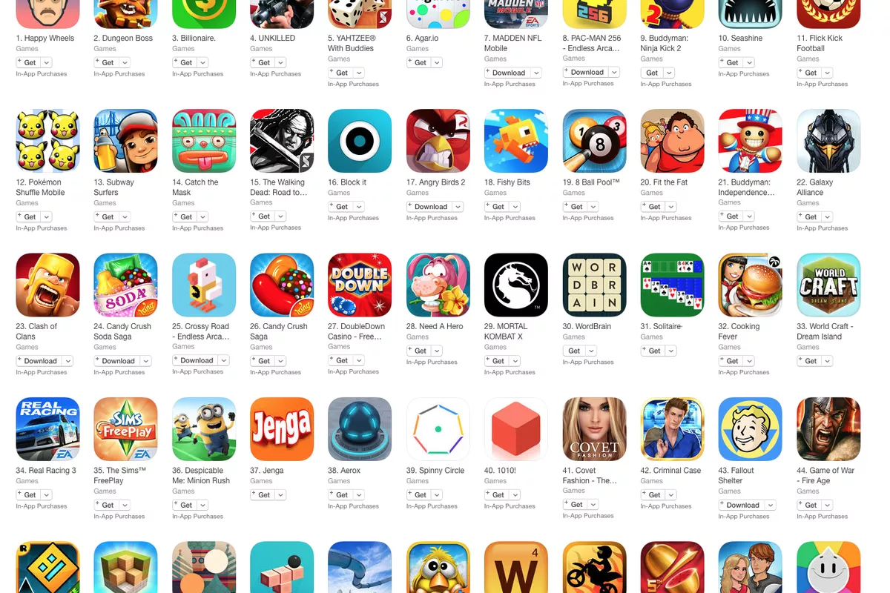

Slide 54
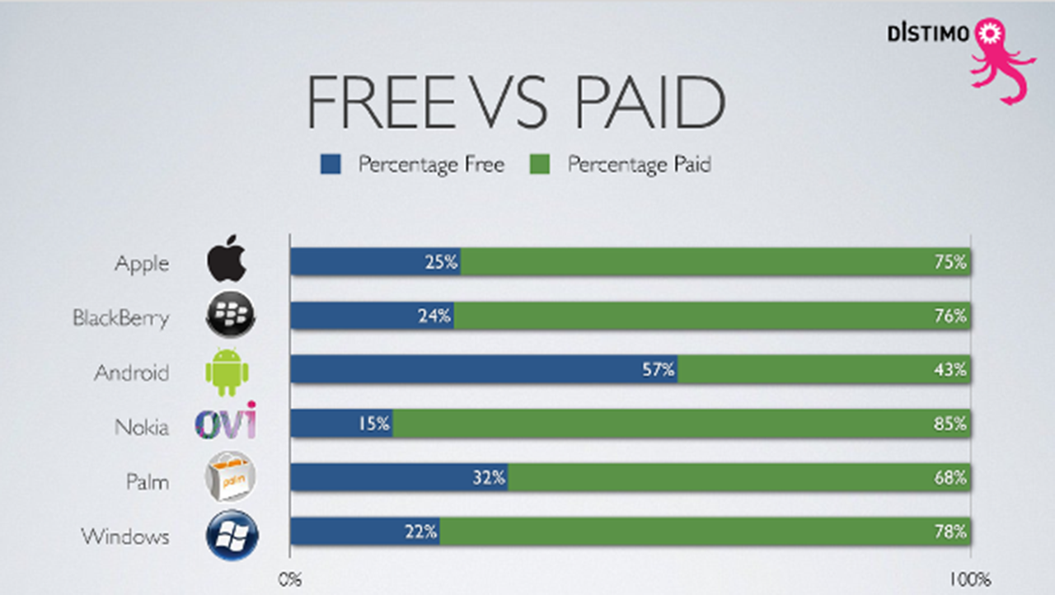

Slide 55
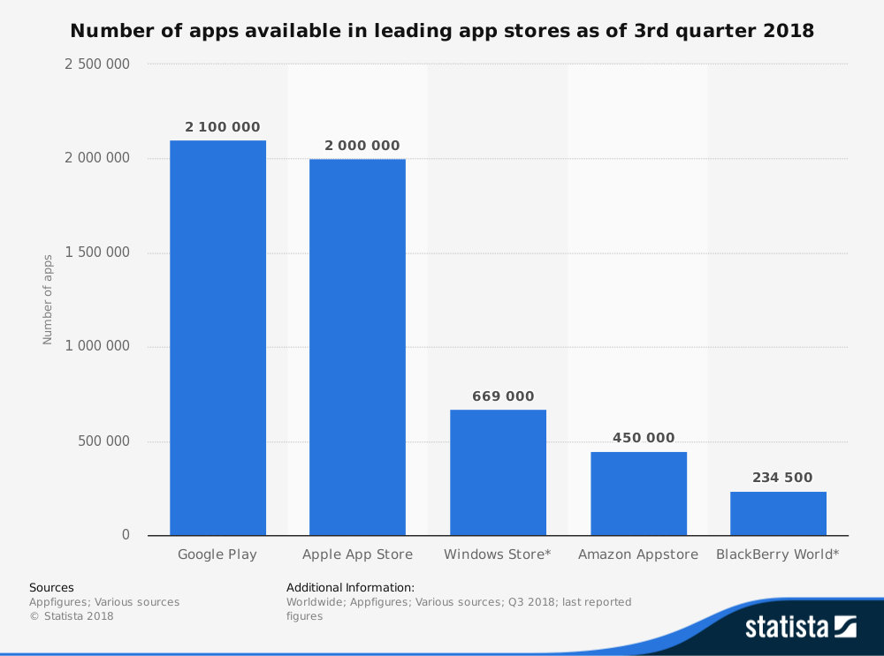

Slide 56



Slide 57
Stock Overview

Slide 58
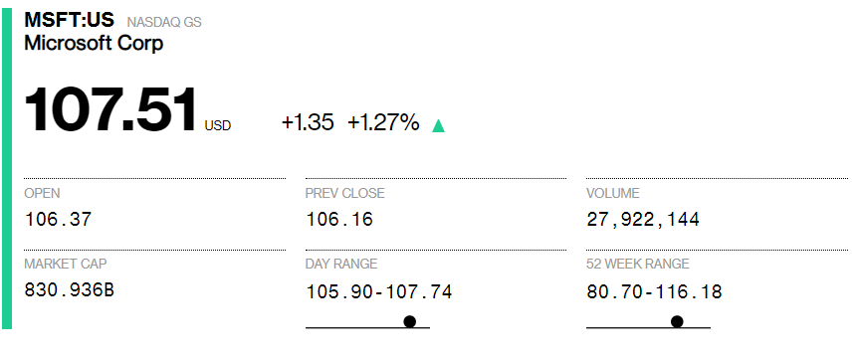

Slide 59
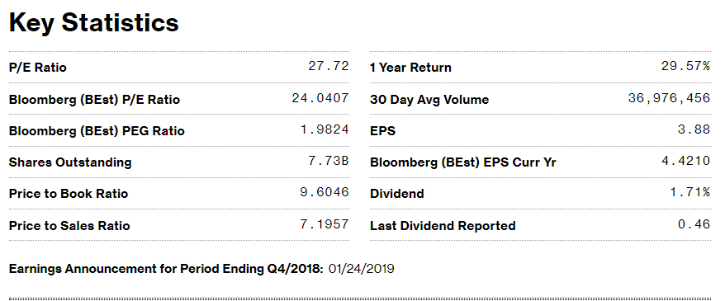

Slide 60
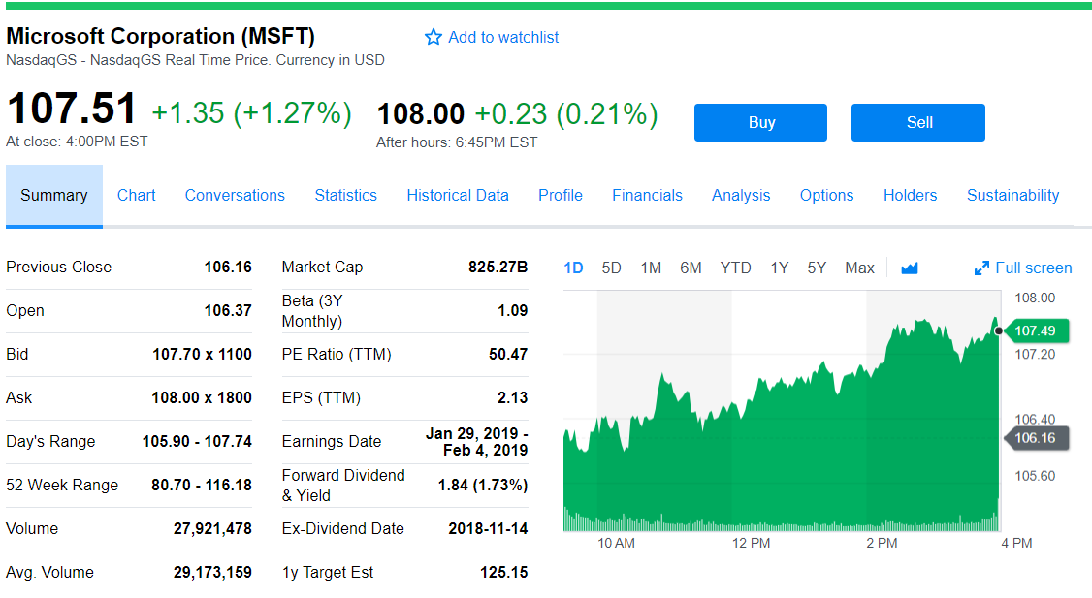

Slide 61
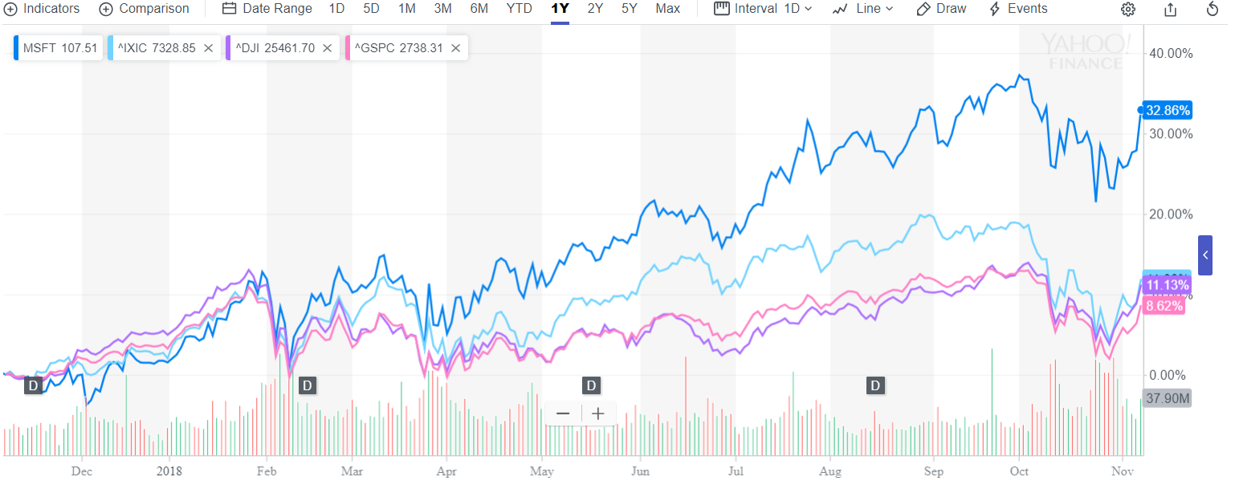
Stock 1 Year Performance

Slide 62
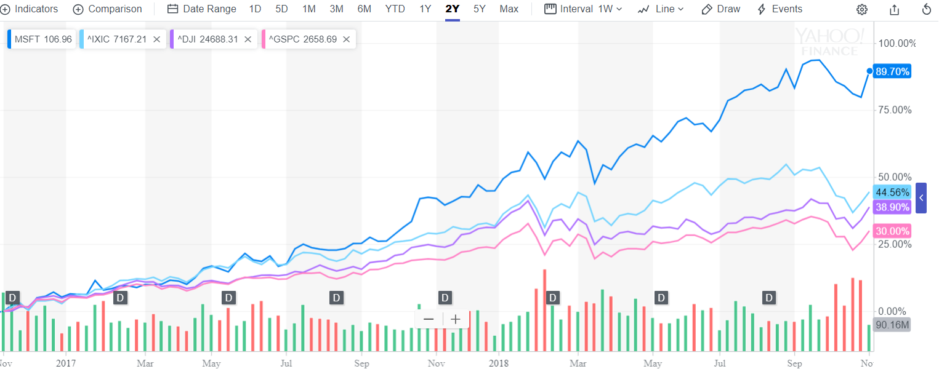
Stock 2 Year Performance

Slide 63
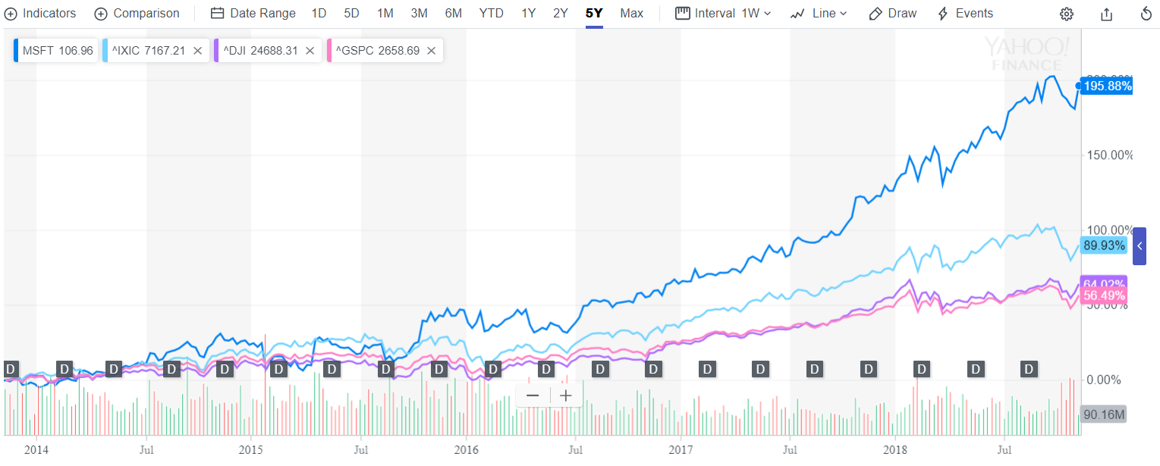
Stock 5 Year Performance

Slide 64
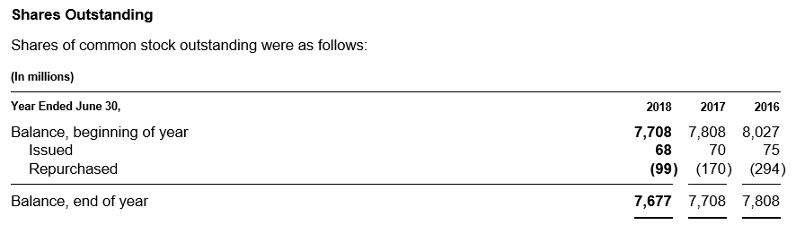
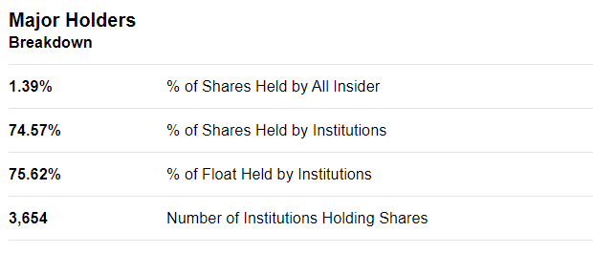
Microsoft Share Structure

Slide 65
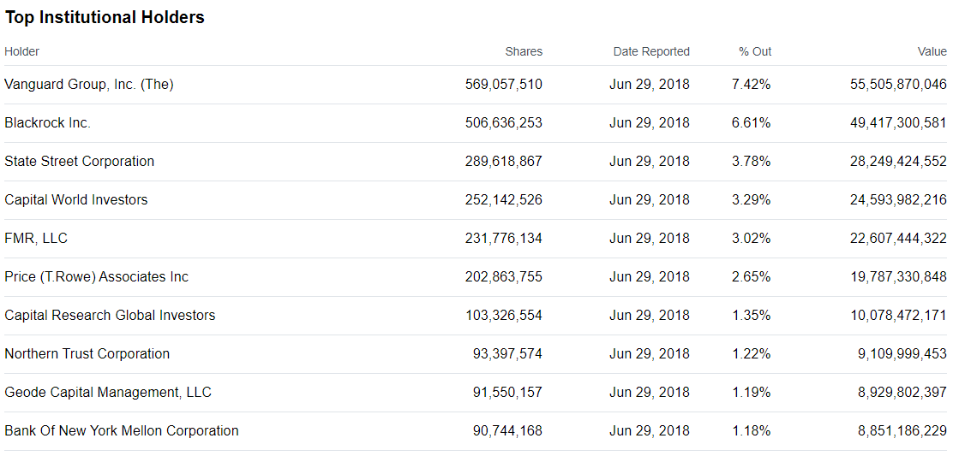
Top 10 Institutional Shareholders

Slide 66
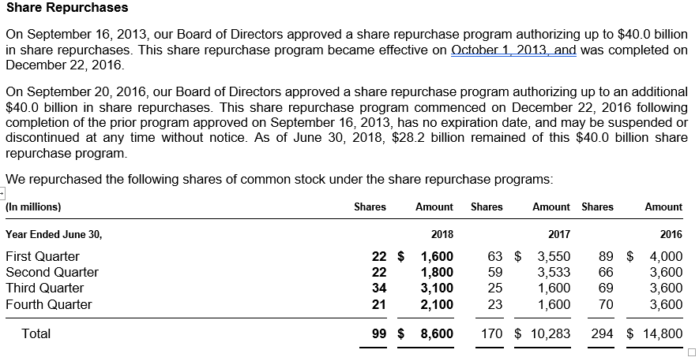
Share Repurchase Program

Slide 67
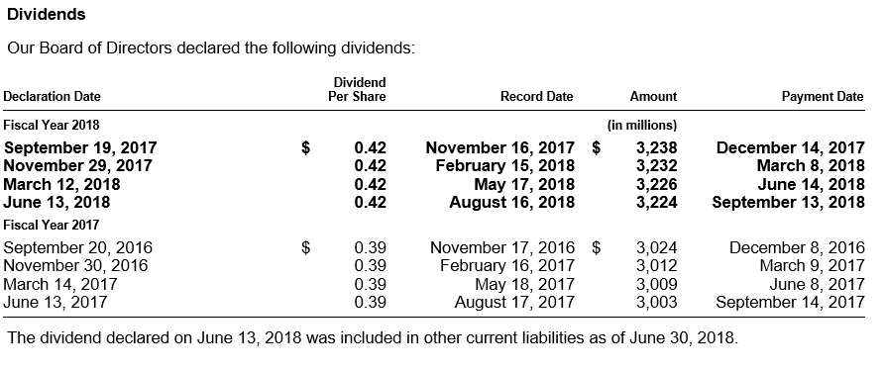
Dividends

Slide 68
Mission and Strategy
Mission
  Empower every person and every organization on the planet to achieve more
Strategy
  Build best-in-class platforms and productivity services for a mobile-first, cloud-first world

Slide 69
History & Management

Slide 70
Microsoft History
1975
  Microsoft founded
1981
  Microsoft incorporates
  IBM introduces its personal computer MS-DOS 1.0
1986
  Microsoft stock goes public
1990
  launches Windows 3.0
1995
  launches Windows 95
1998
  launches Windows 98

Slide 71
2001
  launches Office XP and Xbox
2005
  launches Xbox 360
2007
  launches Windows Vista
2009
  launches Windows 7
2010
  launches general availability of Office
  launches Kinect for Xbox 360
  launches Windows Phone 7
2011
  launches Office 365
  Microsoft closes its acquisition of Skype

Slide 72
2012
  Microsoft launches Windows 8 and Microsoft Surface
2013
  Launches Office 2013, Outlook.com, Windows 8.1
  Launches Surface 2 and Surface Pro 2, and launches Xbox One
  Microsoft announces decision to acquire Nokia
2014
  Satya Nadella named chief executive officer for Microsoft
  Microsoft launches Office for iPad, Surface Pro 3
  Minecraft to join Microsoft announcement
  Microsoft announces Office apps for Android tablets

Slide 73
2015
  Microsoft reveals Windows 10
  Microsoft announce partnership with Baidu
  Microsoft jointly founded the OpenFog Consortium
2016
  Microsoft announces Surface Studio and Surface Dial
  Microsoft launches Microsoft Teams, a cloud-based team collaboration tool

Slide 74
Key Acquisitions
1987 - Forethought
  Forethought was founded in 1983, then later be known as Microsoft PowerPoint
1997 - Hotmail
  Acquired Hotmail for $500 million
2000 - Visio Corporation
  Acquired Visio for $1.375 billion
2002 - Navision
  Purchased Navision for $1.33 billion; turned into a new division as Microsoft Business Solutions (now Microsoft Dynamics)
2011 – Skype Technologies
  Purchased for $8.5 billion; 32 times larger than its value
2013 – Nokia (Hardware Division)
  Formerly developed phones for Microsoft; highlights Microsoft’s move into hardware
2015 - Metanautix
  Metanautix helps big companies to navigate their data

Slide 75
Key Acquisitions
2015 - Mobile Data Labs
  Mobile Data Labs, an intelligent productivity solutions for mobile professionals
2016 - Swiftkey
  Swiftkey is a start-up company that makes keyboard apps for Android and iOS devices
2016 - Xamarin
  Xamarin allows developers to build fully native apps across several platforms from a single shared code base
2016 - Linkedln
  Acquired Linkedln for $26.2 Billion
2017 - Cloudyn
Microsoft bought Israeli cloud startup Cloudyn, a company that helps customers manage their cloud billing across multiple clouds
2018 - GitHub
  Acquired GitHub for $7.5 billion

Slide 76
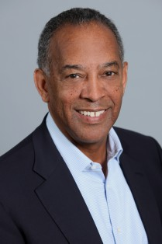
Management Team
John W. Thompson, Chairman (Joined 2012)
John W. Thompson joined the Microsoft Board in February 2012 and became independent chairman of Microsoft Corporation on February 4, 2014.
Education
Thompson received a bachelor’s degree in Business Administration from Florida A&M, and a master’s degree in Management from the Sloan Fellows program of the MIT Sloan School of Management.

Slide 77

Management Team
Bill Gates, Founder and Technology Advisor
William (Bill) H. Gates is founder, technology advisor and board member of Microsoft Corporation. He served as chairman of the board until February 4, 2014.
Education
In 1973, Gates entered Harvard University as a freshman. In his junior year, Gates left Harvard to devote his energies to Microsoft, a company he had begun in 1975 with his childhood friend Paul Allen.

Slide 78
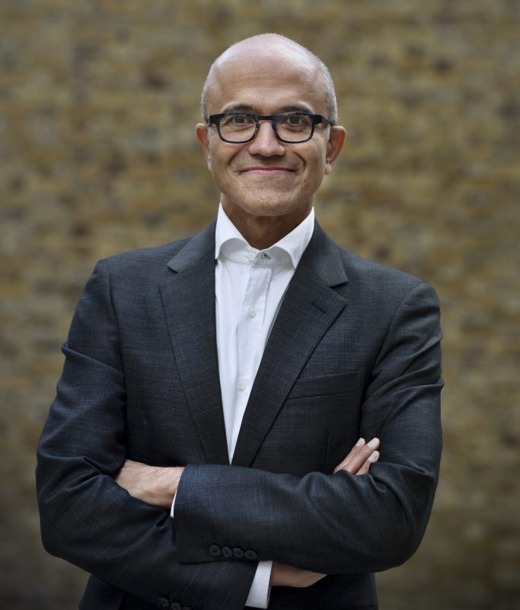
Management Team
Satya Nadella, Chief Executive Officer (Joined 1992)
Satya Nadella is Chief Executive Officer of Microsoft. Before being named CEO in February 2014, Nadella held leadership roles in both enterprise and consumer businesses across the company.
Education
He earned a bachelor’s degree in electrical engineering from Mangalore University, a master’s degree in computer science from the University of Wisconsin – Milwaukee and a master’s degree in business administration from the University of Chicago.

Slide 79

Management Team
Chris Capossela, Executive Vice President and Chief Marketing Officer (Unknown join date)
As chief marketing officer, Chris Capossela leads Microsoft’s global product marketing, advertising, brand, research and communications functions for businesses and consumers.
He oversaw the creation of new business opportunities with partners to deliver new consumer experiences through Windows, Windows Phone, Office and Xbox.
Education
Capossela holds a bachelor’s degree in computer science and economics from Harvard University.

Slide 80

Management Team
Scott Guthrie, Executive Vice President, Microsoft Cloud and Enterprise Group (Joined 1997)
As executive vice president of the Microsoft Cloud and Enterprise Group, Scott Guthrie is responsible for the company’s cloud infrastructure, server, database, CRM, ERP, management and development tools businesses. His engineering team builds Microsoft Azure, SQL Server, Microsoft Dynamics 365, Active Directory, System Center, Visual Studio and .NET.
Education
Guthrie graduated with a bachelor’s degree in computer science from Duke University

Slide 81

Management Team
Rajesh Jha, Executive Vice President, Office Product Group (joined 1990)
As executive vice president of Microsoft’s Office Product Group, Rajesh Jha leads the development and service engineering teams for Office 365 – spanning Office, Skype and OneNote.
Education
Jha has a master’s degree in computer science from the University of Massachusetts, Amherst and a bachelor’s degree in computer science from Indian Institute of Technology, Madras.

Slide 82

Management Team
Terry Myerson, Executive Vice President, Windows and Devices Group (Joined 2001)
As executive vice president of Microsoft’s windows and devices group, Myerson is responsible for the software platform, apps, games, store and devices that power the Windows ecosystem. This includes Windows, Surface, Xbox, Minecraft, Lumia and HoloLens.
Education
After earning a bachelor’s degree in mechanical engineering from Duke University, Myerson founded Intersé, one of the first Web software companies, which Microsoft acquired.

Slide 83
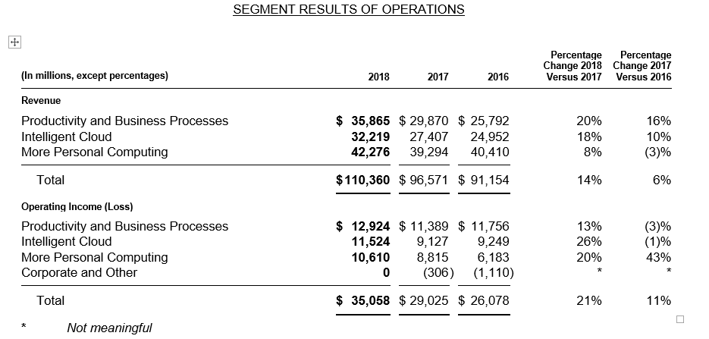
Revenue by Segments

Slide 84
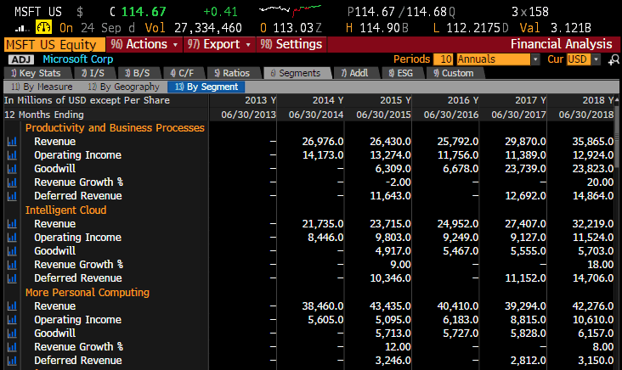
Revenue by Segments

Slide 85
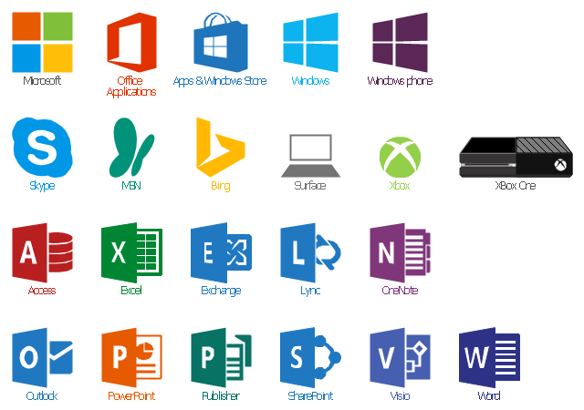
Products and Services

Slide 86
Products and Services
Productivity and Business Process
Intelligent Cloud
More Personal Computing

Slide 87
Productivity and Business Process
Office Commercial, including volume licensing and subscriptions to Office 365 commercial for products and services such as Office, Exchange, SharePoint, and Skype for Business, and related Client Access Licenses (“CALs”).
Office Consumer, including Office sold through retail or through an Office 365 consumer subscription, and Office Consumer Services, including Skype, Outlook.com, and OneDrive.
Dynamics business solutions, including Dynamics ERP products, Dynamics CRM on-premises, and Dynamics CRM Online.

Slide 88
Intelligent Cloud
Server products and cloud services, including Microsoft SQL Server, Windows Server, Visual Studio, System Center, and related CALs, as well as Azure.
Enterprise Services, including Premier Support Services and Microsoft Consulting Services.

Slide 89
More Personal Computing
Windows, including Windows original equipment manufacturer licensing (“Windows OEM”) and other non-volume licensing of the Windows operating system, volume licensing of the Windows operating system, patent licensing, Windows Embedded, MSN display advertising, and Windows Phone licensing.
Devices, including Surface, phones, and PC accessories.
Gaming, including Xbox hardware; Xbox Live, comprising transactions, subscriptions, and advertising; video games; and third-party video game royalties.
Search advertising, including Bing, Bing Ads, and MSN.

Slide 90


Slide 91

Revenue by Geography

Slide 92


Slide 93
Financial Analysis

Slide 94


Slide 96


Slide 97


Slide 99


Slide 100


Slide 101


Slide 102


Slide 103

Stock price

Slide 104


Slide 105


Slide 106

Long-term Trend- Income

Slide 107

Long-term Trend- Cashflow

Slide 108


Slide 109


Slide 110


Slide 111
Recommendation
BUY

Slide 112

Apple

Slide 113

Stock Overview

Slide 114

Stock Information

Slide 115

Stock Information

Slide 116
Share Structure
Shares Outstanding
2015 | 2016 | 2017 | 2018
5.793B | 5.5B | 5.252B | 5B
5.6% decline from 2014 | 5.05% decline from 2015 | 4.52% decline from 2016 | 4.79% decline from YoY
Source:https://www.macrotrends.net/stocks/charts/AAPL/apple/shares-outstanding
Notes:
https://www.macrotrends.net/stocks/charts/AAPL/apple/shares-outstanding
Shares outstanding can be defined as the number of shares held by shareholders (including insiders) assuming conversion of all convertible debt, securities, warrants and options. This metric excludes the company's treasury shares.

Slide 117

Share Structure
Apple 2018 annual EPS was $11.91, a 29.32% increase from 2017.
$9.22
$9.21
$8.31
$6.31
$6.45
$5.68
Notes:
Apple 2018 annual EPS was $11.91, a 29.32% increase from 2017.

Slide 118

Stock 1 Year Performance

Slide 119

Stock 3 Year Performance

Slide 120

Stock 3 Year Comparison

Slide 121

Stock 10 Year Performance

Slide 122

Stock 10 Year Comparison

Slide 123

Apple Stock Chart Max

Slide 124

Top Shareholders - Institutions

Slide 125
Company Overview

Slide 126
Company Background
Apple Inc. (formerly Apple Computer, Inc.) founded by Steve Jobs, Steve Wozniak and Ronald Wayne (1976)
It designs, manufactures, and markets mobile communication and media devices, personal computers, and portable digital music players, and sells a variety of related software, services, peripherals, networking solutions, and third-party digital content and applications
Products sold worldwide through its online stores, its retail stores, its direct sales force, third-party cellular network carriers, wholesalers, and resellers
Headquartered in Cupertino, California

Slide 127
Business Strategy
Commitment to bringing the best user experience to its customers through its innovative hardware, software and services
Unique ability to design and develop its own operating systems, hardware, application software
Services to provide its customers products and solutions with innovative design, superior ease-of-use and seamless integration
Expand platform for discovery and download of digital content by customers
Supporting third-party software and hardware development which can complement their products and services
Investment in R&D, marketing, and advertising to encourage the sale of innovative technology

Slide 128

Products and Services
Iphone
Ipad
Ipod
Accessories
Airpods
Mac (Desktop, Macbook air, Macbook, Macbook pro)
Apple Watch
Apple TV
Internet Services
Icloud
AppleCare
Apple Pay
Operating System Software
iOS, macOS, watchOS, tvOS

Slide 129



Products: Iphone
Smartphone with a user interface built around the device’s multi-touch screen including a virtual keyboard
Shoot video, take pictures, download apps, play music, send/receive text messages and e-mail
Originally released in 2007
Largest market share in the US
Latest models:
Iphone XS and Iphone XR

Slide 130

New Iphones- 2018

Slide 131

Products: Ipad
Line of tablet computers, with user interface and capabilities similar to the iPhone
Series: iPad Mini, iPad, iPad Pro, iPad Pro 2018
Most recent releases are 9.7” Pro and Mini 4
Includes Siri and Touch ID and Face ID

Slide 132

Products: Mac
Line of notebook and desktop
computers based on the MacOS
operating system
MacBook lineup consists of the Macbook Air, Macbook Pro, Macbook, iMac, iMac Pro
Current desktop models include 27-inch LED-backlit Retina 5K display, 3.2GHz, 4TB SSD,
Long battery life, fast storage, beautiful display, thin and lightweight

Slide 133

Services: iCloud
Apple’s cloud storage service which stores music, photos, contacts, calendars, mail, and documents
Works across devices (iPhone, Mac, even Windows personal computers)
Includes the iCloud Drive, Find My iPhone, Notes, iCloud KeyChain and more
Provides means to back-up important personal data directly (wirelessly)
5GB of free storage space, 500GB $1.29/month, 200GB $3.99/month, 2TB $12.99/month

Slide 134

Services: Apple Pay
Mobile payment service available in certain countries. Also available on apple watch.
Offers an easy, secure, fast and private way to pay
Digitalizes and can replace credit or debit cards with the chip and pin or magnetic stripe
Wireless communication with point of sale by using near field communication antenna, secure element (a chip that stores encrypted private information), Touch ID and Wallet

Slide 135

Other Services
iTunes store allows to purchase, rent, and download music, TV shows and podcasts to be played on the iTunes player
App Store allows customers to download and purchase applications for their iOS devices, as well as discover in-app content
iBooks features e-books from major and independent publishers for customers to purchase and read across iOS devices and Mac
Apple Music is the music streaming service, which offers curated playlists and on-demand radio stations and an unlimited music library for download and offline listening. The customer pays a monthly subscription fee for an individual, student or family plan.

Slide 136


Slide 137
Company History

Slide 138
1976
-Founded in Cupertino by Steve Jobs, Ronald Wayne and Steve Wozniak
-Apple I sells for $666.66 (200 units)
1977
-Apple II released at $1,300
-Incorporated in the state of California
1979
- First app unveiled: VisiCalc
1980
December 12: IPO launched at $22M, selling $4.6M shares
Release of Apple III
1983
LISA (Local Integrated System Architecture) released at $9,995, one of the first personal computers to offer a GUI in a machine; sells only 10,000 units
1984
Launch of the Macintosh 128K with initial price of $2,495..beige case, keyboard and mouse

Slide 139
1985
-Steve Jobs leaves Apple and starts NeXT
1987
-Apple registered the Apple.com domain name
1993
-The Newton released (early PDA model)
1994
-Apple releases its first PowerPC -based desktop computers and notebooks
1997
-Apple acquires NeXT and its OS, NeXTSTEP
-Steve Jobs returns as advisor; interim CEO
-Intro of Apple Store
-Company faces financial trouble, as share price hits 12-year low
1998
-iMac launced
1999
-iBook release

Slide 140
2001
-Mac OS X
-Opening of Apple Retail Stores
-First iPod
2002
-iMac G4
2003
-Ttunes Music Store
2004
-Release of iMac G5 and iPod Mini
2005
-- Release of iPod Shuffle and iPod Nano
2006
-Macbook Pro
2007
-iPhone 3G
-iPod Touch
-Apple TV
2008
-Macbook Air
2010
-Ipad and Iphone 4
2011
-iCloud
-Steve Jobs resigns as CEO due to illness, replaced by Tim Cook
-Apple passes Exxon to become the most valuable company in the world

Slide 141


Slide 142
2012
-iPhone 5 and iPad Mini released
-Apple Maps launched
2013
-Iphone 5S/5C
2014
-Apple Pay launced
2015
-iPhone 6 and 6S Plus released
-iPad Pro
-Apple Watch
-Apple Music
2016
-iPhone SE
-MacBook (Rose Gold, Space Grey, Silver, Gold)
2017
-New iPhone 8
-Iphone X
- iOS 11 Released
- latest versions of the iPad, Apple Watch, and Macs
2018
- iOS12
-Iphone XS and XR
-Macbook Air
-Ipad Pro
-Apple Watch 4
- Trading at highest price ever

Slide 143

Key Acquisitions
1997 | NeXT (computer programming services) ▪Derived Products: OS X and iOS ▪$404 million
2000 | SoundJam MP (Software) ▪Derived Products: iTunes ▪2005: Fingerworks ▪Derived Product: Multi-touchscreen
2008 | P.A. Semi (semiconductors) ▪Derived Products: Apple A4 and A5 chips ▪$278 million
2009 | Lala.com (music streaming) ▪Derived Products: iCloud, iTunes Match ▪$80 million

Slide 144


Key Acquisitions
2010 | Siri (Voice control software) ▪Derived Products: Siri ▪$200 million
2012 | Chomp (App search engine) ▪Derived Products: App store ▪$50 million AuthenTec (PC and mobile security) ▪Derived Products: Touch ID ▪$356 million
2014 | Beats Electronics ▪Derived products: Apple Music ▪$3 Billion

Slide 145

Key Acquisitions
2015 | linX (camera) ▪Derived products: iPod, iPhone, iPad ▪$20 Million
2016 | Flyby Media (Augmented reality software) ▪Acquired to aid Apple’s in developing for virtual reality
2017 | Lattice Data (Artificial Intelligence) •Acquired to aid Apple’s Development in AI •$200 Million Workflow •For Shortcuts
2018 | Shazam (Music) •400,000,000

Slide 146
Management Team

Slide 147

Steve Jobs
Co-founder (with Wozniak) and former CEO
Considered as a pioneer of the microcomputer revolution
Education: Reed College (dropped out)
Left the company in 1985, returned in 1997
NeXT
PIXAR
Work closely with Ive and oversaw the development of iMac, iTunes, iPhone, and iPad on the service side, as well as Apple retail stores
Diagnosed with a pancreatic neuroendocrine tumor in 2003 and died in 2011 of respiratory arrest due to the tumor

Slide 148

Tim Cook
Chief Executive Officer (since August 2011, joined company in 1998)
Formerly the COO; previous responsibilities included worldwide sales and operations, end-to-end supply chain, sales activities, service and support in markets across the globe
Headed Macintosh division; led development of reseller and supplier relationships to meet increasing demands
Previous served roles with Compaq, IBM, and Intelligent Electronics
Education: BS in Industrial Engineering from Auburn (1982); MBA from Duke (1988)

Slide 149

Angela Ahrendts
Senior Vice President, Retail (joined company in 2014)
Responsible for strategy, real estate & development, and operations of Apple’s physical stores, Apple’s online store and contact center
Integrated digital and physical retail business for better customer experience for entertaining, enriching, and educating communities
Formerly the CEO of Burberry, where company underwent “outstanding” growth under her leadership
Education: Marketing and Merchandising degree (1982) and honorary doctorate of Humane Letters (2010) from Ball State

Slide 150

Katherine Adams
Senior Vice President and General Counsel (joined 2017)
Overseas all legal matters, including corporate governance, intellectual property, litigation and securities
Joined Apple from Honeywell, where she worked for 14 years
Bachelor’s degree in Comparative Literature from Brown University and law degree from University of Chicago Law School

Slide 151

Eddy Cue
Senior Vice President, Internet Software and Services (joined company in 1989)
Oversees the iTunes Store and Apple Music, as well as Apple Pay, Siri, Maps, iAd, Apple's innovative iCloud services, and Apple’s productivity and creativity apps
Credited for creating the Apple online store in 1998, iTunes store in 2003, and App Store in 2008 and played a key role in the development of the iLife suite
Education: Bachelors’ in Computer Science and Economics from Duke

Slide 152

Craig Federighi
Senior Vice President, Software Engineering (second stint with company in 2009)
Oversees the development of iOS, macOS and Apple's common operating system engineering teams
His teams are responsible for the software of the products – interface, applications, and frameworks
Has led the development of major operating systems including OS X Mavericks
Previously worked at NeXT and Ariba where he was the CTO
Education: MS in Computer Science and BS in in Electrical Engineering and Computer Science from UC Berkeley

Slide 153

Jonathan Ive
Chief Design Officer (joined company in 1992)
Responsible for all design at Apple, including the hardware, user interface, packaging, major architectural projects such as Apple Campus 2 and Apple’s retail stores, as well as new ideas and future initiatives
Has led the Apple design team since 1996, which is considered to among the best in the world
Holder of over 5000 patents and recipient of numerous awards for his design work
Education: Bachelor of Arts from Newcastle Polytechnic, also holds honorary doctorates from 3 other institutions

Slide 154

Luca Maestri
Senior Vice President and Chief Financial Officer (joined company in 2013)
Oversees the accounting, business support, financial planning and analysis, treasury, M&A, investor relations, internal audit and tax functions
Worked as vice president of finance and corporate controller when he arrived
Previously served as CFO at Xerox and Nokia Siemens Networks and CFO of GM’s European operations
Education: Master’s degree in Science of Management from Boston University and Bachelor’s in Economics from Luiss University

Slide 155

Dan Riccio
Senior Vice President, Hardware Engineering (joined company in 1998)
leads the Mac, iPhone, iPad and iPod engineering teams
Joined as VP of Product Design and in 2010 was named VP of iPad of Hardware Engineering
Key contributions to most of Apple’s hardware especially the iPad
Prior to Apple, he worked at Compaq as a Mechanical Engineering manager
Education: Bachelor’s in Mechanical Engineering from University of Massachusetts Amherst

Slide 156

Phillip W. Schiller
Senior Vice President, Worldwide Marketing (re-joined company in 1997)
Has helped the company create the best computers in the world with the Mac, lead the digital music revolution with iPod and iTunes, reinvent mobile phones with iPhone and the App Store, and define the future of mobile computing with iPad
Various roles in marketing management positions (Macromedia, FirePower Systems, Nolan, Norton and Company and Mass. General in Boston)
Education: BS in Biology from Boston College (1982)

Slide 157

Johny Srouji
Senior Vice President, Hardware Technologies (joined in 2008)
Joined company to lead development of the A4 (first Apple-designed system on a chip)
Has built one of the world’s strongest and most innovative teams of silicon and technology engineers, overseeing breakthrough custom silicon and hardware technologies including batteries, application processors, storage controllers, sensors silicon, display silicon and other chipsets across Apple’s entire product line
Prior to Apple, Johny held senior positions at Intel and IBM in the area of processor development and design
Education: Bachelor’s and Master’s degree in Computer Science from Technion, Israel’s Institute of Technology

Slide 158

Jeff Williams
Chief Operating Officer (joined company in 1998)
Oversees the development of Apple Watch, and drives the company’s health initiatives including ResearchKit
Since 2010, he has overseen Apple’s entire supply chain, service and support, and the social responsibility initiatives which protect more than one million workers worldwide
Played a key role in Apple’s entry into the mobile phone market with the launch of iPhone, and since 2010 has led worldwide operations for all products
Previously worked at IBM in operations and engineering
Education: Bachelor's degree in Mechanical Engineering from North Carolina State University and an MBA from Duke

Slide 159
Financial Analysis

Slide 160

Balance Sheet - 2018

Slide 161

Balance Sheet - 2018

Slide 162

Statement of Income - 2018

Slide 163

Sales by Segment and Products

Slide 164

Shareholder Equity - 2018

Slide 165

Statement of Cash Flow - 2018

Slide 166

Statement of Cash Flow - 2018

Slide 167




Trend Analysis
Source: https://www.investing.com/equities/apple-computer-inc-financial-summary

Slide 168




Trend Analysis
SourceL https://www.stock-analysis-on.net/

Slide 169
Risk Factors
Global and regional economic conditions
Products are highly competitive and subject to rapid technological change,
The Company must manage frequent introductions and transitions of products and services.
Performance depends on carriers, wholesalers,retailers and other resellers.
Inventory and other asset risk in addition to purchase commitment cancellation risk.
Depends on manufacturing and logistic services from outsourcing partners
Manufacturing defects
Depends on third-party digital content
Depends on support from third-party software developers
Relied on access to third-party intellectual property
Legal proceedings and intellectual property rights infringement
Laws and regulations worldwide
Risk of international operations
Retail store requirements and risks
New business strategy and acquisitions
Reputational damage from system failures, defects or disruptions
Losses or unauthorized access to confidential info
Political events, trade wars, natural disasters , etc.
Stock price and exchange rate volatility
Notes:
Macroeconomic effects (high inflation, decline in economic conditions )
Aggressive price competition and rapid tech changes

Slide 170

Stock After Q4 published
KEY POINTS FROM Q4
Quarterly revenue $62.0B up 20% YoY
Quarterly earning per diluted share of $2.91 up 41% YoY
Service Revenue reached all-time high - $9.98B up 27% YoY
Generated $19.5B on Operating Cash Flow, returned $23B to Shareholders in dividends and share repurchases
  Total Capital Return 2018 - $90B
SO WHY DID STOCK PRICE GO DOWN?
Notes:
As you can see the apple stock price went from 222 to 206 after Q4 report was published - Key highlights are: revenues are up, earnings per share are up and capital return is at all time high - So why did stock price go down?

Slide 171
Stock After Q4 published
KEY POINTS FROM Q4
Apple’s market cap fell below the $1 trillion mark
Q4 Apple sold 46.8M Iphones and analyst expectations were 46.9M. (Flat YoY - 46.7M 2017)
Apple iPad sales continue to go down
Apple report disappointing forecast for key holiday period. (suggest weaker than expected demand for new iphones)
Apple says it will no longer disclose unit sales
Notes:
As you can see the apple stock price went from 222 to 206 after Q4 report was published because it did not match shareholders expectations
Apple has also said it will no longer disclose unit sales of iphones, ipads or macs and analyst are concerned this means that the company wants to avoid disclosing weak growth numbers

Slide 172

Forecasts After Q4 drop

Slide 173

Stock Price - Nov 13 2018

Slide 174

Forecasts

Slide 175
BUY/HOLD

Slide 176


Slide 177
Stock & Company Overview

Slide 178

Stock Information

Slide 179

Stock Information

Slide 180

Stock Information: 1 Year Performance

Slide 181

Stock Information: 5 Year Performance

Slide 182


Stock Information: 1 Year Google vs. Dow Jones, S&P500

Slide 183

Stock Information: 5 Year Google vs. Dow Jones, S&P500

Slide 184
Common Share Outstanding
2015 | 2016 | 2017 | 2018
0.745B | 0.748B | 0.751B | 0.751B
0.36% increase from 2014 | 0.39% increase from 2015 | 0.42% increase from 2016 | 0.01% decline year-over-year
Notes:
https://www.macrotrends.net/stocks/charts/GOOGL/alphabet/shares-outstanding
Alphabet shares outstanding history from 2006 to 2018. Shares outstanding can be defined as the number of shares held by shareholders (including insiders) assuming conversion of all convertible debt, securities, warrants and options. This metric excludes the company's treasury shares.
Alphabet shares outstanding for the quarter ending September 30, 2018 were 0.751B, a 0.01% decline year-over-year.
Alphabet 2017 shares outstanding were 0.751B, a 0.42% increase from 2016.
Alphabet 2016 shares outstanding were 0.748B, a 0.39% increase from 2015.
Alphabet 2015 shares outstanding were 0.745B, a 0.36% increase from 2014.

Slide 185
Common Share Structure
Common Shares Outstanding: 695,465,998 (Balance as of Oct 19, 2018)
Anyone who owned Google stock before the split got one share of the voting GOOGL stock and one share of the non-voting GOOG stock.
There are also Class B shares of Google stock, however they do not trade in the public market, but are owned by Google insiders and each get ten votes.
Class A (GOOGL) 298,971,186 shares of the registrant’s Class A common stock
  Listed on the NASDAQ Global Select Market since August 19, 2004
  1 vote per share
Class B 46,879,767 shares of the registrant’s Class B common stock outstanding
  10 votes per share
  Only available to Google insiders and executives
Class C (GOOG) 349,615,045 shares of the registrant’s Class C capital stock outstanding.
  Listed on the NASDAQ Global Select Market since April 3, 2014
  No voting rights: maintain control of Google's direction

Slide 186

Top Shareholders’: Institutional Ownership (GOOGL)

Slide 187

Net Income Per Share Class

Slide 188

Revenue by Geographic Region

Slide 189

Revenue Growth Last 10 Years

Slide 190

Total Revenues

Slide 191

Google Segment Revenues

Slide 192

Google Network Member's Properties

Slide 193

Google Other Revenues

Slide 194
History and Management

Slide 195
Google’s History
1996 Larry and Sergey collaborate and create search engine called BackRub. BackRub operates on Stanford servers for. BackRub featured an efficient algorithm called “PageRank”
1997 Google.com is registered as a domain on September 15. The name—a play on the word "googol," a mathematical term for the number represented by the numeral 1 followed by 100 zeroes
1998 Andy Bechtolsheim becomes first investor ($100,000), and Google files for incorporation in California
1999 Venture capital firms Kleiner Perkins Caufield & Byers and Sequoia Capital provide $25 million; Website officially launched
2000 Google AdWords launched (paid web links with associated searches)
The first 10 language versions of Google.com are released: French, German, Italian, Swedish, Finnish, Spanish, Portuguese, Dutch, Norwegian and Danish.
Google Toolbar is released—a browser plug-in that makes it possible to search without visiting the Google homepage.
2001 Eric Schmidt becomes CEO and Chairman of the Board of Directors; “PageRank” granted a patent
Open their first international office, in Tokyo, Japan.
2002 Google labs, Google Scholar released,.. AdWords becomes cost-per-click
Google News launches with 4,000 news sources.

Slide 196
Google’s History (cont.)
2003 Acquire Pyra Labs, the creators of Blogger.
Announce Google AdSense, a new content-targeted advertising service that enables publishers large and small to access Google's vast network of advertisers.
Launch Google Grants—the nonprofit edition of AdWords and launch Google Print
2004 Google Local released (became Google Maps), Gmail released, IPO raised $1.67 billion for of 19,605,052 shares of Class A common stock at $85
Acquire Keyhole, a digital mapping company whose technology will later become Google Earth. Also launch Google Scholar in beta
2005 Google Maps, two months later, add satellite views and directions to the product. Google Earth launched
Google Mobile Web Search is released, specially formulated for viewing search results on mobile phones. Google Analytics also released.
2006 Google Finance launches.
2007 Share prices hit $700
2009 Release Google Voice. Announce Google Ventures.

Slide 197
Google’s History (cont.)
2011 Larry Page takes over as CEO. Eric Schmidt becomes executive chairman. Android exceeds 10 billion app downloads, growth rate of 1 billion downloads per month, Google Drive launched. Announce Chromebooks.
2012 Chrome launches on Android and iOS. Google is the dominant search engine globally with 88.8% market share, Most visited website in the world. Project Glass is unveiled. Google Drive launches.
2013 Google Play music is released. Android passes 1 billion device activations. Announce Calico, a new company that focuses on health and well-being.
2014 Prototypes of self-driving cars revealed. Sold Motorola Mobility to Lenovo for $2.91bn.
2015 In October, Alphabet Inc. was founded as the parent company of Google and several other companies
2016 Announced the Google Station initiative to make public Wi-Fi around the world, with initial development in India.
Released multiple hardware devices (Google Pixel smartphone and DayDream Virtual Reality Headset.
2017 Made its first investment in India and picked up a significant minority stake in hyper-local concierge and delivery player Dunzo.

Slide 198




Key Acquisitions
April 2003: Applied Semantics (AdSense and AdWords) - 102m
October 2004: Keyhole Corp. (Google Maps/ Google Earth)
August 2005: Android 50m – Mobile Software
October 2006: YouTube - 1.65B – Video sharing
April 2007: Double Click - 3.1B – Online Advertising
November 2009: AdMob - 750m – Mobile Advertising
August 2011: Motorola 12.5B – Mobile Device Manufacturer
September 2011: Zagat 151m – Restaurant reviews
During 2012:
  Meebo: Web-based instant messaging service ($100M)
  Sparrow: Email client for iOS and OSX devices ($25M)
  Wildfire: Social marketing software developer ($450M)
  Quickoffice: Productivity suite for Google Docs and smart devices.
March 2013: DNNresearch Inc. 5m – Neural Networks
May 2013: Makani Power 30m – Clean Energy

Slide 199




Key Acquisitions (Cont.)
June 2013: Waze 966m –Navigation Software
December 2013: Boston Dynamics 500m - Robotics
January 2014: DeepMind Technologies 650m – Artificial Intelligence
February 2014: Nest 3.2B – Home Automation
April 2014: Titan Aerospace 60m – Drones and UAVS
June 2014: Skybox Imaging – 500m - Satellite
July 2014: Dropcam – 517m – Home Monitoring
October 2016: Apigee Corp. – 571m – application programming interface
January 2018: Agreement with HTC Corporation – 1.1B – team of engineers and a non-exclusive license of intellectual
property

Slide 200
Company Overview
Focused on improving the ways people connect with information
Organize the world’s information and make it universally accessible and useful.
Innovations in web search and advertising have made their website a top internet property and their brand one of the most recognized in the world.
Revenues primarily by delivering relevant, cost-effective online advertising.
Google’s AdWords program and AdSense program to promote their products and services with advertising

Slide 201

Products and Services – For All
Android Auto
Android OS
Android One
Android Pay
Android Phones
Android Tablets
Android Wear
Calendar
Cardboard
Chrome
Chrome Web Store
Chromebook
Chromecast
News
Nexus
Nik Collection
OnHub
Photos
Pixel
Project Fi
Scholar
Search
Sheets
Sites
Slides
SmartBox
Tango
Google Play
Google Play Apps
Google Play Games
Google Play Movies & TV
Google Play Newsstand
Google Store
Google Sync
Google Wi-Fi
Google for Education
Google+
Hangouts
Inbox by Gmail
Keep
Maps
Tilt Brush
Translate
Voice
Waze
YouTube
YouTube Gaming
YouTube Kids
Zagat

Slide 202

Products and Services – For All

Slide 203

Products and Services – For Business
AdMob
AdSense
AdWords
AdWords Express
Analytics
Android for Work
Blogger
Chrome for Work
DoubleClick by Google
G Suite
Google Cloud Platform
Google Domains
Google Maps Business View
Google Maps for Work
Google Merchant Center
Google My Business
Google Search for Work
Google Shopping Campaigns
Google Surveys
Google Tag Manager
Google Trends
Google Trusted Stores
Google Web Designer
Google+ Brands
Local Inventory Ads
Search Console

Slide 204
AdWords
Advertisers create ads to show alongside Google search results
Advertisers “bid” in an auction to have their ads displayed alongside certain specific keywords
  Pay per click
  Cost-per-thousand
Advertisers create ads to show alongside Google search results
  Consists of 1 headline, 25 characters
  2 text lines, 35 characters each
Advertisers may bid on certain specific keywords to have their ads displayed alongside
  Cost-per-impression (CPM)
  Cost-per-click (CPC)

Slide 205

AdWords

Slide 206
AdSense
Google partnerships with publishers within Google Network Members, who sell the ad space of their websites
Ads are shown on publishers’ websites in terms of relevancy to their products
Google shares profits with the website publishers
  Per click
  Per impression

Slide 207

Products : Google Search Engine
Most popular and widely used search engine in the world
More than 2.3 million google searches a minute.
Uses over 200 factors into account before delivering your results in 1/8th of a second.
About 80% of the search engine market share is taken by Google

Slide 208

Products : Google Chrome
A free web-based web browser
First released in 2008 for windows then later ported to Linux, macOS, iOS and Android
Google Chrome accounts for a 62% share of the worldwide usages of web browsers
Most popular browser for smartphones
Google Chromes success has led to an expansions of the brand name “Chrome” to various products

Slide 209

Products: Android
Mobile operating system designed primarily for touchscreen mobile devices
Further developed for televisions, cars and wrist watches
87.5% of the market share for mobile OS in 2016
9 out of 1Captured0 smartphones run Android OS
List of Android Versions:
  Cupcake, Donut, Éclair, Froyo
  Gingerbread, Honeycomb, Ice Cream Sandwich
  Jelly Bean, KitKat, Lollipop, Marshmallow

Slide 210
New Product: Pixel 3
New function: Camera
Pick the best picture with Top Shot
Get everyone in your selfies with dual, front-facing cameras
Search what you see with Google Lens
Super Res Zoom
Create and play with reactive characters
New function: Battery
Charge fast, last all day
Power for the apps you use most
Charge wirelessly
Other functions:
“Hey Google.”
Keep unlimited memories with unlimited online storage (Google Photos)

Slide 211

Services: YouTube
The standard for online video watching
Has over 1 billion users – almost one-third of all internet users
9% of U.S small businesses use YouTube for marketing purposes
Google aims to monetize video content by leveraging partnerships in the mobile space

Slide 212

Alphabet INC
Alphabet is the parent company of Google (introduced in 2015)
Same founders as Google
Includes other companies:
  Access, Calico, CapitalG, GV, Nest, Verily, Waymo, X

Slide 213

Executive Team
Lawrence Edward Page, Chief Executive Officer & Director at Alphabet Inc. (since October 2015, Co-founded Google in 1998)
Directors of Google Inc., since its inception in 1998.
Formally CEO of Google Inc. from September 1998 to July 2001.
Served as President of Products at Alphabet Inc. from July 2001 to April 2011
Member of the National Advisory Committee (NAC) for the University of Michigan College of Engineering.
Previous served roles with Chips & Technologies Inc.
Education: Bachelors in Computer Engineering from University of Michigan; Masters in computer science from Stanford University.

Slide 214

Executive Team
Eric E. Schmidt, Executive Chairman of Google Inc. (since April 2011, joined company in 2001)
Executive Chairman of Alphabet Inc. since October, 2015
Responsible for the external matters of Google: building partnerships and broader business relationships, government outreach and technology thought leadership.
Also advising the CEO and senior leadership on business and policy issues.
Formerly the CEO from July 2001 to April 2011.
Previous served roles with Novell, Sun Microsystems, and Apple.
Education: Bachelors in Electrical Engineering from Princeton (1982); Masters and PHD in Computer Science from University of Berkley (1988)

Slide 215

Executive Team
Sergey Mikhaylovich Brin, President & Director of Alphabet Inc. (since October 2015, co-founded Google in 1998)
Director of Google Inc. since 1998
Formally President of Google Inc. from September 1998 to July 2011.
Then served as Googles President of Technology from July 2001 until April , 2011
Published more than a dozen academic papers
Research interests include search engines, information extraction from unstructured sources and data mining of large text collections and scientific data.
Education: Bachelors in Mathematics and Computer Science from University of Maryland; Masters in Computer Science from Stanford.

Slide 216

Executive Team
Sundar Pichai, Chief Executive Officer of Google Inc. (since August 2015, joined Google in April 2004)
Previously the Senior Vice President of products at Google from 2008 to August 2015.
Originally worked on the Google search toolbar, Google Gears and Google Pack
Convinced Google to launch its own browser, Google Chrome, in 2008. It became the No.1 browser in the world.
Previous served roles with Applied Materials Inc., McKinsey & Company and Jive Software Inc.
Education: Bachelors in Metallurgical Engineering at Indian Institute of Technology Kharagpur; Masters in Business administration at the Wharton School of the University of Pennsylvania; Masters of Science degree in materials, science and engineering from Stanford.

Slide 217

Executive Team
Ruth M. Porat, Chief Financial Officer & Senior Vice President at Alphabet Inc. (since October 2015, joined company in 2015)
Chief Financial Officer and Senior Vice President at Google Inc. since May, 2015.
Lead Banker on numerous milestone technology financing rounds, including for Amazon, eBay, Netscape, Priceline and Verisign as well as for The Blackstone Group, GE and the NYSE.
Member of the U.S. Treasury's Borrowing Advisory Committee
Previous served roles with Morgan Stanely, Financial Sponsors Group, and Speyer Properties LP
Education: Bachelors of Econmics and Internal relations from Stanford; Masters in Business Administration from the Wharton School at the University of Pennsylvania; Masters in Economics from the London School of Economics.

Slide 218

Executive Team
David C. Drummond, Secretary, Chief Legal Officer & Senior Vice President of Alphabet, Inc. (since August 2015, joined Google in April 2004)
Leads Googles global teams for legal, government relations, corporate development and new business development.
Worked with co-founders of Google to incorporate the company and secure its initial round of financing.
Brought his expertise of working with technology companies on complex mergers, acquisitions and initial public offerings
Previous served roles with SmartForce PLC, Wilson Sonsini Goodrich and Rosati PC
Education: Bachelors of Arts at Santa Clara University; JD from Stanford Law School.

Slide 219
Financial Analysis

Slide 220

Balance Sheet:10-Q (Assets)

Slide 221

Balance Sheet: 10-Q(Liabilities and Shareholder Equity)

Slide 222

Balance Sheet:10-K (Assets)

Slide 223

Balance Sheet: 10-K(Liabilities and Shareholder Equity)

Slide 224

Income Statement: 10-Q

Slide 225

Income Statement: 10-K

Slide 226

Cash Flows: 10-Q (Operating)

Slide 227

Cash Flows: 10-Q (Investing and Financing)

Slide 228

Cash Flows: 10-K (Operating)

Slide 229

Cash Flows: 10-K (Financing & Investing)

Slide 230

Stock Price Forecast

Slide 231

Forecasts

Slide 232
Recommendation
HOLD

Slide 233

Thanks!
Any questions?

