Slide 1
Global airlines Ethan lee nicole zhou ming ju victoria yarotski

Slide 2
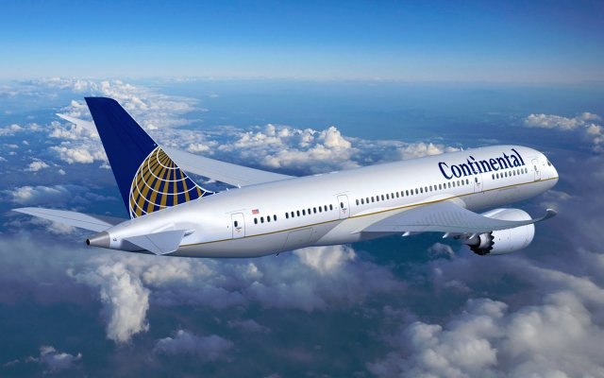
Airline Industry Overview

Slide 3
Introduction
The airlines industry comprises passenger
air transportation (scheduled and chartered)
Current global industry consists of over
2,300 airlines operating more than 23,000 aircraft

Slide 4
Terminology
ATK: Available Tonne Kilometer (Capacity)
= Passenger and cargo capacity
ASK: Available Seat Kilometer (Capacity)
= [Number of seats] * [kilometers flown]
RPK: Revenue Passenger Kilometer (Traffic)
= [Number of paying passengers] * [kilometers flown]
FTK: Freight Tonne Kilometer (Traffic)
= [Freight tonnes carried] * [kilometers flown]

Slide 5
Terminology Cont’d
YIELD
= [Revenue] / [RPK]
LF: Load Factor (Capacity Utilization)
= [RPK] / [ASK]
= [number of passengers]/[number of seats]
Break Even LF: Unit cost / Yield
i.e. Operating cost = Operating Revenue

Slide 6
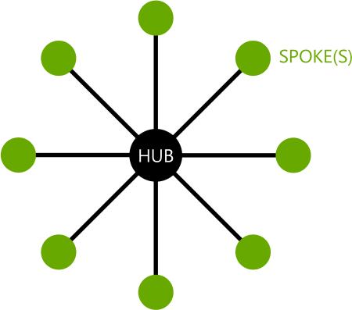
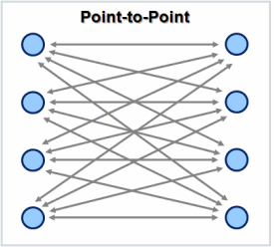
Structure
Hub and Spoke
Legacy carriers use this system for distant,
international routes
Use airport as hub
Inflexible
Point to Point
Low cost-carriers use this system for shorter
routes, usually regional or domestic
Less flexible
More price effective

Slide 7
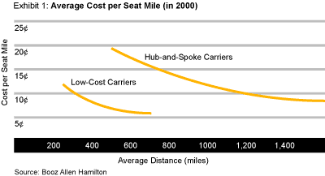
Structure Cont’d
Budget Carriers
Low Fares
Simple Fare Schedule
Legacy Carriers
Price Discrimination
More Luxury Aircrafts
Fewer Services
Depart Early/Late
Reduced Aircraft Diversity
Economy Class
Economy/Business Class
More Services
Alliances
Notes:
Lower volume of business passengers compared to others, however, these customers contribute to higher revenues than passengers flying for pleasure

Slide 8
Alliances
Agreement between two or more airlines to cooperate on a
substantial level
Benefits
Extended network
Lower prices
Downsides
Higher prices when a certain route has no alternative flights
Cost reduction through economies of scale
More departure times and destinations

Slide 9
Alliances Cont’d
Star Alliance (1997)
SkyTeam (2000)
Oneworld (1999)
Notes:
Star: 26 (air canada, air china, singapore airlines)
Skyteam: 20 (air france, delta airlines)
Oneworld: 15 (american airlines, british airways)

Slide 10

Regulations
The civil aeronautics board (CAB), had previously controlled entry, exit, and the pricing of airline services, as well as inter-carrier agreements, mergers, and consumer issues
CAB eliminated (deregulation act of 1978)
Federal aviation authority in the US regulate areas such as safety, environmental impact, airspace usage, and passenger rights
Cabotage: the provision of domestic transport services in a country by companies based in a different country
Notes:
Cabotage by any EU-based carriers is permitted in any other EU-country; also, the Open Skies agreement accords cabotage rights to US carriers in the EU. This liberalization should increase the opportunities for market access in this region. However, in other countries cabotage is generally not possible, and in some cases foreign ownership of domestic airlines is also restricted to a certain percentage.

Slide 11
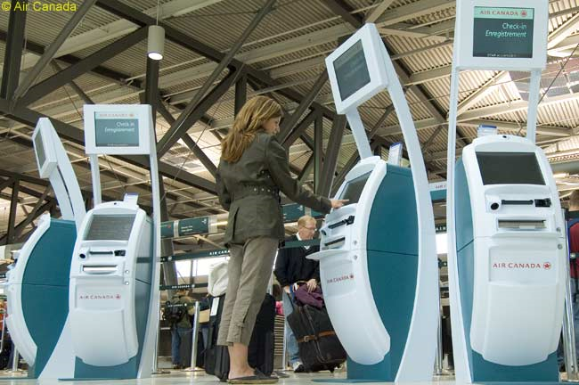
Technology
Growth of online price comparison sites
Engine design improvements: more soundproof, fuel-efficient
Self check-in kiosks
Wi-fi
Notes:
growth of online price comparison sites (contributes to high price sensitivity)

Slide 12
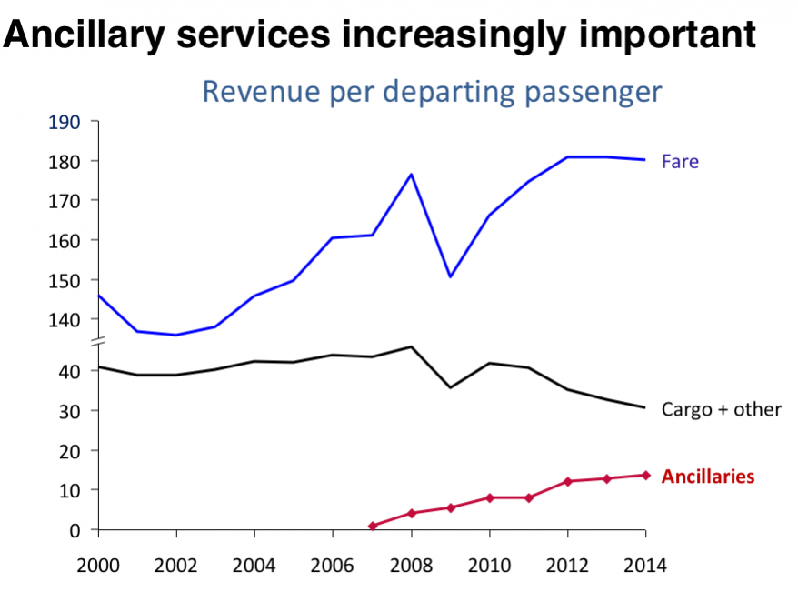
Product Differentiation
Extra leg room
In-flight entertainment
Loyalty programs (JAL mileage bank, united airlines mileage plus etc.)
Ancillary revenue structure (bag fees)
Notes:
ancillary revenues are bringing are crucial and hold the industry afloat

Slide 13
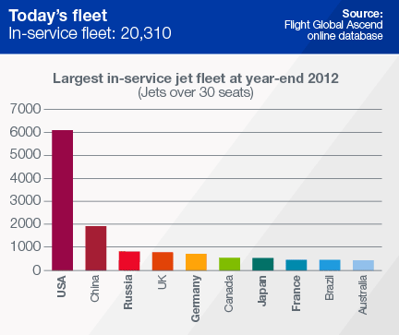
Fleet
Notes:
At year-end 2012, the United States had the world's largest commercial fleet, comprising 6,080 airplanes. China, Russia, and the United Kingdom followed with the second, third, and fourth largest commercial fleets. Commercial airplane backlogs indicate growing geographical diversity in the order base. The United States and China retain the top two positions in terms of number of airplane orders, as new entrants including Indonesia, India, Malaysia, and Russia gain a significant presence.

Slide 14
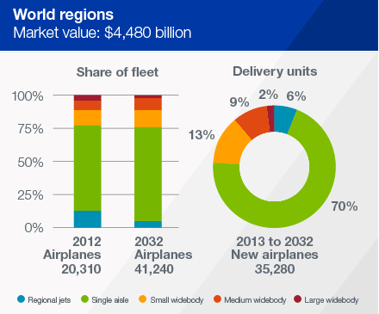
Fleet Cont’d

Slide 15
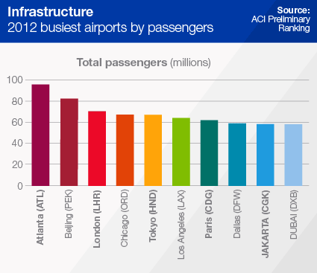
Airport Traffic
Notes:
Airport authorities around the world are investing in large capital projects, including new or improved runways, terminal expansions, and entirely new airports. These investments can significantly increase airport capacity, but are substantial, and development times typically extend more than a decade from initial planning to completion of construction. Community noise and environmental concerns often stretch development times further and may limit the scope of expansion.

Slide 16
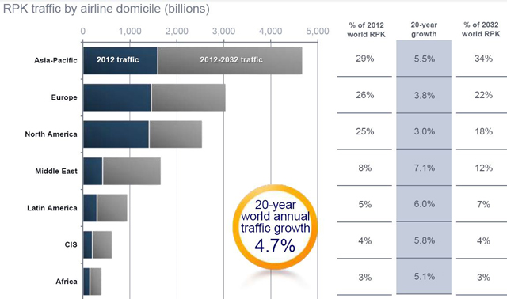
Global Air Traffic By Region

Slide 17
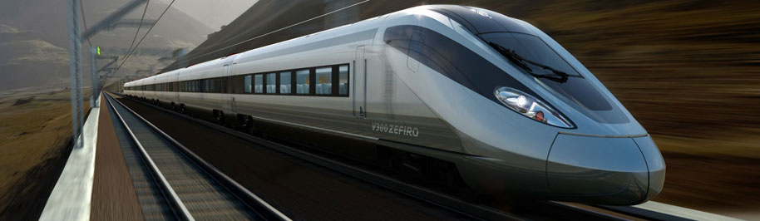
Substitutes
US: few substitutes for international air travel
EU: well developed land transport system
Asia: domestic flights easily substitutable, international travel less vulnerable to threat of substitutes
Virtual meetings
Notes:
US: bus and rail, time consuming. marine: restricted to leisure cruises
EU: domestic flights easily substitutable by bus, rail or car. international flights within europe can also be easily substituted by rail or bus, time-consuming
Asia:

Slide 18
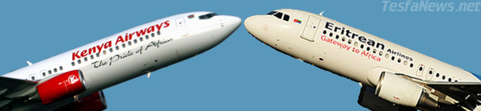
Competition
High levels of competition despite good growth
Competitor size and high exit costs
Low switching costs for buyers
Highly sensitivity to the state of the global economy
price of fuel in constant fluctuation

Slide 19
Industry Factors
High labour, oil and fuel costs
Strength of industry highly correlated with strength of the global economy
Struggle to achieve operational efficiency
Airport capacity
Large capital asset investment
Low profit margins
Political tensions in Ukraine driving up oil prices and slowing growth in emerging markets

Slide 20
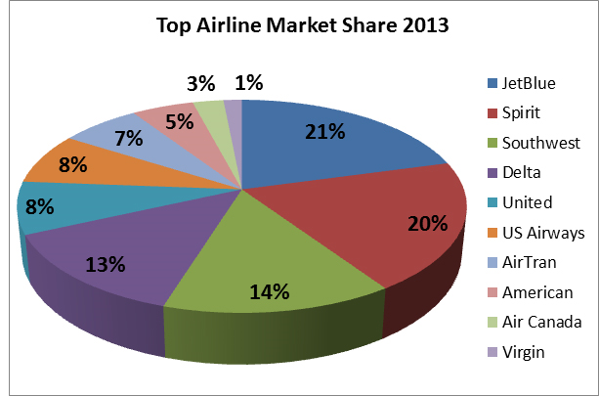
Market Factors
Minimal product differentiation
High price sensitivity
High supplier power (Boeing and Airbus)
Low risk of new entrants (high capital requirements)
Moderate buyer power

Slide 21
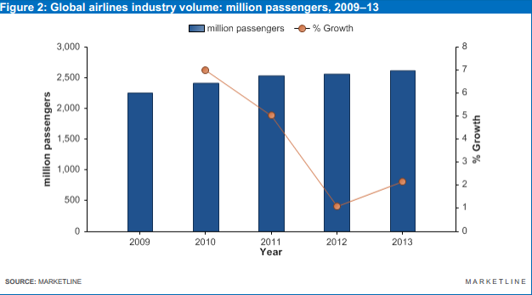
Market Volume
The global airlines industry grew by 2.2% in 2013 to reach a volume of 2,617.3 million passengers

Slide 22
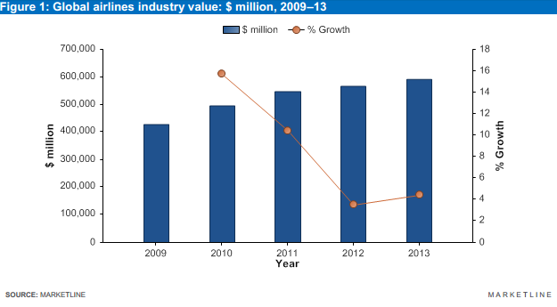
Market Value
The global airlines industry grew by 4.4% in 2013 to reach a value of $591,217.9 million.

Slide 23
Market Growth
The global airlines industry had total revenues of $591,217.9m in 2013
Compound annual growth rate (CAGR) equaled 8.4% between 2009 and 2013
European and Asia-Pacific industries grew with CAGRs of 9% and 12.1% respectively, over the same period ($180,945.8m and $139,349.3m in 2013)

Slide 24
Market Growth Cont’d
Industry volume increased with a CAGR of 3.8% between 2009-2013 (2,617.3 million passengers in 2013)
The domestic segment had the highest volume in the global airlines industry in 2013 (1,695.6 million passengers)
International segment had a volume of 921.7 million passengers in 2013

Slide 25
Market Segmentation
Domestic segment represents the largest segment of the global airlines industry, accounting for 64.8% of total volume
International segment accounts for the remaining 35.2% of volume

Slide 26
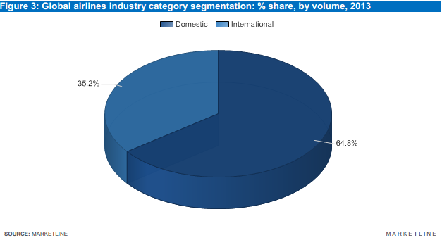
Industry Category Segmentation

Slide 27
Market Segmentation Cont’d
The Americas account for 41.9% of the global airlines industry value
Europe accounts for 30.6% of the global industry value
Asia-pacific, middle east and africa account for the remaining 27.5%

Slide 28
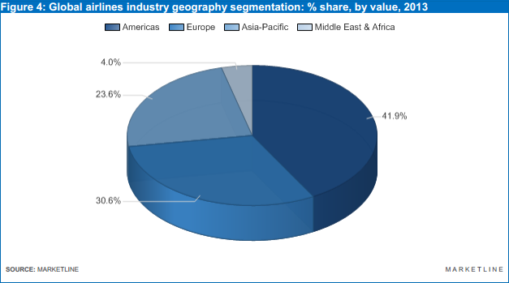
Industry Geography Segmentation

Slide 29
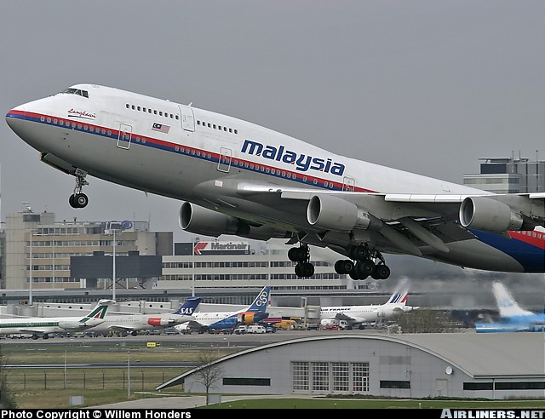
Current Trends: Asia
Economic uncertainty in china
Rising infrastructure costs
Inefficiencies in air traffic management
Malaysian airlines flight disappearance
Largest and fastest growing market

Slide 30
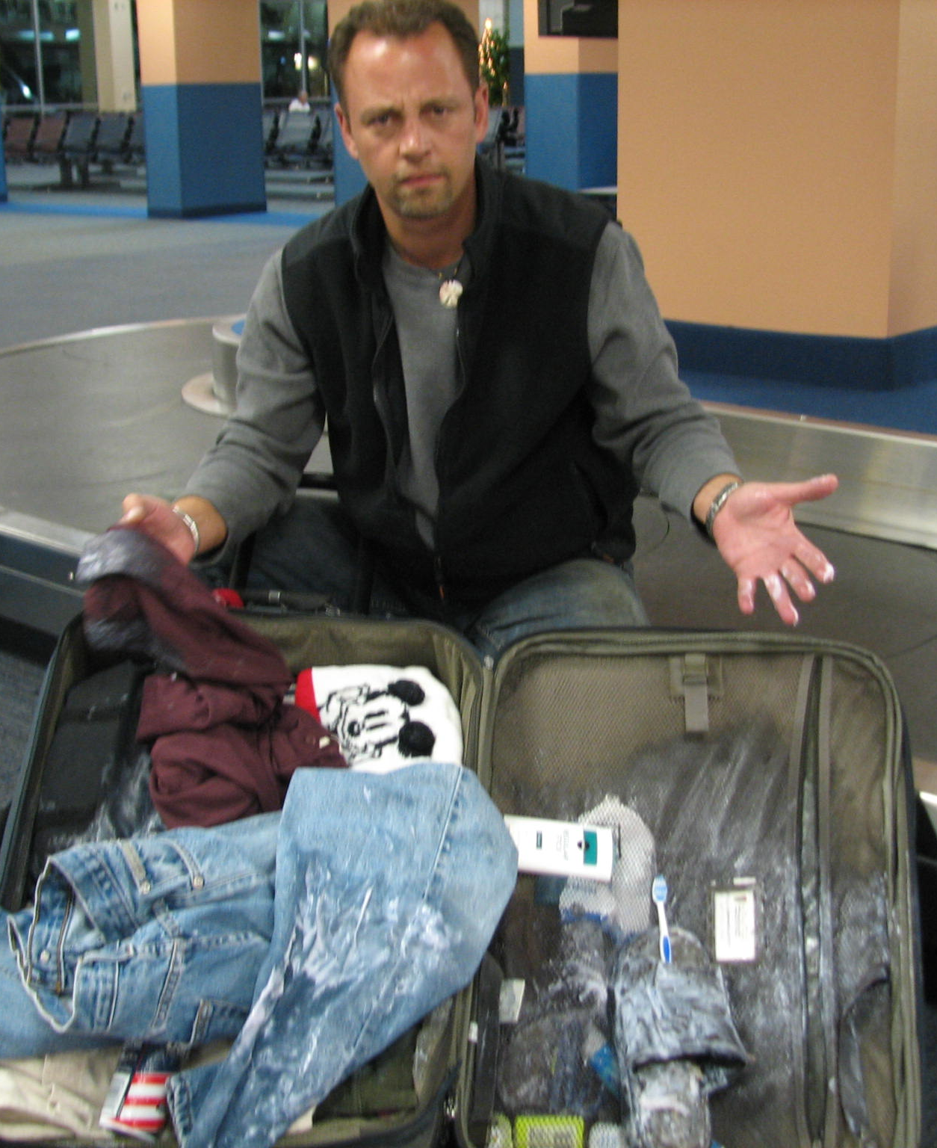
Current Trends: Europe
Slow growth due to unstable economies
Luggage mishandling (9 bags per 1000 passengers mishandled in 2013)

Slide 31
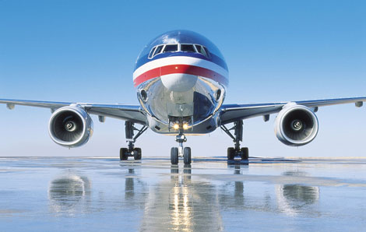
Current Trends: Americas
Consolidation (american airlines and US airways)
Costs driven down
Growth of low-cost carriers

Slide 32

Hedging
Fuel
Oil
Hedging instruments: options, futures, swaps

Slide 33
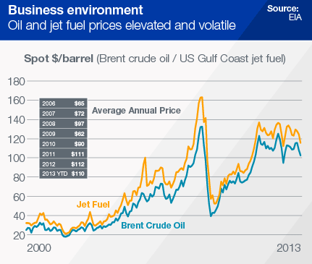
Oil And Jet Fuel Prices

Slide 34
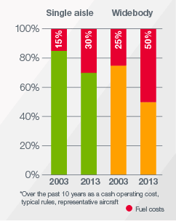
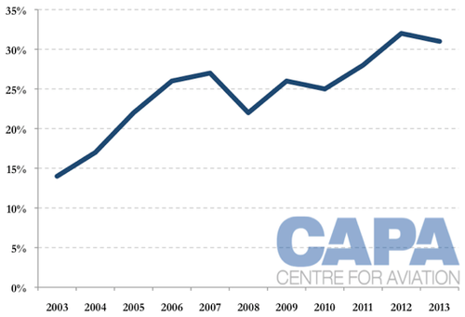
Jet Fuel As Percentage Of Total Operating Costs
Notes:
Fuel costs have nearly doubled over the past 10 years. Fuel represents up to 30 percent of total operating cost for single-aisle airplanes and up to 50 percent for widebody airplanes. Airlines are looking at all opportunities to reduce costs. One way to do this is to replace older, less efficient airplanes with new-technology airplanes, such as the 737 MAX and 787. Other ways include increasing airplane utilization. Utilization for the single-aisle fleet is currently 2 percent higher than it was in 2011, and the widebody fleet is 0.4 percent higher than in 2011. The steadily rising load factor is another way airlines are increasing efficiency. Average load factor reached a record high of 79 percent in 2012

Slide 35
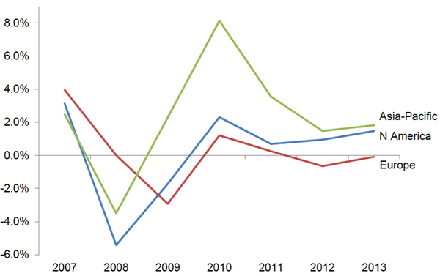
Profit Margins

Slide 36
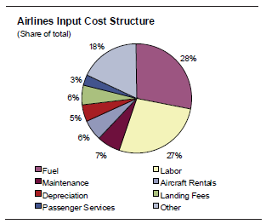
Cost Structure

Slide 37
Current Outlook
Global airline industry expected to make an all-time high net profit of $19.7 billion in 2014 (IATA)
Return on invested capital improving, but still low at 5.4%
Passenger load factors expected exceed 80% this year (first time)

Slide 38
Current Outlook Cont’d
Available seats will continue to increase; projected 3.5 million in 2014 (3.4 million in 2013 and 3.2 million in 2012)
fuel use per revenue ton kilometer (RTK), (currently in long-term decline) will drop 1.9% in 2014
Reduce airline fuel costs by $4 billion (IATA)

Slide 39
Current Outlook Cont’d (2)
Airlines set to receive over 1,400 new aircraft this year ($150 billion)
Over half of these aircrafts will replace old, less fuel-efficient aircraft
Delta Airlines ordered 15 new Airbus Group A321 aircraft ($1.65 billion) to start being delivered in 2018

Slide 40
Current Outlook Cont’d (3)
U.S. and Canada expected to have industry's best margins this year: post-tax profit estimated at 4.3% of total revenue
Estimated after-tax profits for Latin American Airlines are at 3% and 2.6% for the Middle East
European airlines expected to generate 1.3% profit and Asian airlines are expected to book profit of 1.6% ($3.2 billion) (IATA)
Notes:
U.S. and Canada expected to have industry's best margins this year: post-tax profit estimated at 4.3% of total revenue BEST PERFORMANCE SINCE LATE 1990S
European airlines expected to generate 1.3% profit and Asian airlines are expected to book profit of 1.6% ($3.2 billion) RECORD HIGH

Slide 41
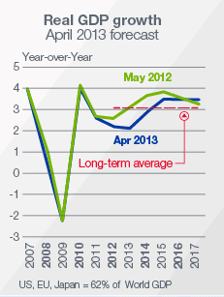
GDP Growth And Forecasts
Notes:
Global GDP growth for 2012 was disappointing at 2.2 percent. Expectations for a strengthening economic recovery as the year progressed failed to materialize. Policy uncertainty in the Eurozone caused the yields of peripheral country sovereign bonds to spike in mid-year, pushing Europe back into recession. US policy uncertainty produced the threat of the economy falling over a "fiscal cliff." The result was weaker growth, not only in these major developed economies, but also in major emerging economies.

Slide 42
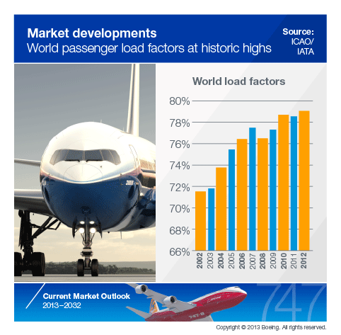
Market Developments

Slide 43
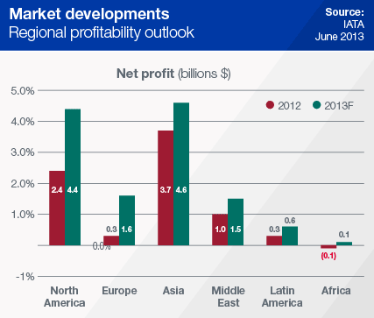
Market Developments Cont’
Notes:
Volatile oil prices have been the greatest challenge to airline profitability apart from the weak economy. Fuel costs have surpassed labor as the largest segment of airline operating cost. Fuel costs, approximately 13 percent of total costs in 2002, are closer to 34 percent today. After spiking in early 2012, oil prices have remained relatively stable. On the demand side, the weak economic outlook has moderated near-term growth projections. On the supply side, rising shale oil production in the United States is moderating near-term price projections. Lower jet fuel prices are bolstering near-term airline profitability outlooks.

Slide 44
Future Outlook
Industry growth expected to decelerate
The global airlines industry is forecast to have a value of $725,172.5 million in 2018 (increase of 22.7% since 2013)
Forecasted volume of 2,839.4 million passengers in 2018 (increase of 8.5% since 2013)

Slide 45
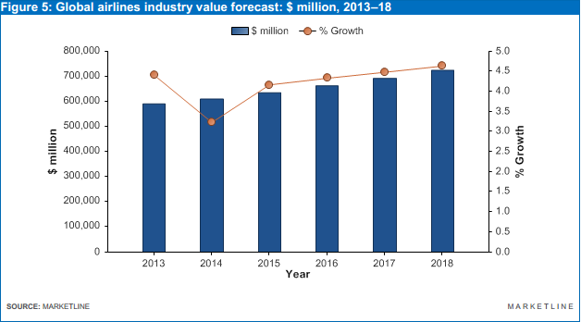
Industry Value Forecast

Slide 46
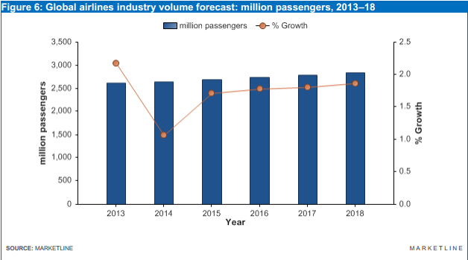
Industry Volume Forecast

Slide 47
Future Outlook Cont’d
CAGR of 1.7% for the 2013-2018 period
Industry value of $728,018.6m by the end of 2018
European and Asia-Pacific industries expected to growth with CAGRs of 3.5% and 6.5% respectively, over the same period ($215,221.2m and $191,006.2m in 2018)

Slide 48
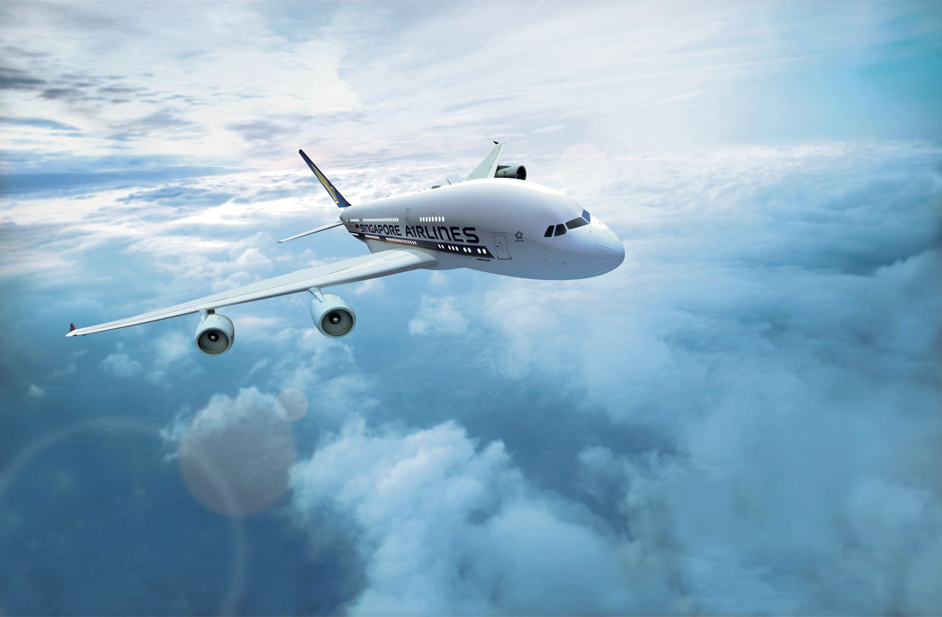

1
Singapore Airlines

Slide 49
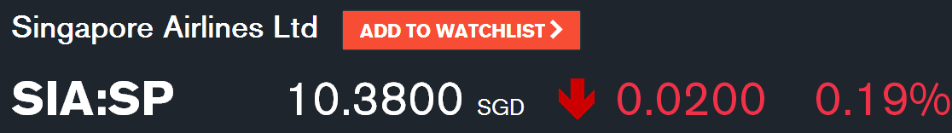
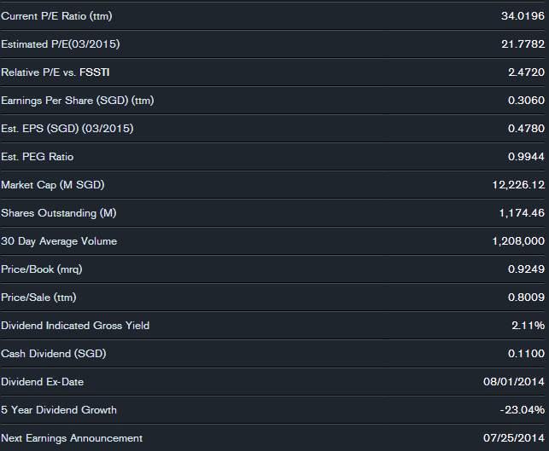
STOCK INFORMATION

Slide 50
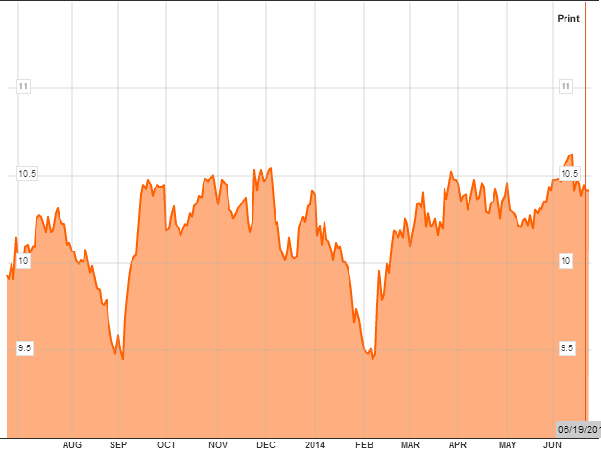
1 YEAR STOCK PRICE MOVEMENTS

Slide 51
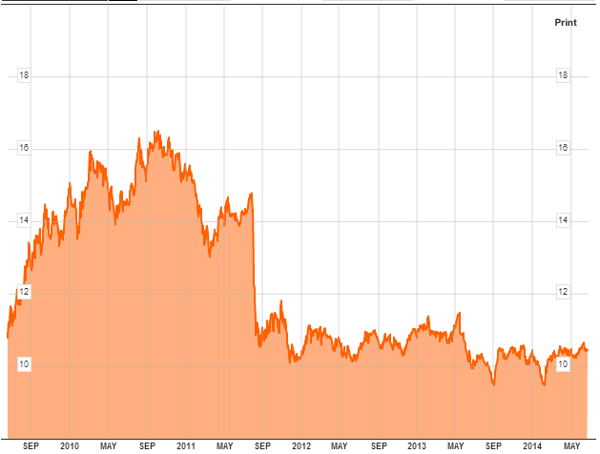
5 YEAR STOCK PRICE MOVEMENTS

Slide 52
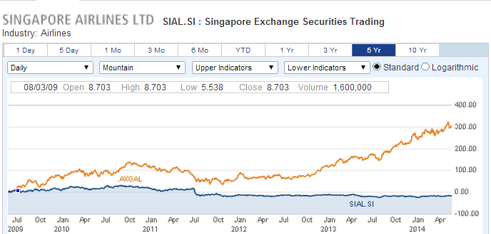
5 YEAR VS. AIRLINE INDEX

Slide 53
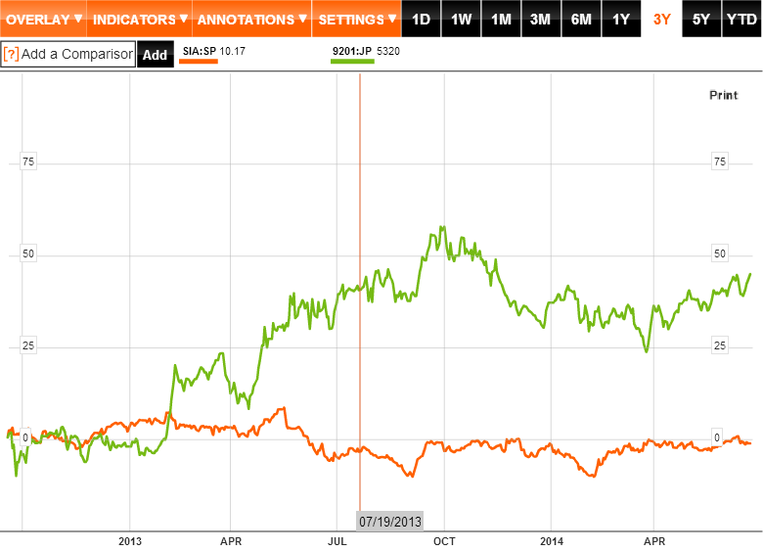
3 YEAR VS JAPAN AIRLINE

Slide 54
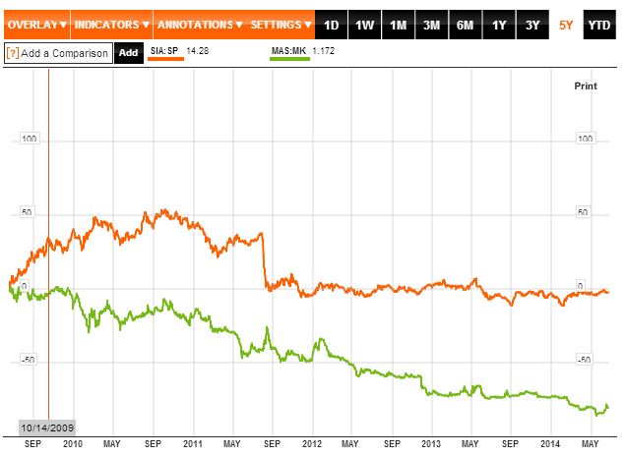
3 YEAR VS Malaysian Airline System Berhad

Slide 55
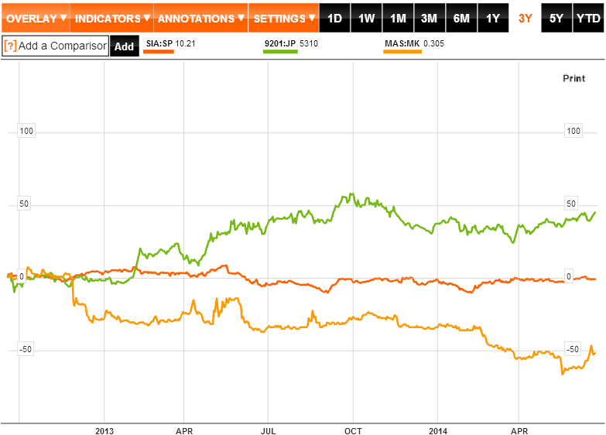
3 YEAR VS JAPAN VS MALAYSIAN AIRLINE

Slide 56
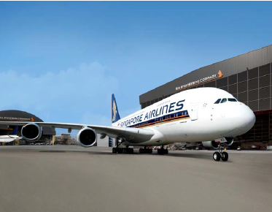
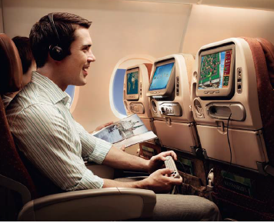
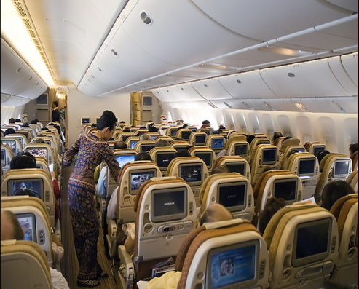
COMPANY PROFILE
Founded in 1972
A regional airline => One of the most respected travel brands around the world
Based at Singapore Changi Airport
has a strong hub in Singapore and has a large geographical spread.
Use a fleet of wide-body Boeing and Airbus aircraft including A380
Join the Star Alliance on April 1, 2000

Slide 57
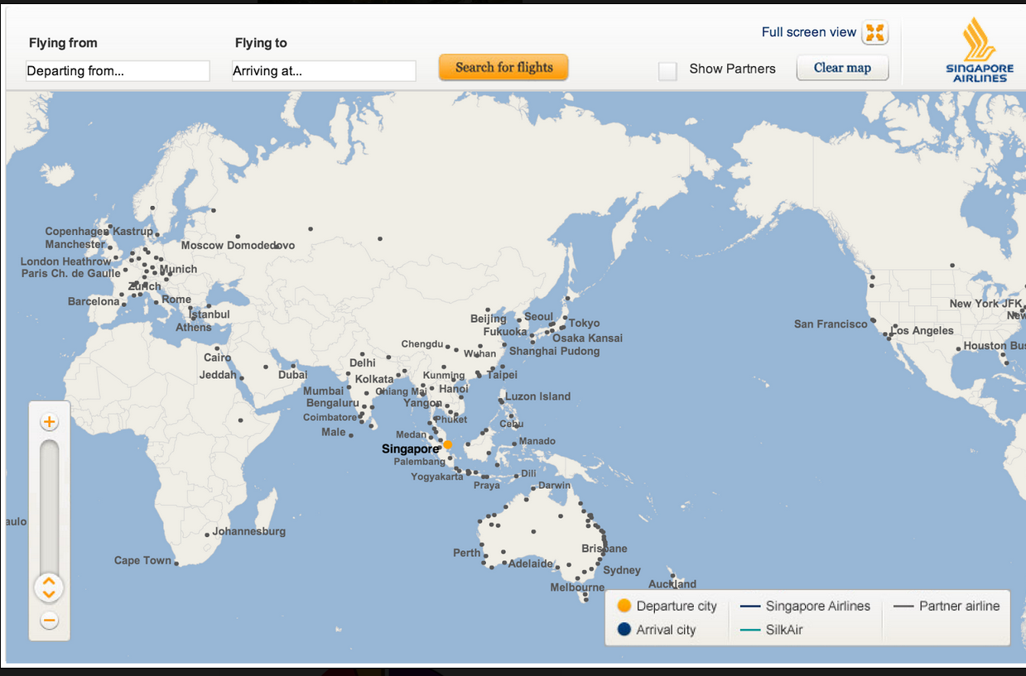
GLOBAL ROUTE MAP

Slide 58
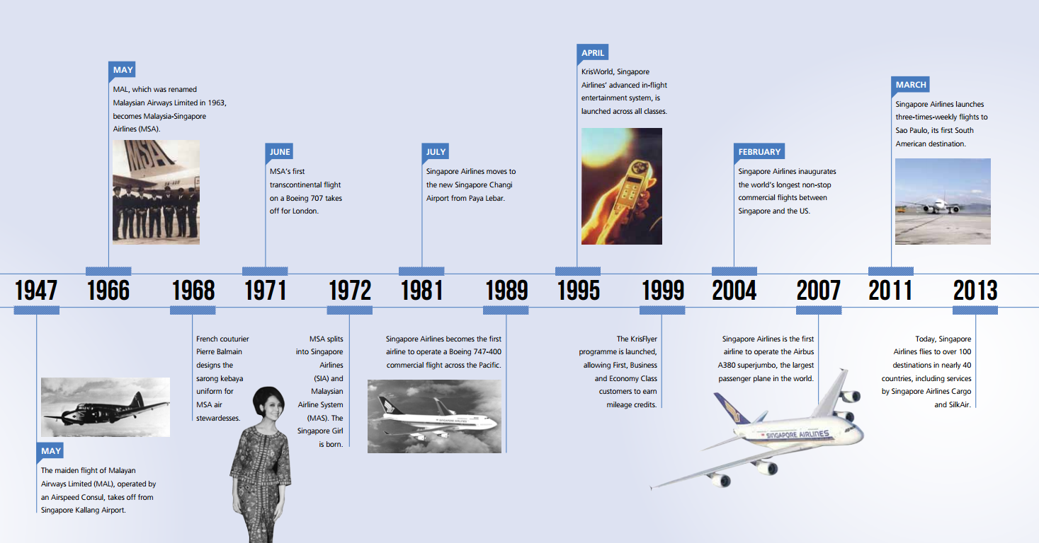
COMPNAY HISTORY

Slide 59
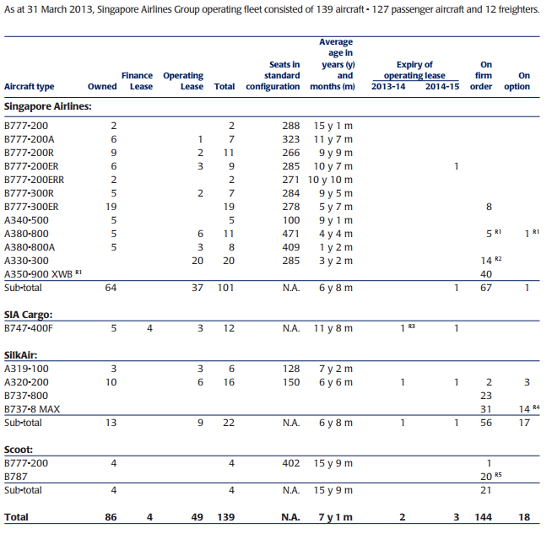
THE GROUP FLEET PROFILE

Slide 60
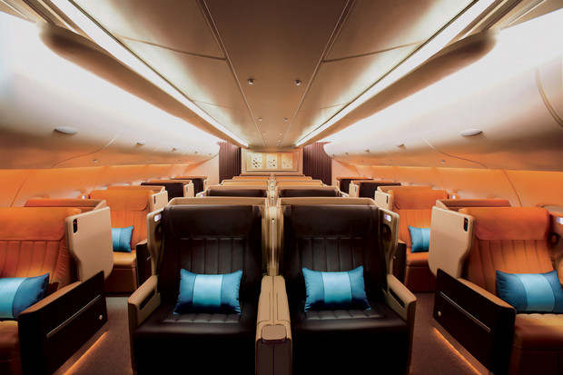
1
MANAGEMENT TEAM

Slide 61
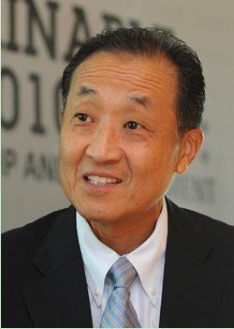
Stephen Lee Ching Yen (BOD Chairman)
Chairman of BOD since January 2006
Managing Director of Shanghai Commercial and Savings Bank Ltd. (Taiwan) and Great Malaysia Textile Investments Pte Ltd.
President of the Singapore National Employers Federation since 1988 and is a Council Member of the Singapore National Wages Council
Nominated Member of Parliament from 1994-1997
Awarded the Distinguished Service Order Award in 2006 and the Public Service Star Award in 1998
Chairman of the Singapore Business Federation from 2002 to 2008 and International Enterprise Singapore from 1995 to 2002
Education: MBA in Northwestern University, Illinois, US (1973)

Slide 62

Goh Choon Phong (CEO)
CEO since January 1, 2011 and Appointed Director on October 1, 2010
Joined SIA in 1990 and served in various key positions
Divisional Vice President Commercial Technology of SIA in 1999 and Senior Vice President for Commercial Technology in 2000
Cjhairman of SilkAir (Singapore) Private Limted and a Member of the Board of Governors at IATA
Executive Vice President of Marketing and the Sales Regions from March 2010 to January 1, 2011
President of Singapore Airlines Cargo Pte Ltd. since June 1, 2006
Education: a MS degree in Computer Science & Electrical Engineering and three BS degrees in Computer Science & Engineering, Management Science and Cognitive Science, all from the Massachusetts Institute of Technology.

Slide 63
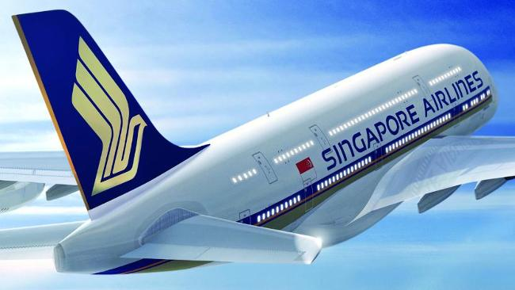

OPERATIONS PERFORMANCE

Slide 64
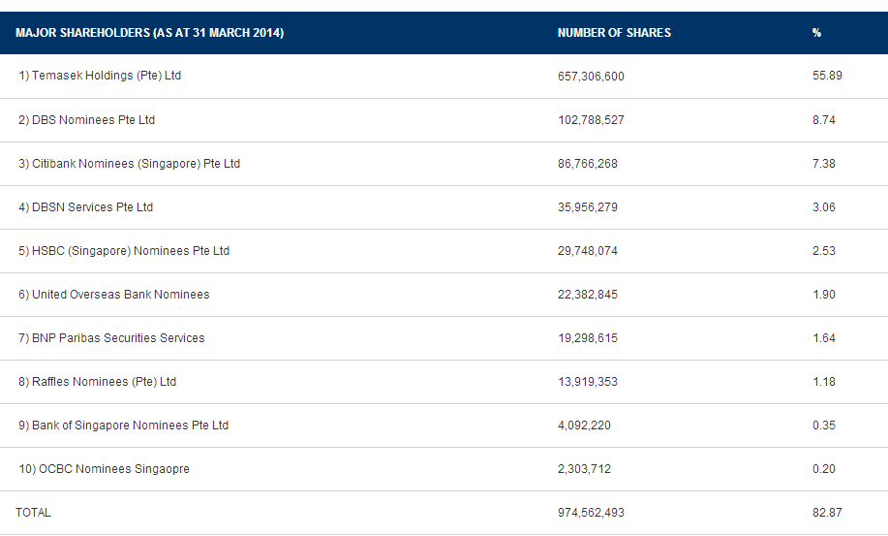
INFORMATION OF SHAREHOLDINGS

Slide 65
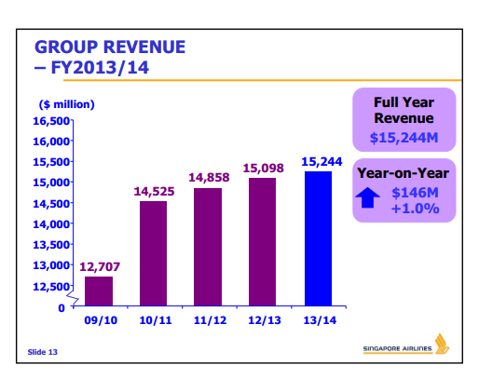
REVENUE

Slide 66

REVENUE COMPOSITION

Slide 67

EXPENDITURE

Slide 68

EXPENDITURE CONT.

Slide 69

TRENDS IN FUEL PRICE AND COST

Slide 70

FUEL EXPENDITURE 13/14

Slide 71

OPERATING PROFITS

Slide 72

OPERATING PROFITS CONT.

Slide 73

FINANCIAL HIGHLIGHTS

Slide 74

FINANCIAL REVIEW

Slide 75

BALANCE SHEET

Slide 76


BALANCE SHEET CONT.

Slide 77

INCOME STATEMENT

Slide 78

INCOME STATEMENT CONT.

Slide 79

DIVIDEND

Slide 80

CASH FLOW STATEMENT

Slide 81

CASH FLOW STATEMENT CONT.

Slide 82

RECOMMENDATION
RECOMMENDATION
1
HOLD!

Slide 83


Slide 84



STOCK INFORMATION
Share outstanding 691,843,000

Slide 85


STOCK- 1 YEAR

Slide 86

STOCK- 5 YEAR

Slide 87

STOCK- 10 YEAR

Slide 88


I year stock compare with JETBLUE

Slide 89

I year stock compare with
American airliners

Slide 90

Comparison to Dow Jones
Industrial Average

Slide 91


History
1967- Air Southwest Co. was incorporated and provide service within the state of Texas
1971- Air Southwest Co. changes its name to Southwest Airlines Co.
Begins service to Dallas, San Antonio and Houston
1975- Common stock listed on
American Stock Exchange under the ticker “LUV
1978- first flight destination outside of Texas, Flies to New Orleans

Slide 92


History
1996- Online booking site launched
2005- Enters first code-share agreement with American Trans Air
2009- Becomes largest carrier in the US, servicing 68 airports in 35 states
2011- Integration of AirTran
2013 -Southwest launched the first Southwest service to a destination outside the 48 contiguous states with service to San Juan, Puerto Rico
2015- published dozens of new nonstop markets for Customers flying the carrier from Dallas Love Field and Ronald Reagan Washington National Airport

Slide 93
COMPANY PROFILE
Southwest is a major domestic airline that provides primarily short-haul, high-frequency, point-to-point, low-fare service
The headquarter is in Dallas, Texas. It was recently expanded.
Southwest Airlines operates more than 3,600 flights a day
Nearly 45,000 People work to deliver exemplary Customer Service throughout the Southwest and AirTran system
Southwest and AirTran serve a combined 96 destinations in 41 states, the District of Columbia, the Commonwealth of Puerto Rico, and five near-international countries.
In 2013, Southwest's average passenger airfare was $154.72 one way, and the average passenger trip length was approximately 966 miles
Southwest Airlines' flight completion record was 99.4 percent in 2013.
Southwest is currently not in any Airline alliance

Slide 94

MISSION

Slide 95

SOUTHWEST ROUTE MAP

Slide 96

TOP 10 AIRPORT
BY DEPARTURES

Slide 97

Types of Aircrafts
In January 2014, Southwest announced the order of 85 Boeing Split Scimitar Winglets for our 737-800 fleet.

Slide 98


SHAREHOLDERS INFORMATION
Institutional & Mutual Fund holders
Major Direct Holders

Slide 99

FUTURE DELIVERY SCHEDUEL

Slide 100
BUSINESS MODEL
Low-Cost Airline
- fly early or late
- Point to Point as main system
- directly to the destination so lower unit costs
- Fewer types of aircraft
-Boeing 737 jet is the mainly aircraft
- Economic class

Slide 101

Management Team
Gary C. Kelly
Chairman of the Board, President & Chief Executive Officer
He joined the company in 1986 as Controller
He became CFO in 1989 and promoted to CEO and Vice Chairman in 2004
He received a B.B.A. in Accounting from the University of Texas at Austin and is a Certified Public Accountant. He is a member of the Texas Society of CPAs

Slide 102

Management Team
Robert E. Jordan
Executive Vice President and Chief Commercial Officer, and President, AirTran Airways
He joined Southwest Airlines in 1988
He has served in roles including Director Revenue Accounting, Corporate Controller, Vice President Procurement, Vice President Technology, Senior Vice President Enterprise Spend Management, and Executive Vice President Strategy and Technology
Bob holds an undergraduate degree in Computer Science and a Masters in Business Administration, both from Texas A&M University

Slide 103

Management Team
Executive Vice President & Chief People & Administrative Office
Jeff Lamb
He joined the company in 2004 as Senior Director People Development
Prior to joining Southwest Airlines, Jeff worked 12 years at Mesa Petroleum
Jeff completed his undergraduate work at West Texas State University - Canyon, Texas (now West Texas A&M) in 1986

Slide 104

Management Team
Executive Vice President & Chief People & Administrative Office
Ron Ricks
Before joining Southwest Airlines, he was a partner in the San Antonio law firm founded by Herb Kelleher, where he worked extensively on the Southwest Airlines' account. All together, he has represented Southwest since 1981
He has an undergraduate degree from the University of Texas at Austin, and, earned a law degree from George Washington University, in Washington, D.C.

Slide 105
Management Team
Executive Vice President & Chief Operating Officer
Mike Van de Ven
He joined the company in 1993.
He has held several positions at Southwest such as Executive Vice President of Aircraft Operations, Senior Vice President of Planning, Vice President Financial Planning & Analysis, Senior Director of Financial Planning & Analysis, Director of Financial Planning, and Director of Internal Audit
He received a B.B.A. from the University of Texas at Austin. He is also a Certified Public Accountant

Slide 106

Management Team
Senior Vice President Finance & Chief Financial Officer
Tammy Romo
She joined the company in 1991 and she became Senior Vice President Planning in 2010
Senior Vice President Finance and Chief Financial Officer since September 2012
She received a B.B.A. in accounting from the University of Texas at Austin

Slide 107

operations

Slide 108
Quarterly Operating Statistics
Record first quarter operating income of $215 million; $242 million excluding special items
Return on invested capital, before taxes and excluding special items (ROIC), for the 12 months ended March 31, 2014, of 14.2

Slide 109

Operating REVENUES & EXPENSES

Slide 110
Operating REVENUES & EXPENSES
The total operating revenues in the first quarter in 2014 is $4166 millions which increased by 2.0%
The total operating expenses in the first quarter in 2014 is $3951 millions which decreased by 1.6%
The maintenance materials and repairs cost is only $250 millions which decreased by 14.1% compared with last quarter in 2013

Slide 111

Operating Statistics

Slide 112
Operating Statistics
The Revenue passengers carried decreased by 0.6%
The Revenue passenger miles increased by 1.7%
The load factor increased by 2.2%
The Average passenger fare increased by 3.1%

Slide 113

Fuel hedging strategy
The Company enters into fuel derivative contracts to manage its risk associated with significant increases in fuel prices
Jet fuel prices were less volatile in 2013 than in some previous years and they remain at high levels
The cost of hedging has increased in recent years with current sustained high jet fuel prices and the potential for volatility in the fuel market
However, The Company is also subject to the risk that the fuel derivatives it uses to hedge against fuel price volatility do not provide adequate protection
The Company held a net position of fuel derivative instruments that represent a hedge for a portion of its anticipated jet fuel purchases for each year from 2014 through 2017

Slide 114

Fuel hedging strategy
The average price of per Gallon was decreased to 3.16 in 2013
Fuel costs have represented the second largest expense for Southwest.

Slide 115


Fuel hedging strategy
The fuel and oil expense drop by 6.7% in 2013
However, if company heavily lock in high prices, they lose money when prices drop

Slide 116


FINANCIAL REVIEW

Slide 117


Balance Sheet

Slide 118

Balance Sheet (quarterly)

Slide 119


Income statement

Slide 120

Income statement
(Quarterly)

Slide 121


CASH FLOW STATEMENT

Slide 122

CASH FLOW STATEMENT
(QUALTERLY)

Slide 123
SWOT ANALYSIS
STRENGTHS
-Point-to-point routing
-Boeing 737s
-Customer service
-Successful marketing
- Best low-fare carrier by standardization of fleet
WEAKNESS
- Growth into congested
markets
- AirTran integration
o Boeing 717s
o Labor relations
- Being copied by other airlines
OPPORTUNITY
- Near-international
destinations
- In-flight WIFI and live
sports
- Growth from AirTran
- Further improve customer satisfaction and value
THREAT
- Fuel price volatility
- Diminishing advantage as
low-cost carrier
- Regulation
- U.S. economic condition
SWOT

Slide 124

RECOMMENDATION
HOLD!

Slide 125



Slide 126



STOCK INFORMATION
Notes:
13.56 closing HKD

Slide 127

1 DAY STOCK PRICE MOVEMENTS

Slide 128

1 YEAR STOCK PRICE MOVEMENTS

Slide 129

5 YEAR STOCK PRICE MOVEMENTS

Slide 130

5 YEAR VS. AIRLINE INDEX

Slide 131

5 YEAR VS. HANGSENG INDEX

Slide 132

5 YEAR VS. OIL & GAS

Slide 133

10 YEAR SUMMARY

Slide 134

KEY STATISTICS

Slide 135

182 destinations in 41 countries and territories

Slide 136

COMPANY PROFILE
Registered and based in Hong Kong
Offering scheduled passenger and cargo services to 182 destinations in 41 countries and territories around the world
Founded in 1946 and remains deeply committed to its home base, making substantial investments to develop Hong Kong as one of the world’s leading international aviation hubs
In addition to its current fleet of 140 wide-bodied aircraft, Cathay Pacific continues to invest heavily in its home city and has another 93 new aircraft due for delivery up to 2024
Cathay Pacific and its subsidiaries employ some 31,800 people worldwide (more than 24,481 of them in Hong Kong)
Cathay Pacific is listed on The Stock Exchange of Hong Kong Limited, as are its substantial shareholders Swire Pacific Limited (45%), CITIC Pacific Limited(1.98%) and Air China(29.99%)

Slide 137


COMPANY HISTORY
1946:
Founded by Farrell and Kantzow
Initially based in Shanghai
1948:
Began to operate the passenger flights;
Swire trading house buys into Cathay Pacific
1980s:
Expanded the international network to include London, Brisbane, Frankfurt, Vancouver, Amsterdam, Rome, San Francisco, Paris, Zurich and Manchester
1960:
Business grew at 20% a year; initiated international services
1970s:
Started to make use of the latest technology with our computerized reservation system and flight simulators;
The first Boeing 747-200 arrived in Hong Kong in mid-1979

Slide 138


COMPANY HISTORY
1990:
Used US$9 billion to assemble a fleet of aircraft that was among the youngest in the world
2002:
Became joint venture partners in Air Hong Kong with DHL
2006:
Closer relationship with Air China by taking 20% shareholding
2003:
Resume passenger services to Beijing & undertook a range of e-business initiatives
2005:
The "Airline of the Year & Airline of the Year 2006

Slide 139

ANNUAL RESULT

Slide 140
FACT SHEET
Major shareholders
Swire Pacific Limited 45%
CITIC Pacific Limited 1.98%
Air China Limited 29.99%
Major subsidiaries and associates
Hong Kong Dragon Airlines Limited | 100%
Cathay Pacific Catering Services (HK) Limited | 100%
Cathay Holidays Limited | 100%
Vogue Laundry Services Limited | 100%
Hong Kong Airport Services Limited | 100%
Cathay Pacific Services Limited | 100%
AHK Air Hong Kong Limited | 60%
Air China Limited | 20.13%

Slide 141

FLEET PROFILE

Slide 142
MANAGEMENT TEAM

Slide 143

MANAGEMENT TEAM
John Slosar
Chairman of Cathay Pacific on 14 March 2014.
Director of the airline since July 2007.
Chief Operating Officer in July 2007 and Chief Executive in March 2011.
Joined the Swire group in 1980 and has worked with the group in Hong Kong, the United States and Thailand.
Also Chairman of John Swire & Sons (H.K.) Limited, Swire Pacific Limited, Swire Properties Limited and Hong Kong Aircraft Engineering Company Limited.

Slide 144

MANAGEMENT TEAM
Ivan Chu
Chief Executive of Cathay Pacific on 14 March 2014.
Chairman of Hong Kong Dragon Airlines Limited and a Director of John Swire & Sons (H.K.) Limited and Swire Pacific Limited.
Director Service Delivery for Cathay Pacific in September 2008 and Chief Operating Officer in March 2011.
Joined the Swire group in 1984 and has worked with the group in Hong Kong, Mainland China, Taiwan, Thailand and Australia.

Slide 145

MANAGEMENT TEAM
Rupert Hogg
Director and Chief Operating Officer of Cathay Pacific on 14 March 2014.
Director Cargo in September 2008 and Director Sales & Marketing in August 2010.
Joined the Swire group in 1986 and has worked with the group in Hong Kong, Southeast Asia, Australia and the United Kingdom.
Chairman of AHK Air Hong Kong Limited and a Director of Hong Kong Dragon Airlines Limited.

Slide 146
OPERATIONS

Slide 147

OPERATING PROFITS

Slide 148

OPERATING RESULTS ANALYSIS

Slide 149

HIGHLIGHTS OF PERFORMANCE

Slide 150

PASSENGER SERVICES
Available seat kilometers (“ASK”), load factor and yield by region for
Cathay Pacific and Dragon air passenger services for 2013 were as follows:

Slide 151

PASSENGER SERVICES – KEY NUMBERS

Slide 152

PASSENGER YIELD

Slide 153

CARGO SERVICES
• Cargo turnover decreased by 6.1% to HK$20,293million, with a 1.7% increase in capacity.
• The cargo load factor decreased by 2.4 percentage points.
The cargo yield decreased by 4.1% to HK$2.32.
•The revenue load factor increased by 1.3 percentage
points to 77.5%. The breakeven load factor was 74.6%.

Slide 154

TURNOVER
Group turnover increased by 1.1% in 2013 compared with 2012.

Slide 155

TURNOVER

Slide 156

OPERATING EXPENSES

Slide 157
FUEL FACTORS

Slide 158

FUEL EXPENDITURE AND HEDGING

Slide 159

FUEL HEDGING Exposure

Slide 160
FINANCIAL REVIEW

Slide 161

BALANCE SHEET

Slide 162

INCOME STATEMENT

Slide 163

CASH FLOW STATEMENT

Slide 164

RECOMMENDATION
HOLD!

