Slide 1
GLOBAL AIRLINE
Bus 417
Security Analysis
Presented by:
Mengting Yang, Ying Tang, Vance Wang

Slide 2
Agenda
Industry Overview
Terminology
History
Current States and Trends
Porter’s Five Forces
WestJet Airline
Cathay Pacific Airline
Singapore Airline

Slide 3
Industry Overview - Terminology
ATK:
Available Tonne Kilometer (Capacity)
= Passenger and cargo capacity
ASK/ASM:
Available Seat Kilometer (Capacity)
= [Number of seats] * [kilometers flown]
RPK:
Revenue Passenger Kilometer (Traffic)
= [Number of paying passengers] * [kilometers flown]
YIELD:
= [Revenue] / [RPK]

Slide 4
Industry Overview - Terminology
FTK:
Freight Tonne Kilometer (Traffic)
= [Freight tonnes carried] * [kilometers flown]
LF:
Load Factor (Capacity Utilization)
= [RPK] / [ASK]
= [number of passengers]/[number of seats]
Break Even LF:
Unit cost / Yield
i.e. Operating cost = Operating Revenue

Slide 5
Industry Overview - History
1909
1910
First jet-propelled aircraft (Coanda) produced
1913
Tony Jannus conducted the United States' first scheduled commercial airline flight on 1 January 1914 for the St. Petersburg-Tampa Airboat Line.
1925
1934
Passenger service is established on the mail routes through the development of the Ford Trimotor, the first successful American airliner with a 12-passenger capacity.
Federal Aviation Administration was formed due to another Airmail Act—Bureau of Air Commerce
Civil Aeronautics Act—delegating federal responsibilities to Civil Aeronautics Authority
1938
The world's first airline Deutsche Luftschiffahrts-Aktiengesellschaft (DELAG) was used for revenue service.

Slide 6
Industry Overview - History
1940
Civil Aeronautics Administration (CAA)—Air traffic control
After 1945
1970s
A big boost for the airlines comes in 1970s, large multi-aisle, wide body planes introduced (Boeing 747, Douglas DC-10, and Lockheed L-1011)
Civil Aeronautics Board (CAB)—Adequate air serve; Regulated fees/schedules
World War II, like World War I, brought new life to the airline industry. Many airlines in the Allied countries were flush from lease contracts to the military, and foresaw a future explosive demand for civil air transport, for both passengers and cargo.
Southwest launches - Era of low-cost airlines
1980
Almost half of the total flying in the world took place in the U.S., and today the domestic industry operates over 10,000 daily departures nationwide.

Slide 7
Industry Overview - Regulations
Contract Air Mail Act → Air mail went to private ownership
- Air mail carriers were soon carrying passengers
- TWA, American and United
Air Commerce Act for Safety improvements
- Ensure safety standards
1925
1926
Bureau of Air Commerce for Air traffic Control
- New Deal Legislation by Franklin Roosevelt
Improved & built additional airfields with paved all-weather runways
1934
Two Regulatory Bodies
- Civil Aeronautics Administration (CAA) → Air traffic control, safety regulations
- Civil Aeronautics Board (CAB) → Economic regulation:
Ensure adequate Service (Regulate entry and exit of carriers),
Regulate fares, Regulate schedules
1926

Slide 8
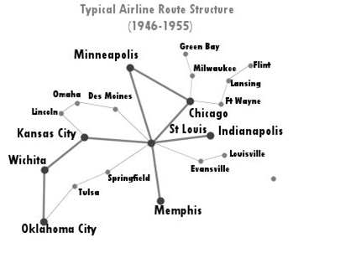
Industry Overview - Regulations
Open skies competition for international routes (After 1945)
→ Air Transport Agreement
Liberalizes the rules for international aviation markets and minimizes government intervention
Adjusts the regime under which military and other state-based flights may be permitted.

Slide 9
Industry Overview - Regulations
Airline Deregulation Act (1978)
A United States federal law signed into law on October 24, 1978.
Aim to remove government control over fares, routes and market entry from commercial aviation.
The Civil Aeronautics Board’s (CAB’S) powers of regulation were to be phased out, eventually allowing passengers to be exposed to market forces in the airline industry.
Mergers between local carriers were allowed
Hub and Spoke System were implemented

Slide 10
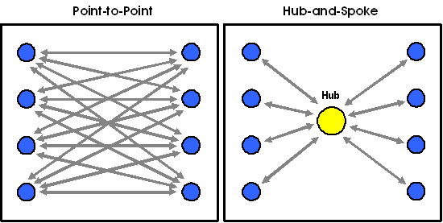
Route Structure
Hub-and-Spoke System:
Used by legacy carriers
Allowed for more distant and international routes
Utilize main airports as hubs
Lead to more efficient use of transportation resource
Centralized model result in inflexible operation (domino effect)
Point-to-Point System:
Used by low-cost (discount) carrier
Shorter routes, usually regional/domestic
Decreased connection & travel time
Increased utilization leads to lower unit cost
Avoid domino effect
Require more routes
Less flexibility in destination

Slide 11




Type of Airlines
Long-haul routes, including international flights, using main airports
works for international carriers
Yield management system
Price discriminate:
Higher product quality
Economies of scale in maintenance, ground services and flight frequency.
Short-haul routes, usually regional flights, using secondary airports
Limited passenger services, charge for add-ons, one service class.
Uniform fleet & High aircraft utilization with high seat density and short turnaround times between operations
Cost reductions leading to lower fare prices
Divisions or subsidiaries of larger passenger airlines.
Forbidden from carrying non-employee passengers.
Network Legacy Airlines:
Hub and spoke system
Low Cost Airlines:
Point to point system
Cargo Airlines:
Notes:
Uniform fleet to reduce maintenance, personnel training costs and increase efficiency/flexibility of staff.

Slide 12
Airline Alliance
an agreement between two or more airlines to cooperate on a substantial level.
Advantage
-A code sharing network
-Cost reduction from sharing of maintenance and operational facilities
-More destinations and departure times for travelers
Disadvantage
-Higher prices when all competition is erased on a certain route.
-Less frequent flights

Slide 13
Airline Alliance
Star Alliance (26 members, founded 1997)
Air Canada, Air China, Air New Zealand, Lufthansa, Singapore Airlines, etc
SkyTeam (20 members, founded 2000)
Air France, China Airlines, Delta Airlines, KLM, Korean Air, Vietnam Airlines, etc
Oneworld (15 members, founded 1999)
American Airlines, British Airways, Cathay Pacific, Japan Airlines, Malaysia Airlines, etc

Slide 14
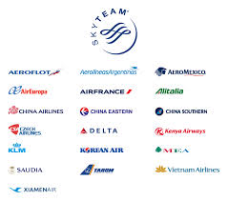

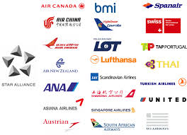
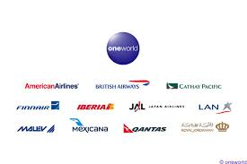
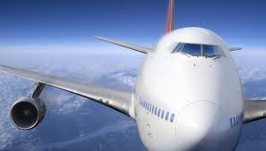
Airline Alliance

Slide 15
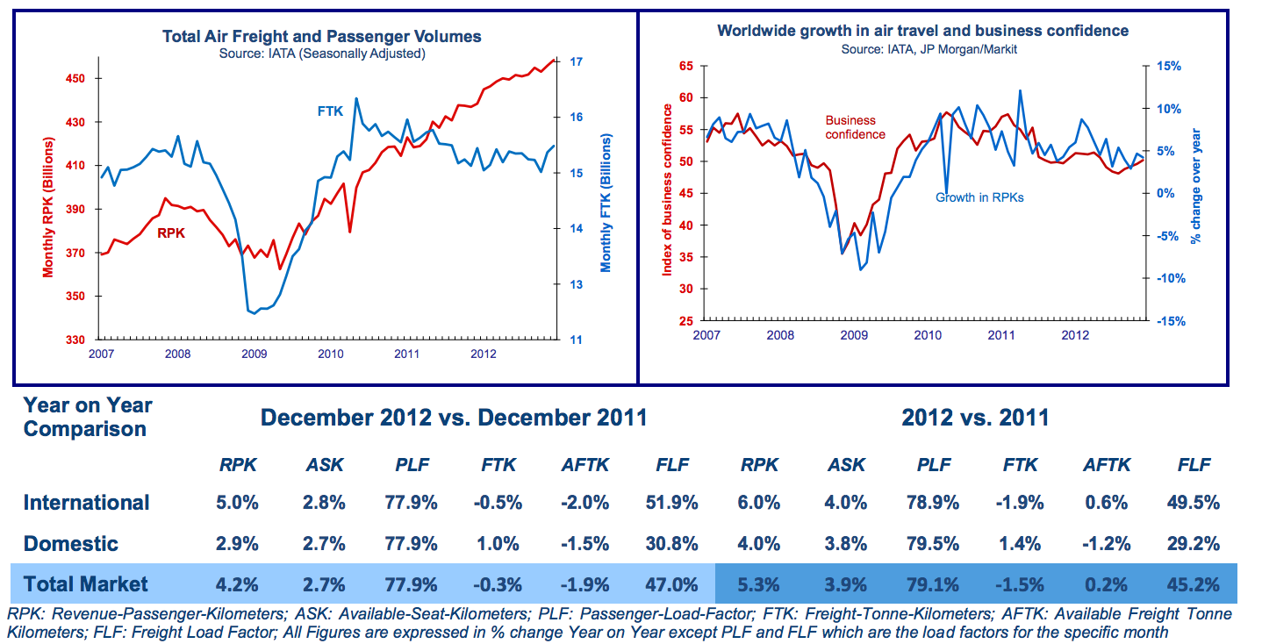
2012 Traffic Analysis

Slide 16
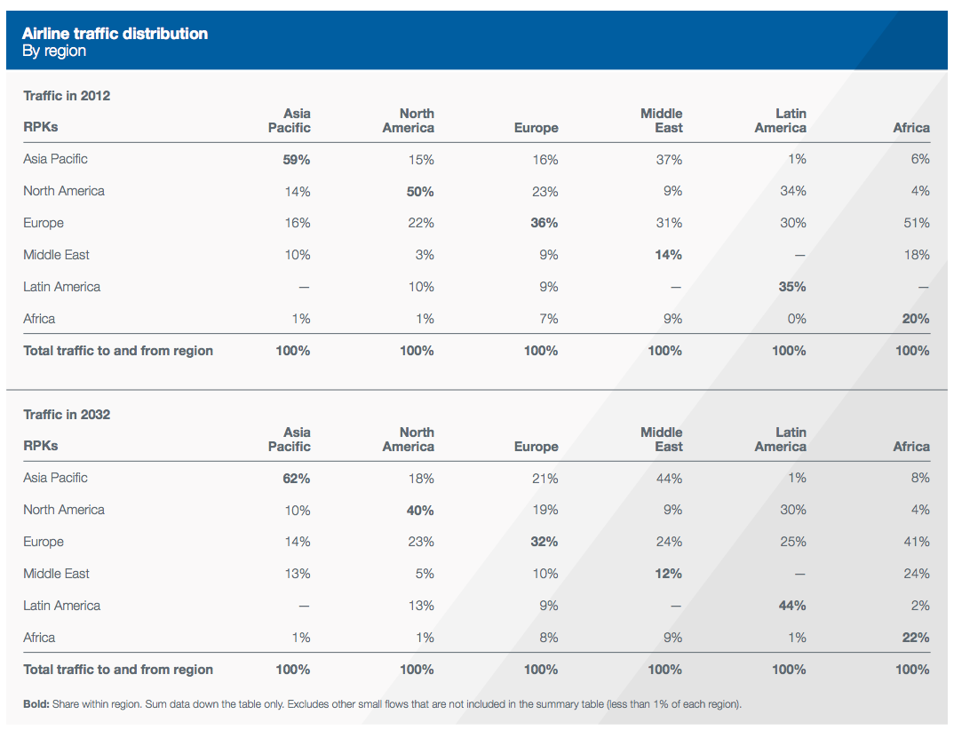
Traffic by Region

Slide 17
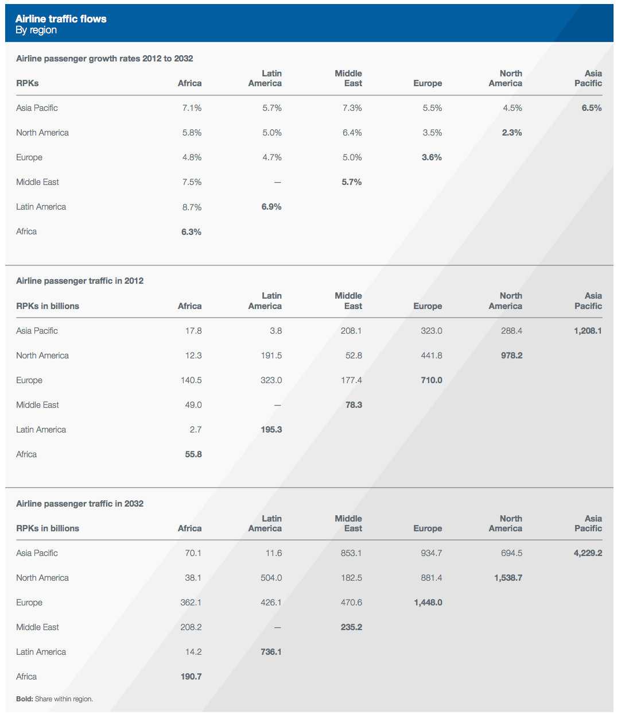
Major Traffic Flows

Slide 18
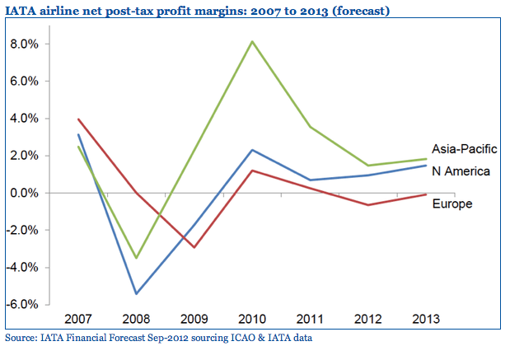
Profit Margin Comparison by Regions

Slide 19
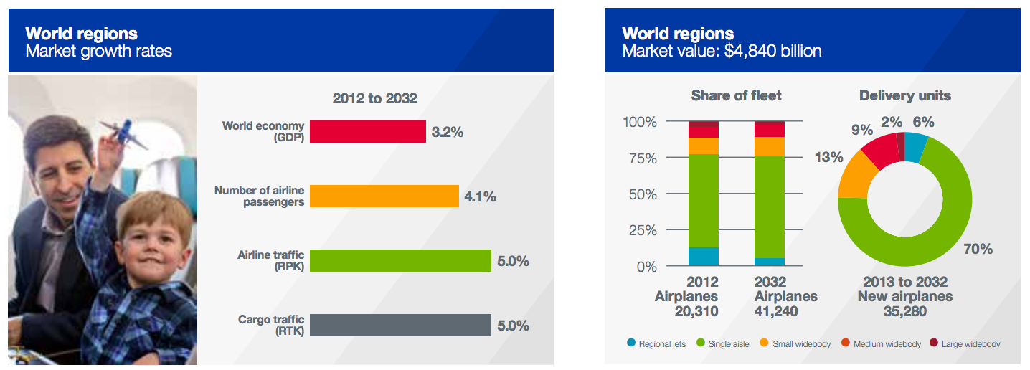
World Regions

Slide 20
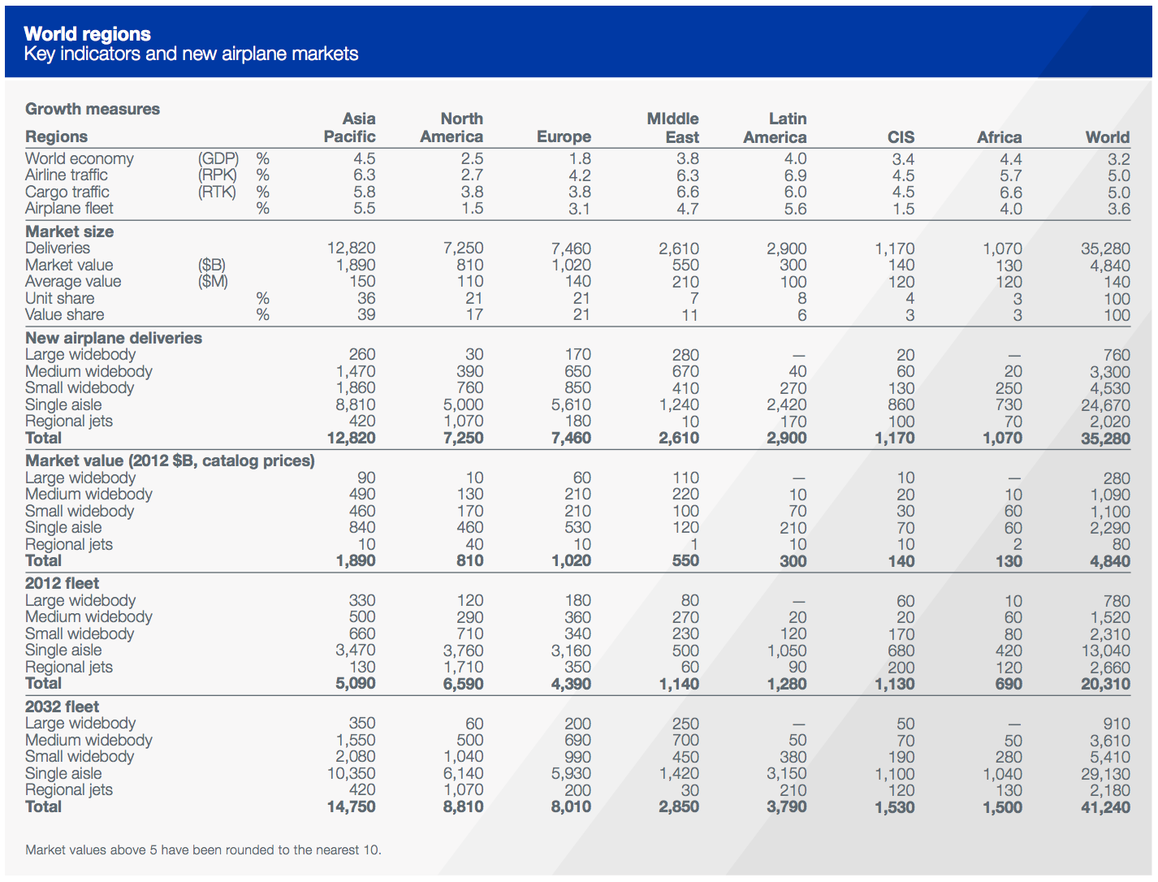
World Regions

Slide 21
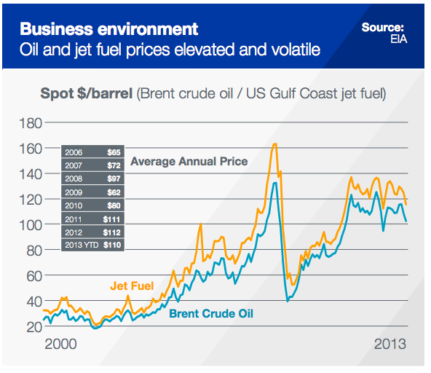
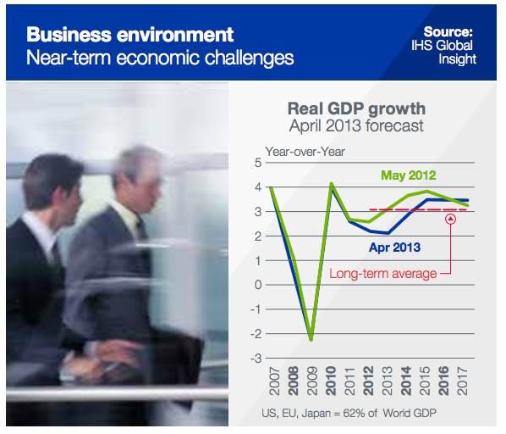
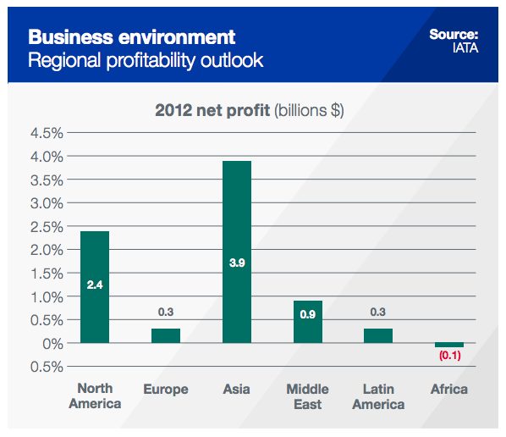
Business Environment

Slide 22
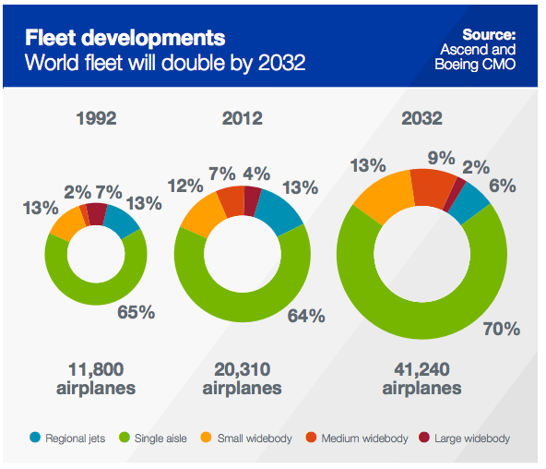
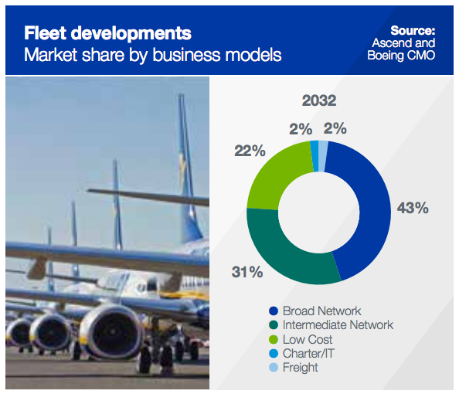
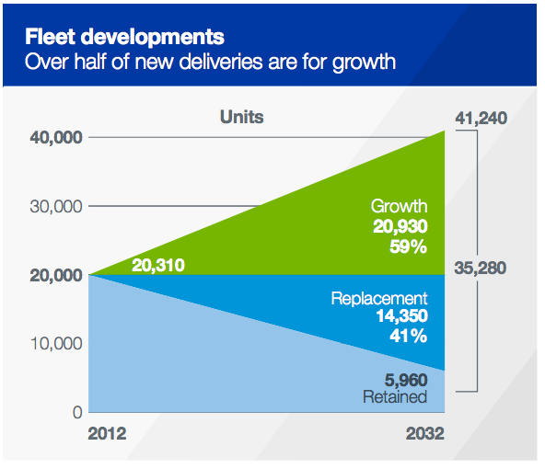
Fleet Development

Slide 23
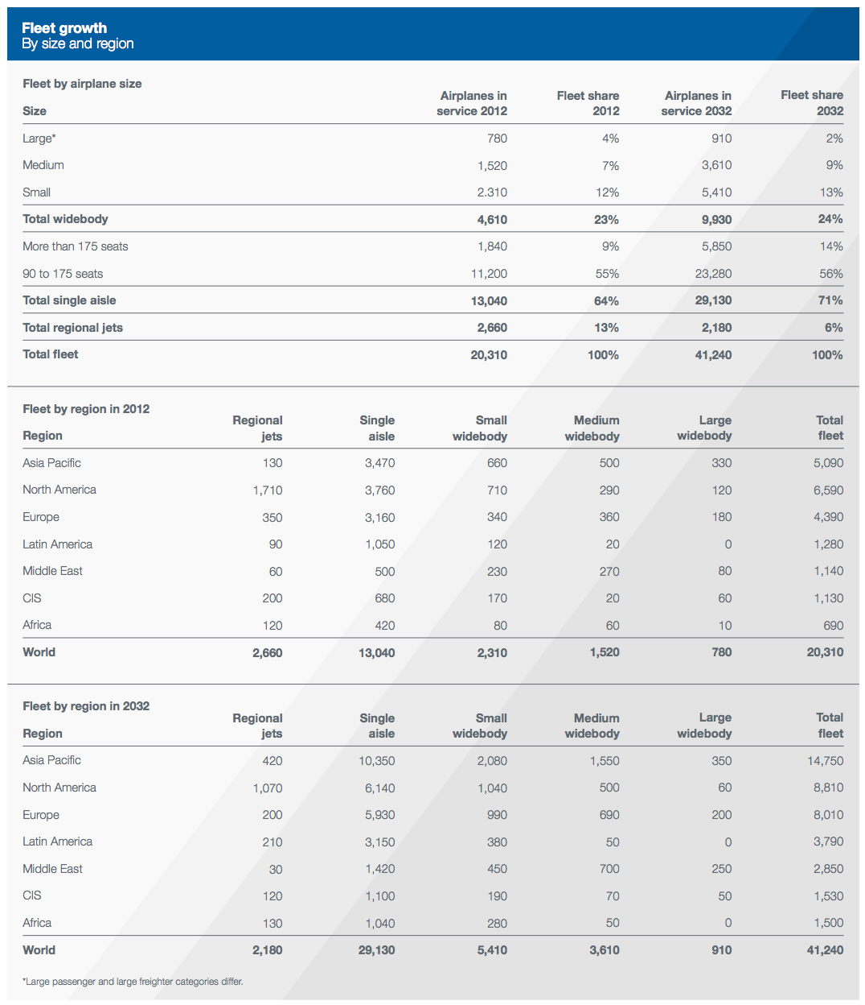
Fleet By Region

Slide 24
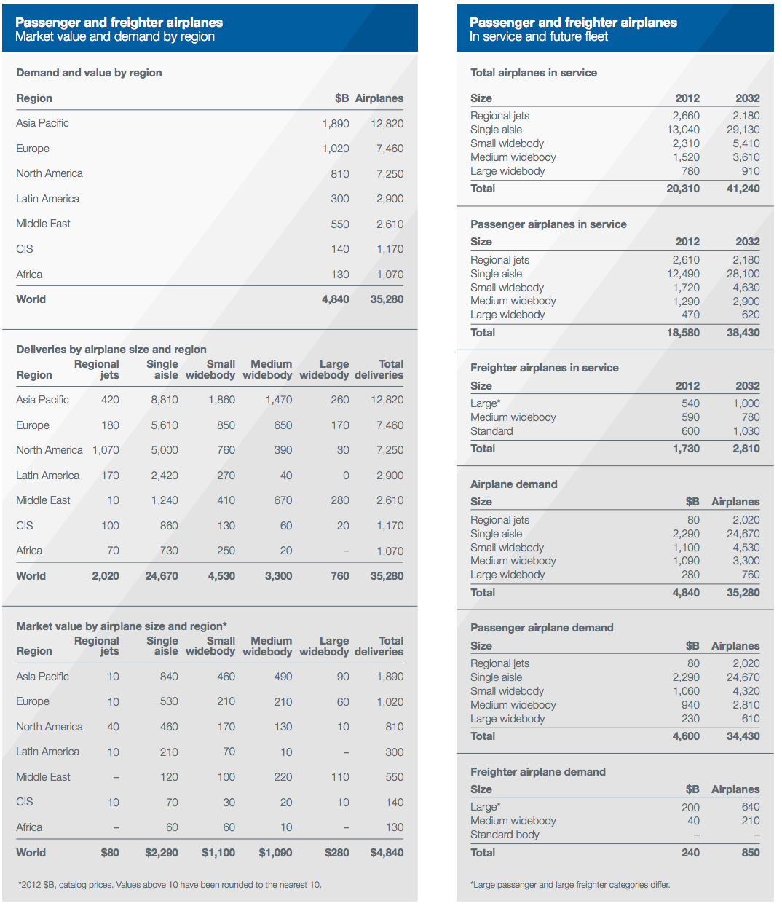
Airplane Requirement

Slide 25
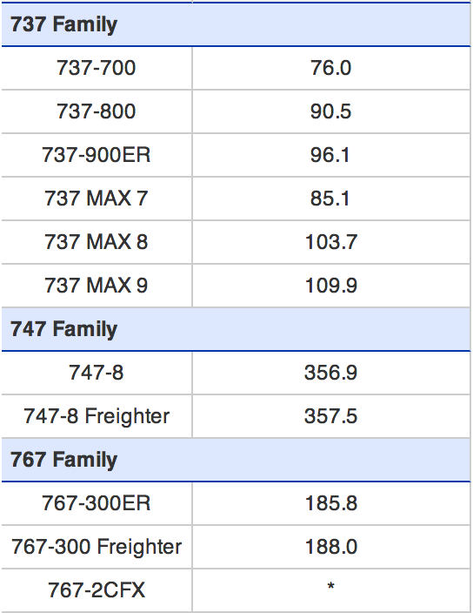
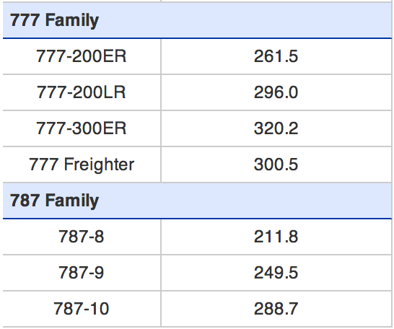
Price of Boeing Airlines

Slide 26
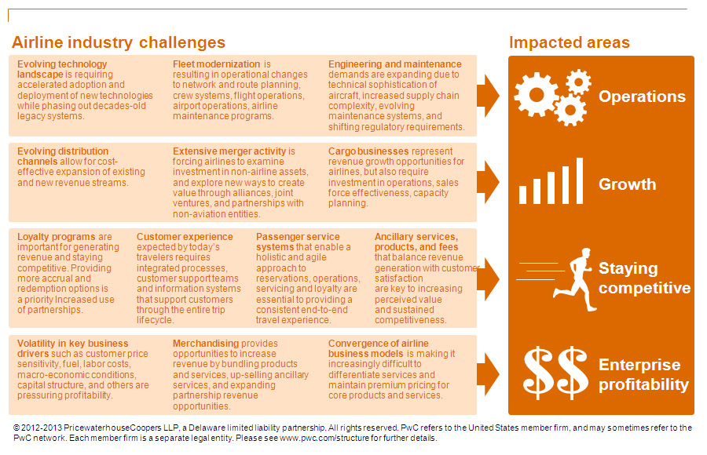
Airline Industry Challenges

Slide 27
Porter’s 5 Forces Analysis
Threat of New Entrants
If borrowing is cheap, then the possibility of more airlines entering the industry will be higher.
The more airlines entering the market, the more saturated for everyone.
An airline with a strong brand name can help.
Power of suppliers
The airline supply business is dominated by Boeing and Airbus.
There isn’t much competition in the industry.
the likelihood of a supplier integrating vertically is low.

Slide 28
Porter’s 5 Forces Analysis
Power of Buyers
The bargain power of buyers in the industry is low.
there are high costs involved with switching airplanes
Availability of Substitutes
For regional airlines, the threat might be a little higher than international carriers.
People tend to drive or take a train to their destinations.
Competitive Rivalry
Highly competitive industries generally earn low returns due to the high competition cost.
This can spell disaster when times get tough.

Slide 29

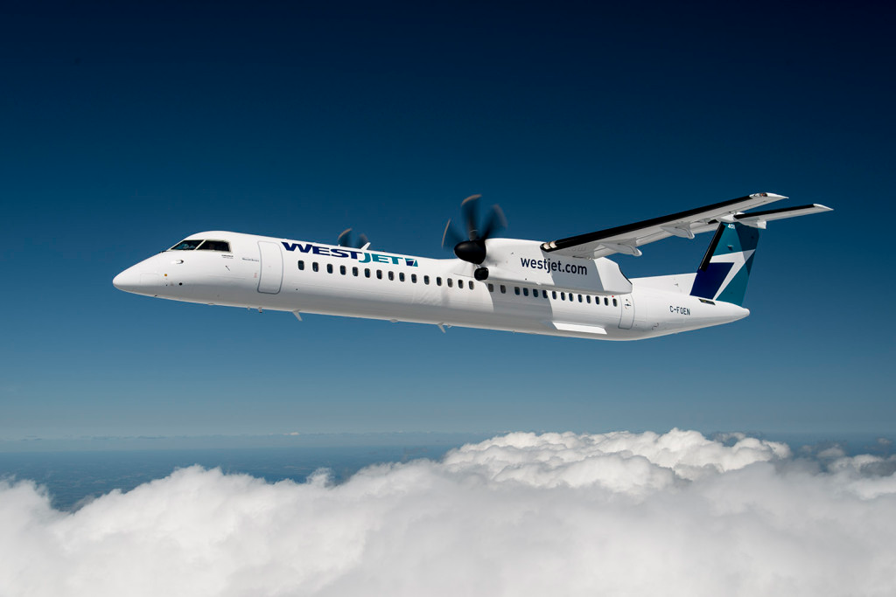

Slide 30
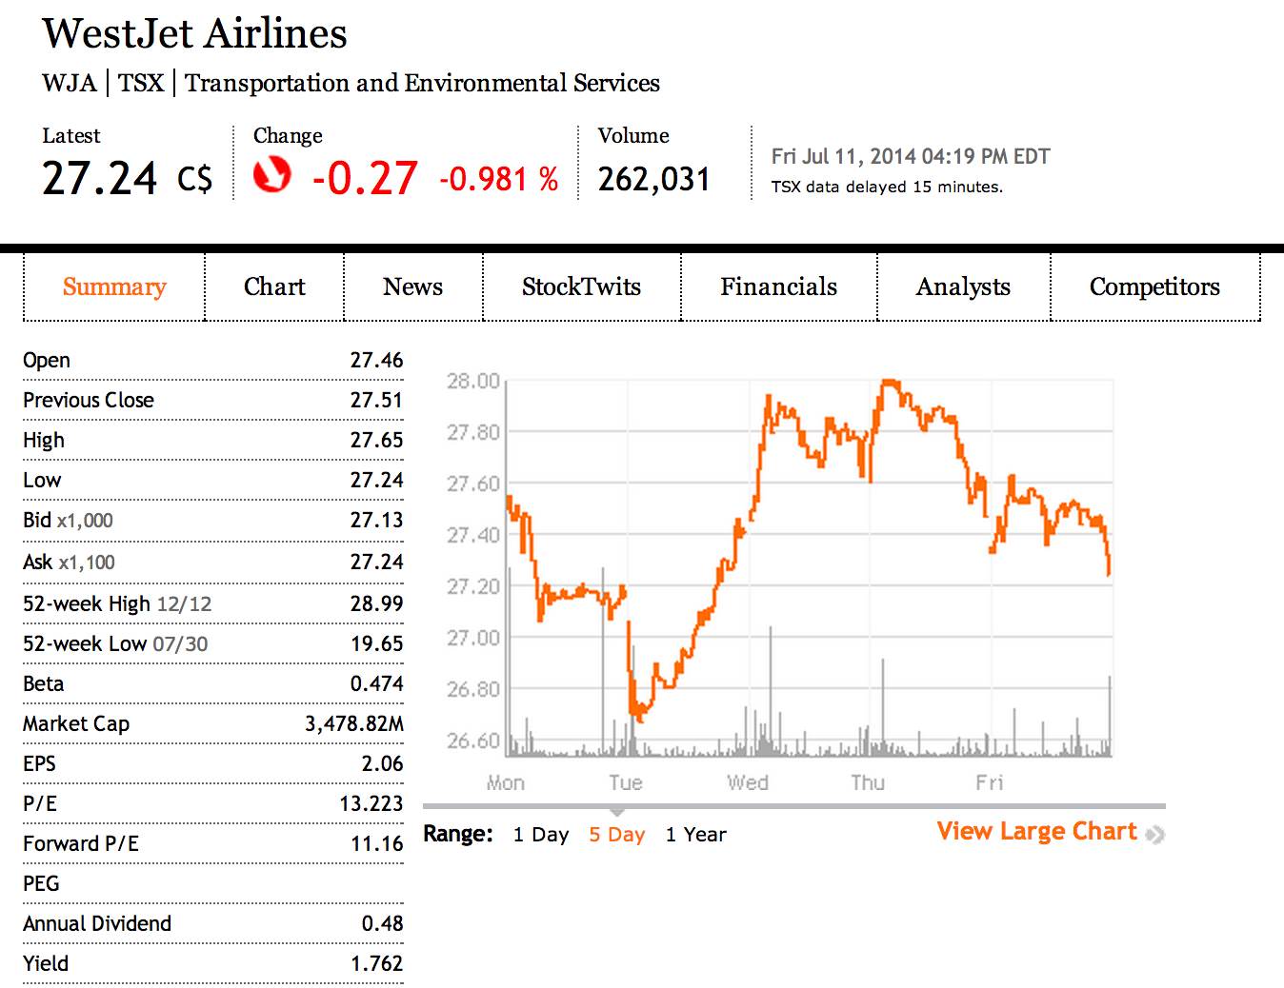
Stock Information

Slide 31
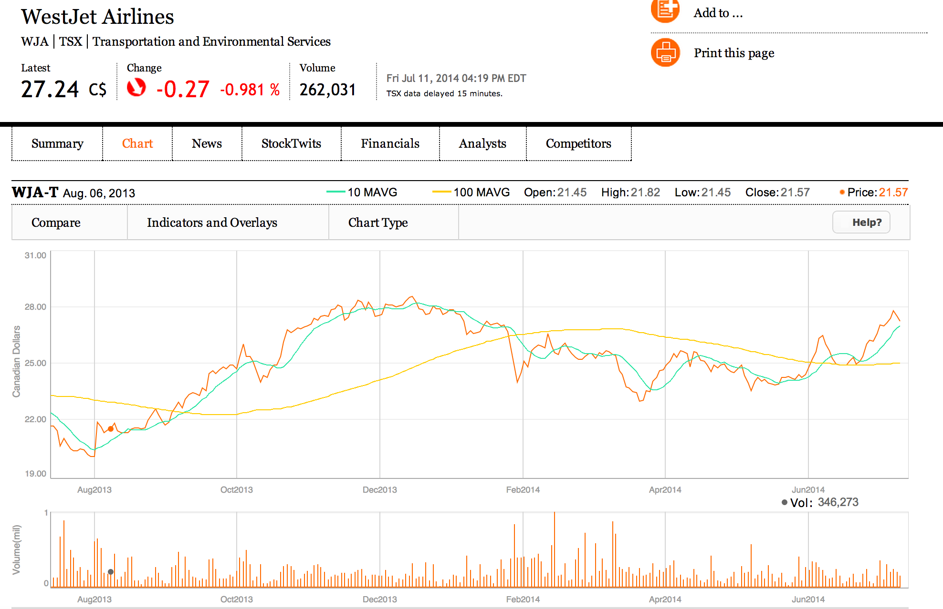
Stock for 1-year

Slide 32
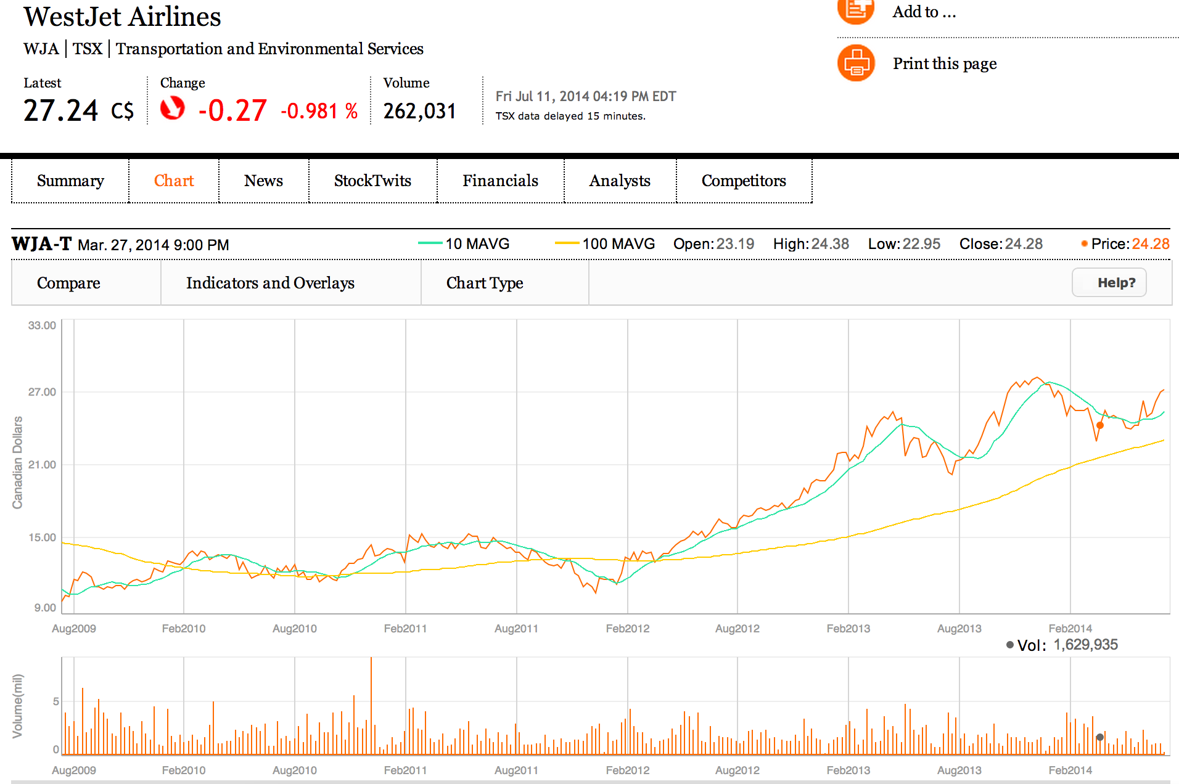
Stock for 5-years

Slide 33
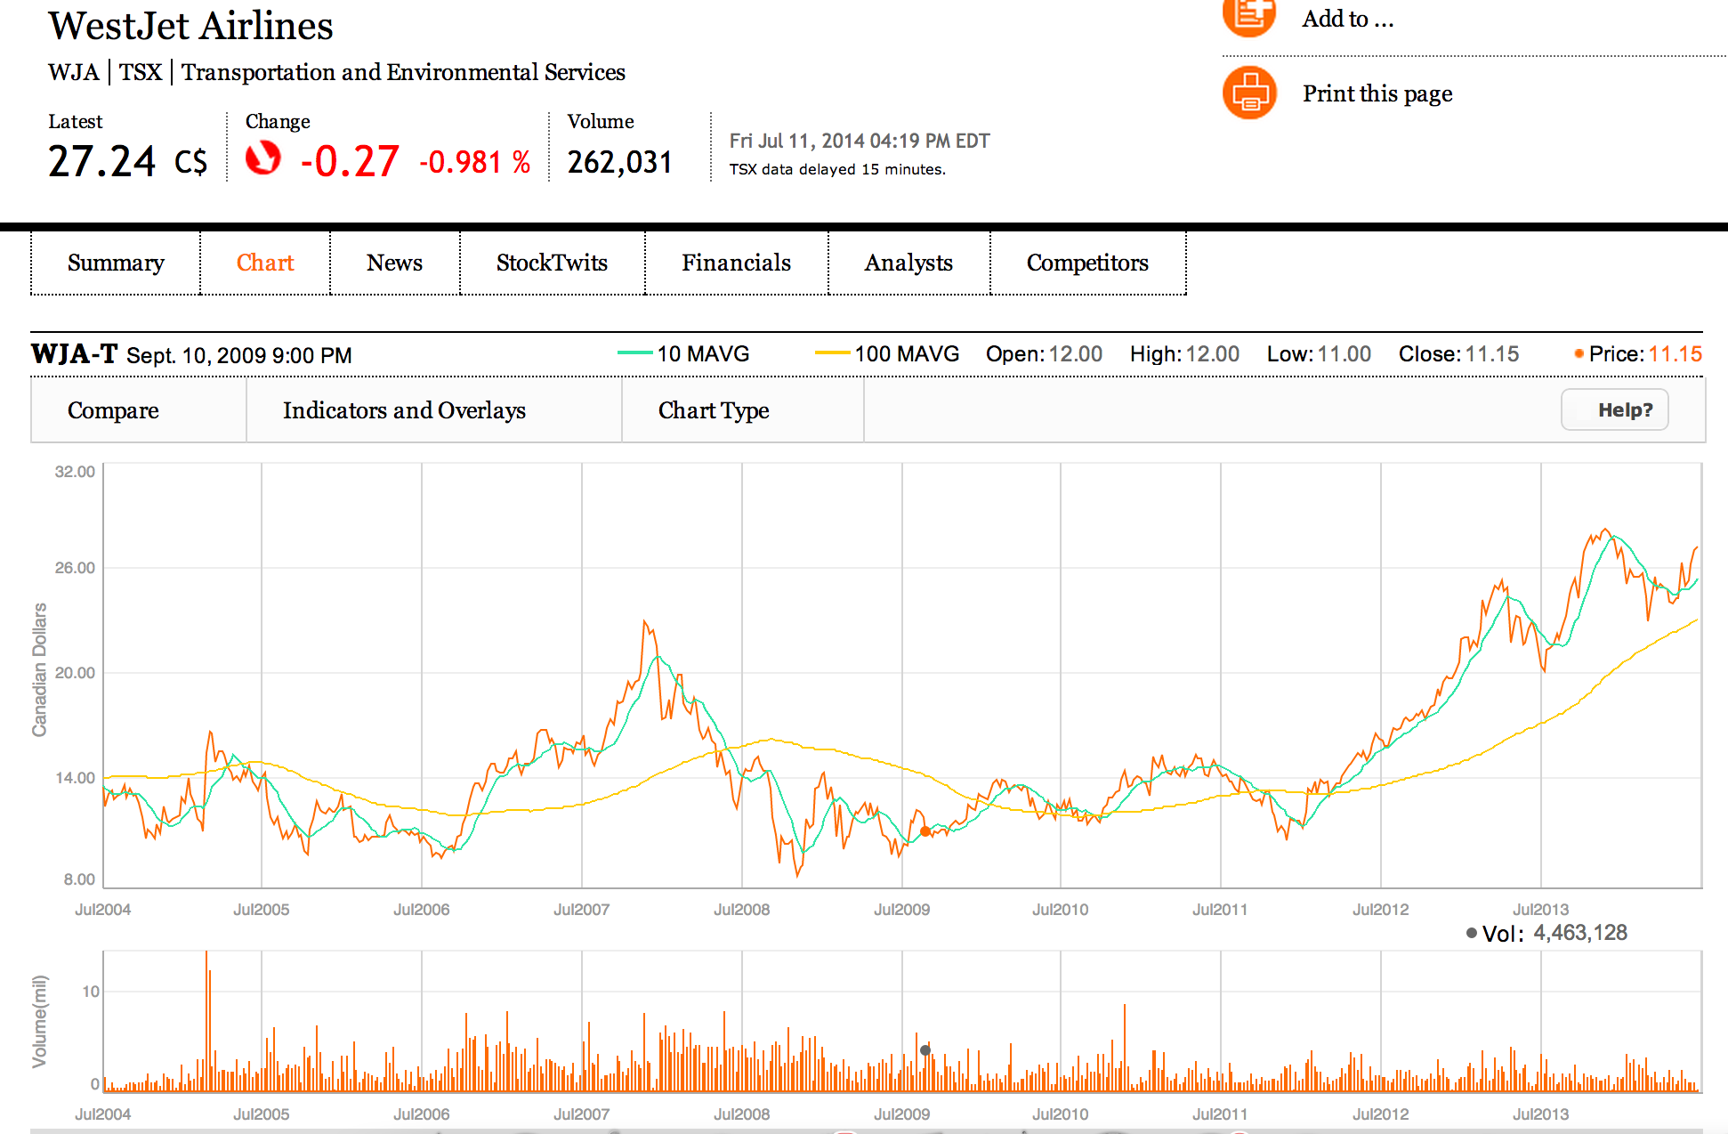
Stock for 10-years

Slide 34
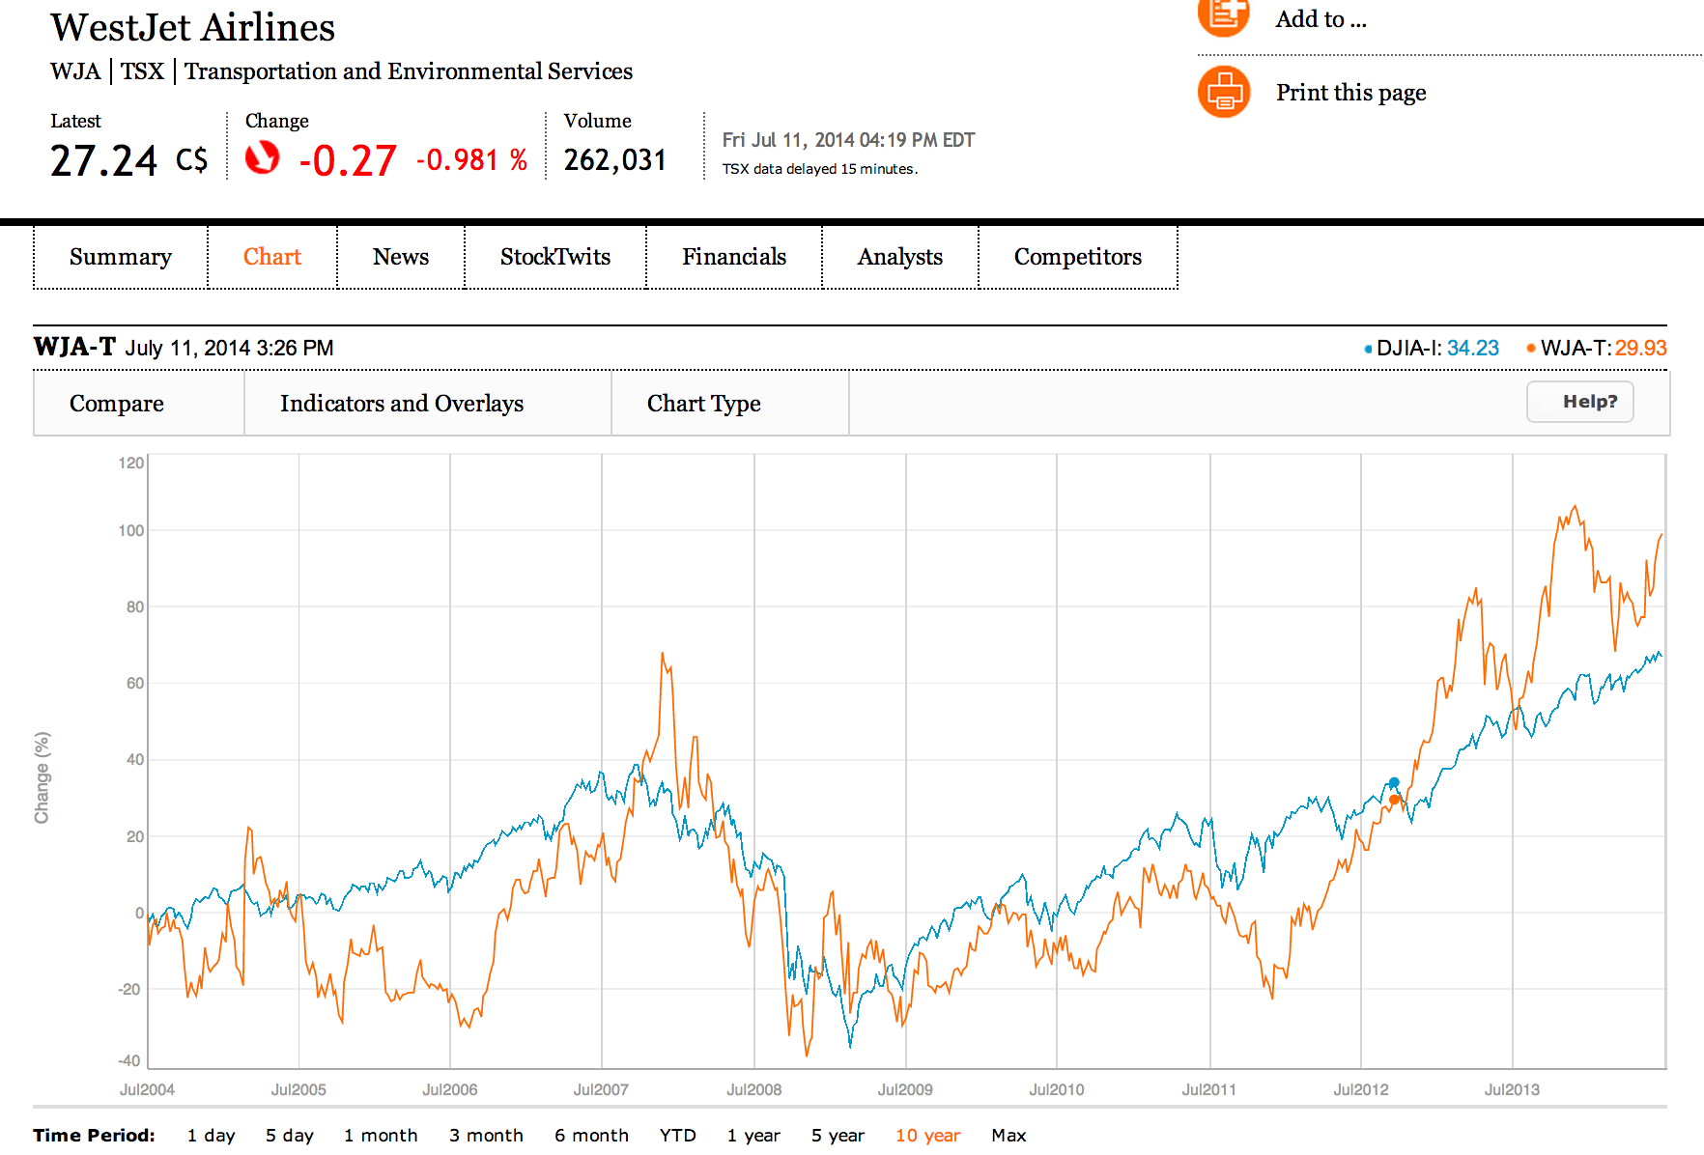
WJA vs. Dow Johns Index for 10-years

Slide 35
Company Background
Corporate Portfolio
WestJet was founded in 1996 by a team of Calgary entrepreneurs, headed by Clive Beddoe, as a western Canadian regional carrier with three aircraft flying to five cities.
WestJet is Canada’s leading high-value low-fare airline offering scheduled service to 76 destinations in North America.
The WestJet Experience
WestJet strives to offer guests a friendly, efficient and relaxing experience from the time of booking to the final destination.
Various check-in methods.
the first airline in North America to launch the electronic boarding pass, which is accepted at all Canadian destinations.

Slide 36
Company Background
Green initiatives
WestJet operates a modern fleet comprised of 98 Boeing Next-Generation 737-600, 737-700 and 737-800 aircraft which are all equipped with blended winglets. This technology improves the aerodynamic performance and handling characteristics of the 737 while boosting range and reducing fuel burn by up to four per cent.
WestJet is the world-wide leader and the first carrier in Canada to adopt Required Navigation Performance (RNP) approach technology to land aircraft.
WestJet’s Calgary campus headquarters attained gold certification under the Leadership in Energy and Environmental Design (LEED) program.

Slide 37
Company Background
Community spirit
Focus on children’s health, community festivals and amateur sports.
The WestJet Cares for Kids community investment program supports charities that work to address children’s health and wellness issues.
The WestJet Fun ‘n Festival Series sponsors more than 40 festivals.
WestJet Vacations
WestJet Vacations provides guests with affordable, reliable and easy to book travel packages.
Offers guests a unique and customized vacation experience.

Slide 38
Company Culture
Promotional Theme: “Owners Care”.
Entire corporate culture has been built around caring for its guests, by providing a great guest experience.
After claiming top spot in Waterstones' study of Canada's 10 Most Admired Corporate Cultures for four years, WestJet was inducted into its Hall of Fame in 2010.
In 2011 WestJet was designated as a J.D. Power Customer Service Champion (one of two companies in Canada and the only airline to make the list), ranked 3rd in Aon Hewitt's best employers in Canada and was chosen as the Canadian airline with the best flight attendants by flightnetwork.com.
WestJet was chosen as Canada's preferred airline. Again.

Slide 39
Fact Sheet
Vision:
By 2016, WestJet will be one of the five most successful international airlines in the world providing guests with a friendly and caring experience that will change air travel forever.
Strategic plan:
People and Culture
Investing in and fostering the growth, development and commitment of our people.
Guest Experience
Consistently and continuously providing an amazing guest experience.
Revenue and Growth
Achieving an average annual compound growth rate in available seat miles of between four and seven per cent.
Costs
Achieving a targeted, sustainable profit margin that will be number one among North American airlines.
Notes:
Due to Owners Care

Slide 40
Company Key History
1994
Clive Beddoe and partners discuss starting a budget airline.
1995
Calgary businessmen invest millions in venture.
1996
survives 17-day grounding, imposed by Canadian transport officials for inadequate record-keeping.
WestJet flies first scheduled routes
1997
1999
2000
Charter and cargo services are added to repertoire
Steven Smith is named CEO.
WestJet goes public.
Expands into eastern Canada.
2004
Begins offering flights to the United States with service to seven U.S. destinations
Announces its first stock split.

Slide 41
Company Key History
2007
Introduces its community investment program, WestJet Cares for Kids.
The first airline in North America to launch an electronic boarding pass.
2009
2010
2011
2012
Opens its new Calgary office building,built in accordance with the Leadership in Energy and Environmental Design (LEED) Green Building Rating System.
The WestJet RBC MasterCard and the WestJet Frequent Guest Program (now WestJet Rewards) are launched.
WestJet launches first code-share agreement with Cathay Pacific.
Signs 11 new interline agreements and three new code-share partnerships to connect new global traffic into its network.
Becomes one of only two Canadian companies to receive the J.D. Power 2011 Customer Service Champion award.
WestJet leadership proposes the launch of a regional airline as a wholly owned subsidiary of WestJet.

Slide 42
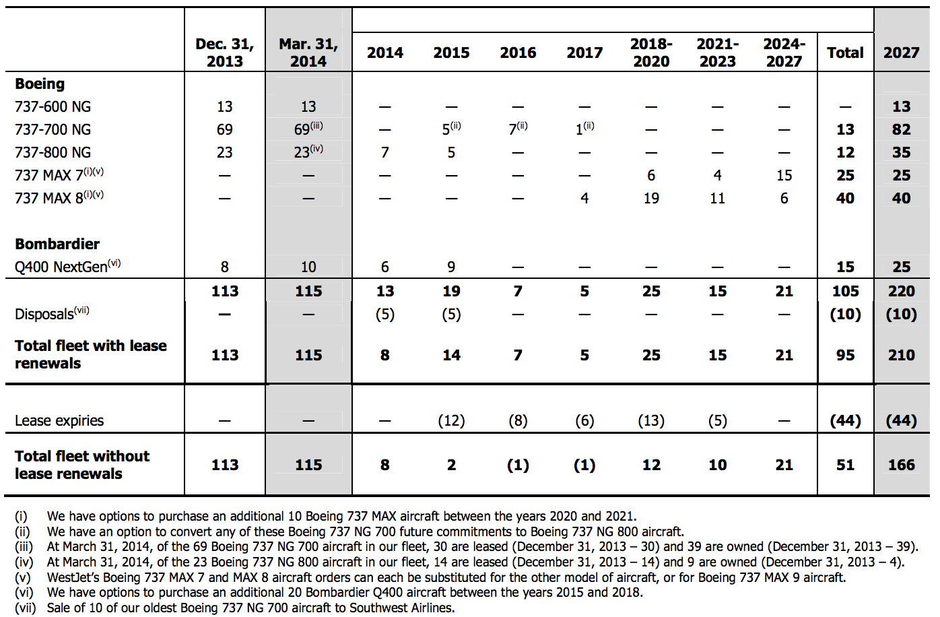
Operating Fleets

Slide 43
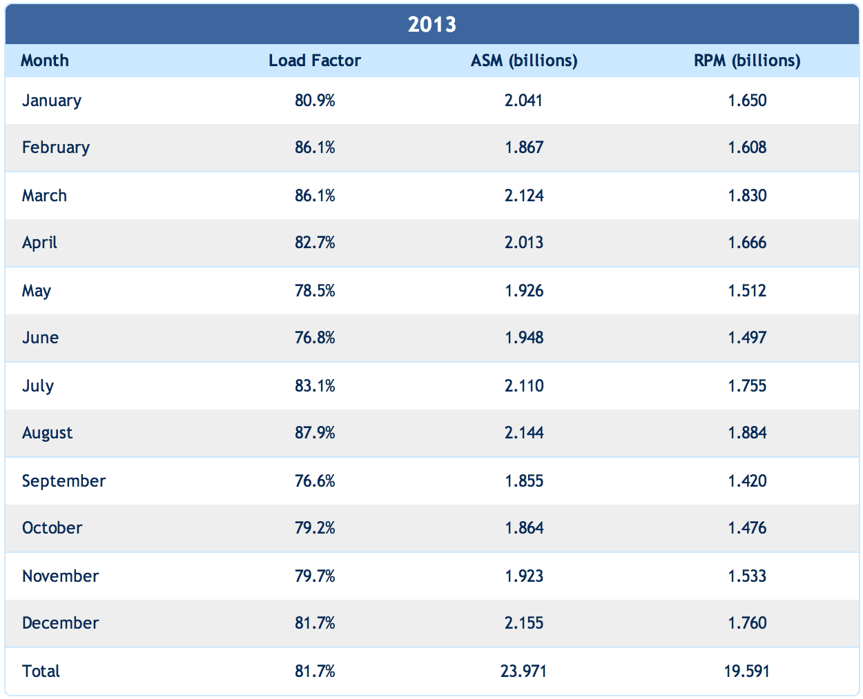
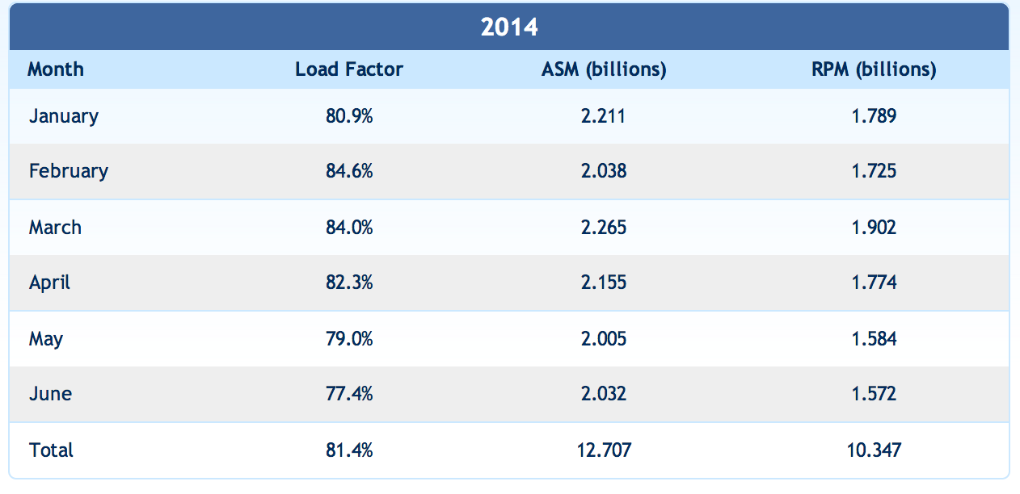
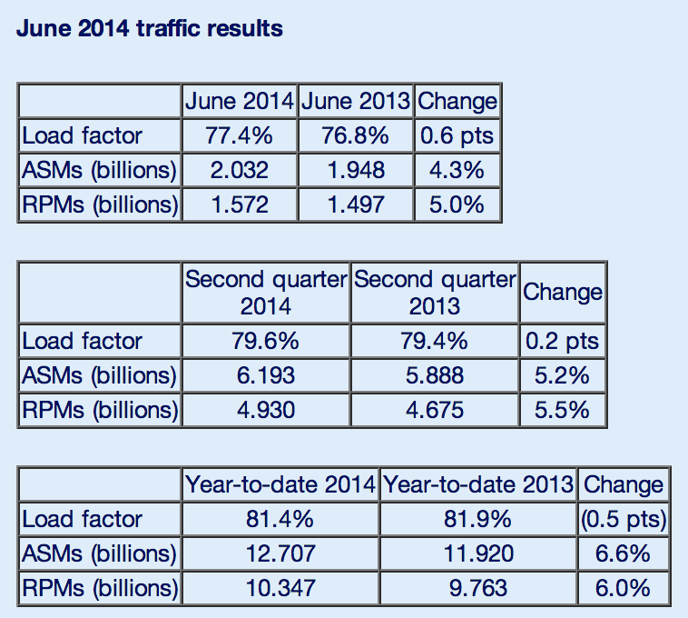
Traffic Statistics

Slide 44
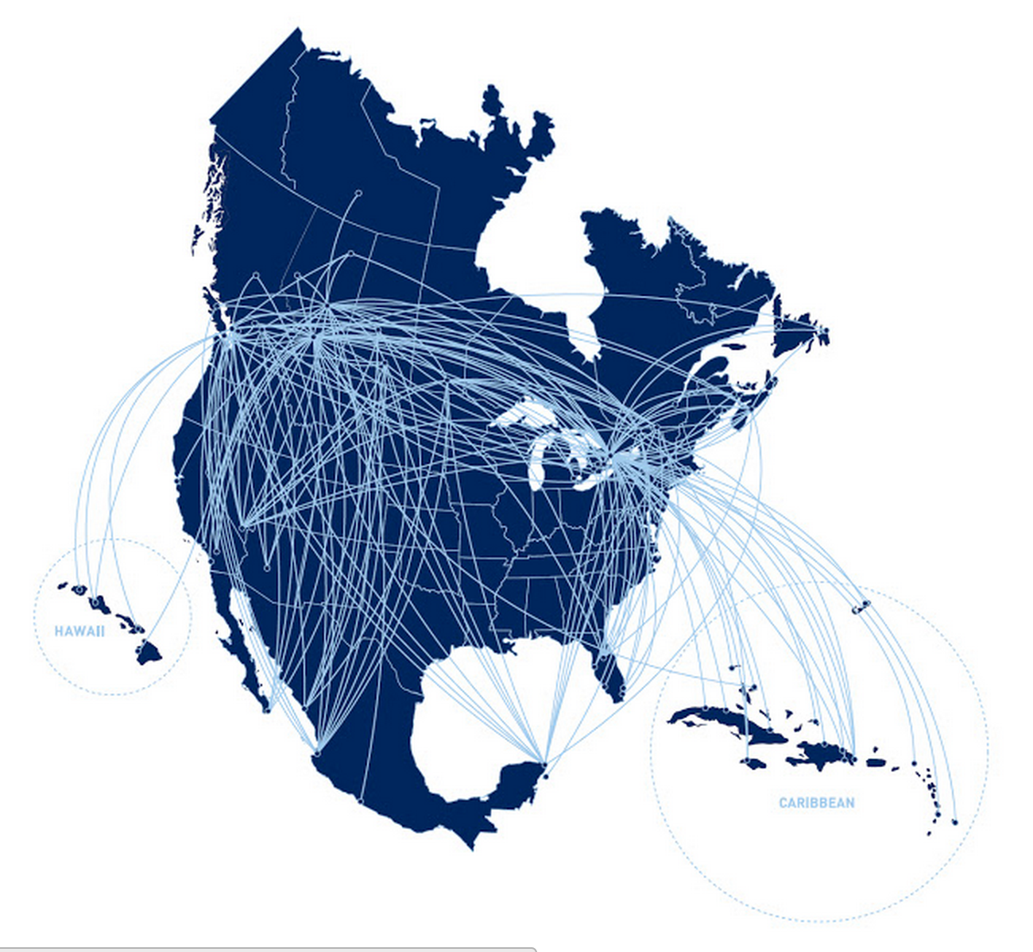
Route Map of WestJet

Slide 45
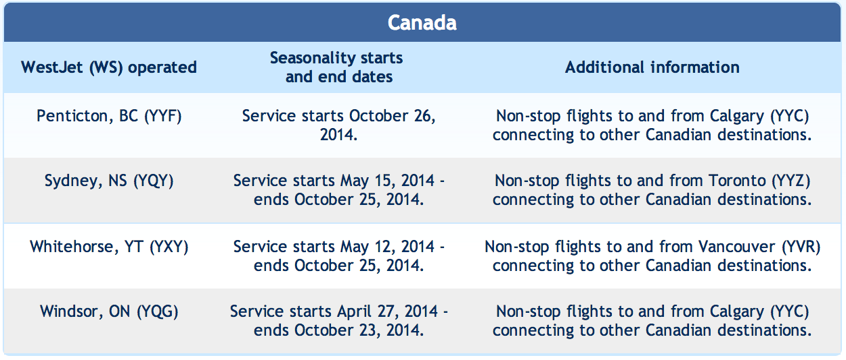
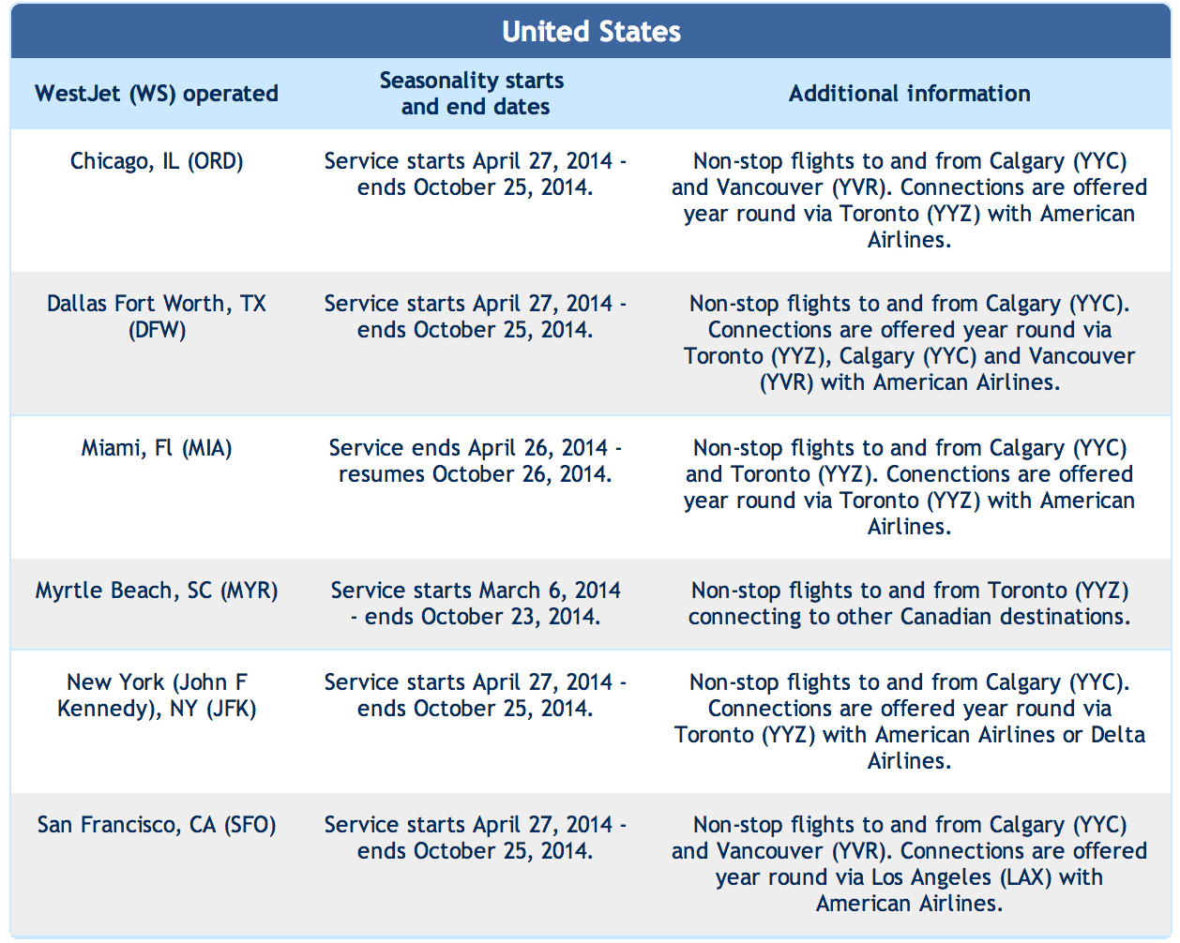
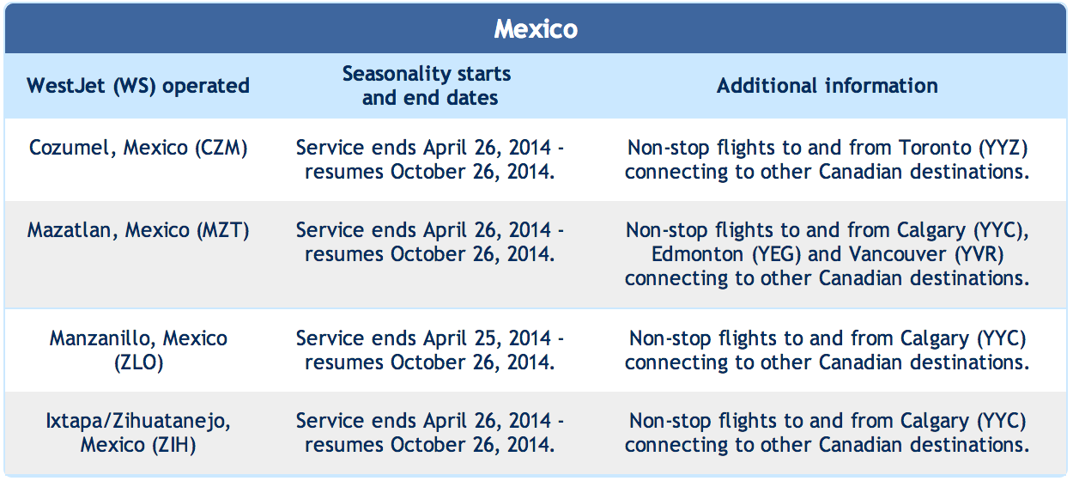
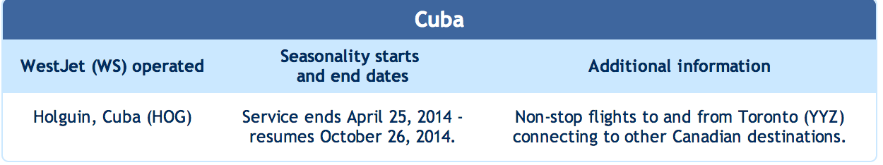
Route Schedule

Slide 46
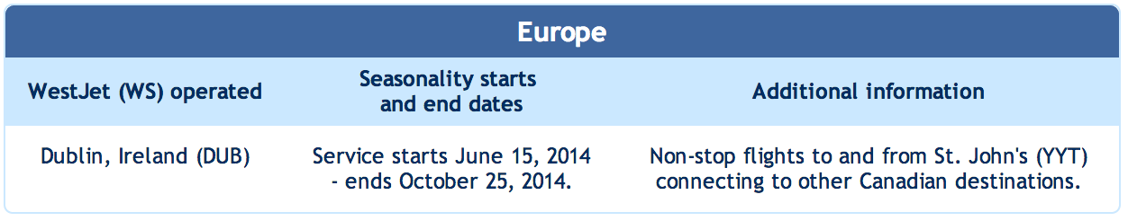
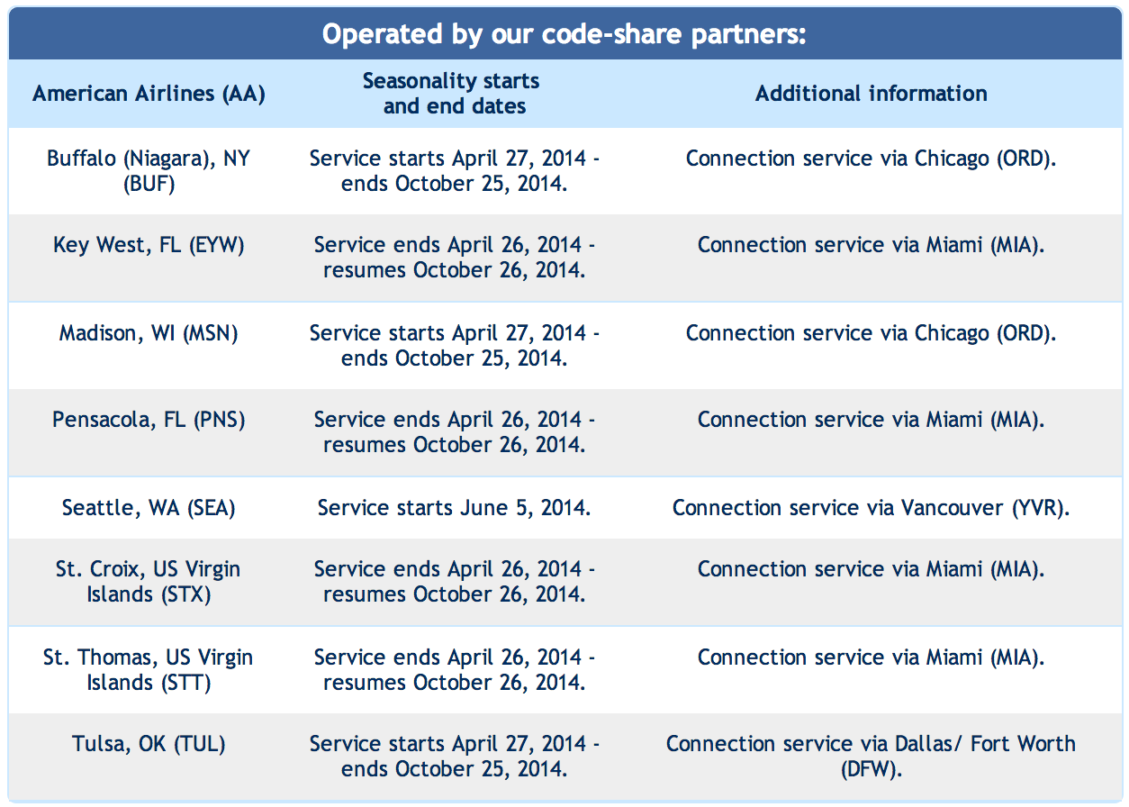
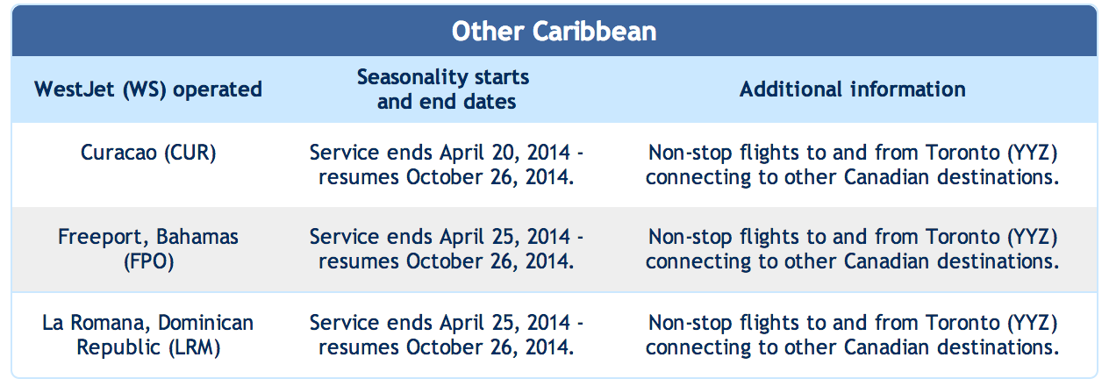
Route Schedule

Slide 47

Management Team

Slide 48

Management Team
1985-1998 he had been CEO at Canadian Airlines International Ltd. (formerly CP Air)
1998-2008 he was executive at Seattle based Alaska Airlines Inc.
In 2009 he joined WestJet Airlines Ltd. as vacation vice-president
He became WestJet President and Chief Executive Officer in April 2010.
Gregg was named Alberta's Business Person of the Year for 2012 by Alberta Venture magazine
Gregg Saretsky
President
Chief Executive Officer

Slide 49

Management Team
He became WestJet’s Executive Vice-President, Operations on January 6, 2014.
He Joins WestJet from a long career spent with both private sector airlines and the military.
He was the Chief Operating Officer and Senior Vice-President of Technical Operations at American Eagle Airlines starting in 2009.
Prior to joining American, he served 28 years in the U.S. Navy in a number of assignments including the Navy Flight Demonstration Squadron, The Blue Angels and Executive Officer of the Naval Air Depot.
Fred Cleveland
Executive Vice-President,
Operations

Slide 50

Management Team
He joined WestJet as Chief Financial Officer and Executive Vice-President, Finance, in March 2007.
He obtained his Chartered Accountant designation in 1989 while at Price Waterhouse and holds a Bachelor of Commerce degree from the University of Toronto.
His previous roles at Molson included Vice-President, Controller and Corporate Finance, Molson Inc.; Vice-President and Chief Financial Officer of Molson U.S.A.; and Vice-President, Commercial Finance at Molson Canada.
Vito Culmone
Executive Vice-President,
Finance,
CFO

Slide 51

Management Team
He became Executive Vice-President, Sales, Marketing and Guest Experience, in 2009.
Prior to that, he held the title of Executive Vice-President, Guest Experience and Marketing.
He joined WestJet in March 2005 as Vice-President, Marketing, and quickly mobilized his team to create the Owners advertising campaign – the most successful brand communications platform in WestJet history.
He was named Canada's top marketing executive by Canadian Business magazine in 2008.
n 2013, Bob was named as one of the top six marketing executives in the airline industry by the Blue Sky organization.
Bob Cummings
Executive Vice-President,
Sales,
Marketing and Guest Experience

Slide 52

Management Team
She became executive vice-president and the first chief information officer in April 2011.
She brings more than 30 years of experience in IT design, development, implementation and operations to her leadership role at WestJet.
She has been the CIO for McKesson, the largest health-care company in the world, as well as the CIO for KeySpan Energy, a major gas and electric energy company in the eastern U.S.
She has held executive positions in IT at Verizon and Honeywell Federal Systems and was a principal in the technology consulting division at Ernst & Young.
Cheryl Smith
Executive Vice-President,
CIO

Slide 53


Management Team
Ferio Pugliese
- President, WestJet Encore
He became President of WestJet's regional airline, WestJet Encore, in November 2012.
He joined WestJet in 2007, initially serving as WestJet's Executive Vice-President People, Culture and Inflight Services.
Brigid Pelino
- Executive Vice-President, People and Culture
She joined WestJet as Executive Vice-President, People and Culture in August, 2013.
She joined WestJet after more than 13 years at Tim Hortons where her last position was Executive Vice President, Human Resources and Continuous Improvement.

Slide 54
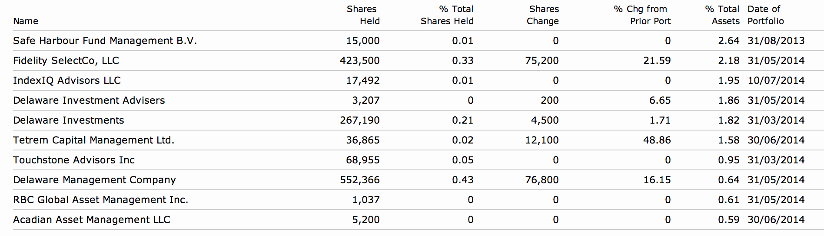
Information of Shareholding

Slide 55
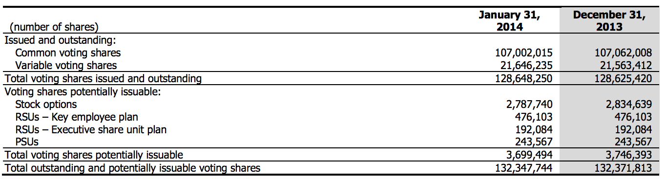
Share Capital

Slide 56
Outstanding Share Data

Slide 57

Operation Analysis

Slide 58
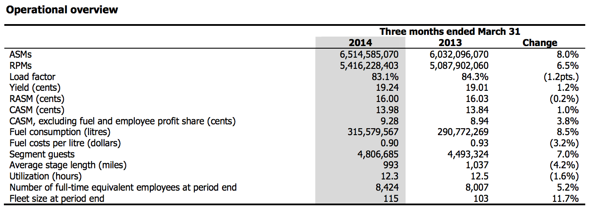
Operation Overview

Slide 59
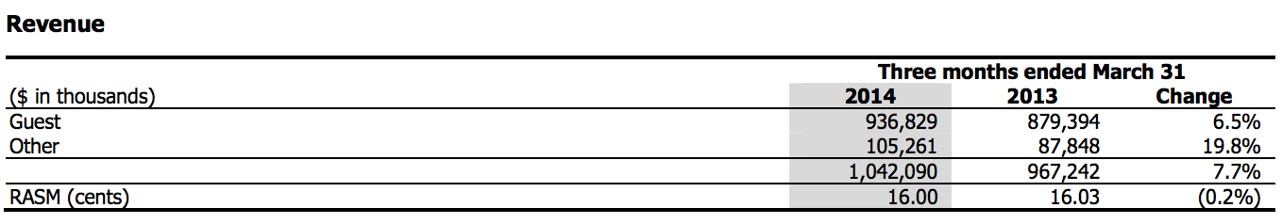
Discussion of Operation
During the first quarter of 2014, total revenue increased by 7.7 per cent to $1,042.1 million compared to $967.2 million in the same quarter of 2013. The overall increase in total revenue was driven mainly by the 6.5 per cent year-over-year increase in traffic, a slight improvement in yield and a significant increase in other revenue mainly driven by ancillary revenue. On an ASM basis, revenue remained relatively flat at 16.00 cents from 16.03 cents in the same quarter of 2013. Contributing to this result was the year-over-year slight improvement in yield offset by our lower load factor compared to the three months ended March 31, 2013. This is consistent with our revised RASM guidance for the first quarter of 2014, as disclosed in our press release dated March 7, 2014.

Slide 60
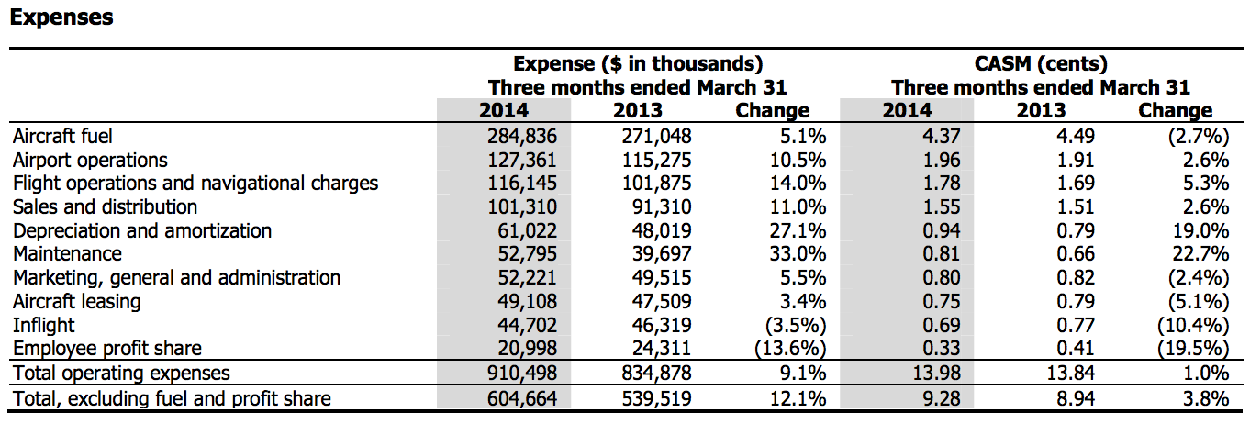
Discussion of Operation
During the three months ended March 31, 2014, operating expenses increased by 9.1 per cent to $910.5 million as compared to $834.9 million in the same period in 2013, primarily driven by the 8.0 per cent period-over-period increase in capacity, the devaluation of the Canadian dollar as well as the increase in depreciation and amortization expense, and maintenance expense, offset by a VAT recovery.

Slide 61
Fuel Cost
Fuel remains our most significant cost representing 31.3 per cent of total operating expenses for the three months ended March 31, 2014 (three months ended March 31, 2013 – 32.5 per cent).
Fuel remains our most significant cost representing 31.3 per cent of total operating expenses for the three months ended March 31, 2014 (three months ended March 31, 2013 – 32.5 per cent).

Slide 62
SWOT Analysis
Having the lowest airfare costs in Canada gives competitive advantage
Strategic alliances through code sharing and interline airline with American Airlines and Cathy Pacific will enable a strong network of operations and marketing
Fluctuating economy reduces demand
Recipient of the Canadian Airline of the year award resulting in very high morale of employees
Strong brand image in Canada as offering a safe, customer focused and enjoyable air travel
Non-unionized labour force keeping costs and risk of labour disputes low 5. Good brand reputation and presence
With increasing cost of fuel it will difficult to provide services at low fares
As WestJet expands internationally, it has to face competition from experienced and well established airlines
Leverage the user-friendly vacation planning site called WestJet Vacations
Being a low cost carrier, in-flight entertainment and snacks are being compromised which is of concern to many passengers
It does not provide any sort of first class seating which can be a factor for losing higher class travelers
Lack of many Trans-Continental flights
Strength
Weakness
Opportunity
Threats

Slide 63

Financial Statement Analysis

Slide 64
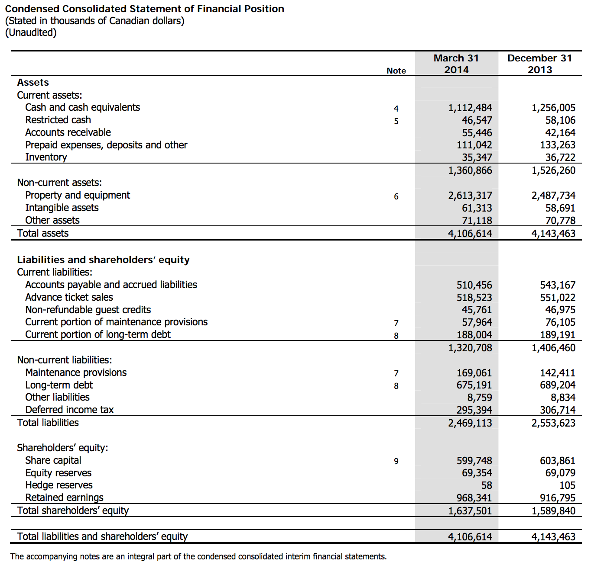
Quarterly Balance Sheet

Slide 65
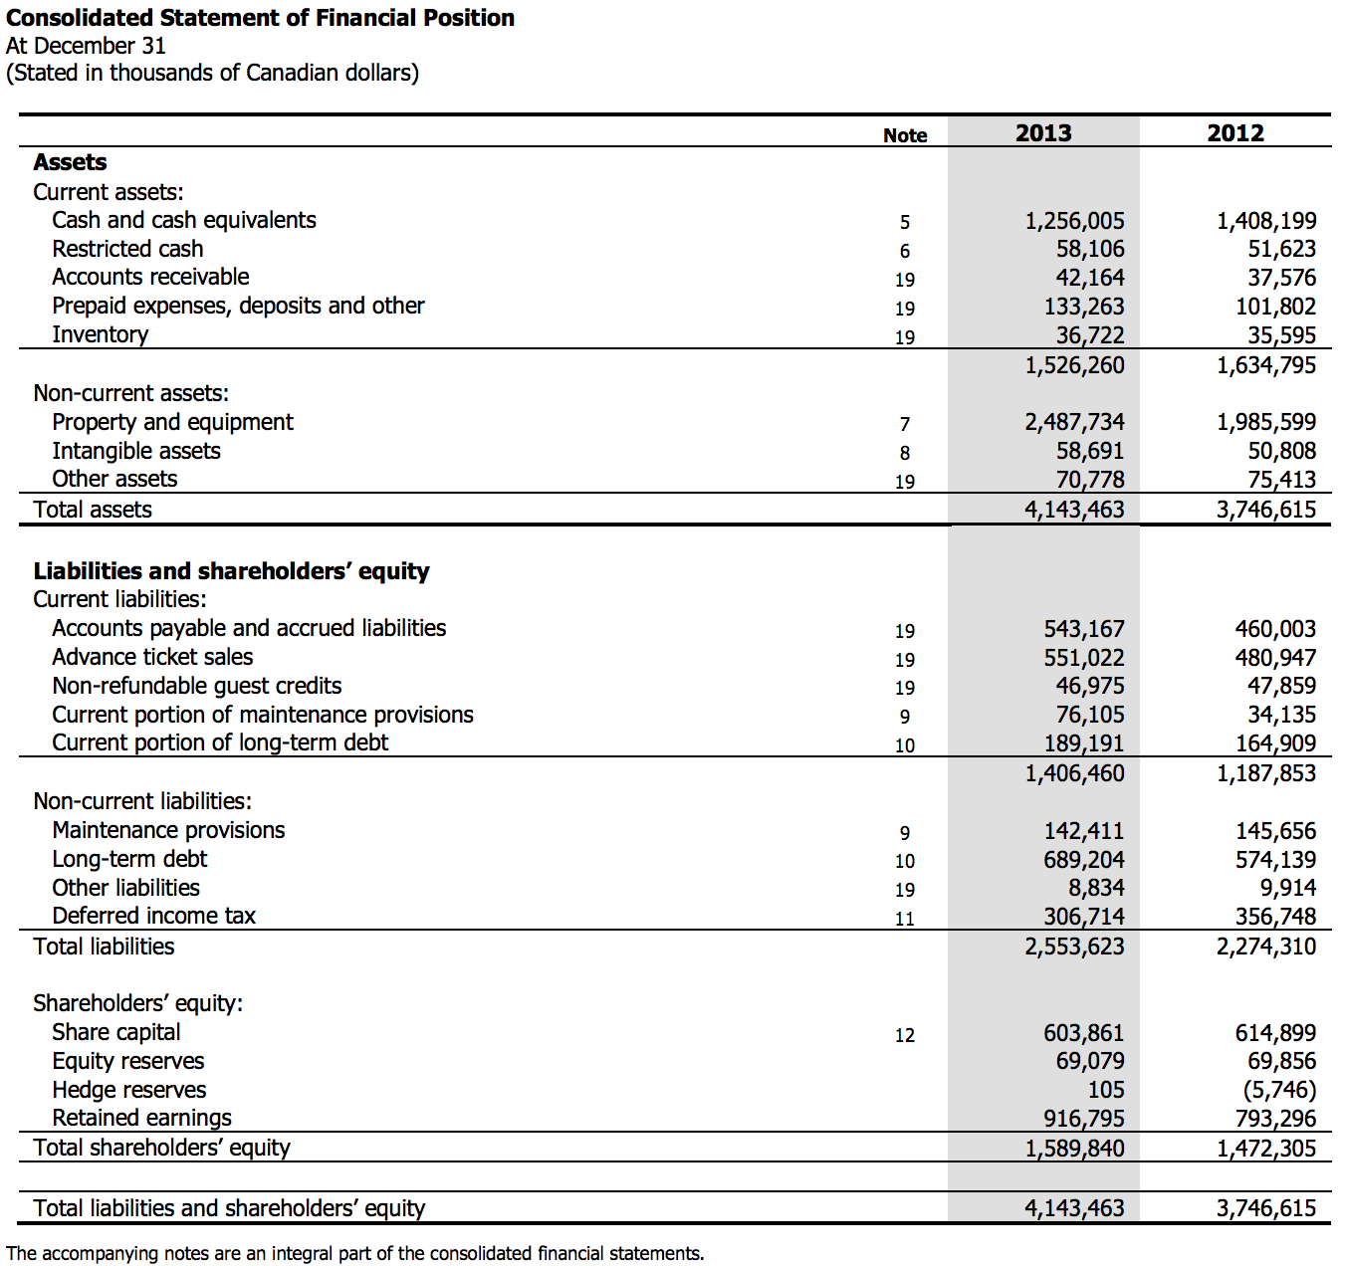
Annually Balance Sheet

Slide 66
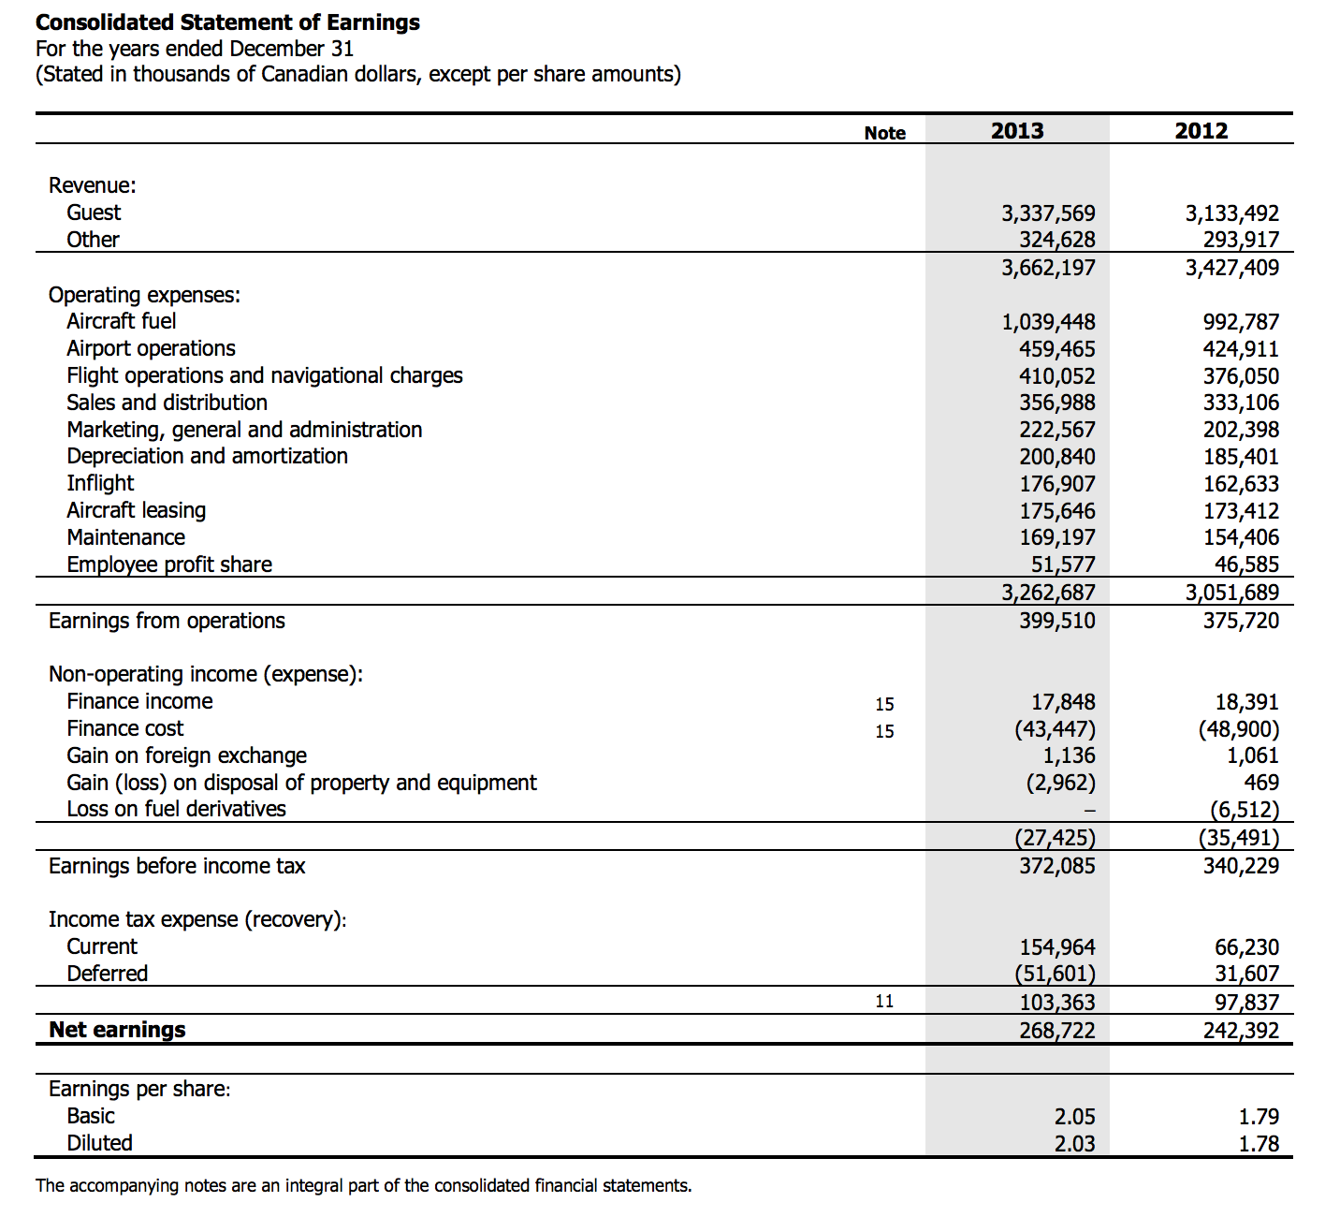
Annually Income Statement

Slide 67
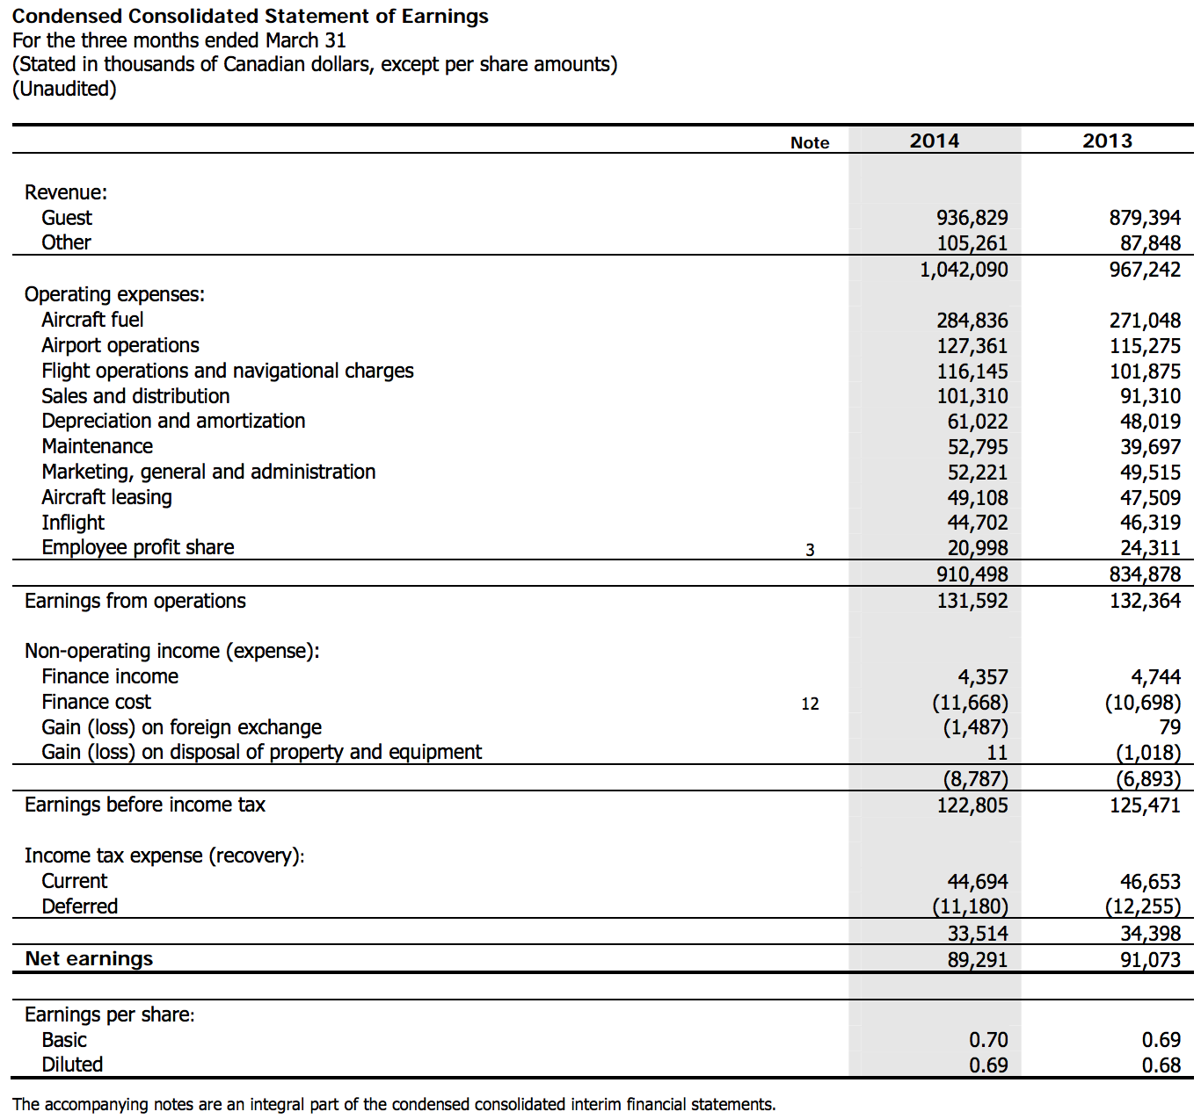
Quarterly Income Statement

Slide 68

Annually Cash Flow

Slide 69

Quarterly Cash Flow

Slide 70
Recommendation
HOLD

Slide 71





Slide 72



Stock information

Slide 73

1 Day Stock Price Movements

Slide 74

1 Year Stock Price Movements

Slide 75

3 Year Stock price Movements

Slide 76

5 Year Stock Price Movements

Slide 77

Comparison to Singapore Airlines

Slide 78

Company Background

Slide 79

Route Map

Slide 80

Company Profile
An international airline registered and based in Hong Kong.
Offering services for passengers and cargo to 182 destinations in 41 countries.
It remains deeply committed to its home base, making investments to develop Hong Kong as one of the world’s leading international aviation centers.
Hong Kong Dragon Airlines Limited (“Dragonair”), is a subsidiary of Cathay Pacific operating 41 aircraft to 47 destinations in Mainland China and elsewhere in Asia.
Cathay Pacific is a founding member of the oneworld global alliance, serving more than 880 destinations worldwide. Also, Dragonair is an affiliate member of oneworld.

Slide 81
Company History
1946
Founded by American Roy C Farrell and Australian Sydney H de Kantzow.
Initially based in Shanghai.
1948
began to operate passenger flights and expansion was fast.
Swire Group took a 45% share in the company.
1960s
Represent the coming of age.
The business grew a tan average rate of 20 percent a year. We also initiated international services.

Slide 82
Company History
1970s
Began to make use the latest technology with computerized reservation system and flight simulators.
The first Boeing 747-200 arrived in Hong Kong.
1980s
Worldwide economic boom
Expansion of international network including London, Brisbane, Frankfurt, Vancouver, Amsterdam, Rome, San Francisco, Paris, Zurich and Manchester.
1990s
We had assembled a fleet of aircraft that was among the youngest in the world
The cargo service played a vital role in the company’s expansion.

Slide 83
Company History
2002
We had joint venture with DHL in Air Hong Kong.
Expanding regional network for express overnight cargo deliveries
2003
Resumed passenger services to Beijing, Xiamen and Shanghai
Strengthen Hong Kong’s position in mainland China
2006
We were named "Airline of the Year 2006" by Air Transport World magazine.
Cathay Pacific brought Dragon Air into the Cathay Pacific Group as a wholly owned subsidiary.

Slide 84

Moving into the Future
The Cathay Pacific Group, including Dragon Air and Air Hong Kong, now operates more than 150 aircraft to some 130 destinations around the world.
The new cabins are, uniquely, being fitted in First, Business and Economy Class at the same time, and are taking the travel experience to new highs.
building the new Cathay Pacific Cargo Terminal which opened in mid-2011

Slide 85

Financial Highlights

Slide 86

Fleet Profile

Slide 87

Fleet Profile

Slide 88

Environmental Performance
1. Clean Air
According to the Hong Kong SAR Government’s air emissions inventory, aviation contributes 5.5% of nitrogen oxides, 3% of carbon monoxide and less than 1% of other air pollutants to local levels of air emissions.
Participating in the Hong Kong Clean Air Charter Certification Scheme
Developing a formal strategy for vehicle replacement across the Cathay Pacific Group
Conducting yearly indoor air quality monitoring – with a “Good” rating achieved for 2009

Slide 89
Environmental Performance
2. Noise Management
Despite a 75% industry-wide reduction in noise over the past 30 years, Cathay Pacific continues to work on ways to reduce noise in its aircraft.
Communicating with airport authorities to more effectively address noise issues
Working with manufacturers and other airline partners on noise-mitigation measures
Working with industry groups, including IATA and AAOa, in the promotion of the “Balanced Approach” to noise management.

Slide 90
Environmental Performance
3. In-flight Waste Management
Despite recycling and reducing in-flight waste is always a challenge for Cathay Pacific in terms of space, time and cost, the airline keeps trying reducing its waste.
Conducted a successful trial on the use of biodegradable plastic bags on board
Actively assessed alternatives to plastic packaging for inflight magazines, headphones, food packaging and other related items.
The introduction of lighter-weight food carts and meal trays.

Slide 91

Management Team

Slide 92

Management Team
John Slosar
Became Chairman of Cathay Pacific since 14 March, 2014
Director of the airline since July 2007
Joined the Swire Group in 1980
Chairman of John Swire & Sons (H.K.) Limited, Swire Pacific Limited, Swire Properties Limited and Hong Kong Aircraft Engineering Company Limited.

Slide 93

Management Team
Ivan Chu
Became Chief Executive of Cathay Pacific since 14 March 2014
Also Chairman of Hong Kong Dragon Airlines Limited and a Director of John Swire & Sons (H.K.) Limited and Swire Pacific Limited.
joined the Swire group in 1984 & worked with the group in Hong Kong, Mainland China, Taiwan, Thailand and Australia.

Slide 94

Management Team
Rupert Hogg
became a Director and Chief Operating Officer of Cathay Pacific since 14 March 2014
He was appointed Director Cargo in September 2008 and Director Sales & Marketing in August 2010.
joined the Swire group in 1986
Also Chairman of AHK Air Hong Kong Limited and a Director of Hong Kong Dragon Airlines Limited

Slide 95

Management Team
James Barrington
Became Director Corporate Development since July 2010
joined the Swire group in 1982 & worked with the Company in Hong Kong, Malaysia and Canada since 1983
He was appointed Director Sales and Marketing in March 2000.
Director of Hong Kong Dragon Airlines Limited and AHK Air Hong Kong Limited.

Slide 96

Fact Sheet
Major Shareholders
Swire Pacific Limited 45%
CITIC Pacific Limited 1.98%
Air China Limited 29.99%
Major Subsidiaries and Associates
100%
100%
100%
100%
100%
100%
100%
60%
20.13%

Slide 97

Operations

Slide 98

Operating Expenses

Slide 99

Operating Expenses

Slide 100

Operating Results Analysis

Slide 101

Passenger Services
The passenger business improved in 2013.
Cathay Pacific and Dragon Air carried 29.9 million passengers, an increase of 3.3% compared to 2012.
Revenue increased by 2.4% to HK$71,826 million.
The load factor increased by 2.1 percentage points to 82.2%.
Yield increased by 1.8% to HK68.5 cents.

Slide 102

Passenger Services

Slide 103

Cargo Services
In 2013, the Cathay Pacific Group’s cargo business was affected by weak demand, high fuel prices and industry over capacity.
Cathay Pacific and Dragon Air carried 1.5 million tonnes of cargo and mail in 2013, a decrease of 1.5% compared to 2012.
Cargo revenue generated by Cathay Pacific and Dragon Air decreased by 6.1% to HK$20,293 million.
Capacity increased by 1.7%.
The load factor decreased by 2.4 percentage points to 61.8%.
Yield decreased by 4.1% to HK$2.32.

Slide 104

Cargo Services

Slide 105
Turnover
The Cathay Pacific Group reported an attributable profit of HK$2,620 million in 2013 compared with a profit of HK$862 million (restated) in 2012.
The improvement in 2013 was largely due to a strengthening of the passenger business and the positive impact of protecting the business from the high price of jet fuel.
The cargo business continued to be affected by weak demand, high fuel prices and over capacity in the industry.

Slide 106

Turnover

Slide 107

Revenue and Breakeven Load Factor
The Revenue load factor increased by 1.3 percentage points to 77.5%. The breakeven load factor was 74.6%.

Slide 108

Quarterly Balance Sheet

Slide 109

Balance Sheet

Slide 110

Income Statement

Slide 111

Quarterly Income Statement

Slide 112

Cash Flow Statement

Slide 113

Quarterly Cash Flow

Slide 114
Recommendation
Hold
Hold

Slide 115


Singapore Airlines Ltd

Slide 116

Stock Information

Slide 117

6 MONTHES STOCK PRICE MOVEMENTS

Slide 118

1 YEAR STOCK PRICE MOVEMENTS

Slide 119

3 YEARS STOCK PRICE MOVEMENTS

Slide 120

5 YEARS STOCK PRICE MOVEMENTS

Slide 121

5 YEARS VS. AIRLINE INDEX

Slide 122

3 YEARS VS JAPAN AIRLINE

Slide 123

3 YEARS VS MALAYSIAN AIRLINES

Slide 124

3 YEARS VS MALAYSIAN AIRLINE VS JAPAN AIRLINE

Slide 125
COMPANY PROFILE
Founded in 1 May,1947
Flag carrier of Singapore and a 5-star airline
Hubs: Singapore Changi Airport
Airbus A380, currently the world’s largest passenger aircraft
Top 15 carriers world wide in terms of revenue passengers carried
10th in the world for international passengers carried

Slide 126

GLOBAL ROUTE MAP

Slide 127

COMPANY HISTORY

Slide 128

Management Team

Slide 129

Chairman: Stephen Lee Ching Yen
Appointed director of SIA on 2005
Appointed Chairman of SIA on 2006
Managing director of Shanghai Commercial and Saving Bank Ltd(Taiwan) and Great Malaysia Textile Investments Pte Ltd
President of the Singapore National employers Federation
Member of the Advisory Panel of Temasek Holdings Limited and an Alternate Member of the Council of Presidential Advisers
Chairman of Singapore Business Federation (2002-2008)
Chairman of International Enterprise Singapore (1995-2002)

Slide 130

Director: Goh Choon Phong
Appointed Director on 2011
Joined SIA in 1990 and has senior management positions in various division in Singapore and overseas, ranging from Marketing to Information Technology to Finance and Cargo
President of Singapore Airline Cargo Pte Ltd(2006-2010)

Slide 131

Operations Performance

Slide 132

Shareholding Information

Slide 133

Revenue

Slide 134

Revenue Composition

Slide 135

Expenditure

Slide 136

Expenditure

Slide 137

Trend in Fuel Price and Cost

Slide 138

Fuel Expenditure

Slide 139

Operating Profits 13/14

Slide 140

Group Operating Profit

Slide 141


Financial Highlights

Slide 142

Financial Review

Slide 143

Balance Sheet

Slide 144


Balance Sheet Cont.

Slide 145

Income Statement

Slide 146

Income Statement CONT.

Slide 147

Dividend

Slide 148

Cash Flow Statement

Slide 149

Cash Flow Statement Cont.

Slide 150

Recommendation
HOLD

