Slide 1
Global Airlines
BUS 417 E100
Kristoffer Hung, Alex Mak, Maggie Ruan, Kiki Tsung

Slide 2
Global Airline Industry
Industry Overview
Terminology
History & Regulations
Business Model
Airline Strategy
Short-Term Trends
Long-Term Trends
Outlook
American Airline
Southwest Airline
Cathay Pacific Airline

Slide 3
Terminology
ATK: Available Tonne Kilometer (Capacity)
= Passenger and cargo capacity
ASK: Available Seat Kilometer (Capacity)
= [Number of seats] * [kilometers flown]
RPK: Revenue Passenger Kilometer (Traffic)
= [Number of paying passengers] * [kilometers flown]
FTK: Freight Tonne Kilometer (Traffic)
= [Freight tonnes carried] * [kilometers flown]
YIELD
= [Revenue] / [RPK]
LF: Load Factor (Capacity Utilization)
= [RPK] / [ASK]
= [number of passengers]/[number of seats]
Break Even LF: Unit cost / Yield
i.e. Operating cost = Operating Revenue

Slide 4
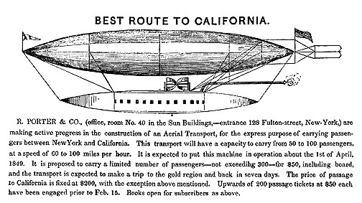
History/Regulations
1909
First Zeppelin (Deutsche Luftschiffahrts-Aktiengesellschaft, DELAG)
1910
First jet-propelled aircraft (Coanda1910)
1919
First non-stop transatlantic flight (Alcock and Brown)
1925
Airmail Act– transferring operations to private companies
1926
Air Commerce Act—safer flying routes needed

Slide 5
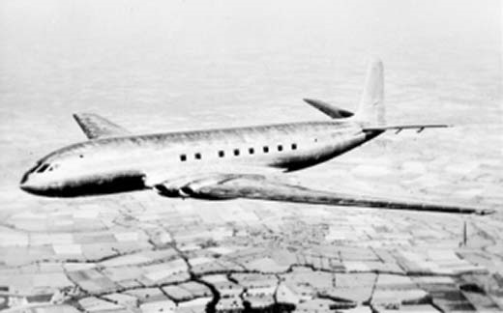
History/Regulations (2)
1934
Federal Aviation Administration was formed due to another Airmail Act – Bureau of Air Commerce
1940
Civil Aeronautics Administration (CAA)
Civil Aeronautics Board (CAB)
Air traffic control
Adequate air service
Regulate fees/schedules
1949
First commercial aircraft (de Havilland DH 106)
1957
Boeing 707 was created
1938
Civil Aeronautics Act: delegating federal responsibilities to Civil Aeronautics Authority

Slide 6
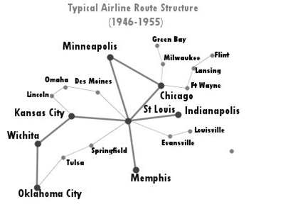
After World War II
Open skies allowed competition for international routes
Open skies refers to the Air Transport Agreement between two or more nations which:
Liberalizes the rules for international aviation markets and minimizes government intervention
Military and other state-based flights may be permitted

Slide 7
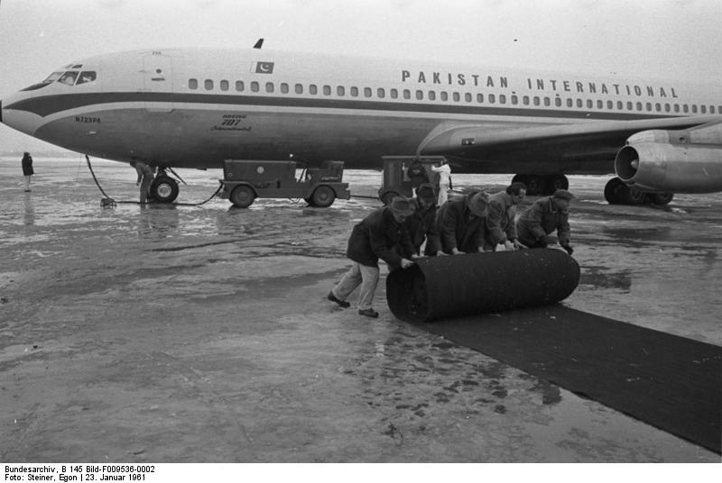
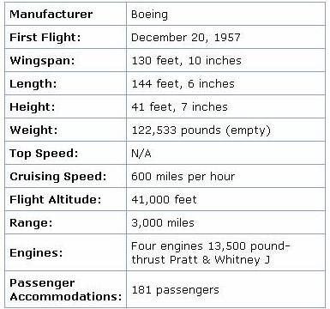
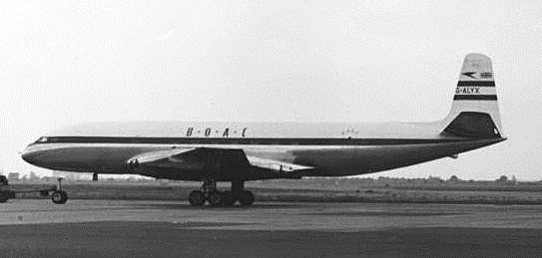
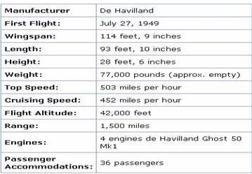
Jet: 1950’s - 1960’s
Boeing 707
DH 106 Comet

Slide 8
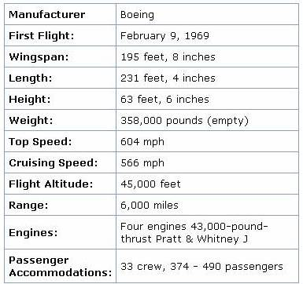
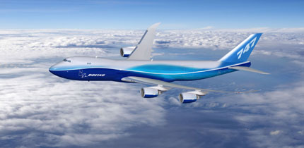
Jumbo Jet: 1960’s – 1970’s
Boeing 747-8

Slide 9
Airline Deregulation Act (1978)
To remove government control over fares, routes, and market entry => CAB eliminated
Underserved airports opened to major carriers
Mergers between local carriers were allowed
Implementation of “Hub and Spoke” system
CAB

Slide 10
Global Airlines
Key factors affecting the business:
Airport capacity
Route structure
Technology
Costs to lease/buy the aircrafts
Weather
Cost of fuel
Cost of labour

Slide 11
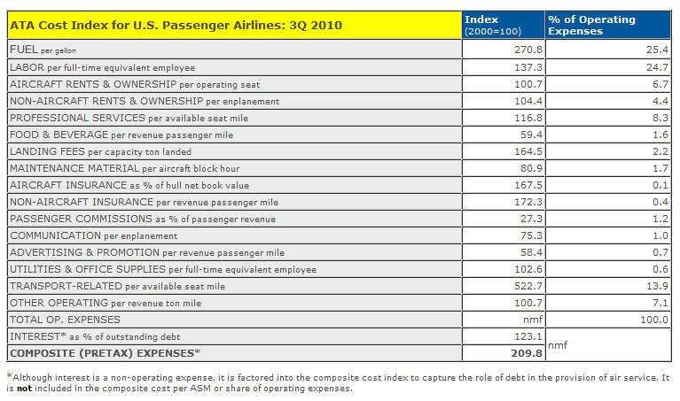

Slide 12
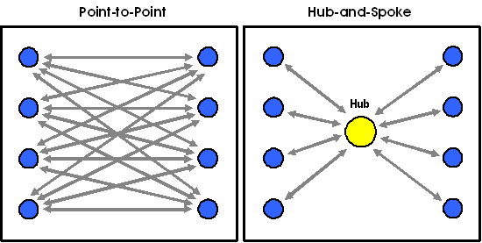
Business Models
Hub-and-Spoke System
Used by legacy carriers
Allowed for more distant and international routes
Utilize main airports as hubs
Lead to more efficient use of transportation resource
Centralized model result in inflexible operation (domino effect)
Cathay Pacific, American Airline
Point to Point System
Used by low-cost carrier
Shorter routes, usually regional/domestic
↓connection & travel time
↑utilization leads to lower unit cost
Avoid domino effect
Require more routes
Less flexibility in destination
Southwest Airline (hybrid)

Slide 13
Types of Airlines
Network-Legacy Carriers
New competition after deregulation
More Luxury aircrafts
Offer Business/First Class
Higher level of services: airport lounges, frequent-flyer program, premium in-flight services
Price discrimination
Yield management system
Different prices for same class
Frills
Airline Alliances
Low-Cost Carriers
Fewer types of aircrafts
Lower maintenance expenses
Economic class
Less services
Fly early/late
Lower landing fees
Simpler fare schedules
Lower fares
No alliance
AKA No-frills

Slide 14

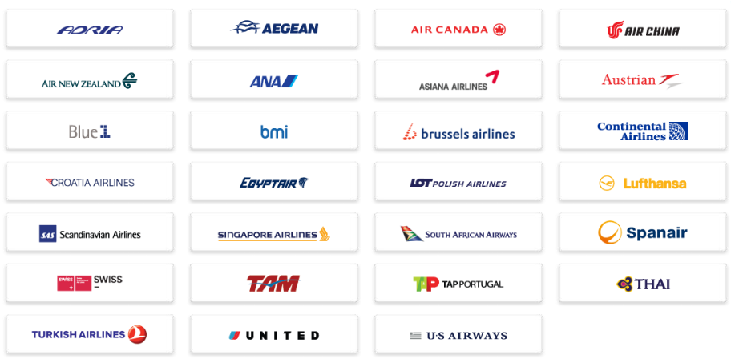
Airline Alliances

Slide 15
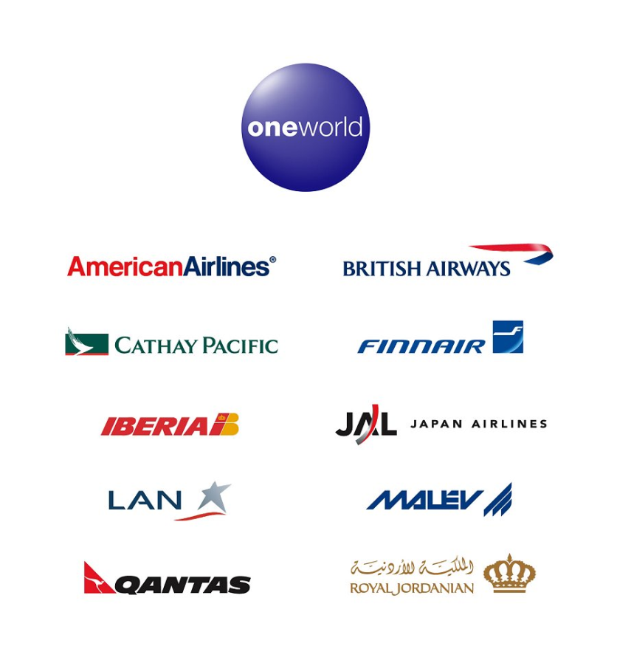
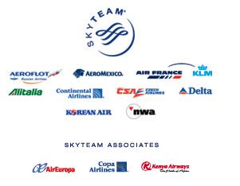
Airline Alliances

Slide 16
Benefits of Alliances
An extended and optimized network through code sharing
Cost reduction from sharing of:
Sales offices
Maintenance/operational facilities
Operational staff
Investment and purchases (bulk purchase)
Benefits traveler through:
Lower price
More choice of departure times, destinations, and airport lounges
Shorter travel time, faster reward

Slide 17
Industry Overview

Slide 18
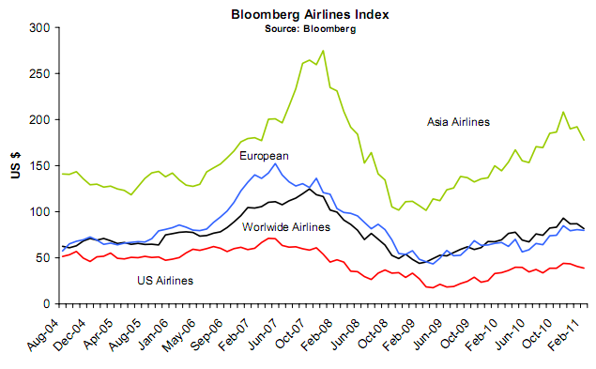

Slide 19
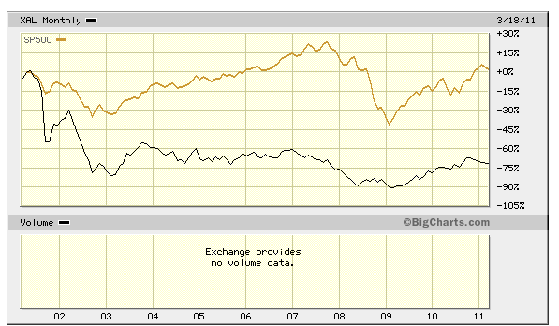

Slide 20
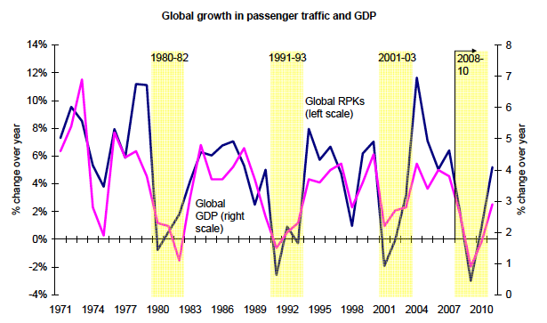

Slide 21
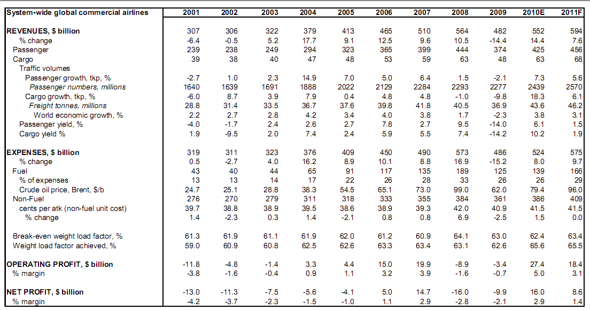

Slide 22
Short term

Slide 23
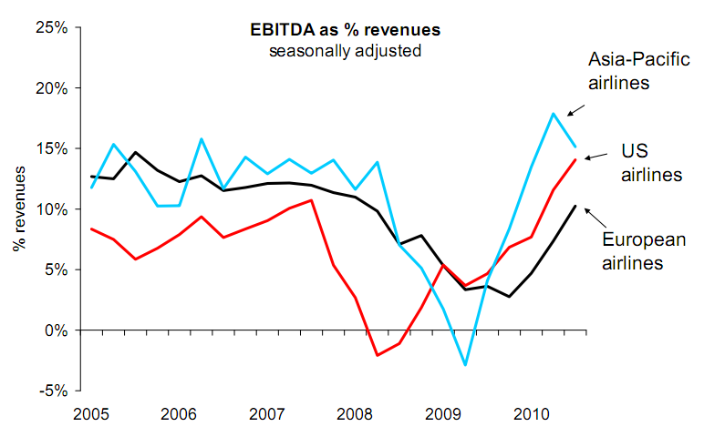
Source: Bloomberg

Slide 24
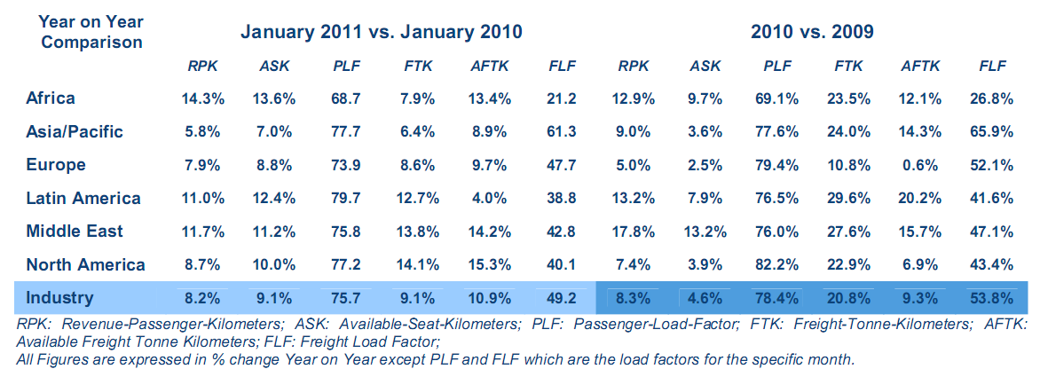

Slide 25
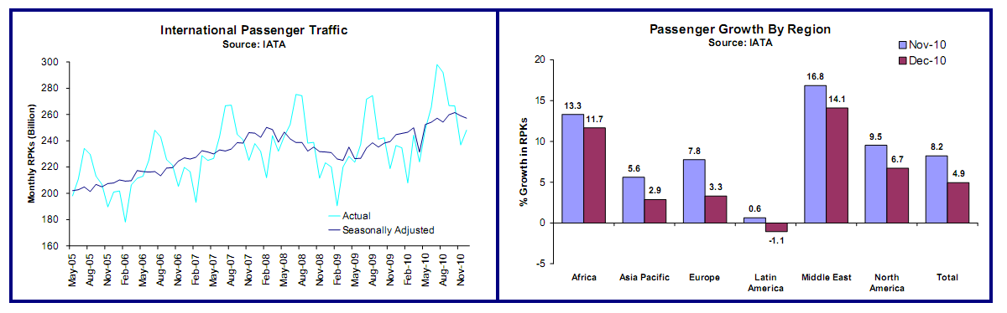
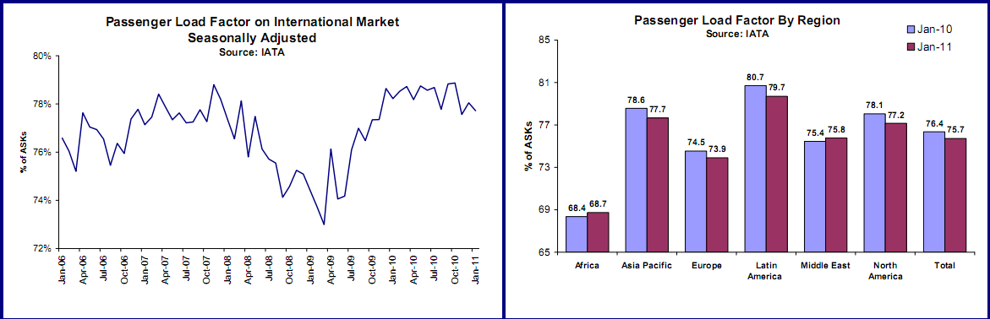

Slide 26
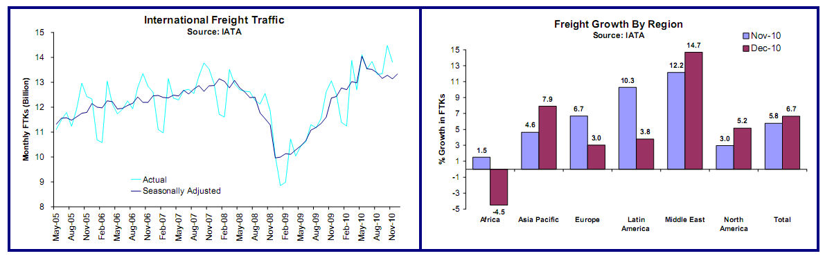
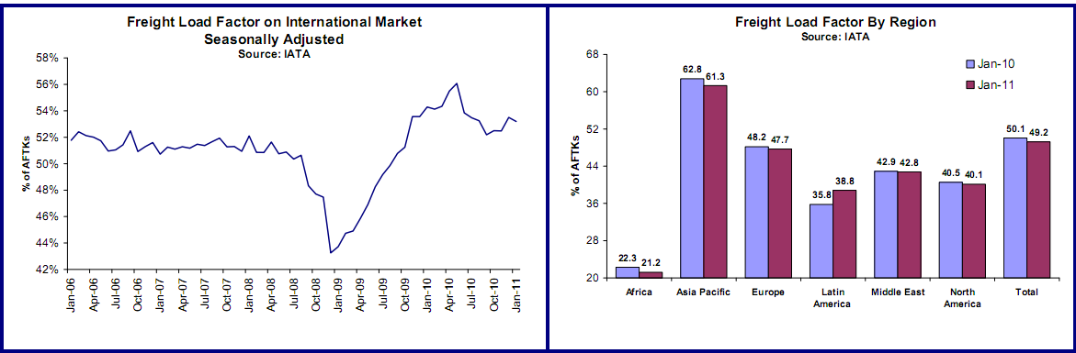

Slide 27
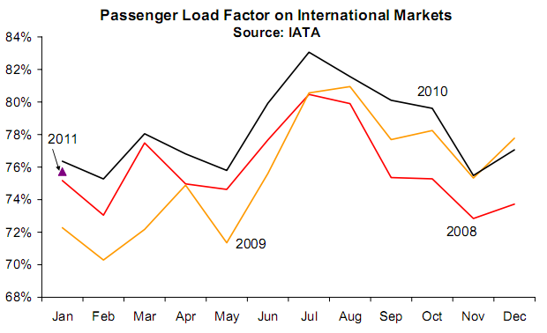

Slide 28
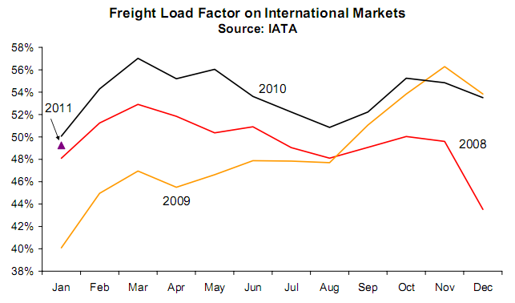

Slide 29
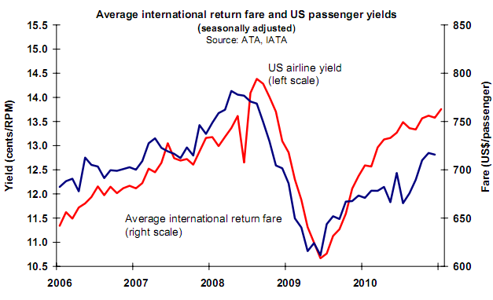

Slide 30
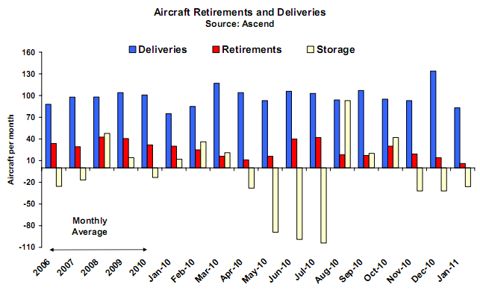

Slide 31
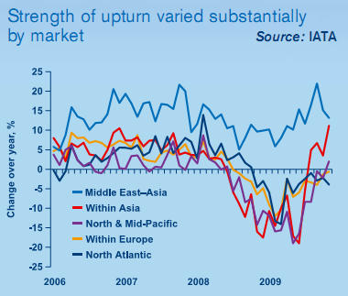

Slide 32
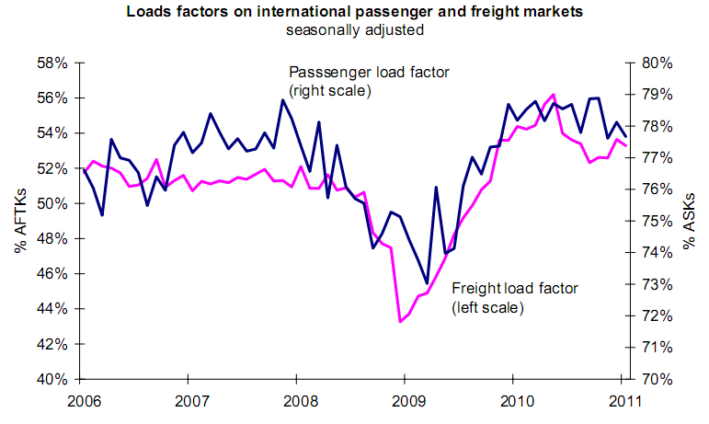

Slide 33
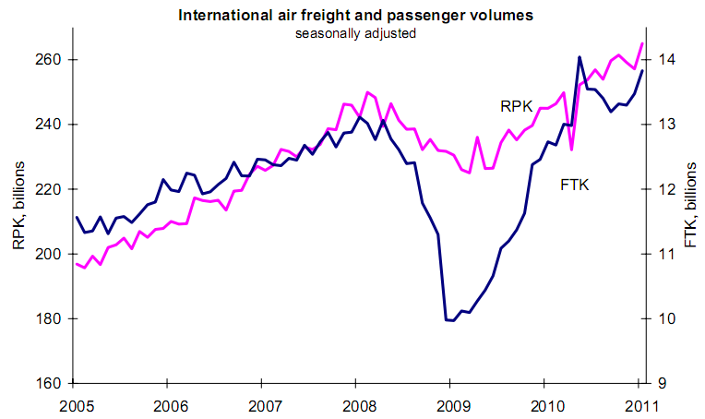

Slide 34
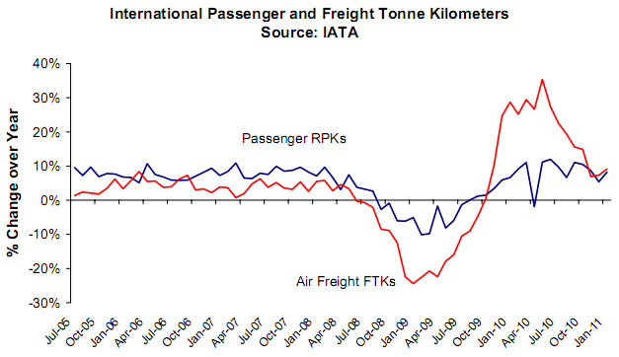

Slide 35
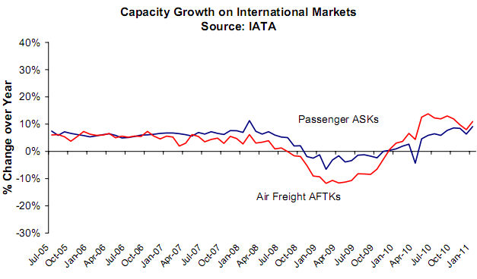

Slide 36
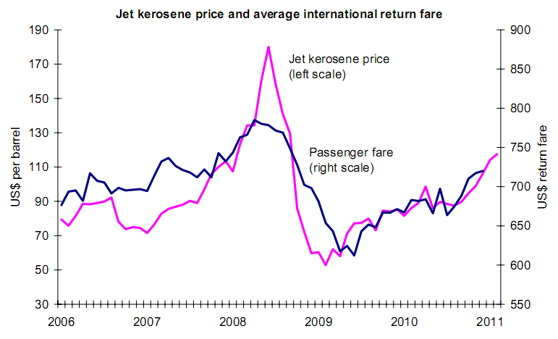

Slide 37
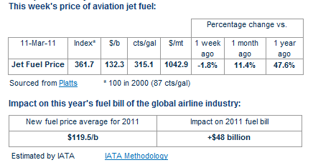
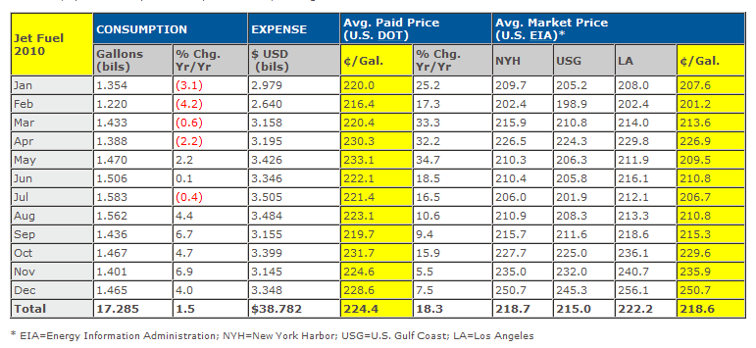

Slide 38
Long term

Slide 39
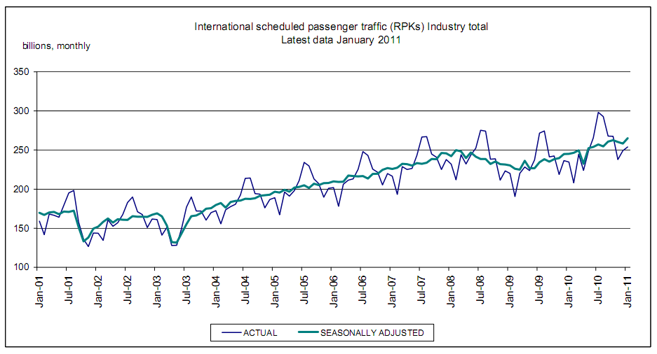

Slide 40
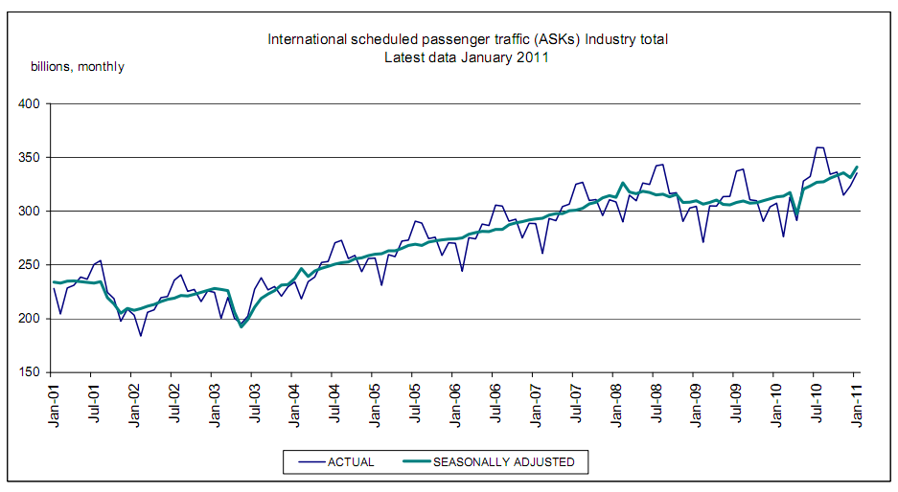

Slide 41
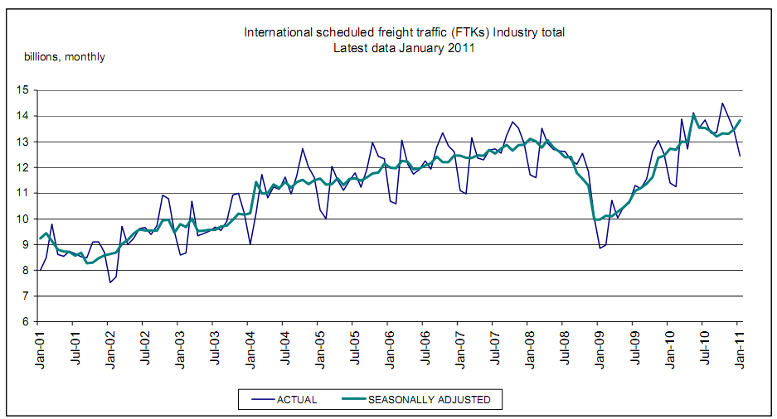

Slide 42
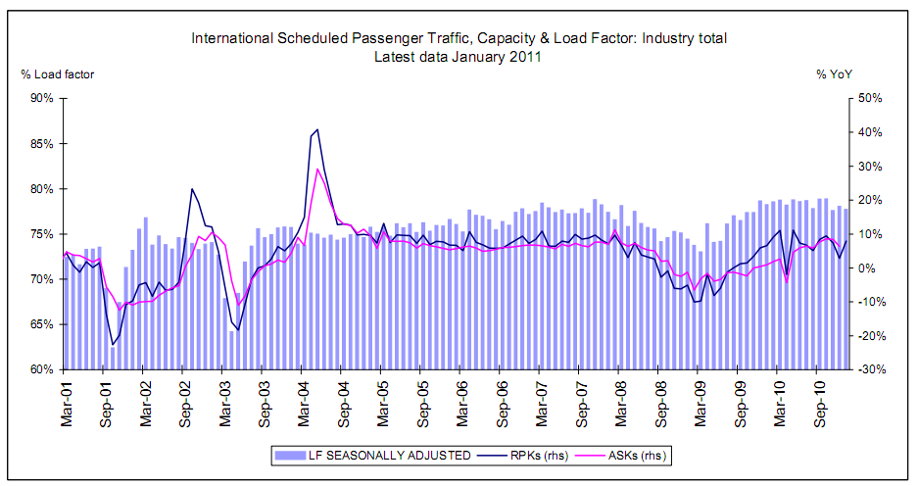

Slide 43
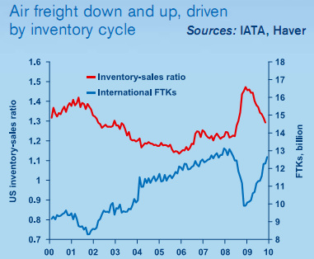

Slide 44
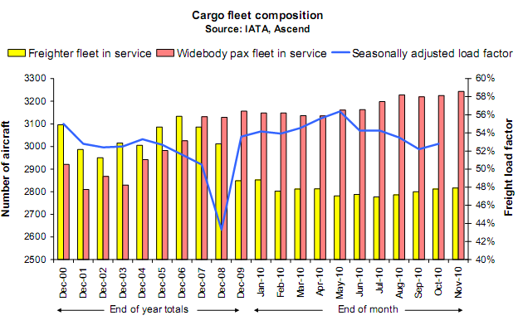

Slide 45
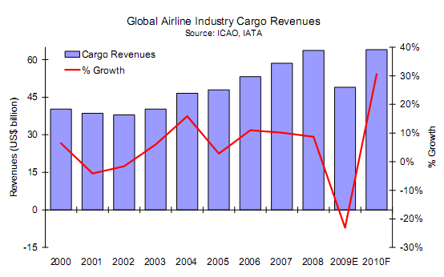

Slide 46
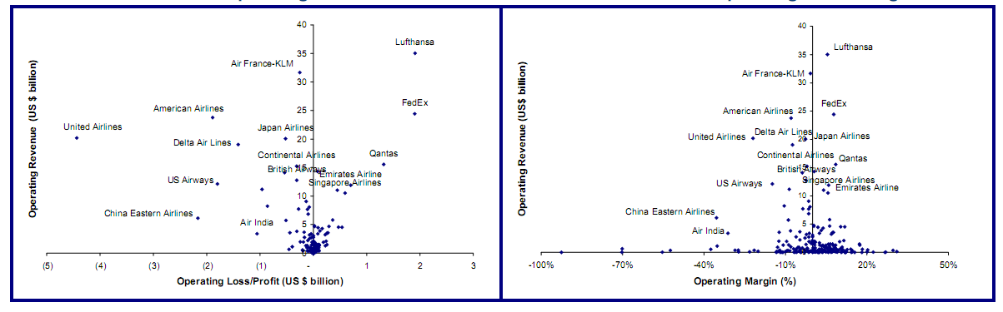

Slide 48
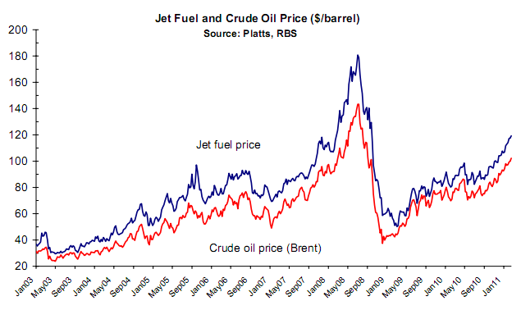

Slide 49
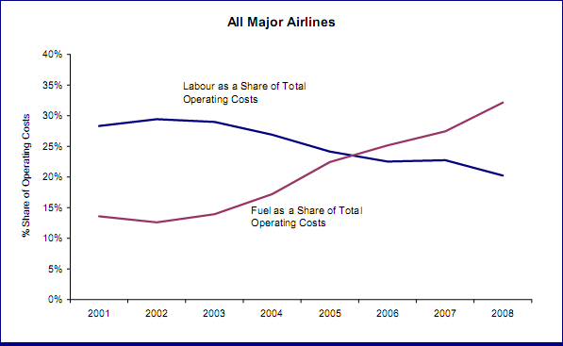

Slide 50
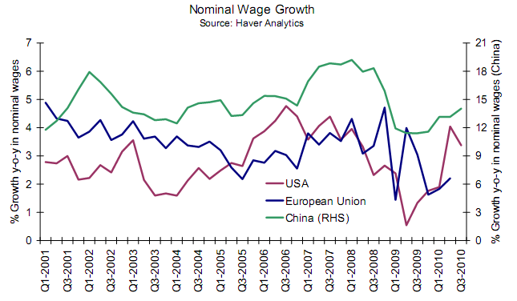

Slide 51
OUTLOOK

Slide 52
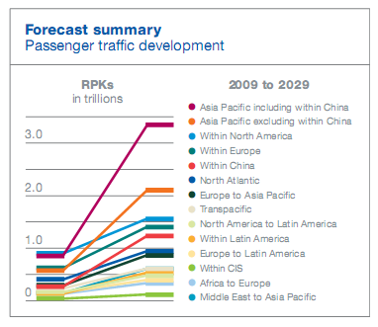
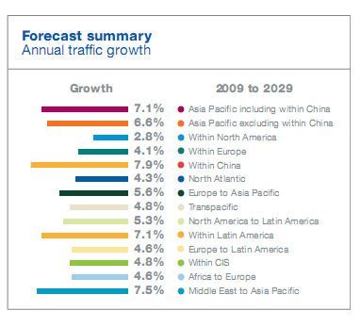

Slide 53
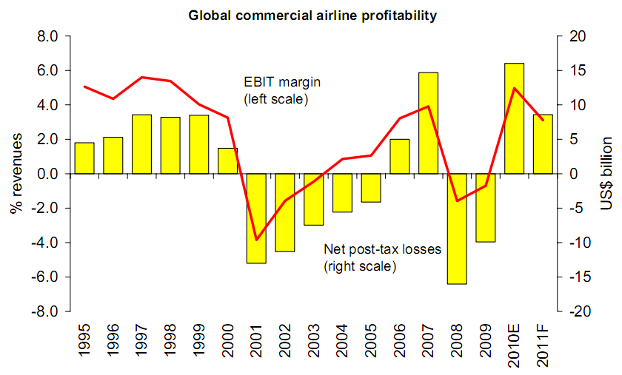

Slide 54


Slide 55


Slide 56


Slide 57


Slide 58


Slide 59


Slide 60


Slide 61


Slide 62


Slide 63


Slide 64



Slide 65

AMR Corporation

Slide 66

Company analysis
AMR Corporation

Slide 67

Current Stock Price

Slide 68

1 Year Performance

Slide 69

5 Year Performance

Slide 70

10 Year Performance

Slide 71

10 Year AMR vs. Dow Jones Transportation

Slide 72

10 Year AMR vs. AMEX Oil

Slide 73
Company Profile
Operates through subsidiaries
American Airlines
AMR Eagle Holding (AMR Eagle)
American Connection
Serves 250 cities in 40 countries
More than 3400 daily flights with 900 aircraft
Founding member of OneWorld alliance

Slide 74


Company Profile cont’d
One of the largest airlines in the world
By scheduled passengers carried By scheduled passengers-kilometer

Slide 75
Company Profile cont’d
Hub and spoke system
Dallas/Fort Worth (DFW)
Chicago O'Hare
Miami
New York City
Los Angeles
Network covers US, Mexico, Puerto Rico, Caribbean, Canada, Latin America, Europe and the Pacific region

Slide 76

Hubs and Destinations

Slide 77
Local Competitors
AirTran Airways (Air Tran)
Alaska Airlines (Alaska)
Continental Airlines (Continental)
Delta Air Lines (including Northwest Airlines) (Delta)
Frontier Airlines
JetBlue Airways (JetBlue)
Hawaiian Airlines
Southwest Airlines (Southwest)
Spirit Airlines
United Airlines (United)
US Airways
Virgin America Airlines

Slide 78
Recent Events
Joint business agreement
Cooperation with British Airways, Iberia, Finnair and Royal Jordanian started in October
Implementation of JBA with JAL expects to being in 2011
Commercial collaboration with JetBlue
Connect American’s 15 international destinations with JetBlue’s 26 domestic cities

Slide 79
Labour Issues
Wages, salaries and benefits represented approximately 31% of operating expenses
78,250 full-time employees as of Dec 31, 2010
Majority of employees are represented by labour unions and covered by collective bargaining agreements
Ongoing labour disputes with the Allied Pilots Association (APA)

Slide 80

Fuel Costs and Hedging
Hedging philosophy
Enters into jet fuel and heating oil hedging contracts to dampen the impact of the volatility of jet fuel prices
Does not take views on the direction of fuel prices
Layers in fuel hedges on a systematic basis

Slide 81

Fuel Costs and Hedging cont’d
Uses primarily heating oil options (NYMEX heating oil) and collar contracts to hedge commodity price risk

Slide 82

Frequent Flyer Program
Established AAdvantage to develop
passenger loyalty by offering
awards to travelers
One of AMR’s competitive advantages
Mileage credits are also sold to over 1000 program participants including credit card issuers, hotels and car rental companies
67 million members, 587 billion outstanding award miles as of Dec 31, 2010

Slide 83
Major Risks
Weak financial conditions caused by significant losses in recent years
Weak demand due to global economic downturn
Significantly below investment grade credit ratings
Substantial additional funds are needed to maintain sufficient liquidity
Exposure to fuel prices and fuel supply
Increasing competition reduces pricing power

Slide 84
Company History
1934
American Airlines founded
1945
started American Overseas Airlines
1964
introduced SABRE
1979 headquarters moved to Dallas/Fort Worth
1980
created AAdvantage

Slide 85
Company History (cont’d)
1982
AMR became the holding company
1987
established American Eagle
1999
formed global alliance OneWorld
2001
acquired TWA;
2 planes involved in 911
2005
expanded to Ireland, India, mainland China
2010
joint business agreements with JBA

Slide 86

Management team
AMR Corporation

Slide 87

Management Team
Gerard J. Arpey
CEO, President, Chairman (since May 2004)
Age: 52
BBA from University of Texas
Started as a financial analyst in 1982
Senior VP of Planning 1992-1995
CFO of AMR 1995-2000
Executive VP of Operations 2000-2002
2009 Basic Salary: $669,646
2009 Total Compensation: $5,631,002

Slide 88

Management Team (cont’d)
Thomas W. Horton
CFO, Executive VP of Finance and Planning (since Mar 2006)
Age: 49
BBA from Baylor University
MBA from Southern Methodist University
Joined AMR in 1985, became VP in 1994
Senior VP and CFO of AMR 2000-2002
Vice Chairman and CFO at AT&T 2002-2006
Returned to AMR in 2006
2009 Basic Salary: $618,135
2009 Total Compensation: $3,037,316

Slide 89

Management Team (cont’d)
Daniel P. Garton
Executive VP of Marketing (since Sept 2002)
Age: 53
BA in Economics from Stanford University
MBA in Finance from Cornell University
Started in Finance Department in 1984
VP and CFO of Continental 1993-1995
President of American Eagle Airlines 1995-1998
Executive VP of Customer Service 2000-2002
2009 Basic Salary: $530,478
2009 Total Compensation: $2,854,334

Slide 90

Company performance
AMR Corporation

Slide 91

Flight Equipment

Slide 92

Leases
Includes various types of equipment and property, primarily aircrafts and airport facilities
202 jet aircraft and 39 turboprop are under operating leases
70 jet aircraft are under capital leases

Slide 93

Contractual Obligations
Notes:
.

Slide 94

Long-term Debts
Significantly below investment grade credit ratings (rated CCC by Morningstar)

Slide 95


Segment Reports

Slide 96

Operating Expenses

Slide 97

Operating Statistics

Slide 98

Financials
AMR Corporation

Slide 99

Consolidated Balance Sheets

Slide 100

Consolidated Balance Sheets (cont’d)

Slide 101

Consolidated Statements of Operations

Slide 102

Consolidated Statements of Cash Flow

Slide 103

Consolidated Statements of Stockholders’ Equity (Deficit)

Slide 104

Shared Based Compensation
The 2003 Employee Stock Incentive Plan
Employees may be granted stock options, restricted stock and deferred stock
The 2009 Long Term Incentive Plan (LTIP Plan)
Officers, key employees may be granted certain types of stock or performance based awards

Slide 105

Retirement Benefits
Poor performance on
Pensions benefits
Retiree medical and other benefits

Slide 106
Conclusion
Intense competition and low pricing power
Global economic downturn and weak demand
CCC credit rating
Net loss
Negative Equity
Large amount of outstanding options
Underfunded retirement funds

Slide 107

Recommendation
SELL!!

Slide 108

Southwest Airline
More Than a Way to Fly — A Way of Life

Slide 109


Stock Information
Year | 2009 | 2008 | 2007 | 2006 | 2005
Shares Outstanding (Millions) | 747.10 | 741.94 | 741.45 | 740.81 | 739.99

Slide 110

1 Year Price Chart

Slide 111

5 Year Price Chart

Slide 112

10 Year Price Chart

Slide 113

10 Year LUV vs. Dow Jones Transportation

Slide 114

10 Year LUV vs. OIL Price

Slide 115

5 Year Cumulative Return
(reinvestment of dividends)

Slide 116

Company Profile

Slide 117
Timeline: 1960 - 1980
1967: Incorporated as Air Southwest Co.
1971: Launches first route with 3 Boeing 737 aircrafts serving only Dallas, Houston and San Antonio
1973: Southwest posts first profit
1976: Renamed to Southwest Airlines Co. (SWA)
1977: SWA carries its 5 millionth passenger and is listed on the NYSE
1978: SWA flies outside Texas to New Orleans

Slide 118
Timeline: 1980 - Present
1982: SWA begins flights to the West Coast
1990: Revenues exceed $1 billion
1994: Morris Air and Arizona One are acquired
1996: Online booking site is launched
2005: SWA enters first ever codeshare arrangement, with ATA Airlines
2009:Southwest Airlines is the largest carrier in the US with 545 Boeing 737 aircrafts servicing 68 airports in 35 states and able to offer more than 3,300 flights a day

Slide 119

Southwest Airlines Culture: 1970s
Promotional Theme: “Love”
Flight attendants were dressed in hot pants and go-go boots
Served “love potions” and “love bites” (drinks and peanuts)
Mostly male business fliers

Slide 120

Southwest Airlines Culture: 1980s
Promotional Theme: “Fun”
Airline was found guilty of sex discrimination
“fun” uniform of golf shirts, surfer shorts and tennis shoes
Offered in-flight games and giveaways
Became the official airline for SeaWorld

Slide 121
Company Today
“The mission of Southwest Airlines is dedication to the highest quality of Customer Service delivered with a sense of warmth, friendliness, individual pride, and Company Spirit.”
Southwest Airlines is the largest low cost carrier in the US with 548 Boeing 737 aircrafts servicing 72 cites in 37 states and able to offer more than 3,400 flights a day with nearly 35,000 employees.
Best cumulative Customer Satisfaction record among airlines for the last 18 years that the Department of Transportation has kept this statistic.
As year end of 2010, SWA has been profitable for 38th consecutive years and declares 138th consecutive Quarterly Dividend

Slide 122
Business Model
Point-to-Point
Flying multiple short quick trips
Factors that allow low operating costs
Employees: Empowerment and Respect
Higher productivity
Flying into the secondary airports of major markets
Reduces costs associated with landing fees, etc.
Less congestion → Increase turnaround
One Aircraft Type: Boeing 737
Reduce costs associated with maintenance, training and ground operations
These factors allow Southwest to provide ‘low-cost’ flights

Slide 123
Size of Southwest Airlines

Slide 124


Aircraft Fleet

Slide 125

Aircraft Fleet

Slide 126

Restricted Stock Units

Slide 127


Stock Option

Slide 128

Customer Services

Slide 129

Servicing Map

Slide 130


Region & Market Share
Southwest ‘s Top Ten Airports- Daily Departures

Slide 131



Innovation
“One of the most innovative companies in the world” – BusinessWeek, 2009
EarlyBird Check-In
By paying $10 (one-way), customers can be checked in
automatically up to 6 hrs before general boarding positions
become available and have a confirmed boarding position
Allows customers to have earlier access to seats and luggage compartments
Generated $15 million in revenue in 2009
P.A.W.S. (Pets Are Welcome on Southwest)
Customers can bring a small dog or cat on board by
paying $75
In the first 7 months (june to dec 2009), it generated more
than $5 million in revenue

Slide 132
Recent News
On Sep 27 2010, Southwest Airlines announced that it has entered into a definitive agreement to acquire all of the outstanding common stock of AirTran Holdings, Inc.
AirTran Airways, a subsidiary of AirTran Holdings, Inc. (NYSE: AAI) and a Fortune 1000 company, has been ranked the number one low cost carrier in the Airline Quality Rating study for the past three years
Using approximately 57 million shares of Southwest Airlines common stock as well as approximately $670 million in cash.
the combined organization would have nearly 43,000 Employees and serve more than 100 million Customers annually from more than 100 different airports in the U.S. and near-international destinations
On Feb 24 2011, FAA accepted transition plan
Beginning March 13, 2011, Southwest will initiate service to Charleston and Greenville/Spartanburg, South Carolina, and on March 27, 2011, service will begin to Newark Liberty International Airport

Slide 133

Southwest Management

Slide 134

Management
Herbert D. Kelleher - Founder and
Chairman Emeritus
Incorporated Southwest in 1967
1976 to 2008: Executive Chairman
1981 to 2001: President and CEO
May 2008: Stepped down from the role of Chairman and resigned from the Board of Directors
Graduated with honors from Wesleyan University, where he was an Olin Scholar
Major in English and Minor in Philosophy
Graduated from NYU Law School, where he was a Root-Tilden Scholar

Slide 135

Management
Gary C. Kelly – Chairman, President
(since 1994), CEO
Age: 55
1986: Joined the company as Controller
1989: CFO and VP of Finance
1991: Executive Vice President
2004: CEO
2008: Chairman of the Board of Directors
Education:
Earned B.B.A. in Accounting from University of Texas
Certified Public Accountant

Slide 136

Management
Laura Wright - CFO, VP of Finance
(Since 2004)
Age: 49
1988: Joined the company as Director of Corporate Taxation
1990: Director of Corporate Finance
1995: Assistant Treasurer
1998: Treasurer
2001: VP of Finance and Treasurer
2004: VP Finance and CFO
Education:
Earned B.S.A and an M.S.A. (emphasis in taxation) from the University of North Texas
Certified Public Accountant

Slide 137

Management
Michael Van de Ven – COO,
Executive Vice President
Age: 48
Joined the company in April 1993
Experience in the Company:
Executive Vice President of Aircraft Operations
Senior Vice President of Planning
Vice President Financial Planning & Analysis
Senior Director of Financial Planning & Analysis
Director of Financial Planning
Director of Internal Audit
Education:
B.B.A. from University of Texas at Austin
Certified Public Accountant

Slide 138

Operating Statistics

Slide 139
Net Income: Annually

Slide 140
Revenue: Annually

Slide 141
Performance

Slide 142
Operating Expenses

Slide 143

Operating Expenses

Slide 144
Summary
Factors affecting increasing operating costs:
Increase price of jet fuel → Hedging strategy
Factors affecting increasing revenues:
Increase in average ticket price

Slide 145

FINANCIALS

Slide 146

Balance Sheet

Slide 147

Income Statement

Slide 148
Income & Expense Figure

Slide 149
Hedging Strategy
Jet fuel contracts are not traded on any exchange therefore to hedge risk they us crude oil, heating oil, and unleaded gasoline futures.
SWA uses call options, collar structures and fixed price swap agreements.
For 2010, SWA had fuel derivatives in place related to approximately 40 percent of its fuel consumption.

Slide 150

Fuel Derivative Contract

Slide 151

Cash Flow Statement

Slide 152
Conclusion
Negative
Increasing fuel cost
Difficult in integration employees
Positive
Largest low cost carrier
Very liquidity, Profitable year
East expansion

Slide 153

Recommendation
HOLD

Slide 154

Cathay Pacific

Slide 155

Stock Information
 | 2010 | 2009 | 2008 | 2007 | 2006 | 2005
Shares Outstanding (million) | 3,933.845 | 3,932.612 | 3,932.612 | 3,940.025 | 3,383.161 | 3,342.213

Slide 156

1 year stock price

Slide 157

5 year stock price

Slide 158

8 year stock price

Slide 159

8 year vs. Airline Index

Slide 160

8 year vs. Hangseng Index

Slide 161

8 year vs. oil & gas

Slide 162

Fleet 2010
The average fleet age is 10.9 years at September 2010

Slide 163

Company Profile

Slide 164
History
1946: Incorporate as Cathay Pacific Airline.
1948:Swire Group took a 45% share in the company
1960s: First to initiated international services to Osaka, Fukuoka and Nagoya
1970s:make use of computerized reservation system and flight simulators
1980s:expand to London, Brisbane, Frankfurt, Vancouver, Amsterdam, Rome, San Francisco, Paris, Zurich, Manchester.
1990s:change green and white striped livery to the dynamic and now famous Asian "brushstroke" image

Slide 165
History (Cont.)
Mid 1990s: used US$9 billion to assemble a fleet of aircraft that was among the youngest in the world
2002: became joint venture partners in Air Hong Kong with DHL
2003:resume passenger services to Beijing & undertook a range of e-business initiatives
2005: the "Airline of the Year & Airline of the Year 2006
2006: closer relationship with Air China by taking 20% shareholding
2010, Cathay signed a framework agreement with Air China to establish a joint venture cargo airline

Slide 166

Cathay Pacific
International airline company based in Hong Kong
Strategy: building its network around the hubs of Hong Kong and Beijing
Slogan: “Great Service. Great People. Great Fares”
OneWorld Alliance partner
Strong reputation for comfort and reliability

Slide 167

Cathay Pacific service
Operations include scheduled passenger and cargo services to 117 destinations in 36 countries worldwide
128 wide-bodied aircrafts: First, Business, Economy classes
Cargo services contributed to 30% of total revenue
Dominant value share of 74% in 2009

Slide 168

Traffic

Slide 169

Operating statistics

Slide 170

Load factor

Slide 171

Capacity, Load factor and yield

Slide 172
Traffic figures

Slide 173

Geographical turnover

Slide 174



Pioneer in Technology:
Development of self-service check-in through internet and airport kiosks
Passenger e-ticket for Oneworld partners
Introduction of paperless cargo
Seats in all classes are equipped with personal TVs
New innovative seat design (3 point seatbelt)

Slide 175
Future technology
Onboard phone calls and unlimited Wifi access from 2012.
Blackberry and PDA messaging will be enabled, along with calls
Limited number of websites will be available free of charge, including cathaypacific.com and its partners, as well as social media services.
Full internet access with only video-streaming and VoIP calls such as Skype

Slide 176


Asia Mile & Marco Polo Club
The number of Asia Miles partners increased to more than 400 in nine categories
More than three million members
Over 90% of Cathay Pacific flights carried passengers redeeming frequent flyer miles
More than 750 destinations worldwide
Travel benefits such as guaranteed Economy class seat, additional baggage allowance, priority flight booking and airport lounge access

Slide 177
Major subsidiaries
Air Hong Kong Limited: 60%
Cathay Pacific Catering Services: 100%
Hong Kong Airport Services Limited: 100%
Dragonair: 100%
Air China Limited: 20%
Hong Kong Aircraft Engineering Company: 15%

Slide 178

Shareholders

Slide 179

Air China
One of the major airlines of People’s Republic of China based at Beijing Capital International Airport
World's 10th largest airline by fleet size
A member of Star Alliance

Slide 180

Swire Pacific Limited
SEHK:0019, founded in 1816
A transnational corporation headquartered in London
Core businesses are grouped into: property, aviation, beverages, marine services, and trading and industrial
Swire Pacific ranks second in Wall Street Journal's Most Admired Company in Hong Kong list

Slide 181
Recent News & Plans
It added 22 destinations to its network
Restored services to Fukuoka and Sendai in Japan and added Okinawa to its network.
A four-times-weekly service to Abu Dhabi in June
Daily flight to Chicago which launches on 1 September.
Will boost passenger capacity 11 % and increase cargo capacity 12 % in coming year
Slower demand in cargo this year

Slide 182

Cathay Pacific Management

Slide 183

Management
Christopher Pratt, aged 53
Honor degree in modern history from University of Oxford
Chairman and a Director of the Company since 2006.
Joined the Swire group in 1978
Chairman of Swire Pacific Limited, Hong Kong Aircraft Engineering Company Limited and Swire Properties Limited, and a Director of The Hongkong and Shanghai Banking Corporation Limited and Air China Limited.

Slide 184

Management
Tony Tyler, aged 56
Graduated from Oxford University
Currently Chief Executive.
Director of the Company since 1996
Director Corporate Development in 1996 and Chief Operating Officer in 2005
Joined the Swire group in 1977
Chairman of Hong Kong Dragon Airlines Limited and Director of Swire Pacific Limited.

Slide 185

Management
John Robert Slosar, aged 53,
Economics degree from Columbia University and Cambridge University.
Director of the Company since July 2007.
Was appointed Chief Operating Officer in 2007.
Joined the Swire group in 1980
A Director of Swire Pacific Limited and Hong Kong Dragon Airlines Limited.

Slide 186

Management
Kwok Leung Chu, aged 49
a Bachelor of Social Science degree from the University of Hong Kong and a Master of Commerce degree from the University of New South Wales
Joined Cathay Pacific in 1984
Chairman of Cathay Pacific Catering Services (H.K.) Limited.
has been Director Service Delivery since September 2008
General Manager Southwest Pacific based in Sydney
Appointed an Executive Director and Chief Operating Officer

Slide 187

Financial Analysis

Slide 188

Operating highlights

Slide 189
Operating highlights

Slide 190

Financial position

Slide 191

Financial position (Cont.)

Slide 192

Comprehensive income

Slide 193

Comprehensive income (cont.)

Slide 194

Operating expense

Slide 195

Operating statistics

Slide 196
Operating statistics 2010

Slide 197

Fuel hedging

Slide 198

Cash flow

Slide 199
Conclusion
Increase in revenue
More net assets
More capacity and destinations
BUT
Negative industry forecast from IATA
Fluctuate fuel price
Change of management

Slide 200

Recommendation
HOLD

