Slide 1
Global Banking Industry: Analysis and Recommendation
Boris Wang
Daniel Zhou
Jingmei Qin
Hannah Sun

Slide 2
Presentation Overview
Industry Analysis
HSBC
JPMorgan Chase
Citigroup

Slide 3
Industry Analysis
Industry Synopsis
Primary Products and Services
Revenue Composition and Cost Structure
Industry Risks
Regulatory Environment
Valuation Methodologies

Slide 4
Industry Synopsis
Banks are the cornerstone of the modern economy
Help to finance capital, provide liquidity, transfer risk, facilitate financial transactions, and monitor credit
Banks consist of 9 of the 20 largest companies in the world
Top 10 largest banks in the world have an aggregate asset of over $24 trillion

Slide 5
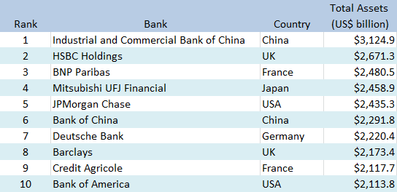
Top 10 Banks by Total Assets

Slide 6
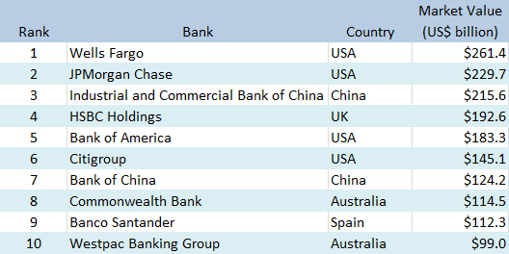
Top 10 Banks by Market Value

Slide 7
Primary Products and Services
Account services
-Deposits, debit and credit cards
Granting loans and advances
-Mortgages, business loans
Facilitation of financial transactions
-Fund transfers, payment services
Capital financing
-Debt and equity market financing

Slide 8
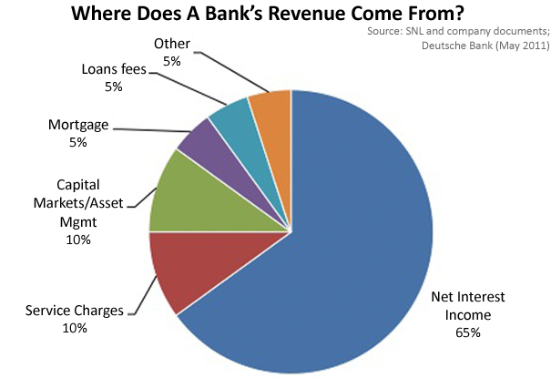
Revenue Composition

Slide 9
Revenue Composition
The primary component of a bank’s revenue comes from Net Interest Income (NII), which is the interest earned from the bank’s earning assets (loans, advances, securities), minus the interest paid on the bank’s liabilities (customer deposits, bank borrowings)
Second largest component of revenue comes from Fees which the bank charge on financial transactions and services

Slide 10
Cost Structure
A bank has two primary expenses:
Interest expense, which comprises of the interest paid on the bank’s liabilities such as customer deposits and other debt
Employee salaries and benefits

Slide 11
Industry Risks
A bank face five main type of risks:
Credit risk, potential for loss due to borrower or counterparty failing to fulfill obligations, this is the most important risk that banks have to manage
Market risk, potential for adverse changes in the price or volatility of financial assets and liabilities

Slide 12
Industry Risks
Interest rate risk, potential for adverse change in interest spread and profitability due to changes in the interest rate
Liquidity risk, possibility that a bank cannot meet a demand for cash or fund it obligations
Operational risk, potential for loss resulting from inadequate or failed internal processes

Slide 13
Regulatory Environment
Banking industry is highly regulated not only by local government but also by global regulatory authorities
Regulations require banks to comply to certain capital, leverage, and liquidity ratios in order to control risk
Regulations also require banks to monitor for illegal transactions and to provide consumer protection
Changes in regulations can significantly influence a bank’s profitability and operations

Slide 14
Regulatory Environment
2008 Financial Crisis resulted in the introduction of many new regulations aimed at protecting consumers and increasing accountability
Dodd-Frank Wall Street Reform and Consumer Protection Act in the US
Independent Commission on Banking in the UK
Basel III global banking standards

Slide 15
Dodd-Frank Wall Street Reform and Consumer Protection Act
Federal law aimed at promoting the financial stability of the US by improving accountability and transparency of the financial system, to end “too big to fail” to protect American taxpayers by ending bailouts, and other purposes.
Volcker Rule: Restriction on US banks from making certain kinds of speculative investments that do not benefit their customers. Commonly known as a ban on proprietary trading by commercial banks.

Slide 16
Independent Commission on Banking
Vickers Report: Requirement on UK banks to ring-fence retail banking from investment banking, in order to protect retail banking customers from the more risky investment banking activities

Slide 17
Basel III
The Third Basel Accord is a global, voluntary regulatory standard which builds on the Second Basel Accord to improve bank capital adequacy, stress testing, and market liquidity risk
Main focus of Basel III is foster greater resilience at the individual bank level in order to reduce the risk of system wide shocks like that of the 2008 Financial Crisis

Slide 18
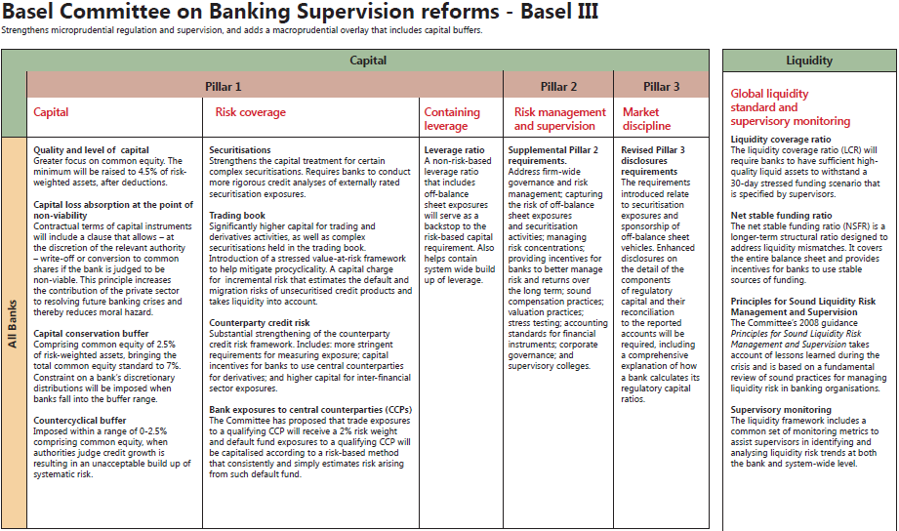

Slide 19
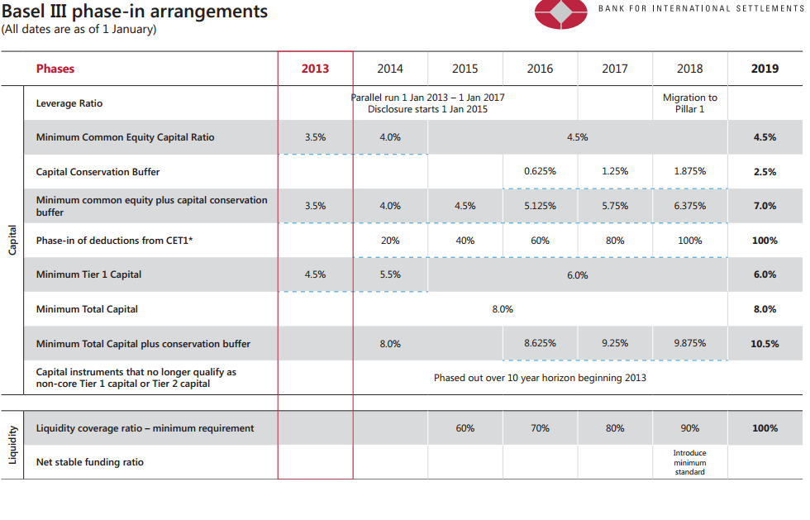

Slide 20
Valuation Methodologies
Valuation of banks and financial firm differ from that of conventional firms in many fundamental aspects:
Cash flows can not be easily estimated, since capital expenditure, working capital, and debt are not clearly defined
Banks are subject to capital requirements, in order for banks to grow their business, they must set aside a certain portion of their earnings as regulatory capital

Slide 21
Valuation Methodologies
A bank’s assets and liabilities are accounted marked-to-market instead of on a historical basis, therefore book value of equity is an accurate measure of current value
Debt resembles working capital or raw materials rather than source of capital, making the cost of capital for banks meaningless
Cannot calculate reinvestment because capital expenditure and working capital cannot be defined

Slide 22


Slide 23
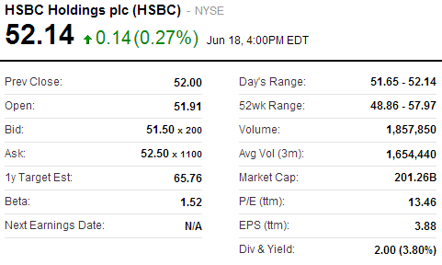
Stock Summary

Slide 24
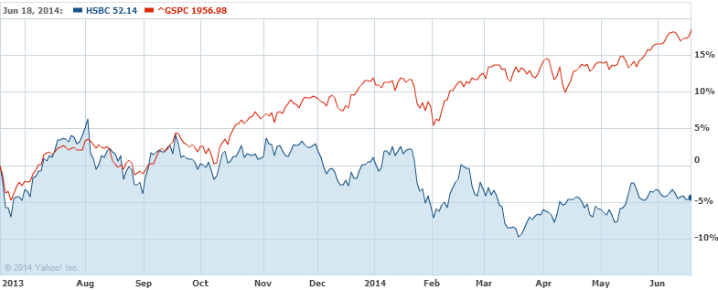
1 Year HSBC vs. S&P 500

Slide 25
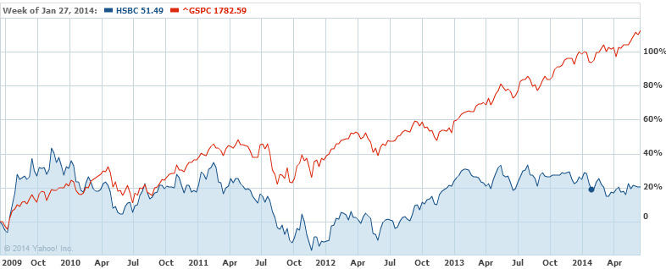
5 Year HSBC vs. S&P 500

Slide 26
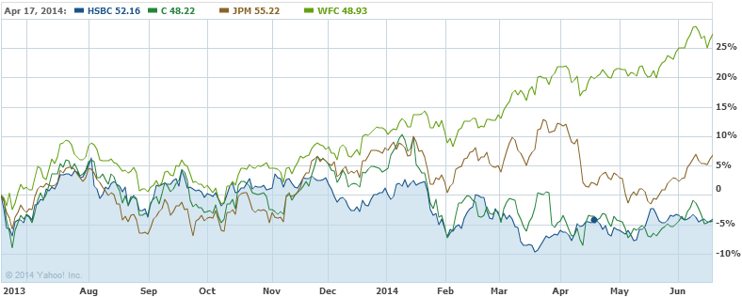
1 Year HSBC vs. Major NYSE Banks
Notes:
C: Citi-group
JPM: JP Morgan
WFC: Wells Fargo & Co

Slide 27
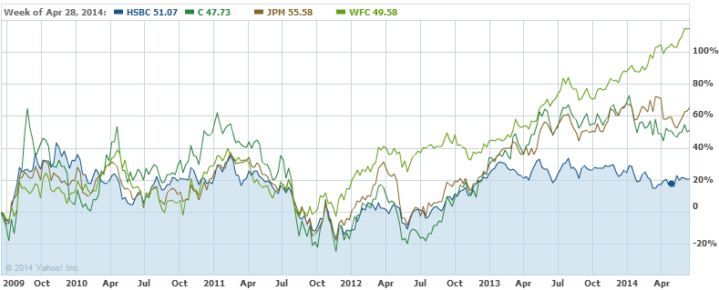
5 Year HSBC vs. Major NYSE Banks

Slide 28
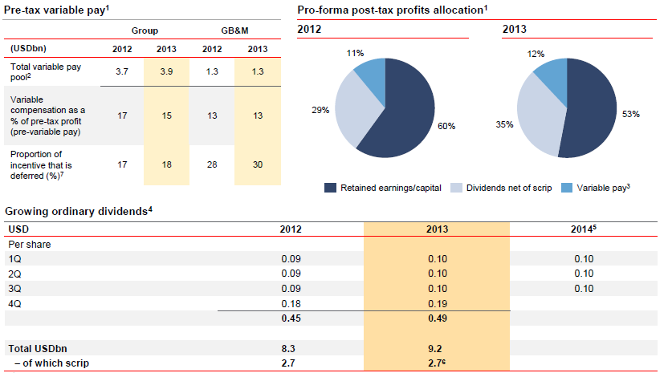
Distribution Summary

Slide 29
Company Overview
Second largest bank in the world by total assets ($2,671 billion)
Operate in 75 countries and serve 54 million customers
Headquartered in London with 254,000 employees worldwide
Ticker: HSBC (NYSE), HSBA (LSE), 0005 (SEHK)
Market Capitalization: $207 billion

Slide 30
Company Overview
HSBC operates through four global businesses:
Retail Banking and Wealth Management
Commercial Banking
Global Banking and Markets
Global Private Banking

Slide 31
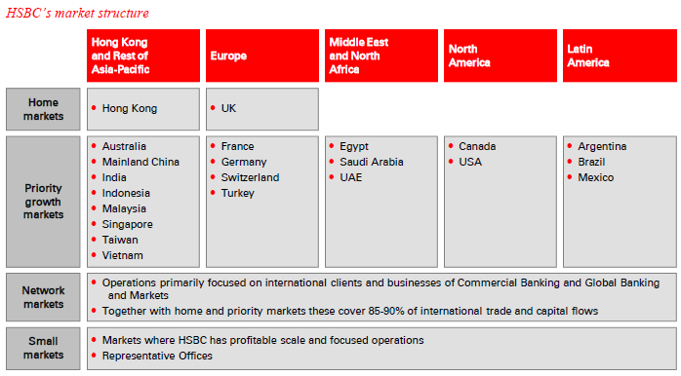
Company Overview

Slide 32
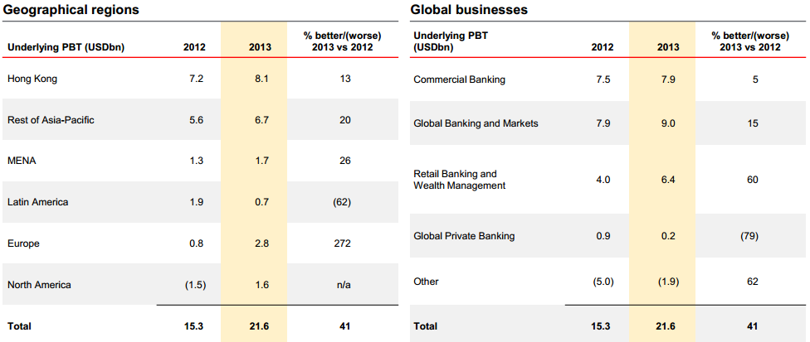
Company Overview

Slide 33
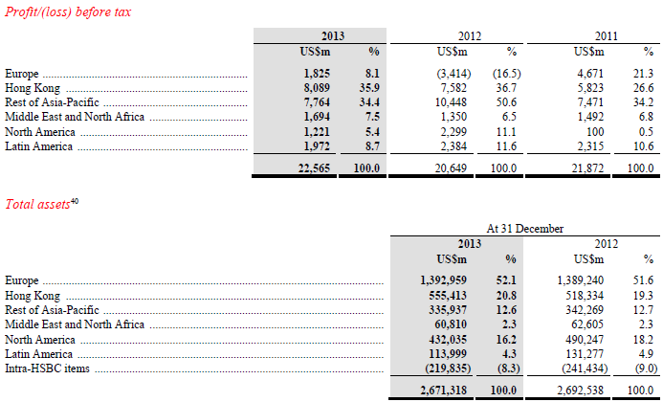
Company Overview

Slide 34
Company Overview

Slide 35
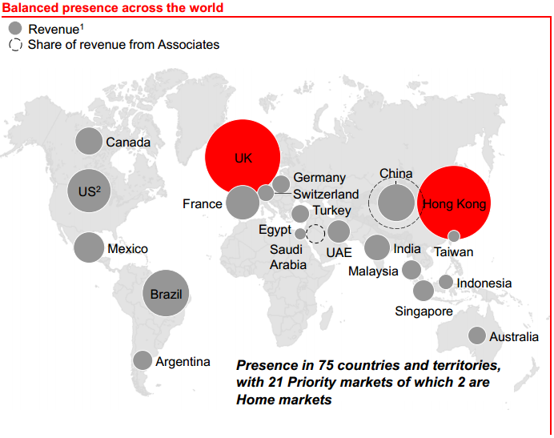
Company Overview

Slide 36
Company Overview

Slide 37
Company Overview

Slide 38
Company Overview

Slide 39
Company Overview

Slide 40
Company Overview

Slide 41
Company Overview

Slide 42
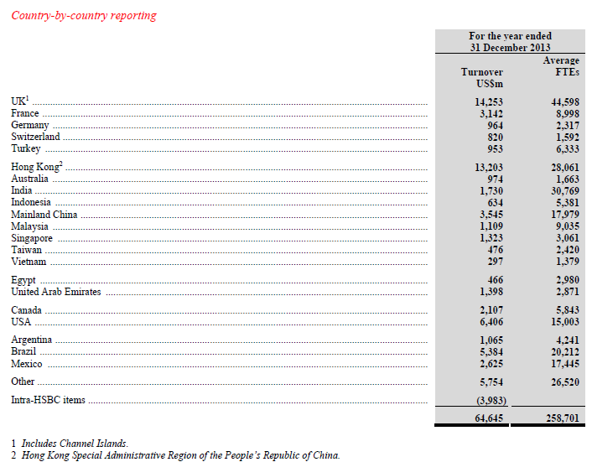
THE CAPITAL REQUIREMENTS REGULATIONS 2013

Slide 43
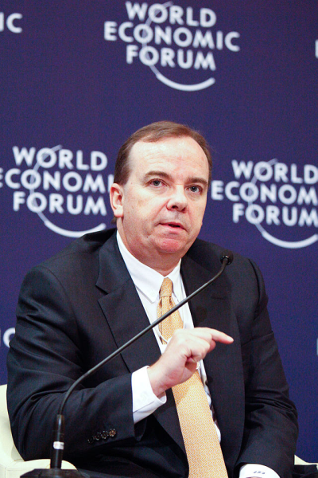
Management Team
Stuart Gulliver
Group CEO. Chairman of The Hongkong
and Shanghai Banking Corporation Limited.
Age: 54
Became Group CEO in 2011
Masters in Jurisprudence, Oxford University
Joined HSBC in 1980, rose through the ranks in the Global Banking and Markets division
Held key positions in London, Hong Kong, Tokyo, Kuala Lumpur, and UAE

Slide 44
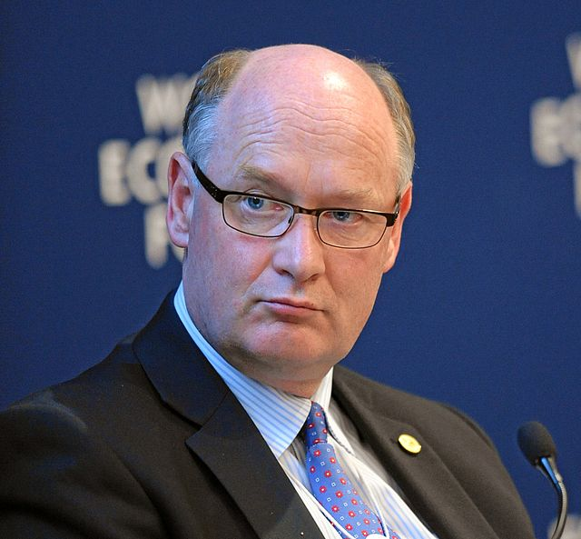
Management Team
Douglas Flint
Group Chairman of HSBC Holdings plc.
Age: 58
Became Group Chairman in 2011
Bachelors in Accounting, University of Glasgow, Chartered Accountant
Began career with KPMG, joined HSBC in 1985, former Group Finance Director

Slide 45
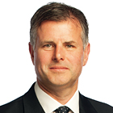
Management Team
Iain Mackay
Group Finance Director
Age: 52
He was appointed as Group Finance Director of HSBC Holdings plc in December 2010.
MA in Business Studies and Accounting from Aberdeen University in Scotland.
Before joining HSBC, Mr Mackay worked at General Electric in the US from 1996 to 2007 as Controller of the Global Consumer Finance unit, which specialised in providing credit cards and personal loans. He then became Chief Financial Officer of GE Consumer Finance - Americas, then Chief Financial Officer of GE Healthcare - Global Diagnostic Imaging.

Slide 46
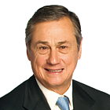
Management Team
Sir Simon Robertson
Executive Director and Group Chief Risk Officer
Age: 72
Sir Simon joined the Board in 2006. His extensive international experience included working in France, Germany, the UK and the USA.
He was educated at Eton College.
His previous roles included non-executive Chairman of Rolls-Royce Holdings plc; a partner of NewShore Partners LLP; Managing Director of Goldman Sachs International and chairman of Dresdner Kleinwort Benson.

Slide 47
Company Strategy
HSBC seeks to be the leading international bank with balanced global business model which emphasizes on resilience to market volatilities
Possess banking network covering 85% of international trade and capital flows
Has strong presence and capabilities in growth markets such as China, ASEAN, Latin America, and Middle East
Seek growth by capturing growth among high growth economies

Slide 48
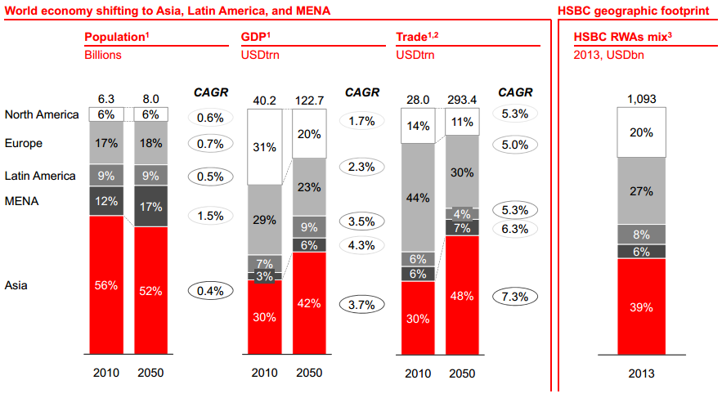
Company Strategy

Slide 49
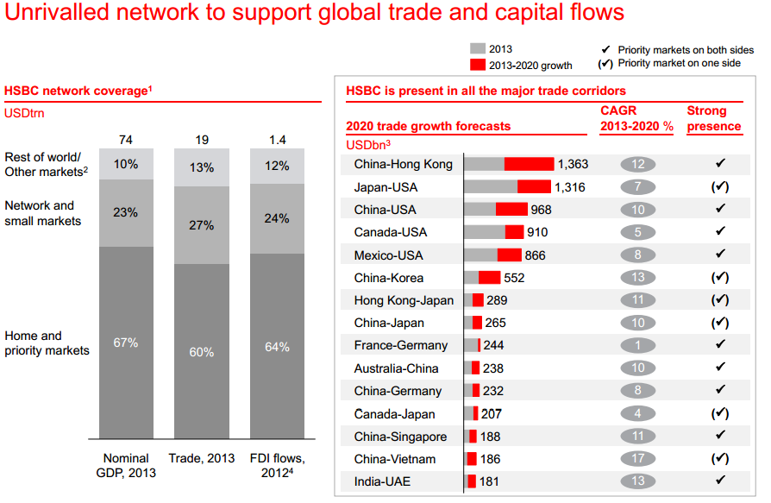
Company Strategy

Slide 50
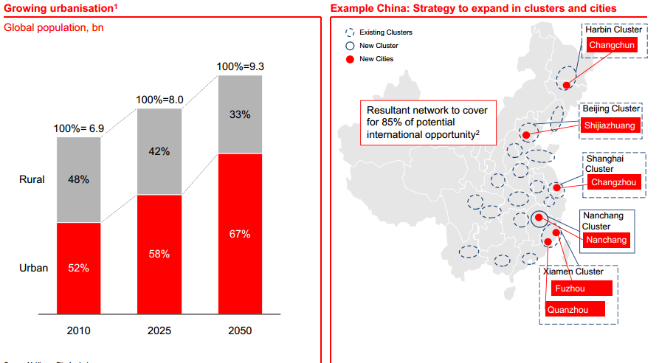
Company Strategy

Slide 51
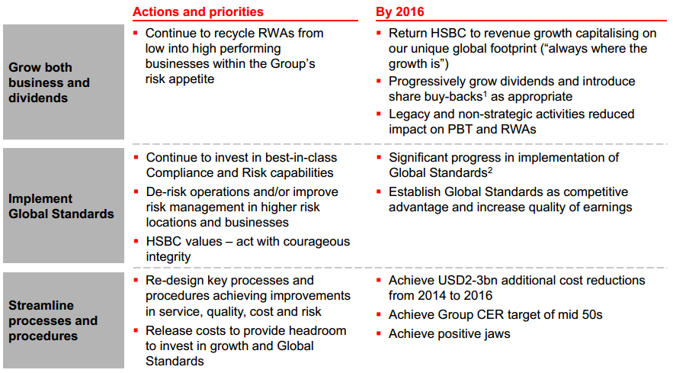
Company Strategy

Slide 52
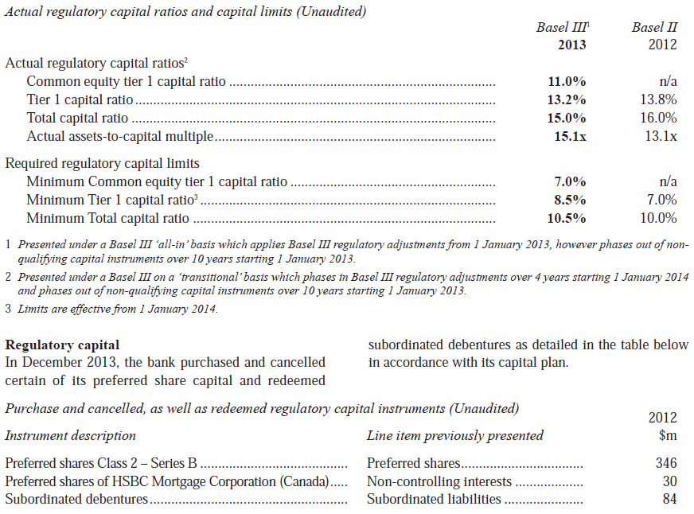
Regulatory capital ratios

Slide 53
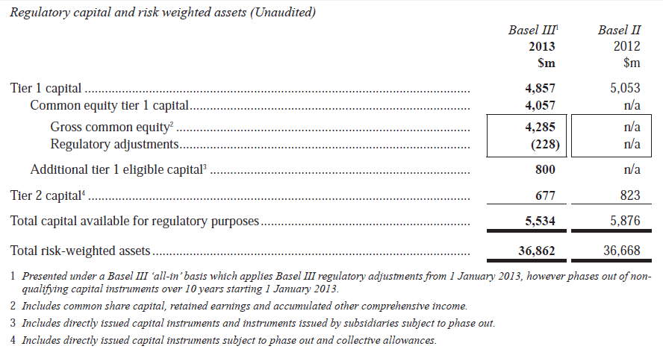
Regulatory capital ratios

Slide 54
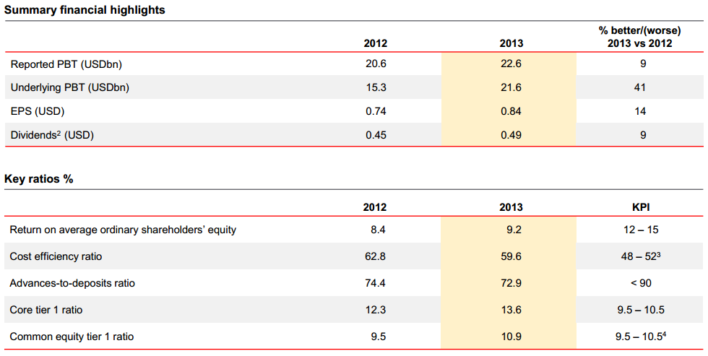
Financial Overview

Slide 55
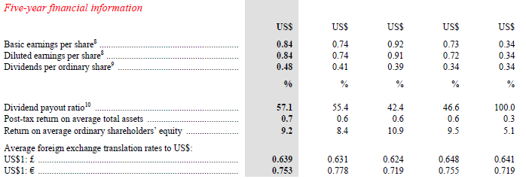
Financial Overview
2013

Slide 56
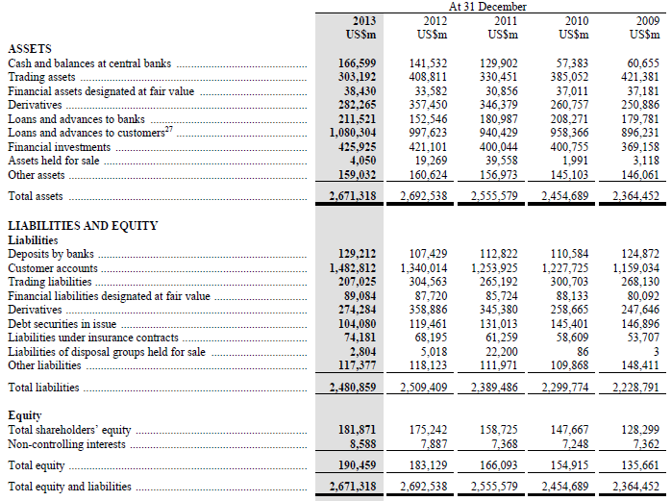
Consolidated Balance Sheet - Yearly

Slide 57
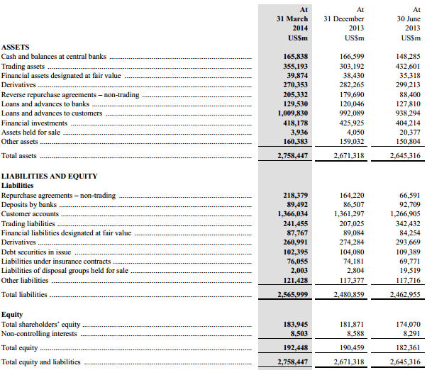
Consolidated Balance Sheet - Quarterly

Slide 58
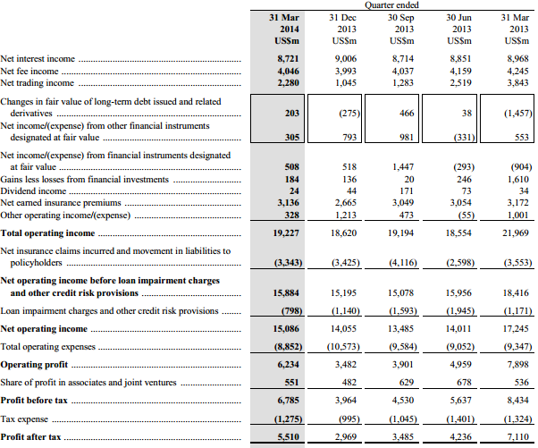
Consolidated Income Statement - Quarterly

Slide 59
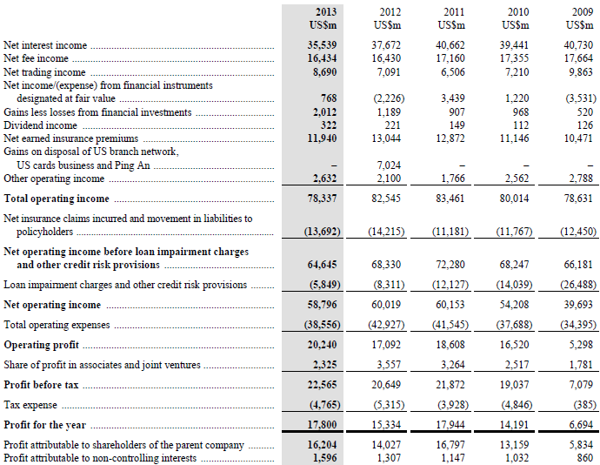
Consolidated Income Statement - Yearly

Slide 60
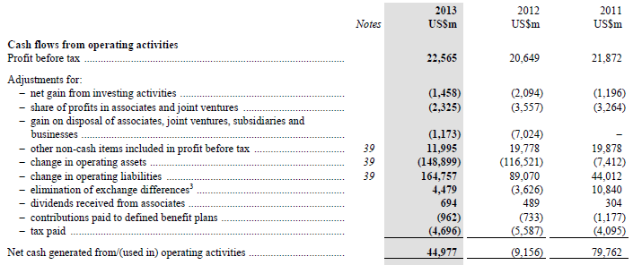
Cash Flow from Operating Activities - Yearly

Slide 61
Note 39: Notes on the statement of cash flows

Slide 62
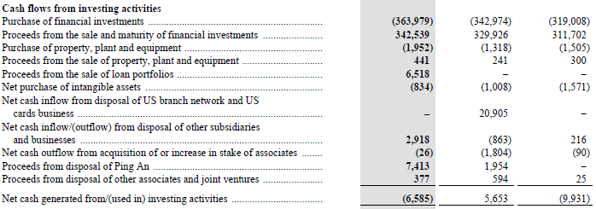
Cash Flow from Investing Activities - Yearly

Slide 63
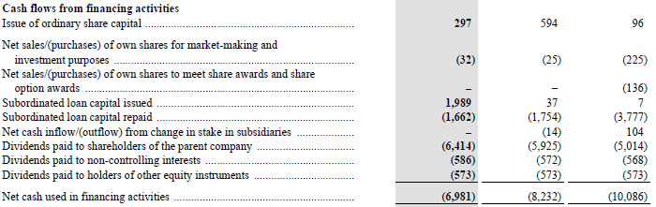
Cash Flow from Financing Activities - Yearly

Slide 64

Net Change in Cash and Equivalents - Yearly

Slide 65
Note 39: Notes on the statement of cash flows

Slide 66
Note 39: Notes on the statement of cash flows

Slide 67
Note 39: Notes on the statement of cash flows

Slide 68
Recommendation
BUY

Slide 69
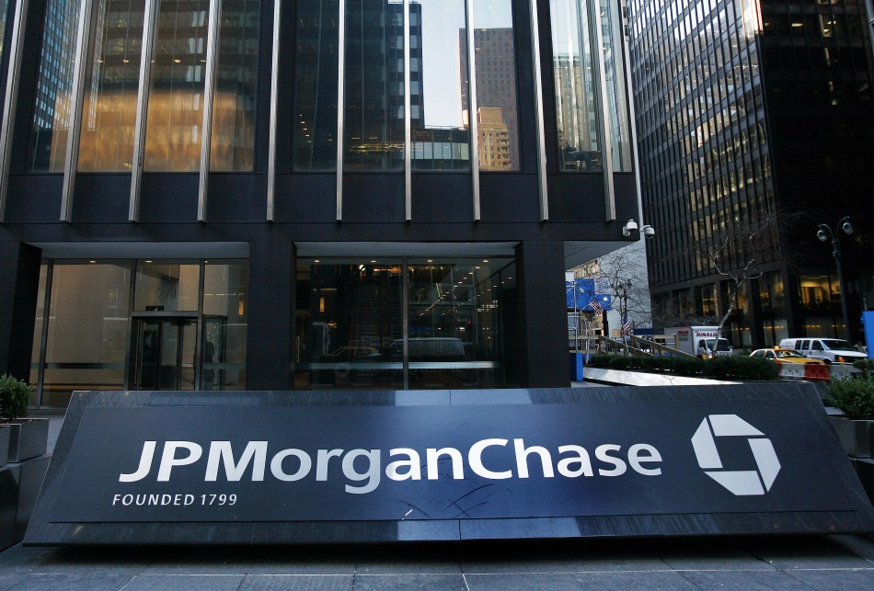

Slide 70
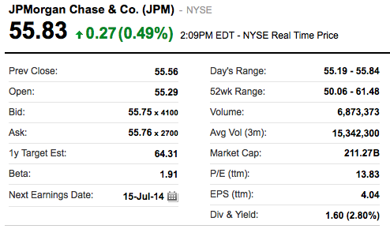
Stock Summary

Slide 71
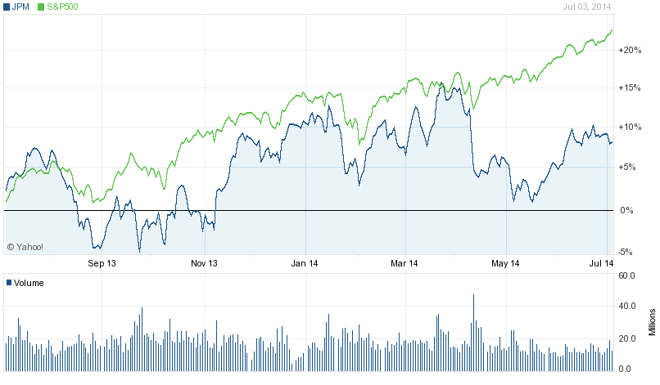
1 Year JPM vs. S&P 500

Slide 72
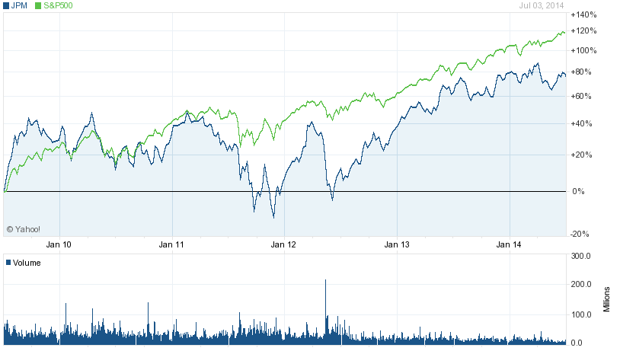
5 Year JPM vs. S&P 500

Slide 73
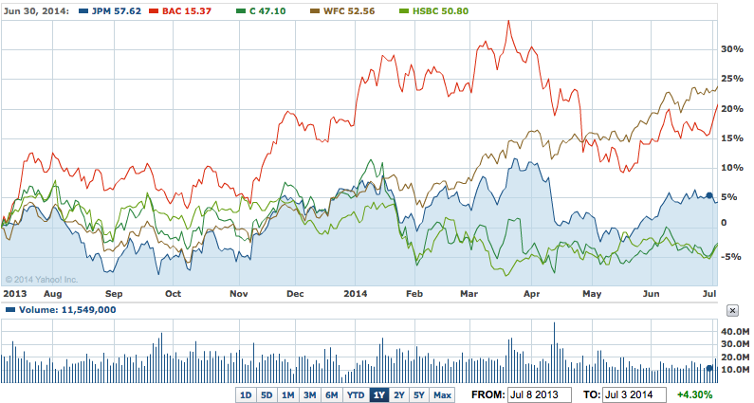
1 Year JPM vs. Major NYSE Banks

Slide 74
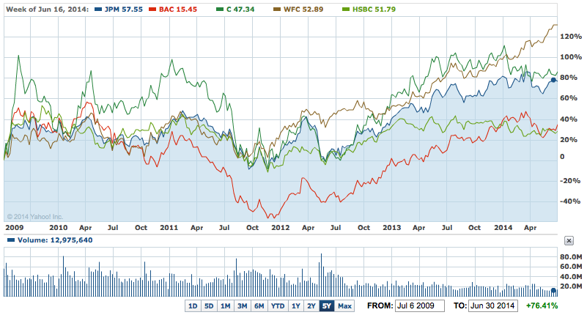
5 Year JPM vs. Major NYSE Banks

Slide 75
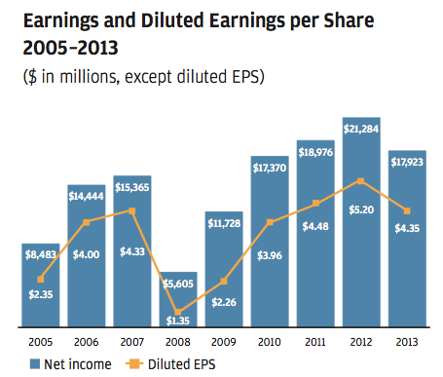
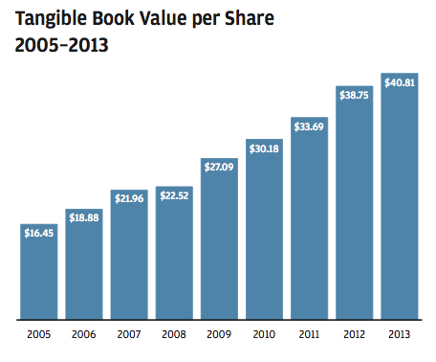
Company Overview

Slide 76
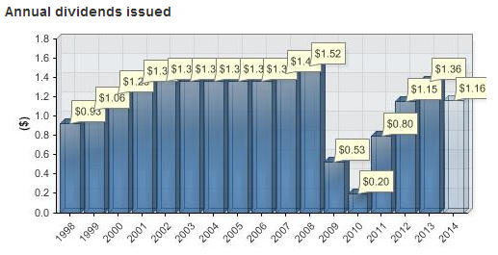
 | 2012 | 2013 | 2014
1Q | 0.3 | 0.38 | 0.38
2Q | 0.3 | 0.38 | 0.38
3Q | 0.3 | 0.3 | 0.4
4Q | 0.25 | 0.3
Total of Dividends Paid | 1.1500 | 1.3600

Slide 77
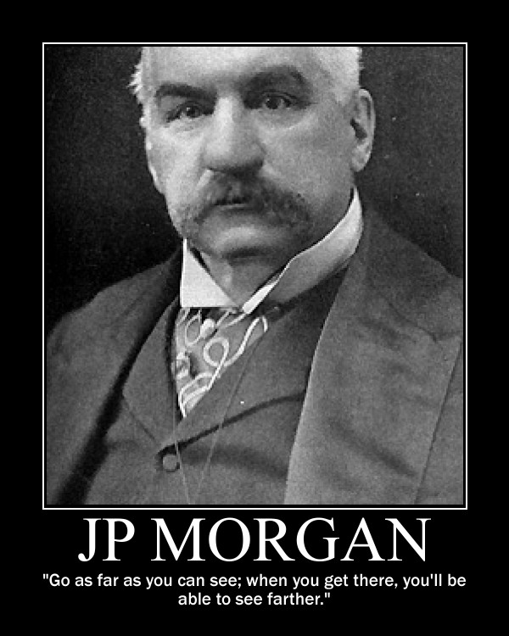
Company Overview
Founded in 1799
Incorporated on October 28, 1968
Key mergers including Chase Manhattan, Chemical, Manufacturers Hanover and Bank One, First Chicago, and National Bank of Detroit…
Largest bank in the U.S., with total assets of US$ 2.515 trillion
The corporate headquarters are in New York City, New York, U.S.; and the retail and commercial bank is headquartered in Chicago, Illinois, U.S.
Market capitalization: 214.45 billion

Slide 78


Company Overview
Four Major Businesses:
Consumer & Community Banking
Corporate & Investment Bank
Commercial Banking
Asset Management

Slide 79
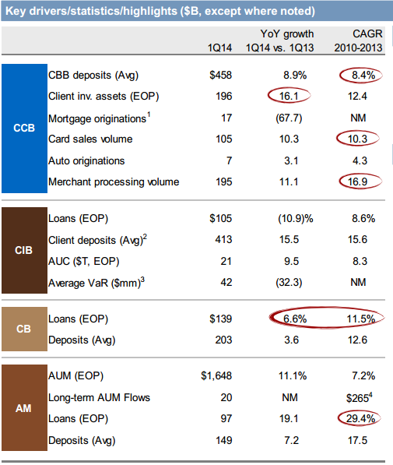
Company Overview

Slide 80
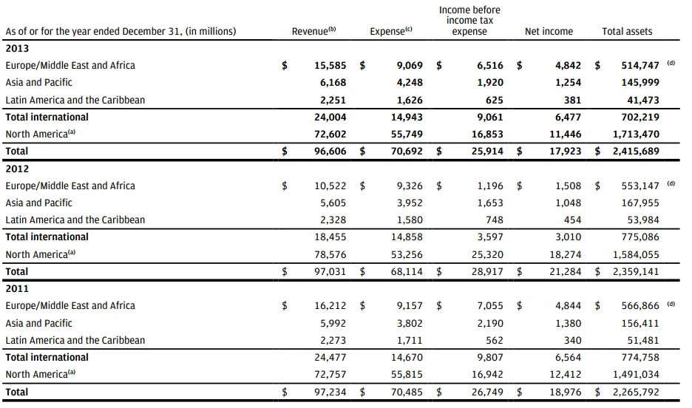
Company Overview

Slide 81
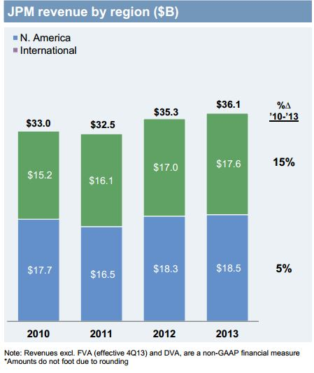
Company Overview

Slide 82
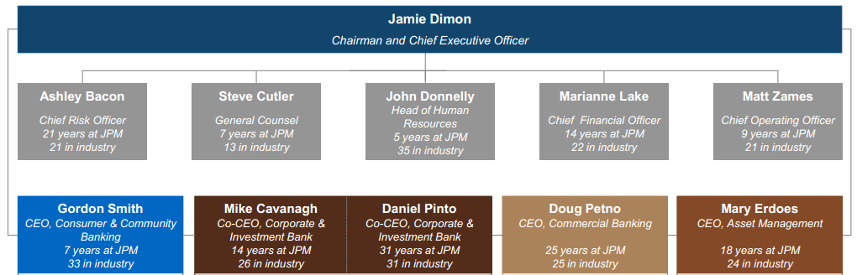
Management Team

Slide 83
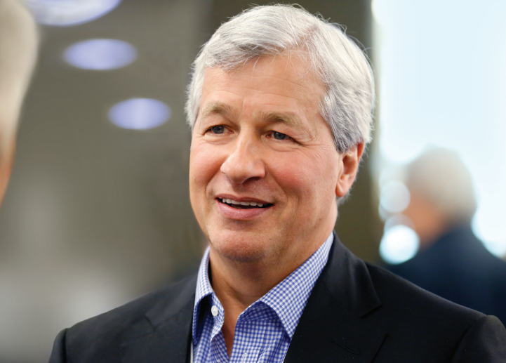
Management Team
James “Jamie” Dimon
Chairman since 2006 and CEO since 2005
Age 58
He had been Chairman and CEO at Bank One
since March 2000 and before JPMorgan Chase’s
merger with Bank One Corporation in July 2004
Began his professional career at American Express since 1982.
Assistant to the President until 1985. CFO and then President When the consumer
lending company was spun off from Control Data Corporation.
COO of Travelers from 1990 through 1998 while concurrently serving as Chief Operating Officer of its Smith Barney Inc. subsidiary. He became CEOof Smith Barney in January 1996 and then co-Chairman and co-CEO of the combined brokerage following the 1997 merger of Smith Barney and Salomon Brothers.
In 1998, Dimon was named President of Citigroup Inc.
In 2000, Dimon was named Chairman and CEO of Bank One.
Dimon earned his bachelors degree from Tufts University and holds an MBA from Harvard Business School.
He serves on the boards of directors of a number of non-profit institutions
Notes:
He serves on the boards of directors of a number of non-profit institutions, including the Clearing House and Harvard Business School. Additionally, he serves on the executive committee of the Business Council, Business Roundtable and the Partnership for New York City, and is a member of the Financial Services Forum, Financial Services Roundtable and Council on Foreign Relations.

Slide 84

Management Team
Marianne Lake
Age 44
CFO and Executive Vice President since 2013
Lake previously was the CFO of Consumer &
Community Banking at JPMorgan Chase.
Investment Bank’s Global Controller, from 2007 to 2009
Lake was in the Corporate Finance group managing global financial infrastructure and control programs from 2004 to 2007.
Prior to 2004, Lake worked at both Chase and J.P. Morgan in London. At Chase, Lake was the Senior Financial Officer in the UK and at J.P. Morgan she was the CFO for the Credit Trading business. Lake started her career as a chartered accountant at PricewaterhouseCoopers in the London and Sydney offices.
Lake received a Bachelor of Science degree in Physics from Reading University in the UK

Slide 85

Management Team
Matthew E. Zames
Age 43
Chief Operating Officer of JPMorgan Chase
& Co. He served as Co-Chief Operating Officer of the Company.
Head of Mortgage Banking Capital Markets since January 2012. He had been Chief Investment Officer from May until September 2012 and was co-head of the Investment Bank Global Fixed Income business (now part of Corporate & Investment Bank) from November 2009 until May 2012 and co-head of Mortgage Banking Capital Markets from July 2011 until January 2012
Prior to 2012 he had served in a number of senior Investment Banking Fixed Income management roles.
Head of proprietary trading at CSFB. Managing Director and Co-head of US rates trading. Director of Business Executives for National Security, Inc.
He graduated from MIT Sloan School of Management with a bachelor's degree in 1993.

Slide 86

Management Team
Gordon A. Smith
Age 55
CEO of Consumer & Community Banking at
JPMorgan Chase & Co. since December 2012.
He served as the CEO of Chase Card Services and Auto Lending at JPMorgan
Chase & Co. since June 2007 and served as its CEO of Mortgage Banking since
July 2012.
He joined American Express in 1978.
President of the U.S. Consumer Card Services Group of American Express Travel Related Services Inc. from 2001 to 2005. President, Global Commercial Card Group for American Express Travel Related Services, Inc., from 2005 to 2007.
Senior VP in charge of the American Express Service Center in Phoenix and Senior VP of Operations and Reengineering for the Latin America and Caribbean region. Senior positions in the U.S. Credit and Fraud operations, at Amex Life Insurance Company and in the international card and Travelers Cheque businesses.
Master's degree in International Management from the Thunderbird - The Garvin School of International Management.
Notes:
the U.S. Consumer Card Services Group of American Express Travel Related Services Inc.is a subsidiary of American Express Company

Slide 87

Management Team
Daniel E. Pinto
Age 51
CEO of Corporate & Investment Bank at
JPMorgan Chase & Co. since March 25, 2014.
Mr. Pinto served as a Co-CEO of The Corporate & Investment Bank at JPMorgan Chase & Co. from July 2012 to March 2014.
CEO of Europe, Middle East & Africa Region at JPMorgan Chase & Co. since June 2011.
Head of Investment Bank and EMEA at JPMorgan Chase & Co.
Head of Emerging Market at JPMorgan Chase & Co. from November 15, 2006 to 2009.
Head of Global Fixed Income at JPMorgan Chase & Co since April 14, 2012.
Head of Investment Bank at JPMorgan Chase & Co. and served as its Co-Head of Global Fixed Income from November 2009 to July 2012.
Pinto holds a bachelor’s degree in Public Accounting and in Science in Business Administration from Universidad Nacional de Lomas de Zamora in Buenos Aires.

Slide 88

Management Team
Douglas B. Petno,
Age 48
CEO of Commercial Banking of JPMorgan
Chase & Co. since January 13, 2012.
Petno began his professional career with the firm in 1989 in Oil & Gas Investment Banking.
Since then, he has held several senior Investment Banking positions.
Most recently, Petno was the global head of the Natural Resources Investment Banking Group at JPMorgan Chase, where he oversaw client coverage for Oil & Gas, Power & Utilities, Chemicals, Metals & Mining, Building Products and Paper & Packaging and advised on some of the largest transactions in the Natural Resources industry over the past decade.
Petno holds a Bachelor of Arts degree in Biology from Wabash College and a Master of Business Administration degree from the Simon School of Business at the University of Rochester.

Slide 89

Management Team
Mary Callahan Erdoes
Age 46
CEO of JPMorgan Chase and Co.'s Asset
Management business, a global leader in investment management and private
banking with more than $1.8 trillion in assets under supervision.
In addition to being a member of JPMorgan Chase & Co.'s Operating and Executive Committees, Erdoes leads the firm’s strategic partnership with Highbridge Capital Management and Gávea Investimentos.
Erdoes joined J.P. Morgan in 1996 from Meredith, Martin & Kaye, a fixed income specialty advisory firm. Previously, she worked at Bankers Trust in corporate finance, merchant banking and high yield debt underwriting.
Erdoes holds a Bachelor of Science degree from Georgetown University and an MBA degree from Harvard Business School. She is also a board member of the U.S. Fund for UNICEF. In 2010, she was recognized by Forbes and Fortune magazines for their “World’s 100 Most Powerful Women” and “50 Most Powerful Women in Business” lists, respectively.

Slide 90

Company Strategy Cross-sell and Synergies

Slide 91
Company Strategy Higher Capital and Increased Liquidity
Maintaining adequate liquidity is the Firm’s top priority
-The Firm holds an appropriate – not excessive – amount of liquidity
Manage liquidity position based on internal liquidity stress framework
-more conservative
-Consistent with: ~20% liquidity buffer above Basel LCR
Modest buffer above NSFR
JPM holds over $500B HQLA with ~60% in cash – a significant portion from liabilities that have limited liquidity value
-Wholesale non-operating deposits
-Operating cash needed to run day-to-day business activities

Slide 92


Slide 93


Slide 94
Company Strategy Take actions to maintain returns
Run-off of unprofitable products.
Product repricing.
Product redesign
Client selection and re-optimization.
Tactical and strategic changes.

Slide 95

Company Strategy Business Simplification aggressively pruning and simplifying the business — allowing them to reduce risk and to focus resources on what is important

Slide 96

Strategy and Targets Conclusion

Slide 97

Financial Overview

Slide 98
2012 “London Whale” Incident
In April and May 2012, large trading losses occurred at JPMorgan's Chief Investment Office, based on transactions booked through its London branch. A series of derivative transactions involving credit default swaps(CDS) were entered, reportedly as part of the bank’s “hedging” strategy.
Trader Bruno Iksil, nicknamed the “London Whale”, accumulated outsized CDS positions in the market. An estimated trading loss of $2 billion was announced, with the actual loss expected to be substantially larger.
These events gave rise to a number of investigations to examine the firm’s risk management systems and internal controls.

Slide 99

Financial Overview

Slide 100

Consolidated Balance Sheet - Quarterly

Slide 101

Consolidated Balance Sheet - Yearly

Slide 102

Consolidated Income Statement - Quarterly

Slide 103


Consolidated Income Statement - Yearly

Slide 104

Cash Flow from Operating Activities - Yearly

Slide 105

Cash Flow from Investing Activities - Yearly

Slide 106

Cash Flow from Financing Activities - Yearly

Slide 107

Net Change in Cash and Equivalents - Yearly

Slide 108

Segment Results – Managed Basis The following table summarizes the business segment results for the periods indicated.

Slide 109

Consumer & Community Banking selected income statement data

Slide 110

Consumer & Community Banking selected balance sheet data

Slide 111


Consumer & Community Banking Mortgage Banking selected income statement data

Slide 112

Consumer & Community Banking Card, Merchant Services & Auto

Slide 113


Corporate & Investment Banking selected income statement data

Slide 114

Corporate & Investment Banking selected balance sheet data

Slide 115


Commercial Banking selected income statement data

Slide 116


Commercial Banking selected balance sheet data

Slide 117

Asset Management selected income statement data

Slide 118


Asset Management selected data -client assets

Slide 119

Asset Management selected data -client assets (international metrics)

Slide 120
Recommendation
HOLD

Slide 121


Slide 122

Stock Summary

Slide 123

1 Year Citigroup vs. S&P 500

Slide 124

5 Year Citigroup vs. S&P 500

Slide 125

1 Year Citigroup vs. Major NYSE Banks

Slide 126

5 Year Citigroup vs. Major NYSE Banks

Slide 127
Company Overview
Third largest bank holding company in the United States by assets
Citigroup has the world’s largest financial services network, spanning 140 countries with approximately 16,000 offices worldwide.
Headquartered in Manhattan, New York City with 357,000 employees worldwide until the global financial crisis of 2008
Market Capitalization: $146.54 billion

Slide 128

Company Overview
Citigroup operates through four global businesses:
Institutional Clients Group
Capital Markets Origination
Corporate and Investment Banking
Markets and Securities Services

Slide 129

Company Overview

Slide 130


Company Overview

Slide 131

Company Overview

Slide 132

Company Overview

Slide 133

Management Team
Michael Corbat
Citigroup Group CEO
Age: 54
Became Group CEO in 2012
Graduated from Harvard University
Joined Citigroup in 1983, was named CEO of Europe, Middle East and Africa in 2011
Previously, Mr. Corbat served as the CEO of Citi Holdings, Citi's portfolio of non-core businesses and assets. In this role, he oversaw the divestiture of more than 40 businesses, including the IPO and sale of Citi's remaining stake in Primerica. Mr. Corbat also successfully restructured Citi's consumer finance and retail partner cards businesses and divested more than $500 billion assets, reducing risk on the Company's balance sheet and freeing up capital to invest in Citi's core banking business.

Slide 134

Management Team
Michael E. O’Neill
Group Chairman
Age: 68
Became Chairman, Citigroup Inc. in 2012
MBA from University of Virginia
Chairman, Chief Executive Officer and Director, Bank of Hawaii Corporation - 2000 to 2004
Director of Citigroup since 2009
Mr. O’Neill is an experienced financial services executive and has been nominated to serve on the Board because of his extensive experience in the areas of Financial Services, International Business, Corporate and Consumer Business, Regulatory Compliance, Risk Management, and Financial Reporting.

Slide 135
Company Strategy
Citi and its management team continue to make steady progress toward the successful execution of its strategy, which is to
Enhance its position as a leading global bank for both institutions and individuals, by building on its unique global network, deep emerging markets expertise, client relationships and product expertise;
Position Citi to seize the opportunities provide by current trends (globalization, digitization and urbanization) for the benefit of clients;
Further its commitment to responsible finance;
Strengthen Citi's performance-including gaining market share with clients, making Citi more efficient and productive, and building upon its history of innovation; and
Wind down Citi Holdings as soon as practicable, in an economically rational manner.

Slide 136

Company Strategy

Slide 137

Company Strategy

Slide 138

Company Strategy

Slide 139

Company Strategy

Slide 140

Company Strategy

Slide 141

Company Strategy

Slide 142

Company Strategy

Slide 143

Company Strategy

Slide 144

Company Strategy

Slide 145

Company Strategy

Slide 146

Company Strategy

Slide 147

Company Strategy

Slide 148

Company Strategy

Slide 149

Financial Overview

Slide 150

Financial Overview

Slide 151

Financial Overview

Slide 152

Consolidated Balance Sheet - Quarterly

Slide 153

Consolidated Balance Sheet - Yearly

Slide 154

Consolidated Balance Sheet - Yearly

Slide 155

Consolidated Income Statement - Yearly

Slide 156

Consolidated Income Statement - Quarterly

Slide 157


Consolidated Statement of Cash Flow - Yearly

Slide 158

Consolidated Statement of Cash Flow - Yearly
(Continued)

Slide 159
Recommendation
HOLD

