Slide 1

Global Airlines
Team 5:
Raman Karatchenia (301207716)
Edward Guo (301177816)
He Shan(301168706)
Hong Viet Pham (301215440)
BUS 417 – D100

Slide 2
Agenda
Industry Overview
Terminology
Characteristics of Airline Industry
History
Current Status and Trends
Porter’s Five Forces
Outlook
Cathay Pacific Airline
Singapore Airline
Southwest

Slide 3
Terminology
ATK: Available Tonne Kilometer (Capacity)
= Passenger and cargo capacity
ASK: Available Seat Kilometer (Capacity)
= [Number of seats] * [kilometers flown]
RPK: Revenue Passenger Kilometer (Traffic)
= [Number of paying passengers] * [kilometers flown]
FTK: Freight Tonne Kilometer (Traffic)
= [Freight tonnes carried] * [kilometers flown]
YIELD
= [Revenue] / [RPK]
LF: Load Factor (Capacity Utilization)
= [RPK] / [ASK]
= [number of passengers]/[number of seats]
Break Even LF: Unit cost / Yield
i.e. Operating cost = Operating Revenue

Slide 4
Characteristics of Airline Industry
Fast growing industry
Highly capital intensive
Highly sensitive to business cycles
Regular business customers consists of largest revenue
Facing increasingly deregulated environment
Highly competitive background
Low profit margin

Slide 5
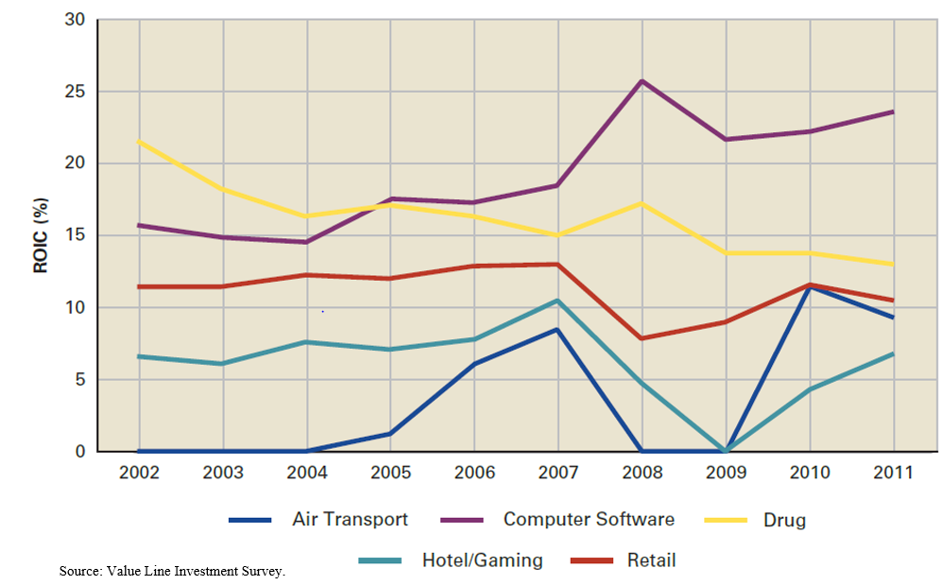
Comparison of Airline Industry with Selected Industries, 2002-2011

Slide 6
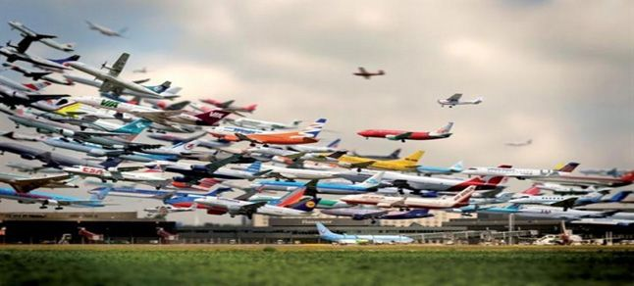
Four Categories of Airline Industry
International
National
Regional
Cargo

Slide 7
History of Airline Industry
The first airlines( DELAG, November 16,1909)
The first fixed wing scheduled air service was started on January 1, 1914 from St. Petersburg, Florida to Tampa, Florida
Historically, air travel has survived largely through state support, whether in the form of equity or subsidies. The airline industry as a whole has made a cumulative loss during its 100-year history, once the costs include subsidies for aircraft development and airport construction

Slide 8
Regulatory considerations
National
Regulation and Deregulation
International
Groups such as the International Civil Aviation Organization establish worldwide standards for safety and other vital concerns

Slide 9
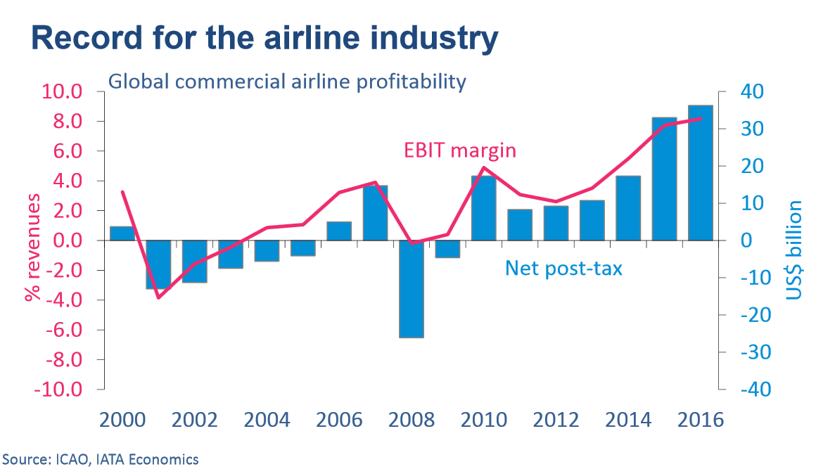
Record for the Airline Industry From 2000

Slide 10
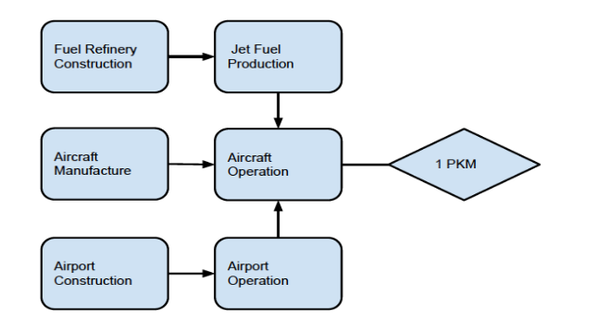
Air Transport System Flow Chart

Slide 11
Conditions Significant in the Airline Industry
Airport capacity
Route structures
Technology
Costs to lease or buy physical aircraft
Weather
Fuel cost
Labor
Economy
Regulations

Slide 12
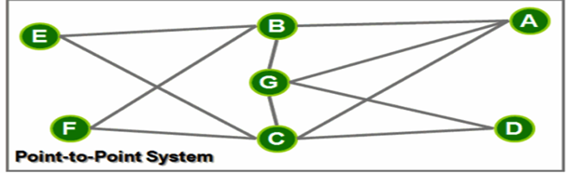
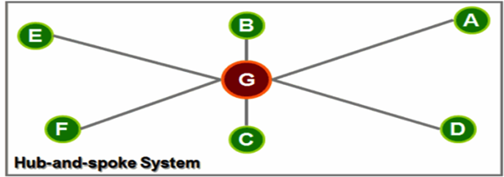
Two Types of Route Structure
Point-to-point
Used by low cost (discount) carriers
Shorter routes, usually regional/domestic
Decreased connection and travel times
Increased utilization leads to lower unit cost
Avoid domino effect
Require more routes, less flexibility in destination
Hub and Spoke
Used by legacy carriers
Allows more distant and international routes
Utilize main airports as hubs
Lead to more efficient use of transportation resource
Centralized model result in inflexible operation

Slide 13
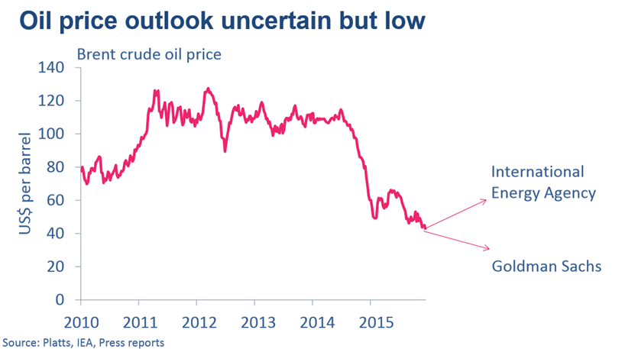
Trend of Oil price

Slide 14
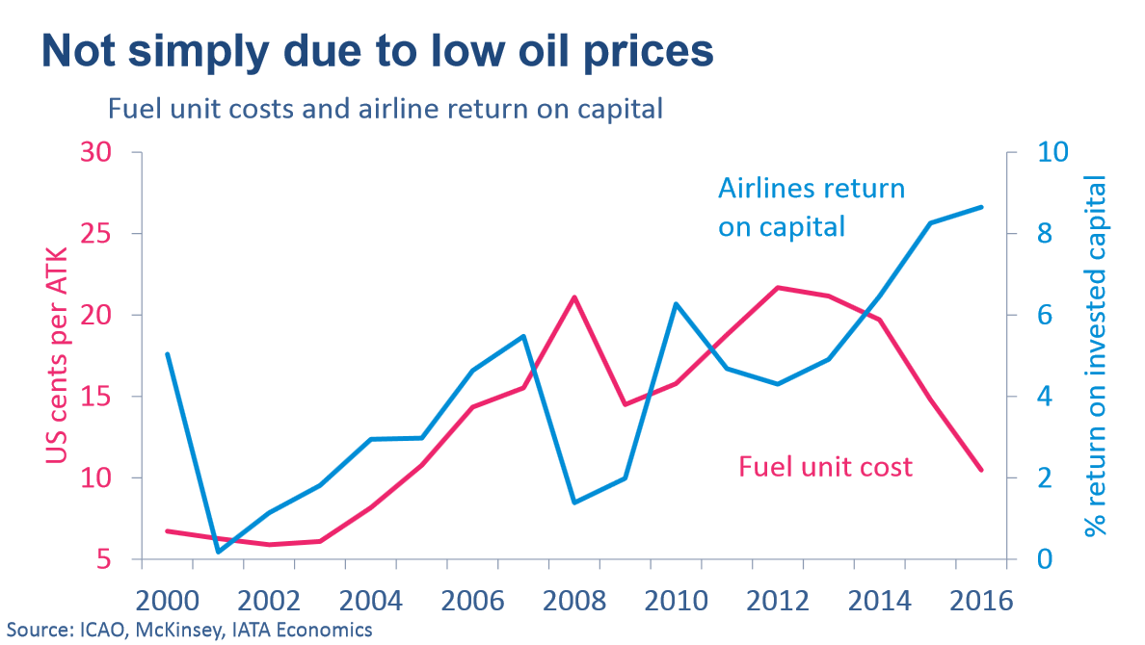

Slide 15
The Customer Drivers
Economy Conditions
Price of Tickets
Exchange Rates

Slide 16
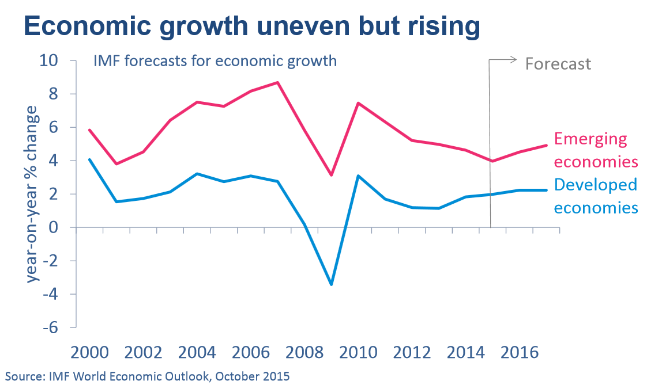
Trend of Economy

Slide 17
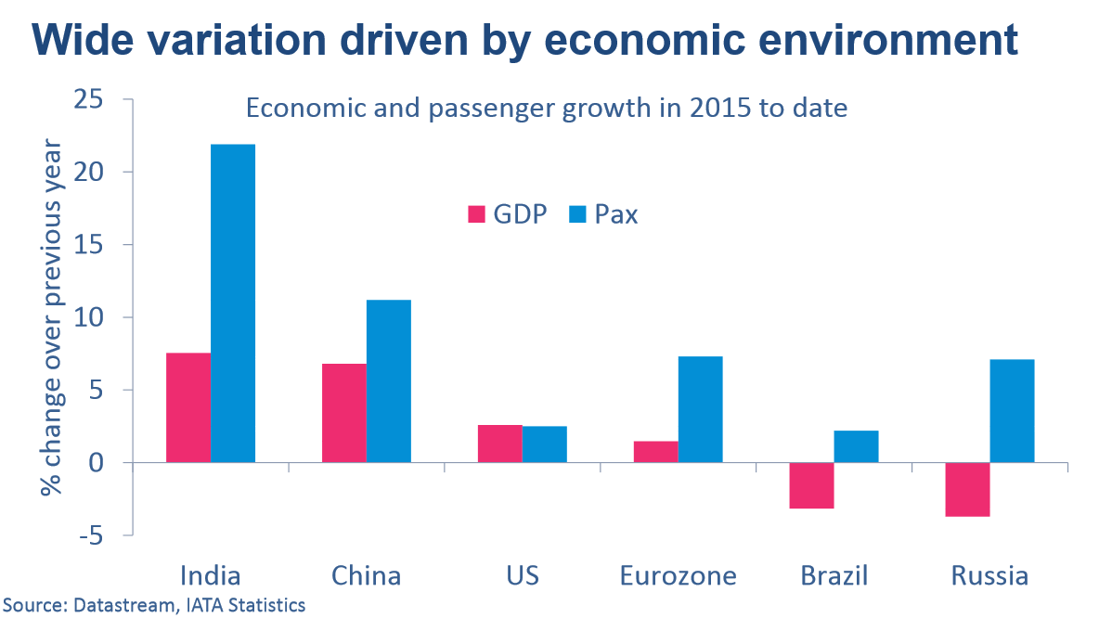
Trend of GDP and Passengers

Slide 18
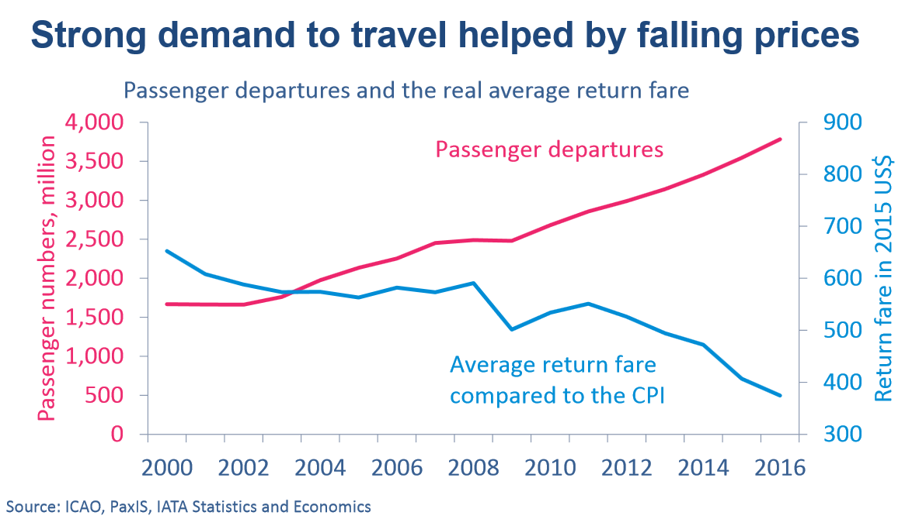

Slide 19
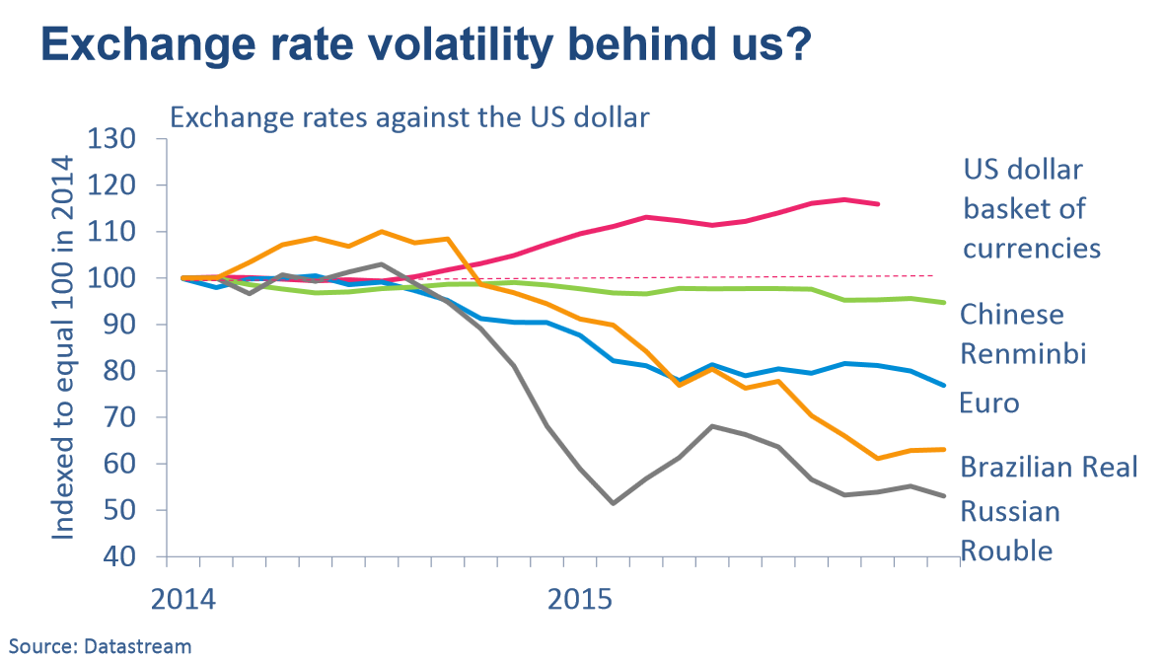

Slide 20
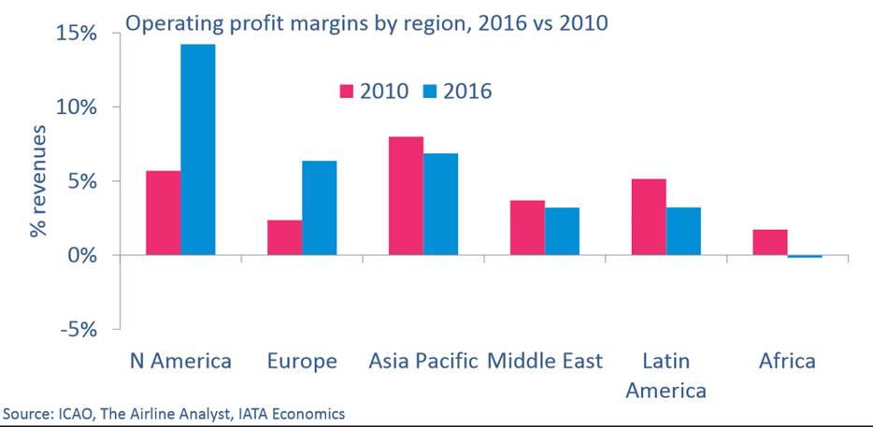
Operating Profit Margins by Region

Slide 21
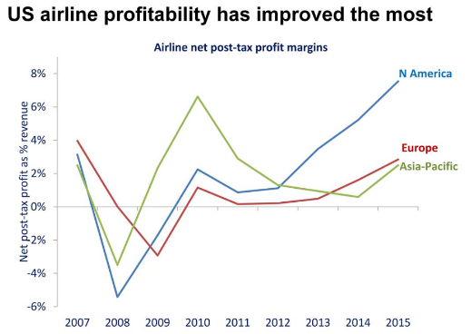
Regional Profit Margins
US airlines experience largest improvement due to post-financial crisis restructuring
Consolidation of US airlines and adding capacity
Strong US economy, rising US dollar, falling fuel prices

Slide 22
Poter’s Five Forces
Power of suppliers – High
Dominated by two major suppliers, Boeing and Airbus
Power of buyers – High
There is low product differentiation across airlines
Leisure consumers are sensitive to price
Many choices among regional and domestic airlines
No switching costs
Competitive Rivalry – Moderate
Intense price competitions, multiple airlines offers the same routes and services
Airlines need to compete on additional services and quality of services offered
Alliances and consolidations
Availability of Substitutes – High
Since alliances have shared networks and hubs, consumers now have more choices among several companies
Threat of New Entrants – Moderate-Low
Depends on the costs to bank loans and the regulation in the market.
Notes:
Threat of New Entrants(The entry barriers are lower in a deregulated market and the markets that have low costs to bank loans. However the airline industry has been around for a quite some time and the industry is not greatly affected by the new entrants. The influence of potential entrants to the sector is weak. But to ensure that no other problem arise the industry and the ticketing and booking system used by Airline companies maintains low cost for the different expenses they make, this helps in making sure that the new entrant will not have advantage over them and it makes sure that the airline industry and companies within it cannot be outrun by any new competitor)
Power of Suppliers( High, dominated by Boeing and Airbus)
Power of Buyers( low for most airlines, high for luxury liners)
Availability of Substitutes( low for international travel, high for other categories)
Competitive Rivalry( historically high, recently there is a decreasing trend of competition along with the development of airline alliances and consolidation)

Slide 23
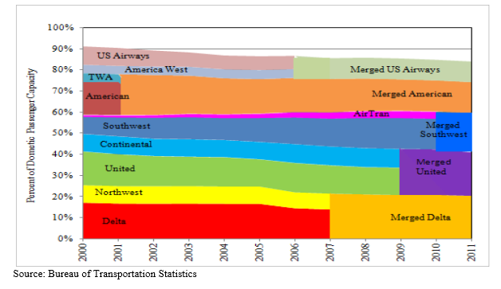
CONSOLIDATIONS

Slide 24
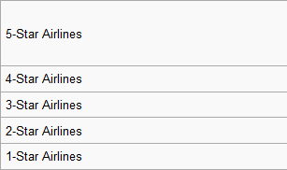
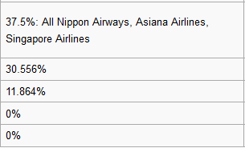
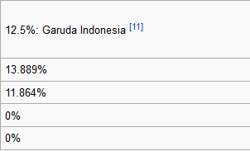
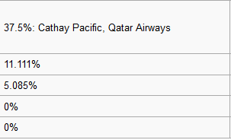

Alliances
Major Alliances:
Star Alliance: 27 members, founded 1997
SkyTeam: 20 members, founded 2000
Oneworld: 15 members, founded 1991
The rest of industry

Slide 25
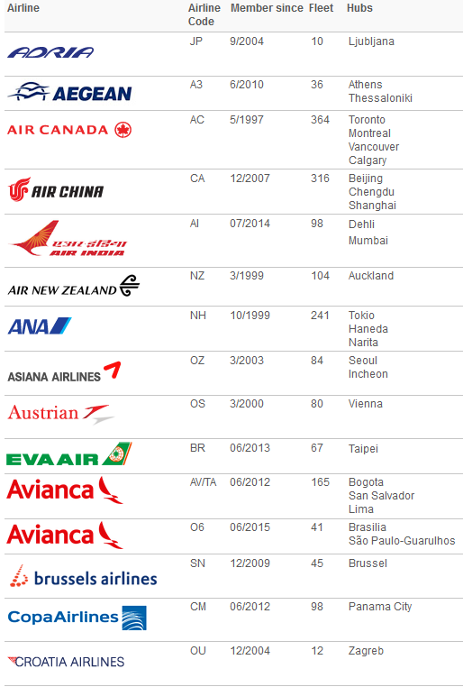
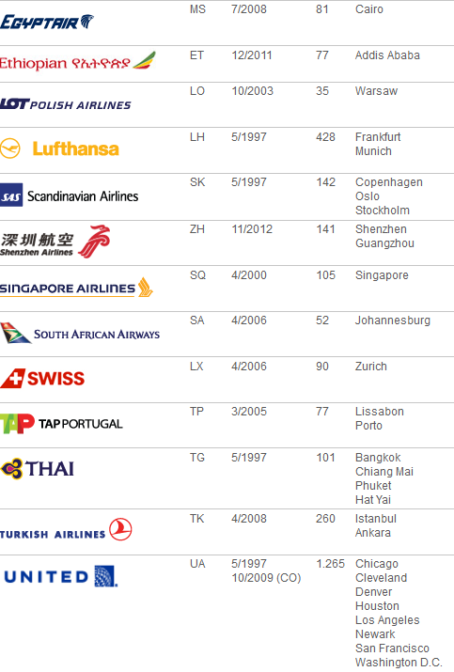
Star Alliance

Slide 26
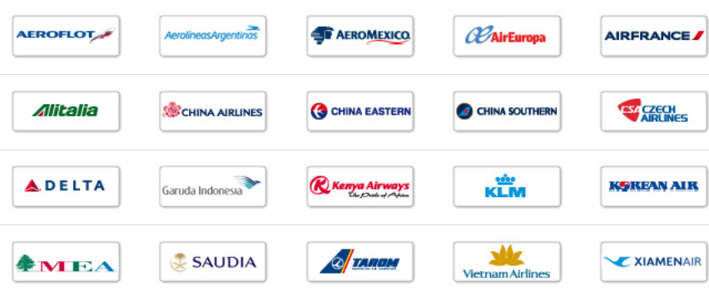
SkyTeam

Slide 27





Oneworld

Slide 28
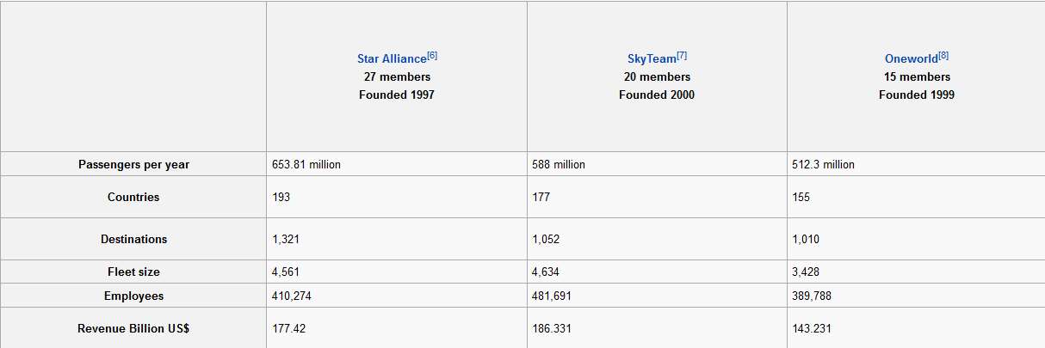

Market Data of the Alliances and the Rest

Slide 29
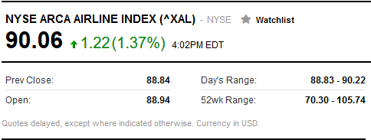
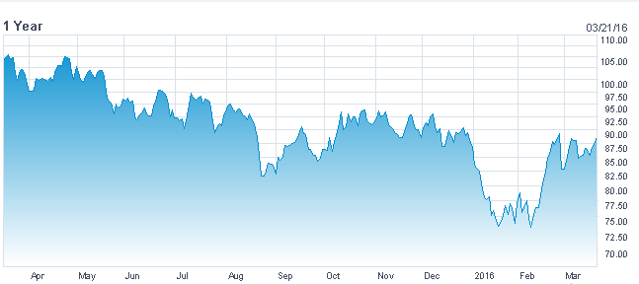
Airline Index (XAL) 1 YEAR

Slide 30
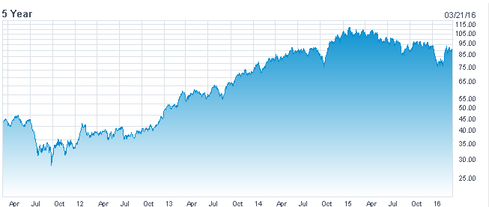
Airline Index ( XAL) 5 YEAR

Slide 31
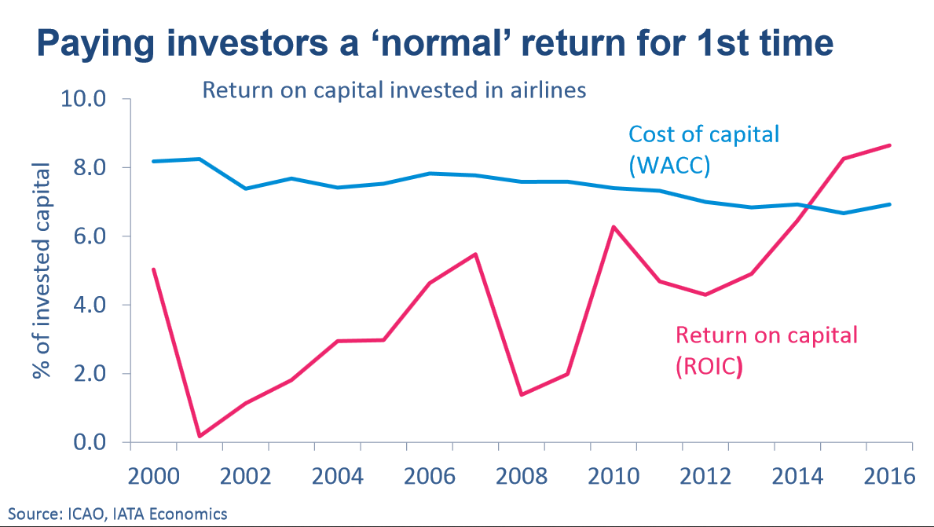
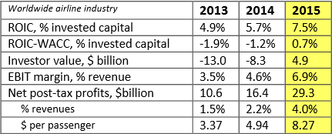
Return, Investment Capital, and Cost

Slide 32
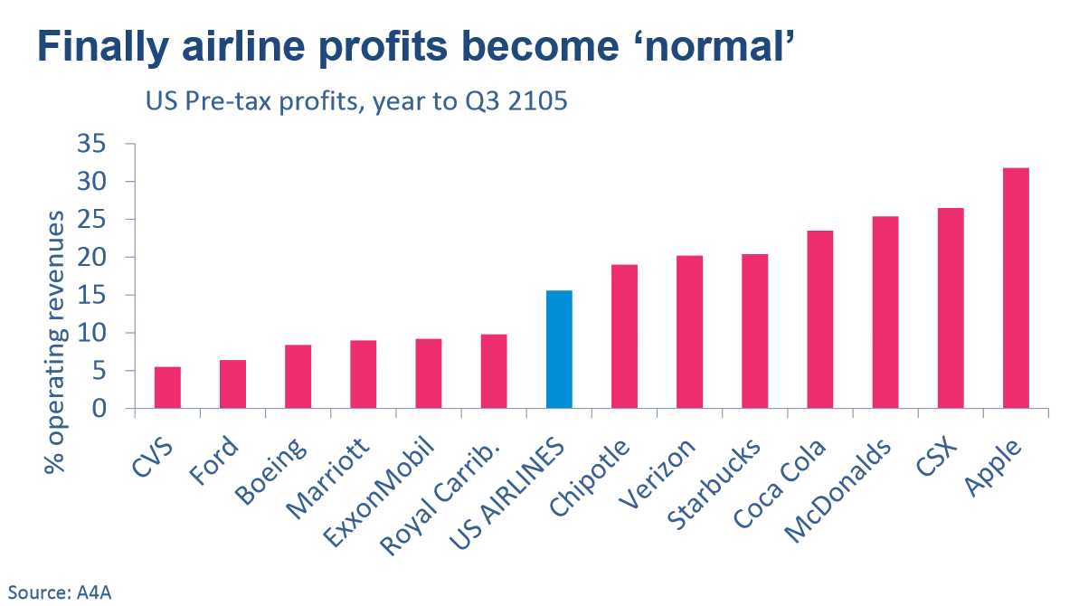

Slide 33
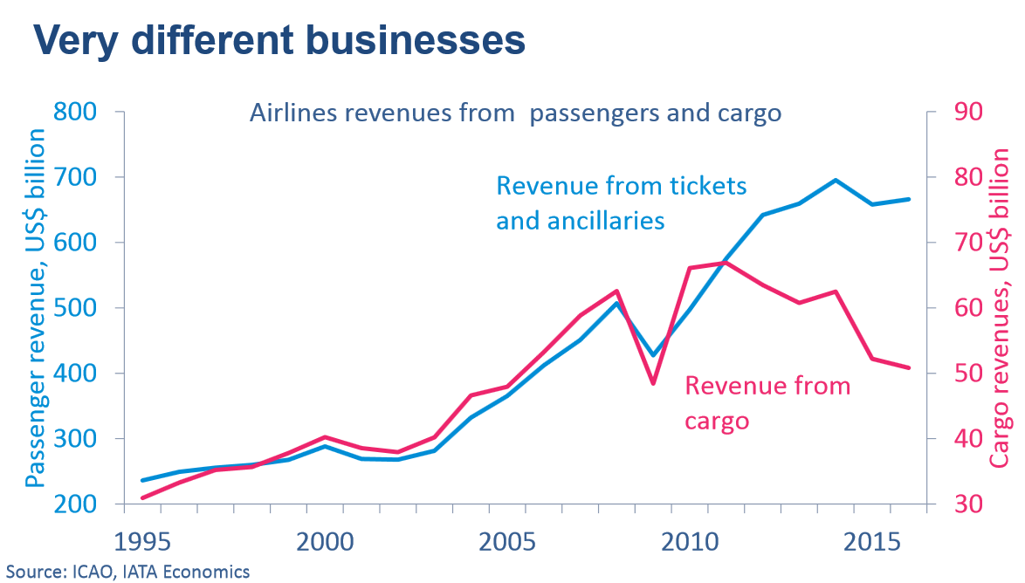

Slide 34
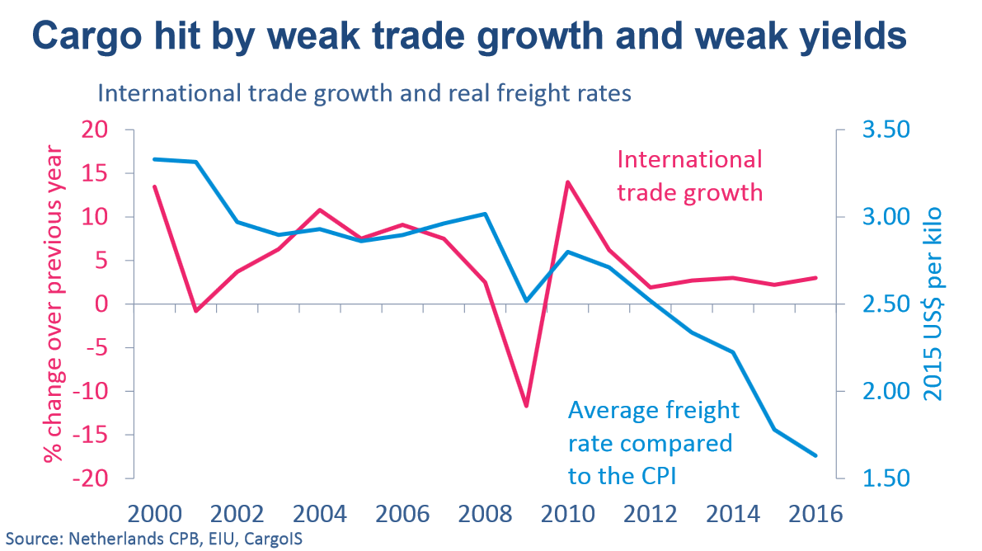

Slide 35
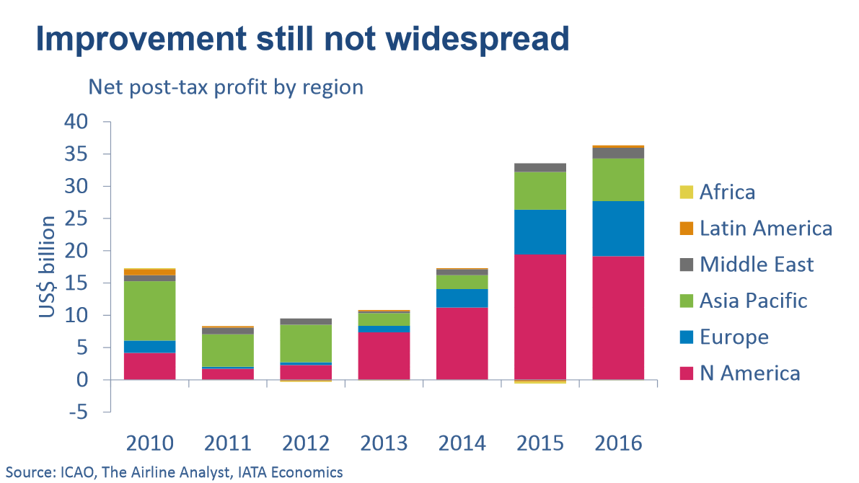

Slide 36
Outlook
Favorable economy condition
Low fuel price
Accelerating growth in air travel
Asset utilization raised and sustained
Paused globalization and cargo transportation
Volatility and risk remains

Slide 37
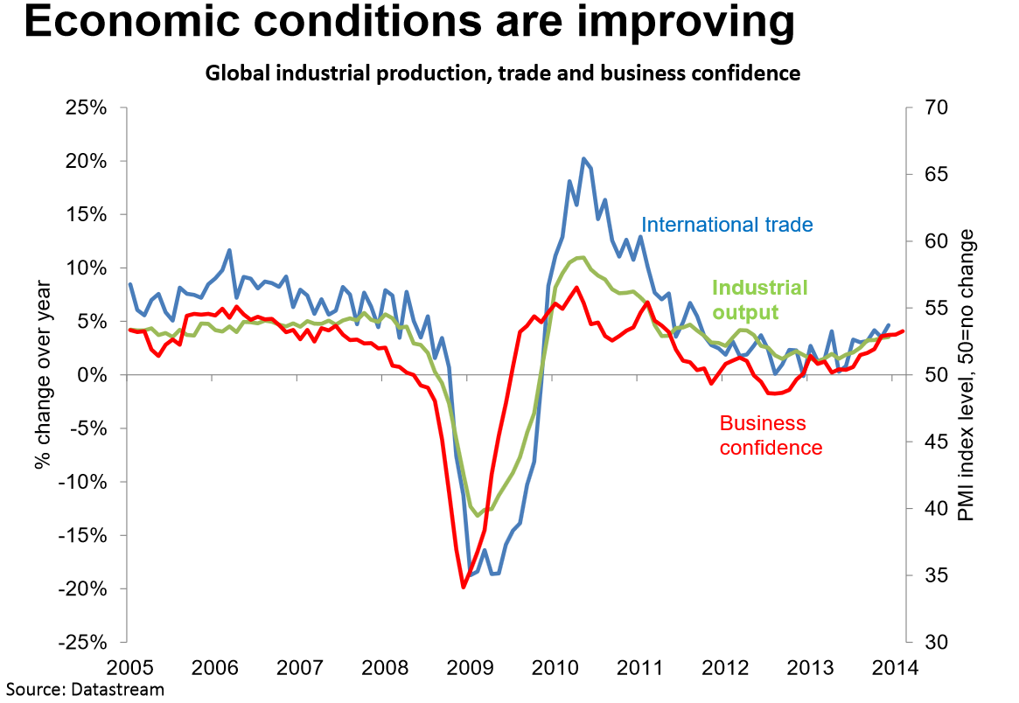

Slide 38


Slide 39
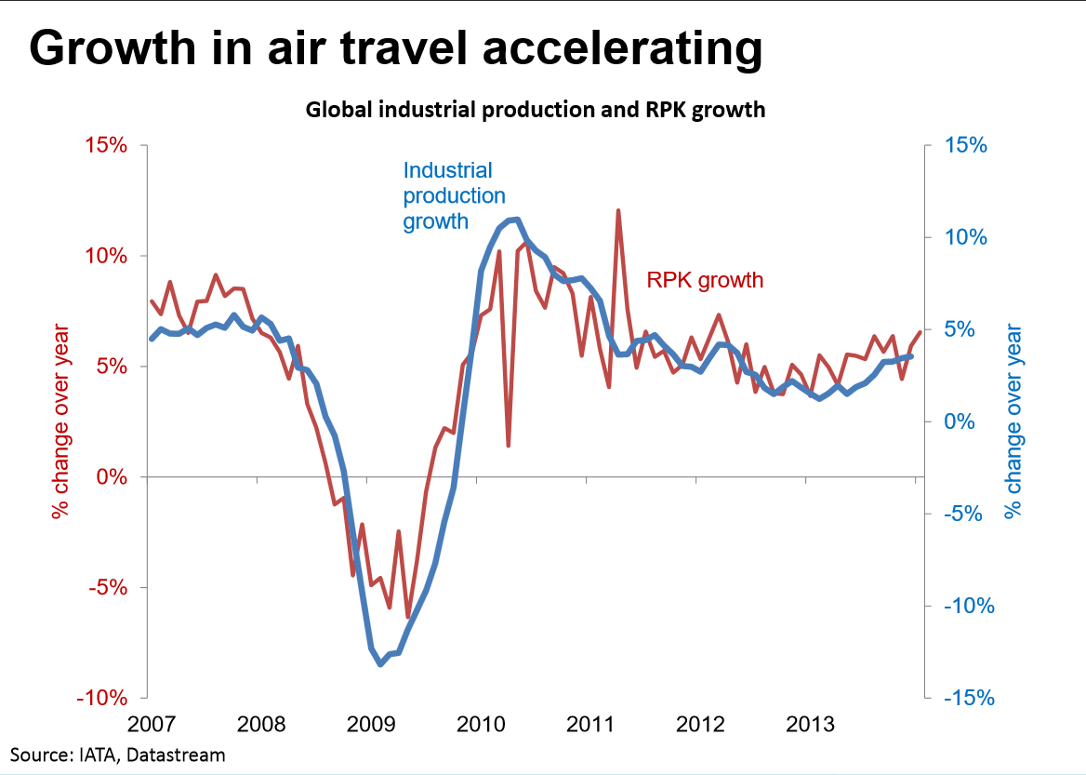

Slide 40


Slide 41
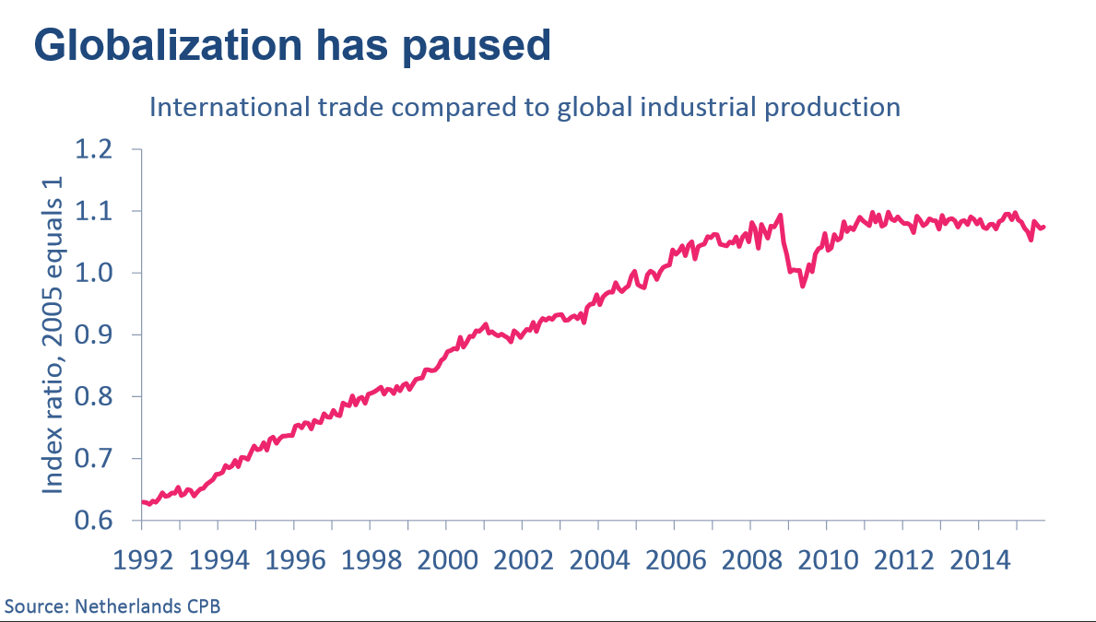

Slide 42
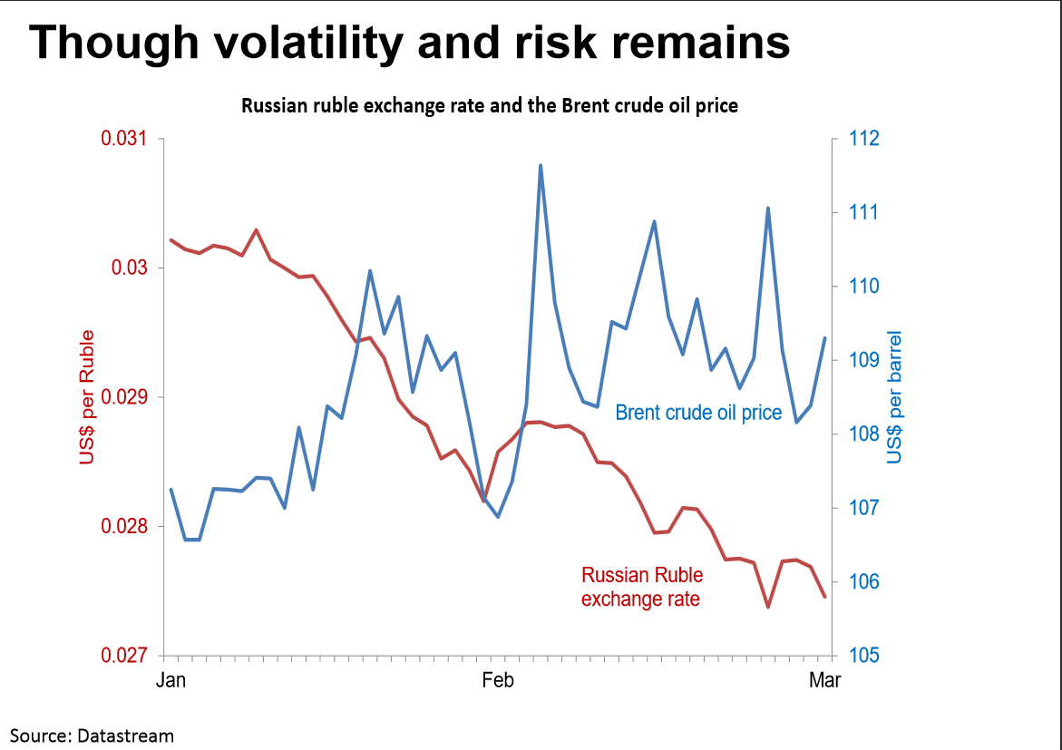

Slide 43
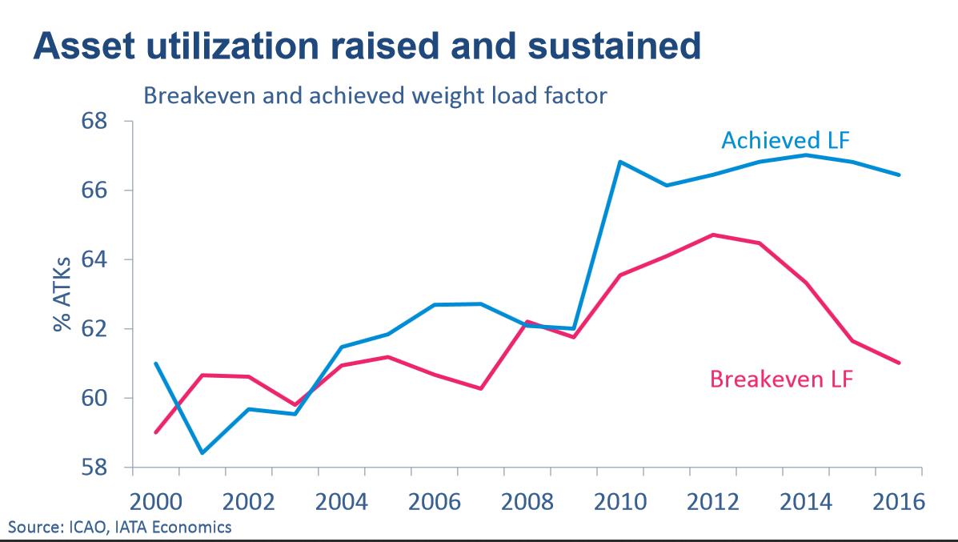

Slide 44
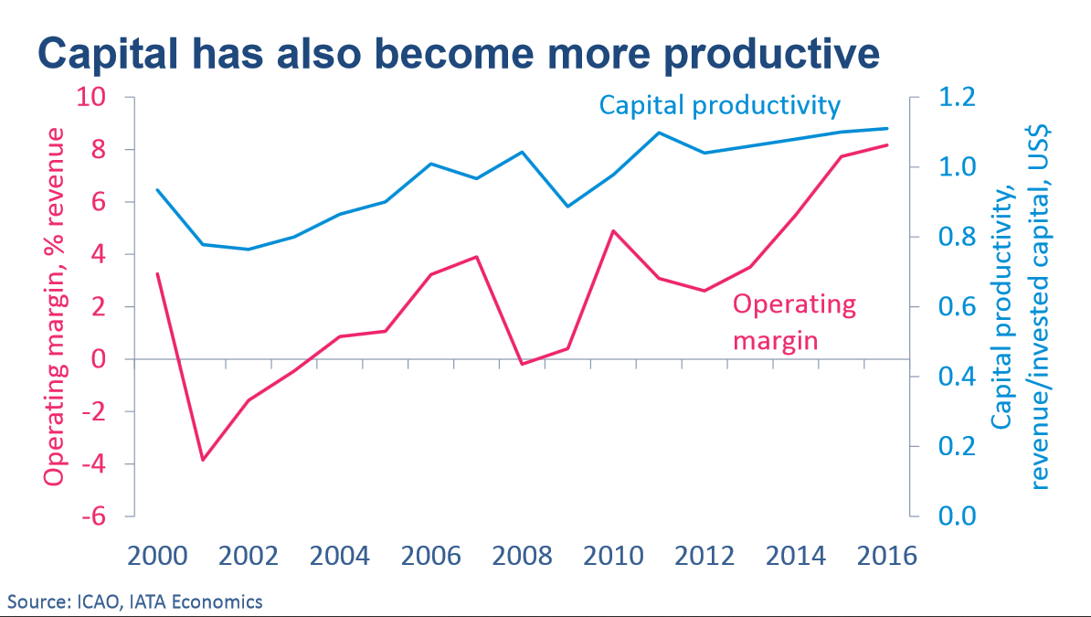

Slide 45
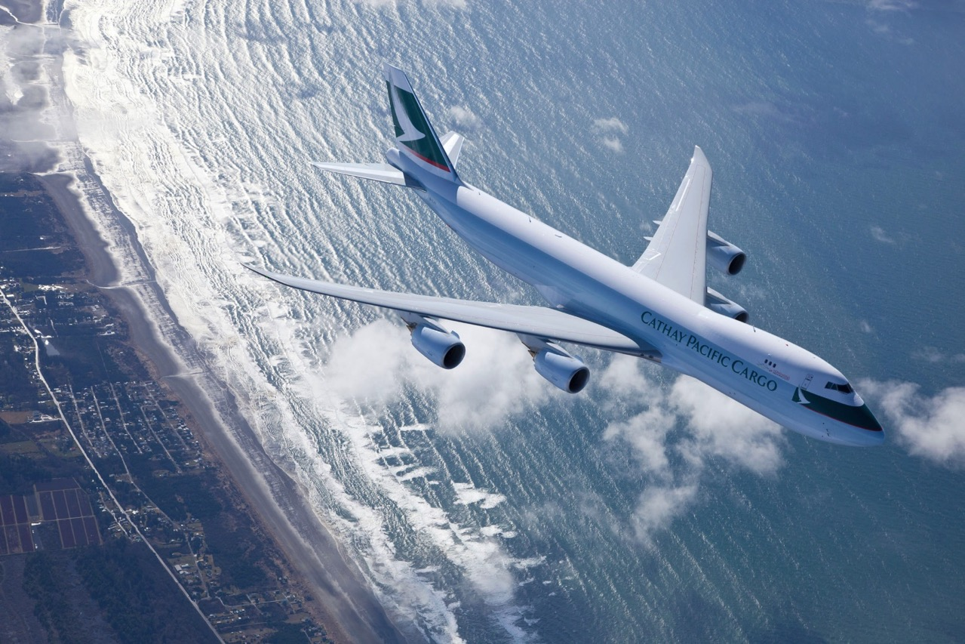
Cathay Pacific Airline

Slide 46
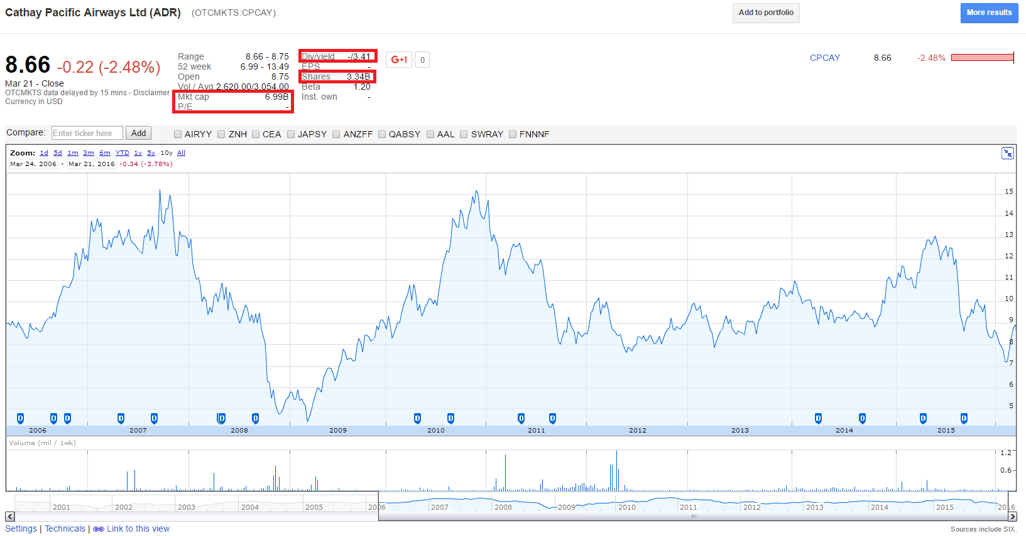

Stock Information

Slide 47
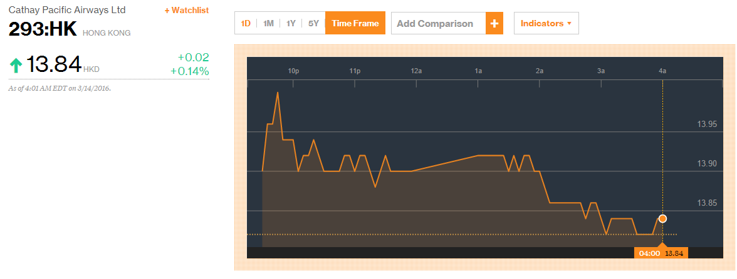
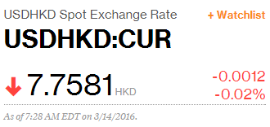
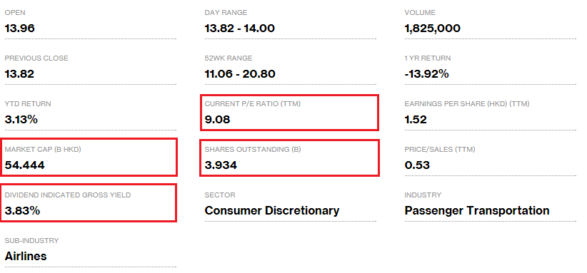
Stock Information

Slide 48
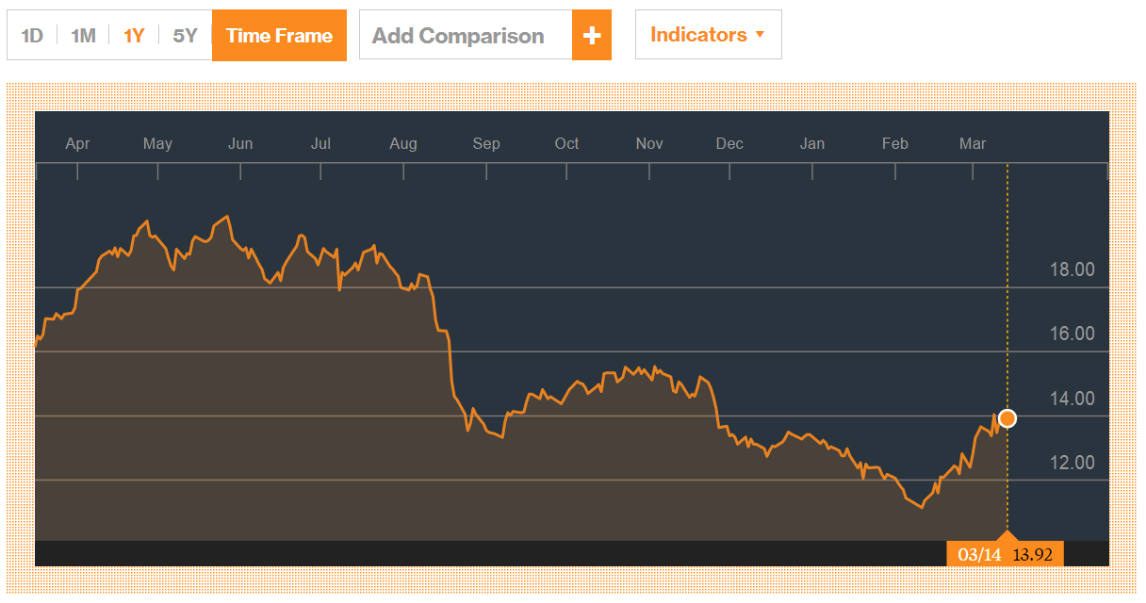
1 Year Stock Price Movements

Slide 49
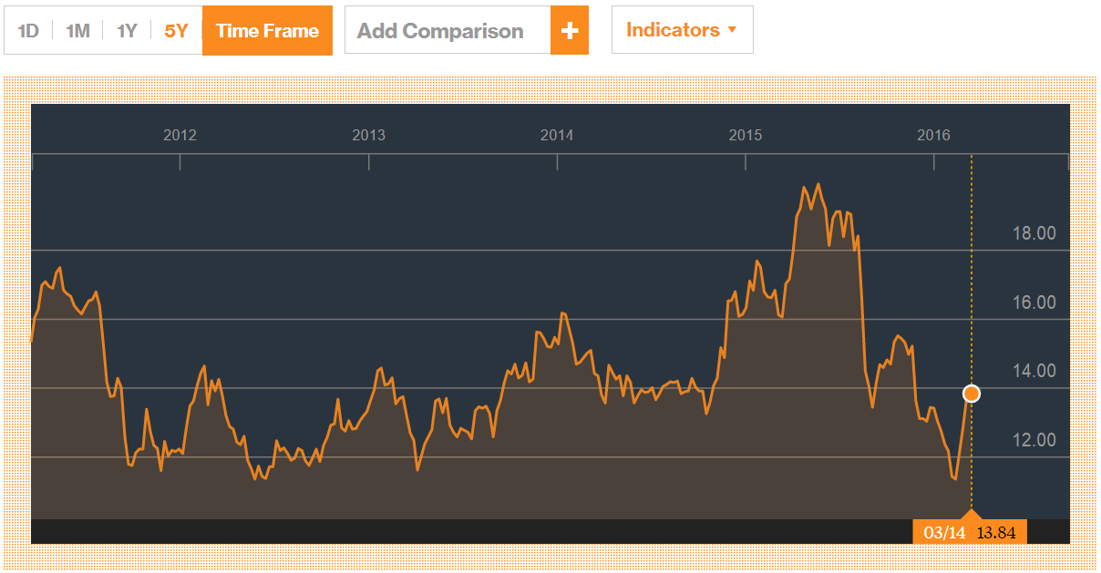
5 Year Stock Price Movements

Slide 50
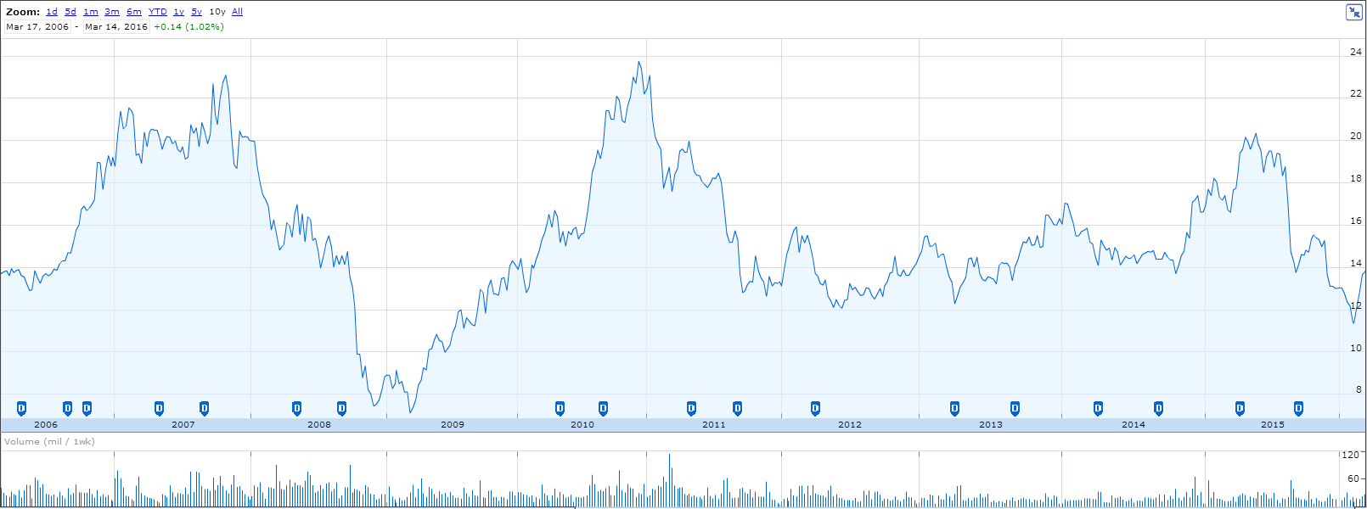
10 Year Stock Price Movements

Slide 51

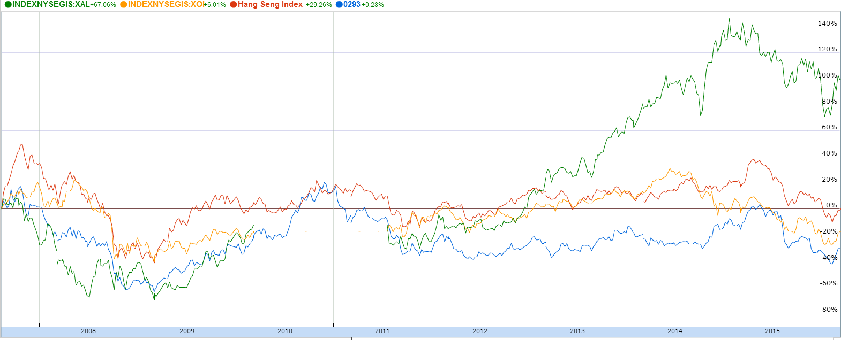
10 year stock price movements compare with Hang Seng, Oil & Gas, Airline Indexes

Slide 52
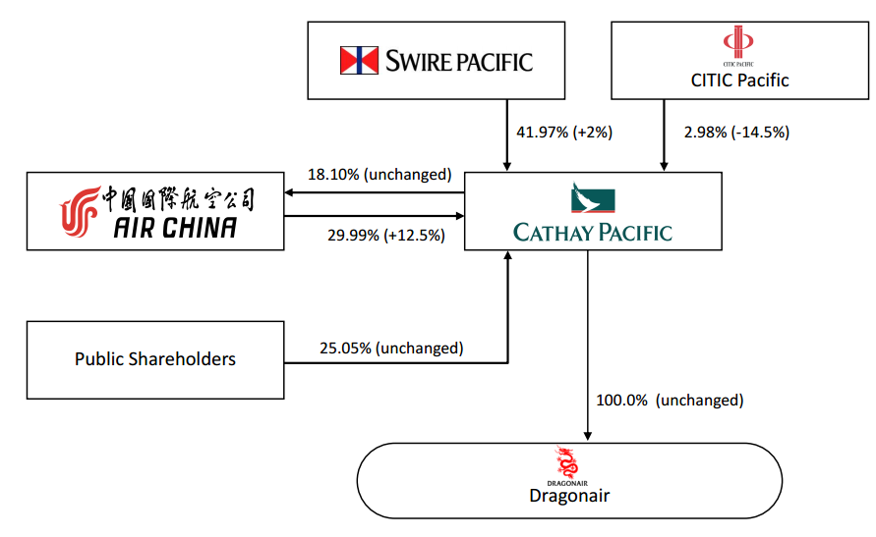
Previous Shareholding Structure

Slide 53
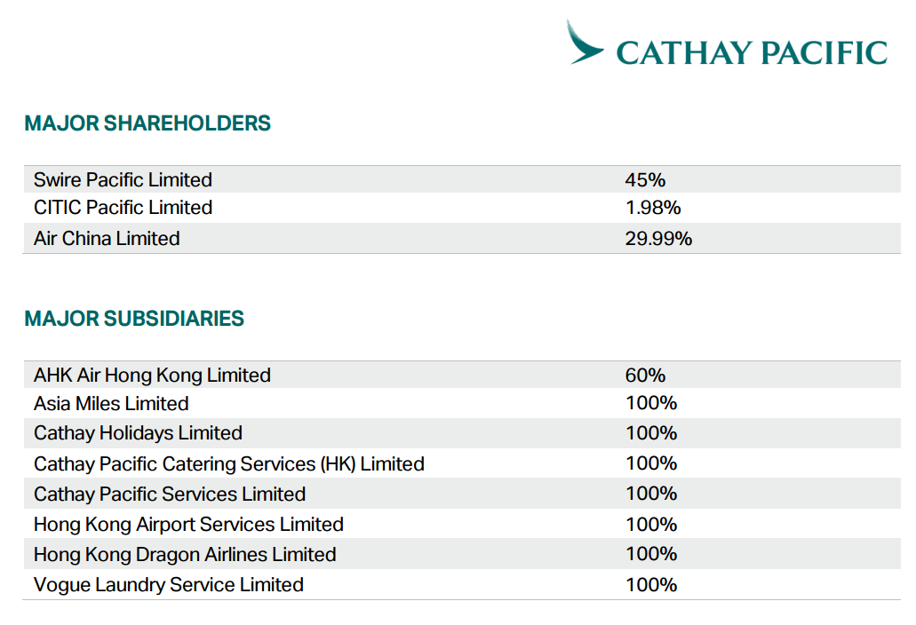
Updated Shareholding Structure

Slide 54

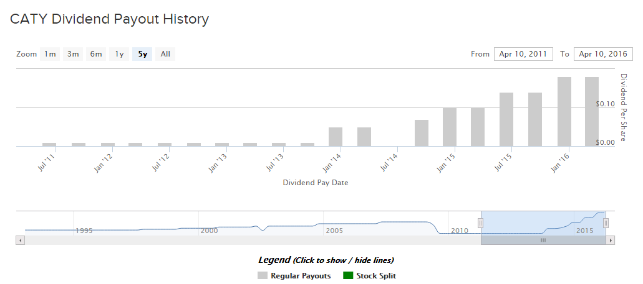
Dividend History

Slide 55


Dividend History

Slide 56
Company Profile
An international airline registered and based in Hong Kong, founded in 1946
A member of the Swire group and is a public company listed on the Hong Kong Stock Exchange.
Dragonair is a wholly owned subsidiary of Cathay Pacific, and the airline also has a 60% stake in AHK Air Hong Kong Ltd.
A founder member of the Oneworld Global Alliance.
At 30th June 2015, the Cathay Pacific Group employed more than 33,300 people worldwide (25,700 in Hong Kong
The Company offers scheduled passenger and cargo services to 203 destinations in 50 countries and territories.
The airline operations are principally to and from Hong Kong. Its segments include the airline business and the non-airline business.
The airline business segment comprises the Company's passenger and cargo operations. The non-airline business segment includes mainly catering, ground handling, aircraft ramp handling services and cargo terminal operations.

Slide 57


Subsidiaries

Slide 58

Associates

Slide 59

The Company Ranking

Slide 60

Company Mission

Slide 61

Changes to Iconic Logo(Brand Refresh) after 20 years
A more contemporary look by simplify, clarify and beautify the outlines of the logo
The Hong Kong-based carrier will keep the outlines of the logo
“The whole premise behind our work on this refresh of our brand, representing a new chapter for Cathay Pacific, is about making the customer experience more enjoyable, simpler and more relevant to what passengers aspire to today.”
Positive change across many of its key touchpoints, products and services including a new and easier-to-use website, new lounges embracing the new design concept , and new company-wide signage in 2015
Advances in Technology: introducing a cloud-based inflight catering system and a self-service bag-drop facility at Hong Kong International Airport, updating existing mobile apps for staff, introducing an inflight passenger information list for cabin crew, which is available on tablet devices.

Slide 62
Company History
1946 ,American Roy C Farrell and Australian Sydney H de Kantzow founded Cathay Pacific Airways. The Company began to operate passenger flights to Manila, Bangkok, Singapore and Shanghai
1948, one of Hong Kong's leading trading companies, Butterfield & Swire (today known as the Swire Group) took a 45% share in the company and became wholly responsible for the management of the airline.
Between 1962 and 1967, business grew at an average rate of 20 percent a year. Also initiated international services to Osaka, Fukuoka and Nagoya in Japan.
In the early 1970s, Cathay Pacific Airways started to make use of the latest technology with computerized reservation system and flight simulators. In 1979, Cathay Pacific Airways receive the first Boeing 747-200 in Hong Kong, applied for traffic rights to start flying to London, expanded services to Europe and North America
In the 1980s, expanded international network to include London, Brisbane, Frankfurt, Vancouver, Amsterdam, Rome, San Francisco, Paris, Zurich and Manchester.
In the 1990s, launched a new programme to offer unprecedented levels of passenger service. Changed green and white striped livery to the dynamic and now famous Asian "brushstroke" image, assembled a fleet of aircraft that was among the youngest in the world

Slide 63
Company History
2002, became joint venture partners with DHL in Air Hong Kong
2003 resumed passenger services to Beijing, commenced passenger services to Xiamen and freighter services to Shangha
2005 winning many major awards including the "Airline of the Year" in the world's largest passenger poll conducted by Skytrax
2006, signed an agreement that brought Dragonair into the Cathay Pacific Group as a wholly owned subsidiary, established a closer relationship with Air China, with each airline taking a 17.5% stake in the other, and named "Airline of the Year 2006" by Air Transport World magazine.
2008, strengthened services to India, adding 20 more flights each week and a new destination, Chennai.
between 2009 and 2012, significantly modernized the Cathay Pacific fleet
2013, The new built Cathay Pacific Cargo Terminal at Hong Kong International Airport (HKIA) commenced operations

Slide 64

Management Team
John Slosar
Became Chairman of Cathay Pacific on 14 March 2014.
Has been a Director of the airline since July 2007.
Was appointed Chief Operating Officer in July 2007 and Chief Executive in March 2011.
Joined the Swire group in 1980 and has worked with the group in Hong Kong, the United States and Thailand.
Is also Chairman of John Swire & Sons (H.K.) Limited, Swire Pacific Limited, Swire Properties Limited and Hong Kong Aircraft Engineering Company Limited.
Holds degrees in Economics from Columbia University and Cambridge University.

Slide 65

Management Team
Ivan Chu
Was appointed as Chief Executive of Cathay Pacific on 14 March 2014.
Is also Chairman of Hong Kong Dragon Airlines Limited and a Director of John Swire & Sons (H.K.) Limited and Swire Pacific Limited.
Was appointed Director Service Delivery for Cathay Pacific in September 2008 and Chief Operating Officer in March 2011.
Joined the Swire group in 1984 and has worked with the group in Hong Kong, Mainland China, Taiwan, Thailand and Australia.
Holds a Master degree in Commerce from the University of New South Wales in Australia and a Bachelor’s degree in Social Science from the University of Hong Kong.

Slide 66

Management Team
Algernon Yau
Was appointed as an Executive Director of Cathay Pacific in September 2015.
Is also currently Chief Executive Officer of Dragonair, the sister airline of Cathay Pacific.
Joined Cathay Pacific in 1982 and has considerable experience working in the commercial aviation field.
Has responsibility for overseeing the business and operations of a number of Cathay Pacific’s subsidiaries
Holds a Bachelor of Business degree in Transport and Logistics from the Royal Melbourne Institute of Technology University, Australia.

Slide 67

Management Team
Rupert Hogg
Became a Director and Chief Operating Officer of Cathay Pacific on 14 March 2014.
Was appointed Director Cargo in September 2008 and Director Sales & Marketing in August 2010.
Joined the Swire group in 1986 and has worked with the group in Hong Kong, Southeast Asia, Australia and the United Kingdom.
Is also Chairman of AHK Air Hong Kong Limited and a Director of Hong Kong Dragon Airlines Limited.
Holds a Master of Arts degree in History from Edinburgh University

Slide 68

Management Team
Martin Murray
Has been Finance Director of the Company since November 2011.
Is also a Director of Hong Kong Dragon Airlines Limited.
Was previously Deputy Finance Director of Swire Pacific Limited.
Joined the Swire group in 1995 and has worked with the group in Hong Kong, the United States, Singapore and Australia.
Graduated from the University of Glasgow in 1988 with a Bachelor of Accountancy degree.
Is a member of the Institute of Chartered Accountants of Scotland and the Hong Kong Institute of Certified Public Accountants.

Slide 69


Fleet Profile

Slide 70

Air Craft
Investing heavily in new aircraft.
69 owned, 79 leased
At 30th June 2015, Cathay Pacific operated 148 aircraft, Dragonair operated 41 aircraft and Air Hong Kong operated 13 aircraft (a total of 202 aircraft for the Group)
Had 72 new aircraft on order for delivery up to 2024.
Began to retire Airbus A340-300 aircraft (1 in 2015, 7 in 2017).
Took delivery of nine new aircraft: four Boeing 777-300ERs, three Airbus A330-300s in first half of 2015, two in the second half.

Slide 71

Company Route Map

Slide 72

Operation Analysis

Slide 73

Revenue Composition

Slide 74


Profit, Debt Ratio, and Group Margin

Slide 75

Revenue and Break-even

Slide 76

Available seat kilometres (“ASK”), load factor and yield by region

Slide 77

Geographical Revenue

Slide 78





Load Cargo vs Seat Kilometers

Slide 79


Competition to other Asian airlines serving North America
Cathay is one of 12 North Asian airlines serving North America.
The concern is increasing capacity from existing competitors, namely those in mainland China (with far wider domestic networks) and Japan and Korea.

Slide 80

Composition of Assets

Slide 81

Composition of Expenses

Slide 82

Debt and Equities Structure

Slide 83

Borrowing strategies
Borrowings are fully repayable by 2026, with 55% currently at fixed rates of interest after taking into account derivative transactions.

Slide 84

Key Statistics

Slide 85

Key Statistics

Slide 86
Risk Management
Jet fuel prices
(Fuel cost accounts for over 35% of the total operating expenses)
Strategy: Use fuel derivatives
BUSINESS RISK
Interest Rate
(Long term borrowings at floating rates)
Strategy: Use interest rate swaps to maintain appropriate fixed and floating rates.
Foreign Exchange Rate
Strategy: Finance assets in those foreign currencies (natural hedge) and use currency derivatives to reduce anticipated foreign currency surpluses.

Slide 87



Fuel Expenditure and Hedging

Slide 88


Recent News

Slide 89


Financial Statements

Slide 90

Balance Sheet (Semi-annual)

Slide 91


Balance Sheet (Annual)

Slide 92


Income Statement (Annual)

Slide 93

Income Statement (Semi-annual)

Slide 94

Statement of Cash Flow (Annual)

Slide 95

Statement of Cash Flow (Semi-annual)

Slide 96

Statement of Changes in Equity

Slide 97
Recommendation
HOLD

Slide 98

Singapore Airlines

Slide 99



Stock Information
Source by Bloomberg

Slide 100


Stock Information
Source by Bloomberg

Slide 101


1 Year Stock Price Movements
Source by Bloomberg

Slide 102

1-Year Price Movements with SPX&DJI
Source by Bloomberg

Slide 103


5-year Stock Price Movements
Source by Bloomberg

Slide 104

5-Year Price Movements with SPX&DJI
Source by Bloomberg

Slide 105

10-year Stock Price Movements
Source by Yahoo Finance

Slide 106

10-Year Price Movements with SPX&DJI
Source by Yahoo Finance

Slide 107

Company information
Company Information

Slide 108
Company Profile
Founded in 1972
Joined the Star Alliance on April 1, 2000
One of the most respected airline brands around the world
One of the largest airlines in Asia
One of the top 15 carriers worldwide in terms of revenue passenger kilometers
First airline company flying with Airbus A380
Based at Singapore Changi Airport
10th in the world for international passengers carried

Slide 109

Company History

Slide 110




Subsidiaries

Slide 111


Employment

Slide 112

Employment

Slide 113

Route Map
Services in more than 60 cities in over 30 countries around the world.

Slide 114

Fleet Profile

Slide 115


Fleet Profile

Slide 116

Management Team
Chairman: Mr. Stephen Lee Ching Yen
Chairman of Singapore Airlines Ltd since January 2006, SIA Engineering Company Ltd and NTUC Income Insurance Co-operative Limited
Chairman of the Singapore Business Federation from 2002 to 2008 and International Enterprise Singapore from 1995 to 2002
Managing Director of Shanghai Commercial & Savings Bank Ltd (Taipei) and GMT Investments Pte Ltd
Nominated Member of Parliament from 1994-1997
President of the Singapore National Employers Federation since 1988 and is a Council Member of the Singapore National Wages Council
Awarded the Distinguished Service Order Award in 2006 and the Public Service Star Award in 1998
Graduated from Northwestern University, Illinois, USA in 1973 with a Master of Business Administration

Slide 117

Management Team
CEO: Mr. Goh Choon Phong
Chief Executive Officer (CEO) of Singapore Airlines Ltd since January 1, 2011 and Director on October 1, 2010
Worked for the SIA group for more than 20 years for the airlines' operations in China and Scandinavia
Divisional Vice President for Commercial Technology of SIA in 1999 and Senior Vice President for Commercial Technology in 2000
Chairman of SilkAir (Singapore) Private Limited and a Member of the Board of Governors at IATA
Executive Vice President of Marketing and the Sales Regions from March 2010 to January 1, 2011
President of Singapore Airlines Cargo Pte Ltd. since June 1, 2006
Education: a MS degree in Computer Science & Electrical Engineering and three BS degrees in Computer Science & Engineering, Management Science and Cognitive Science, all from the Massachusetts Institute of Technology

Slide 118

Management Team
Director: Mr. Gautam Banerjee
Appointed Director on 1 January 2013
Mr Banerjee is a Senior Managing Director of Blackstone, co-Chairman of the firm’s Asia Operating Committee and Chairman of Blackstone Singapore
With professional services firm PricewaterhouseCoopers (PwC) Singapore for over 30 years, including as its Executive Chairman and Chief Operating Officer for the Asia Pacific region
Vice Chairman of the Singapore Business Federation, Advisor to Singapore Institute of International Affairs, and is a Board Member of public listed companies
Nominated Member of Parliament in Singapore between 2007 and 2009
Qualified as a Chartered Accountant in London and was admitted to the partnership on July 1, 1989
Graduated with a Bachelor of Science (Honors) degree in Accounting and Financial Analysis from the University of Warwick

Slide 119

Management Team
Director: Dr William Fung Kwok Lun
Appointed Director on 1 December 2009
The Group Chairman of Li & Fung Limited, a multinational group of companies headquartered in Hong Kong
Chairman of the Hong Kong General Chamber of Commerce (1994 to 1996)
Chairman of the Hong Kong Exporters’ Association (1989 to 1991)
Chairman of the Hong Kong Committee for the Pacific Economic Cooperation Council (1993 to 2002)
Awarded with the Silver Bauhinia Star by the Government of the Hong Kong Special Administrative Region in 2008
Honorary Degrees of Doctor of Business Administration by the Hong Kong University of Science & Technology and by the Hong Kong Polytechnic University

Slide 120

Management Team
Director: Mr. Hsieh Tsun-yan
Appointed Director on 1 September 2012
Chairman and Lead Counselor of LinHart Group, a leadership counselling firm founded by Mr Hsieh in 2008
Extensive experience in international business, leadership development and corporate transformation
With management consulting firm McKinsey & Company for 28 years and held posts in Singapore, Toronto and Copenhagen
A member of the Advisory Board at the School of Business and holds Provost Chair Professorship there and at the Lee Kuan Yew School of Public Policy
Graduated with BSc, Mechanical Engineering from University of Alberta (1970 – 1974)
Graduated with MBA from Harvard Business School (1978 – 1980)

Slide 121

Management Team
Director: Mrs. Christina Ong
Appointed Operating Director on 1 September 2007
Billionaire, one of the wealthiest women in the world
Known as the "Queen of Bond Street”
Owner of various high-end international fashion stores under the Club 21 umbrella
A recipient of The Italian Fashion Hall of Fame Award in 1995 and The Italian Award of Cavaliere De Lavo
A well-known hotelier and fashion retailer who owns the Como Hotels & Resorts Group of hotels and spas

Slide 122

Management Team
Director: Dr Helmut Gunter Wilhelm Panke
Appointed Director on 1 September 2009 and Executive Chairman of the Board of Management for Singapore Airlines Ltd from May 2002 through August 2006
A trained nuclear engineer, was with BMW, AG from 1982 to 2006
Chairman and CEO of BMW (US) Holding Corp, responsible for the carmaker’s North American activities (1993-1996)
Played a key role in the building of the first BMW plant in the USA in Spartanburg, South Carolina
A senior German manager and is currently holding board membership in Microsoft, Bayer AG & also a senior consultant with McKinsey & Company
Graduated from the University of Munich in physics, having started his studies in 1968, and received his Ph.D. in 1976 and an AFS Exchange Student to the U.S.
Awarded of the doctorate degree in nuclear physics and joined the Swiss Institute for Nuclear Research

Slide 123

Management Team
Director: Mr. Lucien Wong Yuen Kuai
Appointed Finance Director on 1 September 2007
Chairman and Senior Partner of Allen & Gledhill LLP
Over 30 years of experience in the practice of law, specializing in banking, corporate and financial services work
Chairman of the Maritime and Port Authority of Singapore
Chairman of the Board of Directors of the Singapore International Arbitration Centre
A member of the Board of Trustees for the Singapore Business Federation and sits on the Board of Directors of Temasek Holdings (Private) Limited, Hap Seng Plantations Holdings Berhad and Singapore Press Holdings Limited
A Board member of the Monetary Authority of Singapore from January 2006 to February 2013
Graduated with LL.B. in 1979 from National University of Singapore

Slide 124

Operation Analysis

Slide 125

Information of Shareholders

Slide 126



Operating Performance

Slide 127

Operating Performance

Slide 128

Operation Analysis

Slide 129


Revenue
Tiger Airways Holdings Limited became a subsidiary of the Group
An operating deficit of $9M
Consolidation on the back of $357M revenue against $366M operating expenditure
2.4% reduction in capacity
reduced overhaul activities

Slide 130

Operating Revenue

Slide 131


Expenditure

Slide 132

Fuel Price and Fuel Cost

Slide 133


Fuel Price and Fuel Cost
15.4% decrease in fuel price from $124.8/BBL to $105.6/BBL
1.9% decline in volume uplifted from $31M to $30.4M BBL
Strengthening of USD against SGD

Slide 134

Operating Profit Margin

Slide 135


Overall Net Operating Profit

Slide 136
Risk Management
(a) Jet fuel prices (Focus Fuel cost by hedging & fuel derivatives)
(b) Review of strategies for managing Information Technology Risks
(c) Foreign Exchange Rate (Finance assets & currency hedging)
(d) Interest Rate (interest rate swaps)

Slide 137

Financial Analysis

Slide 138

Annual Balance Sheet

Slide 139

Balance Sheet Cont.

Slide 140

Statements of Distribution

Slide 141

Comprehensive Income Statement

Slide 142

Income Statement

Slide 143

Income Statement

Slide 144


Cash Flow Statement

Slide 145


Cash Flow Statement

Slide 146

Quarterly Summary of SIA Group

Slide 147

5-Year Financial Summary

Slide 148


5-Year Financial Summary

Slide 149


5-Year Financial Summary

Slide 150

5-Year Financial Summary

Slide 151

Recommendation
BUY

Slide 152


Slide 153

Stock Information

Slide 154

1 Year Stock Price Movement

Slide 155

5 Years Stock Price Movement

Slide 156

10 Years Stock Price Movement

Slide 157

5 Year Comparison of Cumulative Total Return
Southwest Airlines Co. (LUV)
NYSE ARCA Airline Index
S&P 500 Index

Slide 158
Company Profile
Southwest is a major domestic airline that provides primarily short-haul, high-frequency, point-to-point, low-fare services
Headquarters in Dallas, Texas
More than 48,000 employees
#4 Fuel Efficiency U.S Domestic airline
Southwest Airlines operates more than 3,900 flights a day.
Has among the lowest cost structures in domestic airline industry
Uses a single aircraft type – Boeing 737 Southwest’s use of a single aircraft type has allowed for simplified scheduling, maintenance, flight operations, and training activities

Slide 159



Company History
Air Southwest Co. was incorporates and started to provide services within the state of Texas
1967
Air Southwest changes name to Southwest Airlines Co. Begins its service to Dallas, San Antonio and Houston.
1971
Southwest Airlines common stock is listed for trading on the American Stock Exchange under the ticker symbol “LUV”
1975
First destination outside of Texas. Begins its service to New Orleans.
1979
Acquires Morris Air and Arizona One
1994

Slide 160


Company History
Becomes a first Airline to have a website
1995
Online booking site is launched
1996
Becomes largest carrier in the US with 545 Boeing 737 aircrafts servicing 68 airports in 35 states and able to offer more than 3,300 flights a day
2009
Integration of Air Tran. The purchase adds 25 additional destinations previously not served by Southwest in Mexico and the Caribbean , Atlanta, Georgia
2011
AirTran and Southwest are fully integrated. Southwest introduces new branding, including a new livery and logo
2014
International Service countries grew to 7 countries with new services to San Jose, Costa Rica in March
2015

Slide 161

Mission

Slide 162

Business Strategy
Differentiates itself from other low-fare carriers by providing exemplary Customer Service
Short haul passenger and providing rates as low as one third of their competitors
Fly directly to destination
Lower unit cost
putting the employee first, Southwest has found the key to success in the airline business

Slide 163

Southwest Route Map

Slide 164

Route Map (from Dallas)

Slide 165

Top 10 Airports by Departures

Slide 166

Fleet
In 2016
Expects to take delivery of an additional 36 Boeing 737-800 aircraft and 17 Boeing 737-700 Aircraft.
Intending to accelerate the retirement of its 737-300 and 737-500 aircraft.

Slide 167

Management Team

Slide 168

Chairman of the Board, President & CEO (Chief Executive Officer)
In 1986 began his career at Southwest Airlines as Controller, moving up to Chief Financial Officer and Vice President Finance, then Executive Vice President and CFO, before being promoted to CEO and Vice Chairman in July 2004.
He received a B.B.A. in Accounting from the University of Texas at Austin.
He is a Certified Public Accountant and serves on the Board of Directors of the Lincoln National Corporation and Airlines for America, the airline industry advocacy group (serving as Chairman from 2012 - 2014).
Gary C. Kelly

Slide 169

Executive Vice President & CFO (Chief Financial Office)
She joined the company in 1991 and she became Senior Vice President Planning in 2010
Senior Vice President Finance and Chief Financial Officer since September 2012
She received a B.B.A. in accounting from the University of Texas at Austin
Tammy Romo

Slide 170

Executive Vice President & CCO (Chief Commercial Officer)
Joined Southwest Airlines in 1988
He has served in roles including Director Revenue Accounting, Corporate Controller, Vice President Procurement, Vice President Technology, Senior Vice President Enterprise Spend Management, and Executive Vice President Strategy and Technology
Bob holds an undergraduate degree in Computer Science and a Masters in Business Administration, both from Texas A&M University
Robert E. Jordan

Slide 171

Executive Vice President of Corporate Services
Joined Southwest in 2004
Prior to joining Southwest Airlines, Jeff worked 12 years at Mesa Petroleum from 1981 to 1993.
Following Belo, Jeff joined The Staubach Company as their Executive Vice President Corporate Operations and was also President of Staubach Lease Administration Company until 2004 when he came to Southwest Airlines.
Jeff completed his undergraduate work at West Texas State University - Canyon, Texas (now West Texas A&M) in 1986
Jeff Lamb

Slide 172

Executive Vice President, Strategy and Innovation
Rejoined Southwest in January 2016
Previously he served as Group Executive Vice President of J.C. Penny Company Inc. 2006-Dec2011 and Executive Vice President of J.C Penny Company Inc.
2004 - 2006 and served on assignment as Senior Vice President and Chief Information Officer for Southwest Airlines Co.
Tom earned Bachelor of Science degree from Villanova University in Pensilvania and Master’s degree in Business Administration from the University of Dallas
Tom Nealon

Slide 173

Executive Vice President & COO (Chief Operating Officer)
He joined the company in 1993.
He has held several positions at Southwest such as Executive Vice President of Aircraft Operations, Senior Vice President of Planning, Vice President Financial Planning & Analysis, Senior Director of Financial Planning & Analysis, Director of Financial Planning, and Director of Internal Audit
He received a B.B.A. from the University of Texas at Austin. He is also a Certified Public Accountant
Mike Van de Ven

Slide 174

Management Aging

Slide 175


Company Ownership

Slide 176

Operations Analysis

Slide 177


Operating Revenue Review
Operating revenue increased in 4th quarter of 2015 compared to 4th quarter in 2014 by 7.5% while Net Income in the same period increase by 282%

Slide 178



Operating Revenue Comparison
Revenue from passenger has increased by 3.6% from the last year what results in a conclusion that Net Income was majorly impacted by decrease in costs

Slide 179

Impact of Fuel Cost

Slide 180

Fuel Hedging Strategy
The Company enters into fuel derivative contracts to manage its risk associated with significant increases in fuel prices
The more volatile the market the higher the cost of hedging
The cost of hedging has increased in recent years with current high volatility in jet fuel prices and at the same time cost of fuel has decreased substantially what out weighted the increase in cost of hedging
The Company holds a net position of fuel derivative instruments that represent a hedge for a portion of its anticipated jet fuel purchases and the Balance of this position has been decreasing from 2014 (picture on the right)as price of oil has been decreasing.

Slide 181



Operating Expenses (Comparison)
Operating Expenses have decreased in 2015 mainly due to lower cost of fuel

Slide 182

Revenue Increase
Net income also grew to larger demand for cheap air travel in 2015 as compared to previous years
Number of passengers carried in 2015 has increased by 6.8% with majority of it coming from the summer period which is the best time for airlines

Slide 183

Financial Analysis

Slide 184




Balance Sheet (10-K)

Slide 185




Balance Sheet (10-Q)

Slide 186

Balance Sheet (5yr Comparison)

Slide 187


Income Statement (10-Q)

Slide 188


Income Statement (10-K)

Slide 189

Income Statement (5yr Comparison)

Slide 190


Statement of Cash Flow (10-Q)

Slide 191




Statement of Cash Flow (10-K)

Slide 192

Cash Flow Statement (5yr Comparison)

Slide 193

Dividend Growth

Slide 194

BUY

