Slide 1

Global Technology
Presented by Alejandro Rios, Bruno Marinone, Patricio Espinosa, Borna Hamidi & Braden Ahl

Slide 2

Agenda
Sector Outlook
Apple
Google
Microsoft

Slide 3
Global Tech Sector Outlook →

Slide 4
What is Global Tech?
The global technology sector encompasses companies that develop, manufacture, or deliver digital products and services—ranging from software, hardware, and cloud infrastructure to data-driven platforms and artificial intelligence.
As one of the most influential sectors in modern markets, global technology drives productivity, shapes consumer behavior, and underpins digital transformation across all industries.

Slide 5
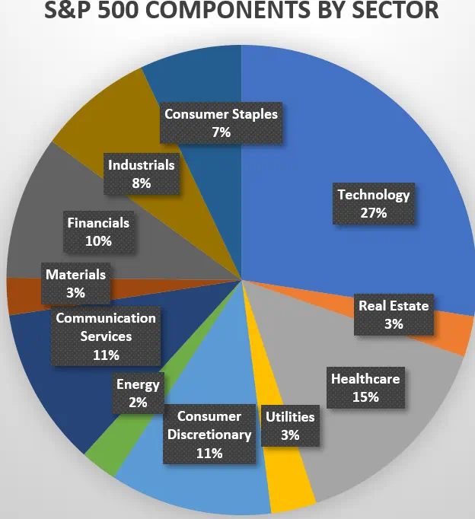
S&P 500 Composition: Tech Leads the Way
Global tech firms account for nearly 27% of the S&P 500 index, making it one of the most dominant and influential sectors in U.S. equity markets.

Slide 6
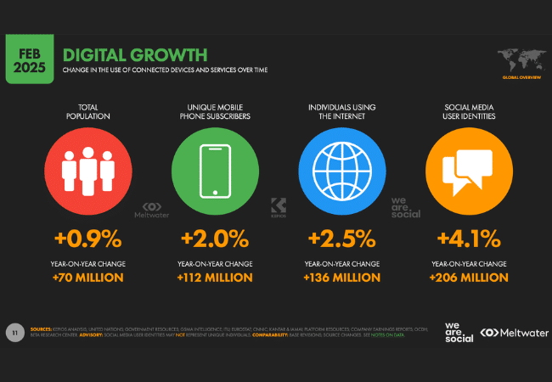
Digital Growth

Slide 7
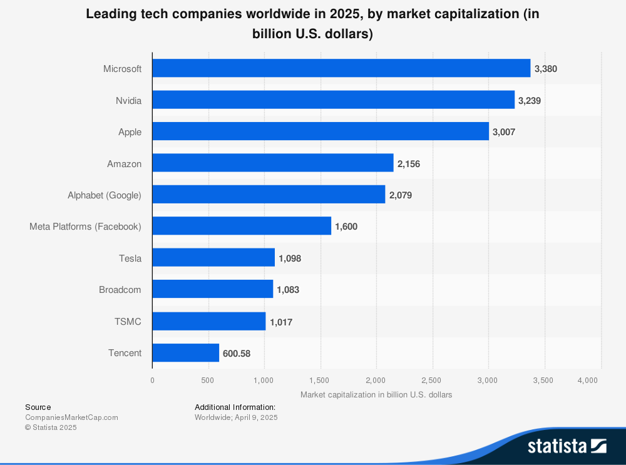
Industry Leaders

Slide 8

Global IT Spending
IT spending continue to rise showcasing companies' confidence and growth in IT sector.
Worldwide IT spending estimated to be around $5.74 trillion in 2025, an increase of 9.4% since 2024.

Slide 9
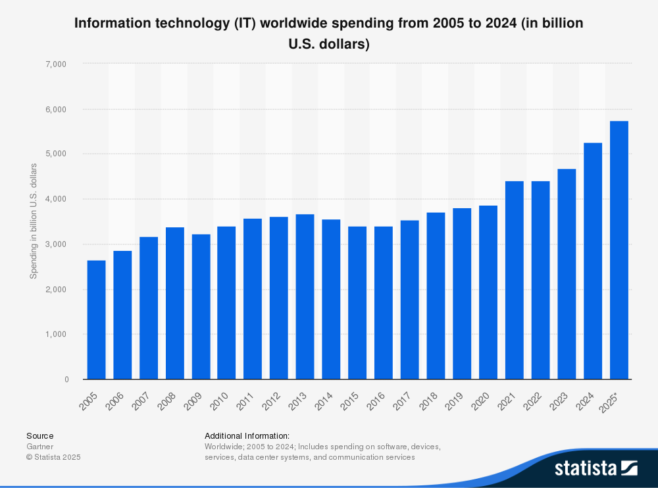
Global IT Spending
Notes:
IT spending spans multiple segments, including devices, data center systems, enterprise software, and communication services. IT services and communication services receive the largest investments, foundational to digital transformation across industries. Spending on data center systems and enterprise software is also increasing, supporting the development of emerging technologies such as AI, cloud computing, and big data.
The global information technology (IT) spending on devices, including PCs, tablets, mobile phones, printers, as well as data center systems, enterprise software, and communications services came to 4.7 trillion U.S. dollars in 2023. By 2024, IT spending is expected to increase to a staggering five trillion dollars worldwide.
IT services and communication services take the largest share of spending
Both IT services and communication services receive the largest amounts of investments, as these segments include a large array of different services and tools that remain cornerstones to different business functions. For example, different unified communication services are vital to connecting employees virtually and therefore enhance business productivity.
Spending on IT segments accelerates digital transformation
In general, spending on the different IT segments is expected to grow, accelerating digital transformation across various industries. Digital transformation encompasses the utilization of artificial intelligence , process automation, and moving data to the cloud, for example. These processes are empowered by strategic spending on and deployment of different information technologies.

Slide 10
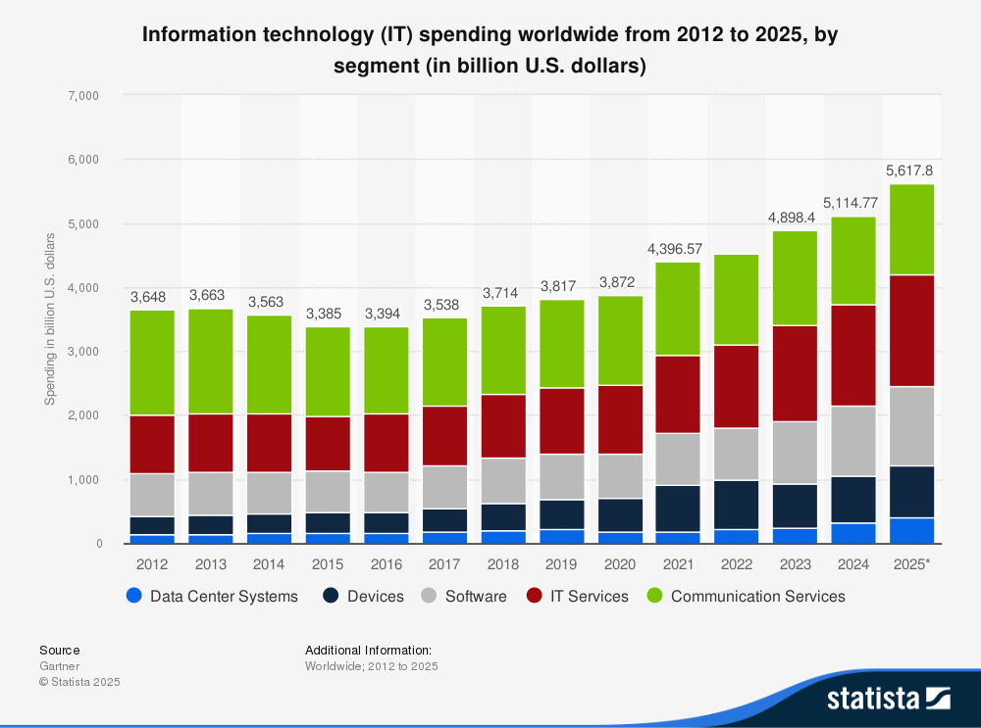
Global IT Spending by Segment
Notes:
IT spending spans multiple segments, including devices, data center systems, enterprise software, and communication services. IT services and communication services receive the largest investments, foundational to digital transformation across industries. Spending on data center systems and enterprise software is also increasing, supporting the development of emerging technologies such as AI, cloud computing, and big data.
The global information technology (IT) spending on devices, including PCs, tablets, mobile phones, printers, as well as data center systems, enterprise software, and communications services came to 4.7 trillion U.S. dollars in 2023. By 2024, IT spending is expected to increase to a staggering five trillion dollars worldwide.
IT services and communication services take the largest share of spending
Both IT services and communication services receive the largest amounts of investments, as these segments include a large array of different services and tools that remain cornerstones to different business functions. For example, different unified communication services are vital to connecting employees virtually and therefore enhance business productivity.
Spending on IT segments accelerates digital transformation
In general, spending on the different IT segments is expected to grow, accelerating digital transformation across various industries. Digital transformation encompasses the utilization of artificial intelligence , process automation, and moving data to the cloud, for example. These processes are empowered by strategic spending on and deployment of different information technologies.

Slide 11

GICS Structure Of Global Tech
The Global Tech Industry Groups:
Software and Services- Cloud Platforms, IT services
Technology Hardware and Equipment- Storage, Device and Communication Equipment
Semiconductors and Semiconductor Equipment- Chips and processors
Notes:
The main sub-division in the global tech industry includes- software and services sector which mainly provides services like cloud platforms and it services. Next is the technology hardware and equipment which provide products like storage devices, communication equipment etc. Lastly there is the semi-conductor which provides with the chips and processors to run the equipment. There are also other tech related sectors like communication services like the social media platforms, e-commerce shopping like amazon and lastly fintech firms like paypal.

Slide 12
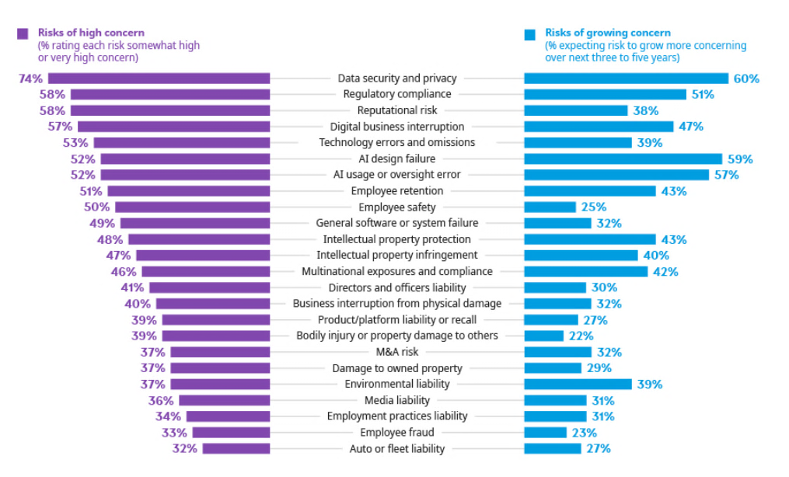
Industry Risks

Slide 13
Sub-Industries Analysis
Cloud Computing
Enterprise Software
Consumer Electronics
Artificial Intelligence
Semiconductors

Slide 14

Cloud Computing
Definition:
The delivery of computing services—including servers, storage, databases, networking, software, and analytics—over the internet (‘the cloud’), enabling on-demand access, scalability, and cost efficiency.
Key Idea:
Instead of owning physical IT infrastructure, businesses rent computing resources from providers such as Amazon Web Services (AWS), Microsoft Azure, and Google Cloud Platform.

Slide 15
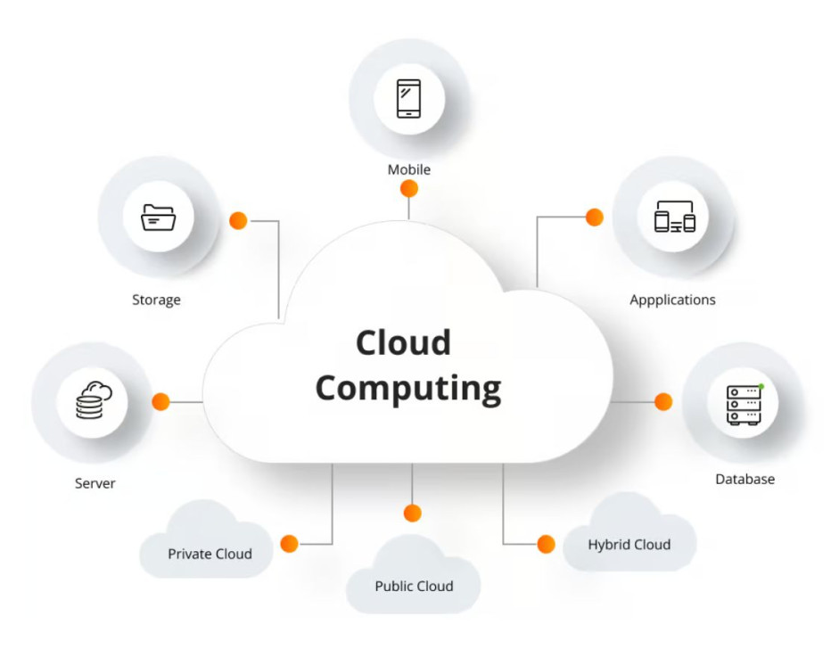
Cloud Computing Models
IaaS – Infrastructure as a Service
Cloud providers offer computing power, storage, and networking (e.g., AWS EC2, Google Compute Engine).
PaaS – Platform as a Service
Tools for developers such as databases, runtime environments, and app hosting (e.g., Azure App Services).
SaaS – Software as a Service
End-user applications delivered through the cloud (e.g., Google Workspace, Salesforce, Microsoft 365).
Notes:
The main sub-division in the global tech industry includes- software and services sector which mainly provides services like cloud platforms and it services. Next is the technology hardware and equipment which provide products like storage devices, communication equipment etc. Lastly there is the semi-conductor which provides with the chips and processors to run the equipment. There are also other tech related sectors like communication services like the social media platforms, e-commerce shopping like amazon and lastly fintech firms like paypal.

Slide 16
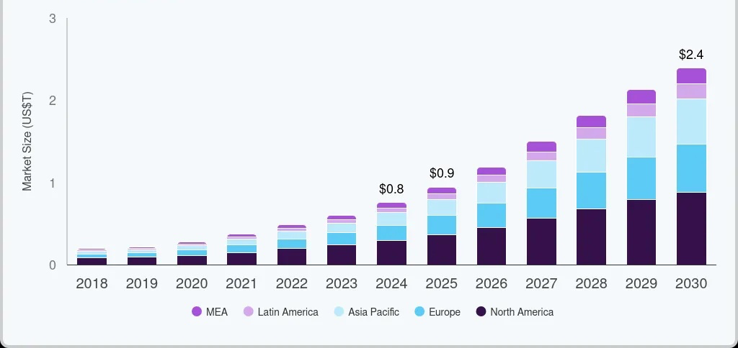
Global Cloud Computing Market Expected Growth

Slide 17

Key Drivers of Cloud Computing Growth
Digital Transformation: Companies are shifting to cloud platforms for scalability, remote collaboration, and faster innovation.
AI & Data Analytics: Demand surges as AI training and big-data workloads rely on cloud infrastructure.
Cost Efficiency: Pay-as-you-go pricing replaces heavy CapEx with flexible OpEx, improving margins.
Hybrid & Multi-Cloud Use: Firms mix providers (AWS, Azure, Google) to enhance reliability and compliance.
Notes:
The main sub-division in the global tech industry includes- software and services sector which mainly provides services like cloud platforms and it services. Next is the technology hardware and equipment which provide products like storage devices, communication equipment etc. Lastly there is the semi-conductor which provides with the chips and processors to run the equipment. There are also other tech related sectors like communication services like the social media platforms, e-commerce shopping like amazon and lastly fintech firms like paypal.

Slide 18

Cloud Computing Infrastructure: Data Centers
Global Networks: Cloud relies on thousands of hyperscale data centers worldwide.
Core Components: Servers, GPUs, storage racks, fiber networking, cooling systems, and power redundancy.
AI & Computing Demand: Growth in AI and machine learning increases the need for high-performance chips (e.g., NVIDIA GPUs).
Scale Advantage: Companies like AWS, Google, and Microsoft gain cost efficiency and speed through massive infrastructure.
Notes:
The main sub-division in the global tech industry includes- software and services sector which mainly provides services like cloud platforms and it services. Next is the technology hardware and equipment which provide products like storage devices, communication equipment etc. Lastly there is the semi-conductor which provides with the chips and processors to run the equipment. There are also other tech related sectors like communication services like the social media platforms, e-commerce shopping like amazon and lastly fintech firms like paypal.

Slide 19
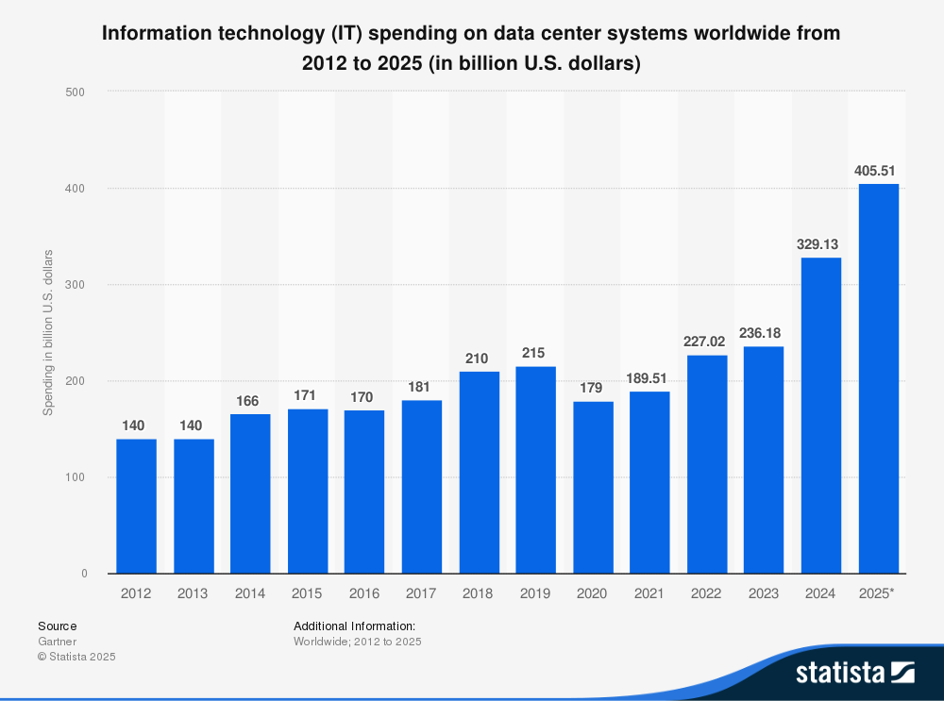
IT Spending on Data Centers

Slide 20
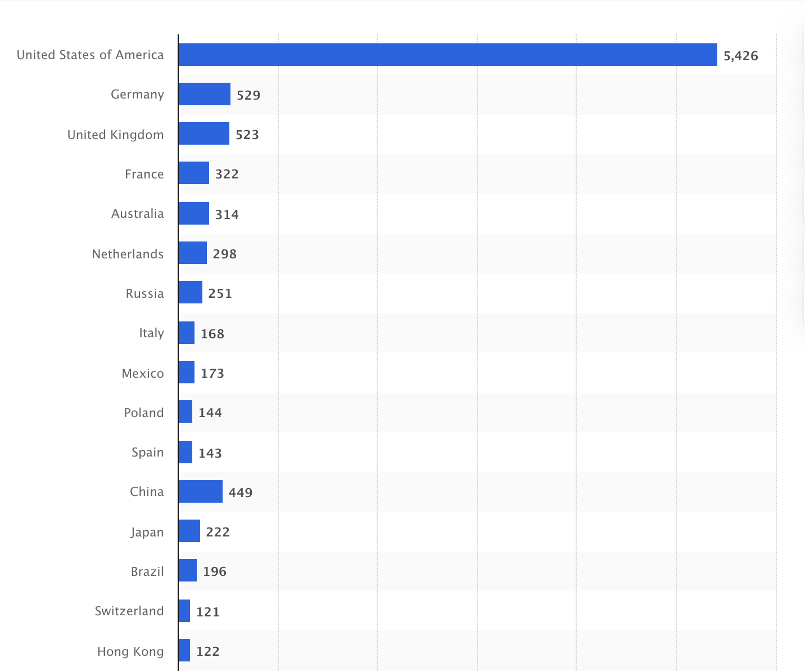
Leading Countries by Data Center

Slide 21

Cloud Computing: Financial & Strategic Implications
Recurring Revenue: Cloud services rely on subscription and usage-based billing, driving stable and predictable cash flows.
High Margins in SaaS: Software-as-a-Service models (like Microsoft 365 and Google Workspace) deliver strong gross margins due to low incremental costs.
Heavy CapEx for IaaS: Infrastructure-as-a-Service providers (AWS, Azure) face significant upfront data-center and server investments, impacting free cash flow.
Valuation Upside: Investors assign premium multiples to firms with scalable cloud growth and durable recurring revenue.
Strategic Synergy: Cloud enables cross-platform ecosystems — e.g., Apple’s iCloud integrating with devices, or Microsoft Azure linking to Office and AI tools.
Notes:
The main sub-division in the global tech industry includes- software and services sector which mainly provides services like cloud platforms and it services. Next is the technology hardware and equipment which provide products like storage devices, communication equipment etc. Lastly there is the semi-conductor which provides with the chips and processors to run the equipment. There are also other tech related sectors like communication services like the social media platforms, e-commerce shopping like amazon and lastly fintech firms like paypal.

Slide 22








Cloud Computing: Risks & Outlook
Risks
Outlook
Price Competition
Data Privacy & Security
High Capital Costs
Regulatory Pressure
Strong AI & Digital Demand
Shift to Edge & Multi-Cloud
Long-Term 20% CAGR
Focus on Sustainability
Notes:
The main sub-division in the global tech industry includes- software and services sector which mainly provides services like cloud platforms and it services. Next is the technology hardware and equipment which provide products like storage devices, communication equipment etc. Lastly there is the semi-conductor which provides with the chips and processors to run the equipment. There are also other tech related sectors like communication services like the social media platforms, e-commerce shopping like amazon and lastly fintech firms like paypal.

Slide 23

Enterprise Software
Definition:
Large-scale computer applications designed to support and automate business operations, improve productivity, and manage organizational data across departments.
Typically includes systems for enterprise resource planning (ERP), customer relationship management (CRM), data analytics, and business process automation.
Key Idea:
Serves as the digital foundation for modern businesses, integrating core operations through scalable, cloud-based systems.

Slide 24
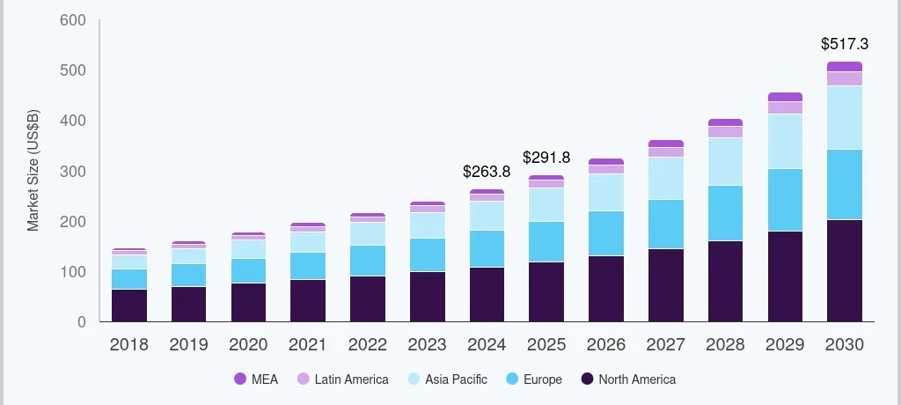
Enterprise Software Market Expected Growth

Slide 25

Types of Enterprise Software
1. ERP – Enterprise Resource Planning: Integrates core business functions like finance, operations, supply chain, and HR into one centralized system.
2. CRM – Customer Relationship Management: Tools for managing sales pipelines, customer communication, marketing automation, and customer analytics.
3. HR & Workforce Management: Manages payroll, recruitment, performance tracking, scheduling, and employee data.
4. Business Intelligence & Analytics: Software for data visualization, reporting, dashboards, and predictive analytics to guide decision-making.
5. Collaboration & Productivity Suites: Cloud-based tools for communication and teamwork, such as document sharing, email, video meetings, and workflows.
Notes:
The main sub-division in the global tech industry includes- software and services sector which mainly provides services like cloud platforms and it services. Next is the technology hardware and equipment which provide products like storage devices, communication equipment etc. Lastly there is the semi-conductor which provides with the chips and processors to run the equipment. There are also other tech related sectors like communication services like the social media platforms, e-commerce shopping like amazon and lastly fintech firms like paypal.

Slide 26

Financial & Strategic Implications
1. Recurring Revenue Models
Enterprise software increasingly uses SaaS subscriptions, creating predictable, high-visibility revenue streams that support premium valuation multiples.
2. High Gross Margins
Software businesses often generate 70–85% gross margins, driven by low incremental costs once platforms are built.
3. Customer Lock-In & Switching Costs
Deep integration into a company’s operations makes enterprise software sticky, reducing churn and strengthening long-term profitability.
4. Cloud & AI Synergies
Enterprise software drives demand for cloud workloads (Azure, Google Cloud) and increasingly incorporates AI automation, boosting expansion opportunities.
Notes:
The main sub-division in the global tech industry includes- software and services sector which mainly provides services like cloud platforms and it services. Next is the technology hardware and equipment which provide products like storage devices, communication equipment etc. Lastly there is the semi-conductor which provides with the chips and processors to run the equipment. There are also other tech related sectors like communication services like the social media platforms, e-commerce shopping like amazon and lastly fintech firms like paypal.

Slide 27

Consumer Electronics (CE)
Definition:
Consumer electronics refer to electronic devices designed for everyday use for communication, entertainment, or information purposes. This includes products like smartphones, laptops, tablets, wearables, TVs, and gaming consoles.
Key Idea:
The consumer electronics industry drives innovation and demand in the tech sector. It is highly competitive and cyclical; growth often depends on new product launches, consumer spending, and global supply chains.

Slide 28


CE Key Barriers and Market Opportunities
Challenges
Opportunities
Component shortages
Supply chain disruptions
Rising compliance costs due to regulations
Limited affordability for low-income consumers
Short Product Lifecycles
Advances in AI implementation
Growing demand for wearable and digital health devices
Growth of e-commerce and direct-to-consumer channels
Expansion into emerging markets
Rising consumer demand for sustainable and energy-efficient electronics
Notes:
Challenges
Component shortages
→ Directly disrupt manufacturing, raise input costs, and limit product availability.
Supply chain disruptions
→ Shipping delays, geopolitical tensions, and logistics bottlenecks slow delivery and increase operational uncertainty.
Limited affordability for low-income consumers
→ Restricts demand for premium devices and limits market expansion in price-sensitive regions.
Rising compliance costs due to regulations
→ Environmental and quality standards increase production costs and reduce profitability industry-wide.
Short Product Lifecycles
→Rapid changes in consumer preferences and technology lead to very short product lifecycles, requiring manufacturers to have efficient new product introduction processes and retailers to manage inventory uncertainty.

Slide 29
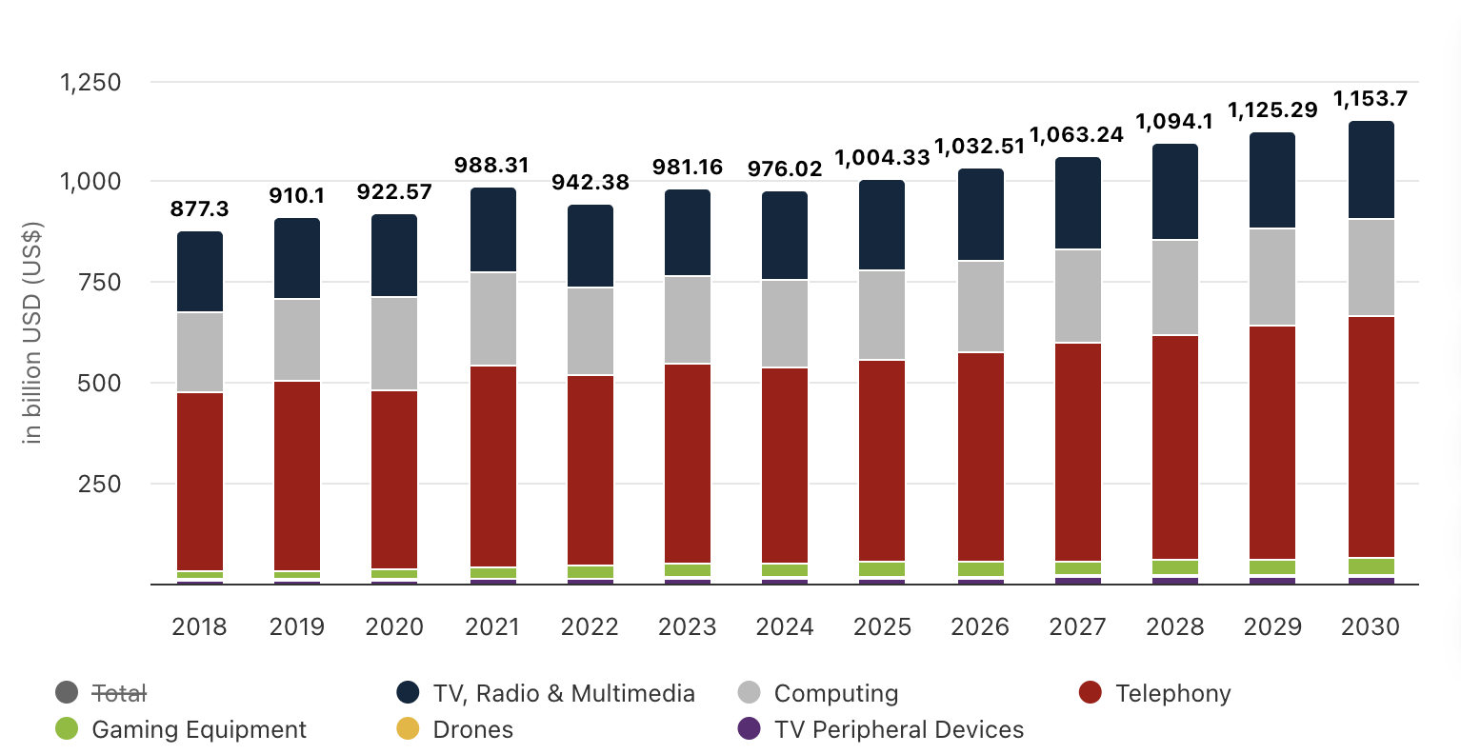
World-Wide Consumer Electronic Sales

Slide 30
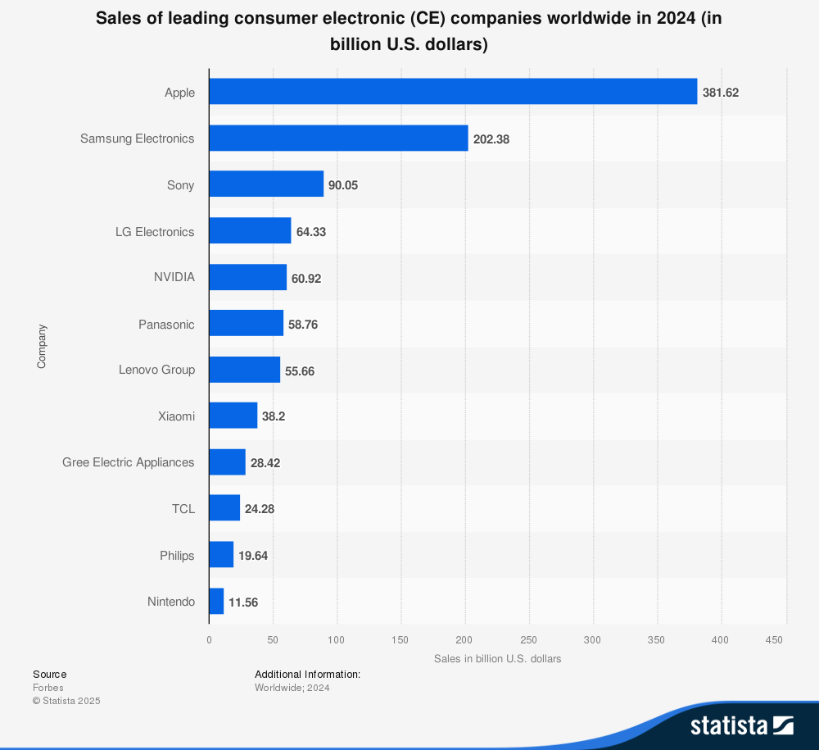
Leading CE Companies

Slide 31
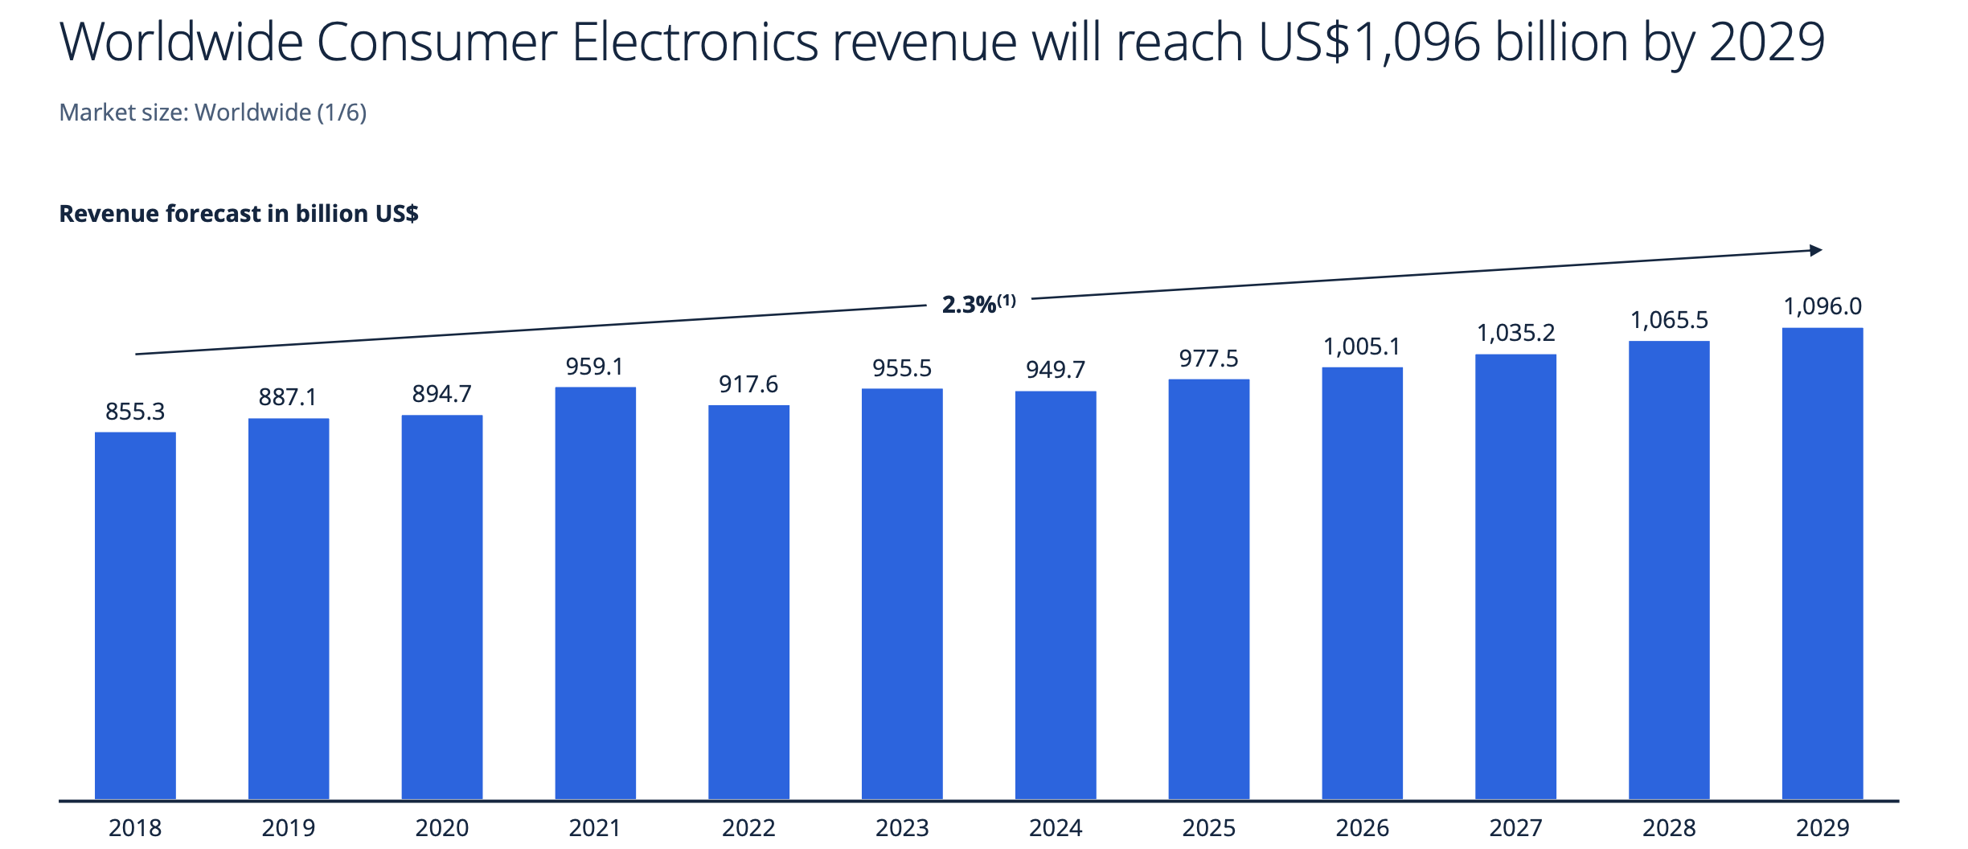
Industry Revenue Forecast

Slide 32
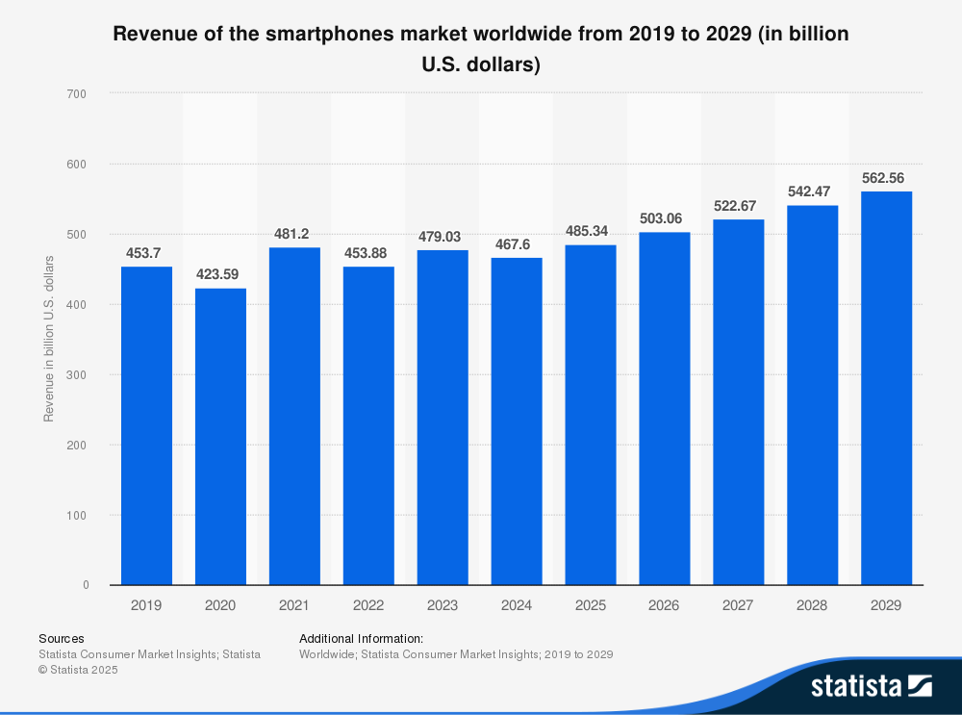
Revenue of Smartphones

Slide 33
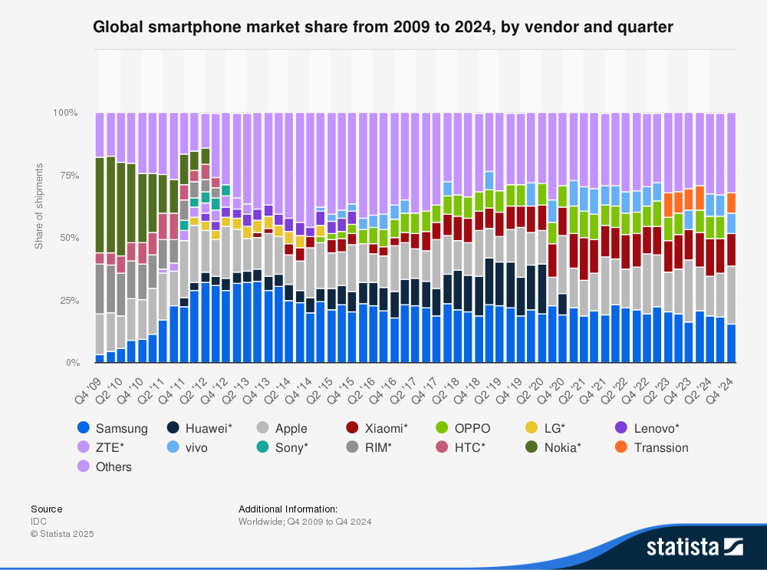
Smartphone Market Share

Slide 34
Smartphone User Interface
iPhone’s at the higher price range
Closed source, with open components
Exclusive communication: iMessage, FaceTime
App Store has over 1.91+ million apps
Used by most phone manufacturers
Giving customers varying price options
Open-Source OS
Versatile
Utilizes third-party app for communications
Google Play Store has 2.06+ million apps
Android
Exclusive for Apple products
User Friendly
Tight integration with other Apple products
IOS

Slide 35
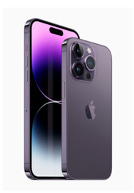

Smartphones
Apple
iOS: Highly optimized with a seamless ecosystem.
Design: Premium materials, excellent durability.
Integration: Works well with other Apple devices.
Security: High-level privacy with Face ID and Touch ID.
Samsung
Android: Customizable with One UI.
Design: High-quality materials, leading display technology.
Variety: Wide range from Galaxy S/Note to foldable phones.
Features: S Pen support, strong multitasking.
Xiaomi
Android: Customizable MIUI interface.
Value: High-performance at competitive prices.
Variety: Flagship Xiaomi, budget Redmi, camera-focused CC series.
Innovation: Fast charging, high refresh rates, advanced cameras.

Slide 36
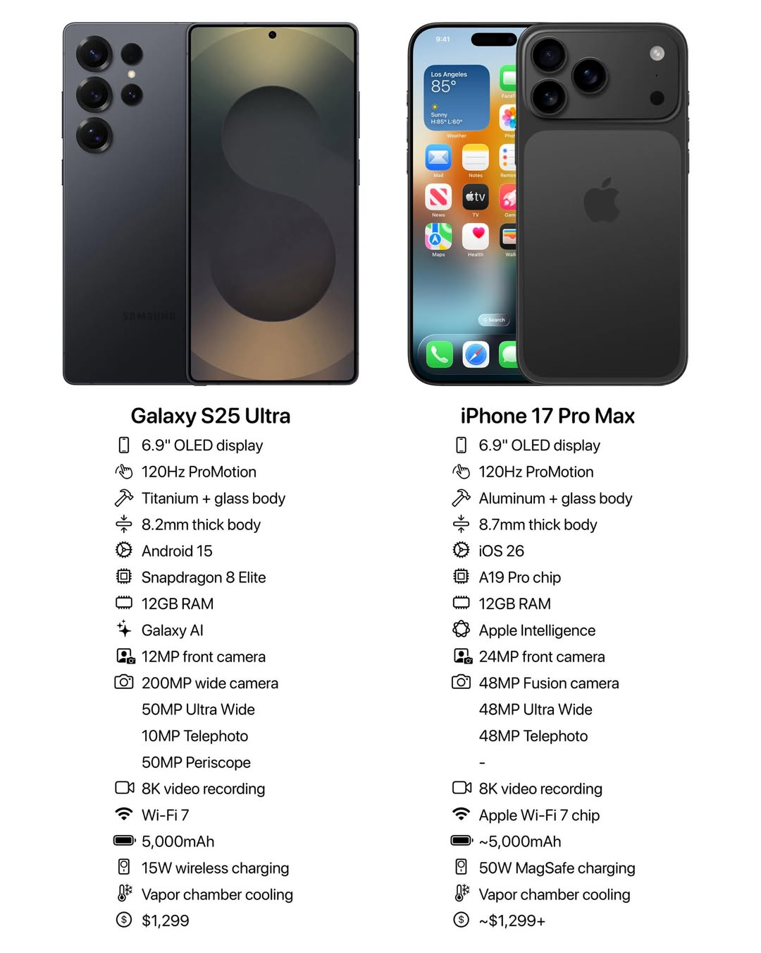
Apple vs Samsung

Slide 37
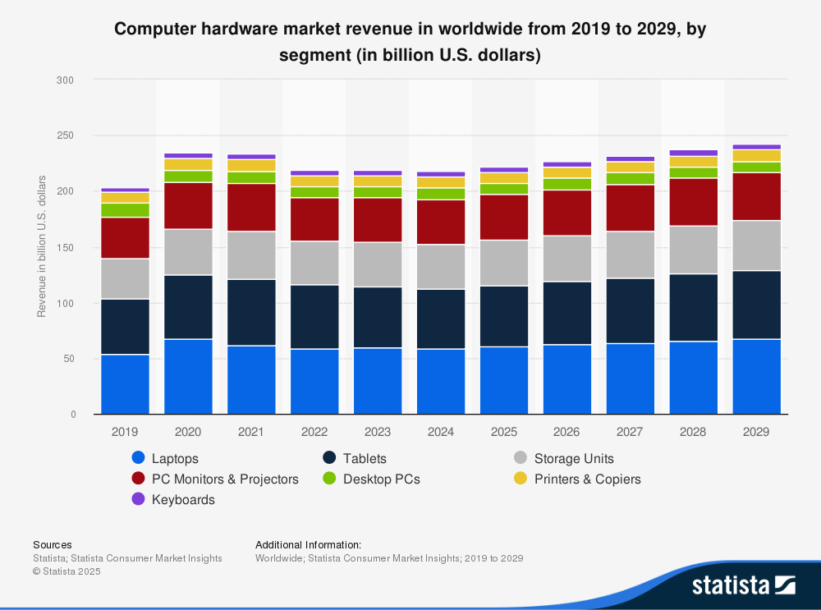
Computer hardware

Slide 38


Laptop Comparison
 | MacBook Air (M4, 2025) | Surface Laptop (7th Edition, 2024)
Processor | Apple M4 (8 or 10 Core GPU | Qualcomm Snapdragon X Elite (or X Plus)
Memory | 16 GB, 32 GB | 16 GB, 32 GB
Storage | 256 GB, configurable up to 2 TB | 256 GB, configurable up to 1 TB
Display | 13.6-inch at 2560 x 1664, 15.3-inch at 2880 x 1864 at 60 Hz (IPS) | 13.8-inch, 2880 x 1800 at 120 Hz (IPS) or 15-inch, 2496 x 1664 at 120 Hz (IPS)
Webcam | 12-megapixel | 1080p
Thickness | 0.44 inches (13-inch), 0.45 inches (15-inch) | 0.69 inches (13.8-inch) or 0.72 inches (15-inch)
Weight | 2.7 pounds (13-inch), 3.3 pounds (15-inch) | 2.96 pounds (13.8-inch) or 3.67 pounds (15-inch)
Price | From CAD $1,399.99 CAD | From CAD $1,349.99

Slide 39

Artificial Intelligence (AI)
Definition:
Artificial Intelligence is the branch of technology focused on creating systems that can perform tasks that normally require human intelligence, such as learning, reasoning, recognizing patterns, and making decisions.
Key Idea:
AI is transforming nearly every industry, from healthcare to finance, and is currently one of the main growth engines for the tech sector. Companies investing in AI infrastructure (like NVIDIA, Microsoft, and Google) are seeing major gains in productivity, automation, and data analytics.

Slide 40

AI: Financial & Strategic Implications
Cost reduction & efficiency gains: Automation lowers labour costs, reduces errors, and speeds up workflows.
Revenue growth through AI-enabled products: Personalized services, predictive maintenance, and autonomous solutions open new revenue streams.
Competitive advantage for early adopters: Firms that integrate AI early gain efficiency, innovation, and market leadership.
Business model transformation: AI enables shifts to service-based, subscription, or personalized offerings.
Data-driven decision-making & resilience: AI enhances forecasting, risk management, and operational resilience, supporting strategic planning.

Slide 41
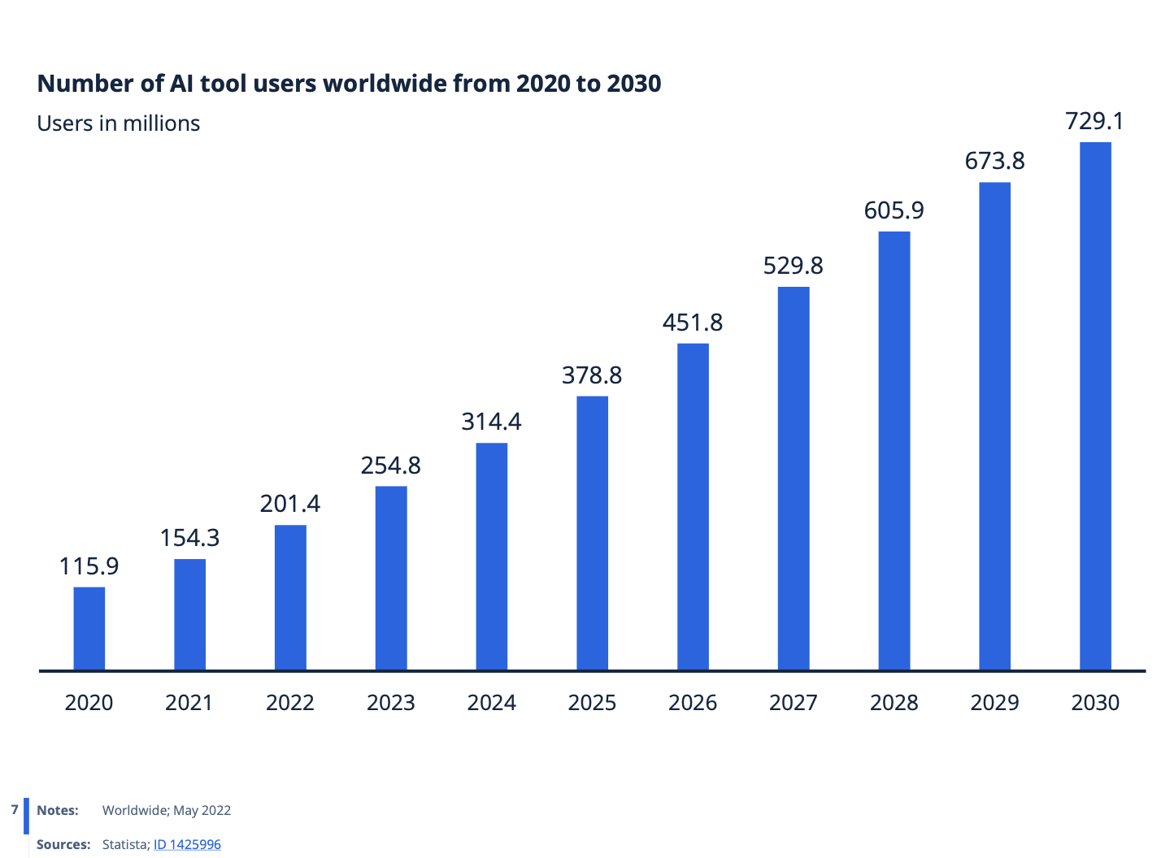
AI Users
Notes:
The rates of AI adoption across multiple industries have accelerated in recent years. As more businesses recognize the transformative potential of artificial intelligence, the AI market is experiencing significant growth. Furthermore, cloud computing platforms are democratizing AI by providing access to powerful AI resources on an on-demand basis, making the technology accessible to businesses of all sizes

Slide 42
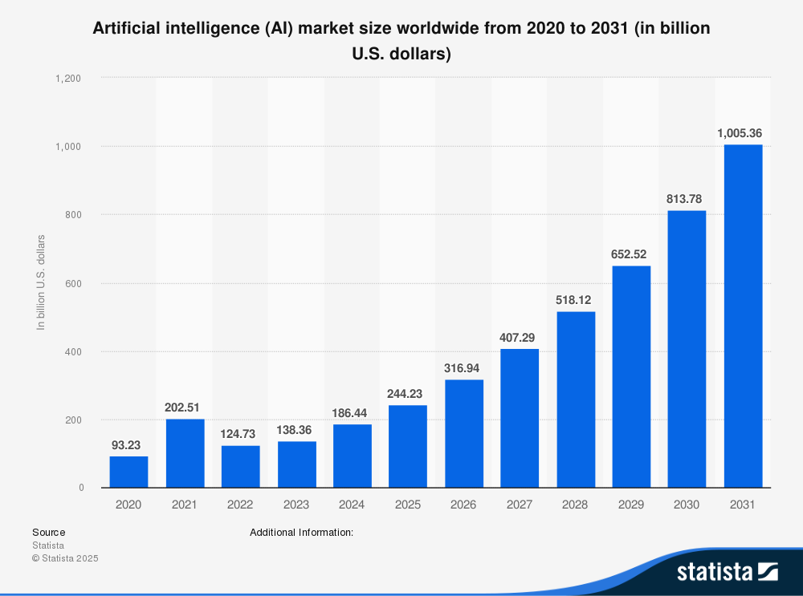
AI Market Size

Slide 43
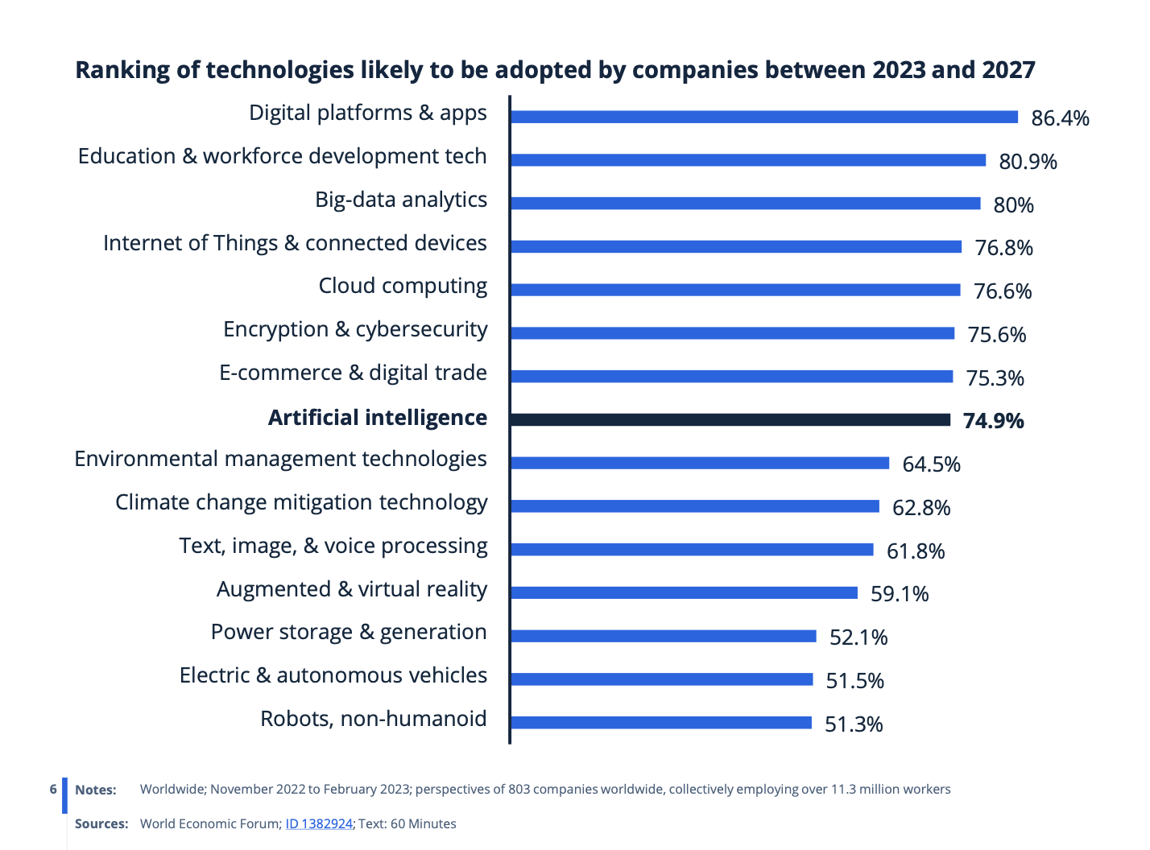
AI Adoption Forecast
Notes:
The rapid advancement of the Fourth Industrial Revolution has expedited the adoption of technologies, reshaping the relationship between humans and machines. This technological transformation not only impacts the way people work but also alters job requirements, skill demands, and the displacement of certain occupations. Gaining insights into how these technologies will influence labor markets is vital in assessing how to transition individuals from declining job roles to the emerging jobs of the future.

Slide 44
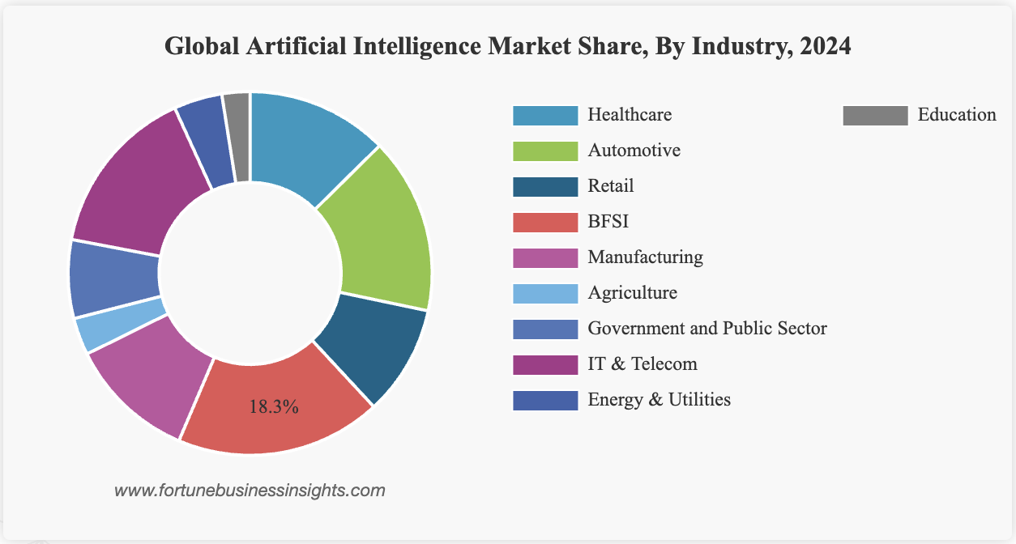
AI Market by Industry Segment
The AI market spans sectors such as healthcare, automotive, retail, BFSI, manufacturing, agriculture, government, IT & telecom, energy, and education.
BFSI led the market in 2024 and holds 18.90% of the 2025 market share, driven by AI adoption in personalized financial advice, chatbots, and improved customer engagement.
AI in BFSI is expanding financial access and could contribute up to 13.6% of the GCC’s GDP through banking by 2030.
Healthcare is expected to record the highest CAGR of 36.50%, supported by the rapid development of AI tools for administration and patient care.
Patients are increasingly receptive to AI, with 64% open to AI for 24/7 support, and AI is being used to reduce medication errors, such as detecting improper insulin or inhaler use, where non-adherence reaches up to 70%.

Slide 45
AI in Tech
AI-Driven Automation and Efficiency
Automated Data Processing
Predictive Maintenance
Intelligent Process Automation
AI-Powered Customer Experience and Personalization
Enhanced Customer Service
Predictive Analytics
Hyper-Personalization
AI in Cybersecurity and Threat Detection
Enhanced threat detection
Behavioral analysis
Automated response

Slide 46

Semi-conductor
Definition:
Semiconductors are materials and components like microchips that power all modern electronics, from smartphones and computers to electric vehicles and data centers.
Key Idea:
The semiconductor industry is the backbone of global technology, enabling advancements in AI, cloud computing, and consumer devices. It’s also highly strategic; supply chain disruptions or geopolitical tensions can impact the entire tech ecosystem.

Slide 47

Semiconductors: Financial & Strategic Implications
Massive capital needs: The industry requires ~$1 trillion in fab investment by 2030, and higher construction/operating costs in the U.S. and Europe put pressure on margins.
Supply chain concentration: Critical materials and advanced packaging are heavily concentrated in a few countries, increasing strategic vulnerability and sourcing risk.
Severe talent shortages: A global lack of engineers and skilled technicians limits fab scaling, raises labour costs, and delays production ramp-up.
Infrastructure bottlenecks: Ports, logistics systems, and local utilities in many regions are underdeveloped for semiconductor needs, causing delays and higher project risks.
Cost vs. resilience trade-off: Regionalizing semiconductor production improves supply security but significantly raises costs, forcing companies to balance resilience against profitability.
Notes:
https://www.mckinsey.com/industries/semiconductors/our-insights/semiconductors-have-a-big-opportunity-but-barriers-to-scale-remain

Slide 48
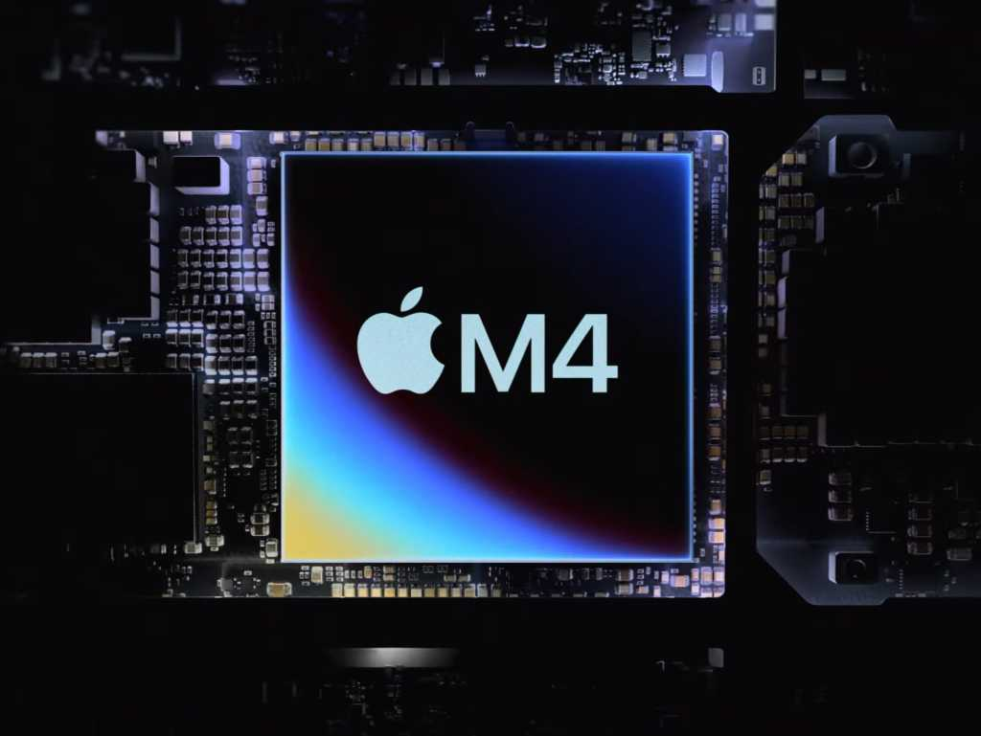
In-House Semiconductor Chip Design: Advantages & Disadvantages
Performance optimization: Custom chips are tailored for products, improving speed, efficiency, and battery life.
Competitive differentiation: Unique designs enable features that competitors cannot easily replicate.
Cost & supply chain control: Reduces dependency on third-party vendors and mitigates supply risks.
High investment & complexity: Developing chips in-house requires large R&D budgets, specialized talent, and carries design risks.
Scale & time-to-market challenges: Smaller production volumes and initial design cycles may limit efficiency and slow product launches.

Slide 49
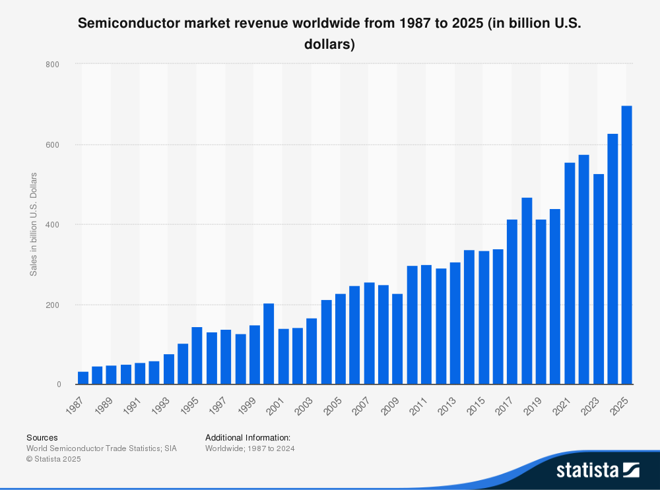
Market Revenue

Slide 50
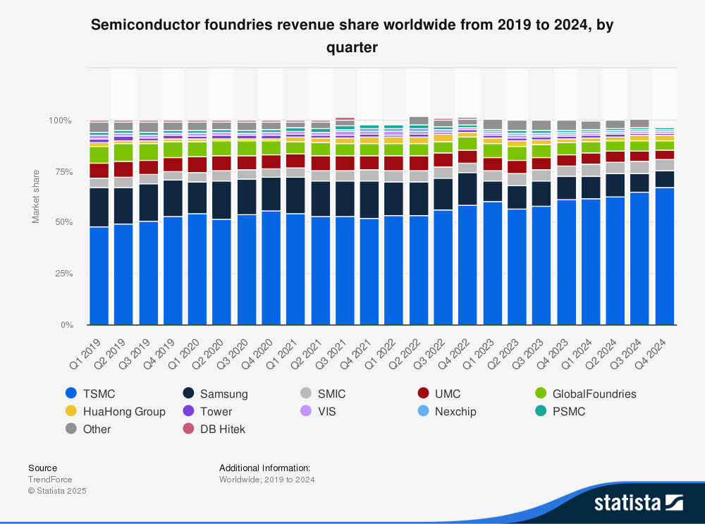
Quaterly Market Revenue

Slide 51
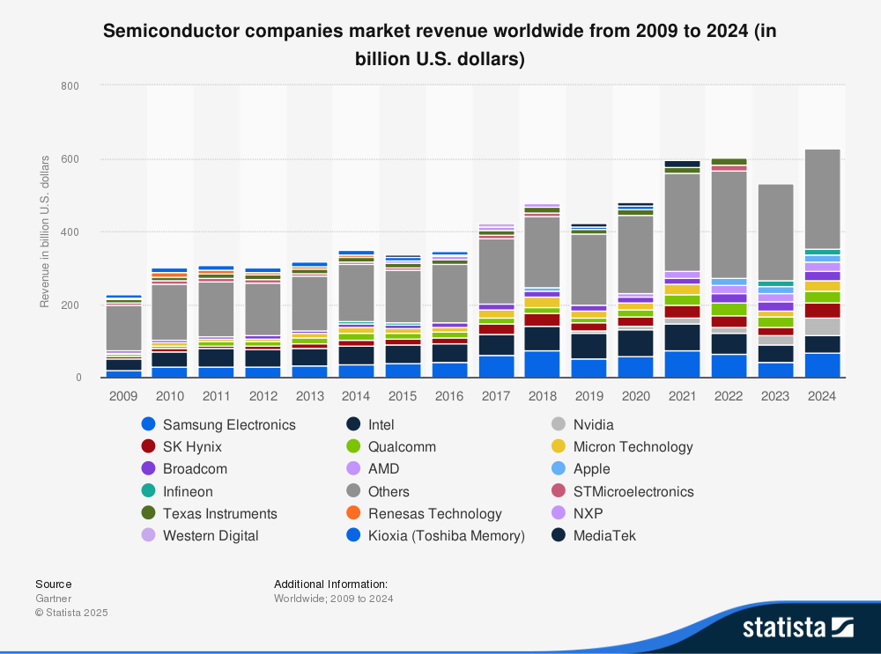
Industry Leaders

Slide 52

Global Tech: Regulatory and Competitive Environment
Regulatory Landscape
  Governments are increasingly establishing rules on data privacy, cybersecurity, AI ethics, and environmental compliance, which in turn affect product design, operations, and market access.
  Trade restrictions and export controls (e.g., U.S.–China tech tensions) impact global supply chains and access to critical components.
Competitive Dynamics
  Rapid innovation cycles and new entrants intensify competition across hardware, software, and AI-driven services.
  Tech giants leverage scale, IP, and ecosystems to maintain market dominance, while startups exploit niche opportunities for agility and specialization.
  Mergers, acquisitions, and strategic partnerships reshape market power and accelerate technology adoption.
Strategic Implications for Companies
  Firms must balance regulatory compliance with the speed of innovation.
  Investment in R&D, supply chain resilience, and talent is critical to sustain competitive advantage.
  Geopolitical and regulatory shifts require flexible business models to navigate global markets.
Notes:
Regulatory Changes
AI Compliance
Safeguarding Consumer Privacy And Data Security
Cybersecurity
Fair Competition Practices
Ethical Use Of Emerging Technologies

Slide 53
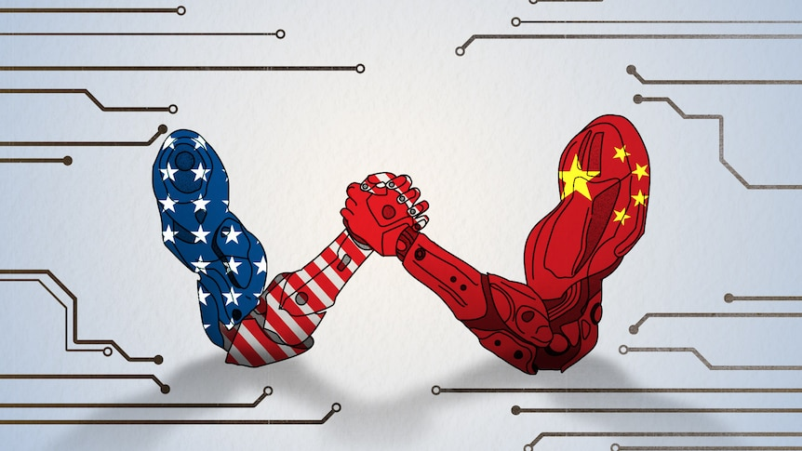
US-China Tech War
Export controls & trade restrictions
The U.S. limits chipmaking equipment and software exports to China, while China restricts rare earth minerals, creating global supply chain risks.
Supply chain diversification
Apple, TSMC, and Mazda are relocating production and sourcing outside China to mitigate geopolitical and operational risks.
Strategic onshoring & investment
TSMC’s $40B US chip fab and Apple’s production realignment highlight major investments to reduce reliance on China.
Rising component costs & production pressures
Export restrictions and mineral limitations are increasing costs and slowing production timelines for tech companies.
Geopolitical leverage of critical minerals
China’s control over rare-earth metals underscores the strategic importance of securing alternative sources and domestic production.

Slide 54

Apple
NASDAQ: AAPL
v

Slide 55
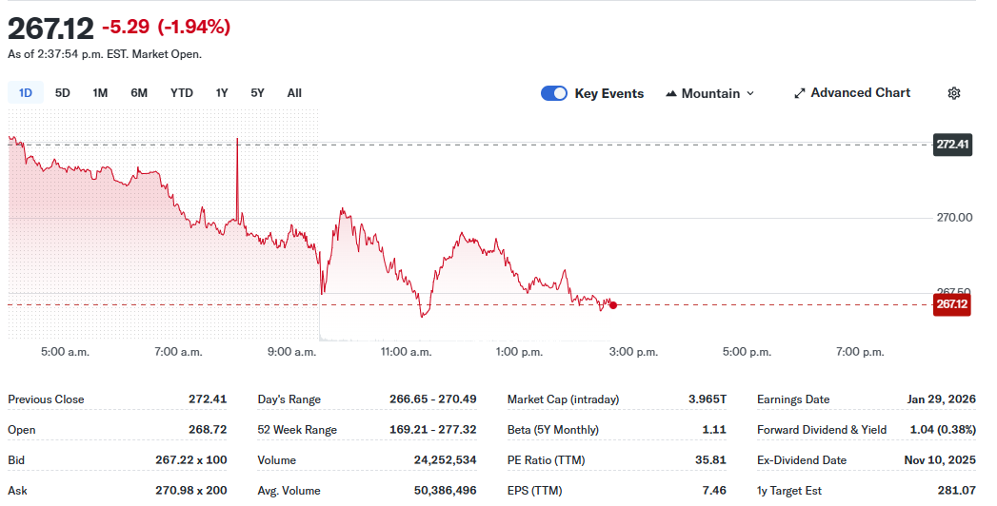

Slide 56
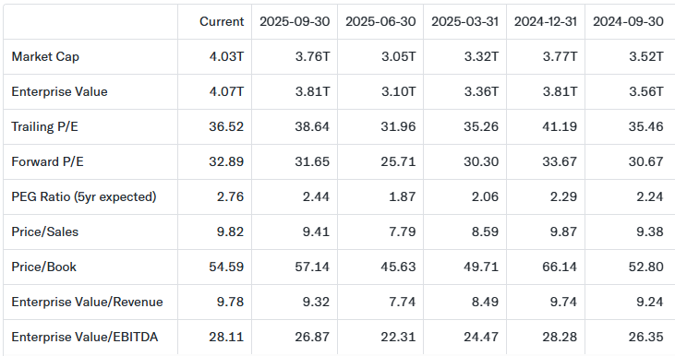
Valuation Metrics

Slide 57
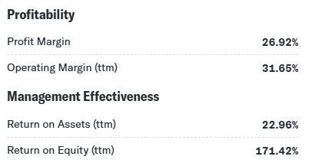
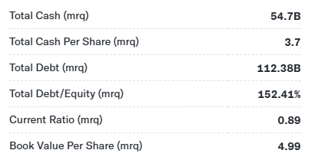
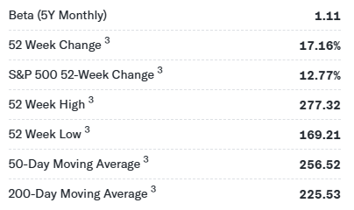
Metrics
Management effectiveness
Balance
Stock price history

Slide 58
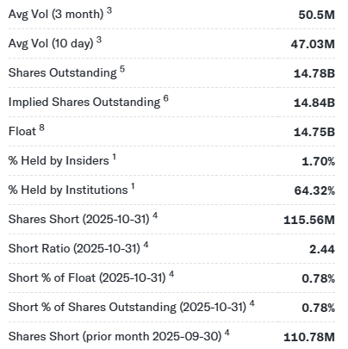
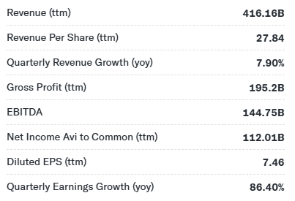
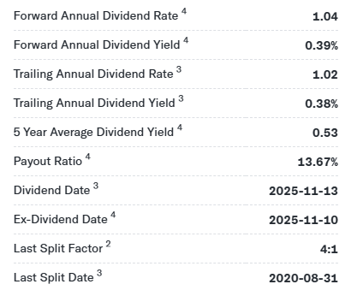
Metrics
Income stats
Share stats
Dividend stats

Slide 59
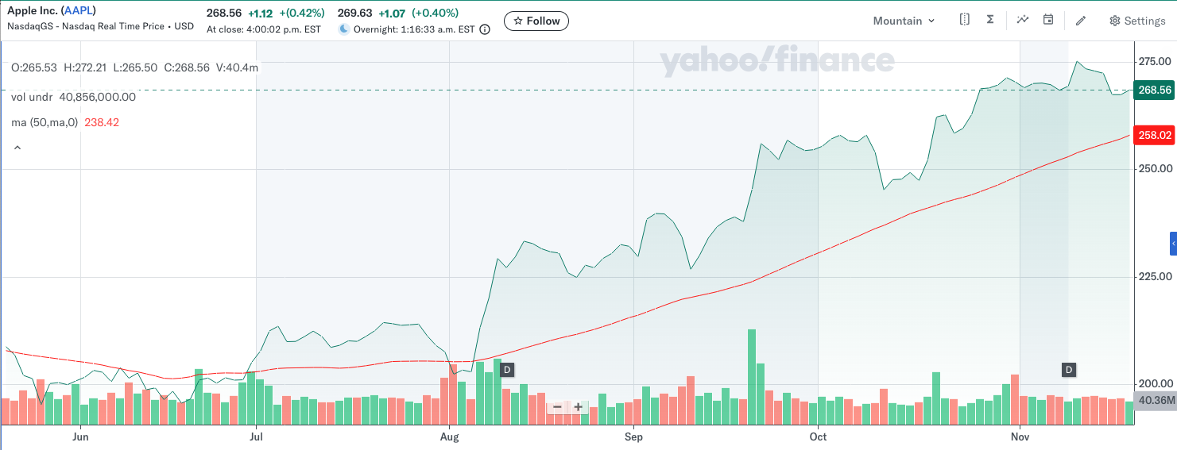
Price Chart 6 months MA

Slide 60
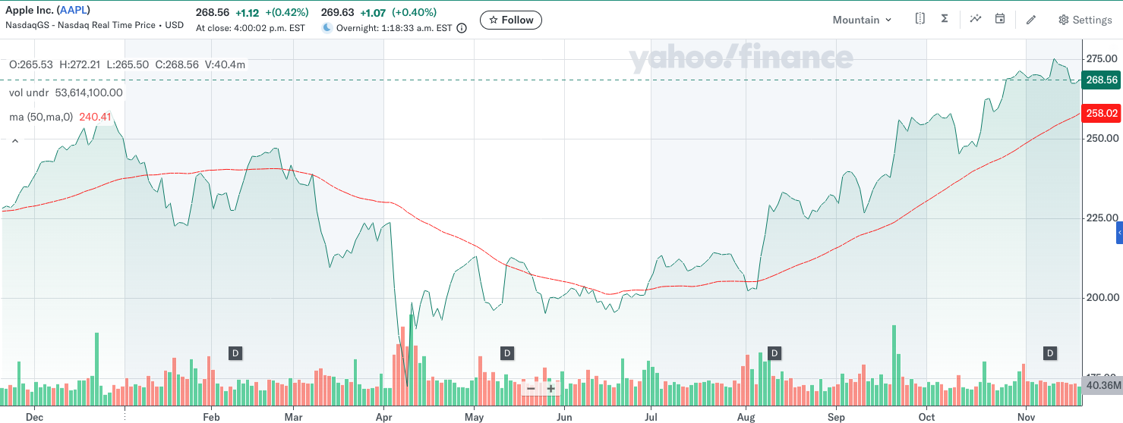
Price Chart 1-yr MA

Slide 61
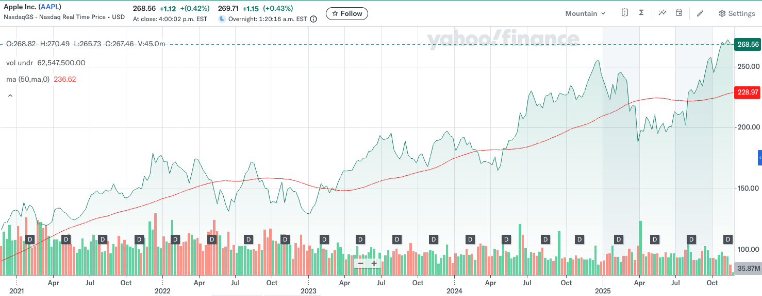
Price Chart 5-yr MA

Slide 62
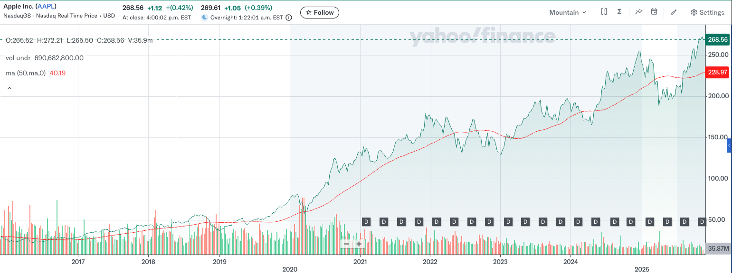
Price Chart 10-yr MA

Slide 63
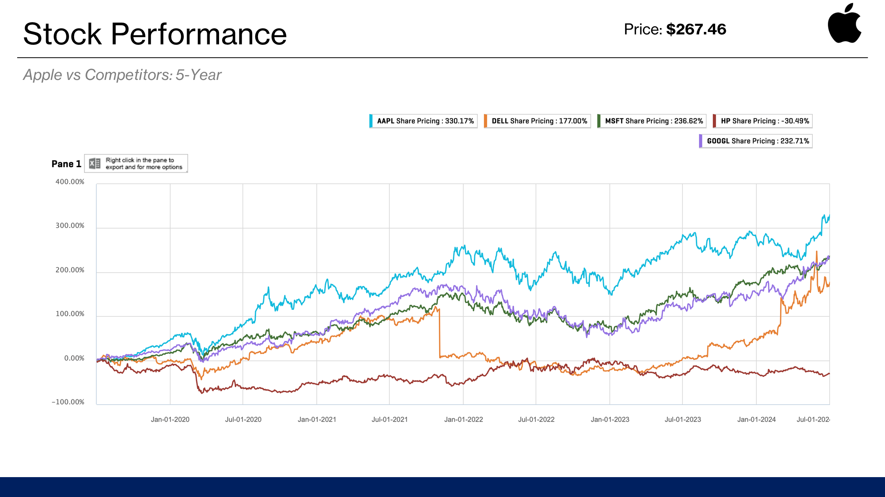

Slide 64
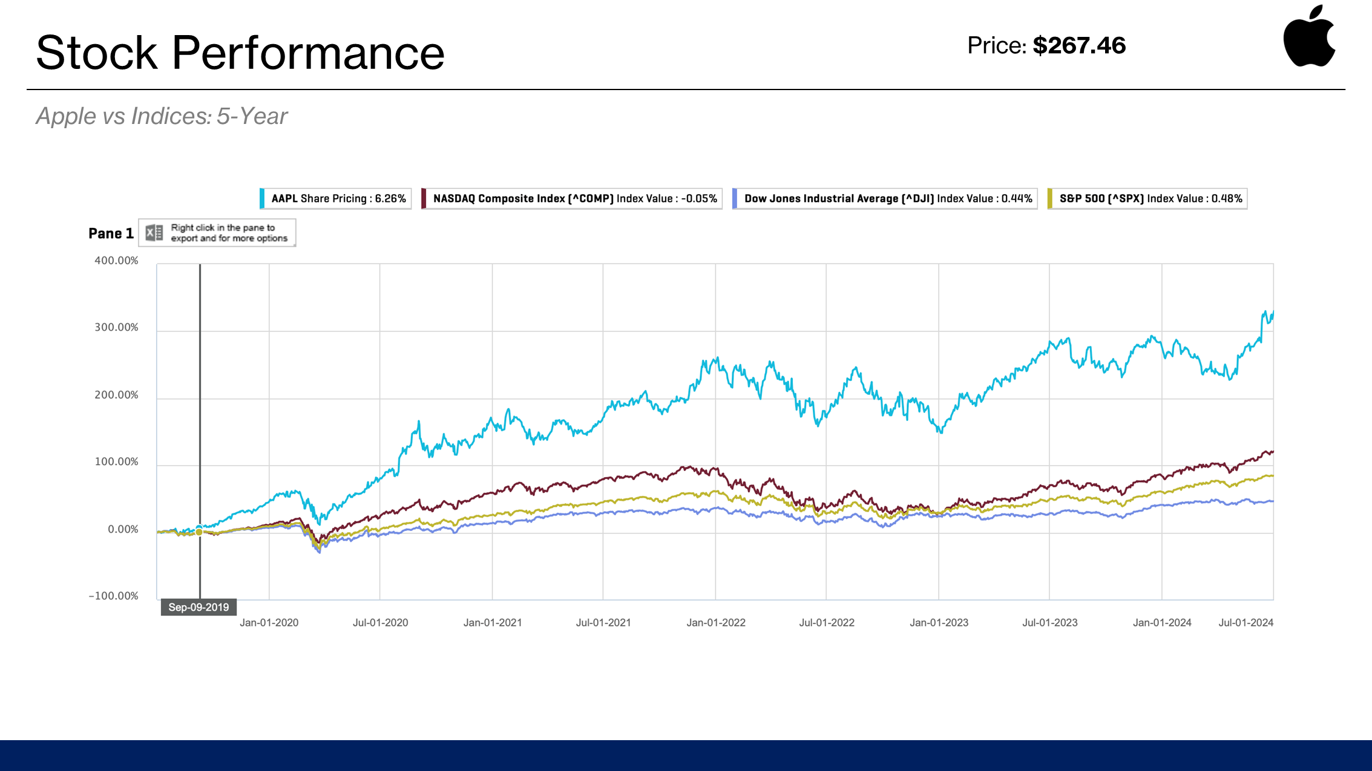

Slide 65
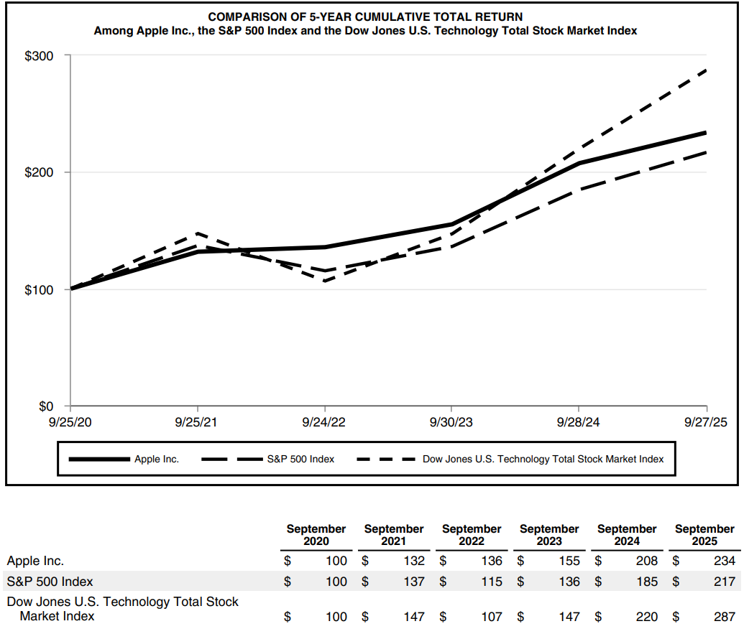

5 year total return vs competitors

Slide 66
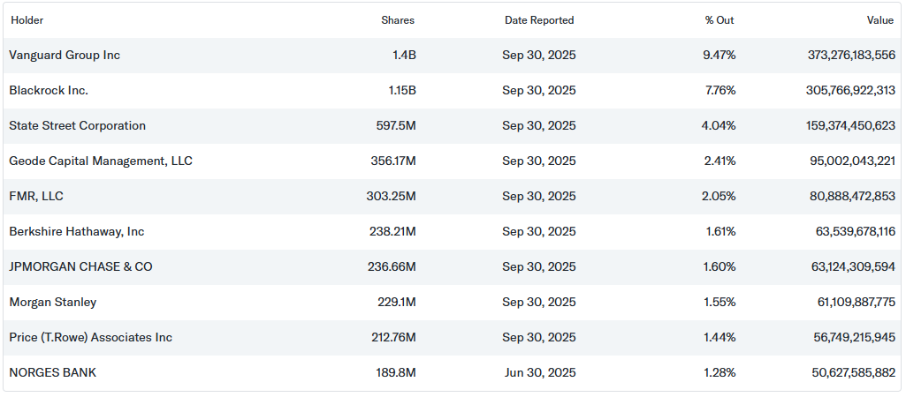
Top Institutional Holders

Slide 67
Company
Overview →
v

Slide 68
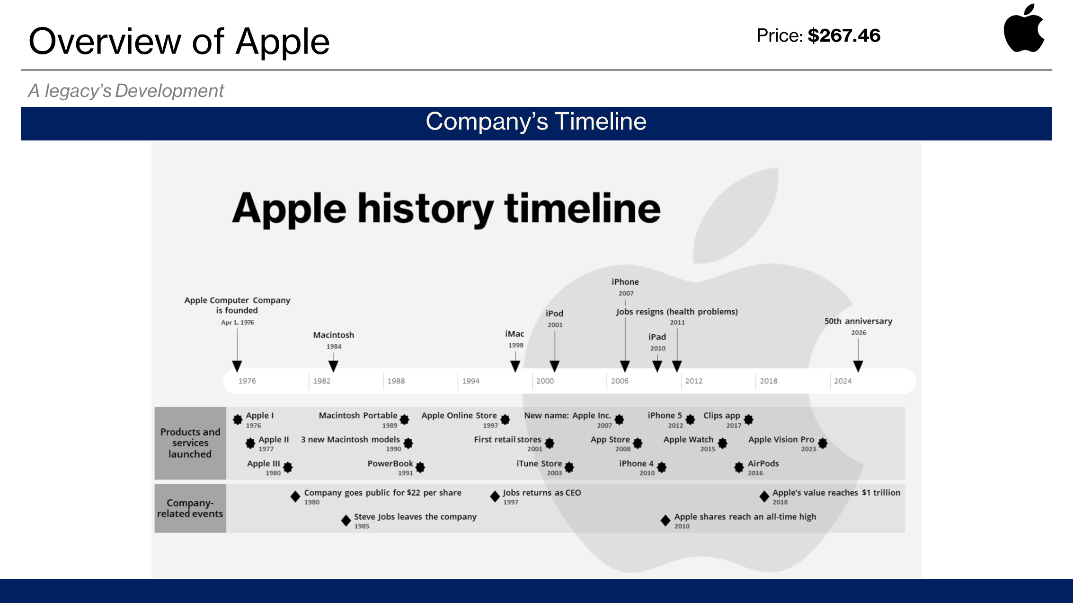
Company Timeline

Slide 69
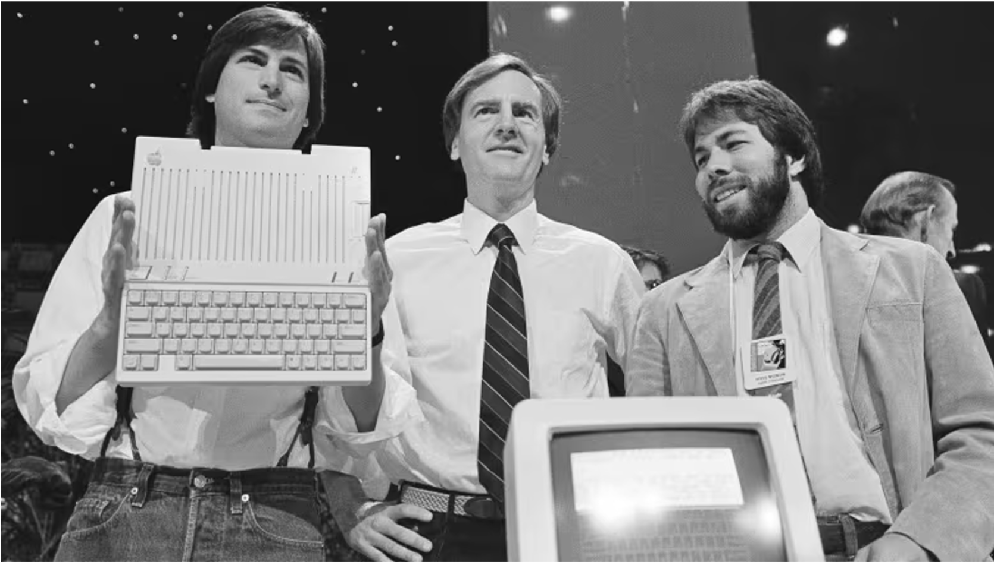
Company profile
Apple Inc. Is a multinational technology company headquartered in Cupertino, California. Founded in 1976 by Steve Jobs, Steve Wozniak, and Ronald Wayne, Apple designs, manufactures and markets a wide range of consumer electronics, software, and services.
Apple Also provides various software and services including the iOS and macOS operating systems, the iTunes Store, the App stores, Apple Music, iCloud and Apple pay.
Apple is currently the second largest company measured by market capitalization. (around $4 trillion)

Slide 70
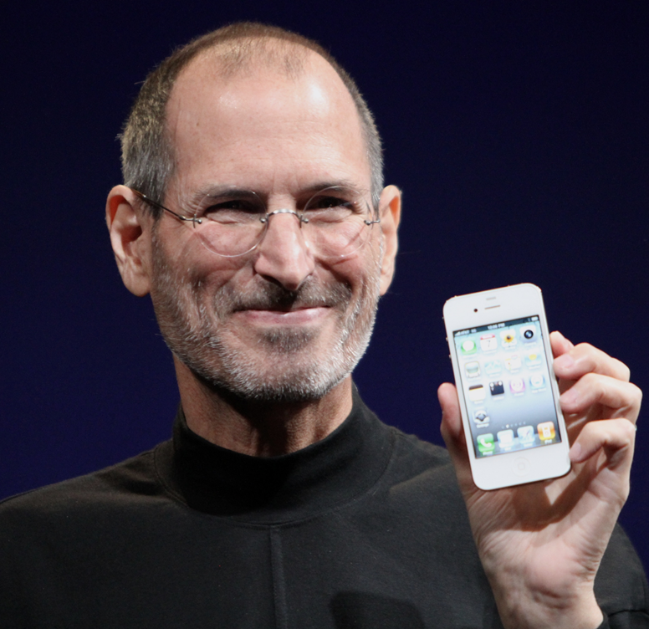
Company's Mission
Mission statement: bringing the best user experience to its customers through innovative hardware, software and services.
Unique ability to design and develop its own operating systems, hardware, application software allowing for enhanced vertical integration:
Refined innovative design and superior ease-of-use
Third party support
Investment in R&D

Slide 71
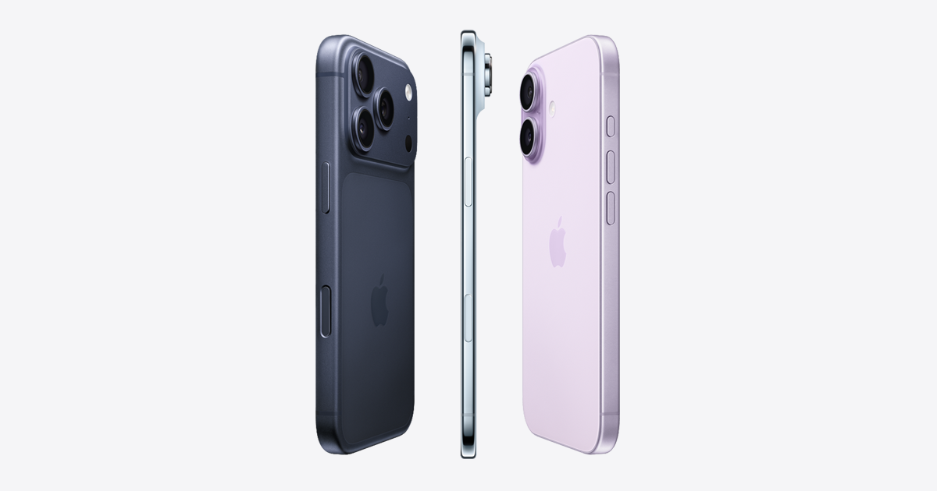
Company Overview
Parent Company: Apple Inc.
Organizational Structure: Functional organizational structure with product-based divisional elements. Core functions (Design, Marketing, Operations, etc...)drive central decision making
Reportable Segments: Apple reports revenue across five major product and service category. (iPhone, iPad, Mac, accessories and services)
Primary Revenue stream: Hardware remains most of the total revenue, yet services are the most profitable and strategic growth engines. Services account for ¼ of revenue.
Other ventures: AI and on-device intelligence, "next gen battery" project, non-invasive health &medical monitoring, Project B518 (Satellite communication), Automation and Robotics, Apple search engine, Neural interface Brain + Computer R&D, Apple payments (banking expansion).

Slide 72
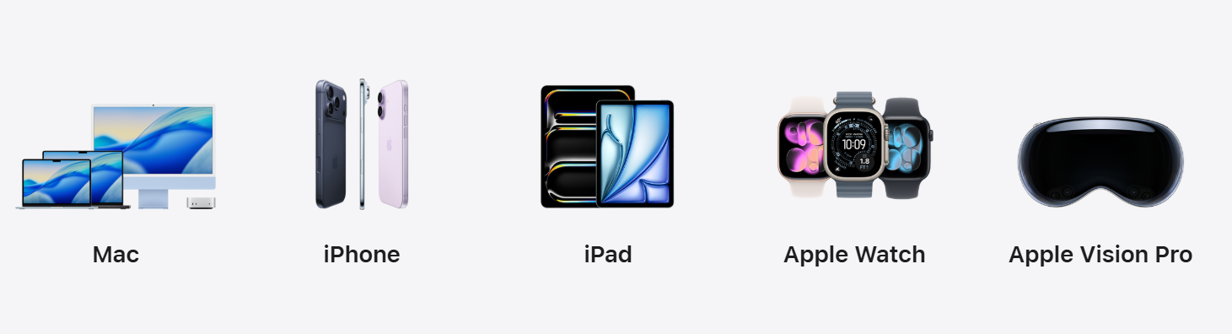
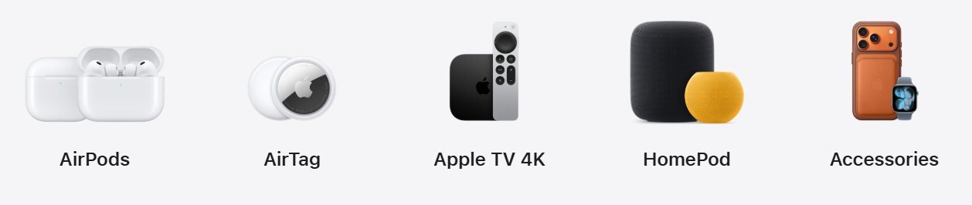
Products

Slide 73



Services
High-margin recurring revenue engine: Services segment is Apple’s fastest-growing and highest-margin business. Generates predictable, subscription-based cash flow.
Deep ecosystem integration: Services are tightly connected to Apple devices, increasing stickiness and customer retention.
Expands lifetime value of each user.
App Store – world’s largest app marketplace, massive developer ecosystem.
Apple Music / Apple TV+ – streaming media, original content, subscription entertainment.
iCloud – cloud storage, device backup, and cross-device sync.
Apple Pay – secure mobile payments, tap-to-pay, and growing financial services footprint.
AppleCare – extended warranty, support, and device protection plans.
Apple Fitness+ – subscription workouts integrated with Apple Watch.
Apple One – bundled subscription offering across Music, TV+, iCloud, Fitness+, and more.

Slide 74

Product and Services Performance

Slide 75

Product and Services Gross Margin

Slide 76
Macro and Market Risks
Slowing Global Consumer Demand
High inflation and rising interest rates reduce discretionary spending.
Smartphones and premium devices are vulnerable during economic slowdowns.
Supply Chain Fragility
Heavy reliance on China for manufacturing.
Geopolitical tensions or shutdowns (COVID-like disruptions) can delay production.
• Foreign Exchange Volatility
Apple earns over 60 percent of revenue internationally.
Strong U.S. dollar reduces reported earnings and margins.
• Component Cost Inflation
Higher costs for silicon, memory, and logistics can pressure profit margins.
Apple absorbs some cost increases to maintain pricing power.

Slide 77
Company Specific Risks
iPhone Dependence
Over 50 percent of revenue still tied to the iPhone.
Slower upgrade cycles and longer device lifespans reduce growth.
• Slowing Growth in Hardware Categories
iPad and Mac growth is inconsistent and highly cyclical.
Wearables growth has moderated after pandemic highs.
• Execution Risk in AI & New Product Categories
Apple was slower than competitors (Microsoft, Google, Meta) in deploying generative AI.
Apple’s “Apple Intelligence” rollout must succeed to remain competitive.
• Innovation Pressure
High expectations force continuous breakthrough products.
Misses or delays (e.g., Apple Car cancellation) could weigh on sentiment.
• Vision Pro Uncertainty
Early-stage adoption.
High price point and niche use cases create uncertainty around scalability.

Slide 78
Regulatory, Legal & Competitive Risks
• Antitrust Scrutiny (U.S. & EU)
EU’s Digital Markets Act challenges App Store commission structure.
U.S. Department of Justice lawsuit targets Apple’s ecosystem practices.
Possible risk: reduced App Store fees and lower Services margins.
• App Store Revenue Threat
Epic Games and global regulators push for alternative app stores and payments.
Could materially impact Apple’s high-margin Services revenue.
• Competition in AI & Cloud
Microsoft, Google, Amazon, and NVIDIA lead in generative AI infrastructure.
Apple must catch up in cloud-based AI or lose developer engagement.
• Market Saturation & Android Competition
Premium smartphone market is saturated in North America and Europe.
Samsung, Google, and emerging Chinese OEMs pressure market share.
• ESG & Sustainability Risks
Pressure to meet environmental targets.
Regulation around repairability, batteries, and component sourcing.

Slide 79

Geographical performance

Slide 80

Earnings per share

Slide 81

Operating expenses

Slide 82
AAPL Valuation
Apple trades at a premium valuation driven by strong brand, ecosystem lock-in, and high-margin services.
Current valuation reflects stability, strong cash flows, and dominant competitive positioning.
Despite trading above market averages, Apple remains justified by earnings quality and long-term growth catalysts.
Relative to mega-cap peers, Apple sits in the middle: not as cheap as Meta/Google, not as expensive as NVIDIA.

Slide 83
Valuation Summary
• Apple currently trades at a premium relative to the broader market, supported by high-quality earnings, strong free cash flow generation, and durable Services margins.
• Market-based valuation metrics (P/E, EV/EBITDA, P/FCF) place Apple near the upper end of mega-cap technology peers, reflecting its brand strength and financial stability.
• Independent third-party intrinsic value models (DCF + relative valuation) generally estimate Apple’s fair value within a broad range between the mid-$200s and low-$300s, depending on growth and margin assumptions.
• Consensus fair-value estimates fall slightly below the current market price, indicating Apple is fairly valued, to modestly overvalued, but not materially mispriced.
• Apple’s valuation premium remains justified by its recurring Services revenue, ecosystem lock-in, superior customer retention, and large-scale capital return programs.

Slide 84
Investment Thesis
• Apple’s premium valuation is supported by unmatched ecosystem lock-in, industry-leading customer loyalty, and consistent long-term demand for its integrated hardware and software products.
• High-margin Services revenue continues to grow, providing stable and recurring cash flows that reduce Apple’s dependence on hardware cycles.
• Apple generates nearly $100B in annual free cash flow, enabling massive share buybacks and rising dividends that enhance shareholder returns.
• Apple Intelligence and upcoming AI-driven product updates represent a major catalyst for future upgrade cycles.
• While the stock trades near the upper end of intrinsic value estimates, Apple remains an attractive BUY/HOLD due to strong fundamentals, low volatility, and durable competitive positioning.

Slide 85
Upcoming Catalysts
• Apple Intelligence rollout across iPhone, iPad, and Mac is expected to drive a new AI-focused upgrade cycle beginning in 2025 and continuing into FY2026.
• Expansion of high-margin Services such as iCloud, Apple Pay, Apple Music, and App Store monetization provides recurring revenue growth and margin stability.
• Continued shift of manufacturing to India and Vietnam reduces geopolitical and supply-chain concentration risk, improving long-term operational efficiency.
• New hardware cycles including next-generation iPhones, M-series processors, and Mac product refreshes support device demand and ecosystem engagement.
• Growth opportunities in emerging categories such as wearables, health monitoring, and spatial computing (Vision Pro) enhance long-term optionality.

Slide 86




Competitive Landscape
• Apple competes across multiple categories, including smartphones, PCs, wearables, services, payments, and emerging AI technologies.
• Major competitors include Samsung, Google, Microsoft, Amazon, Meta, and leading PC manufacturers such as Dell, HP, and Lenovo.
• Competition is strongest in smartphones, cloud AI, digital services, and AR/VR, where rivals push rapid innovation cycles.
• Apple differentiates itself through ecosystem integration, proprietary silicon (A/M series), and industry-leading customer retention.

Slide 87
Competitive advantage
• Industry-leading ecosystem lock-in drives high switching costs and long-term customer loyalty.
• Vertical integration across hardware, software, chips, and services delivers a unified user experience competitors cannot replicate.
• Apple Silicon (M-Series / A-Series) outperforms Intel and Qualcomm in efficiency and performance per watt.
• Premium global brand enables sustained pricing power and resilient demand across product cycles.
• High-margin Services segment provides stable recurring revenue, reducing reliance on hardware growth.

Slide 88
Competitive advantage
• Intangible Assets & Brand Recognition: Apple is synonymous with premium design, quality, and trust. Its brand loyalty is among the strongest in the world, enabling premium pricing and repeat purchasing that competitors struggle to replicate.
• Economies of Scale & Supply Chain Mastery: Apple’s global scale and supply chain expertise (custom manufacturing, long-term supplier contracts, logistics optimization) give it a cost advantage and allow rapid mass production at quality levels few companies can match..
• Innovation & Design Excellence: Apple consistently leads in industrial design, user interface innovation, and custom silicon performance. Products like the M-series chips and Vision Pro illustrate Apple’s ability to blend cutting-edge engineering with intuitive usability.
• Privacy & Security Differentiation: Apple positions itself as the industry leader in privacy. This strengthens trust and differentiates the brand from competitors reliant on ad-based data models.

Slide 89
Competitive disadvantage
• Microsoft and Google lead in cloud infrastructure and generative AI deployment.
• Amazon (AWS) dominates cloud computing scale; Apple has no competing cloud platform.
• Samsung maintains the #1 global smartphone unit share, especially in emerging markets.
• Meta leads in AR/VR device shipments, with Quest outselling Vision Pro at a large scale.
• Google and Meta hold dominant positions in digital advertising, an area Apple is only lightly exposed.

Slide 90
AAPL vs. Peers
• Apple trades at a P/E of ~36x, a clear premium to the S&P 500 and in line with high-quality mega-cap tech.
• On EV/EBITDA (~27x) and P/FCF (~40x), Apple trades above peers like Meta/Google, reflecting stronger brand, cash flow durability, and ecosystem lock-in.
• Valuation premium is supported by high-margin Services, exceptional brand loyalty, and stable free cash flow.
• Apple offers a balanced risk-reward profile: lower volatility and stronger defensibility than Amazon/NVIDIA, more stable financials than Meta/Google.
Company | P/E | EV/EBITDA | P/FCF
AAPL | 36x | 27x | 40x
MSFT | 38x | 26x | 33x
AMZN | 56x | 25x | 44x
GOOG | 27x | 15x | 21x
META | 28x | 13x | 19x

Slide 91
FCF power
• Free cash flow (TTM): $98.8B, one of the largest globally.
• Strong FCF supports massive share buybacks, increasing EPS even during flat revenue years. FCF per share: $6.68.
• Apple’s EV/FCF ≈ 39.8 shows investors are willing to pay a premium for those cash flows
• This FCF funds massive buybacks and rising dividends, while still leaving room for reinvestment.
DCF Valuation
• DCF (2-stage FCFE) estimate: ~$224 per share → suggests Apple is somewhat overvalued at ~$267.
• AlphaSpread base case: intrinsic value ~$178 (DCF ~$139, relative ~$216) → about 33 percent above intrinsic value
• Morningstar fair value: $240 (raised 14 percent after strong earnings) → Apple trades ~11 percent above that estimate
• Sahm Capital DCF: ~$263 → Apple is trading right around model value, essentially “fairly priced.”
Notes:
https://nz.finance.yahoo.com/news/apples-valuation-justified-ai-product-031354571.html
https://www.alphaspread.com/security/nasdaq/aapl/summary
https://www.morningstar.com/stocks/xnas/aapl/quote
https://www.sahmcapital.com/news/content/does-apples-latest-ai-news-signal-a-fair-price-for-the-stock-in-2025-2025-09-28

Slide 92
Sensitivity Analysis
Conservative DCF inputs (higher discount rate, slower growth) cluster around $175–$200.
More optimistic or AI-bullish assumptions push fair value toward $240–$265.
Right now, the market price sits near the top of that range, so upside depends on Apple executing strongly on AI, services, and new products.
Sensitivity Matrix
Long-term Growth
 | Conservative (1.5%) | Base Case (2.0-2.5%) | Optimistic (2.5%+)
10% | $165-$185 | $180-$200 | $200-$220
9% | $185-$200 | $195-$215 | $210-$230
8% | $200-$215 | $215-$240 | $240-$265+
WACC

Slide 93
Leadership
v

Slide 94

Executives
•Tim Cook is the current CEO of Apple and serves on its board of directors
•Cook was appointed to the position of CEO in August of 2011. Prior to this he served as Apples Chief Operating Officer, and was responsible for all of the company’s sales and operations
•Prior to joining Apple, Tim was vice president of Corporate Materials for Compaq. Prior to this he spent 12 years with IBM as the Director of North American Fulfillment.
•Cook earned his MBA from Duke University, and a Bachelor of Science degree in Industrial Engineering from Auburn University.

Slide 95

Executives
•Greg “Joz” Joswiak is Apple’s senior vice president of Worldwide Marketing
•Since joining Apple in June 1986, Joz has played a pivotal role in developing and launching some of the world’s most beloved consumer products, including the original iPod and iPhone.
•Joz began his career at Apple working on the early Macintosh computers and supporting the Mac’s community of third-party developers.
•Joz graduated with a Bachelor of Science in Computer Engineering from the University of Michigan in 1986.

Slide 96

Executives
Eddy Cue is Apple’s SVP of Services
He oversees the full range of Apple’s services, including Apple Music, Apple News, Apple Podcasts, the Apple TV app, and Apple TV+, as well as Apple Pay, Apple Card, Maps, Search Ads, Apple’s iCloud services
Joined Apple in 1989. However, in his early years at Apple, he was a successful manager of software engineering and customer support teams.
Instrumental in creating the Apple online store in 1998, the iTunes Store in 2003, and the App Store in 2008.
Eddy earned a bachelor’s degree in Computer Science and Economics from Duke University.

Slide 97

Executives
•Federighi is Apple’s SVP of Software Engineering
•Oversees the development of mac OS and iOS
•Returned to Apple in 2009 to lead macOS engineering, and in 2012 took on responsibility for iOS as well, delivering all subsequent releases of the world’s most advanced desktop and mobile operating systems.
•Holds a Master of Science degree in Computer Science and a Bachelor of Science in Electrical Engineering and Computer Science from the University of California, Berkeley.

Slide 98

Executives
•Giannandrea is Apples SVP of Machine Learning and AI Strategy
•Joined Apple in 2018 and oversees the strategy for artificial intelligence and machine learning across the company and development of Core ML and Siri technologies.
•Prior to Apple, John spent eight years at Google where he led the Machine Intelligence, Research and Search teams. Before this he co-founded two technology companies, Tellme Networks and Metaweb Technologies. Earlier in his career John was a senior engineer at General Magic.
•Graduated from University in Scotland where he earned a Bachelor of Science with Honors in Computer Science

Slide 99

Executives
•Sabih Khan is Apple’s senior vice president of Operations
•Since joining Apple in 1995, Sabih has played an important role in delivering each of Apple’s innovative products to market
•Sabih oversees Apple’s global supply chain, ensuring product quality and overseeing planning, procurement, manufacturing, logistics and product fulfillment functions, as well as Apple’s supplier responsibility programs that protect and educate workers at production facilities around the world.
•He earned bachelor’s degrees in Economics and Mechanical Engineering, and holds a master’s degree in Mechanical Engineering

Slide 100

Executives
•Johny Srouji serves as senior vice president of Hardware Technologies at Apple
•Built one of the world’s strongest and most innovative teams of silicon and technology engineers, leading breakthrough custom chips and hardware technologies including Apple silicon, batteries, cameras, storage controllers, sensors, displays, and other critical technologies across Apple’s entire product line.
•Johny joined Apple in 2008 to lead development of A4, the first Apple-designed system on a chip
•Hold a bachelors and master's degree in computer science

Slide 101

Executives
•John Ternus is Apple’s senior vice president of Hardware Engineering
•John joined Apple’s Product Design team in 2001 and has been a vice president of Hardware Engineering since 2013.
•Throughout his tenure at Apple, John has overseen hardware engineering work on a variety of groundbreaking products including every generation and model of iPad, the latest iPhone lineup, and AirPods. He has been a key leader in the ongoing transition of the Mac to Apple silicon.
•Holds a bachelor’s degree in Mechanical Engineering from the University of Pennsylvania.

Slide 102

Executives
Katherine Adams is Apple’s Senior Vice President and General Counsel, overseeing all legal matters including litigation, corporate governance, intellectual property, and compliance.
Joined Apple in 2017 after serving as General Counsel at Honeywell for 14 years.
At Apple, she leads the global legal team supporting product development, regulatory issues, privacy, and government affairs.
Plays a key strategic role in Apple’s regulatory positioning, antitrust matters, and global privacy initiatives.
Holds a bachelor’s degree in Comparative Literature from Brown University and a Juris Doctor from the University of Chicago Law School.
Former clerk for U.S. Supreme Court Justice Sandra Day O’Connor.

Slide 103

Executives
Deirdre O’Brien is Apple’s Senior Vice President responsible for both Retail operations and People (HR) functions.
Joined Apple in 1988 and has worked across operations, manufacturing, supply chain, and people management.
Leads over 500 Apple Stores globally and oversees the customer retail experience.
Responsible for all employee functions including hiring, development, culture, and organizational leadership.
Played a pivotal role in Apple’s global retail transformation, Today at Apple programs, and employee wellbeing initiatives.
Holds a bachelor’s degree from San José State University and an MBA from UC Berkeley.

Slide 104

Executives
Kevan Parekh is Apple’s Chief Financial Officer, responsible for the company’s global finance operations including financial planning, accounting, treasury, investor relations, and tax.
Oversees capital allocation, Apple’s share repurchase program, and long-term financial strategy.
Joined Apple after serving as CFO at several large multinational companies (details vary depending on timing, but he is Apple’s current CFO).
Plays a key role in supporting hardware, software, and services financial operations across Apple’s global ecosystem.
Works closely with Tim Cook and senior leadership on corporate strategy and companywide financial health.
Holds degrees in economics and finance

Slide 105
Tim Cook's Tenure
Tim Cook has served as CEO of Apple Inc. since 2011, overseeing the company’s growth from ~$350 billion market value to over $4 trillion.
Under his leadership Apple capitalized on hardware scale and pivoted into high-margin Services and ecosystem lock-in.
The smartphone era has peaked, and Apple now faces a generational pivot: AI, new form-factors, mixed reality, hardware beyond iPhone.
Reports indicate succession-planning has been ramped up, with the board and senior executives actively preparing for leadership change as early as 2026.
This transition presents both risk (leadership disruption) and opportunity (fresh strategic direction) for Apple’s next chapter.

Slide 106
Succession Planning & Candidate Landscape
Apple prefers an internal successor; Tim Cook has publicly stated he wants someone “from within Apple.”
John Ternus (SVP Hardware Engineering) is widely seen as the frontrunner for the CEO role, thanks to his role in Apple Silicon and device development.
Other executive shifts: The forthcoming retirement of longtime COO Jeff Williams and appointment of Sabih Khan as COO signal broader succession activity.
Timing: No official announcement expected before Apple's next earnings release in late January (board wants new leadership settled ahead of major product launches).
The successor will need a bolder risk appetite and stronger alignment with AI and next-gen hardware to lead Apple beyond its iPhone-centric era
Notes:
https://www.ft.com/content/0d424625-f4f8-4646-9f6e-927c8cbe0e3e
https://www.ft.com/content/718d5bac-8bcb-4aaf-8554-08763b6144e4

Slide 107
Financials
v

Slide 108

Consolidated Balance Sheet 10-Q

Slide 109

Consolidated Balance Sheet 10-Q

Slide 110

Consolidated Balance Sheet 10-K

Slide 111
Consolidated Balance Sheet 10-K

Slide 112

Consolidated Statement of Income
10-K

Slide 113

Consolidated Statement of income 10-Q

Slide 114
Consolidated Statement of income 10-Q

Slide 115

Consolidated Statements of Cashflows 10-K

Slide 116
Consolidated Statements of Cashflows 10-K

Slide 117

Consolidated Statements of Cashflows 10-Q

Slide 118
Consolidated Statements of Cashflows 10-Q

Slide 119
Hold
• Apple remains a high-quality, low-volatility long-term compounder supported by durable free cash flow, strong balance sheet health, and industry-leading customer loyalty.
• High-margin Services revenue and ongoing hardware-software integration provide recurring cash flows that justify Apple’s valuation premium.
• Upcoming AI-driven product cycles, continued global expansion, and sustained capital returns offer meaningful long-term value creation.
• While the stock trades near the upper end of fair-value estimates, Apple’s fundamental resilience, ecosystem strength, and predictable earnings profile support a BUY/HOLD stance for long-term investors.
Final Recommendation

Slide 120
Google
NASDAQ: GOOG
NASDAQ: GOOGL
v

Slide 121


Slide 122

Valuation Measures

Slide 123

Top Institutional Holders

Slide 124

Price Chart 6 Months MA

Slide 125

Price Chart 1-yr MA

Slide 126

Price Chart 5-yr MA

Slide 127

Price Chart 10-yr MA

Slide 128

GOOG VS Indices 5-yr

Slide 129
Share Classes
Class | Ticker | Investor Note | Shares outstanding
A | GOOGL | Each share carries one vote. If you want any say in shareholder votes, such as electing board members or approving major proposals, you would purchase GOOGL. Due to the voting right, this class often trades at a negligible premium to Class C shares. | 5,817M
B | NA | Each share carries ten votes. This super-voting structure ensures that the founders, Larry Page and Sergey Brin, along with other key insiders, retain a controlling majority of the total voting power (over 51%), even though they own a much smaller percentage of the company's overall equity. | 847M
C | GOOG | These shares have no voting rights. This class was created as part of a 2014 stock split to allow Alphabet to issue new shares for compensation, acquisitions, or raising capital without diluting the voting power of the founders. For most retail investors, who prioritize economic interest (stock price appreciation and dividends) over governance, this class is functionally identical to GOOGL and usually trades at a slightly lower price point. | 5,430M

Slide 130
Stock Splits
Event | Action | Impact
2014 Dual-Class Split | 2-for-1 Split via a special stock dividend. | For every one share of the original Class A stock (GOOGL) held, shareholders received one additional share of the newly created Class C stock (GOOG). Preserved Voting Power: The Class C shares carried no voting rights. This allowed the company to issue new shares (for employee compensation and acquisitions) without diluting the voting power of the Class B (super-voting) shares held by the founders. This split is the defining feature of Alphabet's controversial dual-class governance structure.
2022 Accessibility Split | 20-for-1 Forward Stock Split. | For every one share of Class A (GOOGL), Class C (GOOG), and Class B stock held, shareholders received 19 additional shares of the same class. Increased Accessibility and Liquidity: The primary goal was to lower the per-share price (which was over $2,000 pre-split) to around $100, making it more affordable for retail investors and facilitating its inclusion in the Dow Jones Industrial Average (which is price-weighted). It had no impact on the existing balance of voting power between the share classes.

Slide 131

Stock Repurchase
During 2024, the company repurchased and subsequently retired 379 million shares for $62.0 billion.
In April 2024, the Board of Directors of Alphabet authorized the company to repurchase up to an additional $70.0 billion of its Class A and Class C shares. As of December 31, 2024, $44.7 billion remained available for Class A and Class C share repurchases.
Significant share buybacks reinforcing strong free cash flow & shareholder returns

Slide 132
Company
Overview →
v

Slide 133

Overview
Parent Company: Alphabet Inc.
Organizational Structure: A functional and divisional structure.
Reportable Segments: Alphabet reports revenue and operating income across three main segments:
Google Services: The largest and most profitable segment (approx. 87% of revenue). This includes Search, Android, Chrome, Hardware, Google Maps, Google Play, and YouTube (Ads and subscriptions).
Google Cloud (GCP & Workspace): The fast-growing cloud computing and enterprise services segment (approx. 12% of revenue).
Other Bets: Smaller, high-risk, high-reward ventures like Waymo (self-driving cars) and Verily (health tech). These typically run at an operating loss.
Primary Revenue Stream: Advertising (primarily Search and YouTube) generates the vast majority (over 75%) of total revenue.

Slide 134

Timeline

Slide 135

Timeline

Slide 136

Timeline

Slide 137

Timeline

Slide 138

Timeline

Slide 139

Competitive Advantage
Intangible Assets & Brand Recognition: Google is synonymous with "search." This brand recognition and trust are nearly impossible to replicate.
Network Effect: The more users Google's services (Search, Maps, Android) have, the more data they collect. This data makes the services (and the AI models powering them) better, which attracts more users, creating a powerful, self-reinforcing Data Flywheel.
Cost Advantage: Google's massive scale and technological infrastructure (e.g., custom data centers and hardware) lead to a significant cost advantage over smaller competitors.
High Customer Switching Costs: Businesses that rely on Google Ads or use Google Workspace/Cloud services face high costs and complexity if they try to move to a competitor.
AI Leadership: Heavy investment in AI (like the Gemini model) is being integrated across Search, Cloud, and other products to drive continued user engagement and monetization.

Slide 140
Risks
Regulatory & Antitrust Pressure:
Google faces lawsuits and regulatory scrutiny globally (e.g., from the U.S. DOJ and the European Commission) for alleged monopolistic practices in search and advertising.
Potential remedies could include being forced to sell off parts of its business, or a ban on exclusive deals (like the one that makes Google the default search engine on Apple devices), which could significantly impact its core Search revenue.
Overdependence on Advertising Revenue: Since over 75% of revenue is tied to ads, the company is vulnerable to:
Economic downturns that cause advertisers to cut spending.
Widespread adoption of ad-blocking software.
Increasing competition and potential for lower "cost-per-click" prices.
AI-Driven Disruption to Search:
The rise of powerful AI assistants (like ChatGPT/other competitors) could pose a risk if users begin getting answers directly from AI platforms outside of Google's control, bypassing Google Search and its lucrative ads. Google's strategy is to evolve Search with its own AI features.

Slide 141

Company Structure

Slide 142
Google Products
Android, Chrome, & Play | Devices and Services | Explore and Get Answers
Android Android Enterprise Chrome Chromebooks Google Play Google TV Wear OS by Google | Chromecast Fitbit Google Nest Pixel Pixel Buds Pixel Tablet Pixel Watch | Google Search Google News Google Shopping Google Maps Google Earth Google Lens Google Assistant AR & VR Bard Gemini

Slide 143
Google Products
In the Cloud | Connect, Communicate and More | Ads and Analytics
Google Drive Google Docs, Sheets, Slides Gmail Google Cloud Google Workspace Google Meet Google One | Google Photos YouTube Google Translate Google Pay Google Fi Google FIt Waze Google Messages Google Calendar | Google Ads Google Ad Manager Google AdMob Google Marketing Platform Google Analytics

Slide 144

Search and Advertising
Market Share: 91.6% global search share; 9B+ daily queries.
Trends: AI-powered ad targeting, higher conversion rates
Google Services revenue comes from advertising, subscriptions, platforms, and devices.
Advertising Breakdown:
•Search & Other: Ads on Google Search, Gmail, Maps, and Play.
YouTube Ads: Ads shown on YouTube.
•Google Network: Ads on partner sites via AdSense, AdMob, and Ad Manager.

Slide 145
Bidding Strategies
Maximize Conversions
One of Google’s most widely used bidding strategies because it automatically drives the highest possible number of conversions within a set budget. Its ease of use and reliance on machine learning make it popular among advertisers looking for fast results, leading to substantial spending across Search and Performance Max campaigns.
Target Cost Per Acquisition
highly profitable strategy for Google, as advertisers rely on it to acquire leads or sales at a predictable cost. By allowing businesses to scale while maintaining cost-efficiency, this strategy encourages consistent and often increased ad budgets, especially for service-based industries and lead-generation campaigns.
Target Return on Ad Spend
Essential for e-commerce and revenue-focused advertisers. It optimizes bidding to achieve a desired return, allowing retailers to scale their campaigns profitably. Because it is heavily used in Google Shopping and Performance Max—two major revenue drivers—Target ROAS is one of Google’s most lucrative bidding strategies.
Maximize Clicks
Remains a popular choice for new advertisers and small businesses looking to drive large volumes of traffic quickly. Its simplicity and focus on generating as many clicks as possible make it a go-to option for top-of-funnel campaigns, contributing meaningfully to Google’s overall ad revenue through high click volume.

Slide 146

Google Subscriptions and Platforms
User Base:
Gmail: 2.5B
Maps: 1B
Drive: 94% of Workspace users.
Subscriptions include services like YouTube Premium and YouTube Music, which offer ad-free experiences and exclusive features for a monthly fee.
Google One provides expanded cloud storage, and Google Workspace offers enterprise productivity tools, both contributing recurring income.
Platforms like Google Play generate revenue by taking a commission on app and in-app purchases.
Google Cloud Platform earns from both consumption-based usage and enterprise subscriptions, while YouTube monetizes through channel memberships, Super Chat, and merchandise sales, sharing revenue with creators.

Slide 147

Youtube
YouTube is Google’s online video-sharing platform, acquired by Google in November 2006 and has over 1B users.
It allows users to watch, upload, and interact with videos, attracting billions of viewers worldwide.
Advertising is the primary revenue source, including ads shown before, during, or alongside videos on YouTube and partner sites.
Subscriptions, such as YouTube Premium and YouTube Music, generate revenue by offering ad-free experiences, offline viewing, and exclusive content.
Additional income comes from creator-focused features like Super Chat, channel memberships, and merchandise sales, with revenue shared between YouTube and creators.

Slide 148

Hardware and App Ecosystem
Hardware
Products: Pixel phones, Pixel Watch, Nest devices, Chromebooks.
Market Share: ~3% smartphone share; strong in Japan.
Growth Drivers: AI integration (Gemini), Tensor chips, expansion to India.
App Ecosystem
Scale: 4.2M apps; 299B downloads in 2025.
Model: Freemium dominates (97% apps free).
Trends: Regulatory changes, alternative app stores, rising consumer spend.

Slide 149

Cloud Services
Google Cloud Platform (GCP)
Infrastructure-as-a-Service (IaaS), Platform-as-a-Service (PaaS), and Software-as-a-Service (SaaS) for businesses.
Key products
Vertex AI and Gemini for Cloud AI infrastructure, cybersecurity, and data analytics tools
Google Workspace
Revenue from enterprise subscriptions
Includes: Gmail, Calendar, Docs, Sheets, Drive, Meet
Enhanced with Gemini for Workspace for AI-powered productivity
Used by businesses, schools, and governments globally

Slide 150


Other Bets
Waymo
Waymo is one of Alphabet’s strongest-performing Other Bets. It operates autonomous ride-hailing services in cities like Phoenix, San Francisco, Los Angeles, and Austin, offering fully driverless taxi rides. The company has completed millions of paid trips and continues to expand its service areas. Waymo has also attracted significant outside investment, raising billions to support growth. Its technology contributes to Alphabet’s broader AI ecosystem, as every mile driven helps improve machine-learning models for perception, navigation, and safety. With the potential to scale into a multi-billion-dollar mobility market, Waymo remains one of Alphabet’s most promising long-term ventures.

Slide 151
Google Reported Segments
Google Services:
Google core services products include Google Search, Ads, Android, Chrome, Gmail, Google Maps, Google Photos, Google Play, and Youtube. The company generates most of its revenue through performance and brand advertising shown across Google Search, Youtube and Google Network partner sites. Also, additonal revenue comes from non-advertising sources like Youtube subscriptions and creator tools and Google Play.
Google Cloud:
Google Cloud provides infrastructure, platform, and other services that allow developers and organizations to build and deploy, and scale applications. This also includes Google Workspace, a suite of productivity and collaboration tools such as mail, Docs, Drive, Calendar, and Meet which brings revenue from enterprise subscriptions.
Other Bets:
Other Bets represent Alphabet's portfolio of emerging businesses, ranging from early R&D initiatives to ventures in the early stages of commercialization. Revenue in this segment mostly comes from health-technology products and various internet-based services. These businesses operate as largely independent companies, and several maintain their own boards with independent members as well as outside investors.

Slide 152

Segment Profitability

Slide 153

Revenues by Type 10-K

Slide 154

Google Services Revenues 10-Q

Slide 155

Cloud Services Revenue 10-Q

Slide 156

Revenues by Geography 10-K

Slide 157

Operating Expenses – R&D
R&D expenses rose by $3.9 billion from 2023 to 2024, mainly due to higher employee compensation, increased depreciation, and higher third-party service fees. Employee compensation grew largely because of a $1.3 billion increase in stock-based compensation, though this was partly offset by lower severance costs. The overall increase was also partially reduced by $640 million in lower office space optimization charges compared to the prior year.

Slide 158

Operating Expenses – Sales and Marketing
Sales and marketing expenses decreased $109 million from 2023 to 2024, due to a combination of factors, none of which were individually significant.

Slide 159

Operating Expenses – General and Admin
General and administrative expenses decreased $2.2 billion from 2023 to 2024, primarily driven by a reduction in charges related to legal and other matters of $1.3 billion and a decrease in employee compensation expenses of $285 million, primarily due to a decrease in average headcount, in addition to a combination of factors, none of which were individually significant.

Slide 160
Revenue Highlights 10-K
Service | Revenue Highlight | Trend
Google Search & other | Google Search & other revenues increased $23.1 billion from 2023 to 2024. The overall growth was driven by interrelated factors including increases in search queries resulting from growth in user adoption and usage on mobile devices; growth in advertiser spending.
YouTube ads | YouTube ads revenues increased $4.6 billion from 2023 to 2024. The growth was driven by our brand advertising products followed by our direct response advertising products, both of which benefited from increased spending by our advertisers.
Google Network | Google Network revenues decreased $953 million from 2023 to 2024, primarily driven by a decrease in Google Ad Manager and AdMob revenues. Additionally, Google Network revenues were adversely affected by changes in foreign currency exchange rates.
Google subscription, platforms, and devices | Google subscriptions, platforms, and devices revenues increased $5.7 billion from 2023 to 2024. The growth was primarily driven by an increase in subscription revenues, largely from growth in the number of paid subscribers for YouTube services followed by GoogleOne.
Google Cloud | Google Cloud revenues increased $10.1 billion from 2023 to 2024 primarily driven by growth in Google Cloud Platform largely from infrastructure services.

Slide 161


Notable Acquisitions

Slide 162
Company
Direction and Strategic Focus→
v

Slide 163

Expanding AI Infrastructure with Project Astra & Mariner
Project Astra: Focuses on real-time, multimodal interaction; it can process text, voice, and visual inputs simultaneously. The goal is to create an assistant that feels more natural and context-aware, capable of handling complex tasks across devices.
Project Mariner: Designed to bring AI into browser workflows, Mariner automates repetitive tasks like form filling, navigation, and contextual actions. It aims to make Chrome smarter and more proactive, reducing friction for users and developers.
Custom Hardware & Data Centers: Google is investing heavily in specialized chips (TPUs) and global infrastructure to ensure low-latency AI experiences. This includes optimizing data centers for energy efficiency and scaling AI workloads.

Slide 164

Gemini Ecosystem & Platform Integration
Gemini as Core AI: Gemini is Google’s flagship AI model family, powering everything from search to productivity tools. It’s multimodal, meaning it can handle text, images, and code in one system.
Gemini 2.0: Released in 2024, this version improved reasoning, speed, and multimodal capabilities, making it suitable for enterprise and consumer applications.
Integration Across Products: Gemini is embedded in over 2 billion user-facing products—Android, Chrome, Gmail, Maps, Play, Search, and YouTube—creating a unified AI experience.
Strategic Shift: Google’s platform strategy is now AI-first, meaning every product update prioritizes AI features for personalization, efficiency, and automation.

Slide 165

AI for Science & Global Impact
AlphaFold 3: A breakthrough AI model predicting the structure and interactions of all molecules in the human body. This accelerates research in biology, medicine, and drug discovery.
Protein Folding Problem: DeepMind’s original AlphaFold solved a decades-old challenge in 2020, and AlphaFold 3 expands this to more complex molecular interactions.
Beyond Biology: Google applies AI to climate modeling, renewable energy optimization, and agricultural research, aiming to tackle global challenges.

Slide 166
Leadership→
v

Slide 167

Larry Page
Co-Founder
Larry Page received a computer engineering degree from the University of Michigan in 1995 and entered the doctorate program at Stanford University, where he met Brin. Page stepped down as CEO of Alphabet, the parent company of Google in 2019, but remains a board member and a controlling shareholder. He cofounded Google in 1998 with fellow Stanford Ph.D. student Sergey Brin. With Brin, Page invented Google's PageRank algorithm, which powers the search engine. Page was CEO until 2001, when Eric Schmidt took over, and then from 2011 until 2015, when he became CEO of Google's new parent firm Alphabet.

Slide 168

Sergey Brin
Co-Founder
Sergey Brin received degrees (1993) in computer science and mathematics at the University of Maryland, he entered Stanford University’s graduate program, where he met Page, a fellow graduate student. Brin received a master’s degree in 1995, but he went on leave from Stanford’s doctorate program to continue working on the search engine. Brin became the company’s president of technology. However, in April 2011, Brin relinquished his duties as president of technology to become director of special projects. Google was reorganized in August 2015 to become a subsidiary of Alphabet Inc., a newly created holding company with Brin as its president. In December 2019 he left the post, though he continued to serve on Alphabet’s board of directors.

Slide 169

Sundar Pichai
Director; Chief Executive Officer of the Company and Google Inc
Sundar Pichai (53), joined Google in 2004 and was named the Chief Executive Officer of Google in October 2015 and of Alphabet in December 2019. Sundar has led product and engineering for Google's products and platforms, including Search, Chrome, Maps, Android, Gmail, and Google Workspace. Sundar served as Google's Senior Vice President of Products from October 2014 to October 2015, and as Google's Senior Vice President of Android, Chrome and Apps from March 2013 to October 2014. As CEO, he has shifted the company's strategy to focus on AI, which is now powering advances in the company's founding product, Search, as well as other helpful products for people around the world. Sundar holds a Bachelor of Technology degree from the Indian Institute of Technology Kharagpur, a Master of Science degree from Stanford University, and a Master of Business Administration degree from The Wharton School of the University of Pennsylvania. Selected Membership: The Pichai Family Foundation.

Slide 170

Anat Ashkenazi
Chief Financial Officer and Senior Vice President of Company and Google LLC
Anat Ashkenazi, 53, has served as Senior Vice President, Chief Financial Officer of Alphabet and Google since July 2024. Prior to joining Google, Anat served as Executive Vice President and Chief Financial Officer of Eli Lilly and Company, a global pharmaceutical company, from February 2021 to July 2024. Anat joined Eli Lilly in 2001 and held various roles across finance, strategy, and operations. From 2016 to 2021, Anat served as Senior Vice President, Controller and Chief Financial Officer of Lilly Research Laboratories. Additionally, Anat held chief financial officer positions for several global business divisions within Eli Lilly, including Oncology, Diabetes, Global Manufacturing & Quality, and Research & Development. Anat holds a Bachelor of Arts degree in economics and business administration from the Hebrew University and a Master of Business Administration degree from Tel Aviv University.

Slide 171

Phillip Schindler
Senior Vice President and Chief Business Officer, Google
Philipp Schindler, 55, has served as Senior Vice President, Chief Business Officer of Google since August 2015, overseeing Google's and YouTube's sales activities, Google's technical and consumer support, partnership and business development teams, and country operations. Philipp previously served at Google as Vice President of Global Sales and Operations from January 2012 to July 2015; as President for Northern and Central Europe from June 2009 to January 2012; and as Managing Director, Germany, Switzerland, Austria and Nordics from September 2005 to June 2009. Philipp holds a Diploma Kaufmann degree with distinction in business administration and management from the European Business School in Oestrich-Winkel, Germany.

Slide 172

Ruth M. Porat
President and Chief Investment Officer of Company and Google LLC
Ruth M. Porat (68), has served as President and Chief Investment Officer of Alphabet and Google since September 2023. Before assuming the role of President and Chief Investment Officer, Ruth served as Alphabet and Google's Senior Vice President, Chief Financial Officer from May 2015 to July 2024. Prior to joining Google, Ruth was Executive Vice President and Chief Financial Officer of Morgan Stanley from January 2010 to April 2015. From February 1996 to December 2009, she served in a number of executive positions at Morgan Stanley, including Vice Chairman of Investment Banking, Global Co-Head of Technology Investment Banking, and Global Head of the Financial Institutions Group. Ruth holds a Bachelor of Arts degree from Stanford University, a Master of Science degree from The London School of Economics, and a Master of Business Administration degree from The Wharton School of the University of Pennsylvania.

Slide 173

Kent Walker
President, Global Affairs; Chief Legal Officer and Secretary of Alphabet and Google
Kent Walker (64), has served as President, Global Affairs, and Chief Legal Officer of Alphabet and Google since November 2021, and Secretary of Alphabet since January 2020. Kent previously served as Senior Vice President, Global Affairs and Chief Legal Officer of Google from June 2018 to November 2021. He oversees teams responsible for content policy, government and regulatory affairs, and legal, risk and compliance matters. Since joining Google in 2006, he has led Google's advocacy on competition, content, copyright, and privacy. He previously held executive positions at Netscape, AOL, and eBay. Kent holds a Bachelor of Arts degree in social studies from Harvard University and a Juris Doctor degree from Stanford Law School.

Slide 174

Amie Thuener O'Toole
President and Chief Investment Officer of Company and Google LLC
Amie Thuener (54) is currently the VP and Chief Accounting Officer at Alphabet Inc., overseeing global accounting policy, SEC reporting, M&A activities, and Treasury controllership. She also leads the finance for Other Bets within Alphabet. Amie has a background in managing director roles at PricewaterhouseCoopers LLP and experience in various board member and leadership positions at organizations such as Financial Executives International and Girls Leadership. Her education includes a BA in Economics (Accounting) and Philosophy from UC Santa Barbara.

Slide 175



Board of Directors

Slide 176
Financial Statements→
v

Slide 177

Consolidated Balance Sheet 10-Q

Slide 178

Consolidated Balance Sheet 10-Q

Slide 179

Consolidated Balance Sheet 10-K

Slide 180

Consolidated Balance Sheet 10-K

Slide 181

Consolidated Statement of income 10-K

Slide 182

Consolidated Statement of income 10-Q

Slide 183

Consolidated Statements of Cashflows 10-K

Slide 184
Consolidated Statements of Cashflows 10-K

Slide 185

Consolidated Statements of Cashflows 10-Q

Slide 186
Consolidated Statements of Cashflows 10-Q

Slide 187
BUY
Google remains a BUY due to its dominant market positions across Search, YouTube, Android, and Maps. Its core Services segment continues to deliver highly profitable and recurring advertising revenue, while additional income from subscriptions, Google Play, and hardware further strengthens diversification. The company’s massive user base and data advantage reinforce its leadership and create durable competitive moats.
Alphabet’s AI leadership, strong cash flows, and shareholder returns make the stock attractive despite regulatory and advertising-related risks. The company continues to invest heavily in custom chips, data centers, and global AI platforms while executing large-scale share buybacks that enhance EPS.
Final Recommendation

Slide 188

Microsoft
NASDAQ: MSFT
v

Slide 189


Slide 190

Valuation Metrics

Slide 191

Institutional Holders

Slide 192
Stock Performance

Slide 193

Price Chart 6 Months MA

Slide 194

Price Chart 1-yr MA

Slide 195

Price Chart 5-yr MA

Slide 196

Price Chart 10-yr MA

Slide 197

MSFT VS Indices 5-yr

Slide 198
Company Info

Slide 199
Company Overview
Name: Microsoft Corporation
Founded: April 4, 1975
Founders: Bill Gates & Paul Allen
Incorporated: Washington State
Headquarters: Redmond, Washington, USA
CEO: Satya Nadella
Exchange Listing: NASDAQ – Ticker: MSFT
Industry: Technology – Software, Cloud Computing, AI, Gaming, Devices
Employees: ~ 228,000 (As of June 20, 2025)
Countries Operated In: over 190

Slide 200

Timeline

Slide 201
Strategic Positioning
Microsoft has transitioned from being a primarily software license business to a cloud-first, AI-integrated global platform:
•Heavy CapEx into AI data centers & infrastructure
•Integration of AI Copilot across Microsoft 365, Azure, and GitHub
•Aggressive acquisition strategy (LinkedIn, GitHub, Nuance, Activision)
•Deepening integration between productivity, cloud, and consumer ecosystems
•Mission: "To empower every person and every organization on the planet to achieve more."
•Vision: Become the world’s leading platform company by enabling digital transformation across industries, powered by AI and the cloud.

Slide 202

Major Acquisitions

Slide 203

Product Portfolio

Slide 204

LinkedIn
Acquired for $26.2Bn. All-cash transaction at $95 per share.
Leading employment-focused social media platform that provides data and analytics in job search.
Has its own subscriptions, including LinkedIn Premium and a certificate course service called LinkedIn Learning.
The plan was to integrate LinkedIn's professional network and data into Microsoft's products, such as Dynamics 365, Office, and Windows.
Strengthened Microsoft's stance against competitors with a more comprehensive offering.

Slide 205

Activision Blizzard
Microsoft’s largest ever purchase ($75.4Bn). All-cash transaction ($196 per LinkedIn share)
The strategy was to boost Microsoft’s gaming across mobile, PC, and cloud.
Integrated Activision's nearly 400 million monthly players.
Expansion of the Game Pass subscription service.
After the acquisition, Microsoft became the world's third-largest gaming company by revenue.

Slide 206
Sources of Revenue
Revenue Model: Recurring subscriptions, enterprise contracts, cloud usage fees, and hardware sales.
1.Software Licensing & Subscriptions
•Microsoft 365, Windows, Dynamics, etc.
2.Cloud Infrastructure & Services
•Azure, GitHub, SQL Server, Enterprise IT
3.Hardware Sales
•Surface, Xbox consoles, accessories
4.Content & Advertising
•LinkedIn ads, Bing search ads, Game Pass subscriptions
5.Professional Services & Support

Slide 207
Segments
Productivity and Business Processes:
Microsoft 365 (Office Suite) – Word, Excel, PowerPoint, Outlook
Teams – Collaboration & remote work platform
LinkedIn – Social business platform
Dynamics 365 – CRM and ERP cloud applications
Largest Business Segment By Revenue
Growth Driver: Commercial service products revenue increased 14% in Fiscal 2025

Slide 208
Segments
2. Intelligent Cloud:
Azure – Cloud computing services (IaaS, PaaS, AI/ML)
Windows Server & SQL Server – Enterprise backend systems
GitHub Enterprise – Developer platform
Enterprise Services – IT solutions for businesses
Growth Driver: Microsoft Cloud Revenue Increased 23% in fiscal 2025

Slide 209
Segments
3. More Personal Computing:
Windows OEM & Commercial – Operating system licensing
Surface Devices – PCs and tablets
Xbox & Gaming – Hardware, content (Game Pass, Activision IPs)
Search & Advertising – Bing and Microsoft Ads
Growth Driver: Gaming revenue increased 9% in Fiscal 2025, largely attributed to Xbox content and services

Slide 210

Microsoft 365
Comprehensive application suite: Includes Word, Excel, PowerPoint, Outlook, and OneNote, accessible from anywhere with an internet connection.
Collaboration tools: Teams for communication and meetings; SharePoint for document management; OneDrive for cloud storage and file sharing.
Subscription-based model: Continuous updates, new features, and flexible plans for personal, business, and enterprise users.
Seamless integration: Works smoothly with the Microsoft ecosystem across PC, Mac, tablets, and smartphones.
Key benefits: Boosts productivity, enables remote flexibility, and provides strong security features to protect data and privacy.

Slide 211

Microsoft Office VS Competitors

Slide 212

Microsoft Azure
Comprehensive cloud platform that enables businesses to build, deploy and manage applications efficiently and securely.
Launched on February 1, 2010.
Powers many global businesses, governments, and startups.
Rapid expansion with over 200 products and cloud services.

Slide 213
Microsoft Azure: Major Services
Compute: Virtual Machines, App Services Networking: Virtual Network, Load Balancer Storage: Blob Storage, Disk Storage
Databases: Azure SQL Database, Cosmos DB
AI and Analytics: Azure Machine Learning, HDInsight
DevOps: Azure DevOps, Azure Pipelines

Slide 214

Microsoft Azure VS Competitors

Slide 215

Xbox: Gaming Console & Services
Console lineup: Xbox Series X, Series S, and Xbox One.
Subscription ecosystem: Xbox Live, Game Pass, and xCloud cloud gaming.
High-performance gaming: Supports 4K, high frame rates, and HDR for immersive gameplay.
Cloud & online features: Multiplayer, social features, and cross-device gaming through Game Pass and xCloud.
Backward compatibility: Supports games from previous Xbox generations.

Slide 216

Xbox VS Competitors

Slide 217

Microsoft Surface
Personal computers designed and developed by Microsoft.
First Surface PC launched on October 26, 2012 by then CEO Steve Ballmer.
Known for their minimalist design and high quality materials.
Popular models include Surface Pro 9, Surface Laptop 5 and Surface Laptop Go 2.

Slide 218

Microsoft Surface VS Competitors

Slide 219

Segment Results

Slide 220

Cloud & AI Infrastructure
AI Infrastructure:
Operates 400+ Datacenters in 70 Regions
Added 2 Gigawatts of capacity this year
All Azure regions now operate AI-first (liquid cooling support)
AI Platforms:
Microsoft Fabric: Fastest-growing analytics product (25k customers)
Azure AI Foundry: Access to 11K+ AI models: used by 80% of Fortune 500 firms
New In-House AI Models: MAI-1, MAI-Voice-1, MAI-Image-1
Copilot Ecosystem:
100M+ monthly Copilot users
New Agent Mode
Notes:
Talk about Chat GPT investment

Slide 221

Open-AI Investment
27% ownership share – Valued at $135 billion
Open AI committed to spending $250 billion on Microsoft products (Azure) through 2030
Includes revenue sharing until AGI is confirmed
Notes:
Talk about Chat GPT investment

Slide 222
Leadership

Slide 223


Satya Nadella - Chairman and Chief Executive Officer
Appointed CEO of Microsoft in February 2014; became Chairman in 2021
Joined Microsoft in 1992; over 30 years with the company
Previously led Microsoft’s Cloud and Enterprise group
  Spearheaded transition to cloud services
  Gained market share and outperformed competitors
Held leadership roles in:
  R&D for Online Services Division
  Microsoft Business Division
Prior experience at Sun Microsystems as part of the technology staff
Educational background:
  B.E. in Electrical Engineering – Mangalore University
  M.S. in Computer Science – University of Wisconsin–Milwaukee
  MBA – University of Chicago Booth School of Business
Serves on the Board of Trustees at the University of Chicago
Based in Bellevue, Washington with his family
Credited with reshaping Microsoft’s culture, strategy, and market relevance

Slide 224

Brad Smith - Vice Chair and President
Oversees Microsoft’s work on tech policy, AI, cybersecurity, privacy, and societal impact
Leads 2,000+ legal, business, and corporate affairs professionals across 120+ countries
Key public voice on regulation and ethics in tech; author of Tools and Weapons
Joined Microsoft in 1993; resolved major antitrust issues and led global legal strategy
Advocates for privacy rights, immigration reform, and digital safety
Serves on boards of Princeton University and Netflix; co-founded KIND
Education: B.A. (Princeton), J.D. (Columbia), international studies in Geneva

Slide 225

Judson Althoff - Executive Vice President and Chief Commercial Officer
Leads global commercial business, driving sales, revenue, and strategy
Oversees enterprise, SMB, public sector, partners, and developers in 120+ regions
Known for customer co-innovation and scaling digital transformation
Key driver behind Microsoft’s commercial cloud revenue growth
Joined Microsoft in 2013 as President, Microsoft North America
Former senior roles at Oracle and EMC
Graduate of Illinois Institute of Technology; board member at Ecolab
Based in Seattle with wife and four children

Slide 226

Kathleen Hogan - Executive Vice President, Office of Strategy and Transformation
Leads Microsoft’s corporate strategy and company-wide transformation
Former Chief Human Resources Officer, responsible for 220,000+ employees
Previously CVP of Microsoft Services, overseeing global consulting/support
Former McKinsey partner and Oracle development manager
Recognized with top HR honors:
  CHRO Innovation Award (2024) – SHRM
  NAHR Fellow (2022)
  HR Executive of the Year (2021) – Human Resource Executive magazine
Serves on boards: NCWIT, SHRM Executive Council, Alaska Air Group
Breast cancer survivor and advocate; former board member – Susan G. Komen Puget Sound
Degrees: B.A. in Applied Math & Economics (Harvard), MBA (Stanford GSB)

Slide 227

Amy Hood - Executive Vice President and Chief Financial Officer
Leads Microsoft’s global finance functions: accounting, FP&A, M&A, treasury, audit, tax, investor relations, and real estate
Microsoft CFO since 2013, with the company since 2002
Key driver behind financial strategy in cloud and AI transformation
Instrumental in major acquisitions: Activision Blizzard, LinkedIn, GitHub
Strategic partner to CEO Satya Nadella, contributing to long-term growth and culture
Education: B.A. in Economics (Duke), MBA (Harvard)

Slide 228

Takeshi Numoto - Executive Vice President and Chief Marketing Officer
Leads global marketing across product, brand, advertising, research, events, and communications
Architect of modern marketing and commerce models, integrating data and customer journey insights
Played key role in expanding Microsoft’s commercial portfolio and cloud business
Joined Microsoft in 1997; previously served in Japan’s Ministry of International Trade and Industry
Education: B.A. in Law (University of Tokyo), MBA (Stanford)

Slide 229

Amy Coleman - Executive Vice President and Chief Human Resources Officer
Leads HR for 220,000+ global employees, driving culture and talent strategy
Focused on making Microsoft an exceptional workplace
Former CVP overseeing HR for Corporate, Legal, Finance, Marketing, and Office of the CEO
25-year veteran of Microsoft HR with multiple leadership roles
Executive lead for Enterprise Crisis Management and Work Environment policies
Campaign executive for Washington State Opportunity Scholarship
Holds a B.A. in Psychology (UC Santa Barbara) and M.A. in Organizational Psychology (Antioch University)

Slide 230
Financials

Slide 231

Balance Sheet (10Q)

Slide 232

Balance Sheet (10Q)

Slide 233

Balance Sheet (10K)

Slide 234

Balance Sheet (10K)

Slide 235

Income Statement (10K)

Slide 236

Income Statement (10Q)

Slide 237

Cash Flow Statement (10K)

Slide 238

Cash Flow Statement (10K)

Slide 239

Cash Flow Statement (10Q)

Slide 240

Cash Flow Statement (10Q)

Slide 241
BUY
Microsoft remains a BUY driven by its dominant enterprise ecosystem and leadership in cloud computing. The company benefits from highly recurring revenue streams across Microsoft 365, Windows Commercial, Dynamics, and LinkedIn, creating exceptional stability and visibility. Its deep integration across productivity, collaboration, and enterprise software continues to reinforce customer lock-in and high switching costs.
Microsoft’s financial strength, AI leadership, and shareholder returns make the stock compelling even at a premium valuation. The company maintains one of the strongest balance sheets in the world, delivers consistent double-digit earnings growth, and returns substantial capital through dividends and buybacks.
Final Recommendation

Slide 242
Thank You!

