Slide 1
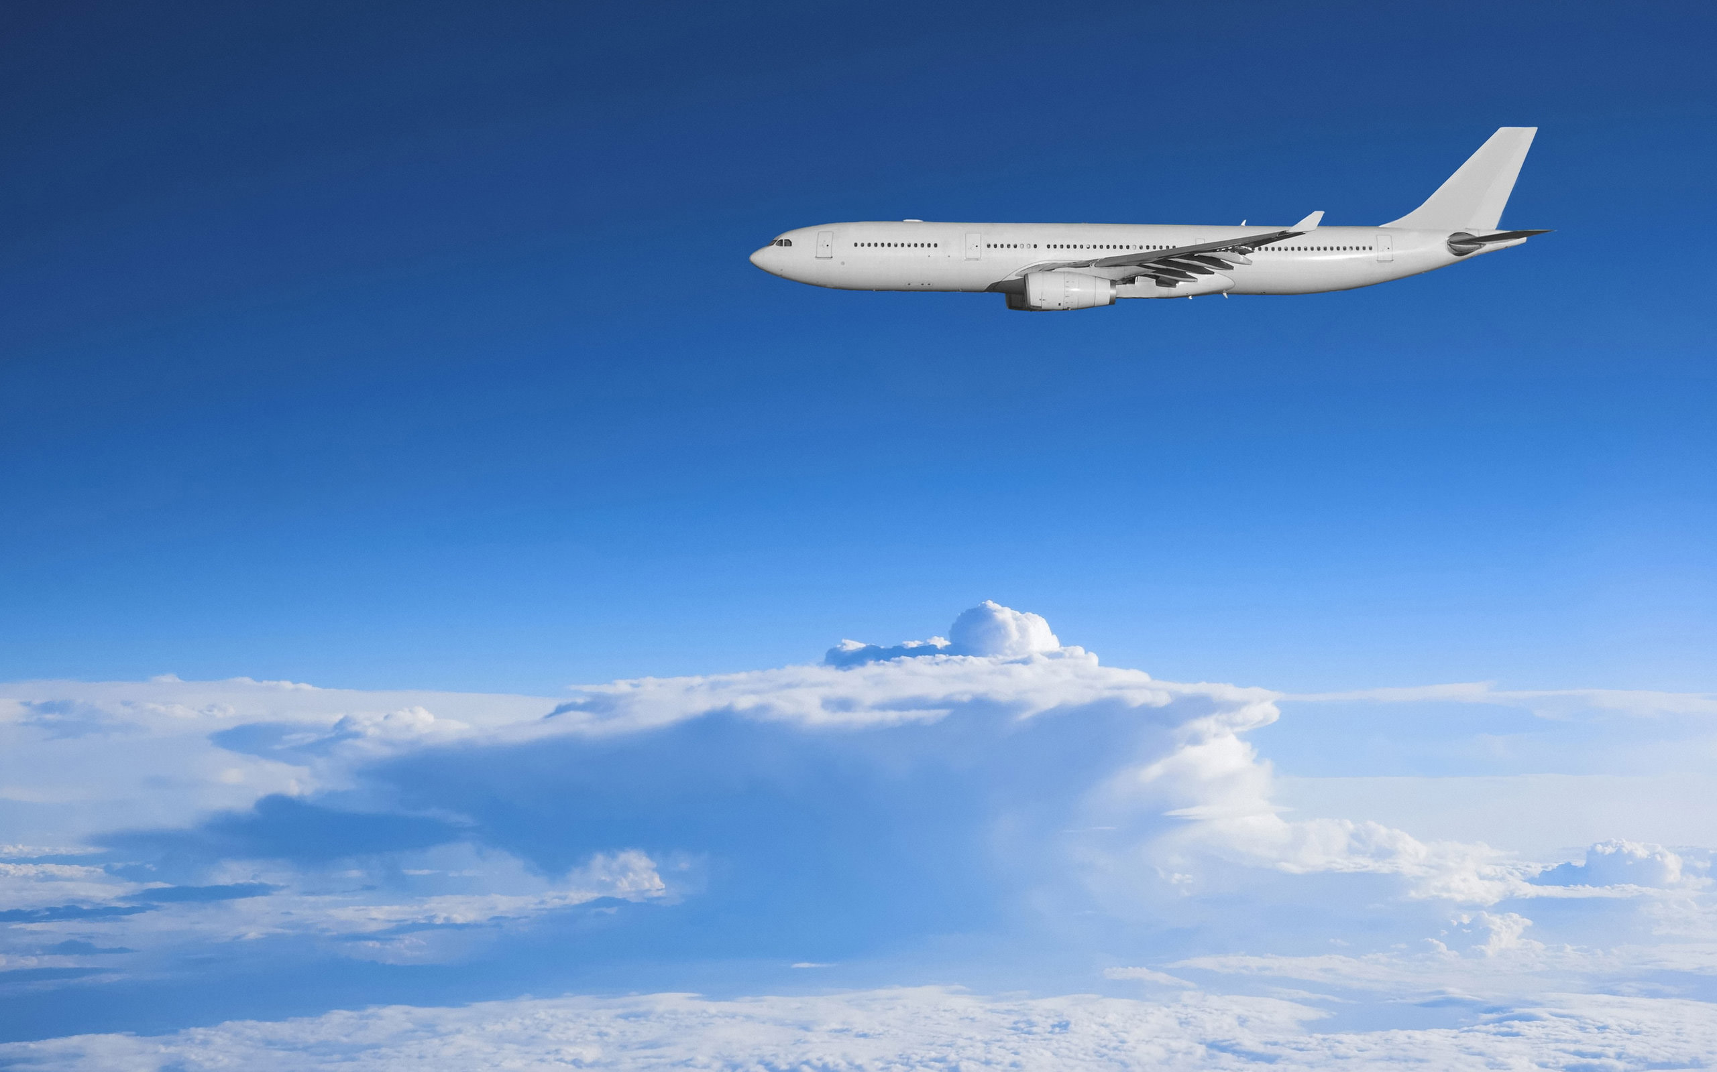
Global Airlines
Bus 417
Woo Jin Choi
Mundeep Grewall
Angel Lin
Weipeng Sun
Coco Zhao

Slide 2
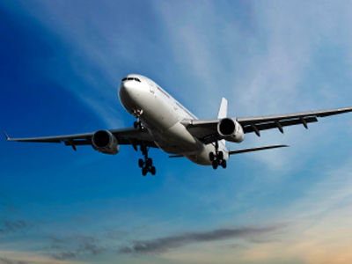
Agenda
Terminology
History and Regulations
Industry Overview
Company Profile
Southwest
Singapore
Cathay Pacific

Slide 3
Terminology
ATK: Available Tonne Kilometer (Capacity)
= Passenger and cargo capacity
ASK: Available Seat Kilometer (Capacity)
= [Number of seats] * [kilometers flown]
RPK: Revenue Passenger Kilometer (Traffic)
= [Number of paying passengers] * [kilometers flown]
FTK: Freight Tonne Kilometer (Traffic)
= [Freight tonnes carried] * [kilometers flown]
YIELD
= [Revenue] / [RPK]
LF: Load Factor (Capacity Utilization)
= [RPK] / [ASK]
= [number of passengers]/[number of seats]
Break Even LF: Unit cost / Yield
i.e. Operating cost = Operating Revenue

Slide 4
HISTORY and Regulations

Slide 5
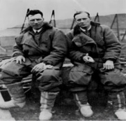
History/Regulation 1909-1957
Airmail Act– transferring operations to private companies
Air Commerce Act—safer flying routes needed
First jet-propelled aircraft (Coanda1910)
1909
1910
1919
1925
1926
First Zeppelin (Deutsche Luftschiffahrts-Aktiengesellschaft, DELAG)
First non-stop transatlantic
flight (Alcock and Brown)

Slide 6
History/Regulation 1909-1957
Federal Aviation Administration was formed due to another Airmail Act – Bureau of Air Commerce
Civil Aeronautics Administration (CAA)
Civil Aeronautics Board (CAB)
Air traffic control
Adequate air service
Regulate fees/schedules
Civil Aeronautics Act: delegating federal responsibilities to Civil Aeronautics Authority
Boeing 707 was created
1934
1938
1940
1949
1957
First commercial aircraft (de Havilland DH 106)

Slide 7
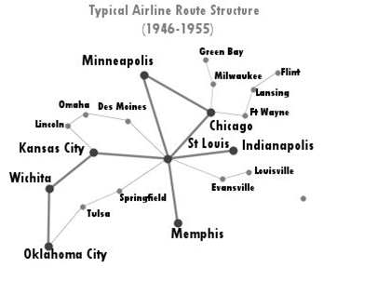
After World War II
Open skies competition for international routes
Open skies refers to the Air Transport Agreement which
Liberalizes the rules for international aviation markets and minimizes government intervention
Military and other state-based flights may be permitted

Slide 8
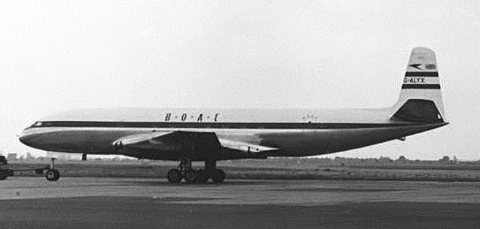
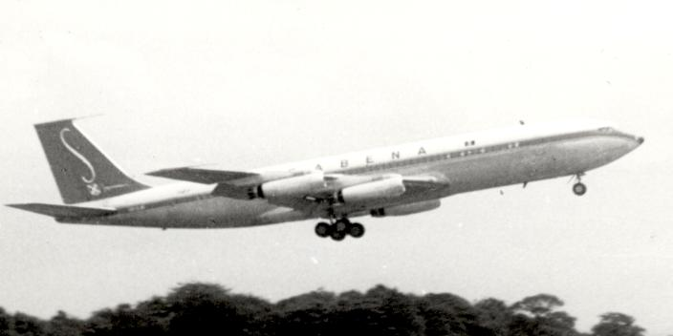
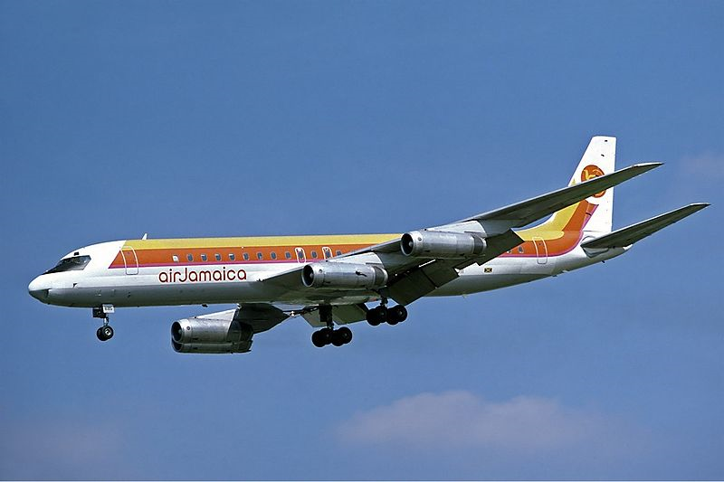
1950’s-1960’s Jet Airliners (Narrow-body)
de Havilland DH 106 Comet – First production commercial airliner
McDonnell Douglas DC-8
Boeing 707

Slide 9
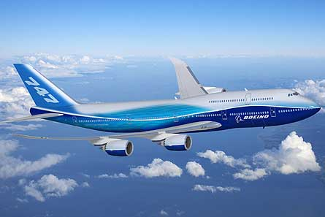
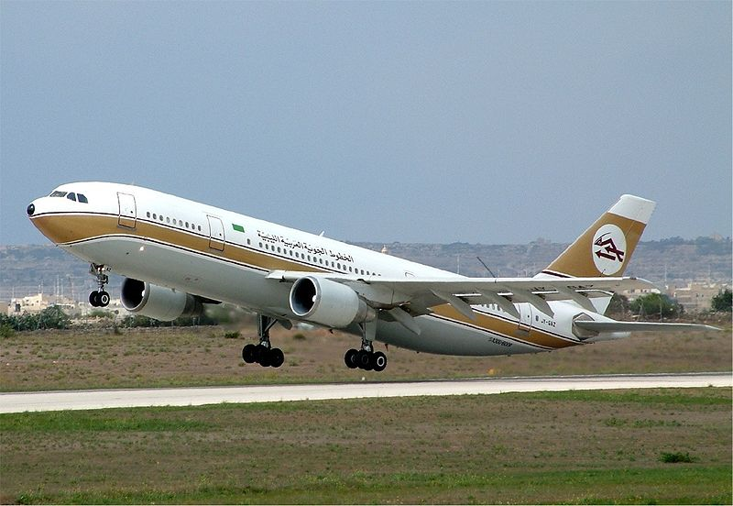
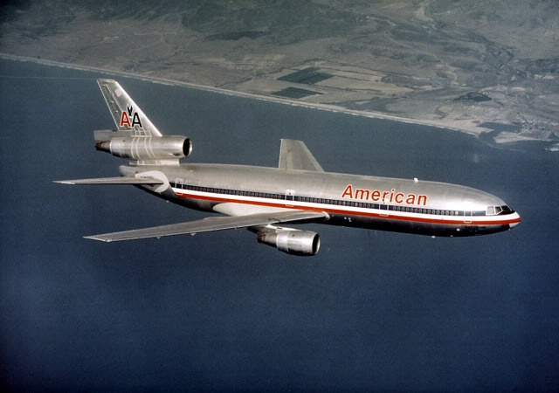
1960’s-1970’s Jumbo Jets (Wide-Body)
Boeing 747 – first wide-body airliner (four engine)
McDonnell Douglas DC-10 – three engine wide-body airliner
Airbus A300 - first twin-engine wide-body airliner

Slide 10
Deregulation Act 1978
American federal law created to remove government control over fares, routes, market entry and to eliminate CAB
Underserved airports to major carriers
Mergers between local carriers allowed
Implementation of “Hub & Spoke” system

Slide 11
Industry Overview

Slide 12
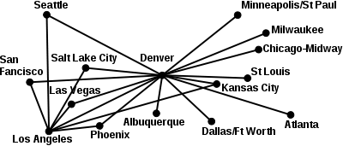
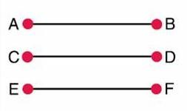

Business Model - Structure
Hub-and-Spoke System
Used by legacy carriers
Allowed for more distant and international routes
Utilize main airports as hubs
Lead to more efficient use of transportation resource
Centralized model result in inflexible operation (domino effect)
Cathay Pacific, American Airline
Point to Point System
Used by low-cost carrier
Shorter routes, usually regional/domestic
↓connection & travel time
↑utilization leads to lower unit cost
Avoid domino effect
Require more routes
Less flexibility in destination
Southwest Airline (hybrid)

Slide 13
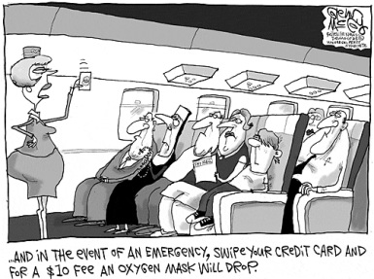
Business Model – Types of Airlines
Network-Legacy Airlines
New competition after deregulation
More Luxury aircrafts
Offer Business/First Class
Higher level of services: airport lounges, frequent-flyer program, premium in-flight services
Price discrimination
Yield management system
Different prices for same class
Frills
Airline Alliances
Low-Cost Airlines
Fewer types of aircrafts
Lower maintenance expenses
Economic class
Less services
Fly early/late
Lower landing fees
Simpler fare schedules
Lower fares
No alliance
AKA No-frills

Slide 14
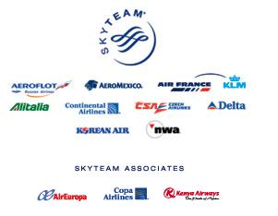
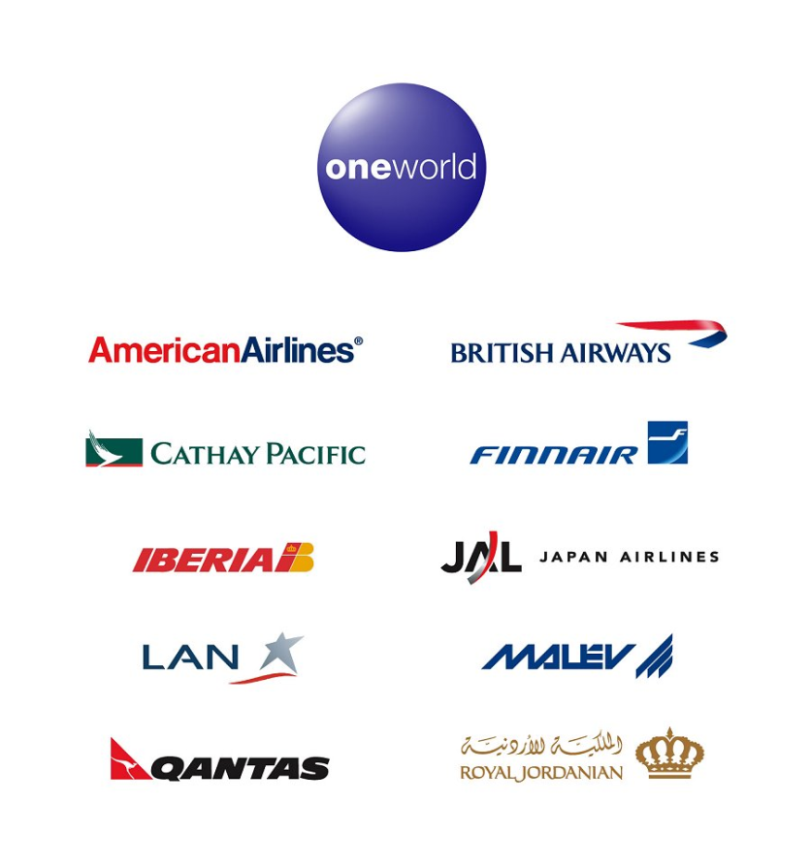
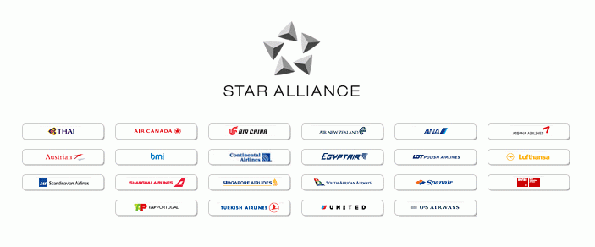
Airline Alliances

Slide 15
Benefits of Alliance
Lower fares for interlining passenger
Lower fares resulting from economies of traffic density
Passengers can more easily combine fares in an itinerary
Airlines can offer passengers a much wider range of schedule
The passenger experience benefits from more seamless service and similar product

Slide 16
General Environmental Factors
Key factors affecting the business:
Airport capacity
Route structure
Technology
Costs to lease/buy the aircrafts
Weather
Cost of fuel
Cost of labour

Slide 17
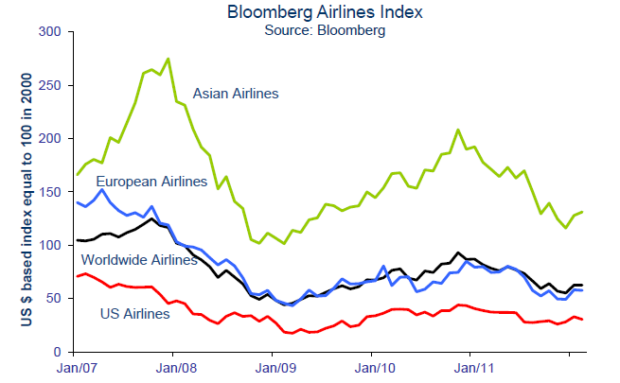
Market Index
Notes:
Airline share prices are underperforming. They are either falling or staying flat

Slide 18
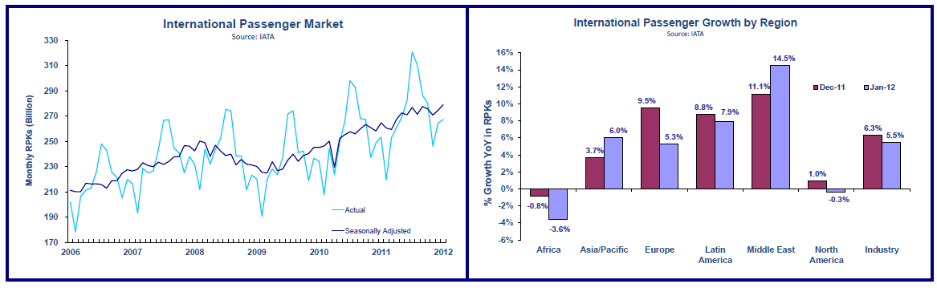
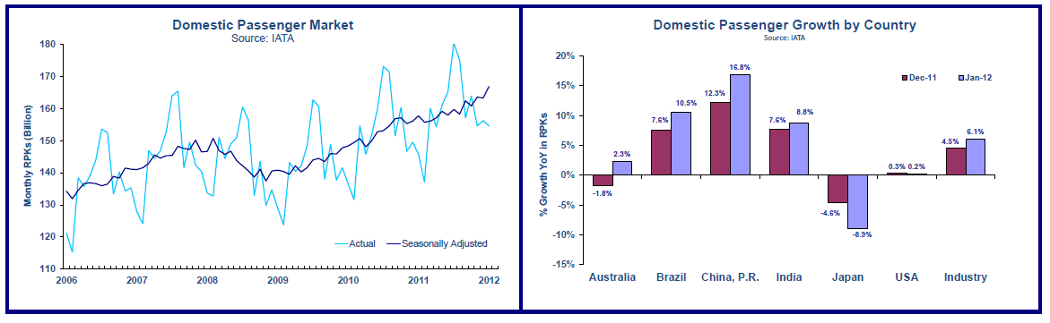
Revenue - Passenger

Slide 19
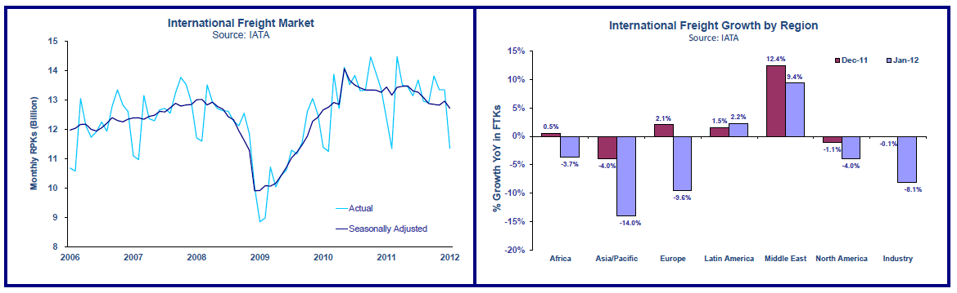
Revenue - Cargo

Slide 20
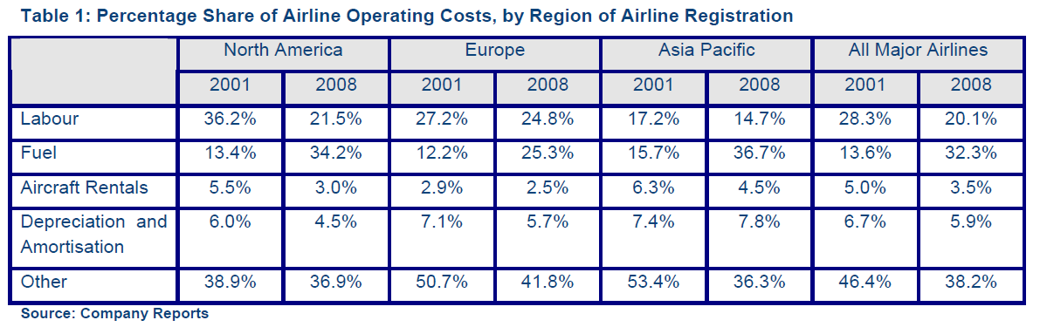
Cost Structure

Slide 21
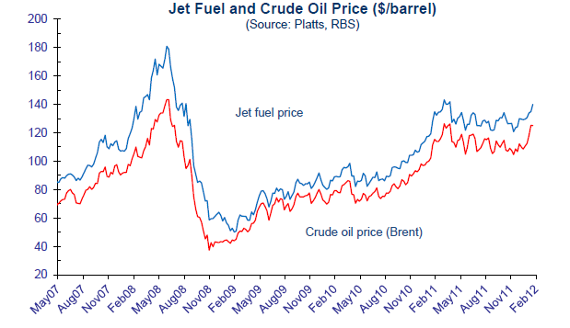
Costs - Fuel
New fuel price average for 2012 | Impact on 2012 fuel bill
$132.7/b | +$37 billion
Estimated by IATA

Slide 22
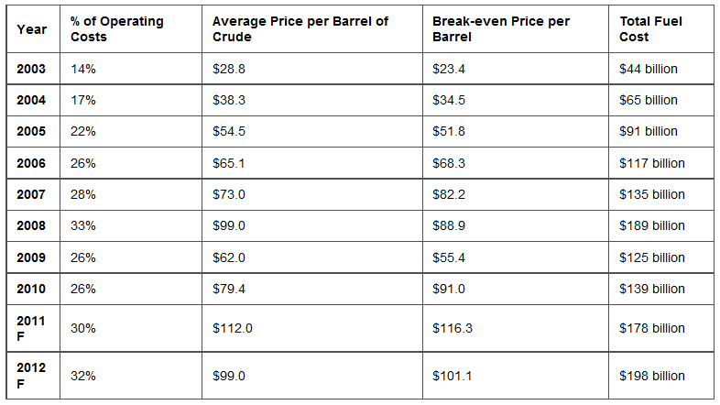
Fuel Impact on Operating Costs

Slide 23
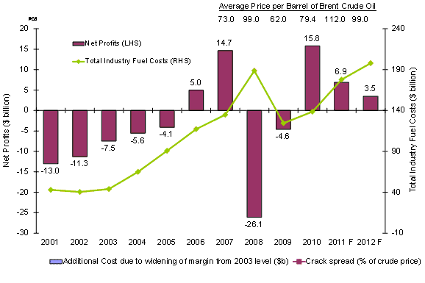
Fuel Costs and Net Profit

Slide 24
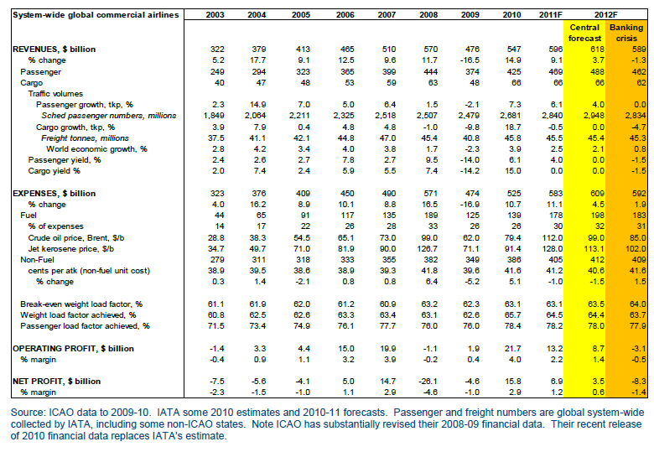
Profitability

Slide 25
Market Performance and Outlook

Slide 26
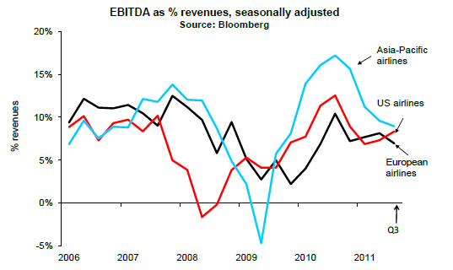
Performance

Slide 27
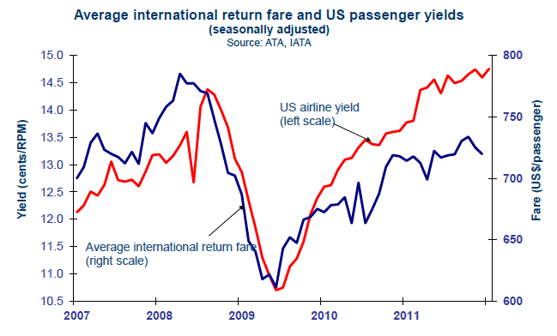
Performance - Yields
Notes:
Yields are now increasing at a slower pace than they did in the first half of 2011,
Pressure from high fuel prices has forced airlines to keep yields high to date, however any resurgence in capacity growth may reduce further scope for yield increases.

Slide 28
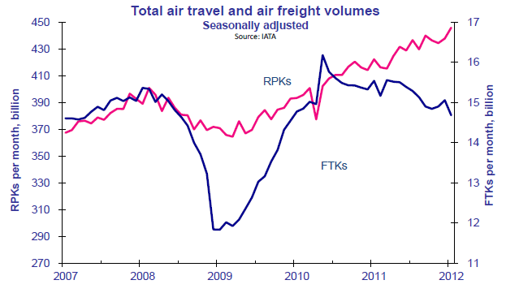
Performance - Demand
Notes:
2012 began with strong performance in air travel markets, while air freight markets showed declined. Worldwide air travel was 5.7% higher in January than a year ago. Air freight markets were down 8% on the year.

Slide 29
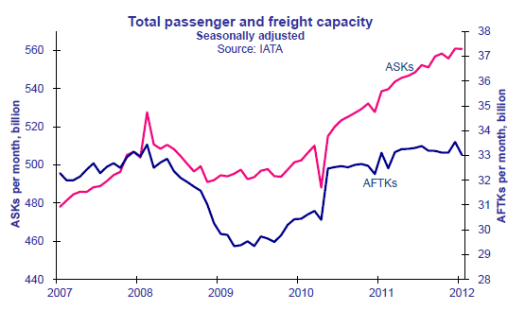
Performance - Capacity
Notes:
Positive trend in passenger capacity since 2010

Slide 30
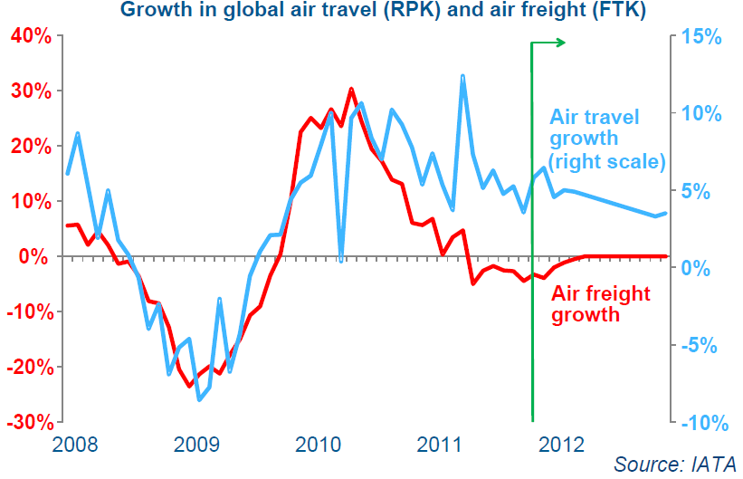
Outlook – Air Travel and Freight
Notes:
Slow or no growth

Slide 31
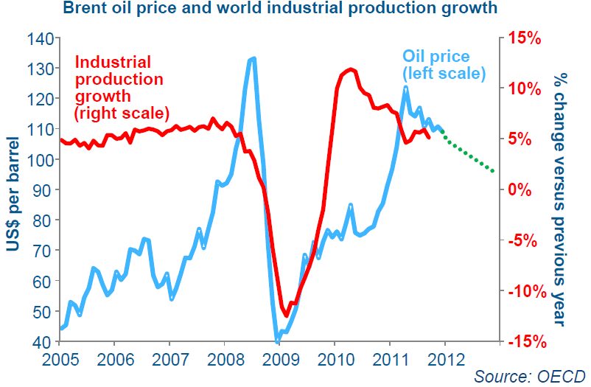
Outlook - Fuel Prices
Notes:
Fuel prices forecasted to stay relatively high due to supply squeeze

Slide 32
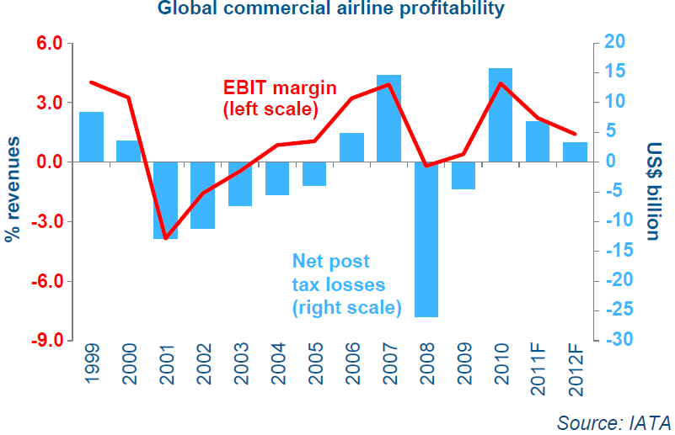
Outlook - Profits

Slide 33
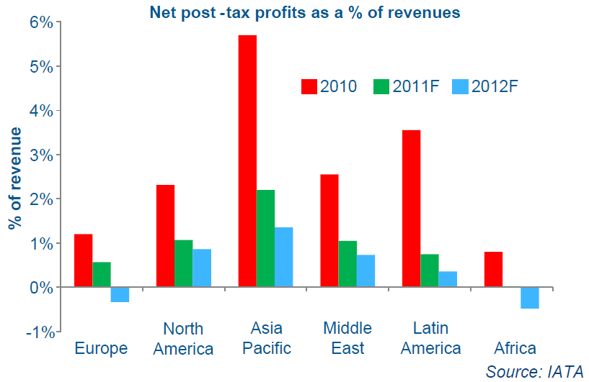
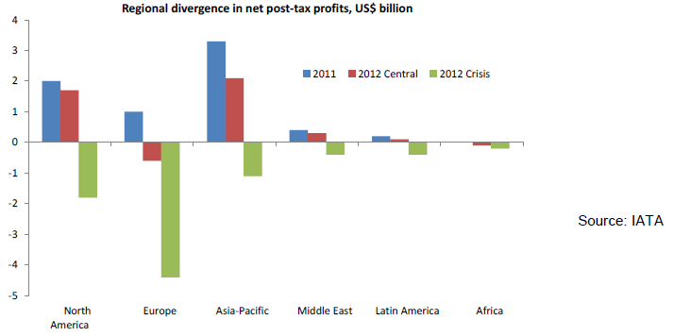
Outlook – Euro Crisis
European airlines hit hardest in 2011
Euro crisis forecast scenario
according to OECD (Organization
for Economic Cooperation and
Development) could drive
airlines toward losses

Slide 34
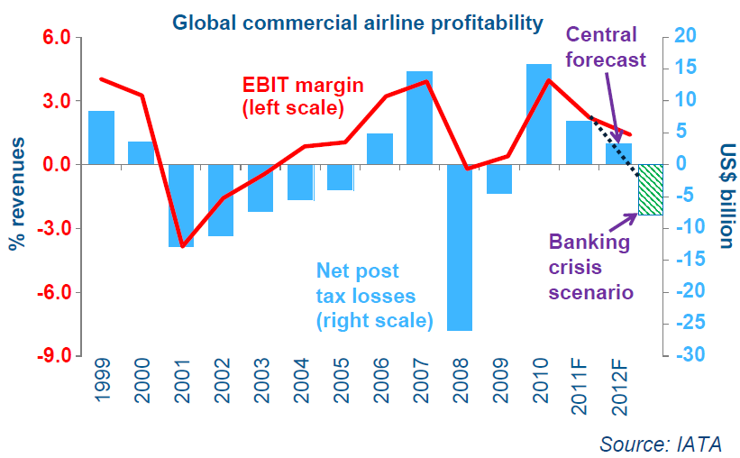
Outlook – Euro Crisis

Slide 35
Companies

Slide 36
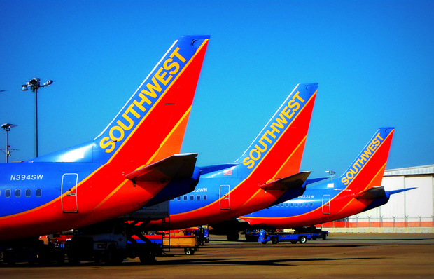

Slide 37
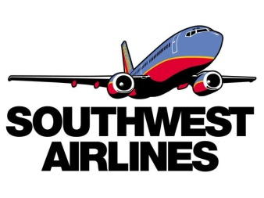
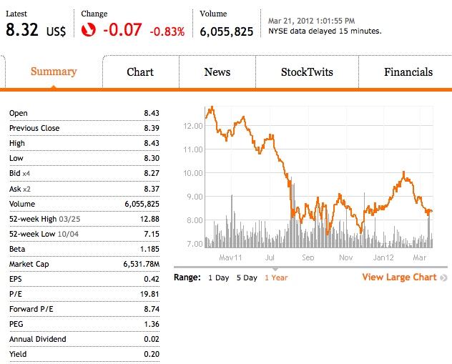
Stock Information
Support level

Slide 38
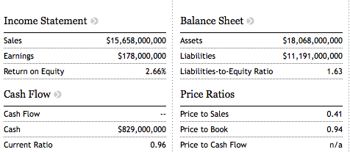
snapshot

Slide 39
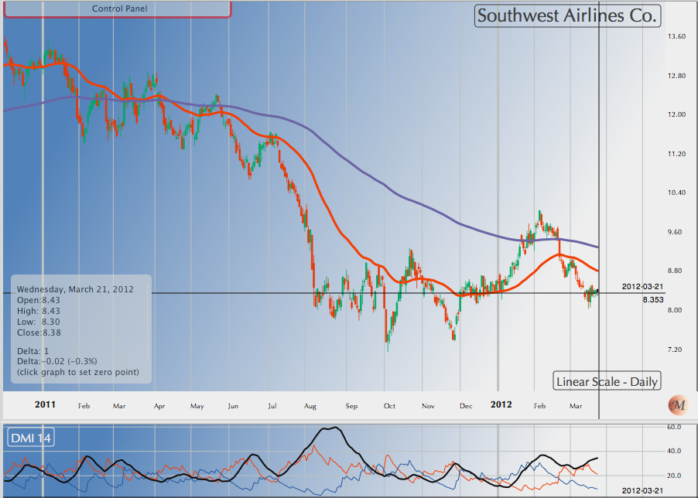
1 year stock price movements

Slide 40
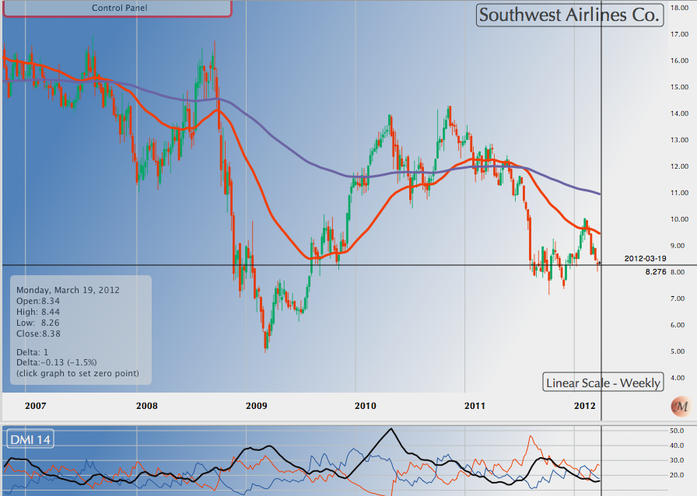
5 YEAR STOCK PRICE MOVEMENTS

Slide 41
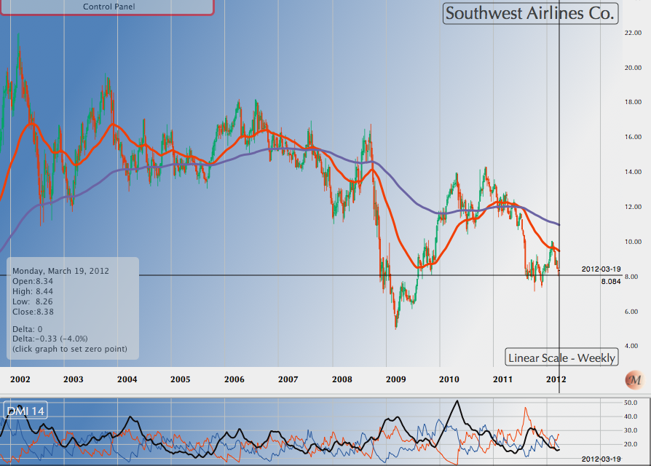
10 year stock price movements

Slide 42
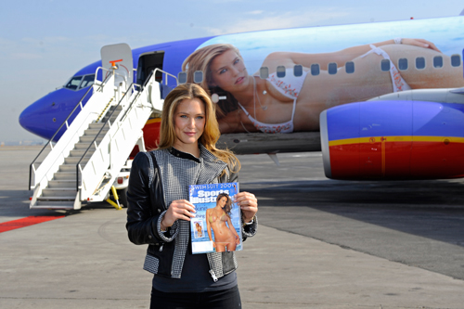
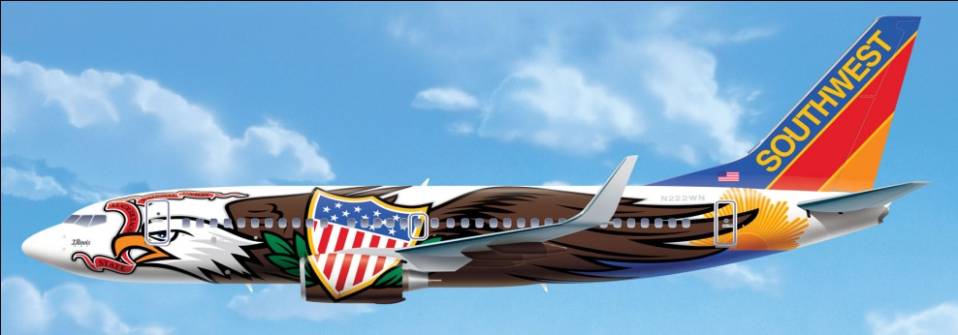
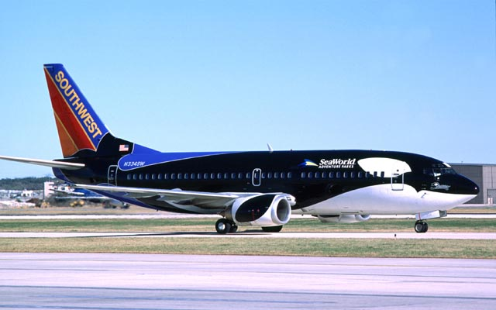
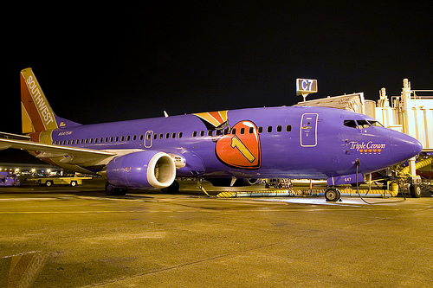
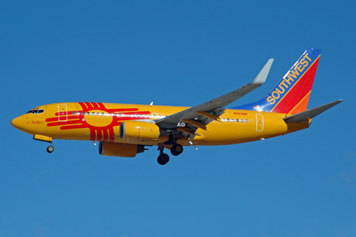
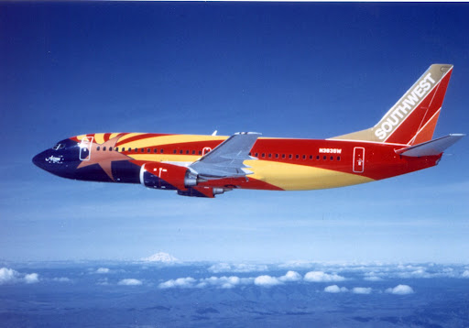
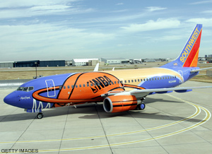
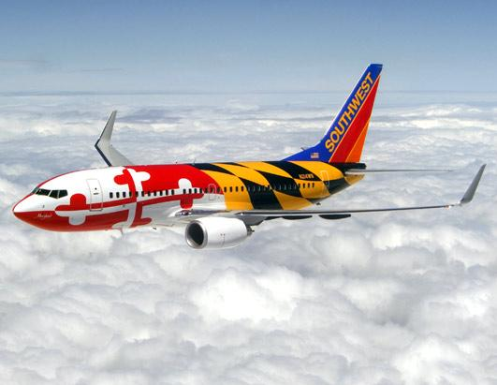

Slide 43
Company Profile
Southwest is a major domestic airline that provides primarily short-haul, high-frequency, point-to-point, low-fare service
Headquarters in Dallas, Texas
Operates over 500 Boeing 737
aircrafts in 69 cities
Has among the lowest cost structures in domestic airline industry and consistently offers the lowest and simplest fares
Average passenger airfare for a one-way ticket is $131.82
Adopted the first profit-sharing plan in U.S. airline industry in 1973 where employees own about 8% of the company stock

Slide 44

Southwest routes

Slide 45

Routes-Top Served Cities

Slide 46

Aircraft

Slide 47



History
Air Southwest Co. was incorporated in 1967
1971
Air Southwest Co. changes its name to Southwest Airlines Co.
Begins service to Dallas, San Antonio and Houston with three Boeing 737s
1975
Common stock listed on
American Stock Exchange under the ticker “LUV”
1973
Ends the year with first yearly profit
1974
Carries one-millionth customer
1978
Flies to New Orleans, first flight
destination outside of Texas

Slide 48


History
1994
Acquires 2 airline companies: Morris Air and Arizona One
1996
Online booking site launched
2005
Enters first code-share agreement with American Trans Air
2009
Becomes largest carrier in the US with 545 Boeing 737 aircrafts servicing 68 airports in 35 states and able to offer more than 3,300 flights a day
2011
Integration of AirTran

Slide 49

Business Model
Low-Cost Airlines
Point to Point as main system
→ Fly directly to destination
→ Lower unit cost
Fewer types of aircraft （Boeing 737 jet is the mainly aircraft ）
Economic class
Fly early/late

Slide 50


WestJet & JetBlue (similar business model)

Slide 51

Southwest & JetBlue& WestJet VS. Oil Price (AMEX) - 5 Year

Slide 52

Southwest VS. Airline Index (AMEX) 5 Year

Slide 53
Management Team

Slide 54

Management Team
Gary C Kelly
Leadership is... "Effectively supporting your team of Employees."
The chief executive officer and chairman of southwest Airlines.
Kelly became CFO in 1989 and promoted to CEO and Vice Chairman in 2004
Gary received a B.B.A. in Accounting from the University of Texas at Austin and is a Certified Public Accountant. He is a member of the Texas Society of CPAs

Slide 55

Management Team
Michael G Van De Ven "Mike”
Leadership is... "Having a passion about the mission needing to be accomplished and instilling that passion in your team by working with them, side by side, and supporting them in any way necessary.”
Executive Vice President& Chief Operating Officer
Mike received a B.B.A. from the University of Texas at Austin. He is also a Certified Public Accountant
Mike has held several positions at Southwest such as Executive Vice President of Aircraft Operations, Senior Vice President of Planning, Vice President Financial Planning & Analysis, Senior Director of Financial Planning & Analysis, Director of Financial Planning, and Director of Internal Audit

Slide 56

Management Team
Ron Ricks
Executive Vice President—Chief Legal and Regulatory Officer at Southwest Airlines in Dallas, Texas.
Before joining Southwest Airlines, Ron was a partner in the San Antonio law firm founded by Herb Kelleher, where Ron worked extensively on the Southwest Airlines' account. All together, Ron has represented Southwest since 1981
Ron has an undergraduate degree from the University of Texas at Austin, and, earned a law degree from George Washington University, in Washington, D.C

Slide 57

Management Team
Jeff Lamb serves Southwest Airlines as Executive Vice President & Chief People & Administrative Officer.
Prior to joining Southwest Airlines, Jeff worked 12 years at Mesa Petroleum, under the leadership of Boone Pickens, from 1981 to 1993.
Following Belo, Jeff joined The Staubach Company as their Executive Vice President Corporate Operations and was also President of Staubach Lease Administration Company until 2004 when he came to Southwest Airlines.
Jeff completed his undergraduate work at West Texas State University - Canyon, Texas (now West Texas A&M) in 1986
Jeff Lamb
Leadership is... Helping People clearly see a picture of the future that creates passion, working hard, serving others, learning from mistakes, and celebrating the victories

Slide 58
OPERATIONS

Slide 59

AirTran Acquisition and related matters
AirTran Acquisition
Each share of AirTran Holdings common stock was exchanged for $3.75 in cash and 0.321 shares of common stock of the Company.
The transaction valued AirTran Holdings common stock at approximately $7.57 per share, or $1.0 billion in the aggregate.

Slide 60

Routes after Acquisition

Slide 61

Fuel hedging
Southwest purchases jet fuel at prevailing market prices, but seeks to protect against significant increases in fuel costs by entering into OTC fuel derivative contracts.
Southwest cross-hedges their jet fuel risks using similar commodities such as heating oil, crude oil (WTI) and gasoline
There is risk associated with this: sometimes the cross hedge does not accurately track jet fuel prices

Slide 62

Fuel hedging

Slide 63

Fuel hedging
The reason for Southwest's rapidly increasing advantage over other big airlines is much simpler: it loaded up years ago on hedges against higher fuel prices.
with oil trading above $90 a barrel, most of the rest of the airline industry is facing a huge run-up in costs, and Southwest is not.
Southwest owns long-term contracts to buy most of its fuel through 2009 for what it would cost if oil were $51 a barrel. The value of those hedges soared as oil raced above $90 a barrel.

Slide 64


Fuel hedging
From 2010 to 2011, fuel cost per gallon went up 27.5%
For the 7th consecutive year, fuel costs have represented the first or second largest expense for Southwest

Slide 65

Double Edged Sword
When airlines like Southwest heavily lock in high prices, they lose money when prices drop
That’s why Southwest Airlines lost $140 million in third quarter 2011 after it was recorded a $239 million charge related to its fuel hedging contracts

Slide 66

Fuel hedging

Slide 67


Fuel Hedging

Slide 68
Long-lived assets
Flight equipment and related assets make up the majority of the Company’s long-lived assets
Stable amortization cost
Flight equipment primarily relates to the 496 Boeing 737 aircraft and 10 Boeing 717 aircraft in the Company’s (including AirTran’s) fleet at December 31, 2011, which are either owned or on capital lease
The remaining 114 Boeing 737 aircraft and 78 Boeing 717 aircraft in the Company’s (including AirTran’s) fleet at December 31, 2011, are operated under operating leases

Slide 69

Financial data & operational data
Consolidated operating expenses per ASM (unit costs) for 2011 increased 9.9 percent compared to 2010. Over 89 percent of this year-over-year cost per available seat mile increase was due to higher fuel costs.

Slide 70
Operating Expense
Consolidated operating expenses for 2011 increased by $3.8 billion, or 34.6 percent, compared to 2010, while capacity increased 22.5 percent compared to 2010. The increase in consolidated operating expenses was primarily due to the inclusion of AirTran’s 2011 operating expenses following the acquisition
On a dollar basis, excluding the results for AirTran following the acquisition, operating expenses increased by $1.9 billion for 2011 compared to 2010, approximately 64 percent of which was due to a higher average jet fuel cost per gallon

Slide 71
Operating revenue
The Company’s consolidated net income of $178 million ($.23 per share, diluted) in 2011 decreased by $281 million, or 61.2 percent, compared to its 2010 net income of $459 million ($.61 per share, diluted)

Slide 72


Operating Expense

Slide 73

Peer comparison

Slide 74
Financial Review

Slide 75

Balance sheet

Slide 76

Balance sheet(Quarterly)

Slide 77

Income statement (Quarterly)

Slide 78

Income statement

Slide 79

cash flow statement

Slide 80

Recommendation
HOLD
HOLD!

Slide 81


Slide 82



STOCK INFORMATION

Slide 83

1 year Stock Price Movements

Slide 84

1 year vs S&P vs AMEX Airline index

Slide 85

5 year Stock Price Movements

Slide 86

5 year vs S&P vs AMEX Airline Index

Slide 87

10 year Stock Price Movements

Slide 88

10 year vs S&P vs AMEX Airline Index

Slide 89

Notes:
Singapore flies high in customer service which allows them to outperform other airlines.

Slide 90

Company profile
Based at Singapore Changi Airport, Singapore Airlines is the national carrier of Singapore
Using a fleet of wide-body Boeing and Airbus aircraft, including the A380 of which Singapore Airlines was the launch customer
Singapore Airlines operates an extensive network across Asia, North America, Australasia, Europe, Africa and the Middle East
Singapore Airlines joined the Star Alliance on April 1, 2000

Slide 91


HISTORY
1937 Malayan Airlines (MAL) was incorporated by the Ocean Steamship Company of Liverpool
1955 Malayan Airway had a fleet including a large number of Douglas DC-3c
1957 The airline went public
1964 The first Boeing aircraft joined the fleet – 707, followed by 737
DC-3

Slide 92

Company routes

Slide 93


History
1964 The first two Boeing 747s
1980s New destinations across the Indian subcontinent and Asia including the U.S., Canada, and Europe
1990s The first global sky telephone service, extended to African destinations
2004 The first non-stop air service between Singapore and the USA
2007 The first Airbus A380

Slide 94

COMPOSITION

Slide 95

Fleet Information

Slide 96
Management Team

Slide 97

Management Team
Stephen Lee Ching Yen
BOD Chairman
Became chairman of BOD in 2006
Managing Director of Shanghai Commercial & Savings Bank (Taiwan) and Great Malaysia Textile Investments Pte Ltd
President of the Singapore National Employers’ Federation since 1988 and is a Council Member of the Singapore National Wages Council
Nominated Member of Parliament from 1994-1997
Graduated from Northwestern University, Illinois, USA in 1973, MBA

Slide 98
Management Team
Goh Choon Phong
Director and CEO
Appointed Director in 2010 and CEO On 1 January 2011
Join SIA since 1990 and held senior management positions in various divisions in Singapore and overseas
President of the Singapore Airlines Cargo Pte Lid from 2006 to 2010 and was EVP for Marketing and the Regions
Received undergraduate degree and a graduate degree from the Massachusetts Institute of Technology.
Notes:
Various position: ranging from
Marketing to Information Technology to Finance and Cargo.

Slide 99
OPERATIONS

Slide 100

Revenue

Slide 101

Operation profits

Slide 102

Financial highlights

Slide 103

Expenditure

Slide 104


Slide 105


Slide 106


Slide 107


Slide 108


Slide 109


Slide 110
Financial review

Slide 111

Balance sheet

Slide 112

Balance sheet (Quarterly)

Slide 113

Property, plant and equipment(Group)

Slide 114

Property, plant and equipment (Company)

Slide 115

Property, plant and equipment (continued)

Slide 116

Income statement (Quarterly)

Slide 117


Slide 118


Slide 119

Cash flow

Slide 120

Cash flow (continued)

Slide 121

Recommendation
Hold!

Slide 122



Slide 123



Stock Information

Slide 124

Stock Information

Slide 125

1 year stock price movements

Slide 126

5 year stock price movements
Notes:
The main story of 2009 was the impact on our
business of one of the most severe economic
downturns in recent memory. The global slump
resulted in extremely challenging business conditions
for the Cathay Pacific Group and commercial aviation in
general

Slide 127

5 year VS. Airline Index

Slide 128

5 year VS. Hangseng Index

Slide 129

5 year VS. Oil & Gas

Slide 130

10 year Summary

Slide 131

Key Statistics

Slide 132

Key Statistics

Slide 133

Destinations served: 162 in 42 countries and territories

Slide 134

Company profile
Registered and based in Hong Kong
Offering scheduled passenger and cargo services to 145 destinations in 40 countries and territories around the world
Founded in 1946 and remains deeply committed to its home base, making substantial investments to develop Hong Kong as one of the world’s leading international aviation hubs
In addition to its current fleet of 128 wide-bodied aircraft, Cathay Pacific continues to invest heavily in its home city and has another 97 new aircraft due for delivery up to 2019
Cathay Pacific and its subsidiaries employ some 28,100 people worldwide (more than 21,000 of them in Hong Kong)
Cathay Pacific is listed on The Stock Exchange of Hong Kong Limited, as are its substantial shareholders Swire Pacific Limited (“Swire Pacific”) and Air China

Slide 135


Company History
1946:
Founded by Farrell and Kantzow
Initially based in Shanghai
1948:
Began to operate the passenger flights;
Swire trading house buys into Cathay Pacific
1980s:
Expanded the international network to include London, Brisbane, Frankfurt, Vancouver, Amsterdam, Rome, San Francisco, Paris, Zurich and Manchester
1960:
Business grew at 20% a year; initiated international services
1970s:
Started to make use of the latest technology with our computerized reservation system and flight simulators;
The first Boeing 747-200 arrived in Hong Kong in mid-1979

Slide 136


Company History
1990:
Used US$9 billion to assemble a fleet of aircraft that was among the youngest in the world
2002:
Became joint venture partners in Air Hong Kong with DHL
2006:
Closer relationship with Air China by taking 20% shareholding
2003:
Resume passenger services to Beijing & undertook a range of e-business initiatives
2005:
The "Airline of the Year & Airline of the Year 2006

Slide 137

Annual Result

Slide 138

Fact sheet
Operation and profits:
Total Number of Cathay Pacific Airways Staff:
Cathay Pacific and its subsidiaries employ 29,217 people worldwide
Cathay Pacific World Rankings:
Cathay Pacific currently ranks as the world's 2nd most profitable airline (net profit) and the 7th largest airline in the world by operating profit.

Slide 139
Fact sheet
Major shareholders
Major subsidiaries and associates
Swire Pacific Limited | 44.97%
Air China Limited | 29.99%
Hong Kong Dragon Airlines Limited | 100%
Cathay Pacific Catering Services (HK) Limited | 100%
Cathay Holidays Limited | 100%
Vogue Laundry Services Limited | 100%
Hong Kong Airport Services Limited | 100%
Cathay Pacific Services Limited | 100%
AHK Air Hong Kong Limited | 60%
Air China Limited | 19.53%

Slide 140

Fleet Profile
Fact sheet

Slide 141
Management Team

Slide 142

Management Team
Chris Pratt
CBE, Chairman
Honors degree in modern history from the University of Oxford
Joined John Swire & Sons Limited ("Swire") group in 1978 and has worked with the group in Hong Kong, Australia and Papua New Guinea
Chairman of Swire Pacific Limited and John Swire & Sons (H.K.) Limited, and a director of Swire Properties Limited
Served as Executive Director of Swire Pacific’s Trading and Industrial Division from 2000 to 2005

Slide 143

Management Team
John Slosar
Chief Executive since March 2011
Holds degrees in Economics from Columbia University and Cambridge University.
Joined the Swire group in 1980 and has worked with the group in Hong Kong, the United States and Thailand.
Appointed Managing Director of Hong Kong Aircraft Engineering Company Limited in 1996, Managing Director of Swire Pacific's Beverages Division in July 1998 and Chief Operating Officer of Cathay Pacific in July 2007
Director of Cathay Pacific, John Swire & Sons (H.K.) Limited, Swire Pacific Limited, and Chairman of Hong Kong Dragon Airlines Limited and Swire Beverages Limited

Slide 144

Management Team
Ivan Chu
Chief Operating Officer since March 2011
Joined Cathay Pacific in 1984 and has worked with the Company in Hong Kong, Mainland China, Taiwan, Thailand and Australia
Was General Manager Southwest Pacific based in Sydney, Australia
Director of Cathay Pacific and Hong Kong Dragon Airlines Limited, and Chairman of AHK Air Hong Kong Limited and Cathay Pacific Catering Services (H.K.) Limited

Slide 145

Management Team
Martin Murray
Finance Director of the Company since November 2011.
Director of Hong Kong Dragon Airlines Limited. He was previously Deputy Finance Director of Swire Pacific Limited
Joined the Swire group in 1995 and has worked with the group in Hong Kong, the United States, Singapore and Australia

Slide 146
Operations

Slide 147

Operating Profits

Slide 148

Reconciliation of airlines’ operating profit before non-recurring items and tax: 2010 to 2011

Slide 149

Highlights of Performance

Slide 150

Passenger Services

Slide 151

Passenger Services- Key numbers
Notes:
Cathay Pacific and Dragonair carried a total of 13.2 million passengers in the first half of 2011, an increase of 1.7% compared to the same period in 2010
The load factor was 79.3%, representing a reduction of 4.7 percentage points compared with the first half of 2010
Both premium and economy class yields improved, together with careful revenue management, was one of the main contributors to the yield increase of 11.8% to HK65.3 cents
Revenue from passenger services in the first half of 2011 grew by 15.9% to HK$31,774 million compared with the same period in 2010 capacity increased by 9.8%

Slide 152

Passenger Yield

Slide 153


Cargo Services
Notes:
Total capacity rose by 14.6% in the first half of 2011. Our load factor dropped by 9.6 percentage points (to 68.4%)by comparison with the first half of 2010
Yield was up by 7.1% to HK$2.42
Cargo revenue increased by 7.7% to HK$11,628 million. The cargo business (while cyclical) is generally stronger in the second half of the calendar year than in the first

Slide 154

Turnover
Group passenger turnover increased 15.9% against a 9.8% increase in capacity.
The increased turnover principally reflected an increase in demand for premium class travel, higher fuel surcharges and careful revenue management.
Group cargo turnover rose by 8.7%
The increase in turnover reflected strong demand in the first quarter of 2011

Slide 155

turnover

Slide 156

Operating expenses

Slide 157


Slide 158

Fuel Expenditure and Hedging

Slide 159

Fuel Hedging as at March 14th 2012

Slide 160
Financial review

Slide 161

Balance Sheet

Slide 162

Income Statement

Slide 163

Cash Flow Statement

Slide 164

Recommendation
HOLD!

Slide 165

Thank you!

