Slide 1
Global Airlines
Presented by: Lin Chen
Justin Lee
Christian Niedermayer
Catherine Yeung
Linda Chen

Slide 2

Agenda
Industry Overview
  Terminology
  History and Regulations
  Current States and Trends
  Porter’s Five Forces
Southwest Airline
Cathay Pacific Airline
Singapore Airline

Slide 3
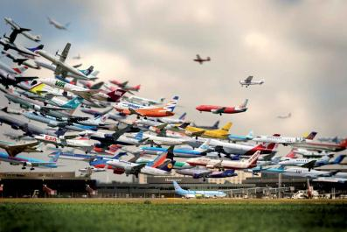
Industry Overview

Slide 4
Terminology
ATK: Available Tonne Kilometer (Capacity)
capacity in tonnes × km flown
ASK/ASM: Available Seat Kilometer (Capacity)
Number of seats X kilometers flown
RPK/RPM: Revenue Passenger Kilometer (Traffic)
Number of paying passengers X kilometers flown
LF: Load Factor (Capacity Utilization)
RPK / ASK

Slide 5
Terminology
Break Even Load Factor: Unit cost / Yield
Operating cost = Operating Revenue
FTK: Freight Tonne Kilometer (Traffic)
Freight tonnes carried X kilometers flown
YIELD: Revenue / Revenue Passenger Kilomete
Revenue Per Available Seat Mile: (Revenue)/(# of seats available)
Notes:
CASM is a commonly used measure of unit cost in the airline industry. CASM is expressed in cents to operate each seat mile offered, and is determined by dividing operating costs by ASMs. This number is frequently used to allow a cost comparison between different airlines or for the same airline across different time periods (say for one year vs the preceding year). A lower CASM means that it is easier for the airline to make a profit, as they have to charge less tobreak even. A low CASM, however, is by no means a guarantee of profitability

Slide 6
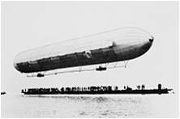
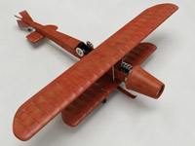
History and Regulations
1906
1919
World first airline ( Deutsche Luftschiffahrts-Aktiengesellschaft)
1910
First jet-propelled aircraft (Coanda 1910)
First non-stop transatlantic flight (Alcock and Brown)
1925
Airmail Act—transferring operations to private companies
1926
Air Commerce Act—safer flying routes needed

Slide 7
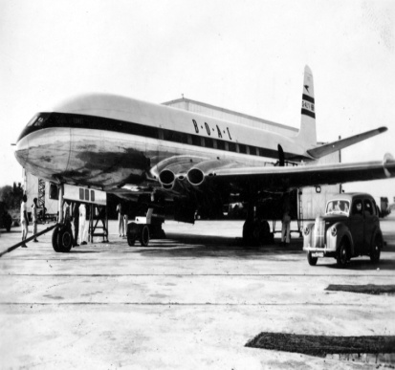
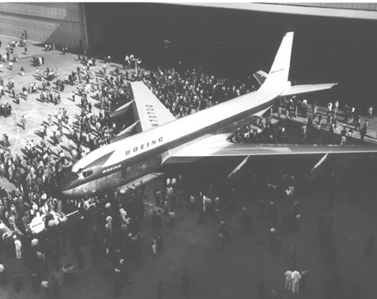
History and Regulations
1934
1940
1938
Civil Aeronautics Act—delegating federal responsibilities to Civil Aeronautics Authority
Civil Aeronautics Administration (CAA)—Air traffic control
1949
First commercial aircraft (de Havilland DH 106)
1957
Boeing 707 was created
Federal Aviation Administration was formed due to another Airmail Act—Bureau of Air Commerce
Civil Aeronautics Board (CAB)—Adequate air serve; Regulated fees/schedules

Slide 8
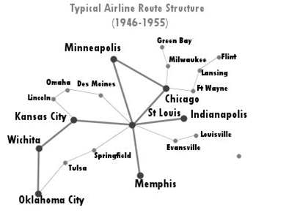
History and Regulations
After WW II:
Open skies competition for international routes
Open skies refers to the Air Transport Agreement which
  Liberalizes the rules for international aviation markets and minimizes government intervention
  Adjusts the regime under which military and other state-based flights may be permitted

Slide 9
History and Regulations
Deregulation Act 1978
A United States federal law signed into law on October 24, 1978.
Remove government control over fares, routes and market entry from commercial aviation.
The Civil Aeronautics Board’s (CAB’S) powers of regulation were to be phased out, eventually allowing passengers to be exposed to market forces in the airline industry.
Mergers between local carriers allowed
Hub and Spoke System implemented

Slide 10



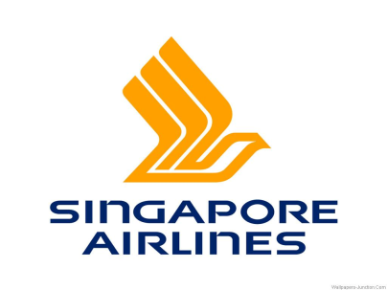
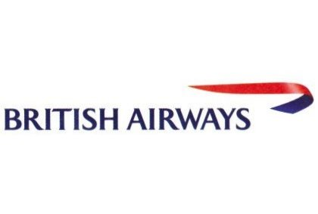
Major Global Airlines
Notes:
How many airlines are there in the world?
Here are some of the major airlines

Slide 11

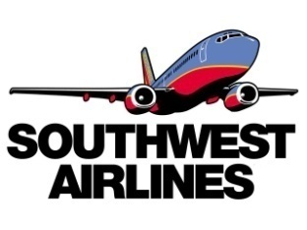

Types of Airline
  Legacy: Global & National
  Discount: National & Regional
  Cargo: Global, National & Regional
Notes:
Airlines could be categorized into three types based on the services they offer.
Legacy Carrier also called network
A low-cost carrier or low-cost airline (also known as a no-frills, discount or budget carrier or airline) is an airline that
Cargo airlines (or airfreight carriers, and derivatives of these names) are airlines .

Slide 12
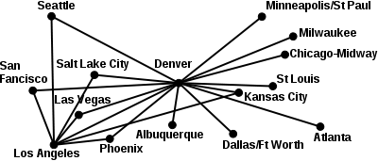
Route Structure
Hub-and-Spoke System:
  Used by legacy carriers
    Allowed for more distant and international routes
    Utilize main airports as hubs
    Lead to more efficient use of transportation resource
    Centralized model result in inflexible operation (domino effect)
    Singapore Airline; Cathay Pacific Airline

Slide 13
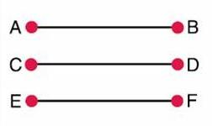
Route Structure
Point-to-Point System:
  Used by low-cost (discount) carrier
    Shorter routes, usually regional/domestic
    Decreased connection & travel time
    Increased utilization leads to lower unit cost
    Avoid domino effect
    Require more routes
    Less flexibility in destination
    Southwest Airline (hybrid)

Slide 14
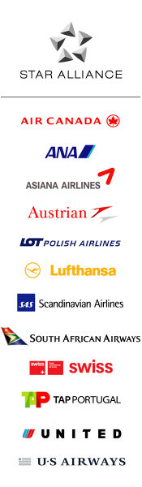
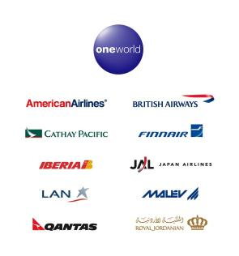
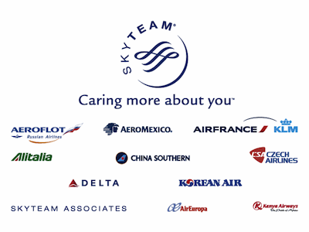
Airline Alliances
An agreement between two or more airlines to cooperate on a substantial level

Slide 15
Benefits of Alliances
Lower fares for interlining passengers
Lower fares resulting from economies of traffic density
Passengers can more easily combine fares in an itinerary
Airlines can offer passengers a much wider range of schedules
The passenger experience benefits from more seamless service and similar products

Slide 16
Current States and Trends
Worldwide international and domestic RPK flown = 5.2 trillion km in 2011
Revenue rose 9.4% to $598 billion, profit fell by almost half compared to 2010, to $7.9 billion
Sharp increase in the cost of fuel; average price of a barrel of oil rose from $79 in 2010 to $111 in 2011
4.8 billion passengers were transported in 2010

Slide 17
Current States and Trends
43.4 million tons of freight were transported by air worldwide
Many developing countries depend heavily on air cargo for exports
Generates roughly 5.5 million direct jobs globally
Negative impact on environment; e.g., noise, green house gas emissions

Slide 18
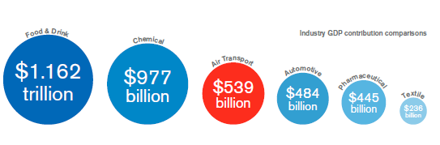
Industry GDP Contribution

Slide 19
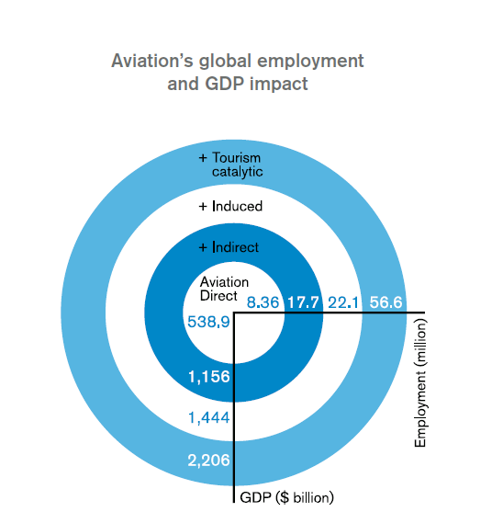
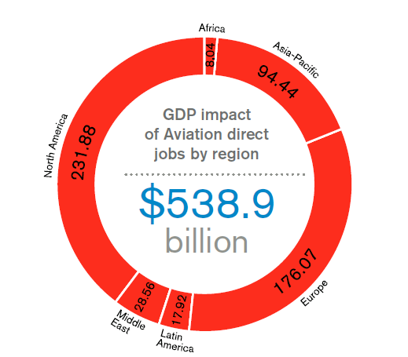
Global Employment and GDP Impact

Slide 20
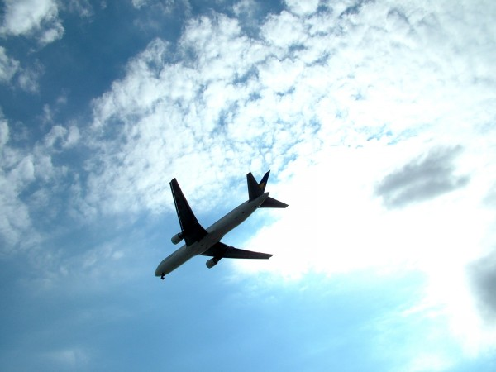

Performance

Slide 21
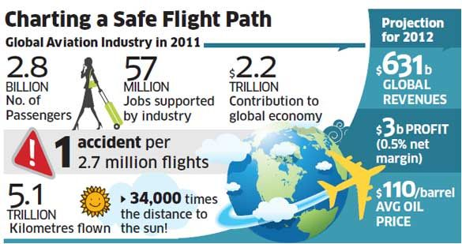
Global Aviation Industry in 2011

Slide 22
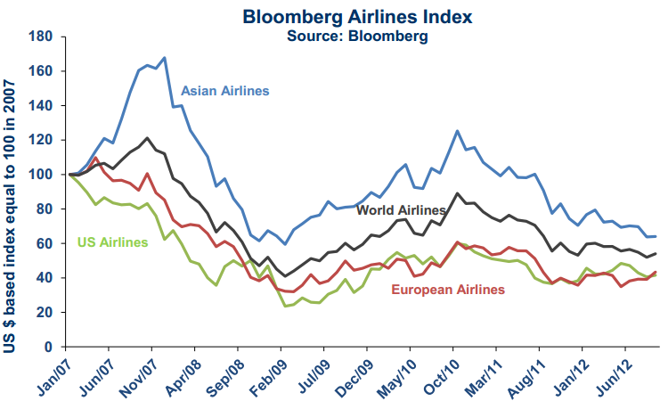
Airline Index

Slide 23
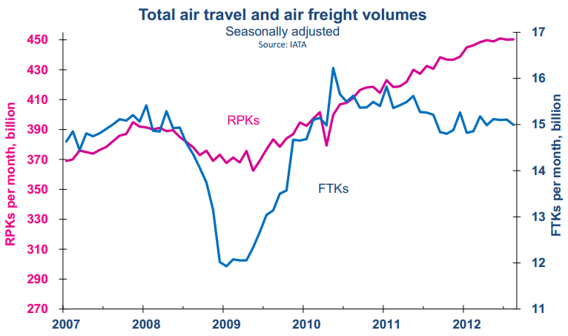
Air Travel and Air Freight
Notes:
RPK: Revenue Passenger Kilometer (Traffic)
Number of paying passengers X kilometers flown
FTK: Freight Tonne Kilometer (Traffic)
Freight tonnes carried X kilometers flown

Slide 24
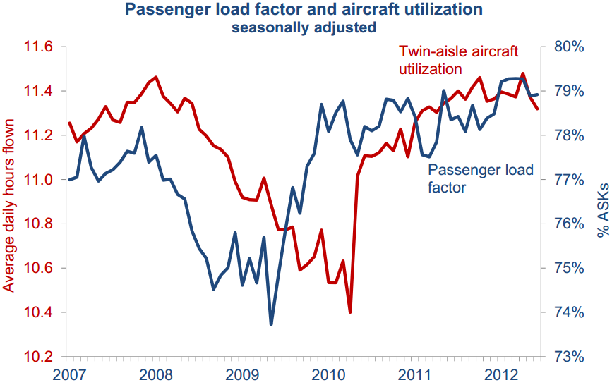
Capacity Utilization
Notes:
ASK: Available Seat Kilometer (Capacity)
Number of seats X kilometers flown
RPK: Revenue Passenger Kilometer (Traffic)
Number of paying passengers X kilometers flown
LF: Load Factor (Capacity Utilization)
RPK / ASK

Slide 25
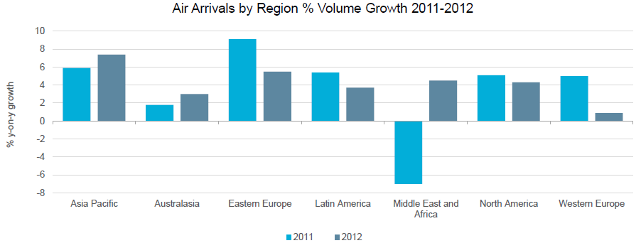
Air Flight Demand
Notes:
Asia Pacific dominates inbound demand growth
▪In 2011, Eastern Europe was the region which recorded the highest volume growth of air arrivals, of over 9%. Double digit growth was registered in countries such as Lithuania, Georgia and Serbia, driven by the increasing number of low cost airlines opening new routes to these markets.
▪Asia Pacific is expected to register the highest growth in 2012, of over 7%, boosted by the increasing number of travellers from countries such as China and India who favour intra-regional travel. The popularity of low cost carriers, such as AirAsia and Spring Airlines, also encourages holiday makers to stay closer to home.

Slide 26
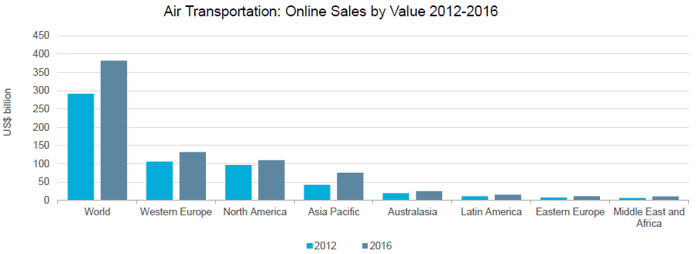
Airline Online Sales
Notes:
▪Global air online value sales are forecast to reach US$382 billion by 2016. This is expected to be driven by Western Europe and North America – the regions where air transportation is well developed, with an increasing number of dominant low cost airlines.
▪Budget carriers are driving online development, along with growing internet penetration, which stimulates online searches among consumers.
▪Asia Pacific is predicted to record the highest growth in terms of online air value sales over 2011-2016, averaging 16% annually. The many new LCCs entering the Asia Pacific market are expected to boost online air travel sales in the region.

Slide 27


Major Cost Factors
Weather, Natural Disasters
Fuel Cost
Labor Cost
Fees & Taxes (especially U.S.)
Notes:
Weather - Variable and unpredictable. Extreme heat, cold, fog and snow can shut down airports and cancel flights, which costs an airline money.
Fuel Cost - most impactful and volatile. According to the Air Transportation Association (ATA), fuel is an airline's second largest expense. Fuel makes up a significant portion of an airline's total costs, although efficiency among different carriers can vary widely. Short haul airlines typically get lower fuel efficiency because take-offs and landings consume high amounts of jet fuel.
Labor - According to the ATA, labor is the an airline's No.1 cost; airlines must pay pilots, flight attendants, baggage handlers, dispatchers, customer service and others.

Slide 28
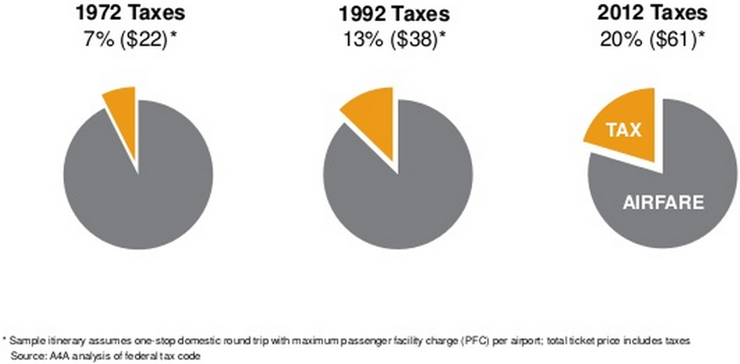
US Government Tax Bite
Notes:
Tax Bite on $300 One-stop domestic round trip => less revenue for domestic carriers

Slide 29
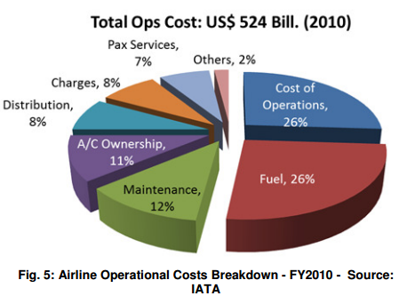
Operating Cost Breakdown

Slide 30
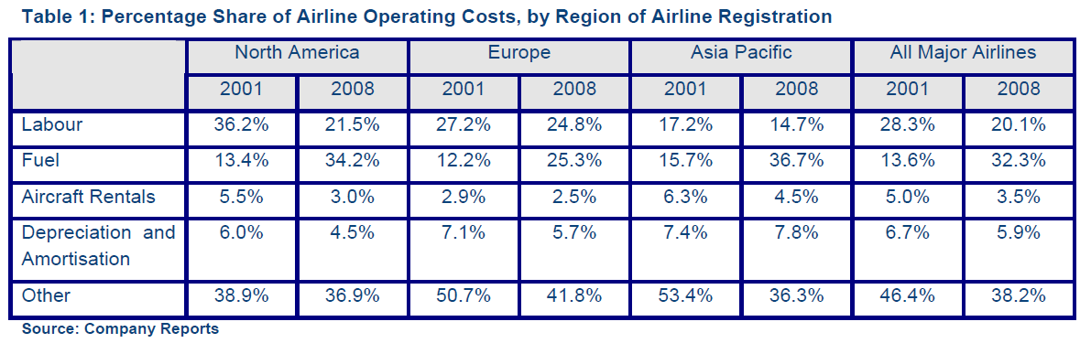
Operating Cost Breakdown

Slide 31
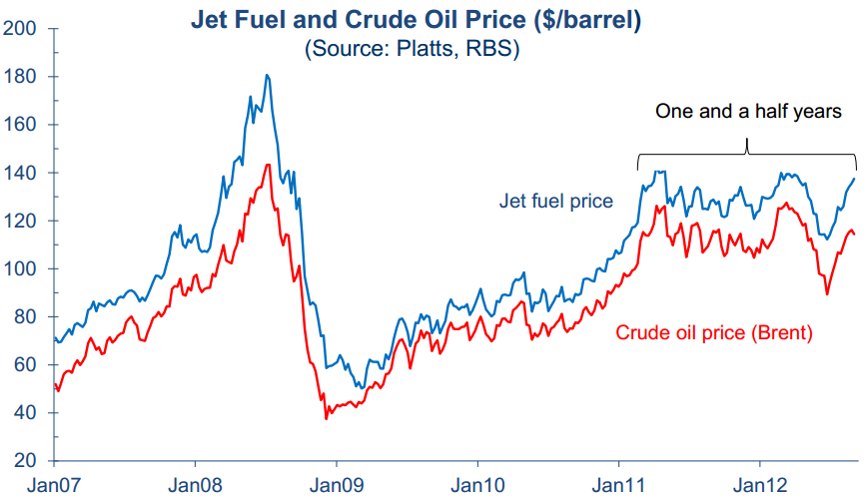
Jet Fuel Costs

Slide 32
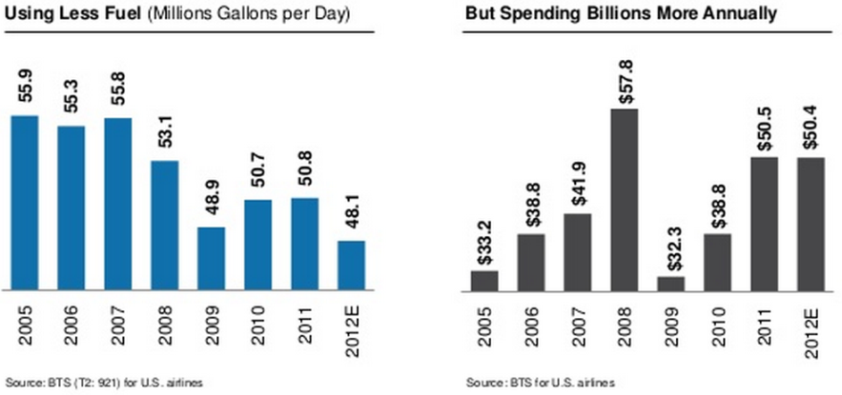
Airline Fuel on the Rise

Slide 33
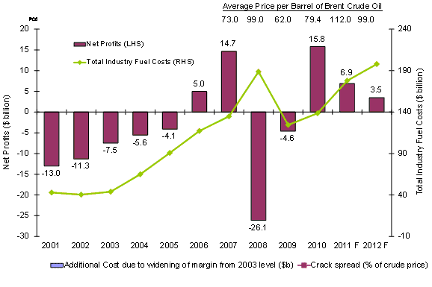
Fuel Cost on Net Profit

Slide 34
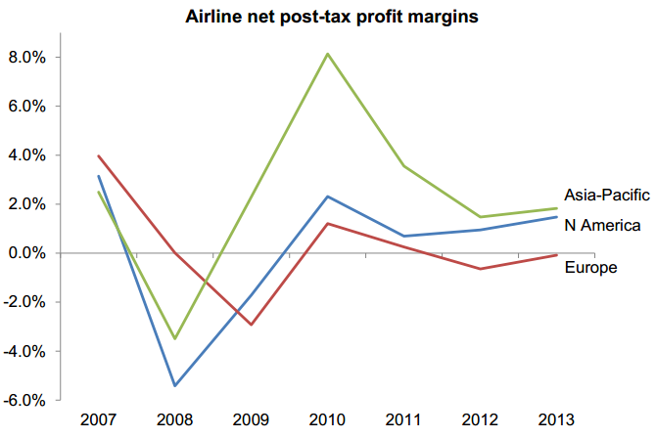
Profit Margin

Slide 35
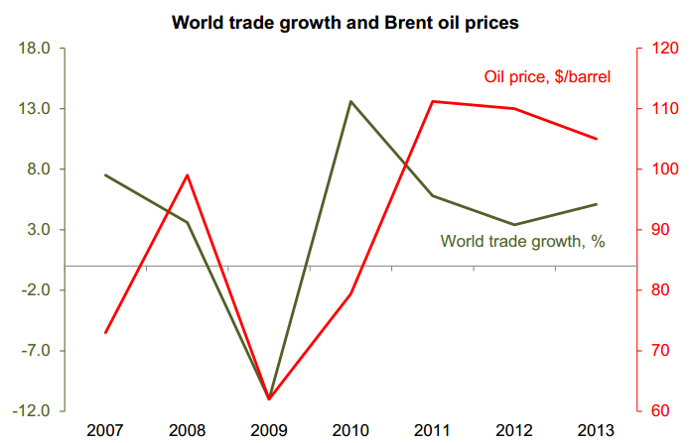
Key Drivers for Profitability

Slide 36
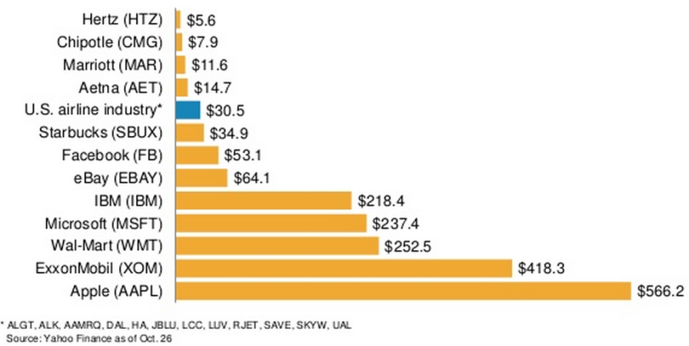
Value of Major US Airlines

Slide 37
Porter’s Five Forces Model
Risk of Entry
Moderate
Supplier power
High
Industry Rivalry
High
Buyer power
High
Substitutes
Moderate

Slide 38
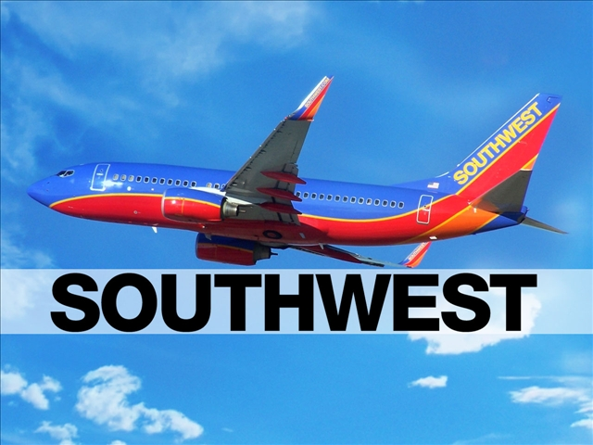

Slide 39
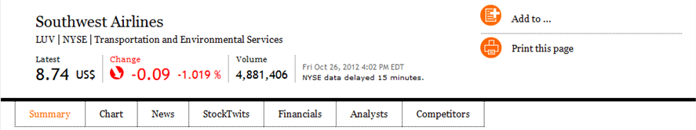
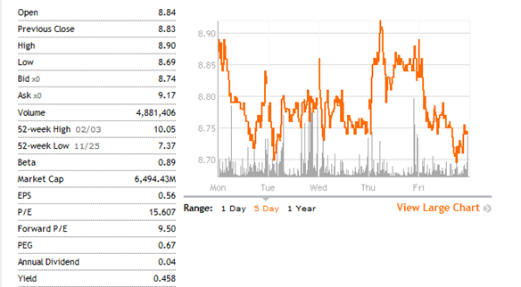
Stock Information
Shares Outstanding 743.07 Million

Slide 40
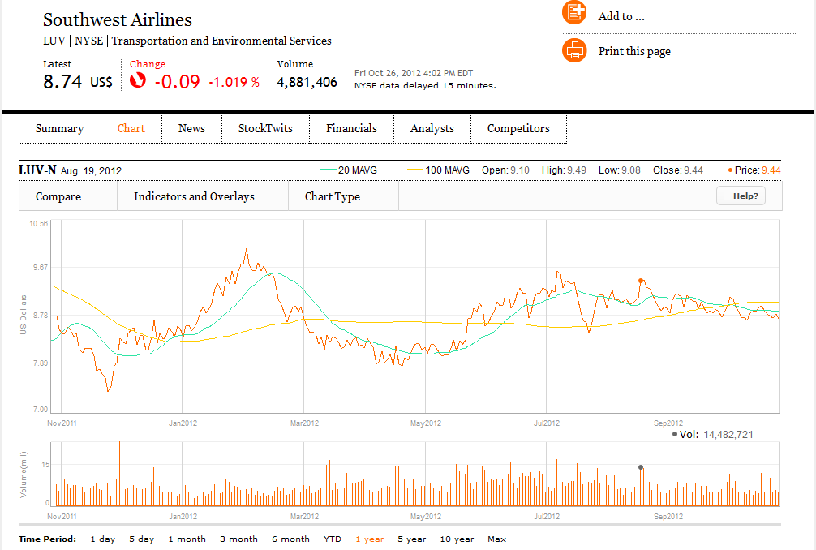
Stock 1 - year

Slide 41
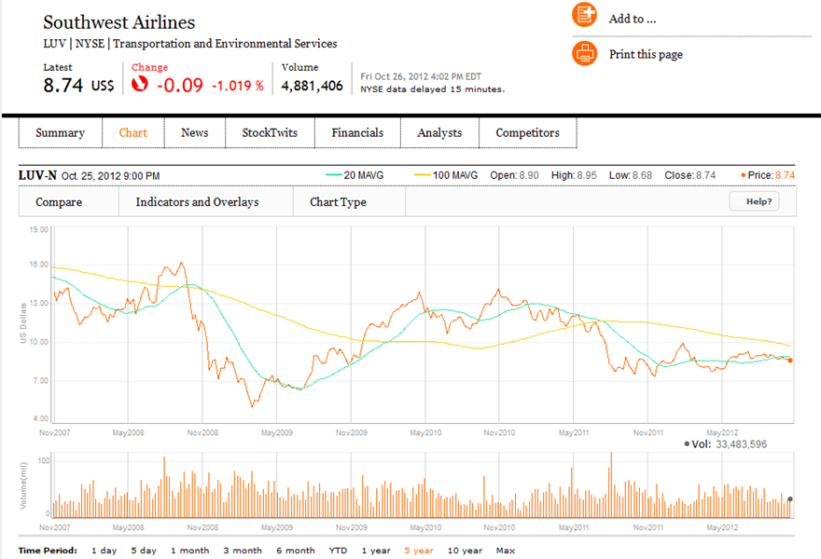
Stock 5 - year

Slide 42
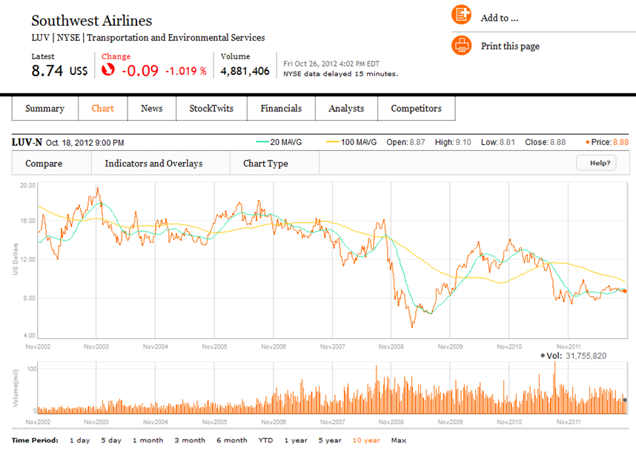
Stock 10 - year

Slide 43
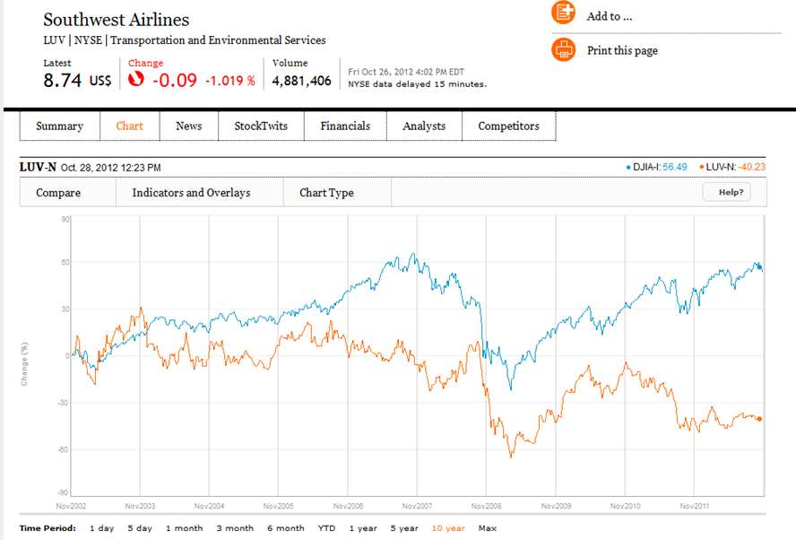
Comparison to Dow Jones Industrial Average

Slide 44
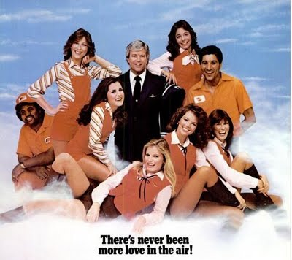
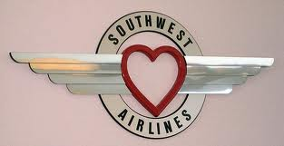
History – 1960 to 1980
1967
1971
1973
1978
1975
Air Southwest Co. was incorporated
Airline established first route, which included Dallas, Houston, and San Antonio
Southwest reaches the first year profit and carries one millionth customer
Common stock listed on American Stock Exchange under the ticker “LUV”
First flight to a destination outside of Texas (New Orleans)

Slide 45
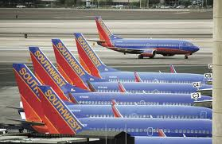
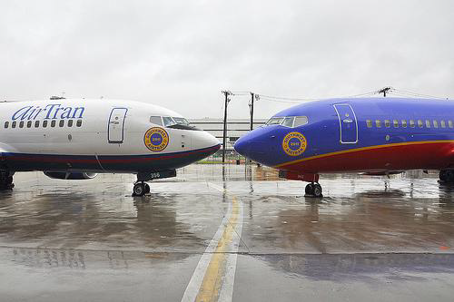
History – 1980 to today
1994
1996
2005
2009
2011
Acquisition of two airline companies: Arizona One and Morris Air
Online booking site launched
Enters first code-share agreement with American Trans Air
Becomes largest carrier in the US, servicing 68 airports in 35 states
Integration of AirTran

Slide 46
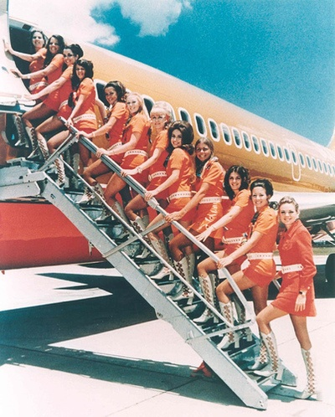
Southwest Airlines Culture: 1970s
Promotional Theme: “Love”
Flight attendants were dressed in hot pants and go-go boots
Southwest served “love potions” and “love bites” (drinks and peanuts)
The main target group were male business man

Slide 47
Company Profile
Southwest is a major domestic airline that provides primarily short-haul, high-frequency, point-to-point, low-fare service
The headquarter is in Dallas, Texas. It was recently expanded.
As of December 2011, Southwest has 37,000 employees
Operates 700 Boeing 737 aircrafts in 77 cities in 39 states
Has among the lowest cost structures in domestic airline industry and consistently offers the lowest and simplest fares
Average passenger airfare for a one-way ticket is $150.31 while serving 127.6 million customers during 2011

Slide 48
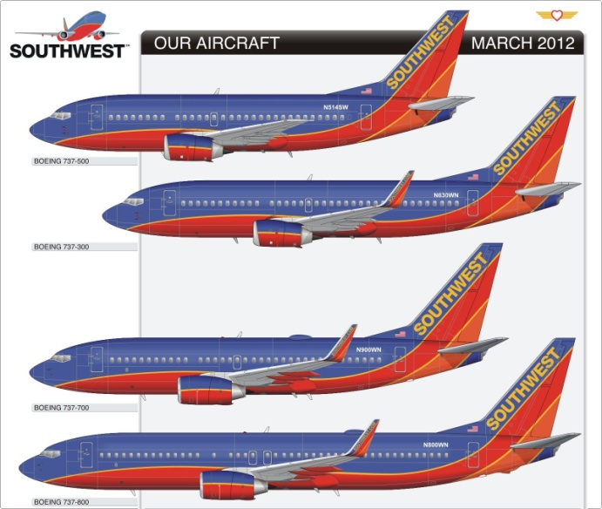
Types of Aircrafts
Southwest inherited the 88 717s when it bought AirTran last year.
Southwest wants to get back to flying all 737s, like it did before the aquisition.
Flying only one type of plane allows it to save on maintenance and streamlines pilot training.
Type ofAircraft | In Service | Nomber owned | Number Leased | Notes
Boeing 737-200 | 88 | 8 | 80 | In process of being retired
Boeing 737-300 | 147 | 88 | 59 | In process of being retired
Boeing 737-500 | 21 | 12 | 9 | In process of being retired
Boeing 737-700 | 424 | 379 | 45 | Seat count being increased to 143 until 2013
Boeing 737-800 | 15 | 10 | 5 | 175 seats
Total | 695 | 497 | 198

Slide 49
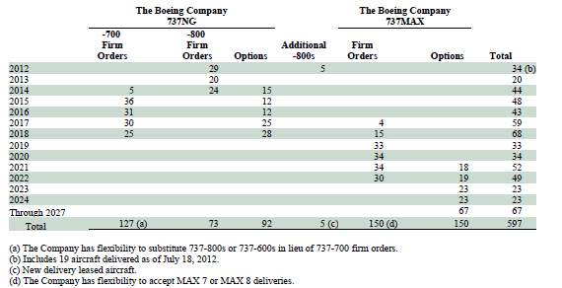
Future Aircraft Purchases

Slide 50
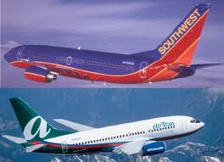

The Acquisition with AirTran
Southwest Airline bought AirTran on May 2,2011 for $1.42 billion
Southwest Airlines operates more than 3,400 flights a day. AirTran Airways operates nearly 700 flights a day.
Southwest and AirTran serve a combined 103 destinations in 41 states, the District of Columbia, the Commonwealth of Puerto Rico, and six near-international countries.

Slide 51
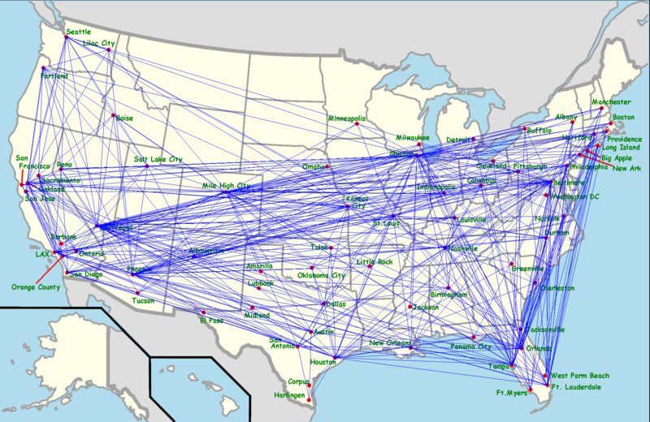
Routes and Destinations

Slide 52
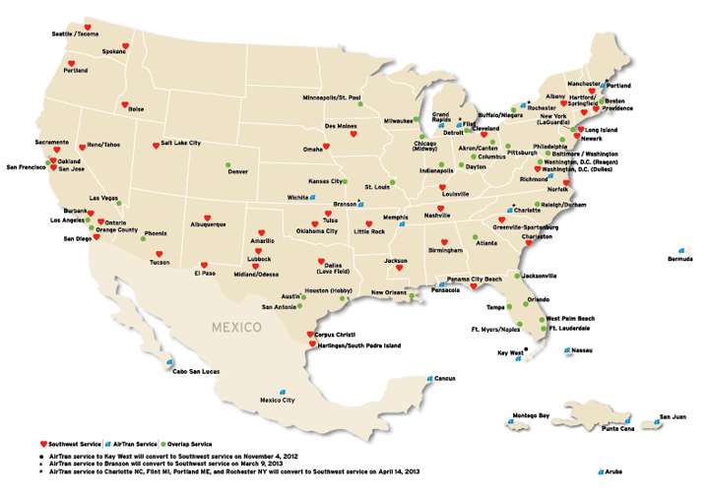
Servicing Map

Slide 53
Airline Partnerships
Current
Volaris
  International codeshare agreement with the Mexican low-cost carrier Volaris
Past
Icelandair
  In 1977 Soutwest and Icelandair entered into interline and marketing agreements
ATA Airlines
  Southwest entered into its first domestic codesharing arrangement
WestJet Airlines
  In 2008 Southwest intent to begin codesharing arrangement with Westjet
Southwest is currently not in any Airline alliance

Slide 54

Management
Chief Executive Officer and Chairman of Southwest Airlines
He joined the company in 1986 as Controller
Kelly became CFO in 1989 and promoted to CEO and Vice Chairman in 2004
He received a Bachelor of Business Administration in accounting from The University of Texas at Austin
Gary C. Kelly

Slide 55

Management
Senior Vice President Finance and Chief Financial Officer since September 2012
She joined the company in 1991
Kelly became Senior Vice President Planning in 2010
Romo received a B.B.A. in accounting from the University of Texas at Austin
Tammy Romo

Slide 56

Management
Chief Operating Officer and Executive Vice President since May 2008
He joined the company in 1993 as Director Internal Audit
He received a Bachelor of Business Administration from the University of Texas at Austin
Michael G. Van de Ven

Slide 57

Management
Chief People and Administrative Officer and Executive Vice President
He joined the company in 2004 as Senior Director People Development
- Prior to joining Southwest Airlines, Jeff worked 12 years at Mesa Petroleum
Lamb completed his undergraduate work at West Texas State University - Canyon, Texas
Jeff Lamb

Slide 58

Strategies
Low-Cost Airline
  Southwest uses Point to Point as main system
    They fly directly to destination, which leads to lower unit costs
  Fewer types of aircraft Boeing 737 jet is the mainly aircraft
  Fly early/late
  Using the secondary airports of major markets
Green Plane was developed in 2009

Slide 59
SWOT Analysis
SWOT
STRENGTHS
- Best low-fare carrier by standardisation of fleet
- Flexible even though unionized - can still negotiate flexible work hours
- Maximizes use of Internet for booking
- Great staff relationships - looks after it's staff
- Top class service
WEAKNESSES
- Being copied by other airlines
- Limited to 60 plus cities
- Operates mainly its own booking service
OPPORTUNITIES
- Expansion to other cities
- International flights
- Further improve customer satisfaction and value
THREATS
- Recession - decrease in air travel
- Oil price
- Terrorist attacks

Slide 60


Operations

Slide 61

Quarterly Operating Statistics
In the third quarter of 2011 Southwest had a negative net income
This year there was a small net income, but in the total nine months period they increased net income, compared to 2011

Slide 62
Operating Statistics
Operating Data: |  |  | 2011 |  |  |  | 2010 |  |  |  | 2009 |  |  |  | 2008 |  |  |  | 2007
Revenue passengers carried |  |  | 103,973,759 |  |  |  | 88,191,322 |  |  |  | 86,310,229 |  |  |  | 88,529,234 |  |  |  | 88,713,472
Enplaned passengers |  |  | 127,551,012 |  |  |  | 106,227,521 |  |  |  | 101,338,228 |  |  |  | 101,920,598 |  |  |  | 101,910,809
Revenue passenger miles (RPMs) (000s) |  |  | 97,582,530 |  |  |  | 78,046,967 |  |  |  | 74,456,710 |  |  |  | 73,491,687 |  |  |  | 72,318,812
Available seat miles (ASMs) (000s) |  |  | 120,578,736 |  |  |  | 98,437,092 |  |  |  | 98,001,550 |  |  |  | 103,271,343 |  |  |  | 99,635,967
Load factor |  |  | 80.9 | % |  |  | 79.3 | % |  |  | 76.0 | % |  |  | 71.2 | % |  |  | 72.6 | %
Average length of passenger haul (miles) |  |  | 939 |  |  |  | 885 |  |  |  | 863 |  |  |  | 830 |  |  |  | 815
Average aircraft stage length (miles) |  |  | 679 |  |  |  | 648 |  |  |  | 639 |  |  |  | 636 |  |  |  | 629
Trips flown |  |  | 1,317,977 |  |  |  | 1,114,451 |  |  |  | 1,125,111 |  |  |  | 1,191,151 |  |  |  | 1,160,699
Average passenger fare |  | $ | 141.72 |  |  | $ | 130.27 |  |  | $ | 114.61 |  |  | $ | 119.16 |  |  | $ | 106.60
Passenger revenue yield per RPM (cents) |  |  | 15.10 |  |  |  | 14.72 |  |  |  | 13.29 |  |  |  | 14.35 |  |  |  | 13.08

Slide 63
Operating Statistics
Operating Data: |  |  | 2011 |  |  |  | 2010 |  |  |  | 2009 |  |  |  | 2008 |  |  |  | 2007
Operating revenue per ASM (cents) |  |  | 12.99 |  |  |  | 12.30 |  |  |  | 10.56 |  |  |  | 10.67 |  |  |  | 9.90
Operating expenses per ASM (cents) |  |  | 12.41 |  |  |  | 11.29 |  |  |  | 10.29 |  |  |  | 10.24 |  |  |  | 9.10
Fuel costs per gallon, including fuel tax |  | $ | 3.19 |  |  | $ | 2.51 |  |  | $ | 2.12 |  |  | $ | 2.44 |  |  | $ | 1.80
Fuel consumed, in gallons (millions) |  |  | 1,764 |  |  |  | 1,437 |  |  |  | 1,428 |  |  |  | 1,511 |  |  |  | 1,489
Active fulltime equivalent Employees |  |  | 45,392 |  |  |  | 34,901 |  |  |  | 34,726 |  |  |  | 35,499 |  |  |  | 34,378
Aircraft in service at period-end |  |  | 698 |  |  |  | 548 |  |  |  | 537 |  |  |  | 537 |  |  |  | 520

Slide 64

Passenger Load Factor
Passenger Load Factor (Domestic and International)

Slide 65
Operating Expenses
 |  | Year ended December 31, |  |  |  |  |  |  |  | Dollar change |  |  |  | Dollar change attributable to AirTran results |  |  |  | Dollar change excluding AirTran results |  |  |  | Percent change excluding AirTran results
(in millions, except for percentages)
 |  | 2011 |  |  |  | 2010
OPERATING EXPENSES:
Salaries, wages, and benefits |  | $ | 4,371 |  |  | $ | 3,704 |  |  | $ | 667 |  |  | $ | 381 |  |  | $ | 286 |  |  |  | 7.7 | %
Fuel and oil |  |  | 5,644 |  |  |  | 3,620 |  |  |  | 2,024 |  |  |  | 811 |  |  |  | 1,213 |  |  |  | 33.5
Maintenance materials and repairs |  |  | 955 |  |  |  | 751 |  |  |  | 204 |  |  |  | 175 |  |  |  | 29 |  |  |  | 3.9
Aircraft rentals |  |  | 308 |  |  |  | 180 |  |  |  | 128 |  |  |  | 159 |  |  |  | (31) |  |  |  | (17.2)
Landing fees and other rentals |  |  | 959 |  |  |  | 807 |  |  |  | 152 |  |  |  | 117 |  |  |  | 35 |  |  |  | 4.3
Depreciation and amortization |  |  | 715 |  |  |  | 628 |  |  |  | 87 |  |  |  | 41 |  |  |  | 46 |  |  |  | 7.3
Acquisition and integration |  |  | 134 |  |  |  | 8 |  |  |  | 126 |  |  |  | 28 |  |  |  | 98 |  |  |  | n.a.
Other operating expenses |  |  | 1,879 |  |  |  | 1,418 |  |  |  | 461 |  |  |  | 250 |  |  |  | 211 |  |  |  | 14.9
Total operating expenses |  | $ | 14,965 |  |  | $ | 11,116 |  |  | $ | 3,849 |  |  | $ | 1,962 |  |  | $ | 1,887 |  |  |  | 17.0 | %

Slide 66
Hedging Strategy
Southwest loaded up years ago on hedges against higher fuel prices („Outside the box thinking“)
They use call options, collar structures and fixed price swap agreements
Between 1999 and 2008 Southwest saved $3.5 billion through fuel hedging
From 2010 to 2011 fuel cost per gallon went up 27,5 %

Slide 67


Fuel Derivative Contract

Slide 68

The Negative Side of the Hedge
When Airlines like Southwest heavily lock in high prices, they lose money when prices drop
Southwest lost $140 million in the third quarter 2011
 |  | Year ended December 31,
 |  | 2010 |  |  |  | 2009
Fuel and oil expense, unhedged |  | $ | 3,296 |  |  | $ | 2,577
Add: Fuel hedge losses included in Fuel and oil expense |  |  | 324 |  |  |  | 467
Fuel and oil expense, as reported |  | $ | 3,620 |  |  | $ | 3,044
Add (Deduct): Net impact from fuel contracts |  |  | (172 | ) |  |  | (222 | )
Fuel and oil expense, non-GAAP |  | $ | 3,448 |  |  | $ | 2,822

Slide 69


Financial Statement Analysis

Slide 70

Balance Sheet (quarterly)

Slide 71

Balance Sheet

Slide 72

Income Statement (quarterly)

Slide 73

Income Statement

Slide 74
Revenues: Annually
USD in Millions

Slide 75

Cash Flow Statement (quarterly)

Slide 76

Cash Flow Statement

Slide 77
Evaluation
Pro | Con
Aquisition of AirTran was succesfully | Financial crisis
Extension of Soutwest‘s network | Increasing fuel costs
High and increasing revenues | High Competition
Largest low cost carrier | Low Margins

Slide 78

Recommendation
HOLD

Slide 79




Slide 80

Stock information

Slide 81



Stock Information (ADR)

Slide 82

1 Year Stock Price Movement

Slide 83

5 Year Stock Price Movement

Slide 84

10 Year Stock Price Movement

Slide 85

Comparison to Hangseng Index

Slide 86


Background

Slide 87
SWOT Analysis
Strengths
- Wide-spread operational network and strong fleet operations
- Robust market position
- Geographical diversified operations
Weaknesses
-Antitrust investigations and proceedings hamper the reputation
-Obligations under finance leases
Opportunities
-Growing global tourism industry
-Positive outlook of Asia-Pacific airlines industry
Threats
-Risk relating to natural calamities
-Volatility in jet fuel prices
-Intense competition and price discounting

Slide 88
Company Profile
Hong Kong based international airline
Offer scheduled cargo and passenger services to 168 destinations in 42 countries and territories
Make substantial investment to develop Hong Kong’s aviation industry and enhance Hong Kong’s position as a regional transport hub.
A founding member of the oneworld global alliance whose combined network serves over 700 destinations worldwide.
Hub-and-spoke business strategy

Slide 89

Vision & Mission

Slide 90


Company History
1946 - Found by American Farrell and Australian Kantzow
- Was based in Shanghai
1960s - Grew at an average rate of 20% a year
- Initiated international services
1980s - The worldwide economic growth
- Expanded the international network Europe and North America
1970s - Start using computerized reservation system and flight simulators;
- The first Boeing 747-200 arrived in Hong Kong
1948 - Began to operate passenger flights
- Butterfield & Swire took a 45% share
Notes:
-Early 1970: they start using the latest technology with computerized reservation system and flight simulators.
-Late 1970: they bought their first Boeing 747-200
-1980s. Its what they called the glory year. Thanks to the worldwide economic boom, they experienced a huge increase in passenger volume more bus travellers, tourists and cargo.
-They also expanded their international network to include London, Brisbane, Frankfurt, Vancouver, Amsterdam, Rome, San Francisco, Paris, Zurich and Manchester.

Slide 91

Company History
1990s - Assembled the youngest fleet of aircraft in the world
2003 -Resumed passenger services to Beijing, Xiamen and Shanghai
-Hong Kong became a predominant gateway to Mainland China
2006 -Bought Dragonair as a wholly owned subsidiary
-Established a closer relationship with Air China by taking 17.5% stake
2005 -Winning the “Airline of the Year”
2002 Became joint venture partners in Air Hong Kong with DHL.
Notes:
The early 90s, it was a difficult time for airline industry, but Cathay Pacific still remained positive
They also launched a new program to offer unprecedented level of passenger service
Changed their image: changing our green and white striped livery to the dynamic and now famous Asian "brushstroke" image

Slide 92



Recent Development
The new Premium Economy Class
New long-haul Economy Class seats
New Business Class seats

Slide 93

Route and Destination
Destination served: 168 in 42 countries and territories

Slide 94

Interim Result

Slide 95

Fact Sheet

Slide 96
Fact Sheet
Total Number of Staff
29,940 people worldwide (including subsidiaries)
World Rankings
2nd most profitable airline
7th largest airline by operating profit
10th-largest in terms of revenue passenger kilometres
4th-largest in freight tonne kilometres

Slide 97


Fact Sheet

Slide 98
Cathay Pacific & Air China
Air China
  Cathay Pacific has 19.53% interest
  From 1 Oct 2011 to 31 March 2012, Air China loss RMB 0.6bn, compared to profit RMB 3.8bn for the same period last year.
  Loss in profits is due to a high oil price, pressure on yield and a weak cargo market.
Air China Cargo and Cathay Pacific Cargo joint venture
  CX acquired 49% economic interest in Air China Cargo (ACC)
  CX Group selling assets to ACC ( Four 747-400BCFs and two spare engines )
  Performance of Air China Cargo has been weak but remains strategically important
Notes:
the cargo joint venture was formally approved and established on 28 Feb 2011 and officially launched in May 2011.

Slide 99
Cathay Pacific &Shanghai Airport
Strategic Objective – to leverage on the resources & management expertise of each of the shareholders to enhance the hub operations and efficiency of ground handling services at the two Shanghai airports
Shanghai International Airport Services Co., Limited is jointly owned and managed by Shanghai Airport Authority, Shanghai International Airport Co., Ltd., Air China Limited and Cathay Pacific Airways
CX Group injected RMB90 million for 25% shareholding
Expected to commence operations in the fourth quarter of 2012 subject to approval by the relevant Chinese government authorities

Slide 100

Fleet Profile
Notes:
They have 181 aircraft in total
67 owned 37%
114 leased 63%
Ordered 92 aircraft that will be deliver in the future
Expiry of operating leases
They are assuming there wil be 28 aircraft that they have leased will be expired.
At the same time we are enhancing our own freighter fleet with six new Boeing 747-400 "Extended Range Freighters" in the process of being delivered and 10 new-generation Boeing 747-8F freighters arriving between 2009 and 2012. These newer, more fuel-efficient aircraft will enable us to offer an even higher level of service to its cargo customers.

Slide 101
Senior Management Team
Chairman | Christopher Pratt
Chief Executive | John Slosar
Chief Operating Officer | Ivan Chu
Director Corporate Development | James Barrington
Finance Director | Martin Murray
Director Flight Operations | Richard Hall
Director Sales & Marketing | Rupert Hogg
Director Personnel | William Chau
Director Information Management | Joe Locandro
Director Cargo | Nick Rhodes
Director Corporate Affairs | Chitty Cheung
Engineering Director | Christopher Gibbs
Notes:
Christopher Pratt
CBE, Chairman
Honors degree in modern history from the University of Oxford
Joined John Swire & Sons Limited ("Swire") group in 1978 and has worked with the group in Hong Kong, Australia and Papua New Guinea
Chairman of Swire Pacific Limited and John Swire & Sons (H.K.) Limited, and a director of Swire Properties Limited
Served as Executive Director of Swire Pacific’s Trading and Industrial Division from 2000 to 2005
John Slosar
Chief Executive since March 2011
Holds degrees in Economics from Columbia University and Cambridge University
Joined the Swire group in 1980 and has worked with the group in Hong Kong, the United States and Thailand.
Appointed Managing Director of Hong Kong Aircraft Engineering Company Limited in 1996, Managing Director of Swire Pacific's Beverages Division in July 1998 and Chief Operating Officer of Cathay Pacific in July 2007
Director of Cathay Pacific, John Swire & Sons (H.K.) Limited, Swire Pacific Limited, and Chairman of Hong Kong Dragon Airlines Limited and Swire Beverages Limited
Ivan Chu
Chief Operating Officer since March 2011
Joined Cathay Pacific in 1984 and has worked with the Company in Hong Kong, Mainland China, Taiwan, Thailand and Australia
Was General Manager Southwest Pacific based in Sydney, Australia
Director of Cathay Pacific and Hong Kong Dragon Airlines Limited, and Chairman of AHK Air Hong Kong Limited and Cathay Pacific Catering Services (H.K.) Limited
Martin Murray
Finance Director of the Company since November 2011.
Director of Hong Kong Dragon Airlines Limited. He was previously Deputy Finance Director of Swire Pacific Limited
Joined the Swire group in 1995 and has worked with the group in Hong Kong, the United States, Singapore and Australia

Slide 102
Senior Management Team
Chris Pratt
- CBE, Chairman
- Honors degree in modern history from University of Oxford
- Joined Swire in 1978
- Chairman of Swire Pacific Limited and John Swire & Sons (H.K.) Limited
- Director of Swire Properties Limited
- Was an Executive Director of Swire Pacific’s Trading and Industrial Division (2000-2005)
John Slosar
- Chief Executive since March 2001
- Joined Swire in 1980
-Director of Cathay Pacific, John Swire & Sons (H.K.) Limited, and Swire Pacific Limited
- Chairman of HK Dragon Airline Limited and Swire Beverage Limited
- Worked with group in HK, US and Thailand

Slide 103
Senior Management Team
Ivan Chu
- COO since March 2011
- Joined Cathay Pacific since March 2011
- Director of Cathay Pacific, HK Dragon Airlines Limited
- Chairman of Air HK Limited and Cathay Pacific Catering Services Limited
- Worked with company in HK, China, Taiwan, Thailand and Australia
- Was General Manager in Southwest Pacific
Martin Murray
- Finance Director since November 2011
- Joined Swire group in 1995
- Director of HK Dragon Airline Limited
- Worked with group in HK, US, Singapore and Australia

Slide 104
Operations

Slide 105

Operating Profits and loss

Slide 106

Reconciliation of Operating Profit

Slide 107

Passenger service- Key number

Slide 108

Passenger Services-by Region
Notes:
Passenger volume growth exceeds capacity growth
Premium traffic is under increasing pressure with yield softening
Demand in economy class met expectations but yield continues to decline

Slide 109


Passenger Yield & Load Factor

Slide 110

Cargo Services- Key number

Slide 111


Cargo Services- Yield & Load Factor

Slide 112

Turnover
Group passenger turnover increased 9.2% against a 6.9% increase in capacity. The increased turnover principally reflected an increase in capacity.
Group cargo turnover decreased by 7.6%. Combined Cathay Pacific and Dragonair cargo turnover decreased by 0.2% against a 4.3% decrease in capacity.
Group turnover from catering, recoveries and other services increased by 4.8%
Notes:
Group passenger turnover increased 9.2%
against a 6.9% increase in capacity. The
increased turnover principally reflected an
increase in capacity.
• Group cargo turnover decreased by 7.6%.
Combined Cathay Pacific and Dragonair cargo
turnover decreased by 0.2% against a 4.3%
decrease in capacity.
• Group turnover from catering, recoveries and
other services increased by 4.8%

Slide 113

Operating Expenses
Notes:
Group’s total operating expenses increased by .6% to HK$49,463 million.
• The combined cost per ATK (with fuel) of Cathay Pacific and Dragonair rose from HK$3.35 to HK$3.72.

Slide 114


Fuel Expenditure and Hedging

Slide 115

Financial Statement-Balance Sheet

Slide 116

Income Statement

Slide 117

Cash flow statement

Slide 118

Recommendation
HOLD

Slide 119




Slide 120


Stock Information

Slide 121

Singapore Airline ADR

Slide 122

Stock 1-year

Slide 123

Stock 5-year

Slide 124

Stock 10-year

Slide 125
Company Profile
Based at Singapore Changi Airport, Singapore Airlines is the national carrier of Singapore
Using a fleet of wide-body Boeing and Airbus aircraft, including the A380 of which Singapore Airlines was the launch customer
First to offer free headsets, a choice of meals and free drinks in Economy Class, in the 1970s
First to introduce satellite-based inflight telephones in 1991

Slide 126
Company Profile
First to involve a comprehensive panel of world-renowned chefs, the International Culinary Panel, in developing inflight meals in 1998
First to offer audio and video on demand (AVOD) capabilities on KrisWorld in all classes in October 2001
First to operate the world’s longest non-stop commercial flight between Singapore and Los Angeles in February 2004 on the A340-500, and then surpassing the record (in terms of distance) later that year with the non-stop service to New York (Newark), in June 2004
First to fly the A380 from Singapore to Sydney on 25 October 2007

Slide 127

Shareholdings Information

Slide 128

Group Fleet Profile

Slide 129

ROUTE GRAPH

Slide 130

Management Team
Stephen Lee Ching Yen
  BOD Chairman
  Became chairman of BOD in 2006
  Managing Director of Shanghai Commercial & Savings Bank (Taiwan) and Great Malaysia Textile Investments Pte Ltd
  President of the Singapore National Employers’ Federation since 1988 and is a Council Member of the Singapore National Wages Council
  Nominated Member of Parliament from 1994-1997
  Graduated from Northwestern University, Illinois, USA in 1973, MBA

Slide 131

Management Team
Goh Choon Phong
  Director and CEO
  Appointed Director in 2010 and CEO On 1 January 2011
  Join SIA since 1990 and held senior management positions in various divisions in Singapore and overseas
  President of the Singapore Airlines Cargo Pte Lid from 2006 to 2010 and was EVP for Marketing and the Regions
  Received undergraduate degree and a graduate degree from the Massachusetts Institute of Technology.

Slide 132
SWOT Analysis
Strengths
service quality, unmatched environment, clean and sanitized food and unparalleled security
legitimate quality, paramount technology and brand strategy
It stood first to soar Airbus Super jumbo A-380 IN 2006 and is also known for its sub-branded aircrafts like 777 jubilee and 747 mega top
Weakness
It is too expensive to travel for middle class people
Huge decline in the financial performance in year 2010 as compared to year 2010
The relation between labor union and management has been not good at times due to cut in wages and downsizing in bad economic conditions.

Slide 133
SWOT Analysis
Opportunities
Innovation” is an important trait of Singapore Airlines
It has vigilantly developed a financial plus rigid cost in order to support their brand name to overcome the competition on costs. .
It can increase revenue by increasing the total number of destinations and fleet size.
Threats
Increasing price of oil may result in high cost per passenger
Rapid growth of low cost airways in the recent past

Slide 134

Operating Performance Analysis

Slide 135

Company Result

Slide 136

Cost Structure

Slide 137

Cost Structure

Slide 138

Cost Structure

Slide 139

Cost Structure

Slide 140

Financial Statement Analysis

Slide 141

Balance Sheet

Slide 142

Balance Sheet Continued..

Slide 143

Dividend Information

Slide 144


Income Statement

Slide 145

Comprehensive Income Statement

Slide 146

Cash Flow Statement

Slide 147


Cash Flow Statement

Slide 148

HOLD!
Recommendation

