Slide 1
Global Gadgets
(AAPL, GOOG, MSFT)
Harvir Grewal
Shan Gao
Paul Hans
Amarpreet Sandhu
Gurbir Sidhu

Slide 2
Agenda: Global Gadgets
Industry Overview
Apple
Google
Microsoft
Conclusion

Slide 3
What are Gadgets?
Gadgets are small technological objects such as devices and tools that have particular functions
Increase of productivity and convenience in daily life
“Smart”→ multi-purpose, multi-tasking
For work, entertainment, or sense of style
Benefits that gadgets provide are through hardware, software, and services

Slide 4


Global Gadgets
Profit relies on gadget sales and service, with the support of software, including OS and apps
Hardware
Software
Service

Slide 5

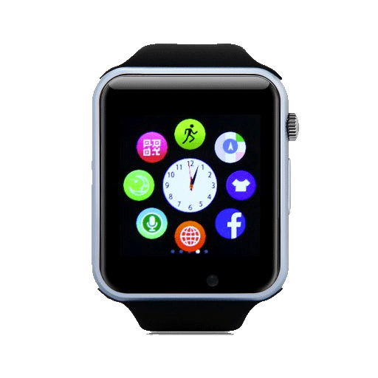
Gadgets: Hardware
Normal Consumer Electronics
Devices that have proven to be useful and have substantially embedded into daily life
PCs
Smart phones
Tablets
GPS’s
E-book readers
Novelty
Tools with features that change or will change the way users conduct daily activities
Smart watch
Smart wristbands
Google glasses
VR
Portable camcorders
Others

Slide 6

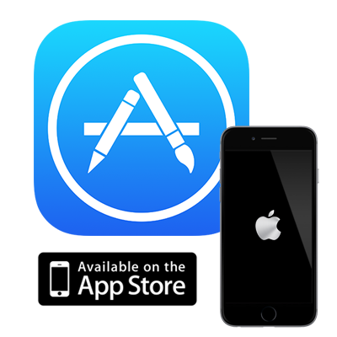

Gadgets: Software & Service
Software & Apps
Operation System
App Stores
Apple’s App Store, Google Play
Third-party contents
Apps
Online payment
PayPal, AliPay
E-commerce
Service
Advertising
Telecommunication service
Open source/Closed Environment
Internet
Wireless connection/Mobile networking

Slide 7
Gadget Industry Overview: Structure
The industry employs a host of engineers, designers, marketers, salespeople, customer service reps, and finance personnel to continually improve familiar products as well as come up with the next big must-have gadget.
Much of the actual manufacturing of the products is done in low labor-cost locations
Involves multi-players in industry’s value chain, such as supplies for parts and materials, tech integration and developing, manufacturing, marketing, etc.
Blurring of traditional categorization: telecommunications, computer hardware, and consumer electronics

Slide 8


Gadget Industry Overview: Trend
Convergence
Players in the consumer electronics, computer hardware, and telecom sectors are increasingly finding themselves competing head-to-head
Turmoil, in the form of mergers and acquisitions and fluctuations in profitability, is likely to result in each of these industries as time passes
Falling price
Technology improves all the time
Products go by fast
Only cutting-edge products cost more for developers and consumers

Slide 9
Today’s Gadget Industry
Part of the consumer electronics industry.
Has seen exciting new developments in recent years and at a rapid pace.
It is continually growing and evolving
Anticipating $606 billion of revenue globally

Slide 10

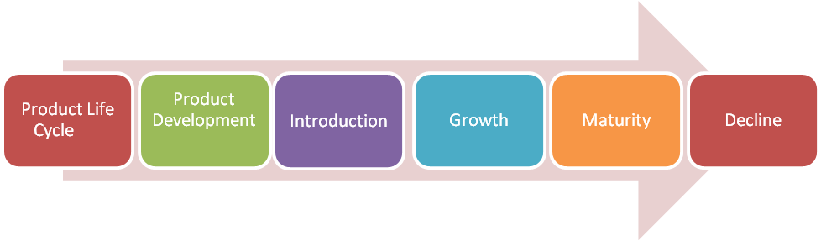
Challenges
Fat operating margins
High capital expenditure
Shortening product lifecycle
Managing a global supply chain
Volatile industry that is rapidly changing

Slide 11
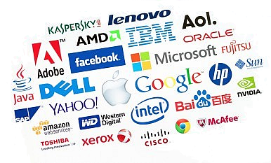
Competition
Market dominated by small number of very large companies
Profits are extremely high
Rapid change in market shares

Slide 12
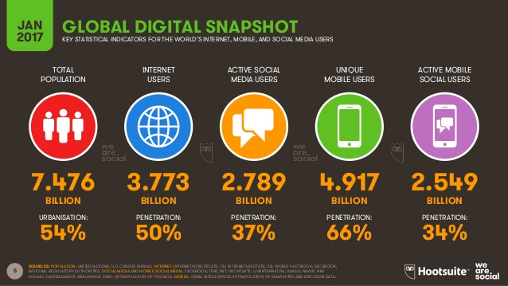

Slide 13
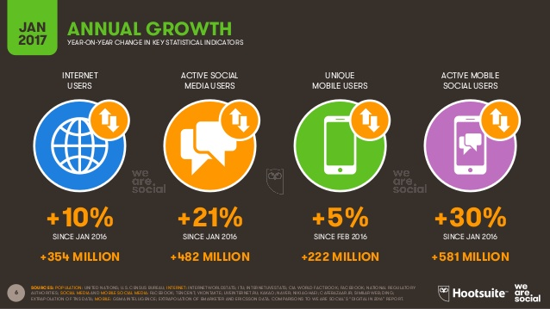

Slide 14
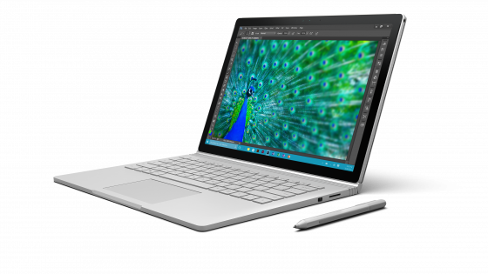


Main Aspects of the Industry
Internet
Computers
Smartphones
Tablets
Smart watches
Operating Systems
Cloud Computing
App Stores
Virtual Reality
Smart Cars

Slide 15

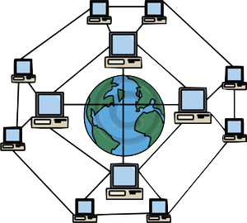
The Internet
Massive network of networks, which connects billions of people online through which communication and other various activities may occur

Slide 16
Internet History
1969 The original Internet (Vietnam War, Dept. of Defence)
1971 First e-mail sent
1990 Archie, the first search engine
1991 Internet available for commercial use
1996 More e-mail than post mail in the US
1996 "BackRub" search engine (Stanford)
1997 Google (Googol)

Slide 17
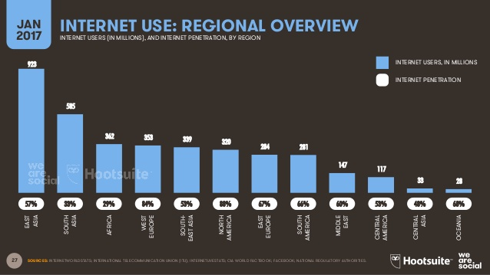

Slide 18
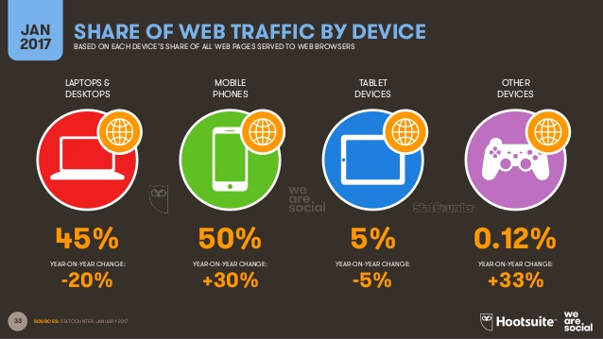
Notes:
IMPORTANT SLIDE

Slide 19
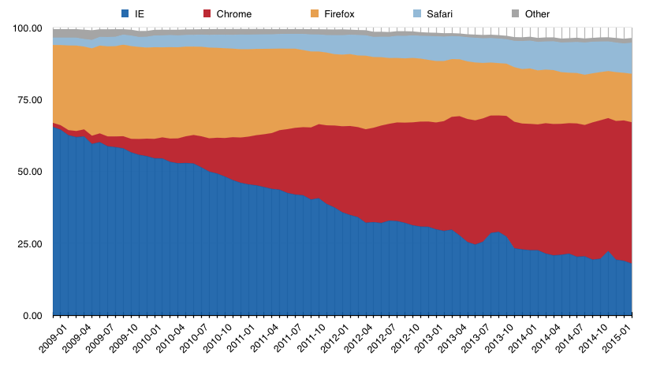
Share of Users on Internet Platforms
Safari
Firefox
Chrome
Internet Explorer

Slide 20
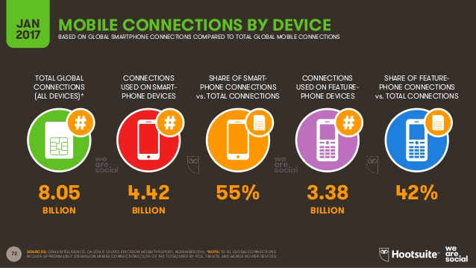
Mobile Connections by Device

Slide 21
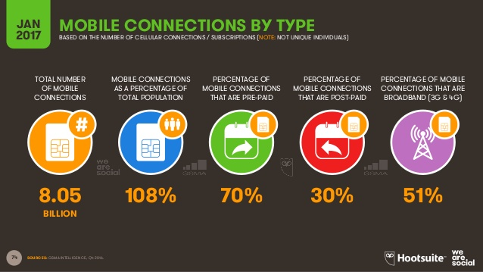

Slide 22
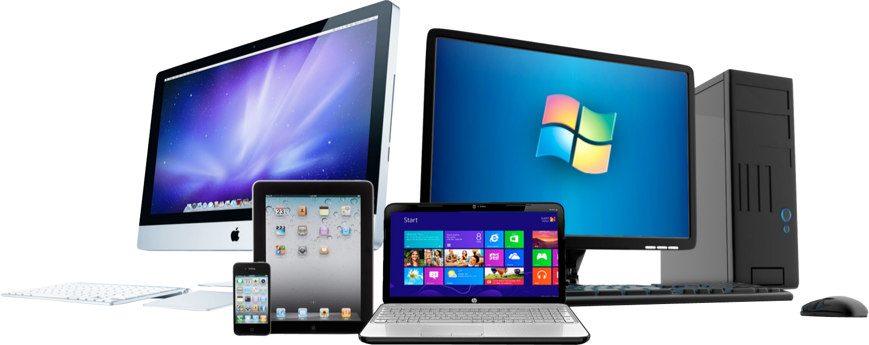
Computers
A device which can do a multitude of tasks ranging from processing and storing data to, doing set tasks based on the software it is operating on.

Slide 23
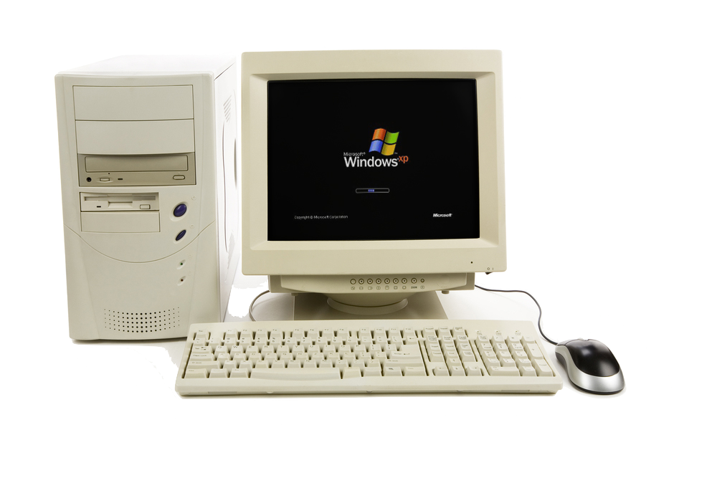
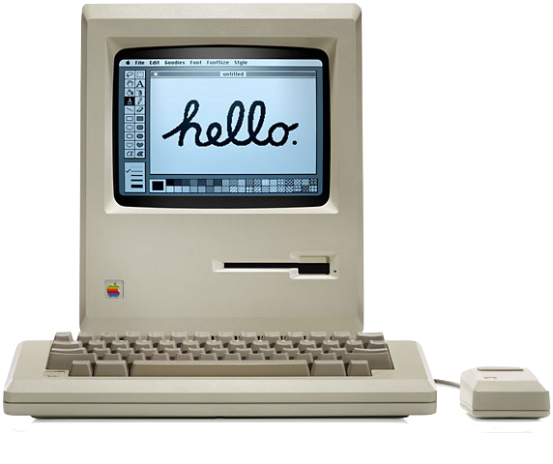
Computer History
1936 First freely programmable computer
1951 First commercial computer released
1974 First consumer computers (IBM)
1976 Apple I and II
1984 Apple Macintosh
1985 Microsoft Windows

Slide 24
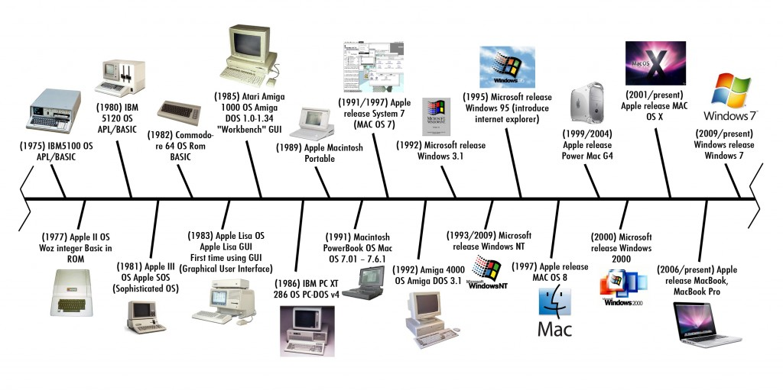
Computer Timeline

Slide 25
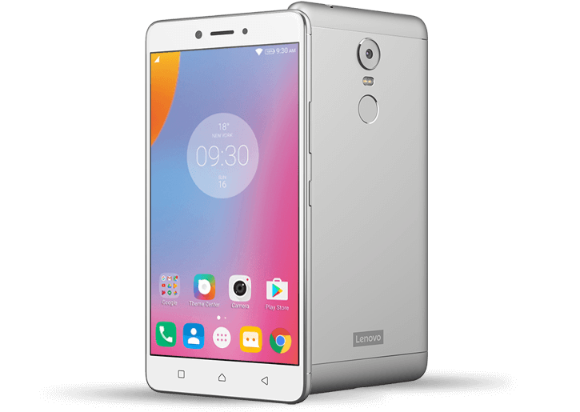
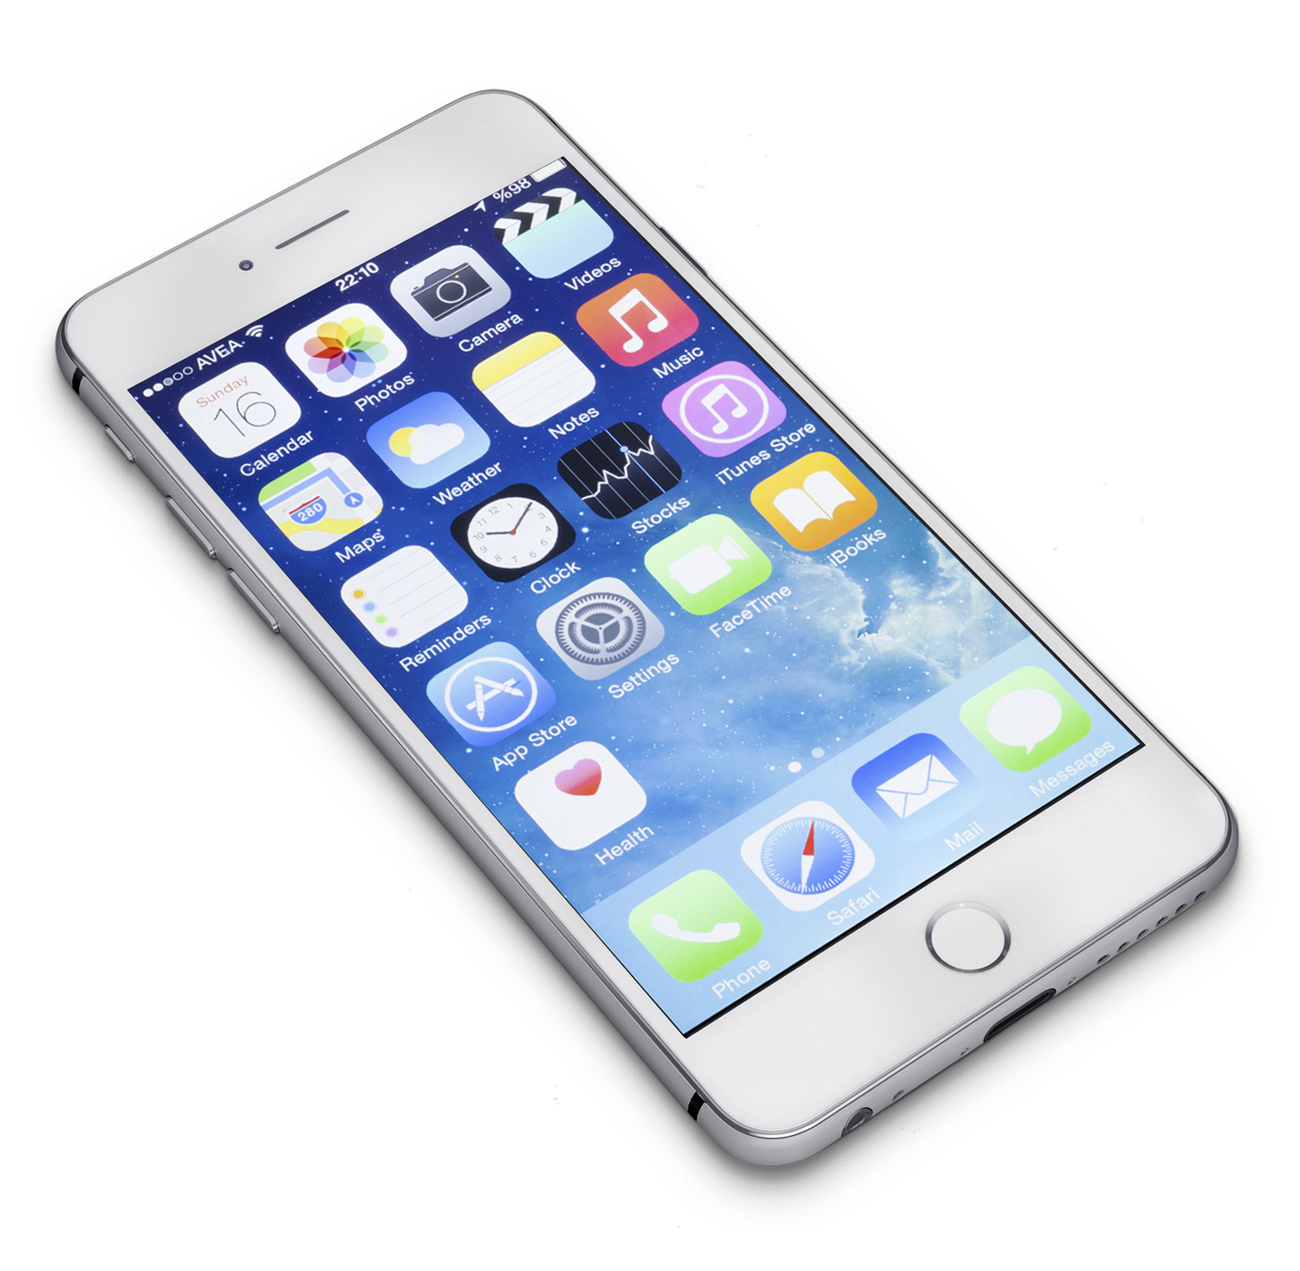
Smartphones
What is a Smartphone?
All in one device that can be used as a cell phone and has computing, PDA functions
Variety of applications available
High Speed Data Access
Multimedia

Slide 26
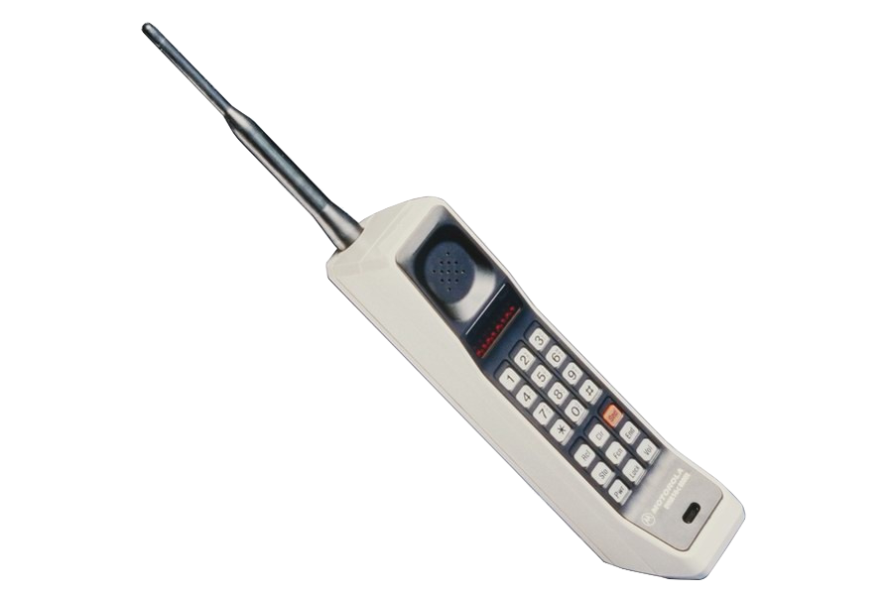
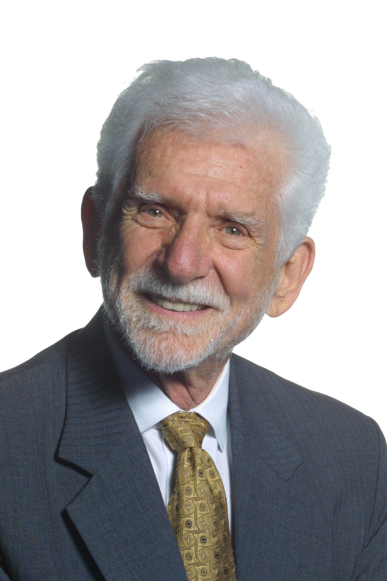
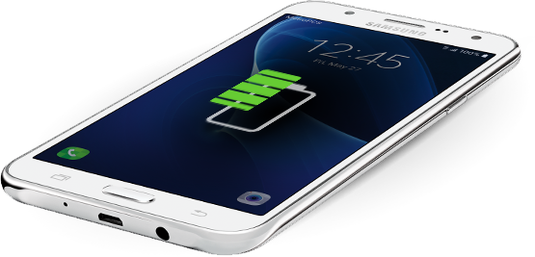
Mobile Phone History
1973 Motorola cell phone created
1973 First cell phone call made by Martin Cooper (April 3)
1983 First cell phone available to consumers
1994 First smartphone
1999 First mobile watch phone
2001 First Commercial 3G Network
2007 First iPhone released
2008 First Android phone released
2010 First LTE Network
2013 First Smart Watch

Slide 27

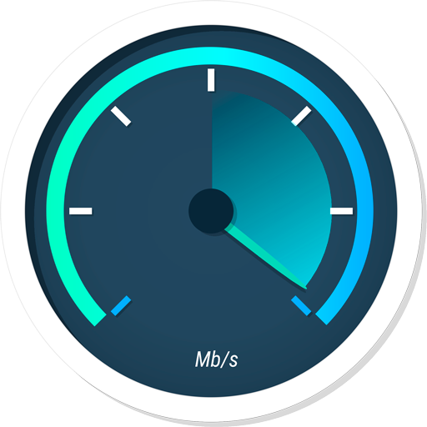
4G/LTE Networks
Speeds of 1 GB/s when stationary
100 MB/s when mobile
However this standard is so high that no commercialized standard actually meets them hence why we have LTE networks
  LTE is part of this generation

Slide 28


Broadband vs Regular Phone Connection
Broadband
Wireless internet access
Nearly all 2G and 3G phones are broadband
Regular internet connection
Wired internet access
More common in underdeveloped countries

Slide 29
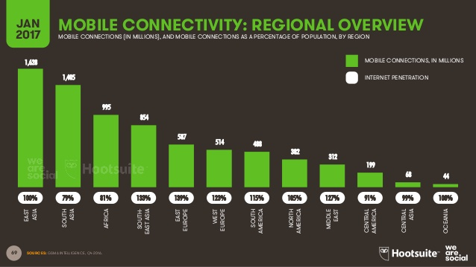
Mobile Regional Overview

Slide 30
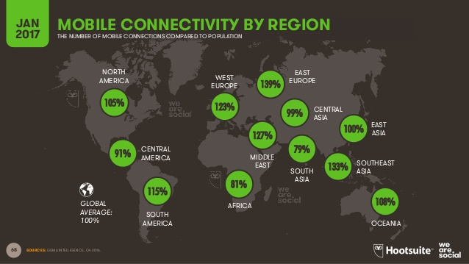

Slide 31
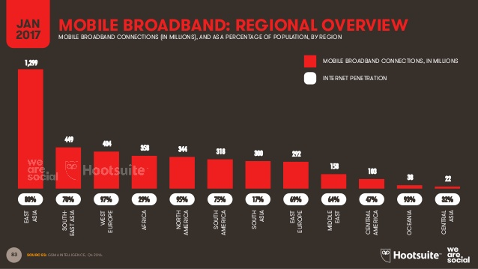
Mobile Broadband by Region

Slide 32
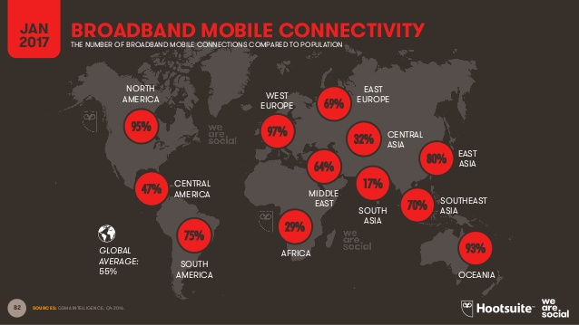

Slide 33
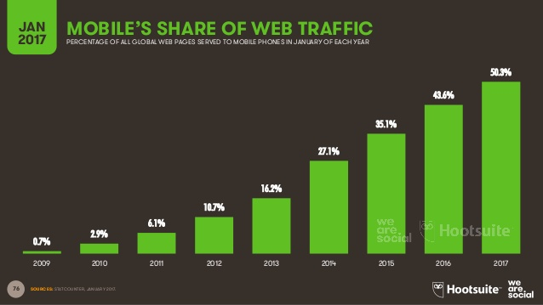
Mobile Share of Web Traffic

Slide 34
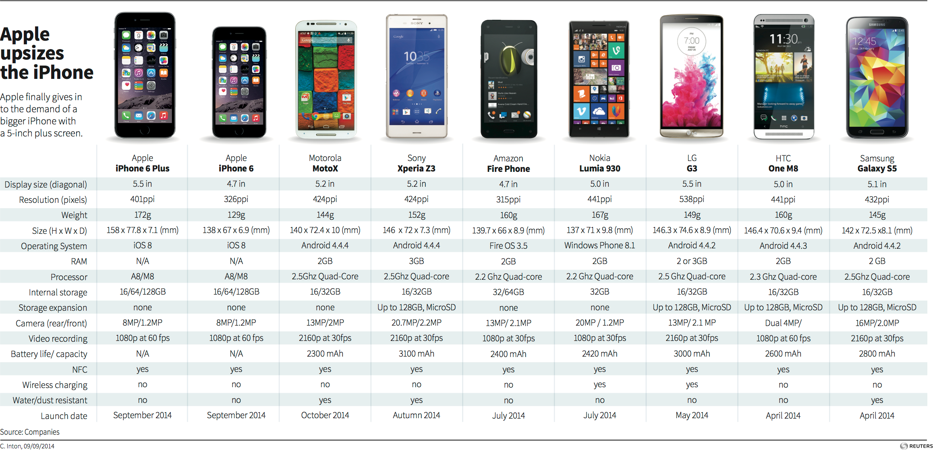
Current Smartphones on the Market

Slide 35
Smartphone market share worldwide by vendor 2009-2016
Global market share held by leading smartphone vendors from 4th quarter 2009 to 4th quarter 2016
Note: Worldwide; 4th quarter 2009 to 4th quarter 2016
Further information regarding this statistic can be found on page 8.
Source: IDC; ID 271496

Slide 37
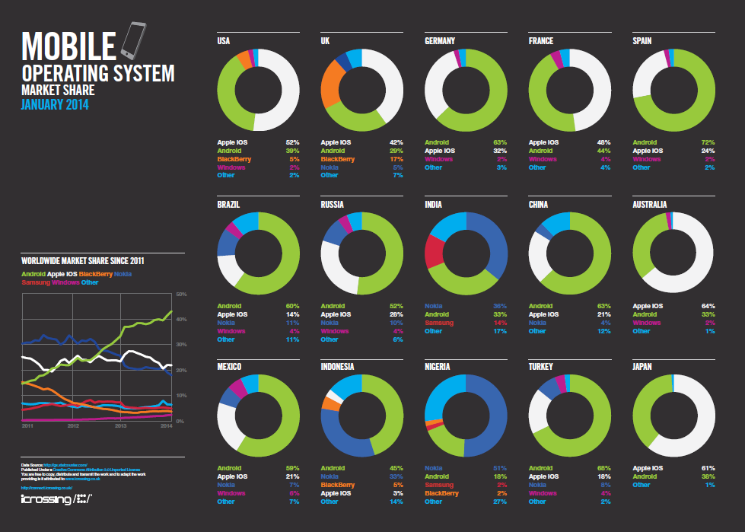

Slide 38

Tablets
What is a Tablet?
Larger than a Smartphone
Touchscreen used as primary method of input
Some typical functions are:
Mobile Browsing
Portable Media Player
Camera
Downloadable Apps

Slide 39
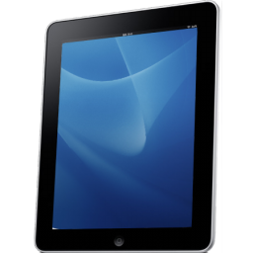
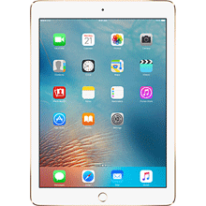
Tablet History
1971: Allan Kay describes a tablet computer at Xerox PARC
1983: Apple and AT&T work on a tablet prototype
1991: IBM markets a tablet computer but fails
1993: Apple Newton launched, also fails
1996: NewsPad debuts; considered one of the first serious prototypes
2009: Various computer manufacturers release tablets to market
2010: Apple iPad launched

Slide 40
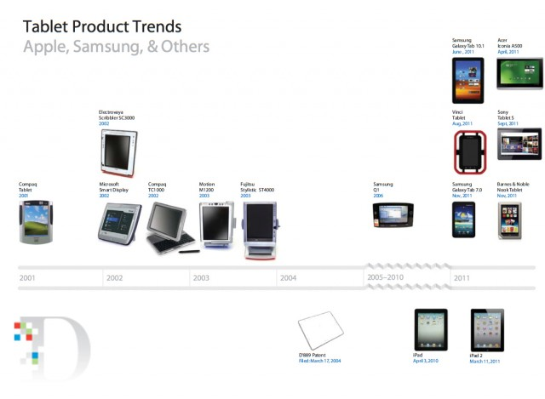

Slide 41
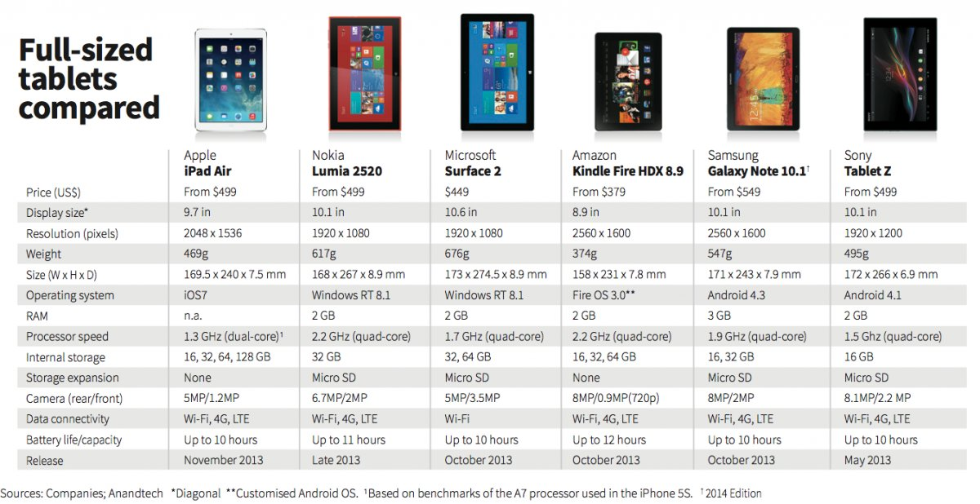
Current Tablets on the Market

Slide 42
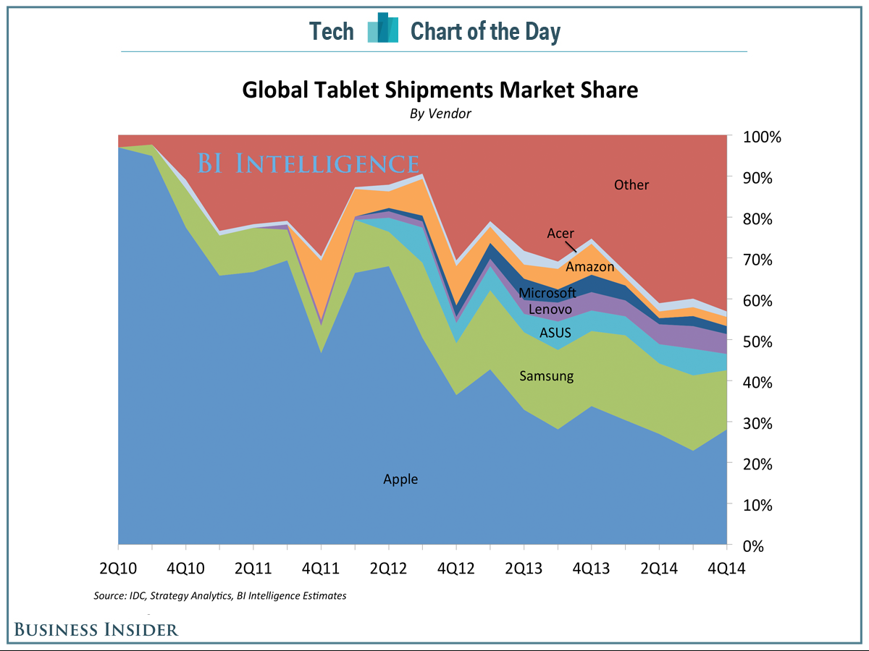
Tablet Shipments Market Share

Slide 43
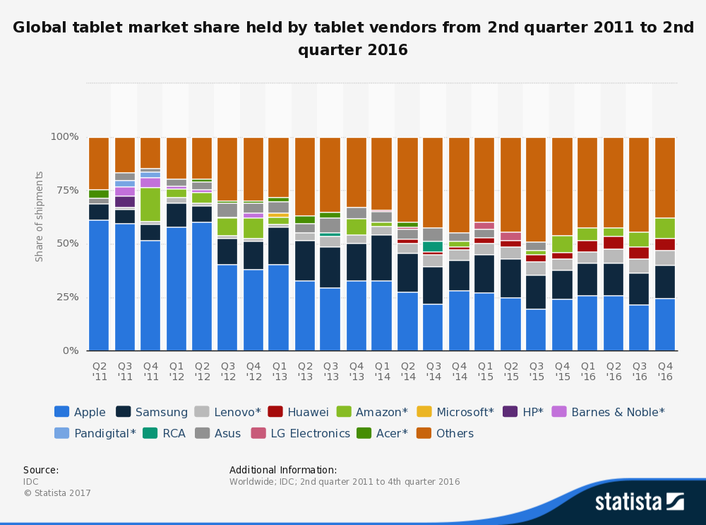
Market Share by Vendor

Slide 44
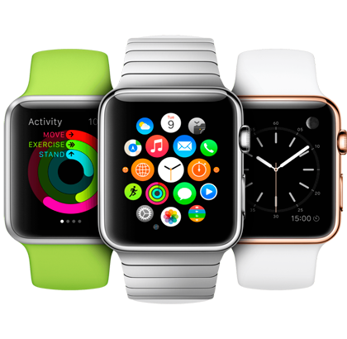
Smart Watch
What is a Smart Watch?
A computerized wristwatch with functionality that is enhanced beyond timekeeping, and is often comparable to a personal digital assistant device

Slide 45
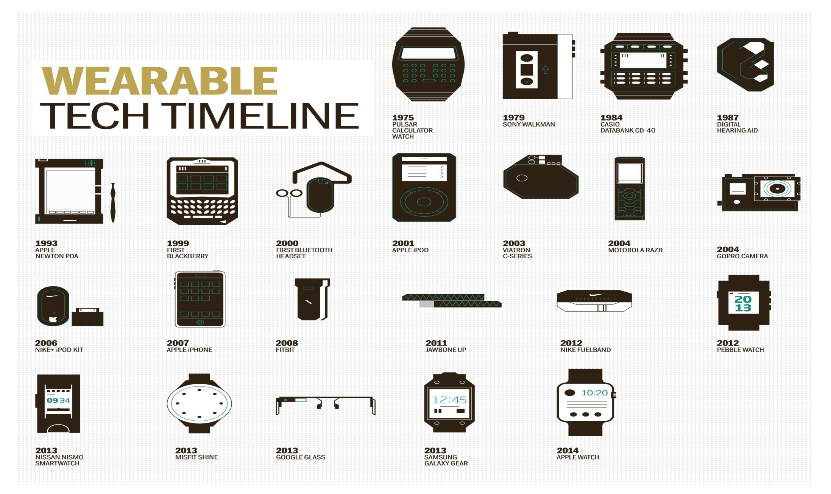

Slide 46
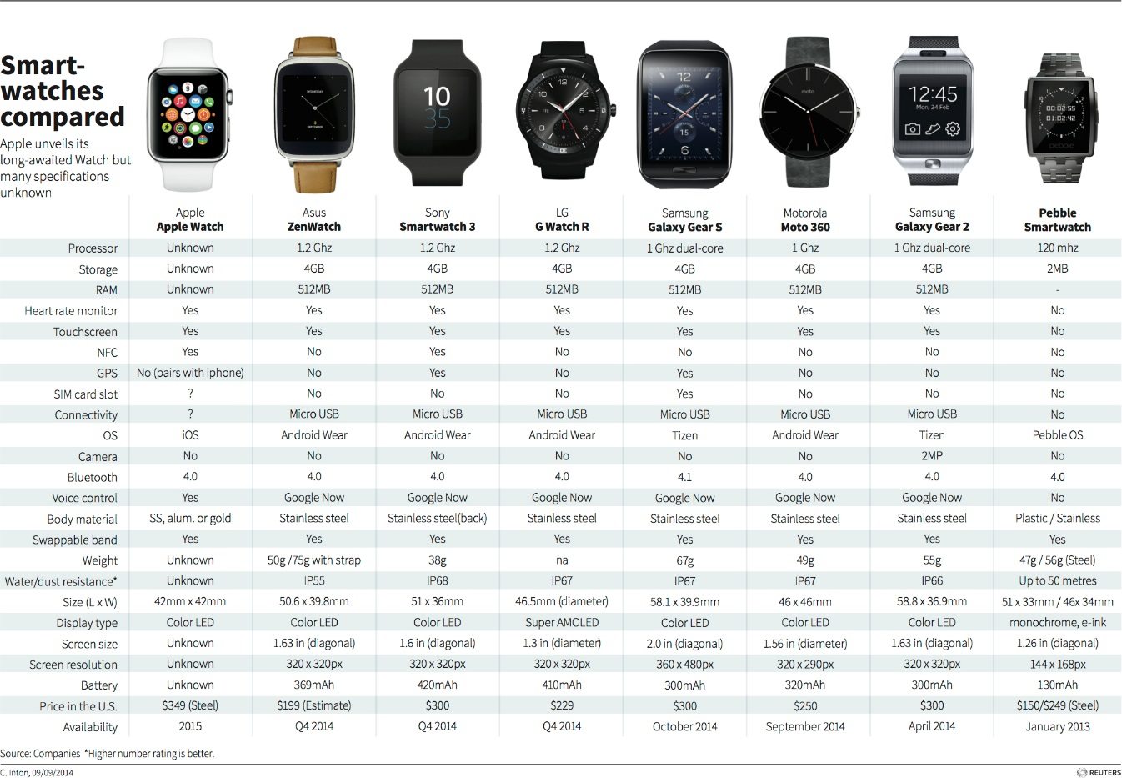
Current Smartwatches on the Market

Slide 47

Operating System (OS)
What is an Operating System?
An operating system (OS) is software that manages computer hardware resources and provides services for computer programs.

Slide 48
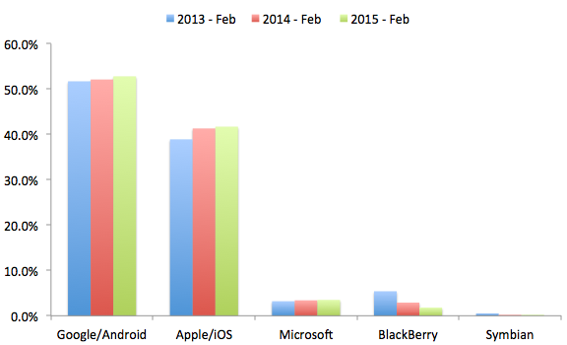
Global Mobile Operating System Share

Slide 49
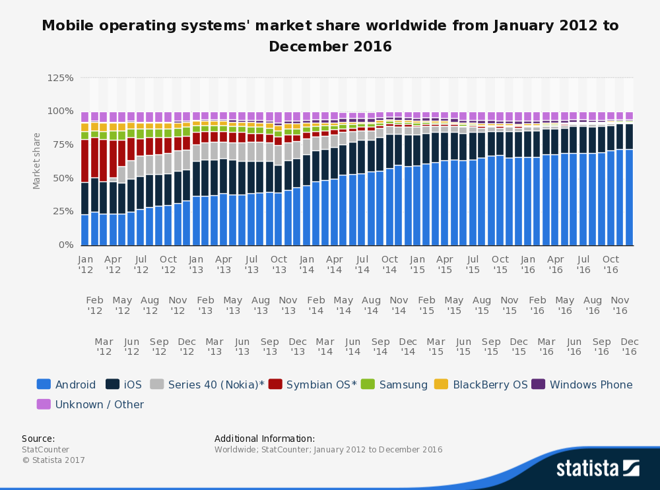

Slide 50
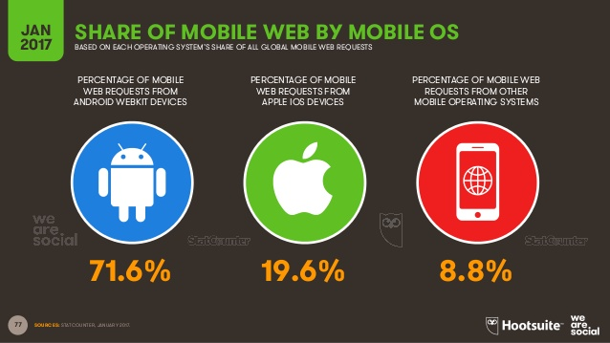
Platforms Share of Mobile Web

Slide 51
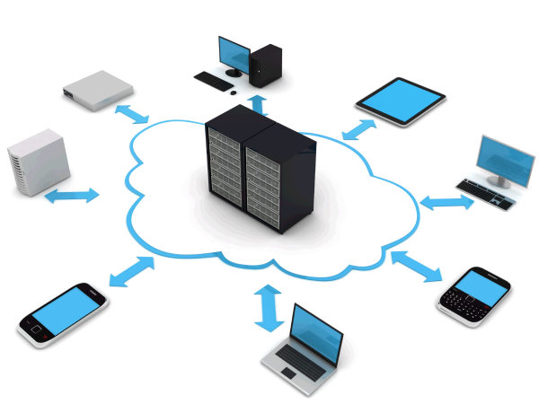
Cloud Computing
A model of network computing where a program or application runs on a connected server or servers rather than on a local computing device.

Slide 52
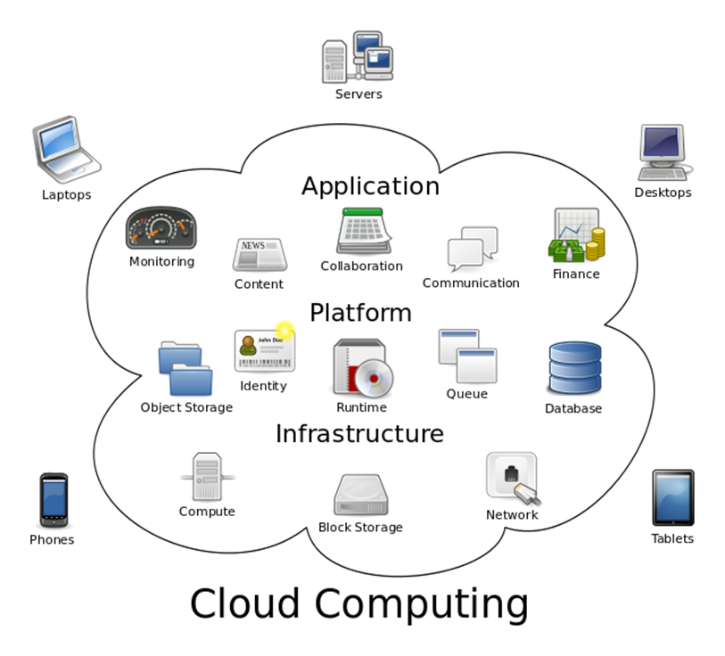
Cloud Computing

Slide 53
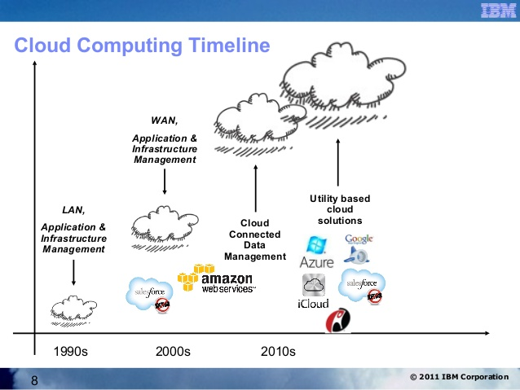
Cloud Computing Timeline

Slide 54
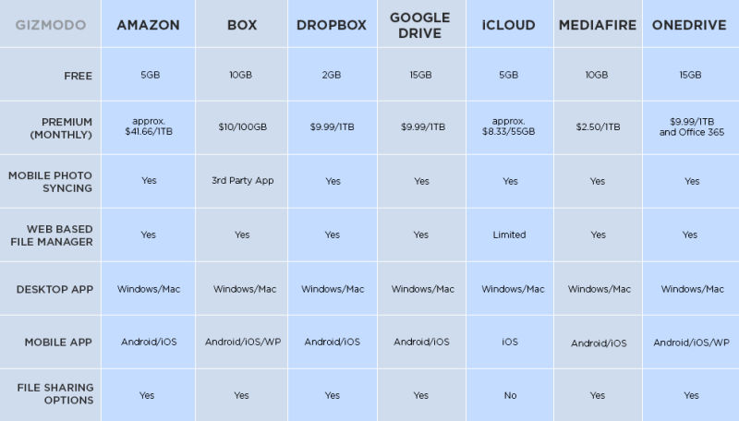

Slide 55
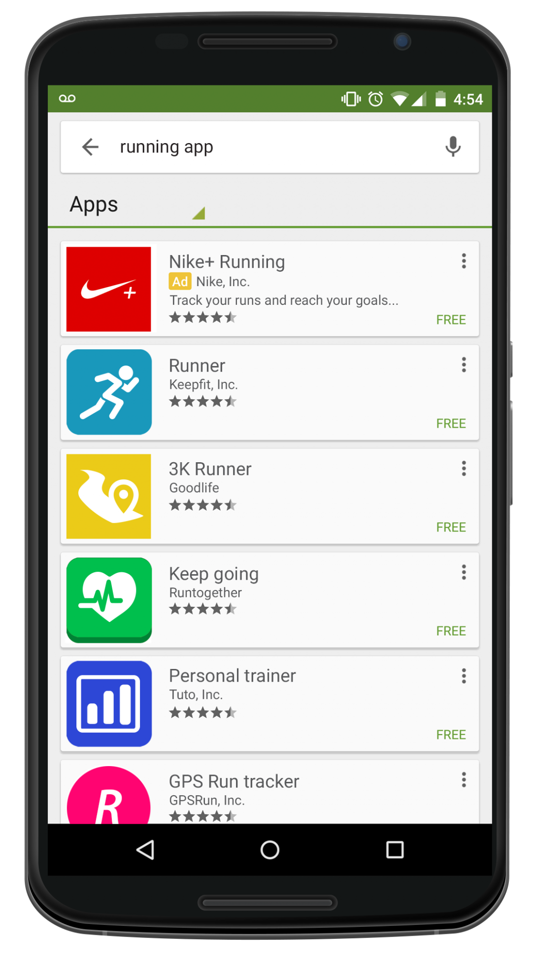

App Store
A place where applications can be downloaded directly to a device to supplement the experience of the device, for recreational use, etc. Some apps are free some have to be bought

Slide 56
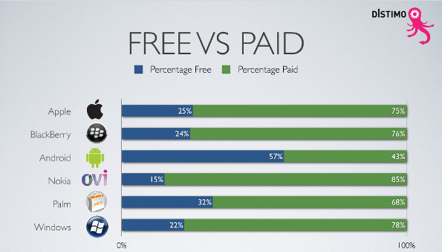

Slide 57
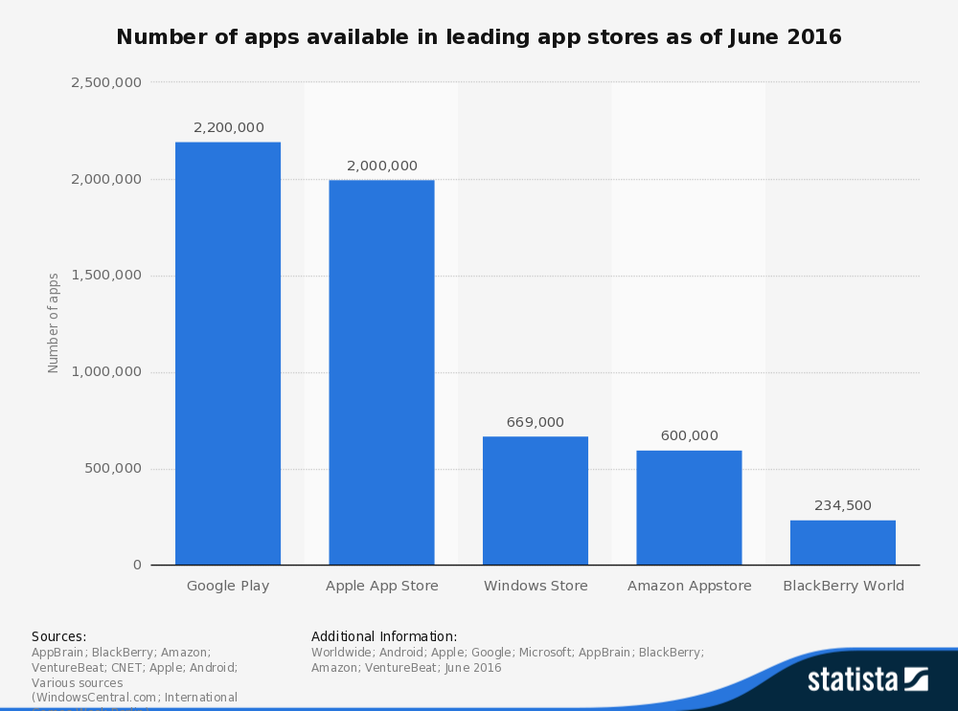

Slide 58
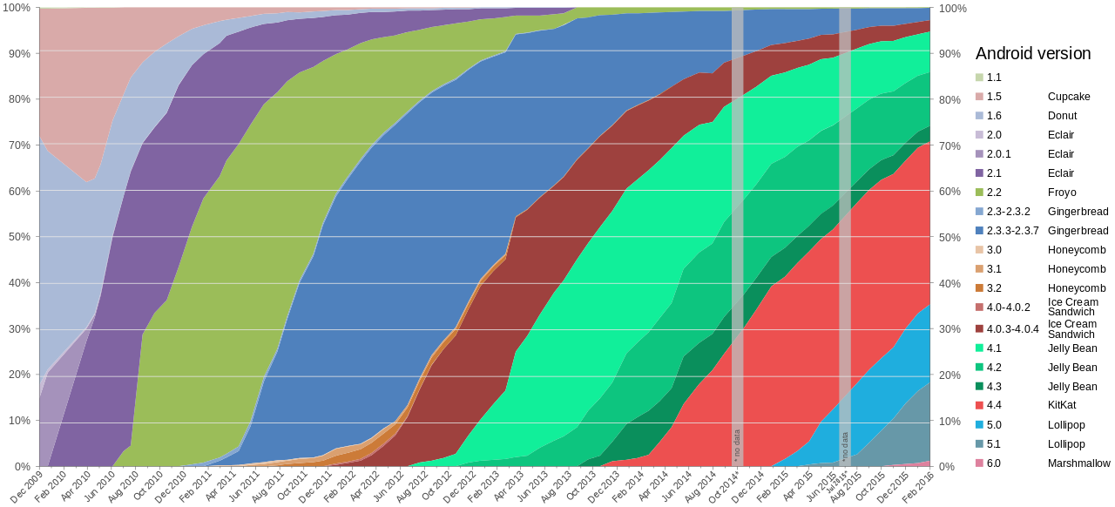
Android Versions

Slide 59

IOS Support Matrix
Notes:
Recent changes: IOS 9.1 and 9.3

Slide 60


Slide 61
Stock and Company Overview

Slide 62



Stock Information

Slide 63
Share Structure
Weighted Average Shares Outstanding (in Millions)
2013 | 2014 | 2015 | Mar 9 2017
6.477 | 6.085 | 5.753 | 5.247
Annual Diluted Earnings Per Share
2013 | 2014 | 2015 | 2016
5.68 | 6.45 | 9.22 | 8.31

Slide 64

Stock Information: 1 Year Performance

Slide 65

Stock Information: 5 Year Performance

Slide 66

Stock Information: 10 Year Performance

Slide 67

Stock Information: Max Performance

Slide 68

Apple Performance Comparison
Apple versus the S&P 500 and Dow Jones U.S. Technology Index
Notes:
03/14/2017
AAPL $138.99
DJUSTC $1373.89
INDEXSP:.INX $2365.45
Discuss index weight (computed weighted average market cap.)

Slide 69

Top Shareholders’: Institutional Ownership

Slide 70

Top Shareholders’: Institutional Ownership

Slide 71
Company Profile
Apple Inc. (formerly Apple Computer, Inc.) founded by Steve Jobs, Steve Wozniak and Ronald Wayne (1976)
It designs, manufactures, and markets mobile communication and media devices, personal computers, and portable digital music players, and sells a variety of related software, services, peripherals, networking solutions, and third-party digital content and applications
Products sold worldwide through its online stores, its retail stores, its direct sales force, third-party cellular network carriers, wholesalers, and resellers
Headquartered in Cupertino, California

Slide 72
Business Strategy
Commitment to bringing the best user experience to its customers through its innovative hardware, software and services
Unique ability to design and develop its own operating systems, hardware, application software
Services to provide its customers products and solutions with innovative design, superior ease-of-use and seamless integration
Expand platform for discovery and download of digital content by customers
Supporting third-party software and hardware development which can complement their products and services
Investment in R&D, marketing, and advertising to encourage the sale of innovative technology

Slide 73


Products and Services
iPhone
iPad
Mac
Operating System Software
  iOS, macOS, watchOS, tvOS
Accessories (connectivity supplies, headphones, displays, storage devices, etc.)
iPod
Apple Watch
Apple TV
Internet Services
iCloud
AppleCare
Apple Pay

Slide 74


Products: iPhone and iPad
Smartphone with a user interface built around the device’s multi-touch screen including a virtual keyboard
Shoot video, take pictures, download apps, play music, send/receive text messages and e-mail
Originally released in 2007
The current models are the 7 and 7 Plus, which are first iPhones without the 3.5mm headphone jack (mixed reception)
Largest market share in the US
Line of tablet computers, with user interface and capabilities similar to the iPhone
Series: iPad Mini, iPad Air, iPad Pro, iPad
Most recent releases are 9.7” Pro and Mini 4
Includes Siri and Touch ID

Slide 75


Products: Mac
Line of notebook and desktop computers based on the MacOS operating system
MacBook lineup consists of the Air, Pro, and the latest 12” display MacBook (2015-)
Current desktop models include the 21.5” iMac with 4K Retina display, 27” with 5K Retina Display
Long battery life, fast storage, beautiful display, thin and lightweight

Slide 76

Services: iCloud
Apple’s cloud storage service which stores music, photos, contacts, calendars, mail, documents and more
Works across devices (iPhone, Mac, even Windows personal computers)
Includes the iCloud Drive, Find My iPhone, Notes, iCloud KeyChain
Provides means to back-up important personal data directly (wirelessly)
5GB of free storage space

Slide 77

Services: Apple Pay
Mobile payment service available in certain countries
Offers an easy, secure, fast and private way to pay
Digitalizes and can replace credit or debit cards with the chip and pin or magnetic stripe
Wireless communication with point of sale by using near field communication antenna, secure element (a chip that stores encrypted private information), Touch ID and Wallet

Slide 78


Internet Services: App Store, iBooks, Apple Music, iTunes
iTunes store allows to purchase, rent, and download music, TV shows and podcasts to be played on the iTunes player
App Store allows customers to download and purchase applications for their iOS devices, as well as discover in-app content
iBooks features e-books from major and independent publishers for customers to purchase and read across iOS devices and Mac
Apple Music is the music streaming service, which offers curated playlists and on-demand radio stations and an unlimited music library for download and offline listening. The customer pays a monthly subscription fee for an individual, student or family plan.
Competing against Spotify and Tidal

Slide 79

Net Sales (Segments and Products)
Notes:
(Dollars in millions, units in thousands)

Slide 80

Q1 2017 - Product Summary

Slide 81


Q1 2017 - Operating Segments
Notes:
Quarter ending on December 31, 2016.
Q1 2017 includes a 14th week to re-align fiscal quarters with calendar quarters. This is done every 5-6 years.
Apple’s 2016 fiscal year ended on September 24, 2016.

Slide 82
History and Management

Slide 83
History and Development of Apple: Early Years
1976
Founded in Cupertino by Steve Jobs, Ronald Wayne and Steve Wozniak
Apple I sells for $666.66 (200 units)
1977
Apple II released at $1,300
Incorporated in the state of California
1979
- First app unveiled: VisiCalc

Slide 84

History and Development of Apple: The 80s
1980
December 12: IPO launched at $22M, selling $4.6M shares
Release of Apple III
1983
LISA (Local Integrated System Architecture) released at $9,995, one of the first personal computers to offer a GUI in a machine; sells only 10,000 units
1984
Launch of the Macintosh 128K with initial price of $2,495..beige case, keyboard and mouse
1985
Steve Jobs leaves Apple and starts NeXT
1987
Apple registered the Apple.com domain name (one of the first companies to use .com)

Slide 85


History and Development of Apple: The 90s
1993
The Newton released (early PDA model)
1994
Apple releases its first PowerPC-based desktop computers and notebooks
1997
Apple acquires NeXT and its OS, NeXTSTEP
Steve Jobs returns as advisor; appointed interim CEO
Introduction of Apple Store
Company faces financial trouble, as share price hits 12-year low
1998
iMac launched
1999
iBook released

Slide 86

History and Development of Apple: The 2000s
2001
Mac OS X
Opening of Apple Retail Stores
First iPod
2002
iMac G4
2003
iTunes Music Store
2004
Release of iMac G5 and iPod Mini
2005
- Release of iPod Shuffle and iPod Nano
2006
MacBook Pro
2007
iPhone and iPhone 3G
iPod Touch
Apple TV
2008
MacBook Air

Slide 87

History and Development of Apple: 2010 - Present
2010
iPad and iPhone 4
2011
iCloud announced
Steve Jobs resigns as CEO due to illness, replaced by Tim Cook
Apple passes Exxon to become the most valuable company in the world
2012
iPhone 5 and iPad Mini released
Apple Maps launched
2013
iPhone 5S/5C launched

Slide 88

History and Development of Apple: 2010 - Present
2014
Apple Pay launched
2015
iPhone 6 and 6S Plus released
iPad Pro
Apple Watch
Apple Music
2016
iPhone SE
MacBook (Rose Gold, Space Grey, Silver, Gold)
2017
New iPhone 8 release expected in September
Operating System updates
Releases for latest versions of the iPad, Apple Watch, and Macs
Currently trading at their highest price ever

Slide 89

Key Acquisitions
1997: NeXT (computer programming services)
  Derived Products: OS X and iOS
  $404 million
2000: SoundJam MP (Software)
  Derived Products: iTunes
  2005: Fingerworks
  Derived Product: Multi-touchscreen
2008: P.A. Semi (semiconductors)
  Derived Products: Apple A4 and A5 chips
  $278 million
2009: Lala.com (music streaming)
  Derived Products: iCloud, iTunes Match
  $80 million

Slide 90


Key Acquisitions
2010: Siri (Voice control software)
  Derived Products: Siri
  $200 million
February 23, 2012: Chomp (App search engine)
  Derived Products: App store
  $50 million
July 27, 2012: AuthenTec (PC and mobile security)
  Derived Products: Touch ID
  $356 million

Slide 91

Key Acquisitions
2014: Beats Electronics
  Derived products: iPhone, iTunes
  $3 Billion
2015: linX (camera)
  Derived products: iPod, iPhone, iPad
  $20 Million
2016: Flyby Media (Augmented reality software)
  Acquired to aid Apple’s in developing for virtual reality

Slide 92

Steve Jobs
Co-founder (with Wozniak) and former CEO
Considered as a pioneer of the microcomputer revolution
Education: Reed College (dropped out)
Left the company in 1985, returned in 1997
  NeXT
  PIXAR
Work closely with Ive and oversaw the development of iMac, iTunes, iPhone, and iPad on the service side, as well as Apple retail stores
Diagnosed with a pancreatic neuroendocrine tumor in 2003 and died in 2011 of respiratory arrest due to the tumor

Slide 93

Executive Team
Tim Cook, Chief Executive Officer (since August 2011, joined company in 1998)
Formerly the COO; previous responsibilities included worldwide sales and operations, end-to-end supply chain, sales activities, service and support in markets across the globe
Headed Macintosh division; led development of reseller and supplier relationships to meet increasing demands
Previous served roles with Compaq, IBM, and Intelligent Electronics
Education: BS in Industrial Engineering from Auburn (1982); MBA from Duke (1988)

Slide 94

Executive Team
Angela Ahrendts, Senior Vice President, Retail (joined company in 2014)
Responsible for strategy, real estate & development, and operations of Apple’s physical stores, Apple’s online store and contact center
Integrated digital and physical retail business for better customer experience for entertaining, enriching, and educating communities
Formerly the CEO of Burberry, where company underwent “outstanding” growth under her leadership
Education: Marketing and Merchandising degree (1982) and honorary doctorate of Humane Letters (2010) from Ball State

Slide 95

Executive Team
Eddy Cue, Senior Vice President, Internet Software and Services (joined company in 1989)
Oversees the iTunes Store and Apple Music, as well as Apple Pay, Siri, Maps, iAd, Apple's innovative iCloud services, and Apple’s productivity and creativity apps
Credited for creating the Apple online store in 1998, iTunes store in 2003, and App Store in 2008 and played a key role in the development of the iLife suite
Education: Bachelors’ in Computer Science and Economics from Duke

Slide 96

Executive Team
Craig Federighi, Senior Vice President, Software Engineering (second stint with company in 2009)
Oversees the development of iOS, macOS and Apple's common operating system engineering teams
His teams are responsible for the software of the products – interface, applications, and frameworks
Has led the development of major operating systems including OS X Mavericks
Previously worked at NeXT and Ariba where he was the CTO
Education: MS in Computer Science and BS in in Electrical Engineering and Computer Science from UC Berkeley

Slide 97

Executive Team
Jonathan Ive, Chief Design Officer (joined company in 1992)
Responsible for all design at Apple, including the hardware, user interface, packaging, major architectural projects such as Apple Campus 2 and Apple’s retail stores, as well as new ideas and future initiatives
Has led the Apple design team since 1996, which is considered to among the best in the world
Holder of over 5000 patents and recipient of numerous awards for his design work
Education: Bachelor of Arts from Newcastle Polytechnic, also holds honorary doctorates from 3 other institutions

Slide 98

Executive Team
Luca Maestri, Senior Vice President and Chief Financial Officer (joined company in 2013)
Oversees the accounting, business support, financial planning and analysis, treasury, M&A, investor relations, internal audit and tax functions
Worked as vice president of finance and corporate controller when he arrived
Previously served as CFO at Xerox and Nokia Siemens Networks and CFO of GM’s European operations
Education: Master’s degree in Science of Management from Boston University and Bachelor’s in Economics from Luiss University

Slide 99

Executive Team
Dan Riccio, Senior Vice President, Hardware Engineering (joined company in 1998)
leads the Mac, iPhone, iPad and iPod engineering teams
Joined as VP of Product Design and in 2010 was named VP of iPad of Hardware Engineering
Key contributions to most of Apple’s hardware especially the iPad
Prior to Apple, he worked at Compaq as a Mechanical Engineering manager
Education: Bachelor’s in Mechanical Engineering from University of Massachusetts Amherst

Slide 100

Executive Team
Phillip W. Schiller, Senior Vice President, Worldwide Marketing (re-joined company in 1997)
Has helped the company create the best computers in the world with the Mac, lead the digital music revolution with iPod and iTunes, reinvent mobile phones with iPhone and the App Store, and define the future of mobile computing with iPad
Various roles in marketing management positions (Macromedia, FirePower Systems, Nolan, Norton and Company and Mass. General in Boston)
Education: BS in Biology from Boston College (1982)

Slide 101

Executive Team
Bruce Sewell, Senior Vice President and General Counsel (joined company in 2009)
Serves on the company's executive team and oversees all legal matters, including corporate governance, intellectual property, litigation and securities compliance, global security and privacy
Previously worked at Intel, leading their legal, corporate and social responsibility programs, managing litigation portfolio and corporate transactions
Education: J.D. from George Washington University (1986) and BS of University of Lancaster (1979)

Slide 102

Executive Team
Johny Srouji, Senior Vice President, Hardware Technologies (joined in 2008)
Joined company to lead development of the A4 (first Apple-designed system on a chip)
Has built one of the world’s strongest and most innovative teams of silicon and technology engineers, overseeing breakthrough custom silicon and hardware technologies including batteries, application processors, storage controllers, sensors silicon, display silicon and other chipsets across Apple’s entire product line
Prior to Apple, Johny held senior positions at Intel and IBM in the area of processor development and design
Education: Bachelor’s and Master’s degree in Computer Science from Technion, Israel’s Institute of Technology

Slide 103

Executive Team
Jeff Williams, Chief Operating Officer (joined company in 1998)
Oversees the development of Apple Watch, and drives the company’s health initiatives including ResearchKit
Since 2010, he has overseen Apple’s entire supply chain, service and support, and the social responsibility initiatives which protect more than one million workers worldwide
Played a key role in Apple’s entry into the mobile phone market with the launch of iPhone, and since 2010 has led worldwide operations for all products
Previously worked at IBM in operations and engineering
Education: Bachelor's degree in Mechanical Engineering from North Carolina State University and an MBA from Duke

Slide 104
Financial Analysis

Slide 105

Balance Sheet: 10-Q (Assets)
Notes:
(In millions, except number of shares which are reflected in thousands and par value)

Slide 106

Balance Sheet: 10-Q (Liabilities and Shareholders’ Equity )
Notes:
(In millions, except number of shares which are reflected in thousands and par value)

Slide 107

Balance Sheet: 10-K (Assets)
Notes:
Consolidated Balance Sheet as of 09/24/16 and 09/26/15
(In millions, except number of shares which are reflected in thousands and par value)

Slide 108

Balance Sheet: 10-K (Liabilities and Shareholders’ Equity)
Notes:
(In millions, except number of shares which are reflected in thousands and par value)

Slide 109

Income Statement: 10-K
Notes:
(In millions, except number of shares which are reflected in thousands and per share amounts)

Slide 110

Income Statement: 10-Q
Notes:
(In millions, except number of shares which are reflected in thousands and per share amounts)

Slide 111

Statement of Cash Flows: 10-K (Operating)
Notes:
(in millions)

Slide 112


Statement of Cash Flows: 10-K (Investing)
Notes:
(in millions)

Slide 113

Statement of Cash Flows: 10-K (Financing)
Notes:
(in millions)

Slide 114

Statement of Cash Flows: 10-Q (Operating)
Notes:
(in millions)

Slide 115


Statement of Cash Flows: 10-Q (Investing)
Notes:
(in millions)

Slide 116

Statement of Cash Flows: 10-Q (Financing)
Notes:
(in millions)

Slide 117

Valuation Measures

Slide 118
Recommendation
HOLD

Slide 119


Slide 120

Stock and Company Overview

Slide 121



Stock Information

Slide 122

Stock Information: 1 Year Performance

Slide 123

Stock Information: 5 Year Performance

Slide 124

Stock Information: 10 Year Performance

Slide 125

Stock Information: Max Performance

Slide 126

Microsoft Performance Comparison

Slide 127

Share Repurchase Program

Slide 128

Microsoft Share Structure
As of January 20, 2017, there were 7,727,529,820 shares of common stock outstanding
Major Holders Breakdown

Slide 129

Top Shareholders’: Institutional Ownership

Slide 130

Top Shareholders’: Institutional Ownership

Slide 131
Mission and Strategy
Mission
  Empower every person and every organization on the planet to achieve more
Strategy
  Build best-in-class platforms and productivity services for a mobile-first, cloud-first world

Slide 132
History and Management

Slide 133
Development Timeline
1975
  Microsoft founded
1981
  Microsoft incorporates
  IBM introduces its personal computer MS-DOS 1.0
1986
  Microsoft stock goes public
1990
  launches Windows 3.0
1995
  launches Windows 95
1998
  launches Windows 98
2000
  launches Windows 2000

Slide 134
Development Timeline
2001
  launches Office XP and Xbox
2005
  launches Xbox 360
2007
  launches Windows Vista
2009
  launches Windows 7
2010
  launches general availability of Office
  launches Kinect for Xbox 360
  launches Windows Phone 7
2011
  launches Office 365
  Microsoft closes its acquisition of Skype

Slide 135
Development Timeline
2012
  Microsoft launches Windows 8 and Microsoft Surface
2013
  Launches Office 2013, Outlook.com, Windows 8.1
  Launches Surface 2 and Surface Pro 2, and launches Xbox One
  Microsoft announces decision to acquire Nokia
2014
  Satya Nadella named chief executive officer for Microsoft
  Microsoft launches Office for iPad, Surface Pro 3
  Minecraft to join Microsoft announcement
  Microsoft announces Office apps for Android tablets

Slide 136
Development Timeline
2015
  Microsoft reveals Windows 10
  Microsoft announce partnership with Baidu
  Microsoft jointly founded the OpenFog Consortium
2016
  Microsoft announces Surface Studio and Surface Dial
  Microsoft launches Microsoft Teams, a cloud-based team collaboration tool

Slide 137
Key Acquisitions
1987 - Forethought
  Forethought was founded in 1983, then later be known as Microsoft PowerPoint
1997 - Hotmail
  Acquired Hotmail for $500 million
2000 - Visio Corporation
  Acquired Visio for $1.375 billion
2002 - Navision
  Purchased Navision for $1.33 billion; turned into a new division as Microsoft Business Solutions (now Microsoft Dynamics)
2011 – Skype Technologies
  Purchased for $8.5 billion; 32 times larger than its value
2013 – Nokia (Hardware Division)
  Formerly developed phones for Microsoft; highlights Microsoft’s move into hardware

Slide 138
Key Acquisitions
2015 - Metanautix
  Metanautix helps big companies to navigate their data
2015 - Secure Islands
  Secure Island, an innovator in advanced information protection solutions
2015 - Mobile Data Labs
  Mobile Data Labs, an intelligent productivity solutions for mobile professionals
2016 - Swiftkey
  Swiftkey is a start-up company that makes keyboard apps for Android and iOS devices
2016 - Xamarin
  Xamarin allows developers to build fully native apps across several platforms from a single shared code base
2016 - Linkedln
  Acquired Linkedln for $26.2 Billion

Slide 139

Management Team
John W. Thompson, Chairman
John W. Thompson joined the Microsoft Board in February 2012 and became independent chairman of Microsoft Corporation on February 4, 2014.
Education
Thompson received a bachelor’s degree in Business Administration from Florida A&M, and a master’s degree in Management from the Sloan Fellows program of the MIT Sloan School of Management.

Slide 140

Management Team
Bill Gates, Founder and Technology Advisor
William (Bill) H. Gates is founder, technology advisor and board member of Microsoft Corporation. He served as chairman of the board until February 4, 2014.
Education
In 1973, Gates entered Harvard University as a freshman. In his junior year, Gates left Harvard to devote his energies to Microsoft, a company he had begun in 1975 with his childhood friend Paul Allen.

Slide 141

Management Team
Satya Nadella, Chief Executive Officer
Satya Nadella is Chief Executive Officer of Microsoft. Before being named CEO in February 2014, Nadella held leadership roles in both enterprise and consumer businesses across the company.
Education
He earned a bachelor’s degree in electrical engineering from Mangalore University, a master’s degree in computer science from the University of Wisconsin – Milwaukee and a master’s degree in business administration from the University of Chicago.

Slide 142

Management Team
Chris Capossela, Executive Vice President and Chief Marketing Officer
As chief marketing officer, Chris Capossela leads Microsoft’s global product marketing, advertising, brand, research and communications functions for businesses and consumers.
He oversaw the creation of new business opportunities with partners to deliver new consumer experiences through Windows, Windows Phone, Office and Xbox.
Education
Capossela holds a bachelor’s degree in computer science and economics from Harvard University.

Slide 143

Management Team
Scott Guthrie, Executive Vice President, Microsoft Cloud and Enterprise Group
As executive vice president of the Microsoft Cloud and Enterprise Group, Scott Guthrie is responsible for the company’s cloud infrastructure, server, database, CRM, ERP, management and development tools businesses. His engineering team builds Microsoft Azure, SQL Server, Microsoft Dynamics 365, Active Directory, System Center, Visual Studio and .NET.
Education
Guthrie graduated with a bachelor’s degree in computer science from Duke University

Slide 144

Management Team
Rajesh Jha, Executive Vice President, Office Product Group
As executive vice president of Microsoft’s Office Product Group, Rajesh Jha leads the development and service engineering teams for Office 365 – spanning Office, Skype and OneNote.
Education
Jha has a master’s degree in computer science from the University of Massachusetts, Amherst and a bachelor’s degree in computer science from Indian Institute of Technology, Madras.

Slide 145

Management Team
Terry Myerson, Executive Vice President, Windows and Devices Group
As executive vice president of Microsoft’s windows and devices group, Myerson is responsible for the software platform, apps, games, store and devices that power the Windows ecosystem. This includes Windows, Surface, Xbox, Minecraft, Lumia and HoloLens.
Education
After earning a bachelor’s degree in mechanical engineering from Duke University, Myerson founded Intersé, one of the first Web software companies, which Microsoft acquired.

Slide 146
Products and Services

Slide 147


Slide 148
Products and Services
Productivity and Business Process
Intelligent Cloud
More Personal Computing

Slide 149
Productivity and Business
Office Commercial, including volume licensing and subscriptions to Office 365 commercial for products and services such as Office, Exchange, SharePoint, and Skype for Business, and related Client Access Licenses (“CALs”).
Office Consumer, including Office sold through retail or through an Office 365 consumer subscription, and Office Consumer Services, including Skype, Outlook.com, and OneDrive.
Dynamics business solutions, including Dynamics ERP products, Dynamics CRM on-premises, and Dynamics CRM Online.

Slide 150
Intelligent Cloud
Server products and cloud services, including Microsoft SQL Server, Windows Server, Visual Studio, System Center, and related CALs, as well as Azure.
Enterprise Services, including Premier Support Services and Microsoft Consulting Services.

Slide 151
More Personal Computing
Windows, including Windows original equipment manufacturer licensing (“Windows OEM”) and other non-volume licensing of the Windows operating system, volume licensing of the Windows operating system, patent licensing, Windows Embedded, MSN display advertising, and Windows Phone licensing.
Devices, including Surface, phones, and PC accessories.
Gaming, including Xbox hardware; Xbox Live, comprising transactions, subscriptions, and advertising; video games; and third-party video game royalties.
Search advertising, including Bing, Bing Ads, and MSN.

Slide 152
Operating Performance

Slide 153

Operating Performance by Segment

Slide 154

Operating Performance by Segment

Slide 155
Operating Performance-Productivity and Business
Office Commercial revenue increased $135 million or 1%, driven by higher revenue from Office 365 commercial
Office Consumer revenue decreased $69 million or 2%, driven by a decline in the consumer PC market, offset in part by higher revenue from Office 365
Dynamics revenue increased 4%, mainly due to higher revenue from Dynamics CRM Online, driven by seat growth.

Slide 156
Operating Performance-Intelligent Cloud
Server products and cloud services revenue grew $686 million or 4%, driven by revenue growth from Azure of 113%, offset in part by a decline in transactional revenue from our on-premises server products.
Enterprise Services revenue grew $536 million or 11%, mainly due to growth in Premier Support Services.

Slide 157
Operating Performance-More Personal Computing
Devices revenue decreased $3.7 billion or 32%, mainly due to lower revenue from phones, offset in part by higher Microsoft Surface (“Surface”) revenue. Phone revenue decreased $4.2 billion or 56. Surface revenue increased $486 million or 13%, primarily driven by the release of Surface Pro 4 and Surface Book, as well as the release of Surface 3, offset in part by a decline in revenue from Surface Pro 3
Windows revenue decreased $871 million or 5%, mainly due to lower revenue from patent licensing, Windows OEM licensing (“Windows OEM”), and Windows Phone licensing.

Slide 158
Operating Performance-Personal Computing
Search advertising revenue increased $1.7 billion or 46%. Search advertising revenue, excluding traffic acquisition costs, increased 17%, primarily driven by growth in Bing.
Gaming revenue increased $132 million or 1%, primarily due to higher revenue from Xbox Live and video games, offset in part by lower Xbox hardware revenue. Video games revenue grew 34%, driven by the launch of Halo 5 and sales of Minecraft. Xbox hardware revenue decreased 16%, mainly due to lower prices of Xbox One consoles sold and a decline in Xbox 360 console volume, offset in part by higher Xbox One console volume.

Slide 159

Operating Performance by Geographical Area

Slide 160
Financial Analysis

Slide 161

Financial Highlights

Slide 162

Balance Sheet: 10-Q (Assets)

Slide 163

Balance Sheet: 10-Q (Liabilities)

Slide 164

Balance Sheet: 10-Q (Stockholder’s Equity)

Slide 165

Balance Sheet: 10-K (Assets)

Slide 166

Balance Sheet: 10-K (Liabilities)

Slide 167

Balance Sheet: 10-K (Stockholder’s Equity)

Slide 168

Income Statement: 10-K

Slide 169

Income Statement: 10-Q

Slide 170

Cash Flows: 10-K (Operations)

Slide 171

Cash Flows: 10-K (Financing and Investing)

Slide 172

Cash Flows: 10-Q (Operations)

Slide 173

Cash Flows: 10-Q (Financing and Investing)

Slide 174

Valuation Measures

Slide 175
Recommendation
BUY

Slide 176


Slide 177

Stock and Company Overview

Slide 178



Stock Information
Notes:
As of 02/13/2017

Slide 179

Stock Information: 1 Year Performance

Slide 180

Stock Information: 5 Year Performance
Notes:
via Investopedia (2/10/2012 - 2/10/2017)

Slide 181

Stock Information: 10 Year Performance

Slide 182

Stock Information: Max Performance

Slide 183

Stock Information: 1 Year Google vs. NASDAQ, DJIA, S&P500

Slide 184

Stock Information: 5 Year Google vs. NASDAQ, DJIA, S&P500

Slide 185

Common Shares Outstanding
Dec, 2011 | Dec, 2012 | Dec, 2013 | Dec, 2014 | Dec, 2015 | Dec, 2016
649.16M | 659.32M | 671.01M | 688.11M | 687.35M | 691.29M
GOOGLE Common Share Outstanding (2011-2016)
Notes:
GOOG stock represents Class C shares, while GOOGL stock represents Class A shares.
Class C shares (GOOG) have no voting rights, while Class A shares (GOOGL) have one vote each.
Anyone who owned Google stock before the split got one share of the voting GOOGL stock and one share of the non-voting GOOG stock.
Of course, there are also Class B shares of Google stock, which do not trade in the public market, are owned by Google insiders and each get ten votes.
The fine print: Every time the company sells a share of Class C stock, it also must convert one Class B share into a Class A share.
Also, Google (as the result of a class-action settlement around the stock split) will compensate non-voting GOOG stock investors in a year if there is a substantial difference in price between the two classes.

Slide 186
Common Share Structure (cont’d)
Common Shares Outstanding: 691.42M(Balance as of Jan 26, 2017
Anyone who owned Google stock before the split got one share of the voting GOOGL stock and one share of the non-voting GOOG stock.
Of course, there are also Class B shares of Google stock, which do not trade in the public market, are owned by Google insiders and each get ten votes.
Class A (GOOGL) 297,117,506 shares of the registrant’s Class A common stock
  Listed on the NASDAQ Global Select Market since August 19, 2004
  1 vote per share
Class B 47,369,687 shares of the registrant’s Class B common stock outstanding
  10 votes per share
  Only available to Google insiders and executives
Class C (GOOG) 346,933,134 shares of the registrant’s Class C capital stock outstanding.
  Listed on the NASDAQ Global Select Market since April 3, 2014
  No voting rights: maintain control of Google's direction

Slide 187

Top Shareholders’: Institutional Ownership (GOOG)

Slide 188

Top Shareholders’: Institutional Ownership (GOOGL)

Slide 189

Net Income Per Share Class

Slide 190

Revenue by Geographic Region

Slide 191

Consolidated Revenues
Notes:
Executive Overview of Results Here are our key financial results for the fiscal year ended December 31, 2016 (consolidated unless otherwise noted): •
Revenues of $90.3 billion and revenue growth of 20% year over year, constant currency revenue growth of 24% year over year.
• Google segment revenues of $89.5 billion with revenue growth of 20% year over year and Other Bets revenues of $0.8 billion with revenue growth of 82% year over year. • Revenues from the United States, the United Kingdom, and Rest of the world were $42.8 billion, $7.8 billion, and $39.7 billion, respectively. •
Cost of revenues was $35.1 billion, consisting of traffic acquisition costs of $16.8 billion and other cost of revenues of $18.3 billion.
Our traffic acquisition costs as a percentage of advertising revenues was 21%. •
Operating expenses (excluding cost of revenues) were $31.4 billion. • Income from operations was $23.7 billion.
• Effective tax rate was 19%.
• Net income was $19.5 billion with diluted net income per share of $27.85. •
Operating cash flow was $36.0 billion. •
Capital expenditures were $10.2 billion. •
Headcount increased to 72,053 as of December 31, 2016.

Slide 192

Google Segment Revenues
Notes:
When assessing our advertising revenue performance, we present information regarding the percentage change in the number of "paid clicks" and "cost-per-click" for our Google properties and Google Network Members' properties. Management views these as important metrics for understanding our business.

Slide 193

Google Properties Revenue
Notes:
Google properties revenues consist primarily of advertising revenue that is generated on: • Google search properties. This includes revenue from traffic generated by search distribution partners who use Google.com as their default search in browsers, toolbars, etc.; • Other Google owned and operated properties like Gmail, Maps, and Google Play; and • YouTube, including but not limited to, YouTube TrueView and Google Preferred.

Slide 194

Google Network Member's Properties
Notes:
Google Network Members' properties revenues consist primarily of advertising revenues generated from ads placed on Google Network Member properties through: • AdSense (such as AdSense for Search, AdSense for Content, etc.); • AdMob; and • DoubleClick AdExchange.

Slide 195

Google Other Revenues
Notes:
Google other revenues consist primarily of revenues and sales from: • Apps, in-app purchases, and digital content in the Google Play store; • Hardware; • Licensing-related revenue; and • Service fees received for our Google Cloud offerings.

Slide 196
History and Management

Slide 197
History
1996 Larry and Sergey begin collaborating on a search engine called BackRub. BackRub operates on Stanford servers for more than a year—eventually taking up too much bandwidth.
1997 Google.com is registered as a domain on September 15. The name—a play on the word "googol," a mathematical term for the number represented by the numeral 1 followed by 100 zeroes
1998 Andy Bechtolsheim becomes first investor ($100,000), and Google files for incorporation in California
1999 Venture capital firms Kleiner Perkins Caufield & Byers and Sequoia Capital provide $25 million; Website officially launched
2000 Google AdWords launched (paid web links with associated searches)
The first 10 language versions of Google.com are released: French, German, Italian, Swedish, Finnish, Spanish, Portuguese, Dutch, Norwegian and Danish.
Google Toolbar is released—a browser plug-in that makes it possible to search without visiting the Google homepage.
2001 Eric Schmidt becomes CEO and Chairman of the Board of Directors; “PageRank” granted a patent
Open their first international office, in Tokyo, Japan.
2002 Google labs, Google Scholar released,.. AdWords becomes cost-per-click
Google News launches with 4,000 news sources.

Slide 198
History
2003 Acquire Pyra Labs, the creators of Blogger.
Announce Google AdSense, a new content-targeted advertising service that enables publishers large and small to access Google's vast network of advertisers.
Launch Google Grants—the nonprofit edition of AdWords and launch Google Print
2004 Google Local released (became Google Maps), Gmail released, IPO raised $1.67 billion for of 19,605,052 shares of Class A common stock at $85
Acquire Keyhole, a digital mapping company whose technology will later become Google Earth. Also launch Google Scholar in beta
2005 Google Maps, two months later, add satellite views and directions to the product. Google Earth launched
Google Mobile Web Search is released, specially formulated for viewing search results on mobile phones. Google Analytics also released.
2006 Google Finance launches.
2007 Share prices hit $700
2009 Release Google Voice. Announce Google Ventures.

Slide 199
History
2011
Larry Page takes over as CEO. Eric Schmidt becomes executive chairman. Android exceeds 10 billion app downloads, growth rate of 1 billion downloads per month, Google Drive launched. Announce Chromebooks.
2012
Chrome launches on Android and iOS. Google is the dominant search engine globally with 88.8% market share, Most visited website in the world. Project Glass is unveiled. Google Drive launches.
2013
Google Play music is released. Android passes 1 billion device activations. Announce Calico, a new company that focuses on health and well-being.
2014
Prototypes of self-driving cars revealed. Sold Motorola Mobility to Lenovo for $2.91bn.
2015
In October, Alphabet Inc. was founded as the parent company of Google and several other companies

Slide 200








Key Acquisitions
April 2003: Applied Semantics (AdSense and AdWords) - 102m
October 2004: Keyhole Corp. (Google Maps/ Google Earth)
August 2005: Android 50m – Mobile Software
October 2006: YouTube - 1.65B – Video sharing
April 2007: Double Click - 3.1B – Online Advertising
November 2009: AdMob - 750m – Mobile Advertising
August 2011: Motorola 12.5B – Mobile Device Manufacturer
September 2011: Zagat 151m – Restaurant reviews
March 2013: DNNresearch Inc. 5m – Neural Networks
May 2013: Makani Power 30m – Clean Energy
Notes:
http://www.businessinsider.com/important-google-acquisitions-2014-8#zagat--restaurant-reviews--151-million-2

Slide 201







Key Acquisitions
June 2013: Waze 966m –Navigation Software
December 2013: Boston Dynamics 500m - Robotics
January 2014: DeepMind Technologies 650m – Artificial Intelligence
February 2014: Nest 3.2B – Home Automation
April 2014: Titan Aerospace 60m – Drones and UAVS
June 2014: Skybox Imaging – 500m - Satellite
July 2014: Dropcam – 517m – Home Monitoring
As of December 2016 , Google as acquired over 200 companies.
Notes:
http://www.businessinsider.com/important-google-acquisitions-2014-8#zagat--restaurant-reviews--151-million-2

Slide 202

Products and Services – For All
Android Auto
Android OS
Android One
Android Pay
Android Phones
Android Tablets
Android Wear
Calendar
Cardboard
Chrome
Chrome Web Store
Chromebook
Chromecast
Contacts
Daydream View
Docs
Drawings
Drive
Earth
Finance
Forms
GBoard
Gmail
Google Alerts
Google Allo
Google Camera
Google Cast
Google Classroom
Google Cloud Print
Google Duo
Google Expeditions
Google Express
Google Fit
Google Flights
Google Fonts
Google Goggles
Google Groups
Google Home
Google Input Tools
Google Messenger
Google One Today
Notes:
http://www.businessinsider.com/important-google-acquisitions-2014-8#zagat--restaurant-reviews--151-million-2

Slide 203

Products and Services: For All
Google Play
Google Play Apps
Google Play Games
Google Play Movies & TV
Google Play Newsstand
Google Store
Google Sync
Google Wi-Fi
Google for Education
Google+
Hangouts
Inbox by Gmail
Keep
Maps
News
Nexus
Nik Collection
OnHub
Photos
Pixel
Project Fi
Scholar
Search
Sheets
Sites
Slides
SmartBox
Tango
Tilt Brush
Translate
Voice
Waze
YouTube
YouTube Gaming
YouTube Kids
Zagat
Notes:
http://www.businessinsider.com/important-google-acquisitions-2014-8#zagat--restaurant-reviews--151-million-2

Slide 204

Products and Services: For Business
AdMob
AdSense
AdWords
AdWords Express
Analytics
Android for Work
Blogger
Chrome for Work
DoubleClick by Google
G Suite
Google Cloud Platform
Google Domains
Google Maps Business View
Google Maps for Work
Google Merchant Center
Google My Business
Google Search for Work
Google Shopping Campaigns
Google Surveys
Google Tag Manager
Google Trends
Google Trusted Stores
Google Web Designer
Google+ Brands
Local Inventory Ads
Search Console
Notes:
http://www.businessinsider.com/important-google-acquisitions-2014-8#zagat--restaurant-reviews--151-million-2

Slide 205

Products : Google Search Engine
Goo
Most popular and widely used search engine in the world
More than 2.3 million google searches a minute.
Uses over 200 factors into account before delivering your results in 1/8th of a second.
About 80% of the search engine market share is taken by Google
Notes:
http://www.businessinsider.com/important-google-acquisitions-2014-8#zagat--restaurant-reviews--151-million-2

Slide 206

Products : Google Chrome
Goo
A free web-based web browser
First released in 2008 for windows then later ported to Linux, macOS, iOS and Android
Google Chrome accounts for a 62% share of the worldwide usages of web browsers
Most popular browser for smartphones
Google Chromes success has led to an expansions of the brand name “Chrome” to various products
Notes:
http://www.businessinsider.com/important-google-acquisitions-2014-8#zagat--restaurant-reviews--151-million-2

Slide 207

Products: Android
Goo
Mobile operating system designed primarily for touchscreen mobile devices
Further developed for televisions, cars and wrist watches
Captured 87.5% of the market share for mobile OS in 2016
9 out of 10 smartphones run Android OS
List of Android Versions
  Cupcake, Donut, Éclair, Froyo
  Gingerbread, Honeycomb, Ice Cream Sandwich
  Jelly Bean, KitKat, Lollipop, Marshmallow
Notes:
http://www.businessinsider.com/important-google-acquisitions-2014-8#zagat--restaurant-reviews--151-million-2

Slide 208

Services: YouTube
Goo
The standard for online video watching
Has over 1 billion users – almost one-third of all internet users
9% of U.S small businesses use YouTube for marketing purposes
Notes:
http://www.businessinsider.com/important-google-acquisitions-2014-8#zagat--restaurant-reviews--151-million-2

Slide 209

Executive Team
Eric E. Schmidt, Executive Chairman of Google Inc. (since April 2011, joined company in 2001)
Executive Chairman of Alphabet Inc. since October, 2015
Responsible for the external matters of Google: building partnerships and broader business relationships, government outreach and technology thought leadership.
Also advising the CEO and senior leadership on business and policy issues.
Formerly the CEO from July 2001 to April 2011.
Previous served roles with Novell, Sun Microsystems, and Apple.
Education: Bachelors in Electrical Engineering from Princeton (1982); Masters and PHD in Computer Science from University of Berkley (1988)

Slide 210

Executive Team
Lawrence Edward Page, Chief Executive Officer & Director at Alphabet Inc. (since October 2015, Co-founded Google in 1998)
Directors of Google Inc., since its inception in 1998.
Formally CEO of Google Inc. from September 1998 to July 2001.
Served as President of Products at Alphabet Inc. from July 2001 to April 2011
Member of the National Advisory Committee (NAC) for the University of Michigan College of Engineering.
Previous served roles with Chips & Technologies Inc.
Education: Bachelors in Computer Engineering from University of Michigan; Masters in computer science from Stanford University.

Slide 211

Executive Team
Sergey Mikhaylovich Brin, President & Director of Alphabet Inc. (since October 2015, co-founded Google in 1998)
Director of Google Inc. since 1998
Formally President of Google Inc. from September 1998 to July 2011.
Then served as Googles President of Technology from July 2001 until April , 2011
Published more than a dozen academic papers
Research interests include search engines, information extraction from unstructured sources and data mining of large text collections and scientific data.
Education: Bachelors in Mathematics and Computer Science from University of Maryland; Masters in Computer Science from Stanford.

Slide 212

Executive Team
Sundar Pichai, Chief Executive Officer of Google Inc. (since August 2015, joined Google in April 2004)
Previously the Senior Vice President of products at Google from 2008 to August 2015.
Originally worked on the Google search toolbar, Google Gears and Google Pack
Convinced Google to launch its own browser, Google Chrome, in 2008. It became the No.1 browser in the world.
Previous served roles with Applied Materials Inc., McKinsey & Company and Jive Software Inc.
Education: Bachelors in Metallurgical Engineering at Indian Institute of Technology Kharagpur; Masters in Business administration at the Wharton School of the University of Pennsylvania; Masters of Science degree in materials, science and engineering from Stanford.

Slide 213

Executive Team
Ruth M. Porat, Chief Financial Officer & Senior Vice President at Alphabet Inc. (since October 2015, joined company in 2015)
Chief Financial Officer and Senior Vice President at Google Inc. since May, 2015.
Lead Banker on numerous milestone technology financing rounds, including for Amazon, eBay, Netscape, Priceline and Verisign as well as for The Blackstone Group, GE and the NYSE.
Member of the U.S. Treasury's Borrowing Advisory Committee
Previous served roles with Morgan Stanely, Financial Sponsors Group, and Speyer Properties LP
Education: Bachelors of Econmics and Internal relations from Stanford; Masters in Business Administration from the Wharton School at the University of Pennsylvania; Masters in Economics from the London School of Economics.

Slide 214

Executive Team
David C. Drummond, Secretary, Chief Legal Officer & Senior Vice President of Alphabet, Inc. (since August 2015, joined Google in April 2004)
Leads Googles global teams for legal, government relations, corporate development and new business development.
Worked with co-founders of Google to incorporate the company and secure its initial round of financing.
Brought his expertise of working with technology companies on complex mergers, acquisitions and initial public offerings
Previous served roles with SmartForce PLC, Wilson Sonsini Goodrich and Rosati PC
Education: Bachelors of Arts at Santa Clara University; JD from Stanford Law School.

Slide 215
Financial Analysis

Slide 216

Balance Sheet: 10-K (Assets)

Slide 217

Balance Sheet: 10-K (Liabilities and Shareholder's Equity)

Slide 218

Income Statement: 10-K

Slide 219

Cash Flows: 10-K (Operating)

Slide 220

Cash Flows: 10-K (Investing and Financing)

Slide 221


Valuation Measures
Alphabet Inc. A (GOOGL) Alphabet Inc. C (GOOG)

Slide 222
Recommendation
BUY

