Slide 1
GLOBAL GADGETS
(AAPL, MSFT, GOOG)
Li,Jianqing (Jane)
Jiang,Dongxu (Jarvis)
Flora Feng
Coleton Mante Chen,Zehua (Nick)

Slide 2





Presenters
Li,Jianqing (Jane)
Jiang,Dongxu (Jarvis)
Flora Feng
Coleton Mante
Chen,Zehua (Nick)
Industry Overview
Industry Overview
Apple
Microsoft
Google

Slide 3
Agenda
Industry Overview
Apple
Microsoft
Google

Slide 4
What are Gadgets?
Small electronic devices that perform some specific functions
--increase our efficiency (e.g. fast access to information, increase communication, and speed up work)
--bring joy and entertainment to our life
Benefits provided through hardware, software and services

Slide 5
Profit
Sales of gadgets (cell phones, laptops, tablets, etc.)
Additional services provided by company (eg. Advertising, internet)
Downloadable software (APPS and OS purchases)

Slide 6
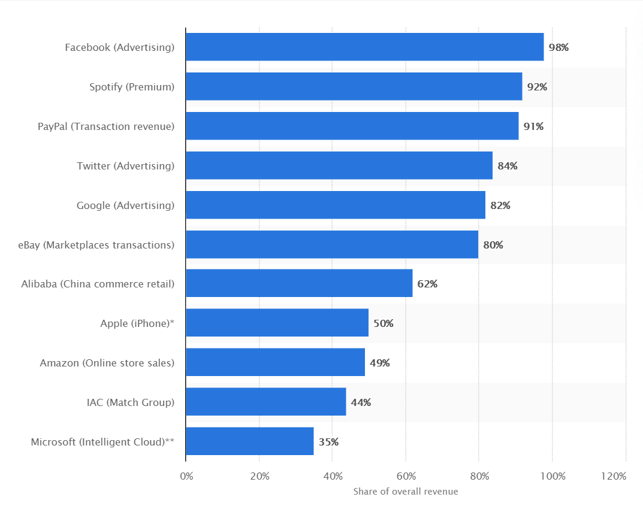
Biggest revenue source of leading online and tech companies in most recently reported quarter ending March 2020

Slide 7
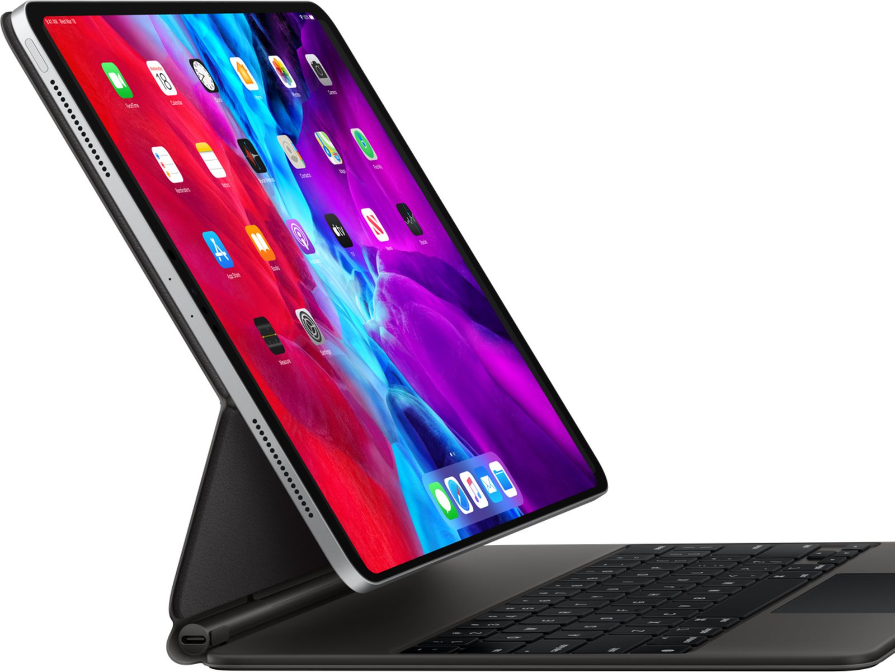
Hardware
Popular consumer electronics
--PCs
--Smart phones
--Tablets
--laptops
--E-book readers

Slide 8
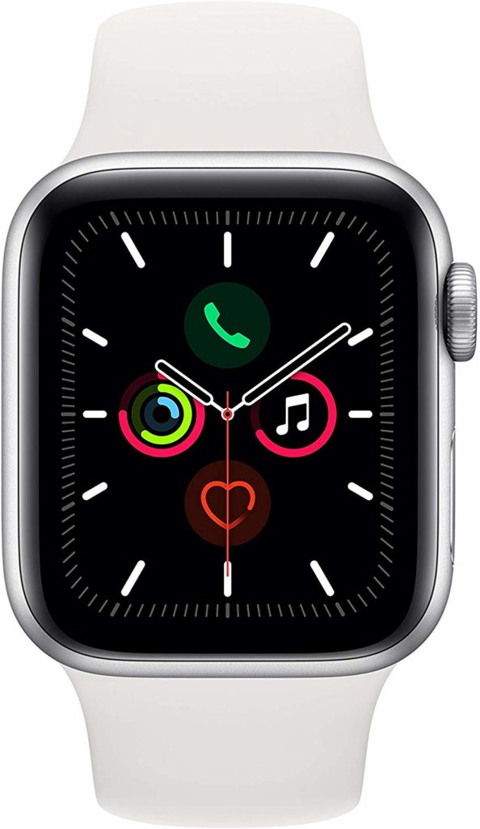
Hardware
Novelty Gadgets
--Smart watch
--Google Glasses
--Virtual Reality (VR) and Augmented Reality (AR)
--3-D Printer
--Smart home device (Amazon Echo Dot Smart Speaker)

Slide 9
Software & Service
Software
Operation System
Apps (apple’s app store & google play)
Social media (twitter, Facebook)
Apple pay, Alipay, WeChat pay (online payment)
Open source software
Services
Advertisements
Internet
E-commerce
Telecommunications services (telephone network, Internet)
Streaming service ( Netflix, YouTube, iTunes)

Slide 10
Gadget Industry Overview: Structure
The gadget industry employs:
--Engineers
--Designers
--Marketers
--Salespeople
--Customer service reps
--Finance personnel
They all work together to continuously innovate and improve existing familiar products.

Slide 11
Gadget Industry Overview: Structure
Manufacture products in low labor-cost locations
Complex value chain involves multiple-players:
--Suppliers
--Technology and developing
--Manufacturing
--Marketing
A mix of traditional industries:
--telecommunications
--computer hardware
--consumer electronics

Slide 12
Gadget Industry Overview: Trend
Convergence
Industries in electronics, computer hardware, and telecommunications are competing to be the leader in the novelty product categories
Turmoil, in the form of mergers and acquisitions and fluctuations in profitability, is likely to occur in each of these industries over time
Quality Advancement
Technological evolution speeds up exponentially
Technology standards are increasing

Slide 13
Today’s Gadget Industry
Under consumer electronics industry
--Revenue in the Consumer Electronics segment is projected to reach US$365,538m in 2020 (Statista, 2020).
--With a projected market volume of US$153,804m in 2020, most revenue is generated in China (Statista, 2020).
It is continuously growing and evolving
Exciting new developments in recent years
--Wearable device is getting popular

Slide 14
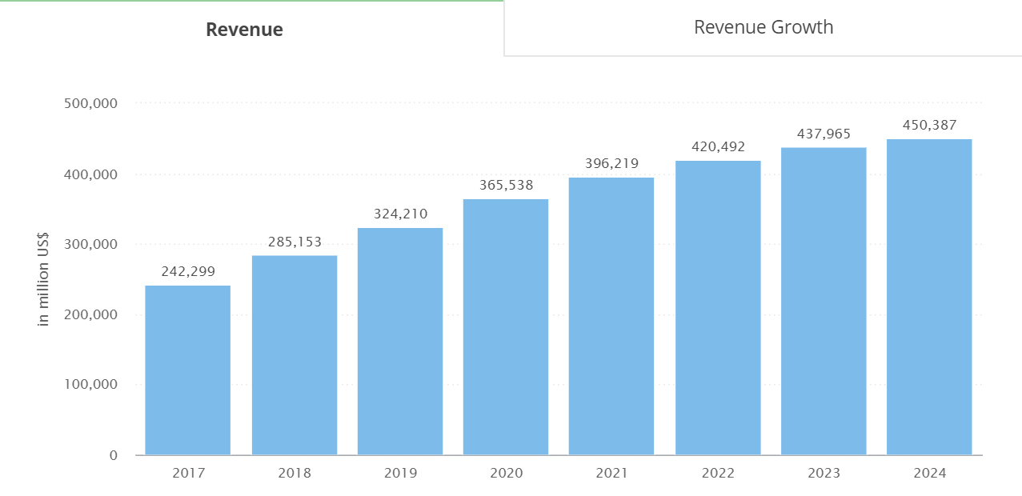
Global Revenue in the Consumer Electronics segment

Slide 15
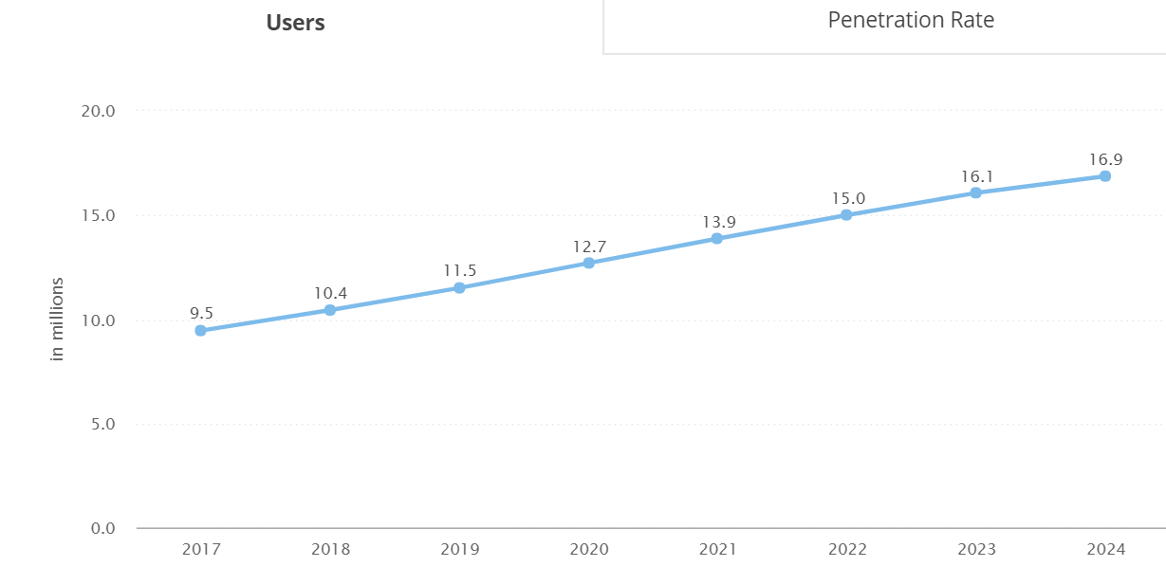
Users of consumer electronic products

Slide 16
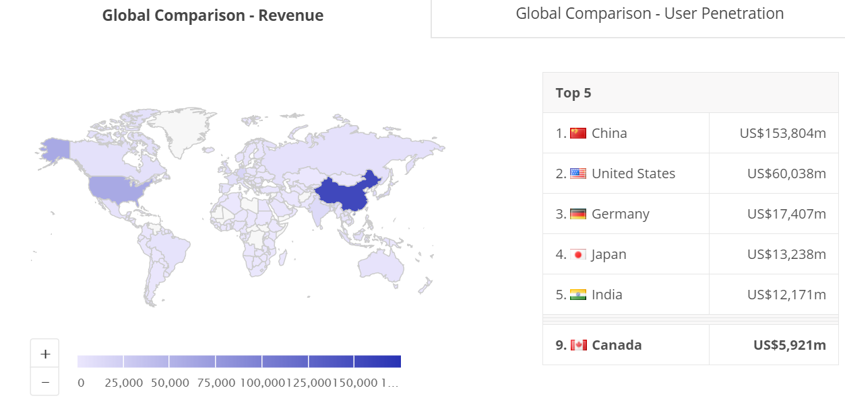

Slide 17
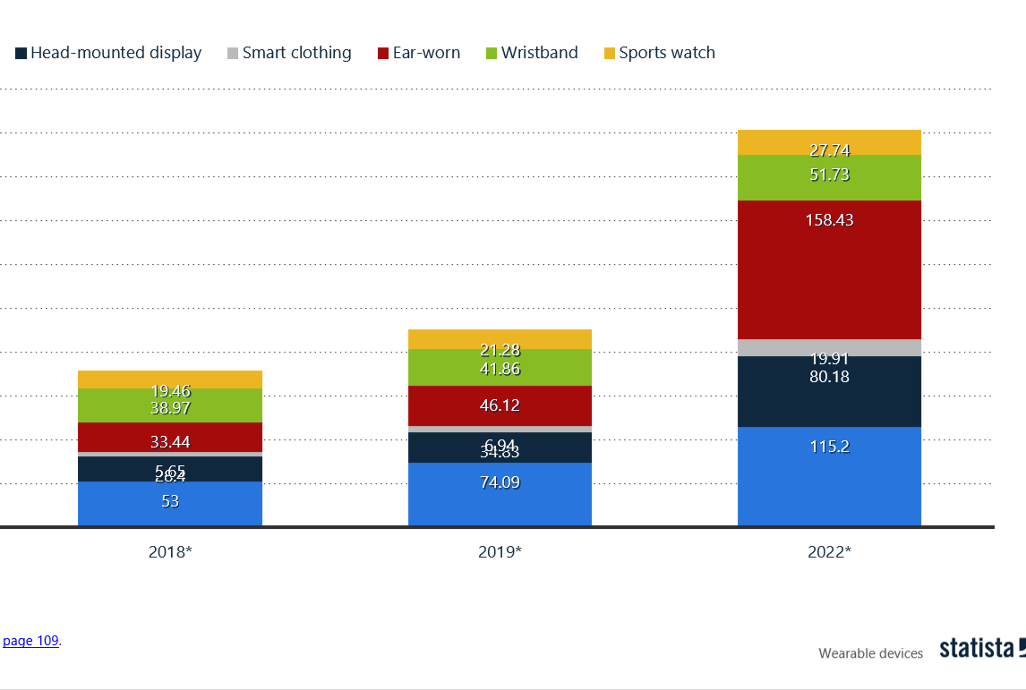
Forecast unit shipments of wearable devices worldwide

Slide 18
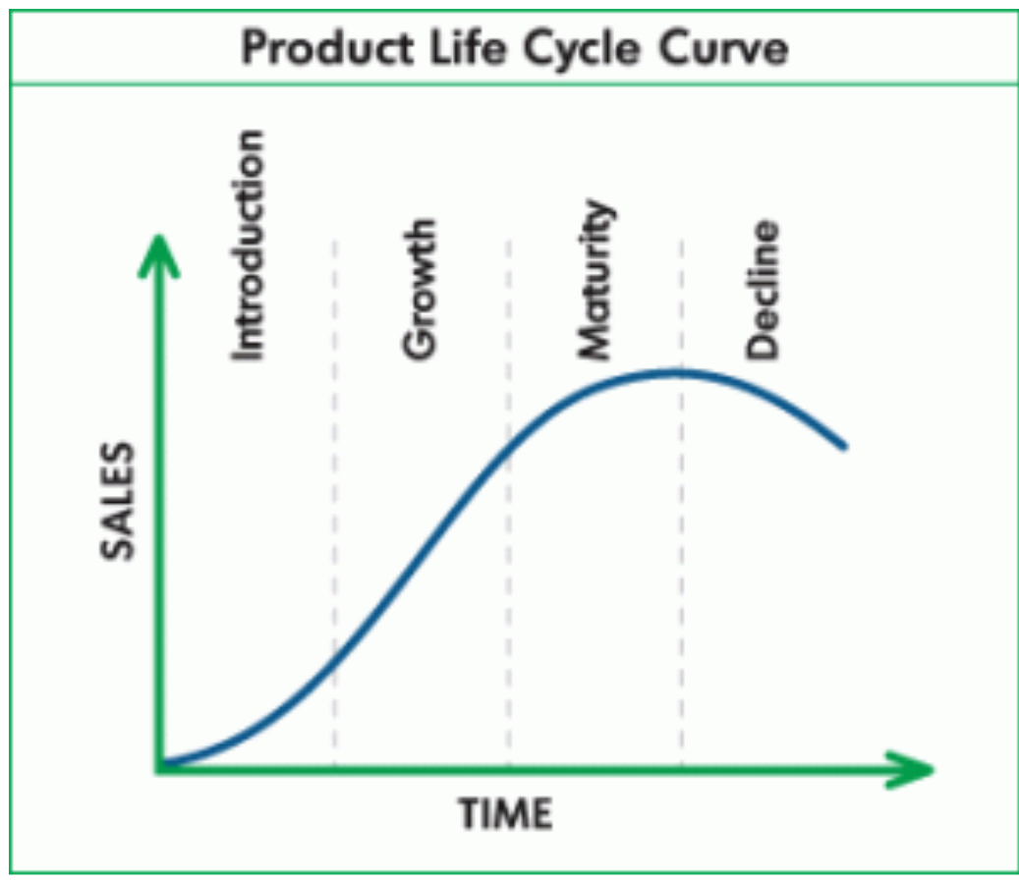
Challenges
High capital expenditure
The rate of innovation is rapidly increasing
Shortening product life-cycle
Managing a global supply chain
--electronic shortage

Slide 19
Competition
Market dominance by small number of large companies
--Profits are extremely high for those companies
Rapid changes in market shares

Slide 20
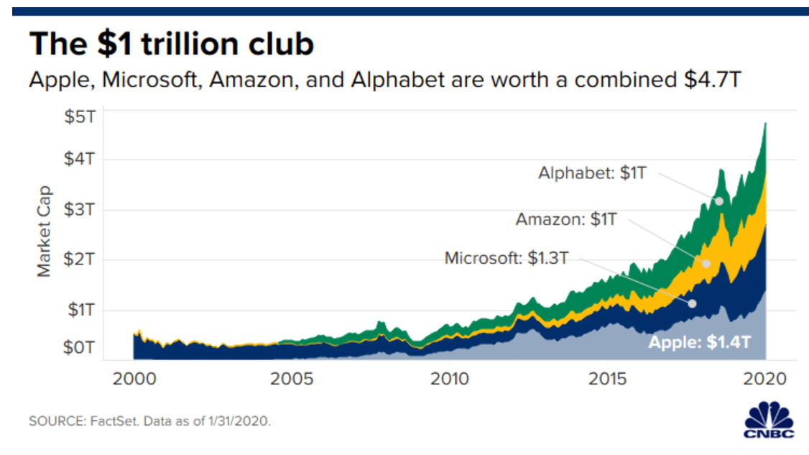

Slide 21
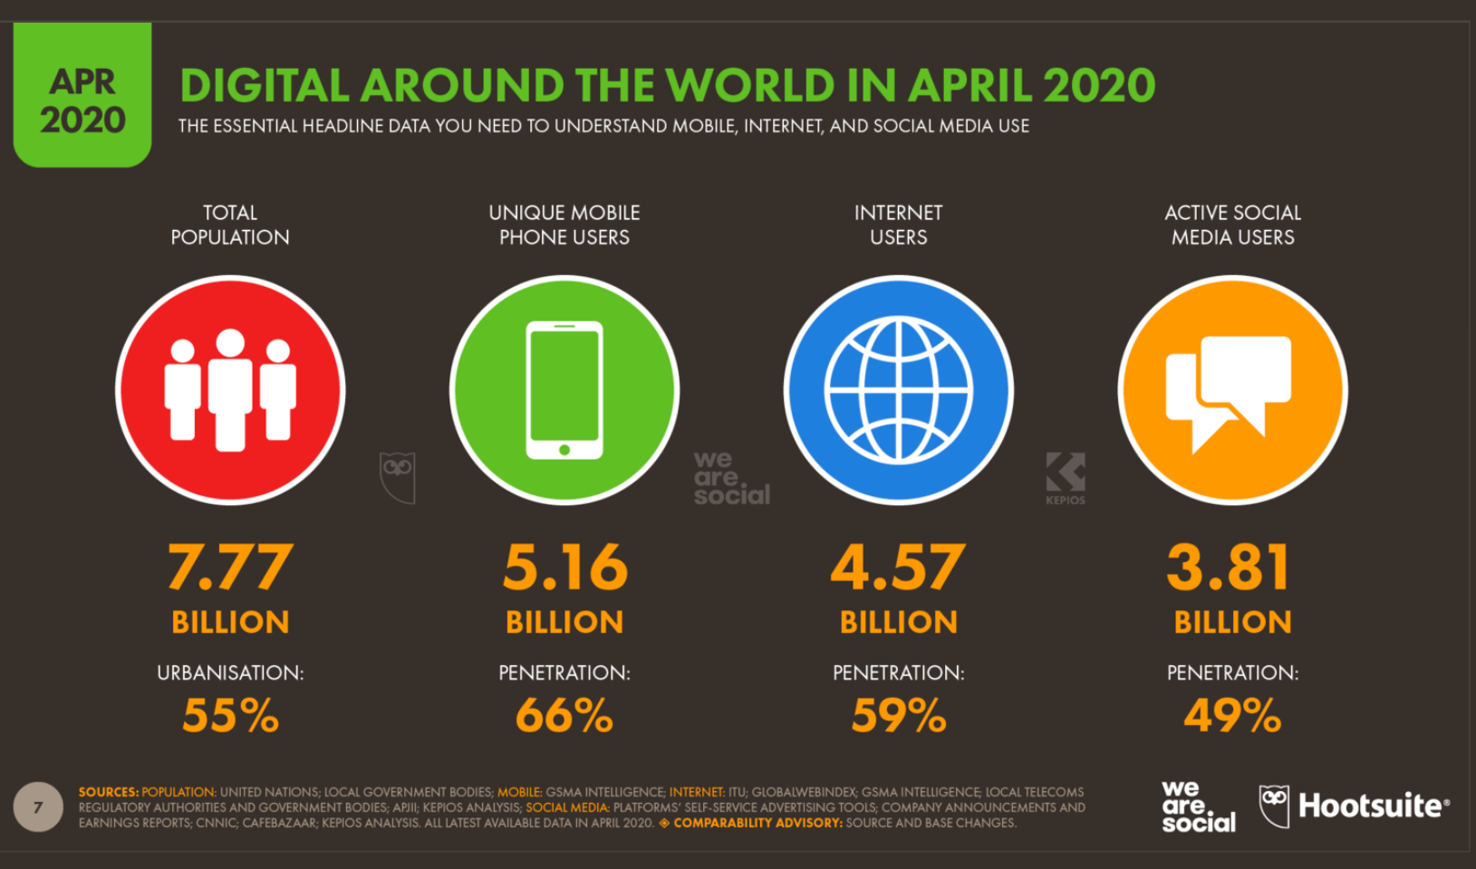

Slide 22
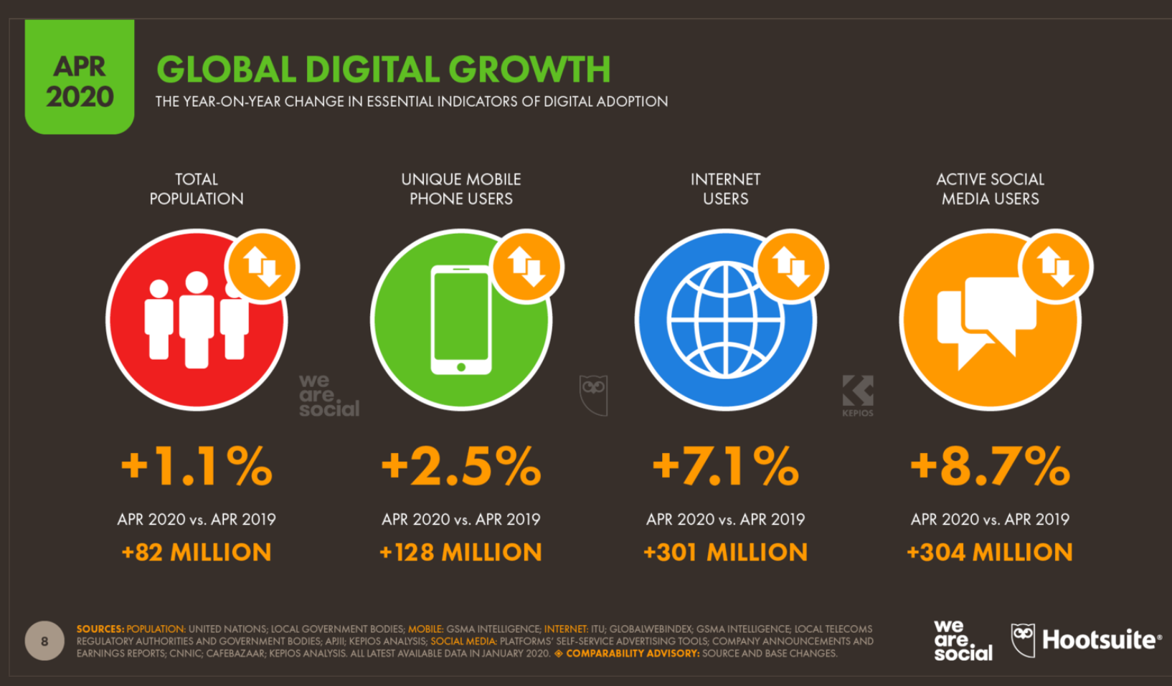
Notes:
over the past twelve months

Slide 23
Main Aspects of the Industry
Internet
Computers
Smartphones
Tablets
Smart Watch
Operation System
Cloud Computing
App Stores
Virtual Reality

Slide 24

The Internet
Called “The Net”, the network of networks, which connect billions of people worldwide and enable communication and other various activities
Notes:
facebook or youtube

Slide 25
Internet History
1969 The first prototype of internet called Appanet (funded by US Dept. of Defense)
1969 First message sent from UCLA to SRI
1990 Archie, the first search engine
1991 Internet available for commercial use
1994-95 Yahoo!, Amazon, eBay
1998 Google search engine
2004 Facebook
2005 YouTube and Reddit
2006 Twitter
2010 Instagram

Slide 26
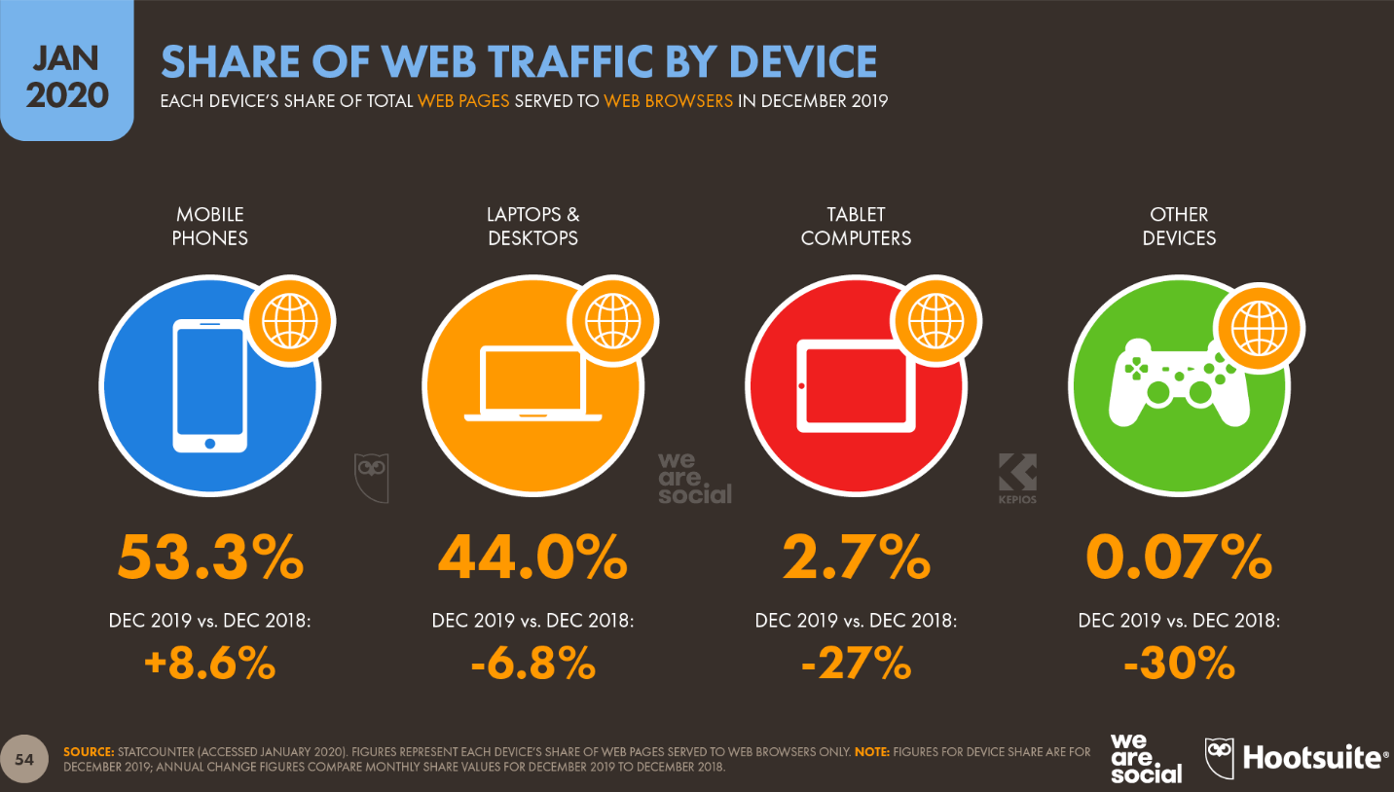

Slide 27
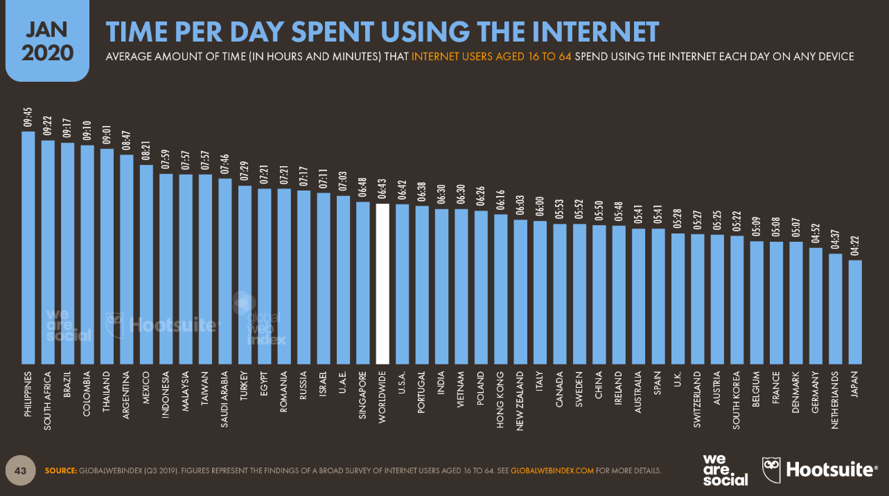

Slide 28
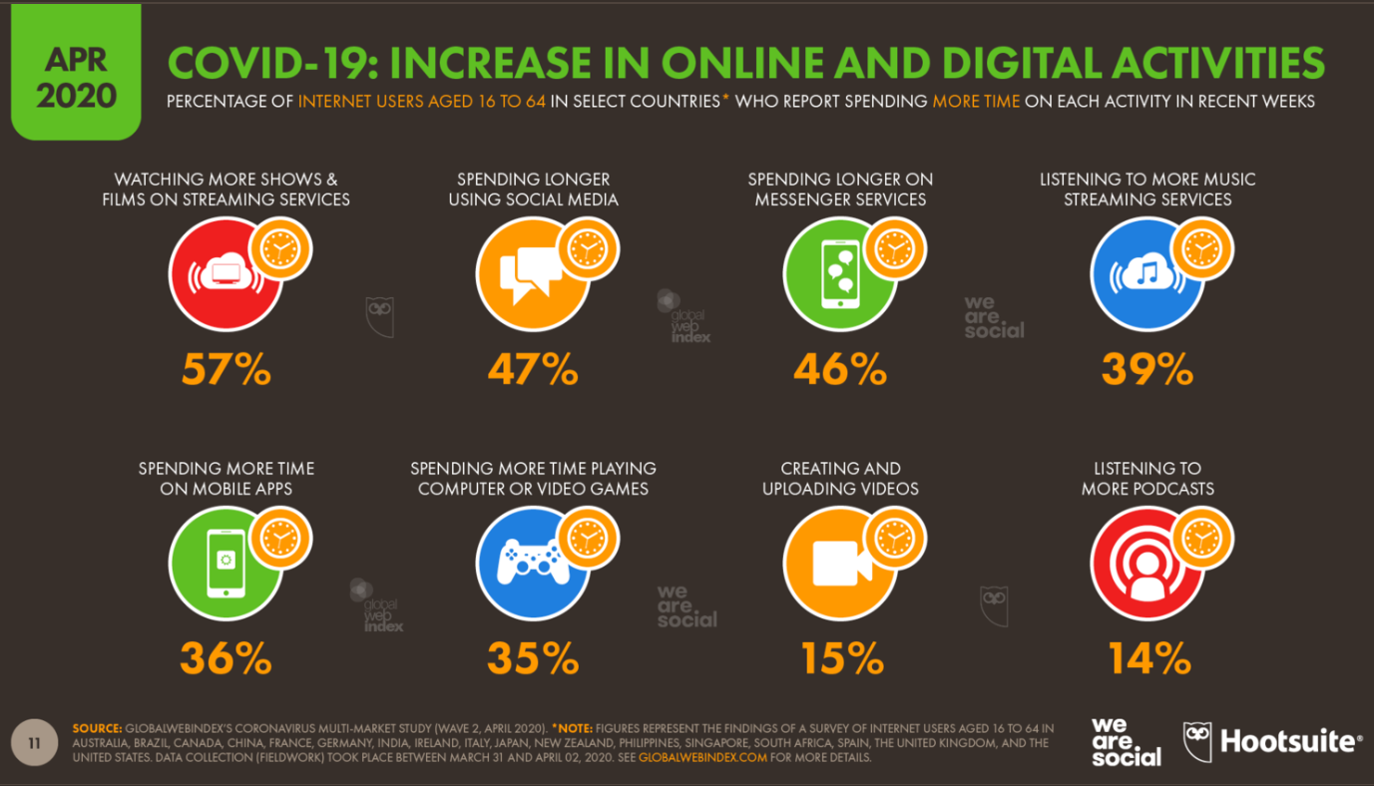

Slide 29

Computers
A device that can do a multitude of tasks
--processing and storing data
--doing set tasks based on the software it is operating on

Slide 30
Computer History
1937 First electronic digital computer
1951 First commercial computer released (first general purpose electronic digital computer)
1974 First personal computer
1976 Apple I
1977 Apple II
1984 Apple Macintosh
1985 Microsoft Windows

Slide 31
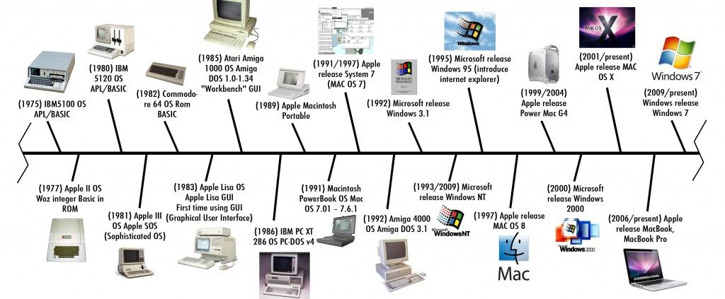
Computer Timeline

Slide 32
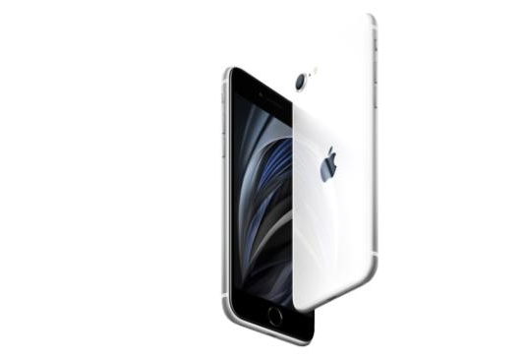
Smartphone
All in one multi-media device that works as a computer
Variety of applications available (free or purchased apps from application stores)
High speed data access
Multimedia

Slide 33
Mobile Phone History
1973 Motorola cell phone created by Martin Cooper
1973 First cell phone call made
1983 First cell phone available to consumers
1994 First smart phone (IBM Simon)
1998 First 3G networks
2002 First blackberry phone
2007 First iPhone released
2008 First Android phone released
2009 First Commercial 4G Network
2019 5G services was expected to begin (China, South Korea, Japan, and U.S.)

Slide 34

4G/LTE Networks
4G: Speeds of 1 Gbps when stationary & 100 MB/s when mobile
However, this ideal standard is too high, and no companies can do it so companies created 4G LET
4G LTE—fourth generation long term evolution (wireless broadband communication for mobile devices and data terminals)
With low data transfer latency of 50ms

Slide 35

5G Networks
Estimated 10 times faster than 4G
Targets high data rate: 20Gbps/s (upper limit) and 1 Gbps/s (minimum)
Energy saving
Reduces latency to 1ms
Higher capacity for bandwidth and devices

Slide 36
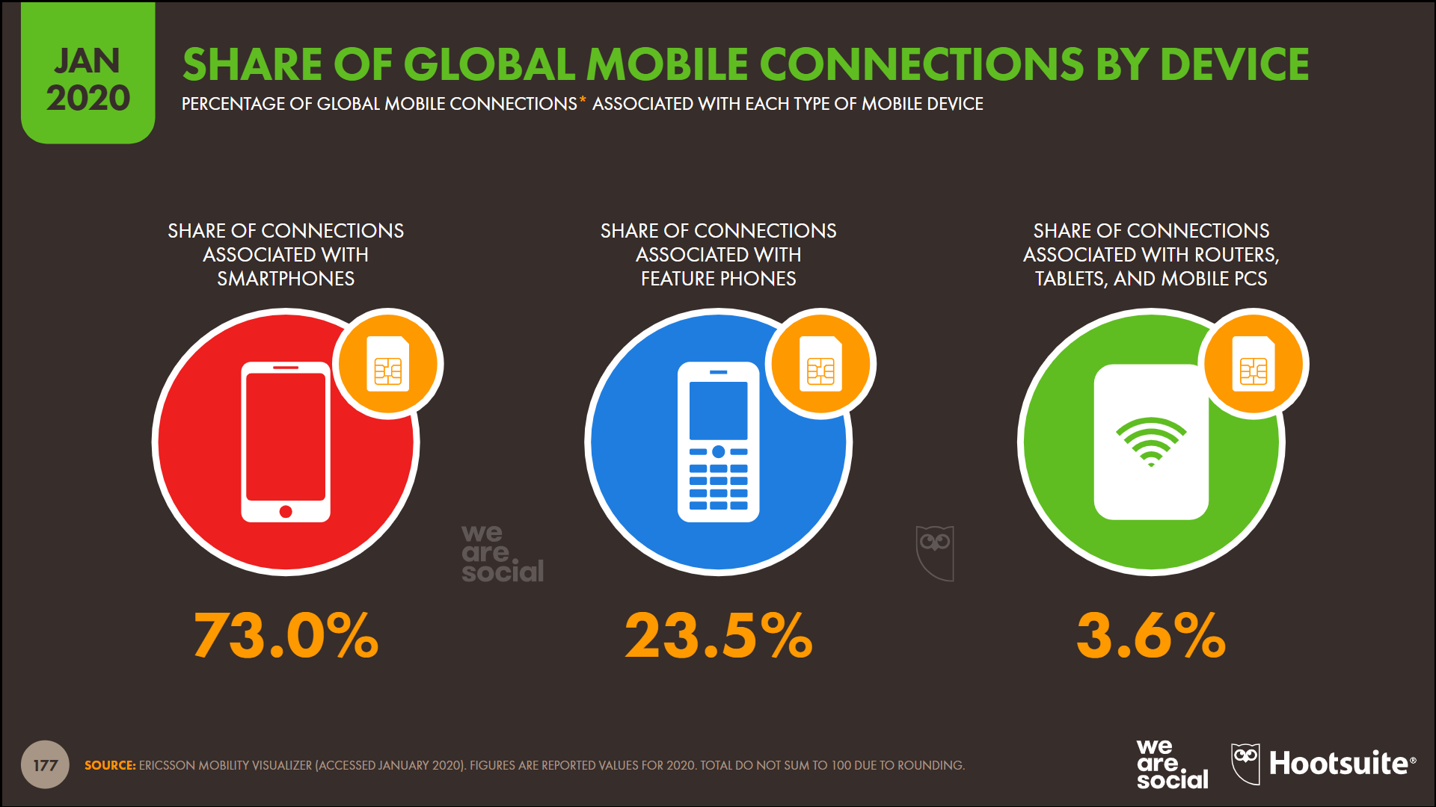

Slide 37
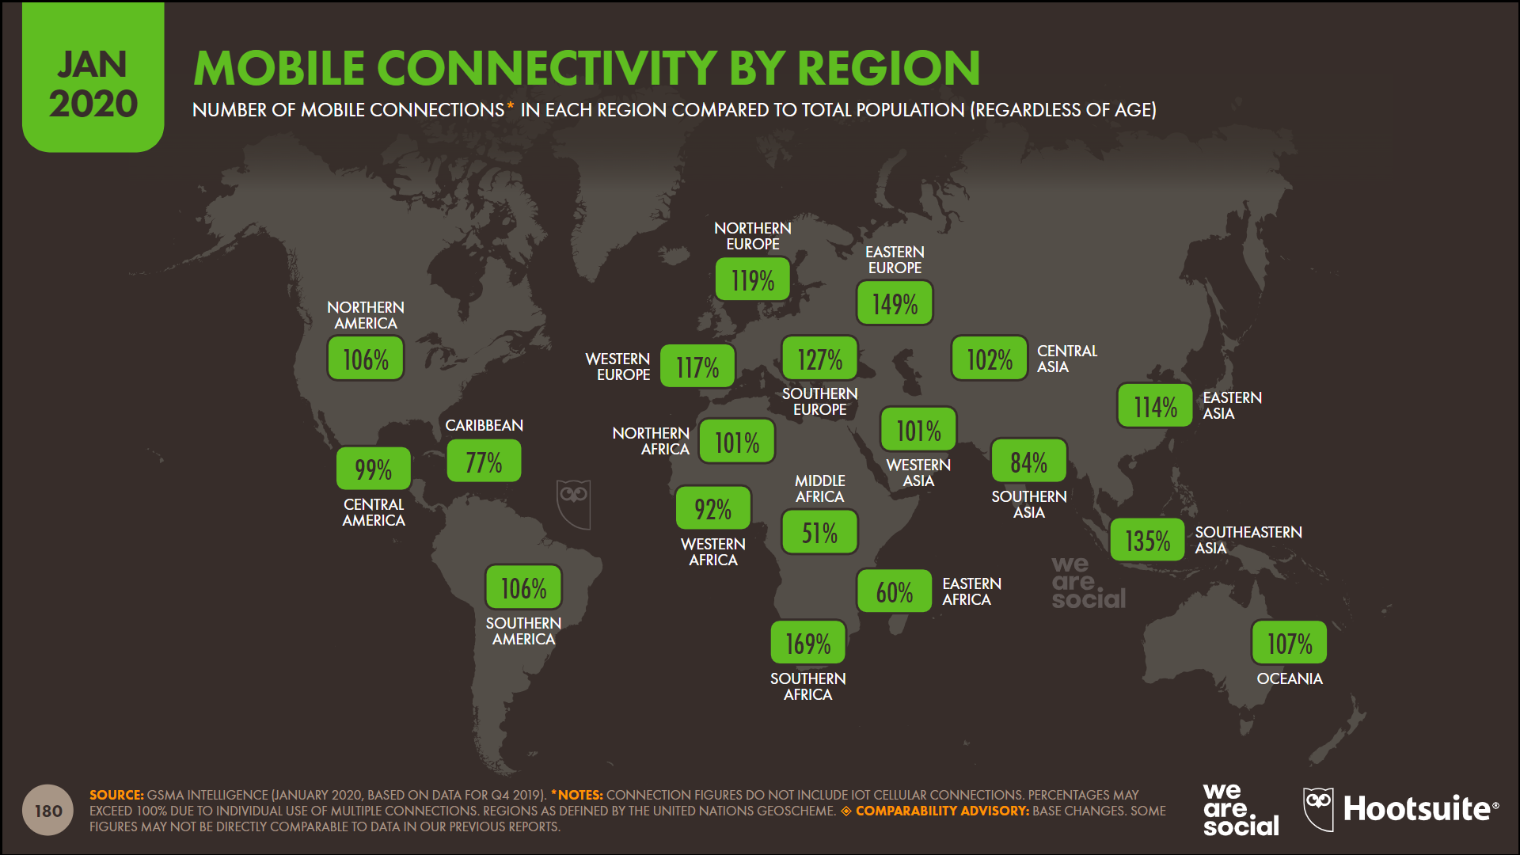

Slide 38
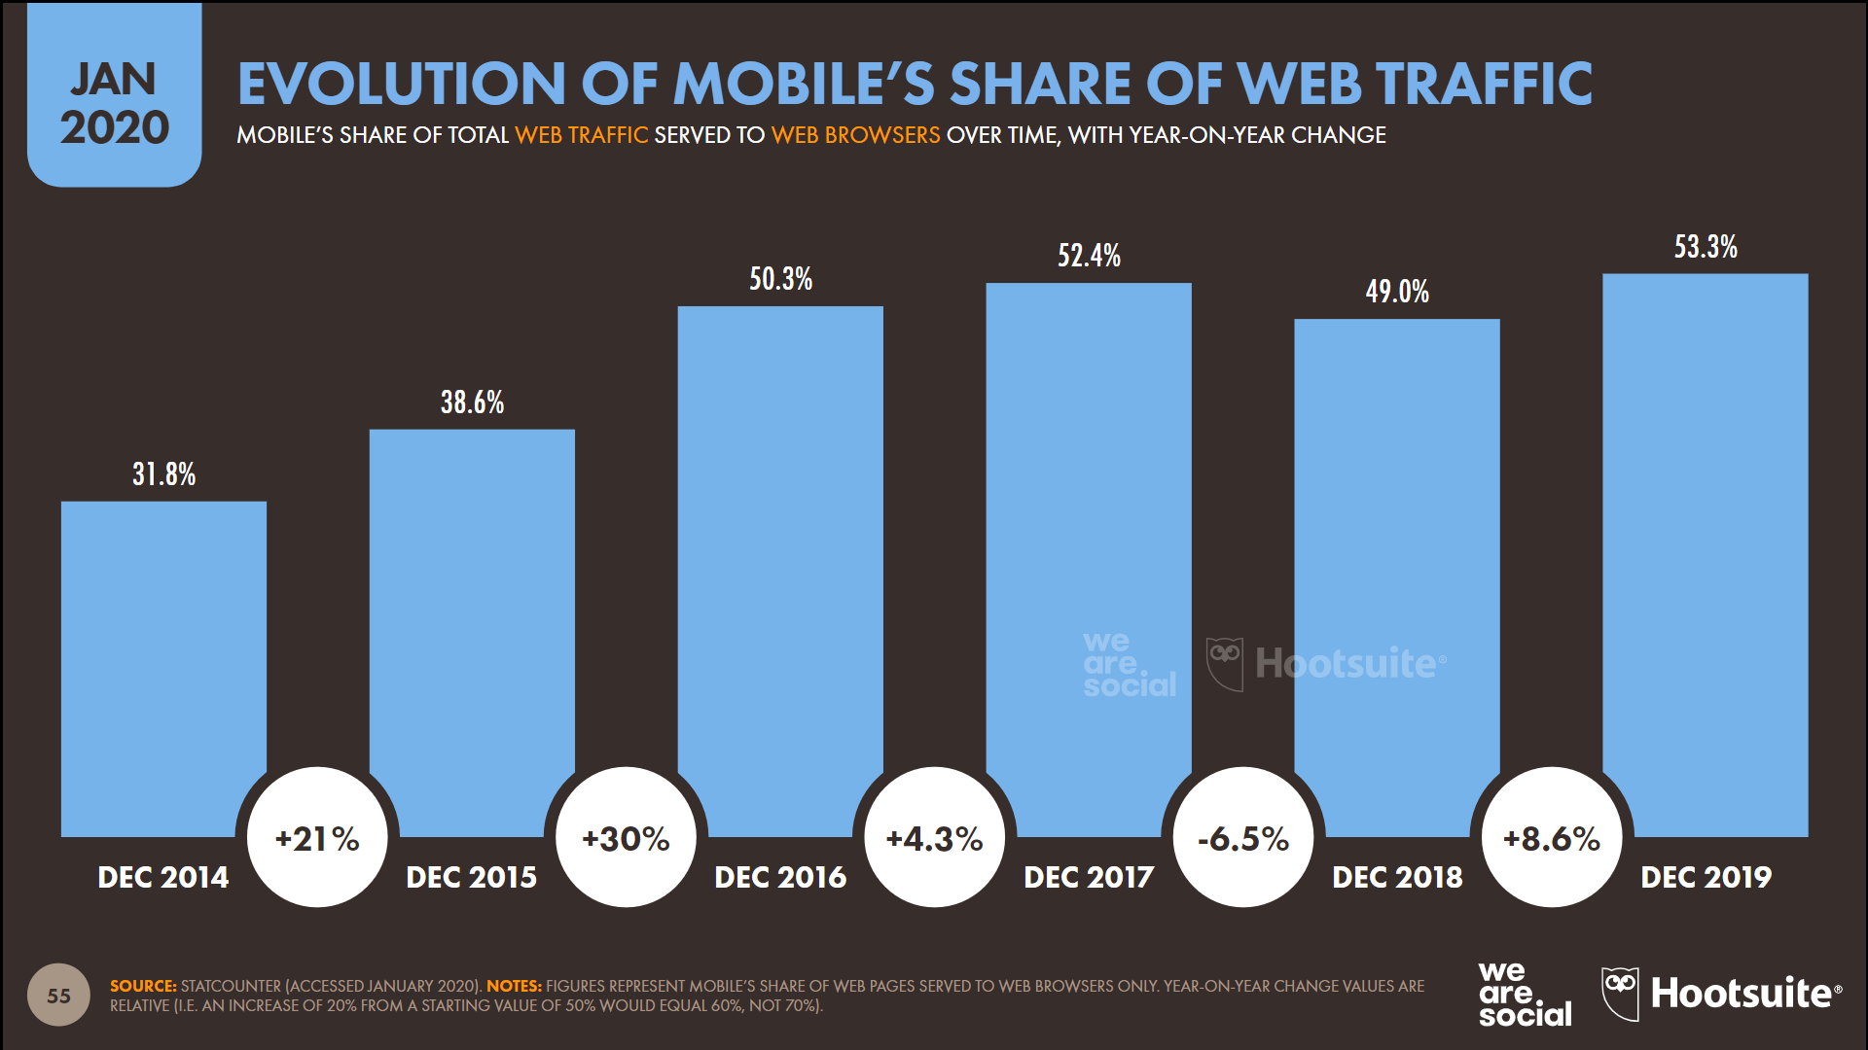

Slide 39
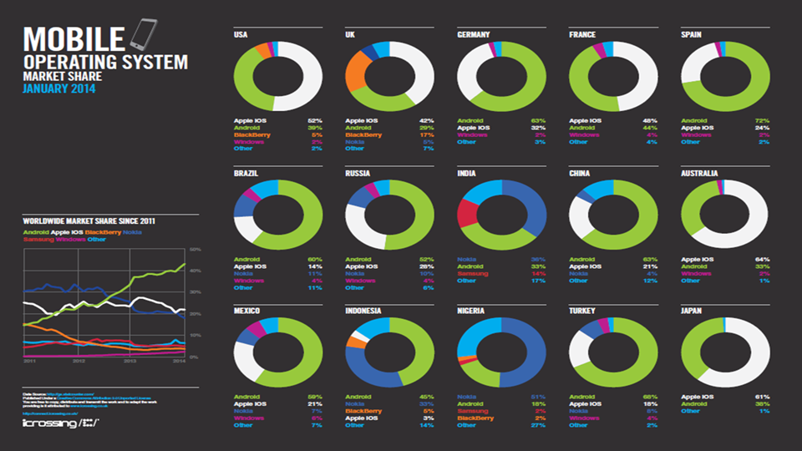

Slide 40
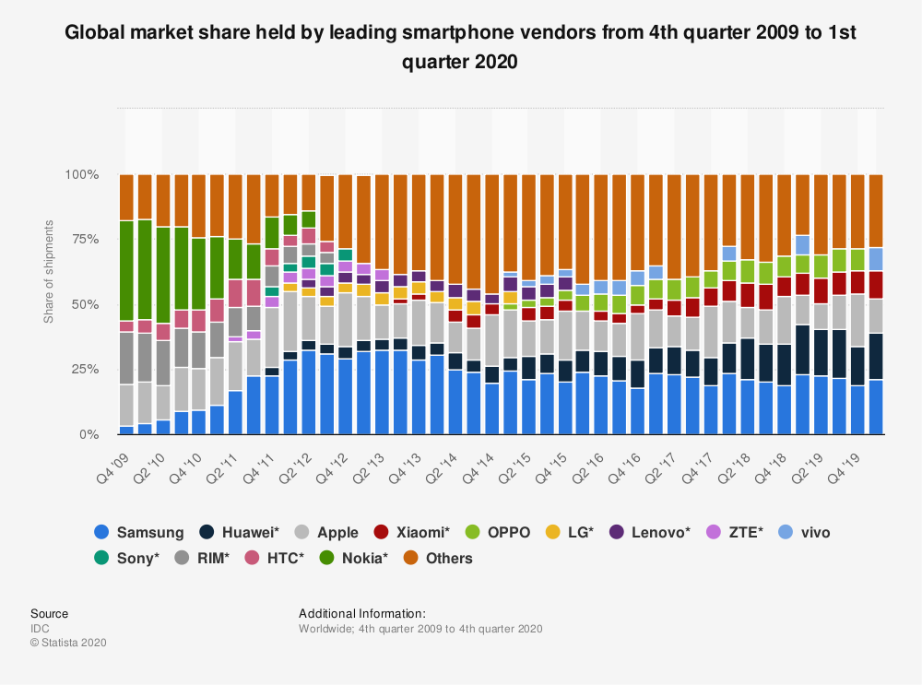

Slide 41
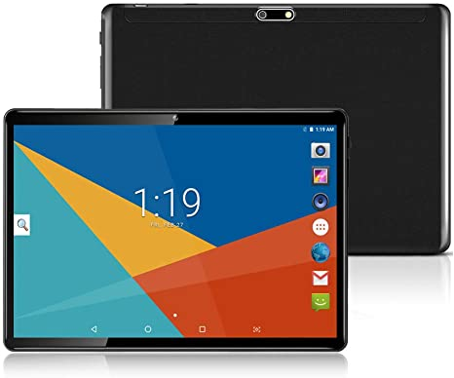
Tablets
What is a Tablet?
Larger than a Smartphone
Touchscreen used as primary method of input
Some typical functions are:
Mobile Browsing
Portable Media Player
Camera
Downloadable Apps

Slide 42
Tablet History
1971: Allan Kay describes a tablet computer at Xerox PARC
1983: Apple and AT&T work on a tablet prototype
1991: IBM markets a tablet computer but fails
1993: Apple Newton launched, also fails
1996: NewsPad debuts; considered one of the first serious prototypes
2009: Various computer manufacturers release tablets to market
2010: Apple iPad and Samsung Galaxy tab launched
2012: Microsoft Surface launched

Slide 43
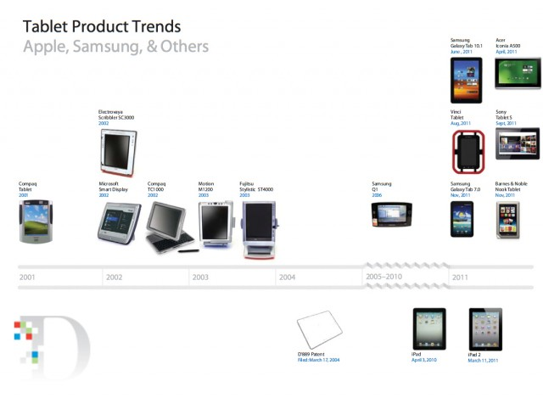

Slide 44
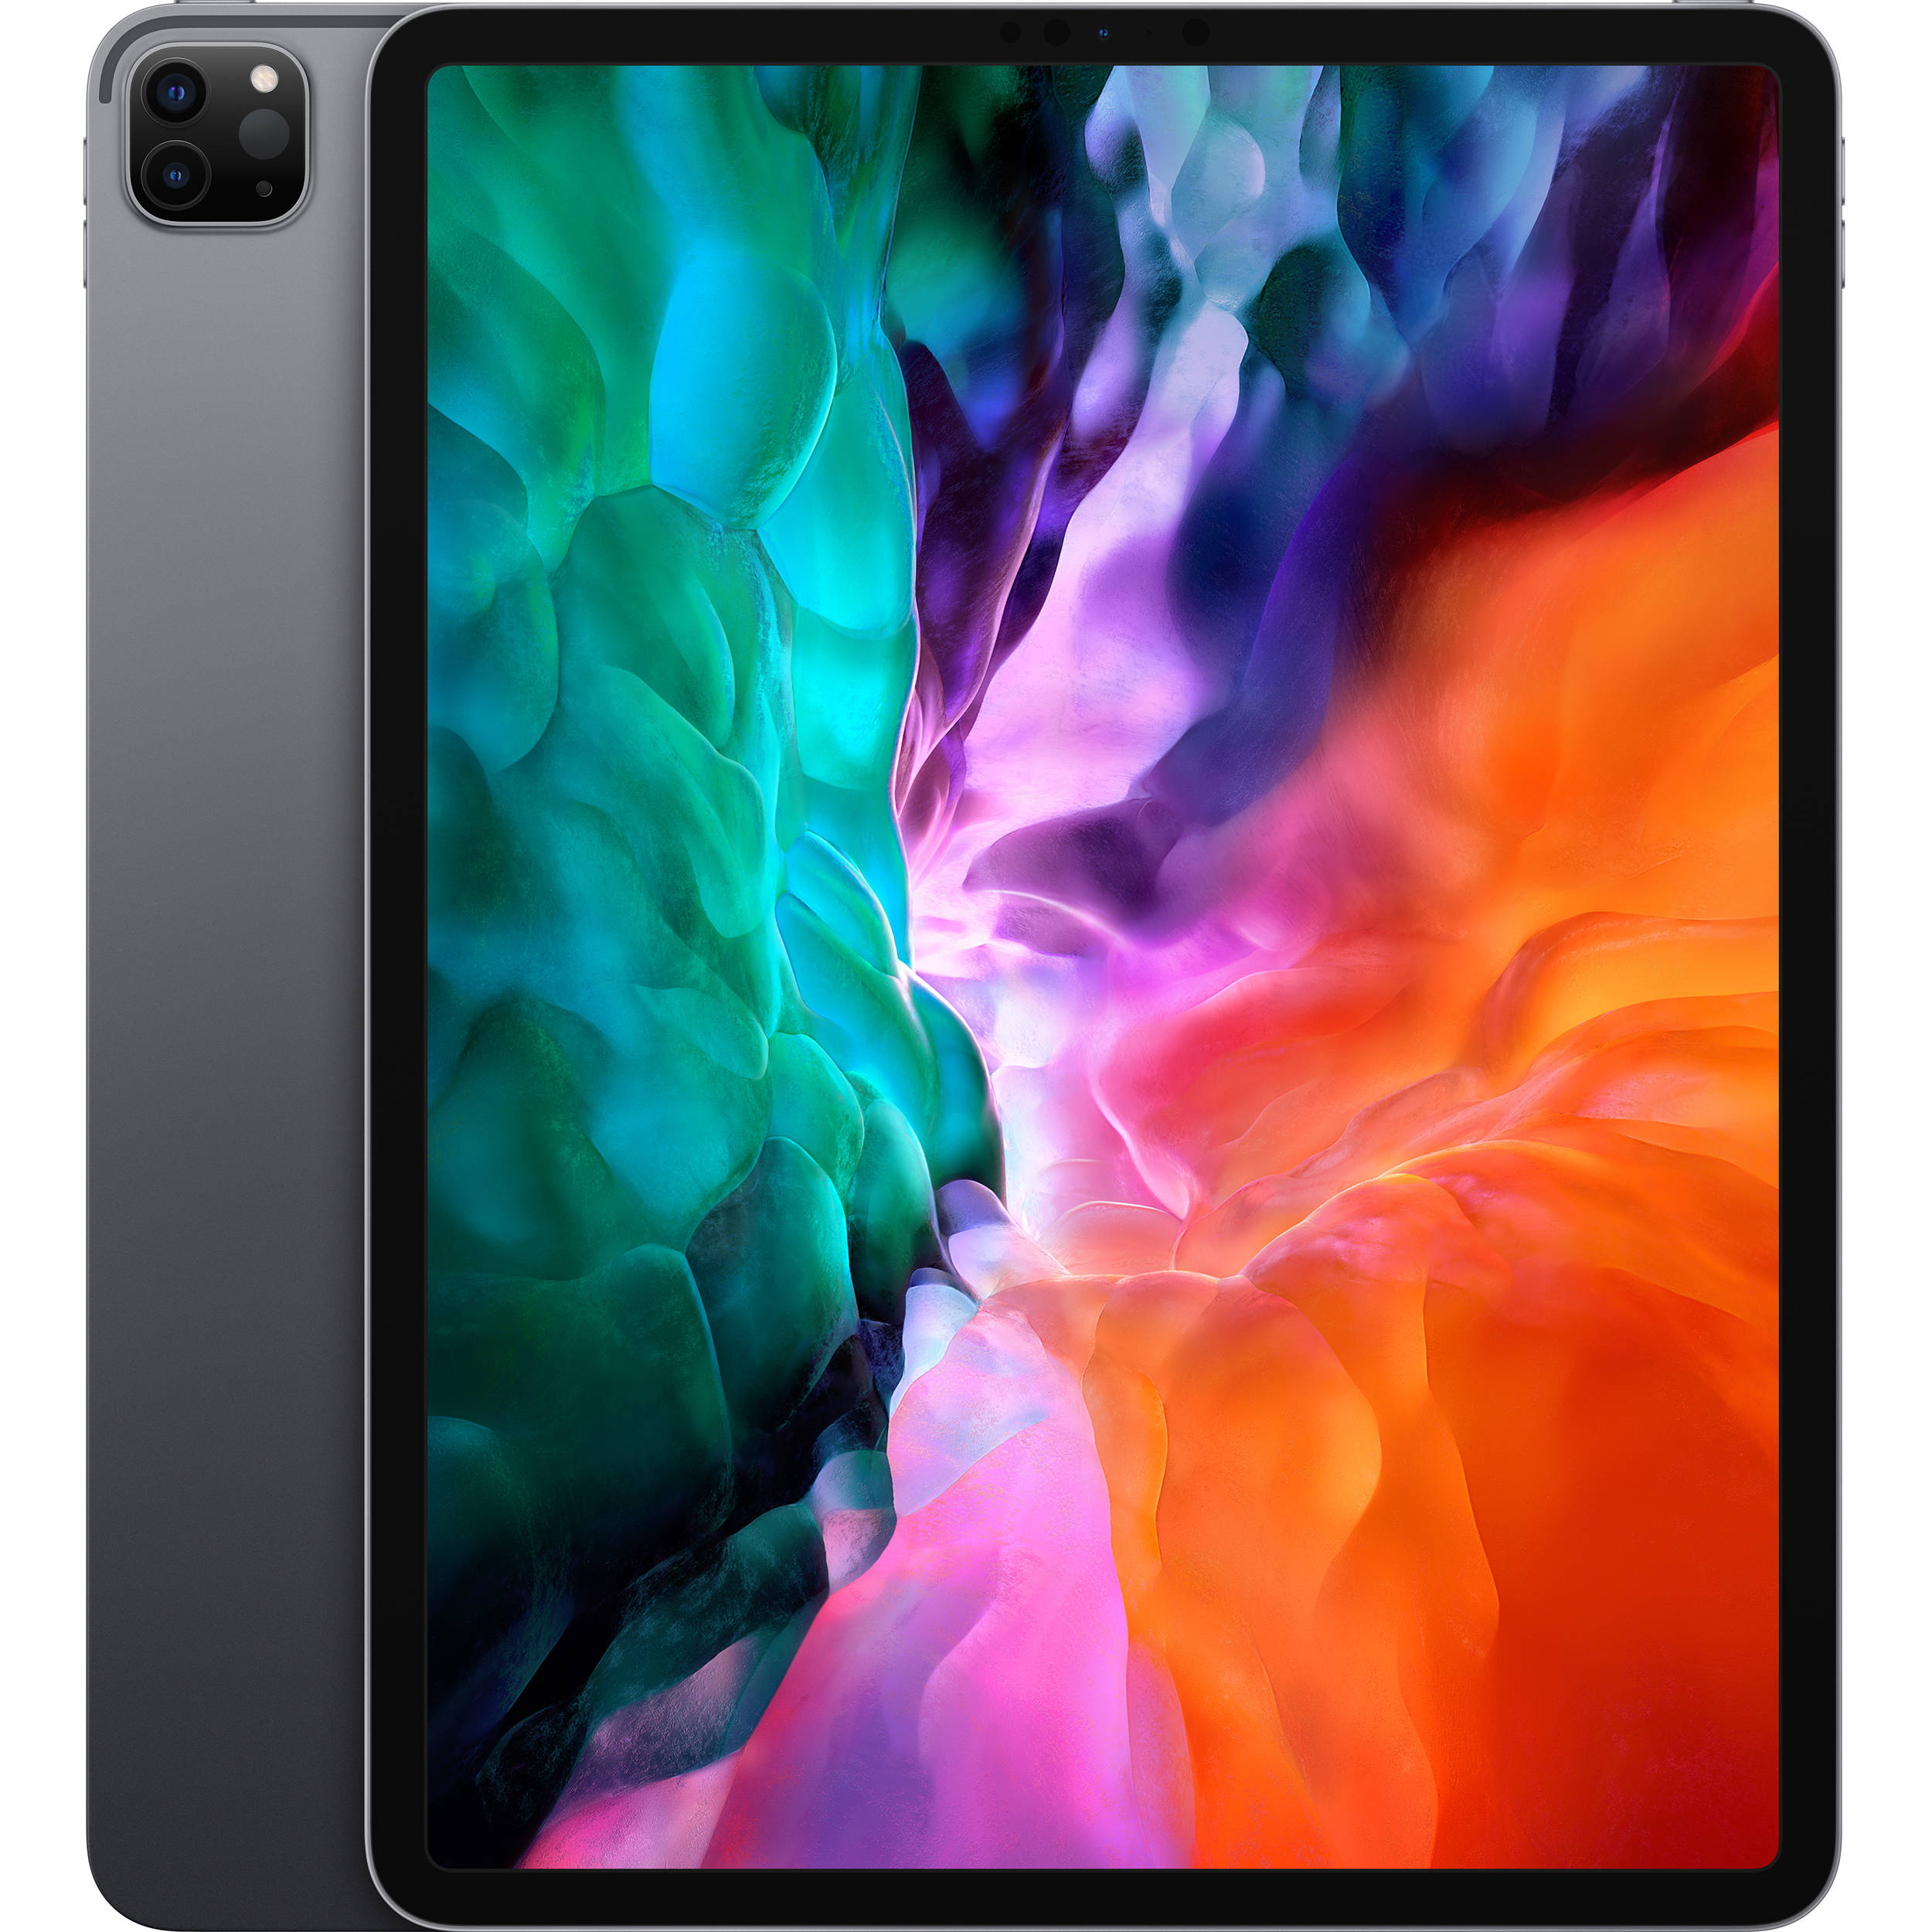
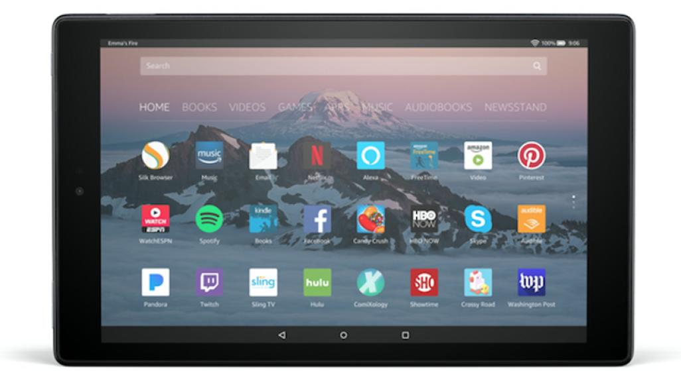
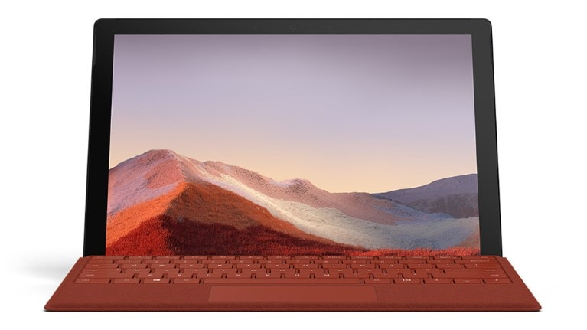
2020 Tablets
Apple iPad (2019)
Apple iPad Pro (12.9-inch, 2020)
Amazon Fire HD 10
Apple iPad mini
Microsoft Surface Pro 7
Apple iPad Air
Microsoft Surface Go 2
Samsung Galaxy Tab S6 Lite
Huawei MediaPad Pro
Samsung Galaxy Tab S6

Slide 45
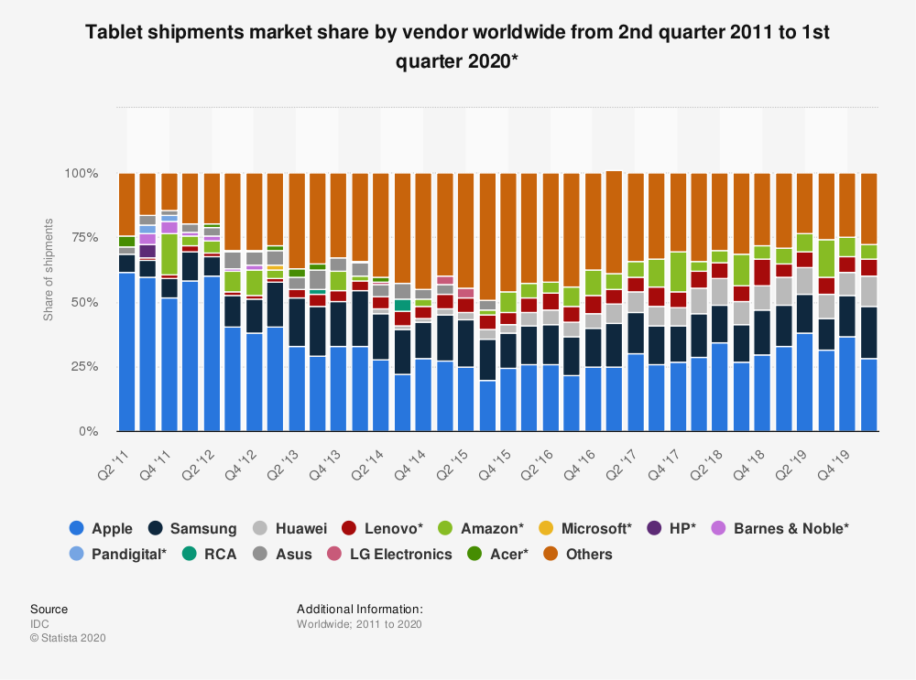

Slide 46
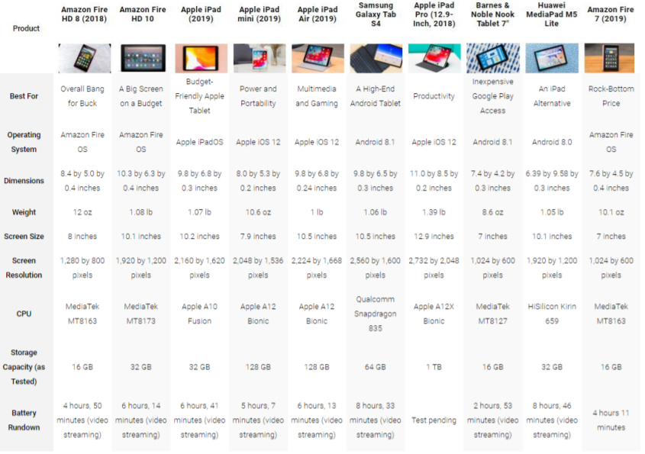

Slide 47
Tablets Comparison Chart 2020

Slide 48
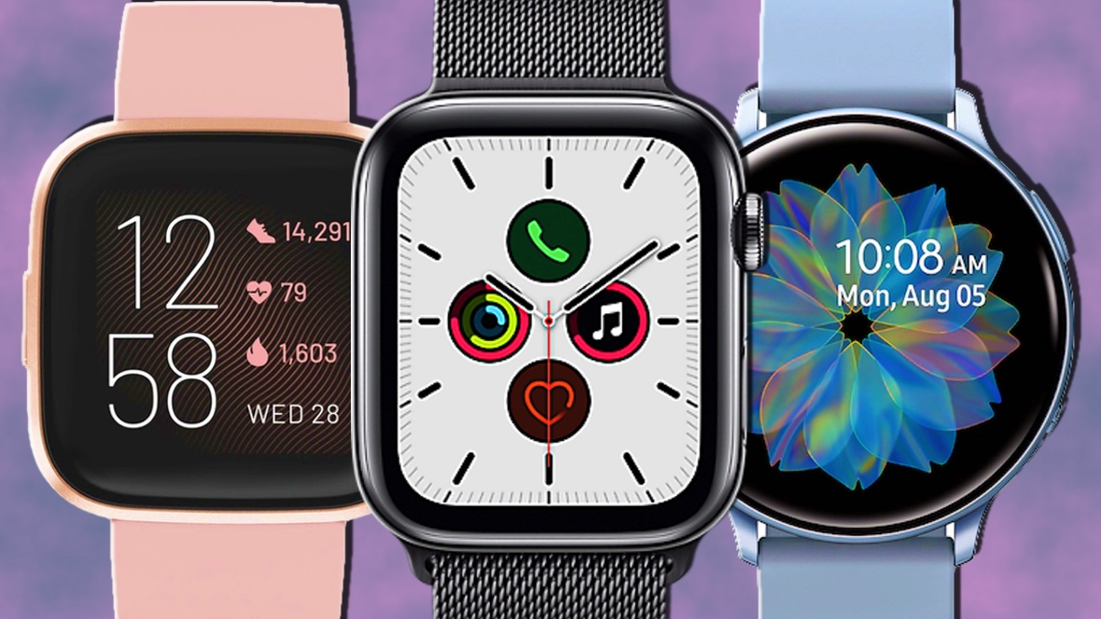
Smart Watches
A computerized wristwatch with functionality that is enhanced beyond timekeeping, and is often comparable to a personal digital assistant device

Slide 49
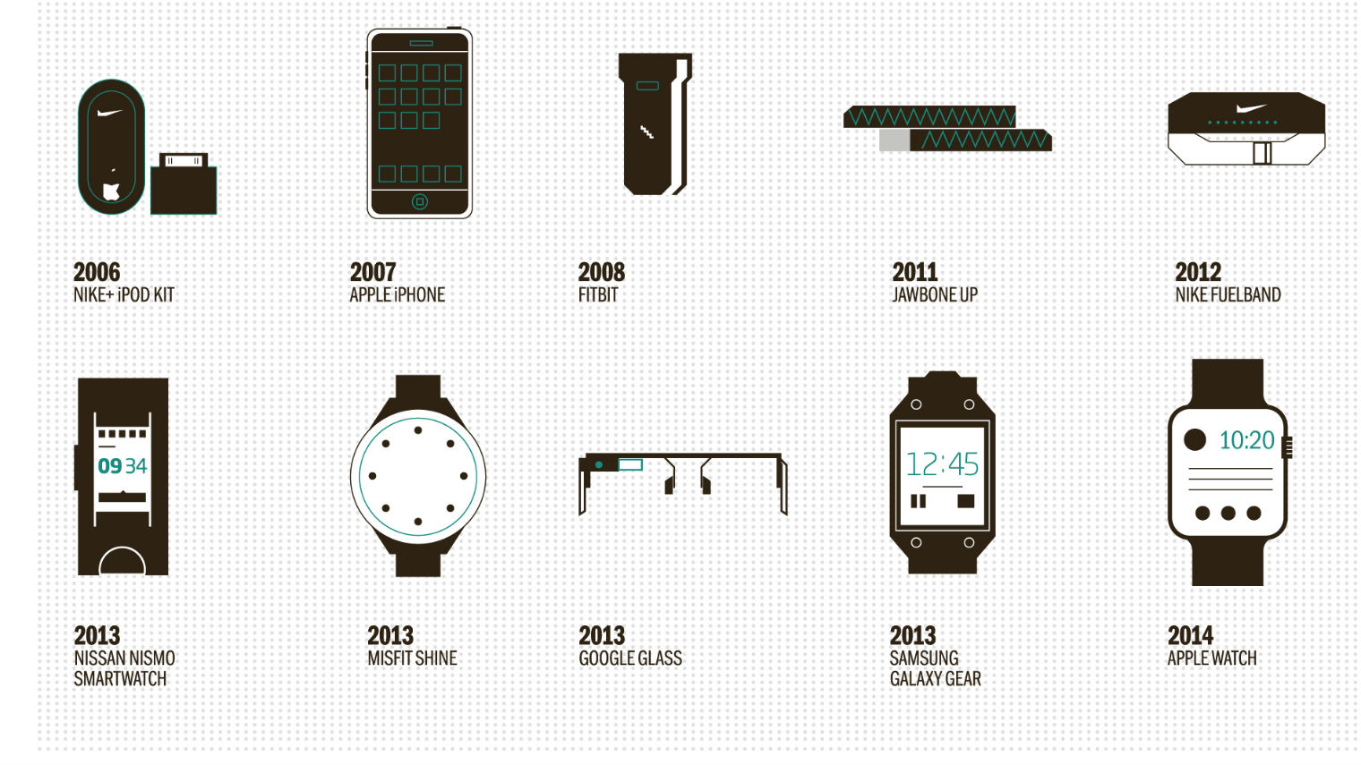

Slide 50
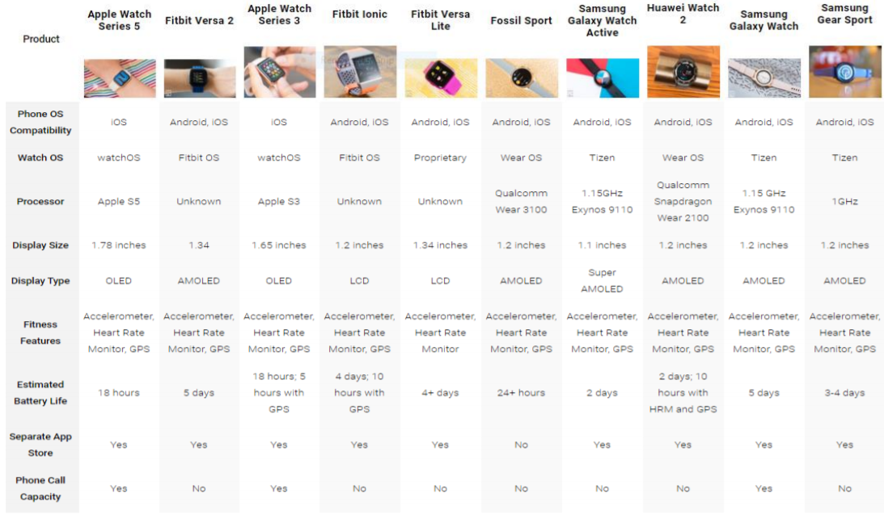

Slide 51
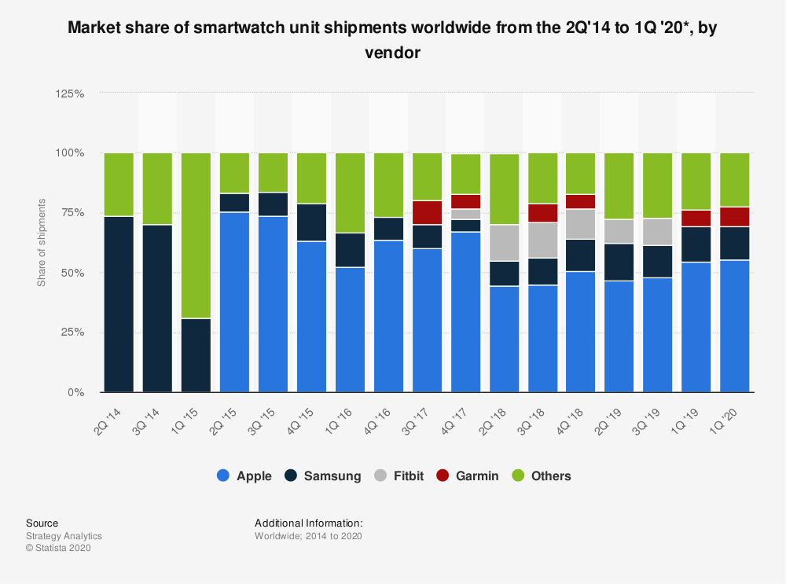

Slide 52

Operating system
Software that manages computer hardware resources
Provides services for computer programs

Slide 53
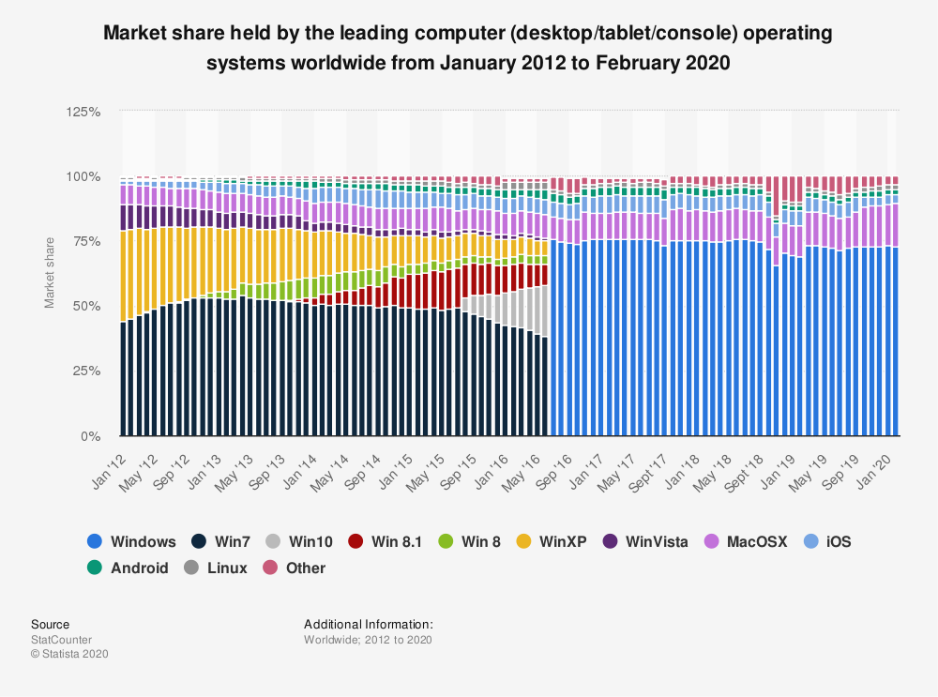

Slide 54
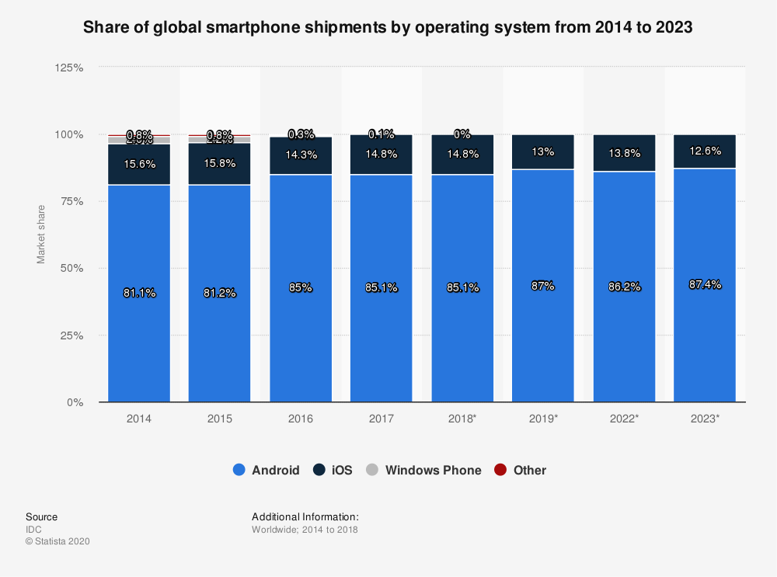

Slide 55
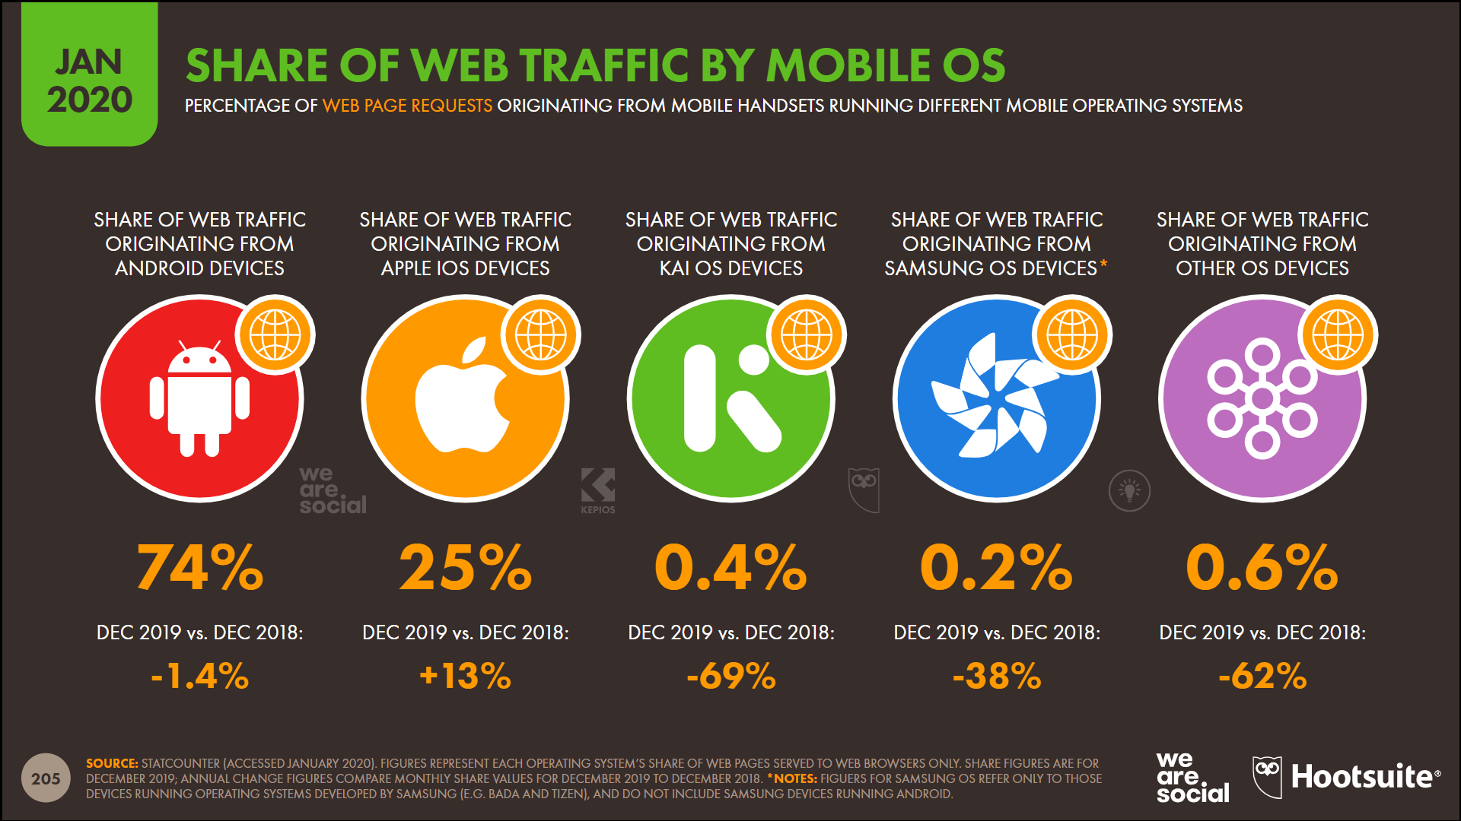

Slide 56

Cloud Computing
A model of network computing where a program or application runs on a connected server or servers rather than on a local computing device

Slide 57
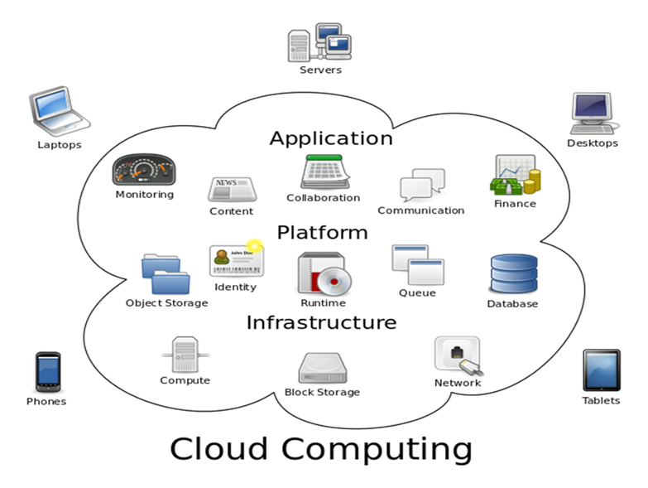
Cloud Computing

Slide 58
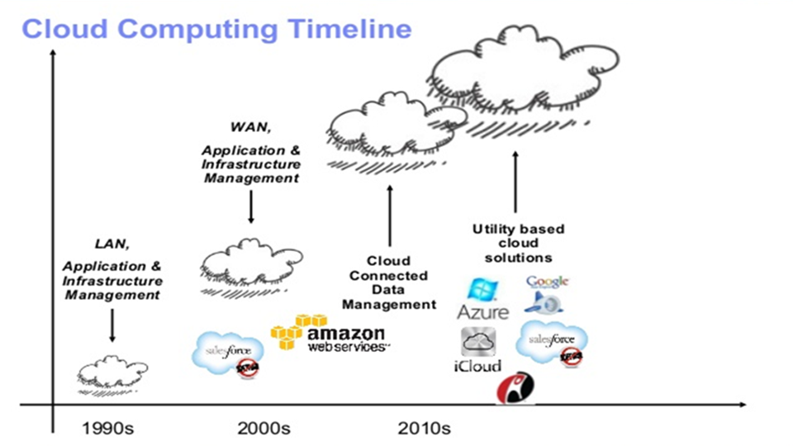

Slide 59
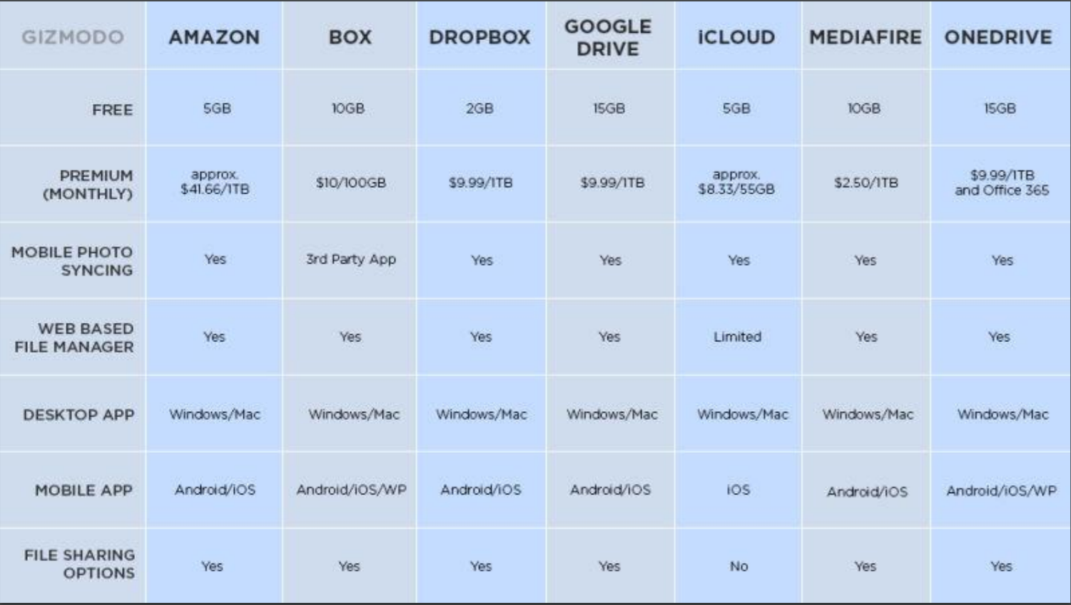

Slide 60
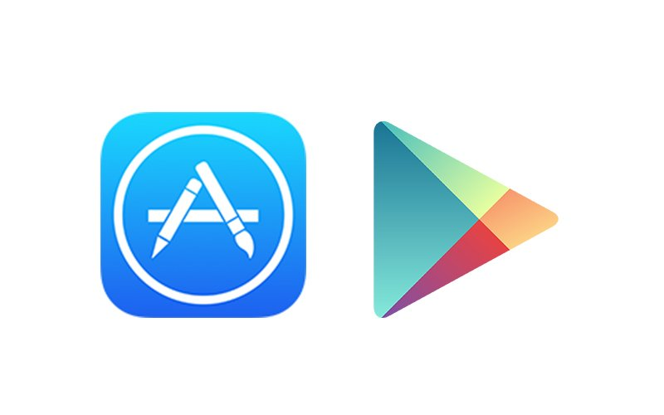
App Stores
A digital distribution platform for users to download or purchase applications for devices
For entertainment, education, lifestyle, etc.

Slide 61
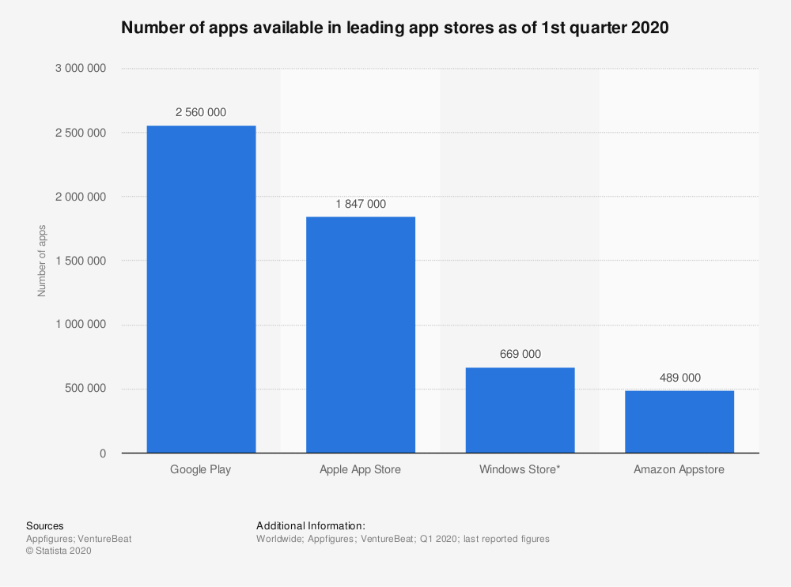

Slide 62
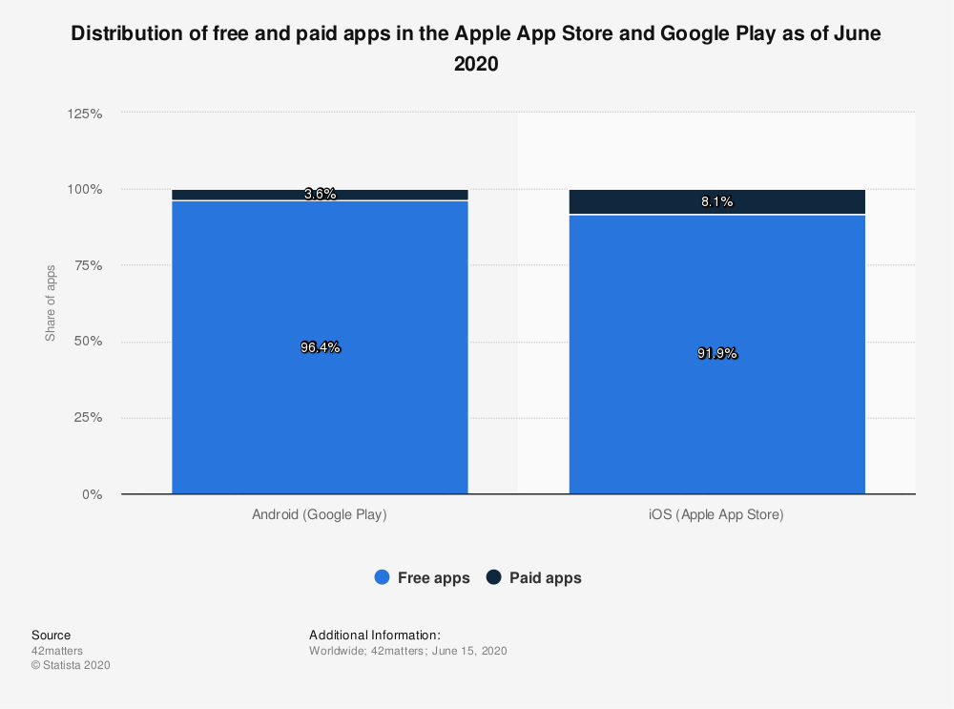

Slide 63
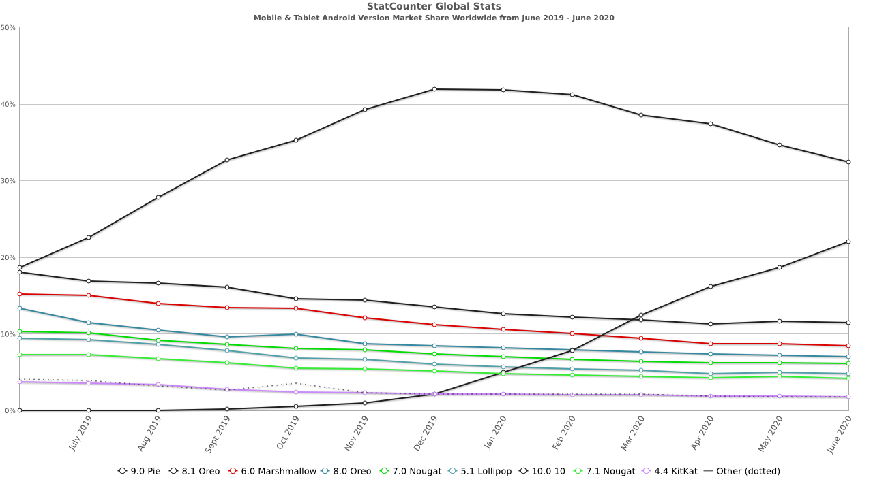

Slide 64
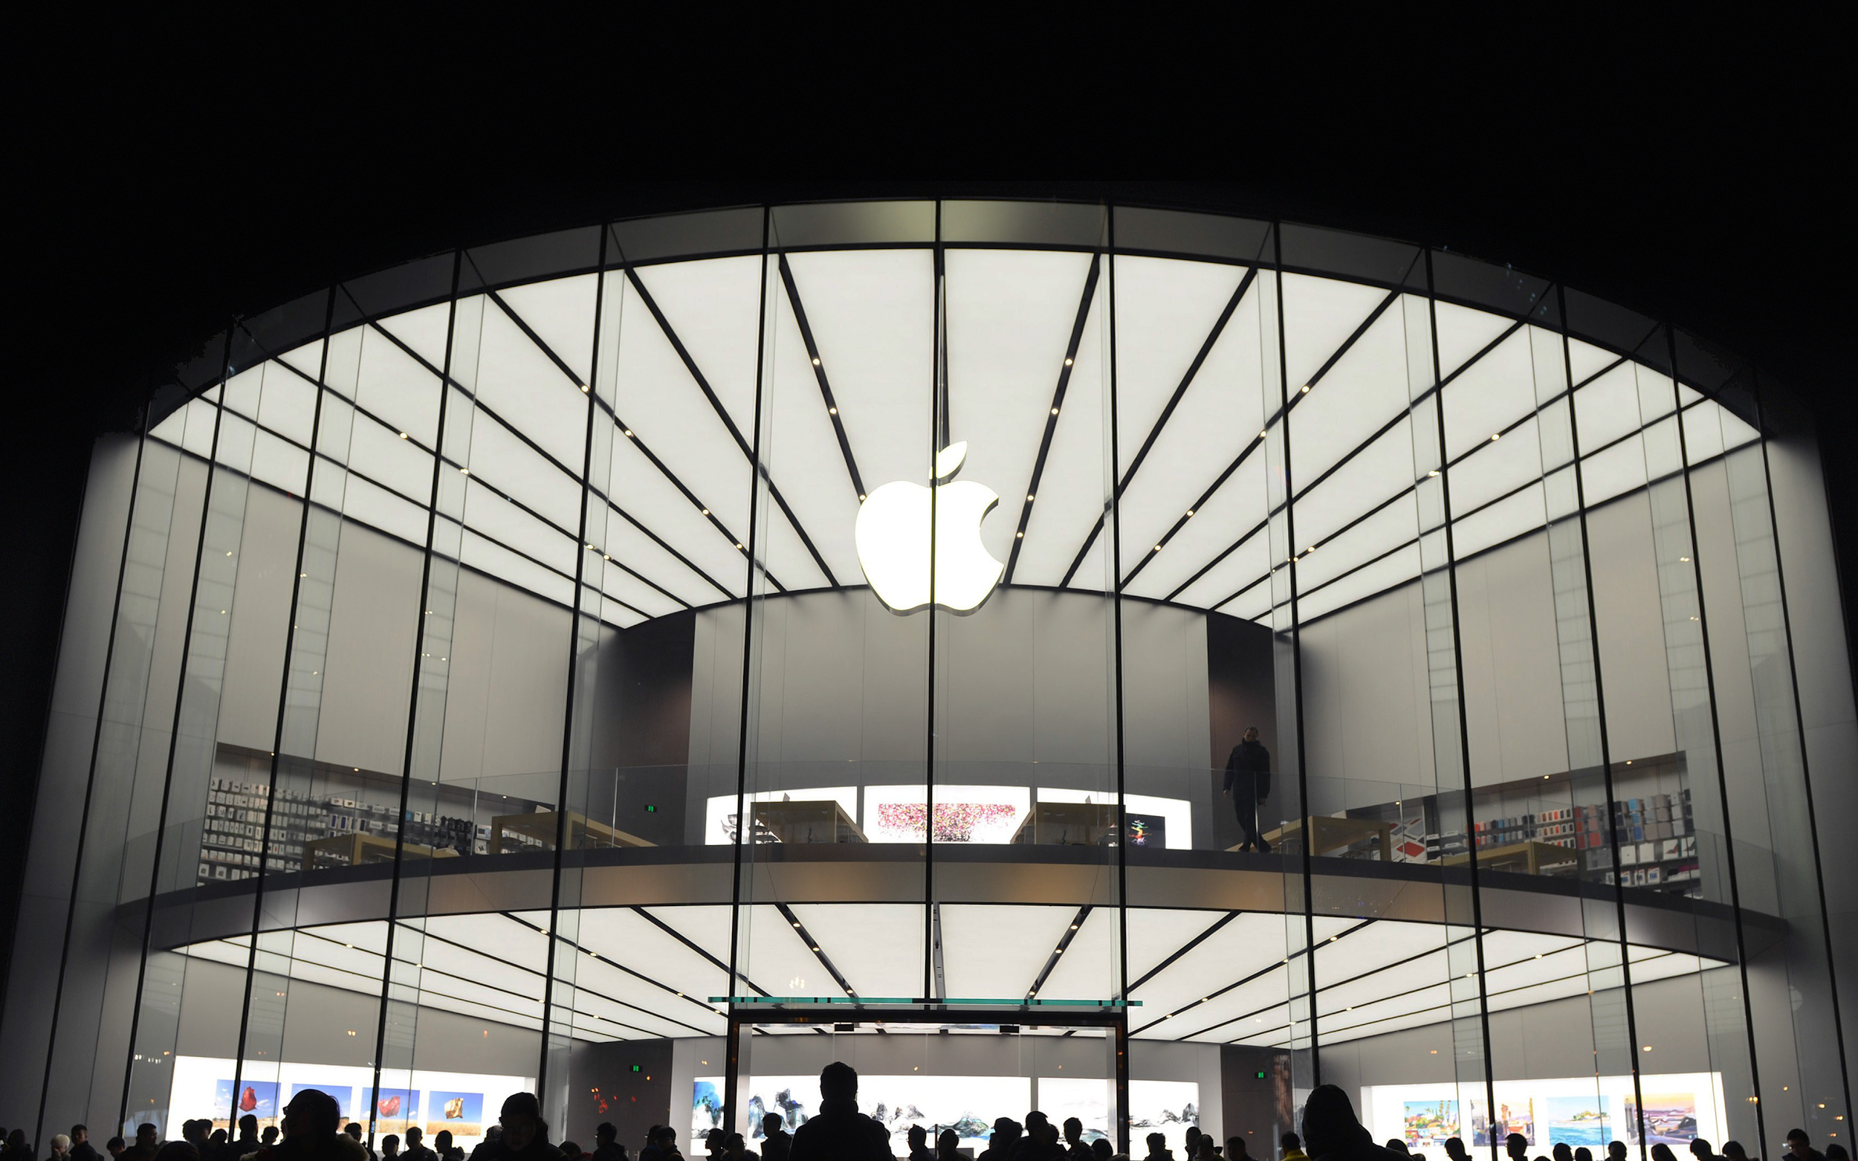
Apple

Slide 65

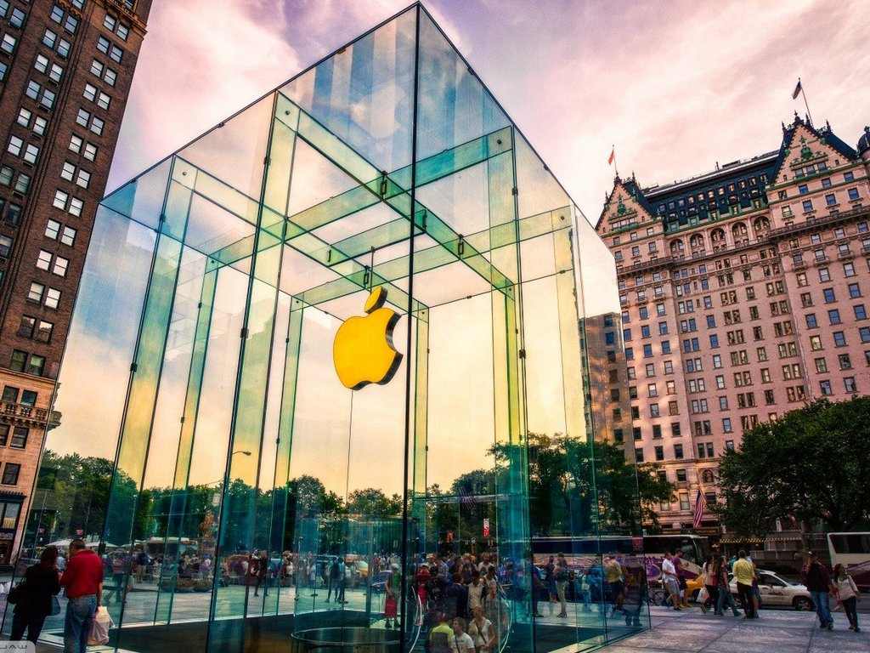

Stock Overview

Slide 66

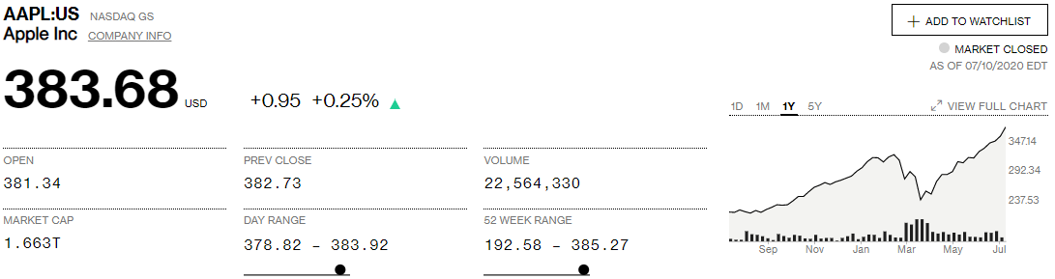
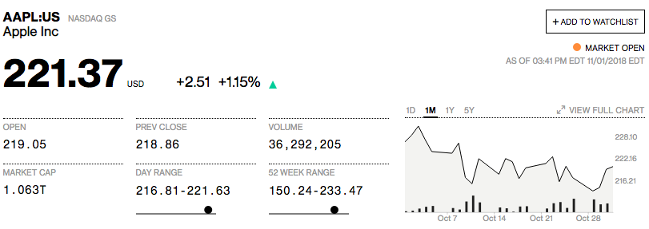
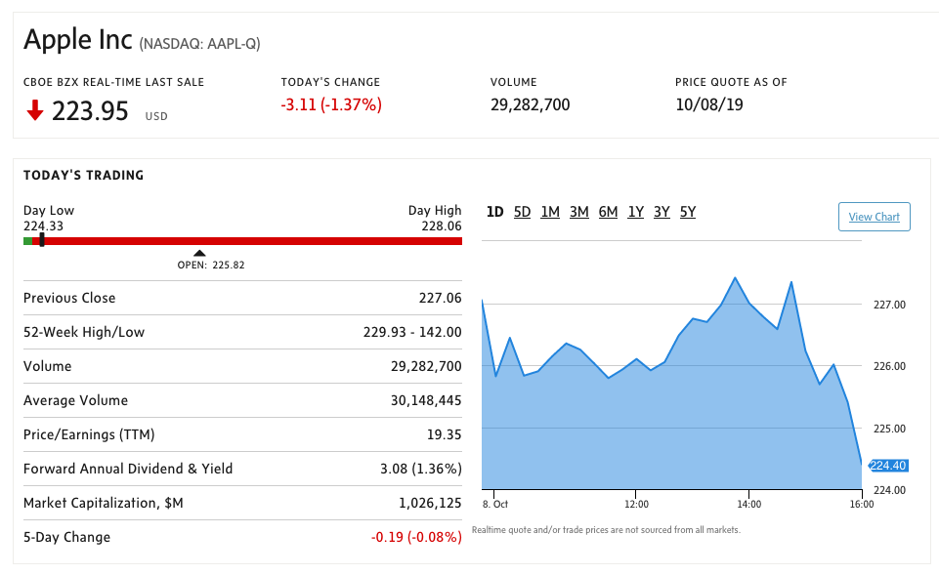
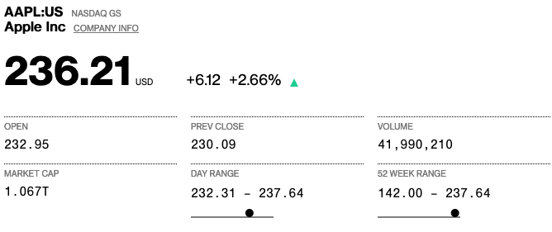
Share Information
Source: Bloomberg

Slide 67
Key Statistics
Share Information
P/E Ratio | 28.57 | 1 Year Return | 81.74%
Shares Outstanding | 4.33B | 30 Day Avg Volume | 34, 801, 660
Price to Book Ratio | 20.0753 | EPS | 12.75
Price to Sales Ratio | 6.0479 | Dividend | 0.90%
Earnings Announcement for Period Ending Q3/2020 | July 30, 2020 | Last Dividend Reported | $0.82 (Declared: April 30, 2020)
Source: Bloomberg

Slide 68
FY 20 Third Quarter Results
Apple’s conference call to discuss fourth fiscal quarter results is scheduled for Thursday, July 30, 2019 at 2:00 p.m. PT / 5:00 p.m. ET.

Slide 69
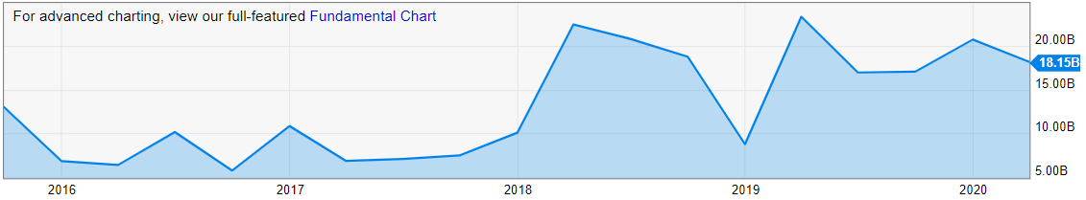
Share Structure
Shares Outstanding
2016 | 2017 | 2018 | 2019 | 2020
5.5B | 5.252B | 5B | 4.649B | 4.405B
5.05% decline from 2015 | 4.52% decline from 2016 | 4.79% decline from 2017 | 7.02% Decline from 2018 | 6.3% Decline from YOY
Apple Stock Buybacks (Quarterly):
18.15B for March 31, 2020
Source: Macrotrends, Y Charts
Notes:
https://www.macrotrends.net/stocks/charts/AAPL/apple/shares-outstanding
Shares outstanding can be defined as the number of shares held by shareholders (including insiders) assuming conversion of all convertible debt, securities, warrants and options. This metric excludes the company's treasury shares.
$9.22
$8.31
$9.21
$11.91
Buybacks are sometimes an indication that a company perceives their stock to be undervalued, but it is up to the investor to determine if the company is correct. Companies that are favorable to shareholders may often issue dividends and perform stock buybacks.
Total Value of Shares Repurchased from the Marketplace. YCharts uses "Net Total Equity Issued" from the statement of cash flows to approximate stock buybacks (multiplying by -1 since this number is negative in the case of a buyback). Hence, it includes the buyback of both common and preferred shares.

Slide 70
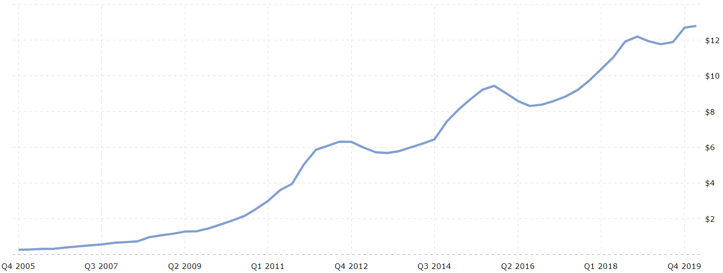

Share Structure
APPL – EPS – Earnings per Share ($USD)
EPS for the 12-month ending March 31, 2020 was $12.79, a 7.21% increase YOY.
Source: Macrotrends
Apple 2018 annual EPS was $11.91, a 29.32% increase from 2017.
$9.22
$9.21
$8.31
$6.31
$6.45
$5.68
Notes:
Apple EPS for the twelve months ending March 31, 2020 was $12.79, a 7.21% increase year-over-year.
Apple 2019 annual EPS was $11.89, a 0.17% decline from 2018.
Apple 2018 annual EPS was $11.91, a 29.32% increase from 2017.
Apple 2017 annual EPS was $9.21, a 10.83% increase from 2016.

Slide 71




1 Year Performance
Apple
Source: Yahoo! Finance

Slide 72




5 Year Performance
Apple
Beta (S&P500) 5 Years, Monthly
1.18
Source: Yahoo! Finance

Slide 73




10 Year Performance
Beta (S&P500) 10 Years, Monthly
Apple
Source: Yahoo! Finance

Slide 74




Maximum Stock Chart
Apple

Slide 75

Shareholders’ Analysis
Top 10 Owners of Apple Inc
Stockholder | Stake | Shares owned | Total value ($) | Shares bought / sold | Total change
The Vanguard Group, Inc. | 7.29% | 315,934,247 | 100,448,134,491 | -5,903,776 | -1.83%
Berkshire Hathaway, Inc. (Investm... | 5.66% | 245,155,566 | 77,944,760,654 | 0 | 0.00%
BlackRock Fund Advisors | 4.32% | 187,354,848 | 59,567,600,373 | -2,500,563 | -1.32%
SSgA Funds Management, Inc. | 4.17% | 180,558,954 | 57,406,913,835 | -2,295,827 | -1.26%
Fidelity Management & Research Co... | 1.97% | 85,450,224 | 27,168,044,219 | -3,083,284 | -3.48%
Geode Capital Management LLC | 1.48% | 64,178,586 | 20,404,939,633 | +1,696,496 | +2.72%
T. Rowe Price Associates, Inc. (I... | 1.30% | 56,203,762 | 17,869,424,090 | +4,424,285 | +8.54%
Northern Trust Investments, Inc.(... | 1.24% | 53,859,611 | 17,124,124,721 | -1,172,528 | -2.13%
Norges Bank Investment Management | 1.08% | 46,856,273 | 14,897,483,438 | -692,563 | -1.46%
BlackRock Investment Management (... | 0.69% | 30,083,697 | 9,564,810,624 | -813,066 | -2.63%
Source: CNN Business
Stockholder | Stake | Shares owned | Total value ($) | Shares bought / sold | Total change
The Vanguard Group, Inc. | 7.27% | 328,525,375 | 73,579,828,239 | -3,317,083 | -1.00%
Berkshire Hathaway, Inc. (Investm... | 5.52% | 249,589,329 | 55,900,522,016 | 0 | 0.00%
BlackRock Fund Advisors | 4.28% | 193,179,452 | 43,266,401,864 | -3,811,227 | -1.93%
SSgA Funds Management, Inc. | 4.14% | 187,085,416 | 41,901,520,622 | -3,564,861 | -1.87%
Fidelity Management & Research Co... | 2.01% | 90,635,159 | 20,299,556,561 | -2,699,602 | -2.89%
Geode Capital Management LLC | 1.37% | 61,746,765 | 13,829,422,957 | +682,953 | +1.12%
Northern Trust Investments, Inc.(... | 1.31% | 58,966,400 | 13,206,704,608 | -311,739 | -0.53%
Norges Bank Investment Management | 1.05% | 47,548,836 | 10,649,512,799 | -3,236,761 | -6.37%
Invesco Capital Management LLC | 0.90% | 40,767,482 | 9,130,692,944 | -119,048 | -0.29%
BlackRock Investment Management (... | 0.68% | 30,830,410 | 6,905,086,928 | -369,899 | -1.19%

Slide 76

Shareholders’ Analysis
Top 10 Owners of Apple Inc
Source: CNN Business
Stockholder | Stake | Shares owned | Total value ($) | Shares bought / sold | Total change
The Vanguard Group, Inc. | 7.27% | 328,525,375 | 73,579,828,239 | -3,317,083 | -1.00%
Berkshire Hathaway, Inc. (Investm... | 5.52% | 249,589,329 | 55,900,522,016 | 0 | 0.00%
BlackRock Fund Advisors | 4.28% | 193,179,452 | 43,266,401,864 | -3,811,227 | -1.93%
SSgA Funds Management, Inc. | 4.14% | 187,085,416 | 41,901,520,622 | -3,564,861 | -1.87%
Fidelity Management & Research Co... | 2.01% | 90,635,159 | 20,299,556,561 | -2,699,602 | -2.89%
Geode Capital Management LLC | 1.37% | 61,746,765 | 13,829,422,957 | +682,953 | +1.12%
Northern Trust Investments, Inc.(... | 1.31% | 58,966,400 | 13,206,704,608 | -311,739 | -0.53%
Norges Bank Investment Management | 1.05% | 47,548,836 | 10,649,512,799 | -3,236,761 | -6.37%
Invesco Capital Management LLC | 0.90% | 40,767,482 | 9,130,692,944 | -119,048 | -0.29%
BlackRock Investment Management (... | 0.68% | 30,830,410 | 6,905,086,928 | -369,899 | -1.19%

Slide 77


Dividend Payments
Declared | Amount
30-Apr-20 | $0.82
28-Jan-20 | $0.77
2020* | $1.59
30-Oct-19 | $0.77
30-Jul-19 | $0.77
30-Apr-19 | $0.77
29-Jan-19 | $0.73
2019 | $3.04
01-Nov-18 | $0.73
31-Jul-18 | $0.73
01-May-18 | $0.73
01-Feb-18 | $0.63
2018 | $2.82
Declared | Amount
02-Nov-17 | $0.63
01-Aug-17 | $0.63
02-May-17 | $0.63
31-Jan-17 | $0.57
2017 | $2.46
25-Oct-16 | $0.57
26-Jul-16 | $0.57
26-Apr-16 | $0.57
26-Jan-16 | $0.52
2016 | $2.23
Source: NASDAQ
Notes:
https://www.nasdaq.com/market-activity/stocks/aapl/dividend-history

Slide 78
Company Overview

Slide 79
Company Background
In 1976, Steve Jobs, Steve Wozniak and Ronald Wayne founded Apple Computer, Inc. (Today’s Apple, Inc.)
Headquartered in Cupertino, California
Designs, manufactures, and markets:
Mobile communication and media devices;
Personal computers;
Portable digital music players
Related software, services, peripherals, networking solutions, and third-party digital content and applications
Sold worldwide through its online stores, retail stores, third-party cellular network carriers, wholesalers, and resellers

Slide 80
Apple’s Mission
Bring users the best experience through its innovative hardware, software and services
Unique ability to design and develop its own operating systems, hardware, application software
Provide its customers products and solutions with innovative design, superior ease-of-use and seamless integration
Supporting third-party software and hardware development which can complement their products and services
Investment in R&D, marketing, and advertising to encourage the sale of innovative technology

Slide 81


Products and Services
Accessories i.e. AirPods
Other Software: watchOS, tvOS
Desktop
MacBook Air
MacBook
MacBook Pro
And More…
Internet Services
iCloud
AppleCare
Apple Pay (Apple Card)

Slide 82




Product: iPhone
Smartphone, the user interface is built around the device’s multi-touch screen including a virtual keyboard
Shoot video, take pictures, download apps, play music, send/receive text messages and e-mail
First released in June, 2007
More than 2.24 b iPhones had been sold (2019)
Latest models: iPhone SE (2nd gen), iPhone 11, iPhone 11 Pro, iPhone 11 Max

Slide 83


Product: iPhone New 2019 iPhone Model

Slide 84




Product: iPhone (Other Models)

Slide 85


Product: iPad
Multimedia tablet computers
User Interface and Capabilities similar to the iPhone
Most recent releases are 10.2” 7th generation iPad (September, 2019)
Includes Siri, Touch ID and Face ID
Consists of accessories i.e. Apple Pencil, Smart Keyboard, etc.

Slide 86


Product: Macintosh
Line of notebook and desktop computers based on the MacOS operating system
Latest notebook models (Macbook Pro) include 8-core processors, 8TB storage, 100Wh battery, etc.
Latest desktop models (iMac) include 27-inch LED-backlit Retina 5K display, 5.0GHz, 2TB SSD,
Long battery life, fast storage, beautiful display, thin and lightweight

Slide 87

Product: Apple Watch
Smartwatch for health, fitness-tracking and other connections with the iPhone for calling functions, etc.
First released in April, 2015
Current desktop models (Series 5) include 1.78-inch, 32GB, 30.8g weight
Now featuring LTE cellular connectivity, allowing independence from iPhone, energy saving, magnetomerter

Slide 88



Service: Apple Pay
Initial release: October 2014
Offers an easy, secure, fast and private way for payment
Payment service available in certain countries through Apple devices i.e. iPhone, Apple Watch, Touch ID on MacBook.
Allows payment within apps i.e. subscription to Apple Music
Digitalizes and replace physical cards with the chip, pin or magnetic stripe
Wireless communication with point of sale by using NFC antenna, secure element

Slide 89

Service: iCloud
Initial launch: October, 2011
Apple’s cloud storage service which stores music, photos, contacts, calendars, mail, notes and files
Safe, up to date and available whenever you are
Works across devices (iPhone, Mac, Windows System)
Provides means to back-up important personal data directly through iCloud Backup and Restore
5GB of free storage space with storage plan: 50GB C$1.29/month, 200GB C$3.99/month, 2TB C$12.99/month

Slide 90



Other Services
Apple Music, Apple TV+ and Apple Podcasts (Formally iTunes) allows to purchase, rent, and download entertainment to be played
App Store allows customers to download and purchase applications for their iOS devices,
Apple Books (Formally iBooks) features e-books reading across iOS devices and Mac and store application from major and independent publishers for customers to purchase

Slide 91
Other Services
Other Apple Wallet Services (incl. Apple Pay)
Apple Card: Credit Card primarily used with Apple Pay on Apple devices, developed by Goldman Sachs
Apple Cash: Peer-to-peer service on the Apple Pay platform allowing users to send, receive, and request money through iMessage

Slide 92



Sales by Segment and Products

Slide 93


Sales by Segment and Products
Sales by Segment and Products

Slide 94


Sales by Segment and Products
Sales by Segment and Products

Slide 95

Sales by Segment and Products

Slide 96




Source: Apple and Statista

Slide 97
Apple’s Current Business Strategy
Product Differentiation: Runs on internally developed iOS platform. Provide simple, yet attractive design and advanced functionality products and services.
4 Strengths and Core Compentencies
Design and Functionality – products are of high quality and are designed with the user experience in mind.
Strengthening Apple ecosystem –Products are synchronized and connected with each other. Makes Apple products easy to use together.
Vertical Integration –through its rich expertise in software, hardware and services
Product/Service Diversification – Decrease dependence on the sales of iPhones: Apple’s services division generated US$10.9b in 2019 1Q, record revenues, 19% increase YOY

Slide 98
Company History

Slide 99


Slide 100



Company History
1976
-Founded in Cupertino by Steve Jobs, Ronald Wayne and Steve Wozniak
-Apple I sells for $666.66 (200 units)
1977
-Apple II released at $1,300
-Incorporated in the state of California
1979
- First app unveiled: VisiCalc
1980
December 12: IPO launched at $22M, selling $4.6M shares Release of Apple III
Apple I
VisiCalc
1983
LISA (Local Integrated System Architecture) released at $9,995, one of the first personal computers to offer a GUI in a machine; sells only 10,000 units
1984
Launch of the Macintosh 128K with initial price of $2,495. Including beige case, keyboard and mouse
1985
-Steve Jobs leaves Apple and starts NeXT
1993
-The Newton released (early PDA model)
1987
-Apple registered the Apple.com domain name
Newton

Slide 101
Company History
1994
-Apple releases its first Power Macintosh, PC -based desktop computers
1997
-Apple acquires NeXT and its OS, NeXTSTEP -Steve Jobs returns as advisor; interim CEO -Intro of Apple Store -Company faces financial trouble, as share price hits 12-year low
1998
-iMac launched
1999
-iBook release
2001
-Mac OS X -Opening of Apple Retail Stores -First iPod
2002
-iMac G4
2003
-iTunes Music Store launch
2004
-Release of iMac G5 and iPod Mini 2005
- Release of iPod Shuffle and iPod Nano
2006
-MacBook Pro
2007
-iPhone 3G -iPod Touch -Apple TV
2008
-MacBook Air
-Launch App Store
2010
-iPad and iPhone 4

Slide 102
Company History
2011
-iCloud -Steve Jobs resigns as CEO due to illness, replaced by Tim Cook -Apple passes Exxon to become the most valuable company in the world
2012
-iPhone 5 and iPad Mini released -Apple Maps launched
2013
-iPhone 5S/5C
2014
-Apple Pay launched
2015
-iPhone 6 and 6S Plus released -iPad Pro -Apple Watch -Apple Music
2016
-iPhone SE -MacBook (Rose Gold, Space Grey, Silver, Gold)
2017
-New iPhone 8 -iPhone X - iOS 11 Released
- latest versions of the iPad, Apple Watch, and Macs
2018
- iOS12 -iPhone XS and XR -MacBook Air -iPad Pro
-Apple Watch 4
2019
-Apple Card
-iPhone 11 models
- Latest versions of the Apple Watch, iPad, iMac, iPod Touch, Airpods, Macbook

Slide 103
Apple in 2020 (January – July)
February 2020: All 42 stores in China have closed due to Covid-19 concerns.
March 13, 2020: Stores in Greater China have reopened. Retails stores outside of Greater China will be closed for 2 weeks over Covid-19 concerns.
March 18, 2020: Introduction of iPad Pro (11” – 2nd gen. and 12.9” – 4th gen.) and newly released Macbook Air
April 24, 2020: iPhone SE 2nd gen.
May 4, 2020: MacBook Pro (13”)

Slide 104

Key Acquisitions
1997 | NeXT (Computer programming services) ▪Derived Products: OS X and iOS ▪$404 million
2000 | SoundJam MP (Software) ▪Derived Products: iTunes ▪2005: Fingerworks ▪Derived Product: Multi-touchscreen
2008 | P.A. Semi (Semiconductors) ▪Derived Products: Apple A4 and A5 chips ▪$278 million
2009 | Lala.com (Music streaming) ▪Derived Products: iCloud, iTunes Match ▪$80 million

Slide 105



Key Acquisitions
Key Acquisitions II
2010 | Siri (Voice control software) ▪Derived Products: Siri ▪$200 million
2012 | Chomp (App search engine) ▪Derived Products: App store ▪$50 million AuthenTec (PC and mobile security) ▪Derived Products: Touch ID ▪$356 million
2014 | Beats Electronics ▪Derived products: Apple Music ▪$3 Billion
2015 | linX (Camera) Derived products: iPod, iPhone, iPad $20 Million

Slide 106
Key Acquisitions III
2016 | Flyby Media (Augmented reality software) Acquired to aid Apple’s in developing for virtual reality
2017 | Lattice Data (Artificial Intelligence) Acquired to aid Apple’s Development in AI $200 Million Workflow (Automation and scripting app)
2018 | Akonia Holographics (Augmented Reality Goggle) Shazam (Music and Image Recognition) $400 Million Dialog Semiconductor (Chip Development)
2019 | Stamplay (Backend Development) $5.6 Million Drive.ai(Autonomous Vehicles) Intel Mobile Communications (Smartphone Modem) $1 Billion

Slide 107
Key Acquisitions IV
2020 | Voysis Acquired to further develop voice recognition to understand natural language Xnor.ai Acquired for $200M to aid in artificial intelligence and deep learning development Next VR Acquisition helps Apple’s development of VR related products, software/content
Notes:
https://www.bloomberg.com/news/articles/2020-04-03/apple-acquires-ai-startup-to-better-understand-natural-language
https://www.bloomberg.com/news/articles/2020-01-15/apple-acquires-artificial-intelligence-company-xnor-ai
https://www.bnnbloomberg.ca/apple-acquires-startup-nextvr-that-broadcasts-vr-content-1.1436491

Slide 108
Management Team

Slide 109

Steve Jobs
Apple’s Key People
Co-founder (with Steve Wozniak) and former CEO
Pioneer of the microcomputer revolution
Education: Reed College (dropped out)
Left the company in 1985, worked in: NeXT and PIXAR
Returned to Apple in 1997
Collaborate with Jony Ive, overseeing the development of iMac, iTunes, iPhone iPad on the service side and Apple retail stores
Diagnosed with a pancreatic neuroendocrine tumor in 2003
Died in 2011 of respiratory arrest due to the tumor

Slide 110


















Apple’s Organization Chart
Source: Apple, CB Insights
Source: Philip Elmer‑DeWitt
Notes:
https://www.ped30.com/2019/03/05/information-apple-org-chart/

Slide 111
Apple’s Board Updates
Angela Ahrendts (known for previously worked at Burberry) resigned her role as Senior Vice President of Retail in February 2019.
Jonathan Ive, Chief Design Officer resigned in June, 2019. A spin off design company will be launched to work on projects with Apple. A new Chief Design Officer is yet to be named. The announcement was made after the launch of 3 services including Apple TV+ but nothing on hardware.
Bob Iger, the long-time Disney CEO, resigned from Apple's board of directors. Apple made the announcement in an SEC filing, where it revealed that Iger stepped down on September 10th -- which happens to be the day the company shared launch details for Apple TV+
Notes:
https://www.cnbc.com/2019/09/13/bob-iger-resigns-from-apple-board.html

Slide 112

Executive Team
Tim Cook
Chief Executive Officer (Since August 2011, Joined in 1998)
Formerly the COO; responsible for worldwide sales and operations, end-to-end supply chain, sales activities, service and support in markets across the globe Head of Macintosh division; led development of reseller and supplier relationships to meet increasing demands Previous served roles with Compaq, IBM, and Intelligent Electronics Education: BS in Industrial Engineering from Auburn (1982); MBA from Duke (1988)

Slide 113

Executive Team
Jonathan Ive
Chief Design Officer (Joined in 1992; Resigned 2019; Now on contract)
Responsible for the designs at Apple, including the hardware, user interface, packaging, architectural projects Will depart the company as an employee later this year An independent design company formed by Jony will have Apple among its primary clients and work closely on a range of projects Holder of over 5000 patents and recipient of numerous awards for his design work Education: Bachelor of Arts from Newcastle Polytechnic, also holds honorary doctorates from 3 other institutions

Slide 114

Executive Team
Deirdre O’Brien
Senior Vice President, Retail (Since February 2019) and People
Focus on the connection between customers and Apple’s employees Replace Angela Ahrendts’ role, when she previously resign in 2019 Veteran of Apple for over 30 years Education: Bachelor’s degree in Operations Management from Michigan State University and an MBA from San Jose State University.

Slide 115

Executive Team
Eddy Cue
Senior Vice President, Internet Software and Services (Joined in 1989)
Oversees Apple Pay, Siri, Maps, iAd, iCloud services, and Apple’s productivity and creativity apps Created the Apple’s online store in 1998, iTunes store in 2003, and App Store in 2008 Played a key role in the development of the iLife: various programs for media creation, organization, editing and publishing i.e. GarageBand Education: Bachelors’ in Computer Science and Economics from Duke

Slide 116

Executive Team
Craig Federighi
Senior Vice President, Software Engineering (Return in 2009)
Oversees the development of Apple's operating system engineering teams Responsible for the software of the products – interface, applications, and frameworks Previously worked at NeXT and Ariba where he was the CTO Education: MS in Computer Science and BS in in Electrical Engineering and Computer Science from UC Berkeley

Slide 117

Executive Team
Luca Maestri
Senior Vice President and Chief Financial Officer (Joined in 2013)
Oversees accounting, business support, financial planning and analysis, merger and acquisition and investor relations Promoted from Vice President of Finance and Corporate Controller Previously served as CFO at Xerox and Nokia Siemens Networks and GM’s European operations Education: Master’s degree in Science of Management from Boston University and Bachelor’s in Economics from Luiss University

Slide 118

Executive Team
Dan Riccio
Senior Vice President, Hardware Engineering (Joined in 1998)
Leads the Mac, iPhone, iPad and iPod engineering teams Promoted from VP of Product Design and in 2010 was named VP of iPad of Hardware Engineering Key contributors to the iPad and other Apple’s hardware Prior to Apple, he worked at Compaq as a Mechanical Engineering manager Education: Bachelor’s in Mechanical Engineering from University of Massachusetts Amherst

Slide 119

Executive Team
Katherine Adams
Senior Vice President and General Counsel (Joined in 2017)
Overseas legal matters, including corporate governance, intellectual property, litigation and securities Joined Apple from Honeywell, where she worked for 14 years Bachelor’s degree in Comparative Literature from Brown University and law degree from University of Chicago Law School

Slide 120

Executive Team
Phillip W. Schiller
Senior Vice President, Worldwide Marketing (Return in 1997)
Helped the company create the best computers in the world with the Mac Lead the digital music revolution with iPod and iTunes Reinvent mobile phones with iPhone and the App Store Define the future of mobile computing with iPad Various roles in marketing management positions including Nolan, Norton and Company and Mass. General in Boston) Education: BS in Biology from Boston College (1982)

Slide 121

Executive Team
Johny Srouji
Senior Vice President, Hardware Technologies (Joined in 2008)
Lead development of the A4 (first Apple-designed chip) Built strong and innovative teams of silicon and technology engineers, overseeing hardware technologies including batteries, application processors, storage controllers, sensors silicon, and chipsets across Apple’s entire product line Johny previously held senior positions in processor development and design at Intel and IBM Education: Bachelor’s and Master’s degree in Computer Science from Technion, Israel’s Institute of Technology

Slide 122

Executive Team
Jeff Williams
Chief Operating Officer (Joined in 1998)
Oversees the development of Apple Watch Drives the company’s health initiatives including ResearchKit Oversee Apple’s worldwide operations for supply chain, service and support and social responsibility initiatives since 2010 Played a key role when Apple launch the iPhone mobile market Previously worked at IBM in operations and engineering Education: Bachelor's degree in Mechanical Engineering from North Carolina State University and an MBA from Duke

Slide 123

Executive Team
Sabih Khan
Senior Vice President, Operations (Returned in 2019, Joined in 1995)
In charge of Apple’s global supply chain, ensuring product quality and overseeing planning, procurement, manufacturing, logistics and product fulfillment functions Reports to COO, Jeff Williams Previously served as an Application Development Engineer and Key Account Technical Leader at GE Plastics Education: Master’s degree in Mechanical Engineering from Rensselaer Polytechnic Institute
Notes:
https://www.apple.com/ca/newsroom/2019/06/apple-names-sabih-khan-senior-vice-president-of-operations/

Slide 124
Financial Analysis

Slide 125

Trend Analysis- Balance Sheet
As of March 28, 2020
Current Assets: Cash and cash equivalents, Short-term marketable securities, Accounts receivables, Inventories, vendor non-trade receivables
Non-Current Assets: Long-term marketable securities, Property, Plant and Equipment (PP&E)
Source: Apple

Slide 126

Balance Sheet -10-Q (2020-Q2)

Slide 127


Balance Sheet -10-Q (2020-Q2)

Slide 128

Balance Sheet -10-K (2019)

Slide 129


Balance Sheet -10-K (2019)

Slide 130


Trend Analysis- Income Statement
Gross Margin TTM | 37.82%
Operating Margin TTM | 24.57%
Net Profit Margin TTM | 21.24%
Return on Investment TTM | 23.81%
Source: Stock Analysis on Net and Investing
Gross Margin TTM | 38.34%
Operating Margin TTM | 26.69%
Net Profit Margin TTM | 22.98%
Return on Investment TTM | 23.32%

Slide 131


Statement of Income - 10-Q (2020 – Q2)

Slide 132

Statement of Income - 10-Q (2020 – Q2)

Slide 133

Statement of Income - 10-K (2019)

Slide 134

Statement of Income - 10-K (2019)

Slide 135
Sales by Segment and Products

Slide 136
Sales by Segment and Products
Sales by Segment and Products

Slide 137

Sales by Segment and Products

Slide 138

Shareholder Equity – 10-Q (2020 - Q2)

Slide 139



Shareholder Equity – 10-K (2019)

Slide 140
Stock Outstanding - 2019

Slide 141



Trend Analysis- Cash Flow Statement
Source: Investing
Notes:
https://www.investing.com/equities/apple-computer-inc-financial-summary

Slide 142

Statement of Cash Flow - 10-Q (2020 – Q2)

Slide 143

Statement of Cash Flow - 10-Q (2020 – Q2)

Slide 144

Statement of Cash Flow - 10-K (2018)
Statement of Cash Flow - 10-K (2019)

Slide 145

Statement of Cash Flow - 10-K (2018)
Statement of Cash Flow - 10-K (2019)

Slide 146
Risk Factors
Global and regional economic conditions i.e. Trade War in China and America, Exchange rate volatility
Products are highly competitive and subject to rapid technological changes
Must manage frequent introductions and transitions of offerings
Performance depends on carriers, wholesalers, retailers and other resellers.
Depends on manufacturing and logistic services from outsourcing partners
Manufacturing defects and ability to obtain components
Relied on access to third-party intellectual property and support from third-party developers
Legal proceedings and intellectual property rights infringement
New business strategy and acquisitions
Reputational damage from system failures, defects, disruptions and unauthorized access to confidential info

Slide 147



Stock Price Forecasts
Source: CNN Money

Slide 148

Stock Price - 11 October 2019
Source: Bloomberg

Slide 149





Analyst Recommendations
Source: CNN Money

Slide 150


Sales Forecasts
Reported Sales in Q2, 2020 is 58.3B
Q3 2020 Sales forecasts range from 32.3B to 55.8B with a consensus estimate of 51.0B (12.61% decline)
Reported Sales in 2019 is 260.2B
2019 Sales forecasts range from 203.4B to 279.5B with a consensus estimate of 262.0B (0.71% increase)
Source: CNN Money

Slide 151

Earnings Forecasts
Reported EPS in Q2, 2020 is 2.55
Q3 2020 EPS forecasts range from 1.52 to 2.73 with a consensus estimate of 2.00 (21.67% decline)
Reported EPS in 2019 is 11.89
2020 EPS forecasts range from 10.16 to 13.69 with a consensus estimate of 12.34 (3.82% increase)
Source: CNN Money

Slide 152

BUY

Slide 153


Slide 154

Stock Info

Slide 155

Key Ratios

Slide 156

Stock 1 Year Performance (Aug 2019 – July 2019)

Slide 157

Comparison Against Indices

Slide 158

5 Year Stock Performance

Slide 159

5 Year Stock Performance Against Indices

Slide 160

5 Year Stock Performance against Apple and Google

Slide 161

10 Year Stock Performance

Slide 162

10 Year Performance Against Indices

Slide 163

Performance Since Inception

Slide 164

Share Structure

Slide 165

Top Shareholders

Slide 166


Share Repurchases

Slide 167



Dividend Distribution
20 Cents

Slide 168
Company Overview and Management
Mission Statement
“To empower every person and every organization on the planet to achieve more”
Core Values
Innovation
Diversity and Inclusion
Corporate Social Responsibility
Artificial Intelligence
Trustworthy Computing

Slide 169






Company Timeline
1995
Launches windows 95 and Internet Explorer Web Browser
2012
Launches Windows 8 and Microsoft Surface Laptop
1975
Bill Gates and Paul Allen found Microsoft
1995
Launches windows 95 and Internet Explorer Web Browser
2000-2001
Launches Windows 2000, Office XP, Xbox
Steve Balmer takes over as President and CEO
2010-2011
Launches Windows Phone, Kinect for 360 and Office 365
1981
IBM introduces PC with Microsoft Operating System (MS-DOS 1.0)
1989
Microsoft Stock introduces first version of Microsoft office applications
2009
Launches Windows 7 and the Bing Search Engine
1985
Microsoft Windows is released
1986
Microsoft Stock goes public at $21 per share
2003-2005
Launches Microsoft Office, Xbox 360

Slide 170

Company Timeline
2015
Launches Windows 10, First Microsoft Store is Opened in New York
2016
Purchases Linkedin
Announces Surface Studio and Surface Dial and Microsoft Teams
2013
Launches Xbox One and Microsoft Outlook.com (email)
2014
Satya Nadella takes over as CEO
2018
Announces Project Mu and opensource implementation of Windows Presentation Foundation
2019
Microsoft Edge is released with rebranded logo
2020
Microsoft announces beta of Windows 10X

Slide 171
Notable Acquisitions
1987 – Forethought (becomes Microsoft Power Point, $14 million)
1997 - Hotmail ($500 Million)
2000 - Visio Corp. ($1.375 Billion)
2011 - Skype ($8.5 Billion)
2014 - Nokia ($7.2 Billion)
2015 – Metanautix (Company used to help manage data)
2016 – LinkedIn ($26.2 Billion)
2017 – Cloudlyn ($60 Million, Cloud company in Israel for managing cloud payments and billing)
2018 – GitHub ($7.5 Billion, manages and stores and revisions of projects)
2020 – Purchased 6 additional Companies (Orions Systems, cyber X, ADRM Software, Softomotive, Metaswitch Networks, Affirmed networks)

Slide 172


Slide 174

Microsoft’s Executive Management

Slide 175

Satya Nadella – CEO, 2014 -Present
Originally from Hyderabad, India
Bachelors degree in electrical engineering and a Masters in Computer Science and Business Administration
Started working for Microsoft in 1992
Known as a leader and innovator in terms of Microsoft’s biggest products, led R&D for online services and was VP of Microsoft’s Business division
Was executive VP of Cloud and Enterprise Group before taking over as CEO in 2014
On the Board of Directors for Starbucks

Slide 176

Judson Althoff – Executive VP, Worldwide Commercial Business (2016-Present)
Began career at companies like Oracle and EMC
Earned a mechanical engineering degree from IIT and servers on the computer science Advisory Board
Joined in March 2013 as president of Microsoft North America, was able to help company achieve double digit revenue growth and triple digit cloud growth

Slide 177

Chris Capossela - Executive VP of Consumer Business/CMO (2011-Present)
Oversees the Consumer Device Sales team, Microsoft Advertising sales and Microsoft Stores
Joined in 1991 as a Marketing Manager, prior to his CMO position he was the leader of the Consumer Channels Group.
Over saw creations such as Windows, Office and Xbox
Bachelors degree in computer science and economics from Harvard
Board Member for Worldreader non-profit
Ranked 11th on Forbes most influential CMO list in 2018

Slide 178

Amy Hood – Executive VP and CFO (2013-Present)
Originally CFO of Microsoft’s Business Division (Office 365, SharePoint, ERP, CRM) Helped lead the transition to Office 365 service and vital in acquisitions of Skype and Yammer
Joined in 2002 after leaving Goldman Sachs and various other investment banking roles
Earned a Bachelors in Economics(Duke) and a Masters in Business Administration(Harvard)

Slide 179

Jean-Philippe Courtois – Executive VP and President, Microsoft Global Sales, Marketing and Operations (2016-Present)
Joined Microsoft in 1984, first position was as a channel sales rep and was promoted to General Manager of Microsoft France in 1994
Has a diploma in advanced business studies from Skema Business School, where he also sits on the board of directors
Served as CEO and President Microsoft EMEA and also was corporate VP of Worldwide Customer Marketing
Prior to his current position he served as president of Microsoft international and led sales and marketing services out side North America.

Slide 180

Peggy Johnson – Executive VP, Business Development (2014 – July 2020)
Worked at GE in the Military Electronics Division
Spent 24 years at Qualcomm in areas such as engineering, sales, marketing and business development and the internet services unit before becoming Executive VP and president of global market development
Started at Microsoft in 2014 and has been responsible for the strategy behind partnerships to improve growth and accessibility for customers
Manages Microsoft’s relationship with venture capitalists and oversees strategic investments through the M12 corporate fund.
Last day at Microsoft was July 7th and has since joined Magic Leap as the new CEO
Bachelor’s degree in electrical engineering from San Diego State university

Slide 181

Dave O’Hara – Corporate VP, CFO, Commercial Finance (2013 – Present)
Bachelor’s degree in economics and MBA from University of South Dakota
Was president of ICONtrol Inc., after being acquired by Great Plains Software he was International VP and VP of mergers and acquisitions
Roles at Microsoft included CFO of Applications and Services Group and the Cloud Enterprise Group, COO for Microsoft Advertising and VP of business development for Microsoft Business Solutions
Began Career at Microsoft in 2001

Slide 182

Kevin Scott – Chief Technology Officer, Executive VP, Technology and Research (2017-Present)
Has a B.S. and M.S. in Computer Science and is completing his Ph.D. in Computer Science at the University of Virginia
First positions were at Google were overseeing mobile ads engineering, soon after helping acquire AdMob, he worked there overseeing engineering and operations for the leading platform for mobile monetization.
Before Microsoft he was Senior VP of engineering and operations at LinkedIn, helped lead the company through it’s IPO
Adviser to a number of start-ups, angel investor, founder of the non-profit Behind the Tech and is on the Advisory Council for Stanford’s Human - Centered Artificial Intelligence

Slide 183






Products and Services
Intelligent cloud
Productivity and Business Processes
Personal Computing

Slide 184


Productivity and Business Process
Dynamics Business Solutions
Dynamics ERP
Dynamics CRM on line and on-premises
Office Consumer
Office 365
Skype
LinkedIn
OneDrive
Office Commercial
Volume Licensing
Commercial Products for:
Skype
Office
SharePoint

Slide 185


Slide 186


Revenue By Segment Q3 2020

Slide 187

Revenue By Segment (10-K)

Slide 188

Cloud Services

Slide 189

Personal Computing
Windows
Windows OEM licenses
Volume Licenses
MSN
Phone OS Licensing
Computer Products
Hardware
Phones
Surface Pro
PC Accessories
Gaming
Xbox/Xbox Live
Subscriptions
Advertising
Video Games
Advertising
Bing/Bing ads

Slide 190

Revenue By Product Q3 2020

Slide 191


Selected Products Year over Year Revenue Percentage Change
ERP and CRM
Cloud Computing Through Microsoft Data Center

Slide 192


Domestic and international Revenue (10-K & 10-Q)

Slide 193


Operating System Market Share

Slide 194


Cloud Services Market Share

Slide 195

Office Suites Market Share 2020

Slide 196

Financial Analysis

Slide 197

Share Structure (10-Q)

Slide 198

Share Structure (10-K)

Slide 199

Balance Sheet – Assets (10-Q)

Slide 200

Balance Sheet – Liabilities and Equity (10-Q)

Slide 201

Balance Sheet – Assets (10-K)

Slide 202

Balance Sheet – Liabilities (10-K)

Slide 203

Income Statement (10-Q)

Slide 204

Income Statement (10-K)

Slide 205

Comprehensive Income (10-Q)

Slide 206

Comprehensive Income (10-K)

Slide 207

Cash Flow Statement – Operations (10-Q)

Slide 208

Cash Flow Statement – Investing & Financing (10-Q)

Slide 209

Cash Flow from Operations (10-K)

Slide 210

Cash Flow From Financing and Investing (10-K)

Slide 211

Statement of Shareholders Equity (10-Q)

Slide 212

Statement of Shareholders’ Equity (10-K)

Slide 213


Earnings Per Share (10-Q)

Slide 214

Earnings Per Share (10-K)

Slide 215


Share Repurchases (10-K)

Slide 216

Q3 2020 Share Repurchases

Slide 217

Market Risk Sensitivity Analysis

Slide 218


Sales & Earnings Forecast (CNN Business)

Slide 219

Stock Price Forecast

Slide 220

Analyst Recommendations

Slide 221

BUY

Slide 222


Slide 223

Agenda
Stock: stock information, share structure, revenue
Company overview: history, key acquisitions, products & services, management team
Financial analysis: balance sheet, income statement, cash flow
Forecasting: sales, earning, stock price
Recommendation

Slide 224

Stock information

Slide 225

Stock statistics
Notes:
Alphabet EPS for the twelve months ending March 31, 2020 was $49.53, a 24.23% increase year-over-year.
Alphabet 2019 annual EPS was $49.16, a 12.49% increase from 2018.
Alphabet 2018 annual EPS was $43.7, a 142.78% increase from 2017.
Alphabet 2017 annual EPS was $18, a 35.37% decline from 2016.
Largest market cap 1000 billion in the computer and technology sector

Slide 226

Stock performance—1 month
6-16-20@ 1447.53
7-16-20@ 1513.85
Increase: 6.77%

Slide 227

Stock performance—1 year
7-16-19@ 1150.51
7-16-20@ 1513.85
Increase: 31.84%

Slide 228

Google vs. SPX ---1 year
Google Increase: 31.84%
SPX Increase: 7.04

Slide 229

5 year Performance
7-20-15@ 672.93
7-16-20@ 1513.85
Increase: 179.35%

Slide 230

Common Share Structure
Notes:
Alphabet is the parent company of Google (introduced in 2015)
Same founders as Google
Includes other companies:
Access, Calico, CapitalG, GV, Nest, Verily, Waymo, X

Slide 231
Common Share Structure
Common shares outstanding – 682.62M‬ (as of April 21, 2020)
Class B Shares - Google Insiders only, not publicly traded, ten votes each
Anyone who owned Google stock before the split got one share of the voting GOOGL stock and one share of the non-voting GOOG stock

Slide 232

Notes:
GOOG and GOOGL are stock ticker symbols for Alphabet (the company formerly known as Google). The main difference between the GOOG and GOOGL stock ticker symbols is that GOOG shares have no voting rights while GOOGL shares do. The company created two classes of shares in April 2014. The reason for the split between the two classes of shares was to preserve the control of founders Larry Page and Sergey Brin. When companies go public, founders often lose control of their company when too many shares are issued.
KEY TAKEAWAYS
Alphabet, Google's parent company, has two listed share classes that use slightly different ticker symbols.
GOOGL shares are its class-A shares, also known as common stock, which have the typical one-share-one-vote structure.
GOOG shares are class-C shares, meaning that these shareholders have no voting rights.
There is a third type of share, class-B, which are held by founders and insiders that grant 10 shares per vote. Class-B shares cannot be publicly traded.
Class A—Held by a regular investor with regular voting rights (GOOGL)
Class B—Held by the founders with 10 times the voting power compared to Class A
Class C—No voting rights, normally held by employees and some Class A stockholders (GOOG)

Slide 233
Company overview
Focused on improving the ways people connect with information
Organize the world’s information and make it universally accessible and useful.
Innovations in web search and advertising have made their website a top internet property and their brand one of the most recognized in the world.
Revenues primarily by delivering relevant, cost-effective online advertising.
Google’s AdWords program and AdSense program to promote their products and services with advertising
Organize the world’s information and make it universally accessible and useful.
Notes:
Google is an American multinational, publicly-traded organization built around the company’s hugely popular search engine. Company was first incorporated as privately held company on September 7,1997

Slide 234
History
1996: Larry and Sergey create search engine BACKRUB, operates on Stanford servers.
1997: BACKRUB was renamed as “GOOGLE”
1998: Bechtolsheim first investors invested $100,000
1999: Venture capital firm invested 25 million, website officially launched.
2000: Google Adwords launched, Google Toolbar released, increase website to ten languages.
2001: Eric Schmidt becomes CEO and chairman of the board
Notes:
Google began in 1996, as a research project by Larry Page who was soon joined by Sergey Brine, two PhD students at Standford University. 1997: BACKRUB was renamed as “GOOGLE” google which means 10 to the power of 100. and in the same year google become google inc. finally, in 1998 the homepage was launched.

Slide 235
2002: Google Labs and Google News released, AdWords becomes cost-per-click.
2003: Launch Google Adsense, Google Grants and Google print
2004: Google Local (Google Map) and Gmail released. IPO for Class A shares raised
2005: Google finance launched
2007: Android mobile operating system is announced
2011: Larry Page took over as CEO. Google Drive launched.
2012: Google has 88.8% market share of search engine
2013: Released Google Play music. Android passed 1B devices activations

Slide 236

2014: Self-driving car prototypes revealed. Launched VR media
2015: Alphabet, Inc. was found as the parent company of Google
2016: Released hardware devices i.e. Pixel Smartphone
2019: Announced Google Stadia, Cloud gaming platform
2020: New Google Assistant and AI smarts

Slide 237

Products and Services

Slide 238

Revenue

Slide 239

Geography Revenue

Slide 240

Revenue Growth

Slide 241
All Products and Services
Android Auto
Android OS
Android One
Android Pay
Android Phones
Android Tablets
Android Wear
Calendar
Cardboard
Chrome
Chrome Web Store
Chromebook
Chromecast
Google Play
Google Play Apps
Google Play Games
Google Play Movies & TV
Google Play Newsstand
Google Store
Google Sync
Google Wi-Fi
Google for Education
Google+
Hangouts
Inbox by Gmail
Keep
Maps
News
Nexus
Nik Collection
OnHub
Photos
Pixel
Project Fi
Scholar
Search
Sheets
Sites
Slides
SmartBox
Tango
Tilt Brush
Translate
Voice
Waze
YouTube
YouTube Gaming
YouTube Kids
Zagat

Slide 242

Google Chrome
A free web-based web browser
First released in 2008 for windows then later ported to Linux, macOS, iOS and Android
Google Chrome accounts for a 62% share of the worldwide usages of web browsers
Most popular browser for smartphones
Google Chromes success has led to an expansions of the brand name “Chrome” to various products

Slide 243

Google Search
Most popular and widely used search engine in the world
More than 2.3 million google searches a minute.
Uses over 200 factors into account before delivering your results in 1/8th of a second.
About 80% of the search engine market share is taken by Google

Slide 244

Android
Mobile operating system designed primarily for touchscreen mobile devices
Further developed for televisions, cars and wrist watches
Captured 86.7% of the market share for mobile OS in 2019
9 out of 10 smartphones run Android OS
Notes:
Open Source Software(Free)
Profits come from
Partnership with carriers (Rogers) and mobile phone producers (HTC, Samsung)
Free Google apps (supported by ads)
Android Apps Market (70% developers; 30% Operation cost to Google and carriers)

Slide 245

YouTube
The standard for online video watching
Has over 1 billion users – almost one-third of all internet users
9% of U.S small businesses use YouTube for marketing purposes
Google aims to monetize video content by leveraging partnerships in the mobile space

Slide 246

Advertising
Notes:
Google Ads is Google’s online advertising program, the program allows you to create online ads to reach audiences that are interested in the products and services you offer. The Google Ads platform runs on pay-per-click (PPC) advertising, i.e. you have to pay every time a visitor clicks your ad ,Cost per click, pays per thousand impressions, pays per acquisition

Slide 247

AdWords
Notes:
Account for major revenue
Measurable, cost-effective and highly relevant advertising
Advertisers bid in an open and competitive auction to have their ads appear alongside the search results for particular keywords.
Pay-per-click (PPC) advertising

Slide 248

AdSense
Notes:
Google partnerships with publishers within Google Network Members, who sell the ad space of their websites
Ads are shown on publishers’ websites in terms of relevancy to their products
Google shares profits with the website publishers
Per click
Per impression

Slide 249
Management Team

Slide 250

Management Team
Alphabet, Inc
Lawrence Edward Page, Chief Executive Officer & Director at Alphabet Inc. (since October 2015, Co-founded Google in 1998)
Directors of Google Inc., since its inception in 1998.
Formally CEO of Google Inc. from September 1998 to July 2001.
Served as President of Products at Alphabet Inc. from July 2001 to April 2011
Member of the National Advisory Committee (NAC) for the University of Michigan College of Engineering.
Previous served roles with Chips & Technologies Inc.
Education: Bachelors in Computer Engineering from University of Michigan; Masters in computer science from Stanford University.

Slide 251

Management Team
Alphabet, Inc
Sergey Mikhaylovich Brin, President & Director of Alphabet Inc. (since October 2015, co-founded Google in 1998)
Director of Google Inc. since 1998
Formally President of Google Inc. from September 1998 to July 2011.
Then served as Google’s President of Technology from July 2001 until April , 2011
Published more than a dozen academic papers
Research interests include search engines, information extraction from unstructured sources and data mining of large text collections and scientific data.
Education: Bachelors in Mathematics and Computer Science from University of Maryland; Masters in Computer Science from Stanford.

Slide 252

Management Team
Eric E. Schmidt, Executive Chairman of Google Inc. (since April 2011, joined company in 2001)
Executive Chairman of Alphabet Inc. since October, 2015
Responsible for the external matters of Google: building partnerships and broader business relationships, government outreach and technology thought leadership.
Also advising the CEO and senior leadership on business and policy issues.
Formerly the CEO from July 2001 to April 2011.
Previous served roles with Novell, Sun Microsystems, and Apple.
Education: Bachelors in Electrical Engineering from Princeton (1982); Masters and PHD in Computer Science from University of Berkley (1988)

Slide 253

Management Team
Sundar Pichai, Chief Executive Officer of Google Inc. (since August 2015, joined Google in April 2004)
Previously the Senior Vice President of products at Google from 2008 to August 2015.
Originally worked on the Google search toolbar, Google Gears and Google Pack
Convinced Google to launch its own browser, Google Chrome, in 2008. It became the No.1 browser in the world.
Previous served roles with Applied Materials Inc., McKinsey & Company and Jive Software Inc.
Education: Bachelors in Metallurgical Engineering at Indian Institute of Technology Kharagpur; Masters in Business administration at the Wharton School of the University of Pennsylvania; Masters of Science degree in materials, science and engineering from Stanford.

Slide 254

Management Team
Ruth M. Porat, Chief Financial Officer & Senior Vice President at Alphabet Inc. (since October 2015, joined company in 2015)
Chief Financial Officer and Senior Vice President at Google Inc. since May, 2015.
Lead Banker on numerous milestone technology financing rounds, including for Amazon, eBay, Netscape, Priceline and Verisign as well as for The Blackstone Group, GE and the NYSE.
Member of the U.S. Treasury's Borrowing Advisory Committee
Previous served roles with Morgan Stanley, Financial Sponsors Group, and Speyer Properties LP
Education: Bachelors of Economics and Internal relations from Stanford; Masters in Business Administration from the Wharton School at the University of Pennsylvania; Masters in Economics from the London School of Economics.

Slide 255
Financial Analysis

Slide 256

Balance Sheet: 10-Q (Assets)

Slide 257

Balance Sheet: 10-Q(Liabilities and Shareholder Equity)

Slide 258

Balance Sheet: 10-K (Assets)

Slide 259

Balance Sheet: 10-K (Liabilities and Shareholder Equity)

Slide 260

Income Statement: 10-Q

Slide 261

Income Statement: 10-K

Slide 262

Comprehensive Income: 10-Q

Slide 263

Comprehensive Income: 10-K

Slide 264

Operating Cash Flow: 10-Q

Slide 265

Cash Flow (Investing and Financing): 10-Q

Slide 266

Operating Cash Flow: 10-K

Slide 267

Cash Flow (Investing and Financing): 10-K

Slide 268

Share Repurchase: 10-Q
Notes:
In July 2019, the board of directors of Alphabet authorized the company to repurchase up to $25.0 billion of its Class C capital stock. The repurchases are being executed from time to time, subject to general business and market conditions and other investment opportunities,

Slide 269

Share Repurchase: 10-K
Notes:
In January 2018, January 2019, and July 2019, the board of directors of Alphabet authorized the company to repurchase up to $8.6 billion, $12.5 billion, and $25.0 billion of its Class C capital stock, respectively. As of December 31, 2019, $20.8 billion remains available for repurchase.

Slide 270

Sales Forecast

Slide 271

Earning Forecast

Slide 272


Analyst Recommendation

Slide 273
Recommendation
BUY

