Slide 1

GLOBAL GADGETS
MICROSOFT | APPLE | HP
Notes:
Change picture to tech based

Slide 2

INDUSTRY OVERVIEW

Slide 3
What are Global Gadgets?
Electronic devices that integrate hardware, software and services to provide functionality
Increase efficiency of everyday life
  Fast access to information
  Increased connectivity and communication
  Completes work tasks more effectively
Brings a level of ease and happiness to lives
Uses include information access, online media, games, and health (i.e. Apple Health App, Google Fit, etc.)
Benefits provided through the use of application software
Used for connectivity, communication, information sharing, entertainment

Slide 4

Global Gadgets
$1.4 Tr
Revenue
$52B
Profit
4.0%
CAGR*
*2021-2026
Notes:
In December 2021, GLOBAL CONSUMER ELECTRONICS MANUFACTURING INDUSTRY OVERVIEW

Slide 5
Global Gadgets
3,884 Businesses
18 M
Employment
$188.5 B
Wages
Notes:
In December 2021

Slide 6
Industry Structure
Employs:
  Engineers
  Designers & marketers
  Salespeople
  Customer service reps
  Finance personnel all work on existing familiar products to help improve them
Low labor cost countries assist in reducing expenses
Traditional categorizations are blurred: hardware, consumer electronics, telecommunications etc.
Complex value chain involving multiple players, such as suppliers, manufacturing, marketing, etc.

Slide 7

TYPES OF GADGETS
NOVELTY
EVERYDAY
Phones
Laptops
Tablets
Smart Watches
Smart Watches
Google Glasses
Smart Home Products (Nest)
VR Goggles

Slide 8

SERVICES & SOFTWARE
Services
Software
E-commerce
Mobile networking
Advertising
Telecommunication service
Customer support
Cloud Computing
Internet
App stores
Other applications
Social Media
Open Source/Closed Environment

Slide 9
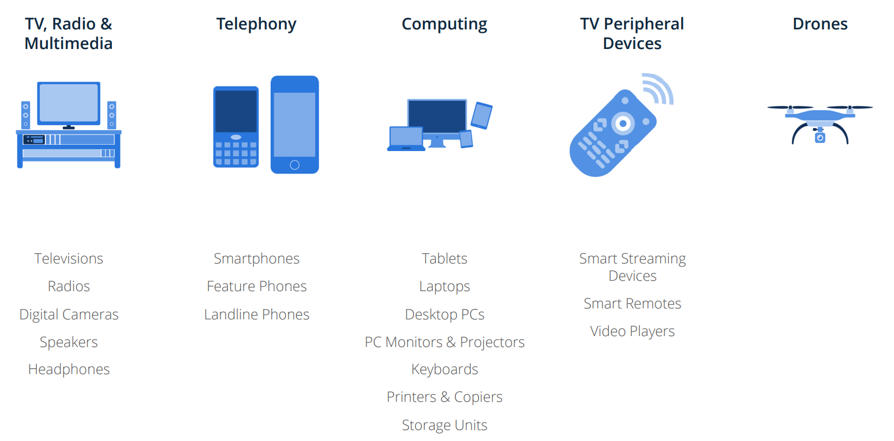
Segmentation

Slide 10
INDUSTRY PERFORMANCE

Slide 11
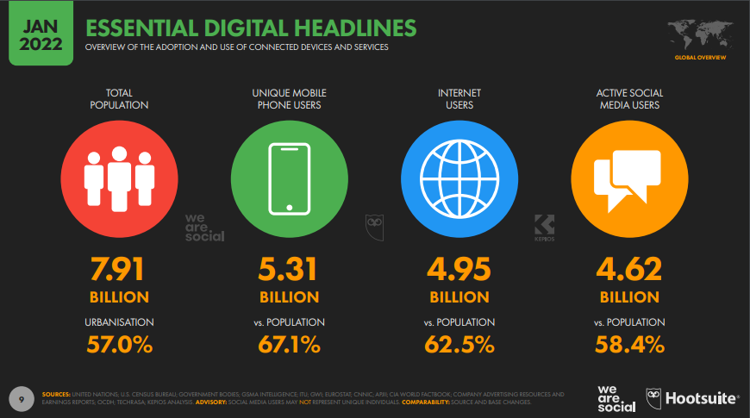

Slide 12
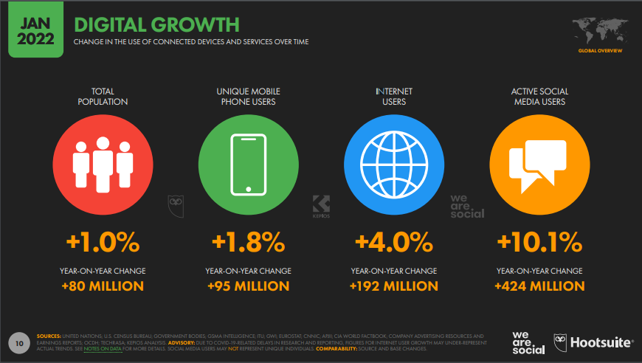

Slide 13
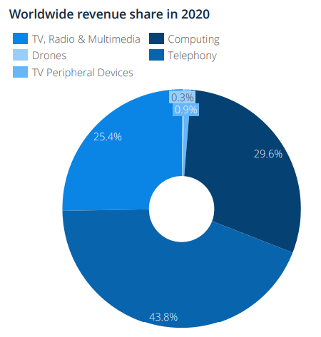
Biggest market share belongs to the telephony segment
With 43.8%, Telephony is the largest segment of the Consumer Electronics market with US$441 billion in revenues in 2020, followed by the Computing segment (US$299 billion). The smallest segment is Drones (US$2.9 billion).
The TV Peripheral Devices and Drones segments are expected to grow by more than 30% between 2020 and 2025, while the Telephony, Computing, and TV, Radio & Multimedia segments are expected to grow by less than 15%, respectively.

Slide 14
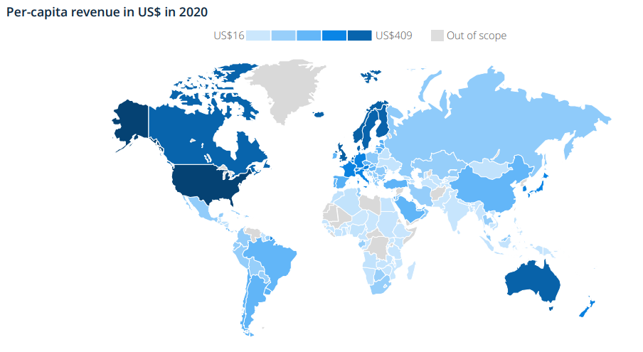
Americans spent the most on electronics in 2020 – US$409B

Slide 15
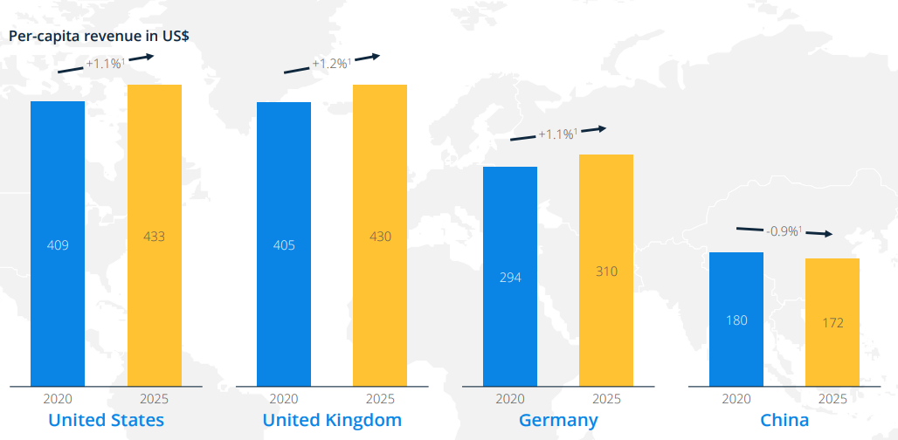
The per-capita revenue in the main markets are expected to remain stable from 2019 to 2025
¹ CAGR

Slide 16
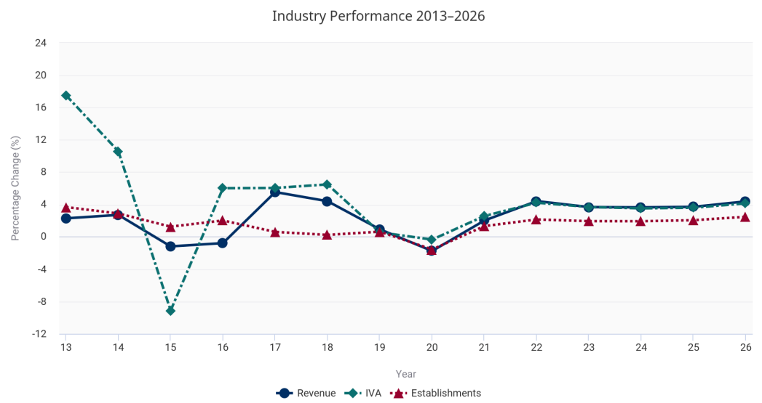
Industry Performance

Slide 17
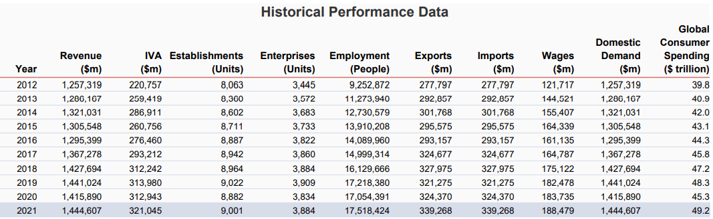
Historical Performance

Slide 18
MARKET DRIVERS

Slide 19
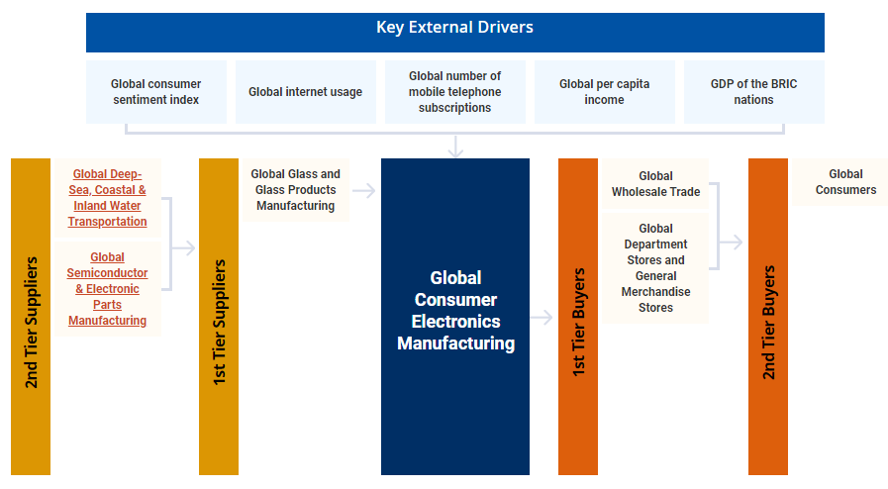
Global Supply Chain

Slide 20

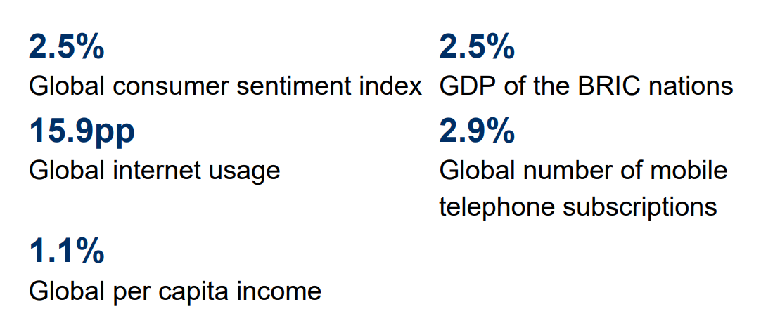
Key External Drivers
% = 2016-21 Annual Growth

Slide 21
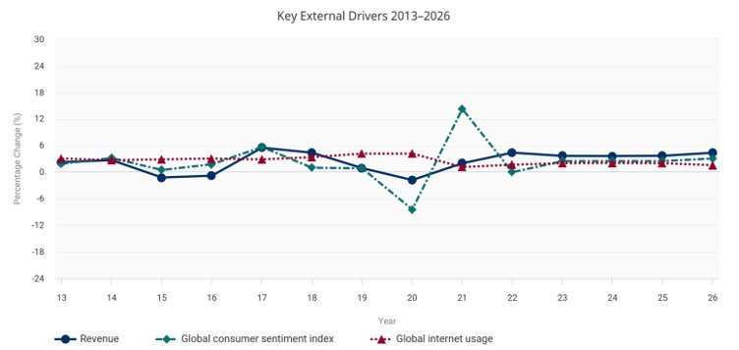
KEY EXTERNAL DRIVERS

Slide 22
Industry Pressures
Convergence
Players in the industry of electronics, hardware, and telecommunications are increasingly competing head-to-head
Turmoil (fluctuations in profit and mergers/acquisitions) will occur in each of these industries over time
Price Competition:
Reliance on the semiconductor industry
Moore’s Law requires industry be competitive in price/performance for market share
Short life span of new products, recycle and move on to the next model

Slide 23
Market Drivers
SMARTPHONE & SMARTHOME
COSTS
Businesses need new investment opportunities but are using old or outdated tools and services
Loss of potential income by not offering investment opportunities for businesses
5G
USABILITY
25% increase of investment inquiries prove that there's consumer interest for simpler portfolio management
Customers want something that’s easy to adopt and simple to use
FINANCIALS
Investing in the stock market increased business portfolios by $20 million in 2019

Slide 24
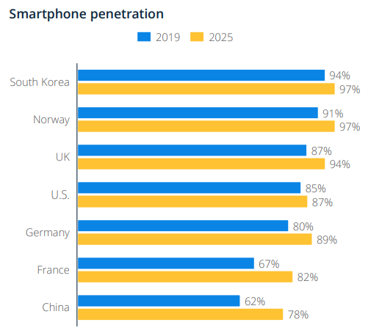
SMARTPHONE PENETRATION
Smartphone penetration is defined as the percentage of total population using a smartphone at least once a month.
Worldwide sales volume growth of smartphones is slowing down gradually, since the market penetration of smartphones is already very high (>65%) in most countries. Therefore, smartphone manufacturers are pushing the limits of what mobile phones are capable of, in terms of sound and vision, storage capacity and speed, to keep demand levels high.
Demand for integrated systems
Smartphones affect other electronics significantly

Slide 25
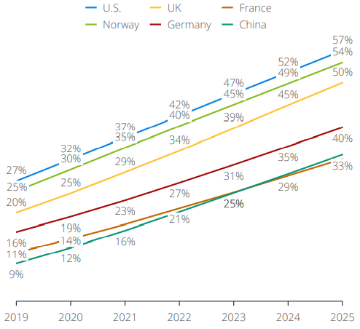
SMARTHOMES PENETRATION
By 2025, 57% of households in the United States will be smart homes.
Consumer preference for ecosystems
With smart home technology, companies can ensure their dominance and enlarge their ecosystems.
Main driver for home entertainment and telecommunication section.

Slide 26
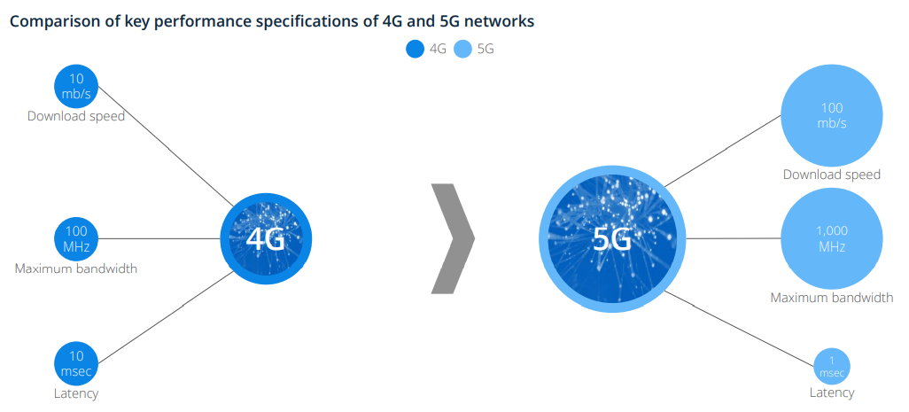
5G REVOLUTION

Slide 27
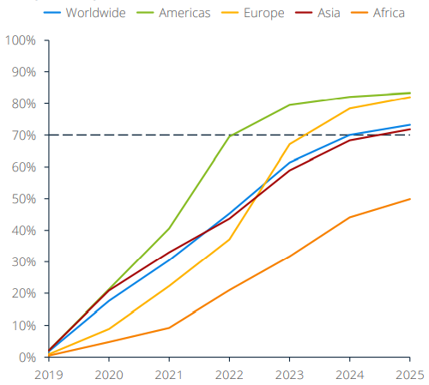
5G PHONES PENETRATION
5G networks are the latest 3GPP standard – with its speed between 10 and 100 times faster than 4G.
as of March 2021, 132 countries around the globe have begun to invest in this technology
5G could serve as the basis for a "Fourth Industrial Revolution" and provide the connectivity required for smart cities of the future

Slide 28
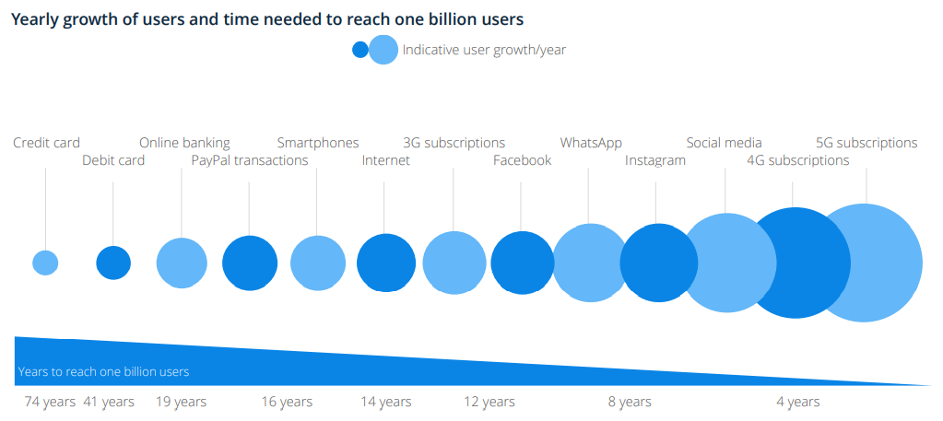
5G users are expected to reach one billion faster than any other technological phenomena

Slide 29
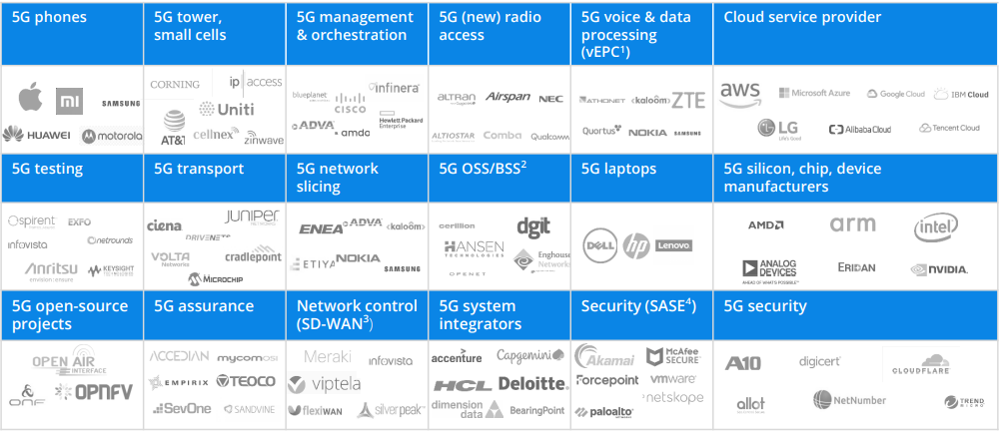
5G Market Ecosystem
Notes:
Predominantly apple concentrates on 5G. Hp and Microsoft

Slide 30
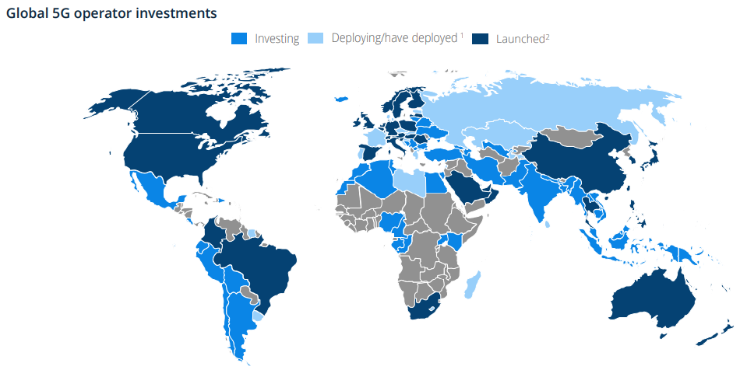
5G Expansion has reached 129 countries

Slide 31

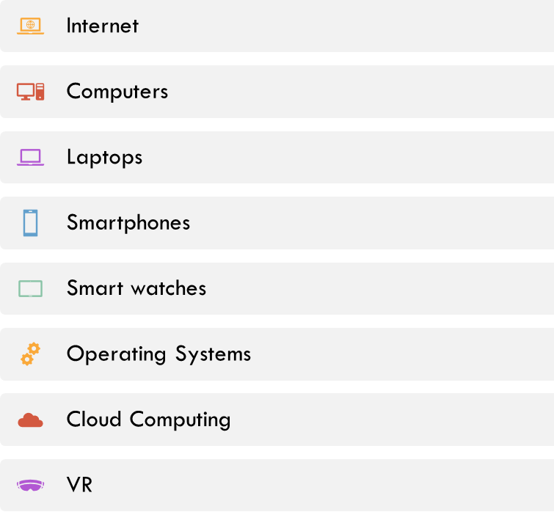
MAIN ASPECTS OF INDUSTRY

Slide 32
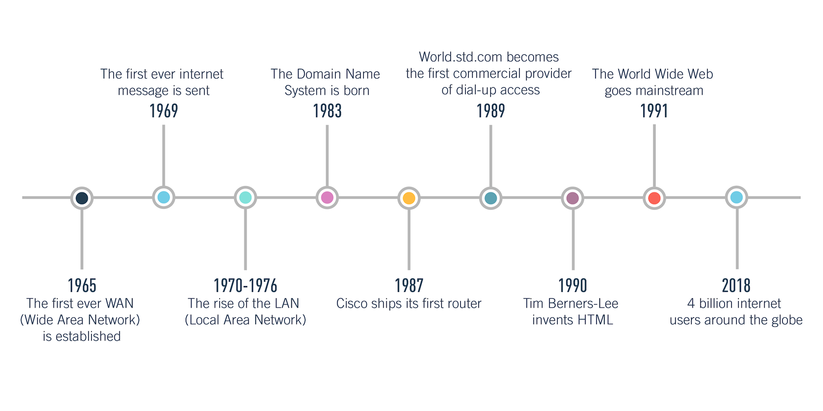
The Internet
The network of networks, which connect billions of people worldwide and enable communication and other various activities

Slide 33
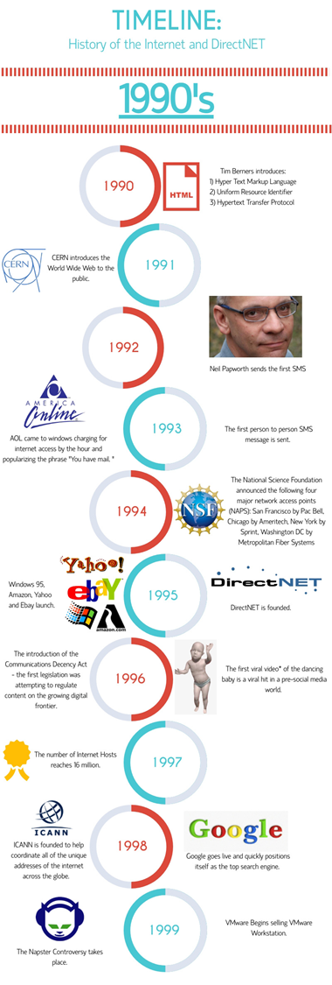
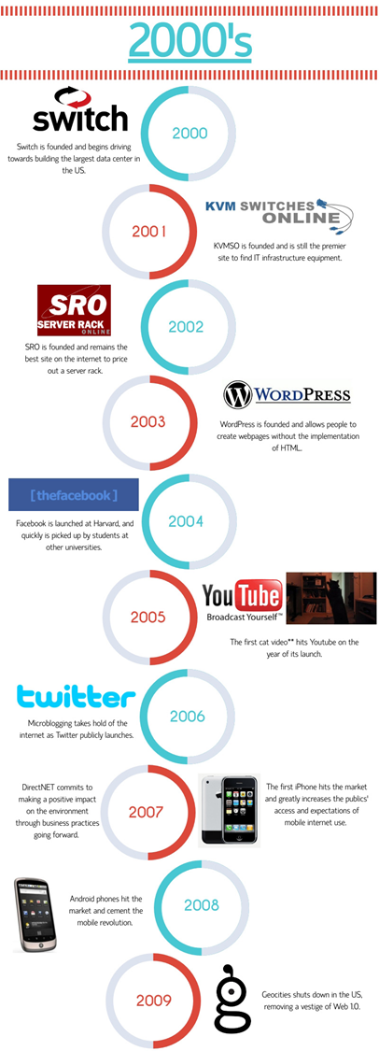
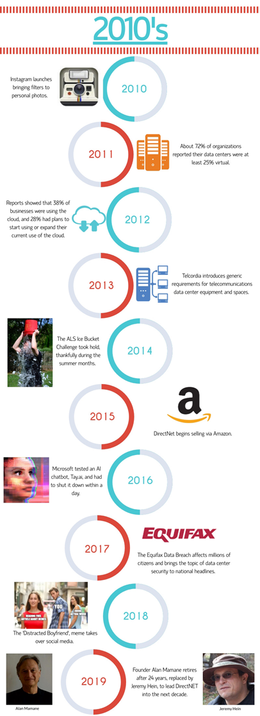

Slide 34
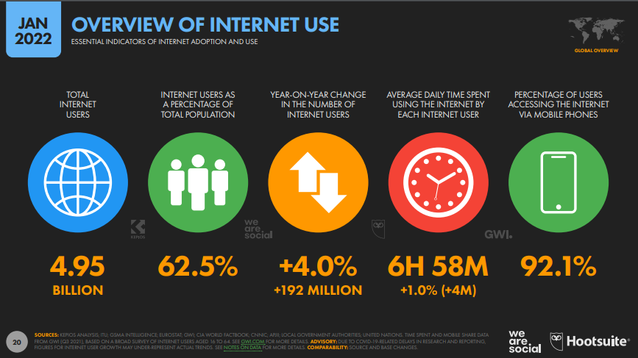

Slide 35
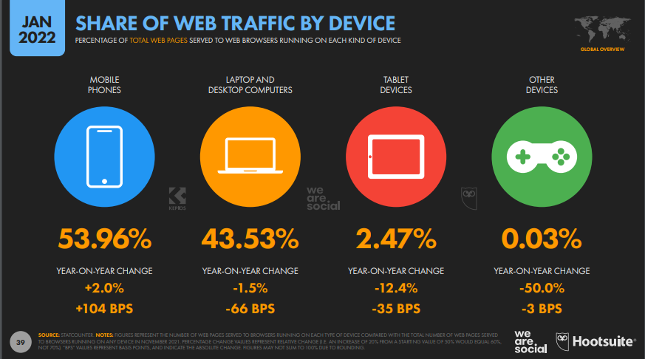

Slide 36
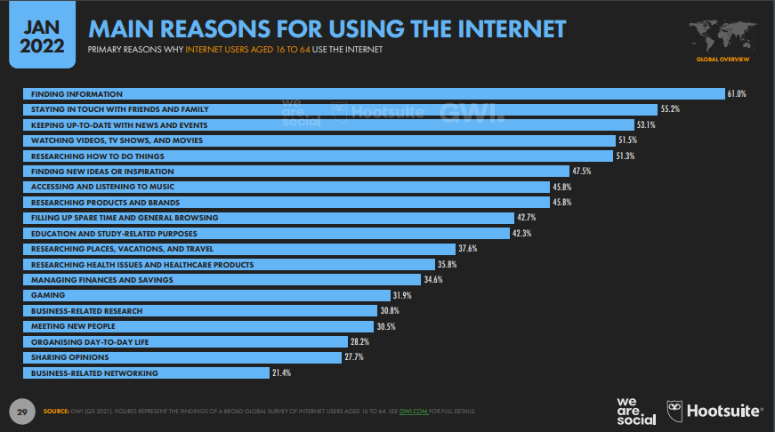

Slide 37
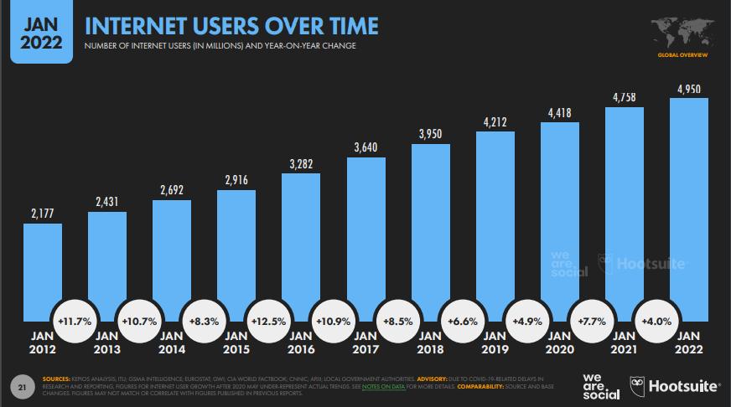

Slide 38
COMPUTING

Slide 39

MARKET COMPARISON
$298.6B
$23.9 B
+1% CAGR
Revenue in 2020
Pieces sold in 2020
2012-2025

Slide 40
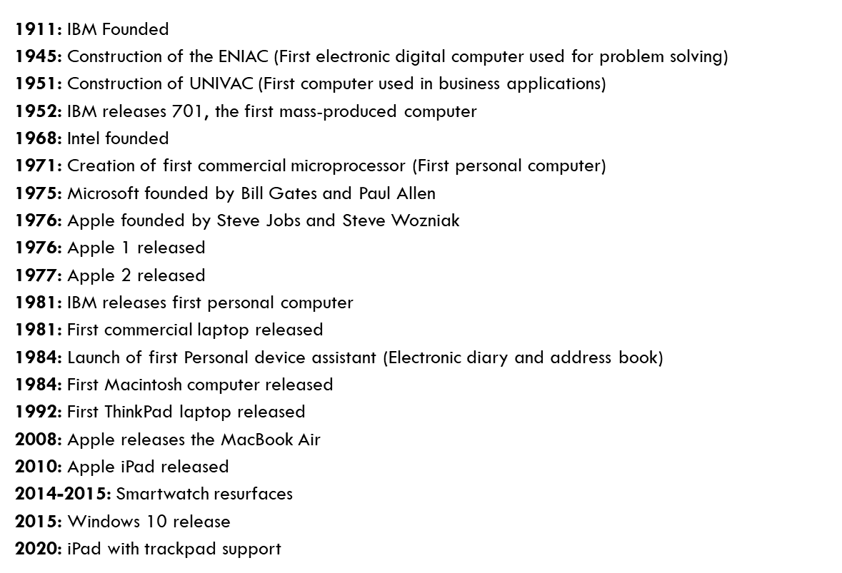
COMPUTER HISTORY

Slide 41
CURRENT TRENDS
Edge Computing
Quantum Computing
Cloud Computing
VR Displays
Conversational Computing
Virtual Desktops (Microsoft)

Slide 42
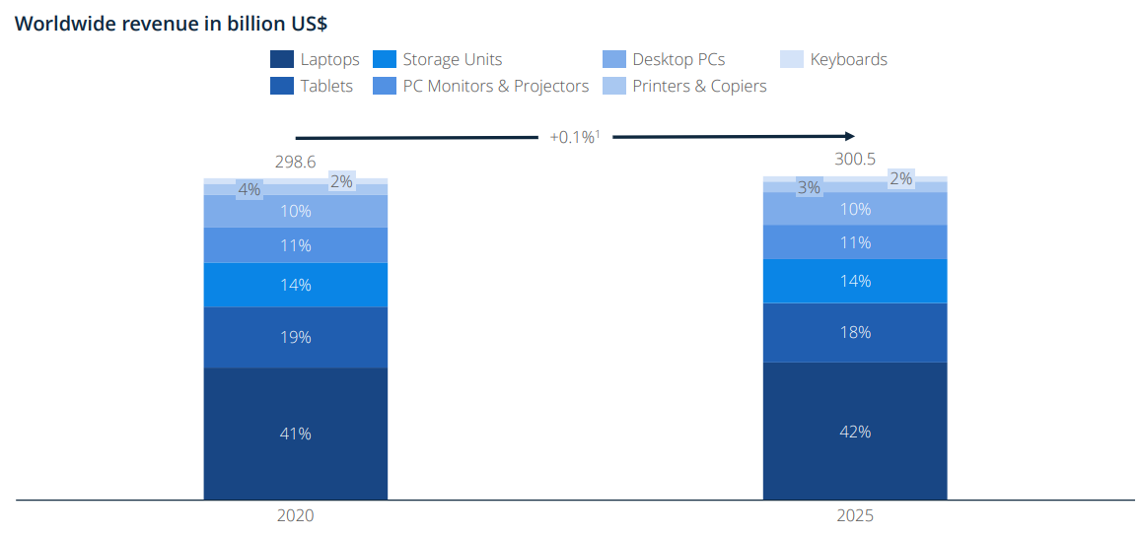
COMPUTING SEGMENTS

Slide 43
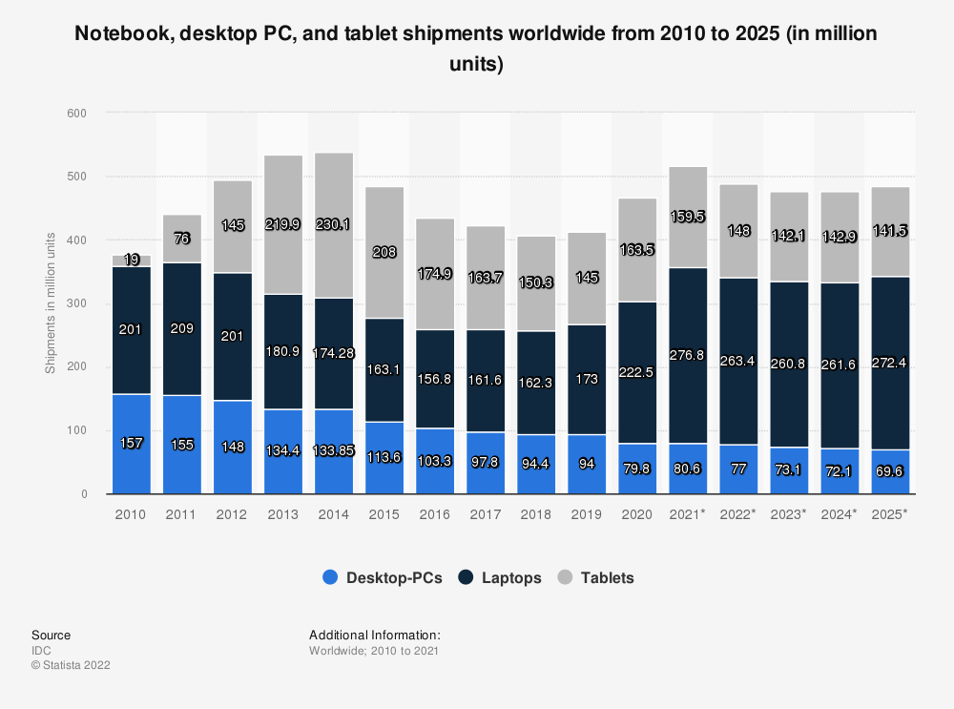
PC TYPES SALES VOLUMES

Slide 44
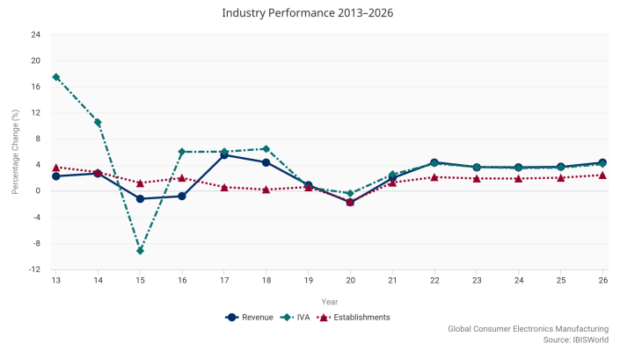
Industry Performance (Electronics)

Slide 45
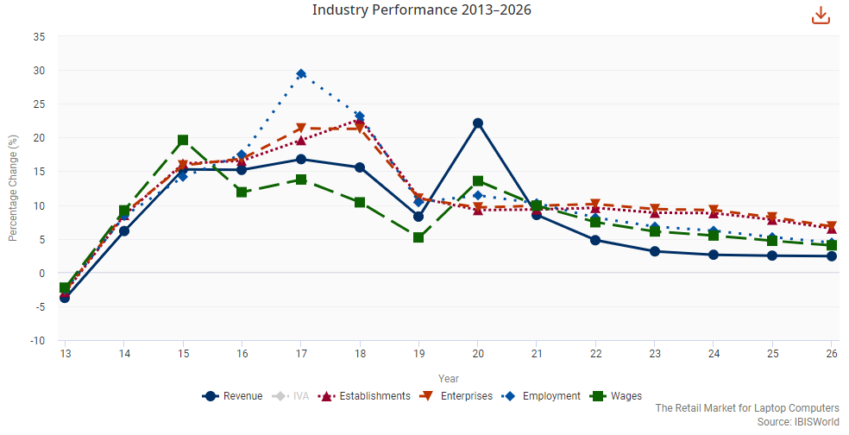
Industry Performance Computer Manufacturing

Slide 46
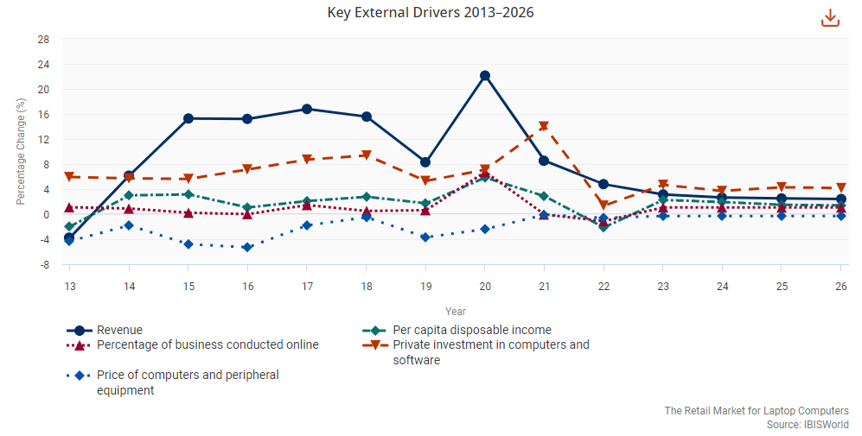
Key Drivers for Laptop Retail

Slide 47
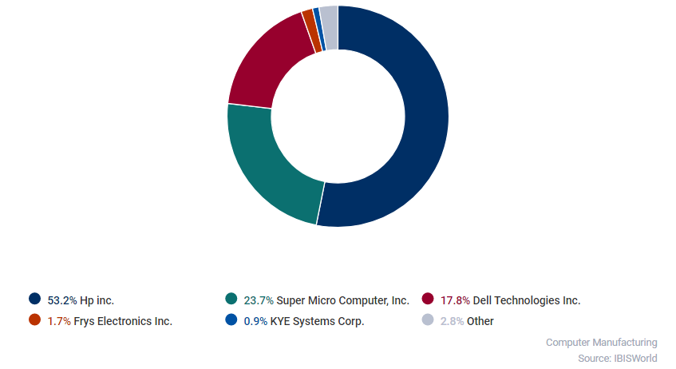
MAJOR PLAYERS

Slide 48
SMARTPHONES

Slide 49

SMARTPHONES
WHAT?
CURRENT TRENDS
Mobile phone that performs many of the
functions of a computer
Typically has a touchscreen interface
Access to internet
Operating system capable of running
downloaded applications & web browsing
Artificaial Intelligence
  Voice Control
  Chatbots
5G
OLED Displays
VR/AR
Mobile IoT Apps
  Smart Home Apps
  Smart Home Appliances
Mobile Wallets
Enhanced Location Services
Wearable/Foldable Devices

Slide 50
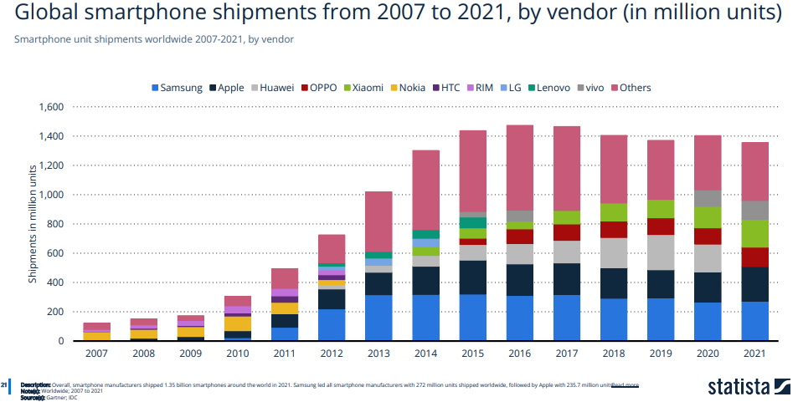
Consolidation in Smartphone Industry

Slide 51
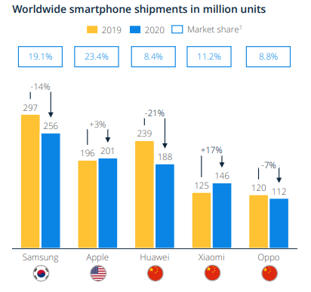
MAJOR PLAYERS

Slide 52
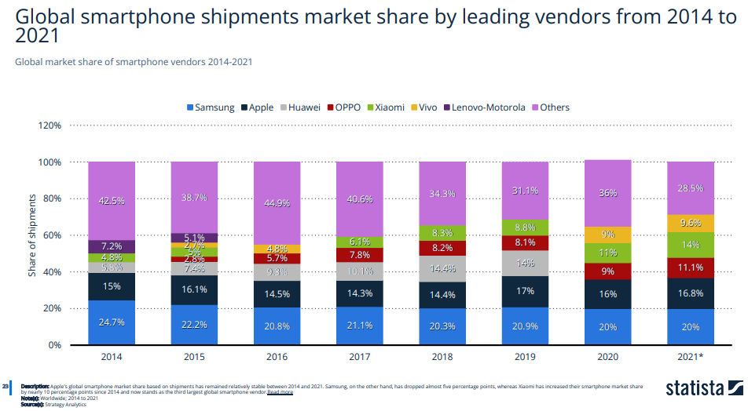
Market Share of Major Players

Slide 53
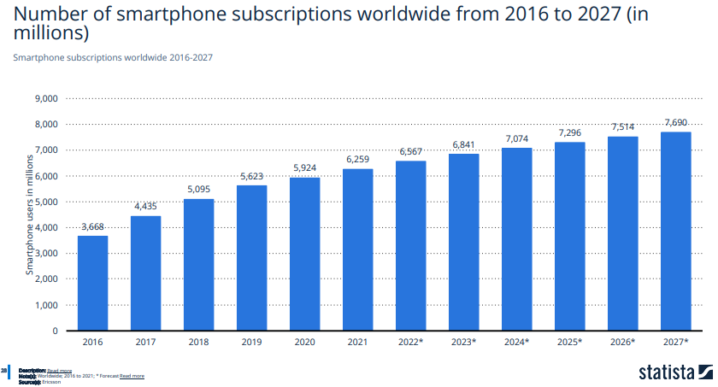
Global Smartphone Subscriptions

Slide 54
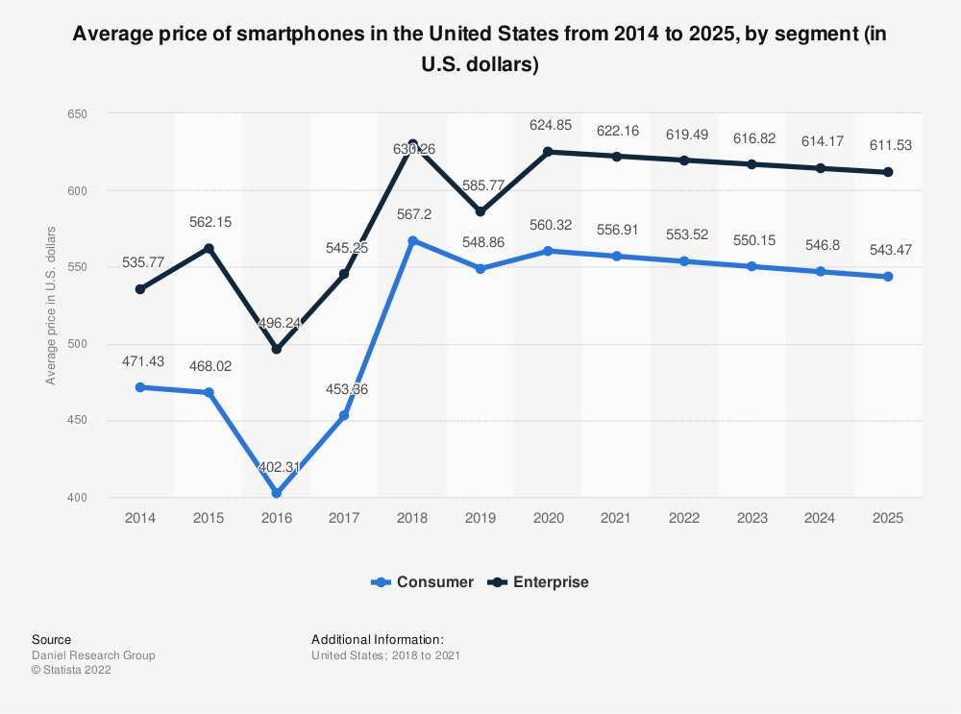
Average Smartphone Price in US (2014-2015)

Slide 55
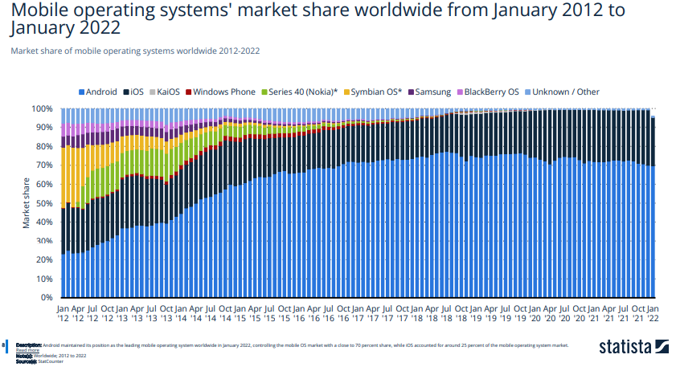
Smartphone OS Evolution (2012-2022)

Slide 56
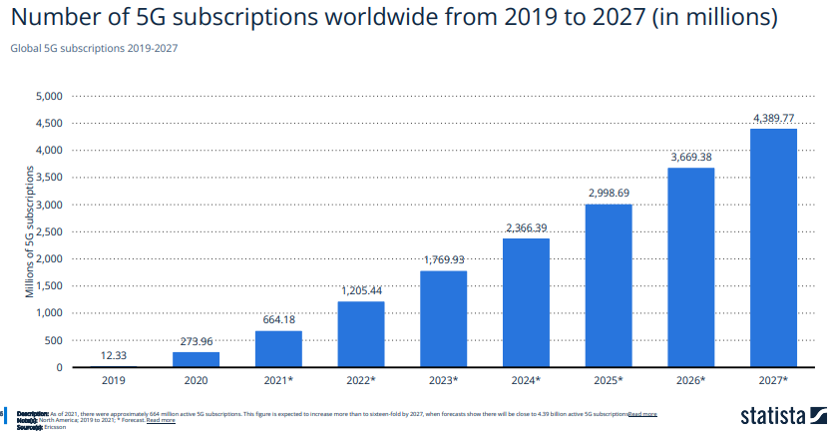
5G Subscriptions

Slide 57
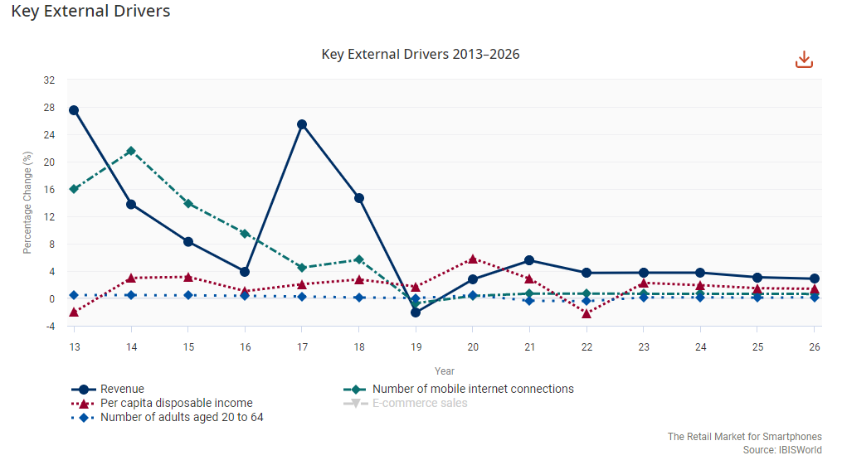
Industry Performance Drivers

Slide 58
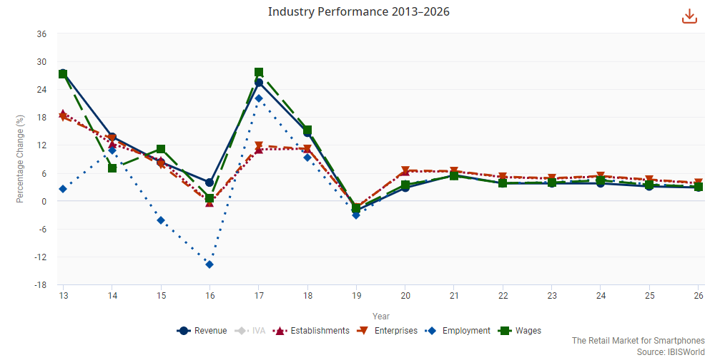
Industry Performance

Slide 59
TABLETS

Slide 60
TABLETS
WHAT?
CURRENT TRENDS
Larger smartphones with touchscreens
Typically used for streaming and more impressive video experience
Access to internet
Similar OS as a smartphone
5G
Increasing functionality blurring lines between tablets and laptops
OLED Displays
VR/AR
Mobile IoT Apps
  Smart Home Apps
  Smart Home Appliances
Mobile Wallets
Enhanced Location Services
Wearable/Foldable Devices

Slide 61
Tablet History
1971: Allan Kay describes a tablet computer at Xerox PARC
1983: Apple and AT&T work on a tablet prototype
1991: IBM markets a tablet computer but fails
1993: Apple Newton launched, also fails
1996: NewsPad debuts; considered one of the first serious prototypes
2009: Various computer manufacturers release tablets to market
2010: Apple iPad and Samsung Galaxy tab launched
2012: Microsoft Surface launched
2013: Sony releases Sony Xperia Tablet Z; Apple releases iPad Air
2014: Nvidia releases Shield Tablet aimed at gaming
2015: Android and Windows Tablets up to 4 gigs of RAM
2016: Apple releases newest iPad Pro with 256gb storage

Slide 62
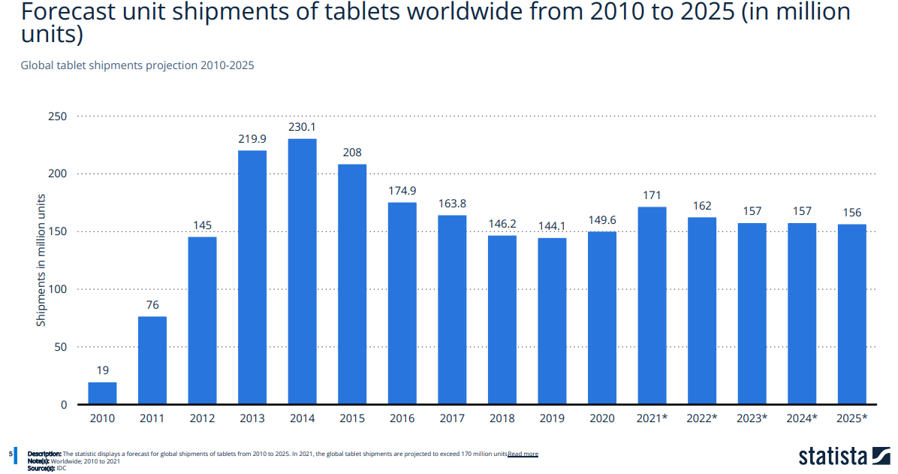
Tablet Demand

Slide 63
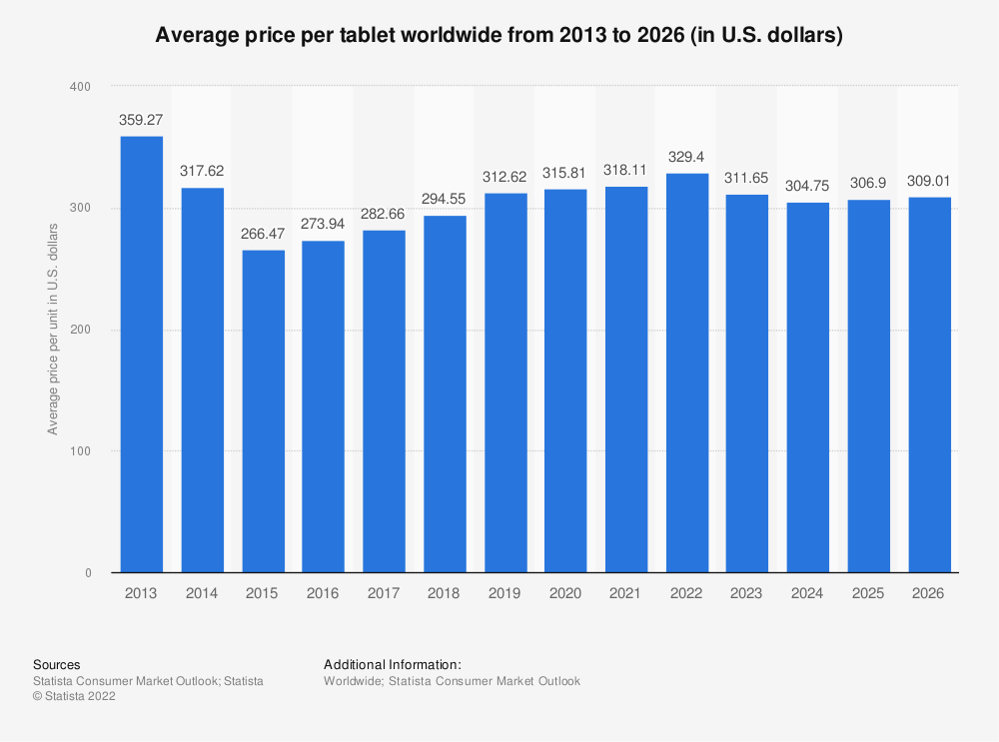
Tablet Price Trend

Slide 64
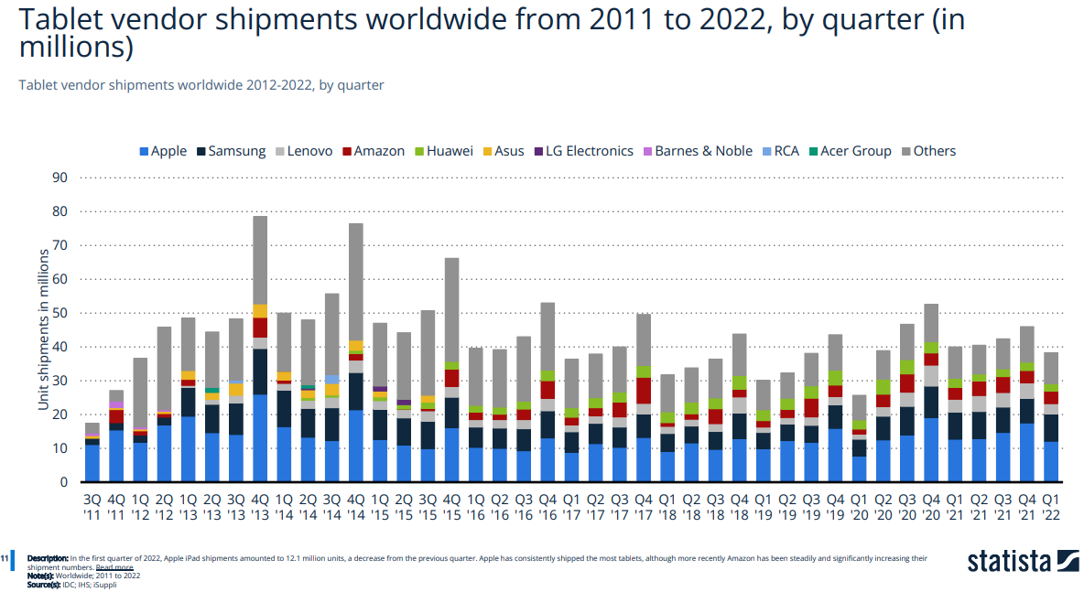
Industry Players

Slide 65
Industry Performance Drivers

Slide 66
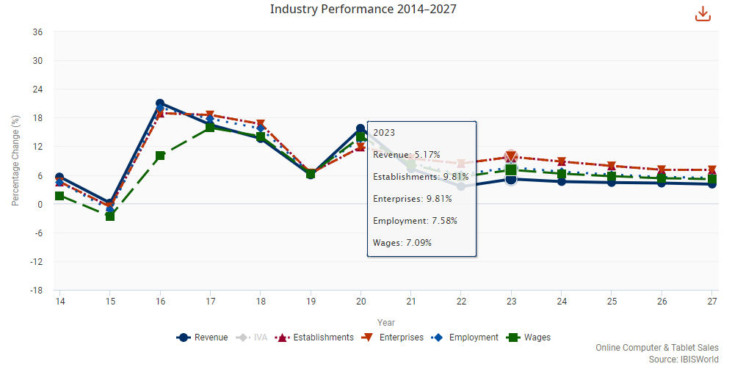
Industry Performance

Slide 67
INTERNET OF THINGS

Slide 68
IoT
WHAT?
CURRENT TRENDS
Network of physical objects—“things”—that are embedded with sensors, software, and other technologies for the purpose of connecting and exchanging data with other devices and systems over the internet.
These devices range from ordinary household objects to sophisticated industrial tools.
With more than 7 billion connected IoT devices today, experts are expecting this number to grow to 10 billion by 2020 and 22 billion by 2025.
5G
IoT Security
Smart Home Technologies
Smart Finance Technologies
Edge Computing
Industrial IoT

Slide 69
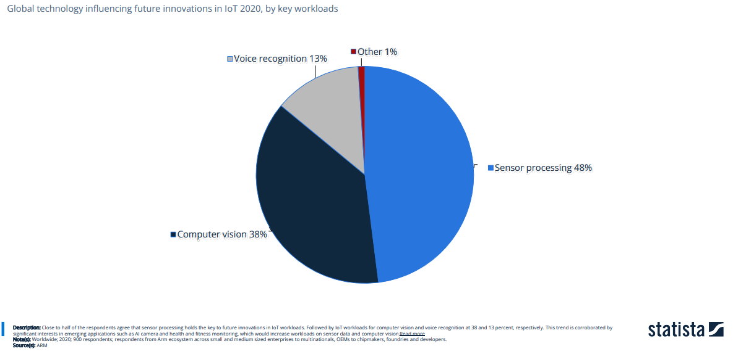
Trends

Slide 70
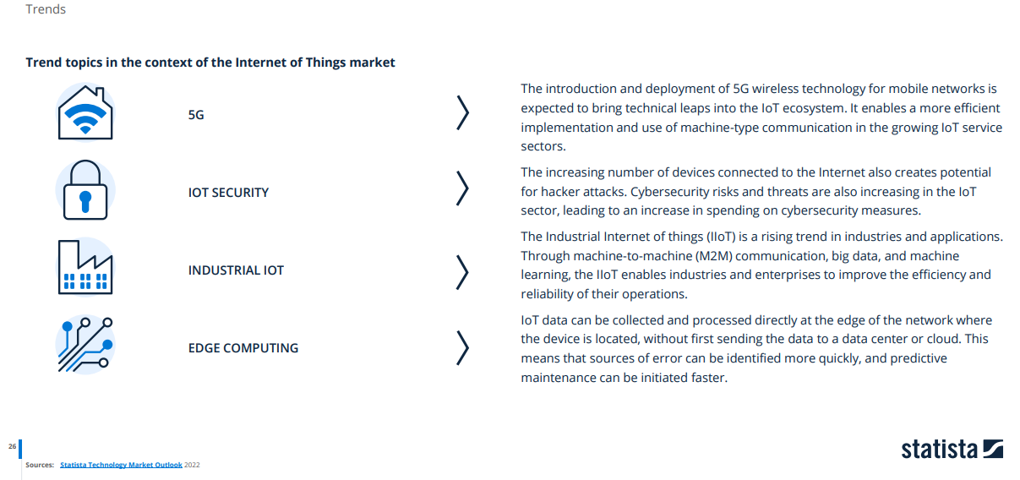
Trends

Slide 71
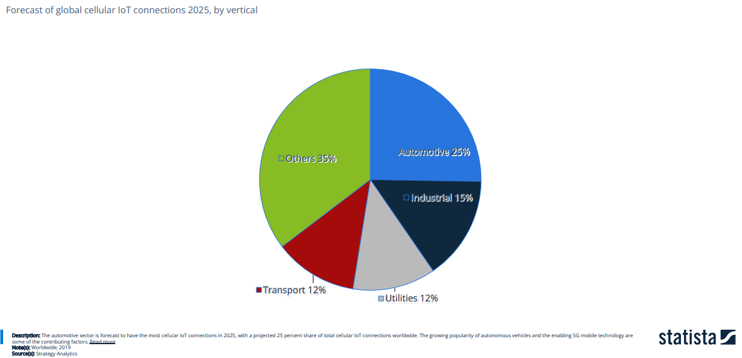
Trends

Slide 72

Trends

Slide 73

IoT Revenue Forecast

Slide 74

Segments

Slide 75
SMARTWATCHES

Slide 76
Smart Watches
WHAT?
CURRENT TRENDS
Computerized wristwatch with functionality that is enhanced beyond timekeeping, and is often comparable to a personal digital assistant device
Growing demand for wireless fitness
and sports devices
Big focus on safety
  Apple Watch fall detection
  Fitbit working towards clinical validation of software to detect health conditions
  Sleep tracking
  ECG tracking
  Increase in demand for voice command capability
Facilitates move to electronic wallet

Slide 77




Other Wearables
Smart
Jewelry
Smart Glasses
Epidermal Electronics
Virtual Reality

Slide 78

Smart Watch Evolution

Slide 79

Smart Watches Demand

Slide 80

Smart Watches Revenue Forecast

Slide 81

Major Players

Slide 82
SMART HOME DEVICES

Slide 83
Smart Home Devices
WHAT?
CURRENT TRENDS
Web-connected devices that allow you to take control of your home and lifestyle.
Segments:
Hubs and smart speakers
Security cameras and smoke detectors
Big and small appliances
Usually capable of:
Streaming audio content
Relaying information
Communicating with other devices.
Notable Devices
  Google Nest
  Amazon Echo
  Apple HomePod
Artificial Intelligence
Integration
Health Tech
Touchless Tech
High-Tech Security
Edge-based solutions

Slide 84

Smart Home Products Penetration

Slide 85

Smart Home Product Segments

Slide 86

Smart Speaker Penetration

Slide 87

Revenue Forecast

Slide 88

Major Players

Slide 89
FUTURE INDUSTRY TRENDS

Slide 90


RECENT DEVLEPOMENTS

Slide 91

Innovation
Growth has reached its limits in the Consumer Electronics market. Companies like Apple, Samsung and Google have to develop new strategies to generate revenues.

Slide 92



Virtual and Augmented Reality
Virtual Reality (VR) and Augmented Reality (AR) are among the dominant trends in the industry and will have a major impact on the Consumer Electronics market. For example, consider the impact that VR and AR can have on laptops and desktops: With virtual desktops, it is possible to share your environment, in 3D and unlimited size, with others worldwide. VR and AR offer the great opportunity to be at home and at the same time walk in an artificial environment in a supermarket or in a warehouse. The possibilities in the area of eCommerce, logistics and warehousing for example are immense

Slide 93

Shy Technology
Consumer focus has changed: While a few years ago, high-tech devices were already the focus of every living room, high-end devices are nowadays expected to adapt to consumers and their environment. With advanced materials such as stretchable, flexible and printed electronics as well as intelligent surfaces, new products emerge that will change the way people interact with electronics and how people interact with each other

Slide 94

Integrated Digital Ecosystems
On average, 56% of internet users want to access their media on all devices

Slide 95

MICROSOFT
Notes:
More stuff on what they do

Slide 96


STOCK INFORMATION
Notes:
Source: Bloomberg
JULY, 1 2022

Slide 97

KEY RATIOS
Notes:
Source: Bloomberg
JULY 1, 2022

Slide 98

STOCK 1 YEAR PERFORMANCE

Slide 99

STOCK 1 YEAR COMPARISON

Slide 100

STOCK 2 YEAR PERFORMANCE

Slide 101
STOCK 2 YEAR COMPARISON

Slide 102

STOCK 5 YEAR PERFORMANCE

Slide 103

STOCK 5 YEAR COMPARISON
Notes:
10 year and the max

Slide 104

STOCK 10 YEAR PERFORMANCE
Notes:
10 year and the max

Slide 105

STOCK 10 YEAR COMPARISON
Notes:
10 year and the max

Slide 106

STOCK MAX PERFORMANCE
Notes:
10 year and the max

Slide 107

STOCK MAX COMPARISON
Notes:
10 year and the max

Slide 108

MSFT Vs APPL Vs HP (10-Year)
Notes:
10 year and the max

Slide 109

Share Repurchases FY21 10-K

Slide 110

Share Repurchases FY22 10-Q

Slide 111

Top Shareholders

Slide 112

COMPANY HISTORY & OVERVIEW

Slide 113
MISSION & STRATEGY
Mission
"Empower every person and every organization on the planet to achieve more"
Core Values
Innovation
Diversity and Inclusion
Corporate Social Responsibility
Artificial Intelligence
Trustworthy Computing
Giving back to local communities
Strategy
Reinvent productivity and business processes
Build the intelligent cloud and intelligent edge platform
Create more personal computing

Slide 114








COMPANY TIMELINE
2008
Microsoft launches Windows Azure
Notes:
https://news.microsoft.com/facts-about-microsoft/

Slide 115









Notes:
https://news.microsoft.com/facts-about-microsoft/

Slide 116
2021
Introduces Microsoft Mesh mixed-reality platform and unveils Windows 365
2022
Microsoft acquires Activision Blizzard and Nuance
Notes:
https://news.microsoft.com/facts-about-microsoft/

Slide 117
NOTABLE ACQUISITIONS
1987 – Forethought (becomes Microsoft Power Point, $14 million)
1997 - Hotmail ($500 Million)
2000 - Visio Corp. ($1.375 Billion)
2011 - Skype ($8.5 Billion)
2014 - Nokia ($7.2 Billion)
2015 – Metanautix (Company used to help manage data)
2016 – LinkedIn ($26.2 Billion)
2017 – Cloudlyn ($60 Million, Cloud company in Israel for managing cloud payments and billing)
2018 – GitHub ($7.5 Billion, provides hosting for software development and version control)
2020 – ZeniMax Media and Bethesda Softworks ($7.5 billion, one of the largest privately held game developers and publishers in the world)
2020 – Orions Systems, cyber X, ADRM Software, Softomotive, Metaswitch Networks, Affirmed networks
2021- The Marsden Group, Nuance Communications Inc., ReFirm Labs, CloudKnox, Peer5, Xandr
2022- Activision Blizzard, Oribi, Minit, Miburo

Slide 118

EXECUTIVE MANAGEMENT

Slide 119

Satya Nadella (CEO, 2014 –Present)
Joined Microsoft in 1992
Led Microsoft’s move to cloud computing and the development of one of the largest cloud infrastructures in the world (created the Azure public cloud business).
Emphasized openness to working with Microsoft’s competitors (e.g. Apple, IBM, Linux)
Lead a series of high-profile acquisitions (e.g. Mojang, LinkedIn, GitHub)
Also serves on the Board of Directors of Starbucks Corporation
Education
Earned a Bachelor’s degree in Electrical Engineering (Mangalore University), a Master’s degree in Computer Science (University of Wisconsin) Business Administration (University of Chicago)

Slide 120

Judson Althoff (Executive VP, Worldwide Commercial Business, 2016 – present)
Joined Microsoft in March 2013 as President of Microsoft North America
Spent several years in senior sales roles at Oracle and EMC
Education
Earned a mechanical engineering degree from the Illinois Institute of Technology (IIT) and serves on the Computer Science Advisory Board

Slide 121

Chris Capossela (Executive VP of Consumer Business, CMO, 2014 - present)
Led Microsoft business for Microsoft’s EMEA region in 1999
Assumed leadership of Microsoft Project in 2001
Promoted to corporate Vice President of Microsoft Office division in 2003
Oversees marketing across all Microsoft product, services, research, brand, advertising, and corporate communications
Education
Holds a bachelor’s degree in computer science and economics (Harvard University)

Slide 122

Amy Hood
(Executive VP, Chief Financial Officer, 2013 – present)
Joined Microsoft in 2002 after leaving Goldman Sachs’ investment banking and various other investment banking roles
General Manager, Microsoft Business Division Strategy from 2006 to 2009. •Helped lead the transition to Office 365 service and vital in acquisitions of Skype and Yammer.
Chief Financial Officer of the Microsoft Business Division from 2010 to 2013
Also serves on the Board of Directors of 3M Corporation
Education
Earned a Bachelor's degree in Economics (Duke University) and an MBA (Harvard University)

Slide 123

Jean-Philippe Courtois – Executive VP and President, Microsoft Global Sales, Marketing and Operations (2016-Present)
Joined Microsoft in 1984 as a channel sales rep and was promoted to General Manager of Microsoft France in 1994
Corporate Vice President, Worldwide Customer Marketing from 1998 to 2000
Senior Vice President and President, Microsoft EMEA from 2000 to 2003
Chief Executive Officer, Microsoft EMEA from 2003 to 2005
President of Microsoft International from 2005 to 2016
Education
Holds a diploma in advanced business studies (Skema Business School), where he also sits on the board of directors.

Slide 124

Kurt DelBene
(Executive VP, Corporate Strategy, Core Services Engineering and Operations, 2015 – present)
Joined Microsoft in 1992 and has served in several roles in Microsoft's product development team
President of Microsoft Office Division from 2010-2013
Previously served as Senior Vice President for Microsoft Business division
Served as Senior Advisor to the Secretary of health and Human Services on Healthcare.gov to help President Obama make improvements to the enrollment website for the Affordable Care Act from 2013-2014
Prior to joining Microsoft DelBene was a management consultant with Mckinsey and company focusing on business strategy for technology companies
Education
Holds a MBA (University of Chicago), a Master of Science degree (Stanford University) and a Bachelor of Industrial Engineering (University of Arizona).

Slide 125

Dave O’Hara
(Corporate VP and CFO, 2013 – present)
Was president of ICONtrol Inc., after being acquired by Great Plains Software he was International VP and VP of mergers and acquisitions
Roles at Microsoft included CFO of Applications and Services Group and the Cloud Enterprise Group, COO for Microsoft Advertising and VP of business development for Microsoft Business Solutions
Began Career at Microsoft in 2001
Education
Holds a Bachelor’s degree in economics and an MBA from University of South Dakota

Slide 126

Rajesh Jha
(Executive VP, Experiences and Devices, 2006 - Present)
Joined Microsoft in 1990
Former Corporate VP delivering Office 365 cross platform through the cloud
Began career as a software design engineer
Education
Has a Master’s Degree in Computer Science from the University of Massachusetts, Amherst and a Bachelor’s Degree in Computer Science from Indian Institute of Technology, Madras

Slide 127

Takeshi Numoto
(Commercial Chief Marketing Officer, 2020 – present)
Joined Microsoft in 1997 as a business Development Manager​
Worked in the Japanese Government’s Ministry of International Trade and Industry before joining Microsoft​
Prior to this role, worked in the Microsoft Office Division, spearheading the Microsoft Office and Office 365 product management group​
​
Education​
Holds a Bachelor’s Degree in Law from the University of Tokyo and an MBA from Stanford University

Slide 128

Board of Directors

Slide 129
REPORTABLE SEGMENTS

Slide 130

Reportable Segments

Slide 131

Productivity and Business Processes
Office Commercial
Volume licensing
Subscriptions to Office 365 commercial for products:
-Office, Exchange, SharePoint, Skype Related Client Access Licenses
Office Consumer
Office 365, Skype, Outlook, OneDrive
LinkedIn
Talent solutions, Marketing solutions, Premium Subscriptions
Sales solutions and Learning Solutions
Dynamics business solutions
Dynamics 365
Dynamics ERP products
Dynamics CRM on-premises
Dynamics CRM Online

Slide 132

Intelligent Cloud
Server products and cloud services
Microsoft SQL Server
Windows Server
Visual Studio
System Center
Related CALs
Azure
Nuance and GitHub
Enterprise Services
Premier Support Services
Microsoft Consulting Services
Nuance Professional services

Slide 133

More Personal Computing
Windows (Windows original equipment manufacturer licensing, other non-volume licensing of the Windows operating system, volume licensing of the Windows operating system, patent licensing, Windows Embedded, MSN display advertising, and Windows Phone licensing)
Devices (Surface, phones, and PC accessories, and other intelligent devices)
Gaming (Xbox hardware, Xbox Live, comprising transactions, subscriptions, and advertising, video games, and third-party video game royalties)
Search advertising (Bing, Bing Ads, and MSN)

Slide 134

Revenue by Segments FY22 10-Q

Slide 135

Revenue by Products and Service Offerings FY22 10-Q

Slide 136

Revenue by Geography FY22 10-Q
Notes:
No sales to an individual customer or country other than the United States accounted for more than 10% of revenue for the three or nine months ended March 31, 2022 or 2021.

Slide 137

Shareholder's Equity Statement FY21 10-K

Slide 138

Shareholder's Equity Statement FY22 10-Q

Slide 139

Earnings Per Share FY21 10-K

Slide 140

Earnings Per Share FY22 10-Q

Slide 141

FINANCIAL ANALYSIS

Slide 142

Balance Sheet FY22 10-Q

Slide 143

Balance Sheet FY22 10-Q

Slide 144

Balance Sheet FY22 10-Q

Slide 145

Balance Sheet FY21 10-K

Slide 146

Balance Sheet FY21 10-K

Slide 147


Balance Sheet FY21 10-K

Slide 148

Income Statement FY21 10-K
Notes:
Balance sheet 10Q, 10k, income statement 10K, 10Q, CF 10k and then 10Q
Share purchases at the beginning (after the max)
Buy back a lot of shares = return a lot of cash to shareholders

Slide 149

Income Statement FY22 10-Q

Slide 150

Comprehensive Income Statement FY21 10-k

Slide 151

Comprehensive Income Statement FY22 10-Q

Slide 152

Cash Flow Statement FY21 10-K

Slide 153

Cash Flow Statement FY21 10-K

Slide 154

Cash Flow Statement FY22 10-Q

Slide 155

Cash Flow Statement FY22 10-Q

Slide 156

Analyst Recommendations
BUY

Slide 157

Apple Inc.

Slide 158


Notes:
https://news.microsoft.com/facts-about-microsoft/

Slide 159
KEY RATIOS
P/E Ratio | 22.59 | 1 Year Return | 2.56%
Shares Outstanding | 16.279B | 30 Day Avg Volume | 79.66M
Price to Book Ratio | 36.06 | EPS | $6.12
Price to Sales Ratio | 6.33 | Dividend | 0.15%
Earnings Announcement for Period Ending Q3/2022 | July 30, 2020 | Last Dividend Reported | $0.23 (Declared: April 27, 2022)
Notes:
Source: Bloomberg

Slide 160

STOCK 1 YEAR PERFORMANCE

Slide 161

STOCK 1 YEAR COMPARISON

Slide 162

STOCK 2 YEAR PERFORMANCE

Slide 163

STOCK 2 YEAR COMPARISON

Slide 164

STOCK 5 YEAR PERFORMANCE

Slide 165

STOCK 5 YEAR COMPARISON
Notes:
10 year and the max

Slide 166

STOCK 10 YEAR PERFORMANCE

Slide 167

STOCK 10 YEAR COMPARISON
Notes:
10 year and the max

Slide 168

STOCK MAX PERFORMANCE
Notes:
10 year and the max

Slide 169

STOCK MAX COMPARISON
Notes:
10 year and the max

Slide 170
APPL Vs MSFT Vs HP (10-Year)
Notes:
10 year and the max

Slide 171

Top Shareholders
Notes:
10 year and the max

Slide 172

COMPANY HISTORY & OVERVIEW

Slide 173


Notes:
10 year and the max

Slide 174

Notes:
10 year and the max

Slide 175


Notes:
10 year and the max

Slide 176

Notes:
10 year and the max

Slide 177

Notes:
10 year and the max

Slide 178

Mission Statement
Apple’s corporate mission is “to bring the best personal computing products and support to students, educators, designers, scientists, engineers, businesspersons and consumers in over 140 countries around the world.”
Notes:
This mission statement considers the changing business landscape that influences the possibilities of what Apple Inc. can do. For instance, the company recognizes trends in the consumer electronics market and the industry environment. Apple’s press releases and official statements point to this corporate mission as a way of addressing current concerns in the global market.

Slide 179

Notes:
10 year and the max

Slide 180

Notes:
10 year and the max

Slide 181

Notes:
10 year and the max

Slide 182


Notes:
10 year and the max

Slide 183


Slide 184








Product Lines
Notes:
This mission statement considers the changing business landscape that influences the possibilities of what Apple Inc. can do. For instance, the company recognizes trends in the consumer electronics market and the industry environment. Apple’s press releases and official statements point to this corporate mission as a way of addressing current concerns in the global market.

Slide 185






Services
Notes:
This mission statement considers the changing business landscape that influences the possibilities of what Apple Inc. can do. For instance, the company recognizes trends in the consumer electronics market and the industry environment. Apple’s press releases and official statements point to this corporate mission as a way of addressing current concerns in the global market.

Slide 186




Notes:
10 year and the max

Slide 187


单击此处添加文本
Notes:
10 year and the max

Slide 188


单击此处添加文本
Notes:
10 year and the max

Slide 189


Notes:
10 year and the max

Slide 190


Notes:
10 year and the max

Slide 191


Smartwatch for health, fitness-tracking and other connections with the iPhone for calling functions etc.
First released in 2015
Current model: Series 7 includes 45mm or 41mm display, LTE connectivity, Blood Oxygen app, ECG app
Notes:
10 year and the max

Slide 192


Notes:
10 year and the max

Slide 193


Notes:
10 year and the max

Slide 194

EXECUTIVE MANAGEMENT

Slide 195

Executive Profiles
Notes:
10 year and the max

Slide 196

Tim Cook is the CEO of Apple and serves on its board of directors.
Joined Apple in 1998.
Tim earned an MBA from Duke University.
Before being named CEO in August 2011, Tim was Apple’s chief operating officer and was responsible for all of the company’s worldwide sales and operations.
Notes:
https://news.microsoft.com/facts-about-microsoft/

Slide 197

Eddy Cue is Apple’s senior vice president of Services, reporting to CEO Tim Cook.
Eddy joined Apple in 1989 .
Eddy earned a bachelor’s degree in Computer Science and Economics from Duke University.
Eddy oversees the full range of Apple’s services,
Notes:
https://news.microsoft.com/facts-about-microsoft/

Slide 198

Greg “Joz” Joswiak is Apple’s senior vice president of Worldwide Marketing, reporting to CEO Tim Cook.
Joz has over 30 years of marketing and management experience at Apple.
Since joining Apple in June 1986, Joz has played a pivotal role in developing and launching products.
Joz graduated with a Bachelor of Science in Computer Engineering from the University of Michigan in 1986.
Notes:
https://news.microsoft.com/facts-about-microsoft/

Slide 199

Deirdre O’Brien is Apple’s senior vice president of Retail + People, reporting to CEO Tim Cook.
Leader of Apple’s retail and online teams.
A 30-year Apple veteran.
Holds a bachelor’s degree in Operations Management from Michigan State University and an MBA from San Jose State University.
Notes:
https://news.microsoft.com/facts-about-microsoft/

Slide 200

John Ternus is Apple’s senior vice president of Hardware Engineering, reporting to CEO Tim Cook.
John leads all hardware engineering, including the teams behind iPhone, iPad, Mac, AirPods, and more.
John joined Apple’s Product Design team in 2001 and has been a vice president of Hardware Engineering since 2013.
Holds a bachelor’s degree in Mechanical Engineering from the University of Pennsylvania.
Notes:
https://news.microsoft.com/facts-about-microsoft/

Slide 201

REPORTABLE SEGMENTS

Slide 202

Gross Margin FY21 10-K

Slide 203

Product and Service Performance FY21 10-K

Slide 204

Sales by Segment and Products FY21 10-K

Slide 205

Sales by Segment and Products FY21 10-K
Notes:
Split the slides

Slide 206

Earnings

Slide 207

Net Sales

Slide 208


Notes:
10 year and the max

Slide 209

Shareholders' Equity FY22 10-Q
Notes:
Split

Slide 210

Shareholders' Equity FY21 10-k
Notes:
Split

Slide 211

Financial Statements

Slide 212

Balance Sheet FY22 10-Q

Slide 213

Balance Sheet FY22 10-Q

Slide 214

Balance Sheet FY21 10-K

Slide 215

Balance Sheet FY21 10-K

Slide 216

Balance Sheet FY21 10-K

Slide 217

Income Statement FY21 10-K

Slide 218

Income Statement FY21 10-K

Slide 219

Income Statement FY22 10-Q

Slide 220

Income Statement FY22 10-Q

Slide 221

Cash flows FY21 10-K

Slide 222


Cash flows FY21 10-K

Slide 223

Cash flows FY21 10-K

Slide 224

Cash flows FY21 10-Q

Slide 225

Cash flows FY21 10-Q

Slide 226

Cash flows FY21 10-Q

Slide 227


BUY

Slide 228

Hewlett-Packard

Slide 229



STOCK INFORMATION
Notes:
Source: Bloomberg
JULY, 1 2022

Slide 230

STOCK 1-YEAR PERFORMANCE
Notes:
Source: Bloomberg
JULY, 1 2022

Slide 231

STOCK 1-YEAR COMPARISON
Notes:
Source: Bloomberg
JULY, 1 2022

Slide 232

STOCK 5-YEAR PERFORMANCE
Notes:
Source: Bloomberg
JULY, 1 2022

Slide 233

STOCK 5-YEAR COMPARISON
Notes:
Source: Bloomberg
JULY, 1 2022

Slide 234

STOCK 10-YEAR PERFORMANCE
Notes:
Source: Bloomberg
JULY, 1 2022

Slide 235

STOCK 10-YEAR COMPARISON
Notes:
Source: Bloomberg
JULY, 1 2022

Slide 236

STOCK MAX PERFORMANCE
Notes:
Source: Bloomberg
JULY, 1 2022

Slide 237

STOCK MAX COMPARISON
Notes:
Source: Bloomberg
JULY, 1 2022

Slide 238

Top Shareholders
Notes:
Source: Bloomberg
JULY, 1 2022

Slide 239


Share Repurchase -10K
Notes:
Source: Bloomberg
JULY, 1 2022

Slide 240

Shareholder’s Deficit
Notes:
Source: Bloomberg
JULY, 1 2022

Slide 241

HP Overview

Slide 242


Overview &
Vision
Notes:
Source: Bloomberg
JULY, 1 2022

Slide 243

History and Notable Achievements
1934
Founded by Bill Hewlett and Dave Packard in 1934
1934–1968
Sound oscillators (Disney), high-speed conductors, atomic clock (1964), invented LED
1957
HP IPOs
1968
First “Personal Computer” by HP via programmable calculator
1980
First HP PC with peripherals
1983
First touchscreen computer
1984
HP LaserJet released
2015
HP splits from HPE, Hewlett Packard Enterprise

Slide 244
HP Segments Explained – Personal systems
Notebooks: Consumer and commercial notebooks and mobile devices
Desktop: Consumer and commercial desktop, also includes POS systems
Workstations: Desktop workstations, monitors and accessories
Others: Consumer and commercial services, includes Personal Systems capabilities
Notes:
Source: Bloomberg
JULY, 1 2022

Slide 245




Personal systems
Desktops
Notebooks
Workstations
Notes:
Source: Bloomberg
JULY, 1 2022

Slide 246

Global PC Market Share
Microsoft is somewhere here
Notes:
Source: Bloomberg
JULY, 1 2022

Slide 247
HP Segments Explained – Printing
Supplies: Printing supplies like ink cartridge
Commercial: Commercial printing solutions, graphics solutions, 3D printing and digital manufacturing
Consumer: Home printing solutions, excluding supplies
Notes:
Source: Bloomberg
JULY, 1 2022

Slide 248

HP Segments Explained – Printing
Notes:
Source: Bloomberg
JULY, 1 2022

Slide 249

Notes:
Source: Bloomberg
JULY, 1 2022

Slide 250
EXECUTIVE MANAGEMENT

Slide 251

Executive team

Slide 252


Notes:
Source: Bloomberg
JULY, 1 2022

Slide 253



Notes:
Source: Bloomberg
JULY, 1 2022

Slide 254


Notes:
Source: Bloomberg
JULY, 1 2022

Slide 255


Notes:
Source: Bloomberg
JULY, 1 2022

Slide 256


Notes:
Source: Bloomberg
JULY, 1 2022

Slide 257
REPORTABLE SEGMENTS

Slide 258

Sales Mix by Segment and Region
Notes:
Source: Bloomberg
JULY, 1 2022

Slide 259

Revenue by Segment
Notes:
Source: Bloomberg
JULY, 1 2022

Slide 260

Sales by Segment
Notes:
Source: Bloomberg
JULY, 1 2022

Slide 261

Total Revenue by Region
Notes:
Source: Bloomberg
JULY, 1 2022

Slide 262
Sales Mix- Personal Systems
Notes:
Source: Bloomberg
JULY, 1 2022

Slide 263
Revenue Growth – Personal Systems
Growth in their “core” segment – Personal Systems
HP 2022 6-months end growth (YoY): 12.15%
Notebook: 8.75% Desktop: 22.42% Workstations: 30.29% Other: -0.6%
Notes:
Source: Bloomberg
JULY, 1 2022

Slide 264
HP Segments Explained – Other
Decline over 2021 → May have consequences of HP
Notes:
Source: Bloomberg
JULY, 1 2022

Slide 265

Notes:
Source: Bloomberg
JULY, 1 2022

Slide 266

Notable Covenants
Notes:
Source: Bloomberg
JULY, 1 2022

Slide 267


Recent Acquisition
Notes:
Source: Bloomberg
JULY, 1 2022

Slide 268

Financial Statements

Slide 269

Balance Sheet – 10Q
~12% increase in inventory
Notes:
Source: Bloomberg
JULY, 1 2022

Slide 270
Balance Sheet – 10Q
Quick Ratio: 0.504
Notes:
Source: Bloomberg
JULY, 1 2022

Slide 271

Balance Sheet – 10K
Notes:
Source: Bloomberg
JULY, 1 2022

Slide 272

Balance Sheet – 10K
Notes:
Source: Bloomberg
JULY, 1 2022

Slide 273

Income Statement-10K
Notes:
Source: Bloomberg
JULY, 1 2022

Slide 274

Income Statement-10Q
Notes:
Source: Bloomberg
JULY, 1 2022

Slide 275

Cashflow Statement-10K
Notes:
Source: Bloomberg
JULY, 1 2022

Slide 276

Cashflow Statement-10K
2021
2020
2019
Notes:
Source: Bloomberg
JULY, 1 2022

Slide 277

Cashflow Statement-10Q
Notes:
Source: Bloomberg
JULY, 1 2022

Slide 278

Cashflow Statement-10Q
2021
2020
2019
Notes:
Source: Bloomberg
JULY, 1 2022

Slide 279

Should you invest?

Slide 280
Notes:
10 year and the max

Slide 281





Notes:
10 year and the max

Slide 282
SELL
BUY

Slide 283
Thank you
Notes:
10 year and the max

