Slide 1
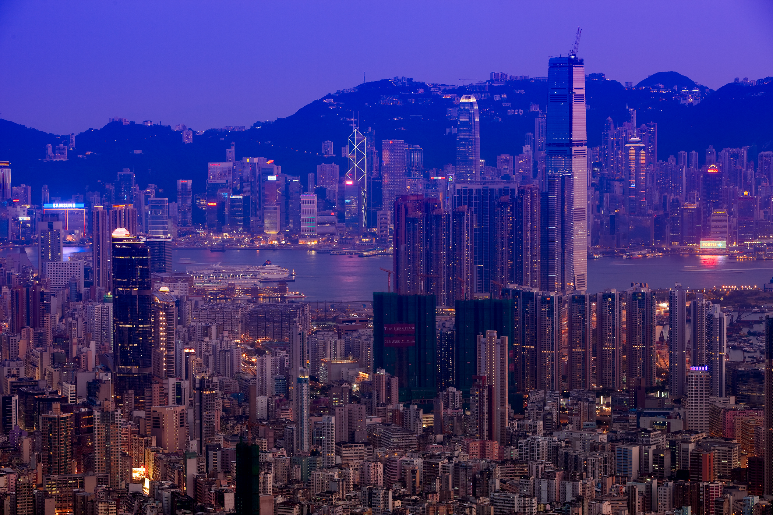
Hong Kong Properties
BUS 417 Security Analysis
GROUP 4 Ryan Li Felix Yeung Bin Wan

Slide 2
Agenda
Overview of Hong Kong
Hong Kong and Mainland Property Market Analysis
Sun Hung Kai Properties Ltd.
Henderson Land Development Company Ltd.
Cheung Kong Holdings Ltd.

Slide 3
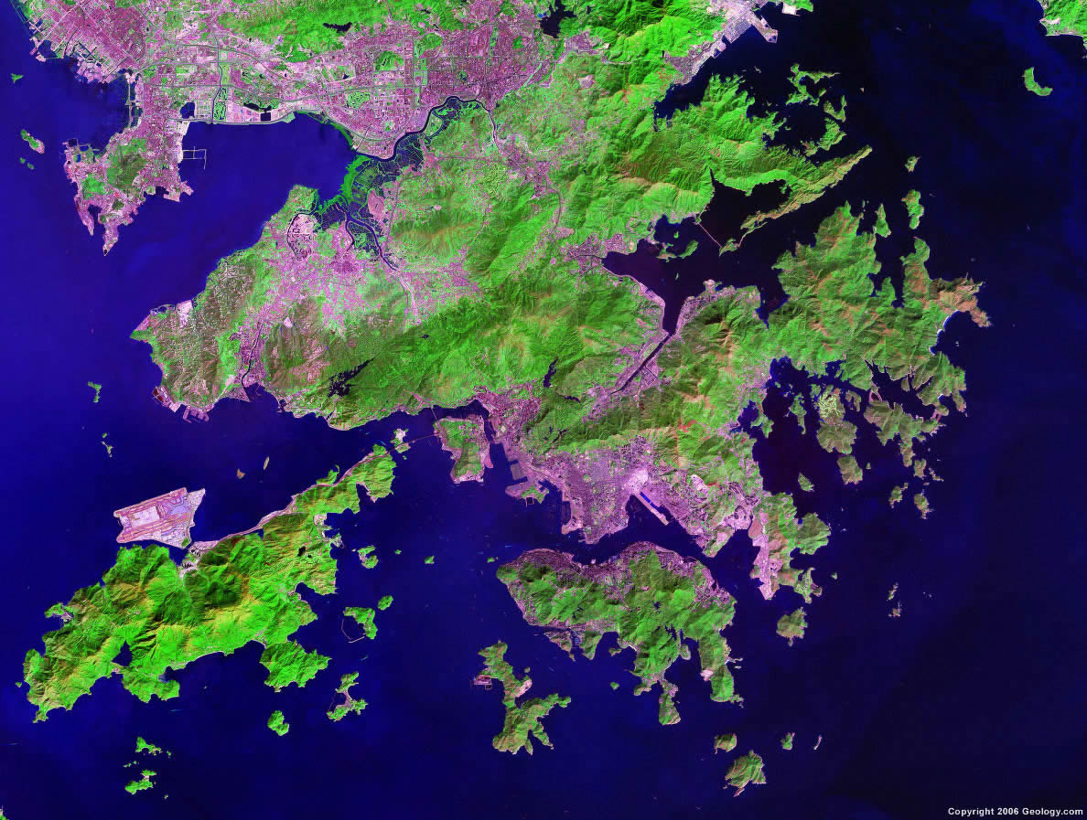
Hong Kong Land Distribution

Slide 4
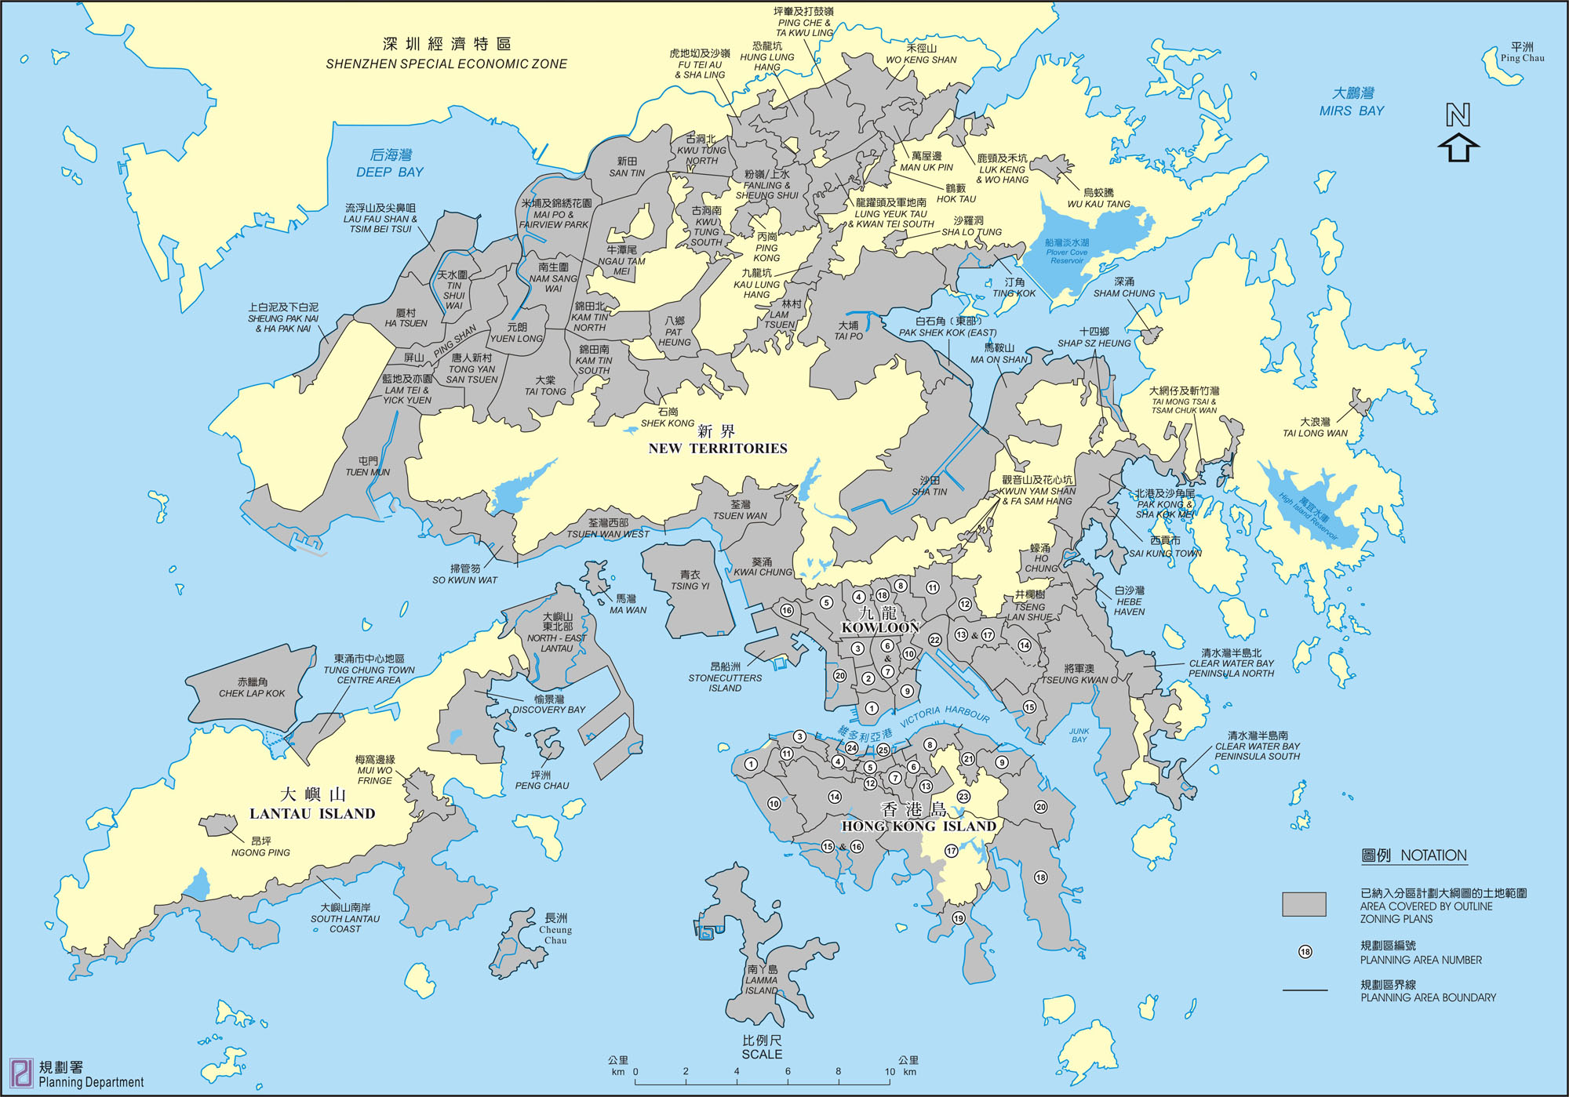
Hong Kong Land Distribution

Slide 5
Hong Kong SAR
Area: 1104 square kilometres
Population: slightly more than 7 million
Population density is very high
6480 persons per square kilometers vs 3.731 persons in Canada
Business Environment
Global financial center
Second most free economy in the world
Low taxation, free trade, minimum government interventions
Hong Kong stock exchange is the 7th largest in the world
Notes:
Source: www.cia.gov

Slide 6
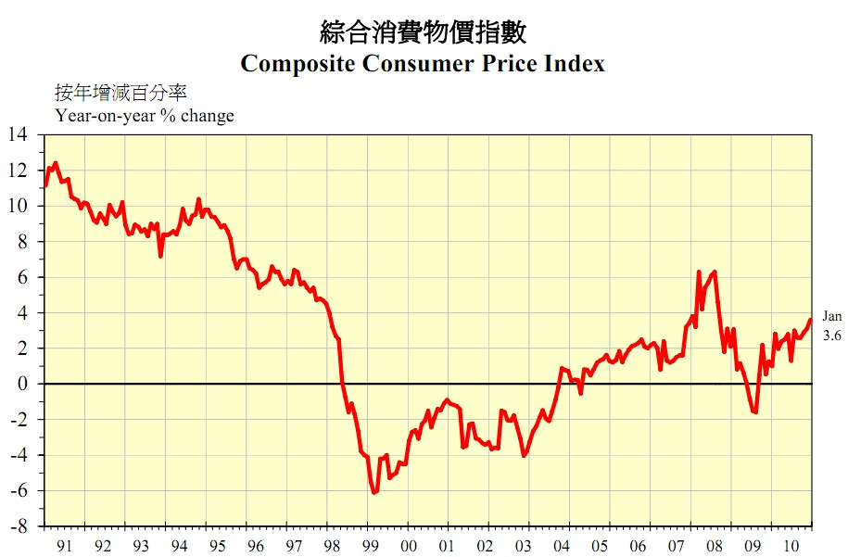
Hong Kong CPI
Notes:
Source: www.hkeconomy.gov.hk

Slide 7
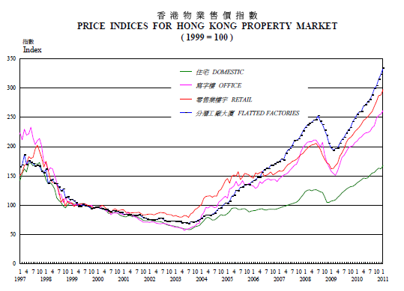
Price Indices for Hong Kong Property Market
Notes:
Source: http://www.hkeconomy.gov.hk/en/pdf/assets.pdf

Slide 8
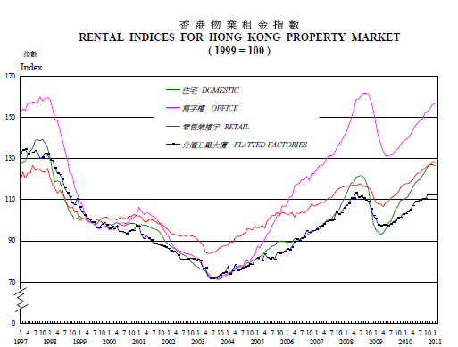
Rental Indices for Hong Kong Property Market
Notes:
Source: http://www.hkeconomy.gov.hk/en/pdf/box-10q3-3-1.pdf

Slide 9
The economic structure of Hong Kong
Labour force: 3.7 million
Notes:
Source: quarterly report on general household survey, census and statistics Department

Slide 10
Key facts in Hong Kong Property Market
Property market is over-heated
One of the most expensive in the world
25% increase since 2008 recession
Price to rental and price to income ratios 50% higher than the historical averages
Middle and low income groups are prices out of the market
Tight supply
High land price policy
high tax
Major source of government income
Notes:
Notes: 2010, hong kong’s meidan home price, at 2.58 million Hong Kong dollars (US$ 331,138) was 11.4 times the median household income of HK$225,400

Slide 11
Industry Structure
Hong Kong Property Market is an Oligopoly
Major Players:
Cheung Kong (Holdings) Limited*
Sun Hung Kai Properties*
Henderson Land Development Company Limited*
Sino Group*
Hang Lung Properties Limited*
Wharf (Holdings) Ltd
New World Development Company Limited
* These 5 companies are included in the Hang Seng Property Index

Slide 12
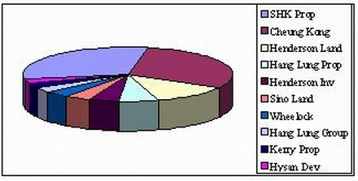
Hong Kong property Market Share

Slide 13
Major Business
Residential Sector
Industrial Sector
Office Sector
Commercial Sector
Business in both Hong Kong and Mainland China

Slide 14
Other Business
Most of the property companies have subsidiary companies
Telecommunications
Life technology
Hotel
Utilities
diversified portfolio to generate revenues

Slide 15
Typical firm cost and revenue
Cost Structure
Land expense
Property Development and Investment
Revenue Composition
Property sale
Rental Income

Slide 16
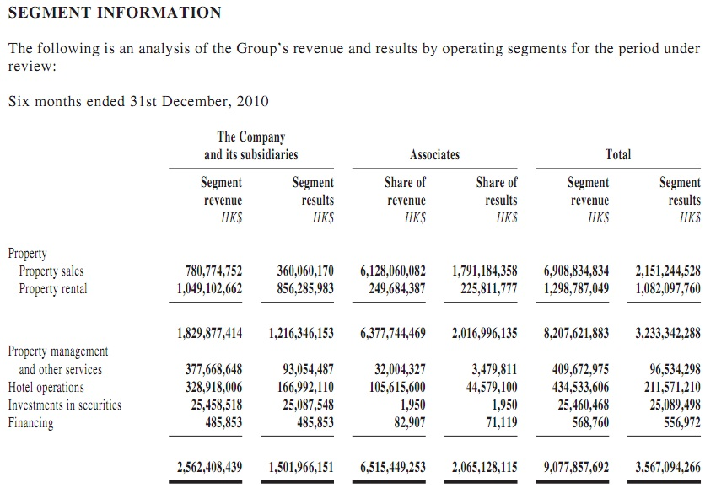
Notes:
http://www.sino.com/eng/images/0436/eSL_101_932011.pdf
Revenue mainly comes from property sales and rental, property management, hotel operations and investments in securities.

Slide 17
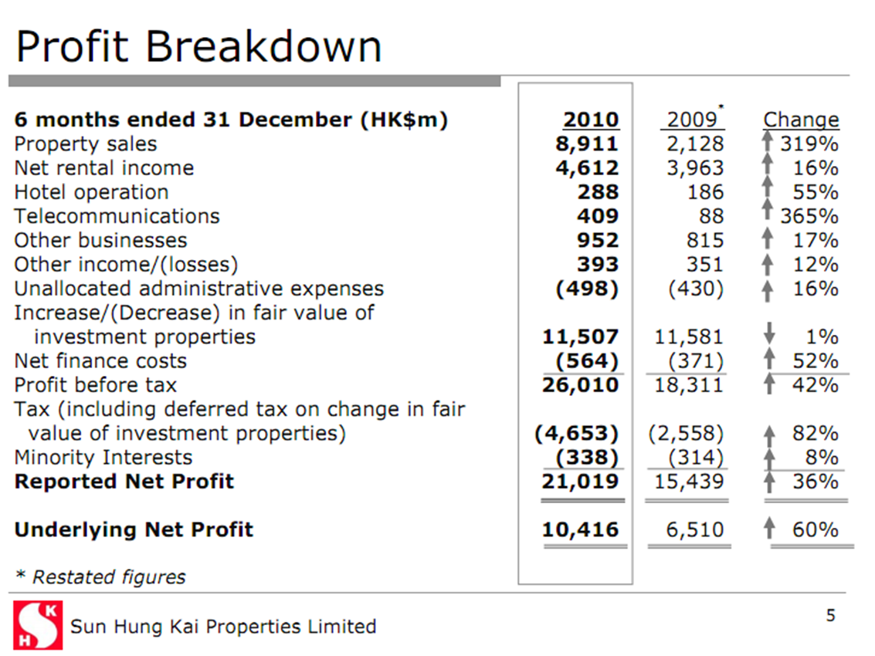
Notes:
http://www.shkp.com/data/investors/presentations/14/14/14_23_en_p.pdf

Slide 18
Profit Drivers
Size
Large firms can influence government
Land Bank
Future Development
Timing of Development
Influence Market
Timing of property completion
Reputation
Subsidiaries
Conglomerates

Slide 19
Factors affecting Property Market
Interest rate
Economic situation
Risk of bubble
Population growth
Government regulations

Slide 20
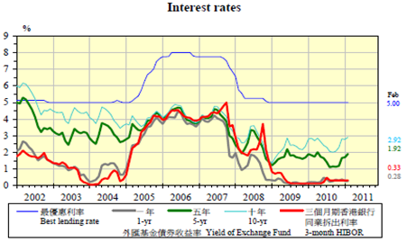
Interest Rate
Best lending rate: flat at 5% for 2 years

Slide 21
Economic Situation
Mainland economy remains robust; economic buoyancy in Hong Kong
Home completion rises to 4 year high
Price indices for both property sale and rental go upward
Positive outlook for HK’s residential market
income growth and low interest rates
Sale and Purchase Agreements: 135,778(2010) vs 115,092(2009)
Total value of transactions US$ 71.88 billion(2010) vs US$ 54.6 billion (2009)

Slide 22
Risk of Bubble
Price increased 15% in the first three quarters of 2010 after a 30% jump in 2009
Middle and low income groups are priced out of the market
Population growth is very low

Slide 23
Distribution by Housing Type

Slide 24
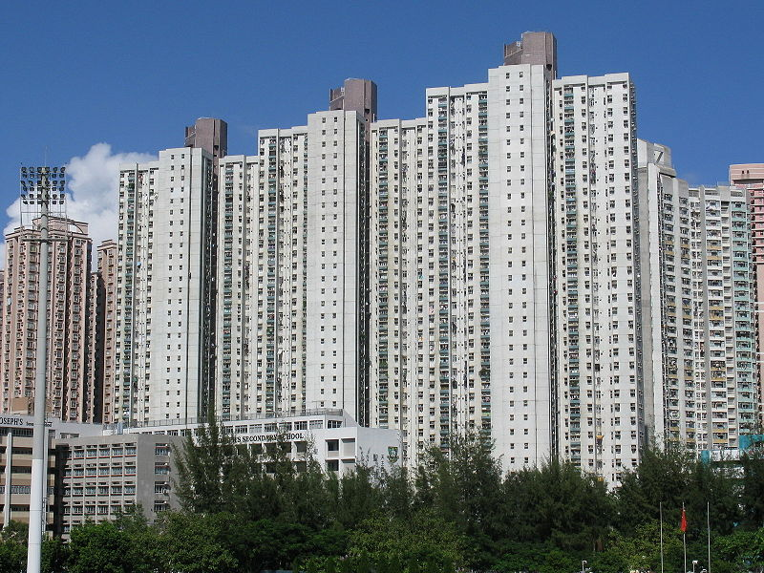
Subsidized Residential Types
Home Ownership Scheme
Subsidized public housing
Buying, selling and mortgage are subject to certain restrictions
Eligible to middle-low income class
High demand
Production ceased

Slide 25
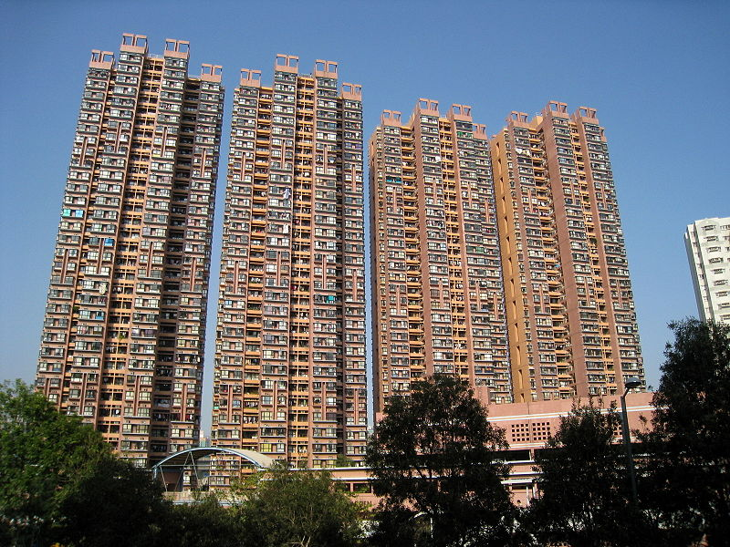
Subsidized Residential Types
Sandwich Class Housing Scheme
Sold at a concessionary price
Subject to buying and selling restrictions
Eligible to middle income class
High vacancy rate
Production ceased
Release of vacant flats show high demand

Slide 26
Hong Kong Government Regulations
Land supply control
Controls and manages all land supply and purchase transactions --Hong Kong Land Registry
Significant source of revenue for the government
Public housing
Land owned by the government authority
Affordable housing (lower rent) for low-income residents, highly subsidized by the government

Slide 27
Hong Kong Lands Department
Main functions:
acquisition of private land for public projects
land lease regrant and modification
land control and lease enforcement
approving the pre-sale of uncompleted flats and deeds of mutual covenant
land disposal for development purposes
valuation of land and property
maintenance of the geodetic survey control network
land boundary survey
aerial survey
map production
maintenance of slopes on unallocated Government land

Slide 28
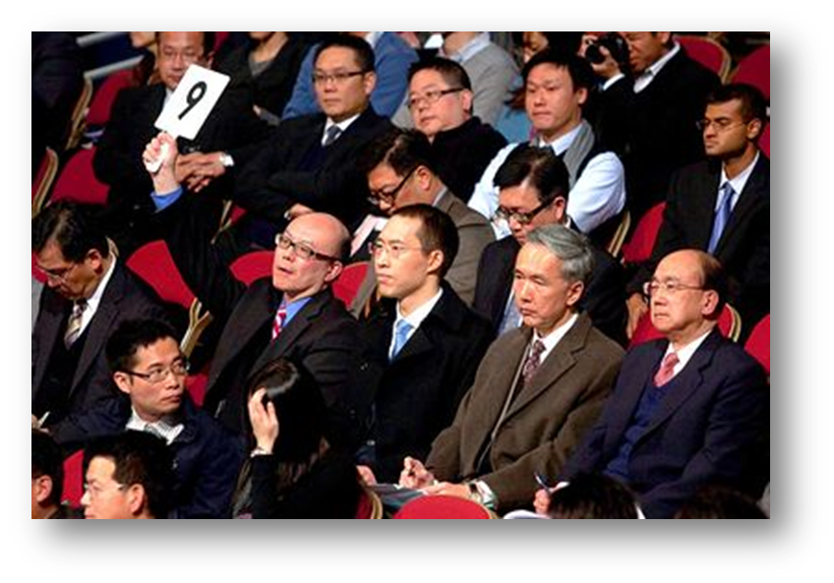
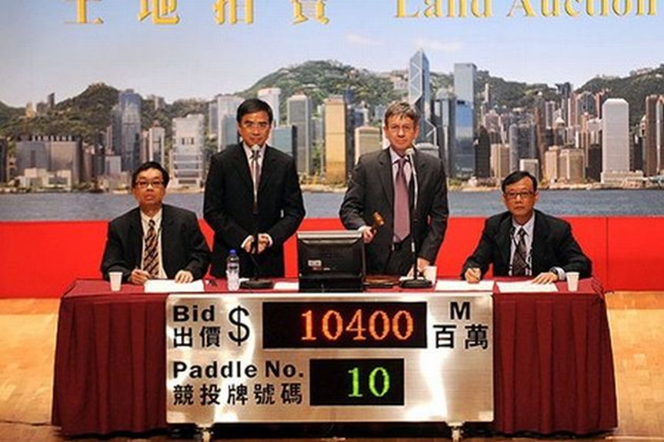
Land Auction
English Auctions
Oral Bidding
Most land in metropolitan area sold through this method
Highest bid wins
Tenders
Sealed Bidding
Used when
User strictly defined and sale is unlikely to attract general interest
Government needs to first examine detailed proposals of potential developments
Private Treaty
Land sales to non-profit organizations
Ex. Land purchases for development of schools, hospitals, etc.

Slide 29
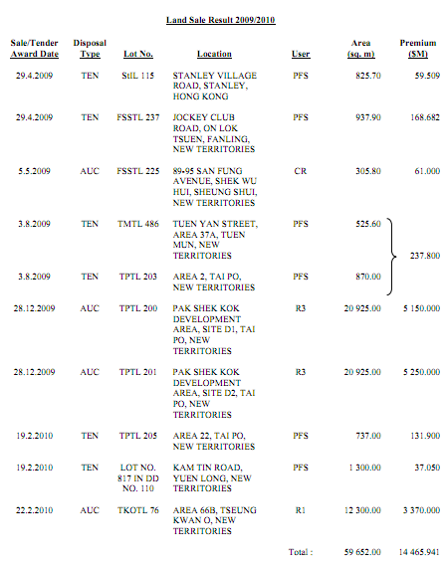
2009/2010 Land Sale

Slide 30
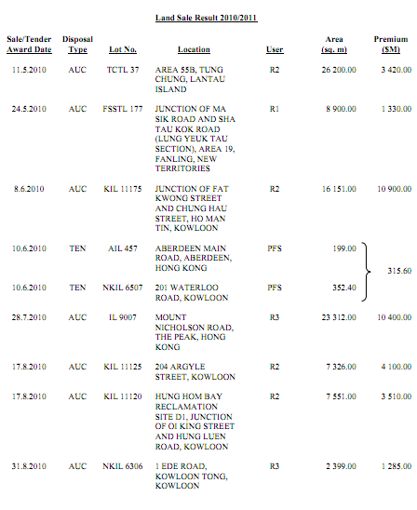
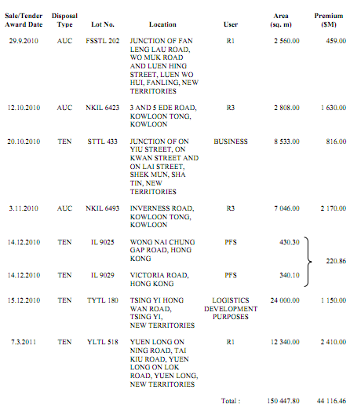
2010/2011 Land Sale

Slide 31
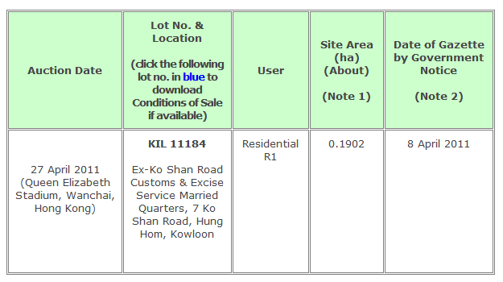
Upcoming Land Sale

Slide 32
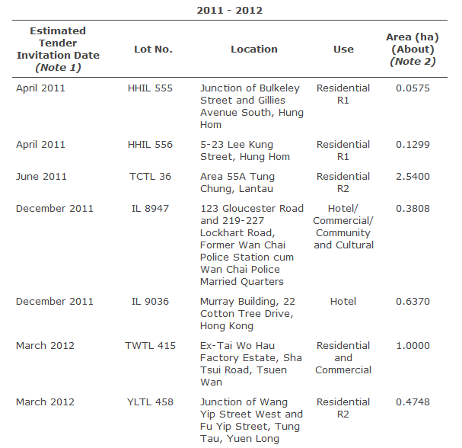
Upcoming Land Sale

Slide 33
Counter Measures to unaffordable housing
Big increase in residential land supply
Stamp Duty
Increased on short-term transactions
Additional duties of up to 15% for the properties bought and sold within two years
Tightening mortgage restrictions
Lowered the mortgage limit to 50% for residences valued at US$ 1.54 million or higher

Slide 34
Development of Mainland Property Market
Until 1999:
welfare housing system: nearly free housing for employees from government agencies, academic & public institutions, state owned companies
March 1998:
Chinese Premier Zhu Rongji introduced a series of housing reforms: subsidized housing phased out
August 1999:
Government announced that all vacant residential housing units build after January 1, 1999 were to be sold, not allocated
After 1999:
Real estate market thrive
Notes:
Chinese property market is developing very fast after 1999

Slide 35
Mainland China Property Market
Transfer of the rights of using property
Land owned by state, no individual own the land
40 yrs for commercial usage
50 yrs for industrial purpose
70 yrs for residential use
Shortage in Land Supply
Ministry of Land Resources: Protecting agriculture land from property development
Land Supply tightly controlled
Land Price grows steadily each year
Eastern part highest, western part lowest
Land Auction
Highest bid wins
Major source of government revenue

Slide 36
Mainland China Economy
Second largest economy in the world
GDP increased over 10% per year during last five years
Income per capita approximately $9600 per year
Average price per square meter is $2950 in Shanghai
notes: 1 square meter = 10.76 square feet
Property price increases very fast (25.1% during 2009 while income increases at 9.7%)

Slide 37
Mainland China Interest Rate
Increase interest rate on February 9th , 2011
6 months loan: 5.6%
6 months to 1 year loan: 6.06%
1 year to 3 years loan: 6.1%
3 years to 5 years loan: 6.45%
5 years or more loan: 6.6%

Slide 38
Mainland China Regulations
2009:
December 17th : Down payment rate increased for property development
Down payment for the land: minimum 50%, must pay the full amount within 1 year, special projects 2 yrs
December 22nd: Transaction tax change
For the property that below 90 sq meter
5 yr above , no transaction tax
Within 5 yr, tax on the incremental value
Otherwise, 5.55% transaction tax

Slide 39
Mainland China Regulations
2010:
April 17th:
at least 30% down payment for first time purchaser of area >90 square meters
No mortgage issued for third house based on risk
September 29th
at least 30% down payment for first time purchaser of any sizes of property
No mortgage can be issued for third house
No mortgage can be issued for non-local residents who cannot provide the proof of paying taxes for more than 1 year in the city

Slide 40
Mainland China Regulations
2011:
January 26th
Down payment at least 60% for second house, mortgage interest rate > 1.1 times of prime rate
February
Property tax implemented in Chongqing and Shanghai
In Shanghai, tax calculated based on 70% of the market value of the house, tax rate is 0.6% per year
Tax free if the average per capita living space is < 60 square meter

Slide 41
American Depositary Receipt (ADR)
Negotiable certificate issued by a U.S. bank representing a specified number of shares (or one share) in a foreign stock that is traded on a U.S. exchange
Listed on NYSE, AMEX or Nasdaq
Denominated in U.S. dollars, with the underlying security held by a U.S. financial institution overseas
Help to reduce administration and duty costs that would otherwise be levied on each transaction
Buy shares in a foreign company while realizing dividends and capital gains in U.S. dollars
Does not eliminate currency and economic risks for the underlying shares in another country.
E.g. dividend payments in euros would be converted to U.S. dollars, net of conversion expenses and foreign taxes and in accordance with the deposit agreement

Slide 42
HKD’s Pegged Rate with USD
Upper limit: $1 USD=$7.75 HKD
Lower limit: $1 USD=$7.85 HKD
Notes:
- 7.75>=USD/HKD>=7.85

Slide 43
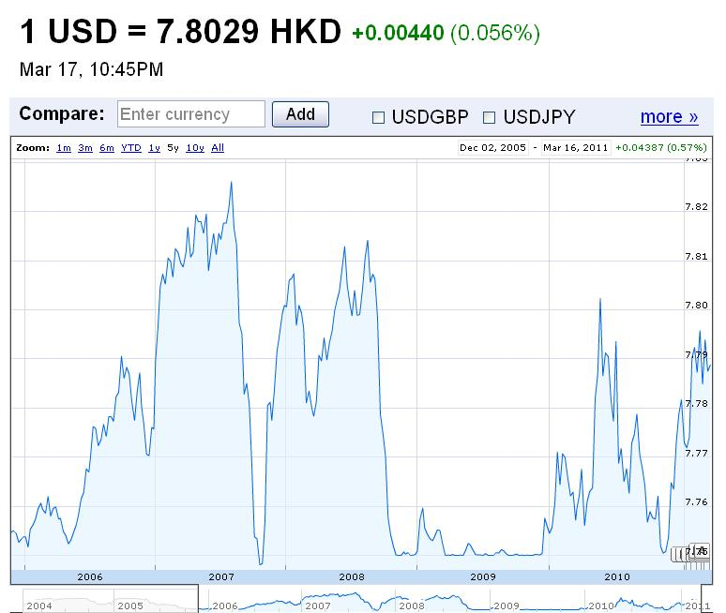
USD vs HKD 5 Year

Slide 44

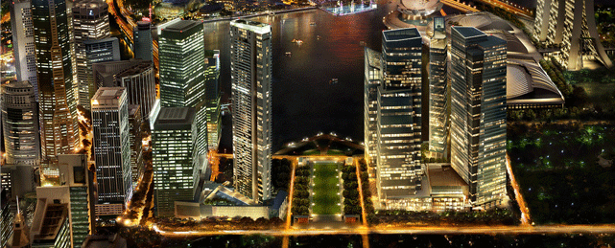
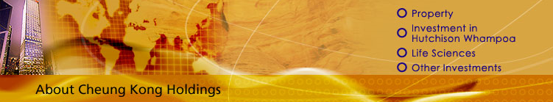
Cheung Kong Holdings Ltd.

Slide 45
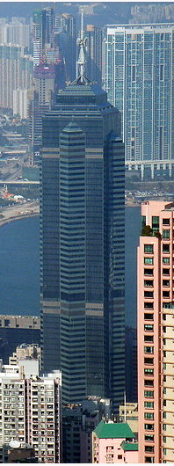
Cheung Kong Holdings
Cheung Kong Holdings is one of the largest developers of residential, office, retail, industrial and hotel properties in Hong Kong. With its long history of property development expertise and residential estates, Cheung Kong Holdings has built some of Hong Kong's notable landmark buildings and complexes.

Slide 46
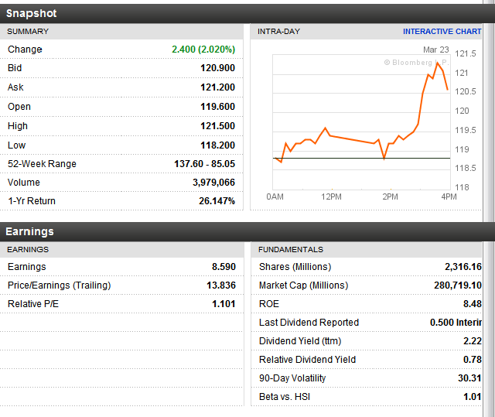
Last trading day performance

Slide 47
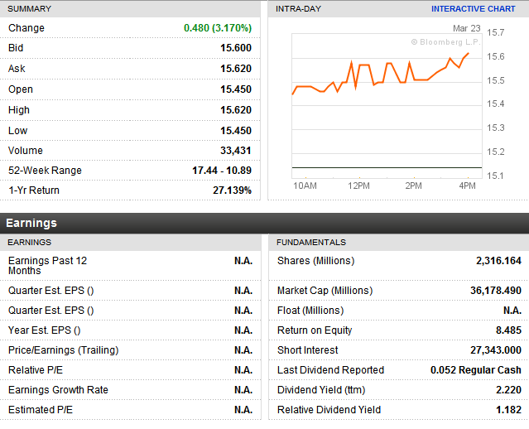
Last trading day ADR

Slide 48
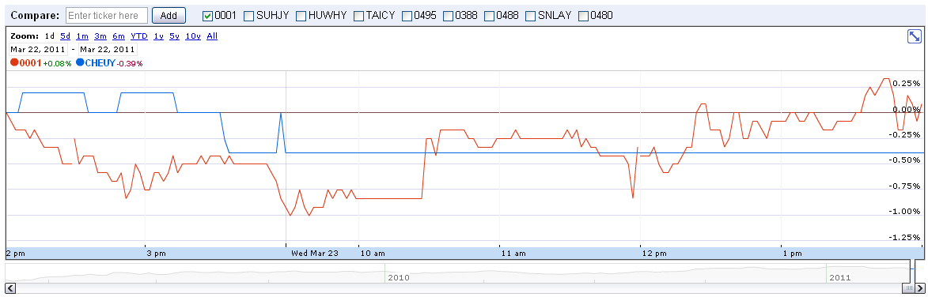
HK vs ADR close-up

Slide 49
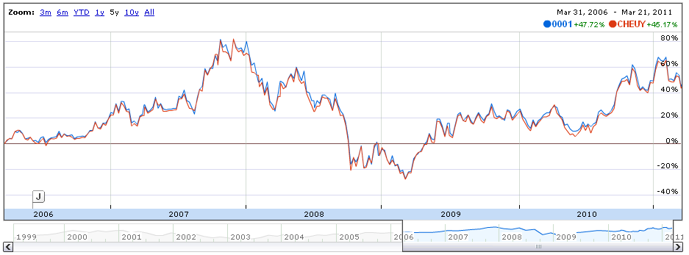
HK vs ADR 5 years

Slide 50
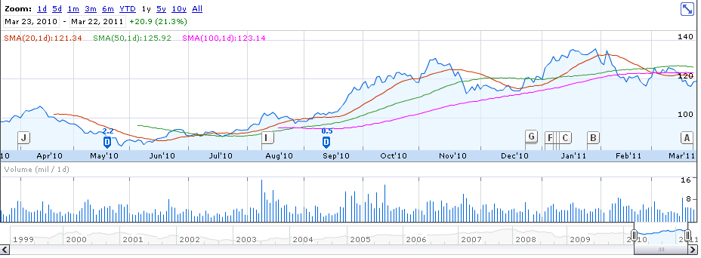
1 year performance

Slide 51
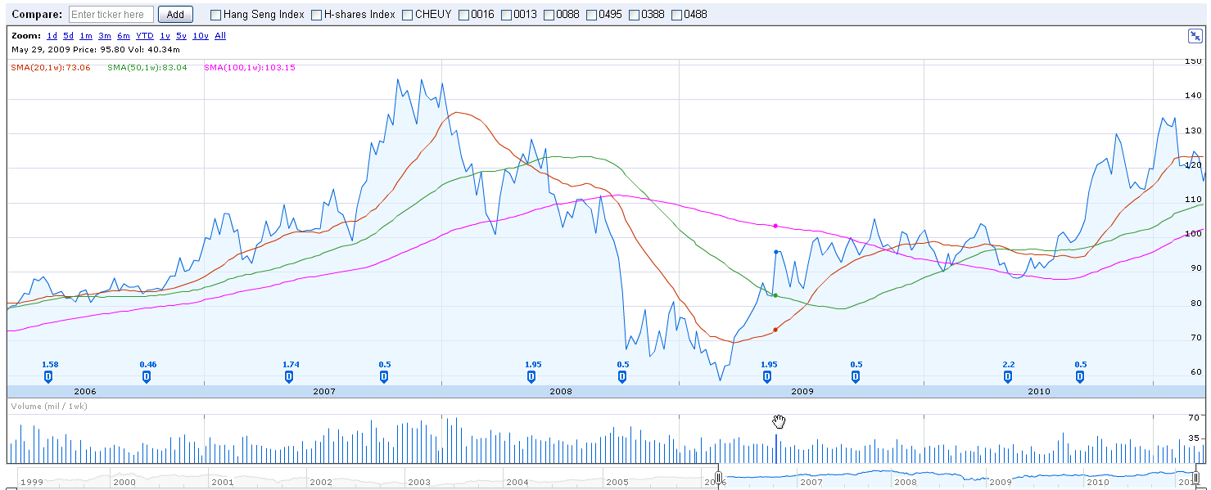
5 years performance

Slide 52
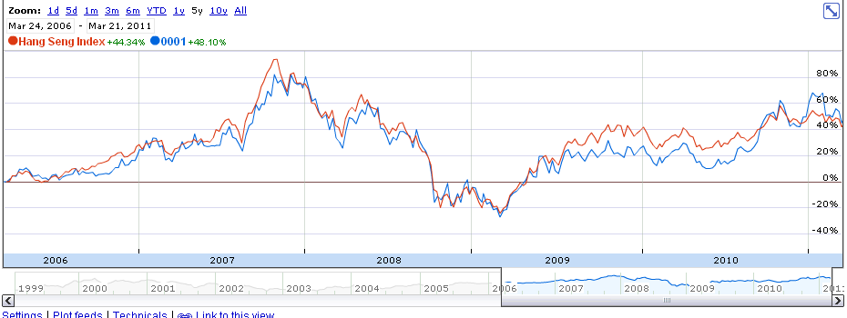
Stock performance vs. HSI 5 years

Slide 53
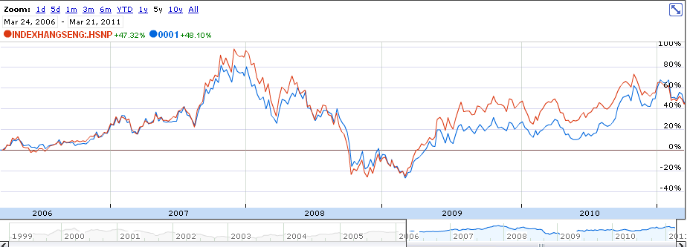
Stock performance vs. HSPI 5 years

Slide 54

Corporate profile
The group consists of 8 companies:
Cheung Kong (Holdings) Limited (stock code: 0001)
- Hutchison Whampoa Limited (stock code: 0013)
Cheung Kong Infrastructure Holdings Limited (stock code: 1038)
Hong Kong Electric Holdings Limited (stock code: 0006)
Hutchison Telecommunications Hong Kong Holdings Limited (stock code: 0215)
Hutchison Harbour Ring Limited (stock code: 0715)
CK Life Sciences Int'l., (Holdings) Inc. (stock code: 0775)
TOM Group Limited. (stock code: 2383)
Combined market capitalization: HK$647 billion (as at 31 December, 2009)
On May 2010, however, the stocks of Hutchison Telecommunications International Limited were delisted as Hutchison Telecom became a fully owned subsidiary of the Hong Kong-based Hutchison Whampoa Group.
Operates in 54 countries and employs about 240,000 staff worldwide
Key countries include: Mainland China, Singapore, United Kingdom

Slide 55
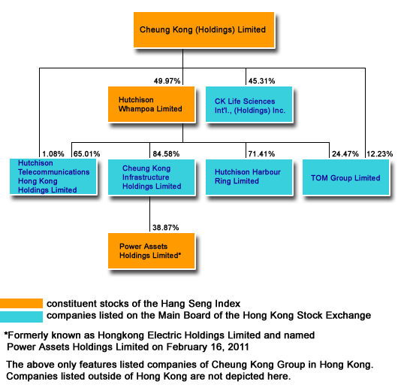
Group structure

Slide 56
Market capitalization
Cheung Kong (Holdings) Limited
Hutchison Whampoa Limited
Shares outstanding Market cap (as at January 31, 2011) | 2,316 million shares HK$297,859 million
Major shareholder Company issued warrants Stock options outstanding Convertible securities Other substantial shareholder | Li family and trust - 42.6% Nil Nil Nil Nil
Dividend per share (2009) Dividend yield (as at January 31, 2011) | HK$2.70 2.1%
Net Profit (2009) EPS (2009) PE (as at January 31, 2011) | HK$19,886 million HK$8.59 15.0
Shares outstanding Market cap (as at January 31, 2011) | 4,263 million shares HK$387,540 million
Major shareholder Company issued warrants Stock options outstanding Convertible securities Other substantial shareholder | Cheung Kong (Holdings) Limited - 49.9% Nil Nil Nil Nil
Dividend per share (2009) Dividend yield (as at January 31, 2011) | HK$1.73 1.9%
Net Profit (2009) EPS (2009) PE (as at January 31, 2011) | HK$14,168 million HK$3.32 27.4
Notes:
http://www.ckh.com.hk/eng/about/about_group.htm

Slide 57
Market capitalization
TOM Group Limited
Cheung Kong Infrastructure Holding
Shares outstanding Market cap (as at January 31, 2011) | 3,893 million shares HK$4,399 million
Major shareholder Company issued warrants Stock options outstanding Convertible securities Other substantial shareholder | Hutchison Whampoa Limited - 24.5% Cheung Kong (Holdings) Limited - 12.2% Cranwood Co. Ltd. - 25.5% Nil 6,976,000 Nil Nil
Dividend per share (2009) Dividend yield (as at January 31, 2011) | Nil N/A
Net Profit (2009) EPS (2009) PE (as at January 31, 2011) | N/A N/A N/A
Shares outstanding Market cap (as at January 31, 2011) | 2,254 million shares HK$83,518 million
Major shareholder Company issued warrants Stock options outstanding Convertible securities Other substantial shareholder | Hutchison Whampoa Limited - 84.6% Nil Nil Nil Nil
Dividend per share (2009) Dividend yield (as at January 31, 2011) | HK$1.201 3.2%
Net Profit (2009) EPS (2009) PE (as at January 31, 2011) | HK$5,568 million HK$2.47 15

Slide 58
Market capitalization
Hutchison Telecommunications International Limited
Hutchison Harbour Ring Limited
Shares outstanding Market cap (as at January 31, 2011) | 4,816 million shares HK$12,763 million
Major shareholder Company issued warrants Stock options outstanding Convertible securities Other substantial shareholder | Hutchison Whampoa Limited - 65.0% Nil 2,940,000 Nil Nil
Dividend per share (2009) Dividend yield (as at January 31, 2011) | HK$0.0728 2.7%
Net Profit (2009) EPS (2009) PE (as at January 31, 2011) | HK$468 million HK$0.0972 27.3
Shares outstanding Market cap (as at January 31, 2011) | 8,967 million shares HK$8,877 million
Major shareholder Company issued warrants Stock options outstanding Convertible securities Other substantial shareholder | Hutchison Whampoa Limited - 71.4% Nil 7,136,000 Nil Nil
Dividend per share (2009) Dividend yield (as at January 31, 2011) | HK$0.022 2.2%
Net Profit (2009) EPS (2009) PE (as at January 31, 2011) | HK$188 million HK$0.021 47.1

Slide 59
Market capitalization
CK Life Sciences Int'l., (Holdings) Inc.
Shares outstanding Market cap (as at January 31, 2011) | 9,611 million shares HK$5,671 million
Major shareholder Company issued warrants Stock options outstanding Convertible securities Other substantial shareholder | Cheung Kong (Holdings) Limited - 45.3% Li Ka Shing Foundation Limited - 29.5% Nil 8,853,073 Nil Nil
Dividend per share (2009) Dividend yield (as at January 31, 2011) | Nil N/A
Net Profit (2009) EPS (2009) PE (as at January 31, 2011) | HK$187 million HK$0.0195 30.3

Slide 60
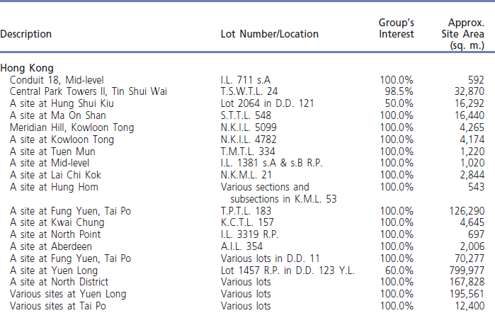
Project Completion Schedule
Properties for/under development
Projects in Hong Kong

Slide 61
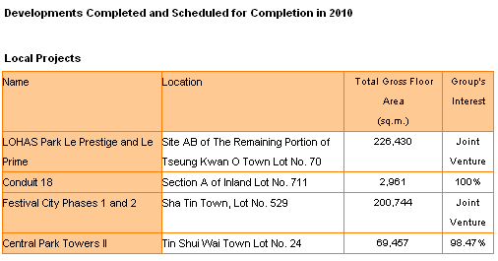
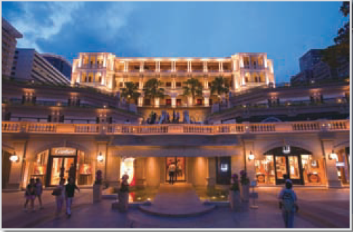
Project Completion Schedule

Slide 62
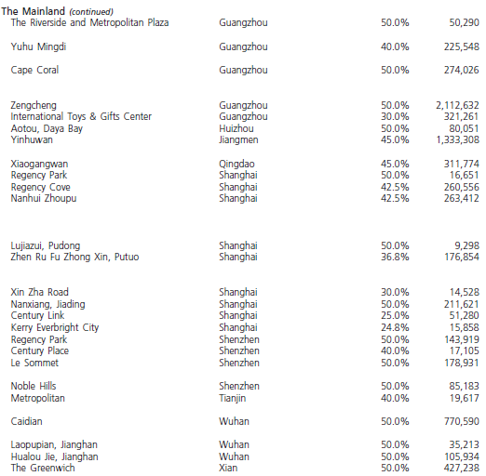
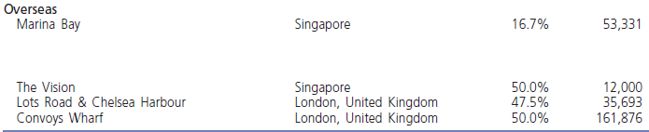
Mainland China and Overseas Projects

Slide 63
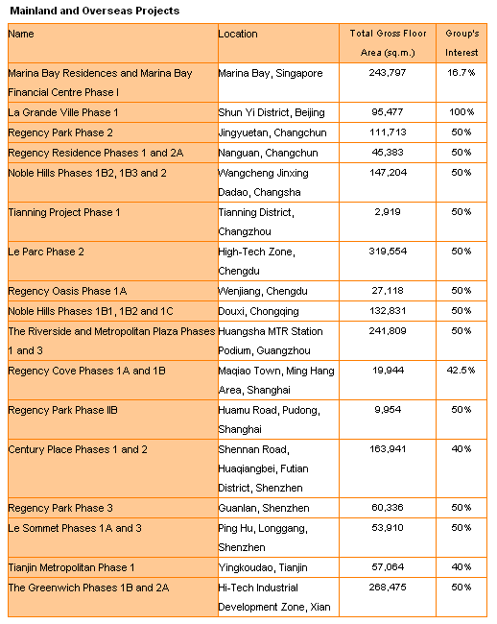
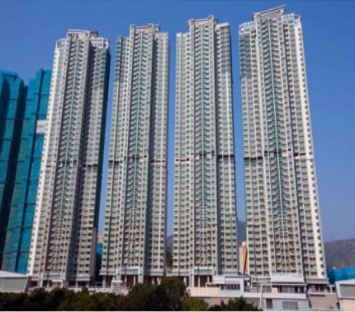
Developments Completed and Scheduled for completion in 2010

Slide 64
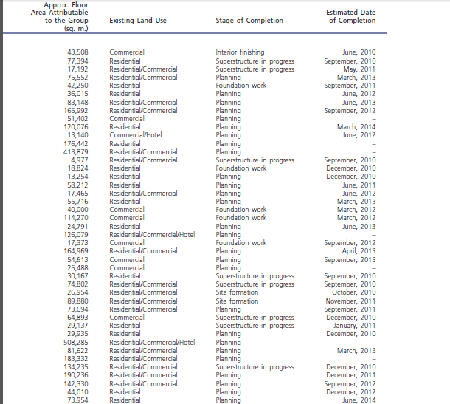

Project Completion Schedule

Slide 65
Completed Developments
1. Residential / Comprehensive Developments
Banyan Garden Bayshore Towers
Bella Vista Belvedere Garden Braemar Hill Mansions CASA 880 CASA 880
Caribbean Coast Phase 1 Caribbean Coast Phase 2 Caribbean Coast Phase 3 Caribbean Coast Phase 4 Celestial Heights (Phase 1) Central Park Towers City Garden City One Shatin DeerHill Bay Elite Villas Elizabeth House Estoril Court Hampton Place Harbourfront Landmark Jubilee Garden Kingswood Villas Laguna City Laguna Verde Phase 4 Laguna Verde Phase 5 Le Point Lido Garden Manderly Garden Metro Town Monte Vista No. 1 Star Street Nob Hill One Beacon Hill Princeton Tower Queen's Terrace Rhine Garden & Rhine Terrace
Robinson Heights Sausalito Sceneway Garden Seasons Monarch Seasons Palace Sheffield Villas Sky Tower St. Paul's Terrace The Apex The Cairnhill The Capitol The Grand Panorama The Legend at Jardine's
The Metropolis Residence The Pacifica Phase 1 The Pacifica Phase 2 The Paramount The Portofino The Victoria Towers Tierra Verde Tsing Yi Garden University Court University Heights Vianni Cove Villa d'Arte Vista Paradiso
Notes:
PIC: capitol

Slide 66
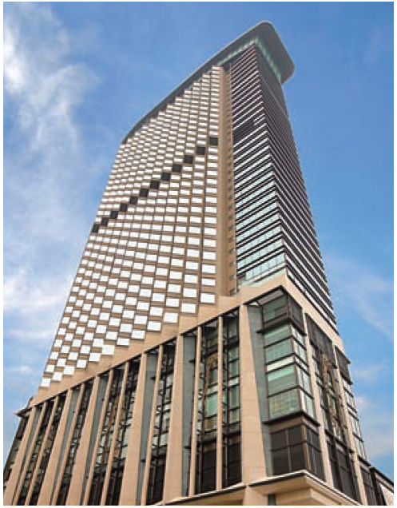
Completed developments
2. Hotels
Harbour Grand Hong Kong
Harbour Plaza 8 Degrees
Harbour Plaza Metropolis
Harbour Plaza North Point
Harbour Plaza Resort City
Harbourfront Horizon
Harbourview Horizon
Horizon Suite Hotel
Rambler Garden Hotel
Ramber Oasis Hotel
The Apex Horizon
The Kowloon Hotel (acquired in 2005)
Notes:
PIC: harbour grand

Slide 67
Completed Developments
3. Office Building
Admiralty Centre
Citicorp Centre
Concordia Plaza
Prosperity Millennia Plaza
Shun Tak Centre
Silvercord
The Center
Wheelock House
World-Wide House
4. Office / Industrial and Industrial Buildings
Modern Warehouse
New Treasure Centre
Prosperity Center
Trendy Centre

Slide 68
Risk factors
Global financial and credit crisis
Property development
Liquidity Risk
Industry trends and interest rates
Highly competitive market
Currency risk
Strategic or Business Partners from non wholly-owned subsidiaries
Impact of local, national, and international regulations
Impact of new accounting standards
Outbreak of highly contagious disease
Risks of Hutchison Whampoa Group
49.9% ownership of the Hutchison Whampoa Group
Past performance and forward looking statements

Slide 69

Management

Slide 70
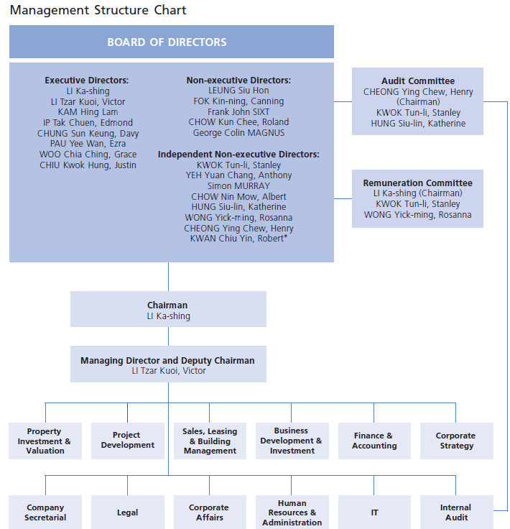
Management structure Chart

Slide 71
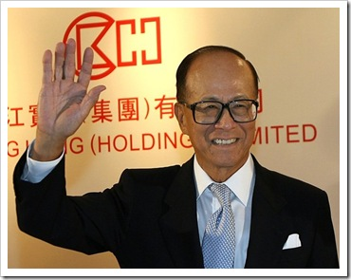
Li Ka Shing
Chairman of Cheung Kong (Holdings) Ltd. Since 1971
Chairman of Hutchison Whampoa Ltd. since 1981
Wealthiest man in Hong Kong and East Asia
Honorary doctorates from several universities
Age 82
Left school at age 15 and worked at a plastic trading company (labored 16 hours a day)
Established Cheung Kong Industries in 1950, a plastic manufacturing company
Transformed the company into a real estate investment company, listed on Hong Kong Stock Exchange in 1972
Acquired Hutchison Whampoa in 1979 and Hong Kong Electric Holdings Ltd. In 1985

Slide 72
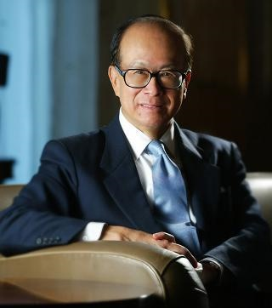

Li Ka Shing
Created a charitable foundation in 1980 – The Li Ka Shing Foundation
Founded Shantou University (Shantou, China) in 1981 – 9 colleges with medical school and affiliated hospitals
Has 2 sons:
Victor – Managing Director and Deputy Chairman of Cheung Kong (Holdings) Ltd., Deputy Chairman of Hutchison Whampoa, Chairman of Cheung Kong Infrastructure Holdings Ltd and CK Life Sciences International (Holdings) Inc.
Richard - Chairman of PCCW (Asia’s leading info tech and telecommunications company)

Slide 73
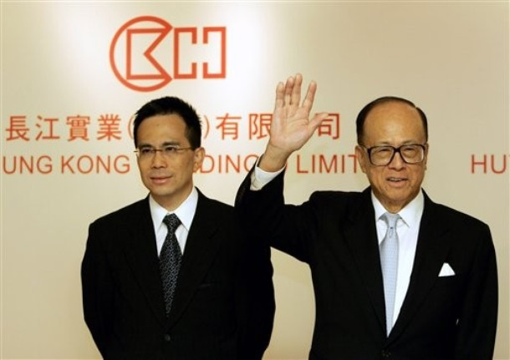
Li Tzar Kuoi, Victor
Deputy Chairman and Managing Director
since 1999
Began career at CKH in 1985
Deputy Managing Director (1993-98)
Executive Director and Deputy Chairman of
Hutchison Whampoa Ltd
Chairman of CK Infrastructure Holdings Ltd and
CK Life Sciences Int’l Inc.
Executive Director of HK Electric Holdings Ltd.
Co-chairman of Husky Energy Inc.
Director of Hong Kong and Shanghai Banking Corporation (HSBC)
Bachelor of Science degree in Civil Engineering
Master of Science degree in Structural Engineering
Honorary degree (Doctor of Laws)
Age 45

Slide 74
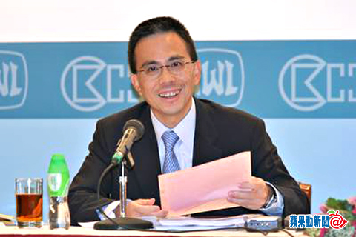
Li Tzar Kuoi, Victor
Vice chairman of Hong Kong General Chamber of Commerce.
Member of:
Standing Committee of the 11th National Committee of the Chinese People’s Political Consultative Conference of the People’s Republic of China
Commission on Strategic Development
Greater Pearl River Delta Business Council
Council for Sustainable Development of the Hong Kong Special Administrative Region

Slide 75
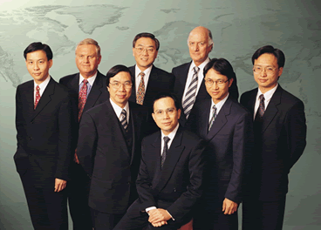
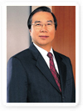
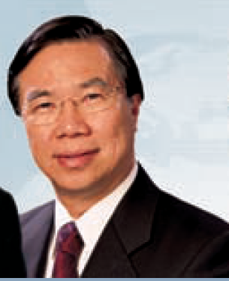
Kam Hing Lam
Brother-in-law of Li Ka-Shing, Uncle to Victor Li
Deputy Managing Director since 1993
Group Managing Director of Cheung Kong Infrastructure Holdings Ltd.
President and CEO of CK Life Sciences International
Executive Director of Hutchinson Whampoa Ltd. and Hong Kong Electric Holdings Ltd.
Non-executive Director of Spark Infrastructure Group
Member of the 11th Beijing Committee of the Chinese People's Political Consultative Conference of the People's Republic of China
Bachelor of Science degree in Engineering
Master’s degree in Business Administration
Age 63

Slide 76
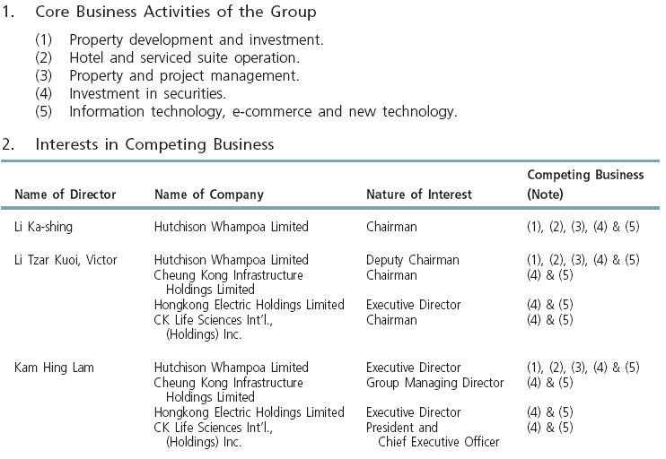
Key people

Slide 77


Board of directors
Executive Directors
LI Ka-shing
LI Tzar Kuoi Victor
KAM Hing Lam
IP Tak Chuen, Edmond
CHUNG Sun Keung, Davy
PAU Yee Wan, Ezra
WOO Chia Ching, Grace
CHIU Kwok Hung, Justin

Slide 78

Board of directors
Non-executive Directors
LEUNG Siu Hon
FOK Kin-ning, Canning
Frank John SIXT
CHOW Kun Chee, Roland
George Colin MAGNUS

Slide 79


Board of directors
Independent Non-executive Directors
KWOK Tun-li, Stanley
YEH Yuan Chang Anthony
Simon MURRAY
CHOW Nin Mow, Albert
HUNG Siu-lin, Katherine
WONG Yick-ming, Rosanna
CHEONG Ying Chew, Henry
KWAN Chiu Yin, Robert

Slide 80

Disclosure of interest
As of Dec 31, 2009

Slide 81

Financial statement analysis

Slide 82
Revenue results
CKH generates revenues through 4 business divisions:
Property sales (80.2% of the total revenues during FY2008)
Revenues of HK$10,309 million (approximately $1,324 million), a decrease of 8.3% compared to 2007.
Property rental (7.4%)
Revenues of HK$945 million (approximately $121.4 million) in FY2008, an increase of 19.3% over 2007.
Hotels and serviced suites (10.8%)
revenues of HK$1383 million (approximately $177.6 million) in FY2008, an increase of 30.1% over 2007.
Property and project management (1.7%).
revenues of HK$219 million (approximately $28.1 million) in FY2008, an increase of 21% over 2007.

Slide 83

Financial highlights

Slide 84

Annual Report 2009

Slide 85

Annual Report 2009

Slide 86

Consolidated Balance Sheet
Associates which materially affect the results or assets of the Group

Slide 87

Consolidated Income Statement 2009

Slide 88

Income Statement 2009

Slide 89

Consolidated Income Statement for the six months ended 30th June, 2010

Slide 90

Consolidated statement of cash flows

Slide 91

Condensed Consolidated Statement of Cash Flows for the six months ended 30th June, 2010

Slide 92

Balance Sheet

Slide 93

Balance sheet as at 30th June, 2010

Slide 94


Consolidated statement of changes in equity

Slide 95

Consolidated Statement of Change of Equity at 1st January, 2010

Slide 96

Consolidated statement of comprehensive income

Slide 97

Consolidated statement of comprehensive income

Slide 98

Turnover of the Group by operating activities for the year ended 31th Dec 2009

Slide 99

Turnover of the Group by operating activities for the six months ended 30th June 2010

Slide 100

Turnover and contribution for the six months ended 31th Dec 2009

Slide 101

Turnover and contribution for the year ended 30th June 2010

Slide 102

Recommendation
HOLD

Slide 103


HKSE: 0016 ADR: SUHJY
Notes:
Sun Hung Kai Properties (SHKP) is primarily engaged in the development of property for sale and
investment. The group is also involved in telecommunications, construction, property management,
financial services, property insurance, transport, infrastructure and logistics, waste treatment facilities,
apparel business and department stores. The group primarily operates in Hong Kong. It is
headquartered in Wanchai,
Sun Hung Kai Properties (SHKP) is a property developer based in Hong Kong.The group specializes
in the development and management of residential properties, office properties and hotels. The
group also earns rental income by leasing its properties. It operates in Hong Kong and Mainland
China.
The group's operations include land bank, property development, property investment, Mainland
China business, property related businesses, telecommunications and information technology,
transportation, infrastructure and logistics, corporate finance and customer service are broadly
categorized under the following divisions: property, hotels, telecommunications and other businesses.

Slide 104

Last Trading Day Performance
Notes:
Source: Google Finance
The directors have recommended the payment of a final dividend of HK$1.70 per share for the year ended 30 June 2009. Together with the interim dividend of HK$0.80 per share, the total dividend for the full year will be HK$2.50; the same as that of last year.

Slide 105

Last Trading Day Performance(ADR)
Notes:
The directors have recommended the payment of a final dividend of HK$1.70 per share for the year ended 30 June 2009. Together with the interim dividend of HK$0.80 per share, the total dividend for the full year will be HK$2.50; the same as that of last year.

Slide 106

0016 vs ADR Close-up

Slide 107

0016 vs ADR 5 Year

Slide 108

1 Year Performance
Notes:
The directors have recommended the payment of a final dividend of HK$1.70 per share for the year ended 30 June 2009. Together with the interim dividend of HK$0.80 per share, the total dividend for the full year will be HK$2.50; the same as that of last year.

Slide 109

5 Year Performance
Notes:
The directors have recommended the payment of a final dividend of HK$1.70 per share for the year ended 30 June 2009. Together with the interim dividend of HK$0.80 per share, the total dividend for the full year will be HK$2.50; the same as that of last year.

Slide 110

10 Year Performance
Lehman Bros
SARS
Notes:
The directors have recommended the payment of a final dividend of HK$1.70 per share for the year ended 30 June 2009. Together with the interim dividend of HK$0.80 per share, the total dividend for the full year will be HK$2.50; the same as that of last year.

Slide 111

0016 vs HSI >10 Year
Notes:
The directors have recommended the payment of a final dividend of HK$1.70 per share for the year ended 30 June 2009. Together with the interim dividend of HK$0.80 per share, the total dividend for the full year will be HK$2.50; the same as that of last year.

Slide 112

0016 vs HSPI 10 Year
Notes:
The directors have recommended the payment of a final dividend of HK$1.70 per share for the year ended 30 June 2009. Together with the interim dividend of HK$0.80 per share, the total dividend for the full year will be HK$2.50; the same as that of last year.

Slide 113


Dividend Payout History

Slide 114


Financial Highlights

Slide 115

Corporate Profile
Notes:
http://www.shkp.com/en/scripts/about/about_profile.php

Slide 116
Basic Facts
Founded by Kwok Tak Seng, Fung King Hey, Lee Shau Kee (Henderson Land’s Chairman)
Publicly listed in 1972
One of the largest property companies in Hong Kong
Specializes in premium-quality residential and commercial projects for sale and investment
Owns a huge list of subsidiaries
Employs more than 33,000 people
Kwok family holds majority of interests

Slide 117








Businesses
Core business
Development of property for sale and investment
Complementary operations:
Hotels
Financial services
Insurance
Property management
Investments in:
Telecommunications
Information technology
Transportation, infrastructure and logistics

Slide 118
Awards and Recognition
2011
Highest Business Value Gold and Best Commercial Landmark awards for Shanghai IFC at the second CBN Property Reporter Real Estate Awards.
Hong Yip was named Hong Kong Top Service Brand by Hong Kong Brand Development Council and the Chinese Manufacturers Association of Hong Kong.
2010
Named Best Developer in Hong Kong for sixth year running and Asia's Best Office Developer by Euromoney magazine.
Won Best Companies in Asia for Corporate Governance Award by Asiamoney Magazine.
Ranked the Best Real Estate Company in Asia and Hong Kong's Best Managed Company by FinanceAsia magazine.
Won The Best of Asia award from Corporate Governance Asia Magazine for the fifth year running.
Won the Asian Corporate platinum award from The Asset Magazine for the second year running.
Top platinum honour in the Reader's Digest Trusted Brand Awards for the fifth year running, ranking first among property developers with more than triple the votes of its nearest rival.
Won fourth honour in the panel poll and third in the public poll in the Real Estate and Development category in the 2010 Hong Kong Corporate Branding Awards presented by Ming Pao and the Chinese University of Hong Kong.
Winner of a Yahoo! Emotive Brand Award for 2009-2010 - the seventh year running.
Most Influential Chinese Real Estate Brand Award from the Boao Real Estate Forum, for second year.
Won Greater China Super Brands Award 2010 from East Week Magazine for achievements in products and service.
Shanghai IFC Mall wins MIPIM Asia 2010 Best Shopping Centre and Participants’ Choice Awards.
And many more…………

Slide 119
Financial Policy
Maintain high liquidity and low leverage
Majority of financing in Hong Kong dollars
Financial strength is reflected in its foreign currency ratings:
'A+' from Standard & Poor's
'A1' from Moody's

Slide 120

Corporate Structure

Slide 121


Slide 122

Property Sales Performance

Slide 123

Property Sales and Rental Performance

Slide 124

Property Rental Performance

Slide 125


Land Bank Comparison

Slide 126


Land Bank Comparison

Slide 127

Recent Additions - HK

Slide 128

Recent Additions - Mainland

Slide 129
Recent Additions - Mainland
80% interest in two adjacent sites with a combined total gross floor area of 30 million square feet in the central district of Foshan.
To be developed large complex of premium residences.
To be served by new rail line linking Foshan town centre to downtown Guangzhou
70% interest in a luxury residential joint-venture project of two million square feet at Linhecun in Tianhe, Guangzhou’s business hub and traditional high-end residential area.
Close proximity to the Guangzhou East railway station

Slide 130
Hong Kong

Slide 131


Property Development

Slide 132


Project Completion Plan

Slide 133
Recent Completions
Project | Group’s Interest (%) | Usage | Attributable Gross Floor Area (sq ft)
The Latitude | 100 | R/S | 1230000
Aria | 100 | R | 775000
Larvotto | 35 | R/S | 320000
Excel Centre | 100 | O | 109000
YOHO Midtown | 100 | R/S | 1663000
Valais | 100 | R | 683000
Peak House | 100 | R | 33000
GreenView | 100 | R | 27000
— | 100 | R | 9000
One Harbour East | 100 | O | 292000
ICC Phase 3 & Ritz-Carlton Hotel | JV | O/H | 1390000
Key : R=Residential, O=Office, S=Shopping Centre/ Shops

Slide 134


Property Investment

Slide 135


Property Investment

Slide 136









Recent Residential Projects

Slide 137







Shopping Malls

Slide 138




International Commerce Centre
Development by SHK and MTR (Subway)
Tallest in Hong Kong
2.5m sq ft of top-quality office space is almost fully leased
Sky 100 observation deck will open in April
Ritz-Carlton Hotel (partner hotel) open soon
Highest Hotel in the World

Slide 139




International Finance Centre
Developed by SHK, Henderson Land and Towngas
3m sq ft office, IFC mall, Four Seasons Hotel, serviced apartments
All office space remained near fully leased

Slide 140

China

Slide 141


Property Development

Slide 142


Property Development

Slide 143

Property Investment

Slide 144





Slide 145





Slide 146
Growth Drivers
Hong Kong
Property sales continue to be launched with satisfactory margins
Satisfactory rental income
Robust leasing demand
High rents for new leases
Mainland
Premium residential developments
More investment properties
Shanghai IFC and ICC expected to contribute gross rental income of HK$2 billion per annum

Slide 147


Other Businesses

Slide 148
Hotel Operation
Royal Hotels
The Royal Garden
Royal Park Hotel
Royal Plaza Hotel
Royal View Hotel
Partner Hotels
Four Seasons Hotel Hong Kong
The Ritz-Carlton Shanghai, Pudong
W Hong Kong
The St. Regis Beijing
Hotel Novotel Hong Kong Citigate

Slide 149









Slide 150
Hotel Operation
Tourist numbers from the mainland continued to see healthy growth
measures allowing Shenzhen residents to visit Hong Kong more conveniently.
Overseas travel numbers returned to positive growth as the effects of the global financial crisis faded.
Average occupancy of the Group’s six existing hotels was close to 90 percent during the year.
Four Seasons was one of the best performers in the top-tier hotel segment, and the stylish W Hong Kong at Kowloon Station recorded significant growth in business during the period.

Slide 151
Recent Projects
Ritz-Carlton at Kowloon Station will be one of the most deluxe hotels in Hong Kong and the tallest hotel in the world when it open
Constructing two hotels above the Tseung Kwan O MTR station, with the first one planned for opening in 2012.
Ritz-Carlton Shanghai, Pudong, has been operating smoothly since its opening in June this year. This luxury hotel occupies the top 18 floors of Shanghai IFC Tower One

Slide 152

Telecommunications
SmarTone
provider of total communications service offering voice, broadband and multimedia applications in the mobile and fixed markets
Growth in service revenue and cost savings resulted in a substantial increase in profit.
Growth in all major areas of operations with improved contribution from both mobile and wireless fixed services.
Mobile benefited from increased adoption of smart phones and mobile broadband, as well as growth in corporate business
Wireless fixed registered healthy growth in both customer numbers and revenue.
Upgrade to all-IP fibre infrastructure that began in 2007 was completed during the year
timely and efficient expansion of backhaul capacity as bandwidth demand increases.
Introduced 3G service in Macau

Slide 153
Management

Slide 154

Management Structure

Slide 155

Directors’ and Executives’ Interests

Slide 156

Key People
Founder
Kwok Tak Seng
Raymond Kwok
Vice Chairman / Managing Director
Walter Kwok
Non-Executive Director
Thomas Kwok
Vice Chairman / Managing Director
Notes:
Walter Kwok - 郭炳湘- Ex- Chairman/CEO
Thomas Kwow - 郭炳江 - second
Raymond Kwow - 郭炳聯
Tak Seng Kwok - 郭得勝

Slide 157

Chairman and Non-Executive Director
KWONG Siu-hing
Age: 81
Wife of Kwok Tak-Seng, the founder.
Over 40 years of experience in real estate business
Notes:
Madam Kwong has been the Chairman and a Non-Executive Director of the Company since May 2008. She is the wife of Mr Kwok Tak-seng, the late Chairman of the Company. Madam Kwong has over 40 years of experience in real estate business. In addition, she has participated in various charity and community activities for Sun Hung Kai Properties-Kwoks' Foundation Limited and The T.S. Kwok Foundation Limited. Madam Kwong is well-respected by the Board and the senior management of the Company. She is the mother of Messrs. Kwok Ping-sheung, Walter, Kwok Ping-kwong, Thomas and Kwok Ping-luen, Raymond and the sister of Mr Kwong Chun.
Walter Kwok

Slide 158

Key People
KWOK Ping-sheung, Walter MSc(Lond), DIC, MICE, JP Non-Executive Director
Age: 59
Has been with the Group for 35 years.
Honorary Doctor of Science degree and a Master of Science degree in Civil Engineering from the Imperial College of Science and Technology, University of London
Member of the Institute of Civil Engineers, U.K. and a Member of the Hong Kong Institution of Engineers.
Non-Executive Director of SUNeVision Holdings Ltd.
Director of The Kowloon Motor Bus Holdings Limited, Wilson Parking (Holdings) Limited and Hung Cheong Import & Export Co., Ltd.
Director of The Real Estate Developers Association of Hong Kong and Tsimshatsui East Property Developers' Association Ltd. and Honorary Treasurer of the Federation of Hong Kong Hotel Owners.
Many other roles in civic activities
The eldest brother of Mr Kwok, Thomas and Mr Kwok, Raymond
s
Notes:
Non-Executive Director
Mr Kwok has been with the Group for 35 years. He holds an Honorary Doctor of Science degree and a Master of Science degree in Civil Engineering from the Imperial College of Science and Technology, University of London, and is a member of the Institution of Civil Engineers, U.K. and a member of the Hong Kong Institution of Engineers. He is an Executive Director of SUNeVision Holdings Ltd., a Non-Executive Director of Transport International Holdings Limited and Director of Wilson Parking (Holdings) Limited and Hung Cheong Import & Export Co., Ltd.
He is also a Director of The Real Estate Developers Association of Hong Kong and Tsimshatsui East Property Developers' Association Ltd. and Honorary Treasurer of the Federation of Hong Kong Hotel Owners. On the community front, he is the Past Chairman of the Former Directors Committee of the Hong Kong Community Chest. He is also a member of MBA Programmes Committee of The Chinese University of Hong Kong and an Honorary Member of The Court of The Hong Kong University of Science & Technology.
Mr Kwok is an Honorary Citizen of Beijing & Guangzhou and a Standing Committee Member of the National Committee of the Chinese People's Political Consultative Conference. Mr Kwok is the son of Madam Kwong Siu-hing, and the elder brother of Messrs. Kwok Ping-kwong, Thomas and Kwok Ping-luen, Raymond.

Slide 159
Key People
KWOK Ping-kwong, Thomas MSc (Bus Adm), BSc (Eng), FCPA, JP Vice Chairman and Managing Director
Age: 59
Has been with the Group for 32 years.
Master's degree in Business Administration from The London Business School, University of London and a Bachelor's degree in Civil Engineering from Imperial College, University of London.
Chairman of Route 3 (CPS) Company Limited, Joint Chairman of IFC Development Limited, Executive Director of SUNeVision Holdings Ltd. ,Independent Non-Executive Director of The Bank of East Asia, Limited.
Chairman of the Board of Directors of the Faculty of Business and Economics of the University of Hong Kong
Executive Vice President of The Real Estate Developers Association of Hong Kong.
Government appointed Member of Exchange Fund Advisory Committee, the Economic and Employment Council, the Provisional Construction Industry Co-ordination Board and the Council for Sustainable Development.
Served as a Member of the Business Advisory Group, the Land & Building Advisory Committee, the Registered Contractors' Disciplinary Board and the General Chamber of Commerce Industrial Affairs Committee.
Many other roles in civic activities
KWOK Ping-luen, Raymond MA(Cantab), MBA, Hon DBA, Hon LLD, JP Vice Chairman and Managing Director
Age: 57
Group for 31 years.
Master of Arts degree in Law from Cambridge University, a Master degree in Business Administration from Harvard University, an Honorary Doctorate degree in Business Administration from The Open University of Hong Kong and an Honorary Doctorate degree in Laws from The Chinese University of Hong Kong.
Chairman of SUNeVision Holdings Ltd., Chairman of SmarTone Telecommunications Holdings Limited, a Director of The Kowloon Motor Bus Holdings Limited and an Independent Non-Executive Director of Standard Chartered Bank (Hong Kong) Limited.
Non-Executive Director of the Securities and Futures Commission, a Director of The Real Estate Developers Association of Hong Kong, a Member of the General Committee of The Hong Kong General Chamber of Commerce, a Member of the Hong Kong Port Development Council, Vice-Chairman of the Council of The Chinese University of Hong Kong.
Chairman of the Management Committees of the Police Children's Education Trust and the Police Education and Welfare Trust.
Notes:
Mr Kwok is Vice Chairman and Managing Director of the Company and a member of the Executive Committee of the Company. He has been with the Group for 32 years. He is also Chairman of Route 3 (CPS) Company Limited, Joint Chairman of IFC Development Limited, an Executive Director of SUNeVision Holdings Ltd. and an Independent Non-Executive Director of The Bank of East Asia, Limited. Mr Kwok holds a master's degree in Business Administration from The London Business School, University of London, and a bachelor's degree in Civil Engineering from Imperial College, University of London. He is a fellow of The Hong Kong Management Association.
He is Chairman of the Board of Directors of the Faculty of Business and Economics, The University of Hong Kong, and Executive Vice President and a member of the Executive Committee of The Real Estate Developers Association of Hong Kong. He also serves as a government appointed member of the Exchange Fund Advisory Committee, Construction Industry Council and the Commission on Strategic Development and a non-official member of the Provisional Minimum Wage Commission. In July 2007, the Government of the HKSAR awarded Mr Kwok the Silver Bauhinia Star for his distinguished community service.
In the past, Mr Kwok served as a member of the Economic and Employment Council, the Business Advisory Group, the Land & Building Advisory Committee, the Registered Contractors' Disciplinary Board, the General Chamber of Commerce Industrial Affairs Committee, Business Facilitation Advisory Committee and the Council for Sustainable Development. He was also Chairman of the Property Management Committee of the Building Contractors' Association and a council member of the Hong Kong Construction Association.
He previously served as a board member of the Community Chest of Hong Kong and as a member of the Social Welfare Policies & Services Committee, and on the Council of The Open University of Hong Kong.
Mr Kwok is an Honorary Citizen of Guangzhou and a Standing Committee Member of the Ninth Chinese People's Political Consultative Conference Shanghai Committee.
Mr Kwok is the son of Madam Kwong Siu-hing, the younger brother of Mr Kwok Ping-sheung, Walter and the elder brother of Mr Kwok Ping-luen, Raymond.
------------------------------------------------------------------------------------------------------------
Mr Kwok is Vice Chairman and Managing Director of the Company and a member of the Executive Committee of the Company. He has been with the Group for 31 years. He holds a Master of Arts degree in Law from Cambridge University, a Master degree in Business Administration from Harvard University, an Honorary Doctorate degree in Business Administration from The Open University of Hong Kong and an Honorary Doctorate degree in Laws from The Chinese University of Hong Kong. He is Chairman of SUNeVision Holdings Ltd. and SmarTone Telecommunications Holdings Limited, a Non-Executive Director of Transport International Holdings Limited and USI Holdings Limited, and an Independent Non-Executive Director of Standard Chartered Bank (Hong Kong) Limited.
In civic activities, Mr Kwok is a Director of The Real Estate Developers Association of Hong Kong, a member of the General Committee of The Hong Kong General Chamber of Commerce and Vice Chairman of the Council of The Chinese University of Hong Kong. He was a member of the Hong Kong Port Development Council. Mr Kwok is the son of Madam Kwong Siu-hing, and the younger brother of Messrs. Kwok Ping-sheung, Walter and Kwok Ping-kwong, Thomas.

Slide 160

Key People
Dr LEE Shau-kee
Vice Chairman and Non-Executive Director
Age: 81
Non-Executive Director of the company for the last 37 year
Founder and Chairman and Managing Director of Henderson Land Development Company Limited and Henderson Investment Limited
Engaged in property development in Hong Kong for more than 50 years.
Chairman of The Hong Kong and China Gas Company Limited and Miramar Hotel and Investment Company, Limited as well as a Director of Hong Kong Ferry (Holdings) Company Limited and The Bank of East Asia, Limited.
Notes:
Dr Lee has been a Non-Executive Director of the Company for the last 37 years. He is the Founder and Chairman and Managing Director of Henderson Land Development Company Limited and Henderson Investment Limited. He has been engaged in property development in Hong Kong for more than 50 years. He is also Chairman of The Hong Kong and China Gas Company Limited and Miramar Hotel and Investment Company, Limited as well as a Director of Hong Kong Ferry (Holdings) Company Limited and The Bank of East Asia, Limited. In July 2007, the Government of the Hong Kong Special Administrative Region ("HKSAR") awarded Dr Lee the Grand Bauhinia Medal for his distinguished community service

Slide 161


Slide 162
Key People
Chan Kui-yuen, Thomas
B Comm
Executive Director (Age: 64)
-United College, The Chinese University of Hong Kong
-Joined the Group in 1973
-Responsible for land acquisitions and project planning matters
-the second highest paid in the Company
Wong Chik-wing, Mike
MSc(IRE), FHKIS, Registered Professional Surveyor (BS)
Executive Director (Age: 54)
Master degree in International Real Estate from the Hong Kong Polytechnic University
Joined the Group in 1981
Appointed an Executive Director in 1996
Responsible for project management matters of the Group’s development projects
-the Highest paid individual in the Company

Slide 163

Substantial Shareholders

Slide 164

Financials

Slide 165

Financial Highlights

Slide 166

Financial Highlights

Slide 167

Consolidated Statement of Financial Position as at 30 June 2010

Slide 168

Consolidated Income Statement for the year ended 30 June 2010

Slide 169

Consolidated Income Statement for the year ended 30 June 2010 (continued)

Slide 170

Dividend Payout

Slide 171

Investment Properties

Slide 172

Consolidated Statement of Cash Flows for the year ended 30 June 2010

Slide 173
Recommendation
HOLD

Slide 174


Slide 175

Last trading day performance

Slide 176

Last trading day ADR

Slide 177

HK vs ADR close up

Slide 178

HK vs ADR 5 years

Slide 179

1 year performance

Slide 180

5 years performance

Slide 181

Stock performance vs. HSI 5 years

Slide 182

Stock performance vs. HSNP 5 years

Slide 183
Company Profile
Listed in Hong Kong since 1981
Leading property developer with business in both Hong Kong and Mainland China
Core Business
Property development
Property investment
Holds strategic investments in many fields
Hong Kong and China Gas Company Ltd.
Hong Kong Ferry Company Ltd
Miramar Hotel
Henderson Investment Limited

Slide 184

Group Structure

Slide 185
Performance of Subsidiaries
Name of the subsidiaries | Profit attributable to equity shareholders | Change compare to 2009
Henderson Investment Limited | US$ 20.89 million | Increase 5%
Hong Kong Ferry | US$ 61.92 million | Decrease 56%
Hong Kong and China Gas Company | US$ 716 million | Increase 6.6%
Miramar Hotel and Investment Company | US 100.5 million | Increase 200%
Notes:
Decrease due to fewer development property sold in 2010

Slide 186
5 year Profitability
Notes: amount in millions of HK$

Slide 187
5 years Earnings Per Share
 | 2005 | 2006 | 2007 | 2008 | 2009 | 2010
EPS | 5.98 | 7.47 | 5.19 | 7.54 | 6.65 | 7.32
Underlying EPS | 2.43 | 2.9 | 3.11 | 2.78 | 2.15 | 2.33
Dividends | 1 | 1.05 | 1.1 | 1.1 | 1 | 1
Note: Currency in HK $

Slide 188
Renewed Vigour in Property Development
Sizeable expansion of land-bank
Low-risk approach to land-banking
A much shorter time to market
Rising Rental Income from Investment Properties

Slide 189
Sizeable Expansion of Land-bank
Urban Areas in Hong Kong
23 old building projects with 80% ownership
Acquisition of 45 old building projects in progress
Total of 68 projects providing total attributable GFA of 7.3 million sq. ft. for redevelopment
Additionally 9 existing projects under planning for redevelopment with GFA 1.84 million sq. ft.

Slide 190
Sizeable Expansion of Land-bank
Suburban Areas in Hong Kong
Agricultural land reserve increased to 40.6 million sq. ft. in site area, the largest holding in HK
Total GFA of 2.6 million sq. ft. from conversion of 2 farmland sites under construction

Slide 191

Land Bank in Hong Kong

Slide 192
Sizeable Expansion of Land-bank
Mainland China
Land-bank with total attributable GFA of 150.4 million sq. ft.
target prime cites for development of large-scale commercial complexes with exceptional design and quality for rental
Residential projects mainly in second-tier and third tier cities with strong end-user demand
More than 10 projects ready for sale/pre-sale in 2011

Slide 193

Land bank in Mainland China

Slide 194


Properties Completed

Slide 195

Properties Under Construction

Slide 196
Low-risk Approach to Land-banking
Hong Kong
Urban Areas: average land cost less than US$ 510 per sq. ft.
Mainland China
Most of the development projects were acquired previous years at relatively low cost
Suburban Areas: US$ 300-450 per sq.ft.

Slide 197
A Much Shorter Time to Market
Hong Kong
Completion of a redevelopment is expected to occur, on average, in the second year after the year of pre-sale
Sizeable pre-sale schedule in Hong Kong for coming years
2011: 1.76 million sq. ft.
2012: 2.02 million sq. ft.
2013: 2.27 million sq. ft.
2014: 2.84 million sq. ft.

Slide 198
Rising Rental Income from Investment Properties
Strong leasing demand in Hong Kong
Average occupancy rate of major investment properties is 94.5% (2010)
Profit contribution from property leasing of IFC complex for 2010 increased by US$ 15.38 million
Increased rental income from mainland China driven by
Rising contribution from World Financial Centre in Beijing: 78%
Newly-completed Centro and Henderson Metropolitan in Shanghai with very encouraging pre-leasing response

Slide 199


Slide 200
Rental Income 2010
Leasing Business | Gross Rental Income (US$) | Percentage Change | Net Rental Income (US$) | Percentage Change
Hong Kong | 563.85 million | +8% | 403.46 million | +9%
Mainland China | 61.15 million | +38% | 30.13 million | +27%
Overall | 625 million | +10% | 433.59 million | +10%

Slide 201
Prospects
Promising:
Large development land-bank in mainland China
Continued expansion of rental portfolio in both Hong Kong and mainland China with an improved property mix
Steady income stream contributed by three listed associates, namely Hong Kong Ferry, Miramar Hotel and Hong Kong and China Gas Company

Slide 202
Management

Slide 203

Ownership

Slide 204
Management Structure
Executive directors:12 members, 5/12 are family members
1 chairman: Lee Shau Kee
3 vice chairman: 2/3 are family members
Non-executive directors: 5 members,1/5
Independent non-executive directors: 3 members
Senior managers: 10 members, 1/10

Slide 205

Management Team
Lee Shau Kee
founder & chairman
83 years old
vice chairman of Sun Hung Kai Properties Limited
- more than 50 years experience in property development
3rd richest person in Hong Kong
Net worth US$ 19.5 Billion

Slide 206

Board of Directors
Lee Ka Kit (Son)
Executive director & Vice Chairman
Vice chairman of Henderson Investment Limited
Director of The Hong Kong and China Gas Company Limited
- National Committee Member of the Chinese People’s Political Consultative Conference, PRC,
- Educated in the United Kingdom
- Awarded an Honorary University Fellowship by The University of Hong Kong in 2009.

Slide 207

Board of Directors
Lee Ka Shing (Son)
Executive director & Vice Chairman
Vice chairman of Henderson Investment Limited
Managing director of Miramar Hotel and Investment Company, Limited
Director of The Hong Kong and China Gas Company Limited
- Educated in Canada

Slide 208
Board of Directors
Li Ning (son-in-law)
- Executive Director of the Company since 1992
- Executive director of Henderson Investment ,
- Director of Hong Kong Ferry (Holdings) Company Limited
- Holds a B.Sc. degree from Babson College and an M.B.A. degree from the University of Southern California

Slide 209

Financial Analysis

Slide 210

Financial Highlights 2010

Slide 211

Financial Highlights 2010

Slide 212

Financial Highlights 2010

Slide 213
Key Financial Ratios
Net reported profit margin: 2.2
Net underlying profit margin: 0.7109
Current Ratio: 5.835
Quick Ratio: 1.5175
P/E ratio: 6.57
Long term debt to equity: 0.3152
Total debt to equity: 0.4007

Slide 214

Financial Highlights 2010
Notes:
US$ 85 million,

Slide 215

Balance Sheet

Slide 216

Balance Sheet(cont)

Slide 217

Income Statement

Slide 218

Income Statement(Cont)

Slide 219

Comprehensive Income Statement

Slide 220

Cash Flow Statement

Slide 221
Recommendation
BUY

