Slide 1

HK Properties
Cheung Kong Limited
Sun Hung Kai Properties Limited
Henderson Land Group

Slide 2
Agenda
Background of Hong Kong
Background of China
Background of Industry

Slide 3
Hong Kong Background
Population: 7,103,700 (2011)
Land area: 1104 km²
Population Density: 6,544 /km²
Most densely populated area: 55,204/km²
Low Tax Rate:
Corporate 16.5%; Individual 0-15%
Notes:
Most dense in Kwun Tong, in general, Hong Kong Island and Kowloon area are denser than New Territories
The independent tax rate depends on your income
40% of revenue is generated from indirect taxation such as land sales

Slide 4
Factors which Affect HK Properties Market
Demographics
age, income, population growth
Interest Rates
Economy
Government Policies

Slide 5
Hong Kong Background

Slide 6
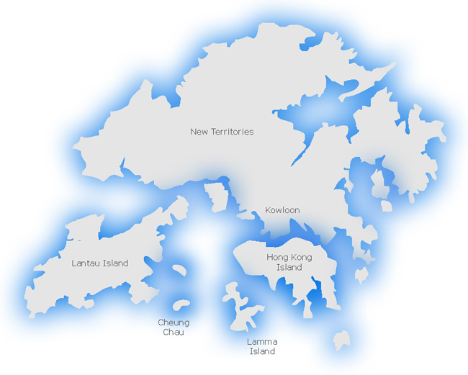
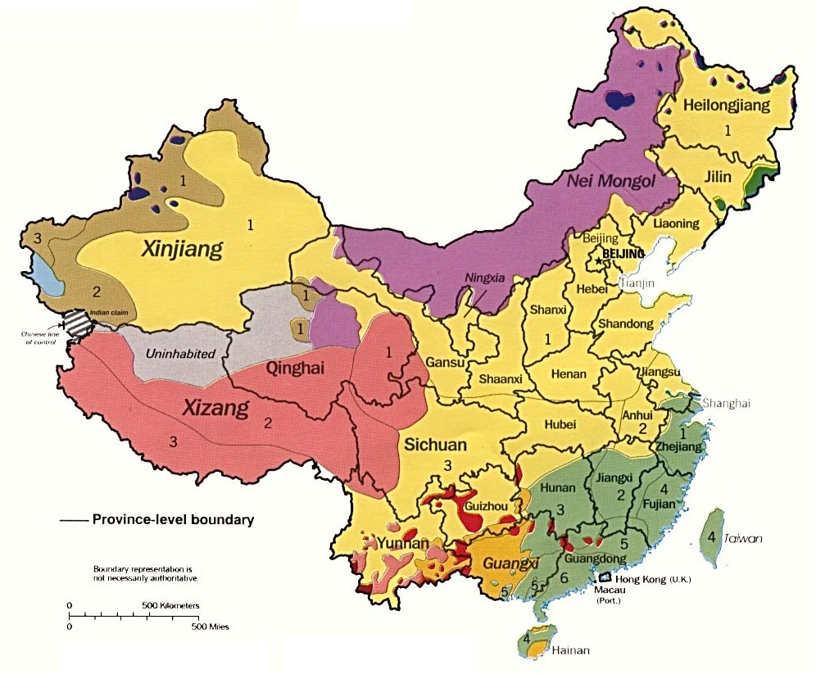
Notes:
Most expensive land are in HK Island and Kowloon. New Territories used to be farmlands but now most of them are well developed.

Slide 7
Source: IMF

Slide 8
Political Factors
All land in Hong Kong is government owned
Restricted sale of land leases: Government controls when and what property can be sold
Affordable Housing Initiatives developed for low-income residents
Public Housing accounts for more than half of housing in Hong Kong – spending on public sector land development outgrew private sector

Slide 9
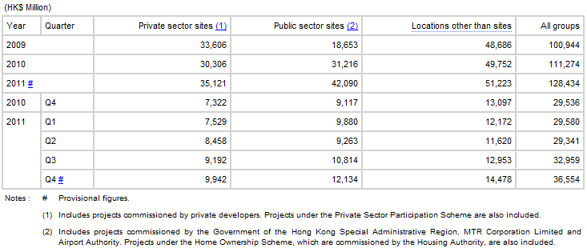
Political Factors
Notes:
There are more houses being built over the years

Slide 10
Economic Factors
Unemployment rate: 3% (November 2011 to January 2012) down from 4.3% in 2010 and 5.3% in 2009
Notes:
http://www.censtatd.gov.hk/hong_kong_statistics/statistical_tables/index.jsp?charsetID=1&tableID=006&subjectID=2

Slide 11
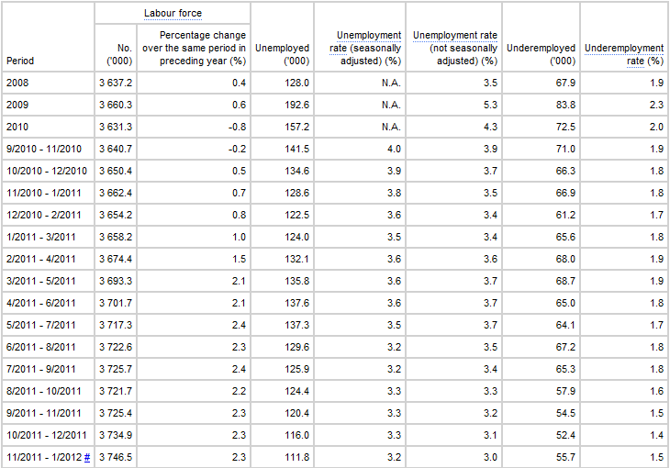
Economic Factors

Slide 12
Economic Factors

Slide 13
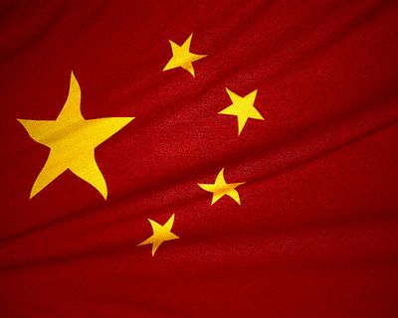
CHINA

Slide 14
Mainland Overview
Much larger market than Hong Kong
Population: 1,339,724,852 (2010)
Population growth rate 0.47%
One of the lowest growth rates in the world by percent but highest by number of people
Currency: Chinese Yuan. $1 USD = ¥6.30389 CNY at current market rates

Slide 15
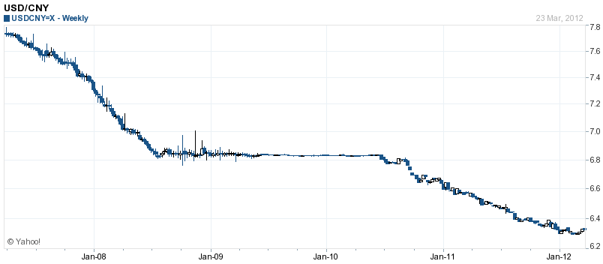
Mainland Overview

Slide 16
Mainland Overview
GDP: $7.43 trillion USD, second highest in world
Income per capita is substantially lower, only $5,184 per capita.
Growth levels for both statistics around 9% per year
Notes:
http://en.wikipedia.org/wiki/Historical_GDP_of_the_People%27s_Republic_of_China

Slide 17
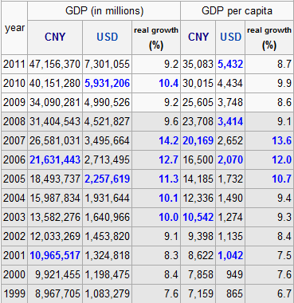
Mainland Overview

Slide 18
Mainland Overview

Slide 19
Mainland Overview

Slide 20
Mainland Overview
Consumer price index was up 3.2% year over year in February, down from almost 5% last year
Consumer price index growth decreasing compared to 2010 and 2011 rates
Negative inflation may be seen next year indicating another bubble similar to early 2008

Slide 21
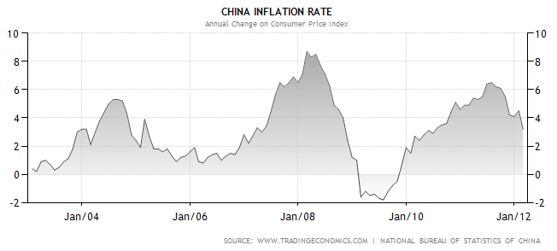
Mainland Overview

Slide 22
Mainland Overview
Unemployment rate is very steady in China due to socialist economic structure
Varied between 3.9% and 4.3% over the last 10 years, and only seeing an increase of 0.3% during the 2009 financial crisis compared to a 1.8% increase in Hong Kong

Slide 23
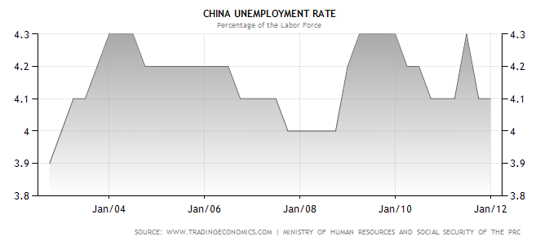
Mainland Overview

Slide 24
Mainland Overview
Interest rates at 6.56% up 25 basis points from mid 2011 rates
Increasing interest rates compared to decreasing and steady rates in Hong Kong and North America as previously shown
Aggressive monetary policy increasing rates in an attempt to tame inflation despite slow economy
Interest rates quickly increasing to almost pre-financial crisis levels

Slide 25
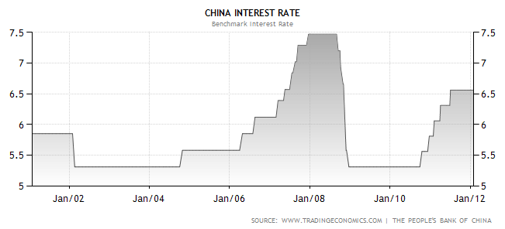
Mainland Overview

Slide 26
Factors which Affect China Properties Market
Government Policies
Economy
Demographics
age, income, population growth
Interest Rates

Slide 27
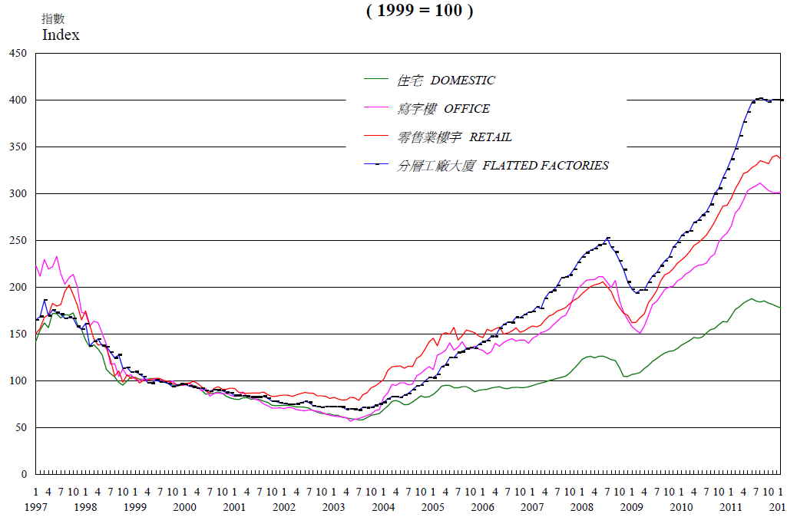
Price Indices for HK Property Market
Domestic: ↑80%
Office: ↑200%
Retail: ↑240%
Flatted Factories: ↑300%
Notes:
http://www.rvd.gov.hk/en/doc/statistics/graph2.pdf
Source: Rating and Valuation Department

Slide 28
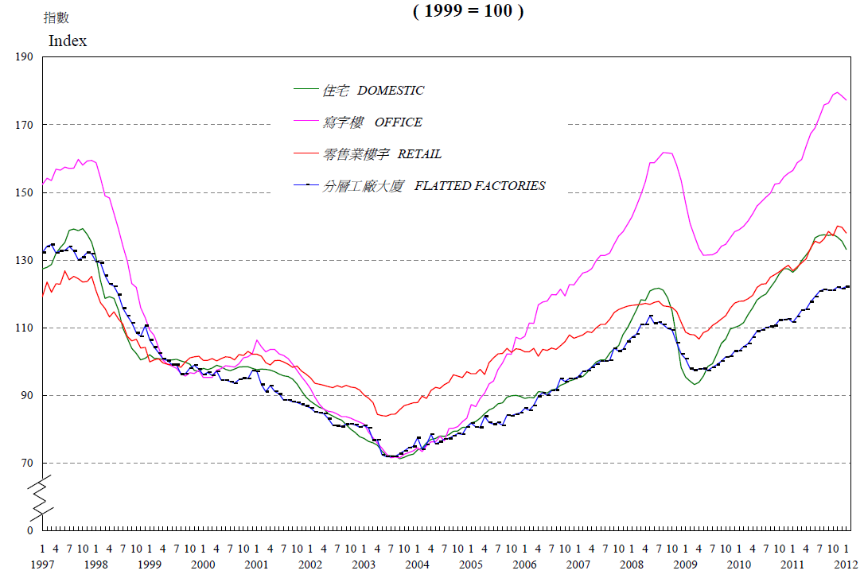
Rental Indices for HK Property Market
Domestic: ↑32%
Office: ↑74%
Retail: ↑34%
Flatted Factories: ↑22%

Slide 29
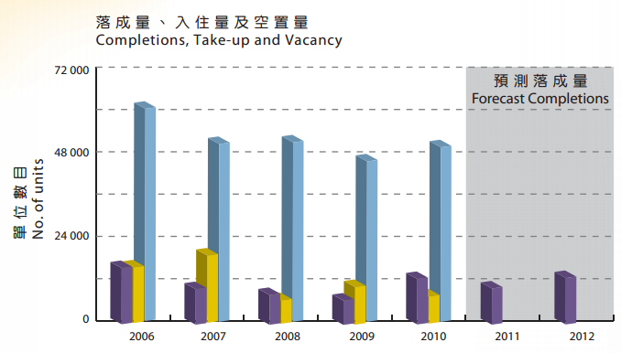
Completions, Take-up, and Vacancy
Private Domestic

Slide 30
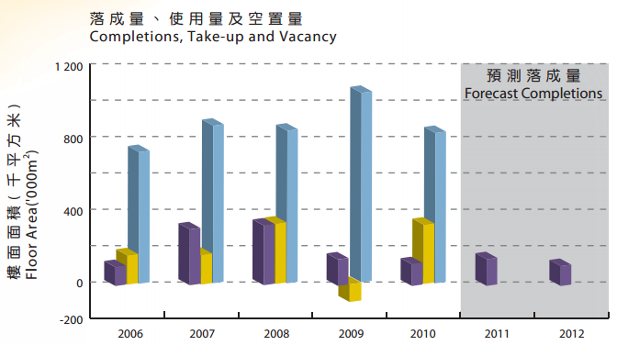
Completions, Take-up, and Vacancy
Private Office

Slide 31
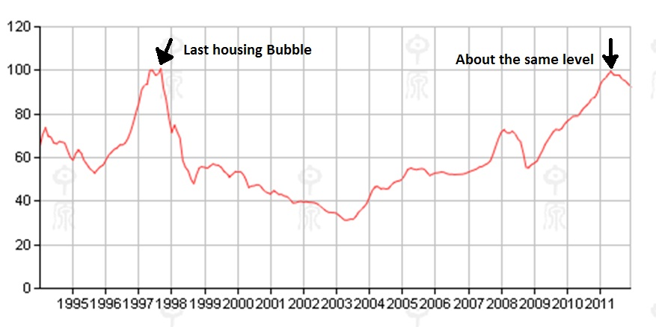
Centa-City Leading Sub-index
 | This Week | Previous Week | Previous Month
HK | 107.99 | 1.02 % | 4.49 %
KLN | 98.25 | 1.93 % | 5.98 %
NT (East) | 93.52 | 0.4 % | 4.26 %
NT (West) | 78.17 | 0.23 % | 5.47 %
Notes:
reflecting secondary private residential property price from 2012/03/12 to 2012/03/18 (based on scheduled formal sale & purchase date; on average, formal S&P are signed within 14 days after preliminary S&P)
Observing at this, from 1999 to current, the increase is about 58%

Slide 32
Price Factors
Centa-City Index measures home price by adjusted transaction price per square foot (HK$)
Monthly chart indicates decreasing prices since mid-2011

Slide 33
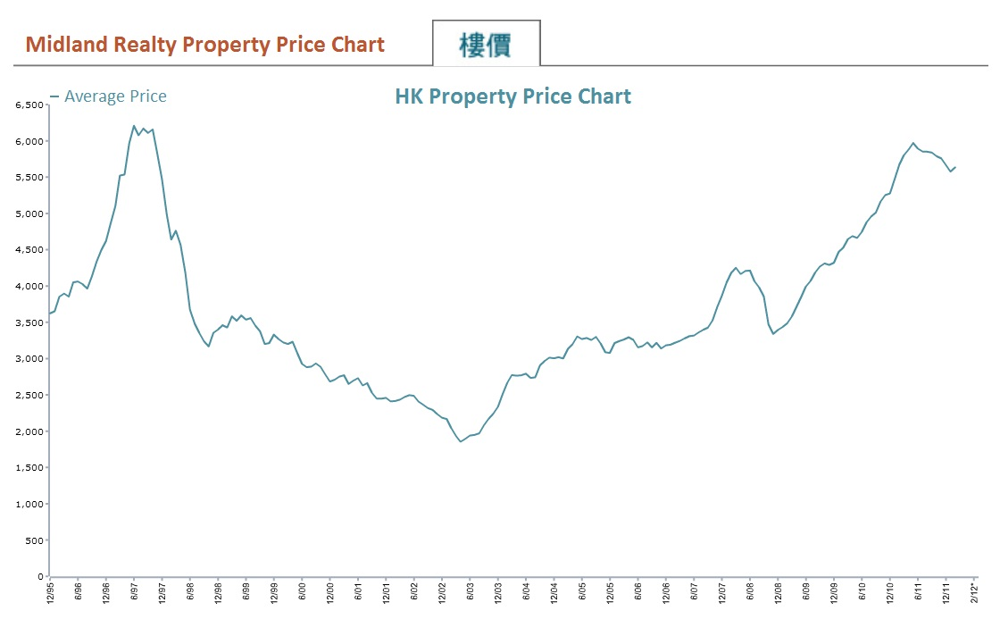
Nominal Property Price
Source: Midland Realty Research

Slide 34
Adapted from: HK Land Registry & Midland Realty Research

Slide 35
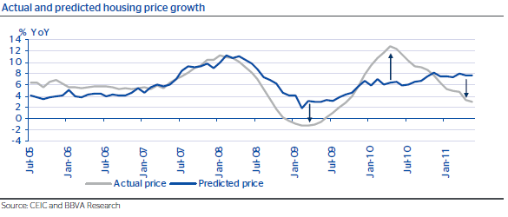
Industry Analysis

Slide 36
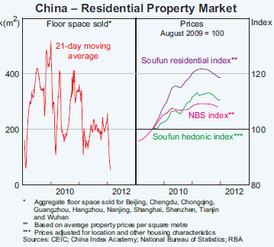
Industry Analysis

Slide 37
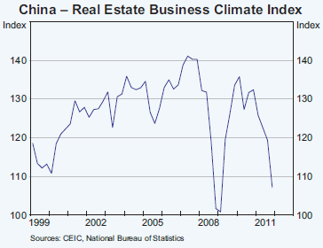
Industry Analysis

Slide 38
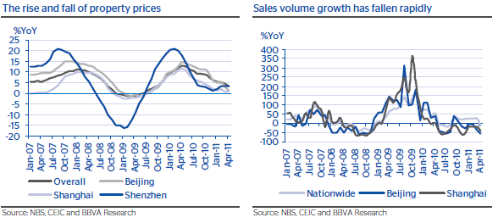
Industry Analysis

Slide 39
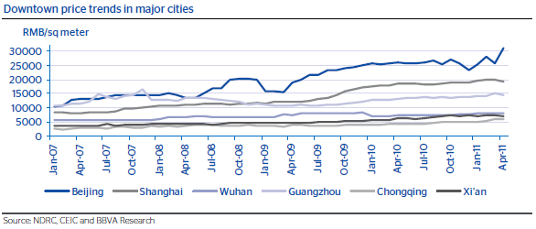
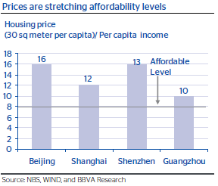
Industry Analysis

Slide 40
Benchmark – HS Properties Index
Freefloat-adjusted Value Weighted
Consists of 7 major property companies:
*Cheung Kong (Holdings) Ltd
*Henderson Land Development Co. Ltd
*Sun Hung Kai Properties Ltd
Sino Land Co Ltd
Hang Lung Properties Ltd
China Overseas Land & Investment Ltd
China Resources Land Ltd

Slide 41
HS Properties Index Composition

Slide 42
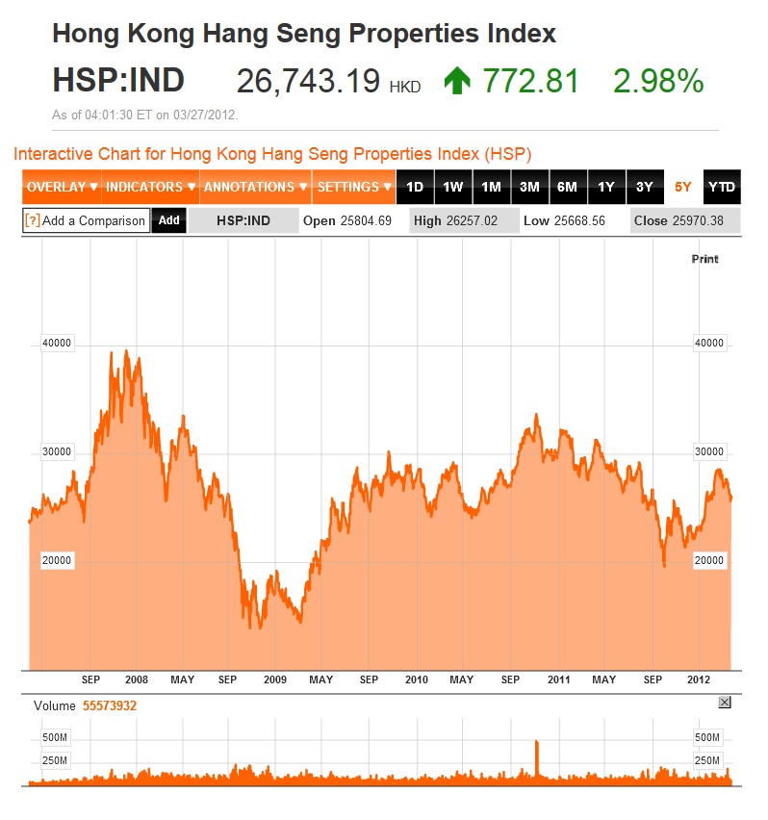
Five Year Chart

Slide 43
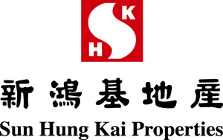

Slide 44
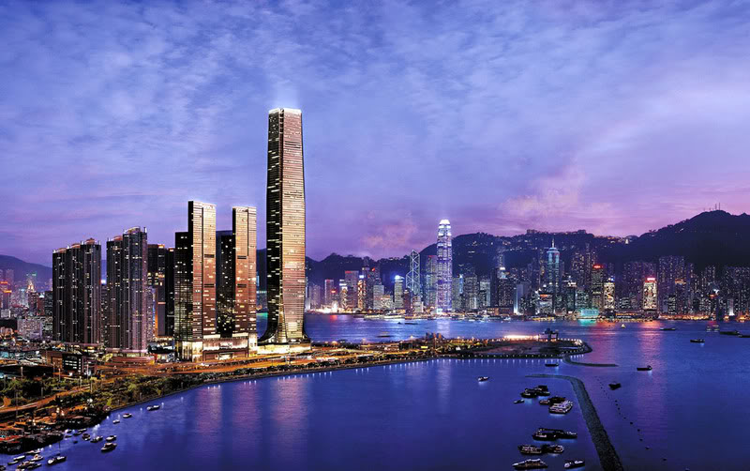

Notes:
Cover Photo: The tallest building is the International Commerce Center located in Kowloon.

Slide 45
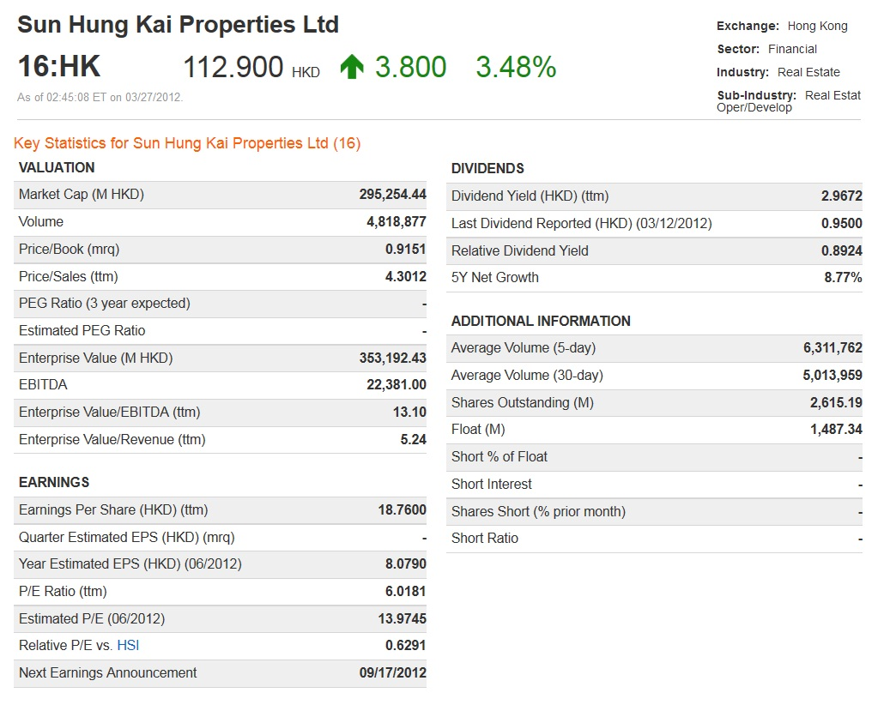
Last Trading Day Performance
Notes:
The stock is also trading in Germany (Frankfurt & Tradegate) and US (ADR and Common stock)

Slide 46
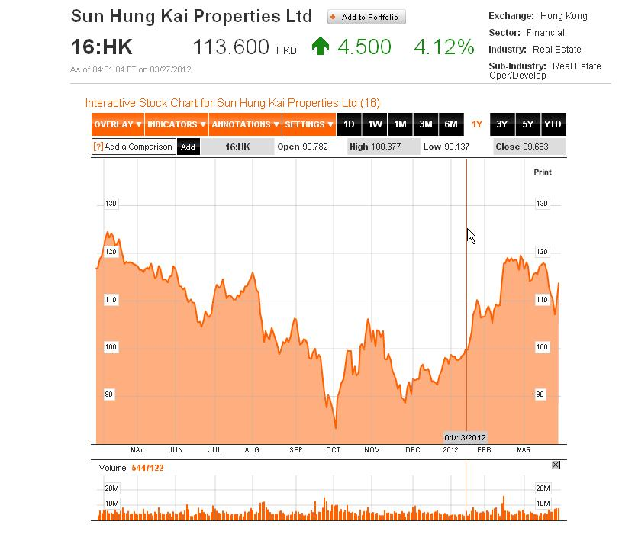
One Year Stock

Slide 47
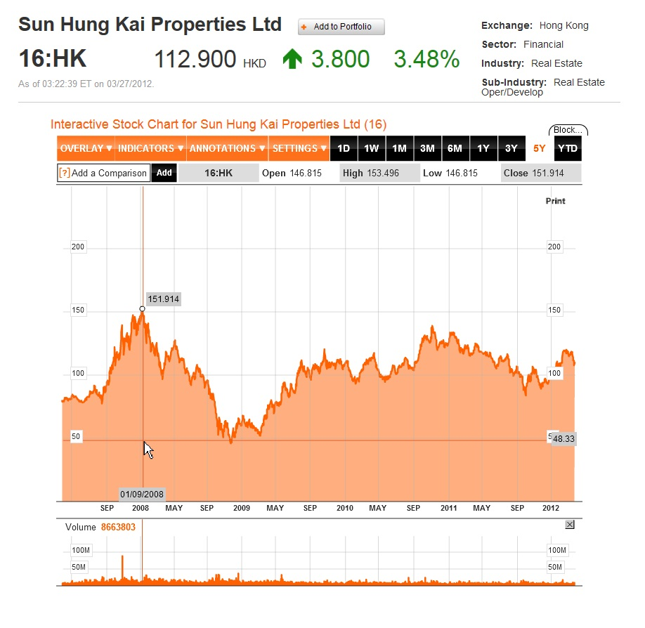
Five Year Stock

Slide 48
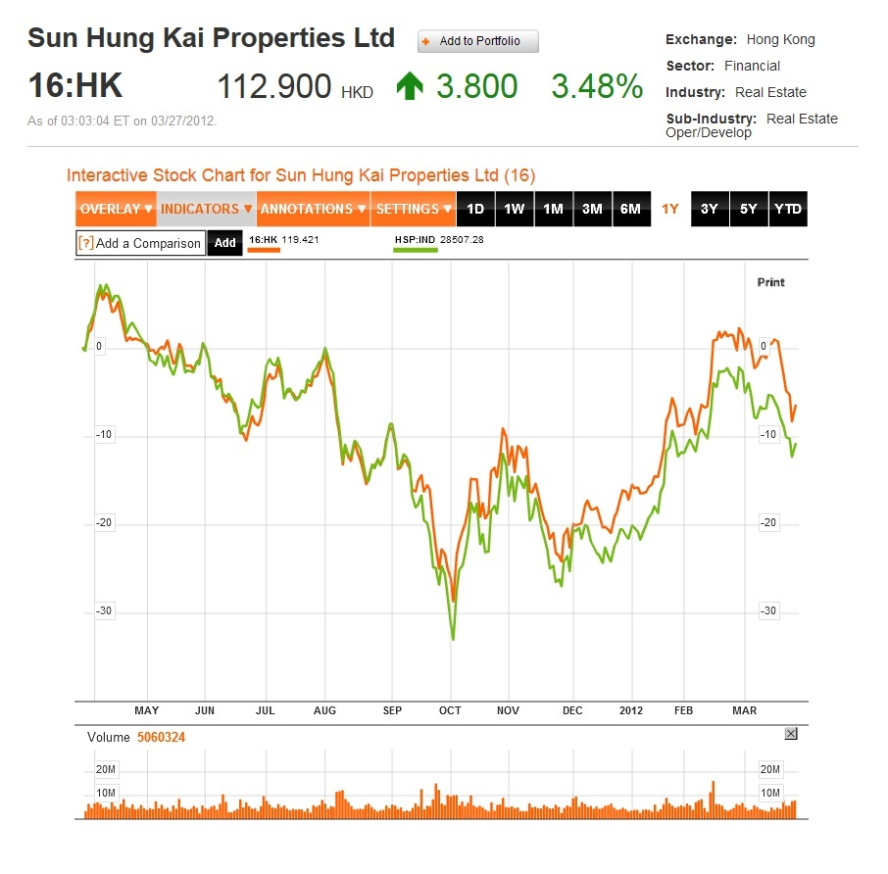
One Year Comparison

Slide 49
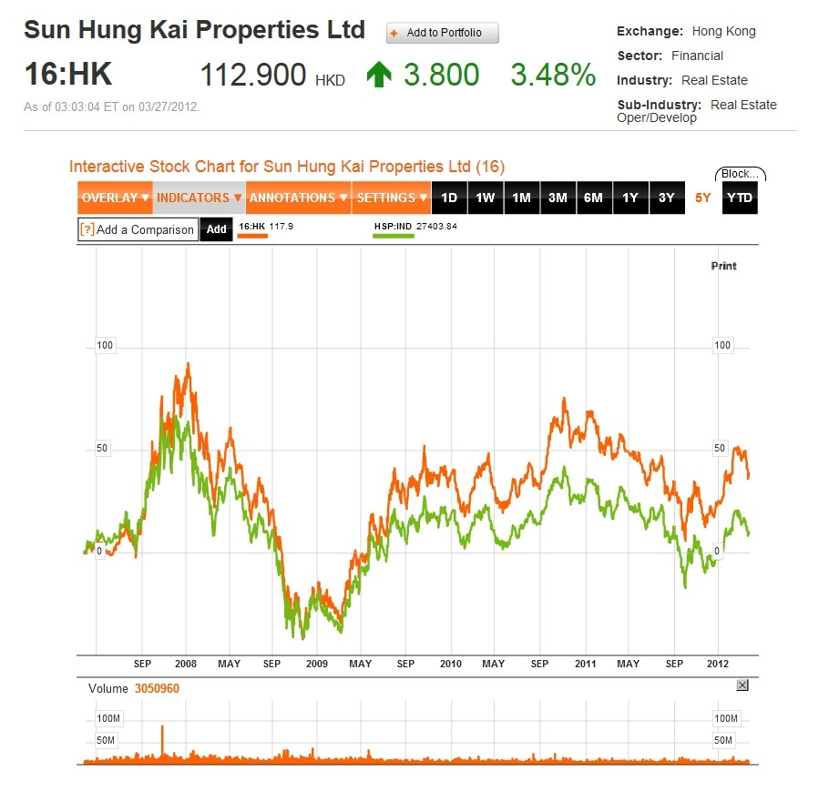
Five Year Comparison
Notes:
If you hold it for 5 years, the return is about 40%. Still pretty decent.

Slide 50
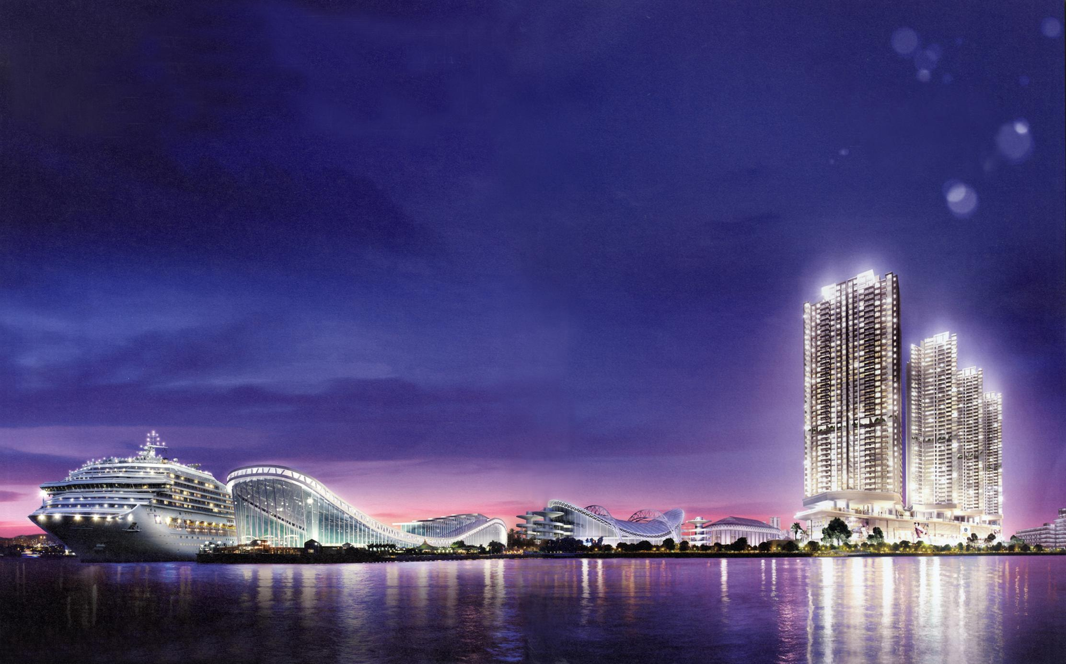
Corporate Profile

Slide 51
Basic Facts
A listed company on the Hong Kong Stock Exchange in 1972
Founded in 1963 by Kwok Tak Seng, along with Fung King-hei and Lee Shau Kee
The largest property company in Hong Kong (by Market Cap)
Specializes in premium-quality residential and commercial projects for sale and investment in Hong Kong and Mainland China
About 35,000 employees

Slide 52
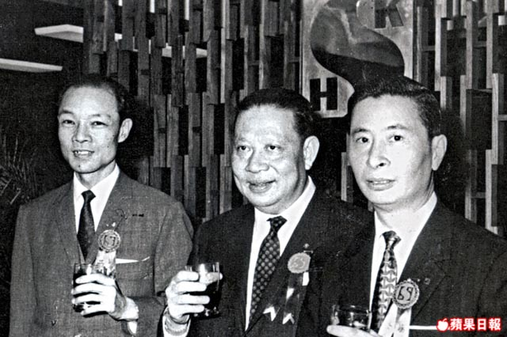
Founders
Fung King-Hei
Kwok Tak-Seng
Lee Shau Kee

Slide 53
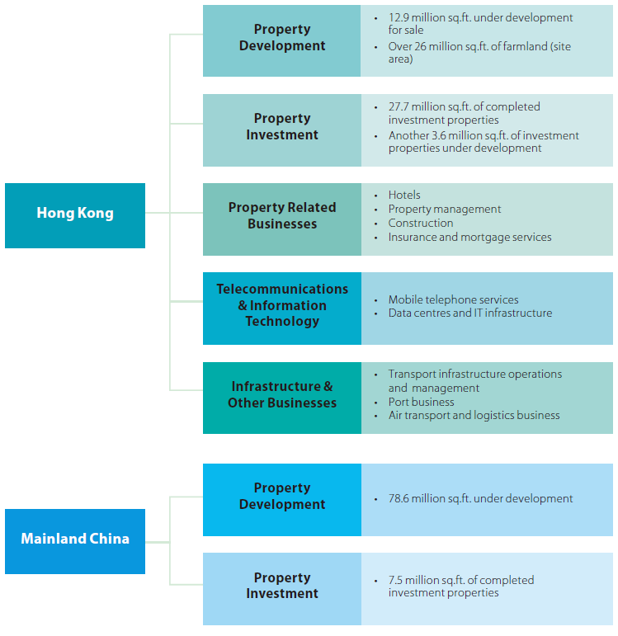
Business Structure
Notes:
The company is also involve in Telecommunication and logistics business through substantial interest in other subsidiaries.

Slide 54
Property Sales
HK$46,478 million (↑209% from FY2010)
Revenue from property sales, including revenue from joint-venture projects
HK$16,647 million (↑152% from FY2010)
Profits generated from property sales
HK$39,148 million
pre-sold properties to be recorded in the future
Notes:
Pretty awesome growth, and future revenue looks good too.

Slide 55
Rental Income
HK$12,609 million (↑14% from FY2010)
Gross rental income, including contributions from joint-venture projects
HK$9,511 million (↑14% from FY2010)
Net rental income

Slide 56
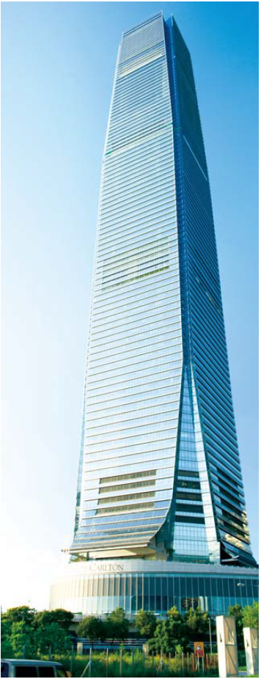
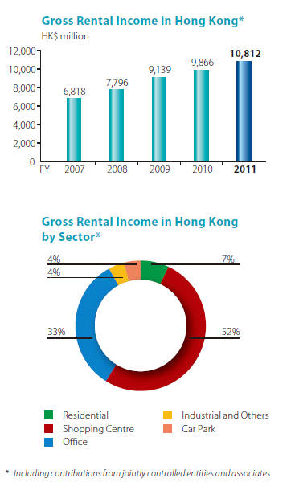
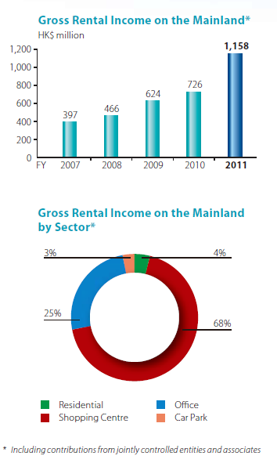
International Commerce Center
Notes:
Over the years, the rental income has been growing steadily.
If we look at Mainland, the growth in 2011 is almost 60%

Slide 57
HONG KONG

Slide 58
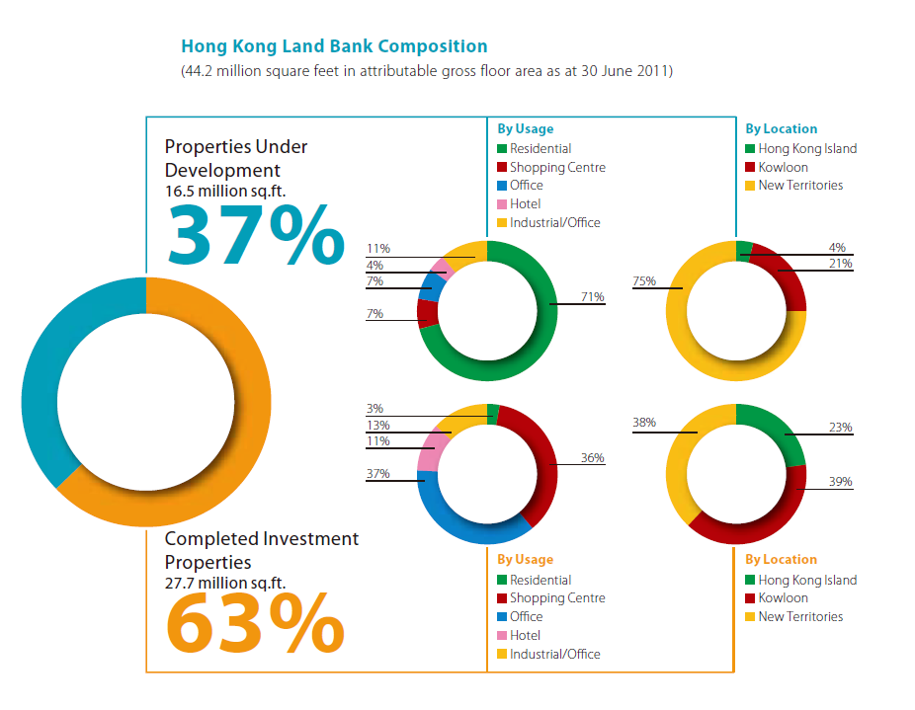
Notes:
Once the housing units are sold, it is removed from the balance sheet.

Slide 59
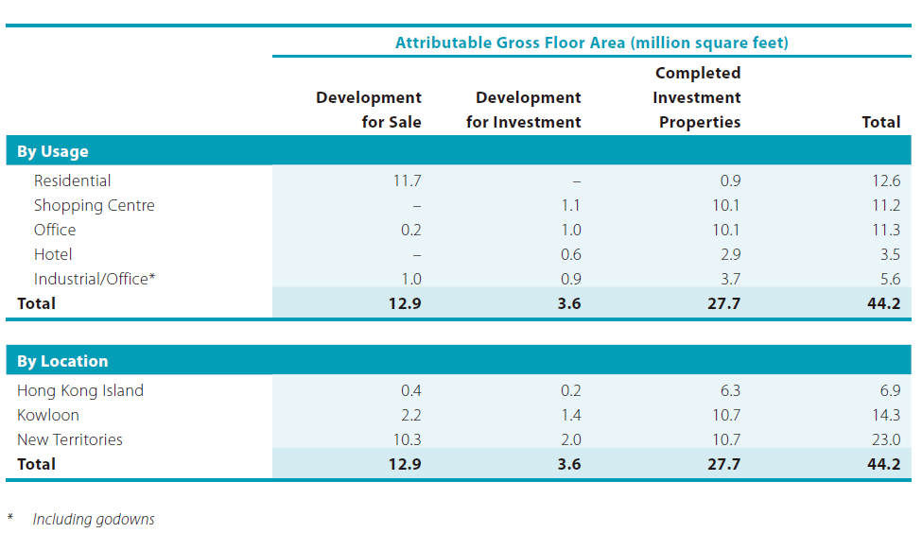
Composition

Slide 60
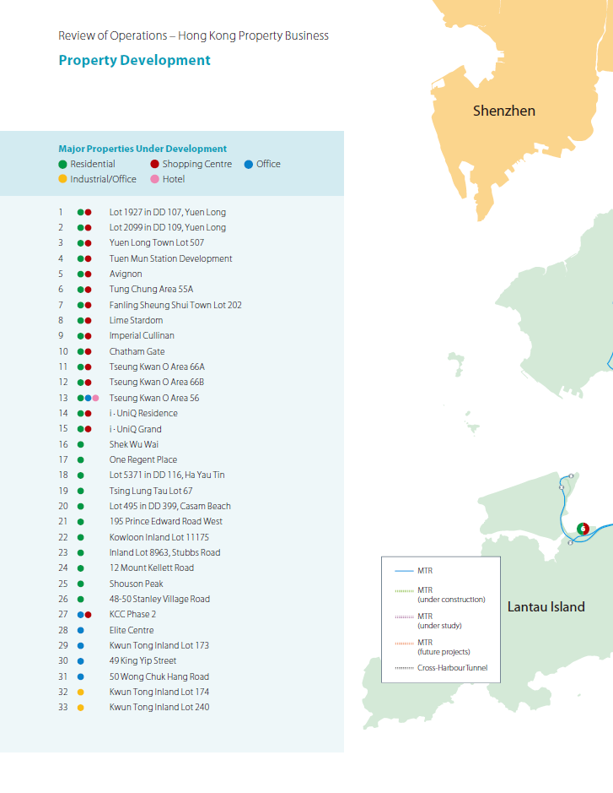
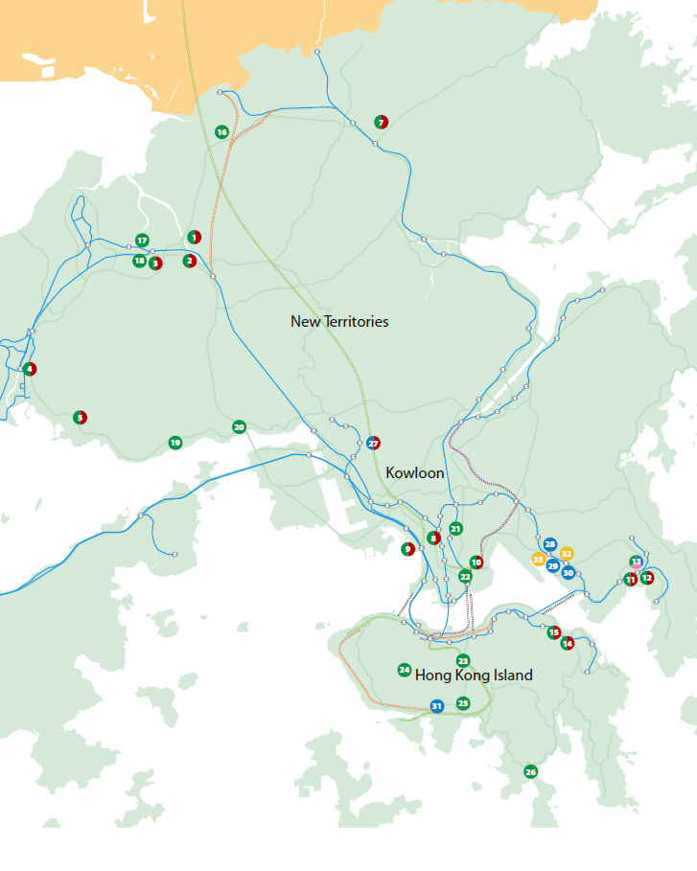
Notes:
A visual representation of the properties under development.

Slide 61
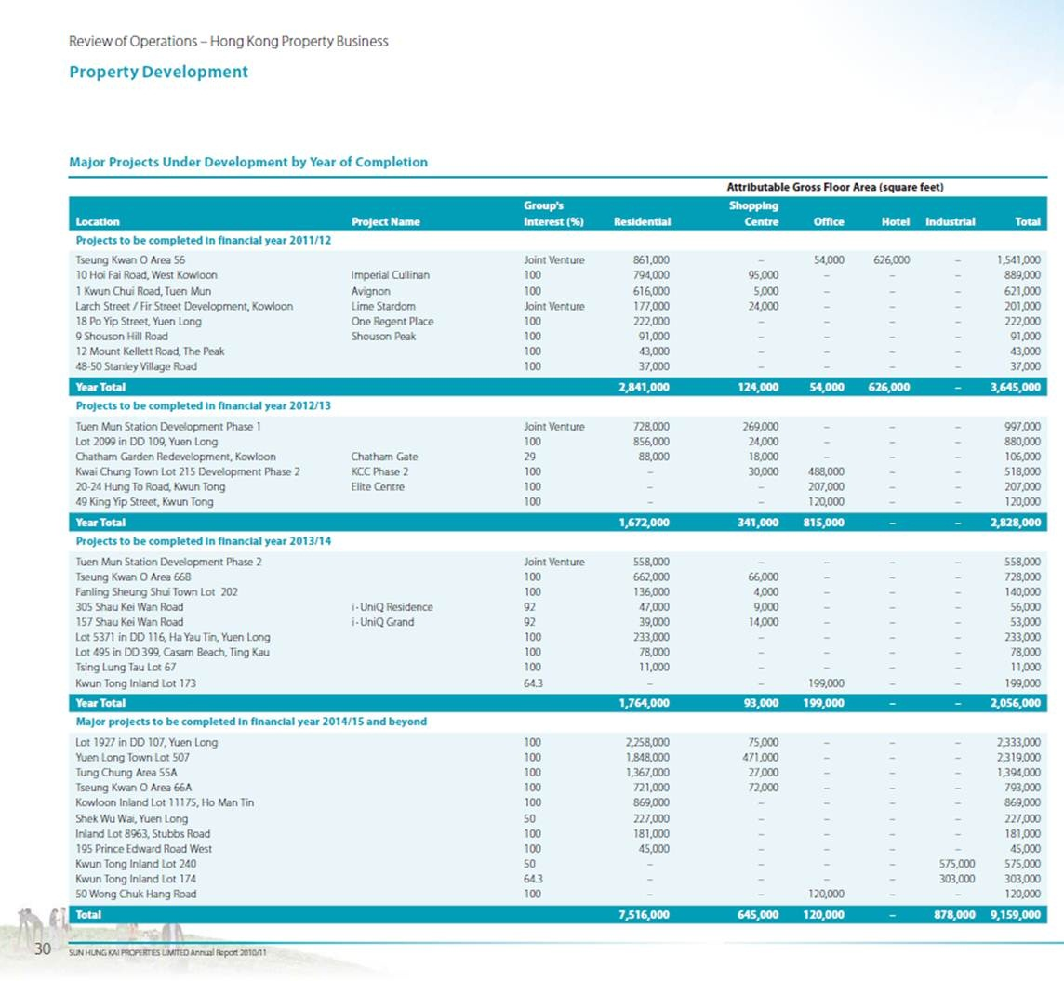

Slide 62
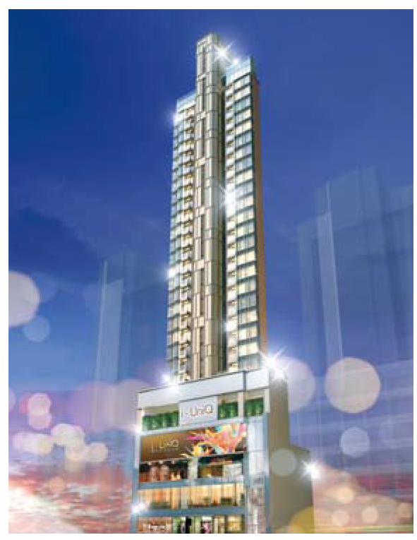
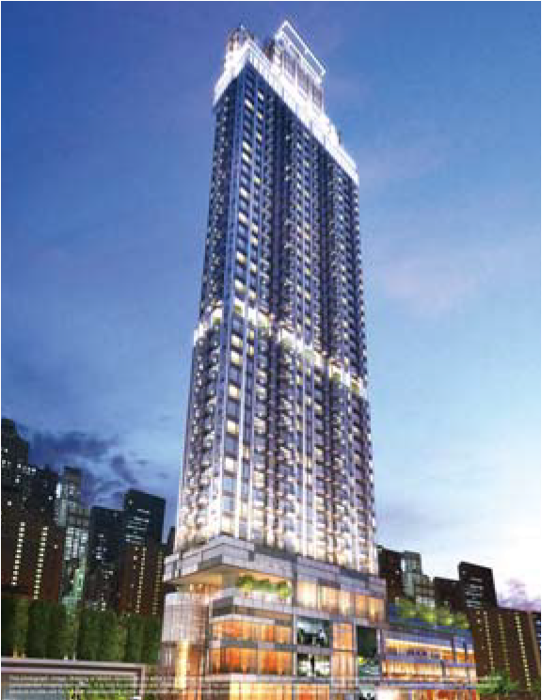
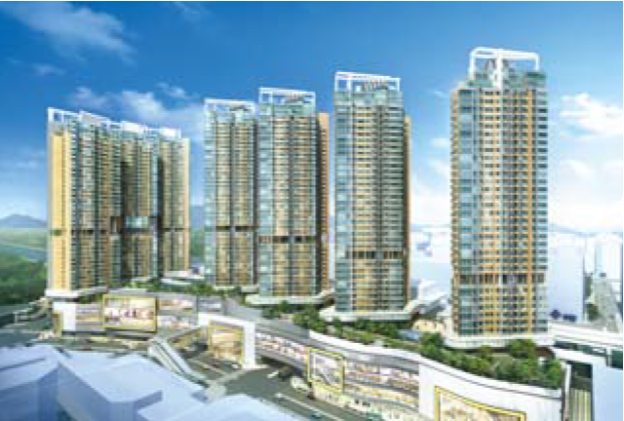
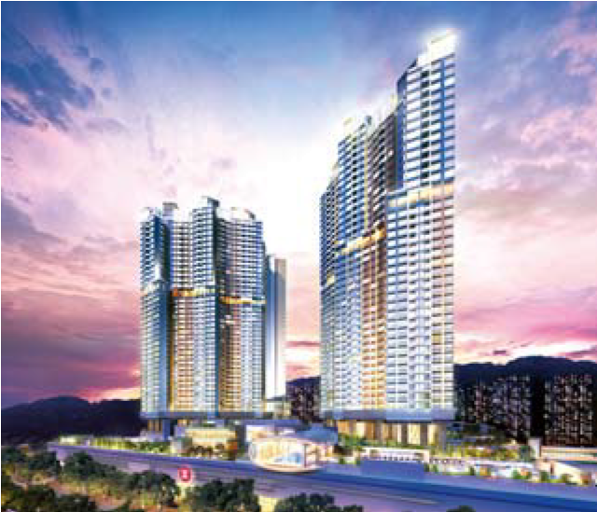
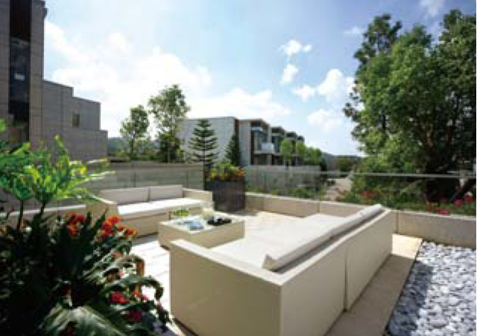
Notes:
Top (left to right):
1. Elegant i-UniQ Grand
2. Tuen Mun Station Development
3. Lime Stardom
Bot (Left to Right):
1. Valais at Beas River
2. Tseung Kwan O Station (將軍澳)

Slide 63
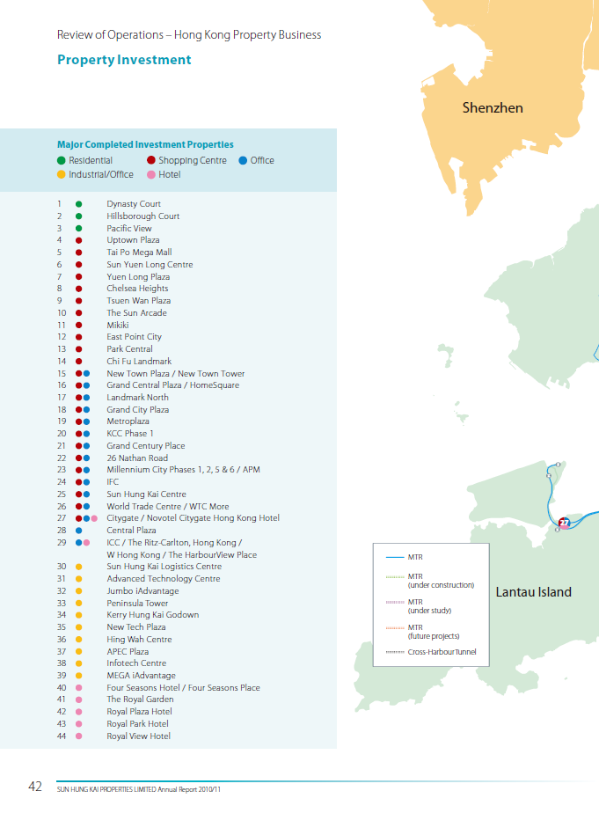
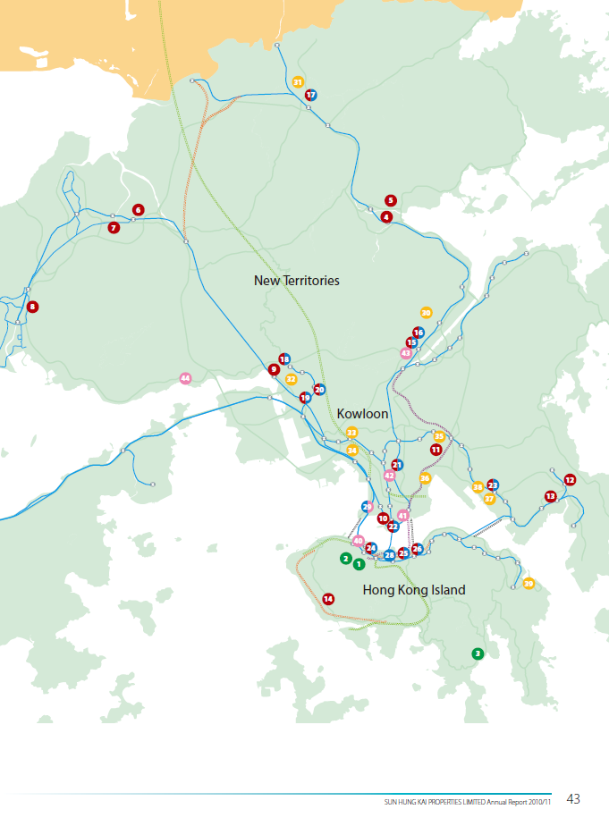

Slide 64
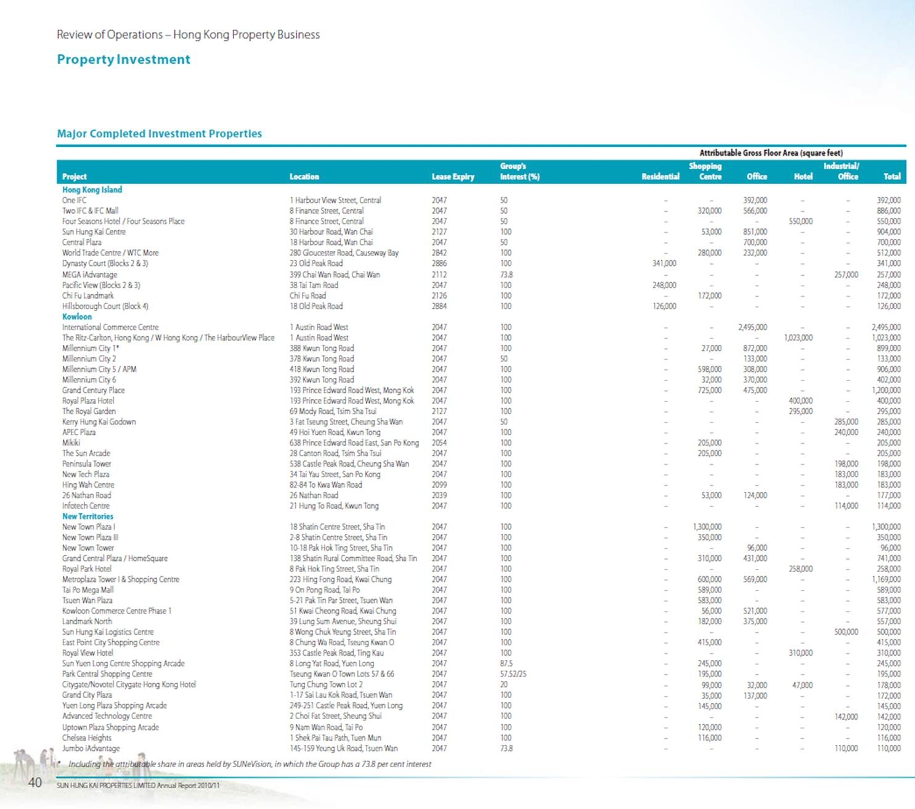
Notes:
They own some of the most prestigious office towers and shopping malls in HK
e.g., IFC (50%), ICC (100%), as long as financial sectors continue to perform well, these office spaces are valuable
Their tenants include famous premium brands such as Louis Vuitton, Salvatore Ferragamo, Prada, Tiffany

Slide 65
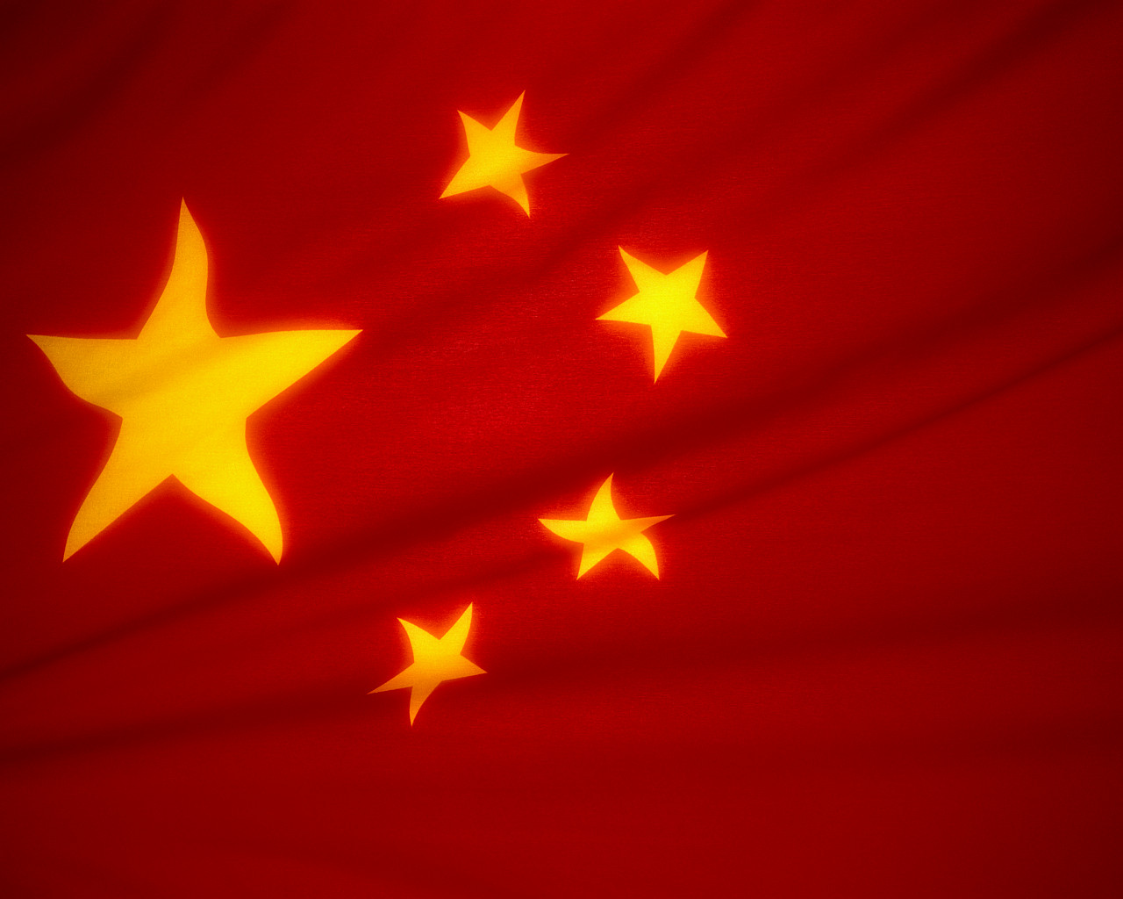
Mainland China

Slide 66


Slide 67

Composition
Notes:
These are lands that are in the Economic Regions

Slide 68



Slide 69


Notes:
All of their buildings are in premium cities and areas which gov’t focuses on developing

Slide 70

Management

Slide 71

Governance

Slide 72

Governance Structure

Slide 73



Notes:
Pretty much the KWOK family owns almost half of the company through being the trustee of certain trusts
There is currently a dispute between Walter’s interest in the company.

Slide 74

Directors’ Profile
Kwong Siu Hing
Retired as Chairman in Dec. 2011
Wife of Kwok Tak Seng
Chairman since May 2008
2nd largest shareholder of the company
Effectively owns 42.17% of the Company
Notes:
In Asia, doing businesses have a lot to do with connections and seniority.

Slide 75

Directors’ Profile (Cont’)
KWOK Ping Kwong, Thomas
(Chairman & Managing Director)
Also a member of the Executive Committee
With the Company for 34 Years
Education: Master's degree in Business Administration from The London Business School, University of London, and a Bachelor's degree in Civil Engineering from Imperial College, University of London
Accreditation: Honorary Doctorate in Engineering from The Hong Kong Polytechnic University and an Honorary Doctorate in Business Administration from The Open University of Hong Kong
Affiliation: a fellow of The Hong Kong Management Association and a fellow of The Australia Certified Public Accountants
Total Compensation (2011): HKD 3.87 million
Notes:
An engineer and also an accountant.

Slide 76

Directors’ Profile (Cont’)
KWOK Ping Luen, Raymond
(Chairman & Managing Director)
Also a member of the Executive Committee
With the Company for 33 Years
Education: Master of Arts degree in Law from Cambridge University, a Master degree in Business Administration from Harvard University
Accreditation: Honorary Doctorate degree in Business Administration from The Open University of Hong Kong and an Honorary Doctorate degree in Laws from The Chinese University of Hong Kong
Civic Duties: director of The Real Estate Developers Association of Hong Kong and member of the General Committee of The Hong Kong General Chamber of Commerce and vice chairman of the council of The Chinese University of Hong Kong
Total Compensation (2011): HKD 4.10 million
Notes:
In short, a law person and businessman.

Slide 77

Directors’ Profile (Cont’)
KWOK Ping Sheung
(Non-Executive Director)
With the Company for 37 Years
Was Chairman and CEO of the company from 1990 to 2008
Eldest brother in the KWOK family
Education: Master of Science degree in Civil Engineering from the Imperial College of Science and Technology, University of London
Accreditation: Honorary Doctor of Science degree in Civil Engineering, honorary fellow of the School of Accountancy of The Central University of Finance and Economics, honorary trustee of Tongji University and Nanjing University
Affiliation: fellow of the Hong Kong Institution of Engineers
Civic Duties: director of The Real Estate Developers Association of Hong Kong and Tsimshatsui East Property Developers’ Association Ltd. and honorary treasurer of the Federation of Hong Kong Hotel Owners
Notes:
This is the guy who got kicked out of the company
Since then, he has partnered with Cheung Kong to work on a couple projects

Slide 78

Compensation
Number in millions
Notes:
Mike = Project Management
Patrick = Corporate Planning and Strategic Investment
Chan Kui-yuen, Thomas = Project Planning and Development

Slide 79



Slide 80

Earnings and Dividends per Share
(excluding FY 2011) Annual Dividend Growth Rate = 4.09%
Notes:
$$g=\sqrt[5]{\left(\frac{3.35 }{2.30}\right)}$$

Slide 81

Other Important Numbers

Slide 82

Financials

Slide 83


5 Year Summary
Total Shares Issued: 2,570,039,181
Notes:
Since they are moving to IFRS, they have to restate their numbers for previous years.

Slide 84

2011 Interim Balance Sheet

Slide 85



Slide 86

2011 Interim Income Statement

Slide 87



Slide 88

2011 Interim Comprehensive Income

Slide 89


Slide 90



Slide 91



Slide 92
Evaluation
NAV/share = HKD127.74
P/B Ratio = 0.85
Net D/E Ratio = 17.1
DuPont: (2011) 0.156 = 0.78 x 0.15 x 1.32 (2010) 0.114 = 0.92 x 0.094 x 1.32 (2009) 0.0435 = 0.31 x 0.11 x 1.29
Notes:
NAV: Since the growth of properties developer has to do with the company’s land bank (Land Reserve, Developing Projects, and Investment Properties), the Net Asset value can be a reliable measure of the value of the share price
Net D/E Ratio: This tells investors the amount of debt the company is carrying. This ratio provides investors insight about the company’s level of leverage.

Slide 93

Recommendation

Slide 94
Rationale
Pros:
Steady growth in rental income
Stock selling at discount
Housing is a good commodity against inflation
Improving asset turnover
Land always appreciate! (in the long term)
Cons:
Heavier Chinese gov’t regulations
Political uncertainty (both HK and China)
Housing unaffordability
Notes:
Selling at discount according to NAV value

Slide 95


Slide 96




Last trading day Performance
Notes:
March 27, 2012

Slide 97

1 Year Performance

Slide 98

5 Year Performance

Slide 99

1 Year Stock Comparison

Slide 100

5 Year Stock Comparison

Slide 101




Subsidiaries Stock Performance

Slide 102

COMPANY OVERVIEW
COMPANY OVERVIEW
Notes:
BEIJING WORLD FINANCIAL CENTRE

Slide 103
Company Profile
Listed in Hong Kong since 1981
One of Hong Kong's largest business enterprises, with approximately 8,000 staff and an operational reach that extends throughout mainland China.
Core Business
Property development
Property investment
Holds strategic investments in many fields
Hong Kong and China Gas Company Ltd.
Hong Kong Ferry Company Ltd
Miramar Hotel
Henderson Investment Limited

Slide 104
Business Segments
Business Segments
A. Property development
B. Property Investment
C. Construction
D .Infrastructure
E. Hotel operation
F. Department store operation
G. Others
Notes:
8024 1871 12 160 98 160 299
C: 12 MILLION

Slide 105
Geographical segments
Hong Kong
Hong Kong island
Kowloon
New territories
Mainland China
Shanghai
Guangzhou
Anshan
Changsha
Chengdu
Chongqing
Nanjing
Shenyang
Suzhou
Xian
Xuzhou
Yixing

Slide 106

Group Structure
Notes:
major subsidiaries. Henderson Land Group comprises six entities that are listed on the Hong Kong Stock Exchange.

Slide 108

BUSINESS IN HONGKONG
Property Development
Land Bank
Property Investment
Notes:
International Finance Centre
Tallest building in honking
Completed in 2003
Henderson’s headquarters

Slide 109

Location Map of New Projects Pending Sale/ Pre-sale in Hong Kong for 2H 2011 & 1H 2012
Property Development

Slide 110

Property Development
Projects pending sale or pre-sale:

Slide 111

Property Development
Unsold units from the major development projects offered for sale

Slide 112


Property Sales Program
Property Development

Slide 113


Land Bank
Land Bank as of June 30, 2011
Total: 21.2 Mn. Sq.ft.
June 30 2011
Notes:
At 30 June 2011, the Group had a land bank in Hong Kong comprising a total attributable gross floor area of approximately 21.2 million square feet, made up as follows:
Total 21.2

Slide 114
Land Bank
Redevelopment of old buildings in the urban areas
Existing projects : 1,005,291
Newly-acquired projects :306,629
Agricultural land
North East New Territories New Development Areas : 5,100,000
Further acquisition : 587,843
Hung Shui Kiu New Development Area :4,000,000
Land Bank Composition
Notes:
Site area: square feet

Slide 115

Land Bank
Low-risk approach to land-banking
(1) acquisition of old buildings
(2)Redevelopment projects from old urban sites offer shorter time to market

Slide 116

Property Investment
Notes:
The overall leasing rate for the Group’s core rental properties stayed high at ~97%

Slide 117

Business in Mainland China
Land Bank
Property Development
Properties Investment
Notes:
In April 2005, the Group entered into an agreement to jointly develop a large-scale waterfront development with a site area of approximately 1.45 million square feet in Taipa, Macau. The project is subject to application for land-use conversion with the total gross floor area to be finalized
HENDERSON METROPOLITION IN sHANGHAI

Slide 118


Land Bank
Land Bank

Slide 119
Land Bank
Notes:
The 96% is composed of…
152.6
6.5
Land under devleopment: 125.3
13.9
9.3
4.1

Slide 120









Property Development
Completed Properties by June 30,2011
Project Name and location | Property type
Henderson Centre, Beijing | Retail
State Apartment, Beijing | Residential
World Financial Centre, Beijing | Office and Retail
Office Tower II , Shanghai | Office
Skycity, Shanghai | Retail
Centro, Shanghai | Residential
Hengbao Plaza, Guangzhou | Retail and Office
Hengli Bayview | Residential
Centro[Shanghai]
Notes:
Property Sales
The Group sold and pre-sold an attributable HK$903 million worth of mainland properties during the period, an increase of 70% over the same period last year. Projects launched included “La Botanica” in Xian, “Riverside Park” in Suzhou, “Villa Green” in Chongqing and “The Arch of Triumph” in Changsha. As at 30 June 2011, the amount of mainland properties pre- sold attributable to the Group totalled HK$1,657 million.

Slide 121

Property Development

Slide 122

Property Development

Slide 123

Property Investment
Increased rental income from mainland China driven by higher rental income contribution from newly completed properties.
Notes:
The above two projects are expected to bring in total annual gross rental income of RMB 490 million for the 12-month ending 30 June 2012 based on the existing tenancy agreements
In Beijing, World Financial Centre recorded a 302% period-on-period growth in rental income to HK$156 million with a leasing rate of 83% by the end of June 2011. Located in Chao Yang Central Business District, World Financial Centre, which was designed as twin “crystal jewel boxes” by the world-famous architect Cesar Pelli, achieved the highest possible “Platinum” rating from both the United States Green Building Council’s LEED and HK-BEAM. With such a prime location, distinctive design and environmentally-friendly features, many discerning financial institutions and multinational corporations, such as Standard Chartered Bank, Westpac Banking Corporation, Mizuho Corporate Bank, CITIC Prudential Insurance Company, The World Economic Forum, RIM-Blackberry, International Air Transport Association, FAW Toyota and Novo Nordisk, have been drawn to this 2.1 million-square-foot International Grade-A office complex as its tenants since its completion in early 2009.

Slide 124

Property Investment
Notes:
6.52
The Group’s mainland completed investment property portfolio, which consists of 7 major projects with an attributable gross floor area of approximately 3.45 million square feet of office space, approximately 2.49 million square feet of commercial space and approximately 0.56 million square feet of car parking space, reported satisfactory leasing performance during the period under review. The Group’s attributable gross rental income and net rental income increased remarkably by 107% period-on-period to HK$418 million and by 155% period-on-period to HK$235 million, respectively attributable mainly to higher rental income growth recorded by the newly completed properties.

Slide 125


Henderson Metropolitan
World Financial Centre

Slide 126
Property Investment
Property | Committed Occupancy Rate at 30 Jun 2011 | Gross rental Income for 1H 2011 | Y-o-Y change
World Financial Centre | 83% | HK $ 156 Million | +302%
Henderson Metropolitan | 96% | HK 54 Million | n/a
Major Tenants
World Financial Centre, Beijing | Henderson Metropolitan, Shanghai
Standard Chartered Bank | Oracle Software
Westpac Banking Corporation | Mitsubishi
CITIC Prudential Insurance Company | Lufthansa and Dentsu
The World Economic Forum | Microsoft
RIM-Blackberry
Notes:
6.52
The Group’s mainland completed investment property portfolio, which consists of 7 major projects with an attributable gross floor area of approximately 3.45 million square feet of office space, approximately 2.49 million square feet of commercial space and approximately 0.56 million square feet of car parking space, reported satisfactory leasing performance during the period under review. The Group’s attributable gross rental income and net rental income increased remarkably by 107% period-on-period to HK$418 million and by 155% period-on-period to HK$235 million, respectively attributable mainly to higher rental income growth recorded by the newly completed properties.

Slide 127




5 Year Financial Comparison
Notes:
Year on year Henderson Land Development Co Ltd had revenues fall 53.43% from 15.23bn to 7.09bn, though the company grew net income 10.47% from 14.32bn to 15.82bn.

Slide 128

Fiver Year Financial Comparison

Slide 129

MANAGEMENT
Notes:
CHONGQING GRAND WATERFRONT

Slide 130



Board of Director

Slide 131

Organizational Structure

Slide 132

Disclosure of Interest- Long Positions in Shares

Slide 133

Management Team
Lee Shau Kee
founder & chairman
84 years old
vice chairman of Sun Hung Kai Properties Limited
- more than 50 years experience in property development
4rd richest person in Hong Kong
Net worth US$ 19.5 Billion

Slide 134

Board of Directors
Lee Ka Kit (Son)
Executive director & Vice Chairman
Vice chairman of Henderson Investment Limited
Director of The Hong Kong and China Gas Company Limited
- National Committee Member of the Chinese People’s Political Consultative Conference, PRC,
- Educated in the United Kingdom
- Awarded an Honorary University Fellowship by The University of Hong Kong in 2009.

Slide 135

Board of Directors
Lee Ka Shing (Son)
Executive director & Vice Chairman
Vice chairman of Henderson Investment Limited
Managing director of Miramar Hotel and Investment Company, Limited
Director of The Hong Kong and China Gas Company Limited
- Educated in Canada

Slide 136
Board of Directors
Li Ning (son-in-law)
- Executive Director of the Company since 1992
- Executive director of Henderson Investment ,
- Director of Hong Kong Ferry (Holdings) Company Limited
- Holds a B.Sc. degree from Babson College and an M.B.A. degree from the University of Southern California

Slide 137

Directors Compensation

Slide 138

FINANCIALS

Slide 139

2011 Interim Balance Sheet

Slide 140

2011 Interim Balance Sheet (Cont.)

Slide 141

2010 Annual Balance Sheet

Slide 142

2010 Annual Balance Sheet (Cont.)

Slide 143

2011 Interim Income Statement

Slide 144


2010 Annual Consolidated Income Statement

Slide 145

Interim Condensed Cash Flow Statement

Slide 146

Annual Consolidate Cash Flow Statement

Slide 147

Annual Consolidate Cash Flow Statement

Slide 148

Annual Consolidate Cash Flow Statement

Slide 149

Note 10: Segment Reporting
Results of reportable segments

Slide 150

Note 10:Segmentreporting (Continue)
Geographical Information

Slide 151
Note 11 :Fix Assets
(a) Transfers
During the six months ended 30 June 2011:
(i) properties under development with carrying amount of HK $536 million have been transferred from “Inventories” to “Fixed assets” upon the commencement of leasing activities; and
(ii) investment properties under development with carrying amount of HK$472 million have been transferred from “Fixed assets” to “Inventories” as the directors determined its intended use as held for sale purposes.

Slide 152
Note 11 :Fix Assets
(b) Valuation
The investment properties were revalued at 30 June 2011 by DTZ Debenham Tie Leung Limited, an independent firm of professional surveyors who have among their staff Fellows of The Hong Kong Institute of Surveyors with recent experience in the location and category of property being valued, on a market value basis in their existing states by reference to comparable market transactions and where appropriate on the basis of capitalisation of the net rental income allowing for reversionary income potential.

Slide 153

Note 12 :Derivative financial instruments

Slide 154

Financial Resources and Liquidity Analysis
Maturity profile and interest cover

Slide 155

Financial Resources and Liquidity Analysis
Maturity profile and interest cover

Slide 156

EVALUATION

Slide 157

Income Statement Evolution

Slide 158

Income Statement Evolution

Slide 159

Finances – Leverage Forecast

Slide 160

Finances – Leverage Forecast

Slide 161

Balance Sheet Forecast

Slide 162

EPS & Dividend Forecast

Slide 163

RECOMENDATION

Slide 164

Cheung Kong (Holdings) Limited

Slide 165


Slide 166

Last Trading Day Performance

Slide 167

One Year Performance

Slide 168

Five Year Performance

Slide 169

One Year Comparison

Slide 170

Five Year Comparison

Slide 171
Corporate Profile

Slide 172
Cheung Kong Holdings
Cheung Kong (Holdings) Limited ("Cheung Kong Holdings") is the flagship of the Cheung Kong Group, one of Hong Kong's leading multi-national conglomerates.
Li Ka Shing founded Cheung Kong Industries in 1950s as a plastics manufacturer. Under his leadership, the company grew rapidly and eventually evolved into a property investment company. "Cheung Kong (Holdings) Limited" from the 1970s.

Slide 173
Cheung Kong Holdings
Hong Kong based
A property development and strategic investment company
One of the largest developers in Hong Kong of residential, commercial and industrial properties
About one in seven private residences in Hong Kong were developed by the company
Operates in 53 countries and employs about 270,000 staff worldwide

Slide 174
Cheung Kong Holdings
In HK, members of the Cheung Kong Group include:
Cheung Kong Holdings (stock code: 0001)
Hutchison Whampoa Limited (0013)
Power Assets Holdings Limited (0006)
Cheung Kong Infrastructure Holdings Limited (1038)
CK Life Sciences Int'l. (Holdings) Inc. (0775)
Hutchison Telecommunications Hong Kong Holdings Limited (0215)
Hutchison Harbour Ring Limited (0715)
TOM Group Limited (2383)
Combined market capitalization: HK$807 billion (31 Jan, 2012)

Slide 175

Group Structure

Slide 176

Market Capitalization

Slide 177

Market Capitalization

Slide 178

Market Capitalization

Slide 179

Market Capitalization

Slide 180

Market Capitalization

Slide 181

Market Capitalization

Slide 182

Market Capitalization

Slide 183

Market Capitalization

Slide 184
Land Bank

Slide 185

Land Bank – Hong Kong

Slide 186


Slide 187

Land Bank – China

Slide 188

Land Bank – China

Slide 189


Slide 190

Land Bank – Overseas

Slide 191

Property Sales

Slide 192


Slide 193


Slide 194


Slide 195


Slide 196


Slide 197


Slide 198
Management

Slide 199

Management Structure

Slide 200

Disclosure of Interest

Slide 201

Li Ka Shing
Chairman of Cheung Kong (Holdings) Ltd. (Since 1971)
Chairman of Hutchison Whampoa Ltd (Since 1981)
Wealthiest man in Hong Kong
Honorary doctorates from several universities
Age 83
Left school at age 15 and worked at a plastic trading company
Established Cheung Kong Industries in 1950, a plastic manufacturing company
Transformed the company into a real estate investment company, listed on Hong Kong Stock Exchange in 1972
Acquired Hutchison Whampoa in 1979 and Hong Kong Electric Holdings Ltd in 1985

Slide 202

Li Tzar Kuoi, Victor
Deputy Chairman and Managing Director since 1999
Began career at CKH in 1985 Deputy Managing Director (1993-98)
Executive Director and Deputy Chairman of Hutchison Whampoa Ltd
Chairman of CK Infrastructure Holdings Ltd and CK Life Sciences Int’l Inc.
Executive Director of HK Electric Holdings Ltd.
Co-chairman of Husky Energy Inc.
Director of Hong Kong and Shanghai Banking Corporation (HSBC)
Bachelor of Science degree in Civil Engineering
Master of Science degree in Structural Engineering
Honorary degree (Doctor of Laws)
Age 47

Slide 203

Kam Hing Lam
Brother-in-law of Li Ka-Shing, Uncle to Victor Li
Deputy Managing Director since 1993
Group Managing Director of Cheung Kong Infrastructure Holdings Ltd.
President and CEO of CK Life Sciences International
Executive Director of Hutchinson Whampoa Ltd. and Hong Kong Electric Holdings Ltd.
Non-executive Director of Spark Infrastructure Group
Member of the 11th Beijing Committee of the Chinese People's Political Consultative Conference of the People's Republic of China
Bachelor of Science degree in Engineering
Master’s degree in Business Administration
Age 64

Slide 204


Board of Directors
Executive Directors:
LI Ka-shing
LI Tzar Kuoi, Victor
KAM Hing Lam
IP Tak Chuen, Edmond
CHUNG Sun Keung, Davy
PAU Yee Wan, Ezra
WOO Chia Ching, Grace
CHIU Kwok Hung, Justin

Slide 205



Board of Directors
Non-executive Directors:
LEUNG Siu Hon
FOK Kin-ning, Canning
Frank John SIXT
CHOW Kun Chee, Roland
George Colin MAGNUS
Independent Non-executive Directors:
KWOK Tun-li, Stanley
YEH Yuan Chang, Anthony
Simon MURRAY
CHOW Nin Mow, Albert
HUNG Siu-lin, Katherine
WONG Yick-ming, Rosanna
CHEONG Ying Chew, Henry

Slide 206
Financial Statement Analysis

Slide 207

10 Year Financial Summary

Slide 208

10 Year Financial Summary

Slide 209

Financial Highlights

Slide 210

Annual Report 2010

Slide 211

Annual Report 2010

Slide 212

Revenue

Slide 213

(2011 Interim) Consolidated Statement of Financial Position

Slide 214

(2010 Annual) Consolidated Statement of Financial Position

Slide 215

(2011 Interim) Consolidated Income Statement

Slide 216

Turnover and Contribution (HK)
Notes:
Mainly from 4 business divisions:
1) Property Sales: HK$ 20433 million
2) Property Rental: HK$662 million
3) Hotels and Serviced Suites:HK$1,151 million
4) Property and Project Management: HK$172 million

Slide 217

Turnover and Contribution (Mainland and Overseas)

Slide 218

(2010 Annual) Consolidated Income Statement

Slide 219

(2011 Interim) Condensed Consolidated Statement of Cash Flows

Slide 220

(2010 Annual) Consolidated Statement of Cash Flows

Slide 221
Recommendation

Slide 222

Recommendation

