Slide 1
Hong Kong Properties
Karen Kwok Sally Xu Qinlan Zhang rachel meng

Slide 2
Agenda
Overview of Hong Kong Market
Overview of Mainland China Market
Cheung Kong Limited
Sun Hung Kai Properties
Henderson Land Development

Slide 3
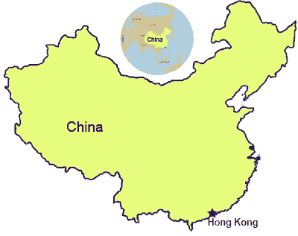
Map

Slide 4
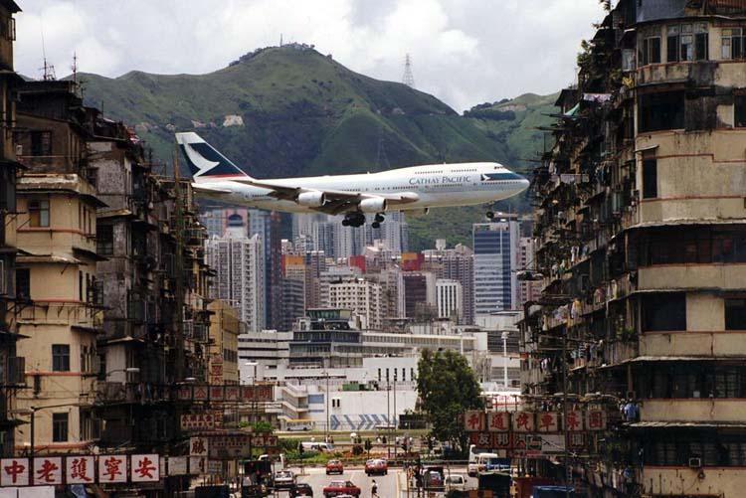
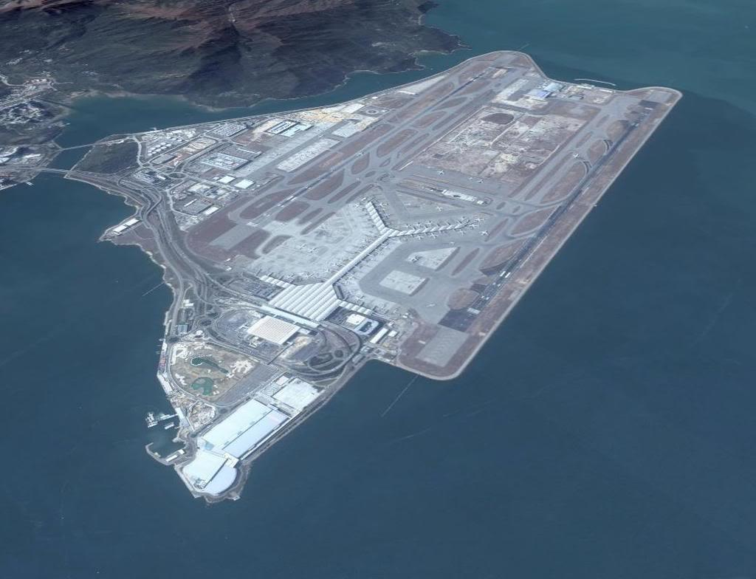
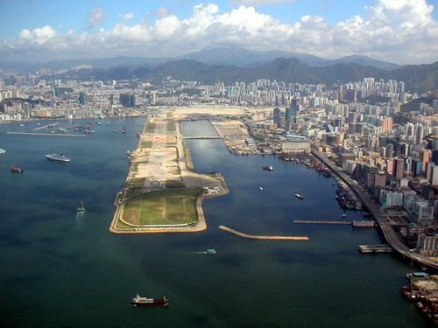
Rapid Land Development
1998 - Present
Before 1998

Slide 5
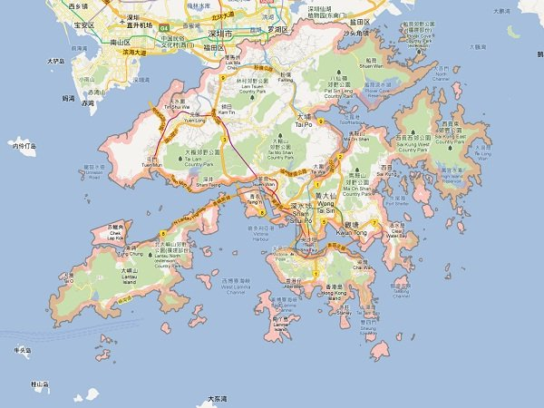

Slide 6
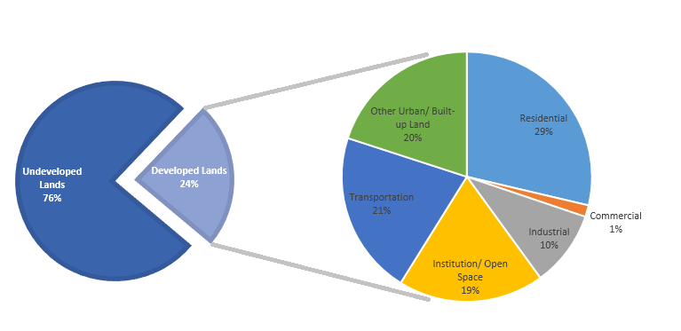
Land Utilization

Slide 7
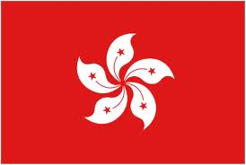

Overview of Hong Kong
Population: 7,136,300 (mid-2012)
Land area: 1,104 km^2
Population Density: 6,544 people / km^2
The highest density in some are: 55,204 people / km^2
Canada’s population density: 3.76 people / km^2

Slide 8
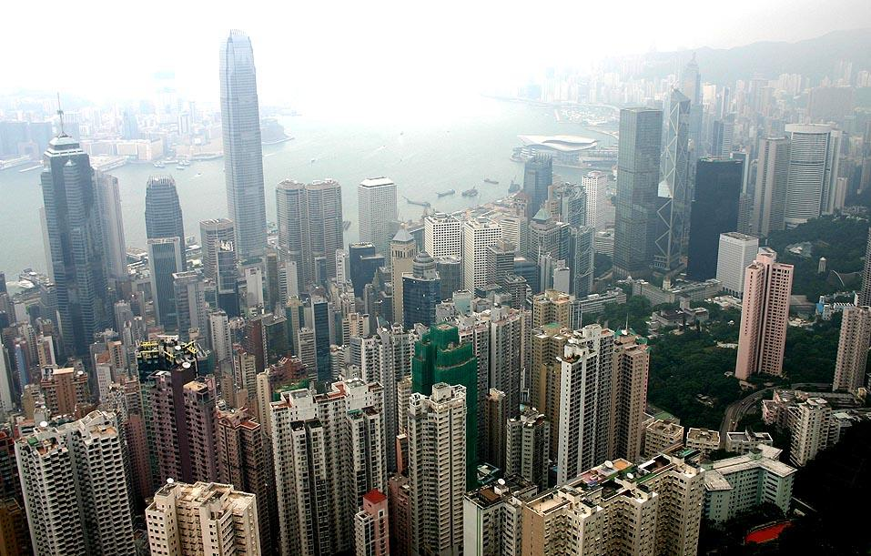
The Central Business District

Slide 9
Overview of Hong Kong (Con’t)
Linked exchange rate system since 1983 7.8 HK dollar = 1 US dollar
Gateway to Mainland China
Favourable time zone location
Hong Kong Stock Exchange – 5th largest in the world (2012)
Hong Kong Dollar – 8th world’s most traded currency (2012)

Slide 10
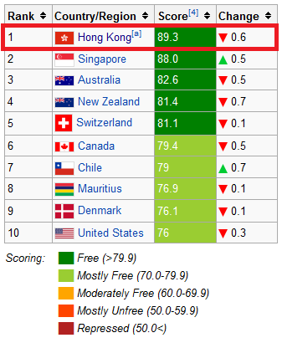
2013 Index of Economic Freedom

Slide 11
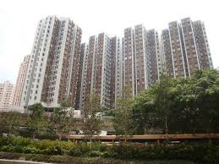
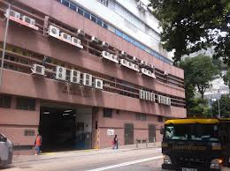
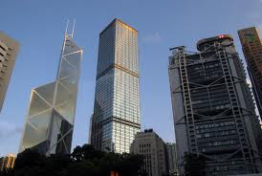
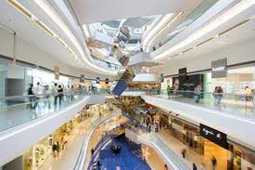
Main Types of Hong Kong Properties
Residential Industrial
Commercial: Office Commercial: Retail

Slide 12
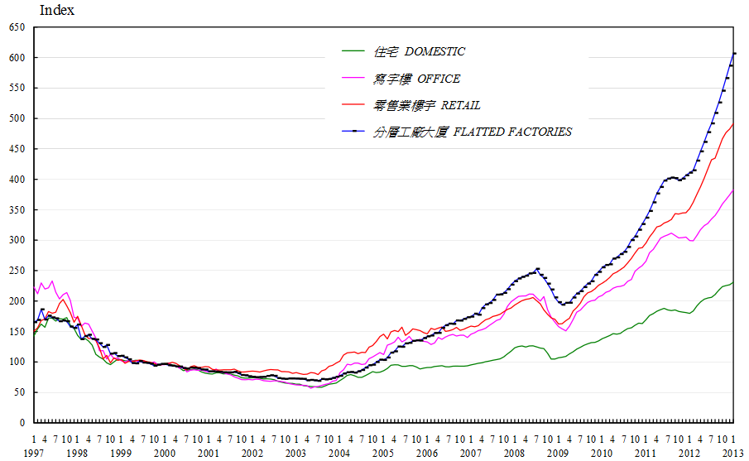
Price Indices for Hong Kong Property Market

Slide 13
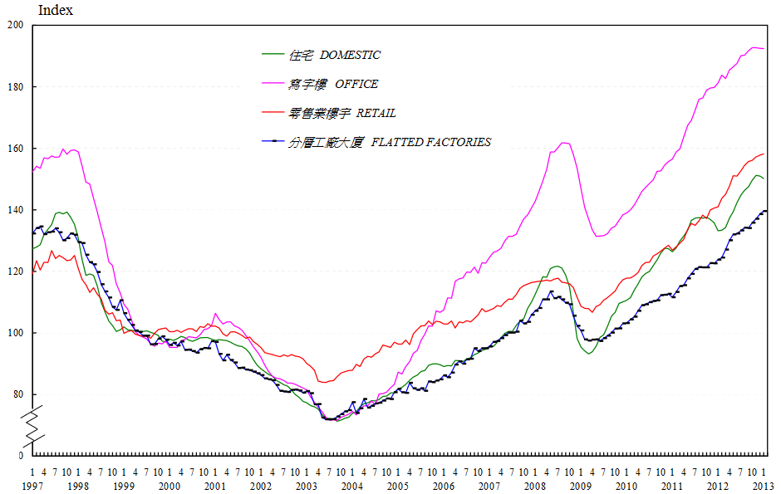
Rental Indices for Hong Kong Property Market

Slide 14
Factors Affecting the Property Market
Government Regulations
Interest Rates
Economy
Risk of Bubble

Slide 15
Government Regulations
Land Supply Control:
Government controls the supply of new land and the land using planning
Government determines when and how much new land will be put on the market as well as the uses allowed on this land
Government leases land to private developers, land for non-institutional uses is generally leased to the highest bidder at public auction

Slide 16
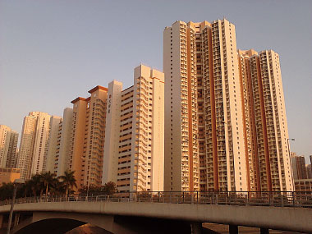
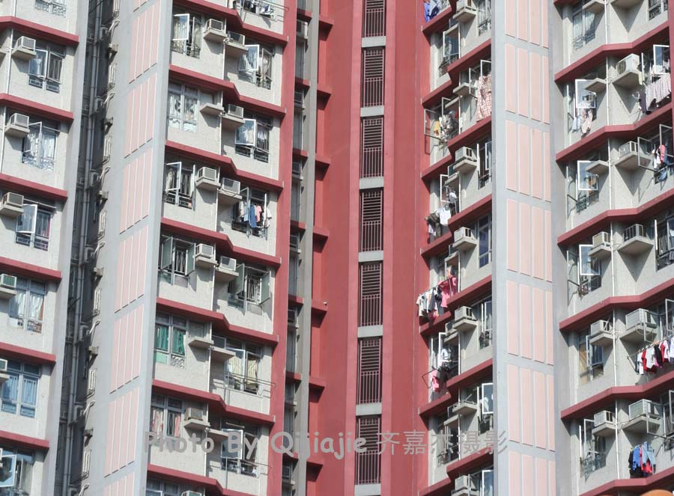
Government Regulations (Con’t)
Public Housing:
A low-cost housing scheme was introduced in 1961
Government provides affordable housing for low-income residents
Rents and prices are significantly lower than private housing
Half of population live in all sorts of public

Slide 17
Government Regulations (Con’t)
New policies on October 26, 2012:
Buyer’s Stamp Duty (BSD)
Extra 15% tax on properties purchases made by foreign investors
Special Transaction Tax
20% on properties sold within 3 years of their purchase, extended from 2 years previously
Aimed to curbing speculation in an overheating market
Residential property transactions in the following weekend: 43% ↓
Cheung Kong Ltd: 4.7% ↓
Henderson Land Development: 6.4% ↓
Sun Hung Kai Properties: 5.1% ↓

Slide 18
Government Regulations (Con’t)
Another new policy on February 22, 2013:
“Double” Stamp Duty - adjust the ad valorem stamp duty (AVD) rates
Increased 1.5% tax on the properties that value less than HK$ 2,000,000 ~ US$ 250,000
Doubled the tax on the properties that value more than HK$ 2,000,000
Exception for first purchase made by local residents
Cheung Kong Ltd: 0.6% ↓
Henderson Land Development: 0.7% ↓
Sun Hung Kai Properties: 1.3% ↓

Slide 19
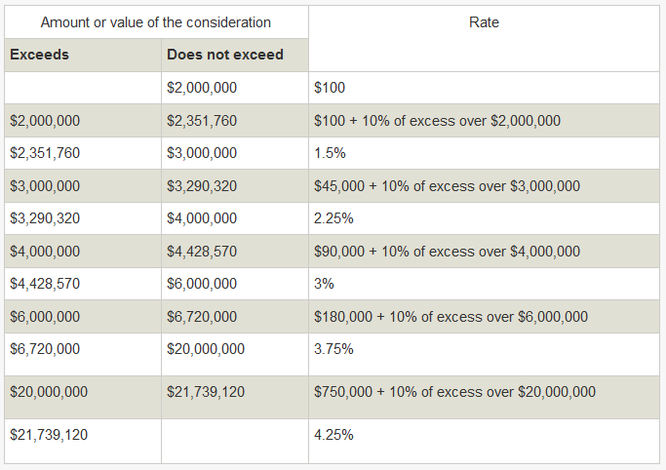
Government Regulations (Con’t)
Tax rate before February 22, 2013:

Slide 20
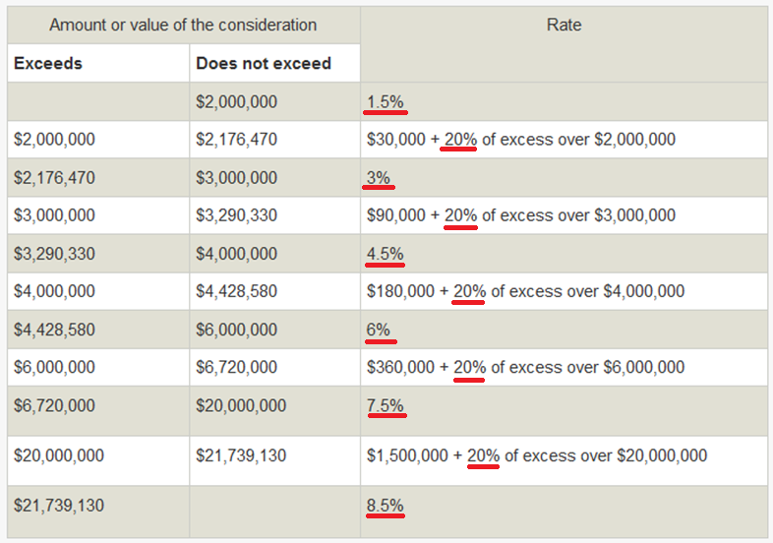
Government Regulations (Con’t)
New tax rate on February 22, 2013:

Slide 21
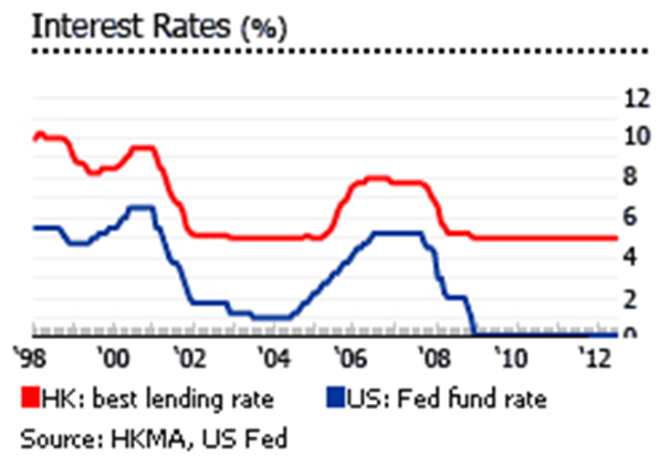
Interest Rates
Shrinking mortgages, low interest rates

Slide 22
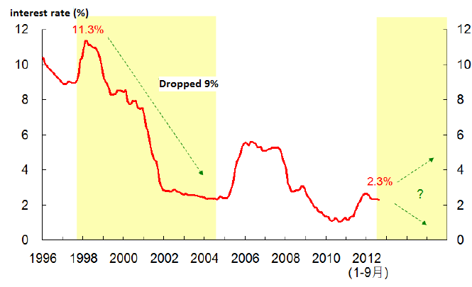
Average Mortgage Rate

Slide 23
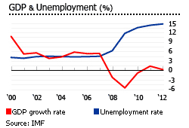
Economy: GDP & Unemployment (%)

Slide 24
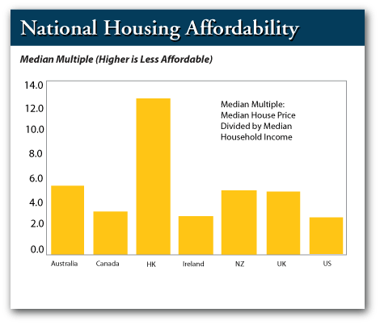
Economy: Housing Affordability

Slide 25
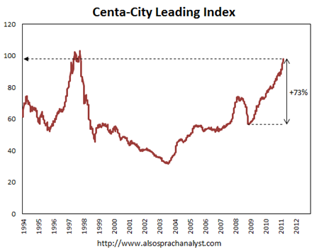
Risk of Bubble
1997: the peak
1997 – 2003: dropped by 69%
2008: dropped by 23%
2009 – 2011: increased by 73%

Slide 26
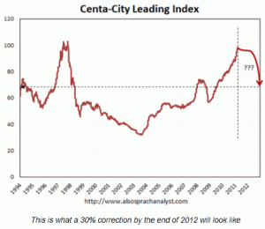
Risk of Bubble (Con’t)
Some analysts predicted a 30% fall in home value after 2012

Slide 27

Hong Kong Lands Department
Main functions:
Land disposal for development purposes
Valuation of land and property
Acquisition of private land for public projects
Land control and lease enforcement
Land and aerial survey
Map production
Maintenance of the geodetic control network
Approve the pre-sale of uncompleted flats and deeds

Slide 28
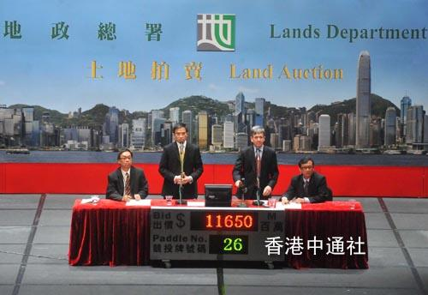
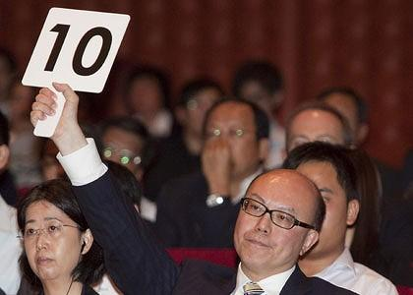
Land Auction

Slide 29

Land Sales
Land auction
Oral bidding
Most land in metropolitan area sold using this method
Tenders
Sealed bidding
Users strictly defined
The government examines detailed proposals
Private Treaty
Sales to non-profit organizations

Slide 30
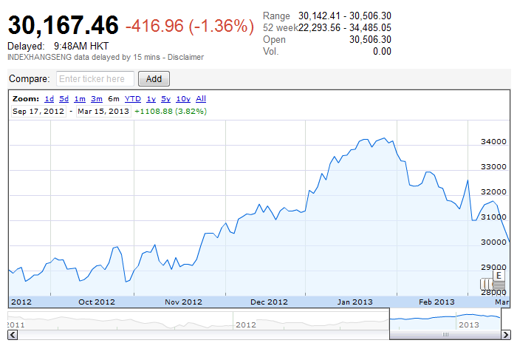
Hang Seng Properties Index (HSNP) (six-month)

Slide 31
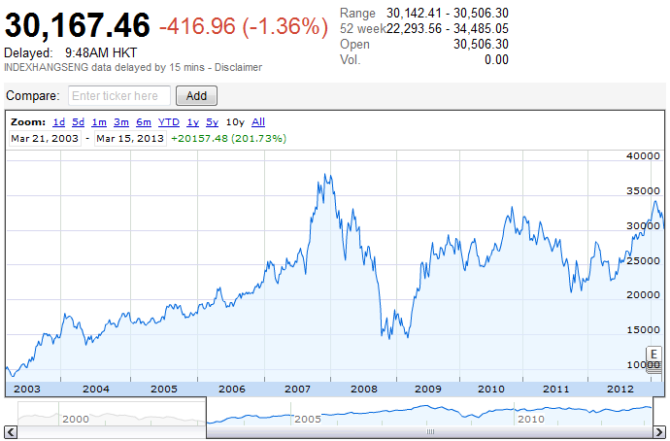
Hang Seng Properties Index (HSNP) (ten-year)

Slide 32
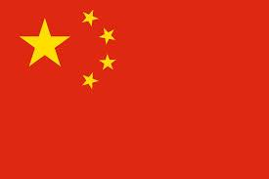
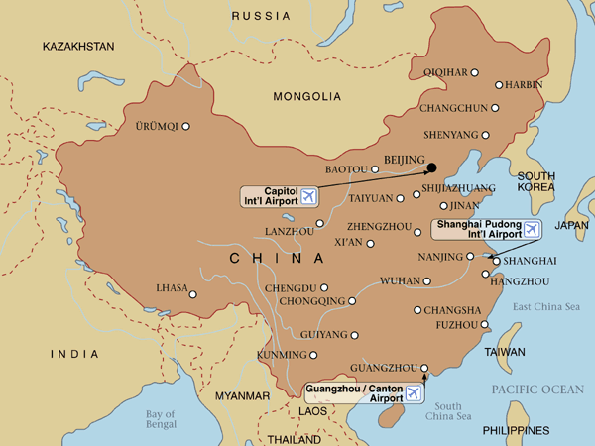
Mainland China

Slide 33
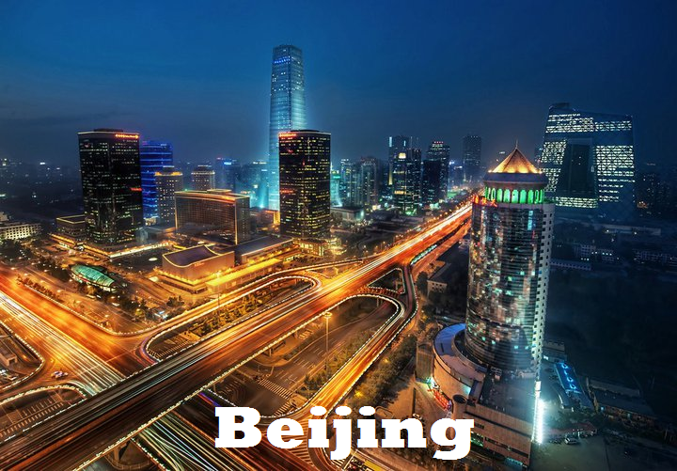
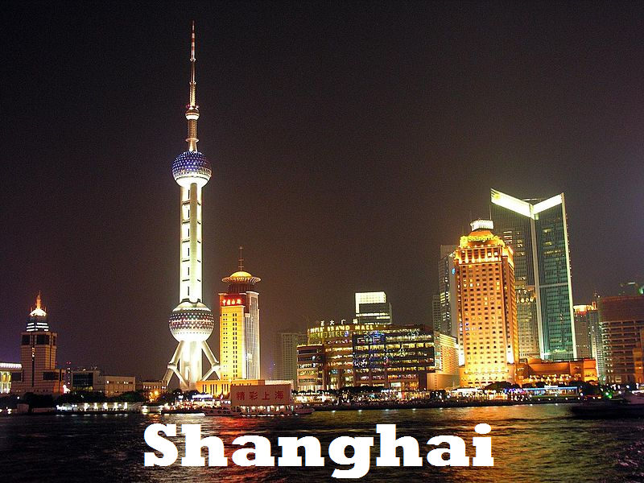
Mainland China Overview
Capital: Beijing
Population: 1,354,040,000 (2012)
Currency: Renminbi (CNY)

Slide 34
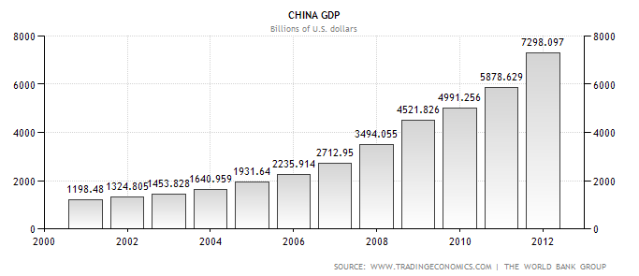
Economy of China: GDP

Slide 35
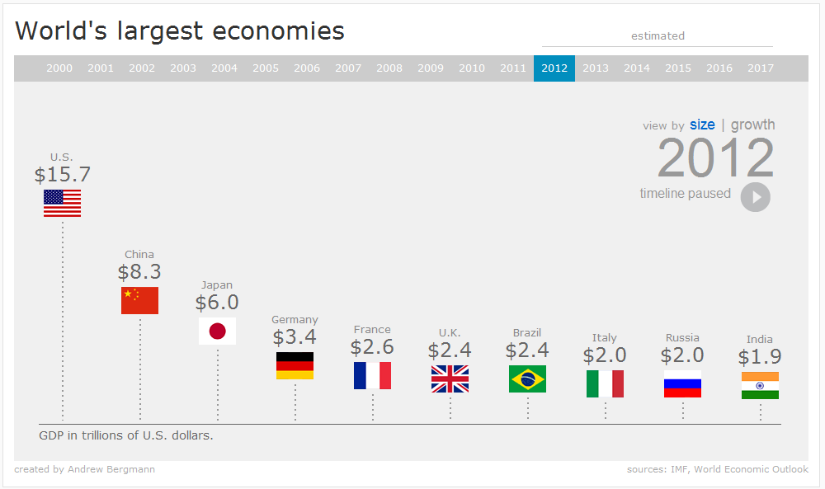
Economy of China

Slide 36
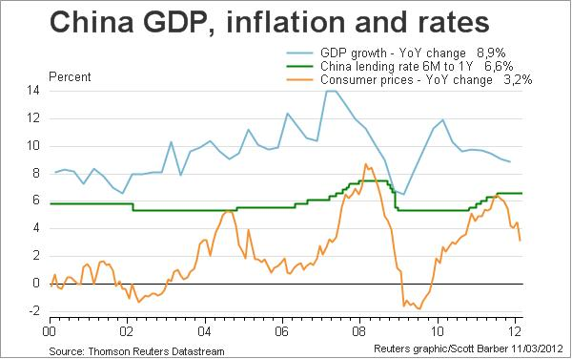
Economy of China: GDP, Inflation and Rates

Slide 37
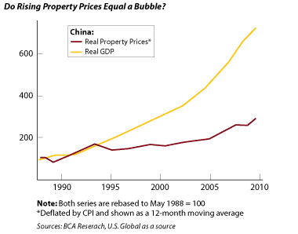
Property Market in China

Slide 38
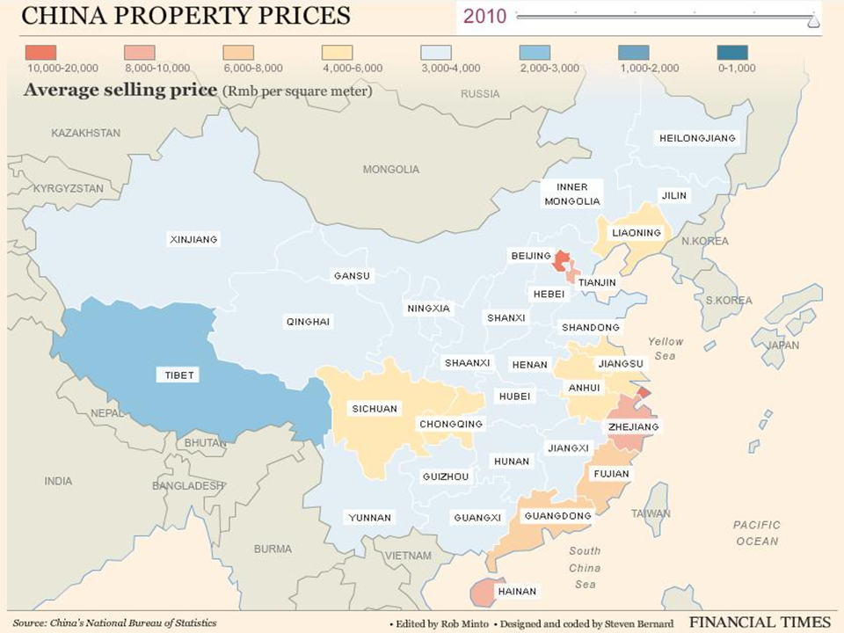

Slide 39
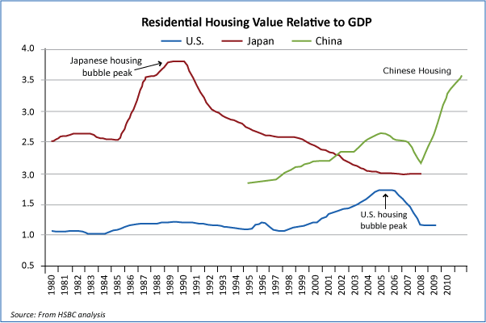
Housing Bubble in China

Slide 40
Restrictions in China Property Market
2010-2011:
Down-payment rules:
Down payment for first-time buyers’ mortgages was increased to 30% from 20%
For second homes down payment rose to 60% from 50%
Mortgages:
Mortgages for third home purchases were prohibited
Mortgage discount for first-time homebuyers was eliminated

Slide 41
Restrictions in China Property Market (Con’t)
Limitations on buyers:
Credit-quota limits
Higher benchmark lending rates
New property taxes:
Shanghai:
between 0.4% and 0.6%
Chongqing:
between 0.5% and 1.2% on luxury homes and newly purchased high-end homes, plus a special tax on second home purchases by people with no business or employment interest in the city
Result: House prices started to decline in the last quarter of 2011

Slide 42
Reversing Policies
2012: the government reversed its policies in an effort to boost the slowing economy
Central Bank slashed its key lending rate to 6%
Beijing government cut bank’s reserve requirement ratio
Allocating land for low-income housing
Housing market has been rebounding the second half of the year

Slide 43
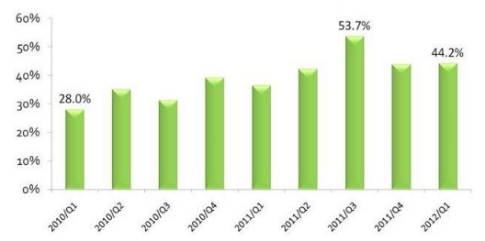
Proportion of Mainland Buyers Purchase in HK Property Market

Slide 44
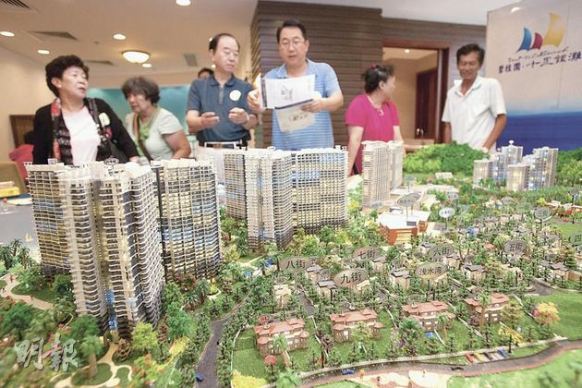
Impacts of Mainland Buyers in Hong Kong Housing Market
Mainland buyers affected limited supply in HK housing market:
Home prices in Hong Kong have surged more than 90% since early 2009 on a shortage of new supply

Slide 45
Impacts of Mainland Buyers in Hong Kong Housing Market (Con’t)
Mainland buyers accounted for almost 20% of the sales in two new private residential projects
Market share of mainland buyers rose from about 10% in late 2009 to nearly 30% in 2011
For properties costing more than HK$12 million, mainlanders featured in 27.3% of the deals in the July to September quarter
Hong Kong government response: new tax policies on foreign investors

Slide 46



Slide 47
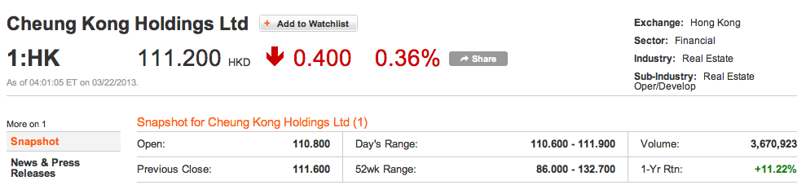
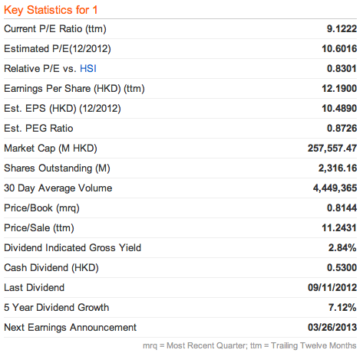
Last Trading Day Performance

Slide 48
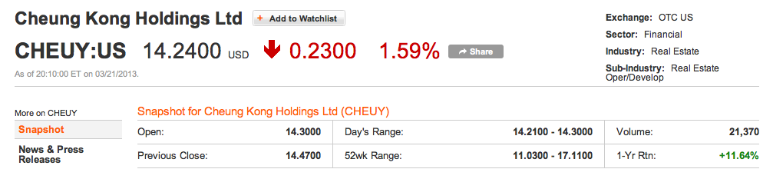
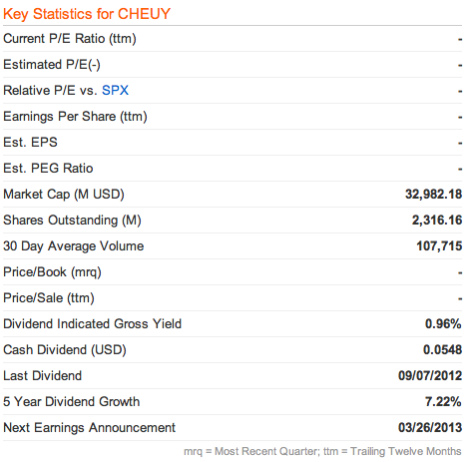
Last Trading Day ADR

Slide 49
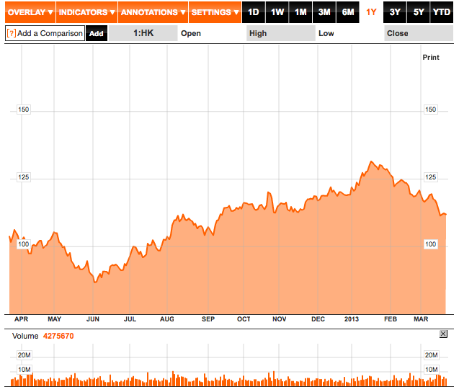
One-year Performance

Slide 50
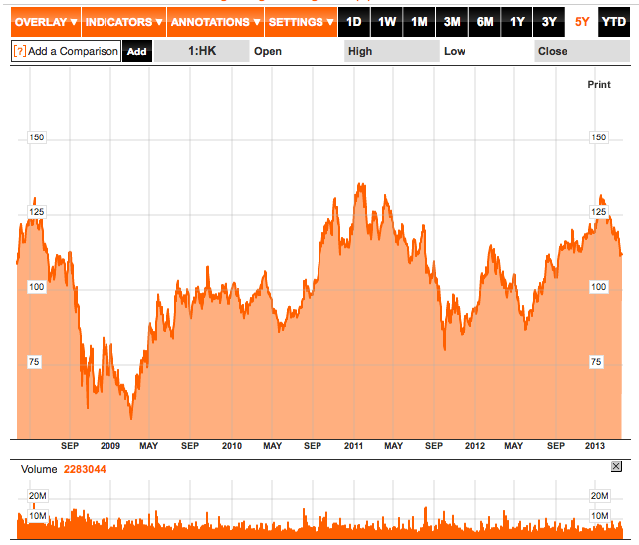
Five-year Performance

Slide 51
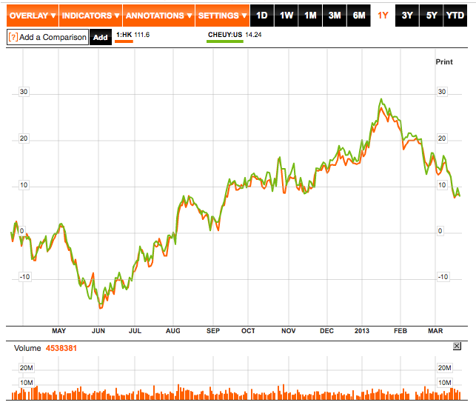
HK vs. ADR (One-year)

Slide 52
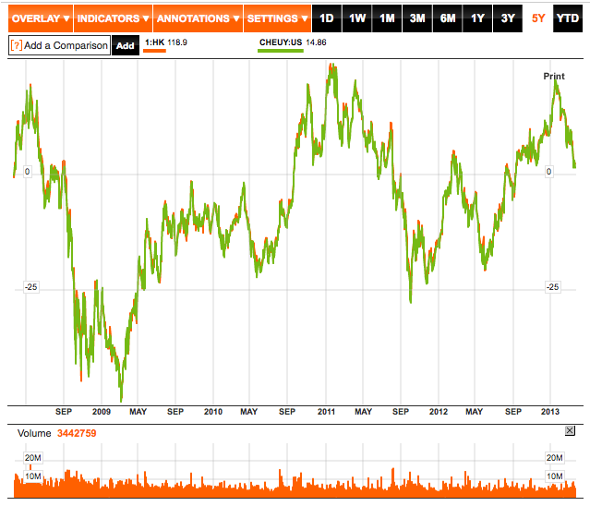
HK vs. ADR (Five-year)

Slide 53
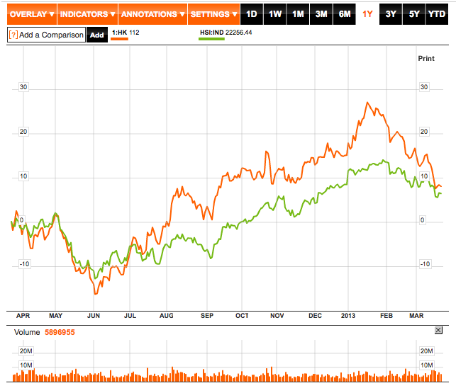
HK vs. Hang Seng (One-year)

Slide 54

HK vs. Hang Seng (Five-year)

Slide 55

Company Overview

Slide 56
Company Overview
The flagship of Cheung Kong Group, headquartered in Hong Kong
One of Hong Kong’s leading multi-national conglomerates
One of the largest developers of residential, office, retail, industrial and hotel properties in Hong Kong
Operate in 52 countries and employs about 260,000 staff worldwide
In Hong Kong alone, the Group includes eight listed companies with a combined market capitalization of approximately HK$914 billion (31 Dec, 2012)

Slide 57
History
1950: Founded by Li Ka Shing as Cheung Kong Industries
1972: Listed on the Hong Kong Stock Exchange
1977: CKH diversified into the hotel trade
1979: Acquired Hutchison Whampoa Limited
1981: Started oversea investment
1985: Acquired Hong Kong Electric Holdings Limited (renamed Power Assets Holdings Limited)
1996: Cheung Kong Infrastructure Holding limited organized
1997: Cheung Kong restructured its business

Slide 58
Group Holdings
Cheung Kong Holdings (stock code: 0001)
Hutchison Whampoa Limited (0013)
Power Assets Holdings Limited (0006)
Cheung Kong Infrastructure Holdings Limited (1038)
CK Life Sciences Int'l. (Holdings) Inc. (0775)
Hutchison Telecommunications Hong Kong Holdings Limited (0215)
Hutchison Harbour Ring Limited (0715)
TOM Group Limited (2383)

Slide 59


Group Structure
* Formerly known as Hong Kong Electric Holdings Limited and named Power Assets Holdings Limited on February 16, 2011
Note: The picture only features listed companies of Cheung Kong Group in Hong Kong. Companies listed outside of Hong Kong are not depicted here.

Slide 60

Land Bank

Slide 61
Completed Developments in HK
Residential / Comprehensive Developments:
University Court University Heights Vianni Cove Villa d'Arte Vista Paradiso
Banyan Garden Bayshore Towers
Bella Vista Belvedere Garden Braemar Hill Mansions CASA 880 CASA 880
Caribbean Coast Phase 1 Caribbean Coast Phase 2 Caribbean Coast Phase 3 Caribbean Coast Phase 4 Celestial Heights (Phase 1) Central Park Towers City Garden City One Shatin DeerHill Bay Elite Villas Elizabeth House Estoril Court
Sceneway Garden
Seasons Monarch Seasons Palace Sheffield Villas Sky Tower St. Paul's Terrace The Apex The Cairnhill The Capitol The Grand Panorama The Legend at Jardine's
The Metropolis Residence The Pacifica Phase 1 The Pacifica Phase 2 The Paramount The Portofino The Victoria Towers Tierra Verde Tsing Yi Garden
Harbourfront Landmark Jubilee Garden Kingswood Villas Laguna City Laguna Verde Phase 4 Laguna Verde Phase 5 Le Point Lido Garden Manderly Garden Metro Town Monte Vista No. 1 Star Street Nob Hill One Beacon Hill Princeton Tower Queen's Terrace Rhine Garden & Rhine Terrace
Robinson Heights Sausalito

Slide 62

Completed Developments in HK (Con’t)
Hotels:
Harbour Grand Hong Kong
Harbour Plaza 8 Degrees
Harbour Plaza Metropolis
Harbour Plaza North Point
Harbour Plaza Resort City
Harbourfront Horizon
Harbourview Horizon
Horizon Suite Hotel
Rambler Garden Hotel
Rambler Oasis Hotel
The Kowloon Hotel
The Apex Horizon Hotel

Slide 63

Breaking News in Last Month
The sale of suites in the Apex Horizon Hotel made headlines last month as it was the first time in Hong Kong that a developer had sold hotel rooms, classified as commercial property, individually to buyers
The first batch of 65 suites were all sold on the first day of sale (Feb 18)
Lawmaker demands probe into the hotel room sale

Slide 64

HK Stock Price on Feb 18

Slide 65

Completed Developments in HK (Con’t)
Office Buildings:
Admiralty Centre
Prosperity Millennia Plaza
Silvercord
The Center
Concordia Plaza
Shun Tak Centre
Wheelock House
World-Wide House

Slide 66

Completed Developments in HK (Con’t)
Office/ Industrial and Industrial Buildings:
Modern Warehouse
New Treasure Center
Prosperity Center
Trendy Center

Slide 67

Developments Completed and Scheduled for Completion in 2012

Slide 68

Mainland and Oversea Projects

Slide 69

Mainland and Oversea Projects (Con’t)

Slide 70

Management Structure

Slide 71


Slide 72


Board of Directors
Executive Directors:
Ka-shing Li Victor Li Hung-Lam Kam Edmond Li
Davy Chung Ezra Pau Grace Woo Justin Chiu

Slide 73



Board of Directors (Con’t)
Non-executive Directors:
Siu-Hon Leung, Canning Fok, Frank J. Sixt, Roland Chow, George C. Magnus
Independent Non-executive Directors:
Stanley Kwok, Anthony Yeh, Simon Murray, Albert Chow
Katherine Hung, Rosanna Wong, Henry Cheong

Slide 74

Disclosure of Interest

Slide 75

Li, Ka-Shing
Born 13 June 1928 in Chaozhou, China
Chairman of CKH since 1971 and Hutchison Whampoa Ltd since 1981)
The richest person in Hong Kong and the 9th richest person in the world (US$ 25.5 billion in 2012)
Left school at age 15 and worked at a plastic trading company
Established Cheung Kong Industries in 1950, a plastic manufacturing company
Transformed it into a real estate investment company, listed on Hong Kong Stock Exchange in 1972
Acquired Hutchison Whampoa in 1979 and Hong Kong Electric Holdings Ltd in 1985

Slide 76
Li, Ka-Shing (Con’t)
Victor Li
Li, Ka-Shing
Richard Li

Slide 77

Victor Li Tzar-Kai
Elder son of LI Ka-shing
Joined CKH in 1985
Deputy Managing Director (1993-98)
Deputy Chairman and Managing Director of CKH since 1999
Executive Director and Deputy Chairman of Hutchison Whampoa Ltd
Chairman of CK Infrastructure Holdings Ltd and CK Life Sciences Int’l Inc.
Executive Director of HK Electric Holdings Ltd.
Co-chairman of Husky Energy Inc.
Director of HSBC

Slide 78

“The Big Spender” Case
Victor Li was Kidnapped by Cheung in May 1996
Li, Ka-shing paid $1.38 billion HKD (~$0.18 billion USD) for ransom
Cheung, Tze-Keung (1955 – 1998)
a kidnapper, robber, arms smuggler
Best known for having masterminded
the abduction of Walter Kwok and
Victor Li

Slide 79

Kam, Hing-Lam
Born in 1946
Brother-in-law of Li Ka-Shing, Uncle of Victor Li
Deputy Managing Director since 1993
Group Managing Director of Cheung Kong Infrastructure Holdings Ltd.
President and CEO of CK Life Sciences International
Executive Director of Hutchinson Whampoa Ltd. and Hong Kong Electric Holdings Ltd.

Slide 80

Financial Performance

Slide 81

Ten-year Performance

Slide 82

Ten-year Performance

Slide 83

Result Highlights

Slide 84

Result Highlights (Con’t)

Slide 85

Interim Balance Sheet

Slide 86

Annual Balance Sheet

Slide 87

Annual Income Statement

Slide 88

Interim Income Statement

Slide 89

Annual Cash Flow

Slide 90

Interim Cash Flow

Slide 91

Recommendation

Slide 92


Slide 93


Last Trading Day Performance

Slide 94


Last Trading Day ADR

Slide 95

One-year Performance

Slide 96

Five-year Performance

Slide 97

Ten-year Performance

Slide 98

HK vs. ADR (One-year)

Slide 99

HK vs. ADR (Five-year)

Slide 100

One-year Performance vs. Hang Seng

Slide 101

Five-year Performance vs. Hang Seng

Slide 102

Ten-year Performance vs. Hang Seng

Slide 103


Company Overview

Slide 104


Company Overview
Founded in 1963 and publicly listed in 1972
Specializes in developing premium-quality residential projects, offices and shopping centers
Employs more than 36,000 people

Slide 105

Business Structure

Slide 106

Land Bank

Slide 107
Land Bank and Property Portfolio
The group is one of Hong Kong’s largest landowners with a land bank of 46.5 million sq. ft (attributable gross floor area) as at December 2012, including:
17.7 million sq. ft under development
28.8million sq. ft of completed investment properties
Over 27 million sq. ft of farmland (site area) in the New Territories, most in various stages of land use conversion, principally for residential development

Slide 108

Property Development in Hong Kong

Slide 109

Property Development in Hong Kong (Con’t)

Slide 110


Slide 111

Hong Kong Land Bank Composition

Slide 112

Property Development Project in Mainland China

Slide 113

Property Development Project in Mainland China (Con’t)

Slide 114


Slide 115

Mainland China Land Bank Composition

Slide 116

Composition

Slide 117
Management Structure

Slide 118

Founders
Fung, King-Hay
(1922 – 1985)
Kwok, Tak-Seng
(1911 – 1990)
Lee, Shau-Kee
(1928 – Present)
Founder and Chairman of Henderson

Slide 119

Kwong, Siu-Hing
Wife of Kwok, Tak-Seng
Chairman since 2008
Retired in December 2011
The 2nd largest shareholder of the company
Effectively owns 42.17 of the company

Slide 120

Kwok Brothers
The 3rd richest in Hong Kong (US$15.4 billion in 2012)

Slide 121

Walter Kwok Ping-Sheung
Eldest son of Kwok, Tak-Seng
Formerly Chairman and CEO of the company
Negotiated his departure from the family business in 2012
Was evicted from the company by his mother in an attempt to protect the family business from this mistress who had started to have an influential role in the company

Slide 122
Kidnapping of Walter Kwok
When the Kwok patriarch died of a heart attach in 1990 at the age of 79, he left behind his wife and three sons
The reins of the Kwok empire passed to eldest son Walter, who became chairman and chief executive
The family’s wealth attracted the notice of Cheung, Tze-Keung, a prominent gangster nicknamed Big Spender
In 1997, Walter was kidnapped by Cheung, beaten, stripped to his underwear and kept for a week in a wooden box before his family negotiated his freedom

Slide 123


Cheung, Tze-Keung (1955 – 1998)

Slide 124


Another Woman – Ida Tong
Knew Walter Kwok when they were young
But Walter broke off his relationship with Tong because his father disapproved of her, but the relationship reportedly bloomed again after his kidnap ordeal

Slide 125

Thomas Kwok Ping-Kwong
Middle son of Kwok, Tak-Seng
Educated in London, England
He has been with the Group for 35 years
Chairman of the company since 2011
Vice Chairman of the company for 21 years prior to becoming the Chairman
Managing Director and a member of the Executive Committee of the company

Slide 126

Raymond Kwok Ping-Luen
Youngest son of Kwok, Tak-Seng
Graduated from Cambridge University and Business School of Harvard University
He has been with the Group for 34 years
Chairman of the company since 2011
Vice Chairman of the company for 21 years prior to becoming the Chairman

Slide 127

Long Positions in Shares and underlying Shares

Slide 128



Kwok Brothers Arrested
First arrested on March 29, 2012

Slide 129


Bribery Investigation
Thomas and Raymond Kwok, and Rafael Hui, HK’s former No. 2 public official, were charged in a bribery investigation surrounding Asia’s largest developer in July 2012.
Since the arrests, SHK’s market cap has shrunk by $5.6 billion.
SHK shares in HK fell 16.5% since the arrest of its billionaire owners on suspicion of corruption in March.
July 13, 2012, Thomas and Raymond Kwok (the co-chairmen) were charged with bribing a former Hong Kong government official with US$4.4million in return for favors.

Slide 130
Financial Performance

Slide 131

Interim Balance Sheet

Slide 132

Annual Balance Sheet

Slide 133

Annual Balance Sheet (Con’t)

Slide 134

Annual Income Statement

Slide 135

Annual Income Statement (Con’t)

Slide 136

Interim Income Statement

Slide 137

Annual Cash Flows

Slide 138

Annual Cash Flows (Con’t)

Slide 139

Interim Cash Flows

Slide 140
Recommendation
HOLD

Slide 141


Slide 142


Last Trading Day Performance

Slide 143


Last Trading Day ADR

Slide 144

One-year Performance

Slide 145

Five-year Performance

Slide 146

Ten-year Performance

Slide 147

HK vs. ADR (One-year)

Slide 148

HK vs. ADR (Five-year)

Slide 149

HK vs. ADR (Ten-year)

Slide 150

One-Year Performance vs. Hang Seng

Slide 151

Five-year Performance vs. Hang Seng

Slide 152

Ten-year Performance vs. Hang Seng

Slide 153

Company Overview

Slide 154



Corporate Profile
Founded in 1976 by current chairman – Lee, Shau-Kee
Listed in Hong Kong since 1981
The 3rd largest real estate developer (market capitalization)
Business mostly in Hong Kong and Mainland China

Slide 155
Business Segments
Business Segments
A. Property development
B. Property Investment
C. Construction
D .Infrastructure
E. Hotel operation
F. Department store operation
G. Others

Slide 156

Corporate Structure
Other
Subsidiaries:
Hang Yick Properties Management Limited,
Well Born Real Estate Management Limited,
GoodWill Management Limited,
Megastrength Security Services Co

Slide 157

Group Structure

Slide 158
Business in Hong Kong
Land Bank
Property Development
Property Investment

Slide 159
Low-risk Approach to Land-banking
The total land bank in Hong Kong amounts to approximately 21.2 million sq.ft. in total attributable gross floor area as of 30 June 2011.
Held around 41.4 million sq.ft. of agricultural land as of 30 June 2011 (largest agricultural land bank among all property developers in Hong Kong )

Slide 160

Low-risk Approach to Land-banking (Con’t)

Slide 161

Low-risk Approach to Land-banking (Con’t)

Slide 162

Property Development (Asset Turnover Focused)

Slide 163

Property Development (Asset Turnover Focused) (Con’t)

Slide 164

Location Map of New Projects Pending Sale/ Pre-sale in HK for 2H 2012

Slide 165

Property Development (Asset Turnover Focused) (Con’t)

Slide 166
Property Investment (Rising Rental)
Completed investment property portfolio as at June 30, 2012
Hong Kong: ~9.1 million sq. ft (end of 2011: ~9.2 million sq. ft)
Certain non-core investment properties, including the entire building at 579 Nathan Road in Mong Kok, Hong Kong, were sold
Strong leasing demand in Hong Kong
Average occupancy rate of major investment properties in Hong Kong as at June 30, 2012: ~97% (end of 2011: ~97%)

Slide 167
Business in Mainland China
Land Bank
Property Development
Property Investment

Slide 168


Low-risk Approach to Land-banking

Slide 169

Low-risk Approach to Land-banking (Con’t)

Slide 170

Property Development (Asset Turnover Focused)

Slide 171
Property Investment (Rising Rental)

Slide 172

Property Investment (Rising Rental) (Con’t)
Completed investment property portfolio as at June 30, 2012
Mainland China: ~6.9 million sq. ft (end of 2011: ~6.5 million sq. ft)
Certain non-core investment properties, including the entire building at 579 Nathan Road in Mong Kok, were sold
Increased rental income from mainland China driven by
Higher rental income contribution from newly completed properties

Slide 173



Business in Vancouver
Henderson Development (Canada) Ltd.
founded in 1990
Commercial Projects
International Village Mall (Downtown Vancouver)
Paris Square (Downtown Vancouver)
Henderson Place Mall (Coquitlam)
Residential Projects
Espana (Vancouver)
Obelisk (Coquitlam)
Firenze (Vancouver)
Guilford Park Place (Surrey)

Slide 174
Management Structure

Slide 175
Board of Directors
12 executive directors
5 of the 12 are family members
5 non-executive directors
1 of the 5 is family member
3 independent non-executive directors
10 senior managers

Slide 176

Lee, Shau-Kee
Founder of the company
Chairman and Managing Director of the Group since 1976
Vice Chairman of Sun Hung Kai Properties Limited
Chairman and Managing Director of Henderson Investment Limited,
Chairman of The Hong Kong & China Gas Company Limited and Miramar Hotel and Investment Company, Limited
The 2nd richest person in Hong Kong (US$17 billion in 2012)

Slide 177

Peter Lee Ka Kit
Elder son of Lee, Shau-Kee
Educated in the United Kingdom
Executive Director since 1985 and Vice Chairman since1993
Primarily responsible for the China business
Vice Chairman of Henderson Investment Limited
Director of the Hong Kong and China Gas Company Limited

Slide 178

Martin Lee Ka Shing
Younger son of Lee, Shau-Kee
Educated in Canada
Executive Director since 1993 and Vice Chairman since 2005
Vice Chairman of Henderson Investment Limited
Managing Director of Miramar Hotel and Investment Company
Director of the Hong Kong and China Gas Company

Slide 179

Ning Li
Son-in-law of Lee, Shau-Kee
Educated in the United States
Executive Director since 1992
Executive Director of Henderson Investment
Director of Hong Kong Ferry (Holdings) Company Limited

Slide 180
FUNG Lee Woon King
Executive Director of the Company since 1976
Treasurer of Henderson Development Group, Henderson Land Group and Henderson Investment Group
Sister of Lee Shau Kee

Slide 181
Financial Performance

Slide 182

2012 Interim Result Highlights (Con’t)

Slide 183

2012 Interim Result Highlights (Con’t)

Slide 184


Interim Balance Sheet

Slide 185


Annual Balance Sheet

Slide 186

Annual Income Statement

Slide 187


Interim Income Statement

Slide 188


Annual Cash Flow Statement

Slide 189

Interim Cash Flow Statement

Slide 190
Recommedation

