Slide 1
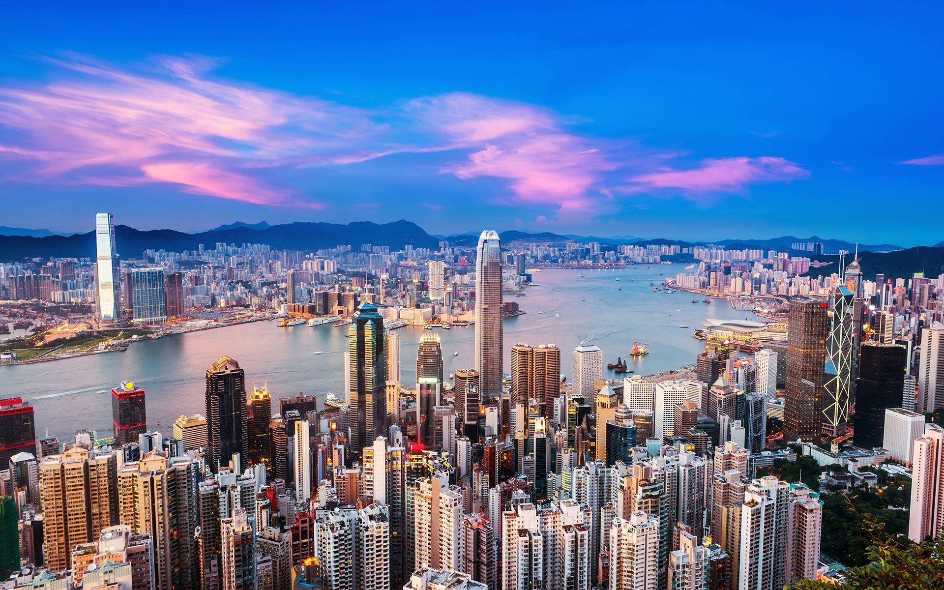
Hong Kong Properties
HONG KONG PROPERTIES
Group 4: Tony Liu
Angela Geng
Michael Enquist
Chelsea Geng
Junyi Xiao
Group 4:
Tony Liu
Angela
Michael
Chelsea G
Junyi Xiao

Slide 2
Agenda
Overview of Hong Kong Properties Market
Overview of Mainland China Properties Market
Sun Hung Kai Properties
Cheung Kong Property Holdings Limited
Henderson Land Development

Slide 3
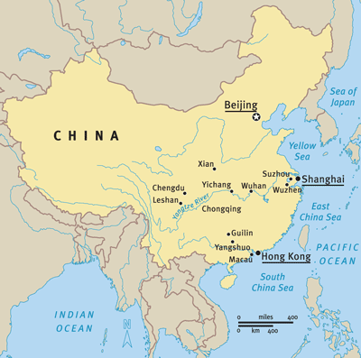
Hong Kong Market Overview
Hong Kong Special Administrative Region of the People's Republic of China
An autonomous territory on the Pearl River Delta of East Asia

Slide 4
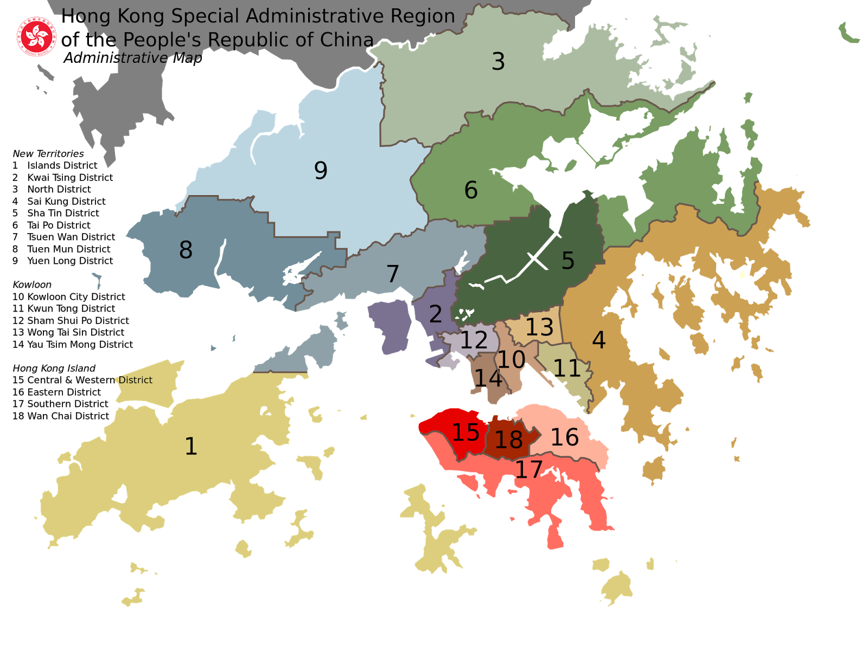
Land Distribution
The District Administration Scheme was implemented in 1982.
In 2000, there are 18 district councils in Hong Kong.
In 2016,
Population:7,346,248
Land Area: 1,104 km²
Density: 6996 people/km²
(Canada: 4 people/km²)
Notes:
http://vivien-urbansurvival.blogspot.ca/2014/11/hong-kong-urban-land-use.html
http://www.worldometers.info/world-population/china-hong-kong-sar-population/

Slide 5
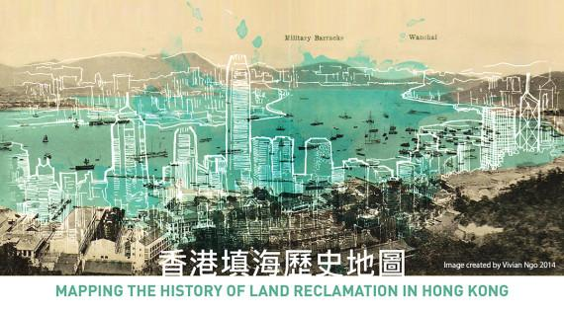
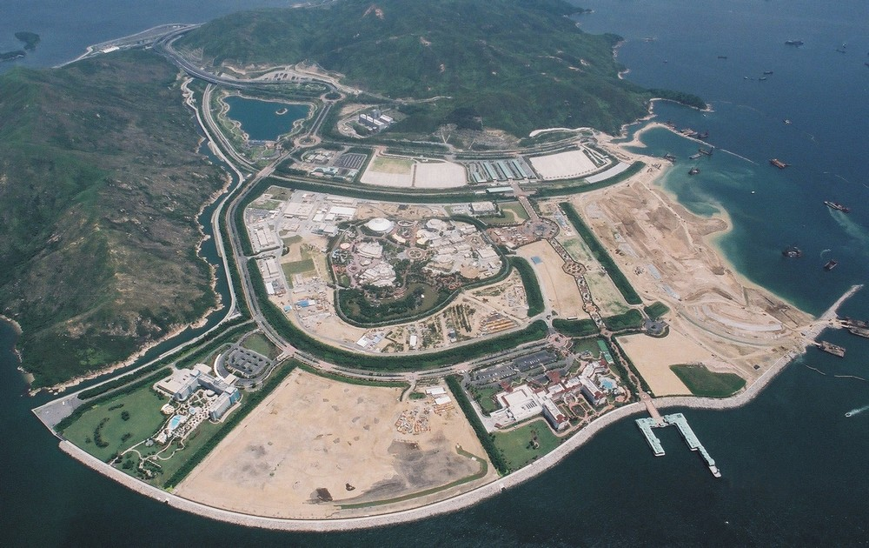
Land Development
Photo Credit: Vivian Ngo

Slide 6
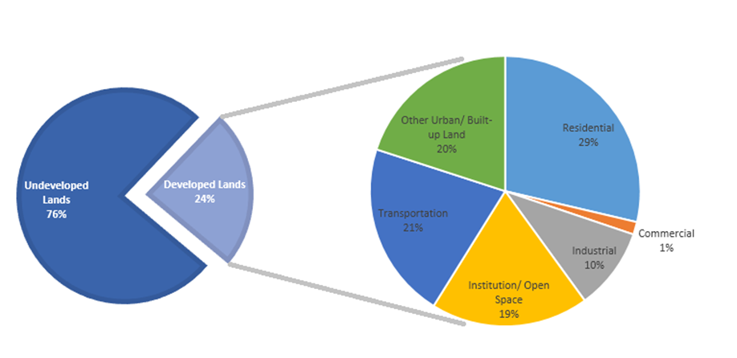
Land Utilization

Slide 7
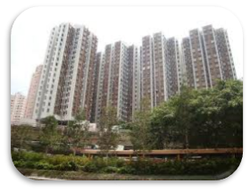
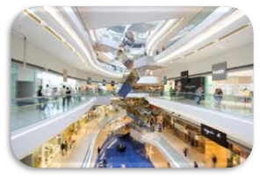
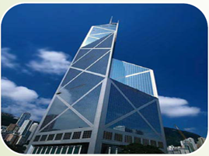
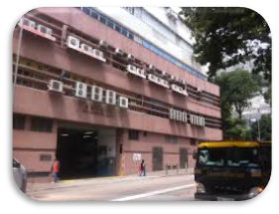
Many types of Properties
Domestic/Residential
Commercial: Retail
Commercial: Office
Industrial/Factory

Slide 8
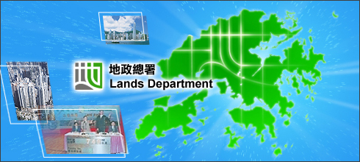
Hong Kong Lands Department
Main Functions:
Land Disposal for development purposes
Valuation of land and property
Acquisition of private land and public projects
Land control and lease enforcement

Slide 9
How is land traded
Land auction
Oral bidding
Most land in metropolitan area sold using this method
Tenders
Sealed bidding
Users strictly defined
The government examines detailed proposals
Private Treaty
Sales to non-profit organizations

Slide 10
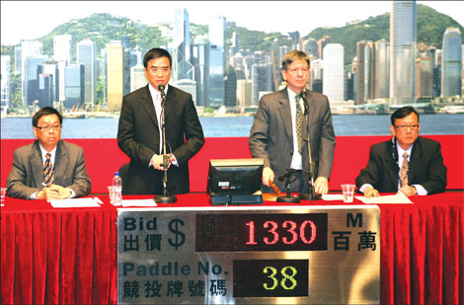
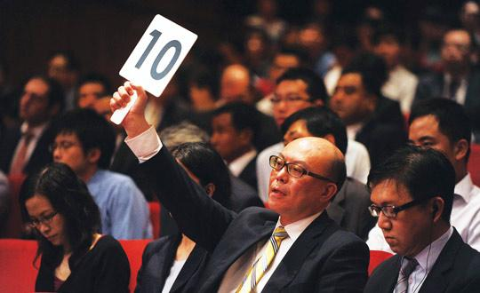
Land Auction

Slide 11
Land Auction
New leases
Generally 50 years from date of grant
Annual rent of 3% of value of property adjusted for any changes in value
Non-renewable leases
Some leases do not have automatic right of renewal
Renewability decided solely by government
If land is being misused, underutilized or needed for public projects, government choose not to renew
Example:
Henderson Land won an auction for a commercial site worth HK$4.7 billion on September 3, 2014

Slide 12
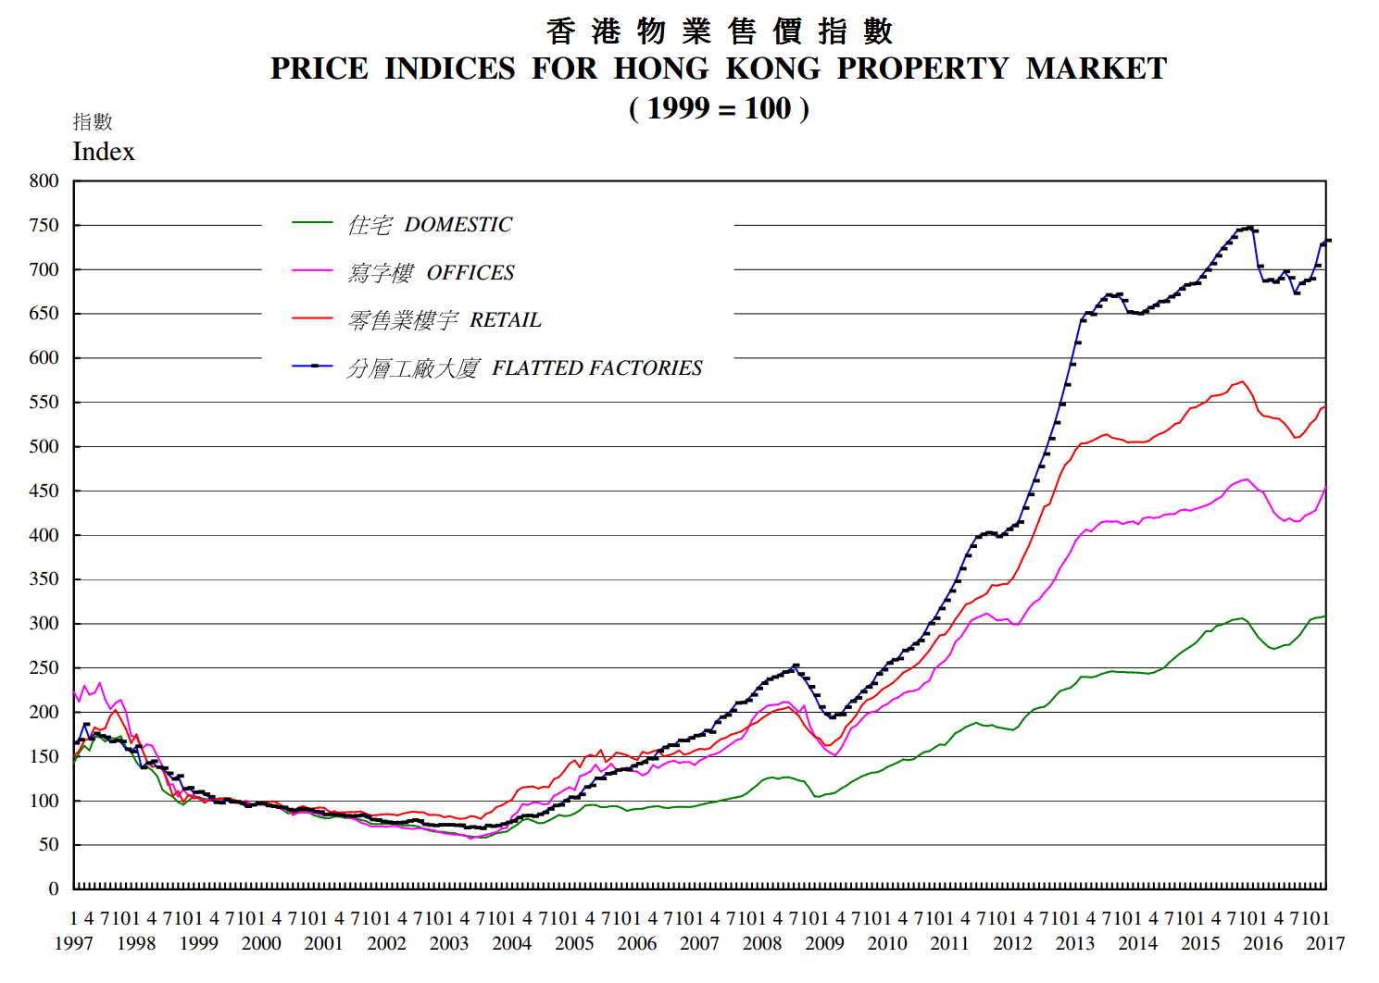
Price Indices for Hong Kong Property Market
Notes:
http://www.rvd.gov.hk/doc/en/statistics/graph2.pdf

Slide 13
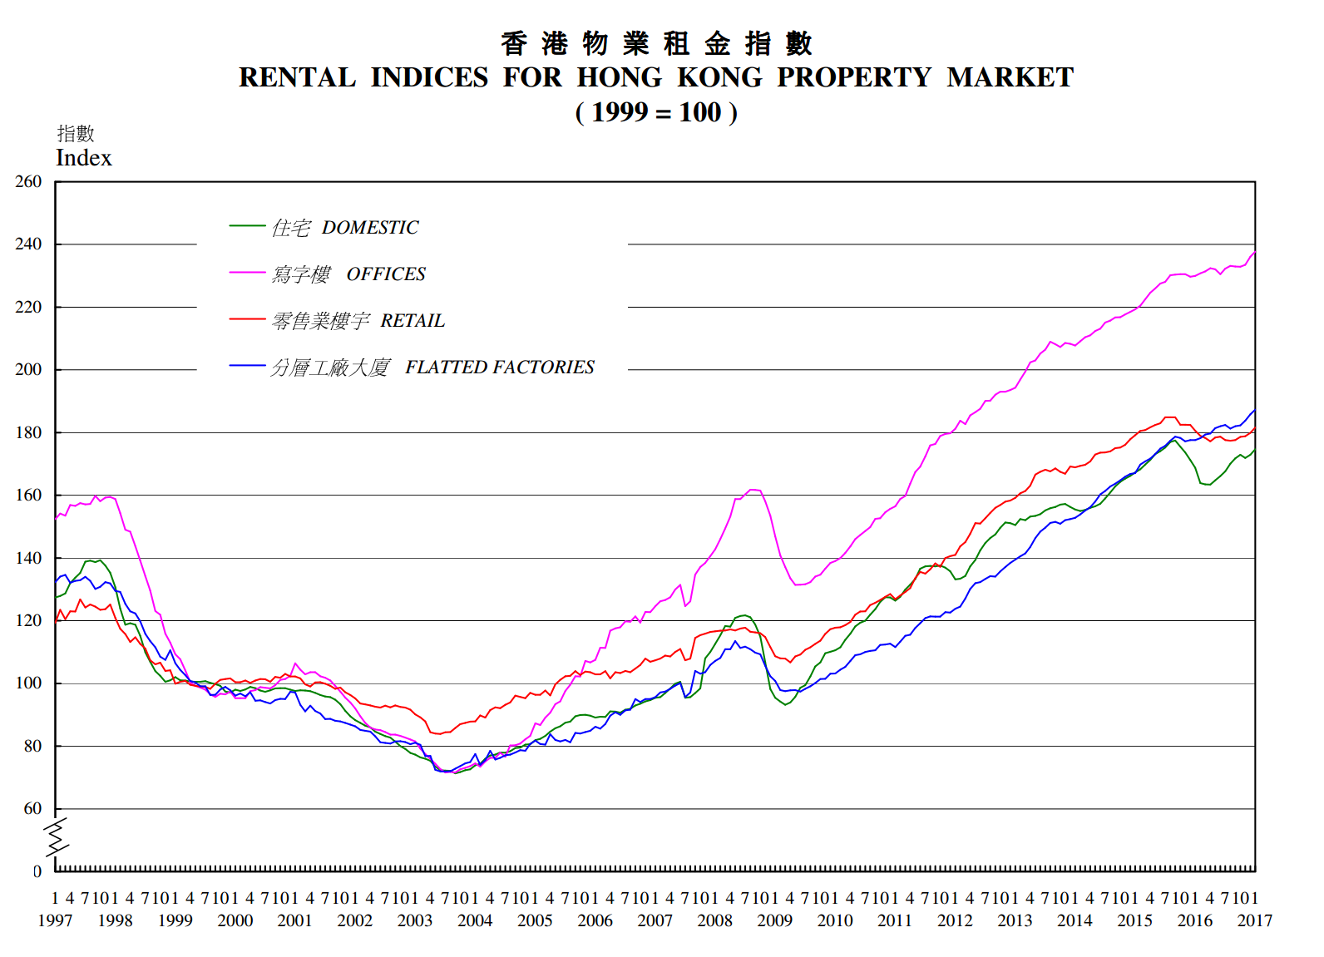
Rental Indices for Hong Kong Property Market
Notes:
http://www.rvd.gov.hk/doc/en/statistics/graph1.pdf

Slide 14
Factors affecting property markets
Government Policy & Regulation
  Public housing
  Benefits
  Policies
  SSD
Interest rate
  MORTGAGE RATE
Economy
Risk of bubble

Slide 15
Government Regulation
Government controls the supply of new land
Government determines when and how much new land will be put on the market as well as the uses allowed on this land
Government leases land to private developers, land for non-institutional uses is generally leased to the highest bidder at public auction
Affordable Housing Initiatives developed for low-income residents
Spending on public sector land development outgrew private sector in 2010

Slide 16
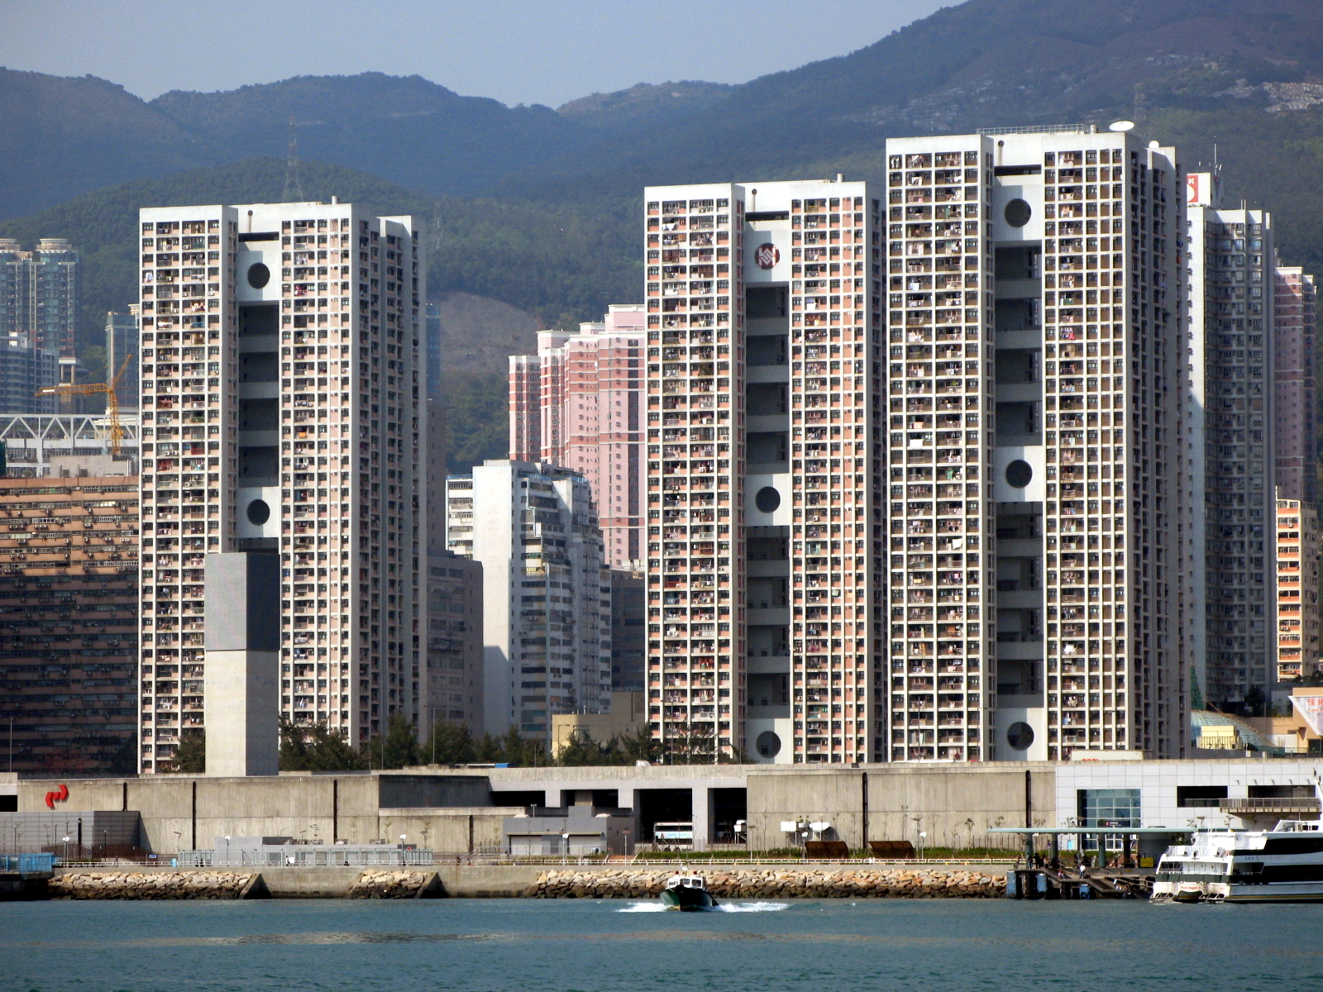
Government Regulation - Public Housing
Introduced in 1961
Major component of housing in Hong Kong
Mainly built by the Hong Kong Housing Authority and the Hong Kong Housing Society
Eligible check before apply
Clague Garden Estate, a public housing in Tsuen Wan

Slide 17
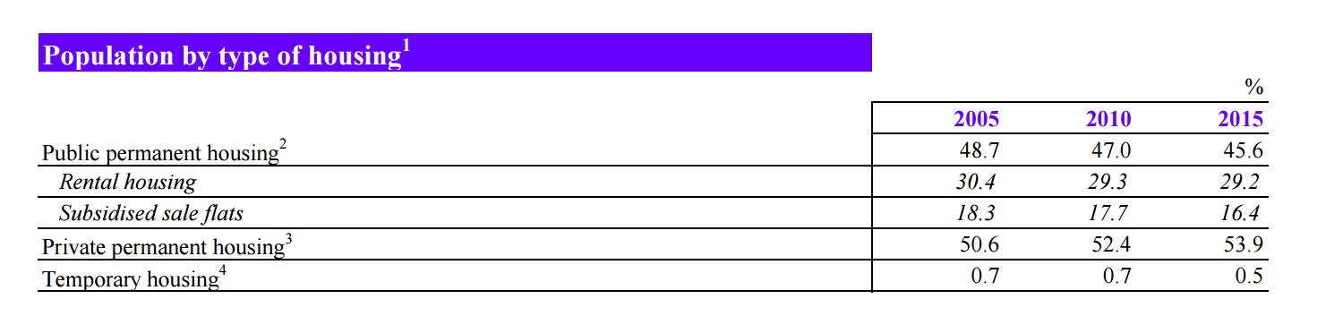
Government Regulation - Benefits
Government of Hong Kong provides affordable housing for lower-income residents.
Rents and prices are significantly lower than those for private housing and are heavily subsidised by the government
Around 50% of the population now residing in some form of public housing.
Notes:
https://www.housingauthority.gov.hk/en/common/pdf/about-us/publications-and-statistics/HIF.pdf

Slide 18
Government Regulation - Policies
New policies on October 27, 2012:
Buyer’s Stamp Duty (BSD)
Extra 15% tax on properties purchases made by foreign investors
Special Stamp Duty (SSD)
10-20% tax on properties resold within 36 months of their acquisition
Aimed to curbing speculation in an overheating market
Residential property transactions in the following weekend: 43% ↓
Cheung Kong Ltd: 4.7% ↓
Henderson Land Development: 6.4% ↓
Sun Hung Kai Properties: 5.1% ↓

Slide 19
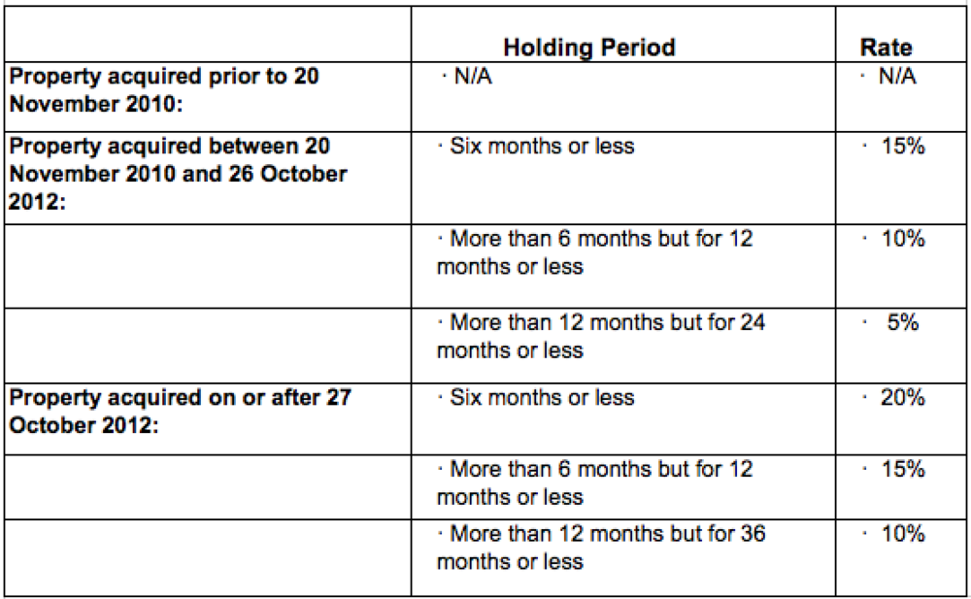
SSD

Slide 20
Government Regulation - Policies (Con’t)
Another new policy on February 22, 2013:
“Double” Stamp Duty - adjust the ad valorem stamp duty (AVD) rates:
Increased 1.5% tax on the properties that value less than HK$ 2,000,000 ~ US$250,000
Doubled the tax on the properties that value more than HK$ 2,000,000
Exception for first purchase made by local residents
Cheung Kong Ltd: 0.6% ↓
Henderson Land Development: 0.7% ↓
Sun Hung Kai Properties: 1.3% ↓

Slide 21
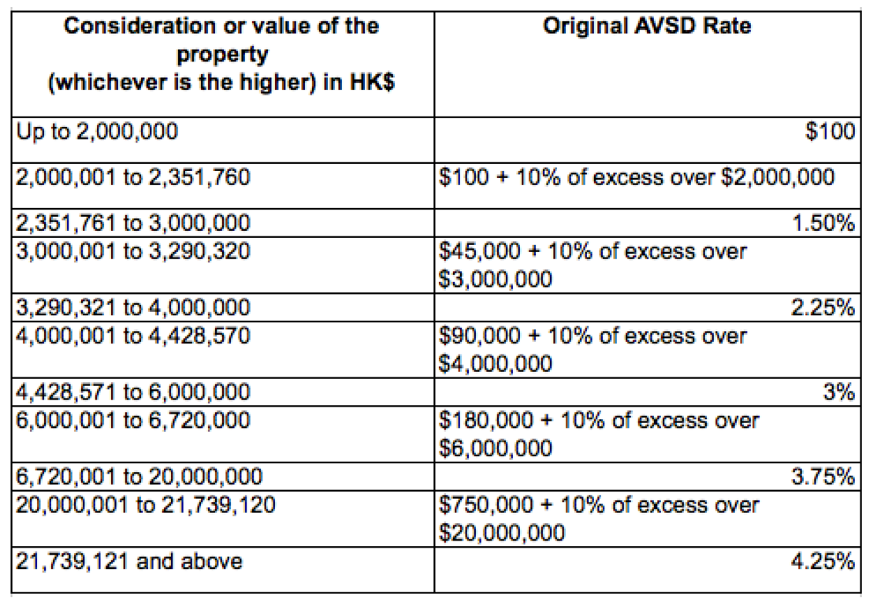
AVD Before February 22, 2013
Notes:
http://www.placeproperty.com/buying-hong-kong-property/residential-property-in-hong-kong/

Slide 22
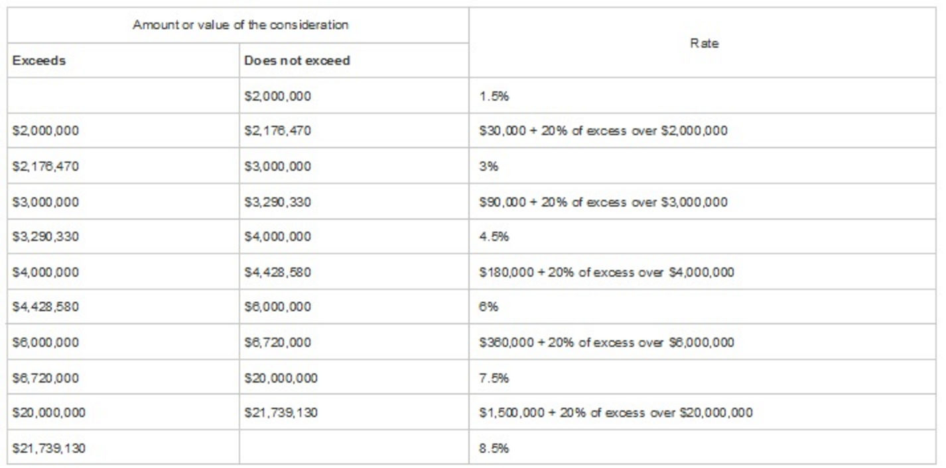
AVD After February 22, 2013
Notes:
http://www.reanda-international.com/index.php?option=com_content&view=article&id=718%3Astamp-duty-amendment-bill-2013-gazetted&Itemid=2

Slide 23
Government Regulation - Policies (Con’t)
Loan-to-Value Ratio and Debt-Servicing Ratio for Property Mortgage Loans
with effect from 27 February, 2015
First time borrower:
Buyers must pay higher down payment
Second time borrower:
Amount of mortgage payments + other debts must not exceed gross income
Makes it harder for buyers to borrow again (also due to “Double” Stamp Duty)
Cheung Kong Ltd: 2.3% ↓
Sun Hung Kai Properties: 1% ↓

Slide 24
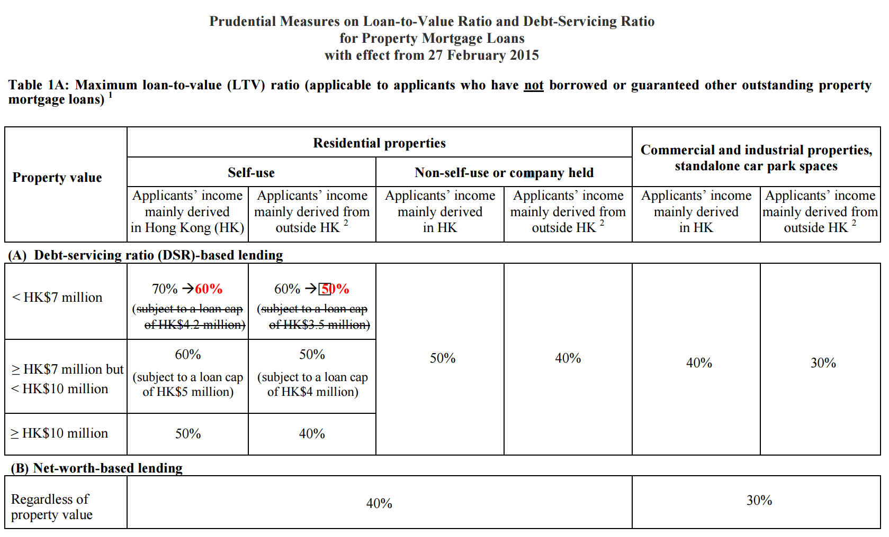

Slide 25
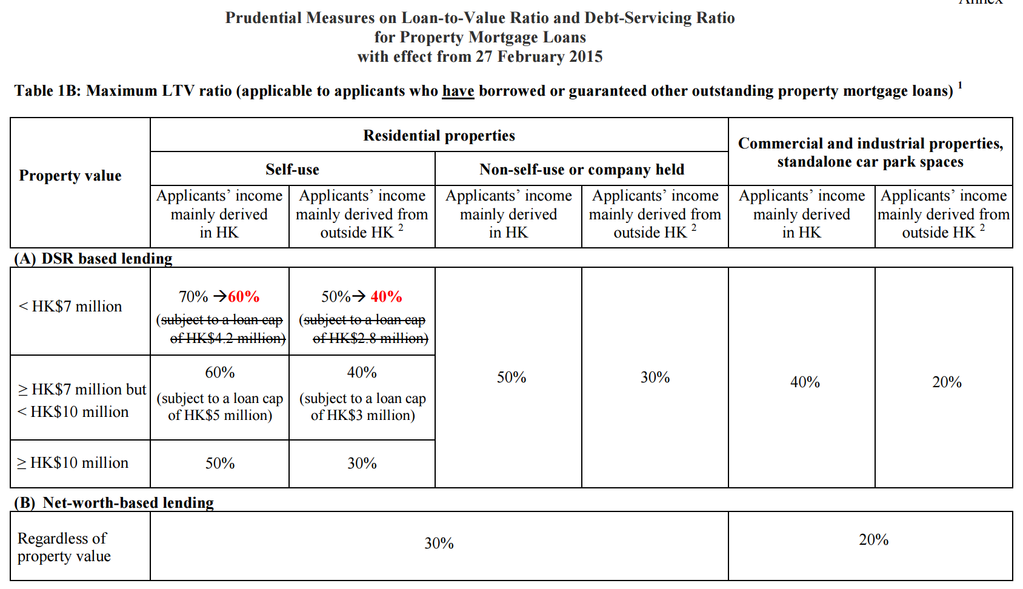

Slide 26
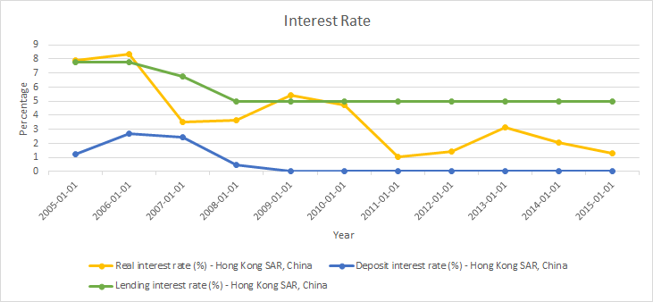
Interest Rate
▪Shrinking mortgages, low interest rates

Slide 27
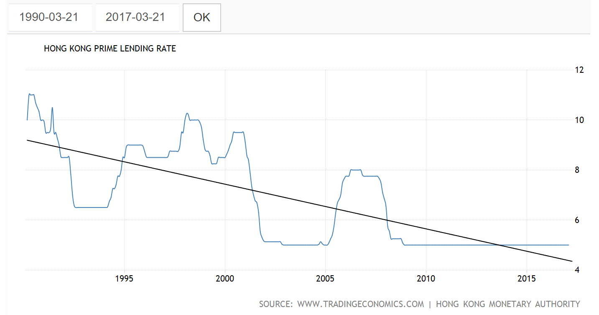
Mortgage Rate

Slide 28
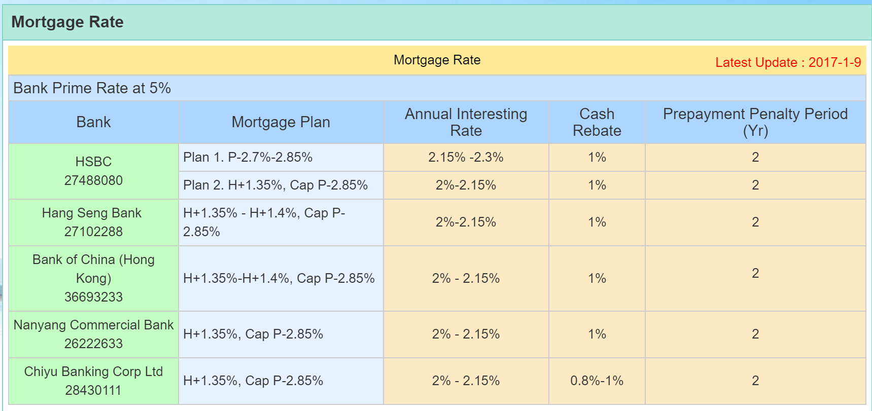
Mortgage Rate

Slide 29
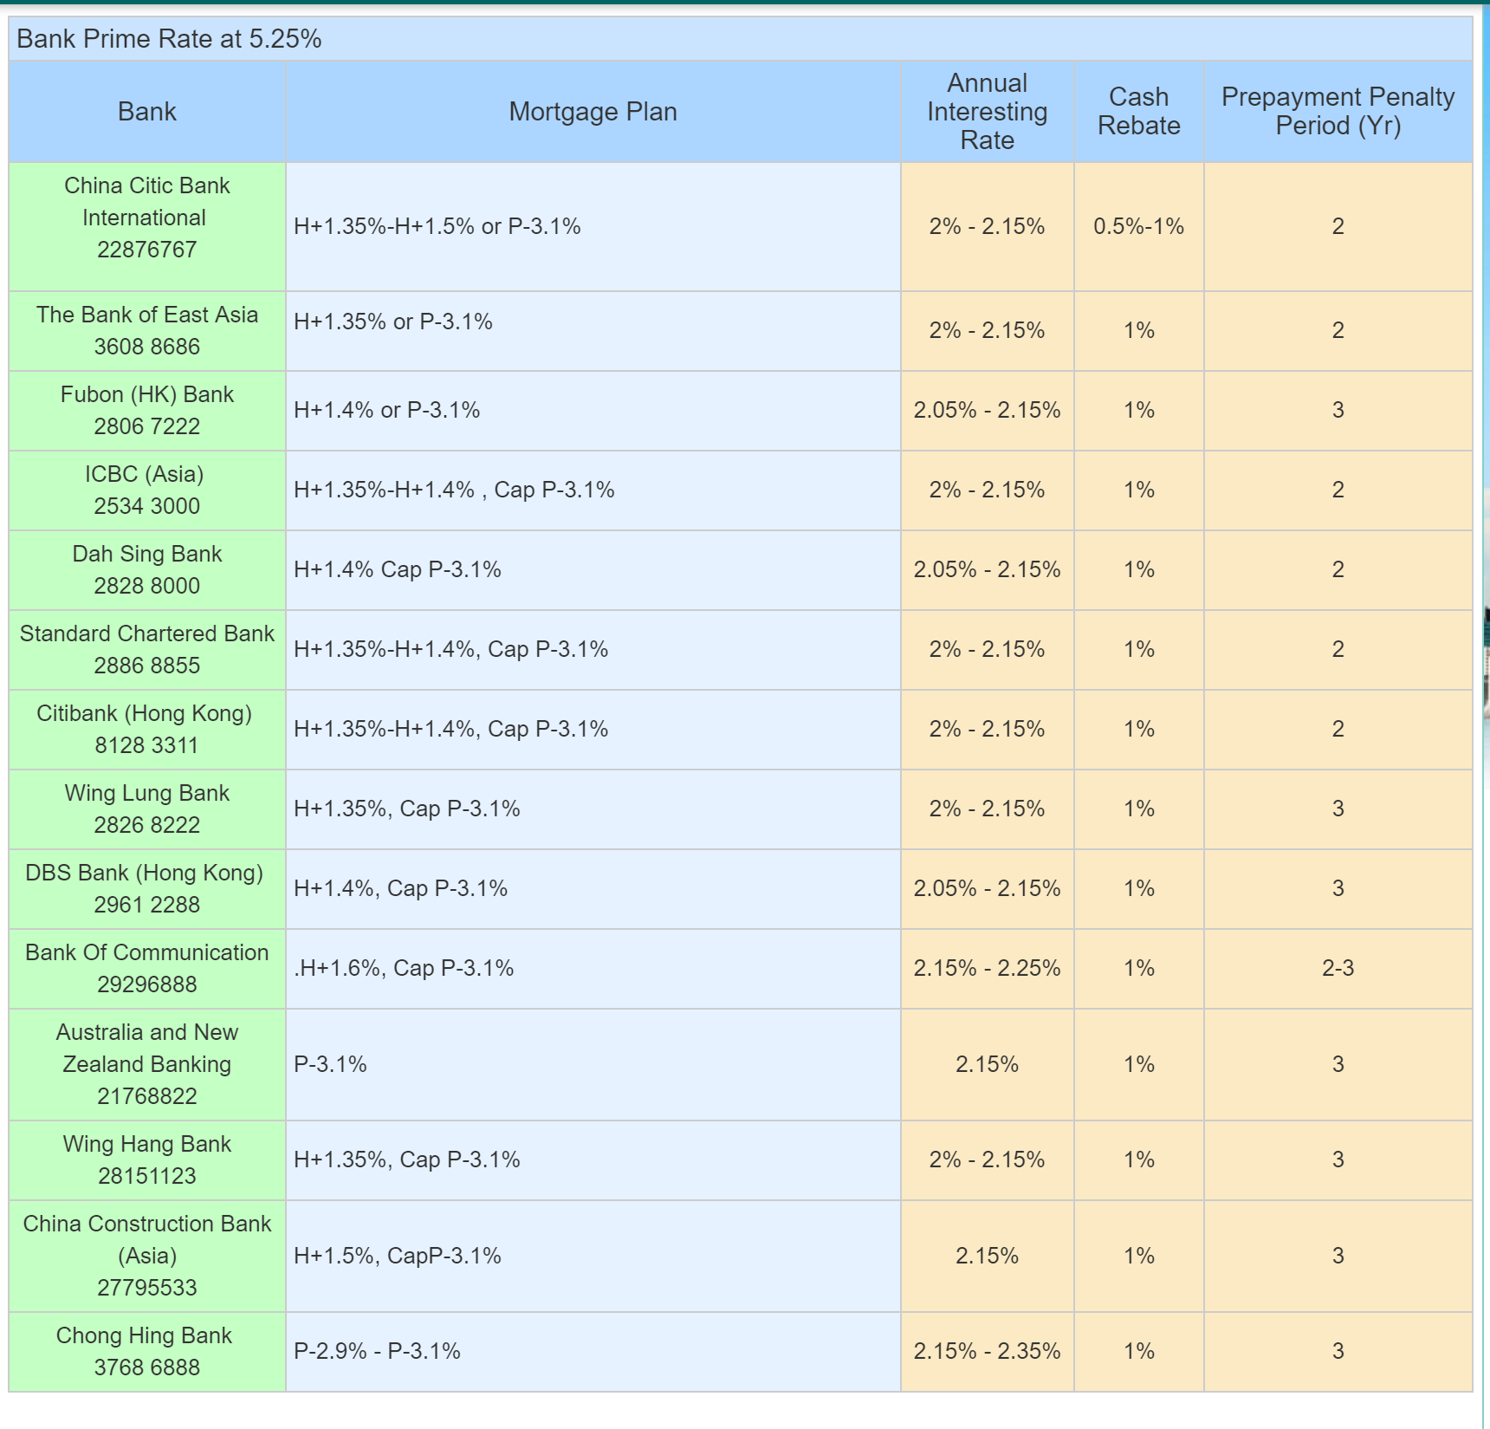
Mortgage Rate

Slide 30
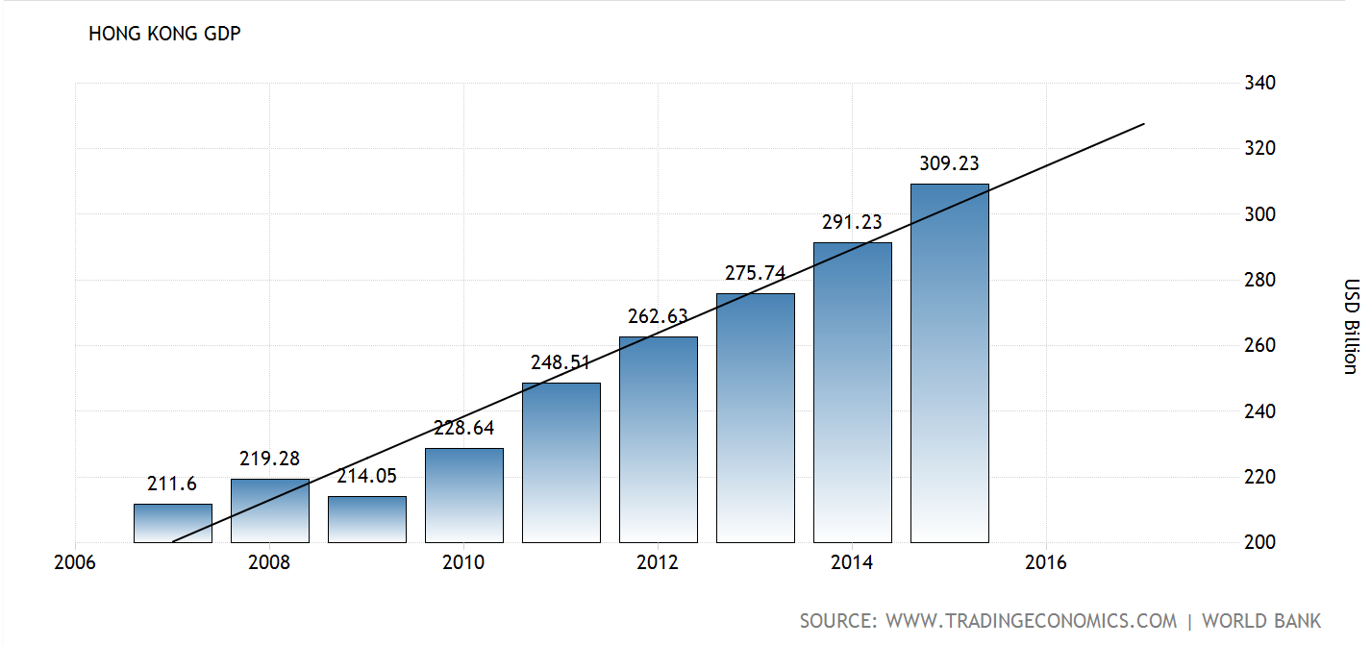
Economy - GDP

Slide 31
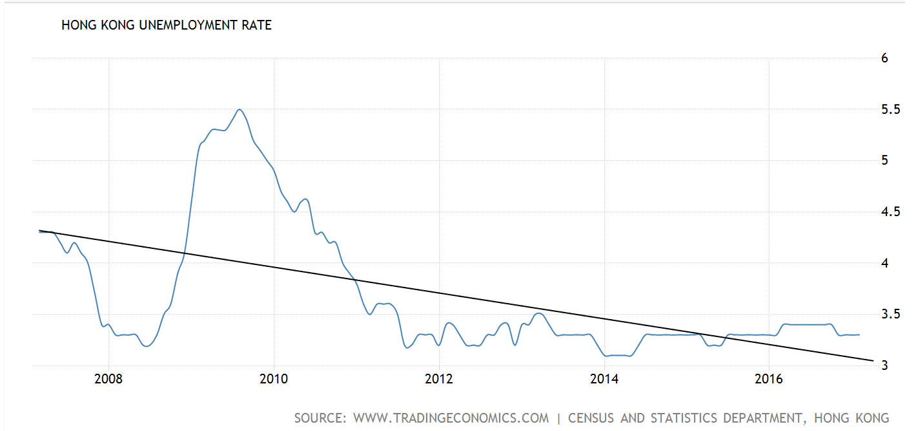
Economy - Unemployment Rate (%)

Slide 32
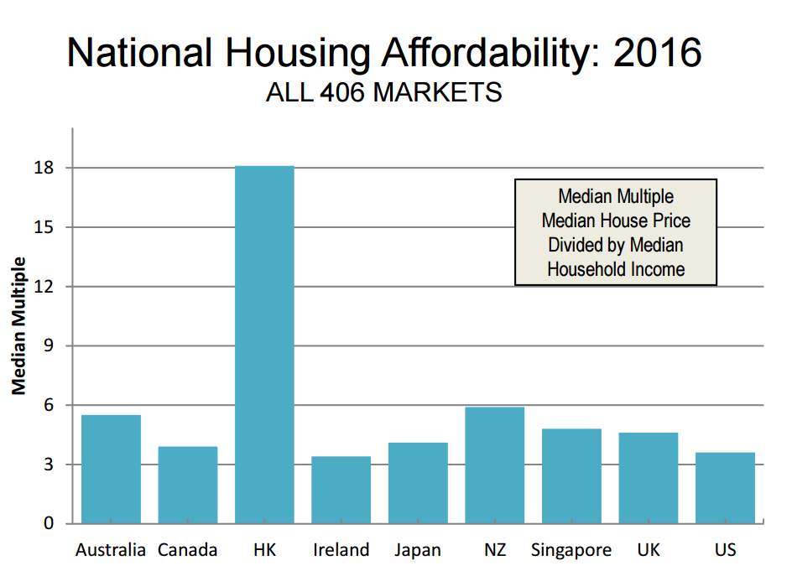
Notes:
http://www.demographia.com/dhi.pdf

Slide 33
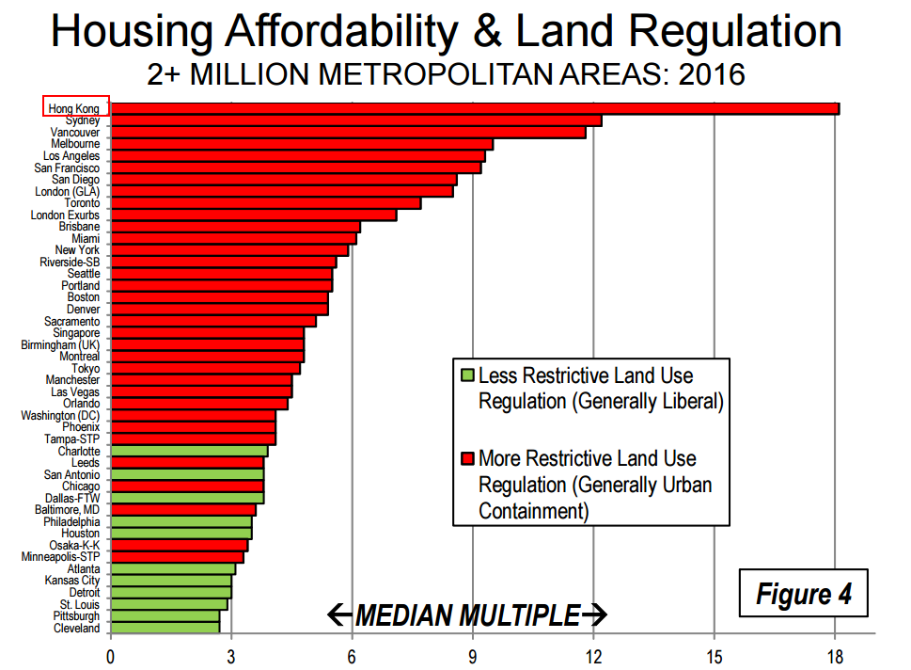

Slide 34
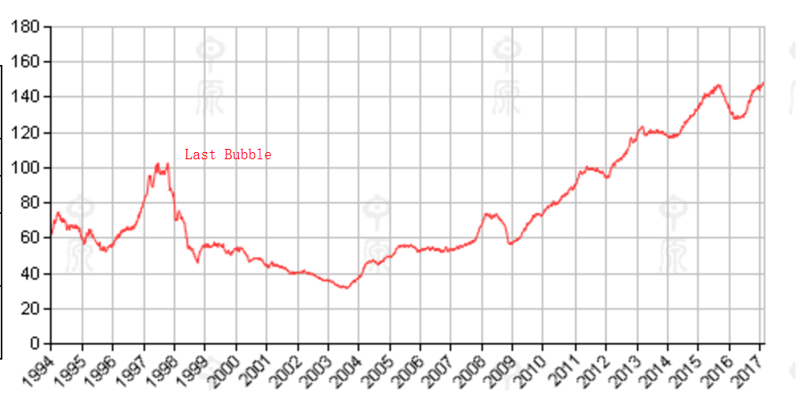
Risk of bubble
HK Centa-City Leading Index
1997: the peak
1997-2003: dropped by 69%
2008-2009: dropped by 23%
2009-2015: increased by 90%
2015 end - 2016: dropped by 10%
2016 end - 2017: increase by around 10%

Slide 35
Hang Seng Property Index
---Record and monitor daily changes of the largest companies of the Hong Kong stock market
---Main indicator of the overall property market performance in Hong Kong
Properties Index made up of 10 major property companies:
0016 Sun Hung Kai Properties Limited | 1109 China Resources Land Limited
1113 CK Property Holdings Limited | 0101 Hang Lung Properties Limited
0012 Henderson Land Development Company Limited | 0017 New World Development Company Limited
0004 Wharf (Holdings) Limited | 0083 Sino Land Company Limited
0688 China Overseas Land & Investment Limited | 0823 The Link REIT

Slide 36
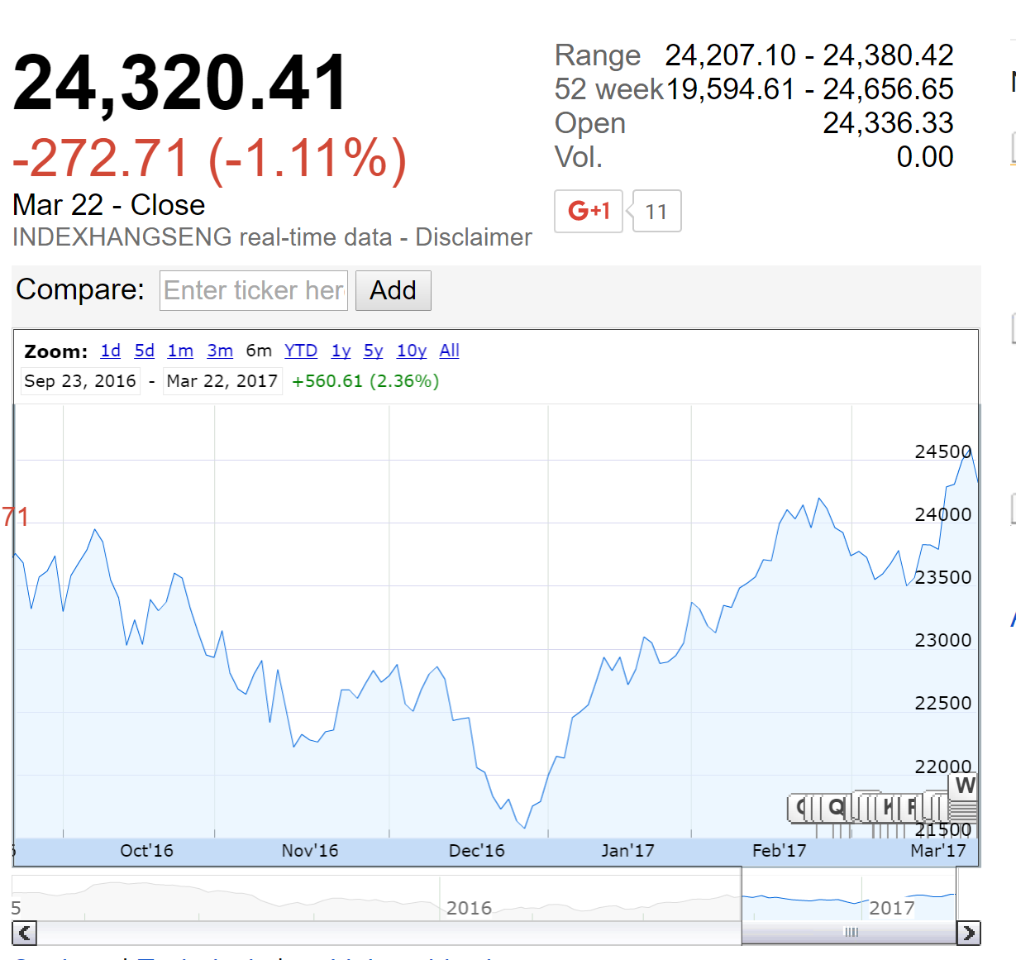
Hang Seng Property Index (6 months)

Slide 37
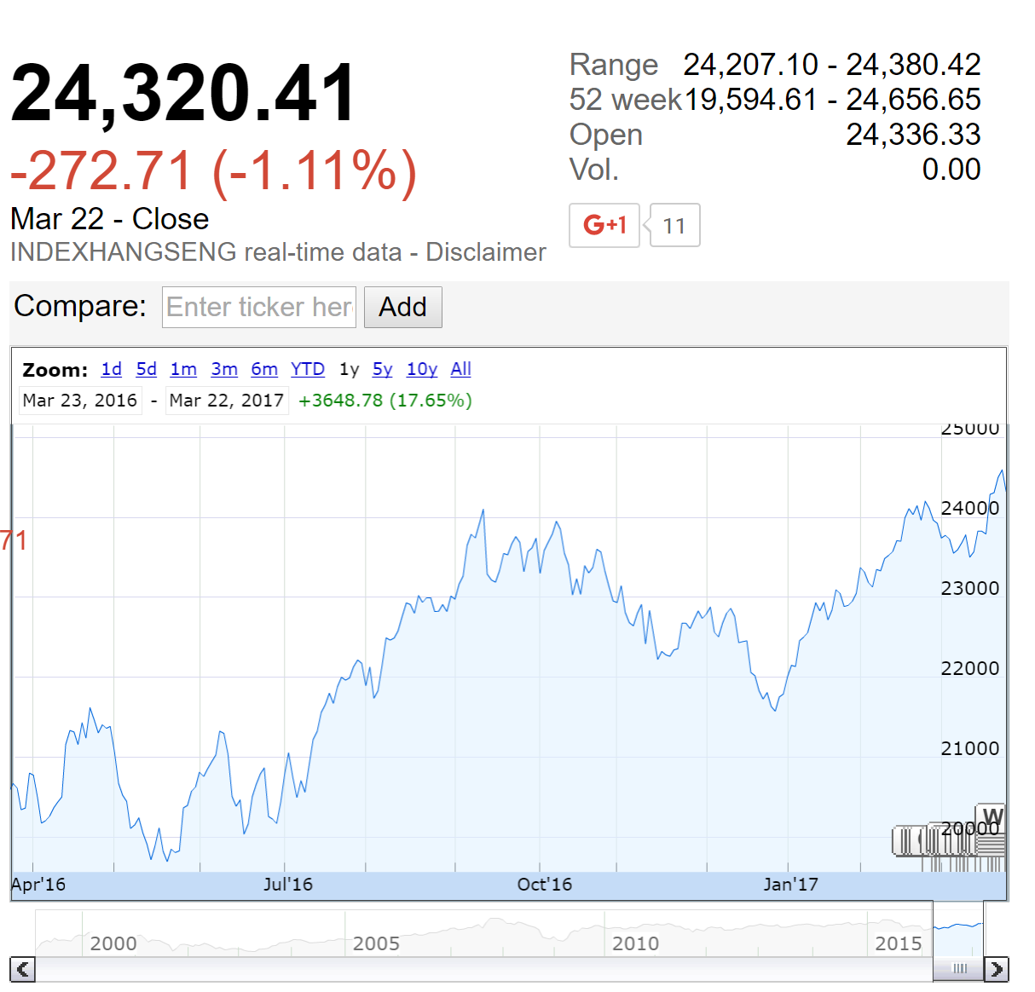
Hang Seng Property Index (1 year)

Slide 38
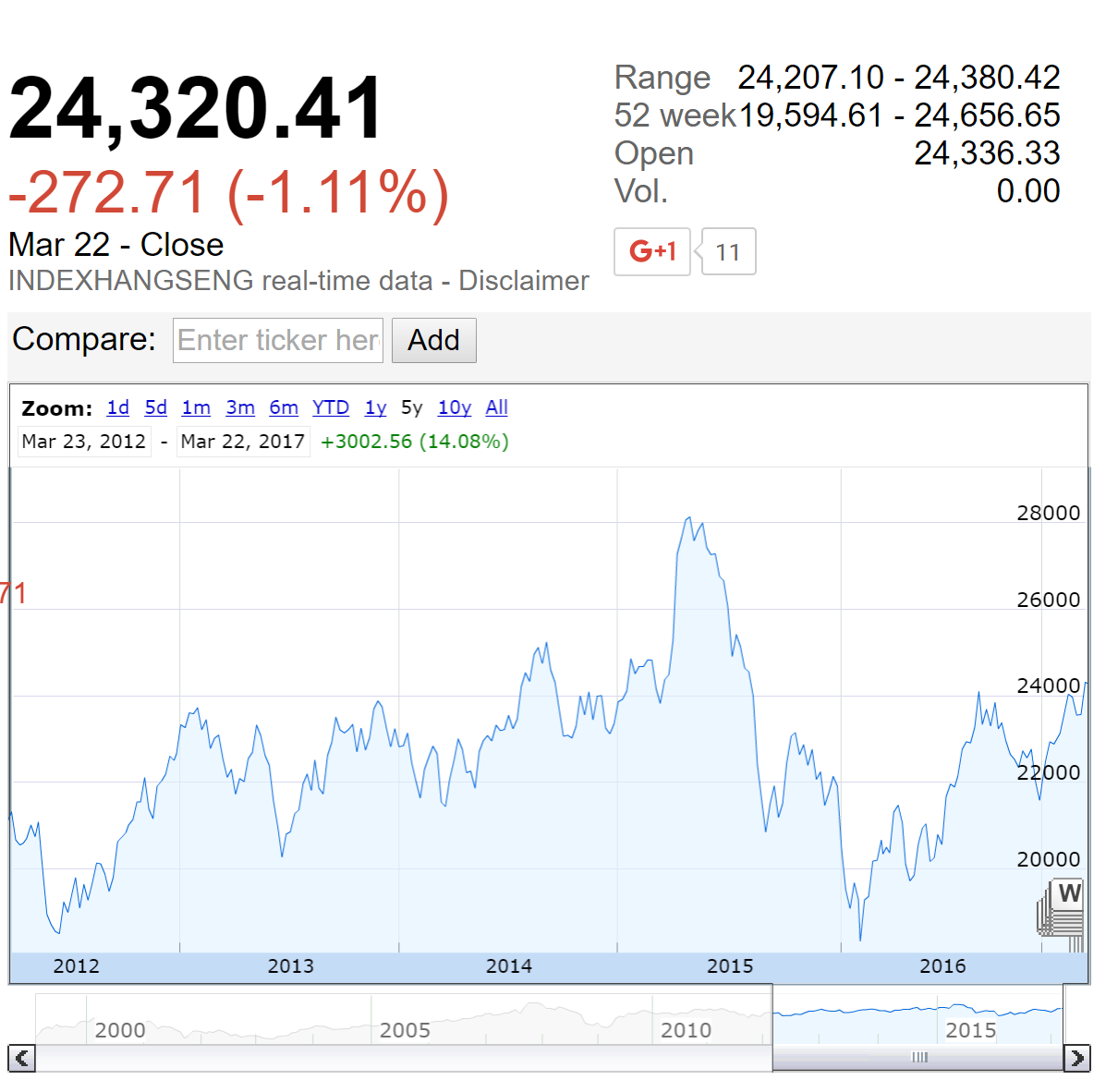
Hang Seng Property Index (5 years)

Slide 39
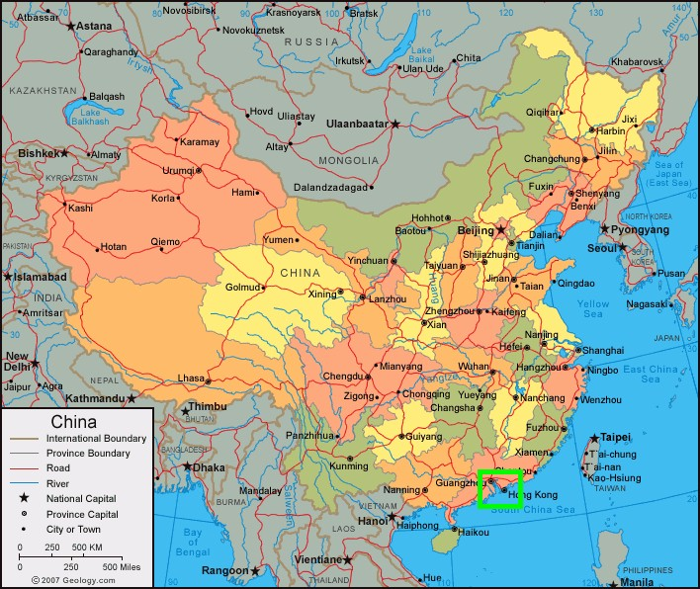
Mainland China

Slide 40
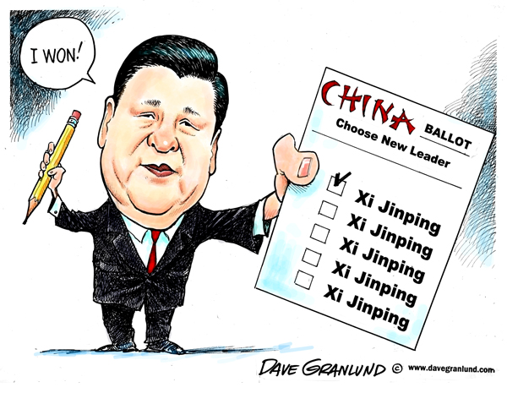
Overview
People’s Republic of China
Capital: Beijing;
Financial Center: Shanghai
Politics: one-party directorship
“two system” policy
Population: 1.38 billion (2016 data)
Currency: RMB

Slide 41
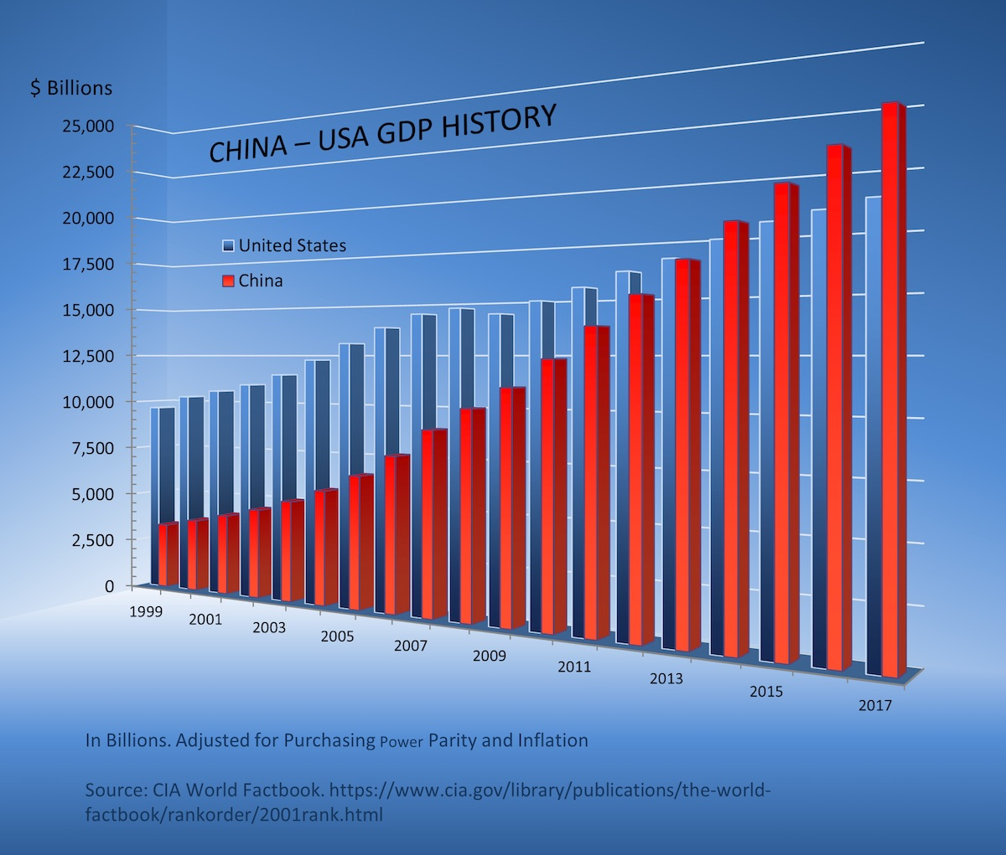
China GDP (Billions of US dollars)

Slide 42
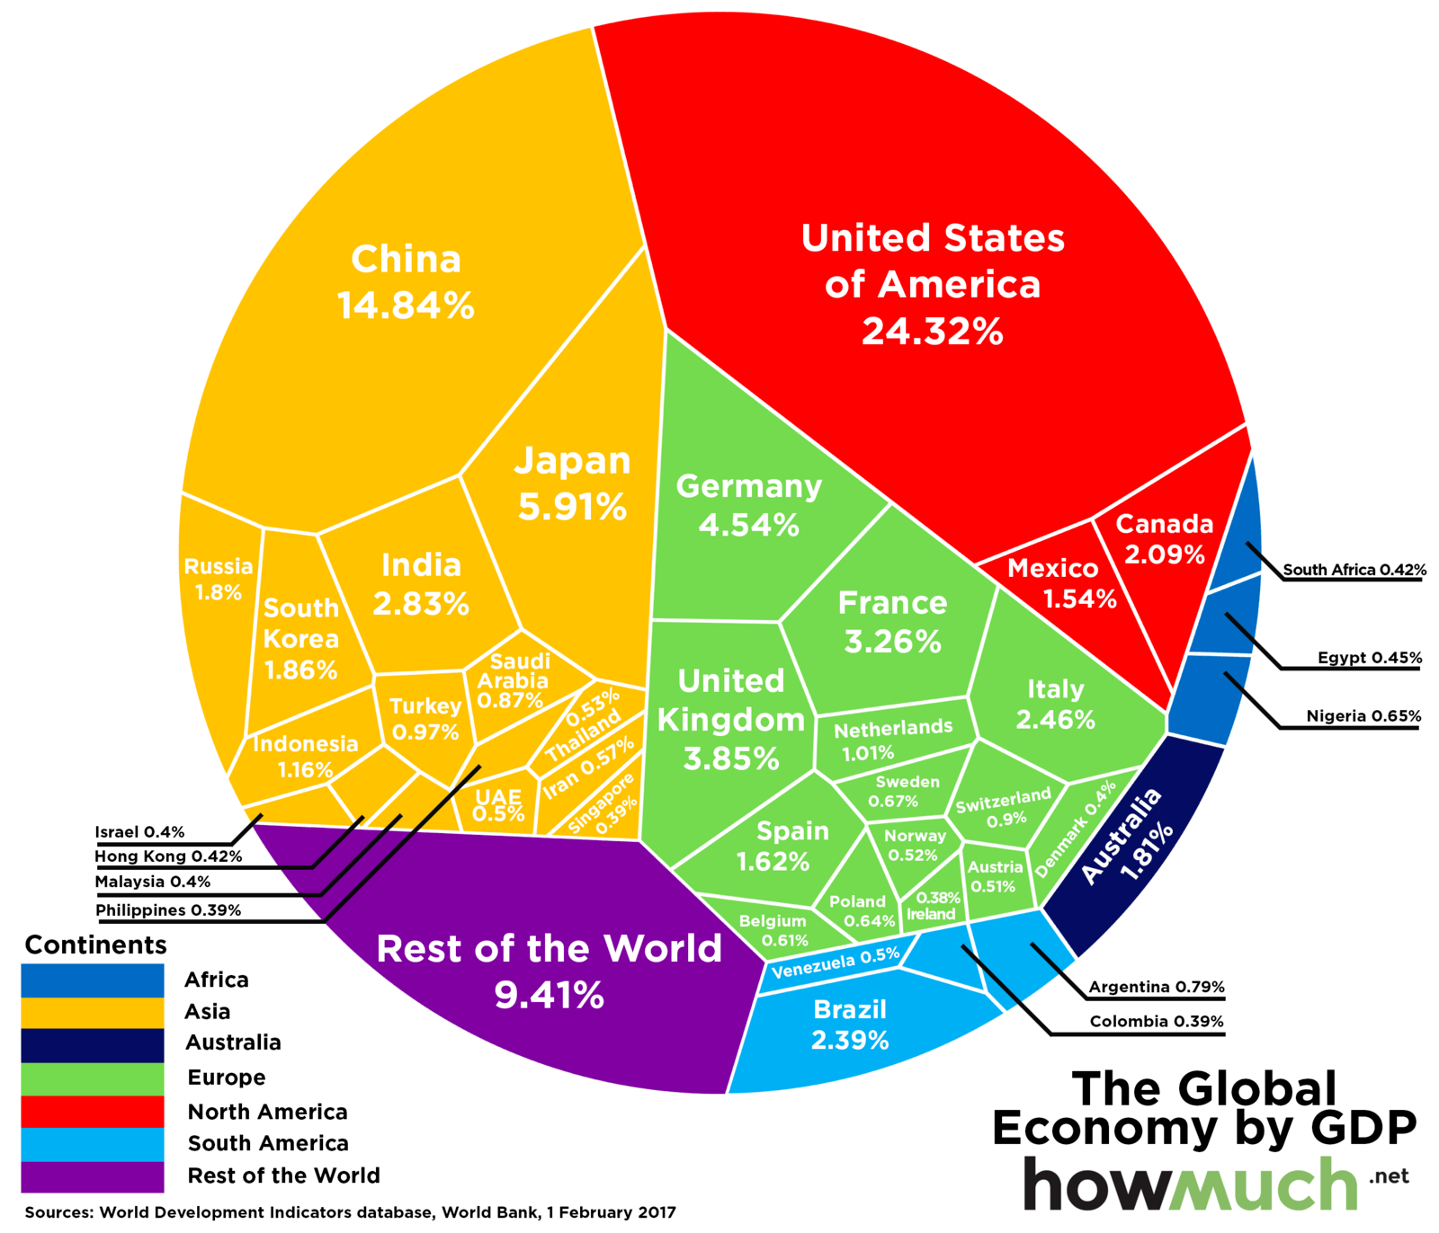
China--- World’s 2nd Largest Economy
Source: World Bank, 1 Feb , 2017

Slide 43
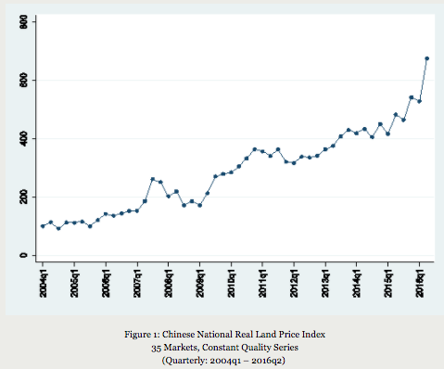
China Property Market

Slide 44
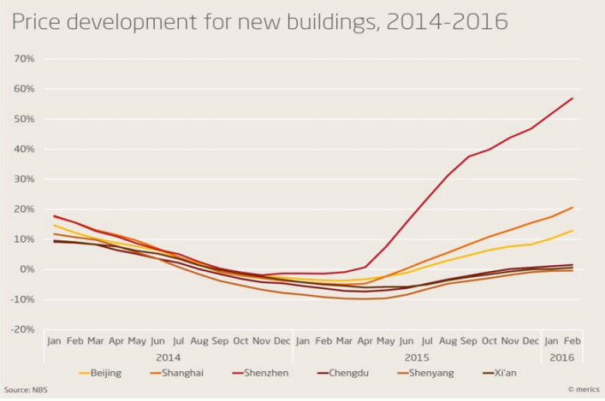

Slide 45
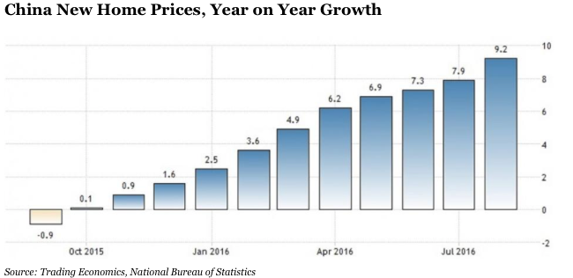
Housing Bubble in China
New home prices rose on average 9.2% year-on-year across China’s 70 major cities, according to the National Bureau of Statistics. Home prices in Shanghai have risen 31.2% year-on-year, while those in second-tier city Xiamen have risen 43.8% in the past year.

Slide 46
Restrictions in China Property Market
Tighter mortgage restrictions on home purchases were introduced, and buyers without a local registration barred from buying more than one property.
For example, First-time home buyers in Shenzhen will face minimum down payments of 30%, but deposits for others will be raised to no less than 50%.
Down payments for second-home buyers in China's Guangdong province near Hong Kong will be increased to no less than 70%. The government has limited local residents to purchasing a maximum of two properties. Non-local residents will be allowed to buy one property, if they can prove they have paid appropriate levels of tax or social security.
Where home price rises exceed city price control targets, People’s Bank of China (PBOC) branches will increase down-payment requirements.
Reducing luxury housing inventories has been a focus of government and developers´ efforts in recent years on.
Notes:
government tries to cool soaring home prices stoked by property speculators in second- and third-tier cities across the country.
The Ministry of Housing and Urban-Rural Development, meanwhile, has investigated and punished 45 property developers and intermediaries for encouraging speculation via false advertising, the spreading of rumors and breaking presale rules,

Slide 47
Restrictions in China Property Market
The government will continue to reform property taxes. The trial holding tax, first introduced in Shanghai and Chongqing, is to be implemented in other cities. Also a transaction tax is to be implemented .
The annual tax rates are 0.5 percent of the transaction prices for villas and apartments priced less than three times the average price, 1 percent for those priced three to four times the average and 1.2 percent for those priced more than four times the average.For non-permanent residents who don't work and run companies in Chongqing, their second homes will be taxed at 0.5 percent regardless of the prices.
Major cities are now required to publish, every year, an annual housing price control target.
Cities with overheating housing markets are required to increase their supply of commodity housing, and their land supply. Conversely, cities with declining prices are required to keep prices stable by stimulating housing demand.
Higher lending rates for second-home buyers
Notes:
Chongqing will tax all villas as well as new apartments priced at least two times the average price of all newly-built homes in the southwestern city
https://www.ft.com/content/ad0b557e-9a82-11e6-8f9b-70e3cabccfae
http://news.xinhuanet.com/english2010/china/2011-01/27/c_13710175.htm
https://www.forbes.com/sites/sarahsu/2016/10/11/chinas-housing-bubble-is-finally-here-as-expected/#6838015660e6
http://news.xinhuanet.com/english2010/china/2011-01/27/c_13710175.htm

Slide 48
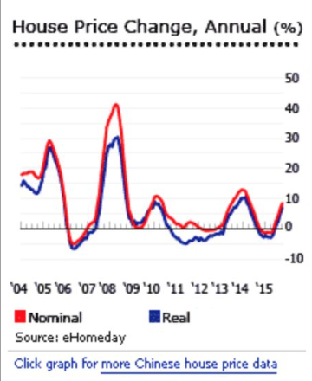
Policy Relaxation
Starting in September 2014, the central bank relaxed mortgage restrictions on second-home buyers by easing down payments and mortgage rates, giving homeowners with paid-off mortgages wanting a second property the same terms as first-time buyers, including a down payment minimum of 30% (previous minimum: 60%).
Foreign nationals working and living in China and overseas’ companies China-based units were permitted to purchase properties in August 2015
In September 2015, the People’s Bank of China went on to reduce down payment requirements for first-time home buyers from 30% to 25%. Down payments for both first and second home purchases were further reduced to 20% in February 2016 The minimum down payment for second-home purchases was cut to 30 percent from 40 percent

Slide 49
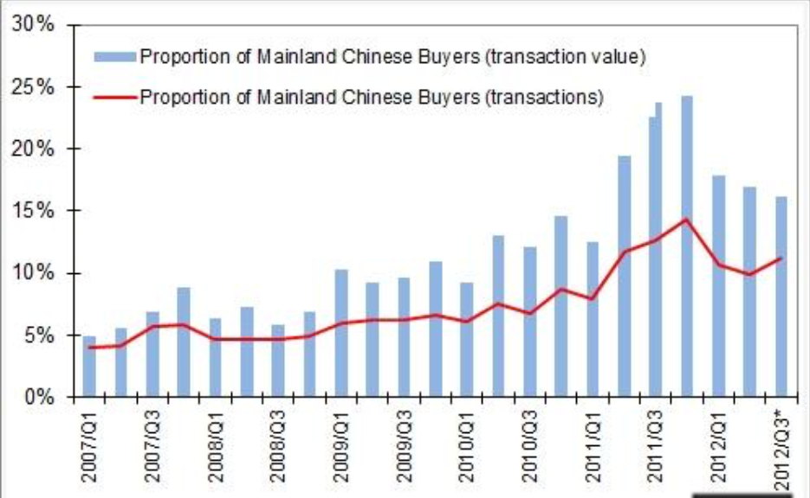
Mainland buyer purchase HK property

Slide 50
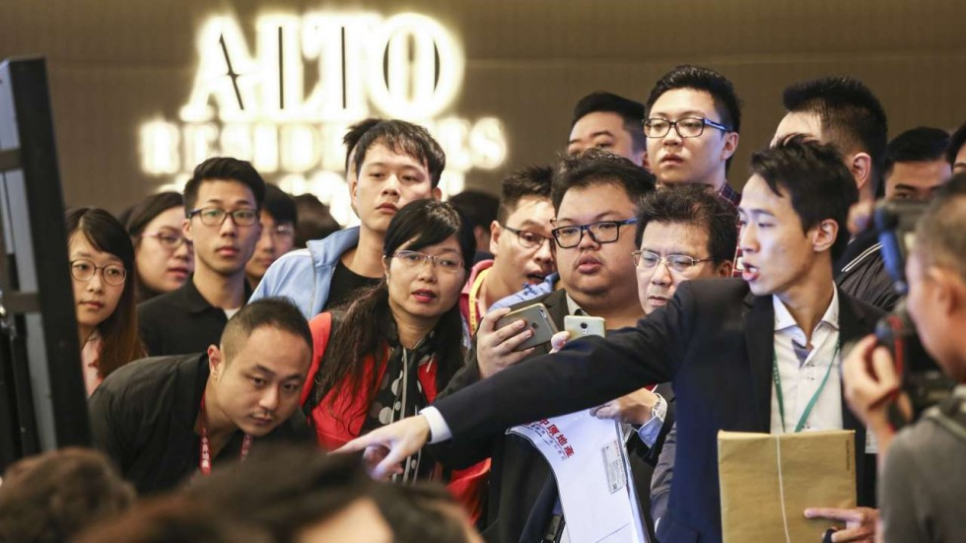
Impacts of Mainland Buyers
Mainland buyers affected limited supply in HK housing market:
Home prices in Hong Kong have surged more than 90% since early 2009 on a shortage of new supply
The Chinese government implemented a stimulus package amounting to CNY4 trillion (USD585 billion) in November 2008, reviving the Chinese housing market, and prompting a surge of mainland buying in Hong Kong.
In 2016, Hong Kong raised stamp duties on property transactions for the first time in three years, the latest effort to check an overheated property market buoyed by capital inflows from China.
Notes:
http://www.scmp.com/news/hong-kong/economy/article/2043304/new-hong-kong-home-sale-measures-dampen-enthusiasm-tseung

Slide 51
Why Hong Kong’s Land Prices are hard to Predict?
Hong Kong’s house prices are among the most volatile in the world.
With a land area of 1,104 sq. km., land supply in Hong Kong is extremely limited and can be released by the government at will.
The market is dominated by few major real estate developers.
The public housing sector is one of the biggest in the world.

Slide 52
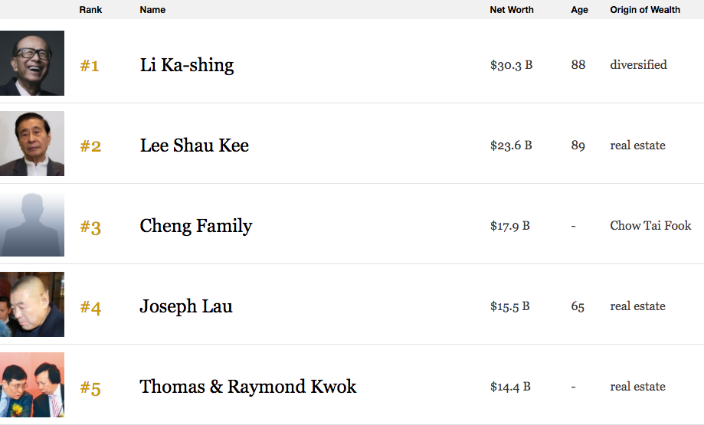
Hong Kong Billionaires Ranking 2017 Ranking

Slide 53
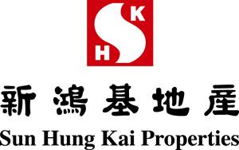

Slide 54
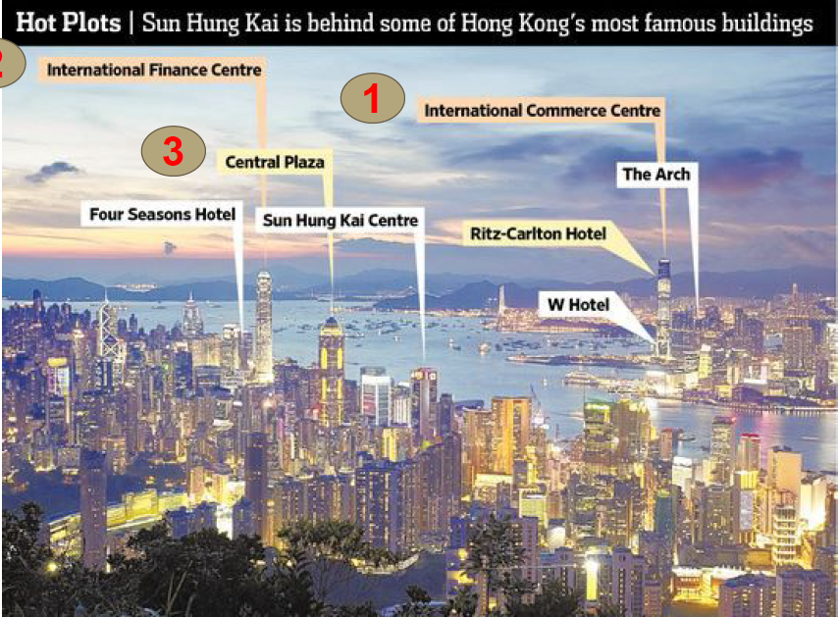

Slide 55
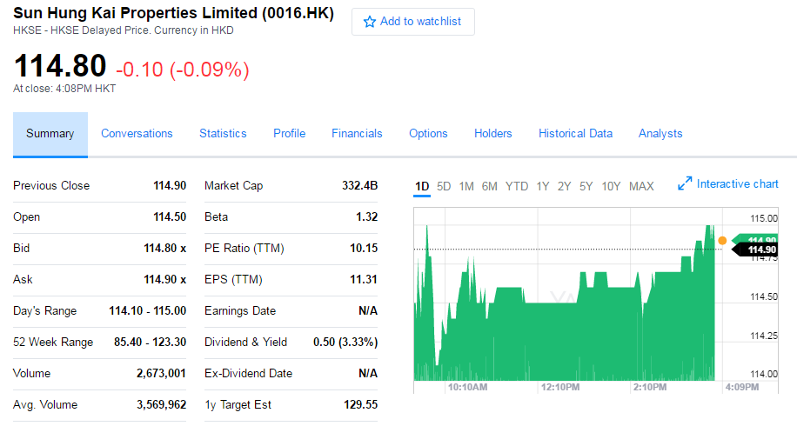

Slide 56
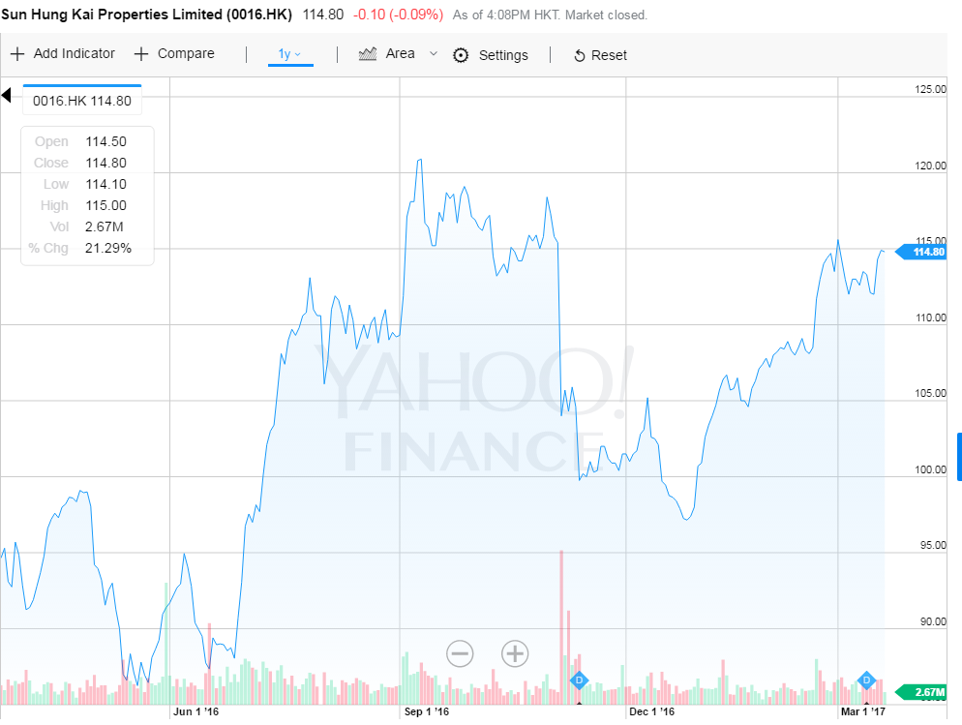

Slide 57
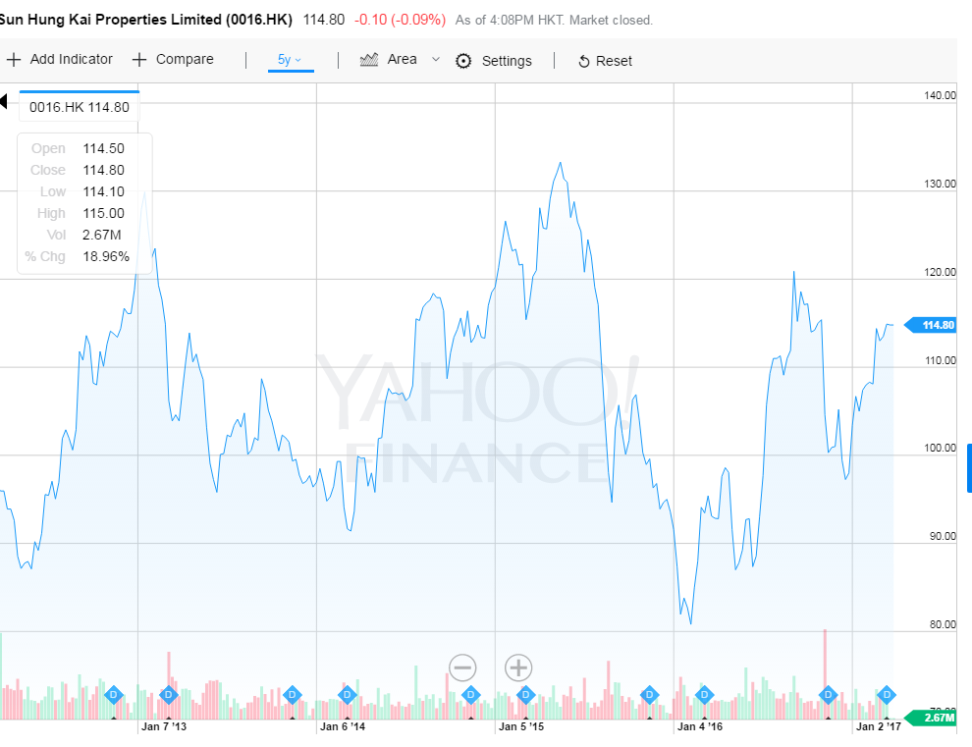

Slide 58


Slide 59

Company Overview
Founded in 1963 by Kwok Tak Seng, along with Fung King-hei and Lee Shau Kee
Was listed on the Hong Kong Stock Exchange in 1972
The largest property company in Hong Kong (by Market Cap)
Specializes in premium-quality residential and commercial projects for sale and investment in Hong Kong and Mainland China
About 37,000 employees
Lee, Shau-Kee (1928 –Present)
Founder and Chairman of
Henderson
Kwok,Tak-Seng
(1911 –1990)
Fung, King-Hay
(1922 –1985)

Slide 60

Company Overview
Core Business
  Hotels
  Property Management
  Construction
  Insurance and mortgage services
The group also invest in
  Telecommunications
  Information technology
  Infrastructure
  Other busienss

Slide 61

The Kwok Family
The 4th richest family in Asia worth $25.2B (Forbes)
Notes:
https://www.forbes.com/asia-families/list/#tab:overall

Slide 62


Slide 63

Kwong Siu Hing
88 years old
Wife of Kwok Tak-Seng
Chairman from 2008-2011

Slide 64

Raymond, Kwok Ping Luen 郭炳聯
65 year old, youngest son of Kwok Tak-Seng
Co Chairman 2011-2014
Chairman since 2014
Law degree from Cambridge University, an MBA from Harvard University

Slide 65

Thomas, Kwok Ping-kwong 郭炳江
66 year old second son of Kwok Tak-Seng
Co-chairman from 2011-2014
In December 2014, Thomas Kwok was convicted of “conspiracy to commit misconduct in public office,”
Jailed for 5 years and free on bail in July 2016
Notes:
holds a Master of Business Administration degree from London Business School, University of London and a Bachelor's degree in Civil Engineering from Imperial College, University of London

Slide 66

Walter, Kwok Ping-sheung
郭炳湘
Oldest son of Kwok Tak-Seng
Inherit chairman title 1990-2008 after death of Kwok Tek-Seng
1997 abduction, Walter was kidnapped, HK$600m (CAD$103m)
Notes:
since then, he handed over the executive duties to his brothers while retaining the title of chairman and CEO.
2008 Public guess: 1. Cheated his wife with Ida who reported Kwok brother’s corruption, mistress , 2. bipolar disorder

Slide 67

Kidnapping
In 1997, Walter was kidnapped by Cheung
He was beaten, stripped to his underwear and kept in a small cage for a week before his family negotiated his freedom for HK$600m (CAD$100M)

Slide 68


Slide 69

Ida Tong
Walter and Ida were together since they were young and broke up because of Walter’s father’s disapproval
After kidnapping case happened, Walter start date Ida again when he already in a marriage
Ida tried to gain an influential role in SHKP and caused Walter to be evicted in 2008 by his mother

Slide 70


Slide 71



Notes:
Since 2009, the hk house pring increase 70%
HK$850 involved in the Bribery case

Slide 72

Notes:
Thomas Kwok sentenced to 5 years of
imprisonment, $0.5 million HKD fine
● Hui Si Yan sentenced to 7.5 years of
imprisonment, $1.1 million HKD fine
● Raymond Kwok cleared of all charges
and become the sole chairman of Sun
Hung Kai

Slide 73
Court Decision
Thomas Kwok sentenced to 5 years of imprisonment, $0.5 million HKD fine
Hui Si Yan sentenced to 7.5 years of imprisonment, $1.1 million HKD fine
Raymond Kwok cleared of all charges and become the sole chairman of Sun Hung Kai

Slide 74
Notes:
Since 2009, the hk house pring increase 70%

Slide 75

Thomas Free on Bail July 12, 2016
Thomas Kwok Ping-kwong walked free on bail set at 10 million Hong Kong dollars ($1.3 million) on July 12.
The disgraced property tycoon was greeted by his son Adam Kwok Kai-fai

Slide 76
Major Event in Kwok Family and SHKP
1997: abduction
1997: Walter and Ida back together
1997-2008: Walter is holding the chairman title but with no power/ control over the business
2008: Kwong Siu Hing evicted Walter’s position and became chairman
2008-2012: Walter and Ida thinking to win back their position
2012: Ida and Walter has reported Kwok Brother Raymond and Thomas’s corruption
2012 March: ICAC started to investigate the bribery case
2014 Dec: Court send Thomas into jail for 5 years
2016 July: Thomas set free on bail for HK$ 10million

Slide 77
Edward, Kwok
Alternative director to Raymond
Son of Raymond
a sales and project manager, responsible for feasibility study, marketing and planning of new residential projects of the Group in Hong Kong
Bachelor of Arts degree from Yale University and a Postgraduate Diploma in Professional Accountancy from The Chinese University of Hong Kong

Slide 78

Adam, Kwok
Son of Thomas
Executive director of Sun Hung Kai since 2014
Bachelor of Science degree in Management Science and Engineering from Stanford University and a Master’s degree in Business Administration from Harvard Business School
project director taking charge of certain key residential and commercial projects of the Group in Hong Kong and the Pearl River Delta region. Since April 2013, he has taken up the overall responsibilities for the property business in Southern China
Notes:
In addition, Mr. Kwok is a vice-president of The Real Estate Developers Association of Hong Kong, a member of board of directors of The Community Chest of Hong Kong, a member of the Working Group on Transportation under Economic Development Commission of the Government of the Hong Kong Special Administrative Region, a member of board of directors of the Faculty of Business and Economics of The University of Hong Kong and a vice-chairman of Hong Kong United Youth Association. He is also a member of Guangdong Provincial Committee of the Chinese People’s Political Consultative Conference, a member of All-China Youth Federation and a vice-chairman of Friends of Hong Kong Association Development Foundation.
Mr. Kwok is a nephew of Mr. Kwok Ping-luen, Raymond. He is also a grandson of Madam Kwong Siu-hing, who is the elder sister of Mr. Kwong Chun and also a substantial shareholder of the Company within the meaning of Part XV of the Securities and Futures Ordinance. Mr. Kwok is a cousin of Messrs. Kwok Kai-wang, Christopher and Kwok Ho-lai, Edward.

Slide 79
Christopher, Kwok
Son of Raymond
Bachelor of Science Degree in Chemistry from Harvard University and a Master’s degree in Business Administration from Stanford Graduate School of Business
sales, project management and leasing of major residential and commercial properties of the Group in Hong Kong and mainland China

Slide 80


Slide 81


Slide 82

Land Bank - Hong Kong

Slide 83



Property Development

Slide 84




Slide 85




Slide 86



Slide 87



Property Investment

Slide 88

Map of the Properties

Slide 89

Shanghai Xujiahui Centre
100% owned
180,000 square feet of offices and
329,000 square feet of retail space,
Scheduled for completion in the first half of 2017.

Slide 90


Shanghai Arch
100% owned
1.7 million square feet
Expected finish 2017/2018

Slide 91

Shanghai IFC

Slide 92

Shanghai ICC

Slide 93


Slide 94
House Price Facts
Shanghai and Yangtze River Delta
New houses saw an average sales price increase of 27.8% y-o-y to CNY 40,912 (US$ 5,917.46) per sq. m. in Q3 2016, according to Colliers.
Shanghai´s high-end market has an average sales price of CNY 69,401 (US$ 10,038.08) per sq. m., up by 15.9% from a year earlier.
Guangzhou
- the average sale price of new houses in nine districts rose by 15.9% y-o-y to CNY 20,716 (US$ 2,996.34) per sq. m., according to the Guangzhou Municipal Land Resources and Housing Administrative Bureau

Slide 95


Slide 96


Slide 97
Financial Statement

Slide 98


Slide 99

Financial Summary for 5 year

Slide 100


Slide 101

Financial Highlights

Slide 102


Slide 103

Annual Balance Sheet

Slide 104


Slide 105

Interim Balance Sheet

Slide 106


Slide 107

Annual Income Statement

Slide 108


Slide 109

Interim Income Statement

Slide 110


Slide 111

Annual Statement of Cash Flow

Slide 112


Slide 113

Interim Cash Flow

Slide 114

Recommendation

Slide 115

Cheung Kong Property Holdings Limited

Slide 116

Last Trading Day Performance

Slide 117

Last Trading Day Performance

Slide 118

Last Trading Day Performance (ADR)
Notes:
American depositary receipt (ADR)
- a stock that trades in the United States but represents a specified number of shares in a foreign corporation.
- bought and sold on American markets just like regular stocks
- are issued/sponsored in the U.S. by a bank or brokerage

Slide 119

6 Month Performance
Notes:
Dec 2016: home sales would fall short of its full-year target http://asia.nikkei.com/Business/Companies/Li-Ka-shing-s-Cheung-Kong-Property-to-miss-sales-target

Slide 120

1 Year Performance
Notes:
May 16, 2016: Moody's changes Cheung Kong Property's A3 rating outlook to positive https://www.moodys.com/research/Moodys-changes-Cheung-Kong-Propertys-A3-rating-outlook-to-positive--PR_349260

Slide 121

6 Months vs Hang Seng
Notes:
Oct 31,2016: Sold a commercial complex to a mainland China company at a record price (HK$ 35.7 billion ~ US$ 4.6 billion). The share price briefly rose 2 Hong Kong dollars, or 3.6%, from Friday to HK$57.70.
http://asia.nikkei.com/Business/AC/Cheung-Kong-Property-shares-soar-on-news-of-Hong-Kong-tower-sale

Slide 122

1 Year vs Hang Seng

Slide 123

Performance vs Hang Seng since June 3, 2015

Slide 124
History
1950: Cheung Kong Industries was founded by Li Ka-Shing as a plastic manufacturer
1971: Evolved into a property investment company. "Cheung Kong (Holdings) Limited"
1972: Listed on the Hong Kong Stock Exchange
1979: Acquired Hutchison Whampoa Limited
1981: Started oversea investment
1985: Acquired Hong Kong Electric Holdings
1996:Cheung Kong Infrastructure Holding limited organized
1997: Cheung Kong restructured its business
2003: Listing of Fortune REIT on Singapore Stock Exchange
2005: Listing of Prosperity REIT on the Main Board of the Stock Exchange
2010: Listing of Fortune REIT on the Main Board of the Stock Exchange
Notes:
1997 reorganization: http://www.cki.com.hk/english/whatsNew/1997/19970106.htm

Slide 125

Business Restructuring (2015)
March 18, 2015: Cheung Kong Holdings (0001.HK) merge Hutchison Whampoa under a new single holding company, CK Hutchison Holdings Limited
Cheung Kong Property Holdings Limited (1113.HK) operates independently of CK Hutchison Holdings Limited

Slide 126

Group Structure Before and After Restructuring
Notes:
http://cdn.static-economist.com/sites/default/files/images/print-edition/20150117_WBC969.png

Slide 127

CK Hutchison Holding Limited - Global Footprint

Slide 128


Group Structure - CK Hutchison

Slide 129
Cheung Kong Property Holdings Limited Overview
Property developer registered in the Cayman Islands, with its headquarters and principal place of business in Hong Kong.
Properties located in Hong Kong, Mainland China, Singapore, and the United Kingdom
Focus on residential, commercial and industrial property development and investment; hotel and serviced suite operation; and property and project management.

Slide 130

Group Structure

Slide 131
Completed Development in Hong Kong
Residential/ Comprehensive Development
Banyan Garden
Bayshore Towers
Bella Vista
Belvedere Garden
Braemar Hill Mansions
CASA 880
CASA 880
Caribbean Coast Phase 1
Caribbean Coast Phase 2
Caribbean Coast Phase 3
Caribbean Coast Phase 4
Celestial Heights (Phase 1)
Central Park Towers
City Garden
City One Shatin
DeerHill Bay
Elite Villas
Elizabeth House
Estoril Court
Harbourfront Landmark
Jubilee Garden
Kingswood Villas
Laguna City
Laguna Verde Phase 4
Laguna Verde Phase 5
Le Point
Lido Garden
Manderly Garden
Metro Town
Monte Vista
No. 1 Star Street
Nob Hill
One Beacon Hill
Princeton Tower
Queen's Terrace
Rhine Garden & Rhine Terrace
Robinson Heights
Sausalito
Sceneway Garden
Seasons Monarch
Seasons Palace
Sheffield Villas
Sky Tower
St. Paul's Terrace
The Apex
The Cairnhill
The Capitol
The Grand Panorama
The Legend at Jardine's
The Metropolis Residence
The Pacifica Phase 1
The Pacifica Phase 2
The Paramount
The Portofino
The Victoria Towers
Tierra Verde
Tsing Yi Garden
University Court University Heights
Vianni Cove
Villa d'Arte
Vista Paradiso

Slide 132
Completed Development in Hong Kong (Cont’)
Hotels:
Harbour Grand Hong Kong
Harbour Plaza 8 Degrees
Harbour Plaza Metropolis
Harbour Plaza North Point
Harbour Plaza Resort City
Harbourfront Horizon
Harbourview Horizon
Horizon Suite Hotel
Rambler Garden Hotel
Rambler Oasis Hotel
The Kowloon Hotel
The Apex Horizon Hotel
Office Buildings:
Admiralty Centre
Prosperity Millennia Plaza
Silvercord
The Center
Concordia Plaza
Shun Tak Centre
Wheelock House
World-Wide House
Office/ Industrial and Industrial Buildings:
ModernWarehouse
New Treasure Center
Prosperity Center
Trendy Center

Slide 133


Current Development in Hong Kong
Notes:
Yuccie Square: https://cdn.spacious.cn/uploads/property_image/3714611/52/32/b1efd630f56919b9a4c6af5bb2013b3870b8/file-large_thumb.png

Slide 134

Completed/Current Development in Mainland China

Slide 135


Slide 136




Current Overseas Development
Notes:
Stars of Kovan: http://www-starsofkovan.com/wp-content/uploads/11.jpg
Chelsea Waterfront: http://twobluecommunications.com/wp-content/uploads/2014/03/1323_022__30_08_Creek-View-Preview_Medres-850x504.jpg

Slide 137

Management Structure

Slide 138

Board of Directors: Executive Directors
LI Ka-shing (Chairman)
LI Tzar Kuoi, Victor (Managing Director and Deputy Chairman)
KAM Hing Lam (Managing Director and Deputy Chairman)
IP Tak Chuen, Edmond (Deputy Managing Director)

Slide 139

Board of Directors: Executive Directors
CHUNG Sun Keung, Davy
CHIU Kwok Hung, Justin
CHOW Wai Kam
PAU Yee Wan, Ezra
WOO Chia Ching, Grace

Slide 140

Board of Directors
Independent Non-executive Directors
CHEONG Ying Chew, Henry
CHOW Nin Mow, Albert
HUNG Siu-lin, Katherine
Simon MURRAY
YEH Yuan Chang, Anthony

Slide 141

Chairman: Li Ka-Shing
88 years old
Chairman of CK Hutchison Holdings Limited and Cheung Kong Property Holdings Limited
Richest person in Hong Kong and 19th in the world
Left school at the age of 15 and worked in a plastic trading company
Found Cheung Kong Industries in 11950
Transformed the company to real estate investment business and became a listed company on Hong Kong Stock Exchange in 1972
Acquired Hutchison Whampoa in 1979. It owns the world's biggest port and telecommunication operations.

Slide 142

Managing Director: Li Tzar Kuoi
52 years old
Elder son of Li Ka-Shing
Completed his B.Sc degree in Civil Engineer and M.Sc degree in Structural Engineer at Standford University
Group Co-Managing Director and Deputy Chairman of CK Hutchison Holdings Limited
Managing Director and Deputy Chairman of Cheung Kong Property Holdings Limited
Co-Chairman of Husky Energy Inc.
Kidnapped by Cheung Tze-Keung in 1996

Slide 143

“The Big Spender” Case
Cheung Tze-Keung
Kidnapped Victor Li on May 23, 1996
Reportedly reaped HK$1.38 billion of ramson from Li Ka-Shing
Sentenced to death by a court in Guangzhou, mainland China and was executed by shooting in 1998

Slide 144

Kam Hing Lam
69 years old
Brother-in-law of Li Ka-Shing, Uncle of Victor Li
Executive Director and designated as Deputy Managing Director
Deputy Managing Director of CK Hutchison Holdings Limited
Chairman of Hui Xian Asset Management Limited as the manager of Hui Xian REIT
Holds a Bachelor of Science degree in Engineering and a Master’s degree in Business Administration.

Slide 145

Disclosure of Interest

Slide 146

Financial Performance
Notes:
http://cdn2.i-scmp.com/sites/default/files/styles/980x551/public/images/methode/2016/03/17/7bef56e4-ec49-11e5-9451-ef5010d885b7_1280x720.jpg?itok=6drvlvmX

Slide 147

Five Year Financial Summary

Slide 148

Notes:
Fixed assets
Investment properties
EPS
Dividends

Slide 149

Interim Balance Sheet

Slide 150

Interim Balance Sheet (Cont’)

Slide 151

Annual Balance Sheet

Slide 152

Annual Balance Sheet (Cont’)

Slide 153

Interim Income Statement

Slide 154

Interim Income Statement (Cont’)

Slide 155

Annual Income Statement

Slide 156

Annual Income Statement (Cont’)

Slide 157

Interim Cash Flow

Slide 158

Interim Cash Flow (Cont’)

Slide 159

Annual Cash Flow

Slide 160

Annual Cash Flow (Cont’)

Slide 161

Recommendation

Slide 162


Slide 163

Last Trading Day Performance

Slide 164

1 Year Performance

Slide 165

5 Year Performance

Slide 166

10 Year Performance

Slide 167

HK vs. ADR (1 Year)

Slide 168

HK vs. ADR (5 Year)

Slide 169

HK vs. ADR (10 Year)

Slide 170

1 Year Performance vs. Hang Seng

Slide 171

5 Year Performance vs. Hang Seng

Slide 172

10 Year Performance vs. Hang Seng

Slide 173

Company Overview
Founded in 1976 by Lee Shau Kee and publicly listed in 1981
Since June 2016, the Group had 8,035 full-time employees
Business Mostly in Hong Kong and mainland China
Core Business:
  Property development
  Property investment
Strategic Investments
  Hong Kong and China Gas Company Ltd
  Hong Kong Ferry Company
  Miramar Hotel
  Henderson Investment Limited

Slide 174

Group Structure

Slide 175

Business In HK

Slide 176

Land Bank
The total land bank of Henderson Land in Hong Kong amounts to approximately 24.4 million sq.ft. in total attributable gross floor area as of 31 Dec 2015.
Held around 45 million sq.ft. of agricultural land spread widely over various districts in the New Territories as of 30 June 2016.

Slide 177

Land Bank
The Group continues to replenish its land bank by acquiring old tenement buildings for redevelopment and applying for land-use conversion for its portfolio of New Territories land. This dual approach to land banking has proven to be a reliable source of land supply with a lower acquisition cost, which is beneficial to the Group’s development returns in the long term.

Slide 178


Property Development
Property development lies at the heart of Henderson Land’s Activities. They are widely acclaimed and have won many awards
The Group has always been committed to building excellence in all its property developments. “Double Cove” achieved the top honour of Grand Award Winner in the Hong Kong Residential (Multiple Buildings) Category of the Quality Building Award 2016.

Slide 179


Property Development

Slide 180

Property Development

Slide 181

Property Investment

Slide 182

Property Investment

Slide 183

Businesses in Mainland China

Slide 184

Land Bank
Henderson Land has a substantial and growing land bank for development in mainland China.
The main strategy is to acquire sites through auction, strategic co-operation and acquisition.

Slide 185

Land Bank

Slide 186

Property Development

Slide 187

Property Investment

Slide 188

Development Investment

Slide 189

Board of Directors

Slide 190

Lee, Shau-Kee

Slide 191

Peter Lee Ka Kit

Slide 192

Martin Lee Ka Shing

Slide 193

Lam Ko Yin, Colin
Dr Lam joined the Company in 1982 and has been an Executive Director since 1985 and Vice Chairman since 1993.
Holds a B.Sc. (Honours) degree from The University of Hong Kong and has over 42 years’ experience in banking and property development
He is also the chairman of Hong Kong Ferry (Holdings) Company Limited, the vice chairman of Henderson Investment Limited as well as a non-executive director of The Hong Kong and China Gas Company Limited and an executive director of Miramar Hotel and Investment Company, Limited, all of which are listed companies

Slide 194

Financial Performance

Slide 195


Slide 196

Revenue and Profit

Slide 197

Revenue and Profit (Con’t)

Slide 198

Net Asset Value Per Share

Slide 199

Net Asset Value Per Share (Con’t)

Slide 200

Net Asset Value Per Share (Con’t)

Slide 201

Balance Sheet

Slide 202

Balance Sheet (Con’t)

Slide 203

Income Statement

Slide 204

Income Statement (Con’t)

Slide 205

Income Statement (Con’t)

Slide 206

Cash Flow Statement

Slide 207

5 Year Summary

Slide 208

5 Year Summary (Con’t)

Slide 209

Recommendation

