Slide 1
Hong Kong Property
Carmen Li
Eileen Li
Ellen Tang
Anna Tian
Yanni Wang

Slide 2
Agenda
Overview
Property Market Analysis
Cheung Kong Holdings Ltd
Sun Hung Kai Properties Ltd
Henderson Land Development Company Ltd
Notes:
1.Overview of Hong Kong
2.Hong Kong and Mainland Property Market Analysis
3.Cheung Kong Holdings Ltd.
4.Sun Hung Kai Properties Ltd.
5.Henderson Land Development Company Ltd.

Slide 3
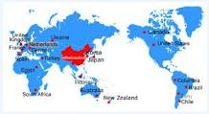
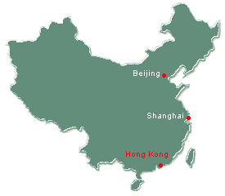
Overview of Hong Kong
Basic Information
Hong Kong is one of two
special administrative regions
(SARs) of the People's Republic
of China (PRC), the other being
Macau
Hong Kong is located on
China's south coast
Area: 1,104 km²
Population: slightly more than 7 million
High Density: 6,757 people/km²
(only 3.76 in Canada)
Currency: 1 CAD = 7.6837 HKD
Notes:
---Hk is located on China's south coast and enclosed by the Pearl River Delta and South China Sea
---With a land mass of 1,104 square kilometres and a population of seven million people, Hong Kong is one of the most densely populated areas in the world. with an overall density of some 6,426 people per 6,757people per square kilometer. 3.76 in Canada
(http://www.tradingeconomics.com/hong-kong/population-density-people-per-sq-km-wb-data.html)

Slide 4

Business Environment
Leading global financial trading center
Low taxation, free trade
Hong Kong stock exchange is the 7th largest in the world as of the end September 2011
market capitalization = US $2.08 trillion
Freest economy through 1995-2011 (Index of freedom)
World's largest re-export center
Notes:
---As one of the world's leading international financial centres, Hong Kong has a major capitalist service economy characterised by low taxation and free trade
---The Hong Kong Stock Exchange is the seventh largest in the world, with a market capitalisation of US$2.08 trillion as of end September 2011
---(http://www.sfc.hk/sfc/doc/EN/research/stat/a01.pdf)
---Hong Kong has remained as the world's freest economy, according to Index of Economic Freedom since the inception of the index in 1995
---Hong Kong is the world's largest re-export centre. Much of Hong Kong's exports consist of re-exports, which are products made outside of the territory, especially in mainland China

Slide 5
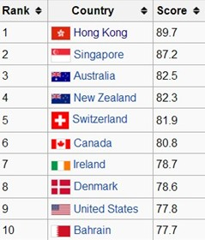
2011 Index of Economic Freedom

Slide 6
Factors Affecting Hong Kong Properties Market
Government policy & regulations
Interest rate
Population growth
Economy
Risk of bubble formation
Notes:
http://www.investopedia.com/articles/mortages-real-estate/11/factors-affecting-real-estate-market.asp#axzz1dQfAuhWa

Slide 7
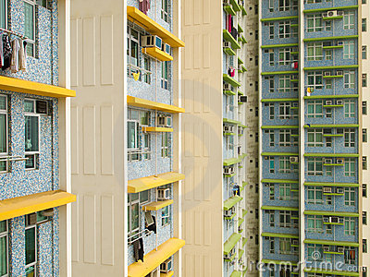
1) Government policy & regulations
Tax credits, deductions and subsidies→ boost demand
Land supply control
  Government controls the supply of new land and the land use planning
  Government determines when and how much new land will be put on the market as well as the uses allowed on this land
  Government leases land to private developers, land for non-institutional uses is generally leased to the highest bidder at public auction
  Significant source of revenue for the government
Public housing
  Government of Hong Kong provides
  affordable housing for lower-income residents
  Nearly half the population live in some sort
  of public housing
  Public housing is mainly built by the
  Hong Kong Housing Authority and
  the Hong Kong Housing Society
Notes:
Tax credits, deductions and subsidies are some of the ways the government can temporarily boost demand for real estate for as long as they are in place.

Slide 8
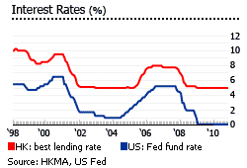
2) Interest rate
Decrease in interest rate→ cost to obtain a mortgage to buy a
home decreases→ higher demand→ price goes up
Best lending
rate fell to 5% from 5.25%
as the US Federal Funds
rate dropped to 0.13% in
December 2008 from 1.5%
Notes:
(http://www.eaa.org.hk/publications/guide/eng/sec6.pdf)
---Interest rates are an important factor as most purchasers depend on mortgage financing for their purchases
That is because as the interest rates fall, the cost to obtain a mortgage to buy a home decreases, which creates a higher demand for real estate, which pushes prices up.

Slide 9
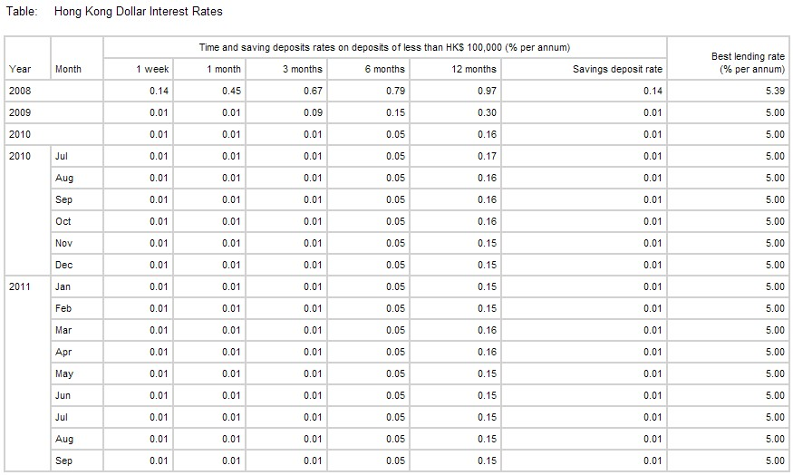
Best lending rate (Cont’d)

Slide 10
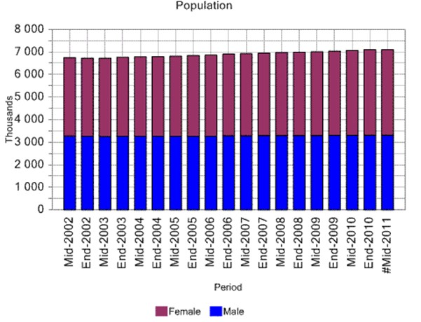
3) Demographics
Age, race, gender, income, migration patterns, and population growth
Population: 7,108,100 (at mid-2011)
Population growth rate: 0.6% (0.6% over mid-2010)
Affects how real estate
is priced and what
type of prosperities
are in demand
Notes:
http://www.censtatd.gov.hk/hong_kong_statistics/statistics_chart/index.jsp?subjectID=1&tableID=001&ID=1
HK Resident Population in mid-2011 was 7108100, in mid-2010 was 7,067,800
representing an increase of 40 300 or 0.6% over mid-2010
---Demographics are the data that describes the composition of a population, such as age, race, gender, income, migration patterns and population growth. These statistics are an often overlooked but significant factor that affects how real estate is priced and what types of properties are in demand

Slide 11
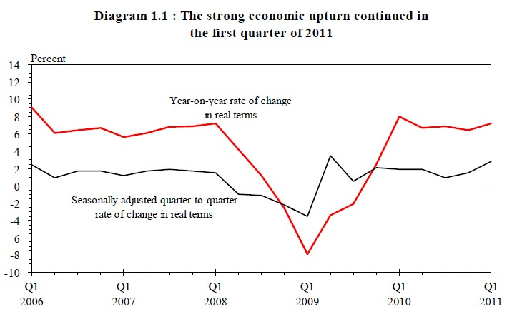
4) Economy
The Hong Kong economy stayed robust in the first quarter of 2011
Gross domestic product (GDP)
Notes:
(http://www.hkeconomy.gov.hk/en/pdf/er_11q1.pdf)
---The state of the economy and economic indices, particularly gross domestic product and the unemployment rate, will substantially affect demand for housing.
---If an economy goes through restructuring, its property market may experience some turbulence.

Slide 12
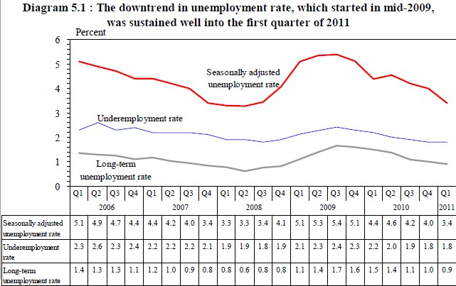
Unemployment rate (Cont’d)

Slide 13
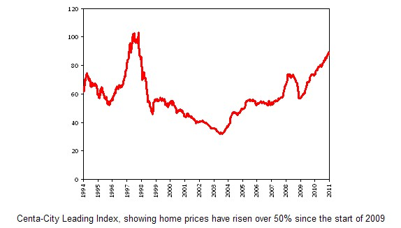
5) Risk of bubble formation
Home prices have increased over 50% since the start of 2009
Notes:
Property prices are at a fairly high level right now, If it continues to increase, it may form a bubble.

Slide 14
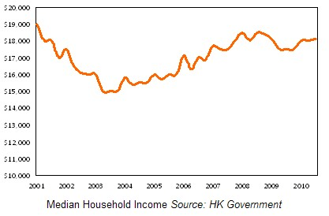
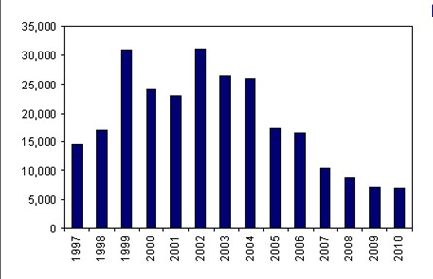
Alleged causes:
median household
income today is not
much different from
10 years ago
Population growth is minimal

Slide 15
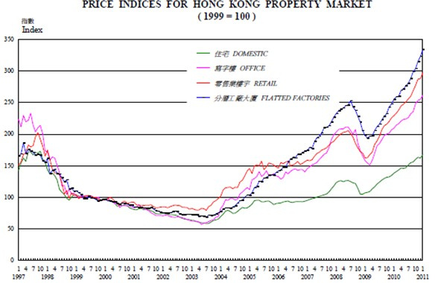
Price Indices by Property Type
Notes:
As explained above average rents and prices may change from one period to another not only
because of value changes but also because of variations in quality. The rental and price
indices, on the other hand, are designed to measure rental and price changes with quality kept
at a constant. Movement of indices may therefore differ from changes in the average rents and
prices for the same period.
The rental and price indices are derived from the same data that are used to compile average
rents and prices. The indices measure value changes by reference to the factor of rent or price
divided by rateable value of the subject properties rather than by reference to the rent or price
per square metre of floor area. In effect, by utilising rateable value, allowance is made not
only for floor area but also other qualitative differences between properties.
Following a General Revaluation of rateable values, the new rateable values are matched with
the old ones for the purpose of maintaining the index series.
The component index (the index for a property class or grade) has been derived from analysis
of all transactions effective in a given period. The composite index for a certain type of
premises is compiled by calculating a weighted average of the component indices. The
weights for compiling the composite index for each type of non-domestic premises are based
on the total floor area of components in respect of the current and previous 11 months. For
domestic premises the weights for both rental and price indices are based on the number of
transactions effected in the current and previous 11 months.
Monthly, quarterly and annual indices are shown. Quarterly and annual indices are the simple
average of the monthly indices in respect of the relevant period.
The indices, especially the rental indices, will tend to understate market trends. Although all
rents are analysed on a net basis (see paragraph 5 above), allowances will not be made for the
“value equivalent” of other contractual terms that are unknown to the Department. In a
“tenants market” for example, landlords are normally prepared to make concessions to tenants
such as refurbishment or the granting of extended rent-free periods. If rents were adjusted to
reflect standard terms of agreement, the rents as adjusted would tend to be lower than the
quoted rents when the index is moving downwards and vice versa.

Slide 16
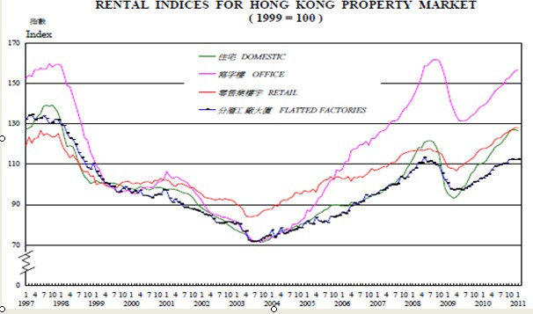
Price Indices by Property Type
Notes:
http://www.rvd.gov.hk/en/publications/pro-review.htm

Slide 17
Industry Structure
Hong Kong Property Market is an Oligopoly
Major Players:
  Cheung Kong (Holdings) Limited*
  Sun Hung Kai Properties*
  Henderson Land Development Company Limited*
  Sino Group*
  Hang Lung Properties Limited*
  Wharf (Holdings) Ltd
  New World Development Company Limited
  * These 5 companies make up the Hang Seng Property Index
Notes:
http://www.responsibleresearch.com/Hong_Kong_Real_Estate___Issues_for_Responsible_Investors___Full_Report.pdf
---The Hong Kong real estate market is an oligopoly, dominated by few major
developers

Slide 18
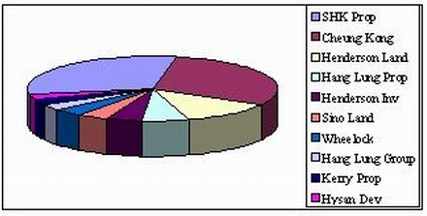
Hong Kong Property Market Share

Slide 19
Hang Seng Property Index
Capitalization-weighted stock market index
Record and monitor daily changes of the largest companies of the Hong Kong stock market
Is the main indicator of the overall market performance in Hong Kong
Notes:
(http://en.wikipedia.org/wiki/Hang_Seng_Index)
---The Hang Seng Property Index is a capitalization-weighted index of all the stocks
---It is designed to measure the performance of the property sector of the Hang Seng Index

Slide 20

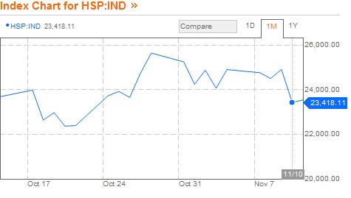
Notes:
(http://www.bloomberg.com/quote/HSP:IND)

Slide 21
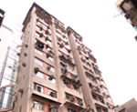
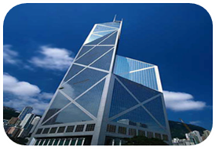
Core Business of Property Development
1)Residential sector
2)Office sector
Sector | Capital Values (Jan–Jun2011) | Rents (Jan–Jun2011)
Luxury | +16.2% | +4.9%
Mass | +10.1% | N/A

Slide 22
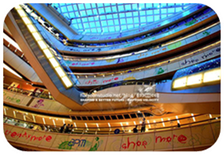
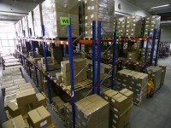
3)Retail sector
4)Warehouse sector
Overall, accelerating growth across all
property sectors in HK!!
Sector | Capital Values (Jan–Jun 2011) | Rents (Jan–Jun 2011)
High Street Shops | +21.3% | +9.7%
Overall Prime Shopping Centers | N/A | +5.5%
Premium Prime Shopping Centers | N/A | +7.9%
Sector | Capital Values (Jan–Jun 2011) | Rents (Jan–Jun 2011)
Warehouse | +13.6% | + 7.1%

Slide 23
Other Investments (Cont’d)
complementary operations
  Telecommunications
  Hotels
  Life technology
  Transportation
  diversified portfolio to generate revenues

Slide 24
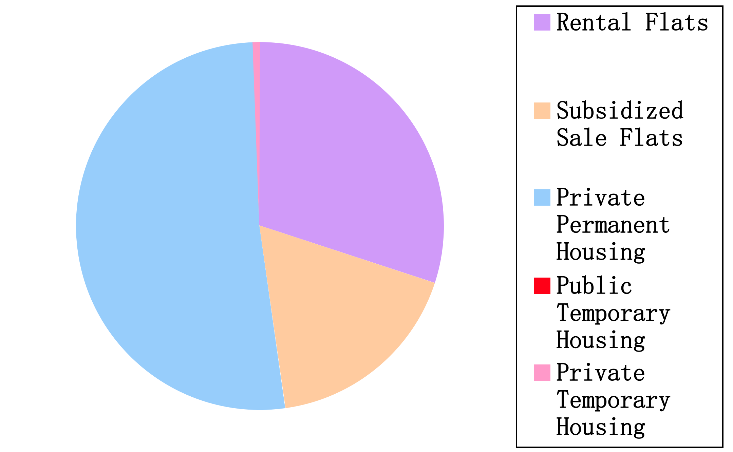
Distribution by Housing Type
Notes:
http://www.housingauthority.gov.hk/hdw/content/document/en/aboutus/resources/statistics/HIF2011.pdf

Slide 25
Profit Drivers
Size---large firms can influence government
Land bank---future Development
Timing of development---influence Market
Timing of property completion---reputation
Subsidiaries---conglomerates
Notes:
Size – Larger firms can influence government
Land Bank – Future Development
Timing of Land purchases – Influence Market
Timing of property completion – Primary Market
Subsidiaries - Conglomerates
Reputaion:
The land auction helps sentiment,'' said Peter Churchouse, who manages about $50 million in property-related stocks and real estate at Lim Advisors Ltd. in Hong Kong. ``People think if smart money like the Kwoks of Sun Hung Kai and the Lis of Cheung Kong is optimistic about the market, why shouldn't we be too?''

Slide 26
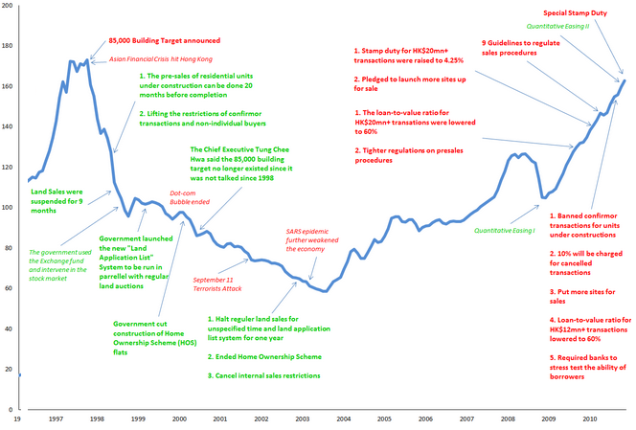
HK Property Market – History
Notes:
Source: 30-year History of Hong Kong Property Market in One Chart. 17 January, 2011, 1:47. Posted by Zarathustra. http://www.alsosprachanalyst.com/real-estate/real-estate-30-year-history-of-hong-kong-property-market-in-one-chart.html

Slide 27
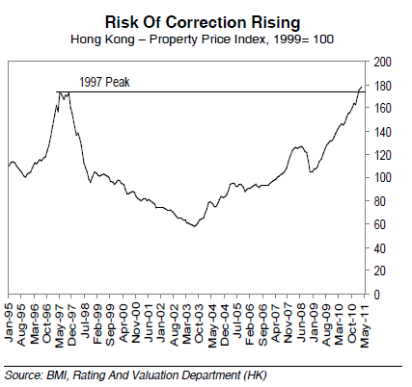
Downward Pressure on HK Property Market
Property price surpassed the 1997 peak by 5.1%
Factors supporting the property boom are waning
Current property prices are unsustainable
Notes:
Source: Chapter 2: Economic Outlook. (2011). Hong Kong Business Forecast Report, (4), 11-17.

Slide 28
Downward Pressure on HK Property Market
HK Monetary Authority Tightens Mortgage Restrictions
Interest Rates Remain Low in HK, But Mortgage Rates Tick Up
≈ 20~30% of Buyers of New HK Property are from Mainland China
Slowing growth of money supply in the mainland & ongoing credit tightening measures
For residential property ≥ HKD 10mn → limit mortgages to 50% of the property’s value
Property ∈ [HKD 7mn, 10mn] → limit mortgages to 60% of the property’s value
Property ≤ HKD 7mn → loans capped at HKD 4.2mn
For nonlocals, caps at least 10% points lower
→ Downward pressure on demand
→ Help deter speculation and dampen buying sentiment
→ Upward pressure on mortgage rates
& increasing interest in yuan deposits
Rampant loan growth & tightening HK dollar liquidity
Notes:
Source: Chapter 2: Economic Outlook. (2011). Hong Kong Business Forecast Report, (4), 11-17.

Slide 29
HK Property Market – Social Issue
Stem
Over-reliance on land receipts as gov’s main revenue source
Problem
Developed economy with world`s widest rich-poor gap;
Solution
New levies on capital gain;
Homebuyers shoulder the cost burden
Reinstate estate duty;
Curb land hoarding;
Remove artificial restrictions on land supply
Notes:
Source: HONG KONG’S LAND POLICY: A RECIPE FOR SOCIAL TROUBLE. By Alice Poon. January 2011. http://www.hkjournal.org/PDF/2011_spring/3.pdf

Slide 30
HK Lands Department
Main Functions
Land Disposal for Development Purpose
Valuation of Land and Property
Acquisition of Private Land for Public Projects
Maintenance of Geodetic Survey Control Network
Land Boundary Survey
Aerial Survey
Land Lease Re-grant and Modification
Land Control and Lease Enforcement
Map Production
Maintenance of Slopes on Unallocated Government Land
Approve Pre-sale of Uncompleted Flats and Deeds of Mutual Covenant
Notes:
Source: Lands Department http://www.landsd.gov.hk/en/about/welcome.htm

Slide 31
HK Land Registry
Main Functions
Registration of documents affecting land under the Land Registration Ordinance
Provision of facilities for search and supply of copies of and the Land Registry and related records
Upon the commencement of the Land Titles Ordinance, the Land Registry will implement the Title Registration System in HK
Currently using the Deeds Registration System, under which instruments affecting real properties are lodged with the land Registry for registration
System
Registration of owners corporations under the Building Management Ordinance
Notes:
Source: http://www.landreg.gov.hk/en/about/lrback.htm

Slide 32
HK Property Market – Land Sales
Land Auction
Oral bidding
Tenders
Sealed bidding
Most land in metropolitan area sold using this method
Users strictly defined
Government examines detailed proposals
Private Treaty
Sales to non-profit organizations (school, hospital, etc.)

Slide 33
HK Property Market – Land Auction
i
Beginning of the year, the Land Department conducts market research to learn about land developers’ & market demand of land
ii
Based on demand & relevant government policy, the Land Department produces and publicizes a list of lands for sale
iii
Land developers submit land transaction applications of lands they are interested to purchase
iv
Government announces successful applications and designated lands to be auctioned
V
Land Auction→ floor price set equal to price specified in the land transaction application→ highest bids win
vii
Successful bidders sign contracts and other relevant documents
vi
If no bidder, the developer who submitted the land transaction application gets the land and pay the price specified in the land transaction application
Notes:
Source: http://baike.baidu.com/view/2426700.html
1、每年年初香港地政总署进行前期市场调研，了解开发商和房地产市场的土地需求情况；
2、地政总署根据开发商和市场的需求，结合政府意识制定年度土地出让的勾地表，并公示勾地表的所有土地；
3、开发商对有需求的土地进行勾地；
4、政府提前一个月对成功勾出的土地进行拍卖公示；
5、土地拍卖，以勾地者最初勾地价为底价，价高者得；
6、如无应价者，土地由勾地者以最初勾地价成交；
7、土地购入者签署土地使用合同，办理相关手续。

Slide 34
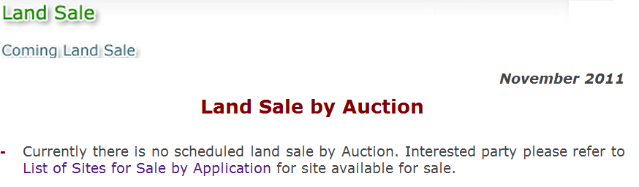
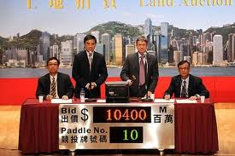
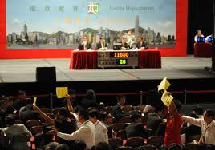
HK Property Market – Land Auction

Slide 35
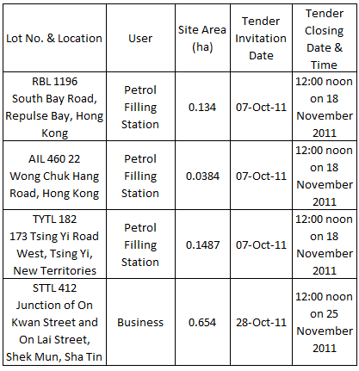
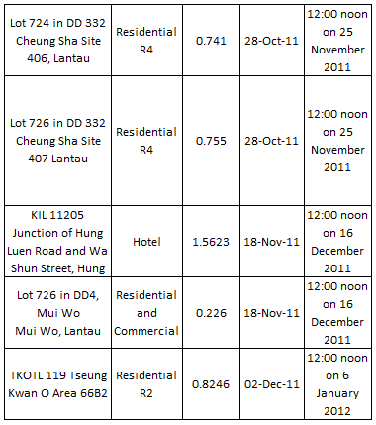
Land Sale – by Tender
Notes:
Source: Lands Department http://www.landsd.gov.hk/en/about/welcome.htm

Slide 36
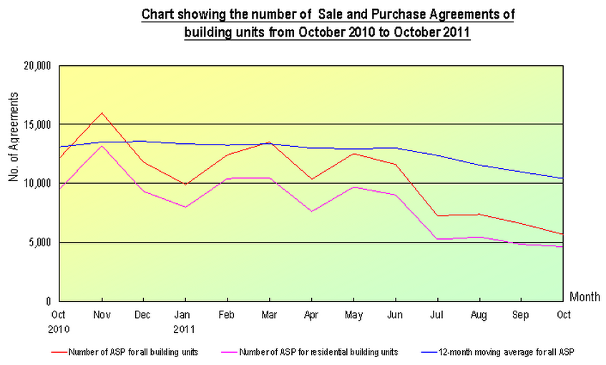
HK Property Market – Sale
Notes:
Source: http://www.landreg.gov.hk/en/monthly/monthly.htm

Slide 37
Mainland China Economy – Overview
2nd-biggest economy since the 2nd quarter of 2010
Nominal GDP US$1.34 trn in 2010
Becoming a major driver of the global economy
Notes:
Source: Economic performance. Country Report. China; Oct2010, Issue 10, p14-16, 3p

Slide 38
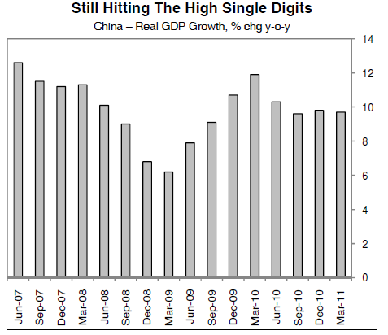
Mainland China Economy – Overview
Notes:
Source: China: Growth And Interest Rate Forecasts Revised Up. Emerging Markets Monitor, 4/25/2011, Vol. 17 Issue 5, p6-6, 1p

Slide 39
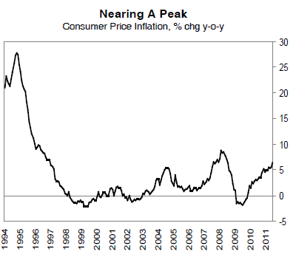
Mainland China Economy -- Overview
Notes:
Source: China Business Forecast Report, Oct2011, Issue 4, p13-24, 12p, 5 Charts, 15 Graphs

Slide 40
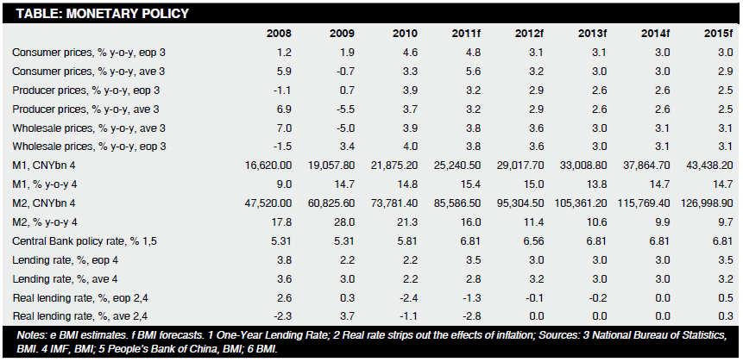
Mainland China Economy – Monetary Policy
Notes:
Source: China Business Forecast Report, Oct2011, Issue 4, p13-24, 12p, 5 Charts, 15 Graphs

Slide 41
Mainland China Economy – Stock Market
Shanghai Stock Exchange (1990) & Shenzheng Stock Exchange (1991)
  A-shares
  B-shares: special shares dominated in the Yuan
  H-shares: overseas investment shares which are listed abroad
Stock Act of the People’s Republic of China (in effect since July 1999) implemented by the Standing Committee of the National People’s Congress→ regulate China’s stock market
Notes:
An Analysis of China's Stock Market in the First 10 Years.
By: Siwei Cheng. Review of Pacific Basin Financial Markets & Policies, Dec2009, Vol. 12 Issue 4, p629-653, 25p, 2 Graphs

Slide 42
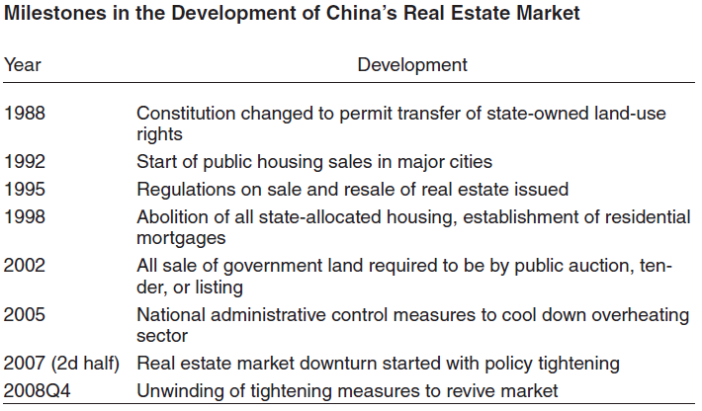
Mainland Property Market – Milestones
Notes:
Source: Xi, R., & Yinggang, Z. (2010). China's Real Estate Market: Mid-Term Correction and Long-Term Growth. Chinese Economy,43(2), 23-32. doi:10.2753/CES1097-1475430202

Slide 43
Mainland China Economy – Stock Market
The 10-year development of China’s stock market indicates that the security market plays an important role in the economic development
Issues to be solved:
  Small Scale and Shallow Depth
  Over Half of the Stocks are Non-Tradable (state-owned & legal person share)
  Numerous Transactions but No Fictitious Transaction
  Significant Influences of he Policies
  Serious Tendency Towards Excessive Speculation
  Lots of Bubbles in the Stock Market
  Prevalence of Short-Term Acts

Slide 44
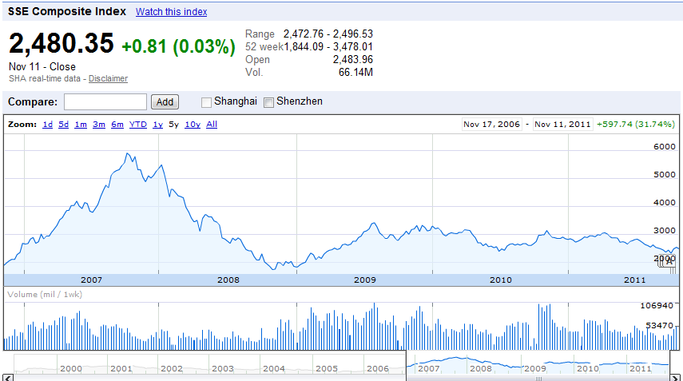
Mainland China Economy – Stock Market
Notes:
Source: http://www.google.com/finance?q=SHA:000001

Slide 45

Mainland Property Market -Overview
Real estate sales in the form of transfer of right to use land
Land users sign land-grant contract with local land authority and pay fees
Max. Term of Land Grant
Commercial → 40yrs
Industrial → 50yrs
Residential → 70yrs
Notes:
Source: The China Property Takeaway. Osborne, Simon. Asian Investor, Nov2010, p46-49, 4p
Source: China Real Estate Market - Laws and Regulations Concerning Land and Real Estate. By Xiannian Ye. http://www.china-window.com/china_market/china_real_estate/china-real-estate-market--7.shtml

Slide 46
Mainland Property Market - Factors
Strong Fundamentals in the Long-term
Strong GDP Growth
Disposable Income, Middle Class Growth and Strong Upgrade Demand
Rural Migration to Cities
300 million new households in past 20yrs
Low Household Leverage, High Saving Rates
Healthy Banking Sector
Notes:
Source: China’s Real Estate Sector: Looming Bubble or Long-term Boom? http://www.slideshare.net/Exolus/chinas-real-estate-sector

Slide 47
Mainland Property Market – Regions
Yangtze River Delta
Pearl River Delta
Bohai-Rim
Shanghai, Nanjing, etc.
Shenzhen, Guangzhou, etc.
Beijing, Dalian, Qingdao, etc.
Western Region
Xi’an, Chengdu, etc.
Real estate has been thriving in Chinese urban cities and towns, largely concentrated in the Eastern coastal areas, and some pockets in Northern as well as Central Western China
Notes:
Source: China Estate A Boom Or A Bubble? April 2010. BRIC Spotlight Report. http://www.thomaswhite.com/pdf/bric-spotlight-report-china-real-estate-april-10.pdf

Slide 48
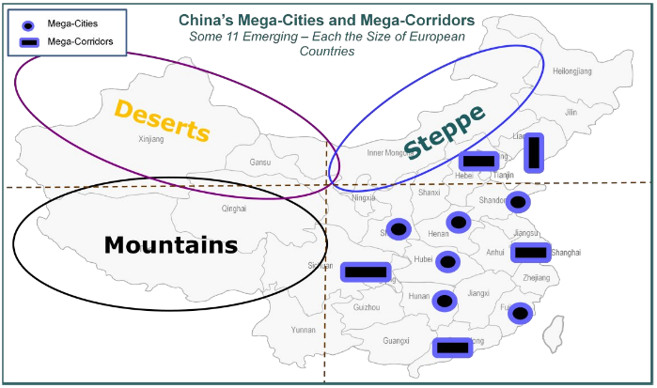
Mainland Property Market – Regions
Notes:
Source: China’s Real Estate Sector: Looming Bubble or Long-term Boom? http://www.slideshare.net/Exolus/chinas-real-estate-sector

Slide 49
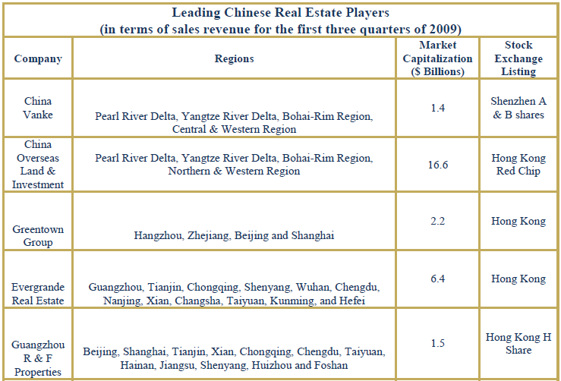
Mainland Property Market – Key Players
Notes:
Source: China Estate A Boom Or A Bubble? April 2010. BRIC Spotlight Report. http://www.thomaswhite.com/pdf/bric-spotlight-report-china-real-estate-april-10.pdf

Slide 50
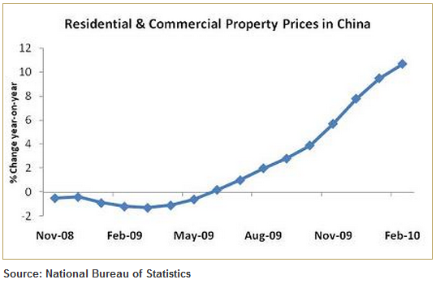
Mainland Property Market – Residential
Facts
≥ 70% of real estate investment in China originate from bank loans
↑ in housing prices exceeded the ↑ in income by 30% in Shanghai and 80% in Beijing (GS)
Real estate investment accounts for roughly 11% of its GDP
Notes:
Source: China Estate A Boom Or A Bubble? April 2010. BRIC Spotlight Report. http://www.thomaswhite.com/pdf/bric-spotlight-report-china-real-estate-april-10.pdf

Slide 51
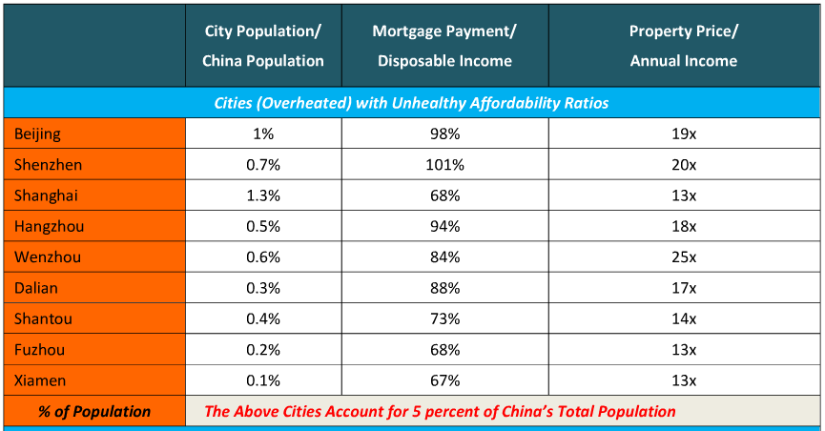
Mainland Property Market – Affordability
Notes:
Source: China’s Real Estate Sector: Looming Bubble or Long-term Boom? http://www.slideshare.net/Exolus/chinas-real-estate-sector

Slide 52
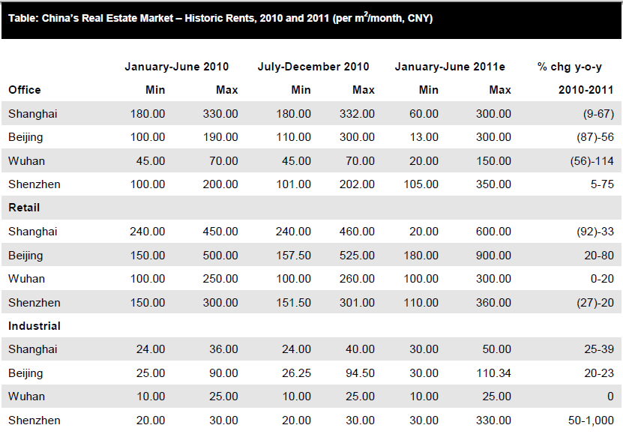
Mainland Property Market – Rents
Notes:
Source: China Real Estate Report, Q4 2011, Vol. 3 Issue 4, p11-15, 5p, 4 Charts
Source: China Real Estate Report, Q1 2011, Vol. 3 Issue 1, p17-25, 9p, 4 Charts, 1 Graph

Slide 53
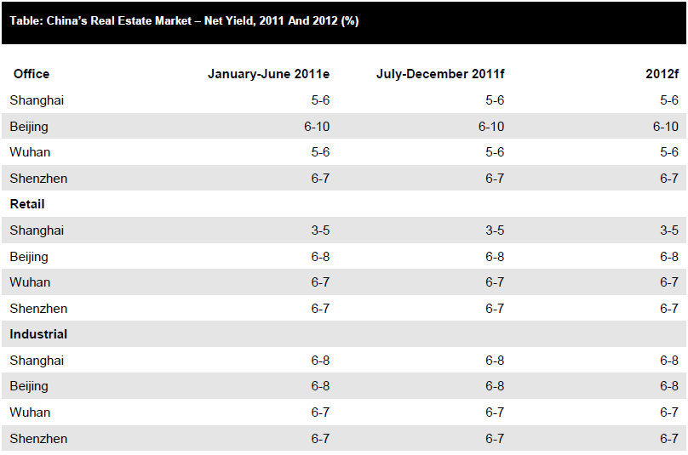
Mainland Property Market – Net Yield
Notes:
Source: China Real Estate Report, Q4 2011, Vol. 3 Issue 4, p11-15, 5p, 4 Charts

Slide 54
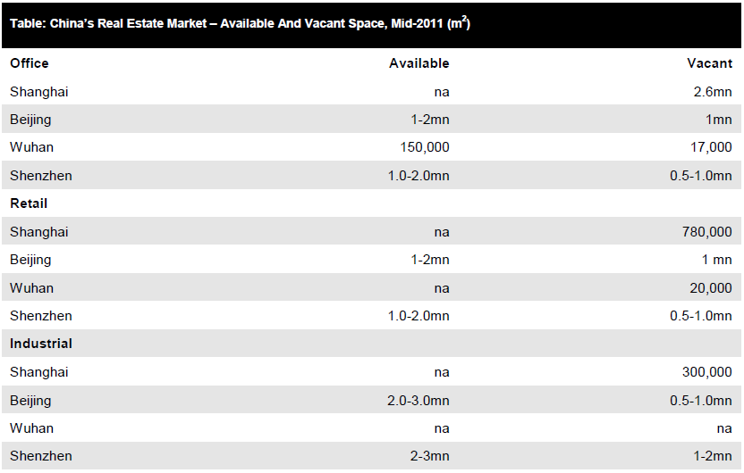
Mainland Property Market – Vacancy
Notes:
Source: China Real Estate Report, Q4 2011, Vol. 3 Issue 4, p11-15, 5p, 4 Charts
Source: China Real Estate Report, Q4 2011, Vol. 3 Issue 4, p10-10, 1p

Slide 55
Mainland Property Market – Signs of Weakness
China’s residential housing market = engine of growth for the entire economy
Market is extremely overvalued and price declines are highly likely over the medium term
Evidence
SouFun: avg. selling price ↓ by 7% m-o-m nationwide
Moody downgraded China’s property sector ∵ expectation of price decline & financing concerns
Notes:
Source: China: Growth And Interest Rate Forecasts Revised Up. Emerging Markets Monitor, 4/25/2011, Vol. 17 Issue 5, p6-6, 1p

Slide 56
Mainland Property Market – Gov. Policy
Significant ↑ in Land Supply & Focus on Economic Housing
Authorities made 185,000 ha of new land available for housing development in 2010
Tough Mortgage Policies – Downpayment Ratios & Mortgage Rates
2nd purchase: downpayment ≥50%, mortgage rates cannot be less than 1.1% of best lending rate
77% allocated for the development of small/medium housing
13% reserved for social welfare housing
1st home purchase: ≤ 90sqm → 20%; ≥ 90sqm → 30% downpayment
3rd or more: State Council announces that commercial banks have the right to restrict mortgages in areas with overheating property prices
Notes:
Source: China’s Real Estate Sector: Looming Bubble or Long-term Boom? http://www.slideshare.net/Exolus/chinas-real-estate-sector

Slide 57
Mainland Property Market – Future Policies
Clamp Down on Land Hoarding
By reclaiming the land from developers, not applied nationwide
Others – Loan Restrictions to Developers
The Ministry of Land and Natural Resources reclaimed 11,300ha, during March to July 2010
Taxes
Property Tax → discourage excessive land hoarding and speculation
Real Estate Tax → for self-owned properties a tax rate of 1.2% will be applied to a taxable base
Notes:
Source: China’s Real Estate Sector: Looming Bubble or Long-term Boom? http://www.slideshare.net/Exolus/chinas-real-estate-sector

Slide 58

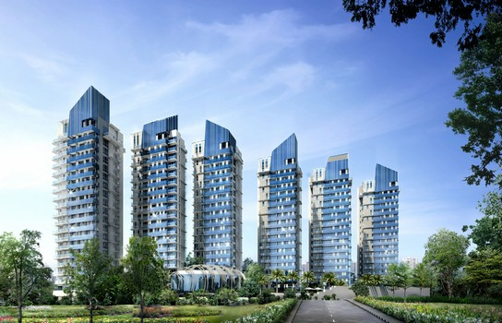

Slide 59

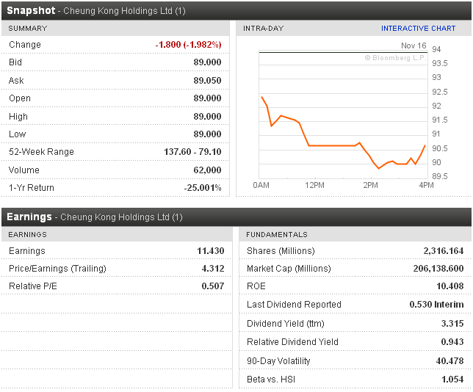
Last Trading Day Performance

Slide 60
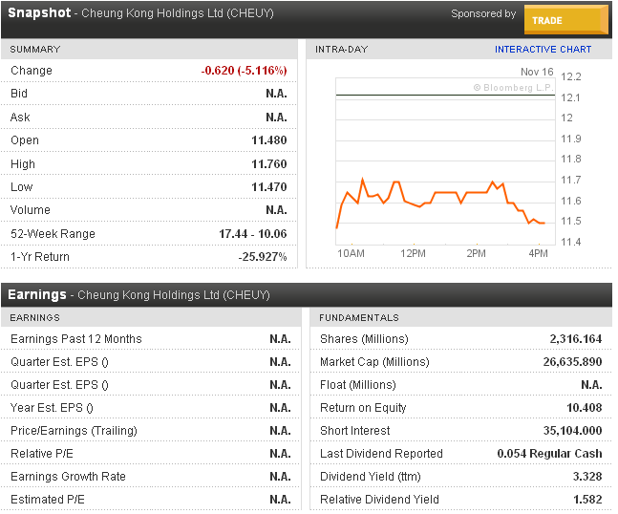
Last Trading Day ADR 1 HKD = 0.1286 USD 1 USD = 7.7760 HKD

Slide 61
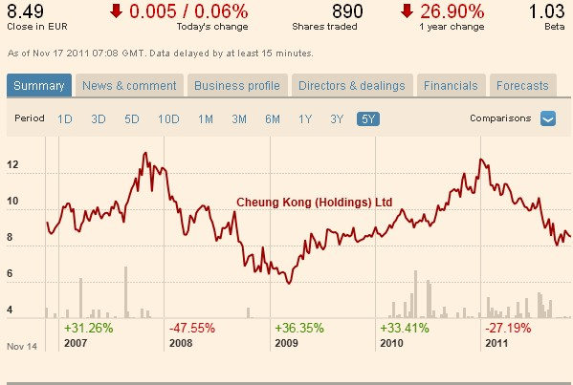
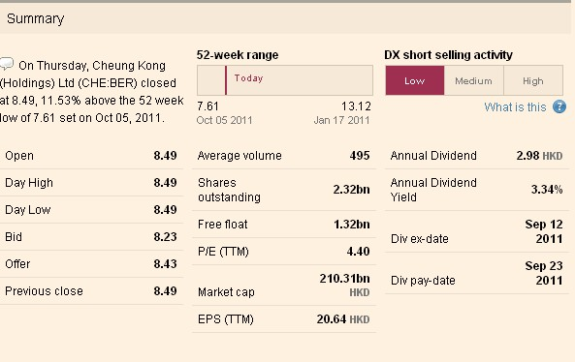
Last Trading Day BER 1 HKD = 0.0935 EUR 1 EUR = 10.6952 HKD

Slide 62
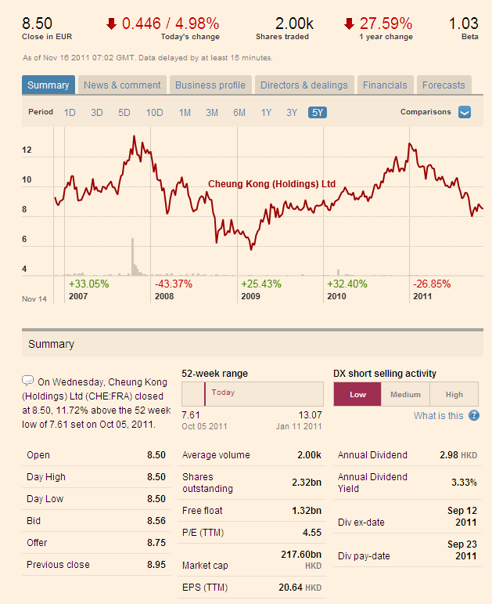
Last Trading Day FRA

Slide 63
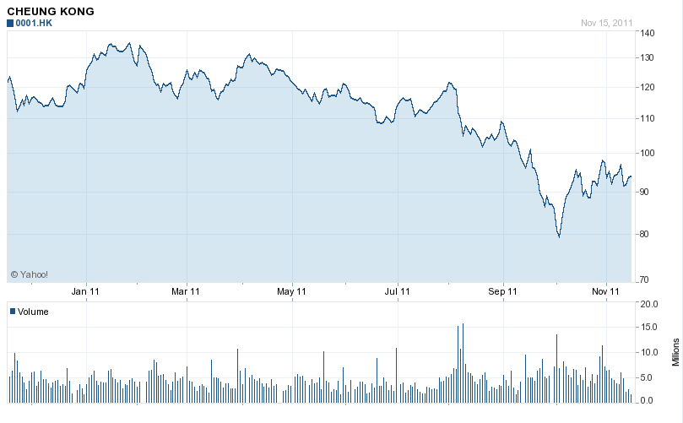
HK V.S. ADR 1 Year

Slide 64
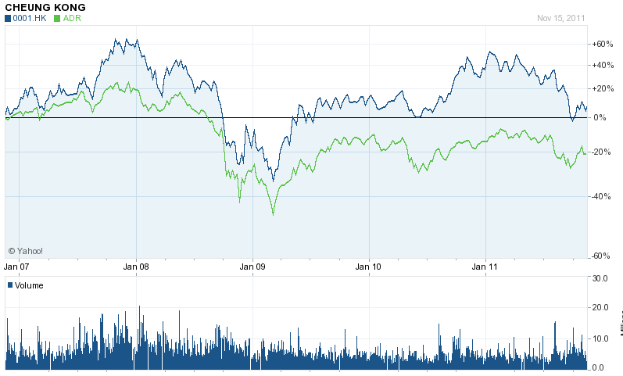
HK V.S. ADR 5 Year

Slide 65
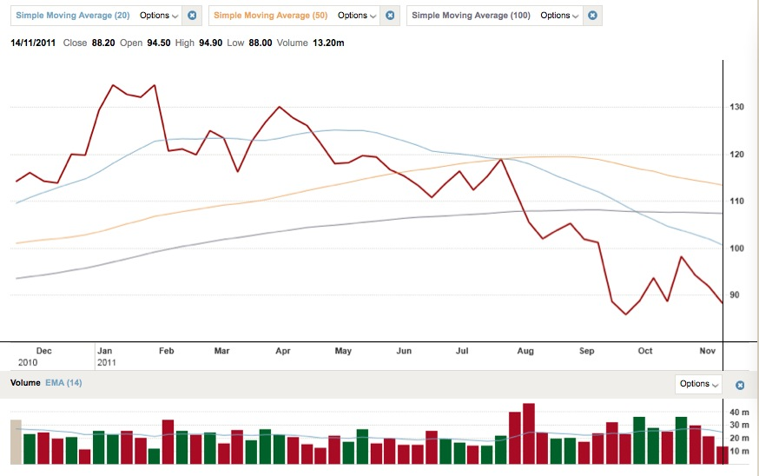
1 Year Performance

Slide 66

5 Year Performance

Slide 67

Stock Performance V.S. HSI 5 Years
Notes:
Berlin Stock Exchange
Frankfurt Stock Exchange

Slide 68

Stock Performance V.S. HSPI 5 Years

Slide 69

Comparative Analysis

Slide 70
History
1950: Founded by Li Ka Shing as Cheung Kong Industries
1972: Listed on the Hong Kong Stock Exchange
1977: CKH diversified into the hotel trade. It acquired Wynncor Limited, which owned the 800-room Hong Kong Hilton Hotel and shopping arcade, and nearly all of the 400-room Bali Hyatt Hotel
1979: Acquired Hutchison Whampoa
1981: Start oversea investment
1985: Acquired Hong Kong Electric Holdings Limited (renamed Power Assets Holdings Limited)
1996: Cheung Kong Infrastructure Holding limited organized, led by Victor Li
1997: Cheung Kong restructured its business

Slide 71
Overview
An investment holding company that engages in property development
Primarily operates in Asia
One of the largest developers in Hong Kong of residential, commercial and industrial properties
About 1/7 private residences in Hong Kong were developed by the company
Also operates in life sciences, information technology and internet business
Flagship of the Cheung Kong Group
Headquartered in Hong Kong
Notes:
Datamonitor, published in 26th August, 2011

Slide 72
Risk Factors
Global Financial and Credit Crisis
Property Developments
Industry Trends and Interest Rates
Highly Competitive Markets
Currency Fluctuations
Strategic Partners
Impact of Local, National and International Regulations
Impact of New Accounting Standards
Outbreak of Highly Contagious Disease
Connected Transactions
The Hutchison Whampoa Group’s Influences
Natural Disasters
Past Performance and Forward Looking Statements

Slide 73
Corporate Profile
Cheung Kong (Holdings) Limited (stock code: 0001)
  Hong Kong Electric Holdings Limited (stock code: 0006)
  Hutchison Telecommunications Hong Kong Holdings Limited (stock code: 0215)
  Hutchison Whampoa Limited (stock code: 0013)
  Cheung Kong Infrastructure Holdings Limited (stock code: 1038)
  Hutchison Harbour Ring Limited (stock code: 0715)
  CK Life Sciences Int'l., (Holdings) Inc. (stock code: 0775)
  TOM Group Limited. (stock code: 2383)
Operates in 53 countries and employs about 250,000 staff worldwide
Key countries include: Mainland China, Singapore, United Kingdom

Slide 74

Group Structure as at 31 Oct, 2011

Slide 75

Cheung Kong Group
Total Market Capitalization=HK$ 785 Billion

Slide 76


Market Capitalization

Slide 77


Market Capitalization

Slide 78


Market Capitalization

Slide 79

Market Capitalization

Slide 80

Property-Sales
Notes:
As a fully-integrated, multi-discipline property development company, Cheung Kong Holdings is one of the largest developers of residential, office, retail, industrial, and hotel property in Hong Kong. With its long history of property development expertise, Cheung Kong Holdings has built many of Hong Kong's most notable landmark buildings and complexes. The company is also a leader in marketing and after-sales services. Our sales, leasing, and building management departments provide comprehensive services to our clients and customers, fulfilling our ambition of meeting every property need that our purchasers and tenants may have.

Slide 81





Property-Leasing
Industrial
Building
Shopping Centre
Office

Slide 82

Development Completed and Scheduled for Completion in 2011 (Hong Kong Projects)

Slide 83




Property-Completed Developments in Hong Kong

Slide 84

Development Completed and Scheduled for Completion in 2011 (Mainland Projects)

Slide 85

Property- Mainland Projects

Slide 86

Property- Overseas Properties-Singapore
Cairnhill Crest*
Costa del Sol*
Marina Bay Financial Centre
One Raffles Quay*
The Vision*
Thomson Grand
*already sold

Slide 87

Management Team

Slide 88


Slide 89

Disclosure of Interest- Long Positions in Shares
As at 30th June, 2011

Slide 90

Li Ka Shing
Age 83
Founder of Cheung Kong Group
Chairman of Cheung Kong (Holdings) Ltd. Since 1971
  Chairman of Hutchison Whampoa Ltd. since 1981
Honorary citizen of many cities on Mainland and Overseas
Established Cheung Kong Industries , a plastic manufacturing company, in 1950
Transformed the company into a real estate investment company, listed on Hong Kong Stock Exchange in 1972
Acquired Hutchison Whampoa in 1979 and Hong Kong Electric Holdings Ltd. In 1985

Slide 91

Li Ka Shing
Created a charitable foundation in 1980 – The Li Ka Shing Foundation
Founded Shantou University (Shantou, China) in 1981 – 9 colleges with medical school and affiliated hospitals
Has 2 sons:
  Victor – Managing Director and Deputy Chairman of Cheung Kong (Holdings) Ltd., Deputy Chairman of Hutchison Whampoa, Chairman of Cheung Kong Infrastructure Holdings Ltd and CK Life Sciences International (Holdings) Inc.
  Richard - Chairman of PCCW (Asia’s leading info tech and telecommunications company)

Slide 92

Li Tzar Kuoi, Victor
Aged 47
Deputy Chairman and Managing Director since 1999
Began career at CKH in 1985
Deputy Managing Director (1993-98)
Executive Director and Deputy Chairman of Hutchison Whampoa Ltd
Chairman of CK Infrastructure Holdings Ltd and CK Life Sciences Int’l Inc
Executive Director of HK Electric Holdings Ltd.
Co-chairman of Husky Energy Inc.
Director of Hong Kong and Shanghai Banking Corporation (HSBC)
Bachelor of Science degree in Civil Engineering
Master of Science degree in Structural Engineering
Honorary degree (Doctor of Laws)

Slide 93

Li Tzar Kuoi, Victor
Vice chairman of Hong Kong General Chamber of Commerce.
Member of:
Standing Committee of the 11th National Committee of the Chinese People’s Political Consultative Conference of the People’s Republic of China
Commission on Strategic Development
Greater Pearl River Delta Business Council
Council for Sustainable Development of the Hong Kong Special Administrative Region

Slide 94

Kam Hing Lam
Brother-in-law of Li Ka-Shing, Uncle to Victor Li
Aged 64
Deputy Managing Director since 1993
Group Managing Director of Cheung Kong Infrastructure Holdings Ltd.
President and CEO of CK Life Sciences International
Executive Director of Hutchinson Whampoa Ltd. and Hong Kong Electric Holdings Ltd.
Non-executive Director of Spark Infrastructure Group
Member of the 11th Beijing Committee of the Chinese People's Political Consultative Conference of the People's Republic of China
Bachelor of Science degree in Engineering
Master’s degree in Business Administration
Council for Sustainable Development of the Hong Kong Special Administrative Region

Slide 95


Executive Directors
LI Ka-shing
LI Tzar Kuoi Victor
KAM Hing Lam
IP Tak Chuen, Edmond
CHUNG Sun Keung, Davy
PAU Yee Wan, Ezra
WOO Chia Ching, Grace
CHIU Kwok Hung, Justin

Slide 96

Non - Executive Directors
LEUNG Siu Hon
FOK Kin-ning, Canning
Frank John SIXT
CHOW Kun Chee, Roland
George Colin MAGNUS

Slide 97


Independent Non- Executive Directors
KWOK Tun-li, Stanley
YEH Yuan Chang Anthony
Simon MURRAY CHOW
Nin Mow, Albert
HUNG Siu-lin, Katherine
WONG Yick-ming, Rosanna
CHEONG Ying Chew, Henry

Slide 98
Financial Statement Analysis
Interim Financial Analysis
Annual Financial Analysis
Financial Highlights

Slide 99

10 Year Financial Summary

Slide 100

10 Year Financial Summary

Slide 101


Financial Highlights

Slide 102
2011 Interim Revenue Results
CKH generates revenues through 4 business divisions:
  Property sales (Turnover for the first half 2011 was HK$ 24118 million, and increase of HK$ 5474 million)
  Property rental (Turnover was HK$662 million, an increase of HK$48 million)
  Hotels and serviced suites (Turnover was HK$1,151 million, an increase of HK$223 million)
  Property and project management (Turnover was HK$172 million, an increase of HK$1 million)

Slide 103

Financial Highlights for 2011 Interim Results

Slide 104

Consolidated Statement of Financial Position
As at 30th June, 2011

Slide 105

Consolidated Income Statement
For the six months ended 30th June, 2011

Slide 106

Consolidated Statement of Comprehensive Income
For the six months ended 30th June, 2011

Slide 107
Consolidated Statement of Comprehensive Income
For the six months ended 30th June, 2011

Slide 108

Condensed Consolidated Statement of Cash Flows
For the six months ended 30th June, 2011

Slide 109

Turnover and Contribution
Six months ended 30th June, 2011

Slide 110

Turnover and Contribution
Six months ended 30th June, 2011

Slide 111

Financial Highlights for 2010

Slide 112

Consolidated Statement of Financial Position
As 31st December, 2010

Slide 113

Consolidated Income Statement
For the year ended 31st December, 2010

Slide 114

Consolidated Statement of Comprehensive Income
For the year ended 31st December, 2010

Slide 115

Consolidated Statement of Cash Flows
For the year ended 31st December, 2010

Slide 116

Turnover and Contribution ended 31st December, 2010

Slide 117

Turnover and Contribution ended 31st December, 2010

Slide 118

Recommendation

Slide 119



Slide 120

Last Trading Day Performance

Slide 121

Last Trading Day ADR
1 HKD = 0.1286 USD 1 USD = 7.7760 HKD

Slide 122


Last Trading Day BER
1 HKD = 0.0935 EUR
1 EUR = 10.6952 HKD

Slide 123

HK V.S. ADR 5 Years

Slide 124

HK V.S. BER 5 Years

Slide 125

HK V.S. FRA 5 Years

Slide 126

HK V.S. MUN 5 Years

Slide 127

1 Year Performance

Slide 128

5 Year Performance

Slide 129

Comparative Analysis

Slide 130

Stock Performance V.S. HSI 5 Years

Slide 131

Stock Performance V.S. HSPI 5 Years

Slide 132

Corporate Profile

Slide 133
Basic Facts
A listed corporation on the Hong Kong Stock Exchange in 1972
Controlled by the family trust set up by Kwok Tak Seng, who founded the company in 1963 together with Fung King-hei and Lee Shau Kee
One of many non-British owned companies
One of the largest property companies in Hong Kong
Specializes in premium-quality residential and commercial projects for sale and investment
Employs more than 35,000 people

Slide 134
Business
Core Business
Development of property for sale and investment
Complementary Operations
Hotels
Property management
Investments
Telecommunications
Information technology
Construction
Insurance and mortgage services
Infrastructure and other businesses

Slide 135

Business Structure

Slide 136
Group Finance
Financial policies: maintaining high liquidity and low ratio of debt to assets
Majority of financing is in Hong Kong dollars→ very low foreign exchange risk
Has always attained the highest credit ratings amongst Hong Kong developers
Moody’s gives the Group an A1 rating with a ‘stable’ outlook
Standard & Poor’s raised the Group’s rating from A to A+ with a ‘stable’ outlook in December 2010

Slide 137
Property Sales
Revenue from joint-venture projects, HK$46,478 million, increase of 209% over last year
Profits generated from property sales, HK$16,647 million, increase of 152%
Sold or pre-sold a record HK$39,148 million worth of properties in attributable terms during the year

Slide 138
Rental Income
Rental income growth
  Higher rents for new leases
  Continued positive rental reversions
  Increased contributions from new properties
Gross rental income including contributions from joint-venture projects, HK$12,609 million, an increase of 14%
Net rental income, HK$9,511 million, an increase of 14%
HK$1,158 million in gross rental income from mainland properties

Slide 139




Rental Income

Slide 140

Hong Kong

Slide 141
Land Bank
Land bank of 44.2 million square feet in terms of attributable gross floor area
Consist of 27.7 million square feet of completed investment properties and 16.5 million square feet of properties under development
Own over 26 million square feet of farmland in the New Territories
Acquired four new sites during the year
Acquired two residential sites totalling 2.2 million square feet gross floor area after financial year end
Notes:
Acquired two residential sites subsequent to the end of the financial year, which will be developed into high-quality residential premises, mainly small-to-medium sized units. The 1.4-million-squarefoot development on the waterfront of Tung Chung in the New Territories will enjoy marvellous sea views, and the other one by an MTR station in Tseung Kwan O town centre will have a gross floor area of nearly 800,000 square feet. This will
be connected to the Group’s nearby residential and integrated projects under construction to build synergy.

Slide 142

Notes:
The Group holds a diverse portfolio in terms of usage. Residential premises for sale account for 71 per cent of the development land bank and 73 per cent of the completed investment properties are shopping malls or prime offices.
The Group’s development land bank is also geographically diverse. About 25 per cent of the sites are in urban areas and the remainder are spread across new towns in the New Territories; most supported by convenient rail and highway transport networks. Completed investment properties are divided 38 per cent in the New Territories and 62 per cent in Kowloon and on Hong Kong Island.

Slide 143

Hong Kong Land Bank Composition

Slide 144




Property Development
Achieved exceptional results in the pre-sale market, selling or pre-selling HK$36,897 million, an increase of 79%
New projects put on sale: Valais at Beas River, Larvotto in Island South, One Regent Place in Yuen Long, Avignon on Castle Peak Road and i.UniQ Residence in Island East
Builds a wide range of premium products with diversified flat mixes
Completed seven projects with 2.9 million square feet of attributable gross floor area

Slide 145

Completed Property Development projects

Slide 146






Major Projects Under Development

Slide 147








Major Projects Under Development (Cont’)

Slide 148



Slide 149

Property Investment
Own the largest portfolio of quality investment properties totalling 27.7 million square feet with over 95 per cent leased
  Office Portfolio
  Retail Portfolio
  Residential and serviced suites

Slide 150









Slide 151

Property Investment

Slide 152


Major Completed Investment Properties

Slide 153



Slide 154

New Sites

Slide 155

Mainland China

Slide 156
Land Bank
Added 5.6 million square feet of gross floor area to its land bank
Major acquisitions: 40% interest in a residential development in the resort area of Zhijiang in Hangzhou, 35 % in an integrated project in Minhang, Shanghai
Land bank of 86.1 million square feet in terms of attributable gross floor area
Include 78.6 million square feet of properties for development and 7.5 million square feet of completed properties for rent

Slide 157


Slide 158

Mainland Land Bank Composition

Slide 159

Land Bank Comparison

Slide 160
Property Development
Adhere to its selective and focused strategy on the mainland, concentrating on major cities including Beijing, Shanghai, Guangzhou and Shenzhen
Recorded property sales of over HK$2,000 million in the year, including sales of the second phase of Lake Dragon in Guangzhou
Seven projects with 5.6 million square feet of attributable gross floor area were completed during the year

Slide 161

Completed Property Development Project

Slide 162












Major Projects Under Development

Slide 163











Major Projects Under Development (Cont’)

Slide 164








Major Projects Under Development (Cont’)

Slide 165


Major Mainland Properties Under Development by Year of Completion

Slide 166



Slide 167


Property Investment
Office: Recent completions of the second phase of Shanghai IFC (at the heart of the Pudong Lujiazui Finance and Trade Zone)and the first phase of Shanghai ICC (in the core of Puxi)
Shopping Centre: 3.6-million-square-foot mainland shopping centre portfolio, Shanghai IFC Mall, Beijing APM

Slide 168

Major Completed Mainland Investment Properties

Slide 169
Investment Properties Under Development
Remaining phases of Shanghai IFC and Shanghai ICC
A grand regional shopping centre at the integrated project in Minhang in Shanghai
Developing first-class integrated complexes to other major mainland cities, such as Suzhou, Chengdu, Guangzhou and Nanjing

Slide 170



Hotels
Own over seven hotels with more than 3,100 rooms in attributable terms in Hong Kong and on the mainland
Average occupancy of the Four Seasons, W Hong Kong and the four Royal brand hotels was over 90%
The Ritz-Carlton, Hong Kong at Kowloon Station, highest hotel in the world, held a grand opening in May this year
The Crowne Plaza and Holiday Inn Express above the MTR Tseung Kwan O Station in Hong Kong are scheduled to open before the end of 2012
Planning to build high-class hotels in other key mainland cities including Suzhou, Nanjing and Chengdu

Slide 171

Management

Slide 172

Notes:
Organization chart

Slide 173

Directors’ and Chief Executives’ Interests

Slide 174

Kwok Brothers
Walter Kwok
Thomas Kwok
Raymond Kwok

Slide 175


Founder and Chairman
Founder: Kwok Tak-Seng
Chairman: Kwong Siu-hing

Slide 176

Directors’ Profile
Kwong Siu-hing
(Chairman & Non-Executive Director)
Born in 1929 in Huadu, Guangzhou
Chairman and Non-Executive Director of the Company since May 2008
Second largest shareholder of the company
Effectively controls about 42.17% of SHK Properties' shares through a trust fund
Wife of Mr. Kwok Tak-seng, the late Chairman of the Company
Over 40 years of experience in real estate business
Participated in various charity and community activities

Slide 177

Directors’ Profile (Cont’)
Dr. the Hon LEE Shau-kee
(Vice Chairman & Non-Executive Director)
Born January 29, 1928 in Shunde, Guangdong, China
Second wealthiest person in Hong Kong and China Region, just after Li Ka Shing
Founder and chairman and managing director of Henderson Land Development Company Limited and Henderson Investment Limited
Engaged in property development in Hong Kong for more than 55 years
Chairman of The Hong Kong and China Gas Company Limited and Miramar Hotel and Investment Company, Limited as well as a director of Hong Kong Ferry (Holdings) Company Limited and The Bank of East Asia, Limited
Known as "Hong Kong's Buffett" ,"Asia's Master of Stock" , "Uncle Four"

Slide 178

Directors’ Profile (Cont’)
KWOK Ping-kwong, Thomas
(Vice Chairman & Managing Director )
Born 1951 in Hong Kong
A member of the Executive Committee
Has been with the Group for 34 years
A Master's degree in Business Administration from The London Business School, University of London, and a Bachelor's degree in Civil Engineering from Imperial College, University of London, Honorary Doctorate in Engineering from The Hong Kong Polytechnic University and an Honorary Doctorate in Business Administration from The Open University of Hong Kong
Younger brother of Mr. Kwok Ping-sheung, Walter and the elder brother of Mr. Kwok Ping-luen, Raymond.

Slide 179

Directors’ Profile (Cont’)
KWOK Ping-luen, Raymond
(Vice Chairman & Managing Director )
Born in 1952 in Hong Kong
A member of the Executive Committee of the Company
Has been with the Group for 33 years
A Master of Arts degree in Law from Cambridge University, a Master degree in Business Administration from Harvard University, an Honorary Doctorate degree in Business Administration from The Open University of Hong Kong and an Honorary Doctorate degree in Laws from The Chinese University of Hong Kong
Younger brother of Messrs. Kwok Ping-sheung, Walter and Kwok Ping-kwong, Thomas

Slide 180

Directors’ Profile (Cont’)
KWOK Ping-sheung, Walter
(Non-Executive Director)
Born 1950 in Hong Kong
Has been with the Group for 37 years
Formerly chairman and CEO of the organization, negotiated his departure from the family firm in 2010
An Honorary Doctor of Science degree and a Master of Science degree in Civil Engineering from the Imperial College of Science and Technology, University of London, and a member of the Institution of Civil Engineers, U.K. and a fellow of the Hong Kong Institution of Engineers, an honorary fellow of the School of Accountancy of The Central University of Finance and Economics, honorary trustee of Tongji University and Nanjing University
Elder brother of Messrs. Kwok Ping-kwong, Thomas and Kwok Ping-luen, Raymond

Slide 181

Directors’ Profile (Cont’)
CHAN Kwok-wai, Patrick
(Executive Director & CFO)
A member of the Executive Committee of the Company
A Master of Business Administration degree from the University of Warwick, England, a fellow member of the Hong Kong Institute of Certified Public Accountants, the Association of Chartered Certified Accountants ("ACCA"), the CPA Australia, a member of The Institute of Chartered Secretaries and Administrators and Society of Trust and Estate Practitioners
Worked for a number of banks and listed companies in Hong Kong
Started his career at Ernst & Young
Previously a vice-chairman of Hang Seng Bank (China) Limited, and a director, an executive committee member and a remuneration committee member of Industrial Bank Co., Ltd.

Slide 182

Interests of Substantial Shareholder and Other Persons

Slide 183

Financials

Slide 184

Financial Summary
Key Financial Information and Ratios

Slide 185

Financial Summary
Key Income Statement Items

Slide 186

Financial Summary
Key Statement of Financial Position Items

Slide 187

Interim Financial Highlights

Slide 188

Financial Highlights

Slide 189


Slide 190

Semi-annual Consolidated Statement of Financial Position as at 31 December 2010

Slide 191

Semi-annual Consolidated Statement of Financial Position (Cont’) as at 31 December 2010

Slide 192

Semi-annual Consolidated Income Statement for the six months ended 31 December 2010

Slide 193

Semi-annual Consolidated Income Statement (Cont’) for the six months ended 31 December 2010

Slide 194

Semi-annual Consolidated Statement of Cash Flows
For the six months ended 31 December 2010

Slide 195

Consolidated Statement of Financial Position as at 30 June 2011

Slide 196

Consolidated Statement of Financial Position (Cont’) as at 30 June 2011

Slide 197


Consolidated Income Statement
For the year ended 30 June 2011

Slide 198

Consolidated Statement of Cash Flows
For the year ended 30 June 2011

Slide 199

Consolidated Statement of Cash Flows (Cont’)
For the year ended 30 June 2011

Slide 200

Recommendation

Slide 201







Slide 202


Trading Day Performance

Slide 203


Last Trading Day ADR
ADR to Ordinary Share Ratio :
1:5

Slide 204


Last Trading Day BER

Slide 205


Last Trading Day FRA

Slide 206


Last Trading Day MUN

Slide 207

Comparative Analysis

Slide 208

HK V.S. ADR 5 Year

Slide 209

HK V.S. BER 5 Year

Slide 210

HK V.S. FRA 5 Year

Slide 211

HK V.S. MUN 5 Year

Slide 212

One Year Performance

Slide 213

Five Years Performance

Slide 214

Stock Performance V.S. HSI 5 Years

Slide 215

Stock Performance V.S. HKPI
5 Years

Slide 216
Basic Facts
Sino Group is one of the leading property developers in Hong Kong.
the Group comprises private holding companies owned by the Ng family, along with three publicly listed companies:
  Tsim Sha Tsui Properties Limited
  Sino Land Company Limited
  Sino Hotels (Holdings) Limited

Slide 217
Business Investment
Sino Group's core business (for sales and investment purpose)
  shopping malls
  building construction
  property management
  car park operations and management
  security services
  cleaning services
  real estate agency services
active in hotel investment, hotel management and club management activities.

Slide 218
History
Established in 1970
Publicly listed on the Hong Kong Stock Exchange in 1981
developed several properties during 1989–92, including City Garden Hotel, Pacific Palisades and Central Plaza.
Became a constituent stock of the Hang Seng Index (blue chip stock) in 1995
Introduced the largest luxury home development in Kowloon city center in 1998.
In 2006, the company’s subsidiary, Precious Treasure, was awarded the Collyer Quay site, a prime central waterfront site on Marina Bay by the Singapore URA.
A consortium led by Sino Land acquired a residential site with a total gross floor area of 11.09 million square feet in Chongqing in 2007.
In August 2010, Sino Property Services, a subsidiary of Sino Land, received 175 “Quality Water Recognition Scheme for Buildings” certificates from Water
Supplies Department crediting 80 properties under the scheme.

Slide 219
Ownership Structure
name of substantial shareholders | number of ordinary shares | % of issued share capital
Mr. Philip Ng Chee Tat | 2,744,675,491 | 51.99%
Mr. Robert Ng Chee Siong | 2,736,494,410 | 51.83%
Tsim Sha Tsui Properties Limited | 2,625,131,030 | 49.72%
name of other shareholders | number of ordinary shares | % of issued share capital
Spangle Investment Limited | 322,572,664 | 6.11%
Ka Fai Land Investment Limited | 282,646,702 | 5.35%

Slide 220


Slide 221


Slide 222


Slide 223


Slide 224

Properties Distribution in HK (On Sale)
Hong Kong:
Island Ressort
Kowloon:
Central Park
Maison Rose
One Madison
One New York
New Territories:
Goodwood Park
Lake Silver
St. Andrews Place
The Balmoral
The Dynasty
The Palazzo
Vision City

Slide 225

Properties Distribution in HK
(Past Development for residential)

Slide 226

Properties Distribution in HK
(Past Development for offices)

Slide 227

Properties Distribution in HK
(Shopping Centers)

Slide 228

Properties Distribution in HK
(Hotels and Yacht Club)

Slide 229

Properties Distribution in HK
(Rental)
Leasing!

Slide 230

Properties Distribution in HK
(Residential)
Leasing!

Slide 231

Properties Distribution in HK
(Offices)
Leasing!

Slide 232

Properties Distribution in HK
(Industries)
Leasing!

Slide 233

Properties Distribution in HK
(Storage)
Leasing!

Slide 234



Slide 235

Property Distribution in China
Property on Sale
Park Place
Sino International Plaza
International Community
Upcoming Properties
Chongqing Project
Chengdu Project
Zhangzhou Project
Le Sommet
Central Park
Binbei Project
Past Developments
Colonnades Court
One Honeylake
Greenfields

Slide 236

Management

Slide 237

  Chairman
    Mr. Robert Ng Chee Siong
  age: 59
  actively engaged in property investment and
  development in HK during the last 35 years
  an Executive Director of Sino Land Co. Ltd. since 1981. has been the Chairman
  of the Group since 1991
  a Member of the 11th National Committee of the Chinese People's Political
  Consultative Conference.
  a director of a number of subsidiaries and associated companies of the Company
    Chairman of Sino Hotels Holdings Limited
    Chairman of Tsim Sha Tsui Properties Limited ("TST Properties”)
    Independent Non-Executive Director of The Hongkong and Shanghai
    Hotels, Limited
    4. Director of The Real Estate Developers Association of Hong Kong

Slide 238

Executive Directors
    Yu Wai Wai
  age:51
  a member of the Hong Kong Institute of Architect,
  a Registered Architect and an Authorized Person
  (Architect)
  joined the Company in 1992
  in charge of the Development Division
  Executive Director of the company since 2003
  extensive experience in design, project management, quality management,
  construction site management and cost management
  a director of a number of subsidiaries and associated companies
  of the Company

Slide 239

Executive Directors
    Thomas Tang Wing Yung
age:56
Bachelor of Science Degree in Modern Mathematics from
Surrey University, United Kingdom
an Associate Member of The Institute of Chartered
Accountants in England and Wales since 1981
over 34 years of experience in accounting and finance
a director of a number of subsidiaries and associated
companies of the Company and Sino Hotels.
a Director and Executive Committee member of a publicly-
listed company in Hong Kong

Slide 240

Executive Directors
    Daryl Ng Win Kong
      the eldest son of chairman Robert Ng
      eldest grandson of the late substantial
      shareholder Mr. Ng Teng Fong.
age: 33
joined the Company as Executive in 2003
has been an Executive Director of the Company since April 2005
holds a Bachelor of Arts Degree in Economics and a Master Degree of
Science in Real Estate
a director of a number of subsidiaries and associated companies of the
Company and is an Executive Director of TST Properties and Sino Hotel
an Independent Non-Executive Director of Blue Cross (Asia-Pacific)
Insurance Limited and BEA Life Limited
a Director of Hong Kong Design Centre
a General Committee member of The Chamber of Hong Kong Listed
Companies
a member of the International Advisory Council of Columbia
University in the City of New York

Slide 241

Executive Directors
    Ringo Chan Wing Kwong
age: 51
an Executive Director of the Company since January
2008
joined the Company in 1988 and has been an Associate
Director (Group Treasury) of the Company since 2005
a director of a number of subsidiaries and certain
associated companies of the Company
a Master Degree of Business Administration
a Fellow Member of the Association of Chartered Certified Accountants
an Associate Member of The Hong Kong Institute of Certified Public
Accountants (Practising)
over 27 years of experience in accounting and finance

Slide 242

Executive Directors
    Alice Ip Mo Lin
Age: 55
joined the Company in 2007 and has been an
Associate Director of the Company since 2009
an Executive Director of the Company since
1st June, 2011
a Bachelor's Degree from the University of British Columbia, Canada
extensive experience in the areas of organization development and human
resources management
currently oversees the Company's human resources management and
development
a member of the Hong Kong Management Association Training &
Development Awards Organizing Committee and the Hong Kong Institute of
Human Resource Management Minimum Wage Task Force
a member of the Hong Kong Professionals and Senior Executives Association
a registered member of the Board of Registration of Social Worker,
British Columbia
a director of certain subsidiaries of the Company.

Slide 243

Non-Executive Director
    Ronald Arculli
Age: 72
a Director of the Company since 1981
a Non-Executive Director of TST Properties and Sino Hotels,
the Chairman of the Honorary Advisory Committee of SVHK Foundation Limited
a member of the board of West Kowloon Cultural District Authority ("WKCDA”)
an Independent Non-Executive Director of Hang Lung Properties Limited and SCMP Group Limited
a Non-Executive Directorf for several companies

Slide 244
Independent Non-executive Directors
  Allan Zeman Age: 63,
    an Independent Non-Executive Director of the Company since September 2004
    Honorary Doctor of Laws Degree from The University of Western Ontario, Canada
  Adrian David Li Man Kiu Age: 38,
    an Independent Non-Executive Director since April 2005
    Deputy Chief Executive of The Bank of East Asia, Limited
    an Independent Non-Executive Director of TST Properties and Sino Hotels
    an Independent Non-Executive Director of China State Construction International Holdings Ltd.
    an Alternate Independent Non-Executive Director of San Miguel Brewery Hong Kong Limited
    a Master‘s Degree in Management from Kellogg School of Management, Northwestern
University, US,
    a Master of Arts degree and a Bachelor of Arts degree in Law from the University of Cambridge, UK
  Steven Ong Kay Age: 65,
    an independent non-executive director since July 2005
    a veteran banker with extensive experience in banking and finance over 43 years

Slide 245

Financial Statement Analysis

Slide 246


Slide 247

Financial Summary
(Revenue Results)

Slide 248

Financial Summary

Slide 249


Slide 250


Slide 251

Financial Summary (Cont’)

Slide 252


Financial Summary (Cont’)

Slide 253


Slide 254


Slide 255

Semi-annual Consolidated Statement of Financial Position
For the six months ended December 31, 2010

Slide 256

Semi-annual Consolidated Statement of Financial Position (Cont’)
For the six months ended December 31, 2010

Slide 257

Semi-annual Consolidated Income Statement
For the six months ended December 31, 2010

Slide 258

Semi-annual Consolidated Statement of Comprehensive Income
For the six months ended December 31, 2010

Slide 259

Semi-annual Consolidated Statement of Cash Flows
For the six months ended December 31, 2010

Slide 260

Statements of Financial Position at 30th June, 2011

Slide 261

Statements of Financial Position (Cont’) at 30th June, 2011

Slide 262

Statements of Financial Position (Cont’) at 30th June, 2011

Slide 263

Consolidated Income Statement for the year ended 30th June, 2011

Slide 264
Consolidated Statement of Comprehensive Income for the year ended 30th June, 2011

Slide 265
Consolidated Statement of Cash Flow for the year ended 30th June, 2011

Slide 266

Consolidated Statement of Cash Flow for the year ended 30th June, 2011

Slide 267

We Suggest

