Slide 1
Metals & Mining
Team 6
BUS 417
By: Arman Dhillon, Jas Gill, Alfred Ng, Nikita Smirnov, & Timothy Tsang

Slide 2
Agenda
1
Industry Overview
2
Cameco
F
3
.
Goldcorp
4
Teck

Slide 3
Economic Contributions
Minerals sector accounted for 634,000 jobs throughout Canada in 2017
  426,000 direct jobs (mining and supporting activities, mineral processing)
  208,000 indirect jobs
Minerals sector contributed approximately $97B (5%) to Canada’s 2017 total nominal GDP
Canada’s mineral production totalled at $44B
  $24B in metals, $14B in non metals, $6B in coal
Notes:
https://www.nrcan.gc.ca/sites/www.nrcan.gc.ca/files/mineralsmetals/pdf/mms-smm/10_Key_Facts_on_Canadas_Mineral_Sector_EN.pdf

Slide 4
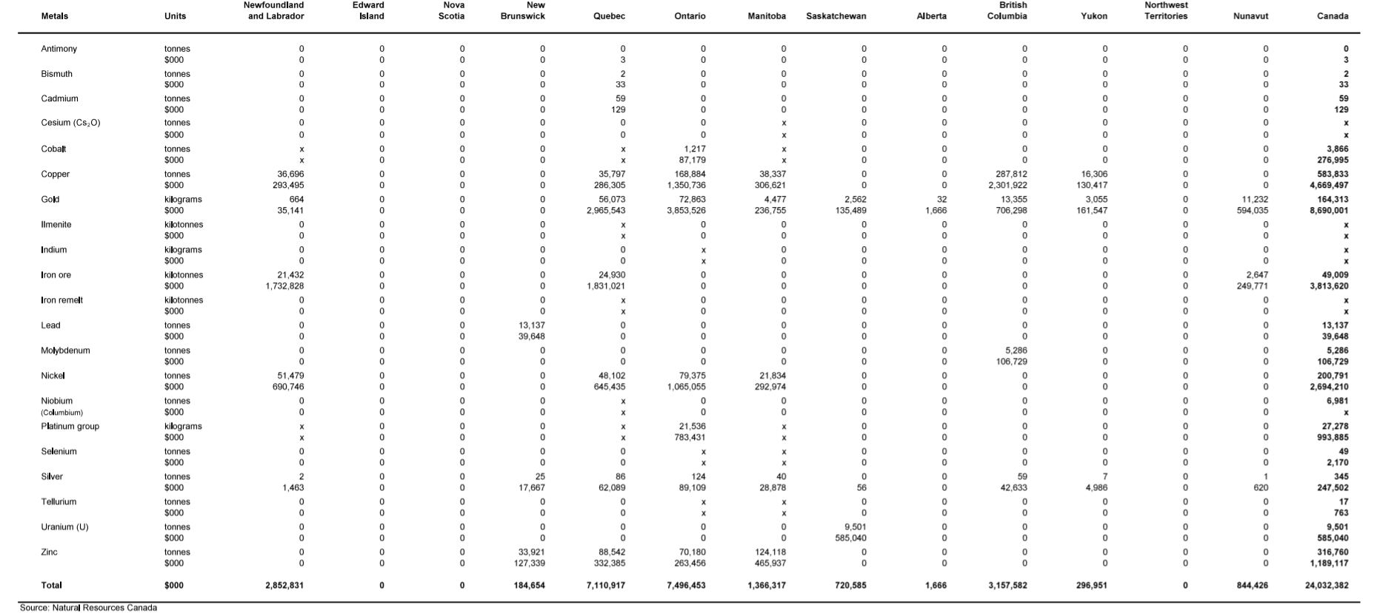
Preliminary Estimates of Mineral Production
Notes:
Preliminary estimates of mineral production in Canada, by province, 2017. hasn’t been fully published yet. Most current as of natural resource Canada. Coincides with “economic impact” numbers.

Slide 5
Industry Overview
Mining for base and precious metals is a capital intensive business
  Large capital expenditures to fund deposit exploration and mine construction if/when deposits are discovered
Numerous risks within the mining industry
  Survival and profitability depend on “deep pockets” and some luck

Slide 6
Industry Overview, Cont.
The global mining industry is consolidating
  Canadian mining companies had assets worth $163.9 B spread across 100 countries
  Mineral exploration expenditures in Canada increased 29.6% to $2.1 B in 2017
Global increase in demand for base materials
Higher prices, sales, and profits are expected in the mining industry’s future
  Rising demand for durable goods in China and India while the rate at which supply of base metals are found is slowing

Slide 7
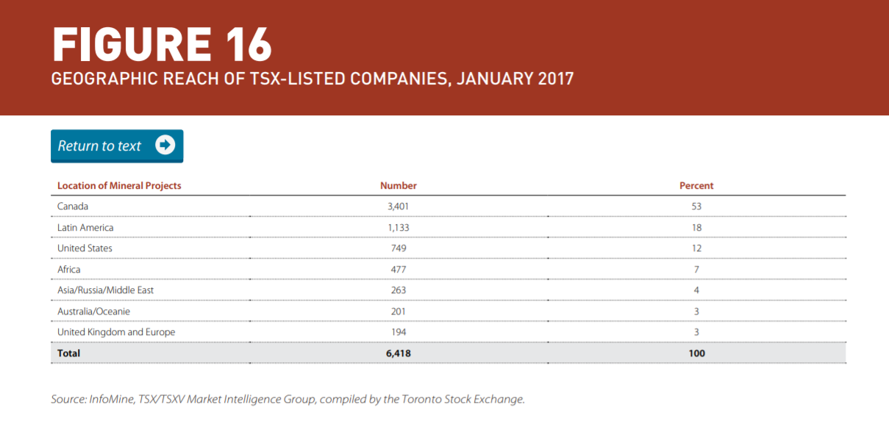
Consolidation of the Global Mining Industry

Slide 8
Uses of Minerals and Metals
Coal for energy
Key ingredient in the manufacturing
of steel and cement
Uranium for nuclear energy
Copper for electrical wires
and cables for its conductivity
Uses
Uses
Zinc in galvanizing
(prevents rusting)
Gold micro circuitry in a range of
electronic products
Silver as a precious metal and
for photography and electronic components
Notes:
https://www.nrcan.gc.ca/mining-materials/facts/20507

Slide 9
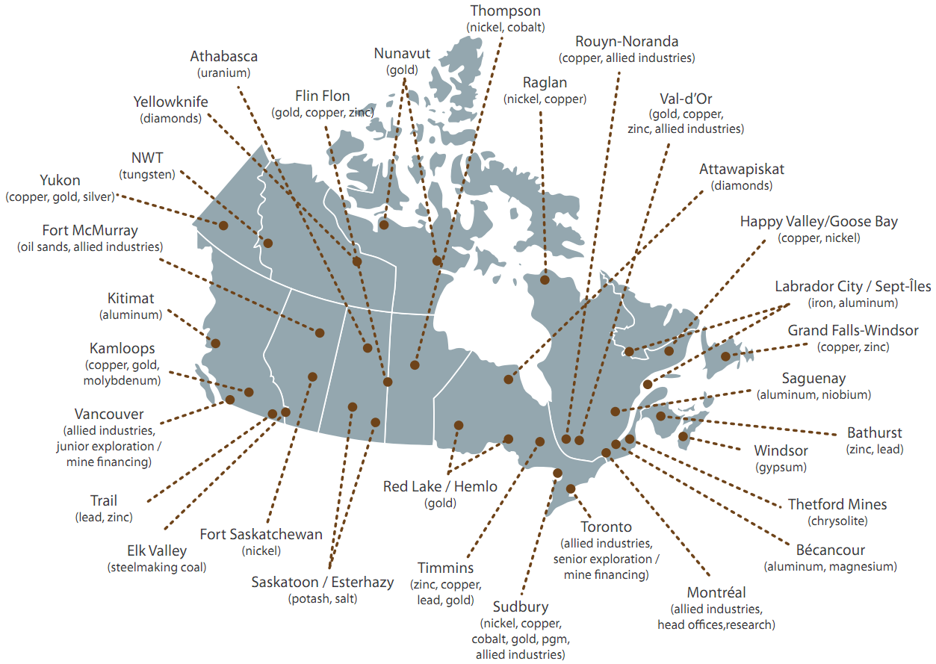
Map of Mineral Deposits in Canada

Slide 10
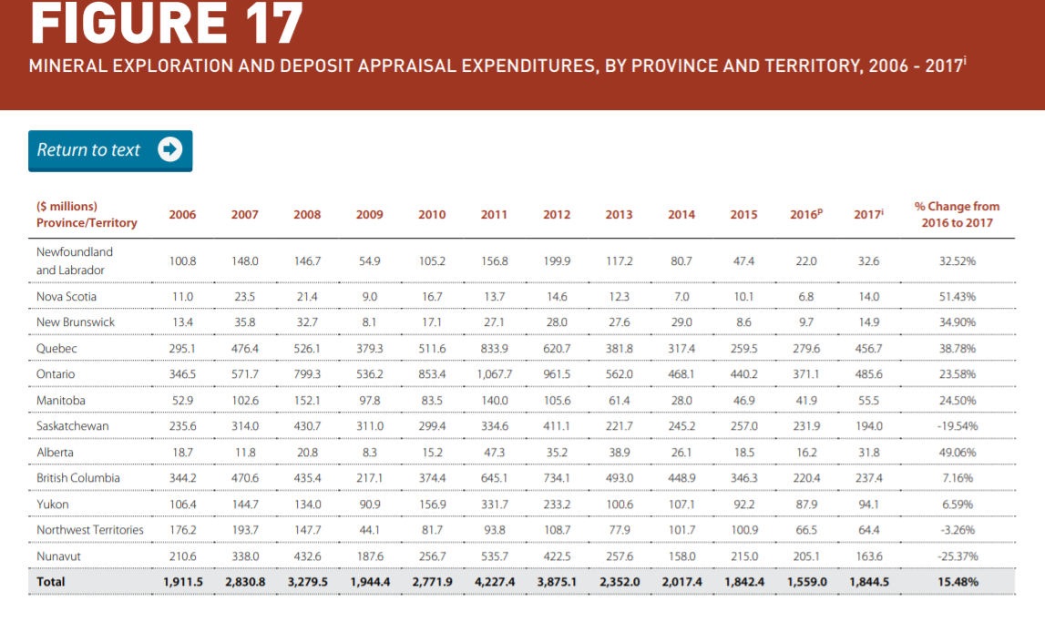
Expenditures by Province and Territory

Slide 11
Mineral Resource Classification
Mineral Resources
Mineral resources that are potentially valuable, and for which reasonable prospects exist for eventual economic extraction
Mineral Reserves
Mineral reserves, or ore reserves, are valuable, and legally, technically, and economically feasible to extract

Slide 12
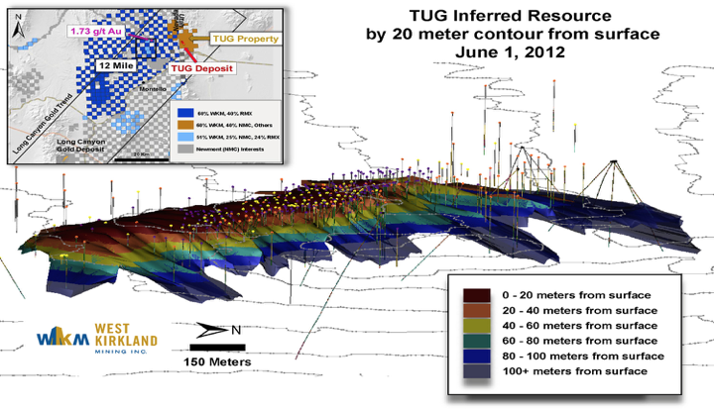
Mineral Resources
Inferred
Mineral resource where tonnage, grade, and mineral content can be estimated with a low level of confidence
  Inferred from geological survey data (assumed but NOT verified)
  Data is gathered from locations such as outcrops, trenches, pits, and drill holes
  Information is of limited quality and reliability

Slide 13
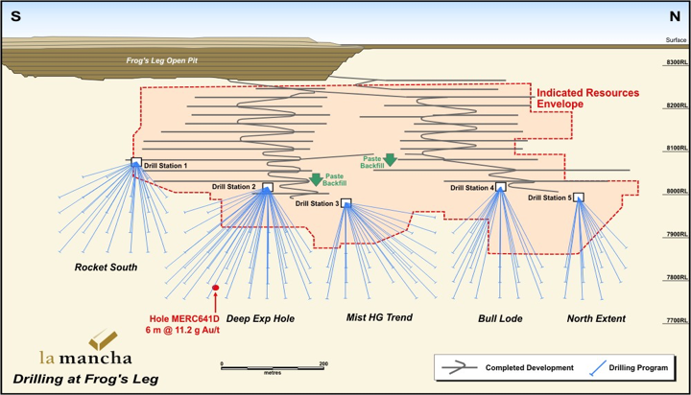
Mineral Resources, Cont.
Indicated
Economical mineral resources that have been sampled to a reasonable level of confidence
  Mineral grade, tonnage, density, characteristics, and shape have been determined with a reasonable level of confidence
  Sampling takes place in locations such as outcrops, trenches, pits, and drill holes

Slide 14
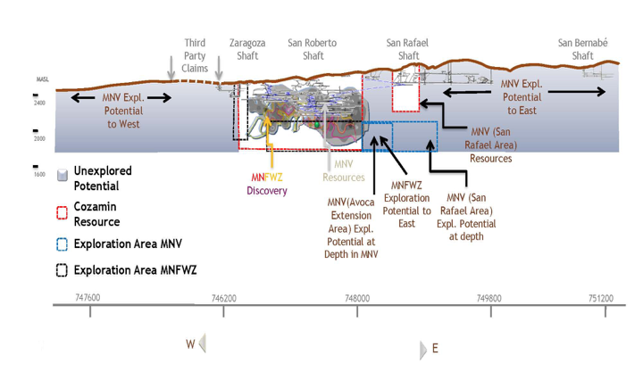
Mineral Resources, Cont.
Measured
Mineral resources that have undergone further extensive sampling by a “competent person” – typically a geologist
  Declared to be an acceptable estimate with a high degree of confidence of the mineral’s grade, tonnage, shape, density, and characteristics

Slide 15
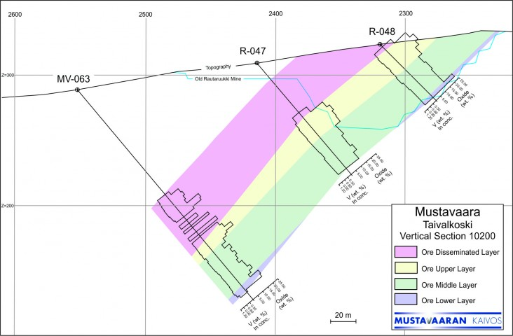
Mineral Reserves
Probable Ore Reserve
Part of the indicated mineral resources that is economically feasible to mine
  Probable reserves have a lower level of confidence than a proved mineral reserve
  Has sufficient quality to serve as a basis for strategic decision making on the development of the deposit extraction

Slide 16
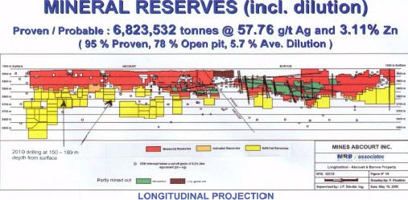
Mineral Reserves, Cont.
Proven Ore Reserve
Part of the of measured mineral resources that is economically feasible to mine
  Includes diluting materials and allowances for losses during the mining process
  Represents the highest level of confidence in reserve estimates

Slide 17
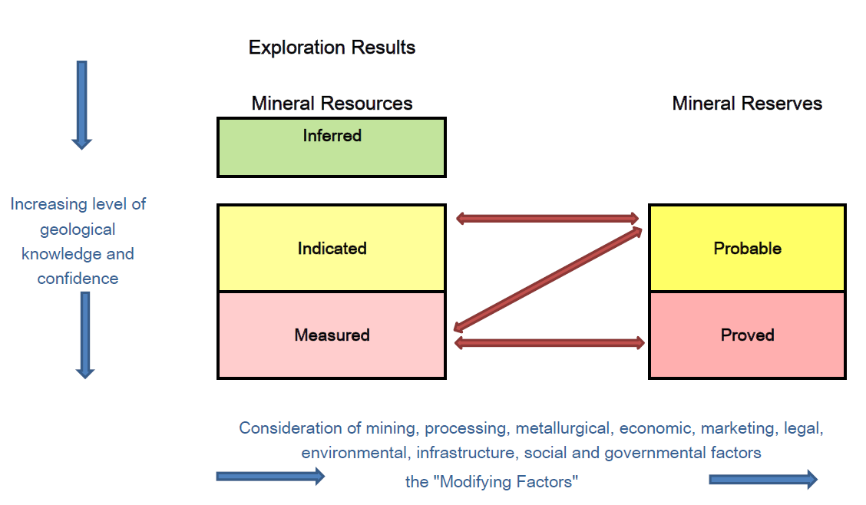
Mineral Resources vs Mineral Reserves

Slide 18
Reclamation of Land Following Mining
The mine and surrounding environment must be restored to the condition that existed before mining began
Highly regulated by government and reclamation plans must be approved before mining permits will be granted
In surface mining, the layers of topsoil, or overburden, that were removed in order to reach the mineral are used to fill in the mine and reshape the land.
Underground mining reclamation is not as extensive; however, companies must ensure that ground water remains uncontaminated and that abandoned mines will not collapse

Slide 19
How to Value Reclamation Costs
Government of Northwest Territories partnered with the Land and Water Boards of the Mackenzie Valley and the Indigenous and Northern Affairs of Canada to develop the “Guidelines for Closure and Reclamation Cost Estimate for Mine”
Any new mining project requires a security deposit to be set up as a condition of land use permits and water licenses
  Security deposits are held to the party responsible for reclamation in case the project is abandoned
  Funds are held by the federal or territorial government
RECLAIM is a Microsoft Excel model used to calculate costs associated with each activity required to meet the objectives of the “Closure and Reclamation Plan”
  Uses a “quantity of work” x “unit cost” formula
  i.e. For example, a reclamation activity may involve using a dozer to contour overburden in a disturbed area. If the quantity of soil to be dozed is 500 m3 and the Unit Cost is $1.05/m3 , then the cost for that reclamation activity would be $525.
  The total cost is equal to the sum of direct costs and indirect costs

Slide 20
Political & Legal Environment
Direct Federal involvement in the regulation of mining operations is limited and specific in nature
Provincial governments are responsible for the mining operations in their jurisdiction

Slide 21
Regulations
Northwest Territories and Nunavut Mining Regulations
Territorial Coal Regulations
Territorial Quarry Regulations
Notes:
In the northern territories sub-surface lands include hard-rock minerals, precious gems and coal. The rights to these materials are administered through the Northwest Territories and Nunavut Mining Regulations (formerly known as the Canada Mining Regulations) and the Territorial Coal Regulations . There is a distinction between sub-surface minerals and surface mineral substances that have specific purposes such as carving stone and building materials. These special use surface minerals are administered through the Territorial Quarry Regulations .

Slide 22
NI 43-101
National Instrument 43-101
Developed by the Canadian Securities Administrators (CSA) and administered by the provincial securities commissions
Governs the quality of information shared by mining companies in the Canadian industry.
Disclosure is based on the advice of a qualified person
Entitles investors to a standard of information to evaluate investment potential
Notes:
the NI43-101 regulation governs all information disclosure for Canadian minerals and mining companies. National Instrument 43-101 (NI 43-101) is a rule developed by the Canadian Securities Administrators (CSA) and administered by the provincial securities commissions that govern how issuers disclose scientific and technical information about their mineral projects to the public. It covers oral statements as well as written documents and websites. It requires that all disclosure be based on advice by a "qualified person" and in some circumstances that the person be independent of the issuer and the property. This rule is important to understand because it sets the standard for all companies involved in this sector. Reliance on a qualified person This standard is currently under revision,

Slide 23
The Future of the Canadian Mining Industry
Growing emphasis on environmental stewardship
  How to achieve economic development without depleting natural resources?
Globalization and the emergence of new mineral producing countries in the developing world increase industry competition
A need for a more efficient and effective federation

Slide 24
Minerals and Metals Policy of Canada
The new Minerals and Metals Policy addresses these challenges and responds to important government commitments.
The Policy was developed after an extensive consultation process involving representatives from federal departments and agencies, provincial and territorial mines ministries, industry, environmental groups, labour, and Aboriginal communities
Notes:
The Policy affirms provincial jurisdiction over mining, delineates a role for the federal government in minerals and metals that is tied to other federal responsibilities, and commits the government to pursuing partnerships with stakeholders in addressing issues within its jurisdiction.
As part of this process, Natural Resources Canada published an issues paper entitled “Sustainable Development and Minerals and Metals” in 1995.

Slide 25
Mining Disasters and Resistance
Mount Polley mine disaster in 2014
  Affected the Cariboo region in British Columbia, Canada
  Breach in the Imperial Metals – owned gold and copper tailing ponds released years worth of mining waste into Polley Lake
  Water levels showed elevated amounts of lead and arsenic
Rising social consciousness and environmental regulations pose a serious risk to the mining industry
  Continuing battle over Taseko's $1.5-billion New Prosperity Mine in B.C. Interior sees Tslihqot'in Nation in court to stop extensive, new exploratory work that includes 122 drill holes
  The project was approved by the provincial government but rejected twice at the Federal level in 2010 and 2013
  Federal government cited damage to fish and fish habitats as the reason for rejection

Slide 26

Copper

Slide 27
Key Facts about Copper
Copper is a soft, malleable metal that is 100% recyclable
  80% of the copper ever mined is still in use today
  Recycling is a major source of copper in today’s world
Canada produced 604,481 tonnes of copper concentrate in 2017
  Roughly half of that originating from British Columbia
An estimated 1.4% of the world’s total copper reserve resides in Canada
  Approximately 11 million tonnes

Slide 28
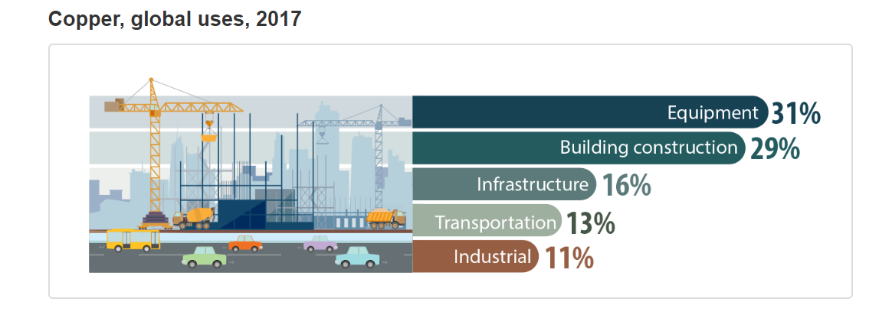
Copper Uses

Slide 29
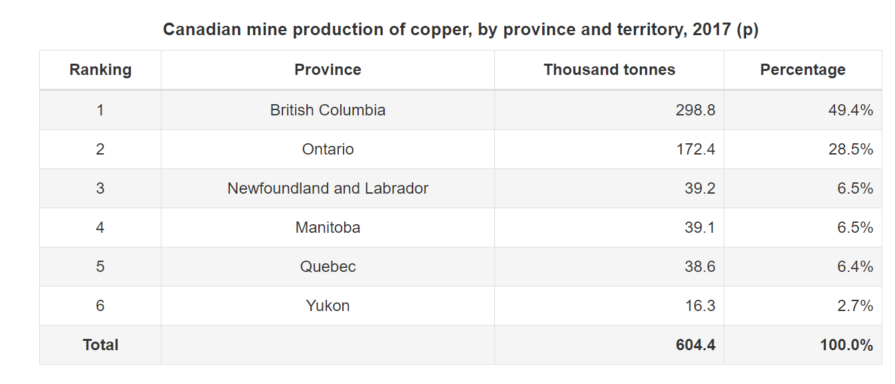
Copper Production

Slide 30
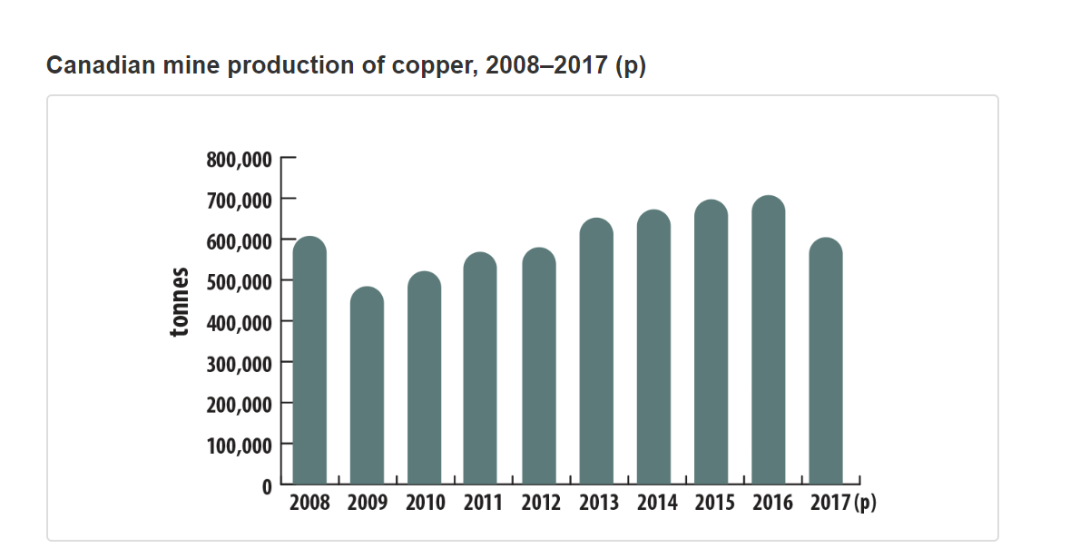
Copper Production, Cont.

Slide 31
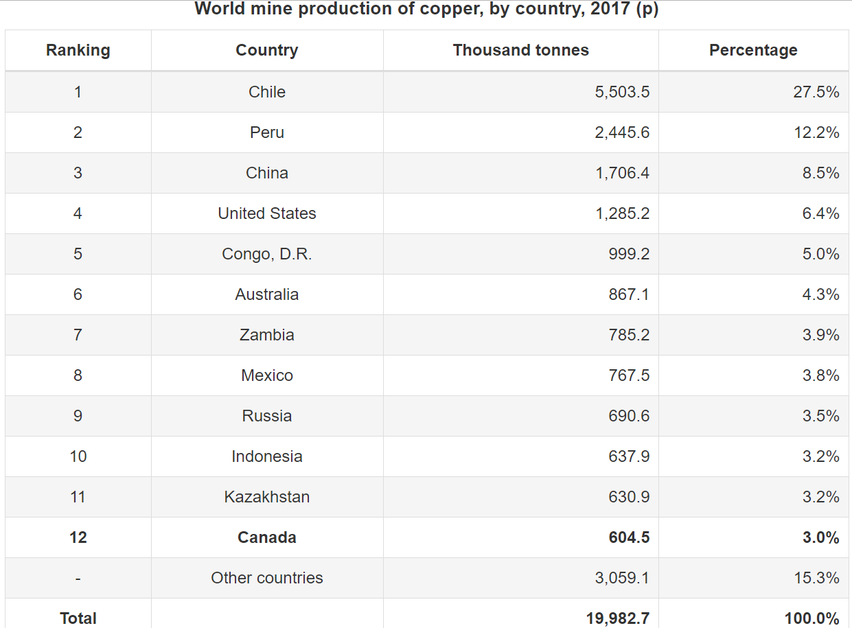
Copper Production, Cont.

Slide 32
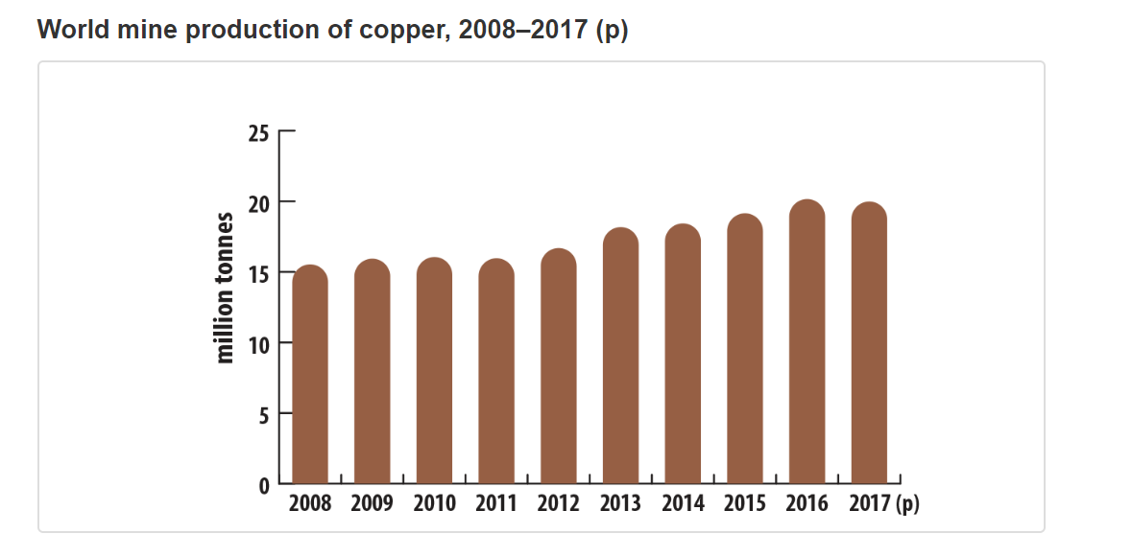
Copper Production, Cont.

Slide 33
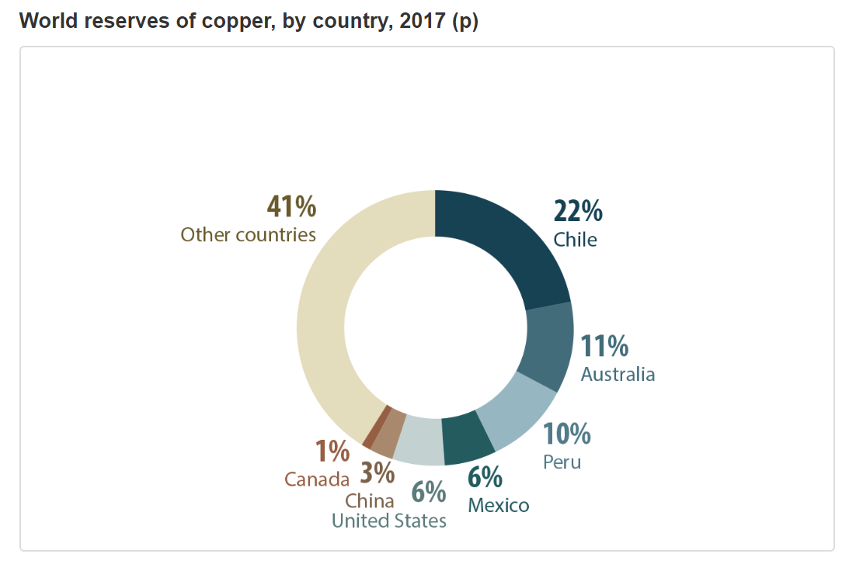
Copper Production, Cont.

Slide 34
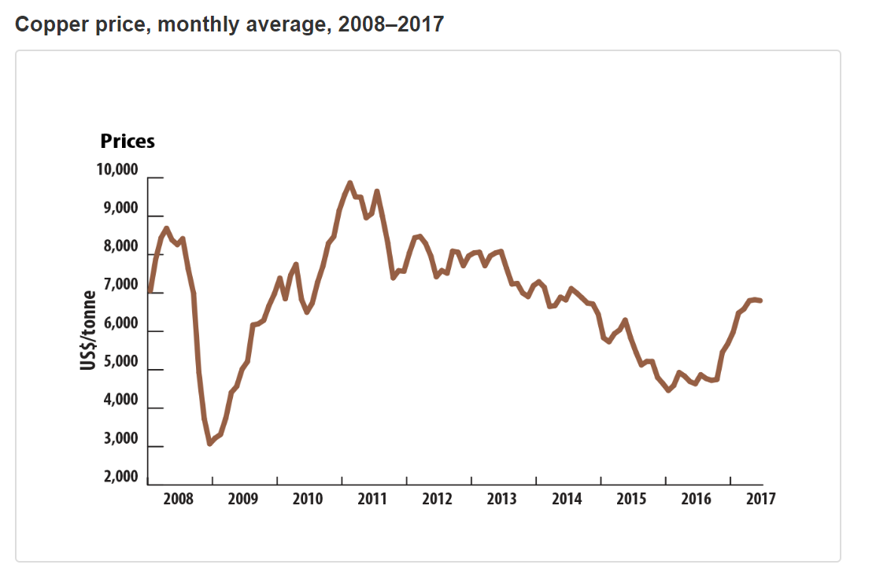
Copper Prices
Notes:
Tight market conditions have kept prices high, 2017 slightly higher then 2016 .
The price of copper per tonne has shown large fluctuations over the last decade, with prices more than tripling from a low in 2008 to a peak in 2011. In 2017, copper prices rose from US$5,737.43 per tonne in January to US$6,801.16 per tonne in December.

Slide 35
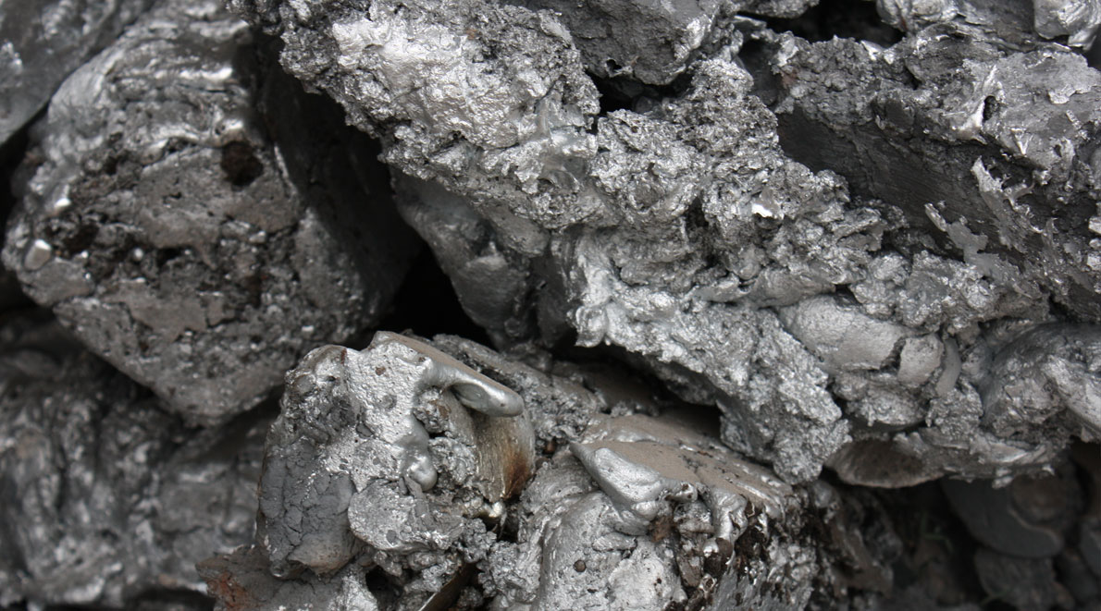
Zinc

Slide 36
Key Facts about Zinc
Zinc is primarily used in galvanizing – which protects iron and steel from rusting
In 2017, Canada produced 344,294 tonnes of zinc from mines located in Manitoba, Ontario, Quebec and New Brunswick
China was the world’s largest producer of refined zinc metal in 2017, accounting for 45% of world production

Slide 37
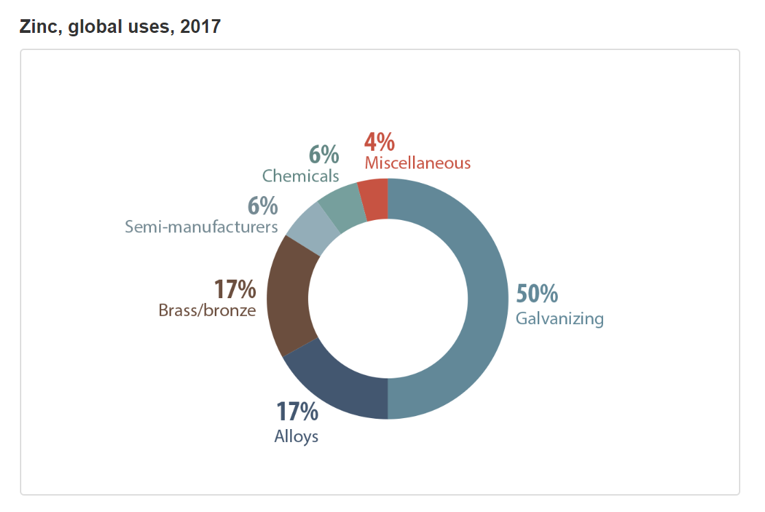
Zinc Uses

Slide 38
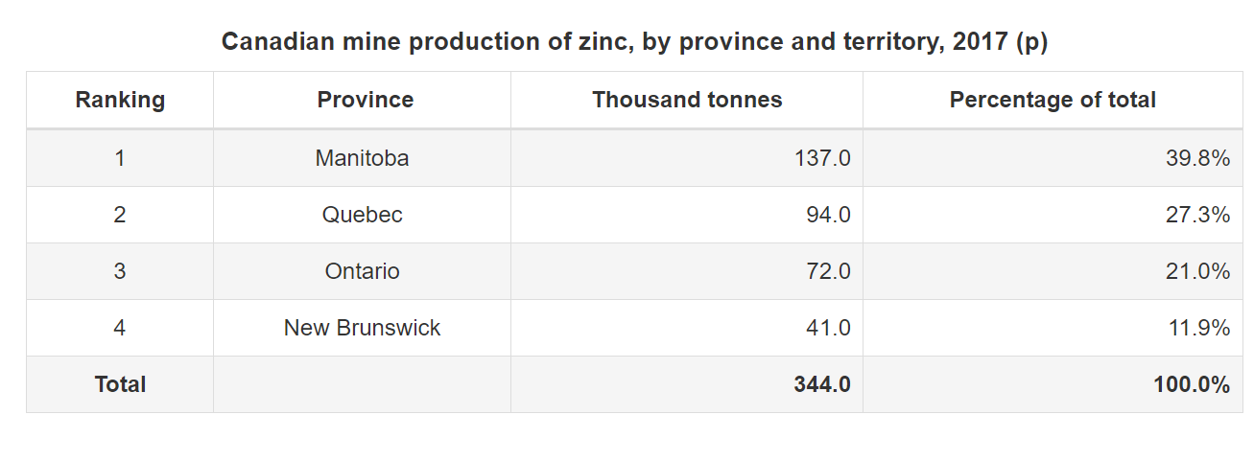
Zinc Production
Notes:
Cant find graph

Slide 39
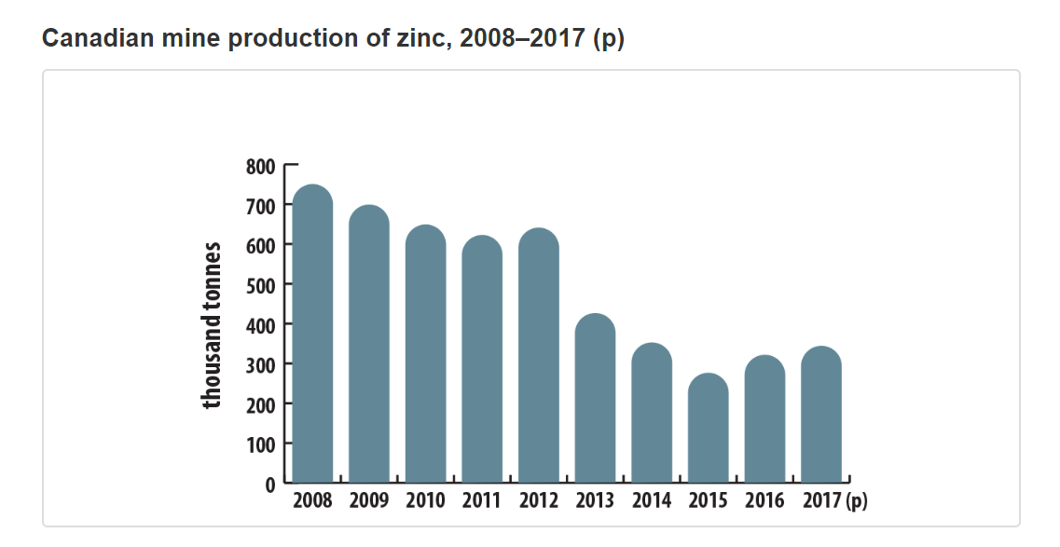
Zinc Production, Cont.

Slide 40
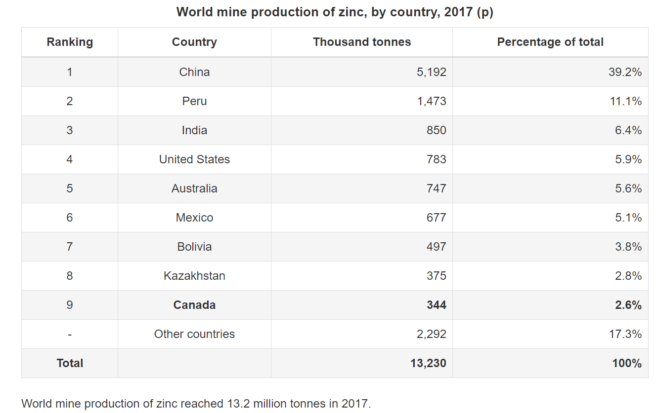
Zinc Production, Cont.

Slide 41
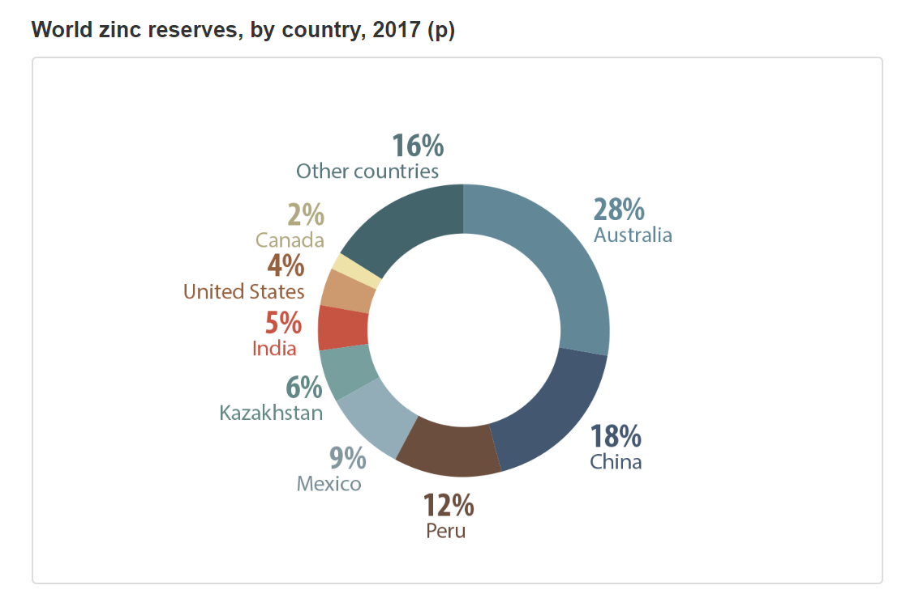
Zinc Production, Cont.

Slide 42
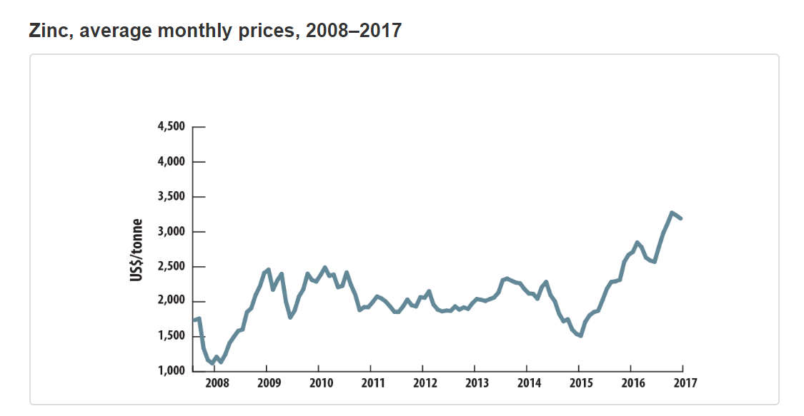
Zinc Prices
Notes:
Prices generally rose throughout 2017, from US$2,713 per ton in January to a high of US$3,274 per ton in October, followed by some weakening in November and December, and closing the year at US$3,192 per ton.
Strong demand of Zinc total export of zinc and zinc product were valued at 2.1 billion

Slide 43

Gold

Slide 44
Key Facts about Gold
Gold is Canada’s most valuable mineral
  Production value of $8.7 B in 2017
In 2017, Ontario and Quebec accounted for more than 75% of mined gold production in Canada
Total value of gold exports in 2017 was $18.6 B

Slide 45
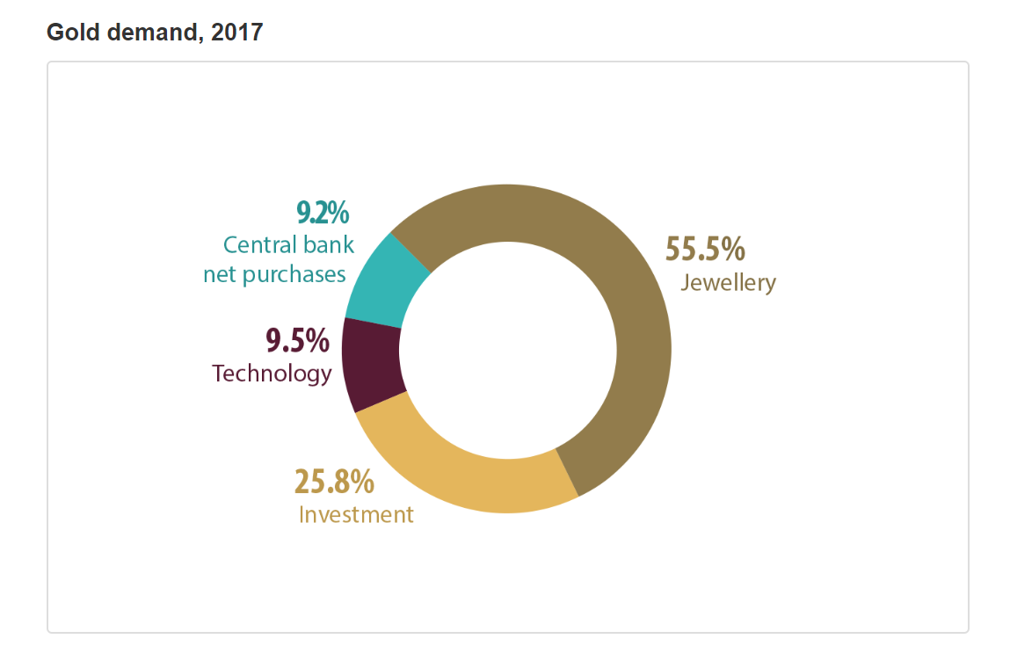
Gold Uses

Slide 46
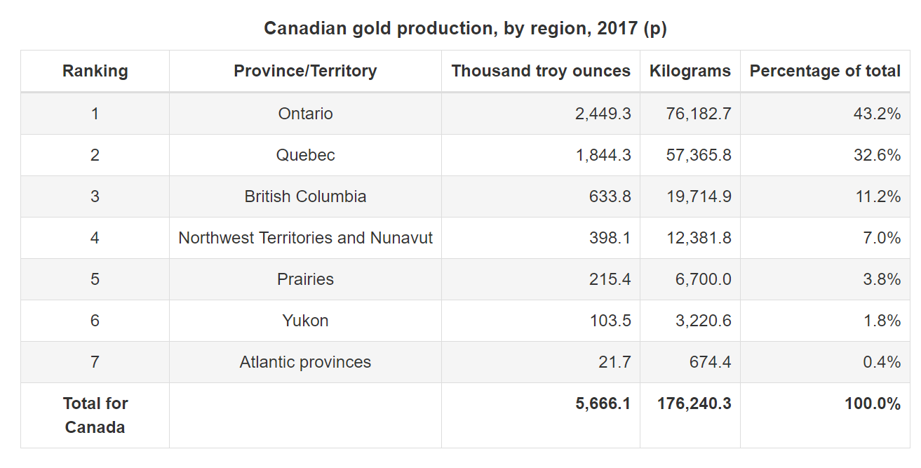
Gold Production

Slide 47
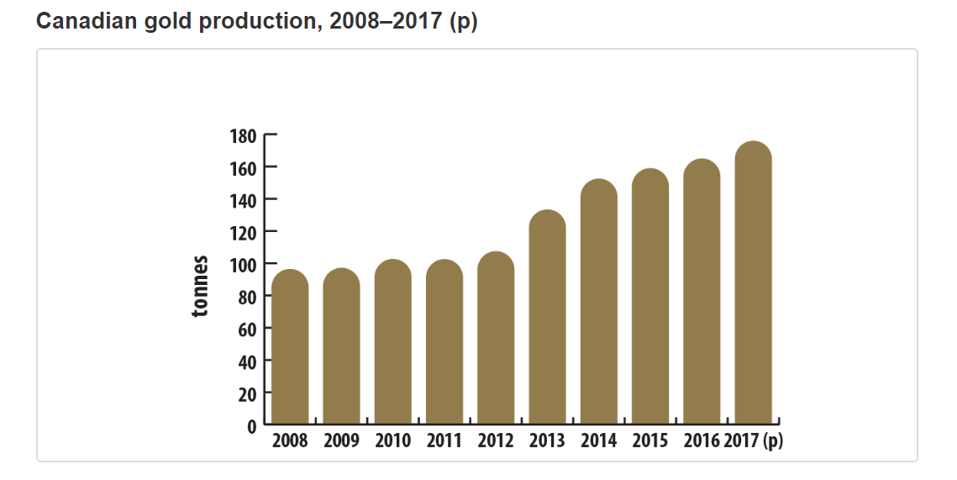
Gold Production, Cont.

Slide 48
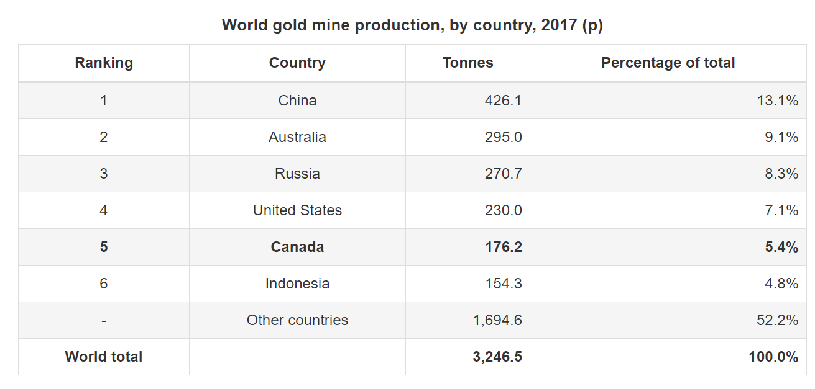
Gold Production, Cont.

Slide 49
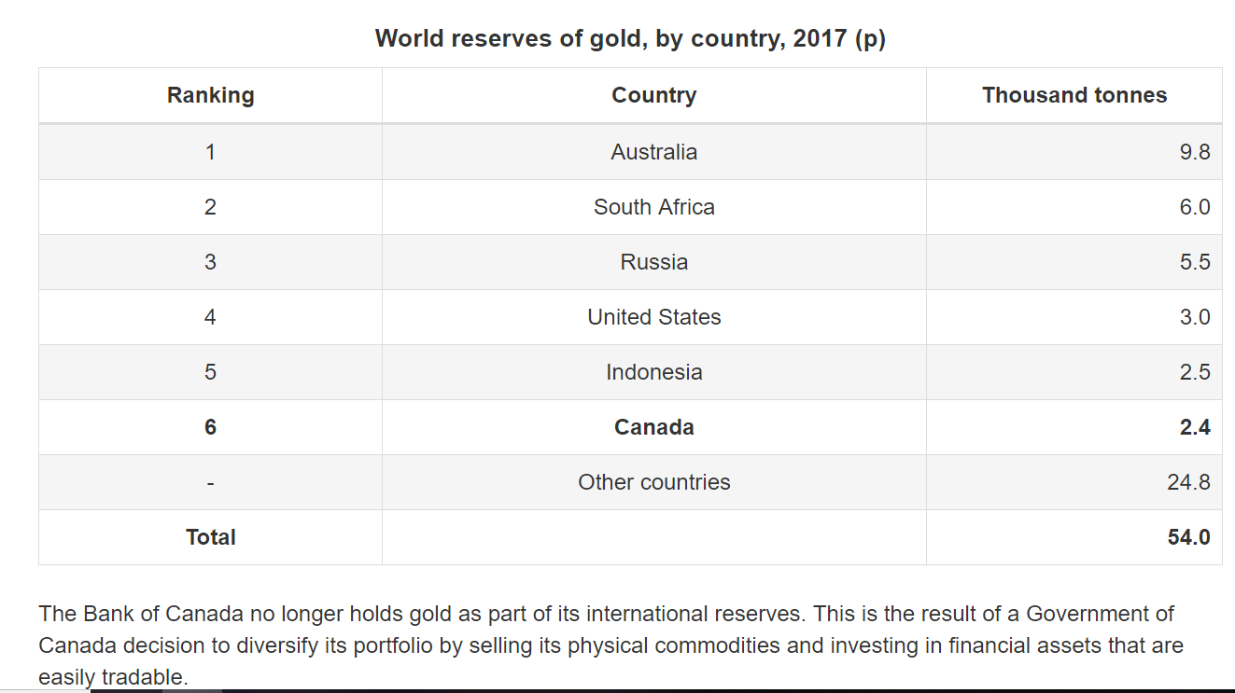
Gold Production, Cont.

Slide 50
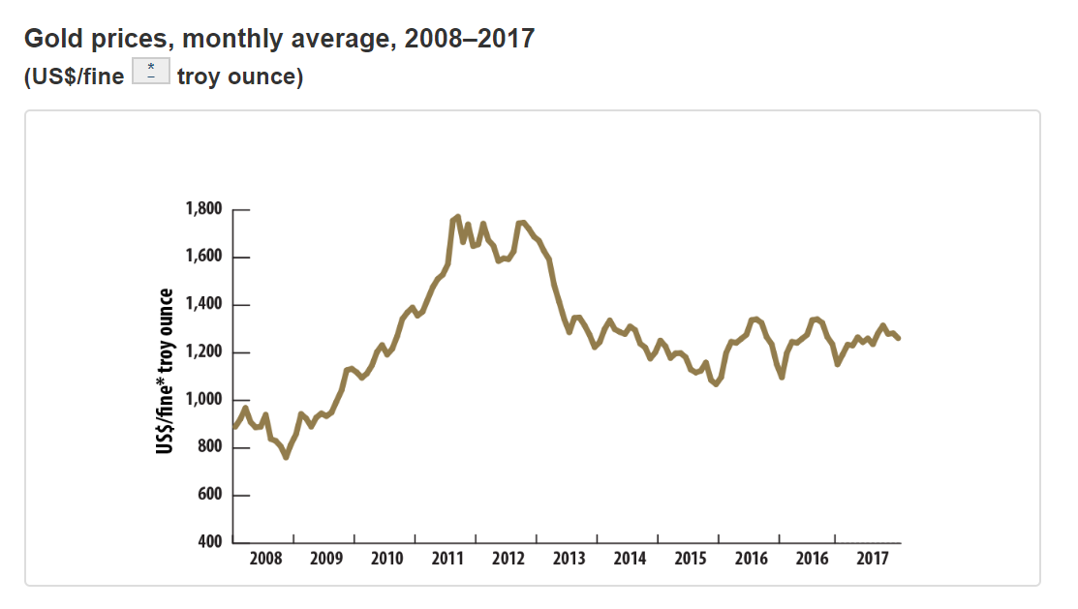
Gold Prices

Slide 51
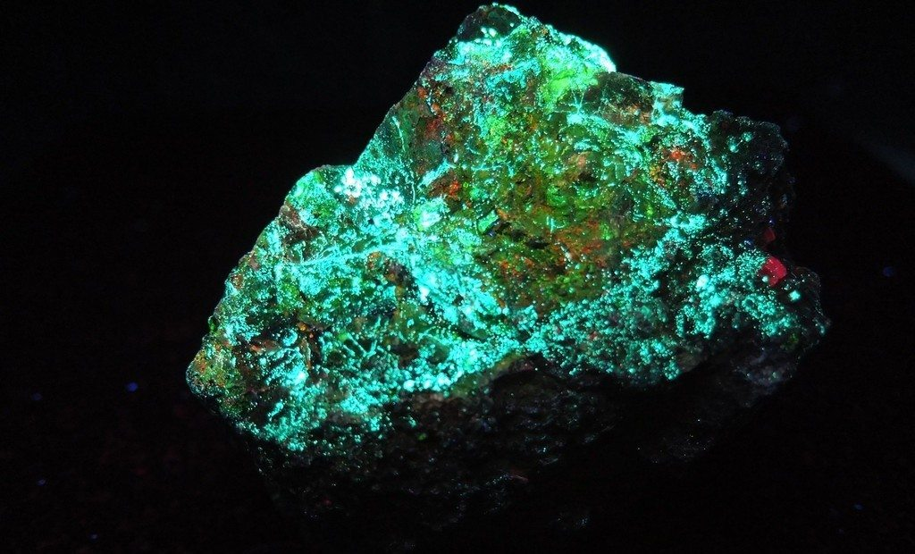
Uranium

Slide 52
Key Facts about Uranium
Canada is the second largest producer and exporter of uranium in the world
  22% global production in 2017
Uranium is primarily used to produce fuel for nuclear power plants (99%)
  Also used in production of medical isotopes and research reactors (1%)
Nuclear power generation accounted for 15% of Canada's electricity in 2016
  Nuclear power is a source of energy that does not emit greenhouse gases
Under Canada’s nuclear non-proliferation policy, Canadian uranium can only be used for peaceful purposes

Slide 53
Uranium Supply and Demand
Nuclear power is a major part of Canadian landscape from coast to coast
Nuclear power plants operate in New Brunswick and Ontario
Uranium mining, refining, and fuel processing take place in Saskatchewan and Ontario

Slide 54
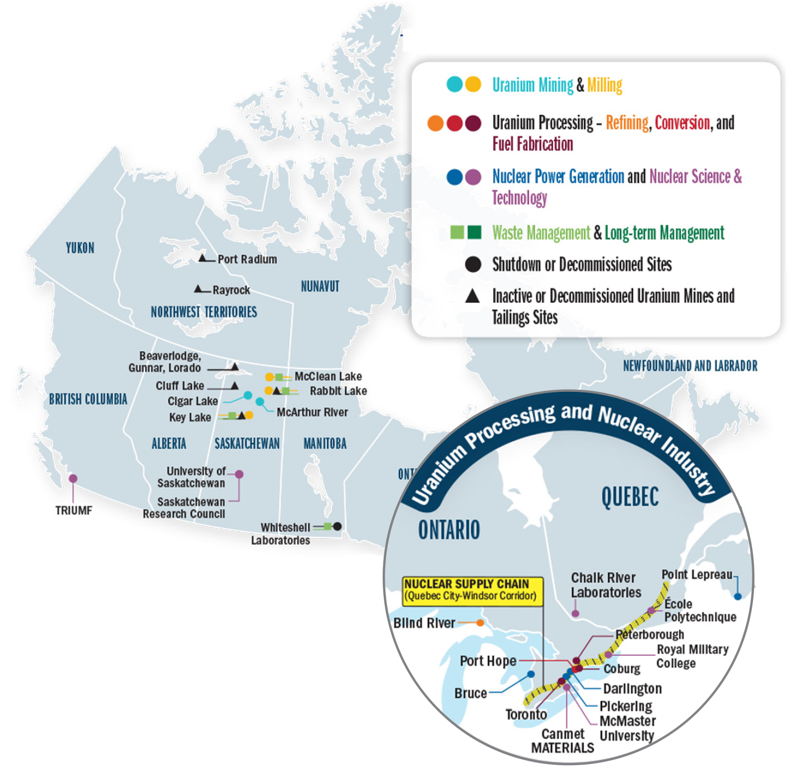
Uranium Supply and Demand

Slide 55
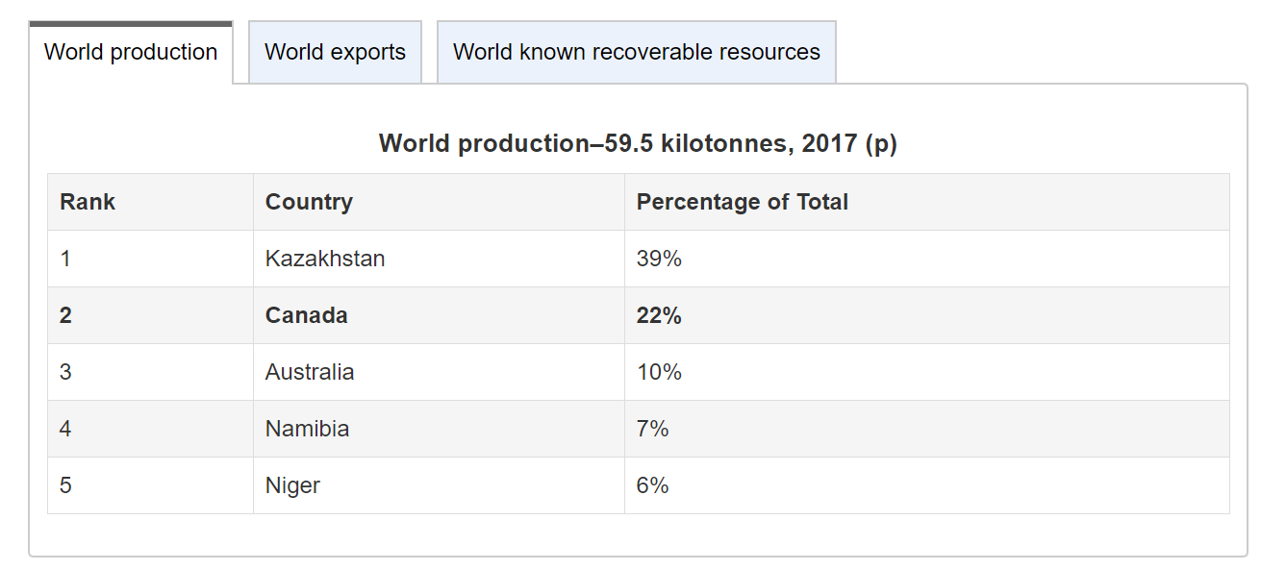
Uranium Production

Slide 56
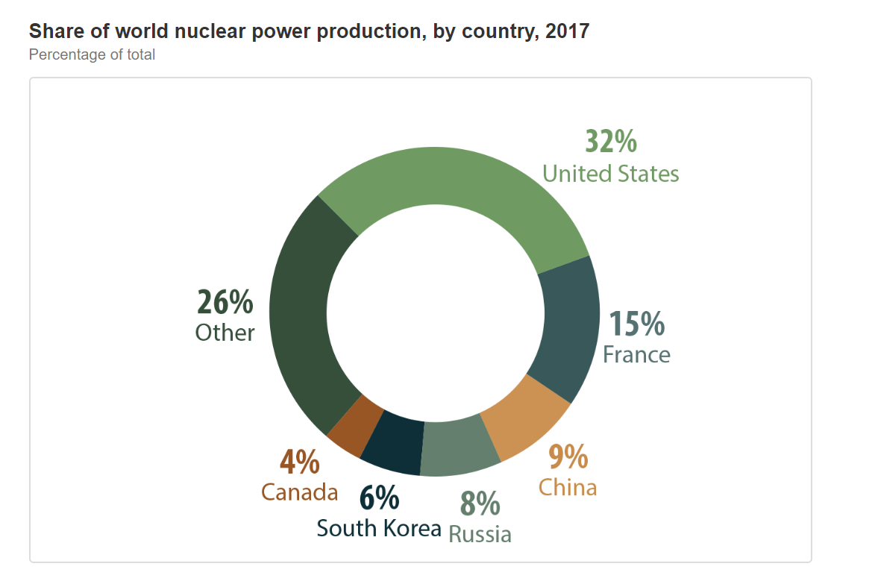
Nuclear Power Production

Slide 57
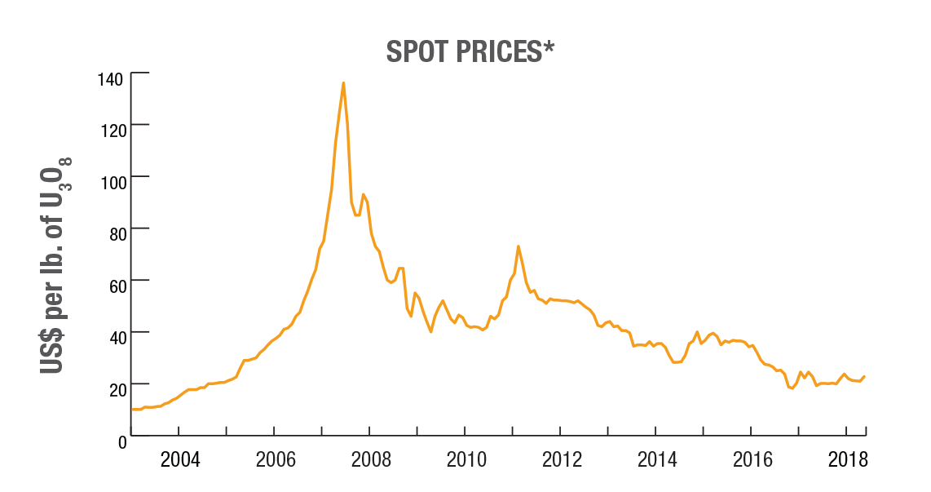
Uranium Prices
Notes:
Uranium does not trade on an open market like other commodities. Buyers and sellers negotiate contracts privately. Prices are published by independent market consultants Ux Consulting and TradeTech.

Slide 58
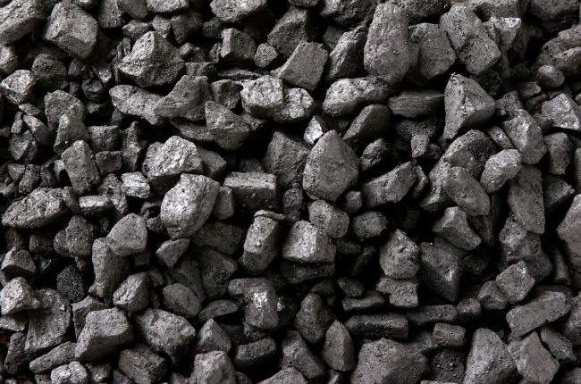
Coal

Slide 59
Key Facts about Coal
Two primary applications of coal
  Thermal coal (electricity generation) and metallurgical coal (steelmaking coal)
Coal is an organically derived material formed from decayed plant material
  Process of coal formation takes compaction through millions of years of chemical changes and pressure
Canada is the world’s third largest exporter of metallurgical coal after Australia and the United States
  Albert and British Columbia typically produce 85% of Canada’s coal

Slide 60
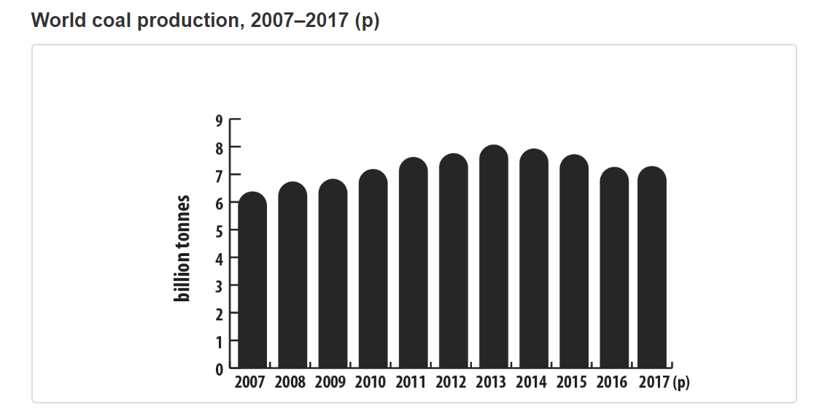
Coal Production

Slide 61
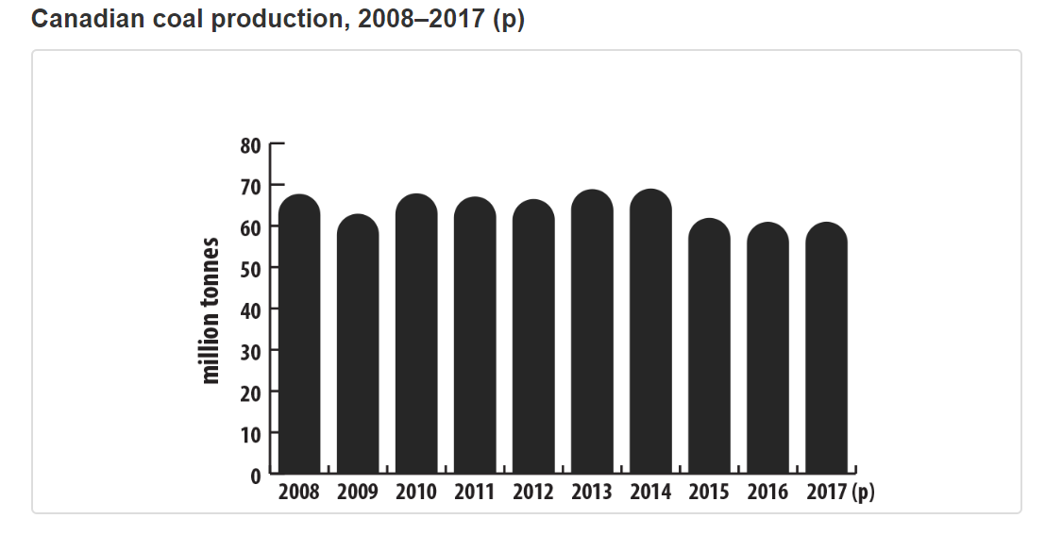
Coal Production, Cont.
Notes:
Averages around 61 million tons

Slide 62
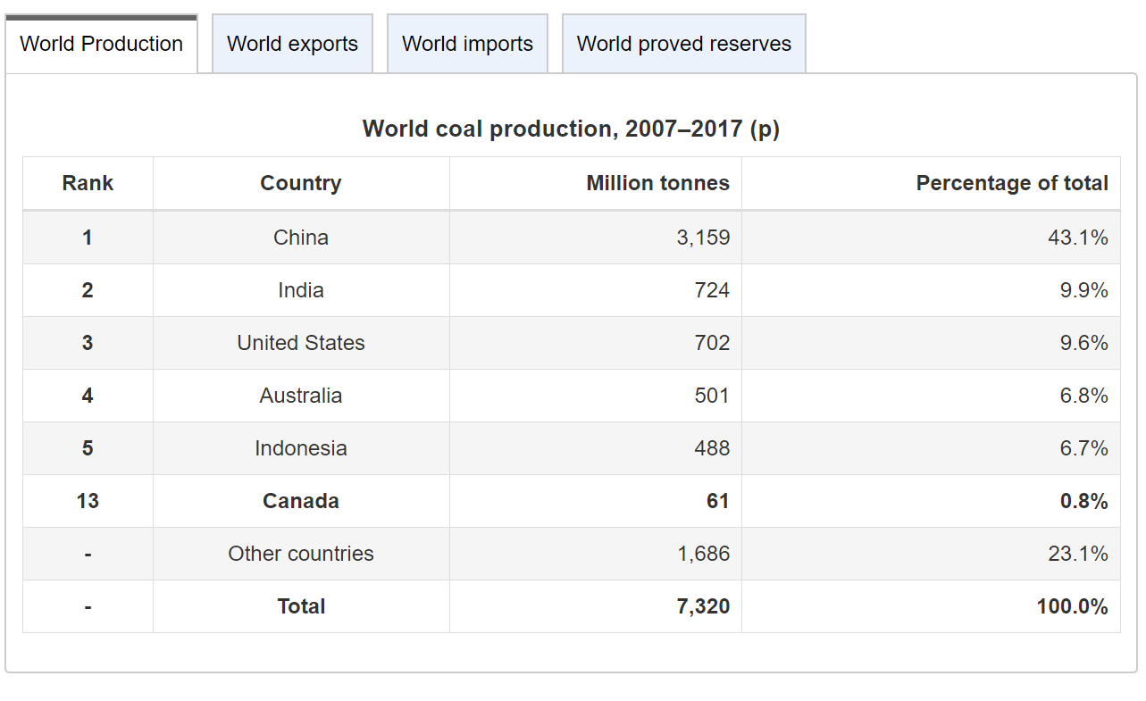
Coal Production, Cont.

Slide 63
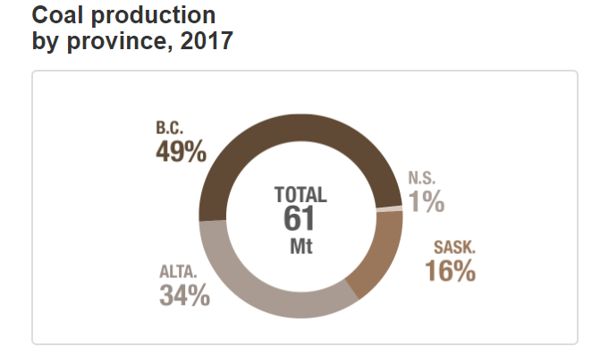
Coal Production, Cont.

Slide 64
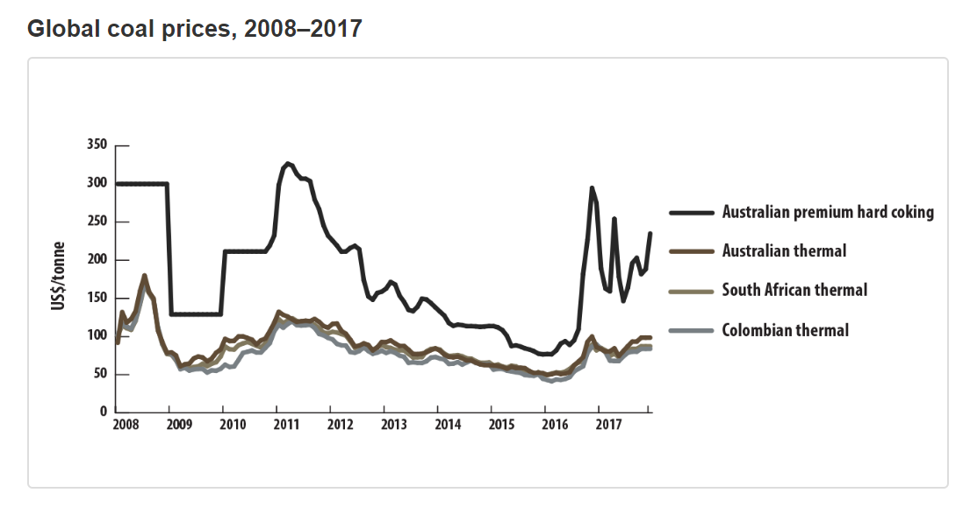
Coal Prices

Slide 65
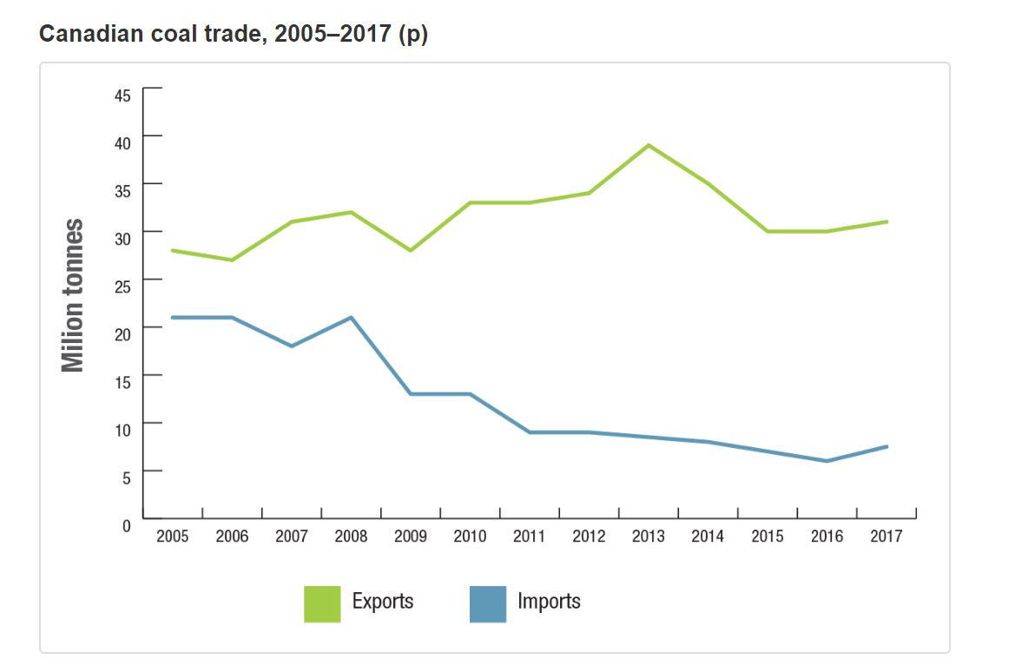
Canadian Coal Trade
Notes:
Canada’s coal imports have trended downwards for the past decade while exports have held steady
Canada exports approximately half of their production
The majority of Canada’s coal exports go to Asia

Slide 66
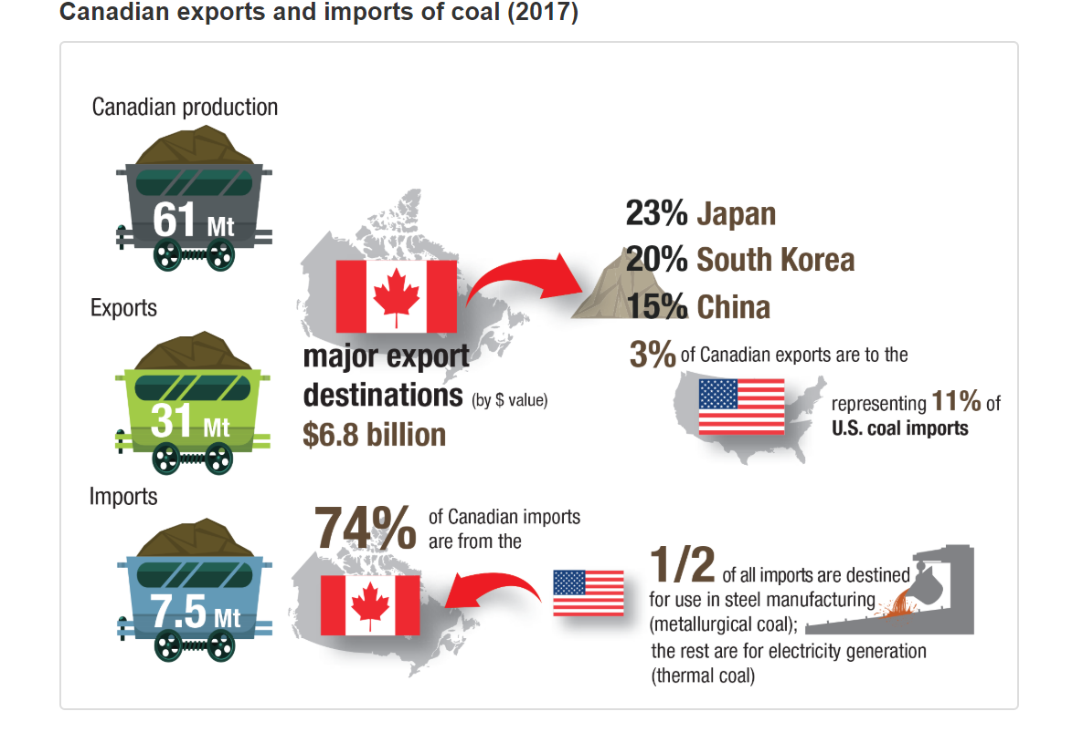
Canadian Coal Trade, Cont.

Slide 67
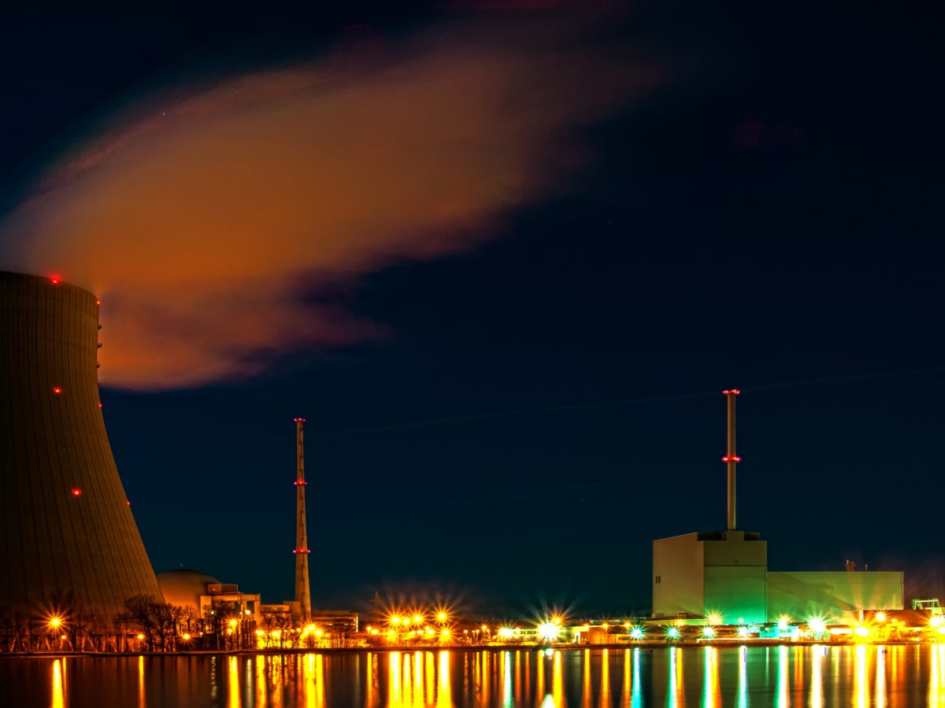


Slide 68
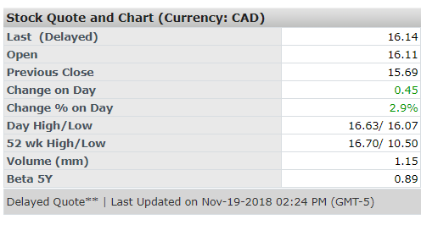
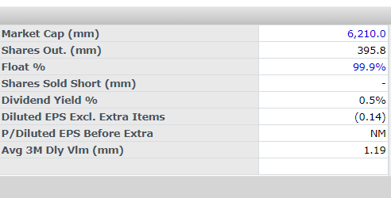
Company Overview
One of the world’s largest providers of uranium fuel
Tier-one operations in Canada and Kazakhstan have the licensed capacity to produce more than 53 million pounds of uranium each year
458 million pounds of proven and probable reserves on three continents
Ticker: CCO
Share Price: $16.14
Source: Company website, Capital IQ

Slide 69
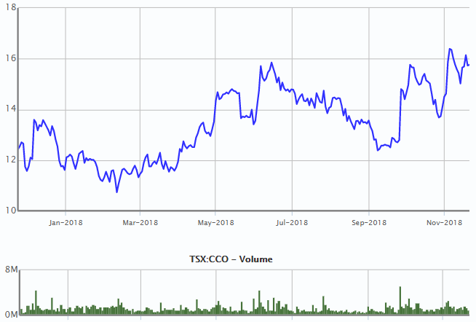
1 Year
Source: Capital IQ

Slide 70
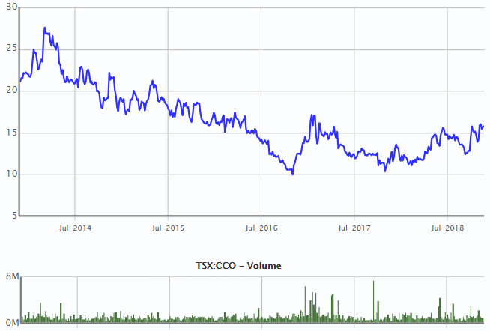
5 Year
Source: Capital IQ

Slide 71
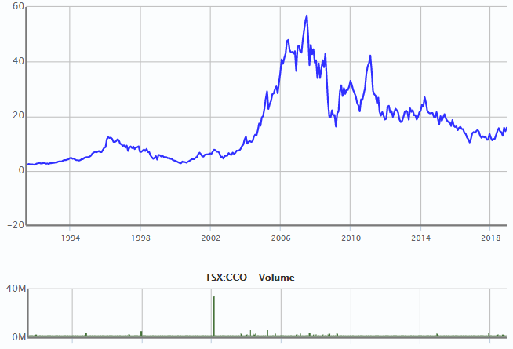
MAX
Source: Capital IQ

Slide 72
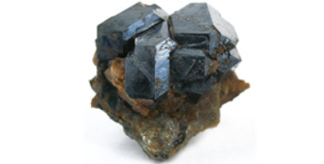

Uranium – Interesting Facts
Silvery-white metal, roughly 70% denser than lead
Uranium is more common than tin, 40x more common than silver and 500x more common than gold
Found in very low concentrations almost everywhere on Earth in soil, rocks, water and even your backyard
One pound of uranium will make a ball of only 1.3 inches in diameter
Largest deposits of ore-grade uranium found in Australia, Kazakhstan and Canada; the only known high-grade deposits are found in Canada
A single uranium fuel pellet the size of a fingertip contains as much energy as 17,000 cubic feet of natural gas, 1,780 pounds of coal or 149 gallons of oil
Source: Company website

Slide 73

Uranium Timeline
1789 - Martin Klaproth discovers Uranium and names it after the planet Uranus
1905 – Albert Einstein puts forward a theory relating mass and energy, E = MC²
1932 – James Chadwick discovers the neutron, an important component in nuclear fission
1933 – Canada’s first uranium mine, at LaBine Point NWT, opens for production
1938 – German scientists proved that when atoms are split, energy is in turn released; thereby discovering nuclear fission and proving Einstein’s theory
Source: Company website

Slide 74
Uranium Timeline (cont.)
1954 – President Eisenhower signs Atomic Energy Act, opening door to private use of nuclear energy
1964 – Ontario provincial government announces plans to build large-scale CANDU nuclear reactors at Pickering
1979 – Three Mile Island nuclear power plant near Harrisburg, PA suffers a partial core meltdown (most significant nuclear energy accident in U.S. history); paved way for new nuclear safety regulations
1986 – Chernobyl explosion occurs; paving way for stronger global nuclear governance
2011 – Fukushima Daiichi plant in Japan destroyed; future of uranium industry put in doubt
Source: Company website

Slide 75

Cameco Timeline
1988 – Cameco is created by the merger of two Crown corporations – Saskatchewan Mining Development and Eldorado Nuclear
1991 – Cameco completes its IPO and begins trading in Toronto and Montreal
1996 – Cameco purchases Power Resources, the largest uranium producer in the United States
2000 – Cameco’s McArthur River mine achieves commercial production and becomes the world’s largest high-grade uranium mine
2015 – Achieves commercial production at Cigar Lake
2017 – Suspends production at McArthur River / Key Lake and reduces dividend
Source: Company website

Slide 76



Nuclear Fuel Cycle – Mining & Milling
Cycle begins with the production of uranium ore
Ore is crushed and mixed with water and then treated with acid to separate uranium from other minerals in the rock
Uranium is now In solution form, which gets purified through a solvent extraction process
Finally, the uranium is dried, which results in uranium oxide concentrate (known as yellowcake)
Yellowcake is packaged into steel drums, which are hauled by truck to uranium refineries for the next stages of processing
Source: Company website

Slide 77



Nuclear Fuel Cycle – Fuel Processing
Yellowcake cannot be used directly as nuclear fuel
First, the uranium is refined to remove impurities and change its chemical form to UO3 and then it is chemically converted to one of two uranium compounds (dependent on the type of reactor to be fueled)
The uranium compounds are then baked into small pellets at a high temperature, where they acquire their characteristics strength and density
From pelleting, the uranium moves into assembly, as pellets are loaded into water reactors
Source: Company website

Slide 78

Nuclear Fuel Cycle – Electricity Generation
Commercial nuclear electricity generation plants work on the same principle as any other source of electricity generation
The plants begin with some kind of energy source that is engineered to drive turbines which generate electricity
Today’s nuclear power plants generate ~13% of the world’s electricity
Nuclear reactors do not emit any significant GHGs, they maintain relatively small physical footprints and consistently provide low-cost, reliable, 24/7 electricity to the world
Source: Company website

Slide 79
Comparing Generation Sources
Generation Source | Advantages | Disadvantages
Coal | Low costs | Large volumes required Produces waste and pollution
Hydro | No pollution Low costs | Destruction of waterways Overdeveloped
Natural Gas | Clean Low costs | N/A
Nuclear | Low pollution Low costs | Produces radioactive waste
Oil | Easy to use / transport | Expensive Huge source of pollution
Solar | Unlimited supply No pollution | Requires heavy battery capacity Cannot generate 24/7
Wind | Unlimited supply No pollution | Noisy Cannot generate 24/7
Biomass | Renewable Many sources | Poor supply chain Expensive
Source: Company website

Slide 80

Clean, safe, reliable source of energy
Only commercial use for uranium is to provide fuel for nuclear power plants that generate electricity
Nuclear power industry is driven by demand for energy, which is expected to grow rapidly over the next 20 years
Most growth in energy demand will come from developing (non-OECD) countries as their populations and standards of living increase
Key Problem: Meeting all of this growing electricity demand through traditional, high-carbon sources of electricity would be terrible for the environment
Uranium is one of the lowest-carbon sources of electricity in the world
Source: Company website, World Energy Outlook IEA 2012

Slide 81

Drivers for nuclear energy growth
Source: Company investor presentation

Slide 82

Nuclear around the globe
Americas - Demand expected to remain flat
Canada - In the process of refurbishing old reactors
U.K. - Pursuing new builds to replace aging capacity
Asia, India, Middle East – Growth continues
55 nuclear reactors under construction today, many more planned
Source: Company investor presentation

Slide 83

China committed to nuclear
Long-term prospects for nuclear energy in China remain strong
Source: Company investor presentation

Slide 84

Japan slowly returning to market
Source: Company investor presentation

Slide 85
TEPCO Dispute
In 2017, Tokyo Electric Power (TEPCO), issued a termination notice for a uranium supply contract with Cameco
TEPCO claims that an event of “force majeure” has occurred due to government regulations that prevent it from operating its nuclear generating plants⁽¹⁾
The termination would affect ~9.3MM lbs of uranium deliveries through 2028, worth ~$1.3B in revenue to Cameco
Cameco has taken TEPCO to arbitration court in the hopes of recovering losses arising from the termination
The market has priced in the loss of this contract; any positive arbitration ruling would be a tailwind for CCO shares
Source: Public company filings
(1) Regulations arise from 2011 Fukushima nuclear accident.

Slide 86

Global growth has been slow recently
Source: Public company filings

Slide 87

Challenging pricing environment for many years
Prices are not rational or sustainable, putting future and existing supply at risk
Source: Company investor presentation

Slide 88

Supply / Demand disconnect
Source: Company investor presentation

Slide 89

No incentive to produce uranium
Source: Company investor presentation

Slide 90

Beginning of an upcycle?
Meaningful contracting activity drives price and market improvement
Source: Company investor presentation

Slide 91

Utilities will need to contract soon
Source: Public company filings

Slide 92
Cameco’s Strategy
Focusing on tier-one assets
Restructuring organization for efficiency
Disciplined management of its production, inventory and purchases
Protecting and extending value of contract portfolio
Maximizing cash flow while maintaining its investment-grade rating
Positioning company to self-manage risk and deliver long-term value
Source: Company investor presentation

Slide 93

Focus on valuable assets
Well positioned for future demand with world-class, tier-one assets
Source: Company investor presentation
Note: Please see CCO’s most recent management’s discussion and analysis (MD&A) for more information about these reserves and resources.

Slide 94

Well positioned for a market shift
Able to meet rising demand with production from its highest margin assets
Unit cash cost of production reflects its tier-one strategy
Able to mitigate risk in the event of prolonged uncertainty
Source: Company investor presentation
Note: Spot price and long-term price are annual industry averages (UxC and TradeTech) converted to C$ using average annual exchange rate for each year.

Slide 95

Cameco’s production strategy
Source: Company investor presentation

Slide 96

2019 Outlook
Source: Company investor presentation
Note: Uranium required based on 2019 delivery commitments of 27-29MM lbs; takes into account spot purchases secured for delivery in 2019; dependent on 2020 delivery commitments; assumes 4.5 months forward sales in inventory.

Slide 97

Management Bios
Tim Gitzel, President & CEO
Over 25 years of legal and senior leadership experience
Appointed CEO in 2011
From 2007 to 2011, was Cameco’s COO
Other uranium mining experience includes stints at French-based AREVA
BA and a law degree from the University of Saskatchewan
2017 Base Salary: $1.0MM
CCO Shares Owned: $4.7MM
Source: Company website, public company filings
Note: CCO Shares Owned excludes PSUs.

Slide 98

Management Bios
Grant Isaac, SVP & CFO
Appointed CFO in 2011
From 2009 to 2011, was Cameco’s SVP, corporate services
Prior to joining Cameco, he was a business school professor at the University of Saskatchewan
BA (economics) and MA (economics) from the University of Saskatchewan and a PhD from the London School of Economics
2017 Base Salary: $0.6MM
CCO Shares Owned: $1.2MM
Source: Company website, public company filings
Note: CCO Shares Owned excludes PSUs.

Slide 99

Management Bios
Brian Reilly, SVP & COO
Over 30 years of experience in the uranium mining industry
Appointed CFO in 2017
From 2011 to 2017, was Managing Director of Cameco Australia
Other uranium mining experience includes stints at French-based AREVA and Titan Uranium (as President & CEO)
BS (Geology), MS (Geology) and MBA
2017 Base Salary: $0.3MM
CCO Shares Owned: $0.0MM
Source: Company website, public company filings
Note: CCO Shares Owned excludes PSUs.

Slide 100

Geographic footprint
Source: Company investor presentation

Slide 101

Operations – Cigar Lake (Tier One)
Location: Northern Saskatchewan, Canada
CCO’s stake: 50%, operator
World’s second largest high-grade uranium deposit, with grades that are 100x the world average
2017 Production: 9.0MM lbs (CCO’s share)
2P Reserves: 99.0MM lbs (CCO’s share)
Source: Company website

Slide 102

Operations – Inkai (Tier One)
Location: Kazakhstan
CCO’s stake: 40%
Significant uranium deposit; operated by KazAtomProm (60% ownership)
2017 Production: 3.2MM lbs (CCO’s share)
2P Reserves: 107.8MM lbs (CCO’s share)
Source: Company website

Slide 103

Operations – McArthur River (Tier One)
Location: Northern Saskatchewan, Canada
CCO’s stake: 70%, operator
World’s largest, high-grade uranium mine, and Key Lake (CCO owns 83%) is the world’s largest uranium mill
Operations are suspended for an indeterminate duration
2017 Production: 11.2MM lbs (CCO’s share)
2P Reserves: 250.7MM lbs (CCO’s share)
Source: Company website

Slide 104

Operations – Rabbit Lake (Tier Two)
Location: Northern Saskatchewan, Canada
CCO’s stake: 100%, operator
Longest operating uranium production facility in North America, and the second largest uranium mill in the world
Operations are suspended for an indeterminate duration
Source: Company website

Slide 105

Operations – U.S. Operations (Tier Two)
Location: Smith Ranch-Highland (Wyoming, U.S.) & Crow Butte (Nebraska, U.S.)
CCO’s stake: 100%, operator
Long-established in situ recovery operations
Operations are suspended for an indeterminate duration
Source: Company website

Slide 106

Project Millenium – Under Evaluation
Location: Northern Saskatchewan, Canada
CCO’s stake: 70%, operator
Uranium deposit that could be mined in the future
Estimated life of mine: 10 years
Source: Company website

Slide 107

Project Kintyre – Under Evaluation
Location: Western Australia
CCO’s stake: 100%, operator
Advanced uranium exploration project that is amenable to open pit mining techniques
Source: Company website

Slide 108

Project Yeelirrie – Under Evaluation
Location: Western Australia
CCO’s stake: 100%, operator
Near-surface calcrete-style deposit that is amenable to open pit mining techniques and is one of Australia’s largest undeveloped uranium deposits
Source: Company website

Slide 109
CRA Dispute
Cameco has been involved in a tax dispute with the CRA over a European marketing and trading structure that it used
If the CRA wins, Cameco would be required to pay cash taxes and transfer pricing penalties that could total between $1.95B - $2.15B, plus interest and instalment penalties
As part of the dispute, Cameco has already paid ~$303MM in remittance, however, a favourable ruling would allow Cameco to recover this money
In Sep 2018, the Tax Court of Canada ruled in Cameco’s favour
However, the CRA has decided to appeal to the Federal Court of Appeal (a process which could take two years); either party could appeal further to the Supreme Court of Canada (a process which could take another two years)
Unclear as to what the outcome will be; clearly poses a material risk to Cameco
Source: Public company filings

Slide 110

Production Highlights
Source: Public company filings

Slide 111

Pricing Highlights
Source: Public company filings

Slide 112

2017 Balance Sheet
Source: Public company filings

Slide 113

Q3/18 Balance Sheet
Source: Public company filings

Slide 114

2017 Income Statement
Source: Public company filings

Slide 115

Q3/18 Income Statement
Source: Public company filings

Slide 116

2017 Cash Flow Statement
Source: Public company filings

Slide 117

Q3/18 Cash Flow Statement
Source: Public company filings

Slide 118

Share Capital
Source: Public company filings

Slide 119

Debt Distribution
Source: Bloomberg

Slide 120

Dividend History
Source: Bloomberg

Slide 121

Enterprise Value
Source: Bloomberg

Slide 122

Top Shareholders
Active managers have built a large stake in CCO
Source: Bloomberg

Slide 123

Insider Transactions
Source: Bloomberg

Slide 124

5 Year Line Chart
Source: Bloomberg

Slide 125

5 Year Bar Chart
Source: Bloomberg

Slide 126

5 Year Candle Chart
Source: Bloomberg

Slide 127

Social Media Sentiment
Source: Bloomberg

Slide 128

5 Year Total Return Analysis
Source: Bloomberg

Slide 129

5 Year Short Interest
Source: Bloomberg

Slide 130

Analyst Recommendations
Source: Bloomberg

Slide 131
Historical EV / NTM EBITDA
Source: Capital IQ

Slide 132
Recommendation Analysis
Well positioned for future growth with high quality portfolio of Tier One assets
Production cuts and a tightening demand environment could help restore uranium market in the coming years
Healthy cash flows and ample liquidity enables company to withstand a lower-for-longer pricing environment
Positive CRA and TEPCO rulings could provide additional upside to the share price
Recent increases in share price and valuation suggest shares may trade sideways in the short-term, but long-term fundamentals remain intact
BUY / HOLD

Slide 133



Slide 134



Company Overview
Ticker: G (TSX), GG (NYSE)
Goldcorp Inc. is senior-tier producer engaged in the acquisition, exploration, development, and operation of precious metal properties in Canada, the United States, Mexico, and Central and South America.
Source: Bloomberg

Slide 135

1 Year Line Chart
Source: Bloomberg

Slide 136

5 Year Line Chart
Source: Bloomberg

Slide 137

MAX Line Chart
Source: Bloomberg

Slide 138

Ratios
Source: Bloomberg

Slide 139

Company Portfolio
Source: Public company filings

Slide 140

Peñasquito
Source: Public company filings

Slide 141

Cerro Negro
Source: Public company filings

Slide 142


Pueblo Viejo
Location: Sanchez Ramirez, Dominican Republic
2018 Expected Gold Production: 415,000 ounces
The Pueblo Viejo Mine is focused on improving operational efficiencies and continuing work on the scoping studies for a plant expansion at the mine and the addition of a pre-oxidation heap leach pad, followed by a prefeasibility study and onsite in-plant proof of concept testing, including a 100 tonne/hour flotation plant and a 200,000 tonne/annum bio-oxidation leach pad.
Source: Public company filings

Slide 143

Musselwhite
Source: Public company filings

Slide 144

Éléonore
Source: Public company filings

Slide 145

Red Lake
Source: Public company filings

Slide 146

Porcupine
Source: Public company filings

Slide 147

Borden Project
Source: Public company filings

Slide 148

Century Gold Project
Source: Public company filings

Slide 149

Coffee Project
Source: Public company filings

Slide 150

NuevaUnión Project
Source: Public company filings

Slide 151

Norte Abierto Project
Source: Public company filings

Slide 152

Strongest Pipeline in Gold Industry
Source: Public company filings

Slide 153

Goldcorp Mineral Reserves
Goldcorp’s proven and probable gold mineral reserves as of June 30, 2018 totaled 52.8 million ounces, compared to 53.5 million ounces as of June 30, 2017 as exploration success at the Company’s operated mines essentially replaced mineral reserves depleted from production and a small net loss in mineral reserves from depletion was experienced at the Company’s non-operated mines.
Source: Public company filings

Slide 154

Goldcorp Mineral Resources
M&I gold resources decreased slightly from 37.1 million ounces at June 30, 2017 to 35.2 million ounces at June 30, 2018, primarily due to the impact of the successful conversion of indicated resources into proven and probable reserves at Musselwhite, Cerro Negro, Peñasquito and Porcupine. Inferred gold resources decreased to 17.5 million ounces at June 30, 2018 from 20.0 million ounces at June 30, 2017.
Source: Public company filings

Slide 155


YOY Change in Reserves
2017
2018
Goldcorp’s proven and probable gold mineral reserves as of June 30, 2018 totaled 52.8 million ounces, compared to 53.5 million ounces as of June 30, 2017 as exploration success at the Company’s operated mines essentially replaced mineral reserves depleted from production and a small net loss in mineral reserves from depletion was experienced at the Company’s non-operated mines
Source: Public company filings

Slide 156

Declining Industry Reserves
Source: Public company filings

Slide 157

Goldcorp’s 20/20/20 and 20/20 Plan Unchanged
In 2016, Goldcorp outlined its 20/20/20 growth plan that is expected to deliver a 20% increase in gold production, a 20% increase in gold reserves, and a 20% reduction in AISC by 2021. In 2018, Goldcorp introduced its Beyond 20/20 program, focusing on the potential for organic growth through the development of the Company's long-term portfolio.
Source: Public company filings

Slide 158
Goldcorp’s 20/20/20 and 20/20 Plan Unchanged
Goldcorp expects gold production to increase to approximately 3 million ounces by 2021
This is a result of the ramp-up to nameplate capacity at Cerro Negro and Éléonore, increased grades at Peñasquito, the execution of the Pyrite Leach project at Peñasquito and the Materials Handling project at Musselwhite, and initial production from the Borden and Coffee projects.
Goldcorp expects AISC to decrease by 20% to approximately $700 per ounce by 2021
Driven by a company-wide program launched in 2016 to drive down costs and deliver productivity improvements which is expected to result in $250 million in annual sustainable efficiencies. Costs are also expected to decrease as a result of increased metal production, lower sustaining capital expenditures and continued portfolio optimization
Goldcorp expects gold mineral reserves to increase by 20% to 60 million ounces by 2021
From the conversion of existing gold mineral resources at the Century project, Coffee, Cerro Negro, Pueblo Viejo, Norte Abierto and other targets at the Company's extensive and diversified portfolio of mining camps in the Americas
Goldcorp is focused on the potential for organic growth through the development of its long-term portfolio 'Beyond 20/20’
The objective of Beyond 20/20 is to maximize the NAV of the Company's existing mines and projects by continuing to grow low-cost gold production from expanding gold mineral reserves through exploration and development
Source: Public company filings

Slide 159

Achieved $250M in Sustainable Efficiencies
Goldcorp embarked upon numerous cost reduction and productivity improvement initiatives across the portfolio – increased target to $350M by 2019
These initiatives are mainly related to operational improvements at Cerro Negro and cross-portfolio sourcing practices
Work is underway across Goldcorp’s operations to define the projects that will contribute in sustainable annual efficiencies
Opportunities being evaluated include mobile equipment, crusher, and processing productivity improvements at Peñasquito, as well as trucking and material handling improvements at Éléonore
These initiatives are expected to continue to drive the Company towards its AISC and production goals
Source: Public company filings

Slide 160

20% Reserve Growth Target
Proven and Probable Gold Mineral Reserves are 52.8 Million Ounces
Reserves increased at Musselwhite with the higher-grade extension of PQ Deeps and the addition of the WEL zone and at Cerro Negro, with an inaugural mineral reserve estimate at the Silica Cap
Overall mineral reserves additions at Goldcorp-operated sites essentially replaced depletion over the 12-month period
Source: Public company filings

Slide 161

Opportunities for Organic Growth
Goldcorp committed over one billion dollars of capital in a pipeline of organic growth opportunities, which are expected to support the growth in NAV by increasing production and decreasing AISC per ounce
During the third quarter of 2018, Goldcorp continued to advance these organic growth opportunities and projects in its long-term portfolio, making significant progress on key permitting and project milestones
Commissioning of the Peñasquito Pyrite Leach Project commenced, with production expected in 4Q2018, the Century Gold Project submitted its associated project description to regulatory authorities in 2018, and the Coffee Project was deemed adequate in 2018
Source: Public company filings

Slide 162

Goldcorp Advantage
Source: Public company filings

Slide 163



YOY Commodity Price Impact
Source: Public company filings

Slide 164

Recent Performance Highlights – 3Q2018
Source: Public company filings

Slide 165

Recent Performance Highlights Cont’d – 3Q2018
Source: Public company filings

Slide 166

3Q2018 Operating & Financial Results
Source: Public company filings

Slide 167

2018E Production Costs
Source: Public company filings

Slide 168

Operating & Financial Outlook
Source: Public company filings

Slide 169


Deleveraging Before Capital Investment Cycle
Source: Public company filings

Slide 170

Debt Distribution
Source: Bloomberg

Slide 171

Management Team
Source: Public company filings

Slide 172

President & CEO
David Garofalo, CPA, ICD.D
Date of Appointment: February 2016
Education:
Bachelor of Commerce (with Distinction), University of Toronto
Chartered Accountant (CPA)
Experience:
President, Chief Executive Officer, Director, HudBay Minerals Inc. (2010 to 2016)
Senior Vice President, Finance and Chief Financial Officer, Agnico-Eagle Mines Limited (1998 to 2010)
Treasurer and held various finance roles, Inmet Mining Corporation (1990 to 1998)
Recognition:
The Northern Miner: Mining Person of the Year (2012)
IR Magazine: Best Investor Relations by a CEO (2011) and Best Investor Relations by a CFO (2009, 2010)
Brendan Wood International: Top Gun CFO (2009, 2010)
Source: Public company filings

Slide 173

Executive VP, CFO & Corporate Development
Jason Attew
Date of Appointment: October 2017
Education:
Master of Business Administration, Finance, Queen’s University
Bachelor of Science (Honours), University of British Columbia
Experience:
Senior Vice President, Corporate Development, Goldcorp (2016 to 2017)
Managing Director, Global Metals and Mining, BMO Capital Markets (2007 to 2016)
Extensive capital markets experience including advising on some of the most formative and transformational mergers and acquisitions transactions in the mining sector
At the forefront of raising equity and debt capital for companies that have become industry leaders over the past two decades including the nascent Canadian diamond sector in the 1990s
Source: Public company filings

Slide 174

Executive VP & COO
Todd White
Date of Appointment: January 2017
Education:
Bachelor of Science, Wildlife Management, University of Nevada
Experience:
Senior Vice President, Technical Services, Goldcorp (2014 to 2016)
Senior Vice President, South America Operations, Newmont Mining Corporation (2012 to 2014)
Has held various leadership roles with Newmont Mining Corporation within the areas of business excellence, operations, and environment, including Global Director of Environmental Affairs since joining the company in 1994
Multinational background and two decades of experience in large-scale development projects, management systems, and operational efficiency
Source: Public company filings

Slide 175

Executive VP, Corp. Affairs & Sustainability
Brent Bergeron
Date of Appointment: January 2015
Education:
Master of Arts, Economics, Carleton University
Bachelor of Arts, Economics, Carleton University
Experience:
Senior Vice President, Corporate Affairs, Goldcorp (2012 to 2014)
Vice President, Corporate Affairs, Goldcorp (2010 to 2012)
Vice President, Business and Strategic Development, Harris Computer Systems (2009 to 2010)
Senior executive with international experience in the fields of construction and infrastructure development, broadcast and media
International experience working in Africa, North, South and Central America over the course of his career
Principal Liaison and Chair of the Environmental and Social Committee at International Council of Mining and Metals
Source: Public company filings

Slide 176

Executive VP, General Counsel
Charlene Ripley
Date of Appointment: April 2013
Education:
Bachelor of Laws Degree (LL.B), Dalhousie University
Bachelor of Arts (with Distinction), Economics, University of Alberta
Experience:
Director, Keyera Corporation (2017 to Present)
Senior Vice President and General Counsel, Linn Energy, Houston (2007 to 2013)
Vice President General Counsel, Corporate Secretary and Chief Compliance Officer, Anadarko Petroleum Corporation, Houston (2003 to 2007)
Previously led enterprise functions including information technology, corporate affairs, government relations and supported several multi-million and billion dollar growth transactions
Source: Public company filings

Slide 177

Senior VP, Exploration
Paul Harbidge
Date of Appointment: April 2016
Education:
Master of Science, Mineral Exploration and Mining Geology, University of Leicester
Bachelor of Science (Honours), Geology, Kingston University
Experience:
Most recently, he ran the exploration function for Randgold Resources
Began his career in 1993 as an Exploration Geologist and assumed various roles under Rio Tinto, Anglo American, and Ashanti Goldfields
Holds over 20 years of industry experience
Source: Public company filings

Slide 178


Asset Specific Financials
Source: Public company filings

Slide 179

Asset Specific Financials Cont’d
Source: Public company filings

Slide 180

Asset Specific Financials Cont’d
Source: Public company filings

Slide 181

Asset Specific Financials
Source: Public company filings

Slide 182

Balance Sheet – FY2017
Source: Public company filings

Slide 183

Balance Sheet Cont’d – FY2017
Source: Public company filings

Slide 184

Balance Sheet – 3Q2018
Source: Public company filings

Slide 185

Balance Sheet Cont’d – 3Q2018
Source: Public company filings

Slide 186

Statement of Earnings – FY2017
Source: Public company filings

Slide 187

Statement of Earnings – 3Q2018
Source: Public company filings

Slide 188

Statement of Comprehensive Income – FY2017
Source: Public company filings

Slide 189

Statement of Comprehensive Income – 3Q2018
Source: Public company filings

Slide 190

Statement of Cash Flows – FY2017
Source: Public company filings

Slide 191

Statement of Cash Flows Cont’d – FY2017
Source: Public company filings

Slide 192

Statement of Cash Flows – 3Q2018
Source: Public company filings

Slide 193

Statement of Cash Flows Cont’d – 3Q2018
Source: Public company filings

Slide 194

Dividend History
Source: Bloomberg

Slide 195

Enterprise Value
Source: Bloomberg

Slide 196

Top Shareholders
Source: Bloomberg

Slide 197

Insider Transactions
Source: Bloomberg

Slide 198
5 Year Line Chart
Source: Bloomberg

Slide 199

5 Year Bar Chart
Source: Bloomberg

Slide 200

5 Year Candle Chart
Source: Bloomberg

Slide 201

Goldcorp & S&P Composite Index
Source: Bloomberg

Slide 202

Goldcorp & S&P Global Gold Index
Source: Bloomberg

Slide 203

Goldcorp & S&P Global Mining Index
Source: Bloomberg

Slide 204

Social Media Sentiment
Source: Bloomberg

Slide 205

5 Year Total Return Analysis
Source: Bloomberg

Slide 206

5 Year Short Interest
Source: Bloomberg

Slide 207

Analyst Recommendations
Source: Bloomberg

Slide 208
Historical EV / NTM EBITDA
Source: Capital IQ

Slide 209
Recommendation Analysis
20/20/20 and 20/20 plan in place
Strong balance sheet – driving towards zero net debt with approximately $3 billion in liquidity
Strong focus on investing in pipeline of organic growth opportunities
Leveraging its exploration spending in the most efficient way possible – initiating small toehold investments in junior mining companies
Experienced CEO
Most attractive valuation in years

Slide 210
Recommendation
BUY/HOLD

Slide 211

Company Overview
Ticker: TECK.B
Share Price: $28.57 CAD
Dividend Yield: 0.7%
Coal
Zinc
Copper
Oil Sands
Source: Company website

Slide 212



Slide 213

1 Year
Source: Capital IQ

Slide 214

5 Year
Source: Capital IQ

Slide 215

MAX
Source: Capital IQ

Slide 216

TECK – Interesting Facts
Second largest seaborne exporter of steelmaking coal;
Significant copper producer in the Americas, with four operating mines in Canada, Chile and Peru;
One of the world’s largest producers of mined zinc, and operates one of the world’s largest fully integrated zinc and lead smelting and refining facilities.
Source: Company website

Slide 217

Industry breakdown

Slide 218

Teck Steelmaking Coal Business Facts
Source: Public company filings

Slide 219

Teck strategic memberships

Slide 220
Steelmaking Coal Facts
Metallurgical coal is used to produce coke, the primary source of carbon used in steelmaking;
Steelmaking coal differs from thermal coal, which is used for energy and heating, by its carbon content and its caking ability;.
Coke making is effectively the carbonization of coal at high temperatures;
Approximately 1.5 metric tons of metallurgical coal are required to produce 1 metric ton (1,000 kilograms) of coke;
On average, about 630 kilograms of coke are required to produce 1 metric ton of steel;
In 2013, an estimated 1.2 billion metric tons of coal was used by the steel industry.

Slide 221

5 year Steel Prices

Slide 222

Steel Production Cycle
Source: Company website

Slide 223




Global Steel Stats
Production
Consumption
Source: Company investor presentation

Slide 224
Teck’s Strategy
Focus on exploring, acquiring, developing and producing natural resources;
Focus on improvement of efficiency of operations of Zinc & Copper production;
Highest ever earned profits in 2017 reinforced company’s focus on development of Tar Sands exploration and production development.

Slide 225

Management Bios
Norman B. Keevil, Chairman Emeritus and Special Advisor to the Board
VP of Exploration 1962-1968
Executive VP 1968-1981
CEO 1981-2001
Chairman of the Board 2001-2018
Lifetime director of the Mining Association of Canada
Member of Canadian Mining Hall of Fame from 2004
Member of Canadian Business Hall of Fame from 2012
BSc UoT; PhD Berkley
Source: Company website, public company filings

Slide 226

Management Bios
Donald R. Lindsay, President & CEO
Over 25 years of legal and senior leadership experience
Appointed CEO in April 2005
Joined the company as president in January 2005
Director of Manulife Financial Corporation
Background of 19 years in investment banking
MBA from Harvard
Source: Company website, public company filings

Slide 227

Management Bios
Marcia M. Smith, SVP, Sustainability & External affairs
Appointed SVP in 2012
Joined as VP, Corporate Affairs in 2010
Experience in public relations from being a managing partner in a leading Canadian public relations firm
BA in English and Psci from Laurentian University
Source: Company website, public company filings

Slide 228

Operations – Elkview – Steelmaking Coal
Location: South Eastern BC, Canada
Teck’s stake: 95%, operator
2017 Production: 7.0MM tonnes (Teck’s share)
Reserves: 294MM tonnes (Teck’s share)
Source: Company website

Slide 229

Operations – Cardinal River – Steelmaking Coal
Location: South of Hinton, Alberta, Canada
Teck’s stake: 100%
2017 Production: 2MM tonnes
Source: Company website

Slide 230

Operations – Coal Mountain – Steelmaking Coal
Location: South Eastern BC, Canada
Teck’s stake: 100%, operator
2017 Production: 2.7MM tonnes
Reserves: Depleted
Source: Company website

Slide 231

Operations – Fording River – Steelmaking Coal
Location: South Eastern BC, Canada
Teck’s stake: 100%, operator
2017 Production: 8.5MM tonnes
Reserves: 382.5MM tonnes
Source: Company website

Slide 232

Operations – Green Heels – Steelmaking Coal
Location: Smith Ranch-Highland (Wyoming, U.S.) & Crow Butte (Nebraska, U.S.)
Teck’s stake: 80%, operator
2017 Production: 27MM tonnes (Teck’s stake)
Reserves: 837MM tonnes (Teck’s stake)
Source: Company website

Slide 233

Operations – Highland Valley - Copper
Location: South West BC, Canada
Teck’s stake: 100%, operator
2017 Production: 89,000 tonnes
Reserves: 890,000 tonnes
Source: Company website

Slide 234

Operations – Line Creek – Steelmaking Coal
Location: South Eastern BC, Canada
Teck’s stake: 100%, operator
2017 Production: 3.5MM tonnes
Reserves: 63MM tonnes
Source: Company website

Slide 235

Operations – Trail - Zinc
Location: Trail, BC, Canada
Teck’s stake: 100%, operator
2017 Production: 309,000 tonnes
World’s largest fully integrated zinc and lead smelting and refining complexes
Source: Company website

Slide 236

Operations – Fort Hills – Oil Sands
Location: North Eastern Alberta, Canada
Teck’s stake: 21.3%, partner
Operations: started in 2018
Source: Company website

Slide 237

Operations – Antamina – Zinc & Copper
Location: North of Lima, Peru
Teck’s stake: 22.5%, open pit
2017 Production: 95MM tonnes
Source: Company website

Slide 238

Operations – Quebrada Blanca - Copper
Location: Northern Chile
Teck’s stake: 90%, open pit
2017 Production: 23,000 tonnes
Operations suspended until 2019
Source: Company website

Slide 239

Operations – Carmen de Andacollo - Copper
Location: Central Chile
Teck’s stake: 90%, open pit
2017 Production: 77,000 tonnes
Reserves: 1,386,000 tonnes
Source: Company website

Slide 240

Expenses

Slide 241

Earnings

Slide 242

Earnings per Share

Slide 243

Financial Summary
Source: Company website

Slide 244

Teck’s production by industry
Source: Public company filings

Slide 245

FY Balance Sheet
Source: Public company filings

Slide 246

Q3/18 Balance Sheet
Source: Public company filings

Slide 247


Teck’s Revenues & Profits
Source: Public company filings

Slide 248

FY Income Statement
Source: Public company filings

Slide 249

Q3/18 Income Statement
Source: Public company filings

Slide 250

FY Cash Flow Statement
Source: Public company filings

Slide 251

Q3/18 Cash Flow Statement
Source: Public company filings

Slide 252

Debt Distribution
Source: Bloomberg

Slide 253

Dividend History
Source: Bloomberg

Slide 254

Enterprise Value
Source: Bloomberg

Slide 255

Top Shareholders
Source: Bloomberg

Slide 256

Insider Transactions
Source: Bloomberg

Slide 257

5 Year Line Chart
Source: Bloomberg

Slide 258

5 Year Bar Chart
Source: Bloomberg

Slide 259

5 Year Candle Chart
Source: Bloomberg

Slide 260

Social Media Sentiment
Source: Bloomberg

Slide 261

5 Year Total Return Analysis
Source: Bloomberg

Slide 262

5 Year Short Interest
Source: Bloomberg

Slide 263

Analyst Recommendations
Source: Bloomberg

Slide 264
Historical EV / NTM EBITDA
Source: Capital IQ

Slide 265
Recommendation
BUY/HOLD

