Slide 1
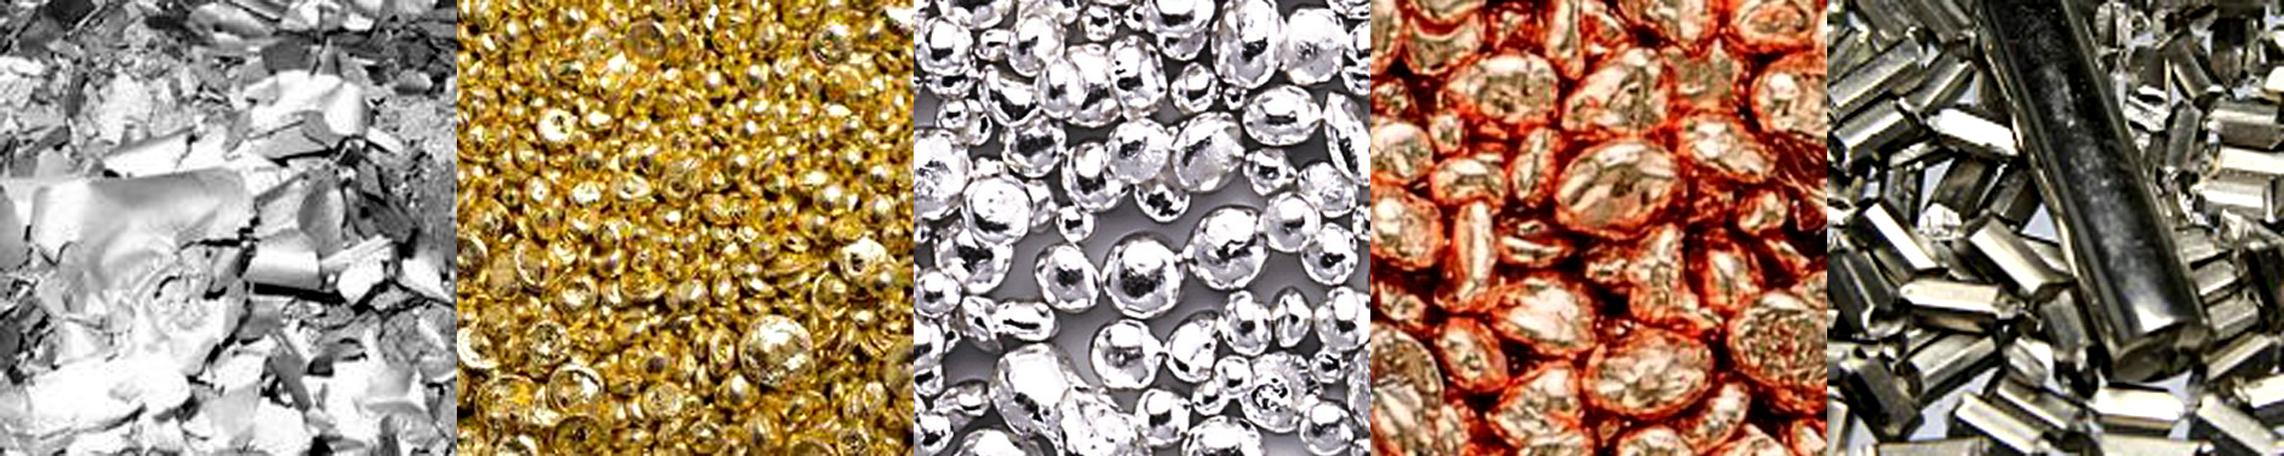
Precious Metals
BUS 417

Slide 2
General Economic Information
Canadian mining industries:
employ more than 375,000 workers. (For extraction, smelting, fabrication and manufacturing)
Contributed $57 billion to Canada’s GDP in 2014.
Accounted for 18.2% of the value of Canadian goods export.
Notes:
World mine
More on NI43 PAGE 11

Slide 3
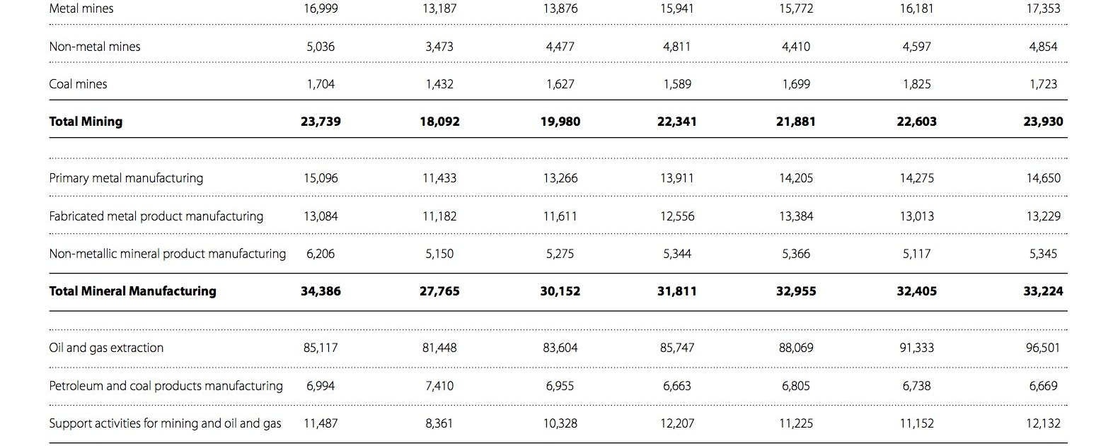

Slide 4
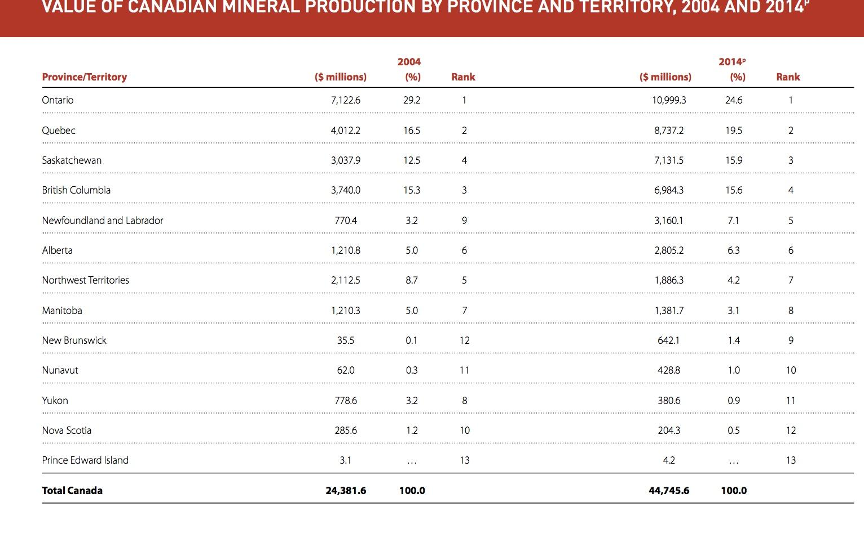

Slide 5
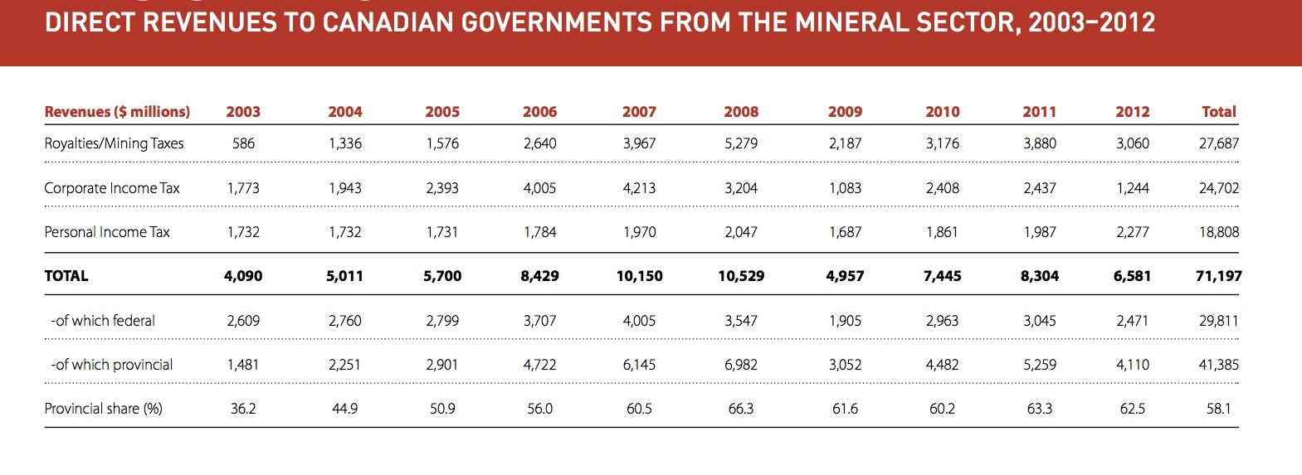

Slide 6
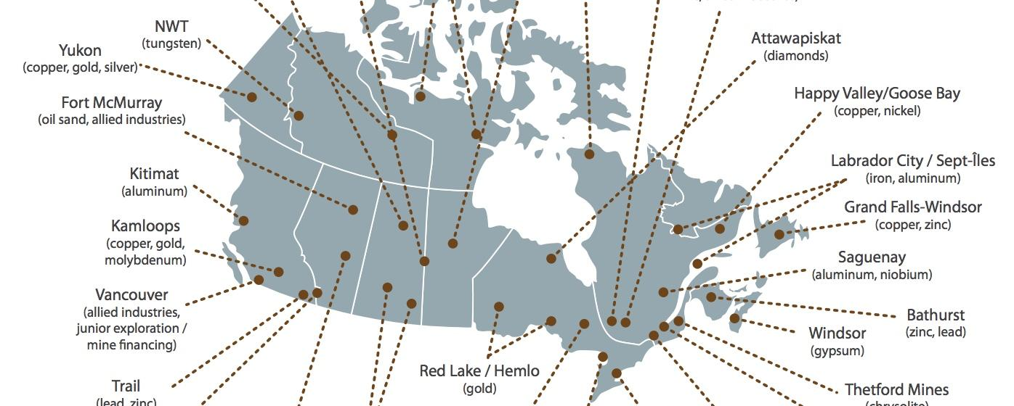

Slide 7
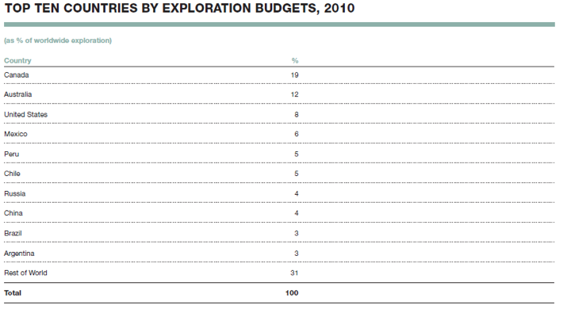
World Top Exploration Budgets

Slide 8
Mineral Resource Classification
Mineral Resources:
Mineral resources that are potentially valuable, and for which reasonable prospects exist for eventual economic extraction
Mineral Reserves:
Mineral reserves or Ore reserves that are valuable and legally and economically and technically feasible to extract

Slide 9
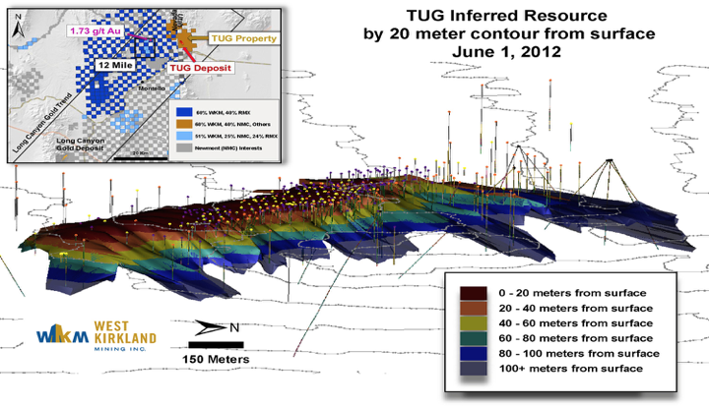
Mineral Resource - Inferred Mineral Resource
Inferred Mineral Resource is that part of a mineral resource for which tonnage, grade and mineral content can be estimated with a low level of confidence. It is inferred from geological evidence and assumed but not verified geological/or grade continuity. It is based on information gathered through appropriate techniques from location such as outcrops, trenches, pits, workings and drill holes which may be of limited or uncertain quality and reliability.
Notes:
Inferred Mineral Resource is that part of a mineral resource for which tonnage, grade and mineral content can be estimated with a low level of confidence. It is inferred from geological evidence and assumed but not verified geological/or grade continuity. It is based on information gathered through appropriate techniques from location such as outcrops, trenches, pits, workings and drill holes which may be of limited or uncertain quality and reliability.

Slide 10
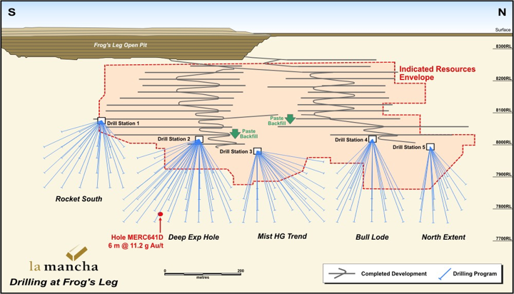
Mineral Resource - Indicated resources
Indicated resources are simply economic mineral occurrences that have been sampled (from locations such as outcrops, trenches, pits and drillholes) to a point where an estimate has been made, at a reasonable level of confidence, of their contained metal, grade, tonnage, shape, densities, physical characteristics
Notes:
Indicated resources are simply economic mineral occurrences that have been sampled (from locations such as outcrops, trenches, pits and drillholes) to a point where an estimate has been made, at a reasonable level of confidence, of their contained metal, grade, tonnage, shape, densities, physical characteristics

Slide 11
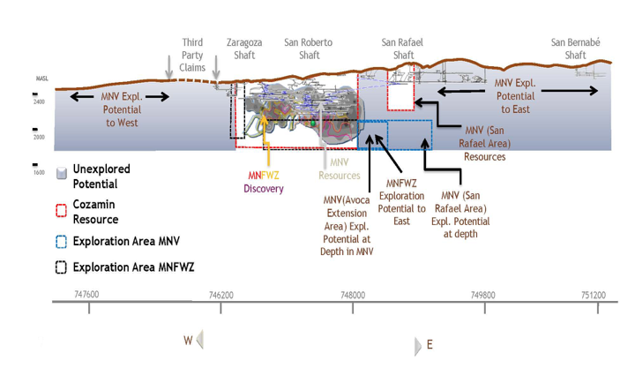
Mineral Resource - Measured resource
Measured resources are indicated resources that have undergone enough further sampling that a 'competent person' (defined by the norms of the relevant mining code; usually a geologist) has declared them to be an acceptable estimate, at a high degree of confidence, of the grade, tonnage, shape, densities, physical characteristics and mineral content of the mineral occurrence
Notes:
Measured resources are indicated resources that have undergone enough further sampling that a 'competent person' (defined by the norms of the relevant mining code; usually a geologist) has declared them to be an acceptable estimate, at a high degree of confidence, of the grade, tonnage, shape, densities, physical characteristics and mineral content of the mineral occurrence

Slide 12
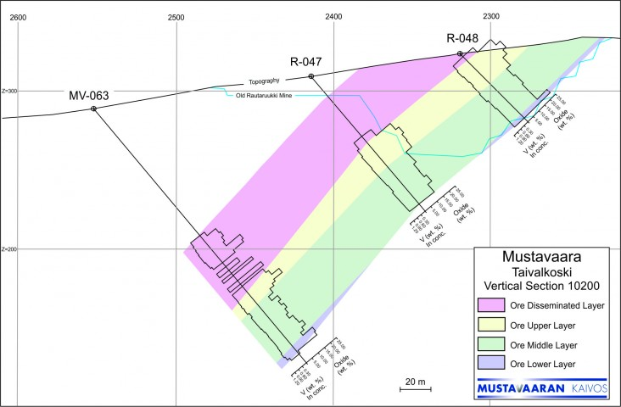
Mineral Reserves - Probable Reserve
A Probable Ore Reserve is the part of Indicated resources that can be mined in an economically viable fashion, and in some circumstances, a Measured Mineral Resource. It includes diluting material and allowances for losses which may occur when the material is mined. A Probable Ore Reserve has a lower level of confidence than a Proved Ore Reserve but is of sufficient quality to serve as the basis for decision on the development of deposit.
Notes:
A Probable Ore Reserve is the part of Indicated resources that can be mined in an economically viable fashion, and in some circumstances, a Measured Mineral Resource. It includes diluting material and allowances for losses which may occur when the material is mined. A Probable Ore Reserve has a lower level of confidence than a Proved Ore Reserve but is of sufficient quality to serve as the basis for decision on the development of deposit.

Slide 13
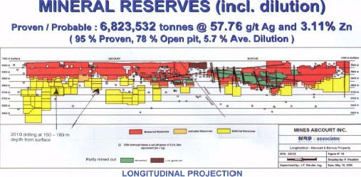
Mineral Reserves – Proven Ore Reserve
A Proven Ore Reserve is the part of Measured resources that can be mined in an economically viable fashion. It includes diluting materials and allowances for losses which occur when the material is mined. A Proven Ore Reserve represents the highest confidence category of reserve estimate. The style of mineralization or other factors could mean that Proven Ore Reserves are not achievable in some deposits
Notes:
A Proven Ore Reserve is the part of Measured resources that can be mined in an economically viable fashion. It includes diluting materials and allowances for losses which occur when the material is mined.
A Proven Ore Reserve represents the highest confidence category of reserve estimate. The style of mineralization or other factors could mean that Proven Ore Reserves are not achievable in some deposits

Slide 14
Legislation and Regulations
The provincial governments are responsible for mining within their jurisdiction.
Direct federal involvement in the regulation of mining operations is limited and specific in nature.
Notes:
The provincial governments are responsible for mining – the exploration for and the development and extraction of mineral resources, as well as he construction, management, reclamation and closure of mine sites – within their jurisdiction.
Direct federal involvement in the regulation of mining operations is limited and specific in nature. It includes uranium in the context of the nuclear fuel cycle (i.e., from exploration through to the final disposal of reactor and mine waste), mineral activities related to federal Crown corporations, and mineral activities on federal lands and in offshore areas.

Slide 15
Regulation
Northwest Territories and Nunavut Mining Regulations
Territorial Coal Regulations
Territorial Quarry Regulations
Notes:
In the northern territories sub-surface lands include hard-rock minerals, precious gems and coal. The rights to these materials are administered through the Northwest Territories and Nunavut Mining Regulations (formerly known as the Canada Mining Regulations) and the Territorial Coal Regulations . There is a distinction between sub-surface minerals and surface mineral substances that have specific purposes such as carving stone and building materials. These special use surface minerals are administered through the Territorial Quarry Regulations .

Slide 16
NI43-101
National Instrument 43-101 (NI 43-101)
Developed by the Canadian Securities Administrators (CSA) and administered by the provincial securities commissions
Governs the quality of information shared by mining companies in the Canadian industry.
Disclosure is based on the advice of a qualified person
Entitles investors to a standard of information to evaluate investment potential
Notes:
the NI43-101 regulation governs all information disclosure for Canadian minerals and mining companies. National Instrument 43-101 (NI 43-101) is a rule developed by the Canadian Securities Administrators (CSA) and administered by the provincial securities commissions that govern how issuers disclose scientific and technical information about their mineral projects to the public. It covers oral statements as well as written documents and websites. It requires that all disclosure be based on advice by a "qualified person" and in some circumstances that the person be independent of the issuer and the property. This rule is important to understand because it sets the standard for all companies involved in this sector. Reliance on a qualified person This standard is currently under revision,

Slide 17
Minerals and Metals Policy of the Government of Canada
The Minerals and Metals Policy of the Government of Canada fulfills important commitments the government made in Creating Opportunity, Mining Agenda and A Guide to Green Government
The Policy was developed after an extensive consultation process involving representatives from federal departments and agencies, provincial and territorial mines ministries, industry, environmental groups, labor, and Aboriginal communities
Notes:
The Policy affirms provincial jurisdiction over mining, delineates a role for the federal government in minerals and metals that is tied to other federal responsibilities, and commits the government to pursuing partnerships with stakeholders in addressing issues within its jurisdiction.
As part of this process, Natural Resources Canada published an issues paper entitled “Sustainable Development and Minerals and Metals” in 1995.

Slide 18
Copper Facts
Current spot price: 2.19US/lb
Value produced in 2015: 4.49 Billion CAD
This is roughly 10.5% of all metal and non-metal mineral production for 2015.
In 20014, Chile was the top mine producer of copper with at least one-third world share followed by the United States, Indonesia and Peru
Copper is 100% recyclable
80% of the copper ever mined is still in use today
Various estimates of existing copper reserves available for mining vary from 25 years to 60 years
Recycling is a major source of copper in the modern world

Slide 19
Copper Uses
Electrical wires (60%),
Roofing and plumbing (20%) and
Industrial machinery (15%).
Notes:
Copper production around the world
World copper council
World gold council
Gold demand
Gold production
International copper study group
International lead+zinc study group
Mention byproducts

Slide 20
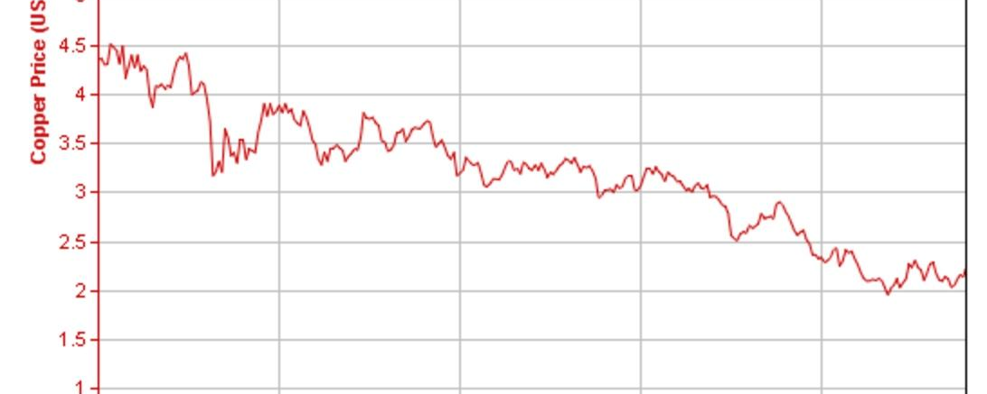

Slide 21
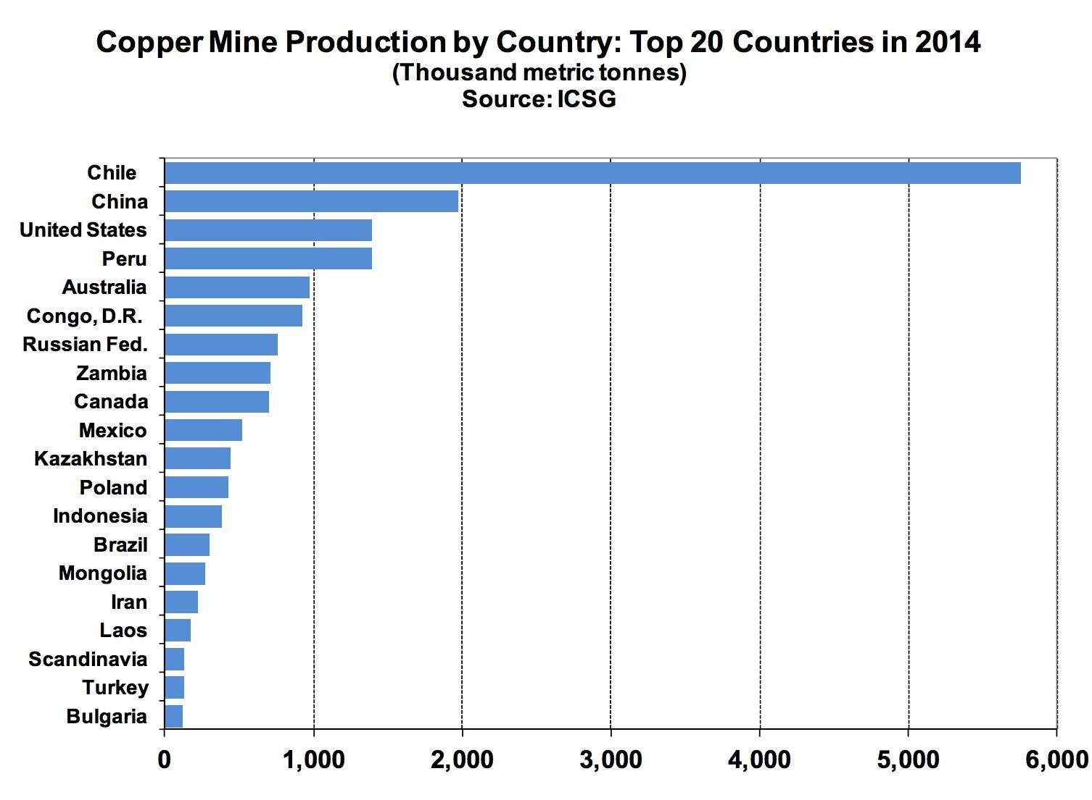

Slide 22
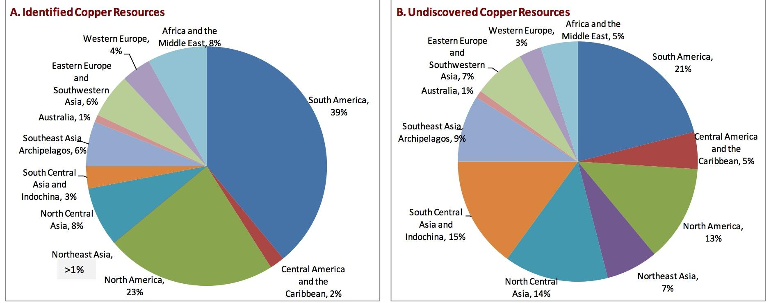

Slide 23
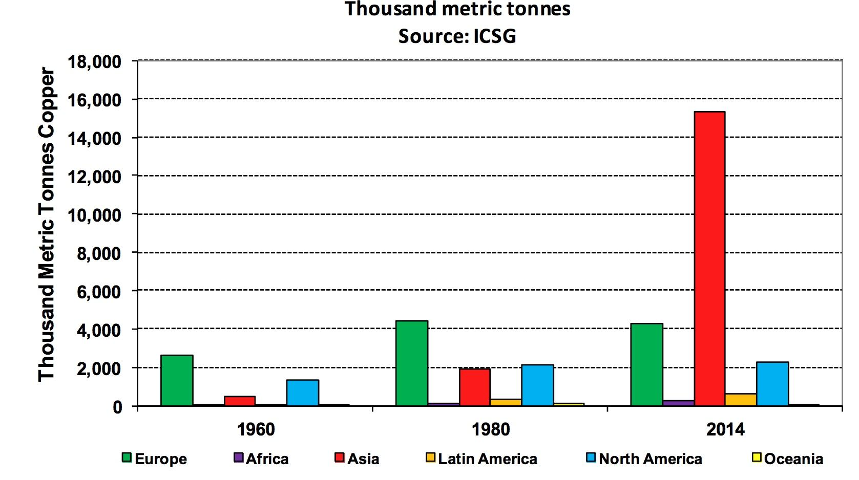
Copper Usage by Region, 1960, 1980 & 2014

Slide 24
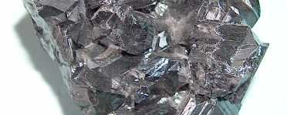
Zinc

Slide 25
Zinc Facts
Current Spot price: 1.01 USD/lb (Jul 15, 2016)
Roughly 4% of all metals and nonmetals produced
The element is normally found in association with other base metals such as copper and lead in ores
Identified world zinc resources total about 1.9 billion tonnes
Total reserve base of 500 million tonnes has been identified
At the current rate of consumption, these reserves are estimated to be depleted sometime between 2027 and 2055
Commercially pure zinc is known as Special High Grade, often abbreviated SHG, and is 99.995% pure

Slide 26
Zinc Uses
Brass, which is an alloy of copper and zinc, has been used since at least 10th century BC
Applications of zinc include:
○Galvanizing (59%)
○Die-casting (16%)
○Brass and bronze(10%)
○Rolled zinc (6.5%)
○Chemicals (6.0%)
○Miscellaneous (2.5%)

Slide 27
Zinc Reserves
During 2010, Canadian reserves of zinc declined by about 117 000 t (3%) to a year-end total of approximately 4.13 million tonnes (Mt).
The greatest zinc reserves was recorded at:
-the Kidd Creek mine in Timmins, Ontario (134 000 t)
-the LaRonde mine in Quebec (98 000 t)
-the Brunswick No. 12 mine in New Brunswick (78 000 t)

Slide 28
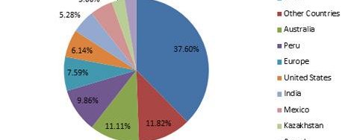
Zinc Production in the World

Slide 29
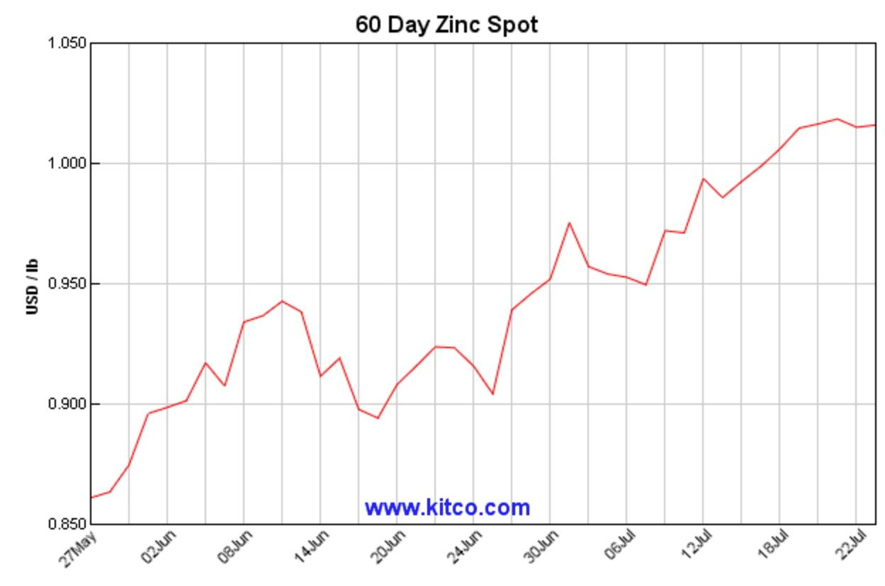
Zinc Spot Price

Slide 30
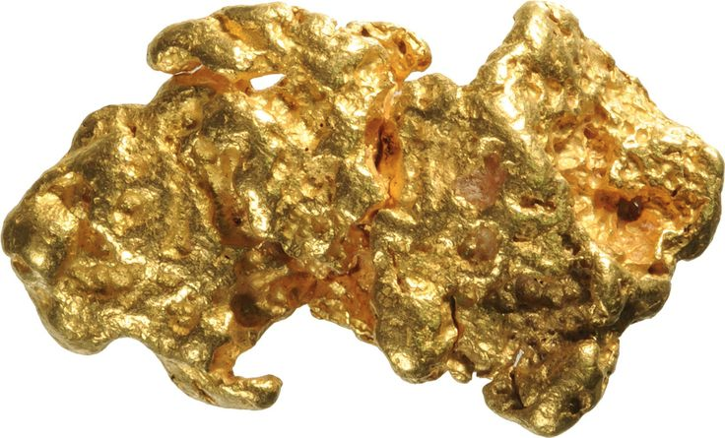
Gold

Slide 31
Gold Facts
Symbol: Au
Current spot price: 1,736.628 CAD/ounce
Value produced in 2015: 7.29 billion CAD
Roughly 17% of of all metals and nonmetals produced

Slide 32
Gold Reserves:
1473 tonnes (t) of gold contained in Canadian mine reserves in December 2010
The largest addition to gold reserves came from:
Canadian Malartic mine in Val-d’Or, Quebec: 278t
Young-Davidson mine in Matachewan: 88t,
the New Afton mine in British Columbia: 33t
Timmins mine in Ontario: 27 t

Slide 33
Gold Uses
Gold is used to make jewellery and other art items- 50%
Electronic applications represent a significant amount of the United States’ annual gold consumption- 10%
Held in reserves- 40%

Slide 34
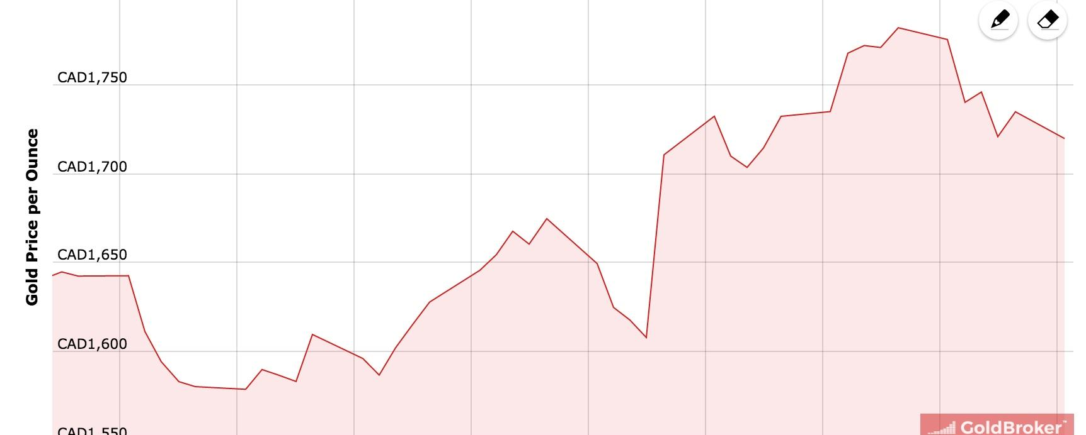
Gold Price (Past Two Months)

Slide 35
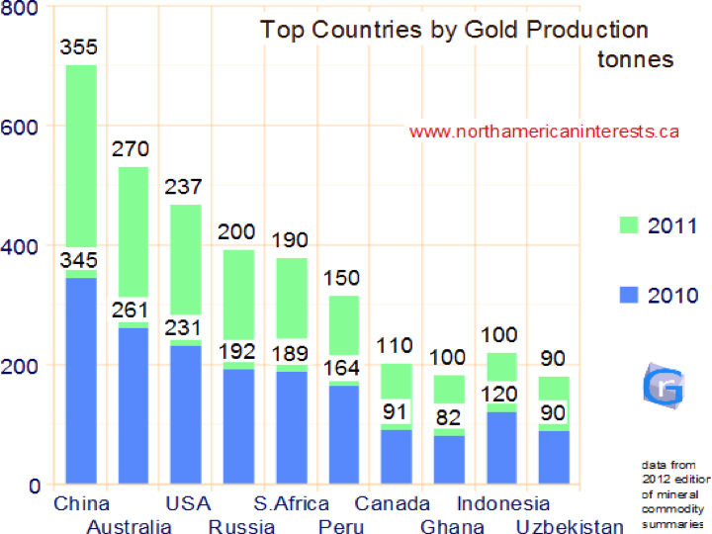
Gold Production

Slide 36
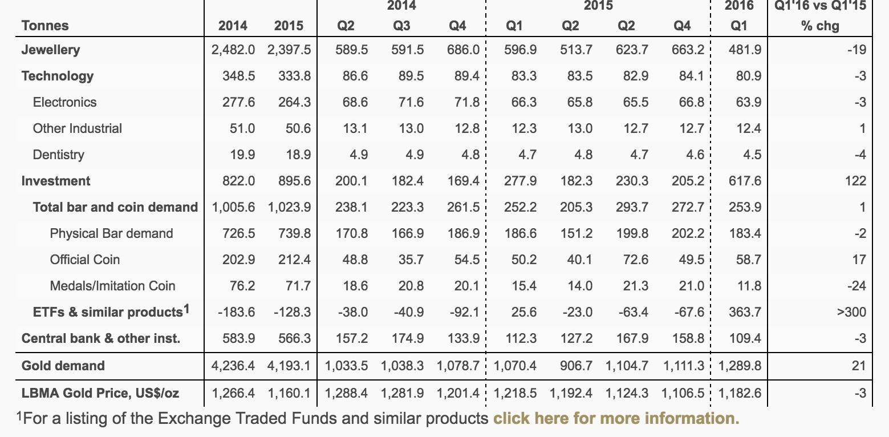
Gold Demand

Slide 37
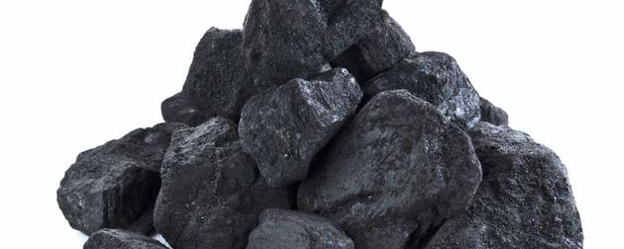
Steelmaking Coal (Metallurgical coal)
Notes:
US Energy information EIA production numbers
Producer
Region price Australia coal price
Price Charts

Slide 38
Types of Coal
Metallurgical (coking)coal
Thermal Coal

Slide 39
Coal Facts
Coal provides over 23% of global primary energy needs
Canada has an abundant coal resource. The largest known reserves are located in the western provinces, which are also Canada’s principal producers. Coal is also mined in Atlantic Canada.
Canada ranks tenth in the world in total coal reserves with 4 billion tonnes of bituminous coal.
Canadian coal is exported to 21 countries on five continents with an annual value of approximately $2 billion.
Canada also imports coal, primarily for electricity generation, as well as for metallurgical applications.
Coal consumption may eventually decline in Canada as a result of environmental policies. It could also continue to thrive with the development of new technologies aimed at reducing air emissions.

Slide 40
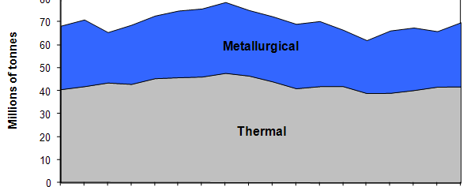
Canadian Coal Production
Notes:
Annual coal production in Canada has remained relatively steady since 1990, hovering between 65 and 75 million tonnes. Canada produces both thermal and metallurgical coals. This graph illustrates in millions of tons the amount of thermal and metallurgical coals produced between 1990 and 2007. In 2007, 70 million tonnes of coal were produced.

Slide 41
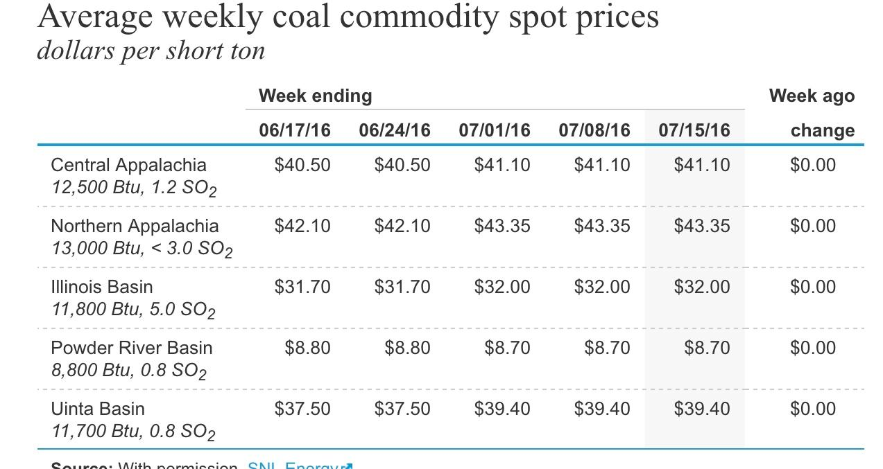
Coal Price

Slide 42
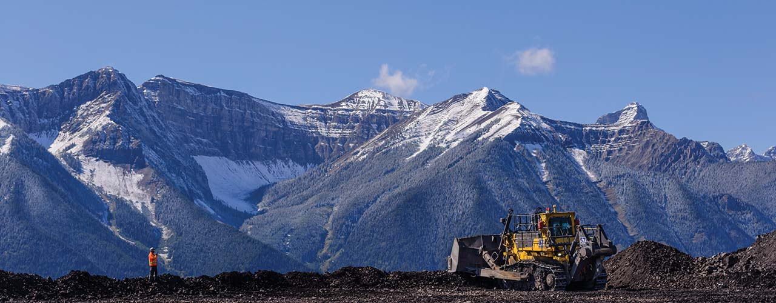
Teck Resources Ltd.

Slide 43
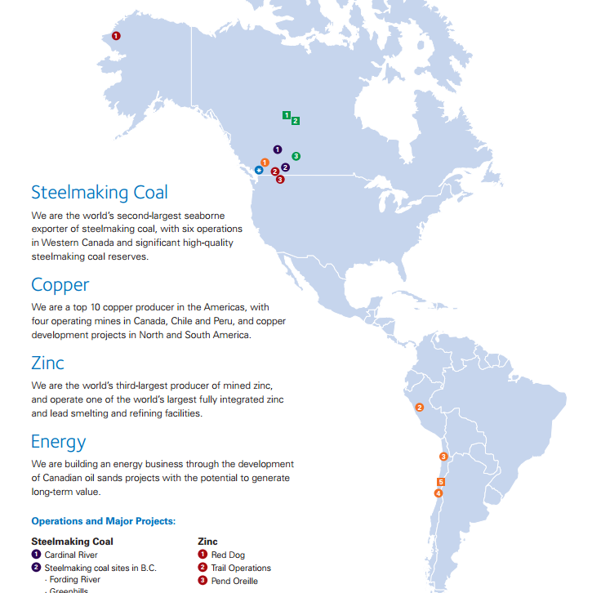
Location of Mines

Slide 44
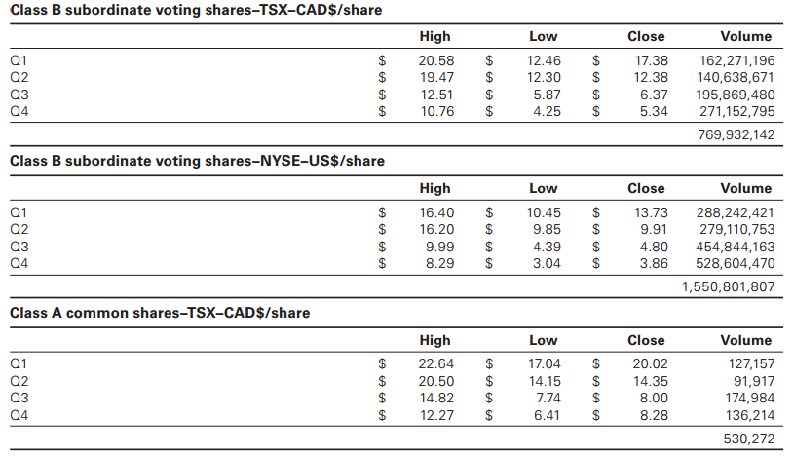
Corporate Info (share volume)

Slide 45
Shares Outstanding & Dividends Paid
Dividends on Class A and B Shares
Shares Outstanding as at April 25, 2016
Amount per Share | Payment Date
$0.0387 | June 30, 2016
$0.0368 | December 30, 2015
$0.1222 | July 2, 2015
$0.393 | January 2, 2015
$0.4123 | July 2, 2014
Class A Common Shares | 9,353,470
Class B Common Shares | 566,906,062
Total Outstanding | 576,259,532

Slide 46
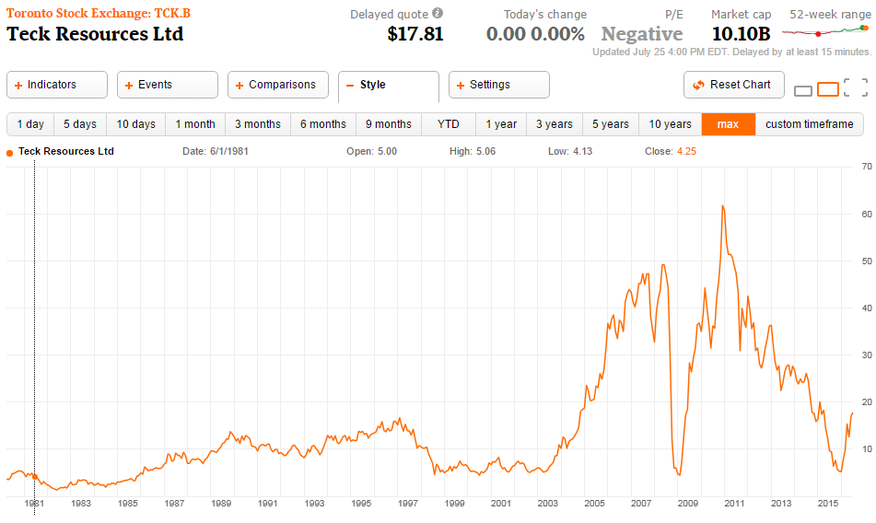
Historical Stock Performance

Slide 47
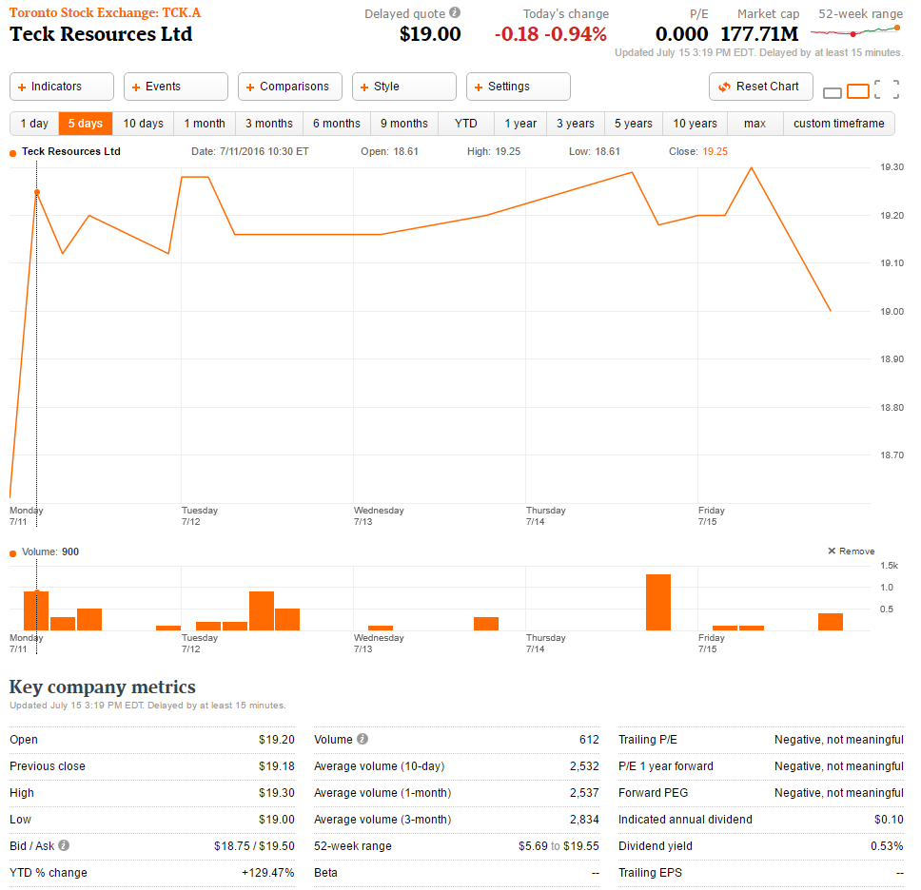
Stock Summary (Type A)

Slide 48
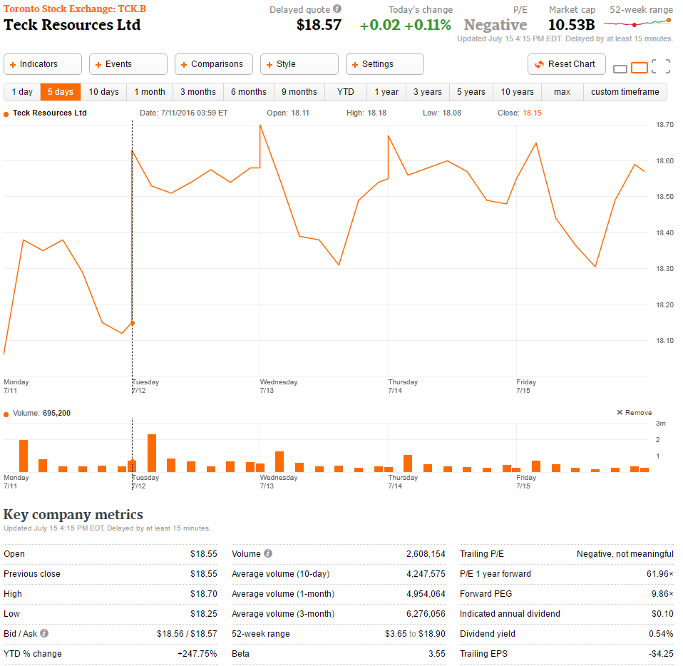
Stock Summary (Type B)
Notes:
Start with this

Slide 49
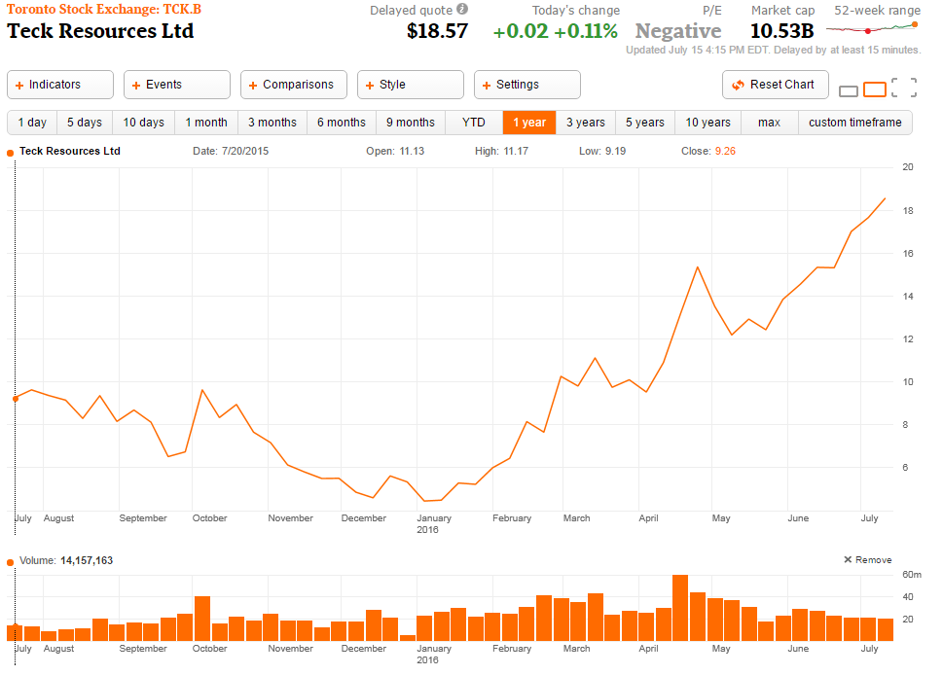
1 Year Stock Performance

Slide 50
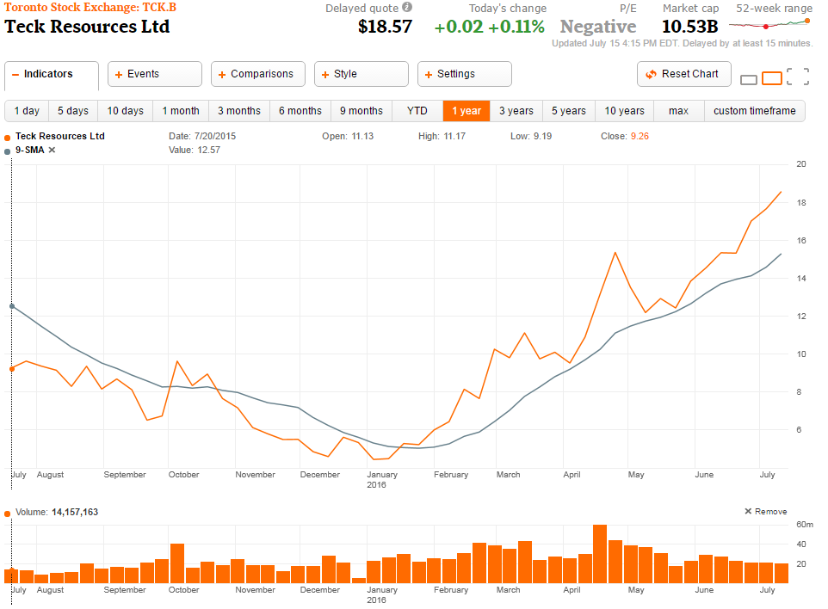
1 Year Moving Average

Slide 51
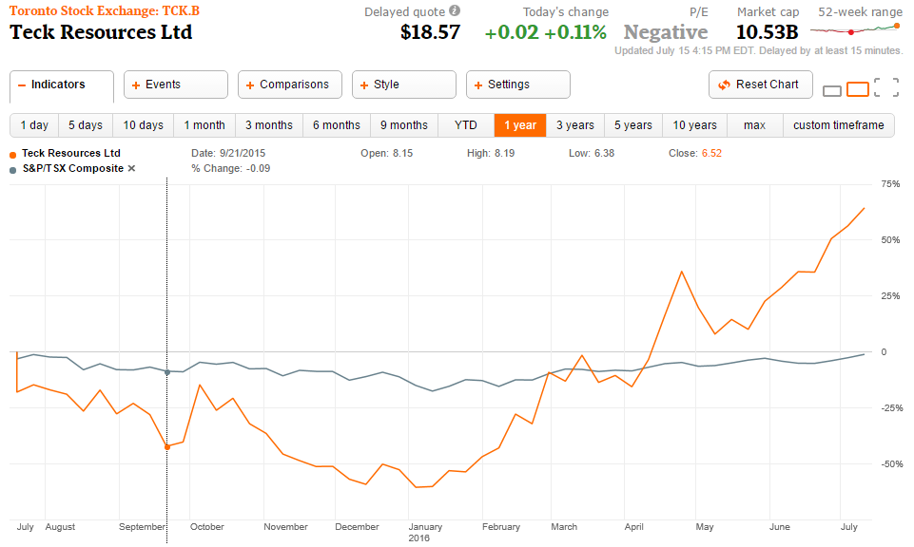
1 Year vs. S&P/TSX Composite

Slide 52
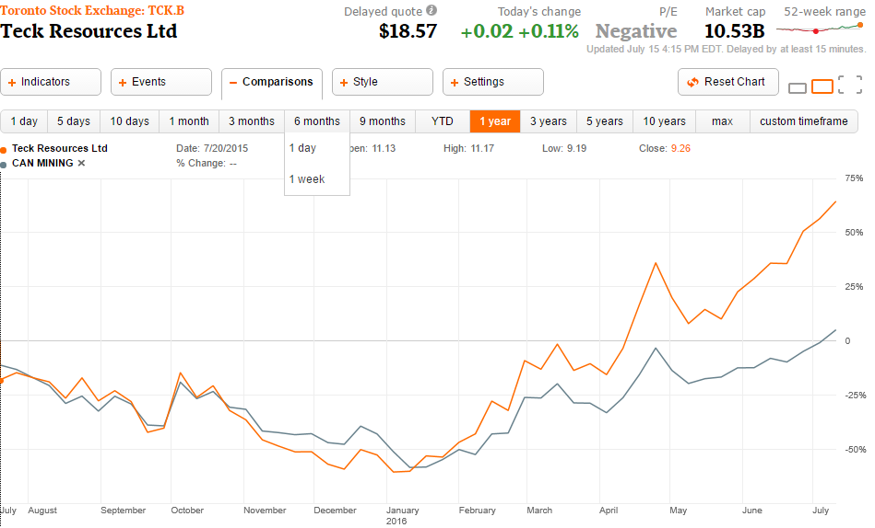
1 Year vs. S&P/TSX Metals & Mining Index

Slide 53
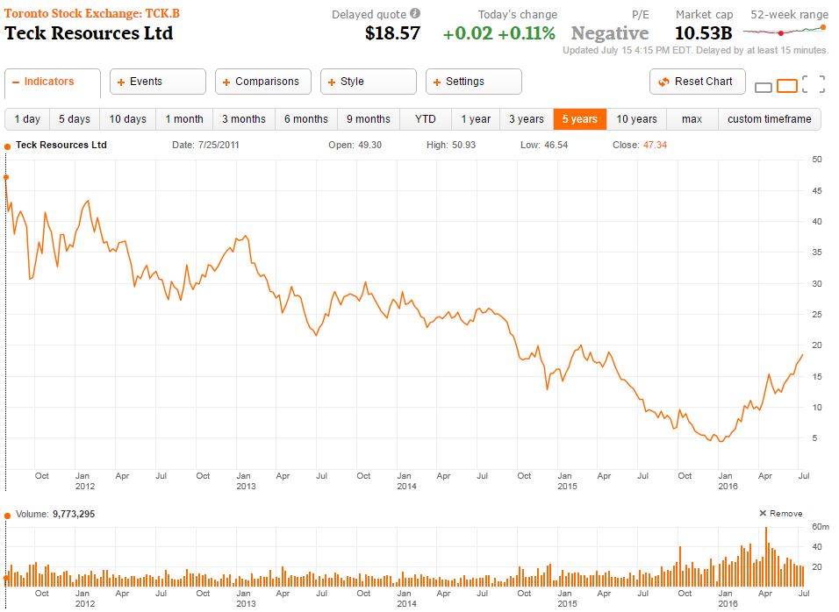
5 Year Stock Performance

Slide 54
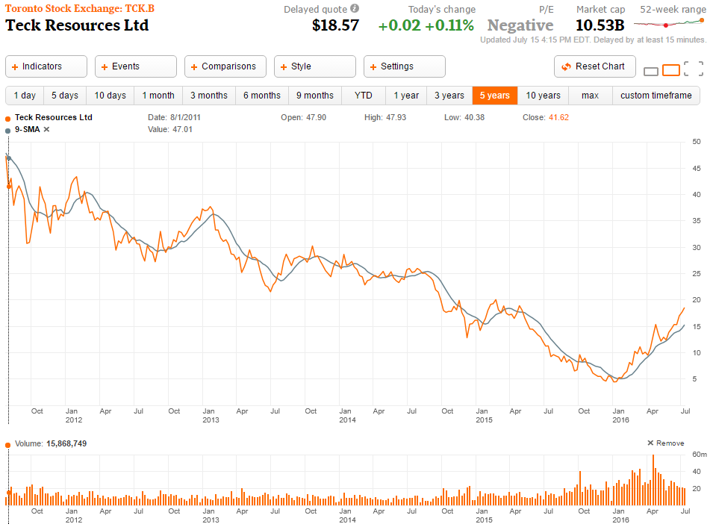
5 Year Moving Average

Slide 55
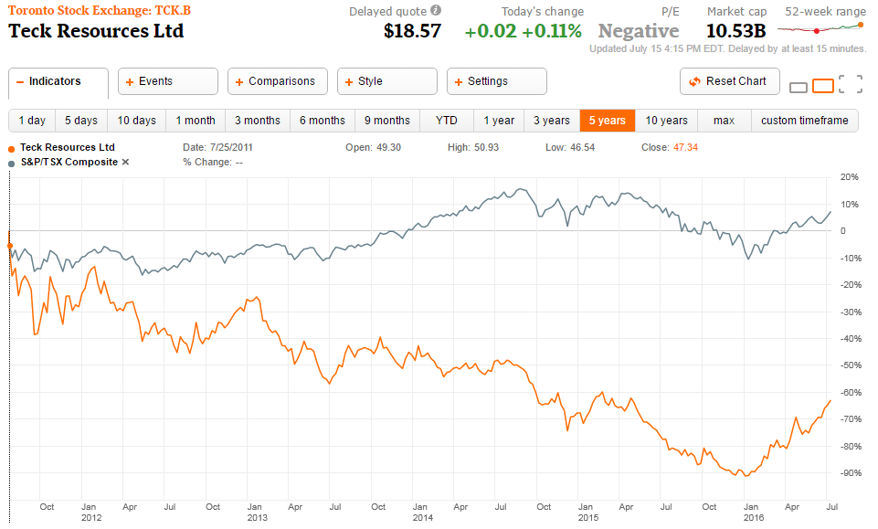
5 Year vs. S&P/TSX Composite
Notes:
10 year for teck

Slide 56
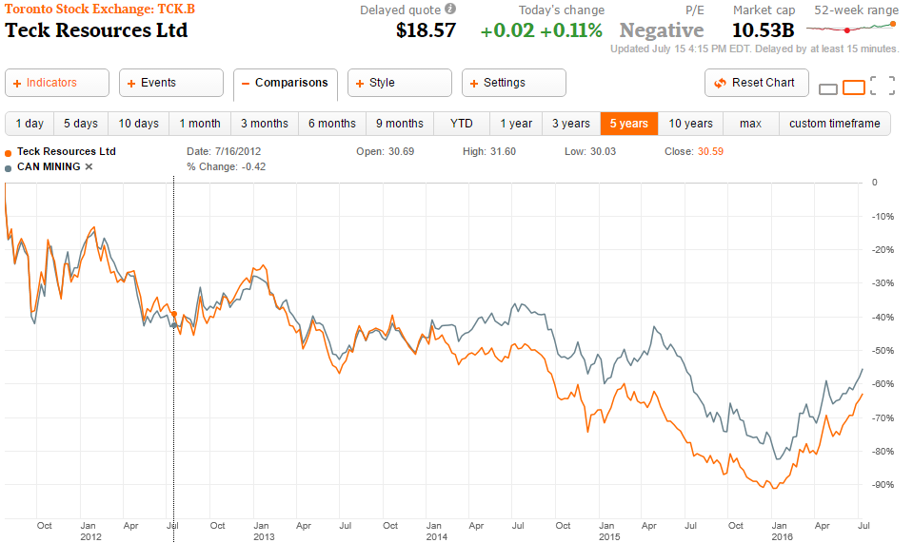
5 Year vs. S&P/TSX Metals & Mining Index

Slide 57
Company History
Teck Resources Ltd. was known as Teck Cominco until 2008
Began in 1913 as Teck-Hughes Gold Mines Limited with the objective to discover gold at Kirkland Lake, Ontario, by prospectors Sandy McIntyre and James Hughes
The mine produced gold for 50 years up until 1965
The partnership between Teck and Cominco began in 1986 when Teck acquired a shareholding from CP limited, and the merger between the two companies was finalized in July 2001

Slide 58
Business Model: Diversified Mining
Teck is a diversified resource company committed to responsible mining and mineral development.
Headquartered in Vancouver, Canada
Significant copper producer in the Americas
Third largest producer of zinc concentrate
Second largest seaborne exporter of steelmaking coal
Building an energy business that will further diversify our resource portfolio and generate significant long-term value
They have operations throughout the Americas and offices and exploration properties globally.
Own or have interests in 12 mines in Canada, the USA, Chile and Peru
One metallurgical complex in Canada
Interests in three oil sands development assets
Global portfolio of copper, zinc and gold exploration
Expertise in exploration, development, mining, smelting, refining, safety, environmental protection, product stewardship, recycling and research

Slide 59
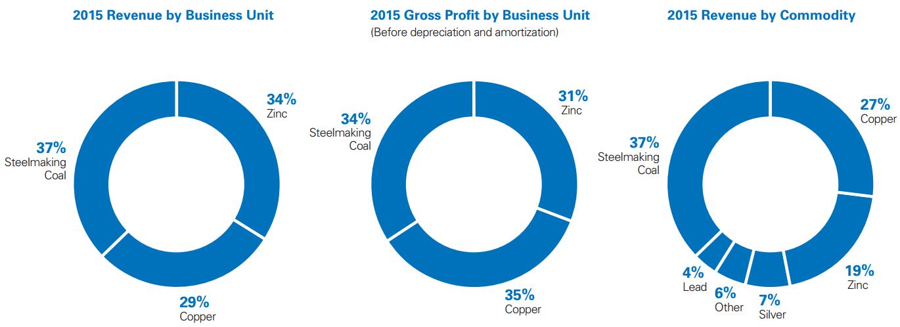
Business Model: Diversified Mining

Slide 60
Current Business Sectors
Steelmaking Coal - World’s second-largest seaborne exporter of steelmaking coal, with six operations in Western Canada and significant high-quality steelmaking coal reserves
Copper - Four operating mines in Canada, Chile, and Peru with copper development projects in North and South America
Zinc - Third-largest producer of mined zinc, and operate one of the world’s largest fully integrated zinc and lead smelting and refining facilities
Gold - Teck is actively exploring for and looking to partner in new gold opportunities. However, this industry is to a significantly lesser extent than steelmaking coal, copper, or zinc
Energy - Building an energy business through the development of Canadian oil sands projects with the potential to generate long-term value

Slide 61
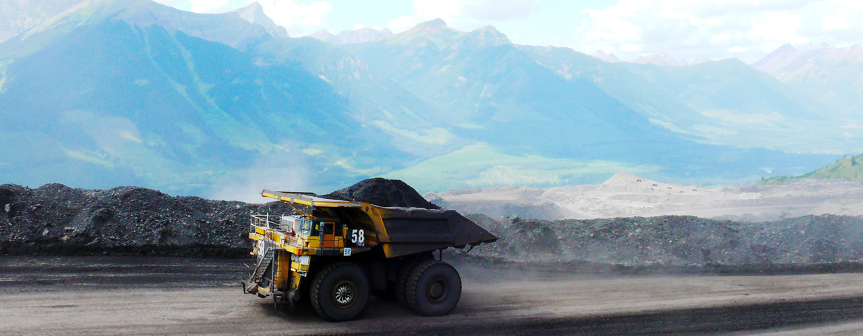
Steelmaking Coal Operations
Six mining locations
Greenhills Operation
Line Creek
Cardinal River
Coal Mountain
Elkview
Fording River
In 2014 the Quintette Project in northeast BC was put on hold due to unfavourable market conditions

Slide 62
Greenhills Operations
Located near Elkford in southeastern British Columbia
Teck has an 80% partnership interest
Other 20% owned by Korean steel producer POSCO Canada Limited
Steel exported by sea to Asia-Pacific region, shipped via rail to Vancouver
Expected to produce coal for another 39 years

Slide 63
Line Creek
Located near Sparwood in southeastern British Columbia
Steel exported by sea to Asia-Pacific region, shipped via rail to Vancouver
Current annual production capacities of mine and preparation plant are approximately 3.5 million tonnes of clean coal
Expected to produce coal for another 23 years

Slide 64
Cardinal River
Located near Hinton in Alberta
Steel exported by sea to Asia-Pacific region, shipped via rail to Vancouver and Prince Rupert
Current annual production capacities of mine and preparation plant are approximately 2.0 and 3.0 million tonnes of clean coal, respectively
Expected to produce coal for another 10 years

Slide 65
Coal Mountain
Located near Sparwood in southeastern British Columbia
Steel exported by sea to Asia-Pacific region, shipped via rail to Vancouver
Current annual production capacities of mine and preparation plant are approximately 2.7 and 3.5 million tonnes of clean coal, respectively
Mining operations are expected to conclude near the end of 2017.

Slide 66
Elkview
Located near Sparwood in southeastern British Columbia
Teck has a 95% partnership interest
Other 5% owned by the Japanese steel producer Nippon Steel & Sumitomo Metal Corporation, and the Korean steel producer POSCO
Steel exported by sea to Asia-Pacific region, shipped via rail to Vancouver
Current annual production capacities of mine and preparation plant are approximately 7.0 million tonnes of clean coal
Expected to produce coal for another 41 years

Slide 67
Fording River
Located near Elkford in southeastern British Columbia
Steel exported by sea to Asia-Pacific region, shipped via rail to Vancouver
Current annual production capacities of mine and preparation plant are approximately 8.5 and 9.5 million tonnes of clean coal, respectively
Expected to produce coal for another 52 years

Slide 68
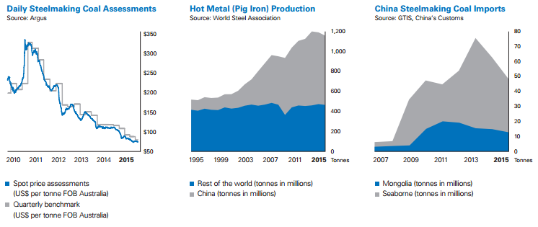
Steelmaking Coal Operations
Steelmaking coal, also known as metallurgical or coking coal, is a higher grade coal which burns at a higher temperature and allows iron to be smelted into higher quality steel
34% of gross profits came from steelmaking coal
25.3 million tonnes of steelmaking coal was produced in 2015
26.0 million tonnes of sales of steelmaking coal in 2015

Slide 69
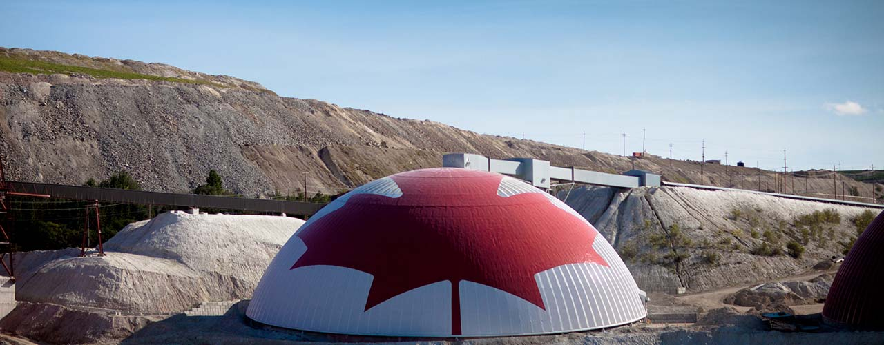
Copper Operations
Four mining locations
Antamina
Quebrada Blanca
Carmen de Andacollo
Also a gold mine
Highland Valley Copper

Slide 70
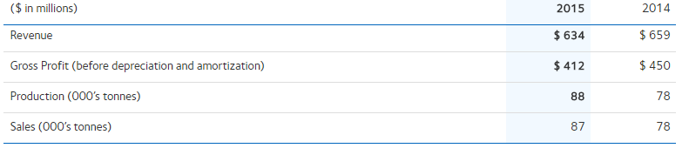
Antamina
Large copper and zinc mine
Located in the Andes mountain range, 270 kilometres north of Lima, Peru at an elevation of 4,200 metres
Teck has a 22.5% partnership interest
33.75% owned by BHP Billiton plc
33.75% owned by Glencore plc
10% owned by Mitsubishi Corporation

Slide 71
Quebrada Blanca
Open pit copper mine
Located in the Tarapaca Region of northern Chile, 240 kilometres southeast of the city of Iquique at an elevation of 4,400 metres
Teck has a 76.5% partnership interest
13.5% owned by INversiones Mineras S.A.
10% owned by Empresa Nacional de Mineria
Mine life options past 2016 are being reviewed in light of current market conditions

Slide 72
Carmen de Andacollo
Open pit mine producing copper in concentrates
Located in the Coquimbo Region of Central Chile, 350 kilometres north of Santiago at an elevation of 1,000 metres
Teck has a 90% partnership interest
Remaining 10% held by Empresa Nacional de Mineria
In July 2015, Carmen de Andacollo entered into a long-term gold offtake agreement to delivery 100% of payable gold to Royal Gold, Inc.
Expected to produce copper and gold until 2036

Slide 73
Highland Valley Copper
Mine produces both copper and molybdenum concentrates
Located near Logan Lake and Kamloops in British Columbia
Teck has an 97.5% partnership interest
They are continuously exploring around the Highland Valley area for new copper deposits near the Bethlehem pits
The pits were previously mined in the 1960s and 70s
Expected to produce copper and molybdenum until 2026

Slide 74
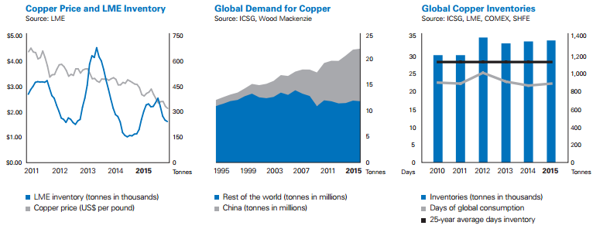
Copper Operations
35% of gross profits came from copper
33.0 million tonnes of copper in proven & probable reserves and measured & indicated resources
358k tonnes of copper produced in 2015

Slide 75
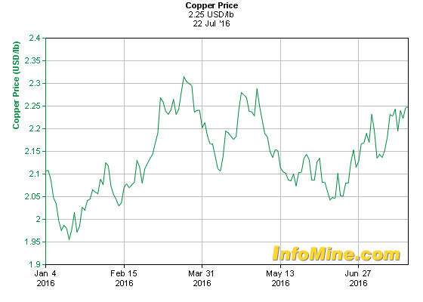
Copper Price

Slide 76
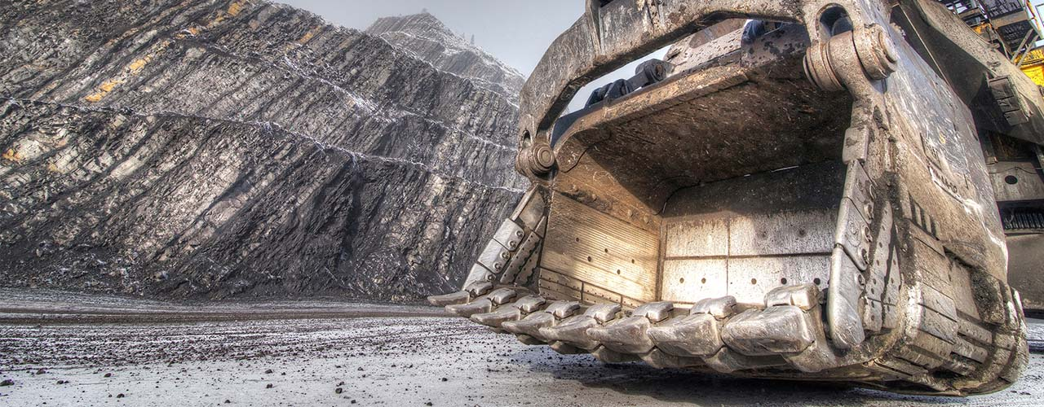
Zinc Operations
Massive zinc refinery in Trail, BC
One of the world’s largest fully integrated zinc and lead smelting and refining complexes
Two mining locations
Pend Oreille
Red Dog
Notes:
Red dog - alaska, one of the largest in the world
Pend Oreille - washington state

Slide 77
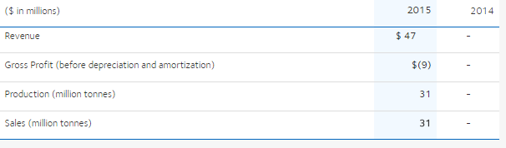
Pend Oreille
Underground zinc and lead mine
Located near Metaline Falls in the Washington State
Mine operations were restarted in December 2014 after previously being on hold since 2009
Has an expected mine life of four and a half more years at 43,000 tons of zinc concentrate per year
Zinc and lead concentrates are shipped to Trail Operations for processing

Slide 78
Red Dog
One of the world’s largest zinc mines
Located in northwest Alaska
Partnership between Teck and the Northwest Arctic Borough (NAB)

Slide 79
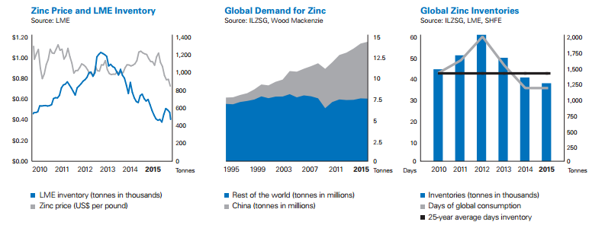
Zinc Operations
31% of gross profits came from zinc
658k tonnes of zinc concentrate was produced in 2015
307k tonnes of refined zinc was produced by the Trail Operations in 2015
100 million people have reached through the Teck Zinc & Health program since 2011

Slide 80
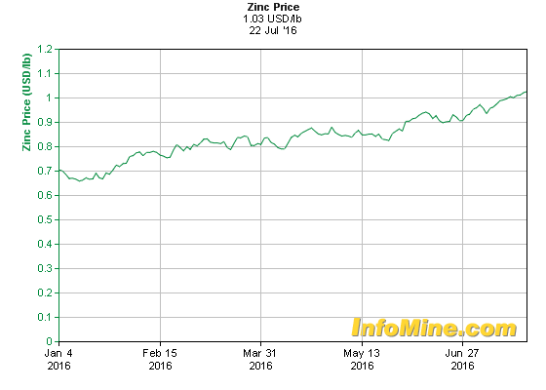
Zinc Price

Slide 81

Expected Share from Operations

Slide 82
Mines and Refineries of Teck
Teck Corporation |  | Cominco Ltd.
1900 - 1930
Teck-Hughes - gold | 1915-1965 | Trail - zinc, lead complex | 1902-
Yukon Consolidated Gold | 1923-1966 | Sulllivan - zinc, lead | 1909-2001
1931 - 1960
Lamaque - gold | 1935-1998 | Con - gold | 1938-1986
Pickle Crow - gold | 1935-1966 | Pinchi Lake - mercury | 1940-1975
Temagami - copper | 1956-1972 | Bluebell - zinc, lead | 1952-1971
Mattagami - copper, zinc | 1963-1973 | HB - zinc, lead | 1955-1978

Slide 83
Teck Corporation |  | Cominco Ltd.
1961 - 1980
Silverfields - silver | 1965-1983 | Pine Point - zinc, lead | 1964-1989
Tribag - copper | 1967-1973 | Magmont - lead | 1968-1994
Beaverdell - silver | 1969-1991 | Vade - potash | 1969-1996
Newfoundland Zinc | 1975-1990 | Black Angel - zinc | 1973-1986
Niobec - niobium | 1975-2001 | Rubiales - zinc, lead | 1978-1991
Afton - copper | 1978-1997
1981 - 1990
Highmont - copper, moly | 1981-1984 | Polaris - zinc, lead | 1982-2002
Bullmoose - coal | 1983-2003 | Highland Valley Copper | 1983-
David Bell - gold | 1985-2009 | Buckhorn - gold | 1984-1991
Williams - gold | 1985-2009 | Troya - lead, zinc | 1987-1993
 |  | Red Dog - zinc, lead | 1989-

Slide 84
Teck Corporation |  | Cominco Ltd.
1991 - 2001
Elkview - coal | 1991-2003 | Snip - gold | 1991-1996
Quintette - coal | 1992-2000 | Cajamarquilla - zinc refinery | 1995-2004
Quebrada Blanca - copper | 1994-2000 | Quebrada Blanca - copper | 1994-2000
Louvicourt - copper, zinc | 1995-2005
Tarmoola - gold | 1998-2001
Carosue Dam - gold | 2000-2001
Antamina - copper, zinc | 2000-

Slide 85
After the Teck Cominco Merger (2002 onwards)
Teck Resources Limited
 | Teck Coal - coal | 2003-
 | Pend Oreille - zinc | 2004-
 | Pogo - gold | 2006-2009
 | Lennard Shelf - zinc | 2007-2008
 | Carmen de Andacollo - copper | 2007-
 | Duck Pond - copper, zinc | 2007-
 | Quebrada Blanca - copper | 2007-

Slide 86

Mineral Reserves (as at March 1, 2016)

Slide 87


Slide 88


Slide 89


Slide 90
Financial Strength
Since the end of the third quarter, Moody’s, S&P, Fitch, and DBRS reduced Teck’s credit ratings to B3, B+, BB+, and BB (high) respectively with a further negative outlook trend.
As of the annual report, Teck paid a 4.63% yield annual dividend paid semi annually.
However, on June 30, 2016 the dividend paid per share was $0.0387 and on December 30, 2015 it was $0.0368 down from a five year high of $0.4554 on January 2, 2013
The decreasing price of steelmaking coal, copper, and zinc greatly harms Teck’s future potential for growth

Slide 91
Management

Slide 92

Leadership

Slide 93

Norman B. Keevil, Chairman of the Board
Director Since: 1963
Norman B. Keevil joined the Board of Teck in 1963. He is a graduate of the University of Toronto (B.A. Sc.) and the University of California at Berkeley (Ph.D.). He received an honorary LL.D from the University of British Columbia in May 1993. He was Vice President Exploration at Teck Corporation from 1962 to 1968, Executive Vice President from 1968 to 1981, President and Chief Executive Officer from 1981 to 2001 and has been Chairman of the Board of Teck since 2001. He is a lifetime director of the Mining Association of Canada. Dr. Keevil was inducted into the Canadian Mining Hall of Fame in January 2004 and the Canadian Business Hall of Fame in 2012.

Slide 94

Warren S. R. Seyffert, Q.C. - Deputy Chairman
Director Since: 1989
Warren S. R. Seyffert, Q.C. was elected to the Board of Teck in 1989 and was a member of the Board of Cominco Ltd. from 2000 to the date of the merger. He is a graduate of the University of Toronto Law School (LL.B.) and York University, Osgoode Hall (LL.M). He is currently Chair of Coco Paving Inc. (a private heavy construction company). He was a partner of the law firm Lang Michener LLP from 1969 to 2001 and counsel from 2002 to 2007. He taught “Law of Corporate Management” for over 12 years at Osgoode Hall Law School. He is a director of various public and private corporations including Allstate Insurance Company of Canada, Pembridge Insurance Company, The Kensington Health Centre and St Andrew Goldfields Ltd. He is an Honourary Trustee of the Royal Ontario Museum.
Mr. Seyffert is a member of the following Board Committees: Executive Committee (Deputy Chair) Audit Committee Compensation Committee Corporate Governance & Nominating Committee (Chair) Safety & Sustainability Committee

Slide 95

Donald R. Lindsay - President & CEO
Director Since: 2005
Don Lindsay joined Teck as President in January 2005, was appointed to the Board in February 2005 and was appointed Chief Executive Officer in April 2005. He is a graduate of Queens University (B.Sc., Hons.) and Harvard Business School (M.B.A.). He is currently a director of Manulife Financial Corporation. Mr. Lindsay was employed by CIBC World Markets Inc. (investment banking) from 1985 to 2004 where he was President of CIBC World Markets Inc., Head of Investment and Corporate Banking and Head of the Asia Pacific Region.
Mr. Lindsay is a member of the following Board Committee: Executive Committee

Slide 96

Ronald A. Millos - Chief Financial Officer
Director Since: 2005
Ron Millos was appointed Senior Vice President, Finance and Chief Financial Officer of Teck in October 2005. He joined Teck Corporation in June 1995 as Assistant Controller and progressed through various management positions within the company and its subsidiaries.
Prior to his current position, Mr. Millos was Vice President and Chief Financial Officer of the Fording Canadian Coal Trust and Elk Valley Coal Partnership from 2003 to 2005. Prior to joining Teck he was a Senior Manager at KPMG LLP.
Mr. Millos holds a Bachelor of Commerce from the University of British Columbia and has completed Harvard Business School’s Advanced Management Program.
He is currently a member of the Canadian Institute of Chartered Accountants and the Institute of Chartered Accountants of British Columbia.

Slide 97

Alex Christopher - Senior Vice President of Exploration, Projects & Technical Services
Director Since: July 2016
Alex Christopher joined Teck’s Exploration Group in 1984 and was appointed Senior Vice President, Exploration, Projects & Technical Services in July 2016. He previously held the position of Vice President, Exploration, and has held a number of positions in the company within Exploration, Exploration Business Development and Corporate Development.
Mr. Christopher holds a Bachelor of Science (Honours) degree in Geology from McMaster University and an Environmental Biology Technology Diploma from Canadore College.
Mr. Christopher, a Professional Geoscientist, is a member of the Association of Professional Engineers and Geoscientists B.C. He is also on the Board of Directors of the Prospectors and Developers Association of Canada and is a Director of Horizonte Minerals Plc

Slide 98
New Vice President Appointments
Lawrence Watkins, Vice President of Health and Safety, October 2015

Slide 99
FINANCIAL STATEMENTS

Slide 100
Consolidated Balance Sheets

Slide 101

2016 Q1

Slide 102

2016 Q1

Slide 103

2015 Annual

Slide 104

2015 Annual

Slide 105
Consolidated Income Statements

Slide 106

2015 Annual

Slide 107

2015 Annual

Slide 108

2016 Q1

Slide 109

2016 Q1

Slide 110
Consolidated Statements of Cash Flows

Slide 111

2015 Annual

Slide 112

2015 Annual

Slide 113

2016 Q1

Slide 114
Recommendation: BUY

Slide 115



Slide 116


Company Snapshot

Slide 117



Slide 118
Outstanding Shares
As at April 27, 2016, there were 832 million common shares of the Company issued and outstanding and 14 million stock options outstanding which are exchangeable into common shares at exercise prices ranging between C$8.54 per share to C$48.72 per share.

Slide 119

Stock Performance- 1 Month

Slide 120

Stock Performance- 1 Year

Slide 121

Stock Performance-5 Year

Slide 122

Stock Performance-10 Year

Slide 123

Stock Performance- Max

Slide 124

Stock Price vs Gold Price

Slide 125
Corporate Overview
A leading gold producer focused on responsible mining practices with safe, low-cost production throughout the Americas.
A portfolio of long-lived, high-quality assets positions the Company to deliver long-term value.
A Canadian company headquartered in Vancouver, British Columbia, Goldcorp employs more than 15,000 people worldwide.
Committed to responsible mining practices and is well positioned to deliver long term value.
Focused on five key attributes: high quality production; low cash costs; maintaining an investment grade balance sheet; operating in regions with low political risk; and conducting business in a responsible manner.
Goldcorp’s operating assets include four mines in Canada, two mines in Mexico, and four in Central and South America.

Slide 126


Slide 127


Slide 128


Slide 129


Slide 130

Financial Highlights(1)

Slide 131


Slide 132



Slide 133


Slide 134


Slide 135


Slide 136


Slide 137


Slide 138
Red Lake, Ontario
Located in one of the world’s most prolific gold districts.
The High Grade Zone : an average grade of more than two ounces of gold per tone.
Proven & Probable Gold Reserves: 2.08Moz
Measured & Indicated Gold Resources: 2.27Moz
2015 gold production: 375,700 oz
2016 gold production expect: 300,000 -330,000 oz

Slide 139
Peñasquito Camp
Largest gold producer in Mexico
Location: Zacatecas, Mexico
2016 gold production expect: 520,000 – 580,000oz
2015 gold production: 860,300oz
Proven & Probable Gold Reserves: 9.87Moz
Measured & Indicated Gold Resources:2.20Moz
Current Mine Life: 12years

Slide 140
Pueblo Viejo
One of world’s largest gold assets
Location: Dominican Republic
Ownership : 40% owned by Goldcorp, 60% owned by Barrick
Total proven & probable gold reserves: 14.93 Moz
Proven & probable gold reserves owned by Goldcorp: 5.97Moz
2016 gold production expect: 400,000-440,000 oz

Slide 141
Cerro Negro Camp, Argentina
A long-lived, high quality asset
Proven &Probable Gold Reserves : 4.66Moz
Measured & Indicated Gold Reserves: 1.28Moz
2015 gold production:375,700oz
2016 gold production expect: 300,000 – 320,000oz
Opportunity to explore aggressively following improved political environment

Slide 142
Éléonore
Located in the James Bay region of Quebec, Canada
New camp with decades-long potential
Proven & Probable Gold Reserves: 5.35Moz
Measured & Indicated Gold Resources: 0.81Moz
2015 gold production: 268,100oz
2016 gold production expect: 250,000- 280,000oz

Slide 143
Management

Slide 144

David Garofalo , President and Chief Executive Officer
Date of Appointment: February 2016
Experience:
President, Chief Executive Officer and Director of Hudbay since July 2010
Senior Vice President, Finance and Chief Financial Officer with Agnico-Eagle Mines Limited (1998–2010).
Treasurer and held various finance roles with Inmet Mining Corporation (1990–1998).
Serves on the board of directors of Mackenzie Health Foundation (formerly York Central Hospital Foundation).
Qualifications:
Canada’s CFO of the Year by Financial Executives International Canada (2009)
Top Gun CFO by Brendan Wood International (2009 and 2010)
Best Investor Relations by a CFO (2009 and 2010) and Best Investor Relations by a CEO (2011) by IR Magazine
The Northern Miner’s Mining Person of the Year for 2012.
Graduated from the University of Toronto (B.Comm.)
Chartered Accountant and Certified Director of the Institute of Corporate Directors (ICD.D).

Slide 145

Russell Ball , Executive Vice President, Chief Financial Officer and Corporate Development
Date of Appointment: March 9, 2016.
Experiences:
Joined Goldcorp in May 2013 as Executive Vice President of Capital Management
Appointed Executive Vice President of Corporate Development and Capital Projects in December 2014 .
Previously served as Executive Vice President and Chief Financial Officer for Newmont Mining Corporation.
Managed in the finance and audit groups with PricewaterhouseCoopers in Durban, South Africa, prior to Newmont
Qualifications:
Chartered Accountant from the Institute of Chartered Accountants of South Africa
Certified Public Accountant in Colorado

Slide 146

George R. Burns , Executive Vice President and Chief Operating Officer
Date of Appointment: August 2012
Experiences：
Over 30 years of experience working in the mineral sector including executive, operations, development and engineering leadership roles in gold, copper and coal operations.
Previously held roles of Senior Vice President, Mexican Operations and Vice President, Canada and United States respectively.
Served as Vice President and Chief Operating Officer of Centerra Gold Inc.; served in various capacities for Asarco including Vice President of mining as well as numerous capacities for Cyprus Minerals Corporation prior joining Goldcorp.
Qualifications:
Bachelor of Science degree in Mining Engineering from the Montana College of Mineral Science and Technology (1982)

Slide 147

Brent Bergeron , Executive Vice President, Corporate Affairs and Sustainability
Date of Appointment: January 2015
Experiences:
Joined Goldcorp in November 2010, and has held the roles of Vice President, Corporate Affairs and from September 2012, Senior Vice President, Corporate Affairs.
Responsible for Goldcorp's external relationships with governments and other relevant stakeholders, communications and corporate social responsibility.
Serves as a member of the Executive Steering Committee for the Responsible Gold Standard Initiative at the World Gold Council
Previously served as a senior executive at several international companies and has extensive experience in the areas of government and public relations, corporate affairs, operations and communications.
Qualifications:
Bachelor of Arts (Hon.) in Economics and a Masters of Arts (Economics) degree from Carleton University in Ottawa.
A member of the Board of Directors of the Canadian Chamber of Commerce, the Canadian Council of the Americas, the Mining Association of Canada, the Quebec Mining Association and MinAlliance.

Slide 148

Charlene Ripley , Executive Vice President, General Counsel
Date of Appointment: April 1st, 2013.
Experiences:
Previously served as SVP & General Counsel at Linn Energy in Houston where she was responsible for leading the legal, information technology, corporate governance, compliance, government affairs, insurance and risk management departments, as well as supporting several multi-million and billion dollar growth transactions.
Chairs the BC and Yukon Provincial Advisory Board for the Canadian Heart and Stroke Foundation
Qualifications:
Bachelor of Arts, with distinction, from the University of Alberta
Bachelor of law degree from Dalhousie University in Halifax, Nova Scotia.
A member of The Law Society of British Columbia, The Law Society of Alberta, Texas State Bar and Canadian Bar Association
Received the Western Canada General Counsel of the Year award, the Women’s Executive Network Canada’s Most Powerful Women: Top 100 award, and the BC Business 50 Most Influential Women award in 2015.
Received The Association of Women Attorneys 2013 Premier Women in Law award.

Slide 149

Wade W. Bristol , Senior Vice President, Canada Region
Date of Appointment: May 2016.
Experiences:
Joined Goldcorp on July 21, 2014 as the Vice President of Mine Improvement and Support.
More than 35 years of expertise in the mineral sector, including operational management, technical services and engineering.
Served in various capacities for Newmont Mining Corporation; held a number of senior level operations roles in the mining sector such as Vice President for Apollo Gold Corporation prior to joining Goldcorp.
Received the coveted Distinguished Alumni Award from Montana Tech in 2013
Qualifications
Bachelor of Science degree in Mining Engineering from Montana Tech
A member of the Nevada Mining Association and the American Institute of Mining Engineers,

Slide 150

Joseph Dick , Senior Vice President, Latin America
Date of Appointment: March 6, 2015.
Experiences:
COO for Goldcorp Mexico, from June 2014 to March 2015.
Served as General Manager of Pueblo Viejo Mine, Manager of the Underground Mines in the leadership team of Barrick GoldStrike, and Maintenance Manager at Kennecott Utah Copper with Rio Tinto prior to joining Goldcorp.
More than 32 years of experience in the mineral sector, including operations, maintenance, engineering, supply chain and sustainability roles in both surface and underground environments.
Qualifications:
Bachelor of Science in Mining Engineering from Montana Tech of the University of Montana in 1983.

Slide 151

Jerry Danni , Senior Vice President, Sustainability
Date of Appointment: January 2015.
Experiences:
Joined Goldcorp in December 2012 as the Vice President, Environment.
Responsible for directing Goldcorp’s sustainability functions, which include environment, corporate social responsibility and security, and for leading the execution of Goldcorp’s Sustainability Excellence Management System.
More than 30 years of international mining industry experience, with extensive experience in environmental and sustainability senior positions.
Held the position of Executive Vice President with Golden Minerals Company; Senior Vice President, Environment, Health and Safety with Kinross Gold Corporation; and Vice President Environmental Affairs with Cyprus Amax prior to joining Goldcorp.
Qualifications:
Bachelor Degree in Chemistry
A member of the Society of Mining Engineers
A past Director of the U.S. National Mining Association.

Slide 152

Richard J. Orazietti , Senior Vice President, Controller
Date of Appointment: March 9, 2016.
Experiences:
Joined Goldcorp in 2012 as the Vice President, Internal Audit.
Served as Vice President of Finance at BCE Inc., Canada’s largest communications company and Director of Operational Finance, at 360networks Corp, a North American telecommunications provider prior to joining Goldcorp.
Extensive experience in financial and operational management, strategic planning, mergers and acquisitions and restructuring.
Qualifications:
Chartered Professional Accountant (CA) in British Columbia
Bachelor of Business Administration from Simon Fraser University.

Slide 153

Mark A. Ruus , Senior Vice President, Tax
Date of Appointment: November 15, 2006.
Experiences:
Joined Goldcorp in 2006.
Responsible for global tax planning, tax-related support of corporate development and finance activities and tax compliance.
Previous served as the Vice President, Taxation for Placer Dome for ten years.
Worked in Price Waterhouse to service primarily international resource companies for 14 years prior to joining Placer
Qualifications:
Chartered Professional Accountant (CA)
Bachelor of Commerce degree from the University of Calgary.

Slide 154

Todd White , Senior Vice President, Technical Services and Business Excellence
Date of Appointment: July 2014.
Experiences:
Formerly Senior Vice President, South America, at Newmont Mining Corporation, responsible for leading business excellence, operations and environmental stewardship.
Expertise in large-scale development projects, management systems and operational efficiency.
Devoted to underscore a culture of continuous performance improvement and implement new opportunities to advance corporate social responsibility and sustainability through technical innovation.
Qualifications:
Bachelor of Science degree from the University of Nevada.

Slide 155
FINANCIAL STATEMENTS

Slide 156
Consolidated Balance Sheets

Slide 157


Slide 158


Slide 159


Slide 160


Slide 161
Condensed Interim Consolidated Statements of Changes in Equity

Slide 162

Notes:
Start with balance sheet

Slide 163
Consolidated Statements of Loss

Slide 164


Slide 165


Slide 166

Reductions in metal price forecasts, increases in estimated future costs of production, increases in estimated future capital expenditures, reductions in the amount of recoverable reserves, resources, and exploration potential, and/or the impact of adverse current economic conditions can result in a write-down of the carrying amounts of the Company’s mining interests and/or goodwill.

Slide 167


Slide 168


Slide 169
Consolidated Statement of Cash Flow

Slide 170


Slide 171


Slide 172


Slide 173


Slide 174
Recommendation: HOLD

Slide 175


Barrick Gold Corporation

Slide 176

Company Overview

Slide 177

Shares Outstanding

Slide 178

5-Day Trend

Slide 179

1-Year Trend

Slide 180

5-Year Trend

Slide 181

5-Year Moving Average

Slide 182

5-Year Comparison Against Gold Spot Prices

Slide 183

10-Year Trend

Slide 184

10-Year Moving Average

Slide 185

Max Trend & Moving Average

Slide 186
Company Overview
Aim to be the leading mining company focused on gold
Has mining operations in Argentina, Australia, Canada, Chile, Dominican Republic, Papua New Guinea, Peru, Saudi Arabia, the United States, and Zambia. More than 75% of gold production comes from the Americas region.
The company was founded in 1983 by Canadian entrepreneur and philanthropist Peter Munk, and is headquartered in Toronto, Canada.
Barrick’s shares trade on the New York Stock Exchange and the Toronto Stock Exchange under the symbol ABX.

Slide 187
Corporate Strategy
Pursuit of 3 strategic goals over the next 5 years:
profound understanding of and commitment to the idea that in the twenty-first century, our core business is building partnerships of real depth and trust with host governments, local communities, NGOs, indigenous people, and others.
produce industry-leading margins by operating in a way that is gold-price agnostic.
superior portfolio management. Prioritize growing free cash flow over growing ounces. And we will always assess existing and new opportunities, both internal and external, with that goal in mind.

Slide 188
Operations

Slide 189

Mines and Operations
Barrick produced 6.12 million ounces of gold in 2015 from a portfolio that includes some of the world’s premier gold assets.

Slide 190

2015 Gold Production and Costs

Slide 191


Cortez Mine - Nevada

Slide 192

Cortez Mine - Nevada
Located 100km southwest of Elko, Nevada
One of the world's most highly-prospective mineral trends
Mined by conventional open-pit methods and underhand cut and fill operation
Highly prospective district for Barrick
Proven and probable mineral reserves as of December 31, 2015, were 11.1 million ounces of gold

Slide 193

Goldstrike Mine - Nevada
Located on the Carlin Trend, the most prolific gold mining district in the Western Hemisphere, about 60km northwest of Elko, Nevada
Operations:
Betze-Post open pit mine -> a truck and shovel operation
Meikle and Rodeo underground mines
Proven and probable mineral reserves as of December 31, 2015, were 8.5 million ounces of gold.

Slide 194

Turquoise Ridge (70%) - Nevada
Located in the Potosi Mining District, about 70km northeast of Winnemucca, Nevada.
Barrick is the operator and owns (75%) the mine along with Newmont (25%)
Uses underhand cut-and-fill mining methods and ore is transported to Newmont’s Twin Creeks mill for processing.
The refractory gold ore is treated by pressure oxidation technology and gold is recovered using conventional carbon-in-leach technology.
Barrick's share of proven and probable mineral reserves was 4.2 million ounces as of December 31, 2015.

Slide 195


Pueblo Viejo (60%) - Dominican Republic

Slide 196

Pueblo Viejo (60%) - Dominican Republic
Located approximately 100km northwest of the capital city of Santo Domingo
Operated by the Pueblo Viejo Dominicanan Corporation -> a joint venture between Barrick (60%) and Goldcorp (40%)
The mine achieved first gold production in 2012 and completed its ramp up in 2014
Proven and probable gold reserves of 8.96 million ounces (Barrick’s share).

Slide 197

Pueblo Viejo - Open Pit Mine

Slide 198

The completed processing facilities at Pueblo Viejo, illustrated. Ore mined from the open pits will be processed by conventional crushing, grinding, pressure oxidation in four autoclaves, cyanidation and refining.

Slide 199


Lagunas Norte - Peru

Slide 200

Lagunas Norte - Peru
Located on the Alto Chicama property in north-central Peru, 140 kilometers east of the coastal city of Trujillo.
The property lies on the western flank of the Peruvian Andes at an elevation of 4,000 to 4,260 meters above sea level.
It's an open-pit, crush, valley-fill heap leach operation.
Proven and probable gold reserves as of December 31, 2015, were 3.7 million ounces.

Slide 201


Veladero - Argentina

Slide 202
Veladero - Argentina
Located in the San Juan Province of Argentina in the highly prospective Frontera District.
The property is located at elevations of 4,000 to 4,850 meters above sea level, approximately 374 kilometers northwest of the city of San Juan.
a conventional open-pit operation where ore is crushed by a two-stage crushing process and transported via overland conveyor and trucks to the leach pad area.
Run-of-mine ore is trucked directly to the valley-fill leach pad.
Proven and probable mineral reserves as of December 31, 2015, were 7.5 million ounces of gold

Slide 203
Management

Slide 204

Management - Executive Chariman of the Board
John L. Thornton - Executive Chairman of the Board
Appointed in April 2014
Focus on strategic vision, strong financial management, entrepreneurial spirit and deep commitment to operational excellence
Previous experience from: China Unicom, Ford Motor Company, HSBC, Industrial and Commercial Bank of China, Intel, and was President of Goldman Sachs
Also on the Board of Directors as Non-Independent Director

Slide 205

Management - President
Kelvin Dushnisky
Joined in 2002, president since August 2015
Provides overall leadership to the organization and holds responsibility for the execution of Barrick’s strategic priorities.
Previous employments: General Counsel, EuroZinc Mining, Sutton Resources, Rescan Consultants
Education: B.Sc from University of Manitoba and M.Sc anf J.D degrees from the University of British Columbia
Member of: Law Society of BC, Canadian Bar Association, Business Council of Canada, International Advisory Board of the Shanghai Gold Exchange, Accenture Global Mining Executive Council
Also on the Board of Directors as a Non-Independent Director

Slide 206


Management
Kevin Thomson - Senior Executive Vice President, Strategic Matters
Appointed in October 2014
Has been a key advisor to Barrick as a securities lawyer since 1995
Involved in all activities of strategic significance to the company
Catherine Raw - Executive Vice President & CFO
Started in May 2015 as Executive Vice President, and appointed as CFO in April 2016
One of the largest investors in the mining sector with an intimate knowledge of global mining investment universe

Slide 207


Management
Darian Rich - Executive Vice President, Talent Management
Appointed in July 2014 to this new position. Joined in 2012
Has more than 25 years of diversified experience in human resources management including Albemarle Corporation, Coca-Cola, and General Motors
Richard Williams - Chief Operating Officer
Appointed in August 2015
In accordance with the company’s decentralized operating model, he will ensure the efficient execution of Barrick’s strategy by the empowered operational leadership teams at the mines and projects

Slide 208


Management
Rob Krcmarov - Executive Vice President, Exploration and Growth
Appointed in March 2016, joined in 2001 through the acquisition of Homestake Mining
Leads a global team of geoscientists and exploration professionals at Barrick who are responsible for the discovery of a number of the largest gold deposits in recent decades
Holds a Bachelor of Science Degree and a Master's in Economic Geology
Kathy Sipos - Chief of Staff
Appointed in September 2015, joined in 1996 and left in 2006
Facilitates and coordinates the activities of the executive leadership team to ensure seamless and efficient decision-making and execution against priority initiatives.

Slide 209


Management
Basie Maree - Chief Technical Officer
Appointed in August 2015, joined in 2010
Seasoned mining industry professional with over 35 years
Provides strategic technical advice and support to the operations, ensuring mine managers have the information and tools they need to realize the full potential of each mine.
Peter Sinclair - Chief Sustainability Officer
Appointed in September 2015, joined in 2005
Has over two decades of experience in stakeholder relations and international development
Oversees Barrick's License-to-Operate advisory group

Slide 210

Board of Directors - Independent & Lead Director
J. Brett Harvey
Director since December 2005
Chairman of CONSOL Energy Inc.
Prior employments: Chairman and CEO of CNX Gas Corporation, President and General Manager of Kaiser Coal of New Mexico, VP for PacifiCorp
Holds an undergraduate degree in mining engineering from the University of Utah
Facilitates the functioning of the Board independent of management
Chair of the Compensation Committee

Slide 211

Board of Directors

Slide 212


Slide 213
Review of Financial Statements

Slide 214
Consolidated Balance Sheets

Slide 215


Slide 216


Slide 217


Slide 218


Slide 219
Consolidated Statements of Income

Slide 220


Slide 221


Slide 222


Slide 223


Slide 224
Consolidated Statements of Cash Flow

Slide 225


Slide 226


Slide 227


Slide 228
Recommendation: SELL

