Slide 1

Telecommunications Industry

Slide 2
Agenda
Industry Overview
Rogers
Verizon
Bell
Overview

Slide 3
Telecommunication Industry
Distance communication by cable, telephone, video, or internet
Involves the sending of information, through a medium, to a receiver
Services – Wireless, Wireline ( local, access and long distance), Internet, Television
Verizon
Bell
Rogers
Overview

Slide 4
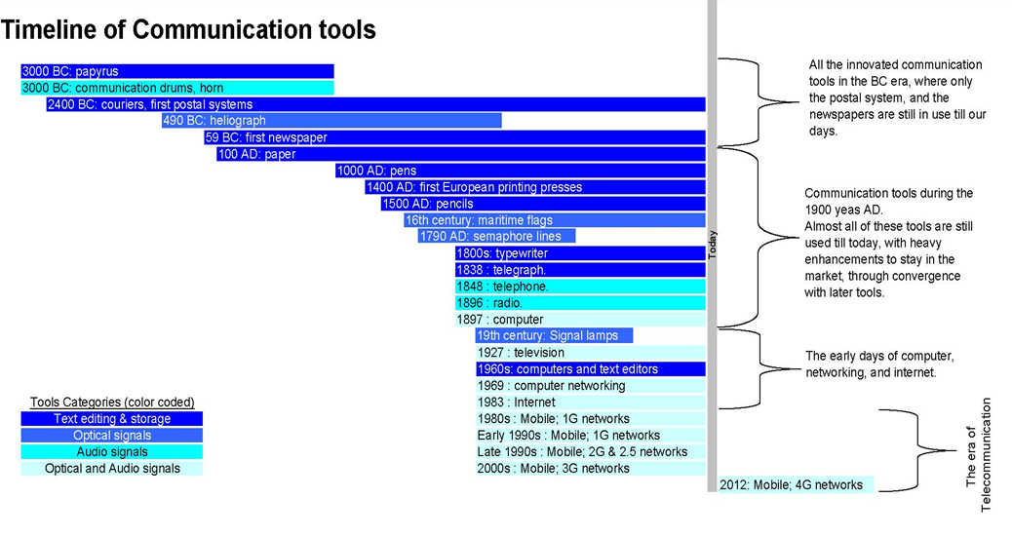
Overview
Rogers
Verizon
Bell

Slide 5
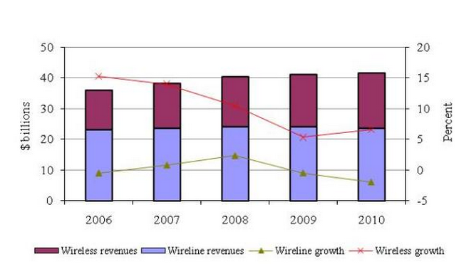
Telecommunications Revenue and Growth
Overview
Rogers
Verizon
Bell

Slide 6
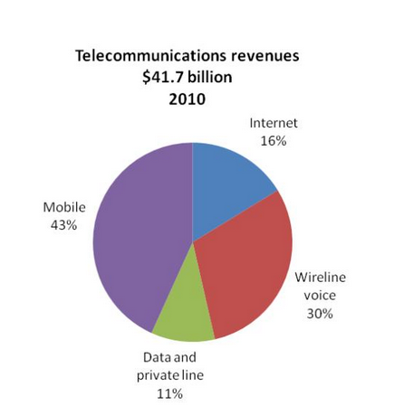
Telecommunications Revenue Breakdown
Canadian telecommunications service industry is dominated by 10 large companies that collectively account for 95% of Canadian telecommunications revenues
Companies operating in all six markets of the telecommunications service industry (i.e. local and access, long distance, Internet, data, private line, and wireless) accounted for approximately 91% of Canadian telecommunications revenues
Overview
Rogers
Verizon
Bell

Slide 7
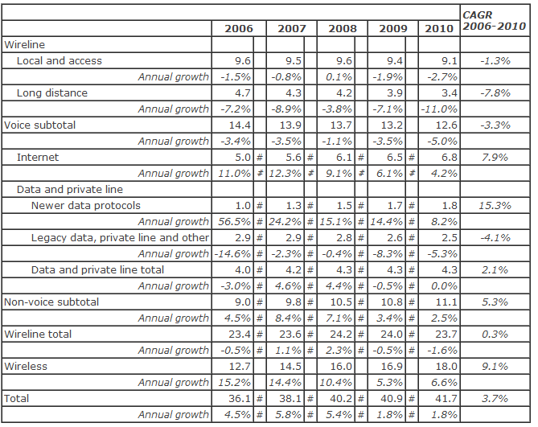
Telecommunications Revenues, by Market Sector ($ billions)
Overview
Rogers
Verizon
Bell

Slide 8
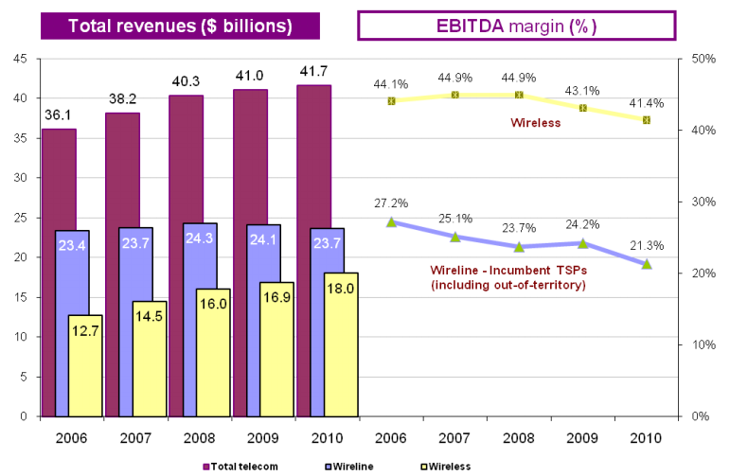
Wireless vs Wireline Revenues
Overview
Rogers
Verizon
Bell

Slide 9
Wireless
Wireless communication is the transfer of information without the use of wires
Encompasses various types of fixed, mobile, and portable two-way radios, cell phones, PDAs, and wireless networking
Use of radio spectrum for wireless communication
Overview
Rogers
Verizon
Bell

Slide 10
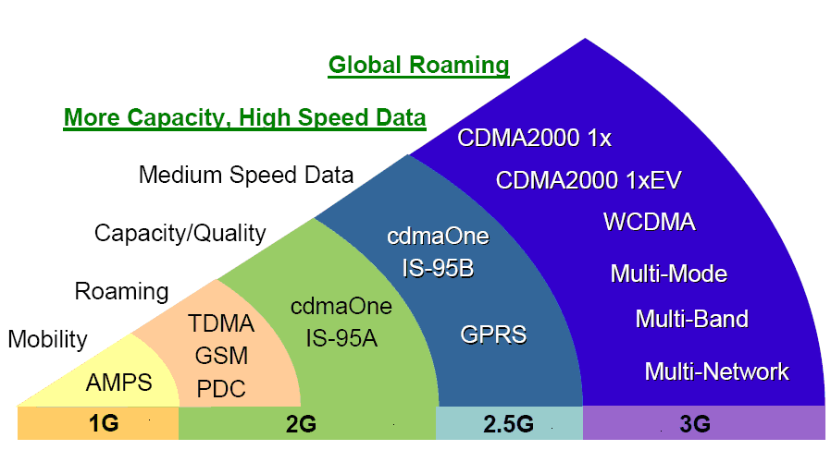
Wireless Data Communications
Overview
Rogers
Verizon
Bell

Slide 11
1G
First generation wireless telephone technology
First cellular network launched in Japan in 1979
For voice only; the technology didn't provide for SMS or other data services
Circuit switched - when you place a call, a connection is established for you, and is maintained until you hang up
Overview
Rogers
Verizon
Bell

Slide 12
2G
Second generation cellular telecom networks were commercially launched on the GSM standard in Finland
Phone conversations were digitally encrypted
2G systems were significantly more efficient on the spectrum allowing for far greater mobile phone penetration levels
2G introduced data services for mobile phones, starting with SMS messages
Overview
Rogers
Verizon
Bell

Slide 13
3G
Substantially higher data transfer rates
Substituted the need to have different networks types
Made global roaming possible
EDGE – allowed for higher data transfer rates for GSM phones
Application services
  wide-area wireless voice telephone
  mobile Internet access
  video calls and mobile TV
Allows simultaneous use of speech and data services
Overview
Rogers
Verizon
Bell

Slide 14
4G
In 2009, the ITU-R organization specified the IMT-Advanced requirements for 4G standards
Setting peak speed requirements for 4G service at 100 Mbit/s for high mobility communication and 1 Gbit/s for low mobility communication
  HSPA+ (up to 42Mbps)
  LTE (up to 75 Mbps)
Overview
Rogers
Verizon
Bell

Slide 15
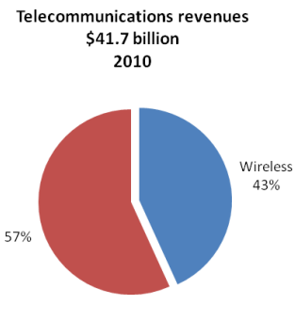
Wireless revenues
The wireless network covers approximately 20% of Canada's geographic area and is available to 99% of Canadians
Wireless market sector revenues are the largest component (43%) of total telecommunications
revenues
Overview
Rogers
Verizon
Bell

Slide 16
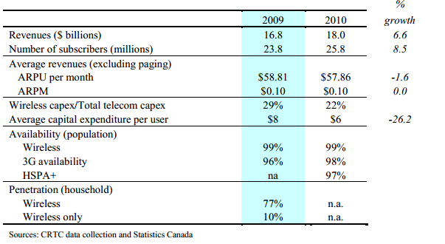
Wireless Sector
Overview
Rogers
Verizon
Bell

Slide 17
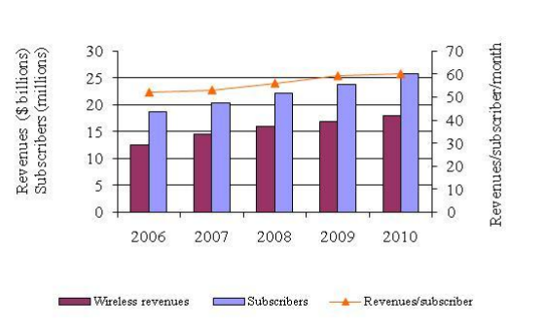
Wireless Revenues, Subscribers, and Revenues Per
Subscriber
Overview
Rogers
Verizon
Bell

Slide 18
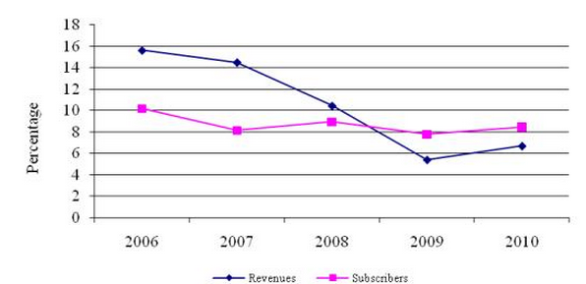
Wireless Revenue and Subscriber Growth Rates
Overview
Rogers
Verizon
Bell

Slide 19
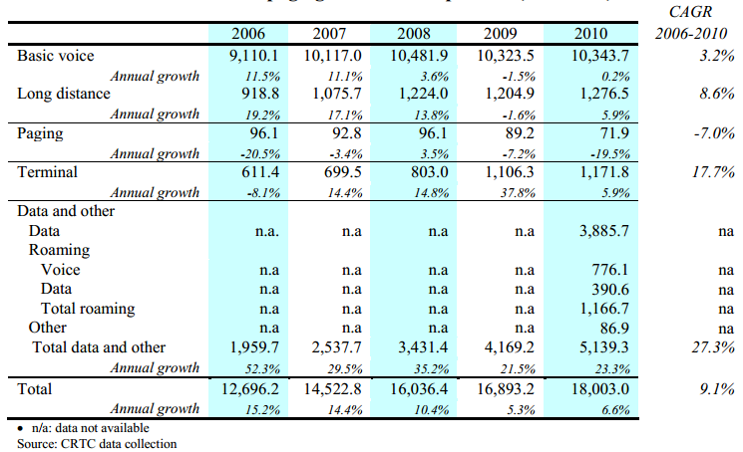
Wireless Revenues Breakdown
Overview
Rogers
Verizon
Bell

Slide 20
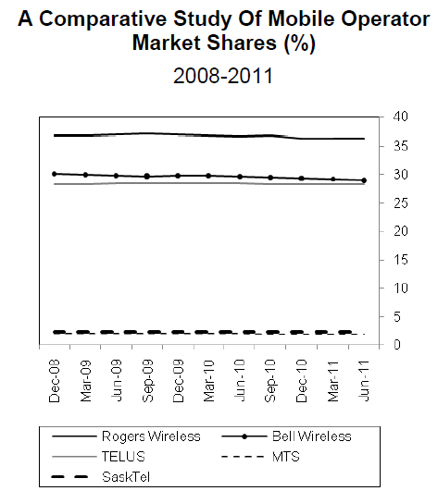
Wireless Market Share
Overview
Rogers
Verizon
Bell

Slide 21
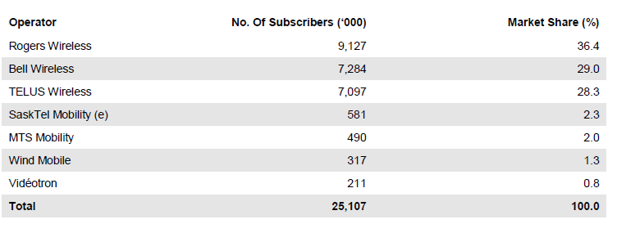
Number of Subscribers
Overview
Rogers
Verizon
Bell

Slide 22
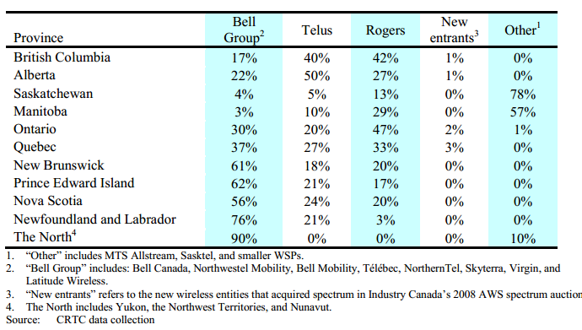
Market Share by Province
Overview
Rogers
Verizon
Bell

Slide 23
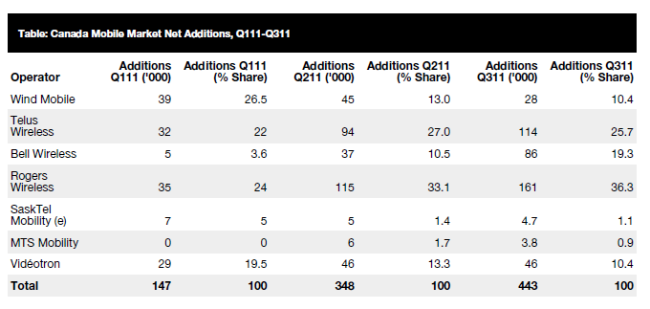
Net Additions
Overview
Rogers
Verizon
Bell

Slide 24
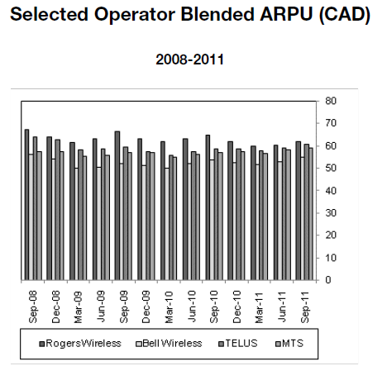
ARPU by Company
High proportion of postpaid subscribers in Canada has helped maintain high ARPUs for operators
The recession had no discernable impact on ARPUs, possibly because many subscribers were already tied to long-term postpaid contracts
Rogers again recorded the highest blended ARPU
Bell -which has the highest proportion of prepaid subscribers - posted the lowest blended ARPU
New operators are opting for different strategies to gather subscriber numbers - cost is obviously a keyfactor - but new users want low prices and access to high-speed data services
Overview
Rogers
Verizon
Bell

Slide 25
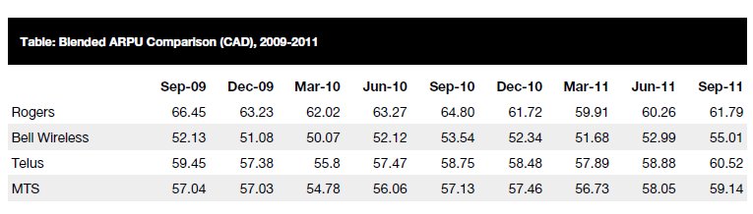
ARPU Comparison
Overview
Rogers
Verizon
Bell

Slide 26
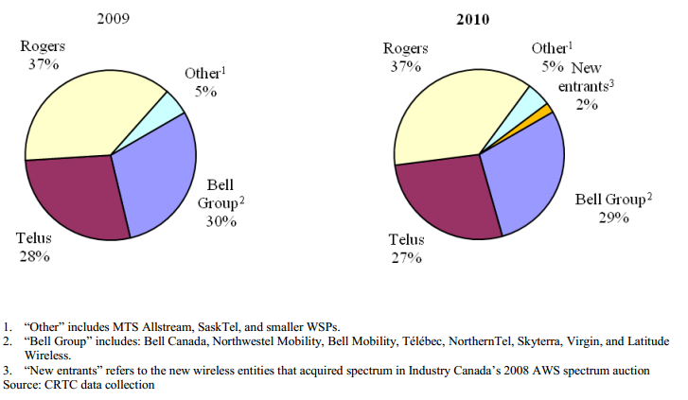
Wireless TSPs’ Subscriber Market Share
Overview
Rogers
Verizon
Bell

Slide 27
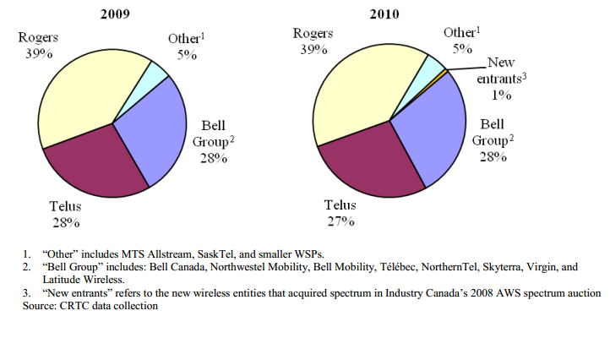
Wireless TSPs’ Revenue Market Share
Overview
Rogers
Verizon
Bell

Slide 28
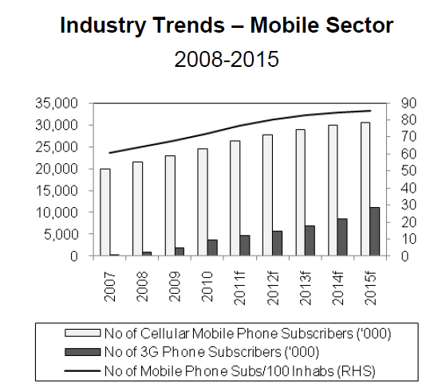
Overview
Rogers
Verizon
Bell

Slide 29
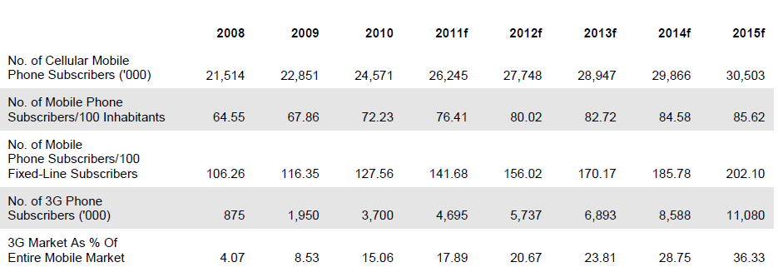
Wireless Industry Forecast
Overview
Rogers
Verizon
Bell

Slide 30
Wireline
In 2010, 91% of Canadian households subscribed to wireline voice communication services
There were over 100 providers of local and access services and over 150 providers of long distance services in 2010
  Large incumbent TSPs, which provide both local and long distance services, primarily over their own networks;
  Small incumbent TSPs, which operate in limited areas of Ontario, Quebec, and British Columbia, and include municipally owned, public, and private carriers;
  Cable BDUs, which provide network-based local and long distance services; and
  Resellers, which do not own their own facilities and tend to concentrate on the long distance market by offering dial-around or prepaid card services
Overview
Rogers
Verizon
Bell

Slide 31
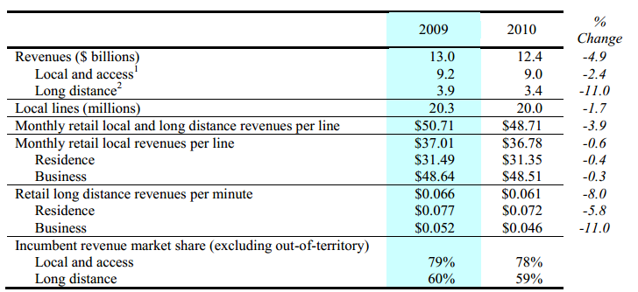
Wireline Revenues
Overview
Rogers
Verizon
Bell

Slide 32
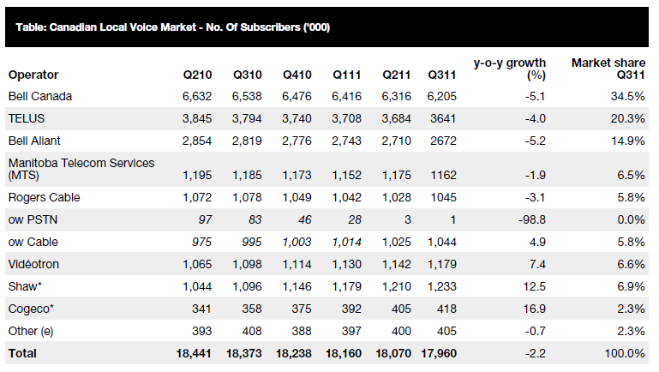
Number of Subscribers
Overview
Rogers
Verizon
Bell

Slide 33
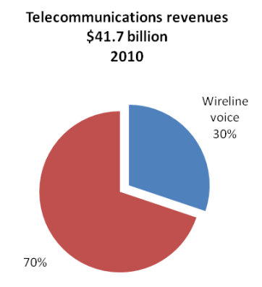
Wireline Revenue
Fixed-line market remains an important part of the Canadian telecoms industry, with areas of the country more reliant on wireline than wireless infrastructure.
Nonetheless, the growth of mobile services at affordable rates has meant that many cope without having a fixed line in their residence
Operators in the fixed-line market are facing a losing battle with declines seen consistently across the market, though the inclusion of pay-TV services has helped stem the decline and benefited cable-based operators more than local telephone companies
Overview
Rogers
Verizon
Bell

Slide 34
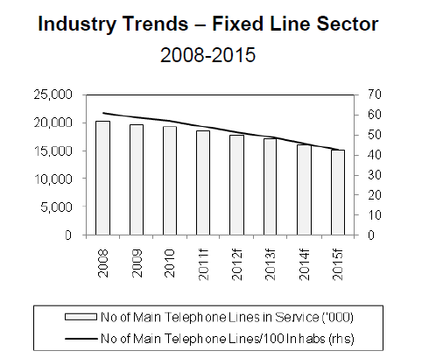
Wireline Trends
The principal operators have reported a slow but steady decline in recent quarters, with any market growth being generated by smaller operators
New mobile operators heightened price competition, which can only serve to lure more customers away from fixed-line connections, but smaller cable and broadband operators have turned to fixed-line services to boost income, primarily with bundled packages
Overview
Rogers
Verizon
Bell

Slide 35
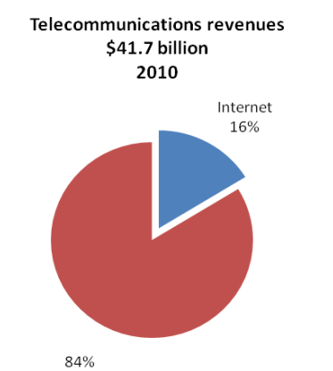
Internet
TSPs provide Internet services using mainly dial-up, DSL, fibre optic, satellite, and fixed wireless facilities
Overview
Rogers
Verizon
Bell

Slide 36
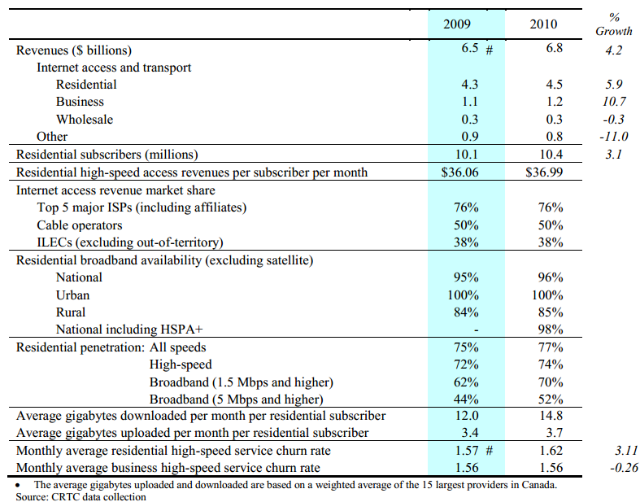
Internet Revenues
Overview
Rogers
Verizon
Bell

Slide 37
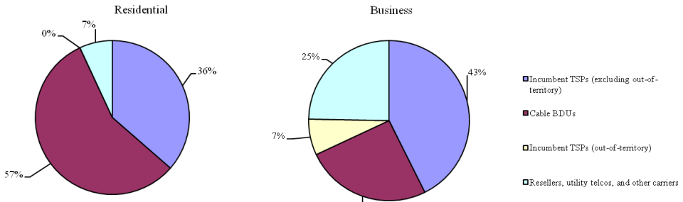
Internet Revenue Share
Overview
Rogers
Verizon
Bell

Slide 38
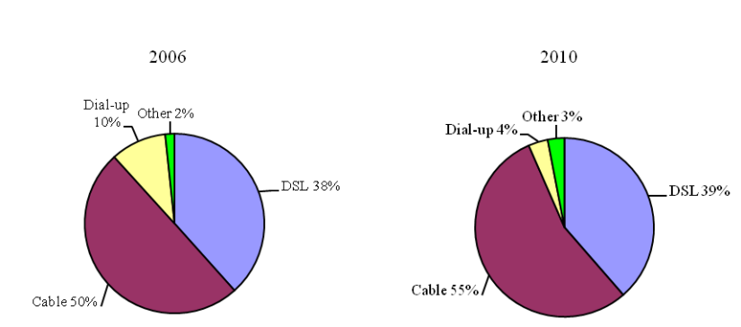
Internet Access Mix
Overview
Rogers
Verizon
Bell

Slide 39
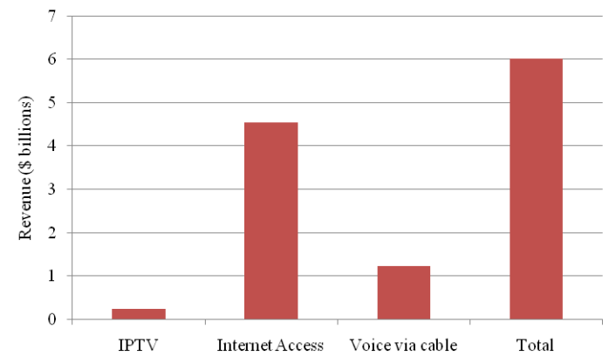
Residential Internet Protocol Provisioned Service Revenues
Overview
Rogers
Verizon
Bell

Slide 40
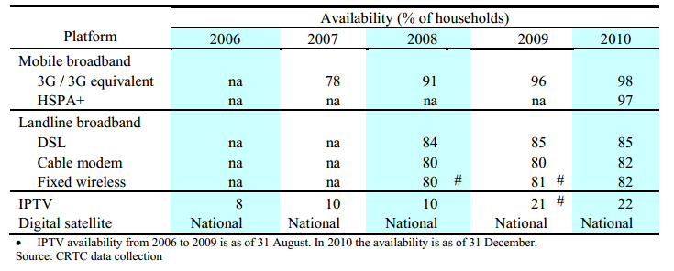
Broadband Availability
Overview
Rogers
Verizon
Bell

Slide 41
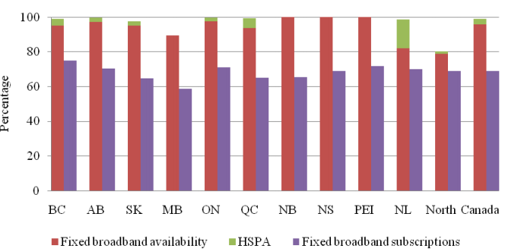
Broadband Availability vs Broadband Subscriptions
Overview
Rogers
Verizon
Bell

Slide 42
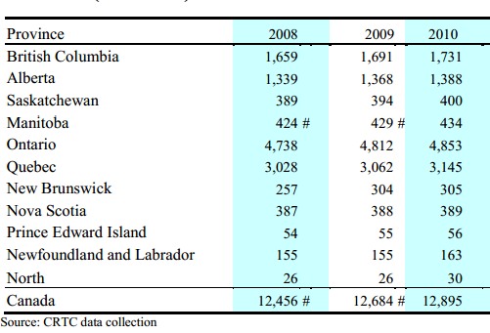
Households that have Broadband Access(thousands)
Overview
Rogers
Verizon
Bell

Slide 43
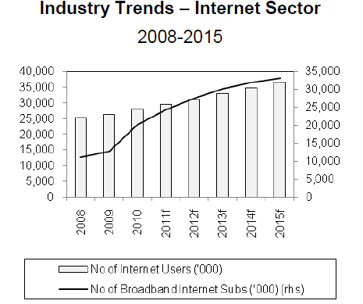
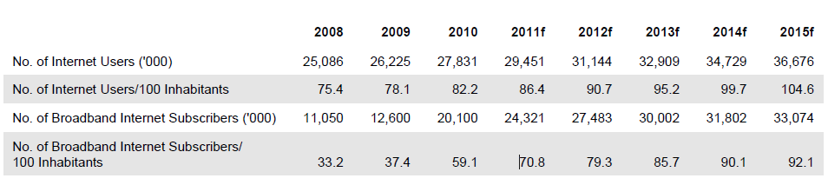
Overview
Rogers
Verizon
Bell

Slide 44
Television
The television broadcasting industry delivers over 700 television services to Canadians
The industry includes a number of large ownership groups representing over 92% of television revenues from private conventional television stations and pay, PPV, VOD, and specialty services
Overview
Rogers
Verizon
Bell

Slide 45
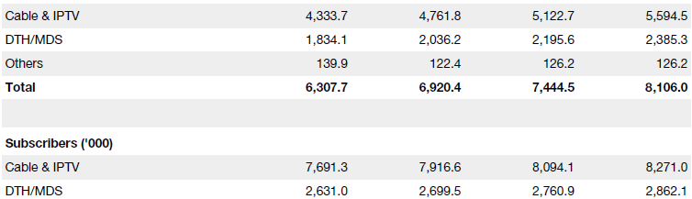
Television Revenues and Subscribers
Overview
Rogers
Verizon
Bell

Slide 46

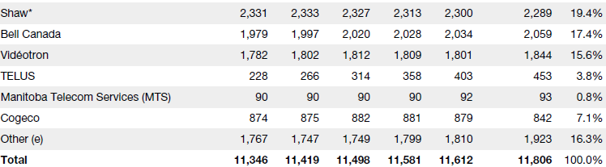
Television Subscriber Market Share
Overview
Rogers
Verizon
Bell

Slide 47
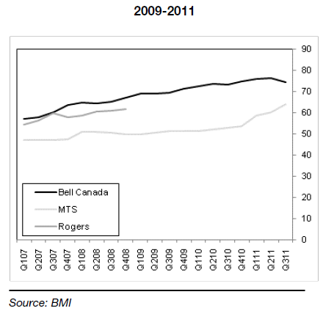
Television ARPU
Overview
Rogers
Verizon
Bell

Slide 48
Canadian Radio-Television Telecommunications Commission
CRTC - public organization with mandate as a regulatory agency for broadcasting and telecommunications
Issuing, renewing and amending broadcasting licenses
Making decisions on mergers, acquisitions and changes of ownership in broadcasting
Approving tariffs and certain agreements for the telecommunications industry
Issuing licenses for international telecommunications services, whose networks allow telephone users to make and receive calls outside Canadian borders
Overview
Rogers
Verizon
Bell

Slide 49
Spectrum
Refers to the full frequency range from 3 kHz to 300 GHz that may be used for wireless communication
Divided into frequency bands and allocated to services such as broadcasting, satellite and mobile services
Spectrum is assigned through administrative licensing
The purpose of spectrum management is to mitigate radio spectrum pollution and maximize the benefit of usable radio spectrum
Overview
Rogers
Verizon
Bell

Slide 50
Spectrum Auction 2008
Several firms participated in the bidding for the spectrum reserved for new entrants in May 2008’s auction and 10 of them had winning bids
Each license has been assigned a series of points for the spectrum available in the area and the population, which frames the opening bids the government has already set
Participants will bid on each license with money, but they have to also keep in mind the total points of the licenses they are bidding on
Overview
Rogers
Verizon
Bell

Slide 51
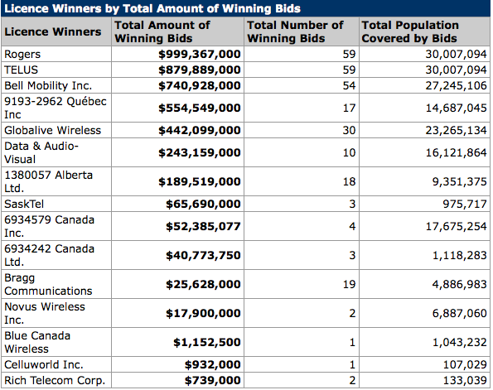
Bids in 2008 Spectrum Auction
Overview
Rogers
Verizon
Bell

Slide 52
Spectrum Auction 2012
Canada will be making the switch from analog to digital television and plans to hold auctions for the 700 MHz and 2500 MHz bands of the spectrum in 2012 that will be freed up by the digital switch
Telecommunications Act will be amended to lift foreign investment restrictions for telecom companies that hold less than a 10-percent share of the total Canadian telecommunications market
Applying caps in the upcoming spectrum auctions to guarantee that both new wireless competitors and incumbent carriers have access to the spectrum up for auction
A limit on prime spectrum will be imposed on incumbents (Rogers, Telus, Bell)
Overview
Rogers
Verizon
Bell

Slide 53
Spectrum Auction 2012 (cont)
Apply specific measures in the 700 MHz auction to see that rural Canadians will have access to the same advanced services as everyone else
Spectrum will allow telecom companies to bring the latest 4G LTE mobile networks to Canadian consumers and businesses, including those in rural areas
Auction of the low-frequency 700 MHz airwaves will take place in 2013
Spectrum will be reserved for small carriers in 14 bidding regions that will be created
Caps in the upcoming spectrum auctions that will enable four or more service providers in each region to obtain spectrum
Overview
Rogers
Verizon
Bell

Slide 54
Spectrum Auction
The country will be sliced into 14 districts (southern and northern Ontario are two, B.C and Alberta are each one, each with seven blocks of frequencies to be auctioned
The 700 MHz band consists of blocks:
  Paired blocks (6+6 MHz each): A, B and C
  Paired blocks (5+5 MHz each): C1 and C2
  Unpaired blocks (6 MHz each): D and E
The large providers are restricted to bidding on only 1 paired block of prime 700 MHz spectrum, in order to leave at least one block available for new entrants
Overview
Rogers
Verizon
Bell

Slide 55
Spectrum Auction
Wireless frequencies can be split into upper and lower bands
For two-way communications, each band can be further split in half: One with, say, 5 MHz for the uplink, the other an equal amount for the downlink
Industry Canada can sell either a pair of frequencies, or a single group. Obviously, paired spectrum is more valuable than unpaired for cellular communications
Overview
Rogers
Verizon
Bell

Slide 56
Spectrum Auction Overview
A, B, C, C1 and C2 will be sold as paired blocks. Blocks D and E are unpaired (or one-way) spectrum
The most valuable is blocks B, C, C1 and C2
Two reasons:
  One is they will be sold with paired frequencies.
  Second, they are aligned with the same 700 MHz blocks that U.S. carriers AT&T (in this case B and C) and Verizon Wireless (C1 and C2)
Canadian carriers want their subscribers to be able to roam in the U.S., so these four blocks will attract the fiercest bidding
Overview
Rogers
Verizon
Bell

Slide 57
Spectrum
AT&T's network is compatible with the new LTE/HSPA wireless standard as well as the older GSM standard
Verizon's new network uses LTE, but it defaults to the older CDMA standard that Bell and Telus also share on their older networks
Overview
Rogers
Verizon
Bell

Slide 58
Spectrum Auction
Of the four prime blocks, Industry Canada says incumbent carriers can only win ONE in each district
If an incumbent carrier wants to buy two paired blocks, Industry Canada mandates one of them has to be the A block
Although it has paired frequencies, at the moment there are technical problems preventing carriers in the U.S. from using it
Overview
Rogers
Verizon
Bell

Slide 59
Spectrum Auction
Unpaired D and E blocks:
  lower band blocks open for any bidder, but they are only one-way blocks 5 MHz wide
  at the moment there are no handsets that can use that spectrum
Spectrum cap framework will also be used in the 2014 auction for spectrum in the 2.5 GHz bands
Overview
Rogers
Verizon
Bell

Slide 60
Spectrum Auction
New entrants can secure two "prime" 700 MHz blocks; effectively 10+10 MHz paired spectrum.
However, a large carrier could also acquire two blocks of paired spectrum if it includes the A license, which is not considered prime spectrum at this time due to the unavailability of equipment.
Otherwise large carriers can only acquire one block of prime 700 MHz spectrum per area
Overview
Rogers
Verizon
Bell

Slide 61
Spectrum Requirements
Strong coverage requirements (90% population coverage after 5 years) will apply to carriers who hold or have access to two or more paired blocks of 700 MHz spectrum
Obligations imposed on spectrum licensees are to support the deployment of next-generation services to rural Canadians
Extending roaming provisions indefinitely and expanding them to all carriers
Overview
Rogers
Verizon
Bell

Slide 62
Spectrum Requirements
Companies that hold more than one block of spectrum will have to provide wireless services to 90 per cent of their coverage areas within five years and to 97 per cent of their coverage areas within seven years
Requiring carriers to make available basic information on all towers to improve transparency and expedite the sharing process
Overview
Rogers
Verizon
Bell

Slide 63
Foreign Ownership
Exempt telecommunications companies with less than 10 percent of total telecommunications Canadian market revenue from foreign investment restrictions
So carriers with broadcast distribution undertakings (BDUs) will not benefit
BDUs are telecommunications carriers that deliver TV programming. By virtue of delivering IPTV, most local phone companies became licensed as BDUs
Investment Canada Act provisions remain in place, which require an application for review if the investment exceeds $330M
Bell, Rogers and TELUS would still have needed to restructure their BDU businesses and be subject to Investment Canada review
Overview
Rogers
Verizon
Bell

Slide 64
Spectrum Auction Analysis
Spectrum cap means that Bell, Rogers, and Telus can all get one nationwide 5 by 5 block of 700 spectrum. It's safe to assume that nobody will outbid them
The fourth block will be divided regionally. In the territories, Ontario, British Columbia, and Alberta, Wind has the deepest pockets, especially with the revised foreign ownership regulation. Mobilicity and Public doesn't have the cash Wind does, even with the option for more foreign investment
Overview
Rogers
Verizon
Bell

Slide 65
Spectrum Auction Analysis
In Quebec, that fourth block belongs to Videotron. They have the desire to shut Wind out, and that 700 block is worth far more to them than it is to Wind
In Manitoba and Saskatchewan, Wind will be in competition with MTS and Sasktel. The spectrum is worth more to MTS and Sasktel, but they have the opportunity to partner with Bell, Rogers, or Telus for network creation, as they have done in the past
Overview
Rogers
Verizon
Bell

Slide 66
Spectrum Auction Analysis
In the maritime provinces, the competitors are Wind and Eastlink
In BC, Alberta, Manitoba, and Saskatchewan, Shaw has AWS spectrum licenses – licenses will become very valuable as incumbents will bid for them
Orascom funded Wind with approximately $1 billion, to outbid either Bell, Rogers or Telus would require significant costs
Overview
Rogers
Verizon
Bell

Slide 67


Slide 68
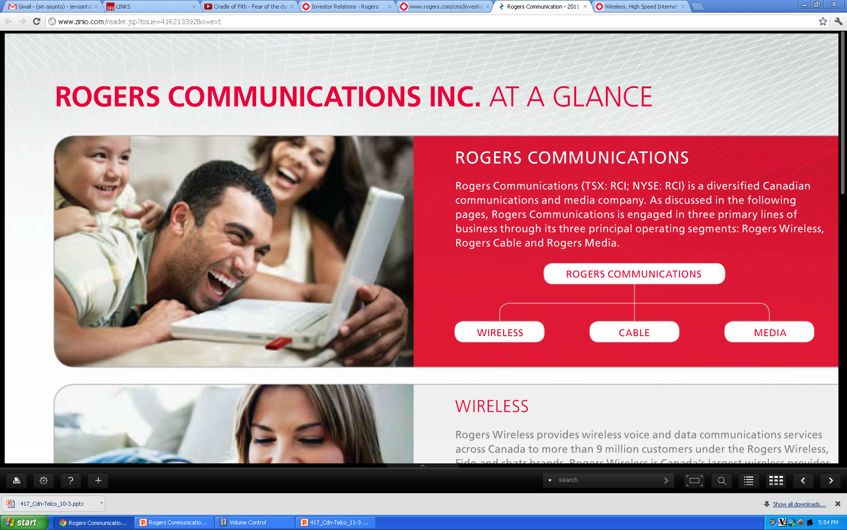

Slide 69
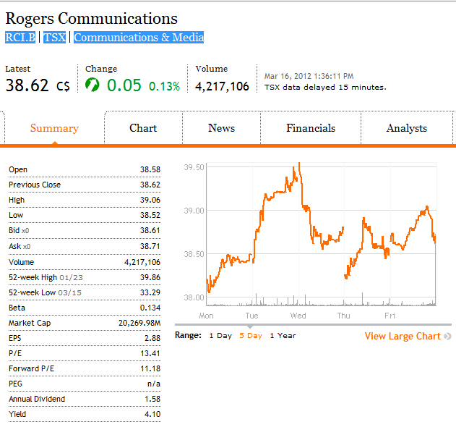
Financial Snapshot
Overview
Rogers
Verizon
Bell

Slide 70
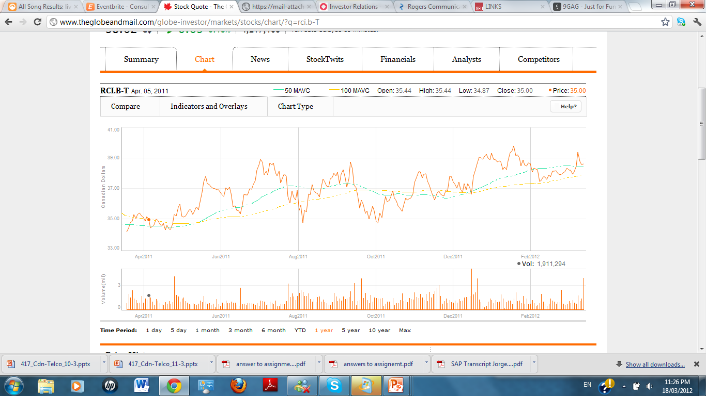
1 Year Performance
Overview
Rogers
Verizon
Bell

Slide 71
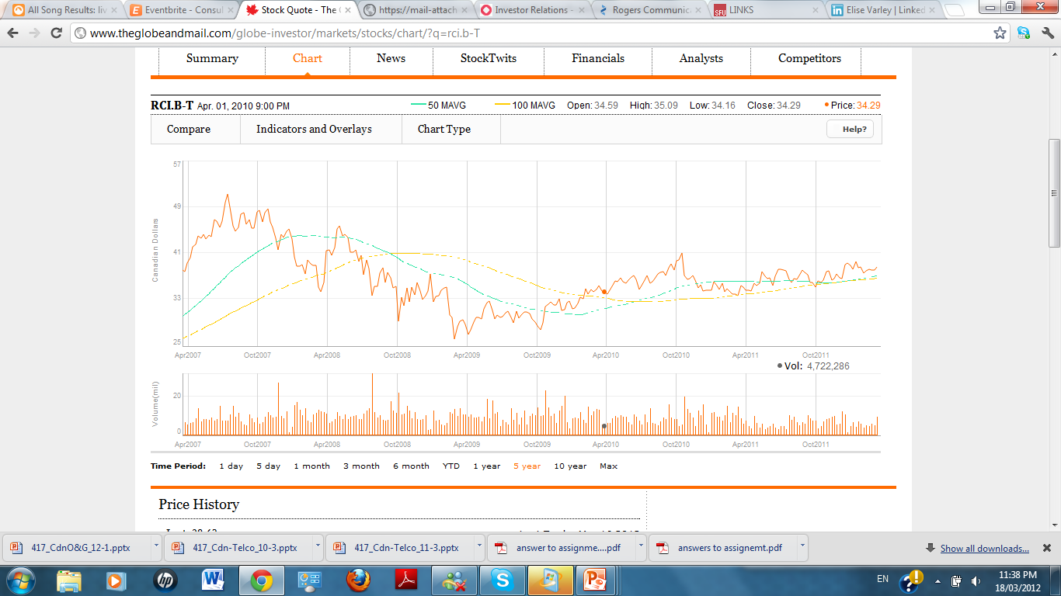
5 Year Performance
Overview
Rogers
Verizon
Bell

Slide 72
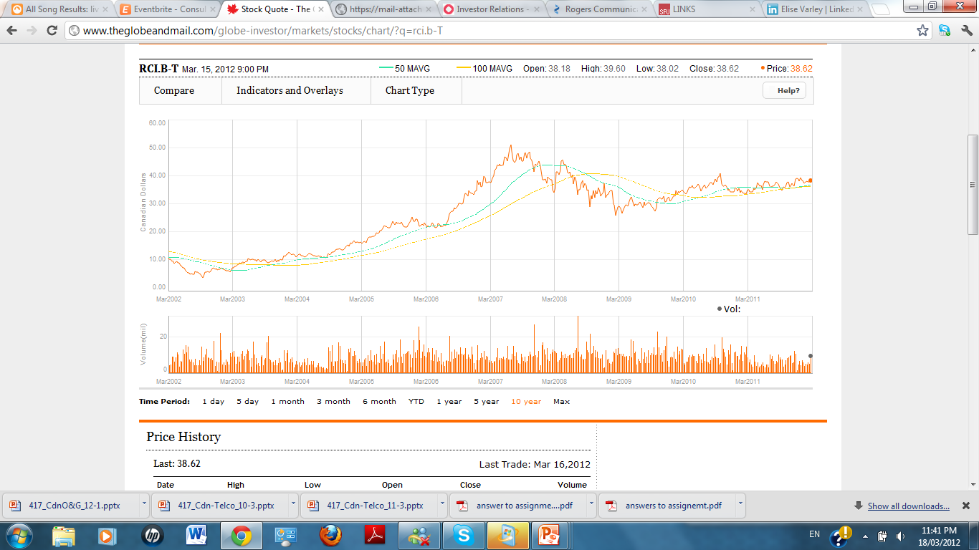
10 Year Performance
Overview
Rogers
Verizon
Bell

Slide 73
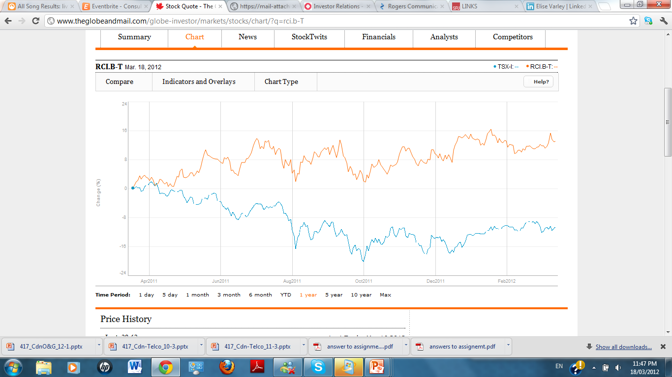
Rogers Vs. TSX
Overview
Rogers
Verizon
Bell

Slide 74
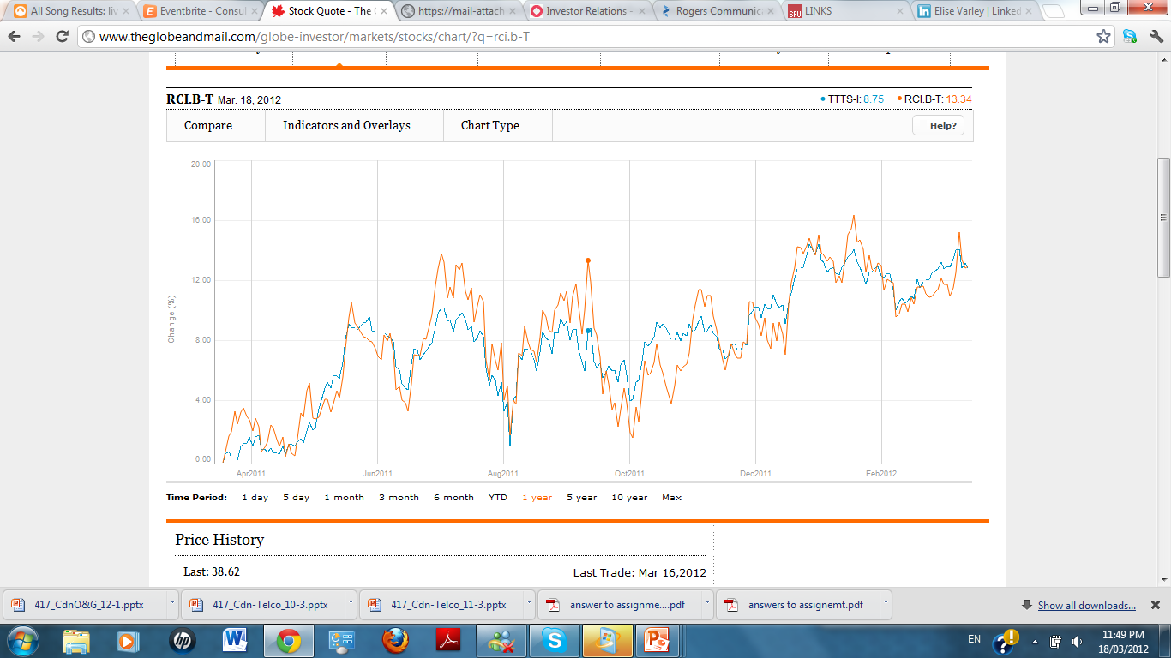
Rogers Vs. TSX Telecom
Overview
Rogers
Verizon
Bell

Slide 75
History
1960→While in School Ted Rogers buys CHFI and makes it successful
1967→Ted Rogers founds Rogers Cable TV, and enters into the cable business
1979→Rogers becomes a public company after acquiring Canadian Cablesystems and becomes biggest cable company in Canada
1981→Rogers enters the America market
Overview
Rogers
Verizon
Bell

Slide 76
History
1985→Rogers enters the cellular market under the brand Cantel
1994→Rogers media is created after the $3.1 billion hostile bid for Maclean Hunter
2000→Rogers acquires the Toronto Blue Jays
2007→Acquires 5 Citytv stations
2009→Nadir Mohamed becomes President & CEO of Rogers Communications Inc
Overview
Rogers
Verizon
Bell

Slide 77
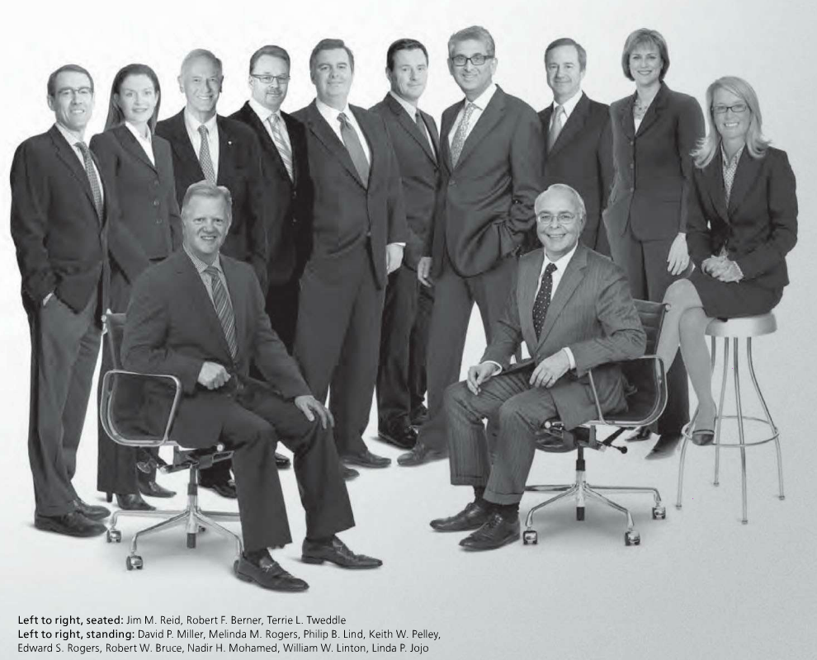
Management Team

Slide 78
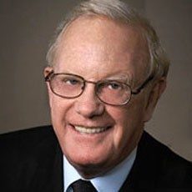
Management Team
Edward S. “Ted” Rogers
Previous President and CEO of Rogers Communications
CEO of Rogers from launch in 1960 until his death in 2008
Grew Rogers Communications into one of Canada’s largest media conglomerates
Overview
Rogers
Verizon
Bell

Slide 79

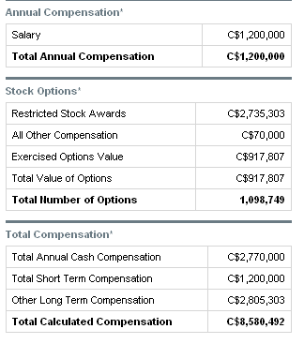
Management Team
Nadir Mohamed, F.C.A.
President and Chief Executive Officer Rogers Communications
Joined in August 2000 as COO of Rogers Wireless
Led Rogers Wireless through 14 consecutive quarters of double digit operating profit growth
Appointed CEO in March 2009
UBC Bachelor of Commerce
Chartered Accountant
Overview
Rogers
Verizon
Bell

Slide 80

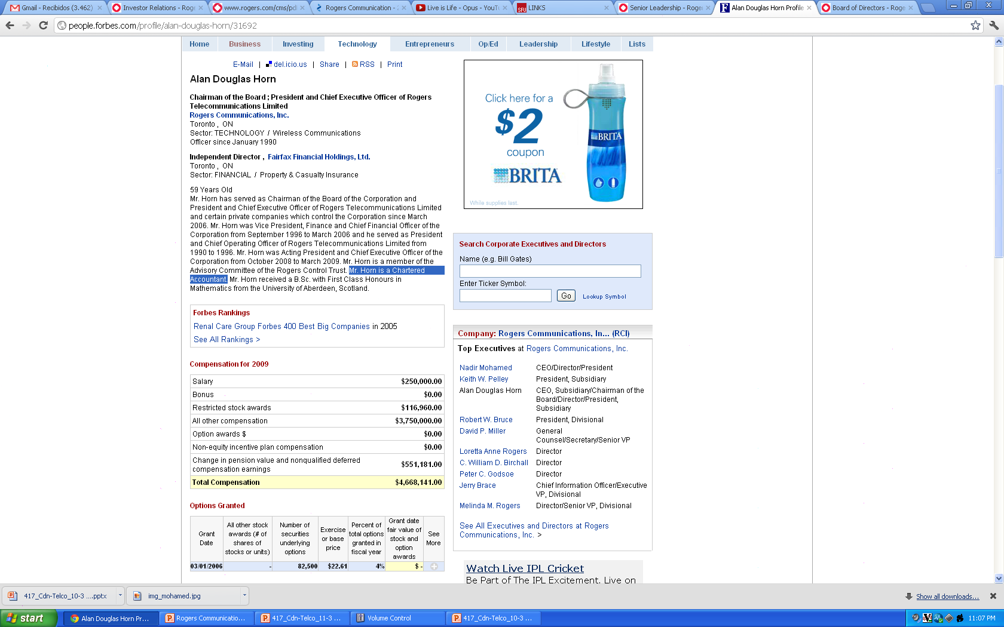
Management Team
Alan Douglas Horn
Chairman , President and Chief Executive Officer Rogers Communications
Chairman since 2006
Served as VP, CFO of Rogers Communications (1996-2006)
President and COO of Rogers Telecommunications Limited (1990-1996)
Mr. Horn received a B.Sc. with First Class Honor's in Mathematics from the University of Aberdeen, Scotland
Mr. Horn is a Chartered Accountant
Overview
Rogers
Verizon
Bell

Slide 81
2011 Overview
Free Cash Flow generation→ generated 2 billion of pre-tax free cash flow
Dividend increase→ It went up 11%, from $1.28 to $1.42
Share buy backs→ Repurchased 31 million Class B shares for 1.1 Billion
Liquidity→2.1 billion of available liquidity, no near term debt maturities
Overview
Rogers
Verizon
Bell

Slide 82
2011 Overview
Operating efficiencies→ reduced the operating expenses on the Cable and Wireless segments compared to 2010 levels
Technology→ Deployed their 4G LTE wireless network and DOCSIS 3.0 capabilities to the internet footprint
Grow wireless data revenue→27% data revenue growth
Top line Growth→2% growth in adjusted operating profit
Overview
Rogers
Verizon
Bell

Slide 83
Spectrum News
Rogers may need a spectrum partner
The potential Scenario in which the federal to group valuable airwaves set for auction into five smaller "blocks" rather than bigger parcels.
BCE's Bell Mobility and Telus confront the same problem, the two operators share their current wireless network assets under an existing agreement
BCE's Bell Mobility and Telus collude to share the spectrum and increase their holdings

Slide 84

Financial Snapshot

Slide 85

Financial Snapshot

Slide 86
Roger Wireless
Over 9.3 million customers across Canada under the Fido, Rogers Wireless and Chatr brand
Only Canadian operator to have GSM, 3G+HSPA and 4G LTE technology platforms
Canada’s leader providing wireless machine to machine solutions to businesses
Leader in wireless data, churn and ARPU metrics
Overview
Rogers
Verizon
Bell

Slide 87
Wireless Strategy
Focusing on offering innovative voice and wireless data services→Moving into HSP+ and LTE
Increasing revenue from existing customers
Maintaining the most technologically advanced, high-quality and national wireless network possible with global coverage
Provide bundled product and service offerings at attractive prices to common customers by implementing cross-selling
Overview
Rogers
Verizon
Bell

Slide 88

Rogers Wireless Coverage
Overview
Rogers
Verizon
Bell

Slide 89


Wireless Financial Snapshot
Overview
Rogers
Verizon
Bell

Slide 90

Wireless Operating and Financial Results
Overview
Rogers
Verizon
Bell

Slide 91

Wireless Operating and Financial Results
Overview
Rogers
Verizon
Bell

Slide 92


Wireless Subscriber Financial Results
Overview
Rogers
Verizon
Bell

Slide 93


Wireless Operating and Financial Results
Overview
Rogers
Verizon
Bell

Slide 94


Wireless operating and Financial Results
Overview
Rogers
Verizon
Bell

Slide 95
Rogers Cable
Covers approximately 3.7 million homes with 2.3M basic cable subs and 5.1M cable service units
Its two way hybrid-coax broadband network provides the leading selection of on demand and high definition television
78% of its cable user subscribe to its internet service and 1.1 million to its land-line
Overview
Rogers
Verizon
Bell

Slide 96
Cable Financial Snapshot
Overview
Rogers
Verizon
Bell

Slide 97

Cable Operating and Financial Results
Overview
Rogers
Verizon
Bell

Slide 98

Cable Subscriber Financial Results
Overview
Rogers
Verizon
Bell

Slide 99


Cable Operating and Financial Results
Overview
Rogers
Verizon
Bell

Slide 100
Rogers Media
Its composed of 55 radio stations across Canada
Five Station Citytv Networks, Sportsnet and Sportsnet one sports television services
Toronto Blue Jays baseball club
Roger’s Center
The Shopping Channel national televised shopping network
Overview
Rogers
Verizon
Bell

Slide 101

Media Financial Snapshot
Overview
Rogers
Verizon
Bell

Slide 102

Media Operating and Financial Results
Overview
Rogers
Verizon
Bell

Slide 103

Outstanding Common Share Data
Overview
Rogers
Verizon
Bell

Slide 104

Stock Option Plans
Overview
Rogers
Verizon
Bell

Slide 105

Financial Statements

Slide 106

Annual-Balance Sheet

Slide 107

Annual-Income Statement

Slide 108

Quarterly-Income Statement

Slide 109

Cash flow statement

Slide 110
Recommendation
Buy!!!

Slide 111


Slide 112

Financial Snapshot
Shares outstanding 2.84B
Overview
Rogers
Verizon
Bell

Slide 113

Financial Snapshot
Overview
Rogers
Verizon
Bell

Slide 114
Financial Snapshot
Overview
Rogers
Verizon
Bell

Slide 115

1 Year Performance - S&P 500
Overview
Rogers
Verizon
Bell

Slide 116

1 Year Performance
Dow Jones Industrial Average
Overview
Rogers
Verizon
Bell

Slide 117

1 Year Performance
50/200MAVG
Overview
Rogers
Verizon
Bell

Slide 118

5 Year Performance - S&P 500
Overview
Rogers
Verizon
Bell

Slide 119

5 Year Performance
Dow Jones Industrial Average
Overview
Rogers
Verizon
Bell

Slide 120

5 Year Performance
50/200MAVG
Overview
Rogers
Verizon
Bell

Slide 121

10 Year Performance
50/200MAVG
Overview
Rogers
Verizon
Bell

Slide 122

Management
Lowell C. McAdam
  Chairman and CEO
  Succeeded Ivan Seidenberg as CEO on Aug. 1, 2011, and as chairman on Jan. 1, 2012
From October 2010 until he assumed his current position, McAdam served as president and COO.
McAdam held key executive positions at Verizon Wireless since its inception in 2000
Bachelor's degree in engineering from Cornell University and a master's degree in business administration from the University of San Diego
Spent six years in the U.S. Navy Civil Engineer Corps and is a licensed professional engineer
Overview
Rogers
Verizon
Bell

Slide 123

Management
Francis J. Shammo
Executive vice president and chief financial officer for Verizon Communications
Before being appointed to his position, effective Nov. 1, 2010, he was president and chief executive officer of Verizon Telecom and Business
Previously, Shammo was president of Verizon Business, and prior to that appointment he served as senior vice president and chief financial officer for Verizon Business
Shammo joined Bell Atlantic Mobile in 1989 as general manager for accounting operations
He holds a bachelor’s degree in accounting from Philadelphia University, a master's degree in business administration from La Salle University, and is a Certified Public Accountant
Overview
Rogers
Verizon
Bell

Slide 124
Company History
Verizon Communications, Inc. based in New York City, incorporated in Delaware
Formed in June, 2000
Trades under VZ
Began trading on the NYSE in July, 2000
Began trading on NASDAQ exchange on March 2010
Overview
Rogers
Verizon
Bell

Slide 125
Verizon’s Formation: Bell Atlantic – GTE Merger
July 27, 1998
GTE was one of the world’s largest telecom companies
  Revenue >$25B in 1999
  Served 35M access lines
  7.1M wireless customers
  Served 6.7M outside of the 50 states
Overview
Rogers
Verizon
Bell

Slide 126
Verizon’s Formation: Bell Atlantic – GTE Merger History
Bell Atlantic was even larger than GTE
1999 revenues >$33B
Served 43 million access lines
7.7M mobile customers
Bell’s sophisticated network + GTE’s national footprint and advanced data communications combined company would be able to provide long-distance and data services nationwide as part of a full package of other communications services
Overview
Rogers
Verizon
Bell

Slide 127
MCI Acquisition
February 14, 2005
Closed on January 6, 2006 for $8.5B
MCI was a global communications provider that delivered advanced communications connectivity to business, government and consumers.
Internet backbone network was the largest in the world based on company-owned points of presence
Overview
Rogers
Verizon
Bell

Slide 128
Recent Investments
March 2008, $9.4B invested for nationwide spectrum footprint + 102 spectrum licenses for individual markets
August 2008, $2.66B to purchase Rural Cellular Corp. for expansion into many rural markets
January 2009, $5.9B for the purchase of Alltel, expanding the company's network coverage to nearly the entire US population
Overview
Rogers
Verizon
Bell

Slide 129
Recent Investments
April 2011, $1.4B to acquire Terremark Worldwide Inc.
  Global provider of managed IT infrastructure and cloud services
Accelerating Verizon’s strategy to deliver a portfolio of highly secure, scalable on-demand solutions to business and government customers globally
Overview
Rogers
Verizon
Bell

Slide 130
Recent Investments
2004 through 2011
  Invested more than $20 billion deploy fiber optic network past 16.5 million premises, and eventually to pass more than 18 million premises (or more than 70% of its landline territory)
Overview
Rogers
Verizon
Bell

Slide 131

Ultra High Frequency (Spectrum)
Overview
Rogers
Verizon
Bell

Slide 132
Spectrum
Each spectrum is allocated for some function (military use, radio, mobile phones, etc..)
Very little empty spectrum
Large auctions happen about once every decade
Spectrum is valuable enough to drive large mergers and acquisitions just to obtain more of it
It is THE strategic asset for any wireless company
Overview
Rogers
Verizon
Bell

Slide 133
Spectrum Auction
Use of radio frequency spectrum must be licensed by the FCC
Any wireless technology can be deployed on the spectrum
FCC holds auctions for these frequencies
Proceeds go to the government
Licenses are issued for a fixed time (usually 10 years)
Must periodically seek renewal (usually approved)
Overview
Rogers
Verizon
Bell

Slide 134
Spectrum Auction
Most recently (2008), Verizon participated in the auction of spectrum in the 700MHz band
  Also called “open access” C Block
  Open access means the network must be open so that any “safe” device can access it. Highest bidder on 109 licenses ($9.4B)
Granted all licenses on November 26, 2008
700MHz band is spectacularly suited for use as a wireless broadband network – perfect for 4GLTE networks
Overview
Rogers
Verizon
Bell

Slide 135

Spectrum Auction
700 MHz Spectrum
Block C has almost at least double the capacity compared to the other blocks, meaning it can potentially handle twice the number of simultaneous phone calls or data throughput.
There will be another 700MHz auction, but so far, there is no set date
Overview
Rogers
Verizon
Bell

Slide 136
Why 700MHz band?
Was used to run analog TV signals
  FCC killed off analog TV Feb. 19 2009
Penetrates walls easily, travels well
This makes it perfect for either cellular or long-range wireless broadband
Overview
Rogers
Verizon
Bell

Slide 137
Advanced Wireless Spectrum (AWS)
December 2011
Agreements to purchase AWS licenses from SpectrumCo (a joint venture between Comcast, Time Warner and Bright House)
  Licenses will be purchased directly from SpectrumCo., whom acquired these licenses through the FCC Spectrum auction
Spectrum licenses cover 93% of the US population
Expected to close in 2012 for $3.6B
Overview
Rogers
Verizon
Bell

Slide 138

Overview
Rogers
Verizon
Bell

Slide 139

Overview
Rogers
Verizon
Bell

Slide 140

Verizon Coverage
Overview
Rogers
Verizon
Bell

Slide 141

Company Overview
Overview
Rogers
Verizon
Bell

Slide 142
Business Units
Wireline – Fixed line, Network and access services, Broadband Video and Data
Wireless – Joint venture with Vodafone (45%)
Overview
Rogers
Verizon
Bell

Slide 143

Wireless Operating Revenues
Overview
Rogers
Verizon
Bell

Slide 144

Wireless Expenses
Overview
Rogers
Verizon
Bell

Slide 145

Wireline Operating Revenues
Overview
Rogers
Verizon
Bell

Slide 146

Wireline Expenses
Overview
Rogers
Verizon
Bell

Slide 147

Wireline
FiOS accounts for more than 60% of wireline revenues
Helps make up for the decline of revenues in traditional services
Overview
Rogers
Verizon
Bell

Slide 148

Performance Summary
Overview
Rogers
Verizon
Bell

Slide 149

Overview
Rogers
Verizon
Bell

Slide 150
2011 Results
Revenues totaled $110.9 billion, up 6.2 percent on an adjusted basis
Revenues in the fourth quarter grew by 7.7 percent year over year, the highest since Verizon was formed 10 years ago
Cash flow from operating activities totaled $29.8 billion for the year
Raised dividend by 2.6 percent, the fifth consecutive annual increase, bringing the annual dividend to $2.00 a share
All in all, Verizon’s total return to shareowners for 2011 was 18.2 percent, as compared with 8.4 percent for the Dow Jones Industrial Average and 2.1 percent for the S&P 500
Overview
Rogers
Verizon
Bell

Slide 151
2012 Strategy
Will complete nationwide build out of 4G LTE by mid 2013
The purchase of more spectrum
  Increase network’s availability and capacity
Become a major solutions provider in the global marketplace
  Securely managed network servers for cloud services
Overview
Rogers
Verizon
Bell

Slide 152
2012 Strategy
“LTE in Rural America” Initiative
  As of January 2012, 15 rural carriers have announced their participation in the program
  These carriers have leased spectrum covering more than 2.7 million people and 90,000 square miles in rural communities across Kentucky, Oklahoma, Michigan, Wisconsin, Utah, North Carolina, Indiana, Idaho, Missouri, West Virginia and Iowa.
Overview
Rogers
Verizon
Bell

Slide 153

Financial Statements

Slide 154


Slide 155


Slide 156


Slide 157
Recommendation
BUY!!!

Slide 158


Slide 159

Current stock price
Overview
Rogers
Verizon
Bell

Slide 160


Share Information
Overview
Rogers
Verizon
Bell

Slide 161

1 Year Movement
Overview
Rogers
Verizon
Bell

Slide 162

1 Year Movement Vs. S&P TSX
Overview
Rogers
Verizon
Bell

Slide 163

1 Year Movement Vs. S&P TSX Capped Telecomm
Overview
Rogers
Verizon
Bell

Slide 164

5 Year Movement
Overview
Rogers
Verizon
Bell

Slide 165

5 Year Movement 50/200 MAVG
Overview
Rogers
Verizon
Bell

Slide 166

10 Year Movement
Overview
Rogers
Verizon
Bell

Slide 167

Major Holders of BCE
Overview
Rogers
Verizon
Bell

Slide 168

Recent Dividends
In 2011, BCE announced 2 increases in the annual dividend payable to common shareholders – consistent with our target payout ratio of 65% to 75% of Adjusted EPS
For a total of 7 dividend increases in the last three years. This represents 49% dividend growth since the fourth quarter of 2008
Overview
Rogers
Verizon
Bell

Slide 169


Returns to Shareholders
Overview
Rogers
Verizon
Bell
Notes:
We initiated a $250-million share buyback program
in december 2011, our third normal course issuer bid
(nCIB) since 2008. This program is 95% complete.
Over the last three years, we have repurchased
62 million common shares at a total cost of
$1.7 billion at an average price per share of $27.82,
representing increased value for our shareholders

Slide 170

Credit Rating
Overview
Rogers
Verizon
Bell

Slide 171


Holdings
Overview
Rogers
Verizon
Bell

Slide 172

Company Overview
Overview
Rogers
Verizon
Bell
Notes:
Our Bell Wireline segment provides local telephone, long distance, data (including Internet access and information and communications technology (ICT) solutions) and other communications services to residential and business customers
Our Bell Wireless segment provides wireless digital voice and Internet/data communications products and services to residential and business customers across Canada
Our Bell Aliant segment provides local telephone, long
distance, Internet, data, video, wireless, IT services and products, and other ICT services to residential and business customers in Canada’s Atlantic provinces, as well as in rural and regional areas of Ontario and Québec
Bell Media - On April 1, 2011, Bell completed its acquisition of CTV and launched the new Bell Media segment encompassing all CTV and other Bell content assets, including the Sympatico.ca portal.
Its operations include television broadcasting and production (including the CTV and CTV Two television networks), radio broadcasting (through Bell Media Radio), Digital Media, and Internet properties.

Slide 173

Product overview
Overview
Rogers
Verizon
Bell

Slide 174

Subscribers - Yearly
Overview
Rogers
Verizon
Bell
Notes:
Excludes bell aliant

Slide 175
Strategic imperatives
Accelerate wireless
Leverage wireline momentum
Expand media leadership
Invest in broadband networks and services
Achieve a competitive cost structure
Improve customer service
Overview
Rogers
Verizon
Bell
Notes:
1. 2011 was another breakthrough year for Bell Wireless as we accelerated the pace of mobile innovation with the launch of next-generation 4G LTE mobile service, continued enhancement of our national HSPA+ network, and expansion of our industry-leading lineup of superphones and data services such as Bell Mobile TV
2. Wireline momentum in 2011 was defined by the new Bell Fibe services for consumers, and the data hosting expansion and cloud computing solutions for business customers made possible by our intensive fibre rollouts
3.To accelerate its broadband content strategy, Bell launched a new business unit in 2011 – Bell Media. Created
following the acquisition of CTV in April, Bell Media manages our company’s broad range of media brands and digital properties
4.Broadband investment is key to Bell’s continued growth in a rapidly transforming communications industry, and
the foundation of Bell’s strategy to deliver Canada’s best content and services to our customers.Enhanced network reach, speed and capacity are supporting customer and revenue growth with nextgeneration services such as Bell Fibe TV and Fibe Internet, Bell Mobile TV, and advanced network, data hosting and cloud computing solutions for business
5. In the increasingly competitive Canadian communications industry, a sharp focus on cost saving and operational efficiency is a primary imperative for Bell. Strategic cost management enables Bell’s investments in networks, content and service enhancement while supporting EBITdA growth and absorbing costs associated with the rapid deployment of next-generation services like Bell Fibe TV.
Bell is investing in the people, networks and new technology required to deliver a better customer experience
at every level, ensuring we attract and keep customers
in a highly competitive communications marketplac

Slide 176

Management Team

Slide 177


George A. Cope
President and CEO of BCE and Bell Canada
Chairman of Board at Bell Aliant
Board member at BMO
Joined Bell in 2005 as President and Chief Operating Officer of Bell Canada, and was appointed President and CEO of BCE and Bell in July 2008
Bcomm honours from University of Western Ontario
Overview
Rogers
Verizon
Bell

Slide 178

Thomas C. O'Neill
Chair of Board at BCE and Bell Canada
Director of Adecco S.A., Loblaw Companies, Nexen Inc. And the Bank of Nova Scotia
CEO of PWC in 2002
Mr. O’Neill is a former Vice-Chair of the Board of Trustees of Queen’s University and a past member of the Advisory Council of Queen’s University School of Business. Mr. O’Neill graduated from Queen’s University with a BComm and is a chartered accountant
Overview
Rogers
Verizon
Bell

Slide 179


Siim A. Vanaselja
Executive Vice-President & Chief Financial Officer
Work Experience
Executive Vice-President and Chief Financial Officer of Bell Canada International from August 1996 to January 2001
A member of the Institute of Chartered Accountants of Ontario
Board director of CGI Group inc., Jones Intercable, Cable and Wireless Communications and the National Ballet of Canada
Ambassador of the Heart and Stroke Foundation of Quebec
Active fundraiser for the Royal Victoria Hospital and the annual Bell Walk for Kids
Education
Honours Bachelor of Business degree from the Schulich School of Business
Overview
Rogers
Verizon
Bell

Slide 180
Competitive Strengths
Canada’s largest communications company, offering a breadth and scope of products and services
Market leader in voice, data, high-speed Internet and direct-to-home satellite television; second in wireless
The Bell brand is the most valuable brand among Canadian communications providers and the seventh most valuable brand among all Canadian companies
Overview
Rogers
Verizon
Bell

Slide 181

Bell Business Performance
Overview
Rogers
Verizon
Bell
Notes:
increased customer adoption of wireless telephony as their primary means of voice communication is resulting in a reduced number of primary NAS lines and contributing to a higher rate of wireless substitution.

Slide 182
Bell Wireline
Local and Access services (fixed line)
Long distance (fixed line)
Data services (internet/broadband)
Video services (Bell TV)
Equipment and other
Overview
Rogers
Verizon
Bell

Slide 183

Bell wireline subscribers
Overview
Rogers
Verizon
Bell
Notes:
Wireline voice revenue declined over last year mainly as a result of higher residential NAS line losses and increased business long distance revenue erosion. In Bell Business Markets, lower data product sales and sustained price competition pressured overall wireline revenues and EBITDA even as business NAS line losses continued to improve year-over-year. Continued strong execution on cost reductions contributed to margin improvement this quarter.

Slide 184


Wireline Revenue
Overview
Rogers
Verizon
Bell
Notes:
Residential growth services deliver solid results
– Internet and TV revenues up 10% and 1.6%,
respectively, in Q4’11
• Voice revenue decline higher vs. Q3’11 due
mainly to increased business LD erosion
• Continued soft Business Markets performance
– Lower data product sales y/y at xwave due to reduced
government and hi-tech sector spending
– Continued volume and price pressures in connectivity
– Offset partly by fewer business access line losses y/y,
growth in IP broadband revenue and cost reductions
• Wireline cost reductionsof ~$50M in Q4’11 and
~$290M in FY2011 drive y/y margin expansion
– Savings help absorb costs related to IPTV growth, higher
residential NAS erosion and lower data product revenues

Slide 185

Wireline Voice erosion
Overview
Rogers
Verizon
Bell
Notes:
Annualized NAS erosion rate lower y/y, even
as residential line losses increased in Q3’11
– Residential performance impacted by competitors’
aggressive back-to-school offers and increasing
wireless substitution
• Business NAS losses down 35% y/y in Q3’11
– Improvement reflects fewer business line
disconnections, gain in wholesale customers
• Voice revenue decline improves y/y to 5.1%
– LD revenue essentially flat y/y, driven by higher
global LD minutes and price increases
– Home phone ARPU kept stable despite
competitive price pressures

Slide 186

Wireline Financials
Overview
Rogers
Verizon
Bell

Slide 187

Fixed Line Market
Overview
Rogers
Verizon
Bell

Slide 188

Bell TV
Provide satellite television services on a nationwide basis
Launched Bell Fibe TV (IP-TV) – different than Bell TV
Overview
Rogers
Verizon
Bell

Slide 189


Bell TV
Overview
Rogers
Verizon
Bell
Notes:
Net adds of 26k, up 41% y/y on strong
gross activations
– 25k in Ontario/Quebec footprint
– Increasing traction of Fibe TV
– Wholesale net adds relatively stable y/y
• Fibe TV ramping up as coverage
footprint expands
– ~1.5M IPTV-enabled households in Toronto
and Montreal at end of Q3’11
– Marketing activities beginning to accelerate
Solid financial performance in Q3’11
– TV revenue growth of 3.9%
– ARPU up 1.5% y/y to $74.45
• TV revenues now equal to total residential
voice revenues
• Absorbing IPTV start-up costs as TV
margins increase y/y

Slide 190

BellTV Market Share
Overview
Rogers
Verizon
Bell

Slide 191

Overview
Rogers
Verizon
Bell
Notes:
Bell Canada is a good example and with the
CAD74.45 ARPU from pay-TV services it
reported in Q311, it is thought to be the market
leader by a clear margin, although MTS is
catching up, recording ARPU of CAD63.9 in
Q311. Bell admits that TV revenues exceed those generated by fixed-line telephony and this gives a clear
insight into its decision to purchase the outstanding shares of CTV in early 2011 and its subsequent creation
of a new media content unit.

Slide 192
Bell Internet
Provide high-speed internet access for residential and business customers
Through digital subscriber line (DSL), fibre-optic or wireless broadband service
At December 31, 2010, has provided high-speed Internet access to approximately 2.1 million customers
Overview
Rogers
Verizon
Bell

Slide 193

Bell Internet Market Share
Overview
Rogers
Verizon
Bell

Slide 194

Wireline Data
Overview
Rogers
Verizon
Bell
Notes:
Data service revenue essentially flat y/y
– Up ~1% y/y when normalized for portal revenue
reclassification to Bell Media
– Total data revenue down 4.3% in Q3’11 on lower
y/y business data product sales
• Strong residential data growth of 8% y/y
– Internet ARPU up 5.5% y/y
– Internet net adds impacted by competitors’
aggressive offers
• Economy impacting overall business results
– Data product revenues down y/y, reflecting reduced
government and high-tech spending
– Offset by higher IP connectivity and ICT growth y/y

Slide 195
Equipment and Other
Revenues from a number of other sources, including:
• Renting, selling and maintaining business terminal equipment
• Video set-top box (STB) sales
• Network installation and maintenance services for third parties
• Product sales, other than wireless products, at national consumer electronics retailer The Source.
Overview
Rogers
Verizon
Bell

Slide 196
Bell Wireless
Broad range of wireless voice and data communications products and services to consumer and business customers across Canada
Bell Mobility is a CDMA and HSPA+ based wireless network (named Bell Cellular up until 1993) and the division of Bell Canada which sells wireless services in Canada
Bell-owned Virgin Mobile Canada and Solo Mobile, as well as Loblaw's PC Mobile, operate as MVNOs on the Bell Mobility network
Overview
Rogers
Verizon
Bell
Notes:
(MVNO = mobile virtual network operator is a mobile phone operator that provides services directly to their own customers but does not own key network assets such as a licensed frequency allocation of radio spectrum and the cell tower infrastructure.[1] Instead these assets are leased from a mobile network operator in the region where the MVNO operates.

Slide 197

Bell Wireless Subscribers
Overview
Rogers
Verizon
Bell

Slide 198

Bell market share
Overview
Rogers
Verizon
Bell

Slide 199

Bell market share
Overview
Rogers
Verizon
Bell

Slide 200

Net additions
Overview
Rogers
Verizon
Bell
Notes:
Bell Wireless added just 86,000 new customers in Q311, around double the 42,000 for H111 as a whole.
The company actually lost prepaid subscribers this quarter - the figure fell by 12.3%. Postpaid, however,
expanded 8.5%. Positive growth was achieved through stronger postpaid additions during this period. Wind
added just 28,000 in Q311, while Videotron's net additions was steady with Q211, at 46,000. Both of these
players focus on the postpaid market.

Slide 201

Average revenue per user
Overview
Rogers
Verizon
Bell
Notes:
As Bell has a higher proportion of prepaid subscribers, it could be expected that the operator would seek to
improve its prepaid ARPU rate. However, both companies see an overall downward trajectory to prepaid
ARPUs (although there are variations on this trend between quarters). For operators, the focus in 2009 was
on riding out the economic downturn. Increased data usage was important for this, but basic voice services
remain an important part of operators' revenues
For its part, Bell attributes the inclusion of Virgin Mobile Canada into its wireless business as one of the
main factors for its depressed prepaid and blended ARPU levels. It does claim that postpaid ARPUs
continue to be high due to increased usage of smartphones, wireless internet sticks and other data-capable
devices, y-o-y. In its Q410 report, Bell reported on a 38% increase in wireless data revenues, which it
attributed to smartphones and similar devices; in each of Q111 and Q211, it once again reported high
smartphone sales and upgrades. In Q211, Bell pointed to 'exclusive' products such as the Samsung Galaxy
S II, the HTC Sensation, the Motorola Atrix and the Motorola XT860 - as well as its enhanced Bell Mobile
TV services - as key drivers of the 34% growth in wireless data revenues.

Slide 202

Bell Coverage
Overview
Rogers
Verizon
Bell

Slide 203

Net and Total Connections
Overview
Rogers
Verizon
Bell

Slide 204

Bell Performance
Overview
Rogers
Verizon
Bell
Notes:
Healthy postpaid net adds of 132k in Q4’11
– Leveraged new devices and promotional offers
– Maintaining strong incumbent postpaid market share
– Churn rate stable y/y despite intensified competition
– As expected, prepaid additions lower y/y, reflecting
aggressive competition at low end of market
• Accelerated smartphone adoption
– 48% of total postpaid base, up from 31% in Q4’10
ARPU up 4.1% y/y
– Focus on growing higher-value postpaid customers
– Smartphone mix drives y/y data growth of 32% in Q4’11
• Higher cost of retention (COR) reflects richer
handset upgrade offers in line with competitors
• Higher COA driven by increased smartphone
sales mix and competitive pricing

Slide 205

Overview
Rogers
Verizon
Bell
Notes:
• Improving service revenue growth trajectory driven by subscriber mix and higher ARPU
– Accelerated smartphone adoption and usage contributed to data revenue growth of 32% in Q4’11
• Product revenues down 3.7% in Q4’11, despite higher y/y smartphone sales
– Lower average handset pricing and fewer unsubsidized upgrades reflecting aggressive acquisition and retention offers
• Healthy EBITDA growth of 9.6% in Q4’11 with 1.1 point y/y service margin improvement
– Reflects benefit from revenue flow-through of significant increase in smartphone customer base in 2011
– Absorbed $24M of incremental y/y subscriber acquisition costs and retention spending
• Strong wireless cash flow contribution in Q4’11, while investing in LTE build-out
– EBITDA-Capex up 46.5%

Slide 206


Bell Wireless Financials
Overview
Rogers
Verizon
Bell
Notes:
Bell Wireless continued to deliver strong postpaid net additions, steady data revenue growth on accelerating smartphone adoption and usage, and higher blended ARPU. Leveraging Bell's leading broadband mobile HSPA+ and LTE networks
Bell Wireless EBITDA increased 9.6% to $421 million this quarter. Higher revenues were partly offset by an increase in acquisition and retention costs from an increased smartphone mix and competitive handset pricing. For the full year, Bell Wireless EBITDA increased 6.1% to $1,823 million.
Smartphone users represented 48% of total postpaid subscribers at the end of 2011, compared to 31% one year earlier.
Postpaid net additions were 131,986 this quarter, compared to 156,708 last year, reflecting aggressive acquisition offers from competitors. The prepaid client base declined by 74,100 this quarter, compared to a customer loss of 39,926 last year, due to higher churn and higher prepaid-to-postpaid migrations.
Postpaid churn remained stable at 1.5% despite intense competition while prepaid churn increased to 4.2% from 3.6%. Blended churn increased marginally to 2.1%.
The Bell Wireless client base reached 7,427,482 at the end of the quarter, an increase of 2.6% over last year.
Cost of acquisition increased 9.5% this quarter to $450 per gross activation. Higher handset subsidies were driven by an increased proportion of postpaid and smartphone activations as well as competitive pricing.

Slide 207
Bell Media
Operations include television broadcasting and production (including the CTV and CTV Two television networks), radio broadcasting (through Bell Media Radio), Digital Media, and Internet properties
Owns 30 cable television specialty channels
Also offers hardware, including personal video recorders (PVRs), Bell TV Online subscription video-ondemand, pick-and-pay programming, and the most HD channels in Canada
Overview
Rogers
Verizon
Bell

Slide 208


Bell Media Performance
Overview
Rogers
Verizon
Bell
Notes:
Strong TV ratings maintained across
all conventional and specialty channels
• Mobile TV content expanded with live
access to CTV and CTV Two
• Launched TSN Radio in Montreal and
Winnipeg markets
• Olympics broadcast partnership with
CBC for 2014 and 2016 games
• Secured rights to FIFA World Cup
Soccer from 2015 through to 2022
• TSN/RDS rate re-negotiations
progressing well

Slide 209

Financial Statements

Slide 210


Slide 211


Slide 212


Slide 213
Recommendation
Hold

