Slide 1



North American Telecommunications
Presented by:
Gary Brar
Kevin Kuang
Jeremy McKeown

Slide 2
Agenda
Telecommunications Industry Overview
Rogers
History/Management/Strategy
Financial Statements/Highlights
Verizon
History/Management/Strategy
Financial Statements/Highlights
Bell
History/Management/Strategy
Financial Statements/Highlights
Overview
Rogers
Verizon
Bell

Slide 3
Intro/Industry Overview
Distance communication by cable, telephone, video, or internet
Involves the sending of information, through a medium, to a receiver
Services – Wireless, Wireline ( local, access and long distance), Internet, Television
Overview
Rogers
Verizon
Bell

Slide 4
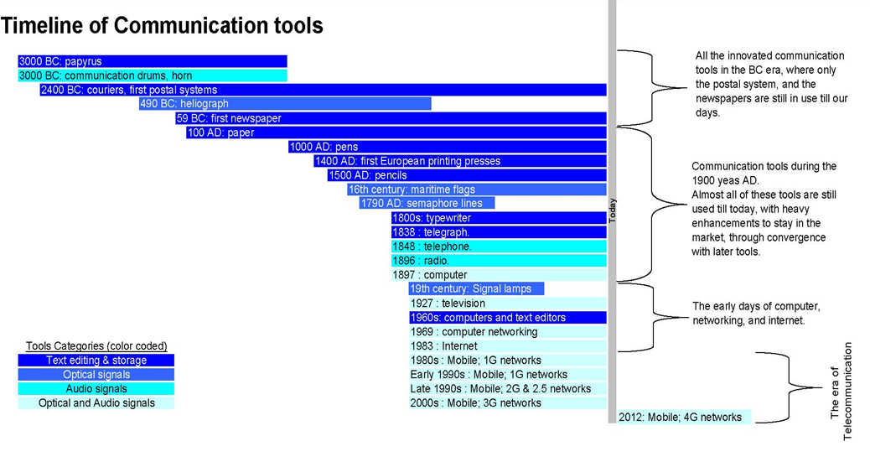
Overview
Rogers
Verizon
Bell

Slide 5
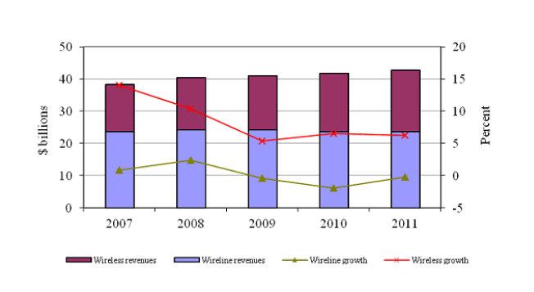
Telecommunications Revenue and Growth
Overview
Rogers
Verizon
Bell

Slide 6
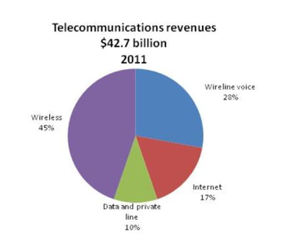
Telecommunications Revenue Breakdown
Overview
Rogers
Verizon
Bell

Slide 7
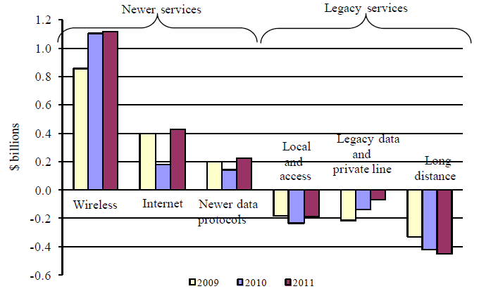
Annual Revenue Growth
Overview
Rogers
Verizon
Bell

Slide 8
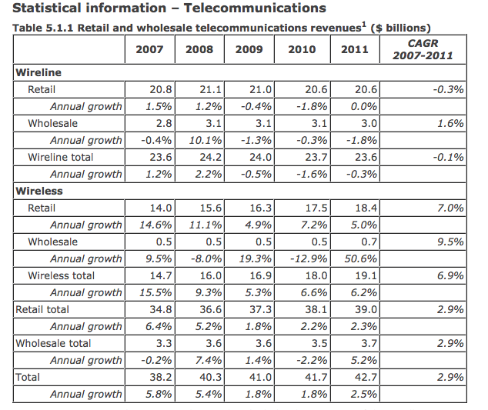
Overview
Rogers
Verizon
Bell

Slide 9
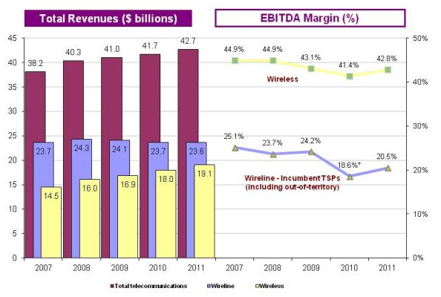
Wireless vs Wireline Revenue
Overview
Rogers
Verizon
Bell

Slide 10
Wireless

Slide 11
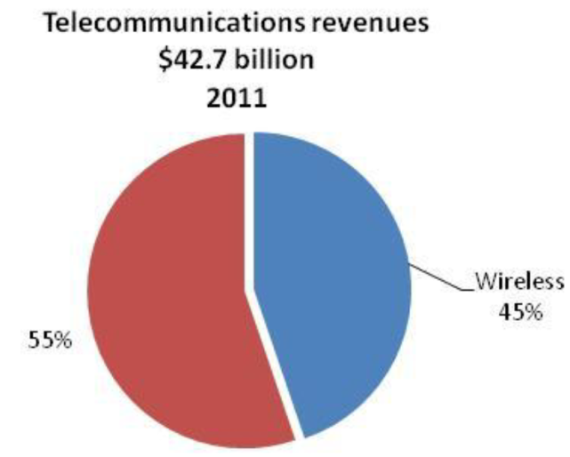
Wireless
The wireless network covers approximately 20% of Canada’s geographic area
And is available to 99% of Canadians
The LTE network is available to approximately 45% of Canadians
Wireless market sector revenues are the largest component (45%) of total telecommunications revenues
Overview
Rogers
Verizon
Bell

Slide 12
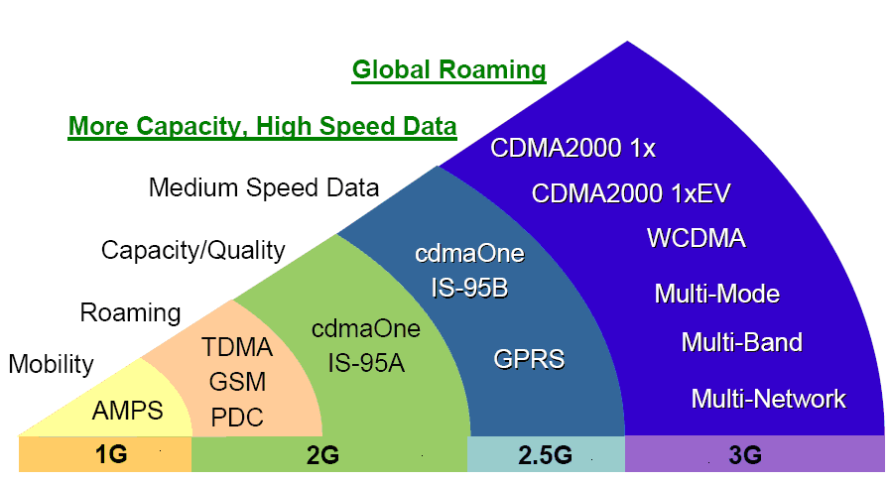
Wireless
Overview
Rogers
Verizon
Bell

Slide 13
1G
2G
First generation wireless telephone technology
First cellular network launched in Japan in 1979
For voice only; the technology didn't provide for SMS or other data services
Circuit switched - when you place a call, a connection is established for you, and is maintained until you hang up
Second generation cellular telecom networks were commercially launched on the GSM standard in Finland
Phone conversations were digitally encrypted
2G systems were significantly more efficient on the spectrum allowing for far greater mobile phone penetration levels
2G introduced data services for mobile phones, starting with SMS messages
Overview
Rogers
Verizon
Bell
Overview
Rogers
Verizon
Bell

Slide 14
3G
4G
Substantially higher data transfer rates
Made global roaming possible
EDGE – allowed for higher data transfer rates for GSM phones
Application services
wide-area wireless voice telephone
mobile Internet access
video calls and mobile TV
In 2009, the ITU-R organization specified the IMT-Advanced requirements for 4G standards
Setting peak speed requirements for 4G service at 100 Mbit/s for high mobility communication and 1 Gbit/s for low mobility communication
HSPA+ (up to 42Mbps)
LTE (up to 75 Mbps)
Overview
Rogers
Verizon
Bell
Overview
Rogers
Verizon
Bell

Slide 15
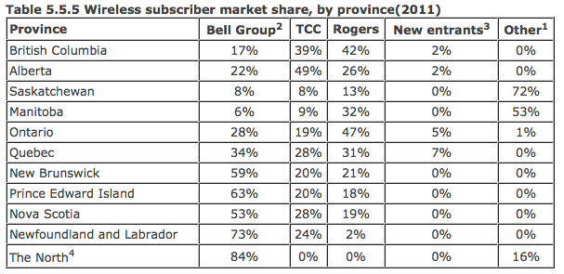
Wireless Subscribers by Province
Overview
Rogers
Verizon
Bell

Slide 16
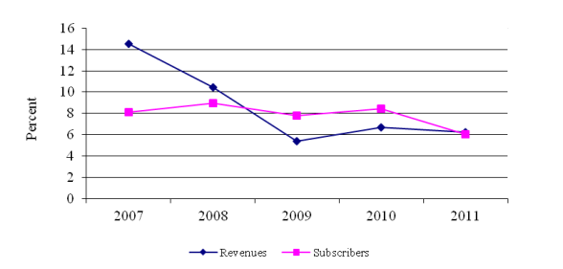
Wireless revenue and subscriber growth rates
Overview
Rogers
Verizon
Bell

Slide 17
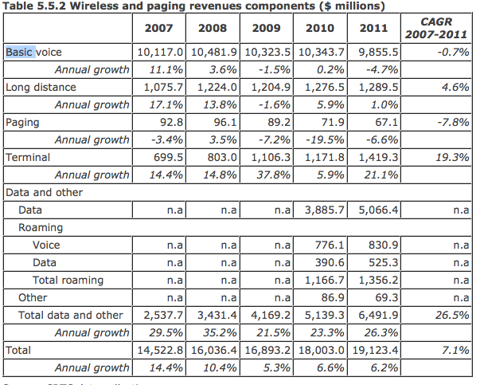
Wireless Revenue Breakdowns
Overview
Rogers
Verizon
Bell

Slide 18
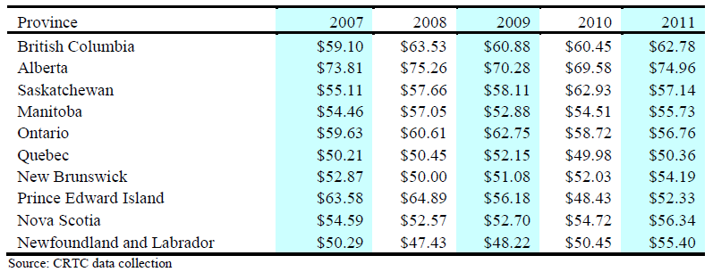
Wireless ARPU by Province
ARPU: Average Revenue per Users
Overview
Rogers
Verizon
Bell

Slide 19
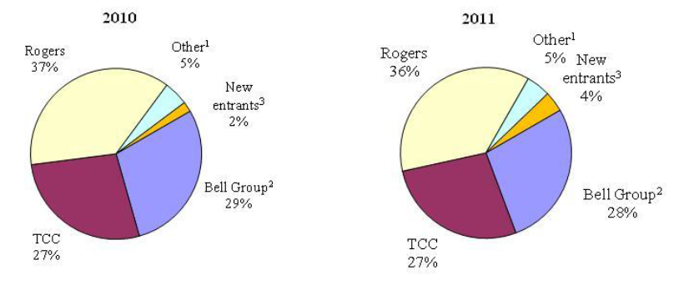
Wireless TSPs’ Subscriber Market Share
TSP: Telecommunication Service Provider
Overview
Rogers
Verizon
Bell

Slide 20
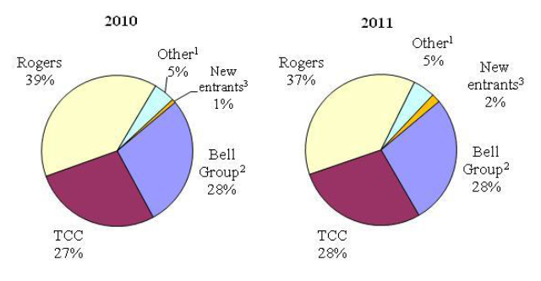
Wireless TSPs’ Revenue Market Share
Overview
Rogers
Verizon
Bell

Slide 21
Wireline

Slide 22
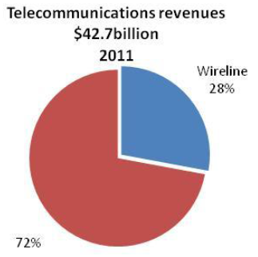
Wireline
In 2011, 91% of Canadian households subscribed to wireline voice communication services
There were over 100 providers of local and access services
and over 150 providers of long distance services in 2011
Overview
Rogers
Verizon
Bell

Slide 23
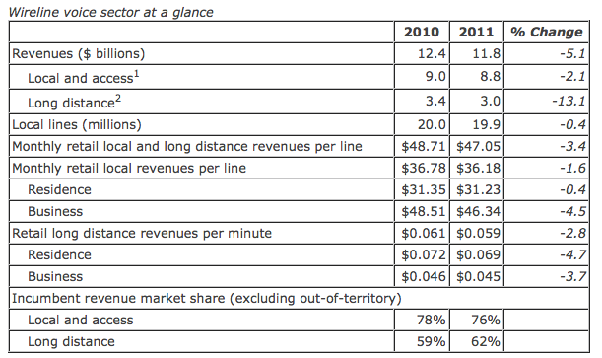
Wireline Voice Market Sector
Overview
Rogers
Verizon
Bell

Slide 24
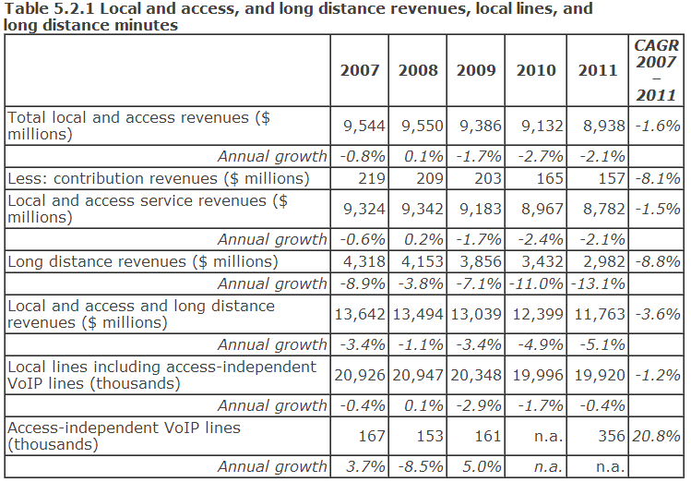
Wireline Revenue Breakdowns
Overview
Rogers
Verizon
Bell

Slide 25
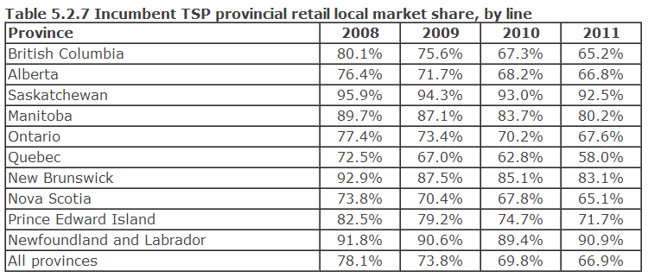
Incumbent TSP provincial retail local market share
Overview
Rogers
Verizon
Bell

Slide 26
Internet and Broadband

Slide 27
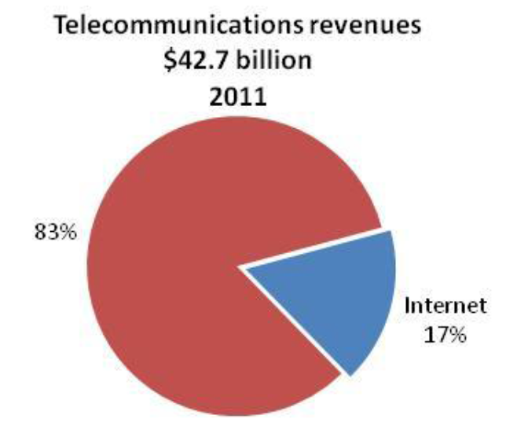
Internet
Incumbent TSPs provide Internet services using mainly dial-up, DSL, fibre-optic, satellite, and fixed wireless facilities.
Overview
Rogers
Verizon
Bell

Slide 28
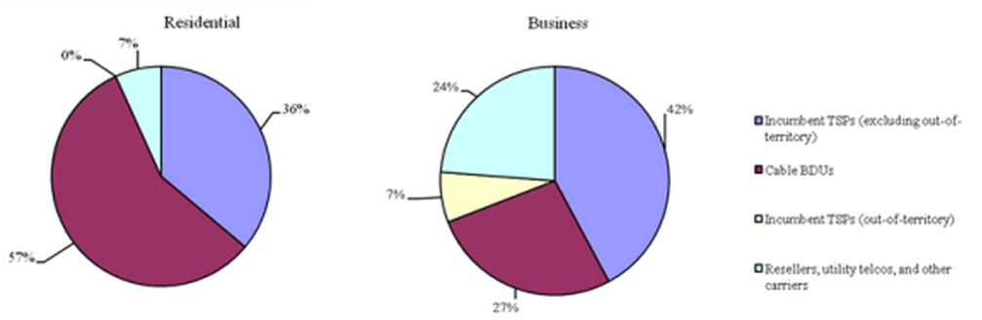
Internet Access Revenue Share
Overview
Rogers
Verizon
Bell

Slide 29
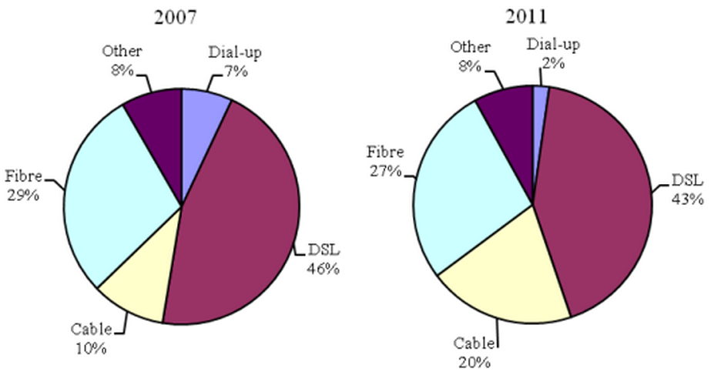
Business Internet Access Revenue
Overview
Rogers
Verizon
Bell

Slide 30
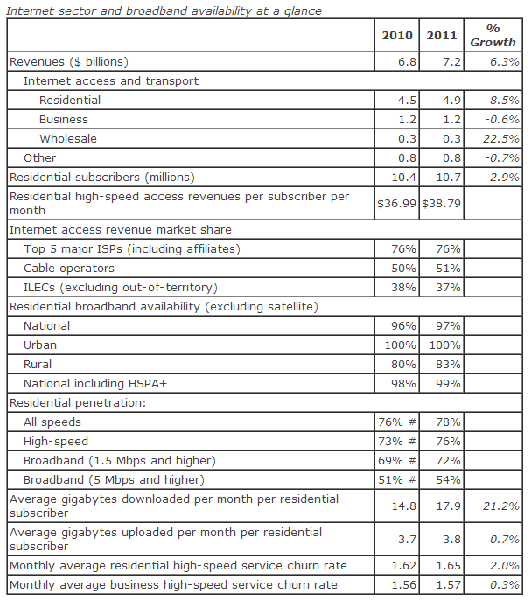
Internet and Broadband
Overview
Rogers
Verizon
Bell

Slide 31
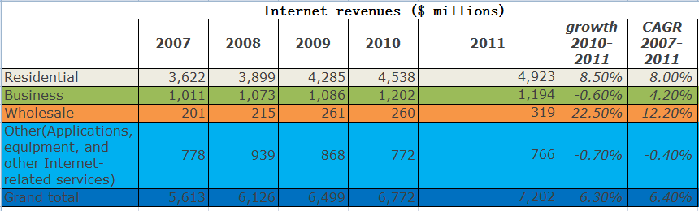
Internet Revenues
Overview
Rogers
Verizon
Bell

Slide 32
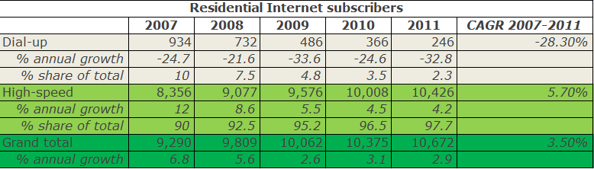
Residential Internet Subscribers
Overview
Rogers
Verizon
Bell

Slide 33
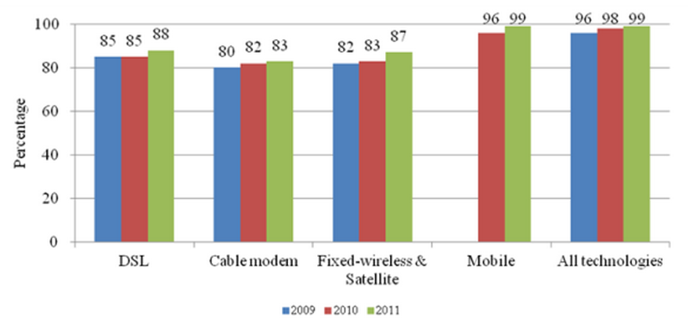
Broadband Availability
Overview
Rogers
Verizon
Bell

Slide 34
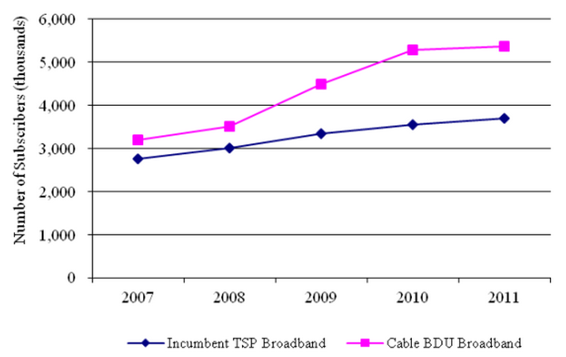
Broadband Subscriptions
Overview
Rogers
Verizon
Bell

Slide 35
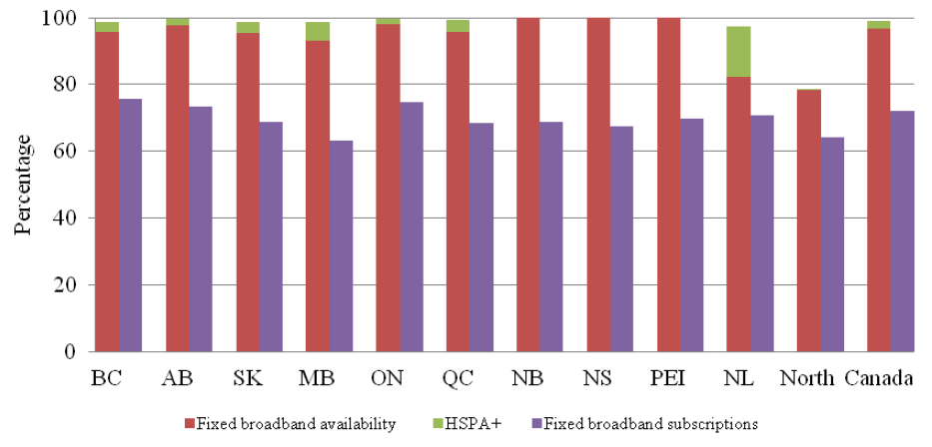
Broadband Availability vs Broadband Subscriptions
Overview
Rogers
Verizon
Bell

Slide 36
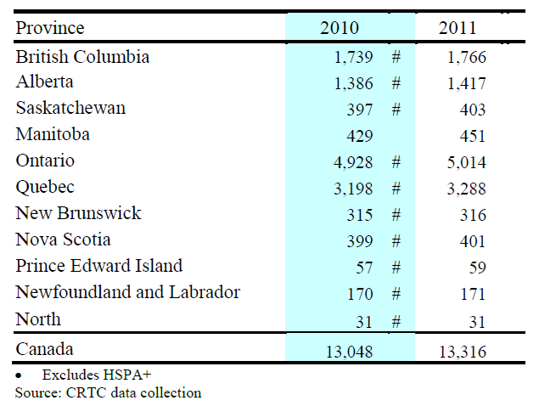
Households that have Broadband Access(thousands)
Overview
Rogers
Verizon
Bell

Slide 37
Spectrum
Refers to the full frequency range from 3 kHz to 300 GHz that may be used for wireless communication
Divided into frequency bands and allocated to services such as broadcasting, satellite and mobile services
Spectrum is assigned through administrative licensing
The purpose of spectrum management is to mitigate radio spectrum pollution and maximize the benefit of usable radio spectrum

Slide 38
Spectrum Auction
An auction process held by government where licenses to transmit signals are sold to various telecommunication service providers
General Process:
Public Consultation
Comment Period
Reply Comment Period
Development of Final Policy
Amendments, Supplements and Clarification Questions
Submission of Applications
Publication of List of Applicants
Publication of List of Qualified Bidders
Auction Opens
Auction Closes
Issuance of Licenses
Unsold Licenses

Slide 39
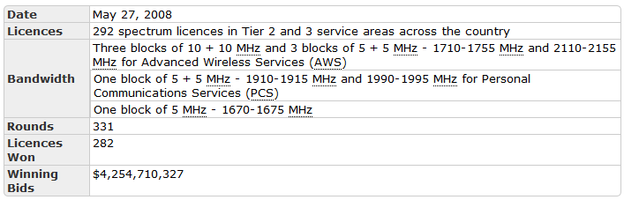
Spectrum Auction – AWS 2GHz

Slide 40
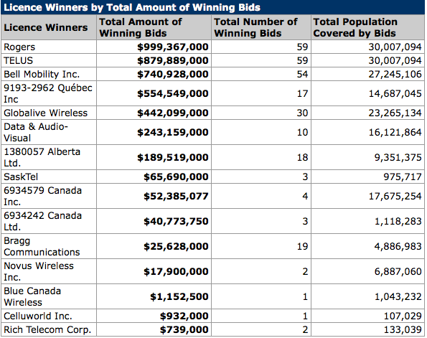
Spectrum Auction – AWS 2GHz

Slide 41
Spectrum Auction – Mobile Broadband Services 700 MHz
Public Consultation
Comment Period
Reply Comment Period
Development of Final Policy
Amendments, Supplements and Clarification Questions
Submission of Applications
Publication of List of Applicants
Publication of List of Qualified Bidders
Auction Opens
Auction Closes
Issuance of Licenses
Unsold Licenses

Slide 42
Spectrum Auction – Mobile Broadband Services 700 MHz
Licences will be "spectrum licences in respect of the utilization of specified radio frequencies within a defined geographic area,“
Licences will be auctioned using Tier 2 service areas (14 service areas) for all frequency blocks
Five blocks of paired spectrum and two blocks of unpaired spectrum will be available in each service area (seven licence blocks)
98 licences will be offered
A spectrum cap of two paired frequency blocks will apply to all licensees; the unpaired blocks will not be subject to a spectrum cap
A spectrum cap of one paired spectrum block from within blocks B, C, C1 and C2 will apply to all large wireless service providers

Slide 43
Spectrum Auction – Mobile Broadband Services 700 MHz
Will Allow Telecom Companies to Bring Latest 4G LTE Mobile Networks to Canadian Consumers and Businesses
The Telecommunications Act will be amended to lift foreign investment restrictions for telecom companies that hold less than a 10-percent share of the total Canadian telecommunications market
The government will be applying caps in the upcoming spectrum auctions to guarantee that both new wireless competitors and incumbent carriers have access to the spectrum up for auction
The government will apply specific measures in the 700 MHz auction to see that rural Canadians will have access to the same advanced services as everyone else in a timely manner
A portion of the 700 MHz spectrum will be reserved for public safety users such as police and firefighters across Canada

Slide 44
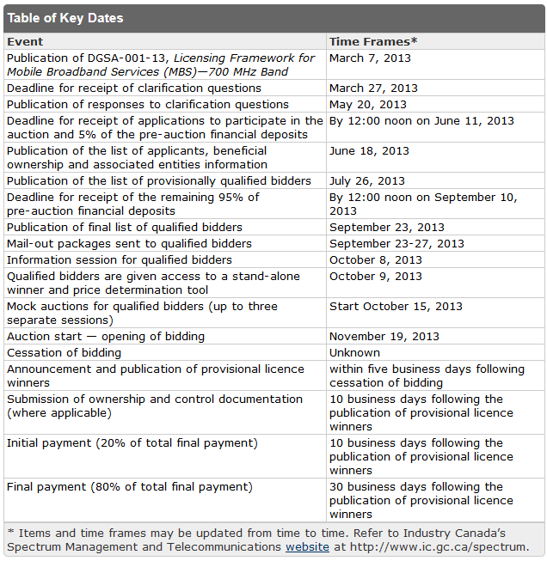
Spectrum Auction – Mobile Broadband Services 700 MHz

Slide 45
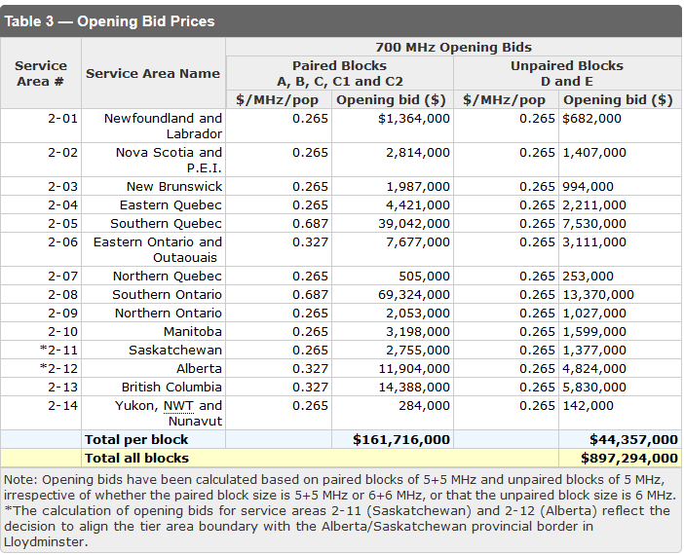
Spectrum Auction – Mobile Broadband Services 700 MHz

Slide 46
Spectrum Auction – Mobile Broadband Services 700 MHz
Eligibility Points:
Each licence is assigned a specific number of eligibility points
The bidder’s initial eligibility is based on its pre-auction financial deposit and defines the upper limit of licences for which the bidder can bid

Slide 47
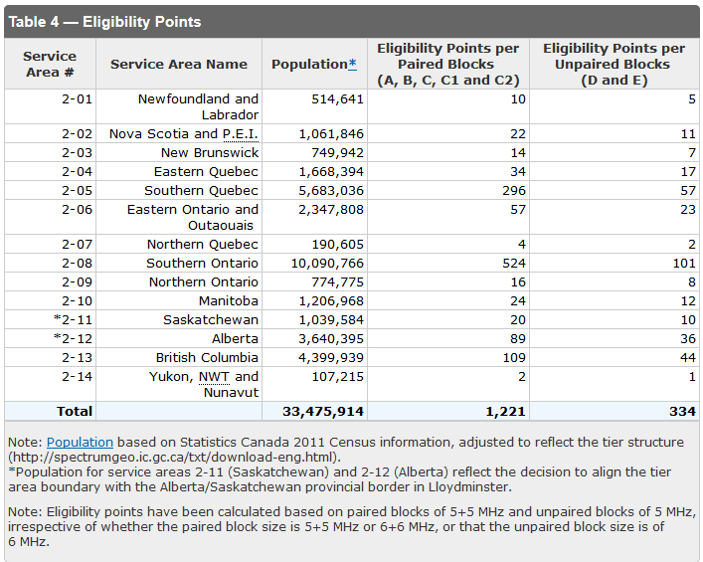
Spectrum Auction – Mobile Broadband Services 700 MHz

Slide 48
Spectrum Auction – Broadband Radio Service 2500 MHz Band
Public Consultation
Comment Period
Reply Comment Period
Development of Final Policy
Amendments, Supplements and Clarification Questions
Submission of Applications
Publication of List of Applicants
Publication of List of Qualified Bidders
Auction Opens
Auction Closes
Issuance of Licenses
Unsold Licenses

Slide 49
Spectrum Auction – Broadband Radio Service 2500 MHz Band
Licences will be "spectrum licences in respect of the utilization of specified radio frequencies within a defined geographic area
Licences will be auctioned using Tier 3 service areas (58 service areas), except in the Northwest Territories, Yukon and Nunavut, where Tier 4 service areas (three service areas) will be used
In the bands 2500-2570 MHz and 2620-2690 MHz ("the paired spectrum"), the spectrum will be licensed in blocks of 10 + 10 MHz in each available service area
In the band 2570-2620 MHz ("the unpaired spectrum"), the spectrum will be licensed in blocks of 25 MHz (which includes the respective 5 MHz restricted band) in each available service area;
318 licences will be offered;
A spectrum aggregation limit of 40 MHz will apply in each service area of the 2500 MHz band, except in the Northwest Territories, Yukon and Nunavut where there is no limit. This amount represents the total spectrum licence holdings in the 2500 MHz band, including both paired and unpaired spectrum, by each licensee in each licence area
In service areas where an existing licensee already has spectrum licence holdings in excess of the spectrum aggregation limit, the licensee will not be required to divest any such holdings in order to meet the spectrum aggregation limit. However, such licensees will not be eligible to bid for additional licences in the auction process or otherwise obtain additional licences in service areas where the limit has been met or exceeded.

Slide 50
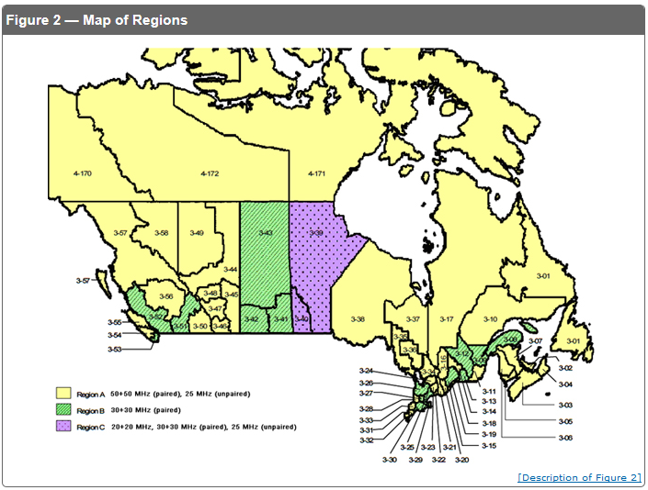
Spectrum Auction – Broadband Radio Services 2500MHz Band

Slide 51
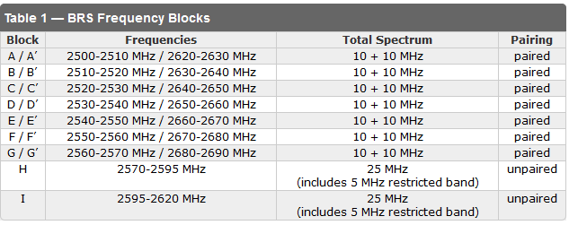
Spectrum Auction – Broadband Radio Services 2500MHz Band

Slide 52
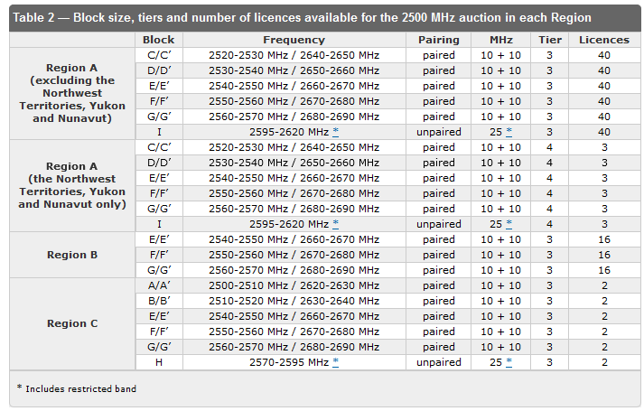
Spectrum Auction – Broadband Radio Services 2500MHz Band

Slide 53
Spectrum Auction – Broadband Radio Services 2500MHz Band
Spectrum Aggregated Limit:
Decision C2-1: With the exception of licensees in the Northwest Territories, Yukon and Nunavut, all licensees are subject to a spectrum aggregation limit of 40 MHz in the 2500 MHz band, excluding the restricted bands at 2570-2575 MHz and 2615-2620 MHz.
Decision C2-2: The spectrum aggregation limit shall remain in effect in the 2500 MHz band for a period of five years after the issuance of licences.

Slide 54
Spectrum Auction – Broadband Radio Services 2500MHz Band
Existing Licenses:
Existing licensees over the limit don’t need to divest; however, will not be eligible for auction
Existing 2500 MHz BRS licences are to be updated to harmonize with the conditions of licence of auctioned licences
The remaining conditions of licence that are not updated, for example, the licence term and the deployment requirements, will remain consistent with the conditions initiated in the June 2010

Slide 55
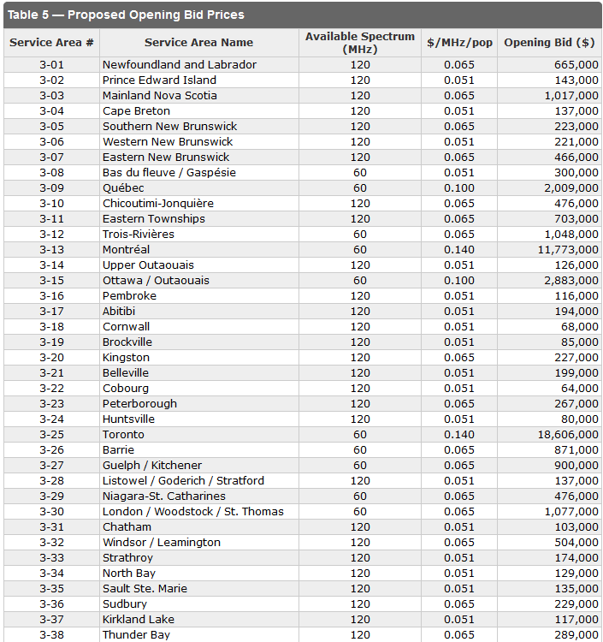
Spectrum Auction – Broadband Radio Services 2500MHz Band

Slide 56
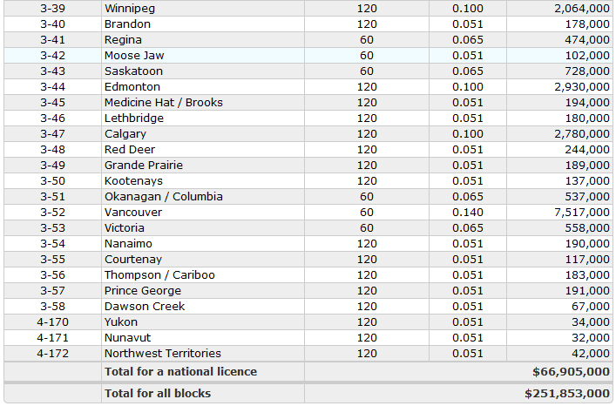
Spectrum Auction – Broadband Radio Services 2500MHz Band

Slide 57
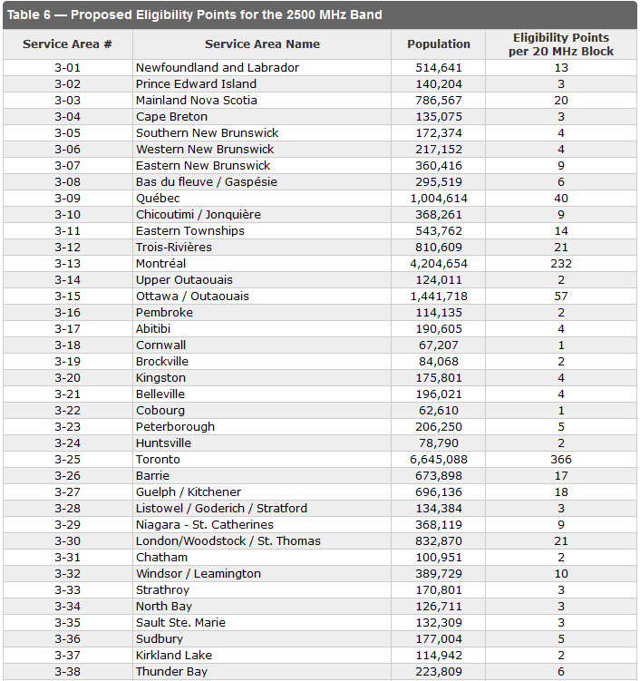
Spectrum Auction – Broadband Radio Services 2500MHz Band

Slide 58
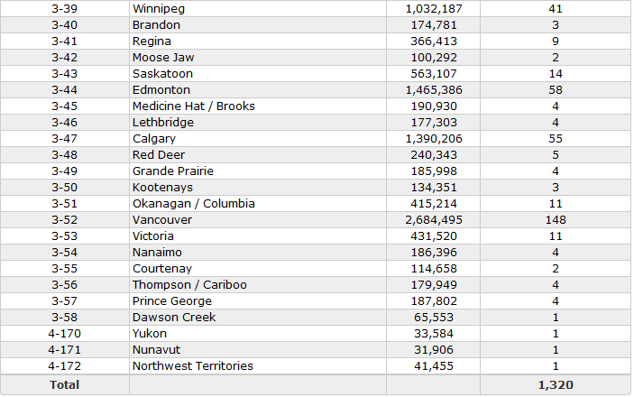
Spectrum Auction – Broadband Radio Services 2500MHz Band

Slide 59


Slide 60
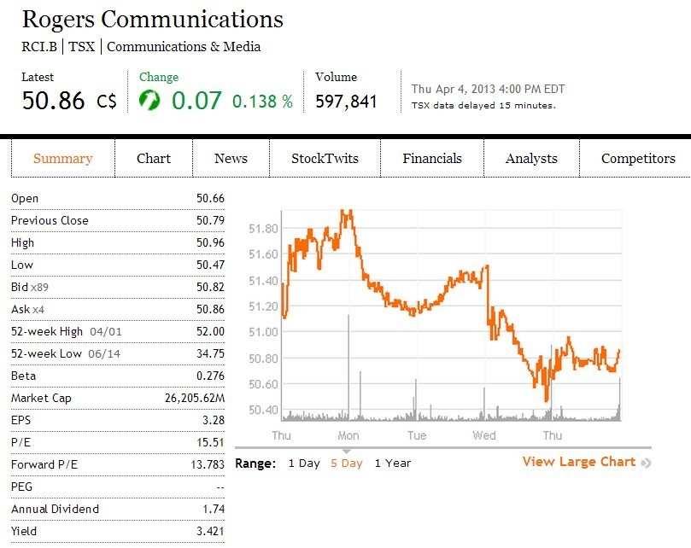
Stock Snapshot
Overview
Rogers
Verizon
Bell

Slide 61
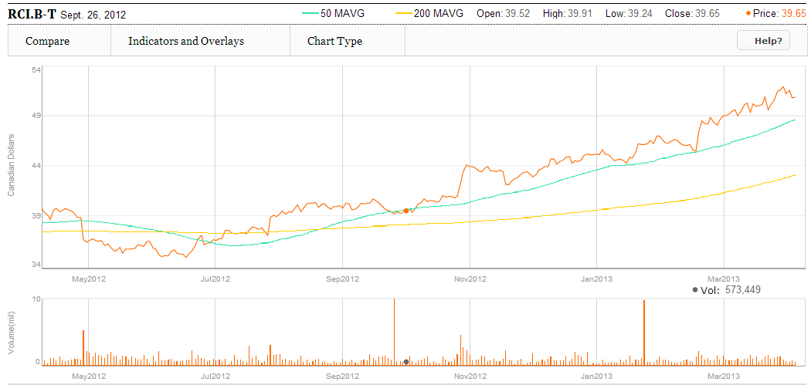
1 Year Performance with 50/200 MA
Overview
Rogers
Verizon
Bell

Slide 62
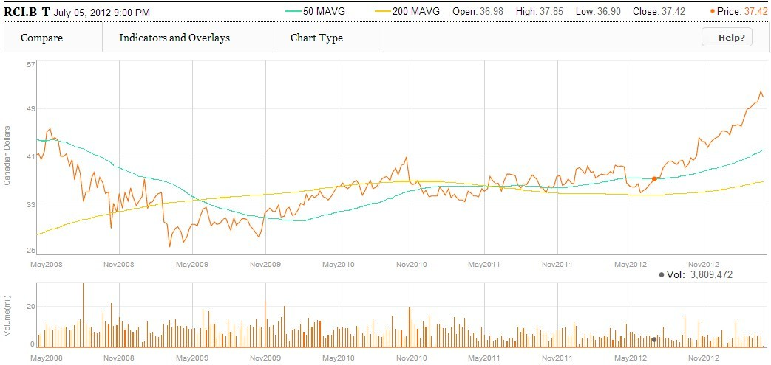
5 Year Performance with 50/200 MA
Image from Globe and Mail
Overview
Rogers
Verizon
Bell

Slide 63
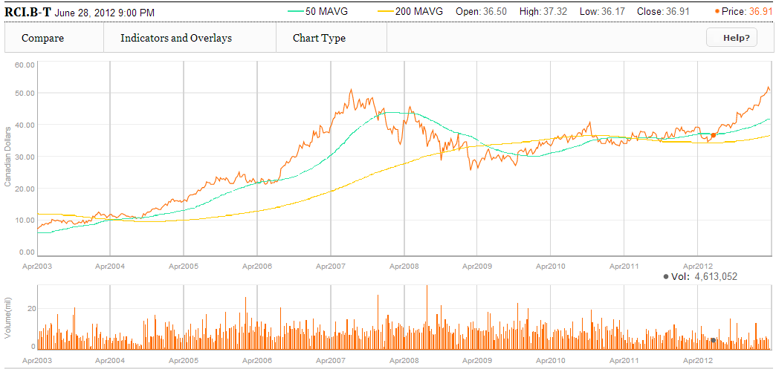
10 Year Performance with 50/200 MA
Image from Globe and Mail
Overview
Rogers
Verizon
Bell

Slide 64
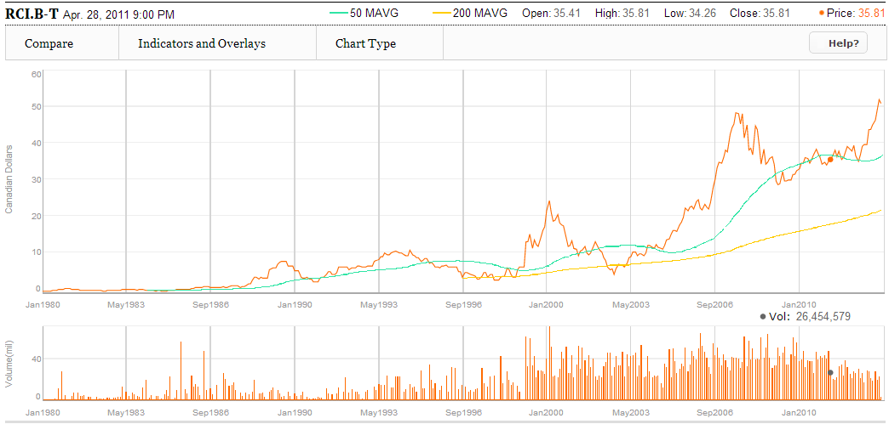
Max Years Performance with 50/200 MA
Overview
Rogers
Verizon
Bell

Slide 65
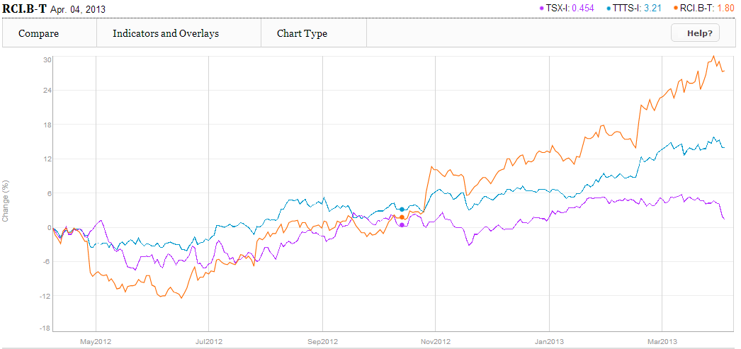
1 Year Rogers vs. S&P/TSX vs. TSX Telecom
Overview
Rogers
Verizon
Bell
Overview
Rogers
Verizon
Bell

Slide 66
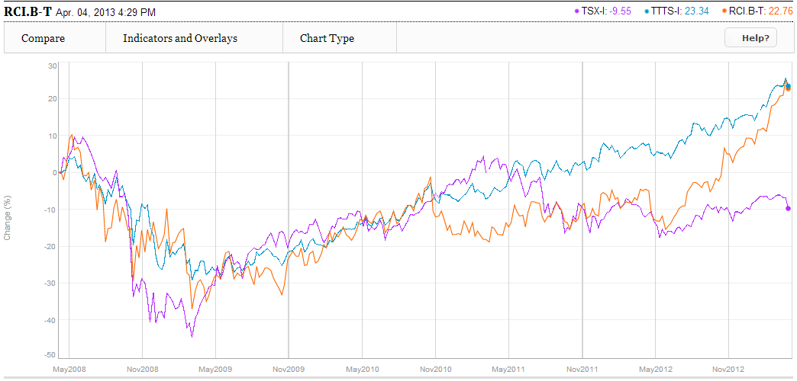
5 Year Rogers v. S&P/TSX v. TSX Telecom
Overview
Rogers
Verizon
Bell
Overview
Rogers
Verizon
Bell

Slide 67
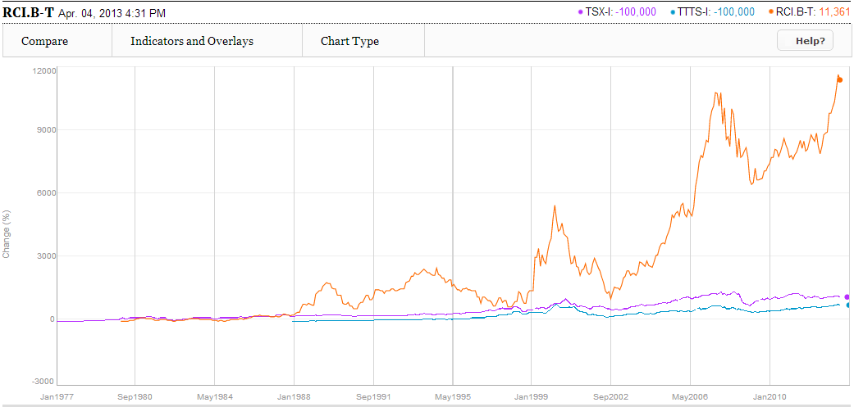
Max v. S&P/TSX v. TSX Telecom
Overview
Rogers
Verizon
Bell
Overview
Rogers
Verizon
Bell

Slide 68
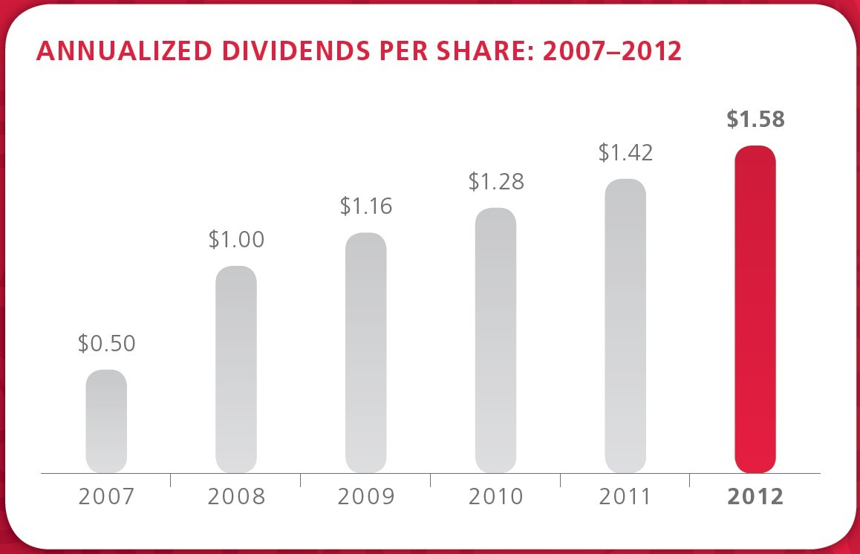
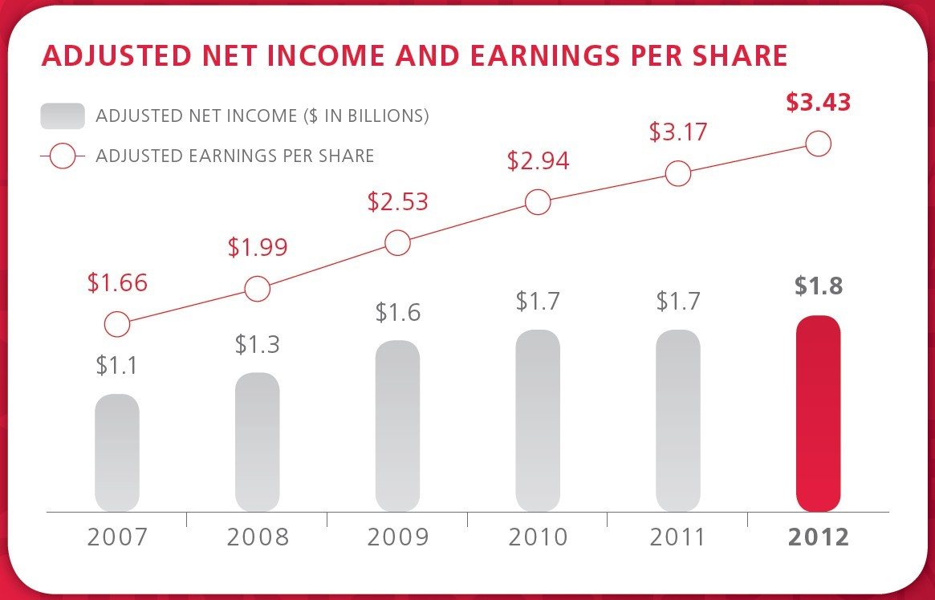
Growth
Overview
Rogers
Verizon
Bell

Slide 69

2012 Commitments
Overview
Rogers
Verizon
Bell

Slide 70

Financial Snapshot
Overview
Rogers
Verizon
Bell

Slide 71

Financial Highlights
Overview
Rogers
Verizon
Bell

Slide 72

Total Shareholder Return
Overview
Rogers
Verizon
Bell

Slide 73
Company Overview

Slide 74

History
1962 – Ted Rogers founded Rogers Radio Broadcasting Limited and also bought CHFI-FM which quickly became a popular radio station
1967 – Rogers cable started and expanded past 12 channels in 1972 (first company in Canada to do so)
1985 – Rogers Cantel Inc. founded and signalled beginning of expansion into mobile phone market (now called Rogers Wireless)
1994 –Launches 3.1 billion takeover for Maclean Hunter, the largest Canadian takeover at the time
Overview
Rogers
Verizon
Bell

Slide 75



History
2000 – Acquires the Toronto Blue Jays, a major league baseball team
2001 – Acquires Sportsnet and launches HDTV (up to 8 channels, the widest selection in Canada)
2004 – Buys back AT&T interest in Rogers Wireless for $1.8 billion and purchases Microcell(a wireless provider) for $1.6 billion
2007 – Acquires 5 Citytv television stations
2008 – Rogers Wireless launches Apple iPhone
2008 – Rogers takeover Aurora Cable
2009 – Rogers and Shaw had effectively agreed to divide the country in half in a lawsuit regarding to cable service, Rogers in the east and Shaw in the west .
Overview
Rogers
Verizon
Bell

Slide 76
Business & Strategy
Deliver differentiated end-to-end customer experiences
Maintain industry-leading networks
Expand our services
Strengthen the customer experience
Improve productivity and cost structure
Drive future growth opportunities
Overview
Rogers
Verizon
Bell

Slide 77


Operations
Overview
Rogers
Verizon
Bell

Slide 78

Structure
Overview
Rogers
Verizon
Bell

Slide 79



Wireless
Canada’s largest wireless carrier with 9.4M subscribers
Approximately 34% national market share
Only national carrier on GSM, HSPA+ and LTE platforms
Top quartile in wireless data, churn and ARPU metrics
Extensive national distribution with Rogers, Fido and chatr brands
Overview
Rogers
Verizon
Bell

Slide 80
Wireless
Wireless Industry Trends
Focus on Customer Retention
Demand for Sophisticated Data Applications
Convergence of Technologies
Increased Competition from Other Wireless Operators
Migration to Next Generation Wireless Technology
Overview
Rogers
Verizon
Bell

Slide 81

Wireless
Coverage
Overview
Rogers
Verizon
Bell

Slide 82

Wireless
Overview
Rogers
Verizon
Bell

Slide 83

Wireless
Overview
Rogers
Verizon
Bell

Slide 84

Wireless
Wireless usage information
Overview
Rogers
Verizon
Bell

Slide 85
Cable
2.2M basic cable subs and 5.2M cable service units
Top quartile penetration of Internet, home phone and digital services
96% 860/750MHz, clustered plant with 99% telephony availability
Next generation IP based solutions for enterprises ~15K business customers
Overview
Rogers
Verizon
Bell

Slide 86
Cable
Cable Industry Trends
Investment in Improved Cable Networks and Expanded Service
Offerings
Increased Competition from Alternative Broadcasting Distribution Undertakings (“BDUs”)
Growth of Internet Protocol-Based Services
Increasing Availability of Online and Wireless Access to Cable
TV Content
Facilities-Based Telephony Services Competitors
Increased Competition from Non-Facilities-Based Internet
Service Providers (“ISPs”)
Overview
Rogers
Verizon
Bell

Slide 87

Cable
Summarized Cable Financial Result
Overview
Rogers
Verizon
Bell

Slide 88

Cable
Overview
Rogers
Verizon
Bell

Slide 89


Cable
Cable Info
Overview
Rogers
Verizon
Bell

Slide 90



Media
Multi-station City and OMNI television networks
Four Sportsnet regional TV networks and national Sportsnet ONE
55 radio stations and over 50 magazine and trade publications
The Shopping Channel national televised shopping network
Toronto Blue Jays, Rogers Centre event venue and 37.5% interest in MLSE
Overview
Rogers
Verizon
Bell

Slide 91

Media
Overview
Rogers
Verizon
Bell

Slide 92


Media
Overview
Rogers
Verizon
Bell

Slide 93
MANAGEMENT

Slide 94

Corporate Governance

Slide 95

Edward S. Rogers Sr.
1900-1939
Regarded as the founder of Rogers Communication
Founded CFRB (Canada’s First Rogers Batteryless) radio station
Overview
Rogers
Verizon
Bell

Slide 96

Edward Samuel "Ted" Rogers, Jr.
May 27, 1933 – December 2, 2008
Former CEO from launch in 1960 until his death in 2008
Was the fifth richest person in Canada
Grew Rogers Communications into one of Canada’s largest media conglomerates
Overview
Rogers
Verizon
Bell

Slide 97

Edward Samuel Rogers III
Deputy Chairman and Executive Vice President Emerging Business, Corporate Development Rogers Communications
Graduated from the University of Western Ontario
Spent 2 ½ years with Comcast Corporation
Joined in March 1996 as Vice President and General Manager of Paging, Data and Emerging Technologies for Rogers Wireless
Overview
Rogers
Verizon
Bell

Slide 98

Nadir Mohamed
President and CEO, Rogers Communication
Appointed CEO in March 2009
Joined in August 2000 as COO of Rogers Wireless
UBC Bachelor of Commerce Degree
C.A. and F.C.A.
Overview
Rogers
Verizon
Bell

Slide 99

Alan D. Horn
Chairman, Rogers Communications since 2006 and President and CEO, Rogers Telecommunications Limited
served as VP, CFO of Rogers Communications (1996-2006)
President and COO of Rogers Telecommunications Limited (1990-1996)
Chartered Accountant and received a B.Sc. with First Class Honors from the University of Aberdeen, Scotland
Overview
Rogers
Verizon
Bell

Slide 100

Philip B. Lind
Executive Vice President Regulatory and Vice Chairman
Joined the Corporation in 1969
Former Chairman of the Canadian Cable Television Association
Chairman of the Board of the CCPTA
B.A. (Political Science and Sociology) from UBC
M.A. (Political Science) from the University of Rochester
Overview
Rogers
Verizon
Bell
Notes:
CCPTA: Central Canadian Public Television Association

Slide 101
Financial Performance

Slide 102

Five Year Balance Sheet
Five years consolidated FS

Slide 103

Annual Balance Sheet

Slide 104

Financial Statements
Five years consolidated FS

Slide 105

Financial Growth

Slide 106

Annual Income Statements

Slide 107

Financial Statements
Annual CF

Slide 108

Statements of Changes in Shareholders’ Equity
SH equity statement

Slide 109
Recommendation
Hold

Slide 110


Slide 111

Stock Performance
Overview
Rogers
Verizon
Bell

Slide 112

Verizon vs. S&P 500 1 year

Slide 113

Verizon vs. DJIA 1 year

Slide 114

Verizon vs. S&P 500 Telecoms (5yr)

Slide 115

1 yr (50d MA and 200d MA)
Overview
Rogers
Verizon
Bell

Slide 116

5 yr (50d MA and 200d MA)
Overview
Rogers
Verizon
Bell

Slide 117

10 yr (50d MA and 200d MA)
Overview
Rogers
Verizon
Bell

Slide 118

Financial Snapshot
Overview
Rogers
Verizon
Bell

Slide 119
Revenue by Segment

Slide 120

Management
Lowell C. McAdam
Chairman and CEO
Succeeded Ivan Seidenberg as CEO on Aug. 1, 2011, and as chairman on Jan. 1, 2012
From October 2010 until he assumed his current position, McAdam served as president and COO.
McAdam held key executive positions at Verizon Wireless since its inception in 2000
Bachelor's degree in engineering from Cornell University and a master's degree in business administration from the University of San Diego
Spent six years in the U.S. Navy Civil Engineer Corps and is a licensed professional engineer
Overview
Rogers
Verizon
Bell

Slide 121

Management
Roy H. Chestnutt
Executive vice president and chief strategy officer for Verizon Communications
Before being appointed to his position, effective Jan 2013, he was senior vice president and was responsible for the execution of Verizon’s strategic plan addressing new markets, solutions areas and capitalizing on the company’s assets
Joined Verizon in 2011 from Motorola Networks where he was corporate vice president of Americas.
Before this he was senior vice president of National Field Sales and General Business for Sprint-Nextel
He holds a B.S. in Business Admin from San Jose State University and an BMA from the University of San Fransisco.
Overview
Rogers
Verizon
Bell

Slide 122

Management
John W. Diercksen
Executive vice president of Verizon Communications responsible for corporate strategy, mergers, acquisitions and divestitures, business development, venture investments, strategic alliances/JVs, strategic planning companywide.
Started career in 1971 with Insurance Company of North America
From 1986 to 1997 was with NYNEX as Vice President/Treasurer.
1998 – CFO of Bell Atlantic’s Directory Group.
2003-2012 – Exec VP of Verizon
Diercksen earned a Bachelor of Business Administration in finance from Iona College, an MBA from Pace University and has completed postgraduate work in financial management.

Slide 123
Company History
Verizon Communications, Inc. based in New York City, incorporated in Delaware
Formed in June, 2000
Trades under VZ
Began trading on the NYSE in July, 2000
Began trading on NASDAQ exchange on March 2010
Overview
Rogers
Verizon
Bell

Slide 124
Verizon’s Formation: Bell Atlantic – GTE Merger
July 27, 1998
GTE was one of the world’s largest telecom companies
52.8B Merger
Revenue >$25B in 1999
Served 35M access lines
7.1M wireless customers
Served 6.7M outside of the 50 states
Overview
Rogers
Verizon
Bell

Slide 125
Verizon’s Formation: Bell Atlantic – GTE Merger History
Bell Atlantic was even larger than GTE
1999 revenues >$33B
Served 43 million access lines
7.7M mobile customers
Bell’s sophisticated network + GTE’s national footprint and advanced data communications combined company would be able to provide long-distance and data services nationwide as part of a full package of other communications services
Overview
Rogers
Verizon
Bell

Slide 126
MCI Acquisition
February 14, 2005
Closed on January 6, 2006 for $8.5B
MCI was a global communications provider that delivered advanced communications connectivity to business, government and consumers.
Internet backbone network was the largest in the world based on company-owned points of presence
Overview
Rogers
Verizon
Bell

Slide 127
Recent Investments
March 2008, $9.4B invested for nationwide spectrum footprint + 102 spectrum licenses for individual markets
August 2008, $2.66B to purchase Rural Cellular Corp. for expansion into many rural markets
January 2009, $5.9B for the purchase of Alltel, expanding the company's network coverage to nearly the entire US population
Overview
Rogers
Verizon
Bell

Slide 128
Recent Investments
April 2011, $1.4B to acquire Terremark Worldwide Inc.
Global provider of managed IT infrastructure and cloud services
Accelerating Verizon’s strategy to deliver a portfolio of highly secure, scalable on-demand solutions to business and government customers globally
Overview
Rogers
Verizon
Bell

Slide 129
Recent Investments
2004 through 2011
Invested more than $20 billion deploy fiber optic network past 16.5 million premises, and eventually to pass more than 18 million premises (or more than 70% of its landline territory)
2012 Onwards
Emphasis on growth of LTE network and subscribers
Expansion of Cloud Data centers around the world
Health Care industry partnerships
Overview
Rogers
Verizon
Bell

Slide 130

Ultra High Frequency (Spectrum)
Overview
Rogers
Verizon
Bell

Slide 131
Spectrum
Each spectrum is allocated for some function (military use, radio, mobile phones, etc..)
Very little empty spectrum
Large auctions happen about once every decade
Spectrum is valuable enough to drive large mergers and acquisitions just to obtain more of it
It is THE strategic asset for any wireless company
Overview
Rogers
Verizon
Bell

Slide 132
Spectrum Auction
Use of radio frequency spectrum must be licensed by the FCC
Any wireless technology can be deployed on the spectrum
FCC holds auctions for these frequencies
Proceeds go to the government
Licenses are issued for a fixed time (usually 10 years)
Must periodically seek renewal (usually approved)
Overview
Rogers
Verizon
Bell

Slide 133
Spectrum Auction
Most recently (2008), Verizon participated in the auction of spectrum in the 700MHz band
Also called “open access” C Block
Open access means the network must be open so that any “safe” device can access it. Highest bidder on 109 licenses ($9.4B)
Granted all licenses on November 26, 2008
700MHz band is spectacularly suited for use as a wireless broadband network – perfect for 4GLTE networks
Overview
Rogers
Verizon
Bell

Slide 134

Spectrum Auction
700 MHz Spectrum
Block C has almost at least double the capacity compared to the other blocks, meaning it can potentially handle twice the number of simultaneous phone calls or data throughput.
There will be another 700MHz auction, but so far, there is no set date
Overview
Rogers
Verizon
Bell

Slide 135
Why 700MHz band?
Was used to run analog TV signals
FCC killed off analog TV Feb. 19 2009
Penetrates walls easily, travels well
This makes it perfect for either cellular or long-range wireless broadband
Overview
Rogers
Verizon
Bell

Slide 136
Advanced Wireless Spectrum (AWS)
December 2011
Agreements to purchase AWS licenses from SpectrumCo (a joint venture between Comcast, Time Warner and Bright House)
Licenses will be purchased directly from SpectrumCo., whom acquired these licenses through the FCC Spectrum auction
Spectrum licenses cover 93% of the US population
Closed in 2012 for $3.6B
Overview
Rogers
Verizon
Bell

Slide 137

Overview
Rogers
Verizon
Bell

Slide 138

Overview
Rogers
Verizon
Bell

Slide 139

Verizon Coverage
Overview
Rogers
Verizon
Bell

Slide 140
Verizon and Vodaphone
Vodaphone owns 45% of Verizon Wireless
“The company was working with AT&T on a plan to take over and break up Vodafone, which is based in London.”
3 Days ago
Did not “…currently have any intention to merge with or make an offer for Vodafone, whether alone or in conjunction with others.”

Slide 141
Business Units
Wireless
Operating as Verizon Wireless, Verizon's wireless products and services include wireless voice and data services and equipment sales delivered over one of the most extensive and reliable wireless networks in the world.
Wireline
Verizon's Wireline segment provides voice, Internet access, broadband video and data, next generation Internet Protocol network services, network access, long distance and other services. These services are provided to consumers, carriers, businesses and government customers both in the United States and internationally in 150 countries.
Overview
Rogers
Verizon
Bell

Slide 142

Wireless Operating Revenues
Overview
Rogers
Verizon
Bell

Slide 143

Verizon Wireless Expenses
Overview
Rogers
Verizon
Bell

Slide 144

Wireline Operating Revenues
Overview
Rogers
Verizon
Bell

Slide 145

Verizon Wireless Expenses
Overview
Rogers
Verizon
Bell

Slide 146

Verizon Wireline Expenses

Slide 147

Verizon Wireline
FiOS accounts for more than 68% of wireline revenues (up from 60%)
Helps make up for the decline of revenues in traditional services (cable and dialup)
Overview
Rogers
Verizon
Bell

Slide 148

Overview
Rogers
Verizon
Bell

Slide 149
2012 Results
Revenues totaled $115.8 billion, up 4.3%
Cash flow from operating activities totaled $29.8 billion for the year
Raised dividend by 3.0%, the sixth consecutive annual increase, bringing the annual dividend to $2.03 a share
Overall, Verizon’s total return to shareowners for 2012 was 13.2 percent, as compared with 10.2 percent for the Dow Jones Industrial Average and 16 percent for the S&P 500.
Overview
Rogers
Verizon
Bell

Slide 150
2013 Strategy
Innovative Products and Services:
Build Nationwide 4G LTE by mid 2013
Expand FiOS subscription base
The purchase of more spectrum
Increase network’s availability and capacity (purchase from competitors)
Strategic Partnerships:
Partner with Redbox, Innovation programs/centers, 125 partners
Overview
Rogers
Verizon
Bell

Slide 151
2013 Strategy
“LTE in Rural America” Initiative
As of January 22, 2013, Verizon’s 4G LTE network covered nearly 89 percent of the U.S. population, and we expect to cover nearly our entire 3G network footprint by the end of this year.
Overview
Rogers
Verizon
Bell

Slide 152

Financial Statements

Slide 153

Consolidated Balance Sheet

Slide 154


Slide 155


Slide 156

Recommendation

Slide 157


Slide 158

Snapshot
Overview
Rogers
Verizon
Bell

Slide 159

1 year 50/200 MA
Overview
Rogers
Verizon
Bell

Slide 160

5 Year 50/200 MA
Overview
Rogers
Verizon
Bell

Slide 161

Max 50/200 MA
Overview
Rogers
Verizon
Bell

Slide 162

1 Year Bell v. S&P/TSX v. TSX Telecom
Overview
Rogers
Verizon
Bell

Slide 163

5 Year Bell v. S&P/TSX v. TSX Telecom
Overview
Rogers
Verizon
Bell

Slide 164

Max Bell v. S&P/TSX v. TSX Telecom
Overview
Rogers
Verizon
Bell

Slide 165

Dividends
Overview
Rogers
Verizon
Bell

Slide 166

Bell Credit Ratings
Overview
Rogers
Verizon
Bell

Slide 167

BCE Credit Ratings
Overview
Rogers
Verizon
Bell

Slide 168
Company Overview
BCE

Slide 169

Company Overview
Overview
Rogers
Verizon
Bell

Slide 170

Product Overview
Overview
Rogers
Verizon
Bell

Slide 171

Bell Subscribers
Overview
Rogers
Verizon
Bell

Slide 172
Strategic Imperatives
Invest in Broadband Networks and Services
Accelerate Wireless
Leverage Wireline Momentum
Expand Media Leadership
Achieve a Competitive Cost Structure
Improve Customer Service
Overview
Rogers
Verizon
Bell

Slide 173
Bell Wireline
Provides telephone, long-distance, data (including internet), and other communication solutions to residential and business customers
Also provides direct-to-home satellite TV services
Services mostly in Ontario and Quebec
Overview
Rogers
Verizon
Bell

Slide 174


Bell Wireline
Overview
Rogers
Verizon
Bell

Slide 175


Bell Wireline
Overview
Rogers
Verizon
Bell

Slide 176



Bell Wireless
Provides integrated digital wireless phone and data services to residential and business customers
Available across Canada
Includes operations from Bell Mobility, The Source, and Northwestel
Overview
Rogers
Verizon
Bell

Slide 177

Bell Wireless
Overview
Rogers
Verizon
Bell

Slide 178

Bell Wireless
Overview
Rogers
Verizon
Bell

Slide 179


Bell Wireless
Overview
Rogers
Verizon
Bell

Slide 180

Bell Wireless
Overview
Rogers
Verizon
Bell

Slide 181



Bell Media
Bell Media created on April 1st, 2011
BCE acquires remaining 85% of CTV common shares
Obtained Exclusive Canadian Media Rights to the 2018 and 2022 World Cup of Soccer and 2016 Women’s World Cup of Soccer
Overview
Rogers
Verizon
Bell

Slide 182




Purchase of MLSE
Announced on December 9th, 2011 that Bell and Rogers purchased 75% stake in MLSE
Split down the middle (37.5% each)
Deal finalized on August 22, 2012
Overview
Rogers
Verizon
Bell

Slide 183



Proposed Acquisition of Astral
Bell signed an agreement to purchase all issued and outstanding shares of Astral on March 16th, 2012
Astral media inc. is a leading Canadian media company
Four main areas:
Television
Radio
Out-of-home Advertisement
Digital
Overview
Rogers
Verizon
Bell

Slide 184
Proposed Acquisition of Astral
Acquisition rejected by CRTC in October 2012
New proposal submitted in November 2012 with amendments made
Competition Bureau cleared new proposal on March 4th, 2013
Still waiting clearance of CRTC
Estimated date for completion of transaction is June 1th, 2013
Overview
Rogers
Verizon
Bell

Slide 185


Bell Media
Overview
Rogers
Verizon
Bell

Slide 186

Bell Aliant
Provides local telephone, long distance, internet, data, tv, IT services, wireless, and other ICT services to residential and business customers
Operates in Atlantic provinces and rural areas in Ontario and Quebec
BCE is the majority shareholder of Bell Aliant with 44.1%
Overview
Rogers
Verizon
Bell

Slide 187


Bell Aliant
Overview
Rogers
Verizon
Bell

Slide 188
Management
BCE

Slide 189

George Cope
President and CEO
Joined Bell in 2005 with 15 years experience in CEO roles in telecommunications industry
Holds a Honors Business Administration degree from the University of Western Ontario
Serves on the advisory board of UWO’s Richard Ivey School of Business
Chairman of the Board for Bell Aliant
Director of BMO, BCE, and Bell Canada
Overview
Rogers
Verizon
Bell

Slide 190

Mirko Bibic
Executive VP and Chief Legal and Regulatory Officer
Join Bell in January 2004 as Senior VP, Regulatory
Prior to Bell, Bibic was managing partner of the Ottawa Office for Strikeman Elliot LLP
Hold a Law degree from the University of Toronto
Called to the bar in 1994
Overview
Rogers
Verizon
Bell

Slide 191

Charles Brown
President, The Source
Joined Bell in 1980 as sales rep
Rejoined Bell in 2006 as President Bell West
Bachelors of Arts degree from University of Toronto
Masters degree from UWO’s Richard Ivey School of Business
Overview
Rogers
Verizon
Bell

Slide 192

Michael Cole
Executive VP and Chief Information Officer
Joined Bell in 1991
Named to Canada’s Top 40 under 40 in 2009
Graduate from the Faculty of Economics from Princeton University
MBA from University of Toronto’s Rotman School of Business
Overview
Rogers
Verizon
Bell

Slide 193

Kevin Crull
President Bell Media
Joined Bell April 1st following the acquisition of CTV
Was CEO of CTV Globe Media prior to acquisition
20 years experience leading sales, marketing, and operational teams in telecommunications and consumer packaged goods industries
Was Senior VP of AT&T Consumer and Small Business
MBA at University of San Francisco
Bachelors degree in Marketing at Ohio State University
Overview
Rogers
Verizon
Bell

Slide 194

Stephen Howe
Executive VP and Chief Technology Officer
Prior to Bell, Howe was Executive VP of Information Technology at Telus Mobility
Bachelors of Engineering in Engineering Physics from McMaster University
MBA from Cornell University
Overview
Rogers
Verizon
Bell

Slide 195

Thomas C. O’Neill
Chairman of the Board since 2009
Prior to Bell, CEO of Pricewaterhouse Coopers, then Chairman of the Board at Pricewaterhouse Coopers
Former Vice-Chair of the Board of Trustees of Queen’s University
Graduated from Queen’s University with Bachelors of Commerce
Chartered Accountant
Received an Honorary LLD from Queen’s University
Fellow of the Institute of Corporate Directors
Also a Director of Adecco S.A., Bell Canada, Loblaw Companies Limited, Nexen Inc., and The Bank of Nova Scotia
Overview
Rogers
Verizon
Bell

Slide 196
Financial Statements
BCE

Slide 197

Outstanding Shares
Overview
Rogers
Verizon
Bell

Slide 198

Balance Sheet (Quarterly)

Slide 199

Balance Sheet (Assets)
Overview
Rogers
Verizon
Bell

Slide 200

Balance Sheet (Liabilities + Equities)

Slide 201

Income Statement (Quarterly)

Slide 202

Income Statement

Slide 203

Cash Flows (Quarterly)

Slide 204

Cash Flows

Slide 205

Cash Flows cont’d

Slide 206

Recommendation

Slide 207

The End
Questions?

