Slide 1
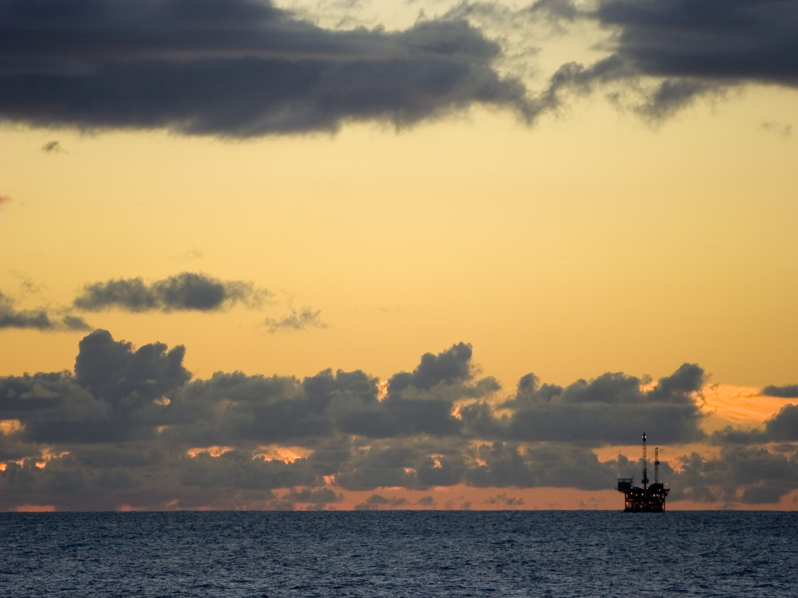
Canadian Oil and Gas Services
Group Members: Nevan Yochim
Michael Nguyen
Patton Cheung
Shae MacLean

Slide 2
Agenda
Canadian Oil and Gas Services
Industry Overview
Transocean
Precision
Inter Pipeline Fund
Industry Overview
Transocean
Precision
Inter Pipeline Fund

Slide 3
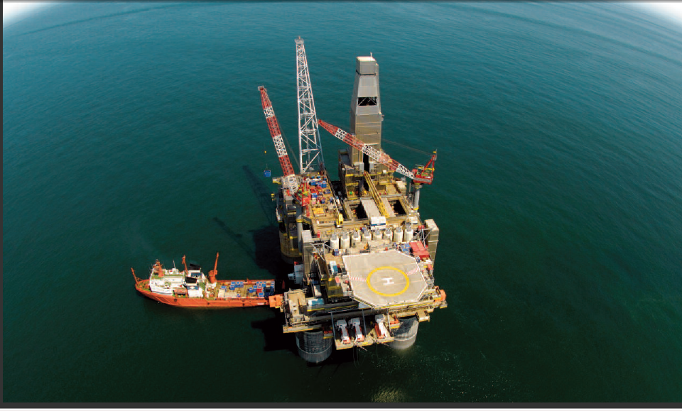
Industry Overview

Slide 4
Canadian Oil and Gas Services
Industry Overview
Transocean
Precision
Inter Pipeline Fund
Large & Vital to many other industries
Industry Structure
Upstream
Downstream
Oil and Gas
Upstream
Production
Downstream
Refining
Marketing
Exploration

Slide 5
Canadian Oil and Gas Services
Industry Overview
Transocean
Precision
Inter Pipeline Fund
Companies driven by:
Location and size of the resource
Costs of developing resource
Fiscal terms in acquiring rights to resource
Commodity Prices

Slide 6
Industry Composition
Canadian Oil and Gas Services
Industry Overview
Transocean
Precision
Inter Pipeline Fund
Oilfield services
Contract drilling
land drilling rigs
deepwater drilling rigs
Equipment Manufacture

Slide 7
Canadian Oil and Gas Services
Industry Overview
Transocean
Precision
Inter Pipeline Fund
Revenue Contribution

Slide 8
Oilfield Services
Canadian Oil and Gas Services
Industry Overview
Transocean
Precision
Inter Pipeline Fund
Prepare wells for production
Repair and Maintenance
Specifically:
Seismic Testing
Transportation Services
Directional Services

Slide 9
Contract Drilling
Canadian Oil and Gas Services
Industry Overview
Transocean
Precision
Inter Pipeline Fund
Physically drill and pump oil out of the ground
Get contract from big oil companies
Specialize in drilling
Own the rigs and highly-skilled employees
Two types of drilling rigs
Land drilling rigs
Deepwater drilling rigs

Slide 10
Canadian Oil and Gas Services
Industry Overview
Transocean
Precision
Inter Pipeline Fund
Drilling Costs
When companies drill, they incur two types of costs:
Non-salvageable: labor, site preparation, engineering, design, etc.
Tangible: equipment and other physical assets.
Non-salvageable or “intangible” costs
typically represent 60-80% of the cost of
the well.

Slide 11
Drilling Steps
Canadian Oil and Gas Services
Industry Overview
Transocean
Precision
Inter Pipeline Fund
1. Obtaining permits
2. Setting up the drilling site
3. Placing drilling rig and setting pilot hole
4. Drill in sections and filling well bore with steel or cement casing to stabilize the well
5. Log the well (test presence of hydrocarbons)
6. Complete well
7. Perforation

Slide 12
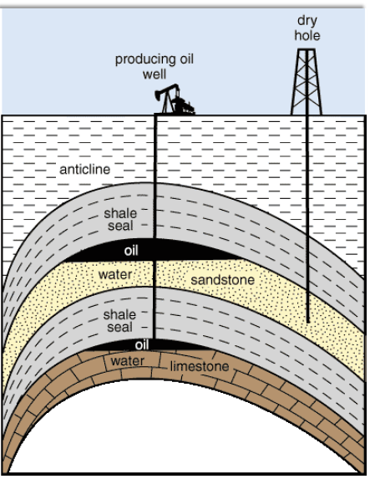
Canadian Oil and Gas Services
Industry Overview
Transocean
Precision
Inter Pipeline Fund
Despite all the
advances in
technology, we still
don’t know what is
down there and
where it is until we
invest the capital,
time and labour to
determine if the well
is going to be a
“producing well” or a
“dry hole.”

Slide 13
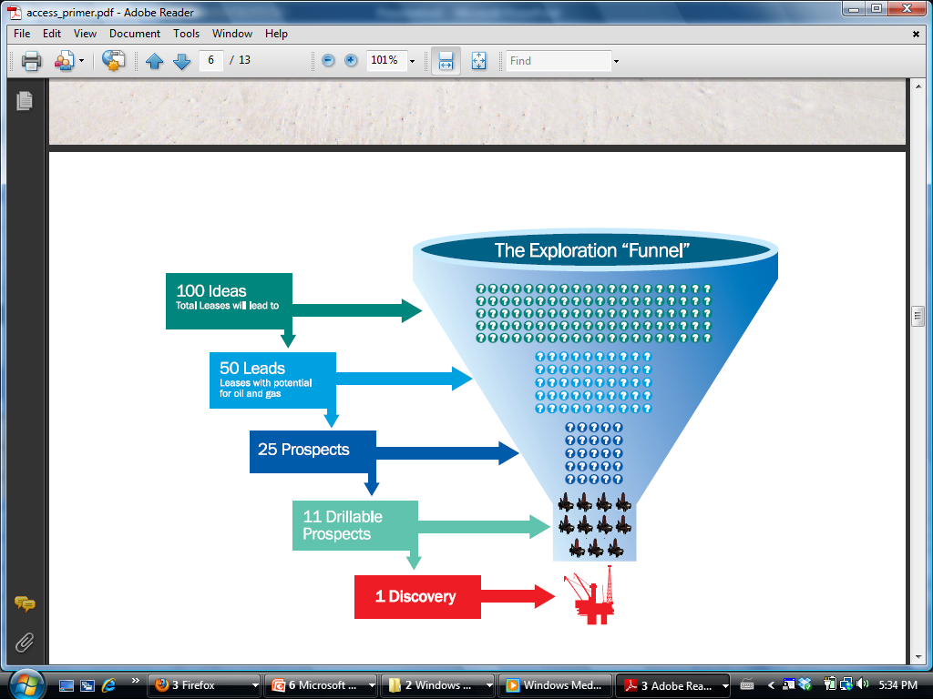
Canadian Oil and Gas Services
Industry Overview
Transocean
Precision
Inter Pipeline Fund

Slide 14
Canadian Oil and Gas Services
Industry Overview
Transocean
Precision
Inter Pipeline Fund
Oil or NG or both
Onshore or Offshore
production wells are drilled primarily for producing oil or gas, once the producing structure and characteristics are determined
appraisal wells are used to assess characteristics (such as flow rate) of a proven hydrocarbon accumulation
exploration wells are drilled purely for exploratory (information gathering) purposes in a new area
wildcat wells are those drilled outside of and not in the vicinity of known oil or gas fields.

Slide 15
Canadian Oil and Gas Services
Industry Overview
Transocean
Precision
Inter Pipeline Fund
Success Rates
About 91 percent for development, 45 percent for exploratory and 88 percent overall.

Slide 16
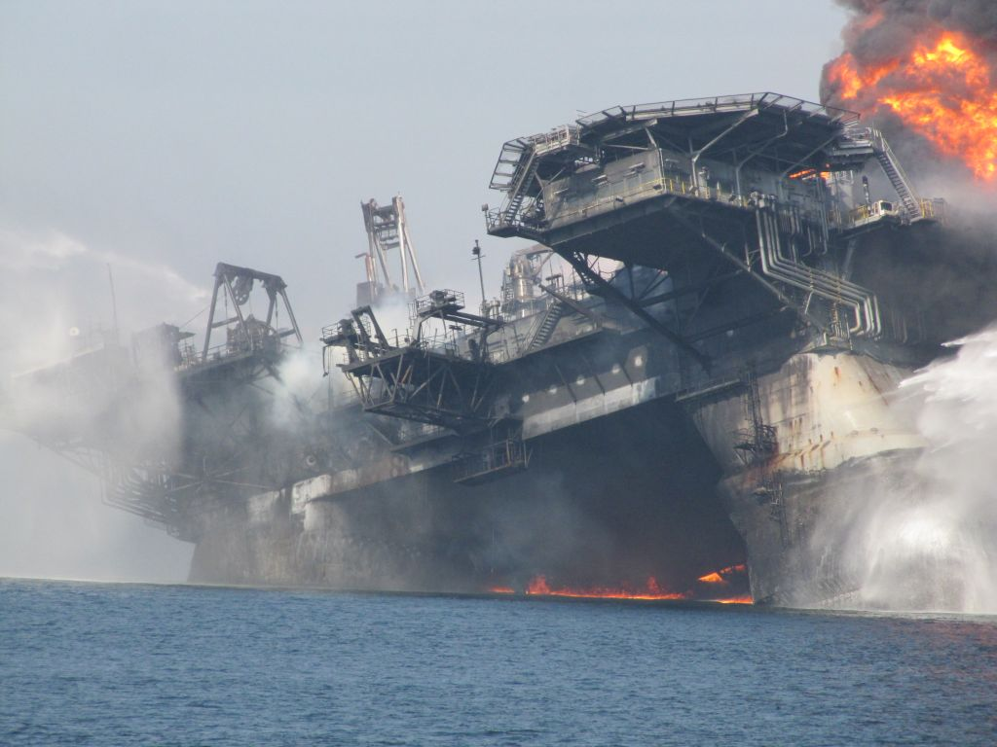
Technologies

Slide 17
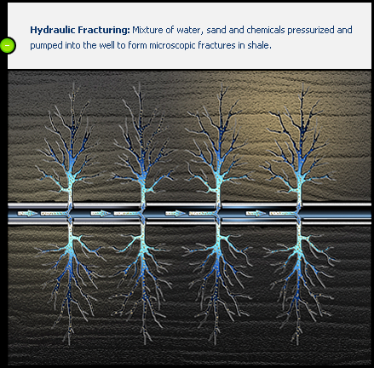
Hydraulic Fracturing
Canadian Oil and Gas Services
Industry Overview
Transocean
Precision
Inter Pipeline Fund

Slide 18
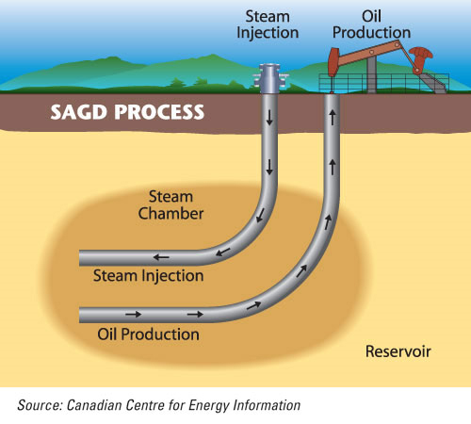
Steam Assisted Gravity Drainage
Canadian Oil and Gas Services
Industry Overview
Transocean
Precision
Inter Pipeline Fund

Slide 19
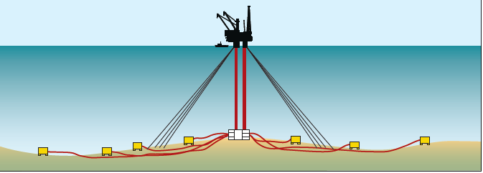
Subsea Technologies
Canadian Oil and Gas Services
Industry Overview
Transocean
Precision
Inter Pipeline Fund

Slide 20
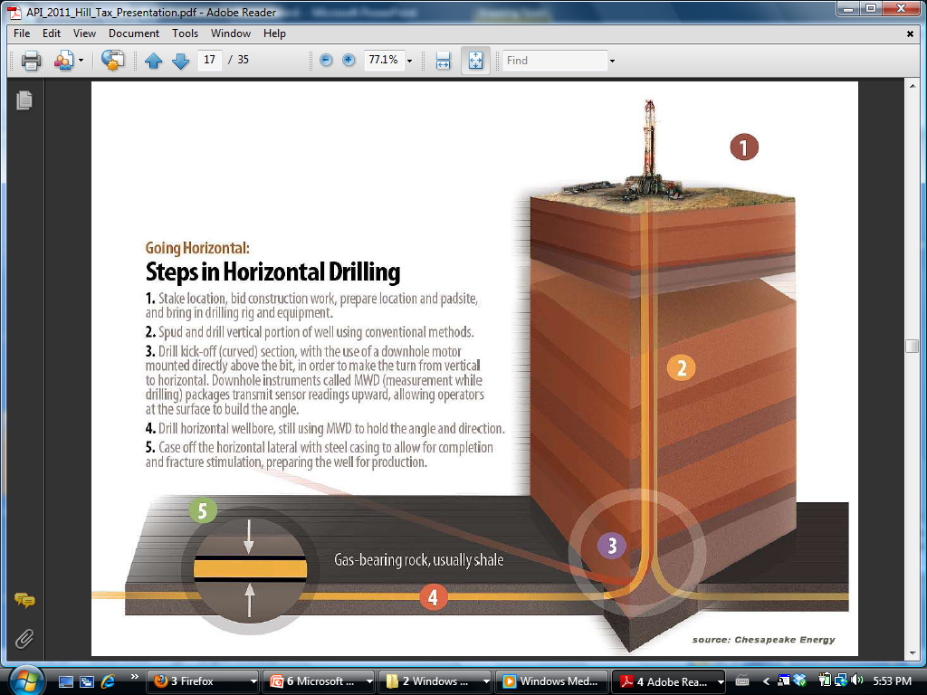
Horizontal Drilling
Canadian Oil and Gas Services
Industry Overview
Transocean
Precision
Inter Pipeline Fund

Slide 21
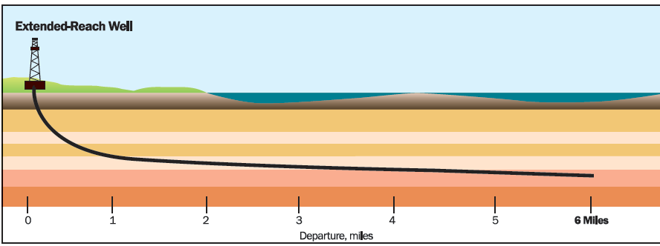
Extended-Reach Drilling
Canadian Oil and Gas Services
Industry Overview
Transocean
Precision
Inter Pipeline Fund

Slide 22
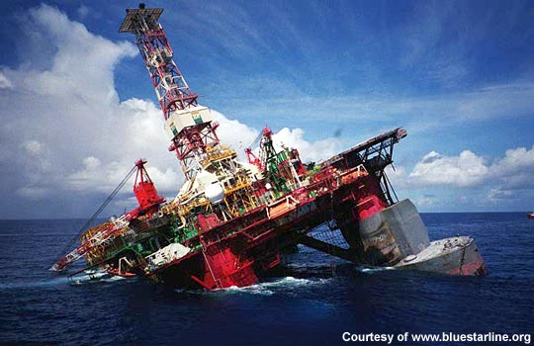
Types of Rigs

Slide 23
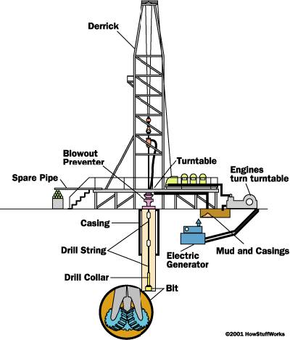
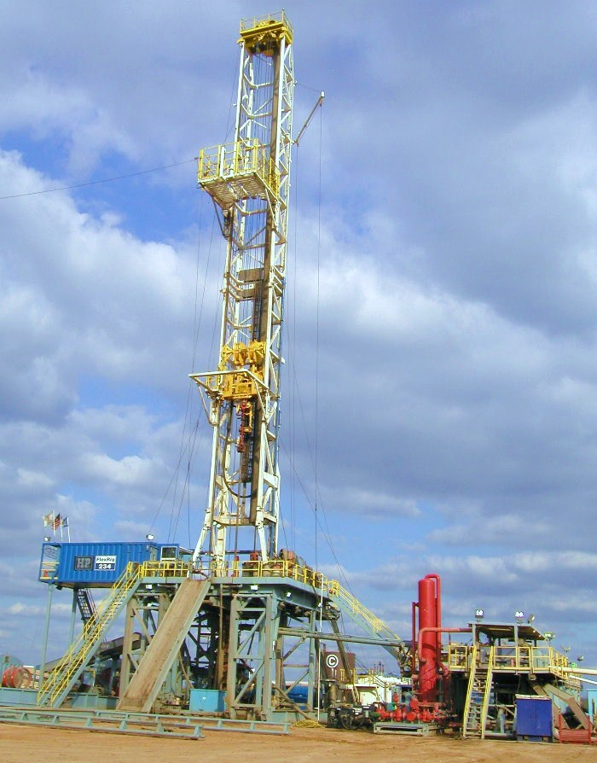
Land Drilling Rigs
Canadian Oil and Gas Services
Industry Overview
Transocean
Precision
Inter Pipeline Fund
Conventional onshore drilling

Slide 24
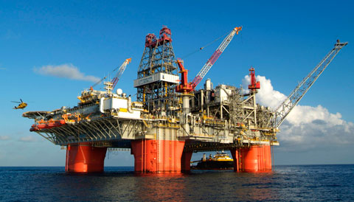
Deepwater Drilling
Canadian Oil and Gas Services
Industry Overview
Transocean
Precision
Inter Pipeline Fund
Drilling further out into the sea and deep under ocean floor
Depths could be greater than 10,000 feet
Expensive

Slide 25
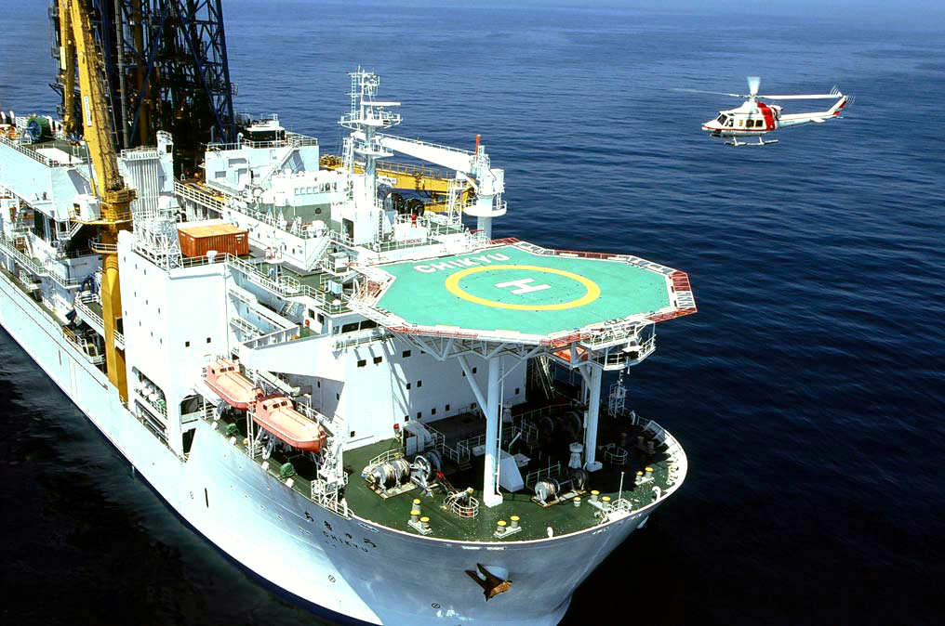
Canadian Oil and Gas Services
Industry Overview
Transocean
Precision
Inter Pipeline Fund
Drillship
Self-propelled and extremely mobile
Ideal for remote locations
Limitations

Slide 26
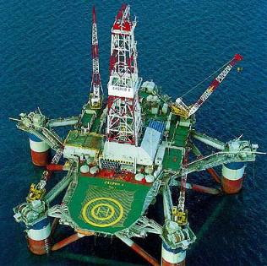
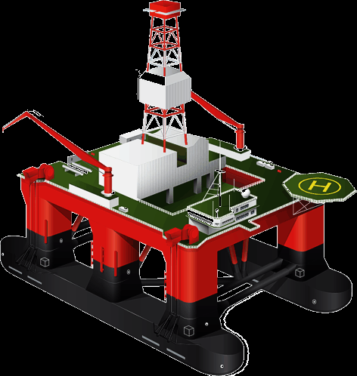
Canadian Oil and Gas Services
Industry Overview
Transocean
Precision
Inter Pipeline Fund
Semi-submersible rigs
Floating vessels

Slide 27
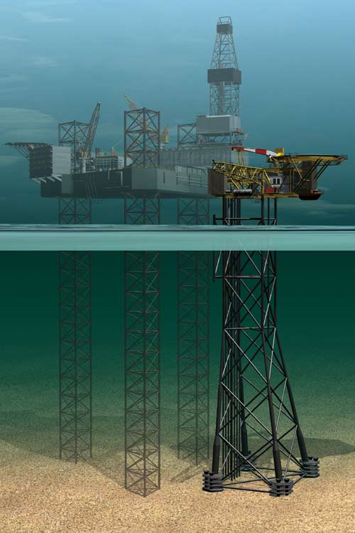
Canadian Oil and Gas Services
Industry Overview
Transocean
Precision
Inter Pipeline Fund
“Jack-up” rigs
Platforms
Legs

Slide 28
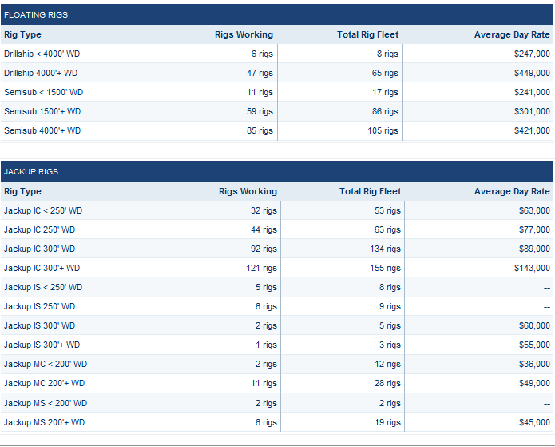
Canadian Oil and Gas Services
Industry Overview
Transocean
Precision
Inter Pipeline Fund

Slide 29
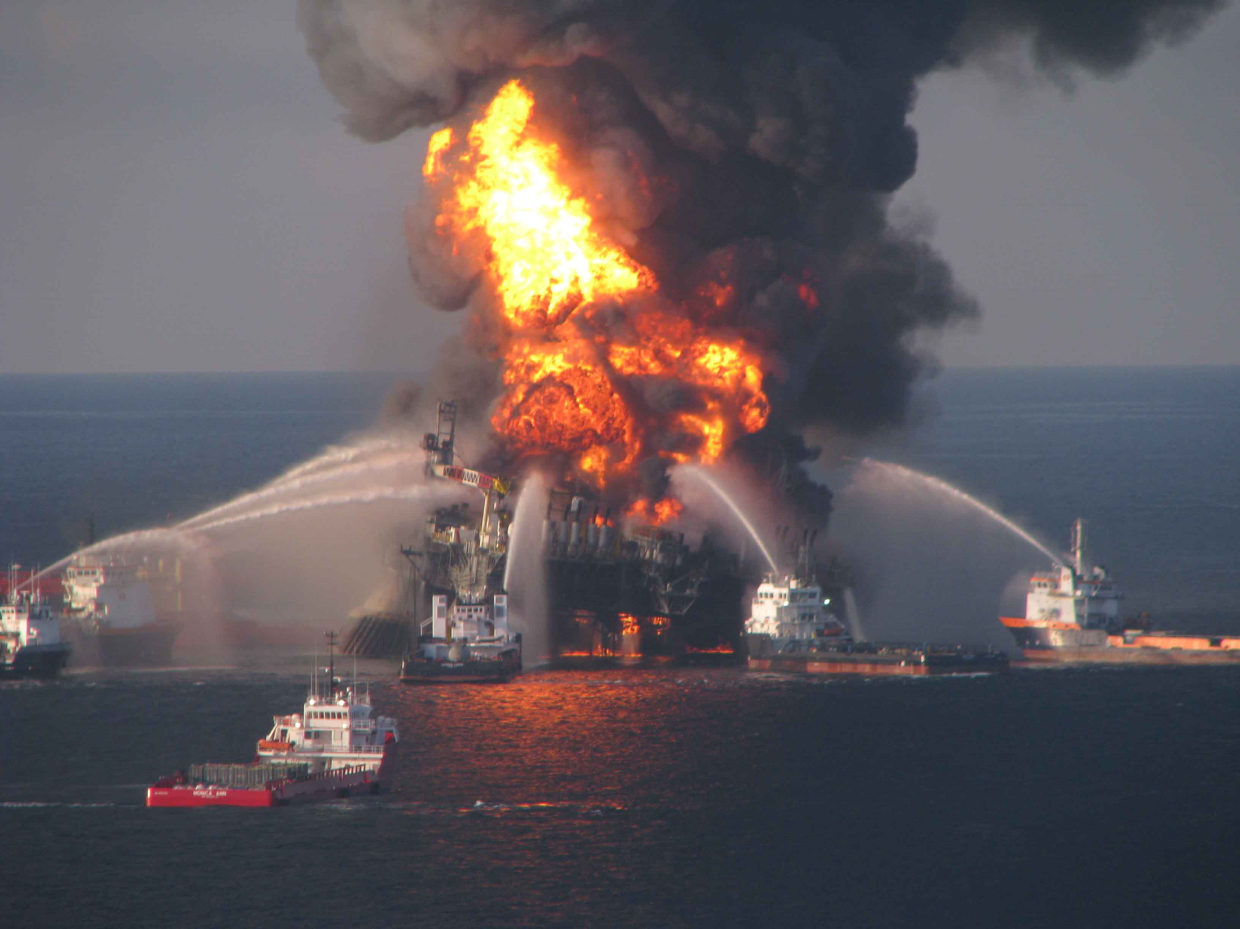
Competitive Landscape

Slide 30
Competitive Landscape
Canadian Oil and Gas Services
Industry Overview
Transocean
Precision
Inter Pipeline Fund
Oil & gas price volatility
Oil & gas reserves, supply and demand
Oil & gas alternatives
Oil & gas services industry characteristics

Slide 31
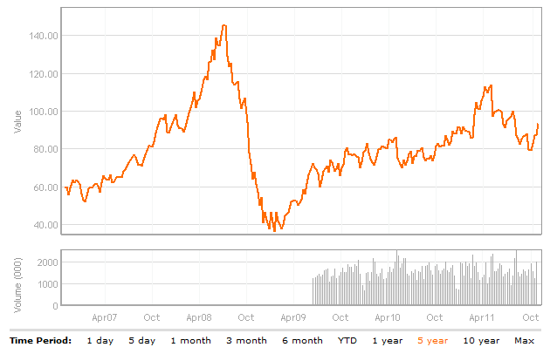
Oil Price Commodity
Canadian Oil and Gas Services
Industry Overview
Transocean
Precision
Inter Pipeline Fund

Slide 32
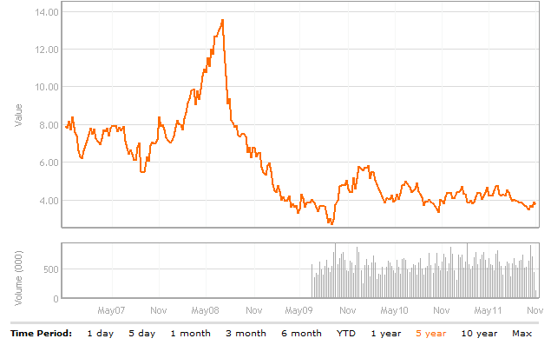
Natural Gas Commodity Price
Canadian Oil and Gas Services
Industry Overview
Transocean
Precision
Inter Pipeline Fund

Slide 33
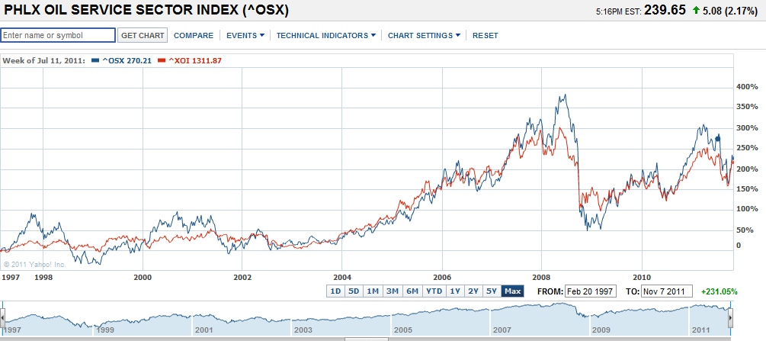
OSX VS XOI
Canadian Oil and Gas Services
Industry Overview
Transocean
Precision
Inter Pipeline Fund

Slide 34
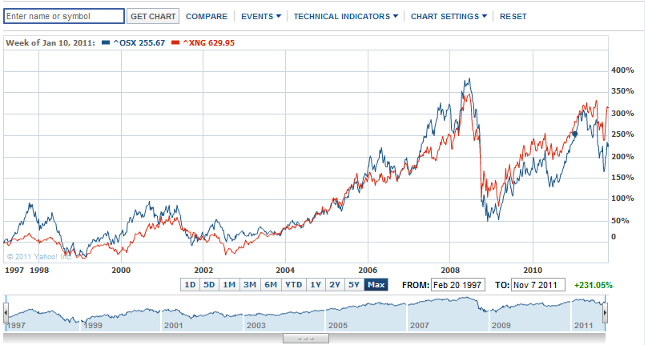
OSX VS XNG
Canadian Oil and Gas Services
Industry Overview
Transocean
Precision
Inter Pipeline Fund

Slide 35
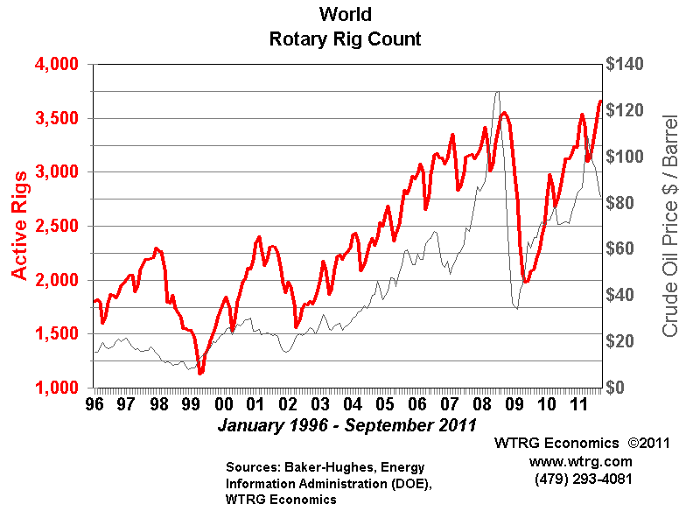
Canadian Oil and Gas Services
Industry Overview
Transocean
Precision
Inter Pipeline Fund
Rotary Rig Count

Slide 36
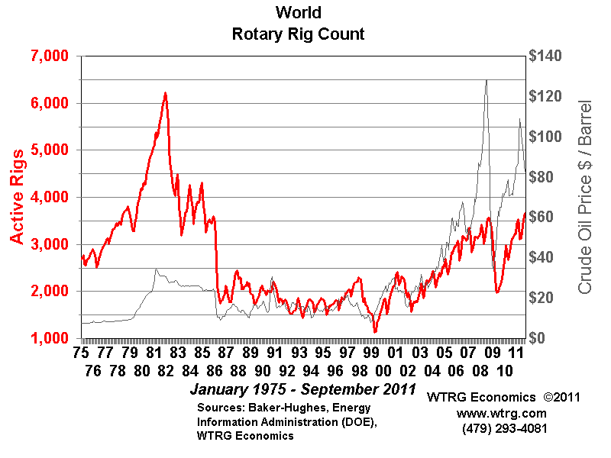
Canadian Oil and Gas Services
Industry Overview
Transocean
Precision
Inter Pipeline Fund
Rotary Rig Count

Slide 37
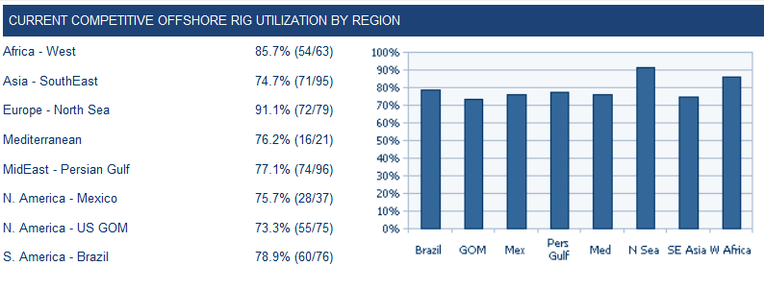
Canadian Oil and Gas Services
Industry Overview
Transocean
Precision
Inter Pipeline Fund
Offshore Rig Utilization

Slide 38
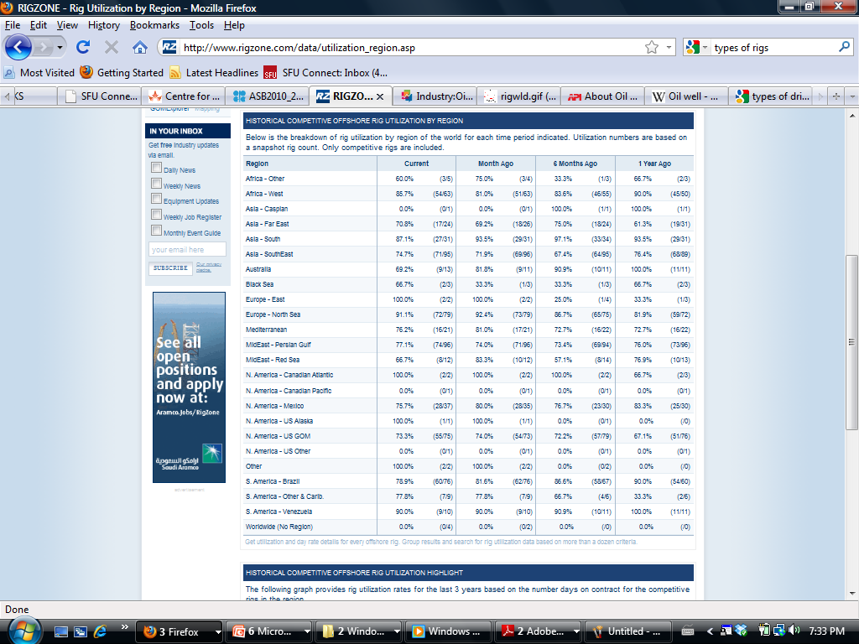
Canadian Oil and Gas Services
Industry Overview
Transocean
Precision
Inter Pipeline Fund

Slide 39
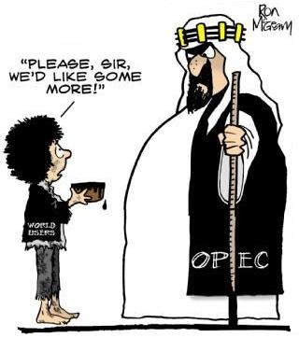
Oil & Gas Reserves, Supply & Demand
Canadian Oil and Gas Services
Industry Overview
Transocean
Precision
Inter Pipeline Fund
OPEC
Control 79% of the world’s proven reserves
Account for 44% of the oil production
Political constraints
Environmental issues

Slide 40
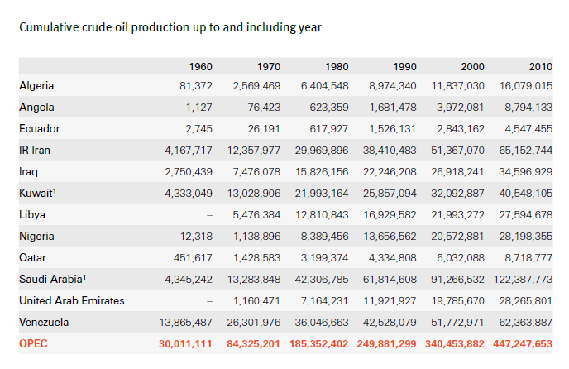
Canadian Oil and Gas Services
Industry Overview
Transocean
Precision
Inter Pipeline Fund

Slide 41
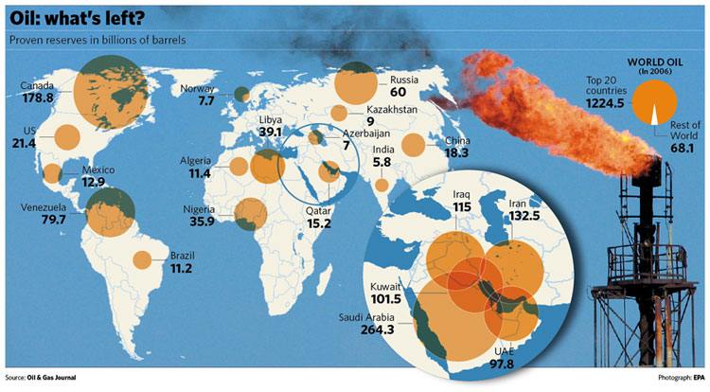
Canadian Oil and Gas Services
Industry Overview
Transocean
Precision
Inter Pipeline Fund

Slide 42
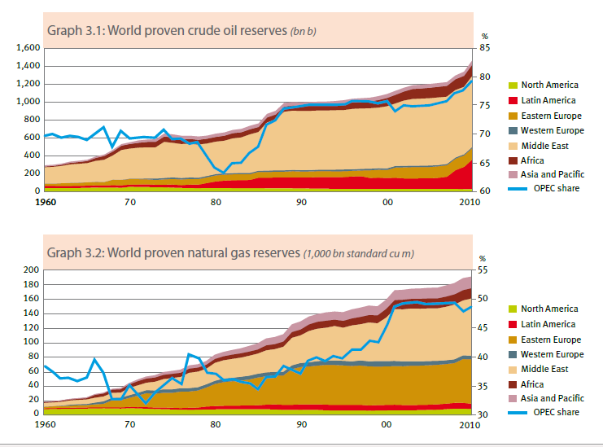
Canadian Oil and Gas Services
Industry Overview
Transocean
Precision
Inter Pipeline Fund

Slide 43
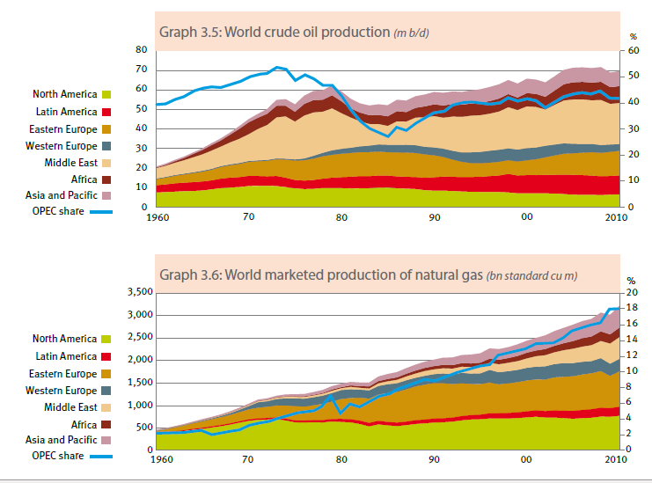
Canadian Oil and Gas Services
Industry Overview
Transocean
Precision
Inter Pipeline Fund

Slide 44
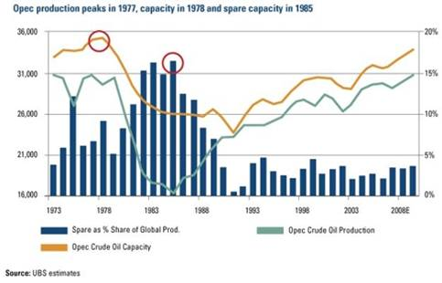
Canadian Oil and Gas Services
Industry Overview
Transocean
Precision
Inter Pipeline Fund

Slide 45
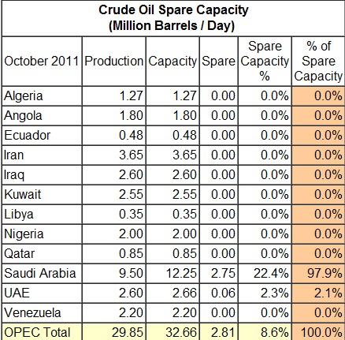
Canadian Oil and Gas Services
Industry Overview
Transocean
Precision
Inter Pipeline Fund

Slide 46
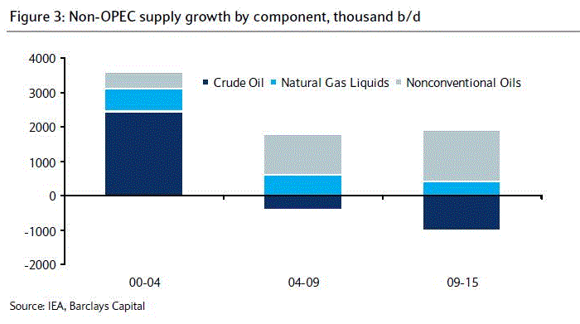
Canadian Oil and Gas Services
Industry Overview
Transocean
Precision
Inter Pipeline Fund

Slide 47
Oilfields 2010 Estimated Production Costs
Canadian Oil and Gas Services
Industry Overview
Transocean
Precision
Inter Pipeline Fund
Mideast/N.Africa oilfields 6 - 28
Other conventional oilfields 6 - 39
CO2 enhanced oil recovery 30 - 80
Deep/ultra-deep-water oilfields 32 – 65
Enhanced oil recovery 32 - 82
Arctic oilfields 32 - 100
Heavy oil/bitumen 32 - 68
Oil shales 52 - 113
Gas to liquids 38 - 113
Coal to liquids 60 - 11

Slide 48

Oil & Gas Alternatives
Canadian Oil and Gas Services
Industry Overview
Transocean
Precision
Inter Pipeline Fund
Biofuel
Unconventional fossil fuel
Crude Oil and Natural Gas Relationship

Slide 49
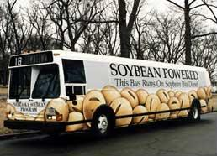
Canadian Oil and Gas Services
Industry Overview
Transocean
Precision
Inter Pipeline Fund
Biofuel
Greenhouse gas emissions
Energy security
Various sources
Growing

Slide 50
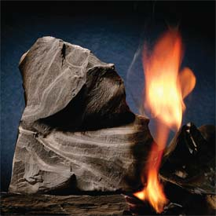
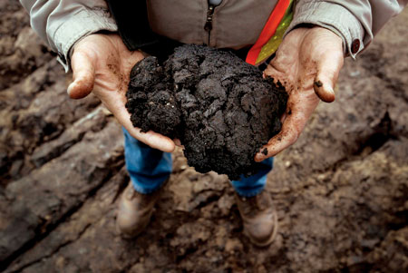
Canadian Oil and Gas Services
Industry Overview
Transocean
Precision
Inter Pipeline Fund
Unconventional fossil fuel
Oil shale
Oil sands

Slide 51
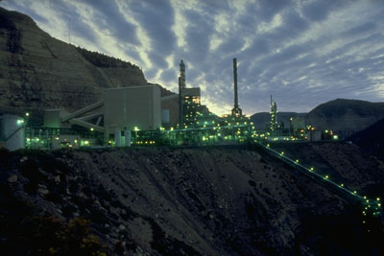
Canadian Oil and Gas Services
Industry Overview
Transocean
Precision
Inter Pipeline Fund
Unconventional fossil fuel
Less efficient
Larger environmental impact
Technology

Slide 52
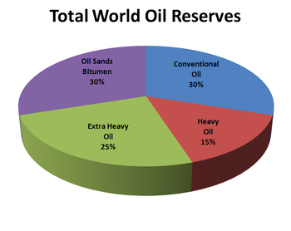
Canadian Oil and Gas Services
Industry Overview
Transocean
Precision
Inter Pipeline Fund

Slide 53
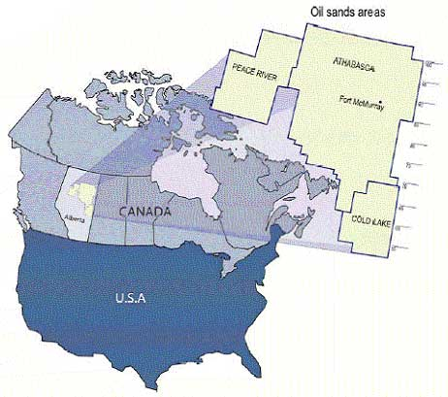
Canadian Oil and Gas Services
Industry Overview
Transocean
Precision
Inter Pipeline Fund
Oil sands in Canada (1.7-2.5 TRILLION) barrels!)

Slide 54
Oilfields Estimated Production Costs ($ 2010)
Canadian Oil and Gas Services
Industry Overview
Transocean
Precision
Inter Pipeline Fund
Mideast/N.Africa oilfields 6 - 28
Other conventional oilfields 6 - 39
CO2 enhanced oil recovery 30 - 80
Deep/ultra-deep-water oilfields 32 – 65
Enhanced oil recovery 32 - 82
Arctic oilfields 32 - 100
Heavy oil/bitumen 32 - 68
Oil shales 52 - 113
Gas to liquids 38 - 113
Coal to liquids 60 - 11

Slide 55
Oil & Gas Industry Characteristic
Canadian Oil and Gas Services
Industry Overview
Transocean
Precision
Inter Pipeline Fund
Capital-intensive
Highly Skilled
Highly Regulated
Highly Competitive
Price dependent
Essential Research and Development
Others

Slide 56
Canadian Oil and Gas Services
Industry Overview
Transocean
Precision
Inter Pipeline Fund
Capital-intensive
Drilling equipments their installation, operation and maintenance is very expensive to buy and maintain
Average annual revenue per employee is about $410,000
Barrier to entry – High fixed cost

Slide 57
Canadian Oil and Gas Services
Industry Overview
Transocean
Precision
Inter Pipeline Fund
Highly Skilled
Highly skilled and labor intensive
People with skills and expertise to operate drilling equipment
minimum requirement on the number of inexperienced personnel

Slide 58
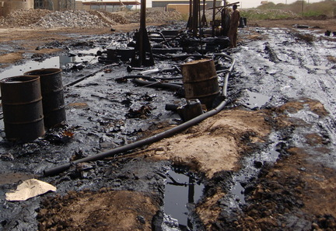
Canadian Oil and Gas Services
Industry Overview
Transocean
Precision
Inter Pipeline Fund
Highly Regulated
Highly regulated with regards to environment and health and safety concerns
Affect the operations of all the drilling companies

Slide 59
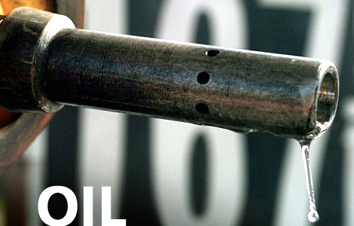
Canadian Oil and Gas Services
Industry Overview
Transocean
Precision
Inter Pipeline Fund
Highly Competitive
Numerous industry participants
Intense price competition

Slide 60
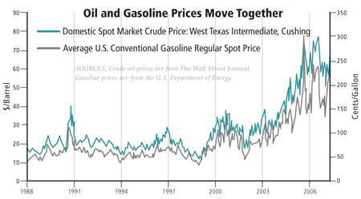
Canadian Oil and Gas Services
Industry Overview
Transocean
Precision
Inter Pipeline Fund
Price Dependent
Oil services
Drilling companies
Rigs

Slide 61
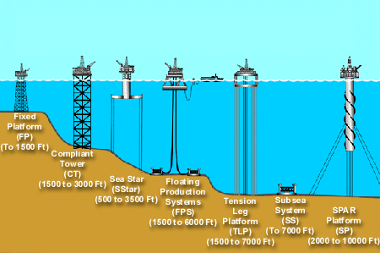
Canadian Oil and Gas Services
Industry Overview
Transocean
Precision
Inter Pipeline Fund
Essential Technology Development
Directional drilling
Challenging geological locations
Less damageable to the environment

Slide 62
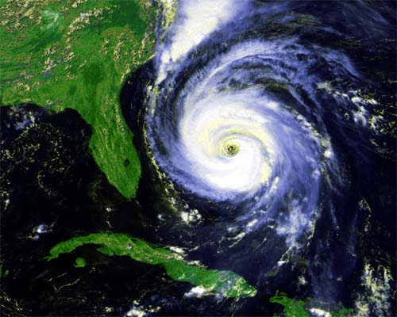
Canadian Oil and Gas Services
Industry Overview
Transocean
Precision
Inter Pipeline Fund
Other Key Factors:
Industry Cycle
Natural calamities
Location
Types of Contract
Length of Contract

Slide 63
Future Outlook
Canadian Oil and Gas Services
Industry Overview
Transocean
Precision
Inter Pipeline Fund
Long-term market growth
Emerging Asia-Pacific economies (China & India)
Decline of conventional fuel (next 20-30 years)
Peak Oil
Switching to more environmentally friendly, cheaper and renewable alternative sources

Slide 64
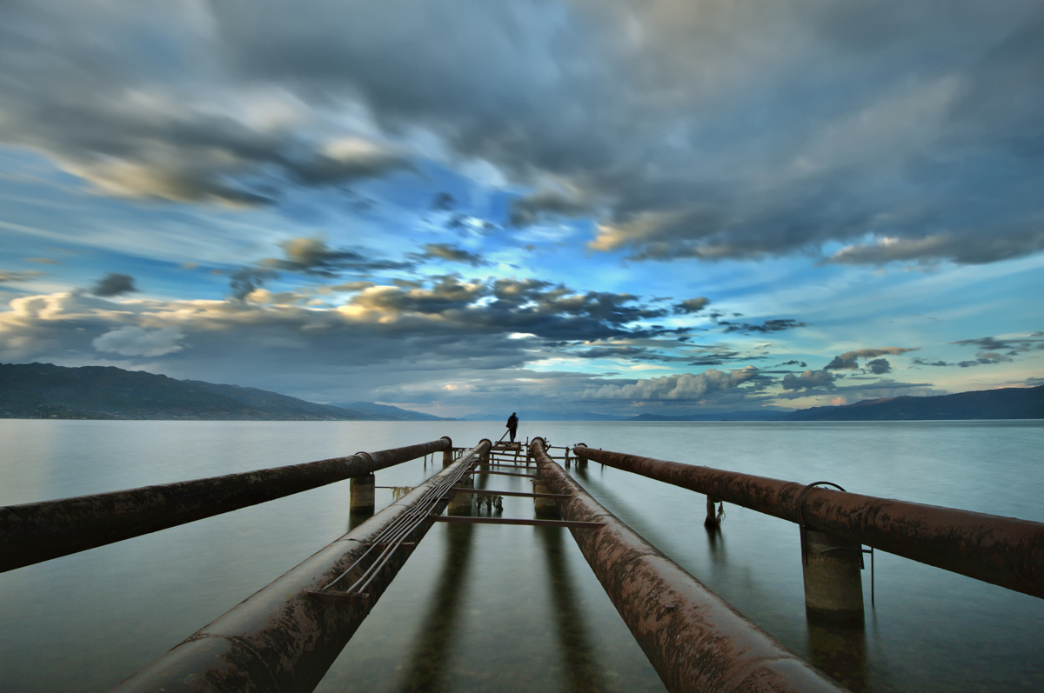
Transportation

Slide 65
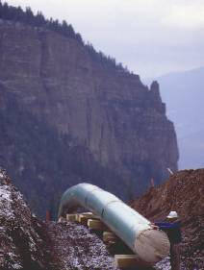
Canadian Oil and Gas Services
Industry Overview
Transocean
Precision
Inter Pipeline Fund
Pipelines are necessary to transport raw materials from their source to refineries and gas processing facilities and then to market.
Pipelines provide a safe, economical and constant flow of crude oil, natural gas and petroleum products
Cheaper than shipping and driving
580,000 km of pipeline in Canada
2.7 million barrels of crude oil per day travel through Canada’s crude oil pipeline network.
15.1 billion cubic feet of natural gas per day travel through Canada’s natural gas pipeline network.
Revenues are generated from various type of usage contracts, example “take-or-pay” contracts

Slide 66
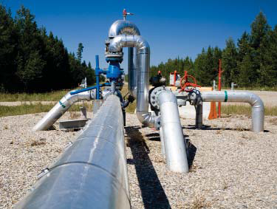
Canadian Oil and Gas Services
Industry Overview
Transocean
Precision
Inter Pipeline Fund
Fee Based Contracts - fixed fee is tied to usage - volume risk exists
Commodity Based Contracts -Price varies based on underlying commodity value -Covers most related operational costs -Beneficial relationship based on profit sharing -Volume and commodity risks
Cost of Service Contracts - Provides for recovery of operating costs and a fixed capital charge - Minimal volume risk and no commodity price exposure

Slide 67
Canadian Oil and Gas Services
Industry Overview
Transocean
Precision
Inter Pipeline Fund
Pipeline costs depend on factors such as:
-type of pipe
-type of coating
-length of pipeline
-diameter of pipe
-Environment and
-terrain
Cost calculations based on cost per pipe diameter per distance to estimate pipeline project costs.
For example, $1,000 per millimetre diameter per kilometre. A 50-kilometre system consisting of 50 millimetre pipe may be roughed out as: 50 millimetres x 50 kilometres x $1,000 per kilometre = $2.5 million/km

Slide 68
Canadian Oil and Gas Services
Industry Overview
Transocean
Precision
Inter Pipeline Fund
Pipeline success fundamentally dependent on oil demand/price
Key Factors:
Human resources intensive
Capital intensive
Highly regulated
Short Term Outlook:
- pipeline growth to the west coast. Serve Asian demand
Long Term Outlook:
- decline as alternative energies are sought

Slide 69

Canadian Oil and Gas Services
Industry Overview
Transocean
Precision
Inter Pipeline Fund

Slide 70

Canadian Oil and Gas Services
Industry Overview
Transocean
Precision
Inter Pipeline Fund

Slide 71

Canadian Oil and Gas Services
Industry Overview
Transocean
Precision
Inter Pipeline Fund

Slide 72

Canadian Oil and Gas Services
Industry Overview
Transocean
Precision
Inter Pipeline Fund

Slide 73

Transocean
Canadian Oil and Gas Services
Industry Overview
Transocean
Precision
Inter Pipeline Fund
Transocean
“We are never out of our depth.”

Slide 74

Company Snapshot
Canadian Oil and Gas Services
Industry Overview
Transocean
Precision
Inter Pipeline Fund

Slide 75

RIG 1 Year Chart
Canadian Oil and Gas Services
Industry Overview
Transocean
Precision
Inter Pipeline Fund

Slide 76

RIG 1 Year vs. TSX 60
Canadian Oil and Gas Services
Industry Overview
Transocean
Precision
Inter Pipeline Fund

Slide 77

Canadian Oil and Gas Services
Industry Overview
Transocean
Precision
Inter Pipeline Fund
RIG 5 Year Chart

Slide 78

RIG 5 year vs. TSX 60
Canadian Oil and Gas Services
Industry Overview
Transocean
Precision
Inter Pipeline Fund

Slide 79
Company overview
Canadian Oil and Gas Services
Industry Overview
Transocean
Precision
Inter Pipeline Fund

Slide 80

Canadian Oil and Gas Services
Industry Overview
Transocean
Precision
Inter Pipeline Fund
Transocean is a leading international provider of offshore contract drilling services for oil and gas wells. The company's key services include the following:
Deepwater drilling
Harsh environment drilling
Inland and shallow water drilling
Offshore drilling

Slide 81
Canadian Oil and Gas Services
Industry Overview
Transocean
Precision
Inter Pipeline Fund
The company conducts its business through two reportable operating segments:
CONTRACT DRILLING: to contract drilling rigs, related equipment, and work crews to drill oil and gas wells on a day-rate basis as well as offshore drilling with a particular focus on deepwater and harsh environment drilling services
OTHER: Oil and gas drilling management services as well as drilling engineering on either a day-rate basis or a completed-project, fixed-price basis

Slide 82


Canadian Oil and Gas Services
Industry Overview
Transocean
Precision
Inter Pipeline Fund
TransOcean operates three types of drilling rigs:
Drillships
Semisubmersibles
Jackups
TransOcean’s fleet also consists of barge drilling rigs and a coring drillship.

Slide 83
fleet
Canadian Oil and Gas Services
Industry Overview
Transocean
Precision
Inter Pipeline Fund

Slide 84

Fleet Lineup
Canadian Oil and Gas Services
Industry Overview
Transocean
Precision
Inter Pipeline Fund
Jackups
Midwater Semisubmersible
Deepwater Semisubmersible
Drillship
Floaters

Slide 85

Canadian Oil and Gas Services
Industry Overview
Transocean
Precision
Inter Pipeline Fund
Transocean owns, has partial ownership interests in, or operates 138 mobile offshore drilling units:
47 High-Specification Floaters
26 Ultra-deepwater floaters
16 Deepwater floaters and
5 Harsh Environmental floaters
25 Midwater Floaters
9 High-Specification Jackups
54 Standard Jackups
3 Other Rigs
2 barge drilling rigs
1 coring drillship
4 Rigs under construction
1 ultra-deepwater floater
3 high-specification jackups

Slide 86

Fleet Operations
Canadian Oil and Gas Services
Industry Overview
Transocean
Precision
Inter Pipeline Fund

Slide 87

Fleet Updates
Canadian Oil and Gas Services
Industry Overview
Transocean
Precision
Inter Pipeline Fund

Slide 88

Canadian Oil and Gas Services
Industry Overview
Transocean
Precision
Inter Pipeline Fund

Slide 89
Firm history
Canadian Oil and Gas Services
Industry Overview
Transocean
Precision
Inter Pipeline Fund

Slide 90
Timeline
Canadian Oil and Gas Services
Industry Overview
Transocean
Precision
Inter Pipeline Fund
TransOcean is based in Vernier, Switzerland
Has offices in 20 countries
Originally incorporated in Delaware, US
1999: TransOcean reincorporated in Cayman Islands
November 27, 2007: Transocean and GlobalSantaFe merge to form TransOcean
December 19, 2008: TransOcean changed place of incorporation from Cayman Islands to Switzerland
TransOcean moves its incorporation location to take advantage of lower taxes in some jurisdictions

Slide 91
Mergers & Acquisitions
Canadian Oil and Gas Services
Industry Overview
Transocean
Precision
Inter Pipeline Fund
Transocean
Global SantaFe
Global Marine
Santa Fe Int’l
Transocean
Transocean Sedco Forex
R&B Falcon
Transocean Offshore
Sedco Forex
Sedco
Forex Neptune
Transocean ASA
SODI
Offshore Drilling
International Drilling
Southern Productions
Southern National Gas
Danciger
Notes:
Southern Production Company (subsidiary of Southern Natural Gas) buys Danciger and forms The Offshore Company.
The Offshore Company acquires Int’l Drilling Co. Ltd.
The Offshore Company becomes Sonat OD Inc.
Sonat OD Inc. spins off SODI.
SODI acquires TransOcean ASA.
KPC acquires SF Int’l Corp (wholly owned subsidiary).
Then divests 40 million shares through an IPO then another 31 million shares through a secondary offering.

Slide 92

Canadian Oil and Gas Services
Industry Overview
Transocean
Precision
Inter Pipeline Fund
TRANSOCEAN & GLOBAL SANTA FE CORP. (the first and second largest drilling companies in the world, respectively) merge to become the world’s largest offshore driller.

Slide 93
Vision & core values
Canadian Oil and Gas Services
Industry Overview
Transocean
Precision
Inter Pipeline Fund

Slide 94

Canadian Oil and Gas Services
Industry Overview
Transocean
Precision
Inter Pipeline Fund
Transocean will be universally recognized for innovation and excellence in unlocking the world's offshore resources.
F inancial Discipline
I ntegrity & Honesty
R espect for Employees, Customers and Suppliers
S afety
T echnical Leadership
Notes:
Our decisions will be made to ensure long-term growth for the benefit of employees, customers and shareholders.
Our actions will be conducted following the highest standard of ethics, honesty and personal integrity. This will foster and maintain trust and confidence of our employees, customers and suppliers.
Our employees will be developed and motivated to meet the challenges ahead. Individuality and diversity will be valued and performance recognized. We will provide our customers with unsurpassed value-added service. Our relationship with suppliers will reflect respect, understanding and sound business practice.
Personal safety and employee health is our greatest responsibility, followed by the protection of our environment and company property.
Our competitive advantage is based on continually improving our processes and finding innovative solutions to the technical challenges in meeting the needs of our customers.

Slide 95
achievements
Canadian Oil and Gas Services
Industry Overview
Transocean
Precision
Inter Pipeline Fund

Slide 96

Canadian Oil and Gas Services
Industry Overview
Transocean
Precision
Inter Pipeline Fund
TransOcean is the world’s largest offshore drilling contractor in addition to being the:
Largest offshore driller with 135 mobile offshore drilling units, plus an additional 8 newbuild rigs
Largest jackup rig driller with 59 units
Largest “floating” rig driller with 75 drillships and semisubmersible rigs
Largest deepwater driller with 43 rigs that can operate in water depths of 4,500 feet or greater
Largest offshore driller by equity market capitalization

Slide 97
Firsts & Records
Canadian Oil and Gas Services
Industry Overview
Transocean
Precision
Inter Pipeline Fund
Transocean holds most of the world records for drilling in the deepest waters.
Other world records include:
First oil and gas exploration well ever drilled in more than 10,000 feet of water
The world’s deepest subsea wells completed in approximately 9,000 feet of water
World water depth record for a moored rig in 8,951 feet of water
The ultra-deepwater drillship Dhirubhai Deepwater KG2 set the current world water depth drilling record in 10,194 feet of water in India in April 2011 working for Reliance.

Slide 98
Contingent liabilities
Canadian Oil and Gas Services
Industry Overview
Transocean
Precision
Inter Pipeline Fund

Slide 99

The Macondo Well Incident
Canadian Oil and Gas Services
Industry Overview
Transocean
Precision
Inter Pipeline Fund
April 22, 2010: ultra-deepwater floater Deepwater Horizon sank after a blowout of the Macondo well caused a fire and explosion on the rig
At the time of the explosion, Deepwater Horizon was located approximately 41 miles off the coast of Louisiana and was contracted to BP America Production Co.
As of September 30, 2011 the
amount of the estimated liability was
approximately $204 million, and the
corresponding estimated recoverable
amount was $184 million (up 51%
and 96%, respectively, from
December 31, 2010 estimates)
206 claims made against TransOcean
Resulted in loss of $590 million of
backlog revenue
BP has yet to honor indemnity
obligations
Legal proceedings are ongoing

Slide 100

Related Risks
Canadian Oil and Gas Services
Industry Overview
Transocean
Precision
Inter Pipeline Fund
Reduced credit ratings
Emphasis placed on negative outlook
Negative publicity
Further increases in premiums for insurance or difficulty obtaining coverage
Diversion of management’s attention from other operations to focus on incident

Slide 101
Management
Canadian Oil and Gas Services
Industry Overview
Transocean
Precision
Inter Pipeline Fund

Slide 102

Steven l. Newman President & CEO
Canadian Oil and Gas Services
Industry Overview
Transocean
Precision
Inter Pipeline Fund
Joined company in 1994 in Corporate Planning Department
Has held his current position since March 2010
BSC in Petroleum Engineering from Colorado School of Mines in 1989
MBA from Harvard Graduate School of Business in 1992
Member of the Society of Petroleum Engineers
Salary | $636,405
Bonus | $0
Restricted stock awards | $2,060,781
All other compensation | $650,652
Option awards $ | $1,458,240
Non-equity incentive plan compensation | $0
Change in pension value and nonqualified deferred compensation earnings | $568,609
Total Compensation (2009) | $5,374,687

Slide 103

Ricardo H. Rosa Executive Vice President & CFO
Canadian Oil and Gas Services
Industry Overview
Transocean
Precision
Inter Pipeline Fund
Has held his current position since September 2009
Master of Arts Degree from Oxford University in 1977
Subsequently qualified as Chartered Accountant with Institute of Chartered Accountants in England & Wales in 1981
Salary | $437,892
Bonus | $0
Restricted stock awards | $1, 125,112
All other compensation | $951,113
Option awards $ | $795,392
Non-equity incentive plan compensation | $0
Change in pension value and nonqualified deferred compensation earnings | $184,248
Total Compensation (2009) | $3,493,757

Slide 104

Ihab Toma Executive Vice President, Operations
Canadian Oil and Gas Services
Industry Overview
Transocean
Precision
Inter Pipeline Fund
Joined company in August 2009 as Senior Vice President, Marketing & Planning
Before being named to his current position, Toma served as Executive Vice President, Global Business
Before joining the company, served in different capacities in Schlumberger
Bachelors degree in Electrical Engineering from Cairo University in 1985

Slide 105
Financial statements
Canadian Oil and Gas Services
Industry Overview
Transocean
Precision
Inter Pipeline Fund

Slide 106

Revenue Methods
Canadian Oil and Gas Services
Industry Overview
Transocean
Precision
Inter Pipeline Fund
Transocean has two main methods for generating revenue from its drilling operations:
OPERATING RATE: Rate that is charged for utilization of rigs.
STAND-BY RATE: Rate charged for the rig being ready for use, regardless of whether it is actually used.

Slide 107

Balance Sheet Q3 2011
Canadian Oil and Gas Services
Industry Overview
Transocean
Precision
Inter Pipeline Fund

Slide 108

Canadian Oil and Gas Services
Industry Overview
Transocean
Precision
Inter Pipeline Fund

Slide 109

Balance Sheet 2010
Canadian Oil and Gas Services
Industry Overview
Transocean
Precision
Inter Pipeline Fund

Slide 110

Canadian Oil and Gas Services
Industry Overview
Transocean
Precision
Inter Pipeline Fund

Slide 111

Income Statement Q3 2011
Canadian Oil and Gas Services
Industry Overview
Transocean
Precision
Inter Pipeline Fund

Slide 112

Income Statement 2010
Canadian Oil and Gas Services
Industry Overview
Transocean
Precision
Inter Pipeline Fund

Slide 113

Cash Flow Statement Q3 2011
Canadian Oil and Gas Services
Industry Overview
Transocean
Precision
Inter Pipeline Fund

Slide 114

Canadian Oil and Gas Services
Industry Overview
Transocean
Precision
Inter Pipeline Fund

Slide 115

Cash Flow Statement 2010
Canadian Oil and Gas Services
Industry Overview
Transocean
Precision
Inter Pipeline Fund

Slide 116

Canadian Oil and Gas Services
Industry Overview
Transocean
Precision
Inter Pipeline Fund

Slide 117
Other Selected financial data
Canadian Oil and Gas Services
Industry Overview
Transocean
Precision
Inter Pipeline Fund

Slide 118

Fleet Revenue
Canadian Oil and Gas Services
Industry Overview
Transocean
Precision
Inter Pipeline Fund
NOTE: average daily revenue is defined as contract drilling revenue earned per revenue earning day. The calculation includes the revenues of rigs that are operating on standby rates.

Slide 119

Fleet Utilization Outlook
Canadian Oil and Gas Services
Industry Overview
Transocean
Precision
Inter Pipeline Fund
NOTE: The uncommitted fleet rate is the number of uncommitted days as a percentage of the total number of available rig calendar days in the period.

Slide 120

Canadian Oil and Gas Services
Industry Overview
Transocean
Precision
Inter Pipeline Fund
Notes:
Average day rate = The weighted average contract dayratefor each rig type based on current backlog from the company's most recent Fleet Status Report as of October 17, 2011. Includes firm contracts only.

Slide 121

Drilling Fleet Expansion
Canadian Oil and Gas Services
Industry Overview
Transocean
Precision
Inter Pipeline Fund

Slide 122

Statement of Operations
Canadian Oil and Gas Services
Industry Overview
Transocean
Precision
Inter Pipeline Fund

Slide 123

Canadian Oil and Gas Services
Industry Overview
Transocean
Precision
Inter Pipeline Fund

Slide 124

Operating Results
Canadian Oil and Gas Services
Industry Overview
Transocean
Precision
Inter Pipeline Fund

Slide 125

Operating Revenues
Canadian Oil and Gas Services
Industry Overview
Transocean
Precision
Inter Pipeline Fund
22.1%
13.5%
12.4%
8.6%
43.4%
100%

Slide 126

Revenue Efficiency
Canadian Oil and Gas Services
Industry Overview
Transocean
Precision
Inter Pipeline Fund
Notes:
Revenue efficiency = actual contract drilling revenue divided by the highest amount of total contract drilling revenue which could have been earned during the relevant period(s).

Slide 127

Future Debt
Canadian Oil and Gas Services
Industry Overview
Transocean
Precision
Inter Pipeline Fund

Slide 128

Canadian Oil and Gas Services
Industry Overview
Transocean
Precision
Inter Pipeline Fund

Slide 129

Shareholder Equity
Canadian Oil and Gas Services
Industry Overview
Transocean
Precision
Inter Pipeline Fund

Slide 130

Canadian Oil and Gas Services
Industry Overview
Transocean
Precision
Inter Pipeline Fund

Slide 131
Recommendation
Canadian Oil and Gas Services
Industry Overview
Transocean
Precision
Inter Pipeline Fund

Slide 132
Canadian Oil and Gas Services
Industry Overview
Transocean
Precision
Inter Pipeline Fund
HOLD!!

Slide 133


Canadian Oil and Gas Services
Industry Overview
Transocean
Precision
Inter Pipeline Fund
Precision Drilling
“High Performance
High Value”

Slide 134

Nov 18, 2011 Snapshot
Canadian Oil and Gas Services
Industry Overview
Transocean
Precision
Inter Pipeline Fund
Current Price $11.53
52-week Range $7.98 – $17.20
Market Capitalization – $3.3 Billion
Beta (vs. SPTSX) – 1.65
EPS (ttm) – 0.820
P/E (ttm) – 14.06
5yr Avg Historical P/E (ttm) – 10.310
Forward P/E – 12.04
Annual Dividend – 0
1yr Total Return – 35.97%
Shares outstanding – 276.059 Million
Source: Bloomberg
Notes:
Precision Drilling Rig # 633 in Alberta’s Foothills Region

Slide 135

1yr Historical Price
Canadian Oil and Gas Services
Industry Overview
Transocean
Precision
Inter Pipeline Fund

Slide 136

5yr Historical Price
Canadian Oil and Gas Services
Industry Overview
Transocean
Precision
Inter Pipeline Fund

Slide 137

10yr Historical price
Canadian Oil and Gas Services
Industry Overview
Transocean
Precision
Inter Pipeline Fund

Slide 138
History
Canadian Oil and Gas Services
Industry Overview
Transocean
Precision
Inter Pipeline Fund
Founded in early 1950s
Head office in Calgary, Alberta
Listed on TSX September 23, 1988
Commercialized Rotary Steerable System Drilling September, 2003
Reorganized into a Trust November 7, 2005
in 2006 a new law in Canada (SIFT) passed to impose tax on income trust distributions (the tax was to be introduced in 2011)
Reverted back to Corporation June 1, 2010
Notes:
SIFT – Specified Investment Flow Through Trust eliminated trust benefits

Slide 139
Recent Mergers & Acquisitions
Canadian Oil and Gas Services
Industry Overview
Transocean
Precision
Inter Pipeline Fund
Acquired Drake Directional Drilling Inc. & Drake MWD Services LLC
March 2011
Acquired Terra Water Group Ltd
September 2006
Acquired Rick’s Well Servicing-Rigs
July 2008
June 2008
Acquired Grey Wolf Inc.
April 2009
AIMCo. acquires a 15% stake in PD
September 2011
Acquired Axis Energy Services Holding
Notes:
Terra Water Group – Provides waste water treatment services
Grey Wolf Inc. – Play to expand into US (located in Houston, Texas) 121 rigs
Rick’s Well Servicing Ltd – 6 rigs
AIMCo - $330M investment, PD debt challenged after acquisition of Grey Wolf. Purchased $175 million in 10% unsecured senior notes, 35M trust units at $3, 15M warrants exercisable at $3.22.
Drake – directional driller in Houston Texas, further expansion into US
Axis – obtain more directional drilling services in Western Canada

Slide 140

Grey Wolf Inc. Merger
Canadian Oil and Gas Services
Industry Overview
Transocean
Precision
Inter Pipeline Fund
Key points
The underlying goal for the merger was to gain penetration into the US market
Merger metrics
Acquired for a total value of US $1.624B (US$9 dollars a share)
Deal EV/Sales was 1.85
Deal EV/EBITDA was 4.96
Gained 121 rigs
Struggled financially after the merger (due to declining oil and natural gas price)
Interesting tidbits
When the deal was announced on June 6, 2008 WTI oil was trading for about $130 bbl and NYMEX natural gas was trading for about $10.6 MMBtu
By the end of the deal December 23, 2008 WTI oil was trading for about $62 bbl and NYMEX natural gas was trading for about $7.7MMBtu

Slide 141
AIMCo’s Bet
Canadian Oil and Gas Services
Industry Overview
Transocean
Precision
Inter Pipeline Fund
“We think they are an excellent drilling company that probably overpaid for Grey Wolf Inc. at the top of the cycle and we saw an opportunity to help them restructure their balance sheet and position themselves for what we see as the next upturn two or three years from now” - AIMCo
Gained a ~15% stake in Precision Drilling
Purchased C$175M 10% senior unsecured notes
35M trust units at a price of C$3 (C$105M total proceeds)
15M warrants exercisable at C$3.22 (C$48M total proceeds)
The warrants remain unexercised as at September 30, 2011
Expire in 2014
Currently deep in the money
The only warrants on the balance sheet

Slide 142
2011 Acquisitions
Canadian Oil and Gas Services
Industry Overview
Transocean
Precision
Inter Pipeline Fund
Drake Directional Drilling LLC & Drake MWD Services LLC
Directional drilling company based in Houston, Texas
Typically operates 10-14 directional drilling jobs per year
2) Axis Energy Services Holdings Inc.
Directional drilling company based in Calgary, Alberta
Primarily serves Western Canada
30 job capacity

Slide 143

Business Segments
Canadian Oil and Gas Services
Industry Overview
Transocean
Precision
Inter Pipeline Fund
Notes:
Contract Drilling Services – land drilling services, directional drilling services, camp and catering services, procurement and distribution of oilfield supplies and the manufacture and refurbishment of drilling and service rig equipment
Completion and Production Services – service rigs for well completion and workover services, snubbing services, wastewater treatment services and the rental of oilfield surface equipment, tubulars, well control equipment and wellsite accommodations

Slide 144

Revenue Segmentation Annual
Canadian Oil and Gas Services
Industry Overview
Transocean
Precision
Inter Pipeline Fund

Slide 145


Revenue Segmentation 3rd Quarter
Canadian Oil and Gas Services
Industry Overview
Transocean
Precision
Inter Pipeline Fund

Slide 146
Contract Drilling Services
Canadian Oil and Gas Services
Industry Overview
Transocean
Precision
Inter Pipeline Fund
Largest oilfield services provider in Canada
25% of the market share
Second largest in North America
6% of the market share

Slide 147
Drilling Rig Types
Canadian Oil and Gas Services
Industry Overview
Transocean
Precision
Inter Pipeline Fund
Tier 1
(Super Series rig)
Newer designs
Tier 2
New or upgraded equipment
Directional or horizontal drilling
Tier 3
Conventional rigs
Lower pumping capacity
Directional or horizontal drilling
Better suited for shale and unconventional plays
Less mobile than Tier 1
Highly mobile

Slide 148

Rig Composition & Location
Canadian Oil and Gas Services
Industry Overview
Transocean
Precision
Inter Pipeline Fund
Notes:
International – 2 in Mexico, and 1 in South America

Slide 149
Seasonality in Canada
Canadian Oil and Gas Services
Industry Overview
Transocean
Precision
Inter Pipeline Fund
“Spring Break-up” in Canada
Spring weather melts frosted ground rendering secondary roads incapable of supporting the transportation of rigs
Late March to May
Canadian rigs utilized for an average of 250 days
US rigs utilized for an average of 365 days

Slide 150

Horizontal Drilling Growth
Canadian Oil and Gas Services
Industry Overview
Transocean
Precision
Inter Pipeline Fund

Slide 151

Drill Activity
Canadian Oil and Gas Services
Industry Overview
Transocean
Precision
Inter Pipeline Fund

Slide 152
Management’s Rig Contract Expectations for North America
Canadian Oil and Gas Services
Industry Overview
Transocean
Precision
Inter Pipeline Fund
130 rigs committed for fourth quarter 2011
114 rigs for first quarter 2012
96 rigs for second quarter 2012

Slide 153
Rig Utilization Days
Canadian Oil and Gas Services
Industry Overview
Transocean
Precision
Inter Pipeline Fund

Slide 154
Average Rigs in Play (During 3rd Quarter)
Canadian Oil and Gas Services
Industry Overview
Transocean
Precision
Inter Pipeline Fund
c
108 Rigs in US an international
Up 13 rigs from same period in 2010
Up 4 rigs over the second quarter of 2011
114 Rigs in Canada
Up 32 rigs from same period in 2010
Up 68 rigs over the second quarter of 2011

Slide 155
Rigs in Play – Canada
Canadian Oil and Gas Services
Industry Overview
Transocean
Precision
Inter Pipeline Fund

Slide 156

Rigs in Play - USA
Canadian Oil and Gas Services
Industry Overview
Transocean
Precision
Inter Pipeline Fund
20% YoY increase

Slide 157

Unconventional Rig Locations
Canadian Oil and Gas Services
Industry Overview
Transocean
Precision
Inter Pipeline Fund
Notes:
Precision’s drilling rig fleet is positioned in virtually every resource play from northern Canada to Southern US

Slide 158
Completion & Production Services
Canadian Oil and Gas Services
Industry Overview
Transocean
Precision
Inter Pipeline Fund
Upstream sector
Service rigs are versatile and capable of working on both oil and natural gas wells
20% market share in Canada

Slide 159

Service Rig Fleet
Canadian Oil and Gas Services
Industry Overview
Transocean
Precision
Inter Pipeline Fund

Slide 160


Service Rig Hours
Canadian Oil and Gas Services
Industry Overview
Transocean
Precision
Inter Pipeline Fund

Slide 161

CAPEX
Canadian Oil and Gas Services
Industry Overview
Transocean
Precision
Inter Pipeline Fund
Break down of CAPEX to maintenance, new drills, and upgrades

Slide 162
Rigs in the Pipeline
Canadian Oil and Gas Services
Industry Overview
Transocean
Precision
Inter Pipeline Fund
4 additional new build drilling rigs contracted this quarter
Total of 42 rigs for the 2011 new build program
20 to be deployed in US
22 to be deployed in Canada
All new rigs expected to be deployed within 12 months
CAPEX for 2011 is estimated to be $880M

Slide 163

Management
Canadian Oil and Gas Services
Industry Overview
Transocean
Precision
Inter Pipeline Fund
October 2010 rescue mission for trapped Chilean miners (Kevin A. Neveu in center)

Slide 164



Kevin A. Neveu President & Chief Executive Officer
Appointed CEO in January 2009
Obtained BSc and BE degree at University of Alberta
Previous president of the Rig Solutions Group of National Oilwell Varco in Houston
Serves on the board of RigNet Inc. and the Executive Committee of the International Association of Drilling Contractors
Director of the Heart and Stroke Foundation of Alberta
Salary | $606,366
Restricted stock awards | $1,073,750
All other Compensation | $6,600
Option awards | $844,406
Non-equity incentive plan compensation | $351,460
Change in pension value an nonqualified deferred compensation earnings | $11,225
Total 2010 compensation | $2,893,807

Slide 165

Rob McNally Executive Vice President & Chief Financial Officer
Became CFO in July 2010
Degree in Mechanical Engineering from University of Illinois, Degree in Mathematics from Knox College, and an MBA in Finance from Tulane University
Prior to PD McNally was the CEO for Dalbo Inc., and prior to that he was an Investment Banker with Simmons and Company International (dealing mainly with oil and gas M&A)
Salary | $157,774
Restricted stock awards | $2,368,174
All other Compensation | $73,258
Option awards | $544,905
Non-equity incentive plan compensation | $222,828
Total 2010 compensation | $3,366,938
Notes:
Dalbo Inc, Drill site service provider private company

Slide 166
Financial Analysis
Most recent Annual and Quarterly statements

Slide 167

2011 Q3 Balance Sheet
Canadian Oil and Gas Services
Industry Overview
Transocean
Precision
Acquisition of Drake and Axis
$400M 6.5% unsecured senior notes due in 2021
$200M 6.5% unsecured senior notes due in 2019
Proceeds used to retire all outstanding 10% unsecured senior notes
Positive net income flowing in
Notes:
Goodwill increase from acquisition of Drake Directional Drilling, LLC and Drake MWD Service, LLC, and Axis Energy Services Holding Inc.
$400M issued as 6.5% senior debt unsecured due on 2021, and $200M issued at 6.5% senior debt unsecured due on 2019 (proceeds used to roll over prior senior notes)

Slide 168

2010 Annual Balance Sheet
Conversion of Trust back to Corporation

Slide 169

2011 Q3 Income Statement
37% YoY Growth
37% YoY Growth
48% YoY Growth
178% YoY Growth

Slide 170

2010 Annual Income Statement
19% YoY Growth
9% YoY Growth
Rig equipment
depreciation
realized on a unit
of production
basis
Cost of new debt
issuances and
losses on early
retirement
of old notes
Increase in usage
rates
Special unit
trust
distribution

Slide 171

2011 Q3 Cash Flow Statement
Approx. FCFF:
= 313,915 – 398,370
= (84,455)
Last years approx. FCFF:
= 231,200 – 64,953
= 166,247
Acquisition of Drake and Axis
Big boost to new rig production and rig upgrades
Retired all 10% senior notes
Issued senior debt at 6.25%

Slide 172

2010 Annual Cash Flow Statement
Approx FCFF:
= 305,395 – 175,901
= 129,494
Last years approx. FCFF:
= 504,729 – 193,435
= 311,294

Slide 173
Recommendation
Canadian Oil and Gas Services
Industry Overview
Transocean
Precision
Inter Pipeline Fund
BUY!!

Slide 174



Slide 175

Company Snapshot
Canadian Oil and Gas Services
Industry Overview
Transocean
Precision
Inter Pipeline Fund

Slide 176

IPL 1-Year
Canadian Oil and Gas Services
Industry Overview
Transocean
Precision
Inter Pipeline Fund

Slide 177

IPL 1-Year vs. TSX Comp.
Canadian Oil and Gas Services
Industry Overview
Transocean
Precision
Inter Pipeline Fund

Slide 178

IPL 5-Year
Canadian Oil and Gas Services
Industry Overview
Transocean
Precision
Inter Pipeline Fund

Slide 179

IPL 5-Year vs. TSX Comp.
Canadian Oil and Gas Services
Industry Overview
Transocean
Precision
Inter Pipeline Fund

Slide 180

IPL 10-Year
Canadian Oil and Gas Services
Industry Overview
Transocean
Precision
Inter Pipeline Fund

Slide 181

IPL 10-Year vs. TSX Comp.
Canadian Oil and Gas Services
Industry Overview
Transocean
Precision
Inter Pipeline Fund

Slide 182
Company Overview
Canadian Oil and Gas Services
Industry Overview
Transocean
Precision
Inter Pipeline Fund

Slide 183
Company Overview/History
Canadian Oil and Gas Services
Industry Overview
Transocean
Precision
Inter Pipeline Fund
Major petroleum transportation, storage, and natural gas liquids (NGL) extraction business created in 1997 and based in Calgary, AB
Publicly traded LLP
Owns and operates diversified energy infrastructure assets in Western Canada, the United Kingdom, Germany, and Ireland
Generates long-term, predictable cash flows

Slide 184
Publicly Traded LLP
Canadian Oil and Gas Services
Industry Overview
Transocean
Precision
Inter Pipeline Fund
Created as a partnership agreement and registered as a limited partnership under the laws of the Province of Alberta on October 9, 1997.
The general partner: Pipeline Management Inc. holds 0.1% partnership interest represented by Class B units
The remaining 99.9% interest is held by public limited partners which are represented by Class A units
Payout ratio of 70%

Slide 185
Publicly Traded LLP
Canadian Oil and Gas Services
Industry Overview
Transocean
Precision
Inter Pipeline Fund
Dependent on general partner for administration and management of operations
General partner entitled to recover all direct and indirect costs incurred on behalf of Inter Pipeline
General partner receives base fee of 2% of annual operating cash
Incentive fee for general partner of 15-35% of annual distributable cash in excess of $1.01 per share
Acquisition fee of 1% and sale fee of 0.5%

Slide 186

Company Structure
Canadian Oil and Gas Services
Industry Overview
Transocean
Precision
Inter Pipeline Fund

Slide 187
Corporate Strategy
Canadian Oil and Gas Services
Industry Overview
Transocean
Precision
Inter Pipeline Fund
Acquire and develop long-life assets to generate sustainable and predictable long-term cash ﬂow
long-term strategy focus:
Expansion of Corridor
Development of Polaris
Expansion of Cold Lake
Development of bulk liquid storage

Slide 188

Past and Future Growth Prospects
Canadian Oil and Gas Services
Industry Overview
Transocean
Precision
Inter Pipeline Fund

Slide 189

Organic vs. Acquisition Growth
Canadian Oil and Gas Services
Industry Overview
Transocean
Precision
Inter Pipeline Fund

Slide 190

Capital Structure
Canadian Oil and Gas Services
Industry Overview
Transocean
Precision
Inter Pipeline Fund

Slide 191

5 Year Growth Overview
Canadian Oil and Gas Services
Industry Overview
Transocean
Precision
Inter Pipeline Fund
118% growth in assets
63% growth in FFO
165% growth in EV
48% growth in pipeline volume

Slide 192

Market Cap and EV Growth
Canadian Oil and Gas Services
Industry Overview
Transocean
Precision
Inter Pipeline Fund

Slide 193

Cash Distributions
Canadian Oil and Gas Services
Industry Overview
Transocean
Precision
Inter Pipeline Fund

Slide 194

Company Overview
Canadian Oil and Gas Services
Industry Overview
Transocean
Precision
Inter Pipeline Fund

Slide 195

Cash Flow by Segment
Canadian Oil and Gas Services
Industry Overview
Transocean
Precision
Inter Pipeline Fund

Slide 196

Canadian Oil and Gas Services
Industry Overview
Transocean
Precision
Inter Pipeline Fund

Slide 197

Oil Sands Pipelines
Canadian Oil and Gas Services
Industry Overview
Transocean
Precision
Inter Pipeline Fund
Largest oil sands gathering business in Canada – 35% of oil sands production
Averaged 638,000 b/d in 2010
Three Major Pipelines:
1.) Corridor
2.) Cold Lake
85% ownership
3.) Polaris

Slide 198

Oil Sands Capacity by Pipeline
Canadian Oil and Gas Services
Industry Overview
Transocean
Precision
Inter Pipeline Fund

Slide 199
The Main Oil Sands Pipelines
Canadian Oil and Gas Services
Industry Overview
Transocean
Precision
Inter Pipeline Fund
Corridor
In 2010 transported 190,000 b/d of bitumen blend
Final stages of CAD $1.85B expansion
Will increase diluted bitumen capacity from 300,000 to 465,000 b/d
Sole transporter of diluted bitumen produced by AOSP
Cold Lake
Sole transporter of Cold Lake diluted bitumen
Defined ship or pay plus capital fee beyond required amount
Current capacity of 535,00 can be expanded to 700,000
Phased expansion in consideration (conference call Q3 2011)
Polaris
Serving Athabasca oil sands region
Partial service expected in late 2012
90,000 b/d long-term contract secured (75% of capacity)
150,000 b/d ultimate capacity
Existing pipeline previously servicing Corridor

Slide 200

Oil Sands 2010 Results
Canadian Oil and Gas Services
Industry Overview
Transocean
Precision
Inter Pipeline Fund

Slide 201

Conventional Oil Pipelines
Canadian Oil and Gas Services
Industry Overview
Transocean
Precision
Inter Pipeline Fund
Three main business components:
Oil gathering
Hardisty South Transmission
Midstream Marketing
Three main pipelines:
Bow River
Central Alberta
Mid-Saskatchewan
Transported 165,000 bpd in 2010
Services to over 150 oil producers and marketers

Slide 202
Three Main Conventional Pipelines
Canadian Oil and Gas Services
Industry Overview
Transocean
Precision
Inter Pipeline Fund
Majority of contracts under short-term with fixed tolling arrangement
No specific volume commitments
Slight volume decreases from 2009-2010

Slide 203

Cash Flow by Component
Canadian Oil and Gas Services
Industry Overview
Transocean
Precision
Inter Pipeline Fund

Slide 204

Conventional Oil 2010 Results
Canadian Oil and Gas Services
Industry Overview
Transocean
Precision
Inter Pipeline Fund

Slide 205

NGL Extraction
Canadian Oil and Gas Services
Industry Overview
Transocean
Precision
Inter Pipeline Fund
Three Main Plants
Cochrane
Empress II
Empress V (50% ownership)
Located on TransCanada natural gas transmission system
Average production of 108,800 b/d
Largest ethane producer in Canada

Slide 206


NLG Extraction 2010 Results
Canadian Oil and Gas Services
Industry Overview
Transocean
Precision
Inter Pipeline Fund

Slide 207

Higher NGL Revenue
Canadian Oil and Gas Services
Industry Overview
Transocean
Precision
Inter Pipeline Fund
Higher realized Frac spreads: difference between the weighted average propane plus price at Mont Belvieu, Texas and the monthly index price of AECO natural gas purchased for shrinkage
Increased ethane production at Empress V

Slide 208

Propane Plus Frac Spread
Canadian Oil and Gas Services
Industry Overview
Transocean
Precision
Inter Pipeline Fund

Slide 209

Bulk Liquid Storage
Canadian Oil and Gas Services
Industry Overview
Transocean
Precision
Inter Pipeline Fund
Operated under the wholly-owned subsidiary Simon Storage Ltd.
Operate eight terminals in the UK, Germany, and Ireland
Eight million barrels of storage capacity
98% average capacity utilization rate
Fee-based revenue

Slide 210

Bulk Liquid Storage 2010 Results
Canadian Oil and Gas Services
Industry Overview
Transocean
Precision
Inter Pipeline Fund
Foreign currency translation loss of $12.9mm
Sale of bulk trucking business decreased ancillary revenues $9.8mm

Slide 211
Management
Canadian Oil and Gas Services
Industry Overview
Transocean
Precision
Inter Pipeline Fund

Slide 212

Management
Canadian Oil and Gas Services
Industry Overview
Transocean
Precision
Inter Pipeline Fund
David Fesyk
Director, President, and Chief Executive Officer
Date of Appointment: November, 1997
Worked for predecessor: Koch Pipelines Canada , as VP Transportation, President and CEO
Bachelor of Science degree from Arizona State University and MBA from the University of Calgary

Slide 213

Management
Canadian Oil and Gas Services
Industry Overview
Transocean
Precision
Inter Pipeline Fund
William A. van Yzerloo
Chief Financial Officer
Date of Appointment: April 15, 2004
more than 18 years of executive experience in the fields of finance, business and corporate development, and operations in the energy industry
Received his Certified General Accountant designation in 1986
Attended the University of Idaho Energy Industry Leadership program

Slide 214

Management
Canadian Oil and Gas Services
Industry Overview
Transocean
Precision
Inter Pipeline Fund
Christian P. Bayle
Chief Operating Officer
Date of Appointment: March 1, 2011
Worked for IPL since its inception in 1997: VP Operations 2002, Senior VP Corporate Development 2005
received a Bachelor of Mechanical Engineering from the University of Alberta in 1992 and a Masters in Engineering Management from the same university in 1993

Slide 215

Board
Canadian Oil and Gas Services
Industry Overview
Transocean
Precision
Inter Pipeline Fund
John F. Driscoll
Director and Chairman of the Board
Former CEO Sentry Select Capital Inc.
Founder and Chairman of both Petrofund Energy Trust and NCE Resources Group
Bachelor’s of science from Boston College Business School, New York Institute of Finance advanced degree, CFA Chart holder

Slide 216
Canadian Oil and Gas Services
Industry Overview
Transocean
Precision
Inter Pipeline Fund
Financials

Slide 217

Canadian Oil and Gas Services
Industry Overview
Transocean
Precision
Inter Pipeline Fund
$1,512mm of current liabilities is current portion of long-term debt

Slide 218


Canadian Oil and Gas Services
Industry Overview
Transocean
Precision
Inter Pipeline Fund

Slide 219

Canadian Oil and Gas Services
Industry Overview
Transocean
Precision
Inter Pipeline Fund

Slide 220

Canadian Oil and Gas Services
Industry Overview
Transocean
Precision
Inter Pipeline Fund

Slide 221

Canadian Oil and Gas Services
Industry Overview
Transocean
Precision
Inter Pipeline Fund

Slide 222

Canadian Oil and Gas Services
Industry Overview
Transocean
Precision
Inter Pipeline Fund

Slide 223
Upcoming Events
Canadian Oil and Gas Services
Industry Overview
Transocean
Precision
Inter Pipeline Fund
Acquisition of Dong Energy Oil Terminals (DEOT) expected November 2011 for CAD $500MM
Establishes IPL as 4th largest storage provider in EU
10.7 million barrels of capacity
Doubles size of storage business
Expansion of additional 10 million barrels can be constructed at Gulfhavn Terminal (GOT)
Distributed cash flow increase of $0.10 annually

Slide 224

Revenue by Type of Contract
Canadian Oil and Gas Services
Industry Overview
Transocean
Precision
Inter Pipeline Fund

Slide 225
HOLD!!
Canadian Oil and Gas Services
Industry Overview
Transocean
Precision
Inter Pipeline Fund

