Slide 1
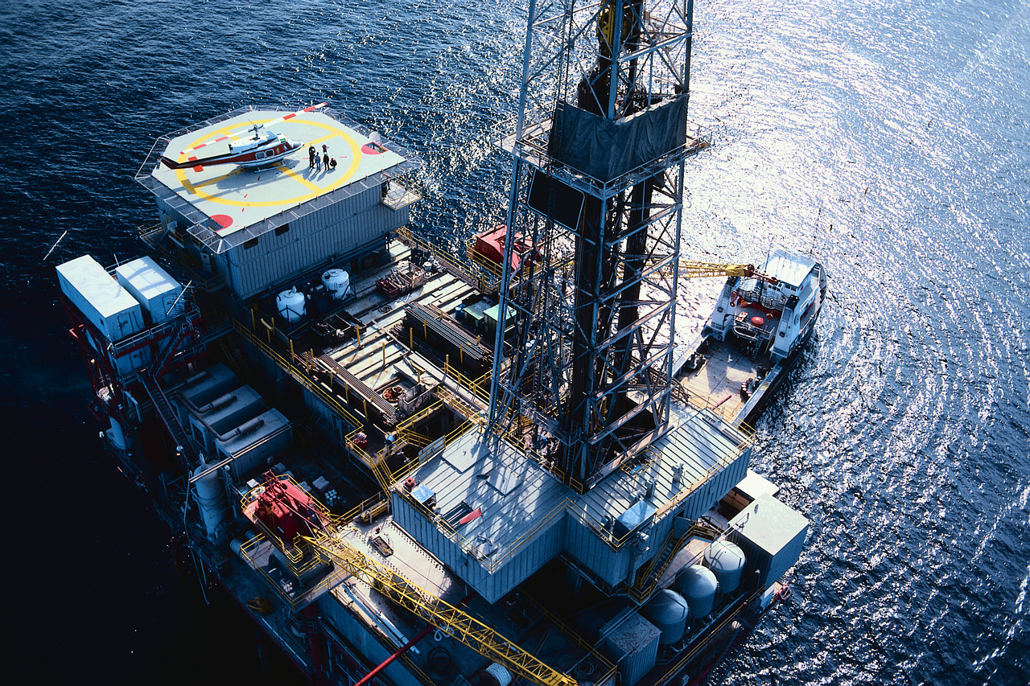
Oil & Gas Service
Dexter Yun
Marc Fernandez
Wendy Ruan
Michael Yan

Slide 2
Agenda
Industry Analysis
Precision Drilling Corp.
McCoy
Trinidad Drilling Ltd.

Slide 3
Industry Overview
Large and vital to many other industries
Oil & Gas
Make up more than 85% of energy consumed in the US as of 2012
Upstream
Exploration
Production
Downstream
Refining
Distribution
Marketing
Notes:
The fossil fuels industry is extremely large, making up more than 80% of the energy consumed in the US as of this year.
They are are vital to many industries and are important to the maintenance of industrial civilization, and is this a critical concern for many nations.
Upstream refers to the origins of the oil business which involves exploration and production of oil and gas.
Downstream refers to operations after the production phase and through the point of sale, whether at gas stations or the delivery of oil for heat.
http://www.eia.gov/totalenergy/data/annual/pecss_diagram.cfm

Slide 4
Industry Overview
Large and vital to many other industries
Oil & Gas
Make up more than 85% of energy consumed in the US as of 2012
Companies driven by:
Location and size of the resource
Costs of developing resource
Fiscal terms in acquiring rights to resources
Commodity prices
Upstream
Exploration
Production
Upstream
Exploration
Production
Downstream
Refining
Distribution
Marketing
Notes:
We’re gonna be focusing on upsteam where companies are driven by:
The size and location of the resource, the costs of developing these resources, fiscal terms in acquiring rights to the resources, and commodity prices
http://www.eia.gov/totalenergy/data/annual/pecss_diagram.cfm

Slide 5
Oil & Gas Industry Characteristics
Capital-intensive
Drilling equipment, installation, operation and maintenance is very expensive to buy and maintain
Intangible costs represent 60-80% of the cost of the well
Average annual revenue per employee is about $410,000
Barrier to entry (high fixed costs)
Highly skilled
Highly regulated
Highly competitive
Price dependent
Essential R&D
Others
Notes:
So the Oil & Gas industry is capital-intensive
Drilling equipment is very expensive to buy and maintain, especially for offshore drilling. In addition, these rigs must be staffed, and the labor market for contract drillers is chronically tight
Once a rig is ordered, its lengthy construction time keeps it off the market for about 3 years.
Intangible costs such as labor, site prep, and engineering represent 60-80 percent of the cost of the well
And average annual revenue per employee is about $410,000
So all its quite clear that these high costs pose as a barrier to entry
The number of offshore rigs has almost double from 2005 to 2006. without contracts in place with oil and gas operators. In addition, these new rigs must be staffed, and the labour market for contract drillers is chronically tight. One reason is the advancing age of worldwide mobile drilling rig fleet. On May 2006 the average age for the existing jackup fleet was 24 years; for the semisubmersible fleet 23 years; and for drillship fleet, 18 years As rigs begin to approach the end of their economic lives, drilling firms will continue to invest in rig upgrades and in new rigs to replace older ones.
When analyzing a drilling company: you want to take a close look at the company’s rig fleet: older rigs lack the ability to drill in remote locations or bore deep holes. Some other factors to consider are the depth of water that the offshore rigs can drill in, hole depth and horsepower. Higher quality rigs will have higher utilization rates which leads to higher revenue growth.
older rigs lack the ability to drill in remote locations or bore deep holes. Some other factors to consider are the depth of water that the offshore rigs can drill in, hole depth and horsepower. Higher quality rigs will have higher utilization rates which leads to higher revenue growth.
Barrier to entry: High fixed costs: capital expenditure and maintenance costs, regulations, and that there is a few players with larger market share and/or with access to greater financial and other resources. More stringent environmental regulations are expected in the next few years. Companies should try to get ready

Slide 6
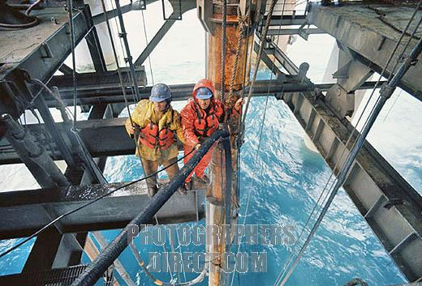
Oil & Gas Industry Characteristics
Capital-intensive
Highly skilled and labor intensive
Workers with expertise to operate drilling equip. are in high demand
Minimum requirement on the number of inexperienced personnel
Highly skilled
Highly regulated
Highly competitive
Price dependent
Essential R&D
Others
Notes:
The drilling industry is classified as highly skilled and labor intensive.
People with skills and expertise to operate drilling equipment are in high demand and cost a lot of money. Most oil and gas producers find it more cost-effective to hire this expertise from drilling companies.
As the industry moves from bust to boom, qualified employees who were laid off are often unwilling to return. The lack of job security hinders the industry’s ability to retain experienced workers and to recruit new people.
Oil and gas producers set the minimum requirement on the number of inexperienced personnel they will permit to work on a rig, given the high opportunity costs that downtime caused by human error can generate.

Slide 7
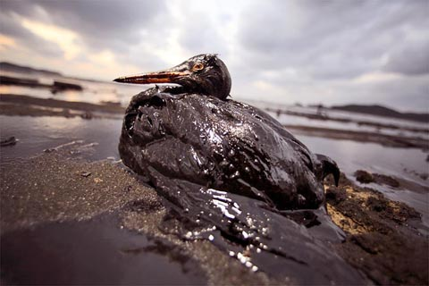
Oil & Gas Industry Characteristics
Capital-intensive
Strict environmental and health safety concerns
Significantly affect the operation of all the drilling companies
Highly skilled
Highly regulated
Highly competitive
Price dependent
Essential R&D
Others
Notes:
This industry is highly regulated with regards to environment and health and safety concerns
The federal, provincial, state, foreign and local laws and regulations controlling the discharge of hazardous wastes and relating to the protection of the environment affect the operations of all the drilling companies. These regulations address oil spill prevention and also significantly expand liability exposure across all segments of the oil and gas industry. Company failure to comply with these statutes and related regulations could result in civil or criminal enforcement action.

Slide 8
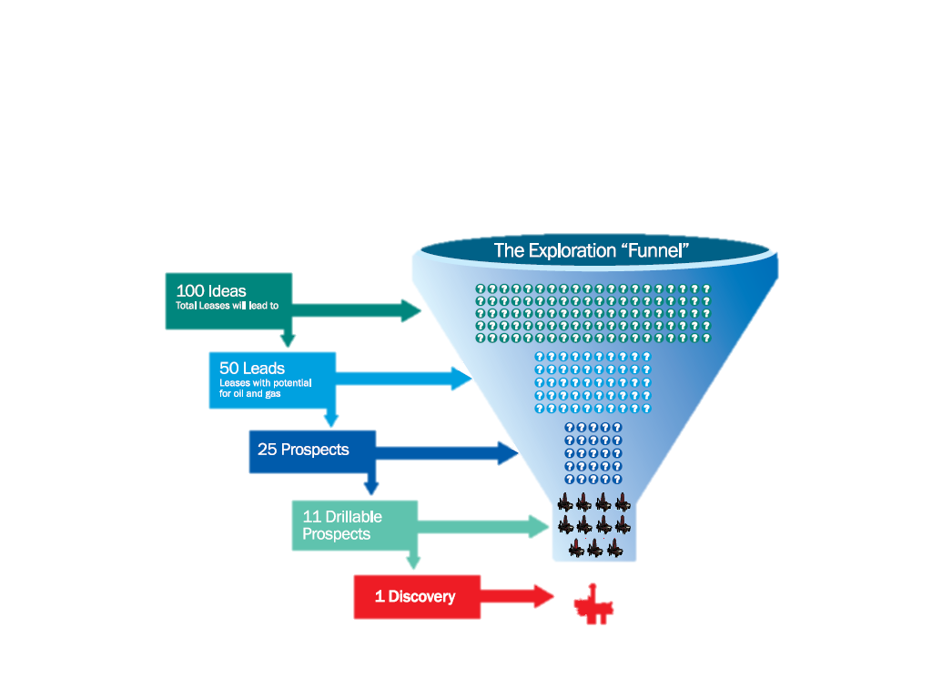
Oil & Gas Industry Characteristics
Capital-intensive
Numerous participants
Intense price competition
Highly skilled
Highly regulated
Highly competitive
Price dependent
Essential R&D
Others
Notes:
The contract drilling business is highly competitive with numerous industry participants. The intense price competition and cyclicality of the drilling industry, is marked by periods of low demand, excess rig availability, and low day rates, all of which can have an adverse affect on the company’s operations.
There are thousands of oil and oil services companies throughout the world, but the barriers to enter this industry scare away all but the serious companies, resulting in much of the oil and gas business being dominated by a handful of powerful companies.
The industry has experienced consolidation in the 90’s when oil prices went down but there is still room for more.

Slide 9
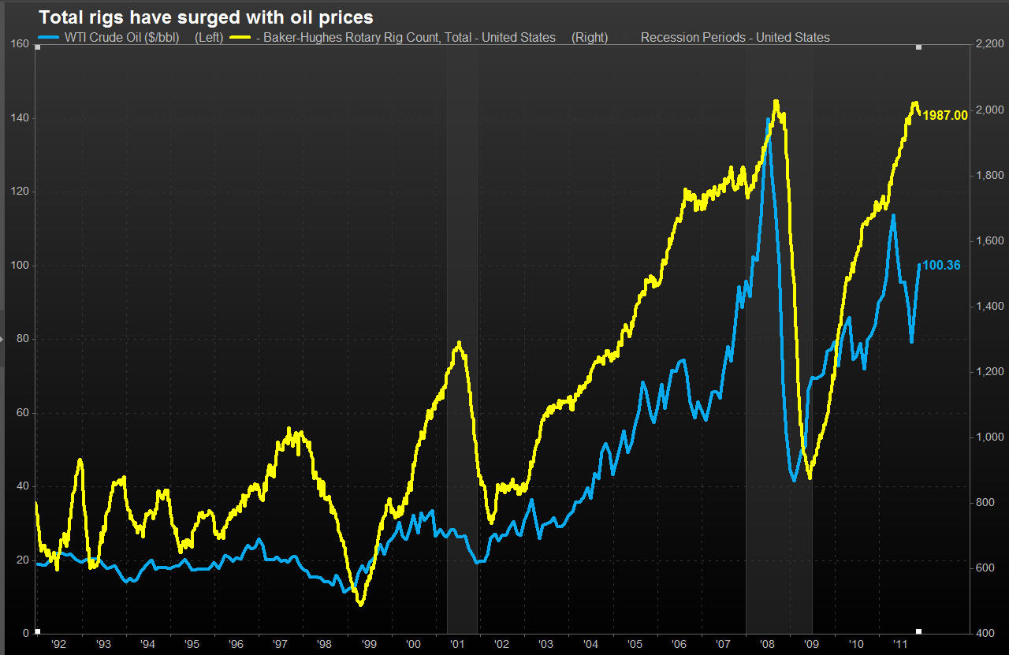
Oil & Gas Industry Characteristics
Capital-intensive
Oil services
Drilling companies
Rigs
Highly skilled
Highly regulated
Highly competitive
Price dependent
Essential R&D
Others
Notes:
The energy industry is not any different than most commodity-based industries as it faces long periods of boom and bust. Drilling and other service firms are highly dependent on the price and demand for petroleum. These firms are some of the first to feel the effects of increased or decreased spending. If oil prices rise, it takes time for petroleum companies to size up land, setup rigs, take out the oil, transport it and refine it before the oil company sees any profit.

Slide 10
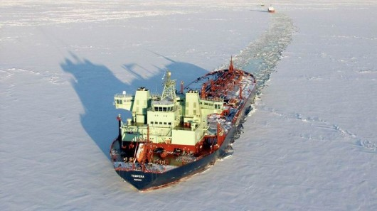
Oil & Gas Industry Characteristics
Capital-intensive
Directional drilling
Challenging geological locations
Less damage to environment
Highly skilled
Highly regulated
Highly competitive
Price dependent
Essential R&D
Others
Notes:
With accelerating decline rates in mature reservoirs around the world, oil and gas producers are facing a difficult job just to maintain existing production. Potential new reservoirs are often located in challenging geological locations, but advances in technology such as directional drilling and hydraulic fracturing are becoming critical to generating future production gains.
Combined with strict environmental regulations, companies are needing to spend increasingly significant amounts of money on developing environmentally safe technologies for the future

Slide 11

Oil & Gas Industry Characteristics
Capital-intensive
Types of contracts / Length of contracts
Location
Natural calamities
Highly skilled
Highly regulated
Highly competitive
Price dependent
Essential R&D
Others
Notes:
When it comes to Types of Contracts: Drillers are generally paid according to one of three methods: a footage contract, a day-work contract, or a turnkey contract. The contract determines a driller’s prospects for future revenue growth.
As for the Length of Contracts: Its good to know when the company’s current contract expires, how many will expire within the next 12 months and how many rigs are locked in for three years or longer. There are advantages and disadvantages to both long and short-term contracts.
For contract drillers, the location of their drilling rigs is of prime importance. Land rigs tend to remain domiciled within a particular region or country, while Offshore rigs are often relocated based on market demand.
Natural calamities such as hurricanes can destroy offshore drilling rigs and other equipment, which can significantly delay the delivery of services and materials to jobsites

Slide 12
Industry Composition
$110 billion
Notes:
Now looking at the composition of sales in the industry:
The US oil and gas services industry includes 10,000 companies with combined annual revenue of $110 billion (2012). Major companies include Schlumberger, Halliburton, Transocean, and Baker Hughes.
Oil & gas field service companies provide drilling and support services for oil and gas wells and make drilling equipment. Drilling provides about 35% of industry revenue, support services 45%, and equipment manufacturing 20%.
Industry revenue is expected to grow 9.6% to $126 billion as continued high oil prices increase demand for new drilling activities and better credit conditions allow customers to resume funding-halted projects.

Slide 13
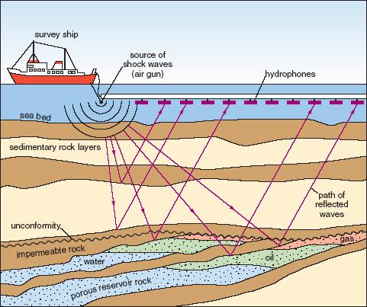
Services
Oilfield Services
Assist drilling co. in setting up oil and gas wells
Manufacture, repair and maintain equipment used in extraction
Seismic Testing
The use of reflected seismic waves to estimate the properties of the Earth’s surface
Notes:
Major support services include preparing wells for Production, maintaining and enhancing the output of producing wells, and exploration
Oilfield service companies assist the drilling companies in setting up oil and gas wells. In general these companies manufacture, repair and maintain equipment used in oil extraction and transport. More specifically, these services can include:
Seismic Testing - This involves mapping the geological structure beneath the surface.
Transport Services - Both land and water rigs need to be moved around at some point in time.
Directional Services - Believe it or not, all oil wells are not drilled straight down, some oil services companies specialize in drilling angled or horizontal holes.

Slide 14
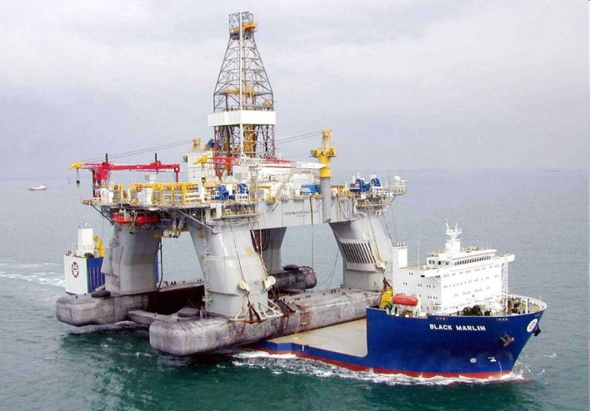
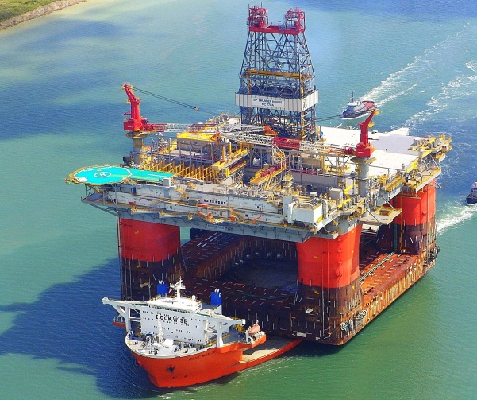
Services
Oilfield Services
Assist drilling co. in setting up oil and gas wells
Manufacture, repair and maintain equipment used in extraction
Transport Services
Moving the rigs to the drill site
Notes:
Major support services include preparing wells for Production, maintaining and enhancing the output of producing wells, and exploration
Oilfield Services - Oilfield service companies assist the drilling companies in setting up oil and gas wells. In general these companies manufacture, repair and maintain equipment used in oil extraction and transport. More specifically, these services can include:
Seismic Testing - This involves mapping the geological structure beneath the surface.
Transport Services for both land and water rigs which need to be moved around at some point in time.
Directional Services - Believe it or not, all oil wells are not drilled straight down, some oil services companies specialize in drilling angled or horizontal holes.

Slide 15
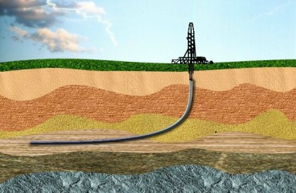
Services
Oilfield Services
Assist drilling co. in setting up oil and gas wells
Manufacture, repair and maintain equipment used in extraction
Directional Services
The practice of drilling angled or non-horizontal holes
Notes:
Major support services include preparing wells for Production, maintaining and enhancing the output of producing wells, and exploration
Oilfield Services - Oilfield service companies assist the drilling companies in setting up oil and gas wells. In general these companies manufacture, repair and maintain equipment used in oil extraction and transport. More specifically, these services can include:
Seismic Testing - This involves mapping the geological structure beneath the surface.
Transport Services - Both land and water rigs which need to be moved around at some point in time.
Directional Services – Not all oil wells are not drilled straight down, some oil services companies specialize in drilling angled or horizontal holes.

Slide 16

Services
Oilfield Services
Assist drilling co. in setting up oil and gas wells
Manufacture, repair and maintain equipment used in extraction
Hydraulic Fracturing
Directional Services
Procedure of creating fractures in rock formations by injecting fluid into cracks to force them further open
Notes:
A particularly important method is hydraulic fracturing, also known as “fracking”
Fracking has been seen as a key method of extracting unconventional oil and gas, due to the economic benefits from vast amounts of formerly inaccessible resources which the process can extract.
However, opponents point to potential environmental impacts such as contamination of ground water and surface contamination from spills. For these reasons, hydraulic fracturing has come under scrutiny internationally.

Slide 17
Services
Contract Drilling
Physically drilling and pumping oil and gas out of the ground
Highly skilled industry
Most drilling companies are contractors hired by oil and gas producers
2 types of drilling rigs:
Land rigs
Offshore rigs
Notes:
Contract drilling involves physically drilling and pumping oil out of the ground. A highly skilled industry where most companies own both the rigs and the skilled employees.
There are 2 types of drilling rigs: land rigs, and deep water rigs

Slide 18
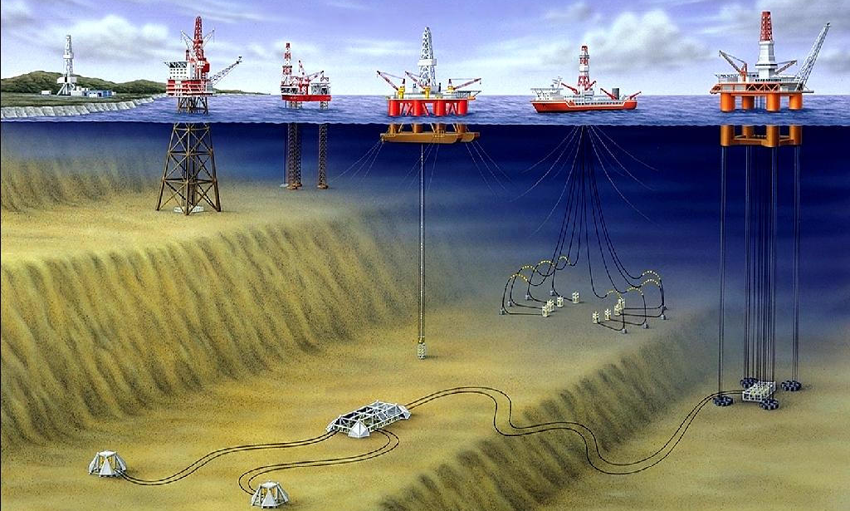
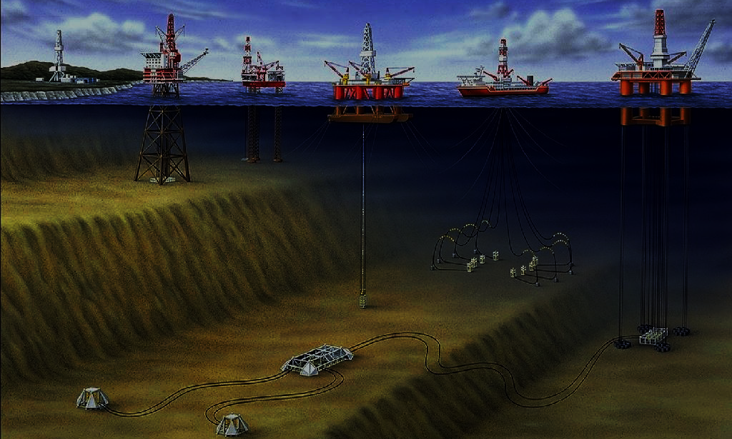
Services
land rig
Conventional
For drilling depth ranges from 5,000 to 30,000 feet
Notes:
Soo rotary rigs, a type of land rig, drill the vast majority of wells today, and are used for drilling depth ranges from 5000 to 30,000 feet

Slide 19
Services
fixed platform
Anchored directly to seabed
Benefit from reduced exposure to wind and wave movement
Notes:
Fixed platform rigs are anchored directly onto the seabed and are only used for shallower water
Since they are attached to the floor, there is limited exposure to movement from wind and water forces

Slide 20
Services
jackup
Towed to the drilling site where legs are lowed to the sea floor
Platform “jacked up” above water surface
Adjustable height, safer to operate than barges
Notes:
Jack-up rigs are towed out to the drilling site, where it’s legs are lowed to the seafloor.
The height of the platform can be adjusted and is safer to operate since the platform is elevated above the water

Slide 21
Services
semi-submersible
Combines advantage of fixed platform rigs with ability to drill in deep water
Most common type of offshore rig
Notes:
Semisubmersible rigs are the most common type of offshore drilling rigs. A lower hull which can be inflated or deflated with air allows the platform to be partially submerged, and is held in place by 10 ton anchors.

Slide 22
Services
drillship
Self-propelled and extremely mobile
Ideal for remote locations
Use GPS to adjust thrusters to keep ship in position at all times
Notes:
Drillships are specially designed to carry drilling platforms out to deep-sea locations. They utilize GPS to adjust electric motors to keep the ship in position at all times.

Slide 23
Services
deep-sea rig
Moored to ocean floor using tendons to keep platform in position in very deep waters
Can drill 40,000 ft (10,000 ft of water/30,000 ft of seabed
Most dangerous type of rig
Notes:
Deep-sea rigs are able to drill up to 40,000 ft (10,000 of water, 30,000 of seabed). They are also one of the most dangerous types of rigs to operate due to the sensitive marine environment

Slide 24
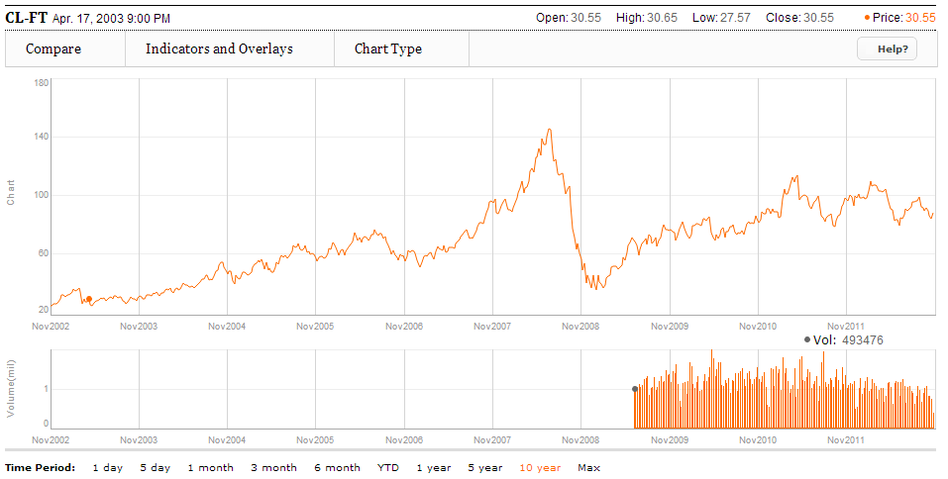
Competitive Landscape
Price Volatility
Crude Oil
Natural Gas
Rig Count
Comparison
Price chart from 2002 to present
Notes:
Now moving on to price volatility
Oil prices averaged a hundred-and-eleven dollars per barrel in 2011, an increase of 40% from the 2010 level. The loss of Libyan supplies early in the year, combined with smaller disruptions in a number of other countries, pushed prices sharply higher despite a large increase in production among other OPEC members.
following the Libyan outages and a release of strategic stocks from International Energy Agency member countries.

Slide 25
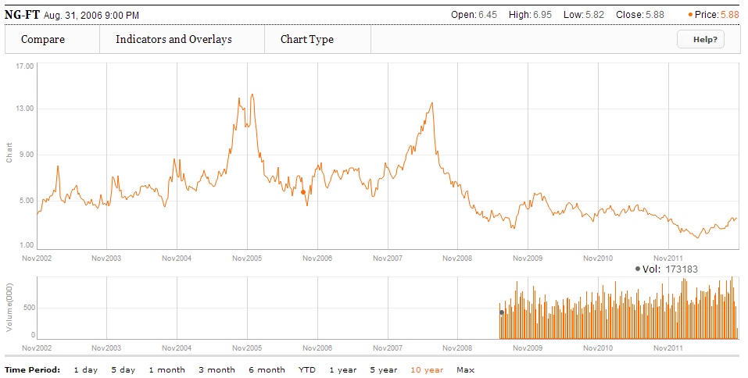
Competitive Landscape
Price Volatility
Crude Oil
Natural Gas
Rig Count
Comparison
Price chart from 2002 to present
Notes:
As for natural gas: prices fell to their lowest point in more than 2 years, underscoring how the nation’s booming energy business is becoming a victim of its own success as new drilling techniques unlocked vast new reserves of natural gas from shale formations and other unconventional reservoirs. Furthermore, unusually mild temperatures across much of the U.S. have damped demand for gas to heat homes and offices.
Oil and gas prices don’t seem to move together

Slide 26
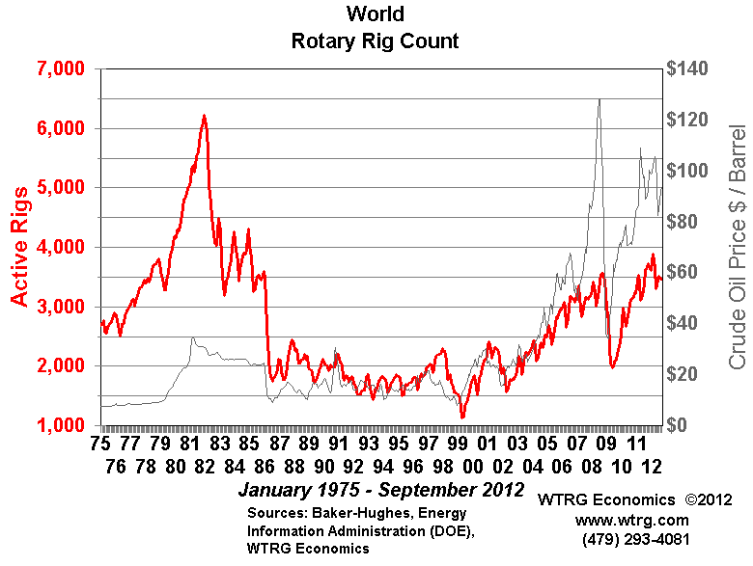
Competitive Landscape
Price Volatility
Crude Oil
Natural Gas
Rig Count
Comparison
Price chart from 1975 to present
Notes:
The Rotary Rig Count is the average number of drilling rigs actively exploring for oil and gas. Drilling an oil or gas well is a capital investment in the expectation of returns from the production and sale of crude oil or natural gas. Rig count is one of the primary measures of the health of the exploration segment of the oil and gas industry. In a very real sense it is a measure of the oil and gas industry's confidence in its own future.

Slide 27
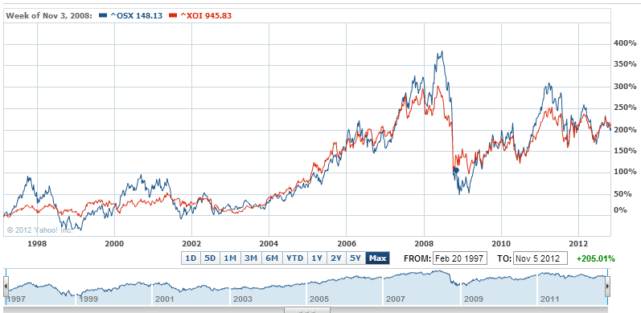
Competitive Landscape
Price Volatility
Crude Oil
Natural Gas
Rig Count
Comparison
Oil Service Index vs. Oil Index (‘97 – Present)

Slide 28
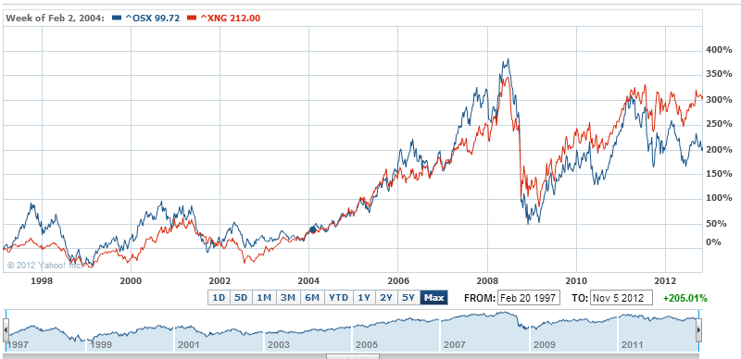
Competitive Landscape
Price Volatility
Crude Oil
Natural Gas
Rig Count
Comparison
Oil Service Index vs. Natural Gas Index (‘97 – Present)

Slide 29
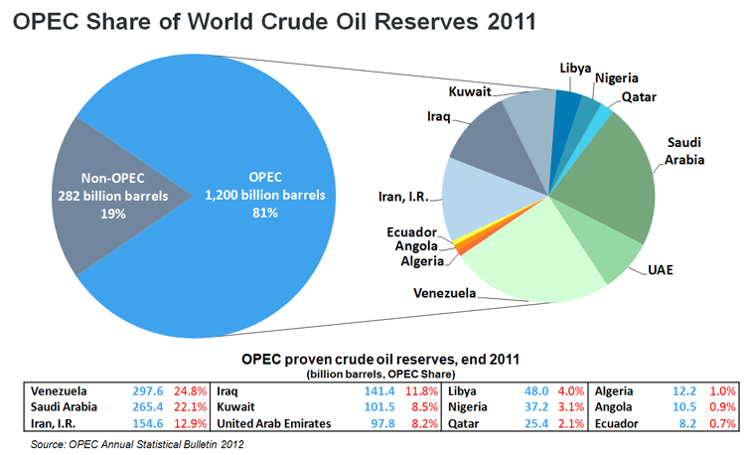
Competitive Landscape
Oil & Gas:
Reserves, Supply & Demand
OPEC
Reserves
What’s Left?
Production
& Consumption
81% of global reserves
44% of oil production
OPEC accounts for
Notes:
Looking at reserves, supply and demand
According to current estimates, more than 80% of the world's proven oil reserves are located in OPEC Member Countries, with the bulk of OPEC oil reserves in the Middle East, amounting to 66% of the OPEC total. OPEC Member Countries have made significant additions to their oil reserves in recent years, for example, by adopting best practices in the industry, realizing intensive explorations and enhancing recoveries. As a result, OPEC's proven oil reserves currently stand at 1.2 billion barrels.

Slide 30
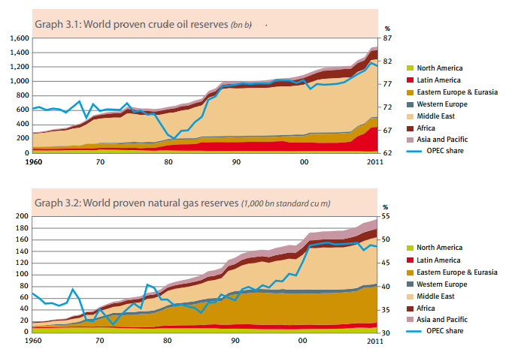
Competitive Landscape
Oil & Gas:
Reserves, Supply & Demand
OPEC
Reserves
What’s Left?
Production
& Consumption
Notes:
Proven oil reserves are those reserves claimed to have a reasonable certainty of being recoverable under existing economic conditions, with existing technology.
World proven crude oil reserves increased by 1% to roughly 1.6 billion barrels at the end of 2011. Of particular interest are the reserves in Latin America, particularly in Venezuela. According to the US Geological Survey, an estimated 380-652 billion barrels can be technically recoverable from Venezuela’s Orinoco Belt, which would make their reserves among the largest in the world. However, since the reserve is ultra-heavy crude oil, recovery may be much more complex and expensive.
World proven natural gas reserves increased by 1.9% to roughly 2 trillion cubic meters in 2011, driven by increases in North America (13%), Asia (4%), and Europe (2.6%)

Slide 31
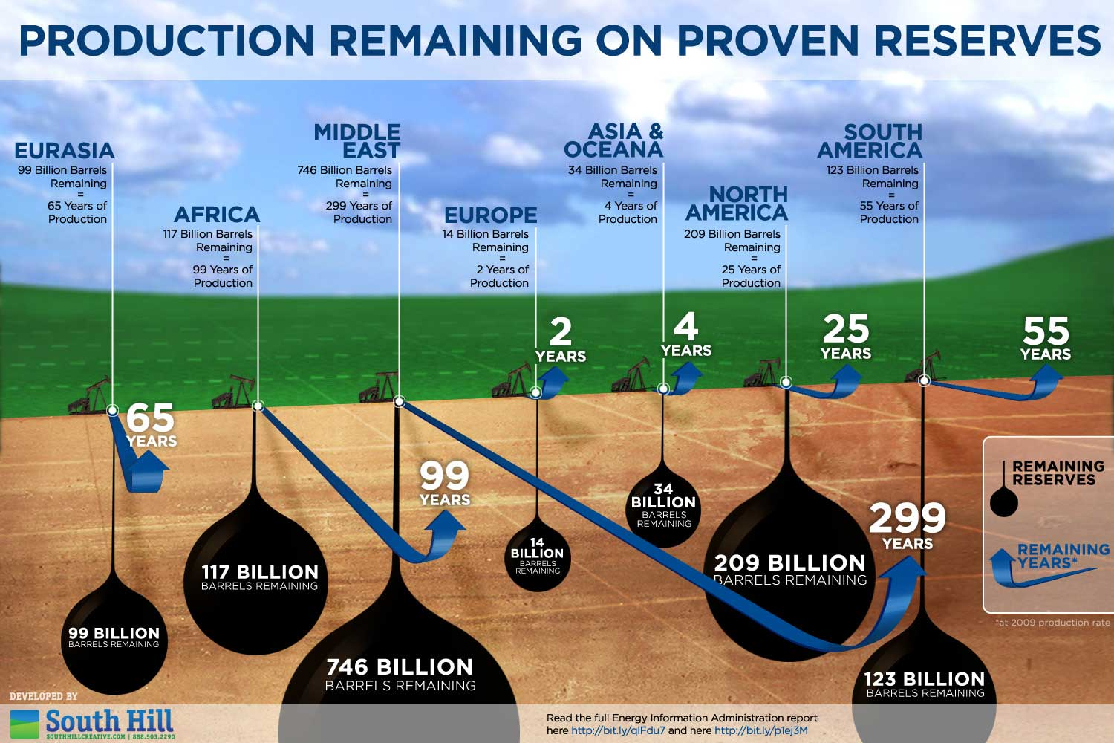
Competitive Landscape
Oil & Gas:
Reserves, Supply & Demand
OPEC
Reserves
What’s Left?
Production
& Consumption
As of 2009
Notes:
This picture shows the amount of reserves across several primary global regions and the years remaining if we continue at our current production rate. Clearly the Middle East has the most with three-quarters of a trillion barrels remaining.
Its important to note that because the geology of the subsurface cannot be examined directly, indirect techniques must be used to estimate the size and recoverability of the resource. And while new technologies have increased the accuracy of these techniques, significant uncertainties still remain.
Furthermore, this picture doesn’t account for reserves which cannot be extracted due to reserve characteristics and limitations in extraction technologies. This is exactly why the industry is capital-intensive with lots of money being spent on research and development.

Slide 32
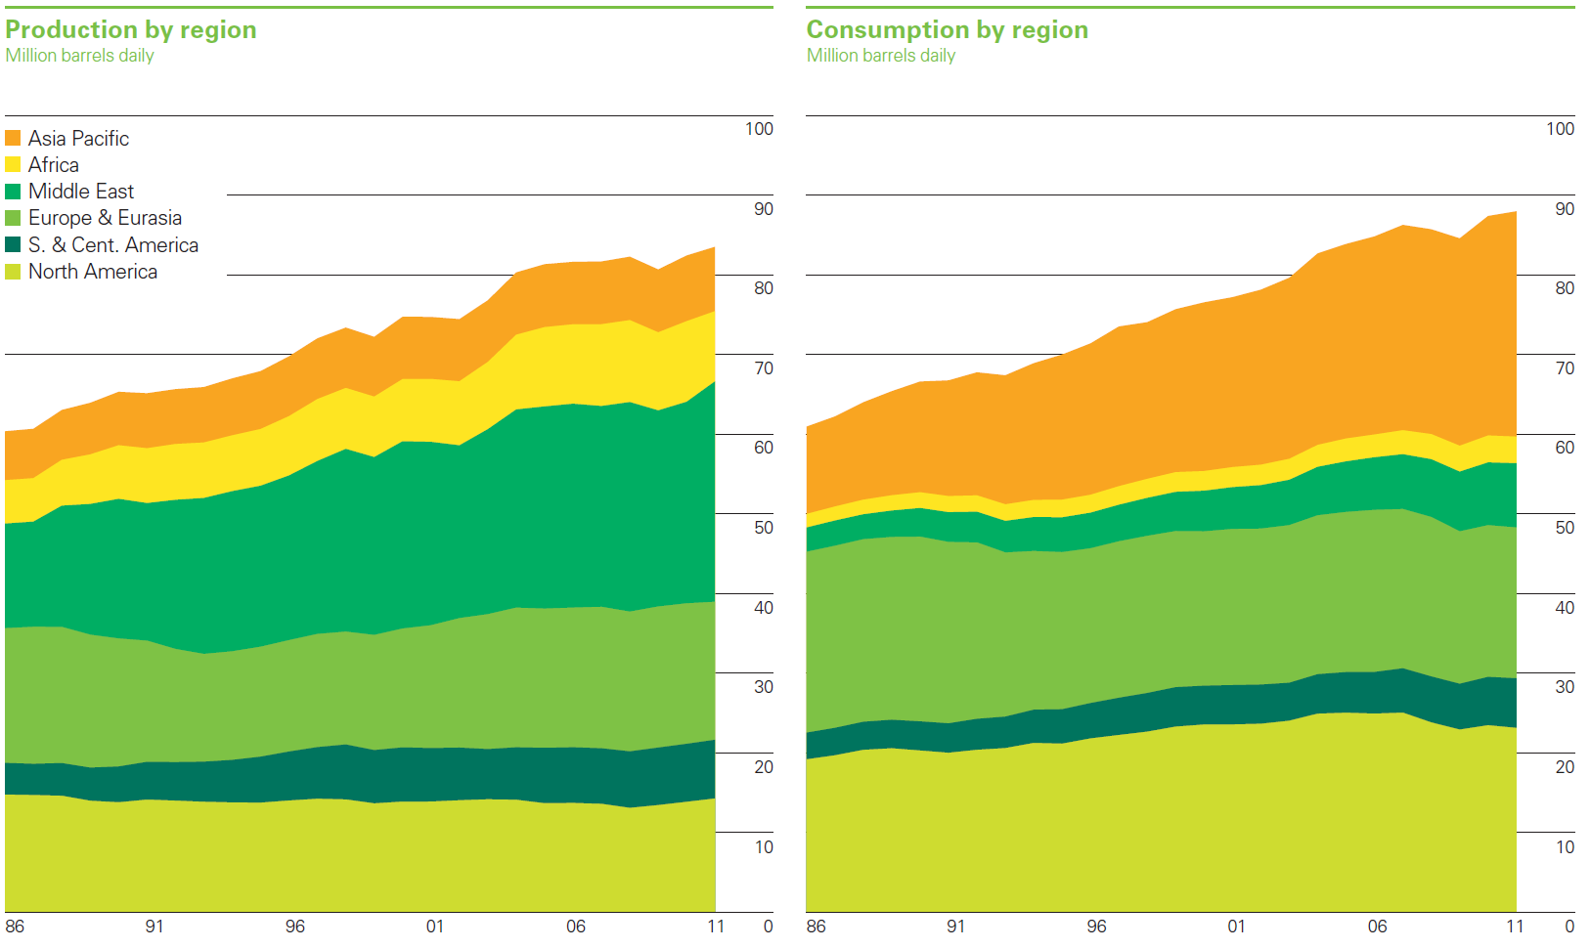
Competitive Landscape
Oil & Gas:
Reserves, Supply & Demand
OPEC
Crude Oil
Reserves
What’s Left?
Production
& Consumption
Production & Consumption of crude oil by region (1986 - 2011)
Notes:
Global oil production increased by 1.3%. Virtually all of the net growth was in OPEC, with large increases in Saudi Arabia, the UAE, Kuwait and Iraq more than offsetting the loss of Libyan supply.
Non-OPEC output was broadly flat, with the US having the largest increase for the 3rd consecutive year. Driven by continued strong growth in onshore production of shale liquids
Global oil consumption grew by a below-average of 0.7%. This was the weakest global growth rate among fossil fuels. OECD consumption declined by 1.2%, the fifth decrease in the past 6 years. Outside the OECD, consumption grew by 2.8%.
Despite strong oil prices, oil consumption growth was below average in producing regions of the Middle East due to regional unrest

Slide 33
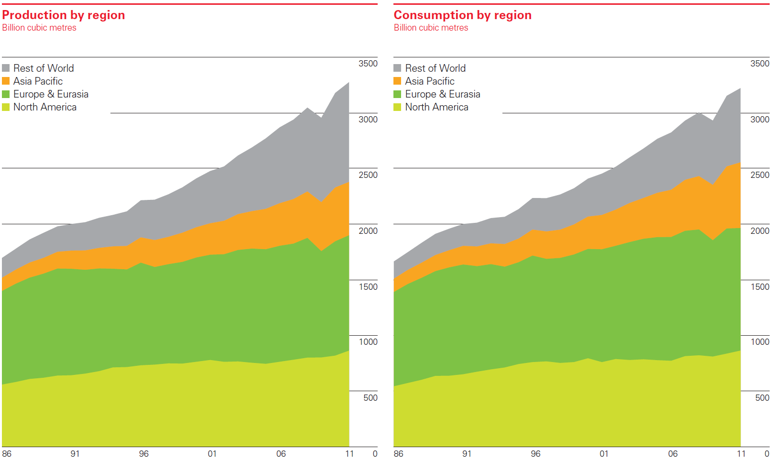
Competitive Landscape
Oil & Gas:
Reserves, Supply & Demand
OPEC
Natural Gas
Reserves
What’s Left?
Production
& Consumption
Production & Consumption of natural gas by region (1986 - 2011)
Notes:
Global gas production grew by 3.1%. The US recorded the largest increase despite lower gas prices, and remained the world’s largest producer.
World natural gas consumption grew by 2.2%. Consumption growth was below average in all regions except North America, where low prices drove robust growth. Outside North America, the largest consumption gains were in China, Saudi Arabia, and Japan. These increases were partly offset by the largest decline on record in EU consumption, driven by a weak economy, high gas prices, warm weather and continued growth in renewable power generation.

Slide 34
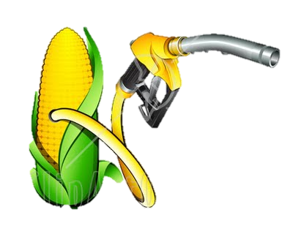
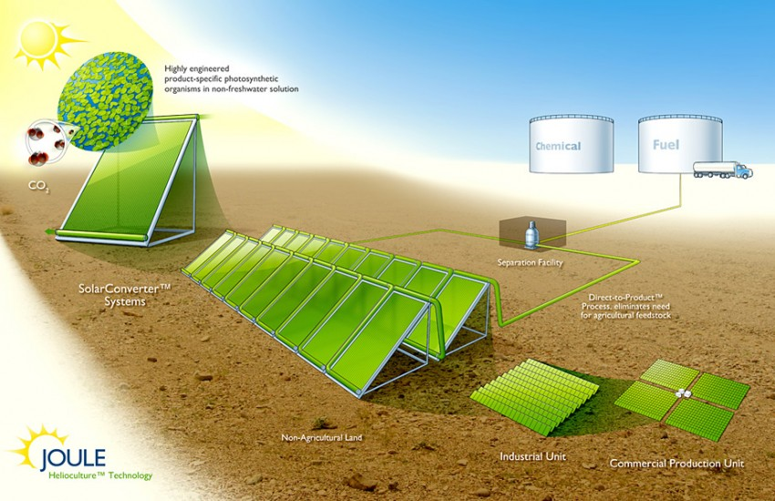
Competitive Landscape
Oil & Gas Alternatives
Derived from biomass
Solid biomass
Liquid fuels
Biogases
Sunlight
Recent increase in public and scientific attention driven by:
Oil price spikes
Need for increased energy security
Fossil fuel and greenhouse gas concerns
Biofuel
Unconventional fossil fuels
Notes:
Biofuels, derived from biomass, are gaining increased public and scientific attention, driven by factors such as increases in oil prices, the need for increased energy security, and concern over greenhouse gas emissions from fossil fuels
A new alternative is sunlight combined with synthetic organisms to produce a bio-based fuel

Slide 35
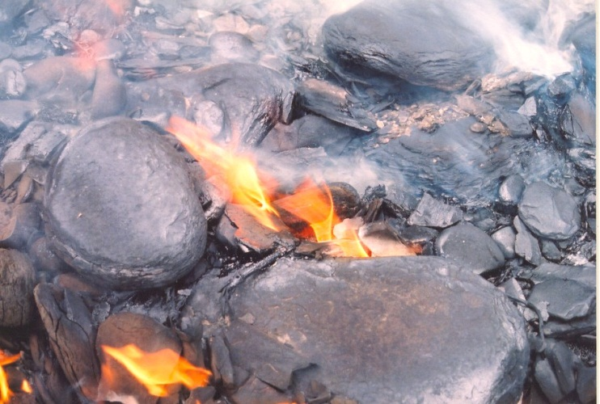
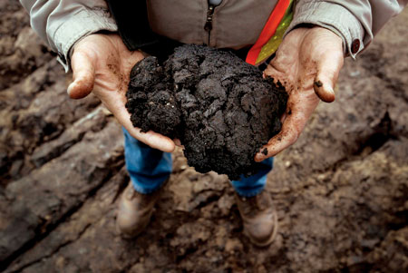
Competitive Landscape
Oil & Gas Alternatives
Biofuel
Unconventional fossil fuels
Oil or gas that is extracted using alternative techniques
Upward trending crude prices are making these alternatives more economically viable
Shale Oil
Oil Sands
Notes:
High oil prices have opened the window to a sea of new exploration opportunities, leading independents and majors to try to develop non-conventional oil from a variety of sources. Oil sands and oil shale are among the most heavily watched.
Oil shale is an organic-rich fine-grained sedimentary rock containing kerogen (a solid mixture of organic chemical compounds) from which liquid hydrocarbons called shale oil can be produced

Slide 36
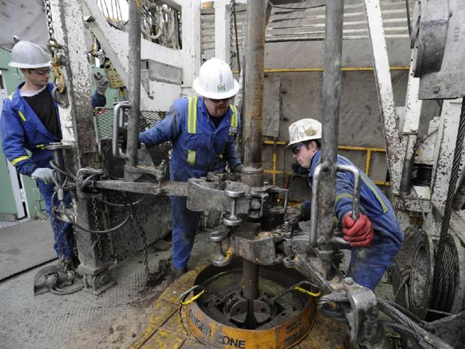
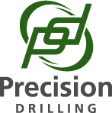
Precision Drilling Corporation

Slide 37
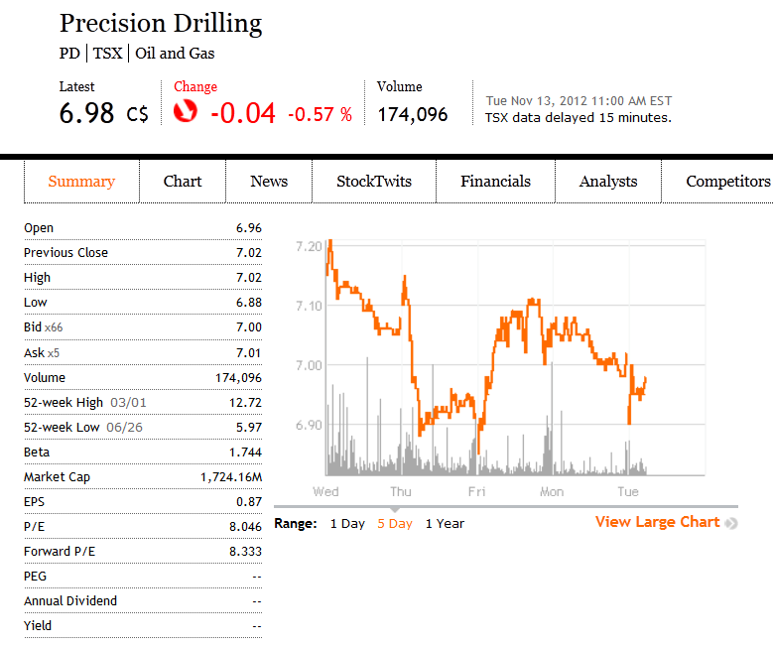
Current Financial Snapshot

Slide 38
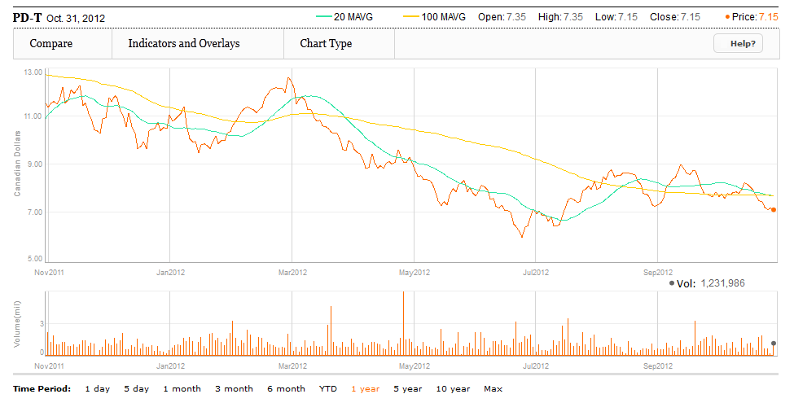
1 Year Stock Performance

Slide 39
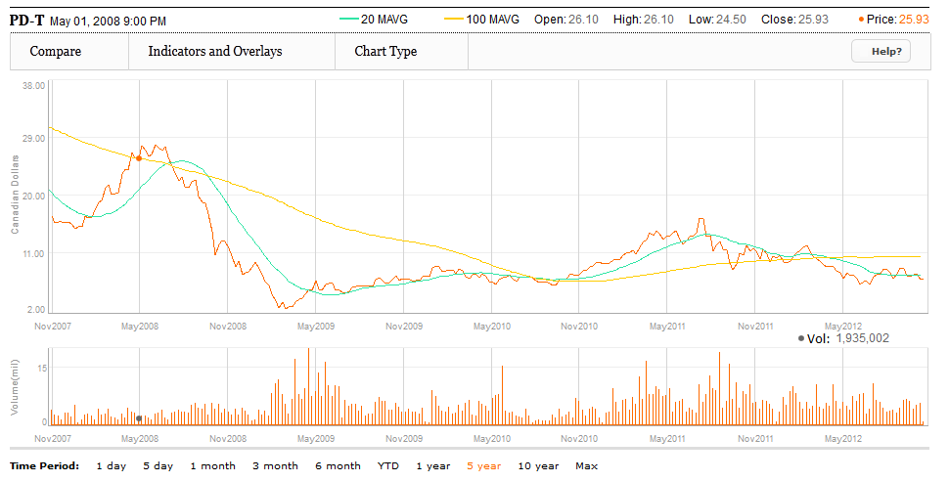
5 Year Stock Performance

Slide 40
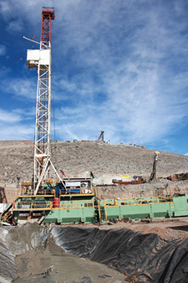
Company Overview
"To be recognized as the High Performance, High Value provider of services for global energy exploration and development”
Canada’s largest oil drilling contractor
Fleet: 350+ drilling rigs, 200 service rigs, 20 snubbing units, 11,300 pieces of rental equipment
Provides contract drilling, well servicing, and strategic support

Slide 41
History
Founded in 1951 as private drilling contractor, headquartered in Calgary, Alberta
Period of high growth in the 1980s; diversification in the 1990s
2005: Reorganized into a open-ended income trust
in 2006 a new law in Canada (SIFT) passed to impose tax on income trust distributions (the tax was to be introduced in 2011)
Commenced trading on TSX on November 7, 2005
2010: Conversion to corporation

Slide 42
Recent Acquisitions
Sept 2006
Acquired Terra Water Group Limited
Sept 2011
Acquired Axis Energy Services Holdings Inc
July 2008
Acquired Rick’s Well Servicing Ltd.
June 2008
Acquired Grey Wolf Inc.
March 2011
Acquired Drake Directional Drilling,LLC and Drake MWD Services,LLC

Slide 43
Recent Acquisitions
Grey Wolf Inc.
Major contract oil and natural gas driller based in Houston, Texas
Drake Directional Drilling,LLC and Drake MWD Services,LLC
Directional drilling and MWDservices in the U.S.
Axis Energy Services Holdings Inc.
Directional drilling services in Western Canada
Drilling fleet: 121 rigs

Slide 44
2011 Goals & Highlights
Delivering high value, high performance
North American organic growth
Improving financial flexibility
Completed 18 drilling rig upgrades (half were rig tier upgrades)
Completed entire 2010 new build rig program
Completed 18 out of 42 rigs of the 2011 new build program
Focus on building super series rigs
Disciplined approach to minimize costs through operational management practices and a variable cost structure, to maximize revenues through term contract positions and with a focus of maintaining a strong balance sheet

Slide 45
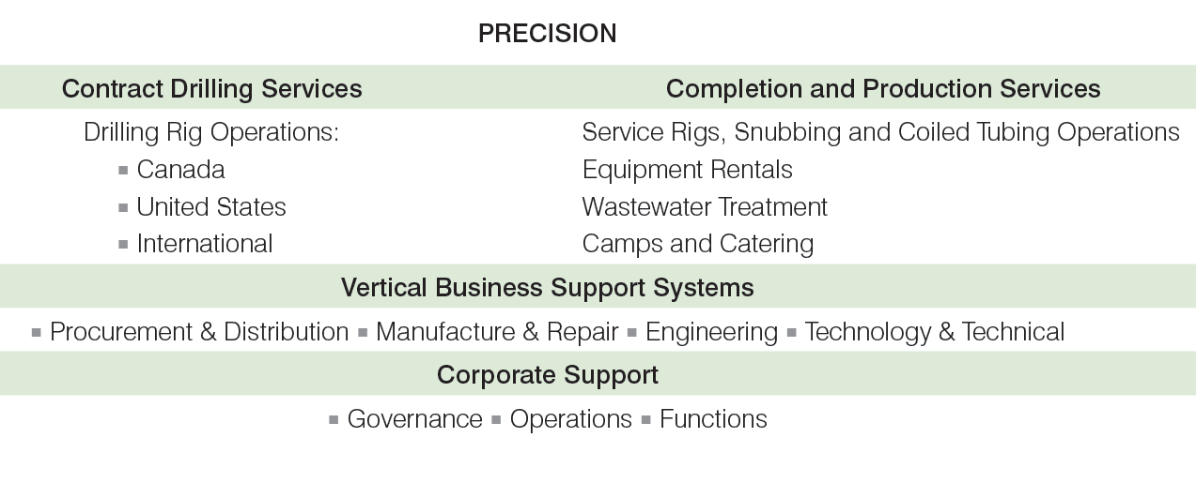
Business Segments

Slide 46
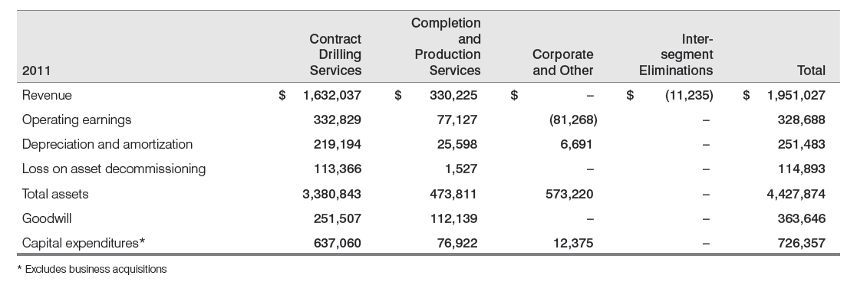
Revenue Segmentation Annual

Slide 47
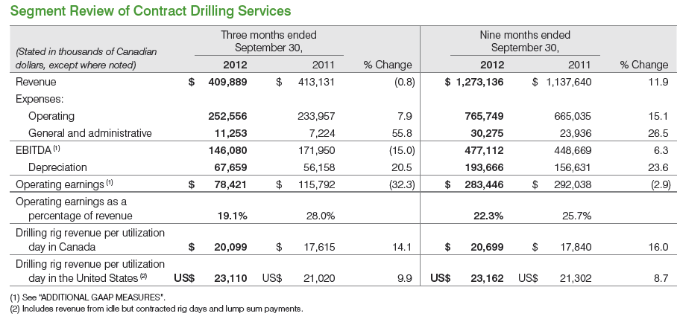
Revenue Segmentation Q3

Slide 48
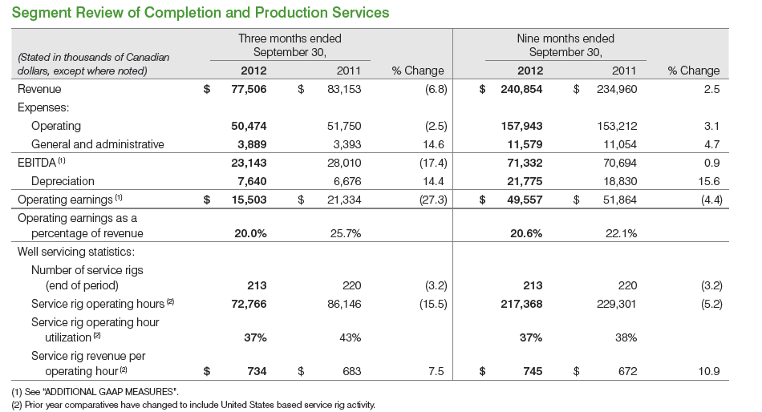
Revenue Segmentation Q3

Slide 49
Contract Drilling Services
Land drilling and directional drilling
Procurement and distribution of oilfield supplies
Manufacture and refurbishment of drilling and service rig equipment
Subsidiaries operating in the U.S., Canada, and internationally

Slide 50
Types of Contract Drilling Rigs
Tier 1
High performance
Tier 2
High performance
Tier 3
Conventional mechanical rigs
Newer designs and manufacture
Directional and horizontal drilling
Highly mobile
Applied new equipment or modification
Directional and horizontal drilling
“Super Series”
Less mobile than tier 1
No automation and lower pump capacity
Usually not capable of directional or horizontal drilling

Slide 51
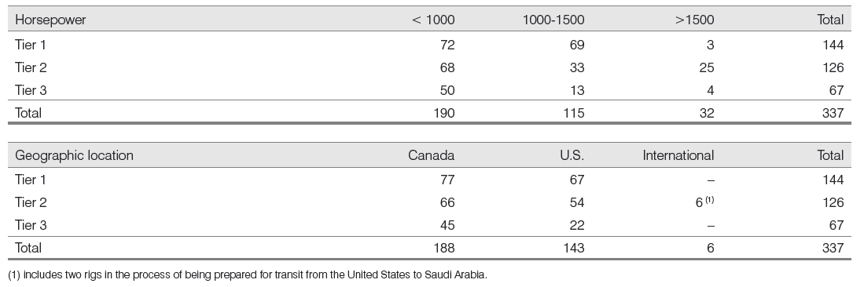
Rig Composition and Location
Notes:
-Diverse fleet of rigs that consists of 144 tier 1 rigs, 126 tier 2 rigs, and 67 tier 3 rigs
-As of the end of 2011, 80% of Precision’s 337 drilling rigs were tier 1 or 2 rigs
-Its rig operations are mostly within Canada and the US

Slide 52
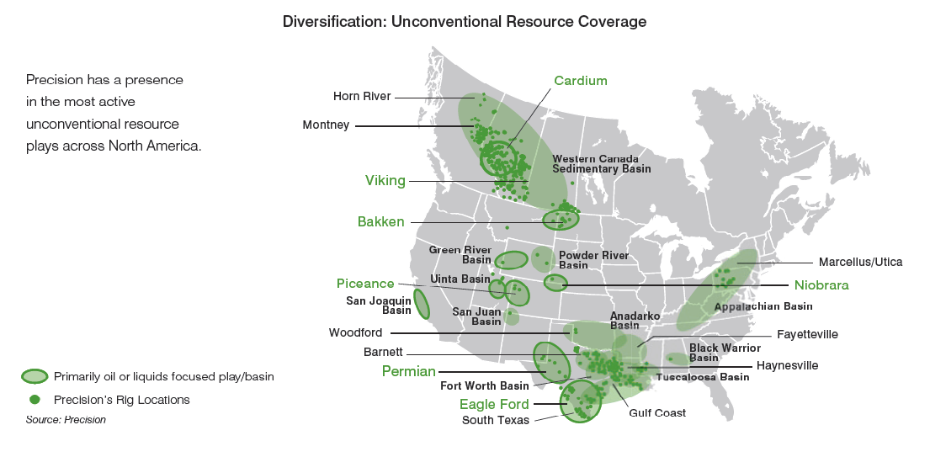
Resource Play and Rig Locations

Slide 53
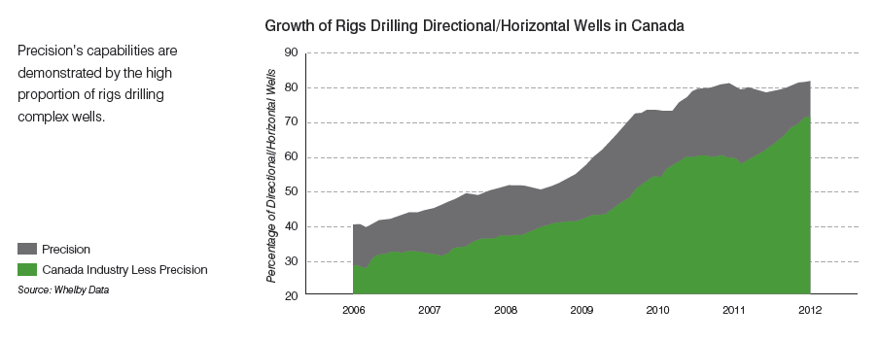
Growth in Directional & Horizontal Drilling in Canada

Slide 54
External Risk: Seasonality in Canada
Winter
Peak activity (Q1 and Q4)
Spring (break)
Temperature rises and ground thaws
Government road bans (Q2)
Activity resumes in the summer

Slide 55
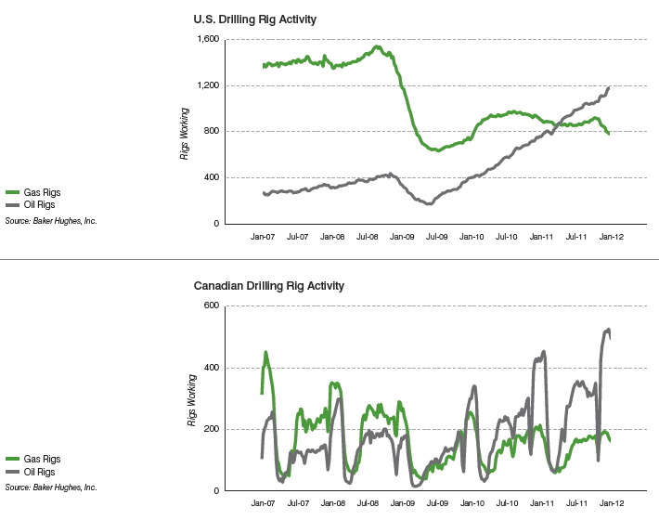
Drilling Activity in Canada & the U.S.

Slide 56
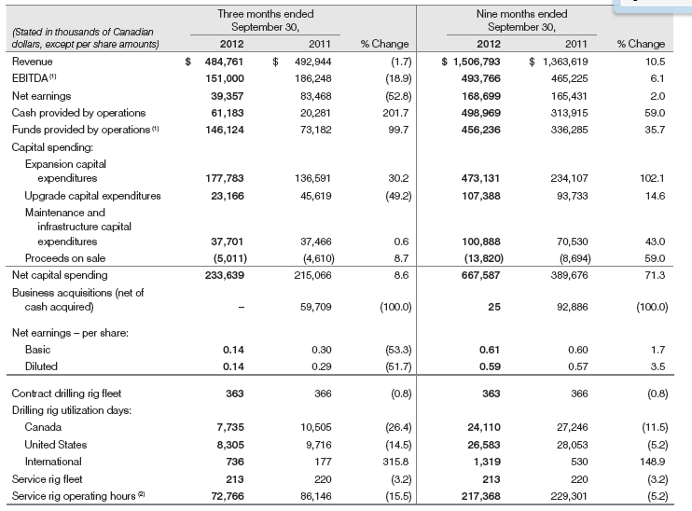
Rig Utilization Days

Slide 57
Active Rigs (3rd Quarter)
Average of 84 rigs worked in Canada, 90 rigs worked in the United States, and 8 work internationally (Total average=182)
Average of 119 rigs under term contracts (4th Quarter, 2012)
Average of 100 rigs (1st Quarter, 2013)
Average of 91 rigs (2nd Quarter, 2013)
Canada: 250 utilizations days per rig
U.S.: 365 utilization days per rig

Slide 58
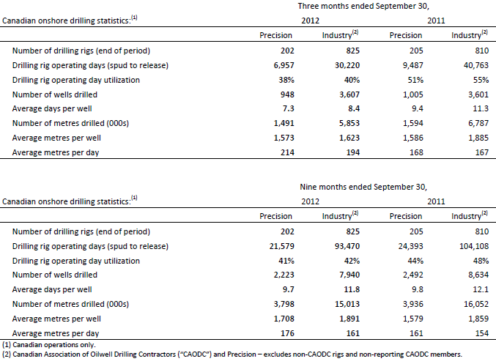
Rigs in Play (Canada)

Slide 59
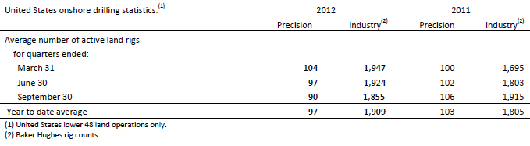
Rigs in Play (U.S.)

Slide 60
Completion and Production Services
Service rigs for well completion and workover services
Snubbing services
Camp and catering services
Wastewater treatment services
Rental of oilfield surface equipment, tubulars, well control equipment, wellsite accommodations, drilling camps

Slide 61
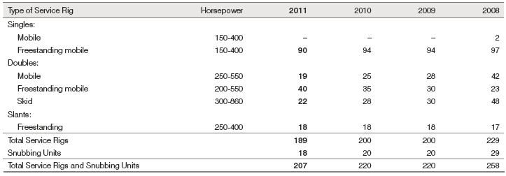
Service Rig Fleet
Notes:
As of 2011, Precision has a total of 189 service rigs and 18 snubbing units

Slide 62
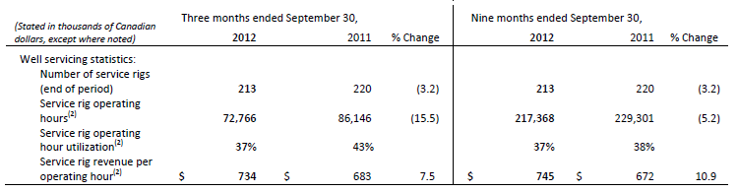
Service Rig Hours

Slide 63
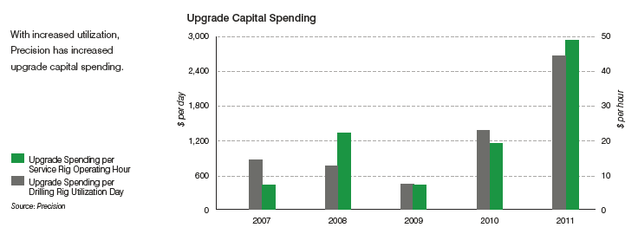
Capital Expenditure
Expected 2012 CAPEX=921 Million (up 5% from 2011)
As of 3rd quarter 2012, CAPEX= 681 million
The increase is associated with additional rig upgrade contracts and two new service rig contracts in 2012

Slide 64
2012 Outlook
Strong base portfolio of long term customer contracts
Softened interest in new build Super Series
pace of contracts in 2012 likely significantly lower than 2011
Increased CAPEX to sustain infrastructures and expenditures
Weak demand for natural gas drilling
More equipment working in oil plays (84% of rigs)
Industry outlook as of Oct.19, 2012
U.S. active rig count down 9%, Canadian active rig count down 29%

Slide 65
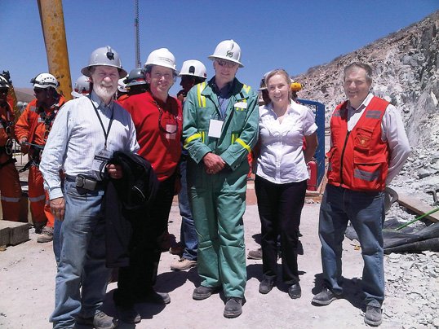
Management

Slide 66
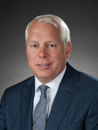
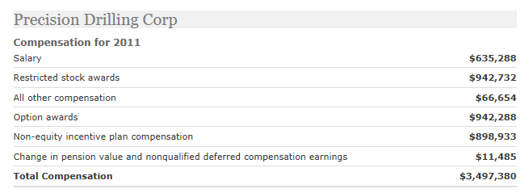
Management
Kevin A. Neveu President and Chief Executive Officer
Appointed as CEO and director of Precision Drilling Corporation in August 2007
Appointed as President and CEO in January 2009
Holds as BSc and BE at the University of Alberta
Previous president of the Rig Solutions Group of National Oilwell Varco in Houston
Serves on the board of RigNet Inc. and the Executive Committee of the International Association of Drilling Contractors
Director of the Heart and Stroke Foundation of Alberta
Notes:
Expected to complete 2011 new build program by the 4th quarter of 2012, and 5 our of 7 completed for 2012
Upgraded 18 drilling rigs during 2011 of which approximately half were rig tier upgrades. Precision’s engineering group
provides design modification to fit customers’ complex drilling needs and requirements. Precision decommissioned
36 Tier 3 drilling rigs and 13 well servicing units to high-grade its fleet.
Enhanced B/S and liquidity helps with financial flexibility

Slide 67
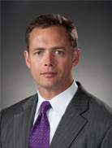
Management
Rob McNally Executive Vice President & Chief Financial Officer
Appointed in July 2010
Degree in Mechanical Engineering from University of Illinois, Degree in Mathematics from Knox College, and an MBA in Finance from Tulane University
Over 18 years of experience in the oilfield services industry
Previous positions:
- CEO for Dalbo Inc.,
- Investment Banker with Simmons and Company International.
Notes:
Expected to complete 2011 new build program by the 4th quarter of 2012, and 5 our of 7 completed for 2012
Upgraded 18 drilling rigs during 2011 of which approximately half were rig tier upgrades. Precision’s engineering group
provides design modification to fit customers’ complex drilling needs and requirements. Precision decommissioned
36 Tier 3 drilling rigs and 13 well servicing units to high-grade its fleet.
Enhanced B/S and liquidity helps with financial flexibility

Slide 68

Management
Niels Espeland President, Internal Operations
Join Precision November 2011
Over 35 years of experience in the international oilfield service and rig contracting industry
Engineering Degree in Petroleum Technology from Clausthal University
Engineering Degree in Drilling Technology from Celle, Germany
Previous position: Group VP, Rig Division for Weatherford International
Notes:
Expected to complete 2011 new build program by the 4th quarter of 2012, and 5 our of 7 completed for 2012
Upgraded 18 drilling rigs during 2011 of which approximately half were rig tier upgrades. Precision’s engineering group
provides design modification to fit customers’ complex drilling needs and requirements. Precision decommissioned
36 Tier 3 drilling rigs and 13 well servicing units to high-grade its fleet.
Enhanced B/S and liquidity helps with financial flexibility

Slide 69

Management
Gene Stahl President, Drilling Operations
Began career with Precision in 1993 on drilling rigs in South Alberta
Studied economics and Business at the University of Calgary
1996: Full time field sales at Precision
1997 to 2001: progressed through various marketing positions for Precision
2001: Investors Relations Officer for Precision
2005: VP, Rental Division
2008: President, Canadian Operations
Notes:
Expected to complete 2011 new build program by the 4th quarter of 2012, and 5 our of 7 completed for 2012
Upgraded 18 drilling rigs during 2011 of which approximately half were rig tier upgrades. Precision’s engineering group
provides design modification to fit customers’ complex drilling needs and requirements. Precision decommissioned
36 Tier 3 drilling rigs and 13 well servicing units to high-grade its fleet.
Enhanced B/S and liquidity helps with financial flexibility

Slide 70

Management
Doug Strong
President, Completion and Production Services
Appointed President, Completion and Production Services in July 2010, and has over 25 years experience in the oilfield services industry
1982 – Bachelor of Commerce degree from the University of Calgary
1994 – Joined Cactus Drilling as Controller. Cactus was acquired by Precision in 1997.
2005 – Chief Financial Officer at Precision
Mr. Strong is a Chartered Accountant
Notes:
Expected to complete 2011 new build program by the 4th quarter of 2012, and 5 our of 7 completed for 2012
Upgraded 18 drilling rigs during 2011 of which approximately half were rig tier upgrades. Precision’s engineering group
provides design modification to fit customers’ complex drilling needs and requirements. Precision decommissioned
36 Tier 3 drilling rigs and 13 well servicing units to high-grade its fleet.
Enhanced B/S and liquidity helps with financial flexibility

Slide 71

Financial Analysis

Slide 72

2011 Annual Balance Sheet
Notes:
-large amount of cash compared to previous years
-increase in long term debt from unsecured senior notes

Slide 73

2011 Annual Income Statement
36.5% YoY Growth

Slide 74

2011 Annual Cash Flow Statement
Approx. FCF:
=532772-726357
= (193585)
Last years approx. FCF:
= 306264-175901
= 130363

Slide 75

2012 Q3 Balance Sheet
Unsecured senior notes:
$US650 mil 6.25% due in 2020
$400 mil 6.5% due in 2012
$200 mil 6.5% due in 2019
Positive net income flowing in

Slide 76

2012 Q3 Income Statement
Notes:
-

Slide 77

2012 Q3 Cash Flow Statement
Approx. FCF:
498969-681407= 182438
Last years approx. FCFF:
313915-398370= 84455
Notes:
Note:
-they purchase quite a lot of PPE throughout the year, specifically purchased $238,650 PPE during the 3rd quarter, about $19k more than last year (this is where most of their capex goes towards)
-the amount of cash they have at the end of the 3rd quarter is less than half of what they have in the previous year’s period

Slide 78
Recommendation
HOLD

Slide 79





Slide 80

COMPANY SNAPSHOT

Slide 81

Notes:
Pays a dividend despite not being a “heavy hitter company”

Slide 82

MCB-t 1 year chart

Slide 83

MCB-t 5 year chart

Slide 84

MCB-t 10 year chart

Slide 85

Earnings Per Share
Has grown over the last 2 years
Growth expected to continue
Notes:
EPS has increased over the years.

Slide 86
COMPANY OVERVIEW

Slide 87

Energy Products and Services
Drilling and Completions
Coatings and Hydraulics
Notes:
The EP&S segment continues to implement lean manufacturing techniques to increase throughput by improving productivity resulting in reduced per unit costs. In addition to growth through acquisition, this segment generates organic growth in two ways:
a) through increasing the proportion of international sales and focusing on domestic growth markets such as the oil sands; and b) development of new products and services that provide McCoy with a competitive advantage using innovative technologies.

Slide 88


Mobile Solutions
Trailers
Notes:
Based in Penticton, BC. McCoy is the market leader in the design and manufacture of specialized custom drilling and well servicing chassis trailers used in pressure pumping and stimulation operations, and particularly in shale oil and gas applications.

Slide 89
Drilling and Completions
Tubular Products
Hydraulic Servicing
Pipe-Handling Equipment
Dies and Inserts
Rig Parts
Engineering Special Projects
Torque/Turn Management System
we Products
Notes:
Tubular Products -full service design, manufacture and repair company for high performance tubular equipment -one of the world’s largest independent manufacturers of hydraulic power tongs and backups. -CLINCHER® and FARR® brands
Hydraulic Servicing -hydraulics service and rebuilding shop is open 24 hours a day, seven days a week, every day of the year
Pipe-Handling Equipment -McCoy Laydown Machine handles the pipes
Dies and Inserts -Since 2005, McCoy has been producing GRITFACE® Dies and Inserts
Rig Parts -provide tubular handling equipment replacement parts (24/7) -state-of-the-art computer measuring machine (CMM) uses both a laser scanner and a probe for precision results
Engineering Special Projects -award-winning engineering and design team specializes in creating customer-specific equipment to meet your individual business and job needs.
Torque/Turn Management System -WINCATT® is a software tool that interacts with external control hardware to provide real-time monitoring and control of tubular connection power tong make-up
-specify make-up parameters, control the make-up process, and evaluate quality. -monitor torque, turns, and rotational speed during make-up.
we Products -we product line are newly developed products created by McCoy, such as the weTORQ, weCATT, weBUCK etc. These products integrate safety, performance, and quality. “we” is a joint partnership by both McCoy and their customers in the creation of the products.

Slide 90
Coating and Hydraulics
Hydraulic Component Service, Repair, and Manufacture
Thermal Spray Service
Plasma Transferred Arc Welding (PTA)
Electroplating: Chrome, Phosphate, and Sulfamate Nickel
Manufacture Complete
Notes:
Hydraulic Component Service, Repair, and Manufacture -With every disassembly, repair quote, and repair completed, we include:
Comprehensive inspection report including Magnetic Particle Inspection.
Detailed photos.
Failure analysis.
All repair requirements will be quoted in detail before repair work begins.
A pre-assembly inspection is completed before each cylinder is reassembled to ensure required specifications are maintained.
Cylinders are tested using our hydraulic test bench during variable pressure settings and within required operating pressures.
Thermal Spray Service -utilize a number of thermal spray application systems to more acutely address our customers’ specific requirements. We have recently renovated our thermal spray division
Plasma Transferred Arc Welding (PTA) -PTA is a high energy, low heat, inert gas welding process.
This process provides minimal dilution and high resistance to chipping because of its dense metallurgical structure, free of voids, oxide films, and discontinuities.
Used on parts subject to corrosion, thermal shock, severe abrasion, slurry erosion, or extreme impact forces to increase component life.
Electroplating: Chrome, Phosphate, and Sulfamate Nickel -McCoy Coatings & Hydraulics are recognized leaders in the electroplating industry. We complete the following plating applications:
Nickel Chrome
Phosphate
Chrome (HEEF 25)
Manufacture Complete -McCoy Coatings & Hydraulics has recently expanded our manufacturing capabilities to keep up with our customers’ demand

Slide 91


Trailers
Wind Energy
Multi-Axle Heavy-Haul
Heavy-Haul
Oilfield
Well Stimulation and Intervention
Oil and Gas, Drilling and Well Servicing
Crane Dollies
Forestry
Power Generation – Transmission
Notes:
Each trailer is specially designed for each specific job. For example, the trailers for forestry jobs have tall pillars along them to hold all the logs or the extended trailers for the oil field.

Slide 92

Revenues From Each Sector
Notes:
Pulled from the Managements’ decision and analysis report, here are the revenue from each sector. You can see that annual percentage increases that revenue increased to 53%, with a big factor of the mobile solutions with 113% increase.

Slide 93

Profits From Each Sector
Notes:
Offsetting this is a decrease in gross profit of 2% from 27% in 2011 compared to 29% in 2010. The decrease in gross profit is due to higher sales from the Mobiles Solutions segment, which has a lower gross profit than the EP&S segment, as a percentage of total revenues.

Slide 94

Revenues From Each Sector (Q3 2012)
Notes:
However, from the 3rd quarter report in 2012, we see a huge decline in revenue and profit for mobile solutions department. In their case, the sharp decline is from the shift from higher margin custom chassis sales to lower margin heavy haul sales.

Slide 95
VISION AND VALUES

Slide 96
McCoy’s vision is to be the trusted provider of innovative products and services for the global energy industry.
McCoy’s values are as follows:
Accountability
Integrity
Respect
Realism
Creativity
Notes:
McCoy’s vision is to be the trusted provider of innovative products and services for the global energy industry. Their values include accountability, integrity, respect, realism, and creativity.

Slide 97
Business Code of Conduct
SHAREHOLDER RELATIONS
McCoy is owned by numerous individual and corporate shareholders. Management is committed to conducting the business activities and operations in the interest of all shareholders. Matters which are of material significance shall be disclosed to shareholders fully and factually on a timely basis.
Employees are prohibited from participating through Internet chat rooms or news groups in discussions relating to the Corporation or its securities.
Notes:
Here is their business code of conduct that demonstrates their commitment to their shareholders. And the strict rules they implement on their employees regarding confident company information.

Slide 98
ACCOMPLISHMENTS

Slide 99
On November 24, 2011, McCoy was the winner of the Oilweek | ATB Financial Annual Report Award for the “Best Financial Statements and Analysis” and received honourable mention for “Editorial and Graphic Design” for McCoy’s 2010 year-end reporting.
On November 25, 2011, McCoy was the recipient of an Alberta Export Award for Manufacturing. McCoy won the award in the “Manufacturing – Other” category that recognizes a company engaged in secondary manufacturing or the production of value-added components, machinery and/or equipment for industrial use.
Notes:
Here are some awards that McCoy has received recently. This includes best financial statements and analysis from ATB financial annual report award and an award from alberta export award for Manufacturing.

Slide 100

Notes:
Here is there award for best in class financial statements and Analysis.

Slide 101
AREAS OF OPERATION

Slide 102

1914 - Henry McCoy opens up a blacksmith shop in Edmonton, Alberta.
Maintained McCoy’s main corporate office in Edmonton, Alberta.
Branch offices are in Alberta, British Columbia, Texas, and Louisiana
Notes:
They first opened in 1914 in Edmonton, AB. And their main corporate office still resides there. Since then, there have expanded branch offices to alerbta, BC, Texas, and Lousiana.

Slide 103

Global Clients
Notes:
Here are some of their global clients who have acquired McCoys products or services. Such Tesco from UK, global companies such halliburton, weatherford.

Slide 104
POSITIVE OUTLOOK

Slide 105
Innovation is key.
Increased capital investment in new product development from less than 1% in 2010 to 4% in 2011.
5 new major pieces are going to be introduced from this year to 2014.
New pieces projected to increase revenue to $150 million over the next five years.
Notes:
Their key focus is to continue making innovative projects for the specific needs of each client. In fact, McCoy has increased their capital investment in new product development to 4% of revenue, which is much higher compared to last years less than 1%. 5 new pieces will be introduced that is projected to increase revenue over the next 5 years.

Slide 106


Growth Potential
Notes:
With new drilling and tubular products being introduced in 2013, McCoy has a positive outlook on more global projects as presented here. Furthermore, on the map listed above, the yellow portion is the countries in which McCoy had sales in 2011.

Slide 107
RISKS

Slide 108
Oil and natural gas commodity price fluctuations
Political unrest
Foreign exchange rate fluctuations
Technology risks
The economy of the energy sector
Weather
Ability to attract and retain key personnel
The competitive environment
McCoy’s ability to successfully integrate and operate additional businesses
Interest rates
Notes:
Here are some risks that could alter McCoys revenue. Each setback is addressed in McCoy’s Managements decision and analysis report on ways the company is attempting to mitigate the risk.

Slide 109
MANAGEMENT

Slide 110

JAMES (JIM) W. RAKIEVICH, ICD.D
PRESIDENT AND CEO
Joined the company at 1996
Promoted to position at 2002
During 2002, company generated just $28 million in revenue
Led company to numerous organizational expansions
Company growth focused
Led McCoy to earn $168 of revenue in 2008

Slide 111

MILICA STOLIC, CMA
CHIEF FINANCIAL OFFICER AND CORPORATE SECRETARY
Joined McCoy in 2000
Became controller in 2003
Became director of finance in 2004
Appointed chief financial officer
Promoted to corporate secretary in 2009
Provided guidance throughout many of the acquisitions and mergers
Contributed majorly with equity financing projects

Slide 112

TOM WATTS
VICE PRESIDENT, HUMAN RESOURCES
Joined McCoy in 2006
Has been VP of Human Resources since 2009
Responsible for all human resource activities
Development and implementation of human resource strategies.

Slide 113


JIM NOWOTNY SENIOR VICE PRESIDENT, DRILLING & COMPLETIONS
Responsible for overseeing the Drilling & Completions division including operations in Louisiana, Texas and Alberta, Canada.
Gained significant international experience, including leading offshore drilling operations and projects in several countries including Australia, Italy, Singapore and Turkey.
Bachelor’s degree in Mechanical Engineering from Texas A&M University
ANDY MCEACHERN VICE PRESIDENT, MCCOY TRAILERS
Joined the company since 2004
Has more than 13 years of experience with McCoy
Oversees entire trailer manufacturing division of McCoy
Degree in Mechanical Engineering
Completed the Executive Development Program at the J.L. Kellogg School of Management at Northwestern University, Chicago.

Slide 114
FINANCIAL STATEMENTS

Slide 115

Annual Report (2011)
Notes:
2011 was a great year. Here we have a listing of McCoy’s revenue earned. We can see that from the change from GAAP to IFRS, McCoy’s revenue has been growing tremendously. Early last year, McCoy also purchased a facility and established an operational base in Houston, Texas to operate Drilling and Completions department. Also to be noted that McCoy increased their spending on capital equipment to increases drilling activity. Earnings from continuing operations for the year ended 2011 have increased to 8% as a percentage of revenue from 6% for the year ended 2010. EBITDAS(1) as a percentage of revenue remained consistent at 14% for both the year ended 2011 and 2010. The increase in earnings from continuing operations as a percentage of revenue is attributable to McCoy reducing its general and administration expense to 12% of revenues for the year ended 2011 compared to 14% in 2010 and its sales and marketing costs to 5% of revenues for the year ended 2011 compared to 6% in 2010.

Slide 116


Annual Report (2011)
Notes:
Here is the amount of cash earned from operating activities and cash used in investing and financing activities. Also, on the bottom is the debt to equity ratio, which has shown an increase since 2010.

Slide 117


Annual Report (2011)
Notes:
The following table shows a maturity analysis of the Corporation’s undiscounted cash flows for its financial liabilities, including interest payments, based on remaining contractual maturities: Also, on the bottom, McCoy views its capital as the combination of borrowings and finance lease obligations (less current portion), as well as shareholders’ equity

Slide 118

Annual Report (2011)
Notes:
Here is McCoy’s balance sheet for 2011. Things to note is the amount of cash earned which mitigates liquidity risk. Their total asset amount has also increased from 2010. Looking at the amount borrowed is not a lot, while shareholders equity is a big portion of L+SE.

Slide 119

Annual Report (2011)
Notes:
Here is McCoy’s statement of cashflows from 2011. We see an increase in continuing operations (good for growth). We also see a purchase of 4.2million of property,plant purchase, which is the purchase and development of a facility in Houston, Texas. And last thing to note is the increased amount of dividends paid. Overall an increase in cash and cash equivalents in 2011 year end.

Slide 120

3rd Quarter Report (2012)
Notes:
Decrease cash earned from operating activities.

Slide 121

3rd Quarter Report (2012)
Notes:
Outstanding share data.

Slide 122

3rd Quarter Report (2012)
Notes:
Here is the 3rd quarter balance sheet. On the plus note, we see assets has still increased. Borrowings has minimally increased. And retained earning has increased.

Slide 123

3rd Quarter Report (2012)
Notes:
Here is the 3rd quarter income statement. We see gross profit is increased.

Slide 124

3rd Quarter Report (2012)
Notes:
Here is the 3rd quarter statement of cash flows. We can see that earning from activities have increased a little bit. Although dividends paid have increased, cash and cash equivalents have decreased by almost 35%.

Slide 125
Summary
PROS:
Growth from new “WE” products
Expansion and growth opportunities globally
Expected revenue to increase over 5 years
Increased capital spending from 1% to 4% of revenue for new product development.
Dividends paid increasing over last year.
CONS:
3rd quarter report showed big loss in Mobile Solutions department
No plan yet on dealing with decreasing profit of mobile solutions.
Risk of a big loss of whole department

Slide 126
RECOMMENDATION

Slide 127
BUY!

Slide 128


Slide 129



Slide 130

Technical Analysis

Slide 131

TECHNICAL ANALYSIS: 1-year TDG vs S&P Composite

Slide 132

TECHNICAL ANALYSIS: 5-year TDG vs S&P Composite

Slide 133

TECHNICAL ANALYSIS: 10-year TDG vs S&P Composite

Slide 134

TECHNICAL ANALYSIS: 5-year TDG VS S&P/TSX Weight Oil and Gas

Slide 135

TECHNICAL ANALYSIS: 5-year 20 vs 50 MAVG

Slide 136

MISSION statement:
Trinidad is a growth-oriented, dividend-paying oil and natural gas services provider based in Calgary, Alberta. Trinidad was founded with passion, persistence and a dedication to superior performance; our clear vision and commitment to our business strategy has created one of North America’s leading drillers. Trinidad’s drilling fleet is one of the most highly capable, expertly designed, well-equipped, adaptable and competitive in the industry. Our built-for-purpose style rigs have been creating a strong reputation for Trinidad in North America’s increasingly complex drilling environment. We are fast becoming a driller of choice in a number of existing and emerging plays in both Canada and the US.

Slide 137
CURRENT NEWS:
Oct 11, 2012
Trinidad Drilling Ltd. to Release Third Quarter 2012 Results and to Hold Conference Call and Webcast
Sep 19, 2012
Trinidad Drilling Ltd. Declares Third Quarter Dividend
January 2012 Trinidad announced changes to its management team. Lyle Whitmarsh, previously Trinidad’s President and Chief Executive Officer became the Company’s Chief Executive Officer, focusing more specifically on the strategic direction and management of the Company. Brent Conway, previously Executive Vice President and Chief Financial Officer was promoted to the role of President; and Lesley Bolster, previously Vice President Finance and Treasurer was promoted to Trinidad’s Chief Financial Officer.

Slide 138

GROUTH HIGHLIGHTS:

Slide 139

Scope of Services

Slide 140


Rigs
Drilling
Canadian, U.S.Land,
International (Mexico)

Slide 141

US Barge Drilling
More cost-effective than jack up rigs when used in shallow water

Slide 142



Well Servicing
Trinidad Well Servicing Ltd.(T.W.S.)
The maintenance procedures performed on an oil or gas well to enhance its productivity

Slide 143

Coring and Pre-Setting
Acquired Titan Surface Casing Ltd.
Coring services drill narrow hole to help evaluate and plan underground oil sands extraction programs
Pre-setting uses shallower rigs to drill and cement the first 200 to 300 metres of a new well to reduce the cost of using larger rigs

Slide 144



Slide 145


Slide 146

Technological Strengths

Slide 147


Slide 148


Slide 149


Slide 150


Slide 151

Q3:

Slide 152

PEER GROUP COMPARABLES
Notes:
Ensign Energy Services; Precision Drilling; Savanna Energy Services

Slide 153

RESULT FROM OPERATION, Q3:

Slide 154

RESULT FROM OPERATION, Q3:

Slide 155


Slide 156

Management

Slide 157

MANAGEMENT TEAM:
Lyle C. Whitmarsh, Chief Executive Officer
Joined Trinidad Drilling in 2000, initially as a Field Supervisor
Promoted to General Manager in 2001
In 2002, he was appointed President
In 2008 he became Trinidad’s Chief Executive Officer
In 1987 he became a Rig Manager with Champion Drilling (a division of Artisan Drilling). In 1995, he was advanced to the position of Senior Field Supervisor
In 1998, Lyle became Operations Manager at Ensign
In 1999 Lyle’s career took the direction of Drilling Consultant when he formed his own company, Summit Oilfield Consulting, Ltd.
Has more than 15 years of oil and gas exploration experience in drilling horizontal, vertical and coal bed methane wells in western Canada. He also specialized in drilling high profile wells in areas with diversified technical problems and environmental issues.

Slide 158

MANAGEMENT TEAM:
Brent J. Conway, President
Joined Trinidad Drilling in 2001 as Chief Financial Officer
In 2012 was promoted to President.
Brent began his business career in 1991 joining Deloitte and Touche, Chartered Accounts where he advanced through the audit group reaching the level of Senior Accountant.
In 1994, Brent joined Bowridge Resource Group Inc. in the capacity of Corporate Controller. He was promoted to Chief Financial Officer
In 1996 and was promoted again in 1999 to Vice President, Finance and Chief Financial Officer.
Brent graduated from the Faculty of Management at the University of Calgary with a Bachelor of Commerce in accounting. He received his Certified General Accountant Designation in 1996.

Slide 159

MANAGEMENT TEAM:
Lesley Bolster, Chief Financial Officer
Joined Trinidad Drilling in 2009 as Corporate Controller
In 2011 was promoted to Vice President, Finance & Treasurer
In 2012, she was promoted to Chief Financial Officer.
Graduated from the University of New Brunswick with a BBA degree. Received her Chartered Accountant designation in 1997 while working at Grant Thornton, Chartered Accountants.
In 1998, she joined Ernst & Young, Calgary and advanced to Manager, Assurance & Advisory services in 1999.
In 2001, Lesley joined a TSX listed technology company, Wireless Matrix Corporation as Controller and was promoted to Interim Chief Financial Officer in 2004.
In 2004, joined Gienow Windows and Doors Income Fund to assist in establishing its public and trust structure. In 2007, Lesley assisted in the privatization of Gienow working with its new private equity ownership then promoted to Vice President, Finance.

Slide 160

MANAGEMENT TEAM:

Slide 161

MANAGEMENT TEAM:

Slide 162

Financial Statement Analysis

Slide 163


Slide 164


Slide 165


Slide 166


Slide 167

Free Cash Flow | 48,418 | 4,901

Slide 168

Q3:

Slide 169

Q3:

Slide 170

Q3:

Slide 171

Q3:

Slide 172

Q3:

Slide 173

Q3:

Slide 174

Q3:
Free Cash Flow | 46,612 | 60,094

Slide 175

RECOMMENDATION
Hold

