Slide 1
Canadian Oil & Gas
Presented by:
Ivy Cen
Irene Chen
Diana Li
Simon Sun

Slide 2
Agenda
Industry overview
Companies fundamental analysis
Imperial Oil Ltd.
Canada Oil Sand.
Suncor Energy Ltd.

Slide 3
Hydrocarbon and Fossil Fuel
Hydrocarbons are a class of organic compounds consisting of carbon and hydrogen and include crude oil, natural gas and coal.
Crude oil, coal, and natural gas are classified as fossil fuels.

Slide 4
Definition of Crude Oil
Crude oil is a mixture of hydrocarbons that exists as a liquid in natural underground reservoirs and remains liquid when brought to the surface.
Petroleum products are produced from the processing of crude oil at petroleum refineries and the extraction of liquid hydrocarbons at natural gas processing plants.
Petroleum includes both crude oil and petroleum products.

Slide 5
Conventional Vs Unconventional Crude Oil
Conventional oil is a category of oil that includes crude oil and natural gas liquids and condensate liquids, which are extracted from natural gas production.
Unconventional oil consists of a wider variety of liquid sources including oil sands, extra heavy oil, gas to liquids and other liquids. In general conventional oil is easier and cheaper to produce than unconventional oil. Higher cost due to addition production cost to turn it into synthetic crude oil

Slide 6
Definition of Natural Gas
Natural gas is a naturally occurring hydrocarbon that exists as a gas which is an odorless, colorless, tasteless, nontoxic clean-burning fossil fuel.

Slide 7
Conventional Gas Vs Unconventional Gas
Conventional gas (shale gas) is natural gas trapped in shale rock formations. It is difficult to locate and wells typically only last about 5 years, but is generally lost costly to extract.
Unconventional gas is contained in low porosity formations usually spread over a large geographic area. It is easier to find but harder to extract. Unconventional gas makes up an increasing large portion of worldwide supply
Notes:
http://www.capp.ca/canadaIndustry/naturalGas/Conventional-Unconventional/Pages/default.aspx

Slide 8
Types of Oil 1
Type 1: Very Light Oils/Light Distillates (Jet Fuels, Gasoline)
Highly volatile (should evaporate within 1-2 days).
High concentrations of toxic (soluble) compounds.
Localized, severe impacts to water column and intertidal resources.
No cleanup possible.
Type 2: Light Oils/Middle Distillates (Diesel, Most Grade 1 and Grade 2 Fuel Oil, Light Crudes)
Moderately volatile; will leave residue (up to one-third of spill amount) after a few days.
Moderate concentrations of toxic (soluble) compounds.
Will "oil" intertidal resources with long-term contamination potential.
Cleanup can be very effective.

Slide 9
Type 3: Medium Oils (Most Crude Oils)
About one-third will evaporate within 24 hours.
Oil contamination of intertidal areas can be severe and long-term.
Oil impacts to waterfowl and fur-bearing mammals can be severe.
Cleanup most effective if conducted quickly.
Type 4: Heavy Oils (Heavy Crude Oils, Grade 3,4,5 and 6 Fuel Oil)
Little or no evaporation or dissolution.
Heavy contamination of intertidal areas likely.
Severe impacts to waterfowl and fur-bearing mammals (coating and ingestion).
Long-term contamination of sediments possible.
Weathers very slowly.
Shoreline cleanup difficult under all conditions.
Notes:
Medium Oils: Most of the crude oil on the market these days falls into this particular category. Low volatility makes for messier & more complex “clean ups” and when it comes to the increased toxicity levels, I believe we have all lived long enough to see what “Medium Oil” spills can do to the local ocean life out on the seas or local wildlife right here on “terra firma!”
(4) Heavy Fuel Oils which include the heavy crude oils, Grade 3,4,5 and 6 Fuel Oils (Bunker B & C) as well as Intermediate and Heavy Marine Fuels. With these oils there is very slow and little evaporation and therefore toxicity is highly increased. This not only means potentially severe contamination for fish, fowl and fur-bearing creatures, but possible “long term” contamination of water and soil as well.

Slide 10
Types of Crude Oil 2
1) light crude oil: liquid petroleum with an API* gravity of 28 degrees or higher
2) heavy crude oil: liquid petroleum with a gravity below 28 degree API*
3) bitumen: petroleum in semisolid or solid form found in bituminous sands with a gravity of less than 12 degrees API*, making it so heavy that it will not flow unless diluted or heated
4) synthetic crude oil: similar to light crude oil, but made by refining or upgrading heavy crude oil and bitumen
5) condensates: hydrocarbons recovered from a natural gas reservoir
6) pentanes: hydrocarbons containing molecules of 5 carbon atoms and 12 hydrogen atoms

Slide 11
Crude Oil & Gas Industry Value Chain
Upstream
Exploration
+
Production
Exploration
+
Production
Midstream
Transportation
Processing
+
Transportation
Downstream
Refining
+
Marketing
Marketing
Oil
Gas

Slide 12
Upstream (Oil & Gas)
Exploration: using technology to find new oil and gas resources.
Production: bringing the oil and gas to the surface. Production begins after the well is drilled.

Slide 13
Midstream (Oil)
Transportation: moving oil to refineries and consumers with tankers, tracks, and pipeline.

Slide 14
Midstream (Gas)
Processing: natural gas produced from underground reservoirs must be processed to remove water, impurities, and heavier hydrocarbons.
Transportation: natural gas pipelines are used to move gas from the field to consumers.

Slide 15
Downstream (Oil)
Refining: convert crude oil into finished products.
Marketing: Distributing and selling refined product.

Slide 16
Downstream (Gas)
Marketing: Distributing and selling natural gas.

Slide 17
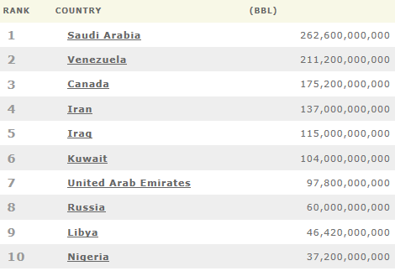
2011 Top 10 Oil Proved Reserves Countries

Slide 18
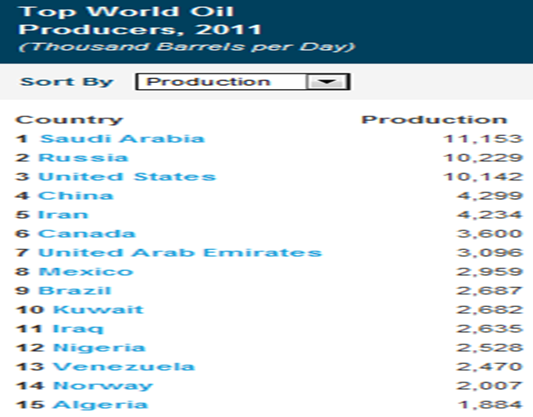
Top world oil producers in 2011
Notes:
Canada ranked number 6 and produce 3600,000 barrels per day.

Slide 19
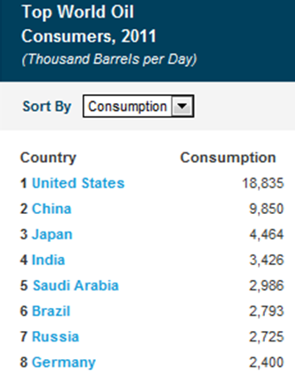
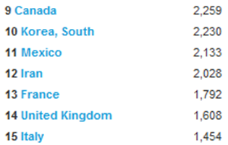
Top world oil consumers in 2011
Notes:
Canada ranked number 9 and consumer 2259,000 barrels per day

Slide 20
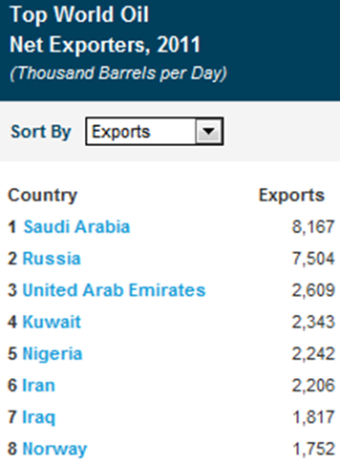
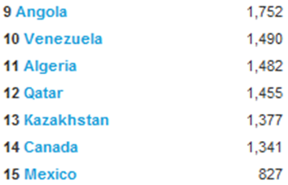
Top Oil Exporting Counties
Notes:
In 2011, Canada ranked number 14 worldly in exporting oil countries. Export 1341,000 barrels per day

Slide 21
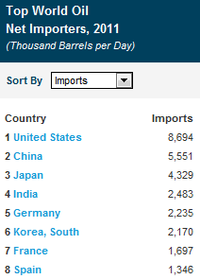
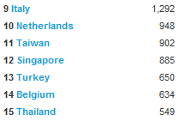
Top world oil net importers in 2011
Notes:
Canada is not in the list. Looks like canada not import any oil

Slide 22
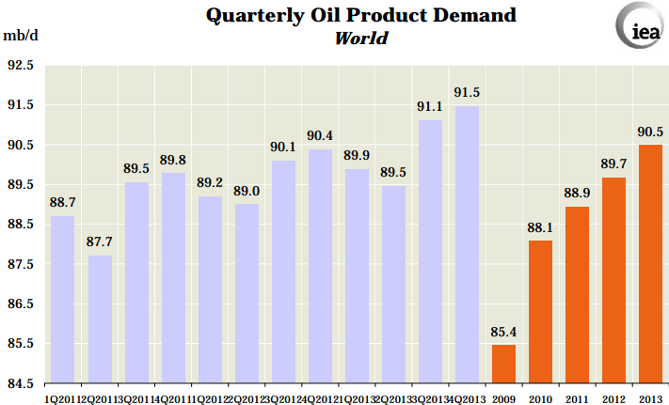

Slide 23
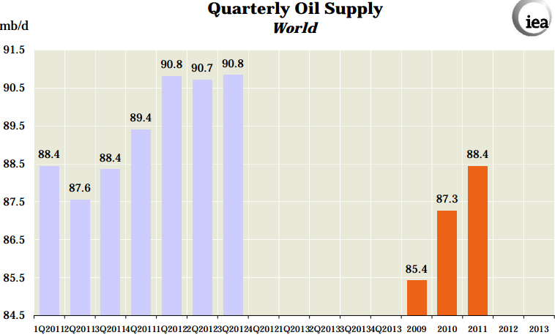

Slide 24
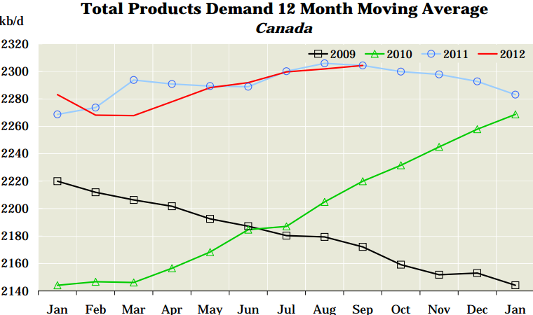
Canada Oil Demand

Slide 25
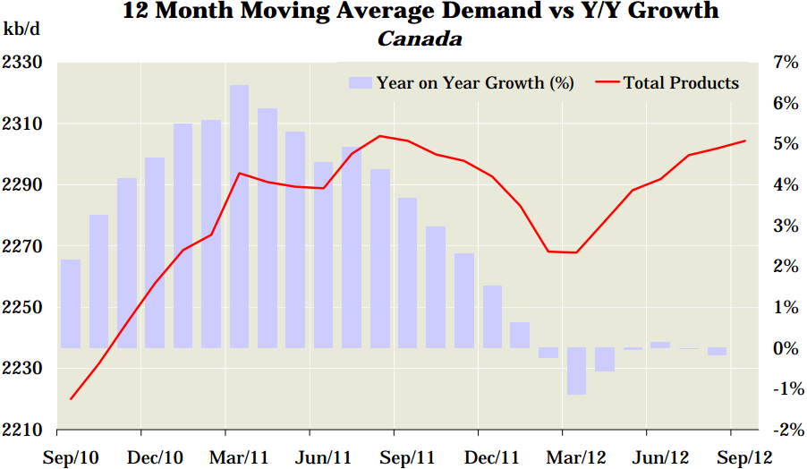

Slide 26
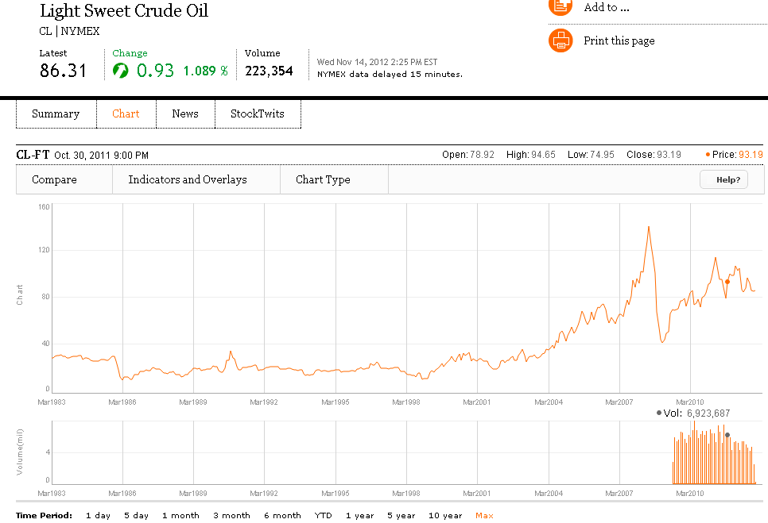

Slide 27
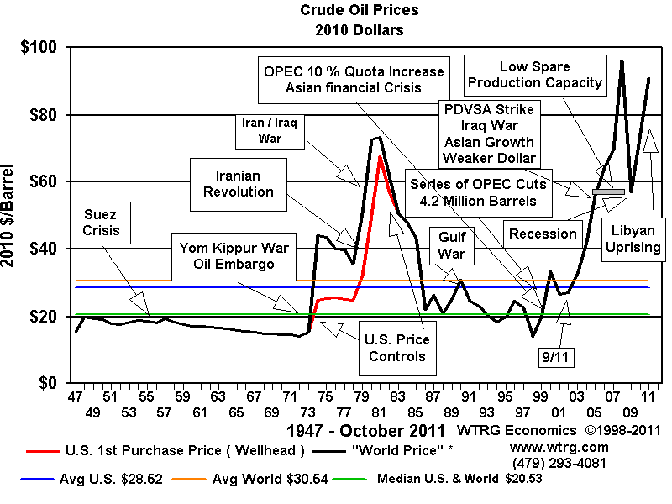
World Event & Oil Price
Notes:
Source: http://www.wtrg.com/oil_graphs/oilprice1947.gif
http://www.wtrg.com/prices.htm have more info
http://www.wtrg.com/prices.htm

Slide 28
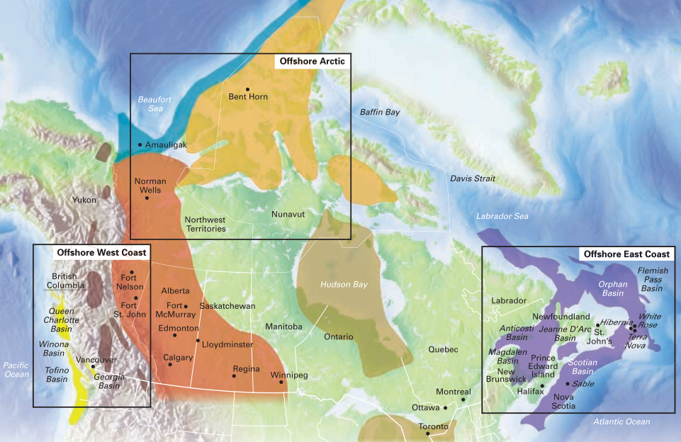
Canada’s Seven Hydrocarbon Regions

Slide 29
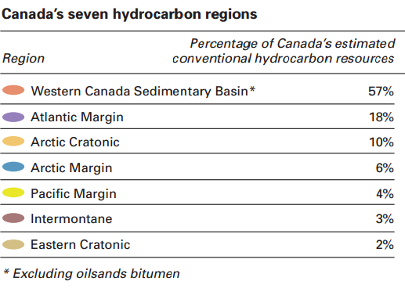
Notes:
Crude oil and natural gas are found in sedimentary rocks . Canada has seven distinct regions or domains of sedimentary rocks.

Slide 30
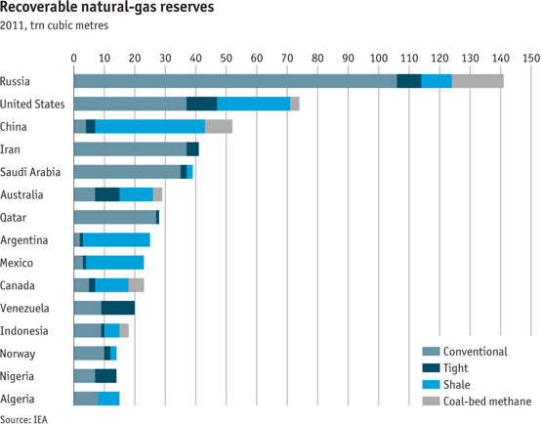
Natural Gas Reserved

Slide 31
World Natural Gas Production (Billion Cubic Feet)
2007
2008
2009
2010
2011

Slide 32
Canada Natural Gas Production and Consumption (Billion Cubic Feet)

Slide 33
World Natural Gas Consumption (Billion Cubic Feet)
2007
2008
2009
2010
2011

Slide 34
Canada Natural Gas Import and Export (Billion Cubic Feet)

Slide 35
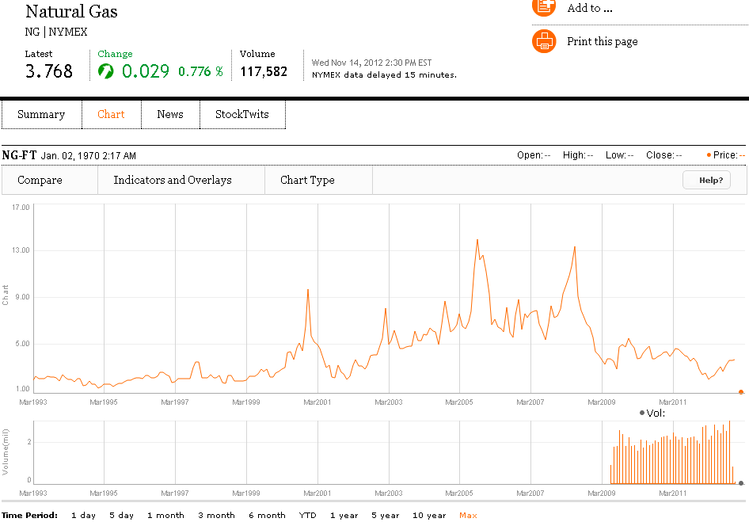

Slide 36
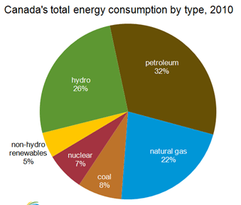
Canada’s Total Energy Consumption by Type

Slide 37
Technology For Crude Oil

Slide 38
Conventional Crude Oil
The oil well is created by drilling a hole into the earth with oil rig. Because of the changes in environment, a different approach must be taken for improved production rates, safety, and transportation.
Notes:
http://theogm.com/2011/04/02/304/
http://www.differencebetween.com/difference-between-onshore-and-vs-offshore/
http://en.wikipedia.org/wiki/Extraction_of_petroleum
http://www.nrcan.gc.ca/energy/sources/petroleum-crude-prices/1225

Slide 39
Onshore & Offshore Drilling
1) Onshore Drilling: the practice of extracting oil from under the surface of earth away from the ocean.
2) Offshore Drilling: the activity of extracting oil from under the sea bed. Currently there are approximately 859 offshore rigs in the world. Close to 78% of them are functioning. Others are still under construction.
Notes:
Oil is found below the surface of earth built sometimes the location is also under water. Though trying to extract oil from below the surface of the ocean is much more difficult than making wells on land and drilling holes, Read more: http://www.differencebetween.com/difference-between-onshore-and-vs-offshore/#ixzz2BPaTCvxG

Slide 40
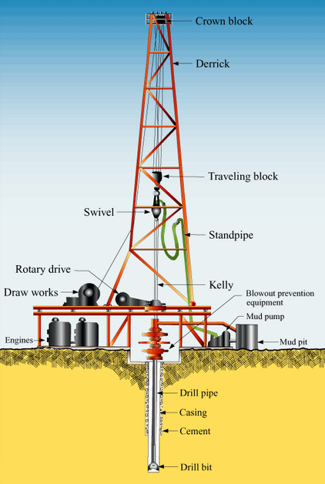
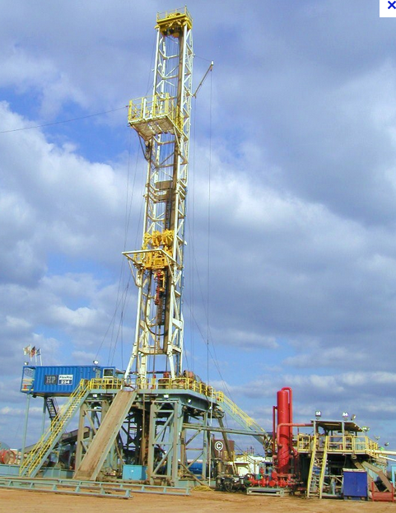
Onshore Drilling

Slide 41
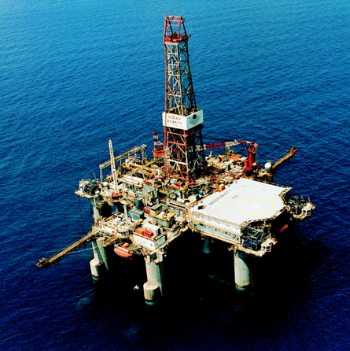
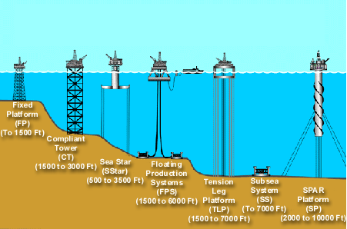
Offshore Drilling
Notes:
To handle these challenges, the industry uses large, stable, self-contained platforms to drill wells
3 types of wells: exploration, delineation and development
-Exploration: confirm whether geological formations identified from seismic surveys do contain hydrocarbons.
-If results are promising, a company may drill delineation wells into different areas of the formation to confirm the formation’s size as well as characteristics of the hydrocarbon resources.
-Then decides whether it will be economically attractive to produce the resource. If test results are favourable, the company will proceed to the third stage, drilling a development well.

Slide 42
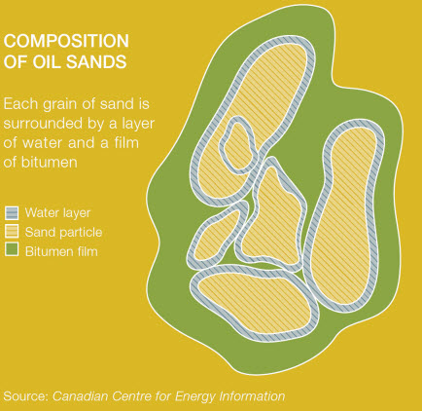
Unconventional: Oil sand
-Oil sand is a naturally occurring mixture of sand, clay or other minerals, water and bitumen
Notes:
http://www.nexeninc.com/en/Operations/OilSands/Process.aspx
Oil sand is a thick, viscous mixture of bitumen hydrocarbons combined with sand, clay or other minerals, and water, which is a heavy and extremely viscous oil that must be treated before it can be used by refineries to produce usable fuels such as gasoline and diesel. Bitumen is so viscous that at room temperature it acts much like cold molasses. The bitumen is separated from the oil sands through heating processes and is then upgraded into higher valued products for end-use markets.
The oil sands are located in three basins in the provinces of Alberta and Saskatchewan, Canada – Athabasca, Cold Lake and Peace River. To date, the Athabasca basin is where the majority of oil sands projects have been developed.

Slide 43
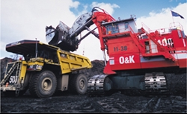
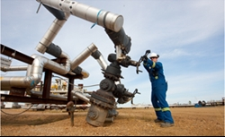
Surface Mining and In-Situ
Notes:
http://www.nexeninc.com/en/Operations/OilSands/Process.aspx
http://www.investopedia.com/terms/o/oilsand.asp#axzz2AlEbnan2
http://www.endress.com/eh/home.nsf/#page/id/DC134ADE19C2BCE4C12578AF00517926
http://environment.gov.ab.ca/info/library/8042.pdf
There are two primary recovery methods for the oil sands to extract bitumen from the ground then process it into a higher quality crude oil: surface mining and in-situ.
Surface Mining
Surface mining is used when bitumen is close to the surface (within 250 feet).
In-situ recovery techniques are used to extract deep deposits of bitumen without removing the soil and materials above it. http://www.conocophillips.com/EN/oilsands/overview/Pages/production.aspx
Surface mining including strip mining, open pit mining and mountaintop removal mining, is a broad category of mining in which soil and rock overlying the mineral deposit are removed.
Truck and shovel mining is used to recover bitumen located close to the surface (70 metres and above). Once mined, it is mixed with hot water and transported to an extraction plant where the bitumen is separated from the sand and water. The bitumen is then upgraded into crude oil.
Surface mining is used when the bitumen deposits are close to the surface, using truck and shovel technology. The sands are transported to a processing facility where hot water is used to separate the bitumen from the sands. Only 20 per cent of all oil sands is close enough to the surface to be mined.
Also call "Open pit mining" resembles conventional mining techniques and is effective in extracting oil sands deposits near the surface.
In-situ Recovery Steam assisted gravity drainage (SAGD) is the most common in-situ recovery process, enabling industry to access 80% of the total oil sands resource. In-situ means “in place,” and this approach allows access to oil sands deposits that are too deep to be reached through mining. In-situ development disturbs less land than oil sands mining.
In situ production recovers deposits that are deeper underground, using techniques that are similar to conventional oil production. Advanced drilling technology is used, typically injecting steam or solvents into the reservoir to mobilize the thick bitumen so it can be pumped to the surface through wells. Steam-assisted gravity drainage (SAGD) uses parallel pairs of horizontal wells, one drilled for steam injection and one for oil recovery.
“In situ” reaches deeper deposits. In situ extraction involves the use of steam to heat and separate bitumen from the surrounding sands, causing it to pool closer to the surface. The bitumen is then pumped from these pools using horizontal drain wells. To date, Canadian oil sands producers have employed each method almost equally, but future production will likely shift to emphasize in situ extraction.

Slide 44
Surface Mining
Strip mining: is the process of removing layers of rock and dirt to reach a mineral deposit. It is most commonly used to mine coal.
Open pit mining: is the process of removing minerals and rock from the earth through an enormous hole, often called a pit or borrow. Open-pit mining is often mistakenly called strip mining.
Mountaintop removal mining: Often used in the Appalachian Mountains to mine coal. Explosives are used to remove the mountaintop in order to expose a coal seam underneath.

Slide 45
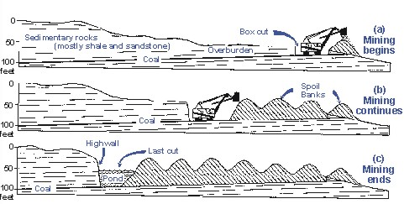
Surface Mining: Strip Mining

Slide 46
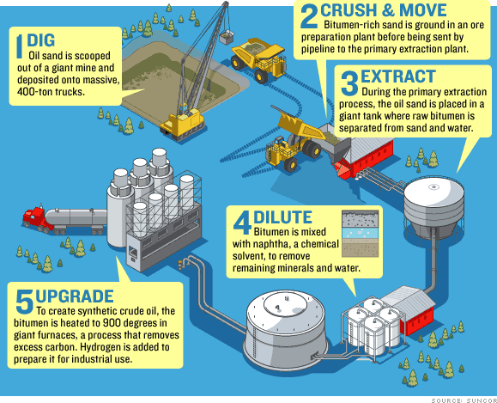
Surface Mining: Open pit

Slide 47
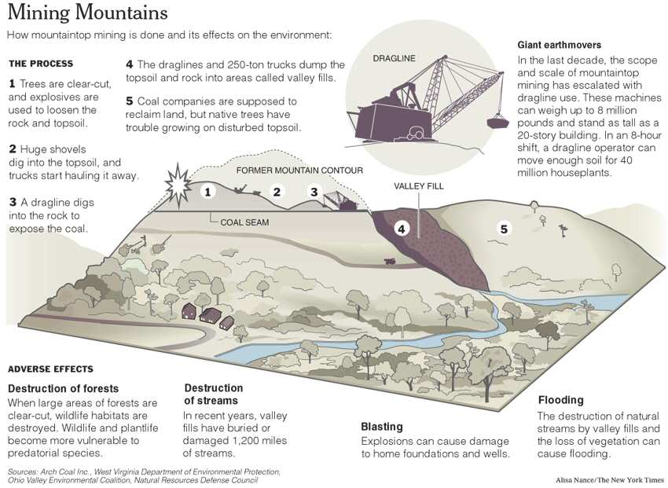
Surface Mining: Mountain Top Removal

Slide 48
In-Situ
There are five in-situ methods of bitumen extraction:
1) Steam Assisted Gravity Drainage (SAGD)
2) Cyclic Steam Stimulation (CSS)
3) Vapor Extraction Process (VAPEX)
4) Toe-to-Heel Air Injection (THAI)
5) Cold Heavy Oil Production with Sand (CHOPS)
Notes:
http://oilsands.infomine.com/commodities/

Slide 49
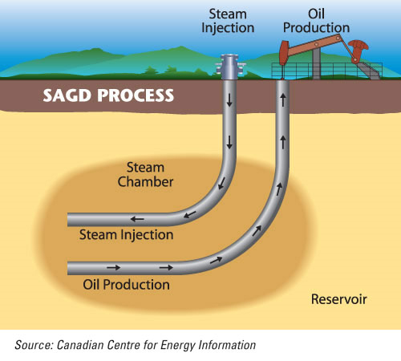
In-situ Technology: Steam Assisted Gravity Drainage (SAGD)

Slide 50
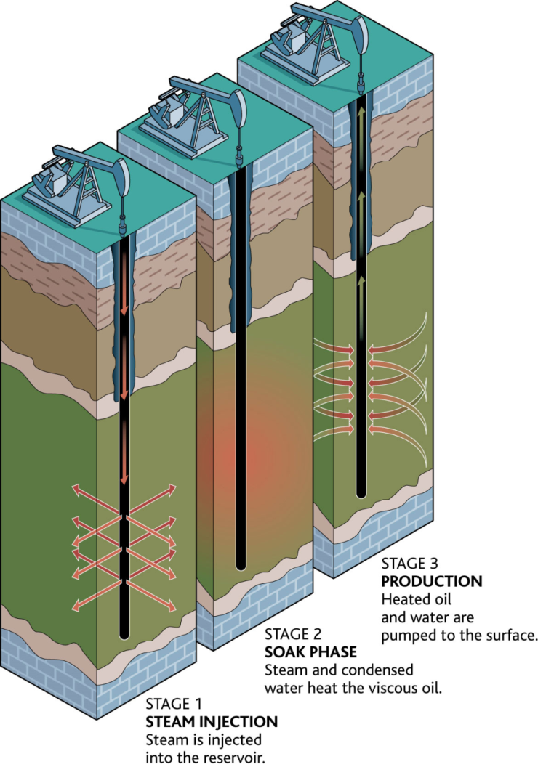
In-situ Technology: Cyclic Steam Stimulation (CSS)

Slide 51
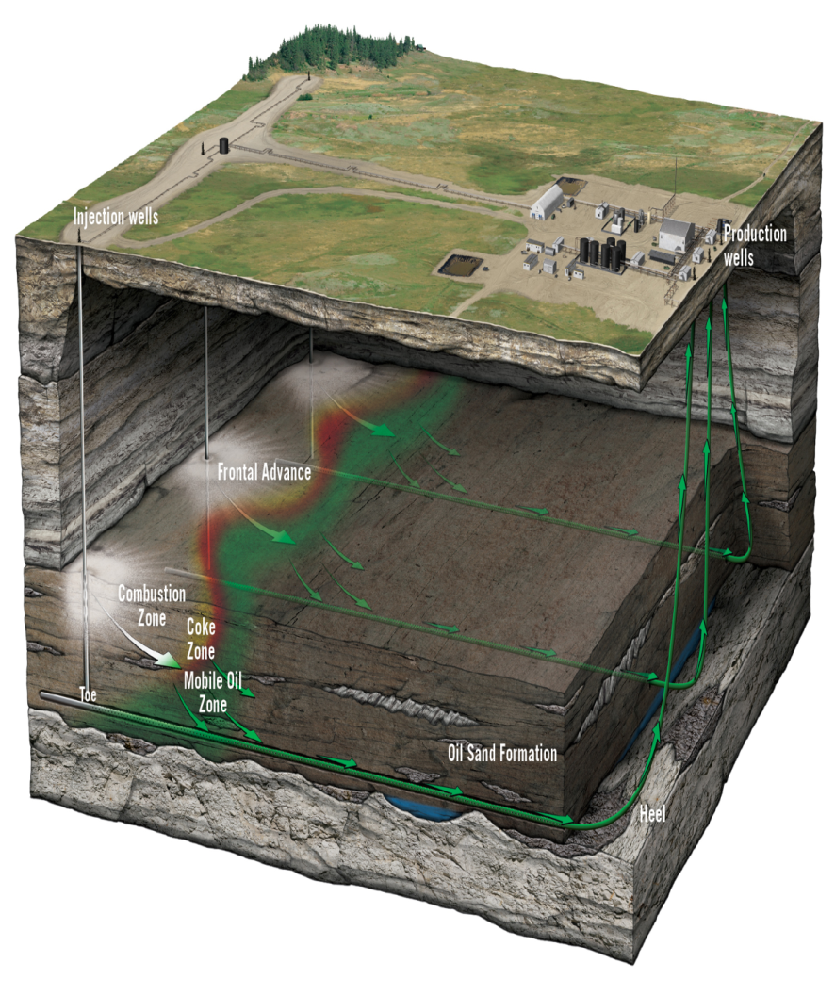
In-situ Technology: Toe-to-Heel Air Injection (THAI)
Notes:
http://www.oilsandsdevelopers.ca/index.php/oil-sands-technologies/in-situ/the-process-2/toe-to-heel-air-injection-thai/
Like CSS and SAGD, THAI technology also uses heat to reduce the viscosity of the bitumen; however, the heat is generated underground by the combustion of a small portion of the bitumen in the ore body.Employed chiefly by Petrobank Energy and Resources Ltd., THAI technology uses two wells; a vertical air injection well with a horizontal production well.Rather than steam, THAI technology injects air and then relies on underground combustion of a portion of the oil in the ground to generate the heat required to “melt” the remainder of the bitumen and allow it to flow into the production well. Air is injected into an injection well where the process ignites oil in the reservoir where it smolders like the embers of a campfire and creates a vertical wall of hot embers. This firewall moves from the injection well (the toe) to the production well (the heel), pushed forward by the pressure of the injected air, causing the heavier oil components to burn and softening the lighter components causing them to flow ahead of the firewall and into the production well where they can be pumped to the surface. THAI technology has the potential to be much less energy intensive than other in-situ technologies because the bitumen “cokes”, meaning it sheds heavy carbon molecules as it moves through the ground towards the production well. This results in a lighter, partially upgraded oil product being brought to the surface, meaning less life-cycle GHG emissions overall as it also reduces the amount of energy-intensive upgrading the produced oil has to undergo. As well, minimal natural gas is used in the process and, as there is little steam required, very little water is used.
Overall, THAI technology produces 50 per cent fewer GHGs than other oil sands production methods, requires very low water use and, like other in-situ projects, has a minimal surface footprint.
-THAI uses two wells; a vertical air injection well with a horizontal production well
-Injects air and then relies on underground combustion of a portion of the oil in the ground to generate the heat required to “melt” the remainder of the bitumen and allow it to flow into the production well.
Pros:
-much less energy intensive than other in-situ technologies
-50 % lower GHGs than other oil sands production methods and low water use

Slide 52
In-situ Technology: VAPEX
The Vapor Extraction Process (VAPEX) is similar to SAGD, but instead of steam, hydrocarbon solvents are injected into the upper well to dilute the bitumen and allow it to flow. It is much more energy efficient than steam injection and some partial upgrading of the bitumen to crude oil occurs right in the sands. This method is new and more expensive than the above but oil companies are experimenting with it.

Slide 53
In-situ Technology: CHOPS
CHOPS utilizes a submersible pump that can pump thick fluids, down to the heavy oil and pumps from there, allowing sand and other rocks up the wellbore -- as it is difficult to separate out the sand from the heavy oil.

Slide 54
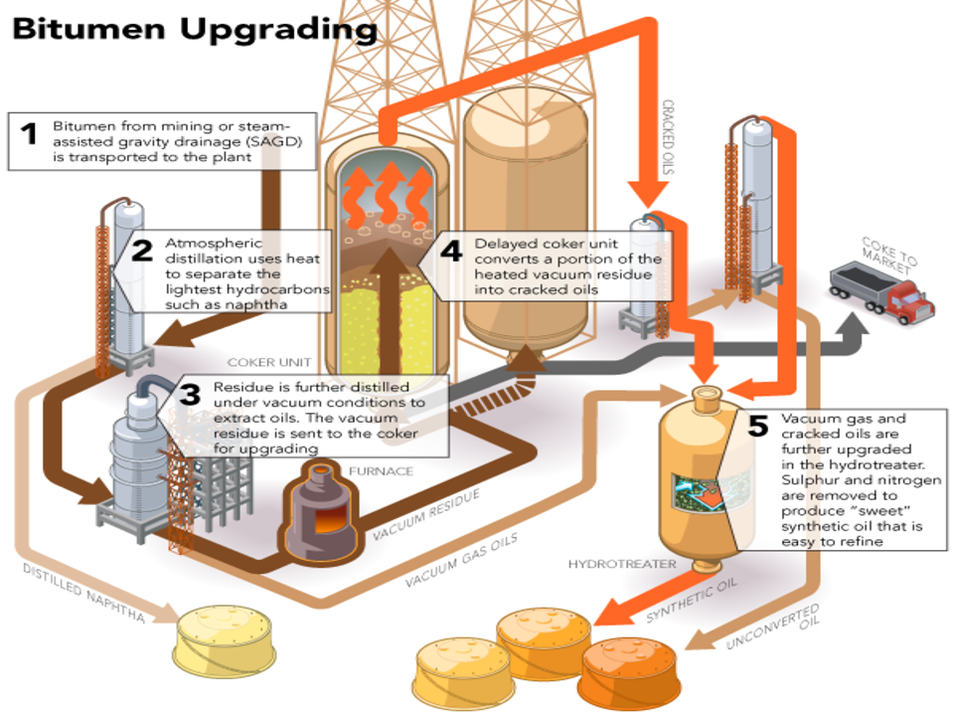
Bitumen Upgrading

Slide 55
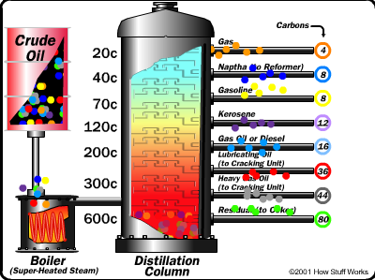
Crude Oil Refineries

Slide 56
Technology For Natural Gas

Slide 57
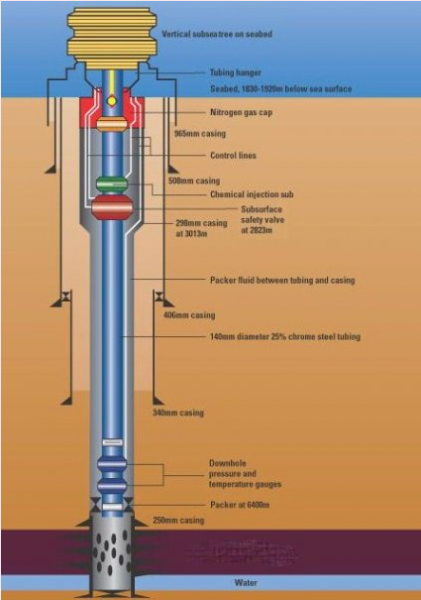
Drilling
Once a deposit is located, a well is set and drilling proceeds similar to oil extraction

Slide 58
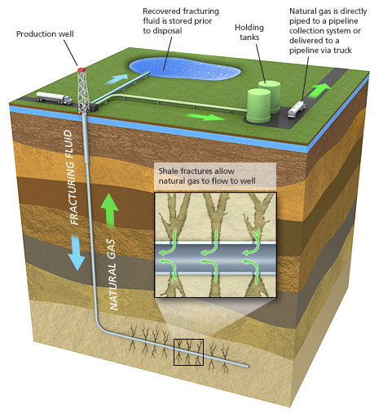
Hydraulic Fracturing
This technique involves shooting water into the ground with high pressure, creating fractures in the rock so the gas can reach the well

Slide 59
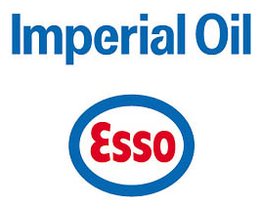
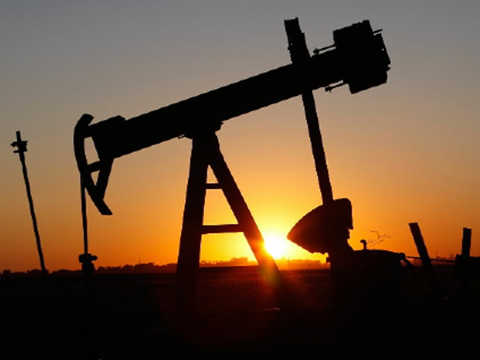
Imperial Oil Ltd.

Slide 60
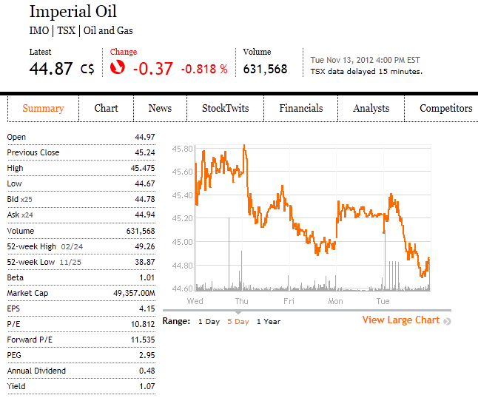
Financial Snapshot

Slide 61
Common share structure
 | Current | 2011 | 2010 | 2009 | 2008
Shares Outstanding (Millions) | 847.599 | 847.599 | 847.599 | 847.599 | 859.402
Millions of Canadian dollars | Q2-12 | Q2-11 | Six Months to June 30 2012 | Six Months to June 30 2011
Issuance of common shares under stock option plan | 21 | 3 | 43 | 14
Common shares purchased | (60) | (8) | (128) | (44)
Dividends paid | (102) | (94) | (195) | (187)

Slide 62
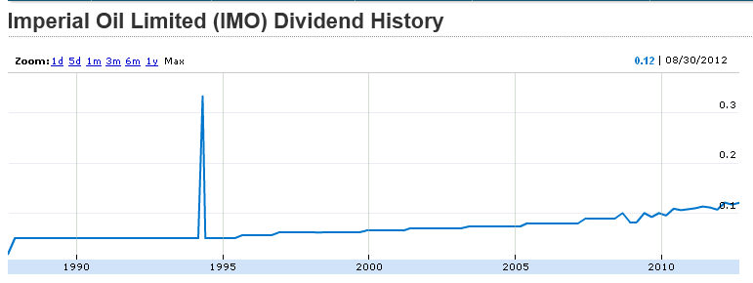
Dividend payout history
Source: dividata.com
Annual dividends paid have increased for the past 17 years.

Slide 63
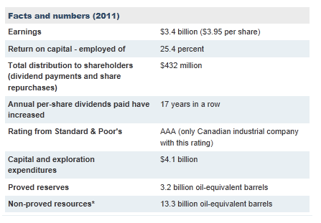
Investor quick facts

Slide 64
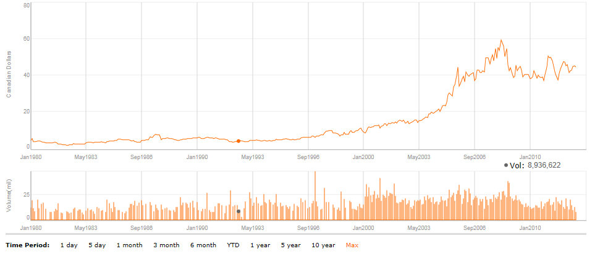
MAX Chart

Slide 65
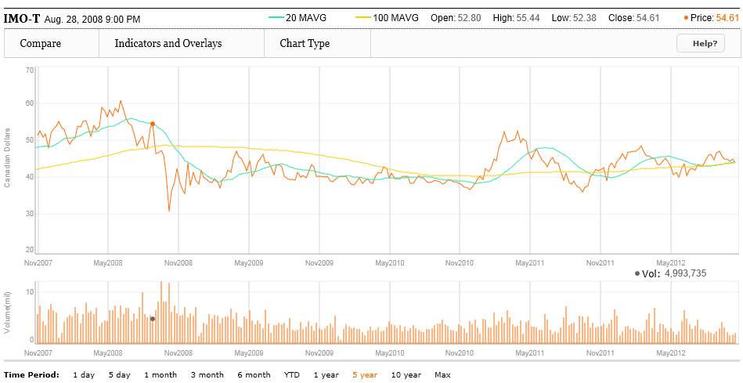
5 Year Chart

Slide 66
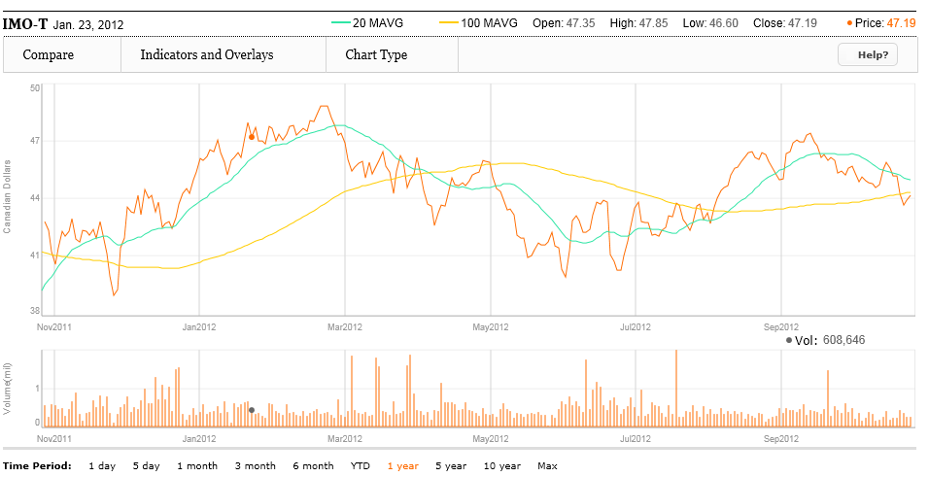
1 Year Chart

Slide 67
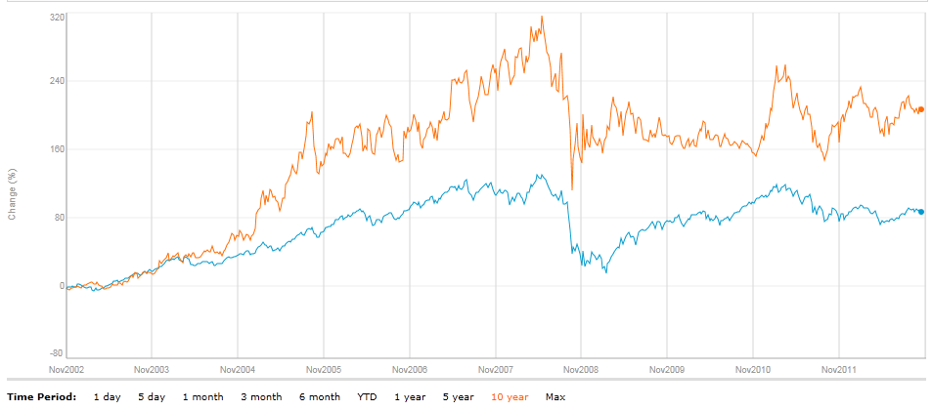
IMO vs. S&P/TSX Composite– 10 Year

Slide 68
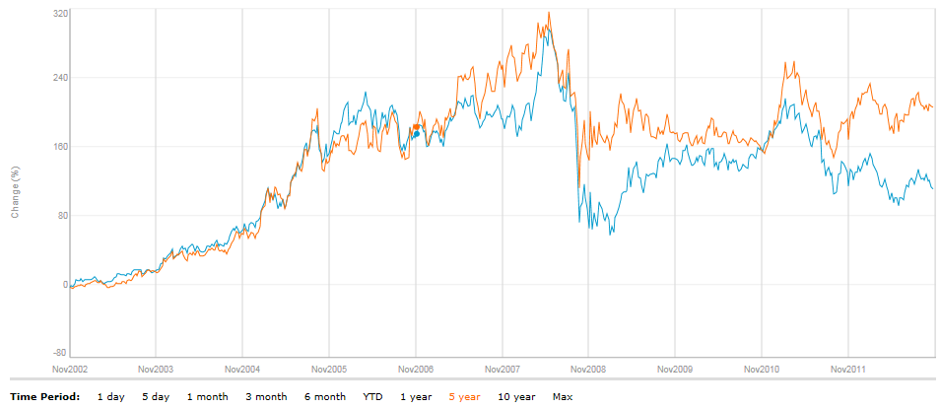
IMO vs. S&P/TSX Capped Energy– 5 Year

Slide 69
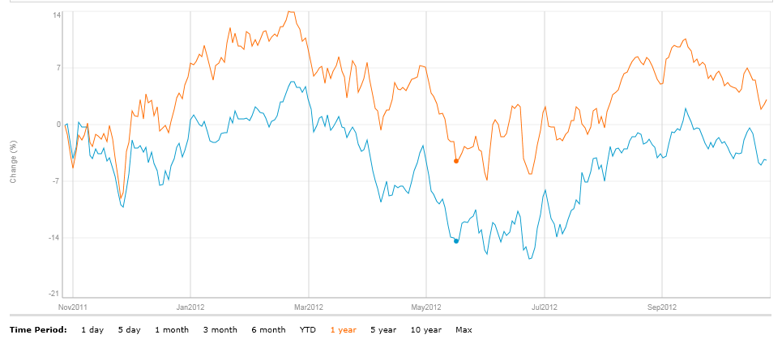
IMO vs. S&P/TSX Wght Oil & Gas 1 Year

Slide 70
Company Background
Founded in London, Ontario in 1880
Controlled by US based ExxonMobil (69.6% share)
Owns 25% of Syncrude Canada Ltd., the world’s largest producer of synthetic crude oil from surface mining of oil sands
Full-time Employees: 5,083
about 1,850 service stations in Canada (Esso)
Most of its production is from its vast natural resource holdings in Alberta and the Northwest Territories
Notes:
ExxonMobil Corp. is an American multinational oil and gas corporation. It was formed on November 30, 1999, by the merger of Exxon and Mobil.

Slide 71
Company Profile
One of Canada’s largest corporations
A leading member of Canada’s oil and gas industry
A major producer of crude oil and natural gas
Canada’s largest petroleum refiner
A key petrochemical producer
A leading marketer with coast-to-coast supply and retail networks

Slide 72
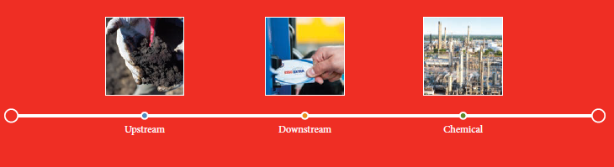
Business Segments
Upstream (Natural Resources):
- Conventional Oil and Gas
- Oil sands operation
Chemical:
Downstream (Petroleum Products):
- Refining, distributing and marketing

Slide 73
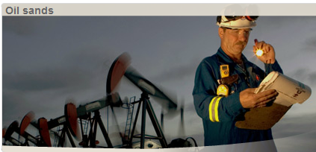
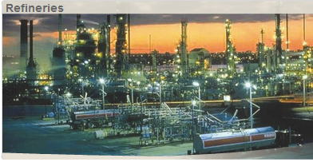

Coast-to-Coast operations
Develop natural resources
Refine, transport and sell to customers
Refiners of petroleum
Market and sell its products through Esso

Slide 74
Upstream
Exploring for oil and gas
Developing energy
Producing oil and gas

Slide 75

Exploring for oil and gas
Beaufort Sea
Location:
Northwest Territories
Overview:
Imperial and ExxonMobil Canada hold a multi-year exploration license in the Beaufort Sea. Its lease area is known as Ajurak and covers more than 500,000 acres.
Key exploration areas:
Athabasca region: oil sands area in northern Alberta
Horn River Basin: shale gas area in northeast British Columbia
Beaufort Sea: hydrocarbon area in Canada’s Far North
Orphan Basin: hydrocarbon area in offshore Atlantic Canada
Orphan Basin
Location:
Offshore Newfoundland and Labrador
Overview:
Imperial holds a 15% interest as a co-venture in the Orphan Basin, a deep-water exploration opportunity.
Horn River (Shale Gas)
Location:
Fort Nelson, BC
Overview:
It is a frontier exploration area where natural gas is trapped in shale rock. Imperial and ExxonMobil Canada have acquired more than 300,000 net acres and are currently conducting exploration work to test the potential of the area.
Notes:
Imperial holds extensive undeveloped land in the Athabasca region of Alberta. This area offers opportunities for future mineable and in-situ oil sands developments. We are carrying out drilling and other exploration work to identify further resource.

Slide 76



Upstream- Conventional Oil & Gas
Imperial is one of Canada’s largest producers of conventional crude oil and natural gas
Produce about 255,000 barrels of crude oil and natural gas liquids, and about 250 million cubic feet a day of natural gas
Crude Oil & NGL Production by Source
Thousands of barrels a day before royalties
Natural Gas production
Millions of cubic feet a day before royalties
Notes:
Source: 2011 AR

Slide 77

Net proved Reserves
Total net proved reserves in 2011 was 3.2 billion barrels.
Non-proved resources 13.3 billion barrels.
Imperial plans to double Upstream production volumes by 2020.

Slide 78
Imperial’s Decade-Long Growth Strategy
2010-2020
CAPEX in 2011 totaled $4.1 billion, mainly focused on advancing the construction of the Kearl Initial Development project
Invest between $35 billion and $40 billion to double the total Upstream production
Source: 2011 Annual Report

Slide 79

Producing Conventional Oil
Conventional production in Western Canada is at a mature stage
Operation focuses on 3 main areas:
- Cost control
-Maximizing production of existing oil and gas fields
-pursuing projects with the potential for strong returns

Slide 80

Upstream- natural gas
Source: ImperialOil.com

Slide 81

Natural gas- opportunities
Mackenzie Gas Project
Horn River
(Shale Gas)
Sable

Slide 82
Natural gas- opportunities
Horn River (Shale Gas)
Has acquired more than 340,000 net acres with ExxonMobil Canada
Currently conducting exploration work to test the potential
Expected to start production from a multi-well pad in 2012
Sable
Located in relatively shallow water to the southeast of Halifax, Nova Scotia (9% interest)
Mackenzie Gas Project
Could bring an estimated six trillion cubic feet of onshore natural gas to North America
Imperial’s wholly owned Taglu field represents about half of the discovered natural gas resource that anchors the project

Slide 83
Downstream Operations
Making petroleum products
Selling petroleum products
Activities including:
Transportation
Refining and Blending of crude oil
Distribution and Marketing

Slide 84

Downstream- Refineries
Nanticoke refinery
Location:
Nanticoke, Ontario
Products:
Gasoline, diesel, home heating fuel, jet fuel, asphalt and chemical products
Daily capacity:
118,000 barrels of crude oil a day
Strathcona refinery
Location:
Edmonton, Alberta
Products:
Gasoline, diesel, aviation fuels, propane, butane, lubricating oils, waxes, asphalt and heavy fuel oil.
Daily capacity:
187,000 barrels of crude oil a day
Up for Sale !
Sarnia manufacturing site
Location:
Sarnia, Ontario
Products:
Sarnia has the most integrated fuels, chemicals manufacturing and petroleum research facility in Canada
Daily capacity:
120,000 barrels of crude oil a day
Dartmouth refinery
(94 years old)
Location:
Dartmouth, Nova Scotia
Products:
Gasoline, diesel, home heating fuel, het fuel, asphalt and chemical products.
Daily capacity:
89,000 barrels of crude oil a day
Notes:
According to the news in May, 2012, Imperial Oil has put the refinery up for sale. Due to the increasing input costs, declining demand and high competition, the refinery has been losing money in recent years. One of the most significant hurdles for the refinery is the cost of Brent crude oil. WTI crude oil is roughly $17 a barrel cheaper.
http://thechronicleherald.ca/metro/97307-imperial-oil-to-sell-refinery

Slide 85
Refineries- 2011
Remained Canada’s largest petroleum refiner
Sales Volume:
- Petroleum product sales volumes were 447,000 barrels a day.
- Gasoline sales were 220,000 barrels a day.

Slide 86
Downstream- Distribution and Marketing
1850 Esso retail stations
400 On the Run convenience stores
Alliance with Tim Hortons, Royal Bank, Aeroplan
Largest network of car washes in Canada
Distributing through both retail and wholesale

Slide 87


Chemical
Produce Petrochemical products
Marketing petrochemicals

Slide 88


key energy projects
-The Syncrude Project
A Joint Venture undertaking by 7 companies, and Syncrude as the project operator
Imperial holds 25% interest
A mining and upgrading operation in the Athabasca oil sands region near Fort McMurray, Alberta
One of the world’s largest producers of crude oil from oil sands
Imperial’s share of gross production averaged 73,000 barrels a day in 2011
Notes:
The Syncrude Project is a Joint Venture undertaking among these companies, Canadian Oil Sands Partnership #1, Imperial Oil Resources, Mocal Energy Limited, Murphy Oil Company Ltd., Nexen Oil Sands Partnership, Sinopec Oil Sands Partnership, and Suncor Energy Oil and Gas Partnership

Slide 89

key energy projects
Cold Lake Oil Sands operation
Located near Cold Lake, northeastern Alberta
100% owned by Imperial Oil
The world’s largest thermal in-situ heavy oil operation
A record Production of 160,000 barrels per day in 2011
In-situ production method (bitumen)
Notes:
2011-AR p6.
Cold Lake is east of Alberta's capital, Edmonton, near Alberta's border with Saskatchewan, and a small portion of the Cold Lake field lies in Saskatchewan.
Some of the oil sands in the Cold Lake deposit have a low enough density that they can be extracted through drilling, as opposed to mining.
Heated with steam, which melted semi-solid bitumen and separate it from accompanying sand → bitumen then pumped onto surface and diluted with condensate for shipping
Lake bitumen is located more than 400 metres below the surface out of the ground and we extract it by injecting steam into the oil sands to thin the heavy bitumen and enable it to flow to the surface through wellbores.

Slide 90

key energy projects
Kearl Oil Sands Project
a $10.9 billion project
Currently in phase one of the project for targeted start up by the end of 2012 (98% complete as of Nov 1)
Jointly owned by Imperial Oil (operator) and ExxonMobil Canada
Will be one of Canada’s largest open-pit mining operations with
Offset decline in conventional oil production and help meet North American’s energy demands
Will be an important new source of volume growth for Imperial and North American energy markets
Kearl Oil Sands Project
Notes:
Located at the Kearl Lake area, the Athabasca Oil Sands Region

Slide 91

Kearl Oil Sands Project
Key Facts:
Estimated total recoverable resource: 4.6 billion barrels of bitumen
Production from initial development at startup: 110,000 bpd
Imperial's share of initial production: 78,000 barrels a day
Contribution to Imperial's proved reserves as at year end 2009: 962 million barrels
Regulatory approval : up to 345,000 bpd
Notes:
With 4.6 billion barrels of recoverable bitumen resource, Kearl is one of Canada’s largest and highest quality oil sands deposits. There is minimal exploration risk because the ore is close to the surface and the volume and quality of the resource has been thoroughly assessed.
Workers are on-site constructing phase one of the project for targeted start up in late 2012. Infrastructure such as roads and power lines are being constructed, foundations are being installed and large-scale facility modules to process the bitumen will soon arrive on-site for assembly.

Slide 92
Safety & environment commitments
Sustained industry-leading employee safety performance
Receives CAPP Stewardship Award for Safety Program
Put safety of people on its number one priority
Committed to developing resources responsibly and minimizing the impact on the air, land and water
More than 95% of produced water is treated and recycled for steam production at Cold Lake production facility
Fined $195K for environmental violations at its facilities in Norman Wells, N.W.T. in 2011
Notes:
http://www.cbc.ca/news/canada/north/story/2011/09/16/north-imperial-oil-fined-normal-wells.html
In 2009, the company pumped a chemical, used to prevent pipes from rusting, in much higher concentrations than allowed.

Slide 93

International Commodity Prices
Determined by the Marketplace, and Affected by :
Global and Regional Demand/Supply Balances
Inventory Levels
Refinery Operations
Import/Export Balances
Currency Fluctuations
Transportation Logistics
Seasonality and Weather
Source: Bloomberg, As of Nov. 1, 2012
Notes:
WTI oil is roughly $20 a barrel cheaper than Brent crude oil.
WTI- Western Texas Intermediate

Slide 94
Exports
Export sales (includes to the US), as follows: Millions of dollars | 2011 | 2010 | 2009
Upstream | 2,180 | 1,759 | 1,671
Downstream | 1,172 | 1,227 | 1,266
Chemical | 823 | 664 | 518
Total export sales | 4,175 | 3,650 | 3,455
% of Total sales | 15.85% | 17.07% | 18.85%
Source: 2011 Annual Financial Statements

Slide 95


CAD/USD exchange rate
1 CAD = 1.0035 USD
Source: Yahoo Finance, As of Nov. 5, 2012
5-Year Trend
1-Year Trend

Slide 96




Commodity price charts
Source: Oil-Price.net, As of Nov. 5, 2012
Notes:
2011:
The average price of Brent crude oil in U.S. dollars, a common benchmark for Atlantic Basin oil markets, was $111.29 a barrel in 2011, up about 40% from the previous year.
Increase in the average price of West Texas Intermediate (WTI) crude oil, a common benchmark for mid-continent North American oil markets, was limited to 19%, due to the continued weakness in WTI crude oil markets.
Higher crude oil commodity prices,
Stronger Canadian dollar

Slide 97


Production & sales

Slide 98

Average realizations

Slide 99

Market risks and other uncertainties
Imperial’s potential exposure to commodity price and margin and Canadian/U.S. dollar exchange rate fluctuations is summarized in the earnings sensitivities table below:
Imperial does not use derivative markets to speculate or hedge future directions
Notes:
2011 Annual Financial Statements p17.
Imperial does not hedge the price of its production, its foreign exchange requirements or interest rate exposure, nor does it use special-purpose financial instruments, or off-balance-sheet financing structures.

Slide 100
Market risks and other uncertainties
Then How does Imperial manage the market risks?

Slide 101
Risk Management
Big company size, strong capital structure, and the complementary nature of 3 segments business reduce the risk from changes in commodity prices and currency rates
Financial strength and debt capacity (Deb/total capital was only 9% in 2011)
Progress large capital projects in a phased manner adjustments can be made when significant changes occur

Slide 102

BUSINESS SEGMENTS PERFORMANCE - Q3
Notes:
Capital and exploration expenditures (CAPEX) include exploration expenses, additions to property, plant, equipment and additions to capital leases.
Cash flows from operating activities are highly dependent on crude oil and natural gas prices, as well as petroleum and chemical product margins.

Slide 103

BUSINESS SEGMENTS STATEMENTS- annual
Notes:
Upstream: earnings increased due to higher crude oil commodity prices and increased Cold Lake bitumen production
Downstream: stronger industry refining margins b/c of the declining overall costs of WTI crude oil
Chemical: improved margins for intermediate and aromatic products, lower costs due to lower planned maintenance activities and higher polyethylene sales volumes were the main contributors to the increase
Net cash generated from downstream operations continued to be used to help fund Imperial’s upstream growth plans.

Slide 104


Management
Bruce March
Chairman, President, and CEO since 2008
Joined Mobil Oil in 1980
Director, refining Europe/Africa/Middle East with ExxonMobil Petroleum & Chemicals BVBA in Belgium in 2007
Graduate of the Rochester Institute of Technology

Slide 105


T. G. (Glenn) Scott
Senior vice-president, Resources division since June 2010
Joined Mobil Oil Corp. in 1986
Former President of ExxonMobil Canada Ltd. , and Production Manager for ExxonMobil Canada East in 2006
B. Sc of Texas A&M University

Slide 106


Paul Masschelin
CFO, Senior Vice-President of Finance & Administration, and Controller since May 2010
Joined Exxon in Belgium in 1980
Controller of ExxonMobil refining and supply, also downstream controller of ExxonMobil research and engineering in 2007
MBA from Catholic University (Belgium)
Bachelor of commercial engineering and actuarial sciences

Slide 107


Brian Livingston
Vice-president, general counsel and corporate secretary since 2004
Joined Imperial Oil in 1985
Former vice-president and general counsel in 2002
Bachelor of law from U of Toronto, Bachelor of mechanical engineering from Queen’s University

Slide 108

Phil dranse
Treasurer since Aug. 2012
Joined Exxon in England in 1976
Joined Imperial Oil in the Chemicals business in Alberta in 1982
Transferring to Corporate Treasurers in 1992
Bachelor of Science in Chemical Engineering from Loughborough University

Slide 109
Financial statements

Slide 110

q3 Balance Sheet
Employee retirement benefits
2,456
Asset retirement obligations and other environmental liabilities
919
Share-based incentive compensation liabilities
175
Other obligations
198
Notes:
Note7-Other long-term obligations: mostly Employee retirement benefits, some Asset retirement obligations and other environmental liabilities
Note7 (a) total recorded employee retirement benefits obligations also included $48 million in current liabilities (December 31, 2011- $48million)
Assets mostly from pp&e. Debt/Equity ratio decreased.
2012 Debt/Equity Ratio=12,819/15,652=82%
2011 Debt/Equity Ratio=12,108/13,321=91%
The company is not so much leveraged.
Note6 Long-term debt: in the 3rd quarter, the company increased the amount of its existing stand-by long-term bank credit facility and extended the maturity date to August 2014.

Slide 111

Annual Balance Sheet
Notes:
2011 Debt-to-Equity Ratio= 12108/13321=91%; 2010 Debt-to-Equity Ratio= 9403/11177=84%;
Note14 Long-term debt: in 2011, the company borrowed an additional $320 million under an existing agreement with ExxonMobile
PP&E: mostly from upstream 15,000 out of 19,000

Slide 112

annual Income Statement
Notes:
Operating revenue and net income increases each year.
Gross margin= (Revenue-COGS)/Revenue
Profit margin= Net Income/Revenue also increases
2011-11.1%; 2010-8.9%; ; 2009-7.4%

Slide 113

Q3 Income Statement
Notes:
3rd quarter profit increased 21%. Net income for the 3rd quarter is $1.04billion, or $1.22 per share, compared to $859million or $1.01 a share for the same period last year. The main reason is b/c of higher margins at its refineries.

Slide 114

annual Cash Flow Statement

Slide 115

q3 Cash Flow Statement

Slide 116

Financial summary- Annual
Zero net debt

Slide 117
Recommendation
HOLD!

Slide 118


Slide 119

Financial Snapshot
Shares Outstanding: 484.5 million

Slide 120

Stock Performance – 1 year

Slide 121

Stock Performance – 5 year

Slide 122

Stock Performance – 10 year

Slide 123

COS VS. S&P/TSX Eq Wght Oil & Gas

Slide 124

COS VS. S&P/TSX Composite

Slide 125

Dividend History

Slide 126


Slide 127
Company Overview
1995 Canadian Oil Sands (COS) Trust with a 10% Interest in Syncrude formed by PanCanadian Petroleum
1996 Athabasca Oil Sands Trust with a 11.74% Interest in Syncrude formed by Gulf Canada
2001 Canadian Oil Sands Trust and Athabasca Oil Sands Trust merged. Owns 21.74% of Syncrude
2003 COS purchases an additional 13.75% interest in Syncrude
2006 stock splits 5 to 1
2007 COS acquires a 1.25% incremental interest in Syncrude. Owns 36.74 % of Syncrude
2011 COS converts from a Trust to a corporation

Slide 128
SYNCRUDE HISTORY
1964 Syncrude consortium formed with the mandate to research the economic and technical feasibility of mining oil from the Athabasca oil sands
1978 Syncrude produces its first barrel of oil
1996 Syncrude introduces truck and shovel and hydrotransport technology to its mining operations, which helps reduce operating costs. This technology is subsequently adopted by other mining operations.
1998 Syncrude becomes the first oil sands producer to ship a cumulative total of one billion barrels of crude oil.
2006 Management Services Agreement signed with Imperial Oil; enables Syncrude to access the best practices, global proprietary systems and people expertise of Imperial Oil and its parent company, ExxonMobil.
2011 Syncrude embarks on a major capital projects program aimed at maintaining and enhancing its operations and improving environmental performance. These projects are slated to be largely complete by 2015, providing Syncrude with a continued strong base of production and operational efficiencies.

Slide 130

Syncrude Canada Ltd.
Operates and administers the Syncrude Project on behalf of its owners.
One of the largest producers of high-quality synthetic crude oil
Investing in several major projects over the next few years
Mine train replacements and relocations
Mildred Lake Mine Replacement
Aurora North Mine Relocation
Notes:
COS announced earlier this month that Syncrude will embark upon a mine extension project at its Mildred Lake
mine (“the MLX Project”). The MLX Project will employ the same mine trains that are currently being constructed at
Mildred Lake. This project is expected to be highly economic, enabling Syncrude to access a large bitumen
source at a cost that is expected to be significantly lower than the cost of a new mine.

Slide 131

Reserves and Resources
11.6
4.3
Syncrude has 8 leases in the heart of Athabasca Oil Sands deposit.
covering 101, 960 hectares.
All of the leases can be mined and are among the best for quality, which enhance the economics of the Syncrude project.
Notes:
Proved Reserves that can be estimated with a high degree of certainty to be recoverable. NI 51-101 further identifies the certainty level for proved reserves as "at least a 90% probability that the quantities actually recovered will equal or exceed the estimated proved reserves".
Proved plus Probable Reserves Additional reserves that are less certain to be recovered than proved reserves. NI 51-101 defines the certainty level as "at least a 50% probability that the quantities actually recovered will equal or exceed the sum of the estimated proved plus probable reserves." Therefore, under NI 51-101, the proved plus probable reserves represent a "best estimate" or "expected reserves".
Contingent Resources Quantities of petroleum estimated, as of a given date, to be potentially recoverable from known accumulations using established technology or technology under development, but which are not currently considered to be commercially recoverable due to one or more contingencies.
Prospective Resources Quantities of petroleum estimated, as of a given date, to be potentially recoverable from undiscovered accumulations by application of future development projects. Prospective resources have both an associated chance of discovery and a chance of development.
Best Estimate Term used to describe an uncertainty category for resources estimates referring to the best estimate of the quantity that will actually be recovered. It is equally likely that the actual remaining quantities recovered will be greater or less than the "best estimate". The best estimate of Contingent and Prospective Resources is prepared independent of the risks associated with achieving commercial production.

Slide 132

Production Process
Syncrude surface mines oil sand, extracts the raw oil known as bitumen and upgrades it into high-quality, sweet light crude oil. The oil is transported via pipeline to refineries.
Notes:
The Syncrude operation encompasses four major technologies: mining, extraction, upgrading and utilities. Syncrude surface mines oil sand, extracts the raw oil known as bitumen and upgrades it into high-quality, sweet light crude oil. The upgrading process subjects the bitumen to fluid coking, hydroprocessing, hydrotreating and reblending.

Slide 133

Production Process
Notes:
The Syncrude operation encompasses four major technologies: mining, extraction, upgrading and utilities. Syncrude surface mines oil sand, extracts the raw oil known as bitumen and upgrades it into high-quality, sweet light crude oil. The upgrading process subjects the bitumen to fluid coking, hydroprocessing, hydrotreating and reblending.

Slide 134

Financial Highlights
Notes:
Revenue is affected by selling price and sales volumes

Slide 135

Production Results

Slide 136

Management Team
Donald J. Lowry
Chairman of the Board
Became a director in 2007
Became Chairman in 2009.
Over 25 years of experience in the industry. Also the President and CEO of EPCOR Utilities, Chairman of Capital Power Corporation, director of Canadian Electricity association, the Conference Board of Canada
Holds bachelor of Commerce(Hons), MBA from University of Manitoba
Graduate of Harvard Advanced Management Program and the Banff School of Management

Slide 137

Management Team
Marcel R. Coutu
President and CEO
Joined COS in September 2001.
Chairman of the Board of Snycrude.
More than 25 years of experience in the energy sector, primarily focused in corporate finance.
Was CFO of Gulf Canada and VP Finance at TransCanada Pipelines.
Holds and H.B.Sc. In geology from the University of Waterloo (1976)
Holds an MBA from the University of Western Ontario

Slide 138

Management Team
Ryan M. Kubik
CFO
Joined COS in September 2002 as Treasurer
Promoted to CFO in April 2007
Chair of the Syncrude Joint Venture Audit and Business Controls Sub-Committee
Held senior finance positions with EnCana Corporation, PanCanadian Energy and PricewaterhouseCoopers prior to COS
Holds ICD.D. designation
Holds CA and CFA desiganations
Bachelor of Commerce degree from the University of Calgary

Slide 139

Management Team
Allen R. Hagerman
Executive VP
Joined COS in June 2003
Responsible for overseeing COS’s crude oil marketing operation.
Was CFO from 2003 to 2007
More than 25 years of experience in the financial management of energy companies
Was VP and CFO of Fording Canadian Coal Trust
Completed the Institute of Corporate Directors, Corporate Governance program and is accredited as a certified director under that program with the ICD.D. designation
Holds CA designation
An MBA from the Harvard Business School

Slide 140

Q3 Balance Sheet
Notes:
Asset retirement obligation???

Slide 141

2011 Consolidated Balance Sheet

Slide 142

2011 Consolidated Income Statement

Slide 143

2012 Q3 Income Statement

Slide 144

2011 Cash Flow Statement

Slide 145

2012 Q3 Cash Flow Statement
Notes:
Decrease in CF from operation is due to a lower average realized selling price, but offset by higher sales volumes.

Slide 146
Recommendation
BUY

Slide 147

Suncor Energy

Slide 148

Financial Snapshot

Slide 149

Stock performance (Max chart)

Slide 150

5 Year Stock Performance

Slide 151

1 Year Stock Performance

Slide 152

SU-T vs. Dow Jones industrial average

Slide 153
Outstanding common shares
 | Current | 2011 | 2010 | 2009
Outstanding shares (million) | 1561 | 1558 | 1565 | 930

Slide 154
Merger with Petro-Canada
Completion of merger with Petro-Canada on August 1, 2009
Suncor’s name is used for operation and the brand of Petro-Canada is used for marketing
Combined market worth of over $43 billion
Petro-Canada’s existing investors will get a 40% piece of the merged entity, and Suncor shareholders own the remaining 60% of the new firm

Slide 155

Merger with Petro-Canada

Slide 156
Synergies Obtained through Merger
Improved financial strength
Increased asset base by $35.8 billion, including goodwill
Stronger cash position primarily due to increased production volumes, higher refining and marketing sales, and higher realized prices
Reduced costs
Job reductions and smaller gas station networks
Reduced capital spending
Shared resources
Petro-Canada: oil sands production and reserves
Save $812 million in capital efficiencies per year

Slide 157
Company profile
integrated energy company headquartered in Calgary, Alberta
Focused on developing one of the world’s largest petroleum resource basins—Canada’s Athabasca oil sands
Pioneering the industry in 1967 and became a publicly traded company in 1992
The core oil sands business is supported by conventional natural gas production in Western Canada and downstream refining, marketing and retail business in Ontario and Colorado
Since 1992, daily oil sands production has increased by 600%, total return on investment has returned 5173% vs. the S&P 500 total shareholder return of 373%

Slide 158

Integrated Strategy

Slide 159
Business Segments
Oil sands
Exploration and Production
Refining and Marketing
Corporate, Energy trading and Eliminations

Slide 160

Segment information

Slide 161

Segment information

Slide 162
Oil sands
located in northeast Alberta, recovers bitumen from mining and in situ operations and upgrades the majority of this production into refinery feedstock, diesel fuel and byproducts
Oil sands activities consists of Oil Sands Base operations and in Situ operations (include oil sands bitumen production from Firebag and MacKay River)
Oil Sands Ventures includes the company’s interests in significant growth projects, including two where Suncor is the operator—the Fort Hills mining project (40.8%) and the Voyageur upgrader project (51%)

Slide 163



Oil Sands Production in Canada

Slide 164
Voyageur upgrader project
Total E&P Canada and Suncor Energy jointly develop the Voyageur Upgrader in Fort McMurray
Early works construction began in January 2012
Will process bitumen from Total’s Fort Hills and Joslyn projects
Expected to intake 269,000 barrels per day of bitumen, approximately 170 megawatts of electricity, and roughly 180 million standard cubic feet per day of natural gas

Slide 165

Voyageur upgrader project

Slide 166



Oil sands

Slide 167

Oil sands

Slide 168
Exploration and Production
In January 2011, Suncor combined its international and Offshore and Natural Gas segments into the Exploration and Production segment
East Coast Canada operations include Suncor’s 37.675% working interest in Terra Nova
International operations include Suncor’s 29.89% working interest in Buzzard and a 26.69% interest in the Golden Eagle Area development
North America Onshore operations include Suncor’s interests in a number of assets in Western Canada, which primarily produce natural gas

Slide 169



Exploration and Production

Slide 170

Exploration and Production

Slide 171
Refining and Marketing
Refining and Product Supply operations refine crude oil into a broad range of petroleum and petrochemical products
Downstream Marketing operations sell refined petroleum products and lubricants to retail, commercial and industrial customers

Slide 172


Refining and Marketing

Slide 173

Refining and Marketing

Slide 174
Corporate, Energy trading and Eliminations
Includes the company’s investments in renewable energy projects, results related to energy supply and trading activities, and other activities not directly attributable to any other operating segment
Renewable energy interests include six operating wind power projects and the St. Clair ethanol plant in Ontario
Energy trading activities primarily involve the marketing and trading of crude oil, natural gas, refined petroleum products and by products, and the use of midstream infrastructure and financial derivatives to optimize related trading strategies

Slide 175


Corporate, Energy trading and Eliminations

Slide 176
Suncor’s Management

Slide 177

Steve Williams, President and Chief Executive Officer
Joined Suncor in May 2002
became chief executive officer during the company’s AGM in May 2012
Before appointment, he was responsible for Octel Corporation's global operation and managed the operation of the largest refinery in the United Kingdom for Esso
Bachelor of Science degree in chemical engineering from Exeter University and graduate from the Advanced Management Program at Harvard Business School as well as the Business Economics Program at Oxford University.

Slide 178

Richard L. George, Past Chief Executive Officer
Appointed president and chief executive officer of Suncor Energy in 1991
Before 1991, held various positions in the areas of project planning, production evaluation, exploration and production, and in the international oil business
Was named “Outstanding CEO of the Year “ in 1999
Bachelor of Science degree in engineering from Colorado State University, a law degree from the University of Houston Law School and is a graduate of the Harvard Business School Program for Management Development

Slide 179
Senior Executives
Mark Little, executive vice-president, Oil Sands and In Situ, leads improvements in safety, sustainability and competitiveness at the company’s Oil Sands and In Situ operations in Northern Alberta.
Steve Reynish, executive vice-president, Oil Sands Ventures, ensures the successful approval, development, commissioning and start up of oil sands growth projects. He also represents Suncor’s interests in non-operated oil sands assets.
Boris Jackman, executive vice-president, Refining and Marketing, has overall responsibility for operations at four refineries, as well as industrial and retail marketing of refined products and lubricants under the Petro-Canada brand. He is also lead executive of the company’s renewable energy strategies and development.
François Langlois, senior vice-president, Exploration and Production, leads Suncor’s onshore and offshore conventional oil and gas business, globally
Kris Smith, senior vice-president, Supply, Trading and Corporate Development, leads marketing, logistics and energy trading and has responsibility for business transformation and corporate strategic planning and development.

Slide 180
Suncor’s Financial Statements

Slide 181

Financial Highlights (Annual)

Slide 182

Financial Highlights (Quarterly)

Slide 183

2012 Q3 Balance Sheet

Slide 184

Consolidated Balance Sheets

Slide 185

Consolidated Statement of Earnings

Slide 186

2012 Q3 Statement of Earnings

Slide 187

Consolidated Statements of Cash Flows

Slide 188




Capital Expenditure
Oil sands: growth spending in 2011 focused primarily on construction of Firebag stage 3 and Firebag stage 4

Slide 189

2012 Q3 Statements of Cash Flows

Slide 190
Recommendation
BUY

