Slide 1
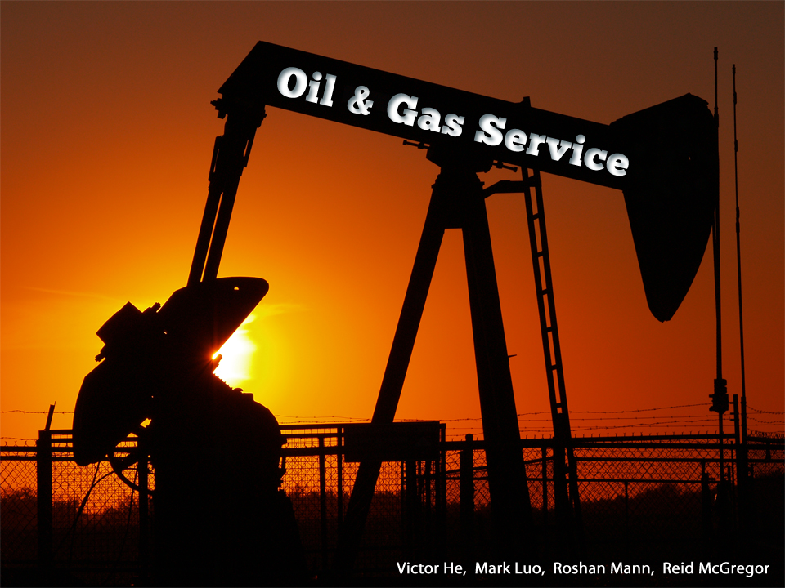

Slide 2
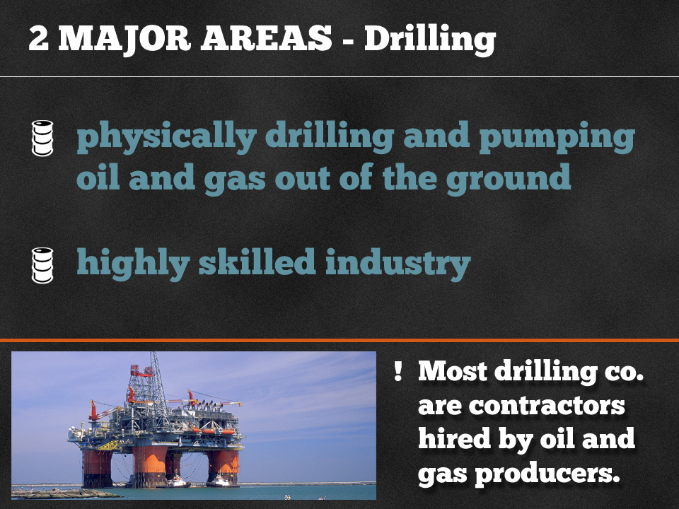

Slide 3
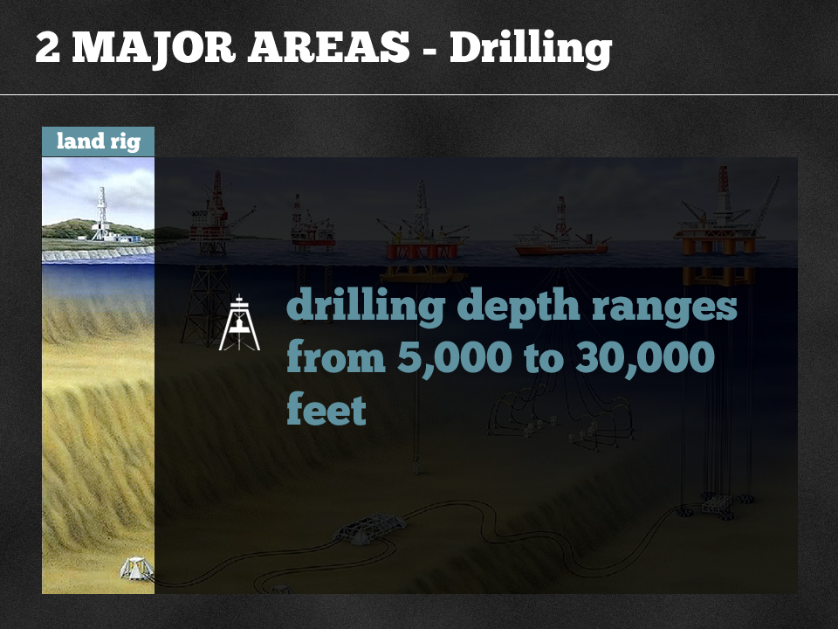

Slide 4
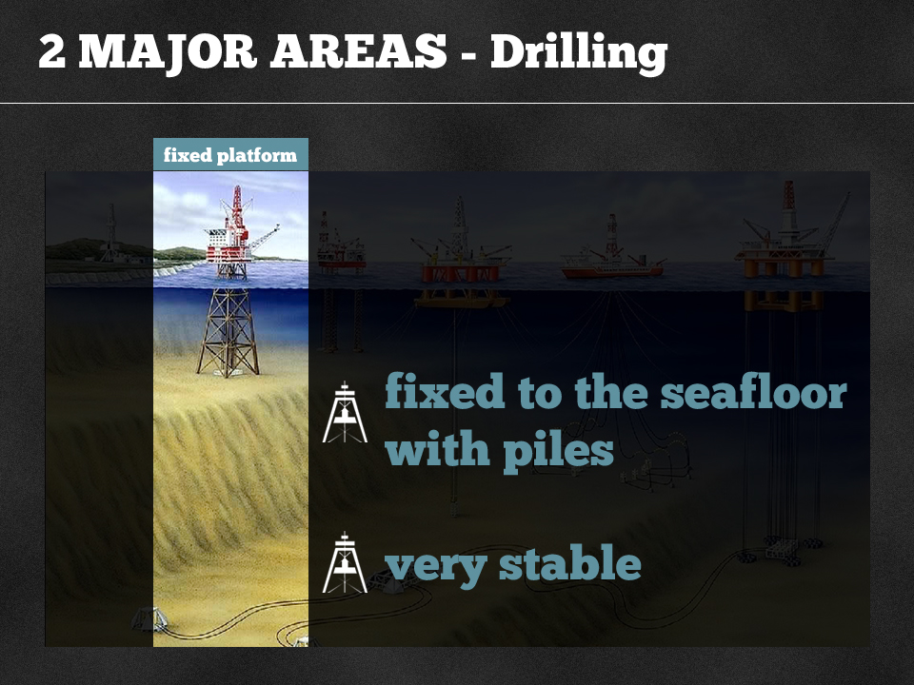

Slide 5
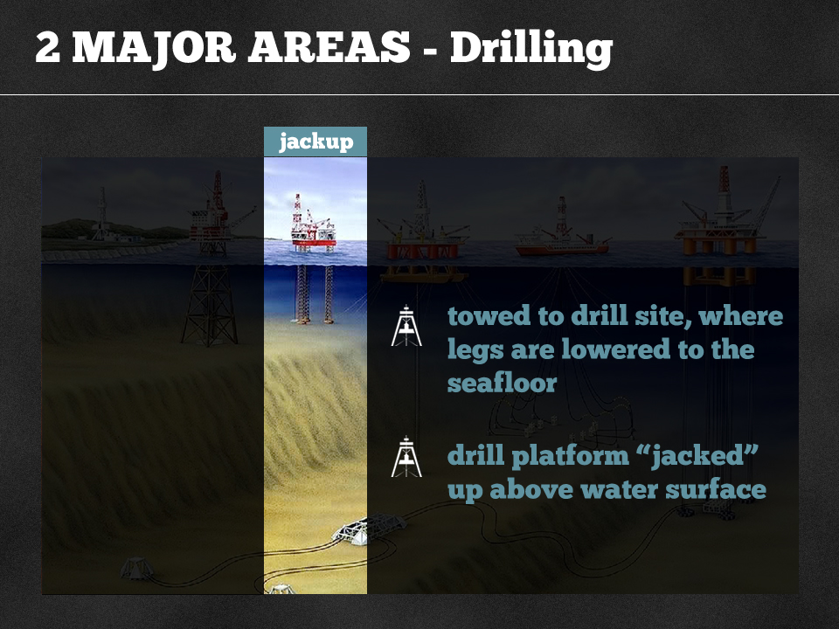

Slide 6
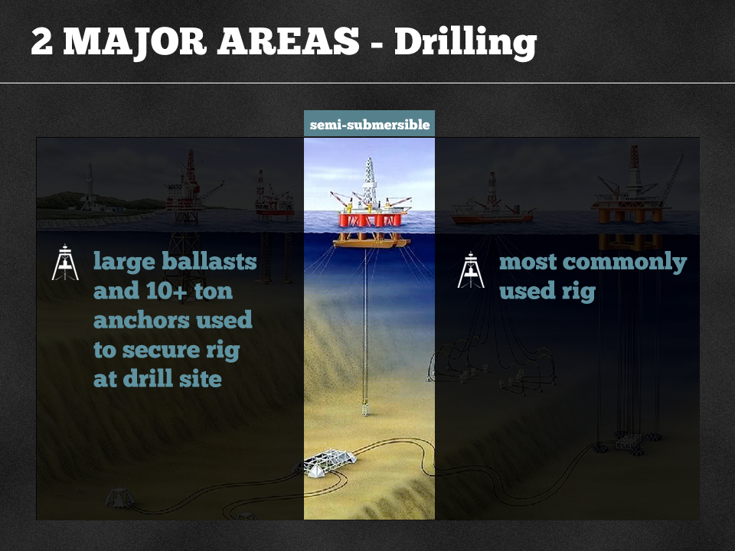

Slide 7
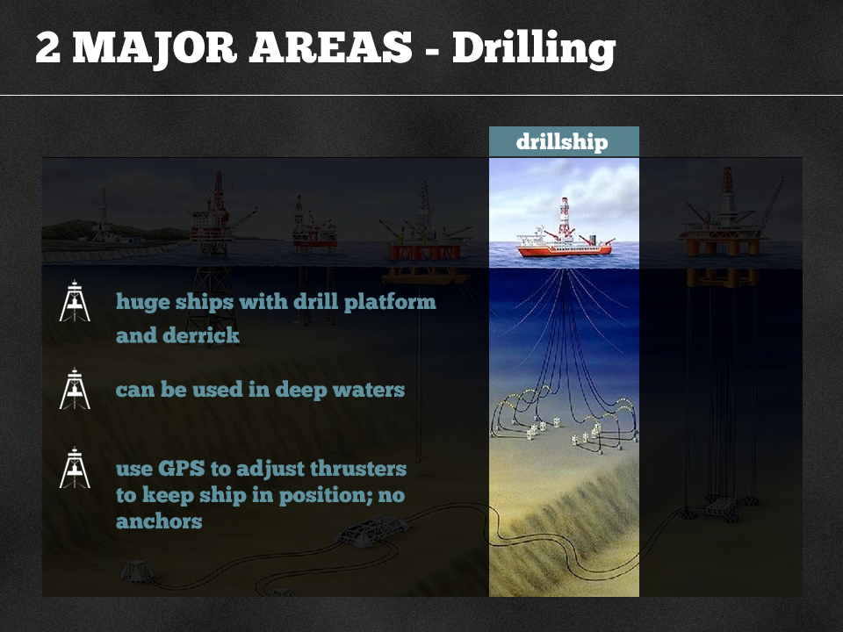

Slide 8
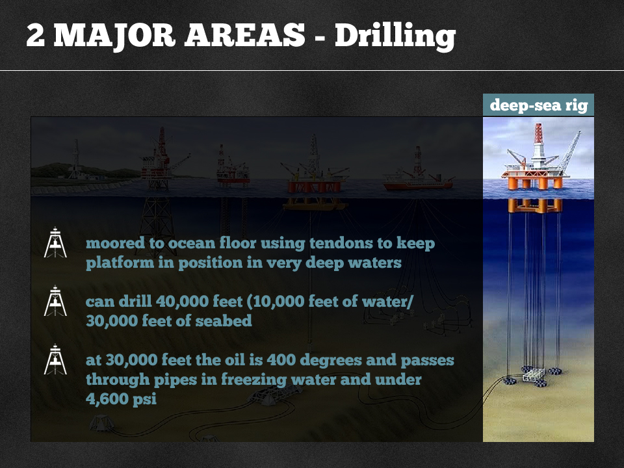

Slide 9
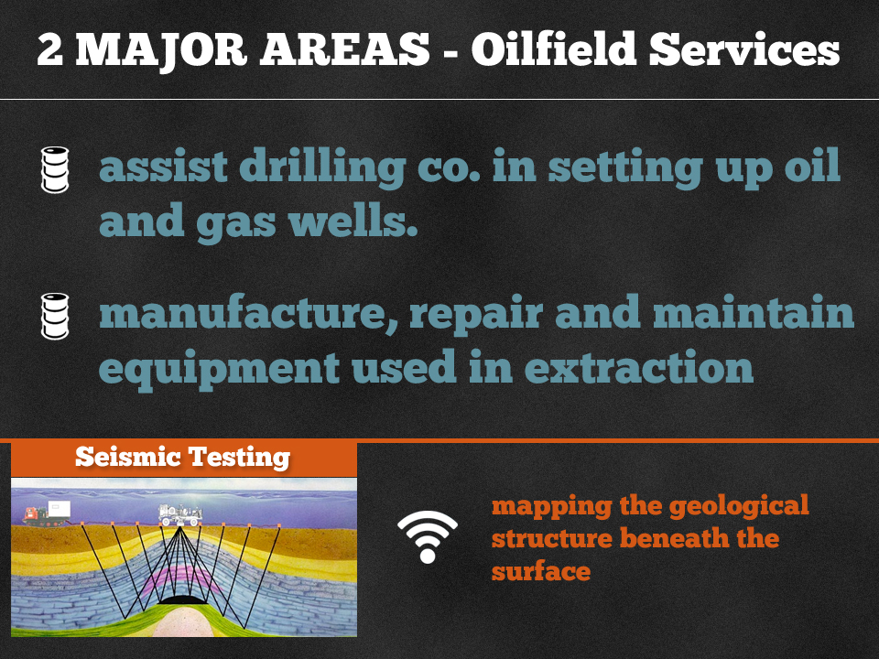

Slide 10
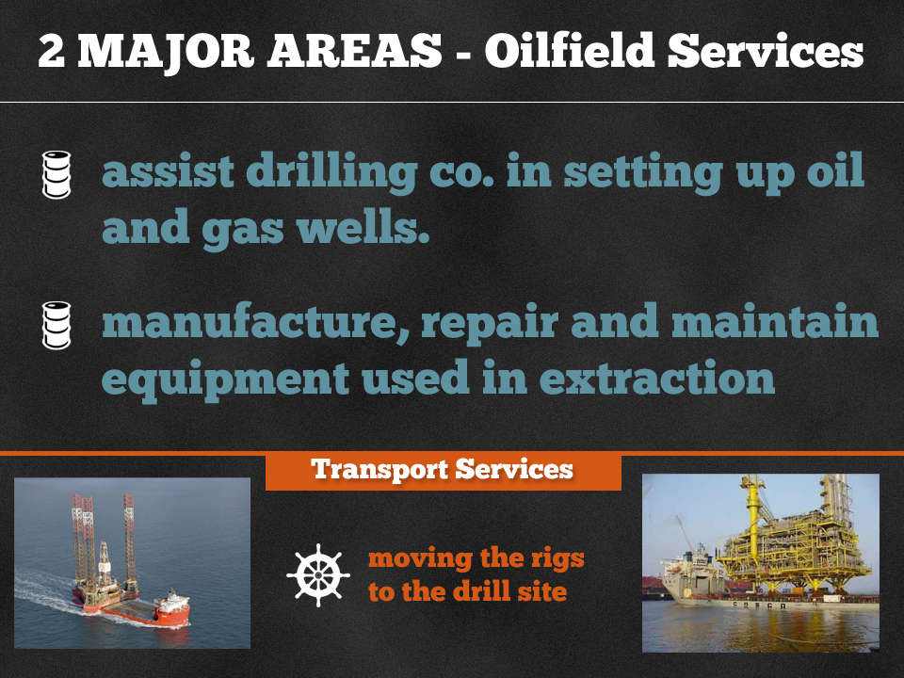

Slide 11
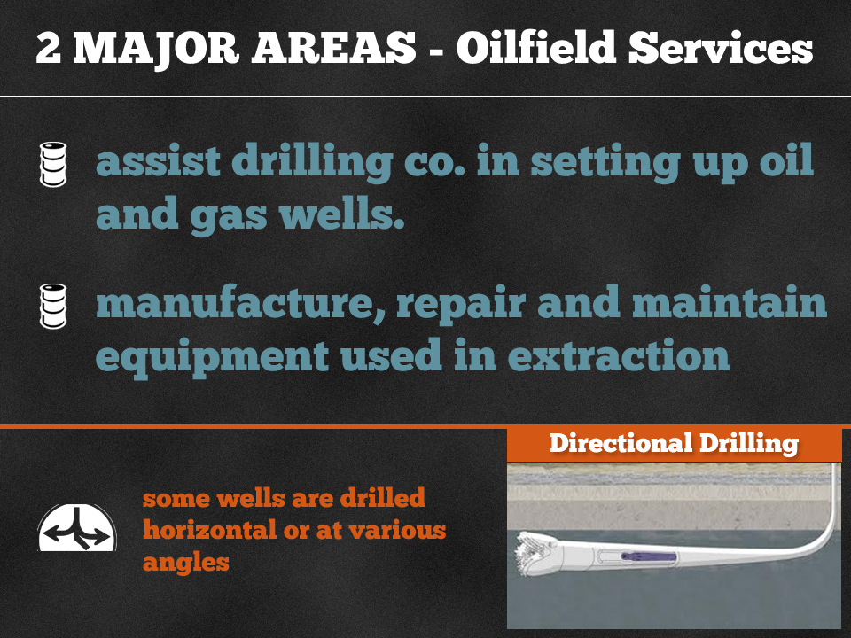

Slide 12
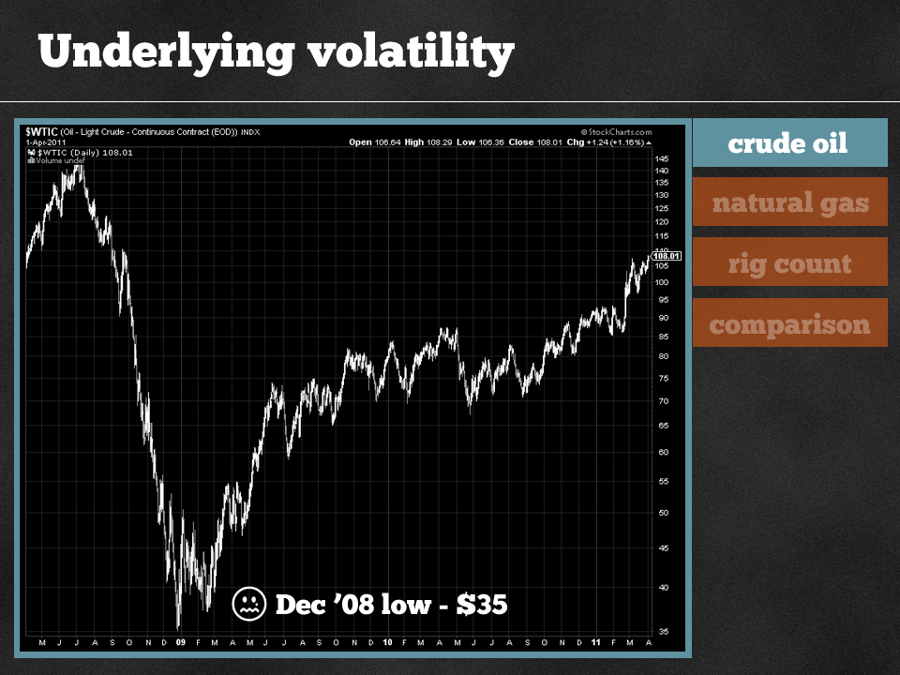

Slide 13
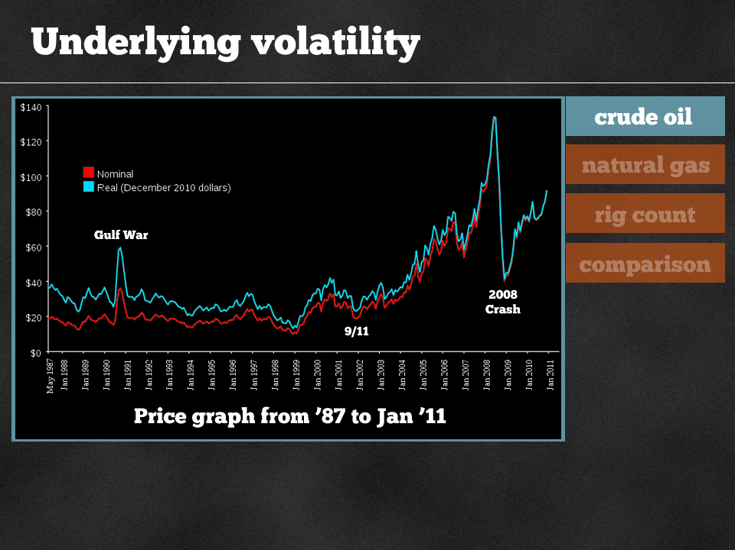

Slide 14
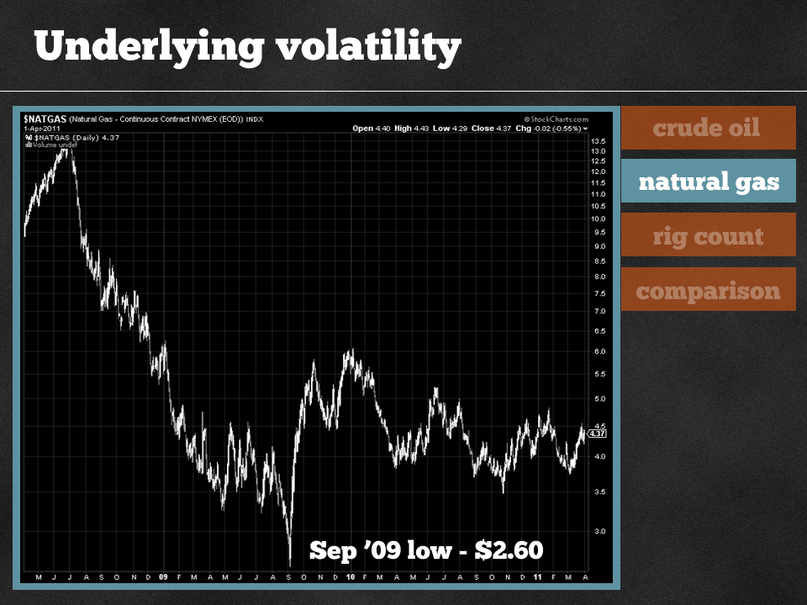

Slide 15
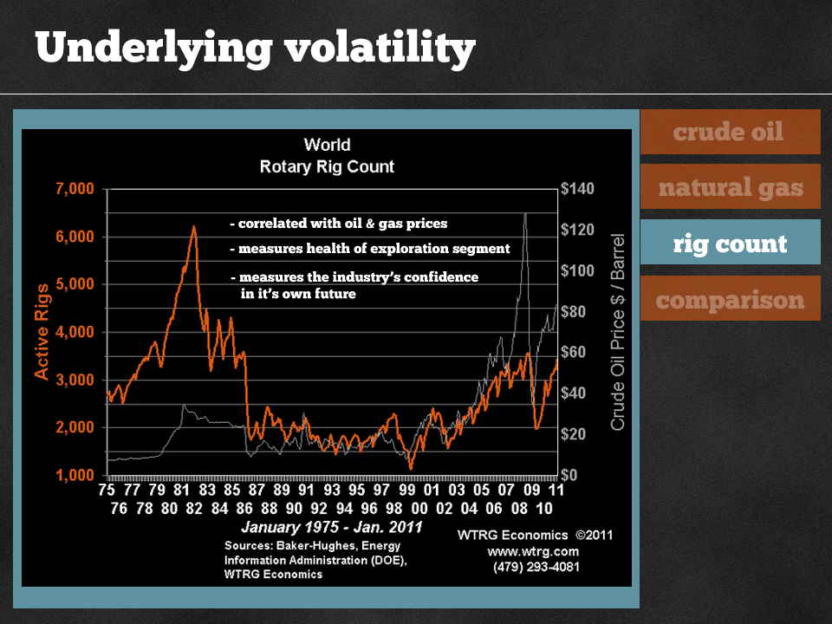

Slide 16
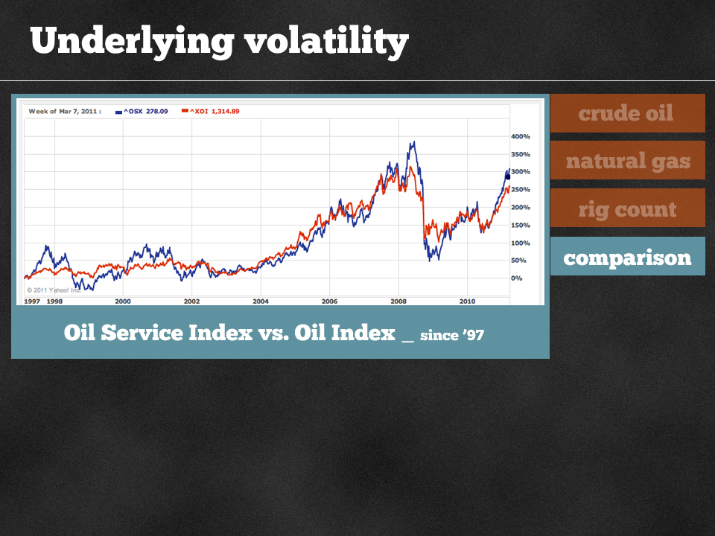

Slide 17
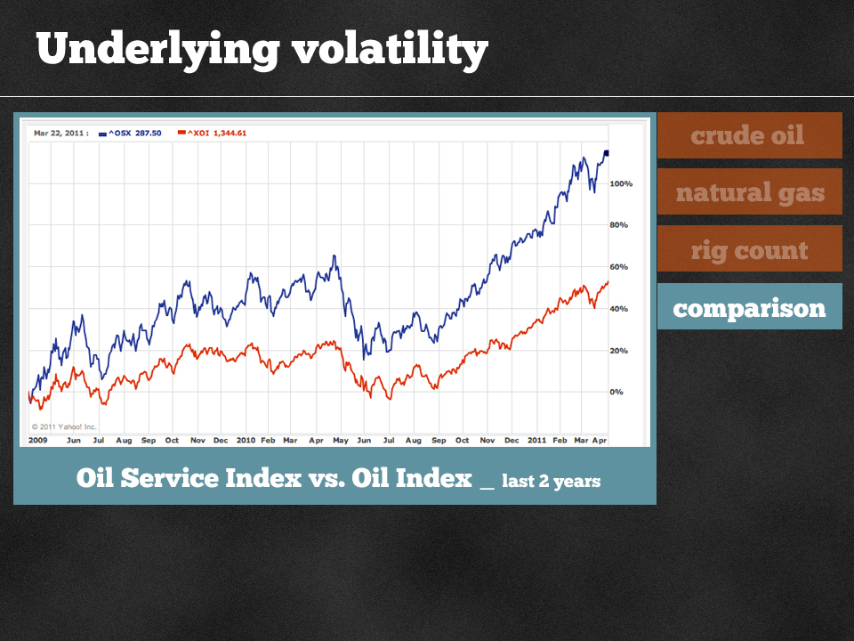

Slide 18
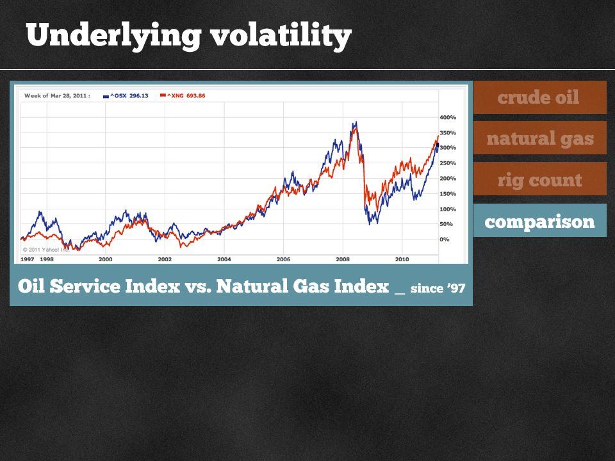

Slide 19
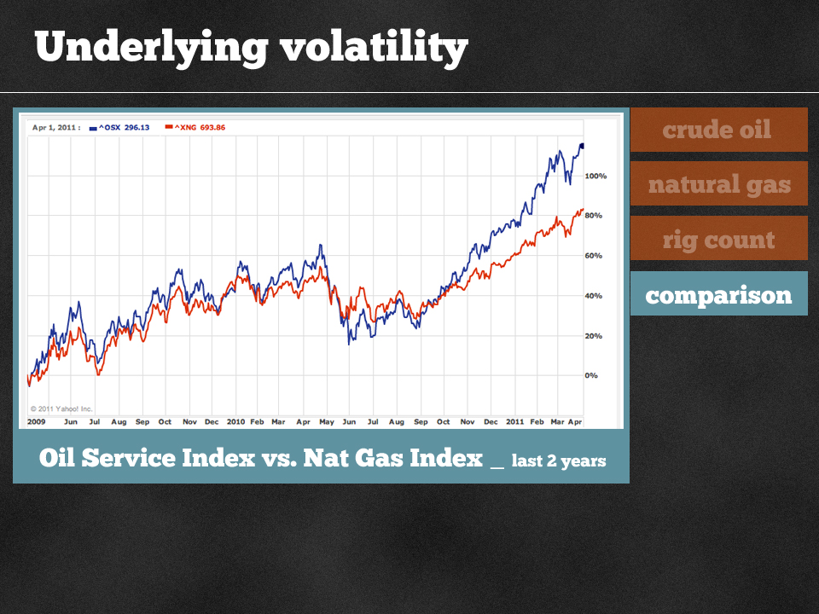

Slide 20
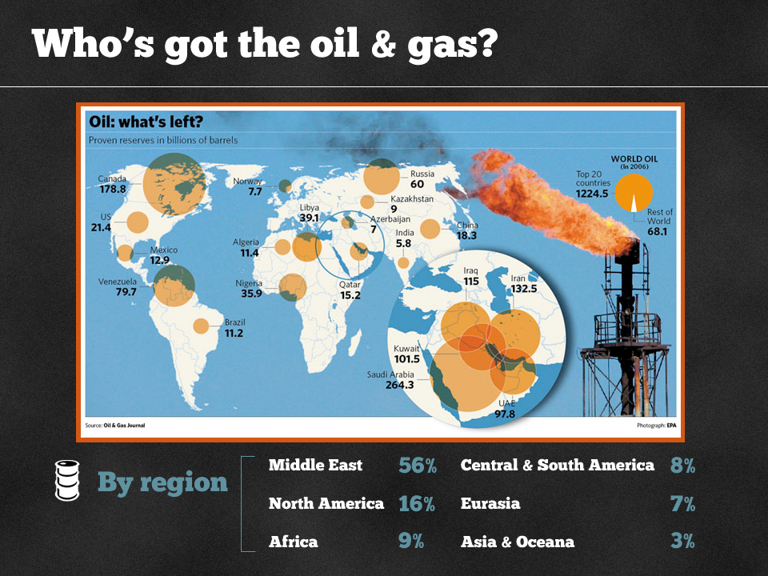

Slide 21
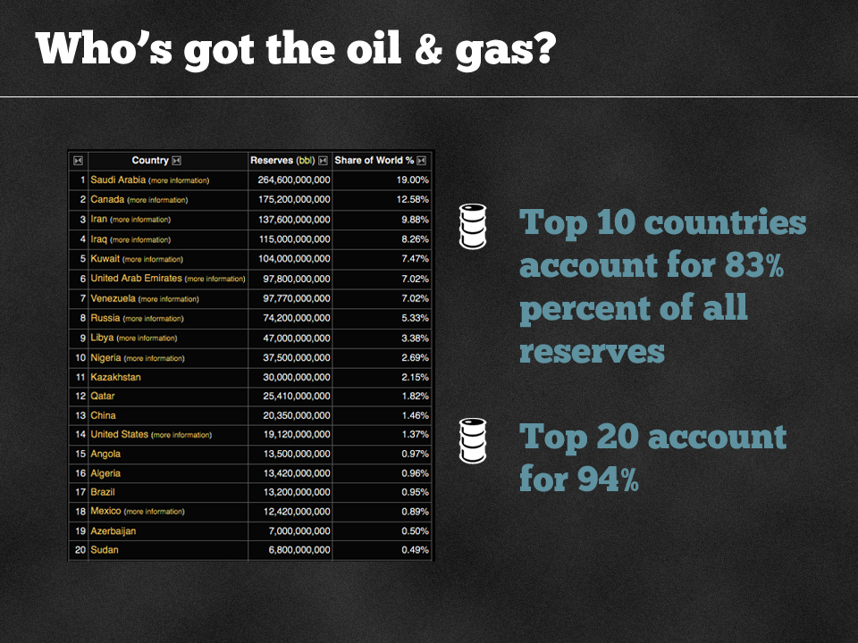

Slide 22
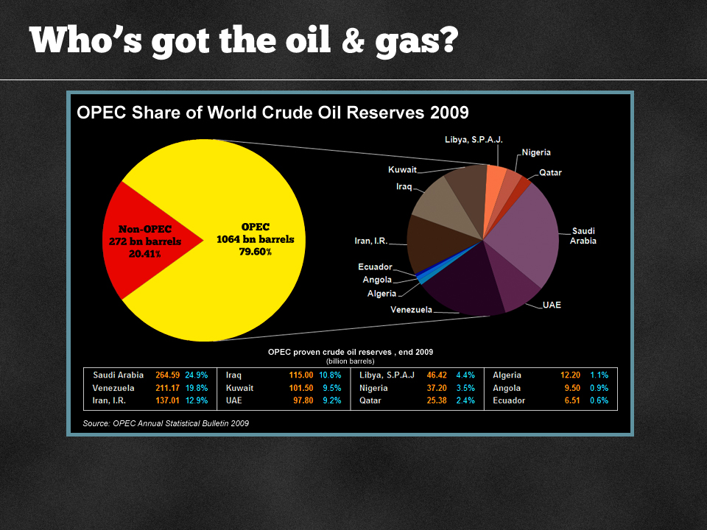

Slide 23
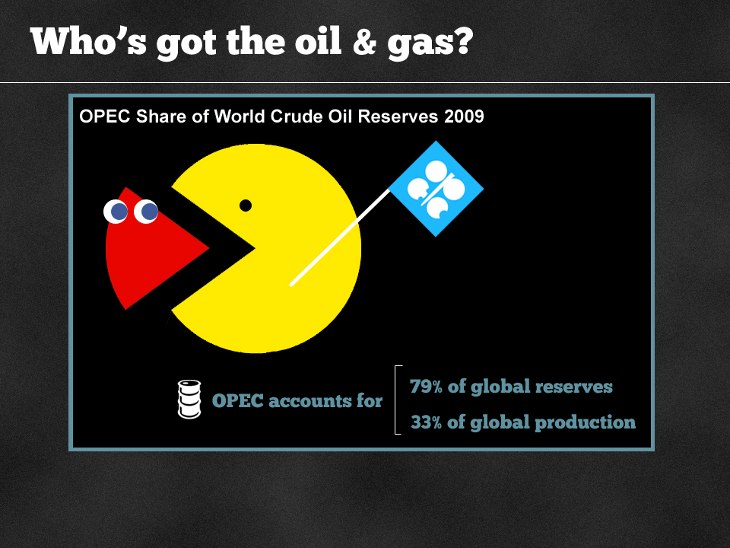

Slide 24
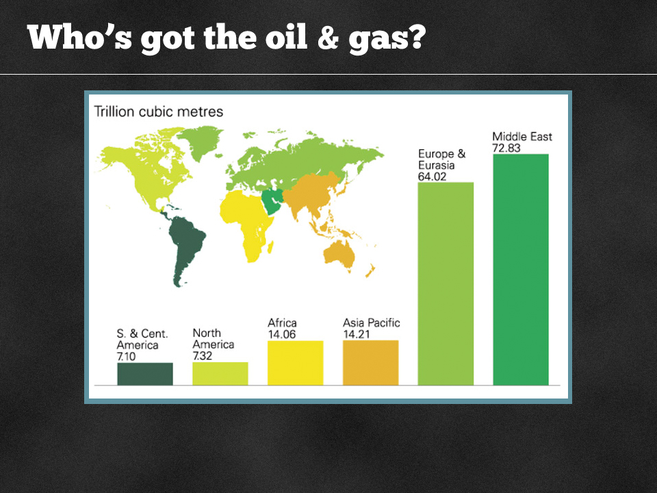

Slide 25
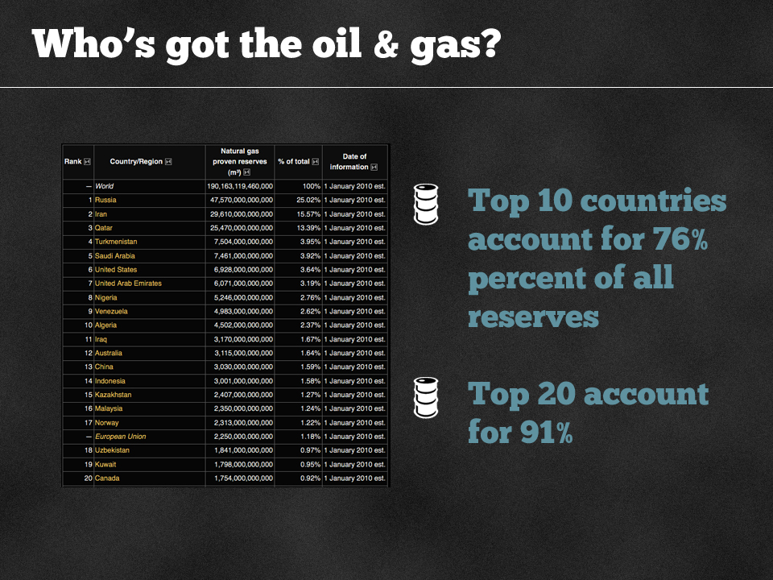

Slide 26
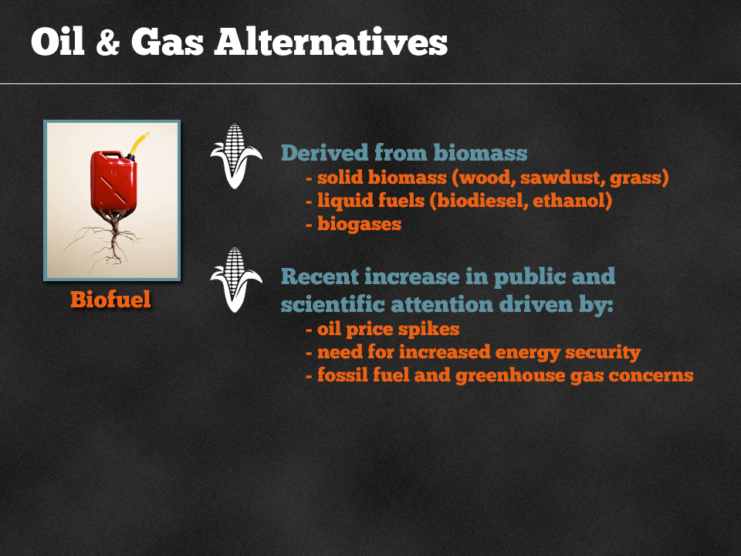

Slide 27
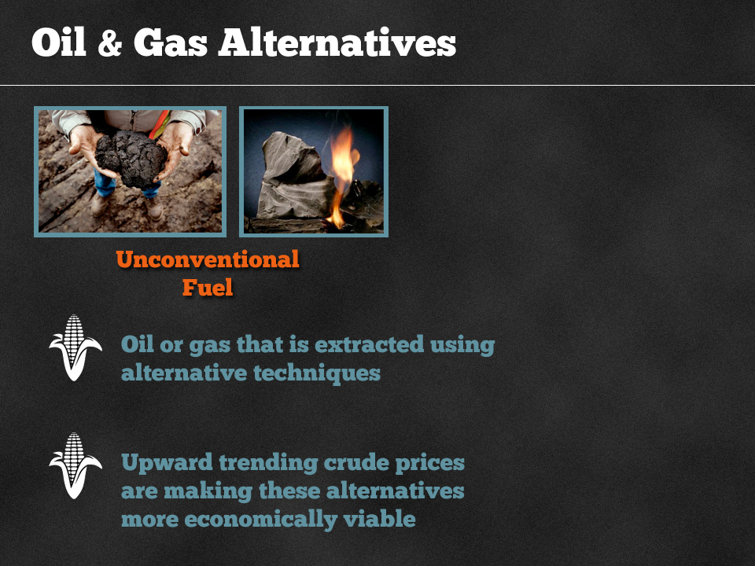

Slide 28
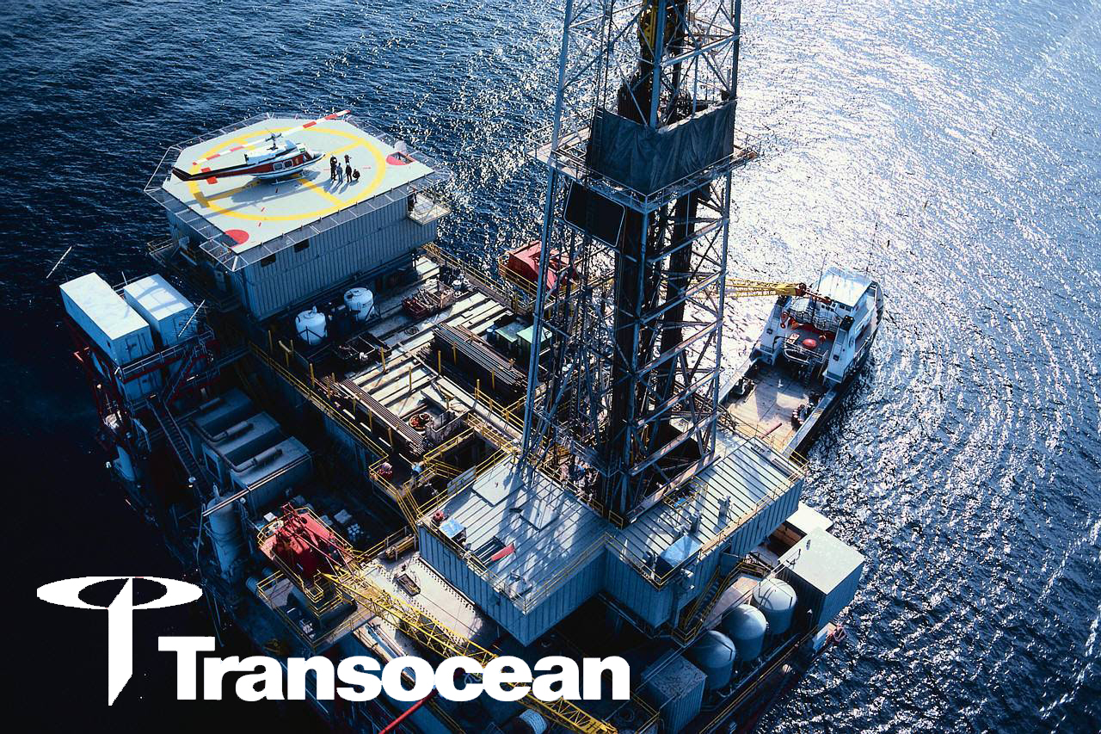

Slide 29

Overview

Slide 30


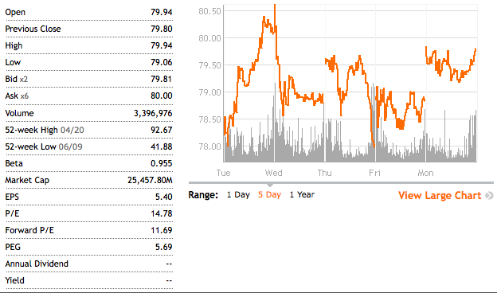
Stock Price

Slide 31
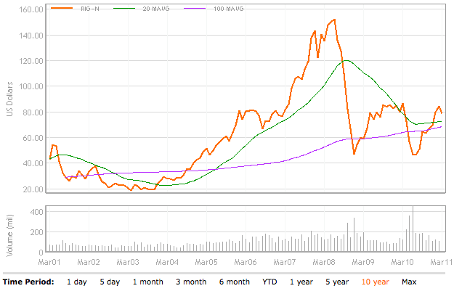
10 Yr RIG Price

Slide 32
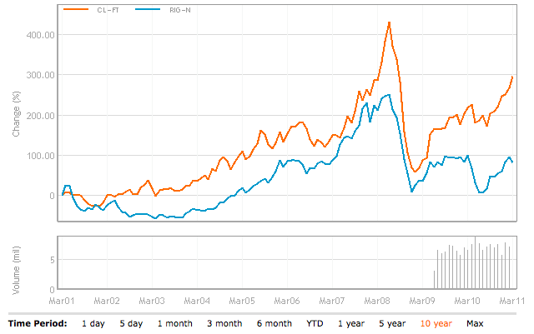
10 Yr RIG Price vs. Crude Oil

Slide 33
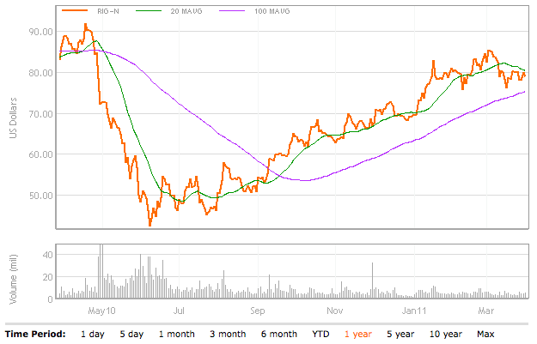
1 Yr RIG Price

Slide 34
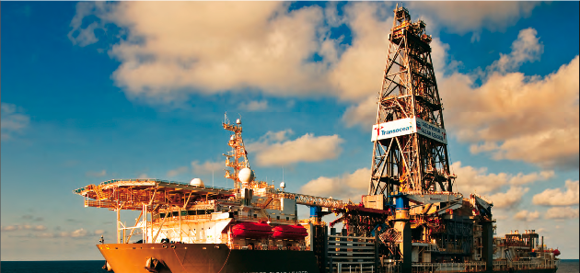
Mission Statement
Our mission is to be the premier offshore drilling company providing worldwide rig-based, well-construction services to our customers through the integration of motivated people, quality equipment and innovative technology, with a particular focus on technically demanding environments.
Transocean: We’re Never Out of our depth

Slide 35
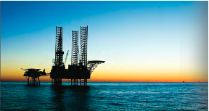
Major Products & Services
Transocean is a global provider of offshore contract drilling services for oil and gas wells. The company's key services include the following:
Deepwater drilling
Harsh environment drilling
Inland and shallow water drilling
Offshore drilling

Slide 36
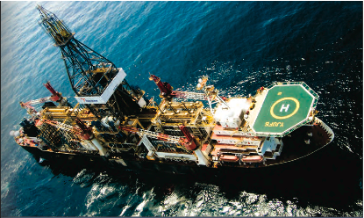
Company Overview
Three types of drilling rigs are used:
Drill Ships
Semi submersibles
Jackups
In addition, Transocean operates barge drilling rigs and a coring drillship

Slide 37
Company Overview
At Transocean – the world’s largest offshore drilling contractor -- we are never out of our depth, from the shallow water to the ultra-deepwater. We are the:
Largest offshore driller with 139 mobile offshore drilling units, plus an additional eight newbuild rigs
Largest jackup rig driller with 65 units
Largest “floating” rig driller with 71 drillships and semisubmersible rigs
Largest deepwater driller with 40 rigs that can operate in water depths of 4,500 feet or greater
Largest offshore driller by equity market capitalization

Slide 38
Achievements
Transocean holds 19 of the past 23 world records for drilling in the deepest waters.
The ultra-deepwater drillship Discoverer Deep Seas set the current world water-depth record in 10,011 feet (3,051 meters) of water.
Other world records include:
Deepest well ever drilled offshore at 34,189 feet.
World’s water-depth record for a moored rig in 8,951 ft of water.
World’s deepest subsea well completed in 8,960 ft of water.

Slide 39
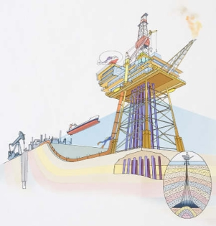
Company Overview
Deepwater Innovation:
Offshore jackup drilling rig
Self-propelled jackup
Turret-moored drillship
Dynamically positioned drillship for exploration
Dynamically positioned semisubmersible
Rig to drill year-round in the North Sea
Semisubmersible for sub-arctic, year round operations
Ultra-deepwater drillship with patented dual-activity drilling system
Drillship capable of working in 10,000 feet of water

Slide 40
Company Overview
The company conducts its business through two reportable operating segments: contract drilling and other.
Contract Drilling: to contract drilling rigs, related equipment, and work crews to drill oil and gas wells on a dayrate basis as well as offshore drilling with a particular focus on deepwater and harsh environment drilling services
Other: Oil and gas drilling management services as well as drilling engineering on either a dayrate basis or a completed-project, fixed-price basis

Slide 41

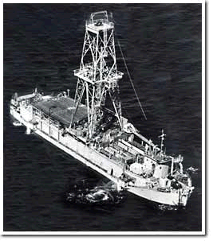
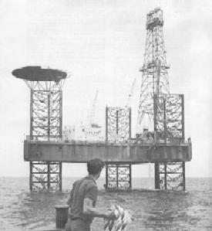
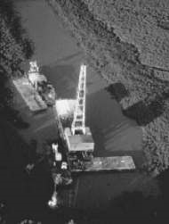
Firm History
1919
Dancinger Oil and Refinery Co. is founded.
1946
Consortium (CUSS) formed to establish feasibility of offshore drilling. Also, Santa Fe Drilling is founded.
1951
CUSS builds prototype for offshore floating rig.
1953
Dancinger merges with Offshore Drilling Co. to construct first jackup drilling rig, in operation by 1954.
1958
CUSS becomes Global Marine.

Slide 42


Firm History
1999
Transocean Offshore merges with Sedco Forex (sold by Schlumberger).
2001
Transocean Sedco Forex merges with R&B Falcon Corp. and form world’s largest offshore drilling company.
2003-2007
Transocean breaks several records for depth drilling (10,000 ft of water) and well depth (35,000 ft).
2007
Transocean and GlobalSantaFe merge to form the world’s largest offshore driller.
2008
Redomesticates to Switzerland from Cayman Islands for geographic centrality and tax benefits.

Slide 43
History of Mergers
Transocean
Global SantaFe
Global Marine
Santa Fe Int’l
Transocean
Transocean Sedco Forex
R&B Falcon
Transocean Offshore
Sedco Forex
Sedco
Forex Neptune
Transocean ASA
SODI
Offshore Drilling
International Drilling
Southern Productions
Southern National Gas
Dacinger

Slide 44
Fleet

Slide 45
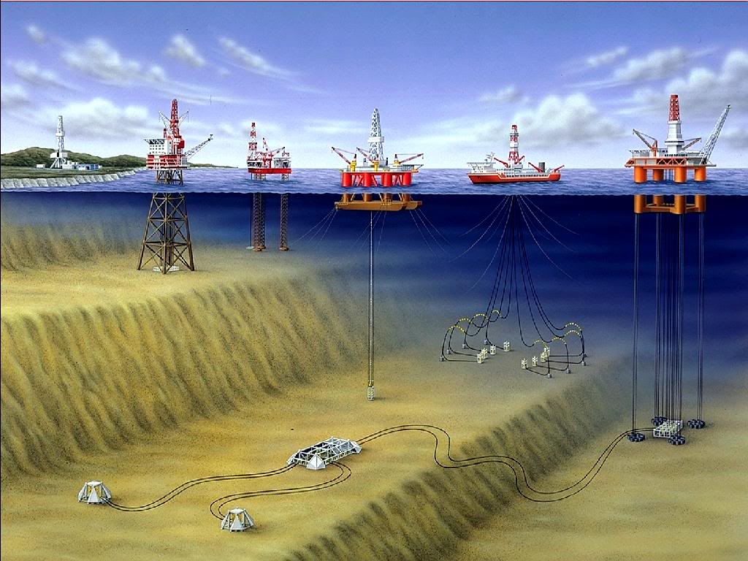
Fleet Lineup
Jackups
Midwater Semisubmersible
Deepwater Semisubmersible
Drillship
Floaters

Slide 46
Firm History
Owns/partial ownership in 139 mobile offshore drilling units
45 High-Specification Floaters (Ultra-deepwater, Deepwater and Harsh Environment semisubmersibles and drillships)
26 Midwater Floaters
10 High-Specification Jackups
55 Standard Jackups
3 Other Rigs
3 Ultra-Deepwater Floaters under construction

Slide 47
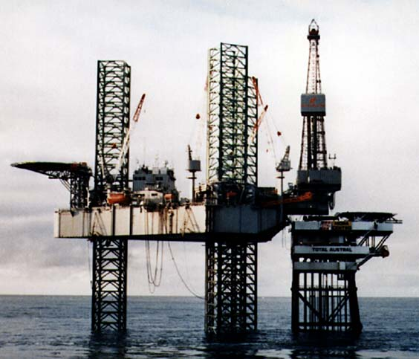
Fleet – Jack Ups
Mobile self-elevating drilling platforms.
Equipped with legs that are lowered to the ocean floor for foundation.
Jacked up just above highest waves.
Suited for water depths of 400 ft and less.

Slide 48
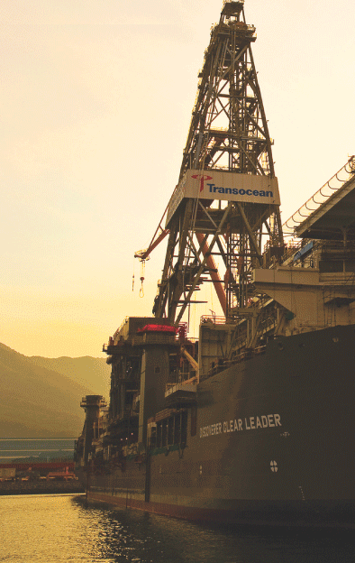
Fleet – Drill Ships
Dynamically positioned in that it does not require anchors
Great load capacity, ideal for remote locations
Limited to calmer water conditions
Self-propelled and extremely mobile
Dual-activity technology (on recent models)
Mid-water, Deepwater, Ultra-deepwater

Slide 49
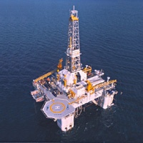
Fleet - Semisubmersibles
Floating vessels that can be submerged by water ballast system so that lower hulls are under water during drilling operations
Maintain position through anchors or computer controlled dynamic positioning thrusters
Moved by propellers or tugging
Suited for rough water conditions
Mid-water, Deepwater, Ultra-deepwater

Slide 50
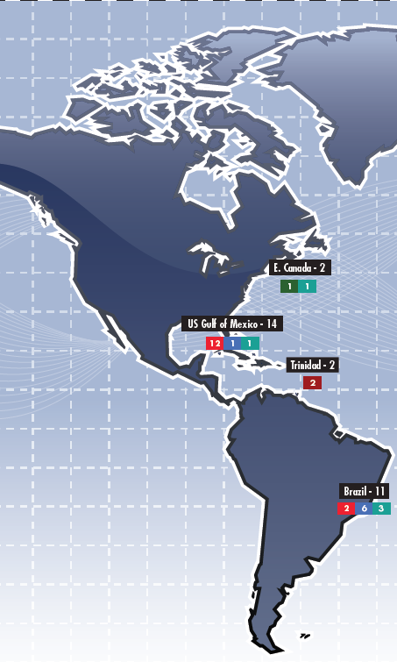
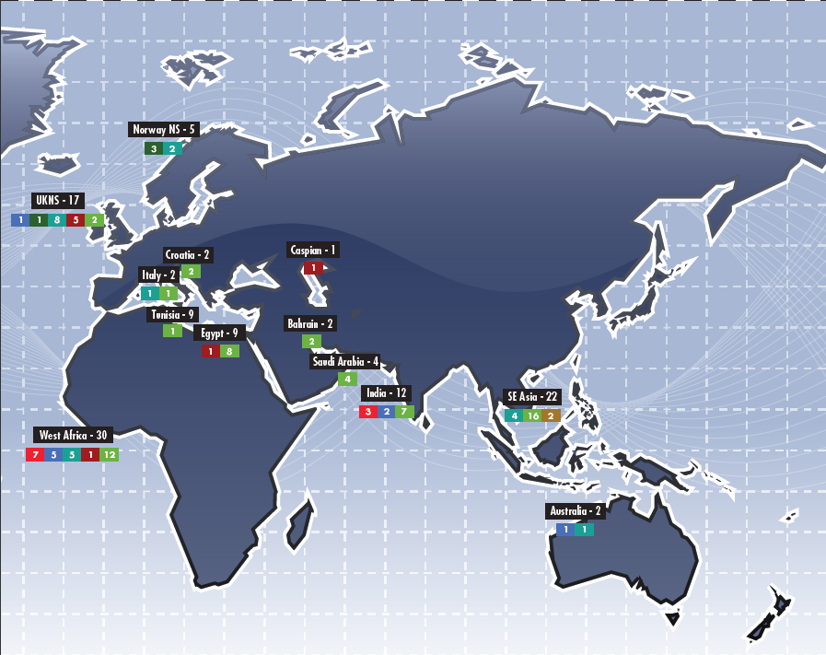

Transocean Operations

Slide 51





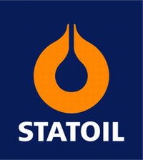


Major Clients
12%

Slide 52
Future Outlook

Slide 53
Revenue Methods
Transocean has two main methods for generating revenue from its drilling operations:
Operating rate: Rate that is charged for utilization of rigs.
Stand-by-rate: Rate charged for the rig being ready for use, regardless of whether it is actually used.

Slide 54
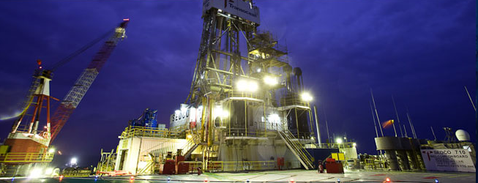
Potential Risks
High expiration of its fleet contracts in early 2011 which is a cause of concern for its future revenue streams
Impacted by the dayrate

Slide 55
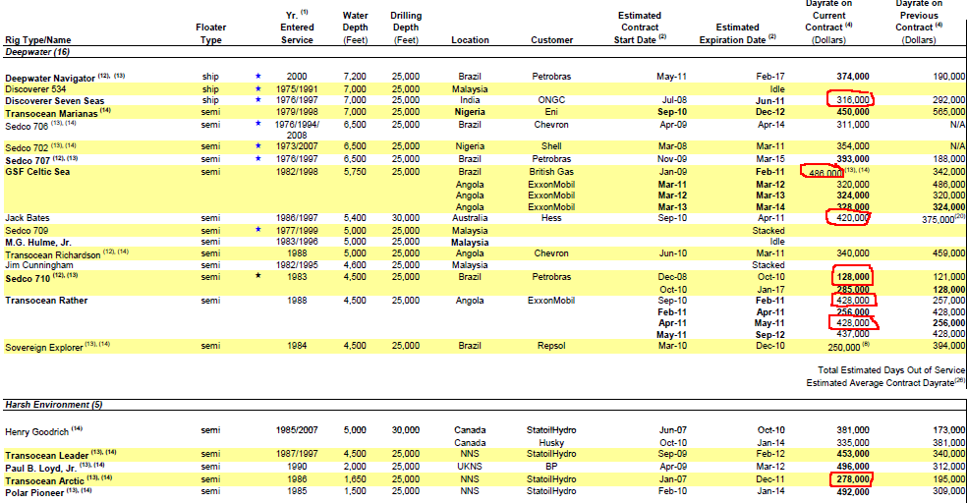
Potential Risks
High expiration of its fleet contracts in early 2011 which is a cause of concern for its future revenue streams
Impacted by the dayrate

Slide 56
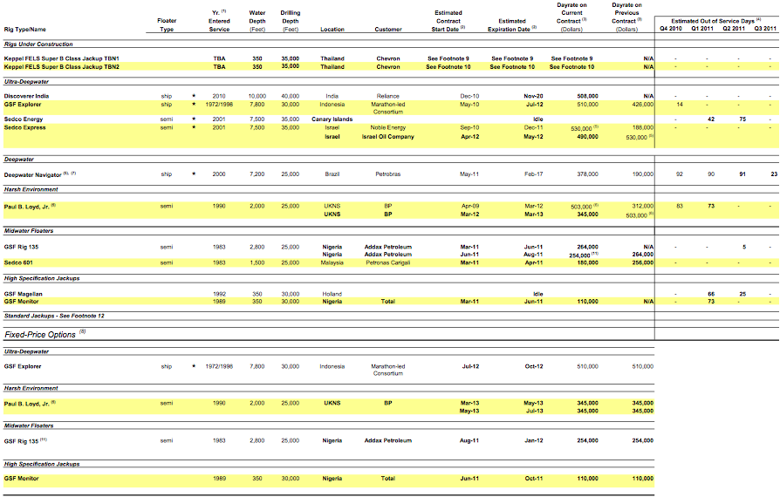
Fleet Updates

Slide 57
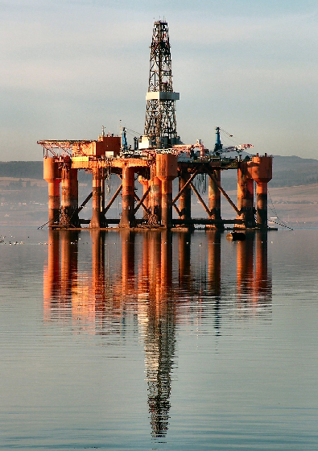
Potential Risks
Revenues highly dependent on economic conditions of market as price of oil dictates demand
Sole focus in offshore drilling, eliminating large oil markets such as Russia and Middle East
Highly competitive and cyclical industry with intense price competition
Contracts may be terminated by a number of events
Revenues concentrated on small group of clients;
dependent on key personnel

Slide 58

Operating Revenue
Divided by each Country
22.1% 13.5% 12.4% 8.6% 43.4%

Slide 59


Fleet Revenue

Slide 60


Fleet Utilization Outlook

Slide 61

Litigations
Macondo well incident
Ultra-Deepwater Floater, Deepwater Horizon leased to BP
Recognized a liability of $80 million under other current liabilities
206 claims made against Transocean
Defence under contractual defence and indemnity
Resulted in loss of $590 million of backlog revenue

Slide 62
Regulations
U.S. Government has lifted its ban on off-shore drilling that was initiated May 30, 2010
Implications include higher costs to business such as executive guarantee for safety of rigs
14 rigs located in the U.S. Gulf of Mexico; Contracts may be terminated leading to loss of $2.1 billion
Compliance with or breach of environmental laws can be costly and could limit operations
Connection with oil spills or waste disposals related to operations in navigable waters

Slide 63
Management

Slide 64

Management
Steven L. Newman
President and CEO
Joined company in 1994 in Corporate Planning Department.
Rig Manager, Project Engineer, Division Manager, Region Marketing and Operational Manager for Asia and Australia Region.
VP of Performance and Technology (2003-05).
Senior VP of HR, Information Process Solutions, and Treasury (2005-06).
Executive VP and COO (2006-07).
Executive VP of Performance and COO (2007-08).
BSC in Petroleum Engineering from Colorado School of Mines. MBA from Harvard Graduate School of Business.

Slide 65

Management
Arnaud A. Y. Bobillier
Executive Vice President, Asset and Performance
Joined company in 1980 as management.
Regional Manager for West Africa Region ( 2001-2004)
Regional Manager for Europe and Africa (2004-2005)
Vice President of Europe and Africa (2005-2008)
Senior Vice President of Europe and Africa (2008)
Executive Vice President , Assets (2008-2010)
Graduated from Ecole Superieure des Techniques de l’ingenieur de Nancy, France (Engineering Degree in Fluid Mechanincs and Thermics).

Slide 66

Management
Ricardo H. Rosa
Senior Vice President and CFO
Joined Schlumberger in 1983.
Held variety of international positions in finance in oilfield services for Schlumberger, (1984-2000).
Product Line Controller of Sedco Forax (1995).
VP and Controller after merge (1999).
Senior VP of Asia and Pacific Unit (2003).
Appointed CFO in September 2009, after predecessor Gregory Cauthen retires (age 51) most likely due to relocation of firm to Switzerland.
Master of Arts Degree from Oxford University. Chartered Accountant.

Slide 67



Management
Ihab Toma
Executive Vice President, Global Business
John Briscoe Vice President and Controller
Nick Deeming
Senior Vice President, General Counsel and Assistant Corporate Secretary

Slide 68
Financial Statements

Slide 69

Selected Financial Data

Slide 70

Balance Sheet - Assets

Slide 71

Balance Sheet - Continued

Slide 72

Future Debt

Slide 73

Income Statement

Slide 74

Revenue Efficiency
FY 2010
88.5% 90.3% 96.1% 92.5% 96.5% 97.4% 98.4% 94.2%

Slide 75

Cash Flow Statement

Slide 76

Cash Flow Statement

Slide 77
Recommendation

Slide 78
Recommendation
BUY

Slide 79


Slide 80

Agenda
Technical Analysis
Company and Industry Background
Management Team
Financial Statement Analysis
Moving Forward
Recommendation

Slide 81


Slide 82

Technical Analysis

Slide 83

1 Year Technical

Slide 84

5 Year Technical

Slide 85

10 Year Moving Average

Slide 86

TDG vs S&P Composite

Slide 87

1 year TDG VS S&P/TSX Weight Oil and Gas

Slide 88

Company and Industry Background

Slide 89

Trinidad Drilling provides modern, reliable, expertly designed oil and gas drilling equipment operated by well-trained personnel.
Fast becoming a driller of unconventional and shale plays in Canada/U.S.

Slide 90


Slide 91


Slide 92


Rigs
Drilling
Canadian, U.S.Land,
International (Mexico)

Slide 93

US Barge Drilling
More cost-effective than jack up rigs when used in shallow water

Slide 94



Well Servicing
Trinidad Well Servicing Ltd.(T.W.S.)
The maintenance procedures performed on an oil or gas well to enhance its productivity

Slide 95

Coring and Pre-Setting
Acquired Titan Surface Casing Ltd.
Coring services drill narrow hole to help evaluate and plan underground oil sands extraction programs
Pre-setting uses shallower rigs to drill and cement the first 200 to 300 metres of a new well to reduce the cost of using larger rigs

Slide 96


Slide 97

Fleet

Slide 98


Slide 99


Slide 100


Slide 101



Slide 102


Slide 103

Specializes in the deep, technically-advanced drilling that is generally found in unconventional oil and gas plays.

Slide 104


Slide 105


Slide 106

Canadian Operations

Slide 107

US & International Operations

Slide 108

2011 Outlook
Completing 2 rigs started in 2010 by the first quarter of 2011
Contracted a rig to be built by the second quarter and will be sent to the Horn River backed by a 5 year take-or-pay contract.
Stronger oil prices
Industry shifting towards crude oil and natural-gas-liquids rich projects

Slide 109

Long Term Canadian Outlook

Slide 110


Slide 111

Management

Slide 112

Mr. Lyle C. Whitmarsh
CEO and President since January 2008
President of Trinidad from November 2002 to January 2008
General Manager, Operations of Trinidad from August 2001 to October 2002
businessman in the oil and gas drilling industry for over 15 years.
graduating from high school in Medicine Hat
1987 when he became a Rig Manager for Champion Drilling
1995 he was Senior Field Supervisor which included supervision of the crews and equipment for 24 drilling rigs in western Canada

Slide 113

Brent J. Conway, Executive Vice-President and Chief Financial Officer
Faculty of Management at the University of Calgary with a Bachelor of Commerce in accounting
Certified General Accountant Designation in 1996.
1991 joining Deloitte and Touche, Chartered Accounts
joined Trinidad Drilling in November of 2001 as Chief Financial Officer and currently still holds this position.

Slide 114


Slide 115
RELATED PARTY TRANSACTIONS
Trinidad engages the law firm of Blake, Cassels & Graydon LLP to provide legal advice. One partner of this law firm holds a board position with Trinidad, and another partner is an officer of the Company.
During the first quarter of 2009, Trinidad purchased a parcel of land from 1010460 Alberta Ltd., a company owned by an executive officer within Trinidad’s Canadian operations

Slide 116

Financial Statement Analysis

Slide 117

Financial Statement Analysis
2010 Balance Sheet

Slide 118

2010 Income Statement and retained earnings (Deficit)

Slide 119


Slide 120

2010 Cash Flow

Slide 121


Slide 122
Profitability
2010 2009 2008
Gross Margin 38% 41% 41%
ROE -9.7% -2.5% 11.0%
Operating CF(million) 119 107 210
-Capital Expenditure -139 -162 -261
Free Cash Flow -20 -55 -51

Slide 123

Growth

Slide 124
Financial Health
2010 2009 2008
Current Ratio 2.8 2.1 1.43
EBITDA/Interest Expense 3.9 3.56 5.74
Debt/Asset 49% 44% 50%

Slide 125

Moving Forward

Slide 126


Slide 127


Slide 128


Slide 129


Slide 130

RECOMMENDATION
Bulls are saying..
added stability through geographical diversification and contracted revenues
track record of value-added growth
Market leader in technology and innovation
Bears are saying..
history of no free cash flow
negative returns on equity
volatile earnings
uncertain future commodity prices
Weakening margins
Higher labor costs

Slide 131

SELL

Slide 132


Slide 133

Stock Metrics
Range: 13.57 - 13.64
52 week: 5.99 - 13.64
Volume / Average: 365,738.00/1.89M
Market Cap: 3.76B
P/E: 64.89
Div/yield: n/a
EPS: 0.21
Shares: 275.73M
Beta: 1.59

Slide 134

Stock Chart (1-Year)

Slide 135

Stock Chart (2-Year)

Slide 136

Stock Chart (5-Year)

Slide 137
Company History

Slide 138
History
Early 1950s: founded as a private land drilling contractor in Canada
Restructuring1980s: largest provider of oilfield services in Canada.
1996: acquisition of a diversified oilfield services company (EnServ Corporation).
1993: acquisition of LRG Oilfield Services Ltd entered the camp and catering business
1996 (Rostel Industries Ltd) and 1997 (Columbia Oilfield Supply Ltd.) acquisitions increased manufacturing and logistical support capabilities

Slide 139
History (Cont.)
2006: acquisition of Terra Water Group
entered the campsite wastewater treatment business with.
2005 converted to an open-ended income trust due to favorable tax rules
Grow into the US drilling market, began to organically grow in late 2007; in late 2008, Precision acquired Grey Wolf Inc., a U.S. based driller with 123 land rigs in the United States and Mexico.
June 1, 2010 converted to a growth-oriented corporation due to tax purpose and access to more capital

Slide 140
Company Overview

Slide 141

Business Segments

Slide 142
2010 Highlights
Has 358 contract drill rigs, 200 service rigs
Contracted and began construction of 9 new rigs; upgraded 12 rigs.
Converted to corporation
Refinanced $550 million of debt at 10% with issuance of $650 million at 6.625%.

Slide 143

-- A drastic increase in revenue compared to a drastic decrease in net earning
-- EPS declined significantly

Slide 144

Precision Rig Locations

Slide 145

Drilling Rig Classifications

Slide 146

Service Rig Classification

Slide 147

Advance in Drilling Technology
As a result of advance in drilling (horizontal/directional) technology, the US has become less reliant on Canada for energy

Slide 148


V.S.

Slide 149


However! Oil drilling has been increasing in both
US and Canada

Slide 150

Corporate Strategy
Debt Reduction:

Slide 151

Corporate Strategy
Capital Expenditure on Expansion:

Slide 152
Management Profile

Slide 153

50 years old. Appointed Chief Executive Officer and a Director of Precision in August 2007 (he was appointed from outside)
Appointed president on January 13, 2009
Previously President of the Rig Solutions Group of National Oilwell Varco in Houston
Mr. Neveu is a graduate of the Faculty of Engineering at the University of Alberta.
Mr. Neveu also serves on the Board of RigNet.
KEVIN A. NEVEU
President & Chief Executive Officer
Notes:
http://www.precisiondrilling.com/AboutPrecision/aboutusboardofdir/BoardOfDirectorsbio.cfm
President and Chief Executive Officer Mr. Neveu, 50, was appointed Chief Executive Officer and a Director of Precision in August 2007 and nominated President and Chief Executive Officer in January 2009. Mr. Neveu was previously President of the Rig Solutions Group of National Oilwell Varco in Houston where he was responsible for the company's drilling equipment business. Over the past 25 years, Mr. Neveu has held senior management positions with National Oilwell Varco and its predecessor companies in London, Moscow, Houston, Edmonton and Calgary. Mr. Neveu holds a Bachelor of Science degree and is a graduate of the Faculty of Engineering at the University of Alberta. In 1984, Mr. Neveu was recognized as a Professional Engineer by the Association of Professional Engineers, Geologists and Geophysicists of Alberta. Mr. Neveu also serves on the boards of; RigNet Inc., Houston, Texas (since 2004), the Heart and Stroke Foundation of Alberta (since 2009) and he was appointed a Member of the Board of Directors and a Member of the Executive Committee of the International Association of Drilling Contractors, Houston, Texas in January 2010.

Slide 154

60 years old. Most recently President and Chief Executive Officer of BCR Group of Companies from 2001 to 2004
1999 – 2001: Executive Vice President at MacMillan Bloedel Limited
1998 – 1999: President and Chief Executive Officer of PTI Group Inc
1994 – 1998: Chief Executive Officer of Dreco Energy Services Ltd
Rob McNally
Executive Vice President & Chief Financial Officer

Slide 155

Has over 16 years in the oilfield services industry. Previously CEO of Dalbo Holdings, a Utah based oilfield service company, and Executive Vice President of Finance and Operations and a member of the board of directors for Warrior Energy Services Corporation
Investment banker with Simmons & Company International for six years, primarily working with oil service companies on mergers and acquisitions and capital markets transactions
Rob McNally
Executive Vice President & Chief Financial Officer

Slide 156

Appointed President, Completion and Production Services in July 2010, and has over 25 years experience in the oilfield services industry
1982 – Bachelor of Commerce degree from the University of Calgary
1994 – Joined Cactus Drilling as Controller. Cactus was acquired by Precision in 1997.
2005 – Chief Financial Officer
Mr. Strong is a Chartered Accountant
Doug Strong
President, Completion and Production Services

Slide 157

Began his career with Precision in 1993 on the drilling rigs in Southern Alberta; In 1996, joined Precision full-time in field sales.
2003 – Vice President of Rental Division
2005 – President and Chief Operating Officer of Precision
2009 – current position
Gene Stahl
President, Drilling Operations

Slide 158
Company Performance

Slide 159


Slide 160

Q3 and Q4 have seen improvement in 2010. The low net earning was explained by the abnormal earning in Q2 2010

Slide 161

Increase in utilization days vs.
Decrease in drilling revenue per utilization day

Slide 162


Slide 163

Lower asset value in Canada generates higher revenue than in the US

Slide 164

Est. Impact of IFRS on Assets

Slide 165

Estimated Impact of IFRS on Liability and Shareholders’ Equity

Slide 166

Reconciling GAAP to EBITDA

Slide 167
Consolidated Financial Statements

Slide 168

Balance Sheet (assets)
A strong increase in cash, account receivable and inventory

Slide 169

Balance Sheet (Cont.)
A strong increase in accounts payable and accrued liabilities

Slide 170

Income Statement

Slide 171

Retained Earning

Slide 172


Slide 173
Recommendation
BUY

