Slide 1

Oil & Gas Services
Group Members: Parham Azizbaeigi
Kelvin Chen
Jehad Sholi
Christin Chen
Lo Chiu

Slide 2
Agenda
Oil and Gas Services
Industry Overview
Transocean
Precision
Trinidad
Industry Overview
Transocean
Precision
Trinidad

Slide 3
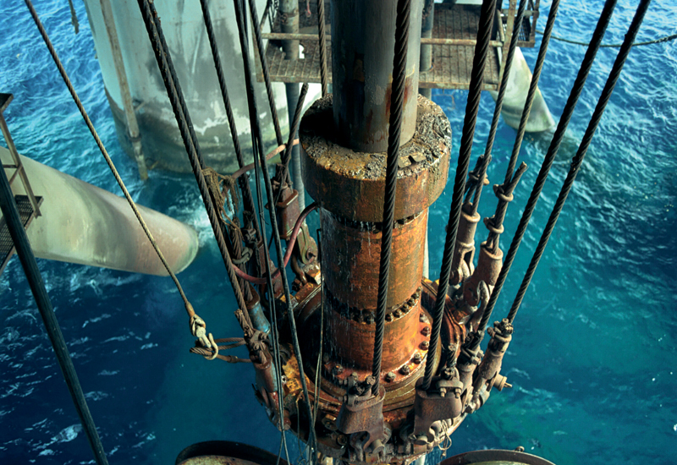
Industry Overview

Slide 4
Oil and Gas Services
Industry Overview
Transocean
Precision
Trinidad
Large & Vital to many other industries
Industry Structure
  Upstream
  Downstream
Upstream
Exploration
Production
Downstream
Marketing
Refining

Slide 5
Oil and Gas Services
Industry Overview
Transocean
Precision
Trinidad
Two Major Areas
  Drilling
  Oilfield Services

Slide 6
Oil and Gas Services
Industry Overview
Transocean
Precision
Trinidad
Drilling
Drilling and pumping oil and gas out of the earth
Contracted by oil companies
Specialized
Types of rigs:
  Land drilling rigs
  Deep-sea drilling rigs

Slide 7
Oil and Gas Services
Industry Overview
Transocean
Precision
Trinidad
Drilling Costs:
Non-salvageable: Design, engineering, labor and preparation (60-80%)
Salvageable: Equipment

Slide 8
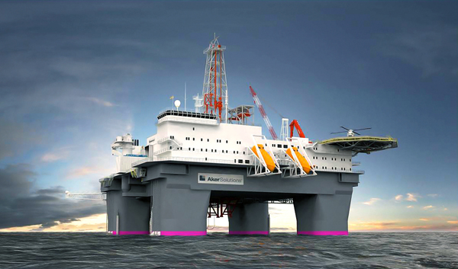
Types of Rigs

Slide 9
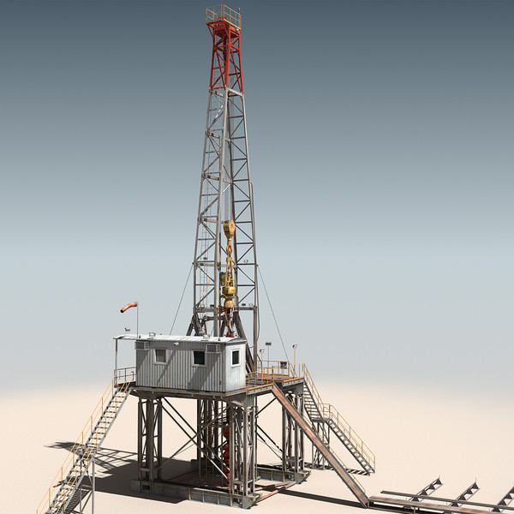
Oil and Gas Services
Industry Overview
Transocean
Precision
Trinidad
Land Drilling Rigs
Drillings depth from 5,000 to 10,000 feet into the ground

Slide 10
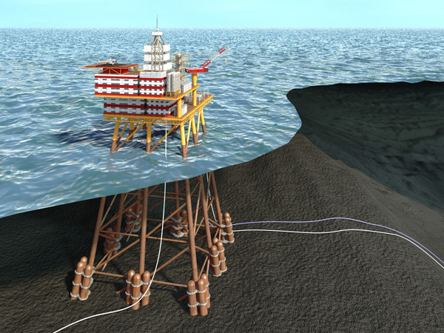
Oil and Gas Services
Industry Overview
Transocean
Precision
Trinidad
Fixed Platform
Economic up to depths of 1,500 feet
Fixed to the seafloor with piles

Slide 11
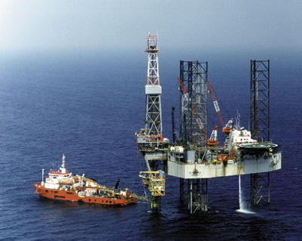
Oil and Gas Services
Industry Overview
Transocean
Precision
Trinidad
Jackups
Towed to drill sites
“Jacked” above water surface
Most popular mobile platform

Slide 12
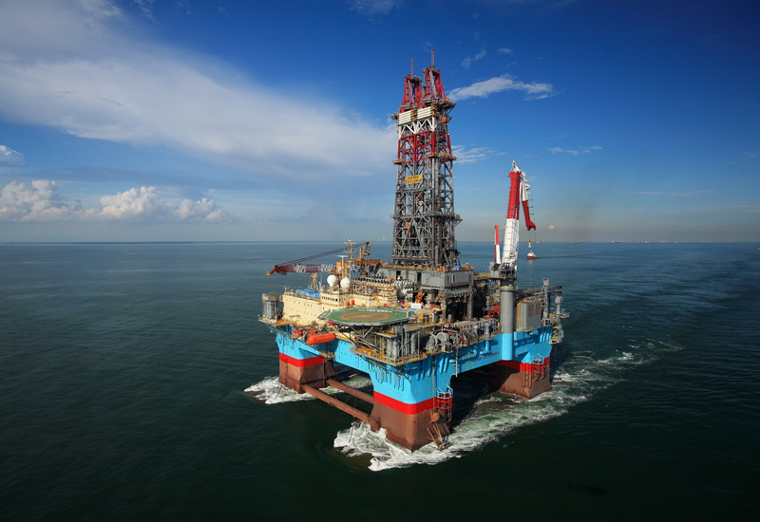
Oil and Gas Services
Industry Overview
Transocean
Precision
Trinidad
Semi-submersible
Gains buoyancy from ballasted, watertight pontoons

Slide 13
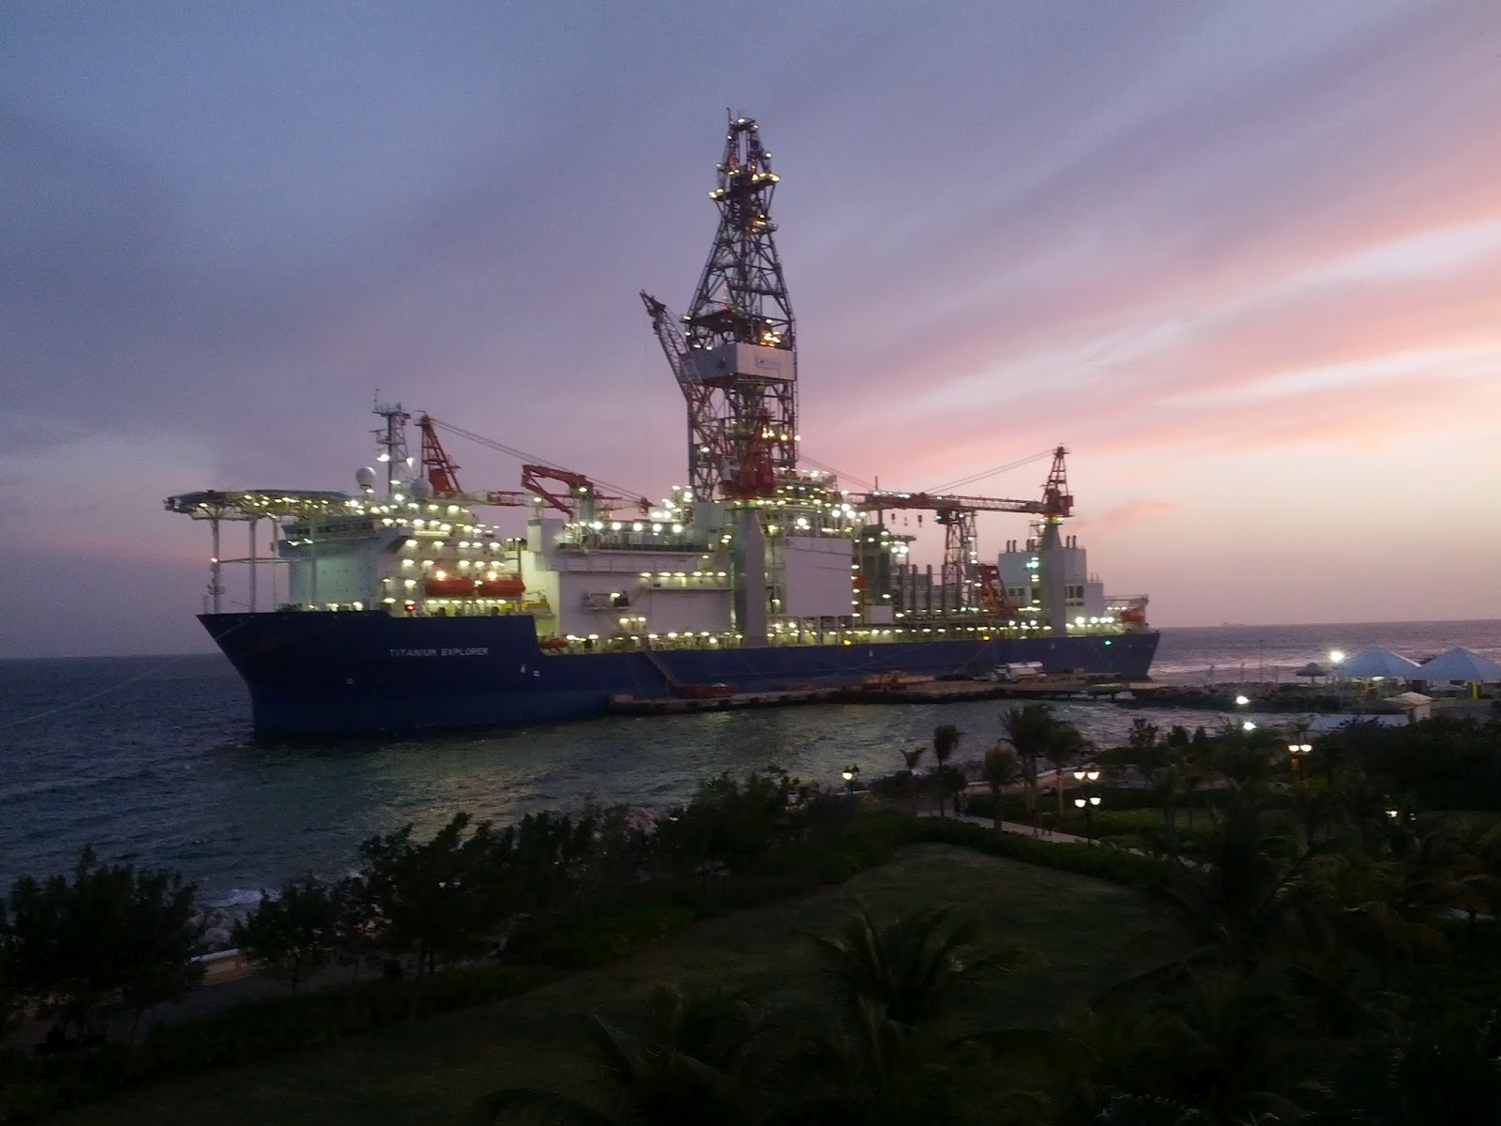
Oil and Gas Services
Industry Overview
Transocean
Precision
Trinidad
Drill ship
Independent: High mobility
Great for remote locations
Dynamic positioning system

Slide 14
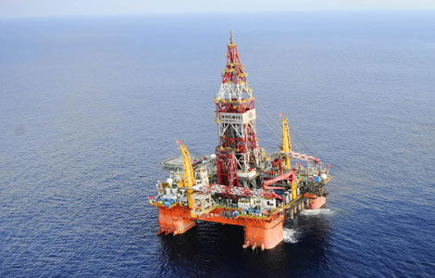
Oil and Gas Services
Industry Overview
Transocean
Precision
Trinidad
Deep-sea Rigs
Capable of drilling to depths of 40,000 feet

Slide 15
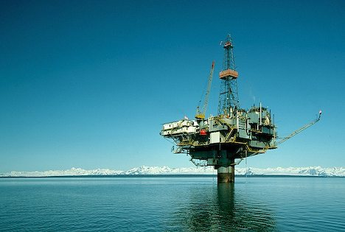
Technology
Technology

Slide 16
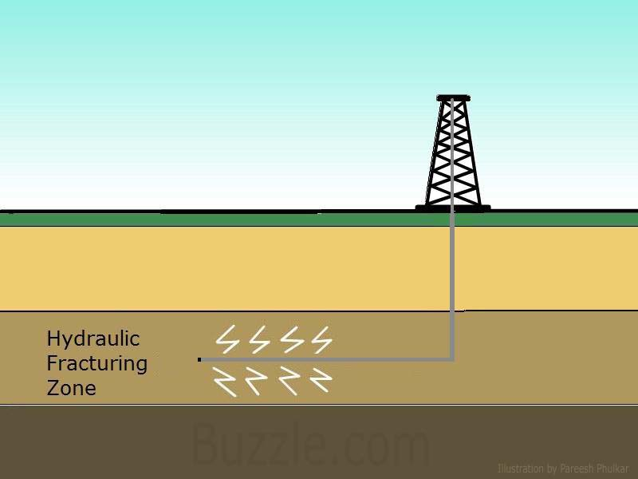
Hydraulic Fracturing
Oil and Gas Services
Industry Overview
Transocean
Precision
Trinidad
Notes:
Hydraulic fracturing is a means of natural gas extraction employed in deep natural gas well drilling. Once a well is drilled, millions of gallons of water, sand and proprietary chemicals are injected, under high pressure, into a well. The pressure fractures the shale and props open fissures that enable natural gas to flow more freely out of the well.
Most widely used drilling technique.

Slide 17
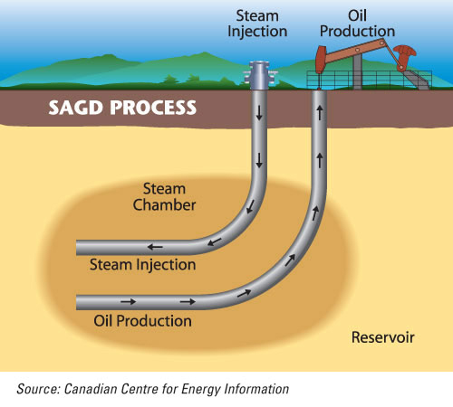
Steam Assisted Gravity Drainage
Oil and Gas Services
Industry Overview
Transocean
Precision
Trinidad
Notes:
SAGD employs two horizontal wells: one injection well (upper well) through which the high pressure steam is continuously injected and one production well (lower well) into which the softened bitumen continuously flows from which it can be pumped to the surface.
the original SAGD wells were drilled horizontally from a tunnel accessed with vertical mine shafts. The development of directional drilling techniques that allowed companies to drill horizontal wells accurately, cheaply and efficiently was key to the current success of SAGD technology. With the lower cost of drilling accurately spaced horizontal well pairs, and the very high recovery rates of the SAGD process, SAGD is an economically attractive recovery technique.

Slide 18
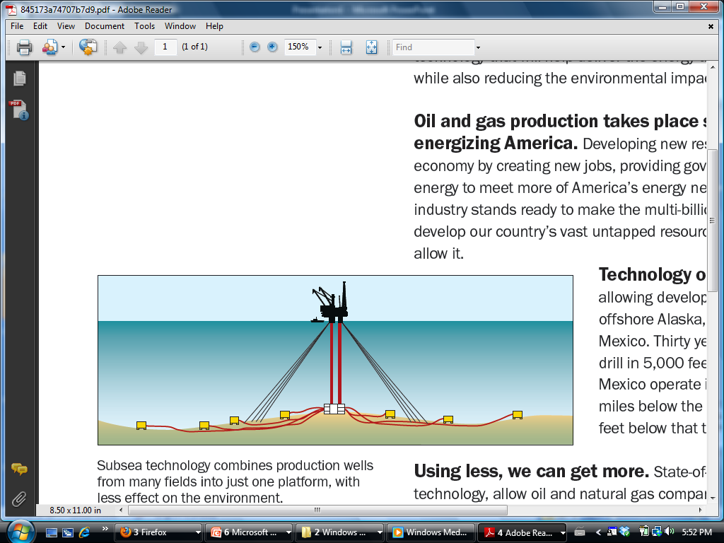
Subsea Drilling System
Oil and Gas Services
Industry Overview
Transocean
Precision
Trinidad

Slide 19
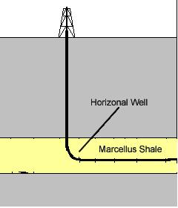
Horizontal Drilling
Oil and Gas Services
Industry Overview
Transocean
Precision
Trinidad
Notes:
Type of direction drilling ,Unlike a directional well that is drilled to position a reservoir entry point, a horizontal well is commonly defined as any well in which the lower part of the well bore parallels the oil zone.

Slide 20
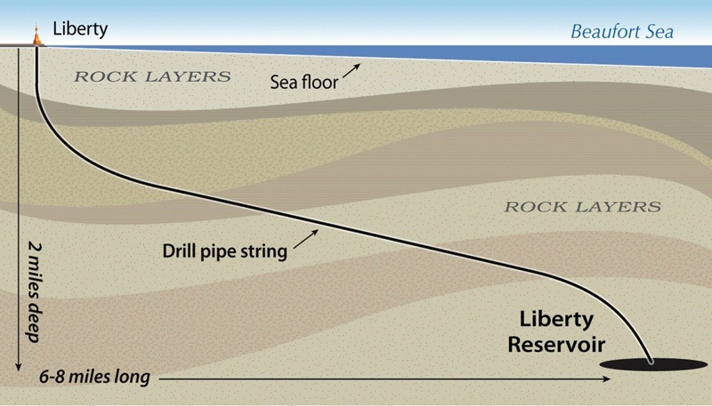
Extended-Reach Drilling
Oil and Gas Services
Industry Overview
Transocean
Precision
Trinidad
Notes:
Extended Reach Drilling (ERD) is directional drilling of very long horizontal wells. The aims of ERD are: a) to reach a larger area from one surface drilling location, and b) to keep a well in a reservoir for a longer distance in order to maximize its productivity and drainage capability.

Slide 21
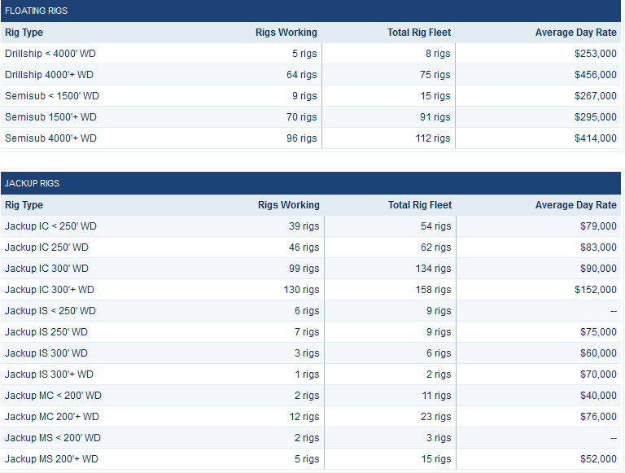
Oil and Gas Services
Industry Overview
Transocean
Precision
Trinidad

Slide 22
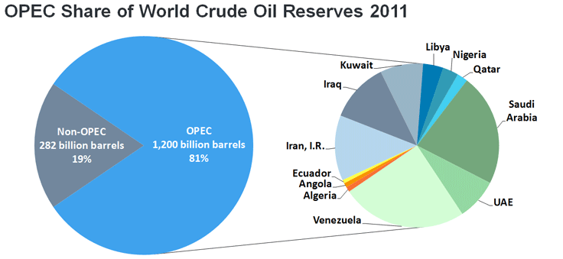
Oil & Gas Reserves, Supply & Demand
Oil and Gas Services
Industry Overview
Transocean
Precision
Trinidad
OPEC
  Control 81% of the world’s proven oil reserves
  Account for 44% of the oil production

Slide 23
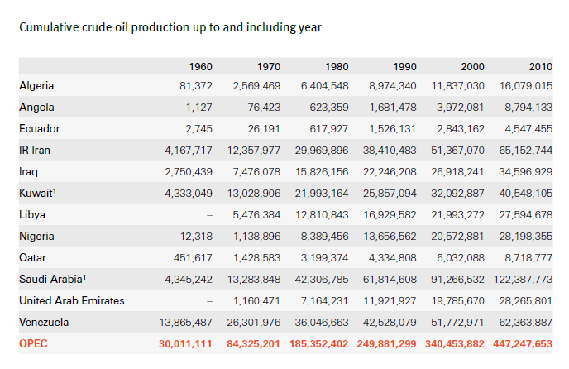
Oil and Gas Services
Industry Overview
Transocean
Precision
Trinidad

Slide 24
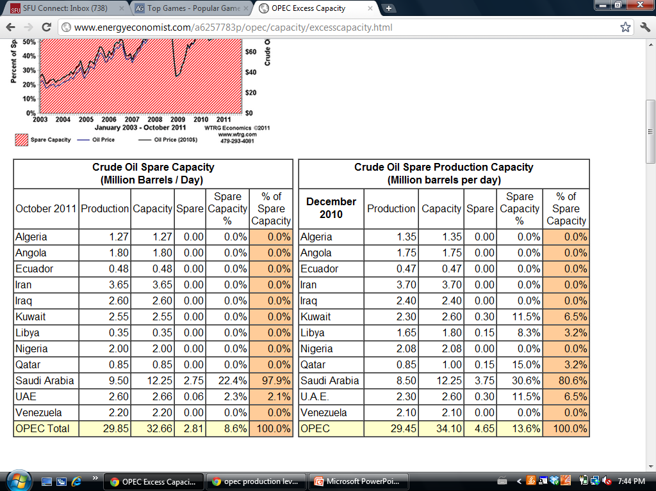
Oil and Gas Services
Industry Overview
Transocean
Precision
Trinidad

Slide 25
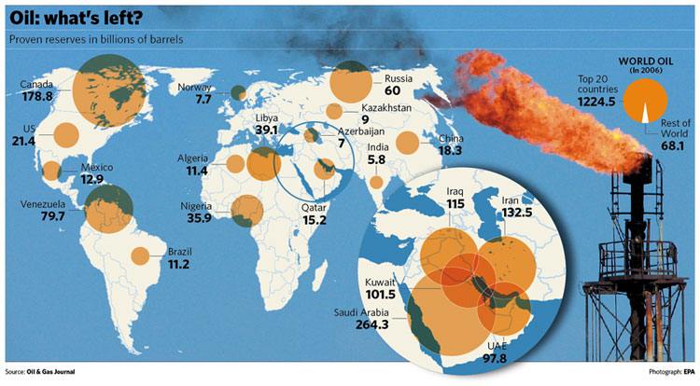
Oil and Gas Services
Industry Overview
Transocean
Precision
Trinidad
  Middle east 56% Central & south America 8%
  North America 16% Eurasia 7%
  Africa 9% Asia & Oceana 3%

Slide 26
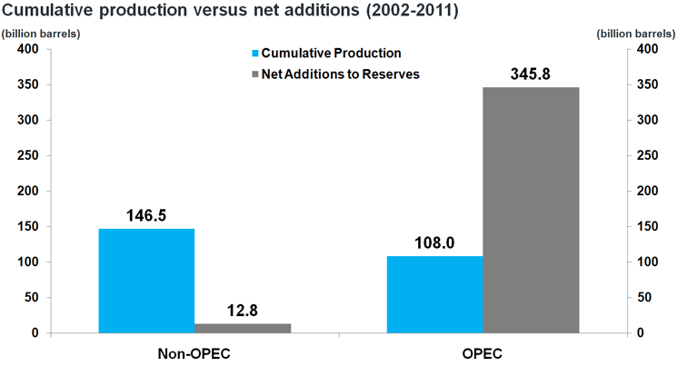
Oil & Gas Reserves, Supply & Demand
Oil and Gas Services
Industry Overview
Transocean
Precision
Trinidad
Non OPEC
  Account for 56% of the oil production

Slide 27
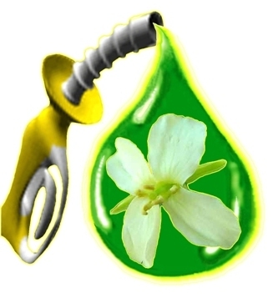
Oil & Gas Alternatives
Oil and Gas Services
Industry Overview
Transocean
Precision
Trinidad
Biofuels
Unconventional fossil fuel
Crude Oil and Natural Gas Relationship

Slide 28

Oil and Gas Services
Industry Overview
Transocean
Precision
Trinidad
Biofuels
2 common types ethanol and biodiesel
Renewable
Clean
Inexpensive

Slide 29
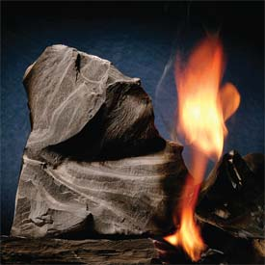
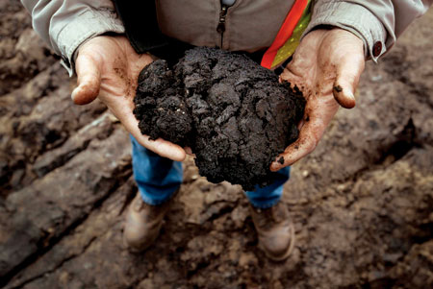
Oil and Gas Services
Industry Overview
Transocean
Precision
Trinidad
Unconventional fossil fuel
Oil shale and Oil sands
Less efficient
Larger environmental impact

Slide 30
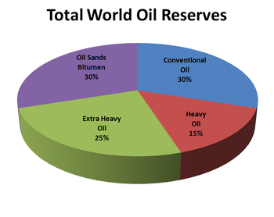
Oil and Gas Services
Industry Overview
Transocean
Precision
Trinidad

Slide 31
Oil & Gas Industry Characteristic
Oil and Gas Services
Industry Overview
Transocean
Precision
Trinidad
Capital-intensive
Highly Skilled
Highly Regulated
Highly Competitive
Price dependent
Essential Technological Development
Others

Slide 32
Oil and Gas Services
Industry Overview
Transocean
Precision
Trinidad
Capital-intensive
  Drilling equipment's installation, operation and maintenance is very expensive to buy and maintain
  Average annual revenue per employee is about $410,000
  Barrier to entry – High fixed cost

Slide 33
Oil and Gas Services
Industry Overview
Transocean
Precision
Trinidad
Highly Skilled
  People with skills and expertise to operate drilling equipment
  minimum requirement of inexperienced personnel
Highly Regulated
  Due to environmental and health and safety concerns
  Affect the operations of all the drilling companies
Highly Competitive
  Numerous industry participants
  Intense price competition

Slide 34
Oil and Gas Services
Industry Overview
Transocean
Precision
Trinidad
Price Dependent
  Oil services
  Drilling companies
  Rigs
Essential Technological Development
  Directional drilling
  Challenging geological locations
  Less damageable to the environment

Slide 35
Oil and Gas Services
Industry Overview
Transocean
Precision
Trinidad
Other Key Factors:
  Industry Cycle
  Natural calamities
  Location
  Types of Contract
  Length of Contract

Slide 36
Oil and Gas Services
Industry Overview
Transocean
Precision
Trinidad
Oil & Gas Price Volatility

Slide 37
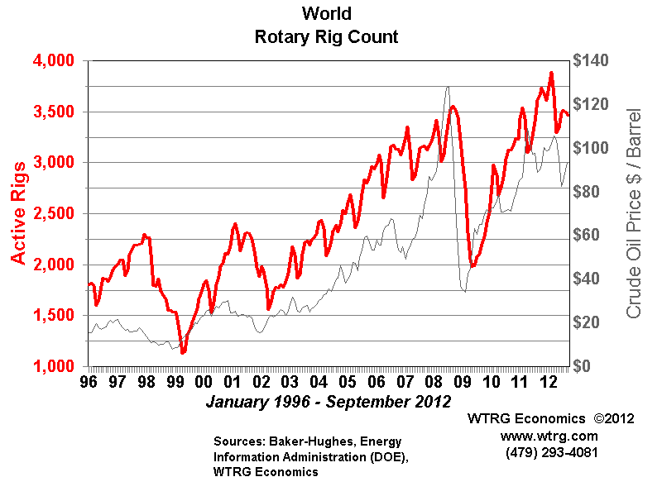
Oil and Gas Services
Industry Overview
Transocean
Precision
Trinidad
Rotary Rig Count

Slide 38
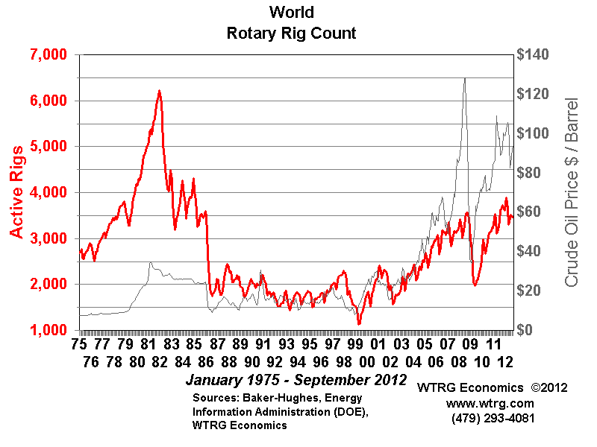
Oil and Gas Services
Industry Overview
Transocean
Precision
Trinidad
Rotary Rig Count

Slide 39
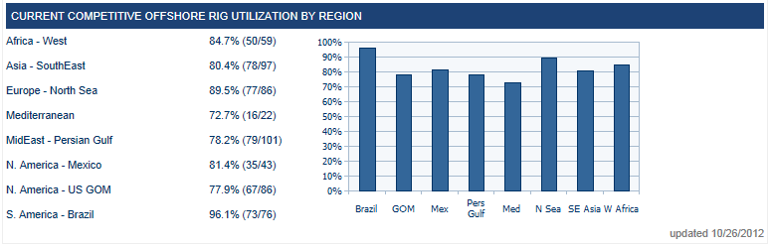
Oil and Gas Services
Industry Overview
Transocean
Precision
Trinidad
Offshore Competitive Rig Utilization Rate

Slide 40
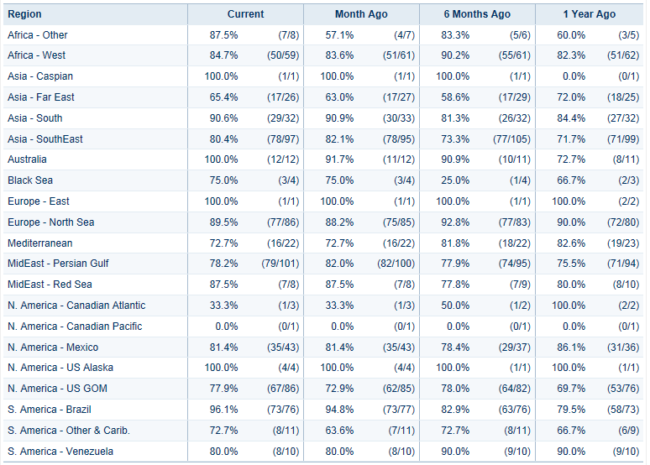
Oil and Gas Services
Industry Overview
Transocean
Precision
Trinidad
Historical Competitive Offshore Rig Utilization by Region

Slide 41
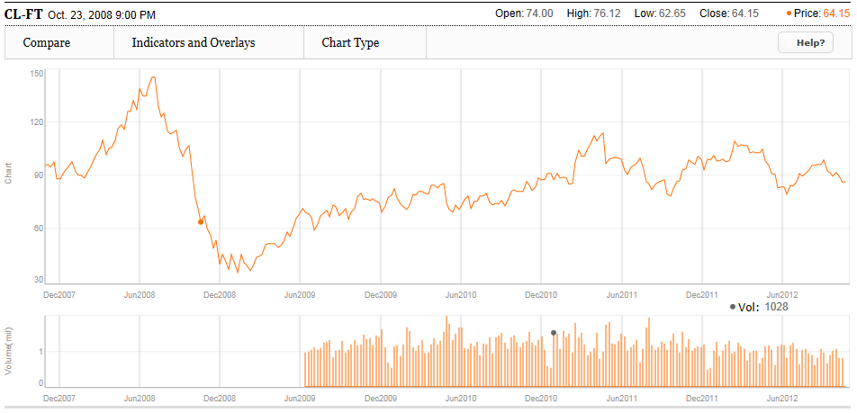
Oil and Gas Services
Industry Overview
Transocean
Precision
Trinidad
5 – year Oil Price Movement

Slide 42
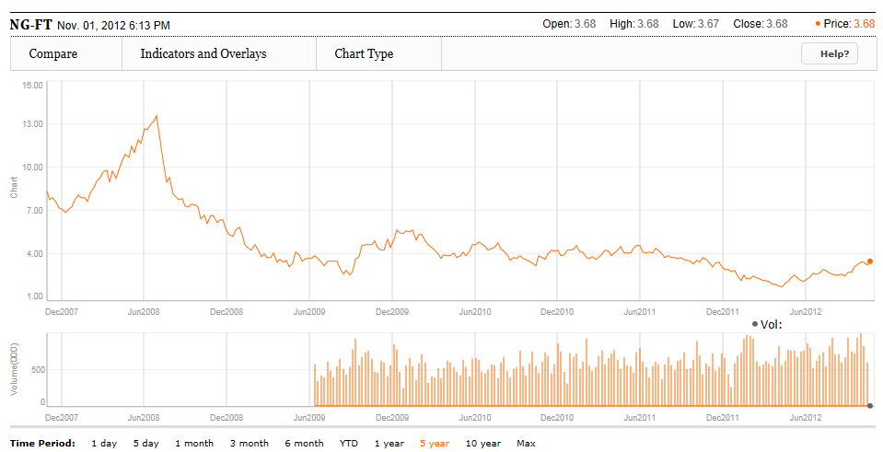
Oil and Gas Services
Industry Overview
Transocean
Precision
Trinidad
5 – year Natural Gas Price Movement

Slide 43
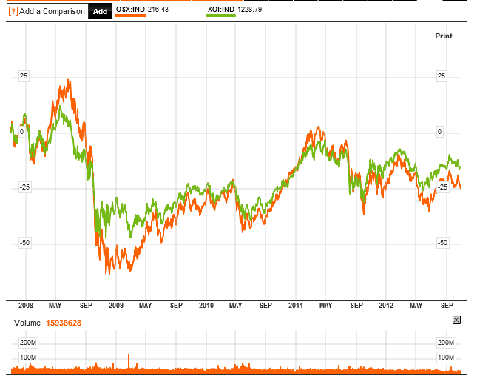
Oil and Gas Services
Industry Overview
Transocean
Precision
Trinidad
5 – year OSX vs. XOI

Slide 44
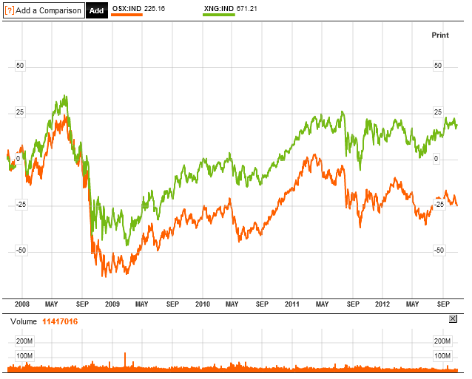
Oil and Gas Services
Industry Overview
Transocean
Precision
Trinidad
5 – year OSX vs. XNG

Slide 45
Future Outlook
Oil and Gas Services
Industry Overview
Transocean
Precision
Trinidad
Long-term market growth
Emerging Asia-Pacific economies (China & India)
Decline of conventional fuel (next 20-30 years)
Peak Oil
Switching to more environmentally friendly, cheaper and renewable alternative sources

Slide 46
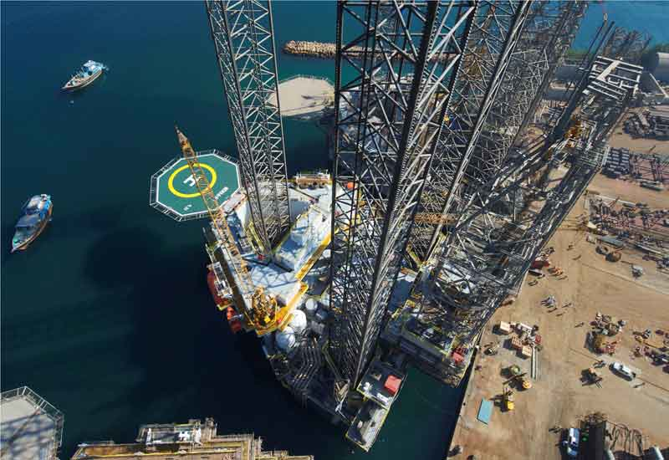
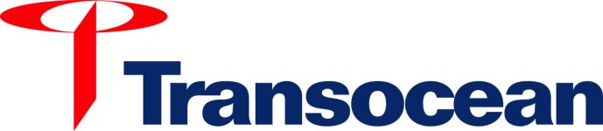
Canadian Oil and Gas Services

Slide 47

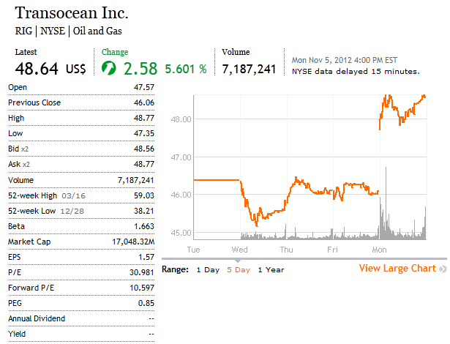
Company Snapshot
Canadian Oil and Gas Services
Industry Overview
Transocean
Precision
Trinidad

Slide 48
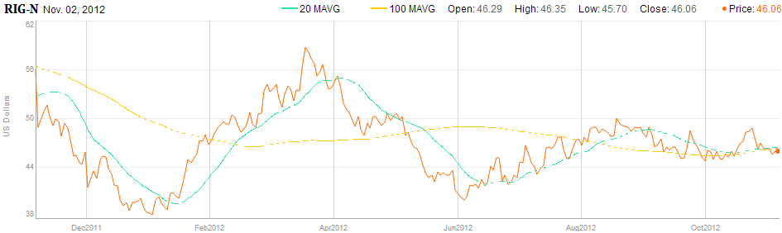
RIG 1 Year Chart
Canadian Oil and Gas Services
Industry Overview
Transocean
Precision

Slide 49
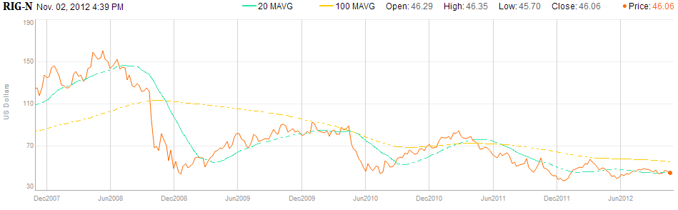
RIG 5 Year Chart
Canadian Oil and Gas Services
Industry Overview
Transocean
Precision

Slide 50
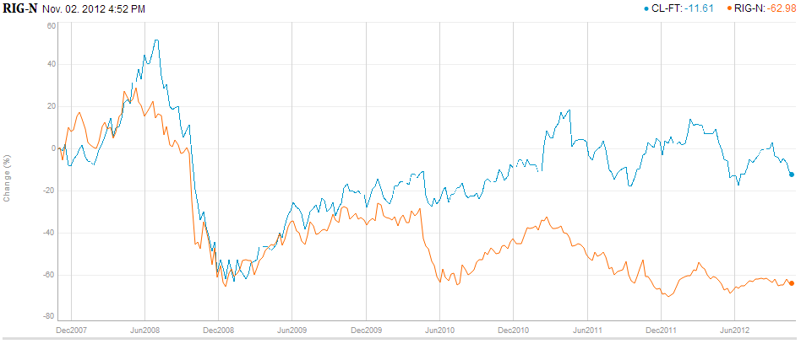
RIG 5 year
Canadian Oil and Gas Services
Industry Overview
Transocean
Precision
RIG 5 Year vs. Crude Oil

Slide 51
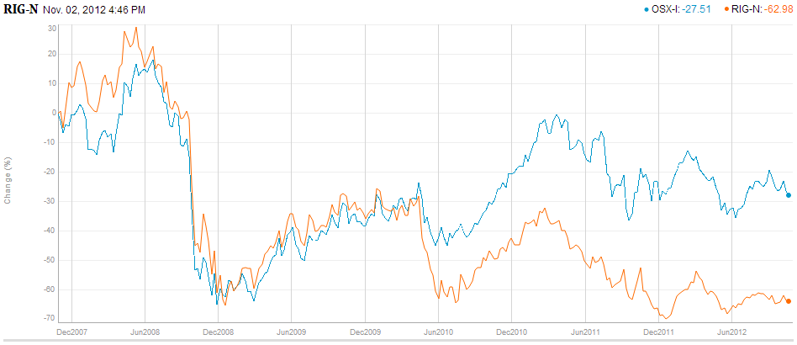
RIG 5 year vs. Philadelphia Oil Service
Canadian Oil and Gas Services
Industry Overview
Transocean
Precision

Slide 52
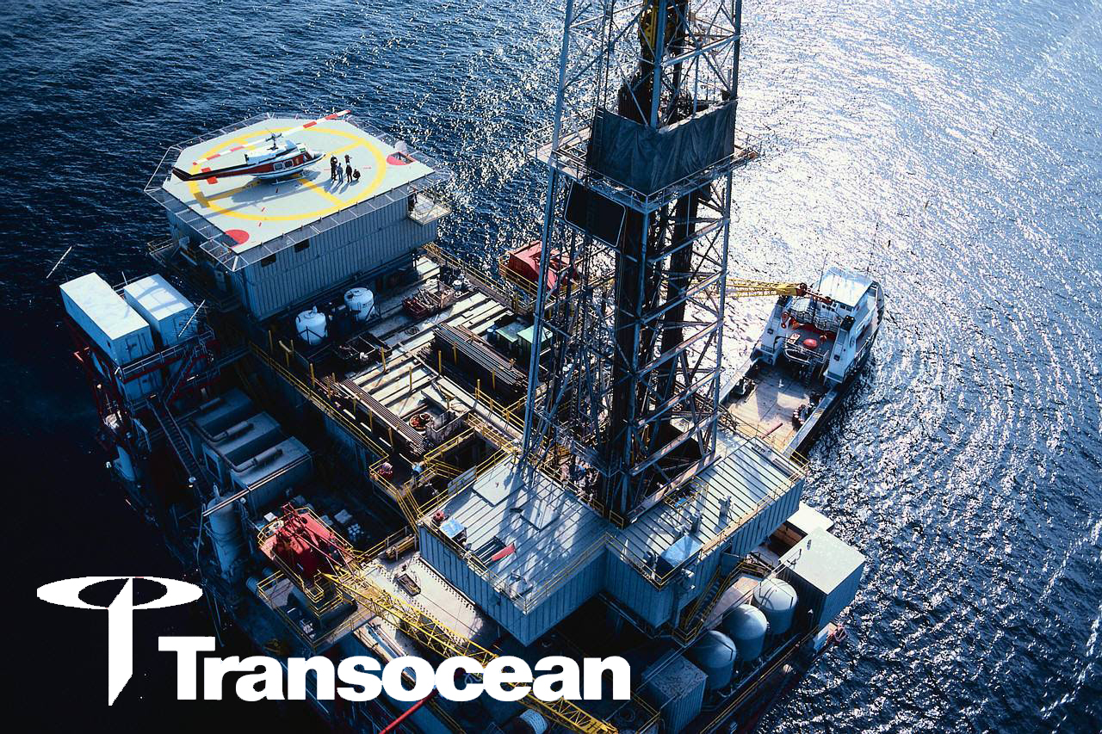
Company Overview
Canadian Oil and Gas Services
Industry Overview
Transocean
Precision
Transocean is the largest offshore contract drilling services provider for oil and gas wells.
Types of drilling include:
  Deepwater drilling
  Harsh environment drilling
  Inland and shallow water drilling

Slide 53
Drilling Rigs
Canadian Oil and Gas Services
Industry Overview
Transocean
Precision
Drillships
Semisubmersibles
Jackups
For water depths of 400ft and less
Mid-water, Deepwater, Ultra-deepwater
Mid-water, Deepwater, Ultra-deepwater
Notes:
Jackups
Mobile self-elevating drilling platforms.
Equipped with legs that are lowered to the ocean floor for foundation.
Jacked up just above highest waves.
Suited for water depths of 400 ft and less.
Drillships
Dynamically positioned in that it does not require anchors
Great load capacity, ideal for remote locations
Limited to calmer water conditions
Self-propelled and extremely mobile
Dual-activity technology (on recent models)
Mid-water, Deepwater, Ultra-deepwater
Semi-sub
Floating vessels that can be submerged by water ballast system so that lower hulls are under water during drilling operations
Maintain position through anchors or computer controlled dynamic positioning thrusters
Moved by propellers or tugging
Suited for rough water conditions
Mid-water, Deepwater, Ultra-deepwater

Slide 54
Core Value
Canadian Oil and Gas Services
Industry Overview
Transocean
Precision
Financial Discipline: Long-term growth
Integrity & Honesty: Highest standard of ethics
Respect for Employees, Customers and Suppliers: Value-added service
Safety: Health and work safety
Technical Leadership: Innovative solution as competitive advantage
Notes:
Our decisions will be made to ensure long-term growth for the benefit of employees, customers and shareholders.
Our actions will be conducted following the highest standard of ethics, honesty and personal integrity. This will foster and maintain trust and confidence of our employees, customers and suppliers.
Our employees will be developed and motivated to meet the challenges ahead. Individuality and diversity will be valued and performance recognized. We will provide our customers with unsurpassed value-added service. Our relationship with suppliers will reflect respect, understanding and sound business practice.
Personal safety and employee health is our greatest responsibility, followed by the protection of our environment and company property.
Our competitive advantage is based on continually improving our processes and finding innovative solutions to the technical challenges in meeting the needs of our customers.

Slide 55
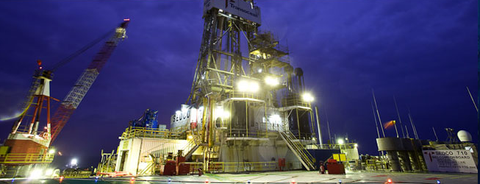
Firsts & Records
Canadian Oil and Gas Services
Industry Overview
Transocean
Precision
Firsts:
First oil and gas exploration well drilled in more than 10,000 feet of water
First offshore jackup drilling rig
First self-propelled jackup
Records:
Water depth drilling record
10,194 feet of water in India working for Reliance in 2011
Deepest extended-reach well ever drilled record
40,320 feet, in offshore Qatar in 2008

Slide 56

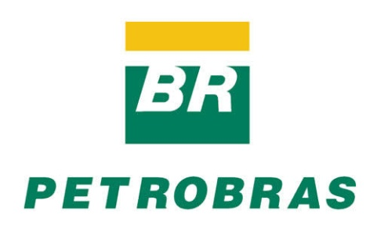
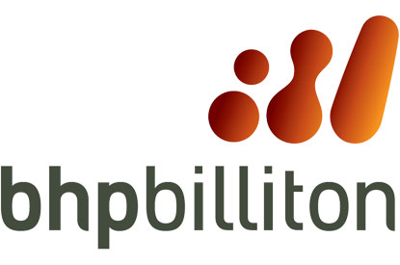
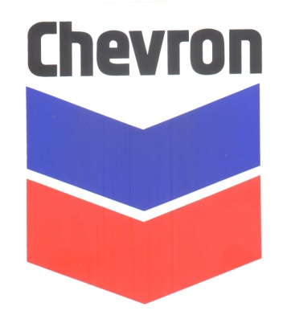


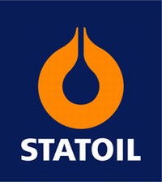


Clients
Canadian Oil and Gas Services
Industry Overview
Transocean
Precision
Notes:
Bp accounted for about 10% of the revenue in 2011.

Slide 57
Two Operating Segments
Canadian Oil and Gas Services
Industry Overview
Transocean
Precision
1. Contract Drilling
2. Engineering Service & Project Management
either a day-rate basis or a completed-project, fixed-price basis
Contract drilling rigs, related equipment, and work crews to drill oil and gas wells on a day-rate
Primary business

Slide 58
fleet
Canadian Oil and Gas Services
Industry Overview
Transocean
Precision

Slide 59
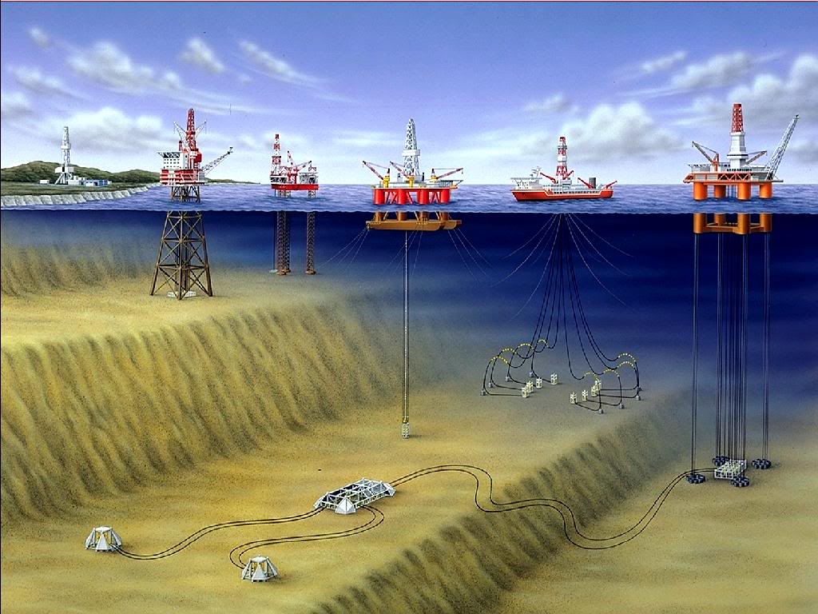
Fleet Lineup
Industry Overview
Transocean
Precision
Jackups
Midwater Semisubmersible
Deepwater Semisubmersible
Drillship
Floaters
Notes:
Jackups
Mobile self-elevating drilling platforms.
Equipped with legs that are lowered to the ocean floor for foundation.
Jacked up just above highest waves.
Suited for water depths of 400 ft and less.
Drillships
Dynamically positioned in that it does not require anchors
Great load capacity, ideal for remote locations
Limited to calmer water conditions
Self-propelled and extremely mobile
Dual-activity technology (on recent models)
Mid-water, Deepwater, Ultra-deepwater
Semi-sub
Floating vessels that can be submerged by water ballast system so that lower hulls are under water during drilling operations
Maintain position through anchors or computer controlled dynamic positioning thrusters
Moved by propellers or tugging
Suited for rough water conditions
Mid-water, Deepwater, Ultra-deepwater

Slide 60
Rigs
Canadian Oil and Gas Services
Industry Overview
Transocean
Precision
Transocean owns or operates 1 mobile offshore drilling units (as of October 2012) :
  48 High-Specification Floaters
    27 Ultra-deepwater, 14 Deepwater,
    7 Harsh Environmental
  25 Midwater Floaters
  9 High-Specification Jackups
  32 Standard Jackups
    12 units holding for sale
  1 Swamp Barge
  5 Rigs under construction
    2 ultra-deepwater Drillships, 3 high-specification Jackups
Notes:
48 High-Specification Drillships
27 Ultra-deepwater
14 Deepwater
7 Harsh Environmental
25 Midwater Drillships
9 High-Specification Jackups
+ 4 new builds
32 Standard Jackups
Discontinued operation
12 Standard Jackups
Hold for sale
1 Swamp Barge
discontinued operation
5 Rigs under construction
2 ultra-deepwater Drillships
3 high-specification Jackups

Slide 61
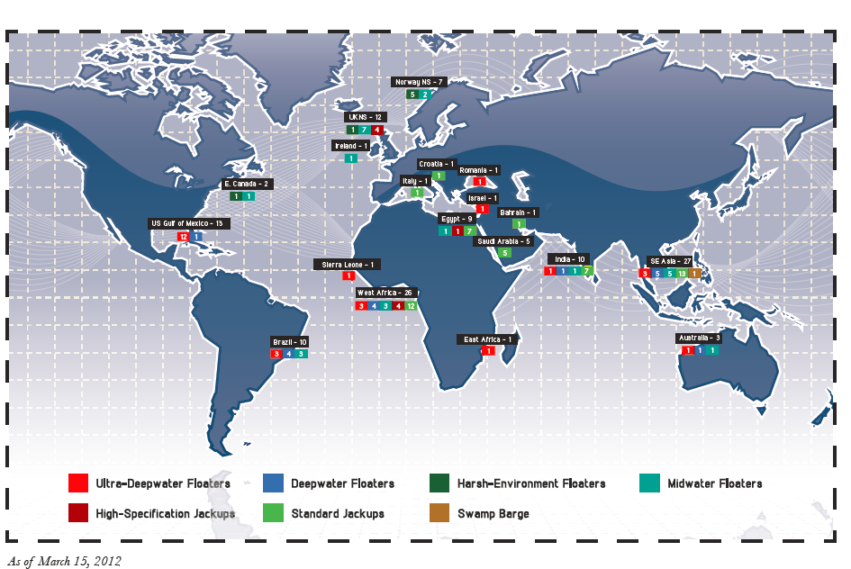
Fleet Operations
Canadian Oil and Gas Services
Industry Overview
Transocean
Precision

Slide 62
Firm history
Canadian Oil and Gas Services
Industry Overview
Transocean
Precision

Slide 63
Timeline
Canadian Oil and Gas Services
Industry Overview
Transocean
Precision
1919
Dancinger Oil and Refinery Co. is founded.
1993
IPO of Transocean
1946
Consortium (CUSS) formed to establish feasibility of offshore drilling. Also, Santa Fe Drilling is founded.
1963
Santa Fe listed in NYSE.
2007
Transocean and GlobalSantaFe merge to form the world’s largest offshore driller.
2003-2007
Breaks several records for depth drilling (10,000 ft of water) and well depth (35,000 ft).

Slide 64

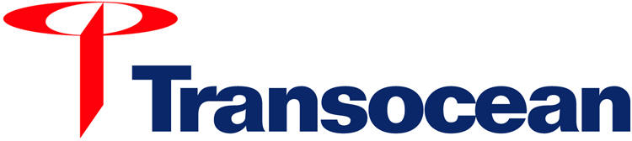
History of Mergers & Acquisitions
Industry Overview
Transocean
Precision
2007: Transocean
2001: Global SantaFe
1953: Global Marine
1946: Santa Fe Int’l
2001: Transocean
1999: Transocean Sedco Forex
1997: R&B Falcon
1996: Transocean Offshore
1985: Sedco Forex by Schlumberger
1947: Sedco
1971: Forex Neptune by Schlumberger
Transocean ASA
1992: SODI
1953: Offshore Company
International Drilling
1950: Southern Productions
1919: Danciger
1963: Offshore Company
1942: Forex
1962: Neptune Offshore
Notes:
Southern Production Company (subsidiary of Southern Natural Gas) buys Danciger and forms The Offshore Company.
The Offshore Company acquires Int’l Drilling Co. Ltd.
The Offshore Company becomes Sonat OD Inc.
Sonat OD Inc. spins off SODI.
SODI acquires TransOcean ASA.
KPC acquires SF Int’l Corp (wholly owned subsidiary).
Then divests 40 million shares through an IPO then another 31 million shares through a secondary offering.

Slide 65
Acquisition of Aker Drilling in 2011
Canadian Oil and Gas Services
Industry Overview
Transocean
Precision
In August 2011, Transocean agreed to buy Aker Drilling for $1.46 billion
  To increase earnings and upgrade fleet units

Slide 66
Management Team
Canadian Oil and Gas Services
Industry Overview
Transocean
Precision

Slide 67
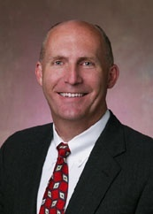
Steven L. Newman
President & CEO
Canadian Oil and Gas Services
Industry Overview
Transocean
Precision
2010: Held his current position since March
2007-08: Executive VP of Performance and COO
2006-07: Executive VP and COO
2005-06: Senior VP of HR, Information Process
Solutions, and Treasury
1994: Joined company in Corporate Planning Department
1992: MBA from Harvard Graduate School of Business
1989: BSC in Petroleum Engineering from Colorado School of Mines
Member of the Society of Petroleum Engineers

Slide 68
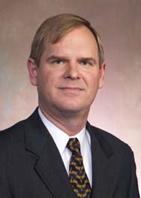
Gregory L. Cauthen
Executive Vice President & Interim CFO
Canadian Oil and Gas Services
Industry Overview
Transocean
Precision
2009-10: Consultant of the company
2001-09: Chief Finance Officer
2001-03: Treasurer of the company from March
2001: Vice President, Finance
Masters in Accounting degree from University of Florida, Gainesville

Slide 69
Future Outlook
Canadian Oil and Gas Services
Industry Overview
Transocean
Precision

Slide 70

Revenue Methods
Canadian Oil and Gas Services
Industry Overview
Transocean
Precision
Transocean has two main methods for generating revenue from its drilling operations:
  1. OPERATING RATE: Rate that is charged for utilization of rigs.
  2. STAND-BY RATE: Rate charged for the rig being ready for use, regardless of whether it is actually used.

Slide 71

Fleet Updates (expired in 6 months)
Canadian Oil and Gas Services
Industry Overview
Transocean
Precision
Inter Pipeline Fund
Notes:
17 contracts expire in 6 months from now

Slide 72

Canadian Oil and Gas Services
Industry Overview
Transocean
Precision

Slide 73

Canadian Oil and Gas Services
Industry Overview
Transocean
Precision

Slide 74

Canadian Oil and Gas Services
Industry Overview
Transocean
Precision

Slide 75

Fleet Revenue
Canadian Oil and Gas Services
Industry Overview
Transocean
Precision
NOTE: average daily revenue is defined as contract drilling revenue earned per revenue earning day. The calculation includes the revenues of rigs that are operating on standby rates.

Slide 76

Fleet Utilization Outlook
Canadian Oil and Gas Services
Industry Overview
Transocean
Precision
NOTE: The uncommitted fleet rate is the number of uncommitted days as a percentage of the total number of available rig calendar days in the period.

Slide 77

Statement of Operations
Canadian Oil and Gas Services
Industry Overview
Transocean
Precision

Slide 78

Operating Revenues
Canadian Oil and Gas Services
Industry Overview
Transocean
Precision

Slide 79

Revenue Efficiency
Canadian Oil and Gas Services
Industry Overview
Transocean
Precision
Notes:
Revenue efficiency = actual contract drilling revenue divided by the highest amount of total contract drilling revenue which could have been earned during the relevant period(s). (actual/highest possible)

Slide 80

Future Debt
Canadian Oil and Gas Services
Industry Overview
Transocean
Precision

Slide 81

Shareholder Equity
Canadian Oil and Gas Services
Industry Overview
Transocean
Precision

Slide 82


Accidents & Incidents
Canadian Oil and Gas Services
Industry Overview
Transocean
Precision
2010: The BP Oil Spill (working for BP)
  The worst accidental oil spill
  Deepwater Horizon was drilling for BP and exploded
  Total lost expected to be greater than $3 billion
  Ongoing lawsuits
2011: Oil Spill in Brazil (working for Chevron)
  Seeking for $20 billion in damage from Chevron and Transocean
  Operation in Brazil almost being suspended by the Brazil court
  Ongoing lawsuits

Slide 83
Financial statements
Canadian Oil and Gas Services
Industry Overview
Transocean
Precision

Slide 84

Balance Sheet Q2 2012
Canadian Oil and Gas Services
Industry Overview
Transocean
Precision

Slide 85

Canadian Oil and Gas Services
Industry Overview
Transocean
Precision

Slide 86

Balance Sheet 2011
Canadian Oil and Gas Services
Industry Overview
Transocean
Precision

Slide 87

Canadian Oil and Gas Services
Industry Overview
Transocean
Precision

Slide 88

Income Statement 2011
Canadian Oil and Gas Services
Industry Overview
Transocean
Precision

Slide 89

Income Statement Q2 2012
Canadian Oil and Gas Services
Industry Overview
Transocean
Precision

Slide 90

Cash Flow Statement 2011
Canadian Oil and Gas Services
Industry Overview
Transocean
Precision

Slide 91

Canadian Oil and Gas Services
Industry Overview
Transocean
Precision

Slide 92

Cash Flow Statement Q2 2012
Canadian Oil and Gas Services
Industry Overview
Transocean
Precision

Slide 93

Canadian Oil and Gas Services
Industry Overview
Transocean
Precision

Slide 94
Recommendation
Canadian Oil and Gas Services
Industry Overview
Transocean
Precision
HOLD!

Slide 95

“High Performance,
High Value”

Slide 96


Stock Performance
Outstanding # of Shares: 76,007,667

Slide 97

1yr Historical Price

Slide 98

5yr Historical Price

Slide 99

10yr Historical Price

Slide 100
History
Founded in early 1950s
Head office in Calgary, Alberta
Listed on TSX September 23, 1988
Reorganized into a Trust November 7, 2005
  in 2006 a new law in Canada (SIFT) passed to impose tax on income trust distributions (the tax was to be introduced in 2011)
Reverted back to Corporation June 1, 2010
Notes:
As a result of Plan of Arrangement approved by the holders of trust units of Precision Drilling Trust and the holders of Class B limited partnership units, the Trust converted from an open-ended income trust to a corporation.

Slide 101
2011 Achievements
Organic growth in the North American market
  Completed 19 new rig builds
  Contracting 33 additional rigs, to be completed in 2012
Completed 18 drilling rig upgrades, mostly tier upgrades
  Decommissioned 36 Tier 3 drilling rigs and 13 well servicing units

Slide 102
2011 Achievements
Expanded directional drilling experience and presence in North America
  Has the capacity to run concurrently 70 directional jobs
Continued organic growth in the Completion and Production Services division
  Through addition of assets and people

Slide 103
Mergers and Acquisitions
Acquired Drake Directional Drilling Inc. & Drake MWD Services LLC
March 2011
Acquired Terra Water Group Ltd
September 2006
Acquired Rick’s Well Servicing-Rigs
July 2008
June 2008
Acquired Grey Wolf Inc.
April 2009
AIMCo. acquires a 15% stake in PD
September 2011
Acquired Axis Energy Services Holding
Notes:
Terra Water Group – Provides waste water treatment services
Grey Wolf Inc. – Play to expand into US (located in Houston, Texas) 121 rigs
Rick’s Well Servicing Ltd – 6 rigs
AIMCo - $330M investment, PD debt challenged after acquisition of Grey Wolf. Purchased $175 million in 10% unsecured senior notes, 35M trust units at $3, 15M warrants exercisable at $3.22.
Drake – directional driller in Houston Texas, further expansion into US
Axis – obtain more directional drilling services in Western Canada

Slide 104
2011 Acquisitions
Drake Directional Drilling LLC & Drake MWD Services LLC
Directional drilling company based in Houston, Texas
Typically operates 10-14 directional drilling jobs per year
2) Axis Energy Services Holdings Inc.
Directional drilling company based in Calgary, Alberta
Primarily serves Western Canada
30 job capacity

Slide 105

Business Segments
Notes:
Contract Drilling Services – land drilling services, directional drilling services, camp and catering services, procurement and distribution of oilfield supplies and the manufacture and refurbishment of drilling and service rig equipment
Completion and Production Services – service rigs for well completion and workover services, snubbing services, wastewater treatment services and the rental of oilfield surface equipment, tubulars, well control equipment and wellsite accommodations

Slide 106

Q3 Revenue Segmentation
Completion and Production Services
Notes:
Completion and Production Services segment revenue for the third quarter decreased by 7% from the third quarter of 2011 to $78 million and EBITDA decreased by 17% to $23 million. The decrease in revenue and EBITDA is attributed to a decrease in activity partially offset by increased service rig rates.
Started in year ended December 31, 2011, Precision changed its depreciation policy on certain Tier 3 rigs from the unit of production method to straight‐line over four years resulting in approximately $6 million in additional depreciation in the quarter.
Additional increases in depreciation are the result of a greater proportion operating days from our Tier 1 drilling rigs in 2012 relative to 2011 and depreciation from the growth in directional drilling and international contract drilling.

Slide 107

Q3 Revenue Segmentation
Contract Drilling Services
Notes:
Contract Drilling Services segment revenue for the third quarter of 2012 decreased by 1% to $410 million and EBITDA decreased by 15% to $146 million compared to the same period in 2011. The decrease in revenue was due to lower activity for both Canada and the United States partially offset by higher average rates per day in Canada and the United States, increased activity internationally and higher directional drilling revenues.
The decrease in
EBITDA was the result of lower activity in Canada and the United States, start‐up costs internationally, lower margin in the United States as a result of increased crew labour and maintenance costs.

Slide 108
Types of Drilling Rig
Tier 1
Lower pumping capacity
Conventional rigs
Tier 3
New or upgraded equipment
Tier 2
Directional or horizontal drilling
Newer Designs
Better suited for shale and unconventional plays
Highly mobile
Directional or horizontal drilling
Less mobile than Tier 1

Slide 109

Rig Composition and Location
Notes:
Demand remains solid for existing Tier 1 Super Series rigs for both Canada and the United States, however,
customer’s interest in contracting new build Super Series rigs has softened.
Precision believes it will have opportunities to contract additional new build and upgraded rigs in late 2012 and during 2013, although the pace of contracts awards is likely to be significantly slower than the pace during 2011.
Industry sources, as at October 19, 2012, the United States active land drilling rig count was down 9% from the prior year period while the Canadian drilling rig count had decreased about 29%.

Slide 110

Horizontal Drilling Growth

Slide 111

Drilling Activity

Slide 112

Rig Utilization Days
Notes:
Drilling rig utilization days in Canada (drilling days plus move days) during the third quarter of 2012 were 7,735, a decrease of 26% compared to 10,505 in 2011 due to lower industry activity with low natural gas prices and uncertainty in global markets with West Texas Intermediate crude oil prices dipping below $80 per barrel in late
9 June.
Drilling rig utilization days for Precision in the United States were 15% lower than the same quarter of 2011 due to a continued reduction in natural gas targeted drilling. On average, Precision had eight rigs working internationally as the Saudi Arabia based business ramped up and Precision had mobilized three additional rigs into Mexico during the second quarter of 2012.

Slide 113
Average Rigs in Q3
Has average of 119 rigs committed under term contracts for Q4 2012
Average of 100 rigs contracted for Q1 2013
Average of 91 for Q2 in 2013
In Canada, term contracted rigs normal generate 250 utilization days per rig
In US and International 365 utilization days per rig
Notes:
Canada has lower utilization days because of seasonal nature of well access

Slide 114

Rigs in Play – Canada
Notes:
Contract Drilling Services segment revenue for the third quarter of 2012 decreased by 1% to $410 million and EBITDA decreased by 15% to $146 million compared to the same period in 2011. The decrease in revenue was due to lower activity for both Canada and the United States partially offset by higher average rates per day in Canada and the United States, increased activity internationally and higher directional drilling revenues.

Slide 115

Rigs in Play – USA
-6% Decrease

Slide 116

Unconventional Rig Locations
Notes:
Precision’s drilling rig fleet is positioned in virtually every resource play from northern Canada to Southern US

Slide 117

Service Rig Fleet

Slide 118

Service Rig Hours
Notes:
Well servicing and snubbing activity decreased 16% from the prior year period, with the fleet generating 72,766 operating hours in the third quarter of 2012 compared with 86,146 hours in the prior year quarter for utilization of 37% and 43%, respectively.
The decrease was a result of lower service rig activity compared to the previous year which had a very active quarter with customers performing well completion and production work on a backlog of oil wells from a prolonged spring break‐up.

Slide 119

CAPEX
Notes:
Capital expenditures are expected to be approximately $921 million for 2012, of which $681 million has been expended during the first nine months of 2012. The expected 2012 total includes $139 million for sustaining and infrastructure expenditures and is based upon currently anticipated activity levels for 2012.

Slide 120
Management Team

Slide 121

Kevin A. Neveu
President & Chief Executive Officer
Appointed as CEO and Director of Precision in August 2007 and nominated as CEO in January 2009
Previously President of Rig Solutions Group of National Oilwell Varco
Serves on the board of:
  RigNet Inc., Houston, Texas (Since 2004)
  The Heart and Stroke Foundation of Alberta (Since 2009)
  Member of the Board of Directors and a Member of the Executive Committee of the International Association of Drilling Contractors, Houston Texas (Since January 2010)
Notes:
At Rig Solutions Group Mr. Neveu was responsible for the company’s drilling equipment business.

Slide 122

Rob McNally
Executive Vice President and Chief Financial Officer
Became CFO in July 2010
Has over 18 years of executive management, finance, operations, mergers and acquisitions and capital markets experience in the oilfield services industry
Prior to joining:
  Investment Principal at Kenda Capital
  CEO of Dalbo Holdings
  Executive Vice President of Finance and Operations and a member of the board of directors for Warrior Energy Services Corporation
  Investment Banker with Simmons & Company International
Notes:
Kenda Capital is a leading private equity investments, strategic management and divestments of technology oriented oil service companies.
Dalbo Holdings is a Utah based oilfield service company
He was with Simmons & Company International for 6 years, primarily working with oil service companies on M&A and capital market transactions.

Slide 123
Financial Analysis

Slide 124

2012 Q3 Balance Sheet
Oil and Gas Services

Slide 125

2011 Annual Balance Sheet
Oil and Gas Services

Slide 126

2011 Annual Income Statement
Oil and Gas Services

Slide 127

2012 Q3 Income Statement
Oil and Gas Services

Slide 128

2011 Annual Cash Flow Statement
Oil and Gas Services

Slide 129

2012 Q3 Cash Flow Statement
Oil and Gas Services

Slide 130
Recommendation
HOLD!

Slide 131



Slide 132


Company Snapshot

Slide 133

1-Year Chart

Slide 134

5-Year Chart

Slide 135

10-Year Chart

Slide 136
Trinidad Overview
Founded in 1996, Calgary, Alberta
Began trading on TSX in 2000
Focused in the oil and gas drilling sector
Strives to maintain utilization rates above industry average

Slide 137

Company Overview

Slide 138
Business Segments
Drilling
  Operating in majority of oil and gas basins in North America
  Depth capacity from 1,000 to 6,000 meters
  Supplies to major North American Operators

Slide 139
Business Segments
Coring and Pre-setting
  20 coring and pre-setting rigs under the name Titan
  Coring: drill narrow holes to evaluate and plan
  Pre-setting: shallower rigs to drill and cement the first 200-300 meters of a new well

Slide 140
Business Segments
Manufacturing and Technology
  Develops technically-advanced fleet of oil and gas drilling rigs
  In-house facility

Slide 141
Business Segments
Well servicing
  Sold to CWC Well Services Corp. on June 16, 2011

Slide 142

Operations

Slide 143


Slide 144


Slide 145


Slide 146


Slide 147


Slide 148


Slide 149


Slide 150


Slide 151


Slide 152


Slide 153


Slide 154

Management
Management

Slide 155

Management
Lyle C. Whitmarsh,
Chief Executive Officer
  Graduated from high school in Medicine Hat
  Rig manager for Champion Drilling in 1987
  Advanced to the position of Senior Field Supervisor in 1995
  Operations Manager in 1998
  Formed his own company, Summit Oilfield Consulting in 1999
  Employed with Trinidad Drilling since July 2000
  Field Supervisor -> General Manager -> President of Trinidad

Slide 156

Management
Brent J. Conway,
President
  Graduated from the University of Calgary with a
  Bachelor of Commerce in accounting
  Received CGA Designation in 1996
  Joined Trinidad Drilling in November 2001,Previous Served as CFO from November 2001 to January 2012 and Executive Vice President from January 2008 to January 2012
  Named president on January 2012

Slide 157

Management
Management
Lesley Bolster,
Chief Financial Officer
  Graduated from the University of New Brunswick with a Bachelor of Business Admin
  Received CGA Designation in 1997 at Grant Thornton, Chartered Accountants.
  In 1998, she joined Ernst & Young, Calgary and advanced to Manager, Assurance & Advisory services in 1999.
  Joined Trinidad Drilling in 2009 as Corporate controller, promoted to Vice President, Finance & Treasurer
  Named CFO on 2012

Slide 158

2011 Q2 Balance Sheet

Slide 159

2011 Annual Balance Sheet

Slide 160

2011 Annual Income Statement

Slide 161

2011 Q2 Income Statement

Slide 162

2011 Annual Cash Flow

Slide 163

2011 Q2 Cash Flow

Slide 164
Recommendation
HOLD/BUY

