Slide 1
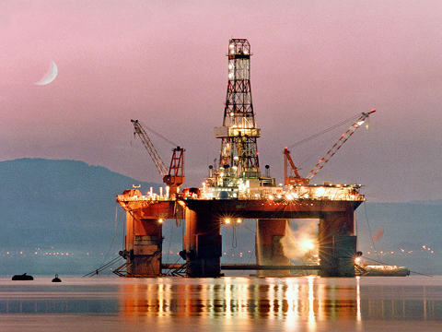
Oil & Gas Service
North America
Vincent Zhou
Andrew Harding
Madina Zhukenova

Slide 2
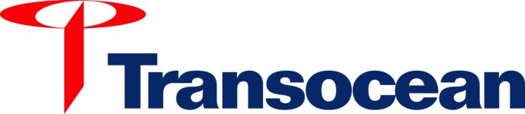
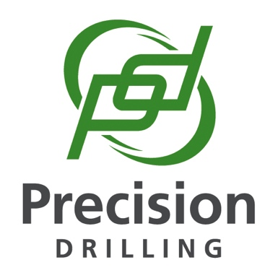

Agenda
Industry Overview
Transocean
Precision
Trinidad

Slide 3
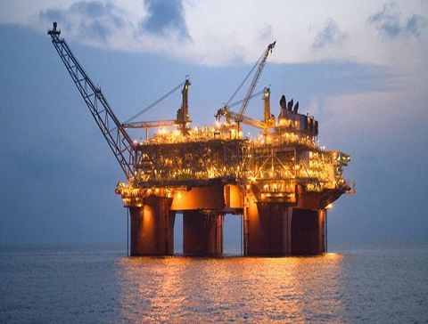
Industry Overview

Slide 4
Industry Overview
Large & Vital to many other industries
Make up more than 85% of energy consumed in the US as of 2012
Upstream
Exploration
+
Production
Exploration
+
Production
Midstream
Transportation
Processing
+
Transportation
Downstream
Refining
+
Marketing
Marketing
Oil
Gas

Slide 5
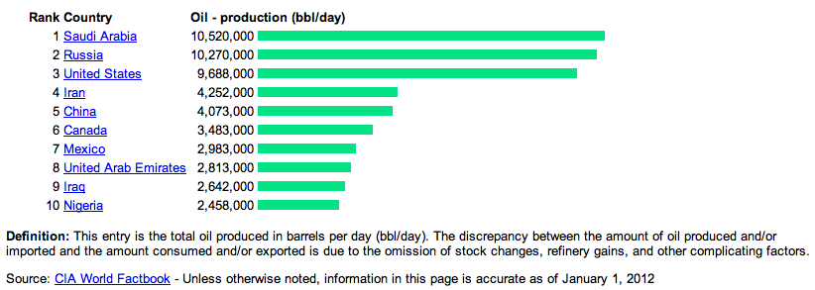
Top 10 Oil Producing Countries

Slide 6
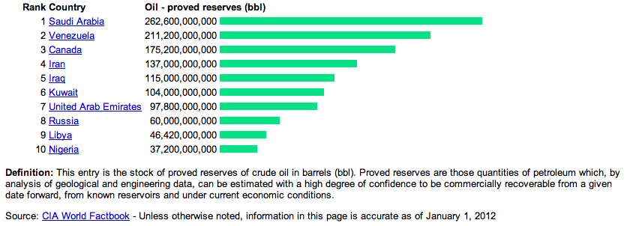
Top 10 Oil Reserves Countries

Slide 7
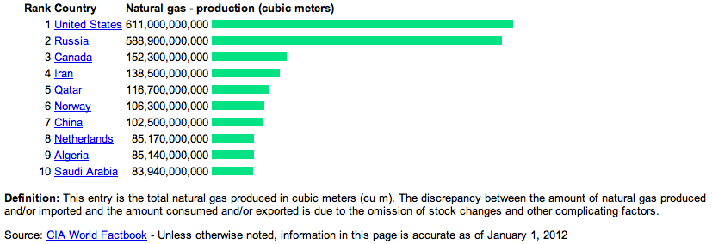
Top 10 Gas Producing Countries

Slide 8
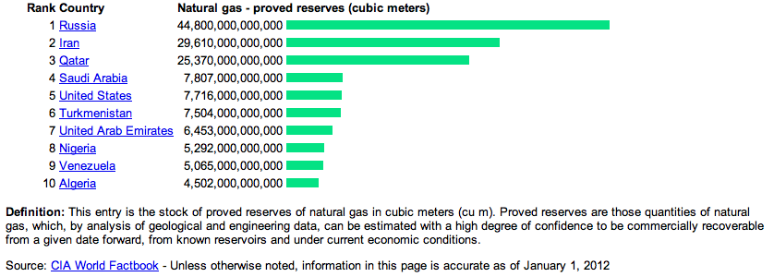
Top 10 Gas Reserves Countries

Slide 9
Oil & Gas Industry Characteristics
Capital-intensive
Drilling equipment, installation, operation and maintenance is very expensive to buy and maintain
Intangible costs represent 60-80% of the cost of the well
Average annual revenue per employee is about $410,000
Barrier to entry (high fixed costs)
Highly skilled
Highly regulated
Highly competitive
Price dependent
Essential R&D
Others
Notes:
So the Oil & Gas industry is capital-intensive
Drilling equipment is very expensive to buy and maintain, especially for offshore drilling. In addition, these rigs must be staffed, and the labor market for contract drillers is chronically tight
Once a rig is ordered, its lengthy construction time keeps it off the market for about 3 years.
Intangible costs such as labor, site prep, and engineering represent 60-80 percent of the cost of the well
And average annual revenue per employee is about $410,000
So all its quite clear that these high costs pose as a barrier to entry
The number of offshore rigs has almost double from 2005 to 2006. without contracts in place with oil and gas operators. In addition, these new rigs must be staffed, and the labour market for contract drillers is chronically tight. One reason is the advancing age of worldwide mobile drilling rig fleet. On May 2006 the average age for the existing jackup fleet was 24 years; for the semisubmersible fleet 23 years; and for drillship fleet, 18 years As rigs begin to approach the end of their economic lives, drilling firms will continue to invest in rig upgrades and in new rigs to replace older ones.
When analyzing a drilling company: you want to take a close look at the company’s rig fleet: older rigs lack the ability to drill in remote locations or bore deep holes. Some other factors to consider are the depth of water that the offshore rigs can drill in, hole depth and horsepower. Higher quality rigs will have higher utilization rates which leads to higher revenue growth.
older rigs lack the ability to drill in remote locations or bore deep holes. Some other factors to consider are the depth of water that the offshore rigs can drill in, hole depth and horsepower. Higher quality rigs will have higher utilization rates which leads to higher revenue growth.
Barrier to entry: High fixed costs: capital expenditure and maintenance costs, regulations, and that there is a few players with larger market share and/or with access to greater financial and other resources. More stringent environmental regulations are expected in the next few years. Companies should try to get ready

Slide 10
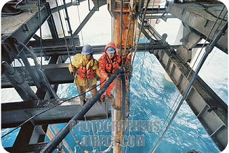
Oil & Gas Industry Characteristics
Capital-intensive
Highly skilled and labor intensive
Workers with expertise to operate drilling equip. are in high demand
Minimum requirement on the number of inexperienced personnel
Highly skilled
Highly regulated
Highly competitive
Price dependent
Essential R&D
Others
Notes:
The drilling industry is classified as highly skilled and labor intensive.
People with skills and expertise to operate drilling equipment are in high demand and cost a lot of money. Most oil and gas producers find it more cost-effective to hire this expertise from drilling companies.
As the industry moves from bust to boom, qualified employees who were laid off are often unwilling to return. The lack of job security hinders the industry’s ability to retain experienced workers and to recruit new people.
Oil and gas producers set the minimum requirement on the number of inexperienced personnel they will permit to work on a rig, given the high opportunity costs that downtime caused by human error can generate.

Slide 11
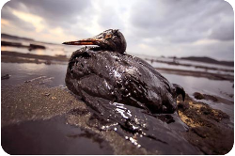
Oil & Gas Industry Characteristics
Capital-intensive
Strict environmental and health safety concerns
Significantly affect the operation of all the drilling companies
Highly skilled
Highly regulated
Highly competitive
Price dependent
Essential R&D
Others
Notes:
This industry is highly regulated with regards to environment and health and safety concerns
The federal, provincial, state, foreign and local laws and regulations controlling the discharge of hazardous wastes and relating to the protection of the environment affect the operations of all the drilling companies. These regulations address oil spill prevention and also significantly expand liability exposure across all segments of the oil and gas industry. Company failure to comply with these statutes and related regulations could result in civil or criminal enforcement action.

Slide 12
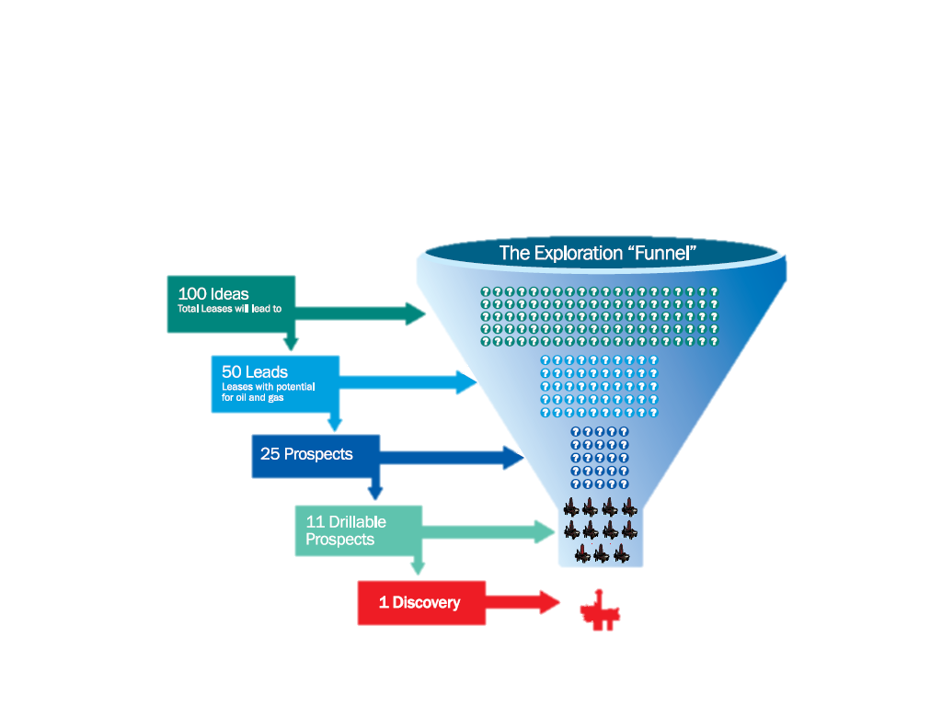
Oil & Gas Industry Characteristics
Capital-intensive
Numerous participants
Intense price competition
Highly skilled
Highly regulated
Highly competitive
Price dependent
Essential R&D
Others
Notes:
The contract drilling business is highly competitive with numerous industry participants. The intense price competition and cyclicality of the drilling industry, is marked by periods of low demand, excess rig availability, and low day rates, all of which can have an adverse affect on the company’s operations.
There are thousands of oil and oil services companies throughout the world, but the barriers to enter this industry scare away all but the serious companies, resulting in much of the oil and gas business being dominated by a handful of powerful companies.
The industry has experienced consolidation in the 90’s when oil prices went down but there is still room for more.

Slide 13
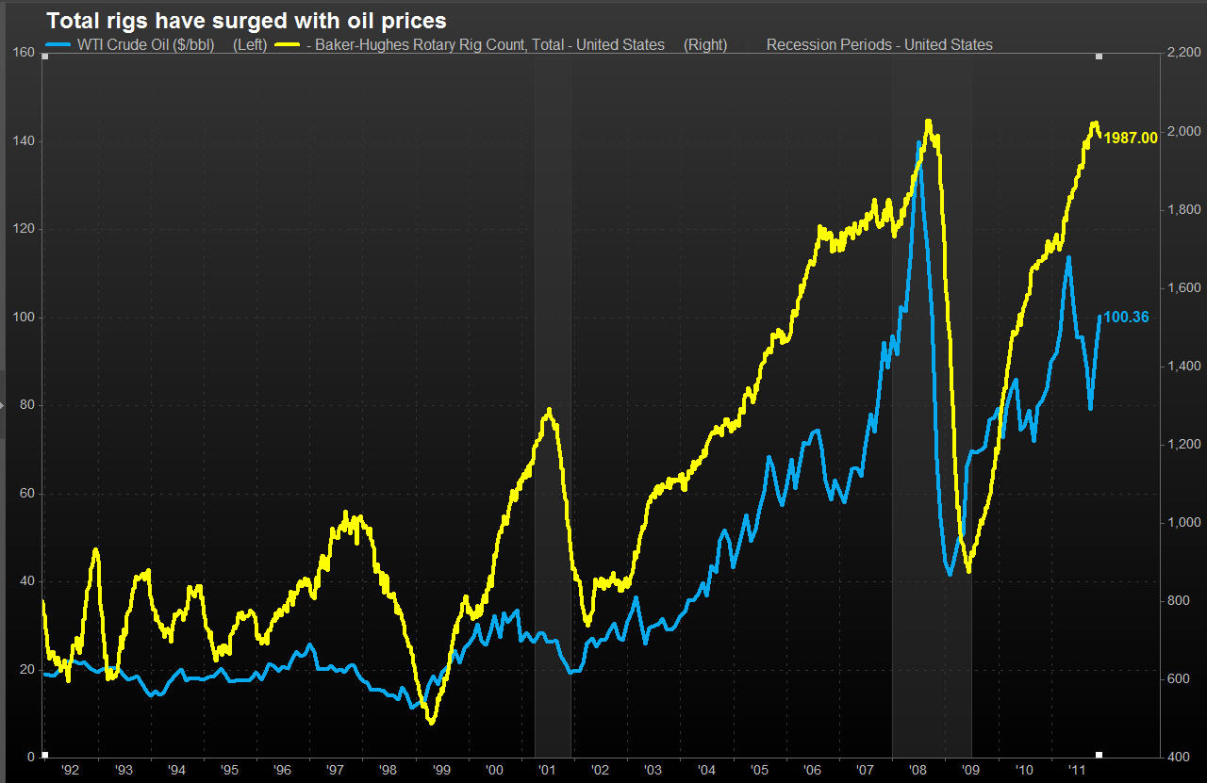
Oil & Gas Industry Characteristics
Capital-intensive
Oil services
Drilling companies
Rigs
Highly skilled
Highly regulated
Highly competitive
Price dependent
Essential R&D
Others
Notes:
The energy industry is not any different than most commodity-based industries as it faces long periods of boom and bust. Drilling and other service firms are highly dependent on the price and demand for petroleum. These firms are some of the first to feel the effects of increased or decreased spending. If oil prices rise, it takes time for petroleum companies to size up land, setup rigs, take out the oil, transport it and refine it before the oil company sees any profit.

Slide 14
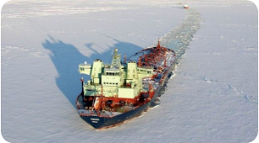
Oil & Gas Industry Characteristics
Capital-intensive
Directional drilling
Challenging geological locations
Less damage to environment
Highly skilled
Highly regulated
Highly competitive
Price dependent
Essential R&D
Others
Notes:
With accelerating decline rates in mature reservoirs around the world, oil and gas producers are facing a difficult job just to maintain existing production. Potential new reservoirs are often located in challenging geological locations, but advances in technology such as directional drilling and hydraulic fracturing are becoming critical to generating future production gains.
Combined with strict environmental regulations, companies are needing to spend increasingly significant amounts of money on developing environmentally safe technologies for the future

Slide 15
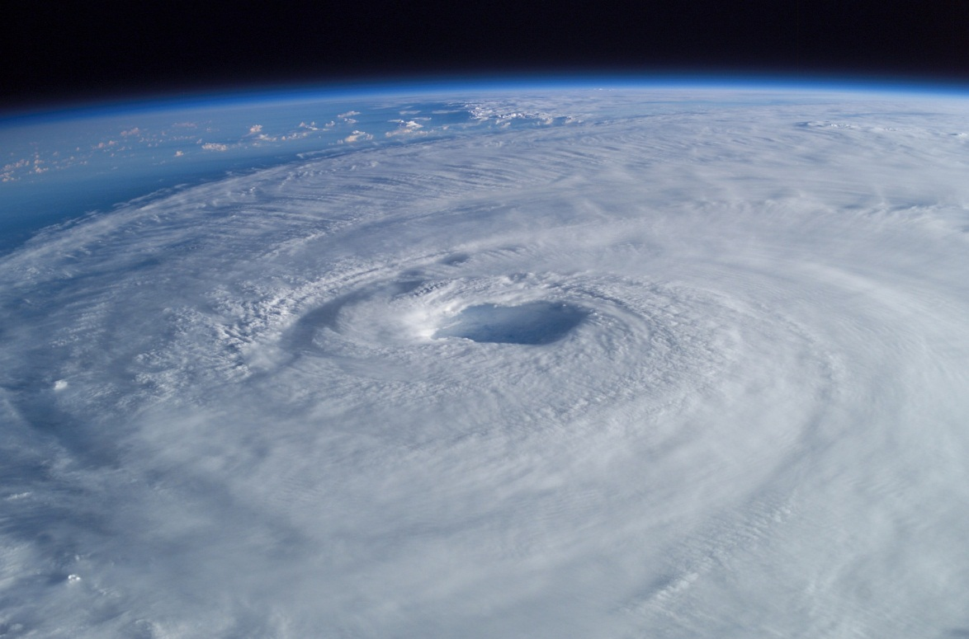
Oil & Gas Industry Characteristics
Capital-intensive
Types of contracts / Length of contracts
Location
Natural calamities
Highly skilled
Highly regulated
Highly competitive
Price dependent
Essential R&D
Others
Notes:
When it comes to Types of Contracts: Drillers are generally paid according to one of three methods: a footage contract, a day-work contract, or a turnkey contract. The contract determines a driller’s prospects for future revenue growth.
As for the Length of Contracts: Its good to know when the company’s current contract expires, how many will expire within the next 12 months and how many rigs are locked in for three years or longer. There are advantages and disadvantages to both long and short-term contracts.
For contract drillers, the location of their drilling rigs is of prime importance. Land rigs tend to remain domiciled within a particular region or country, while Offshore rigs are often relocated based on market demand.
Natural calamities such as hurricanes can destroy offshore drilling rigs and other equipment, which can significantly delay the delivery of services and materials to jobsites

Slide 16
Industry Composition
$110 billion
Notes:
Now looking at the composition of sales in the industry:
The US oil and gas services industry includes 10,000 companies with combined annual revenue of $110 billion (2012). Major companies include Schlumberger, Halliburton, Transocean, and Baker Hughes.
Oil & gas field service companies provide drilling and support services for oil and gas wells and make drilling equipment. Drilling provides about 35% of industry revenue, support services 45%, and equipment manufacturing 20%.
Industry revenue is expected to grow 9.6% to $126 billion as continued high oil prices increase demand for new drilling activities and better credit conditions allow customers to resume funding-halted projects.

Slide 17
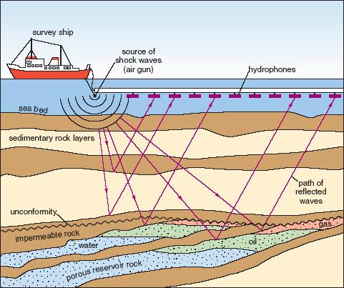
Services
Oilfield Services
Assist drilling co. in setting up oil and gas wells
Manufacture, repair and maintain equipment used in extraction
Seismic Testing
The use of reflected seismic waves to estimate the properties of the Earth’s surface
Notes:
Major support services include preparing wells for Production, maintaining and enhancing the output of producing wells, and exploration
Oilfield service companies assist the drilling companies in setting up oil and gas wells. In general these companies manufacture, repair and maintain equipment used in oil extraction and transport. More specifically, these services can include:
Seismic Testing - This involves mapping the geological structure beneath the surface.
Transport Services - Both land and water rigs need to be moved around at some point in time.
Directional Services - Believe it or not, all oil wells are not drilled straight down, some oil services companies specialize in drilling angled or horizontal holes.

Slide 18
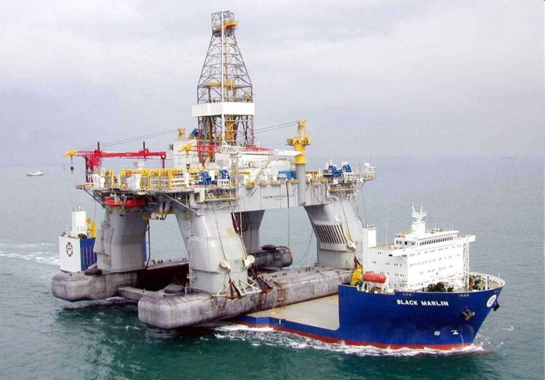
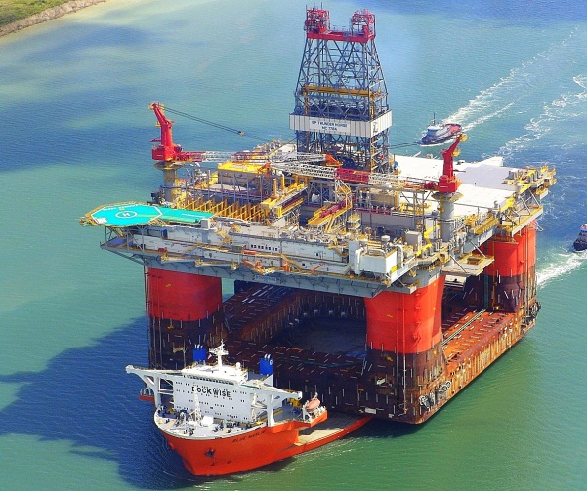
Services
Oilfield Services
Assist drilling co. in setting up oil and gas wells
Manufacture, repair and maintain equipment used in extraction
Transport Services
Moving the rigs to the drill site
Notes:
Major support services include preparing wells for Production, maintaining and enhancing the output of producing wells, and exploration
Oilfield Services - Oilfield service companies assist the drilling companies in setting up oil and gas wells. In general these companies manufacture, repair and maintain equipment used in oil extraction and transport. More specifically, these services can include:
Seismic Testing - This involves mapping the geological structure beneath the surface.
Transport Services for both land and water rigs which need to be moved around at some point in time.
Directional Services - Believe it or not, all oil wells are not drilled straight down, some oil services companies specialize in drilling angled or horizontal holes.

Slide 19
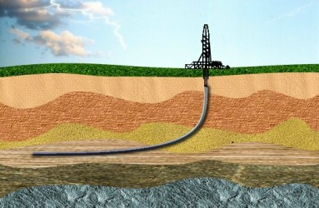
Services
Oilfield Services
Assist drilling co. in setting up oil and gas wells
Manufacture, repair and maintain equipment used in extraction
Directional Services
The practice of drilling angled or non-horizontal holes
Notes:
Major support services include preparing wells for Production, maintaining and enhancing the output of producing wells, and exploration
Oilfield Services - Oilfield service companies assist the drilling companies in setting up oil and gas wells. In general these companies manufacture, repair and maintain equipment used in oil extraction and transport. More specifically, these services can include:
Seismic Testing - This involves mapping the geological structure beneath the surface.
Transport Services - Both land and water rigs which need to be moved around at some point in time.
Directional Services – Not all oil wells are not drilled straight down, some oil services companies specialize in drilling angled or horizontal holes.

Slide 20
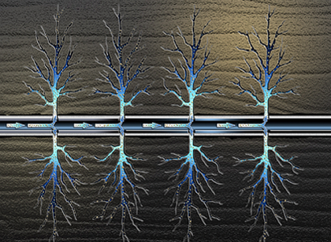
Services
Oilfield Services
Assist drilling co. in setting up oil and gas wells
Manufacture, repair and maintain equipment used in extraction
Hydraulic Fracturing
Directional Services
Procedure of creating fractures in rock formations by injecting fluid into cracks to force them further open
Notes:
A particularly important method is hydraulic fracturing, also known as “fracking”
Fracking has been seen as a key method of extracting unconventional oil and gas, due to the economic benefits from vast amounts of formerly inaccessible resources which the process can extract.
However, opponents point to potential environmental impacts such as contamination of ground water and surface contamination from spills. For these reasons, hydraulic fracturing has come under scrutiny internationally.

Slide 21
Services
Contract Drilling
Physically drilling and pumping oil and gas out of the ground
Highly skilled industry
Most drilling companies are contractors hired by oil and gas producers
2 types of drilling rigs:
Land rigs
Offshore rigs
Notes:
Contract drilling involves physically drilling and pumping oil out of the ground. A highly skilled industry where most companies own both the rigs and the skilled employees.
There are 2 types of drilling rigs: land rigs, and deep water rigs

Slide 22
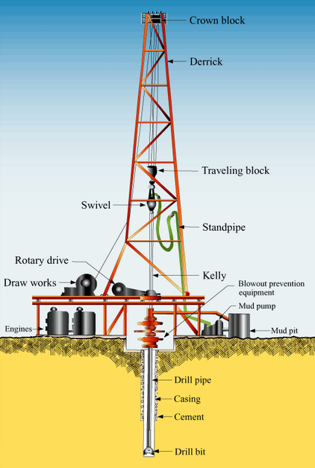
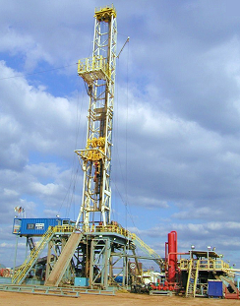
Onshore Drilling

Slide 23
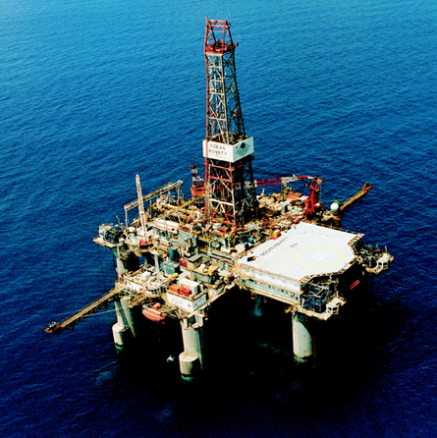
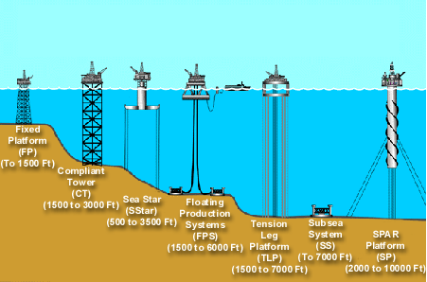
Offshore Drilling
Notes:
To handle these challenges, the industry uses large, stable, self-contained platforms to drill wells
3 types of wells: exploration, delineation and development
-Exploration: confirm whether geological formations identified from seismic surveys do contain hydrocarbons.
-If results are promising, a company may drill delineation wells into different areas of the formation to confirm the formation’s size as well as characteristics of the hydrocarbon resources.
-Then decides whether it will be economically attractive to produce the resource. If test results are favourable, the company will proceed to the third stage, drilling a development well.

Slide 24
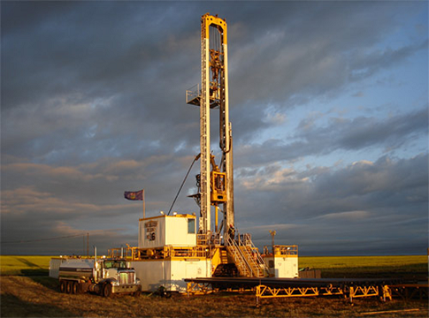
Types of Rigs

Slide 25
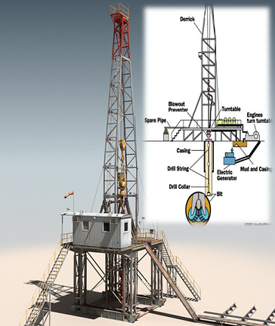
Land Drilling Rigs
Drills between 5,000 and 10,000 feet into the ground

Slide 26
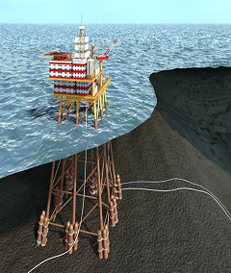
Fixed Platform
Fixed to the seafloor
Best for water 1,500 feet deep or less

Slide 27
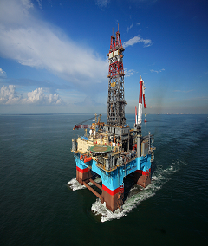
Semi Submersible
Gains buoyancy from ballasted, watertight pontoons

Slide 28
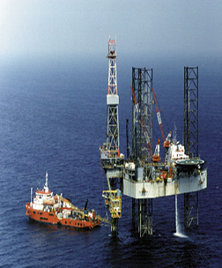
Jack-up Rigs
Towed to drill sites
Suspended above water surface
The most popular mobile platform

Slide 29
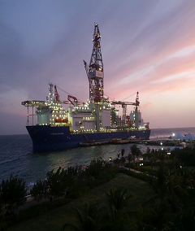
Drill Ship
Highly mobile
Best for remote locations

Slide 30
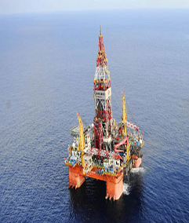
Deep Sea Rigs
Ideal for drilling far away from land
Capable of drilling 40,000 feet deep

Slide 31
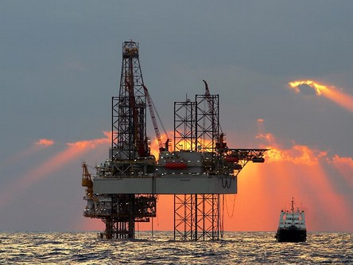
Price Volatilities

Slide 32
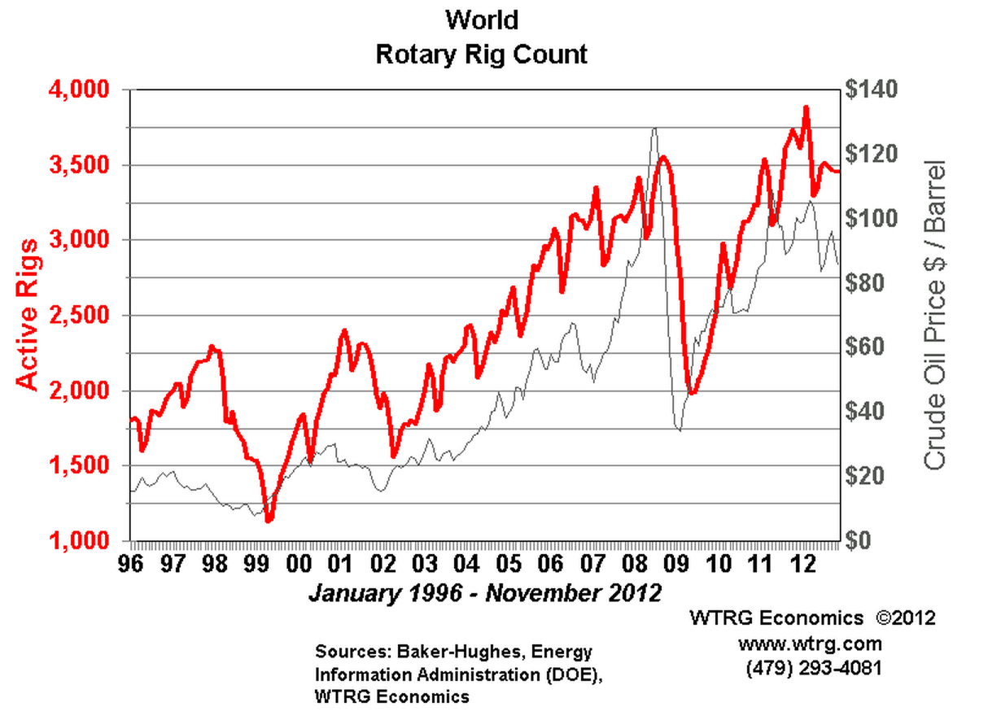

Slide 33
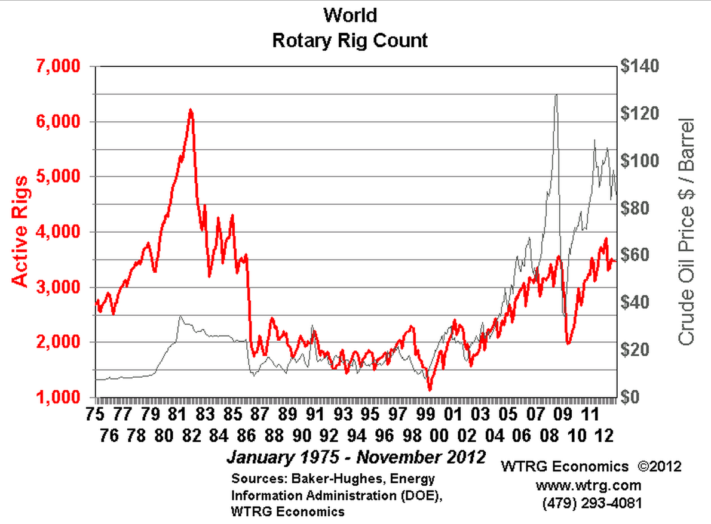

Slide 34
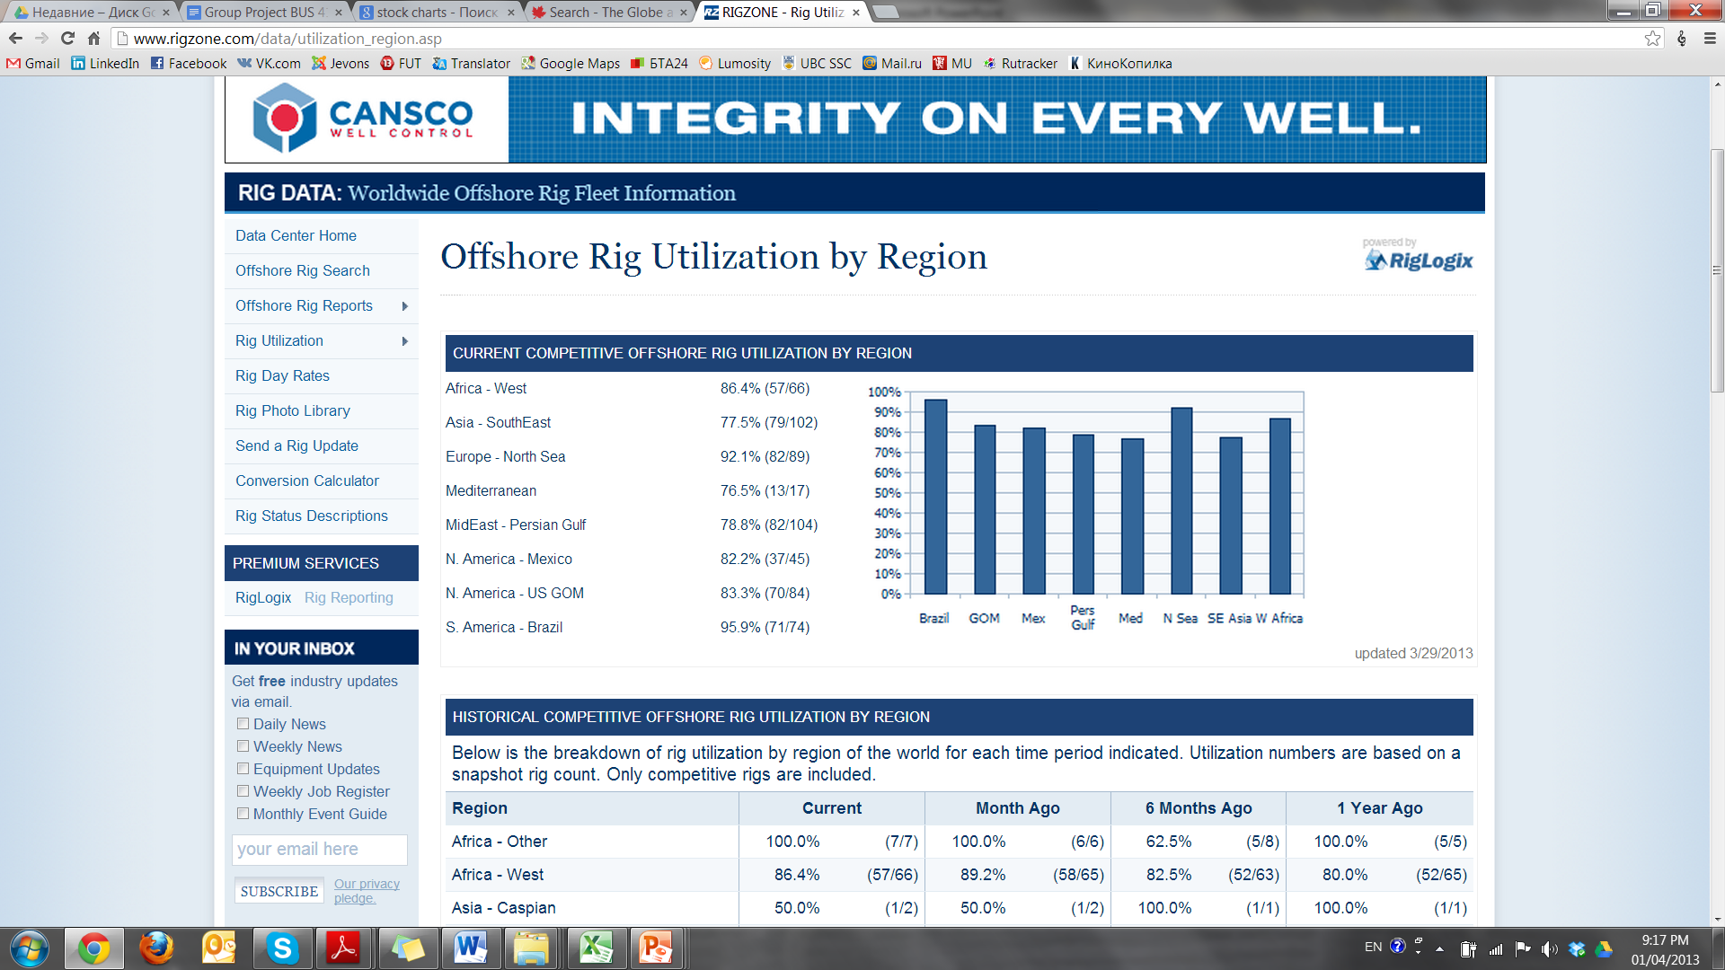
Offshore Competitive Rig Utilization Rate
Updated 3/29/2013

Slide 35
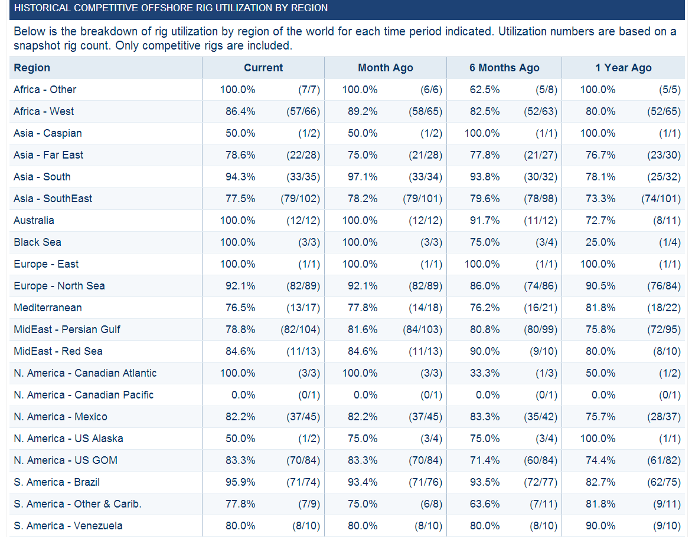
Historical Competitive Offshore Rig Utilization by Region

Slide 36
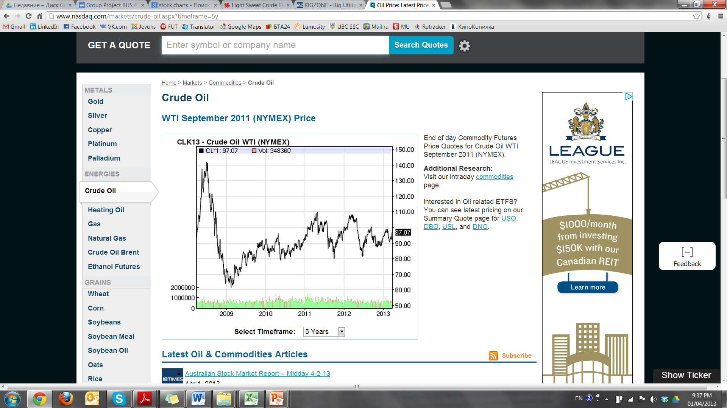
5 – year Oil Price Movement

Slide 37
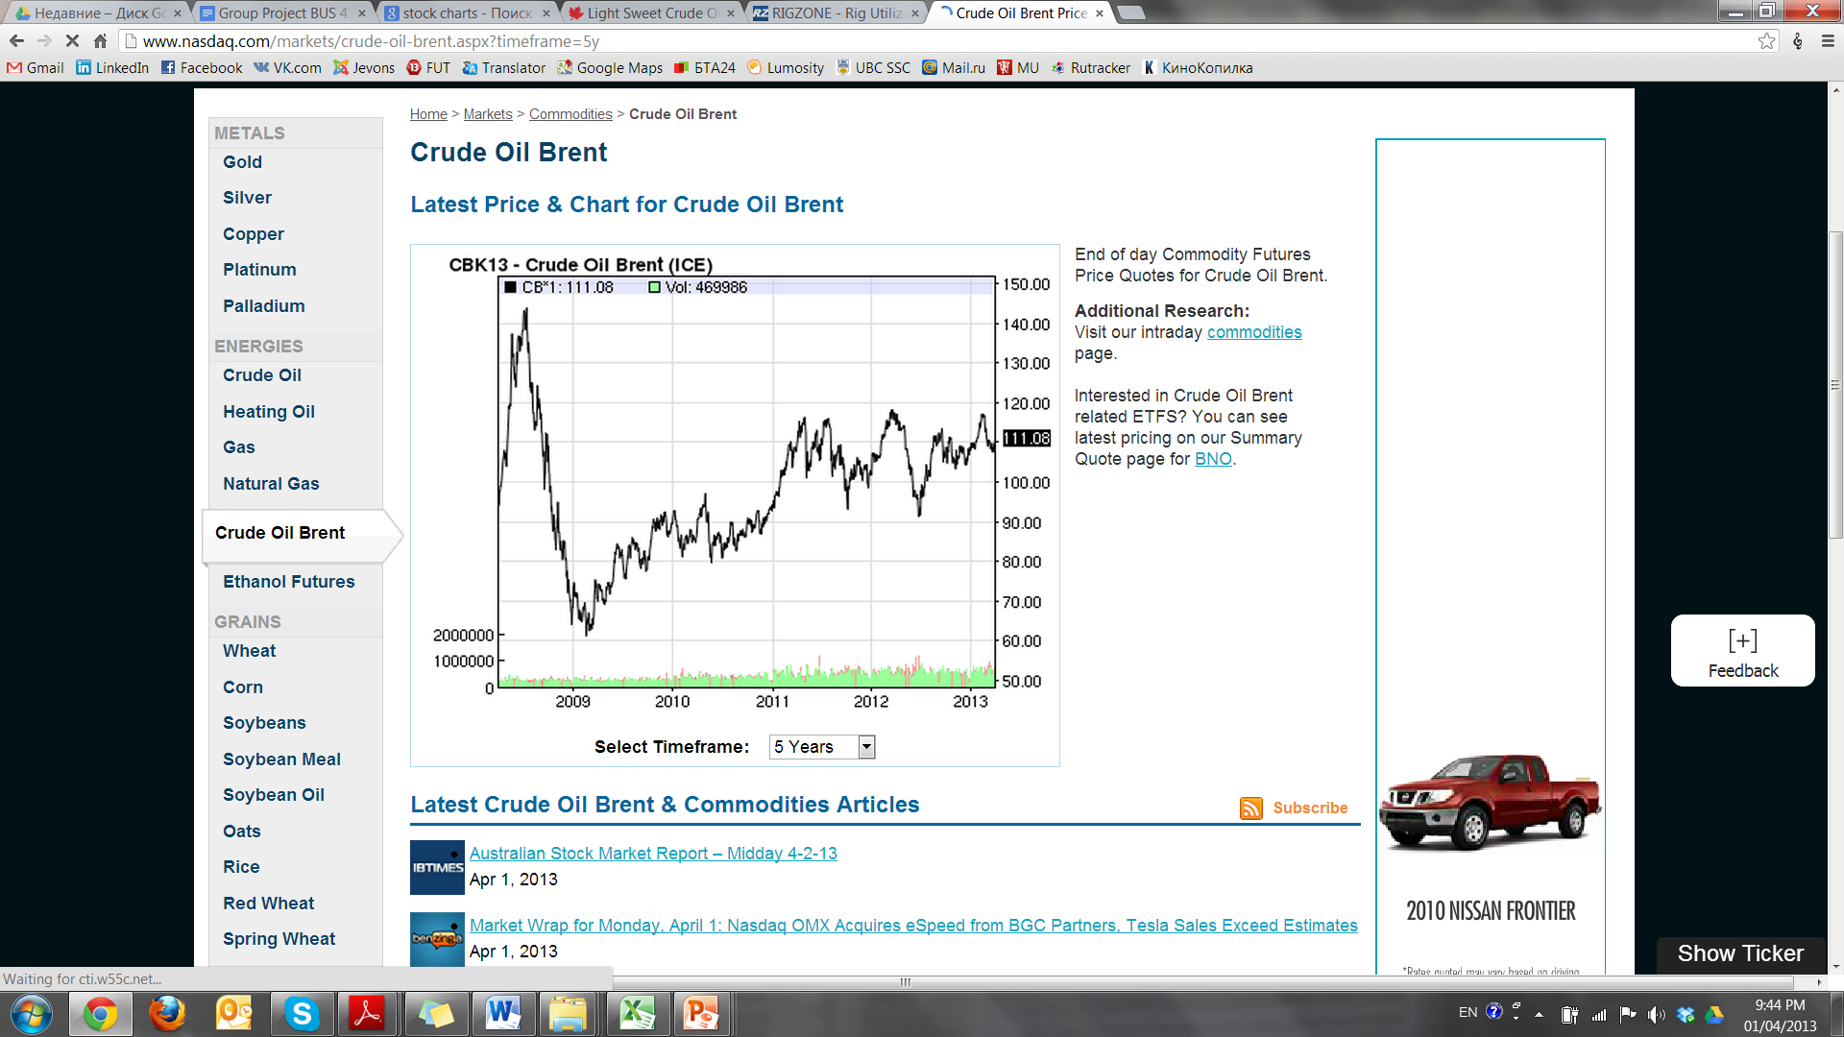

Slide 38
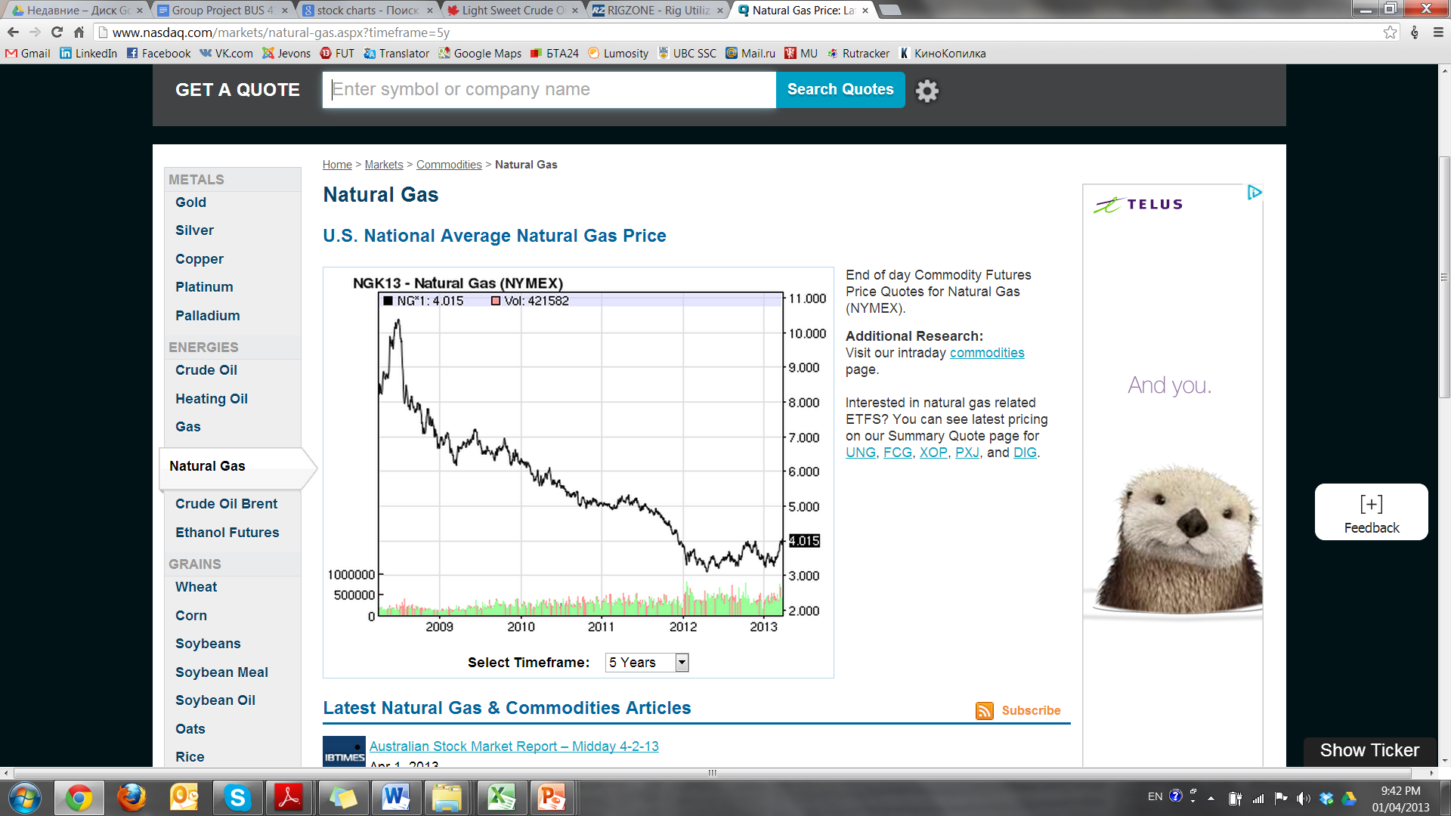
5 – year Natural Gas Price Movement

Slide 39
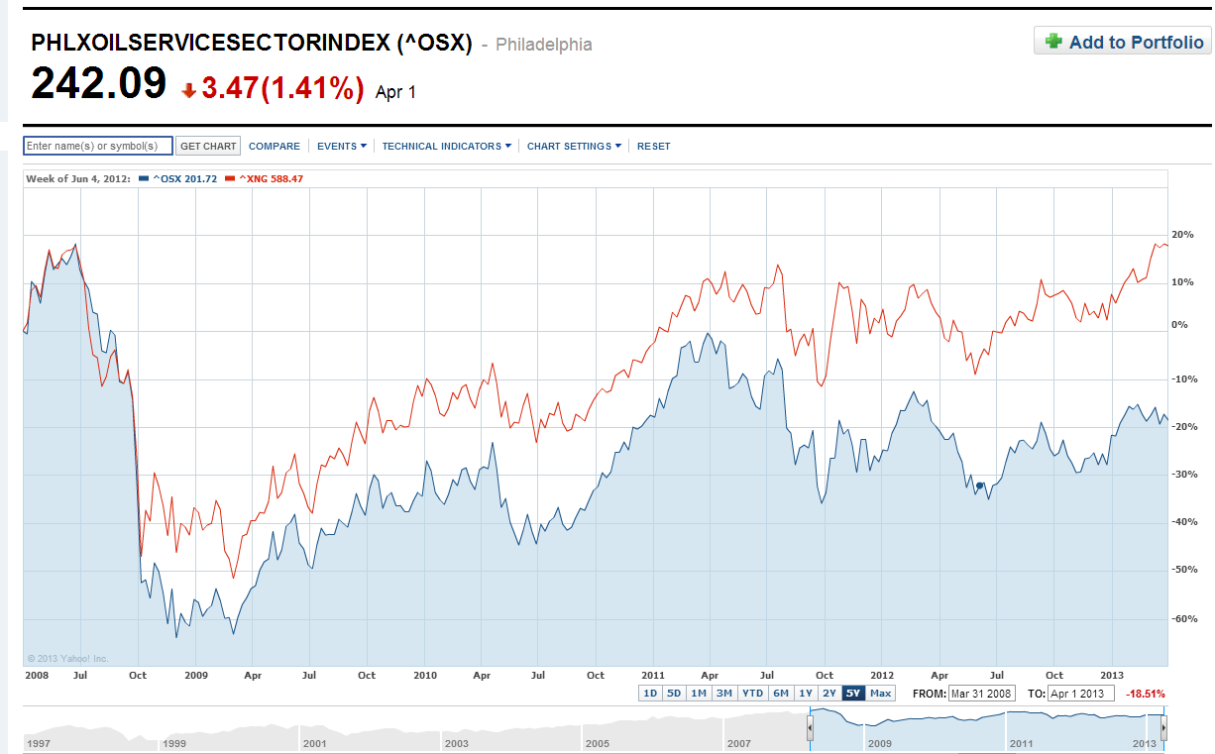
5 – year OSX vs. XNG

Slide 40
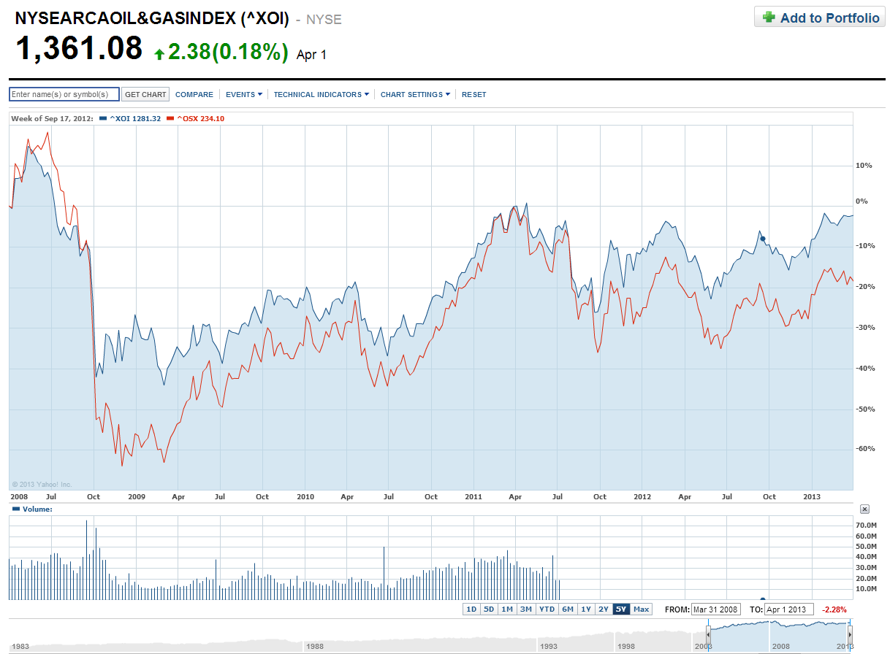
5 – year OSX vs. XOI

Slide 41
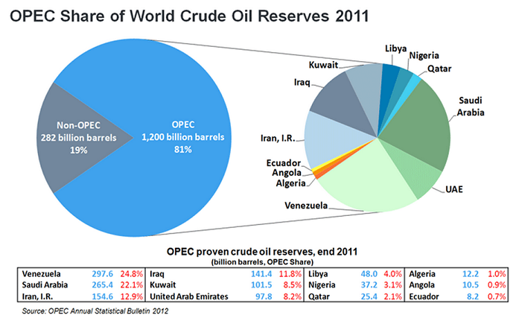

Slide 42
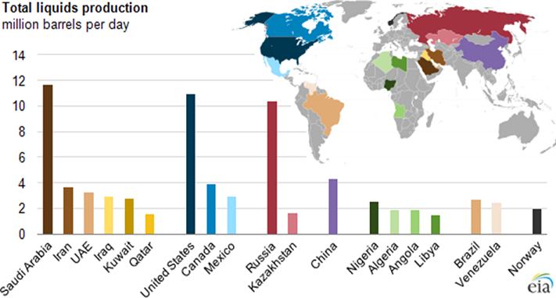

Slide 43
Oil & Gas Reserves, Supply & Demand
OPEC
Control 79% of the world’s proven reserves
Account for 44% of the oil production
Political constraints
Environmental issues

Slide 44
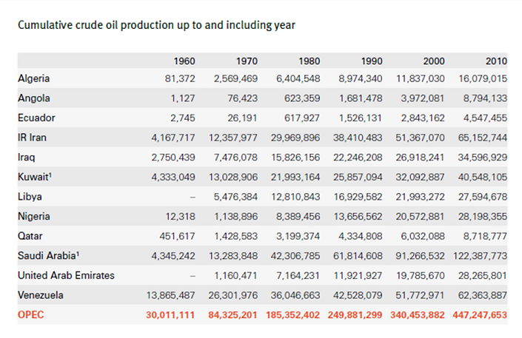

Slide 45
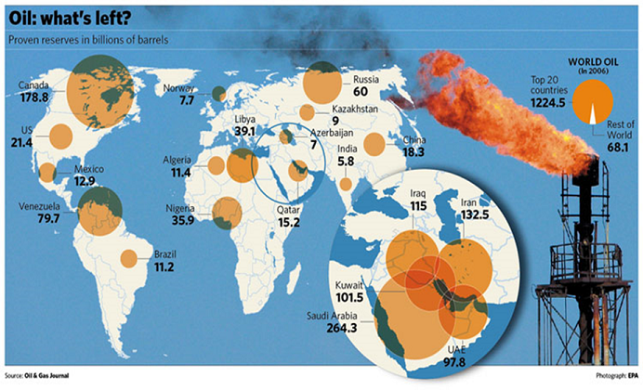

Slide 46
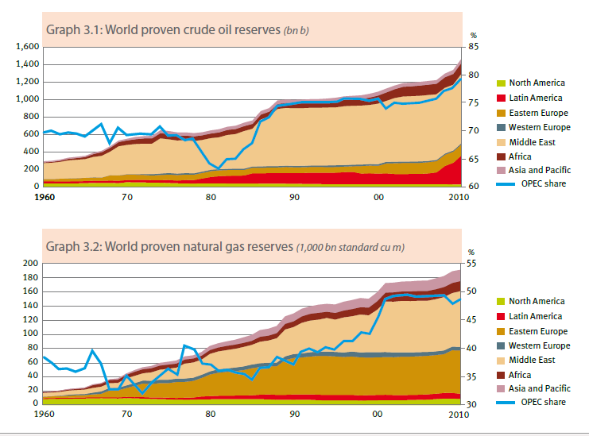

Slide 47
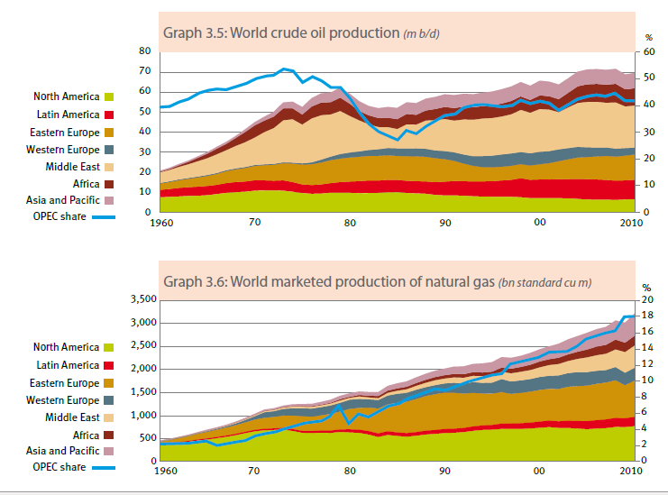

Slide 48
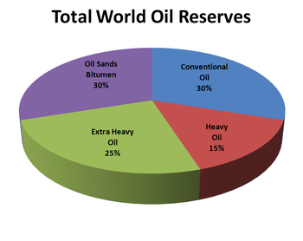

Slide 49
Future Outlook
Market growth
Long-term
Emerging Asia-Pacific economies
China & India
Decline of conventional fuel (next 20-30 years)
Peak Oil
Switching to alternative sources
more environmentally friendly, cheaper and renewable

Slide 50
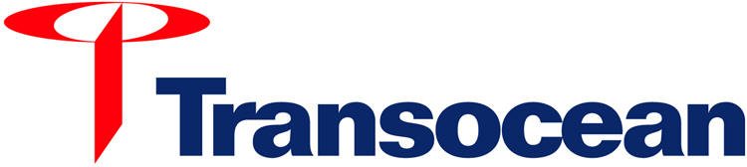
“We are never out of our depth.”

Slide 51
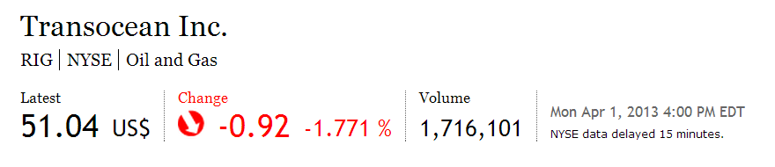
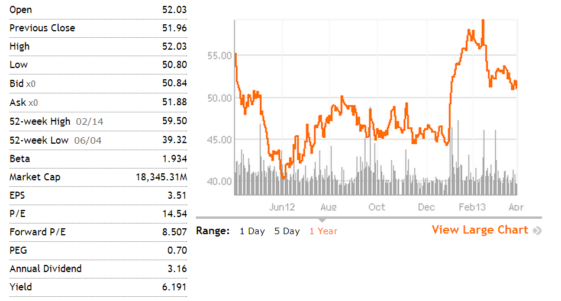
Company Snapshot

Slide 52

RIG 1 Year Chart

Slide 53

RIG 5 Year Chart

Slide 54

5-year RIG vs. Philadelphia Oil Service

Slide 55

5-year RIG vs. Crude oil

Slide 56

Company Overview
Transocean is the largest offshore contract drilling services provider for oil and gas wells.
Types of drilling include:
Deepwater drilling
Harsh environment drilling
Inland and shallow water drilling

Slide 57



Drilling Rigs
Drillships:
Dynamically positioned in that it does not require anchors
Great load capacity, ideal for remote locations
Limited to calmer water conditions
Self-propelled and extremely mobile
Dual-activity technology (on recent models)
Mid-water, Deepwater, Ultra-deepwater
Semisubmersibles:
Floating vessels that can be submerged by water ballast system so that lower hulls are under water during drilling operations
Maintain position through anchors or computer controlled dynamic positioning thrusters
Moved by propellers or tugging
Suited for rough water conditions
Mid-water, Deepwater, Ultra-deepwater
Jackups:
Mobile self-elevating drilling platforms.
Equipped with legs that are lowered to the ocean floor for foundation.
Jacked up just above highest waves. Suited for water depths of 400 ft and less.

Slide 58


Slide 59
Core Value
Mission:
“To be the premier offshore drilling company … through the integration of motivated people, quality equipment and innovative technology, with a focus on technically demanding environments.”
F inancial Discipline
I ntegrity & Honesty
R espect for Employees, Customers and Suppliers
S afety
T echnical Leadership

Slide 60

History
Transocean
2011
Aker Drilling

Slide 61


History
Acquisition of Aker Drilling in 2011
In August 2011, Transocean agreed to buy Aker Drilling for $1.46 billion
To increase earnings and upgrade fleet units

Slide 62
Achievements
Transocean is the world’s largest offshore drilling contractor in addition to being the:
Largest offshore driller with 135 mobile offshore drilling units, plus an additional 8 newbuild rigs
Largest jackup rig driller with 59 units
Largest “floating” rig driller with 75 drillships and semisubmersible rigs
Largest deepwater driller with 43 rigs that can operate in water depths of 4,500 feet or greater
Largest offshore driller by equity market capitalization
Records:
Transocean holds most of the world records for drilling in the deepest waters.
First oil and gas exploration well ever drilled in more than 10,000 feet of water
The world’s deepest subsea wells completed in approximately 9,000 feet of water
a new world record for the deepest water depth by an offshore drilling rig of 10,385 feet of water (3,165 meters) while working for ONGC off the East coast of India, February 2013

Slide 63

Incidents
April 22, 2010: ultra-deepwater floater Deepwater Horizon sank after a blowout of the Macondo well caused a fire and explosion on the rig
At the time of the explosion, Deepwater Horizon was located approximately 41 miles off the coast of Louisiana and was contracted to BP America Production Co.
As of September 30, 2011 the
amount of the estimated liability was
approximately $204 million, and the
corresponding estimated recoverable
amount was $184 million (up 51%
and 96%, respectively, from
December 31, 2010 estimates)
206 claims made against TransOcean
Resulted in loss of $590 million of
backlog revenue
BP has yet to honor indemnity
obligations
Legal proceedings are ongoing

Slide 64
Business Model
1. Contract Drilling
Primary business
Contract drilling rigs, related equipment, and work crews to drill oil and gas wells on a day-rate
2. Engineering Service & Project Management
either a day-rate basis or a completed-project, fixed-price basis

Slide 65

Clients

Slide 66

FLEET
As of February 14, 2013:
48 High-Specification Floaters, which are comprised of:
27 Ultra-Deepwater Floaters;
14 Deepwater Floaters; and
Seven Harsh Environment Floaters;
25 Midwater Floaters; and
Nine High-Specification Jackups.

Slide 67

Rigs under construction

Slide 68

Fleet Updates

Slide 69

March 2013 Updates:

Slide 70

Worldwide Fleet Operations

Slide 71
Management Team

Slide 72

Steven L. Newman President & CEO
2010: Held his current position since March
2007-08: Executive VP of Performance and COO
2006-07: Executive VP and COO
2005-06: Senior VP of HR, Information Process
Solutions, and Treasury
1994: Joined company in Corporate Planning Department
1992: MBA from Harvard Graduate School of Business
1989: BSC in Petroleum Engineering from Colorado School of Mines
Member of the Society of Petroleum Engineers

Slide 73

Esa Ikäheimonen Executive Vice President & CFO
From November 2012: Executive Vice President, Chief Financial Officer of the Company
Since April 2011 to November 2012: non-executive director and the chairman of the audit committee of Ahlstrom Corporation.
From March 2009 to July 2010: Senior Vice President and Chief Financial Officer of Seadrill Ltd. Executive Vice President and Chief Financial Officer of Poyry plc.
Master of Laws degree from the University of Turku in Finland in 1989 specializing in tax law and tax planning.

Slide 74

Ihab Toma Executive Vice President, Chief of Staff
Responsible for Human Resources, Global Supply Chain, Information Technology, Marketing and Asset Divestitures.
Before served as Executive Vice President, Operations, since August 2011 and previously as Executive Vice President, Global Business, and Senior Vice President of Marketing and Planning.
Before joining Transocean in 2009, served in different capacities in Schlumberger, including product line President and various other oilfield services assignments with regional and global responsibilities.
holds a Bachelor's degree in Electrical Engineering from Cairo University where he graduated in 1985.

Slide 75
Future Outlook

Slide 76
Sources Of Revenue
Transocean has two main methods for generating revenue from its drilling operations:
1. OPERATING RATE: Rate that is charged for utilization of rigs.
2. STAND-BY RATE: Rate charged for the rig being ready for use, regardless of whether it is actually used.

Slide 77

Revenue Efficiency by RIG type

Slide 78

Other Revenue Detail

Slide 79

Ultra Deepwater:
Deepwater:
Harsh Environment Floaters:

Slide 80

Midwater Floaters:
High Spec Jackups:
Drilling-Support Costs & other Direct Non-Drilling Operations:
Total Operating and Maintenance Cost($ millions):

Slide 81



Slide 82
Financial statements

Slide 83


Slide 84


Slide 85


Slide 86


Slide 87


Slide 88

Cash Flow Statement 2012

Slide 89


Slide 90
Recommendation:
Hold

Slide 91


Slide 92


Company Snapshot

Slide 93

1 year
(edit right before presentation) get snapshot from globe investor

Slide 94

5 year
(edit right before presentation) get snapshot from globe investor

Slide 95

10 year

Slide 96
History
Founded in early 1950s
Head office in Calgary, Alberta
Listed on TSX September 23, 1988
Reorganized into a Trust November 7, 2005
in 2006 a new law in Canada (SIFT) passed to impose tax on income trust distributions (the tax was to be introduced in 2011)
Reverted back to Corporation June 1, 2010

Slide 97

Mergers and Acquisitions

Slide 98

Business Segments

Slide 99
2012 Highlights
Announced decommissioning of 52 drilling rigs, including 42 Tier 3 rigs.
Exiting Tier 3 drilling business, but are retaining 26 of these rigs as Precision Seasonal Stratification and Turnkey drilling work (PSST).
Write-off of these lower quality rigs resulted in a net loss for 2012 Q4.
Announced the beginning of quarterly dividend payments starting December 2012

Slide 100

Financial Highlights

Slide 101

Revenue Segmentation

Slide 102

Drilling Rigs at Dec 31, 2012
Tier 1:
Newer designs
Directional or horizontal drilling
Better suited for shale and unconventional plays
Highly mobile
Tier 2:
New or upgraded equipment
Directional or horizontal drilling
Less mobile than Tier 1
PSST:
Precision Seasonal Stratification and Turnkey

Slide 103

Service Rigs at Dec 31, 2012

Slide 104

Rig Locations

Slide 105

Drilling Technology Growth

Slide 106

Drilling Activity

Slide 107

2012 Strategy

Slide 108
Management Team

Slide 109

Kevin A. Neveu
Appointed CEO in 2009
Previously President of the Rig Solutions Group of National Oil well Varco in Houston
Holds a Bachelor of Science degree and is a graduate of the Faculty of Engineering at the University of Alberta
Recognized as a Professional Engineer by the Association of Professional Engineers, Geologists and Geophysicists of Alberta

Slide 110

ROB McNALLY
Executive Vice President and Chief Financial Officer
Holds a bachelor degree in Mechanical Engineering from the University of Illinois, a bachelor degree in Mathematics from Knox College and an MBA with a concentration in finance from Tulane University

Slide 111

GENE STAHL
President, Drilling Operations
Began his career with Precision in 1993 on the drilling rigs in Southern Alberta, while studying Economics and Business at the University of Calgary

Slide 112

DOUG STRONG
President, Completion and Production Services
Has over 25 years experience in the oilfield services industry
Began his career in 1982 after earning a Bachelor of Commerce degree from the University of Calgary
Member of the Canadian Institute of Chartered Accountants

Slide 113
Financial Statements

Slide 114

2012
Annual Balance Sheet

Slide 115

2012 Annual Income Statement

Slide 116

2012 Annual Cash Flow Statement

Slide 117

Recommendation

Slide 118


Slide 119



Slide 120

Technical Analysis

Slide 121

TECHNICAL ANALYSIS: 1-year TDG 50-200 MVAG

Slide 122

TECHNICAL ANALYSIS: 5-year TDG 50-200 MAVG

Slide 123

TECHNICAL ANALYSIS: 10-year TDG 50-200 MAVG

Slide 124

TECHNICAL ANALYSIS: 1-year TDG vs. S&P/TSX Eq Wght Oil and Gas

Slide 125
Trinidad Overview
Founded in 1996, Calgary, Alberta
Began trading on TSX in 2000
Focused in the oil and gas drilling sector
Strives to maintain utilization rates above industry average

Slide 126

MISSION statement:
Trinidad is a growth-oriented, dividend-paying oil and natural gas services provider based in Calgary, Alberta. Trinidad was founded with passion, persistence and a dedication to superior performance; our clear vision and commitment to our business strategy has created one of North America’s leading drillers. Trinidad’s drilling fleet is one of the most highly capable, expertly designed, well-equipped, adaptable and competitive in the industry. Our built-for-purpose style rigs have been creating a strong reputation for Trinidad in North America’s increasingly complex drilling environment. We are fast becoming a driller of choice in a number of existing and emerging plays in both Canada and the US.

Slide 127

GROWTH HIGHLIGHTS:

Slide 128

Scope of Services

Slide 129


Rigs
Drilling
Canadian, U.S.Land,
International (Mexico)

Slide 130

US Barge Drilling
More cost-effective than jack up rigs when used in shallow water

Slide 131

Coring and Pre-Setting
Acquired Titan Surface Casing Ltd.
Coring services drill narrow hole to help evaluate and plan underground oil sands extraction programs
Pre-setting uses shallower rigs to drill and cement the first 200 to 300 metres of a new well to reduce the cost of using larger rigs

Slide 132
Well servicing
Effective June 16, 2011 Trinidad sold its well servicing rigs and related equipment to CWC Well Services Corp.

Slide 133


Slide 134


Slide 135


Slide 136


Slide 137


Slide 138


Slide 139


Slide 140


Slide 141


Slide 142



Slide 143

Switch to Oil and Liquids

Slide 144

Technological Strengths

Slide 145


Slide 146


Slide 147


Slide 148



Slide 149


Slide 150

RESULT FROM OPERATION, Q3:

Slide 151

RESULT FROM OPERATION, Q3:

Slide 152


Slide 153

Management

Slide 154

MANAGEMENT TEAM:
CEO and President since January 2008
President of Trinidad from November 2002 to January 2008
General Manager, Operations of Trinidad from August 2001 to October 2002
businessman in the oil and gas drilling industry for over 15 years
1995 he was Senior Field Supervisor which included supervision of the crews and equipment for 24 drilling rigs in western Canada
1987 when he became a Rig Manager for Champion Drilling
graduating from high school in Medicine Hat
Mr. Lyle C. Whitmarsh

Slide 155

MANAGEMENT TEAM:
In 2012 was promoted to President
Joined Trinidad Drilling in 2001 as Chief Financial Officer
In 1999 promoted again to Vice President, Finance and Chief Financial Officer of Bowridge Resource Group Inc.
In 1996 promoted to Chief Financial Officer
In 1994 joined Bowridge Resource Group Inc. serve as a Corporate Controller.
CGA Designation in 1996
In 1991 Joined Deloitte and Touche as a Chartered Accounts
graduated from the Faculty of Management at the University of Calgary with a Bachelor of Commerce in accounting
Brent J. Conway, President

Slide 156

MANAGEMENT TEAM:
In 2012 promoted to Chief Financial Officer
In 2011 was promoted to Vice President, Finance & Treasurer
Joined Trinidad Drilling in 2009 as Corporate Controller
Joined Gienow Windows and Doors Income Fund in 2004, then promoted to Vice President, Finance in 2007
In 2001 joined Wireless Matrix Corporation as Controller and promoted to Interim Chief Financial Officer in 2004.
In 1998, she joined Ernst & Young
CA designation in 1997 while working at Grant Thornton
Graduated from the University of New Brunswick with a BBA
Lesley Bolster, Chief Financial Officer

Slide 157

MANAGEMENT TEAM:
In 2011 promoted to Chief Operational Officer
In 2007 Jason accepted the position of Senior Vice President, Sales and Marketing and played an integral part in maintaining and growing Trinidad’s US and Canadian drilling fleet.
Joined Trinidad Drilling through the acquisition of Titan Drilling in 2005 where he was President and CEO
In 1997 joined Gridiron Drilling Services and promoted to Senior Vice President in 2001
Jason Clemett, Chief Operating Officer, Canadian Operations

Slide 158

MANAGEMENT TEAM:
Now served as Chief Operational Officer, US and International Operations
Joined Trinidad Drilling in 2003 as Senior Vice President – Business Development
Prior to joining Trinidad Drilling, owned his own successful drilling business
Extensive experience in the drilling industry, worked almost 30 years in the drilling, well servicing and oil sands areas
Adrian LaChance, Chief Operating Officer, US and International Operations

Slide 159

Financial Statement Analysis

Slide 160


Slide 161


Slide 162


Slide 163


Slide 164

Free Cash Flow | 48,418 | 4,901

Slide 165

Q3:

Slide 166

Q3:

Slide 167

Q3:

Slide 168

Q3:

Slide 169

Q3:

Slide 170

Q3:

Slide 171

Q3:
Free Cash Flow | 46,612 | 60,094

Slide 172

RECOMMENDATION
Hold

