Slide 1
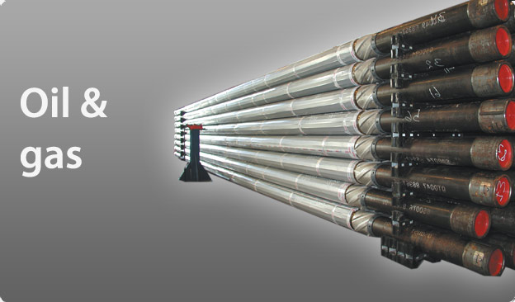
William Kim Clare Lei
John Prpic Jerry Zhang

Slide 2
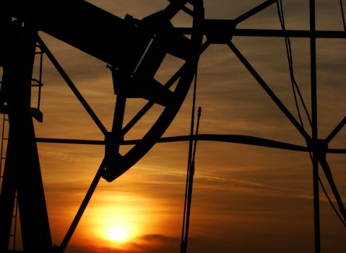
Agenda
Oil & Gas Service
Industry Overview
Companies:
Transocean Inc.
Precision Drilling Trust
Trinidad Ltd.

Slide 3
Industry overview: outline
1. Introduction 2. Industry Composition 3. Competitive Landscape 4. Future Outlook
Notes:
1. Introduction 2. Industry composition 1) oilfield services 2) contract drilling a) land drilling rigs i directional drilling ii onshore drilling iii snubbing b) deepwater drilling rigs i drillships ii semi-submersible rigs iii “jack-up” rigs 3) Equipment Manufacture 3. Competitive Landscape 1) Oil & gas price volatility a) events and price b) rotary rig count and price 2) Oil & gas reserves, supply and demand a) oil reserves b) oil production c) oil consumption d) natural gas reserves e) natural gas production f) natural gas consumption 3) Oil & gas alternatives a) Biofuel b) Unconventional fossil fuel c) Crude oil and natural gas relationship 4) Oil & gas services industry characteristic a) Capital-intensive b) Highly Skilled c) Highly Regulated d) Highly Competitive e) Price dependent f) Essential Research and Development g) Others 4. Future View

Slide 4
Introduction

Slide 5
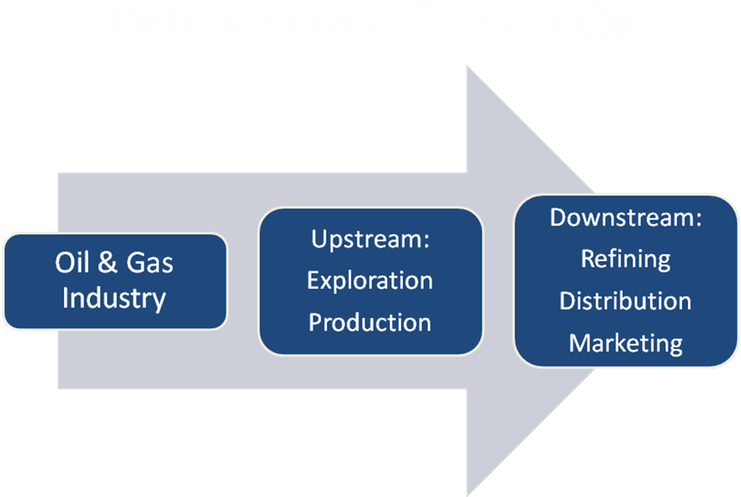
introduction
Large & Vital to many other industries
Industry Structure
Upstream
Downstream
Notes:
There is no doubt that the oil/energy industry is extremely large. According to the Department of Energy (DOE), fossil fuels (including coal, oil and natural gas) make up more than 85% of the energy consumed in the U.S. as of 2008. Oil supplies 40% of U.S. energy needs.
Petroleum is vital to many industries, and is of importance to the maintenance of industrial civilization itself, and thus is a critical concern for many nations. Oil accounts for a large percentage of the world’s energy consumption, ranging from a low of 32% for Europe and Asia, up to a high of 53% for the Middle East.
Downstream: Refers to oil and gas operations after the production phase and through to the point of sale, whether at the gas pump or the home heating oil truck Upstream: The grass roots of the oil business, upstream refers to the exploration and production of oil and gas. Many analysts look at upstream expenditures from previous quarters to estimate future industry trends. For example, a decline in upstream expenditures usually trickles down to other areas such as transportation and marketing.

Slide 6
Industry composition

Slide 7
Industry Composition
Revenue Contribution
$ 85 billion
Notes:
The US oil and gas services industry includes 8000 companies with combined annual revenue of $85 billion. Major companies include Haliburton, Schlumberger, and Baker Hughes. Despite recent consolidation, the industry is still fragmented and characterized by small specialty firms: over half of companies have fewer than 5 employees.
Oil & gas field service companies provide drilling and support services for oil and gas wells and make drilling equipment. Drilling provides about 35% of industry revenue, support services 45%, and equipment manufacture 20%.

Slide 8
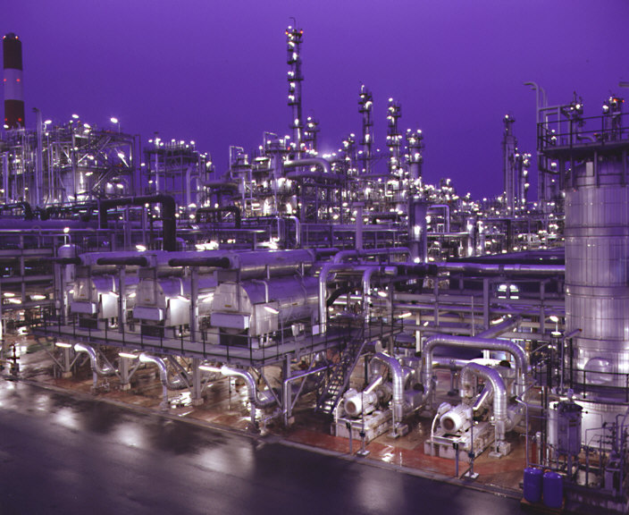
Industry composition
Oilfield services
Contract drilling
land drilling rigs (3)
deepwater drilling rigs (3)
Equipment Manufacture

Slide 9
Oilfield Services
Prepare wells for production
Repair and Maintain
Specifically:
Seismic Testing
Transportation Services
Directional Services
Notes:
Major support services include preparing wells for Production, maintaining and enhancing the output of producing wells, and exploration
Oilfield Services - Oilfield service companies assist the drilling companies in setting up oil and gas wells. In general these companies manufacture, repair and maintain equipment used in oil extraction and transport. More specifically, these services can include:
Seismic Testing - This involves mapping the geological structure beneath the surface.
Transport Services - Both land and water rigs need to be moved around at some point in time.
Directional Services - Believe it or not, all oil wells are not drilled straight down, some oil services companies specialize in drilling angled or horizontal holes.

Slide 10
Contract drilling
Physically drill and pump oil out of the ground
Get contract from big oil companies
Specialize in drilling
Own the rigs and highly-skilled employees
Two types of drilling rigs
Land drilling rigs
Deepwater drilling rigs

Slide 11
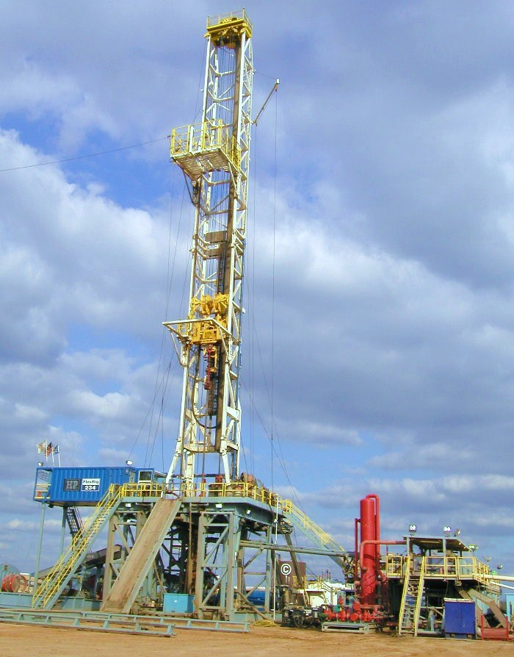
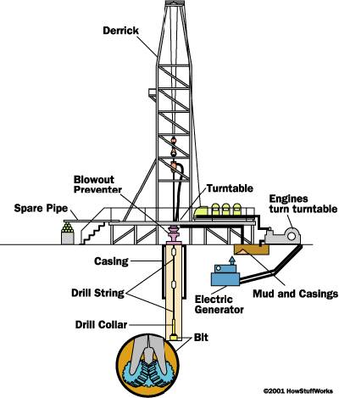
Land drilling rigs
Conventional onshore drilling
Notes:
Drill wells on land

Slide 12
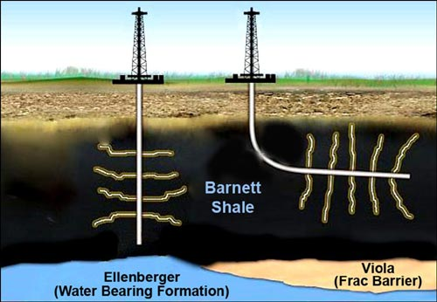
Land Drilling rigs
Directional drilling (slant drilling, horizontal)
The practice of drilling non-vertical wells
Notes:
Directional drilling (or slant drilling) is the practice of drilling non-vertical wells. It can be broken down into three main groups: Oilfield Directional Drilling, Utility Installation Directional Drilling ( or H.D.D., Horizontal Directional Drilling, Directional boring) and in-seam directional drilling (Coal-Bed methane).
Benefits:
Drilling into the reservoir where vertical access is difficult or not possible.
Increasing the exposed section length through the reservoir by drilling through the reservoir at an angle
Disadvantages:
Environmental issue – chemical banded in some states
In 1990, Iraq accused Kuwait of stealing Iraq's oil through slant drilling. The United Nations redrew the border after the 1991 Gulf war that liberated Kuwait from a seven-month Iraqi occupation under former leader Saddam Hussein. It placed 11 oil wells, some farms and an old naval base that used to be in Iraq on the Kuwaiti side.^{[3]}

Slide 13
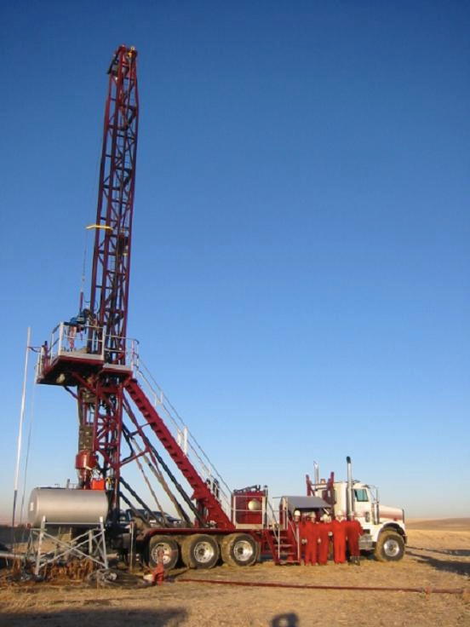
Land drilling rigs
Snubbing
A type of heavy well intervention performed on oil and gas wells
Notes:
Snubbing 不压井起下油管装置 is a type of heavy well intervention performed on oil and gas wells. It involves running the BHA on a pipe string using a hydraulic workover rig. Unlike wireline or coiled tubing, the pipe is not spooled off a drum but made up and broken up while running in and pulling out, much like conventional drill pipe. Due to the large rigup, it is only used for the most demanding of operations when lighter intervention techniques do not offer the strength and durability. Unlike conventional drilling and completions operations, snubbing can be performed with the well still under pressure (not killed). When done so, it is called hydraulic workover. It can also be performed without having to remove the Xmas tree from the wellhead.

Slide 14
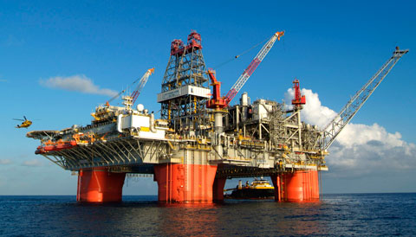
Deepwater drilling
Drilling further out into the sea and deep under ocean floor
Depths could be greater than 10,000 feet
Expensive
Notes:
companies are drilling further out into the sea and deeper under the ocean floor, at depths greater than 1000 feet to tap into one of the last remaining pockets of oil and natural gas in the world. Though deepwater was once prohibitively expensive, high oil prices during 2007 and the first half of 2008 made the economics of deepwater drilling feasible. Oil's collapse during the 2008 Financial Crisis has killed the margins of many in the industry, but demand for deepwater rigs is still high. Tied into long term contracts, companies continue to drill despite falling profits. Even then, new deepwater projects continue to be opened, as prices are expected to rebound in the long term because of rising global demand for energy. According to industry analysts, day rates will likely fall in the future as the shortfall in rigs is met by growing supply, and as the price of oil continues to remain low. That's good for E&P companies, as they need oil. As traditional oil producing basins mature there are only a couple of places left to get oil. Renewable energy is projected to start taking away some of oil's monopoly, but that may not be for decades to come. Proven reserves of oil at the end of 2006 were at 1.15 trillion barrels, of which about 10% is deepwater - a little more than 100 billion barrels.
Source: http://www.wikinvest.com/concept/Deepwater_Oil_Exploration

Slide 15
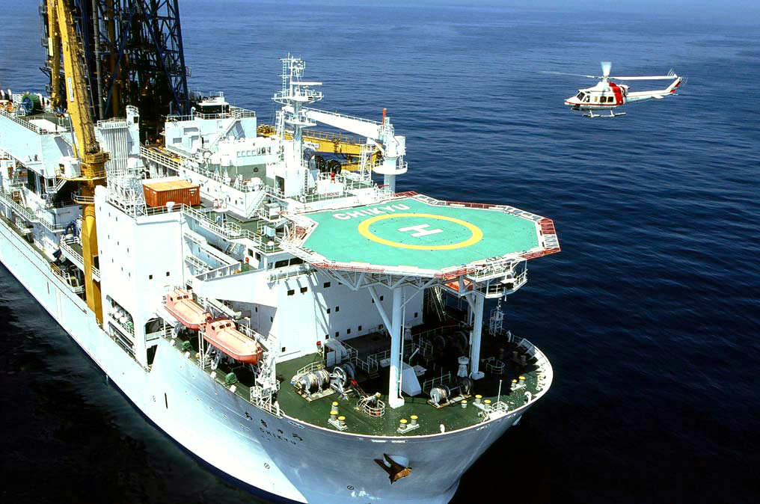
Deepwater drilling rigs
Drillship
Self-propelled and extremely mobile
Ideal for remote locations
Limitations
Notes:
Self-propelled and extremely mobile.
Dynamically positioned (High-spec only), does not require anchors.
Great load capacity, ideal for remote locations.
Limited to calmer water conditions.
Dual-activity technology (on recent models).
Midwater, Deepwater, Ultra-deepwater

Slide 16
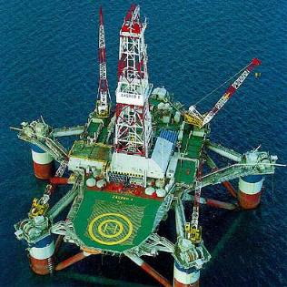
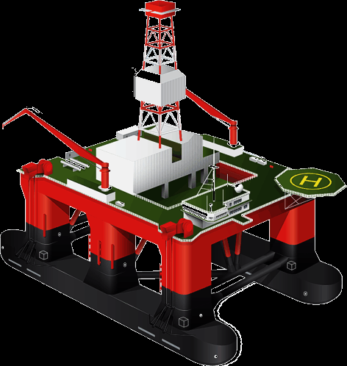
Deepwater drilling rigs
Semi-submersible rigs
Floating vessels
Notes:
Floating vessels that can be submerged by water ballast system so that lower hulls are under water during drilling operations.
Maintain position through anchors or computer controlled dynamic positioning thrusters.
Moved by propellers or tugging.
Suited for rough water conditions.
Midwater, Deepwater, Ultra-deepwater

Slide 17
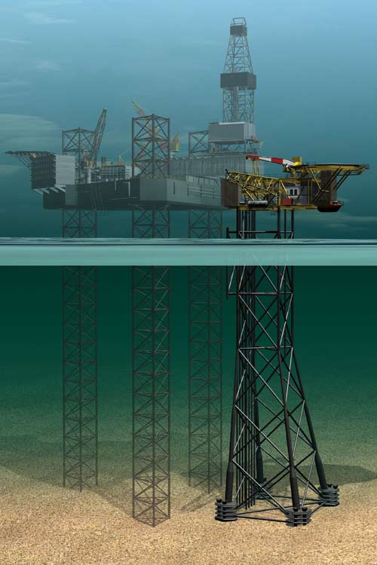
Deepwater drilling rigs
“Jack-up” rigs
Platforms
Legs
Notes:
Mobile self-elevating drilling platforms.
Equipped with legs that are lowered to the ocean floor for foundation.
Jacked up above highest waves.
Suited for water depths of 400 ft and less.

Slide 18
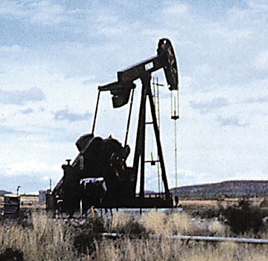
Contract drillers
Transocean Ltd.
Deepwater drilling
Precision Drilling Trust
Directional drilling
Onshore drilling
Trinidad Drilling Ltd.
Directional drilling
Onshore drilling

Slide 19
Competitive Landscapes

Slide 20
Competitive landscape
Oil & gas price volatility
Oil & gas reserves, supply and demand
Oil & gas alternatives
Oil & gas services industry characteristics

Slide 21
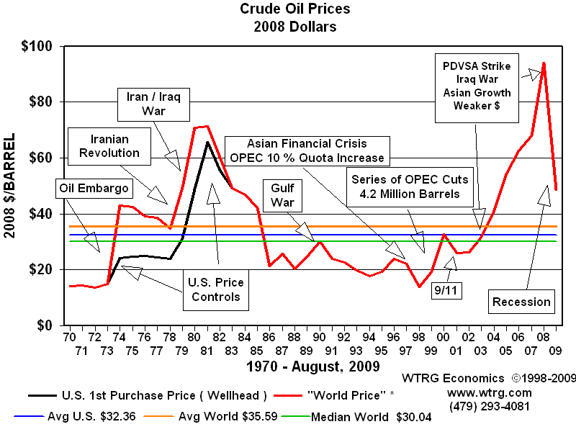
Oil & gas price volatility

Slide 22
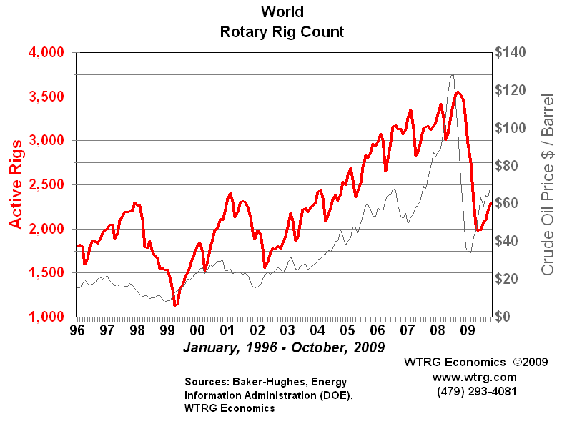
Oil & gas price volatility
Rotary Rig Count
Notes:
The Rotary Rig Count is the average number of drilling rigs actively exploring for oil and gas. Drilling an oil or gas well is a capital investment in the expectation of returns from the production and sale of crude oil or natural gas. Rig count is one of the primary measures of the health of the exploration segment of the oil and gas industry. In a very real sense it is a measure of the oil and gas industry's confidence in its own future.
Source: http://www.wtrg.com/prices.htm

Slide 23
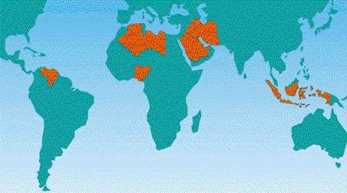
Oil & gas reserves, supply & demand
OPEC
Control 75% of the world’s proven reserves
Account for 33.3% of the oil production
Political constraints
Environmental issues
Notes:
The Organization of the Petroleum Exporting Countries (OPEC) is a cartel of twelve countries made up of Algeria, Angola, Ecuador, Iran, Iraq, Kuwait, Libya, Nigeria, Qatar, Saudi Arabia, the United Arab Emirates, and Venezuela.
OPEC's influence on the market has been widely criticized, since it became effective in determining production and prices. However, OPEC's ability to control the price of oil has diminished somewhat since 1973, due to the subsequent discovery and development of large oil reserves in Alaska, the North Sea, Canada, the Gulf of Mexico, the opening up of Russia, and market modernization.
Risks companies have taken to gain access to known reserves include investing in regions with high political volatility or with extremely harsh operational environments and weather conditions, such as the arctic basins. Operating in politically uncertain regions can expose companies to challenges such unpredictable government interference, changing fiscal regimes, annulment of contracts or civil unrest. Companies that operate in environmentally harsh locations are likely to face technological and ecological challenges.

Slide 24
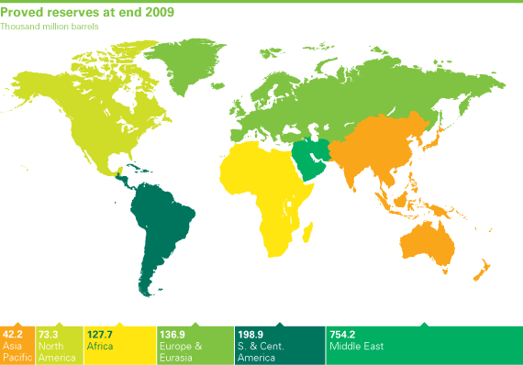
Oil & gas reserves, supply & demand
Global Oil Reserves
Notes:
2009 oil reserves stand at 1333.1 billion barrels
Global proved oil reserves in 2009 rose by 0.7 billion barrels to 1,333.1 billion barrels, with an R/P ratio of 45.7 years. Increases in Brazil, Denmark, Saudi Arabia, Egypt, and Indonesia outpaced declines in Mexico, Russia, Norway, and Vietnam. The 2008 figure was revised higher by 74.4 billion barrels, with an upward revision in Venezuela of 73 billion barrels accounting for a majority of the change.

Slide 25
Oil & gas reserves, supply & demand
Global Oil Production
Global oil production fell by 2 million b/d in 2009, or 2.6%
the largest decline since 1982
Notes:
Global oil production fell by 2 million b/d in 2009, or 2.6%, the largest decline since 1982
OPEC production fell by 2.5 million b/d; Saudi Arabian output fell by 1.1 million b/d, the world’s largest volumetric decline. Production outside OPEC rose by 450,000b/d, led by an increase of 460,000b/d in the US, the largest increase in the world and the strongest US growth since 1970.

Slide 26
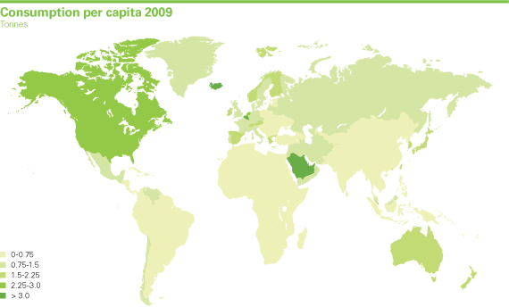
Oil & gas reserves, supply & demand
Global Oil Consumption

Slide 27
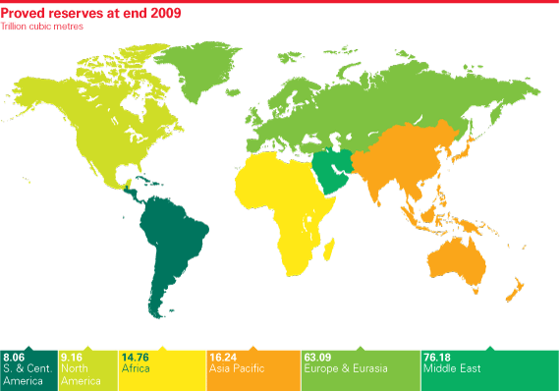
Oil & gas reserves, supply & demand
Global Natural Gas Reserves
Notes:
Global proved reserves of natural gas grew by 2.21 trillion cubic metres in 2009 driven by increases in Russia, Venezuela and Saudi Arabia. The global R/P ratio increased to 62.8 years

Slide 28
Oil & gas reserves, supply & demand
Global Natural Gas Production
Global natural gas production fell by 2.1% in 2009,
the first decline on record
Notes:
Global natural gas production fell by 2.1% in 2009, the first decline on record
Production fell sharply in Russia (-74.2bcm) and Turkmenistan (-29.7), in each case the largest decline on record. The US recorded the largest increase in the world for the third consecutive year.

Slide 29
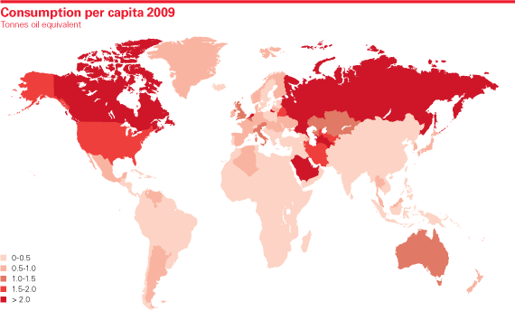
Oil & gas reserves, supply & demand
Global Natural Gas Consumption
Notes:
World natural gas consumption fell by about 2.1%, the most rapid decline on record and the sharpest decline among major fuels
Russia experienced the world’s largest decline, with consumption falling by 26.3bcm. Consumption growth was below average in every region.

Slide 30

Oil & Gas alternatives
Biofuel
Unconventional fossil fuel
Crude Oil and Natural Gas Relationship

Slide 31
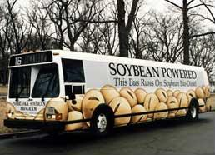
Oil & Gas alternatives
Biofuel
Greenhouse gas emissions
Energy security
Various sources
Growing
Notes:
Biofuels are gaining increased public and scientific attention, driven by factors such as oil price spikes, the need for increased energy security, and concern overgreenhouse gas emissions from fossil fuels.
Vegetable oils, animal fats, sugar and starch crops
Biofuels provided 1.8% of the world's transport fuel in 2008. Investment into biofuels production capacity exceeded $4 billion worldwide in 2007 and is growing.^{[2]}

Slide 32
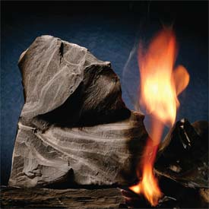
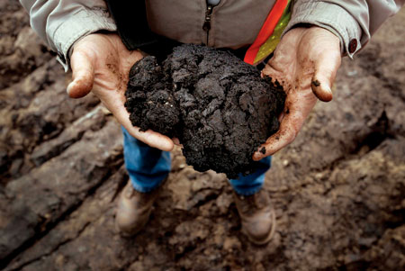
Oil & Gas alternatives
Unconventional fossil fuel
Oil shale
Oil sands
Notes:
High oil prices have opened the window to a sea of new exploration opportunities, leading independents and majors to try to develop non-conventional oil from a variety of sources. Two of the most exciting, and most heavily watched, are oil sands and oil shale.

Slide 33
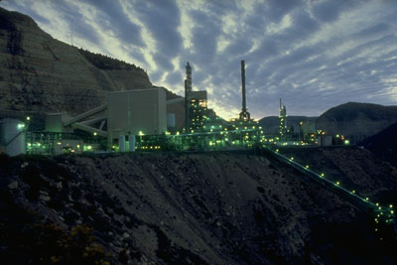
Oil & Gas alternatives
Unconventional fossil fuel
Less efficent
Larger environmental impact
Technology
Notes:
Currently, unconventional oil production is less efficient and some types have a larger environmental impact relative to conventional oil production.
Conventional sources of oil are currently preferred because they provide a much higher ratio of extracted energy over energy used in extraction and refining processes.
Technology, such as using steam injection in oil sands deposits, is being developed to increase the efficiency of unconventional oil production.

Slide 34
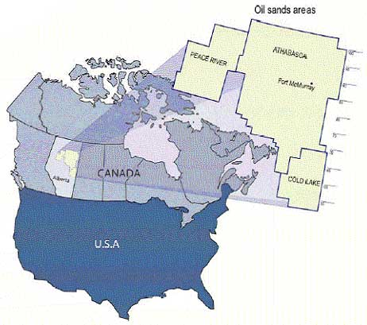
Oil & Gas alternatives
Oil sands in Canada (1.7-2.5 TRILLION barrels!)
Notes:
The oil sands in Canada are particularly interesting for a number of reasons, most notably because they are estimated to hold between 1.7 and 2.5 trillion barrels of non-conventional oil (by contrast, Saudi Arabia, the world's largest oil producer, has about 260 billion barrels of proven oil reserves). The question, of course, is how to get all that oil out. Oil sands mix bitumen, a carbon-rich sludge, with sand, water, and clay. In order to get crude oil from the sands, the bitumen must be extracted, typically by literally digging up the sands and transporting them by truck to plants, where the bitumen can be processed and "upgraded" (by adding hydrogen) to produce what is known as "syncrude." Additional bitumen can often be recovered in situ, where steam is injected into the sands to pump liquid bitumen out of the ground. This is an energy intensive and expensive process, but it is widely recognized to be cost-effective at $30 per barrel.
The majority of oil still will come from conventional extraction methods in the foreseeable future.

Slide 35
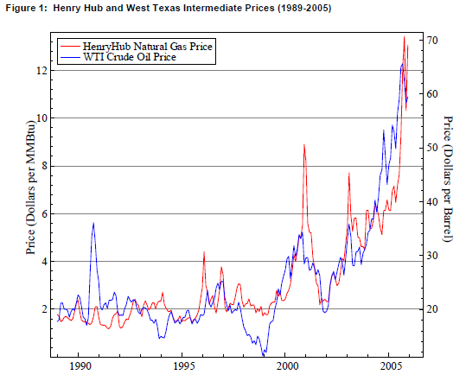
Oil & Gas alternatives
Crude oil and natural gas relationship
Notes:
a significant stable relationship between the crude oil and natural gas price is identified.
An increase in crude oil prices motivates consumers to substitute natural gas for petroleum products in consumption, which increases natural gas demand and hence prices.
An increase in crude oil prices resulting from an increase in crude oil demand may lead to more drilling and development of natural gas projects, which would tend to increase production and decrease natural gas prices.
http://www.eia.doe.gov/pub/oil_gas/natural_gas/feature_articles/2006/reloilgaspri/reloilgaspri.pdf

Slide 36
Oil & Gas Industry Characteristic
Capital-intensive
Highly Skilled
Highly Regulated
Highly Competitive
Price dependent
Essential Research and Development
Others

Slide 37
Oil & Gas Industry Characteristic
Capital-intensive
Drilling equipments their installation, operation and maintenance is very expensive to buy and maintain
Average annual revenue per employee is about $410,000
Barrier to entry – High fixed cost
Notes:
Drilling equipments is very expensive to buy and maintain. In order to remain competitive, drilling companies need to maintain and upgrade their rigs.
Once a rig is ordered, its lengthy construction time keeps it off the market for about 3years.
Rigs have an economical life of more than 25 years.
There are two main categories of drilling rigs: those that work on land and those that work offshore.
Average annual revenue per employee is about $410,000
Drilling equipments, their installation, operation and maintenance is very expensive especially for offshore drilling. The demand for drilling product increase directly with the rise in
The number of offshore rigs has almost double from 2005 to 2006. without contracts in place with oil and gas operators. In addition, these new rigs must be staffed, and the labour market for contract drillers is chronically tight. One reason is the advancing age of worldwide mobile drilling rig fleet. On May 2006 the average age for the existing jackup fleet was 24 years; for the semisubmersible fleet 23 years; and for drillship fleet, 18 years As rigs begin to approach the end of their economic lives, drilling firms will continue to invest in rig upgrades and in new rigs to replace older ones.
Investor tips: When analyzing drilling companies, take a close look at their rig fleet: age, quality, depth ability.
When analyzing a drilling company: you want to take a close look at the company’s rig fleet: older rigs lack the ability to drill in remote locations or bore deep holes. Some other factors to consider are the depth of water that the offshore rigs can drill in, hole depth and horsepower. Higher quality rigs will have higher utilization rates which leads to higher revenue growth.
older rigs lack the ability to drill in remote locations or bore deep holes. Some other factors to consider are the depth of water that the offshore rigs can drill in, hole depth and horsepower. Higher quality rigs will have higher utilization rates which leads to higher revenue growth.
Barrier to entry: High fixed costs: capital expenditure and maintenance costs, regulations, and that there is a few players with larger market share and/or with access to greater financial and other resources. More stringent environmental regulations are expected in the next few years. Companies should try to get ready

Slide 38
Oil & Gas Industry Characteristic
Highly Skilled
Highly skilled and labor intensive
People with skills and expertise to operate drilling equipment
minimum requirement on the number of inexperienced personnel
Notes:
The drilling industry is classified as highly skilled and labor intensive.
People with skills and expertise to operate drilling equipment are in high demand and cost a lot of money. Most oil and gas producers find it more cost-effective to hire this expertise from drilling companies.
As the industry moves from bust to boom, qualified employees are laid off are often unwilling to return. The lack of job security hinders the industry’s ability to retain experienced workers and to recruit new people.
Oil and gas producers set the minimum requirement on the number of inexperienced personnel they will permit to work on a rig, given the high opportunity costs that downtime caused by human error can generate.

Slide 39
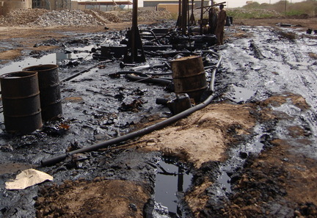
Oil & Gas Industry Characteristic
Highly Regulated
Highly regulated with regards to environment and health and safety concerns
Affect the operations of all the drilling companies
Notes:
This industry is highly regulated with regards to environment and health and safety concerns
The federal, provinces, state, foreign and local laws and regulations controlling the discharge of hazardous wastes and relating to the protection of the environment affect the operations of all the drilling companies. These regulations address oil spill prevention and control and also significantly expand liability exposure across all segments of the oil and gas industry. Company failure to comply with these statutes and related regulations could result in civil or criminal enforcement action.
Can also mention the chemical stuff here

Slide 40
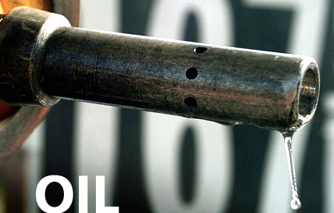
Oil & Gas Industry Characteristic
Highly Competitive
Numerous industry participants
Intense price competition
Notes:
The contract drilling business is highly competitive with numerous industry participants.
The industry has experienced consolidation in the 90’s when oil prices went down but there is still room for more.
Recent mergers among oil and natural gas exploration and production companies have reduced the number of available customers.
Due to the high fixed cost nature of the business, in periods of market weakness drilling contractors have aggressively lowered day-rates to sustain equipment utilization and earnings have fallen sharply.
The contract drilling business is highly competitive with numerous industry participants. The intense price competition and cyclicality of the drilling industry, is marked by periods of low demand, excess rig availability and low day rates, can have a material adverse affect on the company’s operations.

Slide 41
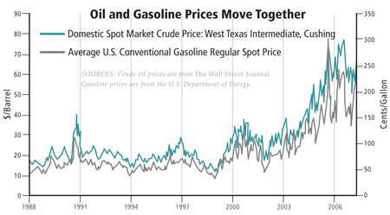
Oil & Gas Industry Characteristic
Price Dependent
Oil services
Drilling companies
Rigs
Notes:
Oil and natural gas prices influence drilling activity, each to various degrees.
Gas-directed rig counts tend to lag natural gas prices by several month while oil-directed rig counts tend not to be influenced by short-term swings in oil prices. Pullbacks in oil drilling take some time because oil contracts tend to be long-term in nature and are not as sensitive to commodity price.
Nevertheless, oil drilling and services companies are the first to feel the effects of increased or decrease in the industry spending. If oil prices rise, oil services and drilling companies are first on the scene when companies decide to start exploring. We can usually see large expansions in the industry during the peaks of energy cycles.
The energy industry just like most commodity based industries as it faces long periods of boom and bust. As rigs begin to approach the end of their economic lives, drilling firms will continue to invest in rig upgrades and in new rigs to replace older ones. The drilling industry has a tendency to overexpand during the peaks of the energy industry.

Slide 42
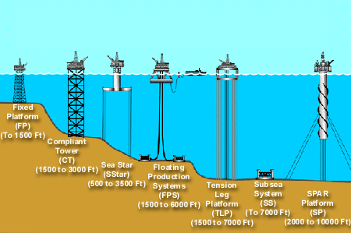
Oil & Gas Industry Characteristic
Essential Technology Development
Directional drilling
Challenging geological locations
Less damageable to the environment
Notes:
With accelerating decline rates in mature reservoirs around the world, oil and gas producers are facing a difficult job just to maintain existing production. Potential new reservoirs are often located in challenging geological locations, advance in technology are becoming critical to generating future production gains. In addition, companies are striving to come up with technologies that would be less damageable to the environment.
Newer Development:
Rapid Rig: speed up transport and rigging up
Subsea separation systems: separate hydrocarbons
before they are sent to the surface, which saves
time and improves overall recovery from the field.
Optical sensor technology

Slide 43
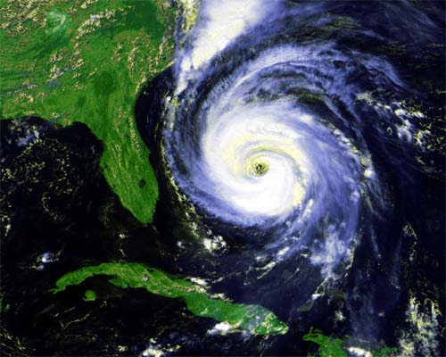
Oil & Gas Industry Characteristic
Other Key Factors:
Industry Cycle
Natural calamities
Location
Types of Contract
Length of Contract
Notes:
Industry Cycle: The health of the drilling and Service Industry is tied to the price of oil. High oil prices usually provoke increased in drilling activity. Fluctuates with oil prices. The energy industry just like most commodity based industries as it faces long periods of boom and bust.
Natural calamities such as hurricanes damage offshore drilling rigs and other equipments. These can delay the delivery of services and materials to jobsites in conformity with the contracts
Location: For contract drillers, the location of their drilling rigs is of prime importance. Land rigs tend to remain domiciled within a particular region and/or country. Offshore rigs are often relocated based on market demand.
Types of Contract: Drillers are generally paid according to one of three methods: a footage contract, a daywork contract, or a turnkey contract. The contract determines a driller’s prospects for future revenue growth.
Length of Contract: Its good to know when the company’s current contract expire, how many will expire within the next 12 months and how many rigs are locked in for three years or longer. There are advantages and disadvantages to both, long and short-term contract.

Slide 44
Future Outlook

Slide 45
Future outlook
Long-term market growth
Emerging Asia-Pacific economies (China & India)
Decline (next 20-30 years)
Switching to more environmentally friendly, cheaper and renewable alternative sources
Notes:
Oil and gas companies are typically large, integrated players that benefit from their scales of operations. The presence of such incumbents intensifies rivalry in the market. Due to the fact that oil and gas operations are highly energy and labor intensive, fixed costs are also high and market is hard to exit as leaving would require significant divestments of assets specific to the business. Main players’ activities are usually geographically and vertically integrated however most of them present similar business models. Long term market growth caused by the rising demand for the product, especially from emerging Asia-Pacific economies, mainly China and India, tends to ease the rivalry somewhat, however on the other hand the estimations for the next 20 – 30 years show the decline in use of oil and gas that should be caused by switching to more environmentally friendly, cheaper and renewable alternative sources. These combine to produce strong rivalry within oil and gas market.

Slide 46
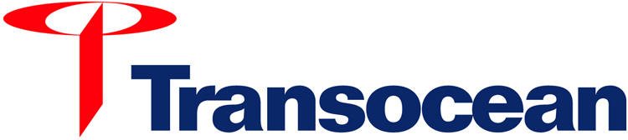

Slide 47
Overview

Slide 48
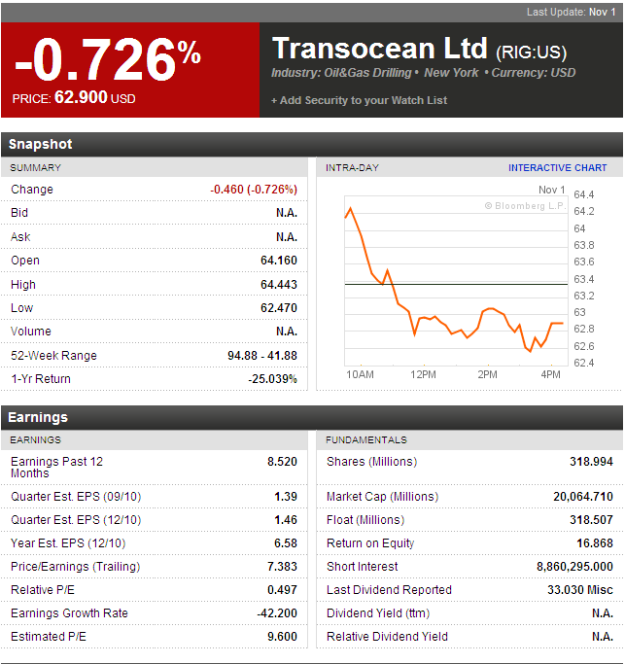

Slide 49
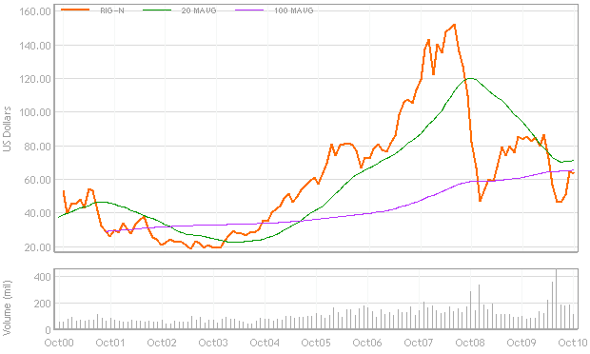
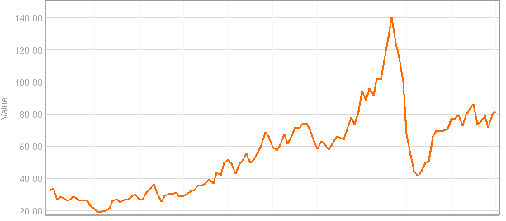
10 Year RIG Price vs Crude Oil

Slide 50
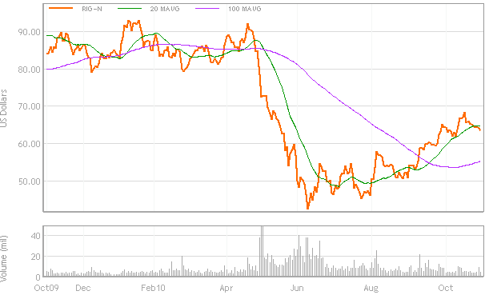
1 Year RIG Price

Slide 51
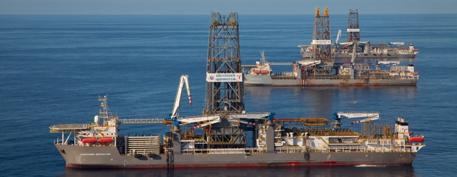
Mission
Our mission is to be the premier offshore drilling company providing worldwide rig-based, well-construction services to our customers through the integration of motivated people, quality equipment and innovative technology, with a particular focus on technically demanding environments.

Slide 52
Major Products & Services
Transocean is a global provider of offshore contract drilling services for oil and gas wells. The company's key services include the following:
Deepwater drilling
Harsh environment drilling
Inland and shallow water drilling
Offshore drilling

Slide 53
Company Overview
Transocean principally uses three types of drilling rigs:
Drill ships
Semi submersibles
Jackups
The company also operates barge drilling rigs and a coring drillship.

Slide 54
Company Overview
At Transocean – the world’s largest offshore drilling contractor -- we are never out of our depth, from the shallow water to the ultra-deepwater. We are the:
Largest offshore driller with 139 mobile offshore drilling units, plus an additional eight newbuild rigs
Largest jackup rig driller with 65 units
Largest “floating” rig driller with 71 drillships and semisubmersible rigs
Largest deepwater driller with 40 rigs that can operate in water depths of 4,500 feet or greater
Largest offshore driller by equity market capitalization

Slide 55
Achievements
Transocean holds 19 of the past 23 world records for drilling in the deepest waters.
The ultra-deepwater drillship Discoverer Deep Seas set the current world water-depth record in 10,011 feet (3,051 meters) of water.
Other world records include:
Deepest well ever drilled offshore at 34,189 feet.
World’s water-depth record for a moored rig in 8,951 ft of water.
World’s deepest subsea well completed in 8,960 ft of water.

Slide 56
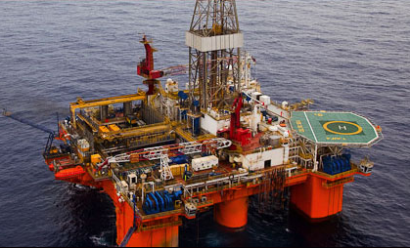
Company Overview
Deepwater Innovation:
Offshore jackup drilling rig
Self-propelled jackup
Turret-moored drillship
Dynamically positioned drillship for exploration
Dynamically positioned semisubmersible
Rig to drill year-round in the North Sea
Semisubmersible for sub-arctic, year round operations
Ultra-deepwater drillship with patented dual-activity drilling system
Drillship capable of working in 10,000 feet of water

Slide 57
Company Overview
The company conducts its business through two reportable operating segments: contract drilling and other.
Contract Drilling: to contract drilling rigs, related equipment, and work crews to drill oil and gas wells on a dayrate basis as well as offshore drilling with a particular focus on deepwater and harsh environment drilling services
Other: Oil and gas drilling management services as well as drilling engineering on either a dayrate basis or a completed-project, fixed-price basis

Slide 58

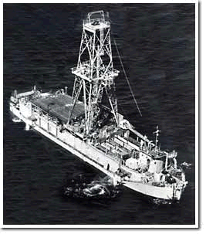
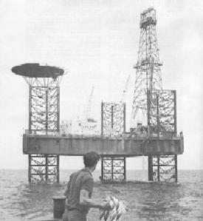
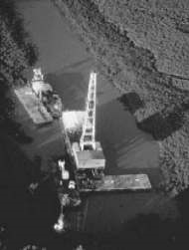
Firm History
1919
Dancinger Oil and Refinery Co. is founded.
1946
Consortium (CUSS) formed to establish feasibility of offshore drilling. Also, Santa Fe Drilling is founded.
1951
CUSS builds prototype for offshore floating rig.
1953
Dancinger merges with Offshore Drilling Co. to construct first jackup drilling rig, in operation by 1954.
1958
CUSS becomes Global Marine.

Slide 59

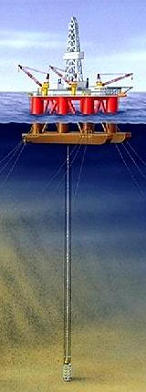
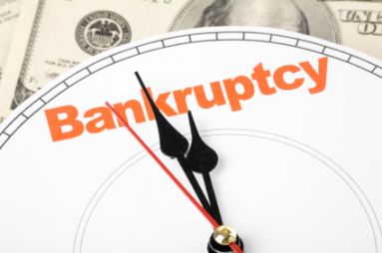
Firm History
1964
Global Marine first to drill in North Sea.
1966
The Offshore Company designs jackup with year-round capabilities.
1969
First semisubmersible rig built by Forex Neptune.
1985
Schlumberger combines Sedco and Forex into single company.
1986-1992
Global Marine files for Ch. 11 bankruptcy. Reemerges in 1989 with BOD, management and fleet intact; deleveraged by 1992.
1996
The Offshore Company (now called SODI) acquires Transocean ANA, doubling its fleet size.

Slide 60


Firm History
1999
Transocean Offshore merges with Sedco Forex (sold by Schlumberger).
2001
Transocean Sedco Forex merges with R&B Falcon Corp. and form world’s largest offshore drilling company.
2003-2007
Transocean breaks several records for depth drilling (10,000 ft of water) and well depth (35,000 ft).
2007
Transocean and GlobalSantaFe merge to form the world’s largest offshore driller.
2008
Redomesticates to Switzerland from Cayman Islands for geographic centrality and tax benefits.

Slide 61
A History of Mergers
Transocean
Global SantaFe
Global Marine
Santa Fe Int’l
Transocean
Transocean Sedco Forex
R&B Falcon
Transocean Offshore
Sedco Forex
Sedco
Forex Neptune
Transocean ASA
SODI
Offshore Drilling
International Drilling
Southern Productions
Southern National Gas
Dacinger

Slide 62
Fleet

Slide 63
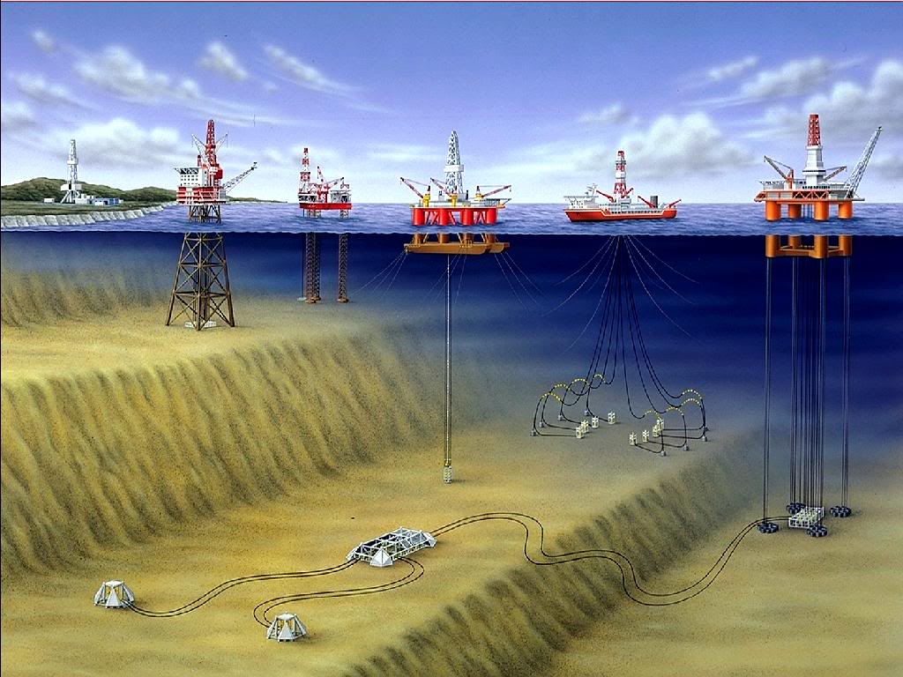
Fleet Lineup
Jackups
Midwater Semisubmersible
Deepwater Semisubmersible
Drillship
Floaters

Slide 64
Fleet Overview
Owns/partial ownership in 139 mobile offshore drilling units
45 High-Specification Floaters (Ultra-deepwater, Deepwater and Harsh Environment semisubmersibles and drillships)
26 Midwater Floaters
10 High-Specification Jackups
55 Standard Jackups
3 Other Rigs
3 Ultra-Deepwater Floaters under construction

Slide 65
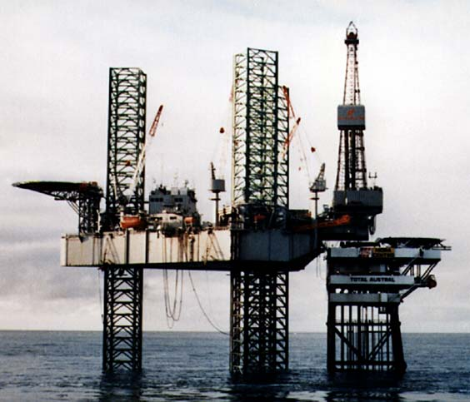
Fleet
Jack ups
Mobile self-elevating drilling platforms.
Equipped with legs that are lowered to the ocean floor for foundation.
Jacked up just above highest waves.
Suited for water depths of 400 ft and less.

Slide 66
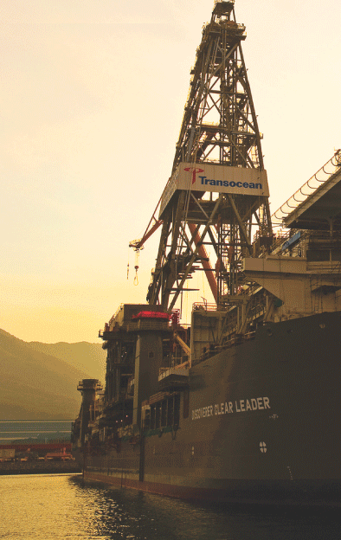
Fleet
Drill ships
Dynamically positioned in that it does not require anchors.
Great load capacity, ideal for remote locations.
Limited to calmer water conditions.
Self-propelled and extremely mobile.
Dual-activity technology (on recent models).
Midwater, Deepwater, Ultra-deepwater

Slide 67
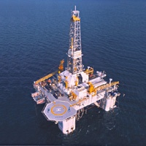
Fleet
Semisubmersibles
Floating vessels that can be submerged by water ballast system so that lower hulls are under water during drilling operations.
Maintain position through anchors or computer controlled dynamic positioning thrusters.
Moved by propellers or tugging.
Suited for rough water conditions.
Midwater, Deepwater, Ultra-deepwater

Slide 68
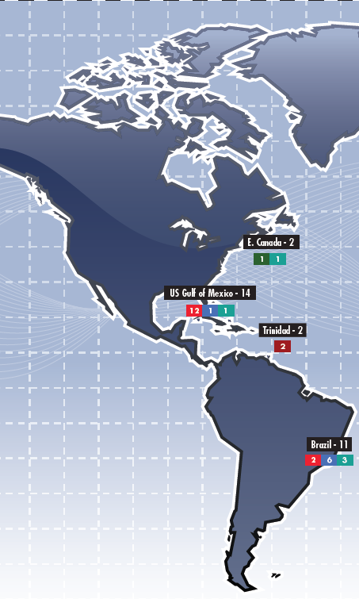
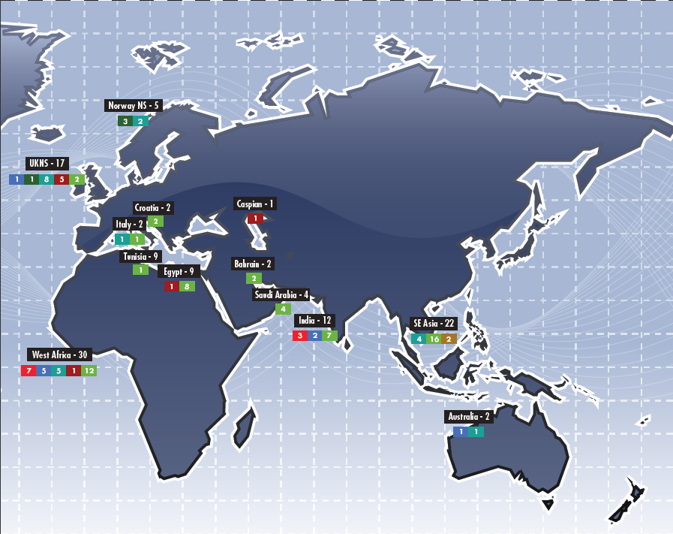

Transocean Operations

Slide 69








Major Clients
12%

Slide 70
Future Outlook

Slide 71
Revenue Methods
Transocean has two main methods for generating revenue from its drilling operations:
Operating rate: Rate that is charged for utilization of rigs.
Stand-by-rate: Rate charged for the rig being ready for use, regardless of whether it is actually used.

Slide 72

Potential Risks
High expiration of its fleet contracts in early 2011 which is a cause of concern for its future revenue streams
Impacted by the dayrate

Slide 73


Slide 74

Potential Risks
Revenues highly dependent on economic conditions of market as price of oil dictates demand.
Sole focus in offshore drilling, eliminating large oil markets such as Russia and Middle East.
Highly competitive and cyclical industry with intense price competition.
Contracts may be terminated by a number
of events.
Revenues concentrated on small group
of clients; dependent on key personnel.

Slide 75

Operating Revenue by Country
19%
14%
9%
58%

Slide 76


Fleet Revenue

Slide 77


Fleet Utilization Outlook

Slide 78


Contract Backlog
Actual
Projected

Slide 79
Litigations
Macondo well indicdent
Ultra-Deepwater Floater, Deepwater Horizon leased to BP
Recognized a liability of $80 under other current liabilities
206 claims made against Transocean
Defence under contractual defence and indemnity
Resulted in loss of $590 million of backlog revenue

Slide 80
Regulations
U.S. Government has just lifted its ban on off-shore drilling that was initiated May 30, 2010
Implications include higher costs to business such as executive guarantee for safety of rigs
14 rigs located in the U.S. Gulf of Mexico; Contracts may be terminated leading to loss of $2.1 billion

Slide 81
Management

Slide 82

Management
Steven L. Newman
President and CEO
Joined company in 1994 in Corporate Planning Department.
Rig Manager, Project Engineer, Division Manager, Region Marketing and Operational Manager for Asia and Australia Region.
VP of Performance and Technology (2003-05).
Senior VP of HR, Information Process Solutions, and Treasury (2005-06).
Executive VP and COO (2006-07).
Executive VP of Performance and COO (2007-08).
BSC in Petroleum Engineering from Colorado School of Mines. MBA from Harvard Graduate School of Business.

Slide 83

Managment
Arnaud A. Y. Bobillier
Executive Vice President, Asset and Performance
Joined company in 1980 as management.
Regional Manager for West Africa Region ( 2001-2004)
Regional Manager for Europe and Africa (2004-2005)
Vice President of Europe and Africa (2005-2008)
Senior Vice President of Europe and Africa (2008)
Executive Vice President , Assets (2008-2010)
Graduated from Ecole Superieure des Techniques de l’ingenieur de Nancy, France (Engineering Degree in Fluid Mechanincs and Thermics).

Slide 84

Management
Ricardo H. Rosa
Senior Vice President and CFO
Joined Schlumberger in 1983.
Held variety of international positions in finance in oilfield services for Schlumberger, (1984-2000).
Product Line Controller of Sedco Forax (1995).
VP and Controller after merge (1999).
Senior VP of Asia and Pacific Unit (2003).
Appointed CFO in September 2009, after predecessor Gregory Cauthen retires (age 51) most likely due to relocation of firm to Switzerland.
Master of Arts Degree from Oxford University. Chartered Accountant.

Slide 85
Financial Statements

Slide 86


Slide 87


Slide 88

Future Debt

Slide 89


Slide 90


Slide 91
2nd Quarter Expense Changes
Decrease in revenue from the oil spill
Cap ex for completing new builds
Increase activities in operating segment
Increase in depreciation from completion of new rigs

Slide 92


Slide 93


Slide 94
Recommendation
Hold

Slide 95

Precision Drilling cORPORATION

Slide 96

Stock
Notes:
In February 09: suspended cash distributions: in response to lower financial operating performance at the start of 2009. The suspension of cash distributions allows Precision to increase debt repayment capability and balance sheet strength. -> we will see this later in the balance sheet
Upon Precision's conversion to an income trust effective November 7, 2005, the Trust adopted a policy of making monthly distributions to holders of Trust units and holders of Exchangeable LP units (together "Unitholders").

Slide 97


Stock 5-year
Notes:
Events? Why?

Slide 98

Stock 1-year

Slide 99
Outline
Business and business segments
History
Performance
Strategy
Management
Financials

Slide 100
Business and business segments

Slide 101
Business
Onshore contract driller - one of the largest onshore drilling rig fleets in the world
a fleet of 352 contract drilling rigs, 200 service rigs
Holds about 26% of the onshore drilling rig market in Canada, 7% in the US and about 20% of the Canadian service rig market
Precision’s fleet can drill virtually all types of onshore conventional and unconventional oil and natural gas wells in North America
Notes:
Natural gas: natural gas fields
All kinds of shale play: Horn River shale play in British Columbia Bakken Shale in North Dakota to the Marcellus Shale
in Pennsylvania
Shale gas play?

Slide 102

Notes:
As depicted in the map of North America,
Precision’s drilling rig fleet is positioned in virtually every resource play from northern Canada to the southern United States

Slide 103
Business Segments
Contract Drilling Services
- initial drilling of oil and natural gas wells
Completion and Production Services
- Subsequent completion and workover of wells to optimize production volumes
Notes:
Precision’s Completion and Production Services completes wells that have been drilled and provides maintenance services
to wells that have been placed into production.

Slide 104

Notes:
09 Annual still called trust.
Precision has been Canada’s largest oilfield services provider and with the acquisition of Grey Wolf in 2008 is the second largest North American land drilling contractor.
25% of the Canadian land drilling market
6% of the United States market
Precision’s service rigs and snubbing units each comprise about 20% of their respective Canadian markets.
In addition to completing and servicing wells with rigs, the segment offers snubbing services to wells while pressurized, a broad mix of rental equipment and wastewater treatment for remote accommodations.

Slide 105

Contract Drilling Services
Tier I -- North American shale and unconventional plays
Tier II -- enhance directional and horizontal drilling capability and less mobile
Tier III -- conventional mechanical rigs for less challenging drilling programs.
Notes:
These improvements are being driven by high customer
demand for Precision’s Tier 1 and 2 rigs in both the United States and Canada and from the re‐establishment of oil
drilling demand.
Dayrates: As demand for Tier 1‐Super Series and Tier 2 rigs remains strong, dayrates
in the United States markets are continuing to modestly improve from previous quarters.”

Slide 106

Completion and Production Services
Notes:
Average operating costs per day for drilling rigs decreased in the third quarter of 2010 to US$12,395 from the
prior year third quarter of US$12,692 in the United States and from $8,802 to $8,303 in Canada. The cost decrease
in Canada was primarily due to rig mix with a higher percentage of spot market work for the double and single rigs
which are lower cost rigs.
Precision has seized market opportunities during 2010 which includes the contracting and construction of nine new rigs that were announced last quarter. Five of these new‐rig builds are Super Singles of which two have been delivered on time and on budget in Canada. Of the remaining three Super Single rigs, two are expected to be
deployed in the United States and one in Canada. The other four new‐rig builds are Super Triple rigs with all four
expected to work in the United States. All nine rigs have been contracted with an average contract term of approximately three years.

Slide 107


Revenue composition and capex
Notes:
Revenue: %
Capital expenditure: increasing

Slide 108
history

Slide 109
History
Early 1950s: founded as a private land drilling contractor in Canada
Restructuring1980s: largest provider of oilfield services in Canada.
1996: acquisition of a diversified oilfield services company (EnServ Corporation).
1993: acquisition LRG Oilfield Services Ltd
entered the camp and catering business
1996 (Rostel Industries Ltd) and 1997 (Columbia Oilfield Supply Ltd.) acquisitions
increased manufacturing and logistical support capabilities
2006: acquisition of Terra Water Group
entered the campsite wastewater treatment business with.

Slide 110
History (cont’d)
2005 converted to an open-ended income trust
favorable tax rules
Grow into the US drilling market
began to organically grow in late 2007.
in late 2008, Precision acquired Grey Wolf Inc., a U.S. based driller with 123 land rigs in the United States and Mexico.
June 1, 2010 converted to a growth-oriented corporation
Tax purpose and access to more capital
Notes:
Effective June 1, 2010 Precision Drilling Trust converted to a growth-oriented corporation pursuant to a plan of arrangement under the Business Corporations Act (Alberta).

Slide 111
performance

Slide 112
Performance
Seasonality --Canadian drilling
activity peaking : fourth and first quarters.
In the spring: temperatures rise, unstable ground unstable
Government road bans: restrict equipment movement
lead to quarterly fluctuations in operating results and working capital requirements.
Notes:
Picture only for Canada.
The second thing we see, is that activity in general goes down.

Slide 113

Not in the us

Slide 114

Drilling rig utilization days
Notes:
Drilling rig utilization days (spud to rig release plus move days) in Canada during the fourth quarter of 2009 were 6,595,
a decrease of 27% compared to 9,066 in 2008. Drilling rig activity for Precision in the United States was 82% higher
than the same quarter of 2008 due to acquisition growth in December 2008.
Prior to the acquisition of Grey Wolf,
Precision did not have any drilling rigs operating internationally in the fourth quarter of 2008 compared to 172 utilization
days in the current quarter from operations in Mexico.

Slide 115

Low rig activity in general
Notes:
148 in the United States= .5811 .6214 Average days per well
119/202
“In the United States, oil related activity has continued to strengthen. Precision’s average active rig count in the
United States for the third quarter of 2010 was up 5% over the second quarter of the year and 76% over the same
period in 2009. Precision’s active rig count in the United States is currently 99 and we expect it to stay at this level
or increase modestly over the coming months. If low natural gas prices persist, there is the potential for further
regional pullback in gas related activity; however, we would expect most of these rigs to be absorbed by oil and
natural gas liquids rich drilling activity. As demand for Tier 1‐Super Series and Tier 2 rigs remains strong, dayrates
in the United States markets are continuing to modestly improve from previous quarters.”
“Higher than normal rainfall through much of the Western Canada Sedimentary Basin during the third quarter
hampered drilling activity. Over the past few weeks, Precision has reactivated approximately 30 rigs sidelined due
to poor weather conditions. Precision’s current active rig count in Canada is at 119 and, despite the wet weather,
the average rig count of 82 for the third quarter of 2010 was 62% higher than the comparable quarter of 2009.
Most of this increase is driven by unconventional horizontal drilling and completion techniques being applied to
conventional oil reservoirs in Western Canada and we believe that the remainder of 2010 activity levels will
exceed those achieved in 2009. While in early discussions with customers, the Canadian 2011 winter drilling
season is expected to be at least as busy as winter 2010. We would expect there to be higher market dayrates
because of this level of anticipated customer demand.”

Slide 116
strategy

Slide 117

Strategy
Want to be recognized as the high performance high value provider of services for global energy exploration and development
A key factor considered by Precision’s customers in selecting oilfield service providers is Safety as this is a measure of performance excellence.
Target Zero program: the workplace and organization can be free from injuries, equipment damage and negative environmental Impact.
Notes:
“Target Zero” which is Precision’s goal of no work place incidents.
Precision is proud to be one of the contractors of choice for several major and large independent exploration and
production companies in North America. In fact, Precision earned “Contractor of the Year” honours from a major
oil company for its United States operations during 2009.
Safety, environmental stewardship and employee wellness is critical for Precision and its customers. The focus on working
safely is one of Precision’s most enduring values. The goal of Target Zero – Precision’s safety vision for eliminating
workplace incidents – is derived from a fundamental belief that all injuries can be prevented. In 2009, 331 of Precision’s
drilling rigs and 209 of Precision’s service rigs achieved Target Zero. Precision continues to embrace technological
advancements which make operations safer.

Slide 118


Strategy (cont’d)
Notes:
(decrease in 09 increase in 10? )But for 2009 capital expenditures on existing equipment have been reduced to a level that will maintain the safety and
overall performance of assets. We will also see this later in the Financials.\
Well-maintained Equipment
Precision reinvests capital to sustain and upgrade existing property, plant and equipment. Equipment repair and
maintenance expenses are benchmarked to activity levels in accordance with Precision’s maintenance and certification
programs. Precision employs systems to track key preventative maintenance indicators for major rig components to record
equipment performance history, schedule equipment certifications, reduce downtime and allow for better asset management.
Precision benefits from internal services for equipment certifications and component manufacturing provided by Rostel
Industries and for standardization and distribution of consumable oilfield products through Columbia Oilfield Supply in
Canada and Grey Wolf Supply in the United States.

Slide 119

Strategy (cont’d)
Expansion
Notes:
In 2009 US first exceed canada (more stable less foreign exchange gain)

Slide 120
Strategy (cont’d)
Super technology:
Over the past 13 years Precision has been developing the Super Series™ drilling rigs
They have large capacity mud pumps, advanced drilling control systems , high mobility, automated pipe handling and minimal environmental impact. That‘s required by customers for long-section horizontal drilling plays

Slide 121
Strategy (cont’d)
During the first nine months of 2009, 16 newly‐built Super Series drilling rigs were added to the fleet under long‐term customer contracts
Last quarter: contracting and construction of 9 new rigs. All contracted with an average contract term of approximately three years.
Since July 22, 2010, Precision added five term contracts for new build Super Series rigs expected to go to work in 2010 and 2011
The expansion capital program includes nine new build Super Series rigs and additional rental and water treatment equipment.

Slide 122

Strategy (cont’d) horizontal drilling
Notes:
FUNDAMENTALS OF THE ENERGY SERVICES INDUSTRY
Management believes that hydrocarbon energy sources, oil and natural gas, are low cost energy sources and there is a
continuing global dependency to replace existing production levels which will remain viable for decades. Alternate energy
sources are necessary, but will take time and technology for improved economics and infrastructure to develop.
The shift from conventional to unconventional oil and natural gas production requires higher capacity equipment and
technical expertise. The gradual steady shift in the drilling of more horizontal wells and fewer vertical wells is evidence of
this trend.
Multi-stage horizontal completion techniques are re-opening many basins to renewed drilling in North America. This is
an emerging development that is gaining credibility, an exciting opportunity for industry to extract greater production from
known resource regions previously thought to be uneconomical.
the average rig count of 82 for the third quarter of 2010 was 62% higher than the comparable quarter of 2009.
Most of this increase is driven by unconventional horizontal drilling and completion techniques being applied to conventional oil reservoirs in Western Canada and we believe that the remainder of 2010 activity levels will exceed those achieved in 2009.
As previously noted, drilling dynamics have changed with recent technological advancements in fracturing, stimulation
and horizontal drilling that have brought about a paradigm shift from the development of conventional to the development
of unconventional natural gas and oil reservoirs in North America. This is especially prevalent in the exploitation of existing
and emerging shale gas plays in the United States where pipeline takeaway capacity improvements have occurred. The
application of these new technologies in unconventional drilling in North America has provided significant productivity
gains in certain United States shale gas plays.
These technological improvements are evident in the proportion of wells drilled using directional and horizontal well
programs. As shown in the graph below, the trend in Canada away from vertical wells to the more demanding requirements
of directional/horizontal well programs is very consistent. Precision’s rig fleet in Canada has been engaged by customers
on these wells to a greater degree than industry, demonstrating Precision’s high performance capabilities.
Technological innovations have been a major factor in the natural gas production increase for the United States. These
productivity gains have reduced the reliance on Canada as a source of natural gas supply. The following graph reflects the
natural gas production increases realized since early 2006 in the United States as new technologies have been employed
to enhance and bring forward the productive life of unconventional natural gas wells.

Slide 123

KEVIN A. NEVEU - Calgary, Alberta
President and Chief Executive Officer 50 years old
Appointed Chief Executive Officer and a Director of Precision in August 2007 (he was appointed from outside)
Appointed president on January 13, 2009
Previously President of the Rig Solutions Group of National Oilwell Varco in Houston
Mr. Neveu is a graduate of the Faculty of Engineering at the University of Alberta.
Mr. Neveu also serves on the Board of RigNet.
Notes:
http://www.precisiondrilling.com/AboutPrecision/aboutusboardofdir/BoardOfDirectorsbio.cfm
President and Chief Executive Officer Mr. Neveu, 50, was appointed Chief Executive Officer and a Director of Precision in August 2007 and nominated President and Chief Executive Officer in January 2009. Mr. Neveu was previously President of the Rig Solutions Group of National Oilwell Varco in Houston where he was responsible for the company's drilling equipment business. Over the past 25 years, Mr. Neveu has held senior management positions with National Oilwell Varco and its predecessor companies in London, Moscow, Houston, Edmonton and Calgary. Mr. Neveu holds a Bachelor of Science degree and is a graduate of the Faculty of Engineering at the University of Alberta. In 1984, Mr. Neveu was recognized as a Professional Engineer by the Association of Professional Engineers, Geologists and Geophysicists of Alberta. Mr. Neveu also serves on the boards of; RigNet Inc., Houston, Texas (since 2004), the Heart and Stroke Foundation of Alberta (since 2009) and he was appointed a Member of the Board of Directors and a Member of the Executive Committee of the International Association of Drilling Contractors, Houston, Texas in January 2010.

Slide 124

Douglas J. Strong - president
Chief Financial Officer since November 7, 2005.
He served as Group Controller of Precision Drilling from 2001 to 2005
He served as Senior Controller of Precision Drilling from 1997 to 2001.
Nearly twenty years of domestic and international oilfield service industry experience.
Mr. Strong is a Chartered Accountant.
Notes:
Precision Drilling Corporation ("Precision) announces the appointment of Robert McNally as Executive Vice President and Chief Financial Officer. Doug Strong, currently Chief Financial Officer of Precision, will become President, Completion and Production Services. Both appointments will be effective July 19, 2010.
"I am very excited about both of these appointments." Kevin Neveu, President and Chief Executive Officer, said. "It is rare to find a CFO like Rob who combines financial and operational experience in the oilfield services business. His energy and demonstrated leadership strengths will fit well with the Precision culture. Doug's strategic approach and deep keeled knowledge of the industry will drive our Completion and Production service areas to the next level."
Mr. McNally has over 16 years of executive management, finance, operations, mergers and acquisitions and capital markets experience in the oilfield service industry. His most recent position was with a private equity firm. Earlier in his career, he spent several years in operations, sales and marketing for a large multinational service company. Mr. McNally holds a bachelor degree in Mechanical Engineering from the University of Illinois, a bachelor degree in Mathematics from Knox College and an MBA from Tulane University.
Mr. Strong has over 25 years of experience in the oilfield services business. In 2005, Mr. Strong was appointed the Chief Financial Officer of Precision and previously served in various controller positions with Precision and its predecessor companies since 1994. Earlier in his career, Mr. Strong spent several years in international contract drilling for a global energy services company. He is a Chartered Accountant and holds a Bachelor of Commerce degree from the University of Calgary.

Slide 125

ROBERT L. PHILLIPS - Vancouver, British Columbia
Chairman of the Board 59 years old
Appointed as a Director of Precision in 2004
Appointed as Chairman of the Board in August 2007.
He was most recently President and Chief Executive Officer of BCR Group of Companies from 2001 to 2004
Notes:
Chairman of the Board Mr. Phillips, 59, was most recently President and Chief Executive Officer of BCR Group of Companies from 2001 to 2004. Previously, he was Executive Vice President at MacMillan Bloedel Limited (1999 – 2001), President and Chief Executive Officer of PTI Group Inc. (1998 – 1999) and President and Chief Executive Officer of Dreco Energy Services Ltd. (1994 – 1998). Mr. Phillips has been a Director of Precision since May 2004 and was appointed as Chairman of the Board of Directors in August 2007. He also serves on the boards of several other major Canadian corporations.

Slide 126
financials

Slide 127

CONSOLIDATED BALANCE SHEET ANNUAL

Slide 128

CONSOLIDATED BALANCE SHEET QUARTERLY

Slide 129


Balance sheet discussion
Notes:
Increase in working capital ?
Decrease in long term debt

Slide 130
Long term debt reduction
Net financial charges were $22 million for the third quarter of 2010 which was down from $8 million when compared to the prior year quarter.
Precision has repaid $104 million in debt during 2010 and may consider further voluntary long‐term debt reduction or refinancing as industry fundamentals stabilize and operating cash flow forecasts become clearer.
As at September 30, 2010, approximately $598 million was outstanding under the Secured Facility and $175 million was outstanding under the unsecured facility.
Precision expects to remain in compliance with financial covenants under its Secured Facility and have complete access to credit lines during 2010.

Slide 131

CONSOLIDATED STATEMENTS OF EARNINGS AND DEFICIT QUARTERLY

Slide 132

CONSOLIDATED STATEMENTS OF EARNINGS AND DEFICIT ANNUAL
Notes:
Reduction in depreciation?

Slide 133

Income statement discussion
9 month unrealized foreign exchange gain
During the first nine months of the year Precision recorded a foreign exchange gain of $12 million
$105 million gain in 2009.
translation Precision’s U.S. dollar denominated credit facilities.
Notes:
Revenue was $994 million, an increase of $83 million or 9% from the prior year due to higher activity in both of
Precision’s business segments.
• Operating earnings were $158 million, a decrease of $54 million or 26% from 2009. Operating earnings were
16% of revenue, compared to 23% in 2009.
In managing foreign exchange risk, Precision endeavours to align the currency of the majority of its debt
obligations and capital expenditures with the currency of the supporting operating cash flows. Interest rate risk is
partially managed through hedging activities and by reducing debt.
Earnings before interest, taxes, depreciation and amortization
and foreign exchange (“EBITDA”) were $113 million for the third quarter of 2010 compared to EBITDA of $86
million for the third quarter of 2009. EBITDA is not a recognized financial measure under Generally Accepted
Accounting Principles ("GAAP") see "Non‐GAAP Measures" in this report. The increase in EBITDA between the two
years is due to the increase in drilling activity.

Slide 134

Finance Charges Financial charges were $22 million, a decrease of $8 million due to the reduction in long‐term debt over the prior year period.

Slide 135


Slide 136
income statement: segment contract drilling
Notes:
The decline in EBITDA was due to lower rig utilization days in Canada.
Despite the significant drop in activity and increased pressure on day rates, EBITDA margins in contract drilling were
only slightly lower than prior year due to term contracts, management control over costs and efforts to minimize the
erosion of drilling rig day rates.

Slide 137

CONSOLIDATED STATEMENTS OF CASH FLOW -- QUARTERLY
Notes:
Free cash flow: 70,194
Free cash (old): 356,135

Slide 138

CONSOLIDATED STATEMENTS OF CASH FLOW ANNUAL
Notes:
132518

Slide 139
Cash flow discussion
Capital expenditures for the purchase of property, plant and equipment were $65 million in 2010, a decrease of
$114 million over the same period in 2009, and included $14 million on expansionary capital initiatives and $51
million on the maintenance and upgrade of existing assets.
Operating within a highly variable cost structure, Precision’s maintenance capital expenditures are tightly
governed by and highly responsive to activity levels with additional cost savings leverage provided through
Precision’s internal manufacturing and supply divisions. Expansion capital for new rig build programs require 2 – 5
year term contracts in order to mitigate capital recovery risk. To capitalize on market opportunities Precision
increased its anticipated capital expenditures by $29 million to a total of $218 million for 2010.

Slide 140
Cash flow discussion
During the first quarter of 2010, Precision amended certain covenants and terms contained in the Secured Facility. These amendments included an increase in the leverage ratio test from 3.00:1 to 3.50:1 through December 31, 2011, a decrease in the interest coverage ratio test from 3.00:1 to 2.75:1 through December 31, 2011 and the removal of the restrictions on expansion related capital expenditures (limitations on total capital expenditures remained unchanged).
During the second quarter of 2010, Precision amended the terms of the Secured Facility to increase the size of the revolving credit facility to US$410 million from US$260 million. In addition, a subsidiary of Precision arranged a new secured operating facility in the amount of US$15 million with a U.S. bank. Advances under this facility are at the bank’s prime lending rate.

Slide 141
Recommendation
BUY
Notes:
Buy them when they are down… cash out when business is at peak ☺

Slide 142


Trinidad Drilling

Slide 143


Slide 144


Slide 145
2010 Highlight
Agreed to resume the construction of six new contracted drilling rigs that were delayed earlier in 2009 due to weak industry conditions
Destination: Shale gas deposits in Haynesville, Louisiana
As the rigs under construction are put into operation, Trinidad’s ability to generate free cash flow and repay debt is expected to increase

Slide 146


Slide 147


Charts
5 Year Stock Performance
5 Year P/E Ratio

Slide 148
Basic Info/Company History
Growth-oriented dividend paying, oil and natural gas services provider, based in Calgary
1996
Started as a small Canadian contract driller in Saskatchewan
2000
2002
Converted to an Income Trust structure
2003
2005
Expanded to the US
2008-9
Converted back to a corporate structure
Expanded to Mexico
Began trading on the TSX under the symbol TDG
Signed of one of the industry’s first long-term, take-or-pay contracts
2010
Resumed the construction of six new contracted drilling rigs

Slide 149


Slide 150
Services
Drilling
Canadian, U.S Land+Barge
International (Mexico)
Coring and Pre-Setting
Acquired Titan Surface Casing Ltd.
Coring services drill narrow hole to help evaluate and plan underground oil sands extraction programs
Pre-setting uses shallower rigs to drill and cement the first 200 to 300 metres of a new well to reduce the cost of using larger rigs
Well Servicing
Trinidad Well Servicing Ltd.(T.W.S.)
The maintenance procedures performed on an oil or gas well to enhance its productivity
Manufacturing and Technology
In-house facility
Acquired Victory Rig Equipment Corporation

Slide 151
Business Focus
Long term, take-or-pay contracts
Results in relatively high utilization rates
Deeper Capacity (onshore)
Responding to changing customer demands
Unconventional shale plays (Montney, Horn River, Bakken)
Capture the first mover advantage

Slide 152
Trinidad operations

Slide 153


Slide 154


Slide 155


Slide 156


Slide 157


Slide 158


Slide 159


Slide 160


Slide 161


Slide 162


Slide 163


Slide 164

Utilization Rates: Trinidad vs Industry Q1 2002 – Q1 2010

Slide 165

US Active Rig Count: Trinidad(TDG) vs Industry Q2 2008-Q2 2010

Slide 166
TOP Management

Slide 167


Top Management
Lyle C. Whitmarsh, CEO
President
Graduated from high school in Medicine Hat
Rig manager for Champion Drilling in 1987
Advanced to the position of Senior Field Supervisor in 1995
Operations Manager in 1998
Formed his own company, Summit Oilfield Consulting in 1999
Employed with Trinidad Drilling since July 2000
Field Supervisor -> General Manager -> President of Trinidad
Brent J. Conway, CFO
Executive Vice-President
Graduated from the University of Calgary with a
Bachelor of Commerce in accounting
Received CGA Designation in 1996
Joined Trinidad Drilling in November 2001
Notes:
Lyle Whitmarsh has more than 15 years of oil and gas exploration experience. After graduating from high school in Medicine Hat, he gained many years of practical hands-on experience in the field by advancing through the various positions until 1987 when he became a Rig Manager for Champion Drilling (a division of Artisan Drilling). In 1995 he was advanced to the position of Senior Field Supervisor which included supervision of the crews and equipment for 24 drilling rigs in western Canada. After Ensign Resources Service Group Inc. acquired Artisan Drilling in 1998 Lyle became Operations Manager.
In 1999 Lyle’s career took the direction of Drilling Consultant when he formed his own company, Summit Oilfield Consulting, Ltd. In this capacity Lyle gained experience in drilling horizontal, vertical and coal bed methane wells in western Canada. He also specialized in drilling high profile wells in areas with diversified technical problems and environmental issues. Mr. Whitmarsh has been employed with Trinidad Drilling since July 2000, initially as a Field Supervisor. He was promoted to General Manager in April of 2001. In November of 2002, he was appointed President and currently still holds this position.
Brent Conway graduated from the Faculty of Management at the University of Calgary with a Bachelor of Commerce in accounting. Brent received his Certified General Accountant Designation in 1996. He began his business career in 1991 joining Deloitte and Touche, Chartered Accounts where he advanced through the audit group reaching the level of Senior Accountant.
In 1994, Brent joined Bowridge Resource Group Inc. in the capacity of Corporate Controller. He was promoted to Chief Financial Officer in 1996 and was promoted again in 1999 to Vice President Finance and Chief Financial Officer. Brent left Bowridge in November 2001 when the company was purchased and privatized. He joined Trinidad Drilling in November of 2001 as Chief Financial Officer and currently still holds this position.

Slide 168


Top Management
Bob Russell, COO
Canada and Mexico Drilling Operations
Adrian LaChance, COO
US Drilling Operations and Manufacturing

Slide 169
Financials

Slide 170


Slide 171


Slide 172


Slide 173


Slide 174


Slide 175


Slide 176


Slide 177
Going forward…

Slide 178


Slide 179


Slide 180


Slide 181

Gross Margin & Net Debt 2003-2009

Slide 182


Slide 183

Based on consensus cash flow of $140m for 2010, $180m for 2011, constant for 2012; Source: Thomson Financial. Projected net debt levels assume free cash flow is applied to debt reduction

Slide 184

Sept 10/2010

Slide 185


Slide 186


Slide 187

?

Slide 188
Recommendation
Hold

