Slide 1
CANADIAN PIPELINES Group 4 Kenneth Nishi LI BAO PEIXUAN WANG Jia Xu bingjie ning

Slide 2
AGENDA
Industrial and Stock Overview
TransCanada Corp.
Inter Pipeline Fund
Pembina Pipeline Corp.

Slide 3
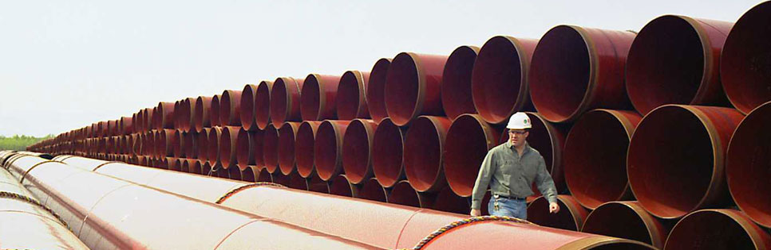
WHY DO PIPELINES EXIST?
Energy Highways: like roads and highways, Canada’s transmission pipelines form a major transportation network.
More than 100,000 km of underground pipeline transport the majority of Canada’s daily crude and natural gas production.

Slide 4
PIPELINE COMPANIES’ ROLE
In the role of gathering, transportation, processing, fractionation, storage and marketing services to the oil and gas industry.
Generally not engaged in exploration and production.
Earn fees for their service without taking ownership of the actual commodity

Slide 5
INDUSTRIAL OVERVIEW
94%
Transportation demand Supplied by refined petroleum products
97%
Canadian natural gas and crude oil production transported by transmission pipelines
$81.7 billion
Canadian crude oil and natural gas exports in 2013, most of which was transported by pipeline
3 million barrels of crude oil
Transported each day by pipeline in Canada

Slide 6
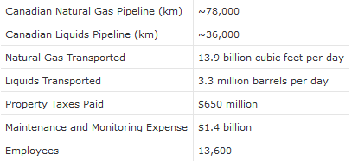
CANADIAN PIPELINE INDUSTRY

Slide 7
INDUSTRIAL NEWS
In 2013, Canadian oil pipeline companies reported total operating revenues of $5.2 billion, up 1.2% from 2012, while total operating expenses rose 7.7% to $2.4 billion. As a result, total net income after taxes decreased 1.0% to $1.7 billion.
The majority of total assets consisted of fixed assets, which were up 20.2% from 2012 to $31.8 billion, and total investments, which were up 40.1% to $10.2 billion. The remaining assets consisted of current assets (up 19.5% to $3.8 billion) and deferred debits (up 3.8% to $1.7 billion). Overall, total assets rose 24.8% from 2012 to $47.5 billion.
Total liabilities consisted of long term debt (up 54.1% to $14.4 billion), capital stocks (up 13.8% to $22.1 billion) and current liabilities (up 29.3% to $10.4 billion). The remaining liabilities of $0.6 billion consisted of deferred credit and appropriations, which decreased 49.6% from the previous year. Overall, total liabilities rose 24.8% from 2012 to $47.5 billion.
The market did not suffer severely during the economic downturn, as the main customers were enterprises related to the oil and gas industry.

Slide 8
IMPORTANT FACT
97% of companies are small and micro-sized (employing fewer than 100 people), 3% of industry players generate 55% of total revenue. The companies are also concentrated around the major gas and oil basins in Canada, in the regions of Alberta, Saskatchewan and Ontario.

Slide 9
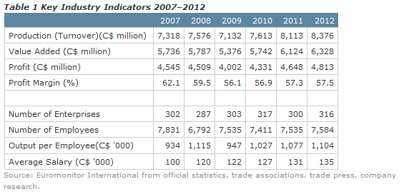
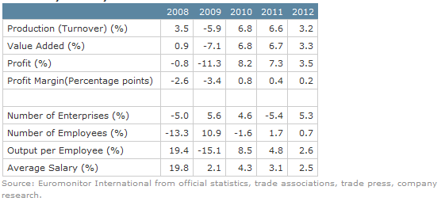
INDUSTRY PERFORMANCE
Industry is growing steadily in terms of turnover and size.
Profit margin has decreased

Slide 10
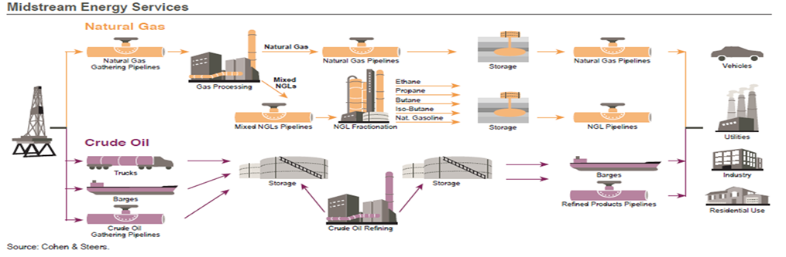
INDUSTRY STRUCTURE
Upstream | Midstream | Downstream
Exploration and Production | Transportation and Gathering | Refining and Retailing

Slide 11
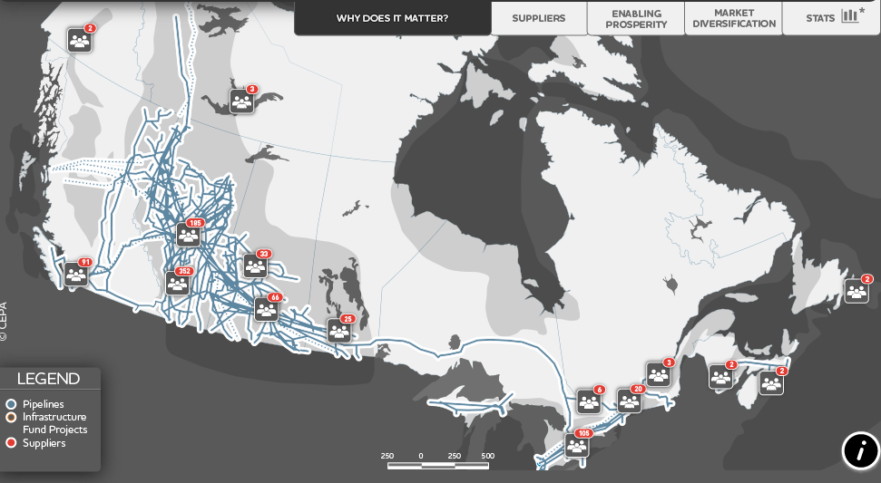
CANADIAN PIPELINE MAP

Slide 12
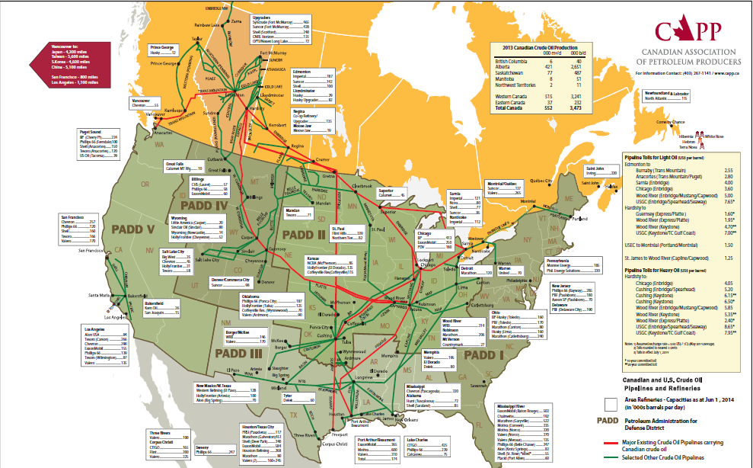
CANADIAN NORTH AMERICAN PIPELINE MAP

Slide 13
TYPES OF PIPELINES
Liquids Pipelines
Crude Oil, Liquefied Natural Gas
Refined petroleum products
Natural Gas Pipelines
Directly to households/Businesses
Ethane, Methane, Propane etc.
Small diameter

Slide 14
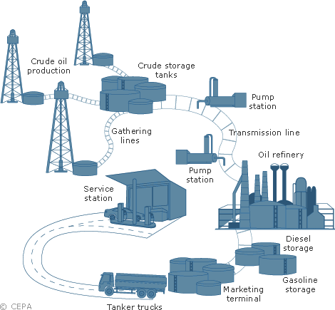
LIQUID FUEL DELIVERY NETWORK
Field → Refinery → Distribution
Extract → Transfer (Pump
& Transmission Line)
→ Breakdown

Slide 15
FRACTIONATION
Essential process in distillation of liquid mixtures.
Separate the mixture into its component parts or fractions based on the differences in volatilities.
Commonly utilized to recover the natural gas liquids (NGL)
Recovered NGL is processed through a fractionation train consisting of three distillation towers in series: deethanizer, depropanizer, and debutanizer.
Purified gas is then pipelined to the end user market.

Slide 16
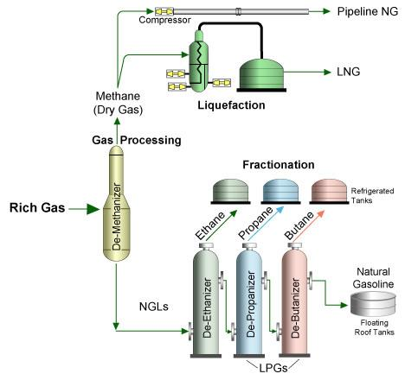
FRACTIONATION PROCESS

Slide 17
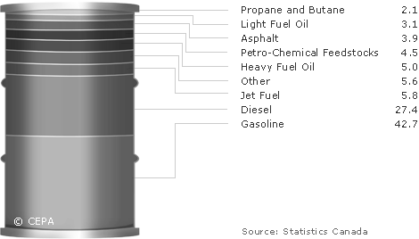
LIQUID FUEL REFINING

Slide 18
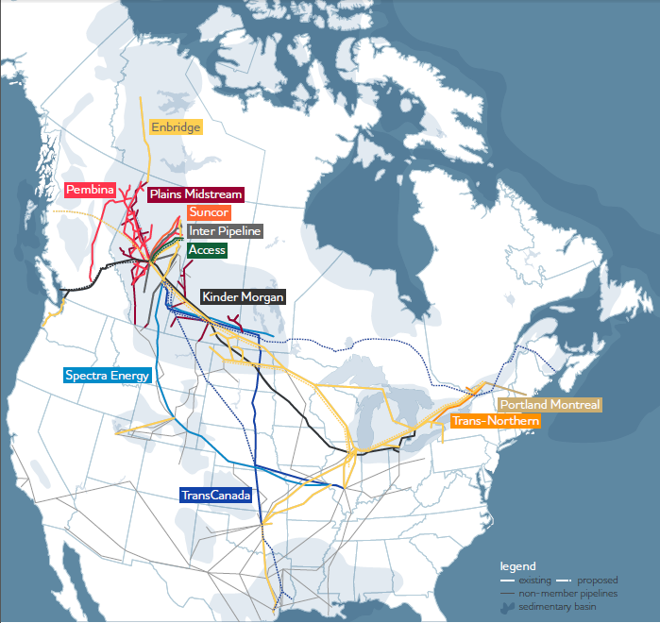
CANADIAN LIQUID PIPELINE MAP

Slide 19
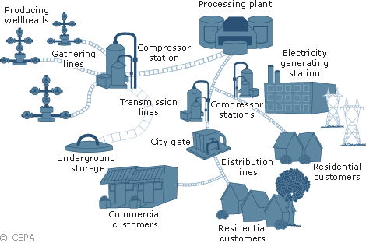
NATURAL GAS DELIVERY WORK
Extract → filter → compressed → transfer (pressure) → Depressurize

Slide 20
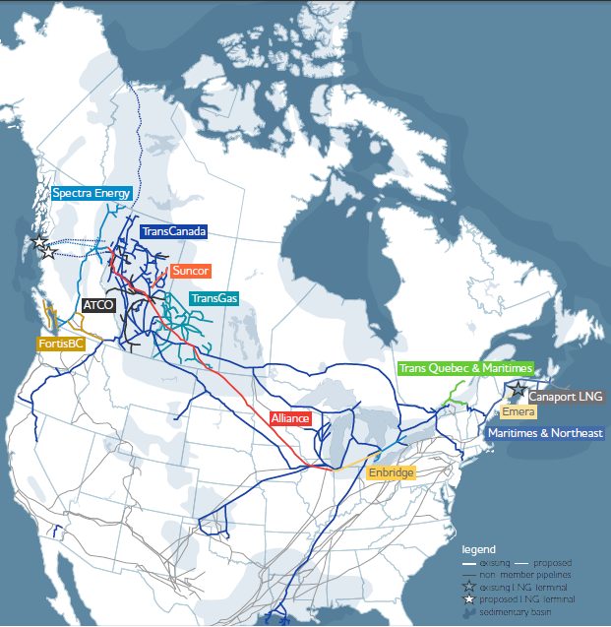
CANADIAN NATURAL GAS PIPELINE MAP

Slide 21
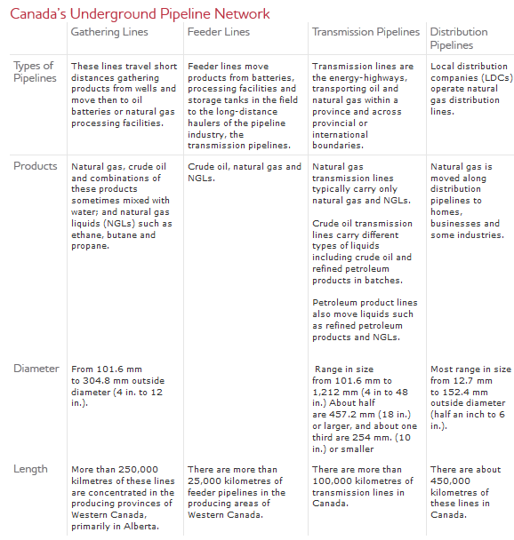
TYPES OF PIPELINE - OVERALL

Slide 22
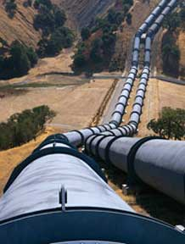
PIPELINE SYSTEMS
Gathering system
Most gathering systems located in the west of Canada
The trunk pipelines
Mostly locate near population center in the East of Canada
Distribution system
Equally divided between eastern and western Canada

Slide 23
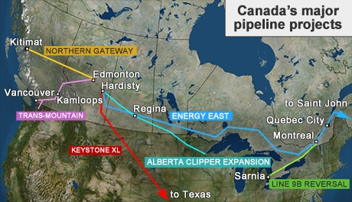
PROPOSED CANADIAN PIPELINE
6 of 14 proposed projects
Enbridge’s Northern Gateway to the B.C. coast.
Enbridge’s Alberta Clipper Expansion to the U.S.
Enbridge’s Line 9B Reversal in Ontario.
Kinder-Morgan’s Trans Mountain doubled line from Alberta to B.C.
TransCanada’s Keystone XL to the U.S. Gulf Coast.
TransCanada Energy East to Eastern Canada.

Slide 24

PIPELINE – HOW?
Pre-Construction
Surveying and staking
Preparing the right-of-way
Digging the trench
Stringing the pipe
Construction
Bending and joining the pipe
Coating the pipeline
Positioning the pipeline
Installing valves and fittings
Backfilling the trench
Post Construction
Pressure Testing
Final clean-up

Slide 25

PIPELINE ASPECTS
Determination of physical aspects
Distance
Expected volumes
Type and range of products
External Factors
Environmental sensitive areas
Proximity to communities
Climate
Geology

Slide 26

ALTERNATIVES FOR TRANSPORTING FUEL
Trucks
Good for short distance
Small Loads
Cargo Ships
Across Continents
Risky
Trains

Slide 27
CRUDE OIL BY RAIL
The absence of adequate capacity in Western Canada, rail transport is expected to continue to rise due to the protracted regulatory processes for new pipelines and other uncertainties.
There can be long-term viability with this mode of transportation as there are also a number of benefits associated with this mode of transportation.

Slide 28
BENEFITS OF RAIL TRANSPORTATION
Speed to market: Unit train averages 28km/hr. Getting oil to the refinery quickly means producers are paid sooner and refiners receive feedstock sooner.
Optionality/Flexibility: Already existing rail tracks in place to reach East Coast, West Coast, Gulf Coast markets in the U.S.
Diluent: Less or no diluent is required when transporting bitumen in rail tank cars, representing a significant cost savings in diluent costs.

Slide 29
BENEFITS OF RAIL TRANSPORTATION
Scalability: Producers have the flexibility to adjust the volumes being shipped with manifest trains. Manifest trains are individual cars of small groups of cars . New loop tracks uploading facilities are being standardized and are typically built to accommodate 120 cars.
Product integrity: Commodity isolation in separate rail tank cars results in no loss at quality at destination. The crude oil loaded is not mixed with other grades of crude during transportation
Low capital requirement: Typical costs to build unit train terminals ranges between $30 million- $50 million with a capital payout of 5 years or less.

Slide 30
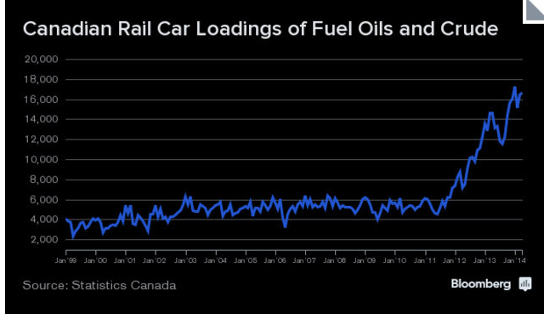

Slide 31
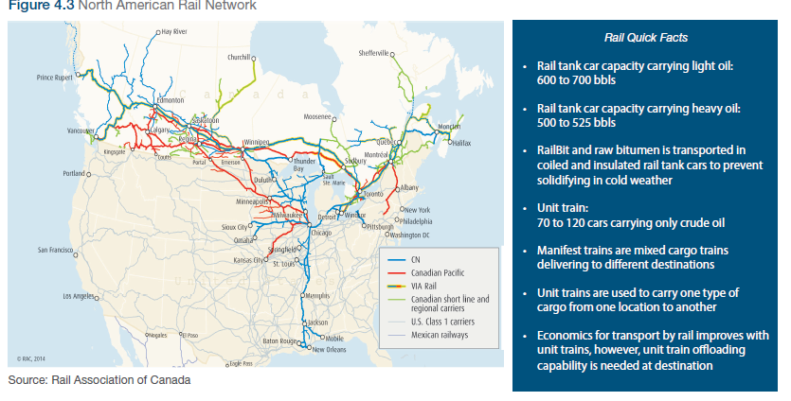

Slide 32
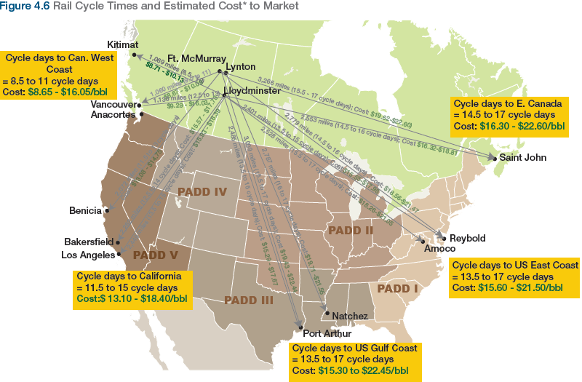
Pipeline cost: price ranges from $7-$10 per barrel.

Slide 33
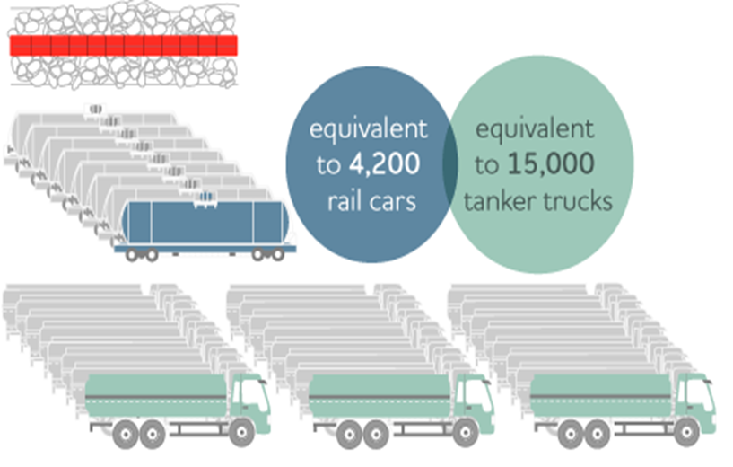
ADVANTAGES OF PIPELINES
Safe
Efficient
Low Pollution
Low Variable Cost
Mass Transporting
Large Scale

Slide 34
DISADVANTAGES OF PIPELINES
High Initial Cost
Possible Environmental Unfriendly
Strongly Regulated by the Government and Other Green Organizations
Low Flexibility

Slide 35
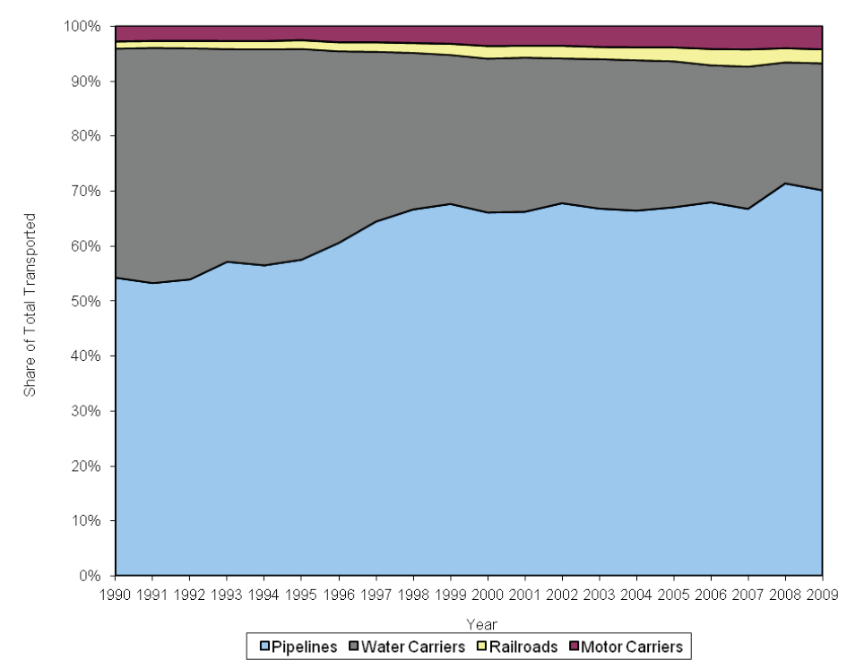
PIPELINES VS. OTHERS

Slide 36


REGULATORS AND LEGISLATION
Canada: National Energy Board (NEB)
USA: Federal Energy Regulatory Commission (FERC)
Pipeline and Hazardous Materials Safety Administration (PHMSA)

Slide 37



PIPELINE ORGANIZATIONS
Canadian Energy Pipeline Association (CEPA)
Canadian Association of Petroleum Producers (CAPP)
Association of Oil Pipe Lines (AOPL)

Slide 38
CANADIAN ENERGY PIPELINE ASSOCIATION (CEPA)
Non-profit Organization
Represents Canada’s pipeline companies operating more than 130,000 km of pipeline in Canada and the United States.
1.2 billion barrels and 5.1 trillion cubic feet of natural gas each year
Transport 97 % of Canada’s daily oil and gas

Slide 39
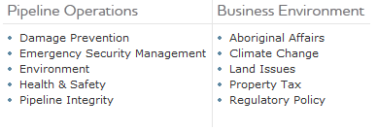
CEPA’S VISION

Slide 40
INDUSTRY OUTLOOK
According to the NEB's, additional capacity is soon needed to accommodate growing supply and provide greater market flexibility.
Proposed pipelines and expansion are increasing
Development of new pipelines is critical to open new markets for Canadian oil and gas
New energy supply needs to be connected to existing pipeline system
The industry must continue to make huge investment in pipelines to provide cost competitive infrastructure

Slide 41
MARKET ACCESS
For the Canadian pipeline industry to continue to strive, it needs access to new and existing markets
Canada is the number one supplier of oil and natural gas to the U.S. and must remain so
Canada is the ideal energy partner for the U.S:
business friendly, politically stable and has abundant source of energy
strong, transparent regulation
CEPA members safety track records is second to none
Access to Asian pacific market is a key strategic outlet

Slide 42
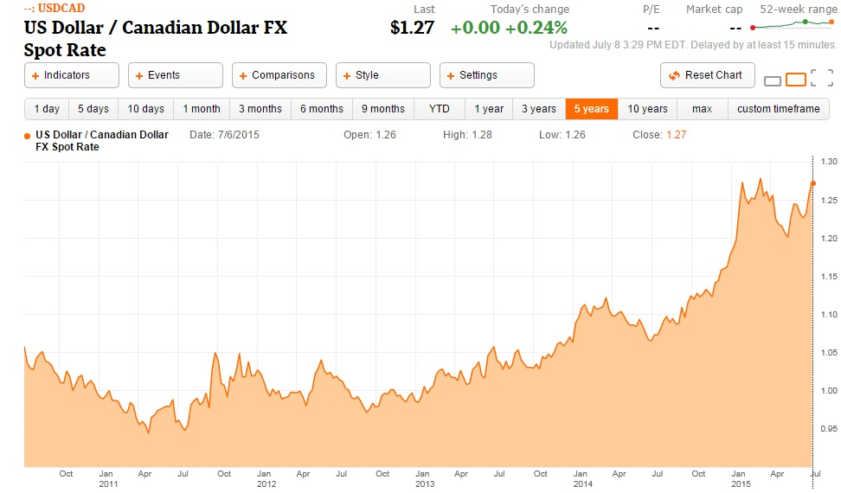
US DOLLAR / CANADIAN DOLLAR, 5 YEARS

Slide 43
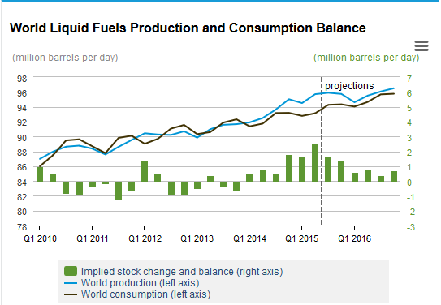
GLOBAL LIQUID FUELS PRODUCTION AND CONSUMPTION

Slide 44
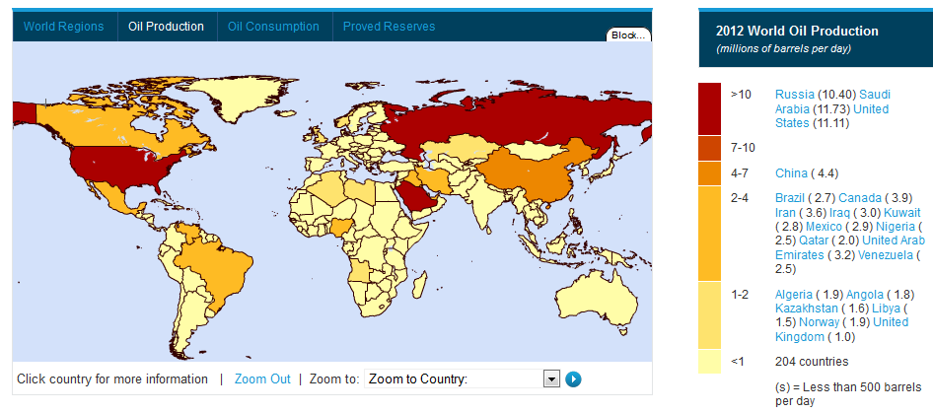
WORLD OIL PRODUCTION BY REGION

Slide 45
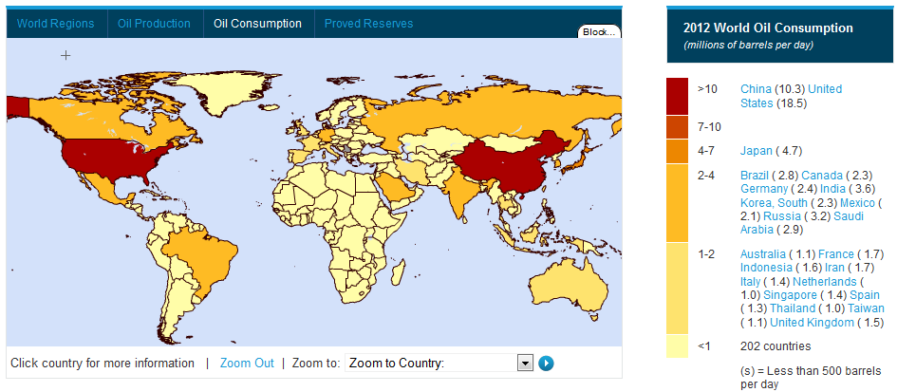
WORLD OIL CONSUMPTION BY REGION

Slide 46
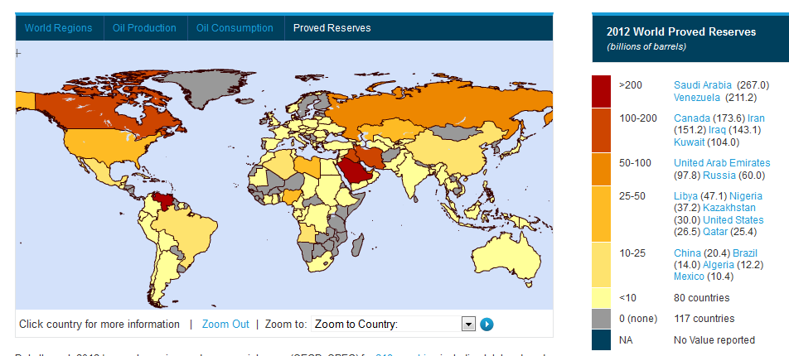
WORLD OIL RESERVE BY REGION

Slide 47
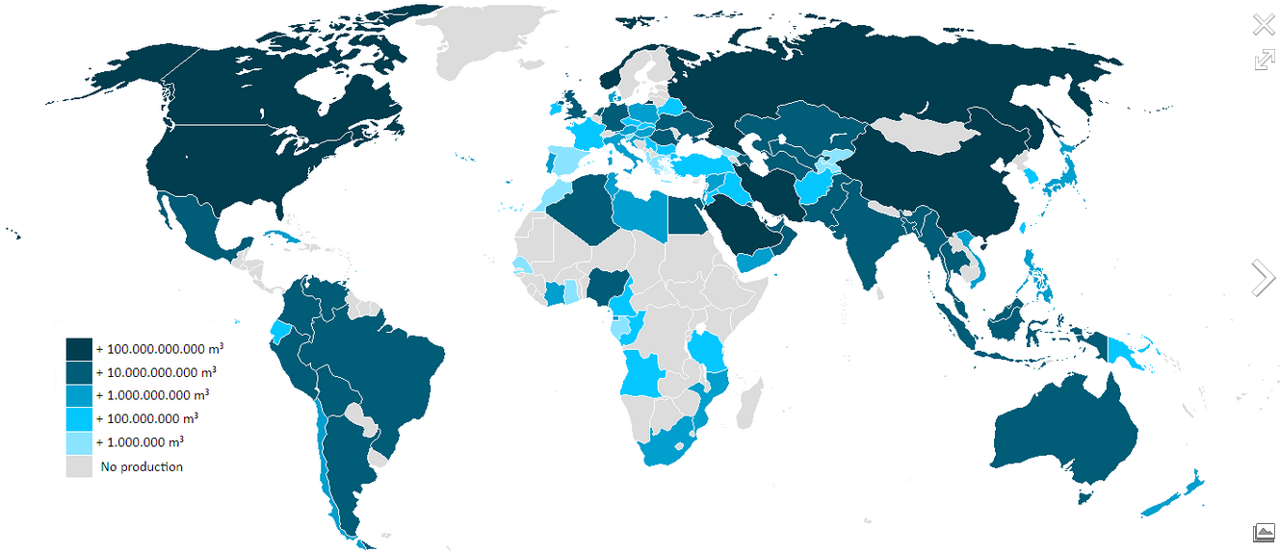
WORLD NATURAL GAS PRODUCTION BY REGION

Slide 48
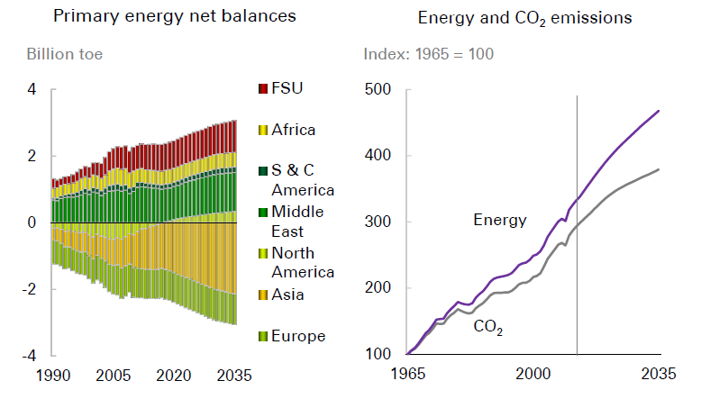
ENERGY NET BALANCES

Slide 49
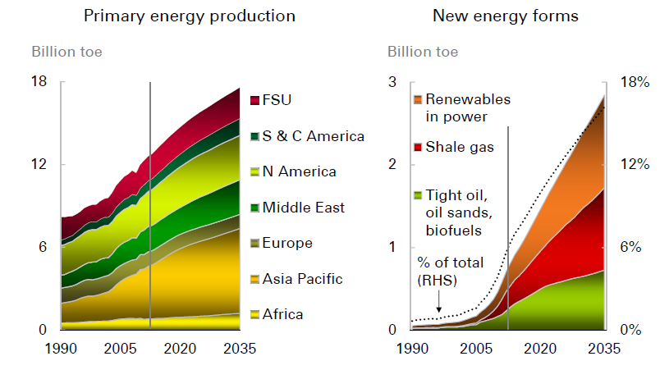
FUTURE ENERGY TRENDS

Slide 50
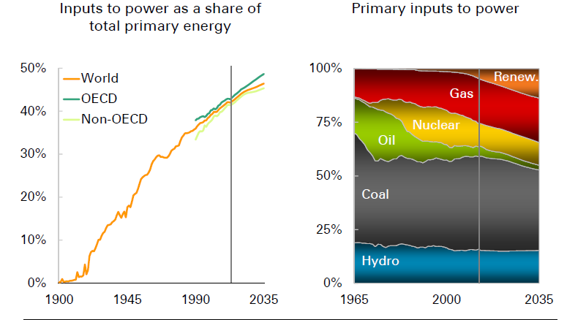
THE COMING TREND: RENEWABLE ENERGY IS DEFINITELY A BIG THREAT
The Coming Trend: Renewable Energy is Definitely a Big Threat

Slide 51
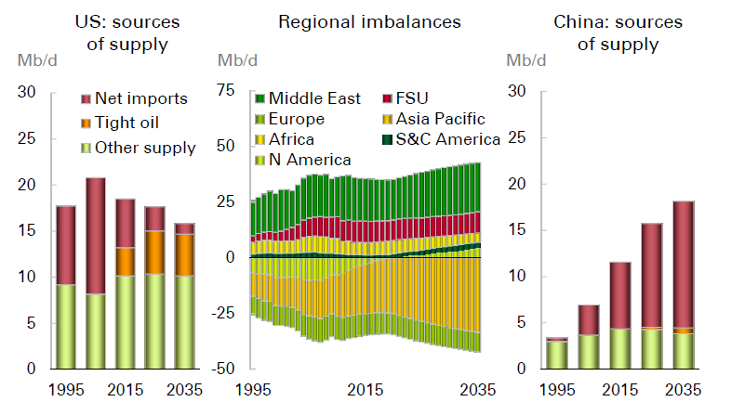
THE COMING OIL TREND: CHINA DEMANDS MORE

Slide 52
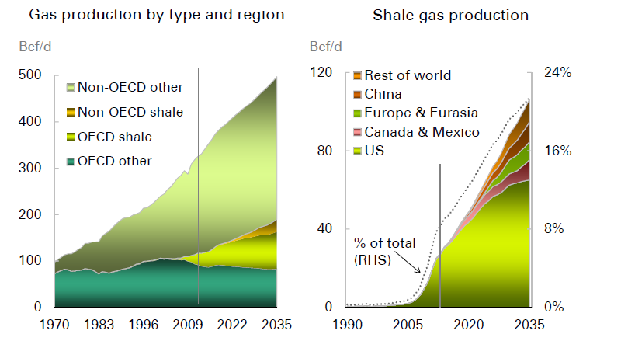
GAS PRODUCTION BY TYPE AND REGION

Slide 53
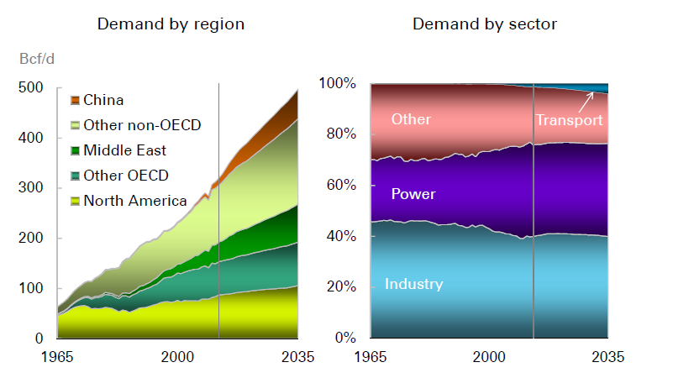
GAS DEMAND BY REGION AND SECTOR

Slide 54
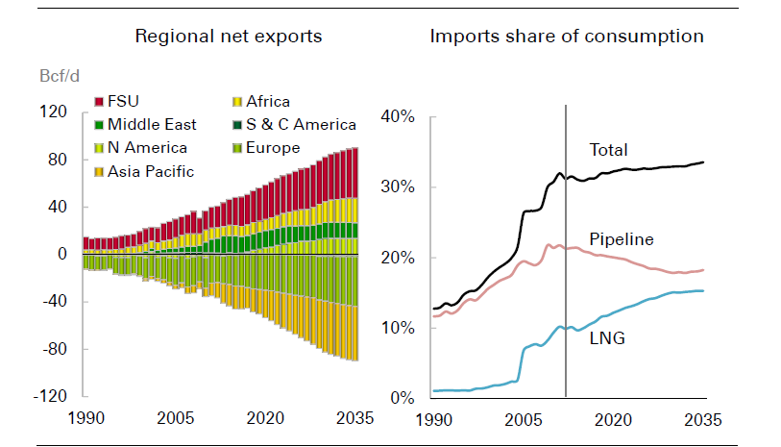
NET GAS EXPORT

Slide 55
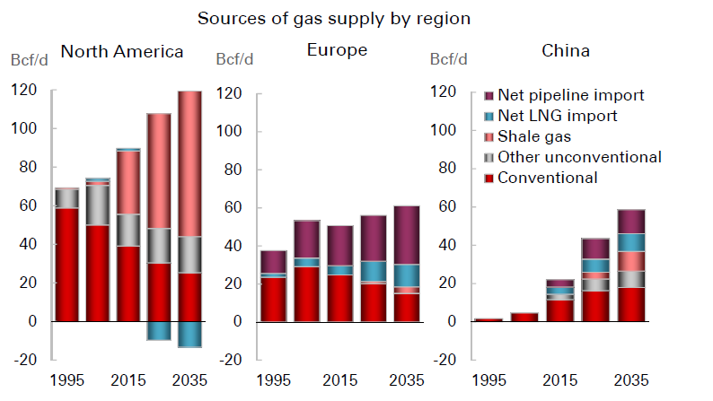
SOURCES OF GAS BY REGION

Slide 56

POTENTIAL BENEFITS OF INVESTING IN ENERGY INFRASTRUCTURE COMPANIES
Growth and Income
Stable Cash Flows
Inflation Hedge (growing distributions faster than inflation)
Tax Advantaged Yields

Slide 57
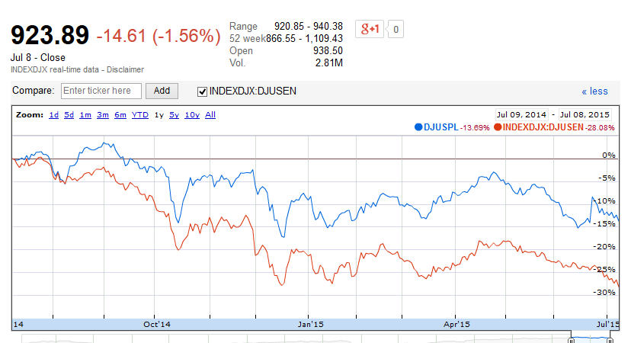
DOW JONES U.S. PIPELINE INDEX VS DOW JOINES OIL & GAS INDEX (1YR)

Slide 58
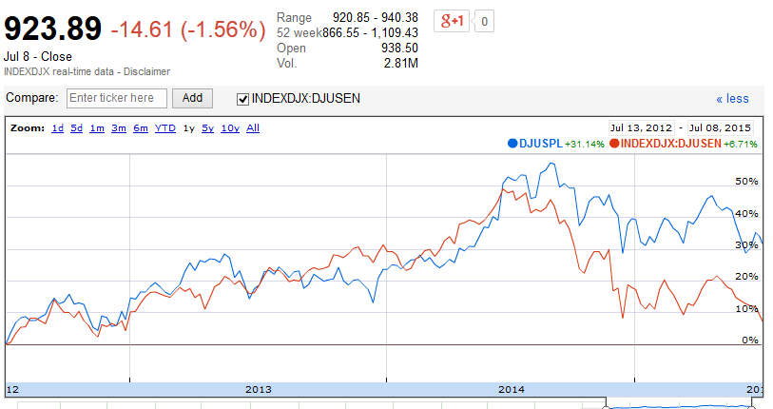
DOW JONES U.S. PIPELINE INDEX VS DOW JOINES OIL & GAS INDEX (3YR)

Slide 59
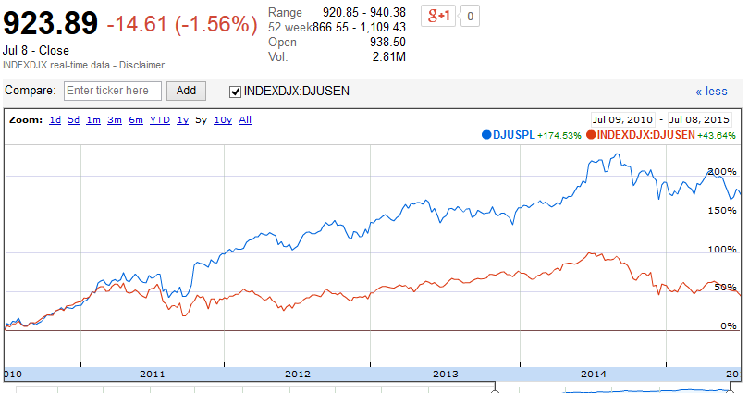
DOW JONES U.S. PIPELINE INDEX VS DOW JOINES OIL & GAS INDEX (5YR)

Slide 60
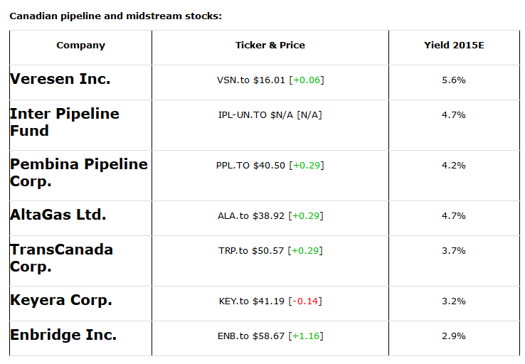
MAJOR STOCK PERFORMANCE OVERVIEW

Slide 61
SPECIFIC BUSINESS RISK FACTORS
Supply/Demand
Strongly depends on the lease's technology and remaining supply
Seasonality
Counterparty risk
Capital Intensity
Cost overruns and weak financial metric during growth stage
Large multi-year growth project vs. smaller shorter construction periods
Huge Investment

Slide 62
SPECIFIC BUSINESS RISK FACTORS
Competitive Environment
Alternative energy sources (Renewable)
Global competition
Regulator/Contractual
Jurisdiction
Allowed ROE and capital structure defined by regulatory bodies
Long-term contracts
Flexibility of regulatory framework
Social Responsibilities
Environment
Politics
Others (Exchange Rate, Warfare etc.)

Slide 63


Slide 64
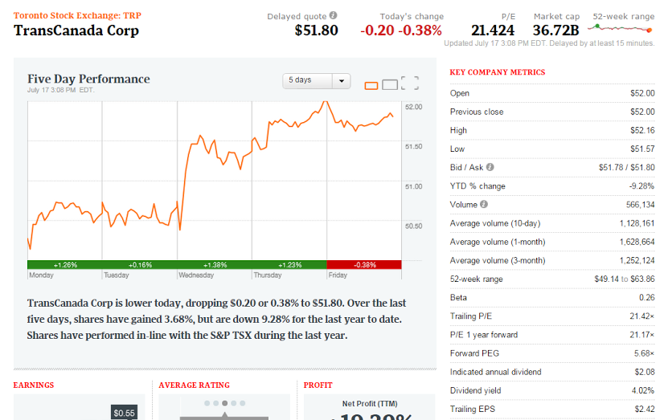
TRP – 5 DAY

Slide 65
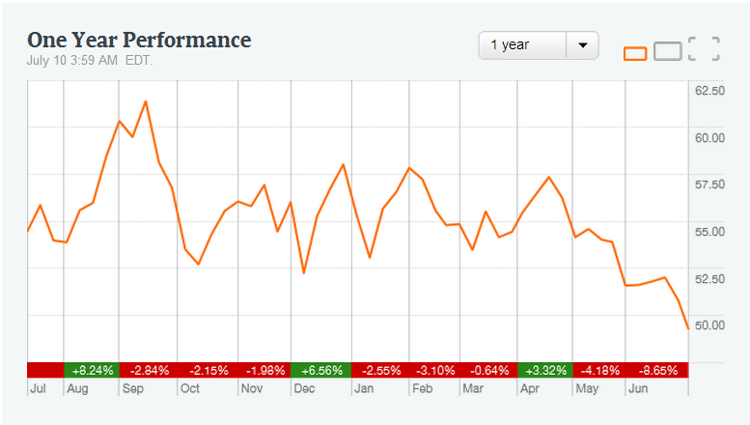
TRP – 1 YEAR

Slide 66
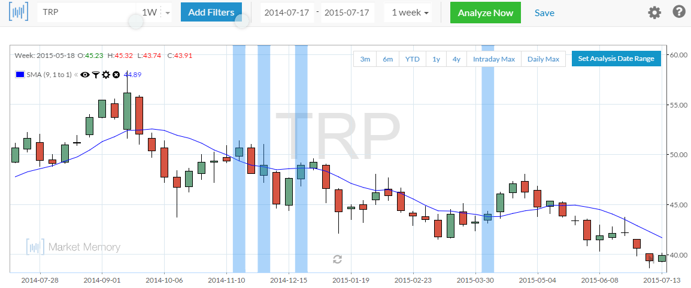
TRP – 1 YEAR (MOVING AVERAGE)

Slide 67
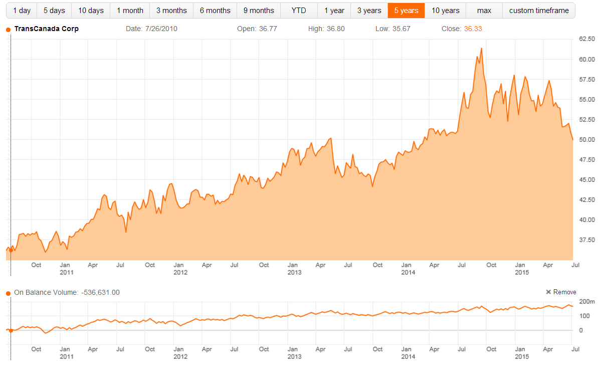
TRP – 5 YEAR

Slide 68
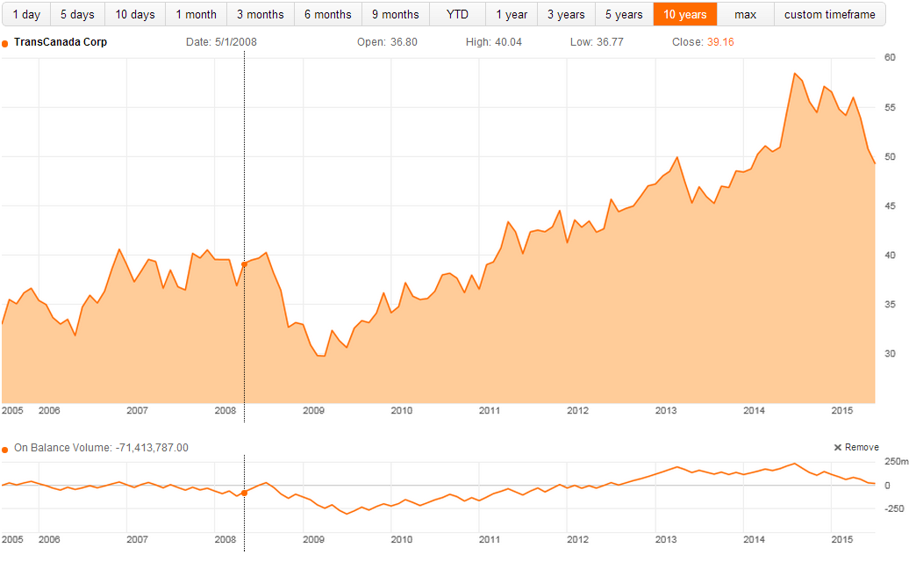
TRP – 10 YEAR

Slide 69
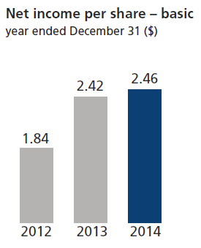
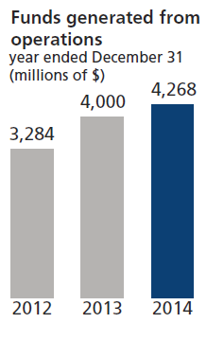
FINANCIAL HIGHLIGHTS

Slide 70
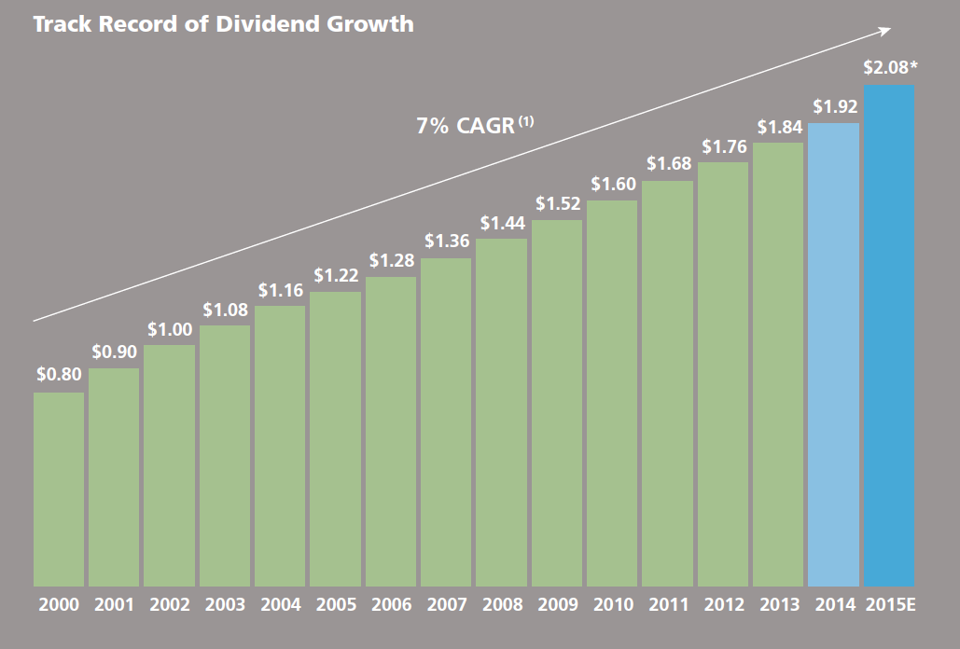
DIVIDENDS PER COMMON SHARE

Slide 71
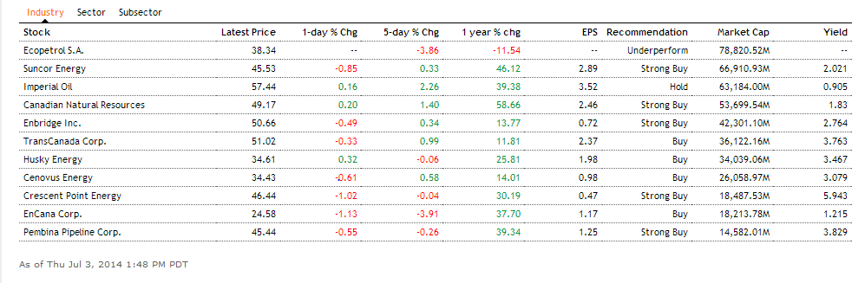
INDUSTRY COMPETITORS

Slide 72
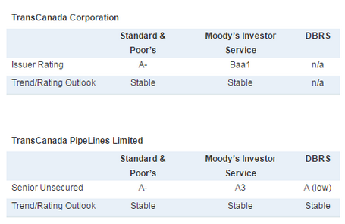
CREDIT RATING

Slide 73
COMPANY OVERVIEW

Slide 74
COMPANY HISTORY
Headquarters in Calgary, Alberta.
TransCanada began operations in 1958.
Organized into two segments: Pipelines and Energy
Operates in Canada, the United States and Mexico.
More than 6,000 employees in three countries (seven provinces, 31 states, 2 locations in Mexico).
Almost 250 locations across the continent.
Hiring 500 new employees per year (excluding people who join through acquisitions).

Slide 75

KEY PROJECTS

Slide 76

UNPRECEDENTED GROWTH

Slide 77

$36 BILLION CAPITAL PROGRAM

Slide 78

TRP – NOVA Merger (July 1998)
TransCanada became the major transporter of Canadian natural gas.
Natural Gas Pipelines Acquired:
Canadian Mainline (1958)
Great Lakes (1968–partially owned)
TQM (1980–partially owned)
Northern Border (1982–partially owned)
Iroquois (1992–partially owned)
Tuscarora (1993–partially owned)
Alberta System (1998)
Foothills (1998–partially owned)
Alaska Pipeline Project (proposed)
Mackenzie Gas Pipeline Project (proposed by producers)

Slide 79

ACQUISITIONS & NEW PROJECTS (2004)
2004 acquisitions
5,700 MW of power generation owned, controlled, or in development.
Natural Gas Pipelines:
Portland (1999–partially owned)
GTN (2004)
North Baja (2004)

Slide 80

ANR PIPELINE ACQUISITION (2007)
Acquired 17,000 km of pipeline.
Became one of the largest gas storage providers on the continent.
Business no longer just focused in Alberta.
Natural Gas Pipelines:
Tamazunchale (2006)
ANR (2007)

Slide 81

KEYSTONE PIPELINE (2010)
Built one of the largest oil delivery systems in North America.
Oil from Alberta reaches refineries in Illinois.
Natural Gas Pipelines:
Guadalajara (under construction)
Bison (under construction)
Groundbirch (under construction)
Horn River (in development)
Oil Pipelines
Keystone Pipeline Project (2010)
Keystone Extension (under construction)
Keystone Expansion (proposed project)

Slide 82

KEYSTONE XL
Permitting process delayed once again
U.S. Department of State said more time needed to gather federal agency input, process public comments and understand Nebraska legal issues
Delay ‘inexplicable’
Majority of Americans want Keystone XL – bipartisan congressional support
State Department review once again found KXL would have limited environmental impact
Believe facts will prevail and expect to eventually receive a Presidential Permit

Slide 83

GULF COAST PROJECT & KEYSTONE XL

Slide 84




Slide 85

OPINION SURVEY

Slide 86


Slide 87

ENERGY EAST PIPELINE PROJECT
$12 billion investment
1.1 million bbl/d capacity
900,000 bbl/d contracted
Regulatory filing mid 2014
Anticipated in-service 2018
Benefits
10,000 direct jobs
$35 billion GDP
$10 billion in tax revenues

Slide 88


Slide 89

ONTARIO SOLAR PROJECT
Agreed to buy nine Ontario solar projects from Canadian Solar Solutions for approximately $500 million
Acquired four facilities in 2013
Expect to acquire four more facilities in fourth quarter 2014. The deal to purchase the final facility should close in mid-2015
Combined capacity of 86 megawatts is sold under 20-year PPA with the Ontario Power Authority

Slide 90


Slide 91

ASSET OUTLOOK

Slide 92

EBITDA OUTLOOK

Slide 93
MANAGEMENT TEAM

Slide 94

Russell K. Girling President and Chief Executive Officer
President CEO since July 1, 2010.
Worked at Suncor Inc., Northridge Petroleum Marketing and Dome Petroleum.
Joined TransCanada in 1994.
1995 - 1999: Executive Vice-President, TransCanada Power.
CFO and Executive Vice-President, Corporate Development of TransCanada until May 31, 2006.
President, Pipelines from June 1, 2006 until June 30, 2010. COO from July 17, 2009 to June 30, 2010.
Bachelor of Commerce degree and a Master of Business Administration in Finance from the University of Calgary.

Slide 95

Alexander J. Pourbaix President, Energy and Oil Pipelines
Responsible for TransCanada Corporation’s non-regulated businesses, including power and non-regulated gas storage, and the oil pipeline business.
Prior to his current appointment, worked as President, Energy and Executive Vice-President, Corporate Development. Was responsible for non-regulated businesses, as well as acquisitions, divestments and execution of major transactions in both Energy and Pipelines.
Holds a Bachelor of Arts, with distinction, and a Bachelor of Law from the University of Alberta.

Slide 96

James (Jim) M. Baggs Executive Vice-President, Operations and Engineering
TransCanada in 1989. Mr. Baggs has held various senior leadership positions
Mr. Baggs is a Director for TransCanada Turbines Ltd.
He is also a standing member of TransCanada’s Health, Safety and Environment Committee for the Board of Directors.
Mr. Baggs is a graduate of both the Institute of Corporate Directors (ICD.D) and Ivy Executive Management Program.
He is a Registered Engineering Technologist in Industrial Electronics, holds an Interprovincial Red Seal as a Journeyman Electrician, and is a member of the Alberta Society of Engineering Technologists.

Slide 97

Donald R. Marchand Executive Vice-President and Chief Financial Officer
Joined the company in 1994.
Appointed Vice-President, Finance and Treasurer in September 1999, before becoming CFO.
Worked at Trizec Corporation Ltd. , and at Clarkson Gordon (a predecessor firm to Ernst & Young).
Member of the Calgary Society of Financial Analysts and the Institute of Chartered Accountants of Alberta.
Holds a Bachelor of Commerce degree with honours from the University of Manitoba. Earned his Chartered Accountant designation in 1988 and became a Chartered Financial Analyst in 1994.

Slide 98
FINANCIAL PERFORMANCE

Slide 99

STATEMENT OF FINANCIAL POSITION

Slide 100

INCOME STATEMENT

Slide 101


Slide 102


Slide 103

EBITDA - ENERGY

Slide 104

EBITDA - GAS

Slide 105

EBITDA - LIQUID

Slide 106

STATEMENT OF CASH FLOWS

Slide 107

RECOMMENDATION

Slide 108


Slide 109




Slide 110

IPL – 1 YEAR

Slide 111

IPL – 5 YEAR

Slide 112

IPL – 10 YEAR

Slide 113


Slide 114

PERFORMANCE OVERVIEW

Slide 115
COMPANY OVERVIEW

Slide 116
COMPANY HISTORY
Created in 1997
Major in petroleum transportation, storage and natural gas liquids (NGL) extraction business in Calgary
Operates diversified energy infrastructure assets in Western Canada, the United Kingdom, Germany, Ireland, and Denmark
Koch Pipelines Canada LP is Inter Pipeline’s predecessor

Slide 117

AREAS OF OPERATION

Slide 118

AREAS OF OPERATION

Slide 119
BUSINESS TYPE
Publicly traded limited partnership under the laws of the Province of Alberta on October 9, 1997
But what is limited partnership?
Limited partner: has a share of ownership but who takes NO part in managing the partnership
: NOT liable for any amount greater than their
original investment in the partnership
General partner: takes part in the daily operations of the partnership
: personally responsible for the liabilities of the
partnership

Slide 120
CLASSIFICATION OF PARTNERSHIP
Class A - Public Unitholders
- Limited liability partnership
- 99.9% partnership interest
- “Distribution Reinvestment Plan”
Additional Units at a discounted subscription price equal to 95% of the Average Market Price
- “Premium Distribution™ Plan”
A premium cash payment equal to 102% of the amount of the cash distribution payable
Class B - Pipeline Management Inc. (General partner of Inter Pipeline)
- Unlimited liability partnership
- 0.1% partnership interest

Slide 121

COMPANY STRUCTURE

Slide 122
BUSINESS STRATEGY
Acquire and develop long-life, high-quality energy infrastructure assets that generate sustainable and predictable cash flow
Support stable and increasing returns to unitholders

Slide 123

CURRENT BUSINESS OPERATIONS

Slide 124

CASH FLOW BY BUSINESS SEGMENT

Slide 125

OIL SANDS TRANSPORTATION

Slide 126
OIL SANDS TRANSPORTATION

Slide 127


OIL SANDS TRANSPORTATION

Slide 128

RESULTS FROM OPERATIONS

Slide 129

CONVENTIONAL OIL PIPELINES

Slide 130

CONVENTIONAL OIL PIPELINES

Slide 131


CONVENTIONAL OIL PIPELINES

Slide 132

RESULTS FROM OPERATIONS

Slide 133

NGL EXTRACTION

Slide 134


NGL EXTRACTION

Slide 135

RESULTS FROM OPERATIONS

Slide 136

BULK LIQUID STORAGE

Slide 137

BULK LIQUID STORAGE

Slide 138

FINANCIAL AND OPERATING HIGHLIGHTS

Slide 139

FINANCIAL AND OPERATING HIGHLIGHTS

Slide 140
ENVIRONMENT, HEALTH, & SAFETY
Aims:
Protect the health and safety of employees, contractors, the public and the environment
Comply with laws, regulations, industry standards and stakeholder expectations
How?
Proactively identify hazards, assess priorities, and implement programs and practices

Slide 141
MANAGEMENT TEAM

Slide 142

RICHARD SHAW
Title: Independent Director and Chairman of the Board
Appointment Date: January 1, 2014
Past Experience:
Senior Partner in the Business Law Group of McCarthy Tetreault LLP
Director on the National Board of the Institute of Corporate Directors
Chair of the National Board of the Institute of Corporate Directors (Calgary Chapter)
lecturer in the Director Education Program at the Haskayne School of Business at the University of Calgary
Chair of the Board of Governors of Mount Royal University
Governor of the Glenbow Museum

Slide 143

DAVID W. FESYK
Director, President & CEO
Appointment Date: November, 1997
Past Experience:
Vice President, Transportation, Koch Petroleum Canada
President, Koch Canada Ltd.
President & CEO, Koch Pipelines Canada Ltd.
Director of South Saskatchewan Pipeline Company
Qualifications:
Bachelor of Science degree from Arizona State University
Master of Business Administration degree from the University of Calgary

Slide 144

CHRISTIAN P. BAYLE
Chief Operating Officer
Appointment Date: March, 2011
Past Experience:
Joined Koch Pipelines Canada LP in 1997
Vice President, Operations, in January 2002
Vice President, Corporate Development, in March 2005
Senior Vice President, Corporate Development in December 2008
Engineer, Sherritt International Corporation
Qualifications:
Bachelor of Mechanical Engineering from the University of Alberta
Masters in Engineering Management from the University of Alberta

Slide 145
FINANCIAL PERFORMANCE

Slide 146


Slide 147


Slide 148


Slide 149

INCOME STATEMENT

Slide 150


Slide 151


STATEMENT OF FINANCIAL POSITION

Slide 152

RECOMMENDATION

Slide 153


Slide 154


PPL – 5 DAY

Slide 155

PPL – 1 YEAR

Slide 156

PPL – 1 YEAR MOVING AVERAGE (100 DAYS)

Slide 157

PPL – 5 YEAR

Slide 158

PPL – MAX

Slide 159


COMMON SHARES

Slide 160
DIVIDEND HISTORY
Total 2010 Dividends: $0.39
Total 2011 Dividends: $1.56
Total 2012 Dividends: $1.605
Total 2013 Dividends: $1.645

Slide 161

EARNINGS PER SHARE

Slide 162
COMPANY OVERVIEW

Slide 163
PEMBINA’S STRATEGY
Preserve value by providing safe, responsible, cost-effective and reliable services;
Diversify the Company's asset base along the hydrocarbon value chain by providing integrated service offerings which enhance profitability
Pursue projects or assets that are expected to generate increased cash flow per share and capture long-life, economic hydrocarbon reserves; and
Maintain a strong balance sheet through the application of prudent financial management to all business decisions

Slide 164
COMPANY HISTORY
Founded as energy industry at 1954
Headquarters located at Calgary, Canada
Leading transportation and midstream service provider that has been serving North America's energy industry for 60 years.
Transports conventional and synthetic crude oil and natural gas liquids produced in western Canada; oil sands and heavy oil pipelines; gas gathering and processing facilities
Oil and natural gas liquids infrastructure and logistics business
Joined TSX in 1997

Slide 165
BENEFITS OF ACQUISITION
Scale and Scope
Complete Value Chain
Key Growth Areas
Expanded Footprint
Strong Leadership Team
Substantial Growth Opportunities
Strong Synergies
Superior Financial Platform

Slide 166
CURRENT BUSINESS OPERATIONS
1) Conventional Pipelines
2) Oil Sands & Heavy Oil
3) Midstream
4) Gas Services

Slide 167

CURRENT BUSINESS OPERATIONS

Slide 168


CONVENTIONAL PIPELINES

Slide 169
CONVENTIONAL PIPELINES
Pembina’s original line of business, started in 1954
8840km pipeline network that transports hydrocarbon products and extends across much of Alberta and parts of B.C.

Slide 170
CONVENTIONAL PIPELINES
As of September 2014, Pembina is planning an expansion between Fox Creek and Namao
10% of this phase III expansion has been completed on schedule and on budget
Planned increase in spending of $440 million
Pembina is continuing work on the previously announced $220 million expansion to its pipeline infrastructure in northeast B.C. (the "NEBC Expansion").
Expected on stream in late 2017

Slide 171


OIL SANDS & HEAVY OIL

Slide 172
OIL SANDS & HEAVY OIL
Pembina is the sole transporter of crude oils for Syncrude Canada Ltd. and the Horizon Oil Sands operation of Canada Natural Resources Ltd.
Operates 1650km of pipeline and has 880mbpd of capacity under extendible, long-term contracts
First quarter revenue in 2015 was approximately 6 percent higher than the prior period due to additional flow-through operating expenses, which were primarily related to integrity work and which were recovered under Pembina's contractual arrangements with its customers

Slide 173


Midstream

Slide 174
Midstream
Pembina offers customers a comprehensive suite of midstream products and services through its Midstream business
Crude oil midstream assets include 17 truck terminals and terminalling at downstream hub locations at the Pembina Nexus Terminal ("PNT"), which features storage, crude-oil-by-rail services and terminal connectivity.
NGL midstream includes two NGL operating systems
The Redwater West NGL system
The Empress East NGL system

Slide 175
Midstream
The decrease in net revenue was primarily due to significantly lower commodity prices and tighter price differentials across all commodities during the first quarter of 2015, combined with the sale of the Company's noncore trucking-related subsidiary in the second quarter of 2014.
Decrease in operating margin was largely due to the factors which impacted net revenue, particularly lower crude oil prices and narrower differentials, somewhat offset by a realized gain on commodity related derivative financial instruments during the first quarter of 2015

Slide 176


Gas Services

Slide 177
Gas Services
Operations include a growing natural gas gathering and processing business, which is integrated with Pembina's other businesses
Operating assets within Gas Services include:
Pembina's Cutbank Complex
Pembina's Saturn I Facility
Pembina's Resthaven Facility

Slide 178
Gas Services
Addition of the Resthaven Facility, which was placed into service in October 2014 and the Musreau II Facility, which was placed into service in December 2014
Contributed to a 29% increase in revenue
Plans to expand its Resthaven Facility to be in-service in mid- 2016

Slide 179

PEMBINA’S FULLY INTEGRATED SERVICES

Slide 180
PPL’S KEYS TO GENERATING VALUE
1) Cost-effective, reliable services
2) Diversification
3) Safe, environmentally responsible practices
4) Prudent financial management

Slide 181
MANAGEMENT TEAM

Slide 182

Michael Dilger
Experience
CEO since January 2014
President since Feburary 2012
COO since November 2008
Vice President of Business Development between 2005-2008
Qualifications
CA Designation
Bachelor of Commerce Degree from University of Calgary

Slide 183

Scott Burrows
Experience
Vice President of Finance and CFO as of January 1, 2015
Joined Pembina in November 2010
Spent 7 years in energy-focused investment banking
Qualifications
CFA Charterholder
Bachelor of Commerce from UBC

Slide 184

Paul Murphy
Experience
Senior Vice President, Pipline & Crude Oil Facilities as of September 2013
Joined in February 2011 as VP, Conventional Pipelines
30 years of industry experience with Inter Pipeline Fund
Qualifications
Member of APPEGA
Bachelor of Science in Geology from University of Calgary

Slide 185

Stuart Taylor
Experience
Senior Vice President, Natural Gas Facilities
Joined Pembina in 2009
25 years of oil and gas industry experience
Qualifications
Member of APPEGA
Bachelor of Science in Geology from University of Calgary

Slide 186

Claudia D’Orazio
Experience
Vice President, Compliance & Risk since 2012
Spent 12 years with RBC
Qualifications
Bachelor of Commerce in Accounting and MIS at McGill University
Chartered Accountant

Slide 187

Mike Massecar
Experience
Vice President, Major Projects
Joined Pembina in 2002
Responsible for completion of Nipisi and Mitsue pipeline projects
Qualifications
Bachelor of Engineering from Carleton University in 1975

Slide 188
FINANCIAL PERFORMANCE

Slide 189

QUARTERLY FINANCIAL INFORMATION

Slide 190
RISK MANAGEMENT
Risks to Hedge Against:
Commodity Price Risk
Foreign Exchange Rate Risk
Interest Rate Risk

Slide 191

STATEMENT OF FINANCIAL POSITION

Slide 192

STATEMENT OF FINANCIAL POSITION

Slide 193

CONDENSED STATEMENT OF FINANCIAL POSITION

Slide 194

CONDENSED STATEMENT OF FINANCIAL POSITION

Slide 195

CONDENSED INCOME STATEMENT

Slide 196

INCOME STATEMENT

Slide 197

STATEMENT OF CASH FLOWS

Slide 198

CONDENSED STATEMENT OF CASH FLOWS

Slide 199


EBITDA

Slide 200
SUMMARY
Abundance of catalysts in a growing industry
Diversified company with intelligent management
Consistent payout of dividends

Slide 201
RECOMMENDATION

Slide 202


