Slide 1
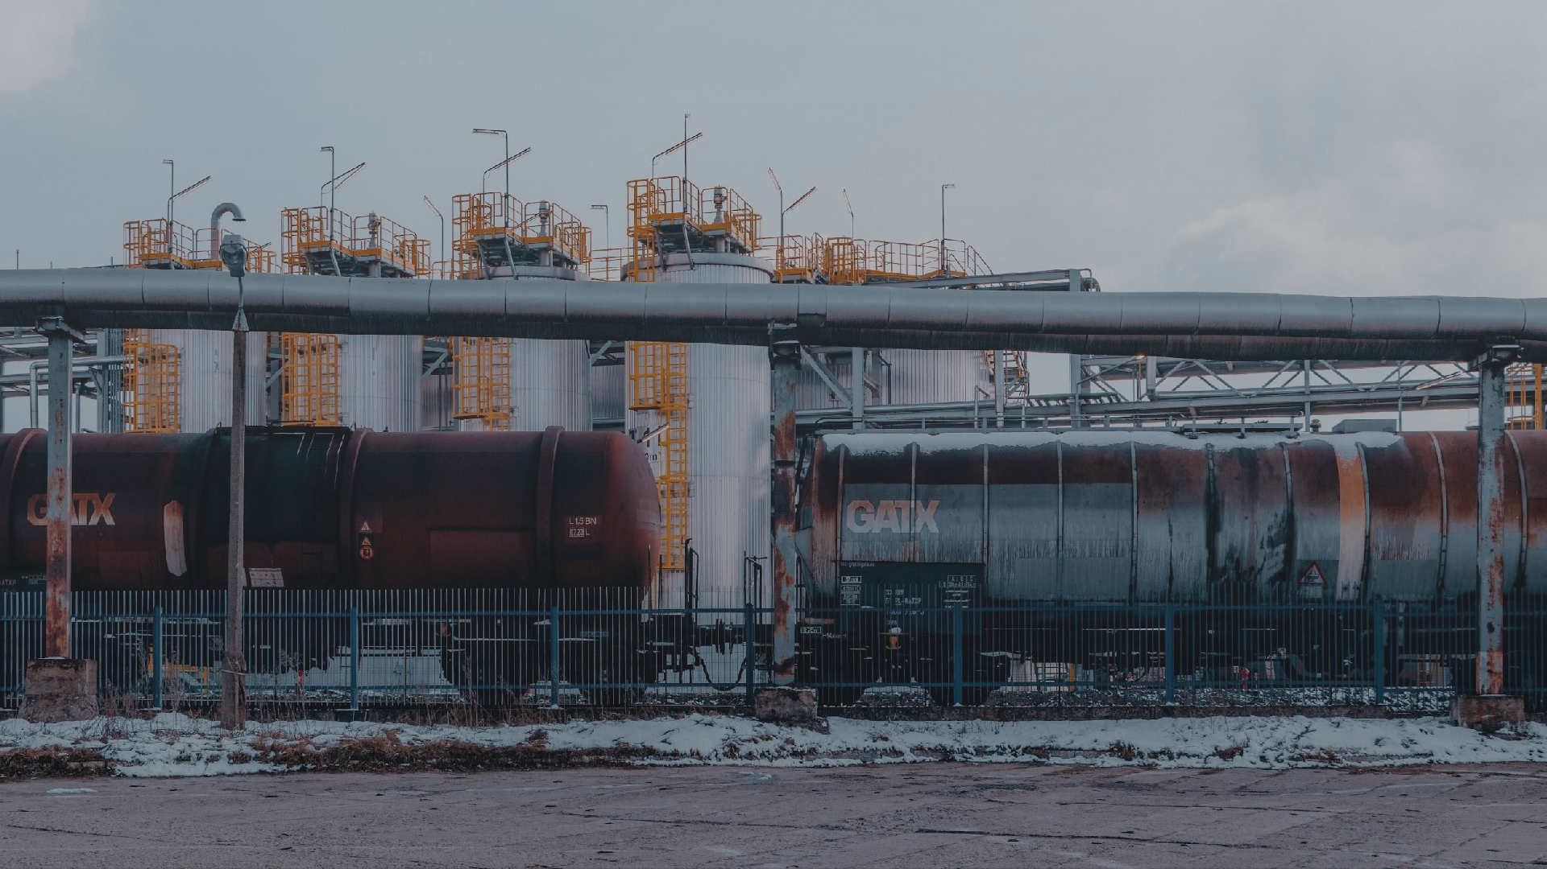
PIPELINES
Presented to:
Presented by:
Professor Geoffrey Poitras
Michelle Chen, Daniel Demch, Zhengwei Lu, Nick Nguyen
July 12, 2023

Slide 2



Research Analyst Coverage
Summary of Coverage
Analyst | Company / Sector | Rating
Michelle Chen | Pipeline Sector Overview | N/A
Nick Nguyen |  | TBD
Daniel Demch |  | TBD
Zhengwei Lu |  | TBD
Industry Overview
Pembina Pipeline
TC Energy

Slide 3
Pipelines Industry Overview
Structure
History
Importance
Crude Oil & Natural Gas
Regulators
Industrial risks
Outlook
Industry Overview
Pembina Pipeline
TC Energy

Slide 4
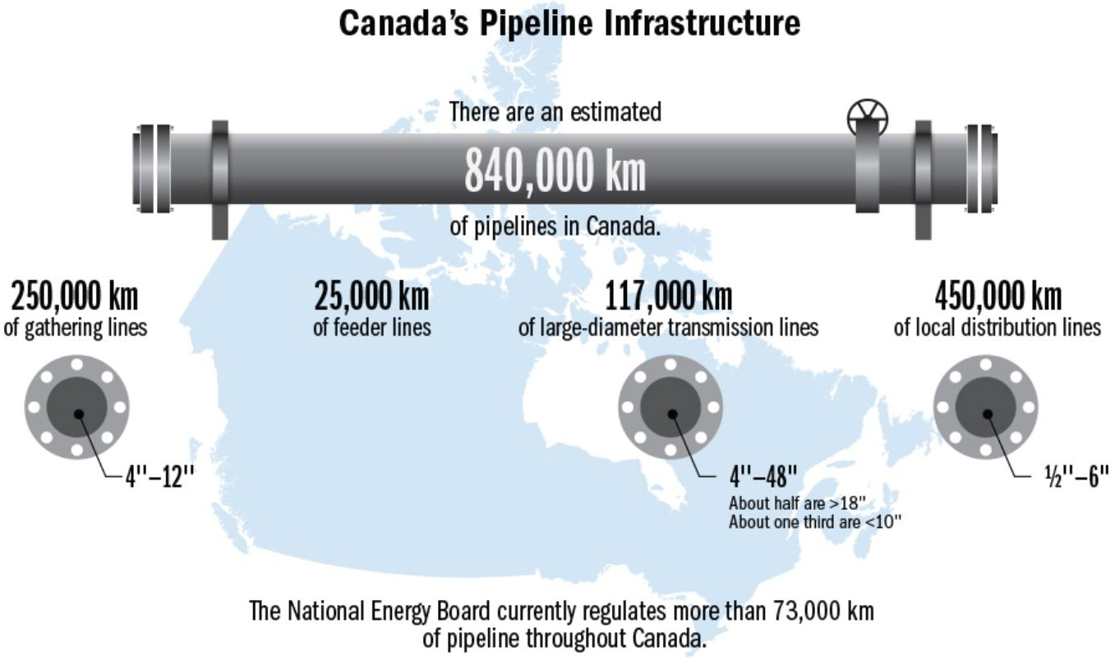
What is Pipeline?
A pipeline is a long-distance transportation system used to transport oil, natural gas, and other petroleum products from production areas to refineries, processing plants, distribution centers, & export terminals.
Generally buried underground and operate in both remote and populated areas
Pipeline companies are primarily responsible for the construction, operation, and maintenance of pipelines used for the transportation of oil, natural gas, and other petroleum products.
Pipeline diameter plays a key role in optimizing pressure, throughput and pipeline capacity.
Industry Overview
Pembina Pipeline
TC Energy

Slide 5
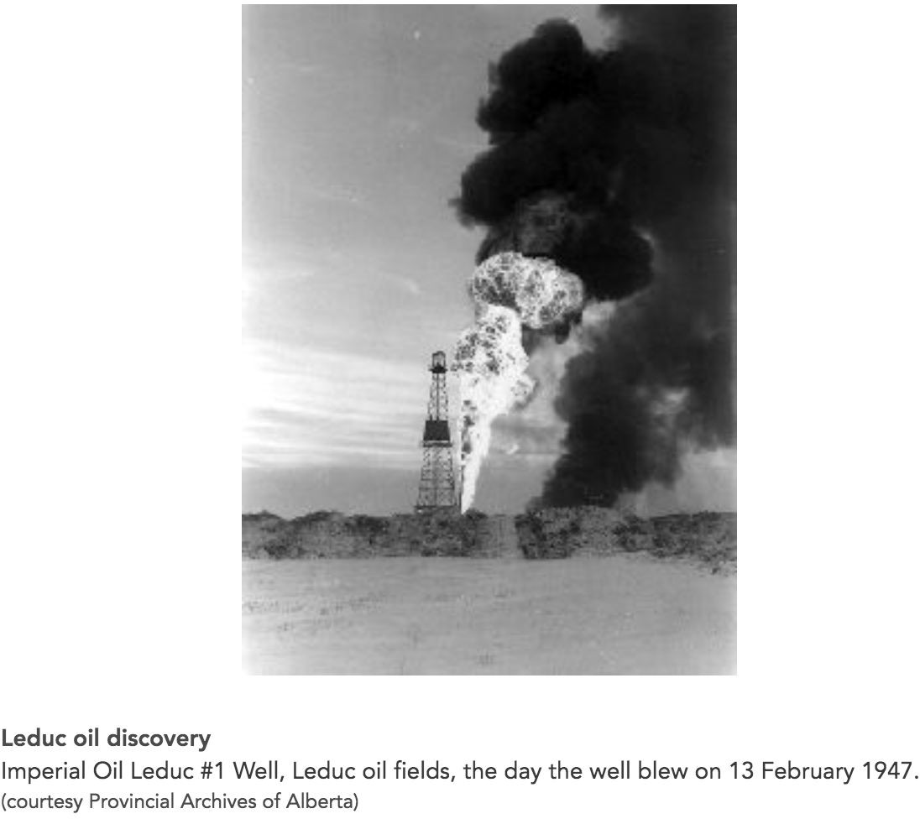
Pipeline History
Fossil fuels were first discovered in Enniskillen Township, near Sarnia, Ontario in the 1850s.
The construction of pipelines to carry crude oil and natural gas to domestic markets soon followed.
Pipeline construction was slow for a century after the Sarnia-area oil discovery, with just 3 routes in production.
From Turner Valley, Alberta to Calgary
Coastal Maine to Montreal
The US Midwest to Ontario
In the late 1940s, sufficient reserves of oil and natural gas were developed in Alberta at the Leduc No.1 oil field, rapid pipeline expansion began to get crude oil to markets in Eastern Canada and the U.S.
By the end of the 1950s, new pipelines were built to ship oil from distant wells into Edmonton, then to Vancouver and south to link up with American pipelines.
This capacity expanded greatly from the 1970s to 2010s with additional pipeline constructions linking Canadian oil and gas fields with refineries in Alaska, Illinois and Oklahoma.
Industry Overview
Pembina Pipeline
TC Energy

Slide 6
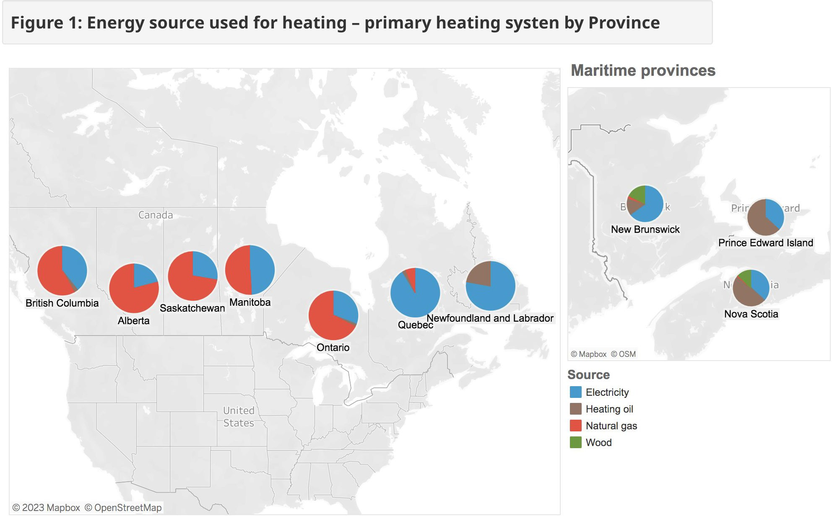
Pipeline Importance
More than half of the heating needs provided by natural gas
Pipeline sector employs about 740,000
people.
The oil and gas sector contributes nearly 11% of Canada’s GDP.
Pays on average more than $20 billion per year in taxes, royalties and fees to governments.
Industry Overview
Pembina Pipeline
TC Energy

Slide 7
Pipeline Companies Revenue Sources
Transportation fees: companies charge producers or customers fees for utilizing their pipelines to transport oil, natural gas and other petroleum products based on the volume of product transported and the distance traveled.
Long term contracts: companies secure long-term transportation contracts with producers, refiners, or other customers. Fees charged might be fixed or include provision for periodic adjustments based on market conditions.
Tariffs and tolling: may be established for pipeline usage, rates are approved by regulatory bodies which include fixed or volumetric charges.
Expansion and new projects: generate additional revenue by securing new transportation agreements and attracting new customers.
Ancillary services: companies may offer additional services such as storage, blending or processing facilities.
Asset leasing or joint ventures: companies may lease their pipeline assets or enter joint ventures in order to monetize their infrastructure while maintaining partial ownership and operational responsibilities.
Hedging and financial activities: some pipeline companies engage in derivative contracts to manage price risks and optimize their cash flow positions.
Industry Overview
Pembina Pipeline
TC Energy

Slide 8
Pipelines in Canada
Major pipeline transportation systems for three energy commodities:
Crude oil
Natural gas
Natural gas liquids
Industry Overview
Pembina Pipeline
TC Energy

Slide 9
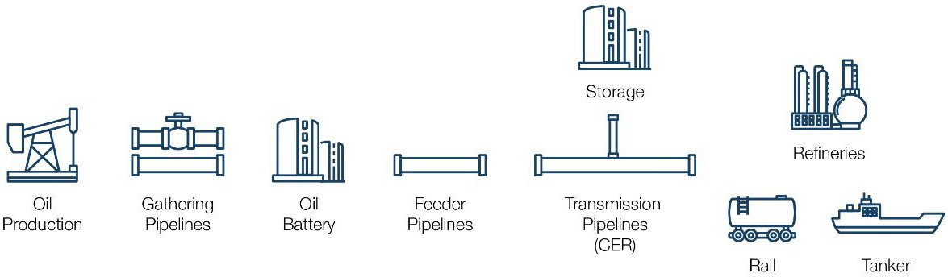
Pipelines in Canada
Pipeline System for Crude Oil
Gathering pipelines: move crude oil from the wellhead to storage and on to upgraders or refineries. (Provincial regulators typically regulate these facilities)
Feeder pipelines: transport crude oil from storage tanks and processing facilities to transmission pipelines. (Provincial regulators typically regulate these facilities)
Transmission pipelines: transport crude oil to refining markets, often across provincial or international boundaries. (Transmission pipelines are typically regulated by the CER)
Industry Overview
Pembina Pipeline
TC Energy

Slide 10
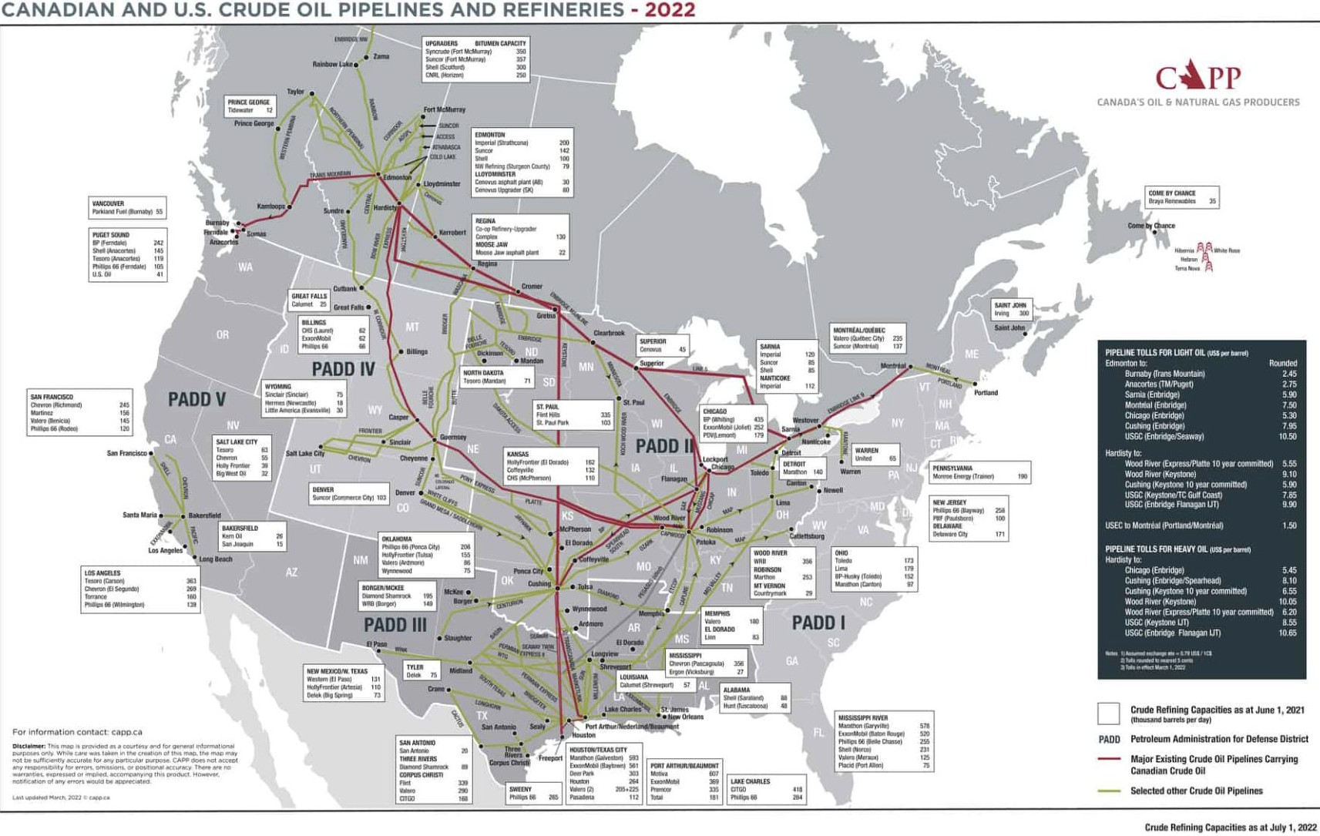
Industry Overview
Pembina Pipeline
TC Energy

Slide 11
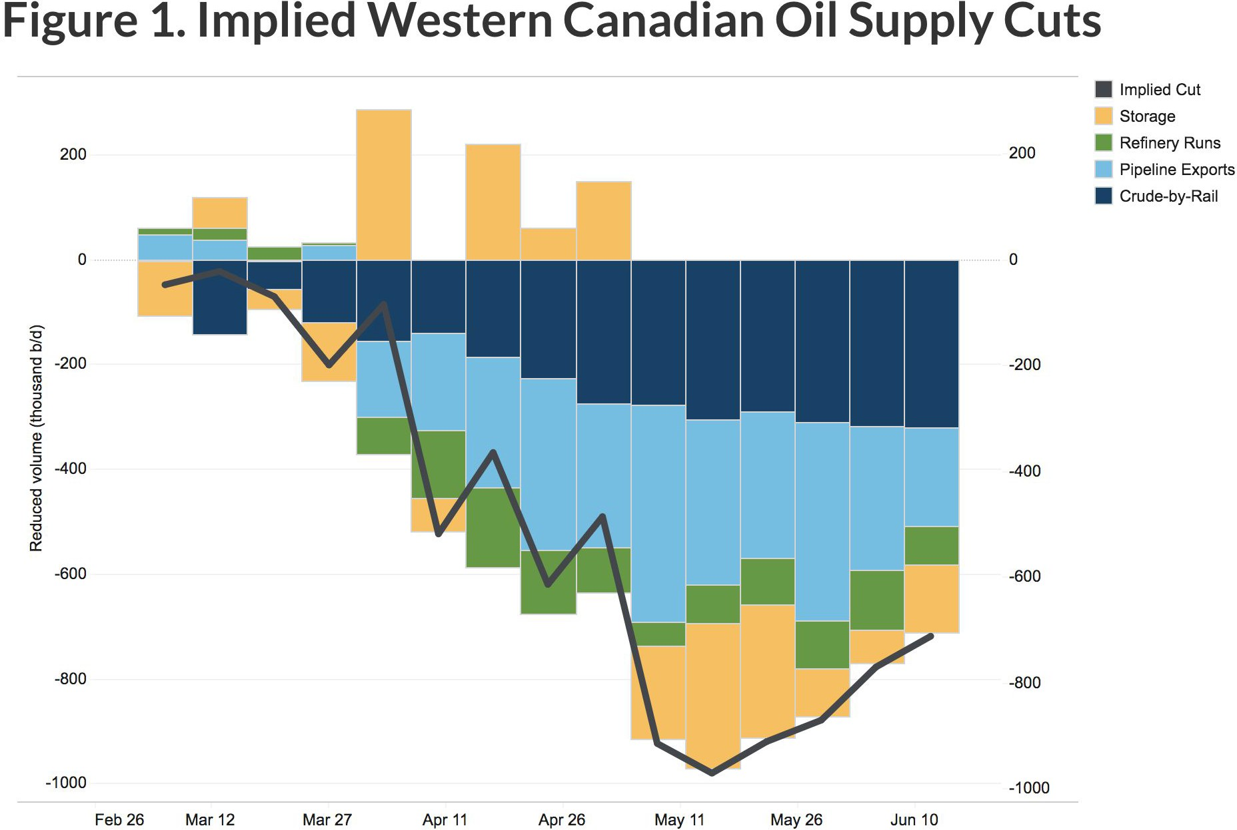
Oil Market
In 2019, Canada was the 4th largest crude oil producer in the world, producing 5.9% of total global supply.
Crude oil production averaged 4.9 million barrels per day.
In March 2020, the COVID-19 pandemic led to significant drop in global crude oil demand, forcing producers in western canada to cut production by estimated 972,000 barrels per day by mid-May 2020.
By January 2021, Canadian production returned to
pre-pandemic levels.
Industry Overview
Pembina Pipeline
TC Energy

Slide 12
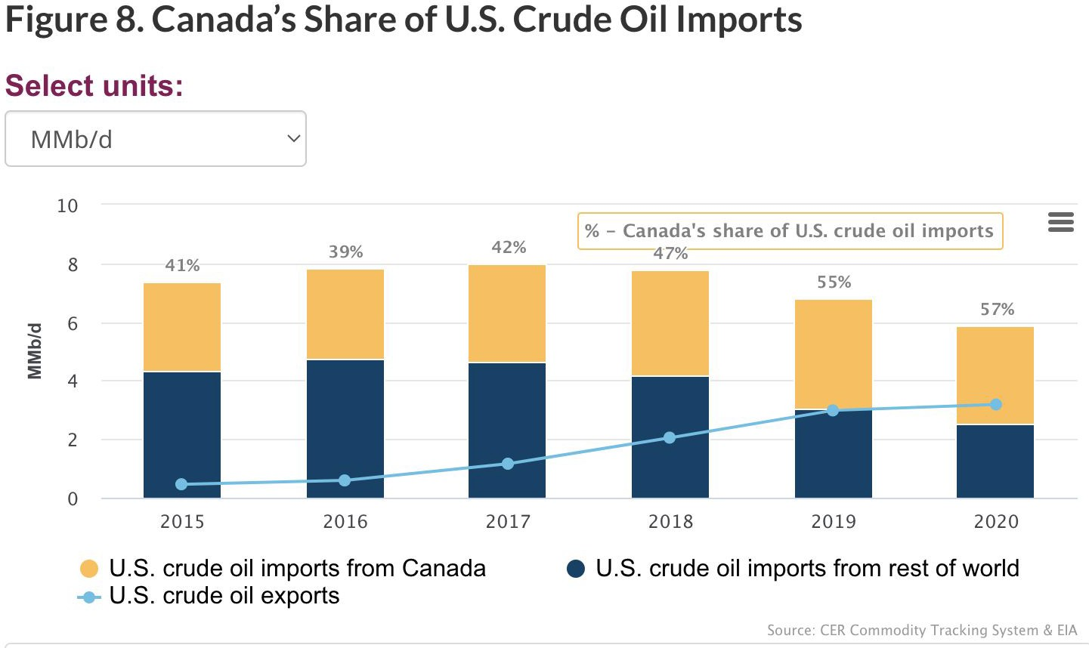
Oil Market
Canada exported 82% of the crude oil it produced, the majority went to the U.S.
The remaining 17% was refined within Canada.
Due to the lack of heavy crude oil process configuration in Canadian refineries, Canada imports light crude oil.
Industry Overview
Pembina Pipeline
TC Energy

Slide 13
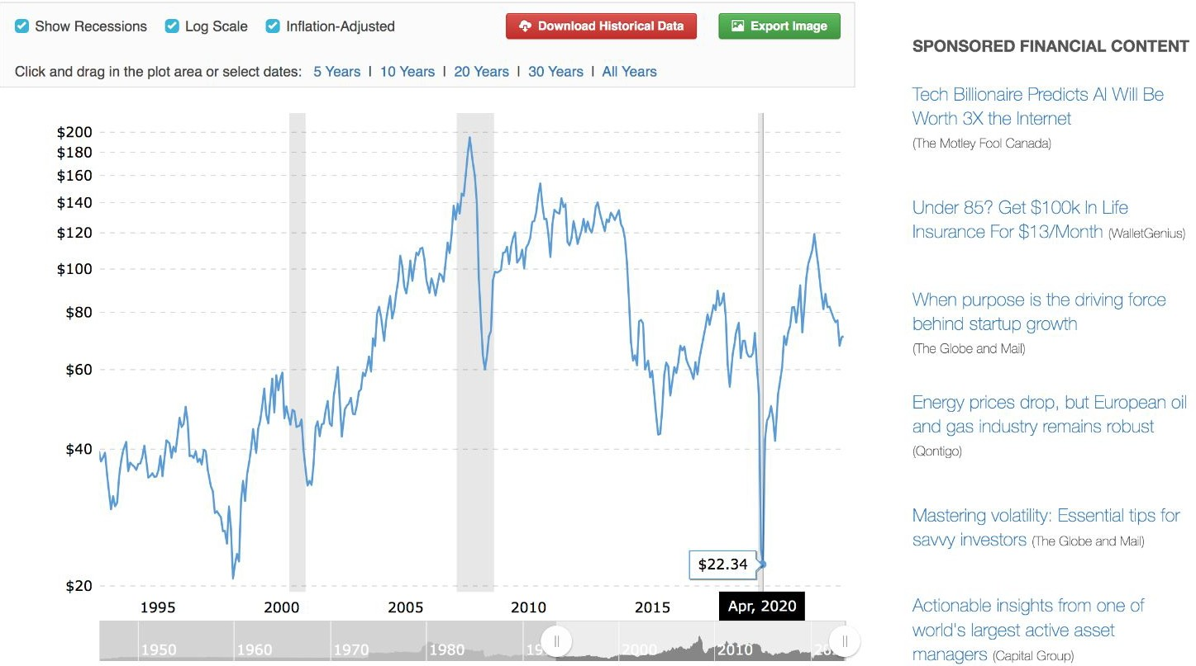
Historical Crude Oil Price (30 yrs)
Industry Overview
Pembina Pipeline
TC Energy

Slide 14
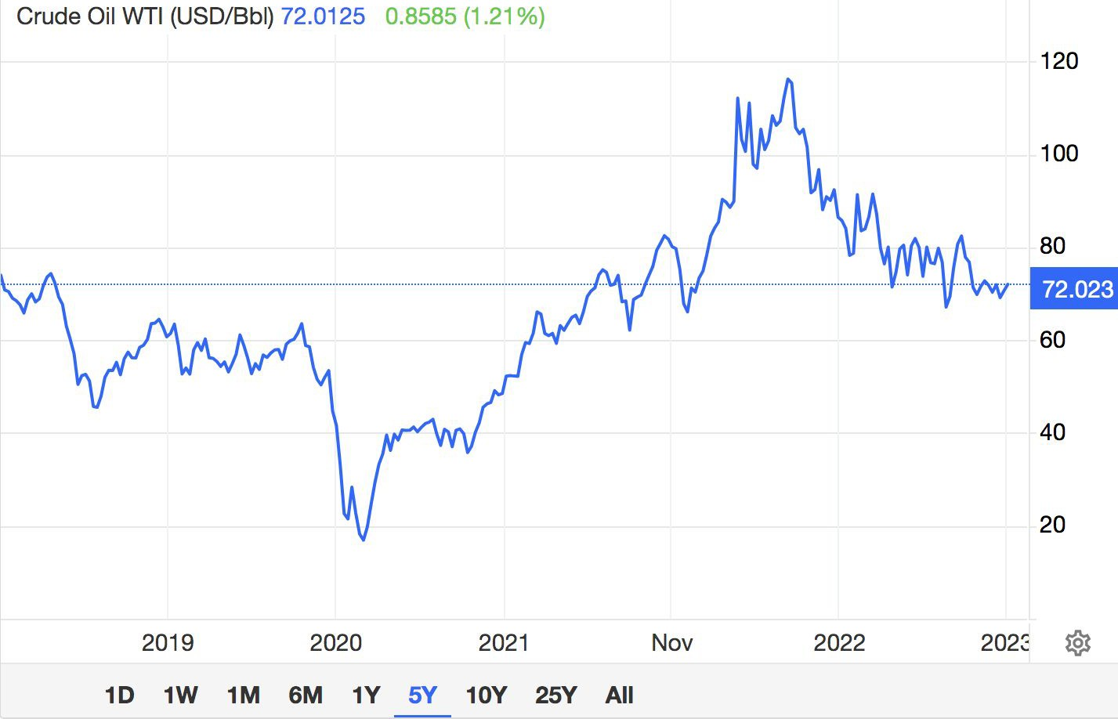
Historical Crude Oil Price (5 yrs)
This fall in crude oil is mainly due to weaker demand / recession fears.
The Organization of Petroleum Exporting Countries and allies (OPEC+) delivered a shock this April when it announced its members would cut one million barrels per day for the rest of the year
Industry Overview
Pembina Pipeline
TC Energy

Slide 15
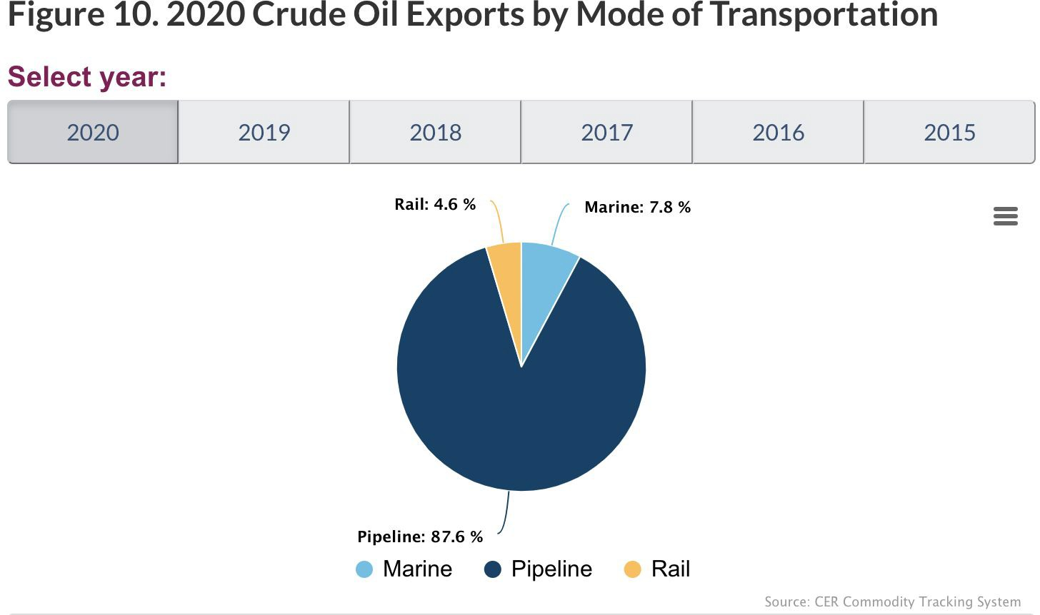
Crude Oil Transportation
Transportation by rail is more expensive than by pipeline and tanker
Industry Overview
Pembina Pipeline
TC Energy

Slide 16
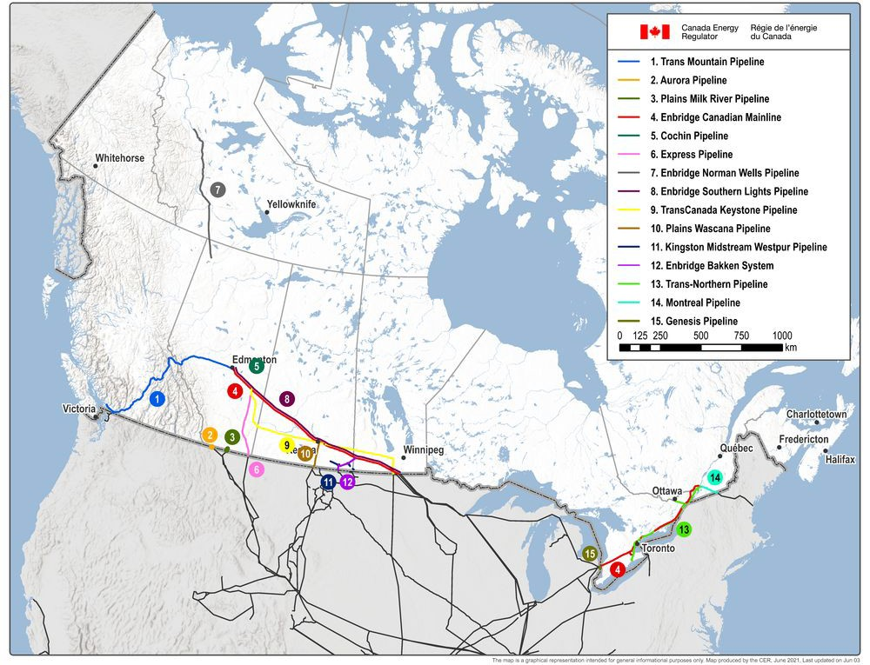
CER- Canada’s Crude Oil Pipeline Transportation System
Industry Overview
Pembina Pipeline
TC Energy

Slide 17
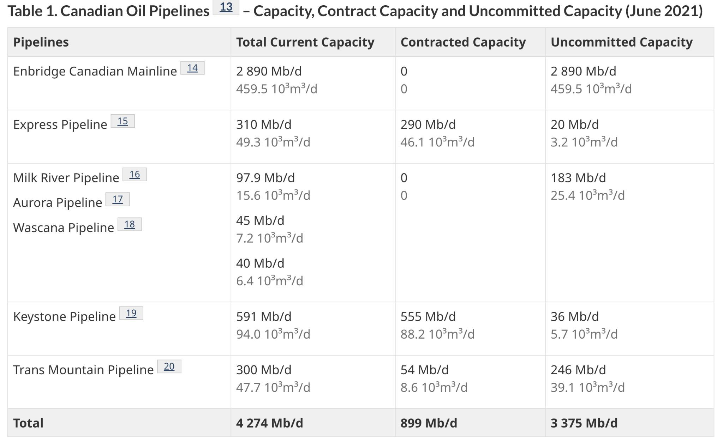
Canadian Oil Pipelines
Keystone Pipeline is owned by TC Energy, it transports about 14% of western canadian crude oil exports to key U.S. refining markets.
Industry Overview
Pembina Pipeline
TC Energy

Slide 18
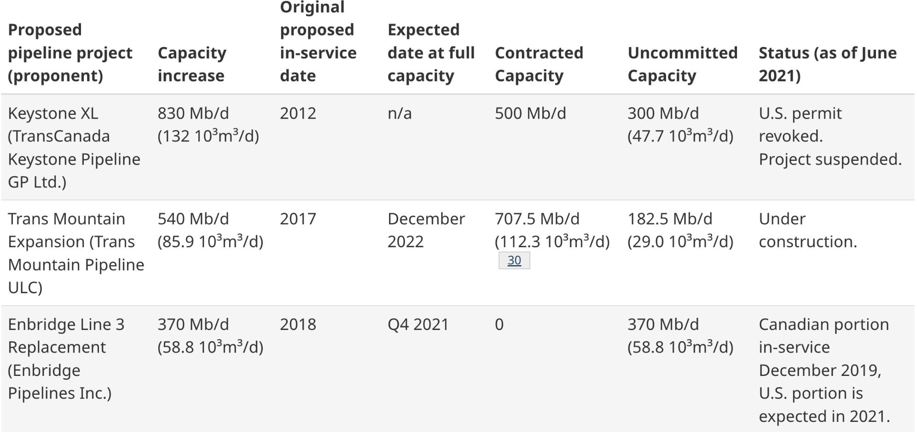
Proposed Pipeline Projects
Industry Overview
Pembina Pipeline
TC Energy

Slide 19
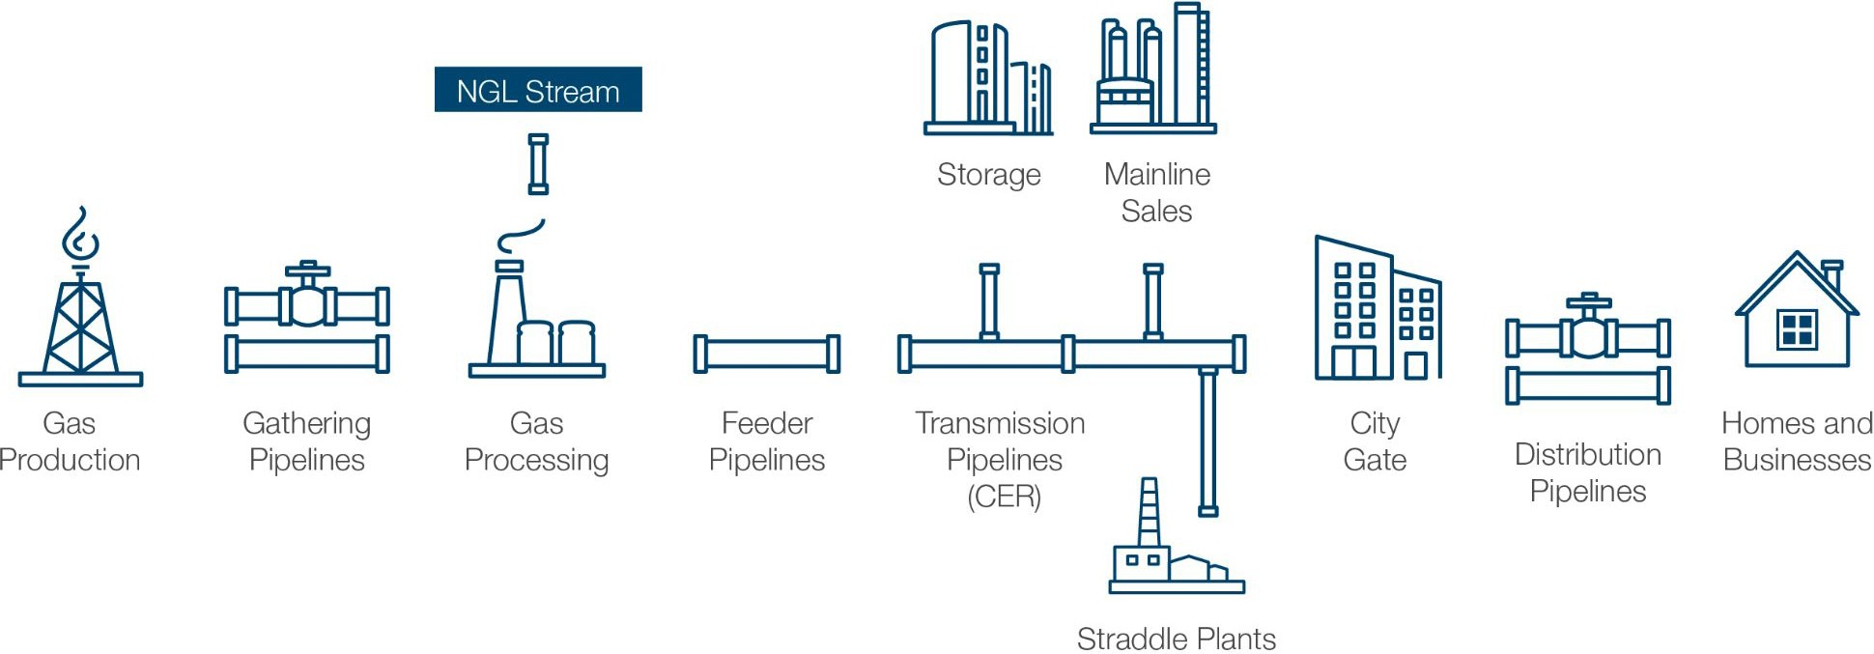
Pipelines in Canada
Pipeline System for Natural Gas
Gathering pipelines: move gas from production wells to gas processing facilities, which remove impurities such as sulphur, water, and carbon dioxide. These pipelines are mainly concentrated in the producing areas of western Canada. Provincial regulators typically regulate these facilities.
Feeder pipelines: transport gas from processing facilities to transmission pipelines, and are also mainly concentrated in the producing areas of western Canada. Provincial regulators typically regulate these facilities.
Transmission pipelines: are the major conduits of the pipeline network, transporting gas to markets, often across provincial or international boundaries. These are typically regulated by the CER.
Distribution pipelines: deliver gas to residences, businesses, and various industries. Provincial regulators typically regulate these facilities.
Industry Overview
Pembina Pipeline
TC Energy

Slide 20
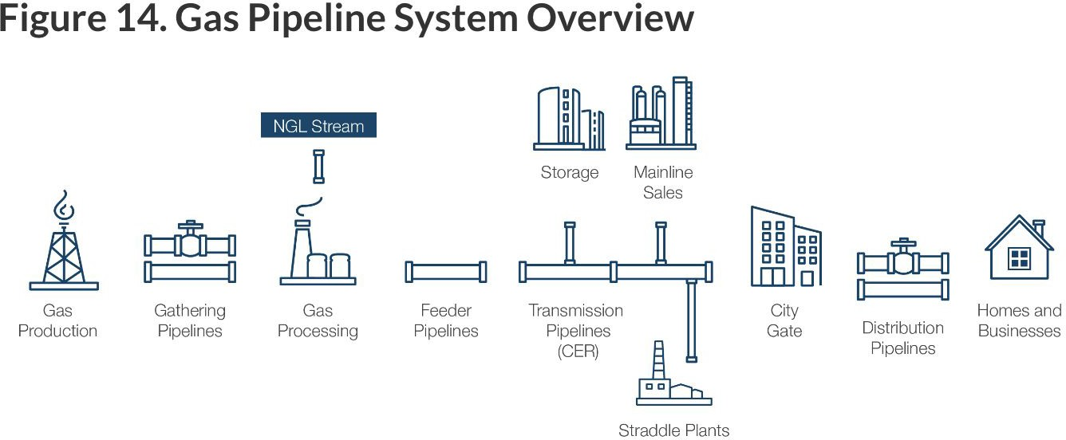
Natural Gas Pipeline System
Industry Overview
Pembina Pipeline
TC Energy

Slide 21
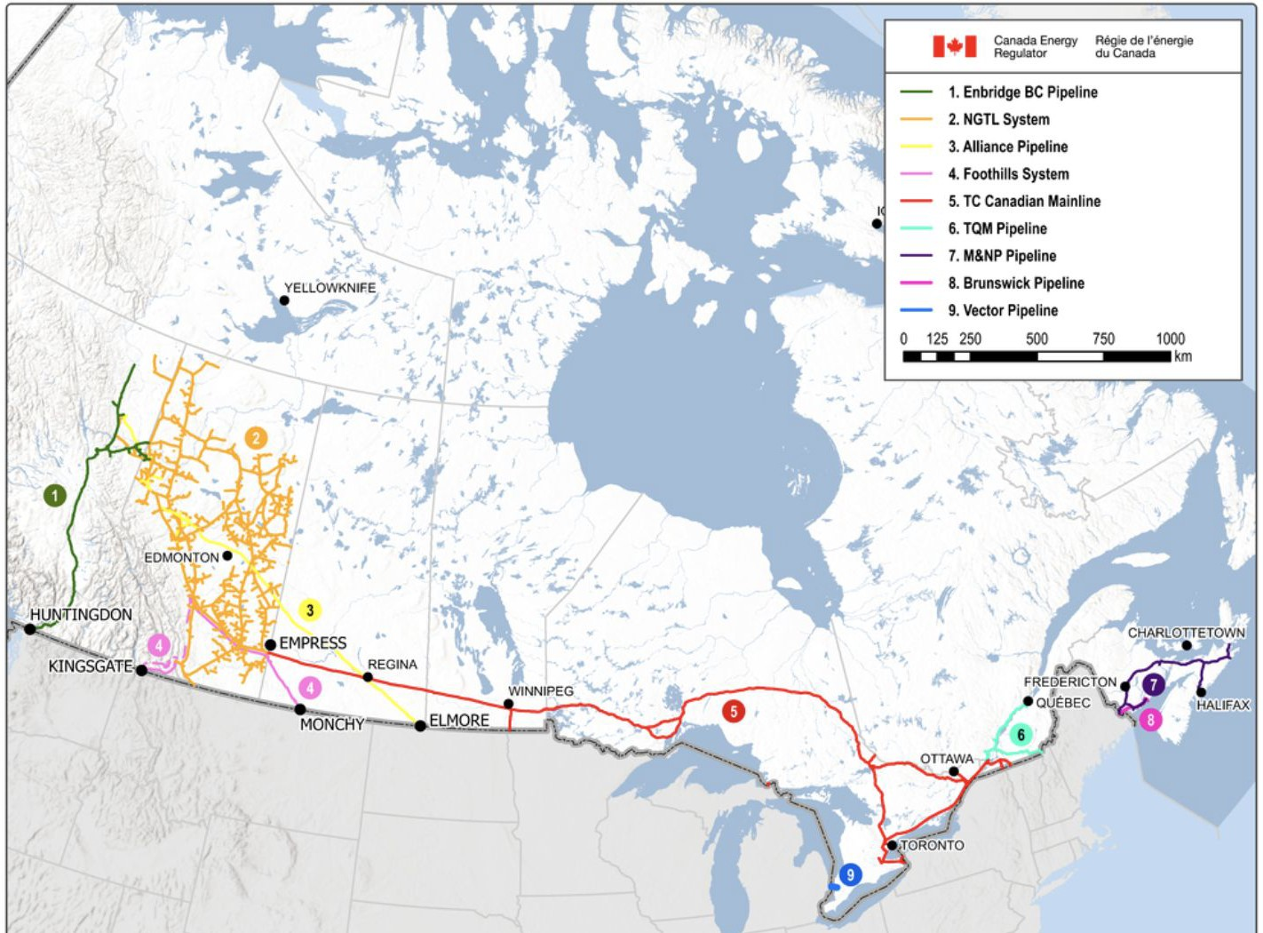
Major CER-regulated Natural Gas Pipelines
Industry Overview
Pembina Pipeline
TC Energy

Slide 22
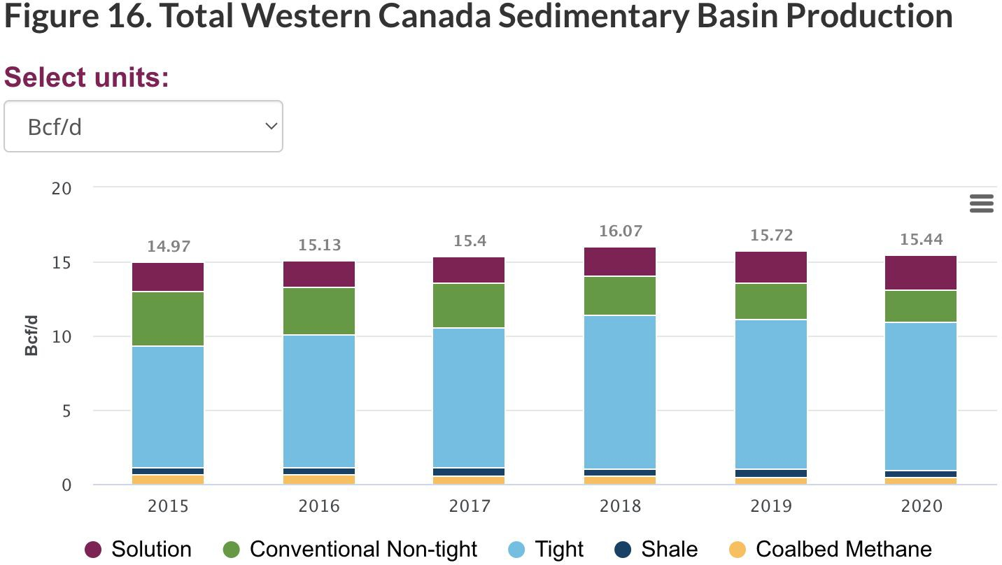
Natural Gas Market
In 2019, Canada was the sixth largest producer of natural gas in the world, accounting for 4.3% of global supply.
The COVID-19 pandemic did not cause Canadian natural gas producers to meaningfully cut production.
Tight gas production has grown significantly over the past five years and accounted for roughly 66% of total Canadian gas production in 2020.
Industry Overview
Pembina Pipeline
TC Energy

Slide 23
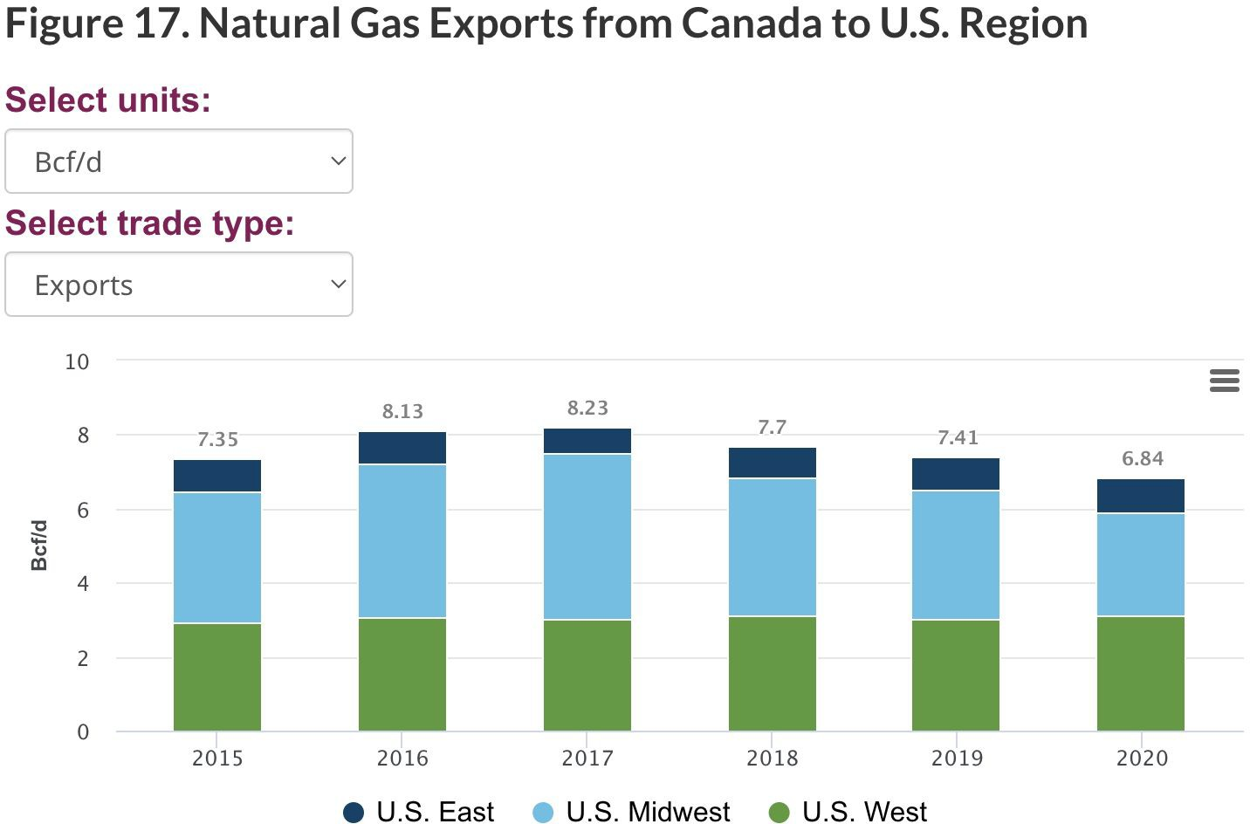
Natural Gas Market
Canada is a natural gas net exporter with almost all natural gas exports destined for the U.S.
But the net export to the U.S. declined by 15% due to both COVID-19 and increased imports from the U.S.
Industry Overview
Pembina Pipeline
TC Energy

Slide 24
Gas Pipeline and Price
Canadian natural gas is typically priced as the difference between a Canadian hub and the continental benchmark, and the difference between prices is known as the basis differential.
Pipeline transportation cost, supply and demand dynamics and general market sentiment affects the basis differential.
Between 2017 and 2019, the basis differential were wide and volatile due to pipeline capacity constraints and lack of access to seasonal storage in western Canada caused local markets to become oversupplied → extremely low spot price
Beginning in late 2019, prices started to recover.
Natural gas price hit the lowest in decades due to the low demand from COVID-19.
Industry Overview
Pembina Pipeline
TC Energy

Slide 25
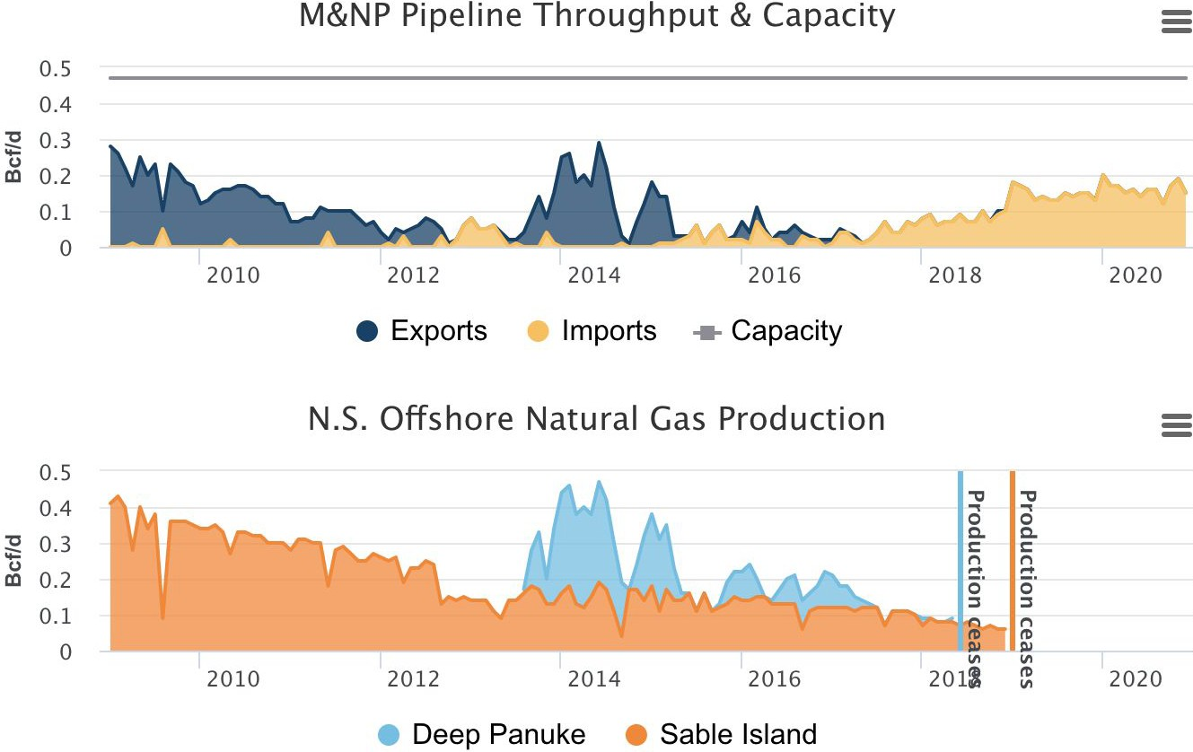
Natural Gas Offshore Production and Exports & Imports at St. Stephen, NB
Industry Overview
Pembina Pipeline
TC Energy

Slide 26
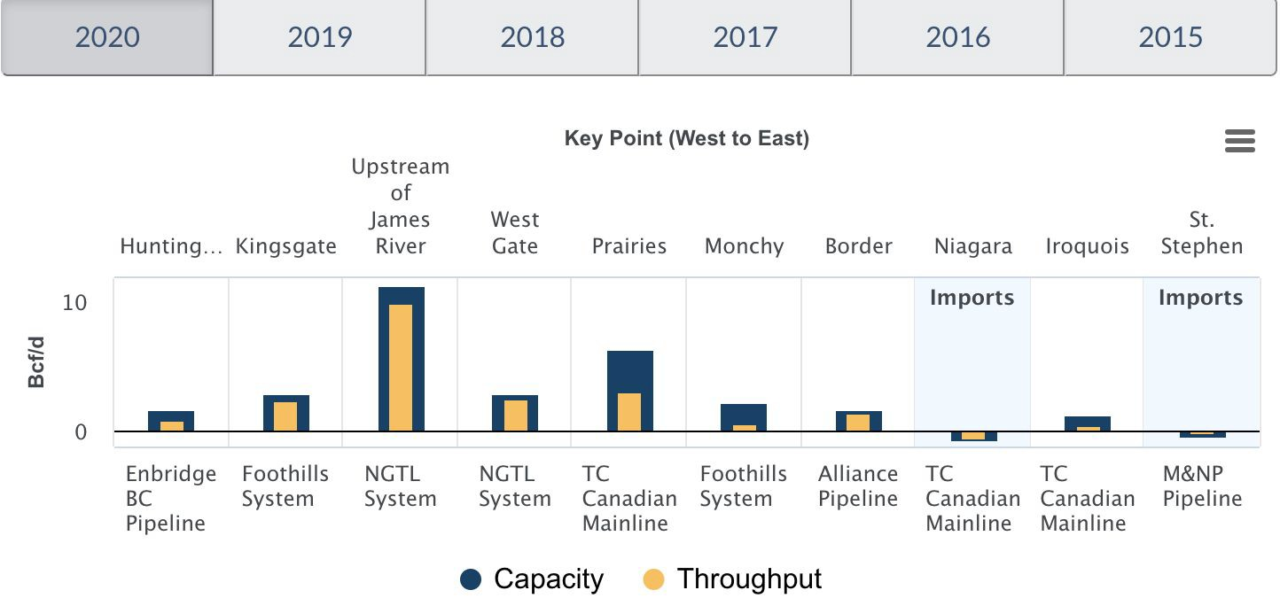
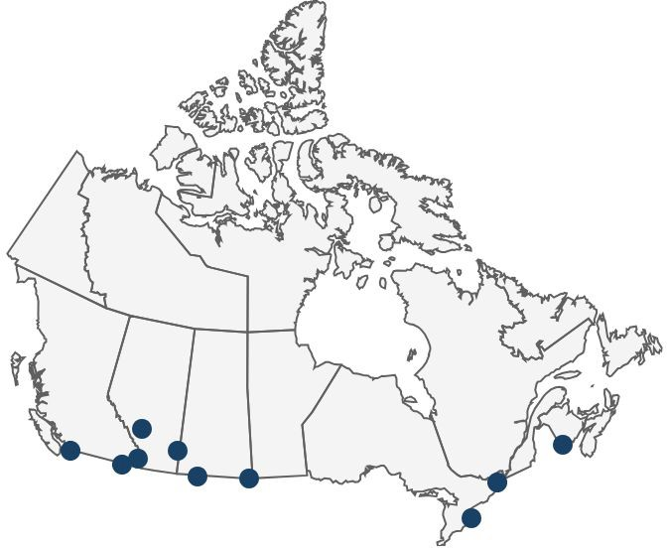
2020 Average Throughput and Capacity at Key Pipeline Points
Industry Overview
Pembina Pipeline
TC Energy

Slide 27
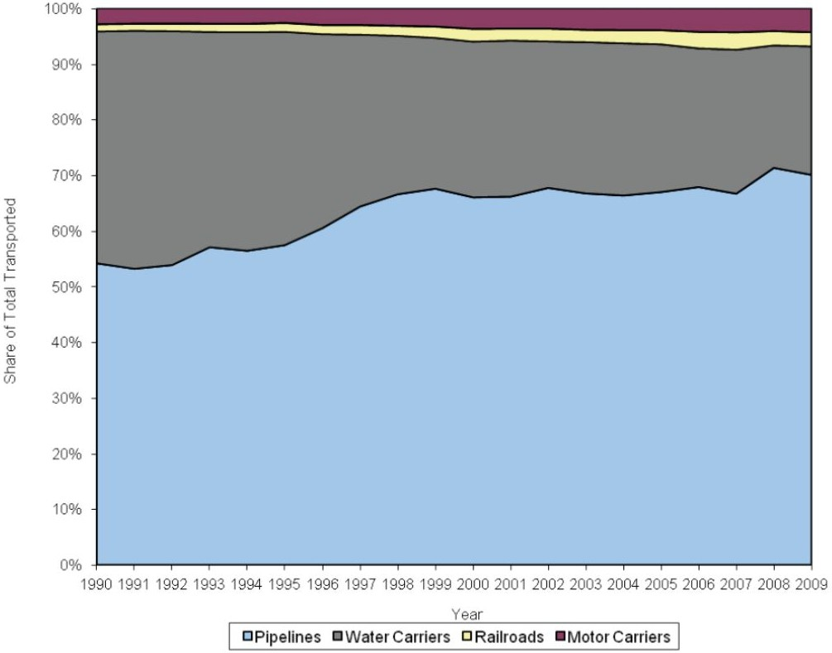
Share of Total Petroleum Transportation
Industry Overview
Pembina Pipeline
TC Energy

Slide 28
Major pipelines and expansions
NGTL System: WCSB Production Area - proposed looping projects to increase capacity along its Grande Prairie Mainline and Northwest Mainline.
NGTL System: East and West Gates - increase gas deliveries to its system border points
The West Path Delivery Project
The West Path Delivery 2023 project
The 2021 NGTL System Expansion Project - serve demand via the TC Canadian Mainline.
Enbridge BC Pipeline: T-South and T-North Expansions
T-South: compression and reliability upgrades at various points
T-North: accommodate growing production in northeast B.C. enabling more gas to be delivered further south, transported to the NGTL system.
Industry Overview
Pembina Pipeline
TC Energy

Slide 29
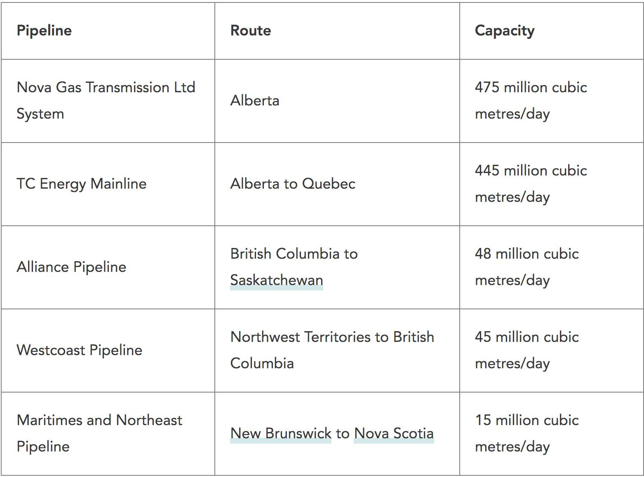
Industry Overview
Pembina Pipeline
TC Energy

Slide 30
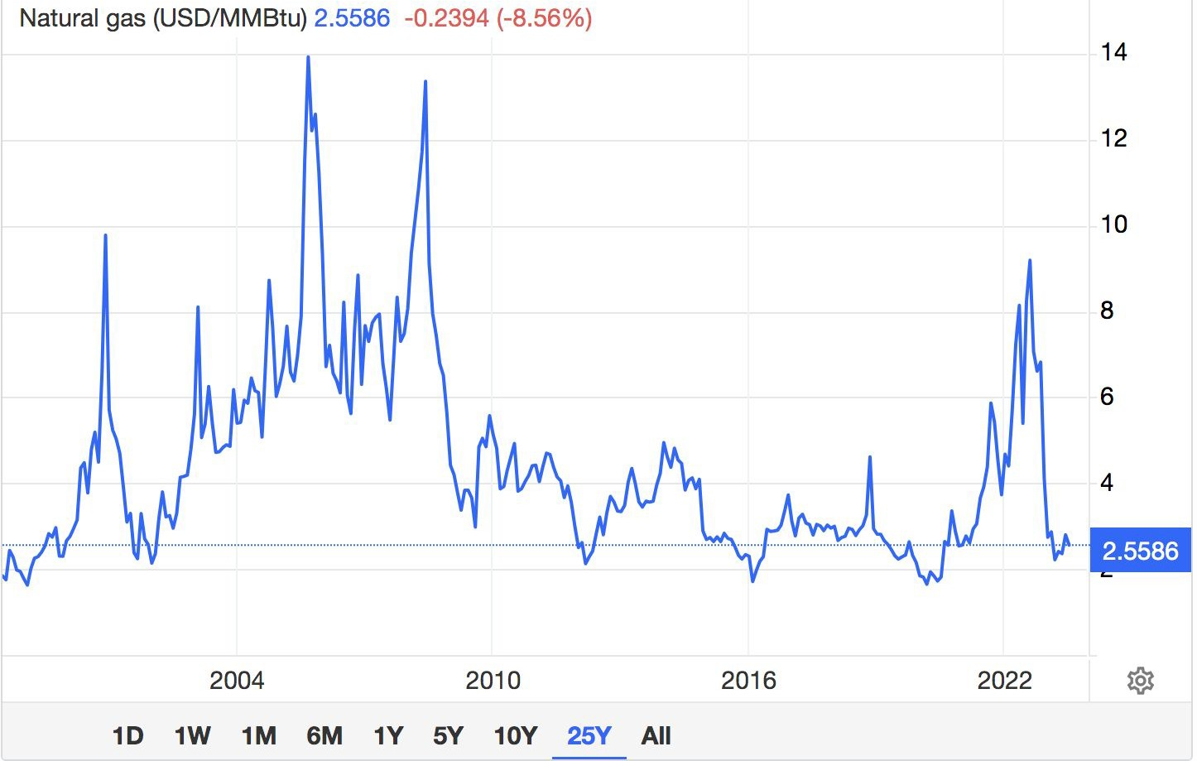
25Y Natural Gas Price
Industry Overview
Pembina Pipeline
TC Energy

Slide 31
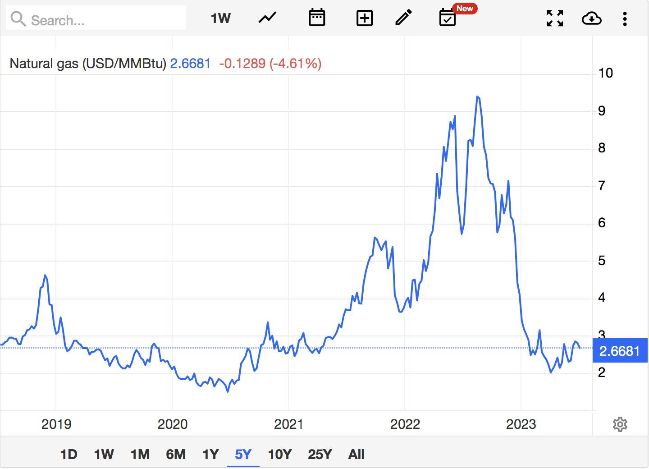
5Y Natural Gas Price
Unreasonably warm weather slowed the global demand for heating from natural gas, resulted in a price drop in second half of 2022.
Industry Overview
Pembina Pipeline
TC Energy

Slide 32
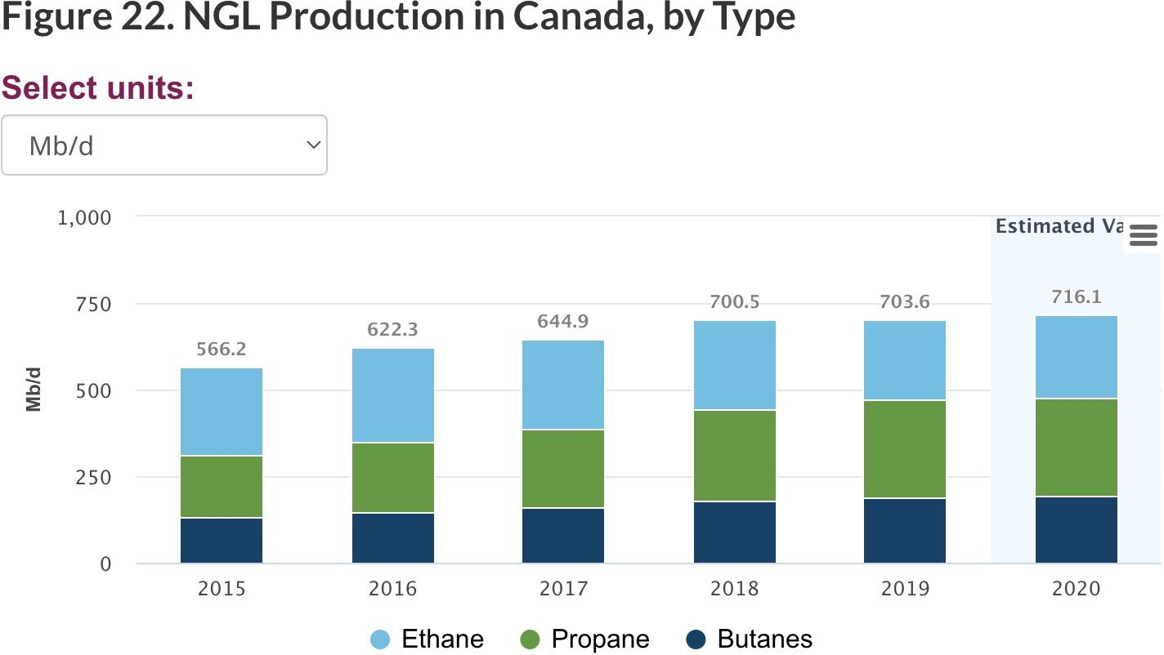
Pipelines in Canada
Pipeline System for Natural Gas Liquids (NGLs)
Natural gas liquids are typically extracted from natural gas but are also produced in smaller volumes as part of crude oil refining and at oil sands operations.
NGLs include:
Ethane
Propane
Butane
Pentanes-plus
Condensate
(delivered ONLY by pipeline) (primarily delivered by trucks) (primarily delivered by trucks)
Industry Overview
Pembina Pipeline
TC Energy

Slide 33
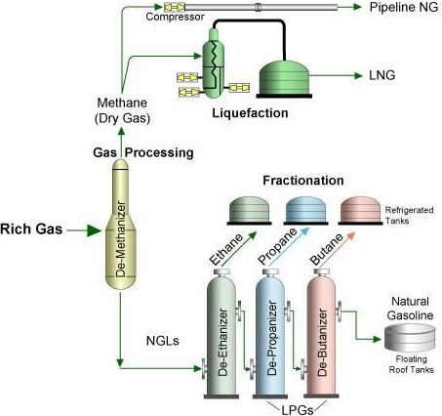
Pipelines in Canada
Natural Gas Liquids Fractionation
Fractionation is the process of boiling off different hydrocarbons one by one. Each hydrocarbon has different boiling point, so after being cooled & as the temperature ↑, the components separate. Steps incl.:
De-Ethanizer: boiling point of −88.5 °C
De-Propanizer: −42 °C
De-Butanizer: from -1°C to 1°C
⇒ The fractionation process provides usable NGLs used for various
purposes – e.g., making fuel, plastics, cell phone parts, etc.
NGLs vs. LNG?
NGLs (natural gas liquids) - components of the natural gas stream that, when cooled, separate into a liquid mixture. Under pressure & heat, this mixture is fractionated into fuels like propane, ethane, butane.
LNG (liquefied natural gas) - natural gas, primarily methane, that has been liquefied by reducing its temperature to −162.2 °C.
→ This is done for ease & safety of storage and transport.
⇒ When LNG reaches its destination, import facilities heat the liquid to convert it back to gas for transportation by pipeline.
Source: williams.com, williams.com
Industry Overview
Pembina Pipeline
TC Energy

Slide 34
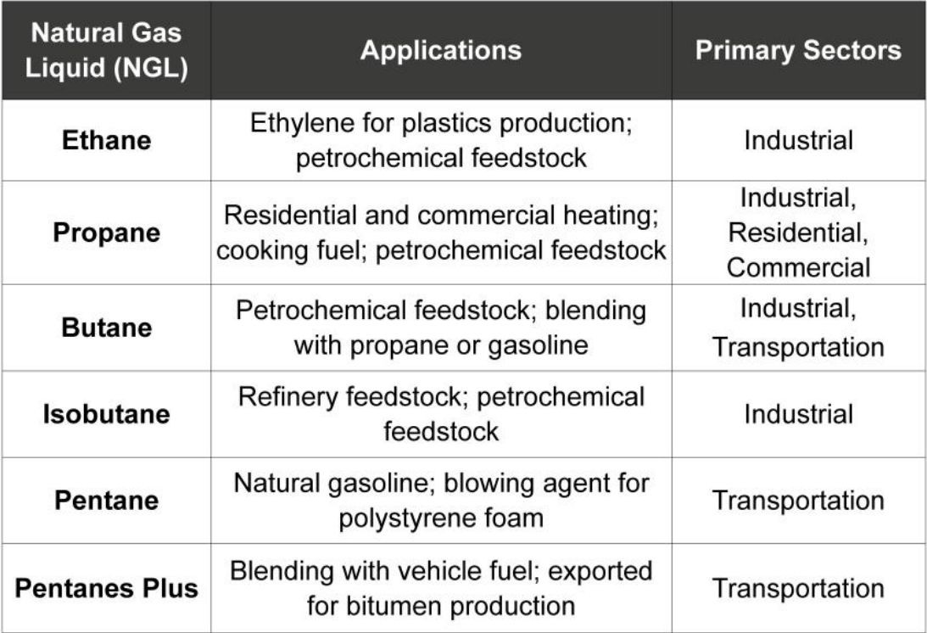
NGLs Application
Industry Overview
Pembina Pipeline
TC Energy

Slide 35
NGL Imports and Pipeline
Canada imports ethane from the U.S. at a low cost through pipelines into Saskatchewan (for the use in Alberta) and southwestern Ontario.
Ethane-import pipelines for Alberta and Ontario’s petrochemical sectors have generally operated at high capacity.
Enbridge Canadian Mainline’s Lines 1 and 5 deliver light crude oil, RPPs, and a mix of propane, butane, and condensate from Edmonton, Alberta to Sarnia, Ontario (and points in between).
Industry Overview
Pembina Pipeline
TC Energy

Slide 36
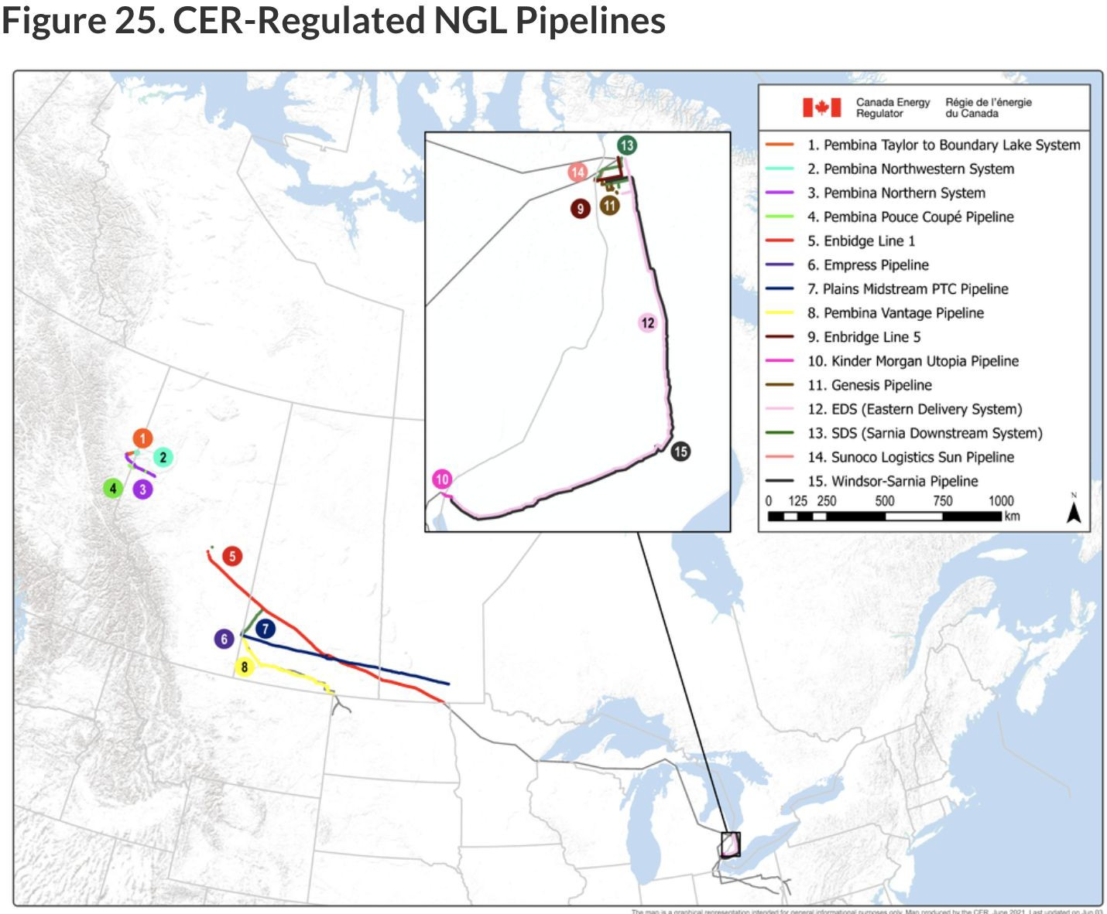
Industry Overview
Pembina Pipeline
TC Energy

Slide 37
Proposed Exports Pipeline and Expansions
Pembina Pipeline’s liquids systems in western Canada, including the CER-regulated Pouce Coupé and Northern Systems, transport ethane-plus, propane-plus, and condensate from northeastern B.C. and west-central Alberta to the NGL and diluent hub in Edmonton, Alberta.
Pembina’s Peace Pipeline system is being expanded in several phases to accommodate growing production from liquids-rich plays of the Montney, Duvernay, and other formations. The fourth and fifth phases of the expansion were put into service in late 2018, while the sixth, seventh, and eighth phases, originally scheduled for commissioning between 2020 and 2022, have been delayed because of COVID-19.
The Pembina Peace Pipeline system originates in multiple points across northeastern B.C. and northwestern Alberta, and terminates in Edmonton. After completing the eighth phase, the Pembina Peace Pipeline system will have a capacity of 1,300 Mb/d (206.7 10³m³/d).
Industry Overview
Pembina Pipeline
TC Energy

Slide 38
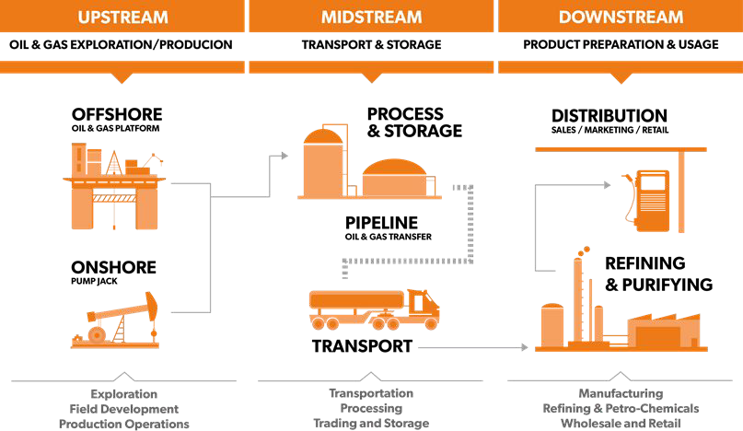
Upstream vs. Downstream in the Oil & Gas Industry
Source: eLand Cables
Industry Overview
Pembina Pipeline
TC Energy

Slide 39
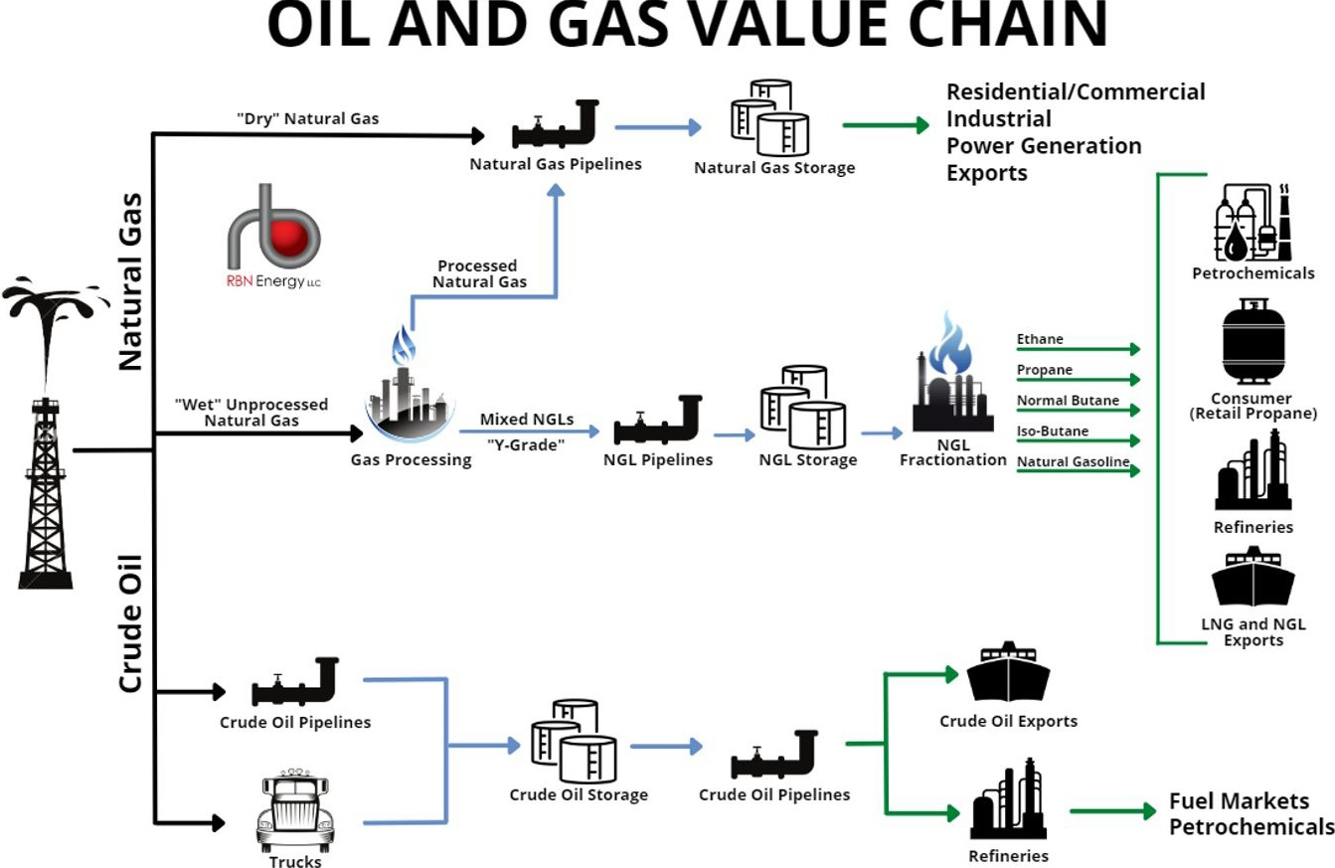
Source: RBN Energy
Industry Overview
Pembina Pipeline
TC Energy

Slide 40
Regulators
The federal government regulates large transmission pipelines that cross provincial boundaries.
The Canada Energy Regulator (CER)
The Canadian Energy Regulator Act (CER Act)
The Pipeline Financial Requirements (FR) Regulations
Canadian Energy Pipeline Association (CEPA)
For the U.S.:
Federal Energy Regulatory Commission (FERC)
The remaining pipelines are regulated provincially
Industry Overview
Pembina Pipeline
TC Energy

Slide 41
The Canada Energy Regulator (CER)
CER regulates 10% of Canadian Total Pipelines
The CER regulates:
Oil & Gas Pipelines – Construction, operation, and abandonment of interprovincial and international pipelines and related tolls and tariffs.
Electricity Transmission – Construction and operation of international power lines and designated interprovincial power lines.
Imports, Exports & Energy Markets – Imports and exports of certain energy products; monitoring aspects of energy supply, demand, production, development and trade.
Exploration & Production – Oil and gas exploration and production activities in the offshore and on frontier lands not covered by an accord.
Offshore Renewables – Offshore renewable projects and offshore power lines.
Industry Overview
Pembina Pipeline
TC Energy

Slide 42
The CER
CER regulates various economic aspects of pipelines under its jurisdiction including:
Tolls and tariffs
Requirements for companies to have access to financial resources to cover potential costs of unintended or uncontrolled releases
Saving funds for future abandonment costs.
Industry Overview
Pembina Pipeline
TC Energy

Slide 43
Tolls and Tariffs
The CER regulates the tolls (the price charged for service) and tariffs (the terms and conditions of service) of pipeline companies under its jurisdiction, to ensure that tolls are just and reasonable, and that there is no unjust discrimination in tolls or services.
The CER closely monitors how pipeline companies comply with regulatory requirements and whether they are providing services to shippers at reasonable prices (tolls).
The CER monitors compliance in a variety of ways, including by:
Requiring regular compliance filings by companies,
Auditing finances,
Soliciting shipper feedback via surveys.
Parties may also file formal complaints with the CER if they are unable to resolve concerns on specific toll and tariff matters.
Industry Overview
Pembina Pipeline
TC Energy

Slide 44
Negotiated Settlements and Toll Proceedings
Negotiated settlements are used as an alternative to toll hearings, aimed to improve the effectiveness and efficiency of the regulatory process.
A negotiated settlement is an agreement between a pipeline company and its stakeholders regarding issues related to the company’s revenue requirement, tolls, tariffs, and/or operational matters.
Negotiated settlements can cover all, or certain elements of, a pipeline’s tolls, traffic, or tariffs.
Generally, negotiated settlements address a pipeline’s toll design, revenue requirement, or both.
Industry Overview
Pembina Pipeline
TC Energy

Slide 45
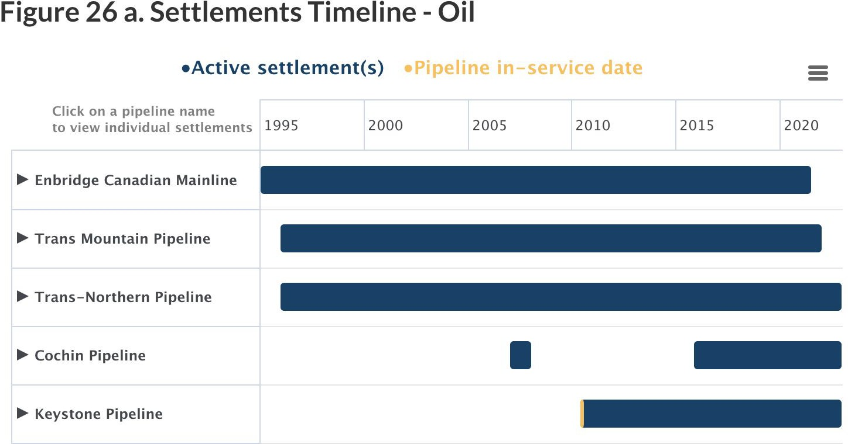
Industry Overview
Pembina Pipeline
TC Energy

Slide 46
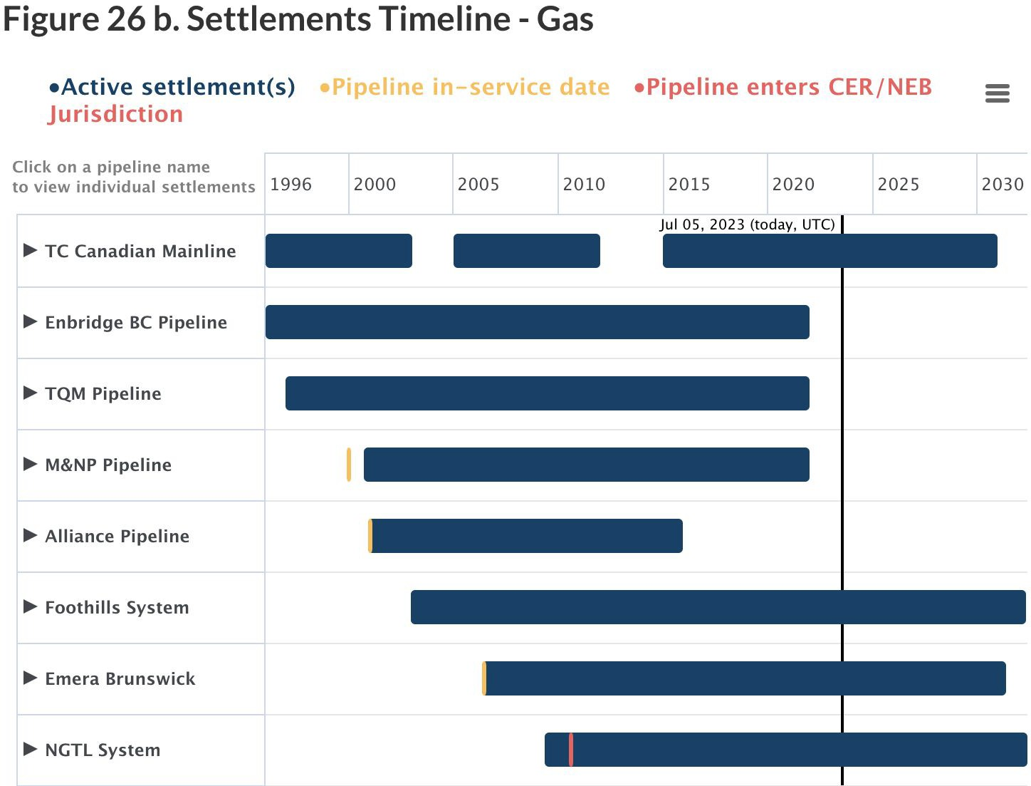
Industry Overview
Pembina Pipeline
Enterprise Products
TC Energy
Conclusions
46

Slide 47
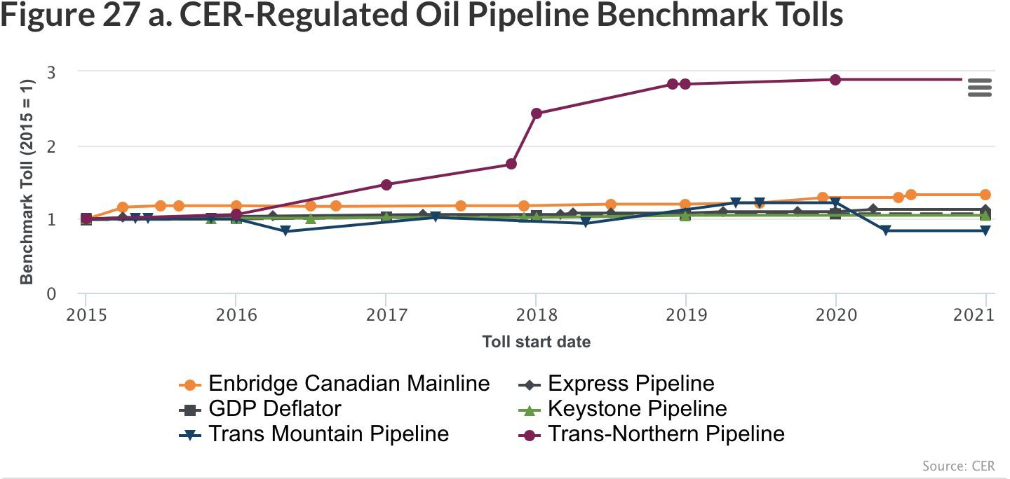
Industry Overview
Pembina Pipeline
Enterprise Products
TC Energy
Conclusions
47

Slide 48
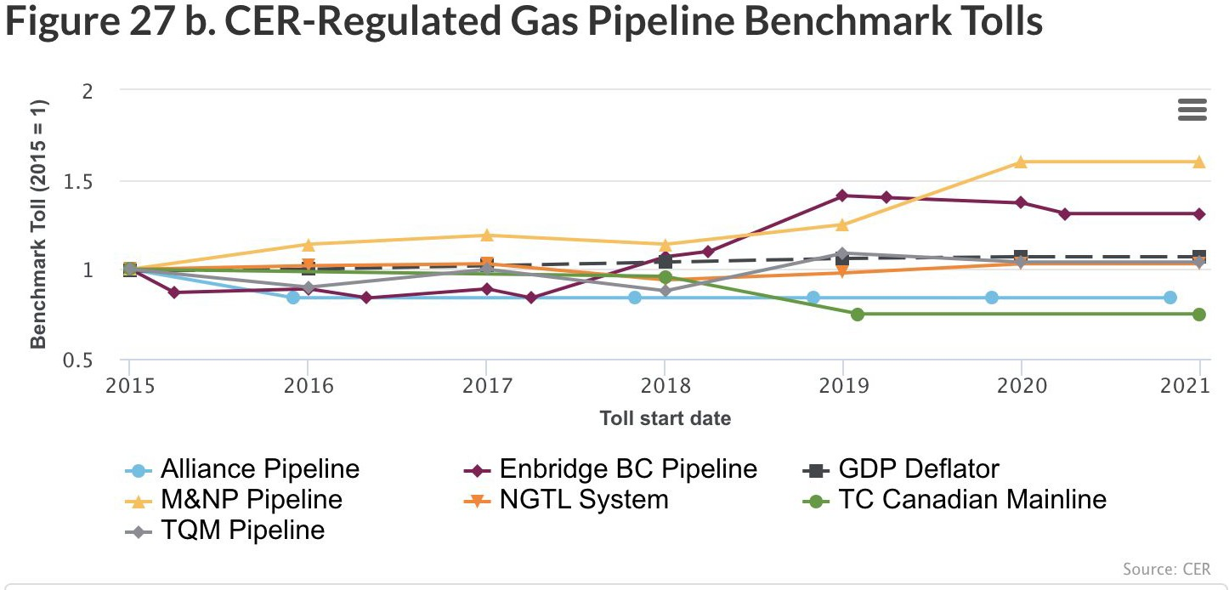
Industry Overview
Pembina Pipeline
TC Energy

Slide 49
The Canadian Energy Regulator Act (CER Act)
Requires companies operating oil and gas pipelines to set aside financial resources to cover the costs of any unintended or uncontrolled release from a pipeline, such as a spill.
Companies are required to maintain financial resources that, at a minimum, match the absolute liability limit applicable to the company under the CER Act.
A portion of these financial resources must be readily accessible to the company.
Industry Overview
Pembina Pipeline
TC Energy

Slide 50
The Pipeline Financial Requirements (FR) Regulations
Came into force in July 2019
It outlines the specific types of financial instruments that the Commission may order companies to maintain, as well as the minimum portion of the financial resources required to be readily accessible to the company.
Companies are required to submit a Financial Resources Plan to the CER, detailing how their financial resources meet the requirements of the CER Act and the FR Regulations
Industry Overview
Pembina Pipeline
TC Energy

Slide 51
Abandonment Funding
Companies that want to permanently stop operating part or all of a pipeline must apply to the CER to abandon the pipeline.
Abandonment can be done by removing the pipeline from the ground or by abandoning it
in place, both of which require the right-of-way to be reclaimed and returned to a state comparable to its surroundings.
Generally, abandonment costs are recovered by the pipeline company through tolls charged to its shippers over their pipeline’s operating life, similar to an individual person saving for retirement.
Industry Overview
Pembina Pipeline
TC Energy

Slide 52
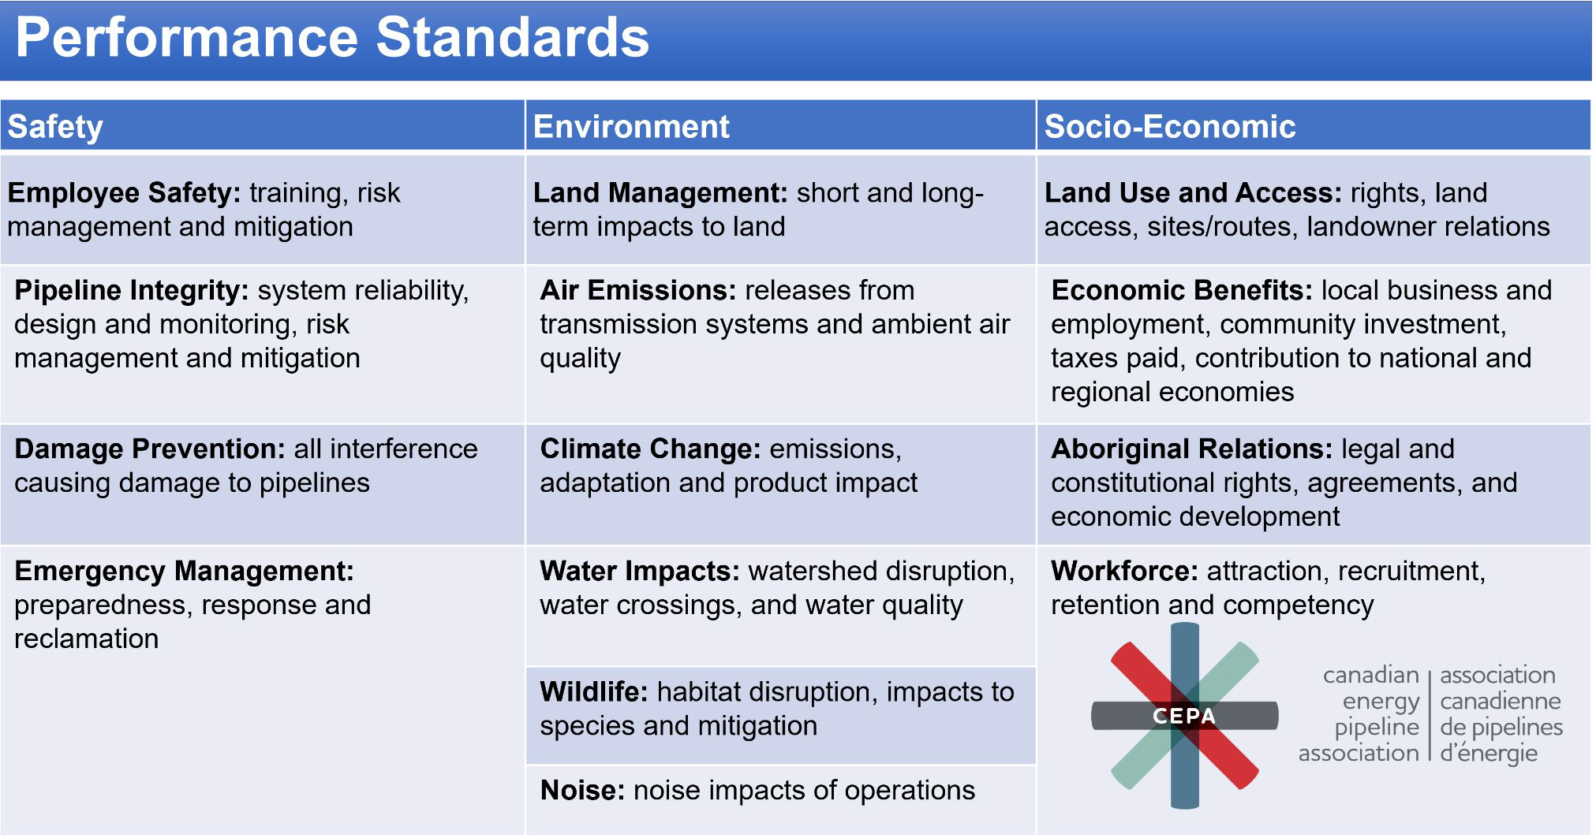
Canadian Energy Pipeline Association (CEPA)
Canadian energy companies form memberships and are organized around CEPA
Industry Overview
Pembina Pipeline
TC Energy

Slide 53
CEPA: Corrosion Prevention
Applying a protective layer around the pipes to prevent corrosion
Cathodic protection: using another piece of metal to draw corrosion away from pipelines using electrical current
Spill:
Pipeline companies are in charge of cleaning up and mitigating damage in the case of a spill Spill management:
Protecting property
Identifying and managing the site
Evaluating the hazards and risks
Selecting the appropriate protective clothing and equipment
Managing information and resource coordination
Implementing response objectives
Decontaminating
Cleaning up the site
Industry Overview
Pembina Pipeline
TC Energy

Slide 54
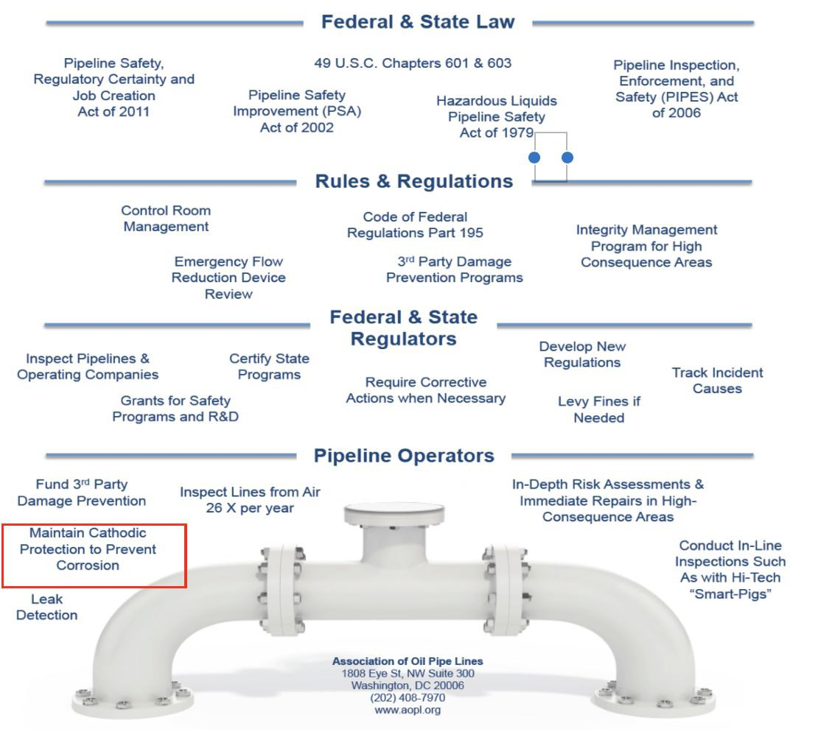
U.S. Regulatory Framework
Federal Energy Regulatory Commission (FERC):
Regulates the rates, terms, and conditions of interstate pipeline transportation
Pipeline and Hazardous Materials Safety Administration (PHMSA):
Regulates pipeline safety, integrity, and environmental protection
the Canada-U.S. Agreement on Border-Crossing Pipelines:
Outlines regulatory cooperation and standards for pipeline operations.
Industry Overview
Pembina Pipeline
TC Energy

Slide 55
Industry risks
Supply and demand risks
The market volatility for oil and gas varies with the economic and political dynamics, which include trade wars and financial crises.
Supply and demand shock can introduce significant risk for oil and gas companies which in turn, affect pipeline companies.
Hedging risks
Fluctuations in underlying assets (e.g., oil) prices
Cost risks
Operational costs
Fixed costs
Abandonment costs
High entry/exit barriers
Industry Overview
Pembina Pipeline
TC Energy

Slide 56
Industry risks
Limited market access
Canada mainly exports and imports from the U.S., future prospects of pipeline companies requires market expansion internationally
Environmental risk
Spills and leaks pose a significant damage to the environment at where pipelines pass through, tightening leaks prevention management is critical.
Substitute risk
The rise of sustainable technology such as electricity poses a threat to gas and oil industry, which directly impacts pipeline industry
Industry Overview
Pembina Pipeline
TC Energy

Slide 57

Industry risk
Social risk
The pipeline protest from Jan - Mar 2020 was held in Canada over the construction of the Coastal Gaslink Pipeline (CGL) through 190 kilometers of Wet’suwet’en First Nation territory in British Columbia.
Wet’suwet’en land defenders in Canada are at risk of serious human rights violations as the construction of the Coastal GasLink pipeline has reportedly begun under the Wedzin Kwa (Morice River) without the free, prior, and informed consent of the Wet’suwet’en Hereditary Chiefs
Moreover, expansion of fossil fuels extraction and infrastructure is against Canada’s obligation to protect human rights from the worst impacts of the climate crisis
The Wedzin Kwa (Morice River) is one of the last remaining clean sources of drinking water and salmon spawning grounds in the territory, and Wet'suwet'en Hereditary Chiefs have raised concerns that the pipeline project would damage the river.
Industry Overview
Pembina Pipeline
TC Energy

Slide 58
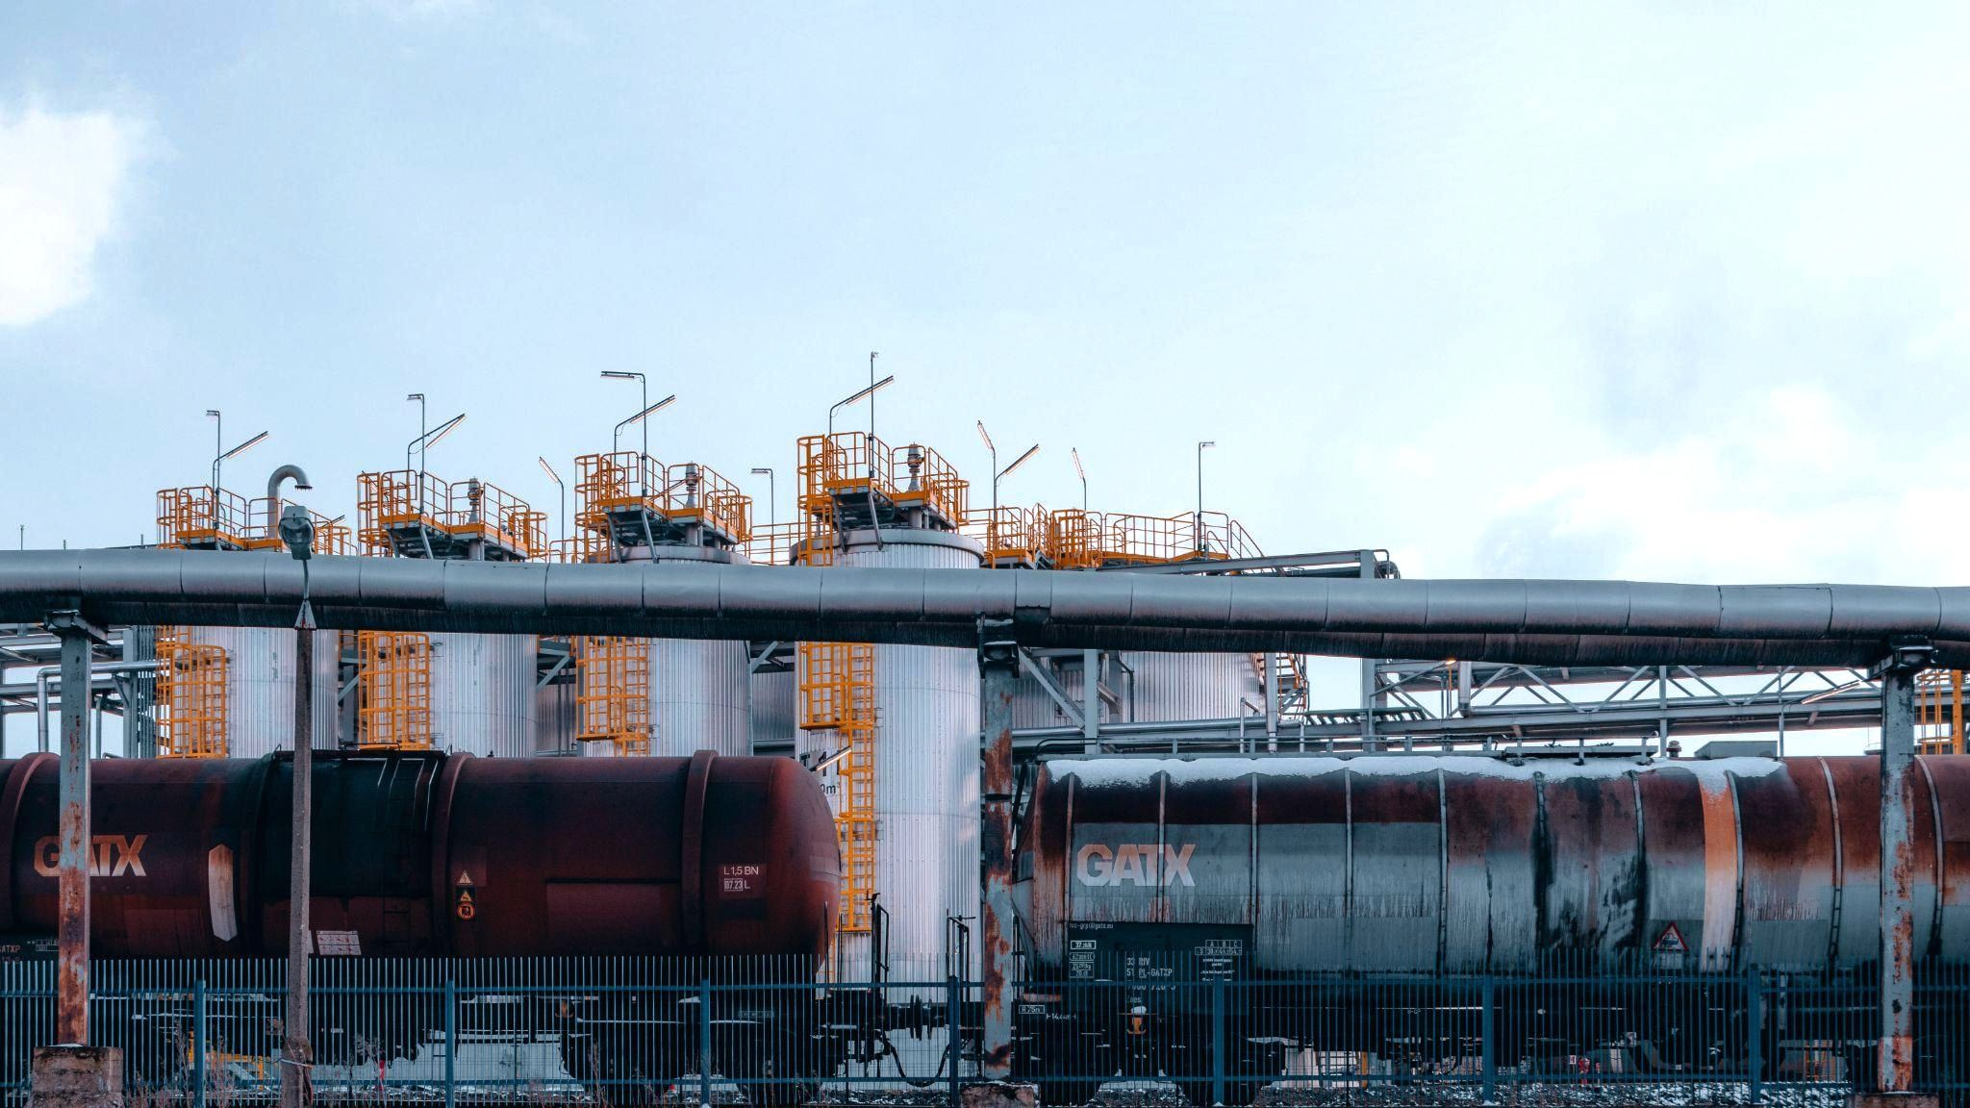

NYSE: PBA, TSX: PPL
Analyst: Nick Nguyen
58

Slide 59
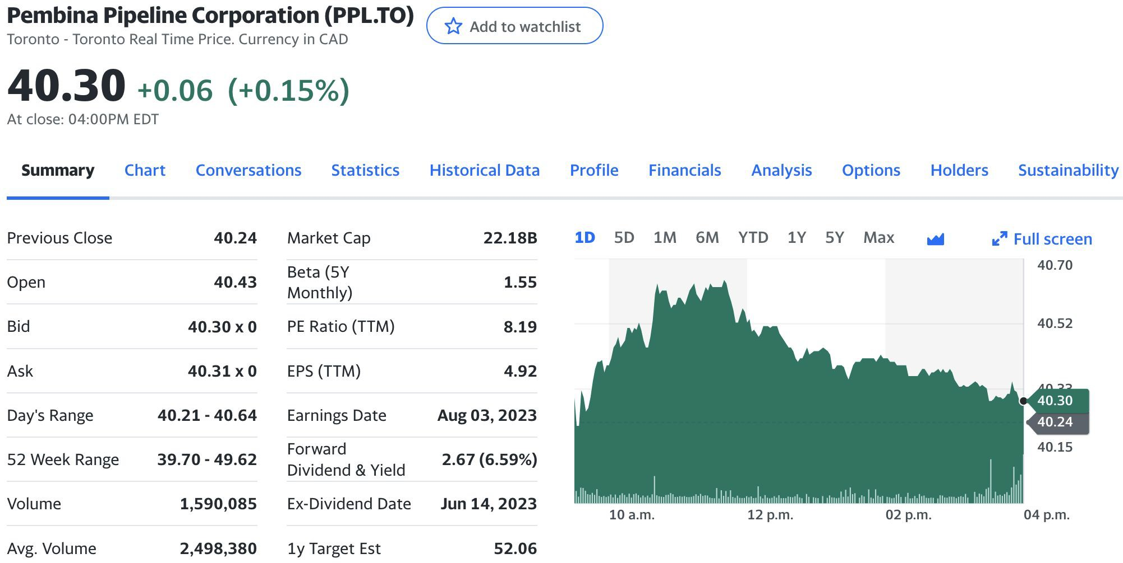
Pembina Pipeline Overview
Stock Information
Price at close July 11
$40.30
Source: Yahoo Finance
Industry Overview
Pembina Pipeline
TC Energy

Slide 60
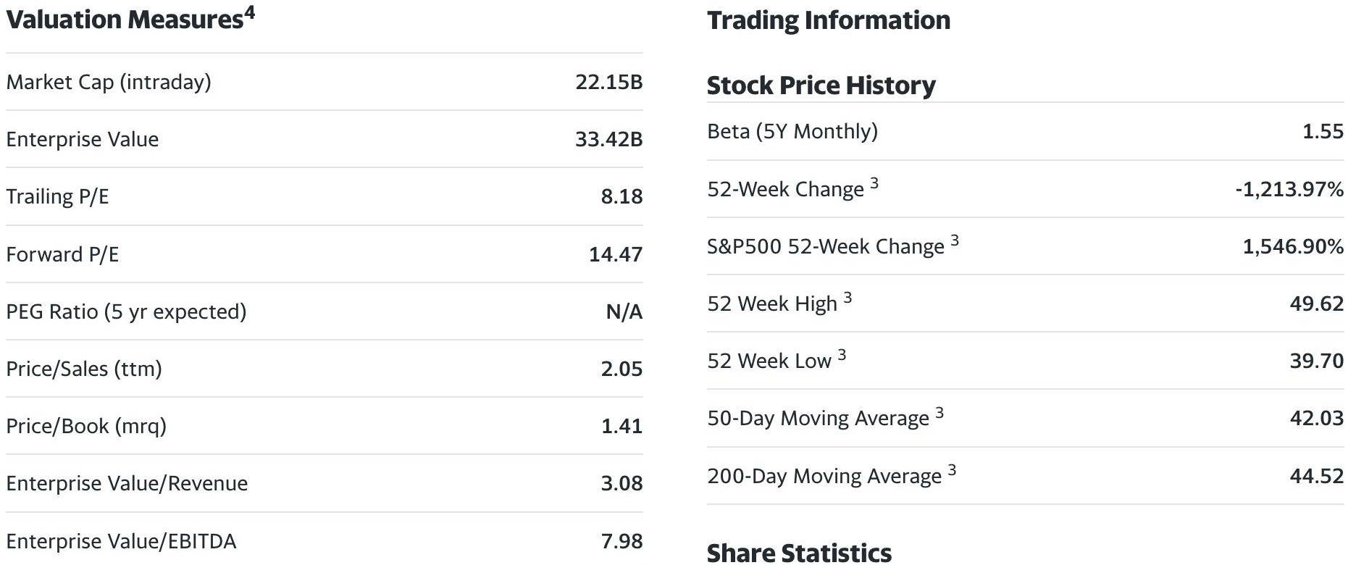
Pembina Pipeline Overview
Key Valuation Measures
Price at close July 11
$40.30
Source: Yahoo Finance
Industry Overview
Pembina Pipeline
TC Energy

Slide 61
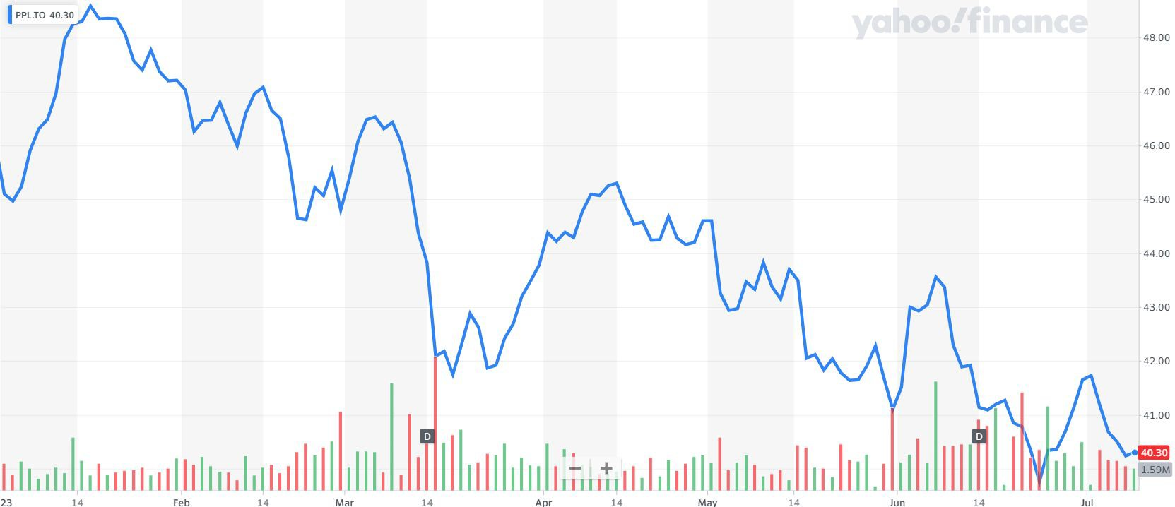
Price Chart - YTD
Price at close July 11
$40.30
Industry Overview
Pembina Pipeline
TC Energy

Slide 62
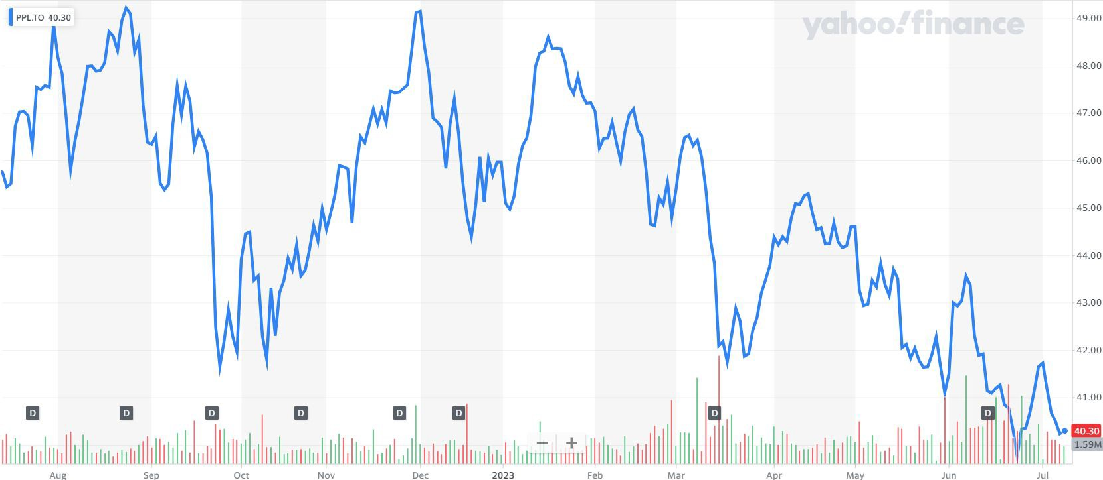
Price Chart - 1 year
Price at close July 11
$40.30
Industry Overview
Pembina Pipeline
TC Energy

Slide 63
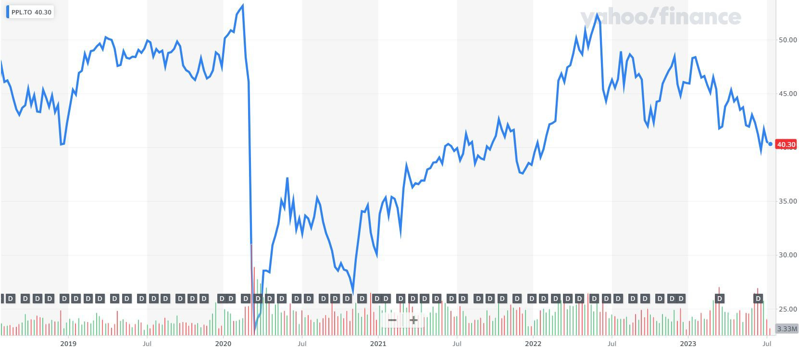
Price Chart - 5 year
Price at close July 11
$40.30
Industry Overview
Pembina Pipeline
TC Energy

Slide 64
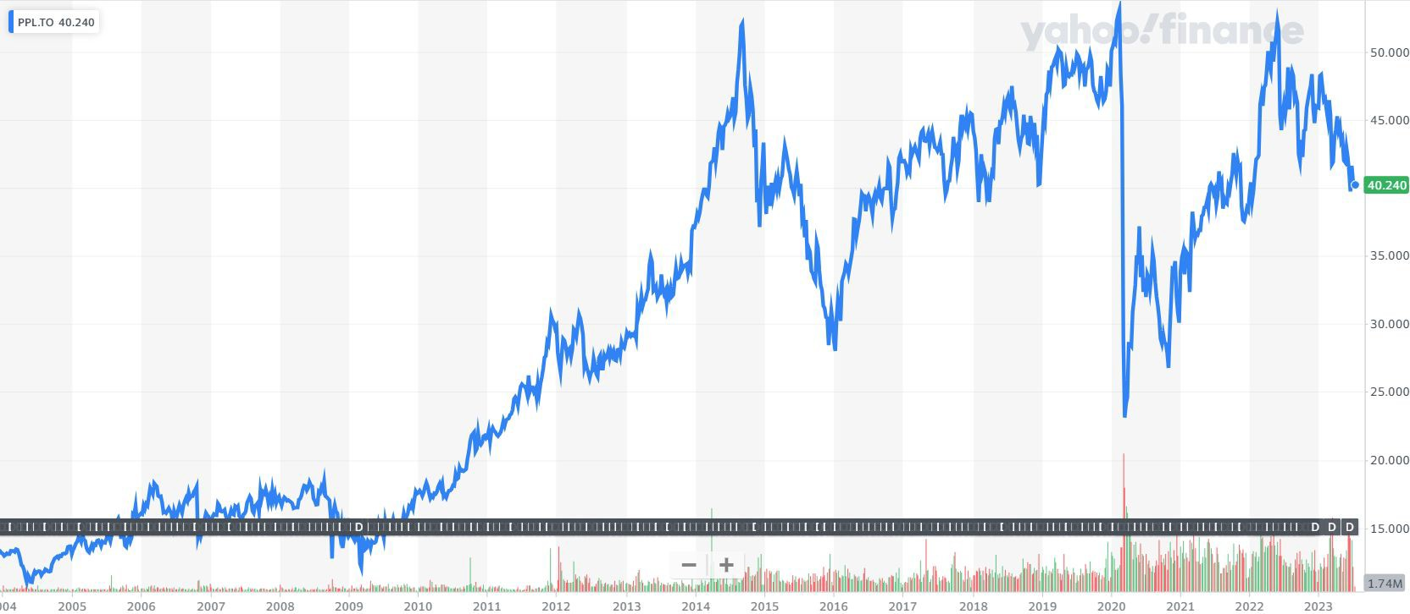
Price Chart - Max
Price at close July 11
$40.30
Industry Overview
Pembina Pipeline
TC Energy

Slide 65
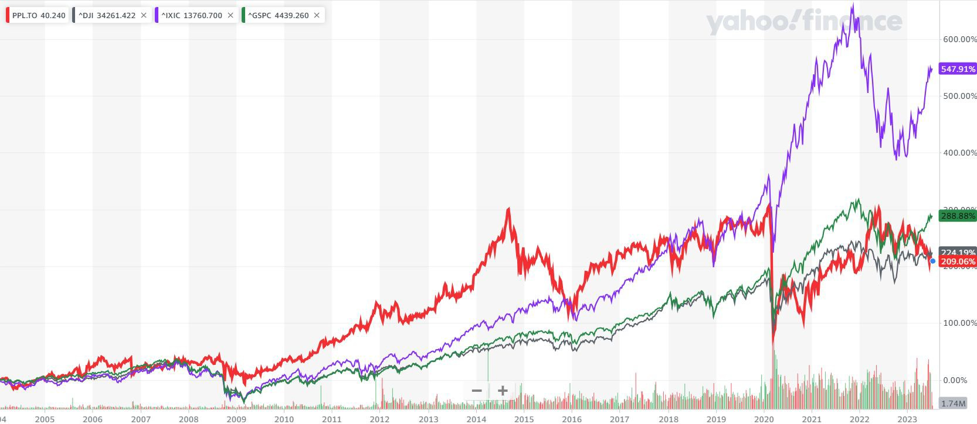
Price Chart - Pembina vs. Indices
Price at close July 11
$40.30
NASDAQ
S&P 500
Dow Jones
Pembina
Industry Overview
Pembina Pipeline
TC Energy

Slide 66
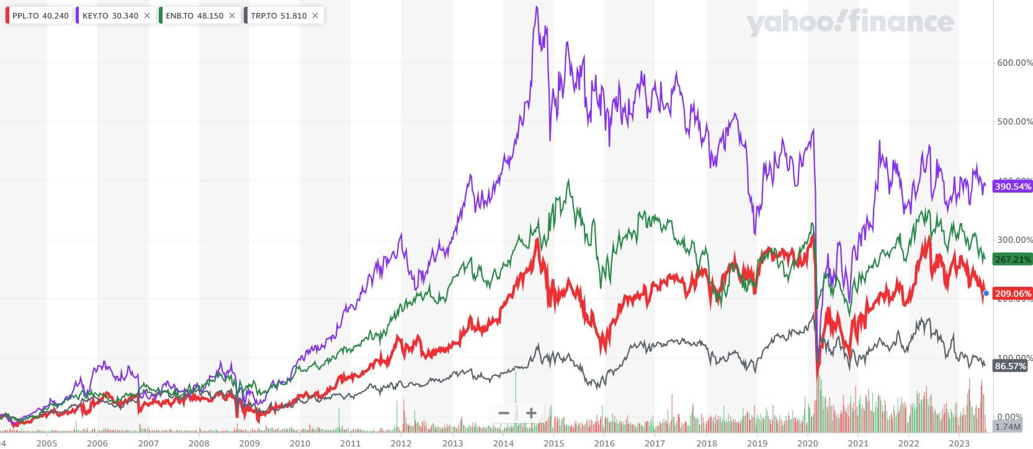
Price Chart - Pembina vs. Peers
Price at close July 11
$40.30
Keyera
Enbridge
Pembina
TC Energy
Industry Overview
Pembina Pipeline
TC Energy

Slide 67
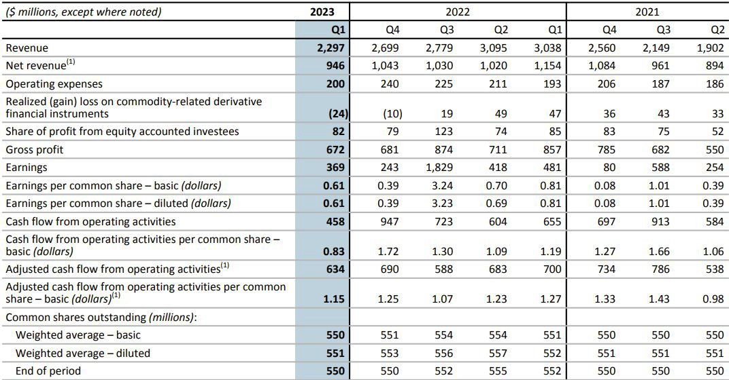
Outstanding Shares
As of end Q1, 2023
Price at close July 11
$40.30
Source: Pembina’s 2023, Q1 Interim Report
Industry Overview
Pembina Pipeline
TC Energy

Slide 68
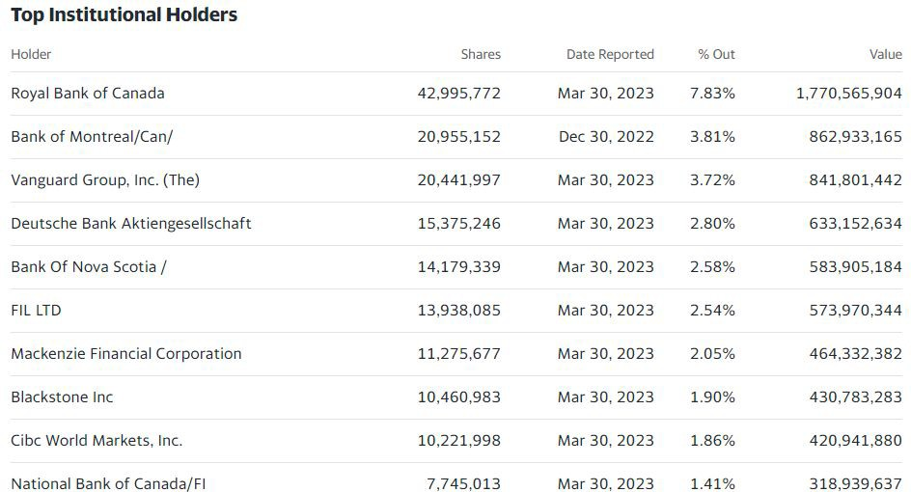
Top Shareholders
Institutional
Price at close July 11
$40.30
Source: Yahoo Finance
Industry Overview
Pembina Pipeline
TC Energy

Slide 69
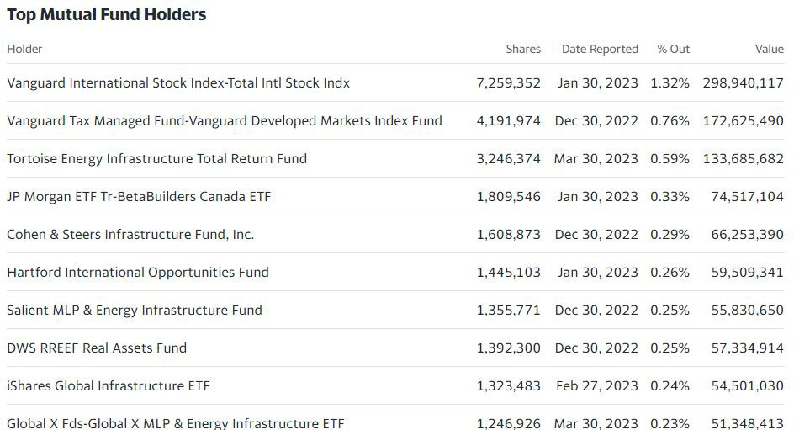
Top Shareholders
Mutual Funds
Price at close July 11
$40.30
Source: Yahoo Finance
Industry Overview
Pembina Pipeline
TC Energy

Slide 70

2022 Common Share Dividends
Price at close July 11
$40.30
In 2022, Pembina paid out
$0.21/common share per month.
Related to the closing of the PGI Transaction on Aug 15, 2022, Pembina's Board of Directors approved a $0.0075 per common share increase to its monthly common share dividend rate from $0.21 to
$0.2175 per common share per month, commencing with the dividend paid on Sep 7, 2022.
Source: Pembina Investors
Industry Overview
Pembina Pipeline
TC Energy

Slide 71

10 Year Historical Dividends
Price at close July 11
$40.30
In the past 10 years, Pembina’s dividend payout has been stable and growing.
Source: Pembina Investors
Industry Overview
Pembina Pipeline
TC Energy

Slide 72


Share Repurchase History
Price at close July 11
$40.30
Date | Value
Dec 31, 2022 | 84.0M
Sep 30, 2022 | 155.0M
Jun 30, 2022 | 66.0M
Mar 31, 2022 | 28.0M
Dec 31, 2021 | 17.0M
Source: Pembina Investors, Pembina News Releases, ycharts
“Pembina believes that the market price of its common shares trade at prices that may not adequately reflect their underlying value and the repurchase of common shares for cancellation may represent an attractive use of its financial resources.”
Industry Overview
Pembina Pipeline
TC Energy

Slide 73

Investment Highlights
Price at close July 11
$40.30
Assigned a ‘BBB’ (investment grade) credit ratings from both DBRS and S&P Global Ratings, signaling Pembina has relatively low default risk.
Over $12B dividends paid out since inception
Track record of sustainable and growing dividend history
Current dividend yield is 6.56%
Source: Pembina Investors, Yahoo Finance
Industry Overview
Pembina Pipeline
TC Energy

Slide 74

Company Overview
About Pembina
Price at close July 11
$40.30
Founded in 1954 in Calgary AB, Pembina is “a leading energy transportation & midstream service provider that has served North America's energy industry for more than 65 years.”
It owns an an integrated network of:
Hydrocarbon liquids and natural gas pipelines,
Gas gathering & processing facilities,
Oil & natural gas liquids infrastructure and logistics services,
An export terminals business.
→ Through the value chain, Pembina seeks to provide safe & reliable energy solutions that connect producers and consumers across the world, support a more sustainable future and benefit their customers, investors, employees & communities.
Source: Pembina Investors, The Globe and Mail
Industry Overview
Pembina Pipeline
TC Energy

Slide 75

Company Overview
Purpose, Values, and Strategic Priorities
Price at close July 11
$40.30
Source: Pembina Investors
Industry Overview
Pembina Pipeline
TC Energy

Slide 76

Company Overview
Timeline & Key Milestones
Price at close July 11
$40.30
1954
Pembina pipeline was incorporated
Founded 1954 in Alberta as the operator of an oil
transporting pipeline system within the Pembina field
1978
Ship the first billionth oil barrel
1997
IPO Date
Traded on the TSX under the symbol PIF.UN
2005
Developed the Midstream Business Unit
2009
Acquired cutbank complex
Marked Pembina’s strategic entry into the
natural gas gathering & processing business
Industry Overview
Pembina Pipeline
E rprise Products
TC Energy
Conclusions
nte
76

Slide 77


Company Overview
Timeline & Key Milestones (cont’d)
Price at close July 11
$40.30
2017
Acquired Veresen Inc.
Pembina’s largest acquisition in history for $9.7B
2021
Partnered with the haisla nation
Formed Cedar LNG, aiming to deliver
responsibly-developed and world-class energy
2022
Formed the pembina gas infrastructure
Through the partnership with KKR Co., Inc.
Industry Overview
Pembina Pipeline
TC Energy

Slide 78






Company Overview
3 Operating Divisions
Price at close July 11
$40.30
18,000 km
Pembina safely operates approx. 18,000 kilometers of conventional, transmission, and
oil sands & heavy oil pipelines across North America.
PIPELINES
FACILITIES
MARKETING
& NEW VENTURES
Value-added commodity marketing activities, incl.:
Buying, selling, and connecting hydrocarbon production to new demand locations
Optimizing storage opportunities (through leasing PPL’s rail fleet & rail logistics)
Provide transportation services to customers. Incl.:
Conventional, oil sands, and transmission pipeline systems
Crude oil storage
Terminalling business & related infrastructure serving various markets and basins across NA
Includes:
Processing & fractionation services
A liquefied propane export facility on Can’s West Coast
→ process & produce natural gas & NGL services
A bulk marine terminal in the Port of Vancouver
Industry Overview
Pembina Pipeline
TC Energy

Slide 79

Company Overview
The Pipelines Division - 3 types of Pipelines
Price at close July 11
$40.30
Conventional Pipelines
Oil Sands & Heavy Oil Pipelines
Transmission Pipelines
Include pipelines & terminalling hubs that gather and transport light & medium crude oils, condensate and natural gas liquids from western Alberta & northeast BC to Edmonton, AB for further processing/transportation on downstream pipelines.
Include pipelines that transport heavy & synthetic crude oils, produced within Alberta.
Also offer associated storage, terminalling, and rail services.
Include pipelines that transport natural gas, ethane, and condensate across Can & US.
Provide linkages between Pembina’s upstream & downstream assets across North America, enabling integrated customer service offerings.
Source: Pembina Filings
Industry Overview
Pembina Pipeline
TC Energy

Slide 80

Company Overview
The Pipelines Division - 3 types of Pipelines
Price at close July 11
$40.30
Source: Pembina Filings
Industry Overview
Pembina Pipeline
TC Energy

Slide 81

Company Overview
Pembina’s Diversified & Integrated Transportation and Midstream Assets
Price at close July 11
$40.30
Source: Pembina Investors
Industry Overview
Pembina Pipeline
TC Energy

Slide 82
Company Overview
Price at close July 11
The Facilities Division
$40.30
The Facilities Division:
Fully integrates with the Pipeline division to provide Pembina’s customers with the processing & fractionation services for natural gas, natural gas liquids (NGLs), and condensates (refer to slide 33 for the fractionation process).
Includes a bulk marine terminal in the Port of Vancouver
Total Capacity: approx. 354 mbpd of NGL fractionation, 21 mmbbls of cavern storage
Gas Services revenue decreased 20% largely due to the change in ownership of Pembina’s formerly wholly-owned
Field-based Gas Processing Assets (including the Cutbank Complex, the Saturn Complex, the Resthaven Facility, the Duvernay Complex, and the Saskatchewan Ethane Extraction Plant) as of Aug 15, 2022 as part of the PGI Transaction.
NGL Services revenue increased 6% due to higher recoveries at the Redwater complex as a result of higher power and fuel costs and the Prince Rupert Terminal being placed into service in March 2021
Source: Pembina Filings
Industry Overview
Pembina Pipeline
TC Energy

Slide 83

Company Overview
Price at close July 11
The Marketing & New Ventures Division
$40.30
The Marketing & New Ventures Division:
Identify opportunities to connect hydrocarbon production to new demand locations through infrastructure development
⇒ Goal: strive to maximize the value of hydrocarbon liquids & natural gas from the basins where PPL operates.
Undertake value-added commodity marketing activities, including:
Buying & selling products (natural gas, ethan, propane, butane, condensate, crude oil & electricity)
Commodity arbitrage
Optimizing storage & facilities operations, by leasing the Company’s expansive rail fleet & logistics capabilities
Net revenue from the Marketing & New Ventures increased 40% YoY resulting from the higher prices across the crude oil complex, combined with contributions from natural gas marketing.
Source: Pembina Filings
Industry Overview
Pembina Pipeline
TC Energy

Slide 84



 | Company Overview |  | Price at close July 11
 | FY 2021-22 Revenue Breakdown by Divisions |  | $40.30
 |  | 2022 | 2021
 | Pembina’s Revenue Breakdown by Divisions (2021-22)
Source: Pembina Filings
Industry Overview
Pembina Pipeline
TC Energy

Slide 85

Company Overview
Business Model - Revenue Breakdown by Contract Nature
Price at close July 11
$40.30
3 types of revenue sources:
Take-or-Pay contract → used for PPL’s transportation, processing, fractionation, terminalling & storage services
A provision in the contract that requires the buyer to either take a specified amount of goods from the seller (PPL) by a certain date or pay a fine.
Common in the energy sector, as it benefits the supplier by ↓ risk of losing money on capital invested upfront.
Fee-for-Service → the revenues that is not subject to take-or-pay commitments ⇒ also used to satisfies PPL’s performance obligations for transportation, processing, fractionation, terminalling & storage services
Product Sales → earn revenue from the sales of hydrocarbon products to demand locations.
Industry Overview
Pembina Pipeline
TC Energy

Slide 86

Company Overview
FY ‘21 - ‘22 Capital Expenditure
Price at close July 11
$40.30
Along with the positive FCF (examined later), the CapEx expense is necessary for Pembina to sustain and keep growing itself in the long run.
Source: Pembina Filings
Industry Overview
Pembina Pipeline
TC Energy

Slide 87

Company Overview
The Pembina Store - Current Value Chain
Price at close July 11
$40.30
Note:
Ethane (C2/C₂H₆) Propane (C3/C₃H₈) Butane (C4/C₄H₁₀) Pentane (C5/C₅H₁₂)
Source:
Pembina Investors
Industry Overview
Pembina Pipeline
TC Energy

Slide 88

Company Overview
What the future Pembina Store could look like?
Price at close July 11
$40.30
Source: Pembina
Investors
Industry Overview
Pembina Pipeline
TC Energy

Slide 89


Company Overview
Competitive Advantages
Price at close July 11
$40.30
Pembina's competitive advantage stems from its integrated value chain, which allows gathering and processing facilities to become part of a
well-head to market infrastructure solution, benefiting from seamless operational and commercial alignment.
- Pembina FY2022 Annual Filing
Source: Pembina Filings
Industry Overview
Pembina Pipeline
TC Energy

Slide 90
Corporate Strategy
Notable Acquisitions – Inorganic Growth Strategy through Acquisitions
Price at close July 11
$40.30
1991 - acquired Peace Pipe Line.
1996 - acquired half of the Bonnie Glen System, a 250 km long network serving oil fields in Alberta.
2000 - acquired Federated Pipe Lines from the Imperial Oil for $340m and British Columbia pipeline assets
of the Western Facilities Fund.
2001 - acquired Alberta Oil Sands Pipeline Ltd.
2003 - acquired 50% non-operated interest in the Fort Saskatchewan Ethylene Storage L.P.
2009 - acquired Cutbank Complex for $300m cash, marking Pembina’s strategic entry into the natural gas gathering and processing business beyond the original pipelines.
2016 - acquired Strategic Midstream assets for $556m and a dividend increase.
2017 - acquired Veresen Inc. for $9.7b (Pembina’s largest acquisition in history)
2019 - acquired Kinder Morgan Canada & Cochin Pipeline for $4.35b (provide exposure to US market)
⇒ These demonstrate Pembina’s inorganic strategy for growth through acquisitions, allowing Pembina to:
Expand into a new business activities (natural gas gathering & processing business)
Provide Pembina with existing infrastructure and facilities to complete its integrated value chain
Expand its operations in the market across North America.
Source: Pembina History
Industry Overview
Pembina Pipeline
TC Energy

Slide 91
About the Pembina Gas Infrastructure (PGI) Transaction
Price at close July 11
$40.30
Aug 15, 2022: Pembina announced a joint venture transaction with KKR & Co., Inc. (KKR), an US global investment company, to combine their Western Canadian natural gas processing assets into a single, new joint venture entity, Pembina Gas Infrastructure Inc. ("PGI").
Pembina contributed to PGI its wholly-owned Field-based Gas Processing Assets, which include the Cutbank Complex, the Saturn Complex, the Resthaven Facility, the Duvernay Complex and the Saskatchewan Ethane Extraction Plant, as well as its 45% interest in Veresen Midstream.
Pembina owns 60% of PGI & operates and manages PGI facilities, while KKR owns 40%.
Purpose: to serve customers from the Montney (northeast BC) to Duvernay (central Alberta)
Following the PGI transaction, Pembina’s Board of Directors approved a $0.0075 increase in per common share monthly dividend to $0.2175, starting Oct 14, 2022.
Benefits: the transaction is expected to provide a capacity of 5 billion cubic feet per day, enhancing Pembina’s market share and capacity.
Pembina also recognized a $1.1B gain on the PGI transaction, driving its FY ‘22 revenue.
Source: Pembina Investors, NewsWire
Industry Overview
Pembina Pipeline
TC Energy

Slide 92

About the Pembina Gas Infrastructure (PGI) Transaction
PGI’s Strategic Advantages
Price at close July 11
$40.30
Source: Pembina Investors
Industry Overview
Pembina Pipeline
TC Energy

Slide 93

About the Pembina Gas Infrastructure (PGI) Transaction
PGI Transaction significantly drove Pembina’s FY22 Earnings
Price at close July 11
$40.30
Source: Pembina Investors
Industry Overview
Pembina Pipeline
TC Energy

Slide 94

About the Pembina Gas Infrastructure (PGI) Transaction
PGI Transaction significantly drove Pembina’s FY22 Earnings
Price at close July 11
$40.30
FY ‘22 earnings was driven by the gain on PGI Transaction
Source: Pembina Investors
Industry Overview
Pembina Pipeline
TC Energy

Slide 95

Company Overview
Growth Opportunities Going Forward - the Pipelines Division
Price at close July 11
$40.30
Phase VIII Peace Pipeline Expansion
Capital budget:
In-service date:
Benefits: “upgrades located throughout the Peace Pipeline system. Phase VIII will add approximately 235,000 bpd of incremental capacity between Gordondale, Alberta and La Glace, Alberta, as well as approximately 65,000 bpd of capacity between La Glace, Alberta and the Namao hub near Edmonton, Alberta.” ⇒ increase the capacity of the Pipeline Division.
$530m
first half 2024 (expected)
Source: Pembina Investors
Industry Overview
Pembina Pipeline
TC Energy

Slide 96


Company Overview
Growth Opportunities Going Forward - the Facilities Division
Price at close July 11
$40.30
RFS IV
Capital budget: $460m
Benefits: “The project includes additional rail loading capacity at the Redwater Complex. It will leverage the design, engineering and operating best practices of its existing facilities.”
⇒ increase capacity of the Facilities Division & add additional capacity to PPL’s integrated value chain.
In-service date: first half 2026 (expected)
Source: Pembina Investors, Pembina’s Media Centre
Industry Overview
Pembina Pipeline
TC Energy
96

Slide 97
Company Overview
Growth Opportunities Going Forward - the Marketing & New Ventures Division
Price at close July 11
$40.30
Recent partnership with the Haisla First Nation on the Cedar LNG Project
Capacity:
In-service date:
Benefits:
3 million tonne per annum floating LNG first half 2024 (expected)
Produce industry-leading low-carbon, cost-competitive Canadian LNG for overseas markets.
Provide a valuable outlet for Western Canadian Sedimentary Basin (WCSB) natural gas to access global markets, achieving higher prices for Canadian producers, contributing to lower overall emissions, and enhancing global energy security.
Provide Pembina with a sustainable stream of cash flow with lower construction & execution risk.
Source: Pembina Investors
Industry Overview
Pembina Pipeline
TC Energy

Slide 98
Company Overview
Key Risks
Price at close July 11
$40.30
Commodity Price Risk
Counterparty Credit Risk
Commodity price volatility & a substantial decline in the prices of these commodities could adversely affect Pembina’s financial results.
Pembina uses derivative instruments to stabilize its financial results.
The risk that the counterparty to a derivative contract fails to honor their obligations
→ financial losses for Pembina.
Pembina uses take-or-pay contracts for its transportation, gas processing, fractionation, terminalling & storage services
Regulatory & Legislative Risk
Expansion & Acquisition Risk
E.g., regulatory blocks to proposed additional projects. Or the regulatory authorities may also establish conditions under which the common carrier must accept and carry product, including the tariffs that may be charged.
Failure to develop efficiencies of scale and obtain the synergies with the new expansion projects, new ventures, or acquisitions.
Industry Overview
Pembina Pipeline
TC Energy

Slide 99


Executive Management
Price at close July 11
$40.30
Scott Burrows
President & Chief Executive Officer
Scott Burrows
President & Chief Executive Officer
Source: Pembina Investors
Industry Overview
Pembina Pipeline
TC Energy

Slide 100
Executive Management
Price at close July 11
$40.30
Scott Burrows
President & Chief Executive Officer
BCom in Finance (UBC), CFA ® Charterholder
Joined Pembina in 2010, appointed President & CEO in Feb 2022
Jan 2015 - Nov 2021, he served as CFO of Pembina for approximately 7 years, overseeing the firm’s financial operations, investor relations, treasury, tax, risk management, corporate planning, corporate development, and capital market financings.
Nov 2010 - Dec 2014, he served as VP, Capital Markets and VP, Corporate Development & Investor Relations, guiding Pembina through corporate-level financial analysis of business opportunities, strategic development, planning, acquisitions, and divestitures as well as overseeing Pembina’s investor relations and related marketing initiatives.
Prior to joining Pembina in 2010, he had had approx. 7 years of energy-focused experience working as Associate Director, Scotia Capital in Calgary.
Source: Pembina Investors
Industry Overview
Pembina Pipeline
TC Energy

Slide 101
Price at close July 11
$40.30
Scott brings the critical capabilities and qualities we need to build on our more than 65-year history, develop our world-class team, strengthen relationships with our stakeholders and deliver value from our core businesses. Just as importantly, he has the strategic vision and experience to advance our position as a truly differentiated, integrated leader in the midstream space. The Board looks forward to continuing to work with Scott and the rest of the Pembina leadership team.
Randy Findlay
Past Chair of the Pembina Board of Directors
Source: NewsWire
Industry Overview
Pembina Pipeline
TC Energy

Slide 102

Executive Management
Price at close July 11
$40.30
Jaret Sprott
Senior Vice President & Chief Operating Officer
Bachelor of Applied Science in Petroleum Systems Engineering (U of Regina), and a member of the Association of Professional Engineers and Geoscientists of Alberta (APEGA®).
Joined in Jan 2015, appointed Senior Vice President & COO in 2022, overseeing:
The Pipelines Division, which provides customers with pipeline transportation, terminalling, storage and rail services in key market hubs in Canada and the United States for crude oil, condensate, natural gas liquids and natural gas.
Pembina's joint ventures including Alliance Pipeline, Aux Sable, and Pembina Gas Infrastructure.
He is a member of the boards of Cedar LNG & Pembina Gas Infrastructure.
Prior to this role, he served as SVP & COO, Facilities and VP, Gas Services managing the safe, reliable, responsible management of gas processing, fractionation, rail, storage, and the firm’s import/export assets.
Source: Pembina Investors
Industry Overview
Pembina Pipeline
TC Energy

Slide 103

Executive Management
Price at close July 11
$40.30
Janet Loduca
SVP, External Affairs & Chief Legal and Sustainability Officer
Doctor of Law (University of San Francisco), and
Bachelor of Arts in Political Science (University of Washington)
Joined Pembina in Nov 2020 and was appointed as Senior Vice President External Affairs, Chief Legal & Sustainability Officer in Apr 2021, overseeing Pembina's Legal, Land, Environment and Regulatory, Community and Indigenous Affairs, Government Relations, Communications and Enterprise Risk departments, as well as leads long-term sustainability strategy.
Previously, Janet has ~26 years of experience in the senior roles, including:
Pacific Gas & Electric Company: SVP & General Counsel, VP Investor Relations, VP Safety, Health and Environment, VP Corporate Relations, Chief of Staff to the President of PG&E
→ she was instrumental in leading PG&E through the San Bruno pipeline explosion in Sep 2010.
Beveridge & Diamond PC and U.S. Department of Justice: Attorney
Source: Pembina Investors
Industry Overview
Pembina Pipeline
TC Energy

Slide 104

Executive Management
Price at close July 11
$40.30
Cameron Goldade
Senior Vice President & Chief Financial Officer
MBA (University of Toronto), BCom (University of Calgary)
Joined Pembina in Jan 2015 and was appointed CFO in Sep 2022, after serving as Interim CFO since Nov 2021.
Jan 2015 - Nov 2021, he served as VP, Capital Markets, overseeing the Company’s corporate development, corporate planning, investor relations, treasury, and cash management functions.
Prior to joining Pembina, Cameron spent 11 years in energy-focused roles, including Scotia Capital and Scotia Waterous (the oil and gas advisory business arm of Scotiabank)
→ knowledgeable in the energy industry, including petroleum, natural gas and other product pipelines and related infrastructure facilities.
Source: Pembina Investors
Industry Overview
Pembina Pipeline
TC Energy

Slide 105



Executive Management
Price at close July 11
$40.30
Chris Scherman
SVP, Marketing & Strategy Officer
Eva Bishop
SVP & Corporate Services Officer
Stuart (Stu) Taylor
SVP & Corporate Development Officer
Oversees Pembina’s commodity marketing activities, incl. buying & selling commodities, commodity arbitrage & optimization, and rail & marine logistics.
Juris Doctor (USask), Bachelor’s (UCalgary)
Oversees the crisis management, compliance, enterprise risk management, strategy development and ESG.
Responsible for Pembina’s investments in energy transition & the export of energy to global markets
Source:
Pembina Investors
Master of Laws in European & Int’l Economic Law (U of Edinburgh)
BSc in Geography (UCalgary)
Industry Overview
Pembina Pipeline
TC Energy
105

Slide 106












Board Members
11/12 Board members are independent within the meaning of Canadian securities laws
Price at close July 11
$40.30
Henry W. Sykes
Chair of the Board
Anne-Marie Ainsworth
Safety Environment Committee
Scott Burrows
President & CEO
Cynthia Carroll
Chair, Safety Environment
Ana Dutra
Audit Committee
Robert G. Gwin
Chair, Human Resources
Maureen E. Howe
Chair, Audit Committee
Gordon J. Kerr
Audit Committee
David LeGresley
Chair, Governance & CSR
Andy J. Mah
Audit Committee
Leslie O'Donoghue
Audit Committee
Bruce D. Rubin
Human Resources
Source: Pembina Investors
Industry Overview
Pembina Pipeline
TC Energy

Slide 107

Balance Sheet (10-Q), Jan-Mar 2023
Financial Statement Analysis
Price at close July 11
$40.30
Industry Overview
Pembina Pipeline
TC Energy

Slide 108

Balance Sheet (10-Q), Jan-Mar 2023 (cont’d)
Financial Statement Analysis
Price at close July 11
$40.30
Industry Overview
Pembina Pipeline
TC Energy

Slide 109

Balance Sheet (10-K)
Financial Statement Analysis
Price at close July 11
$40.30
Industry Overview
Pembina Pipeline
TC Energy

Slide 110

Balance Sheet (10-K) (cont’d)
Financial Statement Analysis
Price at close July 11
$40.30
Industry Overview
Pembina Pipeline
TC Energy

Slide 111

Income Statement (10-K)
Financial Statement Analysis
Price at close July 11
$40.30
FY ‘22
earnings was driven by the gain on PGI Transaction
Industry Overview
Pembina Pipeline
TC Energy

Slide 112

Income Statement (10-Q)
Financial Statement Analysis
Price at close July 11
$40.30
Industry Overview
Pembina Pipeline
TC Energy

Slide 113

Cash Flow Statement (10-K)
Financial Statement Analysis
Price at close July 11
$40.30
Positive & growing FCF trends from FY ‘21-‘22.
Industry Overview
Pembina Pipeline
TC Energy

Slide 114

Cash Flow Statement (10-K) (cont’d)
Financial Statement Analysis
Price at close July 11
$40.30
In 2022, Pembina allocated approx.:
① 333m (~10%) to repurchase common shares
② 1525m (~50%) to pay dividends to common shareholders
③ 605m (~20%) for
growth CapEx
→ funded from CFO & bank borrowings
Industry Overview
Pembina Pipeline
TC Energy

Slide 115

Cash Flow Statement (10-Q)
Financial Statement Analysis
Price at close July 11
$40.30
Industry Overview
Pembina Pipeline
TC Energy

Slide 116

Cash Flow Statement (10-Q) (cont’d)
Financial Statement Analysis
Price at close July 11
$40.30
Industry Overview
Pembina Pipeline
TC Energy

Slide 117
Recommendation
Price at close July 11
$40.30
Expansion projects in progress → prospective in the future
Competitive advantages stem from Pembina’s integrated value chain
Positive growing FCF and cash flow from operations able to cover dividends, common shares repurchases, and growth & sustainable CapEx
BUY
Industry Overview
Pembina Pipeline
TC Energy

Slide 118



NYSE: EPD
Analyst: Daniel Demch

Slide 119
About Enterprise Products Partners
Enterprise Products Partners L.P. is a publicly traded Master Limited Partnership listed on the New York Stock Exchange (NYSE Ticker: EPD). Their origins began with Enterprise Products Company, formed in 1968 by Dan Duncan and two partners as a wholesale marketer of natural gas liquids. Today, our integrated energy infrastructure network provides midstream energy services to producers and consumers of natural gas, natural gas liquids, crude oil, refined products and petrochemicals. We link producers from some of the largest North American supply basins with domestic consumers and international markets.
Industry Overview
Pembina Pipeline
TC Energy

Slide 120
Master Limited Partnerships
An MLP is treated as a limited partnership for tax purposes, which is a significant tax advantage for investors. A limited partnership has a pass-through, or flow-through, tax structure. This means that all profits and losses are passed through to the limited partners. The MLP itself pays no taxes on its revenues, as most incorporated businesses do. Instead, the limited partners pay income taxes only on their portions of the MLP's earnings.
To maintain its pass-through status, at least 90% of the MLP's income must be qualifying income. Qualifying income includes income realized from the exploration, production, or transportation of natural resources or real estate.
Shareholders must pay personal taxes on the income from their holdings. Flow-through entity status (and the absence of double taxation), more capital is available for future projects. The availability of capital keeps the MLP competitive in its industry
Industry Overview
Pembina Pipeline
TC Energy

Slide 121

Overview
Industry Overview
Pembina Pipeline
TC Energy

Slide 122

Overview
Industry Overview
Pembina Pipeline
TC Energy

Slide 123

Price Chart - 6 Month/YTD
Industry Overview
Pembina Pipeline
TC Energy

Slide 124

Price Chart - 1 Year
Industry Overview
Pembina Pipeline
TC Energy

Slide 125

Price Chart - 5 Year
Industry Overview
Pembina Pipeline
TC Energy

Slide 126

Price Chart - Max
Industry Overview
Pembina Pipeline
TC Energy

Slide 127

Price Chart - EPD vs. Indices - Max
Industry Overview
Pembina Pipeline
TC Energy

Slide 128

Price Chart - EPD vs. Peers - Max
Industry Overview
Pembina Pipeline
TC Energy

Slide 129

Total Return - EPD vs Energy Sector vs S&P 500
Industry Overview
Pembina Pipeline
TC Energy

Slide 130


Shareholders
Industry Overview
Pembina Pipeline
TC Energy

Slide 131

Shareholders
Industry Overview
Pembina Pipeline
TC Energy

Slide 132

System Map
Industry Overview
Pembina Pipeline
TC Energy

Slide 133

System Map
Industry Overview
Pembina Pipeline
TC Energy

Slide 134

System Map
Focus on Texas
Industry Overview
Pembina Pipeline
TC Energy

Slide 135

Long Run Strength
Industry Overview
Pembina Pipeline
TC Energy

Slide 136



The Enterprise Model
Industry Overview
Pembina Pipeline
TC Energy

Slide 137
Timeline
1968
Enterprise Products Founded
1998
EPD INITIAL PUBLIC OFFERING
2004
mERGER WITH GULFTERRA
2008
2010
mERGER WITH teppco
Merger with Enterprise GP Holdings
Industry Overview
Pembina Pipeline
TC Energy

Slide 138

Value Chain Model
Earns Fees Delivering Raw Materials Essential to Everyday Life
Industry Overview
Pembina Pipeline
TC Energy

Slide 139

Indicative Attribution of Segment GOM
Industry Overview
Pembina Pipeline
TC Energy

Slide 140

Historical Gross Operating Margin by Segment
Industry Overview
Pembina Pipeline
TC Energy

Slide 141

Historical Gross Operating Margin by Segment
Industry Overview
Pembina Pipeline
TC Energy

Slide 142

NGL Pipelines & Services Segment
Industry Overview
Pembina Pipeline
TC Energy

Slide 143

Crude Oil Pipelines & Services Segment
Industry Overview
Pembina Pipeline
TC Energy

Slide 144

Natural Gas Pipelines & Services Segment
Industry Overview
Pembina Pipeline
TC Energy

Slide 145

Petrochemical & Refined Products Services Segment
Industry Overview
Pembina Pipeline
TC Energy

Slide 146

Historical Adjusted EBITDA
Industry Overview
Pembina Pipeline
TC Energy

Slide 147

Return on Invested Capital
Industry Overview
Pembina Pipeline
TC Energy

Slide 148

Operating Cash Flow per Unit
Industry Overview
Pembina Pipeline
TC Energy

Slide 149

Capital Expenditure 15-year History
Industry Overview
Pembina Pipeline
TC Energy

Slide 150

Distribution Stability & Growth
Industry Overview
Pembina Pipeline
TC Energy

Slide 151

Dividend History
Dividend Payouts 25-year
Industry Overview
Pembina Pipeline
TC Energy

Slide 152

Dividend History
Dividend Yield 23-year
Industry Overview
Pembina Pipeline
TC Energy

Slide 153

Capital Investments (completed by 2025)
Industry Overview
Pembina Pipeline
TC Energy

Slide 154

Growth and Sustaining Capital Investments
Industry Overview
Pembina Pipeline
TC Energy

Slide 155

Growth Capital
Industry Overview
Pembina Pipeline
TC Energy

Slide 156

Navitas Midstream Acquisition
Industry Overview
Pembina Pipeline
TC Energy

Slide 157

Share Repurchase Program
Industry Overview
Pembina Pipeline
TC Energy

Slide 158

Hedging Positions
Industry Overview
Pembina Pipeline
TC Energy

Slide 159

Storm Damage Risk
Industry Overview
Pembina Pipeline
TC Energy

Slide 160

Debt Obligations and Debt Rating
Industry Overview
Pembina Pipeline
TC Energy

Slide 161

Core Strategies to Capture Volatility
Industry Overview
Pembina Pipeline
TC Energy

Slide 162

Basin Outlook
Industry Overview
Pembina Pipeline
TC Energy

Slide 163

Expansions
Industry Overview
Pembina Pipeline
TC Energy

Slide 164

Expansions
Industry Overview
Pembina Pipeline
TC Energy

Slide 165

Expansions
Industry Overview
Pembina Pipeline
TC Energy

Slide 166

Expansions
Industry Overview
Pembina Pipeline
TC Energy

Slide 167

Expansions
Industry Overview
Pembina Pipeline
TC Energy

Slide 168

Expansions
Industry Overview
Pembina Pipeline
TC Energy

Slide 169

Expansions
Industry Overview
Pembina Pipeline
TC Energy

Slide 170

Sea Port Oil Terminal (SPOT) Project
Industry Overview
Pembina Pipeline
TC Energy

Slide 171

Sea Port Oil Terminal (SPOT) Project
Industry Overview
Pembina Pipeline
TC Energy

Slide 172









Executive Leadership
*Enterprise GP Holdings was acquired by Enterprise Products Partners in 2010*
Industry Overview
Pembina Pipeline
TC Energy

Slide 173
Executive Leadership
Co-Chief Executive Officer since January 2020 and has been a director of Enterprise GP since September 2011
previously served as President and Chief Financial Officer of Enterprise GP from August 2018 to January 2020, President of Enterprise GP from January 2016 to August 2018 and as Chief Administrative Officer of Enterprise GP from April 2015 to January 2016. He served as Executive Vice President and Chief Financial Officer of Enterprise GP from November 2010 to March 2015 and as Executive Vice President and Chief Financial Officer of EPGP from August 2007 to November 2010. He also served as President and Chief Executive Officer of DEP GP from April 2010 until September 2011 and as Executive Vice President and Chief Financial Officer of DEP GP from August 2007 to April 2010. He served as a director of DEP GP from September 2006 until September 2011
Chairman of the Board of the Energy Infrastructure Council
Joined Enterprise in 1999
Certified Public Accountant
Master's Degree from Louisiana Technical University
Industry Overview
Pembina Pipeline
TC Energy

Slide 174
Executive Leadership
Co-Chief Executive Officer since January 2020 and has been a director of Enterprise GP since November 2010
serves as Co-Chairman of the Capital Projects Committee
previously served as Chief Executive Officer of Enterprise GP from January 2016 to January 2020, Chief Operating Officer of Enterprise GP from November 2010 to December 2015, and Executive Vice President of Enterprise GP from November 2010 until February 2013, Executive Vice President of EPGP from November 1999 to November 2010 and additionally as a director from July 2008 to November 2010 and as Chief Operating Officer from September 2010 to November 2010. In addition, he served as EP GP’s Chief Commercial Officer from July 2008 until September 2010. He served as Executive Vice President and Chief Commercial Officer of DEP GP from July 2008 to September 2011. He previously served as a director of DEP GP from July 2008 to May 2010 and as a director of Holdings GP from October 2009 to May 2010
joined Enterprise in 1999 in connection with its purchase of certain midstream energy assets from affiliates of Shell Oil Company
From 1998 to 1999, he served as President of Tejas Natural Gas Liquids, LLC, then an affiliate of Shell
graduated from East Texas Baptist University
Industry Overview
Pembina Pipeline
TC Energy

Slide 175
Executive Leadership
Executive Vice President and Chief Operating Officer in September 2019
previously served as Executive Vice President, Operations and Engineering from October 2015 to August 2019, as Group Senior Vice President, Operations and Environmental, Health, Safety & Training from February 2014 to October 2015, as Senior Vice President, Operations from January 2012 to February 2014, as a Vice President, Operations from June 2006 to January 2012, and as a Vice President, Engineering from September 2005 to May 2006
joined Enterprise in 1991 and has held a variety of operations and engineering roles
holds a Bachelor’s degree in Chemical Engineering from Texas A&M University and a Master’s degree in Business Administration from Oklahoma City University
Industry Overview
Pembina Pipeline
TC Energy

Slide 176
Executive Leadership
elected as Executive Vice President-Accounting, Risk Control and Information Technology of Enterprise GP in January 2020
previously served as Senior Vice President-Accounting and Risk Control from August 2016 to January 2020 and Senior Vice President, Regulated Business from March 2015 to August 2016. He served as Vice President, Risk Control from April 2013 to March 2015 and Senior Director, Risk Control from January 2010 to March 2013.
Prior to joining Enterprise, Mr. Boss held leadership positions with Merrill Lynch Commodities and Dynegy Inc
joined in November 2008 as Director, Volume Accounting
Industry Overview
Pembina Pipeline
TC Energy

Slide 177
Executive Leadership
elected Executive Vice President in March 2023
heads the Company’s Fundamentals/Supply Appraisal Team which was formed in 2010 and is responsible for the evaluation of the key supply and demand trends around the Company’s five business lines: Natural Gas, Natural Gas Liquids, Crude Oil, Refined Products and Petrochemicals
previously with El Paso Corporation for seven years where he had gas marketing and business development responsibilities, including leading the natural gas marketing and trading activities
spent the early part of his career with Valero Energy Corporation where he focused on finance, strategic planning and business development
joined Enterprise in 2007
Industry Overview
Pembina Pipeline
TC Energy

Slide 178
Executive Leadership
elected as Executive Vice President - Finance and Sustainability and Treasurer of Enterprise GP in July 2020
responsible for managing Enterprise’s financing activities, business planning and analysis, credit, cash management, corporate risk and insurance, investor relations, sustainability and public relations groups
previously served as Executive Vice President - Finance and Treasurer from January 2020 to July 2020; Senior Vice President - Finance and Treasurer from March 2019 to January 2020; Vice President and Treasurer from April 2015 to February 2019; Senior Director of Finance from April 2011 until March 2015; and Director of Finance from January 2008 to March 2011
spent 10 years with various corporate and investment banks where he executed transactions and maintained relationships with midstream and upstream energy companies and gained experience in strategic advisory, valuation, mergers and acquisitions, and capital raising
Joined Enterprise in 2008
earned a B.B.A. in Finance from the Hankamer School of Business at Baylor University
Industry Overview
Pembina Pipeline
TC Energy

Slide 179
Executive Leadership
elected as Executive Vice President, Asset Optimization of Enterprise GP in January 2020
served as Senior Vice President, Asset Optimization from January 2015 to January 2020 and Vice President, Asset Optimization from June 2011 to January 2015. Mr. Sanders has served Enterprise in several capacities, including as Director of Asset Optimization from September 2006 to June 2011, Director of NGL Pipelines from December 2005 to September 2006, and Director of International Business from November 2004 to December 2005
joined Enterprise in 1979
has been in the midstream oil and gas business for over 35 years
Industry Overview
Pembina Pipeline
TC Energy

Slide 180
Executive Leadership
Executive Vice President and Chief Commercial Officer since September 2019
previously served as Senior Vice President, Commercial from July 2018 to August 2019, as Senior Vice President, Liquid Hydrocarbons Marketing from May 2016 to June 2018, as Vice President, Crude Oil and Refined Products Marketing from October 2015 to May 2016 and as Vice President, Crude Oil Pipelines and Terminals from October 2012 to October 2015
over 25 years of experience in the energy industry and began his career at Basis Petroleum Inc. prior to joining Enterprise in 1996
joined Enterprise in 2012
Industry Overview
Pembina Pipeline
TC Energy

Slide 181
Executive Leadership
elected as Executive Vice President, General Counsel and Secretary of Enterprise GP in January 2020
was elected as a director of Enterprise GP and as a member of its Capital Projects Committee in November 2016. Mr. Weitzel previously served as Senior Vice President, General Counsel and Secretary from April 2016 to January 2020 and as Senior Vice President, Deputy General Counsel and Secretary from January 2015 to April 2016
responsible for all legal functions of the Company, including securities, litigation, employment, mergers and acquisitions, corporate governance and commercial transaction
extensive experience as a commercial litigator, having practiced over 24 years in Texas and California
Joined Enterprise in 2014
earned a Bachelor of Arts degree in Political Science from Texas Christian University and a JD from Harvard Law School
Industry Overview
Pembina Pipeline
TC Energy

Slide 182

Balance Sheet (10-Q)
Assets
Industry Overview
Pembina Pipeline
TC Energy

Slide 183

Balance Sheet (10-Q)
Liabilities and Equity
Industry Overview
Pembina Pipeline
TC Energy

Slide 184

Balance Sheet (10-K)
Assets
Industry Overview
Pembina Pipeline
TC Energy

Slide 185

Balance Sheet (10-K)
Liabilities and Equity
Industry Overview
Pembina Pipeline
TC Energy

Slide 186

Income Statement (10-K)
Industry Overview
Pembina Pipeline
TC Energy

Slide 187

Income Statement (10-K)
Industry Overview
Pembina Pipeline
TC Energy

Slide 188

Income Statement (10-Q)
Industry Overview
Pembina Pipeline
TC Energy

Slide 189

Income Statement (10-Q)
Industry Overview
Pembina Pipeline
TC Energy

Slide 190

Cash Flow Statement (10-K)
Industry Overview
Pembina Pipeline
TC Energy

Slide 191

Cash Flow Statement (10-K)
Industry Overview
Pembina Pipeline
TC Energy

Slide 192

Cash Flow Statement (10-Q)
Industry Overview
Pembina Pipeline
TC Energy

Slide 193

Cash Flow Statement (10-Q)
Industry Overview
Pembina Pipeline
TC Energy

Slide 194
Recommendation
Sustainable Dividend
Growth
Export Capacity (access to developing nations)
24 Consecutive Years of Dividend Growth
BUY
Industry Overview
Pembina Pipeline
TC Energy

Slide 195



NYSE: TRP, TSX:TRP.TO
Analyst: Zhengwei Lu

Slide 196

TC Energy Corporation
Stock Information
Industry Overview
Pembina Pipeline
TC Energy

Slide 197


TC Energy Corporation
Key Ratios
Industry Overview
Pembina Pipeline
TC Energy

Slide 198

TC Energy Corporation
1-Month Stock Performance
Industry Overview
Pembina Pipeline
TC Energy

Slide 199

TC Energy Corporation
1-Year Stock Performance
Industry Overview
Pembina Pipeline
TC Energy

Slide 200

TC Energy Corporation
5-Year Stock Performance
Industry Overview
Pembina Pipeline
TC Energy

Slide 201

TC Energy Corporation
5-Year Comparison Against Indices
Industry Overview
Pembina Pipeline
TC Energy

Slide 202

TC Energy Corporation
5-Year Comparison Against Competitors
Industry Overview
Pembina Pipeline
TC Energy

Slide 203

TC Energy Corporation
10-Year Stock Performance
Industry Overview
Pembina Pipeline
TC Energy

Slide 204

TC Energy Corporation
Shareholders
Industry Overview
Pembina Pipeline
TC Energy

Slide 205

TC Energy Corporation
Shareholders
Industry Overview
Pembina Pipeline
TC Energy

Slide 206
TC Energy Corporation
Company Overview
TC Energy Corporation operates as
an energy infrastructure company
in North America. It operates through
five segments: Canadian Natural Gas Pipelines; U.S. Natural Gas Pipelines; Mexico Natural Gas Pipelines; Liquids Pipelines; and Power and Energy Solutions. The company builds and operates a network of 93,700
kilometers of natural gas pipelines, which
transports natural gas from supply basins to local distribution
companies, power generation plants, industrial facilities, interconnecting pipelines, LNG export terminals, and
other businesses
. It also has regulated natural gas storage facilities with a total working gas capacity of 532
billion cubic feet. In addition, it has approximately 4,900 kilometers of liquids pipeline system that connects Alberta crude oil pipeline to refining markets in Illinois, Oklahoma, and Texas. Further, the company owns or has interests in seven power generation facilities with a combined capacity of approximately 4,300 megawatts that are powered by natural gas and nuclear fuel sources located in Alberta, Ontario, Québec, and New Brunswick; and owns and operates approximately 118 billion cubic feet of non-regulated natural gas storage
capacity in Alberta. and changed its name to
The company was formerly known as TransCanada Corporation
TC Energy Corporation in May 2019. TC Energy Corporation was incorporated in 1951 and is headquartered in Calgary, Canada.
Industry Overview
Pembina Pipeline
TC Energy

Slide 207
TC Energy Corporation
Company Timeline
The company was incorporated as Trans-Canada Pipe Lines Limited.
TransCanada acquired Columbia Pipeline Group (CPG) for US$13 billion from NiSource's Shareholders.
1998
2019
1951
2016
TransCanada Pipelines merged with NOVA Corporation's pipeline business, keeping the TransCanada name and becoming "the fourth largest energy services company in North America".
In May 2019, the company changed its name from TransCanada Corporation to TC Energy Corporation to better reﬂect the company's business.
Industry Overview
Pembina Pipeline
TC Energy

Slide 208

TC Energy Corporation
Corporate Structure
Industry Overview
Pembina Pipeline
TC Energy

Slide 209


TC Energy Corporation
Corporate Values
Industry Overview
Pembina Pipeline
TC Energy

Slide 210

TC Energy Corporation
Business
Industry Overview
Pembina Pipeline
TC Energy

Slide 211

TC Energy Corporation
Financial Highlight
Industry Overview
Pembina Pipeline
TC Energy

Slide 212


TC Energy Corporation
Earnings by Segment & Operating Cash Flow Margin
Earnings by Segment (Canada, U.S., Mexico, Liquids, Power and Energy)
Cash Generated from Operations:
Divide by Total Revenues generated through all segments:
Results a Operating Cash Flow Margin Ratio of 2,074/3,928 = 0.528
Industry Overview
Pembina Pipeline
TC Energy

Slide 213

TC Energy Corporation
Track Record of Dividend Growth
Industry Overview
Pembina Pipeline
TC Energy

Slide 214

TC Energy Corporation
Dividend Information
Industry Overview
Pembina Pipeline
TC Energy

Slide 215

TC Energy Corporation
Shares Information
Industry Overview
Pembina Pipeline
TC Energy

Slide 216


TC Energy Corporation
Shares Information & Repurchase
Industry Overview
Pembina Pipeline
TC Energy

Slide 217


TC Energy Corporation
Corporate Strength & Credit Rating
Industry Overview
Pembina Pipeline
TC Energy

Slide 218

TC Energy Corporation
Secured Project & Project Cost
Industry Overview
Pembina Pipeline
TC Energy

Slide 219

TC Energy Corporation
Secured Project & Project Cost
Industry Overview
Pembina Pipeline
TC Energy

Slide 220

TC Energy Corporation
Project Map
Operate in three core businesses:
Natural Gas Pipelines
Liquids Pipelines
Power and Energy Solutions
Performance is assessed in 5 segments:
Canadian Natural Gas Pipelines
U.S. Natural Gas Pipelines
Mexico Natural Gas Pipelines
Liquids Pipelines
Power and Energy Solutions
Our goal is to develop, build and operate a portfolio of infrastructure assets that enable us to prosper irrespective of the pace and direction of energy transition.
Industry Overview
Pembina Pipeline
TC Energy

Slide 221

TC Energy Corporation
Allocation of Comparable EBITDA
Mostly allocated for the Canadian and U.S. Natural Gas Pipelines.
Industry Overview
Pembina Pipeline
TC Energy

Slide 222

TC Energy Corporation
Canadian Natural Gas Pipelines
Industry Overview
Pembina Pipeline
TC Energy

Slide 223


TC Energy Corporation
Canadian Natural Gas Pipelines
Industry Overview
Pembina Pipeline
TC Energy

Slide 224


TC Energy Corporation
Canadian Natural Gas Pipelines - Impairment of Equity Investment
Industry Overview
Pembina Pipeline
TC Energy

Slide 225



TC Energy Corporation
Canadian Natural Gas Pipelines - Impairment of Equity Investment cont.
Industry Overview
Pembina Pipeline
TC Energy

Slide 226

TC Energy Corporation
U.S. Natural Gas Pipelines
Industry Overview
Pembina Pipeline
TC Energy

Slide 227

TC Energy Corporation
U.S. Natural Gas Pipelines
Industry Overview
Pembina Pipeline
TC Energy

Slide 228

TC Energy Corporation
Mexico Natural Gas Pipelines
Industry Overview
Pembina Pipeline
TC Energy

Slide 229

TC Energy Corporation
Mexico Natural Gas Pipelines
Industry Overview
Pembina Pipeline
TC Energy

Slide 230

TC Energy Corporation
Liquid Pipelines
Industry Overview
Pembina Pipeline
TC Energy

Slide 231

TC Energy Corporation
Liquid Pipelines
Industry Overview
Pembina Pipeline
TC Energy

Slide 232

TC Energy Corporation
Power and Energy Solutions
Industry Overview
Pembina Pipeline
TC Energy

Slide 233

TC Energy Corporation
Power and Energy Solutions
Industry Overview
Pembina Pipeline
TC Energy

Slide 234

TC Energy Corporation
Executives
Industry Overview
Pembina Pipeline
TC Energy

Slide 235

TC Energy Corporation
Executives
Industry Overview
Pembina Pipeline
TC Energy

Slide 236

TC Energy Corporation
Executives
Industry Overview
Pembina Pipeline
TC Energy

Slide 237

TC Energy Corporation
Executives
Industry Overview
Pembina Pipeline
TC Energy

Slide 238

TC Energy Corporation
Executives
Industry Overview
Pembina Pipeline
TC Energy

Slide 239

TC Energy Corporation
Executives
Industry Overview
Pembina Pipeline
TC Energy

Slide 240

TC Energy Corporation
Executives
Industry Overview
Pembina Pipeline
TC Energy

Slide 241

TC Energy Corporation
Executives
Industry Overview
Pembina Pipeline
TC Energy

Slide 242

TC Energy Corporation
Executives
Industry Overview
Pembina Pipeline
TC Energy

Slide 243

TC Energy Corporation
Executives
Industry Overview
Pembina Pipeline
TC Energy

Slide 244





TC Energy Corporation
Board of Directors
Industry Overview
Pembina Pipeline
TC Energy

Slide 245

TC Energy Corporation
Strategy
Our business is well-positioned to seize the exciting opportunities that a global energy transition presents. We also recognize the importance of current energy systems and infrastructure. Energy forecasts show that natural gas and liquids will play a vital role beyond 2050. Our existing assets will remain an essential element of these energy systems, providing an unparalleled base from which we will grow and evolve.
Industry Overview
Pembina Pipeline
TC Energy

Slide 246

TC Energy Corporation
Risk Management: Financial risks
We are exposed to various financial risks and have strategies, policies and limits in place to manage the impact of these risks on our earnings, cash flows and, ultimately, shareholder value.
Market risk
Commodity price risk
Interest rate risk
Foreign exchange risk
Counterparty credit risk
Liquidity risk
Related party transactions
Industry Overview
Pembina Pipeline
TC Energy

Slide 247

TC Energy Corporation
Risk Management
Industry Overview
Pembina Pipeline
TC Energy

Slide 248
TC Energy Corporation
Risk Management
Commodity price risk:
TC Energy enters into natural gas transportation and storage contracts as well as natural gas purchase and sale agreements
TC Energy enters into pipeline and storage terminal capacity contracts as well as crude oil purchase and sale agreements.
TC Energy manages the exposure to fluctuating commodity prices through long-term contracts and hedging activities including selling and purchasing electricity and natural gas in forward markets
TC Energy's exposure to seasonal natural gas price spreads is managed with a portfolio of third-party storage capacity contracts and through offsetting purchases and sales of natural gas in forward markets to lock in future positive margins.
Interest rate risk:
the Company actively manages its interest rate risk using interest rate derivatives.
Foreign exchange risk:
A portion of this risk is offset by interest expense on U.S. dollar-denominated debt.
Industry Overview
Pembina Pipeline
TC Energy

Slide 249

TC Energy Corporation
Foreign Exchange
Industry Overview
Pembina Pipeline
TC Energy

Slide 250

TC Energy Corporation
Financial Condition
In our Canadian Natural Gas Pipelines, U.S. Natural Gas Pipelines and Mexico Natural Gas Pipelines segments, except for seasonal fluctuations in short-term throughput volumes on U.S. pipelines,
quarter-over-quarter revenues and segmented earnings (losses) generally remain relatively stable during any fiscal year.
Industry Overview
Pembina Pipeline
TC Energy

Slide 251

TC Energy Corporation
Quarterly Condensed Consolidated Balance Sheet (Q1 2023)
Industry Overview
Pembina Pipeline
TC Energy

Slide 252

TC Energy Corporation
Quarterly Condensed Consolidated Balance Sheet (Q1 2023)
Industry Overview
Pembina Pipeline
TC Energy

Slide 253

TC Energy Corporation
Quarterly Condensed Consolidated Balance Sheet (Q1 2023)
Industry Overview
Pembina Pipeline
TC Energy

Slide 254

TC Energy Corporation
Consolidated Balance Sheet (Annual Report)
Industry Overview
Pembina Pipeline
TC Energy

Slide 255

TC Energy Corporation
Consolidated Balance Sheet (Annual Report)
Industry Overview
Pembina Pipeline
TC Energy

Slide 256

TC Energy Corporation
Consolidated Balance Sheet (Annual Report)
Industry Overview
Pembina Pipeline
TC Energy

Slide 257

TC Energy Corporation
Consolidated Statement of Income (Annual Report)
Industry Overview
Pembina Pipeline
TC Energy

Slide 258

TC Energy Corporation
Consolidated Statement of Income (Annual Report)
Industry Overview
Pembina Pipeline
TC Energy

Slide 259

TC Energy Corporation
Consolidated Statement of Income (Annual Report)
Industry Overview
Pembina Pipeline
TC Energy

Slide 260

TC Energy Corporation
Quarterly Condensed Consolidated Statement of Income (Q1 2023)
Industry Overview
Pembina Pipeline
TC Energy

Slide 261

TC Energy Corporation
Quarterly Condensed Consolidated Statement of Income (Q1 2023)
Industry Overview
Pembina Pipeline
TC Energy

Slide 262

TC Energy Corporation
Quarterly Condensed Consolidated Statement of Comprehensive Income (Q1 2023)
Industry Overview
Pembina Pipeline
TC Energy

Slide 263

TC Energy Corporation
Consolidated Statement of Comprehensive Income (Annual Report)
Industry Overview
Pembina Pipeline
TC Energy

Slide 264

TC Energy Corporation
Consolidated Statement of Cash Flow (Annual Report)
Industry Overview
Pembina Pipeline
TC Energy

Slide 265

TC Energy Corporation
Consolidated Statement of Cash Flow (Annual Report)
Industry Overview
Pembina Pipeline
TC Energy

Slide 266

TC Energy Corporation
Consolidated Statement of Cash Flow (Annual Report)
Industry Overview
Pembina Pipeline
TC Energy

Slide 267

TC Energy Corporation
Quarterly Condensed Consolidated Statement of Cash Flow (Q1 2023)
Industry Overview
Pembina Pipeline
TC Energy

Slide 268

TC Energy Corporation
Quarterly Condensed Consolidated Statement of Cash Flow (Q1 2023)
Industry Overview
Pembina Pipeline
TC Energy

Slide 269

TC Energy Corporation
Quarterly Condensed Consolidated Statement of Cash Flow (Q1 2023)
Industry Overview
Pembina Pipeline
TC Energy

Slide 270
Recommendation
Stable and consistent Dividend Yield & Growth
Continuous revenue stream from all business segments
Soon to be finished pipeline projects will be a sustaining source of free cash flow
BUY
Industry Overview
Pembina Pipeline
TC Energy

Slide 271
Conclusion
Summary of Coverage
Analyst | Company / Sector | Rating
Michelle Chen | Pipeline Sector Overview | N/A
Nick Nguyen |  | BUY
Daniel Demch |  | BUY
Zhengwei Lu |  | BUY
Industry Overview
Pembina Pipeline
TC Energy

Slide 272
Thank You

