Slide 1
North American Real Estate Investment Trusts
Kevin Yu
Sabrina Gao
Jenny Zhu
Eric Long Ming Chu

Slide 2
Agenda
REITs Overview
RioCan
Calloway
H&R

Slide 3
What is a REIT
REIT is a real estate investment trust, originated in the United State in 1960, and being introduced to Canada in 1993.
Mainly investing in income-producing real estate assets or MBS
Investors purchase REIT’s units instead of directly investing in the real estate properties.

Slide 4
REIT Structure
Trustee
Acts on behalf of Unitholders
Trustee Fees
Unitholder
Invest in a REIT
REIT
Ownership
Properties
Distributions
Property Income
Management Services
Management Fees
Management Company

Slide 5
Characteristics of REITs
Dual market situation where two parallel markets exist for trading real estate
Stock market valuation of property (indirect market), and the private market valuation (direct market) are not always the same
Indirect market (REIT market) tends to lead the private market
When two markets disagree REITs can undertake positive NPV investments either by buying or selling in the private market
When the stock market values property more highly than private property market, REITs can grow merely by buying properties, and thus becoming growth stocks, at least temporarily

Slide 6
Benefits of REIT
Diversified portfolio
Liquid investments
Constantly paying dividends
Relatively high performance
Provide transparency to investors

Slide 7
Market Size
US
153 equity REITs listed on major exchanges
Market capitalization of US $389 billion
Canada
31 REITs listed on TSX
Market capitalization of $28 billion

Slide 8
List of Canadian REITs
Allied Properties Real Estate Investment Trust
Artis Real Estate Investment Trust
Boardwalk Real Estate Investment Trust
BTB Real Estate Investment Trust
Calloway Real Estate Investment Trust
Canadian Apartment Properties Real Estate Investment Trust
Canadian Real Estate Investment Trust
Chartwell Seniors Housing Real Estate Investment Trust
Cominar Real Estate Investment Trust
Crombie Real Estate Investment Trust
Dundee Real Estate Investment Trust
Extendicare Real Estate Investment Trust
H&R Real Estate Investment Trust
Holloway Lodging Real Estate Investment Trust
Homburg Canada Real Estate Investment Trust
Huntingdon Real Estate Investment Trust
InnVest Real Estate Investment Trust
InterRent Real Estate Investment Trust
Lakeview Hotel Real Estate Investment Trust
Lanesborough Real Estate Investment Trust
Morguard Real Estate Investment Trust
Northern Property Real Estate Investment Trust
Northwest Healthcare Properties Real Estate Investment Trust
Primaris Retail Real Estate Investment Trust
Pure Industrial Real Estate Trust
Retrocom Mid-Market Real Estate Investment Trust
Riocan Real Estate Investment Trust
Scott's Real Estate Investment Trust
Temple Real Estate Investment Trust
TransGlobe Apartment Real Estate Investment Trust
Whiterock Real Estate Investment Trust

Slide 9
Substitutes
Mutual Funds
Stocks
Bonds
Unit Trusts

Slide 10
Types of REIT
Equity REITs Equity REITS invest in and own properties (thus responsible for the equity or value of their real estate assets). Their revenues come principally from their properties' rents
Mortgage REITs Mortgage REITs deal in investment and ownership of property mortgages. These REITs loan money for mortgages to owners of real estate, or invest in (purchase) existing mortgages or mortgage backed securities. Their revenues are generated primarily by the interest that they earn on the mortgage loans

Slide 11
Notable REITs’ distribution in the US

Slide 12
Notable REITs’ distribution in Canada

Slide 13
Legal Requirements for US REITs
Be structured as corporation, trust, or association
Be managed by a board of directors or trustees
Have transferable shares or transferable certificates of interest
Otherwise be taxable as a domestic corporation
Not be a financial institution or an insurance company
Be jointly owned by 100 persons or more
Have 95 percent of its income derived from dividends, interest, and property income
Pay dividends of at least 90% of the REIT's taxable income
No more than 50% of the shares can be held by five or fewer individuals during the last half of each taxable year (5/50 rule)
At least 75% of total investment assets must be in real estate
Derive at least 75% of gross income from rents or mortgage interest
No more than 20% of its assets may consist of stocks in taxable REIT subsidiaries.

Slide 14
Legal Requirements for Canadian REITs
Minimum of 150 unit holders, and are listed on a recognized Canadian Exchange
No more than 50% of the shares can be held by five or fewer individuals
At least 95% of its income must be derived from the disposition of or income earned from qualifying investments
At least 80% of its property must be held in any combination of real property in Canada and other qualifying investments
No more than 10% of its property (on a non-consolidated basis) should consist of bonds, securities or shares in the capital stock of any one corporation or debtor
Income is not taxed within the trust as long it is distributed to unit holders

Slide 15
Specified Investment Flow-Through (SIFT – REITS Exemption)
To benefit from this exemption (i.e. to be a REIT) for a given taxation year, a trust must:
At no time in the year hold any non-portfolio property other than real properties situated in Canada;
Have as not less than 95% of its income for the year income from properties (whether in Canada or abroad, and including dividends, interest, rents, etc. and taxable capital gains from dispositions of real properties);
Have as not less than 75% of its income for the year income that is directly or indirectly attributable to rents from, mortgages on, or gains from the disposition of, real properties situated in Canada; and
Hold throughout the year real properties situated in Canada, cash, and debt or other obligations of Governments in Canada (including Crown corporations, etc.) with a total fair market value that is not less than 75% of its equity value.

Slide 16
Tax Fairness Plan for Canadian REITs
Applicable to all Canadian trusts companies that begin trading after Oct. 31, 2006, except qualified REITs
At no time in the year hold any non-portfolio property other than real properties situated in Canada
Must have at least 95% of its income for the year from properties
Have more than 75% of its income to be directly or indirectly attributable to rents from, mortgages on, or gains from the disposition of real properties situated in Canada
Hold throughout the year real properties situated in Canada, cash, and debt or other obligations of governments in Canada with a total fair market value that is not less than 75% of its equity value.

Slide 17
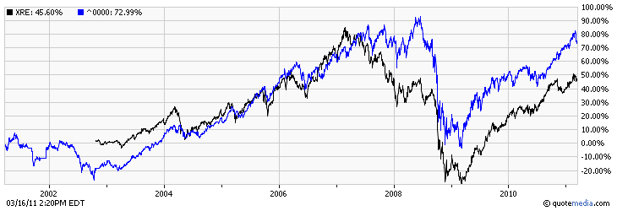
10 Years S&P/TSX Capped REIT vs S&P/TSX Composite
Source: TMXmoney.com
http://tmx.quotemedia.com/charting.php?qm_page=35313&qm_symbol=XRE

Slide 18
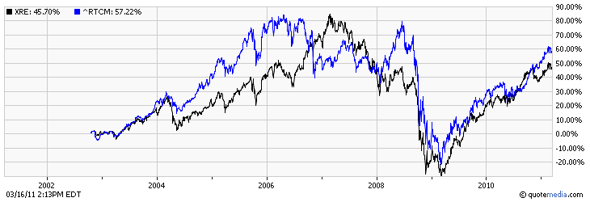
10 Years S&P/TSX Capped REIT vs S&P/TSX Income Trust
Source: TMXmoney.com
http://tmx.quotemedia.com/charting.php?qm_page=98919&qm_symbol=XRE

Slide 19
Value Drivers
Interest Rates
Rise in Interest Rates – Interest expense increases
Fall in Interest Rates – Interest expense reduces

Slide 20
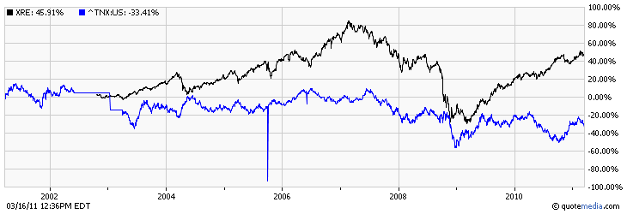
iShare S&P/TSX REIT Index Fund vs 10 Year US Treasure Bond
Source: tmx.com, 2011
From http://tmx.quotemedia.com/charting.php?qm_page=26286&qm_symbol=XRE

Slide 21
Factors to Consider
Management Expertise
Net Asset Value per Share
Portfolio Diversification
Low Leverage
Interest Coverage Ratio
Percentage of Long Term Debt to Capitalization
Earnings available for distribution
FFO, AFFO
Cash Distribution to Unitholders
FFO or AFFO Payout Ratio

Slide 22
Measuring Performance
Net income (NI) or GAAP Earnings – not the best measure largely due to depreciation allowance
Funds from operations (FFO) – closer to economic truth but ignores capital improvements
Funds available for distribution (FAD) – cash flow available to share holders if there is no change in working capital or no new debt
Free cash flow (FCF) – this is REIT’s true operating cash flow

Slide 23
Net Income
Real estate revenue
- Real estate expense
- Depreciation & amortization of real estate
= Income from real estate
+ Other Income
- General and administrative expense
= Net Income per GAAP

Slide 24
Funds From Operation
Net income per GAAP
- Gains from sale of real estate
= Adjusted net income
+ Depreciation and amortization of real estate
= Funds From Operation

Slide 25
Funds Available for Distribution
Funds from operation
+ Rent adjustments
- Capital improvements
= Funds Available for Distribution

Slide 26
Free Cash Flow
Funds available for distribution
- Real estate acquisitions (new investments)
- Changes in working capital
- Principal payments
+ New debt issue
+ Gain on sale of real estate
+ New equity issue
= Free Cash Flow to Equity

Slide 27
Adjusted Funds From Operations
AFFO per unit is calculated by adjusting FFO from straight line and market rent adjustments, non-cash compensation expenses, actual costs incurred for capital expenditures and leasing costs for maintaining shopping centre infrastructure and current lease revenues

Slide 28
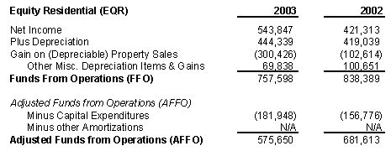
Operating Performance: FFO and AFFO

Slide 29


Slide 30
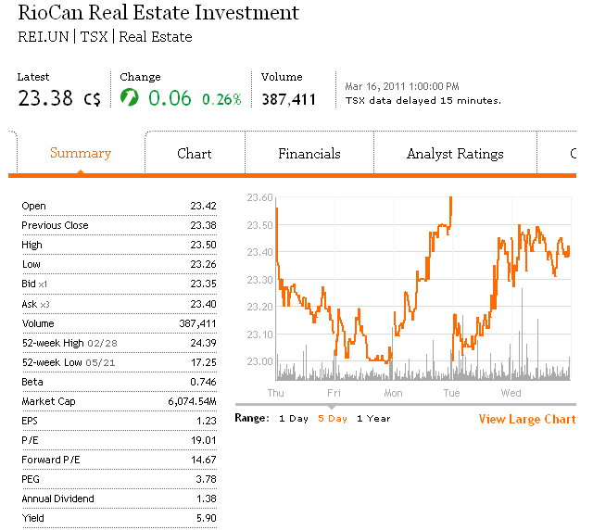
Stock Price Overview

Slide 31
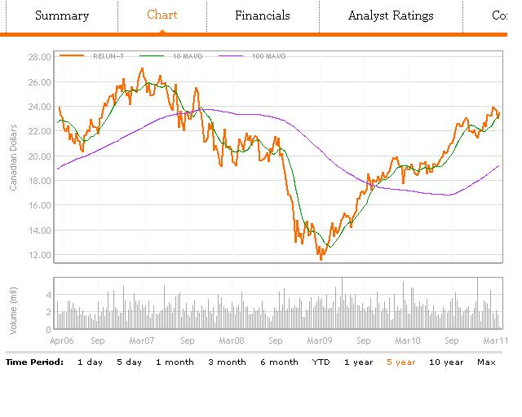
Charts & 5yr Moving Average at 10, 100

Slide 32
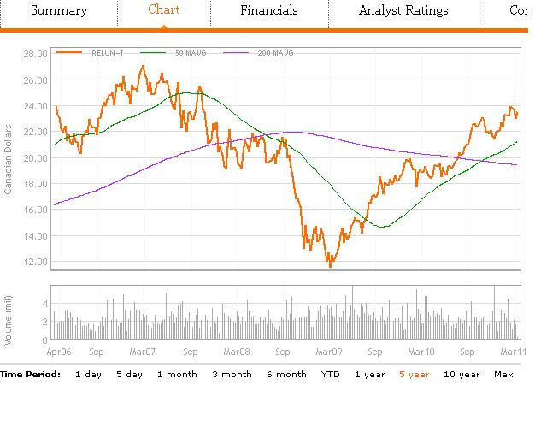
Charts & 5yr Moving Average at 50, 200

Slide 33
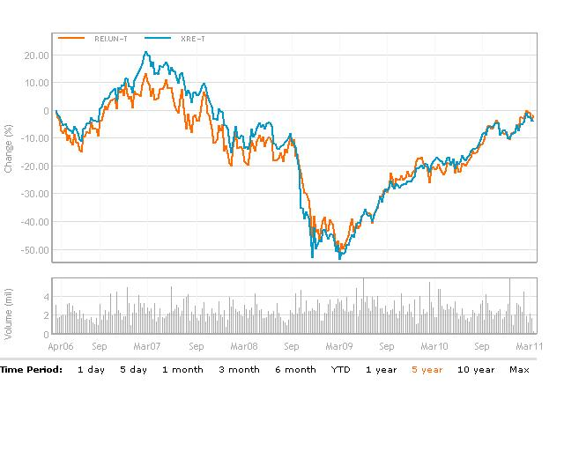
RIOCAN VS iShare (XRE-T, ETF) 5 yr

Slide 34
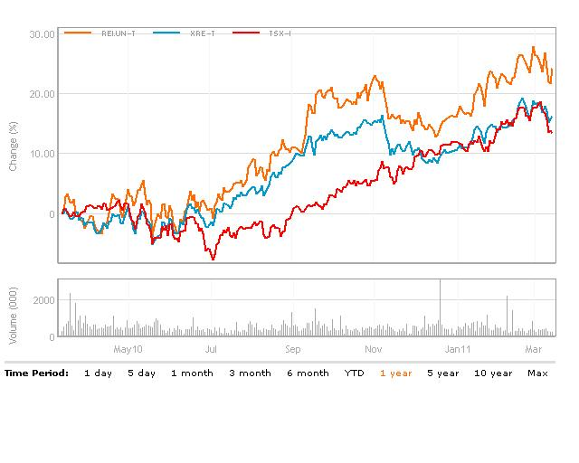
RIO VS iShare, TSX (XRE-T, ETF) 1 yr

Slide 35
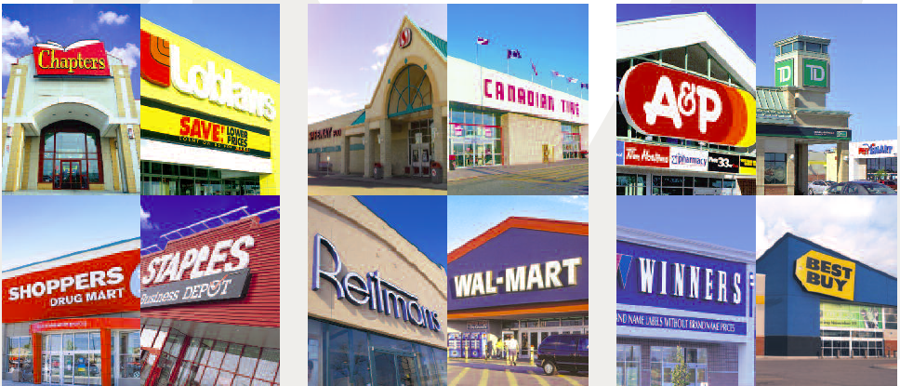
Overview of RIO
RIO is Canada’s largest REIT focused on retail real estate
Total area of aggregated ownership of shopping center is over 70.7 million sq.ft at Dec 31 2010.
10 properties currently under Development
Diversified tenant base
Trust’s purpose is to deliver to its unitholders stable and reliable cash distributions that increase over the long term
Most volatile sector for REITS to be in (Compared with Senior home and apartments)
Notes:
Page 10 Riocan is canada’s largest real estate investment trust, with a total market capitalization of approximately $10.1 billion as at dec 31, 2010. it owns and manages canada’a largest portfolio of shopping centres, with ownership interests in a portfolio of 297 retail properties in canada and the us combined, including 10 under development, contain an aggregate of over 70.7 million square foot at dec 31, 2010. its purpose is to deliver to its unitholders stable and reliable cash distributions that increase over the long term.

Slide 36

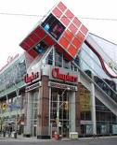
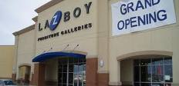
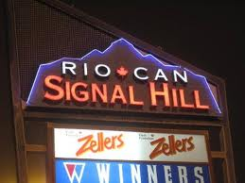
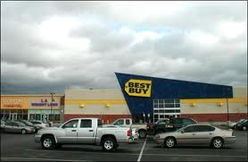
RioCan’s Properties

Slide 37
Specified Investment Flow-Through (SIFT – REITS Exemptions)
To benefit from this exception (i.e. to be a REIT) for a given taxation year, a trust must:
At no time in the year hold any non-portfolio property other than real properties situated in Canada;
Have as not less than 95% of its income for the year income from properties (whether in Canada or abroad, and including dividends, interest, rents, etc. and taxable capital gains from dispositions of real properties);
Have as not less than 75% of its income for the year income that is directly or indirectly attributable to rents from, mortgages on, or gains from the disposition of, real properties situated in Canada; and
Hold throughout the year real properties situated in Canada, cash, and debt or other obligations of Governments in Canada (including Crown corporations, etc.) with a total fair market value that is not less than 75% of its equity value.

Slide 38
Qualification as REIT
Because of RioCan’s recent expansion in the U.S. and its associated investment income, it may be disqualified as REITS
3 and 9 months ended Sept 30, 2010 revenue derived from non-compliant activities is $3.4 and $18.9 million.
Proportion in terms of total revenue is 3.9% and 7.5% respectively
7.5% YTD exceeded the limit for REITS exemption, therefore, restructure is needed.

Slide 39
Current Qualification Plan
Restructure of current mezzanine financing with development partners to RioCan subsidiaries
Sale of non-compliant assets to third parties
Sale of non-compliant assets to RioCan Management Inc.
Continuous training for staffs to ensure compliance with the REIT Exemption
Notes:
During 2010, management of the trust focused on the SIFT Legislation with the goal of enabling riocan to meet the REIT Exception through the implementation of a qualification plan prior to dec 31, 2010. on dec 6, 2010 it announced that it had completed the necessary tax restructuring to qualify commencing for the 2011 taxation year as a REIT under the canadian income tax legislation.

Slide 40
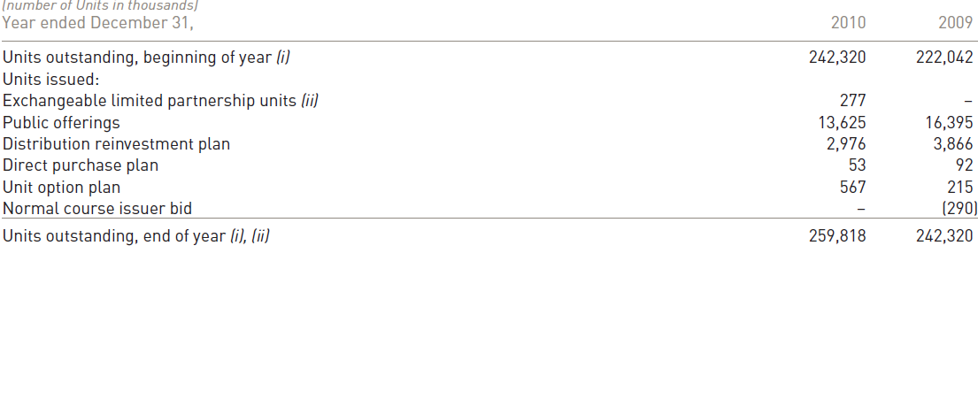
Unit Holders Summary
Notes:
Compare to last year, units was increased by 17,498,000=1.75 million

Slide 41
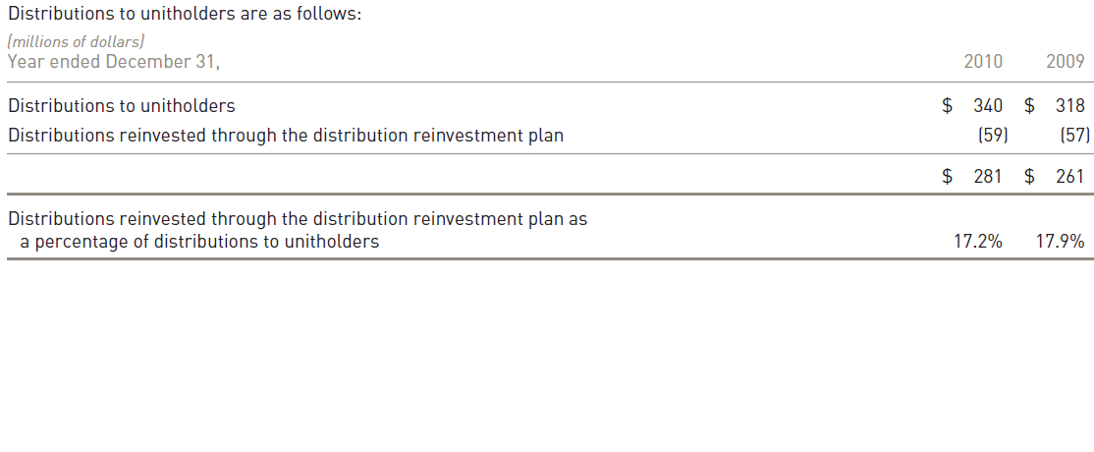
Distribution to Unitholders
Notes:
The monthly distribution to unitholders is currently 0.115 per unit, representing on an annualized basis 1.38 per unit
RioCan today announced a distribution of 11.5 cents per unit for the month of March. The distribution will be payable on April 7, 2011 to unitholders of record as at March 31, 2011.

Slide 42
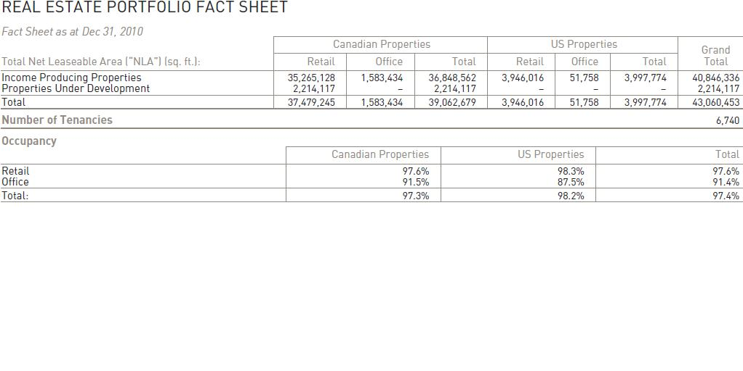
RIO FACTS

Slide 43
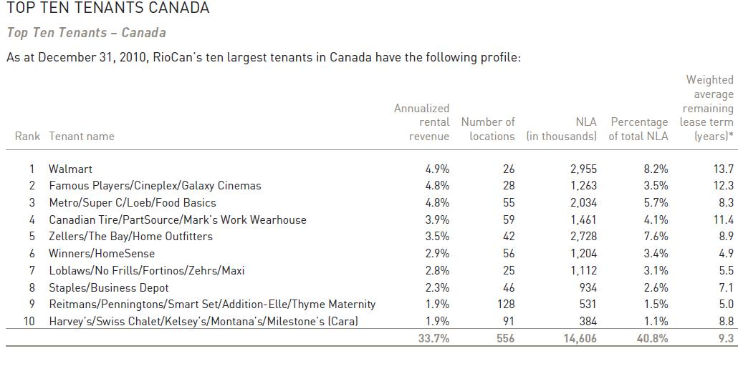
RIO FACTS

Slide 44
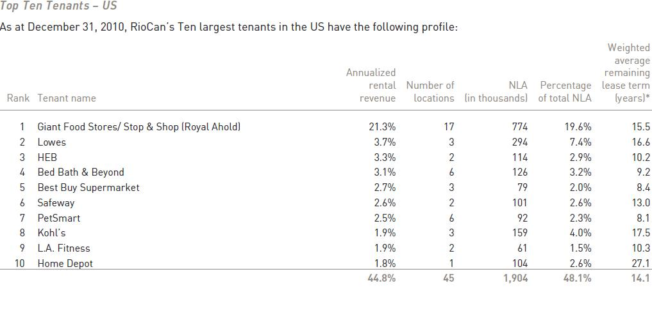
RIO FACTS

Slide 45
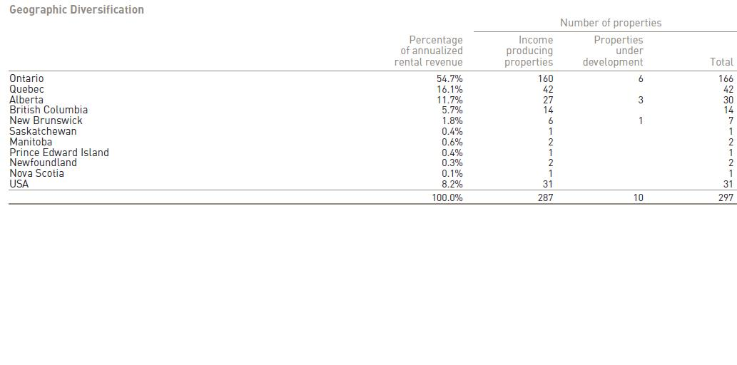
Geographic Diversification

Slide 46
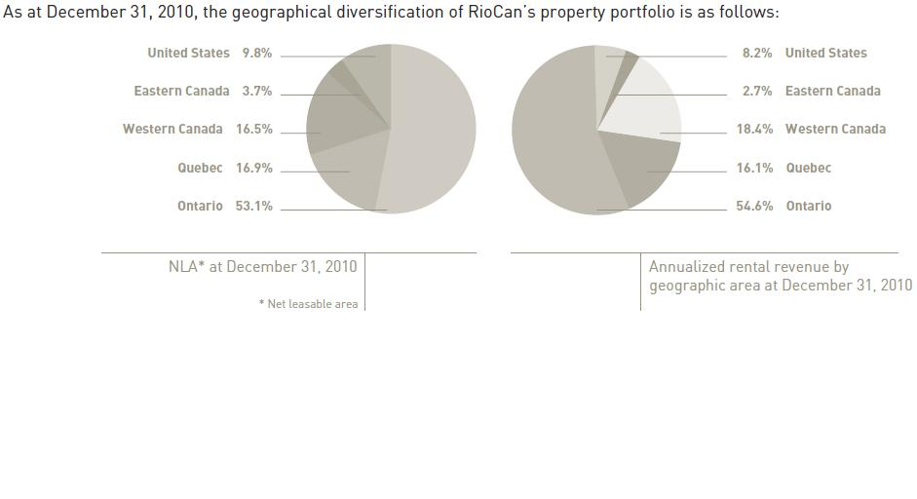
Geographical Diversification (both U.S. CANADA)

Slide 47
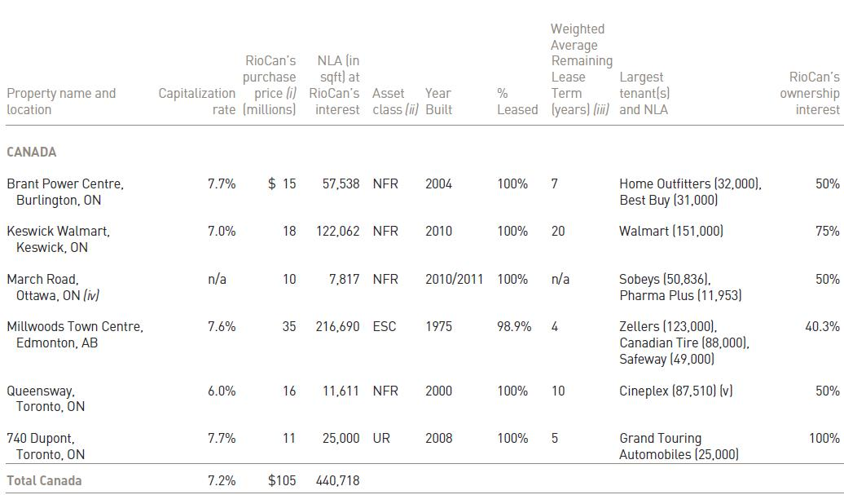
Recent Expansion in Canada
Notes:
Riocan’s Canadian portfolio of properties is concentrated around canada’s largest urban markets, covers calgary and edmonton, alberta, vancouver, toronto, greater ottawa, montreal with a total of 13.6 million residents. These 6 high population growth markets in turn results in more demand for space and higher rents, it now focus to own properties primarily in these high growth markets, it also expands and redevelops components of existing shopping centres to create additional value.

Slide 48
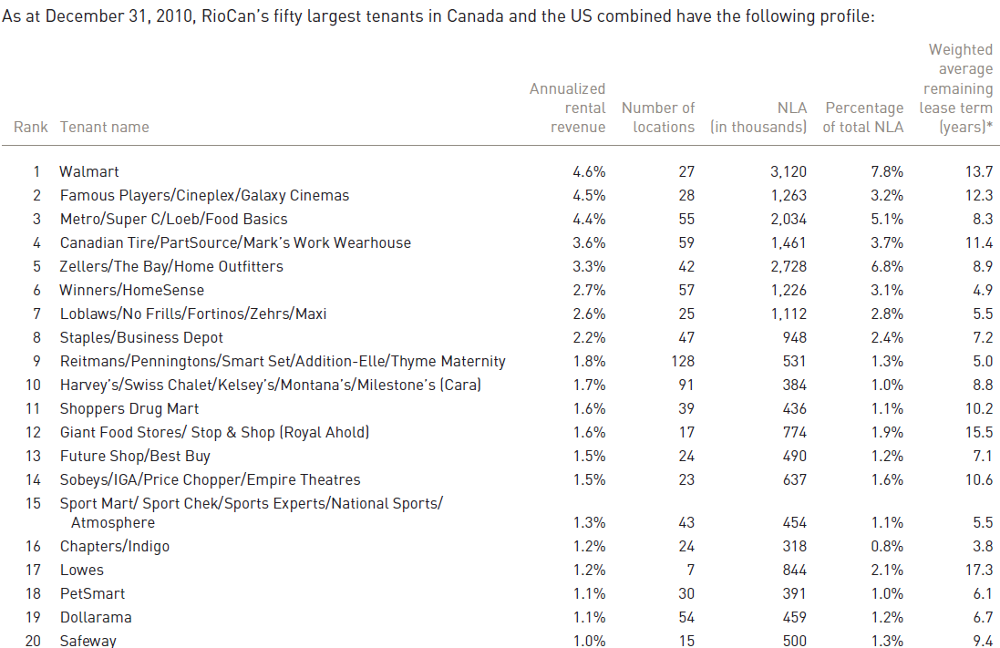
Top 20 Anchors in Canada and the U.S

Slide 49

Recent U.S Expansions
Advance in U.S market due to the lowered real estate prices
Cedar: 80% Interest (Massachusetts, Pennsylvania, and Connecticut)
Inland Western: 80% interest for usd $123.3 million and assume $68.2m property level debt with average interest rate of 5.6% and average term 6 years.
(Dallas – Fort Worth, Houston, and Austin
Notes:
RioCan believes that the us market is expected to yield a greater number of attractive opportunities than will be available in canada. Riocan is presently invested in two geographic areas of the us: the north-eastern states and the state of texas.
Cedar: the real states through joint venture 80% owned by Riocan and 20% owned by Cedar, with the first properties in the joint venture being seven grocery-anchored shopping centre in Massachusetts, Pennsylvania, and Connecticut.
Riocan has owned from inland western an 80% interest in nine new format shopping centres for 80% interest for usd $123.3 million and assume $68.2m property level debt with average interest rate of 5.6% and average term 6 years.

Slide 50
Recent U.S Expansions(cont’d)
Kimco Realty – 31.7% Acquired Las Palmas Market Place in El Paso for $26.4695 million.
Palmas MP is 638,000 square foot with average price of $10 per square foot for 7 years.
Notes:
On oct 8, 2010 RioCan announced the acquisition of Las palmas marketplace in El Paso, Texas through a joint venture arrangement with Kimco and Dunhill. Kimco is a publicly-traded real estate investment trust and is the United State’s largest owner and operator of neighbourhood and community shopping centres.
Las Palmas is a 638,000 square feet new format retail centre, the property is 98% leased and has an average lease term of approximately 7 years at an average lease rate of approximately $10 per square foot.

Slide 51
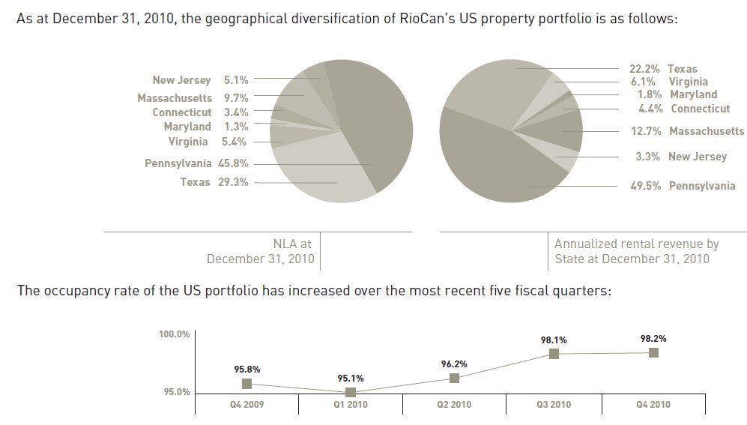
Recent U.S Expansions(cont’d)
Notes:
The expansion in us is increasing rapidly.

Slide 52
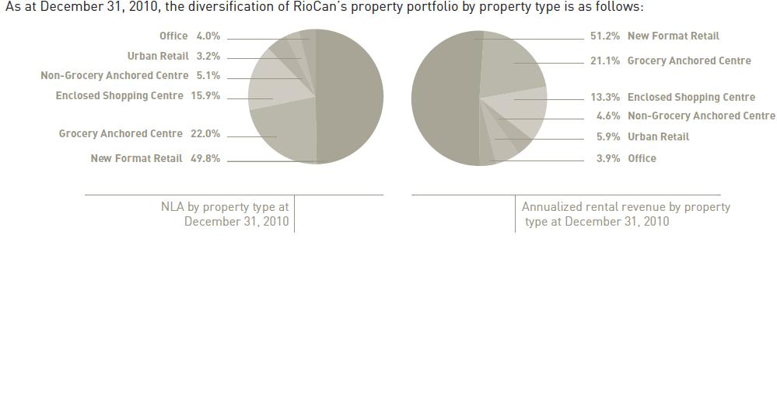
Diversification of Property Type
Notes:
The specific retail assets in which riocan currently invest are: new format retail centres (metro town), neighbourhood convenience unenclosed centres ( supermarkets, junior department stores), enclosed shopping centres ( large retail complex containing stores, restaurants, and other facilities with interior common areas with access to all retail units), urban retail properties ( high quality, innovative, multi-level format retail centres located in major urban markets)

Slide 53
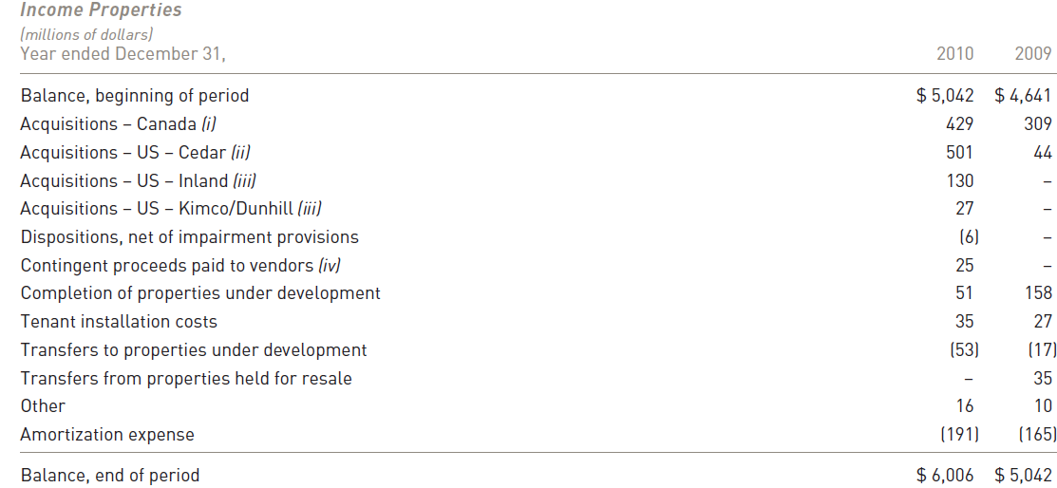
Summery of Income Ppty
Notes:
The committed occupancy rate at dec 31, 2010 was 97.4% compared to 97.1% at sep 30, 2010. the increase in Riocan’s occupancy rate is primarily due to leasing activities and the acquisition of approximately 2 million square feet during the 4th quarter of 2010 with a weighted average rate of 98%.

Slide 54
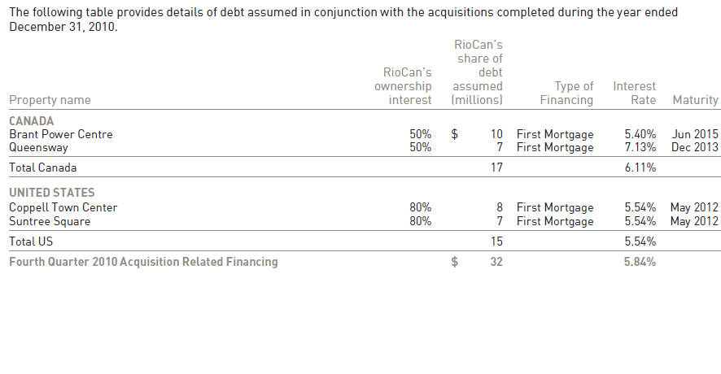
Related Financing on Ppty

Slide 55
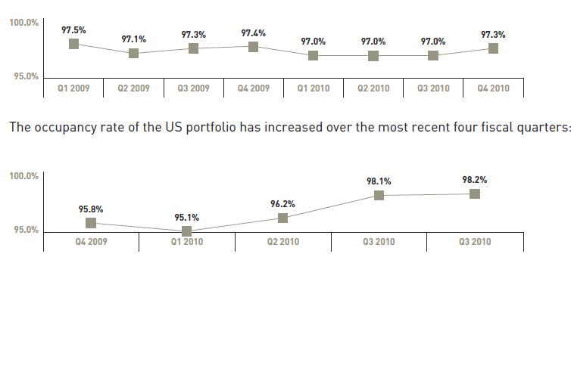
Occupancy Rates
Notes:
Riocan’s canadian property portfolio remained steady with occupancy rates that were at or above 97% throughout 2009 and continuing throughout 2010. during the year ended dec 31, 2010 the tenant retention rate was 90.9% and positive rent spreads on renewing leases of 8.6% were realized. Riocan believes that the us market is expected to yield a greater number of attractive opportunities than will be available in canada, at least in the near term, while providing a long term source of stable cash flow and the opportunity for enhanced returns and growth.

Slide 56
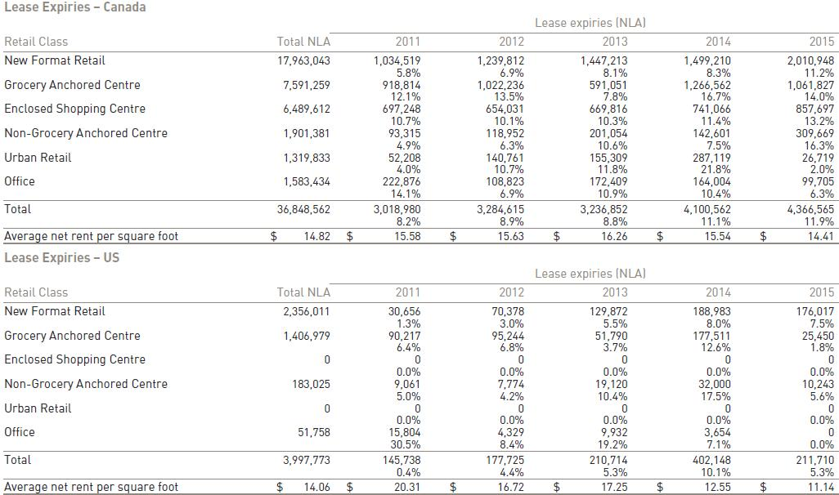
Lease Expiries
Notes:
4th quarter financial report

Slide 57
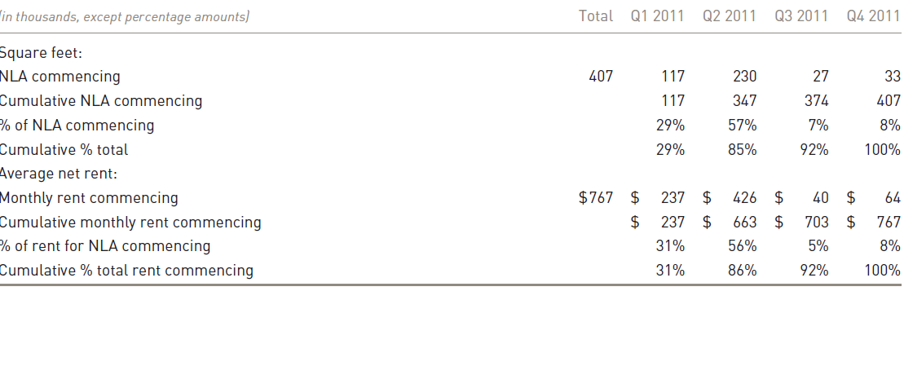
Leasing Activities
Notes:
In 2010, Riocan experienced vacancies of approximately 1,028,000 square feet, excluding lease buyouts, of which Riocan’s interest was 843,000 square feet. Riocan’s committed occupancy rate increased to 97.4% at dec 31, 2010 (included in the rate is 407,000 square feet of NLA that has been leased but is not panying rent )as compared to 97.1% at sep 30, 2010 as a result of leasing activities and acquisitions with high occupancy rates.

Slide 58
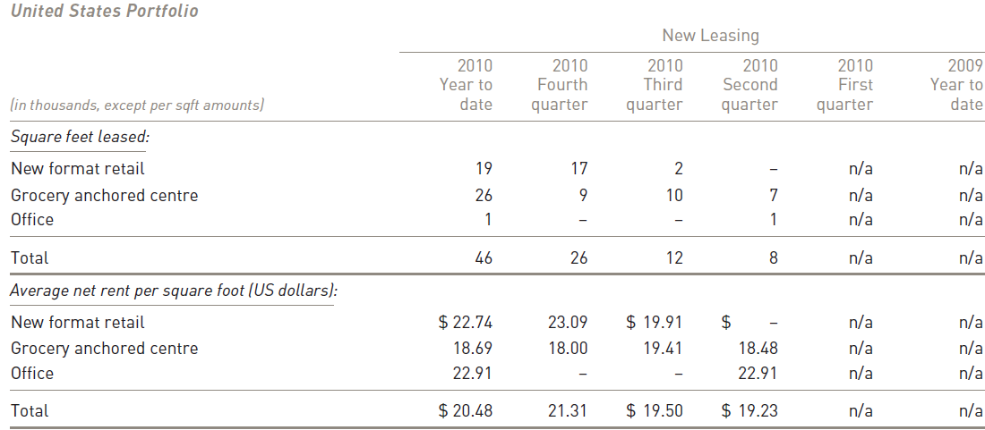
Summary of U.S Lease Breakdown
Notes:
Riocan has made a diligent and measured entrance in to the us, building a defensive portfolio with the potential to achieve greater returns not only from organic rent growth but through the leasing of vacant space. The combination of assets in canada’s fastest growing markets with a stabilized portfolio of high quality retail assets in the us will give riocan a greater presence as one of north america’s leading retail landlords as well as providing an avenue for growth.

Slide 59
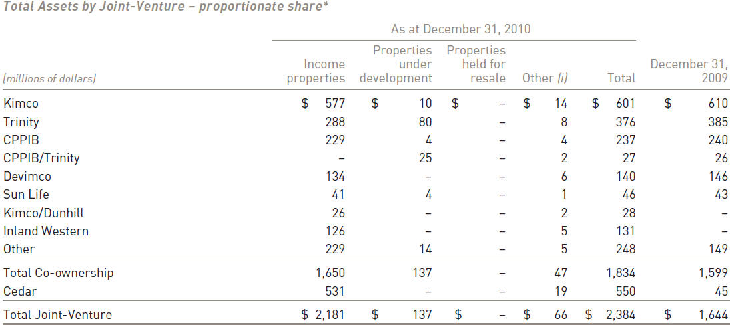
Joint Ventures Summary
Notes:
Joint venture platforms are important to riocan, not only for future potential, but also in carrying forward the strategy of creating reliable, long-term third party fee income streams from long-lived income properties. Riocan continues to solidify and expand its relationships with established partners including the canada pension plan investment board, kimco realty corporation, sunlife financial and trinity development group.
page 40 final report

Slide 60
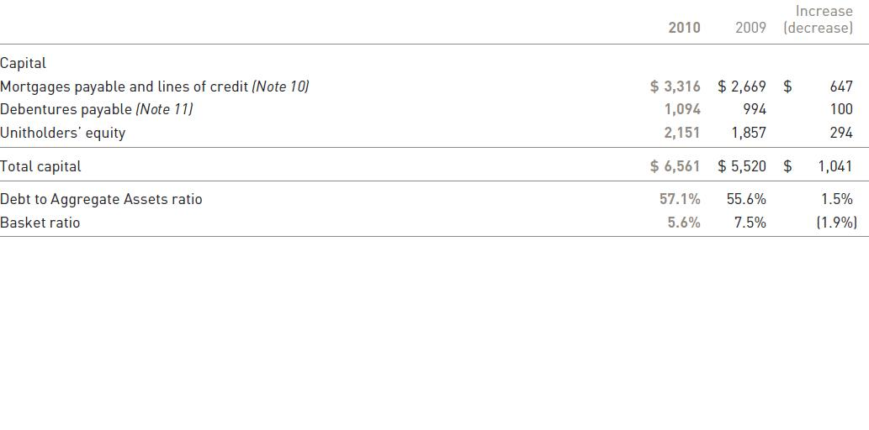
Capital Structure & Financing Activities
Notes:
Page 50 , final report
Riocan defines capital as the aggregate of unit holders’ equity and debt, for 2011, riocan expects to be able to satisfy all of its financing requirements through the use of cash on hand, cash generated by operations, refinancing of maturing debt.

Slide 61
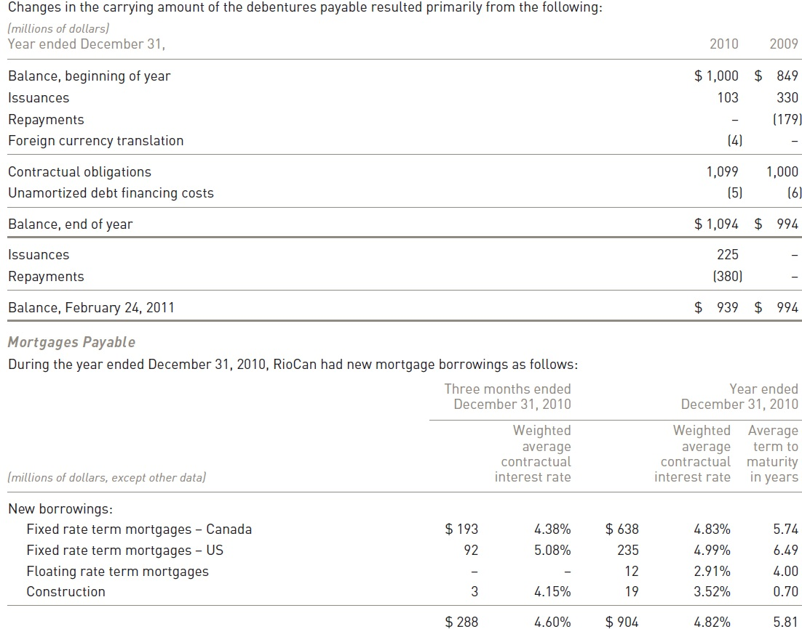

Slide 62
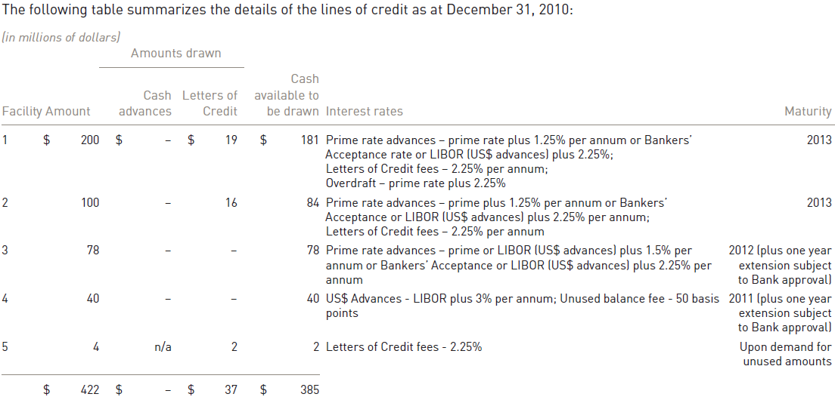
Capital Structure & Financing (Cont’d)
Notes:
50

Slide 63
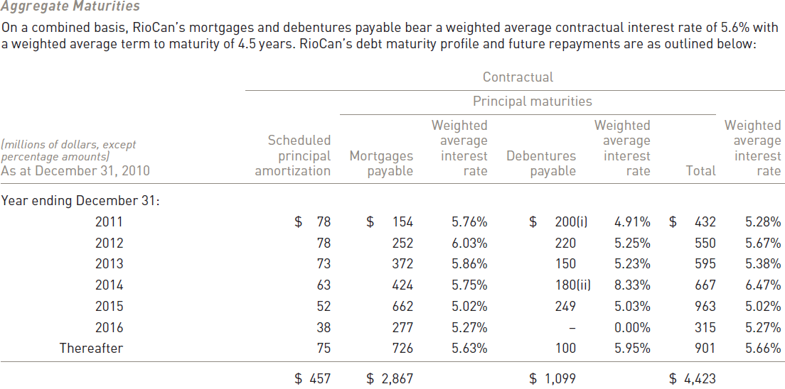
Capital Structure & Financing (Cont’d)

Slide 64
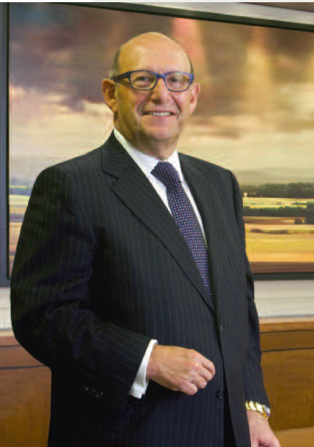
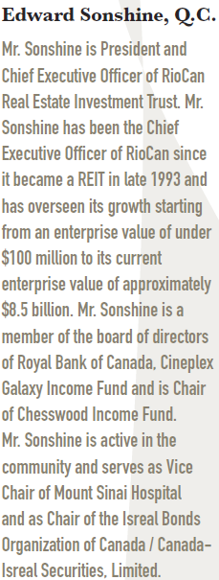
CEO

Slide 65
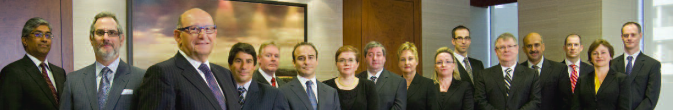
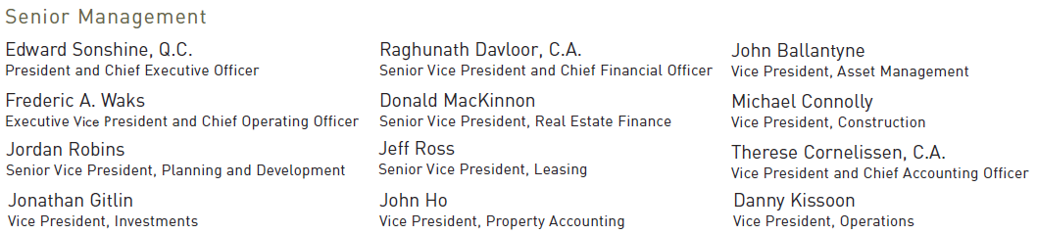

Senior Management

Slide 66
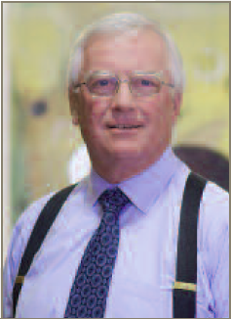
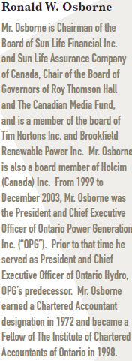
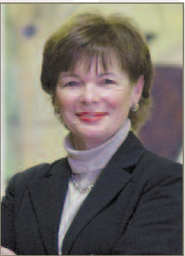
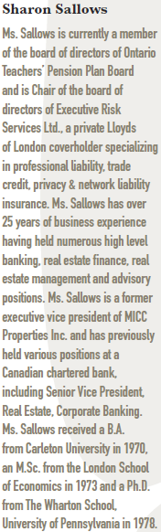
Broad of Trustees

Slide 67
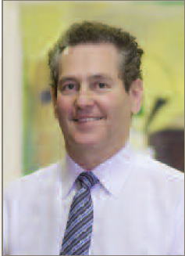
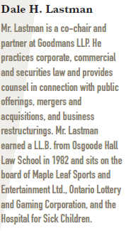
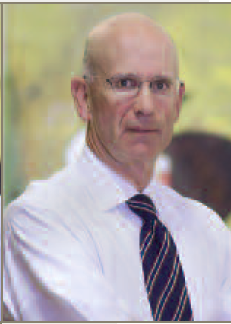
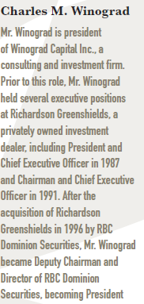
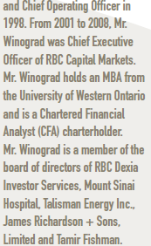
Broad of Trustees

Slide 68
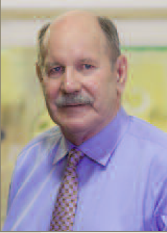



Broad of Trustees

Slide 69




Broad of Trustees

Slide 70


Balance Sheet
Consolidated Balance Sheet (quarterly)

Slide 71

Consolidated Balance Sheet (Annual)

Slide 72

Consolidated Statements of Earnings (Quarterly)

Slide 73

Consolidated Statement of Earning(Annual)

Slide 74


Statement of Cash Flow (Quarterly)

Slide 75


Statement of Cash Flow (Cont’d)

Slide 76

Cash flow (annual)
Notes:
riocan reported net earnings for the year ended dec 31, 2010 of 303m compared to 114m for the same period in 2009, and increase of 166%.

Slide 77

Annual Cash flow (Cont’d)
Notes:
PAGE 7

Slide 78

Funds From Operations
Notes:
Page62 FFO for the year ended dec 31, 2010 was 357m compared to 276m for the same period in 2009, an increase of 29%. The 81m increase in FFO due to : the completion of Greenfield developments, intensification of existing properties and increased lease cancellation fees of 13m. Increased transaction gain of 22m.

Slide 79

Funds from Operation (FFO -Annual)

Slide 80

Recommendation: Buy

Slide 81

CALLOWAY Real Estate Investment Trust
“Creating Exceptional Places to Shop”

Slide 82
Stock Price Overview

Slide 83

Calloway REIT CWT.UN\TSX\Real Estate
Notes:
High yield.
The Units, 6.65% convertible debentures and 5.75% convertible debentures of Calloway are
listed and publicly traded on the Toronto Stock Exchange (“TSX”) under the symbols “CWT.UN”,
“CWT.DB.A” and “CWT.DB.B”, respectively.

Slide 84

1 year with SMA50 and SMA200

Slide 85

5 years with SMA50 and SMA200

Slide 86

1 year compared to iShare S&P TSX Capped REIT
Notes:
Explain ishare S&P TSX capped reit

Slide 87

5 year compared to iShare S&P TSX Capped REIT

Slide 88

About Calloway
Calloway Real Estate Investment Trust is an unincorporated open-ended mutual fund trust governed by the laws of the Province of Alberta created under a declaration of trust.
Calloway’s purpose is to own and manage dominant shopping centers that provide retailers with a platform to reach their customers through convenient locations, intelligent designs, and a desirable tenant.

Slide 89
About Calloway
By the end of December 31, 2010
Shopping centres | 128
Office building | 1
Industrial building | 1
Total gross leasable area | 24.2 million sq. ft.
Notes:
As at December 31, 2010, Calloway owned 128 shopping centres, one office building and one industrial
building, with total gross leasable area of 24.2 million square feet, located in communities across Canada.
Generally, Calloway’s centres are conveniently located close to major highways, which, along with the
anchor stores, provide significant draws to the Calloway portfolio, attracting both value oriented
consumers and retailers.

Slide 90
Recent News
Highlights of the year 2010
Maintained portfolio occupancy above 99% level
Acquired two income properties for $130.1 million and a development property for $25.9 million
Completed developments and earnouts of 508,436 square feet of leasable area for $151.3 million, providing an unleveraged yield of 7.4%
Opened 15 Wal-Mart Supercentres during the year
Issued $306 million in new Trust Units
Issued $260 million in unsecured and convertible debentures
Redeemed $150 million 10.25% Series C senior unsecured debentures, $46 million 4.51% Series A senior unsecured debentures, and the balance of the 6.00% convertible debentures
Net income increased by $19.9 million to $43.2 million compared to 2009
The fair value of the Trust’s investment properties is $1.1 billion over its book value

Slide 91

Distribution History

Slide 92

Portfolio Highlight

Slide 93

Revenue by Provinces
Province | # of properties
British Columbia | 12
Alberta | 5
Saskatchewan | 3
Manitoba | 3
Ontario | 77
Quebec | 17
New Brunswick | 2
Nova Scotia | 4
Prince Edward Island | 1
Newfoundland | 6
Notes:
Rentals from income properties account for 97.3% of revenues for the year ended December 31, 2010,
with 72.5% of the portfolio located in Ontario and Quebec, primarily in the Greater Toronto and Montreal
areas. The balance of the portfolio is located across Canada.

Slide 94


Top ten tenants
Notes:
Annualized as at December 31, 2010.
The five largest tenants account for 40.2% of portfolio revenue.
(2) Calloway has a total of 74 Wal-Marts under lease, of which 37 are SuperCentres. An additional 12 expansions are expected to be completed by
the end of 2011. Calloway has 19 centres with Wal-Mart as shadow anchors, of which eight are SuperCentres.

Slide 95

Occupancy Rate
The occupancy rate of Calloway by the end of 2010 is 99. 1%

Slide 96

Lease Maturity
Average lease term of 9.0 years with an average of 5.4% of total net rentable area rolling annually over the next 10 years.
Average remaining lease term for Wal-Mart is 12.4 years
Average lease term of top 10 tenants is 10.5 years
Average retention rate of 90% and lifts on renewals of 7.5%

Slide 97

Relationship with Wal-Mart
Number of Wal-Marts/ Supercentres | 74/37
Number of Wal-Marts/ Supercentres (including shadows) | 93/45
Total GLA in Wal-Mart anchored centres (sq.ft.) | 20,645,791
Notes:
By the end of 2010, Wal-mart has 323 stores in Canada. Among them, 119 are super centres.

Slide 98

Calloway is Wal-Mart Canada’s biggest landlord
“Its is expected that Wal-Mart will continue to be the dominant anchor tenant in the portfolio and that its presence will continue to attract other retailers and consumers.”

Slide 99
Partnership with Smart!Centre
SmartCentre - A full-service development company, managing every aspect of the development process including acquisition, land use and zoning, construction, leasing and property management.
SmartCentres’ owner - Mitchell Goldhar, owned approximated 21.5% of the issued and outstanding units of Calloway.
Notes:
The Trade-Mark Licence Agreement and Marketing Cost Sharing Agreement (collectively, the Licence Agreement),
under which the Trust has licensed the use of the trademark “Smart!Centres” from SmartCentres for a ten-year term
ending December 31, 2016. Under the Licence Agreement, the Trust will pay 50% of the costs incurred by
SmartCentres in connection with branding and marketing the trademark, together with the Trust’s proportionate
share of signage costs. SmartCentres has the right to terminate the Licence Agreement at any time in the event any
third party acquires 20.0% of the aggregate of the Trust Units and special voting units.
Calloway has partnered with Wal-Mart and Goldhar since 2005 when it doubled its assets by buying interests in 35 newly built shopping centres from FirstPro (later renamed SmartCentres) and Wal-Mart for about $1.1 billion. It has continued to build on that relationship in a series of deals, including the purchase of six properties from SmartCentres in a $252-million deal announced in May 2007 and the acquisition of 16 SmartCentre-owned properties in a $1-billion deal announced in October 2006.

Slide 100

Partnership with Smart!Centre
Calloway has partnered with Wal-Mart and Goldhar since 2005 when it doubled its assets by buying interests in 35 newly built shopping centres from FirstPro (later renamed SmartCentres) and Wal-Mart for about $1.1 billion.
It continued to build on that relationship in a series of deals, including the purchase of six properties from SmartCentres in a $252-million deal announced in May 2007 and the acquisition of 16 SmartCentre-owned properties in a $1-billion deal announced in October 2006.
In 2006, Calloway licensed the use of the trademark “Smart!Centres” for 10 year term.
Notes:
Calloway has entered into agreements with SmartCentres to borrow funds from Smartcentres and to finance various development projects. In addition, the trust has entered into property management, leasing, development and exchange agreements, and co-ownership agreements with Smartcentres.

Slide 101

Development Composition

Slide 102
Acquisitions of Income Properties in 2010
On November 23, 2010, the Trust completed the acquisition of a 50% co-ownership interest in an 18.47acre development property in Toronto, Ontario, for a purchase price totaling $25.9 million
On September 13, 2010, the Trust acquired 731,433 square feet of retail space in two retail properties from a joint venture between SmartCentres and Wal-Mart Canada Realty Inc. for $130.1 million

Slide 103

Future Development Pipeline

Slide 104
Management Team

Slide 105

Chief Executive Officer
Simon Nyilass
President, Chief ExecutiveOfficer
Former executive Vice President of SmartCentres
24-year experience in real estate business
Previously worked in senior financial roles with Markborough Properties, Dundee Realty, Bramalea Limited and CIBC World Markets
Notes:
Simon Nyilassy is the President and Chief Executive Officer of Calloway REIT. Prior to joining Calloway, Mr. Nyilassy was Executive Vice President Finance at SmartCentres. Mr. Nyilassy has 24 years experience in the real estate business, having previously worked in senior financial roles with a number of large public and private Canadian companies, including Markborough Properties, Dundee Realty, Bramalea Limited and CIBC World Markets.

Slide 106

Chief Financial Officer
Bart Munn
Chief Financial Officer
Former vice president and chief financial officer of Morguard corporation (1999-2005)
Chartered Accountant
Notes:
Chief Financial Officer of Calloway Real Estate Investment Trust since December 2005. Vice President and Chief Financial Officer of Morguard Corporation, a publicly traded owner and manager of commercial and residential real estate, from 1999 to 2005. Vice President and Chief Financial Officer of Morguard Real Estate Investment Trust from 1997 to 1999. Also held the position of Senior Vice President Finance & Administration for Morguard Investments Limited, a wholly owned subsidiary of Morguard Corporation, from 1991 until 2005. Mr. Munn is a Chartered Accountant.

Slide 107

Executive Vice President
Rudy Gobin
Executive Vice President in Asset Management
Former Strategy Officer of Calloway
Former executive Vice President, Finance and operations of SmartCentres (2001-2006)
Chartered Accountant
Bachelor of commerce degree from University of Toronto
Notes:
Executive Vice President Asset Management of Calloway Real Estate Investment Trust. Mr. Gobin was previously Calloway's Strategy Officer and prior to that, held the position of EVP, Operations. Before joining Calloway, Mr. Gobin was the Executive Vice President, Finance and Operations of SmartCentres from 2001 to 2006. Chief Financial Officer of Nexacor Realty Management (real estate subsidiary of Bell Canada) from March 1998 to May 2001. Mr. Gobin is a Chartered Accountant and has a Bachelor of Commerce degree from the University of Toronto (1987).

Slide 108
Financial Performance

Slide 109

Annual Balance Sheets
Notes:
Annual balance sheet

Slide 110

5 years balance sheet performance

Slide 111

Annual Income Statements

Slide 112

5 years Income statement performance

Slide 113

Annual Cash Flows 1/2

Slide 114

Annual Cash Flows 2/2

Slide 115

5 years cash flow performance

Slide 116

AFFO and FFO

Slide 117

AFFO and FFO

Slide 118

Summary of key informance

Slide 119
Recommendation

Slide 120

Recommendation

Slide 121

Recommendation

Slide 122
Recommendation
Hold

Slide 123


H&R REIT

Slide 124

Stock Overview March 15, 2011

Slide 125

5 Year: 20 and 100 SMA

Slide 126

5 Year: 50 and 200 SMA

Slide 127

5 Year: H&R vs. S&P/TSX Capped REIT

Slide 128
HR Stock Overview
Exchange: TSX
Ticker: HR.UN
Units Outstanding:
146.1M at December 31, 2010
143.8M at December 31, 2009
147.0M at December 31, 2008
Fund Type: Open Ended

Slide 129
About H&R Reit
H&R REIT is an open-ended Real Estate Investment Trust which owns and manages a portfolio of 35 office properties, 118 industrial properties, 129 retail properties and 3 development projects with a book value totalling approximately $5.3 billion, encompassing 39 million square feet.
Primary Objectives
To provide unitholders with stable and growing cash distributions generated by revenues it derives from a diversified portfolio of income properties.
To increase the value of units through:
active management of H&R’s assets
accretive acquisition of additional properties
development of new projects.

Slide 130
About H&R Reit
The REIT’s strategy to accomplish these two objectives is to accumulate a diversified portfolio of high quality income producing properties in Canada and the United States occupied by creditworthy tenants on a long-term basis.
The REIT does not have any specific allocation targets as to property type, but rather focuses on creditworthy tenants with long-term leases.

Slide 131
Reorganization
Created H&R Finance Trust in Oct, 2008
“Stapled unit”
Shared the same ticker symbol with H&R REIT
Will not trade independently
The sole activity of Finance Trust is to provide capital funding to H&R REIT (U.S.) Holdings Inc. ("U.S. Holdco"), a wholly owned U.S. subsidiary of the REIT
Purpose
To save U.S tax

Slide 132
Management Profile
Thomas J. Hofstedter, President and Chief Executive Officer
Became President and Chief Executive Officer of H&R REIT at its creation in December 1996
Has more than twenty five years of real estate industry experience
Responsible for building most of the properties that comprised the initial assets of the REIT
In addition to commercial development, has experience in high-rise residential and was responsible for building many prominent Toronto condominiums such as Wellington Square, the Penrose, the Metropole and others

Slide 133
Management Profile
Larry Froom, C.A., Chief Financial Officer
Joined H&R Developments in 1997 as Controller, was promoted to VP - Finance for the H&R Group in 2003, was appointed VP - Finance for H&R REIT in January 2006 and CFO in September 2006
Has over 10 years of real estate industry experience
Responsible for overseeing all financial transactions, Unit offerings and investor relations. Prior to joining H&R, he was manager at Ernst & Young where he serviced clients in the real estate industry

Slide 134
Management Profile
Nathan Uhr, Vice-President, Acquisitions
H&R Developments' Director of Leasing and Property Management and held various other positions with H&R over 20 years before becoming Vice-President, Acquisitions of H&R REIT, at its inception, in December 1996.
Has over 25 years of real estate industry experience
Leads the due diligence team on any acquisition or mezzanine financing planned by the REIT and is responsible for management and leasing issues relating to the REIT's properties

Slide 135
Growth
 | Dec. 31, 1997 | Dec. 31, 2004 | Dec. 31, 2010
Properties | 41 | 196 | 282
Square Footage | 5.8M | 30.1M | 39M
Assets | $455.5M | $3.3B | $5.5B
Revenue | $62M | $412.8M | $618.2M

Slide 136
Recent Events

Slide 137
Recent Events
In January 2011
Entered into an agreement to purchase the “Atrium on Bay” in Toronto, Ontario for gross proceeds of $344.8M. The REIT will assume a 7-year non-recourse mortgage of $190M. The acquisition is conditional upon the vendor meeting certain conditions. It is anticipated that the acquisition will close by April 2011 upon satisfaction of such conditions.
Completed the acquisition of the remaining 20% beneficial interest, not already owned by the REIT, of a property under development for an aggregate cash purchase price of approximately $11,000. The REIT now owns 100% of approximately 81 acres of land located in Brampton, Ontario (known as Airport Road).
Completed a public offering of $180M of 4.778% Series D senior debentures due July 27, 2016.
In February 2011
Purchased a 42,000 square foot retail property in Teaneck, New Jersey for a purchase price of U.S. $10.3M. A mortgage payable of U.S. $6.4M was assumed on closing.
Purchased a 116,000 square foot retail property in Columbus, Ohio for a purchase price of U.S. $21.7M.
4th quarter results announced along with an increase in the quarterly distribution policy

Slide 138

Atrium on Bay
President and CEO Tom Hofstedter said
“Below market rents, excess density for expansion of the office space, investment grade institutional tenants, and increasing demand […] are some of the primary reasons why we feel confident that the Atrium on Bay will provide our unitholders with reliable and increasing returns on their investment and will be a prestigious addition to our portfolio of high quality properties.”

Slide 139

Monthly Distribution Schedule

Slide 140

Updated Distribution Schedule

Slide 141

2010 Acquisitions

Slide 142

2010 Dispositions

Slide 143



Properties Under Development
The Bow

Slide 144
Properties Under Development
The Bow
2 million sq. ft. office complex in Calgary for EnCana Corporation
Completion by 2012
Fully pre-leased for 25 years
Budgeted cost of $1.5 billion
Set to incur approximately $360 million in development costs over the next twelve months
77% complete and on budget
Locked in 97% of total budgeted costs before contingencies and has successfully secured all of the financing required
3 months behind schedule with potential cost of $4.7 million for the delay. $30 million in contingency is available to cover this.
The first four tranche completion dates upon which floors are scheduled to be delivered are as follows:
floors 1-14 by July 3, 2011
floors 15-24 by August 29, 2011
floors 25-42 by October 12, 2011
Schedule of completion of floors 43-59 is expected to be set by the end of March 2011
Year one projected income is approximately $94 million.
Rent step ups will be 0.75% per annum on office space and 1.5% per annum on parking income for the full 25-year term.

Slide 145

The Bow Budget

Slide 146


Profiled Properties
Telus, Burnaby, BC
686,697 square foot office complex
Telus
20-year lease
100% Ownership Interest
Bell Canada and Bell Mobility Mississauga, Ontario
1.1M square foot office complex
Bell Canada and Bell Mobility
20-year lease
100% Ownership Interest

Slide 147


Profiled Properties
TransCanada Tower, Calgary, Alberta
936,000 square foot head office tower
TransCanada PipeLines
20-year lease commenced on May 1, 2001
100% Ownership Interest
Place Bell, Ottawa, Ontario
987,328 square foot office building
Bell Canada, Public Works of Canada, Accenture and Gowling Lafleur Henderson LLP.
100% Ownership Interest

Slide 148

Top 20 Sources of Revenues by Tenant

Slide 149

Lease Expiries in Next 5 Years

Slide 150

Key Performance Drivers

Slide 151

Portfolio Overview

Slide 152

Net Book Value of Assets

Slide 153

Average Age of Portfolio From Date Built or Renovated

Slide 154
Net Book Value by Type of Asset

Slide 155
Net Book Value by Region

Slide 156
Number of Properties by Type of Asset

Slide 157

Mortgages Payable

Slide 158

Net Property Operating Income

Slide 159

Debt to Gross Book Value

Slide 160
Financial Statements Analysis
All numbers in 000’s except unit and per unit amounts

Slide 161

Balance Sheet 1/2
Notes:
Other Assets
Mortgages and amount receivable 3,000 (2010) 63,789 (2009)

Slide 162

Balance Sheet 2/2
Notes:
Debentures
Repurchase Non-Convertible Debentures
Fund The Bow
Bank Indebtedness
A general operating facility
A secured construction financing facility for The Bow

Slide 163

Income Statement 1/2

Slide 164

Income Statement 2/2

Slide 165

Net Earnings Summary
H&R REIT completed the necessary restructuring to qualify for REIT Exemption under SIFT rules commencing January 1, 2011. Accordingly, net future income tax liability of $123.3 million was reversed into earnings for the 12 months ended December 31, 2010. Excluding this income tax recovery and the one-time debenture repayment loss of $38.8 million, basic net earnings per Stapled Unit would have been $0.59 for the 12 months ended December 31, 2010.

Slide 166

Cash Flow Statement 1/2

Slide 167

Cash Flow Statement 2/2

Slide 168
FFO, NFFO, and AFFO
Funds from Operations
Normalized Funds from Operations
Adjusted Funds from Operations

Slide 169

FFO

Slide 170

NFFO

Slide 171

AFFO

Slide 172

FFO Summary
For the 12 months ended December 31, 2010, FFO and AFFO were each reduced by a one-time, nonrecurring loss of $38.8 million which resulted from the early repayment of the Fairfax non-convertible debentures in February 2010.

Slide 173

Analyst Reccomentation

Slide 174
Recommendation
Buy

