Slide 1
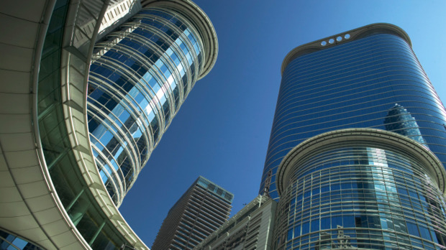

47
Real Estate
Investment Trusts
(REITS)
Presented By: Andres Avila
Pasha Azadmard
Justin Ling
Derek Wiebe
Brian He

Slide 2
Agenda
REITS Overview
RIOCAN
H&R
Calloway
Conclusion

Slide 3
Real Estate Investment Trusts
Real Estate Investment from pooled capital
Majority of income is distributed to investors
Allows investors to purchase REIT units instead of direct real estate purchases
Overview
RIOCAN
H&R
Calloway

Slide 4
Types of REITs
Equity
  Invest in and Own Properties
  Revenue from Rent
Mortgage
  Loan Money for Mortgages
  Invest in Existing Mortgages or MBS
  Revenue from Interest
Hybrid
  Invest in Properties and Mortgages
  Revenue from Rent and Interest
Overview
RIOCAN
H&R
Calloway
Notes:
Brian

Slide 5
REITs Operational Structure
Trustee
Trustee Fees
Act on Behalf of Unitholders
REIT
Unitholder
Distributions
Property Income
Properties
Investment
Ownership
Management Services
Management Fees
Management
Overview
RIOCAN
H&R
Calloway

Slide 6
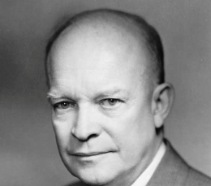



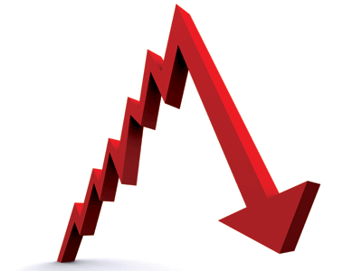


Timeline of REITs
First REIT listed on NYSE - Continental Mortgage Investors
First REIT Index created by NAREIT
REITs Created -Cigar Excise Tax Extension.
REITs first established in Canada
1960
1965
1972
1993
1960
1969
1989-1991
2010
Worst Real Estate Downturn since the Great Depression.
NAREIT Formed
REITs go global with legislation in The Netherlands
Amendments to rules defining “Qualifying REITs” for tax purposes in Canada
Overview
RIOCAN
H&R
Calloway

Slide 7
Benefits to Shareholders
Diversification
  Bonds, Stocks, and REITs
High Yields
Liquidity
Professional Management
Overview
RIOCAN
H&R
Calloway
Notes:
Diversification doesn’t consider that for many people, real estate is already their biggest investment. So adding REITs might not be a good idea after all.

Slide 8
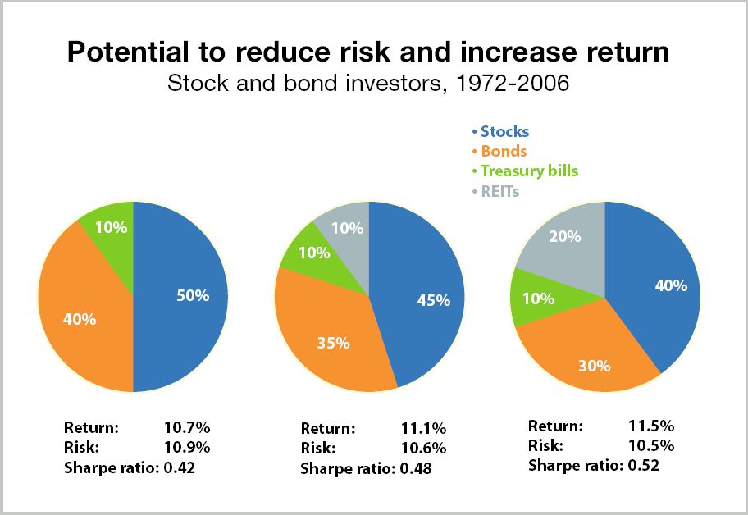
Diversification Benefit
Overview
RIOCAN
H&R
Calloway

Slide 9
Canadian Portfolio Diversification
10yr Return: 7.07% 7.62% 8.18%
3yr Return: 13.29% 15.77% 18.25%
*Source: iShares Data for S&P/TSX Capped REIT Index, S&P TSX Capped Composite Index, and DEX Universe Bond Index
Overview
RIOCAN
H&R
Calloway

Slide 10
Dual Market for Real Estate
REITs create a secondary market for trading real estate
The Private market and the REIT market may disagree on market values of property
  This causes a REIT to trade at a discount or premium to its Net Asset Value (NAV).
Overview
RIOCAN
H&R
Calloway

Slide 11
REIT Requirements
Feature
Governed By
Vehicle
Investors
Revenue Rules
U.S. REITs
Requirements of Internal Revenue Code
Corporation, Trust, or
Association
Min 100 Investors.
No more than 50% of units held by 5 or fewer individuals
Min 75% of Gross Income must be from real estate related sources
Min 95% must be from real estate related sources and passive income sources
Canadian REITs
Self Imposed Trust Declaration and certain requirements of the Income Tax Act
Open- or closed-ended mutual fund trust
Min 150 unit holders. Must be listed on a recognized Canadian Exchange
For closed-end funds: Min 95% of income must be from disposition of, or income earned from qualifying investments.
Overview
RIOCAN
H&R
Calloway

Slide 12
REIT Requirements
Feature
Distributions
Taxation
Transfer of real estate to the REIT
*Source: Deloitte (2004)
U.S. REITs
At least 90% of Taxable Income, excluding net capital gains.
Income is not taxed as long as it is distributed to investors. Income that is not distributed will be taxed at normal corporate rates.
Companies can move assets to the REIT on a tax deferred basis.
Canadian REITs
Set individually by the trust declaration. Usually 85-95% of distributable income.
Income is not taxed within the trust as long as it is distributed to unit holders.
Limited ability to move assets to REIT on a tax deferred basis
Overview
RIOCAN
H&R
Calloway

Slide 13
US REITs Vs. Canadian REITs
As of Jan 2011 - 153 REITs in US registered with SEC
  Market Cap of $389 Billion
  1100 REITs in US that have filed tax returns
30 Publicly Traded REITs in Canada
  Market Cap of $39.6 Billion (As of March 16, 2012)
Overview
RIOCAN
H&R
Calloway

Slide 14
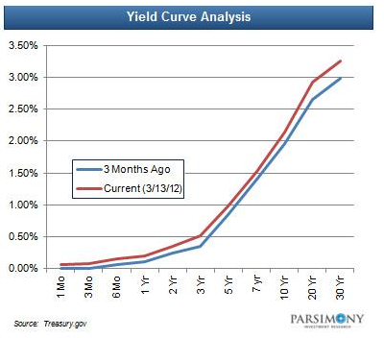
Mortgage REITs
Specific to the US
Mortgage REITs benefit from higher interest rate spreads
In ideal conditions, mREIT holders benefit from very high yields
Overview
RIOCAN
H&R
Calloway
Notes:
Brian
Ridiculous Mortgage Rates (cannot find relevant sources)

Slide 15
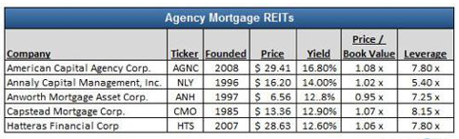
Mortgage REITs Continued
Overview
RIOCAN
H&R
Calloway

Slide 16
Canadian REITs
Overview
RIOCAN
H&R
Calloway
Notes:
Updated version of same thing from past presentation, if possible
BRIAN

Slide 17
US REITs
Overview
RIOCAN
H&R
Calloway
Notes:
Brian

Slide 18
Tax Fairness Plan
  Applicable to all Canadian trusts companies that begin trading after Oct. 31, 2006, except qualified REITs
    At no time in the year hold any non-portfolio property other than real properties situated in Canada
    Must have at least 95% of its income for the year from properties
    Have more than 75% of its income to be directly or indirectly attributable to rents from, mortgages on, or gains from the disposition of real properties situated in Canada
    Hold throughout the year real properties situated in Canada, cash, and debt or other obligations of governments in Canada with a total fair market value that is not less than 75% of its equity value.
Overview
RIOCAN
H&R
Calloway
Notes:
Brian

Slide 19
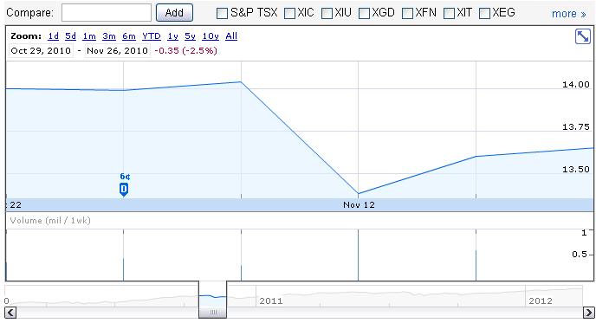
Tax Fairness Plan
iShares S&P TSX Capped REIT Index Fund
Overview
RIOCAN
H&R
Calloway
Notes:
Brian

Slide 20
Affected REITs
Cross-border REITs
  Significant US or Foreign Holdings
Hotel REITs & Senior Housing REITs
  Passive Income vs. Active Income
Overview
RIOCAN
H&R
Calloway
Notes:
Brian

Slide 21
Measuring Performance
Net Income (Accounting Earnings) is not a good measure of performance
  Depreciation allowance is irrelevant to performance
Funds From Operations (FFO) is a better measure
  However, it ignores capital improvements
Funds Available for distribution (FAD) is a good measure of performance
  Accounts for capital improvements
Overview
RIOCAN
H&R
Calloway

Slide 22
Measuring Performance
FFO
Net income
- Gains from sale of real estate
+ Depreciation and amortization of real estate
= Funds From Operation
Adjusted Funds From Operations (AFFO) makes adjustments for recurring capital expenditures used to maintain the quality of the REIT’s underlying assets.
Overview
RIOCAN
H&R
Calloway

Slide 23
Measuring Performance
FAD
Funds from operation
+ Rent adjustments
- Capital improvements
= Funds Available for Distribution
Also called “Cash Available for Distribution (CAD)”, measures cash that is available to be distributed as dividends to unit holders.
Overview
RIOCAN
H&R
Calloway

Slide 24
Measuring Performance
FCF
Funds available for distribution
- Real estate acquisitions (new investments)
- Changes in working capital
- Principal payments
+ New debt issue
+ Gain on sale of real estate
+ New equity issue
= Free Cash Flow to Equity
Overview
RIOCAN
H&R
Calloway

Slide 25
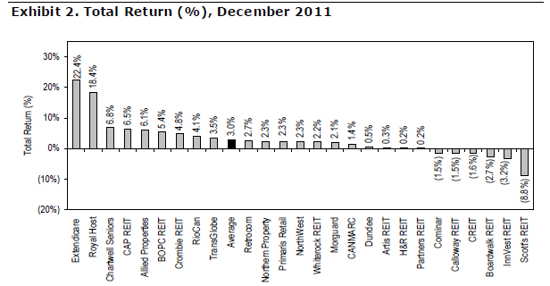
REITs Total Return
Overview
RIOCAN
H&R
Calloway
Notes:
I can redo the chart if necessary. Brian.

Slide 26
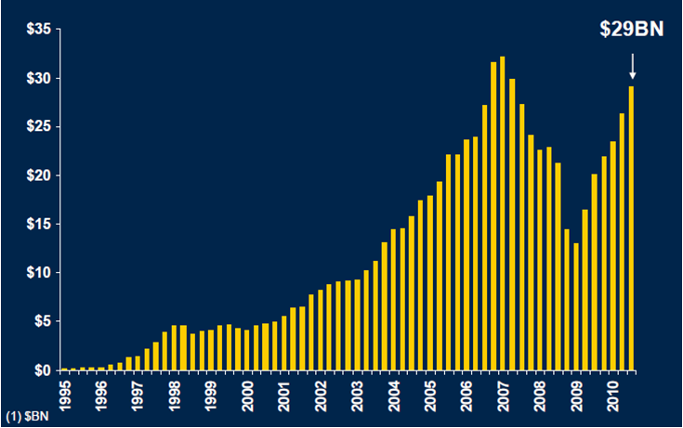
REITs Market Cap Growth
Overview
RIOCAN
H&R
Calloway

Slide 27
Canadian REIT Market Caps
Retail
Total: $13.1B
Overview
RIOCAN
H&R
Calloway

Slide 28
REIT Distribution Yields
Weighted Average: 5.3%
Overview
RIOCAN
H&R
Calloway

Slide 29
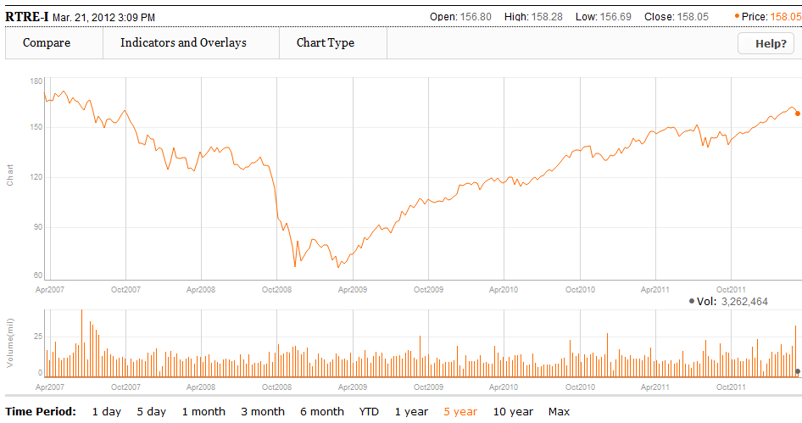
REIT Historical Performance
Overview
RIOCAN
H&R
Calloway
Notes:
Brian – MUST BE UPDATED!!!! THIS AND FOLLOWING SLIDES

Slide 30
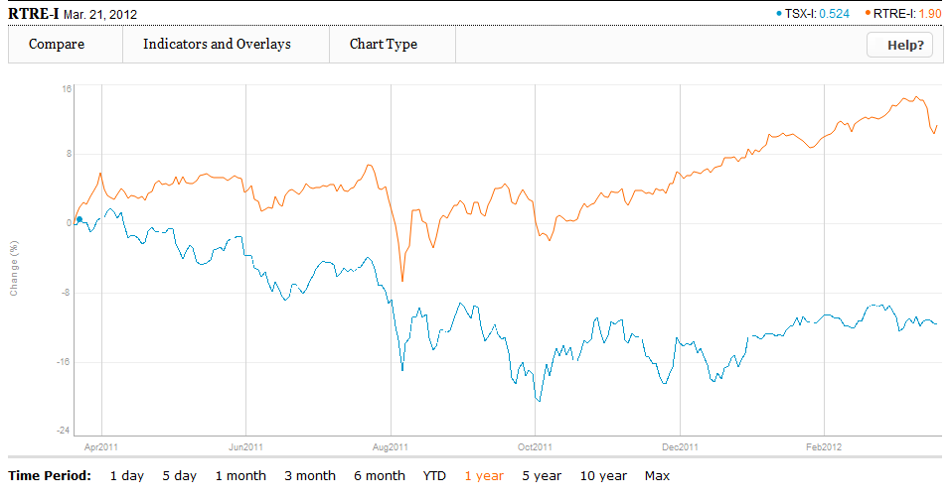
1YR REIT Index Vs. S&P/TSX Composite
Overview
RIOCAN
H&R
Calloway
Notes:
Brian

Slide 31
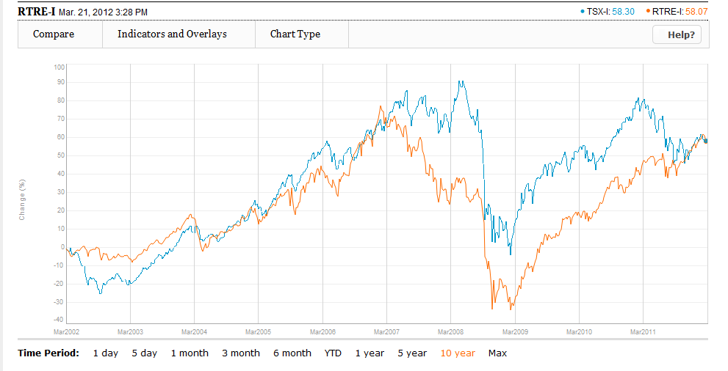
10YR REIT Index Vs. TSX Composite
Overview
RIOCAN
H&R
Calloway
Notes:
Brian

Slide 32
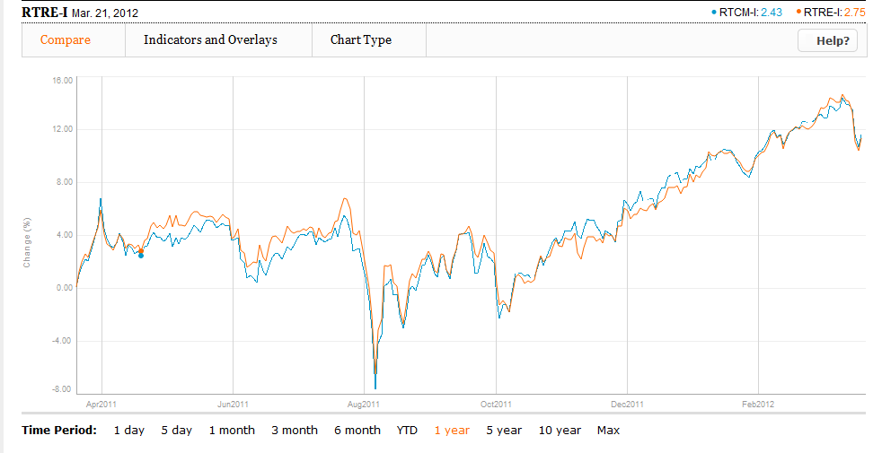
1YR REIT Index Vs. Income Trust Index
Overview
RIOCAN
H&R
Calloway
Notes:
Brian

Slide 33
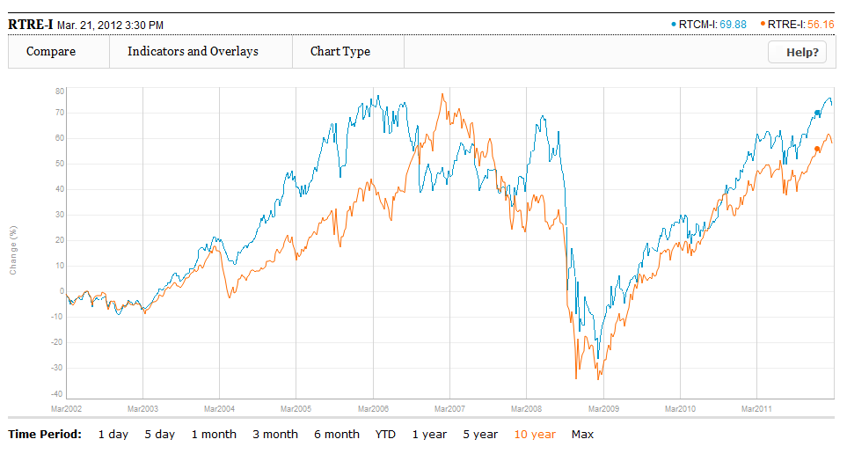
10YR REIT Index Vs. Income Trust Index
Overview
RIOCAN
H&R
Calloway
Notes:
Brian

Slide 34
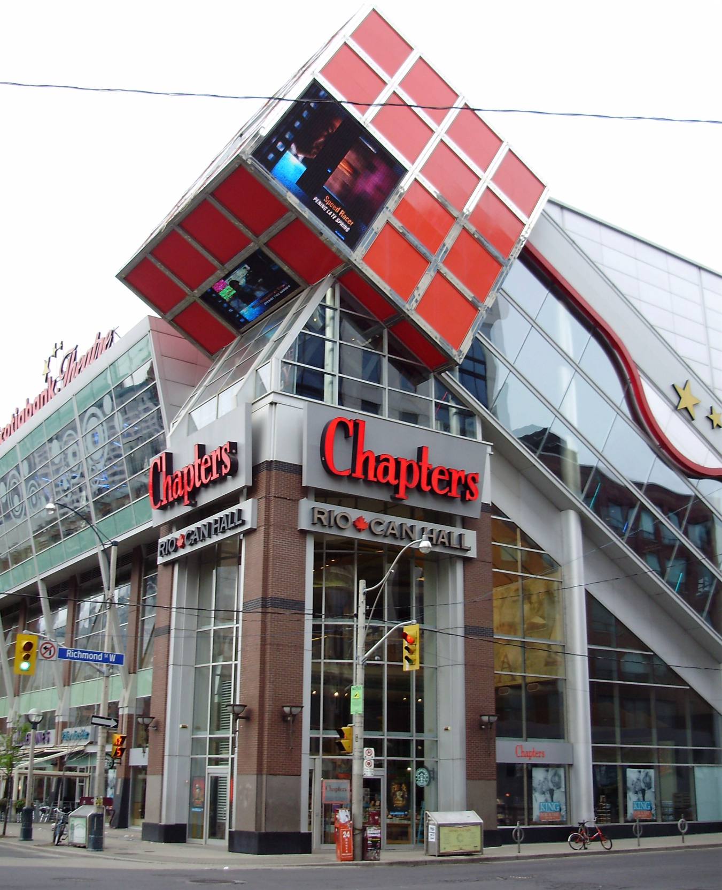










Stock
Overview

Slide 35

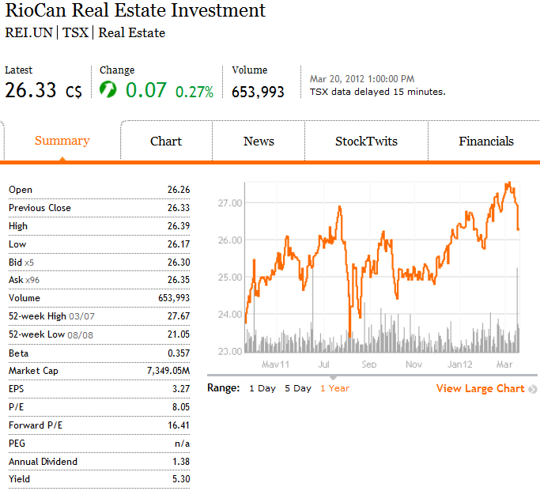
Security Snapshot
Shares Outstanding: 279,113
Overview
RIOCAN
H&R
Calloway

Slide 36
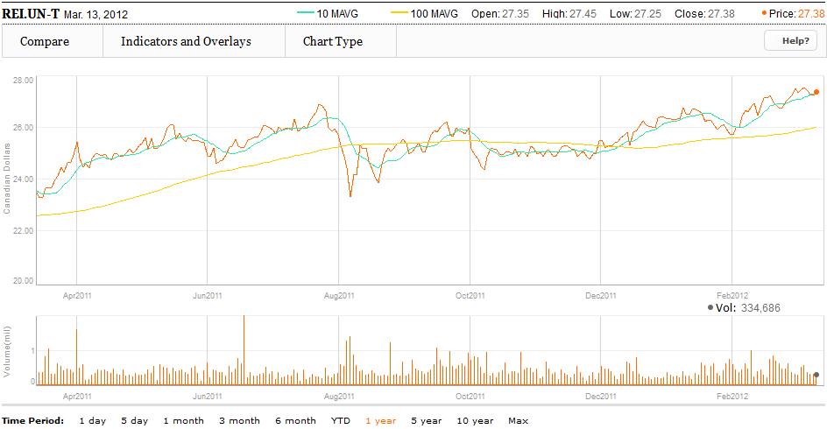
1 Year Chart and Moving
Average at 10 & 100
Overview
RIOCAN
H&R
Calloway

Slide 37
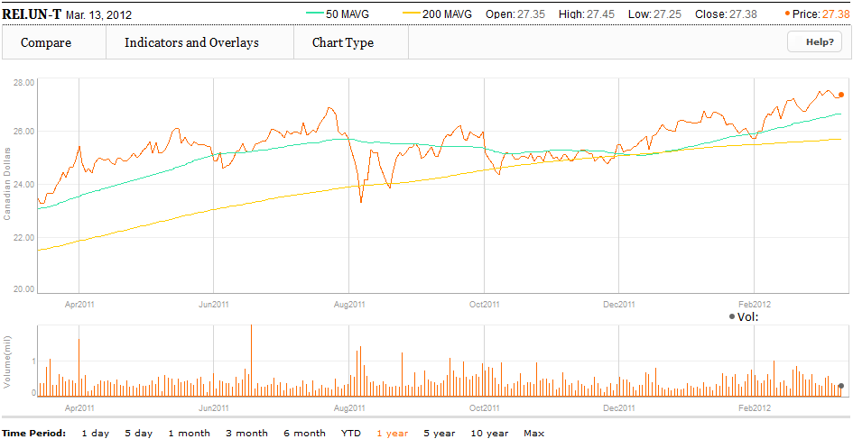
1 Year Chart and Moving
Average at 50 & 200
Overview
RIOCAN
H&R
Calloway

Slide 38
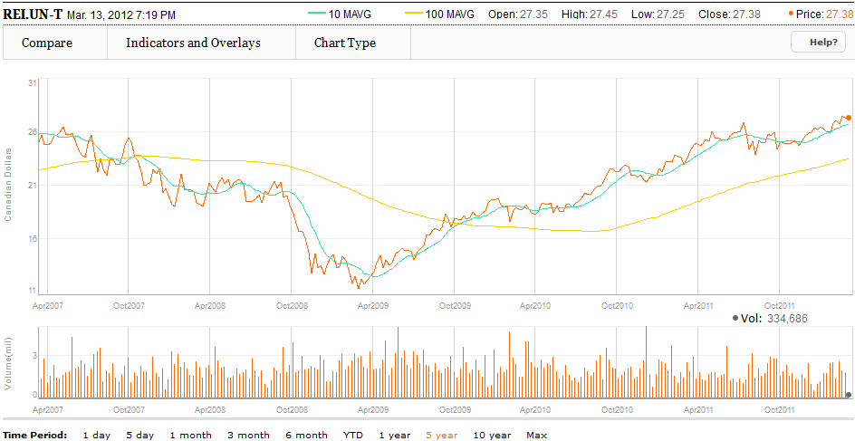
5 Year Chart and Moving
Average at 10 & 100
Overview
RIOCAN
H&R
Calloway

Slide 39
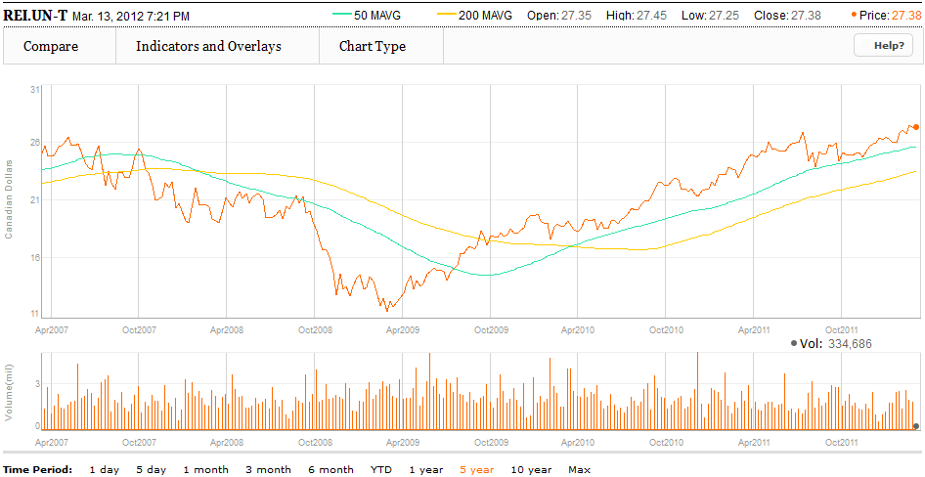
5 Year Chart and Moving
Average at 50 & 200
Overview
RIOCAN
H&R
Calloway

Slide 40
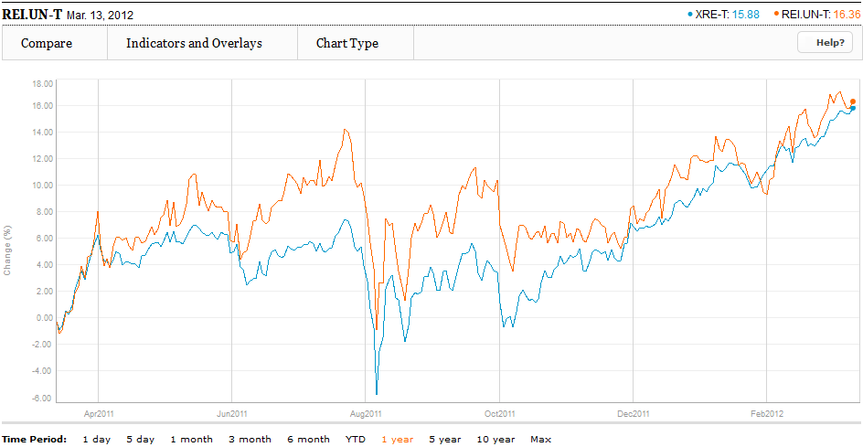
1 Year RioCan Vs. iShares
S&P TSX Capped REIT (XRE-T)
Overview
RIOCAN
H&R
Calloway

Slide 41
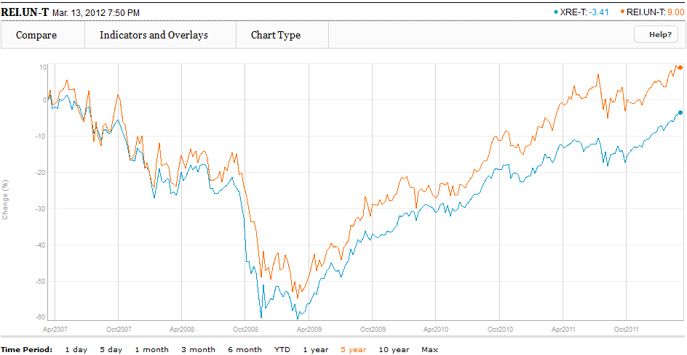
5 Year RioCan Vs. iShares
S&P TSX Capped REIT (XRE-T)
Overview
RIOCAN
H&R
Calloway

Slide 42
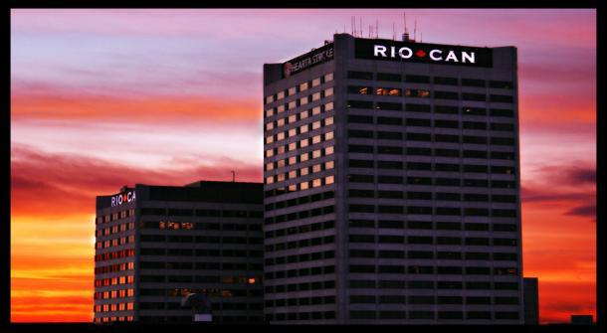
Company
Overview

Slide 43
About RioCan
Largest Canadian REIT with total enterprise value of about $12.5 billion
Portfolio of 331 retail properties with 10 under development containing an aggregate of over 79 million Square feet (as of December 31, 2011)
Core strategy is the ownership and management of community-oriented neighborhood shopping centres anchored by supermarkets, together with an expanding mix of new format retail centres
Investment strategy is to focus on stable, lower risk, mainly retail properties in either stable or high growth urban areas
Engages in growth in the US through joint venture agreements (40 centres) as well as through direct ownership (5 centres)
The trust’s purpose is to provide investors with stable and reliable cash distributions that increase over the long term
Overview
RIOCAN
H&R
Calloway

Slide 44
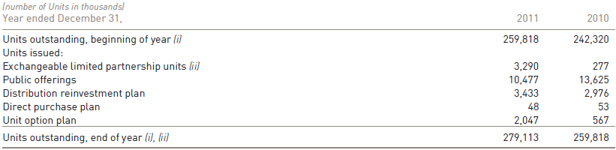
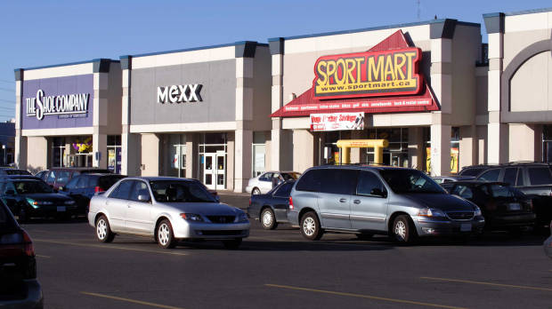
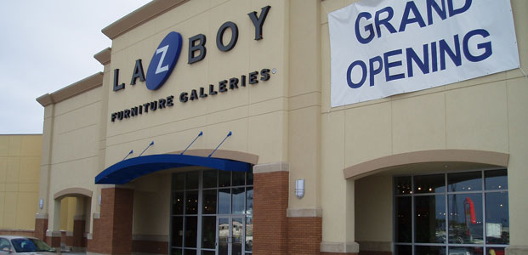
Unit Holder Summary
Overview
RIOCAN
H&R
Calloway

Slide 45
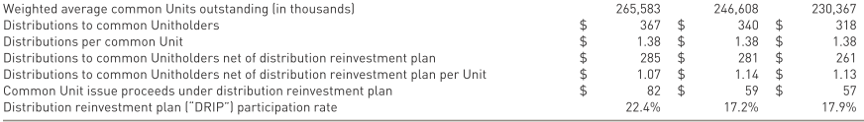
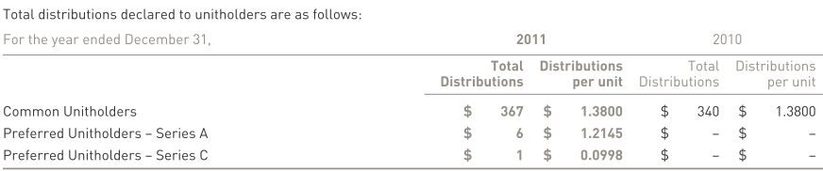
Distributions to
Unit Holders
Overview
RIOCAN
H&R
Calloway
Notes:
Read about what the distribution reinvestment plan is and how it works and affects shareholders that are not part of it.

Slide 46
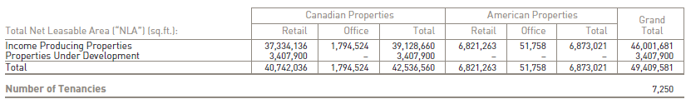

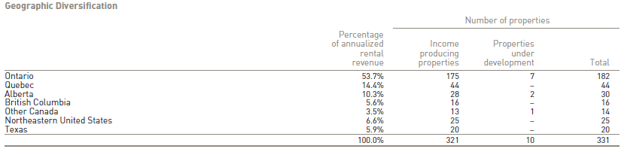
Property Portfolio Facts
Overview
RIOCAN
H&R
Calloway

Slide 47
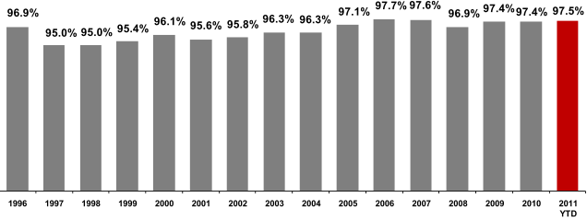
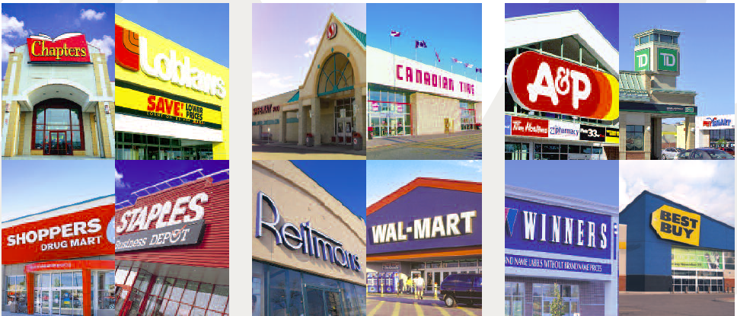
Historical Occupancy
Rates
Overview
RIOCAN
H&R
Calloway

Slide 48
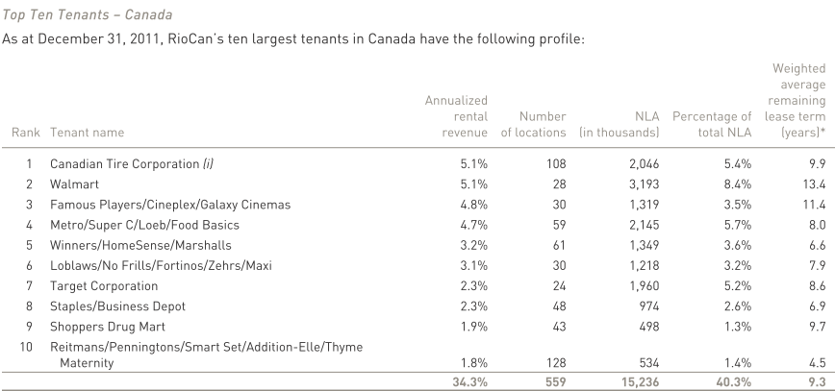
Top 10 Canadian Tenants
Overview
RIOCAN
H&R
Calloway

Slide 49
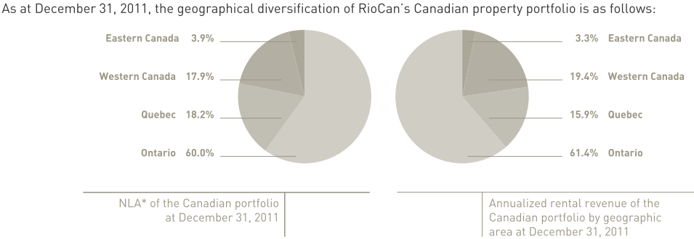
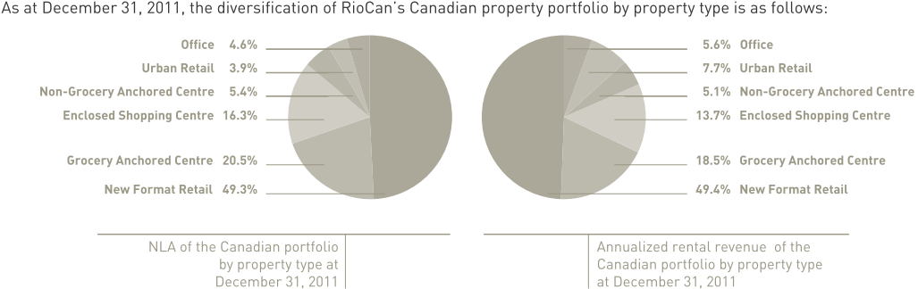
Segmented Canadian Portfolio
Overview
RIOCAN
H&R
Calloway
Notes:
New format retail centres ( or power centres) are large aggregations of dominant retailers grouped together at high traffic and
easily accessible locations. These unenclosed campus-style centres are generally anchored by supermarkets and/or junior
department stores and may include entertainment (movie theatres and restaurants) and fashion components.

Slide 50
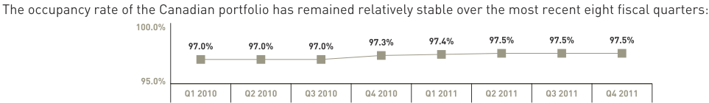
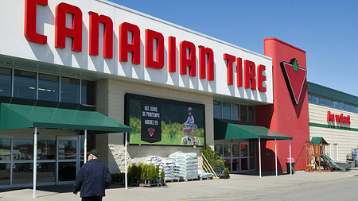
Canadian Occupancy Rates
& Major Partners
Major Canadian partners include:
  Canada Pension Plan Investment Board
  Kimco Realty Corporation
  Kingsett Capital
  Sun Life Financial
  Trinity Development Group
Overview
RIOCAN
H&R
Calloway

Slide 51
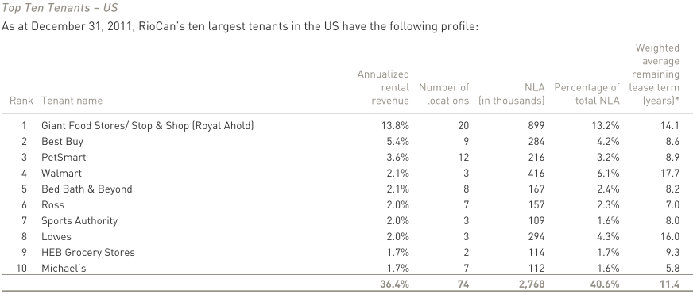
Top 10 US Tenants
Overview
RIOCAN
H&R
Calloway

Slide 52
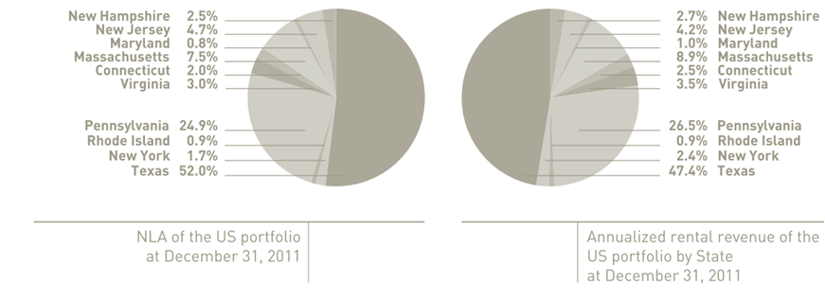
Segmented US Portfolio
As of December 31, 2011, the geographical diversification of RioCan’s US properties is as follows:
Overview
RIOCAN
H&R
Calloway

Slide 53
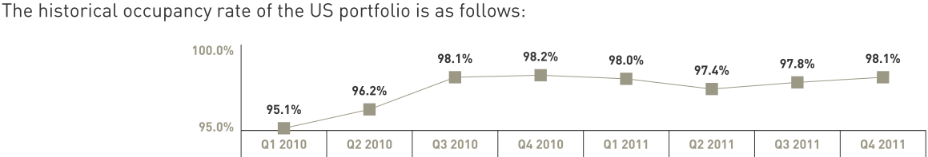
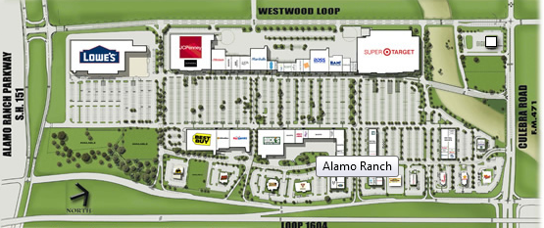
US Occupancy Rates
& Major Partners
Major US partners include:
  Cedar Realty Trust (14% equity interest)
  Dunhill Partners Inc.
  Inland Western Retail Real Estate Trust Inc.
  Kimco Realty Corporation
  Sterling Organization LLC
Overview
RIOCAN
H&R
Calloway

Slide 54
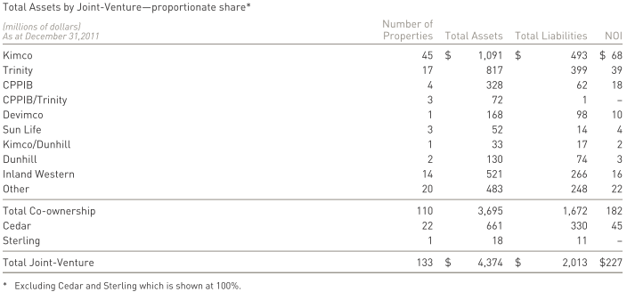
Total Assets by
Joint Venture
Overview
RIOCAN
H&R
Calloway

Slide 55
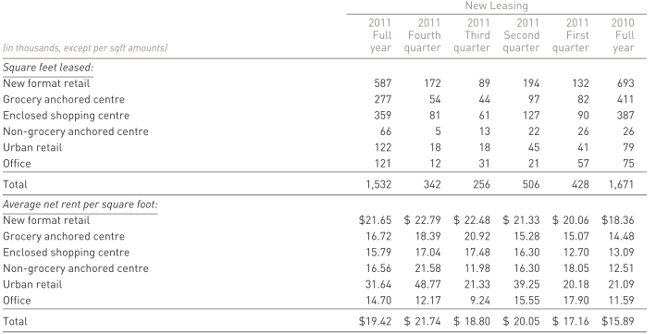
New Leasing Activity in Canada
Overview
RIOCAN
H&R
Calloway
Notes:
Total net rent per square foot increased from 15.89 to 19.42 indicating that new leasing has been successful and resulted in margin from rent

Slide 56
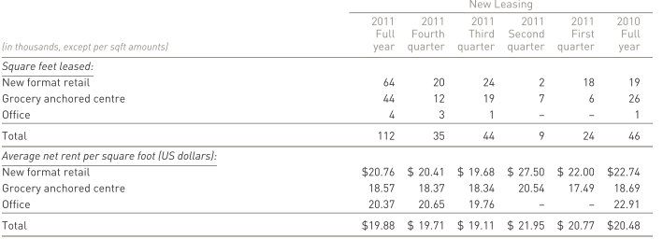
New Leasing Activity in the US
Overview
RIOCAN
H&R
Calloway

Slide 57
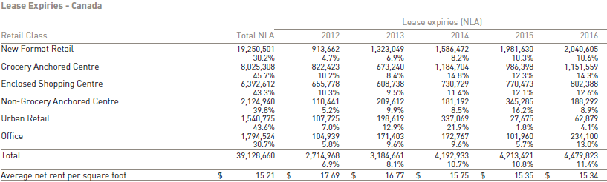
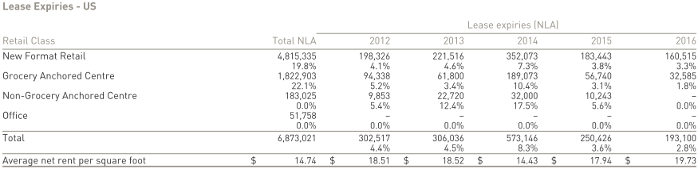
Portfolio Lease Expiries
Overview
RIOCAN
H&R
Calloway

Slide 58
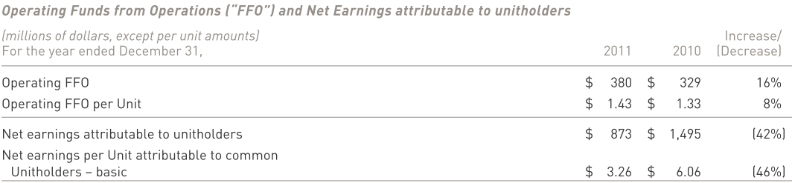
2011 Highlights
Continue to focus on growth through acquisitions and development
  This lead to a net increase in owned NLA of 5.2 million Square feet (12.7% increase from 2010)
38 property acquisitions valued at $1.1 billion (24 in Canada and 14 in the US)
Strong demand for space with portfolio occupancy rate of 97.6%
Result of non-cash deferred tax recovery of $1bn in 2010 which was not recorded in 2011
Excluding this, net earnings increased by $274 million ($0.84 per unit), relative to 2010
Overview
RIOCAN
H&R
Calloway
Notes:
The $17 million increase in Operating FFO for the three months ended December 31, 2011 is primarily due to the following factors:
• increased net operating income from rental properties of $19 million which is due to acquisitions, same store growth of 1.9% for
the Canadian portfolio and 1.2% for the US portfolio and the completion of Greenfield developments;
• increased fee income of $7 million due to higher level of fees arising from leasing and development activities; partially offset by
• increased interest expense and general and administrative expenses of $5 million and $4 million, respectively.
The decrease is the result of a non-cash deferred tax recovery of $1.0 billion in the fourth quarter of
2010, whereas no such deferred tax recovery was recorded in 2011. The deferred tax balance was predominantly the result of the
increase in fair value of the investment property upon adoption of IFRS. Excluding the impact of the deferred tax recovery, net earnings
increased by $274 million ($0.84 per Unit) in 2011, when compared to 2010.

Slide 59
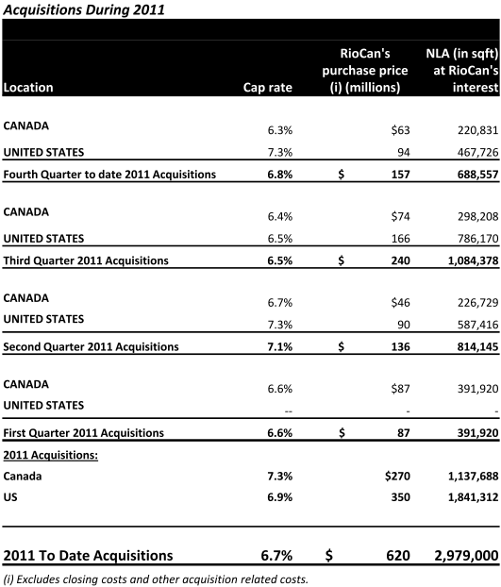
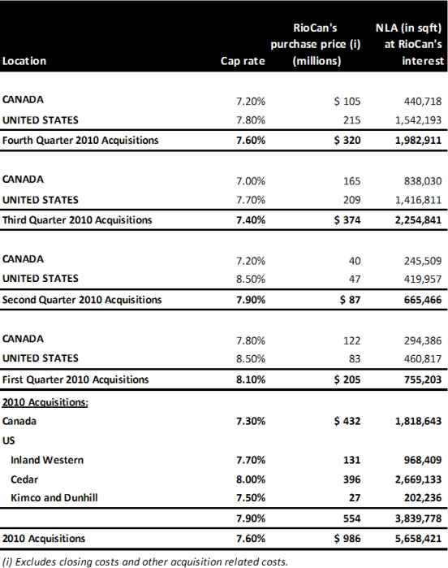
Acquisition Activity
Acquisitions During 2010
Overview
RIOCAN
H&R
Calloway

Slide 60
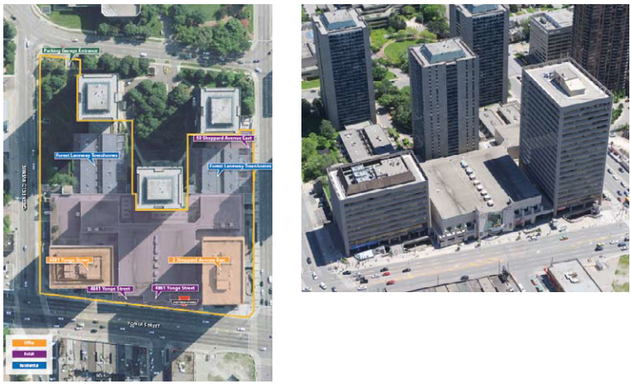
Recent Acquisitions
Sheppard Centre (York, ON)
Purchase price of 218 million
Mixed use property (retail, office and residential )
672,854 sf of space
  257,039 sf of retail
  415,815 sf of office
Acquired on a 50/50 basis with KingSett Capital
Strong demographics
Direct subway line access
Overview
RIOCAN
H&R
Calloway
Notes:
•Entered into firm contract to acquire at a purchase price of $218 million (6.11% cap rate)
672,854 sf space
257,039 sf of retail space (Winners, Shoppers Drug Mart, BMO, CIBC)
5.3 year avg lease term
96% leased
• 415,815 sf of office space (BMO, Aon Hewitt)
6.8 avg lease term
100% leased

Slide 61

Recent Canadian
Acquisitions
Overview
RIOCAN
H&R
Calloway

Slide 62

Recent US Acquisitions
Overview
RIOCAN
H&R
Calloway

Slide 63

Capital Structure
Overview
RIOCAN
H&R
Calloway
Notes:
Ratio of debt to assets actually fell from 2010 even thought the company continues to pursue a growth strategy

Slide 64

Debt Maturity Schedule
Overview
RIOCAN
H&R
Calloway

Slide 65


Debt and Leverage
Metrics
Overview
RIOCAN
H&R
Calloway
Notes:
RioCan has consistently adhered to a conservative debt policy even through periods considerable growth
Maximum leverage permitted under a debt covenant is 60%
Interest coverage is consistently above the 1.65x maintenance covenant

Slide 66

Revolving Lines of Credit
Overview
RIOCAN
H&R
Calloway

Slide 67

Aggregate Maturities
Overview
RIOCAN
H&R
Calloway

Slide 68

Maturities by Lender
Overview
RIOCAN
H&R
Calloway

Slide 69

Target Entry into Canada
Acquisition of Zellers stores by Target is expected to lead to an enhancement to some RioCan properties
Target will revitalize centres where its store will be located leading to higher occupancy, rents and value through higher NOI and lower cap rate
Target has assumed 23 leases of RioCan’s 34 properties which we occupied by Zellers
9 of the remaining locations will remain as Zellers, 1 will be assumed by Walmart and the other by Canadian Tire
RioCan will be Target’s largest landlord in Canada
Overview
RIOCAN
H&R
Calloway

Slide 70
Looking Forward
RioCan expects the Canadian retail real estate market to remain strong through 2012
Significant amount of 2011 acquisitions will contribute to future FFO
The emergence of large US retailers entering the Canadian market should be positive for RioCan potentially driving rents up due to higher demand for space
RioCan will continue to capitalize on the strength of its partnerships in Canada and the US to acquire property, and enhance development projects
Interest rate savings will be realized through refinancing at current attractive market rates which are expected to remain low going into 2013
RioCan continues to evaluate growth opportunities in the US due to attractive real estate prices
Overview
RIOCAN
H&R
Calloway
Notes:
The Canadian market benefits from concentrated retail tenants who generally are financially strong and from fewer development sites, which should create a market in which RioCan can maintain pricing power as a greater number of tenants compete for prime locations, as demonstrated in RioCan’s strong occupancy ratio of over 97%

Slide 71

Management
Team

Slide 72

Edward Sonshine, CEO
CEO of RioCan since 1993
64 Years Old
Member of the board of directors of RBC, Cineplex Galaxy Income Fund and is chair of Chesswood Income Fund
Law degree from Osgoode Hall Law School and a Bachelor of Arts degree from the University of Toronto
2010 compensation: $2.68 million
Overview
RIOCAN
H&R
Calloway
Notes:
Law degree from York University

Slide 73

Raghunath Davloor, CFO and Senior Vice President
CFO and Senior VP since February 2008
50 Years Old
Over 25 years of real estate, management, finance and accounting experience
Prior to RioCan, he served as VP and Director of Investment Banking at TD Securities Covering the estate sector
Bachelor of Commerce from the University of Manitoba and holds a CA designation
2010 compensation: $1.4 million
Overview
RIOCAN
H&R
Calloway

Slide 74

Frederic A. Waks,
COO & Executive VP
Joined RioCan in 1995 as Senior Vice President and was promoted to COO in 2007
Over 30 years of real estate experience
Prior to RioCan, he worked at Royal LePage, First Plazas, Dominion Trust and Confederation Trust
Active community involvement being on the board of several charities
2010 compensation: $760K
Overview
RIOCAN
H&R
Calloway

Slide 75


Key Management
Compensation 2011
Overview
RIOCAN
H&R
Calloway

Slide 76

Financial
Performance

Slide 77

Consolidated Balance Sheet

Slide 78

Consolidated Statement of Earnings

Slide 79

Consolidated Statement of Cash Flows

Slide 80

Consolidated Statement of
Cash Flows (Cont.)
Notes:
Note 17: Distributions to Unitholders
RioCan currently qualifies as a mutual fund trust and real estate investment trust for income tax purposes. RioCan intends, but is
not contractually obligated, to distribute all of the Trust’s taxable income to unitholders in each year, as calculated in accordance
with the Act after all permitted deductions under the Act have been taken.

Slide 81

Funds from Operations

Slide 82

Adjusted Funds from Operations

Slide 83

IFRS Net Earnings Reconciliation
to FFO

Slide 84


Recommendation:
Sector Perform
HOLD

Slide 85

Recommendation - Buy
Good Dividend; price target: $29.90
Strong and experienced management
Impressive property portfolio, being the largest Canadian REIT
Focus on growth in thriving urban markets through stable retailers
Conservative debt profile and access to capital
Strong institutional partnerships
Solid tenants and high occupancy rates
Overview
RIOCAN
H&R
Calloway

Slide 86












Slide 87

Security Snapshot
Overview
RIOCAN
H&R
Calloway

Slide 88

1 Year Chart and Moving
Average at 10 & 100
Overview
RIOCAN
H&R
Calloway

Slide 89

1 Year Chart and Moving
Average at 50 & 200
Overview
RIOCAN
H&R
Calloway

Slide 90

5 Year Chart and Moving
Average at 10 & 100
Overview
RIOCAN
H&R
Calloway

Slide 91

5 Year Chart and Moving
Average at 50 & 200
Overview
RIOCAN
H&R
Calloway

Slide 92

1 Year H&R Vs. iShares
S&P TSX Capped REIT (XRE-T)
Overview
RIOCAN
H&R
Calloway

Slide 93

5 Year RioCan Vs. iShares
S&P TSX Capped REIT (XRE-T)
Overview
RIOCAN
H&R
Calloway

Slide 94

Company Overview

Slide 95
About H&R
H&R REIT is very conservatively managed to provide a stable, consistent and moderately rising cash flow approximating the long term cash flow and value appreciation characterestics of institutional-quality commercial property
The REITS strategy is to produce stable, consistent and growing distributable cash flow by targeting high-wuality, often single-tenant properties and matching long-term leases to high-quality tenants with long-term financing, in a diversified portfolio, by both property type and location
Overview
RIOCAN
H&R
Calloway

Slide 96

Management Team

Slide 97
Thomas J. Hofstedter
(CEO)
  Has more than 30 years of real estate industry experience
  Became President and Chief Executive Officer of H&R REIT at its creation in December 1996
  Responsible for building most of the properties that comprised the initial assets of the REIT
  In addition to commercial development, has experience in high-rise residential and was responsible for building many prominent Toronto condominiums such as Wellington Square, the Penrose, the Metropole and others
Overview
RIOCAN
H&R
Calloway

Slide 98
Larry Froom, CFO
  Has over 15 years of real estate industry experience
  Joined H&R Developments in 1997 as Controller, was promoted to VP - Finance for the H&R Group in 2003, was appointed VP - Finance for H&R REIT in January 2006 and CFO in September 2006
  Responsible for overseeing all financial transactions, Unit offerings and investor relations. Prior to joining H&R, he was manager at Ernst & Young where he serviced clients in the real estate industry
Overview
RIOCAN
H&R
Calloway

Slide 99
Nathan Uhr, COO
  Has over 30 years of real estate industry experience
  H&R Developments' Director of Leasing and Property Management and held various other positions with H&R over 20 years before becoming Vice-President, Acquisitions of H&R REIT, at its inception, in December 1996.
  Leads the due diligence team on any acquisition or mezzanine financing planned by the REIT and is responsible for management and leasing issues relating to the REIT's properties
Overview
RIOCAN
H&R
Calloway

Slide 100

Properties

Slide 101
Properties
H&R REIT holds interests in 40 office properties, 117 single-tenant industrial properties, 133 retail properties and 3 development projects, principally in the Greater Toronto Area.
In 2010, the REIT paid out approximately 72.2% of its adjusted funds from operations to its Unitholders
Overview
RIOCAN
H&R
Calloway

Slide 102

Properties
Overview
RIOCAN
H&R
Calloway

Slide 103
Properties- High Quality
Assets
Overview
RIOCAN
H&R
Calloway

Slide 104

Properties- High Quality
Assets
Overview
RIOCAN
H&R
Calloway

Slide 105


Slide 106


Slide 107
Properties
Overview
RIOCAN
H&R
Calloway

Slide 108
Properties
Overview
RIOCAN
H&R
Calloway

Slide 109

Financial Statement
Analysis
Overview
RIOCAN
H&R
Calloway

Slide 110

Financial Statement
Analysis
Overview
RIOCAN
H&R
Calloway

Slide 111

Cashflow Statement
Overview
RIOCAN
H&R
Calloway

Slide 112

Cashflow Statement
Cont.
Overview
RIOCAN
H&R
Calloway

Slide 113

Financial Statement
Analysis
Overview
RIOCAN
H&R
Calloway

Slide 114

Financial Statement
Analysis
Overview
RIOCAN
H&R
Calloway

Slide 115

Financial Statement
Analysis
Overview
RIOCAN
H&R
Calloway

Slide 116

Financial Statement
Analysis
Overview
RIOCAN
H&R
Calloway

Slide 117

Financial Statement
Analysis
Overview
RIOCAN
H&R
Calloway

Slide 118

Financial Statement
Analysis
Overview
RIOCAN
H&R
Calloway

Slide 119

Financial Statement
Analysis
Overview
RIOCAN
H&R
Calloway

Slide 120

Financial Statement
Analysis
Overview
RIOCAN
H&R
Calloway

Slide 121

Financial Statement
Analysis
Overview
RIOCAN
H&R
Calloway

Slide 122

Risk Management
Overview
RIOCAN
H&R
Calloway

Slide 123

Risk Management Cont
Overview
RIOCAN
H&R
Calloway

Slide 124

Risk Management Cont
Overview
RIOCAN
H&R
Calloway

Slide 125

Risk Management Cont
Overview
RIOCAN
H&R
Calloway

Slide 126

Risk Management Cont
Overview
RIOCAN
H&R
Calloway

Slide 127

Occupancy
Overview
RIOCAN
H&R
Calloway

Slide 128

Funds From Operations
Overview
RIOCAN
H&R
Calloway

Slide 129

Funds From Operations
Overview
RIOCAN
H&R
Calloway

Slide 130

Adjusted Funds From
Operations
Overview
RIOCAN
H&R
Calloway

Slide 131

Adjusted Funds From
Operations
Overview
RIOCAN
H&R
Calloway

Slide 132
Evaluation
In March, the REIT acquired a 0.5 mln sq.ft. office property in Toronto for $186 mln, 100%-leased to Corus Entertainment for 20 yrs.
Distribution continues to rise each quarter, and should reach $1.25/unit by Q4/12 on an annualized basis, reaching a low 87% 2012 AFFO payout.
Overview
RIOCAN
H&R
Calloway

Slide 133
Evaluation
In Nov. H&R issued 8.5 mln units at $22.00/unit for $187 mln and $75 mln of converts,
In Dec. it issued 5.4 mln units at $23.30/unit for $125 mln.
H&R's $1.6 bln Bow office development is on track for completion by Q4/12.
Overview
RIOCAN
H&R
Calloway

Slide 134
Evaluation
Peer group is made of: REI.UN,FCR,CWT.UN,REF.UN,PMZ.UN, MRT.UN
Overview
RIOCAN
H&R
Calloway

Slide 135
HOLD
H&R trades at 0.5x 2012E AFFO discount to its large-cap Canadian REIT peers.
Highest quality assets
H&R’s average remaining lease term is 11.0 years, the highest in the Canadian REIT universe.
Provides lowest yield out of all assets
Overview
RIOCAN
H&R
Calloway

Slide 137












Slide 138

Security Snapshot
Overview
RIOCAN
H&R
Calloway

Slide 139

1 Year Chart and Moving
Average at 10 & 100
Overview
RIOCAN
H&R
Calloway

Slide 140

1 Year Chart and Moving
Average at 50 & 200
Overview
RIOCAN
H&R
Calloway

Slide 141

5 Year Chart and Moving
Average at 10 & 100
Overview
RIOCAN
H&R
Calloway

Slide 142

5 Year Chart and Moving
Average at 50 & 200
Overview
RIOCAN
H&R
Calloway

Slide 143

1 Year Calloway Vs. iShares
S&P TSX Capped REIT (XRE-T)
Overview
RIOCAN
H&R
Calloway

Slide 144

5 Year Calloway Vs. iShares
S&P TSX Capped REIT (XRE-T)
Overview
RIOCAN
H&R
Calloway

Slide 145

Max Chart
Overview
RIOCAN
H&R
Calloway

Slide 146
Company Overview

Slide 147
About Calloway
The Trust is an unincorporated open-ended mutual fund trust governed by the laws of the Province of Alberta
The Trust’s vision is to create exceptional places to shop
The Trust’s purpose is to own and manage shopping centres that provide our retailers with a platform to reach their customers through convenient locations, intelligent designs, and a desirable tenant mix
The Trust’s shopping centres focus on value oriented retailers and include the strongest national and regional names as well as strong neighbourhood merchants (i.e. Walmart)
Owns 127 shopping centres, one office building and one industrial building, with total gross leasable area of 25.5 million square feet, located in communities across Canada
Subject to the availability of acquisition opportunities, the Trust intends to grow distributions, in part, through the accretive acquisition of properties
Overview
RIOCAN
H&R
Calloway

Slide 148
Recent Developments
August 2011
  acquired 3 Walmart anchored shopping centres
  raised $90 million of 7-year unsecured debentures @ 4.70%
  renewed 3-year secured operating line of $200 million and a 1-year unsecured operating line of $35 million @ BA + 1.65%
September 2011
  Announced Target taking over Zellers leases in Oakville and Kitchener and Loblaws taking over in Penticton
November 2011
  announced Q3 2011 results – strong results, ahead of analyst expectations: AFFO per unit – 2% increase over Q2 2011 and 14% increase over Q3 2010.
December 2011
  raised $100 million equity on a bought deal basis @ C$27.05
Overview
RIOCAN
H&R
Calloway

Slide 149

Unit Holder Summary
Overview
RIOCAN
H&R
Calloway

Slide 150

Distribution to Unit Holders
Overview
RIOCAN
H&R
Calloway

Slide 151

Distribution to Unit Holders
Overview
RIOCAN
H&R
Calloway

Slide 152

Portfolio Highlights
Overview
RIOCAN
H&R
Calloway

Slide 153

Investment Properties
The portfolio consists of 25.5 million square feet of built gross leasable area, 4.3 million square feet of future potential gross leasable area in 129 properties and the option to acquire 50.0% or 100.0% interests (1.6 million square feet) in 11 income properties upon their completion pursuant to the terms of mezzanine loans
The Trust targets major urban centres and shopping centres that are dominant in their trade area
Well-located centres attracts quality tenants
Overview
RIOCAN
H&R
Calloway

Slide 154

Investment Properties
Overview
RIOCAN
H&R
Calloway

Slide 155


Top 25 Clients
Overview
RIOCAN
H&R
Calloway

Slide 156

Gross Revenue & Area by Province
Overview
RIOCAN
H&R
Calloway

Slide 157

Portfolio Occupancy and Age
99.0% as at December 31, 2011
Overview
RIOCAN
H&R
Calloway

Slide 158

Lease Maturity
Average lease term of 8.3 years
Average remaining lease term for Walmart is 11.3 years
Average remaining lease term excluding Walmart is 6.3 years
Average retention rate >90% and lifts on renewals of 7.3%
Average expected “same store” NOI growth is 1.0% to 1.5% p.a.
Overview
RIOCAN
H&R
Calloway

Slide 159

Lease Expiration Schedule
Overview
RIOCAN
H&R
Calloway

Slide 160

Strategic Partners – SmartCentres
Largest developer of open format shopping centres in Canada
Largest unitholder (21%)
Relationship provides:
  Market intelligence, tenant relationships
  Development and leasing infrastructure
  Acquisition opportunities and earnout pipeline
  Strategic guidance (3 of 9 board seats)
  Shared administrative services (for efficiency)
All transactions with SmartCentres are approved by Independent Trustees
Overview
RIOCAN
H&R
Calloway

Slide 161

Strategic Partners – Walmart
Largest landlord of Walmart Canada
  Collaboration in site selection
  Operational synergy
  Faster execution
  12 conversions to Supercentres in 2011
Walmart Canada attributes:
  AA credit rating of US parent
  Value pricing and fresh food generates huge traffic
  Dominant retailer – CDN +/- $20 billion in sales; 10%+ of general merchandise sales in Canada; growing market share
Overview
RIOCAN
H&R
Calloway

Slide 162

CAPEX on Acquisitions and Development
$163.0 million of Earnouts and Calloway Developments were completed and transferred to investment properties, compared to $151.3 million in 2010, summarized as follows:
Overview
RIOCAN
H&R
Calloway

Slide 163

Sustaining Capital Expenditures
Sustaining capital expenditures totalling $1.9 million and leasing costs of $3.4 million were incurred
Since the Trust’s investment properties are relatively new and in good condition, management anticipates only modest increases for each of 2012 and 2013, and thus, they are not expected to have an impact on the Trust’s ability to pay distributions at its current level
Overview
RIOCAN
H&R
Calloway

Slide 164

Capital Structure
Overview
RIOCAN
H&R
Calloway

Slide 165

Debt Maturity
Overview
RIOCAN
H&R
Calloway

Slide 166


Debt Ratios
Overview
RIOCAN
H&R
Calloway

Slide 167


Potential Future Pipeline
Overview
RIOCAN
H&R
Calloway

Slide 168


Internal Growth
Overview
RIOCAN
H&R
Calloway

Slide 169
Halton Hills Premium Outlets
50:50 JV with Simon Property Group (NYSE:SPG) at closing
First of its kind in Canada (high-end fashion)
450,000 SF
SPG & CWT partnership working well
Site owned by Calloway – zoned
15 minutes outside of Toronto
6 million population within 1 hour drive
In pre-leasing; expected to commence construction Spring 2012
Overview
RIOCAN
H&R
Calloway

Slide 170
Strategic Focus Moving Forward
Ongoing
  1. Maintain 99%+ occupancy and 85%+ retention rates
  2. Manage lease renewal rent increases in 5-10% range
  3. Enhance asset quality and maximize “same store NOI” growth
  4. Harvest 5.8 million square feet development and acquisition option pipeline including first Premium Outlet Mall
  5. Deploy capital in selective acquisition opportunities
Opportunistic
  1. Capitalize on intensification opportunities in appropriate locations
    New subway stations (Vaughan, Westside Mall)
    Higher growth markets
  2. Re-merchandising opportunities
    Hopedale Mall (Target taking over Zellers)
Overview
RIOCAN
H&R
Calloway

Slide 171
Management

Slide 172

Chief Executive Officer/President
Al Malwani
President, CEO
Replaced Simon Nyilassy as CEO on May 2, 2011
Chartered accountant
MBA from the University of Toronto and a Masters of Laws from Osgoode Hall Law School
Previously the President of Exponent Capital Partners, a real estate advisory and private equity firm
Previously the CFO of Oxford Properties Group for over 10 years
2010 compensation for previous CEO Simon Nyilassy: $951,862

Slide 173

Chief Financial Officer
Bart Munn
Chief Financial Officer
Chartered Accountant
Bachelor of Commerce from Queen’s University
Vice President and CFO of Morguard Corporation (1999-2005)
Vice President and CFO of Morguard Real Estate Investment Trust (1997-1999)
Senior Vice President Finance and Administration for Morguard Investments Limited (1991-2005)
2010 compensation: $617,823

Slide 174

Executive Vice President
Rudy Gobin
Executive Vice President Asset Management
Chartered Accountant
Bachelor of Commerce from the University of Toronto
Former Strategy Officer of Calloway
Former Executive Vice President, Finance and Operations of SmartCentres (2001-2006)
CFO of Nexacor Realty Management (1998-2001)
2010 compensation: $570,171

Slide 175
Financial Performance

Slide 176

Balance Sheet
Overview
RIOCAN
H&R
Calloway

Slide 177

Income Statement
Overview
RIOCAN
H&R
Calloway

Slide 178

Cash Flow Statement
Overview
RIOCAN
H&R
Calloway

Slide 179

Supplemental Cash Flow Information
Overview
RIOCAN
H&R
Calloway

Slide 180

Cash from Operations
Overview
RIOCAN
H&R
Calloway

Slide 181

Results from Operations
Overview
RIOCAN
H&R
Calloway

Slide 182

FFO and AFFO
Overview
RIOCAN
H&R
Calloway

Slide 183

FFO and AFFO Quarterly Information
Overview
RIOCAN
H&R
Calloway

Slide 184

Valuation
At $26.79, Calloway is trading at 15.7x FFO, 16.3x AFFO, lower than its peer groups 16.6x FFO and 18.3x AFFO
Given that the current price is already close to the high end of its 52-week range, it is unlikely that there is much room for higher multiples
The 12-month price target is $28.88, or ~16.5x FFO based on a consensus FFO target of $1.75/unit for 2012
Overview
RIOCAN
H&R
Calloway

Slide 185
Recommendation:
Buy

Slide 186
Recommendation: Buy
Strong financial position
  Driven by an increase in net operating income and a decrease in interest expense, Funds from operation was $1.71/unit in 2011, up from $1.64/unit last year
  Adjusted FFO was $1.65/unit, up from $1.55/unit
Industry-leading occupancy rate
  Calloway has maintained portfolio occupancy at the 99.0% level over the past eight quarters
  The Trust retained 91.9% of the tenants in 2011
  Average lease term to maturity is 8.2 years
Attractive yield
  Calloway offers a dividend yield of 5.8%, higher than the peer group 5.2%.
  This would attract investors who have a defensive strategy and are seeking yield in a low interest environment
Overview
RIOCAN
H&R
Calloway

Slide 187
Conclusion
RANKING:
Calloway
H&R REIT
RioCan

